Slide 1
AP Biology 3.1 to 3.3
LESSON 1 OF 3
BY THE END YOU CAN
Enzymes and cellular energy
Explain how the shape and charge of an active site make an enzyme specific to its substrate (3.1.A)
Explain how an enzyme speeds up a reaction by lowering its activation energy, and why it leaves ΔG unchanged (3.1.A)
What an enzyme does
3.1.A
Specificity from shape and charge, and lowering the activation energy, with a clay model and a gas demo
60 minutes · chapters 1, 2
Minute 0
Notes:
AP Biology 3.1 to 3.3, Enzymes and cellular energy. Lesson 1 of 3: What an enzyme does, 60 minutes.
The plan, minute by minute (each slide's footer says where you are):
0 to 5 min (5) Do now: sugar in a bowl
5 to 15 min (10) The active site
15 to 30 min (15) Modeling clay enzymes
30 to 42 min (12) Activation energy
42 to 54 min (12) Demo: catch the oxygen
54 to 60 min (6) Exit
What students get wrong:
"An enzyme makes a reaction happen that otherwise would not." It only lowers the activation energy; ΔG and the end point are unchanged, and an uphill reaction still needs coupling.
"The substrate is the same shape as the active site." Complementary, not the same, and charge matters as much as shape.
"Exergonic means fast." Sugar in the bowl is exergonic and lasts a year: activation energy decides speed.
Stretch and support:
Support: a printed, pre-drawn energy diagram to annotate during chapter 2, and the free-response table with the rows to compare already highlighted.
The lesson plan to print: https://www.biologybybradford.com/guides/downloads/ap-biology-unit-3-enzymes-lesson-1-plan.pdf

Slide 2
DO NOW
Sugar in a bowl
A spoonful of sugar can sit in a bowl for a year, burns in a flame in seconds, and your cells use it in minutes.
Pairs write what each case needs.
5:00
minutes
Start now: the timer is running.
Minutes 0 to 5
Notes:
Minutes 0 to 5 of 60: Do now: sugar in a bowl (5 min).
The plan: A spoonful of sugar can sit in a bowl for a year, burns in a flame in seconds, and your cells use it in minutes. Pairs write what each case needs. Keep the answers for the end of the lesson.
Start a 5 minute timer as they come in.

Slide 3
STEP 2
10 MIN
The active site
Name the parts with the tap labels.
Minutes 5 to 15
Notes:
Minutes 5 to 15 of 60: The active site (10 min).
The plan: Chapter 1's figure on the board. Offer the enzyme each molecule and have students say, before you click, whether it binds and why. Draw out the double check: shape and charge. Name the parts with the tap labels.

Slide 4
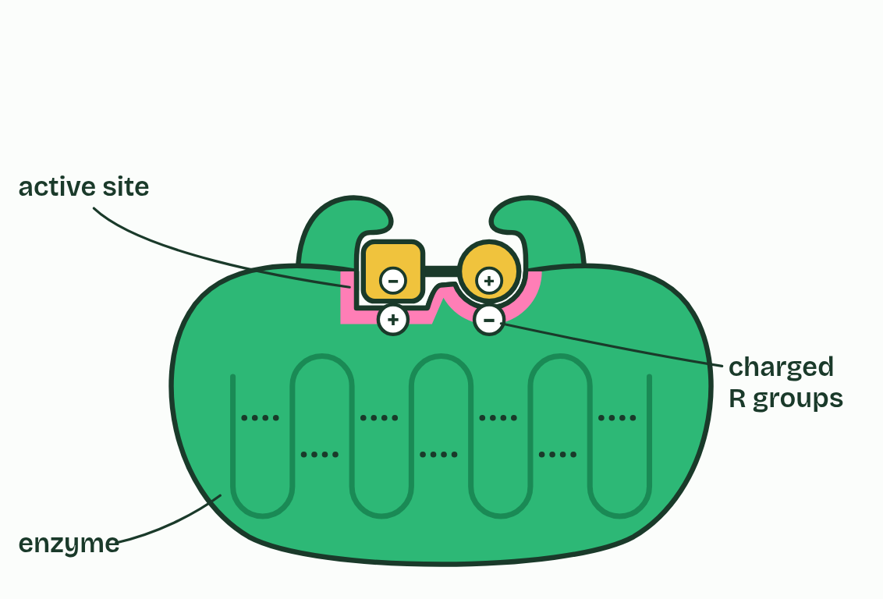
CHAPTER 1 · 3.1.A Enzyme structure
1 / 3
The active site fits one substrate
Substrate
Minutes 5 to 15
Notes:
Minutes 5 to 15 of 60: The active site (10 min).
The plan: Chapter 1's figure on the board. Offer the enzyme each molecule and have students say, before you click, whether it binds and why. Draw out the double check: shape and charge. Name the parts with the tap labels.
An enzyme is a biological catalyst: a protein that makes one reaction go faster and is not used up by it. One molecule of catalase, the enzyme in this guide's dry lab, breaks down millions of hydrogen peroxide molecules every second, for as long as its shape lasts.
That shape is everything. An enzyme is a chain of hundreds of amino acids folded into a precise 3D shape, held there by hydrogen bonds and ionic bonds between R groups. A small pocket in the fold, lined by just a few of those amino acids, is the active site. The molecule the enzyme works on is its substrate.
A substrate binds only if two things match: its shape fits the site, and its charges are opposite to the charged R groups lining it. That double check is why an enzyme is specific. As the substrate settles in, the site shifts to grip it more tightly, which strains the bond that is about to break: induced fit.
Example: Lactase splits lactose, which is glucose joined to galactose. Sucrose is glucose joined to fructose: exactly the same atoms as lactose, arranged differently. Lactase leaves it alone: the site grips the galactose half, and sucrose has none.

Slide 5
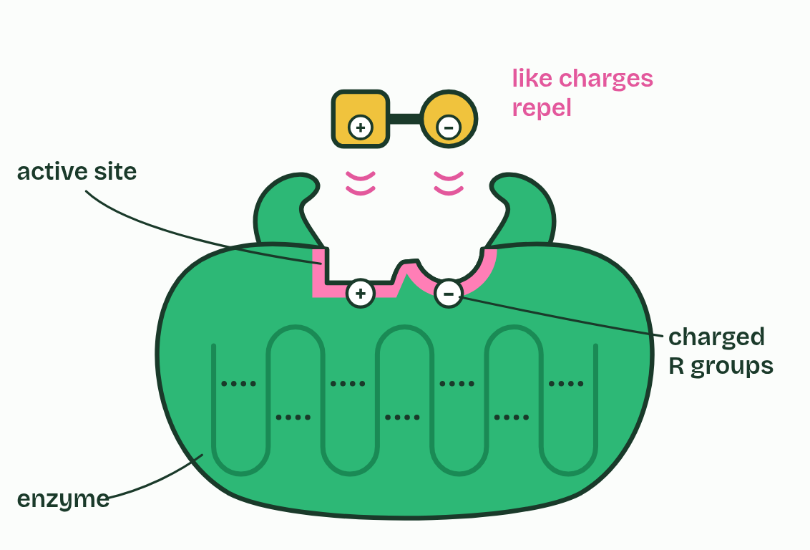
CHAPTER 1 · 3.1.A Enzyme structure
2 / 3
The active site fits one substrate
Look-alike
Minutes 5 to 15
Notes:
Minutes 5 to 15 of 60: The active site (10 min).
The plan: Chapter 1's figure on the board. Offer the enzyme each molecule and have students say, before you click, whether it binds and why. Draw out the double check: shape and charge. Name the parts with the tap labels.
An enzyme is a biological catalyst: a protein that makes one reaction go faster and is not used up by it. One molecule of catalase, the enzyme in this guide's dry lab, breaks down millions of hydrogen peroxide molecules every second, for as long as its shape lasts.
That shape is everything. An enzyme is a chain of hundreds of amino acids folded into a precise 3D shape, held there by hydrogen bonds and ionic bonds between R groups. A small pocket in the fold, lined by just a few of those amino acids, is the active site. The molecule the enzyme works on is its substrate.
A substrate binds only if two things match: its shape fits the site, and its charges are opposite to the charged R groups lining it. That double check is why an enzyme is specific. As the substrate settles in, the site shifts to grip it more tightly, which strains the bond that is about to break: induced fit.
Example: Lactase splits lactose, which is glucose joined to galactose. Sucrose is glucose joined to fructose: exactly the same atoms as lactose, arranged differently. Lactase leaves it alone: the site grips the galactose half, and sucrose has none.

Slide 6
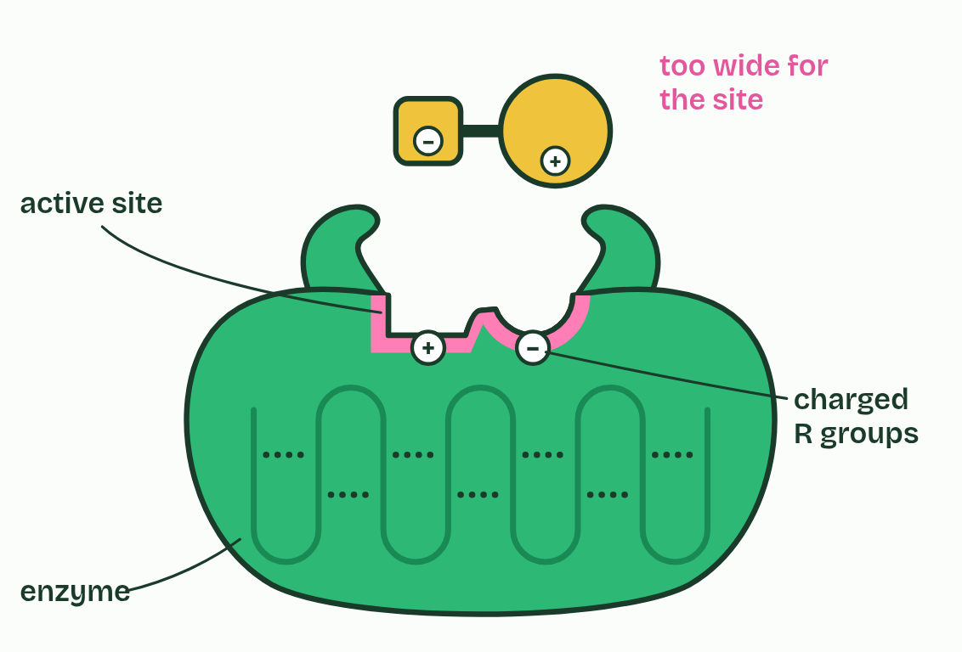
CHAPTER 1 · 3.1.A Enzyme structure
3 / 3
The active site fits one substrate
Wrong shape
Minutes 5 to 15
Notes:
Minutes 5 to 15 of 60: The active site (10 min).
The plan: Chapter 1's figure on the board. Offer the enzyme each molecule and have students say, before you click, whether it binds and why. Draw out the double check: shape and charge. Name the parts with the tap labels.
An enzyme is a biological catalyst: a protein that makes one reaction go faster and is not used up by it. One molecule of catalase, the enzyme in this guide's dry lab, breaks down millions of hydrogen peroxide molecules every second, for as long as its shape lasts.
That shape is everything. An enzyme is a chain of hundreds of amino acids folded into a precise 3D shape, held there by hydrogen bonds and ionic bonds between R groups. A small pocket in the fold, lined by just a few of those amino acids, is the active site. The molecule the enzyme works on is its substrate.
A substrate binds only if two things match: its shape fits the site, and its charges are opposite to the charged R groups lining it. That double check is why an enzyme is specific. As the substrate settles in, the site shifts to grip it more tightly, which strains the bond that is about to break: induced fit.
Example: Lactase splits lactose, which is glucose joined to galactose. Sucrose is glucose joined to fructose: exactly the same atoms as lactose, arranged differently. Lactase leaves it alone: the site grips the galactose half, and sucrose has none.

Slide 7
CHAPTER 1 · 3.1.A Enzyme structure
The active site fits one substrate
Enzyme names usually end in -ase and name the substrate: lactase splits lactose, lipase splits lipids.
Shape and charge both have to match, or there is no binding and no reaction.
The enzyme lets go of the products unchanged and binds the next substrate.
Minutes 5 to 15
Notes:
Minutes 5 to 15 of 60: The active site (10 min).
The plan: Chapter 1's figure on the board. Offer the enzyme each molecule and have students say, before you click, whether it binds and why. Draw out the double check: shape and charge. Name the parts with the tap labels.
An enzyme is a biological catalyst: a protein that makes one reaction go faster and is not used up by it. One molecule of catalase, the enzyme in this guide's dry lab, breaks down millions of hydrogen peroxide molecules every second, for as long as its shape lasts.
That shape is everything. An enzyme is a chain of hundreds of amino acids folded into a precise 3D shape, held there by hydrogen bonds and ionic bonds between R groups. A small pocket in the fold, lined by just a few of those amino acids, is the active site. The molecule the enzyme works on is its substrate.
A substrate binds only if two things match: its shape fits the site, and its charges are opposite to the charged R groups lining it. That double check is why an enzyme is specific. As the substrate settles in, the site shifts to grip it more tightly, which strains the bond that is about to break: induced fit.
Example: Lactase splits lactose, which is glucose joined to galactose. Sucrose is glucose joined to fructose: exactly the same atoms as lactose, arranged differently. Lactase leaves it alone: the site grips the galactose half, and sucrose has none.
Parts of the figure:
Flexible loops Two loops of the chain beside the active site. As the substrate settles in they swing in and close round it, which strains the bond that is about to break: induced fit.
The folded chain An enzyme is a protein: a chain of amino acids folded into one precise 3D shape. Hydrogen bonds and ionic bonds between R groups (the dashed lines) hold the fold, and the fold makes the active site. Break enough of them and the site loses its shape.
Active site The pocket where the substrate binds and reacts, lined by just a few of the enzyme's amino acids. Its shape, and the charges of the R groups lining it, match one substrate.
Charged R groups Side chains of two amino acids lining the site: one positive, one negative. The substrate carries the opposite charges in the same places, so it is pulled in and held.
Substrate Its square half fits the square end of the site and its round half the round end, and each of its charges sits over an opposite charge. It binds, the loops close round it, and the bond in its middle is strained.
A look-alike The same shape as the substrate, but its charges are the other way round. Each one faces a like charge in the site, and like charges repel.
Wrong shape Its charges are right, but its round half is far too wide for the round end of the site. It cannot get close enough for the charges to pull it in.

Slide 8
WATCH OUT
The substrate and the active site are not "the same shape". They are complementary: the site is the mold and the substrate fills it, as a hand fills a glove. And the site is not a rigid lock. It moves as the substrate binds.
Minutes 5 to 15
Notes:
Minutes 5 to 15 of 60: The active site (10 min).
The plan: Chapter 1's figure on the board. Offer the enzyme each molecule and have students say, before you click, whether it binds and why. Draw out the double check: shape and charge. Name the parts with the tap labels.
A common mistake: say it, then ask who can say why it is wrong.

Slide 9
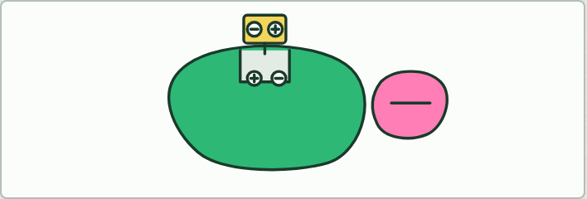
MODEL
15 MIN
Modeling clay enzymes
THE TASK
Pairs shape an enzyme with a pocket and a substrate to fit it, then add a + and a − sticker to each so the charges line up. First the site is rigid (lock and key). Then they rebuild it with soft walls that close around the substrate (induced fit). Last, one partner makes a look-alike with the stickers swapped, and the other explains why it is not held.
STUDENTS NEED
Modeling clay in two colors per pair, small + and − stickers, chapter 1's figure on the board.
Minutes 15 to 30
Notes:
Minutes 15 to 30 of 60: Modeling clay enzymes (15 min).
The plan: Pairs build an enzyme and its substrate, first as a rigid lock and key, then remodeled to show induced fit (activity below). Ask which model explains the evidence that the site changes shape as the substrate binds.
The activity: Modeling clay enzymes. Pairs shape an enzyme with a pocket and a substrate to fit it, then add a + and a − sticker to each so the charges line up. First the site is rigid (lock and key). Then they rebuild it with soft walls that close around the substrate (induced fit). Last, one partner makes a look-alike with the stickers swapped, and the other explains why it is not held.
Needs: modeling clay in two colors per pair, small + and − stickers, chapter 1's figure on the board.
The time: 15 minutes, minutes 15 to 30 of the plan.

Slide 10
STEP 4
12 MIN
Activation energy
Students sketch it, labeling the activation energy with and without the enzyme and ΔG.
Push on the predict box: what does the enzyme not change?
Minutes 30 to 42
Notes:
Minutes 30 to 42 of 60: Activation energy (12 min).
The plan: Play chapter 2's figure a step at a time. Students sketch it, labeling the activation energy with and without the enzyme and ΔG. Push on the predict box: what does the enzyme not change?

Slide 11
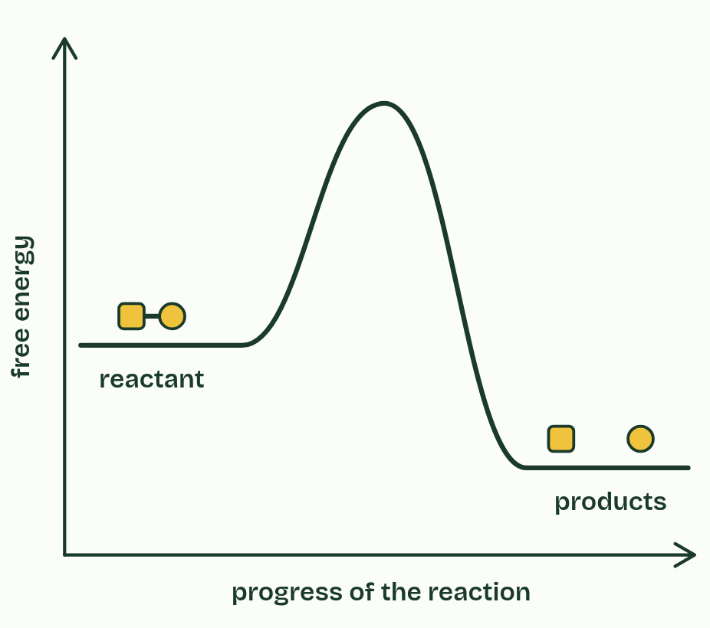
CHAPTER 2 · 3.1.A Enzyme catalysis
1 / 5
Enzymes lower the activation energy
The reactant must pass over a hump before it can become products. Here the products end up lower: this reaction releases energy.
Minutes 30 to 42
Notes:
Minutes 30 to 42 of 60: Activation energy (12 min).
The plan: Play chapter 2's figure a step at a time. Students sketch it, labeling the activation energy with and without the enzyme and ΔG. Push on the predict box: what does the enzyme not change?
Breaking a bond always takes energy in; forming a bond releases energy. So even a reaction that releases energy overall must first be pushed over a hump, while old bonds strain and start to break. That push is the activation energy. At body temperature very few collisions carry enough of it, so most reactions in a cell would crawl.
An enzyme gives the reaction a lower route. Its active site holds the substrate in exactly the right position, induced fit bends the bond that has to break, and charged R groups pull electrons the right way. Less energy is needed, so far more molecules get over the top each second.
What the enzyme cannot change is where the reaction starts and where it ends. The free energy of the reactants and of the products, and so the difference between them, ΔG, are the same with or without it. It changes the route, not the destination, and it speeds the reverse reaction just as much.
Example: One step in making the nucleotides of DNA and RNA has, with no enzyme, a half-life of about 78 million years. Its enzyme, orotidine phosphate decarboxylase, gets each molecule through in about a fortieth of a second: a speed-up of around 10¹⁷.

Slide 12
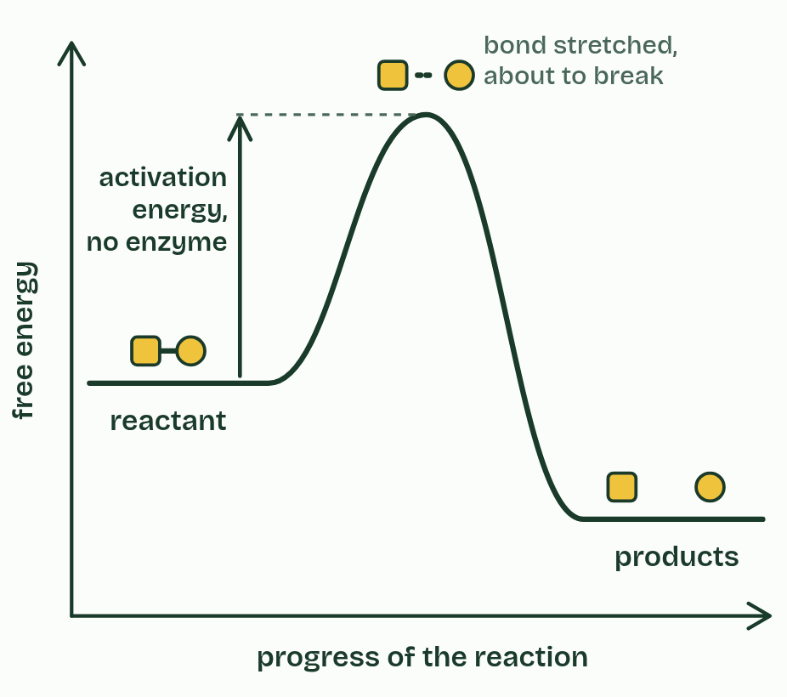
CHAPTER 2 · 3.1.A Enzyme catalysis
2 / 5
Enzymes lower the activation energy
At the top of the hump the bond is stretched and about to break. Getting there takes the activation energy, and at 37 °C few collisions have that much.
Minutes 30 to 42
Notes:
Minutes 30 to 42 of 60: Activation energy (12 min).
The plan: Play chapter 2's figure a step at a time. Students sketch it, labeling the activation energy with and without the enzyme and ΔG. Push on the predict box: what does the enzyme not change?
Breaking a bond always takes energy in; forming a bond releases energy. So even a reaction that releases energy overall must first be pushed over a hump, while old bonds strain and start to break. That push is the activation energy. At body temperature very few collisions carry enough of it, so most reactions in a cell would crawl.
An enzyme gives the reaction a lower route. Its active site holds the substrate in exactly the right position, induced fit bends the bond that has to break, and charged R groups pull electrons the right way. Less energy is needed, so far more molecules get over the top each second.
What the enzyme cannot change is where the reaction starts and where it ends. The free energy of the reactants and of the products, and so the difference between them, ΔG, are the same with or without it. It changes the route, not the destination, and it speeds the reverse reaction just as much.
Example: One step in making the nucleotides of DNA and RNA has, with no enzyme, a half-life of about 78 million years. Its enzyme, orotidine phosphate decarboxylase, gets each molecule through in about a fortieth of a second: a speed-up of around 10¹⁷.

Slide 13
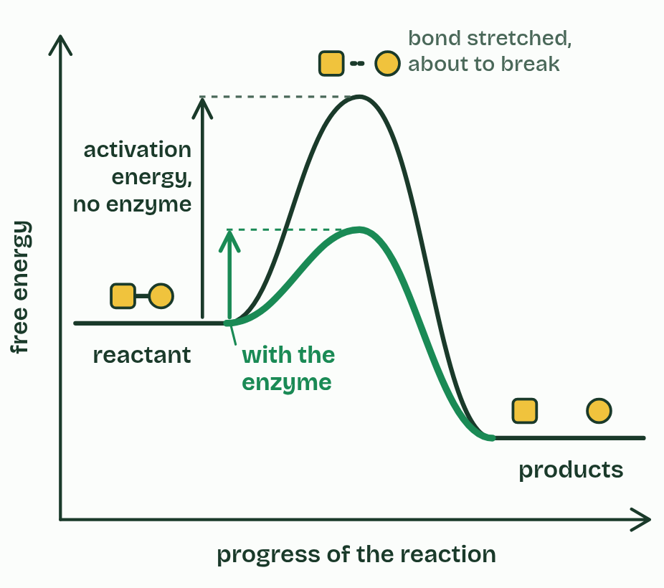
CHAPTER 2 · 3.1.A Enzyme catalysis
3 / 5
Enzymes lower the activation energy
With the enzyme the route is lower: the active site holds the substrate in place and strains its bond, so less energy is needed.
Minutes 30 to 42
Notes:
Minutes 30 to 42 of 60: Activation energy (12 min).
The plan: Play chapter 2's figure a step at a time. Students sketch it, labeling the activation energy with and without the enzyme and ΔG. Push on the predict box: what does the enzyme not change?
Breaking a bond always takes energy in; forming a bond releases energy. So even a reaction that releases energy overall must first be pushed over a hump, while old bonds strain and start to break. That push is the activation energy. At body temperature very few collisions carry enough of it, so most reactions in a cell would crawl.
An enzyme gives the reaction a lower route. Its active site holds the substrate in exactly the right position, induced fit bends the bond that has to break, and charged R groups pull electrons the right way. Less energy is needed, so far more molecules get over the top each second.
What the enzyme cannot change is where the reaction starts and where it ends. The free energy of the reactants and of the products, and so the difference between them, ΔG, are the same with or without it. It changes the route, not the destination, and it speeds the reverse reaction just as much.
Example: One step in making the nucleotides of DNA and RNA has, with no enzyme, a half-life of about 78 million years. Its enzyme, orotidine phosphate decarboxylase, gets each molecule through in about a fortieth of a second: a speed-up of around 10¹⁷.

Slide 14
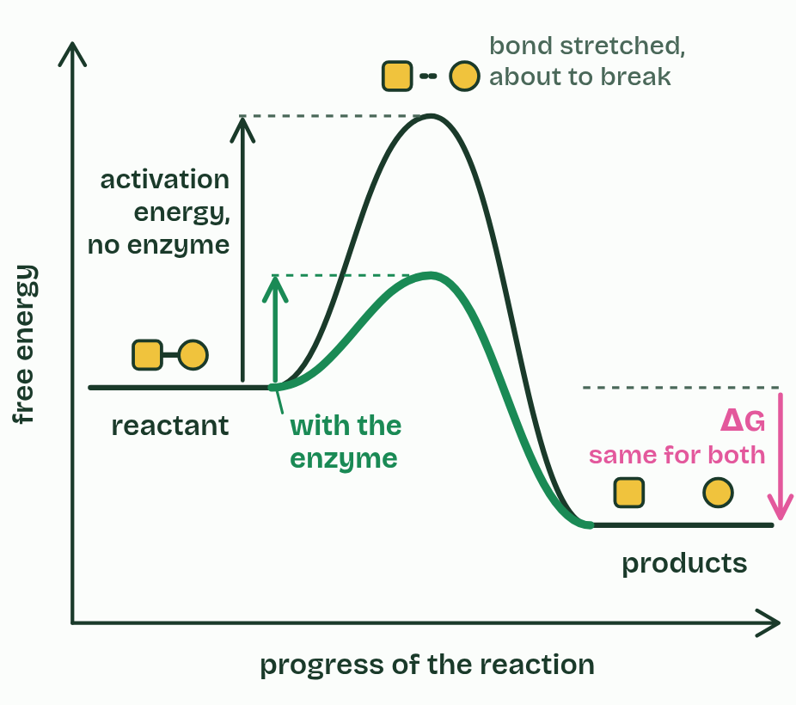
CHAPTER 2 · 3.1.A Enzyme catalysis
4 / 5
Enzymes lower the activation energy
The start and the finish have not moved, so ΔG is the same with or without the enzyme. The enzyme changes the route, never the destination.
Minutes 30 to 42
Notes:
Minutes 30 to 42 of 60: Activation energy (12 min).
The plan: Play chapter 2's figure a step at a time. Students sketch it, labeling the activation energy with and without the enzyme and ΔG. Push on the predict box: what does the enzyme not change?
Breaking a bond always takes energy in; forming a bond releases energy. So even a reaction that releases energy overall must first be pushed over a hump, while old bonds strain and start to break. That push is the activation energy. At body temperature very few collisions carry enough of it, so most reactions in a cell would crawl.
An enzyme gives the reaction a lower route. Its active site holds the substrate in exactly the right position, induced fit bends the bond that has to break, and charged R groups pull electrons the right way. Less energy is needed, so far more molecules get over the top each second.
What the enzyme cannot change is where the reaction starts and where it ends. The free energy of the reactants and of the products, and so the difference between them, ΔG, are the same with or without it. It changes the route, not the destination, and it speeds the reverse reaction just as much.
Example: One step in making the nucleotides of DNA and RNA has, with no enzyme, a half-life of about 78 million years. Its enzyme, orotidine phosphate decarboxylase, gets each molecule through in about a fortieth of a second: a speed-up of around 10¹⁷.

Slide 15
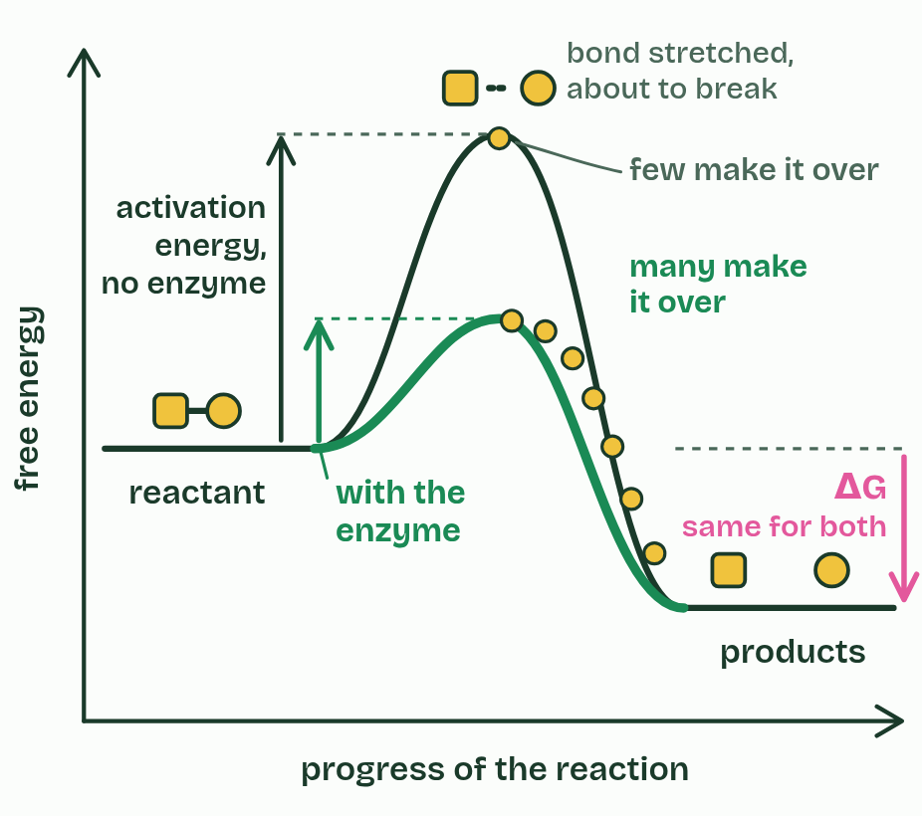
CHAPTER 2 · 3.1.A Enzyme catalysis
5 / 5
Enzymes lower the activation energy
A lower peak means many more molecules have enough energy to cross it each second, so the reaction runs far faster.
Minutes 30 to 42
Notes:
Minutes 30 to 42 of 60: Activation energy (12 min).
The plan: Play chapter 2's figure a step at a time. Students sketch it, labeling the activation energy with and without the enzyme and ΔG. Push on the predict box: what does the enzyme not change?
Breaking a bond always takes energy in; forming a bond releases energy. So even a reaction that releases energy overall must first be pushed over a hump, while old bonds strain and start to break. That push is the activation energy. At body temperature very few collisions carry enough of it, so most reactions in a cell would crawl.
An enzyme gives the reaction a lower route. Its active site holds the substrate in exactly the right position, induced fit bends the bond that has to break, and charged R groups pull electrons the right way. Less energy is needed, so far more molecules get over the top each second.
What the enzyme cannot change is where the reaction starts and where it ends. The free energy of the reactants and of the products, and so the difference between them, ΔG, are the same with or without it. It changes the route, not the destination, and it speeds the reverse reaction just as much.
Example: One step in making the nucleotides of DNA and RNA has, with no enzyme, a half-life of about 78 million years. Its enzyme, orotidine phosphate decarboxylase, gets each molecule through in about a fortieth of a second: a speed-up of around 10¹⁷.

Slide 16
CHAPTER 2 · 3.1.A Enzyme catalysis
Enzymes lower the activation energy
The enzyme lowers the activation energy. It supplies no energy of its own.
ΔG does not change, so an enzyme cannot make an uphill reaction go by itself.
Minutes 30 to 42
Notes:
Minutes 30 to 42 of 60: Activation energy (12 min).
The plan: Play chapter 2's figure a step at a time. Students sketch it, labeling the activation energy with and without the enzyme and ΔG. Push on the predict box: what does the enzyme not change?
Breaking a bond always takes energy in; forming a bond releases energy. So even a reaction that releases energy overall must first be pushed over a hump, while old bonds strain and start to break. That push is the activation energy. At body temperature very few collisions carry enough of it, so most reactions in a cell would crawl.
An enzyme gives the reaction a lower route. Its active site holds the substrate in exactly the right position, induced fit bends the bond that has to break, and charged R groups pull electrons the right way. Less energy is needed, so far more molecules get over the top each second.
What the enzyme cannot change is where the reaction starts and where it ends. The free energy of the reactants and of the products, and so the difference between them, ΔG, are the same with or without it. It changes the route, not the destination, and it speeds the reverse reaction just as much.
Example: One step in making the nucleotides of DNA and RNA has, with no enzyme, a half-life of about 78 million years. Its enzyme, orotidine phosphate decarboxylase, gets each molecule through in about a fortieth of a second: a speed-up of around 10¹⁷.

Slide 17
PREDICT
An enzyme is added to a reaction with ΔG = −20 kJ/mol. What is ΔG now?
A More negative, so more energy is released
B −20 kJ/mol: the enzyme does not change it
C Less negative, as the enzyme absorbs energy
D Zero, because the enzyme brings it to balance
Minutes 30 to 42
Notes:
Minutes 30 to 42 of 60: Activation energy (12 min).
The plan: Play chapter 2's figure a step at a time. Students sketch it, labeling the activation energy with and without the enzyme and ΔG. Push on the predict box: what does the enzyme not change?
Ask for a show of hands, or mini whiteboards, before revealing. (Answer: B, on the next slide.)

Slide 18
WHAT HAPPENS
An enzyme is added to a reaction with ΔG = −20 kJ/mol. What is ΔG now?
A More negative, so more energy is released
B −20 kJ/mol: the enzyme does not change it
C Less negative, as the enzyme absorbs energy
D Zero, because the enzyme brings it to balance
The enzyme lowers the peak, not the start or the finish. Play the figure to step 4: both routes begin at the same level and end at the same level, so ΔG is −20 kJ/mol either way. Only the activation energy drops.
Minutes 30 to 42
Notes:
Minutes 30 to 42 of 60: Activation energy (12 min).
The plan: Play chapter 2's figure a step at a time. Students sketch it, labeling the activation energy with and without the enzyme and ΔG. Push on the predict box: what does the enzyme not change?
Answer: B. The enzyme lowers the peak, not the start or the finish. Play the figure to step 4: both routes begin at the same level and end at the same level, so ΔG is −20 kJ/mol either way. Only the activation energy drops.

Slide 19
WATCH OUT
"Breaking bonds releases energy" is wrong, and it costs marks every year. Breaking a bond always takes energy in. Energy is released when new, more stable bonds form, and the enzyme only lowers the cost of getting started.
Minutes 30 to 42
Notes:
Minutes 30 to 42 of 60: Activation energy (12 min).
The plan: Play chapter 2's figure a step at a time. Students sketch it, labeling the activation energy with and without the enzyme and ΔG. Push on the predict box: what does the enzyme not change?
A common mistake: say it, then ask who can say why it is wrong.

Slide 20
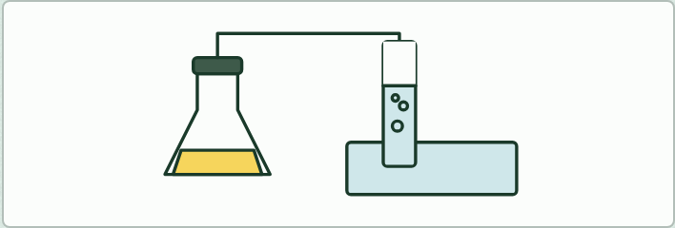
DEMO
12 MIN
Catch the oxygen
THE TASK
Add yeast suspension to 3% hydrogen peroxide in a flask, bung it, and collect the gas over water in an upturned measuring cylinder. Repeat with a gas syringe. Students list what the first method misses: gas lost before the bung goes in, bubbles that stick in the tube, oxygen dissolving, a meniscus that is hard to read.
STUDENTS NEED
3% hydrogen peroxide, yeast suspension (or potato or liver), conical flask with bung and delivery tube, measuring cylinder and trough of water, 100 cm³ gas syringe, stopwatch, eye protection.
Minutes 42 to 54
Notes:
Minutes 42 to 54 of 60: Demo: catch the oxygen (12 min).
The plan: Catalase and hydrogen peroxide, the gas collected two ways (activity below). Students list every way the first method loses gas, then judge which method they would trust for the circus next lesson.
The activity: Catch the oxygen. Add yeast suspension to 3% hydrogen peroxide in a flask, bung it, and collect the gas over water in an upturned measuring cylinder. Repeat with a gas syringe. Students list what the first method misses: gas lost before the bung goes in, bubbles that stick in the tube, oxygen dissolving, a meniscus that is hard to read.
Needs: 3% hydrogen peroxide, yeast suspension (or potato or liver), conical flask with bung and delivery tube, measuring cylinder and trough of water, 100 cm³ gas syringe, stopwatch, eye protection.
The time: 12 minutes, minutes 42 to 54 of the plan.

Slide 21
PLENARY
Can you now...
Explain how the shape and charge of an active site make an enzyme specific to its substrate (3.1.A)
Explain how an enzyme speeds up a reaction by lowering its activation energy, and why it leaves ΔG unchanged (3.1.A)
Minutes 54 to 60
Notes:
Minutes 54 to 60 of 60: Exit (6 min).
The plan: Chapter 1's predict box on paper before you reveal it (a molecule with the substrate's shape but its charges the other way round), then back to the sugar: the flame supplies activation energy, the cell supplies an enzyme.
Thumbs up, sideways or down on each goal before the exit question. The goals come from the statements this lesson covers.

Slide 22
EXIT QUESTION
Before you go
On paper, on your own, before we go through it.
Minutes 54 to 60
Notes:
Minutes 54 to 60 of 60: Exit (6 min).
The plan: Chapter 1's predict box on paper before you reveal it (a molecule with the substrate's shape but its charges the other way round), then back to the sugar: the flame supplies activation energy, the cell supplies an enzyme.

Slide 23
PREDICT
A molecule has exactly the substrate's shape, but its two charges are the other way round. What happens at the active site?
A It binds, because its shape fits the site
B It binds, but is broken down more slowly
C It is pushed away, because like charges repel
D It binds and changes the enzyme's shape for good
Minutes 54 to 60
Notes:
Minutes 54 to 60 of 60: Exit (6 min).
The plan: Chapter 1's predict box on paper before you reveal it (a molecule with the substrate's shape but its charges the other way round), then back to the sugar: the flame supplies activation energy, the cell supplies an enzyme.
Ask for a show of hands, or mini whiteboards, before revealing. (Answer: C, on the next slide.)

Slide 24
WHAT HAPPENS
A molecule has exactly the substrate's shape, but its two charges are the other way round. What happens at the active site?
A It binds, because its shape fits the site
B It binds, but is broken down more slowly
C It is pushed away, because like charges repel
D It binds and changes the enzyme's shape for good
Shape is not enough. Each of its charges now faces a like charge in the site, and like charges repel, so it never settles in. Offer the enzyme the Look-alike in the figure to see it.
Minutes 54 to 60
Notes:
Minutes 54 to 60 of 60: Exit (6 min).
The plan: Chapter 1's predict box on paper before you reveal it (a molecule with the substrate's shape but its charges the other way round), then back to the sugar: the flame supplies activation energy, the cell supplies an enzyme.
Answer: C. Shape is not enough. Each of its charges now faces a like charge in the site, and like charges repel, so it never settles in. Offer the enzyme the Look-alike in the figure to see it.

Slide 25
PRACTISE AND REVISE
Keep going
Exam practice: a fresh paper of exam questions on 3.1 to 3.3, marked as you go
The guide, with the animations and the dry lab
This lesson in the guide: 1 The active site fits one substrate, 2 Enzymes lower the activation energy
BUILD FOR YOUR CLASS
ALREADY ON THE SITE FOR UNIT 3
CARD SETS ON SPLYCR
Tarsia puzzle, dominoes and picture reveal on Unit 3, built from its key terms and ready to print
A pub quiz with rounds on Unit 3, to present or run with no projector
The Kelp Light Habitat escape room, or an escape room built from the question bank on Unit 3
Lesson: Enzymes
Lesson: Environmental Impacts on Enzyme Function
Lesson: Cellular Energy
Quiz: Enzymes
Quiz: Environmental Impacts on Enzyme Function
Quiz: Cellular Energy
Exam questions: Unit 3 in the exam maker, a paper with scoring guidelines
Open a set to host it as a class game, or make a copy to edit.
Unit 3: Cellular Energetics (part 1)
Unit 3: Cellular Energetics (part 2)
Unit 3: Cellular Energetics (part 3)
How this was made. The course structure, the activities and the teaching choices come from my own classroom, my presentations and my years of teaching IB and AP Biology. I use Claude, an AI, to help write and build the interactive guides, lesson plans, slides and practice questions, and to draw the diagrams and code the interactives. I direct the work and review it against the IB and AP specifications before it goes live.
Minute 60: after the lesson
Notes:
Every link here is live. Set the exam practice paper for homework: it is fresh each time, marked as students go and saved to their Exam practice when they are signed in.
Exam practice: https://www.biologybybradford.com/exam-maker/sit?program=ap&units=U3&ced=3.1%2C3.2%2C3.3&paper=quiz&marks=15&src=ep
The guide: https://www.biologybybradford.com/guides/ap-biology-unit-3-enzymes

