Slide 1
AP Biology 3.1 to 3.3
LESSON 2 OF 3
BY THE END YOU CAN
Enzymes and cellular energy
Explain how heat and extreme pH change an enzyme's structure, and when that change can be undone (3.2.A)
Predict how temperature, pH, substrate and product concentrations and inhibitors change the rate of a reaction (3.2.B)
What changes the rate
3.2.A, 3.2.B
Temperature, pH and substrate concentration, tested in a circus of practicals and explained with the figures
60 minutes · chapters 3, 4, 5
Minute 0
Notes:
AP Biology 3.1 to 3.3, Enzymes and cellular energy. Lesson 2 of 3: What changes the rate, 60 minutes.
The plan, minute by minute (each slide's footer says where you are):
0 to 5 min (5) Retrieval: SPITE
5 to 35 min (30) Circus of enzyme labs
35 to 47 min (12) Share and explain
47 to 55 min (8) Data: two enzymes, one graph
55 to 60 min (5) Exit
What students get wrong:
"The plateau is the enzyme being used up." Every active site is busy and every enzyme molecule is still working. Ask what adding more enzyme would do, then show it in chapter 3's figure.
"Cold denatures enzymes." Cold slows them; they are intact and recover when warmed. Keep "denatured" for heat and extreme pH.
Errors that turn up in published slides. Iodine with starch is blue-black, not purple; a positive biuret test is purple (blue means no protein); zanamivir stops neuraminidase cutting sialic acid, not hemagglutinin; cyanide binds the metal center of cytochrome c oxidase and is not an allosteric inhibitor.
Stretch and support:
Stretch: explain why the temperature curve is not symmetrical: two effects with different sensitivity to heat, collisions rising steadily and unfolding switching on sharply.
Stretch: from two saturation curves with the same maximum, decide which enzyme holds its substrate more tightly, and what that means at low substrate concentration.
Stretch: in the dry lab, compare full runs at 50 °C and 65 °C and explain why the 65 °C curve levels off far below the line where all the peroxide is used.
Support: one sentence frame for every graph: "As ___ increases from ___ to ___, the rate ___ because ___."
Support: drag a figure's slider and describe what moves before explaining why; the SPITE and Exits / Enters tiles as a checklist.
The lesson plan to print: https://www.biologybybradford.com/guides/downloads/ap-biology-unit-3-enzymes-lesson-2-plan.pdf

Slide 2
DO NOW
Retrieval: SPITE
The Remember it tiles in chapter 3, then sketch from memory the shape of rate against substrate concentration, temperature and pH.
5:00
minutes
Start now: the timer is running.
Minutes 0 to 5
Notes:
Minutes 0 to 5 of 60: Retrieval: SPITE (5 min).
The plan: The Remember it tiles in chapter 3, then sketch from memory the shape of rate against substrate concentration, temperature and pH. Leave the sketches up; they are tested by the circus.
Start a 5 minute timer as they come in.

Slide 3
REMEMBER IT
The five things that change an enzyme's rate spell SPITE
S
P
I
T
E
Spicy
Peppers
Irritate
Tired
Eyes
Minutes 0 to 5
Notes:
Minutes 0 to 5 of 60: Retrieval: SPITE (5 min).
The plan: The Remember it tiles in chapter 3, then sketch from memory the shape of rate against substrate concentration, temperature and pH. Leave the sketches up; they are tested by the circus.
Ask the class what each letter stands for before revealing.

Slide 4
REMEMBER IT
The five things that change an enzyme's rate spell SPITE
S
P
I
T
E
Spicy
Peppers
Irritate
Tired
Eyes
Substrate
pH
Inhibitors
Temperature
Enzyme
how much there is
charges in the site
block or bend the site
collisions, then unfolding
how much there is
Minutes 0 to 5
Notes:
Minutes 0 to 5 of 60: Retrieval: SPITE (5 min).
The plan: The Remember it tiles in chapter 3, then sketch from memory the shape of rate against substrate concentration, temperature and pH. Leave the sketches up; they are tested by the circus.
Spicy: Substrate (how much there is)
Peppers: pH (charges in the site)
Irritate: Inhibitors (block or bend the site)
Tired: Temperature (collisions, then unfolding)
Eyes: Enzyme (how much there is)

Slide 5

PRACTICAL
30 MIN
Circus of enzyme labs
THE TASK
A filter paper disc soaked in catalase sinks in hydrogen peroxide, then floats up as oxygen collects on it: the time to rise measures the rate. Three stations change one variable each: pH (buffers at 4, 7 and 10), temperature (water baths from ice to 60 °C) and peroxide concentration (0.5% to 3%).
STUDENTS NEED
Hole punch, filter paper, yeast suspension, forceps, hydrogen peroxide at four concentrations, three buffers, water baths, stopwatches, eye protection.
Minutes 5 to 35
Notes:
Minutes 5 to 35 of 60: Circus of enzyme labs (30 min).
The plan: Everyone first times one disc in 3% peroxide to learn the end point (5 minutes). Then two of three stations, about 12 minutes each: pH, temperature, peroxide concentration. At each, read the method twice, draw a results table, run three trials.
The activity: Circus of enzyme labs. A filter paper disc soaked in catalase sinks in hydrogen peroxide, then floats up as oxygen collects on it: the time to rise measures the rate. Three stations change one variable each: pH (buffers at 4, 7 and 10), temperature (water baths from ice to 60 °C) and peroxide concentration (0.5% to 3%).
Needs: hole punch, filter paper, yeast suspension, forceps, hydrogen peroxide at four concentrations, three buffers, water baths, stopwatches, eye protection.
The time: 30 minutes, minutes 5 to 35 of the plan.

Slide 6
STEP 3
12 MIN
Share and explain
Explain each shape with the figures from chapters 3 to 5, dragging the sliders live.
Minutes 35 to 47
Notes:
Minutes 35 to 47 of 60: Share and explain (12 min).
The plan: Each station's groups put their result on the board. Explain each shape with the figures from chapters 3 to 5, dragging the sliders live: collisions and saturation; collisions then unfolding; charges in the site.

Slide 7
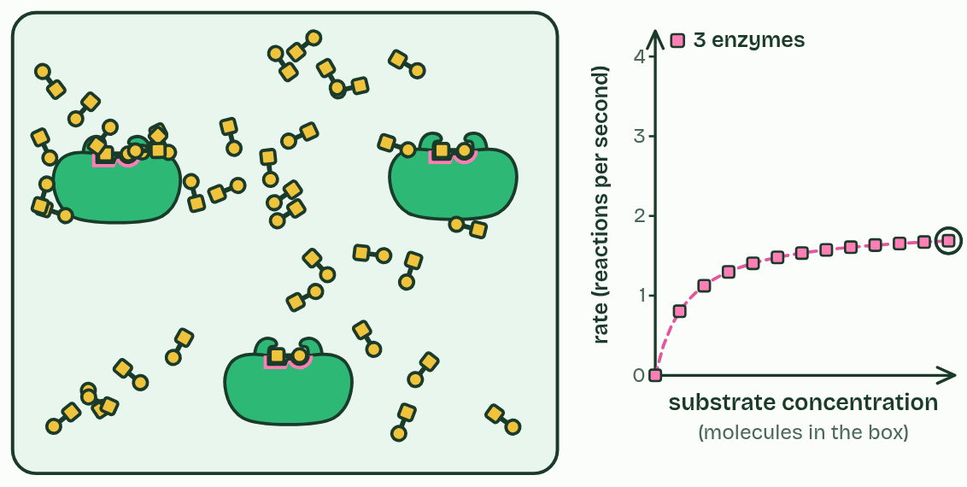
CHAPTER 3 · 3.2.B Substrate and enzyme concentration
1 / 2
More substrate, more collisions, up to a limit
3 enzymes
Minutes 35 to 47
Notes:
Minutes 35 to 47 of 60: Share and explain (12 min).
The plan: Each station's groups put their result on the board. Explain each shape with the figures from chapters 3 to 5, dragging the sliders live: collisions and saturation; collisions then unfolding; charges in the site.
Enzyme and substrate molecules jostle about at random. A reaction can only happen when a substrate meets a free active site the right way round, so the rate depends on how often that happens.
Add more substrate and those meetings happen more often, so the rate climbs. But each enzyme molecule can only work so fast. Once there is so much substrate that every active site is refilled the moment it empties, the enzyme is saturated and the rate levels off at its maximum. Past that point, only more enzyme raises it.
Products matter too. As a reaction runs, substrate is used up and product builds up, so the rate falls: the relative concentrations of substrate and product set how fast it goes. Many reactions are reversible, and the same enzyme speeds whichever direction the concentrations favor.
Example: Carbonic anhydrase in red blood cells turns CO₂ and water into hydrogen carbonate (HCO₃⁻) as they pass through your muscles, where CO₂ is high. In your lungs, where CO₂ is low, the same enzyme turns it back into CO₂ to breathe out.

Slide 8
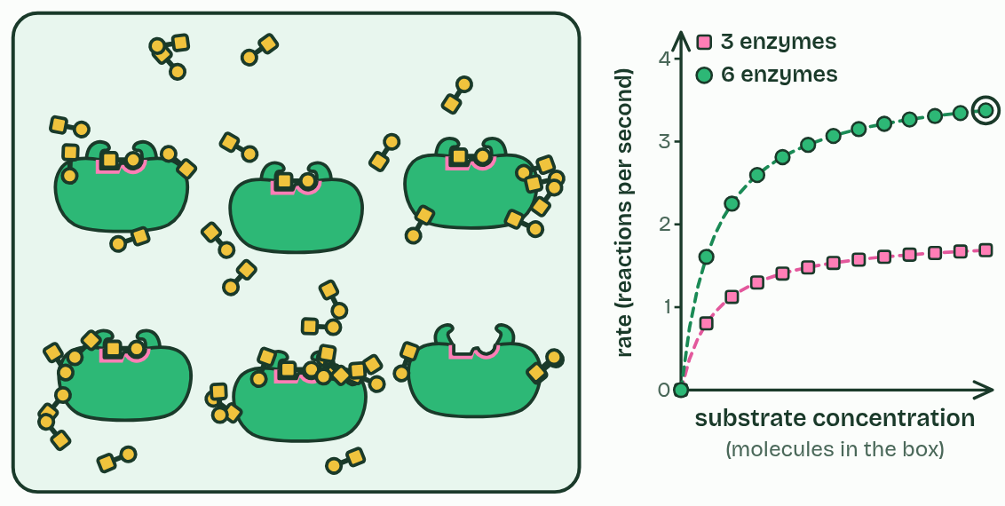
CHAPTER 3 · 3.2.B Substrate and enzyme concentration
2 / 2
More substrate, more collisions, up to a limit
6 enzymes
Minutes 35 to 47
Notes:
Minutes 35 to 47 of 60: Share and explain (12 min).
The plan: Each station's groups put their result on the board. Explain each shape with the figures from chapters 3 to 5, dragging the sliders live: collisions and saturation; collisions then unfolding; charges in the site.
Enzyme and substrate molecules jostle about at random. A reaction can only happen when a substrate meets a free active site the right way round, so the rate depends on how often that happens.
Add more substrate and those meetings happen more often, so the rate climbs. But each enzyme molecule can only work so fast. Once there is so much substrate that every active site is refilled the moment it empties, the enzyme is saturated and the rate levels off at its maximum. Past that point, only more enzyme raises it.
Products matter too. As a reaction runs, substrate is used up and product builds up, so the rate falls: the relative concentrations of substrate and product set how fast it goes. Many reactions are reversible, and the same enzyme speeds whichever direction the concentrations favor.
Example: Carbonic anhydrase in red blood cells turns CO₂ and water into hydrogen carbonate (HCO₃⁻) as they pass through your muscles, where CO₂ is high. In your lungs, where CO₂ is low, the same enzyme turns it back into CO₂ to breathe out.

Slide 9
CHAPTER 3 · 3.2.B Substrate and enzyme concentration
More substrate, more collisions, up to a limit
Low substrate: the rate is limited by how often substrate meets a free site.
High substrate: every site is busy, and the rate is limited by the amount of enzyme.
Minutes 35 to 47
Notes:
Minutes 35 to 47 of 60: Share and explain (12 min).
The plan: Each station's groups put their result on the board. Explain each shape with the figures from chapters 3 to 5, dragging the sliders live: collisions and saturation; collisions then unfolding; charges in the site.
Enzyme and substrate molecules jostle about at random. A reaction can only happen when a substrate meets a free active site the right way round, so the rate depends on how often that happens.
Add more substrate and those meetings happen more often, so the rate climbs. But each enzyme molecule can only work so fast. Once there is so much substrate that every active site is refilled the moment it empties, the enzyme is saturated and the rate levels off at its maximum. Past that point, only more enzyme raises it.
Products matter too. As a reaction runs, substrate is used up and product builds up, so the rate falls: the relative concentrations of substrate and product set how fast it goes. Many reactions are reversible, and the same enzyme speeds whichever direction the concentrations favor.
Example: Carbonic anhydrase in red blood cells turns CO₂ and water into hydrogen carbonate (HCO₃⁻) as they pass through your muscles, where CO₂ is high. In your lungs, where CO₂ is low, the same enzyme turns it back into CO₂ to breathe out.

Slide 10
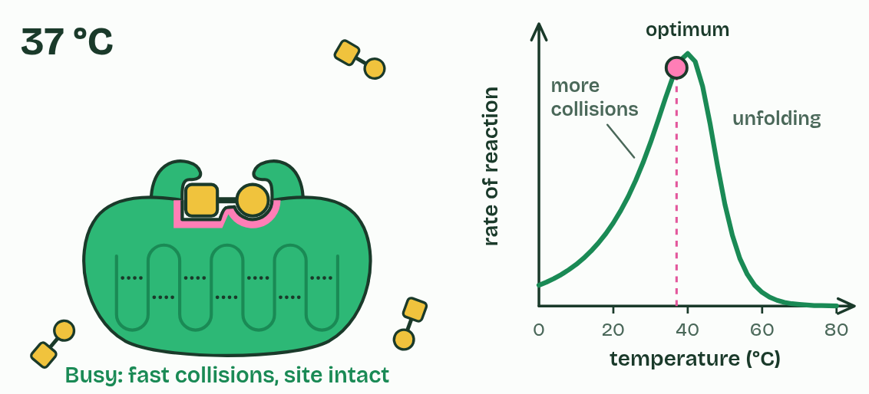
CHAPTER 4 · 3.2.A 3.2.B Temperature
Heat makes it faster, then breaks it
Rising side: more collisions, and more of them with enough energy.
Falling side: denaturation, faster the hotter it gets.
Each enzyme's optimum suits the place it works.
Minutes 35 to 47
Notes:
Minutes 35 to 47 of 60: Share and explain (12 min).
The plan: Each station's groups put their result on the board. Explain each shape with the figures from chapters 3 to 5, dragging the sliders live: collisions and saturation; collisions then unfolding; charges in the site.
Warm a solution and its molecules move faster. Enzyme and substrate collide more often, and more of those collisions carry enough energy to react, so the rate rises. For many enzymes it roughly doubles with every 10 °C.
But an enzyme's shape is held by weak bonds, mostly hydrogen bonds. Past a point, its atoms vibrate so hard that these bonds break: the chain loosens, the active site loses its shape, the substrate no longer fits, and the rate falls steeply. An enzyme whose structure has been disrupted like this is denatured. The temperature where the two effects balance and the rate peaks is the optimum.
Denaturing breaks the bonds between R groups, not the peptide bonds, so the amino acid sequence survives. Sometimes, when conditions return to normal, the chain folds back and the enzyme works again: ribonuclease, unfolded by chemicals, refolds fully active once they are washed away. Chains unfolded by heat usually tangle and stick together instead, and the loss is permanent.
Example: Most human enzymes peak near 37 to 40 °C. The DNA polymerase of Thermus aquaticus, a bacterium from hot springs, works best at about 75 °C, which is why PCR uses it. Antarctic icefish have enzymes that work in water at about 0 °C.

Slide 11
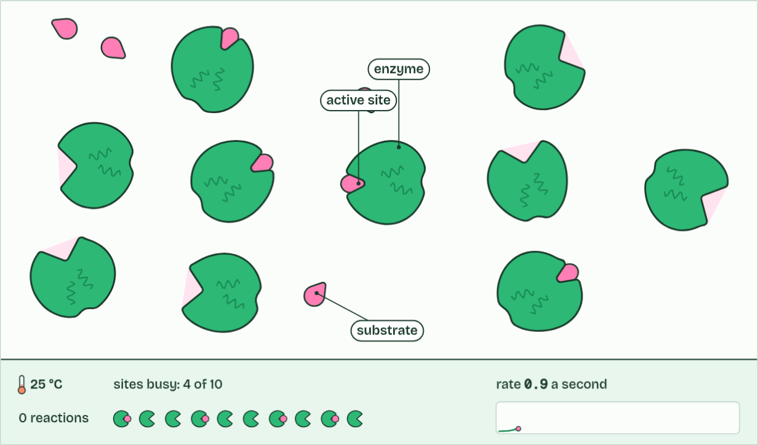
CHAPTER 4 · 3.2.A 3.2.B Temperature
0 reactions
1 / 3
Heat makes it faster, then breaks it
Molecules move at random, and most collisions miss the active site.
Minutes 35 to 47
Notes:
Minutes 35 to 47 of 60: Share and explain (12 min).
The plan: Each station's groups put their result on the board. Explain each shape with the figures from chapters 3 to 5, dragging the sliders live: collisions and saturation; collisions then unfolding; charges in the site.
Warm a solution and its molecules move faster. Enzyme and substrate collide more often, and more of those collisions carry enough energy to react, so the rate rises. For many enzymes it roughly doubles with every 10 °C.
But an enzyme's shape is held by weak bonds, mostly hydrogen bonds. Past a point, its atoms vibrate so hard that these bonds break: the chain loosens, the active site loses its shape, the substrate no longer fits, and the rate falls steeply. An enzyme whose structure has been disrupted like this is denatured. The temperature where the two effects balance and the rate peaks is the optimum.
Denaturing breaks the bonds between R groups, not the peptide bonds, so the amino acid sequence survives. Sometimes, when conditions return to normal, the chain folds back and the enzyme works again: ribonuclease, unfolded by chemicals, refolds fully active once they are washed away. Chains unfolded by heat usually tangle and stick together instead, and the loss is permanent.
Example: Most human enzymes peak near 37 to 40 °C. The DNA polymerase of Thermus aquaticus, a bacterium from hot springs, works best at about 75 °C, which is why PCR uses it. Antarctic icefish have enzymes that work in water at about 0 °C.
The animation "Watch it happen: collisions, heat and inhibitors", paused at 2.0 s. The next slides go on through it, then play it.

Slide 12
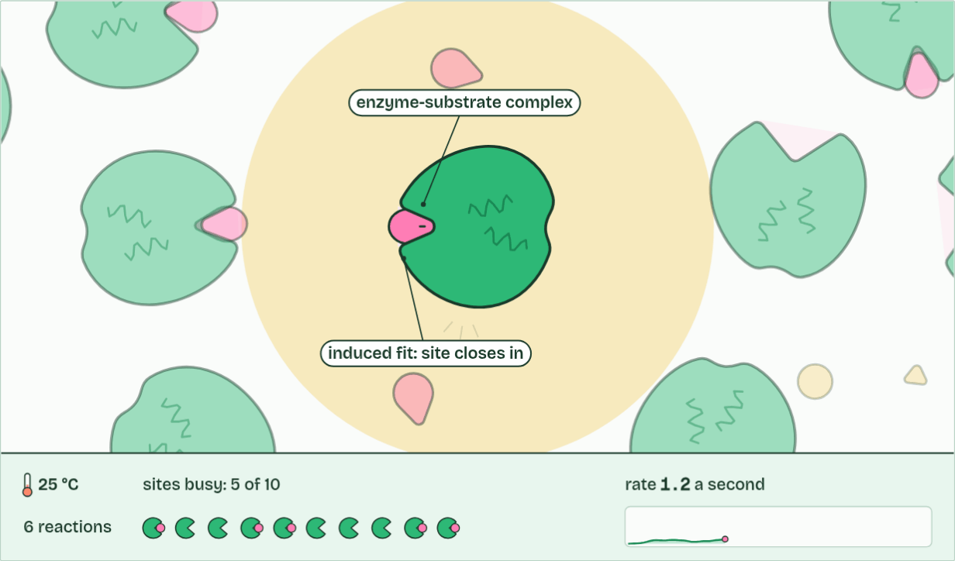
CHAPTER 4 · 3.2.A 3.2.B Temperature
6 reactions
2 / 3
Heat makes it faster, then breaks it
A successful collision: it binds and reacts, and the enzyme is unchanged.
Minutes 35 to 47
Notes:
Minutes 35 to 47 of 60: Share and explain (12 min).
The plan: Each station's groups put their result on the board. Explain each shape with the figures from chapters 3 to 5, dragging the sliders live: collisions and saturation; collisions then unfolding; charges in the site.
Warm a solution and its molecules move faster. Enzyme and substrate collide more often, and more of those collisions carry enough energy to react, so the rate rises. For many enzymes it roughly doubles with every 10 °C.
But an enzyme's shape is held by weak bonds, mostly hydrogen bonds. Past a point, its atoms vibrate so hard that these bonds break: the chain loosens, the active site loses its shape, the substrate no longer fits, and the rate falls steeply. An enzyme whose structure has been disrupted like this is denatured. The temperature where the two effects balance and the rate peaks is the optimum.
Denaturing breaks the bonds between R groups, not the peptide bonds, so the amino acid sequence survives. Sometimes, when conditions return to normal, the chain folds back and the enzyme works again: ribonuclease, unfolded by chemicals, refolds fully active once they are washed away. Chains unfolded by heat usually tangle and stick together instead, and the loss is permanent.
Example: Most human enzymes peak near 37 to 40 °C. The DNA polymerase of Thermus aquaticus, a bacterium from hot springs, works best at about 75 °C, which is why PCR uses it. Antarctic icefish have enzymes that work in water at about 0 °C.
The animation "Watch it happen: collisions, heat and inhibitors", paused at 7.8 s. The next slides go on through it, then play it.

Slide 13
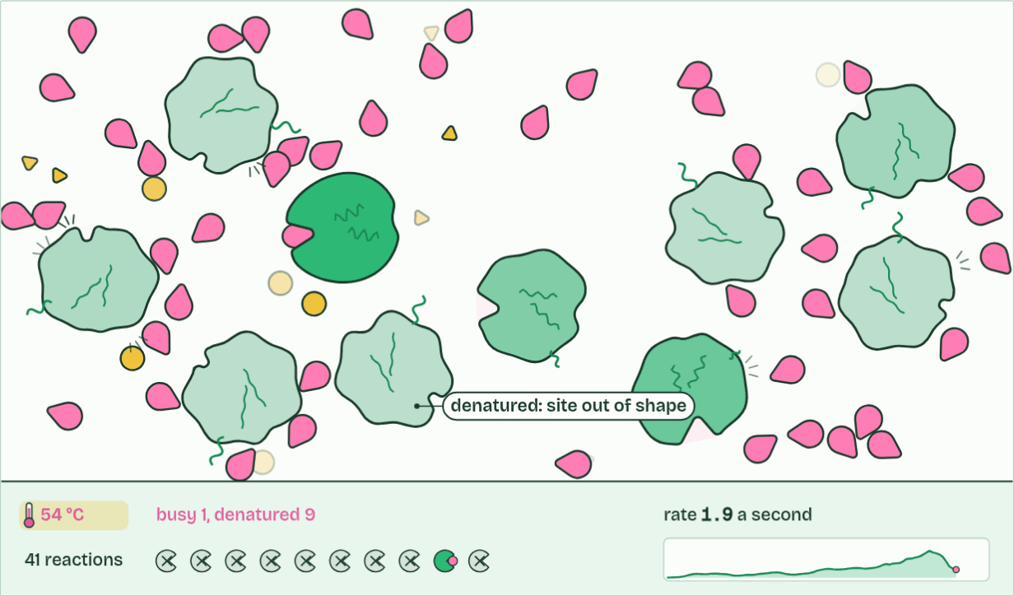
CHAPTER 4 · 3.2.A 3.2.B Temperature
41 reactions
3 / 3
Heat makes it faster, then breaks it
Too hot: enzymes denature. Active sites lose their shape, and the rate falls.
Minutes 35 to 47
Notes:
Minutes 35 to 47 of 60: Share and explain (12 min).
The plan: Each station's groups put their result on the board. Explain each shape with the figures from chapters 3 to 5, dragging the sliders live: collisions and saturation; collisions then unfolding; charges in the site.
Warm a solution and its molecules move faster. Enzyme and substrate collide more often, and more of those collisions carry enough energy to react, so the rate rises. For many enzymes it roughly doubles with every 10 °C.
But an enzyme's shape is held by weak bonds, mostly hydrogen bonds. Past a point, its atoms vibrate so hard that these bonds break: the chain loosens, the active site loses its shape, the substrate no longer fits, and the rate falls steeply. An enzyme whose structure has been disrupted like this is denatured. The temperature where the two effects balance and the rate peaks is the optimum.
Denaturing breaks the bonds between R groups, not the peptide bonds, so the amino acid sequence survives. Sometimes, when conditions return to normal, the chain folds back and the enzyme works again: ribonuclease, unfolded by chemicals, refolds fully active once they are washed away. Chains unfolded by heat usually tangle and stick together instead, and the loss is permanent.
Example: Most human enzymes peak near 37 to 40 °C. The DNA polymerase of Thermus aquaticus, a bacterium from hot springs, works best at about 75 °C, which is why PCR uses it. Antarctic icefish have enzymes that work in water at about 0 °C.
The animation "Watch it happen: collisions, heat and inhibitors", paused at 21.8 s. The next slides go on through it, then play it.

Slide 14
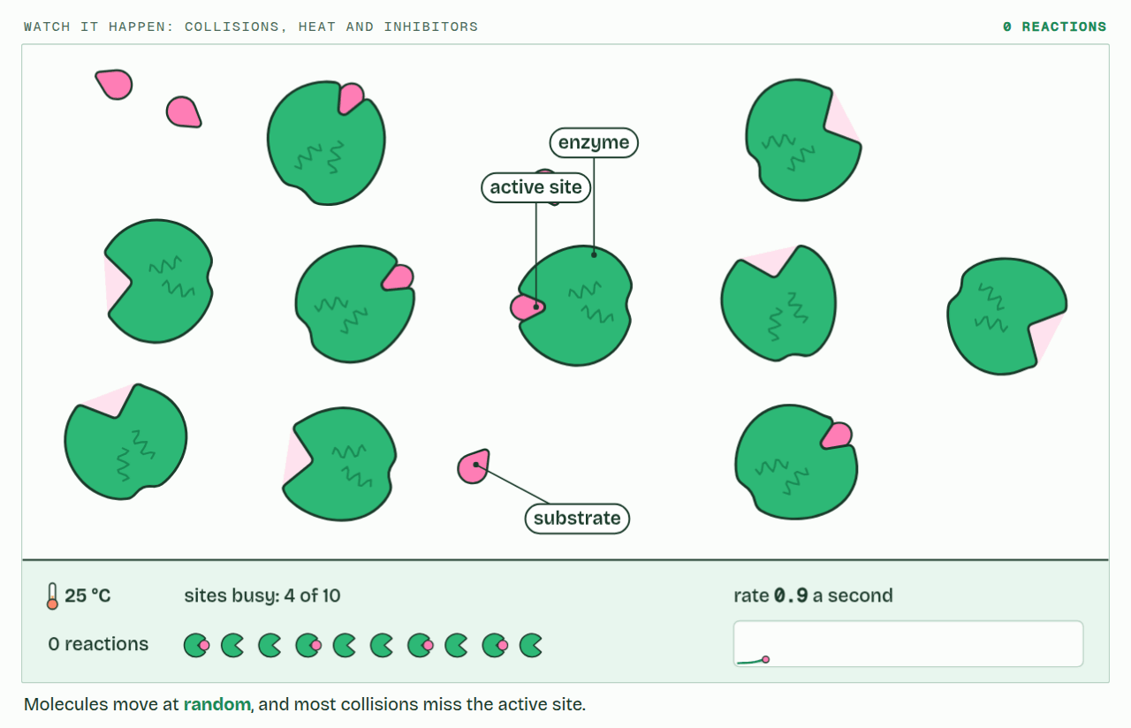
CHAPTER 4 · 3.2.A 3.2.B Temperature
PLAY IT
Heat makes it faster, then breaks it
Watch it happen: collisions, heat and inhibitors: click to play. It loops every 24 seconds.
Minutes 35 to 47
Notes:
Minutes 35 to 47 of 60: Share and explain (12 min).
The plan: Each station's groups put their result on the board. Explain each shape with the figures from chapters 3 to 5, dragging the sliders live: collisions and saturation; collisions then unfolding; charges in the site.
The video is collisions.mp4, one loop of the animation in the guide. It plays in PowerPoint and Keynote. Google Slides does not play a video embedded in a .pptx: download collisions.mp4 (https://www.biologybybradford.com/guides/downloads/scenes/collisions.mp4), upload it to Google Drive, then Insert > Video > Google Drive.
In the guide the class can change it as it runs: https://www.biologybybradford.com/guides/ap-biology-unit-3-enzymes#temperature
What it shows, in order:
1. Molecules move at random, and most collisions miss the active site.
2. A successful collision: it binds and reacts, and the enzyme is unchanged.
3. Too hot: enzymes denature. Active sites lose their shape, and the rate falls.

Slide 15
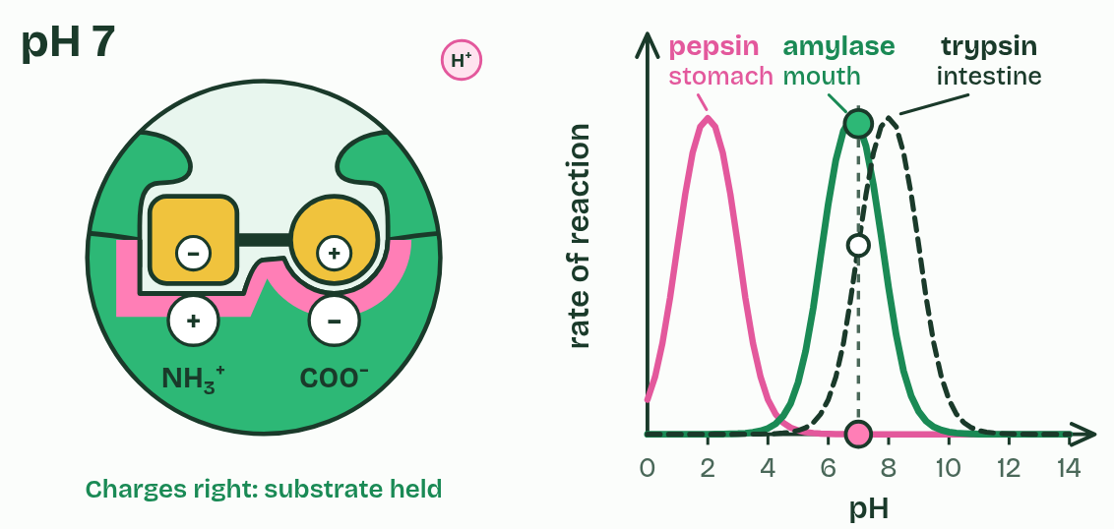
CHAPTER 5 · 3.2.A 3.2.B pH
pH changes the charges in the site
A little off the optimum: charges in the site change, and the effect reverses when the pH returns.
Far off it: the bonds holding the fold break, and the enzyme denatures.
Minutes 35 to 47
Notes:
Minutes 35 to 47 of 60: Share and explain (12 min).
The plan: Each station's groups put their result on the board. Explain each shape with the figures from chapters 3 to 5, dragging the sliders live: collisions and saturation; collisions then unfolding; charges in the site.
pH measures how many hydrogen ions (H⁺) a solution holds: pH = −log[H⁺]. The scale is logarithmic, so each step down means ten times more H⁺, and pH 4 holds a thousand times the H⁺ of pH 7. You need the idea, not the calculation.
Many R groups in an active site can gain or lose H⁺. A carboxyl group (–COO⁻) picks one up in acid and loses its negative charge; an amino group (–NH₃⁺) gives one up in alkali and loses its positive charge. Change those charges and the substrate is no longer held, so the rate drops. Push the pH further and the ionic and hydrogen bonds that hold the fold break too: the enzyme denatures.
So every enzyme has an optimum pH, and it suits the place the enzyme works: pepsin in the acid of the stomach, trypsin in the small intestine, where alkaline juice from the pancreas has neutralized that acid.
Example: Pepsin starts digesting protein in the stomach at about pH 2. When food moves on into the small intestine, pancreatic juice at about pH 8 neutralizes the acid. Pepsin stops working there, and trypsin, which arrives in that juice and works best near pH 8, takes over.

Slide 16
PREDICT
A reaction has reached its plateau: more substrate no longer speeds it up. Which change would raise the rate?
A Adding even more substrate to the mixture
B Adding more of the enzyme
C Taking each product out as soon as it forms
D Leaving the reaction to run for longer
Minutes 35 to 47
Notes:
Minutes 35 to 47 of 60: Share and explain (12 min).
The plan: Each station's groups put their result on the board. Explain each shape with the figures from chapters 3 to 5, dragging the sliders live: collisions and saturation; collisions then unfolding; charges in the site.
Ask for a show of hands, or mini whiteboards, before revealing. (Answer: B, on the next slide.)

Slide 17
PREDICT
Amylase is put in a buffer at pH 5 for a minute, then moved back to pH 7. What is its rate now?
A About normal: its site's charges come back
B Still slow: any change of pH denatures it
C Faster than before: it has got used to acid
D Zero: an enzyme only works at its optimum
Minutes 35 to 47
Notes:
Minutes 35 to 47 of 60: Share and explain (12 min).
The plan: Each station's groups put their result on the board. Explain each shape with the figures from chapters 3 to 5, dragging the sliders live: collisions and saturation; collisions then unfolding; charges in the site.
Ask for a show of hands, or mini whiteboards, before revealing. (Answer: A, on the next slide.)

Slide 18
WHAT HAPPENS
A reaction has reached its plateau: more substrate no longer speeds it up. Which change would raise the rate?
A Adding even more substrate to the mixture
B Adding more of the enzyme
C Taking each product out as soon as it forms
D Leaving the reaction to run for longer
At the plateau every active site is busy, so the number of sites is the limit. More enzyme means more sites. Try it: push the substrate high, then switch from 3 enzymes to 6, and watch the graph.
Minutes 35 to 47
Notes:
Minutes 35 to 47 of 60: Share and explain (12 min).
The plan: Each station's groups put their result on the board. Explain each shape with the figures from chapters 3 to 5, dragging the sliders live: collisions and saturation; collisions then unfolding; charges in the site.
Answer: B. At the plateau every active site is busy, so the number of sites is the limit. More enzyme means more sites. Try it: push the substrate high, then switch from 3 enzymes to 6, and watch the graph.

Slide 19
WHAT HAPPENS
Amylase is put in a buffer at pH 5 for a minute, then moved back to pH 7. What is its rate now?
A About normal: its site's charges come back
B Still slow: any change of pH denatures it
C Faster than before: it has got used to acid
D Zero: an enzyme only works at its optimum
At pH 5 some carboxyl groups in the site pick up H⁺ and lose their charge, so the substrate is held less well. Nothing is broken: back at pH 7 they give the H⁺ up again, the charges return and so does the rate. Only a pH far from the optimum breaks the bonds that hold the fold. Slide the figure from 7 to 4 and on down to 2 to see the difference.
Minutes 35 to 47
Notes:
Minutes 35 to 47 of 60: Share and explain (12 min).
The plan: Each station's groups put their result on the board. Explain each shape with the figures from chapters 3 to 5, dragging the sliders live: collisions and saturation; collisions then unfolding; charges in the site.
Answer: A. At pH 5 some carboxyl groups in the site pick up H⁺ and lose their charge, so the substrate is held less well. Nothing is broken: back at pH 7 they give the H⁺ up again, the charges return and so does the rate. Only a pH far from the optimum breaks the bonds that hold the fold. Slide the figure from 7 to 4 and on down to 2 to see the difference.

Slide 20
WATCH OUT
The plateau is not the enzyme being used up or denatured. Every enzyme molecule is still there and still working, flat out. Add more enzyme and the rate climbs again.
Minutes 35 to 47
Notes:
Minutes 35 to 47 of 60: Share and explain (12 min).
The plan: Each station's groups put their result on the board. Explain each shape with the figures from chapters 3 to 5, dragging the sliders live: collisions and saturation; collisions then unfolding; charges in the site.
A common mistake: say it, then ask who can say why it is wrong.

Slide 21
WATCH OUT
Cold does not denature an enzyme. At 5 °C it is slow because it and its substrate move slowly, but its shape is intact, and it works normally once warmed. Write "denatured" for the hot side only (or an extreme pH).
Minutes 35 to 47
Notes:
Minutes 35 to 47 of 60: Share and explain (12 min).
The plan: Each station's groups put their result on the board. Explain each shape with the figures from chapters 3 to 5, dragging the sliders live: collisions and saturation; collisions then unfolding; charges in the site.
A common mistake: say it, then ask who can say why it is wrong.

Slide 22
WATCH OUT
"Enzymes work best at pH 7" is not true of all of them: pepsin barely works at pH 7. And one pH unit is not a small change. It is ten times the H⁺.
Minutes 35 to 47
Notes:
Minutes 35 to 47 of 60: Share and explain (12 min).
The plan: Each station's groups put their result on the board. Explain each shape with the figures from chapters 3 to 5, dragging the sliders live: collisions and saturation; collisions then unfolding; charges in the site.
A common mistake: say it, then ask who can say why it is wrong.

Slide 23
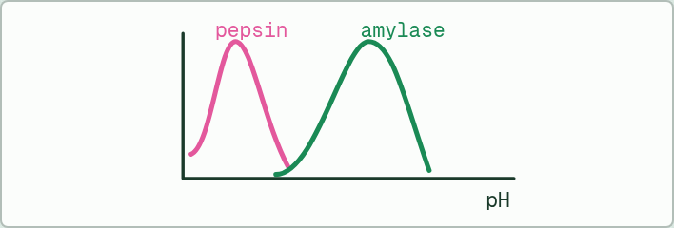
DATA
8 MIN
Two enzymes, one graph
THE TASK
Plot both on one pair of axes, then explain why each peaks where it does and why each falls away on both sides. Activity as a percentage of each enzyme's highest.
pH | Pepsin | Amylase
1 | 62 | 0
2 | 100 | 0
3 | 71 | 2
4 | 34 | 9
5 | 11 | 38
6 | 3 | 83
7 | 0 | 100
8 | 0 | 58
9 | 0 | 17
STUDENTS NEED
Graph paper or a spreadsheet.
Minutes 47 to 55
Notes:
Minutes 47 to 55 of 60: Data: two enzymes, one graph (8 min).
The plan: Plot pepsin and salivary amylase against pH from the table in the activity below, and explain both peaks with charges in the active site. Finish for homework if needed.
The activity: Two enzymes, one graph. Plot both on one pair of axes, then explain why each peaks where it does and why each falls away on both sides.
Activity as a percentage of each enzyme's highest. Needs: graph paper or a spreadsheet.
The time: 8 minutes, minutes 47 to 55 of the plan.

Slide 24
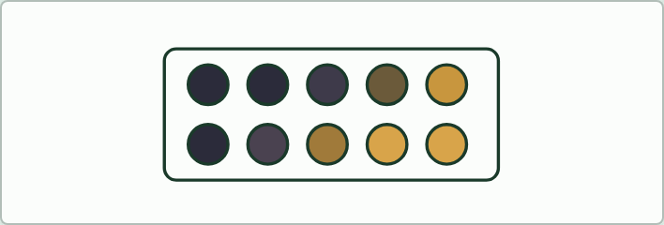
PRACTICAL
8 MIN
The enzyme in your spit
THE TASK
Salivary amylase digests starch. Students mix 2 cm³ of 1% starch with 1 cm³ of their own saliva at three temperatures, and every 30 seconds put a drop on a spotting tile with iodine. Iodine stays blue-black while starch is left; the end point is the first drop that stays yellow-brown. The guided version is the amylase home lab (written for IB, works as it is for AP).
STUDENTS NEED
1% starch, dilute iodine solution, spotting tiles, droppers, stopwatches, iced water, room-temperature water and water at about 40 °C.
Minutes 47 to 55
Notes:
Minutes 47 to 55 of 60: Data: two enzymes, one graph (8 min).
The plan: Plot pepsin and salivary amylase against pH from the table in the activity below, and explain both peaks with charges in the active site. Finish for homework if needed.
The activity: The enzyme in your spit. Salivary amylase digests starch. Students mix 2 cm³ of 1% starch with 1 cm³ of their own saliva at three temperatures, and every 30 seconds put a drop on a spotting tile with iodine. Iodine stays blue-black while starch is left; the end point is the first drop that stays yellow-brown. The guided version is the amylase home lab (written for IB, works as it is for AP).
Needs: 1% starch, dilute iodine solution, spotting tiles, droppers, stopwatches, iced water, room-temperature water and water at about 40 °C. Each student uses only their own saliva; where saliva practicals are not allowed, use 0.5% amylase solution instead.
The time: 8 minutes, minutes 47 to 55 of the plan.

Slide 25
PLENARY
Can you now...
Explain how heat and extreme pH change an enzyme's structure, and when that change can be undone (3.2.A)
Predict how temperature, pH, substrate and product concentrations and inhibitors change the rate of a reaction (3.2.B)
Minutes 55 to 60
Notes:
Minutes 55 to 60 of 60: Exit (5 min).
The plan: Chapter 4's predict box on paper before you reveal it: salivary amylase held at 70 °C, then cooled back to 37 °C.
Thumbs up, sideways or down on each goal before the exit question. The goals come from the statements this lesson covers.

Slide 26
EXIT QUESTION
Before you go
On paper, on your own, before we go through it.
Minutes 55 to 60
Notes:
Minutes 55 to 60 of 60: Exit (5 min).
The plan: Chapter 4's predict box on paper before you reveal it: salivary amylase held at 70 °C, then cooled back to 37 °C.

Slide 27
PREDICT
Salivary amylase is held at 70 °C for ten minutes, then cooled back to 37 °C. What is its rate now?
A Back to normal: 37 °C is near its optimum
B Higher than before, from the heat it took in
C Far lower than normal: it stays unfolded
D Zero at first, then normal again in an hour
Minutes 55 to 60
Notes:
Minutes 55 to 60 of 60: Exit (5 min).
The plan: Chapter 4's predict box on paper before you reveal it: salivary amylase held at 70 °C, then cooled back to 37 °C.
Ask for a show of hands, or mini whiteboards, before revealing. (Answer: C, on the next slide.)

Slide 28
WHAT HAPPENS
Salivary amylase is held at 70 °C for ten minutes, then cooled back to 37 °C. What is its rate now?
A Back to normal: 37 °C is near its optimum
B Higher than before, from the heat it took in
C Far lower than normal: it stays unfolded
D Zero at first, then normal again in an hour
At 70 °C the chains unfold, and as they cool most of them tangle with each other instead of refolding, so their active sites are gone for good. Compare the cold side: drag the slider down to 5 °C and the enzyme is slow but whole.
Minutes 55 to 60
Notes:
Minutes 55 to 60 of 60: Exit (5 min).
The plan: Chapter 4's predict box on paper before you reveal it: salivary amylase held at 70 °C, then cooled back to 37 °C.
Answer: C. At 70 °C the chains unfold, and as they cool most of them tangle with each other instead of refolding, so their active sites are gone for good. Compare the cold side: drag the slider down to 5 °C and the enzyme is slow but whole.

Slide 29
PRACTISE AND REVISE
Keep going
Exam practice: a fresh paper of exam questions on 3.1 to 3.3, marked as you go
The guide, with the animations and the dry lab
This lesson in the guide: 3 More substrate, more collisions, up to a limit, 4 Heat makes it faster, then breaks it, 5 pH changes the charges in the site
BUILD FOR YOUR CLASS
ALREADY ON THE SITE FOR UNIT 3
CARD SETS ON SPLYCR
Tarsia puzzle, dominoes and picture reveal on Unit 3, built from its key terms and ready to print
A pub quiz with rounds on Unit 3, to present or run with no projector
The Kelp Light Habitat escape room, or an escape room built from the question bank on Unit 3
Lesson: Enzymes
Lesson: Environmental Impacts on Enzyme Function
Lesson: Cellular Energy
Quiz: Enzymes
Quiz: Environmental Impacts on Enzyme Function
Quiz: Cellular Energy
Exam questions: Unit 3 in the exam maker, a paper with scoring guidelines
Open a set to host it as a class game, or make a copy to edit.
Unit 3: Cellular Energetics (part 1)
Unit 3: Cellular Energetics (part 2)
Unit 3: Cellular Energetics (part 3)
How this was made. The course structure, the activities and the teaching choices come from my own classroom, my presentations and my years of teaching IB and AP Biology. I use Claude, an AI, to help write and build the interactive guides, lesson plans, slides and practice questions, and to draw the diagrams and code the interactives. I direct the work and review it against the IB and AP specifications before it goes live.
Minute 60: after the lesson
Notes:
Every link here is live. Set the exam practice paper for homework: it is fresh each time, marked as students go and saved to their Exam practice when they are signed in.
Exam practice: https://www.biologybybradford.com/exam-maker/sit?program=ap&units=U3&ced=3.1%2C3.2%2C3.3&paper=quiz&marks=15&src=ep
The guide: https://www.biologybybradford.com/guides/ap-biology-unit-3-enzymes

