Slide 1
AP Biology 3.1 to 3.3
LESSON 3 OF 3
BY THE END YOU CAN
Enzymes and cellular energy
Predict how temperature, pH, substrate and product concentrations and inhibitors change the rate of a reaction (3.2.B)
Describe why a living cell needs a constant input of energy, and how ATP couples an uphill reaction to a downhill one (3.3.A)
Explain why energy pathways run in small steps, and what the same pathways in every domain of life tell us (3.3.B)
Inhibitors, pathways and energy
3.2.B, 3.3.A, 3.3.B
Competitive and noncompetitive inhibition, feedback in pathways, and coupling with ATP, ending on a timed free response
60 minutes · chapters 6, 7, 8 · the dry lab
Minute 0
Notes:
AP Biology 3.1 to 3.3, Enzymes and cellular energy. Lesson 3 of 3: Inhibitors, pathways and energy, 60 minutes.
The plan, minute by minute (each slide's footer says where you are):
0 to 5 min (5) Do now: two extra lines
5 to 15 min (10) Block it or bend it
15 to 25 min (10) Dry lab, Task 3
25 to 37 min (12) Pathways and feedback
37 to 49 min (12) Paying for uphill reactions
49 to 60 min (11) Free response, timed
What students get wrong:
"Breaking ATP's bond releases energy." Breaking any bond takes energy. ATP hydrolysis is exergonic because the products are more stable. Make students write the corrected sentence.
"A competitive inhibitor lowers the maximum rate." It raises the substrate needed to reach the same maximum. The graphs in chapter 6 and Task 3 of the dry lab settle it.
Errors that turn up in published slides. Iodine with starch is blue-black, not purple; a positive biuret test is purple (blue means no protein); zanamivir stops neuraminidase cutting sialic acid, not hemagglutinin; cyanide binds the metal center of cytochrome c oxidase and is not an allosteric inhibitor.
Stretch and support:
Support: drag a figure's slider and describe what moves before explaining why; the SPITE and Exits / Enters tiles as a checklist.
Support: a printed, pre-drawn energy diagram to annotate during chapter 2, and the free-response table with the rows to compare already highlighted.
The lesson plan to print: https://www.biologybybradford.com/guides/downloads/ap-biology-unit-3-enzymes-lesson-3-plan.pdf

Slide 2
DO NOW
Two extra lines
Sketch rate against substrate concentration.
Add a line for something that competes for the active site, and one for something that changes the site's shape from elsewhere.
5:00
minutes
Start now: the timer is running.
Minutes 0 to 5
Notes:
Minutes 0 to 5 of 60: Do now: two extra lines (5 min).
The plan: Sketch rate against substrate concentration. Add a line for something that competes for the active site, and one for something that changes the site's shape from elsewhere.
Start a 5 minute timer as they come in.

Slide 3
STEP 2
10 MIN
Block it or bend it
Chapter 6: Inhibitors block the site, or bend it
Minutes 5 to 15
Notes:
Minutes 5 to 15 of 60: Block it or bend it (10 min).
The plan: Chapter 6's figure: compare the do-now sketches with the curves, then drag the substrate up with each inhibitor and count the molecules. Zanamivir and penicillin as the real cases; flag the cyanide trap.

Slide 4
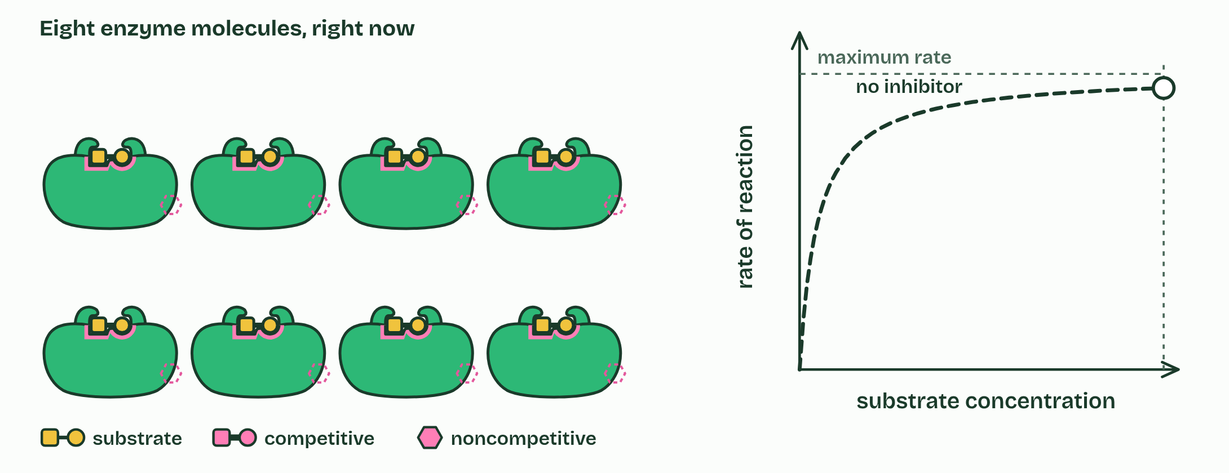
CHAPTER 6 · 3.2.B Inhibitors
1 / 3
Inhibitors block the site, or bend it
None
Minutes 5 to 15
Notes:
Minutes 5 to 15 of 60: Block it or bend it (10 min).
The plan: Chapter 6's figure: compare the do-now sketches with the curves, then drag the substrate up with each inhibitor and count the molecules. Zanamivir and penicillin as the real cases; flag the cyanide trap.
An inhibitor is a molecule that binds to an enzyme and slows it down. There are two ways to do it, and a graph of rate against substrate concentration tells them apart.
A competitive inhibitor looks enough like the substrate to fit the active site, and while it sits there the substrate cannot bind. Most come and go, so inhibitor and substrate take turns at the sites, and the more substrate there is, the more often the substrate wins. Add enough and the rate climbs back to nearly its normal maximum.
A noncompetitive inhibitor binds somewhere else, at an allosteric site. It changes the shape of the enzyme, active site included. The substrate is not competing for that spot, so no amount of substrate wins those enzymes back: the maximum rate stays lower.
Most inhibitors bind reversibly and let go again. Some bond to the enzyme for good and take it out of action permanently, whichever site they use.
Example: s Zanamivir (Relenza), a flu drug, is shaped like sialic acid. New flu virus particles stay stuck to the cell they leave until the virus's enzyme neuraminidase cuts away the sialic acid they cling to. Zanamivir fills that enzyme's active site, so they stay stuck: a competitive inhibitor. Penicillin binds the active site of the enzyme bacteria use to cross-link their cell walls, and bonds to it for good. Isoleucine shuts down its own production by binding an allosteric site (chapter 8).

Slide 5
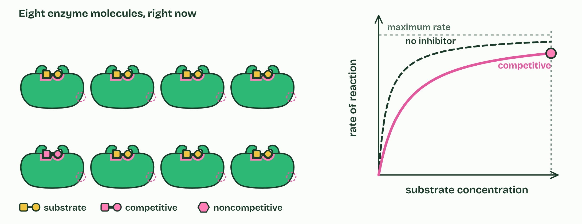
CHAPTER 6 · 3.2.B Inhibitors
2 / 3
Inhibitors block the site, or bend it
Competitive
Minutes 5 to 15
Notes:
Minutes 5 to 15 of 60: Block it or bend it (10 min).
The plan: Chapter 6's figure: compare the do-now sketches with the curves, then drag the substrate up with each inhibitor and count the molecules. Zanamivir and penicillin as the real cases; flag the cyanide trap.
An inhibitor is a molecule that binds to an enzyme and slows it down. There are two ways to do it, and a graph of rate against substrate concentration tells them apart.
A competitive inhibitor looks enough like the substrate to fit the active site, and while it sits there the substrate cannot bind. Most come and go, so inhibitor and substrate take turns at the sites, and the more substrate there is, the more often the substrate wins. Add enough and the rate climbs back to nearly its normal maximum.
A noncompetitive inhibitor binds somewhere else, at an allosteric site. It changes the shape of the enzyme, active site included. The substrate is not competing for that spot, so no amount of substrate wins those enzymes back: the maximum rate stays lower.
Most inhibitors bind reversibly and let go again. Some bond to the enzyme for good and take it out of action permanently, whichever site they use.
Example: s Zanamivir (Relenza), a flu drug, is shaped like sialic acid. New flu virus particles stay stuck to the cell they leave until the virus's enzyme neuraminidase cuts away the sialic acid they cling to. Zanamivir fills that enzyme's active site, so they stay stuck: a competitive inhibitor. Penicillin binds the active site of the enzyme bacteria use to cross-link their cell walls, and bonds to it for good. Isoleucine shuts down its own production by binding an allosteric site (chapter 8).

Slide 6
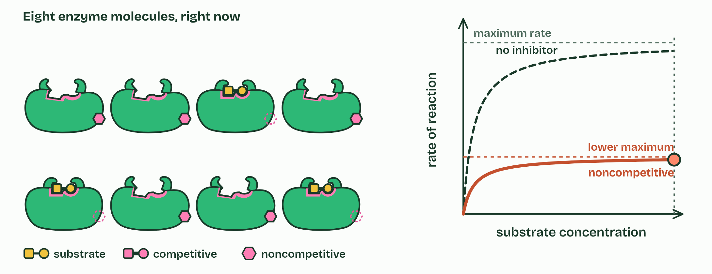
CHAPTER 6 · 3.2.B Inhibitors
3 / 3
Inhibitors block the site, or bend it
Noncompetitive
Minutes 5 to 15
Notes:
Minutes 5 to 15 of 60: Block it or bend it (10 min).
The plan: Chapter 6's figure: compare the do-now sketches with the curves, then drag the substrate up with each inhibitor and count the molecules. Zanamivir and penicillin as the real cases; flag the cyanide trap.
An inhibitor is a molecule that binds to an enzyme and slows it down. There are two ways to do it, and a graph of rate against substrate concentration tells them apart.
A competitive inhibitor looks enough like the substrate to fit the active site, and while it sits there the substrate cannot bind. Most come and go, so inhibitor and substrate take turns at the sites, and the more substrate there is, the more often the substrate wins. Add enough and the rate climbs back to nearly its normal maximum.
A noncompetitive inhibitor binds somewhere else, at an allosteric site. It changes the shape of the enzyme, active site included. The substrate is not competing for that spot, so no amount of substrate wins those enzymes back: the maximum rate stays lower.
Most inhibitors bind reversibly and let go again. Some bond to the enzyme for good and take it out of action permanently, whichever site they use.
Example: s Zanamivir (Relenza), a flu drug, is shaped like sialic acid. New flu virus particles stay stuck to the cell they leave until the virus's enzyme neuraminidase cuts away the sialic acid they cling to. Zanamivir fills that enzyme's active site, so they stay stuck: a competitive inhibitor. Penicillin binds the active site of the enzyme bacteria use to cross-link their cell walls, and bonds to it for good. Isoleucine shuts down its own production by binding an allosteric site (chapter 8).

Slide 7
CHAPTER 6 · 3.2.B Inhibitors
Inhibitors block the site, or bend it
Competitive: same maximum rate, but more substrate is needed to reach it.
Noncompetitive: a lower maximum rate, whatever the substrate concentration.
Minutes 5 to 15
Notes:
Minutes 5 to 15 of 60: Block it or bend it (10 min).
The plan: Chapter 6's figure: compare the do-now sketches with the curves, then drag the substrate up with each inhibitor and count the molecules. Zanamivir and penicillin as the real cases; flag the cyanide trap.
An inhibitor is a molecule that binds to an enzyme and slows it down. There are two ways to do it, and a graph of rate against substrate concentration tells them apart.
A competitive inhibitor looks enough like the substrate to fit the active site, and while it sits there the substrate cannot bind. Most come and go, so inhibitor and substrate take turns at the sites, and the more substrate there is, the more often the substrate wins. Add enough and the rate climbs back to nearly its normal maximum.
A noncompetitive inhibitor binds somewhere else, at an allosteric site. It changes the shape of the enzyme, active site included. The substrate is not competing for that spot, so no amount of substrate wins those enzymes back: the maximum rate stays lower.
Most inhibitors bind reversibly and let go again. Some bond to the enzyme for good and take it out of action permanently, whichever site they use.
Example: s Zanamivir (Relenza), a flu drug, is shaped like sialic acid. New flu virus particles stay stuck to the cell they leave until the virus's enzyme neuraminidase cuts away the sialic acid they cling to. Zanamivir fills that enzyme's active site, so they stay stuck: a competitive inhibitor. Penicillin binds the active site of the enzyme bacteria use to cross-link their cell walls, and bonds to it for good. Isoleucine shuts down its own production by binding an allosteric site (chapter 8).

Slide 8
PREDICT
Two reactions are slowed by inhibitors. You add a large excess of substrate to both. One gets back almost its full rate; the other does not. What does the one that recovered contain?
A A noncompetitive inhibitor at an allosteric site
B A competitive inhibitor, outnumbered by substrate
C An inhibitor that the reaction has now used up
D Too little enzyme to handle the extra substrate
Minutes 5 to 15
Notes:
Minutes 5 to 15 of 60: Block it or bend it (10 min).
The plan: Chapter 6's figure: compare the do-now sketches with the curves, then drag the substrate up with each inhibitor and count the molecules. Zanamivir and penicillin as the real cases; flag the cyanide trap.
Ask for a show of hands, or mini whiteboards, before revealing. (Answer: B, on the next slide.)

Slide 9
WHAT HAPPENS
Two reactions are slowed by inhibitors. You add a large excess of substrate to both. One gets back almost its full rate; the other does not. What does the one that recovered contain?
A A noncompetitive inhibitor at an allosteric site
B A competitive inhibitor, outnumbered by substrate
C An inhibitor that the reaction has now used up
D Too little enzyme to handle the extra substrate
A competitive inhibitor takes turns with the substrate for the same site, so flooding the mixture with substrate wins nearly every site back. A noncompetitive one holds its enzymes out of shape whatever the substrate does. Choose each type in the figure and drag the substrate up.
Minutes 5 to 15
Notes:
Minutes 5 to 15 of 60: Block it or bend it (10 min).
The plan: Chapter 6's figure: compare the do-now sketches with the curves, then drag the substrate up with each inhibitor and count the molecules. Zanamivir and penicillin as the real cases; flag the cyanide trap.
Answer: B. A competitive inhibitor takes turns with the substrate for the same site, so flooding the mixture with substrate wins nearly every site back. A noncompetitive one holds its enzymes out of shape whatever the substrate does. Choose each type in the figure and drag the substrate up.

Slide 10
REMEMBER IT
Two kinds of inhibitor, and where the second binds
C
N
A
Copycat
Nope
Another
Minutes 5 to 15
Notes:
Minutes 5 to 15 of 60: Block it or bend it (10 min).
The plan: Chapter 6's figure: compare the do-now sketches with the curves, then drag the substrate up with each inhibitor and count the molecules. Zanamivir and penicillin as the real cases; flag the cyanide trap.
Ask the class what each letter stands for before revealing.

Slide 11
REMEMBER IT
Two kinds of inhibitor, and where the second binds
C
N
A
Copycat
Nope
Another
Competitive
Noncompetitive
Allosteric site
takes the active site; more substrate wins
bends the site; max rate drops
a site that is not the active site
Minutes 5 to 15
Notes:
Minutes 5 to 15 of 60: Block it or bend it (10 min).
The plan: Chapter 6's figure: compare the do-now sketches with the curves, then drag the substrate up with each inhibitor and count the molecules. Zanamivir and penicillin as the real cases; flag the cyanide trap.
Copycat: Competitive (takes the active site; more substrate wins)
Nope: Noncompetitive (bends the site; max rate drops)
Another: Allosteric site (a site that is not the active site)

Slide 12
WATCH OUT
Cyanide is often given as an allosteric inhibitor. It is not one: it binds the iron and copper center of cytochrome c oxidase, the very place where oxygen should bind at the end of the electron transport chain. And a competitive inhibitor does not lower the maximum rate. It raises the substrate concentration needed to reach it.
Minutes 5 to 15
Notes:
Minutes 5 to 15 of 60: Block it or bend it (10 min).
The plan: Chapter 6's figure: compare the do-now sketches with the curves, then drag the substrate up with each inhibitor and count the molecules. Zanamivir and penicillin as the real cases; flag the cyanide trap.
A common mistake: say it, then ask who can say why it is wrong.

Slide 13
STEP 3
10 MIN
Dry lab, Task 3
Pairs run the substrate series with no inhibitor, then competitive, then noncompetitive, and report each rate at 10% peroxide as a percentage of the uninhibited one.
Minutes 15 to 25
Notes:
Minutes 15 to 25 of 60: Dry lab, Task 3 (10 min).
The plan: Pairs run the substrate series with no inhibitor, then competitive, then noncompetitive, and report each rate at 10% peroxide as a percentage of the uninhibited one. Or run it on the board and have the class predict each point.

Slide 14
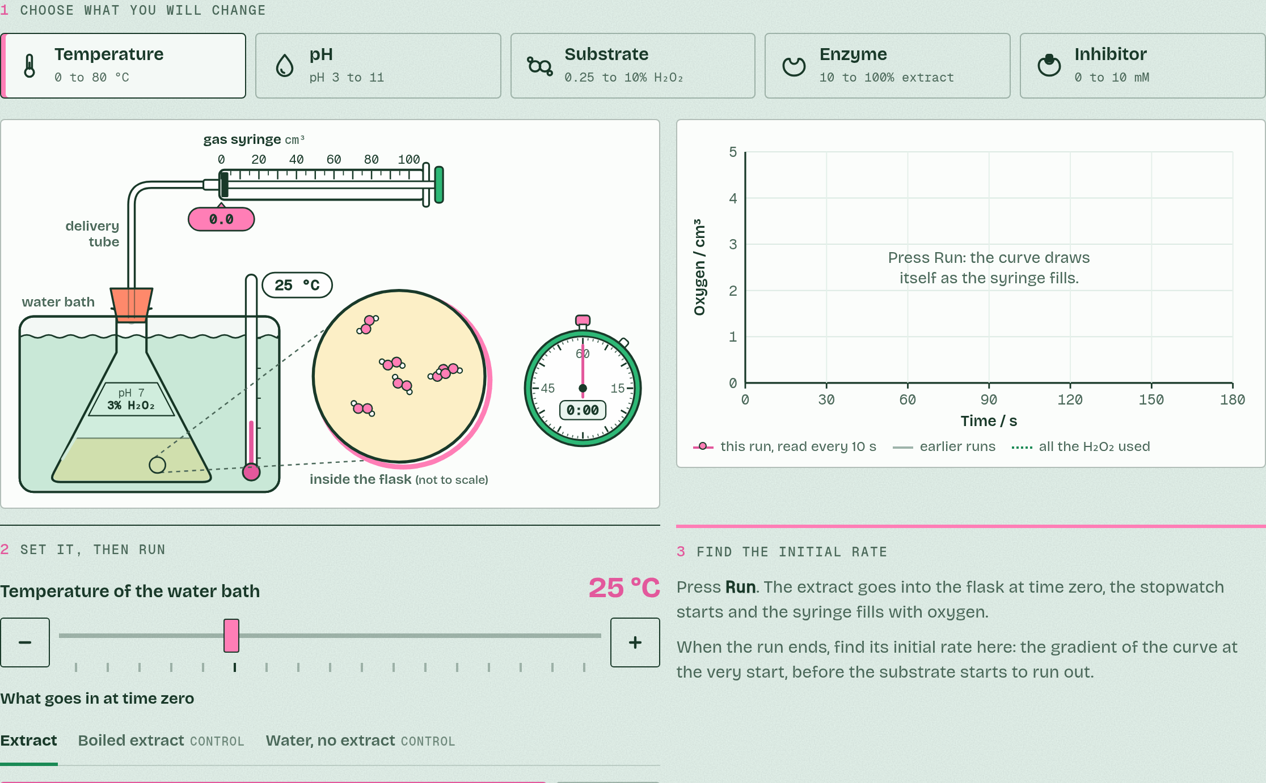
DRY LAB
Catalase and hydrogen peroxide
Your question: How does one factor change the rate at which catalase breaks down hydrogen peroxide? Start with temperature: where is the optimum, and what happens beyond it?
What you can change: One independent variable at a time: temperature, pH, hydrogen peroxide concentration, extract concentration, or an inhibitor, competitive or noncompetitive. Everything else stays fixed unless you change it on purpose.
What to record: The volume of oxygen every 10 seconds, then the initial rate in cm³/min: the gradient at the very start. Three trials at each value, a mean, and a graph of the means.
Run it: biologybybradford.com/guides/ap-biology-unit-3-enzymes#lab
Minutes 15 to 25
Notes:
Minutes 15 to 25 of 60: Dry lab, Task 3 (10 min).
The plan: Pairs run the substrate series with no inhibitor, then competitive, then noncompetitive, and report each rate at 10% peroxide as a percentage of the uninhibited one. Or run it on the board and have the class predict each point.
The dry lab runs in the guide: https://www.biologybybradford.com/guides/ap-biology-unit-3-enzymes#lab

Slide 15
STEP 4
12 MIN
Pathways and feedback
Close with the tree: why the same pathway in every domain?
Minutes 25 to 37
Notes:
Minutes 25 to 37 of 60: Pathways and feedback (12 min).
The plan: The alcohol pathway reading (activity below), then chapter 8's feedback figure, stopped at step 3 for students to predict step 4. Close with the tree: why the same pathway in every domain?

Slide 16
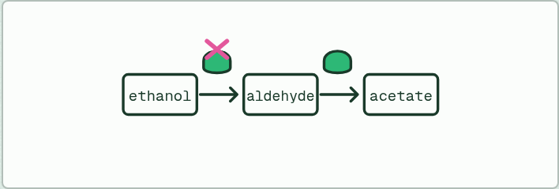
READING
12 MIN
A pathway in the liver
THE TASK
Ethanol is turned into acetaldehyde by alcohol dehydrogenase, acetaldehyde into acetate by aldehyde dehydrogenase, and acetate into acetyl CoA, which enters the Krebs cycle. Ask: which enzyme has acetaldehyde as its product, and which as its substrate? What builds up if the second enzyme is slow? Methanol poisoning is treated with fomepizole, which binds the active site of alcohol dehydrogenase: why does that help, and what kind of inhibitor is it?
STUDENTS NEED
Nothing but the guide.
Minutes 25 to 37
Notes:
Minutes 25 to 37 of 60: Pathways and feedback (12 min).
The plan: The alcohol pathway reading (activity below), then chapter 8's feedback figure, stopped at step 3 for students to predict step 4. Close with the tree: why the same pathway in every domain?
The activity: A pathway in the liver. Ethanol is turned into acetaldehyde by alcohol dehydrogenase, acetaldehyde into acetate by aldehyde dehydrogenase, and acetate into acetyl CoA, which enters the Krebs cycle. Ask: which enzyme has acetaldehyde as its product, and which as its substrate? What builds up if the second enzyme is slow? Methanol poisoning is treated with fomepizole, which binds the active site of alcohol dehydrogenase: why does that help, and what kind of inhibitor is it?
Needs: nothing but the guide. Fomepizole stops methanol being turned into formaldehyde and formic acid, the toxic products, while the methanol is excreted.
The time: 12 minutes, minutes 25 to 37 of the plan.

Slide 17
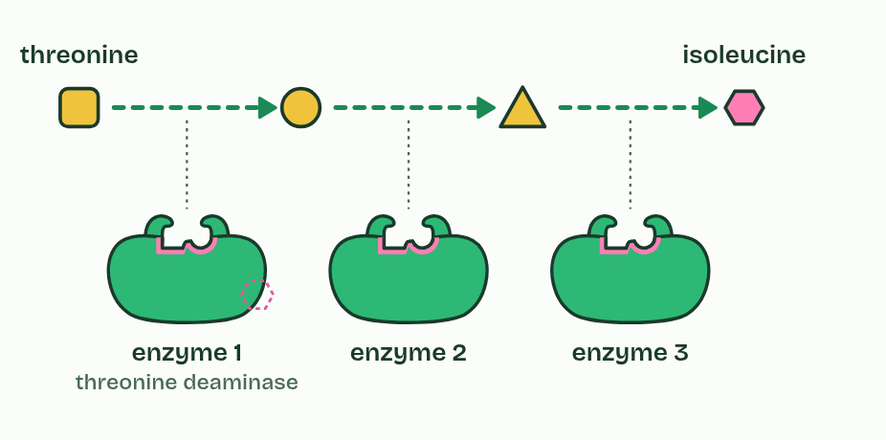
CHAPTER 8 · 3.3.A 3.3.B Energy pathways
1 / 4
Pathways go in small steps, shared by all life
A pathway: each product is the next enzyme's substrate, so threonine is turned into isoleucine step by step (three steps here; the real pathway has five).
Minutes 25 to 37
Notes:
Minutes 25 to 37 of 60: Pathways and feedback (12 min).
The plan: The alcohol pathway reading (activity below), then chapter 8's feedback figure, stopped at step 3 for students to predict step 4. Close with the tree: why the same pathway in every domain?
Cells rarely do anything in one reaction. They use metabolic pathways: chains of reactions, each catalyzed by its own enzyme, where the product of one step is the substrate of the next. Set glucose alight and its energy comes out all at once, as heat and light, and none of it is kept. Broken down in a cell, it goes through dozens of steps, each releasing a little energy that the cell can capture as ATP and control.
Control often acts on the first step. When the end product builds up, it binds an allosteric site on the pathway's first enzyme and switches it off: feedback inhibition. When the product is used up it lets go, and the pathway runs again. No energy or raw material is wasted making what the cell already has.
The same core pathways turn up everywhere. Bacteria, archaea and eukaryotes all use ATP as their energy currency, and versions of glycolysis run in all three, with several of the same enzymes. Pathways shared and conserved like this are best explained by inheritance from a common ancestor of all living things.
Example: Your liver breaks alcohol down in steps: ethanol to acetaldehyde (alcohol dehydrogenase), acetaldehyde to acetate (aldehyde dehydrogenase), then into the Krebs cycle. Some people inherit a slow version of the second enzyme. Toxic acetaldehyde builds up, and their face flushes after a drink.

Slide 18
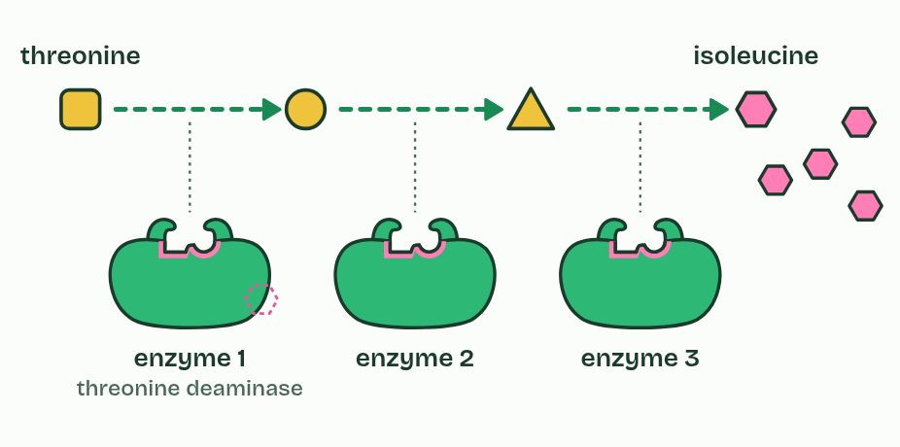
CHAPTER 8 · 3.3.A 3.3.B Energy pathways
2 / 4
Pathways go in small steps, shared by all life
The cell makes more isoleucine than it is using, and it builds up.
Minutes 25 to 37
Notes:
Minutes 25 to 37 of 60: Pathways and feedback (12 min).
The plan: The alcohol pathway reading (activity below), then chapter 8's feedback figure, stopped at step 3 for students to predict step 4. Close with the tree: why the same pathway in every domain?
Cells rarely do anything in one reaction. They use metabolic pathways: chains of reactions, each catalyzed by its own enzyme, where the product of one step is the substrate of the next. Set glucose alight and its energy comes out all at once, as heat and light, and none of it is kept. Broken down in a cell, it goes through dozens of steps, each releasing a little energy that the cell can capture as ATP and control.
Control often acts on the first step. When the end product builds up, it binds an allosteric site on the pathway's first enzyme and switches it off: feedback inhibition. When the product is used up it lets go, and the pathway runs again. No energy or raw material is wasted making what the cell already has.
The same core pathways turn up everywhere. Bacteria, archaea and eukaryotes all use ATP as their energy currency, and versions of glycolysis run in all three, with several of the same enzymes. Pathways shared and conserved like this are best explained by inheritance from a common ancestor of all living things.
Example: Your liver breaks alcohol down in steps: ethanol to acetaldehyde (alcohol dehydrogenase), acetaldehyde to acetate (aldehyde dehydrogenase), then into the Krebs cycle. Some people inherit a slow version of the second enzyme. Toxic acetaldehyde builds up, and their face flushes after a drink.

Slide 19
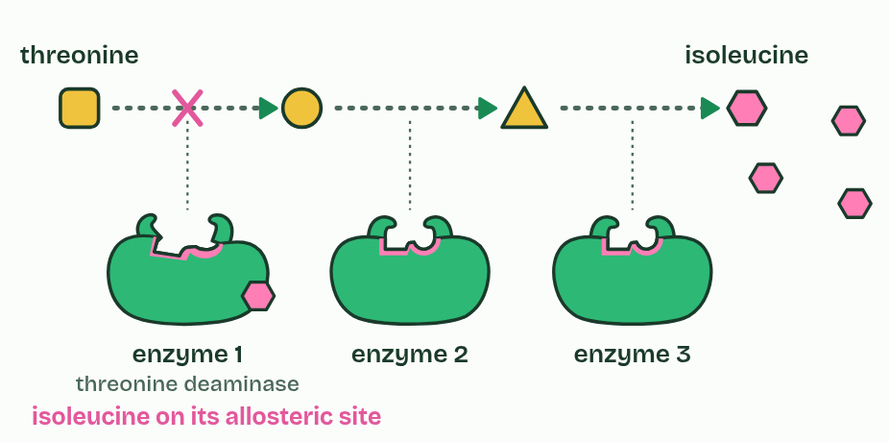
CHAPTER 8 · 3.3.A 3.3.B Energy pathways
3 / 4
Pathways go in small steps, shared by all life
Isoleucine binds an allosteric site on enzyme 1 and bends its active site. The first step stops, so the whole pathway stops.
Minutes 25 to 37
Notes:
Minutes 25 to 37 of 60: Pathways and feedback (12 min).
The plan: The alcohol pathway reading (activity below), then chapter 8's feedback figure, stopped at step 3 for students to predict step 4. Close with the tree: why the same pathway in every domain?
Cells rarely do anything in one reaction. They use metabolic pathways: chains of reactions, each catalyzed by its own enzyme, where the product of one step is the substrate of the next. Set glucose alight and its energy comes out all at once, as heat and light, and none of it is kept. Broken down in a cell, it goes through dozens of steps, each releasing a little energy that the cell can capture as ATP and control.
Control often acts on the first step. When the end product builds up, it binds an allosteric site on the pathway's first enzyme and switches it off: feedback inhibition. When the product is used up it lets go, and the pathway runs again. No energy or raw material is wasted making what the cell already has.
The same core pathways turn up everywhere. Bacteria, archaea and eukaryotes all use ATP as their energy currency, and versions of glycolysis run in all three, with several of the same enzymes. Pathways shared and conserved like this are best explained by inheritance from a common ancestor of all living things.
Example: Your liver breaks alcohol down in steps: ethanol to acetaldehyde (alcohol dehydrogenase), acetaldehyde to acetate (aldehyde dehydrogenase), then into the Krebs cycle. Some people inherit a slow version of the second enzyme. Toxic acetaldehyde builds up, and their face flushes after a drink.

Slide 20
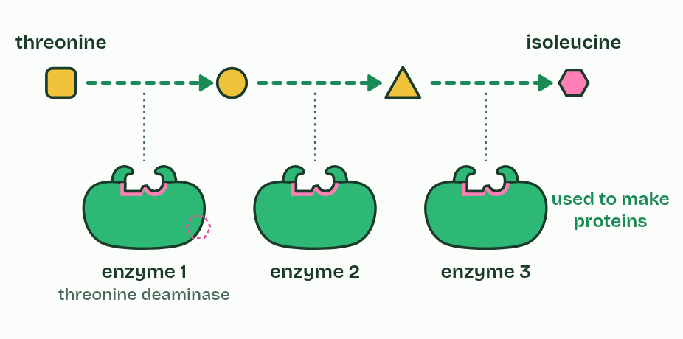
CHAPTER 8 · 3.3.A 3.3.B Energy pathways
4 / 4
Pathways go in small steps, shared by all life
As the cell uses isoleucine to build proteins, the level falls, isoleucine lets go, and the pathway runs again: negative feedback.
Minutes 25 to 37
Notes:
Minutes 25 to 37 of 60: Pathways and feedback (12 min).
The plan: The alcohol pathway reading (activity below), then chapter 8's feedback figure, stopped at step 3 for students to predict step 4. Close with the tree: why the same pathway in every domain?
Cells rarely do anything in one reaction. They use metabolic pathways: chains of reactions, each catalyzed by its own enzyme, where the product of one step is the substrate of the next. Set glucose alight and its energy comes out all at once, as heat and light, and none of it is kept. Broken down in a cell, it goes through dozens of steps, each releasing a little energy that the cell can capture as ATP and control.
Control often acts on the first step. When the end product builds up, it binds an allosteric site on the pathway's first enzyme and switches it off: feedback inhibition. When the product is used up it lets go, and the pathway runs again. No energy or raw material is wasted making what the cell already has.
The same core pathways turn up everywhere. Bacteria, archaea and eukaryotes all use ATP as their energy currency, and versions of glycolysis run in all three, with several of the same enzymes. Pathways shared and conserved like this are best explained by inheritance from a common ancestor of all living things.
Example: Your liver breaks alcohol down in steps: ethanol to acetaldehyde (alcohol dehydrogenase), acetaldehyde to acetate (aldehyde dehydrogenase), then into the Krebs cycle. Some people inherit a slow version of the second enzyme. Toxic acetaldehyde builds up, and their face flushes after a drink.

Slide 21
CHAPTER 8 · 3.3.A 3.3.B Energy pathways
Pathways go in small steps, shared by all life
The product of one step is the substrate of the next.
The end product inhibits the first enzyme: negative feedback.
Conserved pathways in every domain are evidence of common ancestry.
Minutes 25 to 37
Notes:
Minutes 25 to 37 of 60: Pathways and feedback (12 min).
The plan: The alcohol pathway reading (activity below), then chapter 8's feedback figure, stopped at step 3 for students to predict step 4. Close with the tree: why the same pathway in every domain?
Cells rarely do anything in one reaction. They use metabolic pathways: chains of reactions, each catalyzed by its own enzyme, where the product of one step is the substrate of the next. Set glucose alight and its energy comes out all at once, as heat and light, and none of it is kept. Broken down in a cell, it goes through dozens of steps, each releasing a little energy that the cell can capture as ATP and control.
Control often acts on the first step. When the end product builds up, it binds an allosteric site on the pathway's first enzyme and switches it off: feedback inhibition. When the product is used up it lets go, and the pathway runs again. No energy or raw material is wasted making what the cell already has.
The same core pathways turn up everywhere. Bacteria, archaea and eukaryotes all use ATP as their energy currency, and versions of glycolysis run in all three, with several of the same enzymes. Pathways shared and conserved like this are best explained by inheritance from a common ancestor of all living things.
Example: Your liver breaks alcohol down in steps: ethanol to acetaldehyde (alcohol dehydrogenase), acetaldehyde to acetate (aldehyde dehydrogenase), then into the Krebs cycle. Some people inherit a slow version of the second enzyme. Toxic acetaldehyde builds up, and their face flushes after a drink.

Slide 22
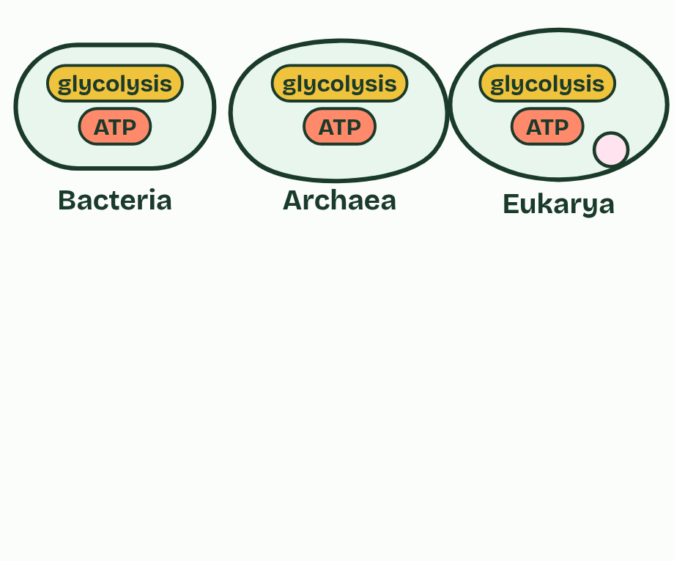
CHAPTER 8 · 3.3.A 3.3.B Energy pathways
1 / 3
Pathways go in small steps, shared by all life
Bacteria, archaea and eukaryotes all run on ATP, and all break glucose down by versions of glycolysis, several of whose enzymes have closely similar sequences in all three.
Minutes 25 to 37
Notes:
Minutes 25 to 37 of 60: Pathways and feedback (12 min).
The plan: The alcohol pathway reading (activity below), then chapter 8's feedback figure, stopped at step 3 for students to predict step 4. Close with the tree: why the same pathway in every domain?
Cells rarely do anything in one reaction. They use metabolic pathways: chains of reactions, each catalyzed by its own enzyme, where the product of one step is the substrate of the next. Set glucose alight and its energy comes out all at once, as heat and light, and none of it is kept. Broken down in a cell, it goes through dozens of steps, each releasing a little energy that the cell can capture as ATP and control.
Control often acts on the first step. When the end product builds up, it binds an allosteric site on the pathway's first enzyme and switches it off: feedback inhibition. When the product is used up it lets go, and the pathway runs again. No energy or raw material is wasted making what the cell already has.
The same core pathways turn up everywhere. Bacteria, archaea and eukaryotes all use ATP as their energy currency, and versions of glycolysis run in all three, with several of the same enzymes. Pathways shared and conserved like this are best explained by inheritance from a common ancestor of all living things.
Example: Your liver breaks alcohol down in steps: ethanol to acetaldehyde (alcohol dehydrogenase), acetaldehyde to acetate (aldehyde dehydrogenase), then into the Krebs cycle. Some people inherit a slow version of the second enzyme. Toxic acetaldehyde builds up, and their face flushes after a drink.

Slide 23
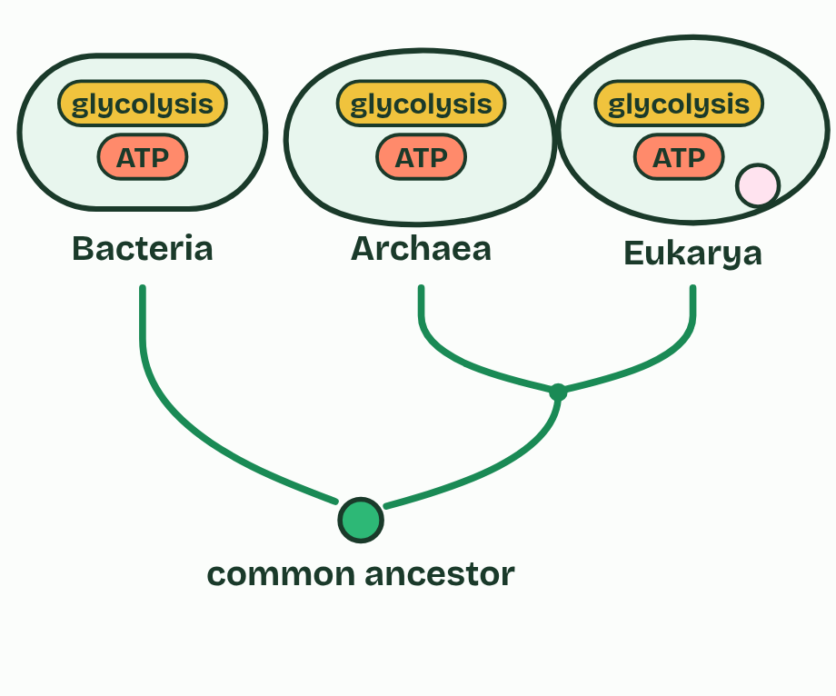
CHAPTER 8 · 3.3.A 3.3.B Energy pathways
2 / 3
Pathways go in small steps, shared by all life
All three groups trace back to one common ancestor. Archaea and eukaryotes share a more recent one as well.
Minutes 25 to 37
Notes:
Minutes 25 to 37 of 60: Pathways and feedback (12 min).
The plan: The alcohol pathway reading (activity below), then chapter 8's feedback figure, stopped at step 3 for students to predict step 4. Close with the tree: why the same pathway in every domain?
Cells rarely do anything in one reaction. They use metabolic pathways: chains of reactions, each catalyzed by its own enzyme, where the product of one step is the substrate of the next. Set glucose alight and its energy comes out all at once, as heat and light, and none of it is kept. Broken down in a cell, it goes through dozens of steps, each releasing a little energy that the cell can capture as ATP and control.
Control often acts on the first step. When the end product builds up, it binds an allosteric site on the pathway's first enzyme and switches it off: feedback inhibition. When the product is used up it lets go, and the pathway runs again. No energy or raw material is wasted making what the cell already has.
The same core pathways turn up everywhere. Bacteria, archaea and eukaryotes all use ATP as their energy currency, and versions of glycolysis run in all three, with several of the same enzymes. Pathways shared and conserved like this are best explained by inheritance from a common ancestor of all living things.
Example: Your liver breaks alcohol down in steps: ethanol to acetaldehyde (alcohol dehydrogenase), acetaldehyde to acetate (aldehyde dehydrogenase), then into the Krebs cycle. Some people inherit a slow version of the second enzyme. Toxic acetaldehyde builds up, and their face flushes after a drink.

Slide 24
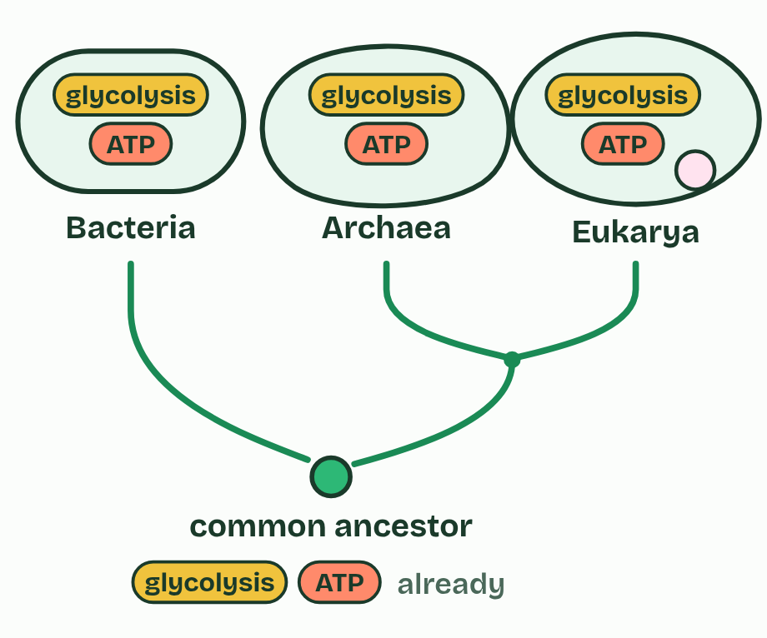
CHAPTER 8 · 3.3.A 3.3.B Energy pathways
3 / 3
Pathways go in small steps, shared by all life
The simplest explanation: the ancestor already had ATP and glycolysis, and every line of descent kept them. Shared, conserved pathways are evidence of common ancestry.
Minutes 25 to 37
Notes:
Minutes 25 to 37 of 60: Pathways and feedback (12 min).
The plan: The alcohol pathway reading (activity below), then chapter 8's feedback figure, stopped at step 3 for students to predict step 4. Close with the tree: why the same pathway in every domain?
Cells rarely do anything in one reaction. They use metabolic pathways: chains of reactions, each catalyzed by its own enzyme, where the product of one step is the substrate of the next. Set glucose alight and its energy comes out all at once, as heat and light, and none of it is kept. Broken down in a cell, it goes through dozens of steps, each releasing a little energy that the cell can capture as ATP and control.
Control often acts on the first step. When the end product builds up, it binds an allosteric site on the pathway's first enzyme and switches it off: feedback inhibition. When the product is used up it lets go, and the pathway runs again. No energy or raw material is wasted making what the cell already has.
The same core pathways turn up everywhere. Bacteria, archaea and eukaryotes all use ATP as their energy currency, and versions of glycolysis run in all three, with several of the same enzymes. Pathways shared and conserved like this are best explained by inheritance from a common ancestor of all living things.
Example: Your liver breaks alcohol down in steps: ethanol to acetaldehyde (alcohol dehydrogenase), acetaldehyde to acetate (aldehyde dehydrogenase), then into the Krebs cycle. Some people inherit a slow version of the second enzyme. Toxic acetaldehyde builds up, and their face flushes after a drink.

Slide 25
CHAPTER 8 · 3.3.A 3.3.B Energy pathways
Pathways go in small steps, shared by all life
The product of one step is the substrate of the next.
The end product inhibits the first enzyme: negative feedback.
Conserved pathways in every domain are evidence of common ancestry.
Minutes 25 to 37
Notes:
Minutes 25 to 37 of 60: Pathways and feedback (12 min).
The plan: The alcohol pathway reading (activity below), then chapter 8's feedback figure, stopped at step 3 for students to predict step 4. Close with the tree: why the same pathway in every domain?
Cells rarely do anything in one reaction. They use metabolic pathways: chains of reactions, each catalyzed by its own enzyme, where the product of one step is the substrate of the next. Set glucose alight and its energy comes out all at once, as heat and light, and none of it is kept. Broken down in a cell, it goes through dozens of steps, each releasing a little energy that the cell can capture as ATP and control.
Control often acts on the first step. When the end product builds up, it binds an allosteric site on the pathway's first enzyme and switches it off: feedback inhibition. When the product is used up it lets go, and the pathway runs again. No energy or raw material is wasted making what the cell already has.
The same core pathways turn up everywhere. Bacteria, archaea and eukaryotes all use ATP as their energy currency, and versions of glycolysis run in all three, with several of the same enzymes. Pathways shared and conserved like this are best explained by inheritance from a common ancestor of all living things.
Example: Your liver breaks alcohol down in steps: ethanol to acetaldehyde (alcohol dehydrogenase), acetaldehyde to acetate (aldehyde dehydrogenase), then into the Krebs cycle. Some people inherit a slow version of the second enzyme. Toxic acetaldehyde builds up, and their face flushes after a drink.

Slide 26
PREDICT
The end product of a pathway builds up in a cell. What happens to the first enzyme of that pathway?
A It is denatured by the build-up of product
B It speeds up to clear the extra product
C It is unaffected; only the last enzyme stops
D It is slowed: the product binds it elsewhere
Minutes 25 to 37
Notes:
Minutes 25 to 37 of 60: Pathways and feedback (12 min).
The plan: The alcohol pathway reading (activity below), then chapter 8's feedback figure, stopped at step 3 for students to predict step 4. Close with the tree: why the same pathway in every domain?
Ask for a show of hands, or mini whiteboards, before revealing. (Answer: D, on the next slide.)

Slide 27
WHAT HAPPENS
The end product of a pathway builds up in a cell. What happens to the first enzyme of that pathway?
A It is denatured by the build-up of product
B It speeds up to clear the extra product
C It is unaffected; only the last enzyme stops
D It is slowed: the product binds it elsewhere
Feedback inhibition: the end product binds an allosteric site on the first enzyme and bends its active site, so the whole pathway slows. Play the top figure to step 3, then step 4, when the product has been used and lets go.
Minutes 25 to 37
Notes:
Minutes 25 to 37 of 60: Pathways and feedback (12 min).
The plan: The alcohol pathway reading (activity below), then chapter 8's feedback figure, stopped at step 3 for students to predict step 4. Close with the tree: why the same pathway in every domain?
Answer: D. Feedback inhibition: the end product binds an allosteric site on the first enzyme and bends its active site, so the whole pathway slows. Play the top figure to step 3, then step 4, when the product has been used and lets go.

Slide 28
WATCH OUT
Feedback inhibition does not destroy the first enzyme. The end product binds reversibly: as its level falls it lets go, and the enzyme works again. That is what makes it a switch.
Minutes 25 to 37
Notes:
Minutes 25 to 37 of 60: Pathways and feedback (12 min).
The plan: The alcohol pathway reading (activity below), then chapter 8's feedback figure, stopped at step 3 for students to predict step 4. Close with the tree: why the same pathway in every domain?
A common mistake: say it, then ask who can say why it is wrong.

Slide 29
STEP 5
12 MIN
Paying for uphill reactions
Students add the ΔG values themselves before step 4 shows the total.
Minutes 37 to 49
Notes:
Minutes 37 to 49 of 60: Paying for uphill reactions (12 min).
The plan: Chapter 7: energy on and off for the cell, then the glutamine coupling a step at a time. Students add the ΔG values themselves before step 4 shows the total.

Slide 30
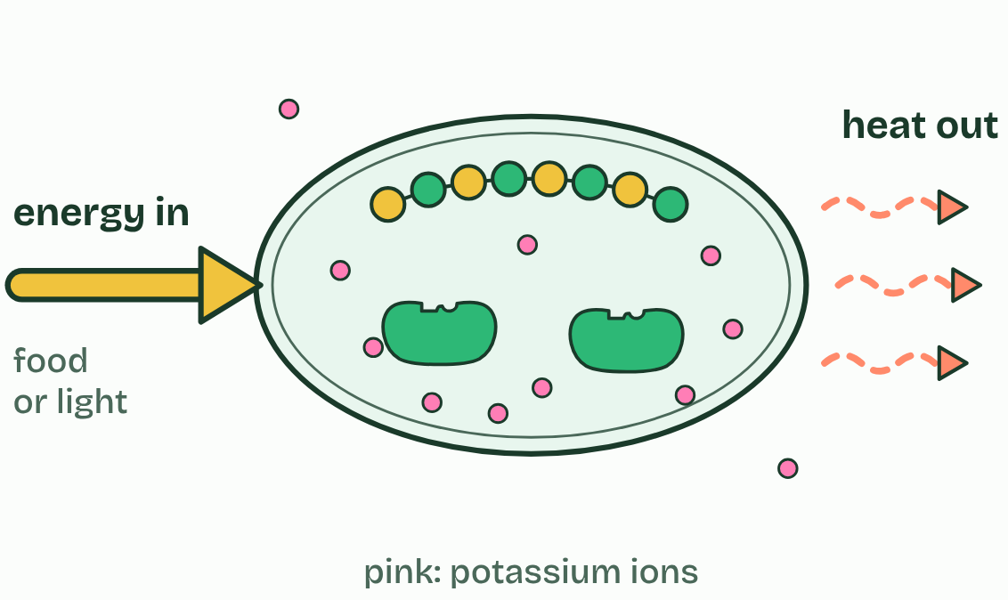
CHAPTER 7 · 3.3.A Cellular energy
1 / 2
Staying alive takes a constant supply of energy
Energy flowing in
Minutes 37 to 49
Notes:
Minutes 37 to 49 of 60: Paying for uphill reactions (12 min).
The plan: Chapter 7: energy on and off for the cell, then the glutamine coupling a step at a time. Students add the ΔG values themselves before step 4 shows the total.
A cell is a highly ordered place: proteins folded just so, membranes whole, more potassium inside than out. The second law of thermodynamics says that every energy transfer turns some energy into heat, and the disorder of the universe as a whole always increases. Order never keeps itself. A cell holds on to it only by taking in energy all the time, from food or from light, faster than it loses energy. Cut off that flow, or lose the order, and the cell dies.
Life does not break the second law. A cell's order is paid for by the heat and disorder it releases into its surroundings.
Reactions come in two kinds. An exergonic reaction releases free energy (ΔG is negative), like the breakdown of glucose. An endergonic reaction needs free energy put in (ΔG is positive), like building a protein. A cell runs an endergonic reaction by coupling it to an exergonic one, and the usual partner is the hydrolysis of ATP, the cell's energy currency.
Example: Your body holds only about 250 grams of ATP at any moment, yet makes and spends roughly its own weight in ATP every day. Each molecule is split to ADP and rebuilt, over and over, with energy from respiration.

Slide 31
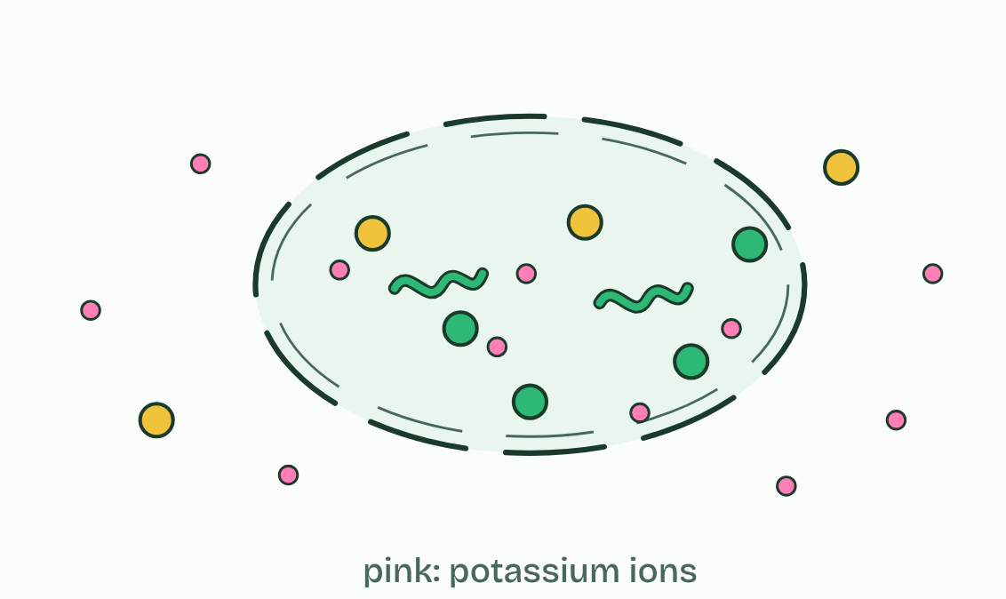
CHAPTER 7 · 3.3.A Cellular energy
2 / 2
Staying alive takes a constant supply of energy
Energy cut off
Minutes 37 to 49
Notes:
Minutes 37 to 49 of 60: Paying for uphill reactions (12 min).
The plan: Chapter 7: energy on and off for the cell, then the glutamine coupling a step at a time. Students add the ΔG values themselves before step 4 shows the total.
A cell is a highly ordered place: proteins folded just so, membranes whole, more potassium inside than out. The second law of thermodynamics says that every energy transfer turns some energy into heat, and the disorder of the universe as a whole always increases. Order never keeps itself. A cell holds on to it only by taking in energy all the time, from food or from light, faster than it loses energy. Cut off that flow, or lose the order, and the cell dies.
Life does not break the second law. A cell's order is paid for by the heat and disorder it releases into its surroundings.
Reactions come in two kinds. An exergonic reaction releases free energy (ΔG is negative), like the breakdown of glucose. An endergonic reaction needs free energy put in (ΔG is positive), like building a protein. A cell runs an endergonic reaction by coupling it to an exergonic one, and the usual partner is the hydrolysis of ATP, the cell's energy currency.
Example: Your body holds only about 250 grams of ATP at any moment, yet makes and spends roughly its own weight in ATP every day. Each molecule is split to ADP and rebuilt, over and over, with energy from respiration.

Slide 32
CHAPTER 7 · 3.3.A Cellular energy
Staying alive takes a constant supply of energy
Energy in must exceed energy lost, to keep order and to do work.
Coupled to ATP hydrolysis, an uphill step becomes part of a downhill pair.
Minutes 37 to 49
Notes:
Minutes 37 to 49 of 60: Paying for uphill reactions (12 min).
The plan: Chapter 7: energy on and off for the cell, then the glutamine coupling a step at a time. Students add the ΔG values themselves before step 4 shows the total.
A cell is a highly ordered place: proteins folded just so, membranes whole, more potassium inside than out. The second law of thermodynamics says that every energy transfer turns some energy into heat, and the disorder of the universe as a whole always increases. Order never keeps itself. A cell holds on to it only by taking in energy all the time, from food or from light, faster than it loses energy. Cut off that flow, or lose the order, and the cell dies.
Life does not break the second law. A cell's order is paid for by the heat and disorder it releases into its surroundings.
Reactions come in two kinds. An exergonic reaction releases free energy (ΔG is negative), like the breakdown of glucose. An endergonic reaction needs free energy put in (ΔG is positive), like building a protein. A cell runs an endergonic reaction by coupling it to an exergonic one, and the usual partner is the hydrolysis of ATP, the cell's energy currency.
Example: Your body holds only about 250 grams of ATP at any moment, yet makes and spends roughly its own weight in ATP every day. Each molecule is split to ADP and rebuilt, over and over, with energy from respiration.

Slide 33
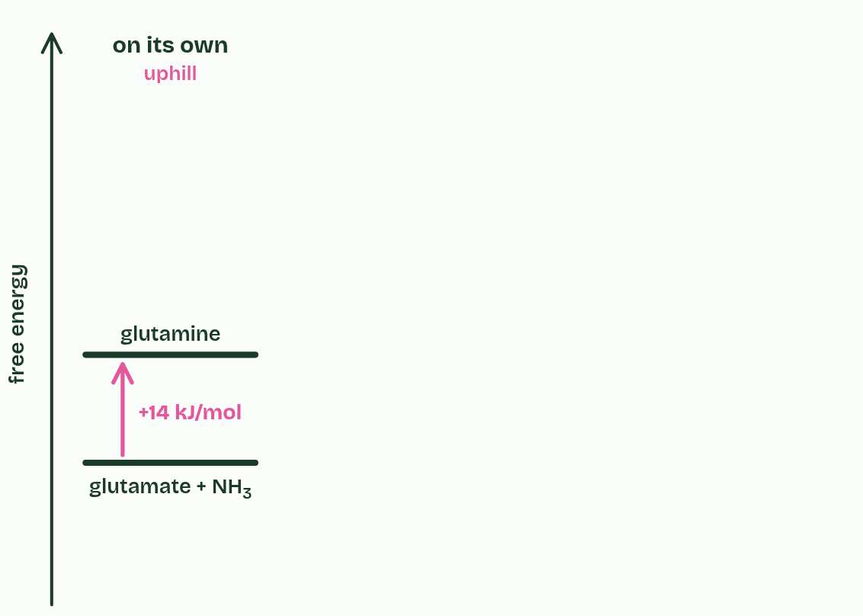
CHAPTER 7 · 3.3.A Cellular energy
1 / 4
Staying alive takes a constant supply of energy
Making glutamine from glutamate and ammonia is uphill: ΔG = +14 kJ/mol. On its own it hardly happens.
Minutes 37 to 49
Notes:
Minutes 37 to 49 of 60: Paying for uphill reactions (12 min).
The plan: Chapter 7: energy on and off for the cell, then the glutamine coupling a step at a time. Students add the ΔG values themselves before step 4 shows the total.
A cell is a highly ordered place: proteins folded just so, membranes whole, more potassium inside than out. The second law of thermodynamics says that every energy transfer turns some energy into heat, and the disorder of the universe as a whole always increases. Order never keeps itself. A cell holds on to it only by taking in energy all the time, from food or from light, faster than it loses energy. Cut off that flow, or lose the order, and the cell dies.
Life does not break the second law. A cell's order is paid for by the heat and disorder it releases into its surroundings.
Reactions come in two kinds. An exergonic reaction releases free energy (ΔG is negative), like the breakdown of glucose. An endergonic reaction needs free energy put in (ΔG is positive), like building a protein. A cell runs an endergonic reaction by coupling it to an exergonic one, and the usual partner is the hydrolysis of ATP, the cell's energy currency.
Example: Your body holds only about 250 grams of ATP at any moment, yet makes and spends roughly its own weight in ATP every day. Each molecule is split to ADP and rebuilt, over and over, with energy from respiration.

Slide 34
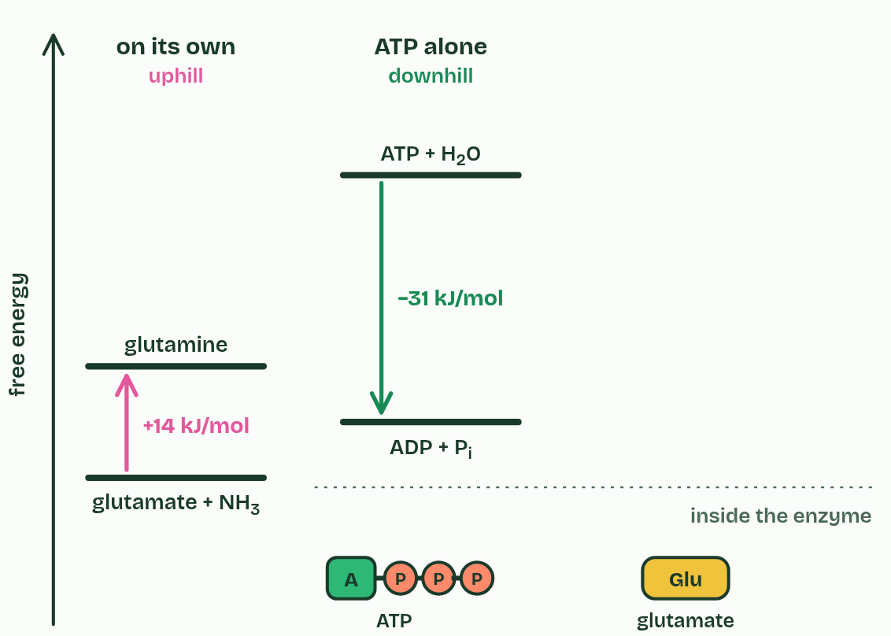
CHAPTER 7 · 3.3.A Cellular energy
2 / 4
Staying alive takes a constant supply of energy
Splitting ATP into ADP and phosphate is downhill: ΔG = −31 kJ/mol. The products are more stable than ATP was.
Minutes 37 to 49
Notes:
Minutes 37 to 49 of 60: Paying for uphill reactions (12 min).
The plan: Chapter 7: energy on and off for the cell, then the glutamine coupling a step at a time. Students add the ΔG values themselves before step 4 shows the total.
A cell is a highly ordered place: proteins folded just so, membranes whole, more potassium inside than out. The second law of thermodynamics says that every energy transfer turns some energy into heat, and the disorder of the universe as a whole always increases. Order never keeps itself. A cell holds on to it only by taking in energy all the time, from food or from light, faster than it loses energy. Cut off that flow, or lose the order, and the cell dies.
Life does not break the second law. A cell's order is paid for by the heat and disorder it releases into its surroundings.
Reactions come in two kinds. An exergonic reaction releases free energy (ΔG is negative), like the breakdown of glucose. An endergonic reaction needs free energy put in (ΔG is positive), like building a protein. A cell runs an endergonic reaction by coupling it to an exergonic one, and the usual partner is the hydrolysis of ATP, the cell's energy currency.
Example: Your body holds only about 250 grams of ATP at any moment, yet makes and spends roughly its own weight in ATP every day. Each molecule is split to ADP and rebuilt, over and over, with energy from respiration.

Slide 35
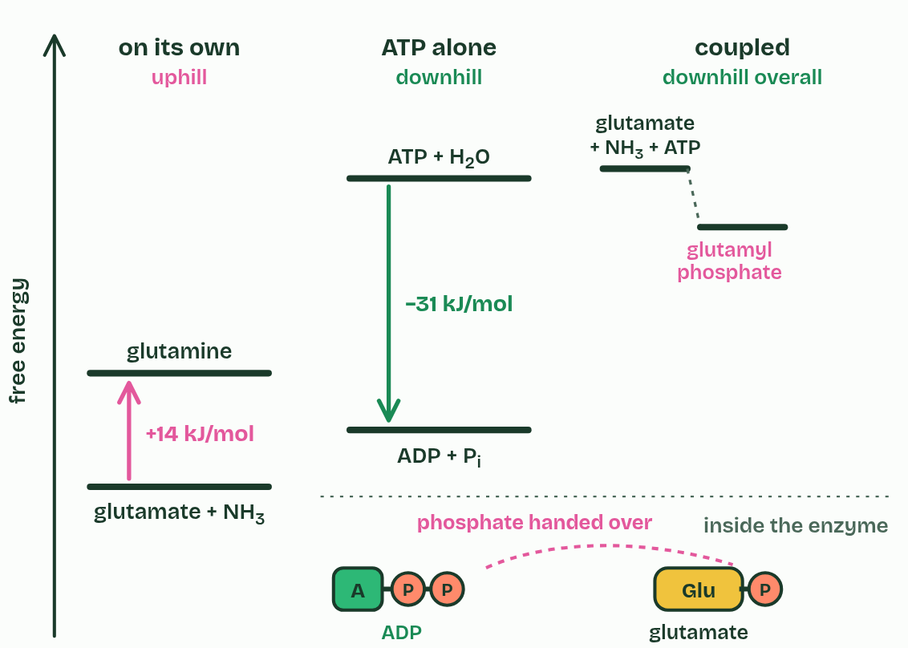
CHAPTER 7 · 3.3.A Cellular energy
3 / 4
Staying alive takes a constant supply of energy
The enzyme glutamine synthetase couples them: ATP hands its end phosphate to glutamate. Glutamyl phosphate is unstable, ready to react.
Minutes 37 to 49
Notes:
Minutes 37 to 49 of 60: Paying for uphill reactions (12 min).
The plan: Chapter 7: energy on and off for the cell, then the glutamine coupling a step at a time. Students add the ΔG values themselves before step 4 shows the total.
A cell is a highly ordered place: proteins folded just so, membranes whole, more potassium inside than out. The second law of thermodynamics says that every energy transfer turns some energy into heat, and the disorder of the universe as a whole always increases. Order never keeps itself. A cell holds on to it only by taking in energy all the time, from food or from light, faster than it loses energy. Cut off that flow, or lose the order, and the cell dies.
Life does not break the second law. A cell's order is paid for by the heat and disorder it releases into its surroundings.
Reactions come in two kinds. An exergonic reaction releases free energy (ΔG is negative), like the breakdown of glucose. An endergonic reaction needs free energy put in (ΔG is positive), like building a protein. A cell runs an endergonic reaction by coupling it to an exergonic one, and the usual partner is the hydrolysis of ATP, the cell's energy currency.
Example: Your body holds only about 250 grams of ATP at any moment, yet makes and spends roughly its own weight in ATP every day. Each molecule is split to ADP and rebuilt, over and over, with energy from respiration.

Slide 36
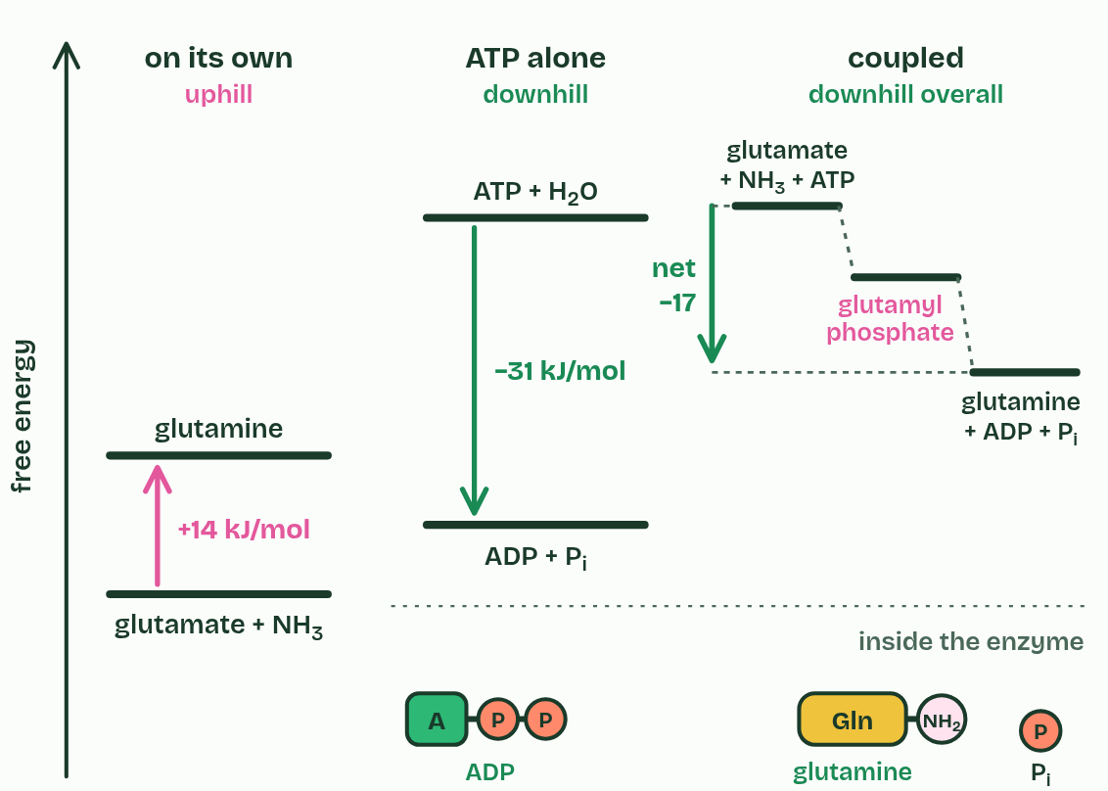
CHAPTER 7 · 3.3.A Cellular energy
4 / 4
Staying alive takes a constant supply of energy
Ammonia takes the phosphate's place, making glutamine. Overall +14 − 31 = −17 kJ/mol: downhill, so it runs. Respiration then rebuilds the ATP.
Minutes 37 to 49
Notes:
Minutes 37 to 49 of 60: Paying for uphill reactions (12 min).
The plan: Chapter 7: energy on and off for the cell, then the glutamine coupling a step at a time. Students add the ΔG values themselves before step 4 shows the total.
A cell is a highly ordered place: proteins folded just so, membranes whole, more potassium inside than out. The second law of thermodynamics says that every energy transfer turns some energy into heat, and the disorder of the universe as a whole always increases. Order never keeps itself. A cell holds on to it only by taking in energy all the time, from food or from light, faster than it loses energy. Cut off that flow, or lose the order, and the cell dies.
Life does not break the second law. A cell's order is paid for by the heat and disorder it releases into its surroundings.
Reactions come in two kinds. An exergonic reaction releases free energy (ΔG is negative), like the breakdown of glucose. An endergonic reaction needs free energy put in (ΔG is positive), like building a protein. A cell runs an endergonic reaction by coupling it to an exergonic one, and the usual partner is the hydrolysis of ATP, the cell's energy currency.
Example: Your body holds only about 250 grams of ATP at any moment, yet makes and spends roughly its own weight in ATP every day. Each molecule is split to ADP and rebuilt, over and over, with energy from respiration.

Slide 37
CHAPTER 7 · 3.3.A Cellular energy
Staying alive takes a constant supply of energy
Energy in must exceed energy lost, to keep order and to do work.
Coupled to ATP hydrolysis, an uphill step becomes part of a downhill pair.
Minutes 37 to 49
Notes:
Minutes 37 to 49 of 60: Paying for uphill reactions (12 min).
The plan: Chapter 7: energy on and off for the cell, then the glutamine coupling a step at a time. Students add the ΔG values themselves before step 4 shows the total.
A cell is a highly ordered place: proteins folded just so, membranes whole, more potassium inside than out. The second law of thermodynamics says that every energy transfer turns some energy into heat, and the disorder of the universe as a whole always increases. Order never keeps itself. A cell holds on to it only by taking in energy all the time, from food or from light, faster than it loses energy. Cut off that flow, or lose the order, and the cell dies.
Life does not break the second law. A cell's order is paid for by the heat and disorder it releases into its surroundings.
Reactions come in two kinds. An exergonic reaction releases free energy (ΔG is negative), like the breakdown of glucose. An endergonic reaction needs free energy put in (ΔG is positive), like building a protein. A cell runs an endergonic reaction by coupling it to an exergonic one, and the usual partner is the hydrolysis of ATP, the cell's energy currency.
Example: Your body holds only about 250 grams of ATP at any moment, yet makes and spends roughly its own weight in ATP every day. Each molecule is split to ADP and rebuilt, over and over, with energy from respiration.

Slide 38
PREDICT
Reaction X has ΔG = +20 kJ/mol. Which of these would make it run in a cell?
A Adding an enzyme that is specific to X
B Raising the temperature to speed it up
C Coupling X to ATP hydrolysis (−31)
D Adding more of X's products to the cell
Minutes 37 to 49
Notes:
Minutes 37 to 49 of 60: Paying for uphill reactions (12 min).
The plan: Chapter 7: energy on and off for the cell, then the glutamine coupling a step at a time. Students add the ΔG values themselves before step 4 shows the total.
Ask for a show of hands, or mini whiteboards, before revealing. (Answer: C, on the next slide.)

Slide 39
WHAT HAPPENS
Reaction X has ΔG = +20 kJ/mol. Which of these would make it run in a cell?
A Adding an enzyme that is specific to X
B Raising the temperature to speed it up
C Coupling X to ATP hydrolysis (−31)
D Adding more of X's products to the cell
An enzyme only lowers the activation energy and heat only speeds up collisions: neither changes ΔG, so X stays uphill. Coupled to ATP hydrolysis, the pair has ΔG = +20 − 31 = −11 kJ/mol, downhill, so it runs. More product would push X backwards.
Minutes 37 to 49
Notes:
Minutes 37 to 49 of 60: Paying for uphill reactions (12 min).
The plan: Chapter 7: energy on and off for the cell, then the glutamine coupling a step at a time. Students add the ΔG values themselves before step 4 shows the total.
Answer: C. An enzyme only lowers the activation energy and heat only speeds up collisions: neither changes ΔG, so X stays uphill. Coupled to ATP hydrolysis, the pair has ΔG = +20 − 31 = −11 kJ/mol, downhill, so it runs. More product would push X backwards.

Slide 40
REMEMBER IT
Which way the energy goes: read the first two letters. EXergonic, energy EXits; ENdergonic, energy ENters.
E
E
Exits
Enters
Minutes 37 to 49
Notes:
Minutes 37 to 49 of 60: Paying for uphill reactions (12 min).
The plan: Chapter 7: energy on and off for the cell, then the glutamine coupling a step at a time. Students add the ΔG values themselves before step 4 shows the total.
Ask the class what each letter stands for before revealing.

Slide 41
REMEMBER IT
Which way the energy goes: read the first two letters. EXergonic, energy EXits; ENdergonic, energy ENters.
E
E
Exits
Enters
Exergonic
Endergonic
energy leaves; ΔG negative
energy goes in; ΔG positive
Minutes 37 to 49
Notes:
Minutes 37 to 49 of 60: Paying for uphill reactions (12 min).
The plan: Chapter 7: energy on and off for the cell, then the glutamine coupling a step at a time. Students add the ΔG values themselves before step 4 shows the total.
Exits: Exergonic (energy leaves; ΔG negative)
Enters: Endergonic (energy goes in; ΔG positive)

Slide 42
WATCH OUT
Energy is not stored in ATP's last phosphate bond like a spring, released when the bond snaps. Breaking any bond takes energy in. ATP hydrolysis releases energy because the products, ADP and phosphate, are more stable than ATP and water were: they hold less free energy.
Minutes 37 to 49
Notes:
Minutes 37 to 49 of 60: Paying for uphill reactions (12 min).
The plan: Chapter 7: energy on and off for the cell, then the glutamine coupling a step at a time. Students add the ΔG values themselves before step 4 shows the total.
A common mistake: say it, then ask who can say why it is wrong.

Slide 43
PLENARY
Free response, timed
Two parts of a free-response question on inhibitors or coupling, from the Unit 3 exam maker, in 6 minutes, then swap and mark against the scoring guide.
Minutes 49 to 60
Notes:
Minutes 49 to 60 of 60: Free response, timed (11 min).
The plan: Two parts of a free-response question on inhibitors or coupling, from the Unit 3 exam maker (in Practise and revise, below), in 6 minutes, then swap and mark against the scoring guide. For homework, the Check step: a fresh paper on 3.1 to 3.3 from the exam bank, marked as students go.

Slide 44
EXIT QUESTION
Before you go
On paper, on your own: one thing the dry lab showed, and one way the model differs from the real thing.
Minutes 49 to 60
Notes:
Minutes 49 to 60 of 60: Free response, timed (11 min).
The plan: Two parts of a free-response question on inhibitors or coupling, from the Unit 3 exam maker (in Practise and revise, below), in 6 minutes, then swap and mark against the scoring guide. For homework, the Check step: a fresh paper on 3.1 to 3.3 from the exam bank, marked as students go.
Collect the slips: they say where to start next lesson.

Slide 45
PRACTISE AND REVISE
Keep going
Exam practice: a fresh paper of exam questions on 3.1 to 3.3, marked as you go
The guide, with the animations and the dry lab
This lesson in the guide: 6 Inhibitors block the site, or bend it, 7 Staying alive takes a constant supply of energy, 8 Pathways go in small steps, shared by all life, the dry lab
BUILD FOR YOUR CLASS
ALREADY ON THE SITE FOR UNIT 3
CARD SETS ON SPLYCR
Tarsia puzzle, dominoes and picture reveal on Unit 3, built from its key terms and ready to print
A pub quiz with rounds on Unit 3, to present or run with no projector
The Kelp Light Habitat escape room, or an escape room built from the question bank on Unit 3
Lesson: Enzymes
Lesson: Environmental Impacts on Enzyme Function
Lesson: Cellular Energy
Quiz: Enzymes
Quiz: Environmental Impacts on Enzyme Function
Quiz: Cellular Energy
Exam questions: Unit 3 in the exam maker, a paper with scoring guidelines
Open a set to host it as a class game, or make a copy to edit.
Unit 3: Cellular Energetics (part 1)
Unit 3: Cellular Energetics (part 2)
Unit 3: Cellular Energetics (part 3)
How this was made. The course structure, the activities and the teaching choices come from my own classroom, my presentations and my years of teaching IB and AP Biology. I use Claude, an AI, to help write and build the interactive guides, lesson plans, slides and practice questions, and to draw the diagrams and code the interactives. I direct the work and review it against the IB and AP specifications before it goes live.
Minute 60: after the lesson
Notes:
Every link here is live. Set the exam practice paper for homework: it is fresh each time, marked as students go and saved to their Exam practice when they are signed in.
Exam practice: https://www.biologybybradford.com/exam-maker/sit?program=ap&units=U3&ced=3.1%2C3.2%2C3.3&paper=quiz&marks=15&src=ep
The guide: https://www.biologybybradford.com/guides/ap-biology-unit-3-enzymes

