Slide 1
IB Biology A1.1
LESSON 1 OF 4
BY THE END YOU CAN
Water
Explain why water is the medium for life: where the first cells arose, and where life's processes still happen (A1.1.1)
Explain how unequal sharing of electrons makes water polar, and draw hydrogen bonds between water molecules with partial charges (A1.1.2)
Explain how cohesion lets water be pulled up xylem under tension, and lets animals live on its surface (A1.1.3)
Water's charges, and what they do
A1.1.1 to A1.1.3
Water as the medium for life, its polar molecules and hydrogen bonds, and cohesion: surface tension and the pull up the xylem
60 minutes · chapters 1, 2, 3
Minute 0
Notes:
IB Biology A1.1, Water. Lesson 1 of 4: Water's charges, and what they do, 60 minutes.
The plan, minute by minute (each slide's footer says where you are):
0 to 5 min (5) Do now: wet hand, dry hand
5 to 13 min (8) Life began in water
13 to 28 min (15) Build it
28 to 35 min (7) Bonds that flicker
35 to 50 min (15) Cohesion
50 to 60 min (10) Exit
What students get wrong:
Hydrogen bonds are inside the molecule. They are between molecules, and the O–H bonds are covalent.
Writing + and − on water. They are partial charges: δ+ and δ−.
Boiling breaks water molecules. Only hydrogen bonds break, and steam is H₂O.
Capillary action lifts water up trees. Cohesion under tension does, and capillarity works in cell walls and soil.
Sweat cools because water has a high specific heat capacity. It cools because evaporation takes heat away (latent heat of vaporisation).
Stretch and support:
Support: give the IB notation as a template to trace, then to complete.
Support: sentence frames for property, cause and consequence: "Because water molecules are polar, ...
Support: use the Remember it tiles as a starter in each lesson.
Stretch: carbon dioxide has polar bonds but is not a polar molecule. Why?
Stretch: ammonia and hydrogen fluoride also form hydrogen bonds, yet water boils far higher than both. Why?
The lesson plan to print: https://www.biologybybradford.com/guides/downloads/ib-biology-a1-1-water-lesson-1-plan.pdf

Slide 2
DO NOW
Wet hand, dry hand
Students wet the back of one hand and blow on both.
Which feels colder, and why?
5:00
minutes
Start now: the timer is running.
Minutes 0 to 5
Notes:
Minutes 0 to 5 of 60: Do now: wet hand, dry hand (5 min).
The plan: Students wet the back of one hand and blow on both. Which feels colder, and why? Take a vote and keep the answer: it comes back in the practical.
Start a 5 minute timer as they come in.

Slide 3
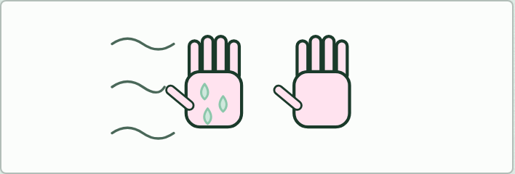
DEMO
5 MIN
Wet hand, dry hand
THE TASK
Students wet the back of one hand, blow on both, and say which is colder and why. Revisit it after the dry lab, when the answer has numbers behind it.
STUDENTS NEED
Water, paper towels.
Minutes 0 to 5
Notes:
Minutes 0 to 5 of 60: Do now: wet hand, dry hand (5 min).
The plan: Students wet the back of one hand and blow on both. Which feels colder, and why? Take a vote and keep the answer: it comes back in the practical.
The activity: Wet hand, dry hand. Students wet the back of one hand, blow on both, and say which is colder and why. Revisit it after the dry lab, when the answer has numbers behind it.
Needs: water, paper towels.
The time: 5 minutes, minutes 0 to 5 of the plan.

Slide 4
STEP 2
8 MIN
Life began in water
Chapter 1: Life began in water, and still runs in it
Minutes 5 to 13
Notes:
Minutes 5 to 13 of 60: Life began in water (8 min).
The plan: Play chapter 1's timeline, then the seed predict box. Ask students to name three things happening in water inside their own bodies right now.

Slide 5
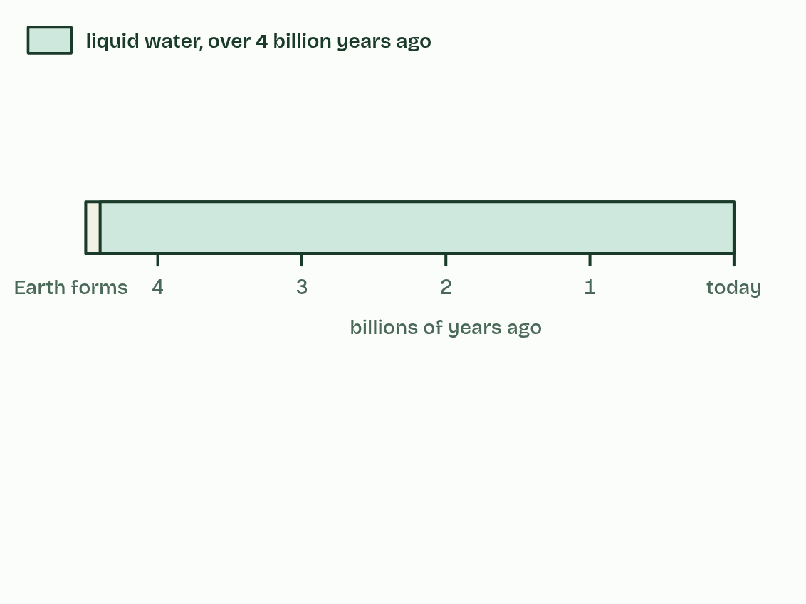
CHAPTER 1 · A1.1.1 Water as the medium for life
1 / 4
Life began in water, and still runs in it
Liquid water appeared very early, over 4 billion years ago.
Minutes 5 to 13
Notes:
Minutes 5 to 13 of 60: Life began in water (8 min).
The plan: Play chapter 1's timeline, then the seed predict box. Ask students to name three things happening in water inside their own bodies right now.
The first cells appeared in water more than 3.5 billion years ago. Where exactly, in the sea or in hot pools, is still debated. What is not in doubt is that for about three billion years every living thing stayed in water, and plants and animals reached land only in the last 500 million years or so.
Water suited them because things dissolve in it. Dissolved substances can move about, meet and react, and that is how the first cells could run their chemistry. Water is the medium for life, and the chemistry it carries, metabolism, still happens in it today.
A typical cell is about 70% water by mass. Its cytoplasm is an aqueous solution, and most of the reactions of metabolism take place in it. Blood plasma, about 90% water, and xylem sap carry dissolved substances round bodies and plants.
Land organisms did not leave water behind. They carry it inside them, in their cells, blood and tissue fluid, and a skin or a waxy cuticle slows its loss.
Example: In numbers A typical cell is about 70% water by mass, an adult human about 60% and a jellyfish about 95%.

Slide 6
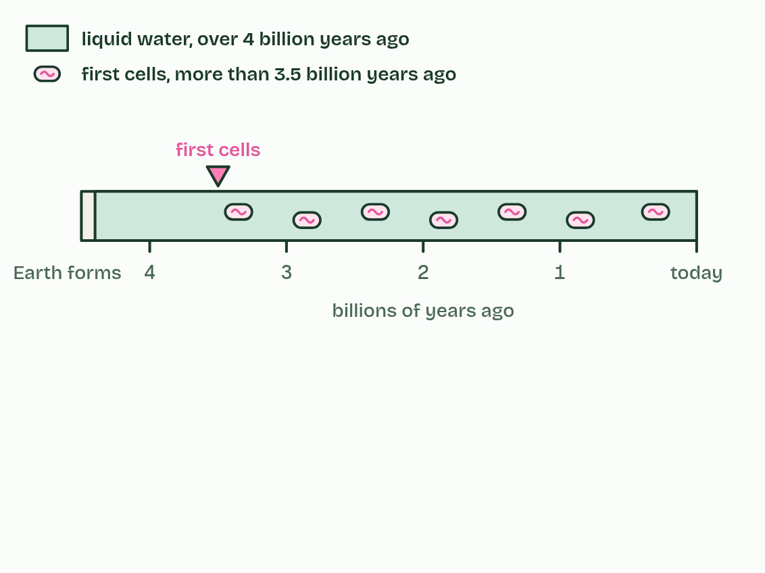
CHAPTER 1 · A1.1.1 Water as the medium for life
2 / 4
Life began in water, and still runs in it
The first cells lived in it, more than 3.5 billion years ago, and for about three billion years every living thing stayed there.
Minutes 5 to 13
Notes:
Minutes 5 to 13 of 60: Life began in water (8 min).
The plan: Play chapter 1's timeline, then the seed predict box. Ask students to name three things happening in water inside their own bodies right now.
The first cells appeared in water more than 3.5 billion years ago. Where exactly, in the sea or in hot pools, is still debated. What is not in doubt is that for about three billion years every living thing stayed in water, and plants and animals reached land only in the last 500 million years or so.
Water suited them because things dissolve in it. Dissolved substances can move about, meet and react, and that is how the first cells could run their chemistry. Water is the medium for life, and the chemistry it carries, metabolism, still happens in it today.
A typical cell is about 70% water by mass. Its cytoplasm is an aqueous solution, and most of the reactions of metabolism take place in it. Blood plasma, about 90% water, and xylem sap carry dissolved substances round bodies and plants.
Land organisms did not leave water behind. They carry it inside them, in their cells, blood and tissue fluid, and a skin or a waxy cuticle slows its loss.
Example: In numbers A typical cell is about 70% water by mass, an adult human about 60% and a jellyfish about 95%.

Slide 7
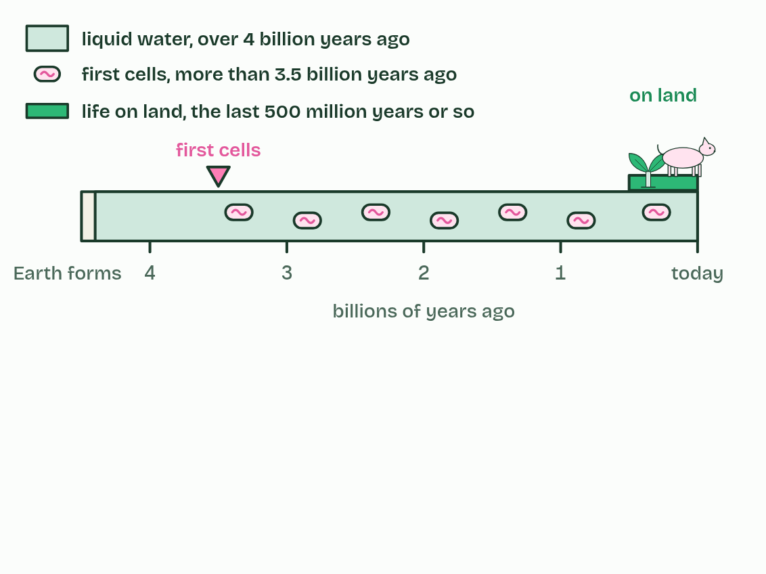
CHAPTER 1 · A1.1.1 Water as the medium for life
3 / 4
Life began in water, and still runs in it
Plants and animals reached land only in the last 500 million years or so.
Minutes 5 to 13
Notes:
Minutes 5 to 13 of 60: Life began in water (8 min).
The plan: Play chapter 1's timeline, then the seed predict box. Ask students to name three things happening in water inside their own bodies right now.
The first cells appeared in water more than 3.5 billion years ago. Where exactly, in the sea or in hot pools, is still debated. What is not in doubt is that for about three billion years every living thing stayed in water, and plants and animals reached land only in the last 500 million years or so.
Water suited them because things dissolve in it. Dissolved substances can move about, meet and react, and that is how the first cells could run their chemistry. Water is the medium for life, and the chemistry it carries, metabolism, still happens in it today.
A typical cell is about 70% water by mass. Its cytoplasm is an aqueous solution, and most of the reactions of metabolism take place in it. Blood plasma, about 90% water, and xylem sap carry dissolved substances round bodies and plants.
Land organisms did not leave water behind. They carry it inside them, in their cells, blood and tissue fluid, and a skin or a waxy cuticle slows its loss.
Example: In numbers A typical cell is about 70% water by mass, an adult human about 60% and a jellyfish about 95%.

Slide 8
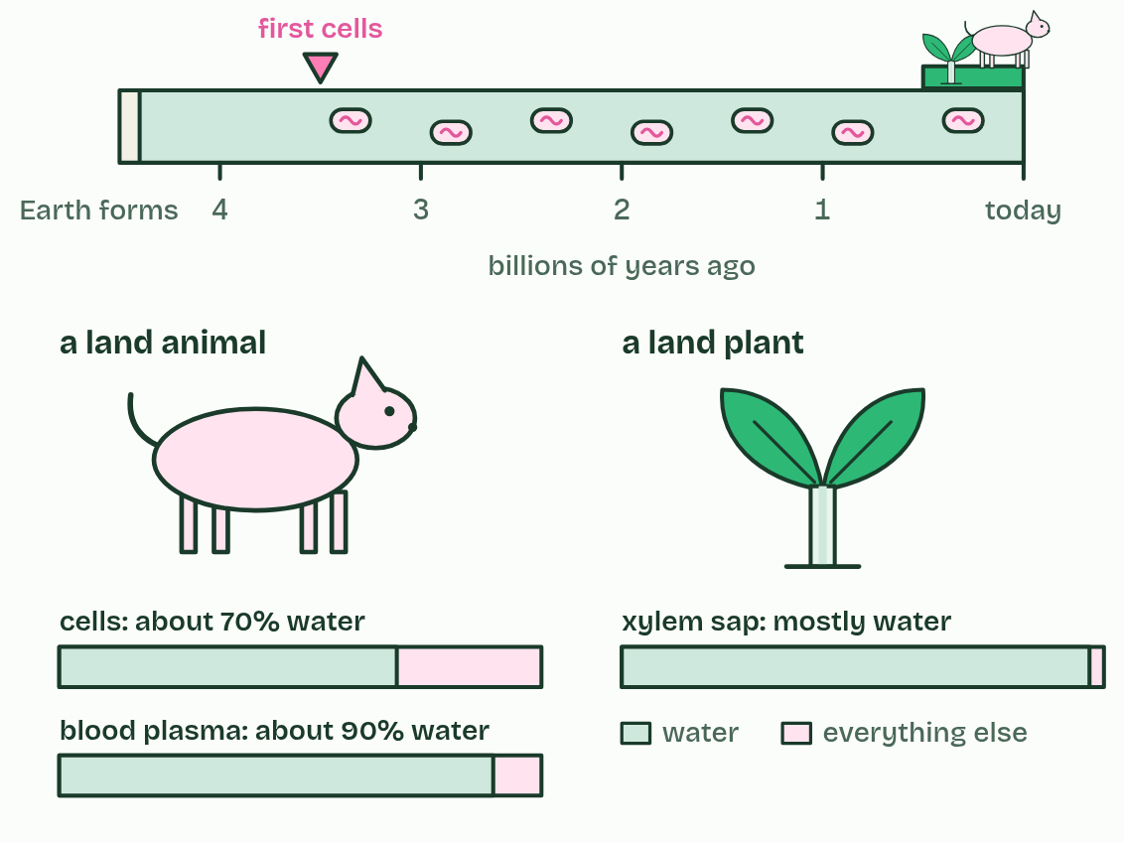
CHAPTER 1 · A1.1.1 Water as the medium for life
4 / 4
Life began in water, and still runs in it
Even there, life carries its water inside it: cells, blood plasma and xylem sap are all mostly water.
Minutes 5 to 13
Notes:
Minutes 5 to 13 of 60: Life began in water (8 min).
The plan: Play chapter 1's timeline, then the seed predict box. Ask students to name three things happening in water inside their own bodies right now.
The first cells appeared in water more than 3.5 billion years ago. Where exactly, in the sea or in hot pools, is still debated. What is not in doubt is that for about three billion years every living thing stayed in water, and plants and animals reached land only in the last 500 million years or so.
Water suited them because things dissolve in it. Dissolved substances can move about, meet and react, and that is how the first cells could run their chemistry. Water is the medium for life, and the chemistry it carries, metabolism, still happens in it today.
A typical cell is about 70% water by mass. Its cytoplasm is an aqueous solution, and most of the reactions of metabolism take place in it. Blood plasma, about 90% water, and xylem sap carry dissolved substances round bodies and plants.
Land organisms did not leave water behind. They carry it inside them, in their cells, blood and tissue fluid, and a skin or a waxy cuticle slows its loss.
Example: In numbers A typical cell is about 70% water by mass, an adult human about 60% and a jellyfish about 95%.

Slide 9
CHAPTER 1 · A1.1.1 Water as the medium for life
Life began in water, and still runs in it
Water is the medium for life, and the chemistry it carries, metabolism, still happens in it today.
Its cytoplasm is an aqueous solution, and most of the reactions of metabolism take place in it.
Blood plasma, about 90% water, and xylem sap carry dissolved substances round bodies and plants.
Minutes 5 to 13
Notes:
Minutes 5 to 13 of 60: Life began in water (8 min).
The plan: Play chapter 1's timeline, then the seed predict box. Ask students to name three things happening in water inside their own bodies right now.
The first cells appeared in water more than 3.5 billion years ago. Where exactly, in the sea or in hot pools, is still debated. What is not in doubt is that for about three billion years every living thing stayed in water, and plants and animals reached land only in the last 500 million years or so.
Water suited them because things dissolve in it. Dissolved substances can move about, meet and react, and that is how the first cells could run their chemistry. Water is the medium for life, and the chemistry it carries, metabolism, still happens in it today.
A typical cell is about 70% water by mass. Its cytoplasm is an aqueous solution, and most of the reactions of metabolism take place in it. Blood plasma, about 90% water, and xylem sap carry dissolved substances round bodies and plants.
Land organisms did not leave water behind. They carry it inside them, in their cells, blood and tissue fluid, and a skin or a waxy cuticle slows its loss.
Example: In numbers A typical cell is about 70% water by mass, an adult human about 60% and a jellyfish about 95%.

Slide 10
PREDICT
A packet of dry bean seeds sits in a cupboard for three years. What is happening to the metabolism inside each seed?
A It runs as normal, slowly using up the seed's food store so that less is left each year
B It has almost stopped: with so little water, enzymes and substrates cannot meet to react
C It has stopped for good: the seeds are dead and will not grow, however much water they get
Minutes 5 to 13
Notes:
Minutes 5 to 13 of 60: Life began in water (8 min).
The plan: Play chapter 1's timeline, then the seed predict box. Ask students to name three things happening in water inside their own bodies right now.
Ask for a show of hands, or mini whiteboards, before revealing. (Answer: B, on the next slide.)

Slide 11
WHAT HAPPENS
A packet of dry bean seeds sits in a cupboard for three years. What is happening to the metabolism inside each seed?
A It runs as normal, slowly using up the seed's food store so that less is left each year
B It has almost stopped: with so little water, enzymes and substrates cannot meet to react
C It has stopped for good: the seeds are dead and will not grow, however much water they get
Almost stopped. A dry seed holds only about a tenth of its mass as water, too little for most reactions. Soak it, and within hours water floods in, its enzymes start working and the seed begins to germinate. Metabolism needs water as its medium, which is what this statement means.
Minutes 5 to 13
Notes:
Minutes 5 to 13 of 60: Life began in water (8 min).
The plan: Play chapter 1's timeline, then the seed predict box. Ask students to name three things happening in water inside their own bodies right now.
Answer: B. Almost stopped. A dry seed holds only about a tenth of its mass as water, too little for most reactions. Soak it, and within hours water floods in, its enzymes start working and the seed begins to germinate. Metabolism needs water as its medium, which is what this statement means.

Slide 12
WATCH OUT
"Land animals live without water." They do not: they carry it inside them, and every reaction in their cells still happens in water.
Minutes 5 to 13
Notes:
Minutes 5 to 13 of 60: Life began in water (8 min).
The plan: Play chapter 1's timeline, then the seed predict box. Ask students to name three things happening in water inside their own bodies right now.
A common mistake: say it, then ask who can say why it is wrong.

Slide 13
STEP 3
15 MIN
Build it
Compare with chapter 2's figure and draw the IB notation on mini whiteboards.
Minutes 13 to 28
Notes:
Minutes 13 to 28 of 60: Build it (15 min).
The plan: With snatoms or model kits, students build three water molecules, then annotate δ+, δ− and dashed hydrogen bonds. Compare with chapter 2's figure and draw the IB notation on mini whiteboards. Then the boiling predict box.

Slide 14

MODEL
15 MIN
Three water molecules
THE TASK
Build three molecules with snatoms or a kit, label δ+ and δ−, and link them with hydrogen bonds. Then compare the model with the drawing and say what the model gets wrong: electrons are a cloud, and bonds are not sticks.
STUDENTS NEED
Snatoms or model kits (or plasticine and cocktail sticks), mini whiteboards.
Minutes 13 to 28
Notes:
Minutes 13 to 28 of 60: Build it (15 min).
The plan: With snatoms or model kits, students build three water molecules, then annotate δ+, δ− and dashed hydrogen bonds. Compare with chapter 2's figure and draw the IB notation on mini whiteboards. Then the boiling predict box.
The activity: Three water molecules. Build three molecules with snatoms or a kit, label δ+ and δ−, and link them with hydrogen bonds. Then compare the model with the drawing and say what the model gets wrong: electrons are a cloud, and bonds are not sticks.
Needs: snatoms or model kits (or plasticine and cocktail sticks), mini whiteboards.
The time: 15 minutes, minutes 13 to 28 of the plan.

Slide 15
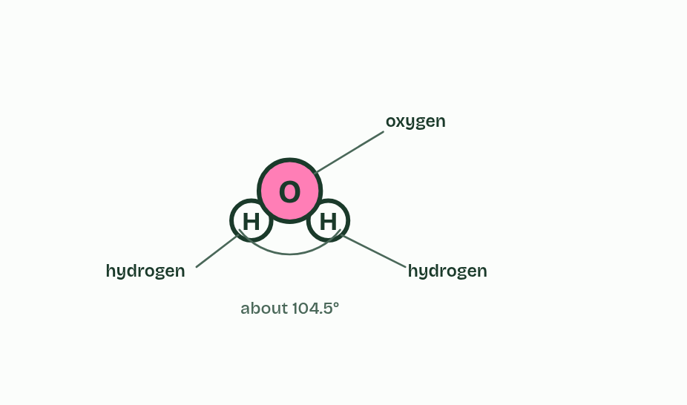
CHAPTER 2 · A1.1.2 Hydrogen bonds
1 / 6
A lopsided molecule makes hydrogen bonds
One water molecule: an oxygen with two hydrogens, bent, with about 104.5° between the bonds.
Minutes 13 to 28
Notes:
Minutes 13 to 28 of 60: Build it (15 min).
The plan: With snatoms or model kits, students build three water molecules, then annotate δ+, δ− and dashed hydrogen bonds. Compare with chapter 2's figure and draw the IB notation on mini whiteboards. Then the boiling predict box.
A water molecule is one oxygen atom joined to two hydrogen atoms by covalent bonds, and it is bent, with about 104.5° between the two bonds.
The sharing is unequal. Oxygen is more electronegative: it pulls on the shared electrons harder than hydrogen does, so they spend more time near the oxygen. That makes each O–H bond a polar covalent bond. The oxygen end gains a small negative charge and each hydrogen a small positive one: partial charges, written δ− and δ+. The molecule is bent, so one side is negative and the other positive, and the whole thing is a polar molecule.
Opposite charges attract. The δ+ hydrogen of one molecule is pulled towards the δ− oxygen of its neighbour, and that attraction is a hydrogen bond. It forms between molecules, never inside one. Each is weak, about a twentieth as strong as a covalent bond, and lasts only a few trillionths of a second. But there are vast numbers, always breaking and re-forming, and one molecule can make up to four.
Why it matters: to pull water molecules apart, hydrogen bonds must be broken, and that takes energy. Water boils at 100 °C, but methane, a molecule of about the same size with no hydrogen bonds, boils at −162 °C. When water evaporates, its fastest molecules break their hydrogen bonds and escape, taking energy with them, so what is left behind cools. Each gram that evaporates takes about 2.4 kJ, the latent heat of vaporisation. That is how sweat cools skin and transpiration cools leaves.
Example: How do we know? No one has watched a hydrogen bond form: each is far too small and lasts a few trillionths of a second. The evidence is indirect. Water boils at 100 °C, where molecules of the same size boil far lower (methane at −162 °C, hydrogen sulfide at −60 °C), and its surface tension and heat capacity are unusually high. One idea, hydrogen bonding, explains all of these at once, and X-ray and neutron studies of ice show each hydrogen pointing at an oxygen on the next molecule. A theory earns trust by explaining many observations and surviving every test so far.

Slide 16
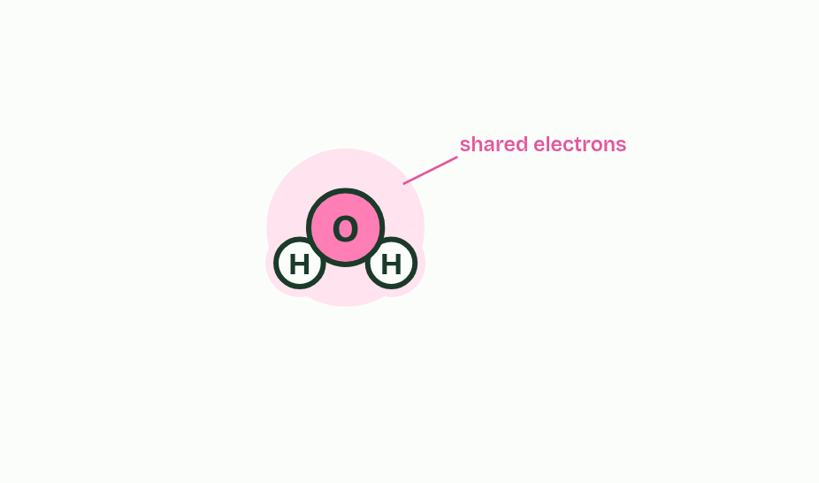
CHAPTER 2 · A1.1.2 Hydrogen bonds
2 / 6
A lopsided molecule makes hydrogen bonds
The shared electrons (the pink cloud) crowd round the oxygen and thin out round each hydrogen.
Minutes 13 to 28
Notes:
Minutes 13 to 28 of 60: Build it (15 min).
The plan: With snatoms or model kits, students build three water molecules, then annotate δ+, δ− and dashed hydrogen bonds. Compare with chapter 2's figure and draw the IB notation on mini whiteboards. Then the boiling predict box.
A water molecule is one oxygen atom joined to two hydrogen atoms by covalent bonds, and it is bent, with about 104.5° between the two bonds.
The sharing is unequal. Oxygen is more electronegative: it pulls on the shared electrons harder than hydrogen does, so they spend more time near the oxygen. That makes each O–H bond a polar covalent bond. The oxygen end gains a small negative charge and each hydrogen a small positive one: partial charges, written δ− and δ+. The molecule is bent, so one side is negative and the other positive, and the whole thing is a polar molecule.
Opposite charges attract. The δ+ hydrogen of one molecule is pulled towards the δ− oxygen of its neighbour, and that attraction is a hydrogen bond. It forms between molecules, never inside one. Each is weak, about a twentieth as strong as a covalent bond, and lasts only a few trillionths of a second. But there are vast numbers, always breaking and re-forming, and one molecule can make up to four.
Why it matters: to pull water molecules apart, hydrogen bonds must be broken, and that takes energy. Water boils at 100 °C, but methane, a molecule of about the same size with no hydrogen bonds, boils at −162 °C. When water evaporates, its fastest molecules break their hydrogen bonds and escape, taking energy with them, so what is left behind cools. Each gram that evaporates takes about 2.4 kJ, the latent heat of vaporisation. That is how sweat cools skin and transpiration cools leaves.
Example: How do we know? No one has watched a hydrogen bond form: each is far too small and lasts a few trillionths of a second. The evidence is indirect. Water boils at 100 °C, where molecules of the same size boil far lower (methane at −162 °C, hydrogen sulfide at −60 °C), and its surface tension and heat capacity are unusually high. One idea, hydrogen bonding, explains all of these at once, and X-ray and neutron studies of ice show each hydrogen pointing at an oxygen on the next molecule. A theory earns trust by explaining many observations and surviving every test so far.

Slide 17
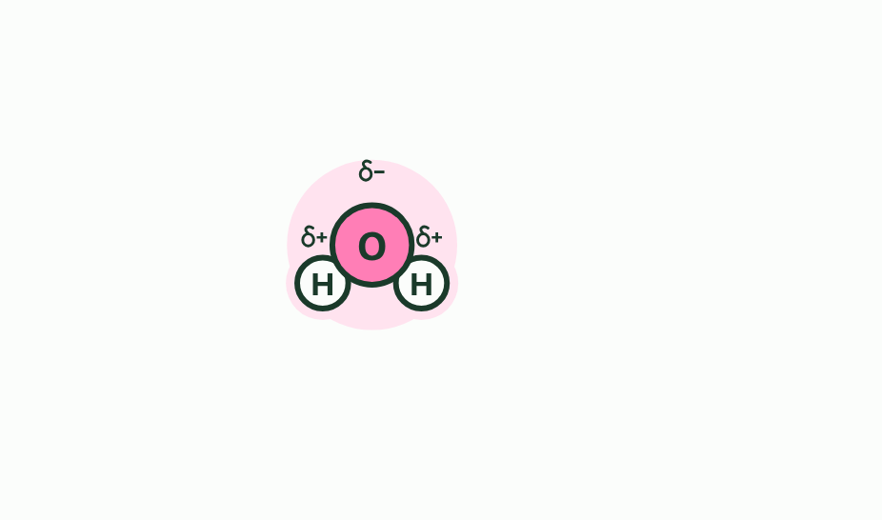
CHAPTER 2 · A1.1.2 Hydrogen bonds
3 / 6
A lopsided molecule makes hydrogen bonds
So the oxygen is slightly negative and each hydrogen slightly positive: partial charges, not whole ones.
Minutes 13 to 28
Notes:
Minutes 13 to 28 of 60: Build it (15 min).
The plan: With snatoms or model kits, students build three water molecules, then annotate δ+, δ− and dashed hydrogen bonds. Compare with chapter 2's figure and draw the IB notation on mini whiteboards. Then the boiling predict box.
A water molecule is one oxygen atom joined to two hydrogen atoms by covalent bonds, and it is bent, with about 104.5° between the two bonds.
The sharing is unequal. Oxygen is more electronegative: it pulls on the shared electrons harder than hydrogen does, so they spend more time near the oxygen. That makes each O–H bond a polar covalent bond. The oxygen end gains a small negative charge and each hydrogen a small positive one: partial charges, written δ− and δ+. The molecule is bent, so one side is negative and the other positive, and the whole thing is a polar molecule.
Opposite charges attract. The δ+ hydrogen of one molecule is pulled towards the δ− oxygen of its neighbour, and that attraction is a hydrogen bond. It forms between molecules, never inside one. Each is weak, about a twentieth as strong as a covalent bond, and lasts only a few trillionths of a second. But there are vast numbers, always breaking and re-forming, and one molecule can make up to four.
Why it matters: to pull water molecules apart, hydrogen bonds must be broken, and that takes energy. Water boils at 100 °C, but methane, a molecule of about the same size with no hydrogen bonds, boils at −162 °C. When water evaporates, its fastest molecules break their hydrogen bonds and escape, taking energy with them, so what is left behind cools. Each gram that evaporates takes about 2.4 kJ, the latent heat of vaporisation. That is how sweat cools skin and transpiration cools leaves.
Example: How do we know? No one has watched a hydrogen bond form: each is far too small and lasts a few trillionths of a second. The evidence is indirect. Water boils at 100 °C, where molecules of the same size boil far lower (methane at −162 °C, hydrogen sulfide at −60 °C), and its surface tension and heat capacity are unusually high. One idea, hydrogen bonding, explains all of these at once, and X-ray and neutron studies of ice show each hydrogen pointing at an oxygen on the next molecule. A theory earns trust by explaining many observations and surviving every test so far.

Slide 18
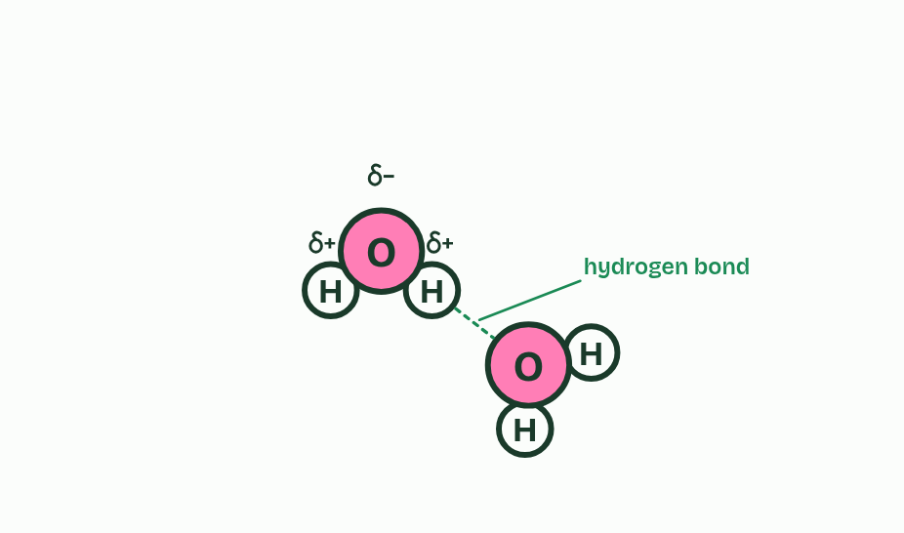
CHAPTER 2 · A1.1.2 Hydrogen bonds
4 / 6
A lopsided molecule makes hydrogen bonds
A second molecule turns its oxygen to face a hydrogen of the first, and a dashed line joins them: a hydrogen bond.
Minutes 13 to 28
Notes:
Minutes 13 to 28 of 60: Build it (15 min).
The plan: With snatoms or model kits, students build three water molecules, then annotate δ+, δ− and dashed hydrogen bonds. Compare with chapter 2's figure and draw the IB notation on mini whiteboards. Then the boiling predict box.
A water molecule is one oxygen atom joined to two hydrogen atoms by covalent bonds, and it is bent, with about 104.5° between the two bonds.
The sharing is unequal. Oxygen is more electronegative: it pulls on the shared electrons harder than hydrogen does, so they spend more time near the oxygen. That makes each O–H bond a polar covalent bond. The oxygen end gains a small negative charge and each hydrogen a small positive one: partial charges, written δ− and δ+. The molecule is bent, so one side is negative and the other positive, and the whole thing is a polar molecule.
Opposite charges attract. The δ+ hydrogen of one molecule is pulled towards the δ− oxygen of its neighbour, and that attraction is a hydrogen bond. It forms between molecules, never inside one. Each is weak, about a twentieth as strong as a covalent bond, and lasts only a few trillionths of a second. But there are vast numbers, always breaking and re-forming, and one molecule can make up to four.
Why it matters: to pull water molecules apart, hydrogen bonds must be broken, and that takes energy. Water boils at 100 °C, but methane, a molecule of about the same size with no hydrogen bonds, boils at −162 °C. When water evaporates, its fastest molecules break their hydrogen bonds and escape, taking energy with them, so what is left behind cools. Each gram that evaporates takes about 2.4 kJ, the latent heat of vaporisation. That is how sweat cools skin and transpiration cools leaves.
Example: How do we know? No one has watched a hydrogen bond form: each is far too small and lasts a few trillionths of a second. The evidence is indirect. Water boils at 100 °C, where molecules of the same size boil far lower (methane at −162 °C, hydrogen sulfide at −60 °C), and its surface tension and heat capacity are unusually high. One idea, hydrogen bonding, explains all of these at once, and X-ray and neutron studies of ice show each hydrogen pointing at an oxygen on the next molecule. A theory earns trust by explaining many observations and surviving every test so far.

Slide 19
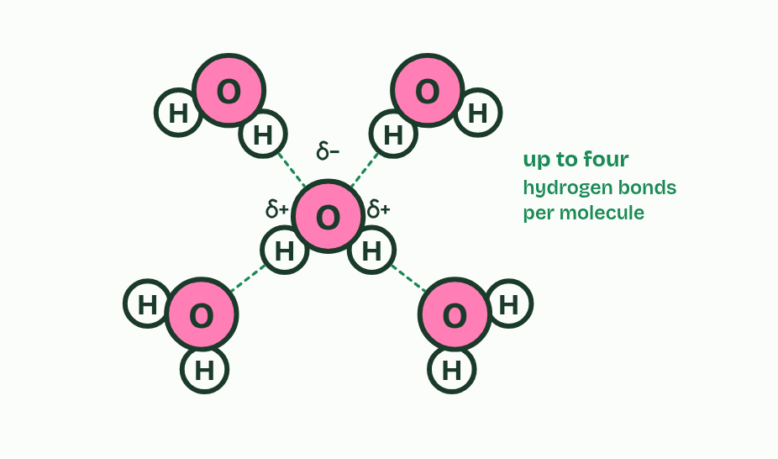
CHAPTER 2 · A1.1.2 Hydrogen bonds
5 / 6
A lopsided molecule makes hydrogen bonds
One molecule can make up to four: two through its hydrogens and two to its oxygen.
Minutes 13 to 28
Notes:
Minutes 13 to 28 of 60: Build it (15 min).
The plan: With snatoms or model kits, students build three water molecules, then annotate δ+, δ− and dashed hydrogen bonds. Compare with chapter 2's figure and draw the IB notation on mini whiteboards. Then the boiling predict box.
A water molecule is one oxygen atom joined to two hydrogen atoms by covalent bonds, and it is bent, with about 104.5° between the two bonds.
The sharing is unequal. Oxygen is more electronegative: it pulls on the shared electrons harder than hydrogen does, so they spend more time near the oxygen. That makes each O–H bond a polar covalent bond. The oxygen end gains a small negative charge and each hydrogen a small positive one: partial charges, written δ− and δ+. The molecule is bent, so one side is negative and the other positive, and the whole thing is a polar molecule.
Opposite charges attract. The δ+ hydrogen of one molecule is pulled towards the δ− oxygen of its neighbour, and that attraction is a hydrogen bond. It forms between molecules, never inside one. Each is weak, about a twentieth as strong as a covalent bond, and lasts only a few trillionths of a second. But there are vast numbers, always breaking and re-forming, and one molecule can make up to four.
Why it matters: to pull water molecules apart, hydrogen bonds must be broken, and that takes energy. Water boils at 100 °C, but methane, a molecule of about the same size with no hydrogen bonds, boils at −162 °C. When water evaporates, its fastest molecules break their hydrogen bonds and escape, taking energy with them, so what is left behind cools. Each gram that evaporates takes about 2.4 kJ, the latent heat of vaporisation. That is how sweat cools skin and transpiration cools leaves.
Example: How do we know? No one has watched a hydrogen bond form: each is far too small and lasts a few trillionths of a second. The evidence is indirect. Water boils at 100 °C, where molecules of the same size boil far lower (methane at −162 °C, hydrogen sulfide at −60 °C), and its surface tension and heat capacity are unusually high. One idea, hydrogen bonding, explains all of these at once, and X-ray and neutron studies of ice show each hydrogen pointing at an oxygen on the next molecule. A theory earns trust by explaining many observations and surviving every test so far.

Slide 20
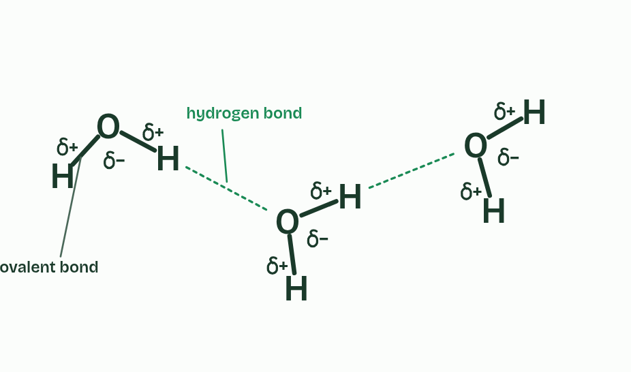
CHAPTER 2 · A1.1.2 Hydrogen bonds
6 / 6
A lopsided molecule makes hydrogen bonds
The notation the exam wants: letters, solid lines for covalent bonds, dashed lines for hydrogen bonds, and δ signs. Draw it like this.
Minutes 13 to 28
Notes:
Minutes 13 to 28 of 60: Build it (15 min).
The plan: With snatoms or model kits, students build three water molecules, then annotate δ+, δ− and dashed hydrogen bonds. Compare with chapter 2's figure and draw the IB notation on mini whiteboards. Then the boiling predict box.
A water molecule is one oxygen atom joined to two hydrogen atoms by covalent bonds, and it is bent, with about 104.5° between the two bonds.
The sharing is unequal. Oxygen is more electronegative: it pulls on the shared electrons harder than hydrogen does, so they spend more time near the oxygen. That makes each O–H bond a polar covalent bond. The oxygen end gains a small negative charge and each hydrogen a small positive one: partial charges, written δ− and δ+. The molecule is bent, so one side is negative and the other positive, and the whole thing is a polar molecule.
Opposite charges attract. The δ+ hydrogen of one molecule is pulled towards the δ− oxygen of its neighbour, and that attraction is a hydrogen bond. It forms between molecules, never inside one. Each is weak, about a twentieth as strong as a covalent bond, and lasts only a few trillionths of a second. But there are vast numbers, always breaking and re-forming, and one molecule can make up to four.
Why it matters: to pull water molecules apart, hydrogen bonds must be broken, and that takes energy. Water boils at 100 °C, but methane, a molecule of about the same size with no hydrogen bonds, boils at −162 °C. When water evaporates, its fastest molecules break their hydrogen bonds and escape, taking energy with them, so what is left behind cools. Each gram that evaporates takes about 2.4 kJ, the latent heat of vaporisation. That is how sweat cools skin and transpiration cools leaves.
Example: How do we know? No one has watched a hydrogen bond form: each is far too small and lasts a few trillionths of a second. The evidence is indirect. Water boils at 100 °C, where molecules of the same size boil far lower (methane at −162 °C, hydrogen sulfide at −60 °C), and its surface tension and heat capacity are unusually high. One idea, hydrogen bonding, explains all of these at once, and X-ray and neutron studies of ice show each hydrogen pointing at an oxygen on the next molecule. A theory earns trust by explaining many observations and surviving every test so far.

Slide 21
CHAPTER 2 · A1.1.2 Hydrogen bonds
A lopsided molecule makes hydrogen bonds
Draw it the IB way: solid lines for covalent bonds, dashed lines for hydrogen bonds.
Write δ+ and δ−, never a bare + or −: the molecule is neutral overall.
Minutes 13 to 28
Notes:
Minutes 13 to 28 of 60: Build it (15 min).
The plan: With snatoms or model kits, students build three water molecules, then annotate δ+, δ− and dashed hydrogen bonds. Compare with chapter 2's figure and draw the IB notation on mini whiteboards. Then the boiling predict box.
A water molecule is one oxygen atom joined to two hydrogen atoms by covalent bonds, and it is bent, with about 104.5° between the two bonds.
The sharing is unequal. Oxygen is more electronegative: it pulls on the shared electrons harder than hydrogen does, so they spend more time near the oxygen. That makes each O–H bond a polar covalent bond. The oxygen end gains a small negative charge and each hydrogen a small positive one: partial charges, written δ− and δ+. The molecule is bent, so one side is negative and the other positive, and the whole thing is a polar molecule.
Opposite charges attract. The δ+ hydrogen of one molecule is pulled towards the δ− oxygen of its neighbour, and that attraction is a hydrogen bond. It forms between molecules, never inside one. Each is weak, about a twentieth as strong as a covalent bond, and lasts only a few trillionths of a second. But there are vast numbers, always breaking and re-forming, and one molecule can make up to four.
Why it matters: to pull water molecules apart, hydrogen bonds must be broken, and that takes energy. Water boils at 100 °C, but methane, a molecule of about the same size with no hydrogen bonds, boils at −162 °C. When water evaporates, its fastest molecules break their hydrogen bonds and escape, taking energy with them, so what is left behind cools. Each gram that evaporates takes about 2.4 kJ, the latent heat of vaporisation. That is how sweat cools skin and transpiration cools leaves.
Example: How do we know? No one has watched a hydrogen bond form: each is far too small and lasts a few trillionths of a second. The evidence is indirect. Water boils at 100 °C, where molecules of the same size boil far lower (methane at −162 °C, hydrogen sulfide at −60 °C), and its surface tension and heat capacity are unusually high. One idea, hydrogen bonding, explains all of these at once, and X-ray and neutron studies of ice show each hydrogen pointing at an oxygen on the next molecule. A theory earns trust by explaining many observations and surviving every test so far.

Slide 22
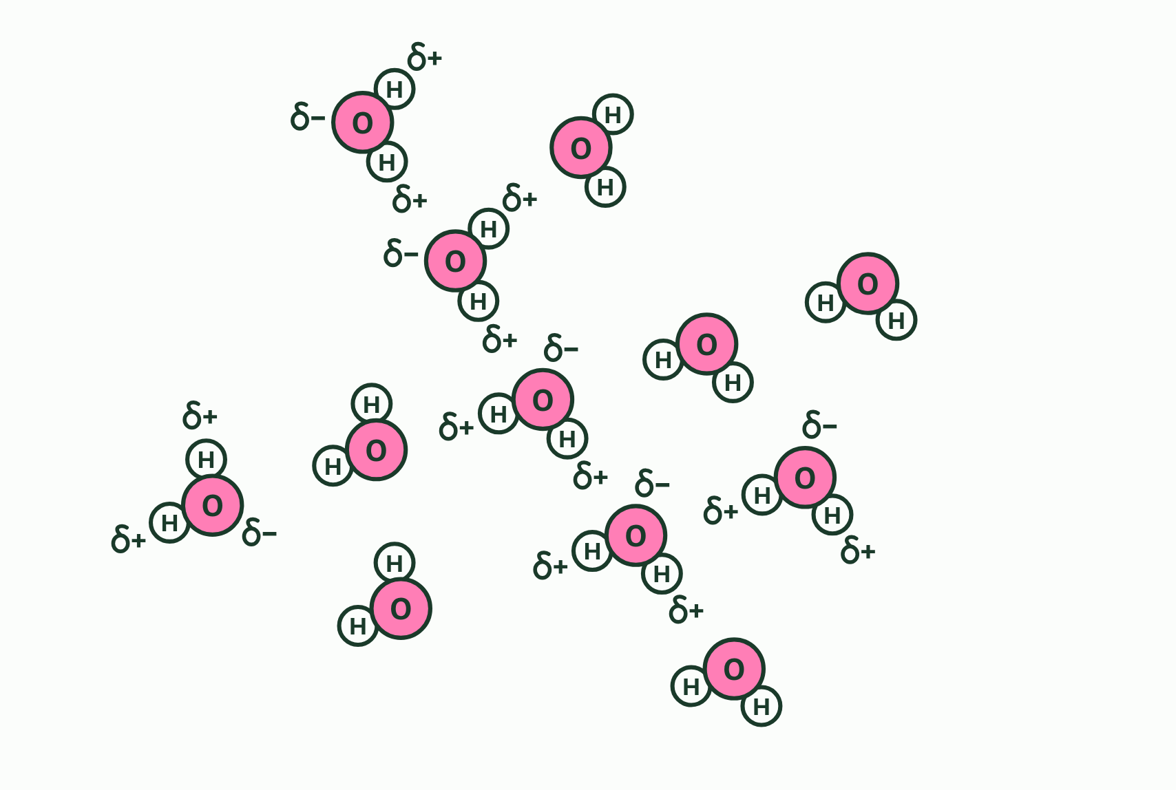
CHAPTER 2 · A1.1.2 Hydrogen bonds
1 / 3
A lopsided molecule makes hydrogen bonds
Each water molecule is polar: the oxygen is slightly negative and the hydrogens slightly positive.
Minutes 13 to 28
Notes:
Minutes 13 to 28 of 60: Build it (15 min).
The plan: With snatoms or model kits, students build three water molecules, then annotate δ+, δ− and dashed hydrogen bonds. Compare with chapter 2's figure and draw the IB notation on mini whiteboards. Then the boiling predict box.
A water molecule is one oxygen atom joined to two hydrogen atoms by covalent bonds, and it is bent, with about 104.5° between the two bonds.
The sharing is unequal. Oxygen is more electronegative: it pulls on the shared electrons harder than hydrogen does, so they spend more time near the oxygen. That makes each O–H bond a polar covalent bond. The oxygen end gains a small negative charge and each hydrogen a small positive one: partial charges, written δ− and δ+. The molecule is bent, so one side is negative and the other positive, and the whole thing is a polar molecule.
Opposite charges attract. The δ+ hydrogen of one molecule is pulled towards the δ− oxygen of its neighbour, and that attraction is a hydrogen bond. It forms between molecules, never inside one. Each is weak, about a twentieth as strong as a covalent bond, and lasts only a few trillionths of a second. But there are vast numbers, always breaking and re-forming, and one molecule can make up to four.
Why it matters: to pull water molecules apart, hydrogen bonds must be broken, and that takes energy. Water boils at 100 °C, but methane, a molecule of about the same size with no hydrogen bonds, boils at −162 °C. When water evaporates, its fastest molecules break their hydrogen bonds and escape, taking energy with them, so what is left behind cools. Each gram that evaporates takes about 2.4 kJ, the latent heat of vaporisation. That is how sweat cools skin and transpiration cools leaves.
Example: How do we know? No one has watched a hydrogen bond form: each is far too small and lasts a few trillionths of a second. The evidence is indirect. Water boils at 100 °C, where molecules of the same size boil far lower (methane at −162 °C, hydrogen sulfide at −60 °C), and its surface tension and heat capacity are unusually high. One idea, hydrogen bonding, explains all of these at once, and X-ray and neutron studies of ice show each hydrogen pointing at an oxygen on the next molecule. A theory earns trust by explaining many observations and surviving every test so far.

Slide 23
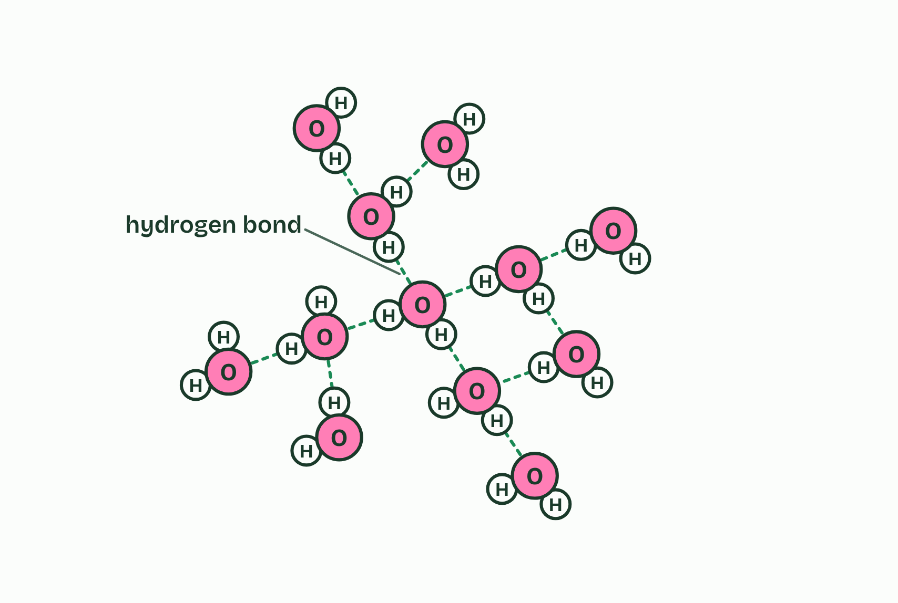
CHAPTER 2 · A1.1.2 Hydrogen bonds
2 / 3
A lopsided molecule makes hydrogen bonds
A slightly positive hydrogen is attracted to the oxygen of another molecule: a hydrogen bond.
Minutes 13 to 28
Notes:
Minutes 13 to 28 of 60: Build it (15 min).
The plan: With snatoms or model kits, students build three water molecules, then annotate δ+, δ− and dashed hydrogen bonds. Compare with chapter 2's figure and draw the IB notation on mini whiteboards. Then the boiling predict box.
A water molecule is one oxygen atom joined to two hydrogen atoms by covalent bonds, and it is bent, with about 104.5° between the two bonds.
The sharing is unequal. Oxygen is more electronegative: it pulls on the shared electrons harder than hydrogen does, so they spend more time near the oxygen. That makes each O–H bond a polar covalent bond. The oxygen end gains a small negative charge and each hydrogen a small positive one: partial charges, written δ− and δ+. The molecule is bent, so one side is negative and the other positive, and the whole thing is a polar molecule.
Opposite charges attract. The δ+ hydrogen of one molecule is pulled towards the δ− oxygen of its neighbour, and that attraction is a hydrogen bond. It forms between molecules, never inside one. Each is weak, about a twentieth as strong as a covalent bond, and lasts only a few trillionths of a second. But there are vast numbers, always breaking and re-forming, and one molecule can make up to four.
Why it matters: to pull water molecules apart, hydrogen bonds must be broken, and that takes energy. Water boils at 100 °C, but methane, a molecule of about the same size with no hydrogen bonds, boils at −162 °C. When water evaporates, its fastest molecules break their hydrogen bonds and escape, taking energy with them, so what is left behind cools. Each gram that evaporates takes about 2.4 kJ, the latent heat of vaporisation. That is how sweat cools skin and transpiration cools leaves.
Example: How do we know? No one has watched a hydrogen bond form: each is far too small and lasts a few trillionths of a second. The evidence is indirect. Water boils at 100 °C, where molecules of the same size boil far lower (methane at −162 °C, hydrogen sulfide at −60 °C), and its surface tension and heat capacity are unusually high. One idea, hydrogen bonding, explains all of these at once, and X-ray and neutron studies of ice show each hydrogen pointing at an oxygen on the next molecule. A theory earns trust by explaining many observations and surviving every test so far.

Slide 24
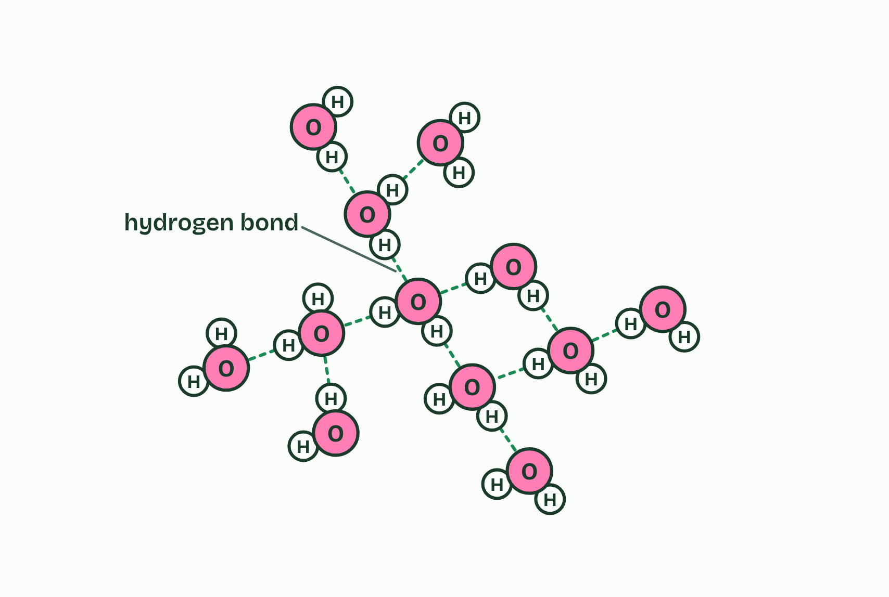
CHAPTER 2 · A1.1.2 Hydrogen bonds
3 / 3
A lopsided molecule makes hydrogen bonds
Each bond lasts only a moment. They break and form all the time as the molecules move; in liquid water most molecules are held by several at once.
Minutes 13 to 28
Notes:
Minutes 13 to 28 of 60: Build it (15 min).
The plan: With snatoms or model kits, students build three water molecules, then annotate δ+, δ− and dashed hydrogen bonds. Compare with chapter 2's figure and draw the IB notation on mini whiteboards. Then the boiling predict box.
A water molecule is one oxygen atom joined to two hydrogen atoms by covalent bonds, and it is bent, with about 104.5° between the two bonds.
The sharing is unequal. Oxygen is more electronegative: it pulls on the shared electrons harder than hydrogen does, so they spend more time near the oxygen. That makes each O–H bond a polar covalent bond. The oxygen end gains a small negative charge and each hydrogen a small positive one: partial charges, written δ− and δ+. The molecule is bent, so one side is negative and the other positive, and the whole thing is a polar molecule.
Opposite charges attract. The δ+ hydrogen of one molecule is pulled towards the δ− oxygen of its neighbour, and that attraction is a hydrogen bond. It forms between molecules, never inside one. Each is weak, about a twentieth as strong as a covalent bond, and lasts only a few trillionths of a second. But there are vast numbers, always breaking and re-forming, and one molecule can make up to four.
Why it matters: to pull water molecules apart, hydrogen bonds must be broken, and that takes energy. Water boils at 100 °C, but methane, a molecule of about the same size with no hydrogen bonds, boils at −162 °C. When water evaporates, its fastest molecules break their hydrogen bonds and escape, taking energy with them, so what is left behind cools. Each gram that evaporates takes about 2.4 kJ, the latent heat of vaporisation. That is how sweat cools skin and transpiration cools leaves.
Example: How do we know? No one has watched a hydrogen bond form: each is far too small and lasts a few trillionths of a second. The evidence is indirect. Water boils at 100 °C, where molecules of the same size boil far lower (methane at −162 °C, hydrogen sulfide at −60 °C), and its surface tension and heat capacity are unusually high. One idea, hydrogen bonding, explains all of these at once, and X-ray and neutron studies of ice show each hydrogen pointing at an oxygen on the next molecule. A theory earns trust by explaining many observations and surviving every test so far.

Slide 25
CHAPTER 2 · A1.1.2 Hydrogen bonds
A lopsided molecule makes hydrogen bonds
Draw it the IB way: solid lines for covalent bonds, dashed lines for hydrogen bonds.
Write δ+ and δ−, never a bare + or −: the molecule is neutral overall.
Minutes 13 to 28
Notes:
Minutes 13 to 28 of 60: Build it (15 min).
The plan: With snatoms or model kits, students build three water molecules, then annotate δ+, δ− and dashed hydrogen bonds. Compare with chapter 2's figure and draw the IB notation on mini whiteboards. Then the boiling predict box.
A water molecule is one oxygen atom joined to two hydrogen atoms by covalent bonds, and it is bent, with about 104.5° between the two bonds.
The sharing is unequal. Oxygen is more electronegative: it pulls on the shared electrons harder than hydrogen does, so they spend more time near the oxygen. That makes each O–H bond a polar covalent bond. The oxygen end gains a small negative charge and each hydrogen a small positive one: partial charges, written δ− and δ+. The molecule is bent, so one side is negative and the other positive, and the whole thing is a polar molecule.
Opposite charges attract. The δ+ hydrogen of one molecule is pulled towards the δ− oxygen of its neighbour, and that attraction is a hydrogen bond. It forms between molecules, never inside one. Each is weak, about a twentieth as strong as a covalent bond, and lasts only a few trillionths of a second. But there are vast numbers, always breaking and re-forming, and one molecule can make up to four.
Why it matters: to pull water molecules apart, hydrogen bonds must be broken, and that takes energy. Water boils at 100 °C, but methane, a molecule of about the same size with no hydrogen bonds, boils at −162 °C. When water evaporates, its fastest molecules break their hydrogen bonds and escape, taking energy with them, so what is left behind cools. Each gram that evaporates takes about 2.4 kJ, the latent heat of vaporisation. That is how sweat cools skin and transpiration cools leaves.
Example: How do we know? No one has watched a hydrogen bond form: each is far too small and lasts a few trillionths of a second. The evidence is indirect. Water boils at 100 °C, where molecules of the same size boil far lower (methane at −162 °C, hydrogen sulfide at −60 °C), and its surface tension and heat capacity are unusually high. One idea, hydrogen bonding, explains all of these at once, and X-ray and neutron studies of ice show each hydrogen pointing at an oxygen on the next molecule. A theory earns trust by explaining many observations and surviving every test so far.

Slide 26
PREDICT
Water boils in a kettle. Which bonds break as it turns to steam?
A The covalent bonds inside each molecule, so the steam is hydrogen gas and oxygen gas
B Both: the molecules split apart first, then the atoms join up again in the steam
C The hydrogen bonds between molecules, so the steam is still made of water molecules
Minutes 13 to 28
Notes:
Minutes 13 to 28 of 60: Build it (15 min).
The plan: With snatoms or model kits, students build three water molecules, then annotate δ+, δ− and dashed hydrogen bonds. Compare with chapter 2's figure and draw the IB notation on mini whiteboards. Then the boiling predict box.
Ask for a show of hands, or mini whiteboards, before revealing. (Answer: C, on the next slide.)

Slide 27
WHAT HAPPENS
Water boils in a kettle. Which bonds break as it turns to steam?
A The covalent bonds inside each molecule, so the steam is hydrogen gas and oxygen gas
B Both: the molecules split apart first, then the atoms join up again in the steam
C The hydrogen bonds between molecules, so the steam is still made of water molecules
Only the hydrogen bonds. Boiling and evaporation separate whole molecules from one another, and the covalent bonds, about twenty times stronger, stay as they are. Breaking all those hydrogen bonds is why water needs so much heat to boil or evaporate, and why sweat cools you. The dry lab puts a number on it.
Minutes 13 to 28
Notes:
Minutes 13 to 28 of 60: Build it (15 min).
The plan: With snatoms or model kits, students build three water molecules, then annotate δ+, δ− and dashed hydrogen bonds. Compare with chapter 2's figure and draw the IB notation on mini whiteboards. Then the boiling predict box.
Answer: C. Only the hydrogen bonds. Boiling and evaporation separate whole molecules from one another, and the covalent bonds, about twenty times stronger, stay as they are. Breaking all those hydrogen bonds is why water needs so much heat to boil or evaporate, and why sweat cools you. The dry lab puts a number on it.

Slide 28
REMEMBER IT
What hydrogen bonds give water
C
A
T
S
Cats
Avoid
Taking
Showers
Minutes 13 to 28
Notes:
Minutes 13 to 28 of 60: Build it (15 min).
The plan: With snatoms or model kits, students build three water molecules, then annotate δ+, δ− and dashed hydrogen bonds. Compare with chapter 2's figure and draw the IB notation on mini whiteboards. Then the boiling predict box.
Ask the class what each letter stands for before revealing.

Slide 29
REMEMBER IT
What hydrogen bonds give water
C
A
T
S
Cats
Avoid
Taking
Showers
Cohesion
Adhesion
Thermal
Solvent
water sticks to water (chapter 3)
water sticks to polar or charged surfaces (chapter 4)
slow to warm, and takes a lot of heat to evaporate (here and chapter 6)
dissolves polar and charged substances (chapter 5)
Minutes 13 to 28
Notes:
Minutes 13 to 28 of 60: Build it (15 min).
The plan: With snatoms or model kits, students build three water molecules, then annotate δ+, δ− and dashed hydrogen bonds. Compare with chapter 2's figure and draw the IB notation on mini whiteboards. Then the boiling predict box.
Cats: Cohesion (water sticks to water (chapter 3))
Avoid: Adhesion (water sticks to polar or charged surfaces (chapter 4))
Taking: Thermal (slow to warm, and takes a lot of heat to evaporate (here and chapter 6))
Showers: Solvent (dissolves polar and charged substances (chapter 5))

Slide 30
WATCH OUT
"A hydrogen bond is the bond between O and H inside a water molecule." Those are covalent bonds. A hydrogen bond is between molecules.
Minutes 13 to 28
Notes:
Minutes 13 to 28 of 60: Build it (15 min).
The plan: With snatoms or model kits, students build three water molecules, then annotate δ+, δ− and dashed hydrogen bonds. Compare with chapter 2's figure and draw the IB notation on mini whiteboards. Then the boiling predict box.
A common mistake: say it, then ask who can say why it is wrong.

Slide 31
STEP 4
7 MIN
Bonds that flicker
Think, pair, share: why is it hard to prove that hydrogen bonds exist?
Minutes 28 to 35
Notes:
Minutes 28 to 35 of 60: Bonds that flicker (7 min).
The plan: Open the water box under chapter 2 and raise the temperature. Think, pair, share: why is it hard to prove that hydrogen bonds exist? Land on the boiling points of methane and hydrogen sulfide.

Slide 32
STEP 5
15 MIN
Cohesion
Demo: Pepper and soap
Chapter 3: Water holds on to itself
Minutes 35 to 50
Notes:
Minutes 35 to 50 of 60: Cohesion (15 min).
The plan: The pepper and soap demo, predicted first, then chapter 3's figure. Step through the pond skater, then show the xylem column and what an air bubble does to it.

Slide 33

DEMO
15 MIN
Pepper and soap
THE TASK
Predict first, then touch a soapy cotton bud to the middle of a bowl of water with pepper on it. Explain what happens with surface tension.
STUDENTS NEED
Bowl, water, ground pepper, washing-up liquid, cotton buds.
Minutes 35 to 50
Notes:
Minutes 35 to 50 of 60: Cohesion (15 min).
The plan: The pepper and soap demo, predicted first, then chapter 3's figure. Step through the pond skater, then show the xylem column and what an air bubble does to it.
The activity: Pepper and soap. Predict first, then touch a soapy cotton bud to the middle of a bowl of water with pepper on it. Explain what happens with surface tension.
Needs: bowl, water, ground pepper, washing-up liquid, cotton buds.
The time: 15 minutes, minutes 35 to 50 of the plan.

Slide 34
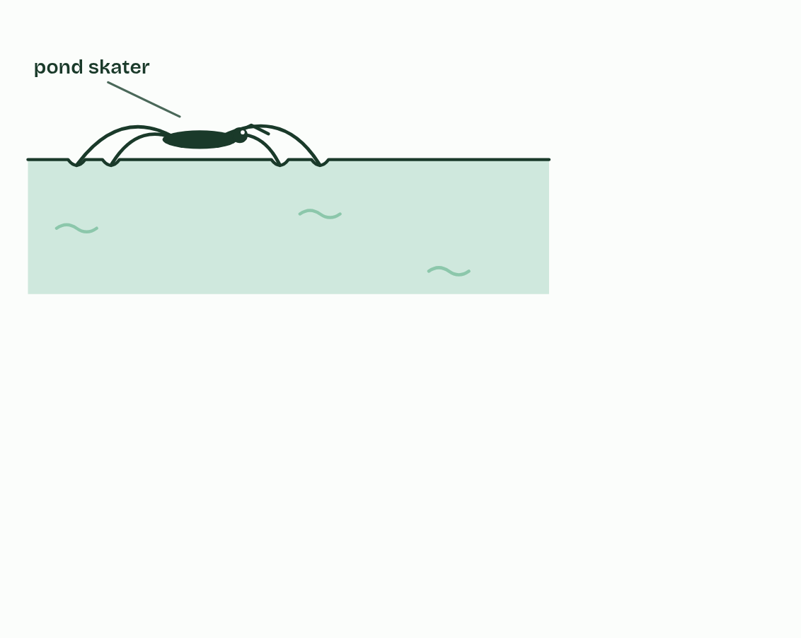
CHAPTER 3 · A1.1.3 Cohesion
1 / 5
Water holds on to itself
A pond skater stands on water. Its long legs spread its weight, and each foot makes a small dimple in the surface.
Minutes 35 to 50
Notes:
Minutes 35 to 50 of 60: Cohesion (15 min).
The plan: The pepper and soap demo, predicted first, then chapter 3's figure. Step through the pond skater, then show the xylem column and what an air bubble does to it.
Hydrogen bonds make water molecules stick to one another. That is cohesion.
Inside a drop, each molecule is pulled equally in every direction by its neighbours. A molecule at the surface has neighbours beside it and below it but none above, so it is pulled sideways and inwards. The surface molecules cling together and the surface acts like a stretched film that resists being broken. That is surface tension, and water's is higher than that of almost any other common liquid.
Small animals use the film as a habitat. A pond skater (Gerris lacustris) spreads its weight over long legs, and water-repellent hairs on its feet press dimples into the surface without breaking through. Mosquito larvae hang from the underside and breathe through a tube that pokes up through the film.
Cohesion also lifts water to the top of a tree. In a leaf, water evaporates from the wet walls of cells and leaves as vapour through small pores, which is transpiration. That pulls water out of the xylem. Because the molecules cohere, the whole column of water is pulled up from the roots, like a rope pulled from the top. The water is under tension: it is being pulled, not pushed. Cohesion keeps the column whole however tall the plant, but an air bubble breaks it, and that tube stops carrying water.
Example: The tallest living tree, a coast redwood in California, is about 116 m tall. Holding up a column of water that tall takes a pull of more than 1 MPa, about eleven times the pressure of the air, and cohesion holds.

Slide 35
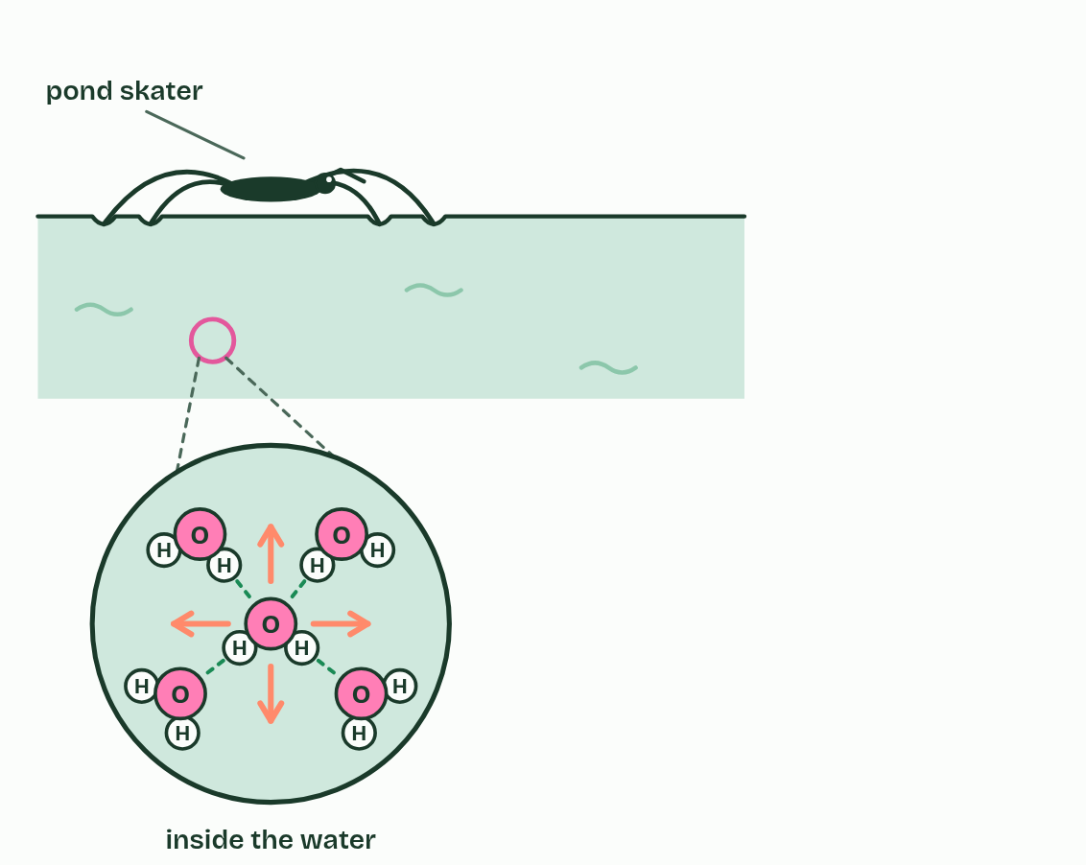
CHAPTER 3 · A1.1.3 Cohesion
2 / 5
Water holds on to itself
Inside the water, each molecule is pulled by its neighbours equally in every direction, so it stays where it is.
Minutes 35 to 50
Notes:
Minutes 35 to 50 of 60: Cohesion (15 min).
The plan: The pepper and soap demo, predicted first, then chapter 3's figure. Step through the pond skater, then show the xylem column and what an air bubble does to it.
Hydrogen bonds make water molecules stick to one another. That is cohesion.
Inside a drop, each molecule is pulled equally in every direction by its neighbours. A molecule at the surface has neighbours beside it and below it but none above, so it is pulled sideways and inwards. The surface molecules cling together and the surface acts like a stretched film that resists being broken. That is surface tension, and water's is higher than that of almost any other common liquid.
Small animals use the film as a habitat. A pond skater (Gerris lacustris) spreads its weight over long legs, and water-repellent hairs on its feet press dimples into the surface without breaking through. Mosquito larvae hang from the underside and breathe through a tube that pokes up through the film.
Cohesion also lifts water to the top of a tree. In a leaf, water evaporates from the wet walls of cells and leaves as vapour through small pores, which is transpiration. That pulls water out of the xylem. Because the molecules cohere, the whole column of water is pulled up from the roots, like a rope pulled from the top. The water is under tension: it is being pulled, not pushed. Cohesion keeps the column whole however tall the plant, but an air bubble breaks it, and that tube stops carrying water.
Example: The tallest living tree, a coast redwood in California, is about 116 m tall. Holding up a column of water that tall takes a pull of more than 1 MPa, about eleven times the pressure of the air, and cohesion holds.

Slide 36
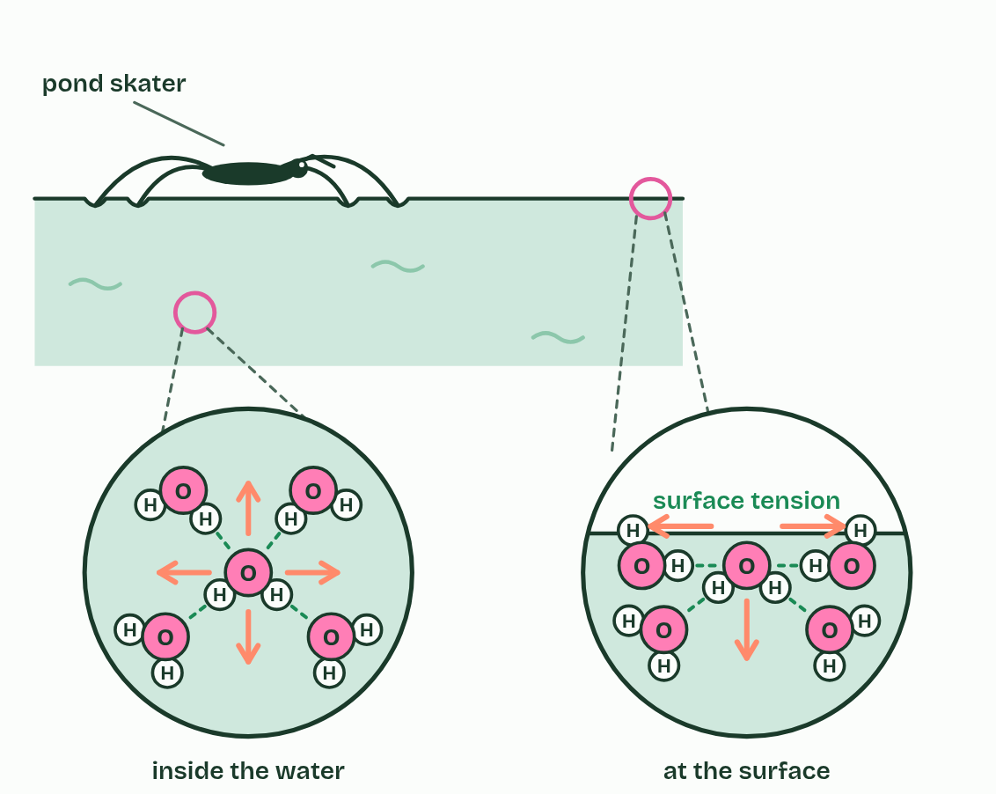
CHAPTER 3 · A1.1.3 Cohesion
3 / 5
Water holds on to itself
At the surface there are no neighbours above: the pull is sideways and inwards, and the surface holds together like a stretched film. That is surface tension.
Minutes 35 to 50
Notes:
Minutes 35 to 50 of 60: Cohesion (15 min).
The plan: The pepper and soap demo, predicted first, then chapter 3's figure. Step through the pond skater, then show the xylem column and what an air bubble does to it.
Hydrogen bonds make water molecules stick to one another. That is cohesion.
Inside a drop, each molecule is pulled equally in every direction by its neighbours. A molecule at the surface has neighbours beside it and below it but none above, so it is pulled sideways and inwards. The surface molecules cling together and the surface acts like a stretched film that resists being broken. That is surface tension, and water's is higher than that of almost any other common liquid.
Small animals use the film as a habitat. A pond skater (Gerris lacustris) spreads its weight over long legs, and water-repellent hairs on its feet press dimples into the surface without breaking through. Mosquito larvae hang from the underside and breathe through a tube that pokes up through the film.
Cohesion also lifts water to the top of a tree. In a leaf, water evaporates from the wet walls of cells and leaves as vapour through small pores, which is transpiration. That pulls water out of the xylem. Because the molecules cohere, the whole column of water is pulled up from the roots, like a rope pulled from the top. The water is under tension: it is being pulled, not pushed. Cohesion keeps the column whole however tall the plant, but an air bubble breaks it, and that tube stops carrying water.
Example: The tallest living tree, a coast redwood in California, is about 116 m tall. Holding up a column of water that tall takes a pull of more than 1 MPa, about eleven times the pressure of the air, and cohesion holds.

Slide 37
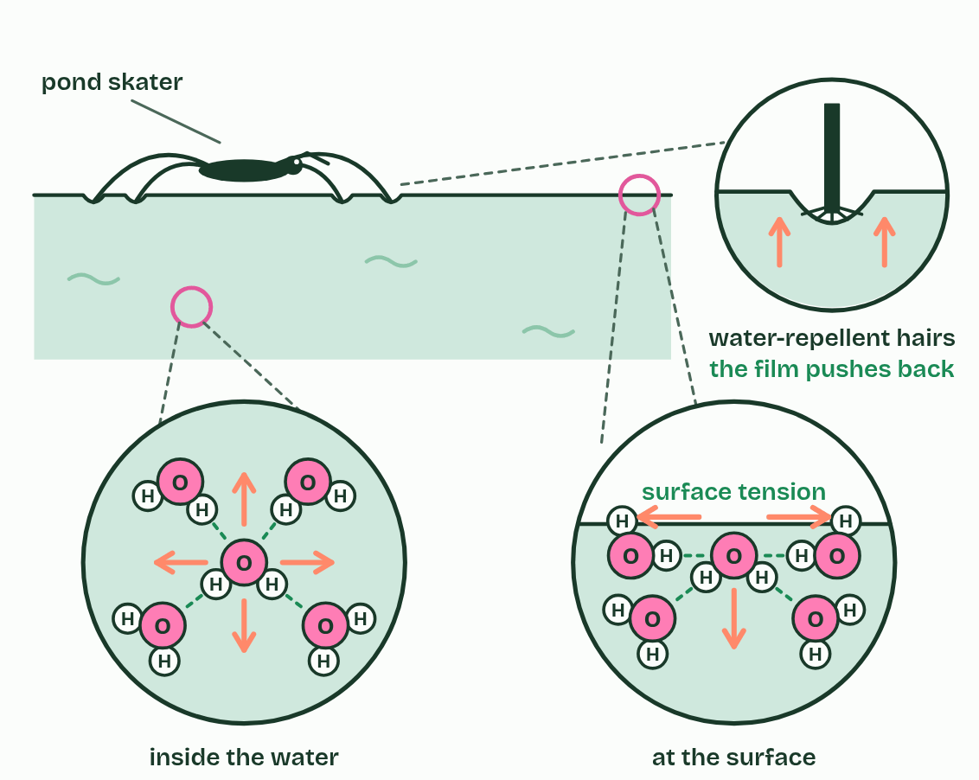
CHAPTER 3 · A1.1.3 Cohesion
4 / 5
Water holds on to itself
Close up, water-repellent hairs on the foot press the film into a dimple without breaking it, and the film pushes back up.
Minutes 35 to 50
Notes:
Minutes 35 to 50 of 60: Cohesion (15 min).
The plan: The pepper and soap demo, predicted first, then chapter 3's figure. Step through the pond skater, then show the xylem column and what an air bubble does to it.
Hydrogen bonds make water molecules stick to one another. That is cohesion.
Inside a drop, each molecule is pulled equally in every direction by its neighbours. A molecule at the surface has neighbours beside it and below it but none above, so it is pulled sideways and inwards. The surface molecules cling together and the surface acts like a stretched film that resists being broken. That is surface tension, and water's is higher than that of almost any other common liquid.
Small animals use the film as a habitat. A pond skater (Gerris lacustris) spreads its weight over long legs, and water-repellent hairs on its feet press dimples into the surface without breaking through. Mosquito larvae hang from the underside and breathe through a tube that pokes up through the film.
Cohesion also lifts water to the top of a tree. In a leaf, water evaporates from the wet walls of cells and leaves as vapour through small pores, which is transpiration. That pulls water out of the xylem. Because the molecules cohere, the whole column of water is pulled up from the roots, like a rope pulled from the top. The water is under tension: it is being pulled, not pushed. Cohesion keeps the column whole however tall the plant, but an air bubble breaks it, and that tube stops carrying water.
Example: The tallest living tree, a coast redwood in California, is about 116 m tall. Holding up a column of water that tall takes a pull of more than 1 MPa, about eleven times the pressure of the air, and cohesion holds.

Slide 38
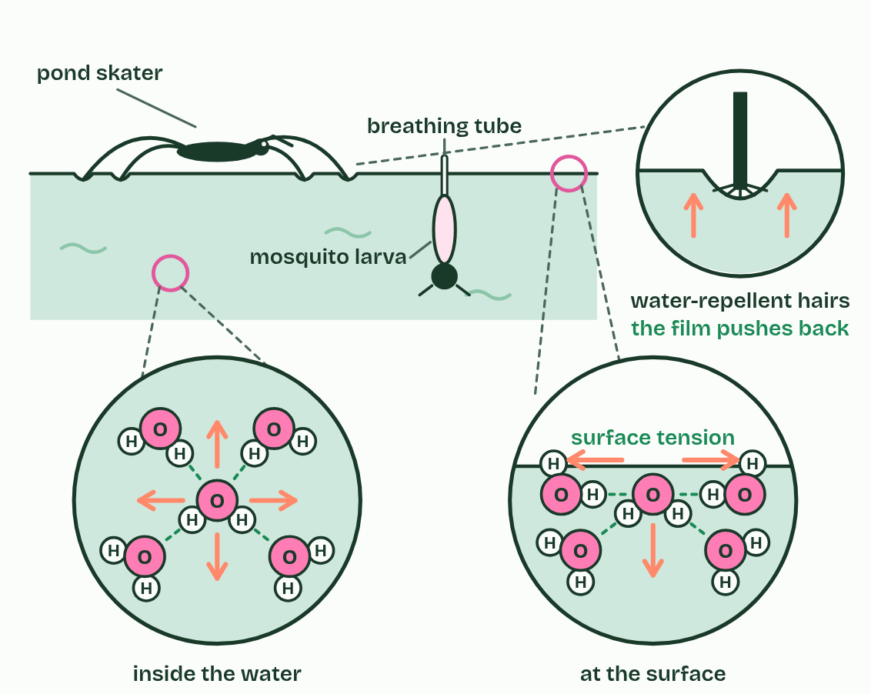
CHAPTER 3 · A1.1.3 Cohesion
5 / 5
Water holds on to itself
A mosquito larva hangs from the underside of the film and breathes through a tube that pokes through it.
Minutes 35 to 50
Notes:
Minutes 35 to 50 of 60: Cohesion (15 min).
The plan: The pepper and soap demo, predicted first, then chapter 3's figure. Step through the pond skater, then show the xylem column and what an air bubble does to it.
Hydrogen bonds make water molecules stick to one another. That is cohesion.
Inside a drop, each molecule is pulled equally in every direction by its neighbours. A molecule at the surface has neighbours beside it and below it but none above, so it is pulled sideways and inwards. The surface molecules cling together and the surface acts like a stretched film that resists being broken. That is surface tension, and water's is higher than that of almost any other common liquid.
Small animals use the film as a habitat. A pond skater (Gerris lacustris) spreads its weight over long legs, and water-repellent hairs on its feet press dimples into the surface without breaking through. Mosquito larvae hang from the underside and breathe through a tube that pokes up through the film.
Cohesion also lifts water to the top of a tree. In a leaf, water evaporates from the wet walls of cells and leaves as vapour through small pores, which is transpiration. That pulls water out of the xylem. Because the molecules cohere, the whole column of water is pulled up from the roots, like a rope pulled from the top. The water is under tension: it is being pulled, not pushed. Cohesion keeps the column whole however tall the plant, but an air bubble breaks it, and that tube stops carrying water.
Example: The tallest living tree, a coast redwood in California, is about 116 m tall. Holding up a column of water that tall takes a pull of more than 1 MPa, about eleven times the pressure of the air, and cohesion holds.

Slide 39
CHAPTER 3 · A1.1.3 Cohesion
Water holds on to itself
Hydrogen bonds make water molecules stick to one another. That is cohesion.
That is surface tension, and water's is higher than that of almost any other common liquid.
Cohesion also lifts water to the top of a tree.
In a leaf, water evaporates from the wet walls of cells and leaves as vapour through small pores, which is transpiration.
Minutes 35 to 50
Notes:
Minutes 35 to 50 of 60: Cohesion (15 min).
The plan: The pepper and soap demo, predicted first, then chapter 3's figure. Step through the pond skater, then show the xylem column and what an air bubble does to it.
Hydrogen bonds make water molecules stick to one another. That is cohesion.
Inside a drop, each molecule is pulled equally in every direction by its neighbours. A molecule at the surface has neighbours beside it and below it but none above, so it is pulled sideways and inwards. The surface molecules cling together and the surface acts like a stretched film that resists being broken. That is surface tension, and water's is higher than that of almost any other common liquid.
Small animals use the film as a habitat. A pond skater (Gerris lacustris) spreads its weight over long legs, and water-repellent hairs on its feet press dimples into the surface without breaking through. Mosquito larvae hang from the underside and breathe through a tube that pokes up through the film.
Cohesion also lifts water to the top of a tree. In a leaf, water evaporates from the wet walls of cells and leaves as vapour through small pores, which is transpiration. That pulls water out of the xylem. Because the molecules cohere, the whole column of water is pulled up from the roots, like a rope pulled from the top. The water is under tension: it is being pulled, not pushed. Cohesion keeps the column whole however tall the plant, but an air bubble breaks it, and that tube stops carrying water.
Example: The tallest living tree, a coast redwood in California, is about 116 m tall. Holding up a column of water that tall takes a pull of more than 1 MPa, about eleven times the pressure of the air, and cohesion holds.

Slide 40
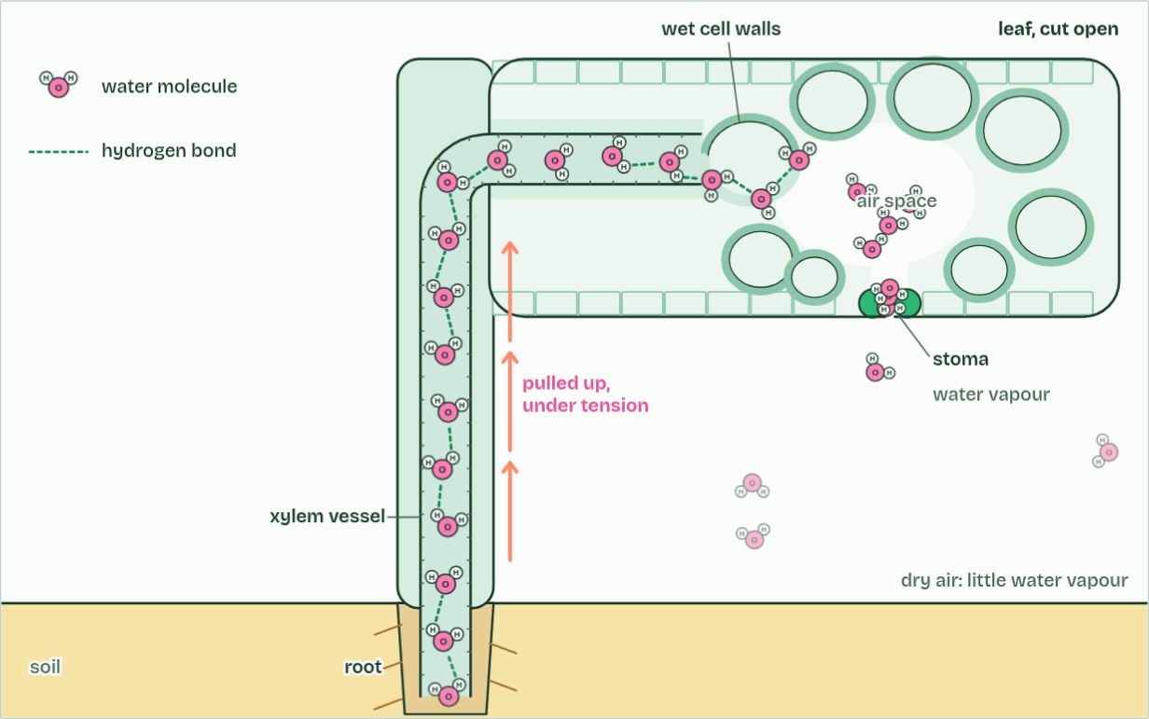
CHAPTER 3 · A1.1.3 Cohesion
Flow: fast
1 / 3
Water holds on to itself
Water evaporates from the wet cell walls in the leaf and escapes through a stoma.
Minutes 35 to 50
Notes:
Minutes 35 to 50 of 60: Cohesion (15 min).
The plan: The pepper and soap demo, predicted first, then chapter 3's figure. Step through the pond skater, then show the xylem column and what an air bubble does to it.
Hydrogen bonds make water molecules stick to one another. That is cohesion.
Inside a drop, each molecule is pulled equally in every direction by its neighbours. A molecule at the surface has neighbours beside it and below it but none above, so it is pulled sideways and inwards. The surface molecules cling together and the surface acts like a stretched film that resists being broken. That is surface tension, and water's is higher than that of almost any other common liquid.
Small animals use the film as a habitat. A pond skater (Gerris lacustris) spreads its weight over long legs, and water-repellent hairs on its feet press dimples into the surface without breaking through. Mosquito larvae hang from the underside and breathe through a tube that pokes up through the film.
Cohesion also lifts water to the top of a tree. In a leaf, water evaporates from the wet walls of cells and leaves as vapour through small pores, which is transpiration. That pulls water out of the xylem. Because the molecules cohere, the whole column of water is pulled up from the roots, like a rope pulled from the top. The water is under tension: it is being pulled, not pushed. Cohesion keeps the column whole however tall the plant, but an air bubble breaks it, and that tube stops carrying water.
Example: The tallest living tree, a coast redwood in California, is about 116 m tall. Holding up a column of water that tall takes a pull of more than 1 MPa, about eleven times the pressure of the air, and cohesion holds.
The animation "Watch it happen: pulling water up a stem", paused at 3.0 s. The next slides go on through it, then play it.

Slide 41
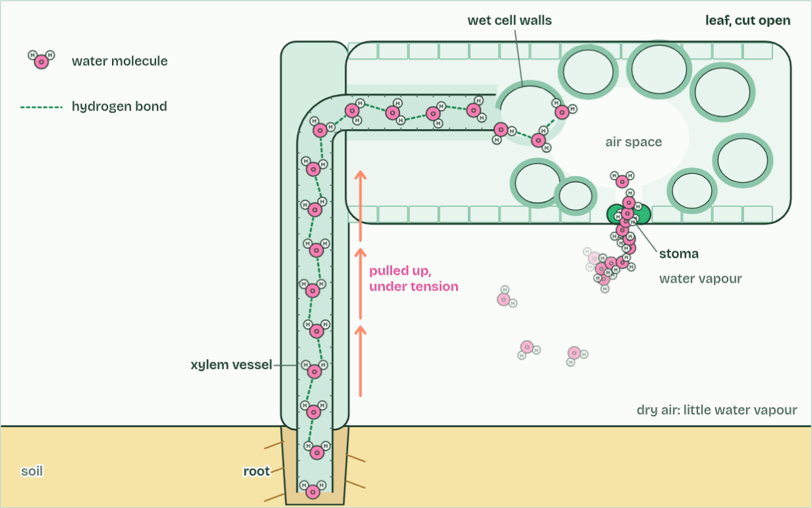
CHAPTER 3 · A1.1.3 Cohesion
Flow: fast
2 / 3
Water holds on to itself
Each molecule that leaves pulls on the next: hydrogen bonds hold the column together.
Minutes 35 to 50
Notes:
Minutes 35 to 50 of 60: Cohesion (15 min).
The plan: The pepper and soap demo, predicted first, then chapter 3's figure. Step through the pond skater, then show the xylem column and what an air bubble does to it.
Hydrogen bonds make water molecules stick to one another. That is cohesion.
Inside a drop, each molecule is pulled equally in every direction by its neighbours. A molecule at the surface has neighbours beside it and below it but none above, so it is pulled sideways and inwards. The surface molecules cling together and the surface acts like a stretched film that resists being broken. That is surface tension, and water's is higher than that of almost any other common liquid.
Small animals use the film as a habitat. A pond skater (Gerris lacustris) spreads its weight over long legs, and water-repellent hairs on its feet press dimples into the surface without breaking through. Mosquito larvae hang from the underside and breathe through a tube that pokes up through the film.
Cohesion also lifts water to the top of a tree. In a leaf, water evaporates from the wet walls of cells and leaves as vapour through small pores, which is transpiration. That pulls water out of the xylem. Because the molecules cohere, the whole column of water is pulled up from the roots, like a rope pulled from the top. The water is under tension: it is being pulled, not pushed. Cohesion keeps the column whole however tall the plant, but an air bubble breaks it, and that tube stops carrying water.
Example: The tallest living tree, a coast redwood in California, is about 116 m tall. Holding up a column of water that tall takes a pull of more than 1 MPa, about eleven times the pressure of the air, and cohesion holds.
The animation "Watch it happen: pulling water up a stem", paused at 8.0 s. The next slides go on through it, then play it.

Slide 42
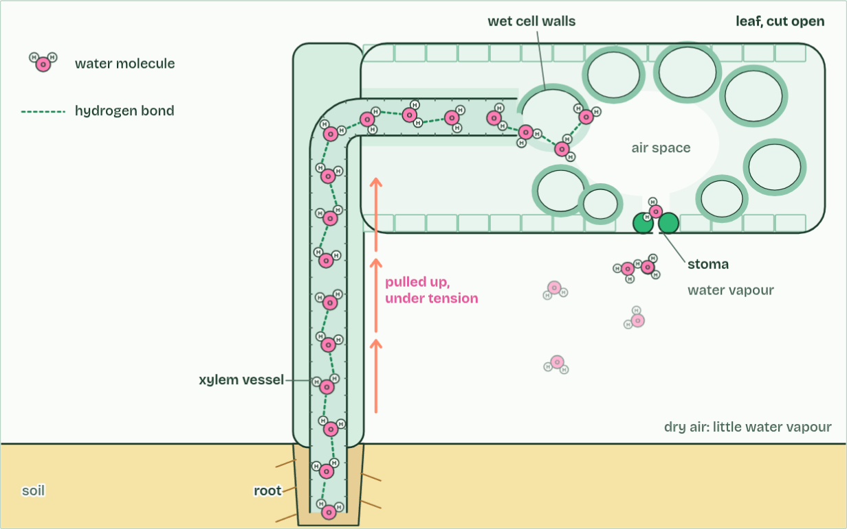
CHAPTER 3 · A1.1.3 Cohesion
Flow: fast
3 / 3
Water holds on to itself
The whole column is pulled up from the roots, under tension.
Minutes 35 to 50
Notes:
Minutes 35 to 50 of 60: Cohesion (15 min).
The plan: The pepper and soap demo, predicted first, then chapter 3's figure. Step through the pond skater, then show the xylem column and what an air bubble does to it.
Hydrogen bonds make water molecules stick to one another. That is cohesion.
Inside a drop, each molecule is pulled equally in every direction by its neighbours. A molecule at the surface has neighbours beside it and below it but none above, so it is pulled sideways and inwards. The surface molecules cling together and the surface acts like a stretched film that resists being broken. That is surface tension, and water's is higher than that of almost any other common liquid.
Small animals use the film as a habitat. A pond skater (Gerris lacustris) spreads its weight over long legs, and water-repellent hairs on its feet press dimples into the surface without breaking through. Mosquito larvae hang from the underside and breathe through a tube that pokes up through the film.
Cohesion also lifts water to the top of a tree. In a leaf, water evaporates from the wet walls of cells and leaves as vapour through small pores, which is transpiration. That pulls water out of the xylem. Because the molecules cohere, the whole column of water is pulled up from the roots, like a rope pulled from the top. The water is under tension: it is being pulled, not pushed. Cohesion keeps the column whole however tall the plant, but an air bubble breaks it, and that tube stops carrying water.
Example: The tallest living tree, a coast redwood in California, is about 116 m tall. Holding up a column of water that tall takes a pull of more than 1 MPa, about eleven times the pressure of the air, and cohesion holds.
The animation "Watch it happen: pulling water up a stem", paused at 13.0 s. The next slides go on through it, then play it.

Slide 43
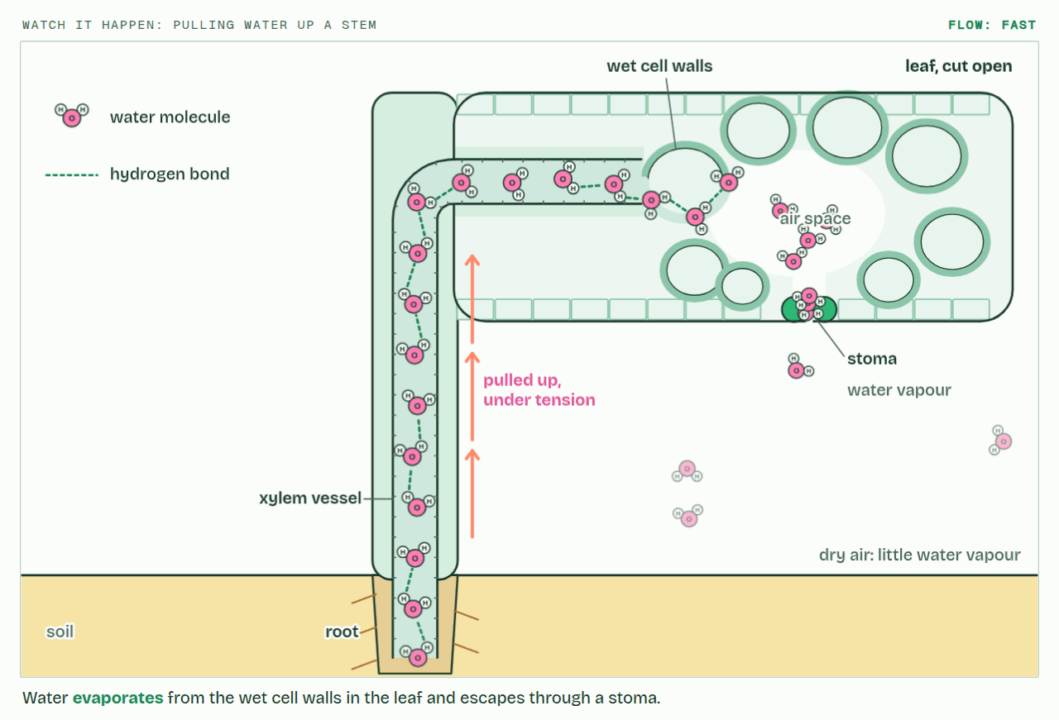
CHAPTER 3 · A1.1.3 Cohesion
PLAY IT
Water holds on to itself
Watch it happen: pulling water up a stem: click to play. It loops every 15 seconds.
Minutes 35 to 50
Notes:
Minutes 35 to 50 of 60: Cohesion (15 min).
The plan: The pepper and soap demo, predicted first, then chapter 3's figure. Step through the pond skater, then show the xylem column and what an air bubble does to it.
The video is water-7066ff.mp4, one loop of the animation in the guide. It plays in PowerPoint and Keynote. Google Slides does not play a video embedded in a .pptx: download water-7066ff.mp4 (https://www.biologybybradford.com/guides/downloads/scenes/water-7066ff.mp4), upload it to Google Drive, then Insert > Video > Google Drive.
In the guide the class can change it as it runs: https://www.biologybybradford.com/guides/ib-biology-a1-1-water#cohesion
What it shows, in order:
1. Water evaporates from the wet cell walls in the leaf and escapes through a stoma.
2. Each molecule that leaves pulls on the next: hydrogen bonds hold the column together.
3. The whole column is pulled up from the roots, under tension.

Slide 44
PREDICT
Ground pepper floats on a bowl of water. You touch the middle of the surface with a finger dipped in washing-up liquid. What does the pepper do?
A It shoots out to the edge of the bowl, dragged by the clean surface that is still pulling all round
B It sinks to the bottom, because the soap makes the water under it heavier than the pepper grains on top
C Nothing happens: the soap mixes into the water and leaves the surface pulling exactly as it was
Minutes 35 to 50
Notes:
Minutes 35 to 50 of 60: Cohesion (15 min).
The plan: The pepper and soap demo, predicted first, then chapter 3's figure. Step through the pond skater, then show the xylem column and what an air bubble does to it.
Ask for a show of hands, or mini whiteboards, before revealing. (Answer: A, on the next slide.)

Slide 45
WHAT HAPPENS
Ground pepper floats on a bowl of water. You touch the middle of the surface with a finger dipped in washing-up liquid. What does the pepper do?
A It shoots out to the edge of the bowl, dragged by the clean surface that is still pulling all round
B It sinks to the bottom, because the soap makes the water under it heavier than the pepper grains on top
C Nothing happens: the soap mixes into the water and leaves the surface pulling exactly as it was
It shoots outwards. Soap molecules crowd into the surface where you touch it and weaken the hydrogen bonding there, so the surface tension falls in the middle. The clean surface all round still pulls strongly and drags the water, and the pepper on it, to the edges. Detergent in a pond does the same to a pond skater: with less surface tension to stand on, it sinks.
Minutes 35 to 50
Notes:
Minutes 35 to 50 of 60: Cohesion (15 min).
The plan: The pepper and soap demo, predicted first, then chapter 3's figure. Step through the pond skater, then show the xylem column and what an air bubble does to it.
Answer: A. It shoots outwards. Soap molecules crowd into the surface where you touch it and weaken the hydrogen bonding there, so the surface tension falls in the middle. The clean surface all round still pulls strongly and drags the water, and the pepper on it, to the edges. Detergent in a pond does the same to a pond skater: with less surface tension to stand on, it sinks.

Slide 46
WATCH OUT
"Capillary action lifts water to the top of a tree." In a xylem vessel, capillary action alone would lift water only a metre or so at most, and far less in wider vessels. The pull comes from evaporation in the leaves, passed down the column by cohesion.
Minutes 35 to 50
Notes:
Minutes 35 to 50 of 60: Cohesion (15 min).
The plan: The pepper and soap demo, predicted first, then chapter 3's figure. Step through the pond skater, then show the xylem column and what an air bubble does to it.
A common mistake: say it, then ask who can say why it is wrong.

Slide 47
PLENARY
Can you now...
Explain why water is the medium for life: where the first cells arose, and where life's processes still happen (A1.1.1)
Explain how unequal sharing of electrons makes water polar, and draw hydrogen bonds between water molecules with partial charges (A1.1.2)
Explain how cohesion lets water be pulled up xylem under tension, and lets animals live on its surface (A1.1.3)
Minutes 50 to 60
Notes:
Minutes 50 to 60 of 60: Exit (10 min).
The plan: Draw three water molecules with hydrogen bonds from memory. Then one sentence: which properties of water let it move up a plant against gravity?
Thumbs up, sideways or down on each goal before the exit question. The goals come from the statements this lesson covers.

Slide 48
EXIT QUESTION
Before you go
Draw three water molecules with hydrogen bonds from memory.
Then one sentence: which properties of water let it move up a plant against gravity?
Minutes 50 to 60
Notes:
Minutes 50 to 60 of 60: Exit (10 min).
The plan: Draw three water molecules with hydrogen bonds from memory. Then one sentence: which properties of water let it move up a plant against gravity?

Slide 49
PRACTISE AND REVISE
Keep going
Exam practice: a fresh paper of exam questions on A1.1 at standard level, marked as you go
The guide, with the animations and the dry lab
This lesson in the guide: 1 Life began in water, and still runs in it, 2 A lopsided molecule makes hydrogen bonds, 3 Water holds on to itself
BUILD FOR YOUR CLASS
ALREADY ON THE SITE FOR A1.1
CARD SETS ON SPLYCR
Tarsia puzzle, dominoes and picture reveal on A1.1, built from its key terms and ready to print
A pub quiz with rounds on A1.1, to present or run with no projector
An escape room built from the question bank on A1.1
Lesson: Water
Summary doodle: Water
Quiz: Water
Revision map: A1.1 Water, to fill in
Exam questions: A1.1 in the exam maker, a paper with its markscheme
Open a set to host it as a class game, or make a copy to edit.
A1.1 Water
How this was made. The course structure, the activities and the teaching choices come from my own classroom, my presentations and my years of teaching IB and AP Biology. I use Claude, an AI, to help write and build the interactive guides, lesson plans, slides and practice questions, and to draw the diagrams and code the interactives. I direct the work and review it against the IB and AP specifications before it goes live.
Minute 60: after the lesson
Notes:
Every link here is live. Set the exam practice paper for homework: it is fresh each time, marked as students go and saved to their Exam practice when they are signed in.
Exam practice: https://www.biologybybradford.com/exam-maker/sit?topics=A1.1&level=SL&paper=quiz&marks=15&src=ep
The guide: https://www.biologybybradford.com/guides/ib-biology-a1-1-water

