Slide 1
IB Biology A1.1
LESSON 2 OF 4
BY THE END YOU CAN
Water
Explain how adhesion draws water through soil and plant cell walls by capillary action (A1.1.4)
Explain why water is the medium for metabolism and transport, and why some molecules work because they do not dissolve (A1.1.5)
Compare water with air for buoyancy, viscosity, thermal conductivity and specific heat capacity, using the black-throated loon and the ringed seal (A1.1.6)
Sticky, soluble, and a place to live
A1.1.4 to A1.1.6
Adhesion and capillary action, water as the solvent, and water against air for the loon and the ringed seal
60 minutes · chapters 4, 5, 6
Minute 0
Notes:
IB Biology A1.1, Water. Lesson 2 of 4: Sticky, soluble, and a place to live, 60 minutes.
The plan, minute by minute (each slide's footer says where you are):
0 to 5 min (5) Walking water challenge
5 to 15 min (10) Paper that drinks
15 to 30 min (15) The solvent
30 to 50 min (20) Water against air
50 to 55 min (5) Back to the cups
55 to 60 min (5) Exit and homework
What students get wrong:
Cohesion and adhesion mixed up. Use Clones and Anything.
Water dissolves everything. Not fats, waxes, cellulose or bone mineral.
Hydrophilic means soluble. Cellulose is hydrophilic and insoluble.
Conductivity and heat capacity are the same. One is how fast heat flows, the other how much heat it takes to warm something.
Fur keeps seals warm in water. Blubber does, because wet fur fails.
Stretch and support:
Support: sentence frames for property, cause and consequence: "Because water molecules are polar, ...
Support: use the Remember it tiles as a starter in each lesson.
Support: give the chapter 6 grid with the properties filled in.
Stretch: how high would capillary action lift water in a vessel 50 µm wide? Compare it with a 100 m tree.
Stretch: why are most large animals in cold water either well insulated or cold-blooded? Use thermal conductivity.
The lesson plan to print: https://www.biologybybradford.com/guides/downloads/ib-biology-a1-1-water-lesson-2-plan.pdf

Slide 2
DO NOW
Walking water challenge
Groups set up the cups and leave them running while the lesson goes on.
5:00
minutes
Start now: the timer is running.
Minutes 0 to 5
Notes:
Minutes 0 to 5 of 60: Walking water challenge (5 min).
The plan: Groups set up the cups (activity below) and leave them running while the lesson goes on.
Start a 5 minute timer as they come in.

Slide 3
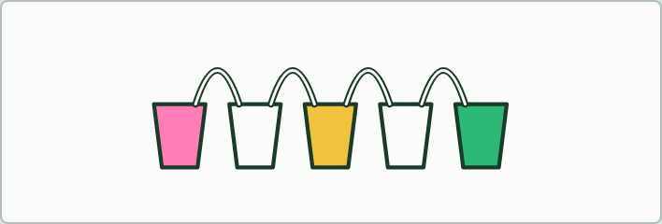
CHALLENGE
5 MIN
Walking water
THE TASK
With five cups, paper towel strips and red, yellow and blue water, make orange in one cup and purple in another: yellow, empty, red, empty, blue, with the red cup fuller. Explain it at the end of the lesson.
STUDENTS NEED
Five clear cups per group, paper towels, food colouring.
Minutes 0 to 5
Notes:
Minutes 0 to 5 of 60: Walking water challenge (5 min).
The plan: Groups set up the cups (activity below) and leave them running while the lesson goes on.
The activity: Walking water. With five cups, paper towel strips and red, yellow and blue water, make orange in one cup and purple in another: yellow, empty, red, empty, blue, with the red cup fuller. Explain it at the end of the lesson.
Needs: five clear cups per group, paper towels, food colouring.
The time: 5 minutes, minutes 0 to 5 of the plan.

Slide 4
STEP 2
10 MIN
Paper that drinks
Coffee filter painting at the tables, then chapter 4's figure: why does the waxed tube fail?
Turn over the Clones and Anything tiles.
Minutes 5 to 15
Notes:
Minutes 5 to 15 of 60: Paper that drinks (10 min).
The plan: Coffee filter painting at the tables, then chapter 4's figure: why does the waxed tube fail? Turn over the Clones and Anything tiles.

Slide 5

PRACTICAL
10 MIN
Coffee filter painting
THE TASK
Drop watercolour on to a filter paper one drop at a time and watch it spread. Explain the spreading with adhesion to cellulose and capillary action.
STUDENTS NEED
Coffee filters or filter paper, watercolours or washable felt tips, droppers, plates.
Minutes 5 to 15
Notes:
Minutes 5 to 15 of 60: Paper that drinks (10 min).
The plan: Coffee filter painting at the tables, then chapter 4's figure: why does the waxed tube fail? Turn over the Clones and Anything tiles.
The activity: Coffee filter painting. Drop watercolour on to a filter paper one drop at a time and watch it spread. Explain the spreading with adhesion to cellulose and capillary action.
Needs: coffee filters or filter paper, watercolours or washable felt tips, droppers, plates.
The time: 10 minutes, minutes 5 to 15 of the plan.

Slide 6
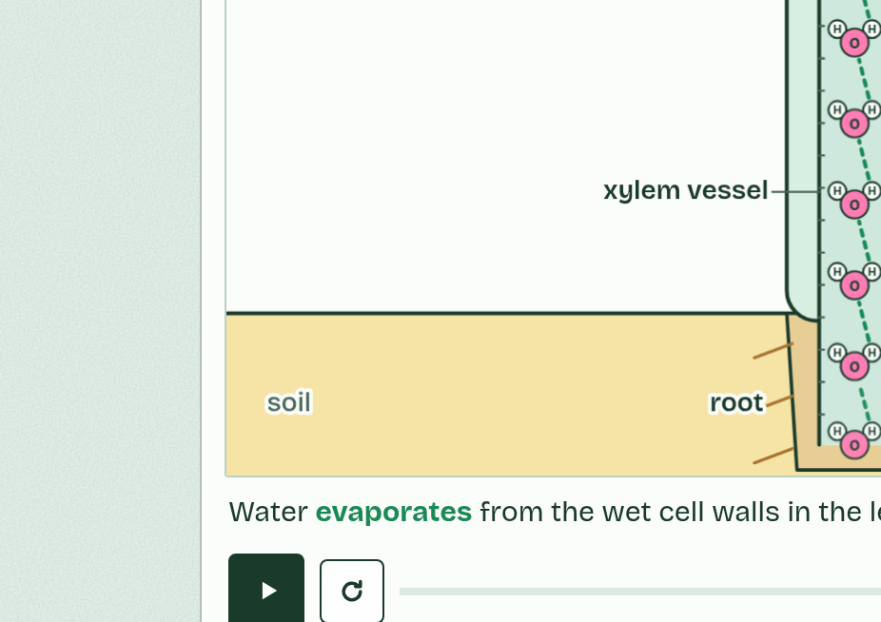
CHAPTER 4 · A1.1.4 Adhesion
1 / 5
Water clings to polar surfaces
Water is attracted to the polar glass wall and forms bonds with it: adhesion. The water’s edge curves up where it meets the glass.
Minutes 5 to 15
Notes:
Minutes 5 to 15 of 60: Paper that drinks (10 min).
The plan: Coffee filter painting at the tables, then chapter 4's figure: why does the waxed tube fail? Turn over the Clones and Anything tiles.
Water is attracted to other materials too, as long as they are polar or carry a charge. That is adhesion: hydrogen bonds or ionic attractions pull water on to the surface. Glass does it. So does cellulose, which is covered in OH groups, and so do the charged surfaces of clay and humus in soil. A waxy, non-polar surface gives water nothing to cling to, so water beads up on it instead.
Put a narrow gap between surfaces that water clings to and something useful happens. Water adheres to the walls and creeps up them, and cohesion drags the rest of the water along behind. This is capillary action. The narrower the gap, the higher the water rises.
In soil, rain is held in the narrow spaces between the particles by adhesion and cohesion, so it does not all drain away, and it can creep through the soil towards roots. Clay, with tiny spaces and charged particles, holds the most.
In a plant, a cell wall is a mesh of cellulose fibres with tiny gaps between them. Water soaks through the wall by capillary action and keeps it wet. In a leaf, those wet walls are where the evaporation of chapter 3 happens.
Example: A cotton towel dries you because water adheres to its cellulose fibres and creeps along the spaces between them.

Slide 7
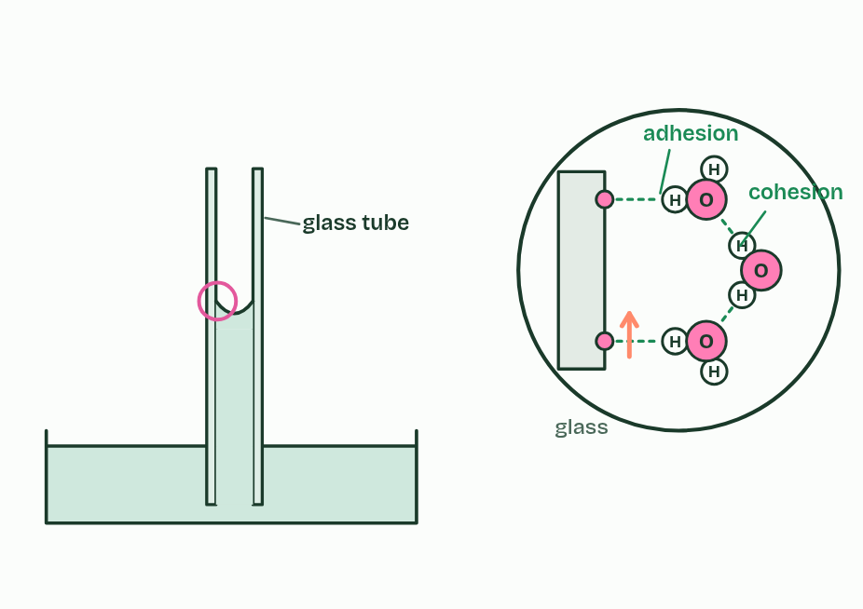
CHAPTER 4 · A1.1.4 Adhesion
2 / 5
Water clings to polar surfaces
Cohesion drags more water up behind the edge, and the column rises until its weight balances the pull.
Minutes 5 to 15
Notes:
Minutes 5 to 15 of 60: Paper that drinks (10 min).
The plan: Coffee filter painting at the tables, then chapter 4's figure: why does the waxed tube fail? Turn over the Clones and Anything tiles.
Water is attracted to other materials too, as long as they are polar or carry a charge. That is adhesion: hydrogen bonds or ionic attractions pull water on to the surface. Glass does it. So does cellulose, which is covered in OH groups, and so do the charged surfaces of clay and humus in soil. A waxy, non-polar surface gives water nothing to cling to, so water beads up on it instead.
Put a narrow gap between surfaces that water clings to and something useful happens. Water adheres to the walls and creeps up them, and cohesion drags the rest of the water along behind. This is capillary action. The narrower the gap, the higher the water rises.
In soil, rain is held in the narrow spaces between the particles by adhesion and cohesion, so it does not all drain away, and it can creep through the soil towards roots. Clay, with tiny spaces and charged particles, holds the most.
In a plant, a cell wall is a mesh of cellulose fibres with tiny gaps between them. Water soaks through the wall by capillary action and keeps it wet. In a leaf, those wet walls are where the evaporation of chapter 3 happens.
Example: A cotton towel dries you because water adheres to its cellulose fibres and creeps along the spaces between them.

Slide 8
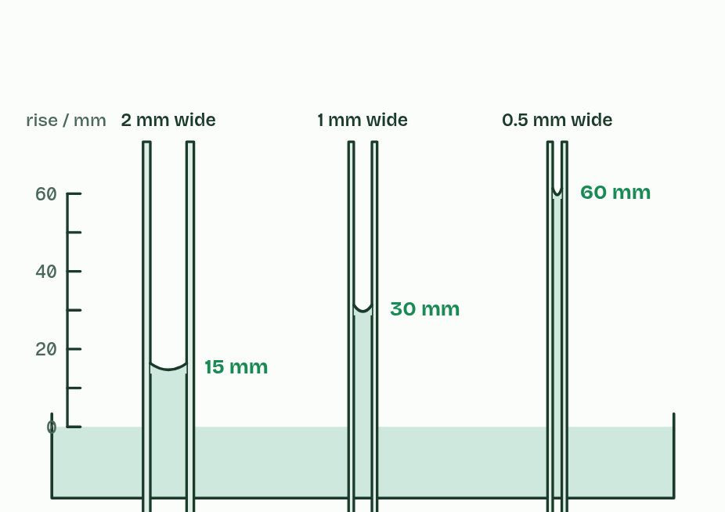
CHAPTER 4 · A1.1.4 Adhesion
3 / 5
Water clings to polar surfaces
The narrower the tube, the higher the water climbs.
Minutes 5 to 15
Notes:
Minutes 5 to 15 of 60: Paper that drinks (10 min).
The plan: Coffee filter painting at the tables, then chapter 4's figure: why does the waxed tube fail? Turn over the Clones and Anything tiles.
Water is attracted to other materials too, as long as they are polar or carry a charge. That is adhesion: hydrogen bonds or ionic attractions pull water on to the surface. Glass does it. So does cellulose, which is covered in OH groups, and so do the charged surfaces of clay and humus in soil. A waxy, non-polar surface gives water nothing to cling to, so water beads up on it instead.
Put a narrow gap between surfaces that water clings to and something useful happens. Water adheres to the walls and creeps up them, and cohesion drags the rest of the water along behind. This is capillary action. The narrower the gap, the higher the water rises.
In soil, rain is held in the narrow spaces between the particles by adhesion and cohesion, so it does not all drain away, and it can creep through the soil towards roots. Clay, with tiny spaces and charged particles, holds the most.
In a plant, a cell wall is a mesh of cellulose fibres with tiny gaps between them. Water soaks through the wall by capillary action and keeps it wet. In a leaf, those wet walls are where the evaporation of chapter 3 happens.
Example: A cotton towel dries you because water adheres to its cellulose fibres and creeps along the spaces between them.

Slide 9
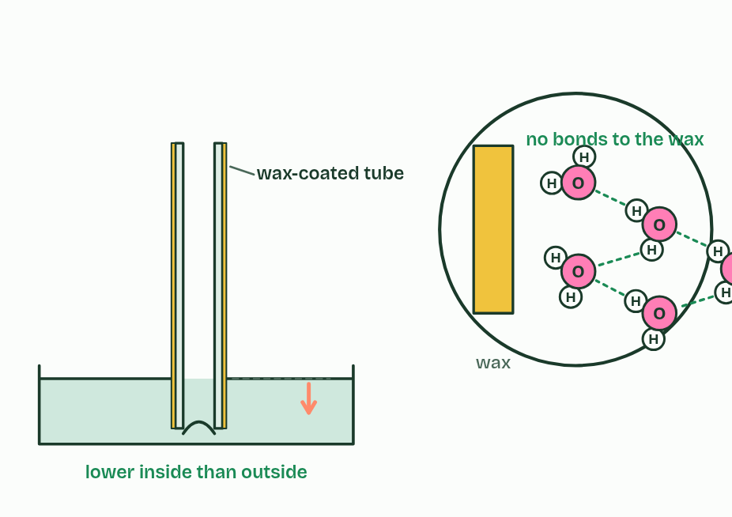
CHAPTER 4 · A1.1.4 Adhesion
4 / 5
Water clings to polar surfaces
Wax has nothing for water to cling to: with no adhesion the surface curves down and sits below the level outside.
Minutes 5 to 15
Notes:
Minutes 5 to 15 of 60: Paper that drinks (10 min).
The plan: Coffee filter painting at the tables, then chapter 4's figure: why does the waxed tube fail? Turn over the Clones and Anything tiles.
Water is attracted to other materials too, as long as they are polar or carry a charge. That is adhesion: hydrogen bonds or ionic attractions pull water on to the surface. Glass does it. So does cellulose, which is covered in OH groups, and so do the charged surfaces of clay and humus in soil. A waxy, non-polar surface gives water nothing to cling to, so water beads up on it instead.
Put a narrow gap between surfaces that water clings to and something useful happens. Water adheres to the walls and creeps up them, and cohesion drags the rest of the water along behind. This is capillary action. The narrower the gap, the higher the water rises.
In soil, rain is held in the narrow spaces between the particles by adhesion and cohesion, so it does not all drain away, and it can creep through the soil towards roots. Clay, with tiny spaces and charged particles, holds the most.
In a plant, a cell wall is a mesh of cellulose fibres with tiny gaps between them. Water soaks through the wall by capillary action and keeps it wet. In a leaf, those wet walls are where the evaporation of chapter 3 happens.
Example: A cotton towel dries you because water adheres to its cellulose fibres and creeps along the spaces between them.

Slide 10
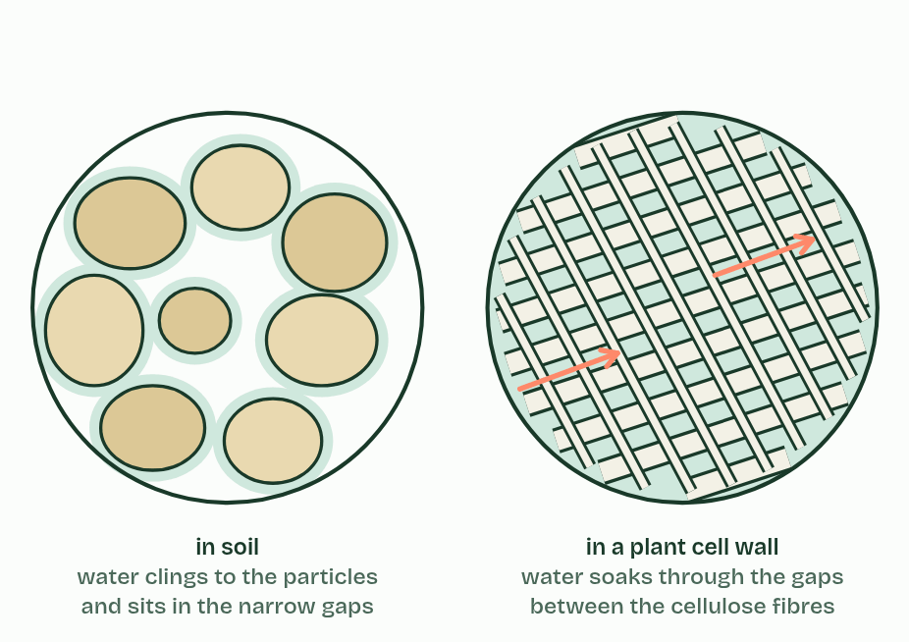
CHAPTER 4 · A1.1.4 Adhesion
5 / 5
Water clings to polar surfaces
The same pull holds water between soil particles and soaks it through the gaps in a cellulose cell wall.
Minutes 5 to 15
Notes:
Minutes 5 to 15 of 60: Paper that drinks (10 min).
The plan: Coffee filter painting at the tables, then chapter 4's figure: why does the waxed tube fail? Turn over the Clones and Anything tiles.
Water is attracted to other materials too, as long as they are polar or carry a charge. That is adhesion: hydrogen bonds or ionic attractions pull water on to the surface. Glass does it. So does cellulose, which is covered in OH groups, and so do the charged surfaces of clay and humus in soil. A waxy, non-polar surface gives water nothing to cling to, so water beads up on it instead.
Put a narrow gap between surfaces that water clings to and something useful happens. Water adheres to the walls and creeps up them, and cohesion drags the rest of the water along behind. This is capillary action. The narrower the gap, the higher the water rises.
In soil, rain is held in the narrow spaces between the particles by adhesion and cohesion, so it does not all drain away, and it can creep through the soil towards roots. Clay, with tiny spaces and charged particles, holds the most.
In a plant, a cell wall is a mesh of cellulose fibres with tiny gaps between them. Water soaks through the wall by capillary action and keeps it wet. In a leaf, those wet walls are where the evaporation of chapter 3 happens.
Example: A cotton towel dries you because water adheres to its cellulose fibres and creeps along the spaces between them.

Slide 11
CHAPTER 4 · A1.1.4 Adhesion
Water clings to polar surfaces
Water is attracted to other materials too, as long as they are polar or carry a charge. That is adhesion: hydrogen bonds or ionic attractions pull water on to the surface.
So does cellulose, which is covered in OH groups, and so do the charged surfaces of clay and humus in soil.
Water adheres to the walls and creeps up them, and cohesion drags the rest of the water along behind. This is capillary action.
In soil, rain is held in the narrow spaces between the particles by adhesion and cohesion, so it does not all drain away, and it can creep through the soil towards roots.
Minutes 5 to 15
Notes:
Minutes 5 to 15 of 60: Paper that drinks (10 min).
The plan: Coffee filter painting at the tables, then chapter 4's figure: why does the waxed tube fail? Turn over the Clones and Anything tiles.
Water is attracted to other materials too, as long as they are polar or carry a charge. That is adhesion: hydrogen bonds or ionic attractions pull water on to the surface. Glass does it. So does cellulose, which is covered in OH groups, and so do the charged surfaces of clay and humus in soil. A waxy, non-polar surface gives water nothing to cling to, so water beads up on it instead.
Put a narrow gap between surfaces that water clings to and something useful happens. Water adheres to the walls and creeps up them, and cohesion drags the rest of the water along behind. This is capillary action. The narrower the gap, the higher the water rises.
In soil, rain is held in the narrow spaces between the particles by adhesion and cohesion, so it does not all drain away, and it can creep through the soil towards roots. Clay, with tiny spaces and charged particles, holds the most.
In a plant, a cell wall is a mesh of cellulose fibres with tiny gaps between them. Water soaks through the wall by capillary action and keeps it wet. In a leaf, those wet walls are where the evaporation of chapter 3 happens.
Example: A cotton towel dries you because water adheres to its cellulose fibres and creeps along the spaces between them.

Slide 12
PREDICT
Three cups in a row: red water, an empty cup, blue water. A strip of paper towel bridges each full cup and the empty one. What is in the middle cup a few hours later?
A Nothing: water cannot climb up and out of a cup by itself, whatever the paper strip is made of
B Only red water, because the red cup was filled first and so its water got into the middle cup first
C Purple water, rising until the levels even out, because water creeps along paper from both sides
Minutes 5 to 15
Notes:
Minutes 5 to 15 of 60: Paper that drinks (10 min).
The plan: Coffee filter painting at the tables, then chapter 4's figure: why does the waxed tube fail? Turn over the Clones and Anything tiles.
Ask for a show of hands, or mini whiteboards, before revealing. (Answer: C, on the next slide.)

Slide 13
WHAT HAPPENS
Three cups in a row: red water, an empty cup, blue water. A strip of paper towel bridges each full cup and the empty one. What is in the middle cup a few hours later?
A Nothing: water cannot climb up and out of a cup by itself, whatever the paper strip is made of
B Only red water, because the red cup was filled first and so its water got into the middle cup first
C Purple water, rising until the levels even out, because water creeps along paper from both sides
Purple water. Paper towel is cellulose. Water adheres to its fibres and creeps up and along the strip by capillary action, cohesion pulling the rest behind, and drips into the empty cup until the levels even out. Both colours arrive and mix. The same process keeps the walls of a leaf's cells wet and moves water through soil.
Minutes 5 to 15
Notes:
Minutes 5 to 15 of 60: Paper that drinks (10 min).
The plan: Coffee filter painting at the tables, then chapter 4's figure: why does the waxed tube fail? Turn over the Clones and Anything tiles.
Answer: C. Purple water. Paper towel is cellulose. Water adheres to its fibres and creeps up and along the strip by capillary action, cohesion pulling the rest behind, and drips into the empty cup until the levels even out. Both colours arrive and mix. The same process keeps the walls of a leaf's cells wet and moves water through soil.

Slide 14
WATCH OUT
"Cohesion and adhesion are the same thing." Cohesion is water to water. Adhesion is water to a different material that is polar or charged. Capillary action needs both.
Minutes 5 to 15
Notes:
Minutes 5 to 15 of 60: Paper that drinks (10 min).
The plan: Coffee filter painting at the tables, then chapter 4's figure: why does the waxed tube fail? Turn over the Clones and Anything tiles.
A common mistake: say it, then ask who can say why it is wrong.

Slide 15
REMEMBER IT
Cohesion or adhesion?
C
A
Clones
Anything
Minutes 5 to 15
Notes:
Minutes 5 to 15 of 60: Paper that drinks (10 min).
The plan: Coffee filter painting at the tables, then chapter 4's figure: why does the waxed tube fail? Turn over the Clones and Anything tiles.
Ask the class what each letter stands for before revealing.

Slide 16
REMEMBER IT
Cohesion or adhesion?
C
A
Clones
Anything
Cohesion
Adhesion
water clings to its clones: other water molecules
water clings to anything polar or charged: glass, cellulose, soil
Minutes 5 to 15
Notes:
Minutes 5 to 15 of 60: Paper that drinks (10 min).
The plan: Coffee filter painting at the tables, then chapter 4's figure: why does the waxed tube fail? Turn over the Clones and Anything tiles.
Clones: Cohesion (water clings to its clones: other water molecules)
Anything: Adhesion (water clings to anything polar or charged: glass, cellulose, soil)

Slide 17
STEP 3
15 MIN
The solvent
Chapter 5: The solvent cells run in
Minutes 15 to 30
Notes:
Minutes 15 to 30 of 60: The solvent (15 min).
The plan: Chapter 5's figure, then the sorter in pairs. Ask which molecules work because they do not dissolve, and what for. Finish with the oxygen predict box.

Slide 18
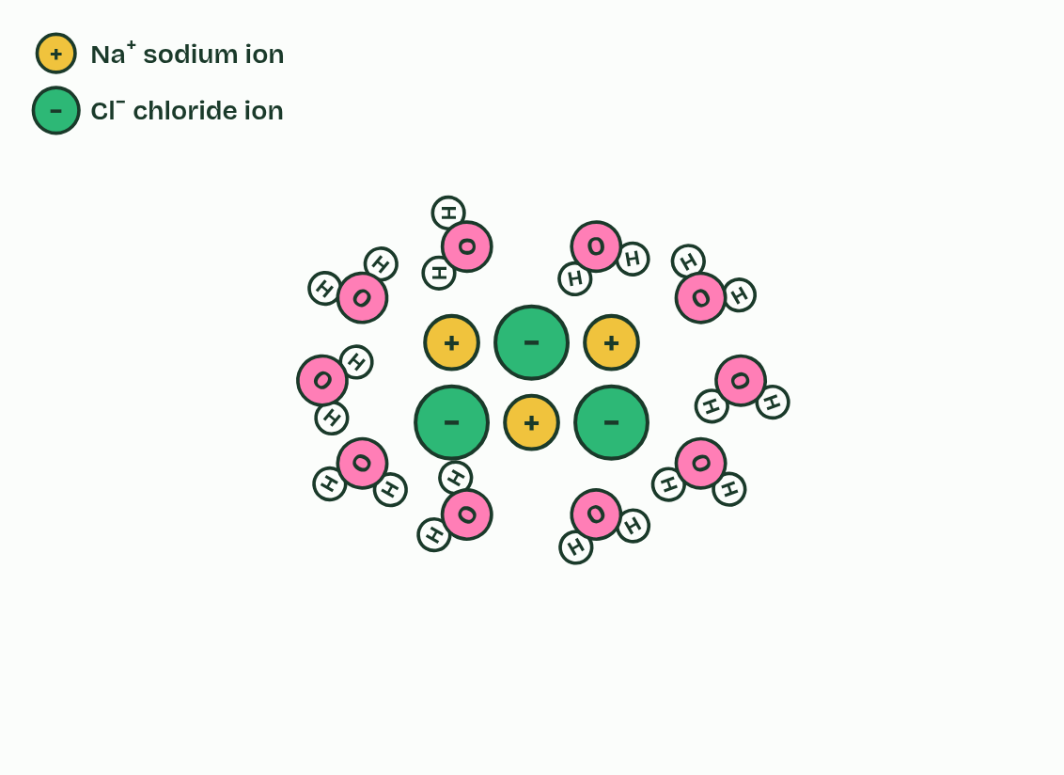
CHAPTER 5 · A1.1.5 Water as a solvent
1 / 5
The solvent cells run in
A grain of salt is a lattice of ions, sodium (Na⁺) and chloride (Cl⁻), held together by their opposite charges.
Minutes 15 to 30
Notes:
Minutes 15 to 30 of 60: The solvent (15 min).
The plan: Chapter 5's figure, then the sorter in pairs. Ask which molecules work because they do not dissolve, and what for. Finish with the oxygen predict box.
A solution is a solute dissolved in a solvent. Water dissolves a wide variety of substances: ions such as Na⁺, K⁺ and Cl⁻, and polar molecules such as glucose, amino acids and urea.
It does so because of its own charges. Water molecules crowd round an ion with their δ− oxygens turned towards positive ions and their δ+ hydrogens towards negative ions, and pull the ions apart. Polar molecules dissolve by forming hydrogen bonds with water. Each dissolved particle ends up wrapped in water molecules, which is called solvation. A positive ion such as Na⁺ is a cation and a negative ion such as Cl⁻ is an anion.
Substances that are polar or charged are hydrophilic. Substances that are non-polar, such as fats, oils and waxes, are hydrophobic: water molecules bond to each other instead, which pushes the non-polar molecules together, as oil forms droplets.
That makes water the medium for metabolism. Most enzymes catalyse reactions in aqueous solution, in the cytoplasm and in the fluids inside organelles, where dissolved enzymes and substrates move about and collide. It also makes water the medium for transport. Blood plasma carries glucose, amino acids, ions, urea and hormones dissolved in it, and xylem sap carries mineral ions such as nitrate and potassium from roots to leaves. Phloem sap carries dissolved sugars. Fats cannot travel dissolved, so in blood they ride inside lipoproteins, packages of lipid and protein that are soluble.
Some molecules work because they are hydrophobic and insoluble. The wax on a leaf stops water escaping. Fat stores energy, and insulates, without dissolving into the cell's water (the seal's insulating fat, in chapter 6). The non-polar tails of phospholipids make membranes a barrier to water-soluble substances (B1.1 and B2.1). Ten substances to sort are below.

Slide 19
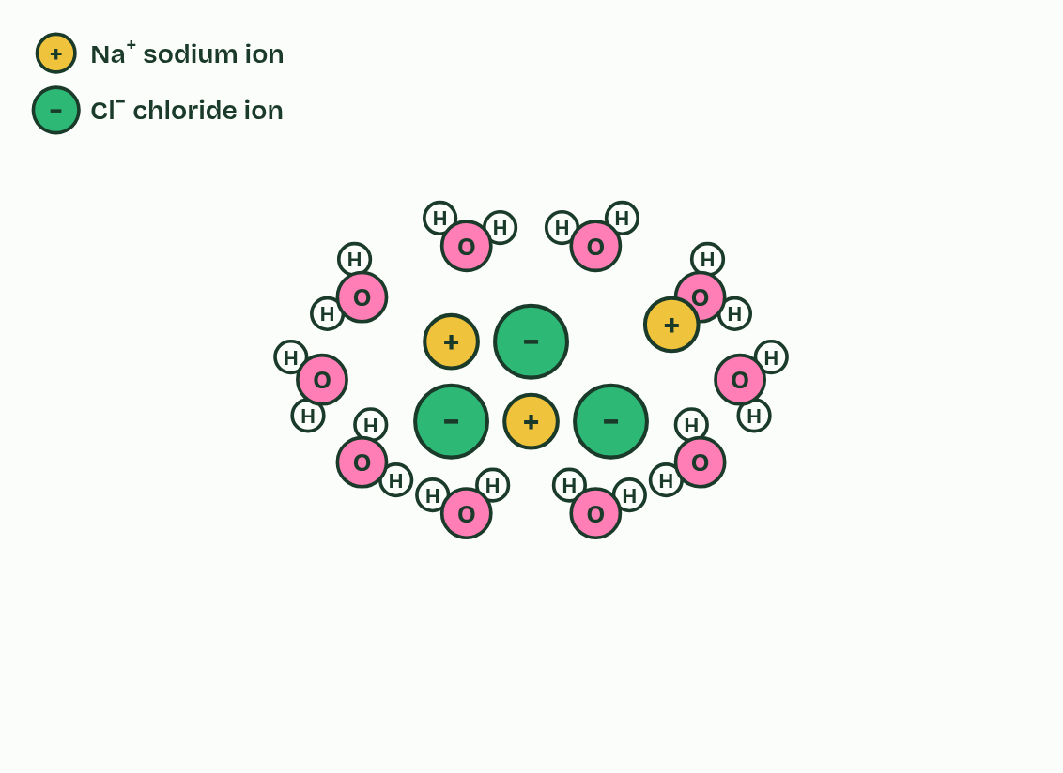
CHAPTER 5 · A1.1.5 Water as a solvent
2 / 5
The solvent cells run in
Water molecules turn to face the ions, oxygen towards Na⁺ and hydrogens towards Cl⁻, and together they pull ions loose.
Minutes 15 to 30
Notes:
Minutes 15 to 30 of 60: The solvent (15 min).
The plan: Chapter 5's figure, then the sorter in pairs. Ask which molecules work because they do not dissolve, and what for. Finish with the oxygen predict box.
A solution is a solute dissolved in a solvent. Water dissolves a wide variety of substances: ions such as Na⁺, K⁺ and Cl⁻, and polar molecules such as glucose, amino acids and urea.
It does so because of its own charges. Water molecules crowd round an ion with their δ− oxygens turned towards positive ions and their δ+ hydrogens towards negative ions, and pull the ions apart. Polar molecules dissolve by forming hydrogen bonds with water. Each dissolved particle ends up wrapped in water molecules, which is called solvation. A positive ion such as Na⁺ is a cation and a negative ion such as Cl⁻ is an anion.
Substances that are polar or charged are hydrophilic. Substances that are non-polar, such as fats, oils and waxes, are hydrophobic: water molecules bond to each other instead, which pushes the non-polar molecules together, as oil forms droplets.
That makes water the medium for metabolism. Most enzymes catalyse reactions in aqueous solution, in the cytoplasm and in the fluids inside organelles, where dissolved enzymes and substrates move about and collide. It also makes water the medium for transport. Blood plasma carries glucose, amino acids, ions, urea and hormones dissolved in it, and xylem sap carries mineral ions such as nitrate and potassium from roots to leaves. Phloem sap carries dissolved sugars. Fats cannot travel dissolved, so in blood they ride inside lipoproteins, packages of lipid and protein that are soluble.
Some molecules work because they are hydrophobic and insoluble. The wax on a leaf stops water escaping. Fat stores energy, and insulates, without dissolving into the cell's water (the seal's insulating fat, in chapter 6). The non-polar tails of phospholipids make membranes a barrier to water-soluble substances (B1.1 and B2.1). Ten substances to sort are below.

Slide 20
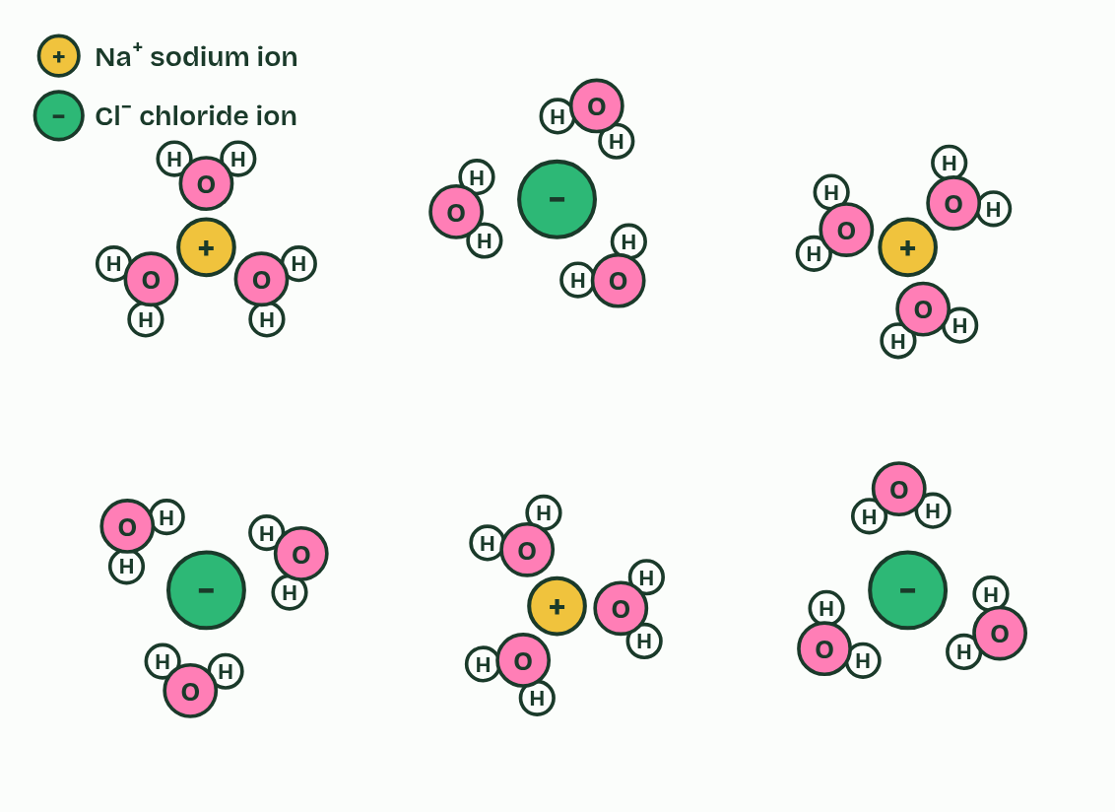
CHAPTER 5 · A1.1.5 Water as a solvent
3 / 5
The solvent cells run in
Dissolved: every ion is wrapped in its own shell of water molecules and drifts away from the rest.
Minutes 15 to 30
Notes:
Minutes 15 to 30 of 60: The solvent (15 min).
The plan: Chapter 5's figure, then the sorter in pairs. Ask which molecules work because they do not dissolve, and what for. Finish with the oxygen predict box.
A solution is a solute dissolved in a solvent. Water dissolves a wide variety of substances: ions such as Na⁺, K⁺ and Cl⁻, and polar molecules such as glucose, amino acids and urea.
It does so because of its own charges. Water molecules crowd round an ion with their δ− oxygens turned towards positive ions and their δ+ hydrogens towards negative ions, and pull the ions apart. Polar molecules dissolve by forming hydrogen bonds with water. Each dissolved particle ends up wrapped in water molecules, which is called solvation. A positive ion such as Na⁺ is a cation and a negative ion such as Cl⁻ is an anion.
Substances that are polar or charged are hydrophilic. Substances that are non-polar, such as fats, oils and waxes, are hydrophobic: water molecules bond to each other instead, which pushes the non-polar molecules together, as oil forms droplets.
That makes water the medium for metabolism. Most enzymes catalyse reactions in aqueous solution, in the cytoplasm and in the fluids inside organelles, where dissolved enzymes and substrates move about and collide. It also makes water the medium for transport. Blood plasma carries glucose, amino acids, ions, urea and hormones dissolved in it, and xylem sap carries mineral ions such as nitrate and potassium from roots to leaves. Phloem sap carries dissolved sugars. Fats cannot travel dissolved, so in blood they ride inside lipoproteins, packages of lipid and protein that are soluble.
Some molecules work because they are hydrophobic and insoluble. The wax on a leaf stops water escaping. Fat stores energy, and insulates, without dissolving into the cell's water (the seal's insulating fat, in chapter 6). The non-polar tails of phospholipids make membranes a barrier to water-soluble substances (B1.1 and B2.1). Ten substances to sort are below.

Slide 21
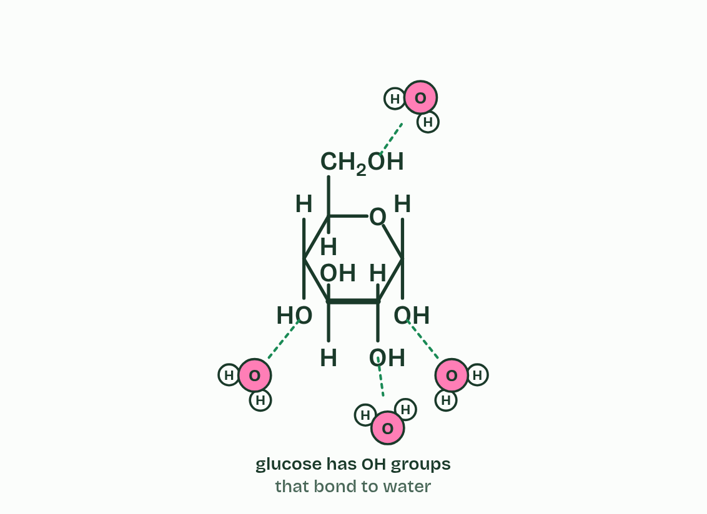
CHAPTER 5 · A1.1.5 Water as a solvent
4 / 5
The solvent cells run in
A sugar is covered in OH groups, which make hydrogen bonds with water, so it dissolves too.
Minutes 15 to 30
Notes:
Minutes 15 to 30 of 60: The solvent (15 min).
The plan: Chapter 5's figure, then the sorter in pairs. Ask which molecules work because they do not dissolve, and what for. Finish with the oxygen predict box.
A solution is a solute dissolved in a solvent. Water dissolves a wide variety of substances: ions such as Na⁺, K⁺ and Cl⁻, and polar molecules such as glucose, amino acids and urea.
It does so because of its own charges. Water molecules crowd round an ion with their δ− oxygens turned towards positive ions and their δ+ hydrogens towards negative ions, and pull the ions apart. Polar molecules dissolve by forming hydrogen bonds with water. Each dissolved particle ends up wrapped in water molecules, which is called solvation. A positive ion such as Na⁺ is a cation and a negative ion such as Cl⁻ is an anion.
Substances that are polar or charged are hydrophilic. Substances that are non-polar, such as fats, oils and waxes, are hydrophobic: water molecules bond to each other instead, which pushes the non-polar molecules together, as oil forms droplets.
That makes water the medium for metabolism. Most enzymes catalyse reactions in aqueous solution, in the cytoplasm and in the fluids inside organelles, where dissolved enzymes and substrates move about and collide. It also makes water the medium for transport. Blood plasma carries glucose, amino acids, ions, urea and hormones dissolved in it, and xylem sap carries mineral ions such as nitrate and potassium from roots to leaves. Phloem sap carries dissolved sugars. Fats cannot travel dissolved, so in blood they ride inside lipoproteins, packages of lipid and protein that are soluble.
Some molecules work because they are hydrophobic and insoluble. The wax on a leaf stops water escaping. Fat stores energy, and insulates, without dissolving into the cell's water (the seal's insulating fat, in chapter 6). The non-polar tails of phospholipids make membranes a barrier to water-soluble substances (B1.1 and B2.1). Ten substances to sort are below.

Slide 22
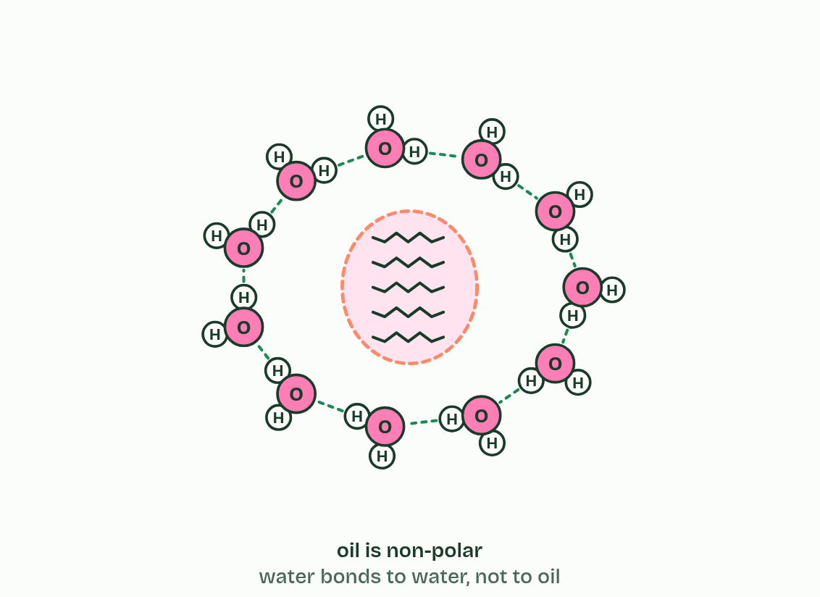
CHAPTER 5 · A1.1.5 Water as a solvent
5 / 5
The solvent cells run in
Oil molecules are non-polar. Water bonds to water, not to oil, so the oil is pushed together into a droplet.
Minutes 15 to 30
Notes:
Minutes 15 to 30 of 60: The solvent (15 min).
The plan: Chapter 5's figure, then the sorter in pairs. Ask which molecules work because they do not dissolve, and what for. Finish with the oxygen predict box.
A solution is a solute dissolved in a solvent. Water dissolves a wide variety of substances: ions such as Na⁺, K⁺ and Cl⁻, and polar molecules such as glucose, amino acids and urea.
It does so because of its own charges. Water molecules crowd round an ion with their δ− oxygens turned towards positive ions and their δ+ hydrogens towards negative ions, and pull the ions apart. Polar molecules dissolve by forming hydrogen bonds with water. Each dissolved particle ends up wrapped in water molecules, which is called solvation. A positive ion such as Na⁺ is a cation and a negative ion such as Cl⁻ is an anion.
Substances that are polar or charged are hydrophilic. Substances that are non-polar, such as fats, oils and waxes, are hydrophobic: water molecules bond to each other instead, which pushes the non-polar molecules together, as oil forms droplets.
That makes water the medium for metabolism. Most enzymes catalyse reactions in aqueous solution, in the cytoplasm and in the fluids inside organelles, where dissolved enzymes and substrates move about and collide. It also makes water the medium for transport. Blood plasma carries glucose, amino acids, ions, urea and hormones dissolved in it, and xylem sap carries mineral ions such as nitrate and potassium from roots to leaves. Phloem sap carries dissolved sugars. Fats cannot travel dissolved, so in blood they ride inside lipoproteins, packages of lipid and protein that are soluble.
Some molecules work because they are hydrophobic and insoluble. The wax on a leaf stops water escaping. Fat stores energy, and insulates, without dissolving into the cell's water (the seal's insulating fat, in chapter 6). The non-polar tails of phospholipids make membranes a barrier to water-soluble substances (B1.1 and B2.1). Ten substances to sort are below.

Slide 23
CHAPTER 5 · A1.1.5 Water as a solvent
The solvent cells run in
A solution is a solute dissolved in a solvent.
Each dissolved particle ends up wrapped in water molecules, which is called solvation.
Substances that are polar or charged are hydrophilic.
Substances that are non-polar, such as fats, oils and waxes, are hydrophobic: water molecules bond to each other instead, which pushes the non-polar molecules together, as oil forms droplets.
Minutes 15 to 30
Notes:
Minutes 15 to 30 of 60: The solvent (15 min).
The plan: Chapter 5's figure, then the sorter in pairs. Ask which molecules work because they do not dissolve, and what for. Finish with the oxygen predict box.
A solution is a solute dissolved in a solvent. Water dissolves a wide variety of substances: ions such as Na⁺, K⁺ and Cl⁻, and polar molecules such as glucose, amino acids and urea.
It does so because of its own charges. Water molecules crowd round an ion with their δ− oxygens turned towards positive ions and their δ+ hydrogens towards negative ions, and pull the ions apart. Polar molecules dissolve by forming hydrogen bonds with water. Each dissolved particle ends up wrapped in water molecules, which is called solvation. A positive ion such as Na⁺ is a cation and a negative ion such as Cl⁻ is an anion.
Substances that are polar or charged are hydrophilic. Substances that are non-polar, such as fats, oils and waxes, are hydrophobic: water molecules bond to each other instead, which pushes the non-polar molecules together, as oil forms droplets.
That makes water the medium for metabolism. Most enzymes catalyse reactions in aqueous solution, in the cytoplasm and in the fluids inside organelles, where dissolved enzymes and substrates move about and collide. It also makes water the medium for transport. Blood plasma carries glucose, amino acids, ions, urea and hormones dissolved in it, and xylem sap carries mineral ions such as nitrate and potassium from roots to leaves. Phloem sap carries dissolved sugars. Fats cannot travel dissolved, so in blood they ride inside lipoproteins, packages of lipid and protein that are soluble.
Some molecules work because they are hydrophobic and insoluble. The wax on a leaf stops water escaping. Fat stores energy, and insulates, without dissolving into the cell's water (the seal's insulating fat, in chapter 6). The non-polar tails of phospholipids make membranes a barrier to water-soluble substances (B1.1 and B2.1). Ten substances to sort are below.

Slide 24
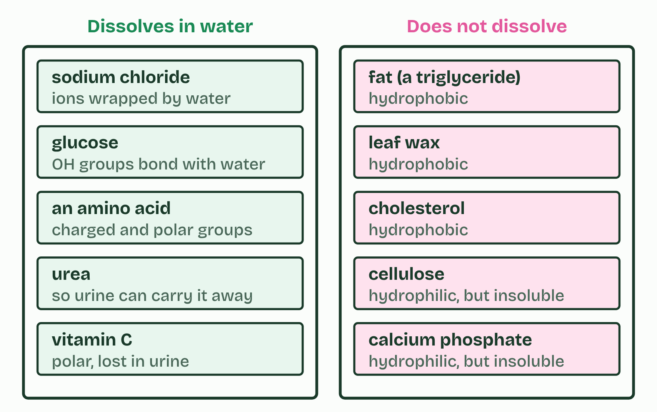
CHAPTER 5 · A1.1.5 Water as a solvent
The solvent cells run in
A solution is a solute dissolved in a solvent.
Each dissolved particle ends up wrapped in water molecules, which is called solvation.
Substances that are polar or charged are hydrophilic.
Substances that are non-polar, such as fats, oils and waxes, are hydrophobic: water molecules bond to each other instead, which pushes the non-polar molecules together, as oil forms droplets.
Minutes 15 to 30
Notes:
Minutes 15 to 30 of 60: The solvent (15 min).
The plan: Chapter 5's figure, then the sorter in pairs. Ask which molecules work because they do not dissolve, and what for. Finish with the oxygen predict box.
A solution is a solute dissolved in a solvent. Water dissolves a wide variety of substances: ions such as Na⁺, K⁺ and Cl⁻, and polar molecules such as glucose, amino acids and urea.
It does so because of its own charges. Water molecules crowd round an ion with their δ− oxygens turned towards positive ions and their δ+ hydrogens towards negative ions, and pull the ions apart. Polar molecules dissolve by forming hydrogen bonds with water. Each dissolved particle ends up wrapped in water molecules, which is called solvation. A positive ion such as Na⁺ is a cation and a negative ion such as Cl⁻ is an anion.
Substances that are polar or charged are hydrophilic. Substances that are non-polar, such as fats, oils and waxes, are hydrophobic: water molecules bond to each other instead, which pushes the non-polar molecules together, as oil forms droplets.
That makes water the medium for metabolism. Most enzymes catalyse reactions in aqueous solution, in the cytoplasm and in the fluids inside organelles, where dissolved enzymes and substrates move about and collide. It also makes water the medium for transport. Blood plasma carries glucose, amino acids, ions, urea and hormones dissolved in it, and xylem sap carries mineral ions such as nitrate and potassium from roots to leaves. Phloem sap carries dissolved sugars. Fats cannot travel dissolved, so in blood they ride inside lipoproteins, packages of lipid and protein that are soluble.
Some molecules work because they are hydrophobic and insoluble. The wax on a leaf stops water escaping. Fat stores energy, and insulates, without dissolving into the cell's water (the seal's insulating fat, in chapter 6). The non-polar tails of phospholipids make membranes a barrier to water-soluble substances (B1.1 and B2.1). Ten substances to sort are below.

Slide 25
PREDICT
Fish get all their oxygen from water. Oxygen molecules (O₂) are non-polar. How does the oxygen get into the water?
A It does not get in as a gas at all: fish split water molecules at the gills and take the oxygen from them
B It forms hydrogen bonds with the water molecules round it, in just the same way that glucose does
C Small non-polar molecules dissolve a little, and a little is enough to reach the gills
Minutes 15 to 30
Notes:
Minutes 15 to 30 of 60: The solvent (15 min).
The plan: Chapter 5's figure, then the sorter in pairs. Ask which molecules work because they do not dissolve, and what for. Finish with the oxygen predict box.
Ask for a show of hands, or mini whiteboards, before revealing. (Answer: C, on the next slide.)

Slide 26
WHAT HAPPENS
Fish get all their oxygen from water. Oxygen molecules (O₂) are non-polar. How does the oxygen get into the water?
A It does not get in as a gas at all: fish split water molecules at the gills and take the oxygen from them
B It forms hydrogen bonds with the water molecules round it, in just the same way that glucose does
C Small non-polar molecules dissolve a little, and a little is enough to reach the gills
A little dissolves. A litre of water at 20 °C holds only about 9 mg of oxygen, about a thirtieth of the oxygen in a litre of air. Small non-polar molecules such as oxygen slip in between water molecules in small amounts. It is enough for fish, which pass a great deal of water over large gills. Warm water holds even less, which is why fish gasp at the surface in a heatwave.
Minutes 15 to 30
Notes:
Minutes 15 to 30 of 60: The solvent (15 min).
The plan: Chapter 5's figure, then the sorter in pairs. Ask which molecules work because they do not dissolve, and what for. Finish with the oxygen predict box.
Answer: C. A little dissolves. A litre of water at 20 °C holds only about 9 mg of oxygen, about a thirtieth of the oxygen in a litre of air. Small non-polar molecules such as oxygen slip in between water molecules in small amounts. It is enough for fish, which pass a great deal of water over large gills. Warm water holds even less, which is why fish gasp at the surface in a heatwave.

Slide 27
WATCH OUT
"Water is the universal solvent." It dissolves more substances than any other common liquid, but not everything: fats, waxes, cellulose and bone mineral do not dissolve, and life depends on that.
Minutes 15 to 30
Notes:
Minutes 15 to 30 of 60: The solvent (15 min).
The plan: Chapter 5's figure, then the sorter in pairs. Ask which molecules work because they do not dissolve, and what for. Finish with the oxygen predict box.
A common mistake: say it, then ask who can say why it is wrong.

Slide 28
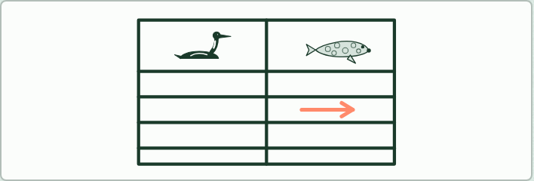
TABLE
20 MIN
Loon and seal: water against air
THE TASK
A grid of four properties by two animals, each cell split into in water and in air. Fill it from chapter 6's figure, then check it in pairs.
STUDENTS NEED
Printed grid or exercise books.
Minutes 30 to 50
Notes:
Minutes 30 to 50 of 60: Water against air (20 min).
The plan: Chapter 6's figure on the board, one property at a time. Pairs fill the loon and seal grid, then the pup predict box.
The activity: Loon and seal: water against air. A grid of four properties by two animals, each cell split into in water and in air. Fill it from chapter 6's figure, then check it in pairs.
Needs: printed grid or exercise books.
The time: 20 minutes, minutes 30 to 50 of the plan.

Slide 29
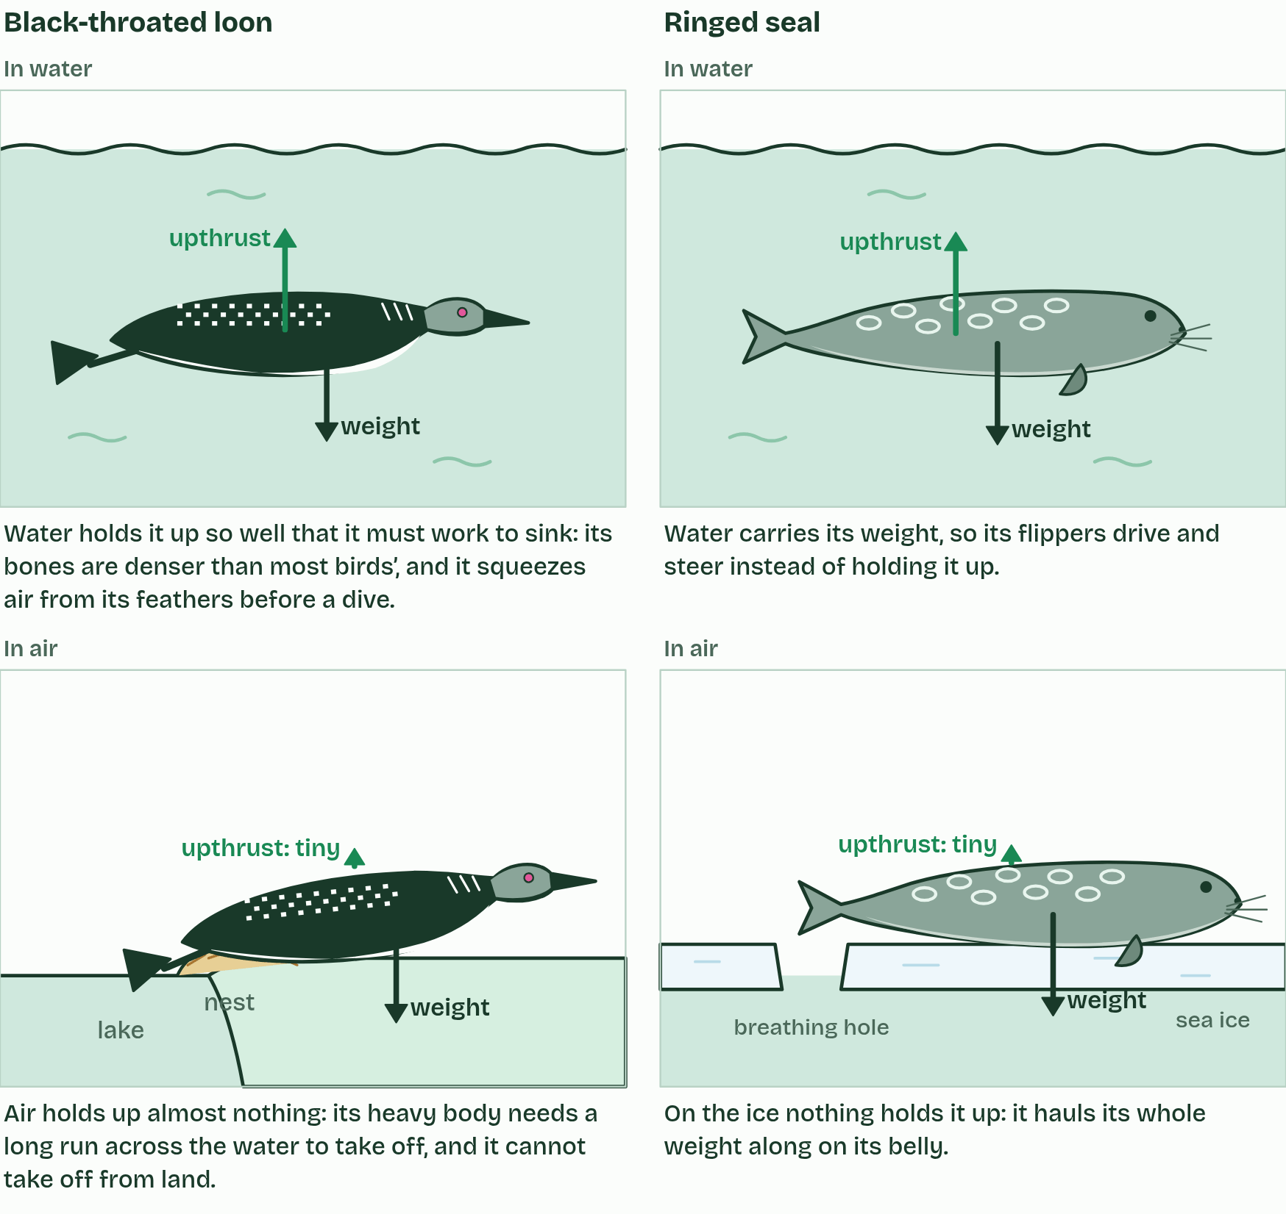
CHAPTER 6 · A1.1.6 Water as a habitat
1 / 4
Life in water, life in air
Buoyancy
Minutes 30 to 50
Notes:
Minutes 30 to 50 of 60: Water against air (20 min).
The plan: Chapter 6's figure on the board, one property at a time. Pairs fill the loon and seal grid, then the pup predict box.
Water is a habitat as well as a medium, and living in it is very different from living in air. Four properties decide most of the difference. The values here are for 20 °C.
Two animals show the contrast. The black-throated loon (Gavia arctica) is a diving bird that breeds on large northern lakes, winters at sea and chases fish underwater. The ringed seal (Pusa hispida) is the commonest Arctic seal. It lives on and under the sea ice, keeps breathing holes open with its claws, and is kept warm in the water by a thick layer of blubber. The figure sets water against air for each property, and shows what it means for each animal.
Example: Same bird, two names: in Britain and Ireland Gavia arctica is the black-throated diver. In an exam, either the common name or the scientific name is accepted.

Slide 30
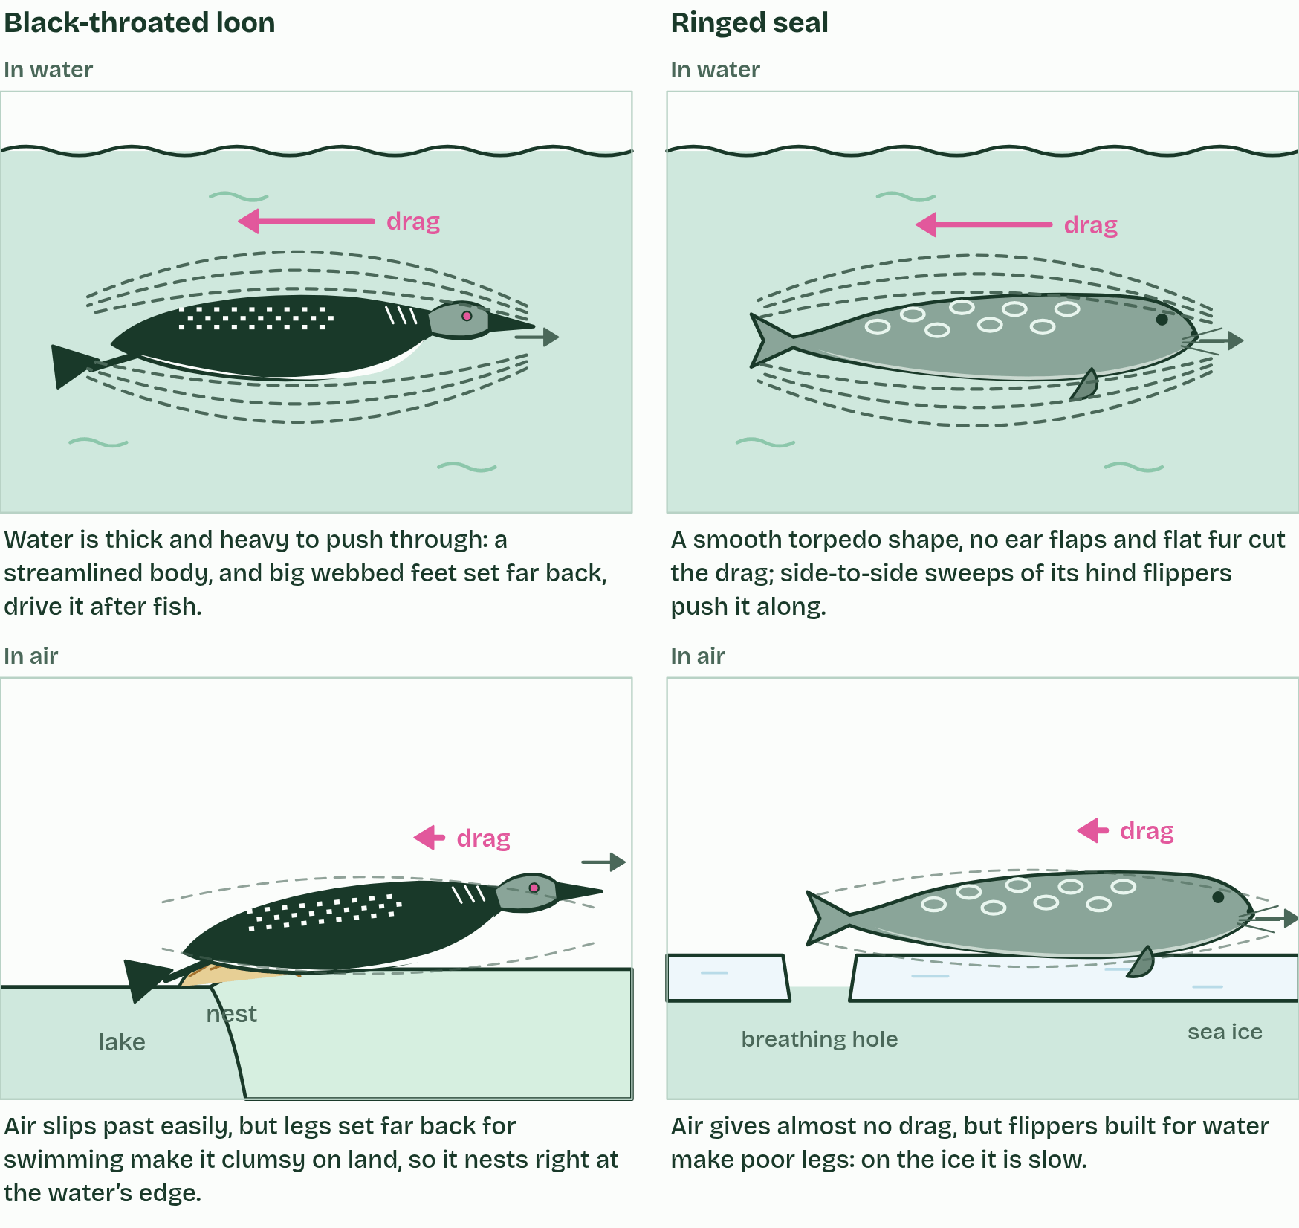
CHAPTER 6 · A1.1.6 Water as a habitat
2 / 4
Life in water, life in air
Viscosity
Minutes 30 to 50
Notes:
Minutes 30 to 50 of 60: Water against air (20 min).
The plan: Chapter 6's figure on the board, one property at a time. Pairs fill the loon and seal grid, then the pup predict box.
Water is a habitat as well as a medium, and living in it is very different from living in air. Four properties decide most of the difference. The values here are for 20 °C.
Two animals show the contrast. The black-throated loon (Gavia arctica) is a diving bird that breeds on large northern lakes, winters at sea and chases fish underwater. The ringed seal (Pusa hispida) is the commonest Arctic seal. It lives on and under the sea ice, keeps breathing holes open with its claws, and is kept warm in the water by a thick layer of blubber. The figure sets water against air for each property, and shows what it means for each animal.
Example: Same bird, two names: in Britain and Ireland Gavia arctica is the black-throated diver. In an exam, either the common name or the scientific name is accepted.

Slide 31
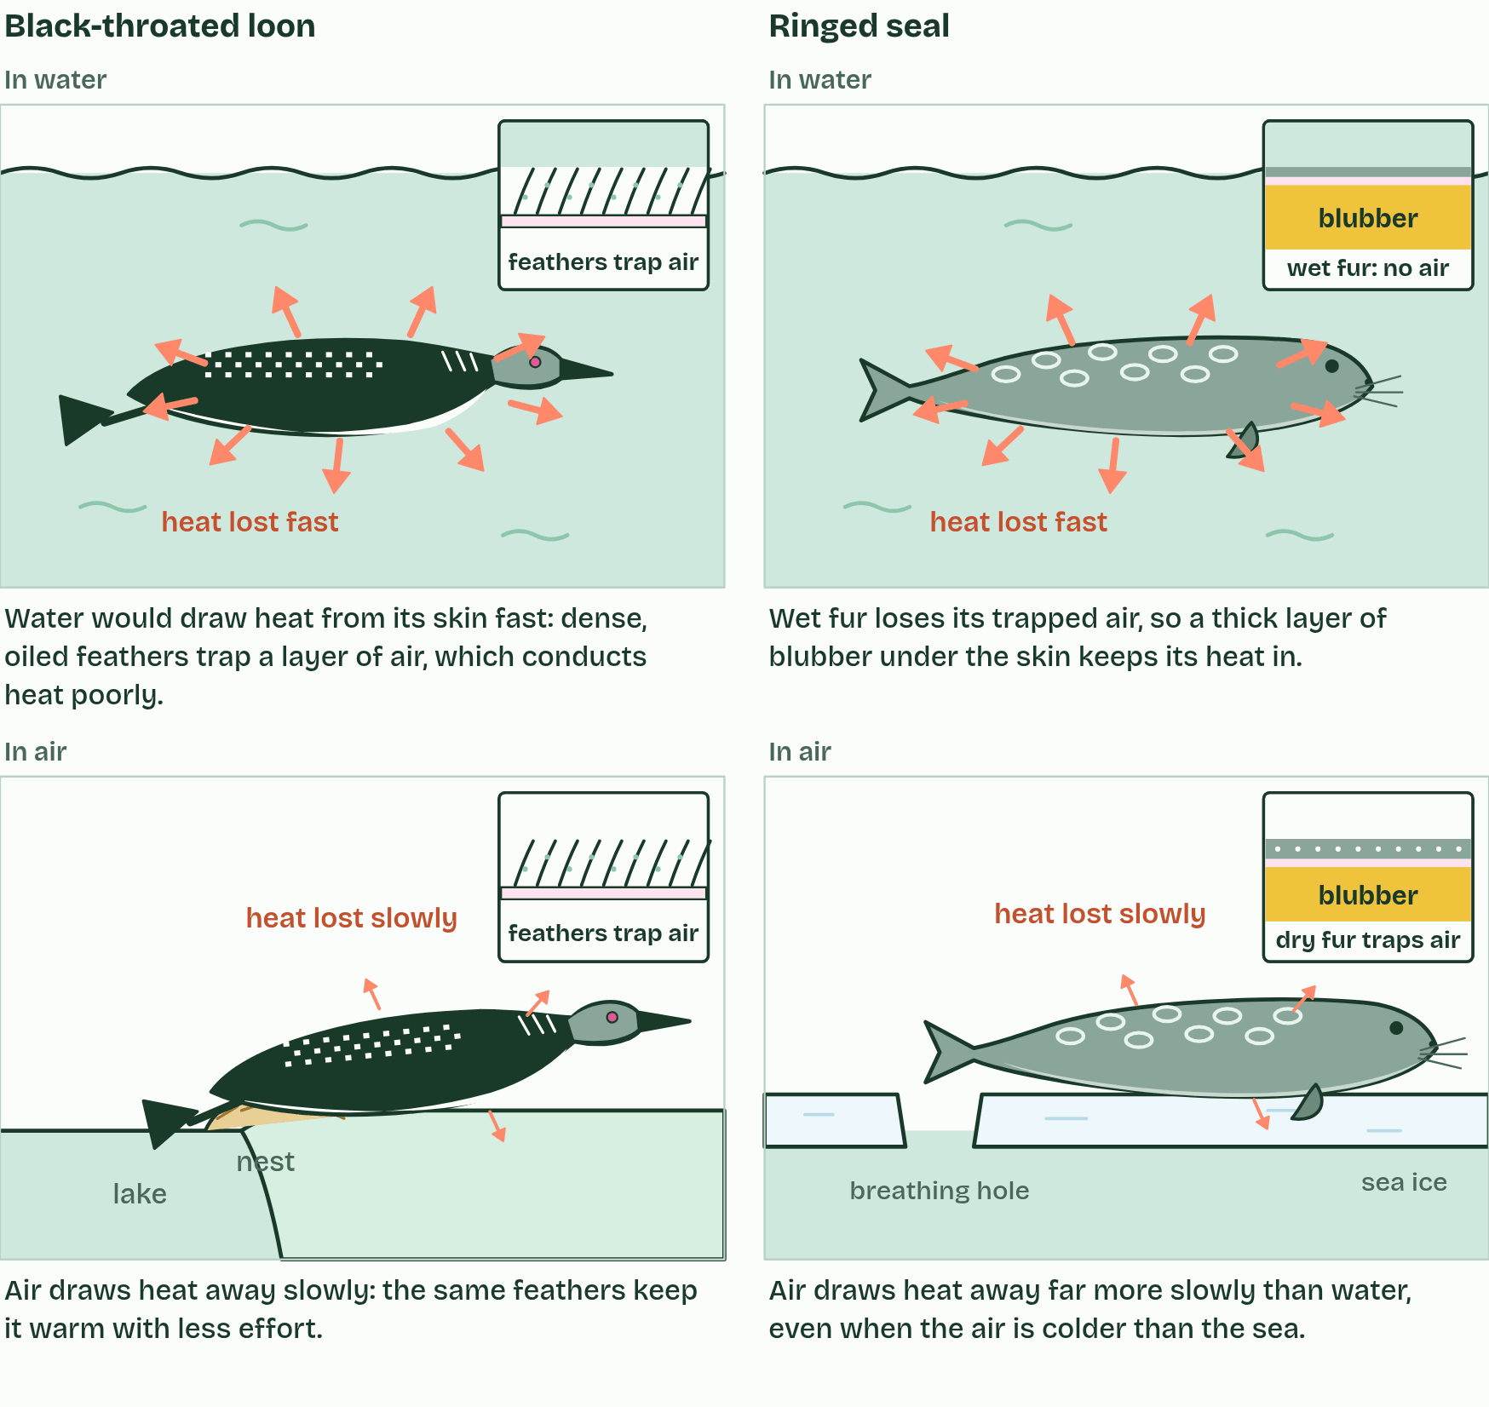
CHAPTER 6 · A1.1.6 Water as a habitat
3 / 4
Life in water, life in air
Heat flow
Minutes 30 to 50
Notes:
Minutes 30 to 50 of 60: Water against air (20 min).
The plan: Chapter 6's figure on the board, one property at a time. Pairs fill the loon and seal grid, then the pup predict box.
Water is a habitat as well as a medium, and living in it is very different from living in air. Four properties decide most of the difference. The values here are for 20 °C.
Two animals show the contrast. The black-throated loon (Gavia arctica) is a diving bird that breeds on large northern lakes, winters at sea and chases fish underwater. The ringed seal (Pusa hispida) is the commonest Arctic seal. It lives on and under the sea ice, keeps breathing holes open with its claws, and is kept warm in the water by a thick layer of blubber. The figure sets water against air for each property, and shows what it means for each animal.
Example: Same bird, two names: in Britain and Ireland Gavia arctica is the black-throated diver. In an exam, either the common name or the scientific name is accepted.

Slide 32
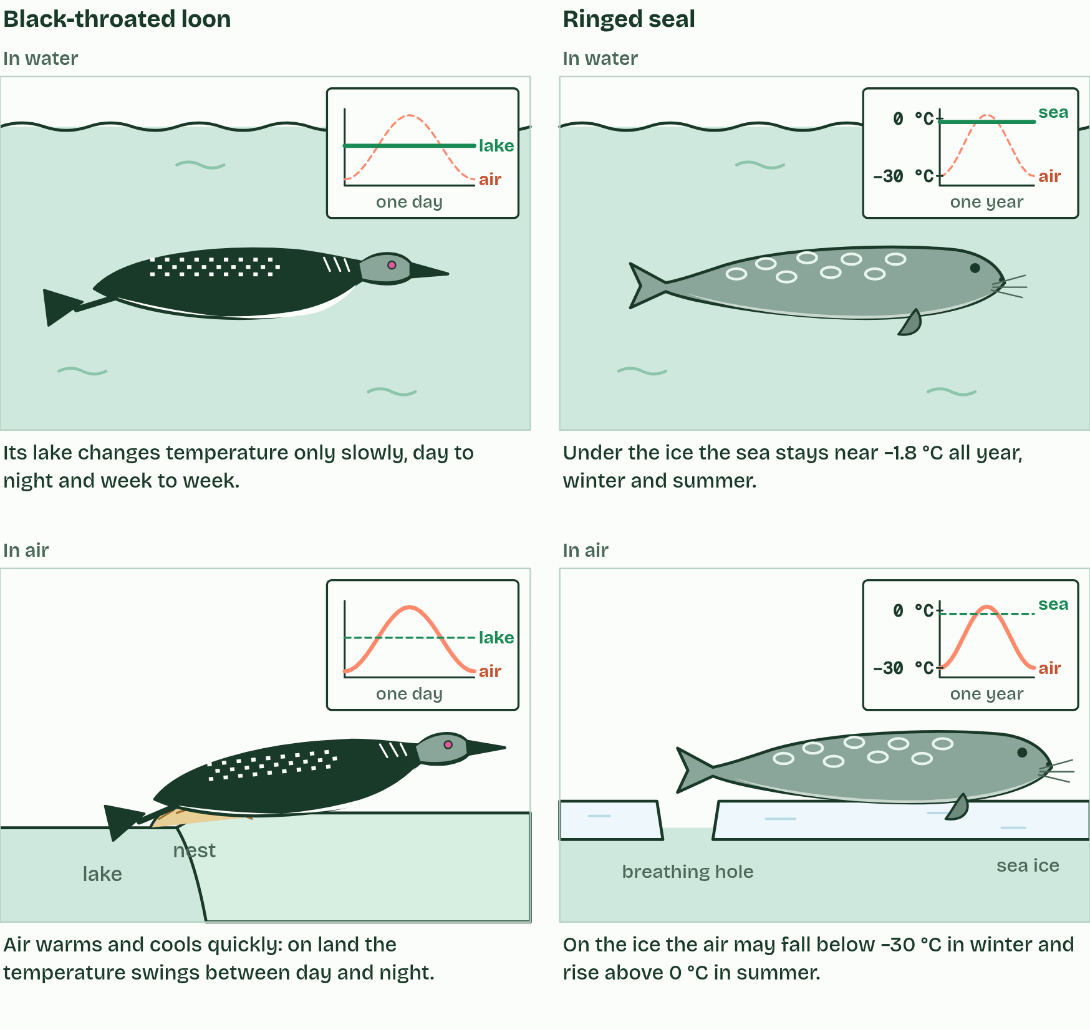
CHAPTER 6 · A1.1.6 Water as a habitat
4 / 4
Life in water, life in air
Heat capacity
Minutes 30 to 50
Notes:
Minutes 30 to 50 of 60: Water against air (20 min).
The plan: Chapter 6's figure on the board, one property at a time. Pairs fill the loon and seal grid, then the pup predict box.
Water is a habitat as well as a medium, and living in it is very different from living in air. Four properties decide most of the difference. The values here are for 20 °C.
Two animals show the contrast. The black-throated loon (Gavia arctica) is a diving bird that breeds on large northern lakes, winters at sea and chases fish underwater. The ringed seal (Pusa hispida) is the commonest Arctic seal. It lives on and under the sea ice, keeps breathing holes open with its claws, and is kept warm in the water by a thick layer of blubber. The figure sets water against air for each property, and shows what it means for each animal.
Example: Same bird, two names: in Britain and Ireland Gavia arctica is the black-throated diver. In an exam, either the common name or the scientific name is accepted.

Slide 33
CHAPTER 6 · A1.1.6 Water as a habitat
Life in water, life in air
Buoyancy. Water is over 800 times as dense as air, so it pushes up on a body with almost as much force as the body weighs. Air hardly supports a body at all.
Viscosity. Water is about 55 times as viscous as air, and far denser, so a body moving through it meets much more drag. Streamlined shapes save energy.
Thermal conductivity. Water conducts heat about 23 times as fast as air, so a warm body loses heat far faster in water than in air at the same temperature. Animals in cold water need thick insulation.
Specific heat capacity. It takes about 4.2 J to warm 1 g of water by 1 °C, about four times as much as for 1 g of air, and a litre of water holds about 3,500 times as much heat for each degree as a litre of air. Much of the energy goes into breaking hydrogen bonds before the molecules can move faster. So lakes and seas change temperature slowly, from day to night and season to season, and make a stable habitat.
Minutes 30 to 50
Notes:
Minutes 30 to 50 of 60: Water against air (20 min).
The plan: Chapter 6's figure on the board, one property at a time. Pairs fill the loon and seal grid, then the pup predict box.
Water is a habitat as well as a medium, and living in it is very different from living in air. Four properties decide most of the difference. The values here are for 20 °C.
Two animals show the contrast. The black-throated loon (Gavia arctica) is a diving bird that breeds on large northern lakes, winters at sea and chases fish underwater. The ringed seal (Pusa hispida) is the commonest Arctic seal. It lives on and under the sea ice, keeps breathing holes open with its claws, and is kept warm in the water by a thick layer of blubber. The figure sets water against air for each property, and shows what it means for each animal.
Example: Same bird, two names: in Britain and Ireland Gavia arctica is the black-throated diver. In an exam, either the common name or the scientific name is accepted.

Slide 34
PREDICT
Ringed seal pups are born in snow caves on the sea ice, with thick woolly fur but almost no blubber. What happens to a young pup that has to stay in the sea for a long time?
A It stays warm: the thick woolly fur traps heat in water just as it does in air, so it needs no blubber
B It chills fast: soaked fur holds no air, and water draws heat away about 23 times faster than air does
C It warms up: the sea under the ice is warmer than the winter air above it, so the pup gains heat from it
Minutes 30 to 50
Notes:
Minutes 30 to 50 of 60: Water against air (20 min).
The plan: Chapter 6's figure on the board, one property at a time. Pairs fill the loon and seal grid, then the pup predict box.
Ask for a show of hands, or mini whiteboards, before revealing. (Answer: B, on the next slide.)

Slide 35
WHAT HAPPENS
Ringed seal pups are born in snow caves on the sea ice, with thick woolly fur but almost no blubber. What happens to a young pup that has to stay in the sea for a long time?
A It stays warm: the thick woolly fur traps heat in water just as it does in air, so it needs no blubber
B It chills fast: soaked fur holds no air, and water draws heat away about 23 times faster than air does
C It warms up: the sea under the ice is warmer than the winter air above it, so the pup gains heat from it
It chills fast. The woolly fur keeps a pup warm in the snow cave because it traps air, a poor conductor of heat. Soaked, it holds water instead, and the pup has almost no blubber yet. The sea, at about −1.8 °C, is indeed warmer than the winter air, but water draws heat away so much faster that the pup loses heat far more quickly in it. That is why the snow caves matter.
Minutes 30 to 50
Notes:
Minutes 30 to 50 of 60: Water against air (20 min).
The plan: Chapter 6's figure on the board, one property at a time. Pairs fill the loon and seal grid, then the pup predict box.
Answer: B. It chills fast. The woolly fur keeps a pup warm in the snow cave because it traps air, a poor conductor of heat. Soaked, it holds water instead, and the pup has almost no blubber yet. The sea, at about −1.8 °C, is indeed warmer than the winter air, but water draws heat away so much faster that the pup loses heat far more quickly in it. That is why the snow caves matter.

Slide 36
WATCH OUT
"Thermal conductivity and specific heat capacity are the same." Water is high in both: it drains heat from a warm body quickly, while its own temperature hardly changes.
Minutes 30 to 50
Notes:
Minutes 30 to 50 of 60: Water against air (20 min).
The plan: Chapter 6's figure on the board, one property at a time. Pairs fill the loon and seal grid, then the pup predict box.
A common mistake: say it, then ask who can say why it is wrong.

Slide 37
STEP 5
5 MIN
Back to the cups
What happened in the cups, and why: adhesion first, then cohesion.
Minutes 50 to 55
Notes:
Minutes 50 to 55 of 60: Back to the cups (5 min).
The plan: What happened in the cups, and why: adhesion first, then cohesion.

Slide 38
PLENARY
Can you now...
Explain how adhesion draws water through soil and plant cell walls by capillary action (A1.1.4)
Explain why water is the medium for metabolism and transport, and why some molecules work because they do not dissolve (A1.1.5)
Compare water with air for buoyancy, viscosity, thermal conductivity and specific heat capacity, using the black-throated loon and the ringed seal (A1.1.6)
Minutes 55 to 60
Notes:
Minutes 55 to 60 of 60: Exit and homework (5 min).
The plan: Turn the Big Vessels Turn Slowly tiles back over and say what each stands for. Homework: research an organism and its water, and the Check step.
Thumbs up, sideways or down on each goal before the exit question. The goals come from the statements this lesson covers.

Slide 39
EXIT QUESTION
Before you go
Turn the Big Vessels Turn Slowly tiles back over and say what each stands for.
Minutes 55 to 60
Notes:
Minutes 55 to 60 of 60: Exit and homework (5 min).
The plan: Turn the Big Vessels Turn Slowly tiles back over and say what each stands for. Homework: research an organism and its water, and the Check step.

Slide 40
REMEMBER IT
The four properties A1.1.6 compares
B
V
T
S
Big
Vessels
Turn
Slowly
Minutes 55 to 60
Notes:
Minutes 55 to 60 of 60: Exit and homework (5 min).
The plan: Turn the Big Vessels Turn Slowly tiles back over and say what each stands for. Homework: research an organism and its water, and the Check step.
Ask the class what each letter stands for before revealing.

Slide 41
REMEMBER IT
The four properties A1.1.6 compares
B
V
T
S
Big
Vessels
Turn
Slowly
Buoyancy
Viscosity
Thermal conductivity
Specific heat capacity
water holds a body up
water resists movement: more drag
water draws heat from a body fast
water's temperature changes slowly
Minutes 55 to 60
Notes:
Minutes 55 to 60 of 60: Exit and homework (5 min).
The plan: Turn the Big Vessels Turn Slowly tiles back over and say what each stands for. Homework: research an organism and its water, and the Check step.
Big: Buoyancy (water holds a body up)
Vessels: Viscosity (water resists movement: more drag)
Turn: Thermal conductivity (water draws heat from a body fast)
Slowly: Specific heat capacity (water's temperature changes slowly)

Slide 42

RESEARCH
5 MIN
An organism and its water
THE TASK
Choose a local species or a favourite. Outline its adaptations to at least three properties of water (cohesion, adhesion, surface tension, solvent, buoyancy, viscosity, thermal conductivity, specific heat capacity) in a one-page profile with a sketch. Finish with a gallery walk. This is an ATL research skills task.
STUDENTS NEED
Devices or the library; a profile template with the properties as headings.
Minutes 55 to 60
Notes:
Minutes 55 to 60 of 60: Exit and homework (5 min).
The plan: Turn the Big Vessels Turn Slowly tiles back over and say what each stands for. Homework: research an organism and its water, and the Check step.
The activity: An organism and its water. Choose a local species or a favourite. Outline its adaptations to at least three properties of water (cohesion, adhesion, surface tension, solvent, buoyancy, viscosity, thermal conductivity, specific heat capacity) in a one-page profile with a sketch. Finish with a gallery walk. This is an ATL research skills task.
Needs: devices or the library; a profile template with the properties as headings.
The time: 5 minutes, minutes 55 to 60 of the plan.

Slide 43
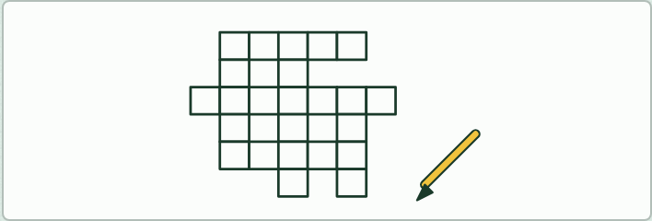
PLENARY
IF THERE IS TIME
Write a cryptic clue
THE TASK
Each student writes cryptic clues for three words from the keyword list, then swaps with a neighbour and solves.
STUDENTS NEED
The A1.1 key terms.
Minutes 55 to 60
Notes:
Minutes 55 to 60 of 60: Exit and homework (5 min).
The plan: Turn the Big Vessels Turn Slowly tiles back over and say what each stands for. Homework: research an organism and its water, and the Check step.
The activity: Write a cryptic clue. Each student writes cryptic clues for three words from the keyword list, then swaps with a neighbour and solves.
Needs: the A1.1 key terms.
The plan sets no time of its own for this activity: use it in this step, in place of part of it, or for homework.

Slide 44
PRACTISE AND REVISE
Keep going
Exam practice: a fresh paper of exam questions on A1.1 at standard level, marked as you go
The guide, with the animations and the dry lab
This lesson in the guide: 4 Water clings to polar surfaces, 5 The solvent cells run in, 6 Life in water, life in air
BUILD FOR YOUR CLASS
ALREADY ON THE SITE FOR A1.1
CARD SETS ON SPLYCR
Tarsia puzzle, dominoes and picture reveal on A1.1, built from its key terms and ready to print
A pub quiz with rounds on A1.1, to present or run with no projector
An escape room built from the question bank on A1.1
Lesson: Water
Summary doodle: Water
Quiz: Water
Revision map: A1.1 Water, to fill in
Exam questions: A1.1 in the exam maker, a paper with its markscheme
Open a set to host it as a class game, or make a copy to edit.
A1.1 Water
How this was made. The course structure, the activities and the teaching choices come from my own classroom, my presentations and my years of teaching IB and AP Biology. I use Claude, an AI, to help write and build the interactive guides, lesson plans, slides and practice questions, and to draw the diagrams and code the interactives. I direct the work and review it against the IB and AP specifications before it goes live.
Minute 60: after the lesson
Notes:
Every link here is live. Set the exam practice paper for homework: it is fresh each time, marked as students go and saved to their Exam practice when they are signed in.
Exam practice: https://www.biologybybradford.com/exam-maker/sit?topics=A1.1&level=SL&paper=quiz&marks=15&src=ep
The guide: https://www.biologybybradford.com/guides/ib-biology-a1-1-water

