Slide 1
IB Biology A1.1
LESSON 3 OF 4
BY THE END YOU CAN
Water
What makes a wet surface cool: the wet wicks dry lab (or the bench stations), with repeats, mean, SD and SE
Wet wicks, or water at the bench
Practical
What makes a wet surface cool: the wet wicks dry lab (or the bench stations), with repeats, mean, SD and SE
60 minutes · the dry lab
Minute 0
Notes:
IB Biology A1.1, Water. Lesson 3 of 4: Wet wicks, or water at the bench, 60 minutes.
The plan, minute by minute (each slide's footer says where you are):
0 to 5 min (5) The question
5 to 20 min (15) Liquids compared
20 to 35 min (15) The hand starter, measured
35 to 45 min (10) Process
45 to 60 min (15) Explain
The same hour can run the bench stations (the activity below) instead, with the dry lab for homework.
What students get wrong:
Sweat cools because water has a high specific heat capacity. It cools because evaporation takes heat away (latent heat of vaporisation).
Stretch and support:
Stretch: in the dry lab, predict the curve for a liquid that boils at about 97 °C, between ethanol and water, then reason about it.
The lesson plan to print: https://www.biologybybradford.com/guides/downloads/ib-biology-a1-1-water-lesson-3-plan.pdf

Slide 2
DO NOW
The question
Name the independent, dependent and controlled variables together.
Why a dry wick and an oil wick?
5:00
minutes
Start now: the timer is running.
Minutes 0 to 5
Notes:
Minutes 0 to 5 of 60: The question (5 min).
The plan: Name the independent, dependent and controlled variables together. Why a dry wick and an oil wick?
Start a 5 minute timer as they come in.

Slide 3
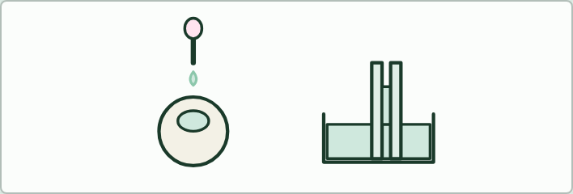
PRACTICAL
THE LESSON
Water at the bench
THE TASK
Four stations. Drops on a coin, water and soapy water, three trials each, with mean, SD and SE (cohesion). Capillary rise in tubes or straws of three widths (adhesion). What dissolves: salt, sugar, oil and sand (solvent). Water against dry sand warmed under a lamp, with the temperature taken every 2 minutes (heat capacity).
STUDENTS NEED
Coins, droppers, washing-up liquid, capillary tubes or straws, beakers, salt, sugar, oil, sand, a lamp, thermometers.
Minutes 0 to 5
Notes:
Minutes 0 to 5 of 60: The question (5 min).
The plan: Name the independent, dependent and controlled variables together. Why a dry wick and an oil wick?
The activity: Water at the bench. Four stations. Drops on a coin, water and soapy water, three trials each, with mean, SD and SE (cohesion). Capillary rise in tubes or straws of three widths (adhesion). What dissolves: salt, sugar, oil and sand (solvent). Water against dry sand warmed under a lamp, with the temperature taken every 2 minutes (heat capacity).
Needs: coins, droppers, washing-up liquid, capillary tubes or straws, beakers, salt, sugar, oil, sand, a lamp, thermometers.
The lesson is built round this activity: the steps that follow run it.

Slide 4
DRY LAB
THE LESSON
Wet wicks
THE TASK
The dry lab, with the tasks and questions under it, and its results table as a CSV for a pooled class graph. Done for real, it needs probes or thermometers, gauze, water, ethanol (flammable: no flames), cooking oil, droppers and a desk fan.
STUDENTS NEED
One device per pair.
Minutes 0 to 5
Notes:
Minutes 0 to 5 of 60: The question (5 min).
The plan: Name the independent, dependent and controlled variables together. Why a dry wick and an oil wick?
The activity: Wet wicks. The dry lab, with the tasks and questions under it, and its results table as a CSV for a pooled class graph. Done for real, it needs probes or thermometers, gauze, water, ethanol (flammable: no flames), cooking oil, droppers and a desk fan.
Needs: one device per pair.
The lesson is built round this activity: the steps that follow run it.

Slide 5
STEP 2
15 MIN
Liquids compared
Pairs open the dry lab and run all four wicks in still air three times, recording each run.
Students write their hypothesis for each wick before the first run.
Minutes 5 to 20
Notes:
Minutes 5 to 20 of 60: Liquids compared (15 min).
The plan: Pairs open the dry lab and run all four wicks in still air three times, recording each run. Students write their hypothesis for each wick before the first run.

Slide 6
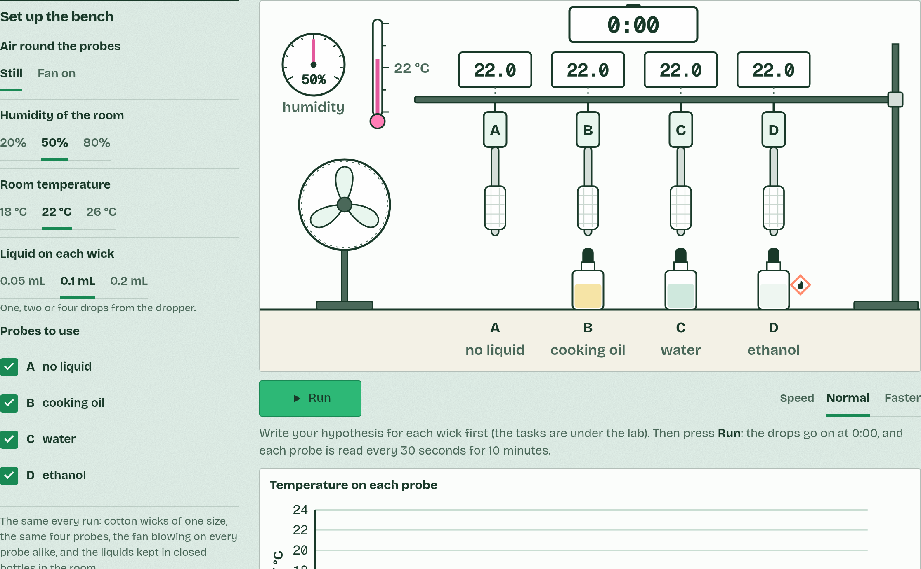
DRY LAB
Wet wicks: cooling by evaporation
Your question: What makes a wet surface cool down? Do different liquids cool it by different amounts, at different speeds, or for different lengths of time?
What you can change: The liquid on each of four wicks (none, cooking oil, water, ethanol), the air (still, or a fan), the room's humidity, the volume of liquid put on each wick and the room temperature.
What to record: Each probe's temperature every 30 seconds for 10 minutes. From each run: the starting temperature, the lowest, the largest fall and when it came. Repeat each set-up at least three times: the runs scatter, as real readings do.
Run it: biologybybradford.com/guides/ib-biology-a1-1-water#lab
Minutes 5 to 20
Notes:
Minutes 5 to 20 of 60: Liquids compared (15 min).
The plan: Pairs open the dry lab and run all four wicks in still air three times, recording each run. Students write their hypothesis for each wick before the first run.
The dry lab runs in the guide: https://www.biologybybradford.com/guides/ib-biology-a1-1-water#lab

Slide 7
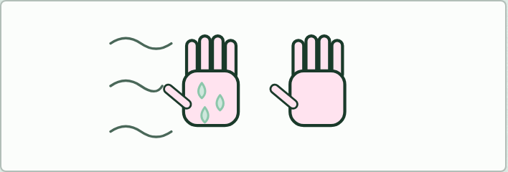
DEMO
IF THERE IS TIME
Wet hand, dry hand
THE TASK
Students wet the back of one hand, blow on both, and say which is colder and why. Revisit it after the dry lab, when the answer has numbers behind it.
STUDENTS NEED
Water, paper towels.
Minutes 5 to 20
Notes:
Minutes 5 to 20 of 60: Liquids compared (15 min).
The plan: Pairs open the dry lab and run all four wicks in still air three times, recording each run. Students write their hypothesis for each wick before the first run.
The activity: Wet hand, dry hand. Students wet the back of one hand, blow on both, and say which is colder and why. Revisit it after the dry lab, when the answer has numbers behind it.
Needs: water, paper towels.
The plan sets no time of its own for this activity: use it in this step, in place of part of it, or for homework.

Slide 8
STEP 3
15 MIN
The hand starter, measured
Each pair takes a different set-up, runs it three times, and the class pools its results on the board.
Minutes 20 to 35
Notes:
Minutes 20 to 35 of 60: The hand starter, measured (15 min).
The plan: In the dry lab, fan on, then humidity at 20% and 80%. Each pair takes a different set-up, runs it three times, and the class pools its results on the board.

Slide 9
STEP 4
10 MIN
Process
Work out one standard deviation and standard error by hand, check them against Graph your results in the lab, and draw a graph with error bars.
Minutes 35 to 45
Notes:
Minutes 35 to 45 of 60: Process (10 min).
The plan: Work out one standard deviation and standard error by hand, check them against Graph your results in the lab, and draw a graph with error bars.

Slide 10
PLENARY
Explain
The three questions under the lab.
Minutes 45 to 60
Notes:
Minutes 45 to 60 of 60: Explain (15 min).
The plan: The three questions under the lab. Link the result to sweating and to leaves, and evaluate the method.

Slide 11
EXIT QUESTION
Before you go
On paper, on your own: one thing the dry lab showed, and one way the model differs from the real thing.
Minutes 45 to 60
Notes:
Minutes 45 to 60 of 60: Explain (15 min).
The plan: The three questions under the lab. Link the result to sweating and to leaves, and evaluate the method.
Collect the slips: they say where to start next lesson.

Slide 12
PRACTISE AND REVISE
Keep going
Exam practice: a fresh paper of exam questions on A1.1 at standard level, marked as you go
The guide, with the animations and the dry lab
This lesson in the guide: the dry lab
BUILD FOR YOUR CLASS
ALREADY ON THE SITE FOR A1.1
CARD SETS ON SPLYCR
Tarsia puzzle, dominoes and picture reveal on A1.1, built from its key terms and ready to print
A pub quiz with rounds on A1.1, to present or run with no projector
An escape room built from the question bank on A1.1
Lesson: Water
Summary doodle: Water
Quiz: Water
Revision map: A1.1 Water, to fill in
Exam questions: A1.1 in the exam maker, a paper with its markscheme
Open a set to host it as a class game, or make a copy to edit.
A1.1 Water
How this was made. The course structure, the activities and the teaching choices come from my own classroom, my presentations and my years of teaching IB and AP Biology. I use Claude, an AI, to help write and build the interactive guides, lesson plans, slides and practice questions, and to draw the diagrams and code the interactives. I direct the work and review it against the IB and AP specifications before it goes live.
Minute 60: after the lesson
Notes:
Every link here is live. Set the exam practice paper for homework: it is fresh each time, marked as students go and saved to their Exam practice when they are signed in.
Exam practice: https://www.biologybybradford.com/exam-maker/sit?topics=A1.1&level=SL&paper=quiz&marks=15&src=ep
The guide: https://www.biologybybradford.com/guides/ib-biology-a1-1-water

