Slide 1
IB Biology A1.1
LESSON 4 OF 4
HL
BY THE END YOU CAN
Water
Outline how asteroids may have brought Earth's water, and why gravity and cool temperatures kept it (A1.1.7)
Explain why the search for life elsewhere looks for liquid water in a star's Goldilocks zone (A1.1.8)
Water from space, and life beyond Earth
A1.1.7, A1.1.8
Where Earth's water came from and why it stayed, and the Goldilocks zone in the search for life
60 minutes · chapters 7, 8
Minute 0
Notes:
IB Biology A1.1, Water. Lesson 4 of 4: Water from space, and life beyond Earth (higher level), 60 minutes.
The plan, minute by minute (each slide's footer says where you are):
0 to 5 min (5) Do now
5 to 20 min (15) Where it came from
20 to 30 min (10) Goldilocks
30 to 45 min (15) The street light effect
45 to 60 min (15) Exam question, timed
What students get wrong:
Every star's zone is where Earth is. It moves with the star.
In the zone means life. It means liquid water could exist.
Stretch and support:
Support: use the Remember it tiles as a starter in each lesson.
Stretch: Europa and Enceladus lie far outside the Sun's Goldilocks zone. What does that say about the zone as a model?
The lesson plan to print: https://www.biologybybradford.com/guides/downloads/ib-biology-a1-1-water-lesson-4-plan.pdf

Slide 2
DO NOW
Do now
Why is there liquid water on Earth, but not on the Moon, Mars or Venus?
5:00
minutes
Start now: the timer is running.
Minutes 0 to 5
Notes:
Minutes 0 to 5 of 60: Do now (5 min).
The plan: Why is there liquid water on Earth, but not on the Moon, Mars or Venus? Collect ideas without correcting them.
Start a 5 minute timer as they come in.

Slide 3
STEP 2
15 MIN
Where it came from
Chapter 7: Water from space, kept by gravity
Minutes 5 to 20
Notes:
Minutes 5 to 20 of 60: Where it came from (15 min).
The plan: Chapter 7's figure, then the evidence card task. Then the Venus predict box and the Grip and Chill tiles.

Slide 4
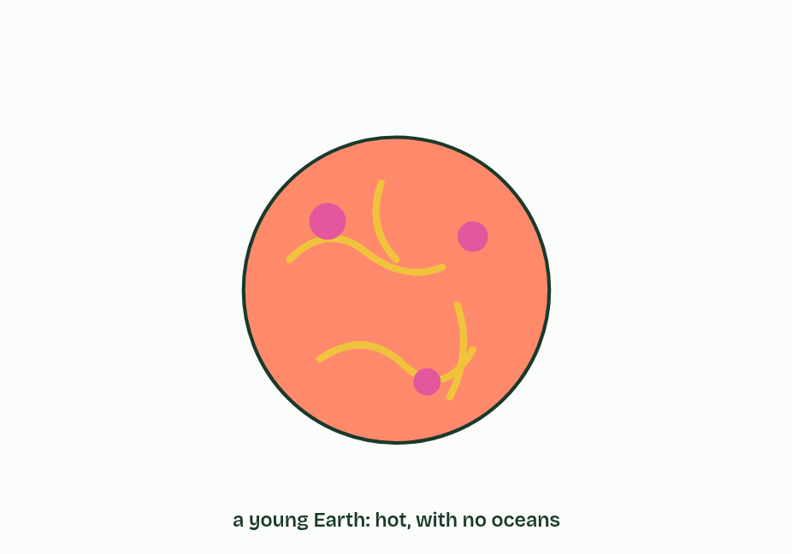
CHAPTER 7 · A1.1.7 The origin of Earth's water
1 / 5
Water from space, kept by gravity
The young Earth, about 4.5 billion years ago, is hot, with no oceans.
Minutes 5 to 20
Notes:
Minutes 5 to 20 of 60: Where it came from (15 min).
The plan: Chapter 7's figure, then the evidence card task. Then the Venus predict box and the Grip and Chill tiles.
Water has been abundant on Earth for billions of years, and that gave life the time it needed to arise and evolve. So where did it come from?
Earth formed about 4.5 billion years ago, and it was hot. Much of its water is thought to have come from space. Asteroids crashed into the young planet, and some of them had water locked inside their minerals. That is the hypothesis this statement asks for.
Bringing water was only half of it. Earth also kept it, for two reasons.
Example: How do we know? No one saw it happen, so the hypothesis is tested with evidence. Hydrogen comes in a light form and a heavy form (deuterium), and the ratio of heavy to light hydrogen in water depends on where in the early Solar System the water formed. Water locked in some meteorites, which are fragments of asteroids, has almost the same ratio as Earth's oceans. That supports the asteroid hypothesis.

Slide 5
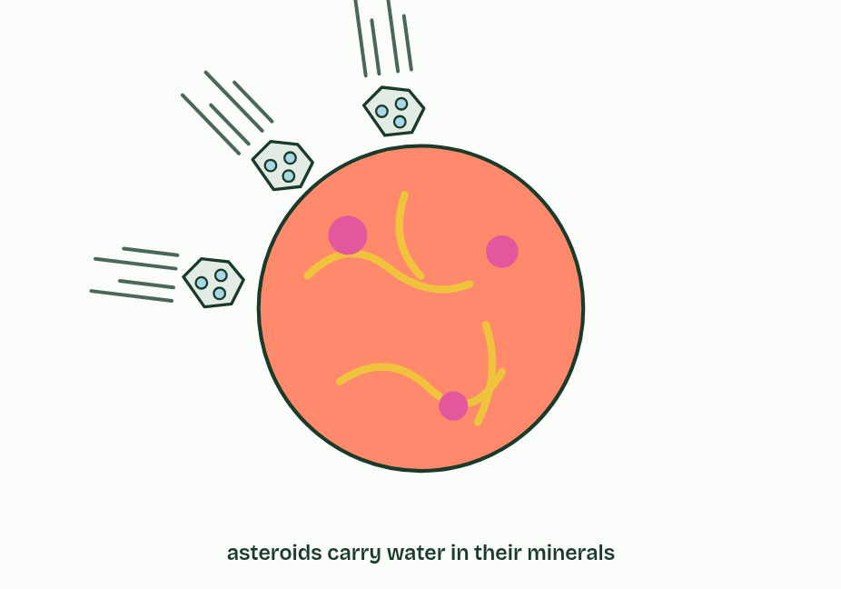
CHAPTER 7 · A1.1.7 The origin of Earth's water
2 / 5
Water from space, kept by gravity
Asteroids crash into it. Some carry water locked inside their minerals, and they bring it to the planet.
Minutes 5 to 20
Notes:
Minutes 5 to 20 of 60: Where it came from (15 min).
The plan: Chapter 7's figure, then the evidence card task. Then the Venus predict box and the Grip and Chill tiles.
Water has been abundant on Earth for billions of years, and that gave life the time it needed to arise and evolve. So where did it come from?
Earth formed about 4.5 billion years ago, and it was hot. Much of its water is thought to have come from space. Asteroids crashed into the young planet, and some of them had water locked inside their minerals. That is the hypothesis this statement asks for.
Bringing water was only half of it. Earth also kept it, for two reasons.
Example: How do we know? No one saw it happen, so the hypothesis is tested with evidence. Hydrogen comes in a light form and a heavy form (deuterium), and the ratio of heavy to light hydrogen in water depends on where in the early Solar System the water formed. Water locked in some meteorites, which are fragments of asteroids, has almost the same ratio as Earth's oceans. That supports the asteroid hypothesis.

Slide 6
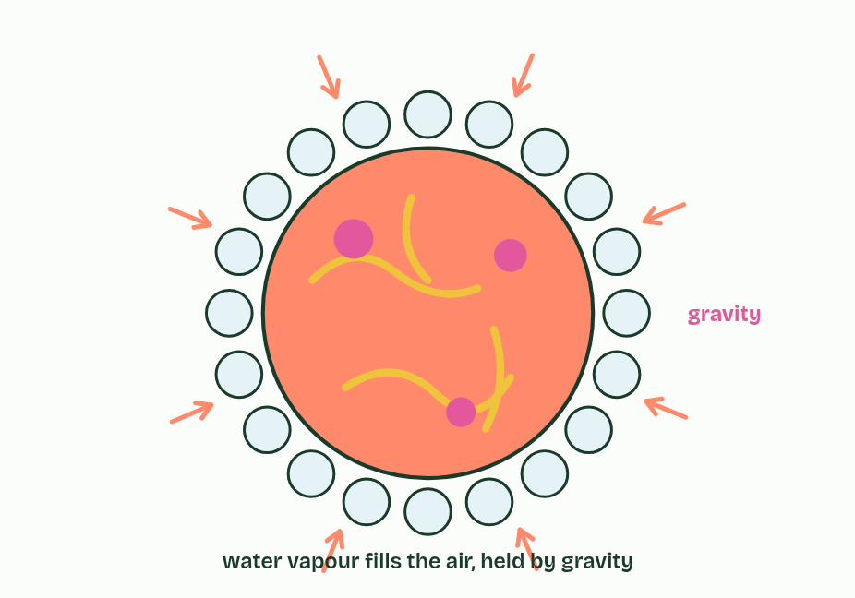
CHAPTER 7 · A1.1.7 The origin of Earth's water
3 / 5
Water from space, kept by gravity
The water turns to vapour and fills the air. Earth’s gravity holds it, and the rest of the atmosphere, in.
Minutes 5 to 20
Notes:
Minutes 5 to 20 of 60: Where it came from (15 min).
The plan: Chapter 7's figure, then the evidence card task. Then the Venus predict box and the Grip and Chill tiles.
Water has been abundant on Earth for billions of years, and that gave life the time it needed to arise and evolve. So where did it come from?
Earth formed about 4.5 billion years ago, and it was hot. Much of its water is thought to have come from space. Asteroids crashed into the young planet, and some of them had water locked inside their minerals. That is the hypothesis this statement asks for.
Bringing water was only half of it. Earth also kept it, for two reasons.
Example: How do we know? No one saw it happen, so the hypothesis is tested with evidence. Hydrogen comes in a light form and a heavy form (deuterium), and the ratio of heavy to light hydrogen in water depends on where in the early Solar System the water formed. Water locked in some meteorites, which are fragments of asteroids, has almost the same ratio as Earth's oceans. That supports the asteroid hypothesis.

Slide 7
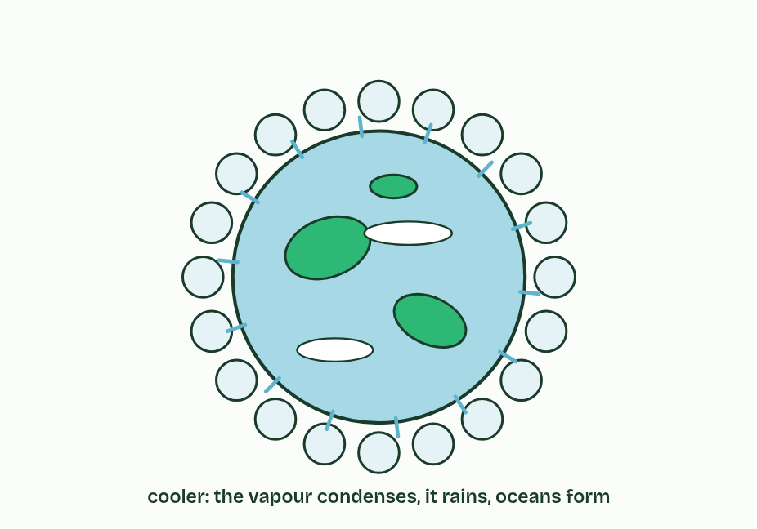
CHAPTER 7 · A1.1.7 The origin of Earth's water
4 / 5
Water from space, kept by gravity
Earth cools until the temperature is low enough for the vapour to condense. It rains, and oceans form.
Minutes 5 to 20
Notes:
Minutes 5 to 20 of 60: Where it came from (15 min).
The plan: Chapter 7's figure, then the evidence card task. Then the Venus predict box and the Grip and Chill tiles.
Water has been abundant on Earth for billions of years, and that gave life the time it needed to arise and evolve. So where did it come from?
Earth formed about 4.5 billion years ago, and it was hot. Much of its water is thought to have come from space. Asteroids crashed into the young planet, and some of them had water locked inside their minerals. That is the hypothesis this statement asks for.
Bringing water was only half of it. Earth also kept it, for two reasons.
Example: How do we know? No one saw it happen, so the hypothesis is tested with evidence. Hydrogen comes in a light form and a heavy form (deuterium), and the ratio of heavy to light hydrogen in water depends on where in the early Solar System the water formed. Water locked in some meteorites, which are fragments of asteroids, has almost the same ratio as Earth's oceans. That supports the asteroid hypothesis.

Slide 8
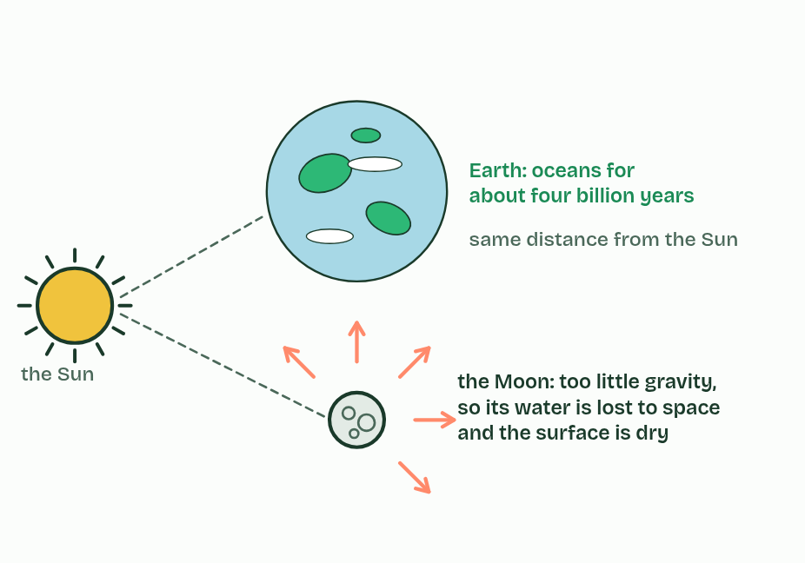
CHAPTER 7 · A1.1.7 The origin of Earth's water
5 / 5
Water from space, kept by gravity
The Moon, at the same distance from the Sun, has too little gravity to hold water, and stays dry. Earth’s oceans have lasted about four billion years.
Minutes 5 to 20
Notes:
Minutes 5 to 20 of 60: Where it came from (15 min).
The plan: Chapter 7's figure, then the evidence card task. Then the Venus predict box and the Grip and Chill tiles.
Water has been abundant on Earth for billions of years, and that gave life the time it needed to arise and evolve. So where did it come from?
Earth formed about 4.5 billion years ago, and it was hot. Much of its water is thought to have come from space. Asteroids crashed into the young planet, and some of them had water locked inside their minerals. That is the hypothesis this statement asks for.
Bringing water was only half of it. Earth also kept it, for two reasons.
Example: How do we know? No one saw it happen, so the hypothesis is tested with evidence. Hydrogen comes in a light form and a heavy form (deuterium), and the ratio of heavy to light hydrogen in water depends on where in the early Solar System the water formed. Water locked in some meteorites, which are fragments of asteroids, has almost the same ratio as Earth's oceans. That supports the asteroid hypothesis.

Slide 9
CHAPTER 7 · A1.1.7 The origin of Earth's water
Water from space, kept by gravity
Gravity. Earth is massive enough for its gravity to hold water vapour and the rest of the atmosphere. The Moon, with about a hundredth of Earth's mass, could not, and has almost no water: only a little ice in craters that sunlight never reaches.
Temperatures low enough for water to condense. Earth is far enough from the Sun, and cooled enough, for water vapour to condense into liquid water. It rained out to form oceans that have lasted about four billion years.
Minutes 5 to 20
Notes:
Minutes 5 to 20 of 60: Where it came from (15 min).
The plan: Chapter 7's figure, then the evidence card task. Then the Venus predict box and the Grip and Chill tiles.
Water has been abundant on Earth for billions of years, and that gave life the time it needed to arise and evolve. So where did it come from?
Earth formed about 4.5 billion years ago, and it was hot. Much of its water is thought to have come from space. Asteroids crashed into the young planet, and some of them had water locked inside their minerals. That is the hypothesis this statement asks for.
Bringing water was only half of it. Earth also kept it, for two reasons.
Example: How do we know? No one saw it happen, so the hypothesis is tested with evidence. Hydrogen comes in a light form and a heavy form (deuterium), and the ratio of heavy to light hydrogen in water depends on where in the early Solar System the water formed. Water locked in some meteorites, which are fragments of asteroids, has almost the same ratio as Earth's oceans. That supports the asteroid hypothesis.

Slide 10
PREDICT
Venus is almost the same size and mass as Earth, but closer to the Sun. Why are there no oceans on Venus?
A It is too hot for water vapour to condense into liquid, so any water stayed in the air as vapour
B Its gravity is too weak to hold on to water vapour, so all of the vapour escaped into space long ago
C No asteroids carrying water ever reached it, so it never had any water at all to form its oceans from
Minutes 5 to 20
Notes:
Minutes 5 to 20 of 60: Where it came from (15 min).
The plan: Chapter 7's figure, then the evidence card task. Then the Venus predict box and the Grip and Chill tiles.
Ask for a show of hands, or mini whiteboards, before revealing. (Answer: A, on the next slide.)

Slide 11
WHAT HAPPENS
Venus is almost the same size and mass as Earth, but closer to the Sun. Why are there no oceans on Venus?
A It is too hot for water vapour to condense into liquid, so any water stayed in the air as vapour
B Its gravity is too weak to hold on to water vapour, so all of the vapour escaped into space long ago
C No asteroids carrying water ever reached it, so it never had any water at all to form its oceans from
Too hot. Venus's gravity is nearly as strong as Earth's, so gravity is not the problem. Its surface is about 460 °C today, so its water stayed as vapour and has since been lost. A planet needs both: enough gravity, and temperatures low enough for water to condense.
Minutes 5 to 20
Notes:
Minutes 5 to 20 of 60: Where it came from (15 min).
The plan: Chapter 7's figure, then the evidence card task. Then the Venus predict box and the Grip and Chill tiles.
Answer: A. Too hot. Venus's gravity is nearly as strong as Earth's, so gravity is not the problem. Its surface is about 460 °C today, so its water stayed as vapour and has since been lost. A planet needs both: enough gravity, and temperatures low enough for water to condense.

Slide 12
WATCH OUT
"Earth kept its water because it has an atmosphere." The atmosphere is itself held by gravity. The two reasons to learn are gravity and temperatures low enough to condense water.
Minutes 5 to 20
Notes:
Minutes 5 to 20 of 60: Where it came from (15 min).
The plan: Chapter 7's figure, then the evidence card task. Then the Venus predict box and the Grip and Chill tiles.
A common mistake: say it, then ask who can say why it is wrong.

Slide 13
REMEMBER IT
Why Earth kept its water
G
C
Grip
Chill
Minutes 5 to 20
Notes:
Minutes 5 to 20 of 60: Where it came from (15 min).
The plan: Chapter 7's figure, then the evidence card task. Then the Venus predict box and the Grip and Chill tiles.
Ask the class what each letter stands for before revealing.

Slide 14
REMEMBER IT
Why Earth kept its water
G
C
Grip
Chill
Gravity
Cool enough to condense
holds water vapour and air to the planet
temperatures low enough for vapour to become liquid
Minutes 5 to 20
Notes:
Minutes 5 to 20 of 60: Where it came from (15 min).
The plan: Chapter 7's figure, then the evidence card task. Then the Venus predict box and the Grip and Chill tiles.
Grip: Gravity (holds water vapour and air to the planet)
Chill: Cool enough to condense (temperatures low enough for vapour to become liquid)

Slide 15

DISCUSSION · HL
10 MIN
Goldilocks and the street light
THE TASK
Start with the porridge line, then the zone. Then argue for and against searching only the zone, with Europa and Enceladus as test cases.
STUDENTS NEED
Chapter 8 on screen.
Minutes 20 to 30
Notes:
Minutes 20 to 30 of 60: Goldilocks (10 min).
The plan: Read the porridge line of the story, then chapter 8's figure and the dim star predict box. Pairs work the Goldilocks scene: move the planet, change the star, shrink the planet.
The activity: Goldilocks and the street light. Start with the porridge line, then the zone. Then argue for and against searching only the zone, with Europa and Enceladus as test cases.
Needs: chapter 8 on screen.
The time: 10 minutes, minutes 20 to 30 of the plan.

Slide 16
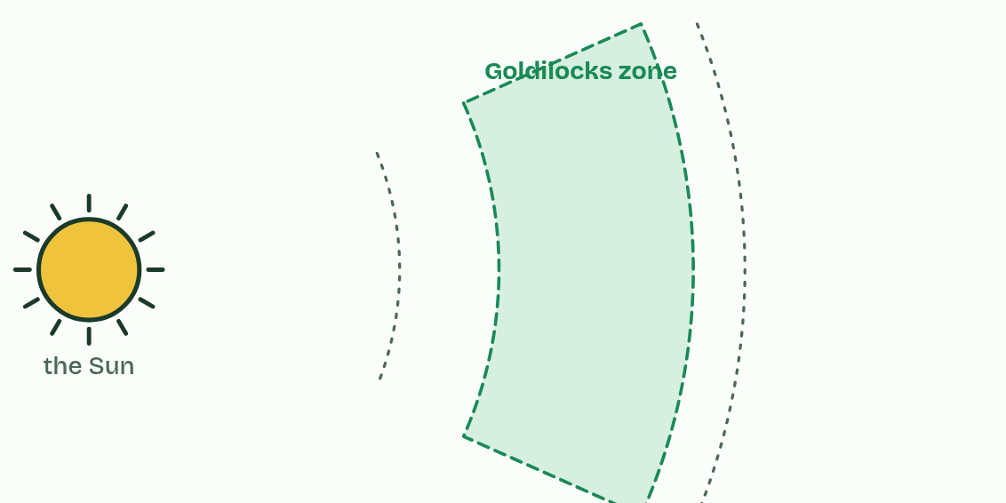
CHAPTER 8 · A1.1.8 The search for life elsewhere
1 / 4
Not too hot, not too cold: the Goldilocks zone
A star warms the planets round it. The pale band is its Goldilocks zone: the distances at which a planet’s surface could keep liquid water.
Minutes 20 to 30
Notes:
Minutes 20 to 30 of 60: Goldilocks (10 min).
The plan: Read the porridge line of the story, then chapter 8's figure and the dim star predict box. Pairs work the Goldilocks scene: move the planet, change the star, shrink the planet.
All the life we know needs liquid water as its medium (chapters 1 and 5), so the search for extraterrestrial life starts by looking for liquid water.
The Goldilocks zone, also called the habitable zone, is the band of distances round a star where a planet's surface is warm enough for water not to freeze and cool enough for it not to boil away, so water could stay liquid. Too close and it is too hot. Too far and it is too cold. The zone depends on the star: a brighter, hotter star has its zone farther out, and a dimmer, cooler star has it closer in.
Earth lies inside the Sun's zone. Venus, closer, is far too hot. Mars, just outside the zone and much smaller than Earth, is cold, with a thin atmosphere and its water frozen. Astronomers have now found more than 5,000 planets round other stars, called exoplanets. The rocky ones in their star's zone are the first targets in the search for life, and space agencies share their missions and data to look for them.
The zone is a model, and every model has limits. Being in the zone does not mean a planet has water: it must have received some and kept it (chapter 7). And liquid water can exist outside the zone, under ice warmed from inside, as on Jupiter's moon Europa and Saturn's moon Enceladus. Searching only the zone could miss life, like looking for lost keys only under the street light because the light is better there.

Slide 17
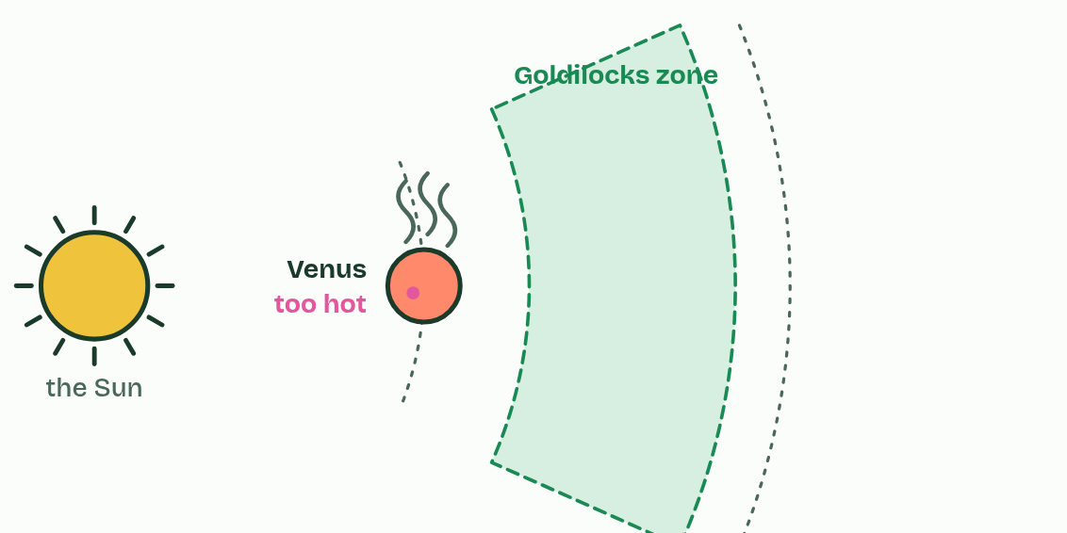
CHAPTER 8 · A1.1.8 The search for life elsewhere
2 / 4
Not too hot, not too cold: the Goldilocks zone
Venus is closer than the zone’s inner edge. It is too hot: water would boil away as vapour.
Minutes 20 to 30
Notes:
Minutes 20 to 30 of 60: Goldilocks (10 min).
The plan: Read the porridge line of the story, then chapter 8's figure and the dim star predict box. Pairs work the Goldilocks scene: move the planet, change the star, shrink the planet.
All the life we know needs liquid water as its medium (chapters 1 and 5), so the search for extraterrestrial life starts by looking for liquid water.
The Goldilocks zone, also called the habitable zone, is the band of distances round a star where a planet's surface is warm enough for water not to freeze and cool enough for it not to boil away, so water could stay liquid. Too close and it is too hot. Too far and it is too cold. The zone depends on the star: a brighter, hotter star has its zone farther out, and a dimmer, cooler star has it closer in.
Earth lies inside the Sun's zone. Venus, closer, is far too hot. Mars, just outside the zone and much smaller than Earth, is cold, with a thin atmosphere and its water frozen. Astronomers have now found more than 5,000 planets round other stars, called exoplanets. The rocky ones in their star's zone are the first targets in the search for life, and space agencies share their missions and data to look for them.
The zone is a model, and every model has limits. Being in the zone does not mean a planet has water: it must have received some and kept it (chapter 7). And liquid water can exist outside the zone, under ice warmed from inside, as on Jupiter's moon Europa and Saturn's moon Enceladus. Searching only the zone could miss life, like looking for lost keys only under the street light because the light is better there.

Slide 18
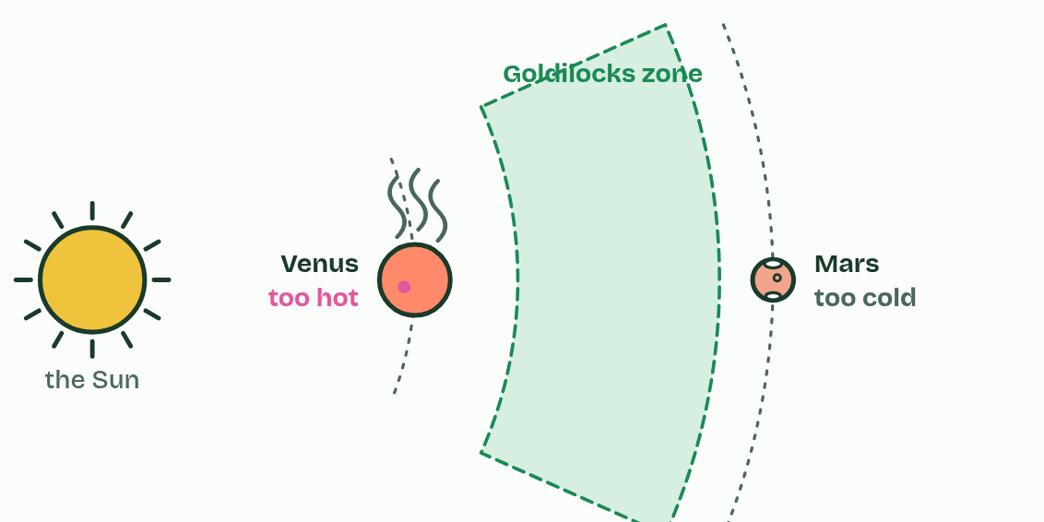
CHAPTER 8 · A1.1.8 The search for life elsewhere
3 / 4
Not too hot, not too cold: the Goldilocks zone
Mars is beyond the outer edge, and small. It is too cold: its water is frozen and its air is thin.
Minutes 20 to 30
Notes:
Minutes 20 to 30 of 60: Goldilocks (10 min).
The plan: Read the porridge line of the story, then chapter 8's figure and the dim star predict box. Pairs work the Goldilocks scene: move the planet, change the star, shrink the planet.
All the life we know needs liquid water as its medium (chapters 1 and 5), so the search for extraterrestrial life starts by looking for liquid water.
The Goldilocks zone, also called the habitable zone, is the band of distances round a star where a planet's surface is warm enough for water not to freeze and cool enough for it not to boil away, so water could stay liquid. Too close and it is too hot. Too far and it is too cold. The zone depends on the star: a brighter, hotter star has its zone farther out, and a dimmer, cooler star has it closer in.
Earth lies inside the Sun's zone. Venus, closer, is far too hot. Mars, just outside the zone and much smaller than Earth, is cold, with a thin atmosphere and its water frozen. Astronomers have now found more than 5,000 planets round other stars, called exoplanets. The rocky ones in their star's zone are the first targets in the search for life, and space agencies share their missions and data to look for them.
The zone is a model, and every model has limits. Being in the zone does not mean a planet has water: it must have received some and kept it (chapter 7). And liquid water can exist outside the zone, under ice warmed from inside, as on Jupiter's moon Europa and Saturn's moon Enceladus. Searching only the zone could miss life, like looking for lost keys only under the street light because the light is better there.

Slide 19
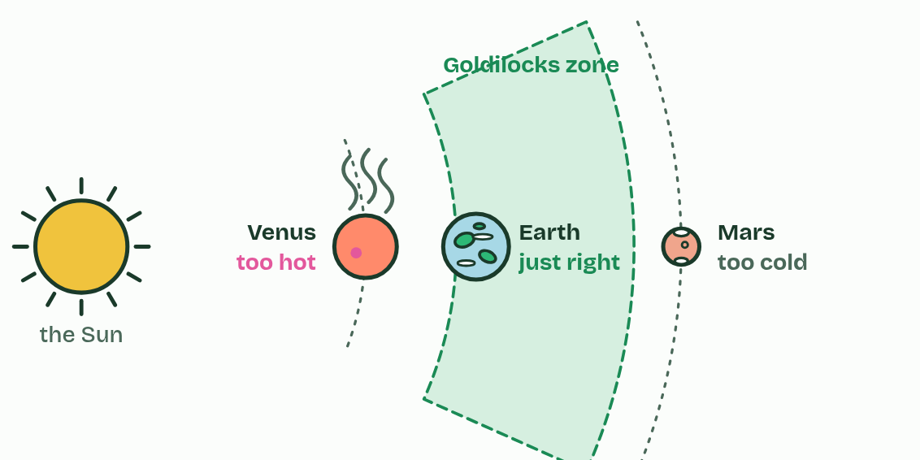
CHAPTER 8 · A1.1.8 The search for life elsewhere
4 / 4
Not too hot, not too cold: the Goldilocks zone
Earth is inside the zone: just right for liquid oceans.
Minutes 20 to 30
Notes:
Minutes 20 to 30 of 60: Goldilocks (10 min).
The plan: Read the porridge line of the story, then chapter 8's figure and the dim star predict box. Pairs work the Goldilocks scene: move the planet, change the star, shrink the planet.
All the life we know needs liquid water as its medium (chapters 1 and 5), so the search for extraterrestrial life starts by looking for liquid water.
The Goldilocks zone, also called the habitable zone, is the band of distances round a star where a planet's surface is warm enough for water not to freeze and cool enough for it not to boil away, so water could stay liquid. Too close and it is too hot. Too far and it is too cold. The zone depends on the star: a brighter, hotter star has its zone farther out, and a dimmer, cooler star has it closer in.
Earth lies inside the Sun's zone. Venus, closer, is far too hot. Mars, just outside the zone and much smaller than Earth, is cold, with a thin atmosphere and its water frozen. Astronomers have now found more than 5,000 planets round other stars, called exoplanets. The rocky ones in their star's zone are the first targets in the search for life, and space agencies share their missions and data to look for them.
The zone is a model, and every model has limits. Being in the zone does not mean a planet has water: it must have received some and kept it (chapter 7). And liquid water can exist outside the zone, under ice warmed from inside, as on Jupiter's moon Europa and Saturn's moon Enceladus. Searching only the zone could miss life, like looking for lost keys only under the street light because the light is better there.

Slide 20
CHAPTER 8 · A1.1.8 The search for life elsewhere
Not too hot, not too cold: the Goldilocks zone
All the life we know needs liquid water as its medium (chapters 1 and 5), so the search for extraterrestrial life starts by looking for liquid water.
The Goldilocks zone, also called the habitable zone, is the band of distances round a star where a planet's surface is warm enough for water not to freeze and cool enough for it not to boil away, so water could stay liquid.
Astronomers have now found more than 5,000 planets round other stars, called exoplanets.
Minutes 20 to 30
Notes:
Minutes 20 to 30 of 60: Goldilocks (10 min).
The plan: Read the porridge line of the story, then chapter 8's figure and the dim star predict box. Pairs work the Goldilocks scene: move the planet, change the star, shrink the planet.
All the life we know needs liquid water as its medium (chapters 1 and 5), so the search for extraterrestrial life starts by looking for liquid water.
The Goldilocks zone, also called the habitable zone, is the band of distances round a star where a planet's surface is warm enough for water not to freeze and cool enough for it not to boil away, so water could stay liquid. Too close and it is too hot. Too far and it is too cold. The zone depends on the star: a brighter, hotter star has its zone farther out, and a dimmer, cooler star has it closer in.
Earth lies inside the Sun's zone. Venus, closer, is far too hot. Mars, just outside the zone and much smaller than Earth, is cold, with a thin atmosphere and its water frozen. Astronomers have now found more than 5,000 planets round other stars, called exoplanets. The rocky ones in their star's zone are the first targets in the search for life, and space agencies share their missions and data to look for them.
The zone is a model, and every model has limits. Being in the zone does not mean a planet has water: it must have received some and kept it (chapter 7). And liquid water can exist outside the zone, under ice warmed from inside, as on Jupiter's moon Europa and Saturn's moon Enceladus. Searching only the zone could miss life, like looking for lost keys only under the street light because the light is better there.

Slide 21
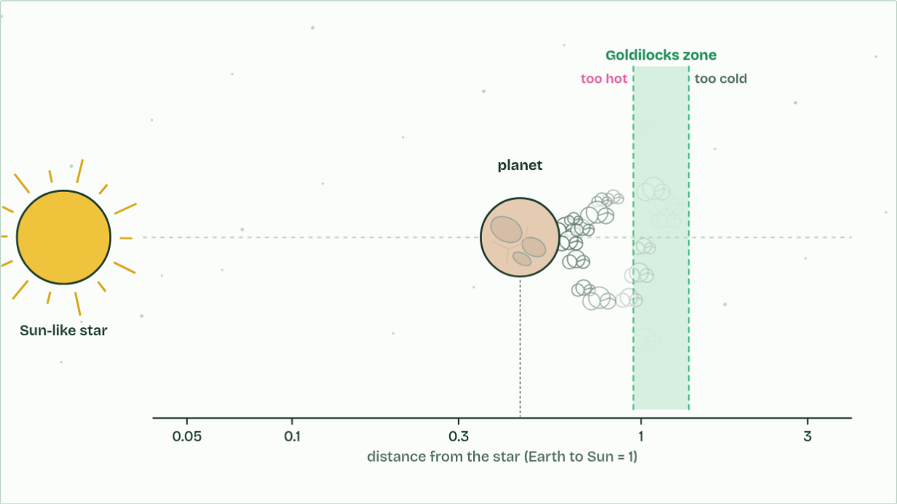
CHAPTER 8 · A1.1.8 The search for life elsewhere
Water: boiling away
1 / 3
Not too hot, not too cold: the Goldilocks zone
Too close, and water boils away.
Minutes 20 to 30
Notes:
Minutes 20 to 30 of 60: Goldilocks (10 min).
The plan: Read the porridge line of the story, then chapter 8's figure and the dim star predict box. Pairs work the Goldilocks scene: move the planet, change the star, shrink the planet.
All the life we know needs liquid water as its medium (chapters 1 and 5), so the search for extraterrestrial life starts by looking for liquid water.
The Goldilocks zone, also called the habitable zone, is the band of distances round a star where a planet's surface is warm enough for water not to freeze and cool enough for it not to boil away, so water could stay liquid. Too close and it is too hot. Too far and it is too cold. The zone depends on the star: a brighter, hotter star has its zone farther out, and a dimmer, cooler star has it closer in.
Earth lies inside the Sun's zone. Venus, closer, is far too hot. Mars, just outside the zone and much smaller than Earth, is cold, with a thin atmosphere and its water frozen. Astronomers have now found more than 5,000 planets round other stars, called exoplanets. The rocky ones in their star's zone are the first targets in the search for life, and space agencies share their missions and data to look for them.
The zone is a model, and every model has limits. Being in the zone does not mean a planet has water: it must have received some and kept it (chapter 7). And liquid water can exist outside the zone, under ice warmed from inside, as on Jupiter's moon Europa and Saturn's moon Enceladus. Searching only the zone could miss life, like looking for lost keys only under the street light because the light is better there.
The animation "Watch it happen: finding the zone", paused at 5.8 s. The next slides go on through it, then play it.

Slide 22
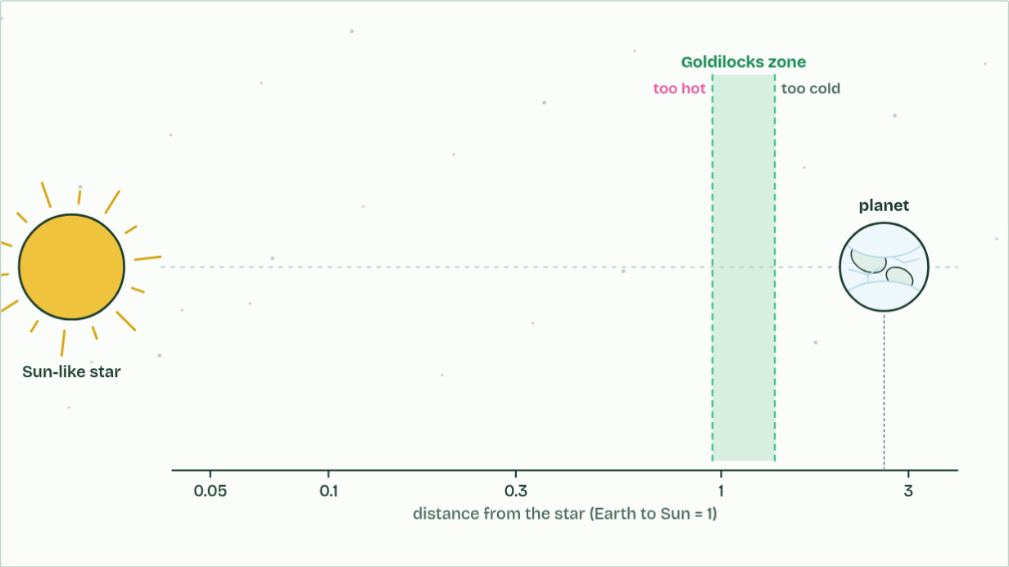
CHAPTER 8 · A1.1.8 The search for life elsewhere
Water: frozen
2 / 3
Not too hot, not too cold: the Goldilocks zone
Too far, and it freezes.
Minutes 20 to 30
Notes:
Minutes 20 to 30 of 60: Goldilocks (10 min).
The plan: Read the porridge line of the story, then chapter 8's figure and the dim star predict box. Pairs work the Goldilocks scene: move the planet, change the star, shrink the planet.
All the life we know needs liquid water as its medium (chapters 1 and 5), so the search for extraterrestrial life starts by looking for liquid water.
The Goldilocks zone, also called the habitable zone, is the band of distances round a star where a planet's surface is warm enough for water not to freeze and cool enough for it not to boil away, so water could stay liquid. Too close and it is too hot. Too far and it is too cold. The zone depends on the star: a brighter, hotter star has its zone farther out, and a dimmer, cooler star has it closer in.
Earth lies inside the Sun's zone. Venus, closer, is far too hot. Mars, just outside the zone and much smaller than Earth, is cold, with a thin atmosphere and its water frozen. Astronomers have now found more than 5,000 planets round other stars, called exoplanets. The rocky ones in their star's zone are the first targets in the search for life, and space agencies share their missions and data to look for them.
The zone is a model, and every model has limits. Being in the zone does not mean a planet has water: it must have received some and kept it (chapter 7). And liquid water can exist outside the zone, under ice warmed from inside, as on Jupiter's moon Europa and Saturn's moon Enceladus. Searching only the zone could miss life, like looking for lost keys only under the street light because the light is better there.
The animation "Watch it happen: finding the zone", paused at 9.8 s. The next slides go on through it, then play it.

Slide 23
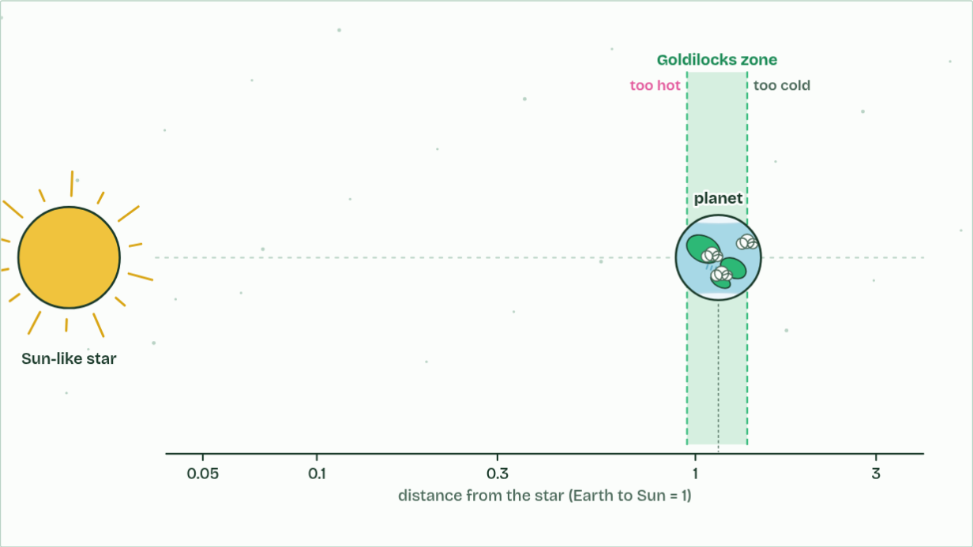
CHAPTER 8 · A1.1.8 The search for life elsewhere
Water: liquid
3 / 3
Not too hot, not too cold: the Goldilocks zone
In between, in the Goldilocks zone, water can stay liquid.
Minutes 20 to 30
Notes:
Minutes 20 to 30 of 60: Goldilocks (10 min).
The plan: Read the porridge line of the story, then chapter 8's figure and the dim star predict box. Pairs work the Goldilocks scene: move the planet, change the star, shrink the planet.
All the life we know needs liquid water as its medium (chapters 1 and 5), so the search for extraterrestrial life starts by looking for liquid water.
The Goldilocks zone, also called the habitable zone, is the band of distances round a star where a planet's surface is warm enough for water not to freeze and cool enough for it not to boil away, so water could stay liquid. Too close and it is too hot. Too far and it is too cold. The zone depends on the star: a brighter, hotter star has its zone farther out, and a dimmer, cooler star has it closer in.
Earth lies inside the Sun's zone. Venus, closer, is far too hot. Mars, just outside the zone and much smaller than Earth, is cold, with a thin atmosphere and its water frozen. Astronomers have now found more than 5,000 planets round other stars, called exoplanets. The rocky ones in their star's zone are the first targets in the search for life, and space agencies share their missions and data to look for them.
The zone is a model, and every model has limits. Being in the zone does not mean a planet has water: it must have received some and kept it (chapter 7). And liquid water can exist outside the zone, under ice warmed from inside, as on Jupiter's moon Europa and Saturn's moon Enceladus. Searching only the zone could miss life, like looking for lost keys only under the street light because the light is better there.
The animation "Watch it happen: finding the zone", paused at 14.5 s. The next slides go on through it, then play it.

Slide 24
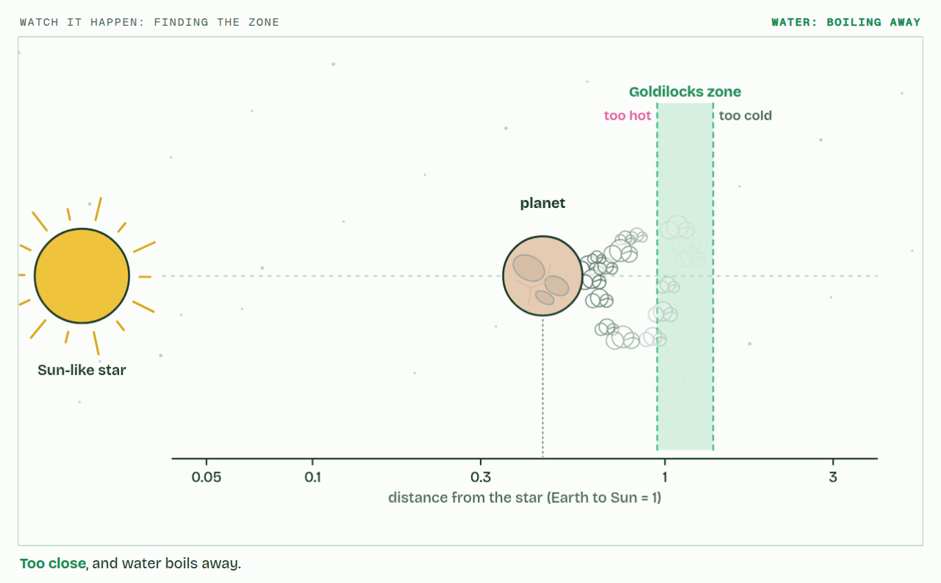
CHAPTER 8 · A1.1.8 The search for life elsewhere
PLAY IT
Not too hot, not too cold: the Goldilocks zone
Watch it happen: finding the zone: click to play. It loops every 16 seconds.
Minutes 20 to 30
Notes:
Minutes 20 to 30 of 60: Goldilocks (10 min).
The plan: Read the porridge line of the story, then chapter 8's figure and the dim star predict box. Pairs work the Goldilocks scene: move the planet, change the star, shrink the planet.
The video is goldilocks-3800a0.mp4, one loop of the animation in the guide. It plays in PowerPoint and Keynote. Google Slides does not play a video embedded in a .pptx: download goldilocks-3800a0.mp4 (https://www.biologybybradford.com/guides/downloads/scenes/goldilocks-3800a0.mp4), upload it to Google Drive, then Insert > Video > Google Drive.
In the guide the class can change it as it runs: https://www.biologybybradford.com/guides/ib-biology-a1-1-water#goldilocks
What it shows, in order:
1. Too close, and water boils away.
2. Too far, and it freezes.
3. In between, in the Goldilocks zone, water can stay liquid.

Slide 25
PREDICT
A star gives out much less energy than the Sun. Where would its Goldilocks zone be?
A Farther out than Earth's orbit, to make up for the dim light by catching more of it as it spreads
B At Earth's distance, because the zone is set only by the freezing and boiling points of water itself
C Much closer to the star, so that a planet there still receives enough energy to keep water liquid
Minutes 20 to 30
Notes:
Minutes 20 to 30 of 60: Goldilocks (10 min).
The plan: Read the porridge line of the story, then chapter 8's figure and the dim star predict box. Pairs work the Goldilocks scene: move the planet, change the star, shrink the planet.
Ask for a show of hands, or mini whiteboards, before revealing. (Answer: C, on the next slide.)

Slide 26
WHAT HAPPENS
A star gives out much less energy than the Sun. Where would its Goldilocks zone be?
A Farther out than Earth's orbit, to make up for the dim light by catching more of it as it spreads
B At Earth's distance, because the zone is set only by the freezing and boiling points of water itself
C Much closer to the star, so that a planet there still receives enough energy to keep water liquid
Much closer. A planet must be near a dim star to receive enough energy to keep water liquid. Round red dwarfs, the commonest stars in our galaxy, the zone is so close that a planet's year there lasts only days or weeks.
Minutes 20 to 30
Notes:
Minutes 20 to 30 of 60: Goldilocks (10 min).
The plan: Read the porridge line of the story, then chapter 8's figure and the dim star predict box. Pairs work the Goldilocks scene: move the planet, change the star, shrink the planet.
Answer: C. Much closer. A planet must be near a dim star to receive enough energy to keep water liquid. Round red dwarfs, the commonest stars in our galaxy, the zone is so close that a planet's year there lasts only days or weeks.

Slide 27
WATCH OUT
"Every star's Goldilocks zone is at Earth's distance." It moves with the star's brightness.
Minutes 20 to 30
Notes:
Minutes 20 to 30 of 60: Goldilocks (10 min).
The plan: Read the porridge line of the story, then chapter 8's figure and the dim star predict box. Pairs work the Goldilocks scene: move the planet, change the star, shrink the planet.
A common mistake: say it, then ask who can say why it is wrong.

Slide 28
STEP 4
15 MIN
The street light effect
Pairs argue for and against focusing the search on the Goldilocks zone, with Europa and Enceladus as test cases.
Minutes 30 to 45
Notes:
Minutes 30 to 45 of 60: The street light effect (15 min).
The plan: Pairs argue for and against focusing the search on the Goldilocks zone, with Europa and Enceladus as test cases. Finish with a class vote.

Slide 29
PLENARY
Exam question, timed
A higher level written question on A1.1.7 or A1.1.8 from the A1.1 exam maker, set at HL, then peer-marked.
Minutes 45 to 60
Notes:
Minutes 45 to 60 of 60: Exam question, timed (15 min).
The plan: A higher level written question on A1.1.7 or A1.1.8 from the A1.1 exam maker (in Practise and revise, below), set at HL, then peer-marked. For homework, the Check step at HL.

Slide 30
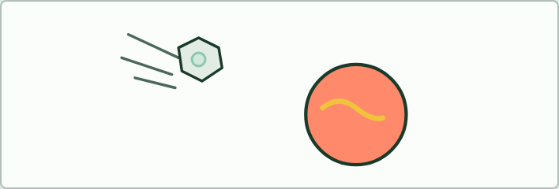
EVIDENCE · HL
15 MIN
Where did the water come from?
THE TASK
Six cards to put in order as an argument: a hot young Earth; asteroids carrying water in their minerals; the matching heavy hydrogen ratio; the Moon too small to keep water; Venus too hot; oceans for four billion years.
STUDENTS NEED
Printed cards.
Minutes 45 to 60
Notes:
Minutes 45 to 60 of 60: Exam question, timed (15 min).
The plan: A higher level written question on A1.1.7 or A1.1.8 from the A1.1 exam maker (in Practise and revise, below), set at HL, then peer-marked. For homework, the Check step at HL.
The activity: Where did the water come from?. Six cards to put in order as an argument: a hot young Earth; asteroids carrying water in their minerals; the matching heavy hydrogen ratio; the Moon too small to keep water; Venus too hot; oceans for four billion years.
Needs: printed cards.
The time: 15 minutes, minutes 45 to 60 of the plan.

Slide 31
EXIT QUESTION
Before you go
On paper, on your own: Explain why the search for life elsewhere looks for liquid water in a star's Goldilocks zone.
Minutes 45 to 60
Notes:
Minutes 45 to 60 of 60: Exam question, timed (15 min).
The plan: A higher level written question on A1.1.7 or A1.1.8 from the A1.1 exam maker (in Practise and revise, below), set at HL, then peer-marked. For homework, the Check step at HL.
Collect the slips: they say where to start next lesson.

Slide 32
PRACTISE AND REVISE
Keep going
Exam practice: a fresh paper of exam questions on A1.1 at higher level, marked as you go
The guide, with the animations and the dry lab
This lesson in the guide: 7 Water from space, kept by gravity, 8 Not too hot, not too cold: the Goldilocks zone
BUILD FOR YOUR CLASS
ALREADY ON THE SITE FOR A1.1
CARD SETS ON SPLYCR
Tarsia puzzle, dominoes and picture reveal on A1.1, built from its key terms and ready to print
A pub quiz with rounds on A1.1, to present or run with no projector
An escape room built from the question bank on A1.1
Lesson: Water
Summary doodle: Water
Quiz: Water
Revision map: A1.1 Water, to fill in
Exam questions: A1.1 in the exam maker, a paper with its markscheme
Open a set to host it as a class game, or make a copy to edit.
A1.1 Water
How this was made. The course structure, the activities and the teaching choices come from my own classroom, my presentations and my years of teaching IB and AP Biology. I use Claude, an AI, to help write and build the interactive guides, lesson plans, slides and practice questions, and to draw the diagrams and code the interactives. I direct the work and review it against the IB and AP specifications before it goes live.
Minute 60: after the lesson
Notes:
Every link here is live. Set the exam practice paper for homework: it is fresh each time, marked as students go and saved to their Exam practice when they are signed in.
Exam practice: https://www.biologybybradford.com/exam-maker/sit?topics=A1.1&level=HL&paper=quiz&marks=15&src=ep
The guide: https://www.biologybybradford.com/guides/ib-biology-a1-1-water

