Slide 1
IB Biology A1.2
LESSON 1 OF 5
BY THE END YOU CAN
Nucleic acids
Explain why DNA is the genetic material of every living organism, and why RNA viruses do not break the rule (A1.2.1)
Draw a nucleotide as a circle, a pentagon and a rectangle, each joined in the right place (A1.2.2)
Explain how condensation builds a strand with a strong sugar–phosphate backbone, and draw a short strand of RNA (A1.2.3, A1.2.5)
Draw two antiparallel strands joined by hydrogen bonds between A and T, and C and G (A1.2.6)
The molecule
A1.2.1 to A1.2.3, A1.2.5, A1.2.6
DNA as the genetic material, the nucleotide, the backbone and the double strand, drawn the IB way and built as models
60 minutes · chapters 1, 2, 3, 5
Minute 0
Notes:
IB Biology A1.2, Nucleic acids. Lesson 1 of 5: The molecule, 60 minutes.
The plan, minute by minute (each slide's footer says where you are):
0 to 8 min (8) Do now: Who am I?
8 to 15 min (7) Where the genetic material is
15 to 27 min (12) Draw it the IB way
27 to 52 min (25) Two models, one Venn
52 to 60 min (8) Exit
What students get wrong:
A nucleotide and a base are the same thing. A nucleotide is a phosphate, a sugar and a base.
Bases join to phosphates. Bases join to sugars; phosphates join sugar to sugar.
Hydrogen bonds hold a strand together. Within a strand, covalent; between strands, hydrogen.
Antiparallel means twisted. It means running in opposite directions.
Stretch and support:
Support: cut the figures' captions into cards to put in order, use the dotted key terms as a glossary, and give a drawing frame with the pentagon corners marked for the IB drawings.
Support: use the three mnemonics (Apples in the Tree, Some Bananas Split, Pure As Gold) as a starter in each lesson.
The lesson plan to print: https://www.biologybybradford.com/guides/downloads/ib-biology-a1-2-nucleic-acids-lesson-1-plan.pdf

Slide 2
DO NOW
Who am I?
Each student wears a card with a term or a scientist on it, unseen, and asks yes or no questions until they guess it.
8:00
minutes
Start now: the timer is running.
Minutes 0 to 8
Notes:
Minutes 0 to 8 of 60: Do now: Who am I? (8 min).
The plan: Each student wears a card with a term or a scientist on it, unseen, and asks yes or no questions until they guess it. The keyword bank is in the activity below.
Start a 8 minute timer as they come in.

Slide 3
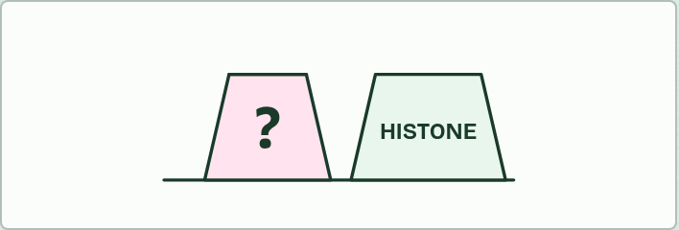
CARD GAME
8 MIN
Who am I?
THE TASK
Each student wears a card with a term or a scientist on it, unseen, and asks yes or no questions until they guess it. The keyword bank: nucleotide, phosphate group, deoxyribose, ribose, adenine, thymine, guanine, cytosine, uracil, hydrogen bond, sugar–phosphate backbone, antiparallel, double helix, complementary base pairing, condensation, DNA, RNA, virus.
STUDENTS NEED
Cards and sticky tape or headbands.
Minutes 0 to 8
Notes:
Minutes 0 to 8 of 60: Do now: Who am I? (8 min).
The plan: Each student wears a card with a term or a scientist on it, unseen, and asks yes or no questions until they guess it. The keyword bank is in the activity below.
The activity: Who am I?. Each student wears a card with a term or a scientist on it, unseen, and asks yes or no questions until they guess it. The keyword bank: nucleotide, phosphate group, deoxyribose, ribose, adenine, thymine, guanine, cytosine, uracil, hydrogen bond, sugar–phosphate backbone, antiparallel, double helix, complementary base pairing, condensation, DNA, RNA, virus.
Needs: cards and sticky tape or headbands.
The time: 8 minutes, minutes 0 to 8 of the plan.

Slide 4
STEP 2
7 MIN
Where the genetic material is
Chapter 1: Every living thing keeps its instructions in DNA
Minutes 8 to 15
Notes:
Minutes 8 to 15 of 60: Where the genetic material is (7 min).
The plan: Chapter 1's figure on the board: tap the cells and viruses. Take the virus predict box by vote before anyone opens the answer.

Slide 5
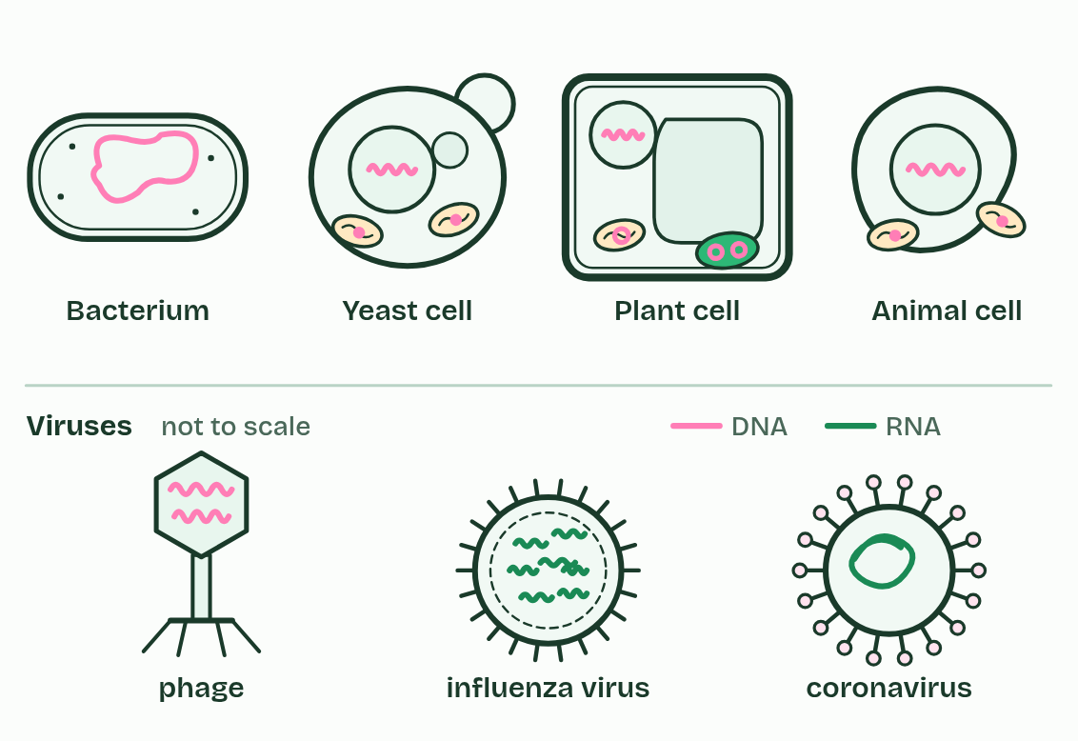
CHAPTER 1 · A1.2.1 DNA as the genetic material
Every living thing keeps its instructions in DNA
The molecule that holds those instructions is its genetic material.
In every living organism studied, the genetic material is DNA, short for deoxyribonucleic acid.
In a cell with a nucleus, most of the DNA is in the nucleus, with a little in the mitochondria and, in plants, the chloroplasts.
DNA belongs to the nucleic acids.
Minutes 8 to 15
Notes:
Minutes 8 to 15 of 60: Where the genetic material is (7 min).
The plan: Chapter 1's figure on the board: tap the cells and viruses. Take the virus predict box by vote before anyone opens the answer.
An organism inherits instructions from its parents: how to build its cells, which proteins to make, when to grow. The molecule that holds those instructions is its genetic material.
In every living organism studied, the genetic material is DNA, short for deoxyribonucleic acid. That is true of bacteria, archaea, protists, fungi, plants and animals. In a cell with a nucleus, most of the DNA is in the nucleus, with a little in the mitochondria and, in plants, the chloroplasts. In a bacterium it lies loose in the cytoplasm.
DNA belongs to the nucleic acids. The other one, RNA, does many jobs in the cell (chapter 6), and a few viruses use it to carry their genes: influenza, measles and the coronavirus that causes COVID-19 are RNA viruses. Other viruses carry DNA. How anyone found out that DNA, and not protein, carries genes is the story of chapter 11.
Both nucleic acids are polymers built from one kind of monomer (chapter 2), and both contain carbon, hydrogen, oxygen, nitrogen and phosphorus.
One more distinction. DNA is the whole molecule. A gene is one stretch of its base sequence, and a single DNA molecule carries many genes.
Parts of the figure:
Bacterium DNA, one long loop, loose in the cytoplasm: there is no nucleus.
Yeast cell DNA in the nucleus, and a little in each mitochondrion.
Plant cell DNA in the nucleus, and small loops in mitochondria and chloroplasts.
Animal cell DNA in the nucleus, and a little in each mitochondrion.
Phage A virus that infects bacteria. Its DNA lies inside a protein coat.
Influenza virus RNA inside a protein coat, with a fatty envelope. It has no cells and makes nothing for itself: it can only be copied inside a host cell.
Coronavirus RNA inside a protein coat, with a fatty envelope. It has no cells and makes nothing for itself: it can only be copied inside a host cell.

Slide 6
PREDICT
A virus is found whose genes are made of RNA. Does that break the rule that DNA is the genetic material of all living organisms?
A Yes: the rule must now say DNA or RNA
B No: viruses are not counted as living organisms
C No: the RNA is only a copy, and the virus keeps its real genes as DNA
Minutes 8 to 15
Notes:
Minutes 8 to 15 of 60: Where the genetic material is (7 min).
The plan: Chapter 1's figure on the board: tap the cells and viruses. Take the virus predict box by vote before anyone opens the answer.
Ask for a show of hands, or mini whiteboards, before revealing. (Answer: B, on the next slide.)

Slide 7
WHAT HAPPENS
A virus is found whose genes are made of RNA. Does that break the rule that DNA is the genetic material of all living organisms?
A Yes: the rule must now say DNA or RNA
B No: viruses are not counted as living organisms
C No: the RNA is only a copy, and the virus keeps its real genes as DNA
No. A virus has no cells and no metabolism of its own, and it can only be copied inside a host cell, so biologists do not count it as alive. The rule is about living things, and in every one studied so far the genetic material is DNA. In an RNA virus the genes really are RNA: there is no hidden DNA original.
Minutes 8 to 15
Notes:
Minutes 8 to 15 of 60: Where the genetic material is (7 min).
The plan: Chapter 1's figure on the board: tap the cells and viruses. Take the virus predict box by vote before anyone opens the answer.
Answer: B. No. A virus has no cells and no metabolism of its own, and it can only be copied inside a host cell, so biologists do not count it as alive. The rule is about living things, and in every one studied so far the genetic material is DNA. In an RNA virus the genes really are RNA: there is no hidden DNA original.

Slide 8
WATCH OUT
"DNA" and "gene" are not two words for one thing. DNA is the molecule; a gene is one stretch of its base sequence, and one DNA molecule carries many genes.
Minutes 8 to 15
Notes:
Minutes 8 to 15 of 60: Where the genetic material is (7 min).
The plan: Chapter 1's figure on the board: tap the cells and viruses. Take the virus predict box by vote before anyone opens the answer.
A common mistake: say it, then ask who can say why it is wrong.

Slide 9
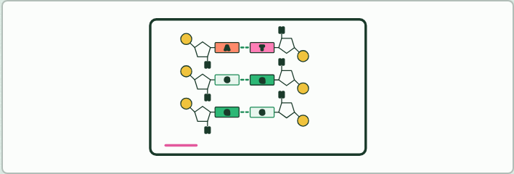
DRAWING
12 MIN
Draw it the IB way
THE TASK
On mini whiteboards: one nucleotide, then a four-nucleotide RNA strand, then three antiparallel base pairs, each checked against the figure at the same step. Stress the corners the bonds leave from.
STUDENTS NEED
Mini whiteboards and pens.
Minutes 15 to 27
Notes:
Minutes 15 to 27 of 60: Draw it the IB way (12 min).
The plan: Chapter 2's and chapter 3's figures step by step, with students drawing on mini whiteboards at the same steps. Then the bond builder on the board: predict the water count for ten nucleotides first.
The activity: Draw it the IB way. On mini whiteboards: one nucleotide, then a four-nucleotide RNA strand, then three antiparallel base pairs, each checked against the figure at the same step. Stress the corners the bonds leave from.
Needs: mini whiteboards and pens.
The time: 12 minutes, minutes 15 to 27 of the plan.

Slide 10
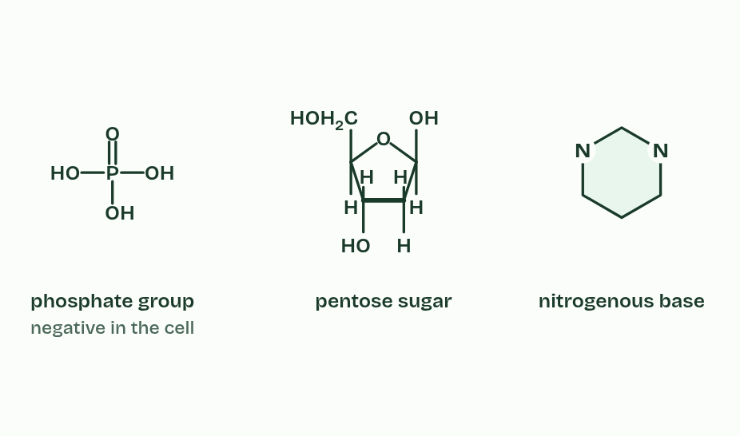
CHAPTER 2 · A1.2.2 Components of a nucleotide
1 / 4
Three parts, one monomer
A nucleotide is built from three parts.
Minutes 15 to 27
Notes:
Minutes 15 to 27 of 60: Draw it the IB way (12 min).
The plan: Chapter 2's and chapter 3's figures step by step, with students drawing on mini whiteboards at the same steps. Then the bond builder on the board: predict the water count for ten nucleotides first.
Nucleic acids are polymers. The small unit, the monomer, is the nucleotide.
A nucleotide has three parts joined by covalent bonds: a phosphate group, a pentose sugar and a nitrogenous base. The sugar is in the middle. The phosphate is bonded to one corner of it and the base to another, and the base and the phosphate are never bonded to each other.
In DNA the sugar is deoxyribose, and in RNA it is ribose (chapter 6). The bases have names of their own (chapter 4).
Between them the three parts contain carbon, hydrogen, oxygen, nitrogen and phosphorus. Nitrogen comes only from the base and phosphorus only from the phosphate. In the cell the phosphate group carries a negative charge, a fact that matters again later in this guide.

Slide 11
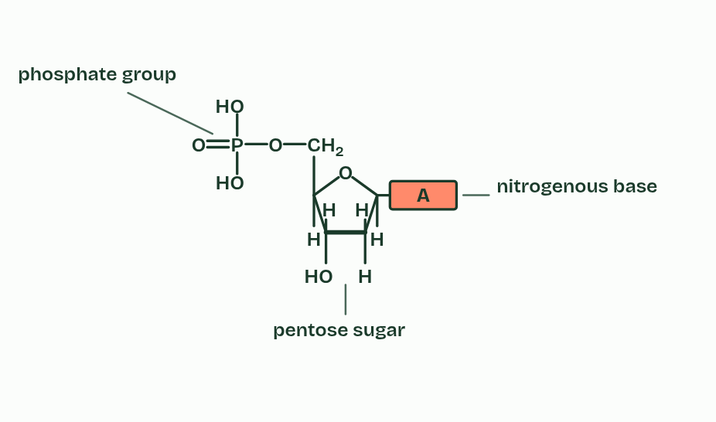
CHAPTER 2 · A1.2.2 Components of a nucleotide
2 / 4
Three parts, one monomer
The sugar sits in the middle, bonded to both of the others.
Minutes 15 to 27
Notes:
Minutes 15 to 27 of 60: Draw it the IB way (12 min).
The plan: Chapter 2's and chapter 3's figures step by step, with students drawing on mini whiteboards at the same steps. Then the bond builder on the board: predict the water count for ten nucleotides first.
Nucleic acids are polymers. The small unit, the monomer, is the nucleotide.
A nucleotide has three parts joined by covalent bonds: a phosphate group, a pentose sugar and a nitrogenous base. The sugar is in the middle. The phosphate is bonded to one corner of it and the base to another, and the base and the phosphate are never bonded to each other.
In DNA the sugar is deoxyribose, and in RNA it is ribose (chapter 6). The bases have names of their own (chapter 4).
Between them the three parts contain carbon, hydrogen, oxygen, nitrogen and phosphorus. Nitrogen comes only from the base and phosphorus only from the phosphate. In the cell the phosphate group carries a negative charge, a fact that matters again later in this guide.

Slide 12
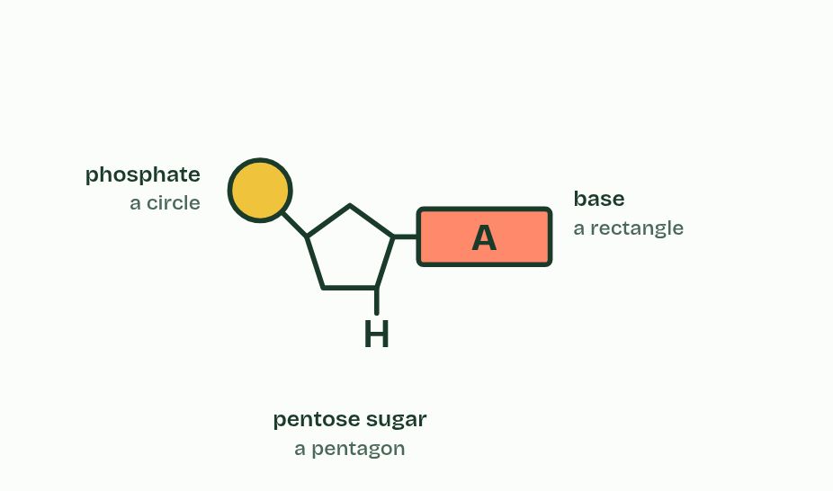
CHAPTER 2 · A1.2.2 Components of a nucleotide
3 / 4
Three parts, one monomer
The IB draws them as a circle, a pentagon and a rectangle, in these positions.
Minutes 15 to 27
Notes:
Minutes 15 to 27 of 60: Draw it the IB way (12 min).
The plan: Chapter 2's and chapter 3's figures step by step, with students drawing on mini whiteboards at the same steps. Then the bond builder on the board: predict the water count for ten nucleotides first.
Nucleic acids are polymers. The small unit, the monomer, is the nucleotide.
A nucleotide has three parts joined by covalent bonds: a phosphate group, a pentose sugar and a nitrogenous base. The sugar is in the middle. The phosphate is bonded to one corner of it and the base to another, and the base and the phosphate are never bonded to each other.
In DNA the sugar is deoxyribose, and in RNA it is ribose (chapter 6). The bases have names of their own (chapter 4).
Between them the three parts contain carbon, hydrogen, oxygen, nitrogen and phosphorus. Nitrogen comes only from the base and phosphorus only from the phosphate. In the cell the phosphate group carries a negative charge, a fact that matters again later in this guide.

Slide 13
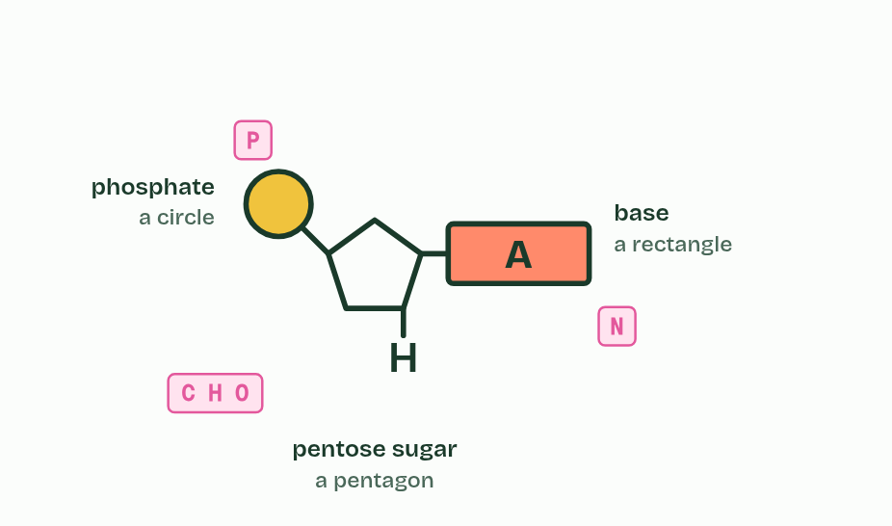
CHAPTER 2 · A1.2.2 Components of a nucleotide
4 / 4
Three parts, one monomer
Nitrogen comes from the base and phosphorus from the phosphate.
Minutes 15 to 27
Notes:
Minutes 15 to 27 of 60: Draw it the IB way (12 min).
The plan: Chapter 2's and chapter 3's figures step by step, with students drawing on mini whiteboards at the same steps. Then the bond builder on the board: predict the water count for ten nucleotides first.
Nucleic acids are polymers. The small unit, the monomer, is the nucleotide.
A nucleotide has three parts joined by covalent bonds: a phosphate group, a pentose sugar and a nitrogenous base. The sugar is in the middle. The phosphate is bonded to one corner of it and the base to another, and the base and the phosphate are never bonded to each other.
In DNA the sugar is deoxyribose, and in RNA it is ribose (chapter 6). The bases have names of their own (chapter 4).
Between them the three parts contain carbon, hydrogen, oxygen, nitrogen and phosphorus. Nitrogen comes only from the base and phosphorus only from the phosphate. In the cell the phosphate group carries a negative charge, a fact that matters again later in this guide.

Slide 14
CHAPTER 2 · A1.2.2 Components of a nucleotide
Three parts, one monomer
Draw it the IB way. A circle for the phosphate, a pentagon for the sugar and a rectangle for the base.
The sugar is in the middle: the circle is at the upper left of the pentagon, on a short stalk, and the rectangle is at its right-hand corner.
One ring round all three marks one nucleotide.
Minutes 15 to 27
Notes:
Minutes 15 to 27 of 60: Draw it the IB way (12 min).
The plan: Chapter 2's and chapter 3's figures step by step, with students drawing on mini whiteboards at the same steps. Then the bond builder on the board: predict the water count for ten nucleotides first.
Nucleic acids are polymers. The small unit, the monomer, is the nucleotide.
A nucleotide has three parts joined by covalent bonds: a phosphate group, a pentose sugar and a nitrogenous base. The sugar is in the middle. The phosphate is bonded to one corner of it and the base to another, and the base and the phosphate are never bonded to each other.
In DNA the sugar is deoxyribose, and in RNA it is ribose (chapter 6). The bases have names of their own (chapter 4).
Between them the three parts contain carbon, hydrogen, oxygen, nitrogen and phosphorus. Nitrogen comes only from the base and phosphorus only from the phosphate. In the cell the phosphate group carries a negative charge, a fact that matters again later in this guide.

Slide 15
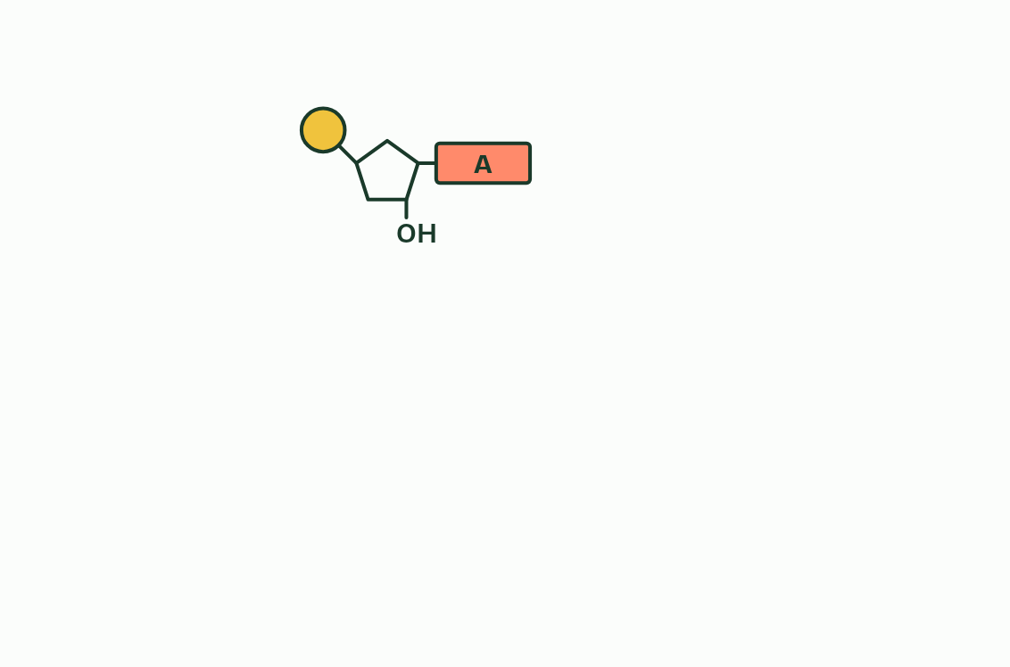
CHAPTER 3 · A1.2.3 A1.2.5 Sugar–phosphate bonding and RNA
1 / 5
Building a strand with a strong backbone
One nucleotide.
Minutes 15 to 27
Notes:
Minutes 15 to 27 of 60: Draw it the IB way (12 min).
The plan: Chapter 2's and chapter 3's figures step by step, with students drawing on mini whiteboards at the same steps. Then the bond builder on the board: predict the water count for ten nucleotides first.
Nucleotides join by condensation, as in the sugars and lipids of B1.1. The phosphate of each new nucleotide bonds to the sugar of the last nucleotide in the chain, and a molecule of water is released. The reverse is hydrolysis: water is added back and the bond breaks, which is how your digestion takes the nucleic acids in food apart.
Repeat the join and you build a strand: sugar, phosphate, sugar, phosphate. Every link is a covalent bond, so the strand is one continuous chain of covalently bonded atoms. That is the sugar–phosphate backbone: strong, and it fixes the order of the nucleotides along it.
The bases are not part of the backbone. Each sticks out sideways from its sugar, all on the same side, free to pair with another base (chapter 4). The backbone is the same all along, whatever the bases are, and any base can follow any other. Chapter 7 builds on that.
RNA is one such strand, a polymer of ribonucleotides made by condensation. DNA strands are built the same way; the enzymes that do it come in D1.1.
To draw an RNA strand, stack the nucleotides, join the lower left corner of each pentagon to the circle of the next, and point every base the same way. To mark one nucleotide, ring a circle, a pentagon and a rectangle together, not a pentagon, a rectangle and the circle below it.
One nucleotide has no order. A strand does. Order is a property of the polymer that its monomers do not have.

Slide 16
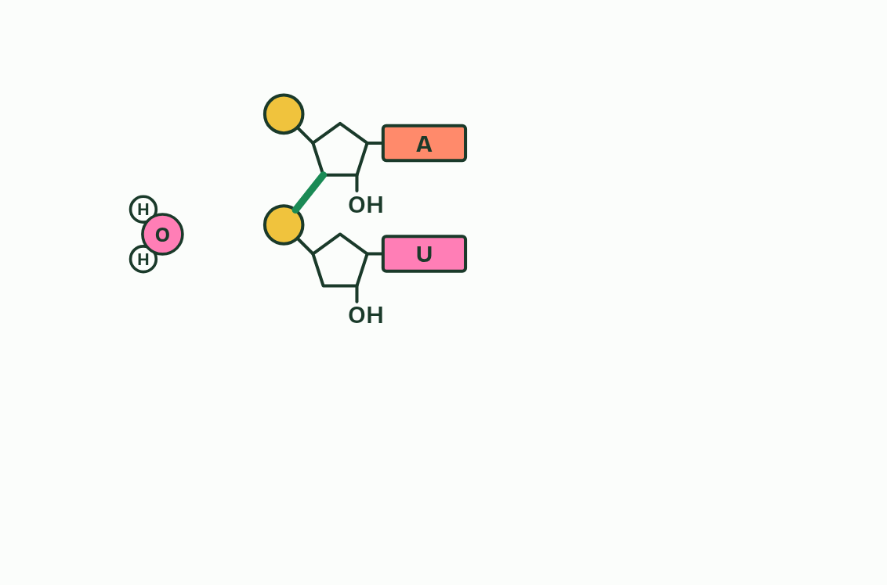
CHAPTER 3 · A1.2.3 A1.2.5 Sugar–phosphate bonding and RNA
2 / 5
Building a strand with a strong backbone
Condensation: the phosphate bonds to the sugar above, and water leaves.
Minutes 15 to 27
Notes:
Minutes 15 to 27 of 60: Draw it the IB way (12 min).
The plan: Chapter 2's and chapter 3's figures step by step, with students drawing on mini whiteboards at the same steps. Then the bond builder on the board: predict the water count for ten nucleotides first.
Nucleotides join by condensation, as in the sugars and lipids of B1.1. The phosphate of each new nucleotide bonds to the sugar of the last nucleotide in the chain, and a molecule of water is released. The reverse is hydrolysis: water is added back and the bond breaks, which is how your digestion takes the nucleic acids in food apart.
Repeat the join and you build a strand: sugar, phosphate, sugar, phosphate. Every link is a covalent bond, so the strand is one continuous chain of covalently bonded atoms. That is the sugar–phosphate backbone: strong, and it fixes the order of the nucleotides along it.
The bases are not part of the backbone. Each sticks out sideways from its sugar, all on the same side, free to pair with another base (chapter 4). The backbone is the same all along, whatever the bases are, and any base can follow any other. Chapter 7 builds on that.
RNA is one such strand, a polymer of ribonucleotides made by condensation. DNA strands are built the same way; the enzymes that do it come in D1.1.
To draw an RNA strand, stack the nucleotides, join the lower left corner of each pentagon to the circle of the next, and point every base the same way. To mark one nucleotide, ring a circle, a pentagon and a rectangle together, not a pentagon, a rectangle and the circle below it.
One nucleotide has no order. A strand does. Order is a property of the polymer that its monomers do not have.

Slide 17
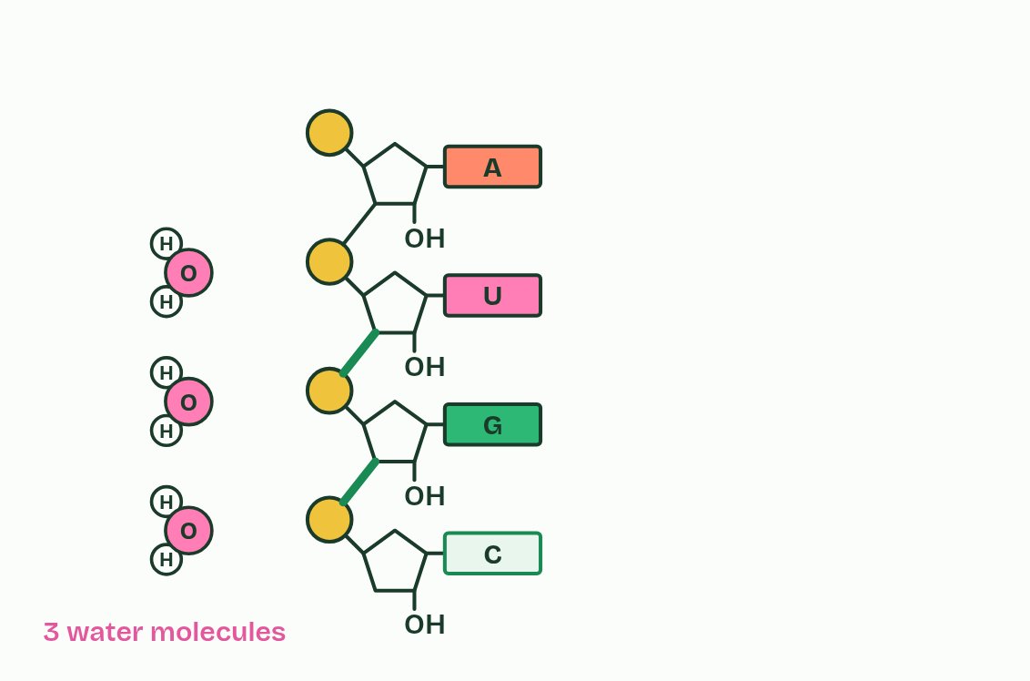
CHAPTER 3 · A1.2.3 A1.2.5 Sugar–phosphate bonding and RNA
3 / 5
Building a strand with a strong backbone
Each new bond releases one water molecule.
Minutes 15 to 27
Notes:
Minutes 15 to 27 of 60: Draw it the IB way (12 min).
The plan: Chapter 2's and chapter 3's figures step by step, with students drawing on mini whiteboards at the same steps. Then the bond builder on the board: predict the water count for ten nucleotides first.
Nucleotides join by condensation, as in the sugars and lipids of B1.1. The phosphate of each new nucleotide bonds to the sugar of the last nucleotide in the chain, and a molecule of water is released. The reverse is hydrolysis: water is added back and the bond breaks, which is how your digestion takes the nucleic acids in food apart.
Repeat the join and you build a strand: sugar, phosphate, sugar, phosphate. Every link is a covalent bond, so the strand is one continuous chain of covalently bonded atoms. That is the sugar–phosphate backbone: strong, and it fixes the order of the nucleotides along it.
The bases are not part of the backbone. Each sticks out sideways from its sugar, all on the same side, free to pair with another base (chapter 4). The backbone is the same all along, whatever the bases are, and any base can follow any other. Chapter 7 builds on that.
RNA is one such strand, a polymer of ribonucleotides made by condensation. DNA strands are built the same way; the enzymes that do it come in D1.1.
To draw an RNA strand, stack the nucleotides, join the lower left corner of each pentagon to the circle of the next, and point every base the same way. To mark one nucleotide, ring a circle, a pentagon and a rectangle together, not a pentagon, a rectangle and the circle below it.
One nucleotide has no order. A strand does. Order is a property of the polymer that its monomers do not have.

Slide 18
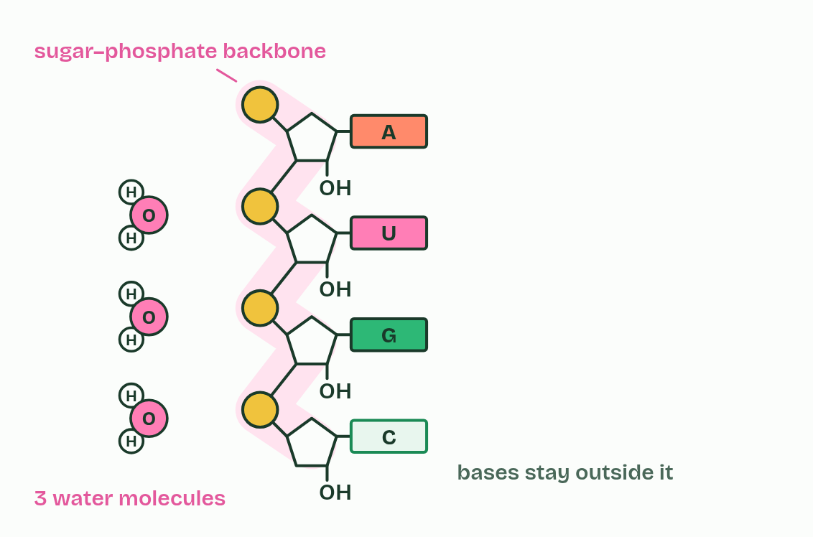
CHAPTER 3 · A1.2.3 A1.2.5 Sugar–phosphate bonding and RNA
4 / 5
Building a strand with a strong backbone
Sugar, phosphate, sugar, phosphate: a covalently bonded backbone.
Minutes 15 to 27
Notes:
Minutes 15 to 27 of 60: Draw it the IB way (12 min).
The plan: Chapter 2's and chapter 3's figures step by step, with students drawing on mini whiteboards at the same steps. Then the bond builder on the board: predict the water count for ten nucleotides first.
Nucleotides join by condensation, as in the sugars and lipids of B1.1. The phosphate of each new nucleotide bonds to the sugar of the last nucleotide in the chain, and a molecule of water is released. The reverse is hydrolysis: water is added back and the bond breaks, which is how your digestion takes the nucleic acids in food apart.
Repeat the join and you build a strand: sugar, phosphate, sugar, phosphate. Every link is a covalent bond, so the strand is one continuous chain of covalently bonded atoms. That is the sugar–phosphate backbone: strong, and it fixes the order of the nucleotides along it.
The bases are not part of the backbone. Each sticks out sideways from its sugar, all on the same side, free to pair with another base (chapter 4). The backbone is the same all along, whatever the bases are, and any base can follow any other. Chapter 7 builds on that.
RNA is one such strand, a polymer of ribonucleotides made by condensation. DNA strands are built the same way; the enzymes that do it come in D1.1.
To draw an RNA strand, stack the nucleotides, join the lower left corner of each pentagon to the circle of the next, and point every base the same way. To mark one nucleotide, ring a circle, a pentagon and a rectangle together, not a pentagon, a rectangle and the circle below it.
One nucleotide has no order. A strand does. Order is a property of the polymer that its monomers do not have.

Slide 19
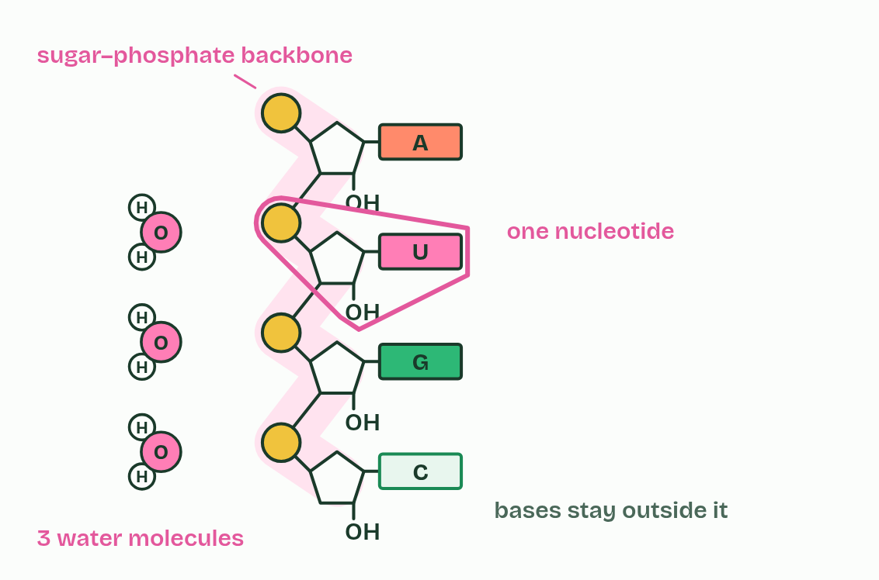
CHAPTER 3 · A1.2.3 A1.2.5 Sugar–phosphate bonding and RNA
5 / 5
Building a strand with a strong backbone
One nucleotide is a circle, a pentagon and a rectangle together.
Minutes 15 to 27
Notes:
Minutes 15 to 27 of 60: Draw it the IB way (12 min).
The plan: Chapter 2's and chapter 3's figures step by step, with students drawing on mini whiteboards at the same steps. Then the bond builder on the board: predict the water count for ten nucleotides first.
Nucleotides join by condensation, as in the sugars and lipids of B1.1. The phosphate of each new nucleotide bonds to the sugar of the last nucleotide in the chain, and a molecule of water is released. The reverse is hydrolysis: water is added back and the bond breaks, which is how your digestion takes the nucleic acids in food apart.
Repeat the join and you build a strand: sugar, phosphate, sugar, phosphate. Every link is a covalent bond, so the strand is one continuous chain of covalently bonded atoms. That is the sugar–phosphate backbone: strong, and it fixes the order of the nucleotides along it.
The bases are not part of the backbone. Each sticks out sideways from its sugar, all on the same side, free to pair with another base (chapter 4). The backbone is the same all along, whatever the bases are, and any base can follow any other. Chapter 7 builds on that.
RNA is one such strand, a polymer of ribonucleotides made by condensation. DNA strands are built the same way; the enzymes that do it come in D1.1.
To draw an RNA strand, stack the nucleotides, join the lower left corner of each pentagon to the circle of the next, and point every base the same way. To mark one nucleotide, ring a circle, a pentagon and a rectangle together, not a pentagon, a rectangle and the circle below it.
One nucleotide has no order. A strand does. Order is a property of the polymer that its monomers do not have.

Slide 20
CHAPTER 3 · A1.2.3 A1.2.5 Sugar–phosphate bonding and RNA
Building a strand with a strong backbone
Nucleotides join by condensation, as in the sugars and lipids of B1.1.
The reverse is hydrolysis: water is added back and the bond breaks, which is how your digestion takes the nucleic acids in food apart.
Repeat the join and you build a strand: sugar, phosphate, sugar, phosphate.
Every link is a covalent bond, so the strand is one continuous chain of covalently bonded atoms.
Minutes 15 to 27
Notes:
Minutes 15 to 27 of 60: Draw it the IB way (12 min).
The plan: Chapter 2's and chapter 3's figures step by step, with students drawing on mini whiteboards at the same steps. Then the bond builder on the board: predict the water count for ten nucleotides first.
Nucleotides join by condensation, as in the sugars and lipids of B1.1. The phosphate of each new nucleotide bonds to the sugar of the last nucleotide in the chain, and a molecule of water is released. The reverse is hydrolysis: water is added back and the bond breaks, which is how your digestion takes the nucleic acids in food apart.
Repeat the join and you build a strand: sugar, phosphate, sugar, phosphate. Every link is a covalent bond, so the strand is one continuous chain of covalently bonded atoms. That is the sugar–phosphate backbone: strong, and it fixes the order of the nucleotides along it.
The bases are not part of the backbone. Each sticks out sideways from its sugar, all on the same side, free to pair with another base (chapter 4). The backbone is the same all along, whatever the bases are, and any base can follow any other. Chapter 7 builds on that.
RNA is one such strand, a polymer of ribonucleotides made by condensation. DNA strands are built the same way; the enzymes that do it come in D1.1.
To draw an RNA strand, stack the nucleotides, join the lower left corner of each pentagon to the circle of the next, and point every base the same way. To mark one nucleotide, ring a circle, a pentagon and a rectangle together, not a pentagon, a rectangle and the circle below it.
One nucleotide has no order. A strand does. Order is a property of the polymer that its monomers do not have.

Slide 21
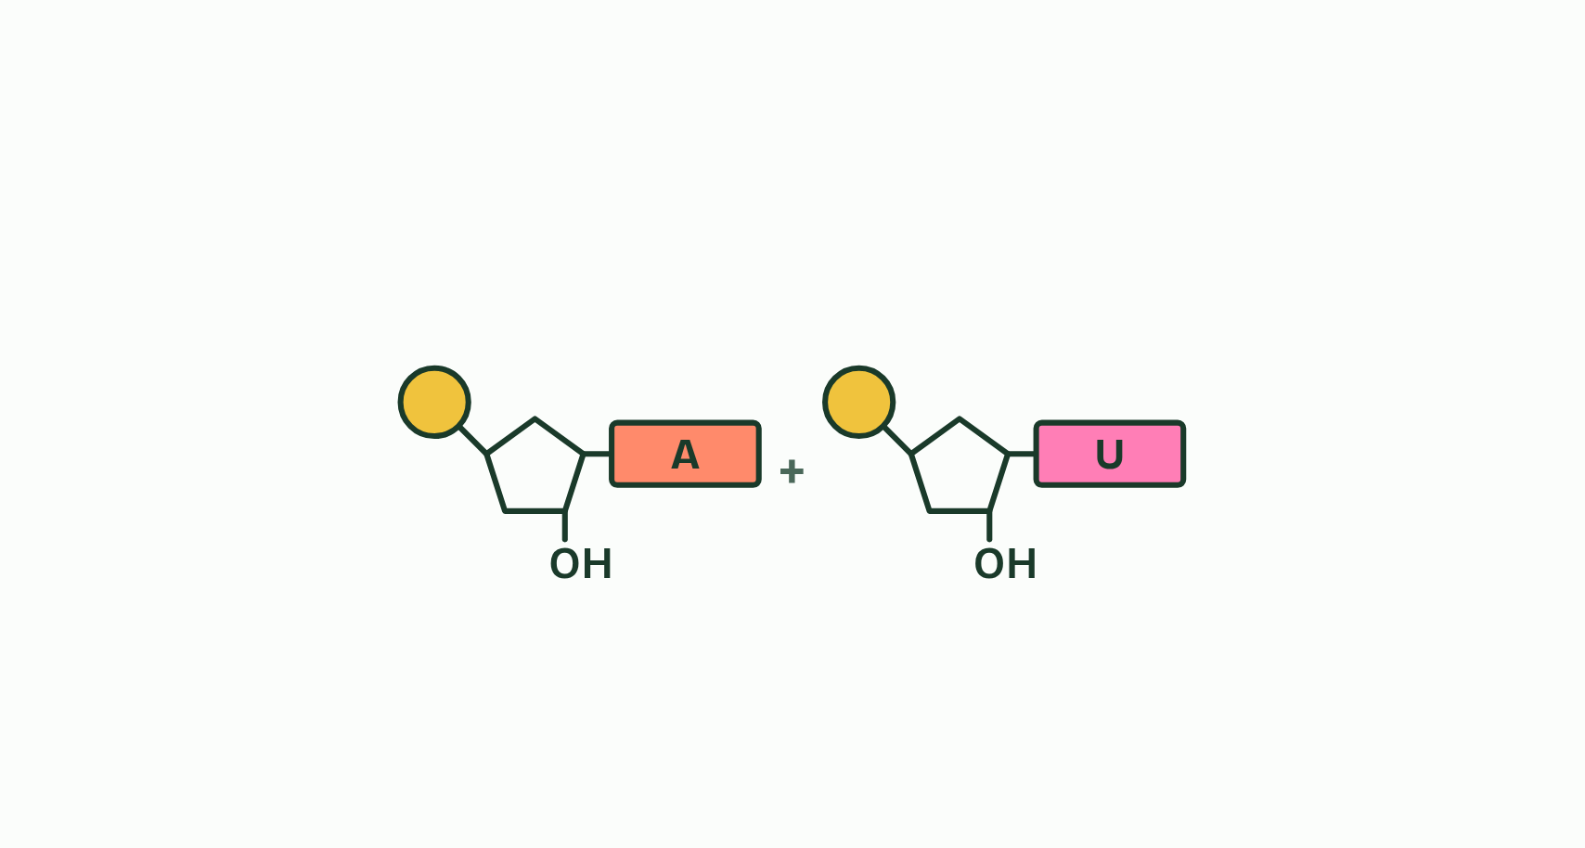
CHAPTER 3 · A1.2.3 A1.2.5 Sugar–phosphate bonding and RNA
1 / 4
Building a strand with a strong backbone
Two nucleotides, each a phosphate, a sugar and a base.
Minutes 15 to 27
Notes:
Minutes 15 to 27 of 60: Draw it the IB way (12 min).
The plan: Chapter 2's and chapter 3's figures step by step, with students drawing on mini whiteboards at the same steps. Then the bond builder on the board: predict the water count for ten nucleotides first.
Nucleotides join by condensation, as in the sugars and lipids of B1.1. The phosphate of each new nucleotide bonds to the sugar of the last nucleotide in the chain, and a molecule of water is released. The reverse is hydrolysis: water is added back and the bond breaks, which is how your digestion takes the nucleic acids in food apart.
Repeat the join and you build a strand: sugar, phosphate, sugar, phosphate. Every link is a covalent bond, so the strand is one continuous chain of covalently bonded atoms. That is the sugar–phosphate backbone: strong, and it fixes the order of the nucleotides along it.
The bases are not part of the backbone. Each sticks out sideways from its sugar, all on the same side, free to pair with another base (chapter 4). The backbone is the same all along, whatever the bases are, and any base can follow any other. Chapter 7 builds on that.
RNA is one such strand, a polymer of ribonucleotides made by condensation. DNA strands are built the same way; the enzymes that do it come in D1.1.
To draw an RNA strand, stack the nucleotides, join the lower left corner of each pentagon to the circle of the next, and point every base the same way. To mark one nucleotide, ring a circle, a pentagon and a rectangle together, not a pentagon, a rectangle and the circle below it.
One nucleotide has no order. A strand does. Order is a property of the polymer that its monomers do not have.

Slide 22
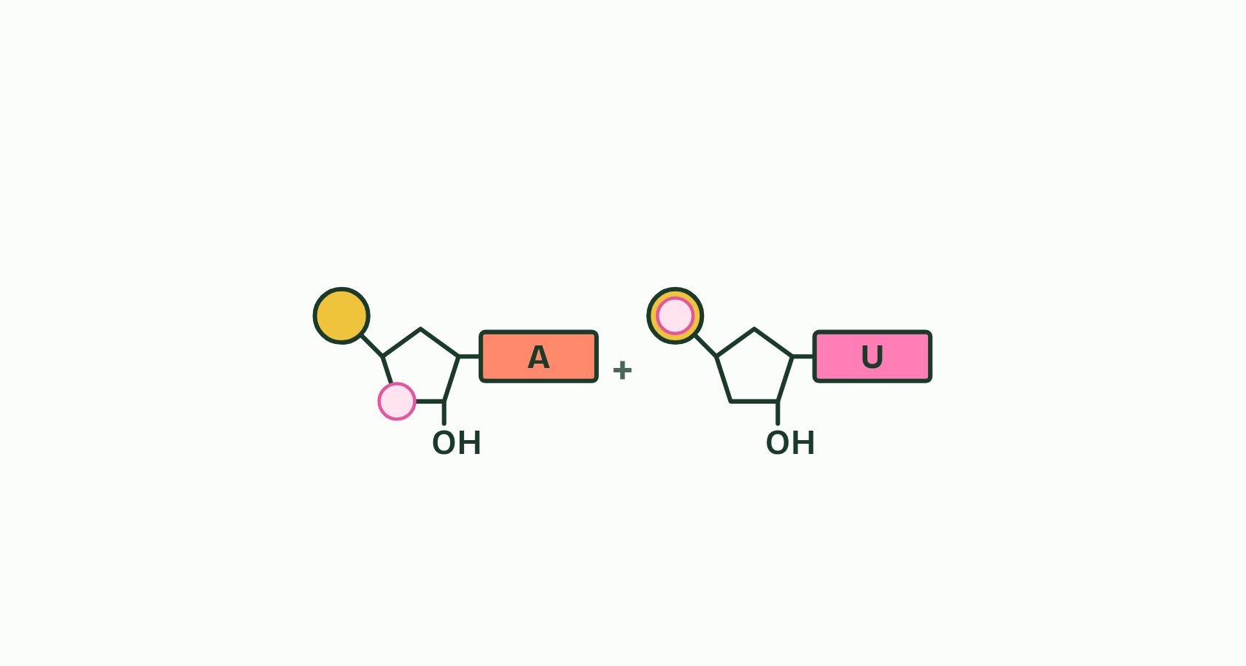
CHAPTER 3 · A1.2.3 A1.2.5 Sugar–phosphate bonding and RNA
2 / 4
Building a strand with a strong backbone
The phosphate of one and the sugar of the other face each other.
Minutes 15 to 27
Notes:
Minutes 15 to 27 of 60: Draw it the IB way (12 min).
The plan: Chapter 2's and chapter 3's figures step by step, with students drawing on mini whiteboards at the same steps. Then the bond builder on the board: predict the water count for ten nucleotides first.
Nucleotides join by condensation, as in the sugars and lipids of B1.1. The phosphate of each new nucleotide bonds to the sugar of the last nucleotide in the chain, and a molecule of water is released. The reverse is hydrolysis: water is added back and the bond breaks, which is how your digestion takes the nucleic acids in food apart.
Repeat the join and you build a strand: sugar, phosphate, sugar, phosphate. Every link is a covalent bond, so the strand is one continuous chain of covalently bonded atoms. That is the sugar–phosphate backbone: strong, and it fixes the order of the nucleotides along it.
The bases are not part of the backbone. Each sticks out sideways from its sugar, all on the same side, free to pair with another base (chapter 4). The backbone is the same all along, whatever the bases are, and any base can follow any other. Chapter 7 builds on that.
RNA is one such strand, a polymer of ribonucleotides made by condensation. DNA strands are built the same way; the enzymes that do it come in D1.1.
To draw an RNA strand, stack the nucleotides, join the lower left corner of each pentagon to the circle of the next, and point every base the same way. To mark one nucleotide, ring a circle, a pentagon and a rectangle together, not a pentagon, a rectangle and the circle below it.
One nucleotide has no order. A strand does. Order is a property of the polymer that its monomers do not have.

Slide 23
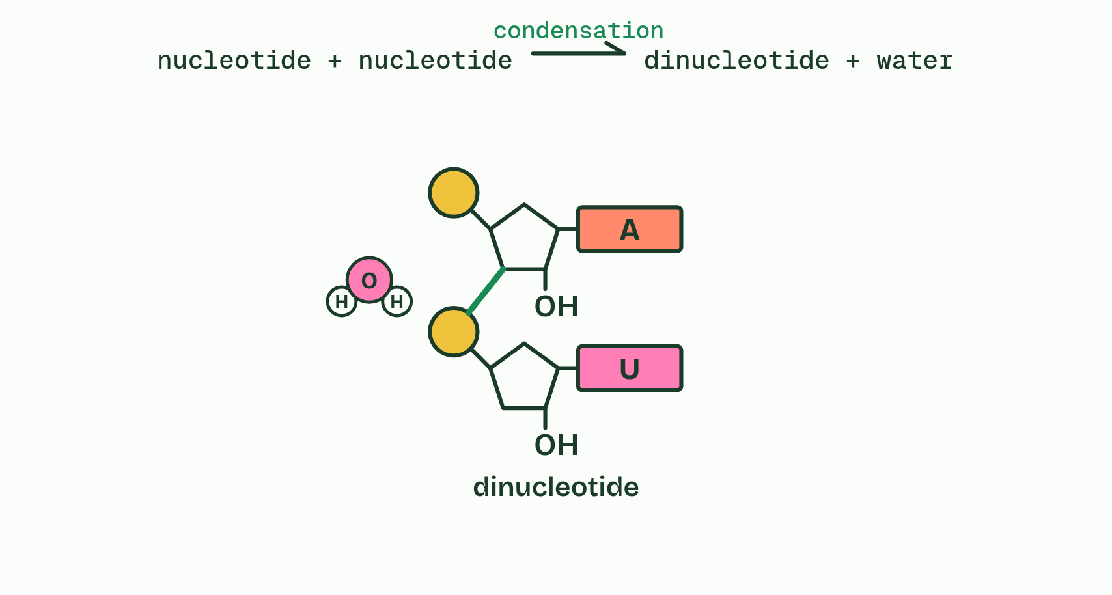
CHAPTER 3 · A1.2.3 A1.2.5 Sugar–phosphate bonding and RNA
3 / 4
Building a strand with a strong backbone
They leave as water, and a sugar-phosphate bond joins the sugar of one to the phosphate of the next: condensation, making a dinucleotide.
Minutes 15 to 27
Notes:
Minutes 15 to 27 of 60: Draw it the IB way (12 min).
The plan: Chapter 2's and chapter 3's figures step by step, with students drawing on mini whiteboards at the same steps. Then the bond builder on the board: predict the water count for ten nucleotides first.
Nucleotides join by condensation, as in the sugars and lipids of B1.1. The phosphate of each new nucleotide bonds to the sugar of the last nucleotide in the chain, and a molecule of water is released. The reverse is hydrolysis: water is added back and the bond breaks, which is how your digestion takes the nucleic acids in food apart.
Repeat the join and you build a strand: sugar, phosphate, sugar, phosphate. Every link is a covalent bond, so the strand is one continuous chain of covalently bonded atoms. That is the sugar–phosphate backbone: strong, and it fixes the order of the nucleotides along it.
The bases are not part of the backbone. Each sticks out sideways from its sugar, all on the same side, free to pair with another base (chapter 4). The backbone is the same all along, whatever the bases are, and any base can follow any other. Chapter 7 builds on that.
RNA is one such strand, a polymer of ribonucleotides made by condensation. DNA strands are built the same way; the enzymes that do it come in D1.1.
To draw an RNA strand, stack the nucleotides, join the lower left corner of each pentagon to the circle of the next, and point every base the same way. To mark one nucleotide, ring a circle, a pentagon and a rectangle together, not a pentagon, a rectangle and the circle below it.
One nucleotide has no order. A strand does. Order is a property of the polymer that its monomers do not have.

Slide 24
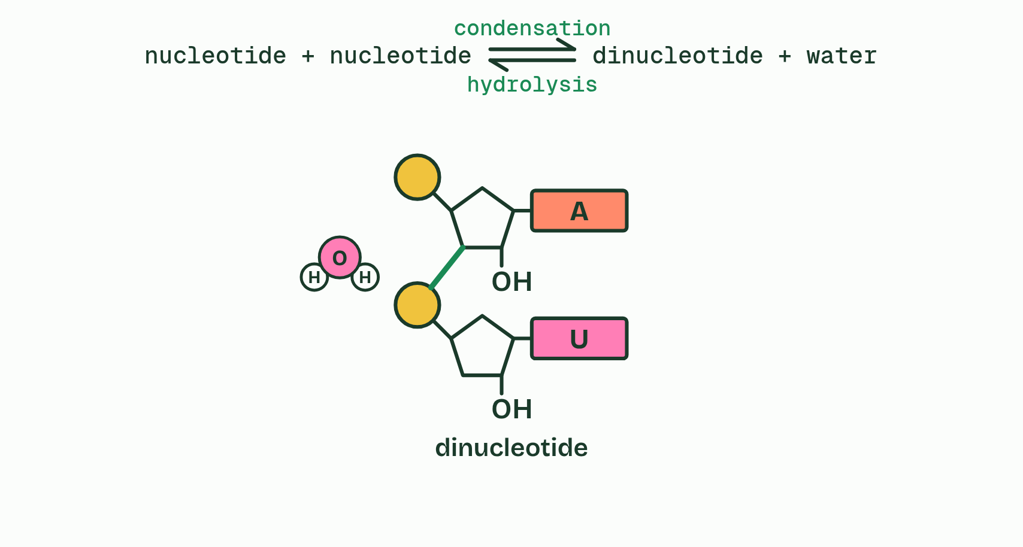
CHAPTER 3 · A1.2.3 A1.2.5 Sugar–phosphate bonding and RNA
4 / 4
Building a strand with a strong backbone
Add water and the bond splits again, the H to one nucleotide and the OH to the other: hydrolysis.
Minutes 15 to 27
Notes:
Minutes 15 to 27 of 60: Draw it the IB way (12 min).
The plan: Chapter 2's and chapter 3's figures step by step, with students drawing on mini whiteboards at the same steps. Then the bond builder on the board: predict the water count for ten nucleotides first.
Nucleotides join by condensation, as in the sugars and lipids of B1.1. The phosphate of each new nucleotide bonds to the sugar of the last nucleotide in the chain, and a molecule of water is released. The reverse is hydrolysis: water is added back and the bond breaks, which is how your digestion takes the nucleic acids in food apart.
Repeat the join and you build a strand: sugar, phosphate, sugar, phosphate. Every link is a covalent bond, so the strand is one continuous chain of covalently bonded atoms. That is the sugar–phosphate backbone: strong, and it fixes the order of the nucleotides along it.
The bases are not part of the backbone. Each sticks out sideways from its sugar, all on the same side, free to pair with another base (chapter 4). The backbone is the same all along, whatever the bases are, and any base can follow any other. Chapter 7 builds on that.
RNA is one such strand, a polymer of ribonucleotides made by condensation. DNA strands are built the same way; the enzymes that do it come in D1.1.
To draw an RNA strand, stack the nucleotides, join the lower left corner of each pentagon to the circle of the next, and point every base the same way. To mark one nucleotide, ring a circle, a pentagon and a rectangle together, not a pentagon, a rectangle and the circle below it.
One nucleotide has no order. A strand does. Order is a property of the polymer that its monomers do not have.

Slide 25
CHAPTER 3 · A1.2.3 A1.2.5 Sugar–phosphate bonding and RNA
Building a strand with a strong backbone
Nucleotides join by condensation, as in the sugars and lipids of B1.1.
The reverse is hydrolysis: water is added back and the bond breaks, which is how your digestion takes the nucleic acids in food apart.
Repeat the join and you build a strand: sugar, phosphate, sugar, phosphate.
Every link is a covalent bond, so the strand is one continuous chain of covalently bonded atoms.
Minutes 15 to 27
Notes:
Minutes 15 to 27 of 60: Draw it the IB way (12 min).
The plan: Chapter 2's and chapter 3's figures step by step, with students drawing on mini whiteboards at the same steps. Then the bond builder on the board: predict the water count for ten nucleotides first.
Nucleotides join by condensation, as in the sugars and lipids of B1.1. The phosphate of each new nucleotide bonds to the sugar of the last nucleotide in the chain, and a molecule of water is released. The reverse is hydrolysis: water is added back and the bond breaks, which is how your digestion takes the nucleic acids in food apart.
Repeat the join and you build a strand: sugar, phosphate, sugar, phosphate. Every link is a covalent bond, so the strand is one continuous chain of covalently bonded atoms. That is the sugar–phosphate backbone: strong, and it fixes the order of the nucleotides along it.
The bases are not part of the backbone. Each sticks out sideways from its sugar, all on the same side, free to pair with another base (chapter 4). The backbone is the same all along, whatever the bases are, and any base can follow any other. Chapter 7 builds on that.
RNA is one such strand, a polymer of ribonucleotides made by condensation. DNA strands are built the same way; the enzymes that do it come in D1.1.
To draw an RNA strand, stack the nucleotides, join the lower left corner of each pentagon to the circle of the next, and point every base the same way. To mark one nucleotide, ring a circle, a pentagon and a rectangle together, not a pentagon, a rectangle and the circle below it.
One nucleotide has no order. A strand does. Order is a property of the polymer that its monomers do not have.

Slide 26
PREDICT
How many different nucleotides does a cell use to build DNA?
A One: every nucleotide in DNA is exactly the same as every other
B Twelve: four kinds of base, four kinds of sugar and four kinds of phosphate
C Four: the sugar and phosphate are the same, only the base differs
Minutes 15 to 27
Notes:
Minutes 15 to 27 of 60: Draw it the IB way (12 min).
The plan: Chapter 2's and chapter 3's figures step by step, with students drawing on mini whiteboards at the same steps. Then the bond builder on the board: predict the water count for ten nucleotides first.
Ask for a show of hands, or mini whiteboards, before revealing. (Answer: C, on the next slide.)

Slide 27
PREDICT
How many water molecules are released when 10 nucleotides join into one strand?
A 9
B 10
C 20
Minutes 15 to 27
Notes:
Minutes 15 to 27 of 60: Draw it the IB way (12 min).
The plan: Chapter 2's and chapter 3's figures step by step, with students drawing on mini whiteboards at the same steps. Then the bond builder on the board: predict the water count for ten nucleotides first.
Ask for a show of hands, or mini whiteboards, before revealing. (Answer: A, on the next slide.)

Slide 28
WHAT HAPPENS
How many different nucleotides does a cell use to build DNA?
A One: every nucleotide in DNA is exactly the same as every other
B Twelve: four kinds of base, four kinds of sugar and four kinds of phosphate
C Four: the sugar and phosphate are the same, only the base differs
Four. Every DNA nucleotide has the same phosphate and the same sugar, deoxyribose; only the base differs, and DNA has four bases. RNA has its own four, built on ribose, so a cell's nucleic acids use eight nucleotides in all.
Minutes 15 to 27
Notes:
Minutes 15 to 27 of 60: Draw it the IB way (12 min).
The plan: Chapter 2's and chapter 3's figures step by step, with students drawing on mini whiteboards at the same steps. Then the bond builder on the board: predict the water count for ten nucleotides first.
Answer: C. Four. Every DNA nucleotide has the same phosphate and the same sugar, deoxyribose; only the base differs, and DNA has four bases. RNA has its own four, built on ribose, so a cell's nucleic acids use eight nucleotides in all.

Slide 29
WHAT HAPPENS
How many water molecules are released when 10 nucleotides join into one strand?
A 9
B 10
C 20
Nine. Each bond releases one water molecule, and ten nucleotides in a row have nine bonds between them: n nucleotides make n − 1 bonds and release n − 1 water molecules. Taking the strand apart again by hydrolysis would use nine water molecules.
Minutes 15 to 27
Notes:
Minutes 15 to 27 of 60: Draw it the IB way (12 min).
The plan: Chapter 2's and chapter 3's figures step by step, with students drawing on mini whiteboards at the same steps. Then the bond builder on the board: predict the water count for ten nucleotides first.
Answer: A. Nine. Each bond releases one water molecule, and ten nucleotides in a row have nine bonds between them: n nucleotides make n − 1 bonds and release n − 1 water molecules. Taking the strand apart again by hydrolysis would use nine water molecules.

Slide 30
WATCH OUT
A nucleotide is not a base. Each nucleotide contains one base, along with a sugar and a phosphate. And the base is bonded to the sugar, never to the phosphate.
Minutes 15 to 27
Notes:
Minutes 15 to 27 of 60: Draw it the IB way (12 min).
The plan: Chapter 2's and chapter 3's figures step by step, with students drawing on mini whiteboards at the same steps. Then the bond builder on the board: predict the water count for ten nucleotides first.
A common mistake: say it, then ask who can say why it is wrong.

Slide 31
WATCH OUT
Hydrogen bonds do not hold a strand together. Inside a strand every link is covalent. Hydrogen bonds only come in between two strands (chapter 4), which is why the two strands of DNA can be parted without breaking either.
Minutes 15 to 27
Notes:
Minutes 15 to 27 of 60: Draw it the IB way (12 min).
The plan: Chapter 2's and chapter 3's figures step by step, with students drawing on mini whiteboards at the same steps. Then the bond builder on the board: predict the water count for ten nucleotides first.
A common mistake: say it, then ask who can say why it is wrong.

Slide 32
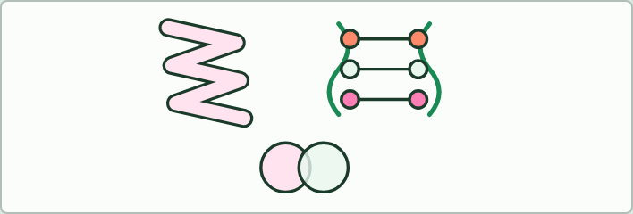
MODEL
25 MIN
Two models, one Venn
THE TASK
Pairs build a paper (origami) model and a sweet model of DNA, then draw a Venn diagram: what each shows, what it leaves out, what both get wrong, and how to improve one. Push for these: the origami shows the twist and the antiparallel strands; the sweets show pairing and the backbone; neither shows atoms, hydrogen bonds or scale.
STUDENTS NEED
A printed DNA origami sheet that you have permission to copy (the guide does not supply one); for the sweet model, two colours of liquorice laces, four colours of soft sweets and cocktail sticks; beads and pipe cleaners for anyone who cannot or will not use sweets.
Minutes 27 to 52
Notes:
Minutes 27 to 52 of 60: Two models, one Venn (25 min).
The plan: Pairs build a paper model and a sweet model of DNA, then complete the Venn diagram. Finish on "Watson and Crick built models too", chapter 5's aside.
The activity: Two models, one Venn. Pairs build a paper (origami) model and a sweet model of DNA, then draw a Venn diagram: what each shows, what it leaves out, what both get wrong, and how to improve one. Push for these: the origami shows the twist and the antiparallel strands; the sweets show pairing and the backbone; neither shows atoms, hydrogen bonds or scale.
Needs: a printed DNA origami sheet that you have permission to copy (the guide does not supply one); for the sweet model, two colours of liquorice laces, four colours of soft sweets and cocktail sticks; beads and pipe cleaners for anyone who cannot or will not use sweets.
The time: 25 minutes, minutes 27 to 52 of the plan.

Slide 33
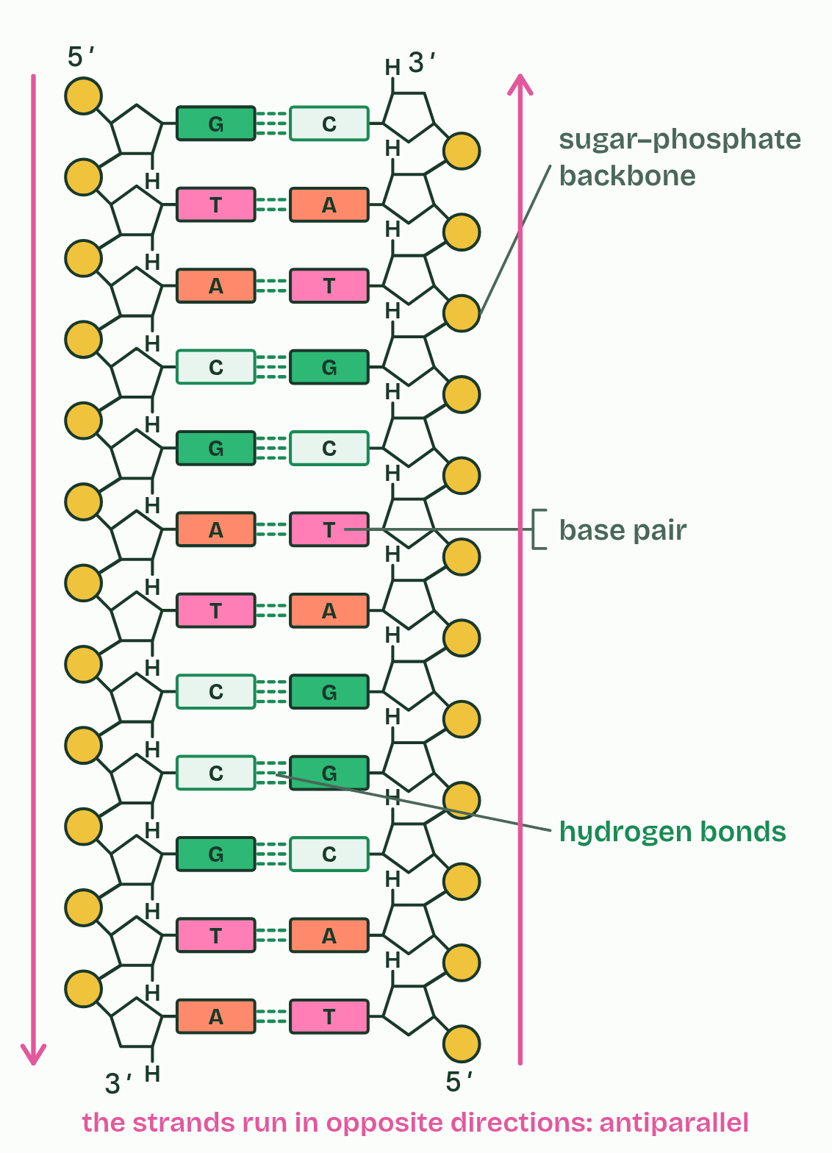
CHAPTER 5 · A1.2.6 The double helix
1 / 2
Two strands, one helix
Flat: the ladder the exam asks for
Minutes 27 to 52
Notes:
Minutes 27 to 52 of 60: Two models, one Venn (25 min).
The plan: Pairs build a paper model and a sweet model of DNA, then complete the Venn diagram. Finish on "Watson and Crick built models too", chapter 5's aside.
DNA is two strands held together by hydrogen bonds between complementary bases: A with T and G with C. The bases are on the inside and the two sugar–phosphate backbones are on the outside. A pair of bases facing each other is a base pair.
The strands are antiparallel: they run in opposite directions, like the two lanes of a road. In a drawing, the second strand's nucleotides are upside down, with the pentagons inverted and the phosphates on the other side. What direction means chemically is chapter 8.
The pair of strands winds into a double helix. In an exam you draw the two strands antiparallel and paired, with A opposite T and G opposite C. You do not have to draw the twist.
One hydrogen bond is weak, but millions of them hold the two strands firmly together. How that squares with copying and reading DNA, which need the strands parted, is the prediction below.
Example: Worked example In a double-stranded DNA molecule, 20% of the bases are adenine. Thymine pairs with adenine, so 20% are thymine. That leaves 60%, shared equally between guanine and cytosine: 30% each. Every nucleotide carries one phosphate, so the number of phosphates equals the number of bases.

Slide 34
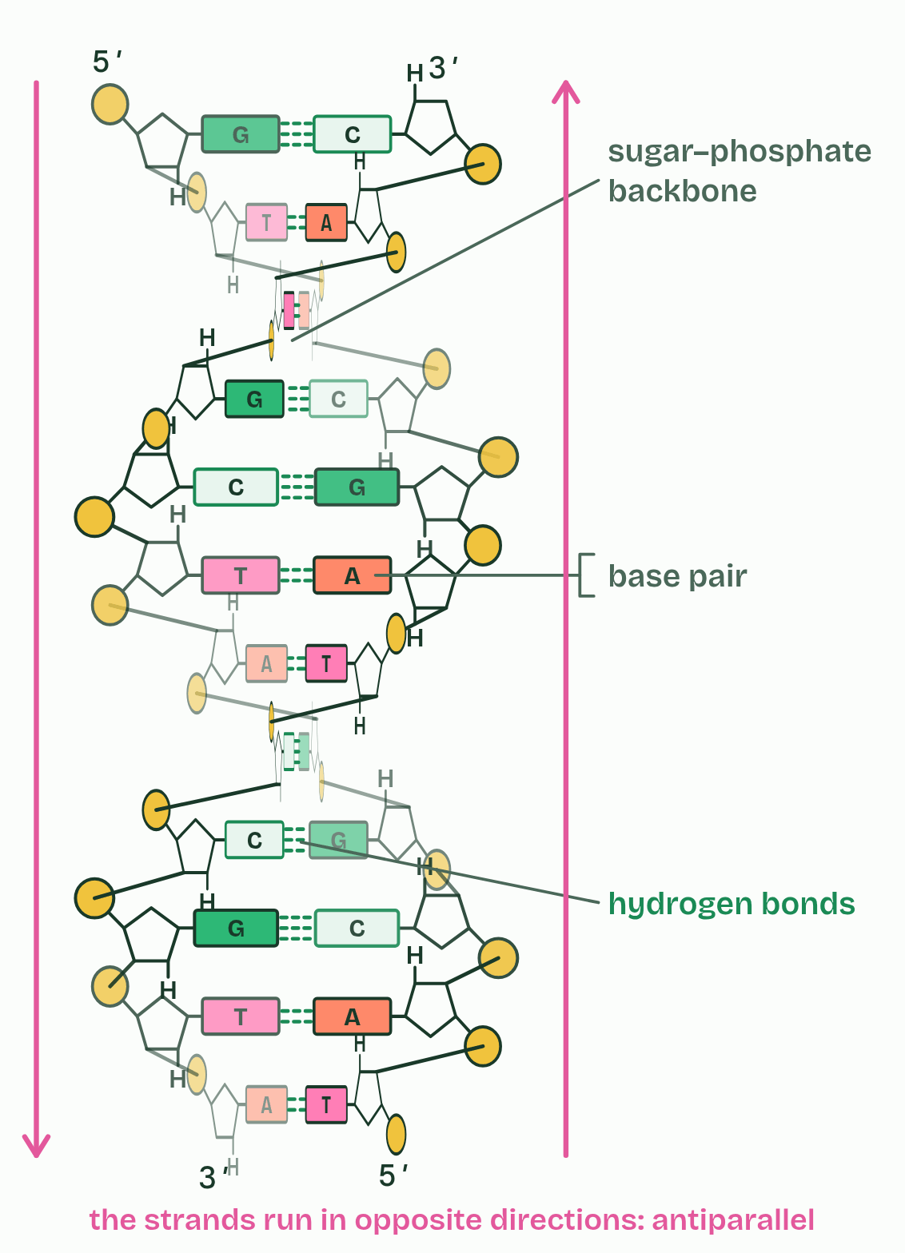
CHAPTER 5 · A1.2.6 The double helix
2 / 2
Two strands, one helix
Twisted into a double helix
Minutes 27 to 52
Notes:
Minutes 27 to 52 of 60: Two models, one Venn (25 min).
The plan: Pairs build a paper model and a sweet model of DNA, then complete the Venn diagram. Finish on "Watson and Crick built models too", chapter 5's aside.
DNA is two strands held together by hydrogen bonds between complementary bases: A with T and G with C. The bases are on the inside and the two sugar–phosphate backbones are on the outside. A pair of bases facing each other is a base pair.
The strands are antiparallel: they run in opposite directions, like the two lanes of a road. In a drawing, the second strand's nucleotides are upside down, with the pentagons inverted and the phosphates on the other side. What direction means chemically is chapter 8.
The pair of strands winds into a double helix. In an exam you draw the two strands antiparallel and paired, with A opposite T and G opposite C. You do not have to draw the twist.
One hydrogen bond is weak, but millions of them hold the two strands firmly together. How that squares with copying and reading DNA, which need the strands parted, is the prediction below.
Example: Worked example In a double-stranded DNA molecule, 20% of the bases are adenine. Thymine pairs with adenine, so 20% are thymine. That leaves 60%, shared equally between guanine and cytosine: 30% each. Every nucleotide carries one phosphate, so the number of phosphates equals the number of bases.

Slide 35
CHAPTER 5 · A1.2.6 The double helix
Two strands, one helix
A pair of bases facing each other is a base pair.
The strands are antiparallel: they run in opposite directions, like the two lanes of a road.
The pair of strands winds into a double helix.
In an exam you draw the two strands antiparallel and paired, with A opposite T and G opposite C.
Minutes 27 to 52
Notes:
Minutes 27 to 52 of 60: Two models, one Venn (25 min).
The plan: Pairs build a paper model and a sweet model of DNA, then complete the Venn diagram. Finish on "Watson and Crick built models too", chapter 5's aside.
DNA is two strands held together by hydrogen bonds between complementary bases: A with T and G with C. The bases are on the inside and the two sugar–phosphate backbones are on the outside. A pair of bases facing each other is a base pair.
The strands are antiparallel: they run in opposite directions, like the two lanes of a road. In a drawing, the second strand's nucleotides are upside down, with the pentagons inverted and the phosphates on the other side. What direction means chemically is chapter 8.
The pair of strands winds into a double helix. In an exam you draw the two strands antiparallel and paired, with A opposite T and G opposite C. You do not have to draw the twist.
One hydrogen bond is weak, but millions of them hold the two strands firmly together. How that squares with copying and reading DNA, which need the strands parted, is the prediction below.
Example: Worked example In a double-stranded DNA molecule, 20% of the bases are adenine. Thymine pairs with adenine, so 20% are thymine. That leaves 60%, shared equally between guanine and cytosine: 30% each. Every nucleotide carries one phosphate, so the number of phosphates equals the number of bases.

Slide 36
PREDICT
To be copied, the two strands of DNA must come apart. Why does pulling them apart not break the strands themselves?
A Strong covalent bonds join the two strands, while each strand is held together by weak hydrogen bonds
B The bases leave the strands while they are copied, then the strands are put back together afterwards
C Weak hydrogen bonds join the two strands, while each strand is a chain of strong covalent bonds
Minutes 27 to 52
Notes:
Minutes 27 to 52 of 60: Two models, one Venn (25 min).
The plan: Pairs build a paper model and a sweet model of DNA, then complete the Venn diagram. Finish on "Watson and Crick built models too", chapter 5's aside.
Ask for a show of hands, or mini whiteboards, before revealing. (Answer: C, on the next slide.)

Slide 37
WHAT HAPPENS
To be copied, the two strands of DNA must come apart. Why does pulling them apart not break the strands themselves?
A Strong covalent bonds join the two strands, while each strand is held together by weak hydrogen bonds
B The bases leave the strands while they are copied, then the strands are put back together afterwards
C Weak hydrogen bonds join the two strands, while each strand is a chain of strong covalent bonds
The bonds between the strands are hydrogen bonds: weak one by one, so the strands can be unzipped. The bonds along each strand are covalent, so each strand, and the sequence it carries, stays whole. Both strands then serve as templates (chapter 4).
Minutes 27 to 52
Notes:
Minutes 27 to 52 of 60: Two models, one Venn (25 min).
The plan: Pairs build a paper model and a sweet model of DNA, then complete the Venn diagram. Finish on "Watson and Crick built models too", chapter 5's aside.
Answer: C. The bonds between the strands are hydrogen bonds: weak one by one, so the strands can be unzipped. The bonds along each strand are covalent, so each strand, and the sequence it carries, stays whole. Both strands then serve as templates (chapter 4).

Slide 38
WATCH OUT
Antiparallel does not mean twisted, or that the bases are opposite each other. It means the two strands run in opposite directions.
Minutes 27 to 52
Notes:
Minutes 27 to 52 of 60: Two models, one Venn (25 min).
The plan: Pairs build a paper model and a sweet model of DNA, then complete the Venn diagram. Finish on "Watson and Crick built models too", chapter 5's aside.
A common mistake: say it, then ask who can say why it is wrong.

Slide 39
PLENARY
Can you now...
Explain why DNA is the genetic material of every living organism, and why RNA viruses do not break the rule (A1.2.1)
Draw a nucleotide as a circle, a pentagon and a rectangle, each joined in the right place (A1.2.2)
Explain how condensation builds a strand with a strong sugar–phosphate backbone, and draw a short strand of RNA (A1.2.3, A1.2.5)
Draw two antiparallel strands joined by hydrogen bonds between A and T, and C and G (A1.2.6)
Minutes 52 to 60
Notes:
Minutes 52 to 60 of 60: Exit (8 min).
The plan: Draw three base pairs, antiparallel, and label a backbone, a hydrogen bond and one whole nucleotide.
Thumbs up, sideways or down on each goal before the exit question. The goals come from the statements this lesson covers.

Slide 40
EXIT QUESTION
Before you go
Draw three base pairs, antiparallel, and label a backbone, a hydrogen bond and one whole nucleotide.
Minutes 52 to 60
Notes:
Minutes 52 to 60 of 60: Exit (8 min).
The plan: Draw three base pairs, antiparallel, and label a backbone, a hydrogen bond and one whole nucleotide.

Slide 41
PRACTISE AND REVISE
Keep going
Exam practice: a fresh paper of exam questions on A1.2 at standard level, marked as you go
The guide, with the animations and the dry lab
This lesson in the guide: 1 Every living thing keeps its instructions in DNA, 2 Three parts, one monomer, 3 Building a strand with a strong backbone, 5 Two strands, one helix
BUILD FOR YOUR CLASS
ALREADY ON THE SITE FOR A1.2
CARD SETS ON SPLYCR
Tarsia puzzle, dominoes and picture reveal on A1.2, built from its key terms and ready to print
A pub quiz with rounds on A1.2, to present or run with no projector
An escape room built from the question bank on A1.2
Lesson: Nucleic Acids
Quiz: Nucleic Acids
Revision map: A1.2 Nucleic acids, to fill in
Exam questions: A1.2 in the exam maker, a paper with its markscheme
Open a set to host it as a class game, or make a copy to edit.
A1.2 Nucleic Acids
How this was made. The course structure, the activities and the teaching choices come from my own classroom, my presentations and my years of teaching IB and AP Biology. I use Claude, an AI, to help write and build the interactive guides, lesson plans, slides and practice questions, and to draw the diagrams and code the interactives. I direct the work and review it against the IB and AP specifications before it goes live.
Minute 60: after the lesson
Notes:
Every link here is live. Set the exam practice paper for homework: it is fresh each time, marked as students go and saved to their Exam practice when they are signed in.
Exam practice: https://www.biologybybradford.com/exam-maker/sit?topics=A1.2&level=SL&paper=quiz&marks=15&src=ep
The guide: https://www.biologybybradford.com/guides/ib-biology-a1-2-nucleic-acids

