Slide 1
IB Biology A1.2
LESSON 2 OF 5
BY THE END YOU CAN
Nucleic acids
Name the bases of DNA and RNA, and explain how complementary pairing lets DNA be copied and read (A1.2.4, A1.2.8)
Give three differences between DNA and RNA, and sketch ribose against deoxyribose (A1.2.7)
Pairing, copying, DNA and RNA
A1.2.4, A1.2.7, A1.2.8
Complementary pairing and why it makes copies exact, DNA against RNA, and the extraction dry lab
60 minutes · chapters 4, 6 · the dry lab
Minute 0
Notes:
IB Biology A1.2, Nucleic acids. Lesson 2 of 5: Pairing, copying, DNA and RNA, 60 minutes.
The plan, minute by minute (each slide's footer says where you are):
0 to 5 min (5) Do now
5 to 20 min (15) Pair it
20 to 30 min (10) DNA or RNA
30 to 55 min (25) The dry lab
55 to 60 min (5) Exit
What students get wrong:
Complementary means identical. The strands differ; the copies match.
Uracil replaces adenine. It replaces thymine.
Deoxyribose has no oxygen in its ring. It lacks the OH on carbon 2 only.
The white threads from the extraction are a DNA molecule. They are millions, tangled together.
Stretch and support:
Support: cut the figures' captions into cards to put in order, use the dotted key terms as a glossary, and give a drawing frame with the pentagon corners marked for the IB drawings.
Support: use the three mnemonics (Apples in the Tree, Some Bananas Split, Pure As Gold) as a starter in each lesson.
Stretch: why might RNA have come before DNA?
The lesson plan to print: https://www.biologybybradford.com/guides/downloads/ib-biology-a1-2-nucleic-acids-lesson-2-plan.pdf

Slide 2
DO NOW
Do now
Turn over the Apples in the Tree tiles, then five quick base pairs on the board.
5:00
minutes
Start now: the timer is running.
Minutes 0 to 5
Notes:
Minutes 0 to 5 of 60: Do now (5 min).
The plan: Turn over the Apples in the Tree tiles, then five quick base pairs on the board.
Start a 5 minute timer as they come in.

Slide 3
STEP 2
15 MIN
Pair it
Chapter 4: Four letters that pair
Minutes 5 to 20
Notes:
Minutes 5 to 20 of 60: Pair it (15 min).
The plan: Chapter 4's figure in pairs: get a wrong base to fail and say why, then Copy it and Read it. Then the copy predict box.

Slide 4
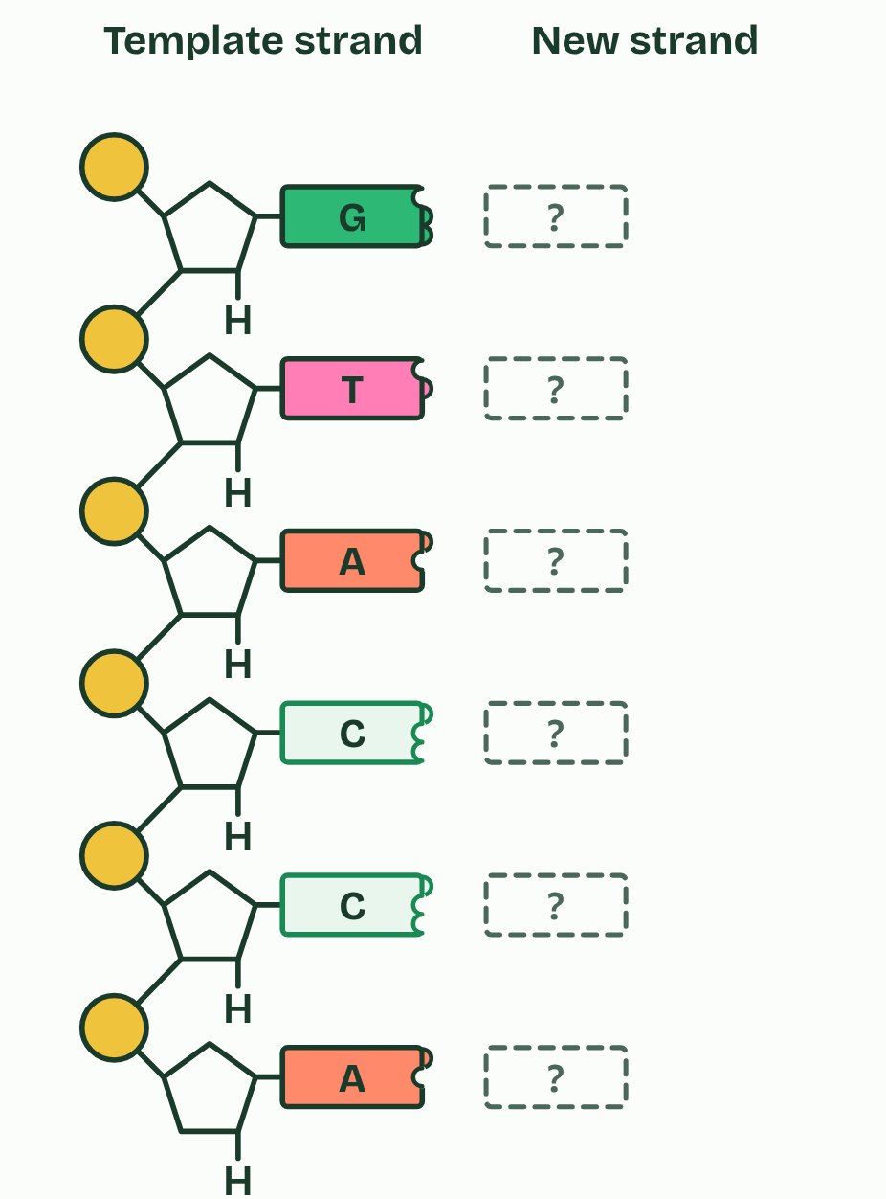
CHAPTER 4 · A1.2.4 A1.2.8 Bases and complementary pairing
1 / 4
Four letters that pair
Which base fits each slot?
Minutes 5 to 20
Notes:
Minutes 5 to 20 of 60: Pair it (15 min).
The plan: Chapter 4's figure in pairs: get a wrong base to fail and say why, then Copy it and Read it. Then the copy predict box.
DNA uses four bases: adenine (A), cytosine (C), guanine (G) and thymine (T). RNA has A, C and G too, but uracil (U) takes the place of thymine. You need the names as well as the letters.
The order of the bases along a strand is the message, like letters spelling words: the base sequence. A gene is a stretch of that sequence, read three bases at a time to choose amino acids (D1.2).
Bases pair across between two strands by complementary base pairing: A with T (or with U when RNA is involved), and C with G. Complementarity rests on hydrogen bonds. Each base has a pattern of atoms that can give or take a hydrogen bond, and only in these two pairs do the patterns line up across the gap. A–T forms two bonds and C–G three; you do not need to memorise those numbers.
That pairing is what makes accurate copying possible. In replication the hydrogen bonds break and the strands separate, while the covalent backbones stay whole. Each strand is a template: free nucleotides pair with its exposed bases, and each new strand is complementary to its template. Each new molecule therefore has exactly the base sequence of the original. That answers the second guiding question: each strand carries what is needed to rebuild the other.
The same rule lets cells read DNA. In transcription, one strand of a gene is the template for an RNA copy, with an RNA base opposite each DNA base and U opposite A. In translation, three bases of messenger RNA pair with three bases of a transfer RNA, which brings the matching amino acid. Here both are outlined; D1.2 teaches them.

Slide 5
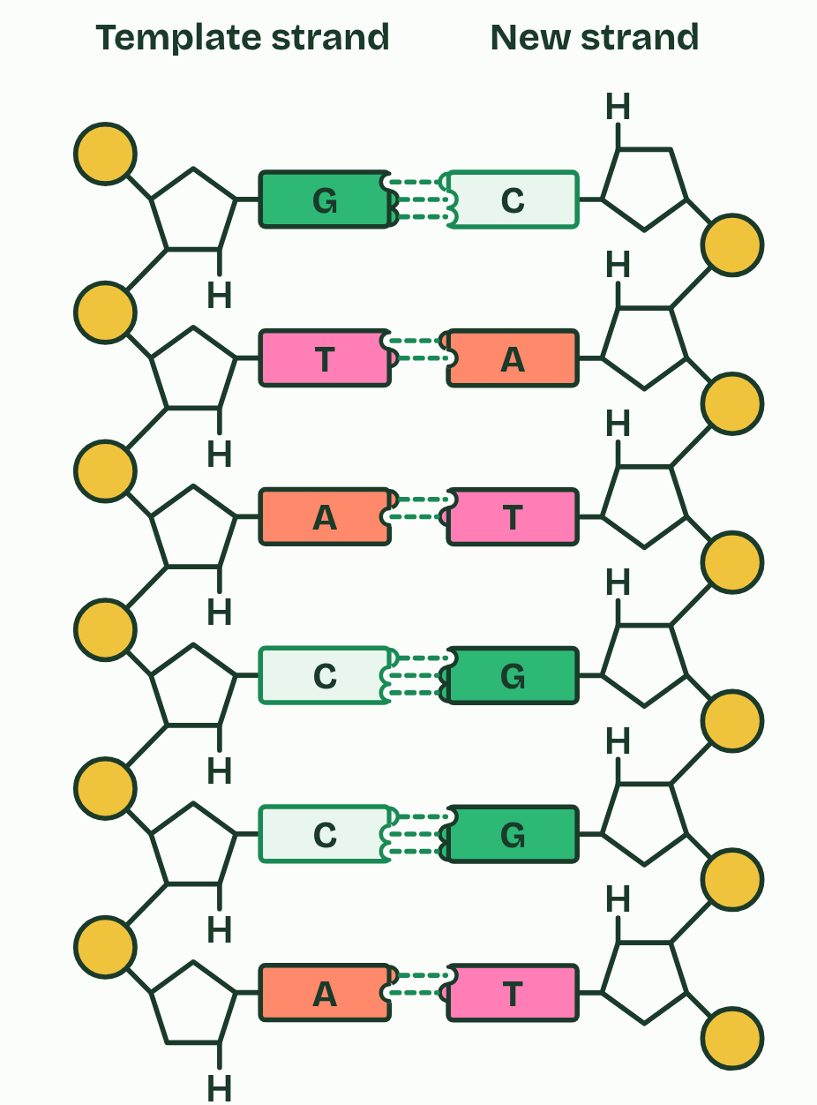
CHAPTER 4 · A1.2.4 A1.2.8 Bases and complementary pairing
2 / 4
Four letters that pair
Paired: only A with T and G with C form hydrogen bonds
Minutes 5 to 20
Notes:
Minutes 5 to 20 of 60: Pair it (15 min).
The plan: Chapter 4's figure in pairs: get a wrong base to fail and say why, then Copy it and Read it. Then the copy predict box.
DNA uses four bases: adenine (A), cytosine (C), guanine (G) and thymine (T). RNA has A, C and G too, but uracil (U) takes the place of thymine. You need the names as well as the letters.
The order of the bases along a strand is the message, like letters spelling words: the base sequence. A gene is a stretch of that sequence, read three bases at a time to choose amino acids (D1.2).
Bases pair across between two strands by complementary base pairing: A with T (or with U when RNA is involved), and C with G. Complementarity rests on hydrogen bonds. Each base has a pattern of atoms that can give or take a hydrogen bond, and only in these two pairs do the patterns line up across the gap. A–T forms two bonds and C–G three; you do not need to memorise those numbers.
That pairing is what makes accurate copying possible. In replication the hydrogen bonds break and the strands separate, while the covalent backbones stay whole. Each strand is a template: free nucleotides pair with its exposed bases, and each new strand is complementary to its template. Each new molecule therefore has exactly the base sequence of the original. That answers the second guiding question: each strand carries what is needed to rebuild the other.
The same rule lets cells read DNA. In transcription, one strand of a gene is the template for an RNA copy, with an RNA base opposite each DNA base and U opposite A. In translation, three bases of messenger RNA pair with three bases of a transfer RNA, which brings the matching amino acid. Here both are outlined; D1.2 teaches them.

Slide 6
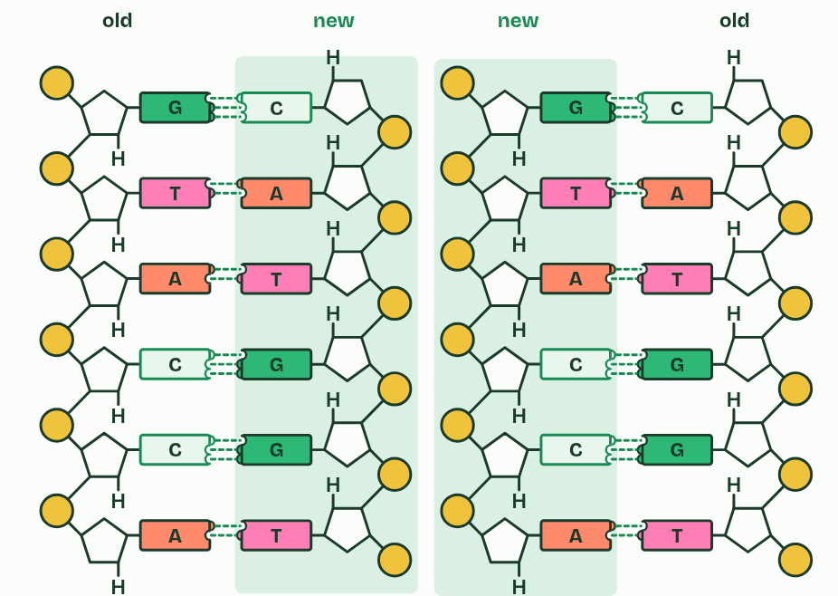
CHAPTER 4 · A1.2.4 A1.2.8 Bases and complementary pairing
3 / 4
Four letters that pair
Copy it: two molecules with the same sequence
Minutes 5 to 20
Notes:
Minutes 5 to 20 of 60: Pair it (15 min).
The plan: Chapter 4's figure in pairs: get a wrong base to fail and say why, then Copy it and Read it. Then the copy predict box.
DNA uses four bases: adenine (A), cytosine (C), guanine (G) and thymine (T). RNA has A, C and G too, but uracil (U) takes the place of thymine. You need the names as well as the letters.
The order of the bases along a strand is the message, like letters spelling words: the base sequence. A gene is a stretch of that sequence, read three bases at a time to choose amino acids (D1.2).
Bases pair across between two strands by complementary base pairing: A with T (or with U when RNA is involved), and C with G. Complementarity rests on hydrogen bonds. Each base has a pattern of atoms that can give or take a hydrogen bond, and only in these two pairs do the patterns line up across the gap. A–T forms two bonds and C–G three; you do not need to memorise those numbers.
That pairing is what makes accurate copying possible. In replication the hydrogen bonds break and the strands separate, while the covalent backbones stay whole. Each strand is a template: free nucleotides pair with its exposed bases, and each new strand is complementary to its template. Each new molecule therefore has exactly the base sequence of the original. That answers the second guiding question: each strand carries what is needed to rebuild the other.
The same rule lets cells read DNA. In transcription, one strand of a gene is the template for an RNA copy, with an RNA base opposite each DNA base and U opposite A. In translation, three bases of messenger RNA pair with three bases of a transfer RNA, which brings the matching amino acid. Here both are outlined; D1.2 teaches them.

Slide 7
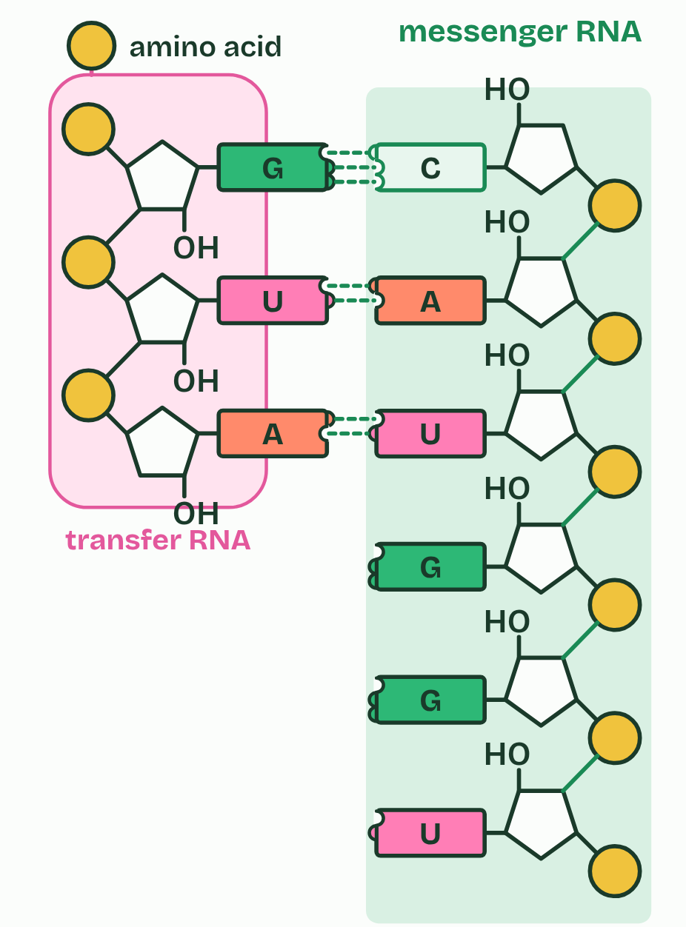
CHAPTER 4 · A1.2.4 A1.2.8 Bases and complementary pairing
4 / 4
Four letters that pair
Read it: messenger RNA, read by a transfer RNA
Minutes 5 to 20
Notes:
Minutes 5 to 20 of 60: Pair it (15 min).
The plan: Chapter 4's figure in pairs: get a wrong base to fail and say why, then Copy it and Read it. Then the copy predict box.
DNA uses four bases: adenine (A), cytosine (C), guanine (G) and thymine (T). RNA has A, C and G too, but uracil (U) takes the place of thymine. You need the names as well as the letters.
The order of the bases along a strand is the message, like letters spelling words: the base sequence. A gene is a stretch of that sequence, read three bases at a time to choose amino acids (D1.2).
Bases pair across between two strands by complementary base pairing: A with T (or with U when RNA is involved), and C with G. Complementarity rests on hydrogen bonds. Each base has a pattern of atoms that can give or take a hydrogen bond, and only in these two pairs do the patterns line up across the gap. A–T forms two bonds and C–G three; you do not need to memorise those numbers.
That pairing is what makes accurate copying possible. In replication the hydrogen bonds break and the strands separate, while the covalent backbones stay whole. Each strand is a template: free nucleotides pair with its exposed bases, and each new strand is complementary to its template. Each new molecule therefore has exactly the base sequence of the original. That answers the second guiding question: each strand carries what is needed to rebuild the other.
The same rule lets cells read DNA. In transcription, one strand of a gene is the template for an RNA copy, with an RNA base opposite each DNA base and U opposite A. In translation, three bases of messenger RNA pair with three bases of a transfer RNA, which brings the matching amino acid. Here both are outlined; D1.2 teaches them.

Slide 8
CHAPTER 4 · A1.2.4 A1.2.8 Bases and complementary pairing
Four letters that pair
DNA uses four bases: adenine (A), cytosine (C), guanine (G) and thymine (T).
RNA has A, C and G too, but uracil (U) takes the place of thymine.
The order of the bases along a strand is the message, like letters spelling words: the base sequence.
Bases pair across between two strands by complementary base pairing: A with T (or with U when RNA is involved), and C with G.
Minutes 5 to 20
Notes:
Minutes 5 to 20 of 60: Pair it (15 min).
The plan: Chapter 4's figure in pairs: get a wrong base to fail and say why, then Copy it and Read it. Then the copy predict box.
DNA uses four bases: adenine (A), cytosine (C), guanine (G) and thymine (T). RNA has A, C and G too, but uracil (U) takes the place of thymine. You need the names as well as the letters.
The order of the bases along a strand is the message, like letters spelling words: the base sequence. A gene is a stretch of that sequence, read three bases at a time to choose amino acids (D1.2).
Bases pair across between two strands by complementary base pairing: A with T (or with U when RNA is involved), and C with G. Complementarity rests on hydrogen bonds. Each base has a pattern of atoms that can give or take a hydrogen bond, and only in these two pairs do the patterns line up across the gap. A–T forms two bonds and C–G three; you do not need to memorise those numbers.
That pairing is what makes accurate copying possible. In replication the hydrogen bonds break and the strands separate, while the covalent backbones stay whole. Each strand is a template: free nucleotides pair with its exposed bases, and each new strand is complementary to its template. Each new molecule therefore has exactly the base sequence of the original. That answers the second guiding question: each strand carries what is needed to rebuild the other.
The same rule lets cells read DNA. In transcription, one strand of a gene is the template for an RNA copy, with an RNA base opposite each DNA base and U opposite A. In translation, three bases of messenger RNA pair with three bases of a transfer RNA, which brings the matching amino acid. Here both are outlined; D1.2 teaches them.

Slide 9
PREDICT
One strand of a DNA molecule reads A A T G C. The strands separate and each is copied. What does the strand built against it read, and the strand built against that one?
A T T A C G, then T T A C G
B T T A C G, then A A T G C
C U U A C G, then A A T G C
Minutes 5 to 20
Notes:
Minutes 5 to 20 of 60: Pair it (15 min).
The plan: Chapter 4's figure in pairs: get a wrong base to fail and say why, then Copy it and Read it. Then the copy predict box.
Ask for a show of hands, or mini whiteboards, before revealing. (Answer: B, on the next slide.)

Slide 10
WHAT HAPPENS
One strand of a DNA molecule reads A A T G C. The strands separate and each is copied. What does the strand built against it read, and the strand built against that one?
A T T A C G, then T T A C G
B T T A C G, then A A T G C
C U U A C G, then A A T G C
Pairing makes a complementary copy, and the complement of the complement is the original. So every molecule made by copying has the same sequence as the one it came from: this is how complementary pairing keeps genetic information exact through replication.
Minutes 5 to 20
Notes:
Minutes 5 to 20 of 60: Pair it (15 min).
The plan: Chapter 4's figure in pairs: get a wrong base to fail and say why, then Copy it and Read it. Then the copy predict box.
Answer: B. Pairing makes a complementary copy, and the complement of the complement is the original. So every molecule made by copying has the same sequence as the one it came from: this is how complementary pairing keeps genetic information exact through replication.

Slide 11
REMEMBER IT
Which base pairs with which
A
T
C
G
Apples
Tree
Cars
Garage
Minutes 5 to 20
Notes:
Minutes 5 to 20 of 60: Pair it (15 min).
The plan: Chapter 4's figure in pairs: get a wrong base to fail and say why, then Copy it and Read it. Then the copy predict box.
Ask the class what each letter stands for before revealing.

Slide 12
REMEMBER IT
Which base pairs with which
A
T
C
G
Apples
Tree
Cars
Garage
Adenine
Thymine
Cytosine
Guanine
pairs with thymine (uracil in RNA)
in DNA only
pairs with guanine
pairs with cytosine
Minutes 5 to 20
Notes:
Minutes 5 to 20 of 60: Pair it (15 min).
The plan: Chapter 4's figure in pairs: get a wrong base to fail and say why, then Copy it and Read it. Then the copy predict box.
Apples: Adenine (pairs with thymine (uracil in RNA))
Tree: Thymine (in DNA only)
Cars: Cytosine (pairs with guanine)
Garage: Guanine (pairs with cytosine)

Slide 13
WATCH OUT
Complementary does not mean identical. The two strands of one molecule have different sequences; it is the two molecules made by copying that are identical. And in RNA, uracil takes the place of thymine, not of adenine.
Minutes 5 to 20
Notes:
Minutes 5 to 20 of 60: Pair it (15 min).
The plan: Chapter 4's figure in pairs: get a wrong base to fail and say why, then Copy it and Read it. Then the copy predict box.
A common mistake: say it, then ask who can say why it is wrong.

Slide 14
STEP 3
10 MIN
DNA or RNA
Students sketch ribose and deoxyribose and mark carbon 2.
Minutes 20 to 30
Notes:
Minutes 20 to 30 of 60: DNA or RNA (10 min).
The plan: Chapter 6's switch. Students sketch ribose and deoxyribose and mark carbon 2. Some Bananas Split.

Slide 15
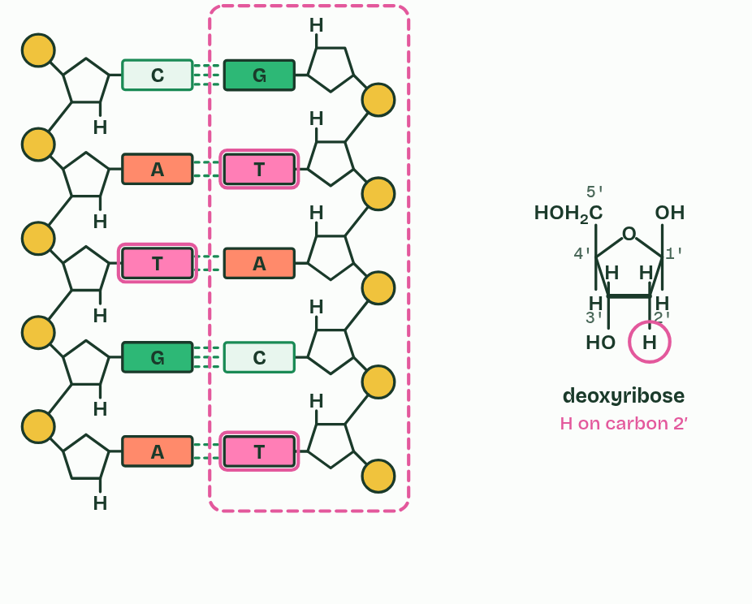
CHAPTER 6 · A1.2.7 Differences between DNA and RNA
1 / 2
DNA and RNA compared
DNA
Minutes 20 to 30
Notes:
Minutes 20 to 30 of 60: DNA or RNA (10 min).
The plan: Chapter 6's switch. Students sketch ribose and deoxyribose and mark carbon 2. Some Bananas Split.
DNA and RNA differ in three ways you need to be able to give: the number of strands, the bases, and the sugar.
Deoxyribose has one oxygen fewer than ribose: on carbon 2 it carries an H where ribose carries an OH, and "deoxy" means "without an oxygen". The ring oxygen is still there. Sketch both rings and mark the difference.
Cells use several kinds of nucleic acid. DNA makes up the chromosomes, with more in mitochondria and chloroplasts. Messenger RNA is a copy of a gene, taken to a ribosome. Transfer RNA brings amino acids to the ribosome. Ribosomal RNA is part of every ribosome. And some viruses have RNA as their genes.
Example: Links What makes RNA more likely than DNA to have been the first genetic material? A start: RNA can carry a base sequence and also act as a catalyst (some RNA molecules speed up reactions, as in the ribosome), so one molecule could have done both jobs. DNA is double-stranded and has no reactive OH on carbon 2, which makes it the steadier store, and that may be why it took over storage later.

Slide 16
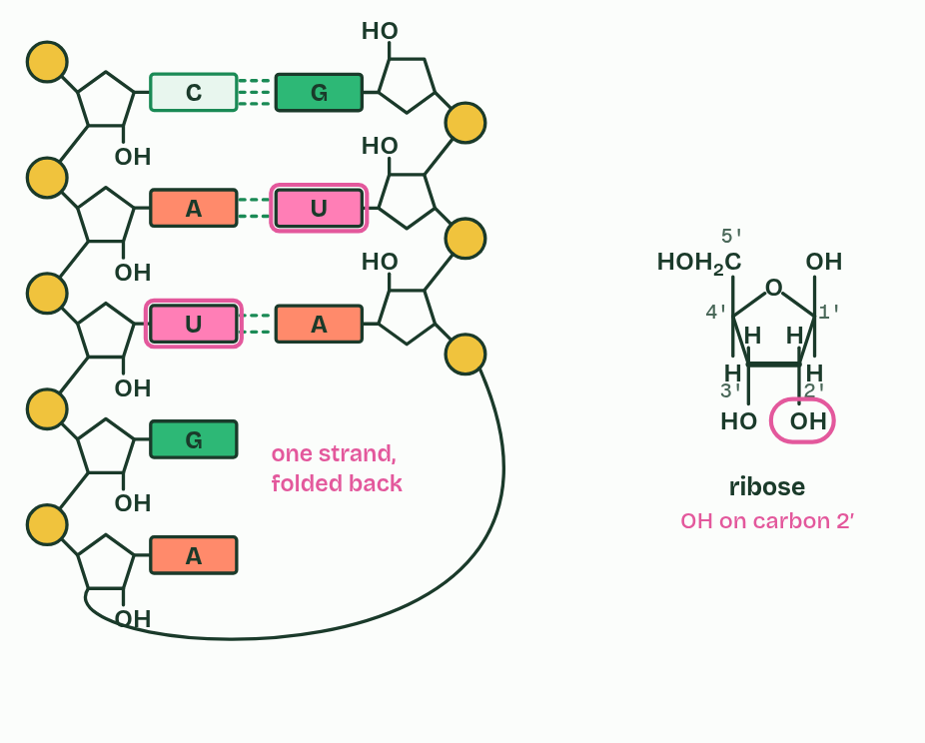
CHAPTER 6 · A1.2.7 Differences between DNA and RNA
2 / 2
DNA and RNA compared
RNA
Minutes 20 to 30
Notes:
Minutes 20 to 30 of 60: DNA or RNA (10 min).
The plan: Chapter 6's switch. Students sketch ribose and deoxyribose and mark carbon 2. Some Bananas Split.
DNA and RNA differ in three ways you need to be able to give: the number of strands, the bases, and the sugar.
Deoxyribose has one oxygen fewer than ribose: on carbon 2 it carries an H where ribose carries an OH, and "deoxy" means "without an oxygen". The ring oxygen is still there. Sketch both rings and mark the difference.
Cells use several kinds of nucleic acid. DNA makes up the chromosomes, with more in mitochondria and chloroplasts. Messenger RNA is a copy of a gene, taken to a ribosome. Transfer RNA brings amino acids to the ribosome. Ribosomal RNA is part of every ribosome. And some viruses have RNA as their genes.
Example: Links What makes RNA more likely than DNA to have been the first genetic material? A start: RNA can carry a base sequence and also act as a catalyst (some RNA molecules speed up reactions, as in the ribosome), so one molecule could have done both jobs. DNA is double-stranded and has no reactive OH on carbon 2, which makes it the steadier store, and that may be why it took over storage later.

Slide 17
CHAPTER 6 · A1.2.7 Differences between DNA and RNA
DNA and RNA compared
Strands. DNA has two, wound into a double helix. RNA usually has one, which can fold back and pair with itself in places: transfer RNA does.
Bases. DNA has A, C, G and T. RNA has A, C, G and U.
Sugar. DNA has deoxyribose. RNA has ribose.
Minutes 20 to 30
Notes:
Minutes 20 to 30 of 60: DNA or RNA (10 min).
The plan: Chapter 6's switch. Students sketch ribose and deoxyribose and mark carbon 2. Some Bananas Split.
DNA and RNA differ in three ways you need to be able to give: the number of strands, the bases, and the sugar.
Deoxyribose has one oxygen fewer than ribose: on carbon 2 it carries an H where ribose carries an OH, and "deoxy" means "without an oxygen". The ring oxygen is still there. Sketch both rings and mark the difference.
Cells use several kinds of nucleic acid. DNA makes up the chromosomes, with more in mitochondria and chloroplasts. Messenger RNA is a copy of a gene, taken to a ribosome. Transfer RNA brings amino acids to the ribosome. Ribosomal RNA is part of every ribosome. And some viruses have RNA as their genes.
Example: Links What makes RNA more likely than DNA to have been the first genetic material? A start: RNA can carry a base sequence and also act as a catalyst (some RNA molecules speed up reactions, as in the ribosome), so one molecule could have done both jobs. DNA is double-stranded and has no reactive OH on carbon 2, which makes it the steadier store, and that may be why it took over storage later.

Slide 18
PREDICT
A sample of nucleic acid is single-stranded and contains thymine but no uracil. What is it most likely to be?
A DNA, from one of the few viruses with single-stranded DNA
B RNA, because RNA is the nucleic acid that has only a single strand
C A mixture of DNA and RNA, from a sample that has been contaminated
Minutes 20 to 30
Notes:
Minutes 20 to 30 of 60: DNA or RNA (10 min).
The plan: Chapter 6's switch. Students sketch ribose and deoxyribose and mark carbon 2. Some Bananas Split.
Ask for a show of hands, or mini whiteboards, before revealing. (Answer: A, on the next slide.)

Slide 19
WHAT HAPPENS
A sample of nucleic acid is single-stranded and contains thymine but no uracil. What is it most likely to be?
A DNA, from one of the few viruses with single-stranded DNA
B RNA, because RNA is the nucleic acid that has only a single strand
C A mixture of DNA and RNA, from a sample that has been contaminated
Thymine is the clue: it is a DNA base. Most DNA is double-stranded, but a few viruses carry single-stranded DNA, so the number of strands is the least reliable of the three differences. The sugar would settle it: deoxyribose means DNA.
Minutes 20 to 30
Notes:
Minutes 20 to 30 of 60: DNA or RNA (10 min).
The plan: Chapter 6's switch. Students sketch ribose and deoxyribose and mark carbon 2. Some Bananas Split.
Answer: A. Thymine is the clue: it is a DNA base. Most DNA is double-stranded, but a few viruses carry single-stranded DNA, so the number of strands is the least reliable of the three differences. The sugar would settle it: deoxyribose means DNA.

Slide 20
WATCH OUT
Deoxyribose still has its ring oxygen: the missing oxygen is the one on carbon 2. And RNA is not always a straight single strand: transfer RNA folds and pairs with itself.
Minutes 20 to 30
Notes:
Minutes 20 to 30 of 60: DNA or RNA (10 min).
The plan: Chapter 6's switch. Students sketch ribose and deoxyribose and mark carbon 2. Some Bananas Split.
A common mistake: say it, then ask who can say why it is wrong.

Slide 21
REMEMBER IT
The three differences between DNA and RNA
S
B
S
Some
Bananas
Split
Minutes 20 to 30
Notes:
Minutes 20 to 30 of 60: DNA or RNA (10 min).
The plan: Chapter 6's switch. Students sketch ribose and deoxyribose and mark carbon 2. Some Bananas Split.
Ask the class what each letter stands for before revealing.

Slide 22
REMEMBER IT
The three differences between DNA and RNA
S
B
S
Some
Bananas
Split
Sugar
Bases
Strands
deoxyribose in DNA, ribose in RNA
thymine in DNA, uracil in RNA
two in DNA, usually one in RNA
Minutes 20 to 30
Notes:
Minutes 20 to 30 of 60: DNA or RNA (10 min).
The plan: Chapter 6's switch. Students sketch ribose and deoxyribose and mark carbon 2. Some Bananas Split.
Some: Sugar (deoxyribose in DNA, ribose in RNA)
Bananas: Bases (thymine in DNA, uracil in RNA)
Split: Strands (two in DNA, usually one in RNA)

Slide 23
STEP 4
25 MIN
The dry lab
Pairs run the dry lab, Getting DNA out.
Minutes 30 to 55
Notes:
Minutes 30 to 55 of 60: The dry lab (25 min).
The plan: Pairs run the dry lab, Getting DNA out: the full method three times, then one step left out at a time, to find out which steps matter. Or run the wet extraction as a demonstration while pairs use the dry lab.

Slide 24
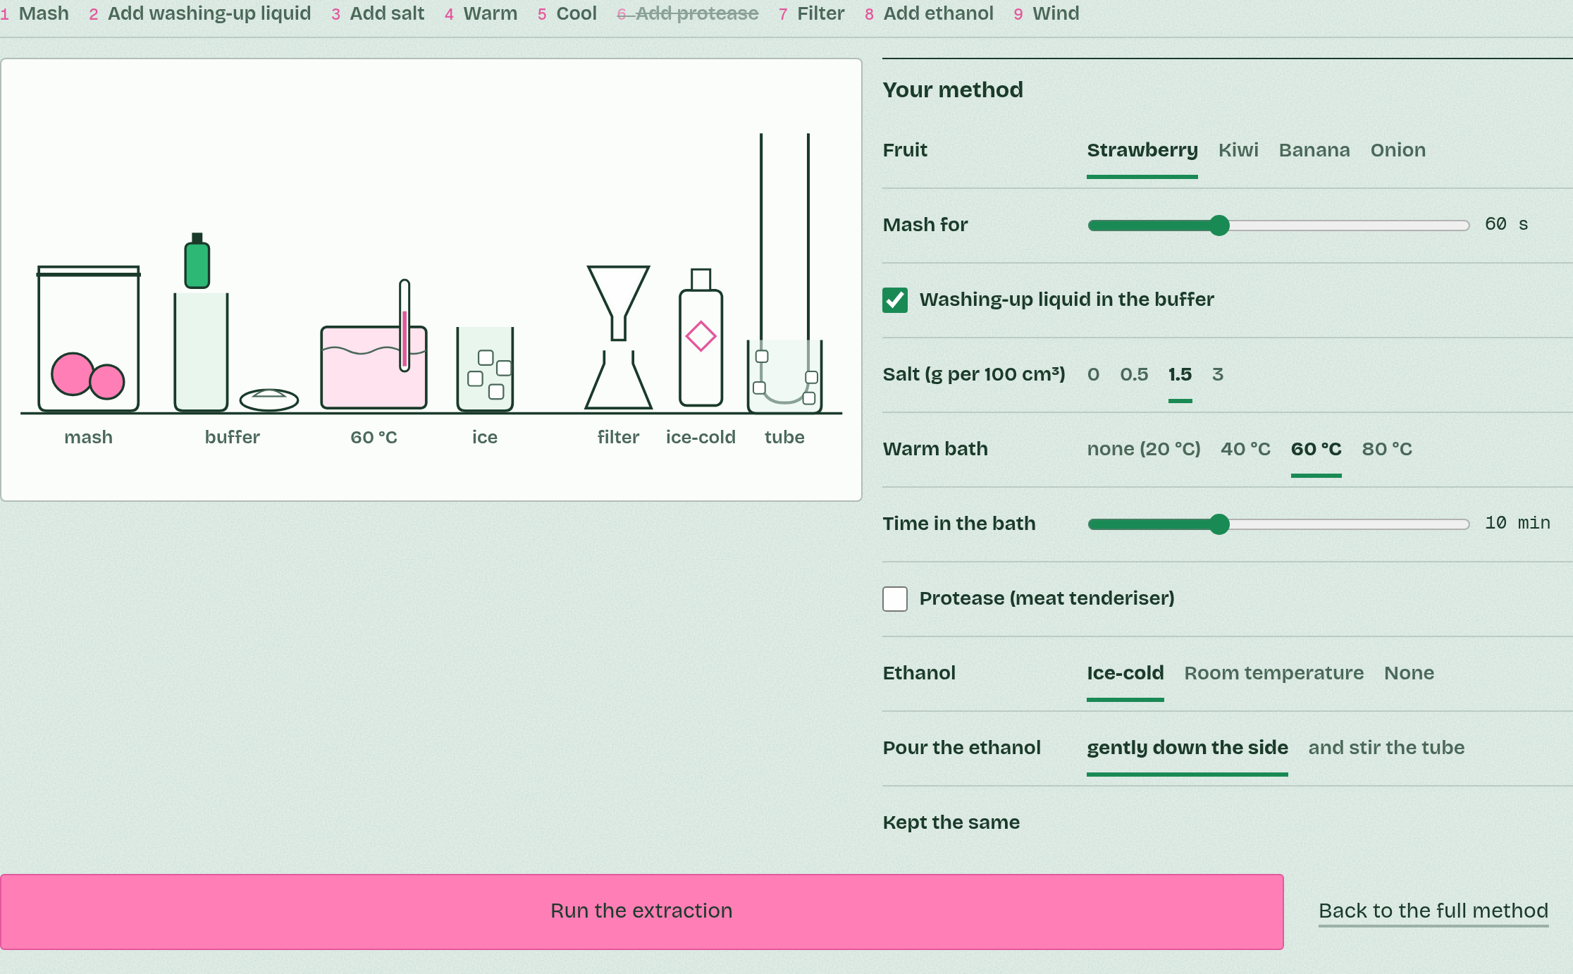
DRY LAB
Getting DNA out
Your question: Which steps of a DNA extraction matter most for how much DNA you get, and why does each one work?
What you can change: The fruit or vegetable, how long you mash it, whether you add washing-up liquid, how much salt, the temperature and time of the warm bath, a protease, and the ethanol: ice-cold, at room temperature, or none. Under Kept the same: the mass of fruit, the buffer, the volume of ethanol and the wait before winding.
What to record: For each run: your settings, the mass of DNA you wind onto the stick (mg) and what the threads look like. Change one thing at a time and repeat each set-up three times: real extractions vary, and so do these.
Run it: biologybybradford.com/guides/ib-biology-a1-2-nucleic-acids#lab
Minutes 30 to 55
Notes:
Minutes 30 to 55 of 60: The dry lab (25 min).
The plan: Pairs run the dry lab, Getting DNA out: the full method three times, then one step left out at a time, to find out which steps matter. Or run the wet extraction as a demonstration while pairs use the dry lab.
The dry lab runs in the guide: https://www.biologybybradford.com/guides/ib-biology-a1-2-nucleic-acids#lab

Slide 25
DRY LAB
25 MIN
Getting DNA out
THE TASK
The dry lab, with its tasks and questions after it, and its results table as a CSV for a pooled class graph. One device per pair.
STUDENTS NEED
One device per pair.
Minutes 30 to 55
Notes:
Minutes 30 to 55 of 60: The dry lab (25 min).
The plan: Pairs run the dry lab, Getting DNA out: the full method three times, then one step left out at a time, to find out which steps matter. Or run the wet extraction as a demonstration while pairs use the dry lab.
The activity: Getting DNA out. The dry lab, with its tasks and questions after it, and its results table as a CSV for a pooled class graph. One device per pair.
Needs: one device per pair.
The time: 25 minutes, minutes 30 to 55 of the plan.

Slide 26
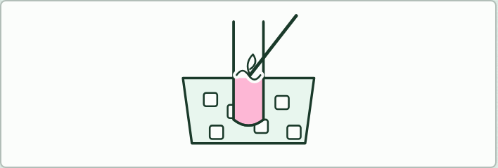
PRACTICAL
IF THERE IS TIME
DNA extraction, the wet version
THE TASK
Optional. The method of the dry lab on a real strawberry, as a demonstration or in pairs. Safety: eye protection; ethanol is highly flammable, so no flames in the room; wash hands after handling meat tenderiser. Afterwards ask what the white threads are: a tangle of millions of DNA molecules, with some RNA and protein, not one molecule.
STUDENTS NEED
Strawberries, sealed bags, washing-up liquid, salt, a 60 °C water bath, ice, coffee filters, funnels, boiling tubes, ethanol from the freezer, wooden skewers.
Minutes 30 to 55
Notes:
Minutes 30 to 55 of 60: The dry lab (25 min).
The plan: Pairs run the dry lab, Getting DNA out: the full method three times, then one step left out at a time, to find out which steps matter. Or run the wet extraction as a demonstration while pairs use the dry lab.
The activity: DNA extraction, the wet version. Optional. The method of the dry lab on a real strawberry, as a demonstration or in pairs. Safety: eye protection; ethanol is highly flammable, so no flames in the room; wash hands after handling meat tenderiser. Afterwards ask what the white threads are: a tangle of millions of DNA molecules, with some RNA and protein, not one molecule.
Needs: strawberries, sealed bags, washing-up liquid, salt, a 60 °C water bath, ice, coffee filters, funnels, boiling tubes, ethanol from the freezer, wooden skewers.
The plan sets no time of its own for this activity: use it in this step, in place of part of it, or for homework.

Slide 27
PLENARY
Can you now...
Name the bases of DNA and RNA, and explain how complementary pairing lets DNA be copied and read (A1.2.4, A1.2.8)
Give three differences between DNA and RNA, and sketch ribose against deoxyribose (A1.2.7)
Minutes 55 to 60
Notes:
Minutes 55 to 60 of 60: Exit (5 min).
The plan: The question under the dry lab on salt.
Thumbs up, sideways or down on each goal before the exit question. The goals come from the statements this lesson covers.

Slide 28
EXIT QUESTION
Before you go
The question under the dry lab on salt.
Minutes 55 to 60
Notes:
Minutes 55 to 60 of 60: Exit (5 min).
The plan: The question under the dry lab on salt.

Slide 29
PRACTISE AND REVISE
Keep going
Exam practice: a fresh paper of exam questions on A1.2 at standard level, marked as you go
The guide, with the animations and the dry lab
This lesson in the guide: 4 Four letters that pair, 6 DNA and RNA compared, the dry lab
BUILD FOR YOUR CLASS
ALREADY ON THE SITE FOR A1.2
CARD SETS ON SPLYCR
Tarsia puzzle, dominoes and picture reveal on A1.2, built from its key terms and ready to print
A pub quiz with rounds on A1.2, to present or run with no projector
An escape room built from the question bank on A1.2
Lesson: Nucleic Acids
Quiz: Nucleic Acids
Revision map: A1.2 Nucleic acids, to fill in
Exam questions: A1.2 in the exam maker, a paper with its markscheme
Open a set to host it as a class game, or make a copy to edit.
A1.2 Nucleic Acids
How this was made. The course structure, the activities and the teaching choices come from my own classroom, my presentations and my years of teaching IB and AP Biology. I use Claude, an AI, to help write and build the interactive guides, lesson plans, slides and practice questions, and to draw the diagrams and code the interactives. I direct the work and review it against the IB and AP specifications before it goes live.
Minute 60: after the lesson
Notes:
Every link here is live. Set the exam practice paper for homework: it is fresh each time, marked as students go and saved to their Exam practice when they are signed in.
Exam practice: https://www.biologybybradford.com/exam-maker/sit?topics=A1.2&level=SL&paper=quiz&marks=15&src=ep
The guide: https://www.biologybybradford.com/guides/ib-biology-a1-2-nucleic-acids

