Slide 1
IB Biology A1.2
LESSON 3 OF 5
BY THE END YOU CAN
Nucleic acids
Explain why DNA can store limitless information, and why one genetic code in all life points to a common ancestor (A1.2.9, A1.2.10)
Storing information
A1.2.9, A1.2.10
Why four bases can store limitless information, and why one shared code points to a common ancestor
60 minutes · chapter 7
Minute 0
Notes:
IB Biology A1.2, Nucleic acids. Lesson 3 of 5: Storing information, 60 minutes.
The plan, minute by minute (each slide's footer says where you are):
0 to 8 min (8) Do now: How much DNA are you?
8 to 20 min (12) Endless sequences
20 to 30 min (10) One code, five readers
30 to 45 min (15) The backbone question
45 to 55 min (10) Exam question, timed
55 to 60 min (5) Exit
What students get wrong:
The universal code means the same DNA in everything. Same code, different sequences.
4n confused with n⁴, or with 4n. Use the three-base predict box.
Stretch and support:
Support: cut the figures' captions into cards to put in order, use the dotted key terms as a glossary, and give a drawing frame with the pentagon corners marked for the IB drawings.
Stretch: the Comparative Genome Viewer at NCBI shows long stretches shared by the chromosomes of related species, such as human and mouse. What does that say about common ancestry, and about the diversity of genomes?
Stretch: make a Tarsia puzzle that is better than the site's own, from your own pairs, in the Tarsia builder.
Stretch: Reading Frame, a codon game, looks ahead to D1.2.
The lesson plan to print: https://www.biologybybradford.com/guides/downloads/ib-biology-a1-2-nucleic-acids-lesson-3-plan.pdf

Slide 2
DO NOW
How much DNA are you?
Pairs estimate the length of DNA in a human body.
8:00
minutes
Start now: the timer is running.
Minutes 0 to 8
Notes:
Minutes 0 to 8 of 60: Do now: How much DNA are you? (8 min).
The plan: Pairs estimate the length of DNA in a human body (activity below).
Start a 8 minute timer as they come in.

Slide 3
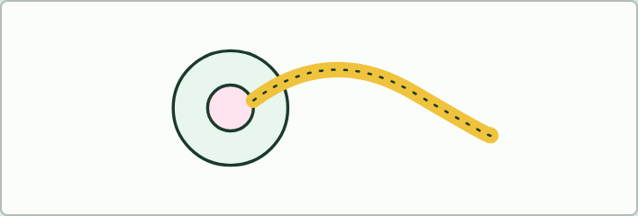
ESTIMATE
8 MIN
How much DNA are you?
THE TASK
Pairs estimate the length of DNA in a human body. A cell with a nucleus holds about 2 m of DNA. A body has about 30 trillion cells, but most of them are red blood cells, which have no nucleus (about 25 trillion of the 30). So take a few trillion cells with a nucleus. A fair answer is around 10 billion km, which is 50 to 70 times the distance from Earth to the Sun (about 150 million km). The size of the answer matters more than the digits.
STUDENTS NEED
Calculators.
Minutes 0 to 8
Notes:
Minutes 0 to 8 of 60: Do now: How much DNA are you? (8 min).
The plan: Pairs estimate the length of DNA in a human body (activity below).
The activity: How much DNA are you?. Pairs estimate the length of DNA in a human body. A cell with a nucleus holds about 2 m of DNA. A body has about 30 trillion cells, but most of them are red blood cells, which have no nucleus (about 25 trillion of the 30). So take a few trillion cells with a nucleus. A fair answer is around 10 billion km, which is 50 to 70 times the distance from Earth to the Sun (about 150 million km). The size of the answer matters more than the digits.
Needs: calculators.
The time: 8 minutes, minutes 0 to 8 of the plan.

Slide 4
STEP 2
12 MIN
Endless sequences
Predict the number of three-base sequences first, then slide to 10, 100 and 1000 bases.
Minutes 8 to 20
Notes:
Minutes 8 to 20 of 60: Endless sequences (12 min).
The plan: Chapter 7's slider. Predict the number of three-base sequences first, then slide to 10, 100 and 1000 bases.

Slide 5
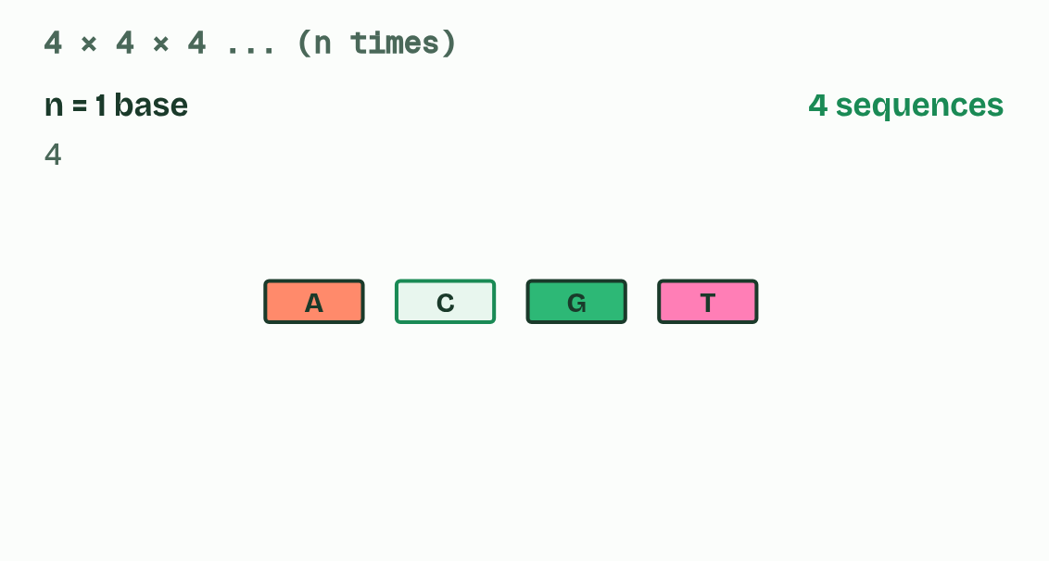
CHAPTER 7 · A1.2.9 A1.2.10 Information storage and the genetic code
Endless sequences, one code
The genetic code is the set of rules by which a sequence of bases in messenger RNA is translated into a sequence of amino acids, three bases at a time.
Each group of three is a codon.
Almost every organism uses the same code: a codon means the same amino acid in a bacterium, a fungus, a plant and a human, with a few small variations, for example in mitochondria.
The code is arbitrary: no chemical law makes a given codon stand for a given amino acid.
Minutes 8 to 20
Notes:
Minutes 8 to 20 of 60: Endless sequences (12 min).
The plan: Chapter 7's slider. Predict the number of three-base sequences first, then slide to 10, 100 and 1000 bases.
Along a strand any base can follow any other: the backbone sets no rule. And a DNA molecule can be any length. So any sequence, of any length, is possible. With four choices at every position the possibilities multiply very fast, as the slider shows. The capacity is, for every practical purpose, limitless.
That information is kept at the scale of molecules. Each human cell with a nucleus holds about 6 billion base pairs, two sets of about 3 billion, which would stretch to about 2 m if laid end to end. They are packed into a nucleus a few micrometres across. Chapter 10 shows how. (Red blood cells have no nucleus, so no DNA.) In one 2017 study, researchers stored computer files in DNA at about 215 petabytes per gram, in the laboratory.
Within a species, DNA sequences are almost the same, with small differences that are the source of different alleles. Between species they differ more. Same molecule, endless messages.
The genetic code is the set of rules by which a sequence of bases in messenger RNA is translated into a sequence of amino acids, three bases at a time. Each group of three is a codon. Almost every organism uses the same code: a codon means the same amino acid in a bacterium, a fungus, a plant and a human, with a few small variations, for example in mitochondria.
The code is arbitrary: no chemical law makes a given codon stand for a given amino acid. If life had begun separately several times, the codes would most likely differ. The best explanation for one shared code is that all life inherited it from a universal common ancestor. A code shared like that is conserved across life, and it is evidence of that shared ancestry. A gene moved from one species into another is read correctly because of it. You do not need to memorise examples: the one in the second figure is only an illustration.
That answers the first guiding question. A chain of simple units can store hereditary information because any order is possible, so the order can carry the message.
Example: Links One nucleotide holds no message. Join many and the strand has a sequence; pair two strands and the molecule can be copied. Storage and copying are properties of the polymer that its monomers do not have.

Slide 6
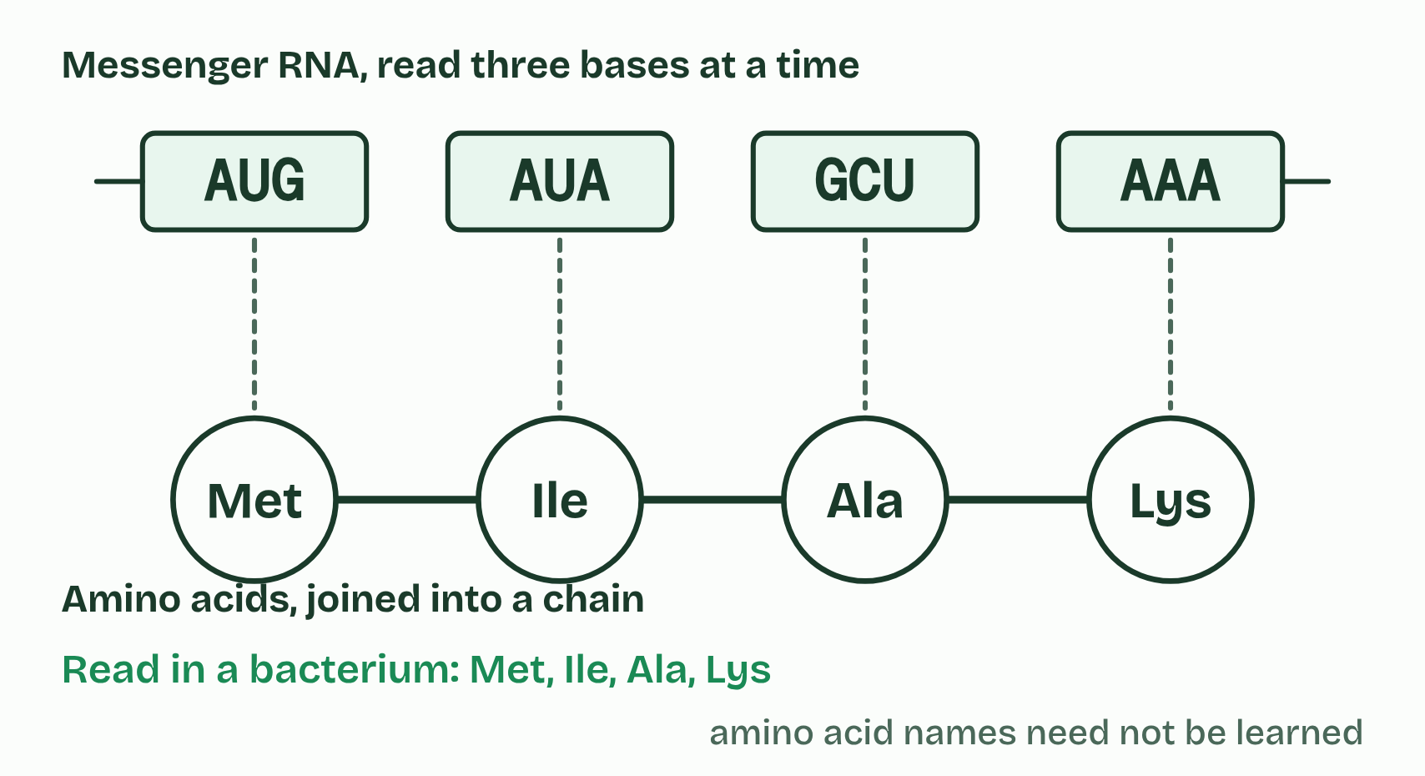
CHAPTER 7 · A1.2.9 A1.2.10 Information storage and the genetic code
1 / 5
Endless sequences, one code
Bacterium
Minutes 8 to 20
Notes:
Minutes 8 to 20 of 60: Endless sequences (12 min).
The plan: Chapter 7's slider. Predict the number of three-base sequences first, then slide to 10, 100 and 1000 bases.
Along a strand any base can follow any other: the backbone sets no rule. And a DNA molecule can be any length. So any sequence, of any length, is possible. With four choices at every position the possibilities multiply very fast, as the slider shows. The capacity is, for every practical purpose, limitless.
That information is kept at the scale of molecules. Each human cell with a nucleus holds about 6 billion base pairs, two sets of about 3 billion, which would stretch to about 2 m if laid end to end. They are packed into a nucleus a few micrometres across. Chapter 10 shows how. (Red blood cells have no nucleus, so no DNA.) In one 2017 study, researchers stored computer files in DNA at about 215 petabytes per gram, in the laboratory.
Within a species, DNA sequences are almost the same, with small differences that are the source of different alleles. Between species they differ more. Same molecule, endless messages.
The genetic code is the set of rules by which a sequence of bases in messenger RNA is translated into a sequence of amino acids, three bases at a time. Each group of three is a codon. Almost every organism uses the same code: a codon means the same amino acid in a bacterium, a fungus, a plant and a human, with a few small variations, for example in mitochondria.
The code is arbitrary: no chemical law makes a given codon stand for a given amino acid. If life had begun separately several times, the codes would most likely differ. The best explanation for one shared code is that all life inherited it from a universal common ancestor. A code shared like that is conserved across life, and it is evidence of that shared ancestry. A gene moved from one species into another is read correctly because of it. You do not need to memorise examples: the one in the second figure is only an illustration.
That answers the first guiding question. A chain of simple units can store hereditary information because any order is possible, so the order can carry the message.
Example: Links One nucleotide holds no message. Join many and the strand has a sequence; pair two strands and the molecule can be copied. Storage and copying are properties of the polymer that its monomers do not have.

Slide 7
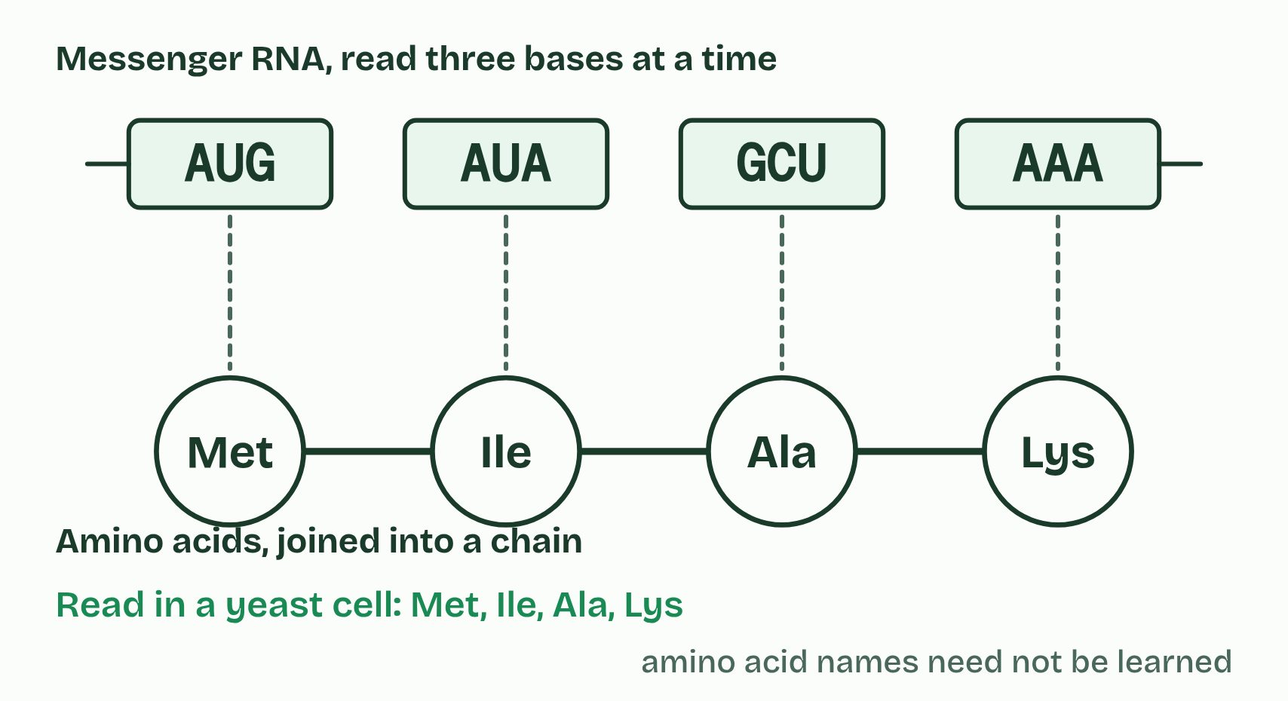
CHAPTER 7 · A1.2.9 A1.2.10 Information storage and the genetic code
2 / 5
Endless sequences, one code
Yeast
Minutes 8 to 20
Notes:
Minutes 8 to 20 of 60: Endless sequences (12 min).
The plan: Chapter 7's slider. Predict the number of three-base sequences first, then slide to 10, 100 and 1000 bases.
Along a strand any base can follow any other: the backbone sets no rule. And a DNA molecule can be any length. So any sequence, of any length, is possible. With four choices at every position the possibilities multiply very fast, as the slider shows. The capacity is, for every practical purpose, limitless.
That information is kept at the scale of molecules. Each human cell with a nucleus holds about 6 billion base pairs, two sets of about 3 billion, which would stretch to about 2 m if laid end to end. They are packed into a nucleus a few micrometres across. Chapter 10 shows how. (Red blood cells have no nucleus, so no DNA.) In one 2017 study, researchers stored computer files in DNA at about 215 petabytes per gram, in the laboratory.
Within a species, DNA sequences are almost the same, with small differences that are the source of different alleles. Between species they differ more. Same molecule, endless messages.
The genetic code is the set of rules by which a sequence of bases in messenger RNA is translated into a sequence of amino acids, three bases at a time. Each group of three is a codon. Almost every organism uses the same code: a codon means the same amino acid in a bacterium, a fungus, a plant and a human, with a few small variations, for example in mitochondria.
The code is arbitrary: no chemical law makes a given codon stand for a given amino acid. If life had begun separately several times, the codes would most likely differ. The best explanation for one shared code is that all life inherited it from a universal common ancestor. A code shared like that is conserved across life, and it is evidence of that shared ancestry. A gene moved from one species into another is read correctly because of it. You do not need to memorise examples: the one in the second figure is only an illustration.
That answers the first guiding question. A chain of simple units can store hereditary information because any order is possible, so the order can carry the message.
Example: Links One nucleotide holds no message. Join many and the strand has a sequence; pair two strands and the molecule can be copied. Storage and copying are properties of the polymer that its monomers do not have.

Slide 8
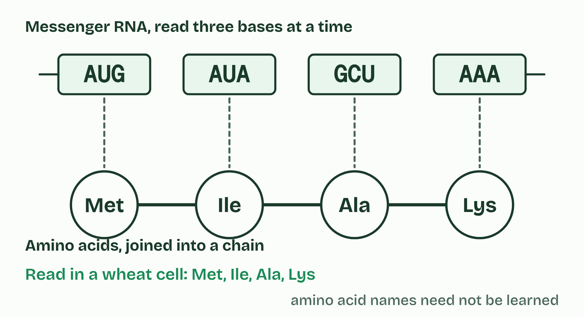
CHAPTER 7 · A1.2.9 A1.2.10 Information storage and the genetic code
3 / 5
Endless sequences, one code
Wheat
Minutes 8 to 20
Notes:
Minutes 8 to 20 of 60: Endless sequences (12 min).
The plan: Chapter 7's slider. Predict the number of three-base sequences first, then slide to 10, 100 and 1000 bases.
Along a strand any base can follow any other: the backbone sets no rule. And a DNA molecule can be any length. So any sequence, of any length, is possible. With four choices at every position the possibilities multiply very fast, as the slider shows. The capacity is, for every practical purpose, limitless.
That information is kept at the scale of molecules. Each human cell with a nucleus holds about 6 billion base pairs, two sets of about 3 billion, which would stretch to about 2 m if laid end to end. They are packed into a nucleus a few micrometres across. Chapter 10 shows how. (Red blood cells have no nucleus, so no DNA.) In one 2017 study, researchers stored computer files in DNA at about 215 petabytes per gram, in the laboratory.
Within a species, DNA sequences are almost the same, with small differences that are the source of different alleles. Between species they differ more. Same molecule, endless messages.
The genetic code is the set of rules by which a sequence of bases in messenger RNA is translated into a sequence of amino acids, three bases at a time. Each group of three is a codon. Almost every organism uses the same code: a codon means the same amino acid in a bacterium, a fungus, a plant and a human, with a few small variations, for example in mitochondria.
The code is arbitrary: no chemical law makes a given codon stand for a given amino acid. If life had begun separately several times, the codes would most likely differ. The best explanation for one shared code is that all life inherited it from a universal common ancestor. A code shared like that is conserved across life, and it is evidence of that shared ancestry. A gene moved from one species into another is read correctly because of it. You do not need to memorise examples: the one in the second figure is only an illustration.
That answers the first guiding question. A chain of simple units can store hereditary information because any order is possible, so the order can carry the message.
Example: Links One nucleotide holds no message. Join many and the strand has a sequence; pair two strands and the molecule can be copied. Storage and copying are properties of the polymer that its monomers do not have.

Slide 9
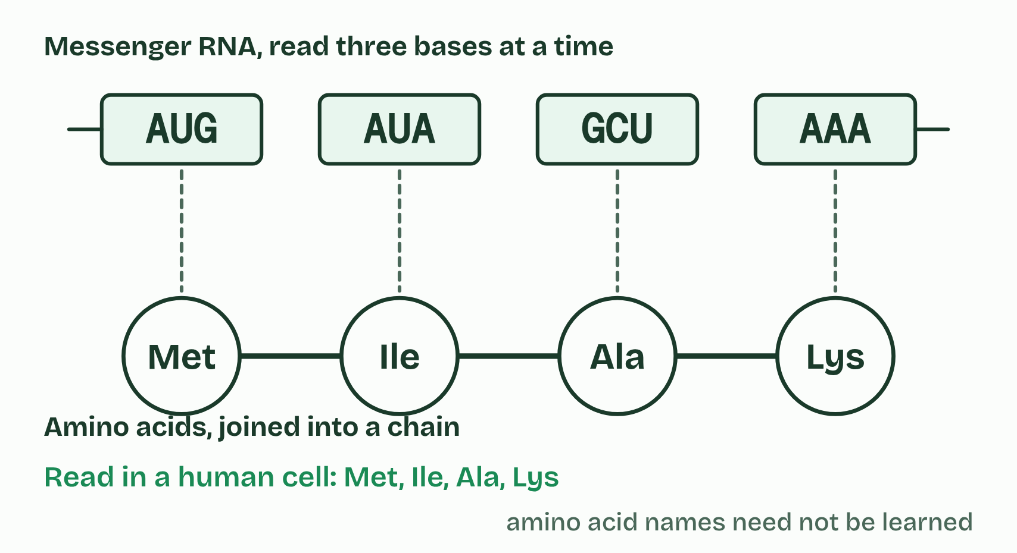
CHAPTER 7 · A1.2.9 A1.2.10 Information storage and the genetic code
4 / 5
Endless sequences, one code
Human cell
Minutes 8 to 20
Notes:
Minutes 8 to 20 of 60: Endless sequences (12 min).
The plan: Chapter 7's slider. Predict the number of three-base sequences first, then slide to 10, 100 and 1000 bases.
Along a strand any base can follow any other: the backbone sets no rule. And a DNA molecule can be any length. So any sequence, of any length, is possible. With four choices at every position the possibilities multiply very fast, as the slider shows. The capacity is, for every practical purpose, limitless.
That information is kept at the scale of molecules. Each human cell with a nucleus holds about 6 billion base pairs, two sets of about 3 billion, which would stretch to about 2 m if laid end to end. They are packed into a nucleus a few micrometres across. Chapter 10 shows how. (Red blood cells have no nucleus, so no DNA.) In one 2017 study, researchers stored computer files in DNA at about 215 petabytes per gram, in the laboratory.
Within a species, DNA sequences are almost the same, with small differences that are the source of different alleles. Between species they differ more. Same molecule, endless messages.
The genetic code is the set of rules by which a sequence of bases in messenger RNA is translated into a sequence of amino acids, three bases at a time. Each group of three is a codon. Almost every organism uses the same code: a codon means the same amino acid in a bacterium, a fungus, a plant and a human, with a few small variations, for example in mitochondria.
The code is arbitrary: no chemical law makes a given codon stand for a given amino acid. If life had begun separately several times, the codes would most likely differ. The best explanation for one shared code is that all life inherited it from a universal common ancestor. A code shared like that is conserved across life, and it is evidence of that shared ancestry. A gene moved from one species into another is read correctly because of it. You do not need to memorise examples: the one in the second figure is only an illustration.
That answers the first guiding question. A chain of simple units can store hereditary information because any order is possible, so the order can carry the message.
Example: Links One nucleotide holds no message. Join many and the strand has a sequence; pair two strands and the molecule can be copied. Storage and copying are properties of the polymer that its monomers do not have.

Slide 10
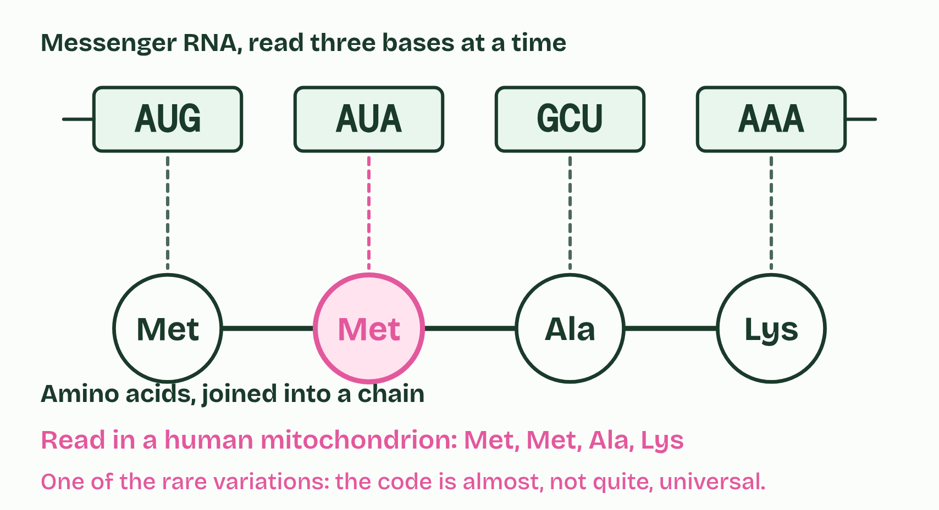
CHAPTER 7 · A1.2.9 A1.2.10 Information storage and the genetic code
5 / 5
Endless sequences, one code
Human mitochondrion
Minutes 8 to 20
Notes:
Minutes 8 to 20 of 60: Endless sequences (12 min).
The plan: Chapter 7's slider. Predict the number of three-base sequences first, then slide to 10, 100 and 1000 bases.
Along a strand any base can follow any other: the backbone sets no rule. And a DNA molecule can be any length. So any sequence, of any length, is possible. With four choices at every position the possibilities multiply very fast, as the slider shows. The capacity is, for every practical purpose, limitless.
That information is kept at the scale of molecules. Each human cell with a nucleus holds about 6 billion base pairs, two sets of about 3 billion, which would stretch to about 2 m if laid end to end. They are packed into a nucleus a few micrometres across. Chapter 10 shows how. (Red blood cells have no nucleus, so no DNA.) In one 2017 study, researchers stored computer files in DNA at about 215 petabytes per gram, in the laboratory.
Within a species, DNA sequences are almost the same, with small differences that are the source of different alleles. Between species they differ more. Same molecule, endless messages.
The genetic code is the set of rules by which a sequence of bases in messenger RNA is translated into a sequence of amino acids, three bases at a time. Each group of three is a codon. Almost every organism uses the same code: a codon means the same amino acid in a bacterium, a fungus, a plant and a human, with a few small variations, for example in mitochondria.
The code is arbitrary: no chemical law makes a given codon stand for a given amino acid. If life had begun separately several times, the codes would most likely differ. The best explanation for one shared code is that all life inherited it from a universal common ancestor. A code shared like that is conserved across life, and it is evidence of that shared ancestry. A gene moved from one species into another is read correctly because of it. You do not need to memorise examples: the one in the second figure is only an illustration.
That answers the first guiding question. A chain of simple units can store hereditary information because any order is possible, so the order can carry the message.
Example: Links One nucleotide holds no message. Join many and the strand has a sequence; pair two strands and the molecule can be copied. Storage and copying are properties of the polymer that its monomers do not have.

Slide 11
CHAPTER 7 · A1.2.9 A1.2.10 Information storage and the genetic code
Endless sequences, one code
The genetic code is the set of rules by which a sequence of bases in messenger RNA is translated into a sequence of amino acids, three bases at a time.
Each group of three is a codon.
Almost every organism uses the same code: a codon means the same amino acid in a bacterium, a fungus, a plant and a human, with a few small variations, for example in mitochondria.
The code is arbitrary: no chemical law makes a given codon stand for a given amino acid.
Minutes 8 to 20
Notes:
Minutes 8 to 20 of 60: Endless sequences (12 min).
The plan: Chapter 7's slider. Predict the number of three-base sequences first, then slide to 10, 100 and 1000 bases.
Along a strand any base can follow any other: the backbone sets no rule. And a DNA molecule can be any length. So any sequence, of any length, is possible. With four choices at every position the possibilities multiply very fast, as the slider shows. The capacity is, for every practical purpose, limitless.
That information is kept at the scale of molecules. Each human cell with a nucleus holds about 6 billion base pairs, two sets of about 3 billion, which would stretch to about 2 m if laid end to end. They are packed into a nucleus a few micrometres across. Chapter 10 shows how. (Red blood cells have no nucleus, so no DNA.) In one 2017 study, researchers stored computer files in DNA at about 215 petabytes per gram, in the laboratory.
Within a species, DNA sequences are almost the same, with small differences that are the source of different alleles. Between species they differ more. Same molecule, endless messages.
The genetic code is the set of rules by which a sequence of bases in messenger RNA is translated into a sequence of amino acids, three bases at a time. Each group of three is a codon. Almost every organism uses the same code: a codon means the same amino acid in a bacterium, a fungus, a plant and a human, with a few small variations, for example in mitochondria.
The code is arbitrary: no chemical law makes a given codon stand for a given amino acid. If life had begun separately several times, the codes would most likely differ. The best explanation for one shared code is that all life inherited it from a universal common ancestor. A code shared like that is conserved across life, and it is evidence of that shared ancestry. A gene moved from one species into another is read correctly because of it. You do not need to memorise examples: the one in the second figure is only an illustration.
That answers the first guiding question. A chain of simple units can store hereditary information because any order is possible, so the order can carry the message.
Example: Links One nucleotide holds no message. Join many and the strand has a sequence; pair two strands and the molecule can be copied. Storage and copying are properties of the polymer that its monomers do not have.

Slide 12
PREDICT
How many different sequences of three bases can DNA's four bases make?
A 12
B 64
C 81
Minutes 8 to 20
Notes:
Minutes 8 to 20 of 60: Endless sequences (12 min).
The plan: Chapter 7's slider. Predict the number of three-base sequences first, then slide to 10, 100 and 1000 bases.
Ask for a show of hands, or mini whiteboards, before revealing. (Answer: B, on the next slide.)

Slide 13
WHAT HAPPENS
How many different sequences of three bases can DNA's four bases make?
A 12
B 64
C 81
Four choices for the first base, four for the second and four for the third: 4 × 4 × 4 = 64. (12 adds when it should multiply; 81 is 3 to the power 4, the right numbers the wrong way round.) Each extra base multiplies the possibilities by four again, which is why the capacity of DNA is limitless.
Minutes 8 to 20
Notes:
Minutes 8 to 20 of 60: Endless sequences (12 min).
The plan: Chapter 7's slider. Predict the number of three-base sequences first, then slide to 10, 100 and 1000 bases.
Answer: B. Four choices for the first base, four for the second and four for the third: 4 × 4 × 4 = 64. (12 adds when it should multiply; 81 is 3 to the power 4, the right numbers the wrong way round.) Each extra base multiplies the possibilities by four again, which is why the capacity of DNA is limitless.

Slide 14
WATCH OUT
A universal code does not mean every organism has the same DNA. The dictionary is shared; the books written with it are different.
Minutes 8 to 20
Notes:
Minutes 8 to 20 of 60: Endless sequences (12 min).
The plan: Chapter 7's slider. Predict the number of three-base sequences first, then slide to 10, 100 and 1000 bases.
A common mistake: say it, then ask who can say why it is wrong.

Slide 15
STEP 3
10 MIN
One code, five readers
Why would an arbitrary code be shared by everything, unless it was inherited?
Minutes 20 to 30
Notes:
Minutes 20 to 30 of 60: One code, five readers (10 min).
The plan: Chapter 7's second figure. Why would an arbitrary code be shared by everything, unless it was inherited?

Slide 16
WRITING
15 MIN
The backbone question
THE TASK
Exam style: "Explain how the strong covalent bonds in each strand and the weak hydrogen bonds between the strands allow (a) the strands to separate, (b) the base sequence to be kept in each copy, and (c) a rare copying mistake to be kept too." Peer-mark against points the class agrees. For (c): once a wrong base is joined into the new strand, the same strong backbone that keeps the right sequence keeps the mistake.
STUDENTS NEED
Paper or exercise books.
Minutes 30 to 45
Notes:
Minutes 30 to 45 of 60: The backbone question (15 min).
The plan: The written question below, then peer-marked against points the class agrees.
The activity: The backbone question. Exam style: "Explain how the strong covalent bonds in each strand and the weak hydrogen bonds between the strands allow (a) the strands to separate, (b) the base sequence to be kept in each copy, and (c) a rare copying mistake to be kept too." Peer-mark against points the class agrees. For (c): once a wrong base is joined into the new strand, the same strong backbone that keeps the right sequence keeps the mistake.
Needs: paper or exercise books.
The time: 15 minutes, minutes 30 to 45 of the plan.

Slide 17
STEP 5
10 MIN
Exam question, timed
A short written question on A1.2 from the A1.2 exam maker, timed.
Minutes 45 to 55
Notes:
Minutes 45 to 55 of 60: Exam question, timed (10 min).
The plan: A short written question on A1.2 from the A1.2 exam maker (in Practise and revise, below), timed. For homework, the Check step.

Slide 18
PLENARY
Can you now...
Explain why DNA can store limitless information, and why one genetic code in all life points to a common ancestor (A1.2.9, A1.2.10)
Minutes 55 to 60
Notes:
Minutes 55 to 60 of 60: Exit (5 min).
The plan: One sentence answering each guiding question.
Thumbs up, sideways or down on each goal before the exit question. The goals come from the statements this lesson covers.

Slide 19
EXIT QUESTION
Before you go
One sentence answering each guiding question.
Minutes 55 to 60
Notes:
Minutes 55 to 60 of 60: Exit (5 min).
The plan: One sentence answering each guiding question.

Slide 20
PRACTISE AND REVISE
Keep going
Exam practice: a fresh paper of exam questions on A1.2 at standard level, marked as you go
The guide, with the animations and the dry lab
This lesson in the guide: 7 Endless sequences, one code
BUILD FOR YOUR CLASS
ALREADY ON THE SITE FOR A1.2
CARD SETS ON SPLYCR
Tarsia puzzle, dominoes and picture reveal on A1.2, built from its key terms and ready to print
A pub quiz with rounds on A1.2, to present or run with no projector
An escape room built from the question bank on A1.2
Lesson: Nucleic Acids
Quiz: Nucleic Acids
Revision map: A1.2 Nucleic acids, to fill in
Exam questions: A1.2 in the exam maker, a paper with its markscheme
Open a set to host it as a class game, or make a copy to edit.
A1.2 Nucleic Acids
How this was made. The course structure, the activities and the teaching choices come from my own classroom, my presentations and my years of teaching IB and AP Biology. I use Claude, an AI, to help write and build the interactive guides, lesson plans, slides and practice questions, and to draw the diagrams and code the interactives. I direct the work and review it against the IB and AP specifications before it goes live.
Minute 60: after the lesson
Notes:
Every link here is live. Set the exam practice paper for homework: it is fresh each time, marked as students go and saved to their Exam practice when they are signed in.
Exam practice: https://www.biologybybradford.com/exam-maker/sit?topics=A1.2&level=SL&paper=quiz&marks=15&src=ep
The guide: https://www.biologybybradford.com/guides/ib-biology-a1-2-nucleic-acids

