Slide 1
IB Biology A1.2
LESSON 4 OF 5
HL
BY THE END YOU CAN
Nucleic acids
Explain what the 5′ and 3′ ends are, and why nucleotides are only ever added at the 3′ end (A1.2.11)
Explain why a purine always pairs with a pyrimidine, and what that does for the helix (A1.2.12)
Describe a nucleosome, and use molecular visualisation software to see how histones hold DNA (A1.2.13)
Direction, width and packing
A1.2.11 to A1.2.13
Directionality, purine with pyrimidine, and the nucleosome, modelled and seen in molecular visualisation software
60 minutes · chapters 8, 9, 10
Minute 0
Notes:
IB Biology A1.2, Nucleic acids. Lesson 4 of 5: Direction, width and packing (higher level), 60 minutes.
The plan, minute by minute (each slide's footer says where you are):
0 to 5 min (5) Do now
5 to 17 min (12) Which end is which
17 to 25 min (8) A big base with a small one
25 to 40 min (15) Plasticine nucleosome
40 to 55 min (15) Nucleosome on screen
55 to 60 min (5) Exit
What students get wrong:
5′ and 3′ are positions on a gene. They are sugar carbons.
Purine pairs with purine because they are the same size. Big pairs with small.
Eight histones plus DNA is the whole story. The ninth sits on the linker DNA.
Stretch and support:
Support: use the three mnemonics (Apples in the Tree, Some Bananas Split, Pure As Gold) as a starter in each lesson.
The lesson plan to print: https://www.biologybybradford.com/guides/downloads/ib-biology-a1-2-nucleic-acids-lesson-4-plan.pdf

Slide 2
DO NOW
Do now
Chapter 8's predict box, 5′-ATGC-3′, on mini whiteboards.
5:00
minutes
Start now: the timer is running.
Minutes 0 to 5
Notes:
Minutes 0 to 5 of 60: Do now (5 min).
The plan: Chapter 8's predict box, 5′-ATGC-3′, on mini whiteboards.
Start a 5 minute timer as they come in.

Slide 3
PREDICT
One DNA strand reads 5′-ATGC-3′. Written 5′ to 3′, what is its partner?
A 5′-TACG-3′
B 5′-CGTA-3′
C 5′-GCAT-3′
Minutes 0 to 5
Notes:
Minutes 0 to 5 of 60: Do now (5 min).
The plan: Chapter 8's predict box, 5′-ATGC-3′, on mini whiteboards.
Ask for a show of hands, or mini whiteboards, before revealing. (Answer: C, on the next slide.)

Slide 4
WHAT HAPPENS
One DNA strand reads 5′-ATGC-3′. Written 5′ to 3′, what is its partner?
A 5′-TACG-3′
B 5′-CGTA-3′
C 5′-GCAT-3′
The partner pairs base by base, T A C G, but runs the other way: 3′-TACG-5′. Read from its own 5′ end, that is 5′-GCAT-3′.
Minutes 0 to 5
Notes:
Minutes 0 to 5 of 60: Do now (5 min).
The plan: Chapter 8's predict box, 5′-ATGC-3′, on mini whiteboards.
Answer: C. The partner pairs base by base, T A C G, but runs the other way: 3′-TACG-5′. Read from its own 5′ end, that is 5′-GCAT-3′. (5′-CGTA-3′ is the first strand backwards, with no pairing at all.)

Slide 5
STEP 2
12 MIN
Which end is which
Students add 5′ and 3′ to their lesson 1 drawing, and an arrow for each of replication, transcription and translation.
Minutes 5 to 17
Notes:
Minutes 5 to 17 of 60: Which end is which (12 min).
The plan: Chapter 8's figure. Students add 5′ and 3′ to their lesson 1 drawing, and an arrow for each of replication, transcription and translation.

Slide 6
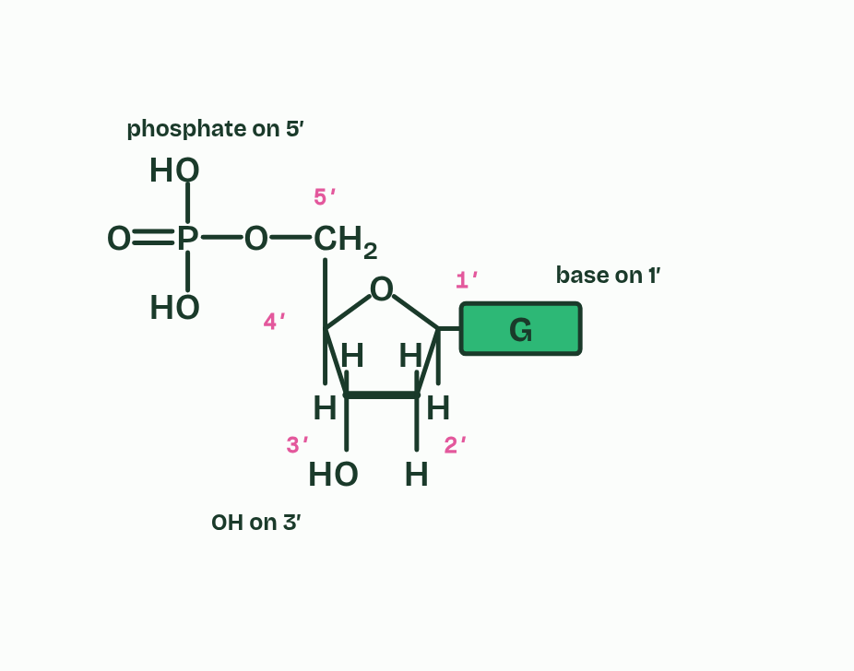
CHAPTER 8 · A1.2.11 Directionality
1 / 5
Every strand has a direction
Carbons 1′ to 5′.
Minutes 5 to 17
Notes:
Minutes 5 to 17 of 60: Which end is which (12 min).
The plan: Chapter 8's figure. Students add 5′ and 3′ to their lesson 1 drawing, and an arrow for each of replication, transcription and translation.
The carbons of the pentose are numbered 1′ to 5′, said "one prime" to "five prime". The prime shows it is a carbon of the sugar and not an atom of the base. The base is on 1′. Carbon 2′ carries the OH of ribose or the H of deoxyribose, 3′ carries an OH, and 5′, outside the ring, carries the phosphate.
In a strand, the phosphate on the 5′ carbon of each nucleotide is bonded to the 3′ carbon of the one before. So every link in the backbone runs the same way, and the strand has directionality. One end has a free phosphate on a 5′ carbon, the 5′ end. The other has a free OH on a 3′ carbon, the 3′ end. New nucleotides are only ever added at the 3′ end, to its OH, so strands grow 5′ to 3′.
Antiparallel can now be said exactly: one strand runs 5′ to 3′ and its partner runs 3′ to 5′ alongside it. A sequence is written 5′ to 3′, left to right, unless it is marked otherwise.

Slide 7
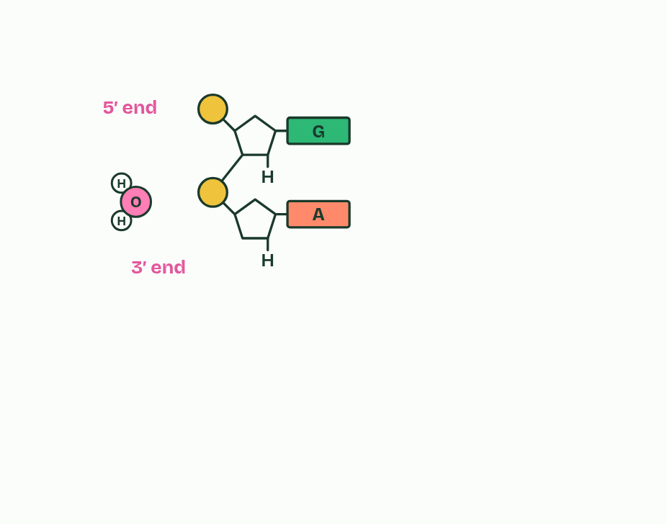
CHAPTER 8 · A1.2.11 Directionality
2 / 5
Every strand has a direction
Each phosphate links a 5′ carbon to the 3′ carbon before it.
Minutes 5 to 17
Notes:
Minutes 5 to 17 of 60: Which end is which (12 min).
The plan: Chapter 8's figure. Students add 5′ and 3′ to their lesson 1 drawing, and an arrow for each of replication, transcription and translation.
The carbons of the pentose are numbered 1′ to 5′, said "one prime" to "five prime". The prime shows it is a carbon of the sugar and not an atom of the base. The base is on 1′. Carbon 2′ carries the OH of ribose or the H of deoxyribose, 3′ carries an OH, and 5′, outside the ring, carries the phosphate.
In a strand, the phosphate on the 5′ carbon of each nucleotide is bonded to the 3′ carbon of the one before. So every link in the backbone runs the same way, and the strand has directionality. One end has a free phosphate on a 5′ carbon, the 5′ end. The other has a free OH on a 3′ carbon, the 3′ end. New nucleotides are only ever added at the 3′ end, to its OH, so strands grow 5′ to 3′.
Antiparallel can now be said exactly: one strand runs 5′ to 3′ and its partner runs 3′ to 5′ alongside it. A sequence is written 5′ to 3′, left to right, unless it is marked otherwise.

Slide 8
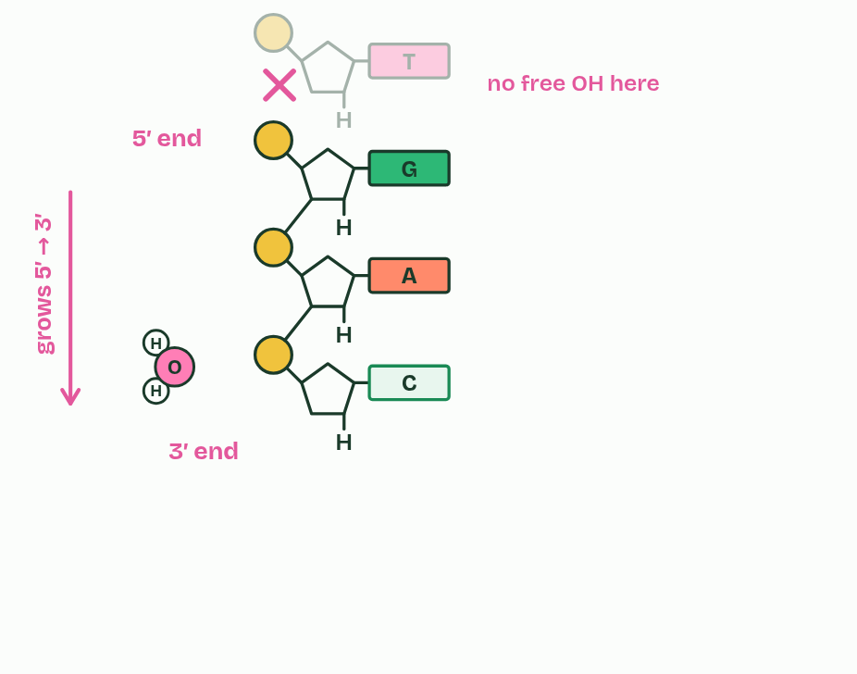
CHAPTER 8 · A1.2.11 Directionality
3 / 5
Every strand has a direction
New nucleotides join only at the 3′ end.
Minutes 5 to 17
Notes:
Minutes 5 to 17 of 60: Which end is which (12 min).
The plan: Chapter 8's figure. Students add 5′ and 3′ to their lesson 1 drawing, and an arrow for each of replication, transcription and translation.
The carbons of the pentose are numbered 1′ to 5′, said "one prime" to "five prime". The prime shows it is a carbon of the sugar and not an atom of the base. The base is on 1′. Carbon 2′ carries the OH of ribose or the H of deoxyribose, 3′ carries an OH, and 5′, outside the ring, carries the phosphate.
In a strand, the phosphate on the 5′ carbon of each nucleotide is bonded to the 3′ carbon of the one before. So every link in the backbone runs the same way, and the strand has directionality. One end has a free phosphate on a 5′ carbon, the 5′ end. The other has a free OH on a 3′ carbon, the 3′ end. New nucleotides are only ever added at the 3′ end, to its OH, so strands grow 5′ to 3′.
Antiparallel can now be said exactly: one strand runs 5′ to 3′ and its partner runs 3′ to 5′ alongside it. A sequence is written 5′ to 3′, left to right, unless it is marked otherwise.

Slide 9
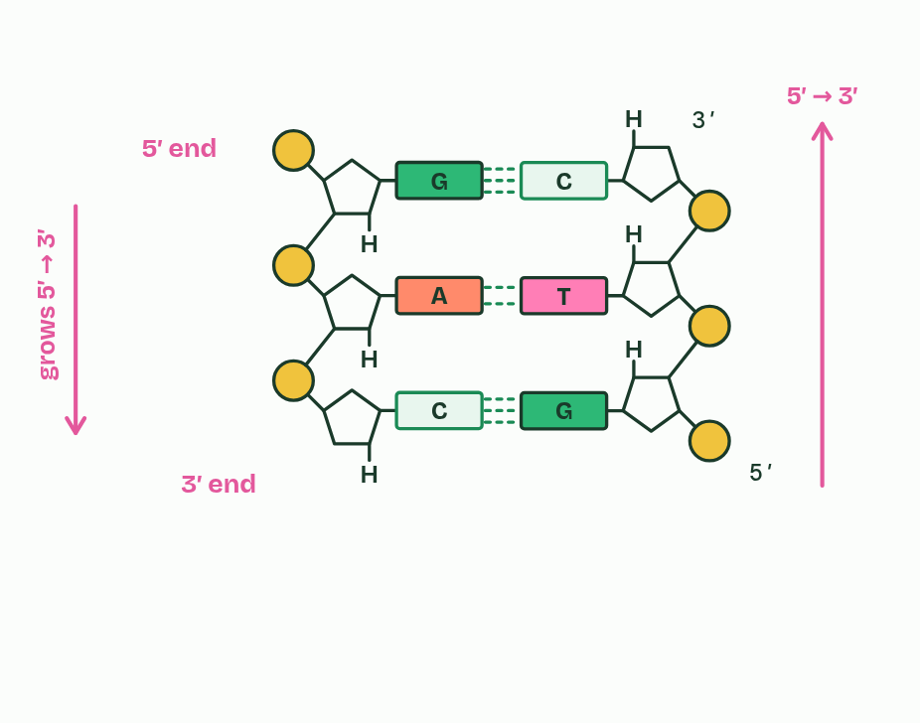
CHAPTER 8 · A1.2.11 Directionality
4 / 5
Every strand has a direction
The strands are antiparallel: one runs 5′ to 3′, the other 3′ to 5′.
Minutes 5 to 17
Notes:
Minutes 5 to 17 of 60: Which end is which (12 min).
The plan: Chapter 8's figure. Students add 5′ and 3′ to their lesson 1 drawing, and an arrow for each of replication, transcription and translation.
The carbons of the pentose are numbered 1′ to 5′, said "one prime" to "five prime". The prime shows it is a carbon of the sugar and not an atom of the base. The base is on 1′. Carbon 2′ carries the OH of ribose or the H of deoxyribose, 3′ carries an OH, and 5′, outside the ring, carries the phosphate.
In a strand, the phosphate on the 5′ carbon of each nucleotide is bonded to the 3′ carbon of the one before. So every link in the backbone runs the same way, and the strand has directionality. One end has a free phosphate on a 5′ carbon, the 5′ end. The other has a free OH on a 3′ carbon, the 3′ end. New nucleotides are only ever added at the 3′ end, to its OH, so strands grow 5′ to 3′.
Antiparallel can now be said exactly: one strand runs 5′ to 3′ and its partner runs 3′ to 5′ alongside it. A sequence is written 5′ to 3′, left to right, unless it is marked otherwise.

Slide 10
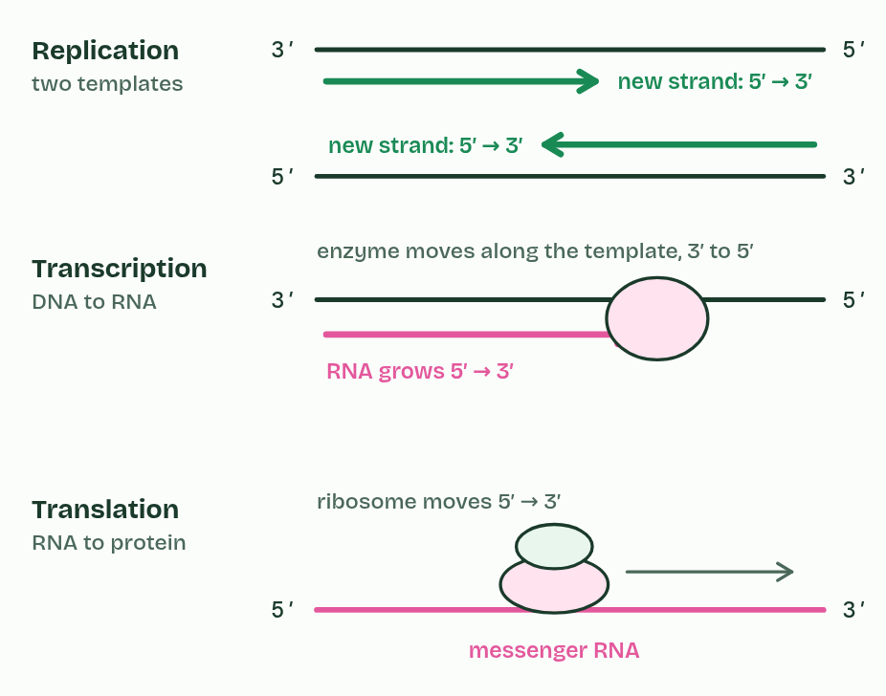
CHAPTER 8 · A1.2.11 Directionality
5 / 5
Every strand has a direction
So DNA is copied, transcribed and read in one direction.
Minutes 5 to 17
Notes:
Minutes 5 to 17 of 60: Which end is which (12 min).
The plan: Chapter 8's figure. Students add 5′ and 3′ to their lesson 1 drawing, and an arrow for each of replication, transcription and translation.
The carbons of the pentose are numbered 1′ to 5′, said "one prime" to "five prime". The prime shows it is a carbon of the sugar and not an atom of the base. The base is on 1′. Carbon 2′ carries the OH of ribose or the H of deoxyribose, 3′ carries an OH, and 5′, outside the ring, carries the phosphate.
In a strand, the phosphate on the 5′ carbon of each nucleotide is bonded to the 3′ carbon of the one before. So every link in the backbone runs the same way, and the strand has directionality. One end has a free phosphate on a 5′ carbon, the 5′ end. The other has a free OH on a 3′ carbon, the 3′ end. New nucleotides are only ever added at the 3′ end, to its OH, so strands grow 5′ to 3′.
Antiparallel can now be said exactly: one strand runs 5′ to 3′ and its partner runs 3′ to 5′ alongside it. A sequence is written 5′ to 3′, left to right, unless it is marked otherwise.

Slide 11
CHAPTER 8 · A1.2.11 Directionality
Every strand has a direction
Replication. Each new strand is built 5′ to 3′, so the two antiparallel templates are copied in opposite directions. (How that works at a replication fork is D1.1.)
Transcription. RNA is built 5′ to 3′, so the enzyme moves along the template strand in that strand's 3′ to 5′ direction.
Translation. A ribosome moves along messenger RNA from its 5′ end towards its 3′ end, so the codons are read in that order.
Minutes 5 to 17
Notes:
Minutes 5 to 17 of 60: Which end is which (12 min).
The plan: Chapter 8's figure. Students add 5′ and 3′ to their lesson 1 drawing, and an arrow for each of replication, transcription and translation.
The carbons of the pentose are numbered 1′ to 5′, said "one prime" to "five prime". The prime shows it is a carbon of the sugar and not an atom of the base. The base is on 1′. Carbon 2′ carries the OH of ribose or the H of deoxyribose, 3′ carries an OH, and 5′, outside the ring, carries the phosphate.
In a strand, the phosphate on the 5′ carbon of each nucleotide is bonded to the 3′ carbon of the one before. So every link in the backbone runs the same way, and the strand has directionality. One end has a free phosphate on a 5′ carbon, the 5′ end. The other has a free OH on a 3′ carbon, the 3′ end. New nucleotides are only ever added at the 3′ end, to its OH, so strands grow 5′ to 3′.
Antiparallel can now be said exactly: one strand runs 5′ to 3′ and its partner runs 3′ to 5′ alongside it. A sequence is written 5′ to 3′, left to right, unless it is marked otherwise.

Slide 12
WATCH OUT
5′ and 3′ name carbon atoms in the sugar. They are not positions along a gene. And new strands are built 5′ to 3′, which means their templates are read 3′ to 5′.
Minutes 5 to 17
Notes:
Minutes 5 to 17 of 60: Which end is which (12 min).
The plan: Chapter 8's figure. Students add 5′ and 3′ to their lesson 1 drawing, and an arrow for each of replication, transcription and translation.
A common mistake: say it, then ask who can say why it is wrong.

Slide 13
STEP 3
8 MIN
A big base with a small one
Chapter 9: A big base with a small one
Minutes 17 to 25
Notes:
Minutes 17 to 25 of 60: A big base with a small one (8 min).
The plan: Chapter 9's states, Pure As Gold, and the 30% adenine predict box.

Slide 14
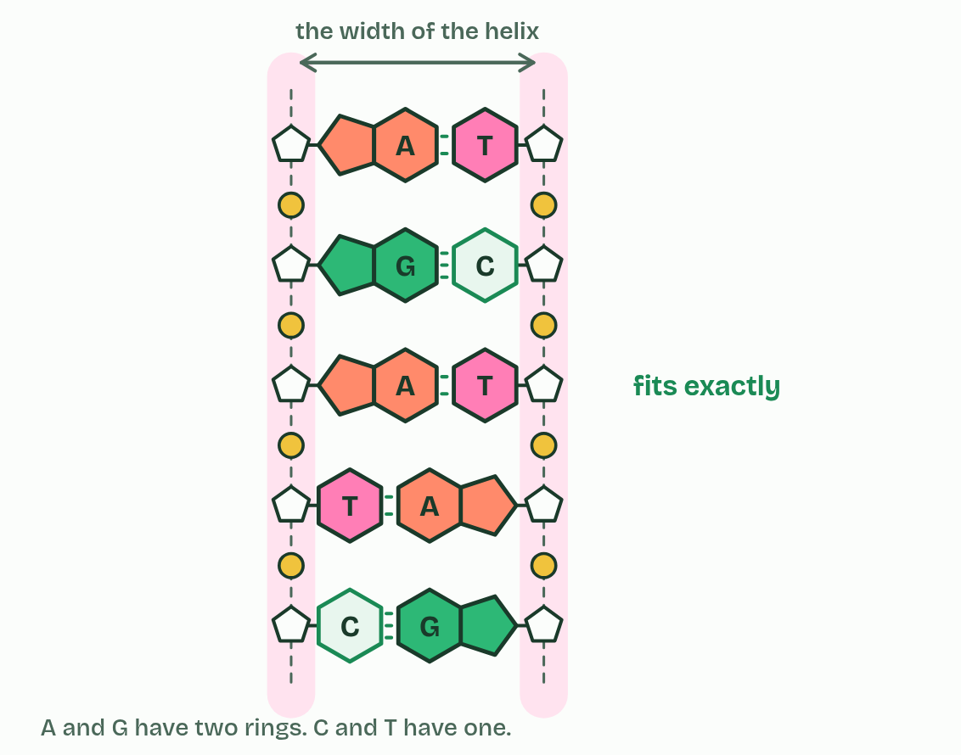
CHAPTER 9 · A1.2.12 Purine-to-pyrimidine bonding
1 / 5
A big base with a small one
A with T
Minutes 17 to 25
Notes:
Minutes 17 to 25 of 60: A big base with a small one (8 min).
The plan: Chapter 9's states, Pure As Gold, and the 30% adenine predict box.
Bases come in two shapes. Purines (adenine and guanine) have two rings fused together, one of six atoms and one of five. Pyrimidines (cytosine, thymine and uracil) have one ring of six.
Every base pair in DNA is one purine and one pyrimidine: A with T, G with C. So every pair is the same length. The two backbones stay the same distance apart all along, and the helix has the same width and the same three-dimensional shape whatever the sequence.
That matters. The helix is regular and stable along its whole length, and any sequence fits the same structure, so the sequence is free to carry information (chapter 7). Proteins that work along DNA, such as the histones of chapter 10 and the enzymes that copy and read it, meet the same shape everywhere.
Two purines would be too wide for the gap, and two pyrimidines too narrow to reach across with hydrogen bonds. A purine with the wrong pyrimidine (A with C, or G with T) is the right length, but its hydrogen bonds do not line up (chapter 4). Try each pairing in the figure.

Slide 15
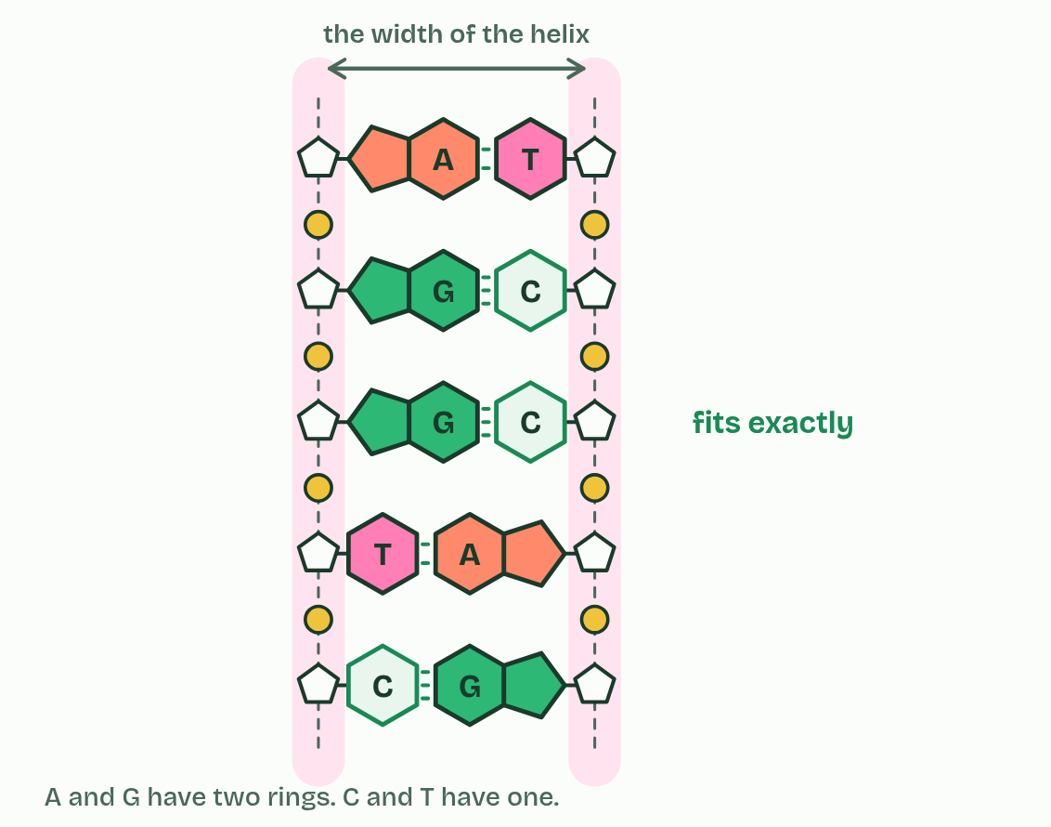
CHAPTER 9 · A1.2.12 Purine-to-pyrimidine bonding
2 / 5
A big base with a small one
G with C
Minutes 17 to 25
Notes:
Minutes 17 to 25 of 60: A big base with a small one (8 min).
The plan: Chapter 9's states, Pure As Gold, and the 30% adenine predict box.
Bases come in two shapes. Purines (adenine and guanine) have two rings fused together, one of six atoms and one of five. Pyrimidines (cytosine, thymine and uracil) have one ring of six.
Every base pair in DNA is one purine and one pyrimidine: A with T, G with C. So every pair is the same length. The two backbones stay the same distance apart all along, and the helix has the same width and the same three-dimensional shape whatever the sequence.
That matters. The helix is regular and stable along its whole length, and any sequence fits the same structure, so the sequence is free to carry information (chapter 7). Proteins that work along DNA, such as the histones of chapter 10 and the enzymes that copy and read it, meet the same shape everywhere.
Two purines would be too wide for the gap, and two pyrimidines too narrow to reach across with hydrogen bonds. A purine with the wrong pyrimidine (A with C, or G with T) is the right length, but its hydrogen bonds do not line up (chapter 4). Try each pairing in the figure.

Slide 16
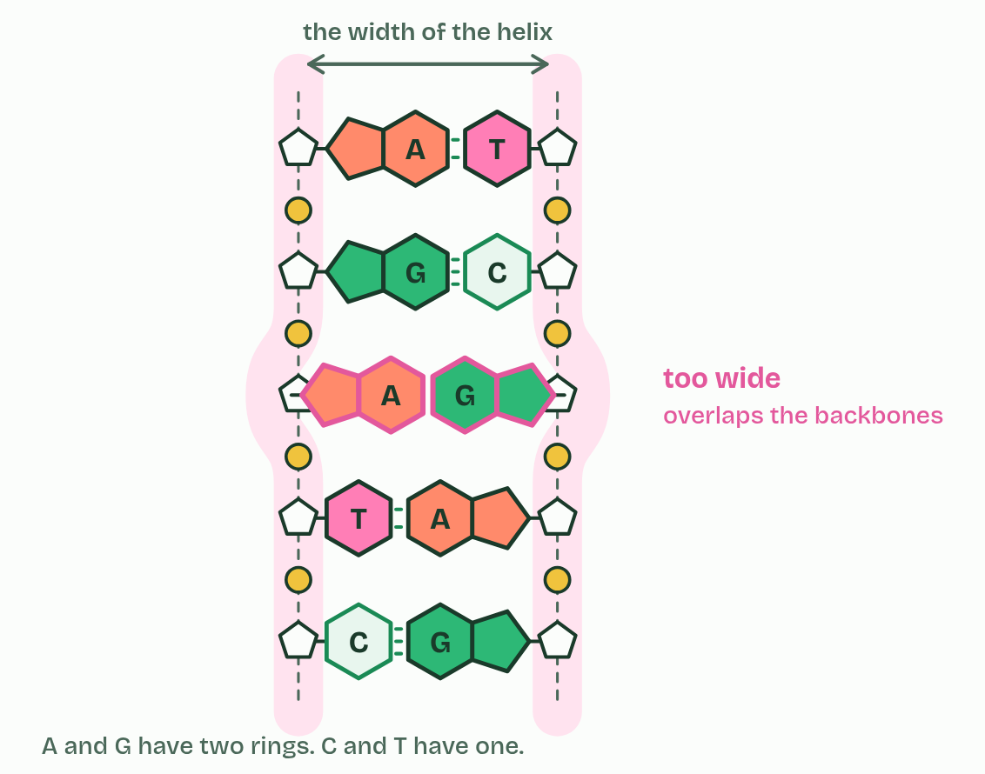
CHAPTER 9 · A1.2.12 Purine-to-pyrimidine bonding
3 / 5
A big base with a small one
A with G
Minutes 17 to 25
Notes:
Minutes 17 to 25 of 60: A big base with a small one (8 min).
The plan: Chapter 9's states, Pure As Gold, and the 30% adenine predict box.
Bases come in two shapes. Purines (adenine and guanine) have two rings fused together, one of six atoms and one of five. Pyrimidines (cytosine, thymine and uracil) have one ring of six.
Every base pair in DNA is one purine and one pyrimidine: A with T, G with C. So every pair is the same length. The two backbones stay the same distance apart all along, and the helix has the same width and the same three-dimensional shape whatever the sequence.
That matters. The helix is regular and stable along its whole length, and any sequence fits the same structure, so the sequence is free to carry information (chapter 7). Proteins that work along DNA, such as the histones of chapter 10 and the enzymes that copy and read it, meet the same shape everywhere.
Two purines would be too wide for the gap, and two pyrimidines too narrow to reach across with hydrogen bonds. A purine with the wrong pyrimidine (A with C, or G with T) is the right length, but its hydrogen bonds do not line up (chapter 4). Try each pairing in the figure.

Slide 17
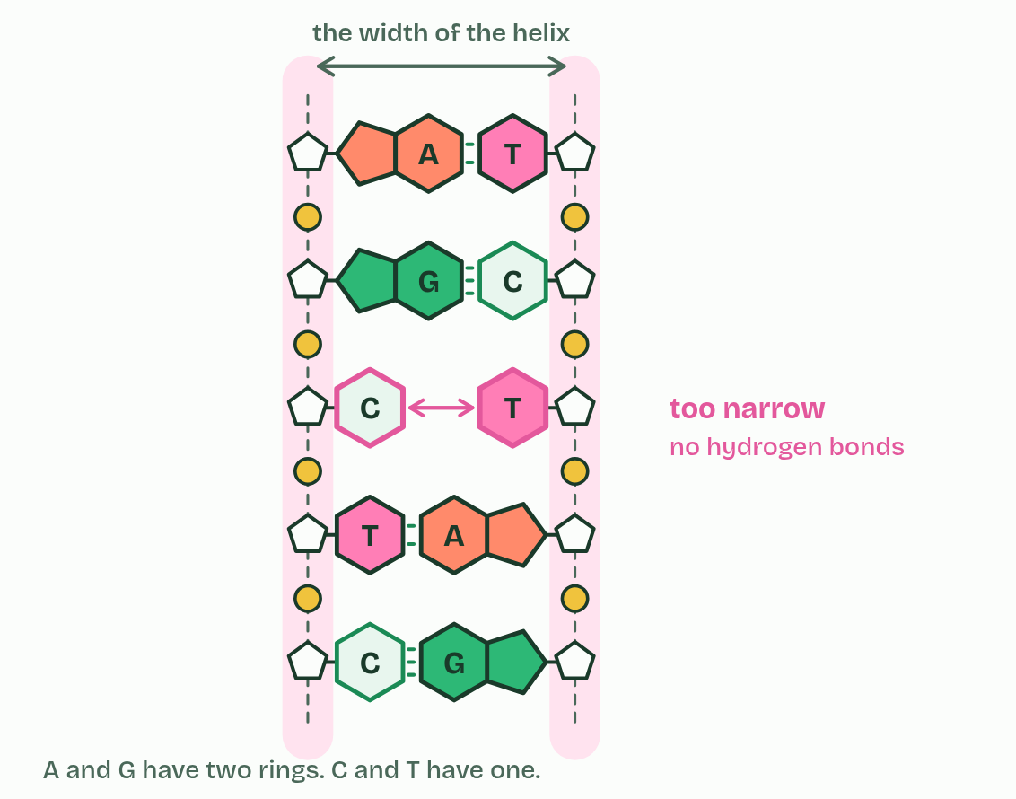
CHAPTER 9 · A1.2.12 Purine-to-pyrimidine bonding
4 / 5
A big base with a small one
C with T
Minutes 17 to 25
Notes:
Minutes 17 to 25 of 60: A big base with a small one (8 min).
The plan: Chapter 9's states, Pure As Gold, and the 30% adenine predict box.
Bases come in two shapes. Purines (adenine and guanine) have two rings fused together, one of six atoms and one of five. Pyrimidines (cytosine, thymine and uracil) have one ring of six.
Every base pair in DNA is one purine and one pyrimidine: A with T, G with C. So every pair is the same length. The two backbones stay the same distance apart all along, and the helix has the same width and the same three-dimensional shape whatever the sequence.
That matters. The helix is regular and stable along its whole length, and any sequence fits the same structure, so the sequence is free to carry information (chapter 7). Proteins that work along DNA, such as the histones of chapter 10 and the enzymes that copy and read it, meet the same shape everywhere.
Two purines would be too wide for the gap, and two pyrimidines too narrow to reach across with hydrogen bonds. A purine with the wrong pyrimidine (A with C, or G with T) is the right length, but its hydrogen bonds do not line up (chapter 4). Try each pairing in the figure.

Slide 18
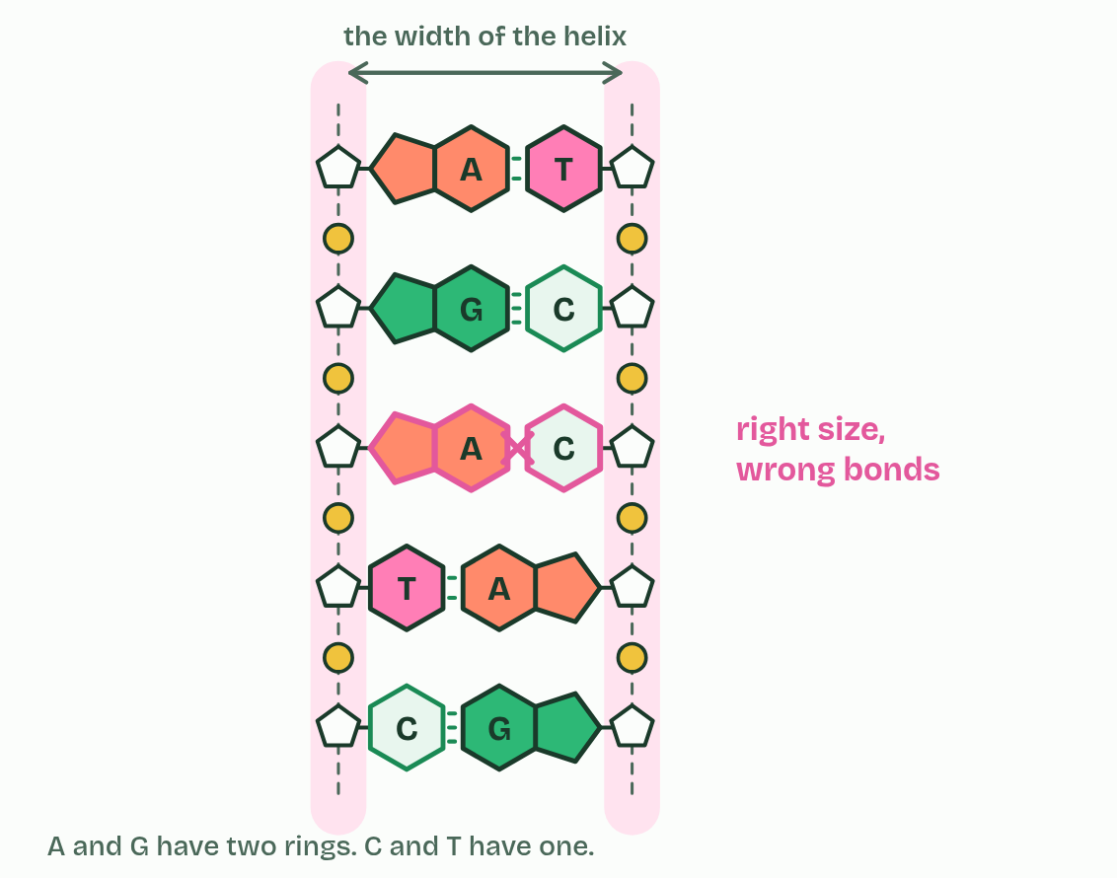
CHAPTER 9 · A1.2.12 Purine-to-pyrimidine bonding
5 / 5
A big base with a small one
A with C
Minutes 17 to 25
Notes:
Minutes 17 to 25 of 60: A big base with a small one (8 min).
The plan: Chapter 9's states, Pure As Gold, and the 30% adenine predict box.
Bases come in two shapes. Purines (adenine and guanine) have two rings fused together, one of six atoms and one of five. Pyrimidines (cytosine, thymine and uracil) have one ring of six.
Every base pair in DNA is one purine and one pyrimidine: A with T, G with C. So every pair is the same length. The two backbones stay the same distance apart all along, and the helix has the same width and the same three-dimensional shape whatever the sequence.
That matters. The helix is regular and stable along its whole length, and any sequence fits the same structure, so the sequence is free to carry information (chapter 7). Proteins that work along DNA, such as the histones of chapter 10 and the enzymes that copy and read it, meet the same shape everywhere.
Two purines would be too wide for the gap, and two pyrimidines too narrow to reach across with hydrogen bonds. A purine with the wrong pyrimidine (A with C, or G with T) is the right length, but its hydrogen bonds do not line up (chapter 4). Try each pairing in the figure.

Slide 19
CHAPTER 9 · A1.2.12 Purine-to-pyrimidine bonding
A big base with a small one
Purines (adenine and guanine) have two rings fused together, one of six atoms and one of five.
Pyrimidines (cytosine, thymine and uracil) have one ring of six.
Two purines would be too wide for the gap, and two pyrimidines too narrow to reach across with hydrogen bonds.
Minutes 17 to 25
Notes:
Minutes 17 to 25 of 60: A big base with a small one (8 min).
The plan: Chapter 9's states, Pure As Gold, and the 30% adenine predict box.
Bases come in two shapes. Purines (adenine and guanine) have two rings fused together, one of six atoms and one of five. Pyrimidines (cytosine, thymine and uracil) have one ring of six.
Every base pair in DNA is one purine and one pyrimidine: A with T, G with C. So every pair is the same length. The two backbones stay the same distance apart all along, and the helix has the same width and the same three-dimensional shape whatever the sequence.
That matters. The helix is regular and stable along its whole length, and any sequence fits the same structure, so the sequence is free to carry information (chapter 7). Proteins that work along DNA, such as the histones of chapter 10 and the enzymes that copy and read it, meet the same shape everywhere.
Two purines would be too wide for the gap, and two pyrimidines too narrow to reach across with hydrogen bonds. A purine with the wrong pyrimidine (A with C, or G with T) is the right length, but its hydrogen bonds do not line up (chapter 4). Try each pairing in the figure.

Slide 20
PREDICT
30% of the bases in a sample of double-stranded DNA are adenine. What percentage are purines?
A 30%
B 50%
C 60%
Minutes 17 to 25
Notes:
Minutes 17 to 25 of 60: A big base with a small one (8 min).
The plan: Chapter 9's states, Pure As Gold, and the 30% adenine predict box.
Ask for a show of hands, or mini whiteboards, before revealing. (Answer: B, on the next slide.)

Slide 21
WHAT HAPPENS
30% of the bases in a sample of double-stranded DNA are adenine. What percentage are purines?
A 30%
B 50%
C 60%
50%, whatever the sequence. Every base pair is one purine and one pyrimidine, so purines are always half the bases in double-stranded DNA: here 30% adenine and 20% guanine. In symbols, A + G = C + T. Chapter 12 picks this up.
Minutes 17 to 25
Notes:
Minutes 17 to 25 of 60: A big base with a small one (8 min).
The plan: Chapter 9's states, Pure As Gold, and the 30% adenine predict box.
Answer: B. 50%, whatever the sequence. Every base pair is one purine and one pyrimidine, so purines are always half the bases in double-stranded DNA: here 30% adenine and 20% guanine. In symbols, A + G = C + T. Chapter 12 picks this up.

Slide 22
REMEMBER IT
Which bases are purines
P
A
G
C
Pure
As
Gold
CUT
Minutes 17 to 25
Notes:
Minutes 17 to 25 of 60: A big base with a small one (8 min).
The plan: Chapter 9's states, Pure As Gold, and the 30% adenine predict box.
Ask the class what each letter stands for before revealing.

Slide 23
REMEMBER IT
Which bases are purines
P
A
G
C
Pure
As
Gold
CUT
Purines
Adenine
Guanine
Pyrimidines
two rings
a purine
a purine
cytosine, uracil, thymine: one ring
Minutes 17 to 25
Notes:
Minutes 17 to 25 of 60: A big base with a small one (8 min).
The plan: Chapter 9's states, Pure As Gold, and the 30% adenine predict box.
Pure: Purines (two rings)
As: Adenine (a purine)
Gold: Guanine (a purine)
CUT: Pyrimidines (cytosine, uracil, thymine: one ring)

Slide 24
WATCH OUT
There is no "big pair" and "small pair". Every pair is one big base and one small one, so every pair is the same size.
Minutes 17 to 25
Notes:
Minutes 17 to 25 of 60: A big base with a small one (8 min).
The plan: Chapter 9's states, Pure As Gold, and the 30% adenine predict box.
A common mistake: say it, then ask who can say why it is wrong.

Slide 25
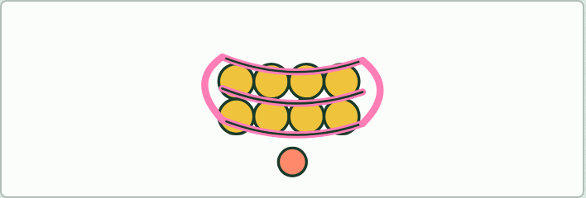
MODEL · HL
15 MIN
Plasticine nucleosome
THE TASK
Press eight equal balls of plasticine (about 1 cm) into a cube. Twist two pipe cleaners into a double helix and wind it just under two turns round the cube. Pin the two ends where they leave with a small ninth piece. Label it, and take a photo for notes.
STUDENTS NEED
Plasticine in two colours, pipe cleaners, labels.
Minutes 25 to 40
Notes:
Minutes 25 to 40 of 60: Plasticine nucleosome (15 min).
The plan: Build the model (activity below), label it, and photograph it for notes.
The activity: Plasticine nucleosome. Press eight equal balls of plasticine (about 1 cm) into a cube. Twist two pipe cleaners into a double helix and wind it just under two turns round the cube. Pin the two ends where they leave with a small ninth piece. Label it, and take a photo for notes.
Needs: plasticine in two colours, pipe cleaners, labels.
The time: 15 minutes, minutes 25 to 40 of the plan.

Slide 26

SOFTWARE · HL
15 MIN
Nucleosome on screen
THE TASK
Pairs work through chapter 10's "Try it" list on laptops, then report which part of the DNA the histones touch, and why. The 3D viewer is poor on phones.
STUDENTS NEED
Laptops.
Minutes 40 to 55
Notes:
Minutes 40 to 55 of 60: Nucleosome on screen (15 min).
The plan: Pairs work through chapter 10's "Try it" list on laptops, then report which part of the DNA the histones touch, and why.
The activity: Nucleosome on screen. Pairs work through chapter 10's "Try it" list on laptops, then report which part of the DNA the histones touch, and why. The 3D viewer is poor on phones.
Needs: laptops.
The time: 15 minutes, minutes 40 to 55 of the plan.

Slide 27
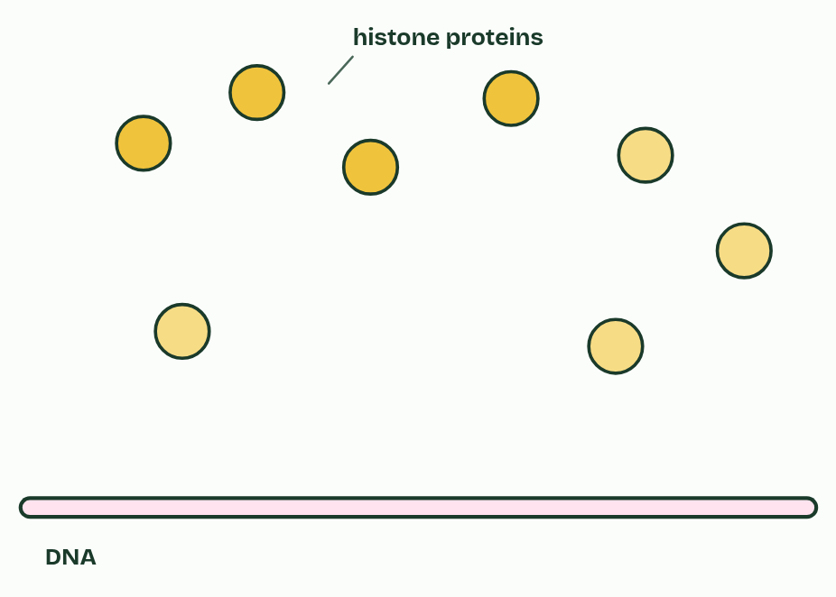
CHAPTER 10 · A1.2.13 Structure of a nucleosome
1 / 5
Wound on a spool
DNA and histone proteins.
Minutes 40 to 55
Notes:
Minutes 40 to 55 of 60: Nucleosome on screen (15 min).
The plan: Pairs work through chapter 10's "Try it" list on laptops, then report which part of the DNA the histones touch, and why.
In eukaryotes, the DNA in the nucleus is wound around proteins called histones. A nucleosome is a core of eight histone proteins with DNA wrapped round it, just under two turns, and one more histone attached to the linker DNA where the DNA enters and leaves, holding the wrapped DNA in place. The linker DNA runs on to the next nucleosome: beads on a string.
Wound this way, about 2 m of DNA fits into a nucleus. The cell can also control which stretches can be read: tags on histones are D2.2. How do the histones hold the DNA on? That is the prediction below.
Example: Try it Best on a laptop. The links open in a new tab. Open the nucleosome core particle entry 1KX5 on the RCSB Protein Data Bank and open its 3D view. Colour by chain. Count the protein chains in the core and the strands of DNA. The eight proteins come as two copies each of four kinds: find each pair. Where does the DNA touch the proteins: at its bases, or at its backbone? Select the lysine and arginine residues and show them as sticks. Where do they point? Find the histone tails reaching out between the turns of DNA. Count the turns of DNA round the core. Is there a ninth histone in this structure? (In a core particle, no: the linker DNA was trimmed off before it was crystallised.) Open an entry that includes a linker histone, such as 4QLC, and find it. On a phone the 3D viewer needs a bigger screen. Answer these from the figure instead: how many histones are in the core, how many turns of DNA wrap round it, and where does the ninth histone sit?

Slide 28
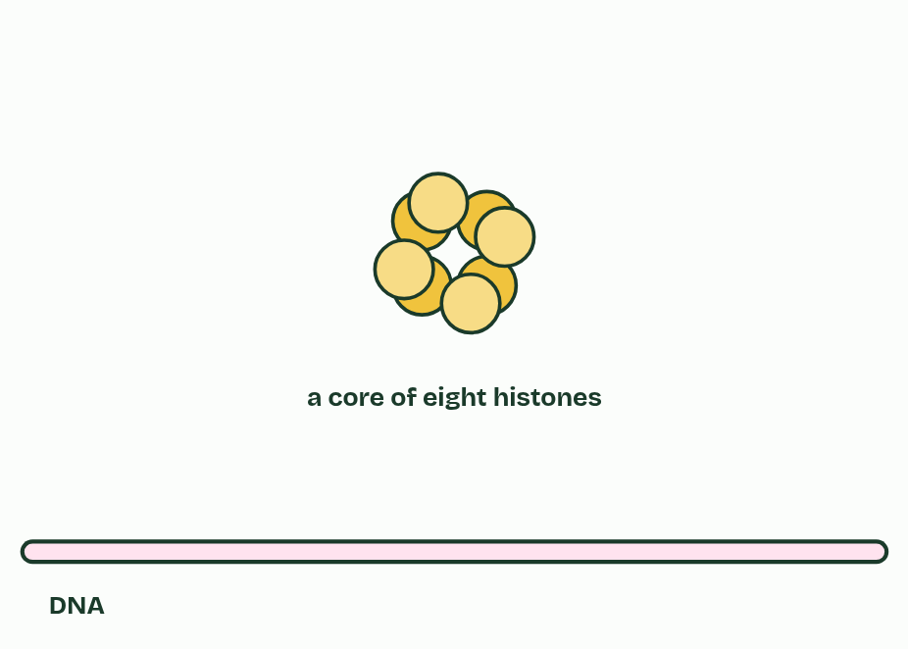
CHAPTER 10 · A1.2.13 Structure of a nucleosome
2 / 5
Wound on a spool
Eight histones form a core.
Minutes 40 to 55
Notes:
Minutes 40 to 55 of 60: Nucleosome on screen (15 min).
The plan: Pairs work through chapter 10's "Try it" list on laptops, then report which part of the DNA the histones touch, and why.
In eukaryotes, the DNA in the nucleus is wound around proteins called histones. A nucleosome is a core of eight histone proteins with DNA wrapped round it, just under two turns, and one more histone attached to the linker DNA where the DNA enters and leaves, holding the wrapped DNA in place. The linker DNA runs on to the next nucleosome: beads on a string.
Wound this way, about 2 m of DNA fits into a nucleus. The cell can also control which stretches can be read: tags on histones are D2.2. How do the histones hold the DNA on? That is the prediction below.
Example: Try it Best on a laptop. The links open in a new tab. Open the nucleosome core particle entry 1KX5 on the RCSB Protein Data Bank and open its 3D view. Colour by chain. Count the protein chains in the core and the strands of DNA. The eight proteins come as two copies each of four kinds: find each pair. Where does the DNA touch the proteins: at its bases, or at its backbone? Select the lysine and arginine residues and show them as sticks. Where do they point? Find the histone tails reaching out between the turns of DNA. Count the turns of DNA round the core. Is there a ninth histone in this structure? (In a core particle, no: the linker DNA was trimmed off before it was crystallised.) Open an entry that includes a linker histone, such as 4QLC, and find it. On a phone the 3D viewer needs a bigger screen. Answer these from the figure instead: how many histones are in the core, how many turns of DNA wrap round it, and where does the ninth histone sit?

Slide 29
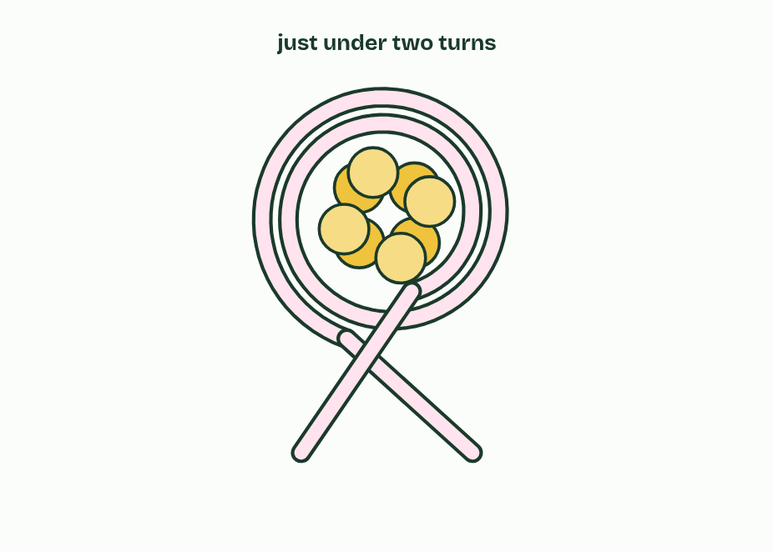
CHAPTER 10 · A1.2.13 Structure of a nucleosome
3 / 5
Wound on a spool
The DNA wraps round the core, just under two turns.
Minutes 40 to 55
Notes:
Minutes 40 to 55 of 60: Nucleosome on screen (15 min).
The plan: Pairs work through chapter 10's "Try it" list on laptops, then report which part of the DNA the histones touch, and why.
In eukaryotes, the DNA in the nucleus is wound around proteins called histones. A nucleosome is a core of eight histone proteins with DNA wrapped round it, just under two turns, and one more histone attached to the linker DNA where the DNA enters and leaves, holding the wrapped DNA in place. The linker DNA runs on to the next nucleosome: beads on a string.
Wound this way, about 2 m of DNA fits into a nucleus. The cell can also control which stretches can be read: tags on histones are D2.2. How do the histones hold the DNA on? That is the prediction below.
Example: Try it Best on a laptop. The links open in a new tab. Open the nucleosome core particle entry 1KX5 on the RCSB Protein Data Bank and open its 3D view. Colour by chain. Count the protein chains in the core and the strands of DNA. The eight proteins come as two copies each of four kinds: find each pair. Where does the DNA touch the proteins: at its bases, or at its backbone? Select the lysine and arginine residues and show them as sticks. Where do they point? Find the histone tails reaching out between the turns of DNA. Count the turns of DNA round the core. Is there a ninth histone in this structure? (In a core particle, no: the linker DNA was trimmed off before it was crystallised.) Open an entry that includes a linker histone, such as 4QLC, and find it. On a phone the 3D viewer needs a bigger screen. Answer these from the figure instead: how many histones are in the core, how many turns of DNA wrap round it, and where does the ninth histone sit?

Slide 30
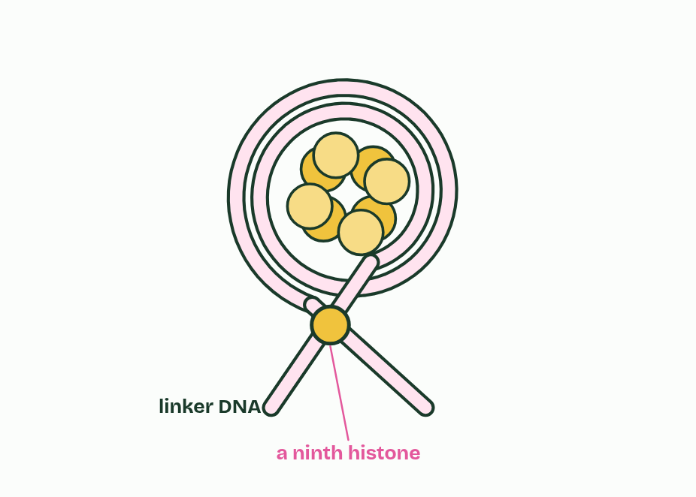
CHAPTER 10 · A1.2.13 Structure of a nucleosome
4 / 5
Wound on a spool
A ninth histone, on the linker DNA, holds it in place.
Minutes 40 to 55
Notes:
Minutes 40 to 55 of 60: Nucleosome on screen (15 min).
The plan: Pairs work through chapter 10's "Try it" list on laptops, then report which part of the DNA the histones touch, and why.
In eukaryotes, the DNA in the nucleus is wound around proteins called histones. A nucleosome is a core of eight histone proteins with DNA wrapped round it, just under two turns, and one more histone attached to the linker DNA where the DNA enters and leaves, holding the wrapped DNA in place. The linker DNA runs on to the next nucleosome: beads on a string.
Wound this way, about 2 m of DNA fits into a nucleus. The cell can also control which stretches can be read: tags on histones are D2.2. How do the histones hold the DNA on? That is the prediction below.
Example: Try it Best on a laptop. The links open in a new tab. Open the nucleosome core particle entry 1KX5 on the RCSB Protein Data Bank and open its 3D view. Colour by chain. Count the protein chains in the core and the strands of DNA. The eight proteins come as two copies each of four kinds: find each pair. Where does the DNA touch the proteins: at its bases, or at its backbone? Select the lysine and arginine residues and show them as sticks. Where do they point? Find the histone tails reaching out between the turns of DNA. Count the turns of DNA round the core. Is there a ninth histone in this structure? (In a core particle, no: the linker DNA was trimmed off before it was crystallised.) Open an entry that includes a linker histone, such as 4QLC, and find it. On a phone the 3D viewer needs a bigger screen. Answer these from the figure instead: how many histones are in the core, how many turns of DNA wrap round it, and where does the ninth histone sit?

Slide 31
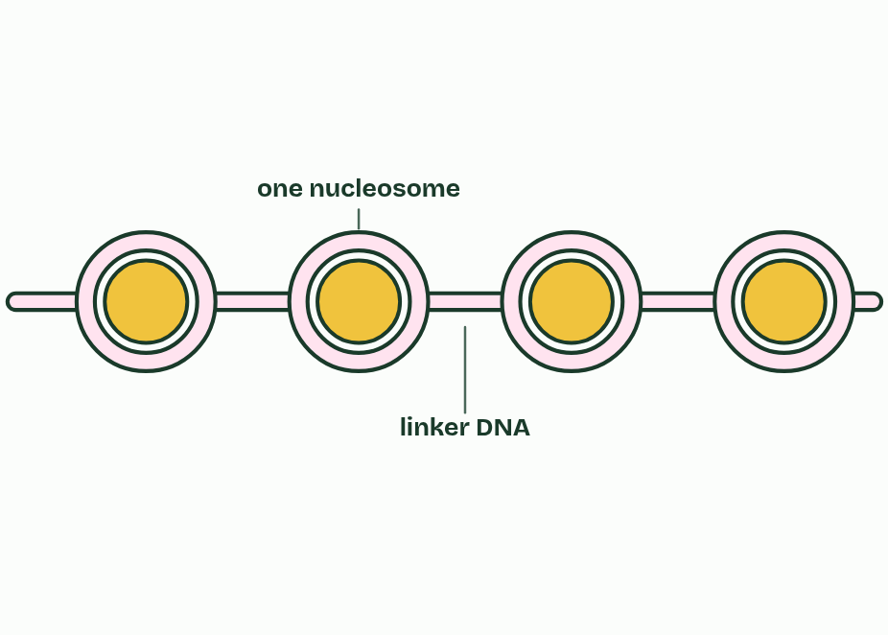
CHAPTER 10 · A1.2.13 Structure of a nucleosome
5 / 5
Wound on a spool
Nucleosomes along the DNA, like beads on a string.
Minutes 40 to 55
Notes:
Minutes 40 to 55 of 60: Nucleosome on screen (15 min).
The plan: Pairs work through chapter 10's "Try it" list on laptops, then report which part of the DNA the histones touch, and why.
In eukaryotes, the DNA in the nucleus is wound around proteins called histones. A nucleosome is a core of eight histone proteins with DNA wrapped round it, just under two turns, and one more histone attached to the linker DNA where the DNA enters and leaves, holding the wrapped DNA in place. The linker DNA runs on to the next nucleosome: beads on a string.
Wound this way, about 2 m of DNA fits into a nucleus. The cell can also control which stretches can be read: tags on histones are D2.2. How do the histones hold the DNA on? That is the prediction below.
Example: Try it Best on a laptop. The links open in a new tab. Open the nucleosome core particle entry 1KX5 on the RCSB Protein Data Bank and open its 3D view. Colour by chain. Count the protein chains in the core and the strands of DNA. The eight proteins come as two copies each of four kinds: find each pair. Where does the DNA touch the proteins: at its bases, or at its backbone? Select the lysine and arginine residues and show them as sticks. Where do they point? Find the histone tails reaching out between the turns of DNA. Count the turns of DNA round the core. Is there a ninth histone in this structure? (In a core particle, no: the linker DNA was trimmed off before it was crystallised.) Open an entry that includes a linker histone, such as 4QLC, and find it. On a phone the 3D viewer needs a bigger screen. Answer these from the figure instead: how many histones are in the core, how many turns of DNA wrap round it, and where does the ninth histone sit?

Slide 32
CHAPTER 10 · A1.2.13 Structure of a nucleosome
Wound on a spool
In eukaryotes, the DNA in the nucleus is wound around proteins called histones.
A nucleosome is a core of eight histone proteins with DNA wrapped round it, just under two turns, and one more histone attached to the linker DNA where the DNA enters and leaves, holding the wrapped DNA in place.
The linker DNA runs on to the next nucleosome: beads on a string.
The cell can also control which stretches can be read: tags on histones are D2.2.
Minutes 40 to 55
Notes:
Minutes 40 to 55 of 60: Nucleosome on screen (15 min).
The plan: Pairs work through chapter 10's "Try it" list on laptops, then report which part of the DNA the histones touch, and why.
In eukaryotes, the DNA in the nucleus is wound around proteins called histones. A nucleosome is a core of eight histone proteins with DNA wrapped round it, just under two turns, and one more histone attached to the linker DNA where the DNA enters and leaves, holding the wrapped DNA in place. The linker DNA runs on to the next nucleosome: beads on a string.
Wound this way, about 2 m of DNA fits into a nucleus. The cell can also control which stretches can be read: tags on histones are D2.2. How do the histones hold the DNA on? That is the prediction below.
Example: Try it Best on a laptop. The links open in a new tab. Open the nucleosome core particle entry 1KX5 on the RCSB Protein Data Bank and open its 3D view. Colour by chain. Count the protein chains in the core and the strands of DNA. The eight proteins come as two copies each of four kinds: find each pair. Where does the DNA touch the proteins: at its bases, or at its backbone? Select the lysine and arginine residues and show them as sticks. Where do they point? Find the histone tails reaching out between the turns of DNA. Count the turns of DNA round the core. Is there a ninth histone in this structure? (In a core particle, no: the linker DNA was trimmed off before it was crystallised.) Open an entry that includes a linker histone, such as 4QLC, and find it. On a phone the 3D viewer needs a bigger screen. Answer these from the figure instead: how many histones are in the core, how many turns of DNA wrap round it, and where does the ninth histone sit?

Slide 33
PREDICT
A chemical is added that cancels the negative charges on DNA's phosphate groups. What would you expect to happen to the nucleosomes?
A The DNA would grip the histones even more tightly than before
B Nothing would change, because histones hold the bases and not the phosphates
C The DNA would come away from the histones more easily
Minutes 40 to 55
Notes:
Minutes 40 to 55 of 60: Nucleosome on screen (15 min).
The plan: Pairs work through chapter 10's "Try it" list on laptops, then report which part of the DNA the histones touch, and why.
Ask for a show of hands, or mini whiteboards, before revealing. (Answer: C, on the next slide.)

Slide 34
WHAT HAPPENS
A chemical is added that cancels the negative charges on DNA's phosphate groups. What would you expect to happen to the nucleosomes?
A The DNA would grip the histones even more tightly than before
B Nothing would change, because histones hold the bases and not the phosphates
C The DNA would come away from the histones more easily
The DNA would loosen. Histones are rich in positively charged amino acids (lysine and arginine), and DNA's phosphate groups are negatively charged, so the two attract. Because the backbone is on the outside and every base pair is the same width (chapter 9), histones can hold any sequence. Take away the negative charges and the attraction goes. Cells do something like this on purpose, tagging histones to loosen or tighten the wrapping (D2.2).
Minutes 40 to 55
Notes:
Minutes 40 to 55 of 60: Nucleosome on screen (15 min).
The plan: Pairs work through chapter 10's "Try it" list on laptops, then report which part of the DNA the histones touch, and why.
Answer: C. The DNA would loosen. Histones are rich in positively charged amino acids (lysine and arginine), and DNA's phosphate groups are negatively charged, so the two attract. Because the backbone is on the outside and every base pair is the same width (chapter 9), histones can hold any sequence. Take away the negative charges and the attraction goes. Cells do something like this on purpose, tagging histones to loosen or tighten the wrapping (D2.2).

Slide 35
WATCH OUT
The DNA is not wrapped round one histone, and the ninth histone is not in the core: eight in the core, one on the linker DNA. Histones hold DNA by charge, not by base pairing.
Minutes 40 to 55
Notes:
Minutes 40 to 55 of 60: Nucleosome on screen (15 min).
The plan: Pairs work through chapter 10's "Try it" list on laptops, then report which part of the DNA the histones touch, and why.
A common mistake: say it, then ask who can say why it is wrong.

Slide 36
PLENARY
Can you now...
Explain what the 5′ and 3′ ends are, and why nucleotides are only ever added at the 3′ end (A1.2.11)
Explain why a purine always pairs with a pyrimidine, and what that does for the helix (A1.2.12)
Describe a nucleosome, and use molecular visualisation software to see how histones hold DNA (A1.2.13)
Minutes 55 to 60
Notes:
Minutes 55 to 60 of 60: Exit (5 min).
The plan: Describe a nucleosome, three marks' worth.
Thumbs up, sideways or down on each goal before the exit question. The goals come from the statements this lesson covers.

Slide 37
EXIT QUESTION
Before you go
Describe a nucleosome, three marks' worth.
Minutes 55 to 60
Notes:
Minutes 55 to 60 of 60: Exit (5 min).
The plan: Describe a nucleosome, three marks' worth.

Slide 38
PRACTISE AND REVISE
Keep going
Exam practice: a fresh paper of exam questions on A1.2 at higher level, marked as you go
The guide, with the animations and the dry lab
This lesson in the guide: 8 Every strand has a direction, 9 A big base with a small one, 10 Wound on a spool
BUILD FOR YOUR CLASS
ALREADY ON THE SITE FOR A1.2
CARD SETS ON SPLYCR
Tarsia puzzle, dominoes and picture reveal on A1.2, built from its key terms and ready to print
A pub quiz with rounds on A1.2, to present or run with no projector
An escape room built from the question bank on A1.2
Lesson: Nucleic Acids
Quiz: Nucleic Acids (HL)
Quiz: Nucleic Acids
Revision map: A1.2 Nucleic acids, to fill in
Exam questions: A1.2 in the exam maker, a paper with its markscheme
Open a set to host it as a class game, or make a copy to edit.
A1.2 Nucleic Acids
How this was made. The course structure, the activities and the teaching choices come from my own classroom, my presentations and my years of teaching IB and AP Biology. I use Claude, an AI, to help write and build the interactive guides, lesson plans, slides and practice questions, and to draw the diagrams and code the interactives. I direct the work and review it against the IB and AP specifications before it goes live.
Minute 60: after the lesson
Notes:
Every link here is live. Set the exam practice paper for homework: it is fresh each time, marked as students go and saved to their Exam practice when they are signed in.
Exam practice: https://www.biologybybradford.com/exam-maker/sit?topics=A1.2&level=HL&paper=quiz&marks=15&src=ep
The guide: https://www.biologybybradford.com/guides/ib-biology-a1-2-nucleic-acids

