Slide 1
IB Biology A1.2
LESSON 5 OF 5
HL
BY THE END YOU CAN
Nucleic acids
Explain how Hershey and Chase's results support the conclusion that DNA, not protein, is the genetic material (A1.2.14)
Use Chargaff's data to falsify the tetranucleotide hypothesis, and explain why one result can falsify what many cannot prove (A1.2.15)
How we know
A1.2.14, A1.2.15
The evidence: Hershey and Chase's film and results, and Chargaff's data against the tetranucleotide hypothesis
60 minutes · chapters 11, 12
Minute 0
Notes:
IB Biology A1.2, Nucleic acids. Lesson 5 of 5: How we know (higher level), 60 minutes.
The plan, minute by minute (each slide's footer says where you are):
0 to 5 min (5) Do now
5 to 17 min (12) Predict, then watch the film
17 to 25 min (8) Error hunt
25 to 40 min (15) Chargaff's table
40 to 55 min (15) Stop-motion Hershey and Chase
55 to 60 min (5) Exit
What students get wrong:
Sulfur labelled the DNA. Sulfur is in protein, phosphorus in DNA.
Hershey and Chase proved it. They gave strong evidence, for T2.
A + T = G + C. No: A = T and G = C.
Stretch and support:
Stretch: a single-stranded DNA virus has 25% A and 33% T. What can you say about its partner strand inside an infected cell, once it is copied?
The lesson plan to print: https://www.biologybybradford.com/guides/downloads/ib-biology-a1-2-nucleic-acids-lesson-5-plan.pdf

Slide 2
DO NOW
Do now
"It is 1950. Would you bet on protein or DNA as the genetic material?"
Then: what did Hershey and Chase need that nobody had before 1946?
5:00
minutes
Start now: the timer is running.
Minutes 0 to 5
Notes:
Minutes 0 to 5 of 60: Do now (5 min).
The plan: "It is 1950. Would you bet on protein or DNA as the genetic material?" Vote, with one reason. Then: what did Hershey and Chase need that nobody had before 1946?
Start a 5 minute timer as they come in.

Slide 3
STEP 2
12 MIN
Predict, then watch the film
It stops on "Where is the radioactivity?" until the prediction is in (in the slides, pause the video on that title card); then play the results and the new phages.
Minutes 5 to 17
Notes:
Minutes 5 to 17 of 60: Predict, then watch the film (12 min).
The plan: Chapter 11's predict box first, by vote, then chapter 11's film of the method. It stops on "Where is the radioactivity?" until the prediction is in (in the slides, pause the video on that title card); then play the results and the new phages.

Slide 4
PREDICT
After blending and spinning, where will most of the radioactivity be in each batch?
A Both in the pellet: the whole phage goes into the bacterium
B Sulfur-35 in the pellet, phosphorus-32 in the liquid
C Sulfur-35 in the liquid, phosphorus-32 in the pellet
Minutes 5 to 17
Notes:
Minutes 5 to 17 of 60: Predict, then watch the film (12 min).
The plan: Chapter 11's predict box first, by vote, then chapter 11's film of the method. It stops on "Where is the radioactivity?" until the prediction is in (in the slides, pause the video on that title card); then play the results and the new phages.
Ask for a show of hands, or mini whiteboards, before revealing. (Answer: C, on the next slide.)

Slide 5
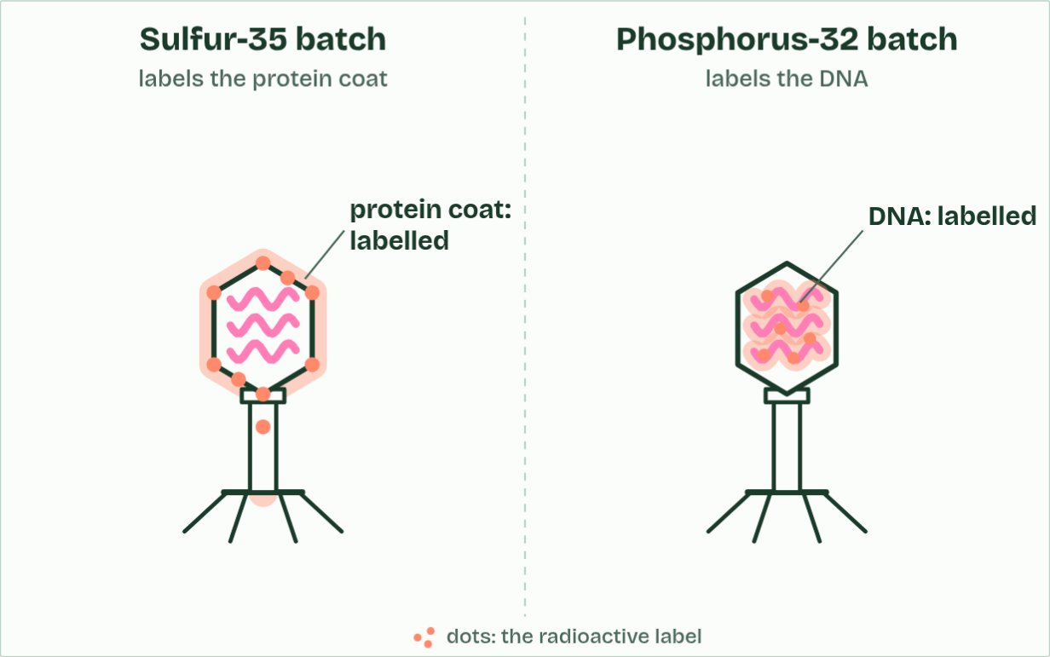
CHAPTER 11 · A1.2.14 Evidence from the Hershey–Chase experiment
the labels
1 / 5
Hershey and Chase: which one carries the genes?
Sulfur is in protein, not DNA, so it labels the protein coat. Phosphorus is in DNA, so it labels the DNA.
Minutes 5 to 17
Notes:
Minutes 5 to 17 of 60: Predict, then watch the film (12 min).
The plan: Chapter 11's predict box first, by vote, then chapter 11's film of the method. It stops on "Where is the radioactivity?" until the prediction is in (in the slides, pause the video on that title card); then play the results and the new phages.
In 1952 nobody knew whether genes were made of protein or of DNA. Many expected protein: proteins are built from 20 different amino acids and vary hugely, while DNA, with only four bases, looked too simple (chapter 12 tells that story).
Alfred Hershey and Martha Chase used a bacteriophage called T2, a virus that infects the bacterium E. coli. T2 is made of only two things: a protein coat, and DNA inside it. It attaches to a bacterium and injects its genetic material, and the bacterium then makes new phages. So whatever goes into the cell is what carries the genetic information.
They needed a way to tell the two apart. Protein contains sulfur, in the amino acids cysteine and methionine, but almost no phosphorus. DNA contains phosphorus, in its phosphate groups, but no sulfur. So phages grown with radioactive sulfur-35 had labelled protein coats, and phages grown with radioactive phosphorus-32 had labelled DNA. A radioisotope gives itself away by its radiation.
Each batch of labelled phages infected unlabelled bacteria. After a few minutes a blender shook the phage coats off the bacteria. A centrifuge then spun the mixture: the heavier bacteria formed a pellet at the bottom, and the light phage coats stayed in the liquid above, the supernatant. The radioactivity in each was measured. Predict what they found before you read on.
Example: Evidence, not proof Some sulfur-35 stayed with the bacteria, and not all the phosphorus-32 went in, so the result was not perfectly clean. It persuaded most biologists, alongside other evidence and, a year later, the double helix.
The animation "Hershey and Chase: the film", paused at 6.5 s. The next slides go on through it, then play it.

Slide 6
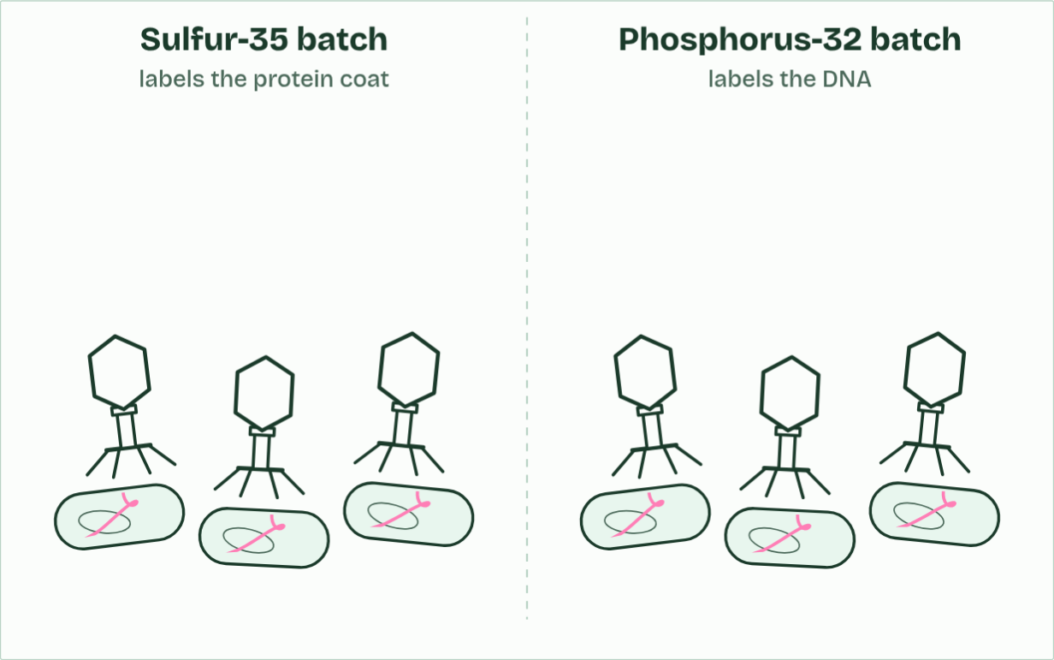
CHAPTER 11 · A1.2.14 Evidence from the Hershey–Chase experiment
infection
2 / 5
Hershey and Chase: which one carries the genes?
It injects its DNA into the bacterium. The empty protein coat stays outside.
Minutes 5 to 17
Notes:
Minutes 5 to 17 of 60: Predict, then watch the film (12 min).
The plan: Chapter 11's predict box first, by vote, then chapter 11's film of the method. It stops on "Where is the radioactivity?" until the prediction is in (in the slides, pause the video on that title card); then play the results and the new phages.
In 1952 nobody knew whether genes were made of protein or of DNA. Many expected protein: proteins are built from 20 different amino acids and vary hugely, while DNA, with only four bases, looked too simple (chapter 12 tells that story).
Alfred Hershey and Martha Chase used a bacteriophage called T2, a virus that infects the bacterium E. coli. T2 is made of only two things: a protein coat, and DNA inside it. It attaches to a bacterium and injects its genetic material, and the bacterium then makes new phages. So whatever goes into the cell is what carries the genetic information.
They needed a way to tell the two apart. Protein contains sulfur, in the amino acids cysteine and methionine, but almost no phosphorus. DNA contains phosphorus, in its phosphate groups, but no sulfur. So phages grown with radioactive sulfur-35 had labelled protein coats, and phages grown with radioactive phosphorus-32 had labelled DNA. A radioisotope gives itself away by its radiation.
Each batch of labelled phages infected unlabelled bacteria. After a few minutes a blender shook the phage coats off the bacteria. A centrifuge then spun the mixture: the heavier bacteria formed a pellet at the bottom, and the light phage coats stayed in the liquid above, the supernatant. The radioactivity in each was measured. Predict what they found before you read on.
Example: Evidence, not proof Some sulfur-35 stayed with the bacteria, and not all the phosphorus-32 went in, so the result was not perfectly clean. It persuaded most biologists, alongside other evidence and, a year later, the double helix.
The animation "Hershey and Chase: the film", paused at 16.5 s. The next slides go on through it, then play it.

Slide 7
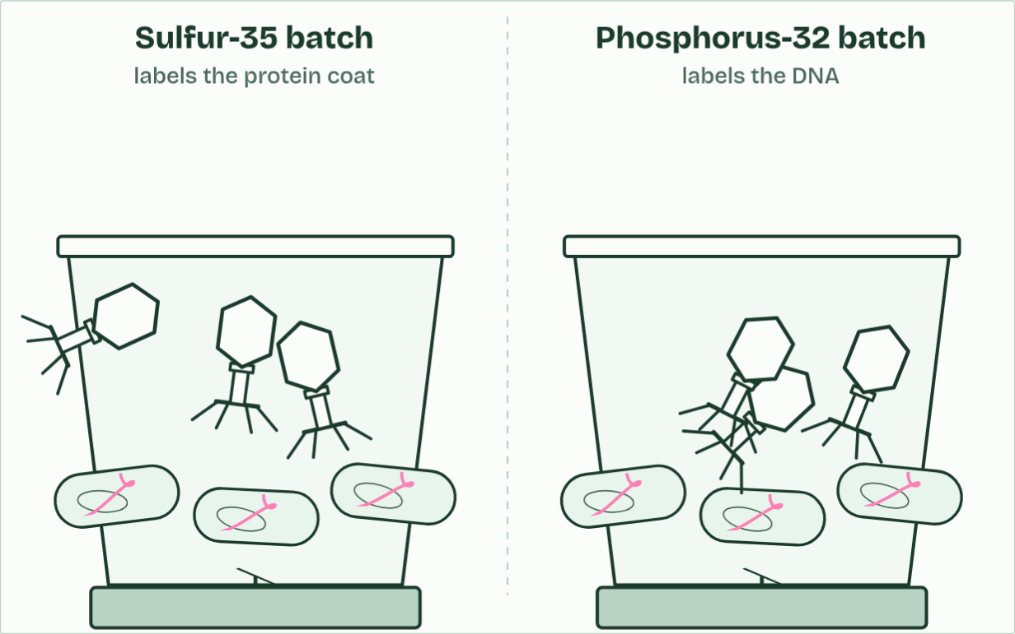
CHAPTER 11 · A1.2.14 Evidence from the Hershey–Chase experiment
the blender
3 / 5
Hershey and Chase: which one carries the genes?
A few minutes later, a blender shakes the coats off the bacteria.
Minutes 5 to 17
Notes:
Minutes 5 to 17 of 60: Predict, then watch the film (12 min).
The plan: Chapter 11's predict box first, by vote, then chapter 11's film of the method. It stops on "Where is the radioactivity?" until the prediction is in (in the slides, pause the video on that title card); then play the results and the new phages.
In 1952 nobody knew whether genes were made of protein or of DNA. Many expected protein: proteins are built from 20 different amino acids and vary hugely, while DNA, with only four bases, looked too simple (chapter 12 tells that story).
Alfred Hershey and Martha Chase used a bacteriophage called T2, a virus that infects the bacterium E. coli. T2 is made of only two things: a protein coat, and DNA inside it. It attaches to a bacterium and injects its genetic material, and the bacterium then makes new phages. So whatever goes into the cell is what carries the genetic information.
They needed a way to tell the two apart. Protein contains sulfur, in the amino acids cysteine and methionine, but almost no phosphorus. DNA contains phosphorus, in its phosphate groups, but no sulfur. So phages grown with radioactive sulfur-35 had labelled protein coats, and phages grown with radioactive phosphorus-32 had labelled DNA. A radioisotope gives itself away by its radiation.
Each batch of labelled phages infected unlabelled bacteria. After a few minutes a blender shook the phage coats off the bacteria. A centrifuge then spun the mixture: the heavier bacteria formed a pellet at the bottom, and the light phage coats stayed in the liquid above, the supernatant. The radioactivity in each was measured. Predict what they found before you read on.
Example: Evidence, not proof Some sulfur-35 stayed with the bacteria, and not all the phosphorus-32 went in, so the result was not perfectly clean. It persuaded most biologists, alongside other evidence and, a year later, the double helix.
The animation "Hershey and Chase: the film", paused at 23.5 s. The next slides go on through it, then play it.

Slide 8
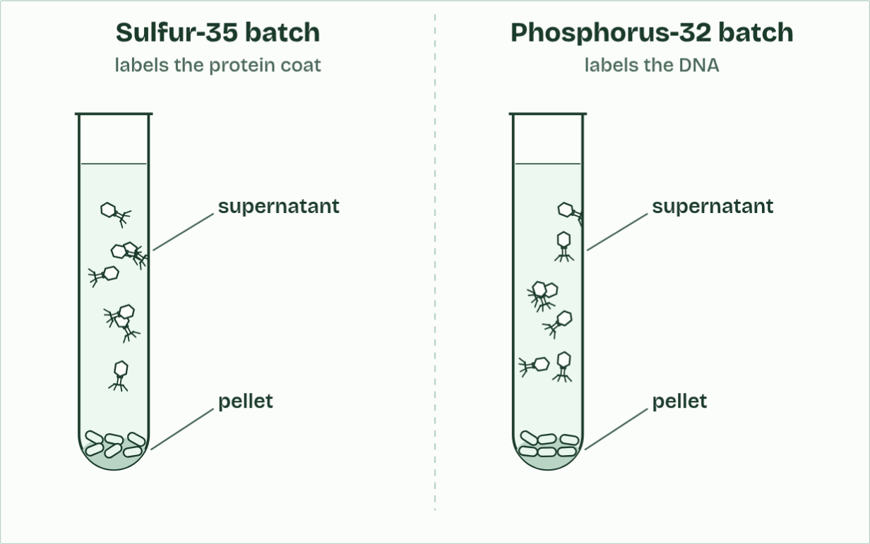
CHAPTER 11 · A1.2.14 Evidence from the Hershey–Chase experiment
the centrifuge
4 / 5
Hershey and Chase: which one carries the genes?
The heavy bacteria sink into a pellet. The light coats stay in the liquid above, the supernatant.
Minutes 5 to 17
Notes:
Minutes 5 to 17 of 60: Predict, then watch the film (12 min).
The plan: Chapter 11's predict box first, by vote, then chapter 11's film of the method. It stops on "Where is the radioactivity?" until the prediction is in (in the slides, pause the video on that title card); then play the results and the new phages.
In 1952 nobody knew whether genes were made of protein or of DNA. Many expected protein: proteins are built from 20 different amino acids and vary hugely, while DNA, with only four bases, looked too simple (chapter 12 tells that story).
Alfred Hershey and Martha Chase used a bacteriophage called T2, a virus that infects the bacterium E. coli. T2 is made of only two things: a protein coat, and DNA inside it. It attaches to a bacterium and injects its genetic material, and the bacterium then makes new phages. So whatever goes into the cell is what carries the genetic information.
They needed a way to tell the two apart. Protein contains sulfur, in the amino acids cysteine and methionine, but almost no phosphorus. DNA contains phosphorus, in its phosphate groups, but no sulfur. So phages grown with radioactive sulfur-35 had labelled protein coats, and phages grown with radioactive phosphorus-32 had labelled DNA. A radioisotope gives itself away by its radiation.
Each batch of labelled phages infected unlabelled bacteria. After a few minutes a blender shook the phage coats off the bacteria. A centrifuge then spun the mixture: the heavier bacteria formed a pellet at the bottom, and the light phage coats stayed in the liquid above, the supernatant. The radioactivity in each was measured. Predict what they found before you read on.
Example: Evidence, not proof Some sulfur-35 stayed with the bacteria, and not all the phosphorus-32 went in, so the result was not perfectly clean. It persuaded most biologists, alongside other evidence and, a year later, the double helix.
The animation "Hershey and Chase: the film", paused at 32.5 s. The next slides go on through it, then play it.

Slide 9
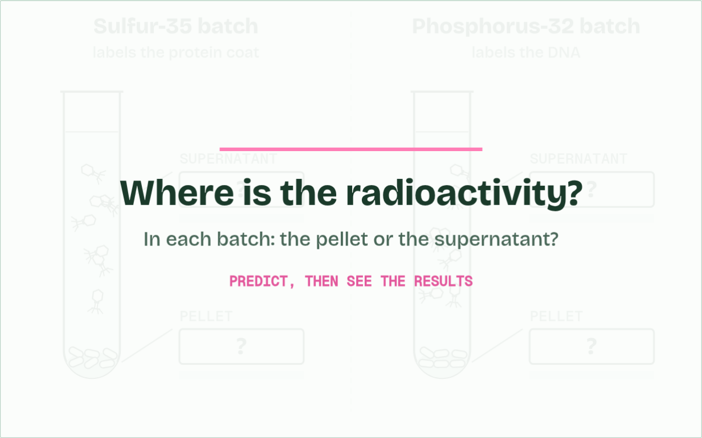
CHAPTER 11 · A1.2.14 Evidence from the Hershey–Chase experiment
your prediction
5 / 5
Hershey and Chase: which one carries the genes?
Where is the radioactivity? Predict before the results.
Minutes 5 to 17
Notes:
Minutes 5 to 17 of 60: Predict, then watch the film (12 min).
The plan: Chapter 11's predict box first, by vote, then chapter 11's film of the method. It stops on "Where is the radioactivity?" until the prediction is in (in the slides, pause the video on that title card); then play the results and the new phages.
In 1952 nobody knew whether genes were made of protein or of DNA. Many expected protein: proteins are built from 20 different amino acids and vary hugely, while DNA, with only four bases, looked too simple (chapter 12 tells that story).
Alfred Hershey and Martha Chase used a bacteriophage called T2, a virus that infects the bacterium E. coli. T2 is made of only two things: a protein coat, and DNA inside it. It attaches to a bacterium and injects its genetic material, and the bacterium then makes new phages. So whatever goes into the cell is what carries the genetic information.
They needed a way to tell the two apart. Protein contains sulfur, in the amino acids cysteine and methionine, but almost no phosphorus. DNA contains phosphorus, in its phosphate groups, but no sulfur. So phages grown with radioactive sulfur-35 had labelled protein coats, and phages grown with radioactive phosphorus-32 had labelled DNA. A radioisotope gives itself away by its radiation.
Each batch of labelled phages infected unlabelled bacteria. After a few minutes a blender shook the phage coats off the bacteria. A centrifuge then spun the mixture: the heavier bacteria formed a pellet at the bottom, and the light phage coats stayed in the liquid above, the supernatant. The radioactivity in each was measured. Predict what they found before you read on.
Example: Evidence, not proof Some sulfur-35 stayed with the bacteria, and not all the phosphorus-32 went in, so the result was not perfectly clean. It persuaded most biologists, alongside other evidence and, a year later, the double helix.
The animation "Hershey and Chase: the film", paused at 38.6 s. The next slides go on through it, then play it.

Slide 10
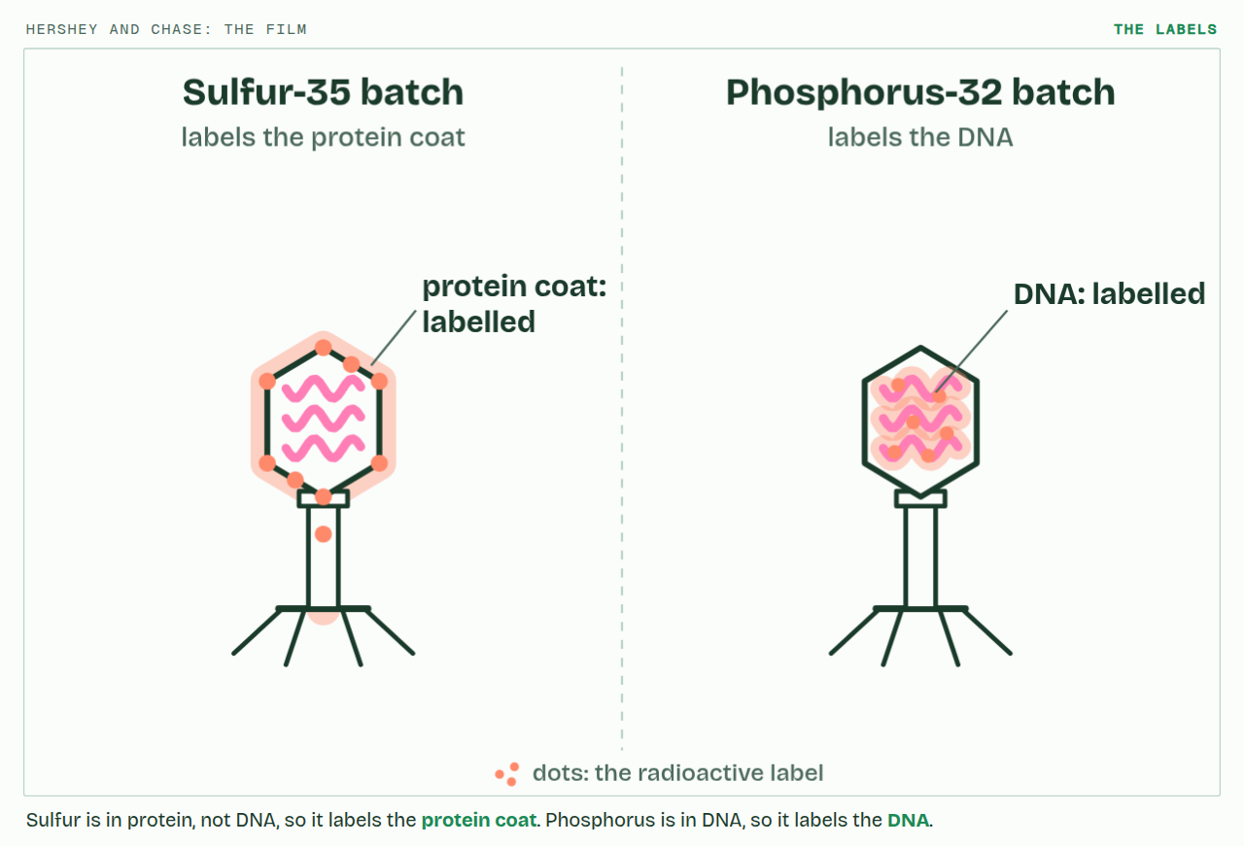
CHAPTER 11 · A1.2.14 Evidence from the Hershey–Chase experiment
PLAY IT
Hershey and Chase: which one carries the genes?
Hershey and Chase: the film: click to play. It loops every 62 seconds.
Minutes 5 to 17
Notes:
Minutes 5 to 17 of 60: Predict, then watch the film (12 min).
The plan: Chapter 11's predict box first, by vote, then chapter 11's film of the method. It stops on "Where is the radioactivity?" until the prediction is in (in the slides, pause the video on that title card); then play the results and the new phages.
The video is hershey-chase.mp4, one loop of the animation in the guide. It plays in PowerPoint and Keynote. Google Slides does not play a video embedded in a .pptx: download hershey-chase.mp4 (https://www.biologybybradford.com/guides/downloads/scenes/hershey-chase.mp4), upload it to Google Drive, then Insert > Video > Google Drive.
In the guide the class can change it as it runs: https://www.biologybybradford.com/guides/ib-biology-a1-2-nucleic-acids#hershey-chase
What it shows, in order:
1. Sulfur is in protein, not DNA, so it labels the protein coat. Phosphorus is in DNA, so it labels the DNA.
2. It injects its DNA into the bacterium. The empty protein coat stays outside.
3. A few minutes later, a blender shakes the coats off the bacteria.
4. The heavy bacteria sink into a pellet. The light coats stay in the liquid above, the supernatant.
5. Where is the radioactivity? Predict before the results.

Slide 11
WHAT HAPPENS
After blending and spinning, where will most of the radioactivity be in each batch?
A Both in the pellet: the whole phage goes into the bacterium
B Sulfur-35 in the pellet, phosphorus-32 in the liquid
C Sulfur-35 in the liquid, phosphorus-32 in the pellet
Almost only the DNA goes in. The protein coats, carrying the sulfur-35, are shaken off and stay in the liquid; the bacteria, now holding the phage DNA with its phosphorus-32, sink to the pellet. The DNA that went in is what made the new phages: phosphorus-32 turned up in the next generation of phages, and sulfur-35 hardly at all. These results are evidence that DNA, not protein, is the genetic material of T2.
Minutes 5 to 17
Notes:
Minutes 5 to 17 of 60: Predict, then watch the film (12 min).
The plan: Chapter 11's predict box first, by vote, then chapter 11's film of the method. It stops on "Where is the radioactivity?" until the prediction is in (in the slides, pause the video on that title card); then play the results and the new phages.
Answer: C. Almost only the DNA goes in. The protein coats, carrying the sulfur-35, are shaken off and stay in the liquid; the bacteria, now holding the phage DNA with its phosphorus-32, sink to the pellet. The DNA that went in is what made the new phages: phosphorus-32 turned up in the next generation of phages, and sulfur-35 hardly at all. These results are evidence that DNA, not protein, is the genetic material of T2.

Slide 12
WATCH OUT
Sulfur labels the protein, phosphorus the DNA: swapping them is the commonest slip. The pellet is the bacteria, not the viruses. And the results supported the conclusion that DNA is the genetic material of T2; saying the same of all life is a generalisation, which is chapter 12's subject.
Minutes 5 to 17
Notes:
Minutes 5 to 17 of 60: Predict, then watch the film (12 min).
The plan: Chapter 11's predict box first, by vote, then chapter 11's film of the method. It stops on "Where is the radioactivity?" until the prediction is in (in the slides, pause the video on that title card); then play the results and the new phages.
A common mistake: say it, then ask who can say why it is wrong.

Slide 13

WRITING · HL
8 MIN
Error hunt: Hershey and Chase
THE TASK
Students find and fix the mistakes in this answer: "Hershey and Chase wanted to find out whether RNA or protein was the genetic material. They grew phages with radioactive phosphorus to label the protein and radioactive sulfur to label the DNA. After infection they found the sulfur inside the bacteria, which proved that DNA is the genetic material of all living things." There are five: RNA for DNA; the labels swapped; the wrong result; "proved"; "all living things".
STUDENTS NEED
The answer printed or on the board.
Minutes 17 to 25
Notes:
Minutes 17 to 25 of 60: Error hunt (8 min).
The plan: Find and fix the five mistakes in the short answer (activity below).
The activity: Error hunt: Hershey and Chase. Students find and fix the mistakes in this answer: "Hershey and Chase wanted to find out whether RNA or protein was the genetic material. They grew phages with radioactive phosphorus to label the protein and radioactive sulfur to label the DNA. After infection they found the sulfur inside the bacteria, which proved that DNA is the genetic material of all living things." There are five: RNA for DNA; the labels swapped; the wrong result; "proved"; "all living things".
Needs: the answer printed or on the board.
The time: 8 minutes, minutes 17 to 25 of the plan.

Slide 14
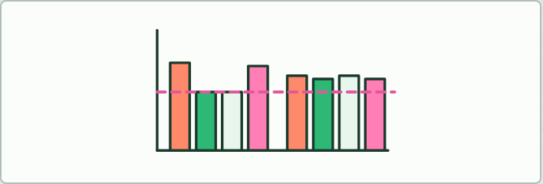
DATA · HL
15 MIN
Chargaff's table
THE TASK
From chapter 12's data (printed, or on screen), work out A/T, G/C and (A + G)/(C + T) for each organism. Say what the tetranucleotide hypothesis predicts, then find the one sample that breaks A = T and explain it. End on the discussion: why does one 30% result outweigh a thousand that agree?
STUDENTS NEED
The table, calculators.
Minutes 25 to 40
Notes:
Minutes 25 to 40 of 60: Chargaff's table (15 min).
The plan: The data task below, ending on the discussion of induction against falsification.
The activity: Chargaff's table. From chapter 12's data (printed, or on screen), work out A/T, G/C and (A + G)/(C + T) for each organism. Say what the tetranucleotide hypothesis predicts, then find the one sample that breaks A = T and explain it. End on the discussion: why does one 30% result outweigh a thousand that agree?
Needs: the table, calculators.
The time: 15 minutes, minutes 25 to 40 of the plan.

Slide 15
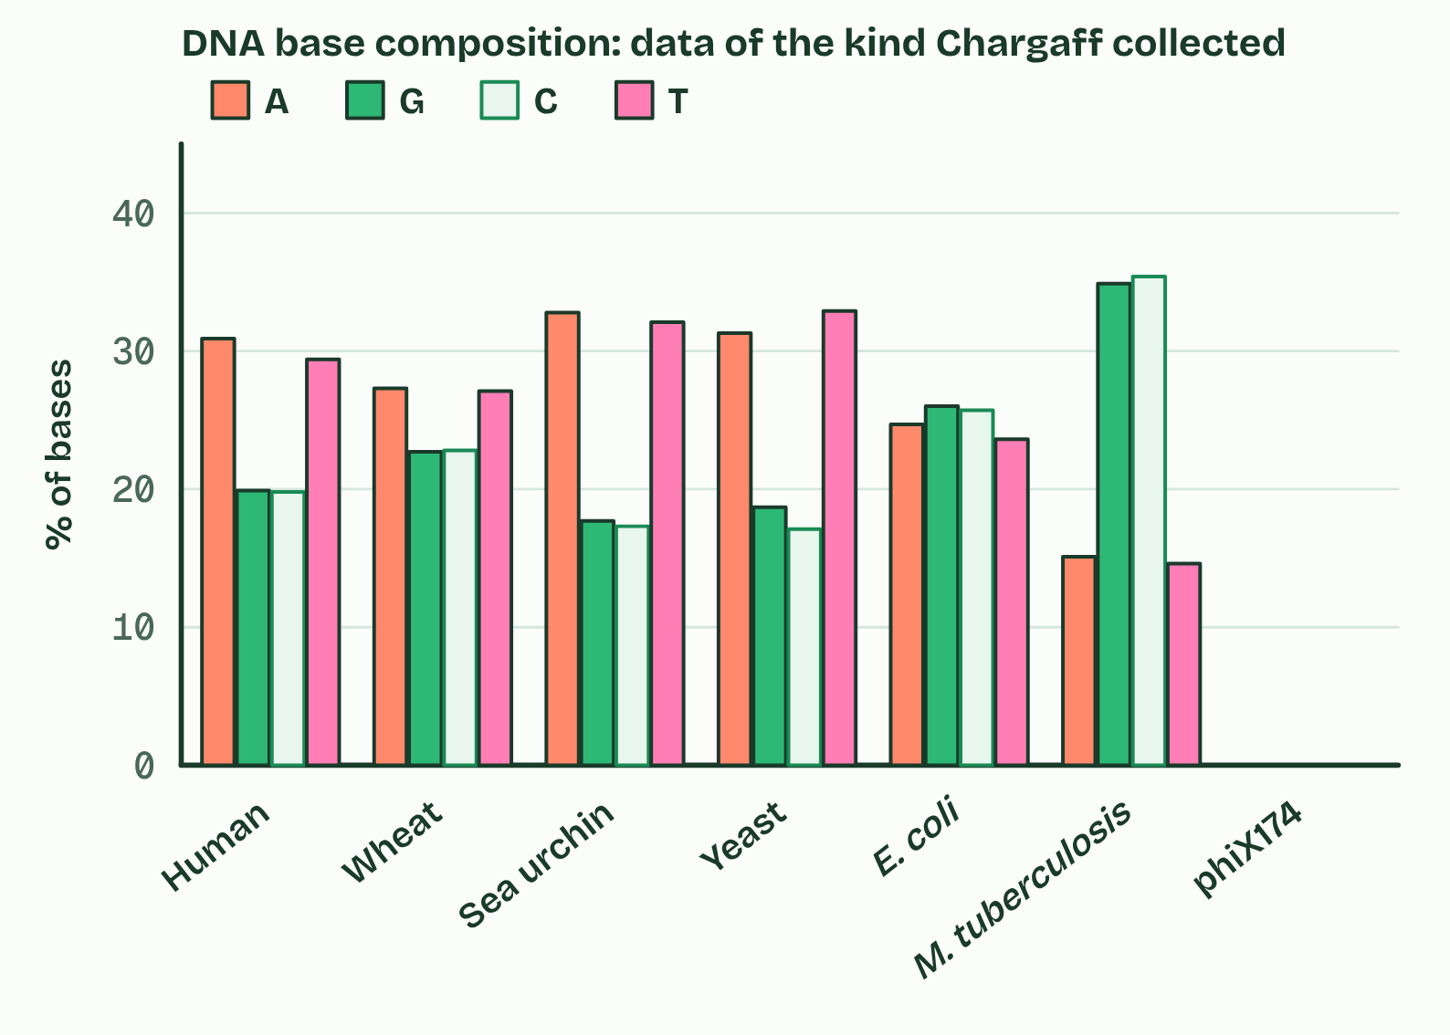
CHAPTER 12 · A1.2.15 Chargaff's data
1 / 4
Chargaff's numbers: one result can falsify
Bases
Minutes 25 to 40
Notes:
Minutes 25 to 40 of 60: Chargaff's table (15 min).
The plan: The data task below, ending on the discussion of induction against falsification.
From the late 1940s Erwin Chargaff took DNA from many organisms, broke it into its bases, separated them and measured how much of each there was.
He found two things. First, in every species the amount of A is about equal to the amount of T, and the amount of G about equals C, so purines (A + G) equal pyrimidines (C + T). Second, the proportions differ from species to species: some DNA is rich in A and T, some in G and C, while different tissues of one species give the same proportions.
The leading idea until then was the tetranucleotide hypothesis, from the early 1900s: that DNA is a monotonous repeat of the four nucleotides in equal amounts. It predicts 25% of each base in every species, and a molecule too simple to carry information.
Chargaff's equalities had no explanation until the double helix, in which A pairs with T and G with C. A virus with single-stranded DNA, such as phiX174, does not show A = T: as expected, if the rule comes from pairing. Try the figure's switches, then predict.
Example: Induction and falsification However many species show A equal to T, you cannot be certain the next one will: a generalisation from observations is never certain. That is the problem of induction. But one reliable result that contradicts a claim is enough to reject it. A claim can be falsified with certainty in a way it can never be proved: that is the certainty of falsification. It is how Chargaff's data settled the tetranucleotide question without anyone testing every species.

Slide 16
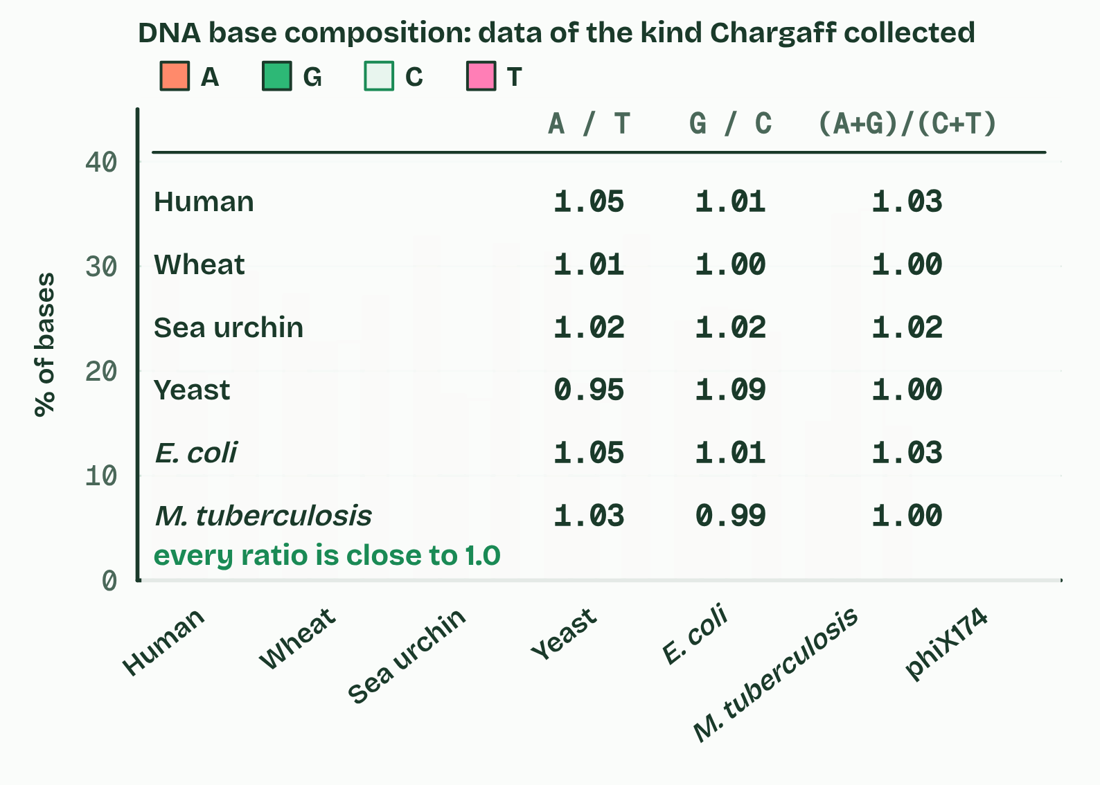
CHAPTER 12 · A1.2.15 Chargaff's data
2 / 4
Chargaff's numbers: one result can falsify
Ratios
Minutes 25 to 40
Notes:
Minutes 25 to 40 of 60: Chargaff's table (15 min).
The plan: The data task below, ending on the discussion of induction against falsification.
From the late 1940s Erwin Chargaff took DNA from many organisms, broke it into its bases, separated them and measured how much of each there was.
He found two things. First, in every species the amount of A is about equal to the amount of T, and the amount of G about equals C, so purines (A + G) equal pyrimidines (C + T). Second, the proportions differ from species to species: some DNA is rich in A and T, some in G and C, while different tissues of one species give the same proportions.
The leading idea until then was the tetranucleotide hypothesis, from the early 1900s: that DNA is a monotonous repeat of the four nucleotides in equal amounts. It predicts 25% of each base in every species, and a molecule too simple to carry information.
Chargaff's equalities had no explanation until the double helix, in which A pairs with T and G with C. A virus with single-stranded DNA, such as phiX174, does not show A = T: as expected, if the rule comes from pairing. Try the figure's switches, then predict.
Example: Induction and falsification However many species show A equal to T, you cannot be certain the next one will: a generalisation from observations is never certain. That is the problem of induction. But one reliable result that contradicts a claim is enough to reject it. A claim can be falsified with certainty in a way it can never be proved: that is the certainty of falsification. It is how Chargaff's data settled the tetranucleotide question without anyone testing every species.

Slide 17
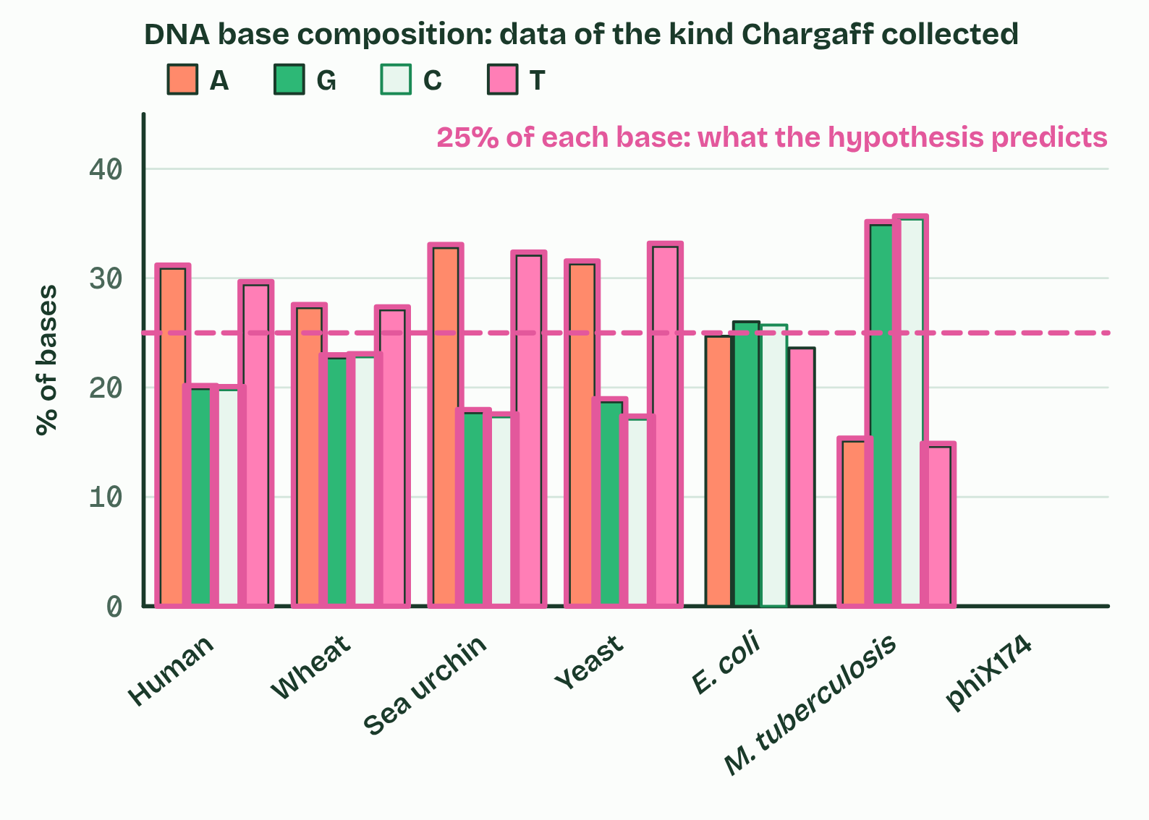
CHAPTER 12 · A1.2.15 Chargaff's data
3 / 4
Chargaff's numbers: one result can falsify
The hypothesis
Minutes 25 to 40
Notes:
Minutes 25 to 40 of 60: Chargaff's table (15 min).
The plan: The data task below, ending on the discussion of induction against falsification.
From the late 1940s Erwin Chargaff took DNA from many organisms, broke it into its bases, separated them and measured how much of each there was.
He found two things. First, in every species the amount of A is about equal to the amount of T, and the amount of G about equals C, so purines (A + G) equal pyrimidines (C + T). Second, the proportions differ from species to species: some DNA is rich in A and T, some in G and C, while different tissues of one species give the same proportions.
The leading idea until then was the tetranucleotide hypothesis, from the early 1900s: that DNA is a monotonous repeat of the four nucleotides in equal amounts. It predicts 25% of each base in every species, and a molecule too simple to carry information.
Chargaff's equalities had no explanation until the double helix, in which A pairs with T and G with C. A virus with single-stranded DNA, such as phiX174, does not show A = T: as expected, if the rule comes from pairing. Try the figure's switches, then predict.
Example: Induction and falsification However many species show A equal to T, you cannot be certain the next one will: a generalisation from observations is never certain. That is the problem of induction. But one reliable result that contradicts a claim is enough to reject it. A claim can be falsified with certainty in a way it can never be proved: that is the certainty of falsification. It is how Chargaff's data settled the tetranucleotide question without anyone testing every species.

Slide 18
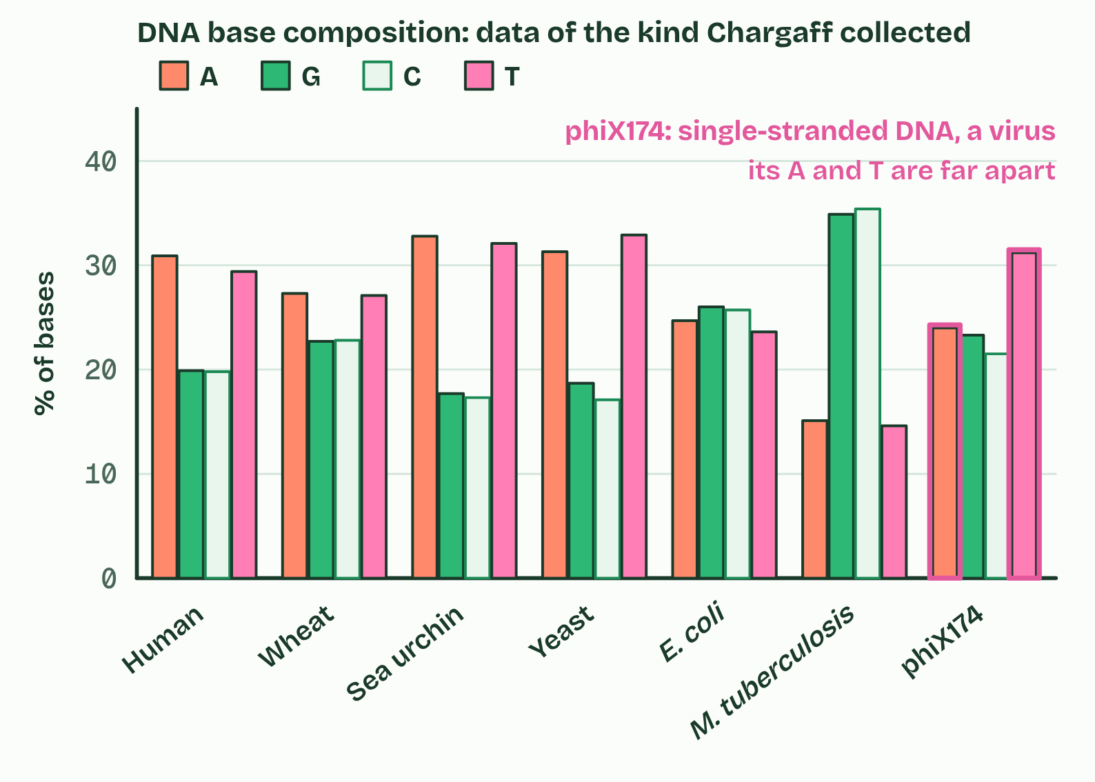
CHAPTER 12 · A1.2.15 Chargaff's data
4 / 4
Chargaff's numbers: one result can falsify
Add a virus
Minutes 25 to 40
Notes:
Minutes 25 to 40 of 60: Chargaff's table (15 min).
The plan: The data task below, ending on the discussion of induction against falsification.
From the late 1940s Erwin Chargaff took DNA from many organisms, broke it into its bases, separated them and measured how much of each there was.
He found two things. First, in every species the amount of A is about equal to the amount of T, and the amount of G about equals C, so purines (A + G) equal pyrimidines (C + T). Second, the proportions differ from species to species: some DNA is rich in A and T, some in G and C, while different tissues of one species give the same proportions.
The leading idea until then was the tetranucleotide hypothesis, from the early 1900s: that DNA is a monotonous repeat of the four nucleotides in equal amounts. It predicts 25% of each base in every species, and a molecule too simple to carry information.
Chargaff's equalities had no explanation until the double helix, in which A pairs with T and G with C. A virus with single-stranded DNA, such as phiX174, does not show A = T: as expected, if the rule comes from pairing. Try the figure's switches, then predict.
Example: Induction and falsification However many species show A equal to T, you cannot be certain the next one will: a generalisation from observations is never certain. That is the problem of induction. But one reliable result that contradicts a claim is enough to reject it. A claim can be falsified with certainty in a way it can never be proved: that is the certainty of falsification. It is how Chargaff's data settled the tetranucleotide question without anyone testing every species.

Slide 19
CHAPTER 12 · A1.2.15 Chargaff's data
Chargaff's numbers: one result can falsify
The leading idea until then was the tetranucleotide hypothesis, from the early 1900s: that DNA is a monotonous repeat of the four nucleotides in equal amounts.
From the late 1940s Erwin Chargaff took DNA from many organisms, broke it into its bases, separated them and measured how much of each there was.
He found two things.
Minutes 25 to 40
Notes:
Minutes 25 to 40 of 60: Chargaff's table (15 min).
The plan: The data task below, ending on the discussion of induction against falsification.
From the late 1940s Erwin Chargaff took DNA from many organisms, broke it into its bases, separated them and measured how much of each there was.
He found two things. First, in every species the amount of A is about equal to the amount of T, and the amount of G about equals C, so purines (A + G) equal pyrimidines (C + T). Second, the proportions differ from species to species: some DNA is rich in A and T, some in G and C, while different tissues of one species give the same proportions.
The leading idea until then was the tetranucleotide hypothesis, from the early 1900s: that DNA is a monotonous repeat of the four nucleotides in equal amounts. It predicts 25% of each base in every species, and a molecule too simple to carry information.
Chargaff's equalities had no explanation until the double helix, in which A pairs with T and G with C. A virus with single-stranded DNA, such as phiX174, does not show A = T: as expected, if the rule comes from pairing. Try the figure's switches, then predict.
Example: Induction and falsification However many species show A equal to T, you cannot be certain the next one will: a generalisation from observations is never certain. That is the problem of induction. But one reliable result that contradicts a claim is enough to reject it. A claim can be falsified with certainty in a way it can never be proved: that is the certainty of falsification. It is how Chargaff's data settled the tetranucleotide question without anyone testing every species.

Slide 20
PREDICT
The tetranucleotide hypothesis says every DNA molecule is 25% of each base. Which result would be enough, on its own, to falsify it?
A A thousand different species, in every one of which the amount of A equals the amount of T
B One species whose DNA is reliably measured as 30% adenine
C One species whose DNA is measured as exactly 25% of each of the four bases
Minutes 25 to 40
Notes:
Minutes 25 to 40 of 60: Chargaff's table (15 min).
The plan: The data task below, ending on the discussion of induction against falsification.
Ask for a show of hands, or mini whiteboards, before revealing. (Answer: B, on the next slide.)

Slide 21
WHAT HAPPENS
The tetranucleotide hypothesis says every DNA molecule is 25% of each base. Which result would be enough, on its own, to falsify it?
A A thousand different species, in every one of which the amount of A equals the amount of T
B One species whose DNA is reliably measured as 30% adenine
C One species whose DNA is measured as exactly 25% of each of the four bases
One reliable contradiction is enough to reject a claim about all DNA. Human DNA is about 30% adenine and 20% guanine, not 25% of each, and the proportions vary between species. A thousand species with A equal to T cannot prove anything about every species, and do not even test the 25% prediction; a species at exactly 25% agrees with the hypothesis, so it cannot falsify it.
Minutes 25 to 40
Notes:
Minutes 25 to 40 of 60: Chargaff's table (15 min).
The plan: The data task below, ending on the discussion of induction against falsification.
Answer: B. One reliable contradiction is enough to reject a claim about all DNA. Human DNA is about 30% adenine and 20% guanine, not 25% of each, and the proportions vary between species. A thousand species with A equal to T cannot prove anything about every species, and do not even test the 25% prediction; a species at exactly 25% agrees with the hypothesis, so it cannot falsify it.

Slide 22
WATCH OUT
Chargaff's rule is A = T and G = C. It is not A = G, and not A + T = G + C. It holds for double-stranded DNA, not for one strand on its own.
Minutes 25 to 40
Notes:
Minutes 25 to 40 of 60: Chargaff's table (15 min).
The plan: The data task below, ending on the discussion of induction against falsification.
A common mistake: say it, then ask who can say why it is wrong.

Slide 23
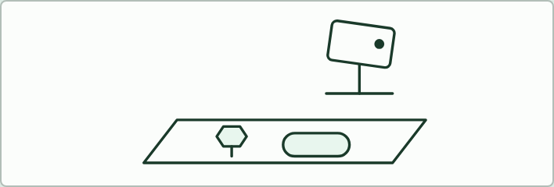
FILM · HL
15 MIN
Stop-motion Hershey and Chase
THE TASK
Groups make a 30-second film of the method and conclusion with paper cut-outs on a phone: labelled phages, injection, blender, centrifuge, counters, conclusion. Mark each step on whether it and its reason are right.
STUDENTS NEED
Phones, paper, scissors, sticky tack, a stand or a pile of books.
Minutes 40 to 55
Notes:
Minutes 40 to 55 of 60: Stop-motion Hershey and Chase (15 min).
The plan: Storyboard and first frames (activity below). Finish for homework.
The activity: Stop-motion Hershey and Chase. Groups make a 30-second film of the method and conclusion with paper cut-outs on a phone: labelled phages, injection, blender, centrifuge, counters, conclusion. Mark each step on whether it and its reason are right.
Needs: phones, paper, scissors, sticky tack, a stand or a pile of books.
The time: 15 minutes, minutes 40 to 55 of the plan.

Slide 24
PLENARY
Can you now...
Explain how Hershey and Chase's results support the conclusion that DNA, not protein, is the genetic material (A1.2.14)
Use Chargaff's data to falsify the tetranucleotide hypothesis, and explain why one result can falsify what many cannot prove (A1.2.15)
Minutes 55 to 60
Notes:
Minutes 55 to 60 of 60: Exit (5 min).
The plan: "S stays out, P passes in" (the teacher's mnemonic below), then one sentence: why does one 30% result outweigh a thousand that agree?
Thumbs up, sideways or down on each goal before the exit question. The goals come from the statements this lesson covers.

Slide 25
EXIT QUESTION
Before you go
"S stays out, P passes in", then one sentence: why does one 30% result outweigh a thousand that agree?
Minutes 55 to 60
Notes:
Minutes 55 to 60 of 60: Exit (5 min).
The plan: "S stays out, P passes in" (the teacher's mnemonic below), then one sentence: why does one 30% result outweigh a thousand that agree?

Slide 26
PRACTISE AND REVISE
Keep going
Exam practice: a fresh paper of exam questions on A1.2 at higher level, marked as you go
The guide, with the animations and the dry lab
This lesson in the guide: 11 Hershey and Chase: which one carries the genes?, 12 Chargaff's numbers: one result can falsify
BUILD FOR YOUR CLASS
ALREADY ON THE SITE FOR A1.2
CARD SETS ON SPLYCR
Tarsia puzzle, dominoes and picture reveal on A1.2, built from its key terms and ready to print
A pub quiz with rounds on A1.2, to present or run with no projector
An escape room built from the question bank on A1.2
Lesson: Nucleic Acids
Quiz: Nucleic Acids (HL)
Quiz: Nucleic Acids
Revision map: A1.2 Nucleic acids, to fill in
Exam questions: A1.2 in the exam maker, a paper with its markscheme
Open a set to host it as a class game, or make a copy to edit.
A1.2 Nucleic Acids
How this was made. The course structure, the activities and the teaching choices come from my own classroom, my presentations and my years of teaching IB and AP Biology. I use Claude, an AI, to help write and build the interactive guides, lesson plans, slides and practice questions, and to draw the diagrams and code the interactives. I direct the work and review it against the IB and AP specifications before it goes live.
Minute 60: after the lesson
Notes:
Every link here is live. Set the exam practice paper for homework: it is fresh each time, marked as students go and saved to their Exam practice when they are signed in.
Exam practice: https://www.biologybybradford.com/exam-maker/sit?topics=A1.2&level=HL&paper=quiz&marks=15&src=ep
The guide: https://www.biologybybradford.com/guides/ib-biology-a1-2-nucleic-acids

