Slide 1
IB Biology A3.1
LESSON 1 OF 5
BY THE END YOU CAN
Diversity of organisms
Explain why variation between organisms is a defining feature of life, and how Linnaeus used shared traits to define a species (A3.1.1, A3.1.2)
Name an organism with a binomial name written to the rules, and say what two species of one genus share (A3.1.3)
State the biological species concept, give challenges to it, and explain why gradual speciation makes the line between populations and species arbitrary (A3.1.4, A3.1.5)
Variation, species and names
A3.1.1 to A3.1.5
Variation, the morphological and biological species concepts, and binomial names
60 minutes · chapters 1, 2, 3
Minute 0
Notes:
IB Biology A3.1, Diversity of organisms. Lesson 1 of 5: Variation, species and names, 60 minutes.
The plan, minute by minute (each slide's footer says where you are):
0 to 8 min (8) Do now: sort the cards your own way
8 to 20 min (12) No two alike
20 to 32 min (12) A name with two parts
32 to 52 min (20) Can they breed?
52 to 60 min (8) Exit: two tests for a species
What students get wrong:
Species members are identical. They are similar, never identical. Variation within a species is normal and is what natural selection acts on.
Binomial names written any which way. Genus with a capital, species in lower case, both in italics or underlined. The species name never stands alone.
The biological test is whether they do breed. It is whether they could produce fertile offspring. Never having met does not make two populations separate species.
A species concept is a fact about nature. It is a working definition, and a different one suits different organisms. That is why the guide says “competing definitions exist”.
Stretch and support:
Support: give the captions of each figure as a cut-up storyboard to put in order, and use the key terms (tap the dotted words) as a glossary.
Support: the three Remember it sets (Green Sloths Inch Along; Five Apes Hug Grumpy Aunts Happily; Cats Eat Any Sausage, Mostly) as a starter or an exit.
Support: for the species concept clinic, give a frame: “The biological test says... but the problem is... so I would use...”.
Stretch: is there a species concept that works for both horses and bacteria? What would it have to ignore?
The lesson plan to print: https://www.biologybybradford.com/guides/downloads/ib-biology-a3-1-diversity-of-organisms-lesson-1-plan.pdf

Slide 2
DO NOW
Sort the cards your own way
Pairs compare with the pair beside them: did anyone sort the same way?
8:00
minutes
Start now: the timer is running.
Minutes 0 to 8
Notes:
Minutes 0 to 8 of 60: Do now: sort the cards your own way (8 min).
The plan: Give each pair the eight beetle cards from chapter 1’s figure, printed and cut up. They sort them into groups however they like, then write one yes or no question that splits their cards into two groups. Pairs compare with the pair beside them: did anyone sort the same way? Leave the groups on the desks and come back to them in a few minutes.
Start a 8 minute timer as they come in.

Slide 3
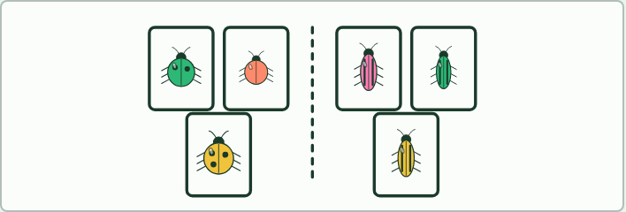
CARD SORT
8 MIN
Sort the cards your own way
THE TASK
Pairs sort eight beetle cards into groups of their own choosing, then split them with one yes or no question each time. They compare groupings with another pair: different people choose different traits, and some traits keep the cards of one kind together while others do not. The lesson takes the point from there.
STUDENTS NEED
Chapter 1’s figure printed and cut into eight cards per pair; scrap paper.
Minutes 0 to 8
Notes:
Minutes 0 to 8 of 60: Do now: sort the cards your own way (8 min).
The plan: Give each pair the eight beetle cards from chapter 1’s figure, printed and cut up. They sort them into groups however they like, then write one yes or no question that splits their cards into two groups. Pairs compare with the pair beside them: did anyone sort the same way? Leave the groups on the desks and come back to them in a few minutes.
The activity: Sort the cards your own way. Pairs sort eight beetle cards into groups of their own choosing, then split them with one yes or no question each time. They compare groupings with another pair: different people choose different traits, and some traits keep the cards of one kind together while others do not. The lesson takes the point from there.
Needs: chapter 1’s figure printed and cut into eight cards per pair; scrap paper.
The time: 8 minutes, minutes 0 to 8 of the plan.

Slide 4
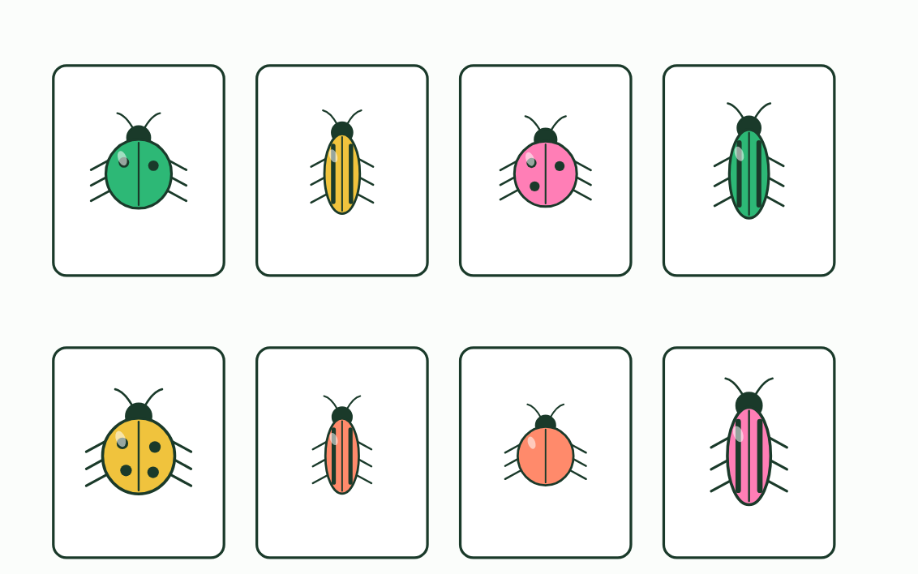
CHAPTER 1 · A3.1.1 A3.1.2 Variation and species
1 / 3
No two beetles are alike, and we sort them anyway
Shuffled
Minutes 0 to 8
Notes:
Minutes 0 to 8 of 60: Do now: sort the cards your own way (8 min).
The plan: Give each pair the eight beetle cards from chapter 1’s figure, printed and cut up. They sort them into groups however they like, then write one yes or no question that splits their cards into two groups. Pairs compare with the pair beside them: did anyone sort the same way? Leave the groups on the desks and come back to them in a few minutes.
Look along a row of beetles, or round a classroom. No two individuals are identical in every trait. Even identical twins differ, in their fingerprints, their scars and their tans. This variation is a defining feature of life, and it has patterns. Eight cards are enough to find them.
Shuffle the cards in the figure, then sort them by colour and by body shape. Colour pairs a round beetle with a long one every time. Body shape gives two tidy groups: every beetle in one is round and every beetle in the other is long, although inside each group the colours, sizes and spots all differ. The trait to sort by is the one that stays the same inside a group.
Patterns like these are the basis for naming and classifying organisms. In the 1700s the Swedish naturalist Carl Linnaeus sorted living things by the traits they share. To him a species was a group of organisms with the same body form and structure, its morphology. This is the morphological species concept. It is a working definition: a tool for grouping what biologists find, which can be improved or replaced.
Example: Some traits vary in steps, like human blood group (A, B, AB or O). Others vary smoothly, like height. Both kinds of pattern help to describe a species.

Slide 5
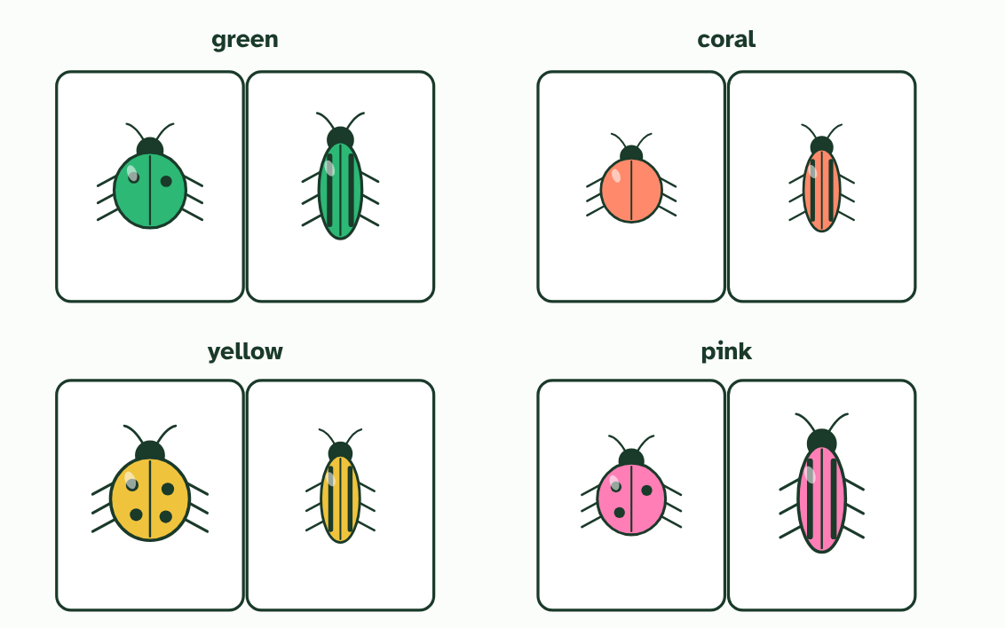
CHAPTER 1 · A3.1.1 A3.1.2 Variation and species
2 / 3
No two beetles are alike, and we sort them anyway
By colour
Minutes 0 to 8
Notes:
Minutes 0 to 8 of 60: Do now: sort the cards your own way (8 min).
The plan: Give each pair the eight beetle cards from chapter 1’s figure, printed and cut up. They sort them into groups however they like, then write one yes or no question that splits their cards into two groups. Pairs compare with the pair beside them: did anyone sort the same way? Leave the groups on the desks and come back to them in a few minutes.
Look along a row of beetles, or round a classroom. No two individuals are identical in every trait. Even identical twins differ, in their fingerprints, their scars and their tans. This variation is a defining feature of life, and it has patterns. Eight cards are enough to find them.
Shuffle the cards in the figure, then sort them by colour and by body shape. Colour pairs a round beetle with a long one every time. Body shape gives two tidy groups: every beetle in one is round and every beetle in the other is long, although inside each group the colours, sizes and spots all differ. The trait to sort by is the one that stays the same inside a group.
Patterns like these are the basis for naming and classifying organisms. In the 1700s the Swedish naturalist Carl Linnaeus sorted living things by the traits they share. To him a species was a group of organisms with the same body form and structure, its morphology. This is the morphological species concept. It is a working definition: a tool for grouping what biologists find, which can be improved or replaced.
Example: Some traits vary in steps, like human blood group (A, B, AB or O). Others vary smoothly, like height. Both kinds of pattern help to describe a species.

Slide 6
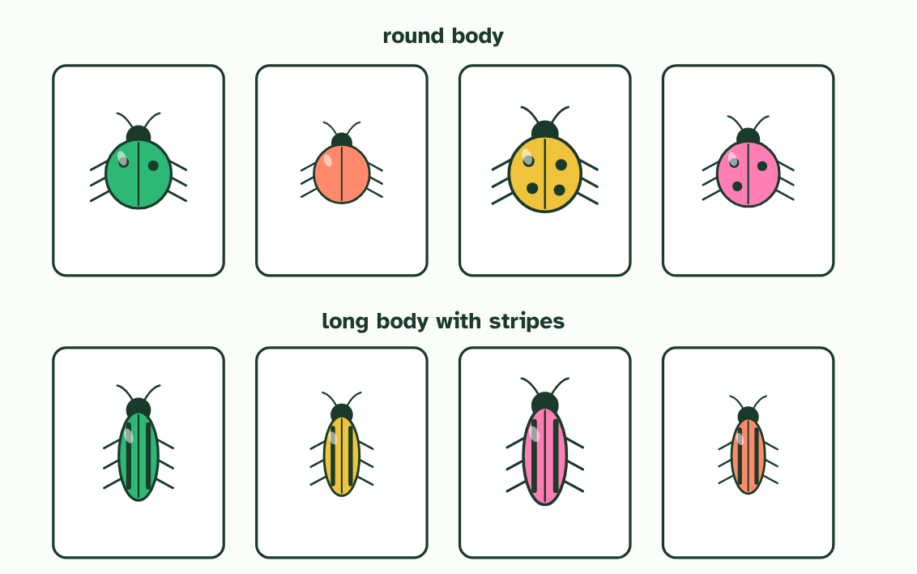
CHAPTER 1 · A3.1.1 A3.1.2 Variation and species
3 / 3
No two beetles are alike, and we sort them anyway
By body shape
Minutes 0 to 8
Notes:
Minutes 0 to 8 of 60: Do now: sort the cards your own way (8 min).
The plan: Give each pair the eight beetle cards from chapter 1’s figure, printed and cut up. They sort them into groups however they like, then write one yes or no question that splits their cards into two groups. Pairs compare with the pair beside them: did anyone sort the same way? Leave the groups on the desks and come back to them in a few minutes.
Look along a row of beetles, or round a classroom. No two individuals are identical in every trait. Even identical twins differ, in their fingerprints, their scars and their tans. This variation is a defining feature of life, and it has patterns. Eight cards are enough to find them.
Shuffle the cards in the figure, then sort them by colour and by body shape. Colour pairs a round beetle with a long one every time. Body shape gives two tidy groups: every beetle in one is round and every beetle in the other is long, although inside each group the colours, sizes and spots all differ. The trait to sort by is the one that stays the same inside a group.
Patterns like these are the basis for naming and classifying organisms. In the 1700s the Swedish naturalist Carl Linnaeus sorted living things by the traits they share. To him a species was a group of organisms with the same body form and structure, its morphology. This is the morphological species concept. It is a working definition: a tool for grouping what biologists find, which can be improved or replaced.
Example: Some traits vary in steps, like human blood group (A, B, AB or O). Others vary smoothly, like height. Both kinds of pattern help to describe a species.

Slide 7
CHAPTER 1 · A3.1.1 A3.1.2 Variation and species
No two beetles are alike, and we sort them anyway
No two individuals are identical in every trait.
Patterns in variation are the basis for naming and classifying organisms.
Linnaeus grouped organisms by shared physical traits: the morphological species concept.
Minutes 0 to 8
Notes:
Minutes 0 to 8 of 60: Do now: sort the cards your own way (8 min).
The plan: Give each pair the eight beetle cards from chapter 1’s figure, printed and cut up. They sort them into groups however they like, then write one yes or no question that splits their cards into two groups. Pairs compare with the pair beside them: did anyone sort the same way? Leave the groups on the desks and come back to them in a few minutes.
Look along a row of beetles, or round a classroom. No two individuals are identical in every trait. Even identical twins differ, in their fingerprints, their scars and their tans. This variation is a defining feature of life, and it has patterns. Eight cards are enough to find them.
Shuffle the cards in the figure, then sort them by colour and by body shape. Colour pairs a round beetle with a long one every time. Body shape gives two tidy groups: every beetle in one is round and every beetle in the other is long, although inside each group the colours, sizes and spots all differ. The trait to sort by is the one that stays the same inside a group.
Patterns like these are the basis for naming and classifying organisms. In the 1700s the Swedish naturalist Carl Linnaeus sorted living things by the traits they share. To him a species was a group of organisms with the same body form and structure, its morphology. This is the morphological species concept. It is a working definition: a tool for grouping what biologists find, which can be improved or replaced.
Example: Some traits vary in steps, like human blood group (A, B, AB or O). Others vary smoothly, like height. Both kinds of pattern help to describe a species.

Slide 8
WATCH OUT
Variation inside a species is not a flaw in the definition. If every member were identical, natural selection would have nothing to act on. A species is a group of similar organisms, never identical ones.
Minutes 0 to 8
Notes:
Minutes 0 to 8 of 60: Do now: sort the cards your own way (8 min).
The plan: Give each pair the eight beetle cards from chapter 1’s figure, printed and cut up. They sort them into groups however they like, then write one yes or no question that splits their cards into two groups. Pairs compare with the pair beside them: did anyone sort the same way? Leave the groups on the desks and come back to them in a few minutes.
A common mistake: say it, then ask who can say why it is wrong.

Slide 9
STEP 2
12 MIN
No two alike
Minutes 8 to 20
Notes:
Minutes 8 to 20 of 60: No two alike (12 min).
The plan: Chapter 1’s figure on the board: shuffle, then sort by colour, then by body shape. Ask which sort puts like with like, and why. Take chapter 1’s predict box on identical twins before the answer opens. Land on two ideas: no two individuals are identical, and Linnaeus sorted by the traits a group shares. A species concept is a working definition, not a fact of nature.

Slide 10
PREDICT
Identical twins share all their DNA. Are they identical in every trait?
A Yes: identical DNA gives identical traits in every way
B No: fingerprints, scars and tans differ even so
C Yes in every physical trait, but not in behaviour
Minutes 8 to 20
Notes:
Minutes 8 to 20 of 60: No two alike (12 min).
The plan: Chapter 1’s figure on the board: shuffle, then sort by colour, then by body shape. Ask which sort puts like with like, and why. Take chapter 1’s predict box on identical twins before the answer opens. Land on two ideas: no two individuals are identical, and Linnaeus sorted by the traits a group shares. A species concept is a working definition, not a fact of nature.
Ask for a show of hands, or mini whiteboards, before revealing. (Answer: B, on the next slide.)

Slide 11
WHAT HAPPENS
Identical twins share all their DNA. Are they identical in every trait?
A Yes: identical DNA gives identical traits in every way
B No: fingerprints, scars and tans differ even so
C Yes in every physical trait, but not in behaviour
No. Twins share their DNA, but traits are shaped by the environment too: a scar or a tan is picked up during life, and even fingerprints differ. Organisms are never alike in every trait, even when their genes match.
Minutes 8 to 20
Notes:
Minutes 8 to 20 of 60: No two alike (12 min).
The plan: Chapter 1’s figure on the board: shuffle, then sort by colour, then by body shape. Ask which sort puts like with like, and why. Take chapter 1’s predict box on identical twins before the answer opens. Land on two ideas: no two individuals are identical, and Linnaeus sorted by the traits a group shares. A species concept is a working definition, not a fact of nature.
Answer: B. No. Twins share their DNA, but traits are shaped by the environment too: a scar or a tan is picked up during life, and even fingerprints differ. Organisms are never alike in every trait, even when their genes match.

Slide 12
STEP 3
12 MIN
A name with two parts
Students write six names on mini whiteboards from your spoken descriptions (the human, the lion, the common chimpanzee, then two shortened ones) and show them at once.
Turn over chapter 2’s Remember it tiles.
Minutes 20 to 32
Notes:
Minutes 20 to 32 of 60: A name with two parts (12 min).
The plan: Chapter 2’s figure, one step at a time. Students write six names on mini whiteboards from your spoken descriptions (the human, the lion, the common chimpanzee, then two shortened ones) and show them at once. Turn over chapter 2’s Remember it tiles. Then chapter 2’s predict box on Panthera tigris and Panthera onca.

Slide 13
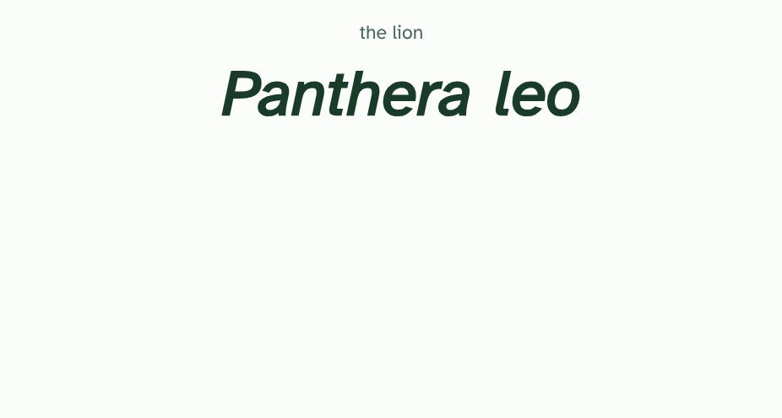
CHAPTER 2 · A3.1.3 Binomial naming
1 / 4
A name with two parts
A binomial name has two words, written in italics.
Minutes 20 to 32
Notes:
Minutes 20 to 32 of 60: A name with two parts (12 min).
The plan: Chapter 2’s figure, one step at a time. Students write six names on mini whiteboards from your spoken descriptions (the human, the lion, the common chimpanzee, then two shortened ones) and show them at once. Turn over chapter 2’s Remember it tiles. Then chapter 2’s predict box on Panthera tigris and Panthera onca.
Common names are slippery. “Robin” means one bird in Britain and a different bird in North America, and many species have a dozen names between them. Scientists need one name that means the same thing in every language.
The answer, from Linnaeus, is the binomial system: every species gets a two-part name. The first part is the genus. The second part picks out one species within it. We are Homo sapiens: genus Homo, species sapiens.
Species in the same genus have similar traits. The lion (Panthera leo), the tiger (P. tigris) and the leopard (P. pardus) are all big cats in one genus, while the domestic cat (Felis catus) belongs to another. Even before you meet a name, its first word tells you what kind of organism to expect.
The rules are short. The genus has a capital letter and the species has none. The whole name is in italics when typed and underlined when handwritten. After the first full use, the genus may be shortened to its initial: H. sapiens.
Write it right Tap the correct way to write each name.

Slide 14
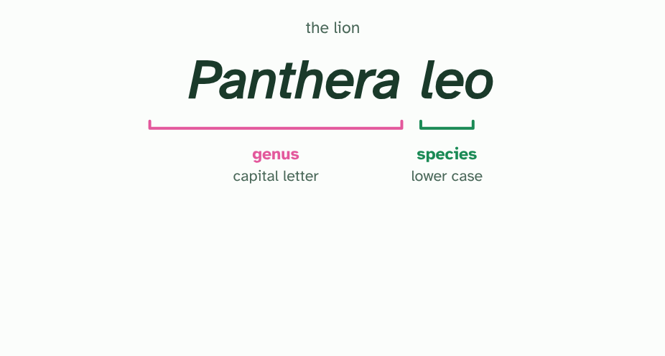
CHAPTER 2 · A3.1.3 Binomial naming
2 / 4
A name with two parts
The first word is the genus, with a capital letter. The second names the species, in lower case.
Minutes 20 to 32
Notes:
Minutes 20 to 32 of 60: A name with two parts (12 min).
The plan: Chapter 2’s figure, one step at a time. Students write six names on mini whiteboards from your spoken descriptions (the human, the lion, the common chimpanzee, then two shortened ones) and show them at once. Turn over chapter 2’s Remember it tiles. Then chapter 2’s predict box on Panthera tigris and Panthera onca.
Common names are slippery. “Robin” means one bird in Britain and a different bird in North America, and many species have a dozen names between them. Scientists need one name that means the same thing in every language.
The answer, from Linnaeus, is the binomial system: every species gets a two-part name. The first part is the genus. The second part picks out one species within it. We are Homo sapiens: genus Homo, species sapiens.
Species in the same genus have similar traits. The lion (Panthera leo), the tiger (P. tigris) and the leopard (P. pardus) are all big cats in one genus, while the domestic cat (Felis catus) belongs to another. Even before you meet a name, its first word tells you what kind of organism to expect.
The rules are short. The genus has a capital letter and the species has none. The whole name is in italics when typed and underlined when handwritten. After the first full use, the genus may be shortened to its initial: H. sapiens.
Write it right Tap the correct way to write each name.

Slide 15
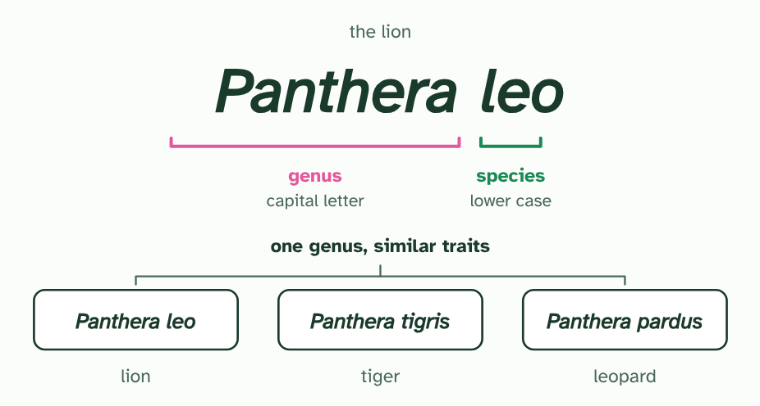
CHAPTER 2 · A3.1.3 Binomial naming
3 / 4
A name with two parts
Species in one genus have similar traits: lion, tiger and leopard share the genus Panthera.
Minutes 20 to 32
Notes:
Minutes 20 to 32 of 60: A name with two parts (12 min).
The plan: Chapter 2’s figure, one step at a time. Students write six names on mini whiteboards from your spoken descriptions (the human, the lion, the common chimpanzee, then two shortened ones) and show them at once. Turn over chapter 2’s Remember it tiles. Then chapter 2’s predict box on Panthera tigris and Panthera onca.
Common names are slippery. “Robin” means one bird in Britain and a different bird in North America, and many species have a dozen names between them. Scientists need one name that means the same thing in every language.
The answer, from Linnaeus, is the binomial system: every species gets a two-part name. The first part is the genus. The second part picks out one species within it. We are Homo sapiens: genus Homo, species sapiens.
Species in the same genus have similar traits. The lion (Panthera leo), the tiger (P. tigris) and the leopard (P. pardus) are all big cats in one genus, while the domestic cat (Felis catus) belongs to another. Even before you meet a name, its first word tells you what kind of organism to expect.
The rules are short. The genus has a capital letter and the species has none. The whole name is in italics when typed and underlined when handwritten. After the first full use, the genus may be shortened to its initial: H. sapiens.
Write it right Tap the correct way to write each name.

Slide 16
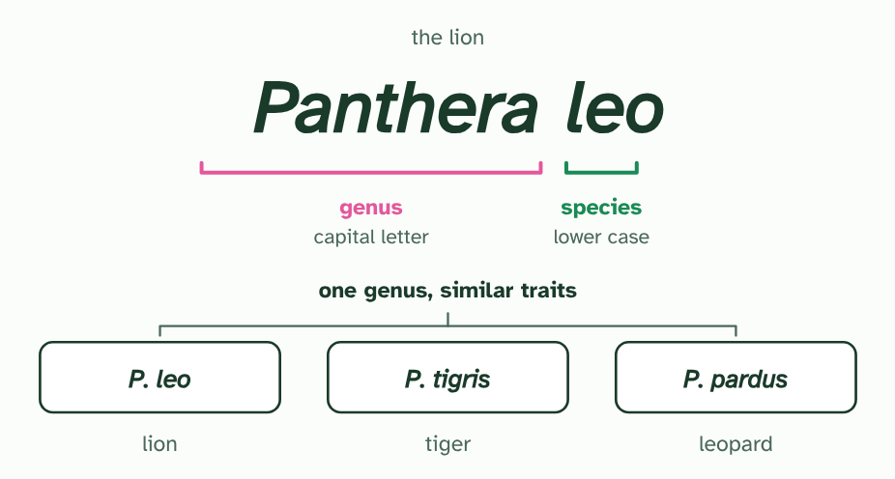
CHAPTER 2 · A3.1.3 Binomial naming
4 / 4
A name with two parts
After the first full use you may shorten the genus to its initial: P. leo.
Minutes 20 to 32
Notes:
Minutes 20 to 32 of 60: A name with two parts (12 min).
The plan: Chapter 2’s figure, one step at a time. Students write six names on mini whiteboards from your spoken descriptions (the human, the lion, the common chimpanzee, then two shortened ones) and show them at once. Turn over chapter 2’s Remember it tiles. Then chapter 2’s predict box on Panthera tigris and Panthera onca.
Common names are slippery. “Robin” means one bird in Britain and a different bird in North America, and many species have a dozen names between them. Scientists need one name that means the same thing in every language.
The answer, from Linnaeus, is the binomial system: every species gets a two-part name. The first part is the genus. The second part picks out one species within it. We are Homo sapiens: genus Homo, species sapiens.
Species in the same genus have similar traits. The lion (Panthera leo), the tiger (P. tigris) and the leopard (P. pardus) are all big cats in one genus, while the domestic cat (Felis catus) belongs to another. Even before you meet a name, its first word tells you what kind of organism to expect.
The rules are short. The genus has a capital letter and the species has none. The whole name is in italics when typed and underlined when handwritten. After the first full use, the genus may be shortened to its initial: H. sapiens.
Write it right Tap the correct way to write each name.

Slide 17
CHAPTER 2 · A3.1.3 Binomial naming
A name with two parts
The answer, from Linnaeus, is the binomial system: every species gets a two-part name.
The first part is the genus.
We are Homo sapiens: genus Homo, species sapiens.
Species in the same genus have similar traits.
Minutes 20 to 32
Notes:
Minutes 20 to 32 of 60: A name with two parts (12 min).
The plan: Chapter 2’s figure, one step at a time. Students write six names on mini whiteboards from your spoken descriptions (the human, the lion, the common chimpanzee, then two shortened ones) and show them at once. Turn over chapter 2’s Remember it tiles. Then chapter 2’s predict box on Panthera tigris and Panthera onca.
Common names are slippery. “Robin” means one bird in Britain and a different bird in North America, and many species have a dozen names between them. Scientists need one name that means the same thing in every language.
The answer, from Linnaeus, is the binomial system: every species gets a two-part name. The first part is the genus. The second part picks out one species within it. We are Homo sapiens: genus Homo, species sapiens.
Species in the same genus have similar traits. The lion (Panthera leo), the tiger (P. tigris) and the leopard (P. pardus) are all big cats in one genus, while the domestic cat (Felis catus) belongs to another. Even before you meet a name, its first word tells you what kind of organism to expect.
The rules are short. The genus has a capital letter and the species has none. The whole name is in italics when typed and underlined when handwritten. After the first full use, the genus may be shortened to its initial: H. sapiens.
Write it right Tap the correct way to write each name.

Slide 18
WATCH OUT
The species name never stands alone: leo means nothing without its genus, because other genera have species with the same second word. And the capital belongs to the genus only: Homo sapiens, never Homo Sapiens.
Minutes 20 to 32
Notes:
Minutes 20 to 32 of 60: A name with two parts (12 min).
The plan: Chapter 2’s figure, one step at a time. Students write six names on mini whiteboards from your spoken descriptions (the human, the lion, the common chimpanzee, then two shortened ones) and show them at once. Turn over chapter 2’s Remember it tiles. Then chapter 2’s predict box on Panthera tigris and Panthera onca.
A common mistake: say it, then ask who can say why it is wrong.

Slide 19
REMEMBER IT
The four rules of a binomial name
G
S
I
A
Green
Sloths
Inch
Along
Minutes 20 to 32
Notes:
Minutes 20 to 32 of 60: A name with two parts (12 min).
The plan: Chapter 2’s figure, one step at a time. Students write six names on mini whiteboards from your spoken descriptions (the human, the lion, the common chimpanzee, then two shortened ones) and show them at once. Turn over chapter 2’s Remember it tiles. Then chapter 2’s predict box on Panthera tigris and Panthera onca.
Ask the class what each letter stands for before revealing.

Slide 20
REMEMBER IT
The four rules of a binomial name
G
S
I
A
Green
Sloths
Inch
Along
Genus first
Species second
Italics
Abbreviate
with a capital letter
all in lower case
underlined if handwritten
the genus to its initial after first use
Minutes 20 to 32
Notes:
Minutes 20 to 32 of 60: A name with two parts (12 min).
The plan: Chapter 2’s figure, one step at a time. Students write six names on mini whiteboards from your spoken descriptions (the human, the lion, the common chimpanzee, then two shortened ones) and show them at once. Turn over chapter 2’s Remember it tiles. Then chapter 2’s predict box on Panthera tigris and Panthera onca.
Green: Genus first (with a capital letter)
Sloths: Species second (all in lower case)
Inch: Italics (underlined if handwritten)
Along: Abbreviate (the genus to its initial after first use)

Slide 21
PREDICT
Two animals are named Panthera tigris and Panthera onca. What can you say about them?
A The same species, because the first word of both names is the same
B Different species in different genera, since the second words differ
C Two species in one genus, so they share similar traits
Minutes 20 to 32
Notes:
Minutes 20 to 32 of 60: A name with two parts (12 min).
The plan: Chapter 2’s figure, one step at a time. Students write six names on mini whiteboards from your spoken descriptions (the human, the lion, the common chimpanzee, then two shortened ones) and show them at once. Turn over chapter 2’s Remember it tiles. Then chapter 2’s predict box on Panthera tigris and Panthera onca.
Ask for a show of hands, or mini whiteboards, before revealing. (Answer: C, on the next slide.)

Slide 22
WHAT HAPPENS
Two animals are named Panthera tigris and Panthera onca. What can you say about them?
A The same species, because the first word of both names is the same
B Different species in different genera, since the second words differ
C Two species in one genus, so they share similar traits
Two species in one genus. The genus is the same (Panthera) and the species names differ (tigris, the tiger, and onca, the jaguar), so they are separate species that share similar traits.
Minutes 20 to 32
Notes:
Minutes 20 to 32 of 60: A name with two parts (12 min).
The plan: Chapter 2’s figure, one step at a time. Students write six names on mini whiteboards from your spoken descriptions (the human, the lion, the common chimpanzee, then two shortened ones) and show them at once. Turn over chapter 2’s Remember it tiles. Then chapter 2’s predict box on Panthera tigris and Panthera onca.
Answer: C. Two species in one genus. The genus is the same (Panthera) and the species names differ (tigris, the tiger, and onca, the jaguar), so they are separate species that share similar traits.

Slide 23
STEP 4
20 MIN
Can they breed?
Chapter 3: Can they breed?
Card sort: The species concept clinic
Minutes 32 to 52
Notes:
Minutes 32 to 52 of 60: Can they breed? (20 min).
The plan: Chapter 3’s figure on the board, then the species concept clinic below: groups rule on six case cards. Take chapter 3’s two predict boxes, the islands and the million years. Run the splitting film once and ask on which day one species became two: the answer is none, so where the line falls is a judgement.

Slide 24
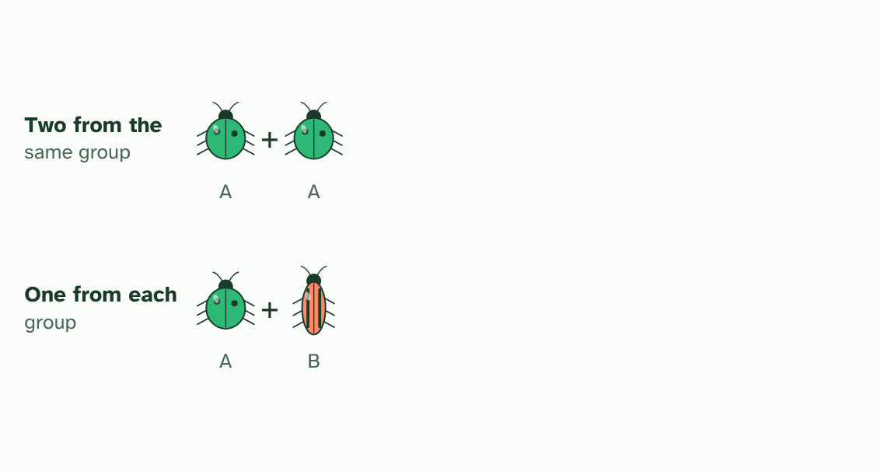
CHAPTER 3 · A3.1.4 A3.1.5 The biological species concept
1 / 4
Can they breed?
A breeding test: two beetles from the same group, and a pair with one from each (imagined beetles).
Minutes 32 to 52
Notes:
Minutes 32 to 52 of 60: Can they breed? (20 min).
The plan: Chapter 3’s figure on the board, then the species concept clinic below: groups rule on six case cards. Take chapter 3’s two predict boxes, the islands and the million years. Run the splitting film once and ask on which day one species became two: the answer is none, so where the line falls is a judgement.
Looks can mislead: males and females of one species may differ, and two species can look almost the same. Many biologists use a different test. The biological species concept says a species is a group of organisms that can breed and produce fertile offspring.
“Fertile” matters. A horse and a donkey can mate and have a healthy mule, but a mule cannot have young of its own, so horses and donkeys count as two species. The figure runs the test on imagined beetles.
No definition is the last word. Other species concepts group organisms by how alike their DNA is, or by the way of life they share. A species concept is a working definition, a tool that helps scientists group what they find, and it is replaced when a better tool comes along.
The breeding test has problems. Fossils cannot be tested. Populations that live far apart may never meet, so nobody knows whether they could breed. Some groups that are called separate species do have fertile young where they meet, as many oaks do. And a few species form a ring around a barrier, where each population breeds with its neighbour but the two ends of the chain do not.
One more problem comes from how species form. Speciation, the splitting of one species into two or more, usually happens gradually (you saw it in A4.1). Populations that stop interbreeding grow apart a little at a time. At first they could still breed if they met, and much later they could not. There is no single day when one species becomes two, so deciding whether two populations are one species or two can be arbitrary.

Slide 25
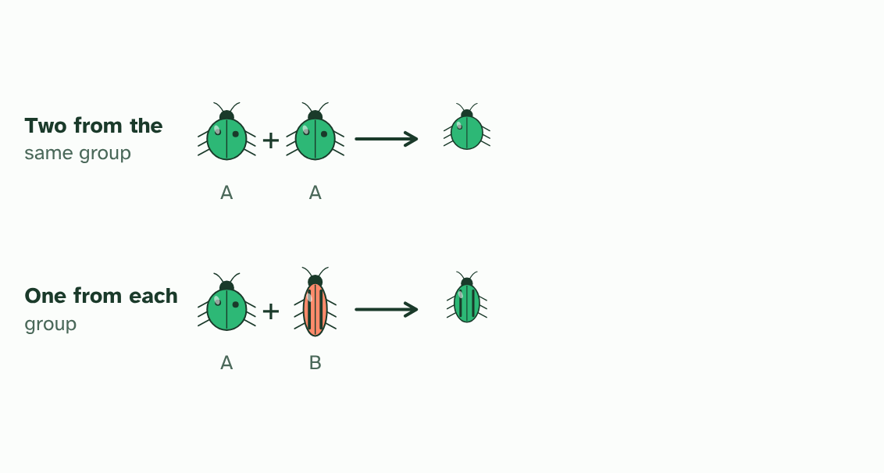
CHAPTER 3 · A3.1.4 A3.1.5 The biological species concept
2 / 4
Can they breed?
Both pairs have young. Mating alone does not decide it.
Minutes 32 to 52
Notes:
Minutes 32 to 52 of 60: Can they breed? (20 min).
The plan: Chapter 3’s figure on the board, then the species concept clinic below: groups rule on six case cards. Take chapter 3’s two predict boxes, the islands and the million years. Run the splitting film once and ask on which day one species became two: the answer is none, so where the line falls is a judgement.
Looks can mislead: males and females of one species may differ, and two species can look almost the same. Many biologists use a different test. The biological species concept says a species is a group of organisms that can breed and produce fertile offspring.
“Fertile” matters. A horse and a donkey can mate and have a healthy mule, but a mule cannot have young of its own, so horses and donkeys count as two species. The figure runs the test on imagined beetles.
No definition is the last word. Other species concepts group organisms by how alike their DNA is, or by the way of life they share. A species concept is a working definition, a tool that helps scientists group what they find, and it is replaced when a better tool comes along.
The breeding test has problems. Fossils cannot be tested. Populations that live far apart may never meet, so nobody knows whether they could breed. Some groups that are called separate species do have fertile young where they meet, as many oaks do. And a few species form a ring around a barrier, where each population breeds with its neighbour but the two ends of the chain do not.
One more problem comes from how species form. Speciation, the splitting of one species into two or more, usually happens gradually (you saw it in A4.1). Populations that stop interbreeding grow apart a little at a time. At first they could still breed if they met, and much later they could not. There is no single day when one species becomes two, so deciding whether two populations are one species or two can be arbitrary.

Slide 26
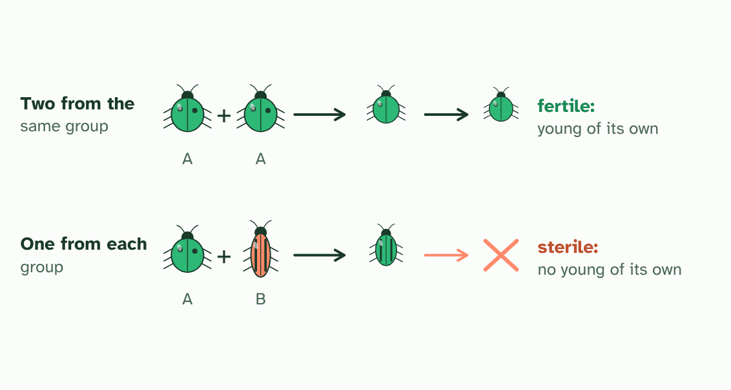
CHAPTER 3 · A3.1.4 A3.1.5 The biological species concept
3 / 4
Can they breed?
Only the first pair’s young are fertile. The mixed pair’s young cannot have young of their own.
Minutes 32 to 52
Notes:
Minutes 32 to 52 of 60: Can they breed? (20 min).
The plan: Chapter 3’s figure on the board, then the species concept clinic below: groups rule on six case cards. Take chapter 3’s two predict boxes, the islands and the million years. Run the splitting film once and ask on which day one species became two: the answer is none, so where the line falls is a judgement.
Looks can mislead: males and females of one species may differ, and two species can look almost the same. Many biologists use a different test. The biological species concept says a species is a group of organisms that can breed and produce fertile offspring.
“Fertile” matters. A horse and a donkey can mate and have a healthy mule, but a mule cannot have young of its own, so horses and donkeys count as two species. The figure runs the test on imagined beetles.
No definition is the last word. Other species concepts group organisms by how alike their DNA is, or by the way of life they share. A species concept is a working definition, a tool that helps scientists group what they find, and it is replaced when a better tool comes along.
The breeding test has problems. Fossils cannot be tested. Populations that live far apart may never meet, so nobody knows whether they could breed. Some groups that are called separate species do have fertile young where they meet, as many oaks do. And a few species form a ring around a barrier, where each population breeds with its neighbour but the two ends of the chain do not.
One more problem comes from how species form. Speciation, the splitting of one species into two or more, usually happens gradually (you saw it in A4.1). Populations that stop interbreeding grow apart a little at a time. At first they could still breed if they met, and much later they could not. There is no single day when one species becomes two, so deciding whether two populations are one species or two can be arbitrary.

Slide 27
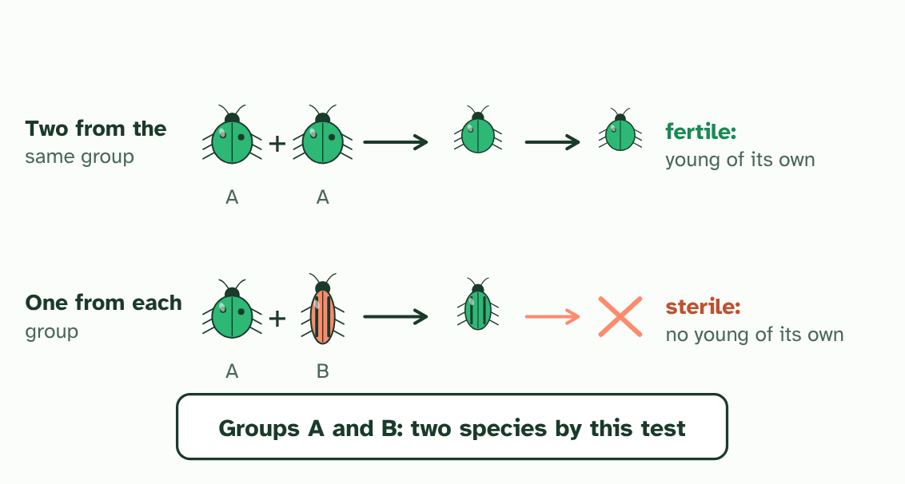
CHAPTER 3 · A3.1.4 A3.1.5 The biological species concept
4 / 4
Can they breed?
By the biological species concept, A and B are separate species.
Minutes 32 to 52
Notes:
Minutes 32 to 52 of 60: Can they breed? (20 min).
The plan: Chapter 3’s figure on the board, then the species concept clinic below: groups rule on six case cards. Take chapter 3’s two predict boxes, the islands and the million years. Run the splitting film once and ask on which day one species became two: the answer is none, so where the line falls is a judgement.
Looks can mislead: males and females of one species may differ, and two species can look almost the same. Many biologists use a different test. The biological species concept says a species is a group of organisms that can breed and produce fertile offspring.
“Fertile” matters. A horse and a donkey can mate and have a healthy mule, but a mule cannot have young of its own, so horses and donkeys count as two species. The figure runs the test on imagined beetles.
No definition is the last word. Other species concepts group organisms by how alike their DNA is, or by the way of life they share. A species concept is a working definition, a tool that helps scientists group what they find, and it is replaced when a better tool comes along.
The breeding test has problems. Fossils cannot be tested. Populations that live far apart may never meet, so nobody knows whether they could breed. Some groups that are called separate species do have fertile young where they meet, as many oaks do. And a few species form a ring around a barrier, where each population breeds with its neighbour but the two ends of the chain do not.
One more problem comes from how species form. Speciation, the splitting of one species into two or more, usually happens gradually (you saw it in A4.1). Populations that stop interbreeding grow apart a little at a time. At first they could still breed if they met, and much later they could not. There is no single day when one species becomes two, so deciding whether two populations are one species or two can be arbitrary.

Slide 28
CHAPTER 3 · A3.1.4 A3.1.5 The biological species concept
Can they breed?
Biological species concept: organisms that can breed and produce fertile offspring.
Competing definitions exist, and any concept is a working definition.
Speciation is gradual, so the line between populations and species can be arbitrary.
Minutes 32 to 52
Notes:
Minutes 32 to 52 of 60: Can they breed? (20 min).
The plan: Chapter 3’s figure on the board, then the species concept clinic below: groups rule on six case cards. Take chapter 3’s two predict boxes, the islands and the million years. Run the splitting film once and ask on which day one species became two: the answer is none, so where the line falls is a judgement.
Looks can mislead: males and females of one species may differ, and two species can look almost the same. Many biologists use a different test. The biological species concept says a species is a group of organisms that can breed and produce fertile offspring.
“Fertile” matters. A horse and a donkey can mate and have a healthy mule, but a mule cannot have young of its own, so horses and donkeys count as two species. The figure runs the test on imagined beetles.
No definition is the last word. Other species concepts group organisms by how alike their DNA is, or by the way of life they share. A species concept is a working definition, a tool that helps scientists group what they find, and it is replaced when a better tool comes along.
The breeding test has problems. Fossils cannot be tested. Populations that live far apart may never meet, so nobody knows whether they could breed. Some groups that are called separate species do have fertile young where they meet, as many oaks do. And a few species form a ring around a barrier, where each population breeds with its neighbour but the two ends of the chain do not.
One more problem comes from how species form. Speciation, the splitting of one species into two or more, usually happens gradually (you saw it in A4.1). Populations that stop interbreeding grow apart a little at a time. At first they could still breed if they met, and much later they could not. There is no single day when one species becomes two, so deciding whether two populations are one species or two can be arbitrary.

Slide 29
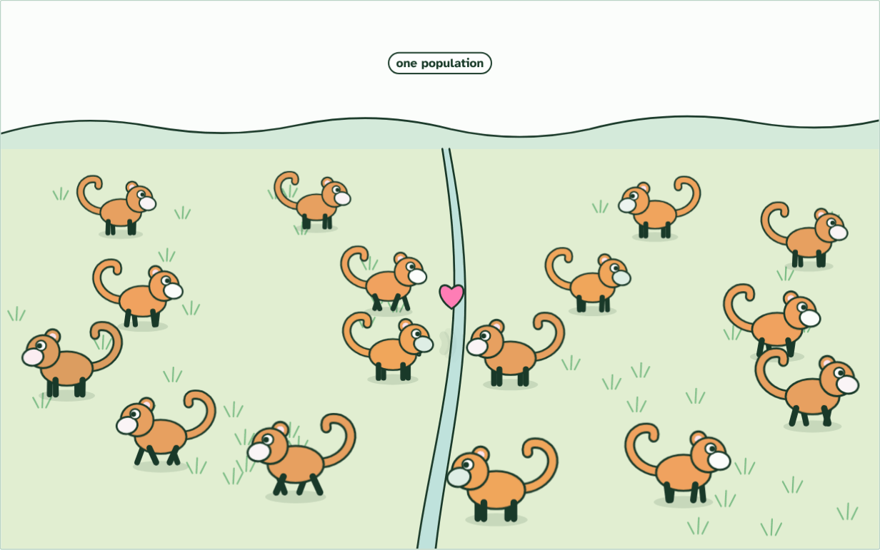
CHAPTER 3 · A3.1.4 A3.1.5 The biological species concept
1 population
1 / 3
Can they breed?
One population: any two can meet and mate, so genes flow across the valley.
Minutes 32 to 52
Notes:
Minutes 32 to 52 of 60: Can they breed? (20 min).
The plan: Chapter 3’s figure on the board, then the species concept clinic below: groups rule on six case cards. Take chapter 3’s two predict boxes, the islands and the million years. Run the splitting film once and ask on which day one species became two: the answer is none, so where the line falls is a judgement.
Looks can mislead: males and females of one species may differ, and two species can look almost the same. Many biologists use a different test. The biological species concept says a species is a group of organisms that can breed and produce fertile offspring.
“Fertile” matters. A horse and a donkey can mate and have a healthy mule, but a mule cannot have young of its own, so horses and donkeys count as two species. The figure runs the test on imagined beetles.
No definition is the last word. Other species concepts group organisms by how alike their DNA is, or by the way of life they share. A species concept is a working definition, a tool that helps scientists group what they find, and it is replaced when a better tool comes along.
The breeding test has problems. Fossils cannot be tested. Populations that live far apart may never meet, so nobody knows whether they could breed. Some groups that are called separate species do have fertile young where they meet, as many oaks do. And a few species form a ring around a barrier, where each population breeds with its neighbour but the two ends of the chain do not.
One more problem comes from how species form. Speciation, the splitting of one species into two or more, usually happens gradually (you saw it in A4.1). Populations that stop interbreeding grow apart a little at a time. At first they could still breed if they met, and much later they could not. There is no single day when one species becomes two, so deciding whether two populations are one species or two can be arbitrary.
The animation "Watch it happen: one population becomes two", paused at 2.0 s. The next slides go on through it, then play it.

Slide 30
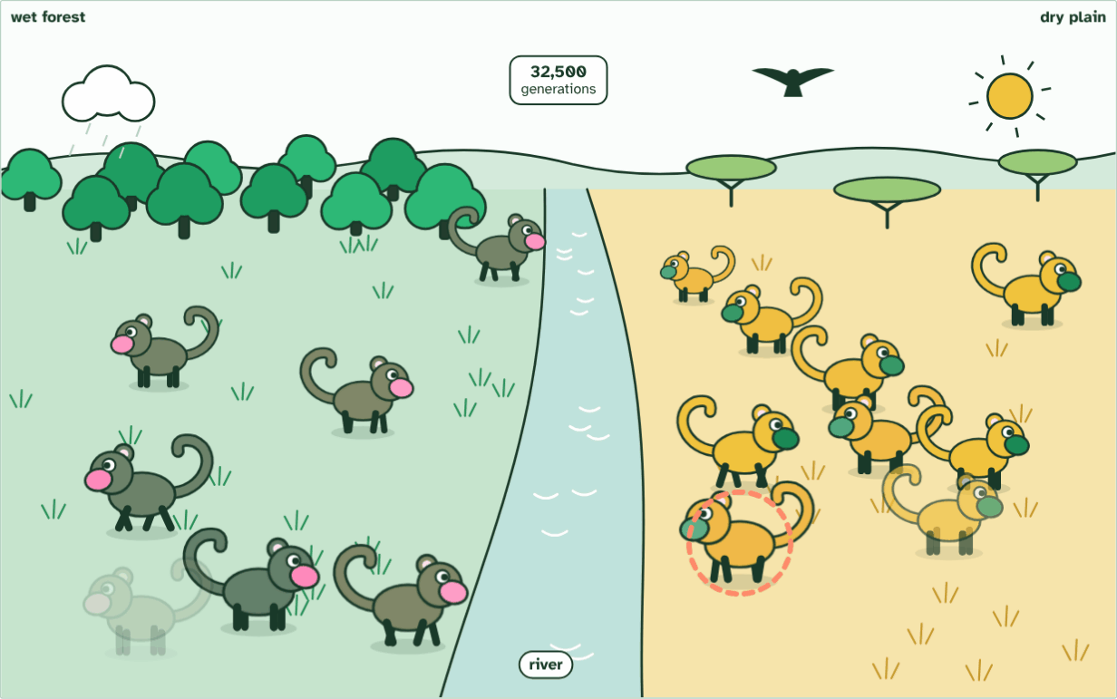
CHAPTER 3 · A3.1.4 A3.1.5 The biological species concept
generation 32,500
2 / 3
Can they breed?
Different selection each side: coats match the ground, displays drift apart.
Minutes 32 to 52
Notes:
Minutes 32 to 52 of 60: Can they breed? (20 min).
The plan: Chapter 3’s figure on the board, then the species concept clinic below: groups rule on six case cards. Take chapter 3’s two predict boxes, the islands and the million years. Run the splitting film once and ask on which day one species became two: the answer is none, so where the line falls is a judgement.
Looks can mislead: males and females of one species may differ, and two species can look almost the same. Many biologists use a different test. The biological species concept says a species is a group of organisms that can breed and produce fertile offspring.
“Fertile” matters. A horse and a donkey can mate and have a healthy mule, but a mule cannot have young of its own, so horses and donkeys count as two species. The figure runs the test on imagined beetles.
No definition is the last word. Other species concepts group organisms by how alike their DNA is, or by the way of life they share. A species concept is a working definition, a tool that helps scientists group what they find, and it is replaced when a better tool comes along.
The breeding test has problems. Fossils cannot be tested. Populations that live far apart may never meet, so nobody knows whether they could breed. Some groups that are called separate species do have fertile young where they meet, as many oaks do. And a few species form a ring around a barrier, where each population breeds with its neighbour but the two ends of the chain do not.
One more problem comes from how species form. Speciation, the splitting of one species into two or more, usually happens gradually (you saw it in A4.1). Populations that stop interbreeding grow apart a little at a time. At first they could still breed if they met, and much later they could not. There is no single day when one species becomes two, so deciding whether two populations are one species or two can be arbitrary.
The animation "Watch it happen: one population becomes two", paused at 11.8 s. The next slides go on through it, then play it.

Slide 31
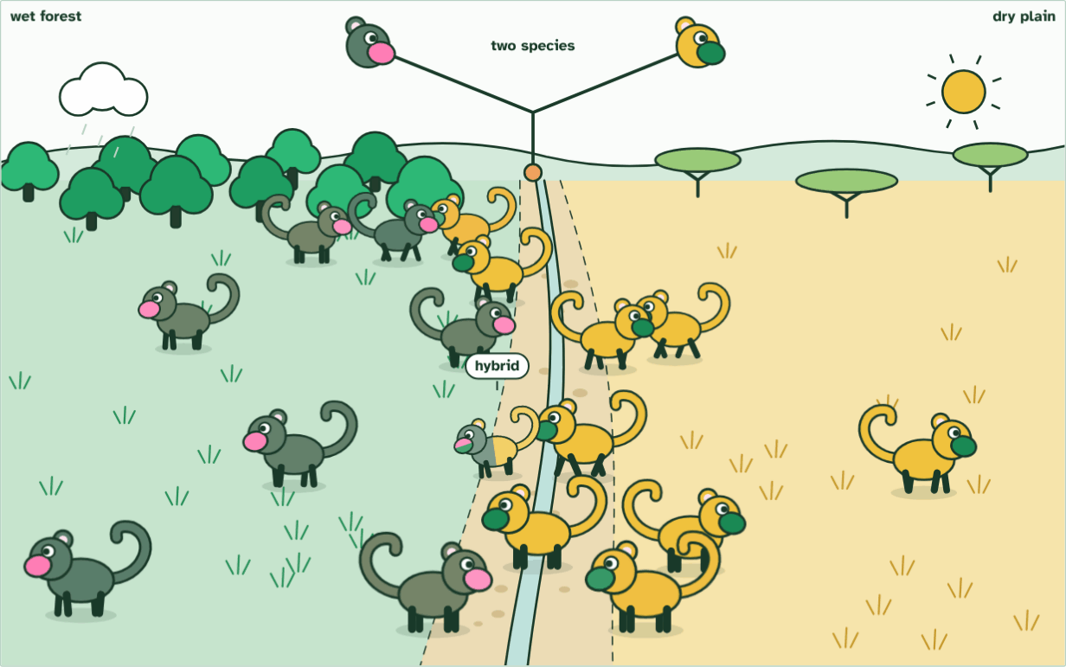
CHAPTER 3 · A3.1.4 A3.1.5 The biological species concept
2 species
3 / 3
Can they breed?
Hybrids are rare, weak and often sterile, so the two never merge: two species.
Minutes 32 to 52
Notes:
Minutes 32 to 52 of 60: Can they breed? (20 min).
The plan: Chapter 3’s figure on the board, then the species concept clinic below: groups rule on six case cards. Take chapter 3’s two predict boxes, the islands and the million years. Run the splitting film once and ask on which day one species became two: the answer is none, so where the line falls is a judgement.
Looks can mislead: males and females of one species may differ, and two species can look almost the same. Many biologists use a different test. The biological species concept says a species is a group of organisms that can breed and produce fertile offspring.
“Fertile” matters. A horse and a donkey can mate and have a healthy mule, but a mule cannot have young of its own, so horses and donkeys count as two species. The figure runs the test on imagined beetles.
No definition is the last word. Other species concepts group organisms by how alike their DNA is, or by the way of life they share. A species concept is a working definition, a tool that helps scientists group what they find, and it is replaced when a better tool comes along.
The breeding test has problems. Fossils cannot be tested. Populations that live far apart may never meet, so nobody knows whether they could breed. Some groups that are called separate species do have fertile young where they meet, as many oaks do. And a few species form a ring around a barrier, where each population breeds with its neighbour but the two ends of the chain do not.
One more problem comes from how species form. Speciation, the splitting of one species into two or more, usually happens gradually (you saw it in A4.1). Populations that stop interbreeding grow apart a little at a time. At first they could still breed if they met, and much later they could not. There is no single day when one species becomes two, so deciding whether two populations are one species or two can be arbitrary.
The animation "Watch it happen: one population becomes two", paused at 20.6 s. The next slides go on through it, then play it.

Slide 32
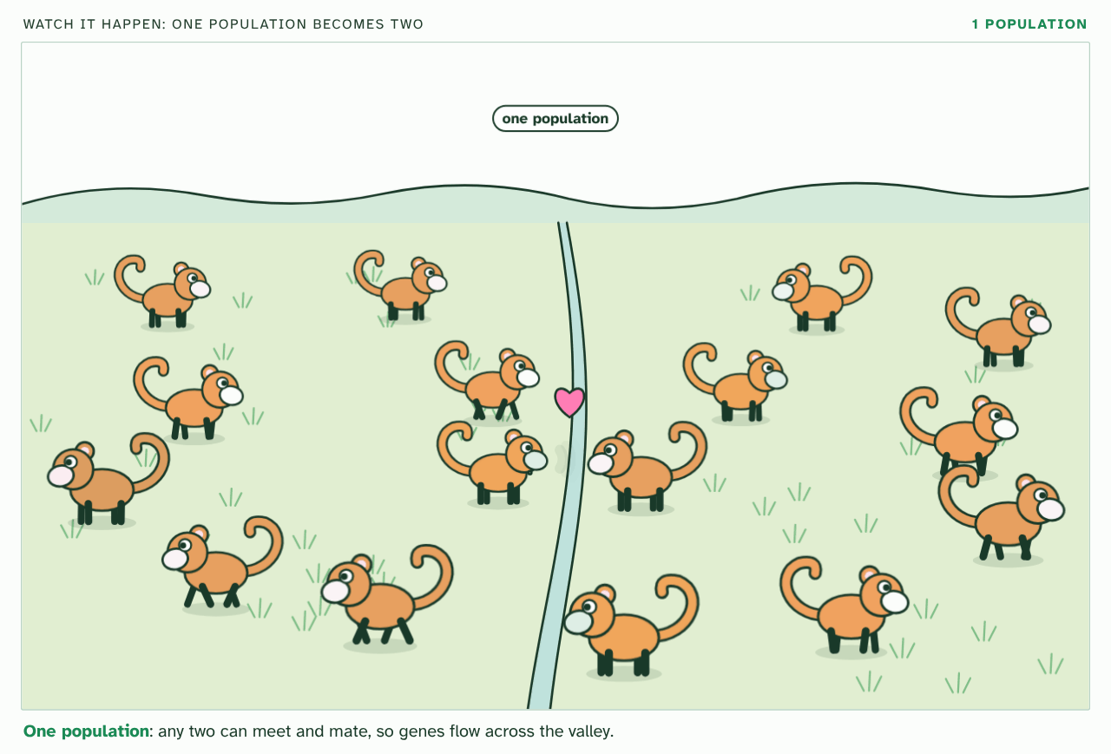
CHAPTER 3 · A3.1.4 A3.1.5 The biological species concept
PLAY IT
Can they breed?
Watch it happen: one population becomes two: click to play. It loops every 23 seconds.
Minutes 32 to 52
Notes:
Minutes 32 to 52 of 60: Can they breed? (20 min).
The plan: Chapter 3’s figure on the board, then the species concept clinic below: groups rule on six case cards. Take chapter 3’s two predict boxes, the islands and the million years. Run the splitting film once and ask on which day one species became two: the answer is none, so where the line falls is a judgement.
The video is split.mp4, one loop of the animation in the guide. It plays in PowerPoint and Keynote. Google Slides does not play a video embedded in a .pptx: download split.mp4 (https://www.biologybybradford.com/guides/downloads/scenes/split.mp4), upload it to Google Drive, then Insert > Video > Google Drive.
In the guide the class can change it as it runs: https://www.biologybybradford.com/guides/ib-biology-a3-1-diversity-of-organisms#species-concept
What it shows, in order:
1. One population: any two can meet and mate, so genes flow across the valley.
2. Different selection each side: coats match the ground, displays drift apart.
3. Hybrids are rare, weak and often sterile, so the two never merge: two species.

Slide 33
WATCH OUT
The test is whether they could produce fertile offspring, not whether they do. Two populations that never meet may be one species, and two that never meet may be two. Looking at their traits and DNA is often the best that can be done.
Minutes 32 to 52
Notes:
Minutes 32 to 52 of 60: Can they breed? (20 min).
The plan: Chapter 3’s figure on the board, then the species concept clinic below: groups rule on six case cards. Take chapter 3’s two predict boxes, the islands and the million years. Run the splitting film once and ask on which day one species became two: the answer is none, so where the line falls is a judgement.
A common mistake: say it, then ask who can say why it is wrong.

Slide 34
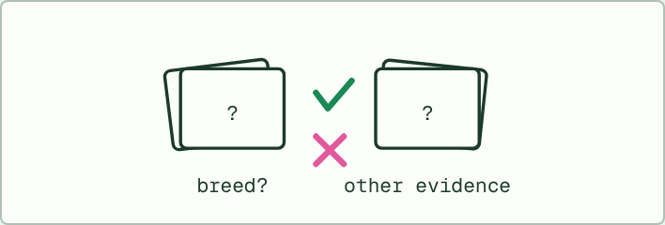
CARD SORT
20 MIN
The species concept clinic
THE TASK
Six case cards, one per group: a horse and a donkey; two populations on mountains far apart; a fossil species; two oak species that make fertile hybrids where they overlap; a chain of populations in which neighbours breed but the two ends do not; a very large and a very small dog breed that could not physically mate. For each card the group decides whether the biological test gives a clear answer, and if not, what evidence they would use instead.
STUDENTS NEED
Six case cards per group; A3 paper.
Minutes 32 to 52
Notes:
Minutes 32 to 52 of 60: Can they breed? (20 min).
The plan: Chapter 3’s figure on the board, then the species concept clinic below: groups rule on six case cards. Take chapter 3’s two predict boxes, the islands and the million years. Run the splitting film once and ask on which day one species became two: the answer is none, so where the line falls is a judgement.
The activity: The species concept clinic. Six case cards, one per group: a horse and a donkey; two populations on mountains far apart; a fossil species; two oak species that make fertile hybrids where they overlap; a chain of populations in which neighbours breed but the two ends do not; a very large and a very small dog breed that could not physically mate. For each card the group decides whether the biological test gives a clear answer, and if not, what evidence they would use instead.
Needs: six case cards per group; A3 paper.
The time: 20 minutes, minutes 32 to 52 of the plan.

Slide 35
PREDICT
Two kinds of snail live on islands 500 km apart, and none has ever crossed the sea. Can the biological species concept say whether they are one species?
A Yes: they have never bred, so they must be two separate species
B Yes: living on separate islands already makes them different species
C Not directly: they have never met, so other evidence is needed
Minutes 32 to 52
Notes:
Minutes 32 to 52 of 60: Can they breed? (20 min).
The plan: Chapter 3’s figure on the board, then the species concept clinic below: groups rule on six case cards. Take chapter 3’s two predict boxes, the islands and the million years. Run the splitting film once and ask on which day one species became two: the answer is none, so where the line falls is a judgement.
Ask for a show of hands, or mini whiteboards, before revealing. (Answer: C, on the next slide.)

Slide 36
WHAT HAPPENS
Two kinds of snail live on islands 500 km apart, and none has ever crossed the sea. Can the biological species concept say whether they are one species?
A Yes: they have never bred, so they must be two separate species
B Yes: living on separate islands already makes them different species
C Not directly: they have never met, so other evidence is needed
Not directly. The test asks whether they could breed and have fertile young, and that has never been tried. Scientists use other evidence: how alike the snails’ bodies and DNA are, and how long ago the islands were separated. Never having bred is not the same as being unable to.
Minutes 32 to 52
Notes:
Minutes 32 to 52 of 60: Can they breed? (20 min).
The plan: Chapter 3’s figure on the board, then the species concept clinic below: groups rule on six case cards. Take chapter 3’s two predict boxes, the islands and the million years. Run the splitting film once and ask on which day one species became two: the answer is none, so where the line falls is a judgement.
Answer: C. Not directly. The test asks whether they could breed and have fertile young, and that has never been tried. Scientists use other evidence: how alike the snails’ bodies and DNA are, and how long ago the islands were separated. Never having bred is not the same as being unable to.

Slide 37
PLENARY
Can you now...
Explain why variation between organisms is a defining feature of life, and how Linnaeus used shared traits to define a species (A3.1.1, A3.1.2)
Name an organism with a binomial name written to the rules, and say what two species of one genus share (A3.1.3)
State the biological species concept, give challenges to it, and explain why gradual speciation makes the line between populations and species arbitrary (A3.1.4, A3.1.5)
Minutes 52 to 60
Notes:
Minutes 52 to 60 of 60: Exit: two tests for a species (8 min).
The plan: Two sentences on a slip: say how the morphological and the biological species concepts each decide whether two organisms are one species, and give one problem with the biological one. Collect them on the way out.
Thumbs up, sideways or down on each goal before the exit question. The goals come from the statements this lesson covers.

Slide 38
EXIT QUESTION
Two tests for a species
Two sentences on a slip: say how the morphological and the biological species concepts each decide whether two organisms are one species, and give one problem with the biological one.
Minutes 52 to 60
Notes:
Minutes 52 to 60 of 60: Exit: two tests for a species (8 min).
The plan: Two sentences on a slip: say how the morphological and the biological species concepts each decide whether two organisms are one species, and give one problem with the biological one. Collect them on the way out.

Slide 39
PRACTISE AND REVISE
Keep going
Exam practice: a fresh paper of exam questions on A3.1 at standard level, marked as you go
The guide, with the animations and the dry lab
This lesson in the guide: 1 No two beetles are alike, and we sort them anyway, 2 A name with two parts, 3 Can they breed?
BUILD FOR YOUR CLASS
ALREADY ON THE SITE FOR A3.1
CARD SETS ON SPLYCR
Tarsia puzzle, dominoes and picture reveal on A3.1, built from its key terms and ready to print
A pub quiz with rounds on A3.1, to present or run with no projector
An escape room built from the question bank on A3.1
Quiz: Diversity of Organisms
Revision map: A3.1 Diversity of organisms, to fill in
Exam questions: A3.1 in the exam maker, a paper with its markscheme
Open a set to host it as a class game, or make a copy to edit.
A3.1 Diversity of Organisms
How this was made. The course structure, the activities and the teaching choices come from my own classroom, my presentations and my years of teaching IB and AP Biology. I use Claude, an AI, to help write and build the interactive guides, lesson plans, slides and practice questions, and to draw the diagrams and code the interactives. I direct the work and review it against the IB and AP specifications before it goes live.
Minute 60: after the lesson
Notes:
Every link here is live. Set the exam practice paper for homework: it is fresh each time, marked as students go and saved to their Exam practice when they are signed in.
Exam practice: https://www.biologybybradford.com/exam-maker/sit?topics=A3.1&level=SL&paper=quiz&marks=15&src=ep
The guide: https://www.biologybybradford.com/guides/ib-biology-a3-1-diversity-of-organisms

