Slide 1
IB Biology A3.1
LESSON 2 OF 5
BY THE END YOU CAN
Diversity of organisms
Say that species differ in chromosome number, using humans (46) and chimpanzees (48), and why diploid numbers are even (A3.1.6)
Classify chromosomes in a karyogram by banding, length and centromere position, and evaluate the evidence that human chromosome 2 arose from a fusion (A3.1.7)
Counting and pairing chromosomes
A3.1.6, A3.1.7
Chromosome numbers, karyograms, and testing the hypothesis that human chromosome 2 is a fusion
60 minutes · chapters 4, 5
Minute 0
Notes:
IB Biology A3.1, Diversity of organisms. Lesson 2 of 5: Counting and pairing chromosomes, 60 minutes.
The plan, minute by minute (each slide's footer says where you are):
0 to 6 min (6) Do now: guess the count
6 to 16 min (10) Counting chromosomes
16 to 36 min (20) Build a karyogram
36 to 52 min (16) Chromosome 2 on trial
52 to 60 min (8) Testable or not?
What students get wrong:
More chromosomes means a more complex organism. A dog has 78 and a human 46. Number says nothing about complexity.
A karyogram shows the genes. It shows chromosomes only: their number, size, banding and centromere. The genes are in the DNA along them.
Evidence for chromosome 2 means we came from chimpanzees. Humans and chimpanzees share an ancestor that was neither. The fusion happened in the line that led to us.
Stretch and support:
Support: give the captions of each figure as a cut-up storyboard to put in order, and use the key terms (tap the dotted words) as a glossary.
Support: give the first three pairs of paper chromosomes already matched, and ask students to explain why before they match the rest.
Stretch: predict what a karyogram of an orangutan would look like beside a human’s, and which chromosomes you would compare first.
The lesson plan to print: https://www.biologybybradford.com/guides/downloads/ib-biology-a3-1-diversity-of-organisms-lesson-2-plan.pdf

Slide 2
DO NOW
Guess the count
On mini whiteboards, students guess the number of chromosomes in a body cell of a fruit fly, a human, a chimpanzee and a dog.
6:00
minutes
Start now: the timer is running.
Minutes 0 to 6
Notes:
Minutes 0 to 6 of 60: Do now: guess the count (6 min).
The plan: On mini whiteboards, students guess the number of chromosomes in a body cell of a fruit fly, a human, a chimpanzee and a dog. Reveal the four (8, 46, 48, 78) and ask what every number has in common. Hold the answer for chapter 4’s predict box.
Start a 6 minute timer as they come in.

Slide 3
PREDICT
Why does a diploid cell always have an even number of chromosomes?
A One of each pair comes from each parent, so the total is even
B A cell copies each chromosome once, so the total is always doubled up
C Natural selection has removed every species with an odd number of them
Minutes 0 to 6
Notes:
Minutes 0 to 6 of 60: Do now: guess the count (6 min).
The plan: On mini whiteboards, students guess the number of chromosomes in a body cell of a fruit fly, a human, a chimpanzee and a dog. Reveal the four (8, 46, 48, 78) and ask what every number has in common. Hold the answer for chapter 4’s predict box.
Ask for a show of hands, or mini whiteboards, before revealing. (Answer: A, on the next slide.)

Slide 4
WHAT HAPPENS
Why does a diploid cell always have an even number of chromosomes?
A One of each pair comes from each parent, so the total is even
B A cell copies each chromosome once, so the total is always doubled up
C Natural selection has removed every species with an odd number of them
Each parent supplies one chromosome of every kind, so the chromosomes match up in pairs. Two sets always make an even number: 23 + 23 = 46 in a human, 24 + 24 = 48 in a chimpanzee.
Minutes 0 to 6
Notes:
Minutes 0 to 6 of 60: Do now: guess the count (6 min).
The plan: On mini whiteboards, students guess the number of chromosomes in a body cell of a fruit fly, a human, a chimpanzee and a dog. Reveal the four (8, 46, 48, 78) and ask what every number has in common. Hold the answer for chapter 4’s predict box.
Answer: A. Each parent supplies one chromosome of every kind, so the chromosomes match up in pairs. Two sets always make an even number: 23 + 23 = 46 in a human, 24 + 24 = 48 in a chimpanzee.

Slide 5
STEP 2
10 MIN
Counting chromosomes
Chapter 4: Every species has its own count
Minutes 6 to 16
Notes:
Minutes 6 to 16 of 60: Counting chromosomes (10 min).
The plan: Chapter 4’s figure, then its predict box. Stress that 46 and 48 are the only numbers to learn, and that a bigger number does not mean a more complex animal. Define diploid, haploid and homologous chromosomes with the figure’s pairs.

Slide 6
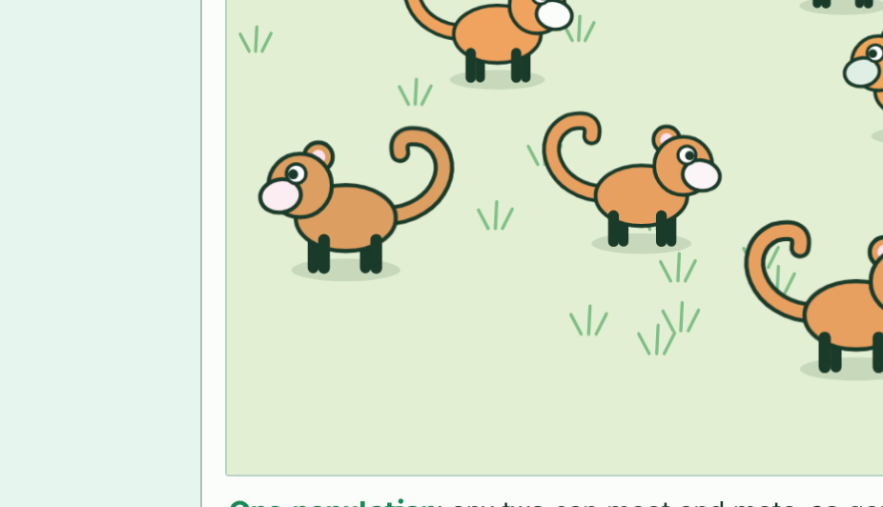
CHAPTER 4 · A3.1.6 Chromosome numbers
1 / 4
Every species has its own count
A fruit fly has 8 chromosomes in its body cells: 4 pairs. A garden pea has 14: 7 pairs. Different species, different numbers.
Minutes 6 to 16
Notes:
Minutes 6 to 16 of 60: Counting chromosomes (10 min).
The plan: Chapter 4’s figure, then its predict box. Stress that 46 and 48 are the only numbers to learn, and that a bigger number does not mean a more complex animal. Define diploid, haploid and homologous chromosomes with the figure’s pairs.
A chromosome is a molecule of DNA wrapped up with proteins. The body cells of each species of plant or animal carry a characteristic number of them, and the numbers vary widely. A human body cell has 46 chromosomes. A chimpanzee’s has 48. Those are the only two numbers the syllabus asks you to know.
The figure adds a few more, only to show the range: a fruit fly has 8, a garden pea 14 and a dog 78. A bigger number does not mean a bigger or more advanced organism.
Look at every number: each is even. A body cell is diploid, with two copies of each chromosome, one inherited from each parent. The two that match are homologous chromosomes, so chromosomes come in pairs: 23 pairs in a human, 24 in a chimpanzee. The sex cells are haploid, with one from each pair: 23 in a human egg or sperm.

Slide 7
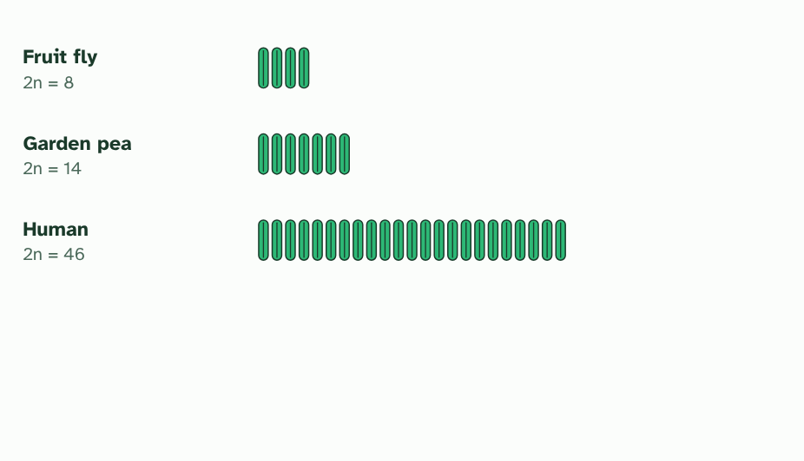
CHAPTER 4 · A3.1.6 Chromosome numbers
2 / 4
Every species has its own count
A human has 46: 23 pairs.
Minutes 6 to 16
Notes:
Minutes 6 to 16 of 60: Counting chromosomes (10 min).
The plan: Chapter 4’s figure, then its predict box. Stress that 46 and 48 are the only numbers to learn, and that a bigger number does not mean a more complex animal. Define diploid, haploid and homologous chromosomes with the figure’s pairs.
A chromosome is a molecule of DNA wrapped up with proteins. The body cells of each species of plant or animal carry a characteristic number of them, and the numbers vary widely. A human body cell has 46 chromosomes. A chimpanzee’s has 48. Those are the only two numbers the syllabus asks you to know.
The figure adds a few more, only to show the range: a fruit fly has 8, a garden pea 14 and a dog 78. A bigger number does not mean a bigger or more advanced organism.
Look at every number: each is even. A body cell is diploid, with two copies of each chromosome, one inherited from each parent. The two that match are homologous chromosomes, so chromosomes come in pairs: 23 pairs in a human, 24 in a chimpanzee. The sex cells are haploid, with one from each pair: 23 in a human egg or sperm.

Slide 8
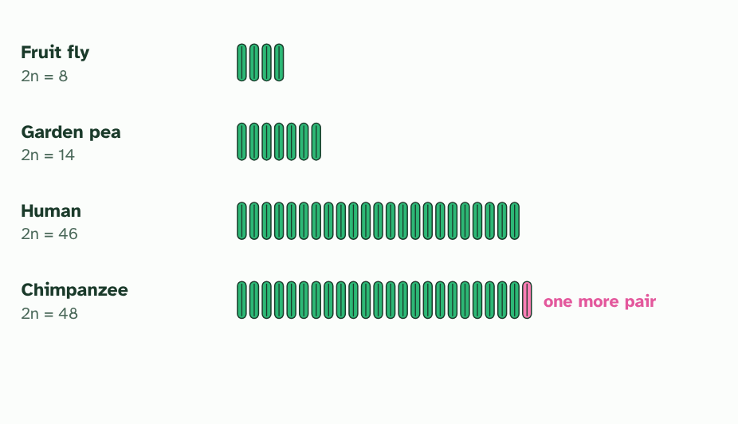
CHAPTER 4 · A3.1.6 Chromosome numbers
3 / 4
Every species has its own count
A chimpanzee has 48: 24 pairs, one more pair than a human.
Minutes 6 to 16
Notes:
Minutes 6 to 16 of 60: Counting chromosomes (10 min).
The plan: Chapter 4’s figure, then its predict box. Stress that 46 and 48 are the only numbers to learn, and that a bigger number does not mean a more complex animal. Define diploid, haploid and homologous chromosomes with the figure’s pairs.
A chromosome is a molecule of DNA wrapped up with proteins. The body cells of each species of plant or animal carry a characteristic number of them, and the numbers vary widely. A human body cell has 46 chromosomes. A chimpanzee’s has 48. Those are the only two numbers the syllabus asks you to know.
The figure adds a few more, only to show the range: a fruit fly has 8, a garden pea 14 and a dog 78. A bigger number does not mean a bigger or more advanced organism.
Look at every number: each is even. A body cell is diploid, with two copies of each chromosome, one inherited from each parent. The two that match are homologous chromosomes, so chromosomes come in pairs: 23 pairs in a human, 24 in a chimpanzee. The sex cells are haploid, with one from each pair: 23 in a human egg or sperm.

Slide 9
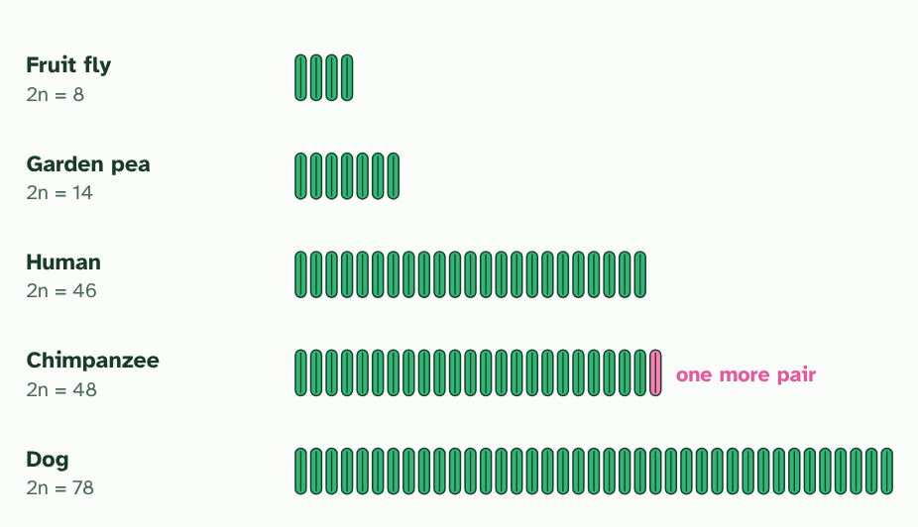
CHAPTER 4 · A3.1.6 Chromosome numbers
4 / 4
Every species has its own count
A dog has 78. More chromosomes does not mean a bigger or more complex animal. Every number is even, because chromosomes come in pairs.
Minutes 6 to 16
Notes:
Minutes 6 to 16 of 60: Counting chromosomes (10 min).
The plan: Chapter 4’s figure, then its predict box. Stress that 46 and 48 are the only numbers to learn, and that a bigger number does not mean a more complex animal. Define diploid, haploid and homologous chromosomes with the figure’s pairs.
A chromosome is a molecule of DNA wrapped up with proteins. The body cells of each species of plant or animal carry a characteristic number of them, and the numbers vary widely. A human body cell has 46 chromosomes. A chimpanzee’s has 48. Those are the only two numbers the syllabus asks you to know.
The figure adds a few more, only to show the range: a fruit fly has 8, a garden pea 14 and a dog 78. A bigger number does not mean a bigger or more advanced organism.
Look at every number: each is even. A body cell is diploid, with two copies of each chromosome, one inherited from each parent. The two that match are homologous chromosomes, so chromosomes come in pairs: 23 pairs in a human, 24 in a chimpanzee. The sex cells are haploid, with one from each pair: 23 in a human egg or sperm.

Slide 10
CHAPTER 4 · A3.1.6 Chromosome numbers
Every species has its own count
Each species has a characteristic number of chromosomes: 46 in humans, 48 in chimpanzees.
Diploid cells have an even number, because chromosomes come in homologous pairs.
Minutes 6 to 16
Notes:
Minutes 6 to 16 of 60: Counting chromosomes (10 min).
The plan: Chapter 4’s figure, then its predict box. Stress that 46 and 48 are the only numbers to learn, and that a bigger number does not mean a more complex animal. Define diploid, haploid and homologous chromosomes with the figure’s pairs.
A chromosome is a molecule of DNA wrapped up with proteins. The body cells of each species of plant or animal carry a characteristic number of them, and the numbers vary widely. A human body cell has 46 chromosomes. A chimpanzee’s has 48. Those are the only two numbers the syllabus asks you to know.
The figure adds a few more, only to show the range: a fruit fly has 8, a garden pea 14 and a dog 78. A bigger number does not mean a bigger or more advanced organism.
Look at every number: each is even. A body cell is diploid, with two copies of each chromosome, one inherited from each parent. The two that match are homologous chromosomes, so chromosomes come in pairs: 23 pairs in a human, 24 in a chimpanzee. The sex cells are haploid, with one from each pair: 23 in a human egg or sperm.

Slide 11
WATCH OUT
Chromosome number is not the number of genes, and it is not the amount of DNA. A chromosome can be long or short and can carry many genes or few. A dog has more chromosomes than a human, which tells you nothing about which is the more complex.
Minutes 6 to 16
Notes:
Minutes 6 to 16 of 60: Counting chromosomes (10 min).
The plan: Chapter 4’s figure, then its predict box. Stress that 46 and 48 are the only numbers to learn, and that a bigger number does not mean a more complex animal. Define diploid, haploid and homologous chromosomes with the figure’s pairs.
A common mistake: say it, then ask who can say why it is wrong.

Slide 12
STEP 3
20 MIN
Build a karyogram
Chapter 5: Laying out the chromosomes
Card sort: Pair the paper chromosomes
Minutes 16 to 36
Notes:
Minutes 16 to 36 of 60: Build a karyogram (20 min).
The plan: Four minutes on chapter 5’s first figure, stopping on each caption. Then pairs pair up the paper chromosomes below by length, banding and centromere position, and line them up longest first. Check against chapter 5’s pairing tool, which tells them what matched.

Slide 13
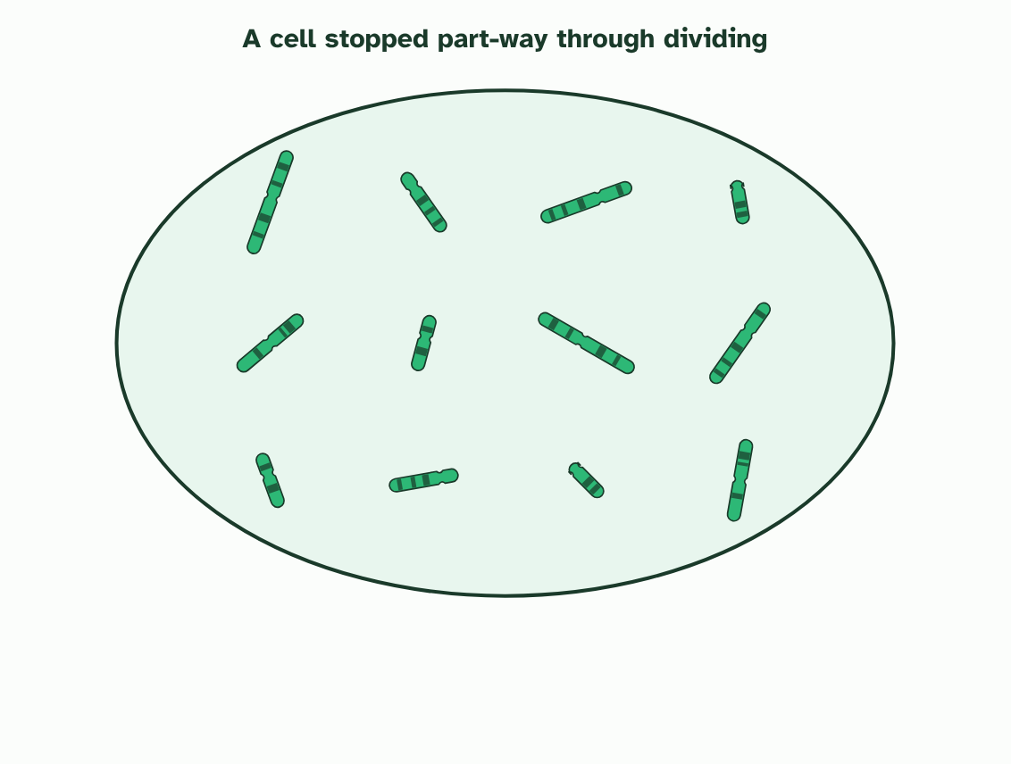
CHAPTER 5 · A3.1.7 Karyotyping and karyograms
1 / 4
Laying out the chromosomes
A cell is stopped part-way through dividing, when its chromosomes are short and thick.
Minutes 16 to 36
Notes:
Minutes 16 to 36 of 60: Build a karyogram (20 min).
The plan: Four minutes on chapter 5’s first figure, stopping on each caption. Then pairs pair up the paper chromosomes below by length, banding and centromere position, and line them up longest first. Check against chapter 5’s pairing tool, which tells them what matched.
How do biologists compare chromosomes? They make a karyotype: the full set of one cell’s chromosomes. Photographed and arranged in pairs, the picture is a karyogram. The cell is stopped part-way through dividing, when the chromosomes are short and thick, and stained so dark bands show.
To arrange them, match each chromosome with its partner using three clues: its length, its banding pattern and the position of its centromere, the pinched point where its two arms meet. Pairs are lined up from the longest. A human karyogram has 22 numbered pairs, roughly from longest to shortest, plus two sex chromosomes: XX in a female, XY in a male. It shows the number, the sex, and any extra or missing chromosome: three copies of chromosome 21 cause Down syndrome.
Now a puzzle. Humans have 46 chromosomes, but chimpanzees, gorillas and orangutans have 48. If we share an ancestor with them, where did a pair go? The hypothesis: human chromosome 2 was made when two ape chromosomes fused end to end in an ancestor we share with chimpanzees.
Look at them in the second tool below. The two ape chromosomes, placed end to end, match human chromosome 2 in length and in banding. Human chromosome 2 has DNA typical of a chromosome end (a telomere) in the middle, where a join would be. And it carries the remains of a second centromere, switched off. Every other human chromosome matches one ape chromosome.
Testing a prediction. A good hypothesis predicts something that could turn out false. If two chromosomes fused, chromosome ends should be found in the middle of the new one, and that can be checked. A claim such as “it fused so that humans could think” predicts nothing anyone can check. It is not testable, however interesting. Try sorting a few statements.
Testable or not? Decide whether evidence could ever show each statement wrong.

Slide 14
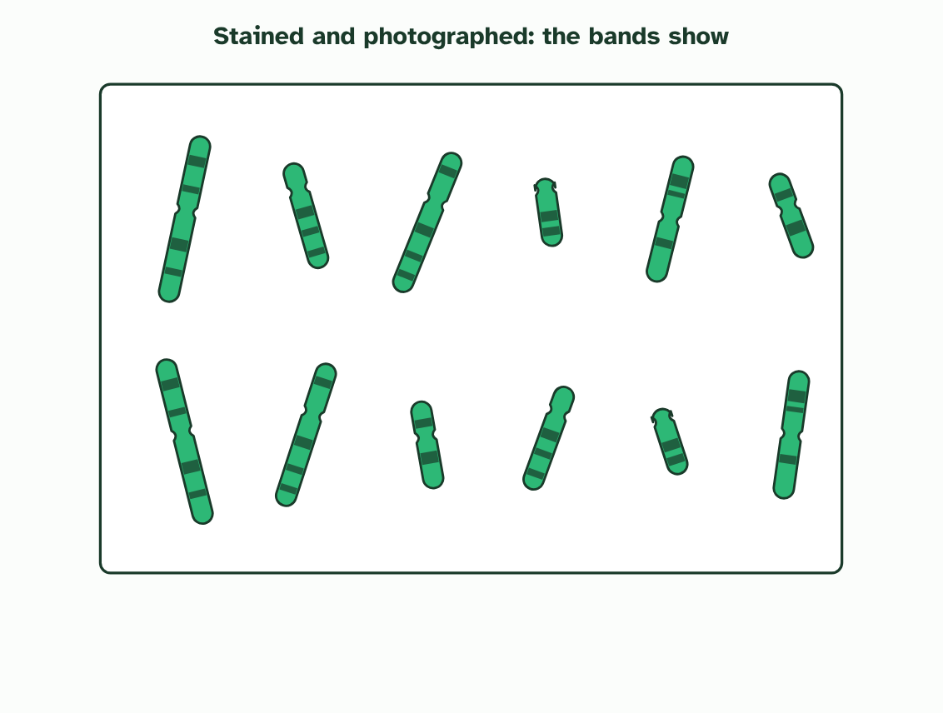
CHAPTER 5 · A3.1.7 Karyotyping and karyograms
2 / 4
Laying out the chromosomes
The chromosomes are stained, so dark bands show, and photographed.
Minutes 16 to 36
Notes:
Minutes 16 to 36 of 60: Build a karyogram (20 min).
The plan: Four minutes on chapter 5’s first figure, stopping on each caption. Then pairs pair up the paper chromosomes below by length, banding and centromere position, and line them up longest first. Check against chapter 5’s pairing tool, which tells them what matched.
How do biologists compare chromosomes? They make a karyotype: the full set of one cell’s chromosomes. Photographed and arranged in pairs, the picture is a karyogram. The cell is stopped part-way through dividing, when the chromosomes are short and thick, and stained so dark bands show.
To arrange them, match each chromosome with its partner using three clues: its length, its banding pattern and the position of its centromere, the pinched point where its two arms meet. Pairs are lined up from the longest. A human karyogram has 22 numbered pairs, roughly from longest to shortest, plus two sex chromosomes: XX in a female, XY in a male. It shows the number, the sex, and any extra or missing chromosome: three copies of chromosome 21 cause Down syndrome.
Now a puzzle. Humans have 46 chromosomes, but chimpanzees, gorillas and orangutans have 48. If we share an ancestor with them, where did a pair go? The hypothesis: human chromosome 2 was made when two ape chromosomes fused end to end in an ancestor we share with chimpanzees.
Look at them in the second tool below. The two ape chromosomes, placed end to end, match human chromosome 2 in length and in banding. Human chromosome 2 has DNA typical of a chromosome end (a telomere) in the middle, where a join would be. And it carries the remains of a second centromere, switched off. Every other human chromosome matches one ape chromosome.
Testing a prediction. A good hypothesis predicts something that could turn out false. If two chromosomes fused, chromosome ends should be found in the middle of the new one, and that can be checked. A claim such as “it fused so that humans could think” predicts nothing anyone can check. It is not testable, however interesting. Try sorting a few statements.
Testable or not? Decide whether evidence could ever show each statement wrong.

Slide 15
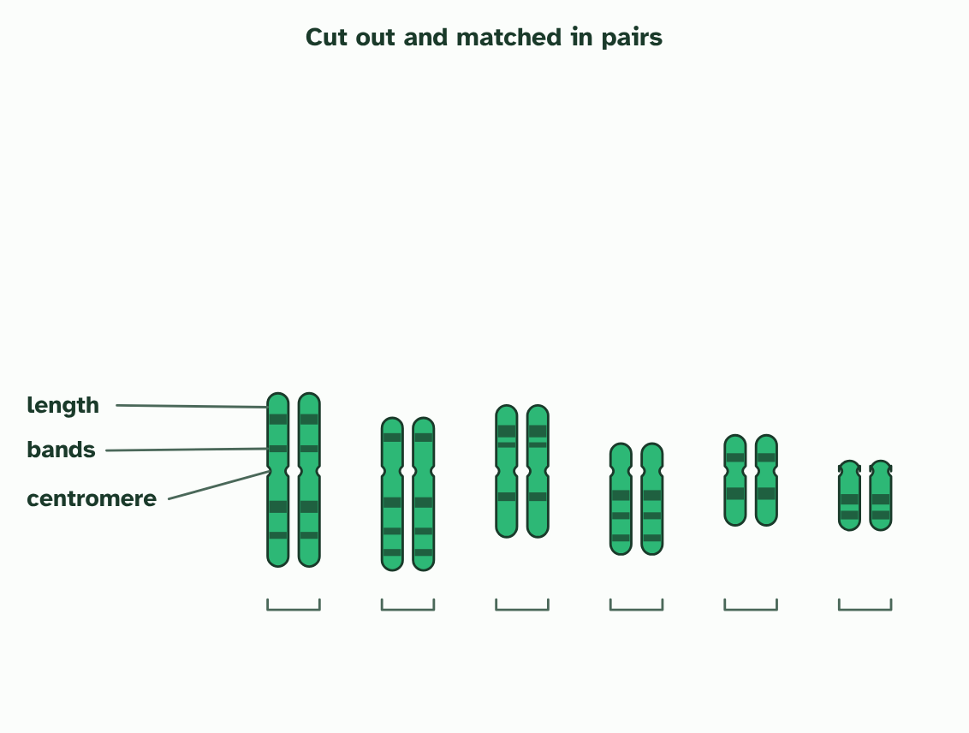
CHAPTER 5 · A3.1.7 Karyotyping and karyograms
3 / 4
Laying out the chromosomes
Each is cut out and matched with its partner by length, banding pattern and centromere position.
Minutes 16 to 36
Notes:
Minutes 16 to 36 of 60: Build a karyogram (20 min).
The plan: Four minutes on chapter 5’s first figure, stopping on each caption. Then pairs pair up the paper chromosomes below by length, banding and centromere position, and line them up longest first. Check against chapter 5’s pairing tool, which tells them what matched.
How do biologists compare chromosomes? They make a karyotype: the full set of one cell’s chromosomes. Photographed and arranged in pairs, the picture is a karyogram. The cell is stopped part-way through dividing, when the chromosomes are short and thick, and stained so dark bands show.
To arrange them, match each chromosome with its partner using three clues: its length, its banding pattern and the position of its centromere, the pinched point where its two arms meet. Pairs are lined up from the longest. A human karyogram has 22 numbered pairs, roughly from longest to shortest, plus two sex chromosomes: XX in a female, XY in a male. It shows the number, the sex, and any extra or missing chromosome: three copies of chromosome 21 cause Down syndrome.
Now a puzzle. Humans have 46 chromosomes, but chimpanzees, gorillas and orangutans have 48. If we share an ancestor with them, where did a pair go? The hypothesis: human chromosome 2 was made when two ape chromosomes fused end to end in an ancestor we share with chimpanzees.
Look at them in the second tool below. The two ape chromosomes, placed end to end, match human chromosome 2 in length and in banding. Human chromosome 2 has DNA typical of a chromosome end (a telomere) in the middle, where a join would be. And it carries the remains of a second centromere, switched off. Every other human chromosome matches one ape chromosome.
Testing a prediction. A good hypothesis predicts something that could turn out false. If two chromosomes fused, chromosome ends should be found in the middle of the new one, and that can be checked. A claim such as “it fused so that humans could think” predicts nothing anyone can check. It is not testable, however interesting. Try sorting a few statements.
Testable or not? Decide whether evidence could ever show each statement wrong.

Slide 16
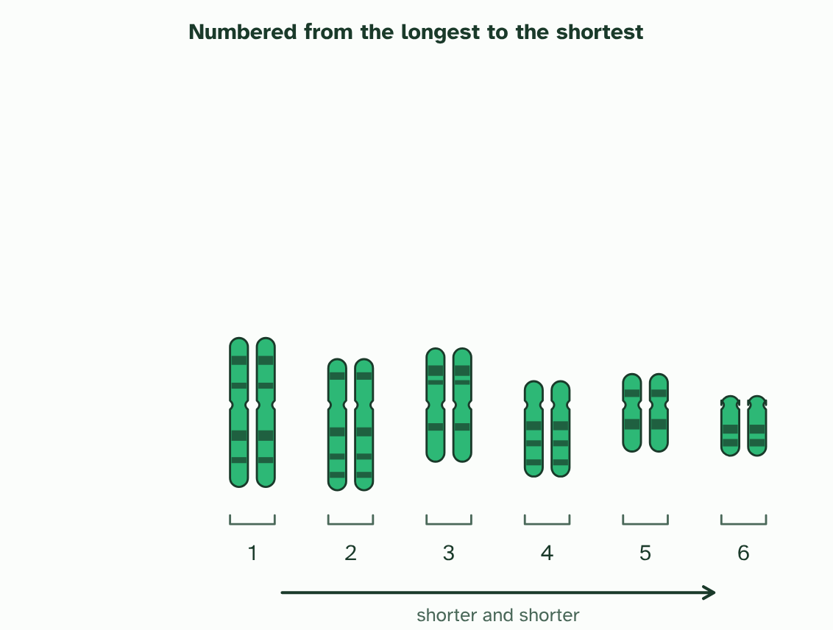
CHAPTER 5 · A3.1.7 Karyotyping and karyograms
4 / 4
Laying out the chromosomes
The pairs are lined up with the centromeres in a row and numbered from the longest: a karyogram. (Simplified: six pairs.)
Minutes 16 to 36
Notes:
Minutes 16 to 36 of 60: Build a karyogram (20 min).
The plan: Four minutes on chapter 5’s first figure, stopping on each caption. Then pairs pair up the paper chromosomes below by length, banding and centromere position, and line them up longest first. Check against chapter 5’s pairing tool, which tells them what matched.
How do biologists compare chromosomes? They make a karyotype: the full set of one cell’s chromosomes. Photographed and arranged in pairs, the picture is a karyogram. The cell is stopped part-way through dividing, when the chromosomes are short and thick, and stained so dark bands show.
To arrange them, match each chromosome with its partner using three clues: its length, its banding pattern and the position of its centromere, the pinched point where its two arms meet. Pairs are lined up from the longest. A human karyogram has 22 numbered pairs, roughly from longest to shortest, plus two sex chromosomes: XX in a female, XY in a male. It shows the number, the sex, and any extra or missing chromosome: three copies of chromosome 21 cause Down syndrome.
Now a puzzle. Humans have 46 chromosomes, but chimpanzees, gorillas and orangutans have 48. If we share an ancestor with them, where did a pair go? The hypothesis: human chromosome 2 was made when two ape chromosomes fused end to end in an ancestor we share with chimpanzees.
Look at them in the second tool below. The two ape chromosomes, placed end to end, match human chromosome 2 in length and in banding. Human chromosome 2 has DNA typical of a chromosome end (a telomere) in the middle, where a join would be. And it carries the remains of a second centromere, switched off. Every other human chromosome matches one ape chromosome.
Testing a prediction. A good hypothesis predicts something that could turn out false. If two chromosomes fused, chromosome ends should be found in the middle of the new one, and that can be checked. A claim such as “it fused so that humans could think” predicts nothing anyone can check. It is not testable, however interesting. Try sorting a few statements.
Testable or not? Decide whether evidence could ever show each statement wrong.

Slide 17
CHAPTER 5 · A3.1.7 Karyotyping and karyograms
Laying out the chromosomes
A karyogram arranges chromosomes in pairs by length, banding pattern and centromere position.
Human chromosome 2 matches two ape chromosomes end to end, has telomere DNA in its middle and a remnant second centromere.
A testable hypothesis makes a prediction that evidence could contradict.
Minutes 16 to 36
Notes:
Minutes 16 to 36 of 60: Build a karyogram (20 min).
The plan: Four minutes on chapter 5’s first figure, stopping on each caption. Then pairs pair up the paper chromosomes below by length, banding and centromere position, and line them up longest first. Check against chapter 5’s pairing tool, which tells them what matched.
How do biologists compare chromosomes? They make a karyotype: the full set of one cell’s chromosomes. Photographed and arranged in pairs, the picture is a karyogram. The cell is stopped part-way through dividing, when the chromosomes are short and thick, and stained so dark bands show.
To arrange them, match each chromosome with its partner using three clues: its length, its banding pattern and the position of its centromere, the pinched point where its two arms meet. Pairs are lined up from the longest. A human karyogram has 22 numbered pairs, roughly from longest to shortest, plus two sex chromosomes: XX in a female, XY in a male. It shows the number, the sex, and any extra or missing chromosome: three copies of chromosome 21 cause Down syndrome.
Now a puzzle. Humans have 46 chromosomes, but chimpanzees, gorillas and orangutans have 48. If we share an ancestor with them, where did a pair go? The hypothesis: human chromosome 2 was made when two ape chromosomes fused end to end in an ancestor we share with chimpanzees.
Look at them in the second tool below. The two ape chromosomes, placed end to end, match human chromosome 2 in length and in banding. Human chromosome 2 has DNA typical of a chromosome end (a telomere) in the middle, where a join would be. And it carries the remains of a second centromere, switched off. Every other human chromosome matches one ape chromosome.
Testing a prediction. A good hypothesis predicts something that could turn out false. If two chromosomes fused, chromosome ends should be found in the middle of the new one, and that can be checked. A claim such as “it fused so that humans could think” predicts nothing anyone can check. It is not testable, however interesting. Try sorting a few statements.
Testable or not? Decide whether evidence could ever show each statement wrong.

Slide 18
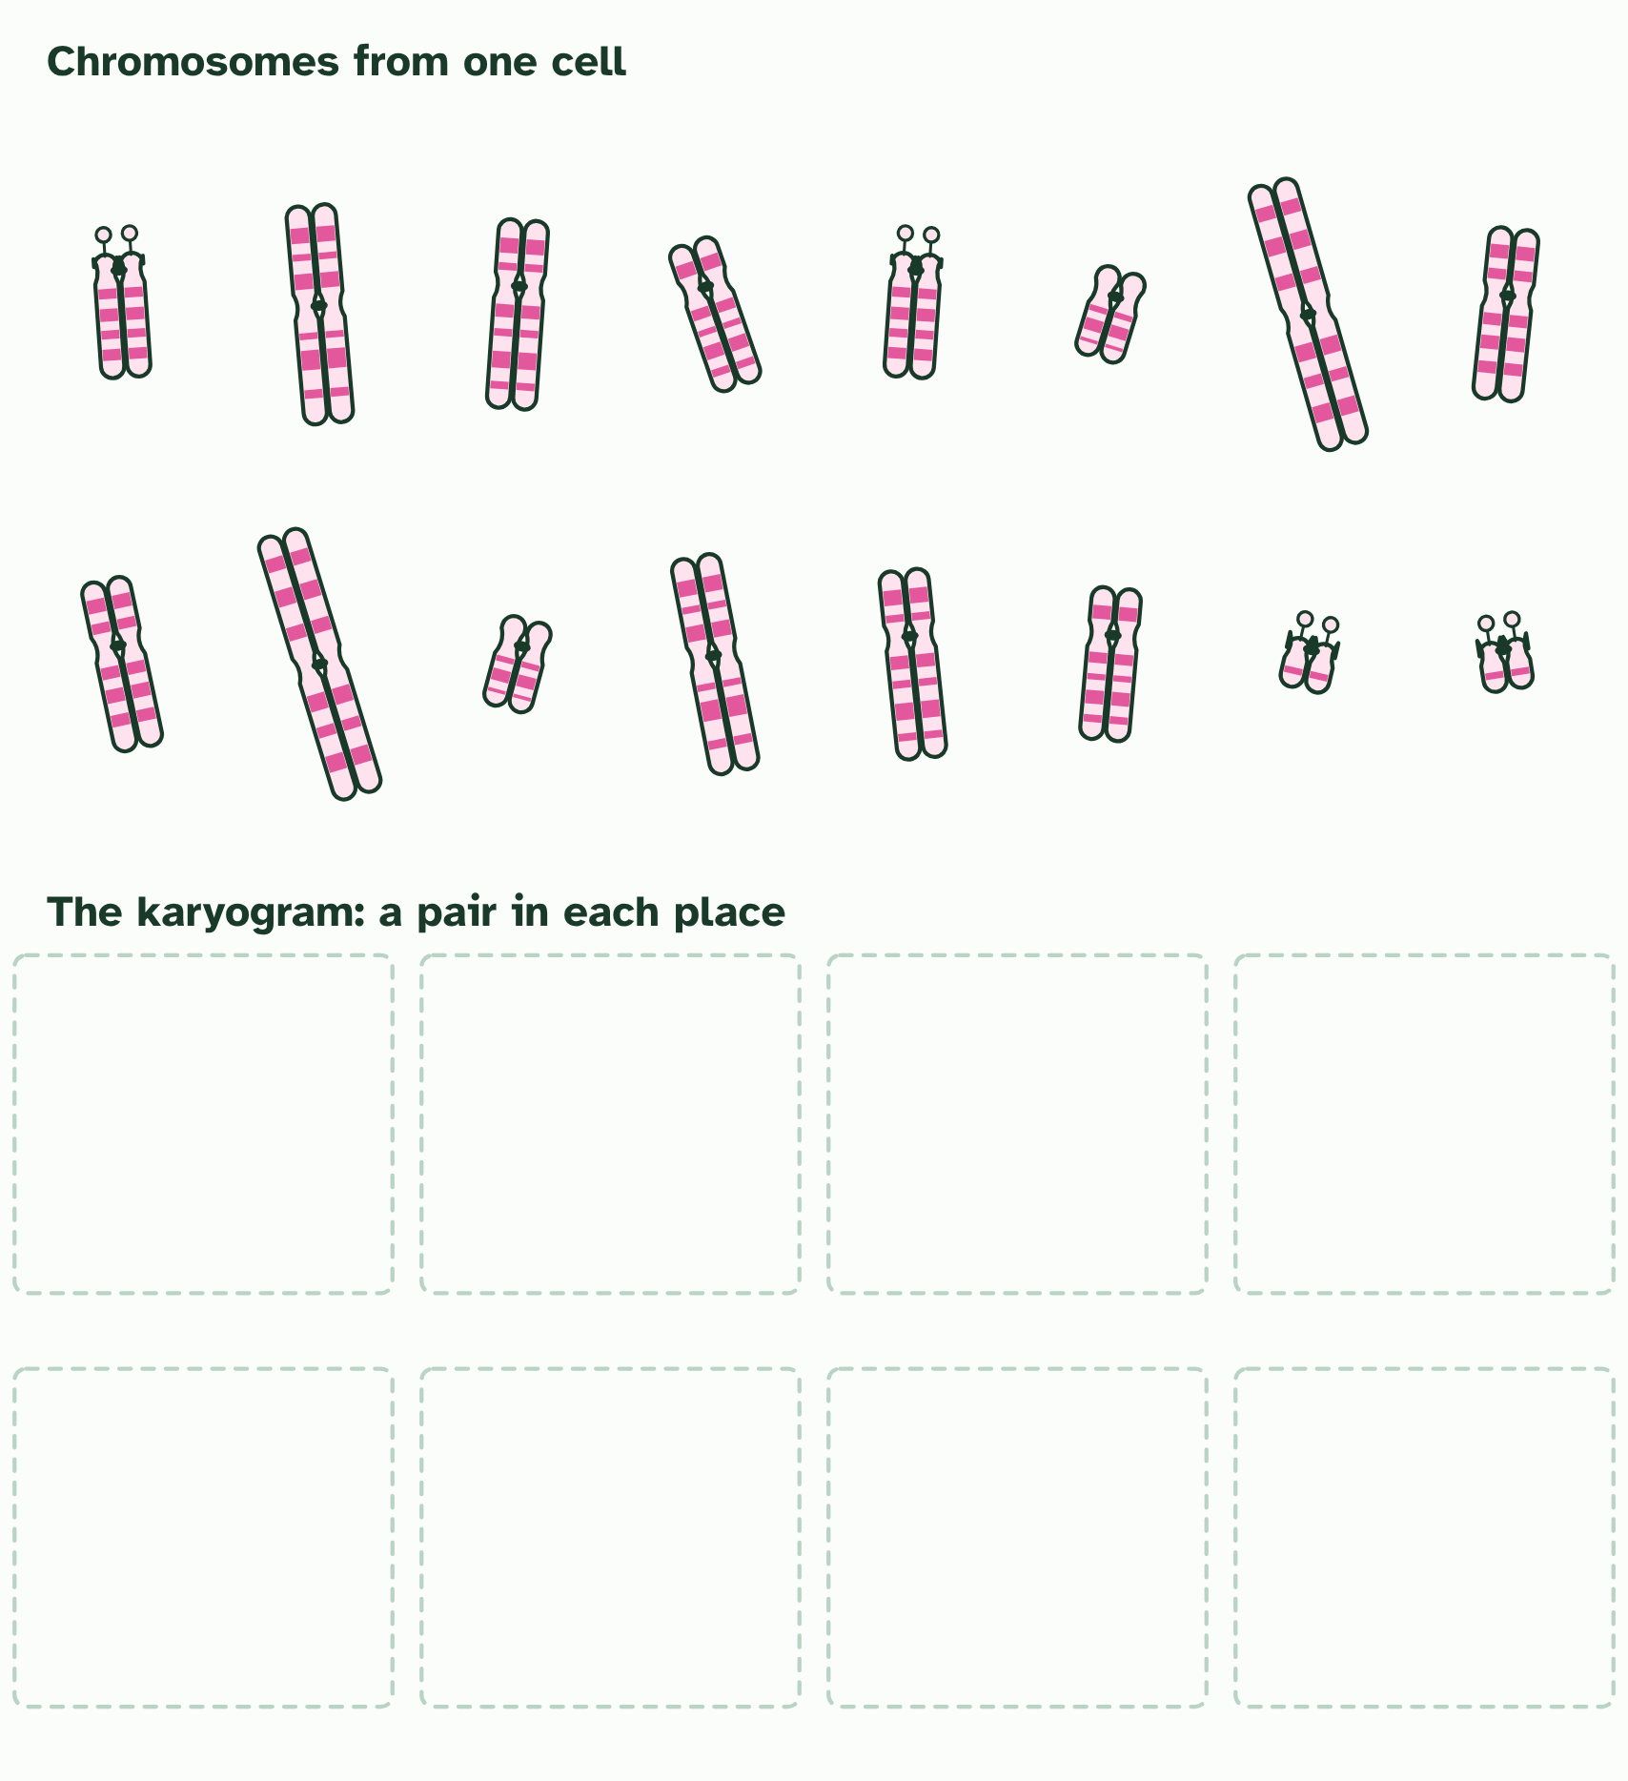
CHAPTER 5 · A3.1.7 Karyotyping and karyograms
1 / 3
Laying out the chromosomes
Chromosomes from one cell, condensed and doubled. Pair them by length, centromere position and bands.
Minutes 16 to 36
Notes:
Minutes 16 to 36 of 60: Build a karyogram (20 min).
The plan: Four minutes on chapter 5’s first figure, stopping on each caption. Then pairs pair up the paper chromosomes below by length, banding and centromere position, and line them up longest first. Check against chapter 5’s pairing tool, which tells them what matched.
How do biologists compare chromosomes? They make a karyotype: the full set of one cell’s chromosomes. Photographed and arranged in pairs, the picture is a karyogram. The cell is stopped part-way through dividing, when the chromosomes are short and thick, and stained so dark bands show.
To arrange them, match each chromosome with its partner using three clues: its length, its banding pattern and the position of its centromere, the pinched point where its two arms meet. Pairs are lined up from the longest. A human karyogram has 22 numbered pairs, roughly from longest to shortest, plus two sex chromosomes: XX in a female, XY in a male. It shows the number, the sex, and any extra or missing chromosome: three copies of chromosome 21 cause Down syndrome.
Now a puzzle. Humans have 46 chromosomes, but chimpanzees, gorillas and orangutans have 48. If we share an ancestor with them, where did a pair go? The hypothesis: human chromosome 2 was made when two ape chromosomes fused end to end in an ancestor we share with chimpanzees.
Look at them in the second tool below. The two ape chromosomes, placed end to end, match human chromosome 2 in length and in banding. Human chromosome 2 has DNA typical of a chromosome end (a telomere) in the middle, where a join would be. And it carries the remains of a second centromere, switched off. Every other human chromosome matches one ape chromosome.
Testing a prediction. A good hypothesis predicts something that could turn out false. If two chromosomes fused, chromosome ends should be found in the middle of the new one, and that can be checked. A claim such as “it fused so that humans could think” predicts nothing anyone can check. It is not testable, however interesting. Try sorting a few statements.
Testable or not? Decide whether evidence could ever show each statement wrong.

Slide 19
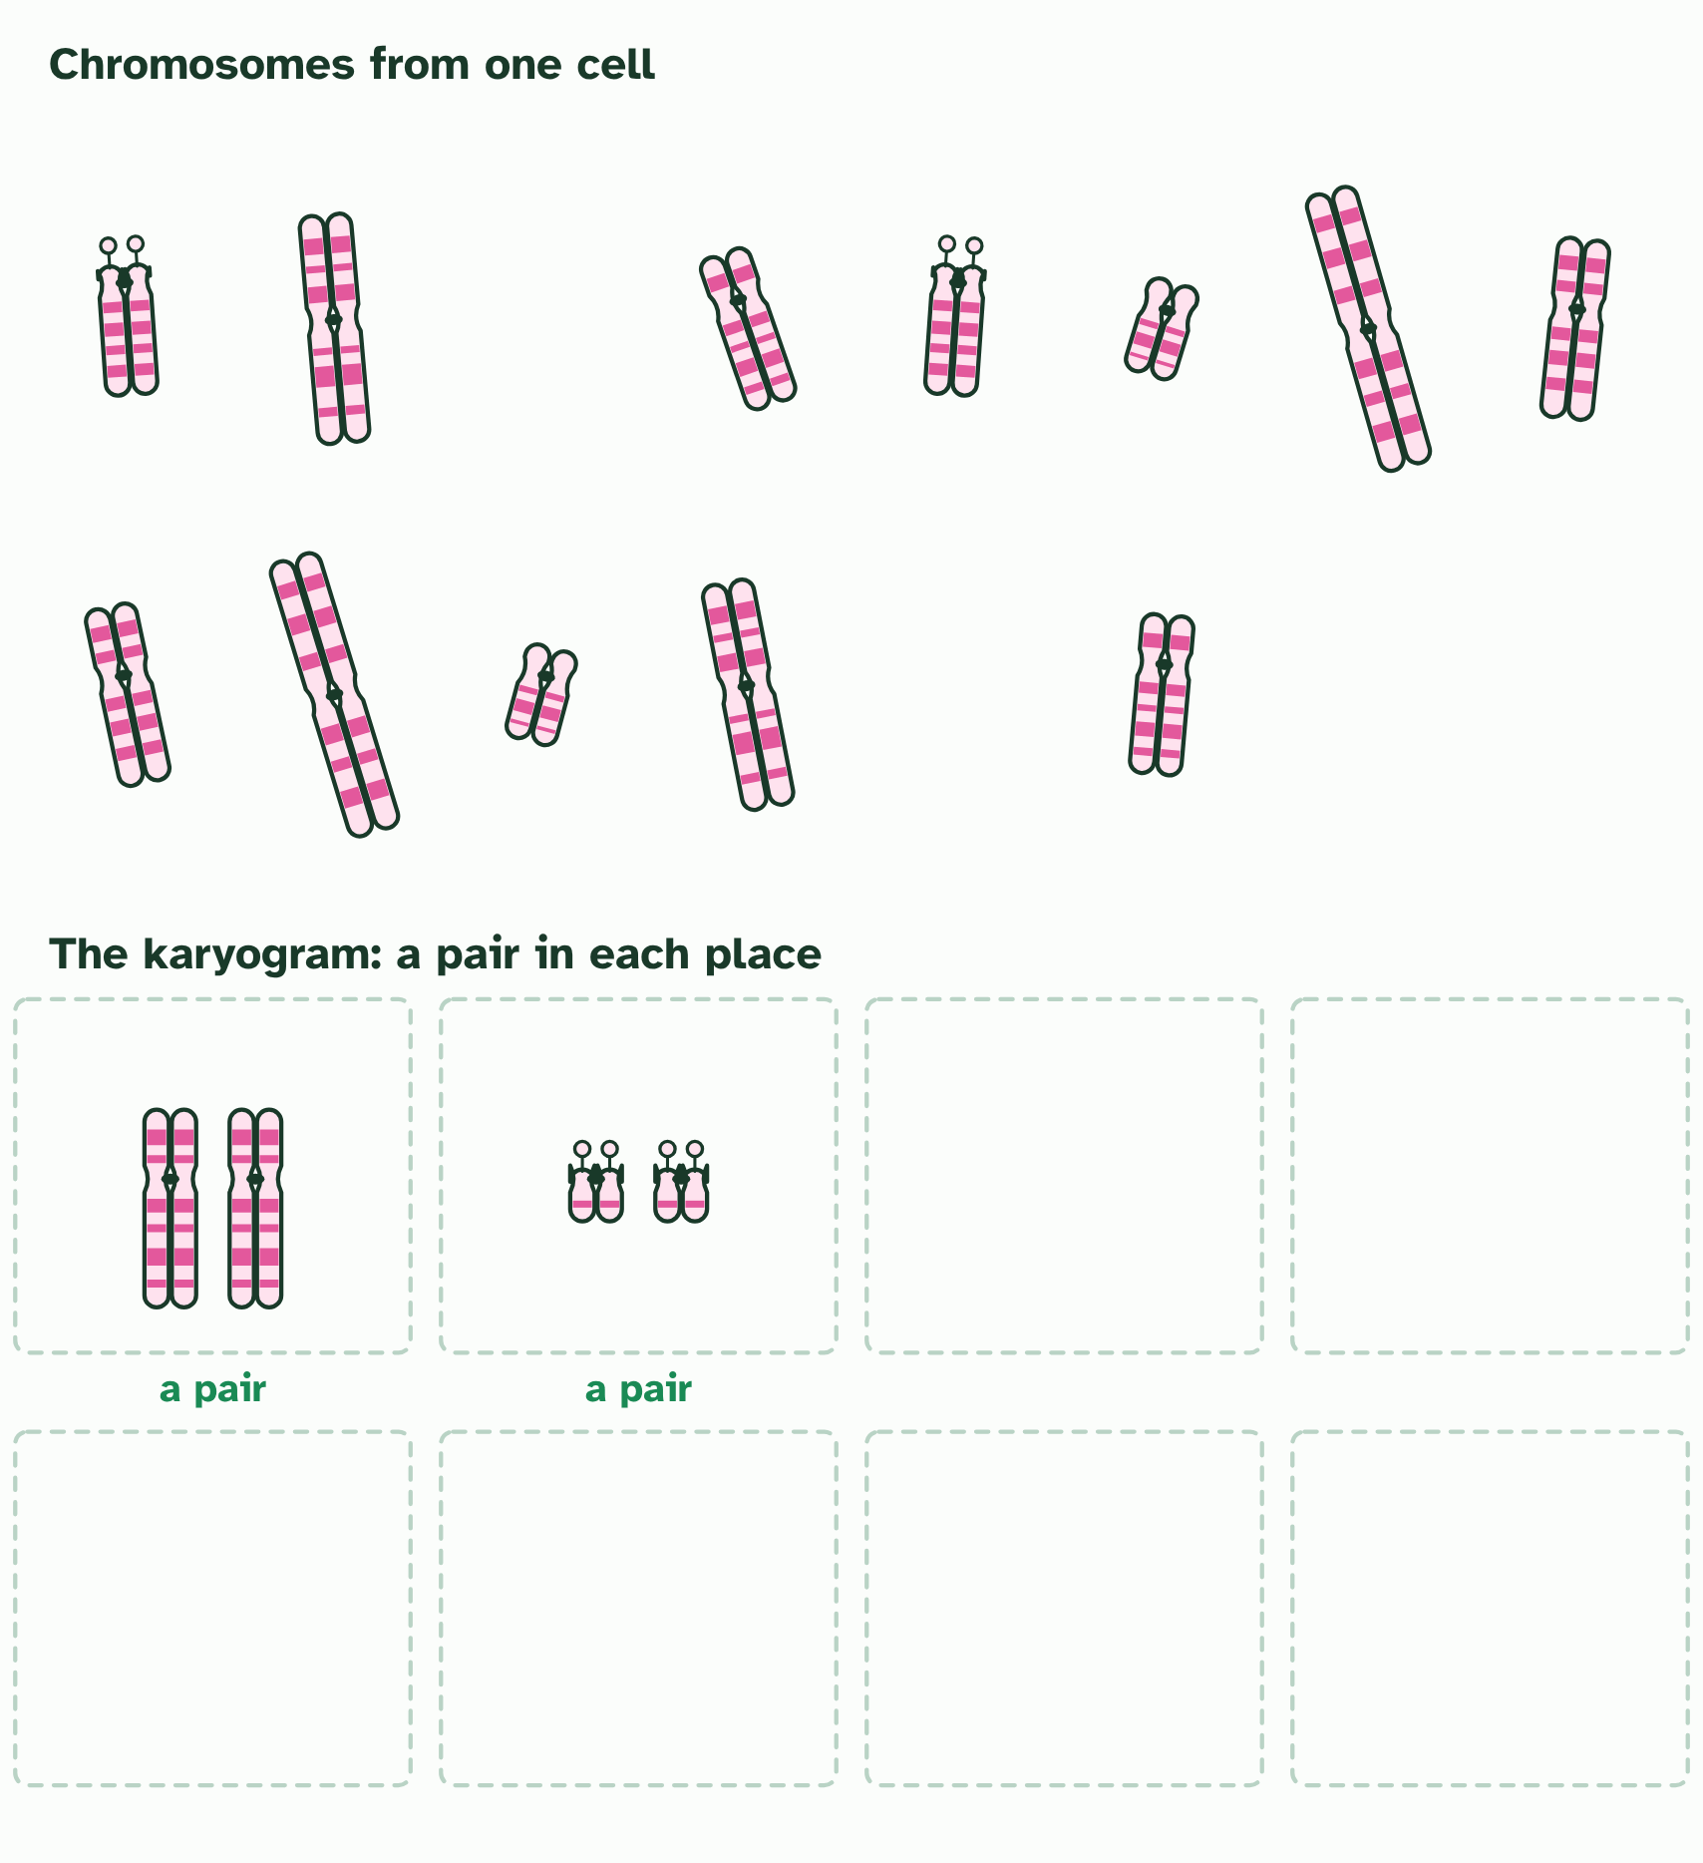
CHAPTER 5 · A3.1.7 Karyotyping and karyograms
2 / 3
Laying out the chromosomes
A pair matches on all three. A karyogram puts the pairs in order, longest first.
Minutes 16 to 36
Notes:
Minutes 16 to 36 of 60: Build a karyogram (20 min).
The plan: Four minutes on chapter 5’s first figure, stopping on each caption. Then pairs pair up the paper chromosomes below by length, banding and centromere position, and line them up longest first. Check against chapter 5’s pairing tool, which tells them what matched.
How do biologists compare chromosomes? They make a karyotype: the full set of one cell’s chromosomes. Photographed and arranged in pairs, the picture is a karyogram. The cell is stopped part-way through dividing, when the chromosomes are short and thick, and stained so dark bands show.
To arrange them, match each chromosome with its partner using three clues: its length, its banding pattern and the position of its centromere, the pinched point where its two arms meet. Pairs are lined up from the longest. A human karyogram has 22 numbered pairs, roughly from longest to shortest, plus two sex chromosomes: XX in a female, XY in a male. It shows the number, the sex, and any extra or missing chromosome: three copies of chromosome 21 cause Down syndrome.
Now a puzzle. Humans have 46 chromosomes, but chimpanzees, gorillas and orangutans have 48. If we share an ancestor with them, where did a pair go? The hypothesis: human chromosome 2 was made when two ape chromosomes fused end to end in an ancestor we share with chimpanzees.
Look at them in the second tool below. The two ape chromosomes, placed end to end, match human chromosome 2 in length and in banding. Human chromosome 2 has DNA typical of a chromosome end (a telomere) in the middle, where a join would be. And it carries the remains of a second centromere, switched off. Every other human chromosome matches one ape chromosome.
Testing a prediction. A good hypothesis predicts something that could turn out false. If two chromosomes fused, chromosome ends should be found in the middle of the new one, and that can be checked. A claim such as “it fused so that humans could think” predicts nothing anyone can check. It is not testable, however interesting. Try sorting a few statements.
Testable or not? Decide whether evidence could ever show each statement wrong.

Slide 20
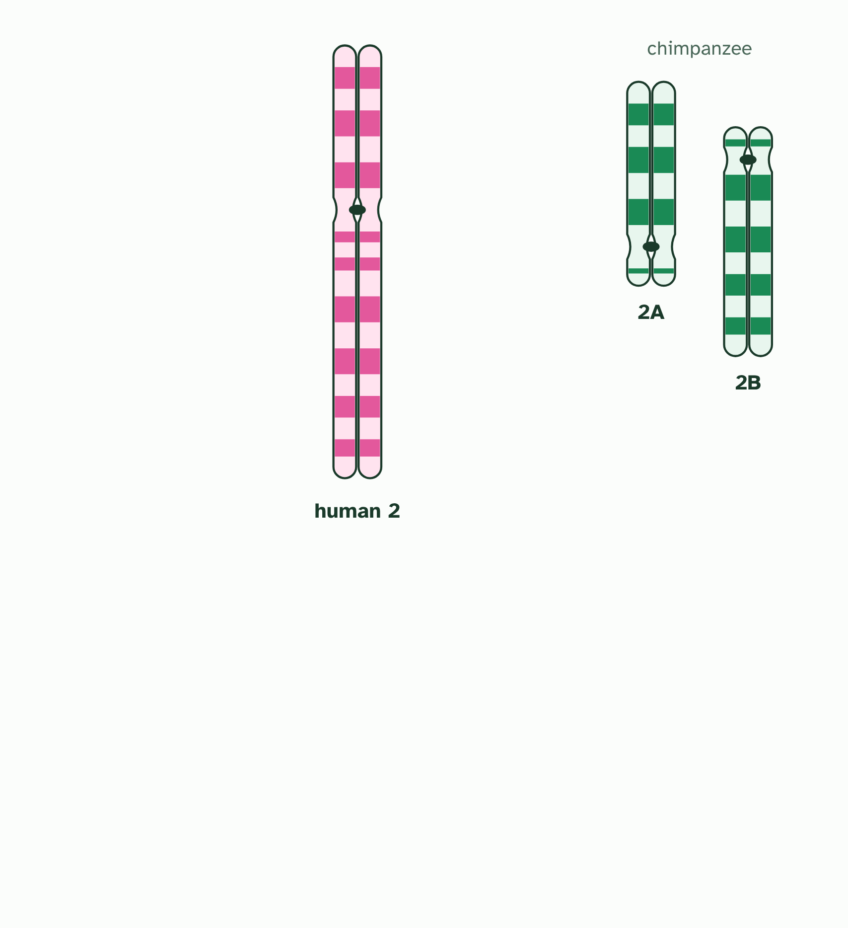
CHAPTER 5 · A3.1.7 Karyotyping and karyograms
3 / 3
Laying out the chromosomes
Human chromosome 2 beside two chimpanzee chromosomes, 2A and 2B. Do they fit together?
Minutes 16 to 36
Notes:
Minutes 16 to 36 of 60: Build a karyogram (20 min).
The plan: Four minutes on chapter 5’s first figure, stopping on each caption. Then pairs pair up the paper chromosomes below by length, banding and centromere position, and line them up longest first. Check against chapter 5’s pairing tool, which tells them what matched.
How do biologists compare chromosomes? They make a karyotype: the full set of one cell’s chromosomes. Photographed and arranged in pairs, the picture is a karyogram. The cell is stopped part-way through dividing, when the chromosomes are short and thick, and stained so dark bands show.
To arrange them, match each chromosome with its partner using three clues: its length, its banding pattern and the position of its centromere, the pinched point where its two arms meet. Pairs are lined up from the longest. A human karyogram has 22 numbered pairs, roughly from longest to shortest, plus two sex chromosomes: XX in a female, XY in a male. It shows the number, the sex, and any extra or missing chromosome: three copies of chromosome 21 cause Down syndrome.
Now a puzzle. Humans have 46 chromosomes, but chimpanzees, gorillas and orangutans have 48. If we share an ancestor with them, where did a pair go? The hypothesis: human chromosome 2 was made when two ape chromosomes fused end to end in an ancestor we share with chimpanzees.
Look at them in the second tool below. The two ape chromosomes, placed end to end, match human chromosome 2 in length and in banding. Human chromosome 2 has DNA typical of a chromosome end (a telomere) in the middle, where a join would be. And it carries the remains of a second centromere, switched off. Every other human chromosome matches one ape chromosome.
Testing a prediction. A good hypothesis predicts something that could turn out false. If two chromosomes fused, chromosome ends should be found in the middle of the new one, and that can be checked. A claim such as “it fused so that humans could think” predicts nothing anyone can check. It is not testable, however interesting. Try sorting a few statements.
Testable or not? Decide whether evidence could ever show each statement wrong.

Slide 21
CHAPTER 5 · A3.1.7 Karyotyping and karyograms
Laying out the chromosomes
A karyogram arranges chromosomes in pairs by length, banding pattern and centromere position.
Human chromosome 2 matches two ape chromosomes end to end, has telomere DNA in its middle and a remnant second centromere.
A testable hypothesis makes a prediction that evidence could contradict.
Minutes 16 to 36
Notes:
Minutes 16 to 36 of 60: Build a karyogram (20 min).
The plan: Four minutes on chapter 5’s first figure, stopping on each caption. Then pairs pair up the paper chromosomes below by length, banding and centromere position, and line them up longest first. Check against chapter 5’s pairing tool, which tells them what matched.
How do biologists compare chromosomes? They make a karyotype: the full set of one cell’s chromosomes. Photographed and arranged in pairs, the picture is a karyogram. The cell is stopped part-way through dividing, when the chromosomes are short and thick, and stained so dark bands show.
To arrange them, match each chromosome with its partner using three clues: its length, its banding pattern and the position of its centromere, the pinched point where its two arms meet. Pairs are lined up from the longest. A human karyogram has 22 numbered pairs, roughly from longest to shortest, plus two sex chromosomes: XX in a female, XY in a male. It shows the number, the sex, and any extra or missing chromosome: three copies of chromosome 21 cause Down syndrome.
Now a puzzle. Humans have 46 chromosomes, but chimpanzees, gorillas and orangutans have 48. If we share an ancestor with them, where did a pair go? The hypothesis: human chromosome 2 was made when two ape chromosomes fused end to end in an ancestor we share with chimpanzees.
Look at them in the second tool below. The two ape chromosomes, placed end to end, match human chromosome 2 in length and in banding. Human chromosome 2 has DNA typical of a chromosome end (a telomere) in the middle, where a join would be. And it carries the remains of a second centromere, switched off. Every other human chromosome matches one ape chromosome.
Testing a prediction. A good hypothesis predicts something that could turn out false. If two chromosomes fused, chromosome ends should be found in the middle of the new one, and that can be checked. A claim such as “it fused so that humans could think” predicts nothing anyone can check. It is not testable, however interesting. Try sorting a few statements.
Testable or not? Decide whether evidence could ever show each statement wrong.

Slide 22

CHAPTER 5 · A3.1.7 Karyotyping and karyograms
1 / 3
Laying out the chromosomes
Chromosomes from one cell, condensed and doubled. Pair them by length, centromere position and bands.
Minutes 16 to 36
Notes:
Minutes 16 to 36 of 60: Build a karyogram (20 min).
The plan: Four minutes on chapter 5’s first figure, stopping on each caption. Then pairs pair up the paper chromosomes below by length, banding and centromere position, and line them up longest first. Check against chapter 5’s pairing tool, which tells them what matched.
How do biologists compare chromosomes? They make a karyotype: the full set of one cell’s chromosomes. Photographed and arranged in pairs, the picture is a karyogram. The cell is stopped part-way through dividing, when the chromosomes are short and thick, and stained so dark bands show.
To arrange them, match each chromosome with its partner using three clues: its length, its banding pattern and the position of its centromere, the pinched point where its two arms meet. Pairs are lined up from the longest. A human karyogram has 22 numbered pairs, roughly from longest to shortest, plus two sex chromosomes: XX in a female, XY in a male. It shows the number, the sex, and any extra or missing chromosome: three copies of chromosome 21 cause Down syndrome.
Now a puzzle. Humans have 46 chromosomes, but chimpanzees, gorillas and orangutans have 48. If we share an ancestor with them, where did a pair go? The hypothesis: human chromosome 2 was made when two ape chromosomes fused end to end in an ancestor we share with chimpanzees.
Look at them in the second tool below. The two ape chromosomes, placed end to end, match human chromosome 2 in length and in banding. Human chromosome 2 has DNA typical of a chromosome end (a telomere) in the middle, where a join would be. And it carries the remains of a second centromere, switched off. Every other human chromosome matches one ape chromosome.
Testing a prediction. A good hypothesis predicts something that could turn out false. If two chromosomes fused, chromosome ends should be found in the middle of the new one, and that can be checked. A claim such as “it fused so that humans could think” predicts nothing anyone can check. It is not testable, however interesting. Try sorting a few statements.
Testable or not? Decide whether evidence could ever show each statement wrong.

Slide 23

CHAPTER 5 · A3.1.7 Karyotyping and karyograms
2 / 3
Laying out the chromosomes
A pair matches on all three. A karyogram puts the pairs in order, longest first.
Minutes 16 to 36
Notes:
Minutes 16 to 36 of 60: Build a karyogram (20 min).
The plan: Four minutes on chapter 5’s first figure, stopping on each caption. Then pairs pair up the paper chromosomes below by length, banding and centromere position, and line them up longest first. Check against chapter 5’s pairing tool, which tells them what matched.
How do biologists compare chromosomes? They make a karyotype: the full set of one cell’s chromosomes. Photographed and arranged in pairs, the picture is a karyogram. The cell is stopped part-way through dividing, when the chromosomes are short and thick, and stained so dark bands show.
To arrange them, match each chromosome with its partner using three clues: its length, its banding pattern and the position of its centromere, the pinched point where its two arms meet. Pairs are lined up from the longest. A human karyogram has 22 numbered pairs, roughly from longest to shortest, plus two sex chromosomes: XX in a female, XY in a male. It shows the number, the sex, and any extra or missing chromosome: three copies of chromosome 21 cause Down syndrome.
Now a puzzle. Humans have 46 chromosomes, but chimpanzees, gorillas and orangutans have 48. If we share an ancestor with them, where did a pair go? The hypothesis: human chromosome 2 was made when two ape chromosomes fused end to end in an ancestor we share with chimpanzees.
Look at them in the second tool below. The two ape chromosomes, placed end to end, match human chromosome 2 in length and in banding. Human chromosome 2 has DNA typical of a chromosome end (a telomere) in the middle, where a join would be. And it carries the remains of a second centromere, switched off. Every other human chromosome matches one ape chromosome.
Testing a prediction. A good hypothesis predicts something that could turn out false. If two chromosomes fused, chromosome ends should be found in the middle of the new one, and that can be checked. A claim such as “it fused so that humans could think” predicts nothing anyone can check. It is not testable, however interesting. Try sorting a few statements.
Testable or not? Decide whether evidence could ever show each statement wrong.

Slide 24

CHAPTER 5 · A3.1.7 Karyotyping and karyograms
3 / 3
Laying out the chromosomes
Human chromosome 2 beside two chimpanzee chromosomes, 2A and 2B. Do they fit together?
Minutes 16 to 36
Notes:
Minutes 16 to 36 of 60: Build a karyogram (20 min).
The plan: Four minutes on chapter 5’s first figure, stopping on each caption. Then pairs pair up the paper chromosomes below by length, banding and centromere position, and line them up longest first. Check against chapter 5’s pairing tool, which tells them what matched.
How do biologists compare chromosomes? They make a karyotype: the full set of one cell’s chromosomes. Photographed and arranged in pairs, the picture is a karyogram. The cell is stopped part-way through dividing, when the chromosomes are short and thick, and stained so dark bands show.
To arrange them, match each chromosome with its partner using three clues: its length, its banding pattern and the position of its centromere, the pinched point where its two arms meet. Pairs are lined up from the longest. A human karyogram has 22 numbered pairs, roughly from longest to shortest, plus two sex chromosomes: XX in a female, XY in a male. It shows the number, the sex, and any extra or missing chromosome: three copies of chromosome 21 cause Down syndrome.
Now a puzzle. Humans have 46 chromosomes, but chimpanzees, gorillas and orangutans have 48. If we share an ancestor with them, where did a pair go? The hypothesis: human chromosome 2 was made when two ape chromosomes fused end to end in an ancestor we share with chimpanzees.
Look at them in the second tool below. The two ape chromosomes, placed end to end, match human chromosome 2 in length and in banding. Human chromosome 2 has DNA typical of a chromosome end (a telomere) in the middle, where a join would be. And it carries the remains of a second centromere, switched off. Every other human chromosome matches one ape chromosome.
Testing a prediction. A good hypothesis predicts something that could turn out false. If two chromosomes fused, chromosome ends should be found in the middle of the new one, and that can be checked. A claim such as “it fused so that humans could think” predicts nothing anyone can check. It is not testable, however interesting. Try sorting a few statements.
Testable or not? Decide whether evidence could ever show each statement wrong.

Slide 25
CHAPTER 5 · A3.1.7 Karyotyping and karyograms
Laying out the chromosomes
A karyogram arranges chromosomes in pairs by length, banding pattern and centromere position.
Human chromosome 2 matches two ape chromosomes end to end, has telomere DNA in its middle and a remnant second centromere.
A testable hypothesis makes a prediction that evidence could contradict.
Minutes 16 to 36
Notes:
Minutes 16 to 36 of 60: Build a karyogram (20 min).
The plan: Four minutes on chapter 5’s first figure, stopping on each caption. Then pairs pair up the paper chromosomes below by length, banding and centromere position, and line them up longest first. Check against chapter 5’s pairing tool, which tells them what matched.
How do biologists compare chromosomes? They make a karyotype: the full set of one cell’s chromosomes. Photographed and arranged in pairs, the picture is a karyogram. The cell is stopped part-way through dividing, when the chromosomes are short and thick, and stained so dark bands show.
To arrange them, match each chromosome with its partner using three clues: its length, its banding pattern and the position of its centromere, the pinched point where its two arms meet. Pairs are lined up from the longest. A human karyogram has 22 numbered pairs, roughly from longest to shortest, plus two sex chromosomes: XX in a female, XY in a male. It shows the number, the sex, and any extra or missing chromosome: three copies of chromosome 21 cause Down syndrome.
Now a puzzle. Humans have 46 chromosomes, but chimpanzees, gorillas and orangutans have 48. If we share an ancestor with them, where did a pair go? The hypothesis: human chromosome 2 was made when two ape chromosomes fused end to end in an ancestor we share with chimpanzees.
Look at them in the second tool below. The two ape chromosomes, placed end to end, match human chromosome 2 in length and in banding. Human chromosome 2 has DNA typical of a chromosome end (a telomere) in the middle, where a join would be. And it carries the remains of a second centromere, switched off. Every other human chromosome matches one ape chromosome.
Testing a prediction. A good hypothesis predicts something that could turn out false. If two chromosomes fused, chromosome ends should be found in the middle of the new one, and that can be checked. A claim such as “it fused so that humans could think” predicts nothing anyone can check. It is not testable, however interesting. Try sorting a few statements.
Testable or not? Decide whether evidence could ever show each statement wrong.

Slide 26
WATCH OUT
The evidence supports the hypothesis from several directions, but nobody watched the fusion. And it does not mean humans came from chimpanzees: both lines come from a shared ancestor, which was neither.
Minutes 16 to 36
Notes:
Minutes 16 to 36 of 60: Build a karyogram (20 min).
The plan: Four minutes on chapter 5’s first figure, stopping on each caption. Then pairs pair up the paper chromosomes below by length, banding and centromere position, and line them up longest first. Check against chapter 5’s pairing tool, which tells them what matched.
A common mistake: say it, then ask who can say why it is wrong.

Slide 27
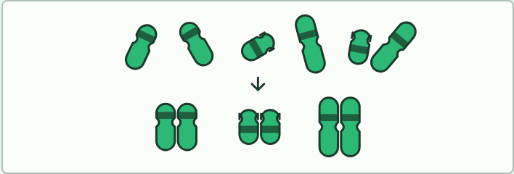
CARD SORT
20 MIN
Pair the paper chromosomes
THE TASK
Students match them, line them up longest first, and say which of the three clues settled each pair. They then check their karyogram with the pairing tool.
STUDENTS NEED
Twelve paper chromosomes per pair (cut from card, bands in marker); the tool on a device.
Minutes 16 to 36
Notes:
Minutes 16 to 36 of 60: Build a karyogram (20 min).
The plan: Four minutes on chapter 5’s first figure, stopping on each caption. Then pairs pair up the paper chromosomes below by length, banding and centromere position, and line them up longest first. Check against chapter 5’s pairing tool, which tells them what matched.
The activity: Pair the paper chromosomes. Teacher-made sets of twelve paper chromosomes, six matching pairs that differ in length, centromere position and the bands drawn on them with a marker. Students match them, line them up longest first, and say which of the three clues settled each pair. They then check their karyogram with the pairing tool.
Needs: twelve paper chromosomes per pair (cut from card, bands in marker); the tool on a device.
The time: 20 minutes, minutes 16 to 36 of the plan.

Slide 28
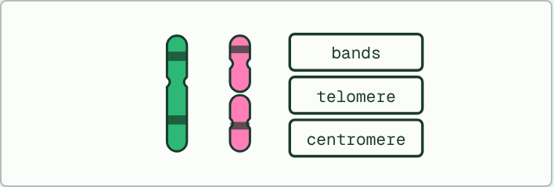
EVIDENCE
16 MIN
Chromosome 2 on trial
THE TASK
Evidence cards from the chromosome 2 tool: the banding of human chromosome 2 against two ape chromosomes, the telomere DNA in its middle, the remains of a second centromere, and the numbers, 46 against 48. For each card, students write what it shows, how strongly it supports the fusion, and one more piece of evidence they would want. A last line says what would make the hypothesis fail.
STUDENTS NEED
Evidence cards; the chromosome 2 tool.
Minutes 36 to 52
Notes:
Minutes 36 to 52 of 60: Chromosome 2 on trial (16 min).
The plan: Chapter 5’s chromosome 2 tool on the board. Groups complete the evidence cards below: for each of the three pieces of evidence, say what it shows and how strongly it supports the fusion. Then take chapter 5’s predict box on what to expect in the middle of a fused chromosome.
The activity: Chromosome 2 on trial. Evidence cards from the chromosome 2 tool: the banding of human chromosome 2 against two ape chromosomes, the telomere DNA in its middle, the remains of a second centromere, and the numbers, 46 against 48. For each card, students write what it shows, how strongly it supports the fusion, and one more piece of evidence they would want. A last line says what would make the hypothesis fail.
Needs: evidence cards; the chromosome 2 tool.
The time: 16 minutes, minutes 36 to 52 of the plan.

Slide 29
PREDICT
If two chromosomes had fused end to end, what would you expect in the middle of the new, longer chromosome?
A A gene that makes the two chromosomes stick together for good
B A stretch of DNA that cannot be copied, so the cell could not divide
C Telomere DNA, normally found only at a chromosome’s end
Minutes 36 to 52
Notes:
Minutes 36 to 52 of 60: Chromosome 2 on trial (16 min).
The plan: Chapter 5’s chromosome 2 tool on the board. Groups complete the evidence cards below: for each of the three pieces of evidence, say what it shows and how strongly it supports the fusion. Then take chapter 5’s predict box on what to expect in the middle of a fused chromosome.
Ask for a show of hands, or mini whiteboards, before revealing. (Answer: C, on the next slide.)

Slide 30
WHAT HAPPENS
If two chromosomes had fused end to end, what would you expect in the middle of the new, longer chromosome?
A A gene that makes the two chromosomes stick together for good
B A stretch of DNA that cannot be copied, so the cell could not divide
C Telomere DNA, normally found only at a chromosome’s end
Telomere DNA. Telomeres cap the ends of chromosomes, so two chromosomes joined end to end would leave two caps in the middle. Human chromosome 2 has such a stretch exactly where the join would be.
Minutes 36 to 52
Notes:
Minutes 36 to 52 of 60: Chromosome 2 on trial (16 min).
The plan: Chapter 5’s chromosome 2 tool on the board. Groups complete the evidence cards below: for each of the three pieces of evidence, say what it shows and how strongly it supports the fusion. Then take chapter 5’s predict box on what to expect in the middle of a fused chromosome.
Answer: C. Telomere DNA. Telomeres cap the ends of chromosomes, so two chromosomes joined end to end would leave two caps in the middle. Human chromosome 2 has such a stretch exactly where the join would be.

Slide 31
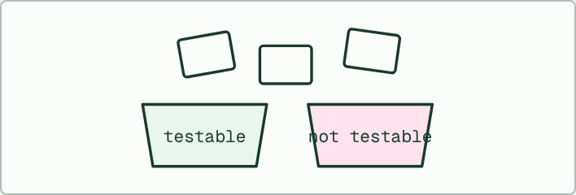
NATURE OF SCIENCE
8 MIN
Testable or not?
THE TASK
Students write six statements about chromosome 2, apes or anything in the lesson, three they believe are testable and three that are not, shuffle them and swap. The partner sorts them into two bins and explains each choice, saying what evidence would count against the testable ones.
STUDENTS NEED
Six blank slips per student; two labelled bins.
Minutes 52 to 60
Notes:
Minutes 52 to 60 of 60: Testable or not? (8 min).
The plan: Chapter 5’s testable or not drill, then students write one testable and one non-testable hypothesis on any topic they like, and swap with a partner to sort. Exit: why is testability what makes a hypothesis scientific?
The activity: Testable or not?. Students write six statements about chromosome 2, apes or anything in the lesson, three they believe are testable and three that are not, shuffle them and swap. The partner sorts them into two bins and explains each choice, saying what evidence would count against the testable ones.
Needs: six blank slips per student; two labelled bins.
The time: 8 minutes, minutes 52 to 60 of the plan.

Slide 32
EXIT QUESTION
Before you go
On paper, on your own: Classify chromosomes in a karyogram by banding, length and centromere position, and evaluate the evidence that human chromosome 2 arose from a fusion.
Minutes 52 to 60
Notes:
Minutes 52 to 60 of 60: Testable or not? (8 min).
The plan: Chapter 5’s testable or not drill, then students write one testable and one non-testable hypothesis on any topic they like, and swap with a partner to sort. Exit: why is testability what makes a hypothesis scientific?
Collect the slips: they say where to start next lesson.

Slide 33
PRACTISE AND REVISE
Keep going
Exam practice: a fresh paper of exam questions on A3.1 at standard level, marked as you go
The guide, with the animations and the dry lab
This lesson in the guide: 4 Every species has its own count, 5 Laying out the chromosomes
BUILD FOR YOUR CLASS
ALREADY ON THE SITE FOR A3.1
CARD SETS ON SPLYCR
Tarsia puzzle, dominoes and picture reveal on A3.1, built from its key terms and ready to print
A pub quiz with rounds on A3.1, to present or run with no projector
An escape room built from the question bank on A3.1
Quiz: Diversity of Organisms
Revision map: A3.1 Diversity of organisms, to fill in
Exam questions: A3.1 in the exam maker, a paper with its markscheme
Open a set to host it as a class game, or make a copy to edit.
A3.1 Diversity of Organisms
How this was made. The course structure, the activities and the teaching choices come from my own classroom, my presentations and my years of teaching IB and AP Biology. I use Claude, an AI, to help write and build the interactive guides, lesson plans, slides and practice questions, and to draw the diagrams and code the interactives. I direct the work and review it against the IB and AP specifications before it goes live.
Minute 60: after the lesson
Notes:
Every link here is live. Set the exam practice paper for homework: it is fresh each time, marked as students go and saved to their Exam practice when they are signed in.
Exam practice: https://www.biologybybradford.com/exam-maker/sit?topics=A3.1&level=SL&paper=quiz&marks=15&src=ep
The guide: https://www.biologybybradford.com/guides/ib-biology-a3-1-diversity-of-organisms

