Slide 1
IB Biology A3.1
LESSON 3 OF 5
BY THE END YOU CAN
Diversity of organisms
Describe a genome, how SNPs give diversity within a species, and why variation between species is much larger (A3.1.8, A3.1.9)
Compare genome sizes of different groups from a database and judge whether size measures complexity (A3.1.10)
Describe how whole genome sequencing has become faster and cheaper, and give current and future uses (A3.1.11)
Genomes and genome size
A3.1.8 to A3.1.11
What a genome is, SNPs, why genome size is not complexity, and whole genome sequencing
60 minutes · chapters 6, 7, 8 · the dry lab
Minute 0
Notes:
IB Biology A3.1, Diversity of organisms. Lesson 3 of 5: Genomes and genome size, 60 minutes.
The plan, minute by minute (each slide's footer says where you are):
0 to 6 min (6) Do now: how different are we?
6 to 18 min (12) One genome, many versions
18 to 40 min (22) Order the genomes
40 to 52 min (12) Reading a whole genome
52 to 60 min (8) Exit: size and complexity
What students get wrong:
A genome is just the genes. It is all the genetic information: genes, the DNA between them and the DNA in organelles. Most of a large genome is not genes.
A bigger genome means a more complex organism. The largest genomes in the lab belong to a plant and a fish. Size counts DNA, not complexity or genes.
A SNP is a disease mutation. A SNP is a one-base difference found in many people. Most have no known effect.
Stretch and support:
Support: give the captions of each figure as a cut-up storyboard to put in order, and use the key terms (tap the dotted words) as a glossary.
Stretch: use a public genome database to look up three organisms of your own choice and add them to the class graph, with the source.
Support: give a sentence frame for the exit: “Organism A has a bigger genome than organism B, but...”.
The lesson plan to print: https://www.biologybybradford.com/guides/downloads/ib-biology-a3-1-diversity-of-organisms-lesson-3-plan.pdf

Slide 2
DO NOW
How different are we?
Students write a guess, as a percentage, for how much of two unrelated people’s DNA is the same.
6:00
minutes
Start now: the timer is running.
Minutes 0 to 6
Notes:
Minutes 0 to 6 of 60: Do now: how different are we? (6 min).
The plan: Students write a guess, as a percentage, for how much of two unrelated people’s DNA is the same. Collect the guesses on the board without comment. Return to them after chapter 6’s predict box.
Start a 6 minute timer as they come in.

Slide 3
PREDICT
Two unrelated people have their whole genomes read and compared. About how different are they?
A About one base in ten differs, so they share only about 90%
B One base in a thousand differs: they share about 99.9%
C None: unrelated people of one species have identical genomes
Minutes 0 to 6
Notes:
Minutes 0 to 6 of 60: Do now: how different are we? (6 min).
The plan: Students write a guess, as a percentage, for how much of two unrelated people’s DNA is the same. Collect the guesses on the board without comment. Return to them after chapter 6’s predict box.
Ask for a show of hands, or mini whiteboards, before revealing. (Answer: B, on the next slide.)

Slide 4
WHAT HAPPENS
Two unrelated people have their whole genomes read and compared. About how different are they?
A About one base in ten differs, so they share only about 90%
B One base in a thousand differs: they share about 99.9%
C None: unrelated people of one species have identical genomes
About one base in a thousand. Humans share nearly all of their genome, and the small differences, mostly SNPs, are what make each genome unique. Between species the differences are far larger.
Minutes 0 to 6
Notes:
Minutes 0 to 6 of 60: Do now: how different are we? (6 min).
The plan: Students write a guess, as a percentage, for how much of two unrelated people’s DNA is the same. Collect the guesses on the board without comment. Return to them after chapter 6’s predict box.
Answer: B. About one base in a thousand. Humans share nearly all of their genome, and the small differences, mostly SNPs, are what make each genome unique. Between species the differences are far larger.

Slide 5
STEP 2
12 MIN
One genome, many versions
Chapter 6: One genome, many versions
Minutes 6 to 18
Notes:
Minutes 6 to 18 of 60: One genome, many versions (12 min).
The plan: Chapter 6’s figure, step by step: first within a species, then between two species. Define genome and SNP. Ask where the pink cells would be if the second species were the chimpanzee, and whether there would be more or fewer. Then chapter 6’s predict box.

Slide 6
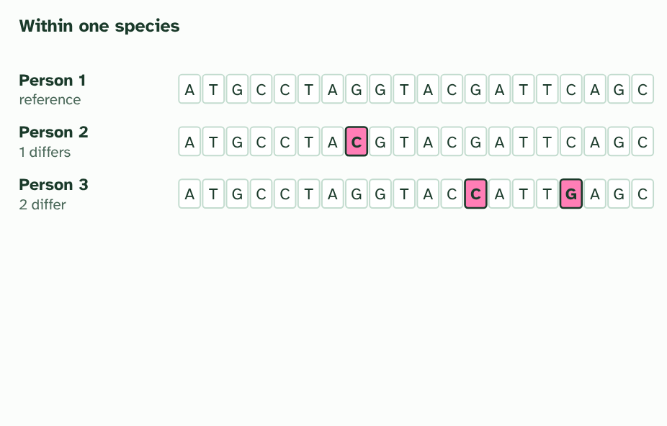
CHAPTER 6 · A3.1.8 A3.1.9 Genomes within and between species
1 / 3
One genome, many versions
One short stretch of the genome in three people. Bases that differ from person 1 are pink: very few.
Minutes 6 to 18
Notes:
Minutes 6 to 18 of 60: One genome, many versions (12 min).
The plan: Chapter 6’s figure, step by step: first within a species, then between two species. Define genome and SNP. Ask where the pink cells would be if the second species were the chimpanzee, and whether there would be more or fewer. Then chapter 6’s predict box.
Your genome is all the genetic information you carry: your genes, the DNA between them, and the small loops of DNA in your mitochondria. Almost every cell in your body holds a full copy.
Two people share most of their genome: the same genes, in the same places. What differs is small and scattered. At about one place in a thousand, one base differs: a single nucleotide polymorphism, or SNP (said “snip”). Any two people share about 99.9% of their genome. Many SNPs lie in DNA that codes for nothing and have no known effect. Others alter a protein, or how much of it is made.
Between species the differences are far greater. Genomes differ in their overall size, which is the total amount of DNA, and in base sequence. Variation between species is much larger than variation within a species. That is why a stretch of DNA can show whose it is, and why a species can be recognised from its genome.

Slide 7
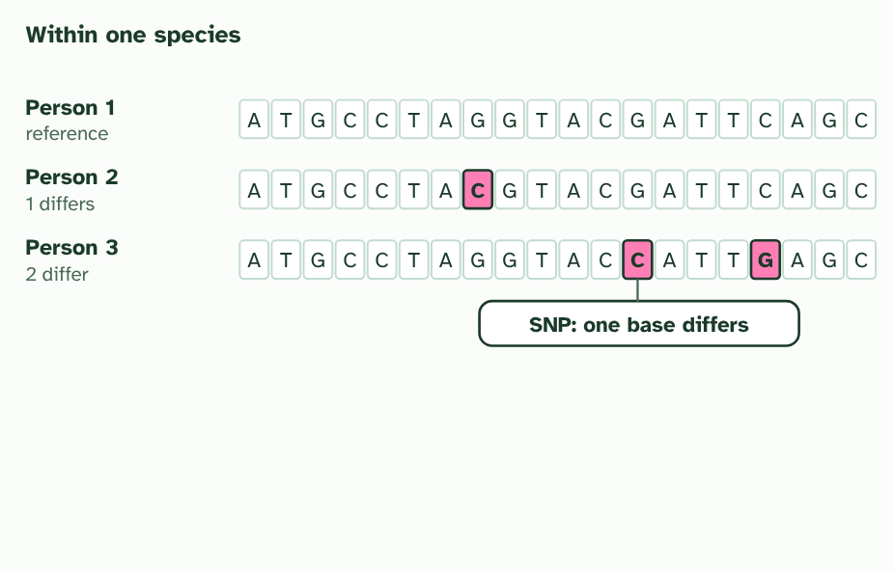
CHAPTER 6 · A3.1.8 A3.1.9 Genomes within and between species
2 / 3
One genome, many versions
A difference at a single base is a single nucleotide polymorphism, or SNP. Together, SNPs make each person’s genome their own.
Minutes 6 to 18
Notes:
Minutes 6 to 18 of 60: One genome, many versions (12 min).
The plan: Chapter 6’s figure, step by step: first within a species, then between two species. Define genome and SNP. Ask where the pink cells would be if the second species were the chimpanzee, and whether there would be more or fewer. Then chapter 6’s predict box.
Your genome is all the genetic information you carry: your genes, the DNA between them, and the small loops of DNA in your mitochondria. Almost every cell in your body holds a full copy.
Two people share most of their genome: the same genes, in the same places. What differs is small and scattered. At about one place in a thousand, one base differs: a single nucleotide polymorphism, or SNP (said “snip”). Any two people share about 99.9% of their genome. Many SNPs lie in DNA that codes for nothing and have no known effect. Others alter a protein, or how much of it is made.
Between species the differences are far greater. Genomes differ in their overall size, which is the total amount of DNA, and in base sequence. Variation between species is much larger than variation within a species. That is why a stretch of DNA can show whose it is, and why a species can be recognised from its genome.

Slide 8
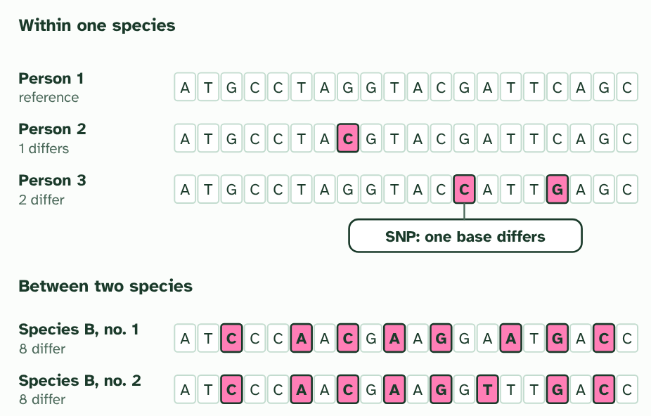
CHAPTER 6 · A3.1.8 A3.1.9 Genomes within and between species
3 / 3
One genome, many versions
The same stretch in another species: far more differences. (Simplified: real differences are much rarer in both cases, but the pattern holds.)
Minutes 6 to 18
Notes:
Minutes 6 to 18 of 60: One genome, many versions (12 min).
The plan: Chapter 6’s figure, step by step: first within a species, then between two species. Define genome and SNP. Ask where the pink cells would be if the second species were the chimpanzee, and whether there would be more or fewer. Then chapter 6’s predict box.
Your genome is all the genetic information you carry: your genes, the DNA between them, and the small loops of DNA in your mitochondria. Almost every cell in your body holds a full copy.
Two people share most of their genome: the same genes, in the same places. What differs is small and scattered. At about one place in a thousand, one base differs: a single nucleotide polymorphism, or SNP (said “snip”). Any two people share about 99.9% of their genome. Many SNPs lie in DNA that codes for nothing and have no known effect. Others alter a protein, or how much of it is made.
Between species the differences are far greater. Genomes differ in their overall size, which is the total amount of DNA, and in base sequence. Variation between species is much larger than variation within a species. That is why a stretch of DNA can show whose it is, and why a species can be recognised from its genome.

Slide 9
CHAPTER 6 · A3.1.8 A3.1.9 Genomes within and between species
One genome, many versions
A genome is all the genetic information of an organism.
Members of one species share most of their genome; SNPs give some diversity.
Variation between species is much larger than variation within a species.
Minutes 6 to 18
Notes:
Minutes 6 to 18 of 60: One genome, many versions (12 min).
The plan: Chapter 6’s figure, step by step: first within a species, then between two species. Define genome and SNP. Ask where the pink cells would be if the second species were the chimpanzee, and whether there would be more or fewer. Then chapter 6’s predict box.
Your genome is all the genetic information you carry: your genes, the DNA between them, and the small loops of DNA in your mitochondria. Almost every cell in your body holds a full copy.
Two people share most of their genome: the same genes, in the same places. What differs is small and scattered. At about one place in a thousand, one base differs: a single nucleotide polymorphism, or SNP (said “snip”). Any two people share about 99.9% of their genome. Many SNPs lie in DNA that codes for nothing and have no known effect. Others alter a protein, or how much of it is made.
Between species the differences are far greater. Genomes differ in their overall size, which is the total amount of DNA, and in base sequence. Variation between species is much larger than variation within a species. That is why a stretch of DNA can show whose it is, and why a species can be recognised from its genome.

Slide 10
WATCH OUT
A SNP is a place in the genome where individuals differ, not a gene and not a disease. Having a SNP is normal: we all carry thousands, and many have no known effect.
Minutes 6 to 18
Notes:
Minutes 6 to 18 of 60: One genome, many versions (12 min).
The plan: Chapter 6’s figure, step by step: first within a species, then between two species. Define genome and SNP. Ask where the pink cells would be if the second species were the chimpanzee, and whether there would be more or fewer. Then chapter 6’s predict box.
A common mistake: say it, then ask who can say why it is wrong.

Slide 11
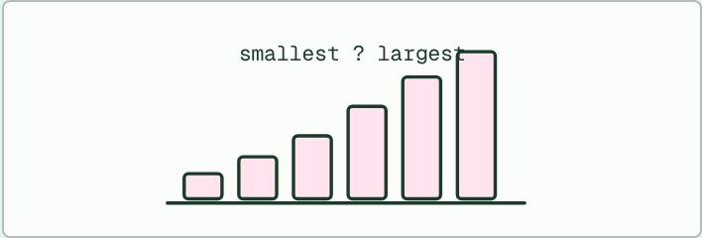
DATA
22 MIN
Order the genomes
THE TASK
Cards of eight organisms (a bacterium, baker’s yeast, a nematode worm, a human, an onion, the Australian lungfish, Paris japonica and thale cress). Pairs put them in the order they predict, smallest genome to largest, and say why. Then the dry lab reveals the sizes. Which prediction was furthest out, and what made it wrong?
STUDENTS NEED
Eight organism cards per pair; the dry lab on a device.
Minutes 18 to 40
Notes:
Minutes 18 to 40 of 60: Order the genomes (22 min).
The plan: Eight minutes on the genome-size order activity below, then reveal with chapter 7’s figure. Fourteen minutes in the dry lab: students look up ten organisms, plot genome size against group, switch to gene count, and judge the four statements. Chapter 7’s predict box comes after.
The activity: Order the genomes. Cards of eight organisms (a bacterium, baker’s yeast, a nematode worm, a human, an onion, the Australian lungfish, Paris japonica and thale cress). Pairs put them in the order they predict, smallest genome to largest, and say why. Then the dry lab reveals the sizes. Which prediction was furthest out, and what made it wrong?
Needs: eight organism cards per pair; the dry lab on a device.
The time: 22 minutes, minutes 18 to 40 of the plan.

Slide 12
DRY LAB
22 MIN
Genome size explorer
THE TASK
The dry lab above, with the tasks and questions under it. Students look up organisms from a table the way a scientist uses a genome database, plot what they find, and judge four statements. It works on a phone as well as a laptop, and the look-ups download as a CSV.
STUDENTS NEED
One device per pair.
Minutes 18 to 40
Notes:
Minutes 18 to 40 of 60: Order the genomes (22 min).
The plan: Eight minutes on the genome-size order activity below, then reveal with chapter 7’s figure. Fourteen minutes in the dry lab: students look up ten organisms, plot genome size against group, switch to gene count, and judge the four statements. Chapter 7’s predict box comes after.
The activity: Genome size explorer. The dry lab above, with the tasks and questions under it. Students look up organisms from a table the way a scientist uses a genome database, plot what they find, and judge four statements. It works on a phone as well as a laptop, and the look-ups download as a CSV.
Needs: one device per pair.
The time: 22 minutes, minutes 18 to 40 of the plan.

Slide 13
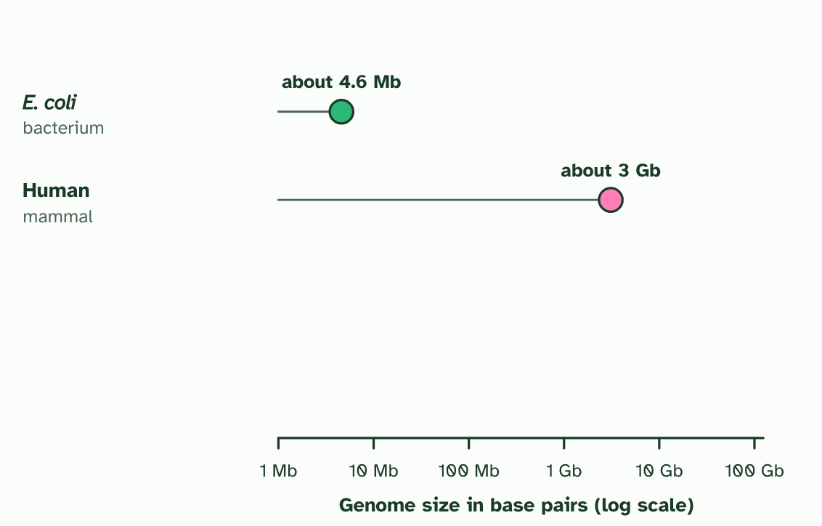
CHAPTER 7 · A3.1.10 Comparing genome sizes
1 / 3
Big genome, small organism
A bacterium’s genome is millions of base pairs. A human’s is about three billion. (Mb is millions, Gb billions of base pairs.)
Minutes 18 to 40
Notes:
Minutes 18 to 40 of 60: Order the genomes (22 min).
The plan: Eight minutes on the genome-size order activity below, then reveal with chapter 7’s figure. Fourteen minutes in the dry lab: students look up ten organisms, plot genome size against group, switch to gene count, and judge the four statements. Chapter 7’s predict box comes after.
A genome’s size is the total amount of DNA, counted in base pairs. A bacterium such as E. coli has a few million. A human has about three billion. You might expect more complex organisms to need more DNA, and the figure shows why that fails.
The Australian lungfish has a genome more than ten times as large as ours, and the flowering plant Paris japonica nearly fifty times. Neither is the most complex organism alive. Genome size is not a valid measure of how complex an organism is.
Why? A bigger genome does not always hold more genes. Much of the extra DNA does not code for a protein. It lies between genes, or is short sequences repeated many times. Some plants have also copied whole sets of chromosomes, which adds copies of the same genes and multiplies their DNA.
In the dry lab you will do what scientists do with a genome database: pick groups of organisms, find the genome sizes, and compare them with how complex the organisms are.

Slide 14
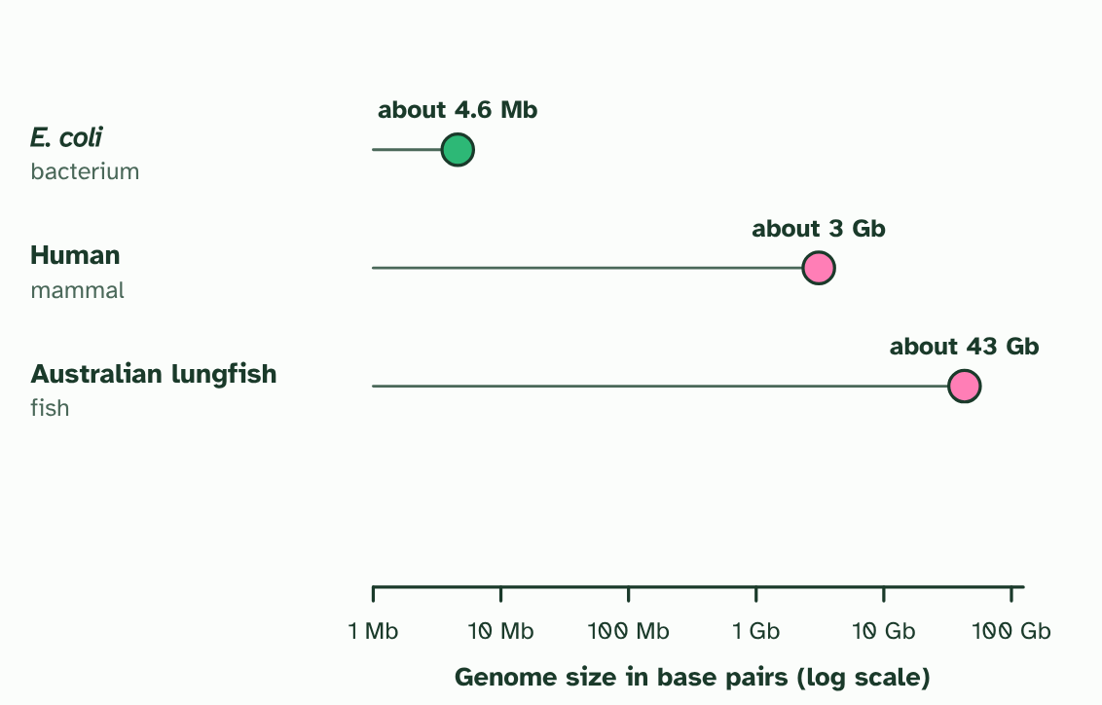
CHAPTER 7 · A3.1.10 Comparing genome sizes
2 / 3
Big genome, small organism
The Australian lungfish’s genome is more than ten times a human’s.
Minutes 18 to 40
Notes:
Minutes 18 to 40 of 60: Order the genomes (22 min).
The plan: Eight minutes on the genome-size order activity below, then reveal with chapter 7’s figure. Fourteen minutes in the dry lab: students look up ten organisms, plot genome size against group, switch to gene count, and judge the four statements. Chapter 7’s predict box comes after.
A genome’s size is the total amount of DNA, counted in base pairs. A bacterium such as E. coli has a few million. A human has about three billion. You might expect more complex organisms to need more DNA, and the figure shows why that fails.
The Australian lungfish has a genome more than ten times as large as ours, and the flowering plant Paris japonica nearly fifty times. Neither is the most complex organism alive. Genome size is not a valid measure of how complex an organism is.
Why? A bigger genome does not always hold more genes. Much of the extra DNA does not code for a protein. It lies between genes, or is short sequences repeated many times. Some plants have also copied whole sets of chromosomes, which adds copies of the same genes and multiplies their DNA.
In the dry lab you will do what scientists do with a genome database: pick groups of organisms, find the genome sizes, and compare them with how complex the organisms are.

Slide 15
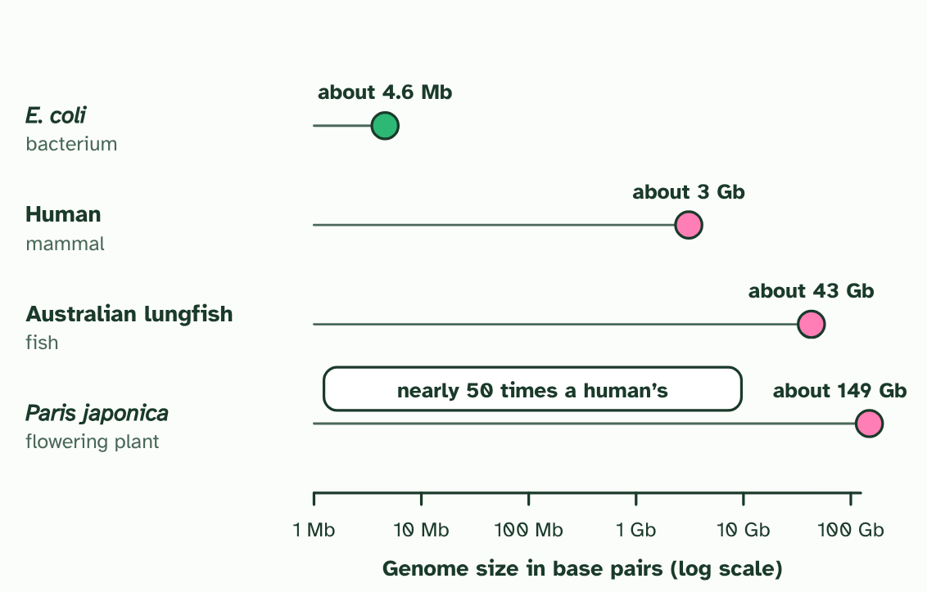
CHAPTER 7 · A3.1.10 Comparing genome sizes
3 / 3
Big genome, small organism
The flowering plant Paris japonica has one of the biggest genomes known. Size is not a measure of how complex an organism is.
Minutes 18 to 40
Notes:
Minutes 18 to 40 of 60: Order the genomes (22 min).
The plan: Eight minutes on the genome-size order activity below, then reveal with chapter 7’s figure. Fourteen minutes in the dry lab: students look up ten organisms, plot genome size against group, switch to gene count, and judge the four statements. Chapter 7’s predict box comes after.
A genome’s size is the total amount of DNA, counted in base pairs. A bacterium such as E. coli has a few million. A human has about three billion. You might expect more complex organisms to need more DNA, and the figure shows why that fails.
The Australian lungfish has a genome more than ten times as large as ours, and the flowering plant Paris japonica nearly fifty times. Neither is the most complex organism alive. Genome size is not a valid measure of how complex an organism is.
Why? A bigger genome does not always hold more genes. Much of the extra DNA does not code for a protein. It lies between genes, or is short sequences repeated many times. Some plants have also copied whole sets of chromosomes, which adds copies of the same genes and multiplies their DNA.
In the dry lab you will do what scientists do with a genome database: pick groups of organisms, find the genome sizes, and compare them with how complex the organisms are.

Slide 16
CHAPTER 7 · A3.1.10 Comparing genome sizes
Big genome, small organism
Genome size varies enormously between groups of organisms.
Genome size is not a measure of complexity: much DNA is non-coding or repeated.
Minutes 18 to 40
Notes:
Minutes 18 to 40 of 60: Order the genomes (22 min).
The plan: Eight minutes on the genome-size order activity below, then reveal with chapter 7’s figure. Fourteen minutes in the dry lab: students look up ten organisms, plot genome size against group, switch to gene count, and judge the four statements. Chapter 7’s predict box comes after.
A genome’s size is the total amount of DNA, counted in base pairs. A bacterium such as E. coli has a few million. A human has about three billion. You might expect more complex organisms to need more DNA, and the figure shows why that fails.
The Australian lungfish has a genome more than ten times as large as ours, and the flowering plant Paris japonica nearly fifty times. Neither is the most complex organism alive. Genome size is not a valid measure of how complex an organism is.
Why? A bigger genome does not always hold more genes. Much of the extra DNA does not code for a protein. It lies between genes, or is short sequences repeated many times. Some plants have also copied whole sets of chromosomes, which adds copies of the same genes and multiplies their DNA.
In the dry lab you will do what scientists do with a genome database: pick groups of organisms, find the genome sizes, and compare them with how complex the organisms are.

Slide 17
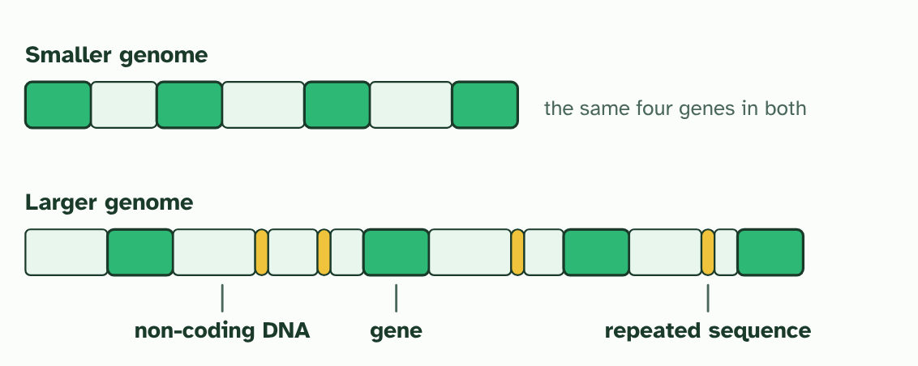
CHAPTER 7 · A3.1.10 Comparing genome sizes
Big genome, small organism
Genome size varies enormously between groups of organisms.
Genome size is not a measure of complexity: much DNA is non-coding or repeated.
Minutes 18 to 40
Notes:
Minutes 18 to 40 of 60: Order the genomes (22 min).
The plan: Eight minutes on the genome-size order activity below, then reveal with chapter 7’s figure. Fourteen minutes in the dry lab: students look up ten organisms, plot genome size against group, switch to gene count, and judge the four statements. Chapter 7’s predict box comes after.
A genome’s size is the total amount of DNA, counted in base pairs. A bacterium such as E. coli has a few million. A human has about three billion. You might expect more complex organisms to need more DNA, and the figure shows why that fails.
The Australian lungfish has a genome more than ten times as large as ours, and the flowering plant Paris japonica nearly fifty times. Neither is the most complex organism alive. Genome size is not a valid measure of how complex an organism is.
Why? A bigger genome does not always hold more genes. Much of the extra DNA does not code for a protein. It lies between genes, or is short sequences repeated many times. Some plants have also copied whole sets of chromosomes, which adds copies of the same genes and multiplies their DNA.
In the dry lab you will do what scientists do with a genome database: pick groups of organisms, find the genome sizes, and compare them with how complex the organisms are.

Slide 18
WATCH OUT
A bigger genome is not a more advanced one. When you see a big number, ask what the DNA is made of, and count genes if you can, not just base pairs.
Minutes 18 to 40
Notes:
Minutes 18 to 40 of 60: Order the genomes (22 min).
The plan: Eight minutes on the genome-size order activity below, then reveal with chapter 7’s figure. Fourteen minutes in the dry lab: students look up ten organisms, plot genome size against group, switch to gene count, and judge the four statements. Chapter 7’s predict box comes after.
A common mistake: say it, then ask who can say why it is wrong.

Slide 19
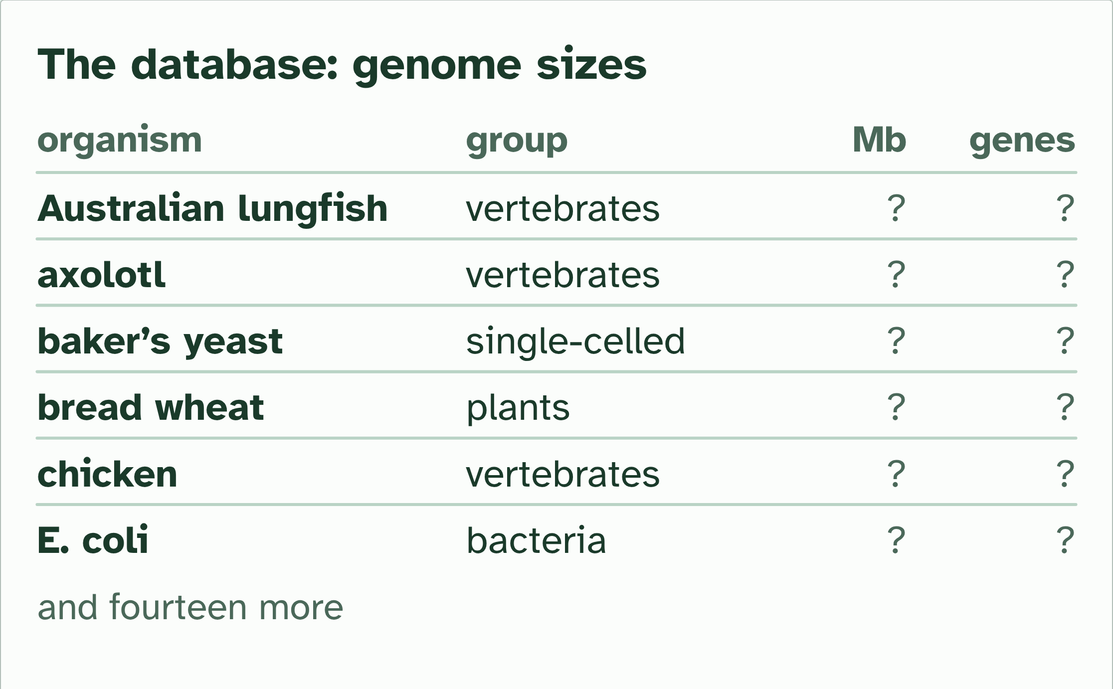
DRY LAB
Genome size explorer
Your question: Does a bigger genome mean a more complex organism, or even more genes? What does the pattern look like inside one group, and between groups?
What you can change: Which organisms you look up (twenty are in the database, in five groups), whether the graph plots genome size against group or against gene count, and which two organisms you compare side by side.
What to record: For each organism you look up: its group, genome size and gene count. After at least ten, note the pattern, the organisms that break it, and your judgement on the four statements. Write a one-sentence conclusion that names two organisms as evidence.
Run it: biologybybradford.com/guides/ib-biology-a3-1-diversity-of-organisms#lab
Minutes 18 to 40
Notes:
Minutes 18 to 40 of 60: Order the genomes (22 min).
The plan: Eight minutes on the genome-size order activity below, then reveal with chapter 7’s figure. Fourteen minutes in the dry lab: students look up ten organisms, plot genome size against group, switch to gene count, and judge the four statements. Chapter 7’s predict box comes after.
The dry lab runs in the guide: https://www.biologybybradford.com/guides/ib-biology-a3-1-diversity-of-organisms#lab

Slide 20
PREDICT
A student says: “The organism with the biggest genome must be the most complex.” Which fact shows this is wrong?
A A fish and a flowering plant have genomes bigger than ours
B Humans have the biggest genome of any organism measured so far, by far
C Bacteria have no DNA, so size cannot be compared at all
Minutes 18 to 40
Notes:
Minutes 18 to 40 of 60: Order the genomes (22 min).
The plan: Eight minutes on the genome-size order activity below, then reveal with chapter 7’s figure. Fourteen minutes in the dry lab: students look up ten organisms, plot genome size against group, switch to gene count, and judge the four statements. Chapter 7’s predict box comes after.
Ask for a show of hands, or mini whiteboards, before revealing. (Answer: A, on the next slide.)

Slide 21
WHAT HAPPENS
A student says: “The organism with the biggest genome must be the most complex.” Which fact shows this is wrong?
A A fish and a flowering plant have genomes bigger than ours
B Humans have the biggest genome of any organism measured so far, by far
C Bacteria have no DNA, so size cannot be compared at all
A fish and a flowering plant have genomes bigger than ours, and neither is more complex than a human. If size measured complexity, a lungfish would beat a mammal. The extra DNA is mostly non-coding or repeated.
Minutes 18 to 40
Notes:
Minutes 18 to 40 of 60: Order the genomes (22 min).
The plan: Eight minutes on the genome-size order activity below, then reveal with chapter 7’s figure. Fourteen minutes in the dry lab: students look up ten organisms, plot genome size against group, switch to gene count, and judge the four statements. Chapter 7’s predict box comes after.
Answer: A. A fish and a flowering plant have genomes bigger than ours, and neither is more complex than a human. If size measured complexity, a lungfish would beat a mammal. The extra DNA is mostly non-coding or repeated.

Slide 22
STEP 4
12 MIN
Reading a whole genome
Then a two-minute talk with a partner: who should be allowed to see your genome, and why?
Minutes 40 to 52
Notes:
Minutes 40 to 52 of 60: Reading a whole genome (12 min).
The plan: Chapter 8’s figure: the falling cost and the two uses. Then a two-minute talk with a partner: who should be allowed to see your genome, and why? Collect three views. Land on the guide’s uses: evolutionary relationships now, personalised medicine in the future.

Slide 23
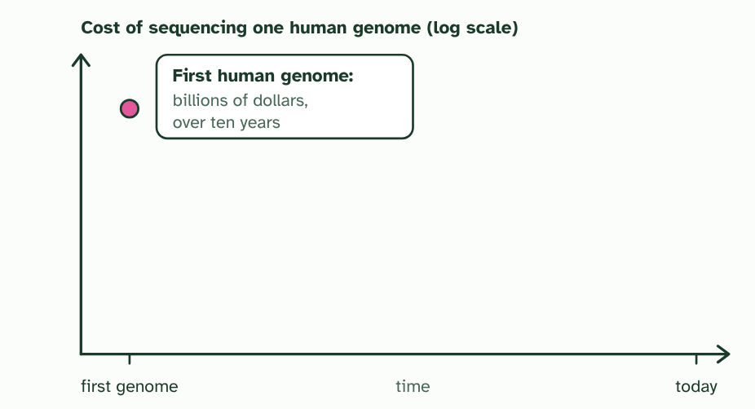
CHAPTER 8 · A3.1.11 Whole genome sequencing
1 / 3
Reading a whole genome
The first human genome was a huge international effort: years of work and billions of dollars.
Minutes 40 to 52
Notes:
Minutes 40 to 52 of 60: Reading a whole genome (12 min).
The plan: Chapter 8’s figure: the falling cost and the two uses. Then a two-minute talk with a partner: who should be allowed to see your genome, and why? Collect three views. Land on the guide’s uses: evolutionary relationships now, personalised medicine in the future.
Whole genome sequencing reads the order of every base in an organism’s genome. The first human genome took an international project more than ten years and billions of dollars. Machines have improved so much that a genome can now be read in days, for a small fraction of the cost.
Faster and cheaper sequencing matters because it brings genomes within reach of ordinary research. Today, comparing whole genomes of different species shows how closely related they are and which changes separated their lines. Genomes read from ancient remains have been compared with ours in this way.
In the future, a doctor may use a patient’s own genome to choose the medicine and dose most likely to work for them: personalised medicine. A genome can also reveal SNPs that raise the risk of a disease, so that it can be watched for or prevented.

Slide 24
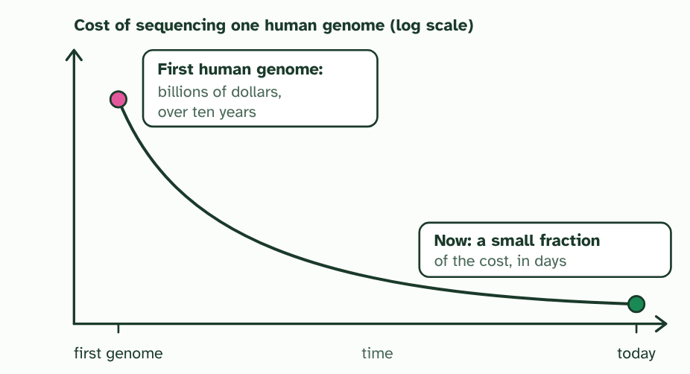
CHAPTER 8 · A3.1.11 Whole genome sequencing
2 / 3
Reading a whole genome
Sequencing machines improved, and the cost and the time fell steeply. (The shape is drawn to show the trend, not exact values.)
Minutes 40 to 52
Notes:
Minutes 40 to 52 of 60: Reading a whole genome (12 min).
The plan: Chapter 8’s figure: the falling cost and the two uses. Then a two-minute talk with a partner: who should be allowed to see your genome, and why? Collect three views. Land on the guide’s uses: evolutionary relationships now, personalised medicine in the future.
Whole genome sequencing reads the order of every base in an organism’s genome. The first human genome took an international project more than ten years and billions of dollars. Machines have improved so much that a genome can now be read in days, for a small fraction of the cost.
Faster and cheaper sequencing matters because it brings genomes within reach of ordinary research. Today, comparing whole genomes of different species shows how closely related they are and which changes separated their lines. Genomes read from ancient remains have been compared with ours in this way.
In the future, a doctor may use a patient’s own genome to choose the medicine and dose most likely to work for them: personalised medicine. A genome can also reveal SNPs that raise the risk of a disease, so that it can be watched for or prevented.

Slide 25
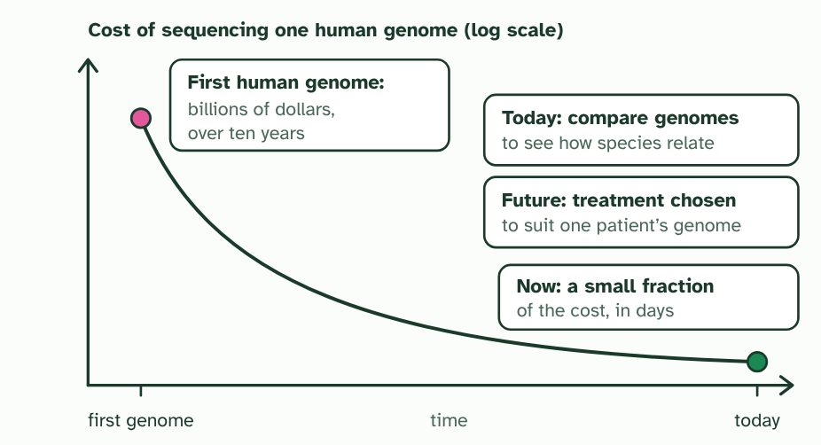
CHAPTER 8 · A3.1.11 Whole genome sequencing
3 / 3
Reading a whole genome
Cheap, fast genomes bring uses within reach: comparing species now, and personalised medicine in the future.
Minutes 40 to 52
Notes:
Minutes 40 to 52 of 60: Reading a whole genome (12 min).
The plan: Chapter 8’s figure: the falling cost and the two uses. Then a two-minute talk with a partner: who should be allowed to see your genome, and why? Collect three views. Land on the guide’s uses: evolutionary relationships now, personalised medicine in the future.
Whole genome sequencing reads the order of every base in an organism’s genome. The first human genome took an international project more than ten years and billions of dollars. Machines have improved so much that a genome can now be read in days, for a small fraction of the cost.
Faster and cheaper sequencing matters because it brings genomes within reach of ordinary research. Today, comparing whole genomes of different species shows how closely related they are and which changes separated their lines. Genomes read from ancient remains have been compared with ours in this way.
In the future, a doctor may use a patient’s own genome to choose the medicine and dose most likely to work for them: personalised medicine. A genome can also reveal SNPs that raise the risk of a disease, so that it can be watched for or prevented.

Slide 26
CHAPTER 8 · A3.1.11 Whole genome sequencing
Reading a whole genome
Whole genome sequencing is getting faster and cheaper.
Current use: research into evolutionary relationships. Future use: personalised medicine.
Minutes 40 to 52
Notes:
Minutes 40 to 52 of 60: Reading a whole genome (12 min).
The plan: Chapter 8’s figure: the falling cost and the two uses. Then a two-minute talk with a partner: who should be allowed to see your genome, and why? Collect three views. Land on the guide’s uses: evolutionary relationships now, personalised medicine in the future.
Whole genome sequencing reads the order of every base in an organism’s genome. The first human genome took an international project more than ten years and billions of dollars. Machines have improved so much that a genome can now be read in days, for a small fraction of the cost.
Faster and cheaper sequencing matters because it brings genomes within reach of ordinary research. Today, comparing whole genomes of different species shows how closely related they are and which changes separated their lines. Genomes read from ancient remains have been compared with ours in this way.
In the future, a doctor may use a patient’s own genome to choose the medicine and dose most likely to work for them: personalised medicine. A genome can also reveal SNPs that raise the risk of a disease, so that it can be watched for or prevented.

Slide 27
PREDICT
How has the cost of sequencing a human genome changed since the first one was done?
A It has hardly changed: sequencing is still a huge, slow project
B It has risen, because genomes now need much dearer machines
C It has fallen steeply, and sequencing has become far faster
Minutes 40 to 52
Notes:
Minutes 40 to 52 of 60: Reading a whole genome (12 min).
The plan: Chapter 8’s figure: the falling cost and the two uses. Then a two-minute talk with a partner: who should be allowed to see your genome, and why? Collect three views. Land on the guide’s uses: evolutionary relationships now, personalised medicine in the future.
Ask for a show of hands, or mini whiteboards, before revealing. (Answer: C, on the next slide.)

Slide 28
WHAT HAPPENS
How has the cost of sequencing a human genome changed since the first one was done?
A It has hardly changed: sequencing is still a huge, slow project
B It has risen, because genomes now need much dearer machines
C It has fallen steeply, and sequencing has become far faster
It has fallen steeply, and the time has fallen too, from years to days. That is why genome sequencing has moved from a few big projects to something used across research and medicine.
Minutes 40 to 52
Notes:
Minutes 40 to 52 of 60: Reading a whole genome (12 min).
The plan: Chapter 8’s figure: the falling cost and the two uses. Then a two-minute talk with a partner: who should be allowed to see your genome, and why? Collect three views. Land on the guide’s uses: evolutionary relationships now, personalised medicine in the future.
Answer: C. It has fallen steeply, and the time has fallen too, from years to days. That is why genome sequencing has moved from a few big projects to something used across research and medicine.

Slide 29
WATCH OUT
A genome is a text, not an explanation. Reading every base does not tell you what every gene does, and a genome does not fix your future: many traits depend on the environment too. It also raises questions of privacy. Who should be allowed to see yours?
Minutes 40 to 52
Notes:
Minutes 40 to 52 of 60: Reading a whole genome (12 min).
The plan: Chapter 8’s figure: the falling cost and the two uses. Then a two-minute talk with a partner: who should be allowed to see your genome, and why? Collect three views. Land on the guide’s uses: evolutionary relationships now, personalised medicine in the future.
A common mistake: say it, then ask who can say why it is wrong.

Slide 30
PLENARY
Can you now...
Describe a genome, how SNPs give diversity within a species, and why variation between species is much larger (A3.1.8, A3.1.9)
Compare genome sizes of different groups from a database and judge whether size measures complexity (A3.1.10)
Describe how whole genome sequencing has become faster and cheaper, and give current and future uses (A3.1.11)
Minutes 52 to 60
Notes:
Minutes 52 to 60 of 60: Exit: size and complexity (8 min).
The plan: Using two organisms from the dry lab as evidence, explain in two sentences why genome size is not a measure of complexity. Check chapter 7’s second figure for the reason: non-coding and repeated DNA.
Thumbs up, sideways or down on each goal before the exit question. The goals come from the statements this lesson covers.

Slide 31
EXIT QUESTION
Size and complexity
Using two organisms from the dry lab as evidence, explain in two sentences why genome size is not a measure of complexity.
Minutes 52 to 60
Notes:
Minutes 52 to 60 of 60: Exit: size and complexity (8 min).
The plan: Using two organisms from the dry lab as evidence, explain in two sentences why genome size is not a measure of complexity. Check chapter 7’s second figure for the reason: non-coding and repeated DNA.

Slide 32
PRACTISE AND REVISE
Keep going
Exam practice: a fresh paper of exam questions on A3.1 at standard level, marked as you go
The guide, with the animations and the dry lab
This lesson in the guide: 6 One genome, many versions, 7 Big genome, small organism, 8 Reading a whole genome, the dry lab
BUILD FOR YOUR CLASS
ALREADY ON THE SITE FOR A3.1
CARD SETS ON SPLYCR
Tarsia puzzle, dominoes and picture reveal on A3.1, built from its key terms and ready to print
A pub quiz with rounds on A3.1, to present or run with no projector
An escape room built from the question bank on A3.1
Quiz: Diversity of Organisms
Revision map: A3.1 Diversity of organisms, to fill in
Exam questions: A3.1 in the exam maker, a paper with its markscheme
Open a set to host it as a class game, or make a copy to edit.
A3.1 Diversity of Organisms
How this was made. The course structure, the activities and the teaching choices come from my own classroom, my presentations and my years of teaching IB and AP Biology. I use Claude, an AI, to help write and build the interactive guides, lesson plans, slides and practice questions, and to draw the diagrams and code the interactives. I direct the work and review it against the IB and AP specifications before it goes live.
Minute 60: after the lesson
Notes:
Every link here is live. Set the exam practice paper for homework: it is fresh each time, marked as students go and saved to their Exam practice when they are signed in.
Exam practice: https://www.biologybybradford.com/exam-maker/sit?topics=A3.1&level=SL&paper=quiz&marks=15&src=ep
The guide: https://www.biologybybradford.com/guides/ib-biology-a3-1-diversity-of-organisms

