Slide 1
IB Biology A3.1
LESSON 4 OF 5
HL
BY THE END YOU CAN
Diversity of organisms
Explain why the biological species concept fails for asexual species and for bacteria that pass genes sideways (A3.1.12)
Explain why parents with different chromosome numbers are unlikely to have fertile offspring (A3.1.13)
When the species rule breaks
A3.1.12, A3.1.13
Asexual species, horizontal gene transfer, and why different chromosome numbers make hybrids infertile
60 minutes · chapters 9, 10
Minute 0
Notes:
IB Biology A3.1, Diversity of organisms. Lesson 4 of 5: When the species rule breaks (higher level), 60 minutes.
The plan, minute by minute (each slide's footer says where you are):
0 to 6 min (6) Do now: can a bacterium be a species?
6 to 20 min (14) Copying and sideways
20 to 30 min (10) Where the species concept struggles
30 to 50 min (20) Paper chromosomes
50 to 60 min (10) Exam question and exit
What students get wrong:
Horizontal gene transfer is bacterial reproduction. Reproduction makes a new cell. Horizontal transfer moves genes between living cells, even of different species.
The hybrid has its parents’ chromosome numbers added. It has the two gametes’ numbers added: 32 + 31 = 63 for the mule, not 64 + 62.
Stretch and support:
Support: give the captions of each figure as a cut-up storyboard to put in order, and use the key terms (tap the dotted words) as a glossary.
Support: the three Remember it sets (Green Sloths Inch Along; Five Apes Hug Grumpy Aunts Happily; Cats Eat Any Sausage, Mostly) as a starter or an exit.
Stretch: why is a change in chromosome number a more usual way to make a new species in plants than in animals? Link it to polyploidy in A4.1.
The lesson plan to print: https://www.biologybybradford.com/guides/downloads/ib-biology-a3-1-diversity-of-organisms-lesson-4-plan.pdf

Slide 2
DO NOW
Can a bacterium be a species?
Ask: “Can you test two bacteria for fertile offspring?”
Pairs write what stops them.
6:00
minutes
Start now: the timer is running.
Minutes 0 to 6
Notes:
Minutes 0 to 6 of 60: Do now: can a bacterium be a species? (6 min).
The plan: Ask: “Can you test two bacteria for fertile offspring?” Pairs write what stops them. Take answers, and keep the words partner, clone and plasmid on the board for the next step.
Start a 6 minute timer as they come in.

Slide 3
STEP 2
14 MIN
Copying and sideways
Chapter 9: When the species rule breaks
Role play: Pass the plasmid
Minutes 6 to 20
Notes:
Minutes 6 to 20 of 60: Copying and sideways (14 min).
The plan: Chapter 9’s figure, step by step: binary fission, then conjugation. Run the pass the plasmid role play below for six minutes. Then chapter 9’s predict box. Land on horizontal gene transfer as a way for genes to cross a species line without any offspring.

Slide 4
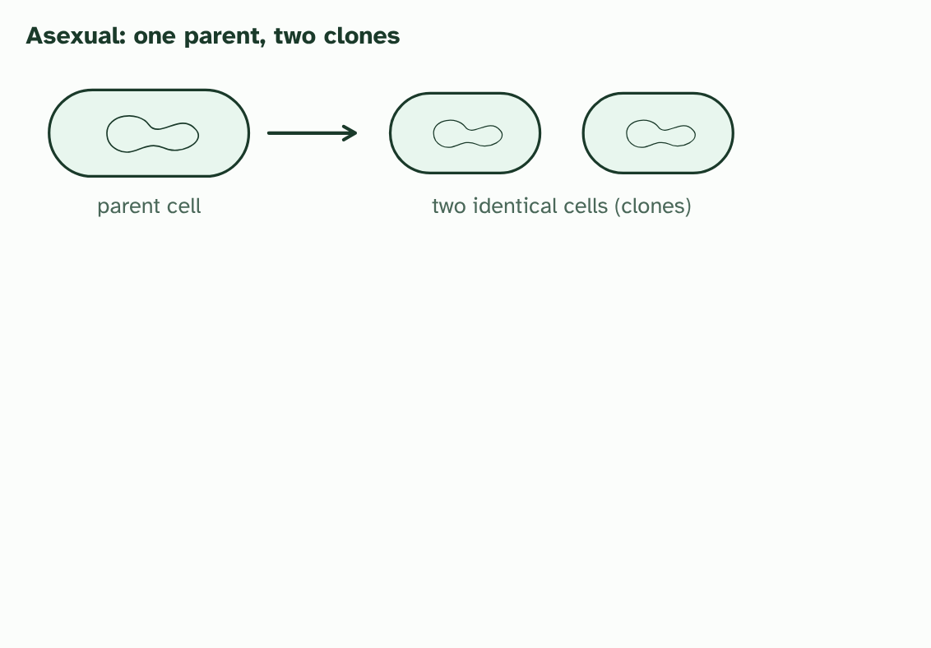
CHAPTER 9 · A3.1.12 Asexual species and horizontal gene transfer
1 / 4
When the species rule breaks
A bacterium reproduces by copying itself: two identical cells, with no partner and nothing to test.
Minutes 6 to 20
Notes:
Minutes 6 to 20 of 60: Copying and sideways (14 min).
The plan: Chapter 9’s figure, step by step: binary fission, then conjugation. Run the pass the plasmid role play below for six minutes. Then chapter 9’s predict box. Land on horizontal gene transfer as a way for genes to cross a species line without any offspring.
The biological species concept needs breeding. But a great many organisms never breed with a partner. A bacterium reproduces by splitting in two, and each new cell is a copy of the first. There are no matings to watch and no offspring that are anything but clones, so the question “can they produce fertile offspring?” has no answer. Some plants, fungi and animals reproduce asexually too. Biologists group these organisms in other ways: by shape and structure, by how they get their energy and, increasingly, by how alike their DNA is.
Bacteria add a second problem. Genes normally pass down from parent to offspring. In horizontal gene transfer they pass sideways, between cells that are already alive. In conjugation two bacteria touch and a copy of a plasmid passes across. Cells can also take up DNA from their surroundings or receive it from a virus. A gene can even cross from one species to another, which is one reason antibiotic resistance spreads so fast.
A species concept that assumes genes stay inside one species’ gene pool breaks down when genes jump between species, so it does not work well for these organisms.

Slide 5
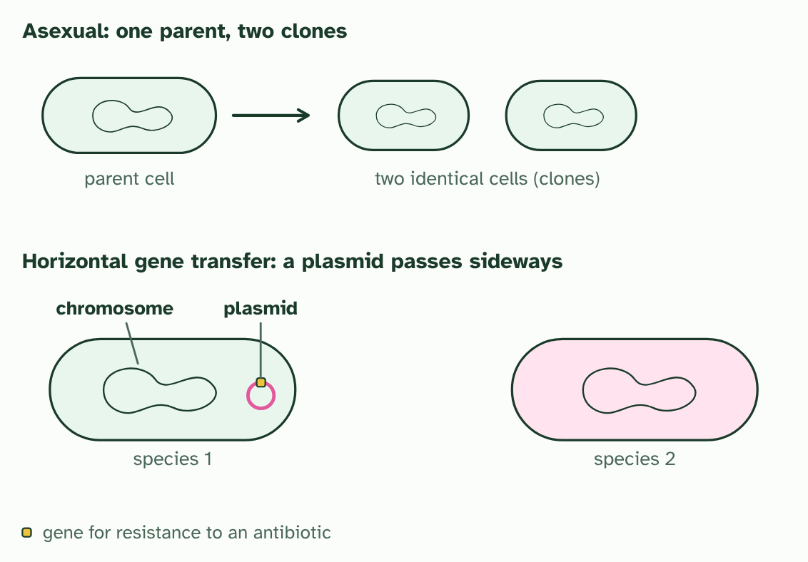
CHAPTER 9 · A3.1.12 Asexual species and horizontal gene transfer
2 / 4
When the species rule breaks
Two bacteria of different species. One carries a plasmid, a small ring of DNA, with a gene on it.
Minutes 6 to 20
Notes:
Minutes 6 to 20 of 60: Copying and sideways (14 min).
The plan: Chapter 9’s figure, step by step: binary fission, then conjugation. Run the pass the plasmid role play below for six minutes. Then chapter 9’s predict box. Land on horizontal gene transfer as a way for genes to cross a species line without any offspring.
The biological species concept needs breeding. But a great many organisms never breed with a partner. A bacterium reproduces by splitting in two, and each new cell is a copy of the first. There are no matings to watch and no offspring that are anything but clones, so the question “can they produce fertile offspring?” has no answer. Some plants, fungi and animals reproduce asexually too. Biologists group these organisms in other ways: by shape and structure, by how they get their energy and, increasingly, by how alike their DNA is.
Bacteria add a second problem. Genes normally pass down from parent to offspring. In horizontal gene transfer they pass sideways, between cells that are already alive. In conjugation two bacteria touch and a copy of a plasmid passes across. Cells can also take up DNA from their surroundings or receive it from a virus. A gene can even cross from one species to another, which is one reason antibiotic resistance spreads so fast.
A species concept that assumes genes stay inside one species’ gene pool breaks down when genes jump between species, so it does not work well for these organisms.

Slide 6
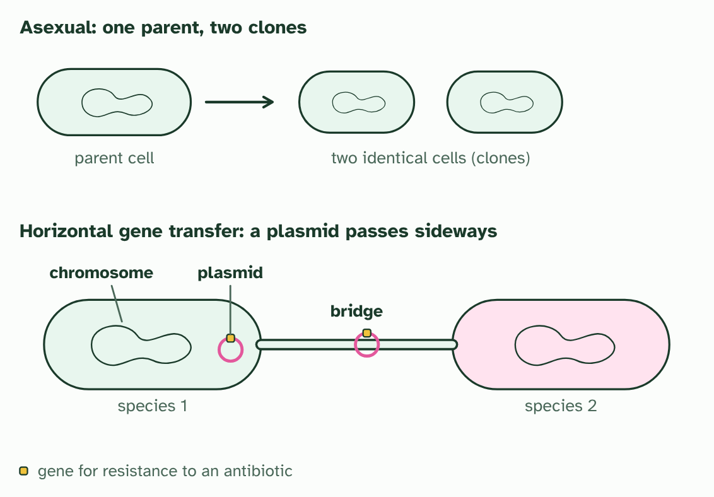
CHAPTER 9 · A3.1.12 Asexual species and horizontal gene transfer
3 / 4
When the species rule breaks
The cells touch and a bridge forms. A copy of the plasmid passes across.
Minutes 6 to 20
Notes:
Minutes 6 to 20 of 60: Copying and sideways (14 min).
The plan: Chapter 9’s figure, step by step: binary fission, then conjugation. Run the pass the plasmid role play below for six minutes. Then chapter 9’s predict box. Land on horizontal gene transfer as a way for genes to cross a species line without any offspring.
The biological species concept needs breeding. But a great many organisms never breed with a partner. A bacterium reproduces by splitting in two, and each new cell is a copy of the first. There are no matings to watch and no offspring that are anything but clones, so the question “can they produce fertile offspring?” has no answer. Some plants, fungi and animals reproduce asexually too. Biologists group these organisms in other ways: by shape and structure, by how they get their energy and, increasingly, by how alike their DNA is.
Bacteria add a second problem. Genes normally pass down from parent to offspring. In horizontal gene transfer they pass sideways, between cells that are already alive. In conjugation two bacteria touch and a copy of a plasmid passes across. Cells can also take up DNA from their surroundings or receive it from a virus. A gene can even cross from one species to another, which is one reason antibiotic resistance spreads so fast.
A species concept that assumes genes stay inside one species’ gene pool breaks down when genes jump between species, so it does not work well for these organisms.

Slide 7
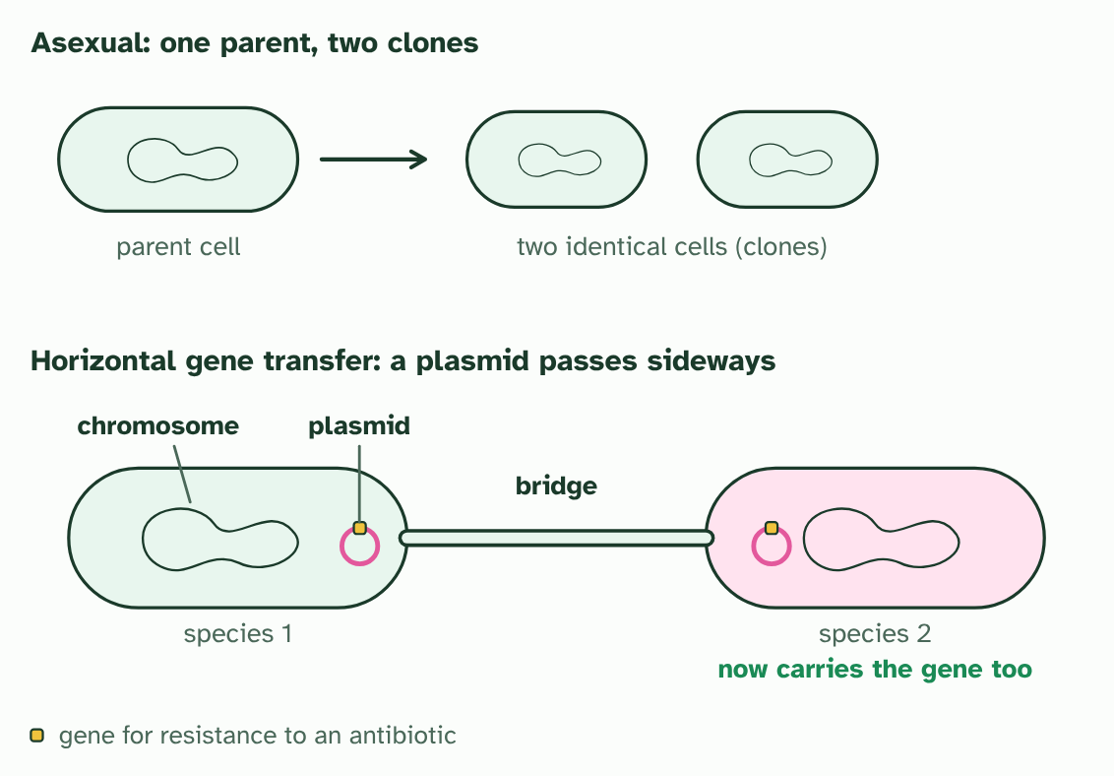
CHAPTER 9 · A3.1.12 Asexual species and horizontal gene transfer
4 / 4
When the species rule breaks
The second species now has the gene. No new cell was made: the gene moved sideways.
Minutes 6 to 20
Notes:
Minutes 6 to 20 of 60: Copying and sideways (14 min).
The plan: Chapter 9’s figure, step by step: binary fission, then conjugation. Run the pass the plasmid role play below for six minutes. Then chapter 9’s predict box. Land on horizontal gene transfer as a way for genes to cross a species line without any offspring.
The biological species concept needs breeding. But a great many organisms never breed with a partner. A bacterium reproduces by splitting in two, and each new cell is a copy of the first. There are no matings to watch and no offspring that are anything but clones, so the question “can they produce fertile offspring?” has no answer. Some plants, fungi and animals reproduce asexually too. Biologists group these organisms in other ways: by shape and structure, by how they get their energy and, increasingly, by how alike their DNA is.
Bacteria add a second problem. Genes normally pass down from parent to offspring. In horizontal gene transfer they pass sideways, between cells that are already alive. In conjugation two bacteria touch and a copy of a plasmid passes across. Cells can also take up DNA from their surroundings or receive it from a virus. A gene can even cross from one species to another, which is one reason antibiotic resistance spreads so fast.
A species concept that assumes genes stay inside one species’ gene pool breaks down when genes jump between species, so it does not work well for these organisms.

Slide 8
CHAPTER 9 · A3.1.12 Asexual species and horizontal gene transfer
When the species rule breaks
The biological species concept fits poorly where organisms reproduce asexually.
Horizontal gene transfer moves genes between species, so gene pools are not closed.
Minutes 6 to 20
Notes:
Minutes 6 to 20 of 60: Copying and sideways (14 min).
The plan: Chapter 9’s figure, step by step: binary fission, then conjugation. Run the pass the plasmid role play below for six minutes. Then chapter 9’s predict box. Land on horizontal gene transfer as a way for genes to cross a species line without any offspring.
The biological species concept needs breeding. But a great many organisms never breed with a partner. A bacterium reproduces by splitting in two, and each new cell is a copy of the first. There are no matings to watch and no offspring that are anything but clones, so the question “can they produce fertile offspring?” has no answer. Some plants, fungi and animals reproduce asexually too. Biologists group these organisms in other ways: by shape and structure, by how they get their energy and, increasingly, by how alike their DNA is.
Bacteria add a second problem. Genes normally pass down from parent to offspring. In horizontal gene transfer they pass sideways, between cells that are already alive. In conjugation two bacteria touch and a copy of a plasmid passes across. Cells can also take up DNA from their surroundings or receive it from a virus. A gene can even cross from one species to another, which is one reason antibiotic resistance spreads so fast.
A species concept that assumes genes stay inside one species’ gene pool breaks down when genes jump between species, so it does not work well for these organisms.

Slide 9
WATCH OUT
Horizontal gene transfer is not reproduction: no new cell is made. And asexual does not mean unclassifiable. Bacteria and other asexual organisms still fall into recognisable groups, just not groups defined by breeding.
Minutes 6 to 20
Notes:
Minutes 6 to 20 of 60: Copying and sideways (14 min).
The plan: Chapter 9’s figure, step by step: binary fission, then conjugation. Run the pass the plasmid role play below for six minutes. Then chapter 9’s predict box. Land on horizontal gene transfer as a way for genes to cross a species line without any offspring.
A common mistake: say it, then ask who can say why it is wrong.

Slide 10
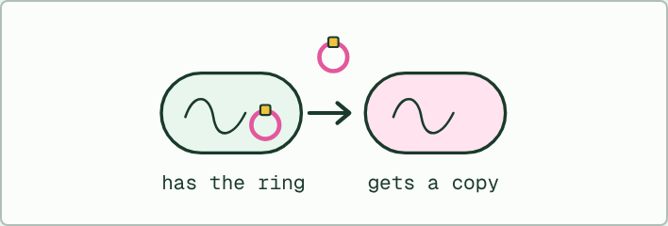
ROLE PLAY · HL
14 MIN
Pass the plasmid
THE TASK
Six students are bacteria. Each holds a card for its species. One holds a paper ring with a coloured sticker (a plasmid with a resistance gene). Cells that touch can pass a copy of the ring by making a second ring on the spot. After two rounds, count the cells holding the ring and ask which species they belong to. Then ask how the species concept would classify them.
STUDENTS NEED
Six species cards, paper rings, stickers, sticky tape.
Minutes 6 to 20
Notes:
Minutes 6 to 20 of 60: Copying and sideways (14 min).
The plan: Chapter 9’s figure, step by step: binary fission, then conjugation. Run the pass the plasmid role play below for six minutes. Then chapter 9’s predict box. Land on horizontal gene transfer as a way for genes to cross a species line without any offspring.
The activity: Pass the plasmid. Six students are bacteria. Each holds a card for its species. One holds a paper ring with a coloured sticker (a plasmid with a resistance gene). Cells that touch can pass a copy of the ring by making a second ring on the spot. After two rounds, count the cells holding the ring and ask which species they belong to. Then ask how the species concept would classify them.
Needs: six species cards, paper rings, stickers, sticky tape.
The time: 14 minutes, minutes 6 to 20 of the plan.

Slide 11
PREDICT
A bacterium carries a plasmid with an antibiotic-resistance gene. It touches a bacterium of a different species. What can happen?
A Nothing can happen, because genes pass only from parent to offspring
B A copy of the plasmid can pass across with no cell dividing
C The two cells fuse into one new cell, which then divides in two
Minutes 6 to 20
Notes:
Minutes 6 to 20 of 60: Copying and sideways (14 min).
The plan: Chapter 9’s figure, step by step: binary fission, then conjugation. Run the pass the plasmid role play below for six minutes. Then chapter 9’s predict box. Land on horizontal gene transfer as a way for genes to cross a species line without any offspring.
Ask for a show of hands, or mini whiteboards, before revealing. (Answer: B, on the next slide.)

Slide 12
WHAT HAPPENS
A bacterium carries a plasmid with an antibiotic-resistance gene. It touches a bacterium of a different species. What can happen?
A Nothing can happen, because genes pass only from parent to offspring
B A copy of the plasmid can pass across with no cell dividing
C The two cells fuse into one new cell, which then divides in two
A copy of the plasmid can pass across. This is horizontal gene transfer: the second bacterium now has the gene without being anyone’s offspring, and the gene has crossed a species line.
Minutes 6 to 20
Notes:
Minutes 6 to 20 of 60: Copying and sideways (14 min).
The plan: Chapter 9’s figure, step by step: binary fission, then conjugation. Run the pass the plasmid role play below for six minutes. Then chapter 9’s predict box. Land on horizontal gene transfer as a way for genes to cross a species line without any offspring.
Answer: B. A copy of the plasmid can pass across. This is horizontal gene transfer: the second bacterium now has the gene without being anyone’s offspring, and the gene has crossed a species line.

Slide 13
STEP 3
10 MIN
Where the species concept struggles
Turn over chapter 9’s Remember it tiles.
In groups, students give one example for each of the six.
Minutes 20 to 30
Notes:
Minutes 20 to 30 of 60: Where the species concept struggles (10 min).
The plan: Turn over chapter 9’s Remember it tiles. In groups, students give one example for each of the six: fossils, populations apart, hybrids, gradual change, asexual species, horizontal transfer. Take the HL half (asexual and horizontal) first.

Slide 14
REMEMBER IT
Where the species concept struggles
F
A
H
G
A
H
Five
Apes
Hug
Grumpy
Aunts
Happily
Minutes 20 to 30
Notes:
Minutes 20 to 30 of 60: Where the species concept struggles (10 min).
The plan: Turn over chapter 9’s Remember it tiles. In groups, students give one example for each of the six: fossils, populations apart, hybrids, gradual change, asexual species, horizontal transfer. Take the HL half (asexual and horizontal) first.
Ask the class what each letter stands for before revealing.

Slide 15
REMEMBER IT
Where the species concept struggles
F
A
H
G
A
H
Five
Apes
Hug
Grumpy
Aunts
Happily
Fossils
Apart
Hybrids
Gradual
Asexual
Horizontal transfer
no breeding test is possible
populations that never meet
some different species have fertile young
no single day when one species becomes two
no partners to breed with
genes jump between species
Minutes 20 to 30
Notes:
Minutes 20 to 30 of 60: Where the species concept struggles (10 min).
The plan: Turn over chapter 9’s Remember it tiles. In groups, students give one example for each of the six: fossils, populations apart, hybrids, gradual change, asexual species, horizontal transfer. Take the HL half (asexual and horizontal) first.
Five: Fossils (no breeding test is possible)
Apes: Apart (populations that never meet)
Hug: Hybrids (some different species have fertile young)
Grumpy: Gradual (no single day when one species becomes two)
Aunts: Asexual (no partners to breed with)
Happily: Horizontal transfer (genes jump between species)

Slide 16
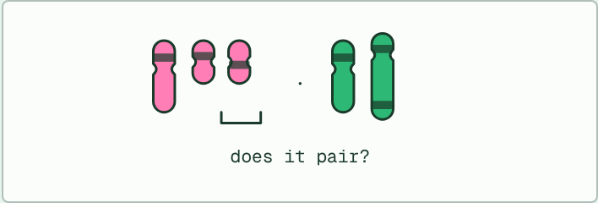
MODEL · HL
20 MIN
Paper chromosomes: a fusion
THE TASK
Strips of card in two colours: species P has three (one long, two short) and species Q has two (one long, one as long as the two short ones together). Students make the hybrid’s five strips, pair them, and find the long Q strip matches both short P strips. They share the chain out by tossing a coin ten times and tally complete against unbalanced sets. It is a toy model, since real ratios differ, but many such mismatches multiply the chance of failure.
STUDENTS NEED
Two colours of card strips, scissors, a coin, a tally table.
Minutes 30 to 50
Notes:
Minutes 30 to 50 of 60: Paper chromosomes (20 min).
The plan: Four minutes on chapter 10’s figure. Then the paper chromosomes model below, with a coin to share out the chain: 16 minutes, ten tosses a pair, tally the complete and unbalanced sets. Connect it to the mule from A4.1.
The activity: Paper chromosomes: a fusion. Strips of card in two colours: species P has three (one long, two short) and species Q has two (one long, one as long as the two short ones together). Students make the hybrid’s five strips, pair them, and find the long Q strip matches both short P strips. They share the chain out by tossing a coin ten times and tally complete against unbalanced sets. It is a toy model, since real ratios differ, but many such mismatches multiply the chance of failure.
Needs: two colours of card strips, scissors, a coin, a tally table.
The time: 20 minutes, minutes 30 to 50 of the plan.

Slide 17
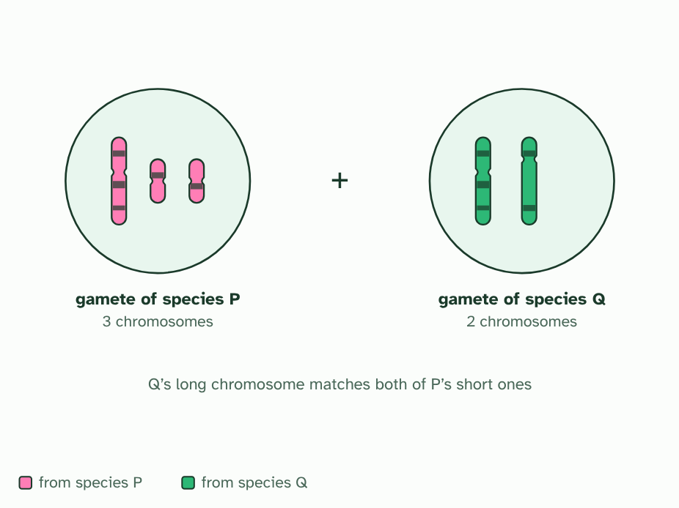
CHAPTER 10 · A3.1.13 Chromosome number as a shared trait
1 / 4
The number that has to match
Two imagined species. Q has one long chromosome where P has two short ones, so they have different chromosome numbers.
Minutes 30 to 50
Notes:
Minutes 30 to 50 of 60: Paper chromosomes (20 min).
The plan: Four minutes on chapter 10’s figure. Then the paper chromosomes model below, with a coin to share out the chain: 16 minutes, ten tosses a pair, tally the complete and unbalanced sets. Connect it to the mule from A4.1.
Chromosome number is a trait that members of a species share, as their body form and their DNA are. It matters most when two species mate. Each parent gives a set of chromosomes to the offspring, and at meiosis every chromosome must find a partner before the sets can be shared out into gametes.
If the parents have the same number and similar chromosomes, they pair cleanly, like the matching pair in the figure. If the numbers differ, the hybrid has chromosomes with no equal partner. When these are shared out, some gametes receive part of the genome twice and part of it not at all. Gametes like that rarely work, so cross-breeding between closely related species is unlikely to produce fertile offspring when their chromosome numbers differ.
The mule shows it (you met it in A4.1). A horse gamete has 32 chromosomes and a donkey gamete 31, so a mule has 63, an odd number, and not every chromosome can have a partner. A mule is healthy but sterile. It is also why different chromosome numbers, such as 46 in humans and 48 in chimpanzees, are one sign that two groups are separate species.
Notice the word unlikely. Some closely related species with different numbers do produce fertile young, and equal numbers do not guarantee fertility. It is a strong pattern, not a law.

Slide 18
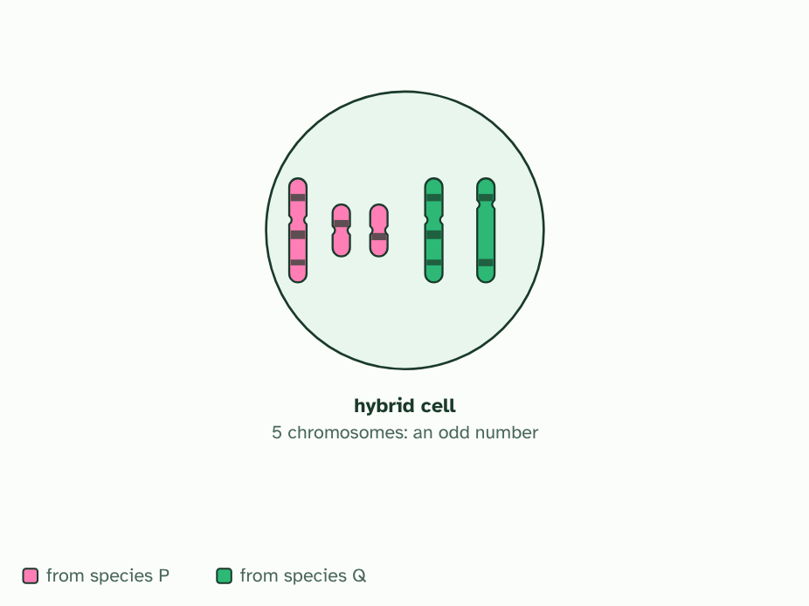
CHAPTER 10 · A3.1.13 Chromosome number as a shared trait
2 / 4
The number that has to match
A hybrid gets both sets: five chromosomes, an odd number. One cannot have an equal partner.
Minutes 30 to 50
Notes:
Minutes 30 to 50 of 60: Paper chromosomes (20 min).
The plan: Four minutes on chapter 10’s figure. Then the paper chromosomes model below, with a coin to share out the chain: 16 minutes, ten tosses a pair, tally the complete and unbalanced sets. Connect it to the mule from A4.1.
Chromosome number is a trait that members of a species share, as their body form and their DNA are. It matters most when two species mate. Each parent gives a set of chromosomes to the offspring, and at meiosis every chromosome must find a partner before the sets can be shared out into gametes.
If the parents have the same number and similar chromosomes, they pair cleanly, like the matching pair in the figure. If the numbers differ, the hybrid has chromosomes with no equal partner. When these are shared out, some gametes receive part of the genome twice and part of it not at all. Gametes like that rarely work, so cross-breeding between closely related species is unlikely to produce fertile offspring when their chromosome numbers differ.
The mule shows it (you met it in A4.1). A horse gamete has 32 chromosomes and a donkey gamete 31, so a mule has 63, an odd number, and not every chromosome can have a partner. A mule is healthy but sterile. It is also why different chromosome numbers, such as 46 in humans and 48 in chimpanzees, are one sign that two groups are separate species.
Notice the word unlikely. Some closely related species with different numbers do produce fertile young, and equal numbers do not guarantee fertility. It is a strong pattern, not a law.

Slide 19
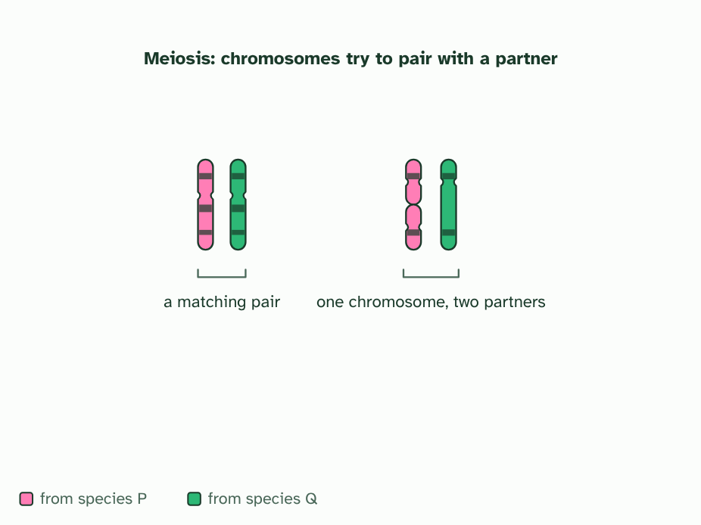
CHAPTER 10 · A3.1.13 Chromosome number as a shared trait
3 / 4
The number that has to match
At meiosis each chromosome looks for its match. Two pair neatly, but the long one is left matching two at once.
Minutes 30 to 50
Notes:
Minutes 30 to 50 of 60: Paper chromosomes (20 min).
The plan: Four minutes on chapter 10’s figure. Then the paper chromosomes model below, with a coin to share out the chain: 16 minutes, ten tosses a pair, tally the complete and unbalanced sets. Connect it to the mule from A4.1.
Chromosome number is a trait that members of a species share, as their body form and their DNA are. It matters most when two species mate. Each parent gives a set of chromosomes to the offspring, and at meiosis every chromosome must find a partner before the sets can be shared out into gametes.
If the parents have the same number and similar chromosomes, they pair cleanly, like the matching pair in the figure. If the numbers differ, the hybrid has chromosomes with no equal partner. When these are shared out, some gametes receive part of the genome twice and part of it not at all. Gametes like that rarely work, so cross-breeding between closely related species is unlikely to produce fertile offspring when their chromosome numbers differ.
The mule shows it (you met it in A4.1). A horse gamete has 32 chromosomes and a donkey gamete 31, so a mule has 63, an odd number, and not every chromosome can have a partner. A mule is healthy but sterile. It is also why different chromosome numbers, such as 46 in humans and 48 in chimpanzees, are one sign that two groups are separate species.
Notice the word unlikely. Some closely related species with different numbers do produce fertile young, and equal numbers do not guarantee fertility. It is a strong pattern, not a law.

Slide 20
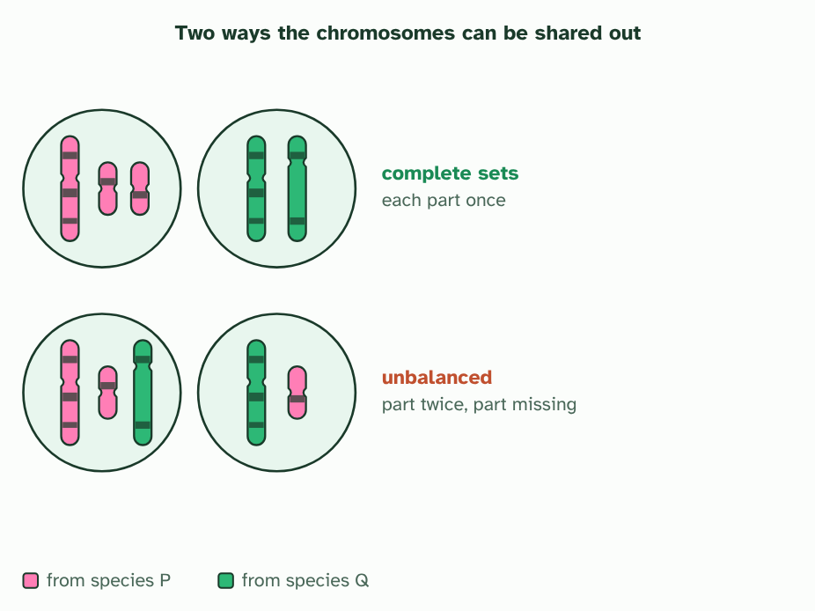
CHAPTER 10 · A3.1.13 Chromosome number as a shared trait
4 / 4
The number that has to match
Some ways of sharing them out give complete sets. Others give a gamete with part of the genome twice and part missing. With many such mismatches, most gametes fail.
Minutes 30 to 50
Notes:
Minutes 30 to 50 of 60: Paper chromosomes (20 min).
The plan: Four minutes on chapter 10’s figure. Then the paper chromosomes model below, with a coin to share out the chain: 16 minutes, ten tosses a pair, tally the complete and unbalanced sets. Connect it to the mule from A4.1.
Chromosome number is a trait that members of a species share, as their body form and their DNA are. It matters most when two species mate. Each parent gives a set of chromosomes to the offspring, and at meiosis every chromosome must find a partner before the sets can be shared out into gametes.
If the parents have the same number and similar chromosomes, they pair cleanly, like the matching pair in the figure. If the numbers differ, the hybrid has chromosomes with no equal partner. When these are shared out, some gametes receive part of the genome twice and part of it not at all. Gametes like that rarely work, so cross-breeding between closely related species is unlikely to produce fertile offspring when their chromosome numbers differ.
The mule shows it (you met it in A4.1). A horse gamete has 32 chromosomes and a donkey gamete 31, so a mule has 63, an odd number, and not every chromosome can have a partner. A mule is healthy but sterile. It is also why different chromosome numbers, such as 46 in humans and 48 in chimpanzees, are one sign that two groups are separate species.
Notice the word unlikely. Some closely related species with different numbers do produce fertile young, and equal numbers do not guarantee fertility. It is a strong pattern, not a law.

Slide 21
CHAPTER 10 · A3.1.13 Chromosome number as a shared trait
The number that has to match
Chromosome number is a trait shared within a species.
Hybrids of parents with different numbers have chromosomes with no partner, so they are usually sterile.
Minutes 30 to 50
Notes:
Minutes 30 to 50 of 60: Paper chromosomes (20 min).
The plan: Four minutes on chapter 10’s figure. Then the paper chromosomes model below, with a coin to share out the chain: 16 minutes, ten tosses a pair, tally the complete and unbalanced sets. Connect it to the mule from A4.1.
Chromosome number is a trait that members of a species share, as their body form and their DNA are. It matters most when two species mate. Each parent gives a set of chromosomes to the offspring, and at meiosis every chromosome must find a partner before the sets can be shared out into gametes.
If the parents have the same number and similar chromosomes, they pair cleanly, like the matching pair in the figure. If the numbers differ, the hybrid has chromosomes with no equal partner. When these are shared out, some gametes receive part of the genome twice and part of it not at all. Gametes like that rarely work, so cross-breeding between closely related species is unlikely to produce fertile offspring when their chromosome numbers differ.
The mule shows it (you met it in A4.1). A horse gamete has 32 chromosomes and a donkey gamete 31, so a mule has 63, an odd number, and not every chromosome can have a partner. A mule is healthy but sterile. It is also why different chromosome numbers, such as 46 in humans and 48 in chimpanzees, are one sign that two groups are separate species.
Notice the word unlikely. Some closely related species with different numbers do produce fertile young, and equal numbers do not guarantee fertility. It is a strong pattern, not a law.

Slide 22
WATCH OUT
A hybrid’s chromosome number is the sum of the two gametes, not of the two parents’ body cells: 32 + 31 = 63 for the mule, not 64 + 62.
Minutes 30 to 50
Notes:
Minutes 30 to 50 of 60: Paper chromosomes (20 min).
The plan: Four minutes on chapter 10’s figure. Then the paper chromosomes model below, with a coin to share out the chain: 16 minutes, ten tosses a pair, tally the complete and unbalanced sets. Connect it to the mule from A4.1.
A common mistake: say it, then ask who can say why it is wrong.

Slide 23
PLENARY
Exam question and exit
A higher level written question on the species concept or chromosome number from the A3.1 exam maker, set at HL, then peer-marked.
Minutes 50 to 60
Notes:
Minutes 50 to 60 of 60: Exam question and exit (10 min).
The plan: A higher level written question on the species concept or chromosome number from the A3.1 exam maker (in Practise and revise, below), set at HL, then peer-marked. Exit: chapter 10’s predict box on a 63-chromosome hybrid. For homework, the Check step, set at HL.

Slide 24
PREDICT
A hybrid cell has 63 chromosomes. Could every one of them have an equal partner at meiosis?
A No: with an odd number, at least one has no partner
B Yes: parents with similar bodies always have chromosomes that pair up
C Yes: meiosis can make a partner for a lone chromosome by copying it
Minutes 50 to 60
Notes:
Minutes 50 to 60 of 60: Exam question and exit (10 min).
The plan: A higher level written question on the species concept or chromosome number from the A3.1 exam maker (in Practise and revise, below), set at HL, then peer-marked. Exit: chapter 10’s predict box on a 63-chromosome hybrid. For homework, the Check step, set at HL.
Ask for a show of hands, or mini whiteboards, before revealing. (Answer: A, on the next slide.)

Slide 25
WHAT HAPPENS
A hybrid cell has 63 chromosomes. Could every one of them have an equal partner at meiosis?
A No: with an odd number, at least one has no partner
B Yes: parents with similar bodies always have chromosomes that pair up
C Yes: meiosis can make a partner for a lone chromosome by copying it
No. An odd number of chromosomes cannot all form pairs, so at least one has no partner. When the unpaired chromosomes are shared out, gametes tend to be unbalanced, which is why the mule is sterile.
Minutes 50 to 60
Notes:
Minutes 50 to 60 of 60: Exam question and exit (10 min).
The plan: A higher level written question on the species concept or chromosome number from the A3.1 exam maker (in Practise and revise, below), set at HL, then peer-marked. Exit: chapter 10’s predict box on a 63-chromosome hybrid. For homework, the Check step, set at HL.
Answer: A. No. An odd number of chromosomes cannot all form pairs, so at least one has no partner. When the unpaired chromosomes are shared out, gametes tend to be unbalanced, which is why the mule is sterile.

Slide 26
EXIT QUESTION
Before you go
On paper, on your own: Explain why parents with different chromosome numbers are unlikely to have fertile offspring.
Minutes 50 to 60
Notes:
Minutes 50 to 60 of 60: Exam question and exit (10 min).
The plan: A higher level written question on the species concept or chromosome number from the A3.1 exam maker (in Practise and revise, below), set at HL, then peer-marked. Exit: chapter 10’s predict box on a 63-chromosome hybrid. For homework, the Check step, set at HL.
Collect the slips: they say where to start next lesson.

Slide 27
PRACTISE AND REVISE
Keep going
Exam practice: a fresh paper of exam questions on A3.1 at higher level, marked as you go
The guide, with the animations and the dry lab
This lesson in the guide: 9 When the species rule breaks, 10 The number that has to match
BUILD FOR YOUR CLASS
ALREADY ON THE SITE FOR A3.1
CARD SETS ON SPLYCR
Tarsia puzzle, dominoes and picture reveal on A3.1, built from its key terms and ready to print
A pub quiz with rounds on A3.1, to present or run with no projector
An escape room built from the question bank on A3.1
Quiz: Diversity of Organisms
Revision map: A3.1 Diversity of organisms, to fill in
Exam questions: A3.1 in the exam maker, a paper with its markscheme
Open a set to host it as a class game, or make a copy to edit.
A3.1 Diversity of Organisms
How this was made. The course structure, the activities and the teaching choices come from my own classroom, my presentations and my years of teaching IB and AP Biology. I use Claude, an AI, to help write and build the interactive guides, lesson plans, slides and practice questions, and to draw the diagrams and code the interactives. I direct the work and review it against the IB and AP specifications before it goes live.
Minute 60: after the lesson
Notes:
Every link here is live. Set the exam practice paper for homework: it is fresh each time, marked as students go and saved to their Exam practice when they are signed in.
Exam practice: https://www.biologybybradford.com/exam-maker/sit?topics=A3.1&level=HL&paper=quiz&marks=15&src=ep
The guide: https://www.biologybybradford.com/guides/ib-biology-a3-1-diversity-of-organisms

