Slide 1
IB Biology A3.1
LESSON 5 OF 5
HL
BY THE END YOU CAN
Diversity of organisms
Build and test a dichotomous key for local organisms (A3.1.14)
Explain how DNA barcodes and environmental DNA identify the species in a habitat rapidly (A3.1.15)
Keys and barcodes
A3.1.14, A3.1.15
Building and testing a dichotomous key, and identifying species from environmental DNA
60 minutes · chapters 11, 12
Minute 0
Notes:
IB Biology A3.1, Diversity of organisms. Lesson 5 of 5: Keys and barcodes (higher level), 60 minutes.
The plan, minute by minute (each slide's footer says where you are):
0 to 8 min (8) Do now: a key to the pencil case
8 to 20 min (12) What makes a good key
20 to 42 min (22) The local key
42 to 54 min (12) Barcodes from a sample
54 to 60 min (6) Exit: limits of eDNA
What students get wrong:
Colour and size make good key features. They change with age and season. Use features that are easy to see and do not change.
eDNA tells you how many. It tells you which species in the library left DNA there, not how many or whether they are still there.
Stretch and support:
Support: give the captions of each figure as a cut-up storyboard to put in order, and use the key terms (tap the dotted words) as a glossary.
Support: the three Remember it sets (Green Sloths Inch Along; Five Apes Hug Grumpy Aunts Happily; Cats Eat Any Sausage, Mostly) as a starter or an exit.
Stretch: design an eDNA survey for the school pond: what would you collect, what could contaminate it, and what could it never tell you?
Support: give the key for the local organisms with two steps missing and ask students to complete it.
The lesson plan to print: https://www.biologybybradford.com/guides/downloads/ib-biology-a3-1-diversity-of-organisms-lesson-5-plan.pdf

Slide 2
DO NOW
A key to the pencil case
Each pair empties a pencil case and writes a yes or no key that names six of the items.
Swap with another pair and test it: does every item end at its own name?
8:00
minutes
Start now: the timer is running.
Minutes 0 to 8
Notes:
Minutes 0 to 8 of 60: Do now: a key to the pencil case (8 min).
The plan: Each pair empties a pencil case and writes a yes or no key that names six of the items. Swap with another pair and test it: does every item end at its own name? Note what went wrong, for the next step.
Start a 8 minute timer as they come in.

Slide 3
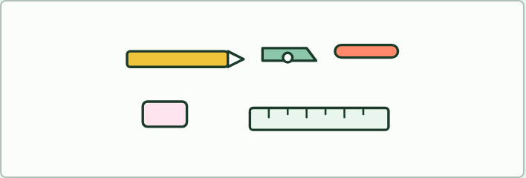
STARTER · HL
8 MIN
A key to the pencil case
THE TASK
Pairs write a yes or no key for six items from a pencil case and swap with another pair to test it. Common faults appear at once: a question with more than two answers, a feature that two items share, and an item that reaches two names. Keep the faults on the board for the lesson.
STUDENTS NEED
A pencil case per pair; scrap paper.
Minutes 0 to 8
Notes:
Minutes 0 to 8 of 60: Do now: a key to the pencil case (8 min).
The plan: Each pair empties a pencil case and writes a yes or no key that names six of the items. Swap with another pair and test it: does every item end at its own name? Note what went wrong, for the next step.
The activity: A key to the pencil case. Pairs write a yes or no key for six items from a pencil case and swap with another pair to test it. Common faults appear at once: a question with more than two answers, a feature that two items share, and an item that reaches two names. Keep the faults on the board for the lesson.
Needs: a pencil case per pair; scrap paper.
The time: 8 minutes, minutes 0 to 8 of the plan.

Slide 4
STEP 2
12 MIN
What makes a good key
Build a class list of good and poor features, sorted by whether they change with age or season.
Students fix their pencil case keys.
Minutes 8 to 20
Notes:
Minutes 8 to 20 of 60: What makes a good key (12 min).
The plan: Chapter 11’s figure, step by step, then trace the holly through it. Take chapter 11’s predict box. Build a class list of good and poor features, sorted by whether they change with age or season. Students fix their pencil case keys.

Slide 5
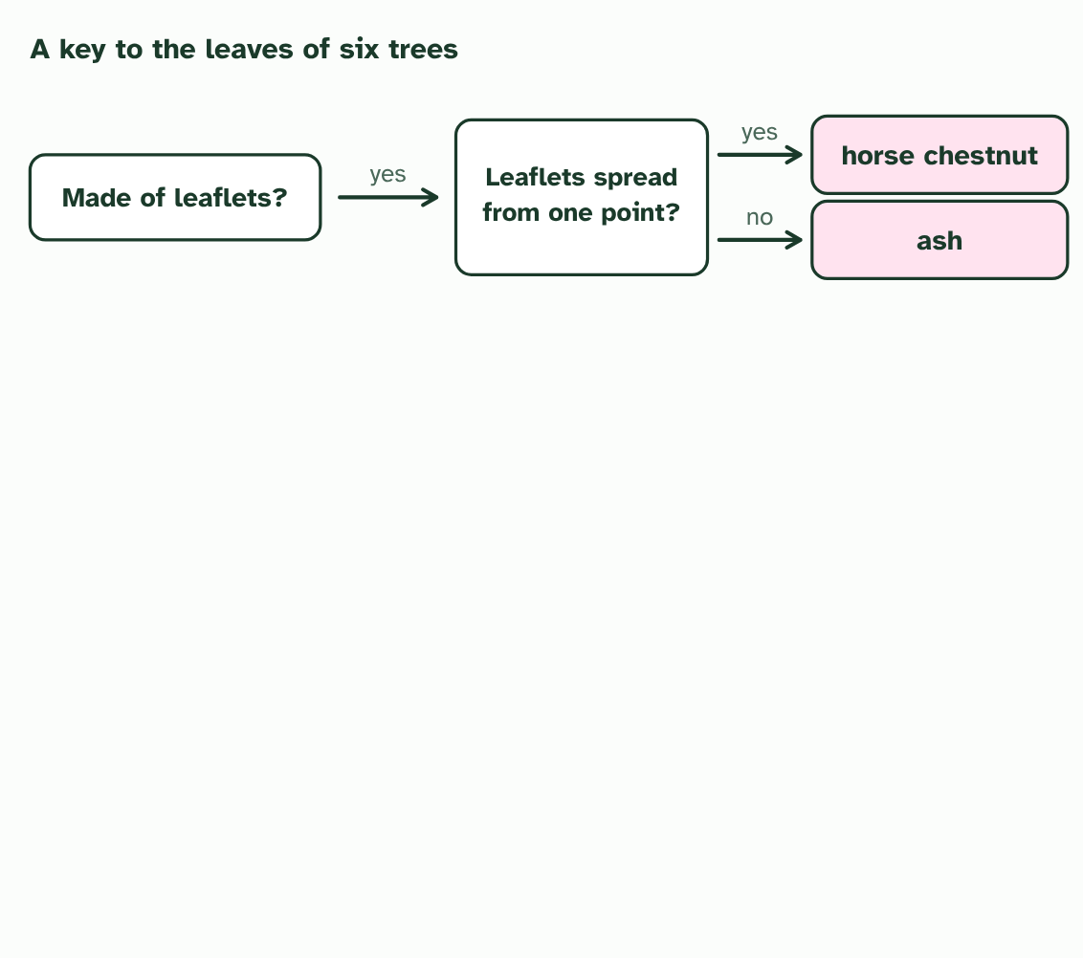
CHAPTER 11 · A3.1.14 Dichotomous keys
1 / 4
Building a key
Every step is a question with two answers. A leaf made of leaflets leads to one more question, and then to horse chestnut or ash.
Minutes 8 to 20
Notes:
Minutes 8 to 20 of 60: What makes a good key (12 min).
The plan: Chapter 11’s figure, step by step, then trace the holly through it. Take chapter 11’s predict box. Build a class list of good and poor features, sorted by whether they change with age or season. Students fix their pencil case keys.
To name an organism you have not met, use a dichotomous key. “Dichotomous” means divided in two. At every step you choose between two statements, or answer a yes or no question, and each choice sends you to the next step or to a name. Follow the right path and you finish at one organism and no other.
A key is only as good as its questions. Use features that are easy to see, that mean the same to anyone, and that do not change as the organism grows or with the season: the number of legs on an animal, or a leaf edge that is toothed or smooth. Avoid size, colour and behaviour. A leaf is green in summer and red in autumn, and a young animal is smaller than an adult.
A key can be drawn as a branching chart, as in the figure, or written as numbered pairs of statements, with the same result.
To build your own, choose six to ten local organisms, such as the leaves of trees in your school grounds. List what tells them apart, find one feature that splits the set into two groups, then split each group again until every organism is alone. Then test the key on someone who does not know the answers. If an organism ends in the wrong place, or two end together, the key needs fixing. The two tools below let you practise on a card set of garden animals: build a key for them and test it, then use a key we give you.
Example: The same key, as numbered statements 1a Leaf made of separate leaflets: go to 2. 1b Leaf in one piece: go to 3. 2a Leaflets spread from one point: horse chestnut. 2b Leaflets in pairs along a stalk: ash. 3a Edge deeply lobed: oak. 3b Edge not deeply lobed: go to 4. And so on.

Slide 6
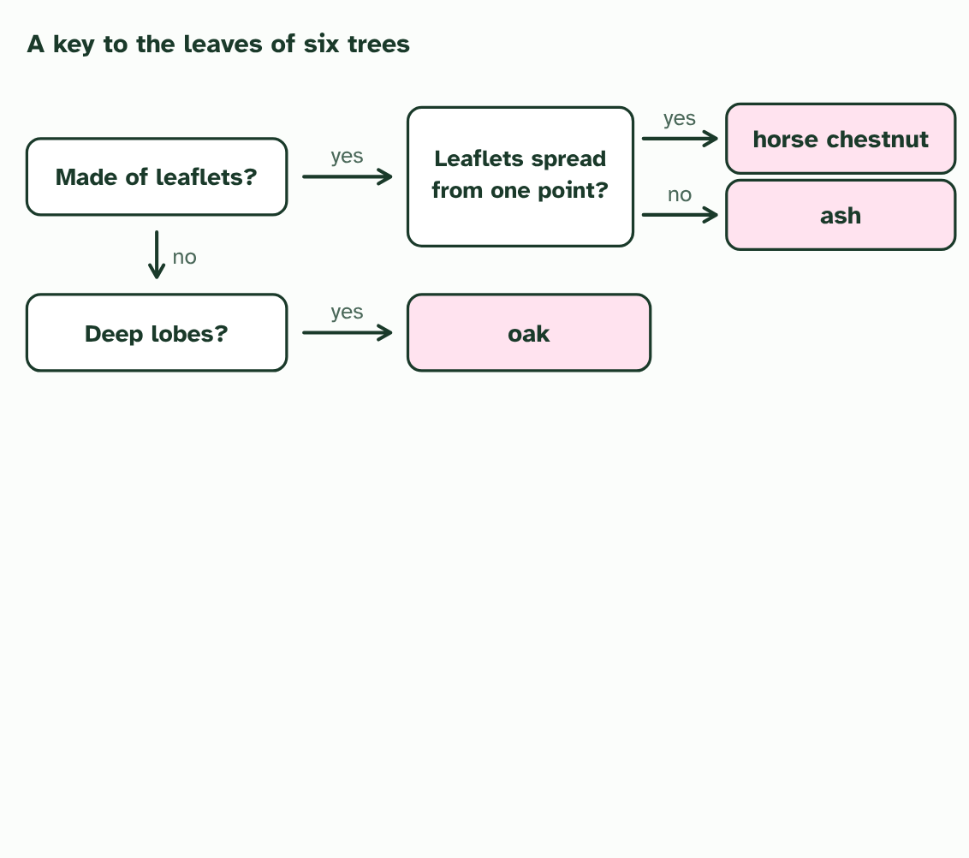
CHAPTER 11 · A3.1.14 Dichotomous keys
2 / 4
Building a key
A leaf in one piece leads to the next question. Deep lobes: oak.
Minutes 8 to 20
Notes:
Minutes 8 to 20 of 60: What makes a good key (12 min).
The plan: Chapter 11’s figure, step by step, then trace the holly through it. Take chapter 11’s predict box. Build a class list of good and poor features, sorted by whether they change with age or season. Students fix their pencil case keys.
To name an organism you have not met, use a dichotomous key. “Dichotomous” means divided in two. At every step you choose between two statements, or answer a yes or no question, and each choice sends you to the next step or to a name. Follow the right path and you finish at one organism and no other.
A key is only as good as its questions. Use features that are easy to see, that mean the same to anyone, and that do not change as the organism grows or with the season: the number of legs on an animal, or a leaf edge that is toothed or smooth. Avoid size, colour and behaviour. A leaf is green in summer and red in autumn, and a young animal is smaller than an adult.
A key can be drawn as a branching chart, as in the figure, or written as numbered pairs of statements, with the same result.
To build your own, choose six to ten local organisms, such as the leaves of trees in your school grounds. List what tells them apart, find one feature that splits the set into two groups, then split each group again until every organism is alone. Then test the key on someone who does not know the answers. If an organism ends in the wrong place, or two end together, the key needs fixing. The two tools below let you practise on a card set of garden animals: build a key for them and test it, then use a key we give you.
Example: The same key, as numbered statements 1a Leaf made of separate leaflets: go to 2. 1b Leaf in one piece: go to 3. 2a Leaflets spread from one point: horse chestnut. 2b Leaflets in pairs along a stalk: ash. 3a Edge deeply lobed: oak. 3b Edge not deeply lobed: go to 4. And so on.

Slide 7
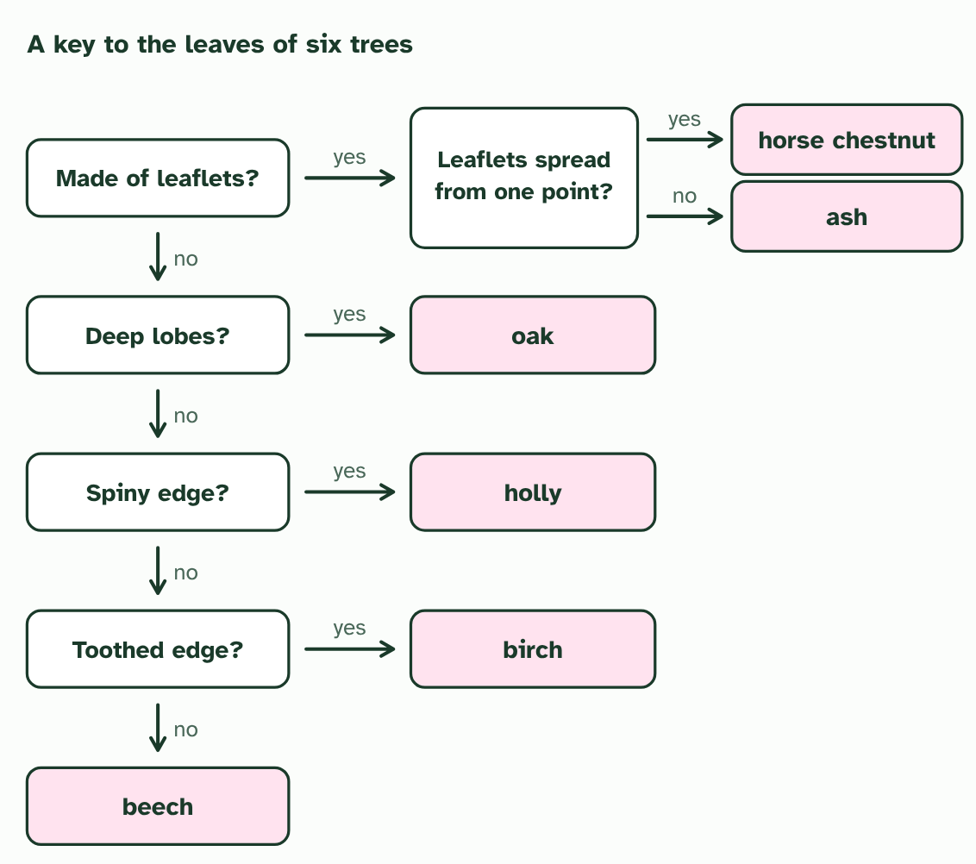
CHAPTER 11 · A3.1.14 Dichotomous keys
3 / 4
Building a key
Each remaining question uses an edge that is easy to see: spiny, toothed, or neither. Every leaf reaches exactly one name.
Minutes 8 to 20
Notes:
Minutes 8 to 20 of 60: What makes a good key (12 min).
The plan: Chapter 11’s figure, step by step, then trace the holly through it. Take chapter 11’s predict box. Build a class list of good and poor features, sorted by whether they change with age or season. Students fix their pencil case keys.
To name an organism you have not met, use a dichotomous key. “Dichotomous” means divided in two. At every step you choose between two statements, or answer a yes or no question, and each choice sends you to the next step or to a name. Follow the right path and you finish at one organism and no other.
A key is only as good as its questions. Use features that are easy to see, that mean the same to anyone, and that do not change as the organism grows or with the season: the number of legs on an animal, or a leaf edge that is toothed or smooth. Avoid size, colour and behaviour. A leaf is green in summer and red in autumn, and a young animal is smaller than an adult.
A key can be drawn as a branching chart, as in the figure, or written as numbered pairs of statements, with the same result.
To build your own, choose six to ten local organisms, such as the leaves of trees in your school grounds. List what tells them apart, find one feature that splits the set into two groups, then split each group again until every organism is alone. Then test the key on someone who does not know the answers. If an organism ends in the wrong place, or two end together, the key needs fixing. The two tools below let you practise on a card set of garden animals: build a key for them and test it, then use a key we give you.
Example: The same key, as numbered statements 1a Leaf made of separate leaflets: go to 2. 1b Leaf in one piece: go to 3. 2a Leaflets spread from one point: horse chestnut. 2b Leaflets in pairs along a stalk: ash. 3a Edge deeply lobed: oak. 3b Edge not deeply lobed: go to 4. And so on.

Slide 8
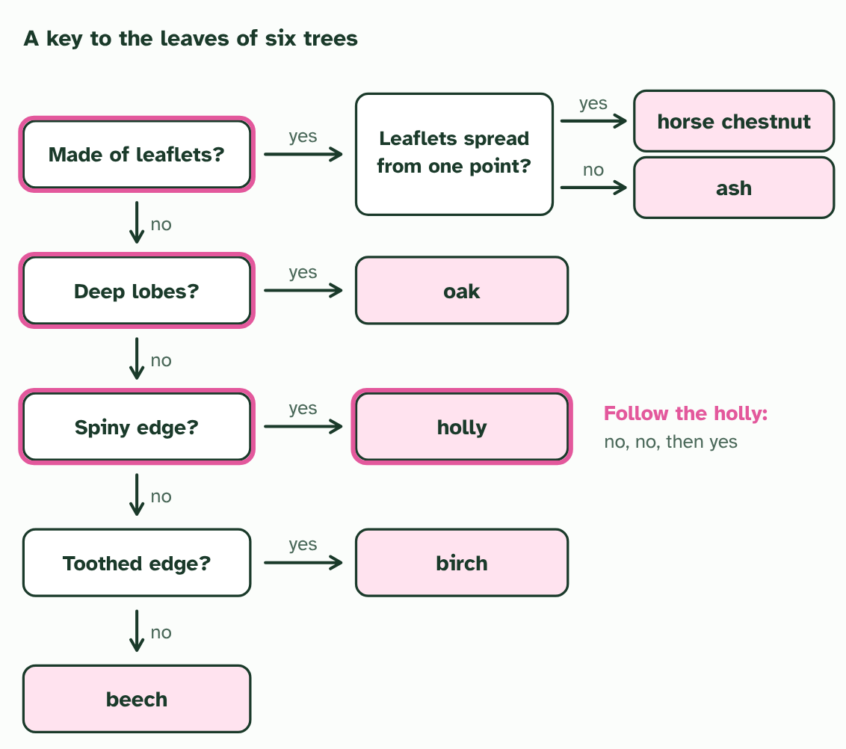
CHAPTER 11 · A3.1.14 Dichotomous keys
4 / 4
Building a key
Check a key by following one leaf through it: holly is no to leaflets, no to deep lobes and yes to a spiny edge.
Minutes 8 to 20
Notes:
Minutes 8 to 20 of 60: What makes a good key (12 min).
The plan: Chapter 11’s figure, step by step, then trace the holly through it. Take chapter 11’s predict box. Build a class list of good and poor features, sorted by whether they change with age or season. Students fix their pencil case keys.
To name an organism you have not met, use a dichotomous key. “Dichotomous” means divided in two. At every step you choose between two statements, or answer a yes or no question, and each choice sends you to the next step or to a name. Follow the right path and you finish at one organism and no other.
A key is only as good as its questions. Use features that are easy to see, that mean the same to anyone, and that do not change as the organism grows or with the season: the number of legs on an animal, or a leaf edge that is toothed or smooth. Avoid size, colour and behaviour. A leaf is green in summer and red in autumn, and a young animal is smaller than an adult.
A key can be drawn as a branching chart, as in the figure, or written as numbered pairs of statements, with the same result.
To build your own, choose six to ten local organisms, such as the leaves of trees in your school grounds. List what tells them apart, find one feature that splits the set into two groups, then split each group again until every organism is alone. Then test the key on someone who does not know the answers. If an organism ends in the wrong place, or two end together, the key needs fixing. The two tools below let you practise on a card set of garden animals: build a key for them and test it, then use a key we give you.
Example: The same key, as numbered statements 1a Leaf made of separate leaflets: go to 2. 1b Leaf in one piece: go to 3. 2a Leaflets spread from one point: horse chestnut. 2b Leaflets in pairs along a stalk: ash. 3a Edge deeply lobed: oak. 3b Edge not deeply lobed: go to 4. And so on.

Slide 9
CHAPTER 11 · A3.1.14 Dichotomous keys
Building a key
A dichotomous key uses paired choices that lead to one name.
Choose features that are visible, countable and do not change.
Test a key on someone else, then fix it where it fails.
Minutes 8 to 20
Notes:
Minutes 8 to 20 of 60: What makes a good key (12 min).
The plan: Chapter 11’s figure, step by step, then trace the holly through it. Take chapter 11’s predict box. Build a class list of good and poor features, sorted by whether they change with age or season. Students fix their pencil case keys.
To name an organism you have not met, use a dichotomous key. “Dichotomous” means divided in two. At every step you choose between two statements, or answer a yes or no question, and each choice sends you to the next step or to a name. Follow the right path and you finish at one organism and no other.
A key is only as good as its questions. Use features that are easy to see, that mean the same to anyone, and that do not change as the organism grows or with the season: the number of legs on an animal, or a leaf edge that is toothed or smooth. Avoid size, colour and behaviour. A leaf is green in summer and red in autumn, and a young animal is smaller than an adult.
A key can be drawn as a branching chart, as in the figure, or written as numbered pairs of statements, with the same result.
To build your own, choose six to ten local organisms, such as the leaves of trees in your school grounds. List what tells them apart, find one feature that splits the set into two groups, then split each group again until every organism is alone. Then test the key on someone who does not know the answers. If an organism ends in the wrong place, or two end together, the key needs fixing. The two tools below let you practise on a card set of garden animals: build a key for them and test it, then use a key we give you.
Example: The same key, as numbered statements 1a Leaf made of separate leaflets: go to 2. 1b Leaf in one piece: go to 3. 2a Leaflets spread from one point: horse chestnut. 2b Leaflets in pairs along a stalk: ash. 3a Edge deeply lobed: oak. 3b Edge not deeply lobed: go to 4. And so on.

Slide 10
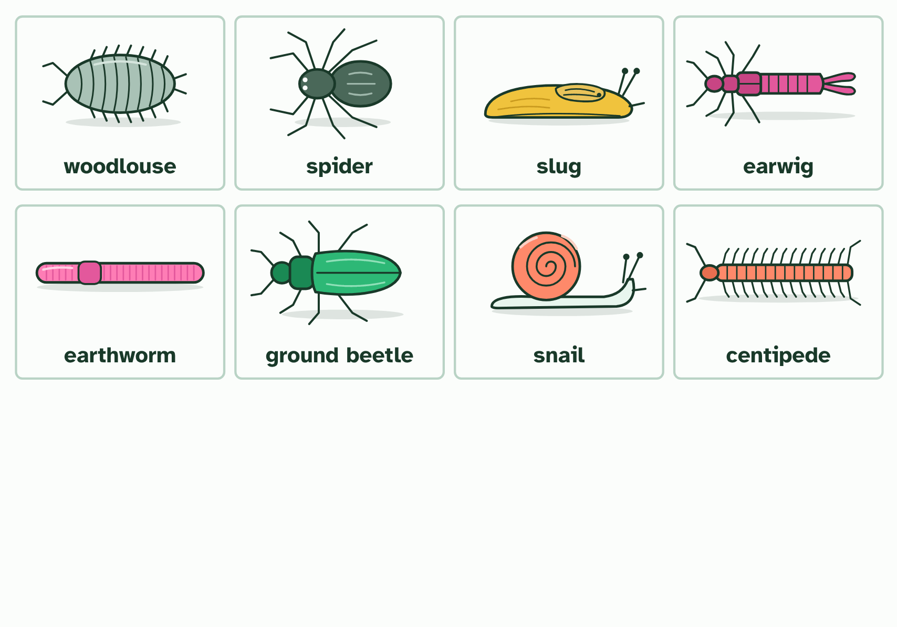
CHAPTER 11 · A3.1.14 Dichotomous keys
1 / 2
Building a key
Eight animals from leaf litter and soil. A dichotomous key tells them apart with questions that each have two answers.
Minutes 8 to 20
Notes:
Minutes 8 to 20 of 60: What makes a good key (12 min).
The plan: Chapter 11’s figure, step by step, then trace the holly through it. Take chapter 11’s predict box. Build a class list of good and poor features, sorted by whether they change with age or season. Students fix their pencil case keys.
To name an organism you have not met, use a dichotomous key. “Dichotomous” means divided in two. At every step you choose between two statements, or answer a yes or no question, and each choice sends you to the next step or to a name. Follow the right path and you finish at one organism and no other.
A key is only as good as its questions. Use features that are easy to see, that mean the same to anyone, and that do not change as the organism grows or with the season: the number of legs on an animal, or a leaf edge that is toothed or smooth. Avoid size, colour and behaviour. A leaf is green in summer and red in autumn, and a young animal is smaller than an adult.
A key can be drawn as a branching chart, as in the figure, or written as numbered pairs of statements, with the same result.
To build your own, choose six to ten local organisms, such as the leaves of trees in your school grounds. List what tells them apart, find one feature that splits the set into two groups, then split each group again until every organism is alone. Then test the key on someone who does not know the answers. If an organism ends in the wrong place, or two end together, the key needs fixing. The two tools below let you practise on a card set of garden animals: build a key for them and test it, then use a key we give you.
Example: The same key, as numbered statements 1a Leaf made of separate leaflets: go to 2. 1b Leaf in one piece: go to 3. 2a Leaflets spread from one point: horse chestnut. 2b Leaflets in pairs along a stalk: ash. 3a Edge deeply lobed: oak. 3b Edge not deeply lobed: go to 4. And so on.

Slide 11
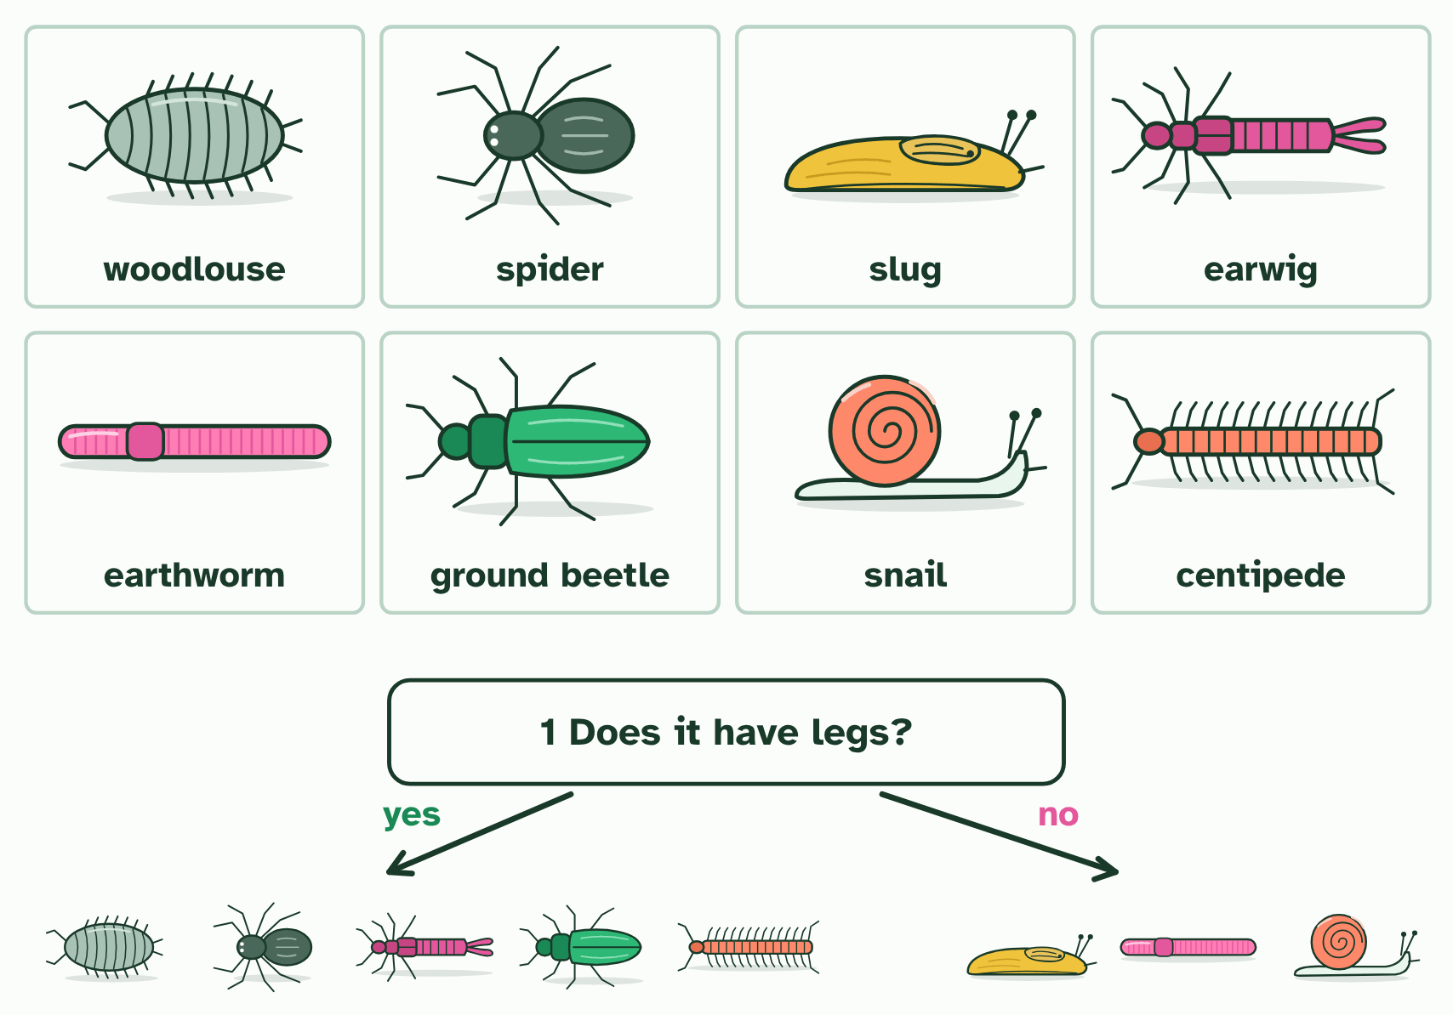
CHAPTER 11 · A3.1.14 Dichotomous keys
2 / 2
Building a key
Each question splits the group in two; the next question splits each part again, until each animal is alone with its name.
Minutes 8 to 20
Notes:
Minutes 8 to 20 of 60: What makes a good key (12 min).
The plan: Chapter 11’s figure, step by step, then trace the holly through it. Take chapter 11’s predict box. Build a class list of good and poor features, sorted by whether they change with age or season. Students fix their pencil case keys.
To name an organism you have not met, use a dichotomous key. “Dichotomous” means divided in two. At every step you choose between two statements, or answer a yes or no question, and each choice sends you to the next step or to a name. Follow the right path and you finish at one organism and no other.
A key is only as good as its questions. Use features that are easy to see, that mean the same to anyone, and that do not change as the organism grows or with the season: the number of legs on an animal, or a leaf edge that is toothed or smooth. Avoid size, colour and behaviour. A leaf is green in summer and red in autumn, and a young animal is smaller than an adult.
A key can be drawn as a branching chart, as in the figure, or written as numbered pairs of statements, with the same result.
To build your own, choose six to ten local organisms, such as the leaves of trees in your school grounds. List what tells them apart, find one feature that splits the set into two groups, then split each group again until every organism is alone. Then test the key on someone who does not know the answers. If an organism ends in the wrong place, or two end together, the key needs fixing. The two tools below let you practise on a card set of garden animals: build a key for them and test it, then use a key we give you.
Example: The same key, as numbered statements 1a Leaf made of separate leaflets: go to 2. 1b Leaf in one piece: go to 3. 2a Leaflets spread from one point: horse chestnut. 2b Leaflets in pairs along a stalk: ash. 3a Edge deeply lobed: oak. 3b Edge not deeply lobed: go to 4. And so on.

Slide 12
CHAPTER 11 · A3.1.14 Dichotomous keys
Building a key
A dichotomous key uses paired choices that lead to one name.
Choose features that are visible, countable and do not change.
Test a key on someone else, then fix it where it fails.
Minutes 8 to 20
Notes:
Minutes 8 to 20 of 60: What makes a good key (12 min).
The plan: Chapter 11’s figure, step by step, then trace the holly through it. Take chapter 11’s predict box. Build a class list of good and poor features, sorted by whether they change with age or season. Students fix their pencil case keys.
To name an organism you have not met, use a dichotomous key. “Dichotomous” means divided in two. At every step you choose between two statements, or answer a yes or no question, and each choice sends you to the next step or to a name. Follow the right path and you finish at one organism and no other.
A key is only as good as its questions. Use features that are easy to see, that mean the same to anyone, and that do not change as the organism grows or with the season: the number of legs on an animal, or a leaf edge that is toothed or smooth. Avoid size, colour and behaviour. A leaf is green in summer and red in autumn, and a young animal is smaller than an adult.
A key can be drawn as a branching chart, as in the figure, or written as numbered pairs of statements, with the same result.
To build your own, choose six to ten local organisms, such as the leaves of trees in your school grounds. List what tells them apart, find one feature that splits the set into two groups, then split each group again until every organism is alone. Then test the key on someone who does not know the answers. If an organism ends in the wrong place, or two end together, the key needs fixing. The two tools below let you practise on a card set of garden animals: build a key for them and test it, then use a key we give you.
Example: The same key, as numbered statements 1a Leaf made of separate leaflets: go to 2. 1b Leaf in one piece: go to 3. 2a Leaflets spread from one point: horse chestnut. 2b Leaflets in pairs along a stalk: ash. 3a Edge deeply lobed: oak. 3b Edge not deeply lobed: go to 4. And so on.

Slide 13

CHAPTER 11 · A3.1.14 Dichotomous keys
1 / 2
Building a key
Eight animals from leaf litter and soil. A dichotomous key tells them apart with questions that each have two answers.
Minutes 8 to 20
Notes:
Minutes 8 to 20 of 60: What makes a good key (12 min).
The plan: Chapter 11’s figure, step by step, then trace the holly through it. Take chapter 11’s predict box. Build a class list of good and poor features, sorted by whether they change with age or season. Students fix their pencil case keys.
To name an organism you have not met, use a dichotomous key. “Dichotomous” means divided in two. At every step you choose between two statements, or answer a yes or no question, and each choice sends you to the next step or to a name. Follow the right path and you finish at one organism and no other.
A key is only as good as its questions. Use features that are easy to see, that mean the same to anyone, and that do not change as the organism grows or with the season: the number of legs on an animal, or a leaf edge that is toothed or smooth. Avoid size, colour and behaviour. A leaf is green in summer and red in autumn, and a young animal is smaller than an adult.
A key can be drawn as a branching chart, as in the figure, or written as numbered pairs of statements, with the same result.
To build your own, choose six to ten local organisms, such as the leaves of trees in your school grounds. List what tells them apart, find one feature that splits the set into two groups, then split each group again until every organism is alone. Then test the key on someone who does not know the answers. If an organism ends in the wrong place, or two end together, the key needs fixing. The two tools below let you practise on a card set of garden animals: build a key for them and test it, then use a key we give you.
Example: The same key, as numbered statements 1a Leaf made of separate leaflets: go to 2. 1b Leaf in one piece: go to 3. 2a Leaflets spread from one point: horse chestnut. 2b Leaflets in pairs along a stalk: ash. 3a Edge deeply lobed: oak. 3b Edge not deeply lobed: go to 4. And so on.

Slide 14
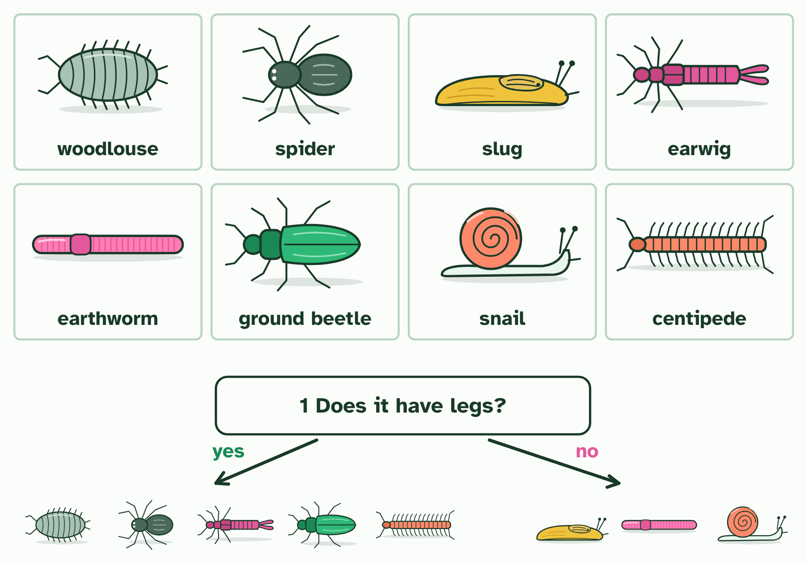
CHAPTER 11 · A3.1.14 Dichotomous keys
2 / 2
Building a key
Each question splits the group in two; the next question splits each part again, until each animal is alone with its name.
Minutes 8 to 20
Notes:
Minutes 8 to 20 of 60: What makes a good key (12 min).
The plan: Chapter 11’s figure, step by step, then trace the holly through it. Take chapter 11’s predict box. Build a class list of good and poor features, sorted by whether they change with age or season. Students fix their pencil case keys.
To name an organism you have not met, use a dichotomous key. “Dichotomous” means divided in two. At every step you choose between two statements, or answer a yes or no question, and each choice sends you to the next step or to a name. Follow the right path and you finish at one organism and no other.
A key is only as good as its questions. Use features that are easy to see, that mean the same to anyone, and that do not change as the organism grows or with the season: the number of legs on an animal, or a leaf edge that is toothed or smooth. Avoid size, colour and behaviour. A leaf is green in summer and red in autumn, and a young animal is smaller than an adult.
A key can be drawn as a branching chart, as in the figure, or written as numbered pairs of statements, with the same result.
To build your own, choose six to ten local organisms, such as the leaves of trees in your school grounds. List what tells them apart, find one feature that splits the set into two groups, then split each group again until every organism is alone. Then test the key on someone who does not know the answers. If an organism ends in the wrong place, or two end together, the key needs fixing. The two tools below let you practise on a card set of garden animals: build a key for them and test it, then use a key we give you.
Example: The same key, as numbered statements 1a Leaf made of separate leaflets: go to 2. 1b Leaf in one piece: go to 3. 2a Leaflets spread from one point: horse chestnut. 2b Leaflets in pairs along a stalk: ash. 3a Edge deeply lobed: oak. 3b Edge not deeply lobed: go to 4. And so on.

Slide 15
CHAPTER 11 · A3.1.14 Dichotomous keys
Building a key
A dichotomous key uses paired choices that lead to one name.
Choose features that are visible, countable and do not change.
Test a key on someone else, then fix it where it fails.
Minutes 8 to 20
Notes:
Minutes 8 to 20 of 60: What makes a good key (12 min).
The plan: Chapter 11’s figure, step by step, then trace the holly through it. Take chapter 11’s predict box. Build a class list of good and poor features, sorted by whether they change with age or season. Students fix their pencil case keys.
To name an organism you have not met, use a dichotomous key. “Dichotomous” means divided in two. At every step you choose between two statements, or answer a yes or no question, and each choice sends you to the next step or to a name. Follow the right path and you finish at one organism and no other.
A key is only as good as its questions. Use features that are easy to see, that mean the same to anyone, and that do not change as the organism grows or with the season: the number of legs on an animal, or a leaf edge that is toothed or smooth. Avoid size, colour and behaviour. A leaf is green in summer and red in autumn, and a young animal is smaller than an adult.
A key can be drawn as a branching chart, as in the figure, or written as numbered pairs of statements, with the same result.
To build your own, choose six to ten local organisms, such as the leaves of trees in your school grounds. List what tells them apart, find one feature that splits the set into two groups, then split each group again until every organism is alone. Then test the key on someone who does not know the answers. If an organism ends in the wrong place, or two end together, the key needs fixing. The two tools below let you practise on a card set of garden animals: build a key for them and test it, then use a key we give you.
Example: The same key, as numbered statements 1a Leaf made of separate leaflets: go to 2. 1b Leaf in one piece: go to 3. 2a Leaflets spread from one point: horse chestnut. 2b Leaflets in pairs along a stalk: ash. 3a Edge deeply lobed: oak. 3b Edge not deeply lobed: go to 4. And so on.

Slide 16
WATCH OUT
Never harm what you study. Photograph organisms, take only a leaf from a plant that has many, and put animals back where you found them. Never taste or touch a plant or fungus you cannot name.
Minutes 8 to 20
Notes:
Minutes 8 to 20 of 60: What makes a good key (12 min).
The plan: Chapter 11’s figure, step by step, then trace the holly through it. Take chapter 11’s predict box. Build a class list of good and poor features, sorted by whether they change with age or season. Students fix their pencil case keys.
A common mistake: say it, then ask who can say why it is wrong.

Slide 17
PREDICT
Which feature is best for a key that tells the leaves of different trees apart?
A Colour, because every leaf looks different at a glance
B Size, because it is the easiest thing to measure
C Whether the edge is toothed or smooth
Minutes 8 to 20
Notes:
Minutes 8 to 20 of 60: What makes a good key (12 min).
The plan: Chapter 11’s figure, step by step, then trace the holly through it. Take chapter 11’s predict box. Build a class list of good and poor features, sorted by whether they change with age or season. Students fix their pencil case keys.
Ask for a show of hands, or mini whiteboards, before revealing. (Answer: C, on the next slide.)

Slide 18
WHAT HAPPENS
Which feature is best for a key that tells the leaves of different trees apart?
A Colour, because every leaf looks different at a glance
B Size, because it is the easiest thing to measure
C Whether the edge is toothed or smooth
The edge. It is easy to see and does not change much with the season or the leaf’s age. Colour changes through the year, and size depends on the age of the leaf and the tree’s conditions, so neither makes a reliable question.
Minutes 8 to 20
Notes:
Minutes 8 to 20 of 60: What makes a good key (12 min).
The plan: Chapter 11’s figure, step by step, then trace the holly through it. Take chapter 11’s predict box. Build a class list of good and poor features, sorted by whether they change with age or season. Students fix their pencil case keys.
Answer: C. The edge. It is easy to see and does not change much with the season or the leaf’s age. Colour changes through the year, and size depends on the age of the leaf and the tree’s conditions, so neither makes a reliable question.

Slide 19

PRACTICAL · HL
22 MIN
The local key
THE TASK
Groups collect or photograph six to eight local plants or animals from the school grounds, a hedge or a park. They list the features that tell them apart, build a key, swap with another group and test each other’s. Take only a leaf from a plant that has many, never tear a plant up, and put every animal back where you found it. In wet weather use photographs or leaves brought in.
STUDENTS NEED
Hand lenses, clipboards, phones for photographs, a field guide if you have one; permission for the site.
Minutes 20 to 42
Notes:
Minutes 20 to 42 of 60: The local key (22 min).
The plan: The local key activity below: collect or photograph six to eight local organisms, write a key, swap and test it. In wet weather use the two key tools under chapter 11’s figure instead, with the leaves of trees or the garden animals.
The activity: The local key. Groups collect or photograph six to eight local plants or animals from the school grounds, a hedge or a park. They list the features that tell them apart, build a key, swap with another group and test each other’s. Take only a leaf from a plant that has many, never tear a plant up, and put every animal back where you found it. In wet weather use photographs or leaves brought in.
Needs: hand lenses, clipboards, phones for photographs, a field guide if you have one; permission for the site.
The time: 22 minutes, minutes 20 to 42 of the plan.

Slide 20
STEP 4
12 MIN
Barcodes from a sample
Students put the five step cards of the sample to species activity in order and say what each step needs.
Turn over chapter 12’s Remember it tiles.
Minutes 42 to 54
Notes:
Minutes 42 to 54 of 60: Barcodes from a sample (12 min).
The plan: Chapter 12’s film, then its figure on the board. Students put the five step cards of the sample to species activity in order and say what each step needs. Turn over chapter 12’s Remember it tiles.

Slide 21
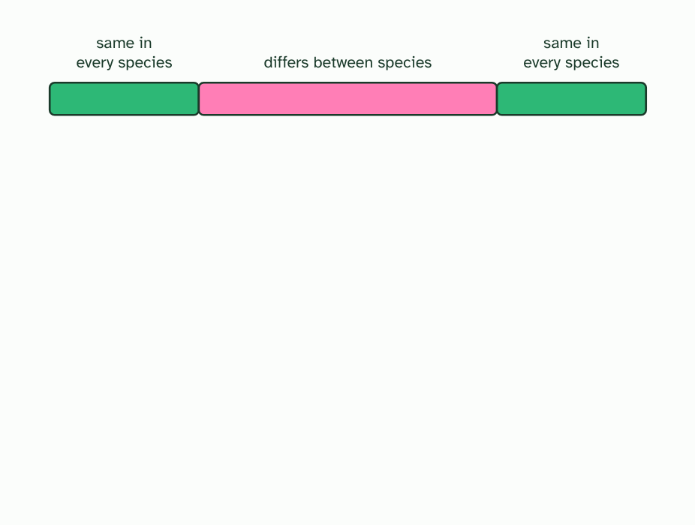
CHAPTER 12 · A3.1.15 DNA barcodes and environmental DNA
1 / 4
Barcodes from the soil
A barcode is a short stretch of DNA with two ends the same in every species and a middle that differs between species.
Minutes 42 to 54
Notes:
Minutes 42 to 54 of 60: Barcodes from a sample (12 min).
The plan: Chapter 12’s film, then its figure on the board. Students put the five step cards of the sample to species activity in order and say what each step needs. Turn over chapter 12’s Remember it tiles.
How many species live in a pond? Netting them all takes weeks, and shy or tiny ones are missed. But every animal leaves traces of itself in the water: skin cells, mucus, droppings. Environmental DNA (eDNA) is the DNA collected from a sample of water, soil or air, not from an animal you have caught.
To tell whose DNA it is, scientists read a DNA barcode: a short stretch of DNA, a few hundred base pairs long, that is alike in members of one species and different between species. A good barcode has two ends that are the same in every species, so one pair of primers works on all of them, and a middle that varies. For animals it is usually part of a mitochondrial gene, for bacteria a ribosomal RNA gene, and plants use other genes.
The steps are always the same: collect a sample, extract the DNA, make millions of copies of the barcode region with PCR, read their sequences, and match each sequence against a reference library of barcodes from known species. Out comes a list of the species present, in a few days, including ones nobody saw.
Because it is so quick, barcoding with eDNA lets the biodiversity of a habitat be investigated rapidly.

Slide 22
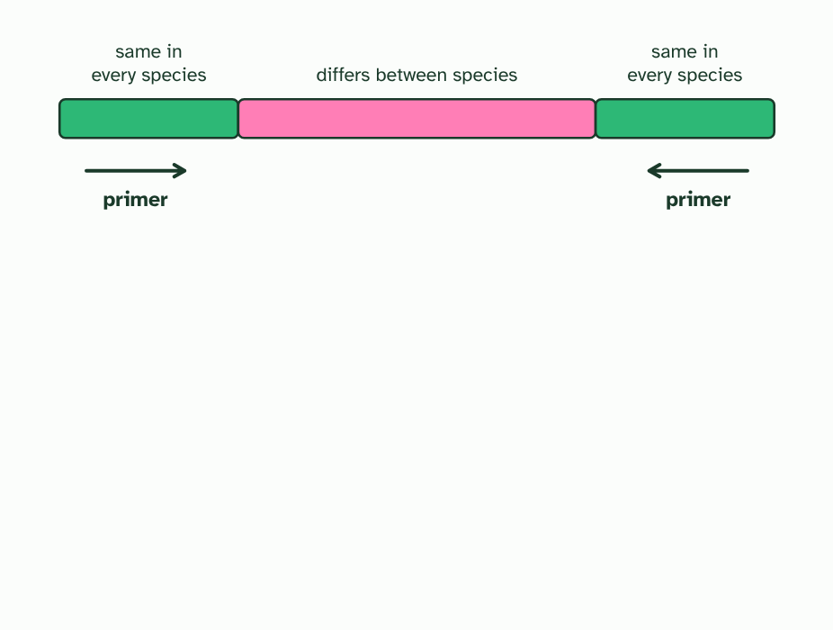
CHAPTER 12 · A3.1.15 DNA barcodes and environmental DNA
2 / 4
Barcodes from the soil
Because the ends match everywhere, one pair of primers can copy the barcode from any species in a mixed sample.
Minutes 42 to 54
Notes:
Minutes 42 to 54 of 60: Barcodes from a sample (12 min).
The plan: Chapter 12’s film, then its figure on the board. Students put the five step cards of the sample to species activity in order and say what each step needs. Turn over chapter 12’s Remember it tiles.
How many species live in a pond? Netting them all takes weeks, and shy or tiny ones are missed. But every animal leaves traces of itself in the water: skin cells, mucus, droppings. Environmental DNA (eDNA) is the DNA collected from a sample of water, soil or air, not from an animal you have caught.
To tell whose DNA it is, scientists read a DNA barcode: a short stretch of DNA, a few hundred base pairs long, that is alike in members of one species and different between species. A good barcode has two ends that are the same in every species, so one pair of primers works on all of them, and a middle that varies. For animals it is usually part of a mitochondrial gene, for bacteria a ribosomal RNA gene, and plants use other genes.
The steps are always the same: collect a sample, extract the DNA, make millions of copies of the barcode region with PCR, read their sequences, and match each sequence against a reference library of barcodes from known species. Out comes a list of the species present, in a few days, including ones nobody saw.
Because it is so quick, barcoding with eDNA lets the biodiversity of a habitat be investigated rapidly.

Slide 23
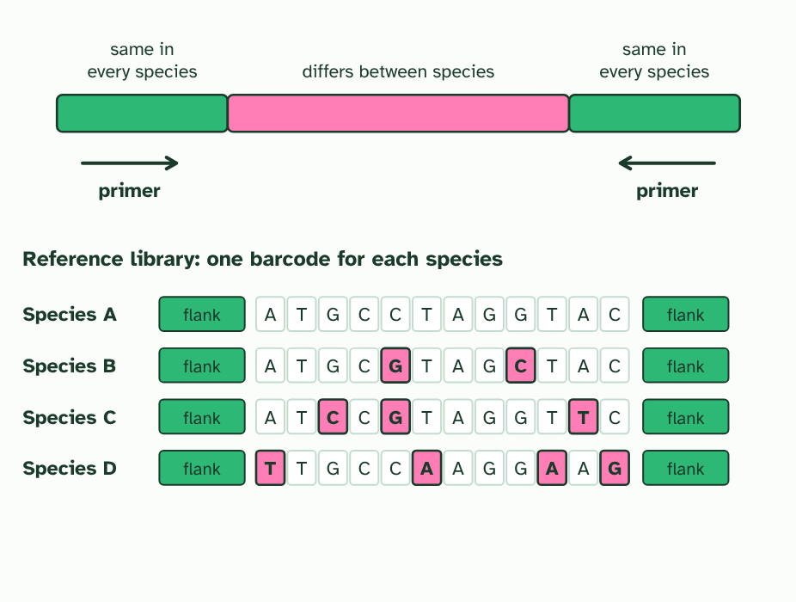
CHAPTER 12 · A3.1.15 DNA barcodes and environmental DNA
3 / 4
Barcodes from the soil
Each species in the reference library has its own barcode. Pink marks where a barcode differs from species A. (Letters invented.)
Minutes 42 to 54
Notes:
Minutes 42 to 54 of 60: Barcodes from a sample (12 min).
The plan: Chapter 12’s film, then its figure on the board. Students put the five step cards of the sample to species activity in order and say what each step needs. Turn over chapter 12’s Remember it tiles.
How many species live in a pond? Netting them all takes weeks, and shy or tiny ones are missed. But every animal leaves traces of itself in the water: skin cells, mucus, droppings. Environmental DNA (eDNA) is the DNA collected from a sample of water, soil or air, not from an animal you have caught.
To tell whose DNA it is, scientists read a DNA barcode: a short stretch of DNA, a few hundred base pairs long, that is alike in members of one species and different between species. A good barcode has two ends that are the same in every species, so one pair of primers works on all of them, and a middle that varies. For animals it is usually part of a mitochondrial gene, for bacteria a ribosomal RNA gene, and plants use other genes.
The steps are always the same: collect a sample, extract the DNA, make millions of copies of the barcode region with PCR, read their sequences, and match each sequence against a reference library of barcodes from known species. Out comes a list of the species present, in a few days, including ones nobody saw.
Because it is so quick, barcoding with eDNA lets the biodiversity of a habitat be investigated rapidly.

Slide 24
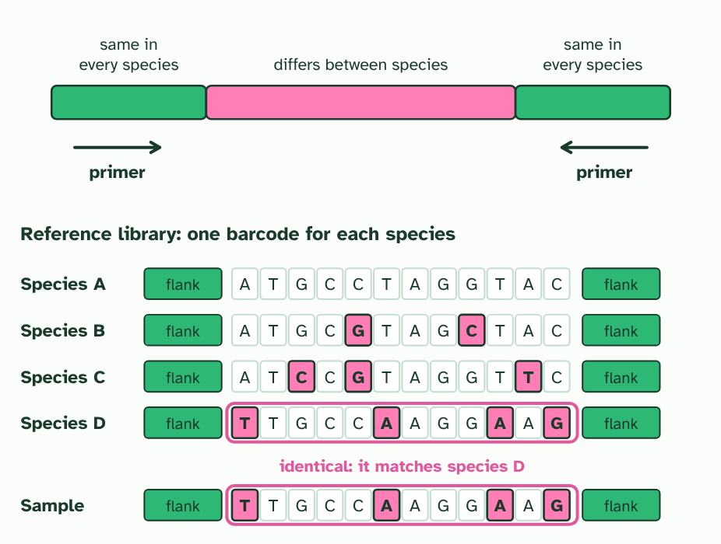
CHAPTER 12 · A3.1.15 DNA barcodes and environmental DNA
4 / 4
Barcodes from the soil
A barcode read from a sample is matched against the library. Here it is identical to one species’ barcode.
Minutes 42 to 54
Notes:
Minutes 42 to 54 of 60: Barcodes from a sample (12 min).
The plan: Chapter 12’s film, then its figure on the board. Students put the five step cards of the sample to species activity in order and say what each step needs. Turn over chapter 12’s Remember it tiles.
How many species live in a pond? Netting them all takes weeks, and shy or tiny ones are missed. But every animal leaves traces of itself in the water: skin cells, mucus, droppings. Environmental DNA (eDNA) is the DNA collected from a sample of water, soil or air, not from an animal you have caught.
To tell whose DNA it is, scientists read a DNA barcode: a short stretch of DNA, a few hundred base pairs long, that is alike in members of one species and different between species. A good barcode has two ends that are the same in every species, so one pair of primers works on all of them, and a middle that varies. For animals it is usually part of a mitochondrial gene, for bacteria a ribosomal RNA gene, and plants use other genes.
The steps are always the same: collect a sample, extract the DNA, make millions of copies of the barcode region with PCR, read their sequences, and match each sequence against a reference library of barcodes from known species. Out comes a list of the species present, in a few days, including ones nobody saw.
Because it is so quick, barcoding with eDNA lets the biodiversity of a habitat be investigated rapidly.

Slide 25
CHAPTER 12 · A3.1.15 DNA barcodes and environmental DNA
Barcodes from the soil
A barcode is a short, variable stretch of DNA flanked by sequences shared by all species.
eDNA plus barcodes gives a rapid species list for a habitat.
Minutes 42 to 54
Notes:
Minutes 42 to 54 of 60: Barcodes from a sample (12 min).
The plan: Chapter 12’s film, then its figure on the board. Students put the five step cards of the sample to species activity in order and say what each step needs. Turn over chapter 12’s Remember it tiles.
How many species live in a pond? Netting them all takes weeks, and shy or tiny ones are missed. But every animal leaves traces of itself in the water: skin cells, mucus, droppings. Environmental DNA (eDNA) is the DNA collected from a sample of water, soil or air, not from an animal you have caught.
To tell whose DNA it is, scientists read a DNA barcode: a short stretch of DNA, a few hundred base pairs long, that is alike in members of one species and different between species. A good barcode has two ends that are the same in every species, so one pair of primers works on all of them, and a middle that varies. For animals it is usually part of a mitochondrial gene, for bacteria a ribosomal RNA gene, and plants use other genes.
The steps are always the same: collect a sample, extract the DNA, make millions of copies of the barcode region with PCR, read their sequences, and match each sequence against a reference library of barcodes from known species. Out comes a list of the species present, in a few days, including ones nobody saw.
Because it is so quick, barcoding with eDNA lets the biodiversity of a habitat be investigated rapidly.

Slide 26
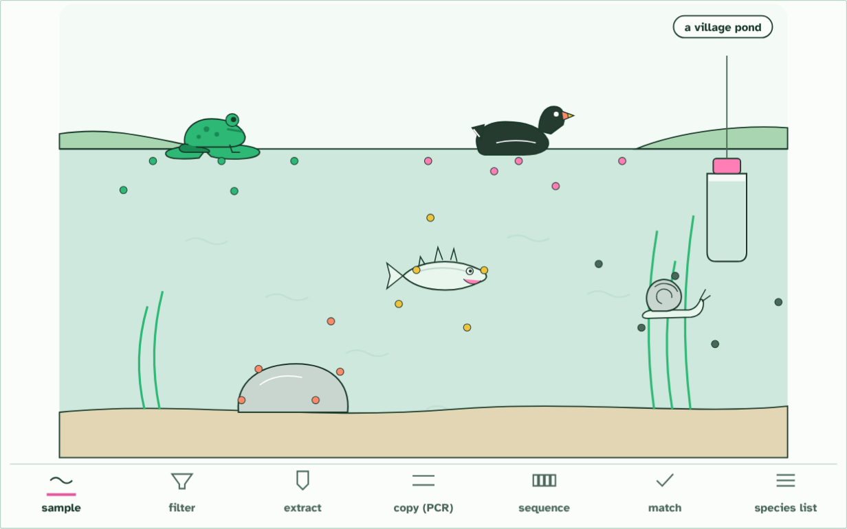
CHAPTER 12 · A3.1.15 DNA barcodes and environmental DNA
1 of 7: sample
1 / 7
Barcodes from the soil
Collect a sample: a bottle of pond water. The DNA in it is environmental DNA (eDNA).
Minutes 42 to 54
Notes:
Minutes 42 to 54 of 60: Barcodes from a sample (12 min).
The plan: Chapter 12’s film, then its figure on the board. Students put the five step cards of the sample to species activity in order and say what each step needs. Turn over chapter 12’s Remember it tiles.
How many species live in a pond? Netting them all takes weeks, and shy or tiny ones are missed. But every animal leaves traces of itself in the water: skin cells, mucus, droppings. Environmental DNA (eDNA) is the DNA collected from a sample of water, soil or air, not from an animal you have caught.
To tell whose DNA it is, scientists read a DNA barcode: a short stretch of DNA, a few hundred base pairs long, that is alike in members of one species and different between species. A good barcode has two ends that are the same in every species, so one pair of primers works on all of them, and a middle that varies. For animals it is usually part of a mitochondrial gene, for bacteria a ribosomal RNA gene, and plants use other genes.
The steps are always the same: collect a sample, extract the DNA, make millions of copies of the barcode region with PCR, read their sequences, and match each sequence against a reference library of barcodes from known species. Out comes a list of the species present, in a few days, including ones nobody saw.
Because it is so quick, barcoding with eDNA lets the biodiversity of a habitat be investigated rapidly.
The animation "Watch it happen: a sample becomes a species list", paused at 6.3 s. The next slides go on through it, then play it.

Slide 27
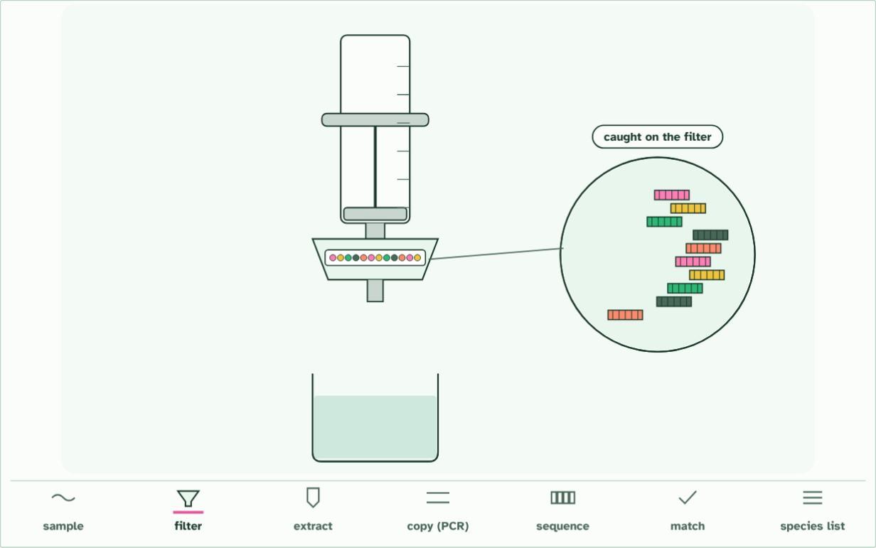
CHAPTER 12 · A3.1.15 DNA barcodes and environmental DNA
2 of 7: filter
2 / 7
Barcodes from the soil
Push the water through a fine filter. Cells and DNA from every species are caught on it.
Minutes 42 to 54
Notes:
Minutes 42 to 54 of 60: Barcodes from a sample (12 min).
The plan: Chapter 12’s film, then its figure on the board. Students put the five step cards of the sample to species activity in order and say what each step needs. Turn over chapter 12’s Remember it tiles.
How many species live in a pond? Netting them all takes weeks, and shy or tiny ones are missed. But every animal leaves traces of itself in the water: skin cells, mucus, droppings. Environmental DNA (eDNA) is the DNA collected from a sample of water, soil or air, not from an animal you have caught.
To tell whose DNA it is, scientists read a DNA barcode: a short stretch of DNA, a few hundred base pairs long, that is alike in members of one species and different between species. A good barcode has two ends that are the same in every species, so one pair of primers works on all of them, and a middle that varies. For animals it is usually part of a mitochondrial gene, for bacteria a ribosomal RNA gene, and plants use other genes.
The steps are always the same: collect a sample, extract the DNA, make millions of copies of the barcode region with PCR, read their sequences, and match each sequence against a reference library of barcodes from known species. Out comes a list of the species present, in a few days, including ones nobody saw.
Because it is so quick, barcoding with eDNA lets the biodiversity of a habitat be investigated rapidly.
The animation "Watch it happen: a sample becomes a species list", paused at 11.3 s. The next slides go on through it, then play it.

Slide 28
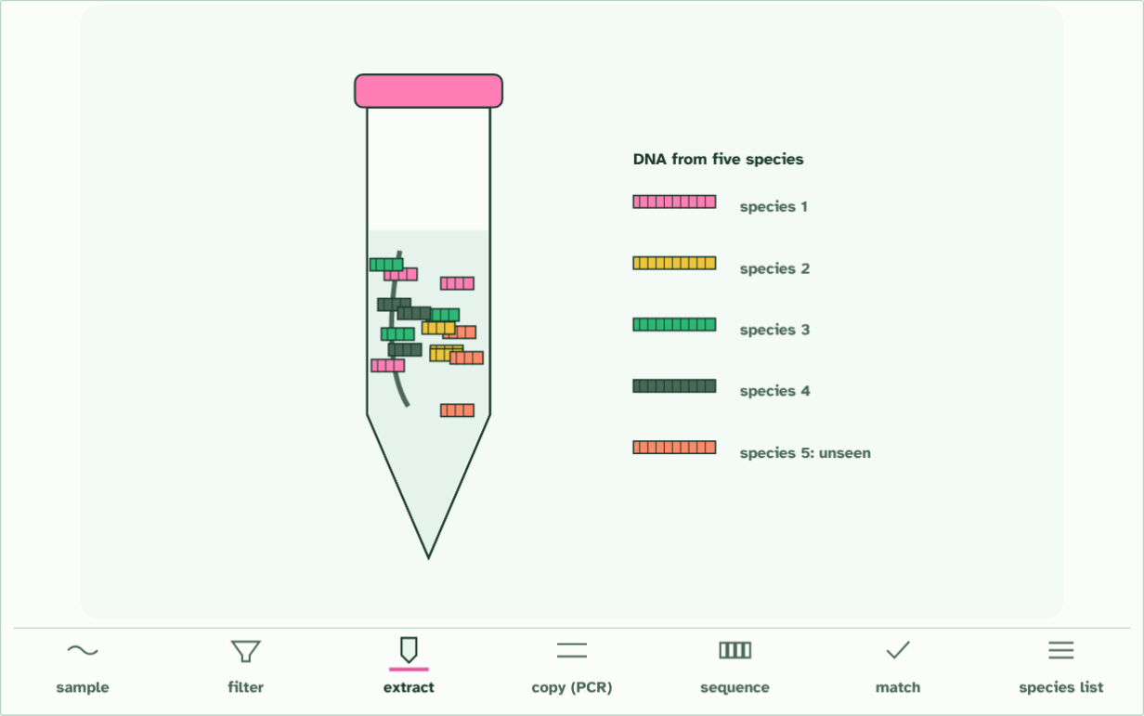
CHAPTER 12 · A3.1.15 DNA barcodes and environmental DNA
3 of 7: extract
3 / 7
Barcodes from the soil
Extract the DNA from the filter: a mixture from every species living there.
Minutes 42 to 54
Notes:
Minutes 42 to 54 of 60: Barcodes from a sample (12 min).
The plan: Chapter 12’s film, then its figure on the board. Students put the five step cards of the sample to species activity in order and say what each step needs. Turn over chapter 12’s Remember it tiles.
How many species live in a pond? Netting them all takes weeks, and shy or tiny ones are missed. But every animal leaves traces of itself in the water: skin cells, mucus, droppings. Environmental DNA (eDNA) is the DNA collected from a sample of water, soil or air, not from an animal you have caught.
To tell whose DNA it is, scientists read a DNA barcode: a short stretch of DNA, a few hundred base pairs long, that is alike in members of one species and different between species. A good barcode has two ends that are the same in every species, so one pair of primers works on all of them, and a middle that varies. For animals it is usually part of a mitochondrial gene, for bacteria a ribosomal RNA gene, and plants use other genes.
The steps are always the same: collect a sample, extract the DNA, make millions of copies of the barcode region with PCR, read their sequences, and match each sequence against a reference library of barcodes from known species. Out comes a list of the species present, in a few days, including ones nobody saw.
Because it is so quick, barcoding with eDNA lets the biodiversity of a habitat be investigated rapidly.
The animation "Watch it happen: a sample becomes a species list", paused at 15.9 s. The next slides go on through it, then play it.

Slide 29
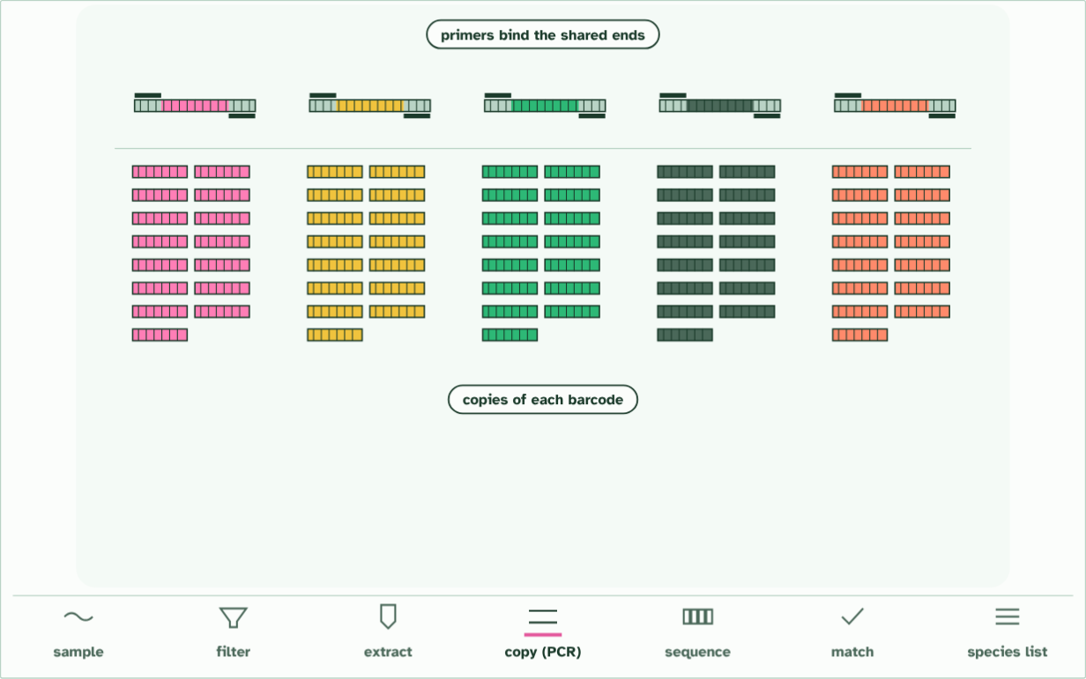
CHAPTER 12 · A3.1.15 DNA barcodes and environmental DNA
cycle 5: 32 copies each
4 / 7
Barcodes from the soil
PCR copies one short stretch, the barcode, from every species at once. The primers fit ends that all of them share; the barcode between them differs.
Minutes 42 to 54
Notes:
Minutes 42 to 54 of 60: Barcodes from a sample (12 min).
The plan: Chapter 12’s film, then its figure on the board. Students put the five step cards of the sample to species activity in order and say what each step needs. Turn over chapter 12’s Remember it tiles.
How many species live in a pond? Netting them all takes weeks, and shy or tiny ones are missed. But every animal leaves traces of itself in the water: skin cells, mucus, droppings. Environmental DNA (eDNA) is the DNA collected from a sample of water, soil or air, not from an animal you have caught.
To tell whose DNA it is, scientists read a DNA barcode: a short stretch of DNA, a few hundred base pairs long, that is alike in members of one species and different between species. A good barcode has two ends that are the same in every species, so one pair of primers works on all of them, and a middle that varies. For animals it is usually part of a mitochondrial gene, for bacteria a ribosomal RNA gene, and plants use other genes.
The steps are always the same: collect a sample, extract the DNA, make millions of copies of the barcode region with PCR, read their sequences, and match each sequence against a reference library of barcodes from known species. Out comes a list of the species present, in a few days, including ones nobody saw.
Because it is so quick, barcoding with eDNA lets the biodiversity of a habitat be investigated rapidly.
The animation "Watch it happen: a sample becomes a species list", paused at 21.9 s. The next slides go on through it, then play it.

Slide 30
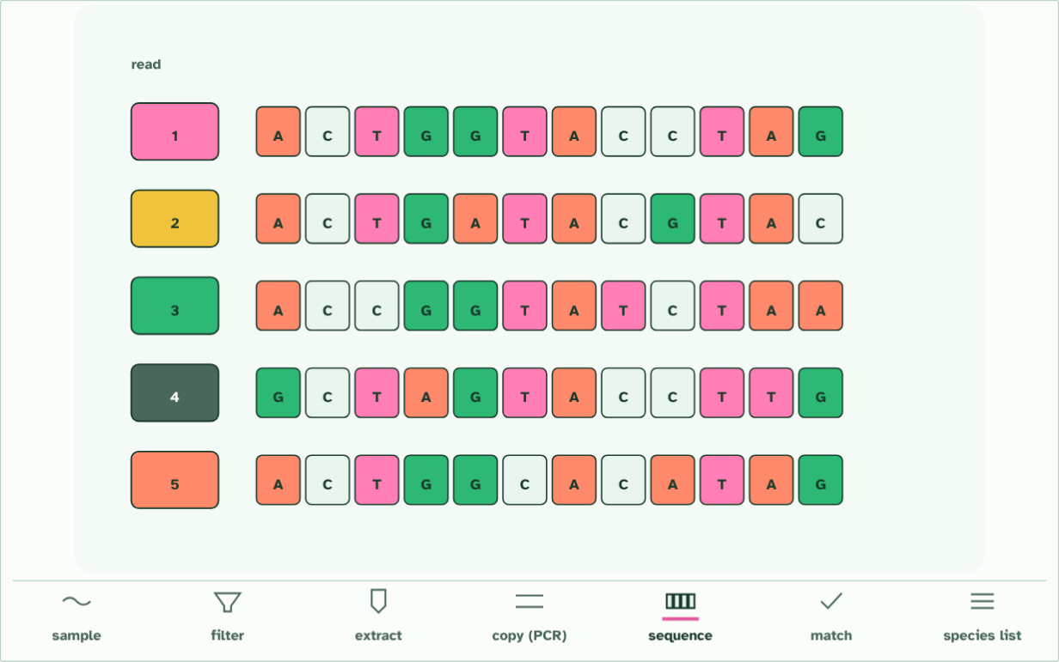
CHAPTER 12 · A3.1.15 DNA barcodes and environmental DNA
5 of 7: sequence
5 / 7
Barcodes from the soil
Sequence the copies: each read is one barcode’s base sequence.
Minutes 42 to 54
Notes:
Minutes 42 to 54 of 60: Barcodes from a sample (12 min).
The plan: Chapter 12’s film, then its figure on the board. Students put the five step cards of the sample to species activity in order and say what each step needs. Turn over chapter 12’s Remember it tiles.
How many species live in a pond? Netting them all takes weeks, and shy or tiny ones are missed. But every animal leaves traces of itself in the water: skin cells, mucus, droppings. Environmental DNA (eDNA) is the DNA collected from a sample of water, soil or air, not from an animal you have caught.
To tell whose DNA it is, scientists read a DNA barcode: a short stretch of DNA, a few hundred base pairs long, that is alike in members of one species and different between species. A good barcode has two ends that are the same in every species, so one pair of primers works on all of them, and a middle that varies. For animals it is usually part of a mitochondrial gene, for bacteria a ribosomal RNA gene, and plants use other genes.
The steps are always the same: collect a sample, extract the DNA, make millions of copies of the barcode region with PCR, read their sequences, and match each sequence against a reference library of barcodes from known species. Out comes a list of the species present, in a few days, including ones nobody saw.
Because it is so quick, barcoding with eDNA lets the biodiversity of a habitat be investigated rapidly.
The animation "Watch it happen: a sample becomes a species list", paused at 26.9 s. The next slides go on through it, then play it.

Slide 31
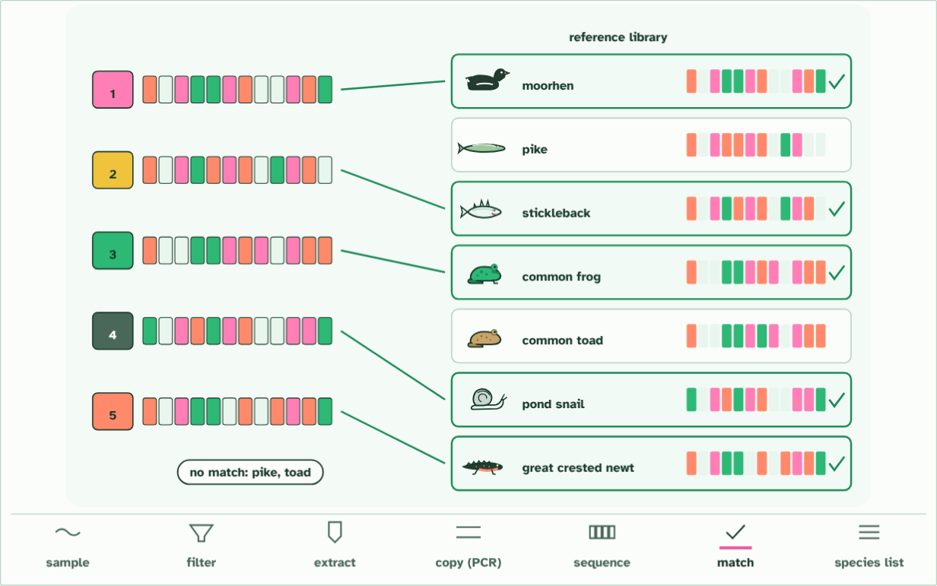
CHAPTER 12 · A3.1.15 DNA barcodes and environmental DNA
6 of 7: match
6 / 7
Barcodes from the soil
Match each read to a reference library of barcodes from identified species.
Minutes 42 to 54
Notes:
Minutes 42 to 54 of 60: Barcodes from a sample (12 min).
The plan: Chapter 12’s film, then its figure on the board. Students put the five step cards of the sample to species activity in order and say what each step needs. Turn over chapter 12’s Remember it tiles.
How many species live in a pond? Netting them all takes weeks, and shy or tiny ones are missed. But every animal leaves traces of itself in the water: skin cells, mucus, droppings. Environmental DNA (eDNA) is the DNA collected from a sample of water, soil or air, not from an animal you have caught.
To tell whose DNA it is, scientists read a DNA barcode: a short stretch of DNA, a few hundred base pairs long, that is alike in members of one species and different between species. A good barcode has two ends that are the same in every species, so one pair of primers works on all of them, and a middle that varies. For animals it is usually part of a mitochondrial gene, for bacteria a ribosomal RNA gene, and plants use other genes.
The steps are always the same: collect a sample, extract the DNA, make millions of copies of the barcode region with PCR, read their sequences, and match each sequence against a reference library of barcodes from known species. Out comes a list of the species present, in a few days, including ones nobody saw.
Because it is so quick, barcoding with eDNA lets the biodiversity of a habitat be investigated rapidly.
The animation "Watch it happen: a sample becomes a species list", paused at 32.4 s. The next slides go on through it, then play it.

Slide 32
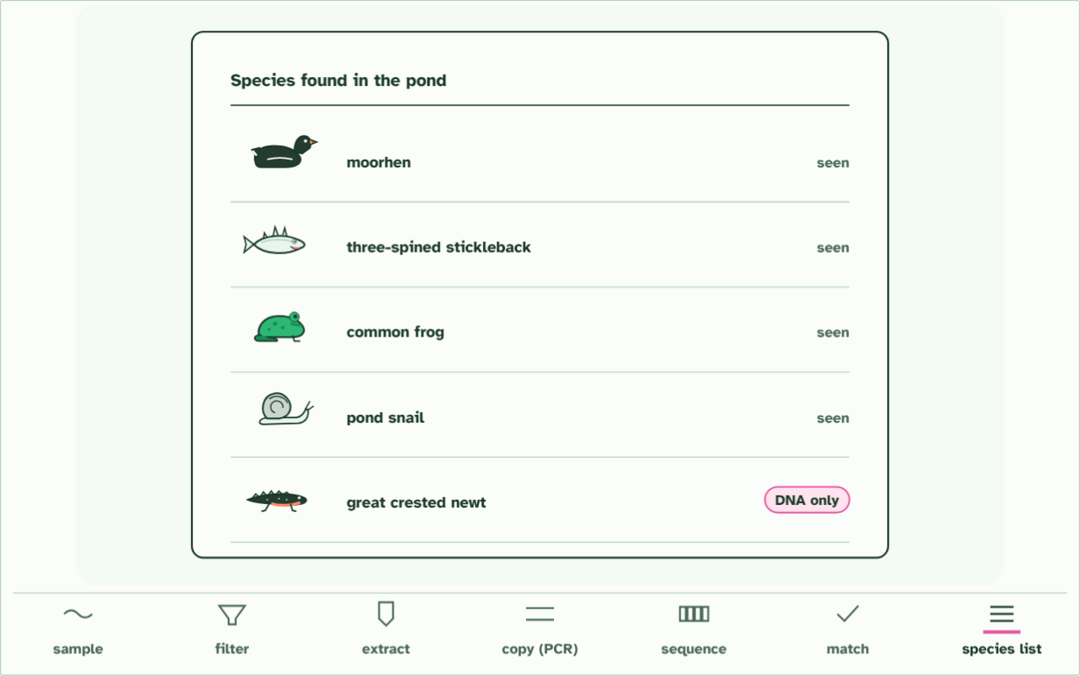
CHAPTER 12 · A3.1.15 DNA barcodes and environmental DNA
7 of 7: species list
7 / 7
Barcodes from the soil
A list of the species present, from one bottle of water, much faster than searching and trapping. One of them nobody saw.
Minutes 42 to 54
Notes:
Minutes 42 to 54 of 60: Barcodes from a sample (12 min).
The plan: Chapter 12’s film, then its figure on the board. Students put the five step cards of the sample to species activity in order and say what each step needs. Turn over chapter 12’s Remember it tiles.
How many species live in a pond? Netting them all takes weeks, and shy or tiny ones are missed. But every animal leaves traces of itself in the water: skin cells, mucus, droppings. Environmental DNA (eDNA) is the DNA collected from a sample of water, soil or air, not from an animal you have caught.
To tell whose DNA it is, scientists read a DNA barcode: a short stretch of DNA, a few hundred base pairs long, that is alike in members of one species and different between species. A good barcode has two ends that are the same in every species, so one pair of primers works on all of them, and a middle that varies. For animals it is usually part of a mitochondrial gene, for bacteria a ribosomal RNA gene, and plants use other genes.
The steps are always the same: collect a sample, extract the DNA, make millions of copies of the barcode region with PCR, read their sequences, and match each sequence against a reference library of barcodes from known species. Out comes a list of the species present, in a few days, including ones nobody saw.
Because it is so quick, barcoding with eDNA lets the biodiversity of a habitat be investigated rapidly.
The animation "Watch it happen: a sample becomes a species list", paused at 38.6 s. The next slides go on through it, then play it.

Slide 33
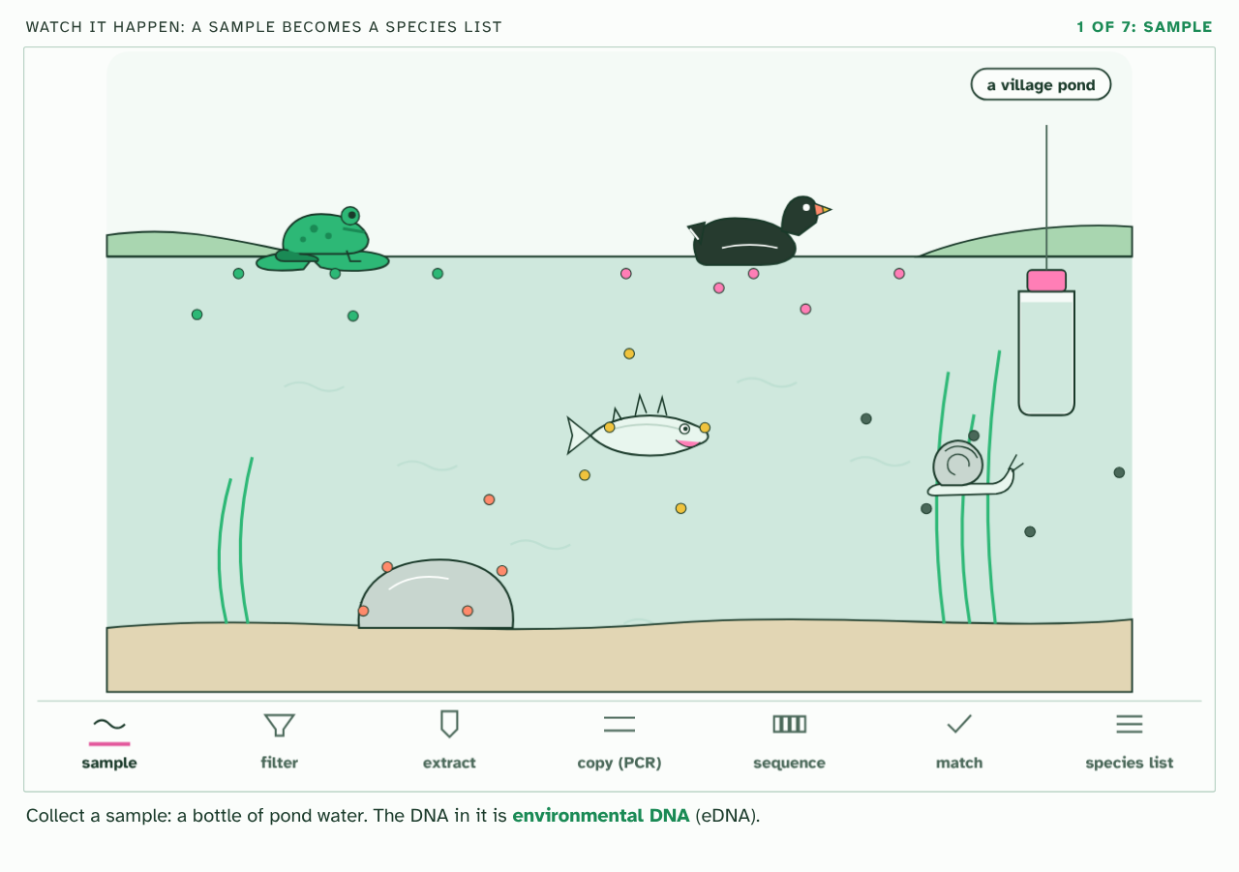
CHAPTER 12 · A3.1.15 DNA barcodes and environmental DNA
PLAY IT
Barcodes from the soil
Watch it happen: a sample becomes a species list: click to play. It loops every 40 seconds.
Minutes 42 to 54
Notes:
Minutes 42 to 54 of 60: Barcodes from a sample (12 min).
The plan: Chapter 12’s film, then its figure on the board. Students put the five step cards of the sample to species activity in order and say what each step needs. Turn over chapter 12’s Remember it tiles.
The video is barcode.mp4, one loop of the animation in the guide. It plays in PowerPoint and Keynote. Google Slides does not play a video embedded in a .pptx: download barcode.mp4 (https://www.biologybybradford.com/guides/downloads/scenes/barcode.mp4), upload it to Google Drive, then Insert > Video > Google Drive.
In the guide the class can change it as it runs: https://www.biologybybradford.com/guides/ib-biology-a3-1-diversity-of-organisms#barcodes
What it shows, in order:
1. Collect a sample: a bottle of pond water. The DNA in it is environmental DNA (eDNA).
2. Push the water through a fine filter. Cells and DNA from every species are caught on it.
3. Extract the DNA from the filter: a mixture from every species living there.
4. PCR copies one short stretch, the barcode, from every species at once. The primers fit ends that all of them share; the barcode between them differs.
5. Sequence the copies: each read is one barcode’s base sequence.
6. Match each read to a reference library of barcodes from identified species.
7. A list of the species present, from one bottle of water, much faster than searching and trapping. One of them nobody saw.

Slide 34
WATCH OUT
eDNA tells you what has left DNA there, not how many, and not that it still lives there. And it can only name species that are in the reference library: a species missing from it gives no match.
Minutes 42 to 54
Notes:
Minutes 42 to 54 of 60: Barcodes from a sample (12 min).
The plan: Chapter 12’s film, then its figure on the board. Students put the five step cards of the sample to species activity in order and say what each step needs. Turn over chapter 12’s Remember it tiles.
A common mistake: say it, then ask who can say why it is wrong.

Slide 35
REMEMBER IT
Steps of an eDNA survey
C
E
A
S
M
Cats
Eat
Any
Sausage
Mostly
Minutes 42 to 54
Notes:
Minutes 42 to 54 of 60: Barcodes from a sample (12 min).
The plan: Chapter 12’s film, then its figure on the board. Students put the five step cards of the sample to species activity in order and say what each step needs. Turn over chapter 12’s Remember it tiles.
Ask the class what each letter stands for before revealing.

Slide 36
REMEMBER IT
Steps of an eDNA survey
C
E
A
S
M
Cats
Eat
Any
Sausage
Mostly
Collect
Extract
Amplify
Sequence
Match
a sample of water or soil
the DNA from it
the barcode region with PCR
the copies
them to a reference library
Minutes 42 to 54
Notes:
Minutes 42 to 54 of 60: Barcodes from a sample (12 min).
The plan: Chapter 12’s film, then its figure on the board. Students put the five step cards of the sample to species activity in order and say what each step needs. Turn over chapter 12’s Remember it tiles.
Cats: Collect (a sample of water or soil)
Eat: Extract (the DNA from it)
Any: Amplify (the barcode region with PCR)
Sausage: Sequence (the copies)
Mostly: Match (them to a reference library)

Slide 37
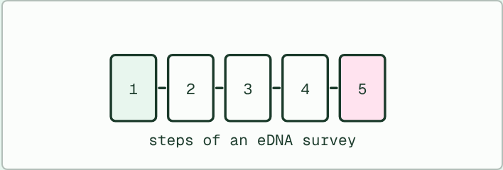
CARD SORT · HL
IF THERE IS TIME
From sample to species
THE TASK
Five step cards (collect a sample, extract the DNA, amplify the barcode region, sequence it, match it to a reference library) and five cards saying what each step produces or needs. Pairs put both sets in order and pair them up. A last card asks what would go wrong if the library lacked the species in the sample.
STUDENTS NEED
Ten cards per pair.
Minutes 42 to 54
Notes:
Minutes 42 to 54 of 60: Barcodes from a sample (12 min).
The plan: Chapter 12’s film, then its figure on the board. Students put the five step cards of the sample to species activity in order and say what each step needs. Turn over chapter 12’s Remember it tiles.
The activity: From sample to species. Five step cards (collect a sample, extract the DNA, amplify the barcode region, sequence it, match it to a reference library) and five cards saying what each step produces or needs. Pairs put both sets in order and pair them up. A last card asks what would go wrong if the library lacked the species in the sample.
Needs: ten cards per pair.
The plan sets no time of its own for this activity: use it in this step, in place of part of it, or for homework.

Slide 38
PLENARY
Can you now...
Build and test a dichotomous key for local organisms (A3.1.14)
Explain how DNA barcodes and environmental DNA identify the species in a habitat rapidly (A3.1.15)
Minutes 54 to 60
Notes:
Minutes 54 to 60 of 60: Exit: limits of eDNA (6 min).
The plan: Chapter 12’s predict box. Then one sentence: give two things an eDNA barcode survey cannot tell you.
Thumbs up, sideways or down on each goal before the exit question. The goals come from the statements this lesson covers.

Slide 39
EXIT QUESTION
Limits of eDNA
On paper, on your own, before we go through it.
Minutes 54 to 60
Notes:
Minutes 54 to 60 of 60: Exit: limits of eDNA (6 min).
The plan: Chapter 12’s predict box. Then one sentence: give two things an eDNA barcode survey cannot tell you.

Slide 40
PREDICT
A water sample from a pond is barcoded and matched. What can the result tell you?
A Exactly how many individuals of each species live there
B Which listed species have left DNA in the water
C The age and the sex of each animal that left DNA
Minutes 54 to 60
Notes:
Minutes 54 to 60 of 60: Exit: limits of eDNA (6 min).
The plan: Chapter 12’s predict box. Then one sentence: give two things an eDNA barcode survey cannot tell you.
Ask for a show of hands, or mini whiteboards, before revealing. (Answer: B, on the next slide.)

Slide 41
WHAT HAPPENS
A water sample from a pond is barcoded and matched. What can the result tell you?
A Exactly how many individuals of each species live there
B Which listed species have left DNA in the water
C The age and the sex of each animal that left DNA
Which species in the reference library have left DNA in the water. It does not give numbers or ages, and it cannot name a species the library lacks, but it can be done quickly from one bottle of water.
Minutes 54 to 60
Notes:
Minutes 54 to 60 of 60: Exit: limits of eDNA (6 min).
The plan: Chapter 12’s predict box. Then one sentence: give two things an eDNA barcode survey cannot tell you.
Answer: B. Which species in the reference library have left DNA in the water. It does not give numbers or ages, and it cannot name a species the library lacks, but it can be done quickly from one bottle of water.

Slide 42
PRACTISE AND REVISE
Keep going
Exam practice: a fresh paper of exam questions on A3.1 at higher level, marked as you go
The guide, with the animations and the dry lab
This lesson in the guide: 11 Building a key, 12 Barcodes from the soil
BUILD FOR YOUR CLASS
ALREADY ON THE SITE FOR A3.1
CARD SETS ON SPLYCR
Tarsia puzzle, dominoes and picture reveal on A3.1, built from its key terms and ready to print
A pub quiz with rounds on A3.1, to present or run with no projector
An escape room built from the question bank on A3.1
Quiz: Diversity of Organisms
Revision map: A3.1 Diversity of organisms, to fill in
Exam questions: A3.1 in the exam maker, a paper with its markscheme
Open a set to host it as a class game, or make a copy to edit.
A3.1 Diversity of Organisms
How this was made. The course structure, the activities and the teaching choices come from my own classroom, my presentations and my years of teaching IB and AP Biology. I use Claude, an AI, to help write and build the interactive guides, lesson plans, slides and practice questions, and to draw the diagrams and code the interactives. I direct the work and review it against the IB and AP specifications before it goes live.
Minute 60: after the lesson
Notes:
Every link here is live. Set the exam practice paper for homework: it is fresh each time, marked as students go and saved to their Exam practice when they are signed in.
Exam practice: https://www.biologybybradford.com/exam-maker/sit?topics=A3.1&level=HL&paper=quiz&marks=15&src=ep
The guide: https://www.biologybybradford.com/guides/ib-biology-a3-1-diversity-of-organisms

