Slide 1
IB Biology A3.2
LESSON 1 OF 4
HL
BY THE END YOU CAN
Classification and cladistics
Explain why classification is needed, and what it makes possible (A3.2.1)
Describe why the traditional hierarchy of taxa does not always match evolution, and why a fixed ranking is arbitrary (A3.2.2)
Explain why a classification that follows evolutionary relationships lets you predict the features of its members (A3.2.3)
Why sort life, and when the boxes fail
A3.2.1 to A3.2.3
Why classification is needed, why the traditional ranks do not always follow evolution, and what a classification by ancestry lets you predict
60 minutes · chapters 1, 2, 3
Minute 0
Notes:
IB Biology A3.2, Classification and cladistics. Lesson 1 of 4: Why sort life, and when the boxes fail (higher level), 60 minutes.
The plan, minute by minute (each slide's footer says where you are):
0 to 8 min (8) Do now: sort it your way
8 to 18 min (10) Why classify?
18 to 30 min (12) When the boxes do not fit
30 to 40 min (10) Questions on a paradigm shift
40 to 52 min (12) What does ancestry let you predict?
52 to 60 min (8) Exit: two groups
What students get wrong:
"Classification is just naming." A name is a label. A group tells you what to expect from an organism, which is why it is useful.
"Look-alikes are close relatives." Convergent evolution gives unrelated lines similar structures: wings, and the flowers of the figworts.
"A higher rank means older, or more different." Ranks have no fixed meaning, which is why a fixed ranking is arbitrary.
Stretch and support:
Support: give the captions of each figure as a cut-up storyboard to put in order, and use the key terms (tap the dotted words) as a glossary.
Support: the two mnemonics (King Philip Came Over For Good Soup; Rabbits Nibble Tasty Carrots Slowly) as a starter, with the tiles turned over for the answers.
The lesson plan to print: https://www.biologybybradford.com/guides/downloads/ib-biology-a3-2-classification-and-cladistics-lesson-1-plan.pdf

Slide 2
DO NOW
Sort it your way
Each pair gets a set of organism cards and two minutes to make groups with any rule.
Pairs then say their rule, and the class notes how many different rules there were.
8:00
minutes
Start now: the timer is running.
Minutes 0 to 8
Notes:
Minutes 0 to 8 of 60: Do now: sort it your way (8 min).
The plan: Each pair gets a set of organism cards (the card sort below) and two minutes to make groups with any rule. Pairs then say their rule, and the class notes how many different rules there were. Leave the rules on the board.
Start a 8 minute timer as they come in.

Slide 3
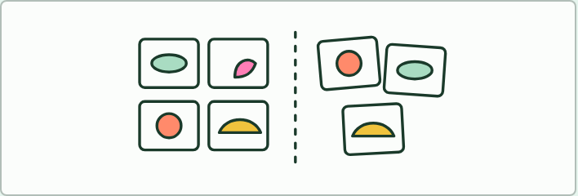
CARD SORT
8 MIN
Sort it your way
THE TASK
Pairs get twelve cards, each with a picture and name of an organism: for example a bat, a bird, a butterfly, a fish, a frog, a lizard, a crocodile, a mushroom, an oak leaf, a bacterium, a mouse and a spider. They sort the cards into groups by any rule, write the rule, then sort again by a different rule. Pairs compare rules around the room. Ask which rule told them the most about each organism, and which would still work if a new species turned up.
STUDENTS NEED
Printed cards, one set per pair (or the six organisms in chapter 1's figure on a screen).
Minutes 0 to 8
Notes:
Minutes 0 to 8 of 60: Do now: sort it your way (8 min).
The plan: Each pair gets a set of organism cards (the card sort below) and two minutes to make groups with any rule. Pairs then say their rule, and the class notes how many different rules there were. Leave the rules on the board.
The activity: Sort it your way. Pairs get twelve cards, each with a picture and name of an organism: for example a bat, a bird, a butterfly, a fish, a frog, a lizard, a crocodile, a mushroom, an oak leaf, a bacterium, a mouse and a spider. They sort the cards into groups by any rule, write the rule, then sort again by a different rule. Pairs compare rules around the room. Ask which rule told them the most about each organism, and which would still work if a new species turned up.
Needs: printed cards, one set per pair (or the six organisms in chapter 1's figure on a screen).
The time: 8 minutes, minutes 0 to 8 of the plan.

Slide 4
STEP 2
10 MIN
Why classify?
Pairs answer "Why do scientists classify organisms?" and "What could a biologist do with a group that she could not do with a heap?"
Minutes 8 to 18
Notes:
Minutes 8 to 18 of 60: Why classify? (10 min).
The plan: Chapter 1's figure on the board, step by step. Pairs answer "Why do scientists classify organisms?" and "What could a biologist do with a group that she could not do with a heap?" Collect two answers and write the key ideas: too many species, and a broad range of further study. Then the predict box.

Slide 5
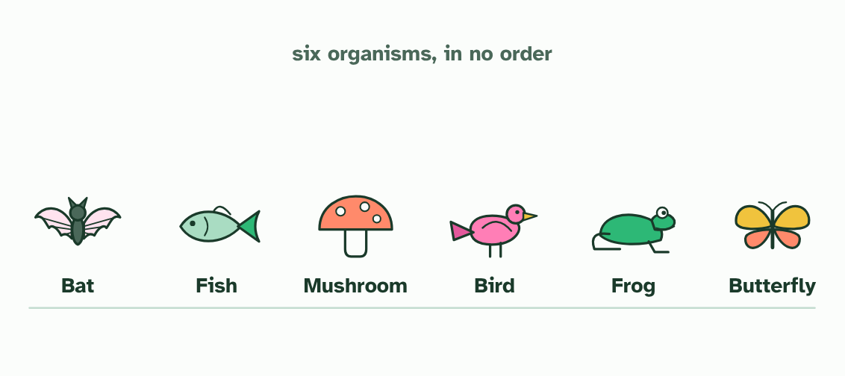
CHAPTER 1 · A3.2.1 Why we classify
1 / 3
Why sort life at all?
Six organisms, to sort any way you like.
Minutes 8 to 18
Notes:
Minutes 8 to 18 of 60: Why classify? (10 min).
The plan: Chapter 1's figure on the board, step by step. Pairs answer "Why do scientists classify organisms?" and "What could a biologist do with a group that she could not do with a heap?" Collect two answers and write the key ideas: too many species, and a broad range of further study. Then the predict box.
There are more kinds of living thing than anyone can hold in their head. Biologists have named well over a million species, and many more are still waiting to be found. Nobody can learn them one by one. So we sort them. Classification turns the diversity of life from a heap into a map.
A good map does two jobs. It helps you name and find an organism: once you know which group a beetle or a fern belongs to, you know where to look it up and what it is probably like. And it makes further study possible. When a new species is found, its group tells a biologist what to ask about it, such as what its relatives eat, how they breed and how best to protect them, instead of starting from nothing. Medicine, farming and conservation all lean on groups in this way.
Example: Try it first Before you read on, sort the six organisms in the figure into two groups, using any rule you like. Then compare your rule with a partner's. You will probably both have made sensible groups, and they will not be the same. A rule is worth keeping if the groups it makes tell you something. The next chapters ask which rule tells you the most.

Slide 6
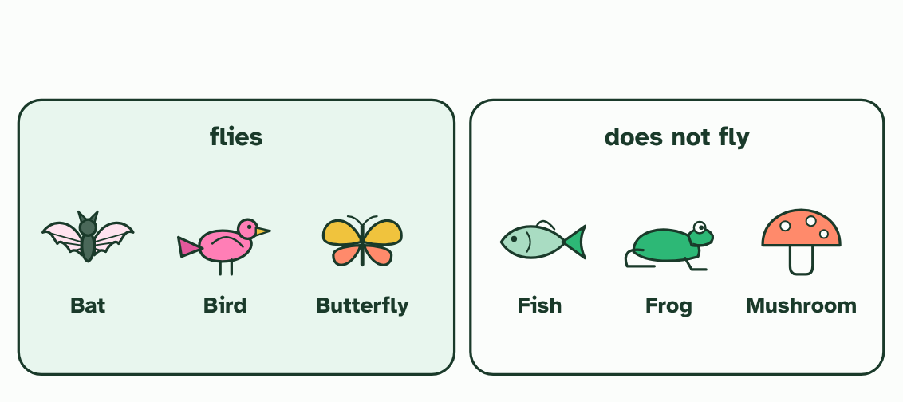
CHAPTER 1 · A3.2.1 Why we classify
2 / 3
Why sort life at all?
Rule one: flies. The bat, the bird and the butterfly go together.
Minutes 8 to 18
Notes:
Minutes 8 to 18 of 60: Why classify? (10 min).
The plan: Chapter 1's figure on the board, step by step. Pairs answer "Why do scientists classify organisms?" and "What could a biologist do with a group that she could not do with a heap?" Collect two answers and write the key ideas: too many species, and a broad range of further study. Then the predict box.
There are more kinds of living thing than anyone can hold in their head. Biologists have named well over a million species, and many more are still waiting to be found. Nobody can learn them one by one. So we sort them. Classification turns the diversity of life from a heap into a map.
A good map does two jobs. It helps you name and find an organism: once you know which group a beetle or a fern belongs to, you know where to look it up and what it is probably like. And it makes further study possible. When a new species is found, its group tells a biologist what to ask about it, such as what its relatives eat, how they breed and how best to protect them, instead of starting from nothing. Medicine, farming and conservation all lean on groups in this way.
Example: Try it first Before you read on, sort the six organisms in the figure into two groups, using any rule you like. Then compare your rule with a partner's. You will probably both have made sensible groups, and they will not be the same. A rule is worth keeping if the groups it makes tell you something. The next chapters ask which rule tells you the most.

Slide 7
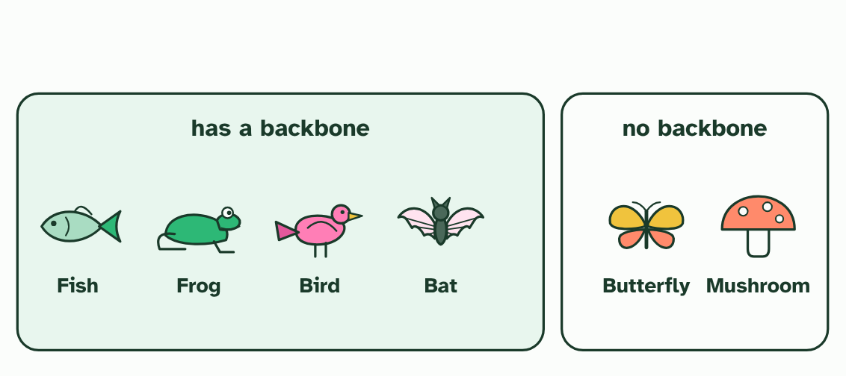
CHAPTER 1 · A3.2.1 Why we classify
3 / 3
Why sort life at all?
Rule two: has a backbone. Now the bat sits with the fish and the frog, and the butterfly has left it. Same six, different groups.
Minutes 8 to 18
Notes:
Minutes 8 to 18 of 60: Why classify? (10 min).
The plan: Chapter 1's figure on the board, step by step. Pairs answer "Why do scientists classify organisms?" and "What could a biologist do with a group that she could not do with a heap?" Collect two answers and write the key ideas: too many species, and a broad range of further study. Then the predict box.
There are more kinds of living thing than anyone can hold in their head. Biologists have named well over a million species, and many more are still waiting to be found. Nobody can learn them one by one. So we sort them. Classification turns the diversity of life from a heap into a map.
A good map does two jobs. It helps you name and find an organism: once you know which group a beetle or a fern belongs to, you know where to look it up and what it is probably like. And it makes further study possible. When a new species is found, its group tells a biologist what to ask about it, such as what its relatives eat, how they breed and how best to protect them, instead of starting from nothing. Medicine, farming and conservation all lean on groups in this way.
Example: Try it first Before you read on, sort the six organisms in the figure into two groups, using any rule you like. Then compare your rule with a partner's. You will probably both have made sensible groups, and they will not be the same. A rule is worth keeping if the groups it makes tell you something. The next chapters ask which rule tells you the most.

Slide 8
CHAPTER 1 · A3.2.1 Why we classify
Why sort life at all?
Classification is needed because there are too many species to study one at a time.
Once organisms are classified, a broad range of further study becomes possible.
Different rules give different groups, so the rule matters.
Minutes 8 to 18
Notes:
Minutes 8 to 18 of 60: Why classify? (10 min).
The plan: Chapter 1's figure on the board, step by step. Pairs answer "Why do scientists classify organisms?" and "What could a biologist do with a group that she could not do with a heap?" Collect two answers and write the key ideas: too many species, and a broad range of further study. Then the predict box.
There are more kinds of living thing than anyone can hold in their head. Biologists have named well over a million species, and many more are still waiting to be found. Nobody can learn them one by one. So we sort them. Classification turns the diversity of life from a heap into a map.
A good map does two jobs. It helps you name and find an organism: once you know which group a beetle or a fern belongs to, you know where to look it up and what it is probably like. And it makes further study possible. When a new species is found, its group tells a biologist what to ask about it, such as what its relatives eat, how they breed and how best to protect them, instead of starting from nothing. Medicine, farming and conservation all lean on groups in this way.
Example: Try it first Before you read on, sort the six organisms in the figure into two groups, using any rule you like. Then compare your rule with a partner's. You will probably both have made sensible groups, and they will not be the same. A rule is worth keeping if the groups it makes tell you something. The next chapters ask which rule tells you the most.

Slide 9
PREDICT
Which is the best reason for classifying organisms?
A So that every species can be given one fixed name, which would stop scientists ever disagreeing about how to group it
B There are too many species to study one by one, and a group lets what we know about one guide the rest
C So that species can be ranked from the simplest up to the most advanced, with humans placed at the very top
Minutes 8 to 18
Notes:
Minutes 8 to 18 of 60: Why classify? (10 min).
The plan: Chapter 1's figure on the board, step by step. Pairs answer "Why do scientists classify organisms?" and "What could a biologist do with a group that she could not do with a heap?" Collect two answers and write the key ideas: too many species, and a broad range of further study. Then the predict box.
Ask for a show of hands, or mini whiteboards, before revealing. (Answer: B, on the next slide.)

Slide 10
WHAT HAPPENS
Which is the best reason for classifying organisms?
A So that every species can be given one fixed name, which would stop scientists ever disagreeing about how to group it
B There are too many species to study one by one, and a group lets what we know about one guide the rest
C So that species can be ranked from the simplest up to the most advanced, with humans placed at the very top
The second. Sorting makes millions of species manageable, and it lets what is found out about one species guide the study of its group. Names are useful but they do not do that, and ranking species from simple to advanced is not what classification is for: no living species is more advanced than another.
Minutes 8 to 18
Notes:
Minutes 8 to 18 of 60: Why classify? (10 min).
The plan: Chapter 1's figure on the board, step by step. Pairs answer "Why do scientists classify organisms?" and "What could a biologist do with a group that she could not do with a heap?" Collect two answers and write the key ideas: too many species, and a broad range of further study. Then the predict box.
Answer: B. The second. Sorting makes millions of species manageable, and it lets what is found out about one species guide the study of its group. Names are useful but they do not do that, and ranking species from simple to advanced is not what classification is for: no living species is more advanced than another.

Slide 11
WATCH OUT
Classification is not just naming. A name tells you nothing about a species. A group tells you what to expect from it.
Minutes 8 to 18
Notes:
Minutes 8 to 18 of 60: Why classify? (10 min).
The plan: Chapter 1's figure on the board, step by step. Pairs answer "Why do scientists classify organisms?" and "What could a biologist do with a group that she could not do with a heap?" Collect two answers and write the key ideas: too many species, and a broad range of further study. Then the predict box.
A common mistake: say it, then ask who can say why it is wrong.

Slide 12
STEP 3
12 MIN
When the boxes do not fit
Students sketch the tree of the bird, crocodile, lizard and mouse, then draw the old class Reptilia round the lizard and crocodile and say what is wrong with it.
Add "arbitrary".
Turn over the mnemonic tiles for the seven ranks.
Minutes 18 to 30
Notes:
Minutes 18 to 30 of 60: When the boxes do not fit (12 min).
The plan: Chapter 2's first figure, stopping on each caption. Students sketch the tree of the bird, crocodile, lizard and mouse, then draw the old class Reptilia round the lizard and crocodile and say what is wrong with it. Add "arbitrary": ask whether a family of beetles and a family of mammals are the same kind of thing. Turn over the mnemonic tiles for the seven ranks.

Slide 13
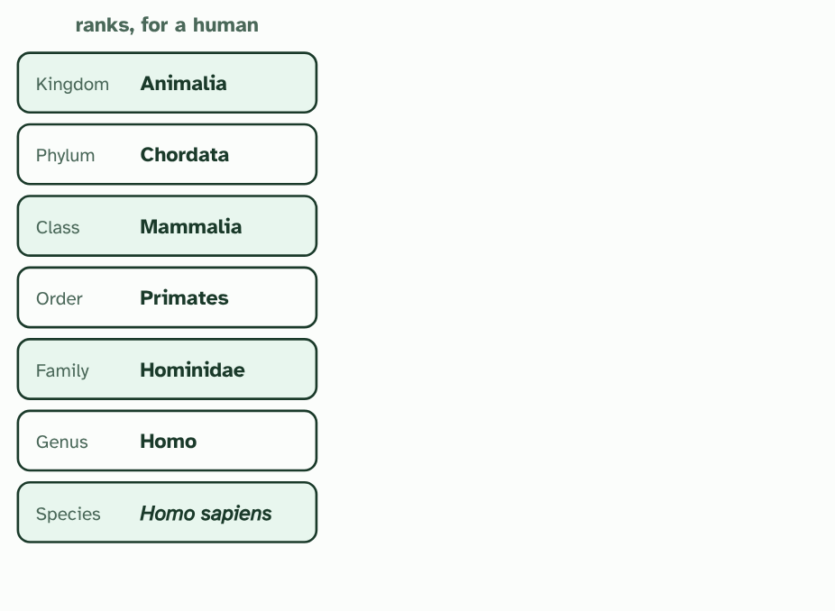
CHAPTER 2 · A3.2.2 The traditional hierarchy of taxa
1 / 4
When the boxes do not fit
The traditional ranks: each one nests inside the next, from kingdom down to species.
Minutes 18 to 30
Notes:
Minutes 18 to 30 of 60: When the boxes do not fit (12 min).
The plan: Chapter 2's first figure, stopping on each caption. Students sketch the tree of the bird, crocodile, lizard and mouse, then draw the old class Reptilia round the lizard and crocodile and say what is wrong with it. Add "arbitrary": ask whether a family of beetles and a family of mammals are the same kind of thing. Turn over the mnemonic tiles for the seven ranks.
Naturalists have long sorted life into a hierarchy of taxa. A taxon is a named group. Each species sits in a genus, each genus in a family, and so on up through order, class and phylum to kingdom. The system dates from Linnaeus, in the 1700s, and it grouped organisms mostly by features you can see.
It is tidy, and it has a problem. Evolution does not make boxes. It makes branches, and the branches split at different times. The ranks do not always follow that pattern.
Groups made from looks can gather unrelated lines: birds, bats and insects all fly, but each evolved its wings separately. Groups can also leave out relatives. In the old system crocodiles and lizards are in the class Reptilia, and birds have a class of their own, Aves. Yet the figure shows that crocodiles and birds share an ancestor that lizards do not.
Ranks are also arbitrary. Variation is gradual, and nothing in nature says how much difference makes a genus or a family. A family of beetles and a family of mammals need not be alike in age or in how much they differ, so a rank measures nothing fixed. Cladistics offers another way: unranked groups that follow the branching.
Example: A paradigm shift A paradigm shift is a fundamental change in how a science works. Classification has had one. Everyone used ranks, cases that did not fit piled up, and groups made from branching replaced them. Step through the second figure.

Slide 14
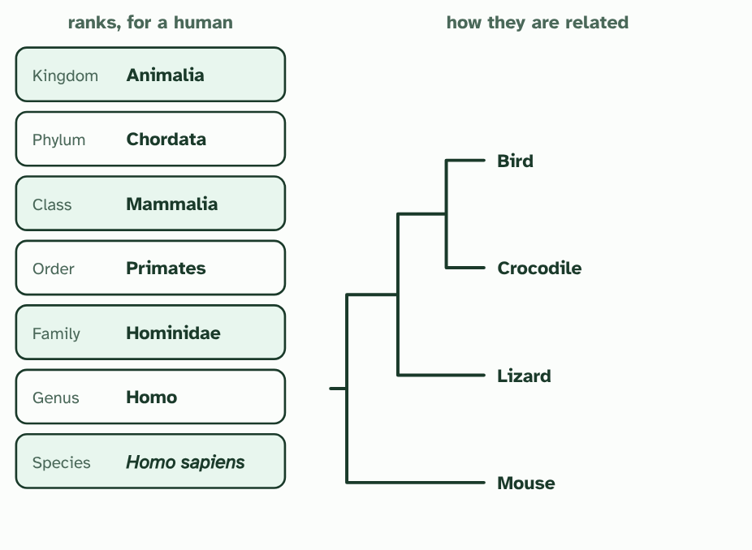
CHAPTER 2 · A3.2.2 The traditional hierarchy of taxa
2 / 4
When the boxes do not fit
Now the branching tree of descent for four vertebrates, built from DNA (simplified).
Minutes 18 to 30
Notes:
Minutes 18 to 30 of 60: When the boxes do not fit (12 min).
The plan: Chapter 2's first figure, stopping on each caption. Students sketch the tree of the bird, crocodile, lizard and mouse, then draw the old class Reptilia round the lizard and crocodile and say what is wrong with it. Add "arbitrary": ask whether a family of beetles and a family of mammals are the same kind of thing. Turn over the mnemonic tiles for the seven ranks.
Naturalists have long sorted life into a hierarchy of taxa. A taxon is a named group. Each species sits in a genus, each genus in a family, and so on up through order, class and phylum to kingdom. The system dates from Linnaeus, in the 1700s, and it grouped organisms mostly by features you can see.
It is tidy, and it has a problem. Evolution does not make boxes. It makes branches, and the branches split at different times. The ranks do not always follow that pattern.
Groups made from looks can gather unrelated lines: birds, bats and insects all fly, but each evolved its wings separately. Groups can also leave out relatives. In the old system crocodiles and lizards are in the class Reptilia, and birds have a class of their own, Aves. Yet the figure shows that crocodiles and birds share an ancestor that lizards do not.
Ranks are also arbitrary. Variation is gradual, and nothing in nature says how much difference makes a genus or a family. A family of beetles and a family of mammals need not be alike in age or in how much they differ, so a rank measures nothing fixed. Cladistics offers another way: unranked groups that follow the branching.
Example: A paradigm shift A paradigm shift is a fundamental change in how a science works. Classification has had one. Everyone used ranks, cases that did not fit piled up, and groups made from branching replaced them. Step through the second figure.

Slide 15
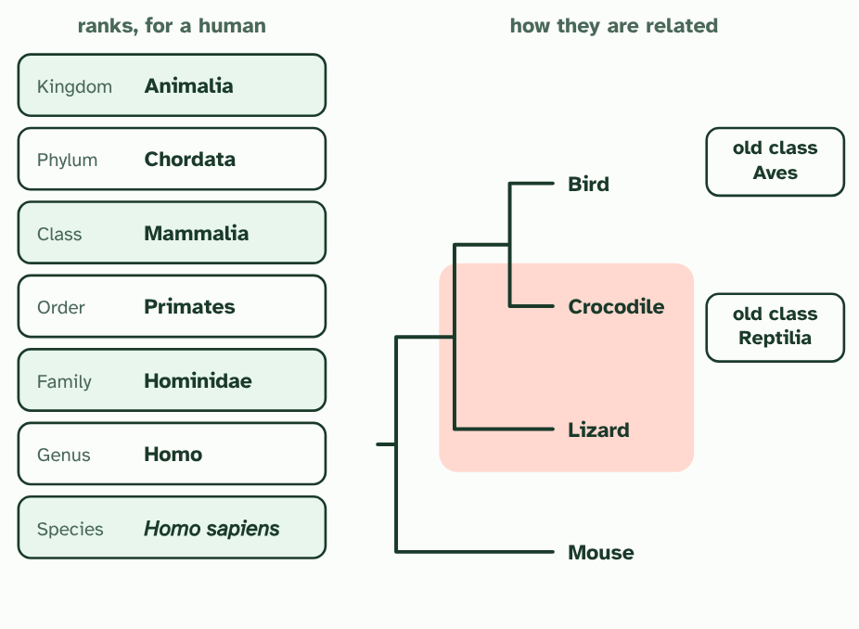
CHAPTER 2 · A3.2.2 The traditional hierarchy of taxa
3 / 4
When the boxes do not fit
The old classes. Reptilia holds the crocodile and the lizard, and Aves holds the bird on its own.
Minutes 18 to 30
Notes:
Minutes 18 to 30 of 60: When the boxes do not fit (12 min).
The plan: Chapter 2's first figure, stopping on each caption. Students sketch the tree of the bird, crocodile, lizard and mouse, then draw the old class Reptilia round the lizard and crocodile and say what is wrong with it. Add "arbitrary": ask whether a family of beetles and a family of mammals are the same kind of thing. Turn over the mnemonic tiles for the seven ranks.
Naturalists have long sorted life into a hierarchy of taxa. A taxon is a named group. Each species sits in a genus, each genus in a family, and so on up through order, class and phylum to kingdom. The system dates from Linnaeus, in the 1700s, and it grouped organisms mostly by features you can see.
It is tidy, and it has a problem. Evolution does not make boxes. It makes branches, and the branches split at different times. The ranks do not always follow that pattern.
Groups made from looks can gather unrelated lines: birds, bats and insects all fly, but each evolved its wings separately. Groups can also leave out relatives. In the old system crocodiles and lizards are in the class Reptilia, and birds have a class of their own, Aves. Yet the figure shows that crocodiles and birds share an ancestor that lizards do not.
Ranks are also arbitrary. Variation is gradual, and nothing in nature says how much difference makes a genus or a family. A family of beetles and a family of mammals need not be alike in age or in how much they differ, so a rank measures nothing fixed. Cladistics offers another way: unranked groups that follow the branching.
Example: A paradigm shift A paradigm shift is a fundamental change in how a science works. Classification has had one. Everyone used ranks, cases that did not fit piled up, and groups made from branching replaced them. Step through the second figure.

Slide 16
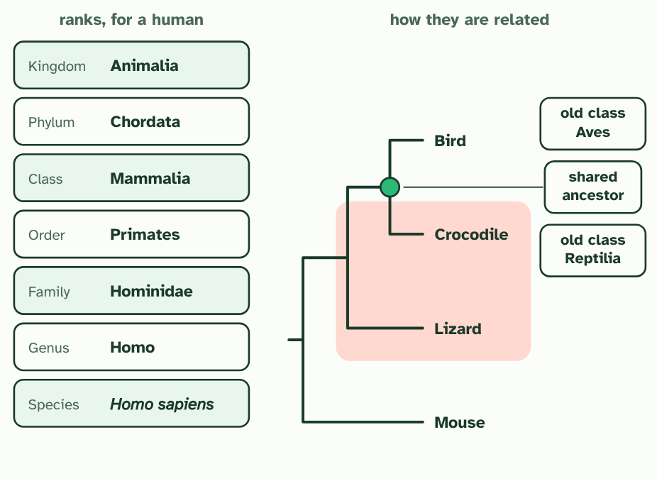
CHAPTER 2 · A3.2.2 The traditional hierarchy of taxa
4 / 4
When the boxes do not fit
But the crocodile and the bird share an ancestor that the lizard does not. The old class cuts that family in two.
Minutes 18 to 30
Notes:
Minutes 18 to 30 of 60: When the boxes do not fit (12 min).
The plan: Chapter 2's first figure, stopping on each caption. Students sketch the tree of the bird, crocodile, lizard and mouse, then draw the old class Reptilia round the lizard and crocodile and say what is wrong with it. Add "arbitrary": ask whether a family of beetles and a family of mammals are the same kind of thing. Turn over the mnemonic tiles for the seven ranks.
Naturalists have long sorted life into a hierarchy of taxa. A taxon is a named group. Each species sits in a genus, each genus in a family, and so on up through order, class and phylum to kingdom. The system dates from Linnaeus, in the 1700s, and it grouped organisms mostly by features you can see.
It is tidy, and it has a problem. Evolution does not make boxes. It makes branches, and the branches split at different times. The ranks do not always follow that pattern.
Groups made from looks can gather unrelated lines: birds, bats and insects all fly, but each evolved its wings separately. Groups can also leave out relatives. In the old system crocodiles and lizards are in the class Reptilia, and birds have a class of their own, Aves. Yet the figure shows that crocodiles and birds share an ancestor that lizards do not.
Ranks are also arbitrary. Variation is gradual, and nothing in nature says how much difference makes a genus or a family. A family of beetles and a family of mammals need not be alike in age or in how much they differ, so a rank measures nothing fixed. Cladistics offers another way: unranked groups that follow the branching.
Example: A paradigm shift A paradigm shift is a fundamental change in how a science works. Classification has had one. Everyone used ranks, cases that did not fit piled up, and groups made from branching replaced them. Step through the second figure.

Slide 17
CHAPTER 2 · A3.2.2 The traditional hierarchy of taxa
When the boxes do not fit
Naturalists have long sorted life into a hierarchy of taxa.
A taxon is a named group.
Cladistics offers another way: unranked groups that follow the branching.
Minutes 18 to 30
Notes:
Minutes 18 to 30 of 60: When the boxes do not fit (12 min).
The plan: Chapter 2's first figure, stopping on each caption. Students sketch the tree of the bird, crocodile, lizard and mouse, then draw the old class Reptilia round the lizard and crocodile and say what is wrong with it. Add "arbitrary": ask whether a family of beetles and a family of mammals are the same kind of thing. Turn over the mnemonic tiles for the seven ranks.
Naturalists have long sorted life into a hierarchy of taxa. A taxon is a named group. Each species sits in a genus, each genus in a family, and so on up through order, class and phylum to kingdom. The system dates from Linnaeus, in the 1700s, and it grouped organisms mostly by features you can see.
It is tidy, and it has a problem. Evolution does not make boxes. It makes branches, and the branches split at different times. The ranks do not always follow that pattern.
Groups made from looks can gather unrelated lines: birds, bats and insects all fly, but each evolved its wings separately. Groups can also leave out relatives. In the old system crocodiles and lizards are in the class Reptilia, and birds have a class of their own, Aves. Yet the figure shows that crocodiles and birds share an ancestor that lizards do not.
Ranks are also arbitrary. Variation is gradual, and nothing in nature says how much difference makes a genus or a family. A family of beetles and a family of mammals need not be alike in age or in how much they differ, so a rank measures nothing fixed. Cladistics offers another way: unranked groups that follow the branching.
Example: A paradigm shift A paradigm shift is a fundamental change in how a science works. Classification has had one. Everyone used ranks, cases that did not fit piled up, and groups made from branching replaced them. Step through the second figure.

Slide 18
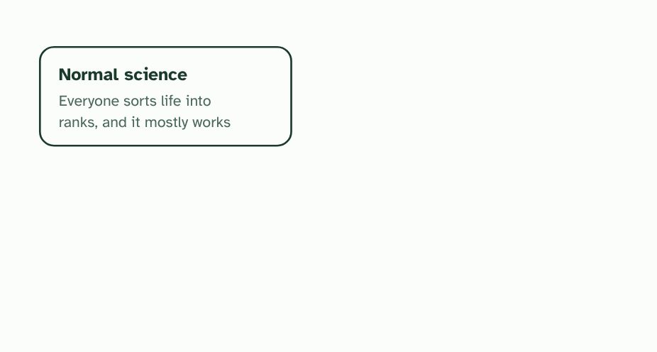
CHAPTER 2 · A3.2.2 The traditional hierarchy of taxa
1 / 4
When the boxes do not fit
Normal science: a framework everyone shares. For classification, the ranks.
Minutes 18 to 30
Notes:
Minutes 18 to 30 of 60: When the boxes do not fit (12 min).
The plan: Chapter 2's first figure, stopping on each caption. Students sketch the tree of the bird, crocodile, lizard and mouse, then draw the old class Reptilia round the lizard and crocodile and say what is wrong with it. Add "arbitrary": ask whether a family of beetles and a family of mammals are the same kind of thing. Turn over the mnemonic tiles for the seven ranks.
Naturalists have long sorted life into a hierarchy of taxa. A taxon is a named group. Each species sits in a genus, each genus in a family, and so on up through order, class and phylum to kingdom. The system dates from Linnaeus, in the 1700s, and it grouped organisms mostly by features you can see.
It is tidy, and it has a problem. Evolution does not make boxes. It makes branches, and the branches split at different times. The ranks do not always follow that pattern.
Groups made from looks can gather unrelated lines: birds, bats and insects all fly, but each evolved its wings separately. Groups can also leave out relatives. In the old system crocodiles and lizards are in the class Reptilia, and birds have a class of their own, Aves. Yet the figure shows that crocodiles and birds share an ancestor that lizards do not.
Ranks are also arbitrary. Variation is gradual, and nothing in nature says how much difference makes a genus or a family. A family of beetles and a family of mammals need not be alike in age or in how much they differ, so a rank measures nothing fixed. Cladistics offers another way: unranked groups that follow the branching.
Example: A paradigm shift A paradigm shift is a fundamental change in how a science works. Classification has had one. Everyone used ranks, cases that did not fit piled up, and groups made from branching replaced them. Step through the second figure.

Slide 19
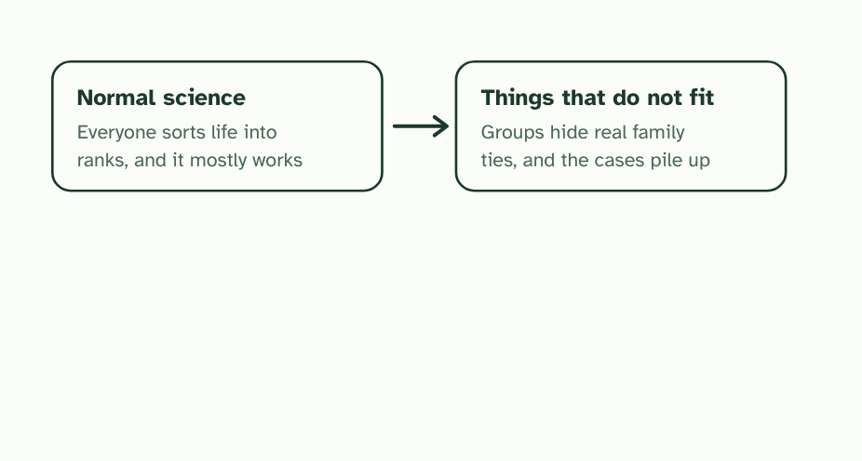
CHAPTER 2 · A3.2.2 The traditional hierarchy of taxa
2 / 4
When the boxes do not fit
Cases that do not fit build up, such as groups that split a family in two.
Minutes 18 to 30
Notes:
Minutes 18 to 30 of 60: When the boxes do not fit (12 min).
The plan: Chapter 2's first figure, stopping on each caption. Students sketch the tree of the bird, crocodile, lizard and mouse, then draw the old class Reptilia round the lizard and crocodile and say what is wrong with it. Add "arbitrary": ask whether a family of beetles and a family of mammals are the same kind of thing. Turn over the mnemonic tiles for the seven ranks.
Naturalists have long sorted life into a hierarchy of taxa. A taxon is a named group. Each species sits in a genus, each genus in a family, and so on up through order, class and phylum to kingdom. The system dates from Linnaeus, in the 1700s, and it grouped organisms mostly by features you can see.
It is tidy, and it has a problem. Evolution does not make boxes. It makes branches, and the branches split at different times. The ranks do not always follow that pattern.
Groups made from looks can gather unrelated lines: birds, bats and insects all fly, but each evolved its wings separately. Groups can also leave out relatives. In the old system crocodiles and lizards are in the class Reptilia, and birds have a class of their own, Aves. Yet the figure shows that crocodiles and birds share an ancestor that lizards do not.
Ranks are also arbitrary. Variation is gradual, and nothing in nature says how much difference makes a genus or a family. A family of beetles and a family of mammals need not be alike in age or in how much they differ, so a rank measures nothing fixed. Cladistics offers another way: unranked groups that follow the branching.
Example: A paradigm shift A paradigm shift is a fundamental change in how a science works. Classification has had one. Everyone used ranks, cases that did not fit piled up, and groups made from branching replaced them. Step through the second figure.

Slide 20
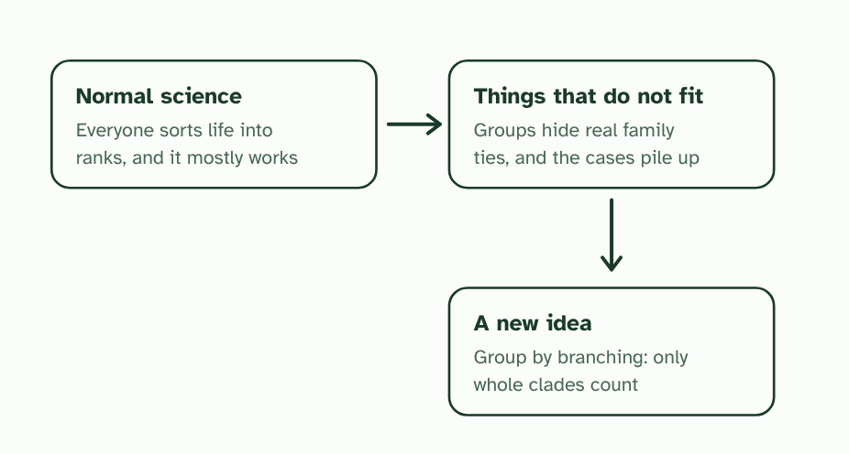
CHAPTER 2 · A3.2.2 The traditional hierarchy of taxa
3 / 4
When the boxes do not fit
A new idea replaces the rule for grouping: use the branching tree, and group only whole clades.
Minutes 18 to 30
Notes:
Minutes 18 to 30 of 60: When the boxes do not fit (12 min).
The plan: Chapter 2's first figure, stopping on each caption. Students sketch the tree of the bird, crocodile, lizard and mouse, then draw the old class Reptilia round the lizard and crocodile and say what is wrong with it. Add "arbitrary": ask whether a family of beetles and a family of mammals are the same kind of thing. Turn over the mnemonic tiles for the seven ranks.
Naturalists have long sorted life into a hierarchy of taxa. A taxon is a named group. Each species sits in a genus, each genus in a family, and so on up through order, class and phylum to kingdom. The system dates from Linnaeus, in the 1700s, and it grouped organisms mostly by features you can see.
It is tidy, and it has a problem. Evolution does not make boxes. It makes branches, and the branches split at different times. The ranks do not always follow that pattern.
Groups made from looks can gather unrelated lines: birds, bats and insects all fly, but each evolved its wings separately. Groups can also leave out relatives. In the old system crocodiles and lizards are in the class Reptilia, and birds have a class of their own, Aves. Yet the figure shows that crocodiles and birds share an ancestor that lizards do not.
Ranks are also arbitrary. Variation is gradual, and nothing in nature says how much difference makes a genus or a family. A family of beetles and a family of mammals need not be alike in age or in how much they differ, so a rank measures nothing fixed. Cladistics offers another way: unranked groups that follow the branching.
Example: A paradigm shift A paradigm shift is a fundamental change in how a science works. Classification has had one. Everyone used ranks, cases that did not fit piled up, and groups made from branching replaced them. Step through the second figure.

Slide 21
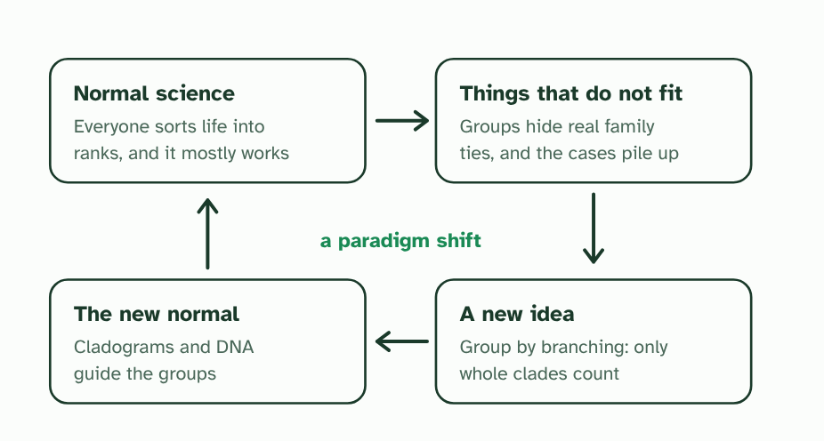
CHAPTER 2 · A3.2.2 The traditional hierarchy of taxa
4 / 4
When the boxes do not fit
The new idea becomes the new normal. A change in the basic ideas of a field is a paradigm shift.
Minutes 18 to 30
Notes:
Minutes 18 to 30 of 60: When the boxes do not fit (12 min).
The plan: Chapter 2's first figure, stopping on each caption. Students sketch the tree of the bird, crocodile, lizard and mouse, then draw the old class Reptilia round the lizard and crocodile and say what is wrong with it. Add "arbitrary": ask whether a family of beetles and a family of mammals are the same kind of thing. Turn over the mnemonic tiles for the seven ranks.
Naturalists have long sorted life into a hierarchy of taxa. A taxon is a named group. Each species sits in a genus, each genus in a family, and so on up through order, class and phylum to kingdom. The system dates from Linnaeus, in the 1700s, and it grouped organisms mostly by features you can see.
It is tidy, and it has a problem. Evolution does not make boxes. It makes branches, and the branches split at different times. The ranks do not always follow that pattern.
Groups made from looks can gather unrelated lines: birds, bats and insects all fly, but each evolved its wings separately. Groups can also leave out relatives. In the old system crocodiles and lizards are in the class Reptilia, and birds have a class of their own, Aves. Yet the figure shows that crocodiles and birds share an ancestor that lizards do not.
Ranks are also arbitrary. Variation is gradual, and nothing in nature says how much difference makes a genus or a family. A family of beetles and a family of mammals need not be alike in age or in how much they differ, so a rank measures nothing fixed. Cladistics offers another way: unranked groups that follow the branching.
Example: A paradigm shift A paradigm shift is a fundamental change in how a science works. Classification has had one. Everyone used ranks, cases that did not fit piled up, and groups made from branching replaced them. Step through the second figure.

Slide 22
CHAPTER 2 · A3.2.2 The traditional hierarchy of taxa
When the boxes do not fit
Naturalists have long sorted life into a hierarchy of taxa.
A taxon is a named group.
Cladistics offers another way: unranked groups that follow the branching.
Minutes 18 to 30
Notes:
Minutes 18 to 30 of 60: When the boxes do not fit (12 min).
The plan: Chapter 2's first figure, stopping on each caption. Students sketch the tree of the bird, crocodile, lizard and mouse, then draw the old class Reptilia round the lizard and crocodile and say what is wrong with it. Add "arbitrary": ask whether a family of beetles and a family of mammals are the same kind of thing. Turn over the mnemonic tiles for the seven ranks.
Naturalists have long sorted life into a hierarchy of taxa. A taxon is a named group. Each species sits in a genus, each genus in a family, and so on up through order, class and phylum to kingdom. The system dates from Linnaeus, in the 1700s, and it grouped organisms mostly by features you can see.
It is tidy, and it has a problem. Evolution does not make boxes. It makes branches, and the branches split at different times. The ranks do not always follow that pattern.
Groups made from looks can gather unrelated lines: birds, bats and insects all fly, but each evolved its wings separately. Groups can also leave out relatives. In the old system crocodiles and lizards are in the class Reptilia, and birds have a class of their own, Aves. Yet the figure shows that crocodiles and birds share an ancestor that lizards do not.
Ranks are also arbitrary. Variation is gradual, and nothing in nature says how much difference makes a genus or a family. A family of beetles and a family of mammals need not be alike in age or in how much they differ, so a rank measures nothing fixed. Cladistics offers another way: unranked groups that follow the branching.
Example: A paradigm shift A paradigm shift is a fundamental change in how a science works. Classification has had one. Everyone used ranks, cases that did not fit piled up, and groups made from branching replaced them. Step through the second figure.

Slide 23
PREDICT
A taxonomist finds that a group in the old system leaves out one species that descends from the same common ancestor as the rest. What does that show?
A The group is a good one, because its members still look alike
B The group is too small, so it needs a higher rank
C The group does not follow the pattern of divergence
Minutes 18 to 30
Notes:
Minutes 18 to 30 of 60: When the boxes do not fit (12 min).
The plan: Chapter 2's first figure, stopping on each caption. Students sketch the tree of the bird, crocodile, lizard and mouse, then draw the old class Reptilia round the lizard and crocodile and say what is wrong with it. Add "arbitrary": ask whether a family of beetles and a family of mammals are the same kind of thing. Turn over the mnemonic tiles for the seven ranks.
Ask for a show of hands, or mini whiteboards, before revealing. (Answer: C, on the next slide.)

Slide 24
WHAT HAPPENS
A taxonomist finds that a group in the old system leaves out one species that descends from the same common ancestor as the rest. What does that show?
A The group is a good one, because its members still look alike
B The group is too small, so it needs a higher rank
C The group does not follow the pattern of divergence
The group does not follow the pattern of divergence. A group that leaves out a descendant of its own ancestor splits a family in two, however alike its members look. That is the problem with the old class Reptilia, which leaves out the birds.
Minutes 18 to 30
Notes:
Minutes 18 to 30 of 60: When the boxes do not fit (12 min).
The plan: Chapter 2's first figure, stopping on each caption. Students sketch the tree of the bird, crocodile, lizard and mouse, then draw the old class Reptilia round the lizard and crocodile and say what is wrong with it. Add "arbitrary": ask whether a family of beetles and a family of mammals are the same kind of thing. Turn over the mnemonic tiles for the seven ranks.
Answer: C. The group does not follow the pattern of divergence. A group that leaves out a descendant of its own ancestor splits a family in two, however alike its members look. That is the problem with the old class Reptilia, which leaves out the birds.

Slide 25
REMEMBER IT
The ranks, from the top
K
P
C
O
F
G
S
King
Philip
Came
Over
For
Good
Soup
Minutes 18 to 30
Notes:
Minutes 18 to 30 of 60: When the boxes do not fit (12 min).
The plan: Chapter 2's first figure, stopping on each caption. Students sketch the tree of the bird, crocodile, lizard and mouse, then draw the old class Reptilia round the lizard and crocodile and say what is wrong with it. Add "arbitrary": ask whether a family of beetles and a family of mammals are the same kind of thing. Turn over the mnemonic tiles for the seven ranks.
Ask the class what each letter stands for before revealing.

Slide 26
REMEMBER IT
The ranks, from the top
K
P
C
O
F
G
S
King
Philip
Came
Over
For
Good
Soup
Kingdom
Phylum
Class
Order
Family
Genus
Species
the biggest group
a major body plan
mammals, birds, insects
primates, carnivores
cats, dogs, apes
close species together
one kind of organism
Minutes 18 to 30
Notes:
Minutes 18 to 30 of 60: When the boxes do not fit (12 min).
The plan: Chapter 2's first figure, stopping on each caption. Students sketch the tree of the bird, crocodile, lizard and mouse, then draw the old class Reptilia round the lizard and crocodile and say what is wrong with it. Add "arbitrary": ask whether a family of beetles and a family of mammals are the same kind of thing. Turn over the mnemonic tiles for the seven ranks.
King: Kingdom (the biggest group)
Philip: Phylum (a major body plan)
Came: Class (mammals, birds, insects)
Over: Order (primates, carnivores)
For: Family (cats, dogs, apes)
Good: Genus (close species together)
Soup: Species (one kind of organism)

Slide 27
DISCUSSION
10 MIN
Questions on a paradigm shift
THE TASK
Four questions to answer from chapter 2: (a) Outline why it is hard to classify flying animals, such as birds and insects, by the features that make traditional groups. (b) Why does the traditional hierarchy not always match the pattern of divergence in evolution? (c) What does it mean to say that a fixed ranking of taxa is arbitrary? (d) Suggest why a classification that follows evolutionary relationships has an advantage over the ranks. Then ask which of the four stages of the cycle in chapter 2's second figure each answer belongs to.
STUDENTS NEED
Chapter 2's figures on screen; the four questions on the board.
Minutes 30 to 40
Notes:
Minutes 30 to 40 of 60: Questions on a paradigm shift (10 min).
The plan: The paradigm shift questions below, in pairs, using chapter 2's second figure. Take one answer to each question, and land on the nature of science point: cladistics replaced fixed ranks with unranked clades, which is a paradigm shift.
The activity: Questions on a paradigm shift. Four questions to answer from chapter 2: (a) Outline why it is hard to classify flying animals, such as birds and insects, by the features that make traditional groups. (b) Why does the traditional hierarchy not always match the pattern of divergence in evolution? (c) What does it mean to say that a fixed ranking of taxa is arbitrary? (d) Suggest why a classification that follows evolutionary relationships has an advantage over the ranks. Then ask which of the four stages of the cycle in chapter 2's second figure each answer belongs to.
Needs: chapter 2's figures on screen; the four questions on the board.
The time: 10 minutes, minutes 30 to 40 of the plan.

Slide 28
STEP 5
12 MIN
What does ancestry let you predict?
Students write one prediction they could make about a member of a clade and one way it could fail (a feature lost along a branch).
Minutes 40 to 52
Notes:
Minutes 40 to 52 of 60: What does ancestry let you predict? (12 min).
The plan: Chapter 3's figure: follow hair and milk down the tree, then add the new species. Students write one prediction they could make about a member of a clade and one way it could fail (a feature lost along a branch). Then the chapter's predict box.

Slide 29
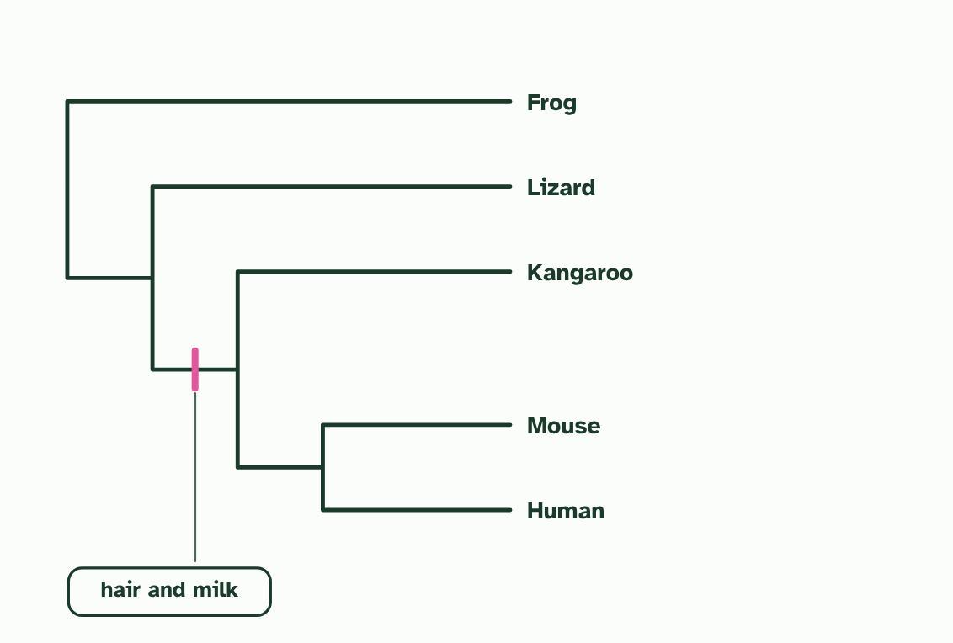
CHAPTER 3 · A3.2.3 Classification that follows relationships
1 / 3
Groups that are family trees
Hair and milk appeared once, on the branch leading to the mammals. Every descendant of that ancestor inherits them, unless a line loses them.
Minutes 40 to 52
Notes:
Minutes 40 to 52 of 60: What does ancestry let you predict? (12 min).
The plan: Chapter 3's figure: follow hair and milk down the tree, then add the new species. Students write one prediction they could make about a member of a clade and one way it could fail (a feature lost along a branch). Then the chapter's predict box.
Think of your own family. Cousins tend to resemble each other more than strangers do, because they share grandparents. Living things are the same, only the family is far bigger and the shared ancestors are further back. The ideal classification follows that family tree, so that every member of a group has evolved from one common ancestor, and none of that ancestor's descendants are left out.
The great strength of such groups is prediction. A feature that appeared in the common ancestor is passed to all its descendants, so it is shared across the group. If you know that one member of the group has hair and feeds its young on milk, you can predict the same of a newly found member without testing it. The figure follows one feature through a tree.
The predictions reach beyond looks, to biochemistry, life cycles, behaviour and disease. Plants in one group often make similar chemicals, so a chemical that proves useful in one plant is first looked for in its relatives. A group made from looks alone cannot promise this, because look-alikes with different ancestors need not share anything underneath.

Slide 30
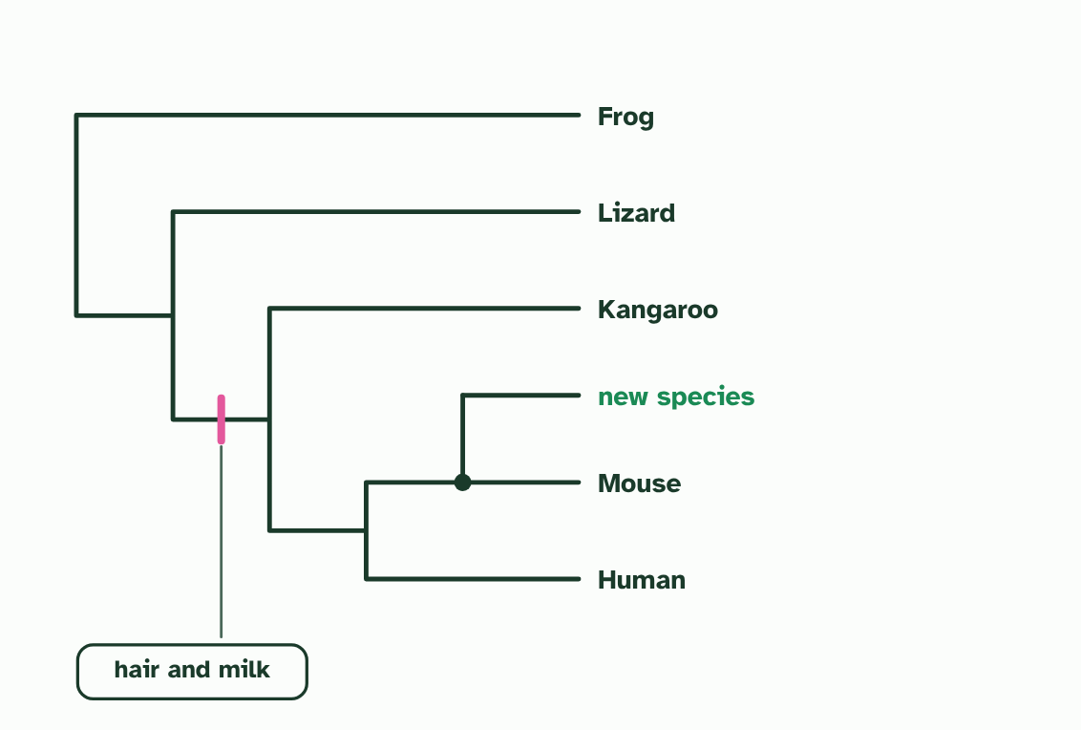
CHAPTER 3 · A3.2.3 Classification that follows relationships
2 / 3
Groups that are family trees
A newly found animal. Its DNA says it is the mouse's closest relative: it joins the tree there (a made-up animal).
Minutes 40 to 52
Notes:
Minutes 40 to 52 of 60: What does ancestry let you predict? (12 min).
The plan: Chapter 3's figure: follow hair and milk down the tree, then add the new species. Students write one prediction they could make about a member of a clade and one way it could fail (a feature lost along a branch). Then the chapter's predict box.
Think of your own family. Cousins tend to resemble each other more than strangers do, because they share grandparents. Living things are the same, only the family is far bigger and the shared ancestors are further back. The ideal classification follows that family tree, so that every member of a group has evolved from one common ancestor, and none of that ancestor's descendants are left out.
The great strength of such groups is prediction. A feature that appeared in the common ancestor is passed to all its descendants, so it is shared across the group. If you know that one member of the group has hair and feeds its young on milk, you can predict the same of a newly found member without testing it. The figure follows one feature through a tree.
The predictions reach beyond looks, to biochemistry, life cycles, behaviour and disease. Plants in one group often make similar chemicals, so a chemical that proves useful in one plant is first looked for in its relatives. A group made from looks alone cannot promise this, because look-alikes with different ancestors need not share anything underneath.

Slide 31
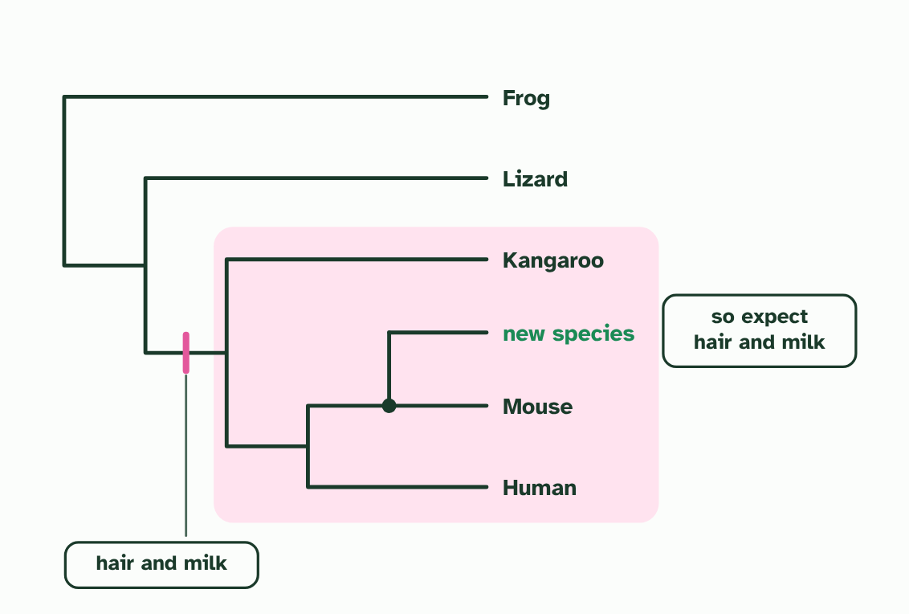
CHAPTER 3 · A3.2.3 Classification that follows relationships
3 / 3
Groups that are family trees
It sits inside the mammal clade, so you can predict its features before you have studied it.
Minutes 40 to 52
Notes:
Minutes 40 to 52 of 60: What does ancestry let you predict? (12 min).
The plan: Chapter 3's figure: follow hair and milk down the tree, then add the new species. Students write one prediction they could make about a member of a clade and one way it could fail (a feature lost along a branch). Then the chapter's predict box.
Think of your own family. Cousins tend to resemble each other more than strangers do, because they share grandparents. Living things are the same, only the family is far bigger and the shared ancestors are further back. The ideal classification follows that family tree, so that every member of a group has evolved from one common ancestor, and none of that ancestor's descendants are left out.
The great strength of such groups is prediction. A feature that appeared in the common ancestor is passed to all its descendants, so it is shared across the group. If you know that one member of the group has hair and feeds its young on milk, you can predict the same of a newly found member without testing it. The figure follows one feature through a tree.
The predictions reach beyond looks, to biochemistry, life cycles, behaviour and disease. Plants in one group often make similar chemicals, so a chemical that proves useful in one plant is first looked for in its relatives. A group made from looks alone cannot promise this, because look-alikes with different ancestors need not share anything underneath.

Slide 32
CHAPTER 3 · A3.2.3 Classification that follows relationships
Groups that are family trees
The ideal classification follows evolutionary relationships: all members of a group descend from one common ancestor.
Features of one member can be predicted for the rest, because they are shared within the group.
Minutes 40 to 52
Notes:
Minutes 40 to 52 of 60: What does ancestry let you predict? (12 min).
The plan: Chapter 3's figure: follow hair and milk down the tree, then add the new species. Students write one prediction they could make about a member of a clade and one way it could fail (a feature lost along a branch). Then the chapter's predict box.
Think of your own family. Cousins tend to resemble each other more than strangers do, because they share grandparents. Living things are the same, only the family is far bigger and the shared ancestors are further back. The ideal classification follows that family tree, so that every member of a group has evolved from one common ancestor, and none of that ancestor's descendants are left out.
The great strength of such groups is prediction. A feature that appeared in the common ancestor is passed to all its descendants, so it is shared across the group. If you know that one member of the group has hair and feeds its young on milk, you can predict the same of a newly found member without testing it. The figure follows one feature through a tree.
The predictions reach beyond looks, to biochemistry, life cycles, behaviour and disease. Plants in one group often make similar chemicals, so a chemical that proves useful in one plant is first looked for in its relatives. A group made from looks alone cannot promise this, because look-alikes with different ancestors need not share anything underneath.

Slide 33
PREDICT
A newly found frog falls inside a clade whose other members all make a toxin in their skin. Which statement is best?
A It must make the toxin, because every member of a clade shares every feature of its common ancestor
B Nothing can be said about it until its skin has been tested, because relatives never share a toxin
C It probably makes the toxin, but a feature can be lost, so the prediction needs testing
Minutes 40 to 52
Notes:
Minutes 40 to 52 of 60: What does ancestry let you predict? (12 min).
The plan: Chapter 3's figure: follow hair and milk down the tree, then add the new species. Students write one prediction they could make about a member of a clade and one way it could fail (a feature lost along a branch). Then the chapter's predict box.
Ask for a show of hands, or mini whiteboards, before revealing. (Answer: C, on the next slide.)

Slide 34
WHAT HAPPENS
A newly found frog falls inside a clade whose other members all make a toxin in their skin. Which statement is best?
A It must make the toxin, because every member of a clade shares every feature of its common ancestor
B Nothing can be said about it until its skin has been tested, because relatives never share a toxin
C It probably makes the toxin, but a feature can be lost, so the prediction needs testing
The second. Membership of the clade makes the toxin likely, because it was probably present in the common ancestor. It is not certain, since a line can lose a feature, and that is why a prediction is tested and not simply assumed.
Minutes 40 to 52
Notes:
Minutes 40 to 52 of 60: What does ancestry let you predict? (12 min).
The plan: Chapter 3's figure: follow hair and milk down the tree, then add the new species. Students write one prediction they could make about a member of a clade and one way it could fail (a feature lost along a branch). Then the chapter's predict box.
Answer: C. The second. Membership of the clade makes the toxin likely, because it was probably present in the common ancestor. It is not certain, since a line can lose a feature, and that is why a prediction is tested and not simply assumed.

Slide 35
WATCH OUT
A prediction is a good bet, not a promise. A feature can be lost along a branch: snakes belong to a group of four-limbed animals, but their ancestors lost the legs. That is why a prediction is then tested.
Minutes 40 to 52
Notes:
Minutes 40 to 52 of 60: What does ancestry let you predict? (12 min).
The plan: Chapter 3's figure: follow hair and milk down the tree, then add the new species. Students write one prediction they could make about a member of a clade and one way it could fail (a feature lost along a branch). Then the chapter's predict box.
A common mistake: say it, then ask who can say why it is wrong.

Slide 36
PLENARY
Can you now...
Explain why classification is needed, and what it makes possible (A3.2.1)
Describe why the traditional hierarchy of taxa does not always match evolution, and why a fixed ranking is arbitrary (A3.2.2)
Explain why a classification that follows evolutionary relationships lets you predict the features of its members (A3.2.3)
Minutes 52 to 60
Notes:
Minutes 52 to 60 of 60: Exit: two groups (8 min).
The plan: On a slip: "A group of look-alike animals has members from two different clades. Give one reason this group is less useful than a clade for predicting."
Thumbs up, sideways or down on each goal before the exit question. The goals come from the statements this lesson covers.

Slide 37
EXIT QUESTION
Two groups
On a slip: "A group of look-alike animals has members from two different clades. Give one reason this group is less useful than a clade for predicting."
Minutes 52 to 60
Notes:
Minutes 52 to 60 of 60: Exit: two groups (8 min).
The plan: On a slip: "A group of look-alike animals has members from two different clades. Give one reason this group is less useful than a clade for predicting."

Slide 38
PRACTISE AND REVISE
Keep going
Exam practice: a fresh paper of exam questions on A3.2 at higher level, marked as you go
The guide, with the animations and the dry lab
This lesson in the guide: 1 Why sort life at all?, 2 When the boxes do not fit, 3 Groups that are family trees
BUILD FOR YOUR CLASS
ALREADY ON THE SITE FOR A3.2
CARD SETS ON SPLYCR
Tarsia puzzle, dominoes and picture reveal on A3.2, built from its key terms and ready to print
A pub quiz with rounds on A3.2, to present or run with no projector
An escape room built from the question bank on A3.2
Quiz: Cladistics (HL)
Revision map: A3.2 Classification and cladistics, to fill in
Exam questions: A3.2 in the exam maker, a paper with its markscheme
Open a set to host it as a class game, or make a copy to edit.
A3.2 Classification and Cladistics (HL)
How this was made. The course structure, the activities and the teaching choices come from my own classroom, my presentations and my years of teaching IB and AP Biology. I use Claude, an AI, to help write and build the interactive guides, lesson plans, slides and practice questions, and to draw the diagrams and code the interactives. I direct the work and review it against the IB and AP specifications before it goes live.
Minute 60: after the lesson
Notes:
Every link here is live. Set the exam practice paper for homework: it is fresh each time, marked as students go and saved to their Exam practice when they are signed in.
Exam practice: https://www.biologybybradford.com/exam-maker/sit?topics=A3.2&level=HL&paper=quiz&marks=15&src=ep
The guide: https://www.biologybybradford.com/guides/ib-biology-a3-2-classification-and-cladistics

