Slide 1
IB Biology A3.2
LESSON 2 OF 4
HL
BY THE END YOU CAN
Classification and cladistics
Define a clade, and say what evidence best places organisms in one (A3.2.4)
Explain how the molecular clock estimates when clades diverged, and why it only gives estimates (A3.2.5)
Clades, and a clock made of DNA
A3.2.4, A3.2.5
What a clade is, why sequences are the most objective evidence, and how the molecular clock estimates divergence times
60 minutes · chapters 4, 5
Minute 0
Notes:
IB Biology A3.2, Classification and cladistics. Lesson 2 of 4: Clades, and a clock made of DNA (higher level), 60 minutes.
The plan, minute by minute (each slide's footer says where you are):
0 to 6 min (6) Do now: clade or not?
6 to 20 min (14) Ring the clades
20 to 30 min (10) Which evidence would you trust?
30 to 46 min (16) Plot the clock
46 to 54 min (8) Why only an estimate?
54 to 60 min (6) Exit
What students get wrong:
"Any group of relatives is a clade." A clade is an ancestor and all its descendants. Leave one out, as the old reptiles do with birds, and it is not a clade.
"The molecular clock gives dates." It gives estimates, calibrated from fossils, which shift with generation time, population size and selection pressure.
Stretch and support:
Support: give the captions of each figure as a cut-up storyboard to put in order, and use the key terms (tap the dotted words) as a glossary.
Stretch: why might the same gene tick at different rates in different lines? Give an example for each of the three factors.
The lesson plan to print: https://www.biologybybradford.com/guides/downloads/ib-biology-a3-2-classification-and-cladistics-lesson-2-plan.pdf

Slide 2
DO NOW
Clade or not?
Is it a clade?
Students vote, then defend their vote in pairs.
6:00
minutes
Start now: the timer is running.
Minutes 0 to 6
Notes:
Minutes 0 to 6 of 60: Do now: clade or not? (6 min).
The plan: On the board: an ancestor X with four descendants P, Q, R and S, and the group P, Q, R. Is it a clade? Students vote, then defend their vote in pairs. Do not reveal the answer: chapter 4's predict box does that.
Start a 6 minute timer as they come in.

Slide 3
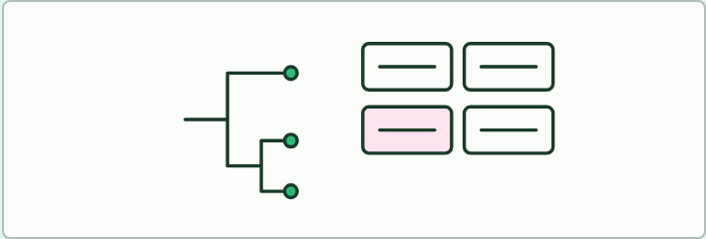
CARD SORT
6 MIN
Clade or not?
THE TASK
A printed tree of six or seven organisms and a set of cards, each naming a group of tips. Pairs sort the cards into "a clade" and "not a clade", and for each one that is not, name the descendant that is missing or the member that does not belong. Include the old reptiles. Then say for each clade which evidence (sequences or structure) you would use to check it.
STUDENTS NEED
The tree from chapter 4 printed, one per pair; cards cut from a sheet.
Minutes 0 to 6
Notes:
Minutes 0 to 6 of 60: Do now: clade or not? (6 min).
The plan: On the board: an ancestor X with four descendants P, Q, R and S, and the group P, Q, R. Is it a clade? Students vote, then defend their vote in pairs. Do not reveal the answer: chapter 4's predict box does that.
The activity: Clade or not?. A printed tree of six or seven organisms and a set of cards, each naming a group of tips. Pairs sort the cards into "a clade" and "not a clade", and for each one that is not, name the descendant that is missing or the member that does not belong. Include the old reptiles. Then say for each clade which evidence (sequences or structure) you would use to check it.
Needs: the tree from chapter 4 printed, one per pair; cards cut from a sheet.
The time: 6 minutes, minutes 0 to 6 of the plan.

Slide 4
PREDICT
A tree shows an ancestor X with four descendants, P, Q, R and S. Someone proposes the group P, Q and R. Is it a clade?
A No, because S also descends from X and is left out
B Yes, because P, Q and R all share the common ancestor X
C Yes, provided P, Q and R look more alike than S does
Minutes 0 to 6
Notes:
Minutes 0 to 6 of 60: Do now: clade or not? (6 min).
The plan: On the board: an ancestor X with four descendants P, Q, R and S, and the group P, Q, R. Is it a clade? Students vote, then defend their vote in pairs. Do not reveal the answer: chapter 4's predict box does that.
Ask for a show of hands, or mini whiteboards, before revealing. (Answer: A, on the next slide.)

Slide 5
WHAT HAPPENS
A tree shows an ancestor X with four descendants, P, Q, R and S. Someone proposes the group P, Q and R. Is it a clade?
A No, because S also descends from X and is left out
B Yes, because P, Q and R all share the common ancestor X
C Yes, provided P, Q and R look more alike than S does
No. A clade holds the ancestor and all of its descendants, and S descends from X as well. P, Q and R do share X, but the group is missing a descendant, so it does not follow the branching.
Minutes 0 to 6
Notes:
Minutes 0 to 6 of 60: Do now: clade or not? (6 min).
The plan: On the board: an ancestor X with four descendants P, Q, R and S, and the group P, Q, R. Is it a clade? Students vote, then defend their vote in pairs. Do not reveal the answer: chapter 4's predict box does that.
Answer: A. No. A clade holds the ancestor and all of its descendants, and S descends from X as well. P, Q and R do share X, but the group is missing a descendant, so it does not follow the branching.

Slide 6
STEP 2
14 MIN
Ring the clades
Students write the two-question test for a clade.
Minutes 6 to 20
Notes:
Minutes 6 to 20 of 60: Ring the clades (14 min).
The plan: Chapter 4's figure: tap each lettered node and say the clade it rings, then tap the old reptiles and say why the ring is not a clade. Students write the two-question test for a clade. Then the predict box.

Slide 7
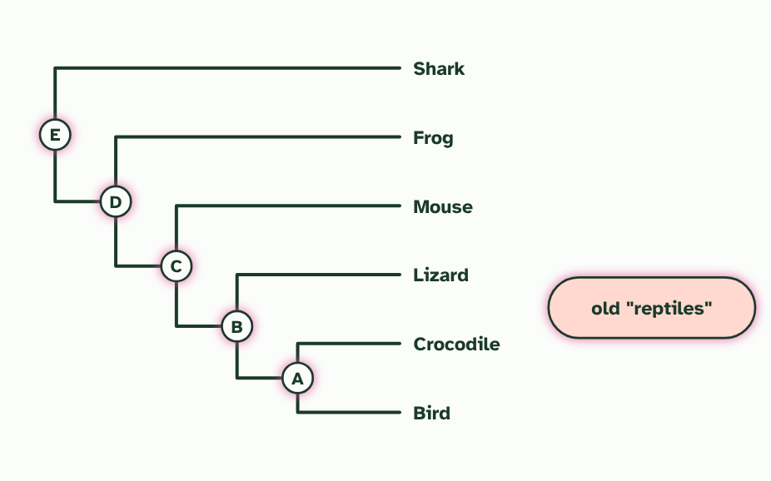
CHAPTER 4 · A3.2.4 Clades
A clade is an ancestor and all its descendants
A clade is one common ancestor plus all of its descendants.
Sequence evidence is the most objective, and morphological traits can also be used.
Minutes 6 to 20
Notes:
Minutes 6 to 20 of 60: Ring the clades (14 min).
The plan: Chapter 4's figure: tap each lettered node and say the clade it rings, then tap the old reptiles and say why the ring is not a clade. Students write the two-question test for a clade. Then the predict box.
A clade is a common ancestor together with every organism that descends from it. Test any group with two questions. Do all its members share one common ancestor? And are all of that ancestor's descendants inside the group? Both answers must be yes. Leave out one descendant, or add one that is not a descendant, and it is not a clade.
Clades nest like boxes inside boxes: birds are a clade, and so is the larger clade that holds birds and crocodiles. Tap the lettered nodes on the tree to ring the clade that starts at each one, then tap the old group called reptiles.
How do you decide which organisms share an ancestor? The most objective evidence comes from the base sequences of genes or the amino acid sequences of proteins. A sequence is a long string that can be compared position by position, and anyone counting the differences gets the same answer. Morphological traits can also place organisms in clades, but they need a judgement about which features count, and they can mislead when unrelated lines evolve similar structures.
Parts of the figure:
Node E, the root: every organism on the tree. The whole tree is always a clade.
Node D: add the frog and the ring holds every descendant of node D, so it is a clade too.
Node C: add the mouse and the ring still holds everything that descends from this ancestor. Still a clade.
Node B: the lizard, the crocodile and the bird all descend from this ancestor, and it has no other descendants. The bird is inside this clade.
Node A: the crocodile and the bird, and nothing else, descend from this ancestor. Together they are a clade.
The old reptiles: the lizard and the crocodile only. They share their ancestor with the bird, which is left out, so this group is not a clade. Leave out even one descendant and it fails.

Slide 8
WATCH OUT
A clade is not decided by how organisms look, how big the group is or what rank it once had. Only descent counts. A group of look-alikes that leaves out a relative is not a clade.
Minutes 6 to 20
Notes:
Minutes 6 to 20 of 60: Ring the clades (14 min).
The plan: Chapter 4's figure: tap each lettered node and say the clade it rings, then tap the old reptiles and say why the ring is not a clade. Students write the two-question test for a clade. Then the predict box.
A common mistake: say it, then ask who can say why it is wrong.

Slide 9
STEP 3
10 MIN
Which evidence would you trust?
Pairs decide for each card which evidence would place the organism, and where morphology could mislead.
Minutes 20 to 30
Notes:
Minutes 20 to 30 of 60: Which evidence would you trust? (10 min).
The plan: The clade or not card sort below. Pairs decide for each card which evidence would place the organism, and where morphology could mislead. Land on: base and amino acid sequences are the most objective evidence, and morphological traits can also be used.

Slide 10
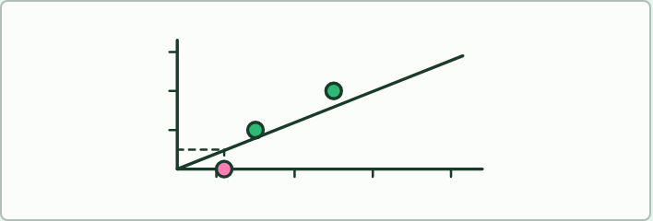
DATA TASK
16 MIN
Plot the clock
THE TASK
Students plot three pairs of species with fossil-dated splits against the number of differences in one gene (the teacher gives made-up numbers that fall on a straight line, such as 5, 10 and 15 differences at 10, 20 and 30 million years), draw the line through the origin, then read off the age of an undated pair. A second part gives one line a faster rate and asks how the answer changes. Ask what the gradient measures.
STUDENTS NEED
Graph paper, rulers, a table of made-up data on the board or printed.
Minutes 30 to 46
Notes:
Minutes 30 to 46 of 60: Plot the clock (16 min).
The plan: The data task below on graph paper: plot the fossil-dated pairs, draw the clock, and read the undated pair. Then chapter 5's figure and its last step on a faster clock, and the film for the changes building up along two lines.
The activity: Plot the clock. Students plot three pairs of species with fossil-dated splits against the number of differences in one gene (the teacher gives made-up numbers that fall on a straight line, such as 5, 10 and 15 differences at 10, 20 and 30 million years), draw the line through the origin, then read off the age of an undated pair. A second part gives one line a faster rate and asks how the answer changes. Ask what the gradient measures.
Needs: graph paper, rulers, a table of made-up data on the board or printed.
The time: 16 minutes, minutes 30 to 46 of the plan.

Slide 11
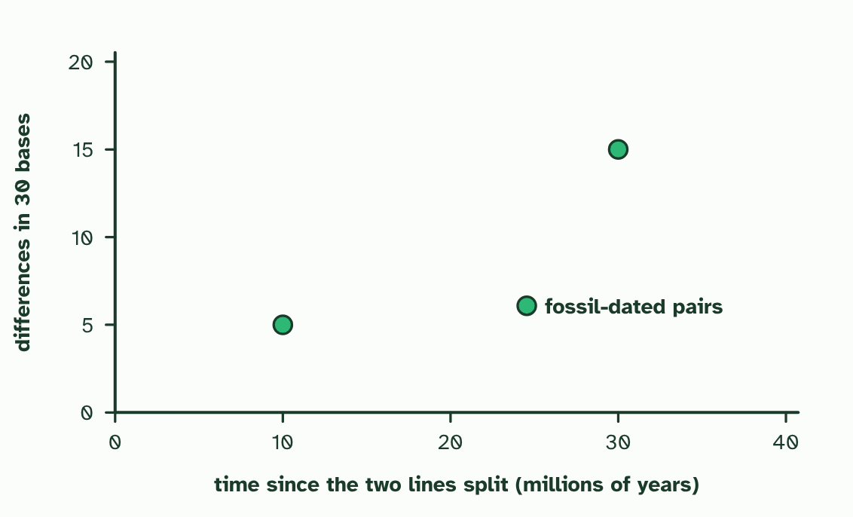
CHAPTER 5 · A3.2.5 The molecular clock
1 / 4
Differences that count the years
Two pairs of species whose split is dated from fossils: 5 differences at 10 million years and 15 at 30 million (made-up numbers).
Minutes 30 to 46
Notes:
Minutes 30 to 46 of 60: Plot the clock (16 min).
The plan: The data task below on graph paper: plot the fossil-dated pairs, draw the clock, and read the undated pair. Then chapter 5's figure and its last step on a faster clock, and the film for the changes building up along two lines.
Mutations change a gene's sequence at random. When one species splits in two, each line collects its own mutations from then on. So the longer ago two species split, the more differences you find between the same gene in each (you met this with sequences in A4.1). If changes arrive at a roughly steady rate, the differences work like a clock.
To turn a count into a date you need a calibration. Take pairs of species whose split is dated from fossils, and plot their differences against time. A straight line through the points is the molecular clock. Now a pair with no fossil date can be placed: read its number of differences across to the line and down to the time.
The result is an estimate, never a date. The rate at which changes build up is not the same everywhere, because it is affected by the length of the generation time, the size of the population, the intensity of selection and other factors. In the figure's last step, a line that collected changes faster gives a quite different answer from the same count.

Slide 12
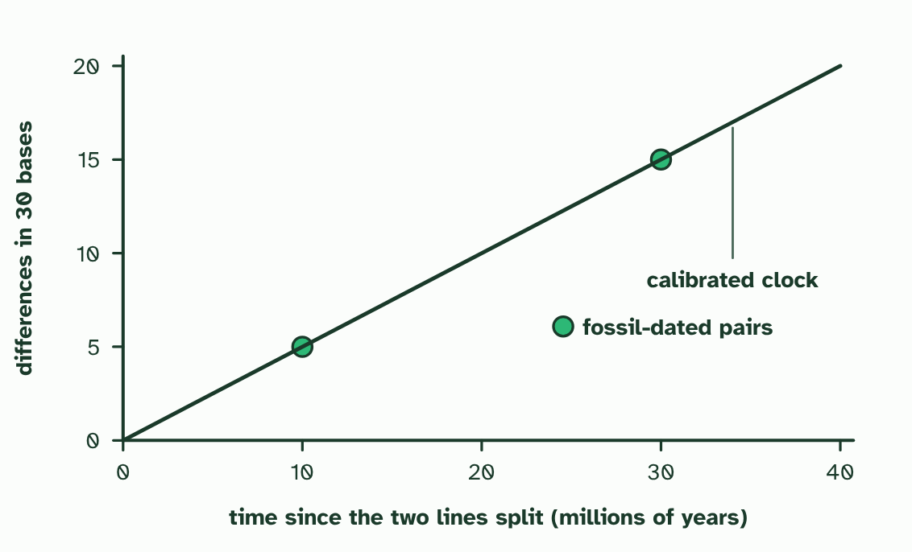
CHAPTER 5 · A3.2.5 The molecular clock
2 / 4
Differences that count the years
The differences grow steadily with time, so a straight line through the points is the molecular clock.
Minutes 30 to 46
Notes:
Minutes 30 to 46 of 60: Plot the clock (16 min).
The plan: The data task below on graph paper: plot the fossil-dated pairs, draw the clock, and read the undated pair. Then chapter 5's figure and its last step on a faster clock, and the film for the changes building up along two lines.
Mutations change a gene's sequence at random. When one species splits in two, each line collects its own mutations from then on. So the longer ago two species split, the more differences you find between the same gene in each (you met this with sequences in A4.1). If changes arrive at a roughly steady rate, the differences work like a clock.
To turn a count into a date you need a calibration. Take pairs of species whose split is dated from fossils, and plot their differences against time. A straight line through the points is the molecular clock. Now a pair with no fossil date can be placed: read its number of differences across to the line and down to the time.
The result is an estimate, never a date. The rate at which changes build up is not the same everywhere, because it is affected by the length of the generation time, the size of the population, the intensity of selection and other factors. In the figure's last step, a line that collected changes faster gives a quite different answer from the same count.

Slide 13
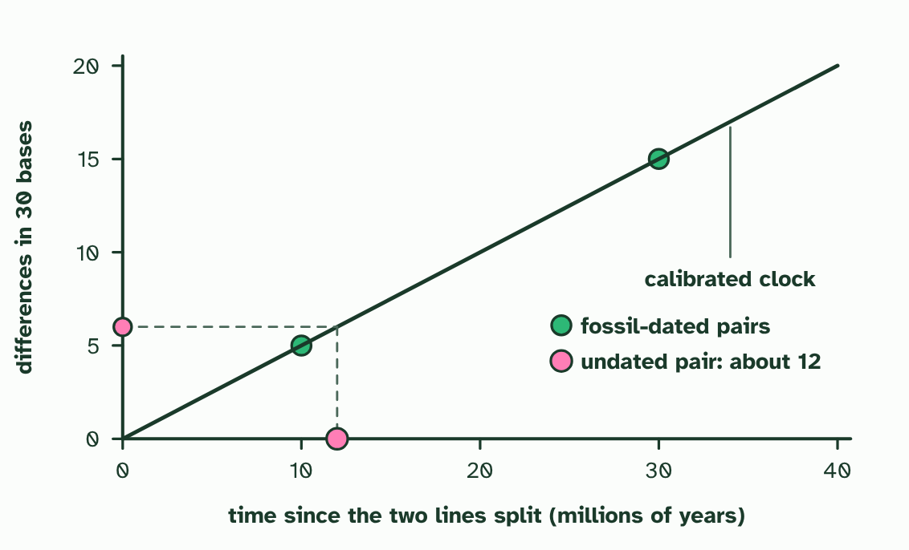
CHAPTER 5 · A3.2.5 The molecular clock
3 / 4
Differences that count the years
A pair with no fossil date differs at 6 places. Read across to the clock, then down: about 12 million years.
Minutes 30 to 46
Notes:
Minutes 30 to 46 of 60: Plot the clock (16 min).
The plan: The data task below on graph paper: plot the fossil-dated pairs, draw the clock, and read the undated pair. Then chapter 5's figure and its last step on a faster clock, and the film for the changes building up along two lines.
Mutations change a gene's sequence at random. When one species splits in two, each line collects its own mutations from then on. So the longer ago two species split, the more differences you find between the same gene in each (you met this with sequences in A4.1). If changes arrive at a roughly steady rate, the differences work like a clock.
To turn a count into a date you need a calibration. Take pairs of species whose split is dated from fossils, and plot their differences against time. A straight line through the points is the molecular clock. Now a pair with no fossil date can be placed: read its number of differences across to the line and down to the time.
The result is an estimate, never a date. The rate at which changes build up is not the same everywhere, because it is affected by the length of the generation time, the size of the population, the intensity of selection and other factors. In the figure's last step, a line that collected changes faster gives a quite different answer from the same count.

Slide 14
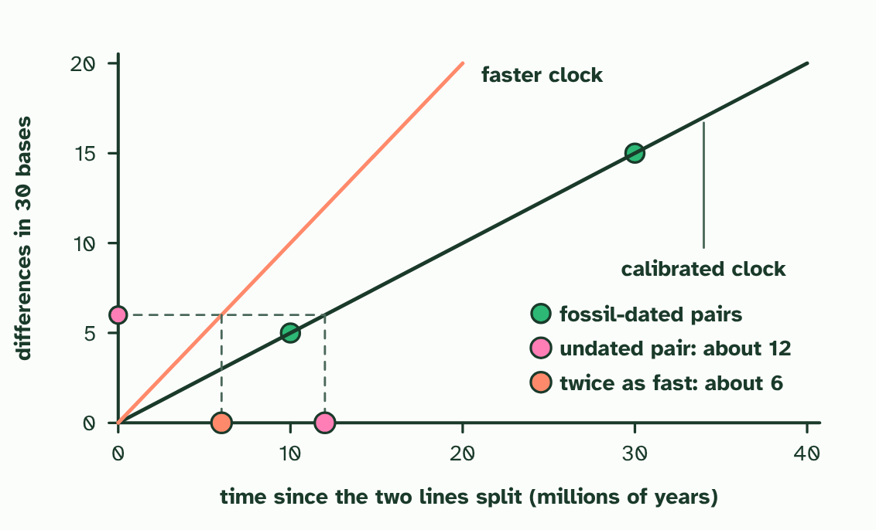
CHAPTER 5 · A3.2.5 The molecular clock
4 / 4
Differences that count the years
If this pair's lines collected changes twice as fast, the same 6 differences would mean about 6 million years. The clock gives an estimate, not a date.
Minutes 30 to 46
Notes:
Minutes 30 to 46 of 60: Plot the clock (16 min).
The plan: The data task below on graph paper: plot the fossil-dated pairs, draw the clock, and read the undated pair. Then chapter 5's figure and its last step on a faster clock, and the film for the changes building up along two lines.
Mutations change a gene's sequence at random. When one species splits in two, each line collects its own mutations from then on. So the longer ago two species split, the more differences you find between the same gene in each (you met this with sequences in A4.1). If changes arrive at a roughly steady rate, the differences work like a clock.
To turn a count into a date you need a calibration. Take pairs of species whose split is dated from fossils, and plot their differences against time. A straight line through the points is the molecular clock. Now a pair with no fossil date can be placed: read its number of differences across to the line and down to the time.
The result is an estimate, never a date. The rate at which changes build up is not the same everywhere, because it is affected by the length of the generation time, the size of the population, the intensity of selection and other factors. In the figure's last step, a line that collected changes faster gives a quite different answer from the same count.

Slide 15
CHAPTER 5 · A3.2.5 The molecular clock
Differences that count the years
A straight line through the points is the molecular clock.
Mutations change a gene's sequence at random.
The result is an estimate, never a date.
Minutes 30 to 46
Notes:
Minutes 30 to 46 of 60: Plot the clock (16 min).
The plan: The data task below on graph paper: plot the fossil-dated pairs, draw the clock, and read the undated pair. Then chapter 5's figure and its last step on a faster clock, and the film for the changes building up along two lines.
Mutations change a gene's sequence at random. When one species splits in two, each line collects its own mutations from then on. So the longer ago two species split, the more differences you find between the same gene in each (you met this with sequences in A4.1). If changes arrive at a roughly steady rate, the differences work like a clock.
To turn a count into a date you need a calibration. Take pairs of species whose split is dated from fossils, and plot their differences against time. A straight line through the points is the molecular clock. Now a pair with no fossil date can be placed: read its number of differences across to the line and down to the time.
The result is an estimate, never a date. The rate at which changes build up is not the same everywhere, because it is affected by the length of the generation time, the size of the population, the intensity of selection and other factors. In the figure's last step, a line that collected changes faster gives a quite different answer from the same count.

Slide 16
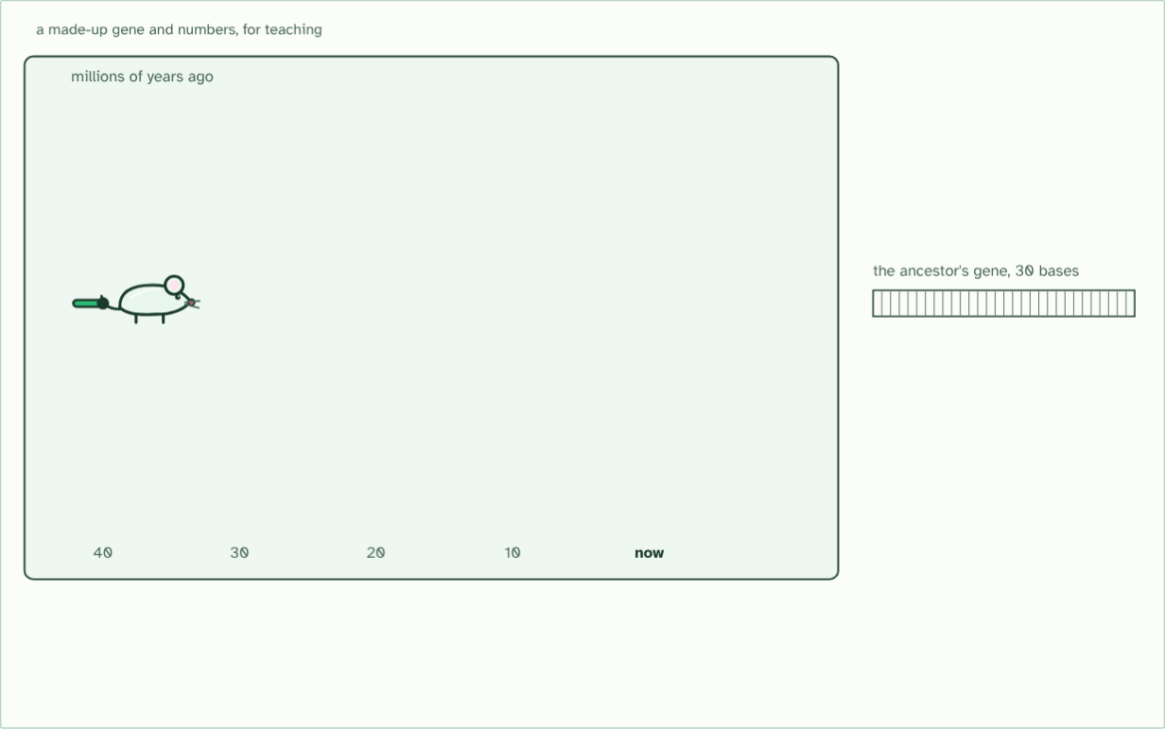
CHAPTER 5 · A3.2.5 The molecular clock
40 million years ago
1 / 7
Differences that count the years
One ancestor species, and one of its genes: a stretch of 30 bases, drawn as boxes.
Minutes 30 to 46
Notes:
Minutes 30 to 46 of 60: Plot the clock (16 min).
The plan: The data task below on graph paper: plot the fossil-dated pairs, draw the clock, and read the undated pair. Then chapter 5's figure and its last step on a faster clock, and the film for the changes building up along two lines.
Mutations change a gene's sequence at random. When one species splits in two, each line collects its own mutations from then on. So the longer ago two species split, the more differences you find between the same gene in each (you met this with sequences in A4.1). If changes arrive at a roughly steady rate, the differences work like a clock.
To turn a count into a date you need a calibration. Take pairs of species whose split is dated from fossils, and plot their differences against time. A straight line through the points is the molecular clock. Now a pair with no fossil date can be placed: read its number of differences across to the line and down to the time.
The result is an estimate, never a date. The rate at which changes build up is not the same everywhere, because it is affected by the length of the generation time, the size of the population, the intensity of selection and other factors. In the figure's last step, a line that collected changes faster gives a quite different answer from the same count.
The animation "Watch it happen: two lines collect changes", paused at 2.5 s. The next slides go on through it, then play it.

Slide 17
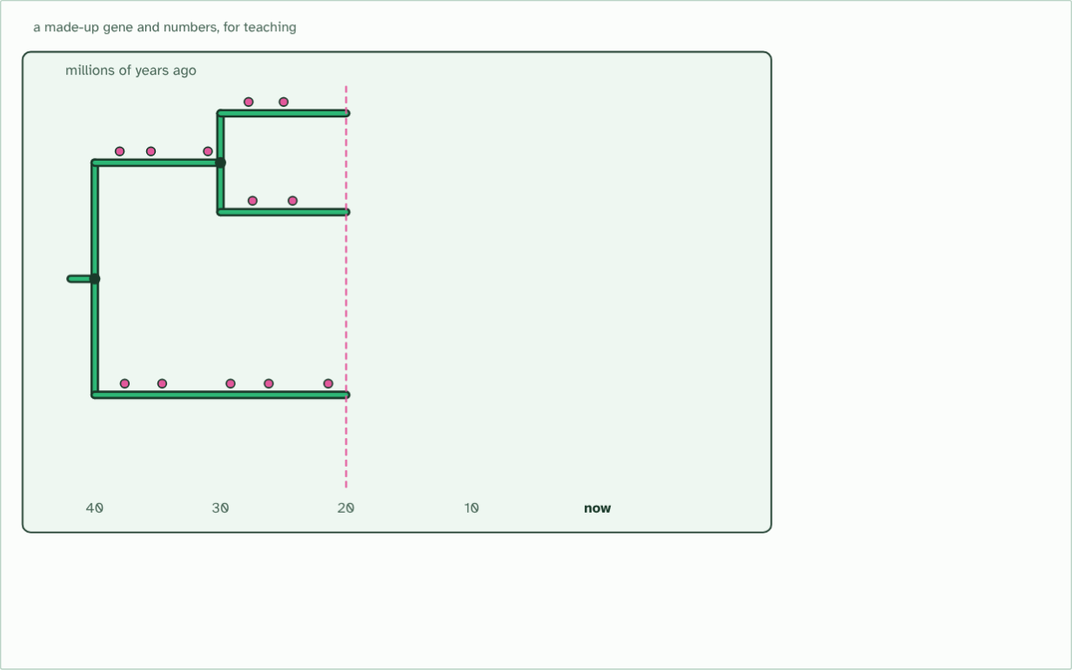
CHAPTER 5 · A3.2.5 The molecular clock
20 million years ago
2 / 7
Differences that count the years
Its descendants split into new species. In every line, mutations build up in the gene at a fairly steady rate: the ticks of a clock.
Minutes 30 to 46
Notes:
Minutes 30 to 46 of 60: Plot the clock (16 min).
The plan: The data task below on graph paper: plot the fossil-dated pairs, draw the clock, and read the undated pair. Then chapter 5's figure and its last step on a faster clock, and the film for the changes building up along two lines.
Mutations change a gene's sequence at random. When one species splits in two, each line collects its own mutations from then on. So the longer ago two species split, the more differences you find between the same gene in each (you met this with sequences in A4.1). If changes arrive at a roughly steady rate, the differences work like a clock.
To turn a count into a date you need a calibration. Take pairs of species whose split is dated from fossils, and plot their differences against time. A straight line through the points is the molecular clock. Now a pair with no fossil date can be placed: read its number of differences across to the line and down to the time.
The result is an estimate, never a date. The rate at which changes build up is not the same everywhere, because it is affected by the length of the generation time, the size of the population, the intensity of selection and other factors. In the figure's last step, a line that collected changes faster gives a quite different answer from the same count.
The animation "Watch it happen: two lines collect changes", paused at 9.0 s. The next slides go on through it, then play it.

Slide 18
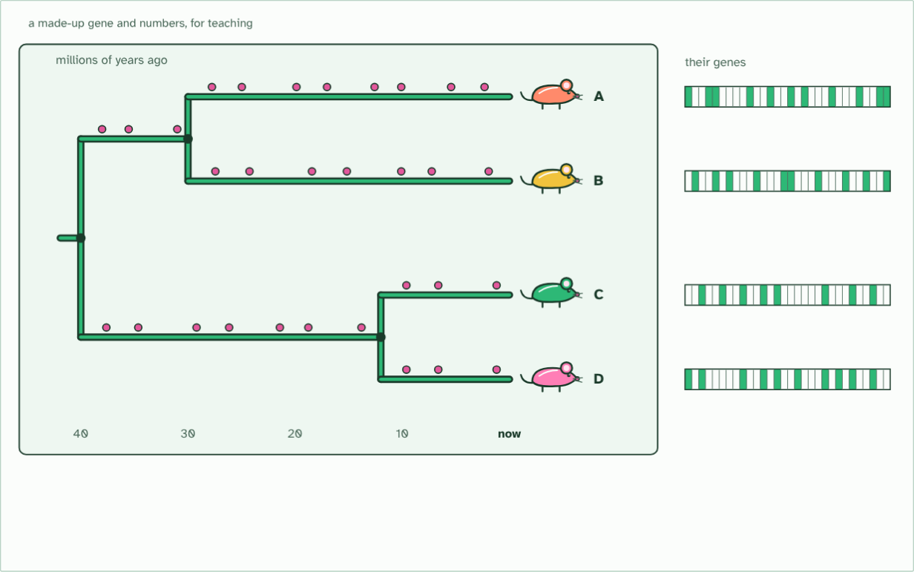
CHAPTER 5 · A3.2.5 The molecular clock
4 species
3 / 7
Differences that count the years
Today there are four species, A to D. Each gene now differs from the ancestor's, in its own places.
Minutes 30 to 46
Notes:
Minutes 30 to 46 of 60: Plot the clock (16 min).
The plan: The data task below on graph paper: plot the fossil-dated pairs, draw the clock, and read the undated pair. Then chapter 5's figure and its last step on a faster clock, and the film for the changes building up along two lines.
Mutations change a gene's sequence at random. When one species splits in two, each line collects its own mutations from then on. So the longer ago two species split, the more differences you find between the same gene in each (you met this with sequences in A4.1). If changes arrive at a roughly steady rate, the differences work like a clock.
To turn a count into a date you need a calibration. Take pairs of species whose split is dated from fossils, and plot their differences against time. A straight line through the points is the molecular clock. Now a pair with no fossil date can be placed: read its number of differences across to the line and down to the time.
The result is an estimate, never a date. The rate at which changes build up is not the same everywhere, because it is affected by the length of the generation time, the size of the population, the intensity of selection and other factors. In the figure's last step, a line that collected changes faster gives a quite different answer from the same count.
The animation "Watch it happen: two lines collect changes", paused at 16.5 s. The next slides go on through it, then play it.

Slide 19
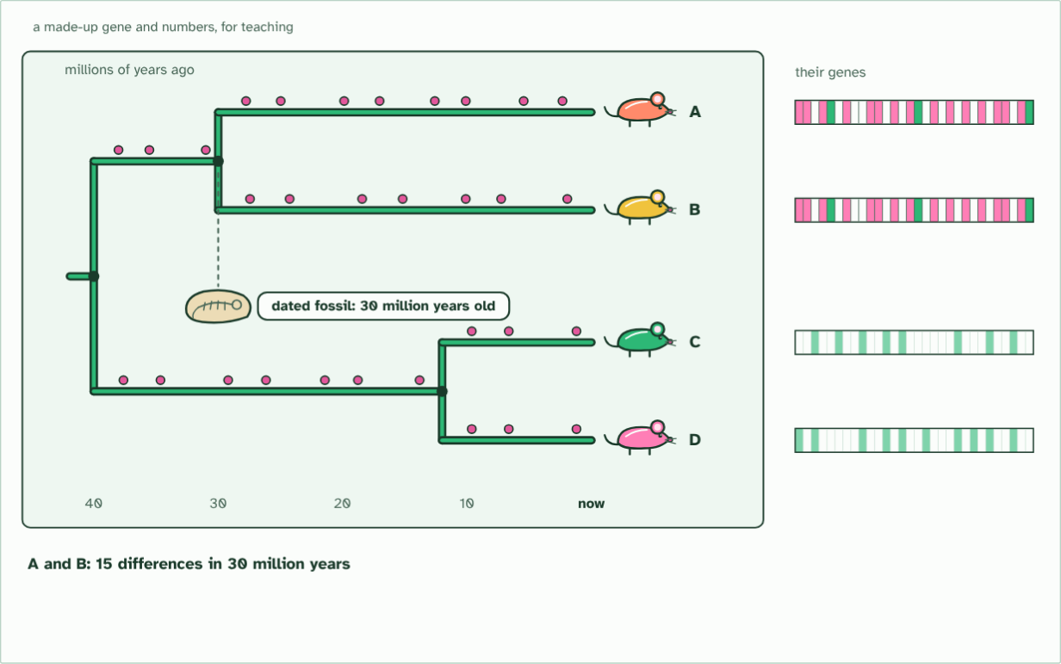
CHAPTER 5 · A3.2.5 The molecular clock
A and B: 15 differences
4 / 7
Differences that count the years
A dated fossil shows that A and B split 30 million years ago. Their genes differ at 15 bases.
Minutes 30 to 46
Notes:
Minutes 30 to 46 of 60: Plot the clock (16 min).
The plan: The data task below on graph paper: plot the fossil-dated pairs, draw the clock, and read the undated pair. Then chapter 5's figure and its last step on a faster clock, and the film for the changes building up along two lines.
Mutations change a gene's sequence at random. When one species splits in two, each line collects its own mutations from then on. So the longer ago two species split, the more differences you find between the same gene in each (you met this with sequences in A4.1). If changes arrive at a roughly steady rate, the differences work like a clock.
To turn a count into a date you need a calibration. Take pairs of species whose split is dated from fossils, and plot their differences against time. A straight line through the points is the molecular clock. Now a pair with no fossil date can be placed: read its number of differences across to the line and down to the time.
The result is an estimate, never a date. The rate at which changes build up is not the same everywhere, because it is affected by the length of the generation time, the size of the population, the intensity of selection and other factors. In the figure's last step, a line that collected changes faster gives a quite different answer from the same count.
The animation "Watch it happen: two lines collect changes", paused at 21.0 s. The next slides go on through it, then play it.

Slide 20
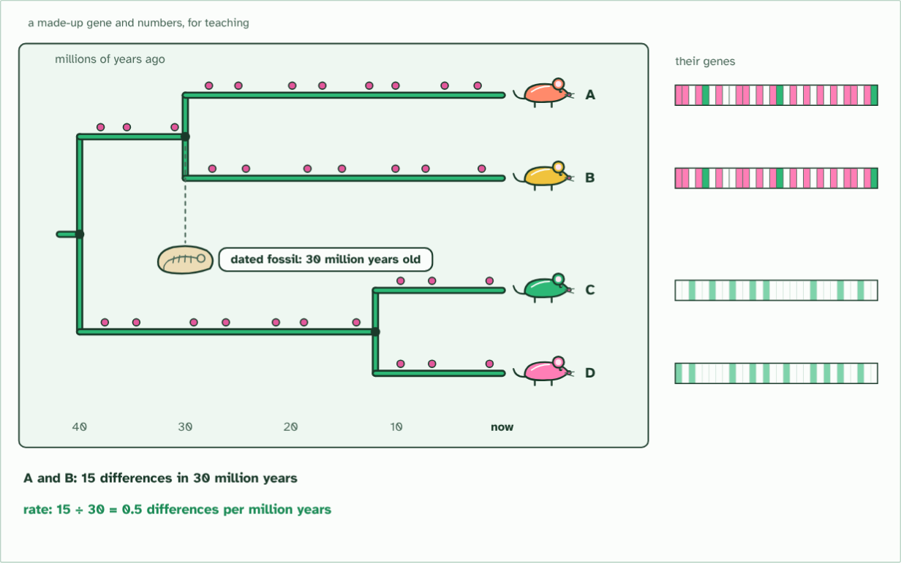
CHAPTER 5 · A3.2.5 The molecular clock
0.5 differences a million years
5 / 7
Differences that count the years
So this clock runs at 15 ÷ 30 = 0.5 differences per million years.
Minutes 30 to 46
Notes:
Minutes 30 to 46 of 60: Plot the clock (16 min).
The plan: The data task below on graph paper: plot the fossil-dated pairs, draw the clock, and read the undated pair. Then chapter 5's figure and its last step on a faster clock, and the film for the changes building up along two lines.
Mutations change a gene's sequence at random. When one species splits in two, each line collects its own mutations from then on. So the longer ago two species split, the more differences you find between the same gene in each (you met this with sequences in A4.1). If changes arrive at a roughly steady rate, the differences work like a clock.
To turn a count into a date you need a calibration. Take pairs of species whose split is dated from fossils, and plot their differences against time. A straight line through the points is the molecular clock. Now a pair with no fossil date can be placed: read its number of differences across to the line and down to the time.
The result is an estimate, never a date. The rate at which changes build up is not the same everywhere, because it is affected by the length of the generation time, the size of the population, the intensity of selection and other factors. In the figure's last step, a line that collected changes faster gives a quite different answer from the same count.
The animation "Watch it happen: two lines collect changes", paused at 25.5 s. The next slides go on through it, then play it.

Slide 21
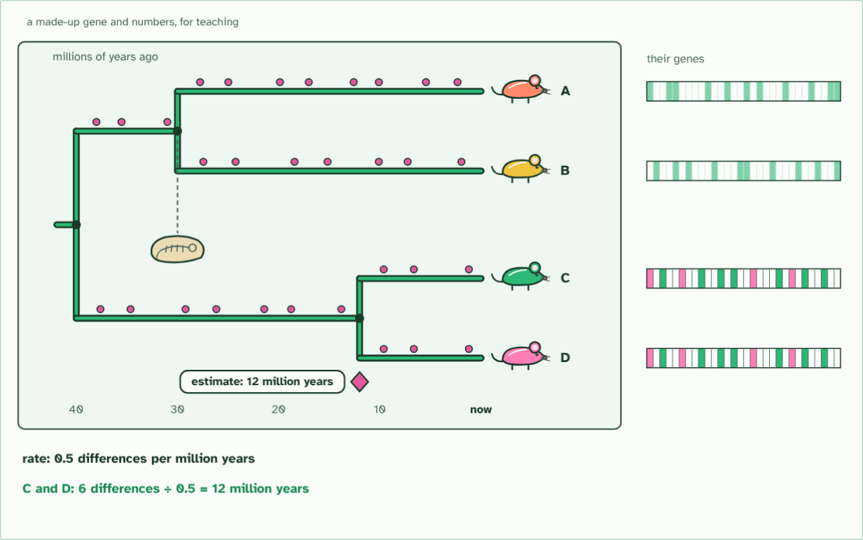
CHAPTER 5 · A3.2.5 The molecular clock
estimate: 12 million years
6 / 7
Differences that count the years
C and D differ at 6 bases: 6 ÷ 0.5 = about 12 million years since they split.
Minutes 30 to 46
Notes:
Minutes 30 to 46 of 60: Plot the clock (16 min).
The plan: The data task below on graph paper: plot the fossil-dated pairs, draw the clock, and read the undated pair. Then chapter 5's figure and its last step on a faster clock, and the film for the changes building up along two lines.
Mutations change a gene's sequence at random. When one species splits in two, each line collects its own mutations from then on. So the longer ago two species split, the more differences you find between the same gene in each (you met this with sequences in A4.1). If changes arrive at a roughly steady rate, the differences work like a clock.
To turn a count into a date you need a calibration. Take pairs of species whose split is dated from fossils, and plot their differences against time. A straight line through the points is the molecular clock. Now a pair with no fossil date can be placed: read its number of differences across to the line and down to the time.
The result is an estimate, never a date. The rate at which changes build up is not the same everywhere, because it is affected by the length of the generation time, the size of the population, the intensity of selection and other factors. In the figure's last step, a line that collected changes faster gives a quite different answer from the same count.
The animation "Watch it happen: two lines collect changes", paused at 30.0 s. The next slides go on through it, then play it.

Slide 22
CHAPTER 5 · A3.2.5 The molecular clock
estimate: 12 million years
7 / 7
Differences that count the years
Only an estimate: generation time, population size and selection all change how fast differences build up. Try the settings.
Minutes 30 to 46
Notes:
Minutes 30 to 46 of 60: Plot the clock (16 min).
The plan: The data task below on graph paper: plot the fossil-dated pairs, draw the clock, and read the undated pair. Then chapter 5's figure and its last step on a faster clock, and the film for the changes building up along two lines.
Mutations change a gene's sequence at random. When one species splits in two, each line collects its own mutations from then on. So the longer ago two species split, the more differences you find between the same gene in each (you met this with sequences in A4.1). If changes arrive at a roughly steady rate, the differences work like a clock.
To turn a count into a date you need a calibration. Take pairs of species whose split is dated from fossils, and plot their differences against time. A straight line through the points is the molecular clock. Now a pair with no fossil date can be placed: read its number of differences across to the line and down to the time.
The result is an estimate, never a date. The rate at which changes build up is not the same everywhere, because it is affected by the length of the generation time, the size of the population, the intensity of selection and other factors. In the figure's last step, a line that collected changes faster gives a quite different answer from the same count.
The animation "Watch it happen: two lines collect changes", paused at 37.0 s. The next slides go on through it, then play it.

Slide 23
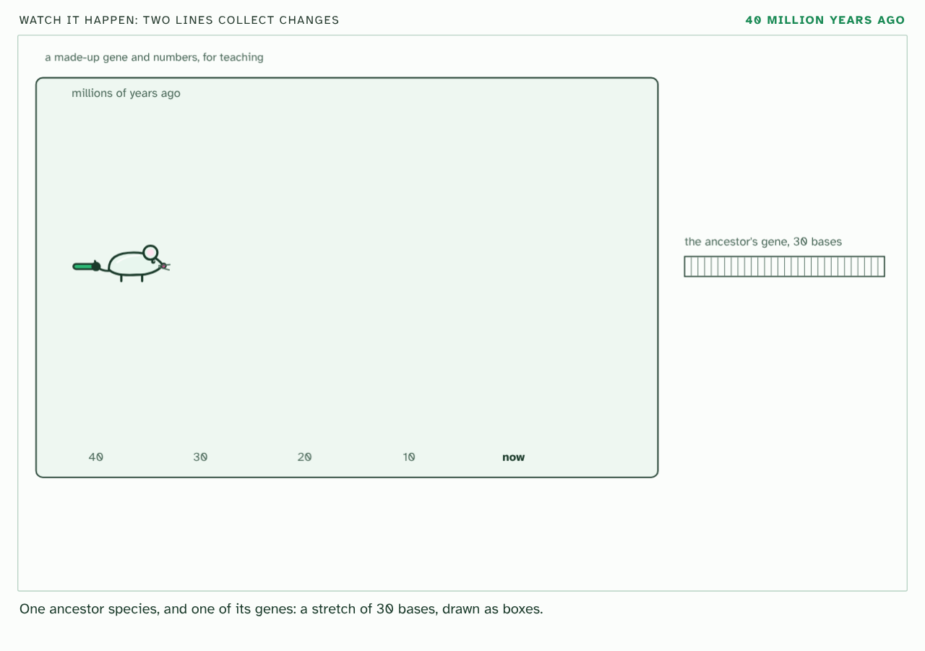
CHAPTER 5 · A3.2.5 The molecular clock
PLAY IT
Differences that count the years
Watch it happen: two lines collect changes: click to play. It loops every 40 seconds.
Minutes 30 to 46
Notes:
Minutes 30 to 46 of 60: Plot the clock (16 min).
The plan: The data task below on graph paper: plot the fossil-dated pairs, draw the clock, and read the undated pair. Then chapter 5's figure and its last step on a faster clock, and the film for the changes building up along two lines.
The video is clock.mp4, one loop of the animation in the guide. It plays in PowerPoint and Keynote. Google Slides does not play a video embedded in a .pptx: download clock.mp4 (https://www.biologybybradford.com/guides/downloads/scenes/clock.mp4), upload it to Google Drive, then Insert > Video > Google Drive.
In the guide the class can change it as it runs: https://www.biologybybradford.com/guides/ib-biology-a3-2-classification-and-cladistics#clock
What it shows, in order:
1. One ancestor species, and one of its genes: a stretch of 30 bases, drawn as boxes.
2. Its descendants split into new species. In every line, mutations build up in the gene at a fairly steady rate: the ticks of a clock.
3. Today there are four species, A to D. Each gene now differs from the ancestor's, in its own places.
4. A dated fossil shows that A and B split 30 million years ago. Their genes differ at 15 bases.
5. So this clock runs at 15 ÷ 30 = 0.5 differences per million years.
6. C and D differ at 6 bases: 6 ÷ 0.5 = about 12 million years since they split.
7. Only an estimate: generation time, population size and selection all change how fast differences build up. Try the settings.

Slide 24
PREDICT
A clock is calibrated on mammals that breed every few years. It is then used to date a split between two lines of insects that breed several times a year. What will the estimate probably be?
A Too young, because insects gather fewer changes each year than mammals do
B About right, because DNA is copied and mutates in the same way in every animal
C Too old, because the insects probably collected changes faster each year
Minutes 30 to 46
Notes:
Minutes 30 to 46 of 60: Plot the clock (16 min).
The plan: The data task below on graph paper: plot the fossil-dated pairs, draw the clock, and read the undated pair. Then chapter 5's figure and its last step on a faster clock, and the film for the changes building up along two lines.
Ask for a show of hands, or mini whiteboards, before revealing. (Answer: C, on the next slide.)

Slide 25
WHAT HAPPENS
A clock is calibrated on mammals that breed every few years. It is then used to date a split between two lines of insects that breed several times a year. What will the estimate probably be?
A Too young, because insects gather fewer changes each year than mammals do
B About right, because DNA is copied and mutates in the same way in every animal
C Too old, because the insects probably collected changes faster each year
Too old. With more generations each year there are more chances for changes to build up, so the insects gather differences faster than the mammal clock allows for. The same number of differences stands for fewer years than the clock says.
Minutes 30 to 46
Notes:
Minutes 30 to 46 of 60: Plot the clock (16 min).
The plan: The data task below on graph paper: plot the fossil-dated pairs, draw the clock, and read the undated pair. Then chapter 5's figure and its last step on a faster clock, and the film for the changes building up along two lines.
Answer: C. Too old. With more generations each year there are more chances for changes to build up, so the insects gather differences faster than the mammal clock allows for. The same number of differences stands for fewer years than the clock says.

Slide 26
REMEMBER IT
What shifts the clock
G
P
S
Gerbils
Play
Sports
Minutes 30 to 46
Notes:
Minutes 30 to 46 of 60: Plot the clock (16 min).
The plan: The data task below on graph paper: plot the fossil-dated pairs, draw the clock, and read the undated pair. Then chapter 5's figure and its last step on a faster clock, and the film for the changes building up along two lines.
Ask the class what each letter stands for before revealing.

Slide 27
REMEMBER IT
What shifts the clock
G
P
S
Gerbils
Play
Sports
Generation time
Population size
Selection pressure
short generations copy DNA more often each year
chance spreads changes differently
selection removes some changes, keeps others
Minutes 30 to 46
Notes:
Minutes 30 to 46 of 60: Plot the clock (16 min).
The plan: The data task below on graph paper: plot the fossil-dated pairs, draw the clock, and read the undated pair. Then chapter 5's figure and its last step on a faster clock, and the film for the changes building up along two lines.
Gerbils: Generation time (short generations copy DNA more often each year)
Play: Population size (chance spreads changes differently)
Sports: Selection pressure (selection removes some changes, keeps others)

Slide 28
WATCH OUT
A molecular clock is not a watch. It gives an average rate, calibrated against fossils, and different genes and different lines can tick at different rates. That is why scientists quote a range and not a single date.
Minutes 30 to 46
Notes:
Minutes 30 to 46 of 60: Plot the clock (16 min).
The plan: The data task below on graph paper: plot the fossil-dated pairs, draw the clock, and read the undated pair. Then chapter 5's figure and its last step on a faster clock, and the film for the changes building up along two lines.
A common mistake: say it, then ask who can say why it is wrong.

Slide 29
STEP 5
8 MIN
Why only an estimate?
Students link each of the three factors (generation time, population size, selection pressure) to what it does to the number of changes, using the mnemonic tiles.
Minutes 46 to 54
Notes:
Minutes 46 to 54 of 60: Why only an estimate? (8 min).
The plan: Students link each of the three factors (generation time, population size, selection pressure) to what it does to the number of changes, using the mnemonic tiles. Then the chapter's predict box on calibrating a clock on mammals and using it on insects.

Slide 30
PLENARY
Can you now...
Define a clade, and say what evidence best places organisms in one (A3.2.4)
Explain how the molecular clock estimates when clades diverged, and why it only gives estimates (A3.2.5)
Minutes 54 to 60
Notes:
Minutes 54 to 60 of 60: Exit (6 min).
The plan: Two sentences: what a molecular clock measures, and one reason its estimate could be wrong.
Thumbs up, sideways or down on each goal before the exit question. The goals come from the statements this lesson covers.

Slide 31
EXIT QUESTION
Before you go
Two sentences: what a molecular clock measures, and one reason its estimate could be wrong.
Minutes 54 to 60
Notes:
Minutes 54 to 60 of 60: Exit (6 min).
The plan: Two sentences: what a molecular clock measures, and one reason its estimate could be wrong.

Slide 32
PRACTISE AND REVISE
Keep going
Exam practice: a fresh paper of exam questions on A3.2 at higher level, marked as you go
The guide, with the animations and the dry lab
This lesson in the guide: 4 A clade is an ancestor and all its descendants, 5 Differences that count the years
BUILD FOR YOUR CLASS
ALREADY ON THE SITE FOR A3.2
CARD SETS ON SPLYCR
Tarsia puzzle, dominoes and picture reveal on A3.2, built from its key terms and ready to print
A pub quiz with rounds on A3.2, to present or run with no projector
An escape room built from the question bank on A3.2
Quiz: Cladistics (HL)
Revision map: A3.2 Classification and cladistics, to fill in
Exam questions: A3.2 in the exam maker, a paper with its markscheme
Open a set to host it as a class game, or make a copy to edit.
A3.2 Classification and Cladistics (HL)
How this was made. The course structure, the activities and the teaching choices come from my own classroom, my presentations and my years of teaching IB and AP Biology. I use Claude, an AI, to help write and build the interactive guides, lesson plans, slides and practice questions, and to draw the diagrams and code the interactives. I direct the work and review it against the IB and AP specifications before it goes live.
Minute 60: after the lesson
Notes:
Every link here is live. Set the exam practice paper for homework: it is fresh each time, marked as students go and saved to their Exam practice when they are signed in.
Exam practice: https://www.biologybybradford.com/exam-maker/sit?topics=A3.2&level=HL&paper=quiz&marks=15&src=ep
The guide: https://www.biologybybradford.com/guides/ib-biology-a3-2-classification-and-cladistics

