Slide 1
IB Biology A3.2
LESSON 3 OF 4
HL
BY THE END YOU CAN
Classification and cladistics
Build a cladogram from sequence data using parsimony, and say why different criteria can give different trees (A3.2.6)
Read a cladogram: its root, nodes and terminal branches, its clades and common ancestors (A3.2.7)
Building and reading cladograms
A3.2.6, A3.2.7
Choosing a tree by parsimony, reading nodes and clades, and what changes when you change the data
60 minutes · chapters 6, 7 · the dry lab
Minute 0
Notes:
IB Biology A3.2, Classification and cladistics. Lesson 3 of 4: Building and reading cladograms (higher level), 60 minutes.
The plan, minute by minute (each slide's footer says where you are):
0 to 6 min (6) Do now: who goes with whom?
6 to 20 min (14) Parsimony by hand
20 to 32 min (12) Cladogram cards
32 to 42 min (10) Reading a cladogram
42 to 54 min (12) Grow a tree
54 to 60 min (6) Exit
What students get wrong:
"The tip at the top is the most advanced." Every node can be spun, so the order of the tips means nothing. Only the branching order carries meaning.
"A node is a real species we know of." A node is a hypothetical common ancestor. It need not be a known fossil.
"The most parsimonious tree is the true one." It is the most probable on the data, and it can change when more data is added.
Stretch and support:
Support: give the captions of each figure as a cut-up storyboard to put in order, and use the key terms (tap the dotted words) as a glossary.
Support: the two mnemonics (King Philip Came Over For Good Soup; Rabbits Nibble Tasty Carrots Slowly) as a starter, with the tiles turned over for the answers.
Support: for parsimony by hand, give a table with the three trees already drawn, so students only count.
Stretch: in the dry lab, find a data set where adding one feature changes the winning tree, and explain what that feature does.
The lesson plan to print: https://www.biologybybradford.com/guides/downloads/ib-biology-a3-2-classification-and-cladistics-lesson-3-plan.pdf

Slide 2
DO NOW
Who goes with whom?
Four short sequences on the board with a fifth as the outgroup.
Pairs mark the sites where two species share a difference from the outgroup and say which two species they would put together.
6:00
minutes
Start now: the timer is running.
Minutes 0 to 6
Notes:
Minutes 0 to 6 of 60: Do now: who goes with whom? (6 min).
The plan: Four short sequences on the board with a fifth as the outgroup. Pairs mark the sites where two species share a difference from the outgroup and say which two species they would put together. Do not reveal the tree yet.
Start a 6 minute timer as they come in.

Slide 3
STEP 2
14 MIN
Parsimony by hand
Students count the changes on the three trees from the table, and compare with the figure's counts of 7, 10 and 9.
Minutes 6 to 20
Notes:
Minutes 6 to 20 of 60: Parsimony by hand (14 min).
The plan: Chapter 6's figure step by step. Students count the changes on the three trees from the table, and compare with the figure's counts of 7, 10 and 9. Then the cladogram tool: join the beetles, watch the count, and ask whether a tree with fewer changes exists. Run it again with the DNA column. Finish with the predict box on a tie.

Slide 4
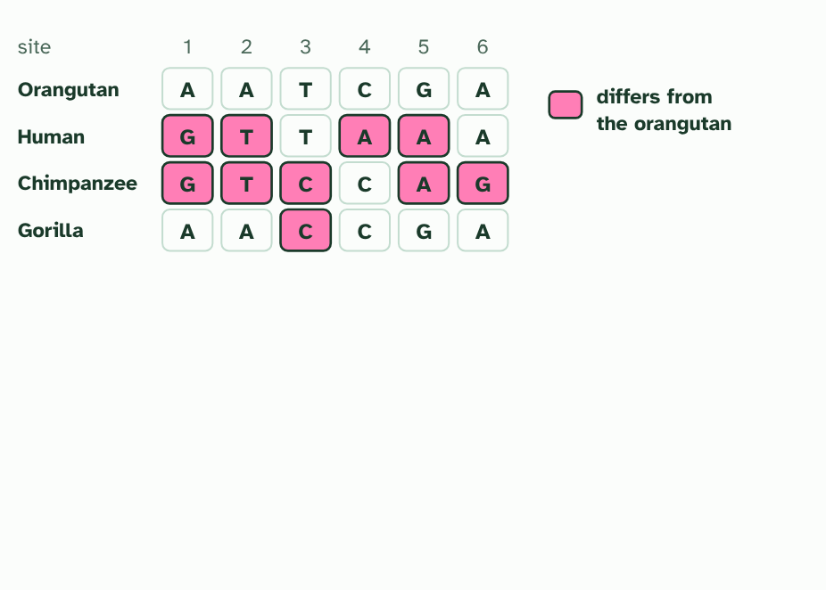
CHAPTER 6 · A3.2.6 Building a cladogram
1 / 4
The tree with the fewest changes
A made-up stretch of six sites in one gene. Pink marks where a species differs from the orangutan, the outgroup.
Minutes 6 to 20
Notes:
Minutes 6 to 20 of 60: Parsimony by hand (14 min).
The plan: Chapter 6's figure step by step. Students count the changes on the three trees from the table, and compare with the figure's counts of 7, 10 and 9. Then the cladogram tool: join the beetles, watch the count, and ask whether a tree with fewer changes exists. Run it again with the DNA column. Finish with the predict box on a tie.
A cladogram is a hypothesis about the order of splits. To build one from sequences, line up the same gene from each species and compare it position by position. Many trees could join the same species, so you need a rule to choose between them.
The rule used here is parsimony: choose the tree that accounts for the sequence differences with the fewest changes. Mutations are rare, so the explanation that needs fewest of them is the most probable. Add an outgroup, a species that split off earlier, to show which base is the older one.
The figure uses made-up data, small enough to count by hand. Each site is a column. A site where one species stands alone costs one change on every tree, so it cannot help. The sites where two species share a change are the ones that decide. Then try the tool: join the beetles yourself, watch the count, and run it again with a DNA column.
A cladogram is not a fact, and the method matters. Different criteria for judgement can lead to different hypotheses. A different gene, a different rule or traits of the body instead of sequences could give another tree, and new data can overturn one.

Slide 5
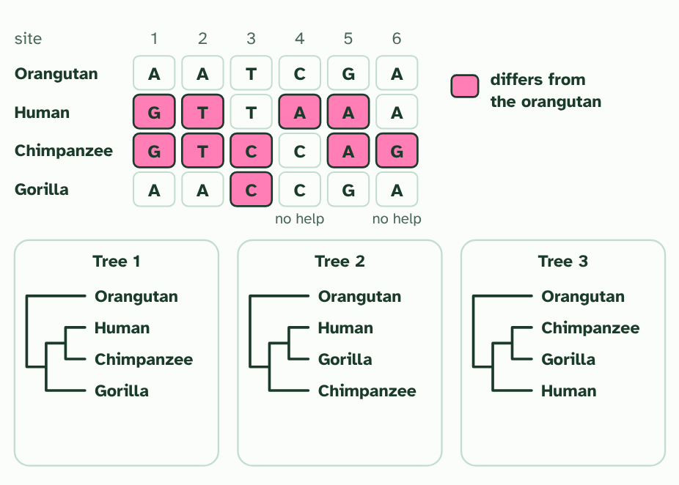
CHAPTER 6 · A3.2.6 Building a cladogram
2 / 4
The tree with the fewest changes
Three trees could join the human, chimpanzee and gorilla. Sites 4 and 6 differ in only one species, so they cost one change on every tree and cannot choose between them.
Minutes 6 to 20
Notes:
Minutes 6 to 20 of 60: Parsimony by hand (14 min).
The plan: Chapter 6's figure step by step. Students count the changes on the three trees from the table, and compare with the figure's counts of 7, 10 and 9. Then the cladogram tool: join the beetles, watch the count, and ask whether a tree with fewer changes exists. Run it again with the DNA column. Finish with the predict box on a tie.
A cladogram is a hypothesis about the order of splits. To build one from sequences, line up the same gene from each species and compare it position by position. Many trees could join the same species, so you need a rule to choose between them.
The rule used here is parsimony: choose the tree that accounts for the sequence differences with the fewest changes. Mutations are rare, so the explanation that needs fewest of them is the most probable. Add an outgroup, a species that split off earlier, to show which base is the older one.
The figure uses made-up data, small enough to count by hand. Each site is a column. A site where one species stands alone costs one change on every tree, so it cannot help. The sites where two species share a change are the ones that decide. Then try the tool: join the beetles yourself, watch the count, and run it again with a DNA column.
A cladogram is not a fact, and the method matters. Different criteria for judgement can lead to different hypotheses. A different gene, a different rule or traits of the body instead of sequences could give another tree, and new data can overturn one.

Slide 6
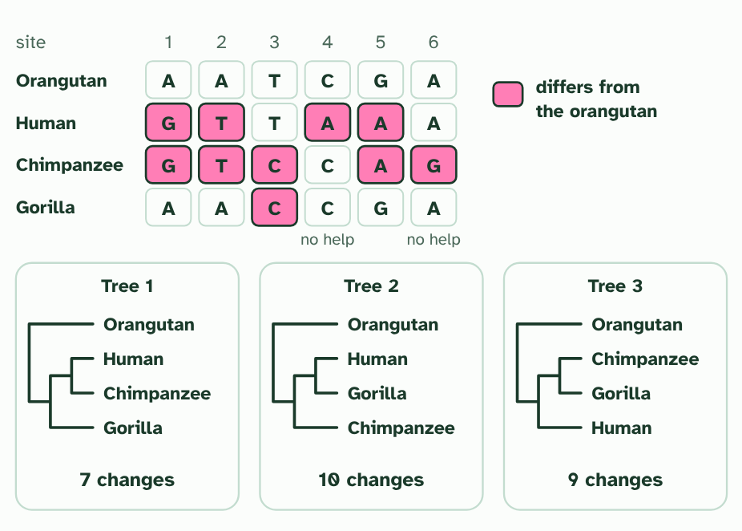
CHAPTER 6 · A3.2.6 Building a cladogram
3 / 4
The tree with the fewest changes
Count the changes each tree needs to explain all six sites. Tree 1 needs 7, tree 2 needs 10 and tree 3 needs 9.
Minutes 6 to 20
Notes:
Minutes 6 to 20 of 60: Parsimony by hand (14 min).
The plan: Chapter 6's figure step by step. Students count the changes on the three trees from the table, and compare with the figure's counts of 7, 10 and 9. Then the cladogram tool: join the beetles, watch the count, and ask whether a tree with fewer changes exists. Run it again with the DNA column. Finish with the predict box on a tie.
A cladogram is a hypothesis about the order of splits. To build one from sequences, line up the same gene from each species and compare it position by position. Many trees could join the same species, so you need a rule to choose between them.
The rule used here is parsimony: choose the tree that accounts for the sequence differences with the fewest changes. Mutations are rare, so the explanation that needs fewest of them is the most probable. Add an outgroup, a species that split off earlier, to show which base is the older one.
The figure uses made-up data, small enough to count by hand. Each site is a column. A site where one species stands alone costs one change on every tree, so it cannot help. The sites where two species share a change are the ones that decide. Then try the tool: join the beetles yourself, watch the count, and run it again with a DNA column.
A cladogram is not a fact, and the method matters. Different criteria for judgement can lead to different hypotheses. A different gene, a different rule or traits of the body instead of sequences could give another tree, and new data can overturn one.

Slide 7
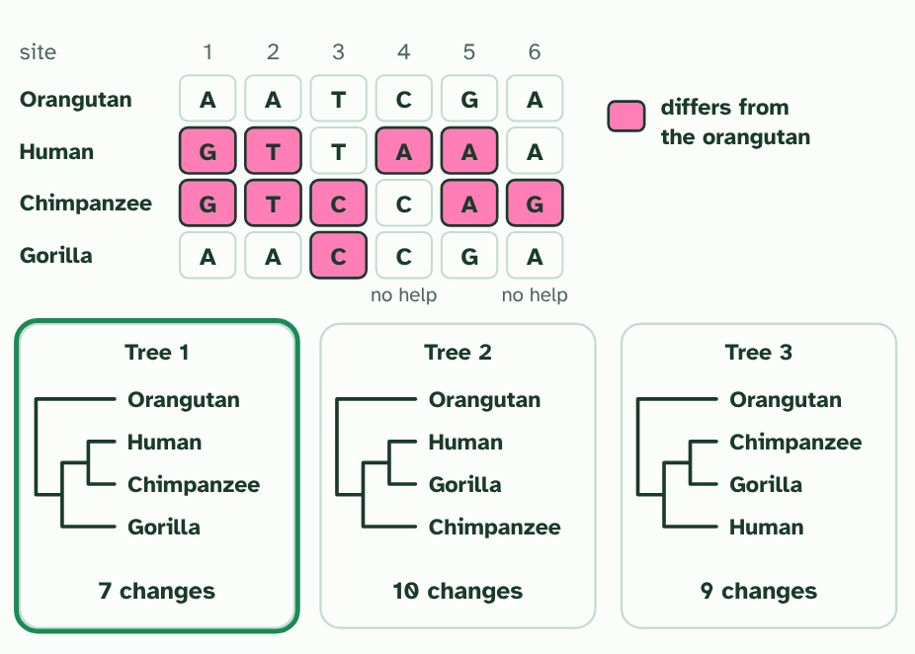
CHAPTER 6 · A3.2.6 Building a cladogram
4 / 4
The tree with the fewest changes
Parsimony picks the tree that explains the data with the fewest changes: tree 1, with the human and chimpanzee as closest relatives.
Minutes 6 to 20
Notes:
Minutes 6 to 20 of 60: Parsimony by hand (14 min).
The plan: Chapter 6's figure step by step. Students count the changes on the three trees from the table, and compare with the figure's counts of 7, 10 and 9. Then the cladogram tool: join the beetles, watch the count, and ask whether a tree with fewer changes exists. Run it again with the DNA column. Finish with the predict box on a tie.
A cladogram is a hypothesis about the order of splits. To build one from sequences, line up the same gene from each species and compare it position by position. Many trees could join the same species, so you need a rule to choose between them.
The rule used here is parsimony: choose the tree that accounts for the sequence differences with the fewest changes. Mutations are rare, so the explanation that needs fewest of them is the most probable. Add an outgroup, a species that split off earlier, to show which base is the older one.
The figure uses made-up data, small enough to count by hand. Each site is a column. A site where one species stands alone costs one change on every tree, so it cannot help. The sites where two species share a change are the ones that decide. Then try the tool: join the beetles yourself, watch the count, and run it again with a DNA column.
A cladogram is not a fact, and the method matters. Different criteria for judgement can lead to different hypotheses. A different gene, a different rule or traits of the body instead of sequences could give another tree, and new data can overturn one.

Slide 8
CHAPTER 6 · A3.2.6 Building a cladogram
The tree with the fewest changes
A cladogram is a hypothesis about the order of splits.
The rule used here is parsimony: choose the tree that accounts for the sequence differences with the fewest changes.
A cladogram is not a fact, and the method matters.
Minutes 6 to 20
Notes:
Minutes 6 to 20 of 60: Parsimony by hand (14 min).
The plan: Chapter 6's figure step by step. Students count the changes on the three trees from the table, and compare with the figure's counts of 7, 10 and 9. Then the cladogram tool: join the beetles, watch the count, and ask whether a tree with fewer changes exists. Run it again with the DNA column. Finish with the predict box on a tie.
A cladogram is a hypothesis about the order of splits. To build one from sequences, line up the same gene from each species and compare it position by position. Many trees could join the same species, so you need a rule to choose between them.
The rule used here is parsimony: choose the tree that accounts for the sequence differences with the fewest changes. Mutations are rare, so the explanation that needs fewest of them is the most probable. Add an outgroup, a species that split off earlier, to show which base is the older one.
The figure uses made-up data, small enough to count by hand. Each site is a column. A site where one species stands alone costs one change on every tree, so it cannot help. The sites where two species share a change are the ones that decide. Then try the tool: join the beetles yourself, watch the count, and run it again with a DNA column.
A cladogram is not a fact, and the method matters. Different criteria for judgement can lead to different hypotheses. A different gene, a different rule or traits of the body instead of sequences could give another tree, and new data can overturn one.

Slide 9
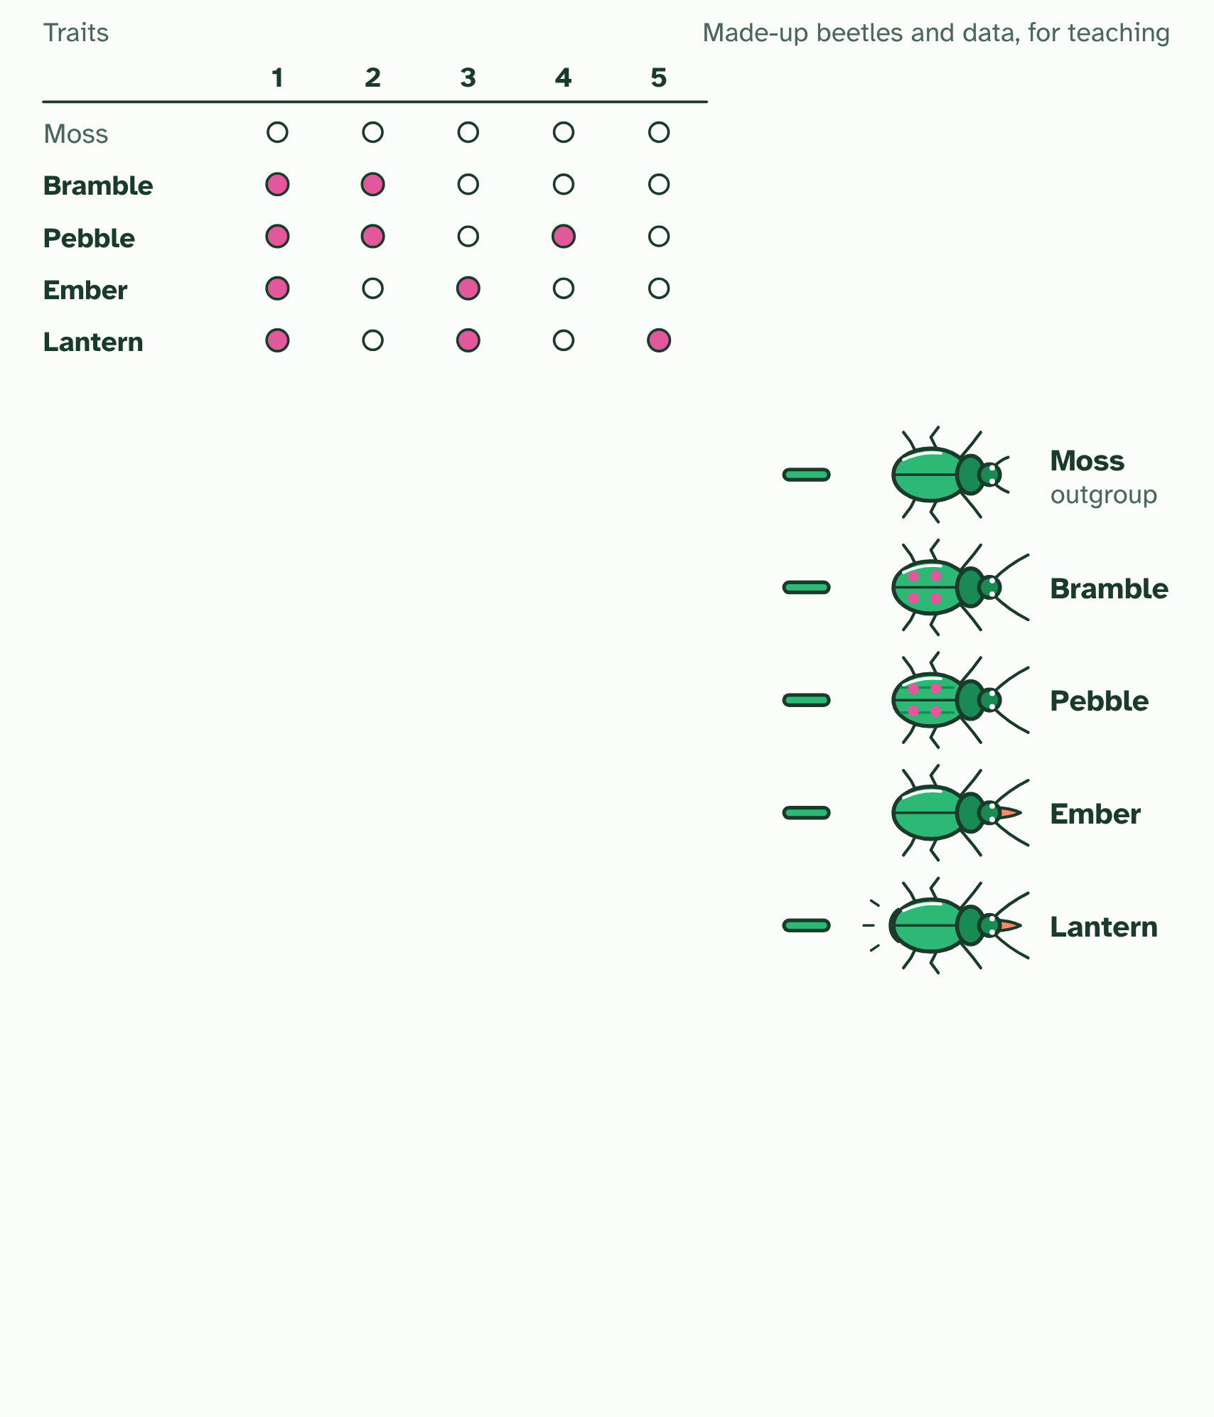
CHAPTER 6 · A3.2.6 Building a cladogram
1 / 2
The tree with the fewest changes
The table gives each beetle's traits (made up for teaching). Moss is the outgroup: its states are taken as the ancestral ones.
Minutes 6 to 20
Notes:
Minutes 6 to 20 of 60: Parsimony by hand (14 min).
The plan: Chapter 6's figure step by step. Students count the changes on the three trees from the table, and compare with the figure's counts of 7, 10 and 9. Then the cladogram tool: join the beetles, watch the count, and ask whether a tree with fewer changes exists. Run it again with the DNA column. Finish with the predict box on a tie.
A cladogram is a hypothesis about the order of splits. To build one from sequences, line up the same gene from each species and compare it position by position. Many trees could join the same species, so you need a rule to choose between them.
The rule used here is parsimony: choose the tree that accounts for the sequence differences with the fewest changes. Mutations are rare, so the explanation that needs fewest of them is the most probable. Add an outgroup, a species that split off earlier, to show which base is the older one.
The figure uses made-up data, small enough to count by hand. Each site is a column. A site where one species stands alone costs one change on every tree, so it cannot help. The sites where two species share a change are the ones that decide. Then try the tool: join the beetles yourself, watch the count, and run it again with a DNA column.
A cladogram is not a fact, and the method matters. Different criteria for judgement can lead to different hypotheses. A different gene, a different rule or traits of the body instead of sequences could give another tree, and new data can overturn one.

Slide 10
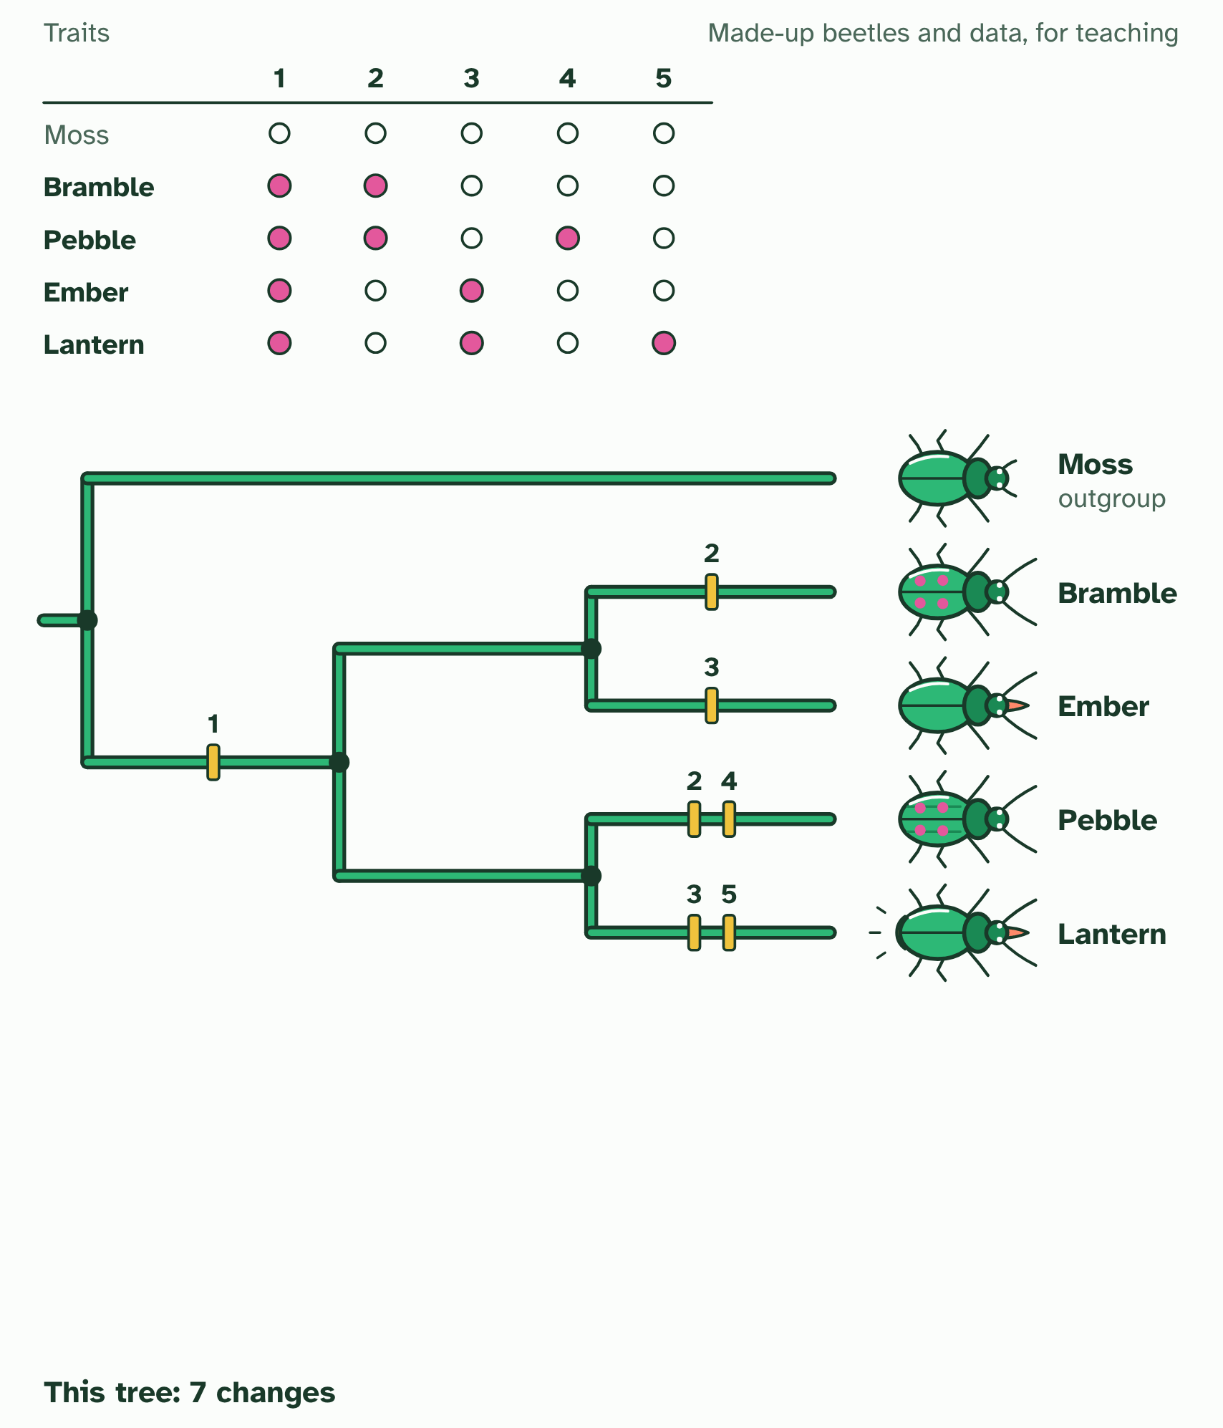
CHAPTER 6 · A3.2.6 Building a cladogram
2 / 2
The tree with the fewest changes
One tree, with a bar on each branch where a trait changes: 7 changes. Can you find a tree that needs fewer?
Minutes 6 to 20
Notes:
Minutes 6 to 20 of 60: Parsimony by hand (14 min).
The plan: Chapter 6's figure step by step. Students count the changes on the three trees from the table, and compare with the figure's counts of 7, 10 and 9. Then the cladogram tool: join the beetles, watch the count, and ask whether a tree with fewer changes exists. Run it again with the DNA column. Finish with the predict box on a tie.
A cladogram is a hypothesis about the order of splits. To build one from sequences, line up the same gene from each species and compare it position by position. Many trees could join the same species, so you need a rule to choose between them.
The rule used here is parsimony: choose the tree that accounts for the sequence differences with the fewest changes. Mutations are rare, so the explanation that needs fewest of them is the most probable. Add an outgroup, a species that split off earlier, to show which base is the older one.
The figure uses made-up data, small enough to count by hand. Each site is a column. A site where one species stands alone costs one change on every tree, so it cannot help. The sites where two species share a change are the ones that decide. Then try the tool: join the beetles yourself, watch the count, and run it again with a DNA column.
A cladogram is not a fact, and the method matters. Different criteria for judgement can lead to different hypotheses. A different gene, a different rule or traits of the body instead of sequences could give another tree, and new data can overturn one.

Slide 11
CHAPTER 6 · A3.2.6 Building a cladogram
The tree with the fewest changes
A cladogram is a hypothesis about the order of splits.
The rule used here is parsimony: choose the tree that accounts for the sequence differences with the fewest changes.
A cladogram is not a fact, and the method matters.
Minutes 6 to 20
Notes:
Minutes 6 to 20 of 60: Parsimony by hand (14 min).
The plan: Chapter 6's figure step by step. Students count the changes on the three trees from the table, and compare with the figure's counts of 7, 10 and 9. Then the cladogram tool: join the beetles, watch the count, and ask whether a tree with fewer changes exists. Run it again with the DNA column. Finish with the predict box on a tie.
A cladogram is a hypothesis about the order of splits. To build one from sequences, line up the same gene from each species and compare it position by position. Many trees could join the same species, so you need a rule to choose between them.
The rule used here is parsimony: choose the tree that accounts for the sequence differences with the fewest changes. Mutations are rare, so the explanation that needs fewest of them is the most probable. Add an outgroup, a species that split off earlier, to show which base is the older one.
The figure uses made-up data, small enough to count by hand. Each site is a column. A site where one species stands alone costs one change on every tree, so it cannot help. The sites where two species share a change are the ones that decide. Then try the tool: join the beetles yourself, watch the count, and run it again with a DNA column.
A cladogram is not a fact, and the method matters. Different criteria for judgement can lead to different hypotheses. A different gene, a different rule or traits of the body instead of sequences could give another tree, and new data can overturn one.

Slide 12
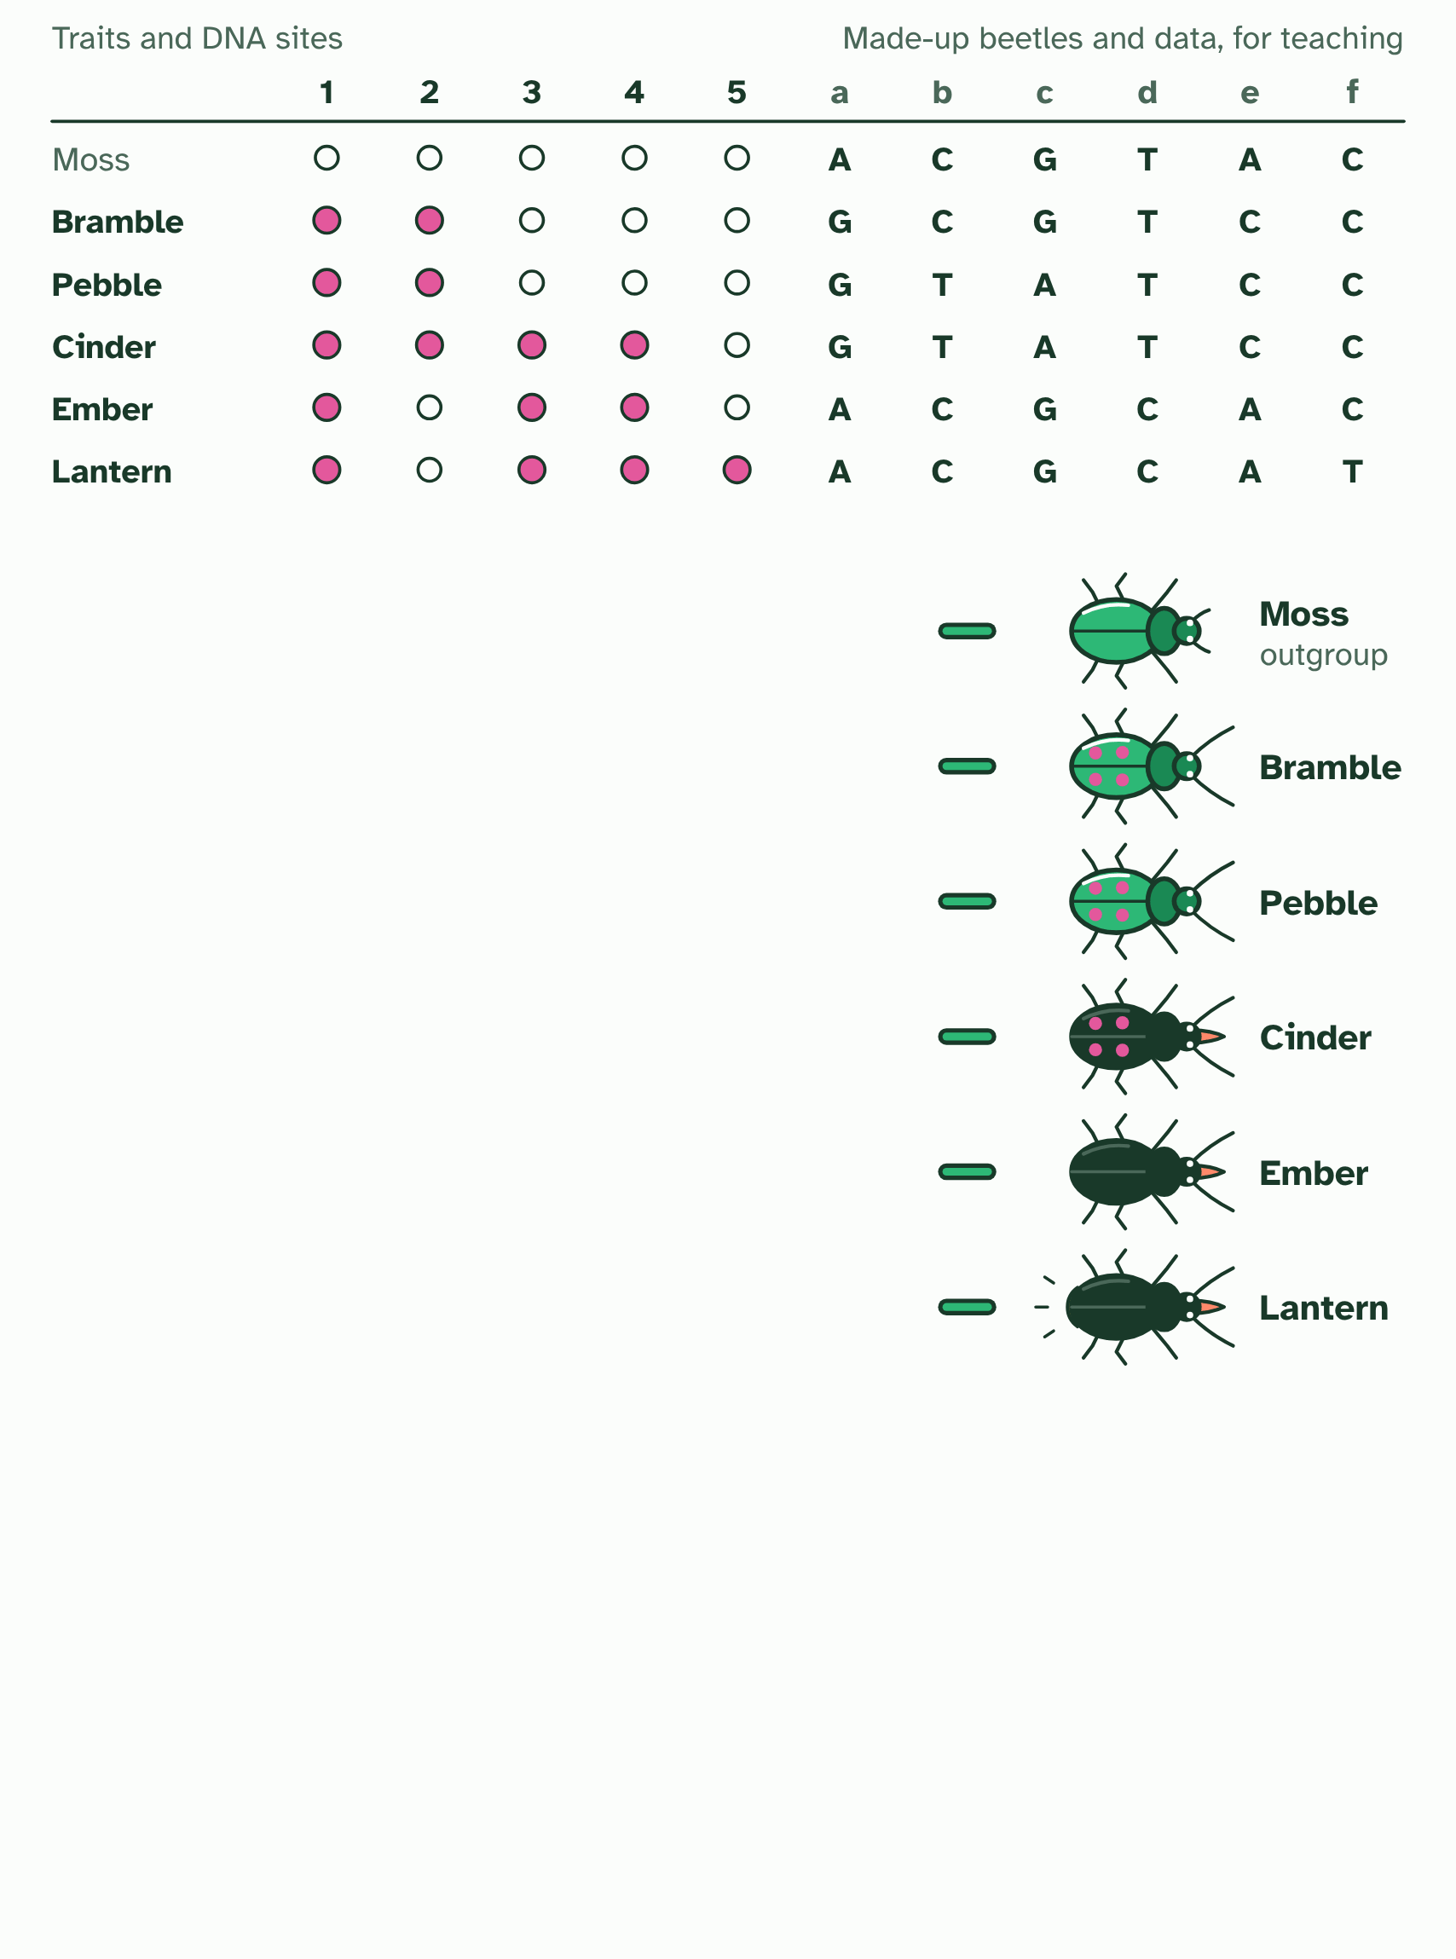
CHAPTER 6 · A3.2.6 Building a cladogram
1 / 2
The tree with the fewest changes
The table gives each beetle's traits (made up for teaching). Moss is the outgroup: its states are taken as the ancestral ones.
Minutes 6 to 20
Notes:
Minutes 6 to 20 of 60: Parsimony by hand (14 min).
The plan: Chapter 6's figure step by step. Students count the changes on the three trees from the table, and compare with the figure's counts of 7, 10 and 9. Then the cladogram tool: join the beetles, watch the count, and ask whether a tree with fewer changes exists. Run it again with the DNA column. Finish with the predict box on a tie.
A cladogram is a hypothesis about the order of splits. To build one from sequences, line up the same gene from each species and compare it position by position. Many trees could join the same species, so you need a rule to choose between them.
The rule used here is parsimony: choose the tree that accounts for the sequence differences with the fewest changes. Mutations are rare, so the explanation that needs fewest of them is the most probable. Add an outgroup, a species that split off earlier, to show which base is the older one.
The figure uses made-up data, small enough to count by hand. Each site is a column. A site where one species stands alone costs one change on every tree, so it cannot help. The sites where two species share a change are the ones that decide. Then try the tool: join the beetles yourself, watch the count, and run it again with a DNA column.
A cladogram is not a fact, and the method matters. Different criteria for judgement can lead to different hypotheses. A different gene, a different rule or traits of the body instead of sequences could give another tree, and new data can overturn one.

Slide 13
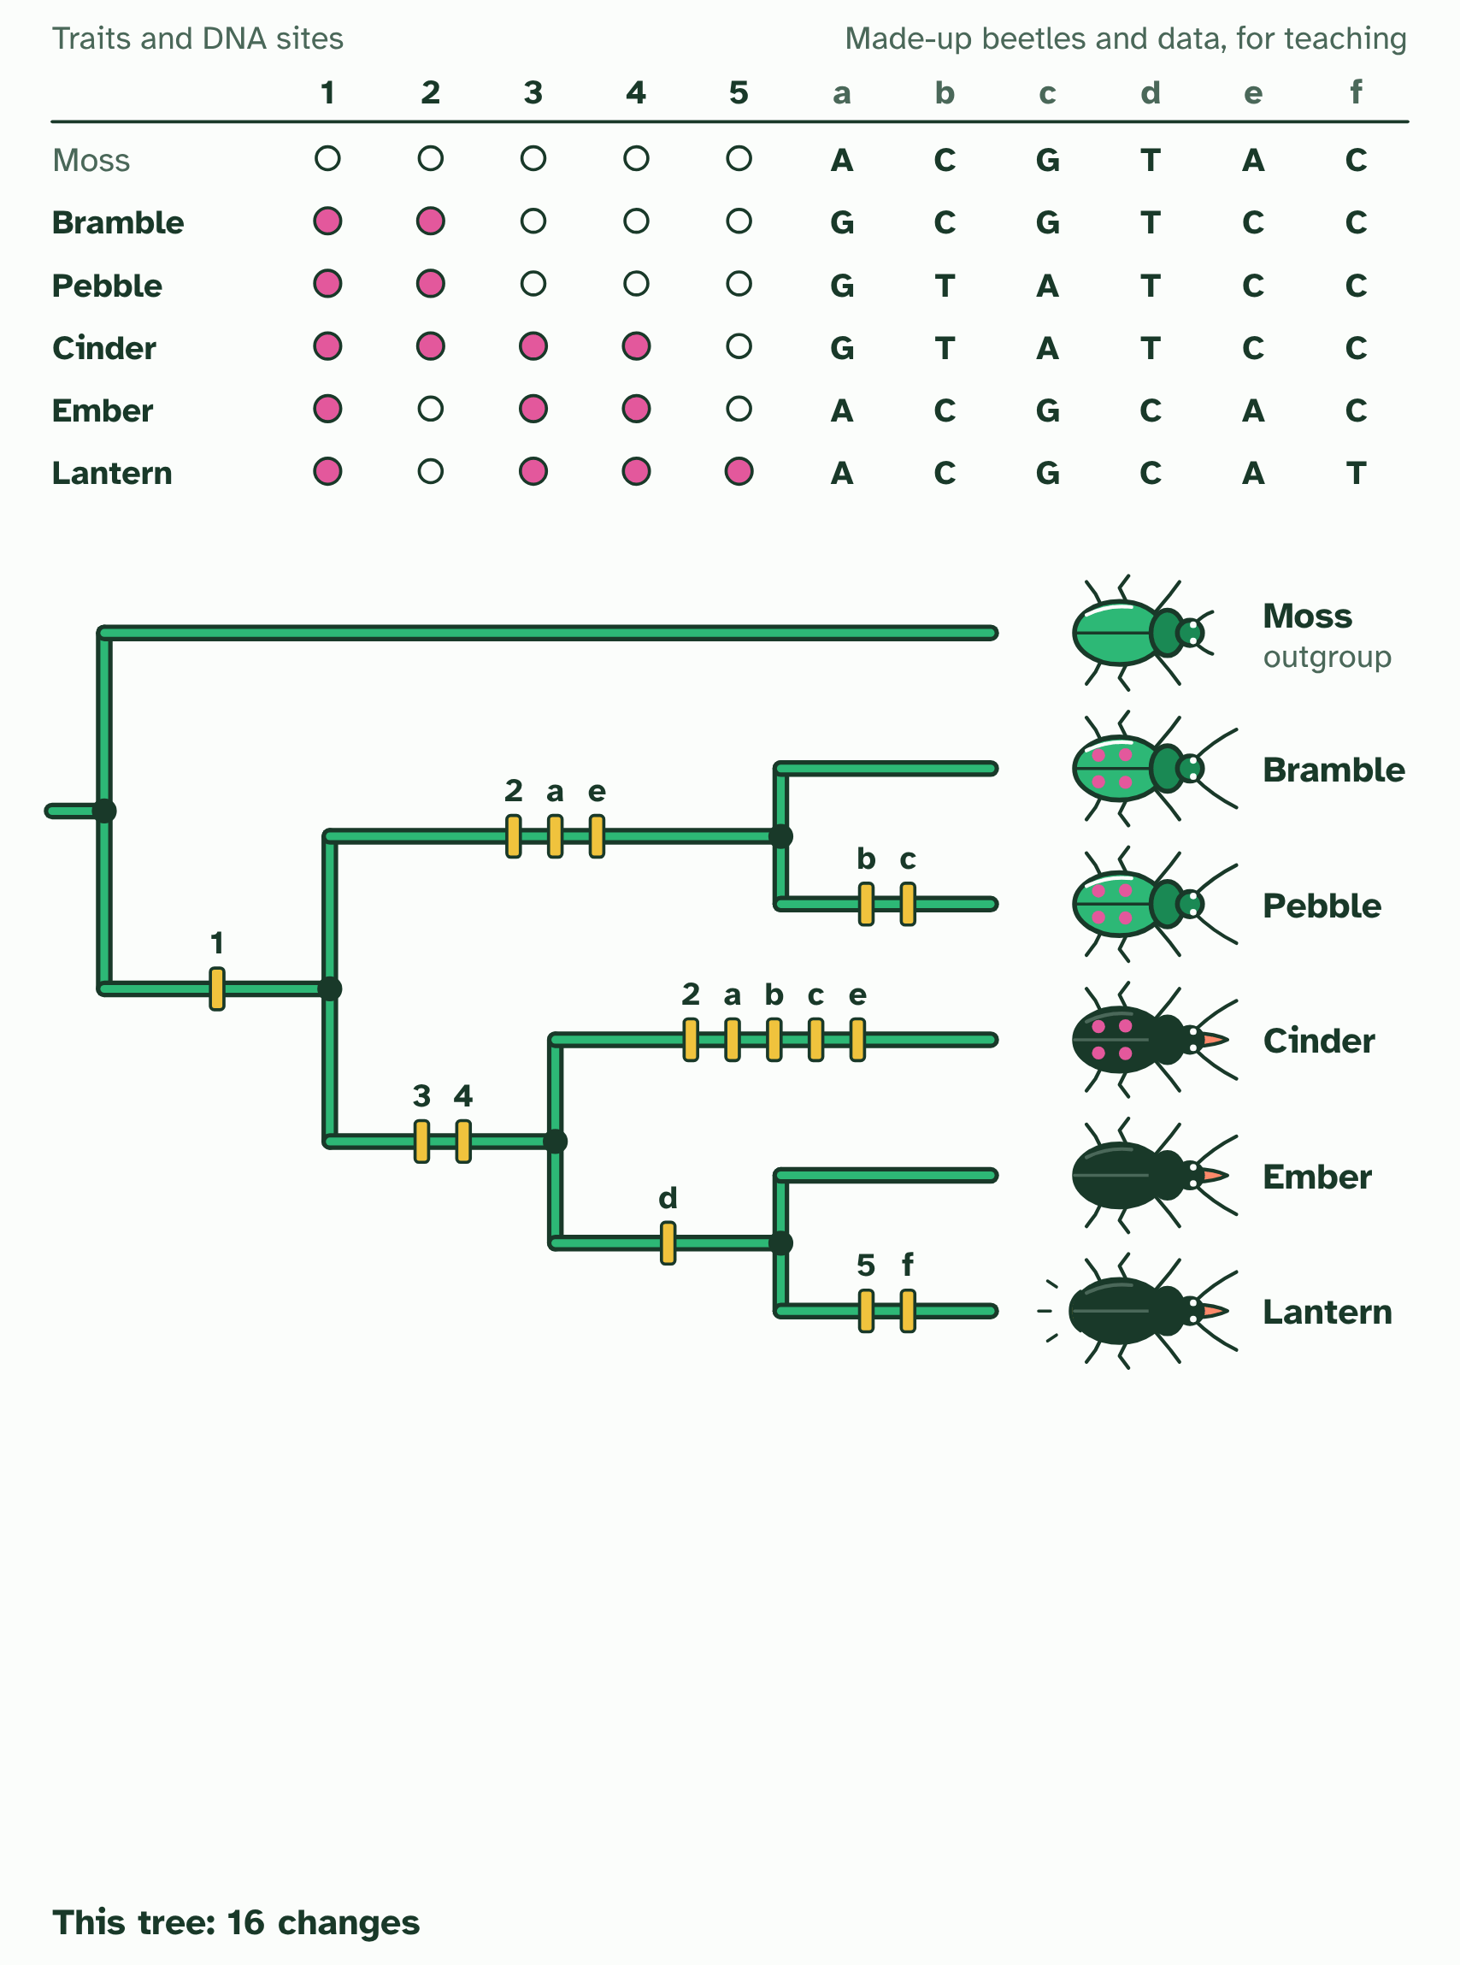
CHAPTER 6 · A3.2.6 Building a cladogram
2 / 2
The tree with the fewest changes
One tree, with a bar on each branch where a trait changes: 16 changes. Can you find a tree that needs fewer?
Minutes 6 to 20
Notes:
Minutes 6 to 20 of 60: Parsimony by hand (14 min).
The plan: Chapter 6's figure step by step. Students count the changes on the three trees from the table, and compare with the figure's counts of 7, 10 and 9. Then the cladogram tool: join the beetles, watch the count, and ask whether a tree with fewer changes exists. Run it again with the DNA column. Finish with the predict box on a tie.
A cladogram is a hypothesis about the order of splits. To build one from sequences, line up the same gene from each species and compare it position by position. Many trees could join the same species, so you need a rule to choose between them.
The rule used here is parsimony: choose the tree that accounts for the sequence differences with the fewest changes. Mutations are rare, so the explanation that needs fewest of them is the most probable. Add an outgroup, a species that split off earlier, to show which base is the older one.
The figure uses made-up data, small enough to count by hand. Each site is a column. A site where one species stands alone costs one change on every tree, so it cannot help. The sites where two species share a change are the ones that decide. Then try the tool: join the beetles yourself, watch the count, and run it again with a DNA column.
A cladogram is not a fact, and the method matters. Different criteria for judgement can lead to different hypotheses. A different gene, a different rule or traits of the body instead of sequences could give another tree, and new data can overturn one.

Slide 14
CHAPTER 6 · A3.2.6 Building a cladogram
The tree with the fewest changes
A cladogram is a hypothesis about the order of splits.
The rule used here is parsimony: choose the tree that accounts for the sequence differences with the fewest changes.
A cladogram is not a fact, and the method matters.
Minutes 6 to 20
Notes:
Minutes 6 to 20 of 60: Parsimony by hand (14 min).
The plan: Chapter 6's figure step by step. Students count the changes on the three trees from the table, and compare with the figure's counts of 7, 10 and 9. Then the cladogram tool: join the beetles, watch the count, and ask whether a tree with fewer changes exists. Run it again with the DNA column. Finish with the predict box on a tie.
A cladogram is a hypothesis about the order of splits. To build one from sequences, line up the same gene from each species and compare it position by position. Many trees could join the same species, so you need a rule to choose between them.
The rule used here is parsimony: choose the tree that accounts for the sequence differences with the fewest changes. Mutations are rare, so the explanation that needs fewest of them is the most probable. Add an outgroup, a species that split off earlier, to show which base is the older one.
The figure uses made-up data, small enough to count by hand. Each site is a column. A site where one species stands alone costs one change on every tree, so it cannot help. The sites where two species share a change are the ones that decide. Then try the tool: join the beetles yourself, watch the count, and run it again with a DNA column.
A cladogram is not a fact, and the method matters. Different criteria for judgement can lead to different hypotheses. A different gene, a different rule or traits of the body instead of sequences could give another tree, and new data can overturn one.

Slide 15
PREDICT
Three possible trees need 14, 11 and 11 changes. What does parsimony tell you?
A The two trees that need 11 are tied, so more data is needed to choose between them
B The tree that needs 14 is best, because it explains the most differences between the species
C Either tree that needs 11 is right, so they must show exactly the same relationships
Minutes 6 to 20
Notes:
Minutes 6 to 20 of 60: Parsimony by hand (14 min).
The plan: Chapter 6's figure step by step. Students count the changes on the three trees from the table, and compare with the figure's counts of 7, 10 and 9. Then the cladogram tool: join the beetles, watch the count, and ask whether a tree with fewer changes exists. Run it again with the DNA column. Finish with the predict box on a tie.
Ask for a show of hands, or mini whiteboards, before revealing. (Answer: A, on the next slide.)

Slide 16
WHAT HAPPENS
Three possible trees need 14, 11 and 11 changes. What does parsimony tell you?
A The two trees that need 11 are tied, so more data is needed to choose between them
B The tree that needs 14 is best, because it explains the most differences between the species
C Either tree that needs 11 is right, so they must show exactly the same relationships
The two 11-change trees tie as most parsimonious. Parsimony cannot choose between them, so a scientist adds data, such as more positions or a second gene, and counts again. A tie is also a reminder that a cladogram is a hypothesis.
Minutes 6 to 20
Notes:
Minutes 6 to 20 of 60: Parsimony by hand (14 min).
The plan: Chapter 6's figure step by step. Students count the changes on the three trees from the table, and compare with the figure's counts of 7, 10 and 9. Then the cladogram tool: join the beetles, watch the count, and ask whether a tree with fewer changes exists. Run it again with the DNA column. Finish with the predict box on a tie.
Answer: A. The two 11-change trees tie as most parsimonious. Parsimony cannot choose between them, so a scientist adds data, such as more positions or a second gene, and counts again. A tie is also a reminder that a cladogram is a hypothesis.

Slide 17
WATCH OUT
The most parsimonious tree is the most probable, not the certain one. Two trees can tie on the count, and then more data, more positions or another gene, is needed to choose between them.
Minutes 6 to 20
Notes:
Minutes 6 to 20 of 60: Parsimony by hand (14 min).
The plan: Chapter 6's figure step by step. Students count the changes on the three trees from the table, and compare with the figure's counts of 7, 10 and 9. Then the cladogram tool: join the beetles, watch the count, and ask whether a tree with fewer changes exists. Run it again with the DNA column. Finish with the predict box on a tie.
A common mistake: say it, then ask who can say why it is wrong.

Slide 18
PRACTICE
IF THERE IS TIME
Make your own sequences
THE TASK
Each pair writes four six-base sequences and an outgroup, then swaps with another pair. The other pair draws the three possible trees, counts the changes on each and says which tree is most parsimonious, and whether two trees tie. Pairs check each other's counts. Ask them to design a set with a tie.
STUDENTS NEED
Squared paper; no devices needed.
Minutes 6 to 20
Notes:
Minutes 6 to 20 of 60: Parsimony by hand (14 min).
The plan: Chapter 6's figure step by step. Students count the changes on the three trees from the table, and compare with the figure's counts of 7, 10 and 9. Then the cladogram tool: join the beetles, watch the count, and ask whether a tree with fewer changes exists. Run it again with the DNA column. Finish with the predict box on a tie.
The activity: Make your own sequences. Each pair writes four six-base sequences and an outgroup, then swaps with another pair. The other pair draws the three possible trees, counts the changes on each and says which tree is most parsimonious, and whether two trees tie. Pairs check each other's counts. Ask them to design a set with a tie.
Needs: squared paper; no devices needed.
The plan sets no time of its own for this activity: use it in this step, in place of part of it, or for homework.

Slide 19
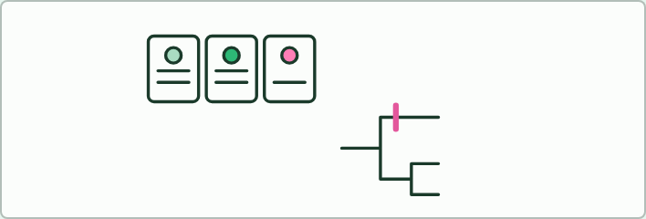
CARDS
12 MIN
Cladogram cards
THE TASK
Five cards, one for each of a lamprey, a shark, a frog, a lizard and a mouse, each with a strip of features (jaws, four limbs, an amnion around the embryo, hair). Groups arrange the cards into a tree so that each feature appears once, mark the branch where each feature first appears, and count the changes. Then give one group a card with a feature that fits nowhere neatly, and ask what they do. A rewrite of the classic sorting-cookies idea, with no food: the point is the counting.
STUDENTS NEED
Printed cards and tape for the branches, one set per group; the cladogram tool for checking.
Minutes 20 to 32
Notes:
Minutes 20 to 32 of 60: Cladogram cards (12 min).
The plan: The sorting cards below: groups place five organisms on a tree from a table of features, then write one change on each branch. Compare trees across groups and ask why two groups could end with different trees.
The activity: Cladogram cards. Five cards, one for each of a lamprey, a shark, a frog, a lizard and a mouse, each with a strip of features (jaws, four limbs, an amnion around the embryo, hair). Groups arrange the cards into a tree so that each feature appears once, mark the branch where each feature first appears, and count the changes. Then give one group a card with a feature that fits nowhere neatly, and ask what they do. A rewrite of the classic sorting-cookies idea, with no food: the point is the counting.
Needs: printed cards and tape for the branches, one set per group; the cladogram tool for checking.
The time: 12 minutes, minutes 20 to 32 of the plan.

Slide 20
STEP 4
10 MIN
Reading a cladogram
Turn over the mnemonic tiles.
Pairs use the read task in the tool.
Minutes 32 to 42
Notes:
Minutes 32 to 42 of 60: Reading a cladogram (10 min).
The plan: Chapter 7's figure: tap the root, a node, a terminal branch, a clade and sister groups, then spin the tree. Turn over the mnemonic tiles. Pairs use the read task in the tool.

Slide 21
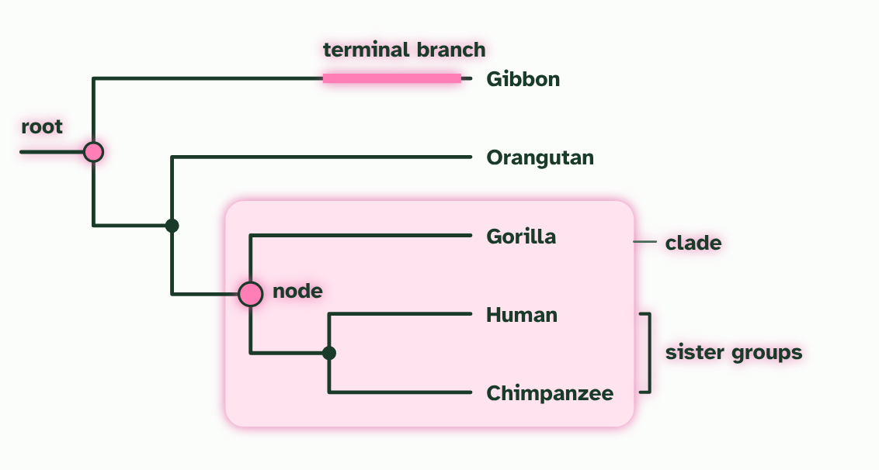
CHAPTER 7 · A3.2.7 Analysing cladograms
1 / 2
Reading a cladogram
Parts
Minutes 32 to 42
Notes:
Minutes 32 to 42 of 60: Reading a cladogram (10 min).
The plan: Chapter 7's figure: tap the root, a node, a terminal branch, a clade and sister groups, then spin the tree. Turn over the mnemonic tiles. Pairs use the read task in the tool.
A cladogram is a map of splits, so you read it from the base up to the tips. The base is the root. Each fork is a node, which stands for a hypothetical common ancestor: it must have existed to explain the split, but it need not be a known fossil. Each line out to a tip is a terminal branch. Tap the parts.
To deduce a relationship, follow two tips back until their lines meet. That node is their most recent common ancestor. The nearer it is to the tips, the closer the relatives. Two groups that branch from the same node are sister groups. In the figure the human and chimpanzee meet at a node that the gorilla has not yet joined, so a human is closer to a chimpanzee than to a gorilla.
Any node and everything beyond it is a clade, so you can read clades straight off the tree. Then use the clade to deduce what its members share.

Slide 22
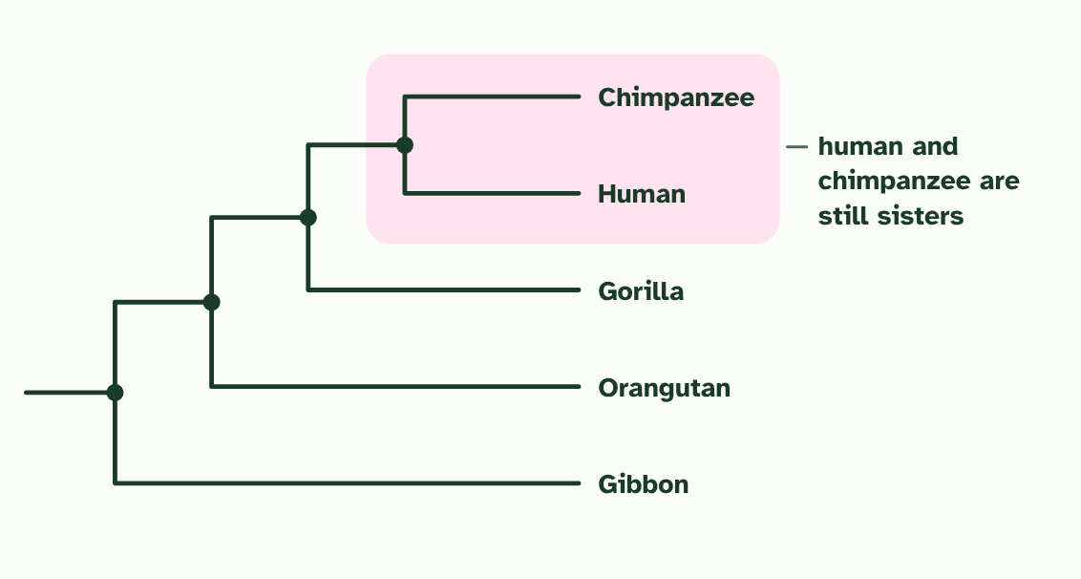
CHAPTER 7 · A3.2.7 Analysing cladograms
2 / 2
Reading a cladogram
Spin it
Minutes 32 to 42
Notes:
Minutes 32 to 42 of 60: Reading a cladogram (10 min).
The plan: Chapter 7's figure: tap the root, a node, a terminal branch, a clade and sister groups, then spin the tree. Turn over the mnemonic tiles. Pairs use the read task in the tool.
A cladogram is a map of splits, so you read it from the base up to the tips. The base is the root. Each fork is a node, which stands for a hypothetical common ancestor: it must have existed to explain the split, but it need not be a known fossil. Each line out to a tip is a terminal branch. Tap the parts.
To deduce a relationship, follow two tips back until their lines meet. That node is their most recent common ancestor. The nearer it is to the tips, the closer the relatives. Two groups that branch from the same node are sister groups. In the figure the human and chimpanzee meet at a node that the gorilla has not yet joined, so a human is closer to a chimpanzee than to a gorilla.
Any node and everything beyond it is a clade, so you can read clades straight off the tree. Then use the clade to deduce what its members share.

Slide 23
CHAPTER 7 · A3.2.7 Analysing cladograms
Reading a cladogram
The base is the root.
Each fork is a node, which stands for a hypothetical common ancestor: it must have existed to explain the split, but it need not be a known fossil.
Each line out to a tip is a terminal branch.
To deduce a relationship, follow two tips back until their lines meet. That node is their most recent common ancestor.
Minutes 32 to 42
Notes:
Minutes 32 to 42 of 60: Reading a cladogram (10 min).
The plan: Chapter 7's figure: tap the root, a node, a terminal branch, a clade and sister groups, then spin the tree. Turn over the mnemonic tiles. Pairs use the read task in the tool.
A cladogram is a map of splits, so you read it from the base up to the tips. The base is the root. Each fork is a node, which stands for a hypothetical common ancestor: it must have existed to explain the split, but it need not be a known fossil. Each line out to a tip is a terminal branch. Tap the parts.
To deduce a relationship, follow two tips back until their lines meet. That node is their most recent common ancestor. The nearer it is to the tips, the closer the relatives. Two groups that branch from the same node are sister groups. In the figure the human and chimpanzee meet at a node that the gorilla has not yet joined, so a human is closer to a chimpanzee than to a gorilla.
Any node and everything beyond it is a clade, so you can read clades straight off the tree. Then use the clade to deduce what its members share.
Parts of the figure:
Clade: an ancestor (the node at the left edge of the ring) and all of its descendants. The gorilla, human and chimpanzee make one.
Root: the common ancestor of every organism on the tree, at its base. Everything else descends from it.
Node: a branching point. It stands for a hypothetical common ancestor: a species that must have existed to explain the split, though we may never find it.
Terminal branch: the line from the last node out to a tip. A tip is one species, or one group, being compared.
Sister groups: the two groups that branch from the same node, so each is the other's closest relative. Here, human and chimpanzee.

Slide 24
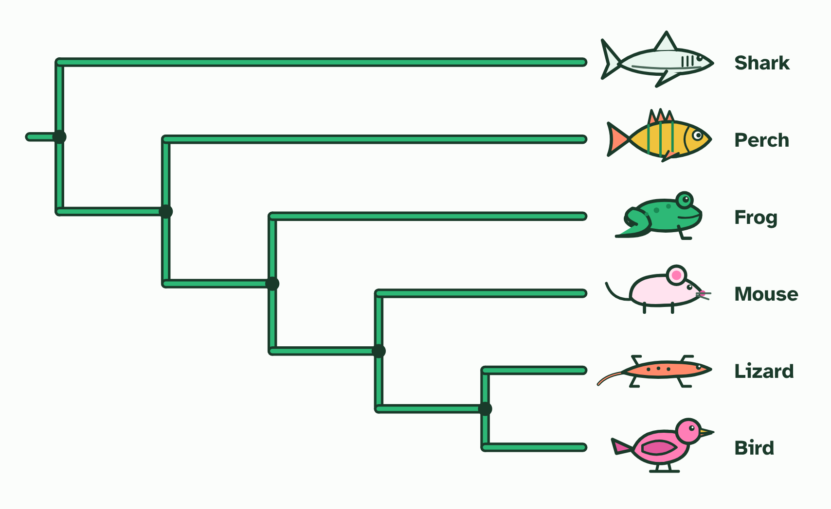
CHAPTER 7 · A3.2.7 Analysing cladograms
Reading a cladogram
The base is the root.
Each fork is a node, which stands for a hypothetical common ancestor: it must have existed to explain the split, but it need not be a known fossil.
Each line out to a tip is a terminal branch.
To deduce a relationship, follow two tips back until their lines meet. That node is their most recent common ancestor.
Minutes 32 to 42
Notes:
Minutes 32 to 42 of 60: Reading a cladogram (10 min).
The plan: Chapter 7's figure: tap the root, a node, a terminal branch, a clade and sister groups, then spin the tree. Turn over the mnemonic tiles. Pairs use the read task in the tool.
A cladogram is a map of splits, so you read it from the base up to the tips. The base is the root. Each fork is a node, which stands for a hypothetical common ancestor: it must have existed to explain the split, but it need not be a known fossil. Each line out to a tip is a terminal branch. Tap the parts.
To deduce a relationship, follow two tips back until their lines meet. That node is their most recent common ancestor. The nearer it is to the tips, the closer the relatives. Two groups that branch from the same node are sister groups. In the figure the human and chimpanzee meet at a node that the gorilla has not yet joined, so a human is closer to a chimpanzee than to a gorilla.
Any node and everything beyond it is a clade, so you can read clades straight off the tree. Then use the clade to deduce what its members share.

Slide 25
PREDICT
In a cladogram, species X and Y branch from node 1, and node 1 and species Z branch from node 2. Which statement is correct?
A Z is the most advanced, because it is drawn at the bottom of the tree, below the others
B X is closer to Y than to Z, because X and Y share a more recent ancestor
C Y is descended from X, because their two lines meet at node 1 on the tree
Minutes 32 to 42
Notes:
Minutes 32 to 42 of 60: Reading a cladogram (10 min).
The plan: Chapter 7's figure: tap the root, a node, a terminal branch, a clade and sister groups, then spin the tree. Turn over the mnemonic tiles. Pairs use the read task in the tool.
Ask for a show of hands, or mini whiteboards, before revealing. (Answer: B, on the next slide.)

Slide 26
WHAT HAPPENS
In a cladogram, species X and Y branch from node 1, and node 1 and species Z branch from node 2. Which statement is correct?
A Z is the most advanced, because it is drawn at the bottom of the tree, below the others
B X is closer to Y than to Z, because X and Y share a more recent ancestor
C Y is descended from X, because their two lines meet at node 1 on the tree
X is closer to Y than to Z. X and Y share node 1, which is more recent than node 2, the ancestor they share with Z. Neither X nor Y is the ancestor of the other: node 1 is a hypothetical ancestor of both.
Minutes 32 to 42
Notes:
Minutes 32 to 42 of 60: Reading a cladogram (10 min).
The plan: Chapter 7's figure: tap the root, a node, a terminal branch, a clade and sister groups, then spin the tree. Turn over the mnemonic tiles. Pairs use the read task in the tool.
Answer: B. X is closer to Y than to Z. X and Y share node 1, which is more recent than node 2, the ancestor they share with Z. Neither X nor Y is the ancestor of the other: node 1 is a hypothetical ancestor of both.

Slide 27
REMEMBER IT
The parts of a cladogram
R
N
T
C
S
Rabbits
Nibble
Tasty
Carrots
Slowly
Minutes 32 to 42
Notes:
Minutes 32 to 42 of 60: Reading a cladogram (10 min).
The plan: Chapter 7's figure: tap the root, a node, a terminal branch, a clade and sister groups, then spin the tree. Turn over the mnemonic tiles. Pairs use the read task in the tool.
Ask the class what each letter stands for before revealing.

Slide 28
REMEMBER IT
The parts of a cladogram
R
N
T
C
S
Rabbits
Nibble
Tasty
Carrots
Slowly
Root
Node
Terminal branch
Clade
Sister groups
the base: ancestor of everything
a fork: a hypothetical ancestor
the line out to a tip
an ancestor and all its descendants
two groups from one node
Minutes 32 to 42
Notes:
Minutes 32 to 42 of 60: Reading a cladogram (10 min).
The plan: Chapter 7's figure: tap the root, a node, a terminal branch, a clade and sister groups, then spin the tree. Turn over the mnemonic tiles. Pairs use the read task in the tool.
Rabbits: Root (the base: ancestor of everything)
Nibble: Node (a fork: a hypothetical ancestor)
Tasty: Terminal branch (the line out to a tip)
Carrots: Clade (an ancestor and all its descendants)
Slowly: Sister groups (two groups from one node)

Slide 29
WATCH OUT
The order of the tips means nothing, because every node can be spun like a mobile. Tips at the top are not more advanced, and a tip is never the ancestor of another tip: humans did not evolve from chimpanzees, they share an ancestor. In this course, only the branching order carries meaning.
Minutes 32 to 42
Notes:
Minutes 32 to 42 of 60: Reading a cladogram (10 min).
The plan: Chapter 7's figure: tap the root, a node, a terminal branch, a clade and sister groups, then spin the tree. Turn over the mnemonic tiles. Pairs use the read task in the tool.
A common mistake: say it, then ask who can say why it is wrong.

Slide 30
DRY LAB
12 MIN
Grow a tree
THE TASK
The dry lab above, with the tasks and questions under it. It works on a phone as well as a laptop, and the results can be copied into a table for the class.
STUDENTS NEED
One device per pair.
Minutes 42 to 54
Notes:
Minutes 42 to 54 of 60: Grow a tree (12 min).
The plan: The dry lab. Pairs run the tree lab on features, add one feature at a time, and record the winning tree and its score each time. Then they switch to sequence data and ask whether the winner changes.
The activity: Grow a tree. The dry lab above, with the tasks and questions under it. It works on a phone as well as a laptop, and the results can be copied into a table for the class.
Needs: one device per pair.
The time: 12 minutes, minutes 42 to 54 of the plan.

Slide 31
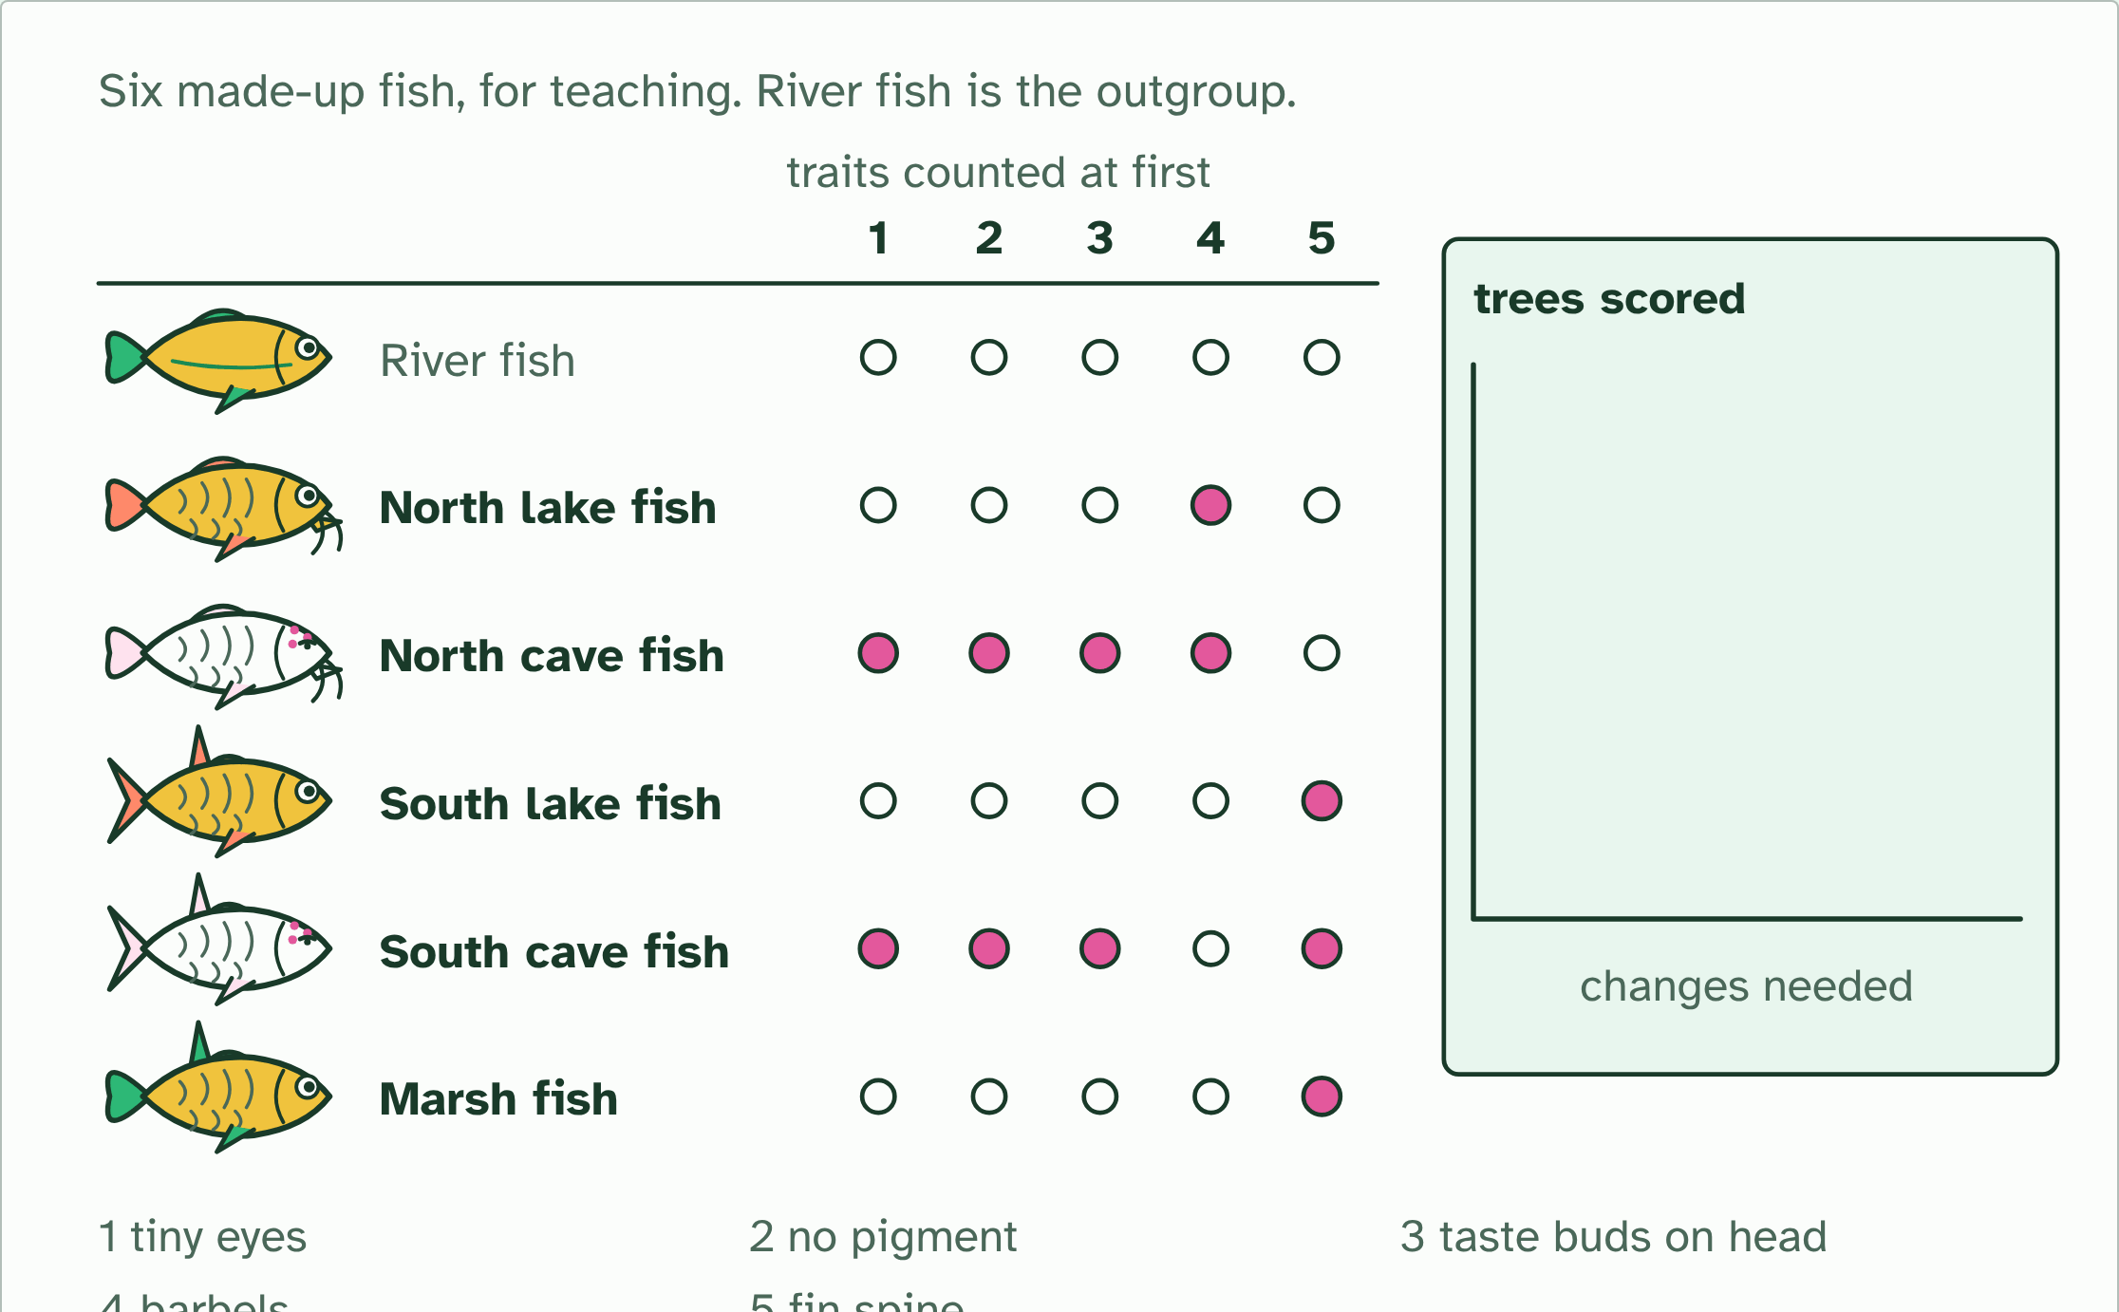
DRY LAB
Grow a tree
Your question: Does the tree you get depend on the data you choose? When you add more features, or switch from features to sequences, does the winning tree change, and does it ever tie?
What you can change: The data (a table of features or a DNA sequence), the features included, and the number of sites used. The tool counts the changes each candidate tree needs.
What to record: For each run: the data you used, the tree that needed the fewest changes, its score, and the score of the runner-up. Change one thing at a time. The tool gives the same answer for the same data every time, so the experiment is in your choice of data.
Run it: biologybybradford.com/guides/ib-biology-a3-2-classification-and-cladistics#lab
Minutes 42 to 54
Notes:
Minutes 42 to 54 of 60: Grow a tree (12 min).
The plan: The dry lab. Pairs run the tree lab on features, add one feature at a time, and record the winning tree and its score each time. Then they switch to sequence data and ask whether the winner changes.
The dry lab runs in the guide: https://www.biologybybradford.com/guides/ib-biology-a3-2-classification-and-cladistics#lab

Slide 32
PLENARY
Can you now...
Build a cladogram from sequence data using parsimony, and say why different criteria can give different trees (A3.2.6)
Read a cladogram: its root, nodes and terminal branches, its clades and common ancestors (A3.2.7)
Minutes 54 to 60
Notes:
Minutes 54 to 60 of 60: Exit (6 min).
The plan: A cladogram is a hypothesis. Give one thing that could make a scientist redraw it.
Thumbs up, sideways or down on each goal before the exit question. The goals come from the statements this lesson covers.

Slide 33
EXIT QUESTION
Before you go
A cladogram is a hypothesis.
Minutes 54 to 60
Notes:
Minutes 54 to 60 of 60: Exit (6 min).
The plan: A cladogram is a hypothesis. Give one thing that could make a scientist redraw it.

Slide 34
PRACTISE AND REVISE
Keep going
Exam practice: a fresh paper of exam questions on A3.2 at higher level, marked as you go
The guide, with the animations and the dry lab
This lesson in the guide: 6 The tree with the fewest changes, 7 Reading a cladogram, the dry lab
BUILD FOR YOUR CLASS
ALREADY ON THE SITE FOR A3.2
CARD SETS ON SPLYCR
Tarsia puzzle, dominoes and picture reveal on A3.2, built from its key terms and ready to print
A pub quiz with rounds on A3.2, to present or run with no projector
An escape room built from the question bank on A3.2
Quiz: Cladistics (HL)
Revision map: A3.2 Classification and cladistics, to fill in
Exam questions: A3.2 in the exam maker, a paper with its markscheme
Open a set to host it as a class game, or make a copy to edit.
A3.2 Classification and Cladistics (HL)
How this was made. The course structure, the activities and the teaching choices come from my own classroom, my presentations and my years of teaching IB and AP Biology. I use Claude, an AI, to help write and build the interactive guides, lesson plans, slides and practice questions, and to draw the diagrams and code the interactives. I direct the work and review it against the IB and AP specifications before it goes live.
Minute 60: after the lesson
Notes:
Every link here is live. Set the exam practice paper for homework: it is fresh each time, marked as students go and saved to their Exam practice when they are signed in.
Exam practice: https://www.biologybybradford.com/exam-maker/sit?topics=A3.2&level=HL&paper=quiz&marks=15&src=ep
The guide: https://www.biologybybradford.com/guides/ib-biology-a3-2-classification-and-cladistics

