Slide 1
IB Biology A3.2
LESSON 4 OF 4
HL
BY THE END YOU CAN
Classification and cladistics
Use the figwort family to show how cladistics tests a classification, and why a claim can be falsified (A3.2.8)
Explain how rRNA sequences led to the three domains, and what was new about them (A3.2.9)
Figworts, three domains and putting it together
A3.2.8, A3.2.9
Cladistics testing an old classification, rRNA and the three domains, and an exam question on the whole subtopic
60 minutes · chapters 8, 9
Minute 0
Notes:
IB Biology A3.2, Classification and cladistics. Lesson 4 of 4: Figworts, three domains and putting it together (higher level), 60 minutes.
The plan, minute by minute (each slide's footer says where you are):
0 to 6 min (6) Do now: look-alikes
6 to 20 min (14) Two trees for the figworts
20 to 26 min (6) A hypothesis that failed
26 to 40 min (14) Three domains
40 to 54 min (14) Exam practice
54 to 60 min (6) Plenary: back to the sort
What students get wrong:
"Humans evolved from chimpanzees." Both descend from a shared ancestor, and are sister groups on the tree.
"Archaea are a kind of bacteria." Under a microscope they look alike, but their rRNA puts Archaea nearer to Eukarya. "Prokaryote" does not name a clade.
Stretch and support:
Support: give the captions of each figure as a cut-up storyboard to put in order, and use the key terms (tap the dotted words) as a glossary.
Stretch: bacteria can pass genes sideways to other cells. How would that make a tree of all life harder to draw?
Stretch: use a sequence database to compare one real gene across five species and build a tree by parsimony.
The lesson plan to print: https://www.biologybybradford.com/guides/downloads/ib-biology-a3-2-classification-and-cladistics-lesson-4-plan.pdf

Slide 2
DO NOW
Look-alikes
Two plants with almost the same flowers, one DNA result that puts them in different clades.
Students say which evidence they trust and why.
6:00
minutes
Start now: the timer is running.
Minutes 0 to 6
Notes:
Minutes 0 to 6 of 60: Do now: look-alikes (6 min).
The plan: Two plants with almost the same flowers, one DNA result that puts them in different clades. Students say which evidence they trust and why. Leave the answers up for the plenary.
Start a 6 minute timer as they come in.

Slide 3
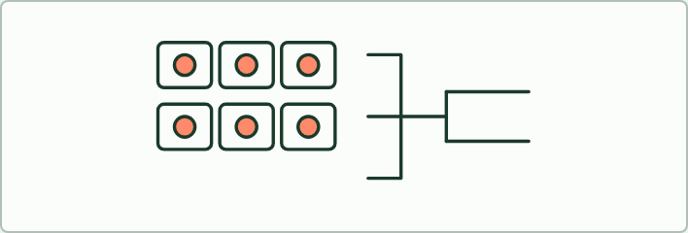
CARD SORT
14 MIN
Two trees for the figworts
THE TASK
Cards for nine plants (foxglove, snapdragon, monkeyflower, yellow rattle, mullein, figwort, plantain, broomrape and mint) with a note on their flowers. Round one: group them by flower structure. Round two: the teacher reveals which are in which clade from the chloroplast gene (use chapter 8's figure), and groups redraw. Ask what the flower resemblance turned out to be, and what that says about trusting structure alone.
STUDENTS NEED
Printed cards, one set per group; chapter 8's figure hidden until round two.
Minutes 6 to 20
Notes:
Minutes 6 to 20 of 60: Two trees for the figworts (14 min).
The plan: Chapter 8's figure, then the figwort cards below: students group the nine plants by flower structure, then regroup them from the DNA. Use the word convergent evolution, and the nature of science point that a claim can be falsified.
The activity: Two trees for the figworts. Cards for nine plants (foxglove, snapdragon, monkeyflower, yellow rattle, mullein, figwort, plantain, broomrape and mint) with a note on their flowers. Round one: group them by flower structure. Round two: the teacher reveals which are in which clade from the chloroplast gene (use chapter 8's figure), and groups redraw. Ask what the flower resemblance turned out to be, and what that says about trusting structure alone.
Needs: printed cards, one set per group; chapter 8's figure hidden until round two.
The time: 14 minutes, minutes 6 to 20 of the plan.

Slide 4
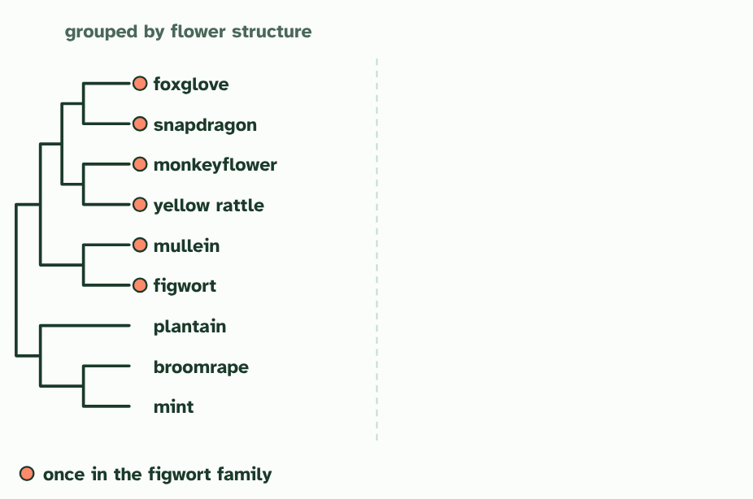
CHAPTER 8 · A3.2.8 Testing a classification with cladistics
1 / 3
Testing the boxes
Grouped by flower structure: six plants with similar flowers sit together as the figwort family (a simplified sketch).
Minutes 6 to 20
Notes:
Minutes 6 to 20 of 60: Two trees for the figworts (14 min).
The plan: Chapter 8's figure, then the figwort cards below: students group the nine plants by flower structure, then regroup them from the DNA. Use the word convergent evolution, and the nature of science point that a claim can be falsified.
Cladistics can test an old classification. If a group is real, its members should form a clade. A case study is the figwort family, a large family of flowering plants that was built on the structure of its members, mostly their flowers. You do not need to learn the names, only the story.
Researchers then compared the base sequences of a gene from the chloroplasts of these plants and built a cladogram. The figworts were not one clade. Many of the plants belonged with plants that were not figworts, and the family was broken up, its members moved to other families, leaving a much smaller figwort family.
Why had structure misled? Plants in different lines had evolved flowers that look alike, by convergent evolution. The likeness came from similar pressures, not from shared ancestry, so a grouping built on it was false.
This is science working, not failing. The old classification was a hypothesis, and it made a testable prediction: its members form a clade. New evidence tested it and it was falsified. Scientific knowledge claims may eventually be falsified, which is why they are always open to new tests.
Example: In an exam You can use either the common name or the scientific name of an organism. You are not asked to memorise the details of this case study, but you should be able to explain what it shows.

Slide 5
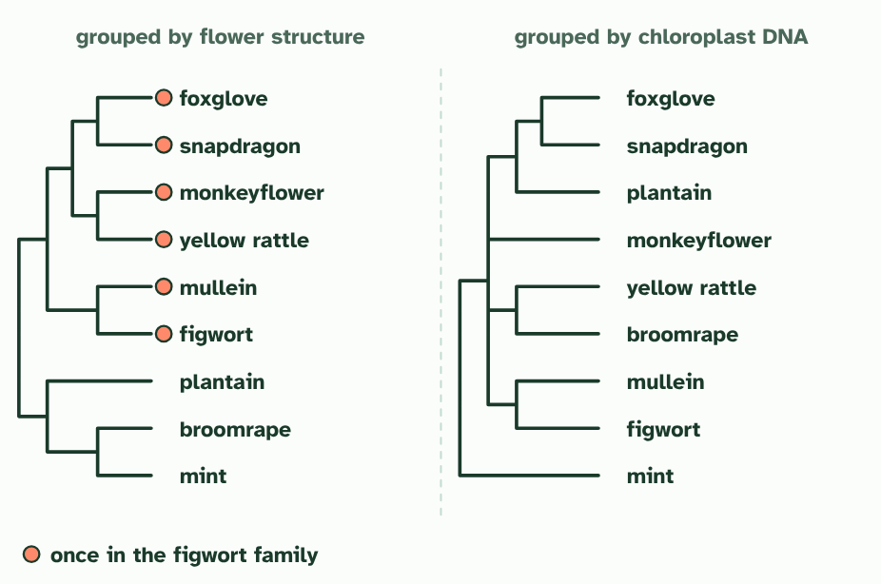
CHAPTER 8 · A3.2.8 Testing a classification with cladistics
2 / 3
Testing the boxes
Grouped by chloroplast DNA instead. The same plants now fall into several different clades, with other plants between them.
Minutes 6 to 20
Notes:
Minutes 6 to 20 of 60: Two trees for the figworts (14 min).
The plan: Chapter 8's figure, then the figwort cards below: students group the nine plants by flower structure, then regroup them from the DNA. Use the word convergent evolution, and the nature of science point that a claim can be falsified.
Cladistics can test an old classification. If a group is real, its members should form a clade. A case study is the figwort family, a large family of flowering plants that was built on the structure of its members, mostly their flowers. You do not need to learn the names, only the story.
Researchers then compared the base sequences of a gene from the chloroplasts of these plants and built a cladogram. The figworts were not one clade. Many of the plants belonged with plants that were not figworts, and the family was broken up, its members moved to other families, leaving a much smaller figwort family.
Why had structure misled? Plants in different lines had evolved flowers that look alike, by convergent evolution. The likeness came from similar pressures, not from shared ancestry, so a grouping built on it was false.
This is science working, not failing. The old classification was a hypothesis, and it made a testable prediction: its members form a clade. New evidence tested it and it was falsified. Scientific knowledge claims may eventually be falsified, which is why they are always open to new tests.
Example: In an exam You can use either the common name or the scientific name of an organism. You are not asked to memorise the details of this case study, but you should be able to explain what it shows.

Slide 6
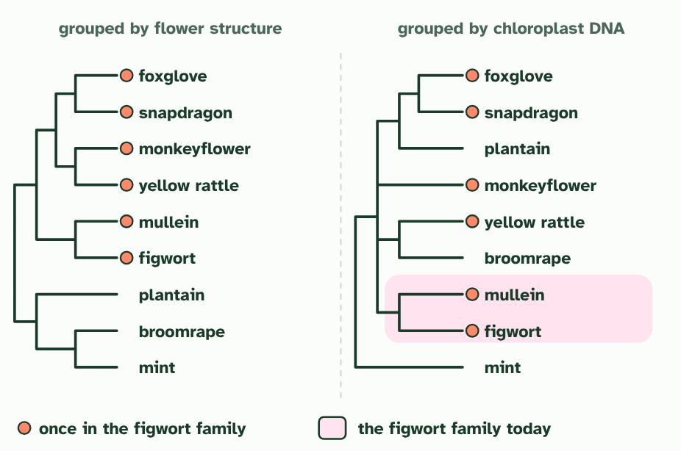
CHAPTER 8 · A3.2.8 Testing a classification with cladistics
3 / 3
Testing the boxes
Only a small clade is still the figwort family. The flower resemblance was convergence, so the old family was not a real clade.
Minutes 6 to 20
Notes:
Minutes 6 to 20 of 60: Two trees for the figworts (14 min).
The plan: Chapter 8's figure, then the figwort cards below: students group the nine plants by flower structure, then regroup them from the DNA. Use the word convergent evolution, and the nature of science point that a claim can be falsified.
Cladistics can test an old classification. If a group is real, its members should form a clade. A case study is the figwort family, a large family of flowering plants that was built on the structure of its members, mostly their flowers. You do not need to learn the names, only the story.
Researchers then compared the base sequences of a gene from the chloroplasts of these plants and built a cladogram. The figworts were not one clade. Many of the plants belonged with plants that were not figworts, and the family was broken up, its members moved to other families, leaving a much smaller figwort family.
Why had structure misled? Plants in different lines had evolved flowers that look alike, by convergent evolution. The likeness came from similar pressures, not from shared ancestry, so a grouping built on it was false.
This is science working, not failing. The old classification was a hypothesis, and it made a testable prediction: its members form a clade. New evidence tested it and it was falsified. Scientific knowledge claims may eventually be falsified, which is why they are always open to new tests.
Example: In an exam You can use either the common name or the scientific name of an organism. You are not asked to memorise the details of this case study, but you should be able to explain what it shows.

Slide 7
CHAPTER 8 · A3.2.8 Testing a classification with cladistics
Testing the boxes
Plants in different lines had evolved flowers that look alike, by convergent evolution.
New evidence tested it and it was falsified.
Scientific knowledge claims may eventually be falsified, which is why they are always open to new tests.
Minutes 6 to 20
Notes:
Minutes 6 to 20 of 60: Two trees for the figworts (14 min).
The plan: Chapter 8's figure, then the figwort cards below: students group the nine plants by flower structure, then regroup them from the DNA. Use the word convergent evolution, and the nature of science point that a claim can be falsified.
Cladistics can test an old classification. If a group is real, its members should form a clade. A case study is the figwort family, a large family of flowering plants that was built on the structure of its members, mostly their flowers. You do not need to learn the names, only the story.
Researchers then compared the base sequences of a gene from the chloroplasts of these plants and built a cladogram. The figworts were not one clade. Many of the plants belonged with plants that were not figworts, and the family was broken up, its members moved to other families, leaving a much smaller figwort family.
Why had structure misled? Plants in different lines had evolved flowers that look alike, by convergent evolution. The likeness came from similar pressures, not from shared ancestry, so a grouping built on it was false.
This is science working, not failing. The old classification was a hypothesis, and it made a testable prediction: its members form a clade. New evidence tested it and it was falsified. Scientific knowledge claims may eventually be falsified, which is why they are always open to new tests.
Example: In an exam You can use either the common name or the scientific name of an organism. You are not asked to memorise the details of this case study, but you should be able to explain what it shows.

Slide 8
PREDICT
Chloroplast DNA places two plants with almost identical flowers in different clades. What is the best explanation?
A The DNA must be wrong, because flowers are easier to examine than DNA
B They share a recent ancestor, and the DNA only seems to separate them
C Their flowers probably evolved separately, by convergent evolution
Minutes 6 to 20
Notes:
Minutes 6 to 20 of 60: Two trees for the figworts (14 min).
The plan: Chapter 8's figure, then the figwort cards below: students group the nine plants by flower structure, then regroup them from the DNA. Use the word convergent evolution, and the nature of science point that a claim can be falsified.
Ask for a show of hands, or mini whiteboards, before revealing. (Answer: C, on the next slide.)

Slide 9
WHAT HAPPENS
Chloroplast DNA places two plants with almost identical flowers in different clades. What is the best explanation?
A The DNA must be wrong, because flowers are easier to examine than DNA
B They share a recent ancestor, and the DNA only seems to separate them
C Their flowers probably evolved separately, by convergent evolution
Their flowers probably evolved separately. Similar structures can arise in unrelated lines, so a classification built on them can be false. DNA is the more objective evidence, and where the two disagree, sequences are used to decide.
Minutes 6 to 20
Notes:
Minutes 6 to 20 of 60: Two trees for the figworts (14 min).
The plan: Chapter 8's figure, then the figwort cards below: students group the nine plants by flower structure, then regroup them from the DNA. Use the word convergent evolution, and the nature of science point that a claim can be falsified.
Answer: C. Their flowers probably evolved separately. Similar structures can arise in unrelated lines, so a classification built on them can be false. DNA is the more objective evidence, and where the two disagree, sequences are used to decide.

Slide 10
STEP 3
6 MIN
A hypothesis that failed
Think, pair, share: "Is it a failure of science that the figwort family had to be broken up?"
Minutes 20 to 26
Notes:
Minutes 20 to 26 of 60: A hypothesis that failed (6 min).
The plan: Think, pair, share: "Is it a failure of science that the figwort family had to be broken up?" Land on: it was a prediction that was tested, which is science working.

Slide 11
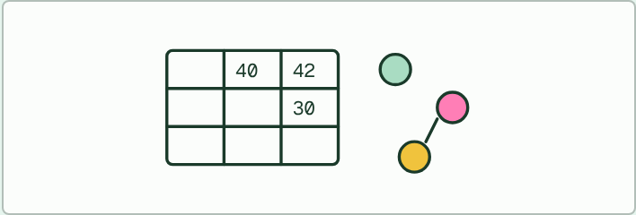
DATA TASK
14 MIN
Three domains, from a table
THE TASK
A made-up table of rRNA differences (out of 100 compared sites) between a bacterium, a methane-making archaeon and a yeast: 40 between the bacterium and the archaeon, 42 between the bacterium and the yeast, and 30 between the archaeon and the yeast. Students say which two organisms the table joins first, draw the tree, and say why the result was a surprise to biologists who thought the archaeon was just a kind of bacterium. Make clear that the numbers are invented to show the method.
STUDENTS NEED
The table on the board or printed; no devices needed.
Minutes 26 to 40
Notes:
Minutes 26 to 40 of 60: Three domains (14 min).
The plan: The rRNA table task below, then chapter 9's figure and the film. Students say which two groups the table joins first and why the result was a surprise. Then the predict box on why rRNA is a good molecule to compare.
The activity: Three domains, from a table. A made-up table of rRNA differences (out of 100 compared sites) between a bacterium, a methane-making archaeon and a yeast: 40 between the bacterium and the archaeon, 42 between the bacterium and the yeast, and 30 between the archaeon and the yeast. Students say which two organisms the table joins first, draw the tree, and say why the result was a surprise to biologists who thought the archaeon was just a kind of bacterium. Make clear that the numbers are invented to show the method.
Needs: the table on the board or printed; no devices needed.
The time: 14 minutes, minutes 26 to 40 of the plan.

Slide 12
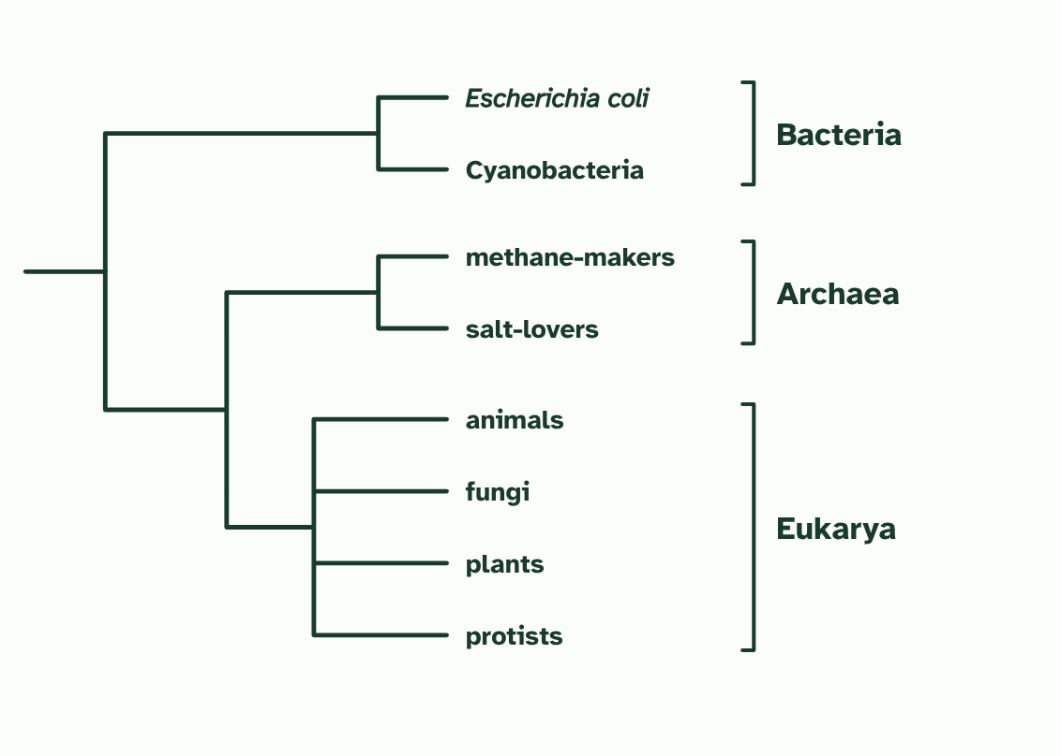
CHAPTER 9 · A3.2.9 The three domains
1 / 3
A new level above kingdom
The tree from rRNA sequences: three main branches, the domains Bacteria, Archaea and Eukarya. Relationships inside each domain are not shown.
Minutes 26 to 40
Notes:
Minutes 26 to 40 of 60: Three domains (14 min).
The plan: The rRNA table task below, then chapter 9's figure and the film. Students say which two groups the table joins first and why the result was a surprise. Then the predict box on why rRNA is a good molecule to compare.
For a long time life was sorted into a few kingdoms: animals, plants, fungi, and two kinds of single-celled life, the ones with nuclei and the ones without. The cells without nuclei, the prokaryotes, were treated as one group. Then, in 1977, Carl Woese and George Fox compared rRNA base sequences from many organisms, and the picture changed.
Why rRNA? Every living cell has ribosomes, so every organism has rRNA genes to compare. They can be lined up across the whole of life, from a bacterium to a whale. The comparison showed that the prokaryotes were not one group. Some, such as the methane-makers, had rRNA as different from ordinary bacteria's as bacteria's is from ours.
Life falls into three great branches, now called domains: Bacteria, Archaea and Eukarya (organisms whose cells have nuclei). Archaea look like bacteria under a microscope, but they share a more recent common ancestor with Eukarya. This was a revolutionary reclassification, with an extra level above the kingdoms.
Example: Where the kingdoms went Animals, plants and fungi are all in the domain Eukarya. The kingdoms did not vanish: they sit one level below the domains.

Slide 13
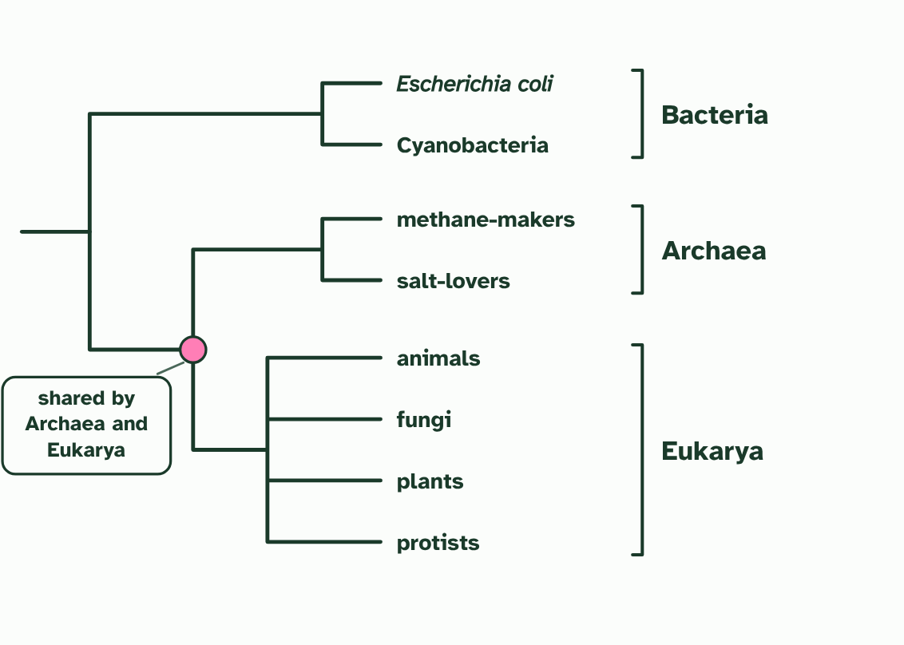
CHAPTER 9 · A3.2.9 The three domains
2 / 3
A new level above kingdom
Archaea look like bacteria under a microscope, but their rRNA shows they share a more recent ancestor with Eukarya.
Minutes 26 to 40
Notes:
Minutes 26 to 40 of 60: Three domains (14 min).
The plan: The rRNA table task below, then chapter 9's figure and the film. Students say which two groups the table joins first and why the result was a surprise. Then the predict box on why rRNA is a good molecule to compare.
For a long time life was sorted into a few kingdoms: animals, plants, fungi, and two kinds of single-celled life, the ones with nuclei and the ones without. The cells without nuclei, the prokaryotes, were treated as one group. Then, in 1977, Carl Woese and George Fox compared rRNA base sequences from many organisms, and the picture changed.
Why rRNA? Every living cell has ribosomes, so every organism has rRNA genes to compare. They can be lined up across the whole of life, from a bacterium to a whale. The comparison showed that the prokaryotes were not one group. Some, such as the methane-makers, had rRNA as different from ordinary bacteria's as bacteria's is from ours.
Life falls into three great branches, now called domains: Bacteria, Archaea and Eukarya (organisms whose cells have nuclei). Archaea look like bacteria under a microscope, but they share a more recent common ancestor with Eukarya. This was a revolutionary reclassification, with an extra level above the kingdoms.
Example: Where the kingdoms went Animals, plants and fungi are all in the domain Eukarya. The kingdoms did not vanish: they sit one level below the domains.

Slide 14
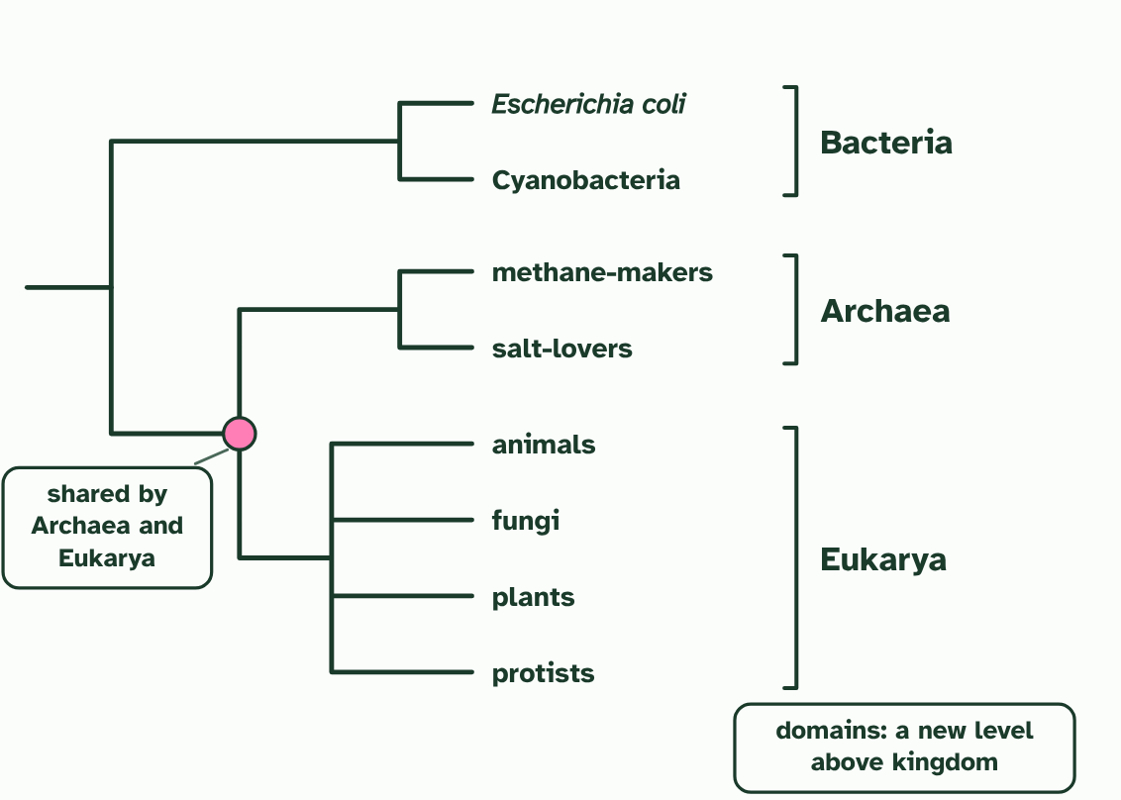
CHAPTER 9 · A3.2.9 The three domains
3 / 3
A new level above kingdom
A new top level of classification, above kingdom, proposed in 1977.
Minutes 26 to 40
Notes:
Minutes 26 to 40 of 60: Three domains (14 min).
The plan: The rRNA table task below, then chapter 9's figure and the film. Students say which two groups the table joins first and why the result was a surprise. Then the predict box on why rRNA is a good molecule to compare.
For a long time life was sorted into a few kingdoms: animals, plants, fungi, and two kinds of single-celled life, the ones with nuclei and the ones without. The cells without nuclei, the prokaryotes, were treated as one group. Then, in 1977, Carl Woese and George Fox compared rRNA base sequences from many organisms, and the picture changed.
Why rRNA? Every living cell has ribosomes, so every organism has rRNA genes to compare. They can be lined up across the whole of life, from a bacterium to a whale. The comparison showed that the prokaryotes were not one group. Some, such as the methane-makers, had rRNA as different from ordinary bacteria's as bacteria's is from ours.
Life falls into three great branches, now called domains: Bacteria, Archaea and Eukarya (organisms whose cells have nuclei). Archaea look like bacteria under a microscope, but they share a more recent common ancestor with Eukarya. This was a revolutionary reclassification, with an extra level above the kingdoms.
Example: Where the kingdoms went Animals, plants and fungi are all in the domain Eukarya. The kingdoms did not vanish: they sit one level below the domains.

Slide 15
CHAPTER 9 · A3.2.9 The three domains
A new level above kingdom
Then, in 1977, Carl Woese and George Fox compared rRNA base sequences from many organisms, and the picture changed.
Why rRNA?
Every living cell has ribosomes, so every organism has rRNA genes to compare.
Some, such as the methane-makers, had rRNA as different from ordinary bacteria's as bacteria's is from ours.
Minutes 26 to 40
Notes:
Minutes 26 to 40 of 60: Three domains (14 min).
The plan: The rRNA table task below, then chapter 9's figure and the film. Students say which two groups the table joins first and why the result was a surprise. Then the predict box on why rRNA is a good molecule to compare.
For a long time life was sorted into a few kingdoms: animals, plants, fungi, and two kinds of single-celled life, the ones with nuclei and the ones without. The cells without nuclei, the prokaryotes, were treated as one group. Then, in 1977, Carl Woese and George Fox compared rRNA base sequences from many organisms, and the picture changed.
Why rRNA? Every living cell has ribosomes, so every organism has rRNA genes to compare. They can be lined up across the whole of life, from a bacterium to a whale. The comparison showed that the prokaryotes were not one group. Some, such as the methane-makers, had rRNA as different from ordinary bacteria's as bacteria's is from ours.
Life falls into three great branches, now called domains: Bacteria, Archaea and Eukarya (organisms whose cells have nuclei). Archaea look like bacteria under a microscope, but they share a more recent common ancestor with Eukarya. This was a revolutionary reclassification, with an extra level above the kingdoms.
Example: Where the kingdoms went Animals, plants and fungi are all in the domain Eukarya. The kingdoms did not vanish: they sit one level below the domains.

Slide 16
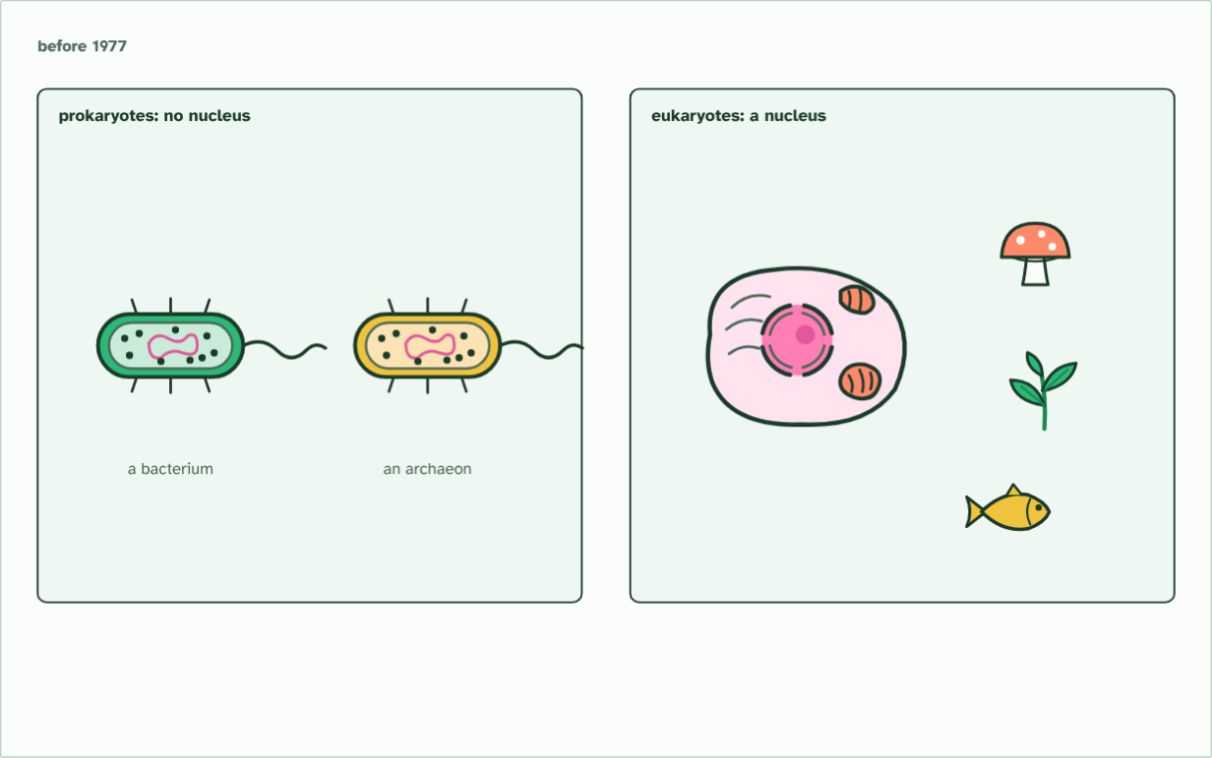
CHAPTER 9 · A3.2.9 The three domains
two groups
1 / 7
A new level above kingdom
Before 1977, life was sorted by its cells: prokaryotes, with no nucleus, and eukaryotes, with one. All prokaryotes looked alike, so they were grouped together.
Minutes 26 to 40
Notes:
Minutes 26 to 40 of 60: Three domains (14 min).
The plan: The rRNA table task below, then chapter 9's figure and the film. Students say which two groups the table joins first and why the result was a surprise. Then the predict box on why rRNA is a good molecule to compare.
For a long time life was sorted into a few kingdoms: animals, plants, fungi, and two kinds of single-celled life, the ones with nuclei and the ones without. The cells without nuclei, the prokaryotes, were treated as one group. Then, in 1977, Carl Woese and George Fox compared rRNA base sequences from many organisms, and the picture changed.
Why rRNA? Every living cell has ribosomes, so every organism has rRNA genes to compare. They can be lined up across the whole of life, from a bacterium to a whale. The comparison showed that the prokaryotes were not one group. Some, such as the methane-makers, had rRNA as different from ordinary bacteria's as bacteria's is from ours.
Life falls into three great branches, now called domains: Bacteria, Archaea and Eukarya (organisms whose cells have nuclei). Archaea look like bacteria under a microscope, but they share a more recent common ancestor with Eukarya. This was a revolutionary reclassification, with an extra level above the kingdoms.
Example: Where the kingdoms went Animals, plants and fungi are all in the domain Eukarya. The kingdoms did not vanish: they sit one level below the domains.
The animation "Watch it happen: the tree of life from rRNA", paused at 3.5 s. The next slides go on through it, then play it.

Slide 17
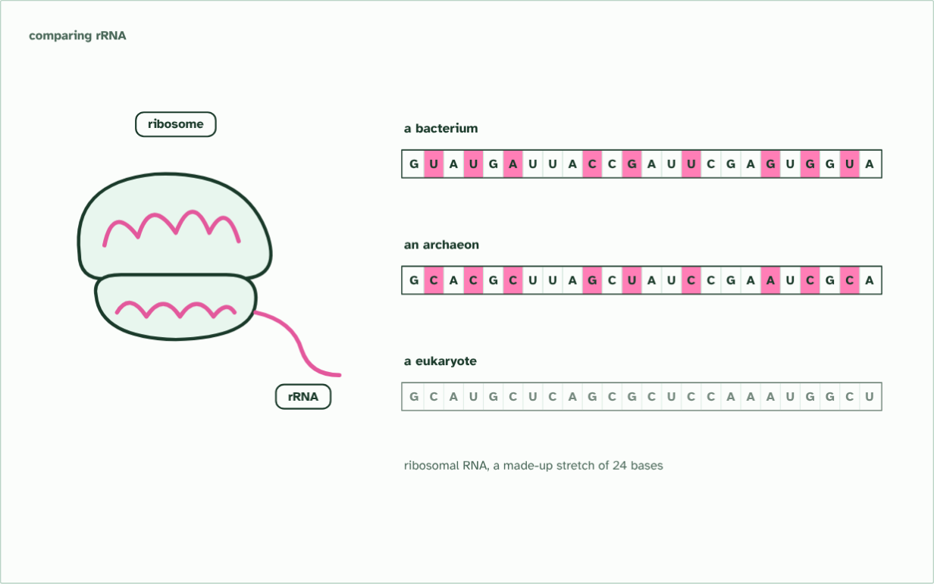
CHAPTER 9 · A3.2.9 The three domains
9 bases differ
2 / 7
A new level above kingdom
Carl Woese compared the base sequence of ribosomal RNA, which every cell has. Some prokaryotes, the archaea, differed from bacteria at many bases.
Minutes 26 to 40
Notes:
Minutes 26 to 40 of 60: Three domains (14 min).
The plan: The rRNA table task below, then chapter 9's figure and the film. Students say which two groups the table joins first and why the result was a surprise. Then the predict box on why rRNA is a good molecule to compare.
For a long time life was sorted into a few kingdoms: animals, plants, fungi, and two kinds of single-celled life, the ones with nuclei and the ones without. The cells without nuclei, the prokaryotes, were treated as one group. Then, in 1977, Carl Woese and George Fox compared rRNA base sequences from many organisms, and the picture changed.
Why rRNA? Every living cell has ribosomes, so every organism has rRNA genes to compare. They can be lined up across the whole of life, from a bacterium to a whale. The comparison showed that the prokaryotes were not one group. Some, such as the methane-makers, had rRNA as different from ordinary bacteria's as bacteria's is from ours.
Life falls into three great branches, now called domains: Bacteria, Archaea and Eukarya (organisms whose cells have nuclei). Archaea look like bacteria under a microscope, but they share a more recent common ancestor with Eukarya. This was a revolutionary reclassification, with an extra level above the kingdoms.
Example: Where the kingdoms went Animals, plants and fungi are all in the domain Eukarya. The kingdoms did not vanish: they sit one level below the domains.
The animation "Watch it happen: the tree of life from rRNA", paused at 9.0 s. The next slides go on through it, then play it.

Slide 18
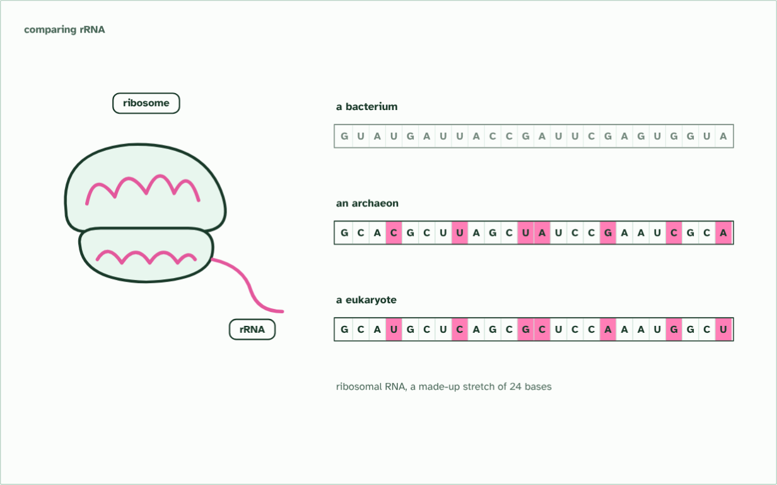
CHAPTER 9 · A3.2.9 The three domains
7 bases differ
3 / 7
A new level above kingdom
In this made-up stretch the archaeon differs from the bacterium at 9 bases but from the eukaryote at 7: not a bacterium at all, and a little nearer to us.
Minutes 26 to 40
Notes:
Minutes 26 to 40 of 60: Three domains (14 min).
The plan: The rRNA table task below, then chapter 9's figure and the film. Students say which two groups the table joins first and why the result was a surprise. Then the predict box on why rRNA is a good molecule to compare.
For a long time life was sorted into a few kingdoms: animals, plants, fungi, and two kinds of single-celled life, the ones with nuclei and the ones without. The cells without nuclei, the prokaryotes, were treated as one group. Then, in 1977, Carl Woese and George Fox compared rRNA base sequences from many organisms, and the picture changed.
Why rRNA? Every living cell has ribosomes, so every organism has rRNA genes to compare. They can be lined up across the whole of life, from a bacterium to a whale. The comparison showed that the prokaryotes were not one group. Some, such as the methane-makers, had rRNA as different from ordinary bacteria's as bacteria's is from ours.
Life falls into three great branches, now called domains: Bacteria, Archaea and Eukarya (organisms whose cells have nuclei). Archaea look like bacteria under a microscope, but they share a more recent common ancestor with Eukarya. This was a revolutionary reclassification, with an extra level above the kingdoms.
Example: Where the kingdoms went Animals, plants and fungi are all in the domain Eukarya. The kingdoms did not vanish: they sit one level below the domains.
The animation "Watch it happen: the tree of life from rRNA", paused at 12.5 s. The next slides go on through it, then play it.

Slide 19
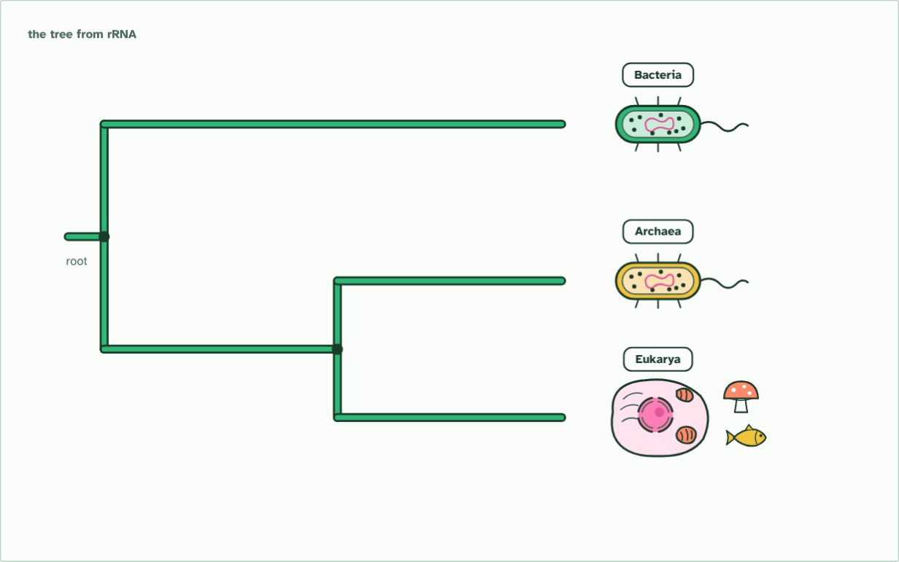
CHAPTER 9 · A3.2.9 The three domains
three domains
4 / 7
A new level above kingdom
So the tree of life has three main branches, the three domains: Bacteria, Archaea and Eukarya. Archaea and eukaryotes share a more recent common ancestor.
Minutes 26 to 40
Notes:
Minutes 26 to 40 of 60: Three domains (14 min).
The plan: The rRNA table task below, then chapter 9's figure and the film. Students say which two groups the table joins first and why the result was a surprise. Then the predict box on why rRNA is a good molecule to compare.
For a long time life was sorted into a few kingdoms: animals, plants, fungi, and two kinds of single-celled life, the ones with nuclei and the ones without. The cells without nuclei, the prokaryotes, were treated as one group. Then, in 1977, Carl Woese and George Fox compared rRNA base sequences from many organisms, and the picture changed.
Why rRNA? Every living cell has ribosomes, so every organism has rRNA genes to compare. They can be lined up across the whole of life, from a bacterium to a whale. The comparison showed that the prokaryotes were not one group. Some, such as the methane-makers, had rRNA as different from ordinary bacteria's as bacteria's is from ours.
Life falls into three great branches, now called domains: Bacteria, Archaea and Eukarya (organisms whose cells have nuclei). Archaea look like bacteria under a microscope, but they share a more recent common ancestor with Eukarya. This was a revolutionary reclassification, with an extra level above the kingdoms.
Example: Where the kingdoms went Animals, plants and fungi are all in the domain Eukarya. The kingdoms did not vanish: they sit one level below the domains.
The animation "Watch it happen: the tree of life from rRNA", paused at 19.5 s. The next slides go on through it, then play it.

Slide 20
CHAPTER 9 · A3.2.9 The three domains
three domains
5 / 7
A new level above kingdom
So the tree of life has three main branches, the three domains: Bacteria, Archaea and Eukarya. Archaea and eukaryotes share a more recent common ancestor.
Minutes 26 to 40
Notes:
Minutes 26 to 40 of 60: Three domains (14 min).
The plan: The rRNA table task below, then chapter 9's figure and the film. Students say which two groups the table joins first and why the result was a surprise. Then the predict box on why rRNA is a good molecule to compare.
For a long time life was sorted into a few kingdoms: animals, plants, fungi, and two kinds of single-celled life, the ones with nuclei and the ones without. The cells without nuclei, the prokaryotes, were treated as one group. Then, in 1977, Carl Woese and George Fox compared rRNA base sequences from many organisms, and the picture changed.
Why rRNA? Every living cell has ribosomes, so every organism has rRNA genes to compare. They can be lined up across the whole of life, from a bacterium to a whale. The comparison showed that the prokaryotes were not one group. Some, such as the methane-makers, had rRNA as different from ordinary bacteria's as bacteria's is from ours.
Life falls into three great branches, now called domains: Bacteria, Archaea and Eukarya (organisms whose cells have nuclei). Archaea look like bacteria under a microscope, but they share a more recent common ancestor with Eukarya. This was a revolutionary reclassification, with an extra level above the kingdoms.
Example: Where the kingdoms went Animals, plants and fungi are all in the domain Eukarya. The kingdoms did not vanish: they sit one level below the domains.
The animation "Watch it happen: the tree of life from rRNA", paused at 23.0 s. The next slides go on through it, then play it.

Slide 21
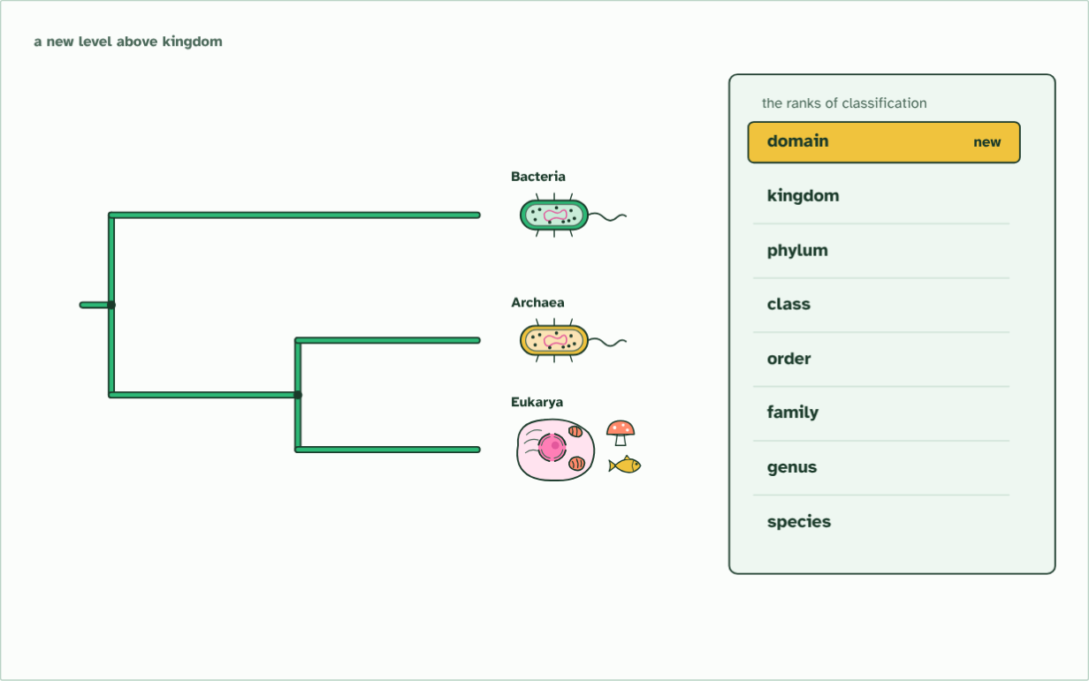
CHAPTER 9 · A3.2.9 The three domains
1977
6 / 7
A new level above kingdom
Woese and Fox proposed the three groups in 1977: a new level above kingdom. In 1990 they were named domains.
Minutes 26 to 40
Notes:
Minutes 26 to 40 of 60: Three domains (14 min).
The plan: The rRNA table task below, then chapter 9's figure and the film. Students say which two groups the table joins first and why the result was a surprise. Then the predict box on why rRNA is a good molecule to compare.
For a long time life was sorted into a few kingdoms: animals, plants, fungi, and two kinds of single-celled life, the ones with nuclei and the ones without. The cells without nuclei, the prokaryotes, were treated as one group. Then, in 1977, Carl Woese and George Fox compared rRNA base sequences from many organisms, and the picture changed.
Why rRNA? Every living cell has ribosomes, so every organism has rRNA genes to compare. They can be lined up across the whole of life, from a bacterium to a whale. The comparison showed that the prokaryotes were not one group. Some, such as the methane-makers, had rRNA as different from ordinary bacteria's as bacteria's is from ours.
Life falls into three great branches, now called domains: Bacteria, Archaea and Eukarya (organisms whose cells have nuclei). Archaea look like bacteria under a microscope, but they share a more recent common ancestor with Eukarya. This was a revolutionary reclassification, with an extra level above the kingdoms.
Example: Where the kingdoms went Animals, plants and fungi are all in the domain Eukarya. The kingdoms did not vanish: they sit one level below the domains.
The animation "Watch it happen: the tree of life from rRNA", paused at 27.0 s. The next slides go on through it, then play it.

Slide 22
CHAPTER 9 · A3.2.9 The three domains
1977
7 / 7
A new level above kingdom
Every organism is now classed first by its domain, then kingdom, phylum, class, order, family, genus and species.
Minutes 26 to 40
Notes:
Minutes 26 to 40 of 60: Three domains (14 min).
The plan: The rRNA table task below, then chapter 9's figure and the film. Students say which two groups the table joins first and why the result was a surprise. Then the predict box on why rRNA is a good molecule to compare.
For a long time life was sorted into a few kingdoms: animals, plants, fungi, and two kinds of single-celled life, the ones with nuclei and the ones without. The cells without nuclei, the prokaryotes, were treated as one group. Then, in 1977, Carl Woese and George Fox compared rRNA base sequences from many organisms, and the picture changed.
Why rRNA? Every living cell has ribosomes, so every organism has rRNA genes to compare. They can be lined up across the whole of life, from a bacterium to a whale. The comparison showed that the prokaryotes were not one group. Some, such as the methane-makers, had rRNA as different from ordinary bacteria's as bacteria's is from ours.
Life falls into three great branches, now called domains: Bacteria, Archaea and Eukarya (organisms whose cells have nuclei). Archaea look like bacteria under a microscope, but they share a more recent common ancestor with Eukarya. This was a revolutionary reclassification, with an extra level above the kingdoms.
Example: Where the kingdoms went Animals, plants and fungi are all in the domain Eukarya. The kingdoms did not vanish: they sit one level below the domains.
The animation "Watch it happen: the tree of life from rRNA", paused at 32.0 s. The next slides go on through it, then play it.

Slide 23
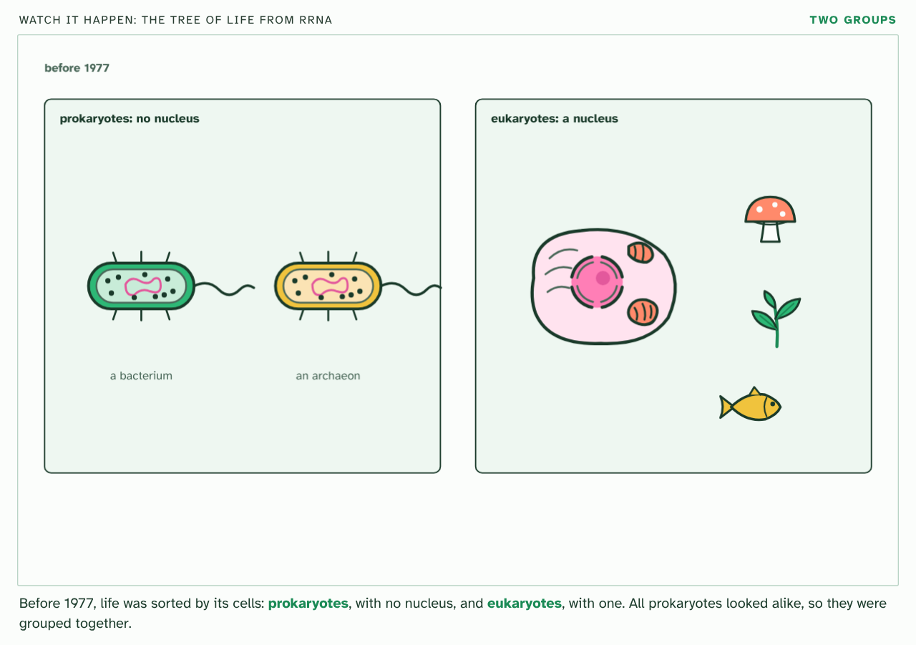
CHAPTER 9 · A3.2.9 The three domains
PLAY IT
A new level above kingdom
Watch it happen: the tree of life from rRNA: click to play. It loops every 34 seconds.
Minutes 26 to 40
Notes:
Minutes 26 to 40 of 60: Three domains (14 min).
The plan: The rRNA table task below, then chapter 9's figure and the film. Students say which two groups the table joins first and why the result was a surprise. Then the predict box on why rRNA is a good molecule to compare.
The video is domains.mp4, one loop of the animation in the guide. It plays in PowerPoint and Keynote. Google Slides does not play a video embedded in a .pptx: download domains.mp4 (https://www.biologybybradford.com/guides/downloads/scenes/domains.mp4), upload it to Google Drive, then Insert > Video > Google Drive.
In the guide the class can change it as it runs: https://www.biologybybradford.com/guides/ib-biology-a3-2-classification-and-cladistics#domains
What it shows, in order:
1. Before 1977, life was sorted by its cells: prokaryotes, with no nucleus, and eukaryotes, with one. All prokaryotes looked alike, so they were grouped together.
2. Carl Woese compared the base sequence of ribosomal RNA, which every cell has. Some prokaryotes, the archaea, differed from bacteria at many bases.
3. In this made-up stretch the archaeon differs from the bacterium at 9 bases but from the eukaryote at 7: not a bacterium at all, and a little nearer to us.
4. So the tree of life has three main branches, the three domains: Bacteria, Archaea and Eukarya. Archaea and eukaryotes share a more recent common ancestor.
5. So the tree of life has three main branches, the three domains: Bacteria, Archaea and Eukarya. Archaea and eukaryotes share a more recent common ancestor.
6. Woese and Fox proposed the three groups in 1977: a new level above kingdom. In 1990 they were named domains.
7. Every organism is now classed first by its domain, then kingdom, phylum, class, order, family, genus and species.

Slide 24
PREDICT
Why was rRNA a good choice for comparing all of life?
A Every organism has ribosomes, so every organism has rRNA that can be compared
B rRNA changes so fast that even close relatives look completely different from each other
C rRNA carries the code for the proteins that every organism uses to copy its DNA
Minutes 26 to 40
Notes:
Minutes 26 to 40 of 60: Three domains (14 min).
The plan: The rRNA table task below, then chapter 9's figure and the film. Students say which two groups the table joins first and why the result was a surprise. Then the predict box on why rRNA is a good molecule to compare.
Ask for a show of hands, or mini whiteboards, before revealing. (Answer: A, on the next slide.)

Slide 25
WHAT HAPPENS
Why was rRNA a good choice for comparing all of life?
A Every organism has ribosomes, so every organism has rRNA that can be compared
B rRNA changes so fast that even close relatives look completely different from each other
C rRNA carries the code for the proteins that every organism uses to copy its DNA
Every organism has ribosomes, and so has rRNA genes, so the same molecule can be compared across bacteria, archaea and eukaryotes. That is what allowed one tree of all life. rRNA does not code for proteins: it is part of the ribosome that makes them.
Minutes 26 to 40
Notes:
Minutes 26 to 40 of 60: Three domains (14 min).
The plan: The rRNA table task below, then chapter 9's figure and the film. Students say which two groups the table joins first and why the result was a surprise. Then the predict box on why rRNA is a good molecule to compare.
Answer: A. Every organism has ribosomes, and so has rRNA genes, so the same molecule can be compared across bacteria, archaea and eukaryotes. That is what allowed one tree of all life. rRNA does not code for proteins: it is part of the ribosome that makes them.

Slide 26
WATCH OUT
"Prokaryote" does not name a clade. Bacteria and Archaea are both prokaryotes, but neither is the other's closest relative. Many archaea live in hot springs and salty lakes, but not all do: some live in the guts of animals.
Minutes 26 to 40
Notes:
Minutes 26 to 40 of 60: Three domains (14 min).
The plan: The rRNA table task below, then chapter 9's figure and the film. Students say which two groups the table joins first and why the result was a surprise. Then the predict box on why rRNA is a good molecule to compare.
A common mistake: say it, then ask who can say why it is wrong.

Slide 27
STEP 5
14 MIN
Exam practice
A written question on A3.2 from the exam maker, set at HL, in 10 minutes, then peer-marked against the markscheme.
Minutes 40 to 54
Notes:
Minutes 40 to 54 of 60: Exam practice (14 min).
The plan: A written question on A3.2 from the exam maker (in Practise and revise, below), set at HL, in 10 minutes, then peer-marked against the markscheme. For homework, the Check step: a fresh paper on A3.2 from the exam bank, marked as students go.

Slide 28
PLENARY
Plenary: back to the sort
Which of those rules would a cladist accept, and why?
One sentence each.
Minutes 54 to 60
Notes:
Minutes 54 to 60 of 60: Plenary: back to the sort (6 min).
The plan: Return to the rules on the board from lesson 1. Which of those rules would a cladist accept, and why? One sentence each.

Slide 29
EXIT QUESTION
Before you go
On paper, on your own: Explain how rRNA sequences led to the three domains, and what was new about them.
Minutes 54 to 60
Notes:
Minutes 54 to 60 of 60: Plenary: back to the sort (6 min).
The plan: Return to the rules on the board from lesson 1. Which of those rules would a cladist accept, and why? One sentence each.
Collect the slips: they say where to start next lesson.

Slide 30
PRACTISE AND REVISE
Keep going
Exam practice: a fresh paper of exam questions on A3.2 at higher level, marked as you go
The guide, with the animations and the dry lab
This lesson in the guide: 8 Testing the boxes, 9 A new level above kingdom
BUILD FOR YOUR CLASS
ALREADY ON THE SITE FOR A3.2
CARD SETS ON SPLYCR
Tarsia puzzle, dominoes and picture reveal on A3.2, built from its key terms and ready to print
A pub quiz with rounds on A3.2, to present or run with no projector
An escape room built from the question bank on A3.2
Quiz: Cladistics (HL)
Revision map: A3.2 Classification and cladistics, to fill in
Exam questions: A3.2 in the exam maker, a paper with its markscheme
Open a set to host it as a class game, or make a copy to edit.
A3.2 Classification and Cladistics (HL)
How this was made. The course structure, the activities and the teaching choices come from my own classroom, my presentations and my years of teaching IB and AP Biology. I use Claude, an AI, to help write and build the interactive guides, lesson plans, slides and practice questions, and to draw the diagrams and code the interactives. I direct the work and review it against the IB and AP specifications before it goes live.
Minute 60: after the lesson
Notes:
Every link here is live. Set the exam practice paper for homework: it is fresh each time, marked as students go and saved to their Exam practice when they are signed in.
Exam practice: https://www.biologybybradford.com/exam-maker/sit?topics=A3.2&level=HL&paper=quiz&marks=15&src=ep
The guide: https://www.biologybybradford.com/guides/ib-biology-a3-2-classification-and-cladistics

