Slide 1
IB Biology A4.1
LESSON 1 OF 5
BY THE END YOU CAN
Evolution and speciation
Explain why evolution is a change in the heritable characteristics of a population, and why a change gained in one lifetime is not (A4.1.1)
Use differences in base and amino acid sequences to judge which species share the most recent common ancestor (A4.1.2)
What evolves, and what DNA shows
A4.1.1, A4.1.2
Evolution as a change in a population's heritable characteristics, and what base and amino acid sequences show
60 minutes · chapters 1, 2
Minute 0
Notes:
IB Biology A4.1, Evolution and speciation. Lesson 1 of 5: What evolves, and what DNA shows, 60 minutes.
The plan, minute by minute (each slide's footer says where you are):
0 to 8 min (8) Do now: two stories of a long neck
8 to 20 min (12) The drought on Daphne Major
20 to 25 min (5) "Just a theory"?
25 to 45 min (20) Sequence detectives
45 to 55 min (10) Evidence organiser, row 1
55 to 60 min (5) Exit: back to the vote
What students get wrong:
"Animals evolve to survive." Individuals do not evolve, and nothing changes because it is needed. Insist on "the population" and "more offspring".
Acquired changes are inherited. Use the hedge and the chipped beak: only alleles in gametes are passed on.
Evolution as a ladder. Pictures of a line of apes walking into a human are wrong: every living species is the tip of a branch, and humans did not come from chimpanzees.
Stretch and support:
Support: give the captions of each figure as a cut-up storyboard to put in order, and use the key terms (tap the dotted words) as a glossary.
Support: the three mnemonics (Dragons Breathe Heat; Hungry Rats Chew My Pencils; Grumpy Birds Tweet) as a starter on each lesson.
Stretch: use a sequence database to compare one real protein across five species and build a tree.
The lesson plan to print: https://www.biologybybradford.com/guides/downloads/ib-biology-a4-1-evolution-and-speciation-lesson-1-plan.pdf

Slide 2
DO NOW
Two stories of a long neck
On the board: "Giraffes stretched for high leaves and passed longer necks on" against "Giraffes with longer necks happened to feed better and left more young".
Students vote, then defend their vote in pairs.
8:00
minutes
Start now: the timer is running.
Minutes 0 to 8
Notes:
Minutes 0 to 8 of 60: Do now: two stories of a long neck (8 min).
The plan: On the board: "Giraffes stretched for high leaves and passed longer necks on" against "Giraffes with longer necks happened to feed better and left more young". Students vote, then defend their vote in pairs. Leave the votes up; come back to them at the end.
Start a 8 minute timer as they come in.

Slide 3
STEP 2
12 MIN
The drought on Daphne Major
Chapter 1: Evolution is a change in what a population inherits
Minutes 8 to 20
Notes:
Minutes 8 to 20 of 60: The drought on Daphne Major (12 min).
The plan: Play chapter 1's figure step by step. At each step students sketch the dot plot and say what changed and what did not: no bird's beak changed, the population did. Write the definition only after the sketches: evolution is a change in the heritable characteristics of a population.

Slide 4
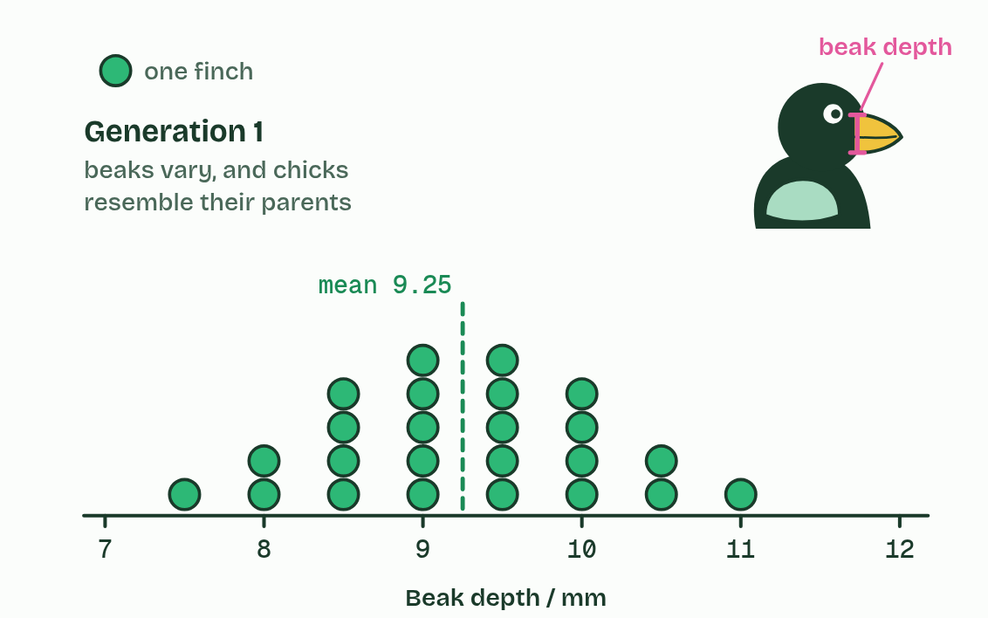
CHAPTER 1 · A4.1.1 What evolution is
1 / 5
Evolution is a change in what a population inherits
Each dot is one finch. Beak depth varies, and the variation is heritable: chicks resemble their parents.
Minutes 8 to 20
Notes:
Minutes 8 to 20 of 60: The drought on Daphne Major (12 min).
The plan: Play chapter 1's figure step by step. At each step students sketch the dot plot and say what changed and what did not: no bird's beak changed, the population did. Write the definition only after the sketches: evolution is a change in the heritable characteristics of a population.
Evolution is not something one animal does in its lifetime. It is a change, over generations, in the heritable characteristics of a population. Genes carry those characteristics, so evolution shows up as some alleles becoming more common and others rarer.
The figure follows a real case. In 1977 a drought on Daphne Major, a tiny Galápagos island, left mostly big, hard seeds. Medium ground finches with deep beaks could crack them; many with shallow beaks starved. The survivors bred, their chicks inherited their alleles, and the next generation's beaks were about 4% deeper on average. No finch changed its own beak. The population changed, because some birds left more offspring than others.
Example: Why "theory"? Evolution by natural selection explains and predicts a vast range of observations, and nothing found so far contradicts it. But science cannot prove an idea true by checking it against the whole world; it can only fail to disprove it. So it is called a theory: a pragmatic truth, true for every practical purpose and very unlikely ever to be overturned.

Slide 5
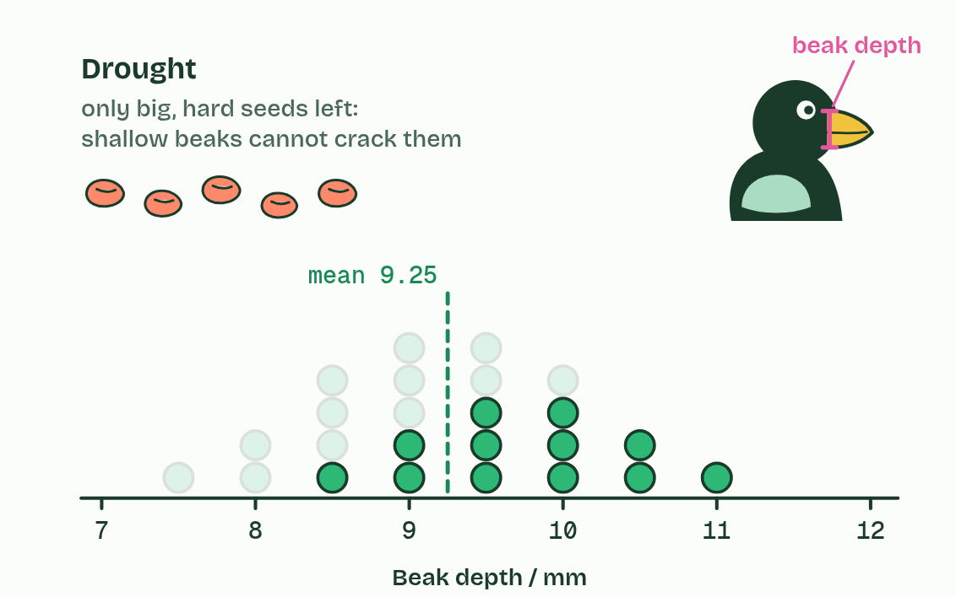
CHAPTER 1 · A4.1.1 What evolution is
2 / 5
Evolution is a change in what a population inherits
A drought leaves only big, hard seeds. Most finches with shallow beaks starve.
Minutes 8 to 20
Notes:
Minutes 8 to 20 of 60: The drought on Daphne Major (12 min).
The plan: Play chapter 1's figure step by step. At each step students sketch the dot plot and say what changed and what did not: no bird's beak changed, the population did. Write the definition only after the sketches: evolution is a change in the heritable characteristics of a population.
Evolution is not something one animal does in its lifetime. It is a change, over generations, in the heritable characteristics of a population. Genes carry those characteristics, so evolution shows up as some alleles becoming more common and others rarer.
The figure follows a real case. In 1977 a drought on Daphne Major, a tiny Galápagos island, left mostly big, hard seeds. Medium ground finches with deep beaks could crack them; many with shallow beaks starved. The survivors bred, their chicks inherited their alleles, and the next generation's beaks were about 4% deeper on average. No finch changed its own beak. The population changed, because some birds left more offspring than others.
Example: Why "theory"? Evolution by natural selection explains and predicts a vast range of observations, and nothing found so far contradicts it. But science cannot prove an idea true by checking it against the whole world; it can only fail to disprove it. So it is called a theory: a pragmatic truth, true for every practical purpose and very unlikely ever to be overturned.

Slide 6
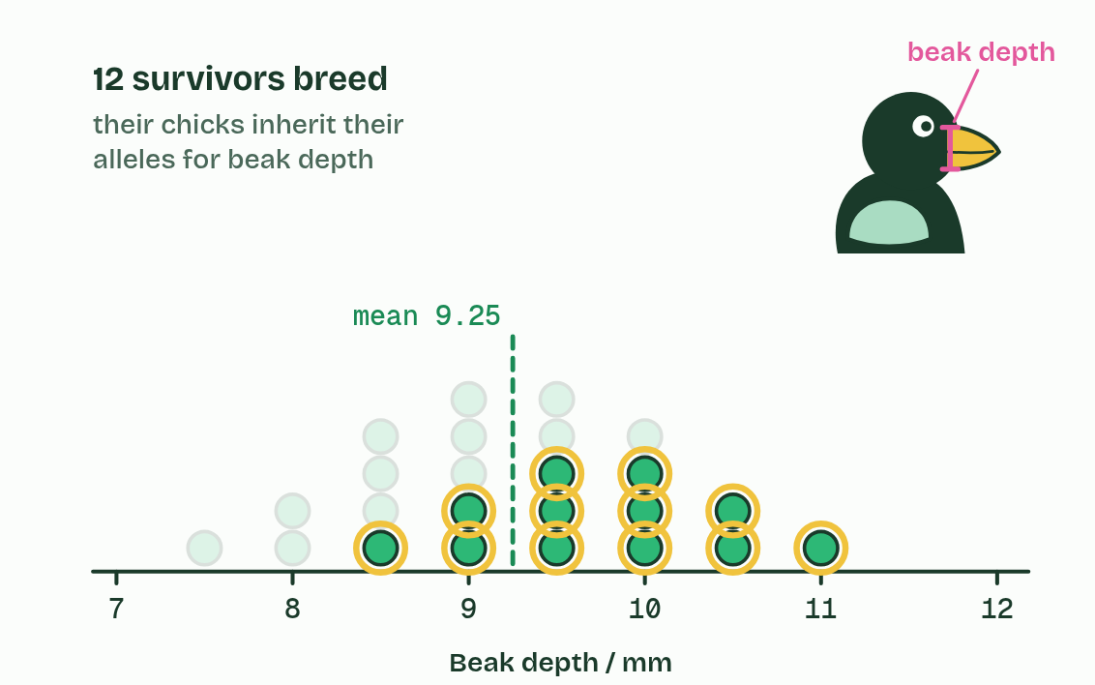
CHAPTER 1 · A4.1.1 What evolution is
3 / 5
Evolution is a change in what a population inherits
The survivors breed and pass on their alleles, deep-beak alleles included.
Minutes 8 to 20
Notes:
Minutes 8 to 20 of 60: The drought on Daphne Major (12 min).
The plan: Play chapter 1's figure step by step. At each step students sketch the dot plot and say what changed and what did not: no bird's beak changed, the population did. Write the definition only after the sketches: evolution is a change in the heritable characteristics of a population.
Evolution is not something one animal does in its lifetime. It is a change, over generations, in the heritable characteristics of a population. Genes carry those characteristics, so evolution shows up as some alleles becoming more common and others rarer.
The figure follows a real case. In 1977 a drought on Daphne Major, a tiny Galápagos island, left mostly big, hard seeds. Medium ground finches with deep beaks could crack them; many with shallow beaks starved. The survivors bred, their chicks inherited their alleles, and the next generation's beaks were about 4% deeper on average. No finch changed its own beak. The population changed, because some birds left more offspring than others.
Example: Why "theory"? Evolution by natural selection explains and predicts a vast range of observations, and nothing found so far contradicts it. But science cannot prove an idea true by checking it against the whole world; it can only fail to disprove it. So it is called a theory: a pragmatic truth, true for every practical purpose and very unlikely ever to be overturned.

Slide 7
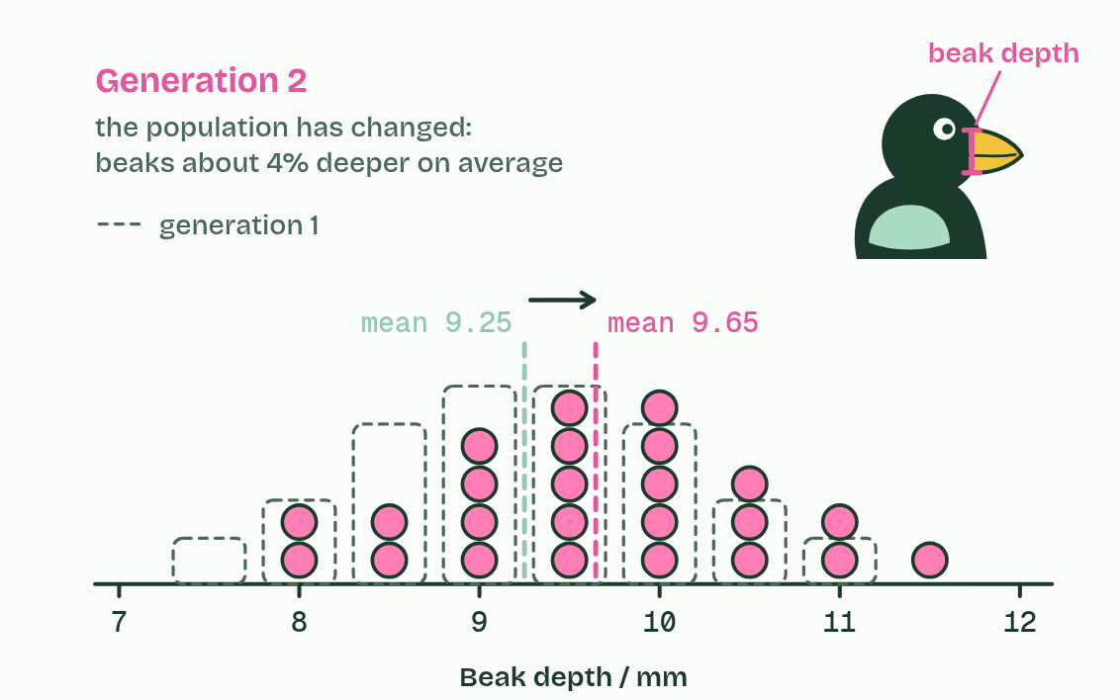
CHAPTER 1 · A4.1.1 What evolution is
4 / 5
Evolution is a change in what a population inherits
The next generation's beaks are deeper on average: the population has evolved. (Numbers simplified from the real study.)
Minutes 8 to 20
Notes:
Minutes 8 to 20 of 60: The drought on Daphne Major (12 min).
The plan: Play chapter 1's figure step by step. At each step students sketch the dot plot and say what changed and what did not: no bird's beak changed, the population did. Write the definition only after the sketches: evolution is a change in the heritable characteristics of a population.
Evolution is not something one animal does in its lifetime. It is a change, over generations, in the heritable characteristics of a population. Genes carry those characteristics, so evolution shows up as some alleles becoming more common and others rarer.
The figure follows a real case. In 1977 a drought on Daphne Major, a tiny Galápagos island, left mostly big, hard seeds. Medium ground finches with deep beaks could crack them; many with shallow beaks starved. The survivors bred, their chicks inherited their alleles, and the next generation's beaks were about 4% deeper on average. No finch changed its own beak. The population changed, because some birds left more offspring than others.
Example: Why "theory"? Evolution by natural selection explains and predicts a vast range of observations, and nothing found so far contradicts it. But science cannot prove an idea true by checking it against the whole world; it can only fail to disprove it. So it is called a theory: a pragmatic truth, true for every practical purpose and very unlikely ever to be overturned.

Slide 8
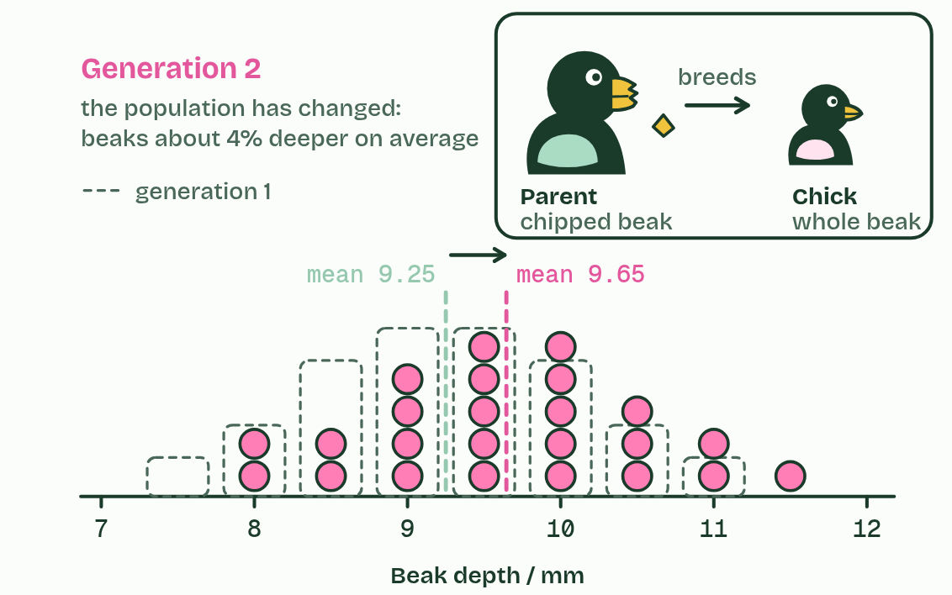
CHAPTER 1 · A4.1.1 What evolution is
5 / 5
Evolution is a change in what a population inherits
A beak chipped on a hard seed is not passed on: the chick hatches with a whole beak. An acquired change is not evolution.
Minutes 8 to 20
Notes:
Minutes 8 to 20 of 60: The drought on Daphne Major (12 min).
The plan: Play chapter 1's figure step by step. At each step students sketch the dot plot and say what changed and what did not: no bird's beak changed, the population did. Write the definition only after the sketches: evolution is a change in the heritable characteristics of a population.
Evolution is not something one animal does in its lifetime. It is a change, over generations, in the heritable characteristics of a population. Genes carry those characteristics, so evolution shows up as some alleles becoming more common and others rarer.
The figure follows a real case. In 1977 a drought on Daphne Major, a tiny Galápagos island, left mostly big, hard seeds. Medium ground finches with deep beaks could crack them; many with shallow beaks starved. The survivors bred, their chicks inherited their alleles, and the next generation's beaks were about 4% deeper on average. No finch changed its own beak. The population changed, because some birds left more offspring than others.
Example: Why "theory"? Evolution by natural selection explains and predicts a vast range of observations, and nothing found so far contradicts it. But science cannot prove an idea true by checking it against the whole world; it can only fail to disprove it. So it is called a theory: a pragmatic truth, true for every practical purpose and very unlikely ever to be overturned.

Slide 9
CHAPTER 1 · A4.1.1 What evolution is
Evolution is a change in what a population inherits
Evolution is not something one animal does in its lifetime. It is a change, over generations, in the heritable characteristics of a population.
The population changed, because some birds left more offspring than others.
Minutes 8 to 20
Notes:
Minutes 8 to 20 of 60: The drought on Daphne Major (12 min).
The plan: Play chapter 1's figure step by step. At each step students sketch the dot plot and say what changed and what did not: no bird's beak changed, the population did. Write the definition only after the sketches: evolution is a change in the heritable characteristics of a population.
Evolution is not something one animal does in its lifetime. It is a change, over generations, in the heritable characteristics of a population. Genes carry those characteristics, so evolution shows up as some alleles becoming more common and others rarer.
The figure follows a real case. In 1977 a drought on Daphne Major, a tiny Galápagos island, left mostly big, hard seeds. Medium ground finches with deep beaks could crack them; many with shallow beaks starved. The survivors bred, their chicks inherited their alleles, and the next generation's beaks were about 4% deeper on average. No finch changed its own beak. The population changed, because some birds left more offspring than others.
Example: Why "theory"? Evolution by natural selection explains and predicts a vast range of observations, and nothing found so far contradicts it. But science cannot prove an idea true by checking it against the whole world; it can only fail to disprove it. So it is called a theory: a pragmatic truth, true for every practical purpose and very unlikely ever to be overturned.

Slide 10
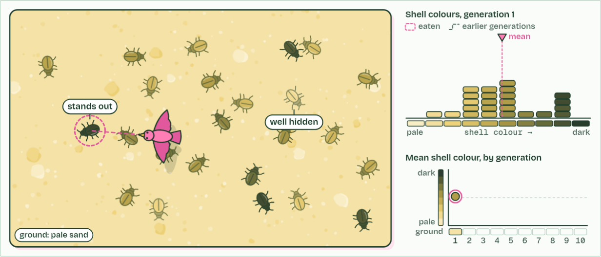
CHAPTER 1 · A4.1.1 What evolution is
generation 1
1 / 3
Evolution is a change in what a population inherits
Birds spot the beetles that stand out. The best hidden survive and breed.
Minutes 8 to 20
Notes:
Minutes 8 to 20 of 60: The drought on Daphne Major (12 min).
The plan: Play chapter 1's figure step by step. At each step students sketch the dot plot and say what changed and what did not: no bird's beak changed, the population did. Write the definition only after the sketches: evolution is a change in the heritable characteristics of a population.
Evolution is not something one animal does in its lifetime. It is a change, over generations, in the heritable characteristics of a population. Genes carry those characteristics, so evolution shows up as some alleles becoming more common and others rarer.
The figure follows a real case. In 1977 a drought on Daphne Major, a tiny Galápagos island, left mostly big, hard seeds. Medium ground finches with deep beaks could crack them; many with shallow beaks starved. The survivors bred, their chicks inherited their alleles, and the next generation's beaks were about 4% deeper on average. No finch changed its own beak. The population changed, because some birds left more offspring than others.
Example: Why "theory"? Evolution by natural selection explains and predicts a vast range of observations, and nothing found so far contradicts it. But science cannot prove an idea true by checking it against the whole world; it can only fail to disprove it. So it is called a theory: a pragmatic truth, true for every practical purpose and very unlikely ever to be overturned.
The animation "Watch it happen: a population changes", paused at 3.2 s. The next slides go on through it, then play it.

Slide 11
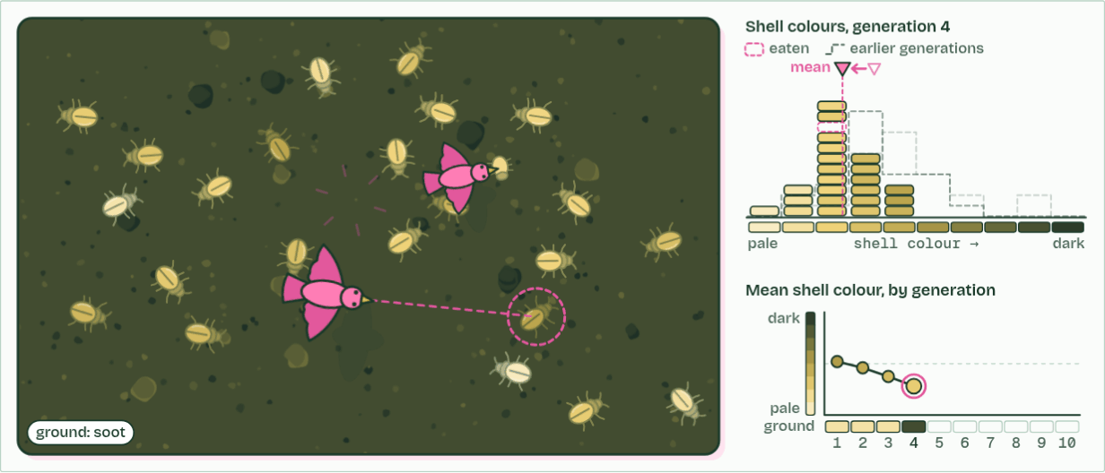
CHAPTER 1 · A4.1.1 What evolution is
generation 4
2 / 3
Evolution is a change in what a population inherits
Then soot from a fire darkens the ground. Now the pale beetles stand out.
Minutes 8 to 20
Notes:
Minutes 8 to 20 of 60: The drought on Daphne Major (12 min).
The plan: Play chapter 1's figure step by step. At each step students sketch the dot plot and say what changed and what did not: no bird's beak changed, the population did. Write the definition only after the sketches: evolution is a change in the heritable characteristics of a population.
Evolution is not something one animal does in its lifetime. It is a change, over generations, in the heritable characteristics of a population. Genes carry those characteristics, so evolution shows up as some alleles becoming more common and others rarer.
The figure follows a real case. In 1977 a drought on Daphne Major, a tiny Galápagos island, left mostly big, hard seeds. Medium ground finches with deep beaks could crack them; many with shallow beaks starved. The survivors bred, their chicks inherited their alleles, and the next generation's beaks were about 4% deeper on average. No finch changed its own beak. The population changed, because some birds left more offspring than others.
Example: Why "theory"? Evolution by natural selection explains and predicts a vast range of observations, and nothing found so far contradicts it. But science cannot prove an idea true by checking it against the whole world; it can only fail to disprove it. So it is called a theory: a pragmatic truth, true for every practical purpose and very unlikely ever to be overturned.
The animation "Watch it happen: a population changes", paused at 12.4 s. The next slides go on through it, then play it.

Slide 12
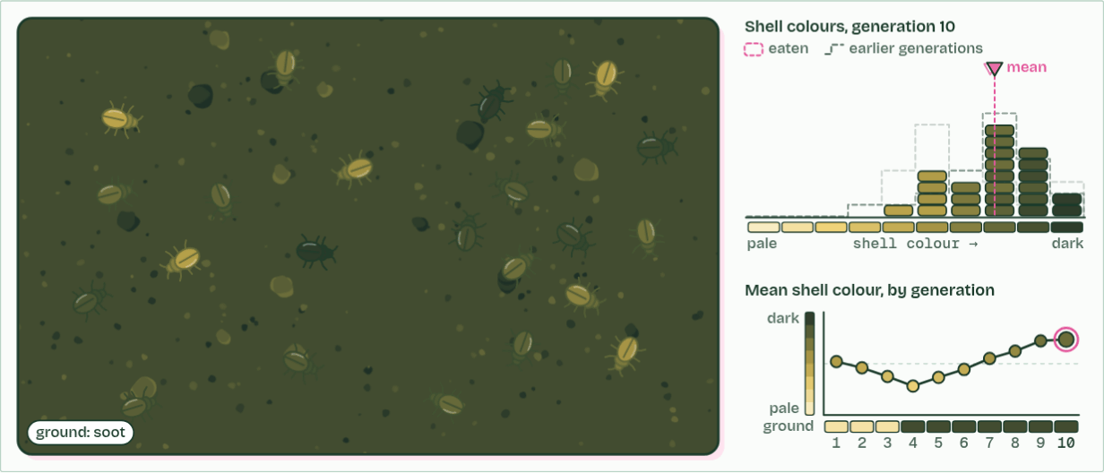
CHAPTER 1 · A4.1.1 What evolution is
generation 10
3 / 3
Evolution is a change in what a population inherits
No beetle ever changed its shell. The population changed: that is evolution.
Minutes 8 to 20
Notes:
Minutes 8 to 20 of 60: The drought on Daphne Major (12 min).
The plan: Play chapter 1's figure step by step. At each step students sketch the dot plot and say what changed and what did not: no bird's beak changed, the population did. Write the definition only after the sketches: evolution is a change in the heritable characteristics of a population.
Evolution is not something one animal does in its lifetime. It is a change, over generations, in the heritable characteristics of a population. Genes carry those characteristics, so evolution shows up as some alleles becoming more common and others rarer.
The figure follows a real case. In 1977 a drought on Daphne Major, a tiny Galápagos island, left mostly big, hard seeds. Medium ground finches with deep beaks could crack them; many with shallow beaks starved. The survivors bred, their chicks inherited their alleles, and the next generation's beaks were about 4% deeper on average. No finch changed its own beak. The population changed, because some birds left more offspring than others.
Example: Why "theory"? Evolution by natural selection explains and predicts a vast range of observations, and nothing found so far contradicts it. But science cannot prove an idea true by checking it against the whole world; it can only fail to disprove it. So it is called a theory: a pragmatic truth, true for every practical purpose and very unlikely ever to be overturned.
The animation "Watch it happen: a population changes", paused at 23.0 s. The next slides go on through it, then play it.

Slide 13
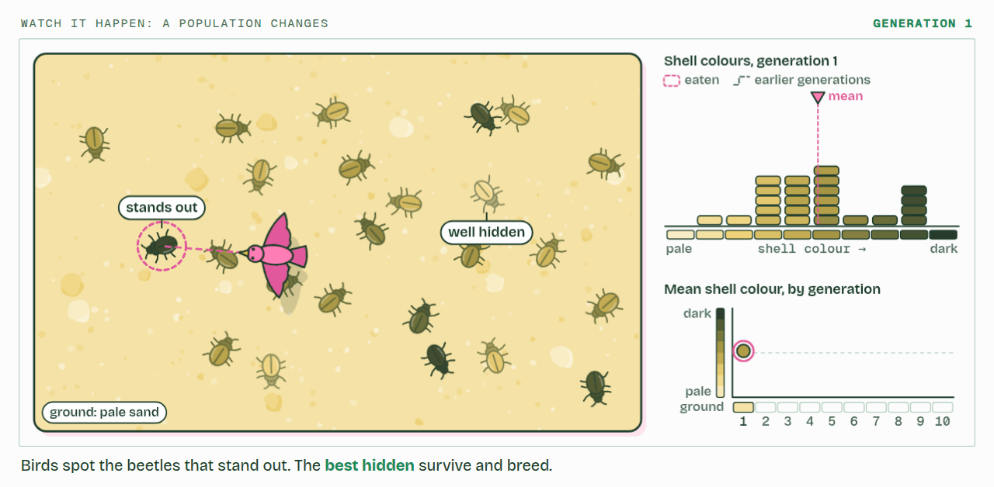
CHAPTER 1 · A4.1.1 What evolution is
PLAY IT
Evolution is a change in what a population inherits
Watch it happen: a population changes: click to play. It loops every 24 seconds.
Minutes 8 to 20
Notes:
Minutes 8 to 20 of 60: The drought on Daphne Major (12 min).
The plan: Play chapter 1's figure step by step. At each step students sketch the dot plot and say what changed and what did not: no bird's beak changed, the population did. Write the definition only after the sketches: evolution is a change in the heritable characteristics of a population.
The video is selection-1f3022.mp4, one loop of the animation in the guide. It plays in PowerPoint and Keynote. Google Slides does not play a video embedded in a .pptx: download selection-1f3022.mp4 (https://www.biologybybradford.com/guides/downloads/scenes/selection-1f3022.mp4), upload it to Google Drive, then Insert > Video > Google Drive.
In the guide the class can change it as it runs: https://www.biologybybradford.com/guides/ib-biology-a4-1-evolution-and-speciation#heritable
What it shows, in order:
1. Birds spot the beetles that stand out. The best hidden survive and breed.
2. Then soot from a fire darkens the ground. Now the pale beetles stand out.
3. No beetle ever changed its shell. The population changed: that is evolution.

Slide 14
PREDICT
A gardener clips a hedge into a perfect cube every year for 40 years. Seeds from the hedge are sown. What shape do the seedlings grow into?
A Cubes: forty years of clipping is long enough for the shape to be inherited
B Slightly squarer than usual: a little of each year's change is passed on
C The usual shape for the species: clipping never touched their alleles
Minutes 8 to 20
Notes:
Minutes 8 to 20 of 60: The drought on Daphne Major (12 min).
The plan: Play chapter 1's figure step by step. At each step students sketch the dot plot and say what changed and what did not: no bird's beak changed, the population did. Write the definition only after the sketches: evolution is a change in the heritable characteristics of a population.
Ask for a show of hands, or mini whiteboards, before revealing. (Answer: C, on the next slide.)

Slide 15
WHAT HAPPENS
A gardener clips a hedge into a perfect cube every year for 40 years. Seeds from the hedge are sown. What shape do the seedlings grow into?
A Cubes: forty years of clipping is long enough for the shape to be inherited
B Slightly squarer than usual: a little of each year's change is passed on
C The usual shape for the species: clipping never touched their alleles
The usual shape. Clipping changes the hedge's body, not the alleles in its pollen and ovules, so nothing about it reaches the seeds. Only changes to the alleles in gametes can be inherited, which is why only they count as evolution.
Minutes 8 to 20
Notes:
Minutes 8 to 20 of 60: The drought on Daphne Major (12 min).
The plan: Play chapter 1's figure step by step. At each step students sketch the dot plot and say what changed and what did not: no bird's beak changed, the population did. Write the definition only after the sketches: evolution is a change in the heritable characteristics of a population.
Answer: C. The usual shape. Clipping changes the hedge's body, not the alleles in its pollen and ovules, so nothing about it reaches the seeds. Only changes to the alleles in gametes can be inherited, which is why only they count as evolution.

Slide 16
WATCH OUT
A change gained during a life is not passed on: a finch's chipped beak, a weightlifter's muscles, a giraffe stretching for leaves. None of these changes the alleles in eggs or sperm. Lamarck thought such changes were inherited; they are not, and they are not evolution.
Minutes 8 to 20
Notes:
Minutes 8 to 20 of 60: The drought on Daphne Major (12 min).
The plan: Play chapter 1's figure step by step. At each step students sketch the dot plot and say what changed and what did not: no bird's beak changed, the population did. Write the definition only after the sketches: evolution is a change in the heritable characteristics of a population.
A common mistake: say it, then ask who can say why it is wrong.

Slide 17
STEP 3
5 MIN
"Just a theory"?
Think, pair, share: why is evolution called a theory when nothing contradicts it?
Minutes 20 to 25
Notes:
Minutes 20 to 25 of 60: "Just a theory"? (5 min).
The plan: Think, pair, share: why is evolution called a theory when nothing contradicts it? Land on the nature of science point: it explains and predicts a huge range of observations, but no theory can be proved true, only fail to be disproved.

Slide 18

DATA
20 MIN
Sequence detectives
THE TASK
Pairs use the sequence figure in chapter 2, or a printed copy of its five sequences. They count differences from the human sequence, put the species in order, and draw the tree. Extension: why are there more differences between base sequences than between amino acid sequences?
STUDENTS NEED
The guide on devices, or printed alignments; squared paper.
Minutes 25 to 45
Notes:
Minutes 25 to 45 of 60: Sequence detectives (20 min).
The plan: Students predict the most different species (chapter 2's predict box), then use the sequence figure in pairs: compare each species, record the differences in a table, and watch the tree build. Switch to amino acids and ask why some differences vanish. Then the cytochrome c facts: identical in chimpanzees, one difference in rhesus monkeys, over 40 in yeast.
The activity: Sequence detectives. Pairs use the sequence figure in chapter 2, or a printed copy of its five sequences. They count differences from the human sequence, put the species in order, and draw the tree. Extension: why are there more differences between base sequences than between amino acid sequences? Teachers who want real data can give the cytochrome c difference counts from a database.
Needs: the guide on devices, or printed alignments; squared paper.
The time: 20 minutes, minutes 25 to 45 of the plan.

Slide 19
PREDICT
Before you compare: which species' sequence will differ from the human one at the most positions?
A Chimpanzee
B Mouse
C Chicken
D Frog
Minutes 25 to 45
Notes:
Minutes 25 to 45 of 60: Sequence detectives (20 min).
The plan: Students predict the most different species (chapter 2's predict box), then use the sequence figure in pairs: compare each species, record the differences in a table, and watch the tree build. Switch to amino acids and ask why some differences vanish. Then the cytochrome c facts: identical in chimpanzees, one difference in rhesus monkeys, over 40 in yeast.
Ask for a show of hands, or mini whiteboards, before revealing. (Answer: D, on the next slide.)

Slide 20
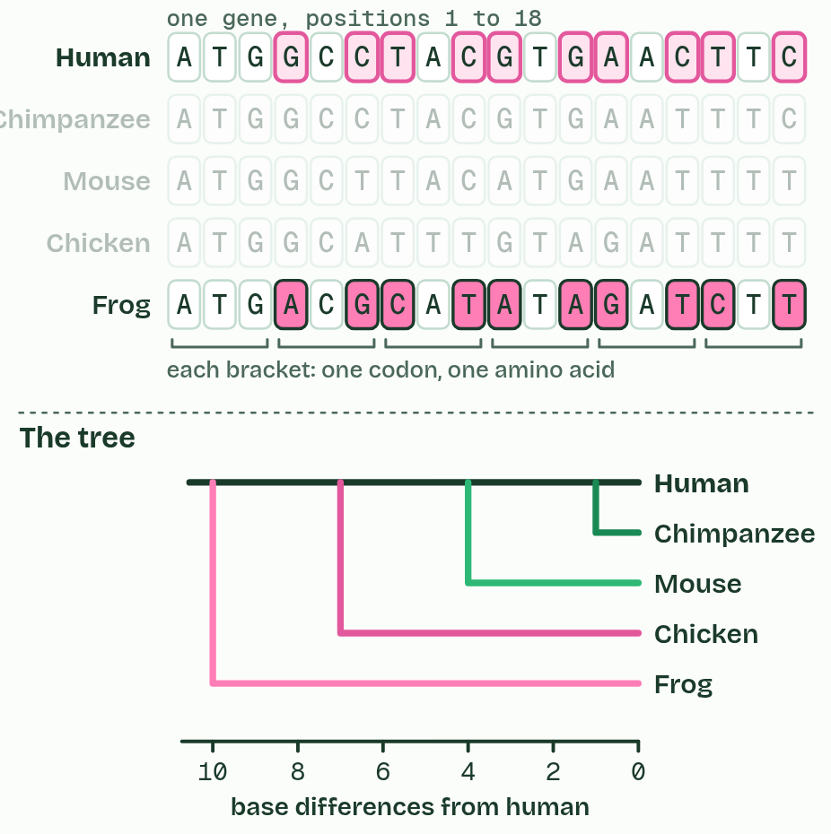
CHAPTER 2 · A4.1.2 Evidence from sequences
1 / 2
Sequences remember common ancestors
Bases
Minutes 25 to 45
Notes:
Minutes 25 to 45 of 60: Sequence detectives (20 min).
The plan: Students predict the most different species (chapter 2's predict box), then use the sequence figure in pairs: compare each species, record the differences in a table, and watch the tree build. Switch to amino acids and ask why some differences vanish. Then the cytochrome c facts: identical in chimpanzees, one difference in rhesus monkeys, over 40 in yeast.
Every living thing keeps its genes in DNA, and almost all of them read it with the same genetic code. That shared machinery already points to one common ancestor. The sequences themselves hold the detail.
When a species splits in two, each new line copies its own DNA, and mutations build up separately in each. So the longer ago two species shared an ancestor, the more differences there are between the same gene in each. Compare one gene across species, count the differences, and the fewest differences mark the closest relatives.
Base sequences, in DNA or RNA, change faster than the amino acid sequences of the proteins they code for. Most amino acids have several codons, so many base changes leave the protein the same. Switch the figure to amino acids and some differences vanish: base sequences sort out close relatives, amino acid sequences reach further back.
Example: Cytochrome c, a protein every aerobic cell uses, is 104 amino acids long in humans. A chimpanzee's is identical, a rhesus monkey's differs at one position, and a yeast's at more than 40.

Slide 21
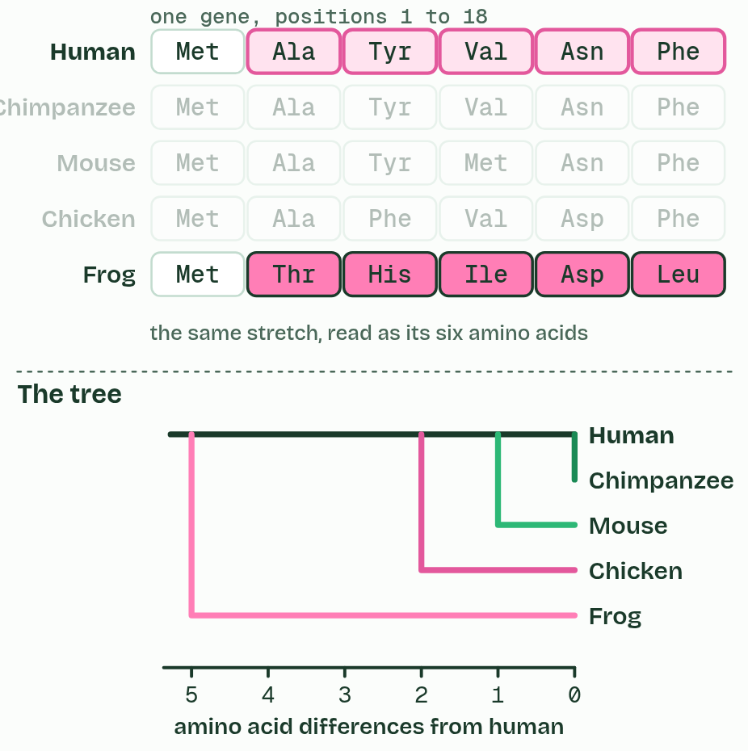
CHAPTER 2 · A4.1.2 Evidence from sequences
2 / 2
Sequences remember common ancestors
Amino acids
Minutes 25 to 45
Notes:
Minutes 25 to 45 of 60: Sequence detectives (20 min).
The plan: Students predict the most different species (chapter 2's predict box), then use the sequence figure in pairs: compare each species, record the differences in a table, and watch the tree build. Switch to amino acids and ask why some differences vanish. Then the cytochrome c facts: identical in chimpanzees, one difference in rhesus monkeys, over 40 in yeast.
Every living thing keeps its genes in DNA, and almost all of them read it with the same genetic code. That shared machinery already points to one common ancestor. The sequences themselves hold the detail.
When a species splits in two, each new line copies its own DNA, and mutations build up separately in each. So the longer ago two species shared an ancestor, the more differences there are between the same gene in each. Compare one gene across species, count the differences, and the fewest differences mark the closest relatives.
Base sequences, in DNA or RNA, change faster than the amino acid sequences of the proteins they code for. Most amino acids have several codons, so many base changes leave the protein the same. Switch the figure to amino acids and some differences vanish: base sequences sort out close relatives, amino acid sequences reach further back.
Example: Cytochrome c, a protein every aerobic cell uses, is 104 amino acids long in humans. A chimpanzee's is identical, a rhesus monkey's differs at one position, and a yeast's at more than 40.

Slide 22
CHAPTER 2 · A4.1.2 Evidence from sequences
Sequences remember common ancestors
Fewer differences: a more recent common ancestor.
Different genes and different proteins give largely the same branching pattern, and so does the fossil record. Independent lines of evidence agreeing is what makes this powerful.
Minutes 25 to 45
Notes:
Minutes 25 to 45 of 60: Sequence detectives (20 min).
The plan: Students predict the most different species (chapter 2's predict box), then use the sequence figure in pairs: compare each species, record the differences in a table, and watch the tree build. Switch to amino acids and ask why some differences vanish. Then the cytochrome c facts: identical in chimpanzees, one difference in rhesus monkeys, over 40 in yeast.
Every living thing keeps its genes in DNA, and almost all of them read it with the same genetic code. That shared machinery already points to one common ancestor. The sequences themselves hold the detail.
When a species splits in two, each new line copies its own DNA, and mutations build up separately in each. So the longer ago two species shared an ancestor, the more differences there are between the same gene in each. Compare one gene across species, count the differences, and the fewest differences mark the closest relatives.
Base sequences, in DNA or RNA, change faster than the amino acid sequences of the proteins they code for. Most amino acids have several codons, so many base changes leave the protein the same. Switch the figure to amino acids and some differences vanish: base sequences sort out close relatives, amino acid sequences reach further back.
Example: Cytochrome c, a protein every aerobic cell uses, is 104 amino acids long in humans. A chimpanzee's is identical, a rhesus monkey's differs at one position, and a yeast's at more than 40.

Slide 23
WHAT HAPPENS
Before you compare: which species' sequence will differ from the human one at the most positions?
A Chimpanzee
B Mouse
C Chicken
D Frog
The frog. Our line split from the chimpanzee's about 6 to 7 million years ago, from the mouse's about 90 million, from the birds' about 310 million and from the amphibians' about 350 million. The frog's line has had longest for differences to build up.
Minutes 25 to 45
Notes:
Minutes 25 to 45 of 60: Sequence detectives (20 min).
The plan: Students predict the most different species (chapter 2's predict box), then use the sequence figure in pairs: compare each species, record the differences in a table, and watch the tree build. Switch to amino acids and ask why some differences vanish. Then the cytochrome c facts: identical in chimpanzees, one difference in rhesus monkeys, over 40 in yeast.
Answer: D. The frog. Our line split from the chimpanzee's about 6 to 7 million years ago, from the mouse's about 90 million, from the birds' about 310 million and from the amphibians' about 350 million. The frog's line has had longest for differences to build up.

Slide 24
WATCH OUT
Similar sequences do not mean one living species came from the other. Humans did not evolve from chimpanzees: both evolved from an ancestor that lived about 6 to 7 million years ago, and both lines have changed since.
Minutes 25 to 45
Notes:
Minutes 25 to 45 of 60: Sequence detectives (20 min).
The plan: Students predict the most different species (chapter 2's predict box), then use the sequence figure in pairs: compare each species, record the differences in a table, and watch the tree build. Switch to amino acids and ask why some differences vanish. Then the cytochrome c facts: identical in chimpanzees, one difference in rhesus monkeys, over 40 in yeast.
A common mistake: say it, then ask who can say why it is wrong.

Slide 25
STEP 5
10 MIN
Evidence organiser, row 1
A grid with a row for each kind of evidence (sequences, selective breeding, homologous structures) and columns for what it is, a sketch, a named example and why it supports evolution.
Minutes 45 to 55
Notes:
Minutes 45 to 55 of 60: Evidence organiser, row 1 (10 min).
The plan: A grid with a row for each kind of evidence (sequences, selective breeding, homologous structures) and columns for what it is, a sketch, a named example and why it supports evolution. Fill the sequences row now; the others come in lesson 2.

Slide 26
PLENARY
Can you now...
Explain why evolution is a change in the heritable characteristics of a population, and why a change gained in one lifetime is not (A4.1.1)
Use differences in base and amino acid sequences to judge which species share the most recent common ancestor (A4.1.2)
Minutes 55 to 60
Notes:
Minutes 55 to 60 of 60: Exit: back to the vote (5 min).
The plan: Which giraffe story was Lamarck's, and why is it wrong? One sentence each, using the word "allele".
Thumbs up, sideways or down on each goal before the exit question. The goals come from the statements this lesson covers.

Slide 27
EXIT QUESTION
Back to the vote
Which giraffe story was Lamarck's, and why is it wrong?
One sentence each, using the word "allele".
Minutes 55 to 60
Notes:
Minutes 55 to 60 of 60: Exit: back to the vote (5 min).
The plan: Which giraffe story was Lamarck's, and why is it wrong? One sentence each, using the word "allele".

Slide 28
PRACTISE AND REVISE
Keep going
Exam practice: a fresh paper of exam questions on A4.1 at standard level, marked as you go
The guide, with the animations and the dry lab
This lesson in the guide: 1 Evolution is a change in what a population inherits, 2 Sequences remember common ancestors
BUILD FOR YOUR CLASS
ALREADY ON THE SITE FOR A4.1
CARD SETS ON SPLYCR
Tarsia puzzle, dominoes and picture reveal on A4.1, built from its key terms and ready to print
A pub quiz with rounds on A4.1, to present or run with no projector
An escape room built from the question bank on A4.1
Quiz: Evolution & Speciation
Revision map: A4.1 Evolution and speciation, to fill in
Exam questions: A4.1 in the exam maker, a paper with its markscheme
Open a set to host it as a class game, or make a copy to edit.
A4.1 Evolution and Speciation (SL)
How this was made. The course structure, the activities and the teaching choices come from my own classroom, my presentations and my years of teaching IB and AP Biology. I use Claude, an AI, to help write and build the interactive guides, lesson plans, slides and practice questions, and to draw the diagrams and code the interactives. I direct the work and review it against the IB and AP specifications before it goes live.
Minute 60: after the lesson
Notes:
Every link here is live. Set the exam practice paper for homework: it is fresh each time, marked as students go and saved to their Exam practice when they are signed in.
Exam practice: https://www.biologybybradford.com/exam-maker/sit?topics=A4.1&level=SL&paper=quiz&marks=15&src=ep
The guide: https://www.biologybybradford.com/guides/ib-biology-a4-1-evolution-and-speciation

