Slide 1
IB Biology A4.1
LESSON 2 OF 5
BY THE END YOU CAN
Evolution and speciation
Explain how crops and domestic animals show how quickly heritable characteristics can change (A4.1.3)
Name the bones of the pentadactyl limb and tell homologous structures from analogous ones made by convergent evolution (A4.1.4, A4.1.5)
Breeding, bones and wings
A4.1.3 to A4.1.5
Selective breeding, the pentadactyl limb, and homologous against analogous structures
60 minutes · chapters 3, 4
Minute 0
Notes:
IB Biology A4.1, Evolution and speciation. Lesson 2 of 5: Breeding, bones and wings, 60 minutes.
The plan, minute by minute (each slide's footer says where you are):
0 to 5 min (5) Do now: which are the same species?
5 to 20 min (15) Six vegetables, one species
20 to 35 min (15) One bone plan
35 to 45 min (10) Homologous or analogous?
45 to 55 min (10) Evidence organiser, rows 2 and 3
55 to 60 min (5) Exit
What students get wrong:
Looking different means a different species. Dog breeds and cabbage cultivars are one species each.
Analogous means "looks similar". It means same function, different origin; the flippers are the classic trap.
Pentadactyl means five fingers. It names the bone plan; a horse has one digit on the same plan.
Stretch and support:
Support: give the captions of each figure as a cut-up storyboard to put in order, and use the key terms (tap the dotted words) as a glossary.
Support: the three mnemonics (Dragons Breathe Heat; Hungry Rats Chew My Pencils; Grumpy Birds Tweet) as a starter on each lesson.
The lesson plan to print: https://www.biologybybradford.com/guides/downloads/ib-biology-a4-1-evolution-and-speciation-lesson-2-plan.pdf

Slide 2
DO NOW
Which are the same species?
Six vegetables on the front bench (or six pictures): kale, cabbage, Brussels sprouts, kohlrabi, broccoli, cauliflower.
How many species?
5:00
minutes
Start now: the timer is running.
Minutes 0 to 5
Notes:
Minutes 0 to 5 of 60: Do now: which are the same species? (5 min).
The plan: Six vegetables on the front bench (or six pictures): kale, cabbage, Brussels sprouts, kohlrabi, broccoli, cauliflower. How many species? Most students guess four to six. The answer is one.
Start a 5 minute timer as they come in.

Slide 3

PRACTICAL
15 MIN
Six vegetables, one species
THE TASK
Groups get one of each cultivar of Brassica oleracea and a drawing of wild cabbage (chapter 3's figure). They cut each vegetable lengthways, find which organ has been enlarged (leaf, terminal bud, side bud, stem, flower stalk, flower buds) and label it on the wild plant. Finish by asking what farmers chose each time, and what that shows about how fast heritable characteristics can change.
STUDENTS NEED
Kale, cabbage, Brussels sprouts on the stalk if you can get them, kohlrabi, broccoli, cauliflower; knives and boards; hand lenses.
Minutes 5 to 20
Notes:
Minutes 5 to 20 of 60: Six vegetables, one species (15 min).
The plan: The practical below, then chapter 3's figure. Ask why this counts as evidence for evolution, and why it is not an example of new species forming.
The activity: Six vegetables, one species. Groups get one of each cultivar of Brassica oleracea and a drawing of wild cabbage (chapter 3's figure). They cut each vegetable lengthways, find which organ has been enlarged (leaf, terminal bud, side bud, stem, flower stalk, flower buds) and label it on the wild plant. Finish by asking what farmers chose each time, and what that shows about how fast heritable characteristics can change.
Needs: kale, cabbage, Brussels sprouts on the stalk if you can get them, kohlrabi, broccoli, cauliflower; knives and boards; hand lenses.
The time: 15 minutes, minutes 5 to 20 of the plan.

Slide 4
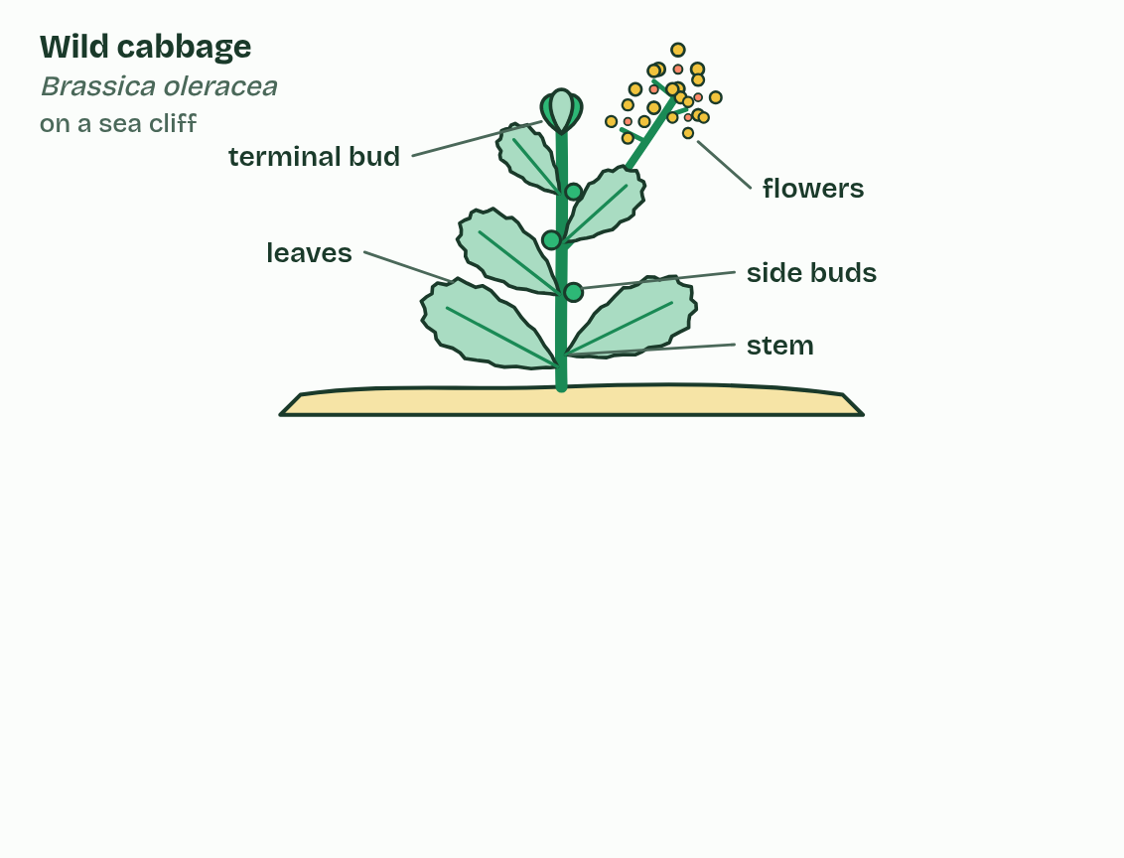
CHAPTER 3 · A4.1.3 Evidence from selective breeding
1 / 4
Six vegetables, one wild weed
Wild cabbage: leaves, buds at the tip and along the stem, and yellow flowers.
Minutes 5 to 20
Notes:
Minutes 5 to 20 of 60: Six vegetables, one species (15 min).
The plan: The practical below, then chapter 3's figure. Ask why this counts as evidence for evolution, and why it is not an example of new species forming.
Wild cabbage grows on sea cliffs in western Europe: a straggly, leafy plant with yellow flowers. Over the last few thousand years, farmers kept seed only from the plants they liked best. This is selective breeding.
Choose the plants with the biggest leaves, generation after generation, and you get kale. Choose a fat terminal bud and you get cabbage; fat side buds, Brussels sprouts; a swollen stem, kohlrabi; thick flower stalks, broccoli; a dense mass of flower buds, cauliflower. Every one is still Brassica oleracea.
Why is this evidence for evolution? The cultivars differ from each other, and from wild cabbage, far more than the wild plant varies, and the changes are heritable: their seeds grow true. People choosing which plants breed changed a species this much in a few thousand years. Natural selection, choosing by survival and reproduction over millions of years, can change species far more.
Example: Maize was bred from teosinte, a wild grass of Mexico. A teosinte ear holds fewer than a dozen kernels, each in a stone-hard case; a cob of maize holds hundreds of soft ones. Dogs were domesticated from wolves more than 15,000 years ago, and most of today's breeds, from chihuahua to Great Dane, were bred in the last few hundred years.

Slide 5
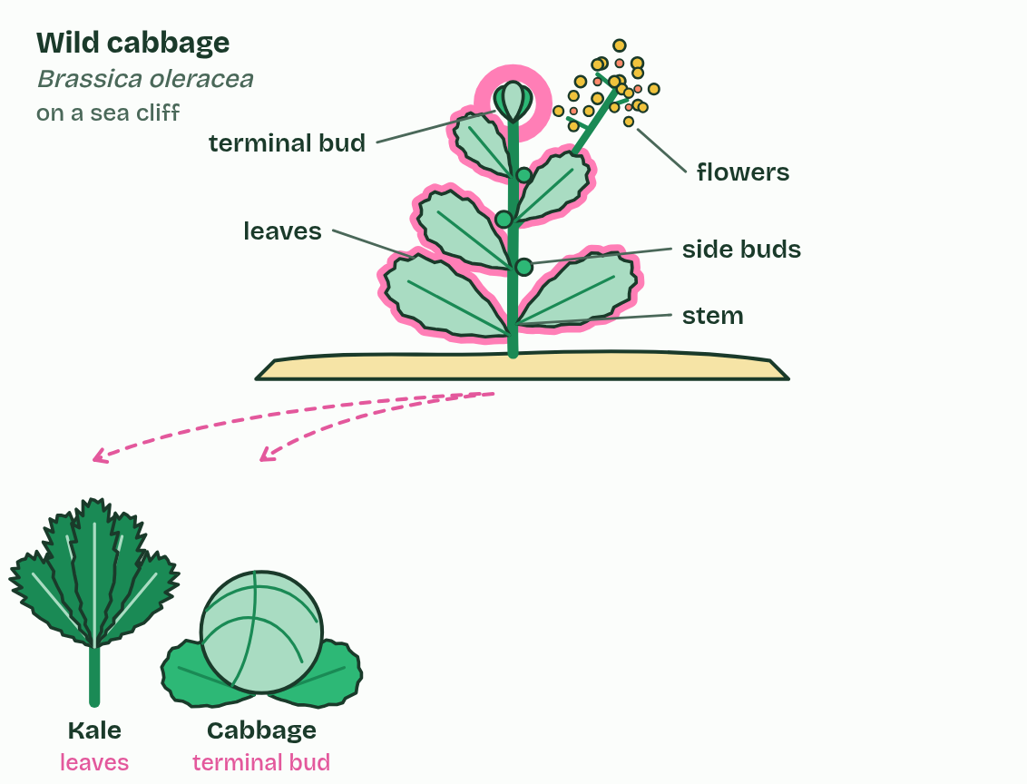
CHAPTER 3 · A4.1.3 Evidence from selective breeding
2 / 4
Six vegetables, one wild weed
Selected for leaves: kale. Selected for a big terminal bud: cabbage.
Minutes 5 to 20
Notes:
Minutes 5 to 20 of 60: Six vegetables, one species (15 min).
The plan: The practical below, then chapter 3's figure. Ask why this counts as evidence for evolution, and why it is not an example of new species forming.
Wild cabbage grows on sea cliffs in western Europe: a straggly, leafy plant with yellow flowers. Over the last few thousand years, farmers kept seed only from the plants they liked best. This is selective breeding.
Choose the plants with the biggest leaves, generation after generation, and you get kale. Choose a fat terminal bud and you get cabbage; fat side buds, Brussels sprouts; a swollen stem, kohlrabi; thick flower stalks, broccoli; a dense mass of flower buds, cauliflower. Every one is still Brassica oleracea.
Why is this evidence for evolution? The cultivars differ from each other, and from wild cabbage, far more than the wild plant varies, and the changes are heritable: their seeds grow true. People choosing which plants breed changed a species this much in a few thousand years. Natural selection, choosing by survival and reproduction over millions of years, can change species far more.
Example: Maize was bred from teosinte, a wild grass of Mexico. A teosinte ear holds fewer than a dozen kernels, each in a stone-hard case; a cob of maize holds hundreds of soft ones. Dogs were domesticated from wolves more than 15,000 years ago, and most of today's breeds, from chihuahua to Great Dane, were bred in the last few hundred years.

Slide 6
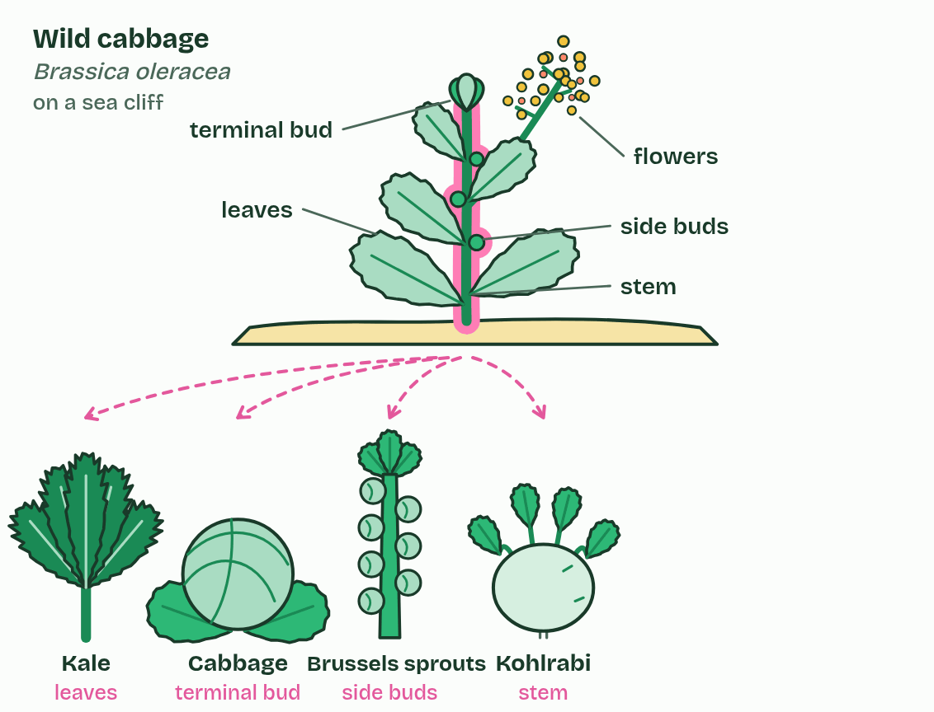
CHAPTER 3 · A4.1.3 Evidence from selective breeding
3 / 4
Six vegetables, one wild weed
Selected for side buds: Brussels sprouts. Selected for a swollen stem: kohlrabi.
Minutes 5 to 20
Notes:
Minutes 5 to 20 of 60: Six vegetables, one species (15 min).
The plan: The practical below, then chapter 3's figure. Ask why this counts as evidence for evolution, and why it is not an example of new species forming.
Wild cabbage grows on sea cliffs in western Europe: a straggly, leafy plant with yellow flowers. Over the last few thousand years, farmers kept seed only from the plants they liked best. This is selective breeding.
Choose the plants with the biggest leaves, generation after generation, and you get kale. Choose a fat terminal bud and you get cabbage; fat side buds, Brussels sprouts; a swollen stem, kohlrabi; thick flower stalks, broccoli; a dense mass of flower buds, cauliflower. Every one is still Brassica oleracea.
Why is this evidence for evolution? The cultivars differ from each other, and from wild cabbage, far more than the wild plant varies, and the changes are heritable: their seeds grow true. People choosing which plants breed changed a species this much in a few thousand years. Natural selection, choosing by survival and reproduction over millions of years, can change species far more.
Example: Maize was bred from teosinte, a wild grass of Mexico. A teosinte ear holds fewer than a dozen kernels, each in a stone-hard case; a cob of maize holds hundreds of soft ones. Dogs were domesticated from wolves more than 15,000 years ago, and most of today's breeds, from chihuahua to Great Dane, were bred in the last few hundred years.

Slide 7
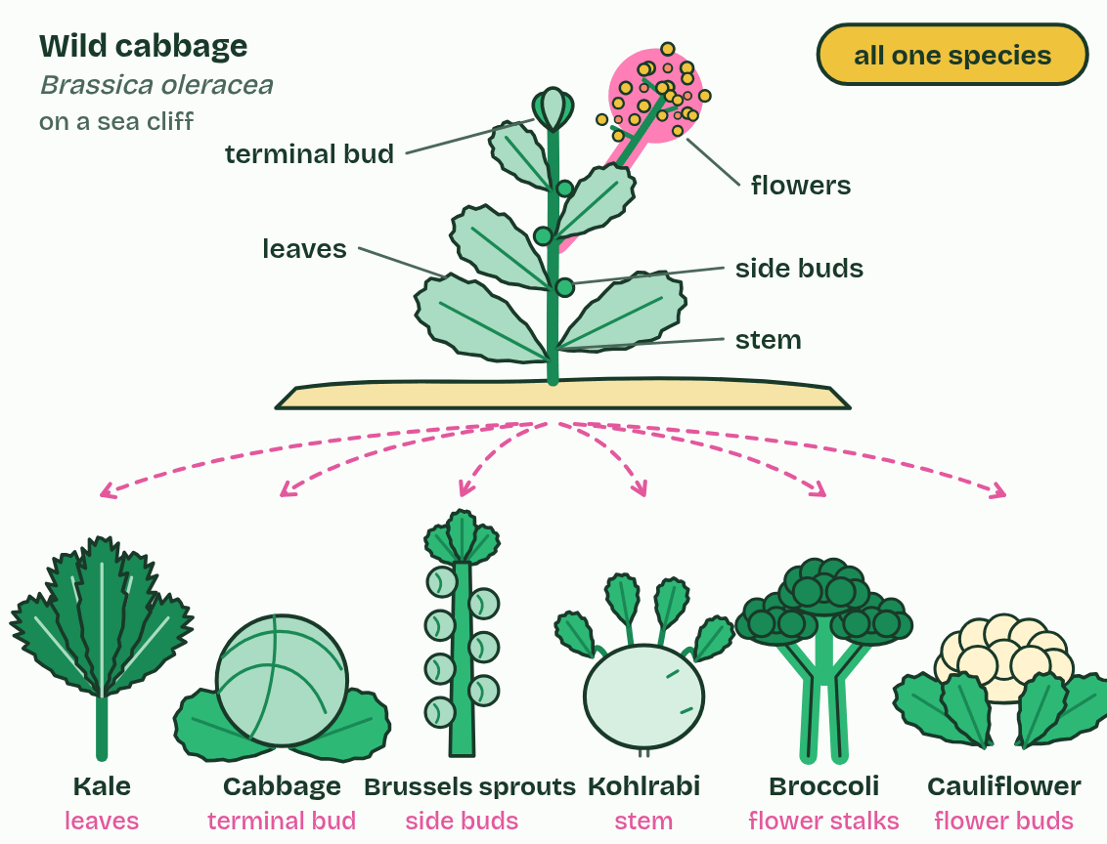
CHAPTER 3 · A4.1.3 Evidence from selective breeding
4 / 4
Six vegetables, one wild weed
Selected for flower stalks and buds: broccoli and cauliflower. All six can still interbreed: one species.
Minutes 5 to 20
Notes:
Minutes 5 to 20 of 60: Six vegetables, one species (15 min).
The plan: The practical below, then chapter 3's figure. Ask why this counts as evidence for evolution, and why it is not an example of new species forming.
Wild cabbage grows on sea cliffs in western Europe: a straggly, leafy plant with yellow flowers. Over the last few thousand years, farmers kept seed only from the plants they liked best. This is selective breeding.
Choose the plants with the biggest leaves, generation after generation, and you get kale. Choose a fat terminal bud and you get cabbage; fat side buds, Brussels sprouts; a swollen stem, kohlrabi; thick flower stalks, broccoli; a dense mass of flower buds, cauliflower. Every one is still Brassica oleracea.
Why is this evidence for evolution? The cultivars differ from each other, and from wild cabbage, far more than the wild plant varies, and the changes are heritable: their seeds grow true. People choosing which plants breed changed a species this much in a few thousand years. Natural selection, choosing by survival and reproduction over millions of years, can change species far more.
Example: Maize was bred from teosinte, a wild grass of Mexico. A teosinte ear holds fewer than a dozen kernels, each in a stone-hard case; a cob of maize holds hundreds of soft ones. Dogs were domesticated from wolves more than 15,000 years ago, and most of today's breeds, from chihuahua to Great Dane, were bred in the last few hundred years.

Slide 8
CHAPTER 3 · A4.1.3 Evidence from selective breeding
Six vegetables, one wild weed
Over the last few thousand years, farmers kept seed only from the plants they liked best. This is selective breeding.
Choose the plants with the biggest leaves, generation after generation, and you get kale.
Why is this evidence for evolution?
Minutes 5 to 20
Notes:
Minutes 5 to 20 of 60: Six vegetables, one species (15 min).
The plan: The practical below, then chapter 3's figure. Ask why this counts as evidence for evolution, and why it is not an example of new species forming.
Wild cabbage grows on sea cliffs in western Europe: a straggly, leafy plant with yellow flowers. Over the last few thousand years, farmers kept seed only from the plants they liked best. This is selective breeding.
Choose the plants with the biggest leaves, generation after generation, and you get kale. Choose a fat terminal bud and you get cabbage; fat side buds, Brussels sprouts; a swollen stem, kohlrabi; thick flower stalks, broccoli; a dense mass of flower buds, cauliflower. Every one is still Brassica oleracea.
Why is this evidence for evolution? The cultivars differ from each other, and from wild cabbage, far more than the wild plant varies, and the changes are heritable: their seeds grow true. People choosing which plants breed changed a species this much in a few thousand years. Natural selection, choosing by survival and reproduction over millions of years, can change species far more.
Example: Maize was bred from teosinte, a wild grass of Mexico. A teosinte ear holds fewer than a dozen kernels, each in a stone-hard case; a cob of maize holds hundreds of soft ones. Dogs were domesticated from wolves more than 15,000 years ago, and most of today's breeds, from chihuahua to Great Dane, were bred in the last few hundred years.

Slide 9
PREDICT
Kohlrabi and Brussels sprouts look nothing alike. A grower lets them cross-pollinate. What happens?
A No seeds form at all: by now they are different species
B Seeds form and grow into fertile plants: one species
C Seeds form but grow into sterile plants, like a mule
Minutes 5 to 20
Notes:
Minutes 5 to 20 of 60: Six vegetables, one species (15 min).
The plan: The practical below, then chapter 3's figure. Ask why this counts as evidence for evolution, and why it is not an example of new species forming.
Ask for a show of hands, or mini whiteboards, before revealing. (Answer: B, on the next slide.)

Slide 10
WHAT HAPPENS
Kohlrabi and Brussels sprouts look nothing alike. A grower lets them cross-pollinate. What happens?
A No seeds form at all: by now they are different species
B Seeds form and grow into fertile plants: one species
C Seeds form but grow into sterile plants, like a mule
They cross easily and the offspring are fertile, which is why seed growers keep the cultivars far apart. However different they look, they are still one species with one gene pool.
Minutes 5 to 20
Notes:
Minutes 5 to 20 of 60: Six vegetables, one species (15 min).
The plan: The practical below, then chapter 3's figure. Ask why this counts as evidence for evolution, and why it is not an example of new species forming.
Answer: B. They cross easily and the offspring are fertile, which is why seed growers keep the cultivars far apart. However different they look, they are still one species with one gene pool.

Slide 11
REMEMBER IT
The three lines of evidence for evolution in A4.1
D
B
H
Darwin’s
Big
Hunch
Minutes 5 to 20
Notes:
Minutes 5 to 20 of 60: Six vegetables, one species (15 min).
The plan: The practical below, then chapter 3's figure. Ask why this counts as evidence for evolution, and why it is not an example of new species forming.
Ask the class what each letter stands for before revealing.

Slide 12
REMEMBER IT
The three lines of evidence for evolution in A4.1
D
B
H
Darwin’s
Big
Hunch
DNA and protein sequences
Breeding
Homologous structures
fewer differences, closer relatives
big heritable changes, fast
one bone plan, many jobs
Minutes 5 to 20
Notes:
Minutes 5 to 20 of 60: Six vegetables, one species (15 min).
The plan: The practical below, then chapter 3's figure. Ask why this counts as evidence for evolution, and why it is not an example of new species forming.
Darwin’s: DNA and protein sequences (fewer differences, closer relatives)
Big: Breeding (big heritable changes, fast)
Hunch: Homologous structures (one bone plan, many jobs)

Slide 13
WATCH OUT
Dog breeds and cabbage cultivars look like different species but are not: a chihuahua and a Great Dane share one gene pool, which their alleles can still cross through dogs of in-between sizes. Selective breeding shows how fast heritable characteristics can change. It is not an example of new species forming.
Minutes 5 to 20
Notes:
Minutes 5 to 20 of 60: Six vegetables, one species (15 min).
The plan: The practical below, then chapter 3's figure. Ask why this counts as evidence for evolution, and why it is not an example of new species forming.
A common mistake: say it, then ask who can say why it is wrong.

Slide 14
STEP 3
15 MIN
One bone plan
Students colour the same five groups on a blank limb outline, then learn the order with the mnemonic tiles.
Ask: why would anyone build a wing, a paddle and a leg from the same parts?
Minutes 20 to 35
Notes:
Minutes 20 to 35 of 60: One bone plan (15 min).
The plan: Chapter 4's figure on the board: tap each bone group across all four limbs. Students colour the same five groups on a blank limb outline, then learn the order with the mnemonic tiles. Ask: why would anyone build a wing, a paddle and a leg from the same parts?

Slide 15
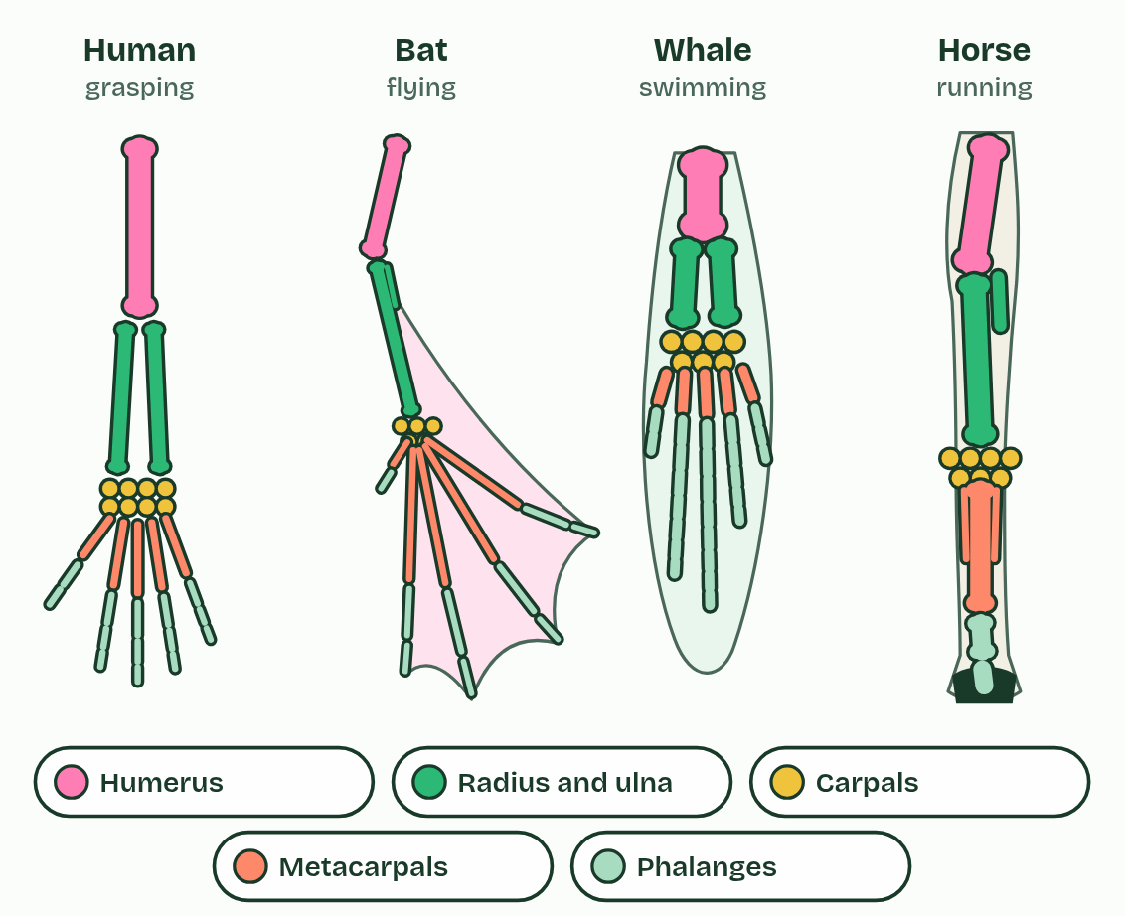
CHAPTER 4 · A4.1.4 A4.1.5 Homologous and analogous structures
1 / 2
Same bones, different jobs, and the reverse
Homologous
Minutes 20 to 35
Notes:
Minutes 20 to 35 of 60: One bone plan (15 min).
The plan: Chapter 4's figure on the board: tap each bone group across all four limbs. Students colour the same five groups on a blank limb outline, then learn the order with the mnemonic tiles. Ask: why would anyone build a wing, a paddle and a leg from the same parts?
Your arm, a bat's wing, a whale's flipper and a horse's front leg do very different jobs. Inside, they are built from the same bones in the same order: one upper arm bone, two in the forearm, a block of wrist bones, a row of palm bones, then the digits. This shared plan is the pentadactyl limb, and structures built on a plan inherited from a common ancestor are homologous structures.
No engineer would build a wing, a paddle and a leg from the same parts. Evolution does not design from scratch: it modifies what an ancestor already had. The shared plan makes sense only if all four limbs were inherited from one common ancestor, an early four-legged vertebrate, and each line then modified it for its own way of life.
Now switch the figure. A bird's wing and an insect's wing both fly, but one is a forelimb full of bones and the other a thin fold of the body wall with no bones at all. Features with the same function but different evolutionary origins are analogous structures, and they arise by convergent evolution: unrelated lines meeting similar demands with similar solutions. The camera eyes of octopuses and vertebrates are another pair.

Slide 16
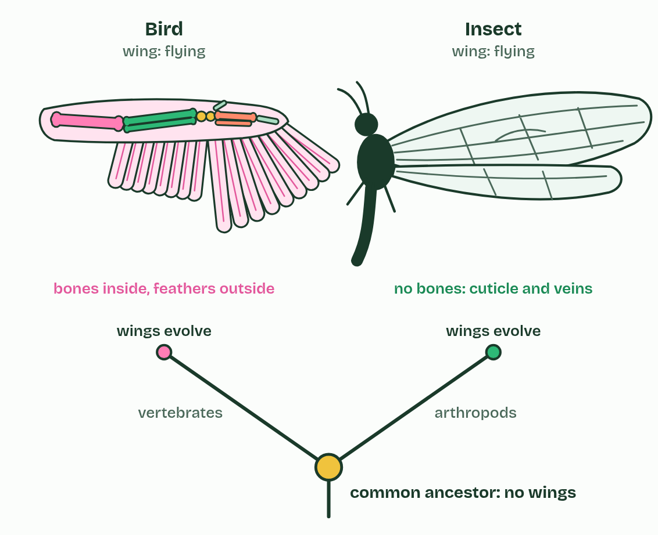
CHAPTER 4 · A4.1.4 A4.1.5 Homologous and analogous structures
2 / 2
Same bones, different jobs, and the reverse
Analogous
Minutes 20 to 35
Notes:
Minutes 20 to 35 of 60: One bone plan (15 min).
The plan: Chapter 4's figure on the board: tap each bone group across all four limbs. Students colour the same five groups on a blank limb outline, then learn the order with the mnemonic tiles. Ask: why would anyone build a wing, a paddle and a leg from the same parts?
Your arm, a bat's wing, a whale's flipper and a horse's front leg do very different jobs. Inside, they are built from the same bones in the same order: one upper arm bone, two in the forearm, a block of wrist bones, a row of palm bones, then the digits. This shared plan is the pentadactyl limb, and structures built on a plan inherited from a common ancestor are homologous structures.
No engineer would build a wing, a paddle and a leg from the same parts. Evolution does not design from scratch: it modifies what an ancestor already had. The shared plan makes sense only if all four limbs were inherited from one common ancestor, an early four-legged vertebrate, and each line then modified it for its own way of life.
Now switch the figure. A bird's wing and an insect's wing both fly, but one is a forelimb full of bones and the other a thin fold of the body wall with no bones at all. Features with the same function but different evolutionary origins are analogous structures, and they arise by convergent evolution: unrelated lines meeting similar demands with similar solutions. The camera eyes of octopuses and vertebrates are another pair.

Slide 17
CHAPTER 4 · A4.1.4 A4.1.5 Homologous and analogous structures
Same bones, different jobs, and the reverse
This shared plan is the pentadactyl limb, and structures built on a plan inherited from a common ancestor are homologous structures.
Features with the same function but different evolutionary origins are analogous structures, and they arise by convergent evolution: unrelated lines meeting similar demands with similar solutions.
No engineer would build a wing, a paddle and a leg from the same parts.
Minutes 20 to 35
Notes:
Minutes 20 to 35 of 60: One bone plan (15 min).
The plan: Chapter 4's figure on the board: tap each bone group across all four limbs. Students colour the same five groups on a blank limb outline, then learn the order with the mnemonic tiles. Ask: why would anyone build a wing, a paddle and a leg from the same parts?
Your arm, a bat's wing, a whale's flipper and a horse's front leg do very different jobs. Inside, they are built from the same bones in the same order: one upper arm bone, two in the forearm, a block of wrist bones, a row of palm bones, then the digits. This shared plan is the pentadactyl limb, and structures built on a plan inherited from a common ancestor are homologous structures.
No engineer would build a wing, a paddle and a leg from the same parts. Evolution does not design from scratch: it modifies what an ancestor already had. The shared plan makes sense only if all four limbs were inherited from one common ancestor, an early four-legged vertebrate, and each line then modified it for its own way of life.
Now switch the figure. A bird's wing and an insect's wing both fly, but one is a forelimb full of bones and the other a thin fold of the body wall with no bones at all. Features with the same function but different evolutionary origins are analogous structures, and they arise by convergent evolution: unrelated lines meeting similar demands with similar solutions. The camera eyes of octopuses and vertebrates are another pair.
Parts of the figure:
Humerus One upper arm bone, in every limb. Short and thick in the whale, a strut for the wing in the bat.
Radius and ulna Two forearm bones. In the horse they have fused into one strong support, with only the top of the ulna (the point of the elbow) still clear; in the bat the ulna is a thin splint.
Carpals A block of small wrist bones: eight in your wrist. In the horse they make the joint people call its knee.
Metacarpals The palm bones. Very long in the bat, holding the wing out. The horse stands on one, the cannon bone, with two thin splint bones beside it: what is left of two more.
Phalanges The finger bones. Long and spread in the bat, extra ones in the whale, and in the horse just three in a single digit, the last inside the hoof.
Bird wing A forelimb: humerus, radius and ulna, wrist and hand bones (fewer digits, partly fused), with feathers for the flight surface. It is homologous with your arm.
Insect wing No bones and no muscles inside: a thin double layer of cuticle, the insect's outer skeleton, stiffened by veins. Muscles in the thorax drive it.
Their last common ancestor A small animal living more than 550 million years ago, with no wings at all. Wings evolved separately in the two lines, from different starting parts: convergent evolution.

Slide 18
PREDICT
A bat's wing and a bird's wing: homologous or analogous?
A Analogous only: they look different and are built differently
B Homologous only: both are forelimbs, so nothing about them converged
C Both: homologous as forelimbs, analogous as wings for flight
Minutes 20 to 35
Notes:
Minutes 20 to 35 of 60: One bone plan (15 min).
The plan: Chapter 4's figure on the board: tap each bone group across all four limbs. Students colour the same five groups on a blank limb outline, then learn the order with the mnemonic tiles. Ask: why would anyone build a wing, a paddle and a leg from the same parts?
Ask for a show of hands, or mini whiteboards, before revealing. (Answer: C, on the next slide.)

Slide 19
WHAT HAPPENS
A bat's wing and a bird's wing: homologous or analogous?
A Analogous only: they look different and are built differently
B Homologous only: both are forelimbs, so nothing about them converged
C Both: homologous as forelimbs, analogous as wings for flight
Both. As forelimbs they share the pentadactyl plan from a common ancestor: homologous. But that ancestor could not fly, so wings evolved separately in bats (skin stretched over long fingers) and birds (feathers on a shortened hand): as wings, analogous.
Minutes 20 to 35
Notes:
Minutes 20 to 35 of 60: One bone plan (15 min).
The plan: Chapter 4's figure on the board: tap each bone group across all four limbs. Students colour the same five groups on a blank limb outline, then learn the order with the mnemonic tiles. Ask: why would anyone build a wing, a paddle and a leg from the same parts?
Answer: C. Both. As forelimbs they share the pentadactyl plan from a common ancestor: homologous. But that ancestor could not fly, so wings evolved separately in bats (skin stretched over long fingers) and birds (feathers on a shortened hand): as wings, analogous.

Slide 20
REMEMBER IT
The pentadactyl limb, shoulder to fingertip
H
R
C
M
P
Hungry
Rats
Chew
My
Pencils
Minutes 20 to 35
Notes:
Minutes 20 to 35 of 60: One bone plan (15 min).
The plan: Chapter 4's figure on the board: tap each bone group across all four limbs. Students colour the same five groups on a blank limb outline, then learn the order with the mnemonic tiles. Ask: why would anyone build a wing, a paddle and a leg from the same parts?
Ask the class what each letter stands for before revealing.

Slide 21
REMEMBER IT
The pentadactyl limb, shoulder to fingertip
H
R
C
M
P
Hungry
Rats
Chew
My
Pencils
Humerus
Radius and ulna
Carpals
Metacarpals
Phalanges
upper arm, one bone
forearm, two bones
wrist
palm
fingers
Minutes 20 to 35
Notes:
Minutes 20 to 35 of 60: One bone plan (15 min).
The plan: Chapter 4's figure on the board: tap each bone group across all four limbs. Students colour the same five groups on a blank limb outline, then learn the order with the mnemonic tiles. Ask: why would anyone build a wing, a paddle and a leg from the same parts?
Hungry: Humerus (upper arm, one bone)
Rats: Radius and ulna (forearm, two bones)
Chew: Carpals (wrist)
My: Metacarpals (palm)
Pencils: Phalanges (fingers)

Slide 22
WATCH OUT
Penguin, turtle and whale flippers are often given as analogous structures, but all three are forelimbs with the pentadactyl bones inside: homologous as limbs, with only the flipper shape converging. And "pentadactyl" names the plan, not a count: the horse has one digit left, on the same plan.
Minutes 20 to 35
Notes:
Minutes 20 to 35 of 60: One bone plan (15 min).
The plan: Chapter 4's figure on the board: tap each bone group across all four limbs. Students colour the same five groups on a blank limb outline, then learn the order with the mnemonic tiles. Ask: why would anyone build a wing, a paddle and a leg from the same parts?
A common mistake: say it, then ask who can say why it is wrong.

Slide 23

CARD SORT
10 MIN
Homologous or analogous?
THE TASK
Ten pairs of structures, each on a card, to sort into homologous, analogous, or both. Include the bird and bee wing, a human arm and a bat wing, a horse and a cat foreleg, octopus and human eyes, a cactus stem and a euphorbia stem, and two traps: whale and penguin flippers (homologous as forelimbs, analogous only in their flipper shape), and bat and bird wings (homologous as forelimbs, analogous as wings).
STUDENTS NEED
Printed cards, one set per pair.
Minutes 35 to 45
Notes:
Minutes 35 to 45 of 60: Homologous or analogous? (10 min).
The plan: The card sort below, in pairs. Take feedback on the two trap cards (the flippers, and the bat and bird wings) before anything else.
The activity: Homologous or analogous?. Ten pairs of structures, each on a card, to sort into homologous, analogous, or both. Include the bird and bee wing, a human arm and a bat wing, a horse and a cat foreleg, octopus and human eyes, a cactus stem and a euphorbia stem, and two traps: whale and penguin flippers (homologous as forelimbs, analogous only in their flipper shape), and bat and bird wings (homologous as forelimbs, analogous as wings).
Needs: printed cards, one set per pair.
The time: 10 minutes, minutes 35 to 45 of the plan.

Slide 24
STEP 5
10 MIN
Evidence organiser, rows 2 and 3
Students swap with a partner and add one thing to each other's rows.
Minutes 45 to 55
Notes:
Minutes 45 to 55 of 60: Evidence organiser, rows 2 and 3 (10 min).
The plan: Selective breeding and homologous structures. Students swap with a partner and add one thing to each other's rows.

Slide 25
PLENARY
Can you now...
Explain how crops and domestic animals show how quickly heritable characteristics can change (A4.1.3)
Name the bones of the pentadactyl limb and tell homologous structures from analogous ones made by convergent evolution (A4.1.4, A4.1.5)
Minutes 55 to 60
Notes:
Minutes 55 to 60 of 60: Exit (5 min).
The plan: Name one pair of analogous structures and say why they are not homologous.
Thumbs up, sideways or down on each goal before the exit question. The goals come from the statements this lesson covers.

Slide 26
EXIT QUESTION
Before you go
Name one pair of analogous structures and say why they are not homologous.
Minutes 55 to 60
Notes:
Minutes 55 to 60 of 60: Exit (5 min).
The plan: Name one pair of analogous structures and say why they are not homologous.

Slide 27
PRACTISE AND REVISE
Keep going
Exam practice: a fresh paper of exam questions on A4.1 at standard level, marked as you go
The guide, with the animations and the dry lab
This lesson in the guide: 3 Six vegetables, one wild weed, 4 Same bones, different jobs, and the reverse
BUILD FOR YOUR CLASS
ALREADY ON THE SITE FOR A4.1
CARD SETS ON SPLYCR
Tarsia puzzle, dominoes and picture reveal on A4.1, built from its key terms and ready to print
A pub quiz with rounds on A4.1, to present or run with no projector
An escape room built from the question bank on A4.1
Quiz: Evolution & Speciation
Revision map: A4.1 Evolution and speciation, to fill in
Exam questions: A4.1 in the exam maker, a paper with its markscheme
Open a set to host it as a class game, or make a copy to edit.
A4.1 Evolution and Speciation (SL)
How this was made. The course structure, the activities and the teaching choices come from my own classroom, my presentations and my years of teaching IB and AP Biology. I use Claude, an AI, to help write and build the interactive guides, lesson plans, slides and practice questions, and to draw the diagrams and code the interactives. I direct the work and review it against the IB and AP specifications before it goes live.
Minute 60: after the lesson
Notes:
Every link here is live. Set the exam practice paper for homework: it is fresh each time, marked as students go and saved to their Exam practice when they are signed in.
Exam practice: https://www.biologybybradford.com/exam-maker/sit?topics=A4.1&level=SL&paper=quiz&marks=15&src=ep
The guide: https://www.biologybybradford.com/guides/ib-biology-a4-1-evolution-and-speciation

