Slide 1
IB Biology A4.1
LESSON 3 OF 5
BY THE END YOU CAN
Evolution and speciation
Explain why splitting is the only way new species arise, and why gradual change in one line is not speciation (A4.1.6)
Explain how reproductive isolation and differential selection split bonobos from common chimpanzees (A4.1.7)
How one species becomes two
A4.1.6, A4.1.7
Speciation by splitting: reproductive isolation and differential selection in bonobos and chimpanzees
60 minutes · chapters 5, 6
Minute 0
Notes:
IB Biology A4.1, Evolution and speciation. Lesson 3 of 5: How one species becomes two, 60 minutes.
The plan, minute by minute (each slide's footer says where you are):
0 to 5 min (5) Do now
5 to 15 min (10) Splits add, extinctions take away
15 to 25 min (10) Storyboard: from one gene pool to two
25 to 50 min (25) The river case file
50 to 60 min (10) Exam question, timed
What students get wrong:
The barrier causes the change. It only stops gene flow; selection, mutation and drift do the changing.
Gradual change is speciation. Only a split adds a species.
Stretch and support:
Support: give the captions of each figure as a cut-up storyboard to put in order, and use the key terms (tap the dotted words) as a glossary.
Support: for the river case file, give a writing frame with the five headings and a sentence starter for each.
Support: the three mnemonics (Dragons Breathe Heat; Hungry Rats Chew My Pencils; Grumpy Birds Tweet) as a starter on each lesson.
Stretch: the bonobos and chimpanzees still have traces of later interbreeding in their genomes. Does that change whether they are two species? What does it say about the species concept?
The lesson plan to print: https://www.biologybybradford.com/guides/downloads/ib-biology-a4-1-evolution-and-speciation-lesson-3-plan.pdf

Slide 2
DO NOW
Do now
"A chihuahua and a grey wolf: one species or two? How would you decide?"
5:00
minutes
Start now: the timer is running.
Minutes 0 to 5
Notes:
Minutes 0 to 5 of 60: Do now (5 min).
The plan: "A chihuahua and a grey wolf: one species or two? How would you decide?" Draw out the definition: able to interbreed and have fertile offspring. By that test they are one species: dogs and wolves still interbreed and have fertile pups, and the dog is often classed as a subspecies of the grey wolf.
Start a 5 minute timer as they come in.

Slide 3
STEP 2
10 MIN
Splits add, extinctions take away
Chapter 5: New species arise only by splitting
Minutes 5 to 15
Notes:
Minutes 5 to 15 of 60: Splits add, extinctions take away (10 min).
The plan: Play chapter 5's figure and keep the species counter in view. Stop at step 4 and ask whether the count should go up. Then the snail predict box.

Slide 4
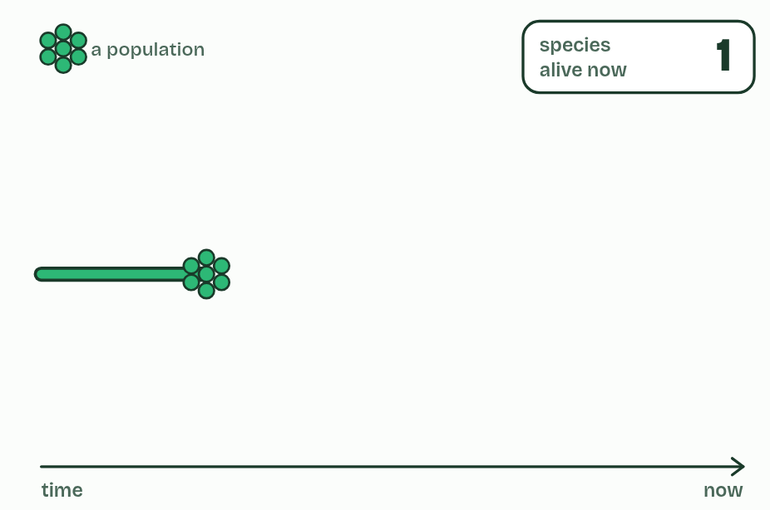
CHAPTER 5 · A4.1.6 Speciation
1 / 6
New species arise only by splitting
One species: every population can interbreed with every other.
Minutes 5 to 15
Notes:
Minutes 5 to 15 of 60: Splits add, extinctions take away (10 min).
The plan: Play chapter 5's figure and keep the species counter in view. Stop at step 4 and ask whether the count should go up. Then the snail predict box.
A species, in the definition biologists use most, is a group of organisms that can interbreed and produce fertile offspring. Its populations share one pool of alleles, because individuals move and mate between them.
Speciation happens when that sharing stops. Split a species into two populations that no longer interbreed and each changes in its own way: different mutations, different chance events, different selection. Given long enough, they differ so much that they could not interbreed even if they met again. One species has become two.
Every new species has appeared like this, by splitting from one that already existed. Speciation adds to the number of species on Earth and extinction takes species away; the diversity alive today is the balance of the two.
Example: Where the definition struggles Organisms that reproduce asexually, like bacteria, do not interbreed, and fossils cannot be tested, so these are grouped by their characteristics and sequences instead. And because splitting takes time, some pairs of populations are part-way: they interbreed a little where they meet, and whether they count as one species or two is a judgement.

Slide 5
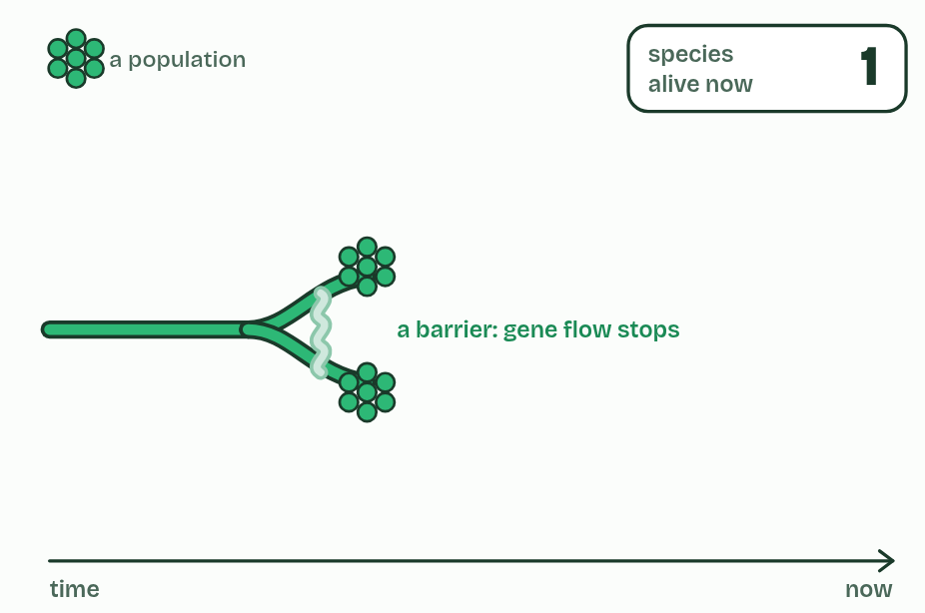
CHAPTER 5 · A4.1.6 Speciation
2 / 6
New species arise only by splitting
A barrier divides it into two populations. Gene flow stops, but for now they are still one species.
Minutes 5 to 15
Notes:
Minutes 5 to 15 of 60: Splits add, extinctions take away (10 min).
The plan: Play chapter 5's figure and keep the species counter in view. Stop at step 4 and ask whether the count should go up. Then the snail predict box.
A species, in the definition biologists use most, is a group of organisms that can interbreed and produce fertile offspring. Its populations share one pool of alleles, because individuals move and mate between them.
Speciation happens when that sharing stops. Split a species into two populations that no longer interbreed and each changes in its own way: different mutations, different chance events, different selection. Given long enough, they differ so much that they could not interbreed even if they met again. One species has become two.
Every new species has appeared like this, by splitting from one that already existed. Speciation adds to the number of species on Earth and extinction takes species away; the diversity alive today is the balance of the two.
Example: Where the definition struggles Organisms that reproduce asexually, like bacteria, do not interbreed, and fossils cannot be tested, so these are grouped by their characteristics and sequences instead. And because splitting takes time, some pairs of populations are part-way: they interbreed a little where they meet, and whether they count as one species or two is a judgement.

Slide 6
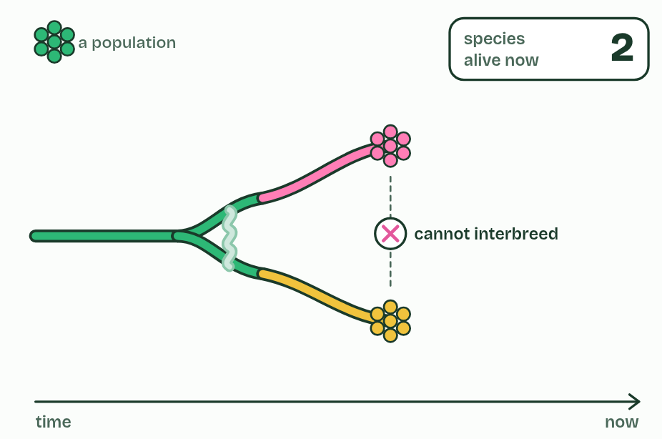
CHAPTER 5 · A4.1.6 Speciation
3 / 6
New species arise only by splitting
Each population changes separately until they cannot interbreed: two species.
Minutes 5 to 15
Notes:
Minutes 5 to 15 of 60: Splits add, extinctions take away (10 min).
The plan: Play chapter 5's figure and keep the species counter in view. Stop at step 4 and ask whether the count should go up. Then the snail predict box.
A species, in the definition biologists use most, is a group of organisms that can interbreed and produce fertile offspring. Its populations share one pool of alleles, because individuals move and mate between them.
Speciation happens when that sharing stops. Split a species into two populations that no longer interbreed and each changes in its own way: different mutations, different chance events, different selection. Given long enough, they differ so much that they could not interbreed even if they met again. One species has become two.
Every new species has appeared like this, by splitting from one that already existed. Speciation adds to the number of species on Earth and extinction takes species away; the diversity alive today is the balance of the two.
Example: Where the definition struggles Organisms that reproduce asexually, like bacteria, do not interbreed, and fossils cannot be tested, so these are grouped by their characteristics and sequences instead. And because splitting takes time, some pairs of populations are part-way: they interbreed a little where they meet, and whether they count as one species or two is a judgement.

Slide 7
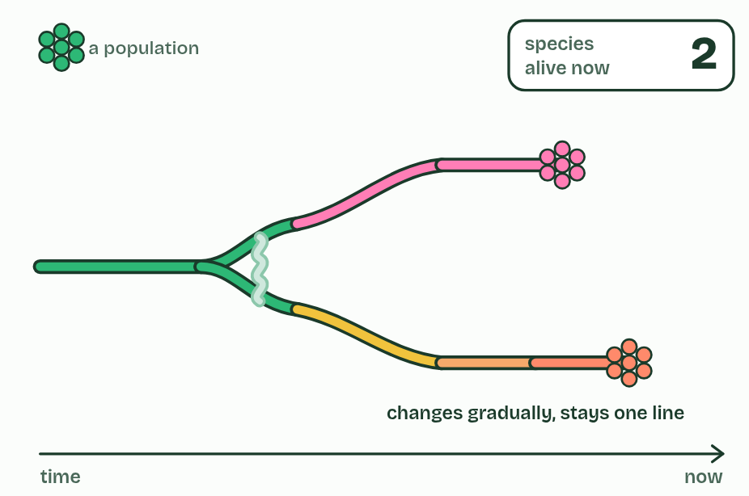
CHAPTER 5 · A4.1.6 Speciation
4 / 6
New species arise only by splitting
The lower species changes gradually but never splits: still one species, so the count stays at two.
Minutes 5 to 15
Notes:
Minutes 5 to 15 of 60: Splits add, extinctions take away (10 min).
The plan: Play chapter 5's figure and keep the species counter in view. Stop at step 4 and ask whether the count should go up. Then the snail predict box.
A species, in the definition biologists use most, is a group of organisms that can interbreed and produce fertile offspring. Its populations share one pool of alleles, because individuals move and mate between them.
Speciation happens when that sharing stops. Split a species into two populations that no longer interbreed and each changes in its own way: different mutations, different chance events, different selection. Given long enough, they differ so much that they could not interbreed even if they met again. One species has become two.
Every new species has appeared like this, by splitting from one that already existed. Speciation adds to the number of species on Earth and extinction takes species away; the diversity alive today is the balance of the two.
Example: Where the definition struggles Organisms that reproduce asexually, like bacteria, do not interbreed, and fossils cannot be tested, so these are grouped by their characteristics and sequences instead. And because splitting takes time, some pairs of populations are part-way: they interbreed a little where they meet, and whether they count as one species or two is a judgement.

Slide 8
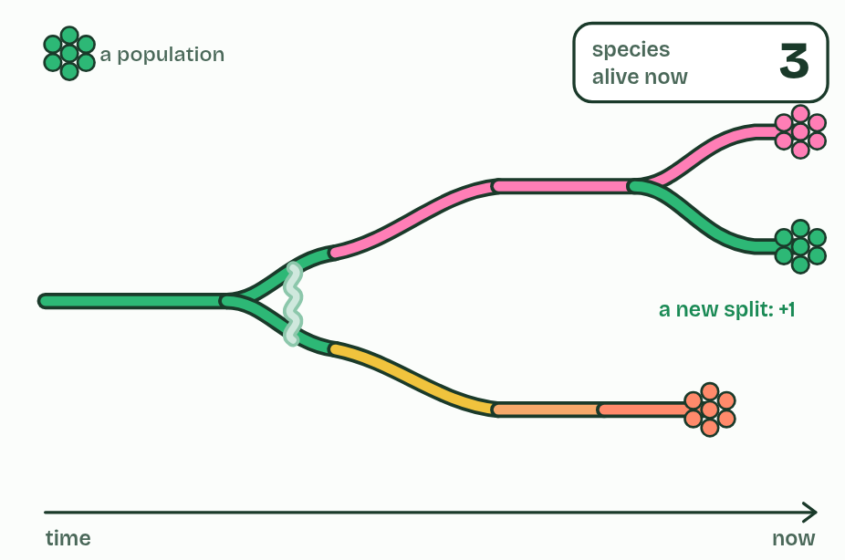
CHAPTER 5 · A4.1.6 Speciation
5 / 6
New species arise only by splitting
The upper species splits again: three.
Minutes 5 to 15
Notes:
Minutes 5 to 15 of 60: Splits add, extinctions take away (10 min).
The plan: Play chapter 5's figure and keep the species counter in view. Stop at step 4 and ask whether the count should go up. Then the snail predict box.
A species, in the definition biologists use most, is a group of organisms that can interbreed and produce fertile offspring. Its populations share one pool of alleles, because individuals move and mate between them.
Speciation happens when that sharing stops. Split a species into two populations that no longer interbreed and each changes in its own way: different mutations, different chance events, different selection. Given long enough, they differ so much that they could not interbreed even if they met again. One species has become two.
Every new species has appeared like this, by splitting from one that already existed. Speciation adds to the number of species on Earth and extinction takes species away; the diversity alive today is the balance of the two.
Example: Where the definition struggles Organisms that reproduce asexually, like bacteria, do not interbreed, and fossils cannot be tested, so these are grouped by their characteristics and sequences instead. And because splitting takes time, some pairs of populations are part-way: they interbreed a little where they meet, and whether they count as one species or two is a judgement.

Slide 9
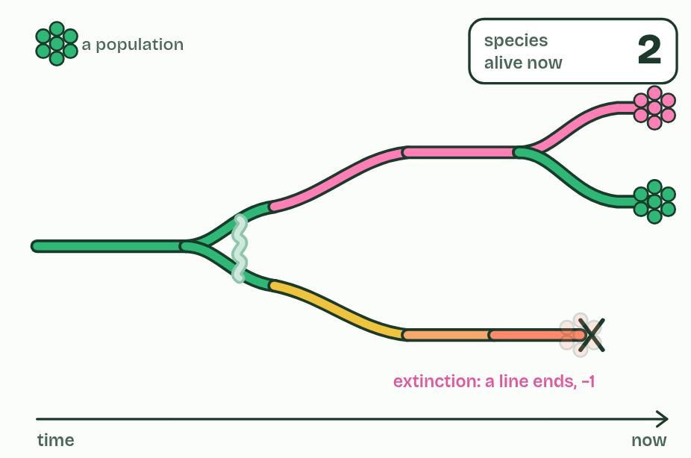
CHAPTER 5 · A4.1.6 Speciation
6 / 6
New species arise only by splitting
The lower species dies out: extinction takes the count back to two.
Minutes 5 to 15
Notes:
Minutes 5 to 15 of 60: Splits add, extinctions take away (10 min).
The plan: Play chapter 5's figure and keep the species counter in view. Stop at step 4 and ask whether the count should go up. Then the snail predict box.
A species, in the definition biologists use most, is a group of organisms that can interbreed and produce fertile offspring. Its populations share one pool of alleles, because individuals move and mate between them.
Speciation happens when that sharing stops. Split a species into two populations that no longer interbreed and each changes in its own way: different mutations, different chance events, different selection. Given long enough, they differ so much that they could not interbreed even if they met again. One species has become two.
Every new species has appeared like this, by splitting from one that already existed. Speciation adds to the number of species on Earth and extinction takes species away; the diversity alive today is the balance of the two.
Example: Where the definition struggles Organisms that reproduce asexually, like bacteria, do not interbreed, and fossils cannot be tested, so these are grouped by their characteristics and sequences instead. And because splitting takes time, some pairs of populations are part-way: they interbreed a little where they meet, and whether they count as one species or two is a judgement.

Slide 10
CHAPTER 5 · A4.1.6 Speciation
New species arise only by splitting
A species, in the definition biologists use most, is a group of organisms that can interbreed and produce fertile offspring.
Speciation happens when that sharing stops.
Split a species into two populations that no longer interbreed and each changes in its own way: different mutations, different chance events, different selection.
One species has become two.
Minutes 5 to 15
Notes:
Minutes 5 to 15 of 60: Splits add, extinctions take away (10 min).
The plan: Play chapter 5's figure and keep the species counter in view. Stop at step 4 and ask whether the count should go up. Then the snail predict box.
A species, in the definition biologists use most, is a group of organisms that can interbreed and produce fertile offspring. Its populations share one pool of alleles, because individuals move and mate between them.
Speciation happens when that sharing stops. Split a species into two populations that no longer interbreed and each changes in its own way: different mutations, different chance events, different selection. Given long enough, they differ so much that they could not interbreed even if they met again. One species has become two.
Every new species has appeared like this, by splitting from one that already existed. Speciation adds to the number of species on Earth and extinction takes species away; the diversity alive today is the balance of the two.
Example: Where the definition struggles Organisms that reproduce asexually, like bacteria, do not interbreed, and fossils cannot be tested, so these are grouped by their characteristics and sequences instead. And because splitting takes time, some pairs of populations are part-way: they interbreed a little where they meet, and whether they count as one species or two is a judgement.

Slide 11
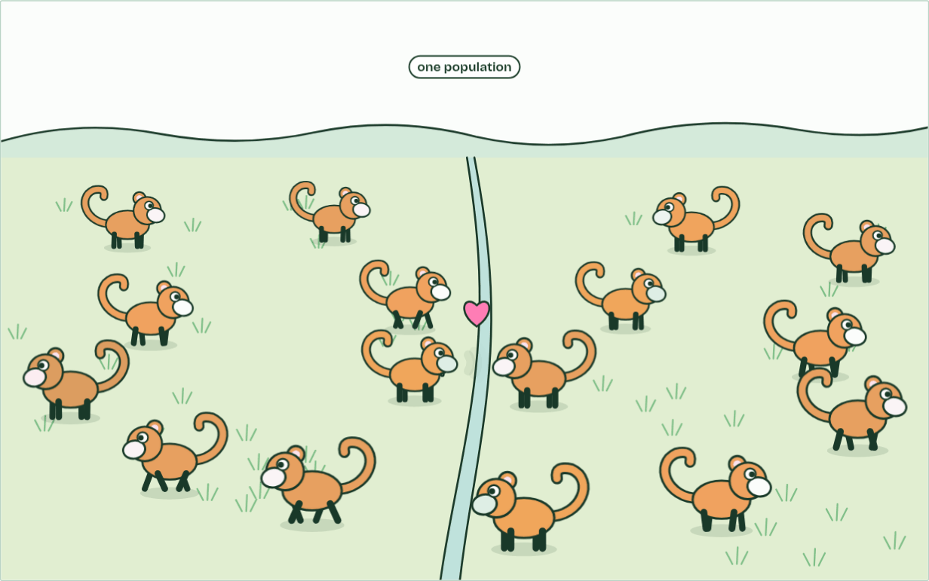
CHAPTER 5 · A4.1.6 Speciation
1 population
1 / 3
New species arise only by splitting
One population: any two can meet and mate, so genes flow across the valley.
Minutes 5 to 15
Notes:
Minutes 5 to 15 of 60: Splits add, extinctions take away (10 min).
The plan: Play chapter 5's figure and keep the species counter in view. Stop at step 4 and ask whether the count should go up. Then the snail predict box.
A species, in the definition biologists use most, is a group of organisms that can interbreed and produce fertile offspring. Its populations share one pool of alleles, because individuals move and mate between them.
Speciation happens when that sharing stops. Split a species into two populations that no longer interbreed and each changes in its own way: different mutations, different chance events, different selection. Given long enough, they differ so much that they could not interbreed even if they met again. One species has become two.
Every new species has appeared like this, by splitting from one that already existed. Speciation adds to the number of species on Earth and extinction takes species away; the diversity alive today is the balance of the two.
Example: Where the definition struggles Organisms that reproduce asexually, like bacteria, do not interbreed, and fossils cannot be tested, so these are grouped by their characteristics and sequences instead. And because splitting takes time, some pairs of populations are part-way: they interbreed a little where they meet, and whether they count as one species or two is a judgement.
The animation "Watch it happen: one population becomes two", paused at 2.0 s. The next slides go on through it, then play it.

Slide 12
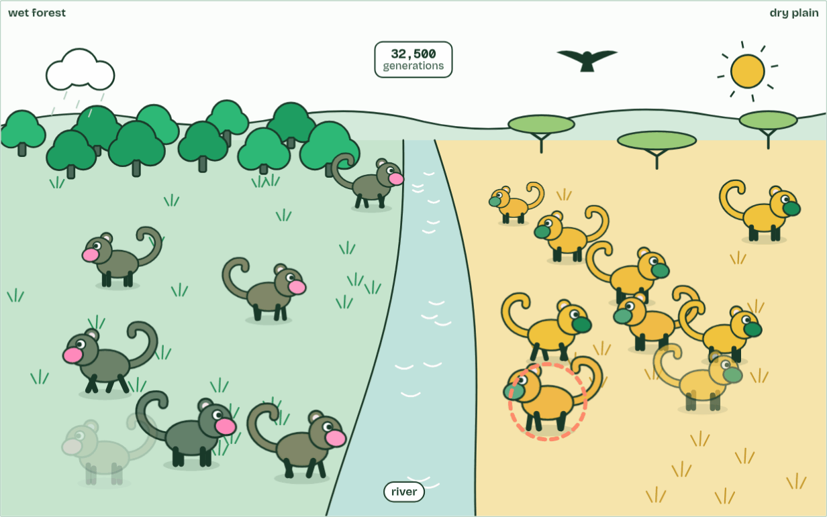
CHAPTER 5 · A4.1.6 Speciation
generation 32,500
2 / 3
New species arise only by splitting
Different selection each side: coats match the ground, displays drift apart.
Minutes 5 to 15
Notes:
Minutes 5 to 15 of 60: Splits add, extinctions take away (10 min).
The plan: Play chapter 5's figure and keep the species counter in view. Stop at step 4 and ask whether the count should go up. Then the snail predict box.
A species, in the definition biologists use most, is a group of organisms that can interbreed and produce fertile offspring. Its populations share one pool of alleles, because individuals move and mate between them.
Speciation happens when that sharing stops. Split a species into two populations that no longer interbreed and each changes in its own way: different mutations, different chance events, different selection. Given long enough, they differ so much that they could not interbreed even if they met again. One species has become two.
Every new species has appeared like this, by splitting from one that already existed. Speciation adds to the number of species on Earth and extinction takes species away; the diversity alive today is the balance of the two.
Example: Where the definition struggles Organisms that reproduce asexually, like bacteria, do not interbreed, and fossils cannot be tested, so these are grouped by their characteristics and sequences instead. And because splitting takes time, some pairs of populations are part-way: they interbreed a little where they meet, and whether they count as one species or two is a judgement.
The animation "Watch it happen: one population becomes two", paused at 11.8 s. The next slides go on through it, then play it.

Slide 13
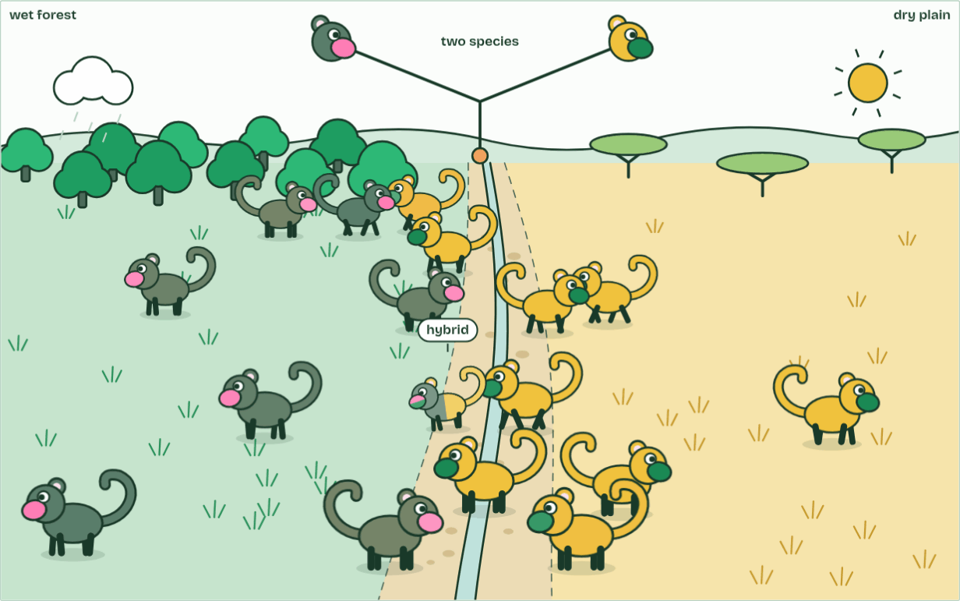
CHAPTER 5 · A4.1.6 Speciation
2 species
3 / 3
New species arise only by splitting
Hybrids are rare, weak and often sterile, so the two never merge: two species.
Minutes 5 to 15
Notes:
Minutes 5 to 15 of 60: Splits add, extinctions take away (10 min).
The plan: Play chapter 5's figure and keep the species counter in view. Stop at step 4 and ask whether the count should go up. Then the snail predict box.
A species, in the definition biologists use most, is a group of organisms that can interbreed and produce fertile offspring. Its populations share one pool of alleles, because individuals move and mate between them.
Speciation happens when that sharing stops. Split a species into two populations that no longer interbreed and each changes in its own way: different mutations, different chance events, different selection. Given long enough, they differ so much that they could not interbreed even if they met again. One species has become two.
Every new species has appeared like this, by splitting from one that already existed. Speciation adds to the number of species on Earth and extinction takes species away; the diversity alive today is the balance of the two.
Example: Where the definition struggles Organisms that reproduce asexually, like bacteria, do not interbreed, and fossils cannot be tested, so these are grouped by their characteristics and sequences instead. And because splitting takes time, some pairs of populations are part-way: they interbreed a little where they meet, and whether they count as one species or two is a judgement.
The animation "Watch it happen: one population becomes two", paused at 20.6 s. The next slides go on through it, then play it.

Slide 14
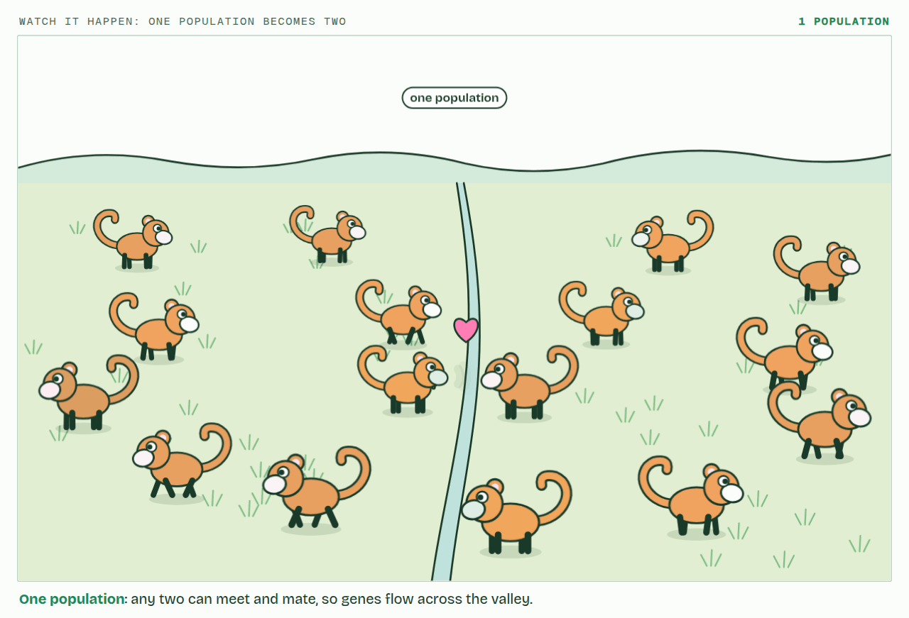
CHAPTER 5 · A4.1.6 Speciation
PLAY IT
New species arise only by splitting
Watch it happen: one population becomes two: click to play. It loops every 23 seconds.
Minutes 5 to 15
Notes:
Minutes 5 to 15 of 60: Splits add, extinctions take away (10 min).
The plan: Play chapter 5's figure and keep the species counter in view. Stop at step 4 and ask whether the count should go up. Then the snail predict box.
The video is split.mp4, one loop of the animation in the guide. It plays in PowerPoint and Keynote. Google Slides does not play a video embedded in a .pptx: download split.mp4 (https://www.biologybybradford.com/guides/downloads/scenes/split.mp4), upload it to Google Drive, then Insert > Video > Google Drive.
In the guide the class can change it as it runs: https://www.biologybybradford.com/guides/ib-biology-a4-1-evolution-and-speciation#splitting
What it shows, in order:
1. One population: any two can meet and mate, so genes flow across the valley.
2. Different selection each side: coats match the ground, displays drift apart.
3. Hybrids are rare, weak and often sterile, so the two never merge: two species.

Slide 15
PREDICT
A line of snails changes its shell shape steadily for two million years and never splits. The oldest and newest shells look so different that fossil experts give them different names. How many species has the line added to the Earth?
A One: the oldest and newest shells now carry different names
B None: at every moment there was still only one species
C It depends on how different the oldest and newest shells look
Minutes 5 to 15
Notes:
Minutes 5 to 15 of 60: Splits add, extinctions take away (10 min).
The plan: Play chapter 5's figure and keep the species counter in view. Stop at step 4 and ask whether the count should go up. Then the snail predict box.
Ask for a show of hands, or mini whiteboards, before revealing. (Answer: B, on the next slide.)

Slide 16
WHAT HAPPENS
A line of snails changes its shell shape steadily for two million years and never splits. The oldest and newest shells look so different that fossil experts give them different names. How many species has the line added to the Earth?
A One: the oldest and newest shells now carry different names
B None: at every moment there was still only one species
C It depends on how different the oldest and newest shells look
None. At every moment there was one species of these snails, so the count never went up. The two names are a convenience for describing change along one line. Gradual change within one line is evolution, but only a split adds a species.
Minutes 5 to 15
Notes:
Minutes 5 to 15 of 60: Splits add, extinctions take away (10 min).
The plan: Play chapter 5's figure and keep the species counter in view. Stop at step 4 and ask whether the count should go up. Then the snail predict box.
Answer: B. None. At every moment there was one species of these snails, so the count never went up. The two names are a convenience for describing change along one line. Gradual change within one line is evolution, but only a split adds a species.

Slide 17
WATCH OUT
A species that changes gradually without splitting is still one line. It has evolved, but no species has been added, so that is not speciation. Play the figure to step 4.
Minutes 5 to 15
Notes:
Minutes 5 to 15 of 60: Splits add, extinctions take away (10 min).
The plan: Play chapter 5's figure and keep the species counter in view. Stop at step 4 and ask whether the count should go up. Then the snail predict box.
A common mistake: say it, then ask who can say why it is wrong.

Slide 18
STEP 3
10 MIN
Storyboard: from one gene pool to two
Four panels, drawn by each student with no notes: one population; a barrier; each side changing differently; the barrier gone and the two unable to interbreed.
Minutes 15 to 25
Notes:
Minutes 15 to 25 of 60: Storyboard: from one gene pool to two (10 min).
The plan: Four panels, drawn by each student with no notes: one population; a barrier; each side changing differently; the barrier gone and the two unable to interbreed. A caption under each panel must use one of: gene flow, differential selection, mutation, genetic drift.

Slide 19
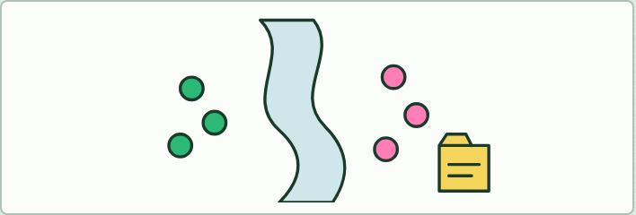
RESEARCH AND WRITING
25 MIN
The river case file
THE TASK
Each group gets evidence cards: the map; where gorillas live; food on each bank; group behaviour; body differences; the genetic estimate of 1 to 2 million years; the traces of later crossings. They write a one-page case file under five headings: the barrier, the two populations, what differed on each side, how they diverged, and what is still uncertain. The last heading is the point: good science says how sure it is.
STUDENTS NEED
Chapter 6 on screen; evidence cards; A3 paper.
Minutes 25 to 50
Notes:
Minutes 25 to 50 of 60: The river case file (25 min).
The plan: The activity below: groups build a one-page case file on the bonobos and chimpanzees from evidence cards, including what is still uncertain. Play chapter 6's map first.
The activity: The river case file. Each group gets evidence cards: the map; where gorillas live; food on each bank; group behaviour; body differences; the genetic estimate of 1 to 2 million years; the traces of later crossings. They write a one-page case file under five headings: the barrier, the two populations, what differed on each side, how they diverged, and what is still uncertain. The last heading is the point: good science says how sure it is.
Needs: chapter 6 on screen; evidence cards; A3 paper.
The time: 25 minutes, minutes 25 to 50 of the plan.

Slide 20
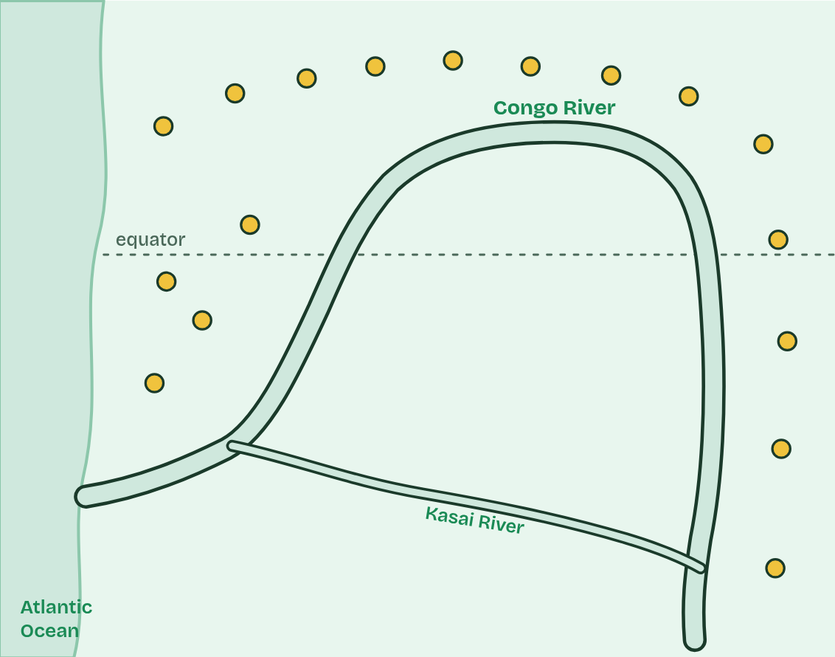
CHAPTER 6 · A4.1.7 Reproductive isolation and differential selection
1 / 5
One river, two apes
Long ago: one population of ancestral apes, north of the Congo River.
Minutes 25 to 50
Notes:
Minutes 25 to 50 of 60: The river case file (25 min).
The plan: The activity below: groups build a one-page case file on the bonobos and chimpanzees from evidence cards, including what is still uncertain. Play chapter 6's map first.
Speciation needs two things. First, reproductive isolation: the populations must stop interbreeding, so alleles no longer pass between them. A sea, a mountain range or a river can do it: geographical isolation. Second, differential selection: different conditions on each side favour different characteristics, so the populations diverge. New mutations and chance (genetic drift), different on each side, add to it.
The Congo River is a real case. Common chimpanzees live north of it and beyond its upper reaches; bonobos live only in the forests south of its great bend. Neither ape can swim, and the river is wide and deep. Genetic evidence suggests their ancestors were divided roughly 1 to 2 million years ago, perhaps when a few reached the south bank during a dry spell and were then cut off.
South of the river there are no gorillas, and plants on the forest floor, which the apes eat when fruit is scarce, are plentiful. North of it, chimpanzees share the forest with gorillas and food is patchier. One widely held explanation is that these differences selected for different behaviour: bonobos live in large, calm groups in which females form strong alliances, while chimpanzee groups are led by males and compete more fiercely. Their bodies differ too: bonobos are more slender, with longer legs and smaller skulls.
Example: How clean was the split? Their genomes show that a few apes did cross the river long after the split, a few hundred thousand years ago, but too rarely to stop the two populations diverging.

Slide 21
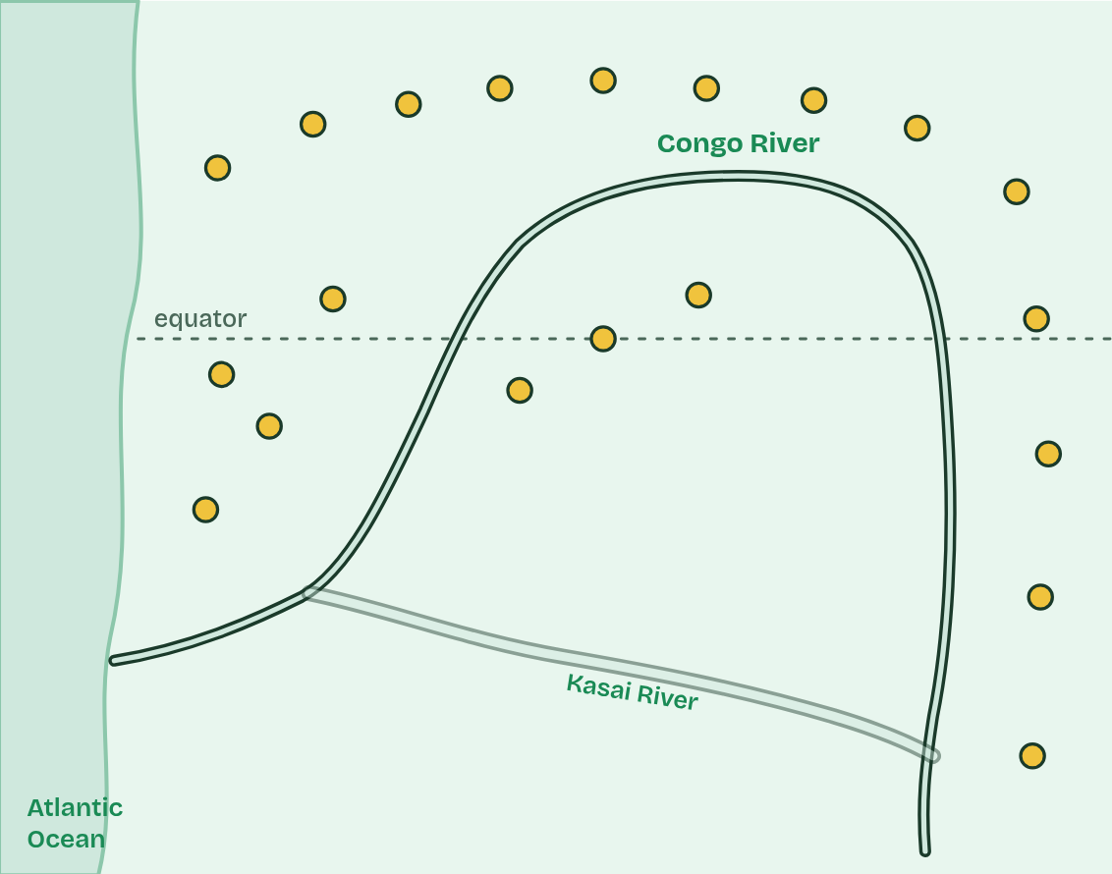
CHAPTER 6 · A4.1.7 Reproductive isolation and differential selection
2 / 5
One river, two apes
Perhaps in a dry spell, the river runs low and a few apes reach the south bank.
Minutes 25 to 50
Notes:
Minutes 25 to 50 of 60: The river case file (25 min).
The plan: The activity below: groups build a one-page case file on the bonobos and chimpanzees from evidence cards, including what is still uncertain. Play chapter 6's map first.
Speciation needs two things. First, reproductive isolation: the populations must stop interbreeding, so alleles no longer pass between them. A sea, a mountain range or a river can do it: geographical isolation. Second, differential selection: different conditions on each side favour different characteristics, so the populations diverge. New mutations and chance (genetic drift), different on each side, add to it.
The Congo River is a real case. Common chimpanzees live north of it and beyond its upper reaches; bonobos live only in the forests south of its great bend. Neither ape can swim, and the river is wide and deep. Genetic evidence suggests their ancestors were divided roughly 1 to 2 million years ago, perhaps when a few reached the south bank during a dry spell and were then cut off.
South of the river there are no gorillas, and plants on the forest floor, which the apes eat when fruit is scarce, are plentiful. North of it, chimpanzees share the forest with gorillas and food is patchier. One widely held explanation is that these differences selected for different behaviour: bonobos live in large, calm groups in which females form strong alliances, while chimpanzee groups are led by males and compete more fiercely. Their bodies differ too: bonobos are more slender, with longer legs and smaller skulls.
Example: How clean was the split? Their genomes show that a few apes did cross the river long after the split, a few hundred thousand years ago, but too rarely to stop the two populations diverging.

Slide 22
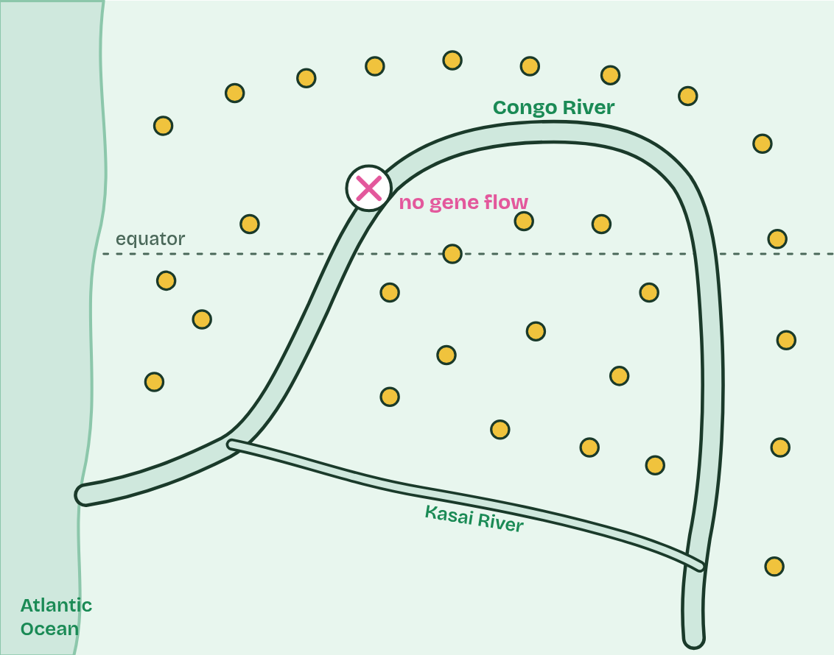
CHAPTER 6 · A4.1.7 Reproductive isolation and differential selection
3 / 5
One river, two apes
The water rises. Neither side can cross: no gene flow between the populations.
Minutes 25 to 50
Notes:
Minutes 25 to 50 of 60: The river case file (25 min).
The plan: The activity below: groups build a one-page case file on the bonobos and chimpanzees from evidence cards, including what is still uncertain. Play chapter 6's map first.
Speciation needs two things. First, reproductive isolation: the populations must stop interbreeding, so alleles no longer pass between them. A sea, a mountain range or a river can do it: geographical isolation. Second, differential selection: different conditions on each side favour different characteristics, so the populations diverge. New mutations and chance (genetic drift), different on each side, add to it.
The Congo River is a real case. Common chimpanzees live north of it and beyond its upper reaches; bonobos live only in the forests south of its great bend. Neither ape can swim, and the river is wide and deep. Genetic evidence suggests their ancestors were divided roughly 1 to 2 million years ago, perhaps when a few reached the south bank during a dry spell and were then cut off.
South of the river there are no gorillas, and plants on the forest floor, which the apes eat when fruit is scarce, are plentiful. North of it, chimpanzees share the forest with gorillas and food is patchier. One widely held explanation is that these differences selected for different behaviour: bonobos live in large, calm groups in which females form strong alliances, while chimpanzee groups are led by males and compete more fiercely. Their bodies differ too: bonobos are more slender, with longer legs and smaller skulls.
Example: How clean was the split? Their genomes show that a few apes did cross the river long after the split, a few hundred thousand years ago, but too rarely to stop the two populations diverging.

Slide 23
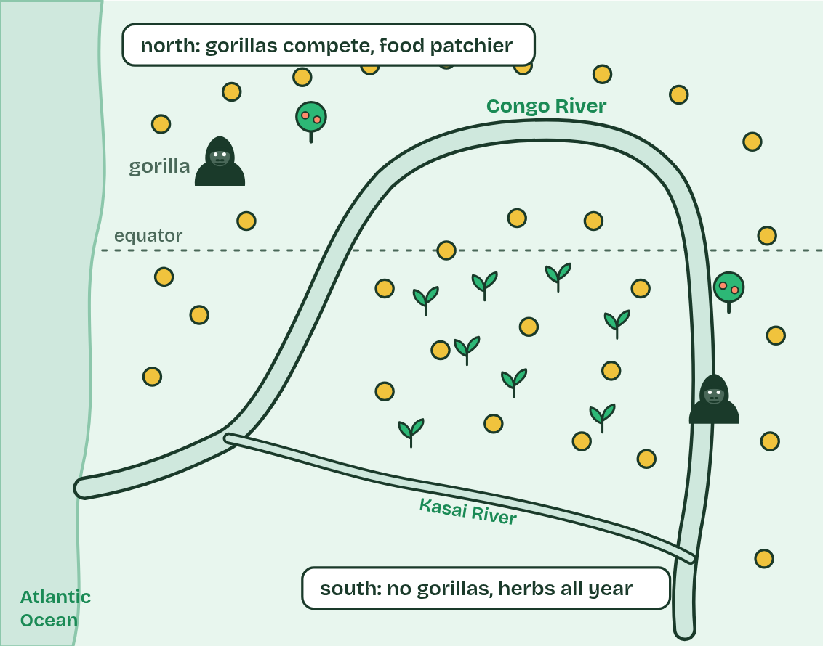
CHAPTER 6 · A4.1.7 Reproductive isolation and differential selection
4 / 5
One river, two apes
Different conditions on each bank: differential selection favours different behaviour and bodies.
Minutes 25 to 50
Notes:
Minutes 25 to 50 of 60: The river case file (25 min).
The plan: The activity below: groups build a one-page case file on the bonobos and chimpanzees from evidence cards, including what is still uncertain. Play chapter 6's map first.
Speciation needs two things. First, reproductive isolation: the populations must stop interbreeding, so alleles no longer pass between them. A sea, a mountain range or a river can do it: geographical isolation. Second, differential selection: different conditions on each side favour different characteristics, so the populations diverge. New mutations and chance (genetic drift), different on each side, add to it.
The Congo River is a real case. Common chimpanzees live north of it and beyond its upper reaches; bonobos live only in the forests south of its great bend. Neither ape can swim, and the river is wide and deep. Genetic evidence suggests their ancestors were divided roughly 1 to 2 million years ago, perhaps when a few reached the south bank during a dry spell and were then cut off.
South of the river there are no gorillas, and plants on the forest floor, which the apes eat when fruit is scarce, are plentiful. North of it, chimpanzees share the forest with gorillas and food is patchier. One widely held explanation is that these differences selected for different behaviour: bonobos live in large, calm groups in which females form strong alliances, while chimpanzee groups are led by males and compete more fiercely. Their bodies differ too: bonobos are more slender, with longer legs and smaller skulls.
Example: How clean was the split? Their genomes show that a few apes did cross the river long after the split, a few hundred thousand years ago, but too rarely to stop the two populations diverging.

Slide 24
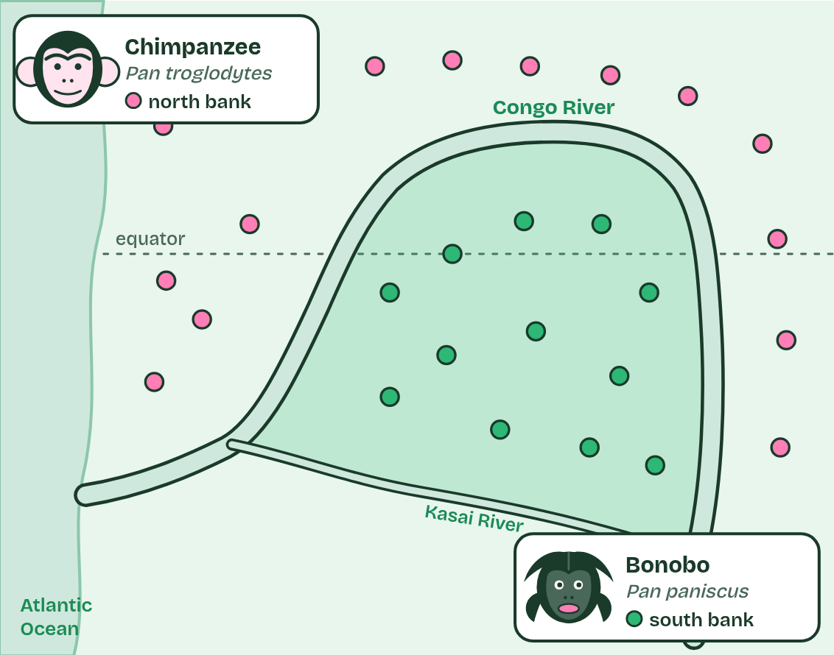
CHAPTER 6 · A4.1.7 Reproductive isolation and differential selection
5 / 5
One river, two apes
Over about 1 to 2 million years they diverge into two species: chimpanzees north, bonobos south.
Minutes 25 to 50
Notes:
Minutes 25 to 50 of 60: The river case file (25 min).
The plan: The activity below: groups build a one-page case file on the bonobos and chimpanzees from evidence cards, including what is still uncertain. Play chapter 6's map first.
Speciation needs two things. First, reproductive isolation: the populations must stop interbreeding, so alleles no longer pass between them. A sea, a mountain range or a river can do it: geographical isolation. Second, differential selection: different conditions on each side favour different characteristics, so the populations diverge. New mutations and chance (genetic drift), different on each side, add to it.
The Congo River is a real case. Common chimpanzees live north of it and beyond its upper reaches; bonobos live only in the forests south of its great bend. Neither ape can swim, and the river is wide and deep. Genetic evidence suggests their ancestors were divided roughly 1 to 2 million years ago, perhaps when a few reached the south bank during a dry spell and were then cut off.
South of the river there are no gorillas, and plants on the forest floor, which the apes eat when fruit is scarce, are plentiful. North of it, chimpanzees share the forest with gorillas and food is patchier. One widely held explanation is that these differences selected for different behaviour: bonobos live in large, calm groups in which females form strong alliances, while chimpanzee groups are led by males and compete more fiercely. Their bodies differ too: bonobos are more slender, with longer legs and smaller skulls.
Example: How clean was the split? Their genomes show that a few apes did cross the river long after the split, a few hundred thousand years ago, but too rarely to stop the two populations diverging.

Slide 25
CHAPTER 6 · A4.1.7 Reproductive isolation and differential selection
One river, two apes
First, reproductive isolation: the populations must stop interbreeding, so alleles no longer pass between them.
A sea, a mountain range or a river can do it: geographical isolation.
Second, differential selection: different conditions on each side favour different characteristics, so the populations diverge.
Minutes 25 to 50
Notes:
Minutes 25 to 50 of 60: The river case file (25 min).
The plan: The activity below: groups build a one-page case file on the bonobos and chimpanzees from evidence cards, including what is still uncertain. Play chapter 6's map first.
Speciation needs two things. First, reproductive isolation: the populations must stop interbreeding, so alleles no longer pass between them. A sea, a mountain range or a river can do it: geographical isolation. Second, differential selection: different conditions on each side favour different characteristics, so the populations diverge. New mutations and chance (genetic drift), different on each side, add to it.
The Congo River is a real case. Common chimpanzees live north of it and beyond its upper reaches; bonobos live only in the forests south of its great bend. Neither ape can swim, and the river is wide and deep. Genetic evidence suggests their ancestors were divided roughly 1 to 2 million years ago, perhaps when a few reached the south bank during a dry spell and were then cut off.
South of the river there are no gorillas, and plants on the forest floor, which the apes eat when fruit is scarce, are plentiful. North of it, chimpanzees share the forest with gorillas and food is patchier. One widely held explanation is that these differences selected for different behaviour: bonobos live in large, calm groups in which females form strong alliances, while chimpanzee groups are led by males and compete more fiercely. Their bodies differ too: bonobos are more slender, with longer legs and smaller skulls.
Example: How clean was the split? Their genomes show that a few apes did cross the river long after the split, a few hundred thousand years ago, but too rarely to stop the two populations diverging.

Slide 26
PREDICT
Suppose the river had divided the apes but the forests on both banks were identical. What would you expect after a million years?
A No differences at all: without selection, nothing in them would change
B Some differences, from mutation and drift, but less divergence
C Just as much divergence: isolation on its own does all the work
Minutes 25 to 50
Notes:
Minutes 25 to 50 of 60: The river case file (25 min).
The plan: The activity below: groups build a one-page case file on the bonobos and chimpanzees from evidence cards, including what is still uncertain. Play chapter 6's map first.
Ask for a show of hands, or mini whiteboards, before revealing. (Answer: B, on the next slide.)

Slide 27
WHAT HAPPENS
Suppose the river had divided the apes but the forests on both banks were identical. What would you expect after a million years?
A No differences at all: without selection, nothing in them would change
B Some differences, from mutation and drift, but less divergence
C Just as much divergence: isolation on its own does all the work
Some differences. Mutations and drift still differ on each side, so the populations slowly drift apart, but with no differential selection nothing pushes them in different directions. Try it in the dry lab: the control has the same food on both islands.
Minutes 25 to 50
Notes:
Minutes 25 to 50 of 60: The river case file (25 min).
The plan: The activity below: groups build a one-page case file on the bonobos and chimpanzees from evidence cards, including what is still uncertain. Play chapter 6's map first.
Answer: B. Some differences. Mutations and drift still differ on each side, so the populations slowly drift apart, but with no differential selection nothing pushes them in different directions. Try it in the dry lab: the control has the same food on both islands.

Slide 28
WATCH OUT
The river did not make the apes change. It stopped gene flow. Different selection on each side, with mutation and chance, did the changing.
Minutes 25 to 50
Notes:
Minutes 25 to 50 of 60: The river case file (25 min).
The plan: The activity below: groups build a one-page case file on the bonobos and chimpanzees from evidence cards, including what is still uncertain. Play chapter 6's map first.
A common mistake: say it, then ask who can say why it is wrong.

Slide 29
PLENARY
Exam question, timed
A written question on speciation from the A4.1 exam maker, such as the one on bonobos and chimpanzees, in 8 minutes, then peer-marked against the markscheme.
Minutes 50 to 60
Notes:
Minutes 50 to 60 of 60: Exam question, timed (10 min).
The plan: A written question on speciation from the A4.1 exam maker (in Practise and revise, below), such as the one on bonobos and chimpanzees, in 8 minutes, then peer-marked against the markscheme. Point out that the markscheme has more points than marks. For homework, the Check step: a fresh paper on A4.1 from the exam bank, marked as students go.

Slide 30
EXIT QUESTION
Before you go
On paper, on your own: Explain how reproductive isolation and differential selection split bonobos from common chimpanzees.
Minutes 50 to 60
Notes:
Minutes 50 to 60 of 60: Exam question, timed (10 min).
The plan: A written question on speciation from the A4.1 exam maker (in Practise and revise, below), such as the one on bonobos and chimpanzees, in 8 minutes, then peer-marked against the markscheme. Point out that the markscheme has more points than marks. For homework, the Check step: a fresh paper on A4.1 from the exam bank, marked as students go.
Collect the slips: they say where to start next lesson.

Slide 31
PRACTISE AND REVISE
Keep going
Exam practice: a fresh paper of exam questions on A4.1 at standard level, marked as you go
The guide, with the animations and the dry lab
This lesson in the guide: 5 New species arise only by splitting, 6 One river, two apes
BUILD FOR YOUR CLASS
ALREADY ON THE SITE FOR A4.1
CARD SETS ON SPLYCR
Tarsia puzzle, dominoes and picture reveal on A4.1, built from its key terms and ready to print
A pub quiz with rounds on A4.1, to present or run with no projector
An escape room built from the question bank on A4.1
Quiz: Evolution & Speciation
Revision map: A4.1 Evolution and speciation, to fill in
Exam questions: A4.1 in the exam maker, a paper with its markscheme
Open a set to host it as a class game, or make a copy to edit.
A4.1 Evolution and Speciation (SL)
How this was made. The course structure, the activities and the teaching choices come from my own classroom, my presentations and my years of teaching IB and AP Biology. I use Claude, an AI, to help write and build the interactive guides, lesson plans, slides and practice questions, and to draw the diagrams and code the interactives. I direct the work and review it against the IB and AP specifications before it goes live.
Minute 60: after the lesson
Notes:
Every link here is live. Set the exam practice paper for homework: it is fresh each time, marked as students go and saved to their Exam practice when they are signed in.
Exam practice: https://www.biologybybradford.com/exam-maker/sit?topics=A4.1&level=SL&paper=quiz&marks=15&src=ep
The guide: https://www.biologybybradford.com/guides/ib-biology-a4-1-evolution-and-speciation

