Slide 1
IB Biology A4.1
LESSON 4 OF 5
BY THE END YOU CAN
Evolution and speciation
Explain why splitting is the only way new species arise, and why gradual change in one line is not speciation (A4.1.6)
Explain how reproductive isolation and differential selection split bonobos from common chimpanzees (A4.1.7)
The island dry lab
A4.1.6 to A4.1.8
The finches dry lab: what isolation, gene flow and population size do to two populations
60 minutes · chapters 5, 6 · the dry lab
Minute 0
Notes:
IB Biology A4.1, Evolution and speciation. Lesson 4 of 5: The island dry lab, 60 minutes.
The plan, minute by minute (each slide's footer says where you are):
0 to 5 min (5) The question
5 to 20 min (15) Control against split
20 to 35 min (15) How much gene flow undoes it?
35 to 45 min (10) Small against large
45 to 60 min (15) What it shows
Stretch and support:
Support: the three mnemonics (Dragons Breathe Heat; Hungry Rats Chew My Pencils; Grumpy Birds Tweet) as a starter on each lesson.
Stretch: in the dry lab, find settings that give a split on one island and explain why mate choice is needed.
The lesson plan to print: https://www.biologybybradford.com/guides/downloads/ib-biology-a4-1-evolution-and-speciation-lesson-4-plan.pdf

Slide 2
DO NOW
The question
What does it take to turn one population into two species?
Name the independent, dependent and controlled variables together before anyone touches a slider.
5:00
minutes
Start now: the timer is running.
Minutes 0 to 5
Notes:
Minutes 0 to 5 of 60: The question (5 min).
The plan: What does it take to turn one population into two species? Name the independent, dependent and controlled variables together before anyone touches a slider.
Start a 5 minute timer as they come in.

Slide 3
STEP 2
15 MIN
Control against split
Pairs run the control (same food both sides) three times and the split with very different food three times, recording the isolation index each time.
Why repeat?
Minutes 5 to 20
Notes:
Minutes 5 to 20 of 60: Control against split (15 min).
The plan: Pairs run the control (same food both sides) three times and the split with very different food three times, recording the isolation index each time. Why repeat? Because the runs scatter, as real populations do.

Slide 4
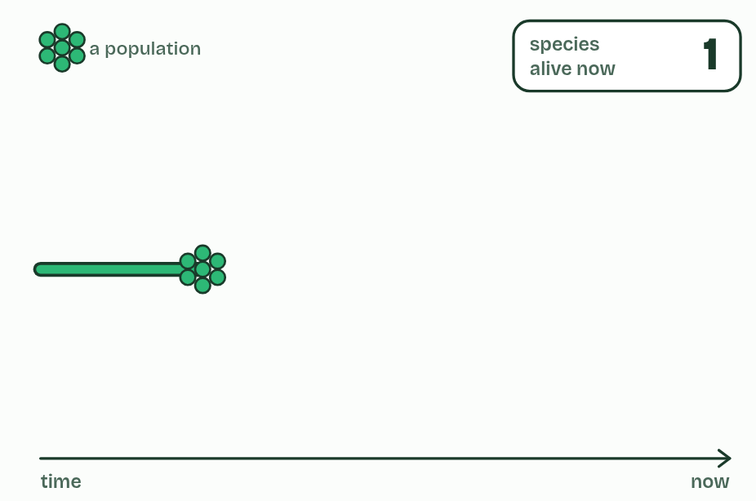
CHAPTER 5 · A4.1.6 Speciation
1 / 6
New species arise only by splitting
One species: every population can interbreed with every other.
Minutes 5 to 20
Notes:
Minutes 5 to 20 of 60: Control against split (15 min).
The plan: Pairs run the control (same food both sides) three times and the split with very different food three times, recording the isolation index each time. Why repeat? Because the runs scatter, as real populations do.
A species, in the definition biologists use most, is a group of organisms that can interbreed and produce fertile offspring. Its populations share one pool of alleles, because individuals move and mate between them.
Speciation happens when that sharing stops. Split a species into two populations that no longer interbreed and each changes in its own way: different mutations, different chance events, different selection. Given long enough, they differ so much that they could not interbreed even if they met again. One species has become two.
Every new species has appeared like this, by splitting from one that already existed. Speciation adds to the number of species on Earth and extinction takes species away; the diversity alive today is the balance of the two.
Example: Where the definition struggles Organisms that reproduce asexually, like bacteria, do not interbreed, and fossils cannot be tested, so these are grouped by their characteristics and sequences instead. And because splitting takes time, some pairs of populations are part-way: they interbreed a little where they meet, and whether they count as one species or two is a judgement.

Slide 5
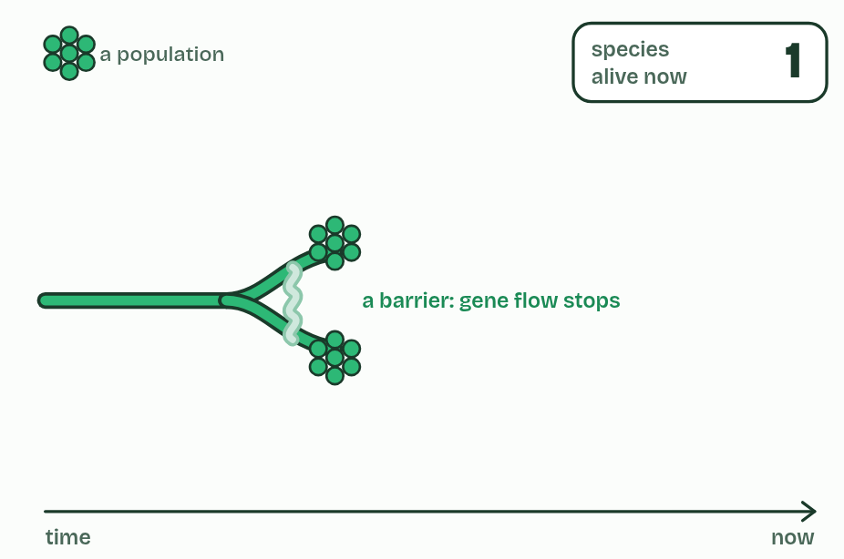
CHAPTER 5 · A4.1.6 Speciation
2 / 6
New species arise only by splitting
A barrier divides it into two populations. Gene flow stops, but for now they are still one species.
Minutes 5 to 20
Notes:
Minutes 5 to 20 of 60: Control against split (15 min).
The plan: Pairs run the control (same food both sides) three times and the split with very different food three times, recording the isolation index each time. Why repeat? Because the runs scatter, as real populations do.
A species, in the definition biologists use most, is a group of organisms that can interbreed and produce fertile offspring. Its populations share one pool of alleles, because individuals move and mate between them.
Speciation happens when that sharing stops. Split a species into two populations that no longer interbreed and each changes in its own way: different mutations, different chance events, different selection. Given long enough, they differ so much that they could not interbreed even if they met again. One species has become two.
Every new species has appeared like this, by splitting from one that already existed. Speciation adds to the number of species on Earth and extinction takes species away; the diversity alive today is the balance of the two.
Example: Where the definition struggles Organisms that reproduce asexually, like bacteria, do not interbreed, and fossils cannot be tested, so these are grouped by their characteristics and sequences instead. And because splitting takes time, some pairs of populations are part-way: they interbreed a little where they meet, and whether they count as one species or two is a judgement.

Slide 6
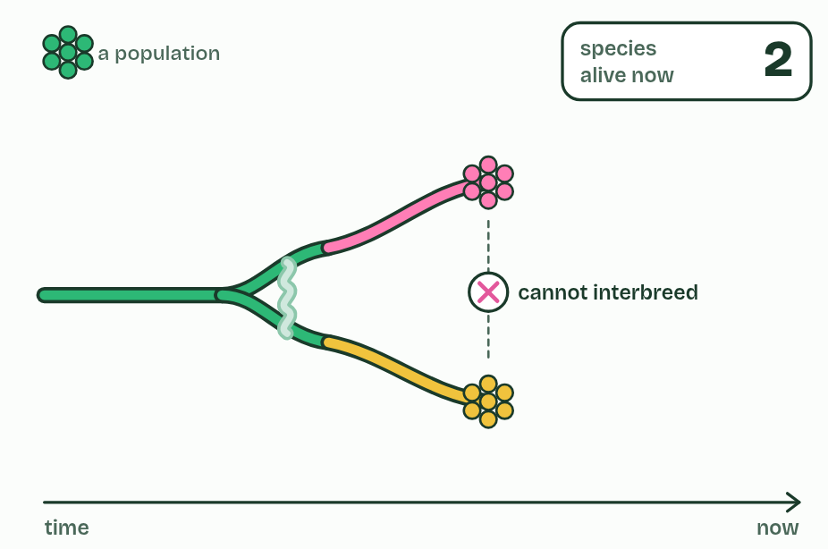
CHAPTER 5 · A4.1.6 Speciation
3 / 6
New species arise only by splitting
Each population changes separately until they cannot interbreed: two species.
Minutes 5 to 20
Notes:
Minutes 5 to 20 of 60: Control against split (15 min).
The plan: Pairs run the control (same food both sides) three times and the split with very different food three times, recording the isolation index each time. Why repeat? Because the runs scatter, as real populations do.
A species, in the definition biologists use most, is a group of organisms that can interbreed and produce fertile offspring. Its populations share one pool of alleles, because individuals move and mate between them.
Speciation happens when that sharing stops. Split a species into two populations that no longer interbreed and each changes in its own way: different mutations, different chance events, different selection. Given long enough, they differ so much that they could not interbreed even if they met again. One species has become two.
Every new species has appeared like this, by splitting from one that already existed. Speciation adds to the number of species on Earth and extinction takes species away; the diversity alive today is the balance of the two.
Example: Where the definition struggles Organisms that reproduce asexually, like bacteria, do not interbreed, and fossils cannot be tested, so these are grouped by their characteristics and sequences instead. And because splitting takes time, some pairs of populations are part-way: they interbreed a little where they meet, and whether they count as one species or two is a judgement.

Slide 7
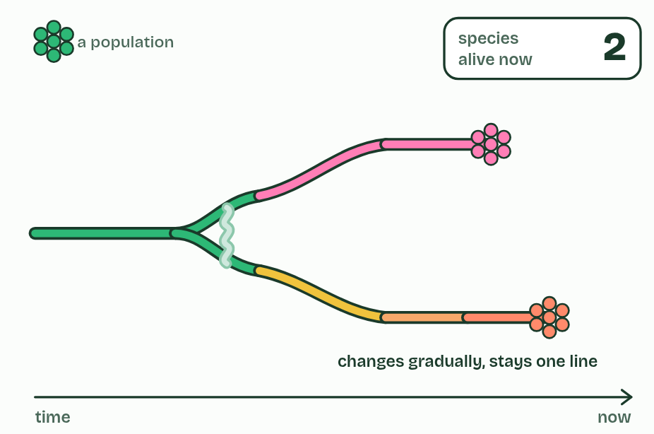
CHAPTER 5 · A4.1.6 Speciation
4 / 6
New species arise only by splitting
The lower species changes gradually but never splits: still one species, so the count stays at two.
Minutes 5 to 20
Notes:
Minutes 5 to 20 of 60: Control against split (15 min).
The plan: Pairs run the control (same food both sides) three times and the split with very different food three times, recording the isolation index each time. Why repeat? Because the runs scatter, as real populations do.
A species, in the definition biologists use most, is a group of organisms that can interbreed and produce fertile offspring. Its populations share one pool of alleles, because individuals move and mate between them.
Speciation happens when that sharing stops. Split a species into two populations that no longer interbreed and each changes in its own way: different mutations, different chance events, different selection. Given long enough, they differ so much that they could not interbreed even if they met again. One species has become two.
Every new species has appeared like this, by splitting from one that already existed. Speciation adds to the number of species on Earth and extinction takes species away; the diversity alive today is the balance of the two.
Example: Where the definition struggles Organisms that reproduce asexually, like bacteria, do not interbreed, and fossils cannot be tested, so these are grouped by their characteristics and sequences instead. And because splitting takes time, some pairs of populations are part-way: they interbreed a little where they meet, and whether they count as one species or two is a judgement.

Slide 8
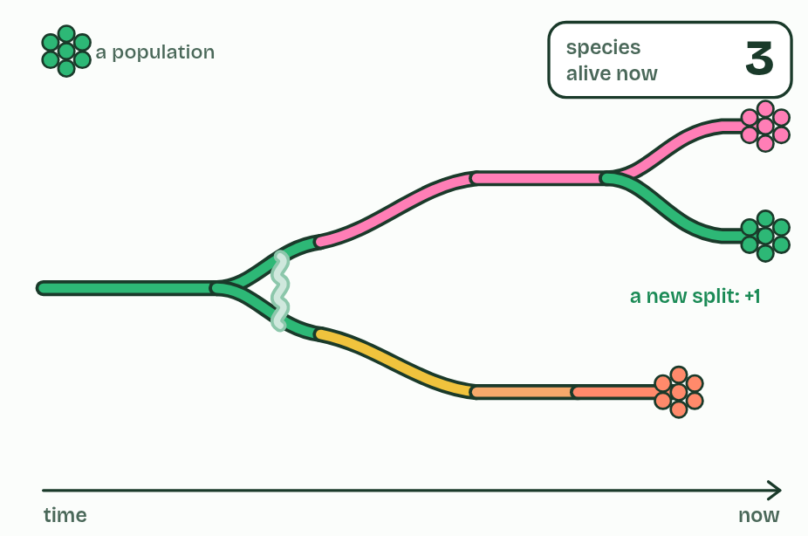
CHAPTER 5 · A4.1.6 Speciation
5 / 6
New species arise only by splitting
The upper species splits again: three.
Minutes 5 to 20
Notes:
Minutes 5 to 20 of 60: Control against split (15 min).
The plan: Pairs run the control (same food both sides) three times and the split with very different food three times, recording the isolation index each time. Why repeat? Because the runs scatter, as real populations do.
A species, in the definition biologists use most, is a group of organisms that can interbreed and produce fertile offspring. Its populations share one pool of alleles, because individuals move and mate between them.
Speciation happens when that sharing stops. Split a species into two populations that no longer interbreed and each changes in its own way: different mutations, different chance events, different selection. Given long enough, they differ so much that they could not interbreed even if they met again. One species has become two.
Every new species has appeared like this, by splitting from one that already existed. Speciation adds to the number of species on Earth and extinction takes species away; the diversity alive today is the balance of the two.
Example: Where the definition struggles Organisms that reproduce asexually, like bacteria, do not interbreed, and fossils cannot be tested, so these are grouped by their characteristics and sequences instead. And because splitting takes time, some pairs of populations are part-way: they interbreed a little where they meet, and whether they count as one species or two is a judgement.

Slide 9
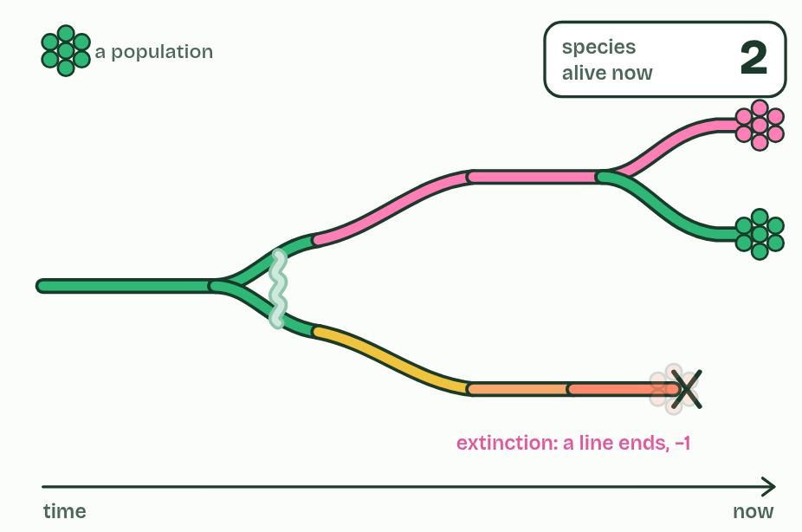
CHAPTER 5 · A4.1.6 Speciation
6 / 6
New species arise only by splitting
The lower species dies out: extinction takes the count back to two.
Minutes 5 to 20
Notes:
Minutes 5 to 20 of 60: Control against split (15 min).
The plan: Pairs run the control (same food both sides) three times and the split with very different food three times, recording the isolation index each time. Why repeat? Because the runs scatter, as real populations do.
A species, in the definition biologists use most, is a group of organisms that can interbreed and produce fertile offspring. Its populations share one pool of alleles, because individuals move and mate between them.
Speciation happens when that sharing stops. Split a species into two populations that no longer interbreed and each changes in its own way: different mutations, different chance events, different selection. Given long enough, they differ so much that they could not interbreed even if they met again. One species has become two.
Every new species has appeared like this, by splitting from one that already existed. Speciation adds to the number of species on Earth and extinction takes species away; the diversity alive today is the balance of the two.
Example: Where the definition struggles Organisms that reproduce asexually, like bacteria, do not interbreed, and fossils cannot be tested, so these are grouped by their characteristics and sequences instead. And because splitting takes time, some pairs of populations are part-way: they interbreed a little where they meet, and whether they count as one species or two is a judgement.

Slide 10
CHAPTER 5 · A4.1.6 Speciation
New species arise only by splitting
A species, in the definition biologists use most, is a group of organisms that can interbreed and produce fertile offspring.
Speciation happens when that sharing stops.
Split a species into two populations that no longer interbreed and each changes in its own way: different mutations, different chance events, different selection.
One species has become two.
Minutes 5 to 20
Notes:
Minutes 5 to 20 of 60: Control against split (15 min).
The plan: Pairs run the control (same food both sides) three times and the split with very different food three times, recording the isolation index each time. Why repeat? Because the runs scatter, as real populations do.
A species, in the definition biologists use most, is a group of organisms that can interbreed and produce fertile offspring. Its populations share one pool of alleles, because individuals move and mate between them.
Speciation happens when that sharing stops. Split a species into two populations that no longer interbreed and each changes in its own way: different mutations, different chance events, different selection. Given long enough, they differ so much that they could not interbreed even if they met again. One species has become two.
Every new species has appeared like this, by splitting from one that already existed. Speciation adds to the number of species on Earth and extinction takes species away; the diversity alive today is the balance of the two.
Example: Where the definition struggles Organisms that reproduce asexually, like bacteria, do not interbreed, and fossils cannot be tested, so these are grouped by their characteristics and sequences instead. And because splitting takes time, some pairs of populations are part-way: they interbreed a little where they meet, and whether they count as one species or two is a judgement.

Slide 11
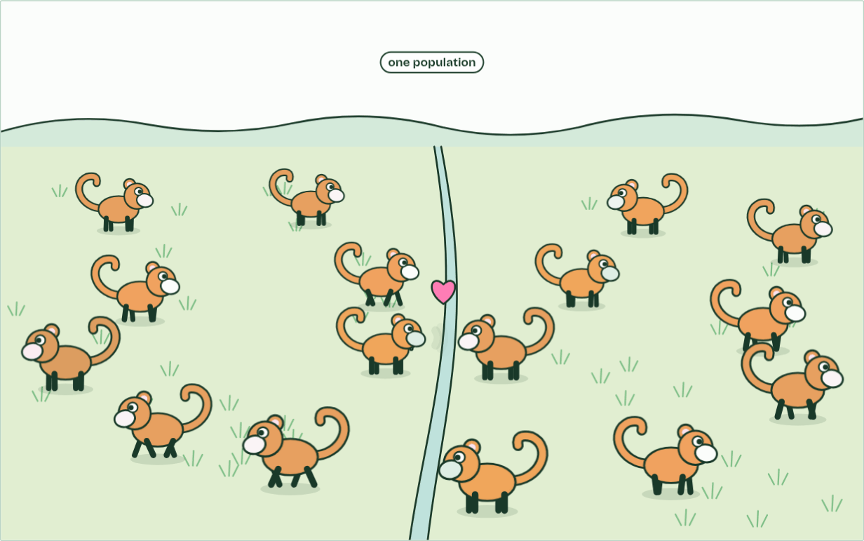
CHAPTER 5 · A4.1.6 Speciation
1 population
1 / 3
New species arise only by splitting
One population: any two can meet and mate, so genes flow across the valley.
Minutes 5 to 20
Notes:
Minutes 5 to 20 of 60: Control against split (15 min).
The plan: Pairs run the control (same food both sides) three times and the split with very different food three times, recording the isolation index each time. Why repeat? Because the runs scatter, as real populations do.
A species, in the definition biologists use most, is a group of organisms that can interbreed and produce fertile offspring. Its populations share one pool of alleles, because individuals move and mate between them.
Speciation happens when that sharing stops. Split a species into two populations that no longer interbreed and each changes in its own way: different mutations, different chance events, different selection. Given long enough, they differ so much that they could not interbreed even if they met again. One species has become two.
Every new species has appeared like this, by splitting from one that already existed. Speciation adds to the number of species on Earth and extinction takes species away; the diversity alive today is the balance of the two.
Example: Where the definition struggles Organisms that reproduce asexually, like bacteria, do not interbreed, and fossils cannot be tested, so these are grouped by their characteristics and sequences instead. And because splitting takes time, some pairs of populations are part-way: they interbreed a little where they meet, and whether they count as one species or two is a judgement.
The animation "Watch it happen: one population becomes two", paused at 2.0 s. The next slides go on through it, then play it.

Slide 12
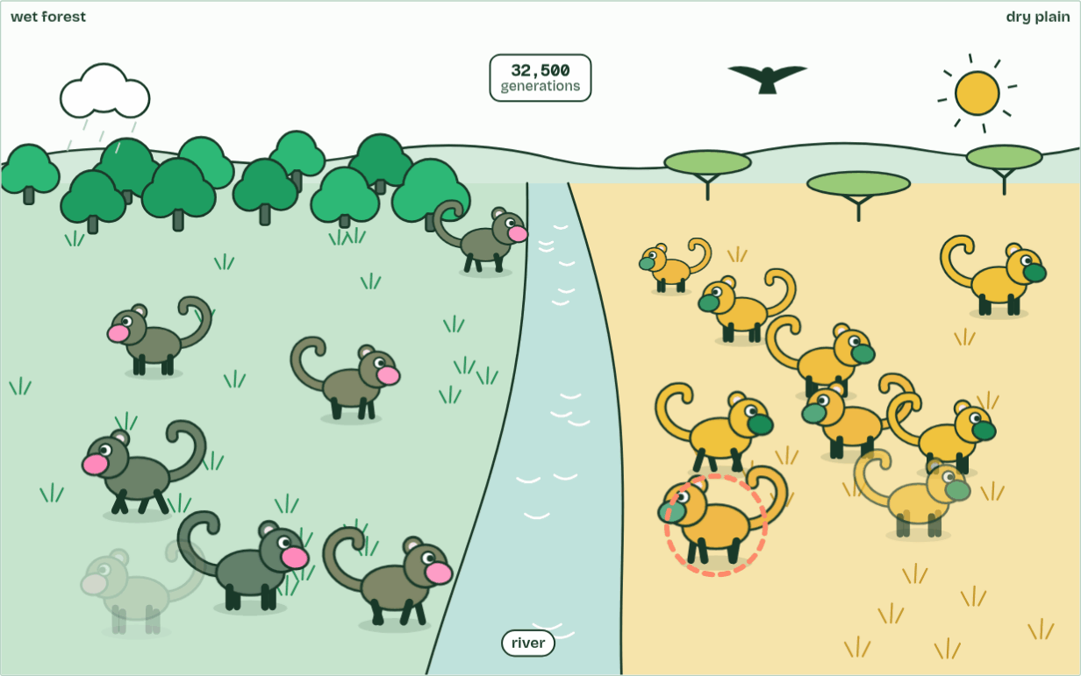
CHAPTER 5 · A4.1.6 Speciation
generation 32,500
2 / 3
New species arise only by splitting
Different selection each side: coats match the ground, displays drift apart.
Minutes 5 to 20
Notes:
Minutes 5 to 20 of 60: Control against split (15 min).
The plan: Pairs run the control (same food both sides) three times and the split with very different food three times, recording the isolation index each time. Why repeat? Because the runs scatter, as real populations do.
A species, in the definition biologists use most, is a group of organisms that can interbreed and produce fertile offspring. Its populations share one pool of alleles, because individuals move and mate between them.
Speciation happens when that sharing stops. Split a species into two populations that no longer interbreed and each changes in its own way: different mutations, different chance events, different selection. Given long enough, they differ so much that they could not interbreed even if they met again. One species has become two.
Every new species has appeared like this, by splitting from one that already existed. Speciation adds to the number of species on Earth and extinction takes species away; the diversity alive today is the balance of the two.
Example: Where the definition struggles Organisms that reproduce asexually, like bacteria, do not interbreed, and fossils cannot be tested, so these are grouped by their characteristics and sequences instead. And because splitting takes time, some pairs of populations are part-way: they interbreed a little where they meet, and whether they count as one species or two is a judgement.
The animation "Watch it happen: one population becomes two", paused at 11.8 s. The next slides go on through it, then play it.

Slide 13
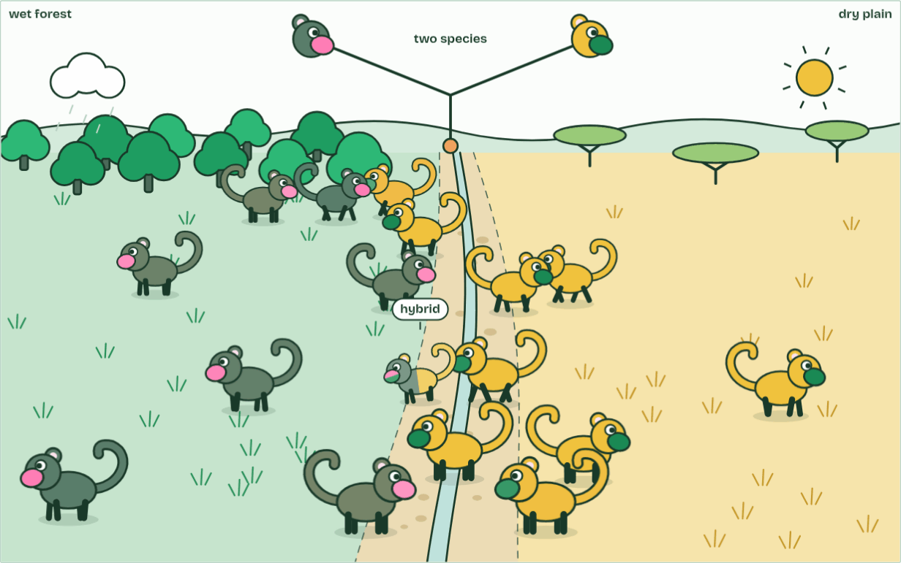
CHAPTER 5 · A4.1.6 Speciation
2 species
3 / 3
New species arise only by splitting
Hybrids are rare, weak and often sterile, so the two never merge: two species.
Minutes 5 to 20
Notes:
Minutes 5 to 20 of 60: Control against split (15 min).
The plan: Pairs run the control (same food both sides) three times and the split with very different food three times, recording the isolation index each time. Why repeat? Because the runs scatter, as real populations do.
A species, in the definition biologists use most, is a group of organisms that can interbreed and produce fertile offspring. Its populations share one pool of alleles, because individuals move and mate between them.
Speciation happens when that sharing stops. Split a species into two populations that no longer interbreed and each changes in its own way: different mutations, different chance events, different selection. Given long enough, they differ so much that they could not interbreed even if they met again. One species has become two.
Every new species has appeared like this, by splitting from one that already existed. Speciation adds to the number of species on Earth and extinction takes species away; the diversity alive today is the balance of the two.
Example: Where the definition struggles Organisms that reproduce asexually, like bacteria, do not interbreed, and fossils cannot be tested, so these are grouped by their characteristics and sequences instead. And because splitting takes time, some pairs of populations are part-way: they interbreed a little where they meet, and whether they count as one species or two is a judgement.
The animation "Watch it happen: one population becomes two", paused at 20.6 s. The next slides go on through it, then play it.

Slide 14
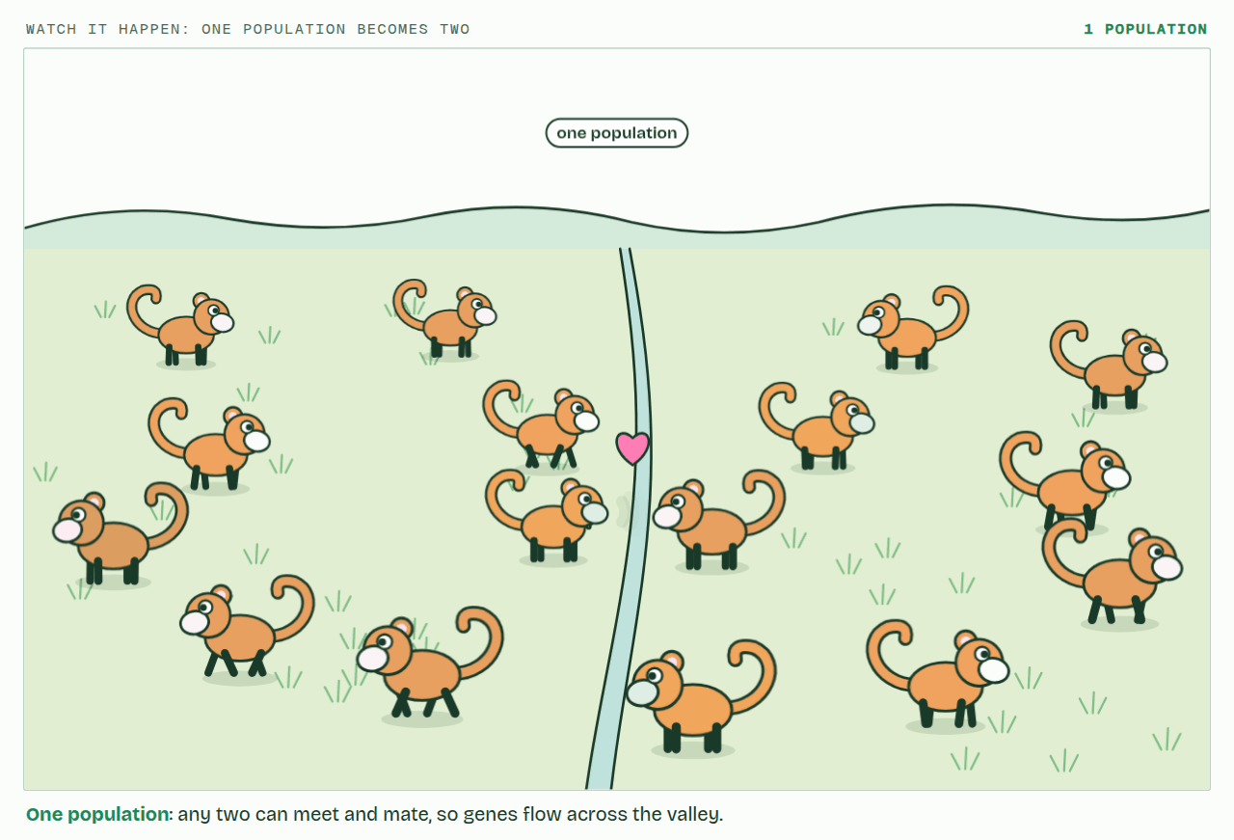
CHAPTER 5 · A4.1.6 Speciation
PLAY IT
New species arise only by splitting
Watch it happen: one population becomes two: click to play. It loops every 23 seconds.
Minutes 5 to 20
Notes:
Minutes 5 to 20 of 60: Control against split (15 min).
The plan: Pairs run the control (same food both sides) three times and the split with very different food three times, recording the isolation index each time. Why repeat? Because the runs scatter, as real populations do.
The video is split.mp4, one loop of the animation in the guide. It plays in PowerPoint and Keynote. Google Slides does not play a video embedded in a .pptx: download split.mp4 (https://www.biologybybradford.com/guides/downloads/scenes/split.mp4), upload it to Google Drive, then Insert > Video > Google Drive.
In the guide the class can change it as it runs: https://www.biologybybradford.com/guides/ib-biology-a4-1-evolution-and-speciation#splitting
What it shows, in order:
1. One population: any two can meet and mate, so genes flow across the valley.
2. Different selection each side: coats match the ground, displays drift apart.
3. Hybrids are rare, weak and often sterile, so the two never merge: two species.

Slide 15
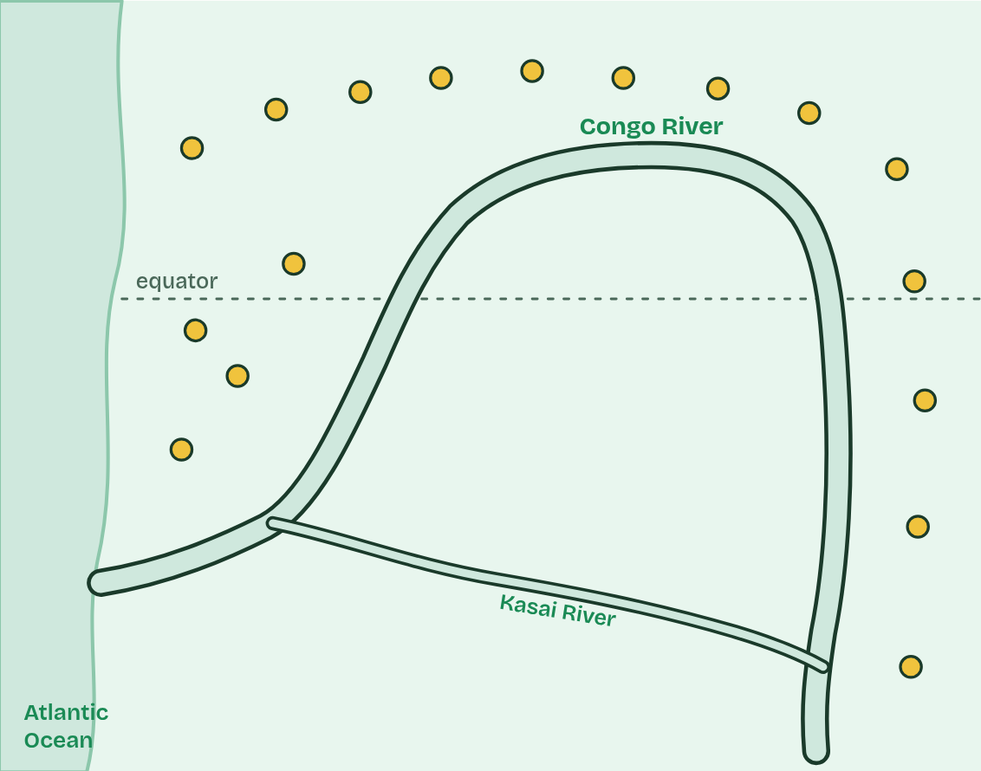
CHAPTER 6 · A4.1.7 Reproductive isolation and differential selection
1 / 5
One river, two apes
Long ago: one population of ancestral apes, north of the Congo River.
Minutes 5 to 20
Notes:
Minutes 5 to 20 of 60: Control against split (15 min).
The plan: Pairs run the control (same food both sides) three times and the split with very different food three times, recording the isolation index each time. Why repeat? Because the runs scatter, as real populations do.
Speciation needs two things. First, reproductive isolation: the populations must stop interbreeding, so alleles no longer pass between them. A sea, a mountain range or a river can do it: geographical isolation. Second, differential selection: different conditions on each side favour different characteristics, so the populations diverge. New mutations and chance (genetic drift), different on each side, add to it.
The Congo River is a real case. Common chimpanzees live north of it and beyond its upper reaches; bonobos live only in the forests south of its great bend. Neither ape can swim, and the river is wide and deep. Genetic evidence suggests their ancestors were divided roughly 1 to 2 million years ago, perhaps when a few reached the south bank during a dry spell and were then cut off.
South of the river there are no gorillas, and plants on the forest floor, which the apes eat when fruit is scarce, are plentiful. North of it, chimpanzees share the forest with gorillas and food is patchier. One widely held explanation is that these differences selected for different behaviour: bonobos live in large, calm groups in which females form strong alliances, while chimpanzee groups are led by males and compete more fiercely. Their bodies differ too: bonobos are more slender, with longer legs and smaller skulls.
Example: How clean was the split? Their genomes show that a few apes did cross the river long after the split, a few hundred thousand years ago, but too rarely to stop the two populations diverging.

Slide 16
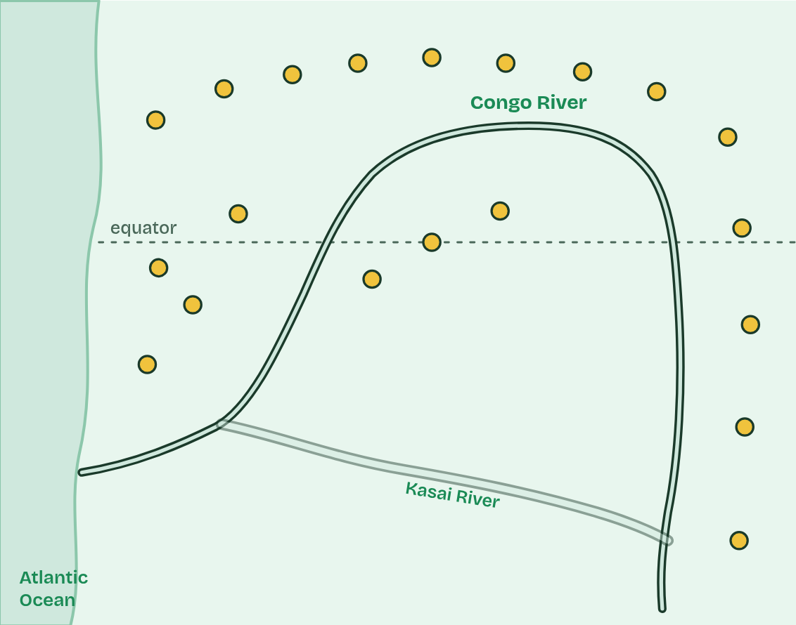
CHAPTER 6 · A4.1.7 Reproductive isolation and differential selection
2 / 5
One river, two apes
Perhaps in a dry spell, the river runs low and a few apes reach the south bank.
Minutes 5 to 20
Notes:
Minutes 5 to 20 of 60: Control against split (15 min).
The plan: Pairs run the control (same food both sides) three times and the split with very different food three times, recording the isolation index each time. Why repeat? Because the runs scatter, as real populations do.
Speciation needs two things. First, reproductive isolation: the populations must stop interbreeding, so alleles no longer pass between them. A sea, a mountain range or a river can do it: geographical isolation. Second, differential selection: different conditions on each side favour different characteristics, so the populations diverge. New mutations and chance (genetic drift), different on each side, add to it.
The Congo River is a real case. Common chimpanzees live north of it and beyond its upper reaches; bonobos live only in the forests south of its great bend. Neither ape can swim, and the river is wide and deep. Genetic evidence suggests their ancestors were divided roughly 1 to 2 million years ago, perhaps when a few reached the south bank during a dry spell and were then cut off.
South of the river there are no gorillas, and plants on the forest floor, which the apes eat when fruit is scarce, are plentiful. North of it, chimpanzees share the forest with gorillas and food is patchier. One widely held explanation is that these differences selected for different behaviour: bonobos live in large, calm groups in which females form strong alliances, while chimpanzee groups are led by males and compete more fiercely. Their bodies differ too: bonobos are more slender, with longer legs and smaller skulls.
Example: How clean was the split? Their genomes show that a few apes did cross the river long after the split, a few hundred thousand years ago, but too rarely to stop the two populations diverging.

Slide 17
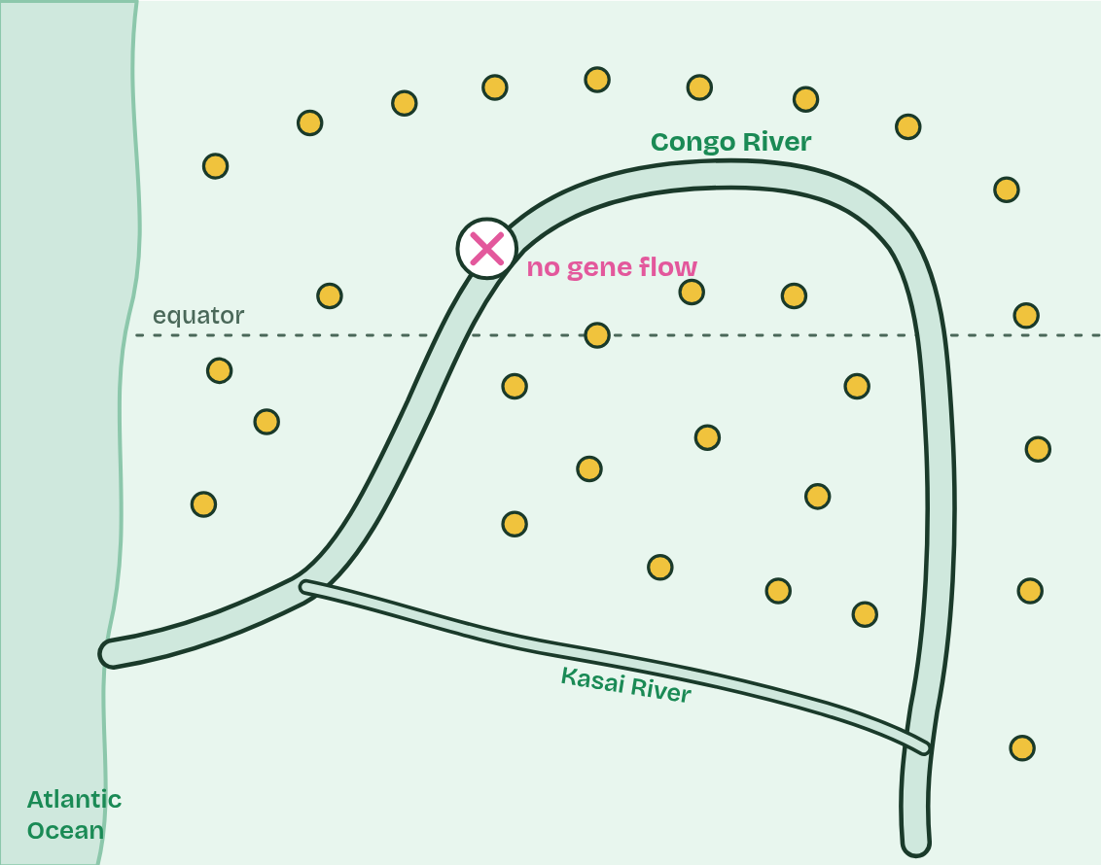
CHAPTER 6 · A4.1.7 Reproductive isolation and differential selection
3 / 5
One river, two apes
The water rises. Neither side can cross: no gene flow between the populations.
Minutes 5 to 20
Notes:
Minutes 5 to 20 of 60: Control against split (15 min).
The plan: Pairs run the control (same food both sides) three times and the split with very different food three times, recording the isolation index each time. Why repeat? Because the runs scatter, as real populations do.
Speciation needs two things. First, reproductive isolation: the populations must stop interbreeding, so alleles no longer pass between them. A sea, a mountain range or a river can do it: geographical isolation. Second, differential selection: different conditions on each side favour different characteristics, so the populations diverge. New mutations and chance (genetic drift), different on each side, add to it.
The Congo River is a real case. Common chimpanzees live north of it and beyond its upper reaches; bonobos live only in the forests south of its great bend. Neither ape can swim, and the river is wide and deep. Genetic evidence suggests their ancestors were divided roughly 1 to 2 million years ago, perhaps when a few reached the south bank during a dry spell and were then cut off.
South of the river there are no gorillas, and plants on the forest floor, which the apes eat when fruit is scarce, are plentiful. North of it, chimpanzees share the forest with gorillas and food is patchier. One widely held explanation is that these differences selected for different behaviour: bonobos live in large, calm groups in which females form strong alliances, while chimpanzee groups are led by males and compete more fiercely. Their bodies differ too: bonobos are more slender, with longer legs and smaller skulls.
Example: How clean was the split? Their genomes show that a few apes did cross the river long after the split, a few hundred thousand years ago, but too rarely to stop the two populations diverging.

Slide 18
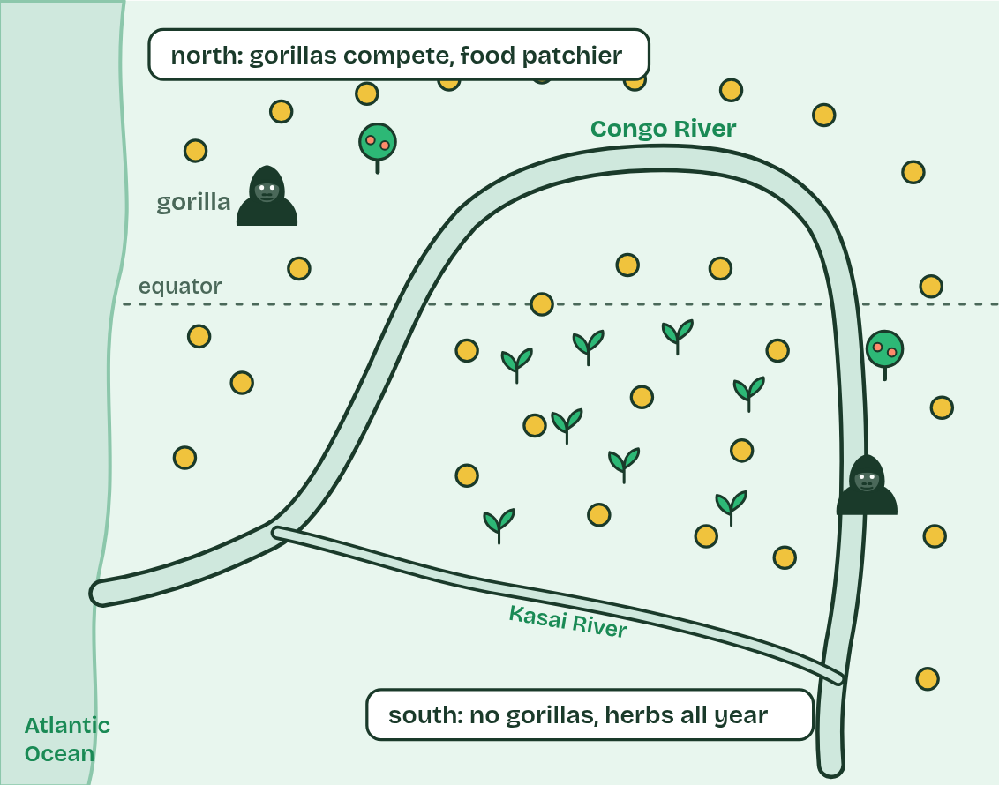
CHAPTER 6 · A4.1.7 Reproductive isolation and differential selection
4 / 5
One river, two apes
Different conditions on each bank: differential selection favours different behaviour and bodies.
Minutes 5 to 20
Notes:
Minutes 5 to 20 of 60: Control against split (15 min).
The plan: Pairs run the control (same food both sides) three times and the split with very different food three times, recording the isolation index each time. Why repeat? Because the runs scatter, as real populations do.
Speciation needs two things. First, reproductive isolation: the populations must stop interbreeding, so alleles no longer pass between them. A sea, a mountain range or a river can do it: geographical isolation. Second, differential selection: different conditions on each side favour different characteristics, so the populations diverge. New mutations and chance (genetic drift), different on each side, add to it.
The Congo River is a real case. Common chimpanzees live north of it and beyond its upper reaches; bonobos live only in the forests south of its great bend. Neither ape can swim, and the river is wide and deep. Genetic evidence suggests their ancestors were divided roughly 1 to 2 million years ago, perhaps when a few reached the south bank during a dry spell and were then cut off.
South of the river there are no gorillas, and plants on the forest floor, which the apes eat when fruit is scarce, are plentiful. North of it, chimpanzees share the forest with gorillas and food is patchier. One widely held explanation is that these differences selected for different behaviour: bonobos live in large, calm groups in which females form strong alliances, while chimpanzee groups are led by males and compete more fiercely. Their bodies differ too: bonobos are more slender, with longer legs and smaller skulls.
Example: How clean was the split? Their genomes show that a few apes did cross the river long after the split, a few hundred thousand years ago, but too rarely to stop the two populations diverging.

Slide 19
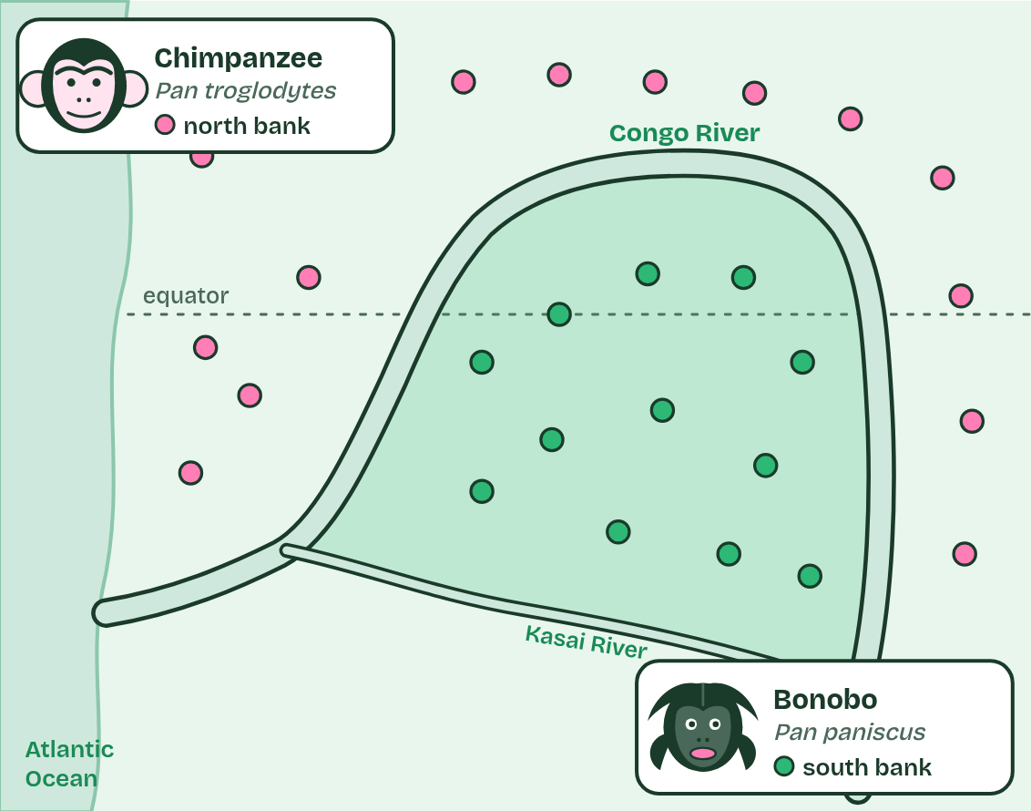
CHAPTER 6 · A4.1.7 Reproductive isolation and differential selection
5 / 5
One river, two apes
Over about 1 to 2 million years they diverge into two species: chimpanzees north, bonobos south.
Minutes 5 to 20
Notes:
Minutes 5 to 20 of 60: Control against split (15 min).
The plan: Pairs run the control (same food both sides) three times and the split with very different food three times, recording the isolation index each time. Why repeat? Because the runs scatter, as real populations do.
Speciation needs two things. First, reproductive isolation: the populations must stop interbreeding, so alleles no longer pass between them. A sea, a mountain range or a river can do it: geographical isolation. Second, differential selection: different conditions on each side favour different characteristics, so the populations diverge. New mutations and chance (genetic drift), different on each side, add to it.
The Congo River is a real case. Common chimpanzees live north of it and beyond its upper reaches; bonobos live only in the forests south of its great bend. Neither ape can swim, and the river is wide and deep. Genetic evidence suggests their ancestors were divided roughly 1 to 2 million years ago, perhaps when a few reached the south bank during a dry spell and were then cut off.
South of the river there are no gorillas, and plants on the forest floor, which the apes eat when fruit is scarce, are plentiful. North of it, chimpanzees share the forest with gorillas and food is patchier. One widely held explanation is that these differences selected for different behaviour: bonobos live in large, calm groups in which females form strong alliances, while chimpanzee groups are led by males and compete more fiercely. Their bodies differ too: bonobos are more slender, with longer legs and smaller skulls.
Example: How clean was the split? Their genomes show that a few apes did cross the river long after the split, a few hundred thousand years ago, but too rarely to stop the two populations diverging.

Slide 20
CHAPTER 6 · A4.1.7 Reproductive isolation and differential selection
One river, two apes
First, reproductive isolation: the populations must stop interbreeding, so alleles no longer pass between them.
A sea, a mountain range or a river can do it: geographical isolation.
Second, differential selection: different conditions on each side favour different characteristics, so the populations diverge.
Minutes 5 to 20
Notes:
Minutes 5 to 20 of 60: Control against split (15 min).
The plan: Pairs run the control (same food both sides) three times and the split with very different food three times, recording the isolation index each time. Why repeat? Because the runs scatter, as real populations do.
Speciation needs two things. First, reproductive isolation: the populations must stop interbreeding, so alleles no longer pass between them. A sea, a mountain range or a river can do it: geographical isolation. Second, differential selection: different conditions on each side favour different characteristics, so the populations diverge. New mutations and chance (genetic drift), different on each side, add to it.
The Congo River is a real case. Common chimpanzees live north of it and beyond its upper reaches; bonobos live only in the forests south of its great bend. Neither ape can swim, and the river is wide and deep. Genetic evidence suggests their ancestors were divided roughly 1 to 2 million years ago, perhaps when a few reached the south bank during a dry spell and were then cut off.
South of the river there are no gorillas, and plants on the forest floor, which the apes eat when fruit is scarce, are plentiful. North of it, chimpanzees share the forest with gorillas and food is patchier. One widely held explanation is that these differences selected for different behaviour: bonobos live in large, calm groups in which females form strong alliances, while chimpanzee groups are led by males and compete more fiercely. Their bodies differ too: bonobos are more slender, with longer legs and smaller skulls.
Example: How clean was the split? Their genomes show that a few apes did cross the river long after the split, a few hundred thousand years ago, but too rarely to stop the two populations diverging.

Slide 21
PREDICT
A line of snails changes its shell shape steadily for two million years and never splits. The oldest and newest shells look so different that fossil experts give them different names. How many species has the line added to the Earth?
A One: the oldest and newest shells now carry different names
B None: at every moment there was still only one species
C It depends on how different the oldest and newest shells look
Minutes 5 to 20
Notes:
Minutes 5 to 20 of 60: Control against split (15 min).
The plan: Pairs run the control (same food both sides) three times and the split with very different food three times, recording the isolation index each time. Why repeat? Because the runs scatter, as real populations do.
Ask for a show of hands, or mini whiteboards, before revealing. (Answer: B, on the next slide.)

Slide 22
PREDICT
Suppose the river had divided the apes but the forests on both banks were identical. What would you expect after a million years?
A No differences at all: without selection, nothing in them would change
B Some differences, from mutation and drift, but less divergence
C Just as much divergence: isolation on its own does all the work
Minutes 5 to 20
Notes:
Minutes 5 to 20 of 60: Control against split (15 min).
The plan: Pairs run the control (same food both sides) three times and the split with very different food three times, recording the isolation index each time. Why repeat? Because the runs scatter, as real populations do.
Ask for a show of hands, or mini whiteboards, before revealing. (Answer: B, on the next slide.)

Slide 23
WHAT HAPPENS
A line of snails changes its shell shape steadily for two million years and never splits. The oldest and newest shells look so different that fossil experts give them different names. How many species has the line added to the Earth?
A One: the oldest and newest shells now carry different names
B None: at every moment there was still only one species
C It depends on how different the oldest and newest shells look
None. At every moment there was one species of these snails, so the count never went up. The two names are a convenience for describing change along one line. Gradual change within one line is evolution, but only a split adds a species.
Minutes 5 to 20
Notes:
Minutes 5 to 20 of 60: Control against split (15 min).
The plan: Pairs run the control (same food both sides) three times and the split with very different food three times, recording the isolation index each time. Why repeat? Because the runs scatter, as real populations do.
Answer: B. None. At every moment there was one species of these snails, so the count never went up. The two names are a convenience for describing change along one line. Gradual change within one line is evolution, but only a split adds a species.

Slide 24
WHAT HAPPENS
Suppose the river had divided the apes but the forests on both banks were identical. What would you expect after a million years?
A No differences at all: without selection, nothing in them would change
B Some differences, from mutation and drift, but less divergence
C Just as much divergence: isolation on its own does all the work
Some differences. Mutations and drift still differ on each side, so the populations slowly drift apart, but with no differential selection nothing pushes them in different directions. Try it in the dry lab: the control has the same food on both islands.
Minutes 5 to 20
Notes:
Minutes 5 to 20 of 60: Control against split (15 min).
The plan: Pairs run the control (same food both sides) three times and the split with very different food three times, recording the isolation index each time. Why repeat? Because the runs scatter, as real populations do.
Answer: B. Some differences. Mutations and drift still differ on each side, so the populations slowly drift apart, but with no differential selection nothing pushes them in different directions. Try it in the dry lab: the control has the same food on both islands.

Slide 25
WATCH OUT
A species that changes gradually without splitting is still one line. It has evolved, but no species has been added, so that is not speciation. Play the figure to step 4.
Minutes 5 to 20
Notes:
Minutes 5 to 20 of 60: Control against split (15 min).
The plan: Pairs run the control (same food both sides) three times and the split with very different food three times, recording the isolation index each time. Why repeat? Because the runs scatter, as real populations do.
A common mistake: say it, then ask who can say why it is wrong.

Slide 26
WATCH OUT
The river did not make the apes change. It stopped gene flow. Different selection on each side, with mutation and chance, did the changing.
Minutes 5 to 20
Notes:
Minutes 5 to 20 of 60: Control against split (15 min).
The plan: Pairs run the control (same food both sides) three times and the split with very different food three times, recording the isolation index each time. Why repeat? Because the runs scatter, as real populations do.
A common mistake: say it, then ask who can say why it is wrong.

Slide 27
STEP 3
15 MIN
How much gene flow undoes it?
Give each pair a different number of birds crossing each generation (0, 1, 2, 4, 8, 15) and the same other settings.
Minutes 20 to 35
Notes:
Minutes 20 to 35 of 60: How much gene flow undoes it? (15 min).
The plan: Give each pair a different number of birds crossing each generation (0, 1, 2, 4, 8, 15) and the same other settings. Pool the results on the board.

Slide 28
STEP 4
10 MIN
Small against large
Which drifts apart more by chance?
Minutes 35 to 45
Notes:
Minutes 35 to 45 of 60: Small against large (10 min).
The plan: Run the control with 20 birds and with 300. Which drifts apart more by chance?

Slide 29
PLENARY
What it shows
Plot the class's mean isolation index against birds crossing.
Answer the questions under the lab.
Minutes 45 to 60
Notes:
Minutes 45 to 60 of 60: What it shows (15 min).
The plan: Plot the class's mean isolation index against birds crossing. Answer the questions under the lab. End on the limits of the model: real species also build up genetic incompatibilities over far more generations.

Slide 30
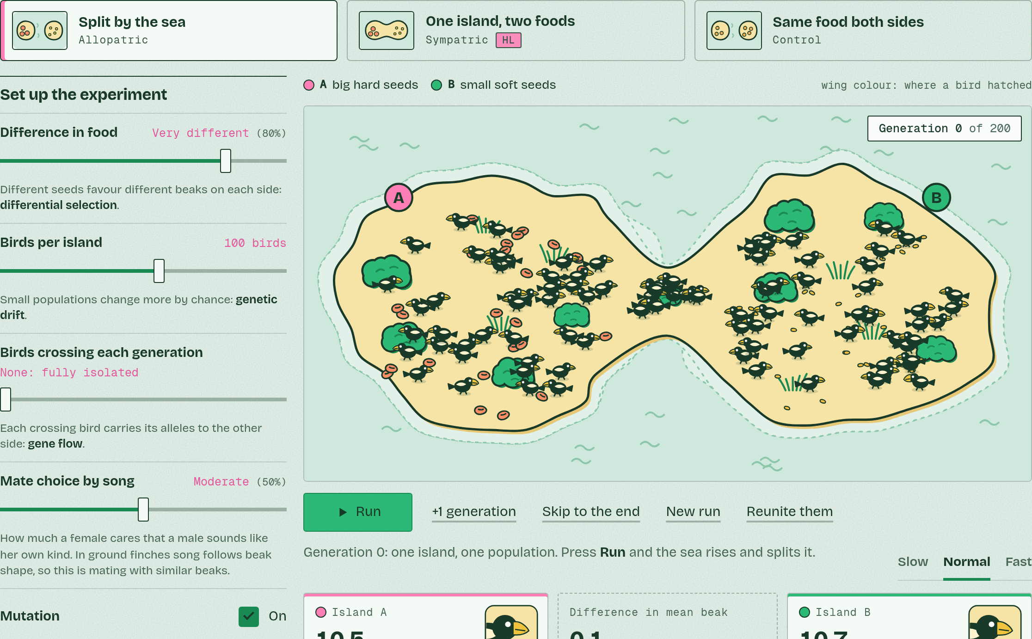
DRY LAB
Finches on islands
Your question: What does it take to turn one population into two species? Is cutting off gene flow enough, or do the two sides also need different selection? How much gene flow undoes it?
What you can change: The scenario, the difference in food, the number of birds, how many cross each generation, how strongly females choose mates by song, mutation, and how many generations to run.
What to record: For each run: the settings, the difference in mean beak depth when you stop, and the isolation index and verdict when you reunite them. Change one setting at a time and repeat each set-up at least three times: the runs scatter, as real populations do.
Run it: biologybybradford.com/guides/ib-biology-a4-1-evolution-and-speciation#lab
Minutes 45 to 60
Notes:
Minutes 45 to 60 of 60: What it shows (15 min).
The plan: Plot the class's mean isolation index against birds crossing. Answer the questions under the lab. End on the limits of the model: real species also build up genetic incompatibilities over far more generations.
The dry lab runs in the guide: https://www.biologybybradford.com/guides/ib-biology-a4-1-evolution-and-speciation#lab

Slide 31
DRY LAB
IF THERE IS TIME
Finches on islands
THE TASK
The dry lab above, with the tasks and questions under it. It works on a phone as well as a laptop, and the results table downloads as a CSV for the class's pooled graph.
STUDENTS NEED
One device per pair.
Minutes 45 to 60
Notes:
Minutes 45 to 60 of 60: What it shows (15 min).
The plan: Plot the class's mean isolation index against birds crossing. Answer the questions under the lab. End on the limits of the model: real species also build up genetic incompatibilities over far more generations.
The activity: Finches on islands. The dry lab above, with the tasks and questions under it. It works on a phone as well as a laptop, and the results table downloads as a CSV for the class's pooled graph.
Needs: one device per pair.
The plan sets no time of its own for this activity: use it in this step, in place of part of it, or for homework.

Slide 32
EXIT QUESTION
Before you go
On paper, on your own: one thing the dry lab showed, and one way the model differs from the real thing.
Minutes 45 to 60
Notes:
Minutes 45 to 60 of 60: What it shows (15 min).
The plan: Plot the class's mean isolation index against birds crossing. Answer the questions under the lab. End on the limits of the model: real species also build up genetic incompatibilities over far more generations.
Collect the slips: they say where to start next lesson.

Slide 33
PRACTISE AND REVISE
Keep going
Exam practice: a fresh paper of exam questions on A4.1 at standard level, marked as you go
The guide, with the animations and the dry lab
This lesson in the guide: 5 New species arise only by splitting, 6 One river, two apes, the dry lab
BUILD FOR YOUR CLASS
ALREADY ON THE SITE FOR A4.1
CARD SETS ON SPLYCR
Tarsia puzzle, dominoes and picture reveal on A4.1, built from its key terms and ready to print
A pub quiz with rounds on A4.1, to present or run with no projector
An escape room built from the question bank on A4.1
Quiz: Evolution & Speciation
Revision map: A4.1 Evolution and speciation, to fill in
Exam questions: A4.1 in the exam maker, a paper with its markscheme
Open a set to host it as a class game, or make a copy to edit.
A4.1 Evolution and Speciation (SL)
How this was made. The course structure, the activities and the teaching choices come from my own classroom, my presentations and my years of teaching IB and AP Biology. I use Claude, an AI, to help write and build the interactive guides, lesson plans, slides and practice questions, and to draw the diagrams and code the interactives. I direct the work and review it against the IB and AP specifications before it goes live.
Minute 60: after the lesson
Notes:
Every link here is live. Set the exam practice paper for homework: it is fresh each time, marked as students go and saved to their Exam practice when they are signed in.
Exam practice: https://www.biologybybradford.com/exam-maker/sit?topics=A4.1&level=SL&paper=quiz&marks=15&src=ep
The guide: https://www.biologybybradford.com/guides/ib-biology-a4-1-evolution-and-speciation

