Slide 1
IB Biology A4.1
LESSON 5 OF 5
HL
BY THE END YOU CAN
Evolution and speciation
Compare allopatric and sympatric speciation, and explain how adaptive radiation fills vacant niches (A4.1.8, A4.1.9)
Explain why a mule is sterile, and how hybridisation and polyploidy make a new plant species at once (A4.1.10, A4.1.11)
Higher level
A4.1.8 to A4.1.11
Allopatric and sympatric speciation, adaptive radiation, and new plant species by polyploidy
60 minutes · chapters 7, 8, 9
Minute 0
Notes:
IB Biology A4.1, Evolution and speciation. Lesson 5 of 5: Higher level (higher level), 60 minutes.
The plan, minute by minute (each slide's footer says where you are):
0 to 5 min (5) Do now: Grumpy Birds Tweet
5 to 15 min (10) Apart or together
15 to 30 min (15) Beak buffet
30 to 45 min (15) Paper chromosomes
45 to 55 min (10) Chromosome arithmetic
55 to 60 min (5) Exit
What students get wrong:
The hybrid's number is the parents' numbers added. It is the gametes' numbers added: 32 + 31 = 63, not 126.
Stretch and support:
Support: give the captions of each figure as a cut-up storyboard to put in order, and use the key terms (tap the dotted words) as a glossary.
Support: the three mnemonics (Dragons Breathe Heat; Hungry Rats Chew My Pencils; Grumpy Birds Tweet) as a starter on each lesson.
Stretch: why is sympatric speciation commoner in plants than in animals?
The lesson plan to print: https://www.biologybybradford.com/guides/downloads/ib-biology-a4-1-evolution-and-speciation-lesson-5-plan.pdf

Slide 2
DO NOW
Grumpy Birds Tweet
Six one-line cases to sort into geographic, behavioural and temporal isolation (the crickets that sing in different seasons, the frogs in March and May, the apes either side of a river, fireflies with different flash codes, and two more of your own).
5:00
minutes
Start now: the timer is running.
Minutes 0 to 5
Notes:
Minutes 0 to 5 of 60: Do now: Grumpy Birds Tweet (5 min).
The plan: Six one-line cases to sort into geographic, behavioural and temporal isolation (the crickets that sing in different seasons, the frogs in March and May, the apes either side of a river, fireflies with different flash codes, and two more of your own).
Start a 5 minute timer as they come in.

Slide 3
REMEMBER IT
Three kinds of reproductive isolation
G
B
T
Grumpy
Birds
Tweet
Minutes 0 to 5
Notes:
Minutes 0 to 5 of 60: Do now: Grumpy Birds Tweet (5 min).
The plan: Six one-line cases to sort into geographic, behavioural and temporal isolation (the crickets that sing in different seasons, the frogs in March and May, the apes either side of a river, fireflies with different flash codes, and two more of your own).
Ask the class what each letter stands for before revealing.

Slide 4
REMEMBER IT
Three kinds of reproductive isolation
G
B
T
Grumpy
Birds
Tweet
Geographic
Behavioural
Temporal
a barrier between them
different courtship
breed at different times
Minutes 0 to 5
Notes:
Minutes 0 to 5 of 60: Do now: Grumpy Birds Tweet (5 min).
The plan: Six one-line cases to sort into geographic, behavioural and temporal isolation (the crickets that sing in different seasons, the frogs in March and May, the apes either side of a river, fireflies with different flash codes, and two more of your own).
Grumpy: Geographic (a barrier between them)
Birds: Behavioural (different courtship)
Tweet: Temporal (breed at different times)

Slide 5
STEP 2
10 MIN
Apart or together
Students make a Venn diagram of allopatric and sympatric speciation.
Minutes 5 to 15
Notes:
Minutes 5 to 15 of 60: Apart or together (10 min).
The plan: Chapter 7's figure, then the apple maggot fly. Students make a Venn diagram of allopatric and sympatric speciation: what is the same (gene flow stops, then divergence) and what differs (how it stops).

Slide 6
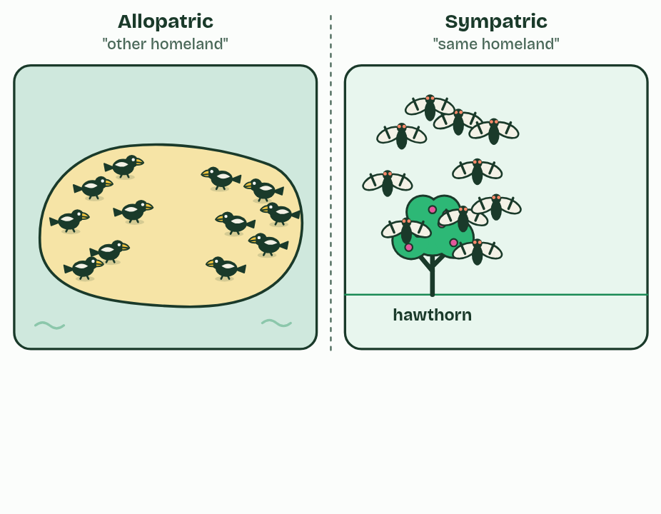
CHAPTER 7 · A4.1.8 Allopatric and sympatric speciation
1 / 4
Apart or together: two routes to a new species
Two populations, each of one species: finches on an island, flies on hawthorn trees.
Minutes 5 to 15
Notes:
Minutes 5 to 15 of 60: Apart or together (10 min).
The plan: Chapter 7's figure, then the apple maggot fly. Students make a Venn diagram of allopatric and sympatric speciation: what is the same (gene flow stops, then divergence) and what differs (how it stops).
Every speciation needs the same first step: gene flow between two groups has to stop, so they can change separately. The two routes differ in what stops it.
In allopatric speciation ("other homeland") a geographical barrier does it: a sea, a mountain range, or a river, as for the bonobos. In sympatric speciation ("same homeland") the groups live side by side, and something else keeps them from mating. They may breed at different times (temporal isolation) or choose mates differently (behavioural isolation).
Apple maggot flies in North America show it happening. They used to lay their eggs only in hawthorn fruit, and adults find mates on the kind of fruit they grew up in. After apple trees were planted in North America, some flies switched to apples; apple-infested fruit was first recorded in the 1860s. Apples ripen weeks before hawthorns, so apple flies now emerge, meet and mate earlier, on apples. The two groups share the same orchards, yet interbreed far less than they would by chance: they are on their way to becoming separate species.

Slide 7
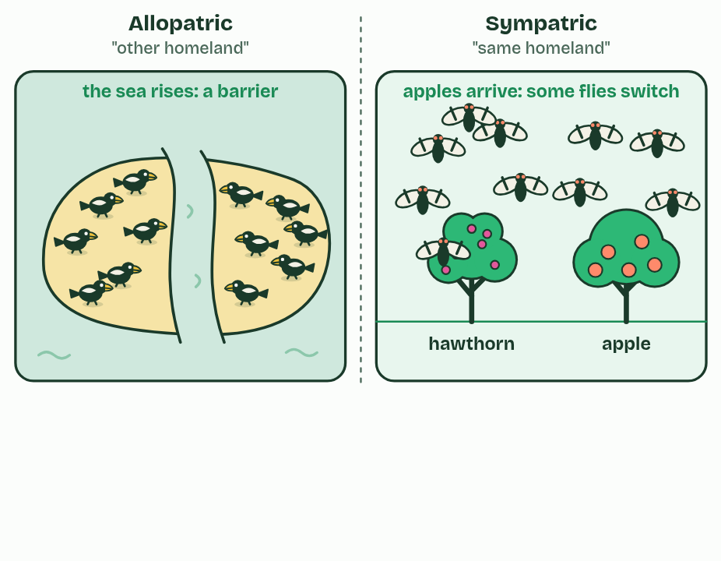
CHAPTER 7 · A4.1.8 Allopatric and sympatric speciation
2 / 4
Apart or together: two routes to a new species
Left: the sea rises and splits the island. Right: apple trees arrive and some flies switch to them; no barrier.
Minutes 5 to 15
Notes:
Minutes 5 to 15 of 60: Apart or together (10 min).
The plan: Chapter 7's figure, then the apple maggot fly. Students make a Venn diagram of allopatric and sympatric speciation: what is the same (gene flow stops, then divergence) and what differs (how it stops).
Every speciation needs the same first step: gene flow between two groups has to stop, so they can change separately. The two routes differ in what stops it.
In allopatric speciation ("other homeland") a geographical barrier does it: a sea, a mountain range, or a river, as for the bonobos. In sympatric speciation ("same homeland") the groups live side by side, and something else keeps them from mating. They may breed at different times (temporal isolation) or choose mates differently (behavioural isolation).
Apple maggot flies in North America show it happening. They used to lay their eggs only in hawthorn fruit, and adults find mates on the kind of fruit they grew up in. After apple trees were planted in North America, some flies switched to apples; apple-infested fruit was first recorded in the 1860s. Apples ripen weeks before hawthorns, so apple flies now emerge, meet and mate earlier, on apples. The two groups share the same orchards, yet interbreed far less than they would by chance: they are on their way to becoming separate species.

Slide 8
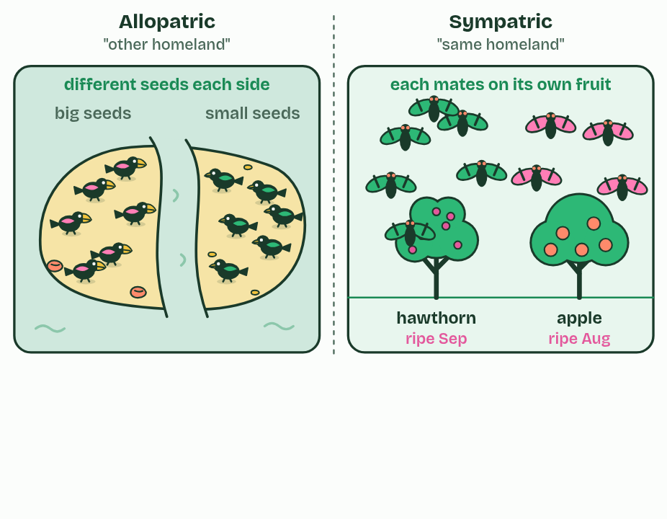
CHAPTER 7 · A4.1.8 Allopatric and sympatric speciation
3 / 4
Apart or together: two routes to a new species
Left: different seeds each side select different beaks. Right: apple flies mate earlier, on apples. Gene flow stops in both.
Minutes 5 to 15
Notes:
Minutes 5 to 15 of 60: Apart or together (10 min).
The plan: Chapter 7's figure, then the apple maggot fly. Students make a Venn diagram of allopatric and sympatric speciation: what is the same (gene flow stops, then divergence) and what differs (how it stops).
Every speciation needs the same first step: gene flow between two groups has to stop, so they can change separately. The two routes differ in what stops it.
In allopatric speciation ("other homeland") a geographical barrier does it: a sea, a mountain range, or a river, as for the bonobos. In sympatric speciation ("same homeland") the groups live side by side, and something else keeps them from mating. They may breed at different times (temporal isolation) or choose mates differently (behavioural isolation).
Apple maggot flies in North America show it happening. They used to lay their eggs only in hawthorn fruit, and adults find mates on the kind of fruit they grew up in. After apple trees were planted in North America, some flies switched to apples; apple-infested fruit was first recorded in the 1860s. Apples ripen weeks before hawthorns, so apple flies now emerge, meet and mate earlier, on apples. The two groups share the same orchards, yet interbreed far less than they would by chance: they are on their way to becoming separate species.

Slide 9
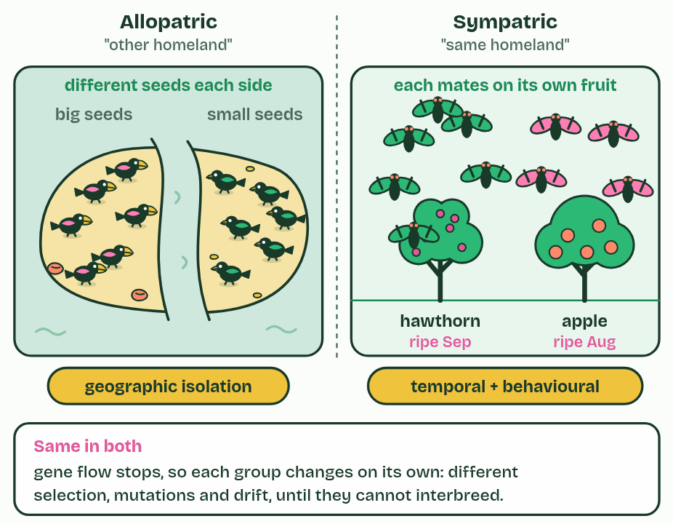
CHAPTER 7 · A4.1.8 Allopatric and sympatric speciation
4 / 4
Apart or together: two routes to a new species
Both groups diverge. What stopped gene flow differs: geography, or timing and behaviour.
Minutes 5 to 15
Notes:
Minutes 5 to 15 of 60: Apart or together (10 min).
The plan: Chapter 7's figure, then the apple maggot fly. Students make a Venn diagram of allopatric and sympatric speciation: what is the same (gene flow stops, then divergence) and what differs (how it stops).
Every speciation needs the same first step: gene flow between two groups has to stop, so they can change separately. The two routes differ in what stops it.
In allopatric speciation ("other homeland") a geographical barrier does it: a sea, a mountain range, or a river, as for the bonobos. In sympatric speciation ("same homeland") the groups live side by side, and something else keeps them from mating. They may breed at different times (temporal isolation) or choose mates differently (behavioural isolation).
Apple maggot flies in North America show it happening. They used to lay their eggs only in hawthorn fruit, and adults find mates on the kind of fruit they grew up in. After apple trees were planted in North America, some flies switched to apples; apple-infested fruit was first recorded in the 1860s. Apples ripen weeks before hawthorns, so apple flies now emerge, meet and mate earlier, on apples. The two groups share the same orchards, yet interbreed far less than they would by chance: they are on their way to becoming separate species.

Slide 10
CHAPTER 7 · A4.1.8 Allopatric and sympatric speciation
Apart or together: two routes to a new species
In allopatric speciation ("other homeland") a geographical barrier does it: a sea, a mountain range, or a river, as for the bonobos.
In sympatric speciation ("same homeland") the groups live side by side, and something else keeps them from mating.
They may breed at different times (temporal isolation) or choose mates differently (behavioural isolation).
Minutes 5 to 15
Notes:
Minutes 5 to 15 of 60: Apart or together (10 min).
The plan: Chapter 7's figure, then the apple maggot fly. Students make a Venn diagram of allopatric and sympatric speciation: what is the same (gene flow stops, then divergence) and what differs (how it stops).
Every speciation needs the same first step: gene flow between two groups has to stop, so they can change separately. The two routes differ in what stops it.
In allopatric speciation ("other homeland") a geographical barrier does it: a sea, a mountain range, or a river, as for the bonobos. In sympatric speciation ("same homeland") the groups live side by side, and something else keeps them from mating. They may breed at different times (temporal isolation) or choose mates differently (behavioural isolation).
Apple maggot flies in North America show it happening. They used to lay their eggs only in hawthorn fruit, and adults find mates on the kind of fruit they grew up in. After apple trees were planted in North America, some flies switched to apples; apple-infested fruit was first recorded in the 1860s. Apples ripen weeks before hawthorns, so apple flies now emerge, meet and mate earlier, on apples. The two groups share the same orchards, yet interbreed far less than they would by chance: they are on their way to becoming separate species.

Slide 11
PREDICT
Two populations of a cricket share one meadow. One sings and mates in spring, the other in late summer. Which kind of isolation is this, and which route to speciation?
A Geographic isolation: allopatric speciation
B Temporal isolation: sympatric speciation
C Behavioural isolation: allopatric speciation
Minutes 5 to 15
Notes:
Minutes 5 to 15 of 60: Apart or together (10 min).
The plan: Chapter 7's figure, then the apple maggot fly. Students make a Venn diagram of allopatric and sympatric speciation: what is the same (gene flow stops, then divergence) and what differs (how it stops).
Ask for a show of hands, or mini whiteboards, before revealing. (Answer: B, on the next slide.)

Slide 12
WHAT HAPPENS
Two populations of a cricket share one meadow. One sings and mates in spring, the other in late summer. Which kind of isolation is this, and which route to speciation?
A Geographic isolation: allopatric speciation
B Temporal isolation: sympatric speciation
C Behavioural isolation: allopatric speciation
Temporal isolation, and sympatric, because they live in the same place. Nothing separates them but the time of year when they breed, which is enough to stop gene flow.
Minutes 5 to 15
Notes:
Minutes 5 to 15 of 60: Apart or together (10 min).
The plan: Chapter 7's figure, then the apple maggot fly. Students make a Venn diagram of allopatric and sympatric speciation: what is the same (gene flow stops, then divergence) and what differs (how it stops).
Answer: B. Temporal isolation, and sympatric, because they live in the same place. Nothing separates them but the time of year when they breed, which is enough to stop gene flow.

Slide 13
WATCH OUT
Sympatric does not mean the groups never meet; it means they could meet and still do not mate. It is rarer than allopatric in animals, because any interbreeding mixes their alleles again. In plants it is common, by polyploidy (chapter 9).
Minutes 5 to 15
Notes:
Minutes 5 to 15 of 60: Apart or together (10 min).
The plan: Chapter 7's figure, then the apple maggot fly. Students make a Venn diagram of allopatric and sympatric speciation: what is the same (gene flow stops, then divergence) and what differs (how it stops).
A common mistake: say it, then ask who can say why it is wrong.

Slide 14
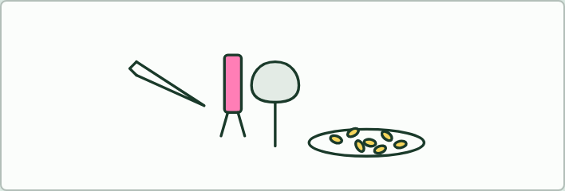
PRACTICAL · HL
15 MIN
Beak buffet
THE TASK
Each student gets a "beak" (tweezers, clothes peg, pliers, chopsticks, a teaspoon) and 30 seconds per food station: sunflower seeds, rice grains, marbles in a dish, a raisin wedged in foam, water in a test tube. Count items moved to a cup. Pool the class's results in a table: which beak wins where? Then ask what would happen to the tweezers birds if a plier-beaked species already ate every seed.
STUDENTS NEED
Five kinds of tool, foods, cups, a timer, a results table on the board.
Minutes 15 to 30
Notes:
Minutes 15 to 30 of 60: Beak buffet (15 min).
The plan: The short version of the practical below, then chapter 8's figure. Link each tool to a finch and each food to a niche, and ask why the species can share an island.
The activity: Beak buffet. Each student gets a "beak" (tweezers, clothes peg, pliers, chopsticks, a teaspoon) and 30 seconds per food station: sunflower seeds, rice grains, marbles in a dish, a raisin wedged in foam, water in a test tube. Count items moved to a cup. Pool the class's results in a table: which beak wins where? Then ask what would happen to the tweezers birds if a plier-beaked species already ate every seed.
Needs: five kinds of tool, foods, cups, a timer, a results table on the board.
The time: 15 minutes, minutes 15 to 30 of the plan.

Slide 15
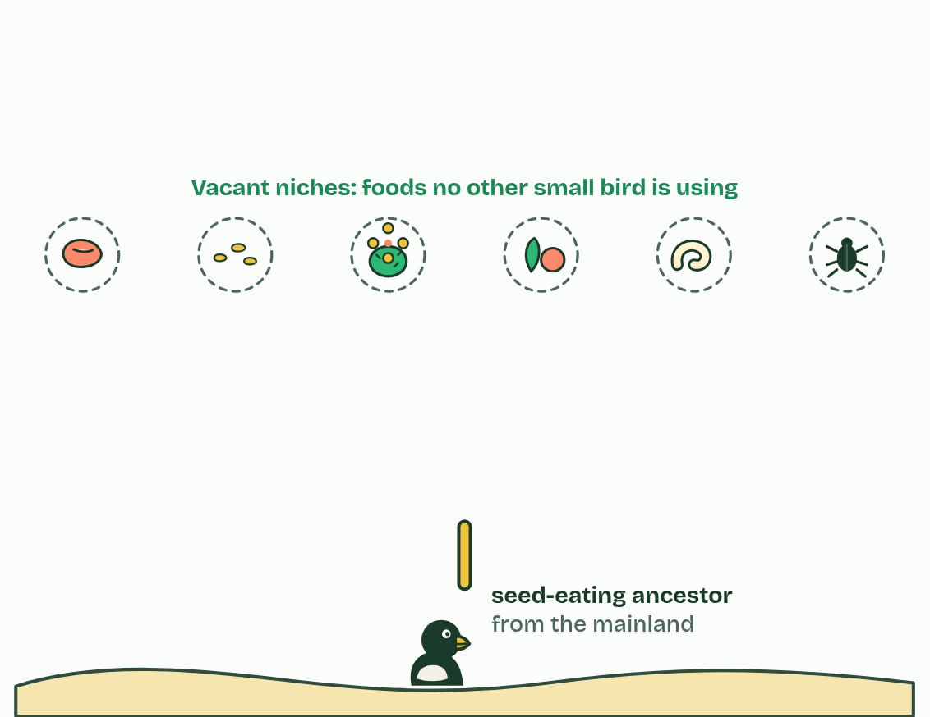
CHAPTER 8 · A4.1.9 Adaptive radiation
1 / 5
One ancestor, many niches
A seed-eating finch arrives on islands with vacant niches: foods no other small bird is using.
Minutes 15 to 30
Notes:
Minutes 15 to 30 of 60: Beak buffet (15 min).
The plan: The short version of the practical below, then chapter 8's figure. Link each tool to a finch and each food to a niche, and ask why the species can share an island.
When a species reaches a place with food and ways of life that nothing else is using, its descendants can split again and again, each line adapting to a different way of life. This is adaptive radiation. The unused ways of life are vacant niches.
About 1 to 2 million years ago a few seed-eating finches reached the Galápagos from the American mainland. The islands had few other small birds, so niches stood empty: big seeds, small seeds, cactus flowers, buds and fruit, insects, grubs hidden in bark. Today about 18 species of Darwin's finches descend from that one ancestor, each with a beak suited to its food. The woodpecker finch even pries out grubs with a cactus spine held in its beak.
Because each species uses a different food, closely related species can live on the same island without competing much. That is why adaptive radiation raises biodiversity: one species has become many, living side by side. In Lake Malawi, cichlid fish have radiated into hundreds of species in one lake, scraping algae, crushing snails, eating scales or other fish.

Slide 16
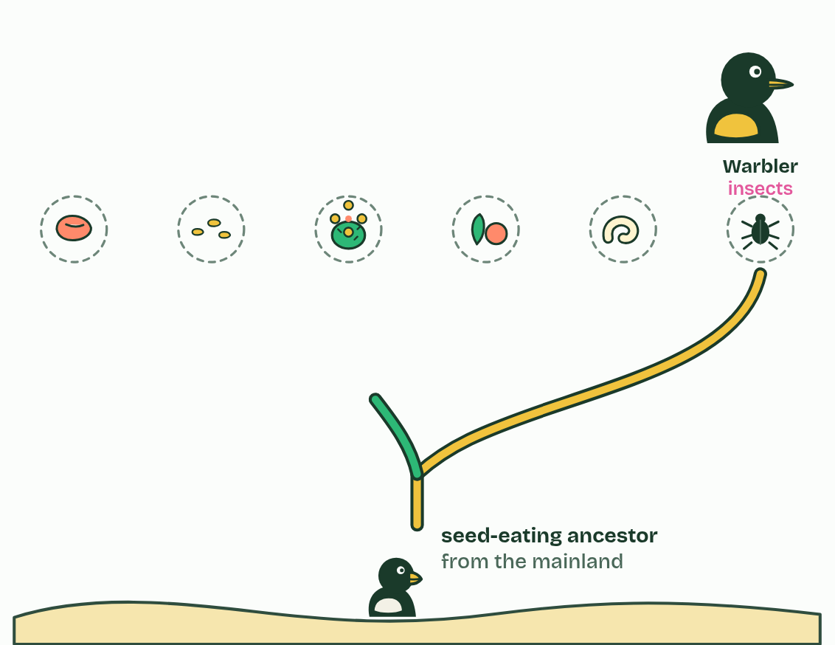
CHAPTER 8 · A4.1.9 Adaptive radiation
2 / 5
One ancestor, many niches
The first split: one line takes to eating insects, with a thin, pointed beak.
Minutes 15 to 30
Notes:
Minutes 15 to 30 of 60: Beak buffet (15 min).
The plan: The short version of the practical below, then chapter 8's figure. Link each tool to a finch and each food to a niche, and ask why the species can share an island.
When a species reaches a place with food and ways of life that nothing else is using, its descendants can split again and again, each line adapting to a different way of life. This is adaptive radiation. The unused ways of life are vacant niches.
About 1 to 2 million years ago a few seed-eating finches reached the Galápagos from the American mainland. The islands had few other small birds, so niches stood empty: big seeds, small seeds, cactus flowers, buds and fruit, insects, grubs hidden in bark. Today about 18 species of Darwin's finches descend from that one ancestor, each with a beak suited to its food. The woodpecker finch even pries out grubs with a cactus spine held in its beak.
Because each species uses a different food, closely related species can live on the same island without competing much. That is why adaptive radiation raises biodiversity: one species has become many, living side by side. In Lake Malawi, cichlid fish have radiated into hundreds of species in one lake, scraping algae, crushing snails, eating scales or other fish.

Slide 17
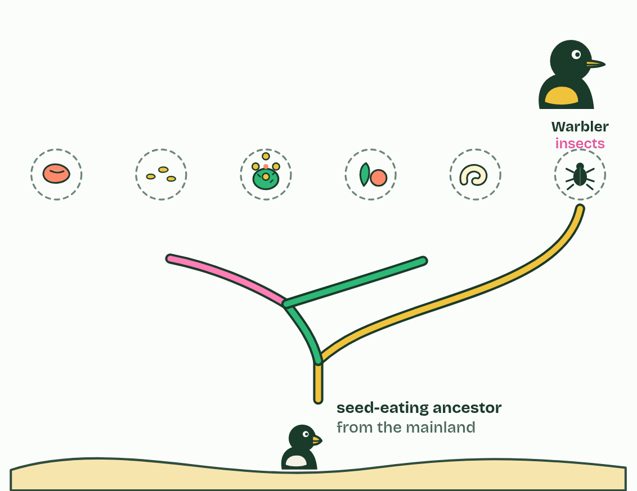
CHAPTER 8 · A4.1.9 Adaptive radiation
3 / 5
One ancestor, many niches
The rest split into ground finches and tree finches.
Minutes 15 to 30
Notes:
Minutes 15 to 30 of 60: Beak buffet (15 min).
The plan: The short version of the practical below, then chapter 8's figure. Link each tool to a finch and each food to a niche, and ask why the species can share an island.
When a species reaches a place with food and ways of life that nothing else is using, its descendants can split again and again, each line adapting to a different way of life. This is adaptive radiation. The unused ways of life are vacant niches.
About 1 to 2 million years ago a few seed-eating finches reached the Galápagos from the American mainland. The islands had few other small birds, so niches stood empty: big seeds, small seeds, cactus flowers, buds and fruit, insects, grubs hidden in bark. Today about 18 species of Darwin's finches descend from that one ancestor, each with a beak suited to its food. The woodpecker finch even pries out grubs with a cactus spine held in its beak.
Because each species uses a different food, closely related species can live on the same island without competing much. That is why adaptive radiation raises biodiversity: one species has become many, living side by side. In Lake Malawi, cichlid fish have radiated into hundreds of species in one lake, scraping algae, crushing snails, eating scales or other fish.

Slide 18
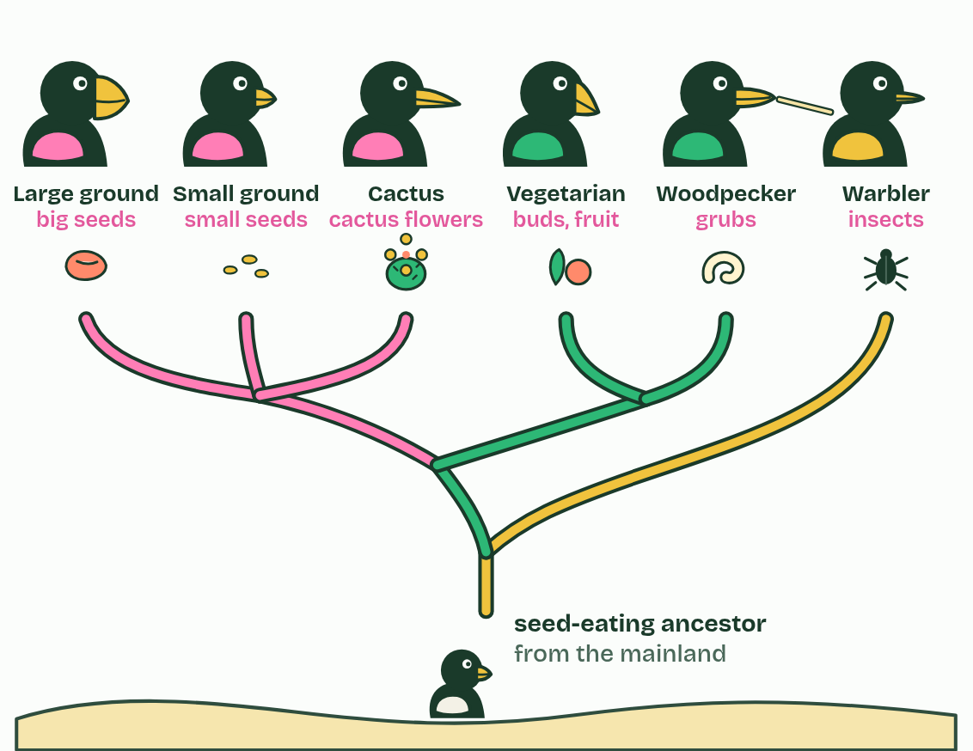
CHAPTER 8 · A4.1.9 Adaptive radiation
4 / 5
One ancestor, many niches
Each line splits again, each species with a beak suited to its food.
Minutes 15 to 30
Notes:
Minutes 15 to 30 of 60: Beak buffet (15 min).
The plan: The short version of the practical below, then chapter 8's figure. Link each tool to a finch and each food to a niche, and ask why the species can share an island.
When a species reaches a place with food and ways of life that nothing else is using, its descendants can split again and again, each line adapting to a different way of life. This is adaptive radiation. The unused ways of life are vacant niches.
About 1 to 2 million years ago a few seed-eating finches reached the Galápagos from the American mainland. The islands had few other small birds, so niches stood empty: big seeds, small seeds, cactus flowers, buds and fruit, insects, grubs hidden in bark. Today about 18 species of Darwin's finches descend from that one ancestor, each with a beak suited to its food. The woodpecker finch even pries out grubs with a cactus spine held in its beak.
Because each species uses a different food, closely related species can live on the same island without competing much. That is why adaptive radiation raises biodiversity: one species has become many, living side by side. In Lake Malawi, cichlid fish have radiated into hundreds of species in one lake, scraping algae, crushing snails, eating scales or other fish.

Slide 19
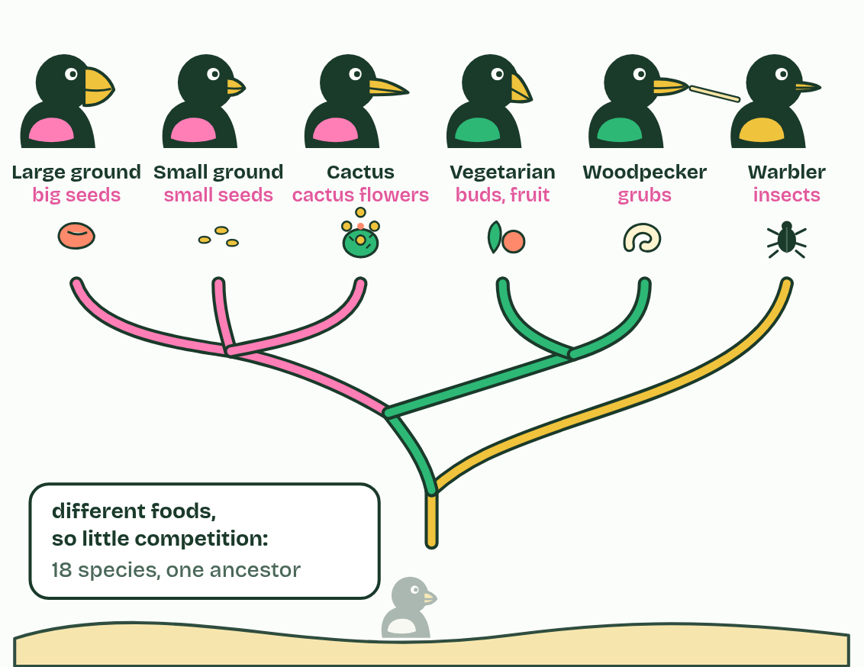
CHAPTER 8 · A4.1.9 Adaptive radiation
5 / 5
One ancestor, many niches
Different foods mean little competition: many related species live side by side.
Minutes 15 to 30
Notes:
Minutes 15 to 30 of 60: Beak buffet (15 min).
The plan: The short version of the practical below, then chapter 8's figure. Link each tool to a finch and each food to a niche, and ask why the species can share an island.
When a species reaches a place with food and ways of life that nothing else is using, its descendants can split again and again, each line adapting to a different way of life. This is adaptive radiation. The unused ways of life are vacant niches.
About 1 to 2 million years ago a few seed-eating finches reached the Galápagos from the American mainland. The islands had few other small birds, so niches stood empty: big seeds, small seeds, cactus flowers, buds and fruit, insects, grubs hidden in bark. Today about 18 species of Darwin's finches descend from that one ancestor, each with a beak suited to its food. The woodpecker finch even pries out grubs with a cactus spine held in its beak.
Because each species uses a different food, closely related species can live on the same island without competing much. That is why adaptive radiation raises biodiversity: one species has become many, living side by side. In Lake Malawi, cichlid fish have radiated into hundreds of species in one lake, scraping algae, crushing snails, eating scales or other fish.

Slide 20
CHAPTER 8 · A4.1.9 Adaptive radiation
One ancestor, many niches
When a species reaches a place with food and ways of life that nothing else is using, its descendants can split again and again, each line adapting to a different way of life. This is adaptive radiation.
The unused ways of life are vacant niches.
That is why adaptive radiation raises biodiversity: one species has become many, living side by side.
Minutes 15 to 30
Notes:
Minutes 15 to 30 of 60: Beak buffet (15 min).
The plan: The short version of the practical below, then chapter 8's figure. Link each tool to a finch and each food to a niche, and ask why the species can share an island.
When a species reaches a place with food and ways of life that nothing else is using, its descendants can split again and again, each line adapting to a different way of life. This is adaptive radiation. The unused ways of life are vacant niches.
About 1 to 2 million years ago a few seed-eating finches reached the Galápagos from the American mainland. The islands had few other small birds, so niches stood empty: big seeds, small seeds, cactus flowers, buds and fruit, insects, grubs hidden in bark. Today about 18 species of Darwin's finches descend from that one ancestor, each with a beak suited to its food. The woodpecker finch even pries out grubs with a cactus spine held in its beak.
Because each species uses a different food, closely related species can live on the same island without competing much. That is why adaptive radiation raises biodiversity: one species has become many, living side by side. In Lake Malawi, cichlid fish have radiated into hundreds of species in one lake, scraping algae, crushing snails, eating scales or other fish.

Slide 21
PREDICT
Suppose the first finches had landed on islands already full of small birds of many kinds. What would you expect?
A Fewer finch species: most niches would already be filled
B More finch species: competition makes new species faster
C The same number: radiation depends only on the finches' genes
Minutes 15 to 30
Notes:
Minutes 15 to 30 of 60: Beak buffet (15 min).
The plan: The short version of the practical below, then chapter 8's figure. Link each tool to a finch and each food to a niche, and ask why the species can share an island.
Ask for a show of hands, or mini whiteboards, before revealing. (Answer: A, on the next slide.)

Slide 22
WHAT HAPPENS
Suppose the first finches had landed on islands already full of small birds of many kinds. What would you expect?
A Fewer finch species: most niches would already be filled
B More finch species: competition makes new species faster
C The same number: radiation depends only on the finches' genes
Fewer. A finch with a beak suited to insects would compete with established insect-eaters, which already do that job well, so selection would not favour it. Vacant niches are what let a radiation happen.
Minutes 15 to 30
Notes:
Minutes 15 to 30 of 60: Beak buffet (15 min).
The plan: The short version of the practical below, then chapter 8's figure. Link each tool to a finch and each food to a niche, and ask why the species can share an island.
Answer: A. Fewer. A finch with a beak suited to insects would compete with established insect-eaters, which already do that job well, so selection would not favour it. Vacant niches are what let a radiation happen.

Slide 23
WATCH OUT
The finches did not grow new beaks because they needed them. In each population, birds whose beaks happened to suit an unused food survived and bred better: natural selection acting on variation that was already there.
Minutes 15 to 30
Notes:
Minutes 15 to 30 of 60: Beak buffet (15 min).
The plan: The short version of the practical below, then chapter 8's figure. Link each tool to a finch and each food to a niche, and ask why the species can share an island.
A common mistake: say it, then ask who can say why it is wrong.

Slide 24
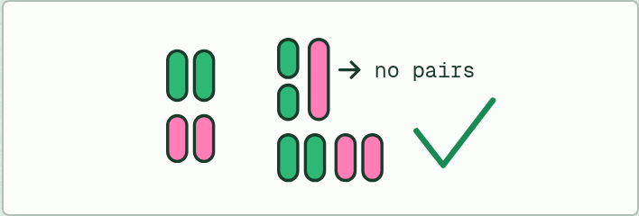
MODEL · HL
15 MIN
Paper chromosomes
THE TASK
Strips of card in two colours: a horse set (with two short chromosomes) and a donkey set (with one long chromosome matching those two). Students make a mule cell and try to pair every chromosome for meiosis: they cannot. Then a smartweed hybrid with three of each colour, no pairs; photocopy the set (doubling) and pair again: every strip finds its twin.
STUDENTS NEED
Printed chromosome strips in two colours, scissors, glue.
Minutes 30 to 45
Notes:
Minutes 30 to 45 of 60: Paper chromosomes (15 min).
The plan: The model below: pair up a mule's chromosomes and fail, then double a smartweed hybrid's and succeed. Chapter 9's figure confirms it.
The activity: Paper chromosomes. Strips of card in two colours: a horse set (with two short chromosomes) and a donkey set (with one long chromosome matching those two). Students make a mule cell and try to pair every chromosome for meiosis: they cannot. Then a smartweed hybrid with three of each colour, no pairs; photocopy the set (doubling) and pair again: every strip finds its twin.
Needs: printed chromosome strips in two colours, scissors, glue.
The time: 15 minutes, minutes 30 to 45 of the plan.

Slide 25
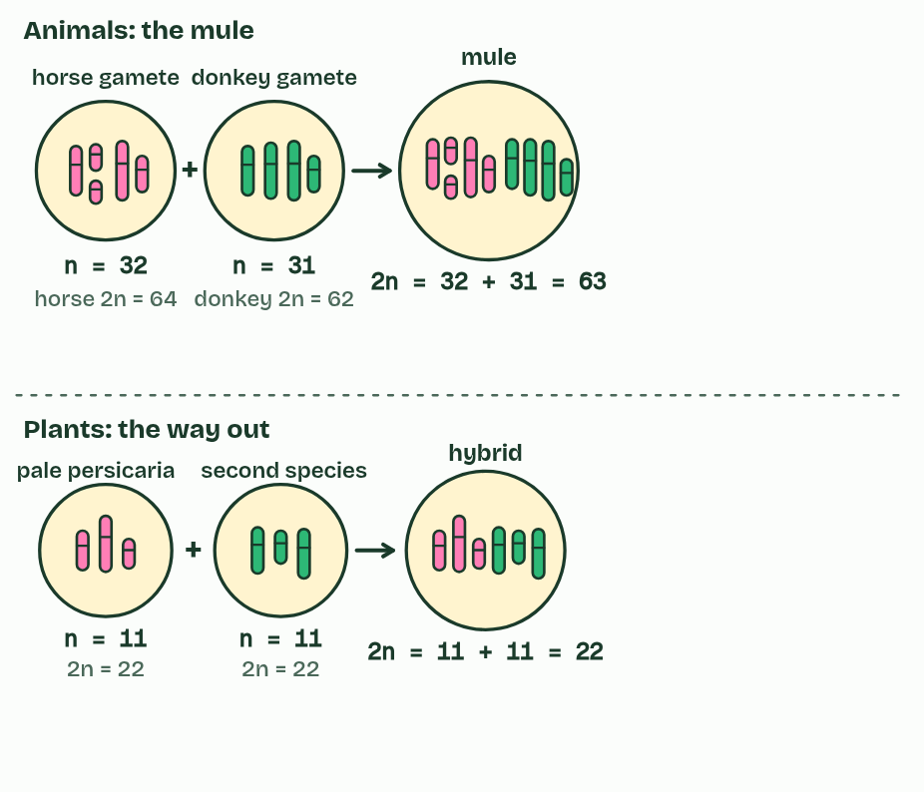
CHAPTER 9 · A4.1.10 A4.1.11 Hybrids and polyploidy
1 / 6
The mule's dead end, the plant's way out
A horse gamete (32 chromosomes) and a donkey gamete (31) make a mule with 63. A few of each set are drawn.
Minutes 30 to 45
Notes:
Minutes 30 to 45 of 60: Paper chromosomes (15 min).
The plan: The model below: pair up a mule's chromosomes and fail, then double a smartweed hybrid's and succeed. Chapter 9's figure confirms it.
Even where two species meet, their alleles rarely mix. Barriers act before fertilisation and after it. Before, courtship usually prevents hybridisation: many animals choose mates by songs, dances, colours or scents that belong to their own species, and ignore the rest. Each firefly species flashes its own code, and a female answers only her own species' code.
After fertilisation, a hybrid may die young, or live but be sterile. A horse (2n = 64) and a donkey (2n = 62) can produce a mule, with 32 chromosomes from the horse and 31 from the donkey: 63. A mule is strong and healthy, but at meiosis its chromosomes cannot all pair up, because horse and donkey chromosomes differ in number and arrangement. Its gametes get unbalanced sets and almost never work, so horse and donkey alleles go no further.
Plants have a way out. A hybrid of two plant species is usually sterile for the same reason. But if its chromosome number doubles, every chromosome gains an identical partner, meiosis works, and the plant is fertile. It is a polyploid, and it cannot breed successfully with either parent: a new species in a generation or two. This is abrupt speciation.
The smartweeds and knotweeds, genus Persicaria, are full of examples: DNA studies show that several of their species, some of them common weeds, began as hybrids like this. Redshank, Persicaria maculosa (2n = 44), is one, with pale persicaria (2n = 22) as one of its parents.

Slide 26
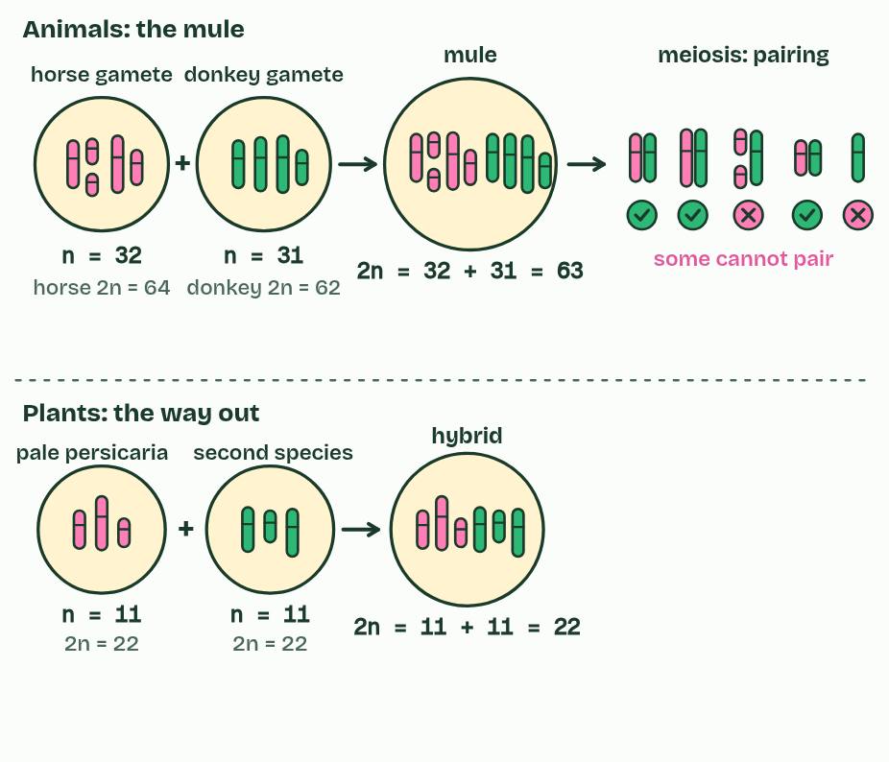
CHAPTER 9 · A4.1.10 A4.1.11 Hybrids and polyploidy
2 / 6
The mule's dead end, the plant's way out
At meiosis, matching chromosomes pair up, but horse and donkey sets differ in number and arrangement: some cannot pair.
Minutes 30 to 45
Notes:
Minutes 30 to 45 of 60: Paper chromosomes (15 min).
The plan: The model below: pair up a mule's chromosomes and fail, then double a smartweed hybrid's and succeed. Chapter 9's figure confirms it.
Even where two species meet, their alleles rarely mix. Barriers act before fertilisation and after it. Before, courtship usually prevents hybridisation: many animals choose mates by songs, dances, colours or scents that belong to their own species, and ignore the rest. Each firefly species flashes its own code, and a female answers only her own species' code.
After fertilisation, a hybrid may die young, or live but be sterile. A horse (2n = 64) and a donkey (2n = 62) can produce a mule, with 32 chromosomes from the horse and 31 from the donkey: 63. A mule is strong and healthy, but at meiosis its chromosomes cannot all pair up, because horse and donkey chromosomes differ in number and arrangement. Its gametes get unbalanced sets and almost never work, so horse and donkey alleles go no further.
Plants have a way out. A hybrid of two plant species is usually sterile for the same reason. But if its chromosome number doubles, every chromosome gains an identical partner, meiosis works, and the plant is fertile. It is a polyploid, and it cannot breed successfully with either parent: a new species in a generation or two. This is abrupt speciation.
The smartweeds and knotweeds, genus Persicaria, are full of examples: DNA studies show that several of their species, some of them common weeds, began as hybrids like this. Redshank, Persicaria maculosa (2n = 44), is one, with pale persicaria (2n = 22) as one of its parents.

Slide 27
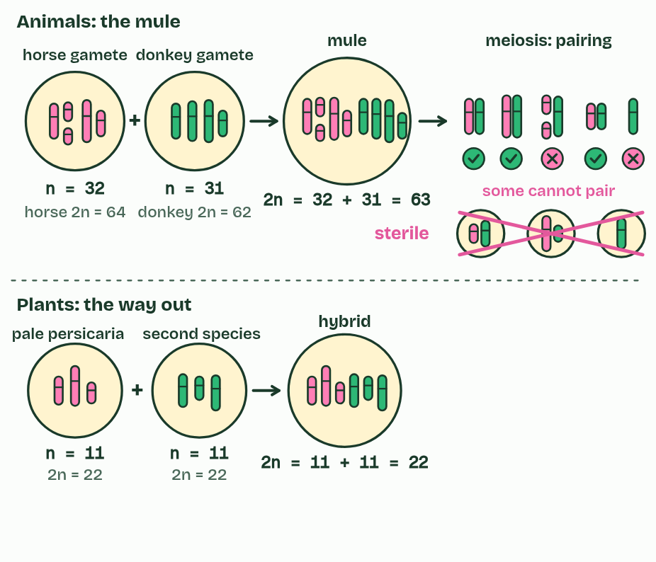
CHAPTER 9 · A4.1.10 A4.1.11 Hybrids and polyploidy
3 / 6
The mule's dead end, the plant's way out
So the gametes get unbalanced sets and do not work: the mule is sterile.
Minutes 30 to 45
Notes:
Minutes 30 to 45 of 60: Paper chromosomes (15 min).
The plan: The model below: pair up a mule's chromosomes and fail, then double a smartweed hybrid's and succeed. Chapter 9's figure confirms it.
Even where two species meet, their alleles rarely mix. Barriers act before fertilisation and after it. Before, courtship usually prevents hybridisation: many animals choose mates by songs, dances, colours or scents that belong to their own species, and ignore the rest. Each firefly species flashes its own code, and a female answers only her own species' code.
After fertilisation, a hybrid may die young, or live but be sterile. A horse (2n = 64) and a donkey (2n = 62) can produce a mule, with 32 chromosomes from the horse and 31 from the donkey: 63. A mule is strong and healthy, but at meiosis its chromosomes cannot all pair up, because horse and donkey chromosomes differ in number and arrangement. Its gametes get unbalanced sets and almost never work, so horse and donkey alleles go no further.
Plants have a way out. A hybrid of two plant species is usually sterile for the same reason. But if its chromosome number doubles, every chromosome gains an identical partner, meiosis works, and the plant is fertile. It is a polyploid, and it cannot breed successfully with either parent: a new species in a generation or two. This is abrupt speciation.
The smartweeds and knotweeds, genus Persicaria, are full of examples: DNA studies show that several of their species, some of them common weeds, began as hybrids like this. Redshank, Persicaria maculosa (2n = 44), is one, with pale persicaria (2n = 22) as one of its parents.

Slide 28
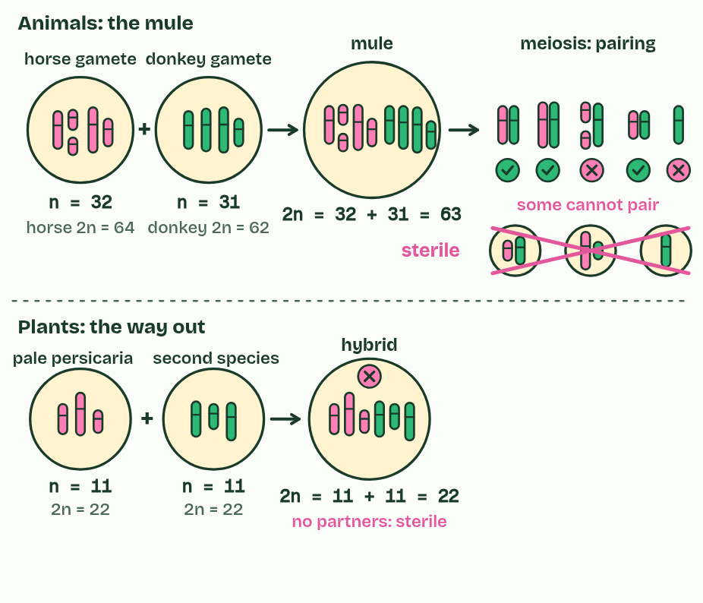
CHAPTER 9 · A4.1.10 A4.1.11 Hybrids and polyploidy
4 / 6
The mule's dead end, the plant's way out
Two smartweed species make a hybrid with 11 + 11 = 22. No chromosome has a matching partner: sterile, like the mule.
Minutes 30 to 45
Notes:
Minutes 30 to 45 of 60: Paper chromosomes (15 min).
The plan: The model below: pair up a mule's chromosomes and fail, then double a smartweed hybrid's and succeed. Chapter 9's figure confirms it.
Even where two species meet, their alleles rarely mix. Barriers act before fertilisation and after it. Before, courtship usually prevents hybridisation: many animals choose mates by songs, dances, colours or scents that belong to their own species, and ignore the rest. Each firefly species flashes its own code, and a female answers only her own species' code.
After fertilisation, a hybrid may die young, or live but be sterile. A horse (2n = 64) and a donkey (2n = 62) can produce a mule, with 32 chromosomes from the horse and 31 from the donkey: 63. A mule is strong and healthy, but at meiosis its chromosomes cannot all pair up, because horse and donkey chromosomes differ in number and arrangement. Its gametes get unbalanced sets and almost never work, so horse and donkey alleles go no further.
Plants have a way out. A hybrid of two plant species is usually sterile for the same reason. But if its chromosome number doubles, every chromosome gains an identical partner, meiosis works, and the plant is fertile. It is a polyploid, and it cannot breed successfully with either parent: a new species in a generation or two. This is abrupt speciation.
The smartweeds and knotweeds, genus Persicaria, are full of examples: DNA studies show that several of their species, some of them common weeds, began as hybrids like this. Redshank, Persicaria maculosa (2n = 44), is one, with pale persicaria (2n = 22) as one of its parents.

Slide 29
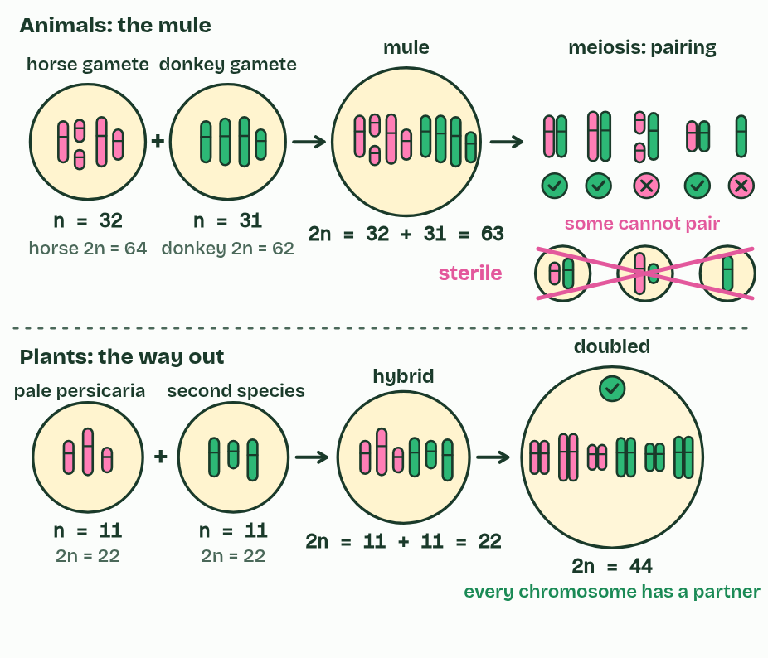
CHAPTER 9 · A4.1.10 A4.1.11 Hybrids and polyploidy
5 / 6
The mule's dead end, the plant's way out
The chromosome number doubles to 44: every chromosome now has an identical partner, so meiosis works.
Minutes 30 to 45
Notes:
Minutes 30 to 45 of 60: Paper chromosomes (15 min).
The plan: The model below: pair up a mule's chromosomes and fail, then double a smartweed hybrid's and succeed. Chapter 9's figure confirms it.
Even where two species meet, their alleles rarely mix. Barriers act before fertilisation and after it. Before, courtship usually prevents hybridisation: many animals choose mates by songs, dances, colours or scents that belong to their own species, and ignore the rest. Each firefly species flashes its own code, and a female answers only her own species' code.
After fertilisation, a hybrid may die young, or live but be sterile. A horse (2n = 64) and a donkey (2n = 62) can produce a mule, with 32 chromosomes from the horse and 31 from the donkey: 63. A mule is strong and healthy, but at meiosis its chromosomes cannot all pair up, because horse and donkey chromosomes differ in number and arrangement. Its gametes get unbalanced sets and almost never work, so horse and donkey alleles go no further.
Plants have a way out. A hybrid of two plant species is usually sterile for the same reason. But if its chromosome number doubles, every chromosome gains an identical partner, meiosis works, and the plant is fertile. It is a polyploid, and it cannot breed successfully with either parent: a new species in a generation or two. This is abrupt speciation.
The smartweeds and knotweeds, genus Persicaria, are full of examples: DNA studies show that several of their species, some of them common weeds, began as hybrids like this. Redshank, Persicaria maculosa (2n = 44), is one, with pale persicaria (2n = 22) as one of its parents.

Slide 30
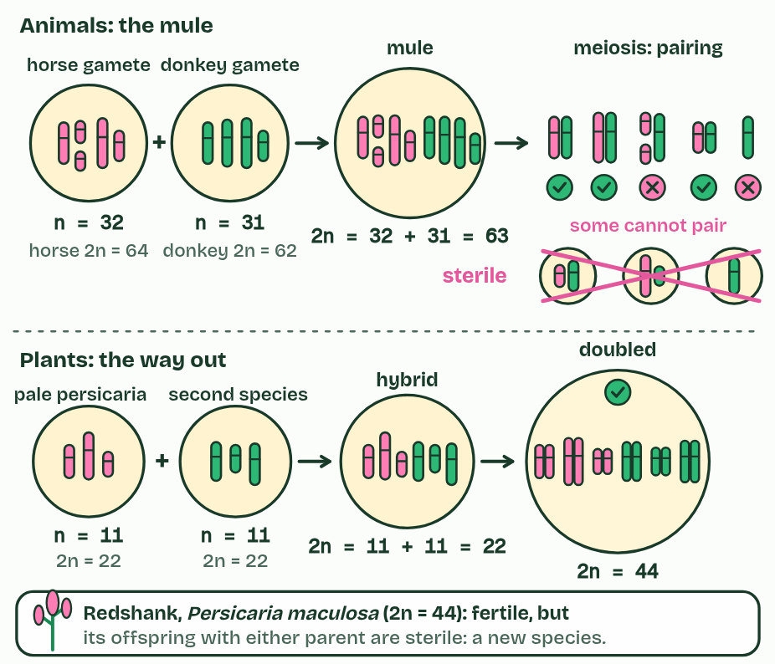
CHAPTER 9 · A4.1.10 A4.1.11 Hybrids and polyploidy
6 / 6
The mule's dead end, the plant's way out
A fertile polyploid whose offspring with either parent are sterile: a new species, made in a generation or two.
Minutes 30 to 45
Notes:
Minutes 30 to 45 of 60: Paper chromosomes (15 min).
The plan: The model below: pair up a mule's chromosomes and fail, then double a smartweed hybrid's and succeed. Chapter 9's figure confirms it.
Even where two species meet, their alleles rarely mix. Barriers act before fertilisation and after it. Before, courtship usually prevents hybridisation: many animals choose mates by songs, dances, colours or scents that belong to their own species, and ignore the rest. Each firefly species flashes its own code, and a female answers only her own species' code.
After fertilisation, a hybrid may die young, or live but be sterile. A horse (2n = 64) and a donkey (2n = 62) can produce a mule, with 32 chromosomes from the horse and 31 from the donkey: 63. A mule is strong and healthy, but at meiosis its chromosomes cannot all pair up, because horse and donkey chromosomes differ in number and arrangement. Its gametes get unbalanced sets and almost never work, so horse and donkey alleles go no further.
Plants have a way out. A hybrid of two plant species is usually sterile for the same reason. But if its chromosome number doubles, every chromosome gains an identical partner, meiosis works, and the plant is fertile. It is a polyploid, and it cannot breed successfully with either parent: a new species in a generation or two. This is abrupt speciation.
The smartweeds and knotweeds, genus Persicaria, are full of examples: DNA studies show that several of their species, some of them common weeds, began as hybrids like this. Redshank, Persicaria maculosa (2n = 44), is one, with pale persicaria (2n = 22) as one of its parents.

Slide 31
CHAPTER 9 · A4.1.10 A4.1.11 Hybrids and polyploidy
The mule's dead end, the plant's way out
Before, courtship usually prevents hybridisation: many animals choose mates by songs, dances, colours or scents that belong to their own species, and ignore the rest.
It is a polyploid, and it cannot breed successfully with either parent: a new species in a generation or two.
This is abrupt speciation.
Minutes 30 to 45
Notes:
Minutes 30 to 45 of 60: Paper chromosomes (15 min).
The plan: The model below: pair up a mule's chromosomes and fail, then double a smartweed hybrid's and succeed. Chapter 9's figure confirms it.
Even where two species meet, their alleles rarely mix. Barriers act before fertilisation and after it. Before, courtship usually prevents hybridisation: many animals choose mates by songs, dances, colours or scents that belong to their own species, and ignore the rest. Each firefly species flashes its own code, and a female answers only her own species' code.
After fertilisation, a hybrid may die young, or live but be sterile. A horse (2n = 64) and a donkey (2n = 62) can produce a mule, with 32 chromosomes from the horse and 31 from the donkey: 63. A mule is strong and healthy, but at meiosis its chromosomes cannot all pair up, because horse and donkey chromosomes differ in number and arrangement. Its gametes get unbalanced sets and almost never work, so horse and donkey alleles go no further.
Plants have a way out. A hybrid of two plant species is usually sterile for the same reason. But if its chromosome number doubles, every chromosome gains an identical partner, meiosis works, and the plant is fertile. It is a polyploid, and it cannot breed successfully with either parent: a new species in a generation or two. This is abrupt speciation.
The smartweeds and knotweeds, genus Persicaria, are full of examples: DNA studies show that several of their species, some of them common weeds, began as hybrids like this. Redshank, Persicaria maculosa (2n = 44), is one, with pale persicaria (2n = 22) as one of its parents.

Slide 32
WATCH OUT
The hybrid's number is the sum of the gametes, not of the parents: 32 + 31 = 63 for the mule, 11 + 11 = 22 for the smartweed hybrid. Doubling then gives 44. Japanese knotweed, the invasive garden weed, is a polyploid too, but it belongs to a different genus (Reynoutria, also called Fallopia); name a Persicaria for this example.
Minutes 30 to 45
Notes:
Minutes 30 to 45 of 60: Paper chromosomes (15 min).
The plan: The model below: pair up a mule's chromosomes and fail, then double a smartweed hybrid's and succeed. Chapter 9's figure confirms it.
A common mistake: say it, then ask who can say why it is wrong.

Slide 33
STEP 5
10 MIN
Chromosome arithmetic
Three quick problems: gamete numbers, hybrid number, doubled number (one with an odd parental number).
Minutes 45 to 55
Notes:
Minutes 45 to 55 of 60: Chromosome arithmetic (10 min).
The plan: Three quick problems: gamete numbers, hybrid number, doubled number (one with an odd parental number). Then a higher level written question on polyploidy from the A4.1 exam maker, set at HL.

Slide 34
PLENARY
Can you now...
Compare allopatric and sympatric speciation, and explain how adaptive radiation fills vacant niches (A4.1.8, A4.1.9)
Explain why a mule is sterile, and how hybridisation and polyploidy make a new plant species at once (A4.1.10, A4.1.11)
Minutes 55 to 60
Notes:
Minutes 55 to 60 of 60: Exit (5 min).
The plan: Chapter 9's predict box: a 44-chromosome redshank crossed with a 22-chromosome parent.
Thumbs up, sideways or down on each goal before the exit question. The goals come from the statements this lesson covers.

Slide 35
EXIT QUESTION
Before you go
On paper, on your own, before we go through it.
Minutes 55 to 60
Notes:
Minutes 55 to 60 of 60: Exit (5 min).
The plan: Chapter 9's predict box: a 44-chromosome redshank crossed with a 22-chromosome parent.

Slide 36
PREDICT
Redshank (2n = 44) is crossed with one of its parents, pale persicaria (2n = 22). How many chromosomes do the offspring have, and are they fertile?
A 44: they take after redshank, so they are fertile
B 33: three sets that cannot pair evenly, so sterile
C 66: six sets, so fertile, like any polyploid
Minutes 55 to 60
Notes:
Minutes 55 to 60 of 60: Exit (5 min).
The plan: Chapter 9's predict box: a 44-chromosome redshank crossed with a 22-chromosome parent.
Ask for a show of hands, or mini whiteboards, before revealing. (Answer: B, on the next slide.)

Slide 37
WHAT HAPPENS
Redshank (2n = 44) is crossed with one of its parents, pale persicaria (2n = 22). How many chromosomes do the offspring have, and are they fertile?
A 44: they take after redshank, so they are fertile
B 33: three sets that cannot pair evenly, so sterile
C 66: six sets, so fertile, like any polyploid
33. A redshank gamete carries 22 and a pale persicaria gamete 11. The offspring have three sets of 11, and an odd number of sets cannot pair evenly at meiosis, so they are sterile. That is why the new polyploid is reproductively isolated from its parents straight away.
Minutes 55 to 60
Notes:
Minutes 55 to 60 of 60: Exit (5 min).
The plan: Chapter 9's predict box: a 44-chromosome redshank crossed with a 22-chromosome parent.
Answer: B. 33. A redshank gamete carries 22 and a pale persicaria gamete 11. The offspring have three sets of 11, and an odd number of sets cannot pair evenly at meiosis, so they are sterile. That is why the new polyploid is reproductively isolated from its parents straight away.

Slide 38
PRACTISE AND REVISE
Keep going
Exam practice: a fresh paper of exam questions on A4.1 at higher level, marked as you go
The guide, with the animations and the dry lab
This lesson in the guide: 7 Apart or together: two routes to a new species, 8 One ancestor, many niches, 9 The mule's dead end, the plant's way out
BUILD FOR YOUR CLASS
ALREADY ON THE SITE FOR A4.1
CARD SETS ON SPLYCR
Tarsia puzzle, dominoes and picture reveal on A4.1, built from its key terms and ready to print
A pub quiz with rounds on A4.1, to present or run with no projector
An escape room built from the question bank on A4.1
Quiz: Evolution & Speciation
Revision map: A4.1 Evolution and speciation, to fill in
Exam questions: A4.1 in the exam maker, a paper with its markscheme
Open a set to host it as a class game, or make a copy to edit.
A4.1 Evolution and Speciation (SL)
A4.1 Evolution and Speciation (HL)
How this was made. The course structure, the activities and the teaching choices come from my own classroom, my presentations and my years of teaching IB and AP Biology. I use Claude, an AI, to help write and build the interactive guides, lesson plans, slides and practice questions, and to draw the diagrams and code the interactives. I direct the work and review it against the IB and AP specifications before it goes live.
Minute 60: after the lesson
Notes:
Every link here is live. Set the exam practice paper for homework: it is fresh each time, marked as students go and saved to their Exam practice when they are signed in.
Exam practice: https://www.biologybybradford.com/exam-maker/sit?topics=A4.1&level=HL&paper=quiz&marks=15&src=ep
The guide: https://www.biologybybradford.com/guides/ib-biology-a4-1-evolution-and-speciation

