Slide 1
IB Biology B1.1
LESSON 1 OF 4
BY THE END YOU CAN
Carbohydrates and lipids
Explain how carbon's four covalent bonds let it build chains, branches and rings (B1.1.1)
Describe how condensation joins monomers into polymers and hydrolysis splits them, saying where the water goes (B1.1.2, B1.1.3)
Tell pentoses from hexoses and alpha from beta glucose in ring diagrams, and link glucose's properties to its uses (B1.1.4)
Building blocks
B1.1.1 to B1.1.4
Carbon skeletons, condensation and hydrolysis, and telling the sugars apart
60 minutes · chapters 1, 2, 3
Minute 0
Notes:
IB Biology B1.1, Carbohydrates and lipids. Lesson 1 of 4: Building blocks, 60 minutes.
The plan, minute by minute (each slide's footer says where you are):
0 to 6 min (6) Do now
6 to 14 min (8) Carbon’s four bonds
14 to 29 min (15) Build α-glucose
29 to 39 min (10) Condensation by hand
39 to 54 min (15) Pentose, hexose, two or many?
54 to 60 min (6) Exit
What students get wrong:
A double bond is one bond. It uses two of carbon’s four.
Condensation and hydrolysis swapped, or hydrolysis as “adding water” with no idea where the H and OH go.
Counting corners, not carbons: fructose called a pentose.
α- and β-glucose as different sugars. They have the same formula and differ only in carbon 1’s OH.
Stretch and support:
Support: chapter 3’s second figure with Number the carbons on.
Support: the tiles as a starter in each lesson (ABBA, Sweet Treats Stay Energetic, Double Kinks Leave Liquids).
Support: the key terms (tap the dotted words) as a glossary, and the bond builder’s tap mode on a tablet.
The lesson plan to print: https://www.biologybybradford.com/guides/downloads/ib-biology-b1-1-carbohydrates-and-lipids-lesson-1-plan.pdf

Slide 2
DO NOW
Do now
Define monomer and polymer.
6:00
minutes
Start now: the timer is running.
Minutes 0 to 6
Notes:
Minutes 0 to 6 of 60: Do now (6 min).
The plan: Define monomer and polymer. Then name the reaction in chapter 2’s figure at step 3 and say what it releases.
Start a 6 minute timer as they come in.

Slide 3
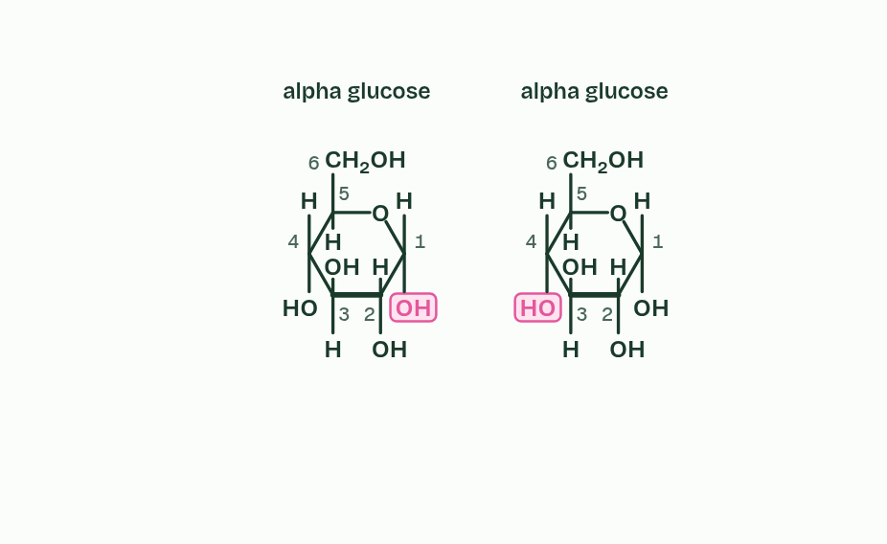
CHAPTER 2 · B1.1.2 B1.1.3 Condensation and hydrolysis
1 / 5
Water out to build, water in to break
Two monomers: alpha glucose. Watch the OH groups that face each other.
Minutes 0 to 6
Notes:
Minutes 0 to 6 of 60: Do now (6 min).
The plan: Define monomer and polymer. Then name the reaction in chapter 2’s figure at step 3 and say what it releases.
Many of life’s large molecules are polymers: long chains of similar small units called monomers. Very large molecules like these are macromolecules.
Monomers are joined by a condensation reaction. An OH group from one monomer and an H from the other leave together as a molecule of water, and a covalent bond forms between the two monomers. One water molecule is released for every bond made.
Three families of polymer are built this way. Polysaccharides are monosaccharides joined by glycosidic bonds. Polypeptides are chains of amino acids (B1.2) and nucleic acids are chains of nucleotides (A1.2).
Hydrolysis runs the other way: hydro means water and lysis means splitting. A water molecule is split, its H joins one monomer and its OH joins the other, and the bond between them breaks. Digestion is hydrolysis: it turns the polymers in food back into monomers. In the amylase lab you can watch an enzyme hydrolyse starch.
In cells, enzymes catalyse both reactions. Building polymers by condensation is part of anabolism, and breaking them down by hydrolysis part of catabolism (C1.1). Not every large molecule is a polymer: triglycerides are also made by condensation, but they are not chains of repeating units (chapter 7). Why water behaves as it does is in A1.1.

Slide 4
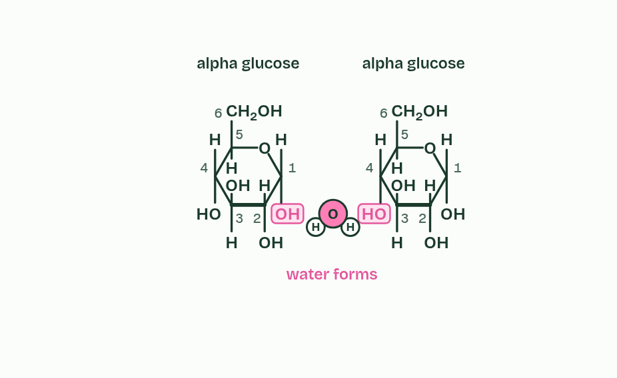
CHAPTER 2 · B1.1.2 B1.1.3 Condensation and hydrolysis
2 / 5
Water out to build, water in to break
Condensation: an OH and an H leave together as a molecule of water.
Minutes 0 to 6
Notes:
Minutes 0 to 6 of 60: Do now (6 min).
The plan: Define monomer and polymer. Then name the reaction in chapter 2’s figure at step 3 and say what it releases.
Many of life’s large molecules are polymers: long chains of similar small units called monomers. Very large molecules like these are macromolecules.
Monomers are joined by a condensation reaction. An OH group from one monomer and an H from the other leave together as a molecule of water, and a covalent bond forms between the two monomers. One water molecule is released for every bond made.
Three families of polymer are built this way. Polysaccharides are monosaccharides joined by glycosidic bonds. Polypeptides are chains of amino acids (B1.2) and nucleic acids are chains of nucleotides (A1.2).
Hydrolysis runs the other way: hydro means water and lysis means splitting. A water molecule is split, its H joins one monomer and its OH joins the other, and the bond between them breaks. Digestion is hydrolysis: it turns the polymers in food back into monomers. In the amylase lab you can watch an enzyme hydrolyse starch.
In cells, enzymes catalyse both reactions. Building polymers by condensation is part of anabolism, and breaking them down by hydrolysis part of catabolism (C1.1). Not every large molecule is a polymer: triglycerides are also made by condensation, but they are not chains of repeating units (chapter 7). Why water behaves as it does is in A1.1.

Slide 5
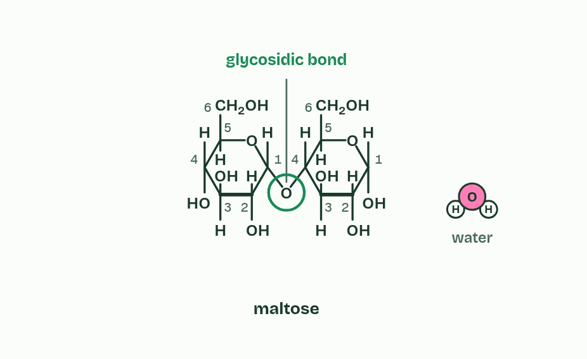
CHAPTER 2 · B1.1.2 B1.1.3 Condensation and hydrolysis
3 / 5
Water out to build, water in to break
A covalent glycosidic bond now joins them.
Minutes 0 to 6
Notes:
Minutes 0 to 6 of 60: Do now (6 min).
The plan: Define monomer and polymer. Then name the reaction in chapter 2’s figure at step 3 and say what it releases.
Many of life’s large molecules are polymers: long chains of similar small units called monomers. Very large molecules like these are macromolecules.
Monomers are joined by a condensation reaction. An OH group from one monomer and an H from the other leave together as a molecule of water, and a covalent bond forms between the two monomers. One water molecule is released for every bond made.
Three families of polymer are built this way. Polysaccharides are monosaccharides joined by glycosidic bonds. Polypeptides are chains of amino acids (B1.2) and nucleic acids are chains of nucleotides (A1.2).
Hydrolysis runs the other way: hydro means water and lysis means splitting. A water molecule is split, its H joins one monomer and its OH joins the other, and the bond between them breaks. Digestion is hydrolysis: it turns the polymers in food back into monomers. In the amylase lab you can watch an enzyme hydrolyse starch.
In cells, enzymes catalyse both reactions. Building polymers by condensation is part of anabolism, and breaking them down by hydrolysis part of catabolism (C1.1). Not every large molecule is a polymer: triglycerides are also made by condensation, but they are not chains of repeating units (chapter 7). Why water behaves as it does is in A1.1.

Slide 6
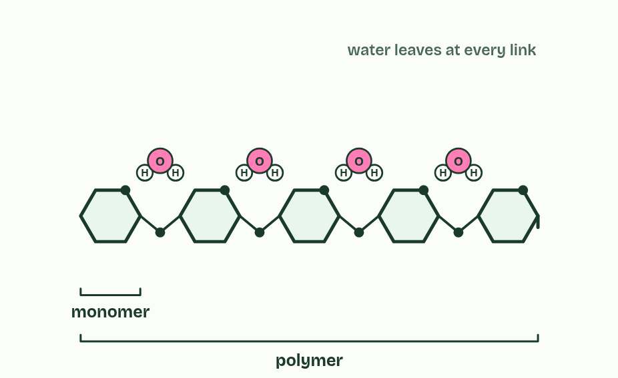
CHAPTER 2 · B1.1.2 B1.1.3 Condensation and hydrolysis
4 / 5
Water out to build, water in to break
Repeat it and a chain grows: a polymer. Polysaccharides, polypeptides and nucleic acids are all built like this.
Minutes 0 to 6
Notes:
Minutes 0 to 6 of 60: Do now (6 min).
The plan: Define monomer and polymer. Then name the reaction in chapter 2’s figure at step 3 and say what it releases.
Many of life’s large molecules are polymers: long chains of similar small units called monomers. Very large molecules like these are macromolecules.
Monomers are joined by a condensation reaction. An OH group from one monomer and an H from the other leave together as a molecule of water, and a covalent bond forms between the two monomers. One water molecule is released for every bond made.
Three families of polymer are built this way. Polysaccharides are monosaccharides joined by glycosidic bonds. Polypeptides are chains of amino acids (B1.2) and nucleic acids are chains of nucleotides (A1.2).
Hydrolysis runs the other way: hydro means water and lysis means splitting. A water molecule is split, its H joins one monomer and its OH joins the other, and the bond between them breaks. Digestion is hydrolysis: it turns the polymers in food back into monomers. In the amylase lab you can watch an enzyme hydrolyse starch.
In cells, enzymes catalyse both reactions. Building polymers by condensation is part of anabolism, and breaking them down by hydrolysis part of catabolism (C1.1). Not every large molecule is a polymer: triglycerides are also made by condensation, but they are not chains of repeating units (chapter 7). Why water behaves as it does is in A1.1.

Slide 7
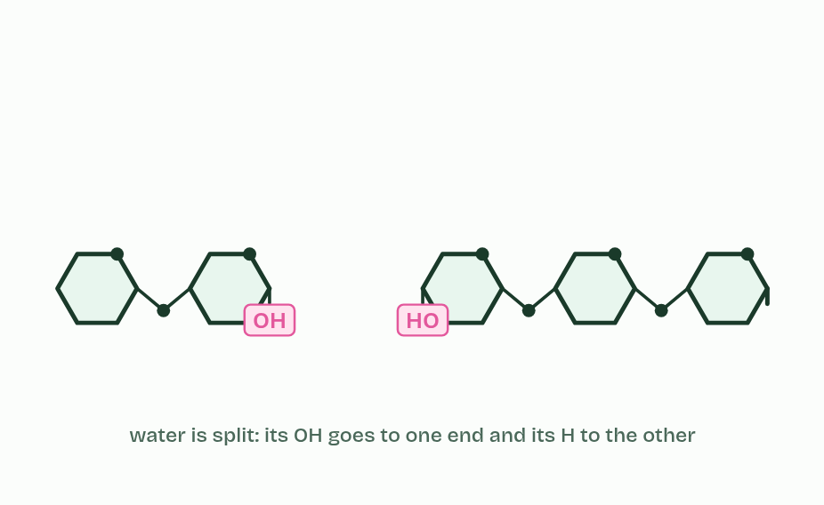
CHAPTER 2 · B1.1.2 B1.1.3 Condensation and hydrolysis
5 / 5
Water out to build, water in to break
Hydrolysis runs it backwards: water is split, its H to one monomer and its OH to the other.
Minutes 0 to 6
Notes:
Minutes 0 to 6 of 60: Do now (6 min).
The plan: Define monomer and polymer. Then name the reaction in chapter 2’s figure at step 3 and say what it releases.
Many of life’s large molecules are polymers: long chains of similar small units called monomers. Very large molecules like these are macromolecules.
Monomers are joined by a condensation reaction. An OH group from one monomer and an H from the other leave together as a molecule of water, and a covalent bond forms between the two monomers. One water molecule is released for every bond made.
Three families of polymer are built this way. Polysaccharides are monosaccharides joined by glycosidic bonds. Polypeptides are chains of amino acids (B1.2) and nucleic acids are chains of nucleotides (A1.2).
Hydrolysis runs the other way: hydro means water and lysis means splitting. A water molecule is split, its H joins one monomer and its OH joins the other, and the bond between them breaks. Digestion is hydrolysis: it turns the polymers in food back into monomers. In the amylase lab you can watch an enzyme hydrolyse starch.
In cells, enzymes catalyse both reactions. Building polymers by condensation is part of anabolism, and breaking them down by hydrolysis part of catabolism (C1.1). Not every large molecule is a polymer: triglycerides are also made by condensation, but they are not chains of repeating units (chapter 7). Why water behaves as it does is in A1.1.

Slide 8
CHAPTER 2 · B1.1.2 B1.1.3 Condensation and hydrolysis
Water out to build, water in to break
Many of life’s large molecules are polymers: long chains of similar small units called monomers.
Very large molecules like these are macromolecules.
Monomers are joined by a condensation reaction.
An OH group from one monomer and an H from the other leave together as a molecule of water, and a covalent bond forms between the two monomers.
Minutes 0 to 6
Notes:
Minutes 0 to 6 of 60: Do now (6 min).
The plan: Define monomer and polymer. Then name the reaction in chapter 2’s figure at step 3 and say what it releases.
Many of life’s large molecules are polymers: long chains of similar small units called monomers. Very large molecules like these are macromolecules.
Monomers are joined by a condensation reaction. An OH group from one monomer and an H from the other leave together as a molecule of water, and a covalent bond forms between the two monomers. One water molecule is released for every bond made.
Three families of polymer are built this way. Polysaccharides are monosaccharides joined by glycosidic bonds. Polypeptides are chains of amino acids (B1.2) and nucleic acids are chains of nucleotides (A1.2).
Hydrolysis runs the other way: hydro means water and lysis means splitting. A water molecule is split, its H joins one monomer and its OH joins the other, and the bond between them breaks. Digestion is hydrolysis: it turns the polymers in food back into monomers. In the amylase lab you can watch an enzyme hydrolyse starch.
In cells, enzymes catalyse both reactions. Building polymers by condensation is part of anabolism, and breaking them down by hydrolysis part of catabolism (C1.1). Not every large molecule is a polymer: triglycerides are also made by condensation, but they are not chains of repeating units (chapter 7). Why water behaves as it does is in A1.1.

Slide 9
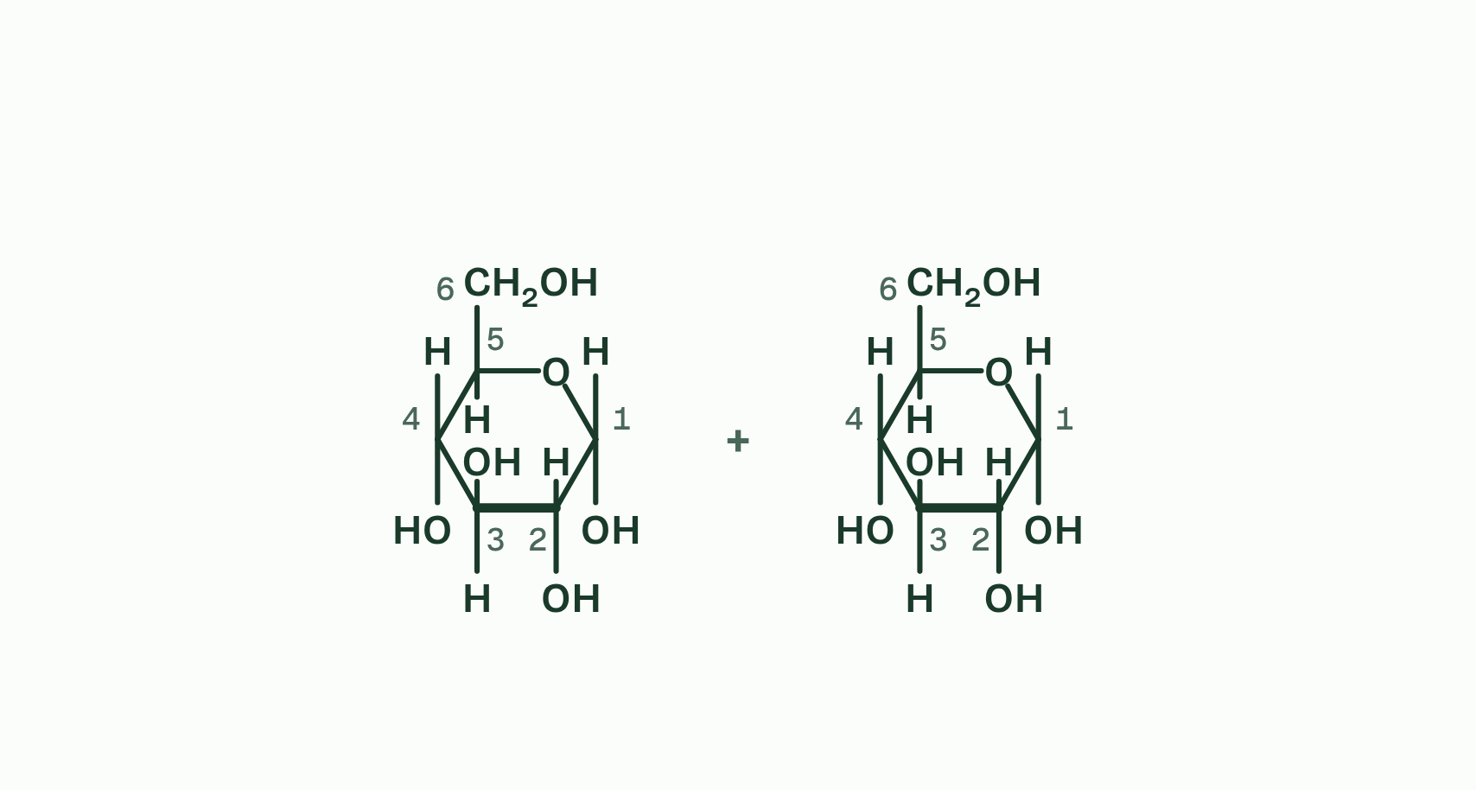
CHAPTER 2 · B1.1.2 B1.1.3 Condensation and hydrolysis
1 / 4
Water out to build, water in to break
Two alpha glucose molecules, their carbons numbered.
Minutes 0 to 6
Notes:
Minutes 0 to 6 of 60: Do now (6 min).
The plan: Define monomer and polymer. Then name the reaction in chapter 2’s figure at step 3 and say what it releases.
Many of life’s large molecules are polymers: long chains of similar small units called monomers. Very large molecules like these are macromolecules.
Monomers are joined by a condensation reaction. An OH group from one monomer and an H from the other leave together as a molecule of water, and a covalent bond forms between the two monomers. One water molecule is released for every bond made.
Three families of polymer are built this way. Polysaccharides are monosaccharides joined by glycosidic bonds. Polypeptides are chains of amino acids (B1.2) and nucleic acids are chains of nucleotides (A1.2).
Hydrolysis runs the other way: hydro means water and lysis means splitting. A water molecule is split, its H joins one monomer and its OH joins the other, and the bond between them breaks. Digestion is hydrolysis: it turns the polymers in food back into monomers. In the amylase lab you can watch an enzyme hydrolyse starch.
In cells, enzymes catalyse both reactions. Building polymers by condensation is part of anabolism, and breaking them down by hydrolysis part of catabolism (C1.1). Not every large molecule is a polymer: triglycerides are also made by condensation, but they are not chains of repeating units (chapter 7). Why water behaves as it does is in A1.1.

Slide 10
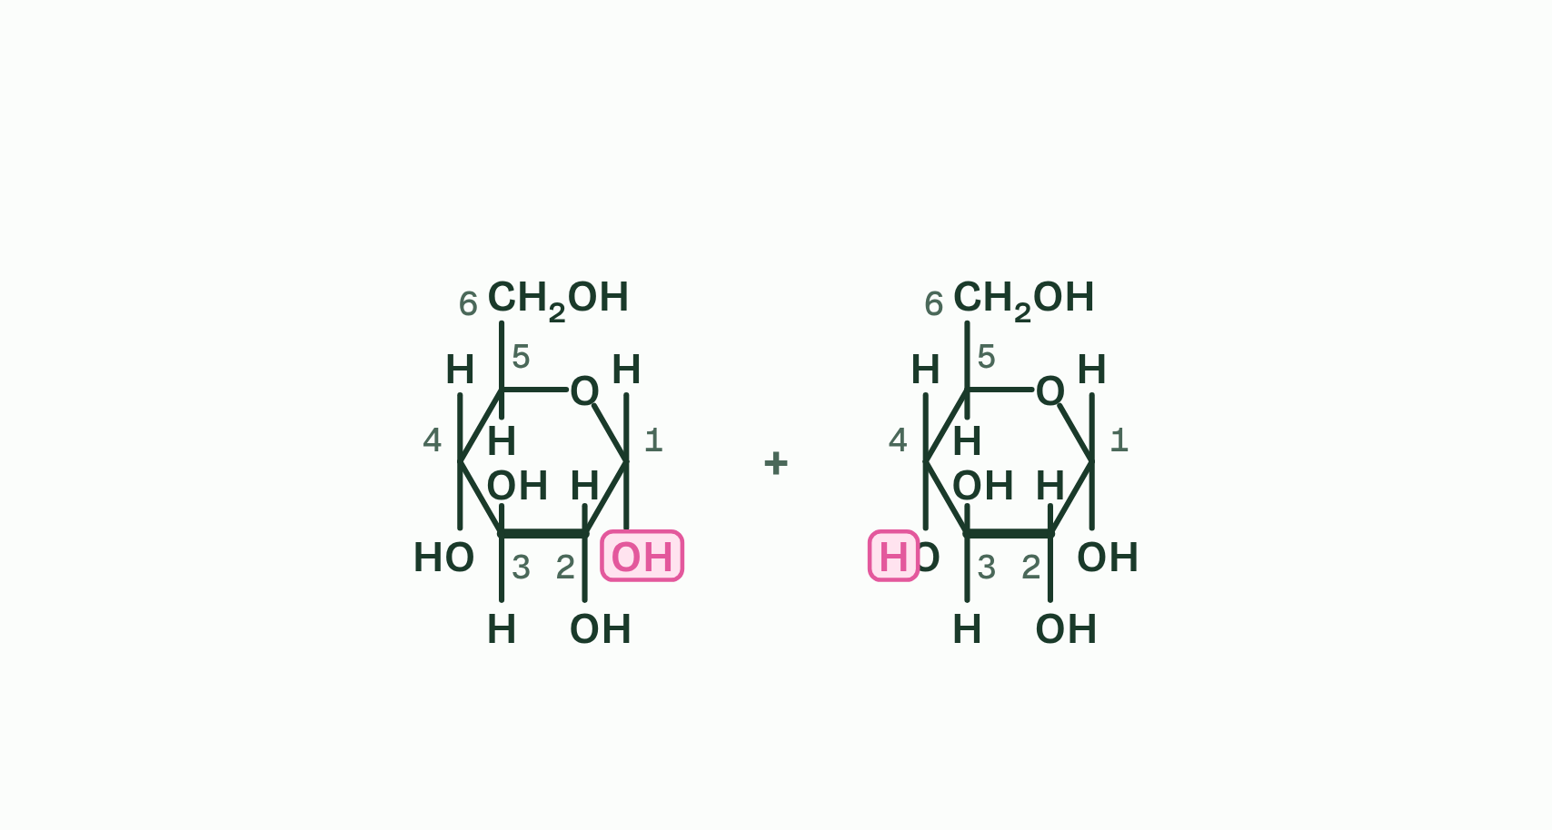
CHAPTER 2 · B1.1.2 B1.1.3 Condensation and hydrolysis
2 / 4
Water out to build, water in to break
The OH on carbon 1 of one and the H from the OH on carbon 4 of the other face each other.
Minutes 0 to 6
Notes:
Minutes 0 to 6 of 60: Do now (6 min).
The plan: Define monomer and polymer. Then name the reaction in chapter 2’s figure at step 3 and say what it releases.
Many of life’s large molecules are polymers: long chains of similar small units called monomers. Very large molecules like these are macromolecules.
Monomers are joined by a condensation reaction. An OH group from one monomer and an H from the other leave together as a molecule of water, and a covalent bond forms between the two monomers. One water molecule is released for every bond made.
Three families of polymer are built this way. Polysaccharides are monosaccharides joined by glycosidic bonds. Polypeptides are chains of amino acids (B1.2) and nucleic acids are chains of nucleotides (A1.2).
Hydrolysis runs the other way: hydro means water and lysis means splitting. A water molecule is split, its H joins one monomer and its OH joins the other, and the bond between them breaks. Digestion is hydrolysis: it turns the polymers in food back into monomers. In the amylase lab you can watch an enzyme hydrolyse starch.
In cells, enzymes catalyse both reactions. Building polymers by condensation is part of anabolism, and breaking them down by hydrolysis part of catabolism (C1.1). Not every large molecule is a polymer: triglycerides are also made by condensation, but they are not chains of repeating units (chapter 7). Why water behaves as it does is in A1.1.

Slide 11
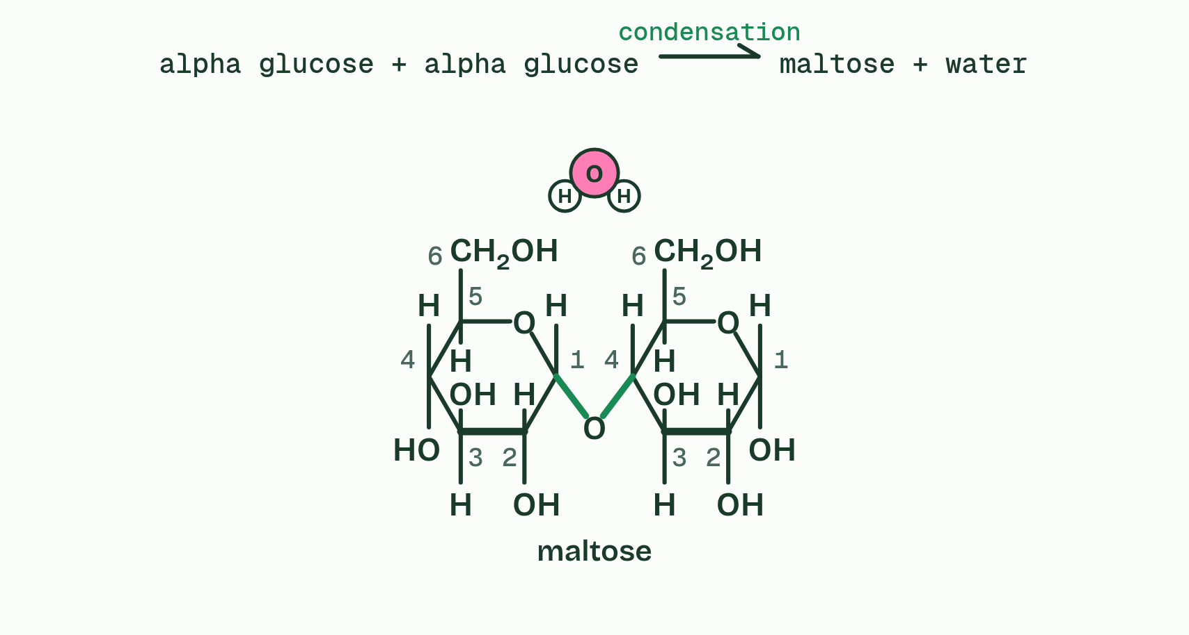
CHAPTER 2 · B1.1.2 B1.1.3 Condensation and hydrolysis
3 / 4
Water out to build, water in to break
They leave as water, and a 1,4 glycosidic bond joins the rings: condensation, making maltose.
Minutes 0 to 6
Notes:
Minutes 0 to 6 of 60: Do now (6 min).
The plan: Define monomer and polymer. Then name the reaction in chapter 2’s figure at step 3 and say what it releases.
Many of life’s large molecules are polymers: long chains of similar small units called monomers. Very large molecules like these are macromolecules.
Monomers are joined by a condensation reaction. An OH group from one monomer and an H from the other leave together as a molecule of water, and a covalent bond forms between the two monomers. One water molecule is released for every bond made.
Three families of polymer are built this way. Polysaccharides are monosaccharides joined by glycosidic bonds. Polypeptides are chains of amino acids (B1.2) and nucleic acids are chains of nucleotides (A1.2).
Hydrolysis runs the other way: hydro means water and lysis means splitting. A water molecule is split, its H joins one monomer and its OH joins the other, and the bond between them breaks. Digestion is hydrolysis: it turns the polymers in food back into monomers. In the amylase lab you can watch an enzyme hydrolyse starch.
In cells, enzymes catalyse both reactions. Building polymers by condensation is part of anabolism, and breaking them down by hydrolysis part of catabolism (C1.1). Not every large molecule is a polymer: triglycerides are also made by condensation, but they are not chains of repeating units (chapter 7). Why water behaves as it does is in A1.1.

Slide 12
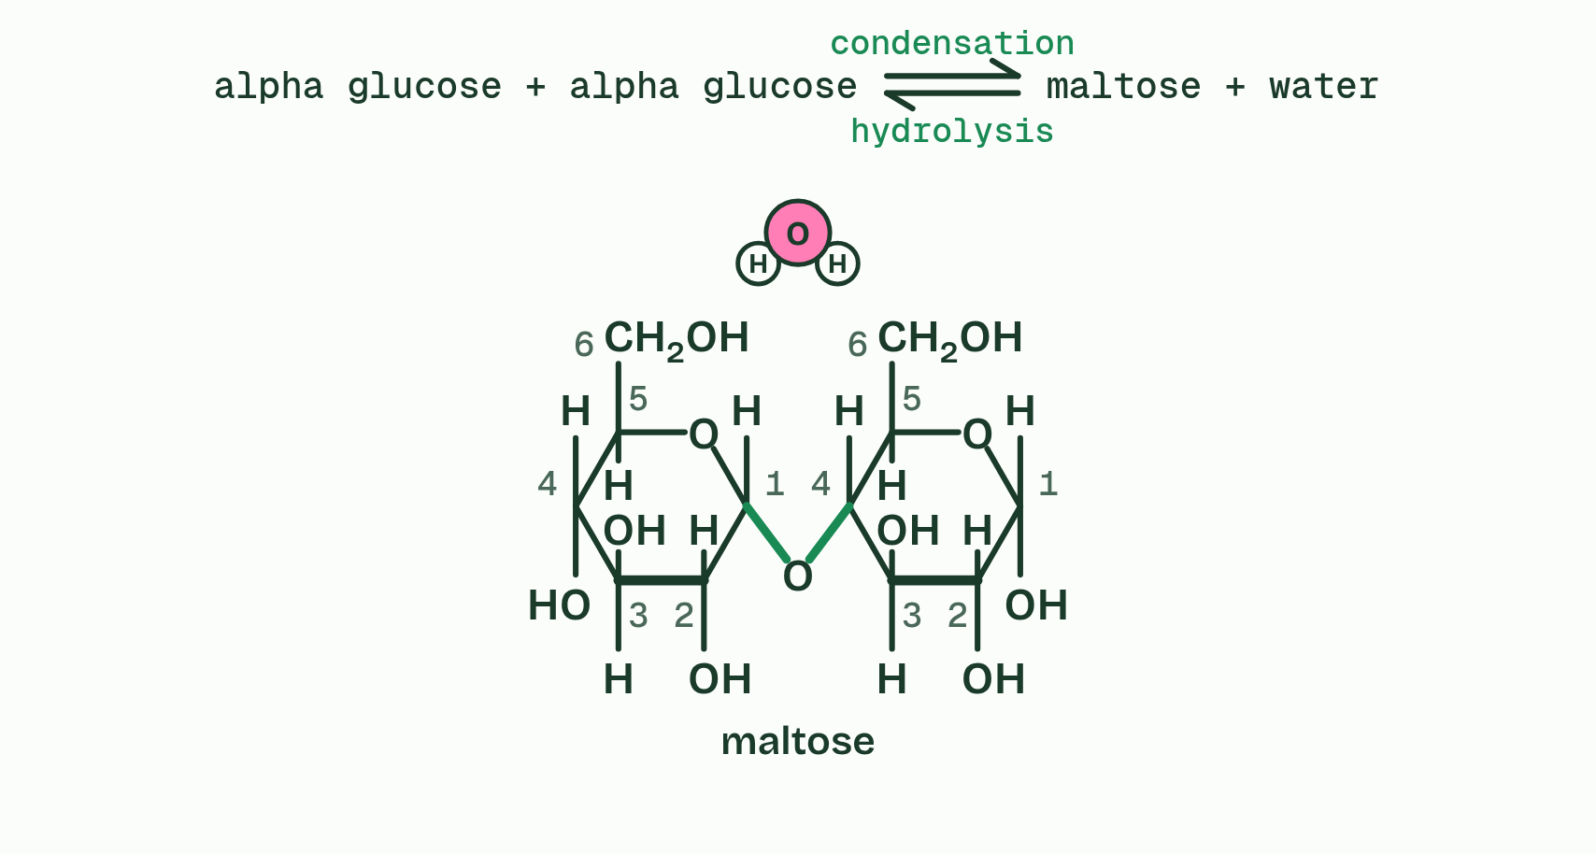
CHAPTER 2 · B1.1.2 B1.1.3 Condensation and hydrolysis
4 / 4
Water out to build, water in to break
Add water and the bond splits again, the H to one sugar and the OH to the other: hydrolysis.
Minutes 0 to 6
Notes:
Minutes 0 to 6 of 60: Do now (6 min).
The plan: Define monomer and polymer. Then name the reaction in chapter 2’s figure at step 3 and say what it releases.
Many of life’s large molecules are polymers: long chains of similar small units called monomers. Very large molecules like these are macromolecules.
Monomers are joined by a condensation reaction. An OH group from one monomer and an H from the other leave together as a molecule of water, and a covalent bond forms between the two monomers. One water molecule is released for every bond made.
Three families of polymer are built this way. Polysaccharides are monosaccharides joined by glycosidic bonds. Polypeptides are chains of amino acids (B1.2) and nucleic acids are chains of nucleotides (A1.2).
Hydrolysis runs the other way: hydro means water and lysis means splitting. A water molecule is split, its H joins one monomer and its OH joins the other, and the bond between them breaks. Digestion is hydrolysis: it turns the polymers in food back into monomers. In the amylase lab you can watch an enzyme hydrolyse starch.
In cells, enzymes catalyse both reactions. Building polymers by condensation is part of anabolism, and breaking them down by hydrolysis part of catabolism (C1.1). Not every large molecule is a polymer: triglycerides are also made by condensation, but they are not chains of repeating units (chapter 7). Why water behaves as it does is in A1.1.

Slide 13
CHAPTER 2 · B1.1.2 B1.1.3 Condensation and hydrolysis
Water out to build, water in to break
Many of life’s large molecules are polymers: long chains of similar small units called monomers.
Very large molecules like these are macromolecules.
Monomers are joined by a condensation reaction.
An OH group from one monomer and an H from the other leave together as a molecule of water, and a covalent bond forms between the two monomers.
Minutes 0 to 6
Notes:
Minutes 0 to 6 of 60: Do now (6 min).
The plan: Define monomer and polymer. Then name the reaction in chapter 2’s figure at step 3 and say what it releases.
Many of life’s large molecules are polymers: long chains of similar small units called monomers. Very large molecules like these are macromolecules.
Monomers are joined by a condensation reaction. An OH group from one monomer and an H from the other leave together as a molecule of water, and a covalent bond forms between the two monomers. One water molecule is released for every bond made.
Three families of polymer are built this way. Polysaccharides are monosaccharides joined by glycosidic bonds. Polypeptides are chains of amino acids (B1.2) and nucleic acids are chains of nucleotides (A1.2).
Hydrolysis runs the other way: hydro means water and lysis means splitting. A water molecule is split, its H joins one monomer and its OH joins the other, and the bond between them breaks. Digestion is hydrolysis: it turns the polymers in food back into monomers. In the amylase lab you can watch an enzyme hydrolyse starch.
In cells, enzymes catalyse both reactions. Building polymers by condensation is part of anabolism, and breaking them down by hydrolysis part of catabolism (C1.1). Not every large molecule is a polymer: triglycerides are also made by condensation, but they are not chains of repeating units (chapter 7). Why water behaves as it does is in A1.1.

Slide 14
WATCH OUT
Condensation releases water and hydrolysis uses it. And in hydrolysis the water is not simply added: it is split, and its H and OH end up in the two new ends.
Minutes 0 to 6
Notes:
Minutes 0 to 6 of 60: Do now (6 min).
The plan: Define monomer and polymer. Then name the reaction in chapter 2’s figure at step 3 and say what it releases.
A common mistake: say it, then ask who can say why it is wrong.

Slide 15
STEP 2
8 MIN
Carbon’s four bonds
Pairs build methane and ethene with model kits and check that every carbon has four bonds.
Minutes 6 to 14
Notes:
Minutes 6 to 14 of 60: Carbon’s four bonds (8 min).
The plan: Chapter 1’s figure. Pairs build methane and ethene with model kits and check that every carbon has four bonds. Then the chapter 1 predict box.

Slide 16
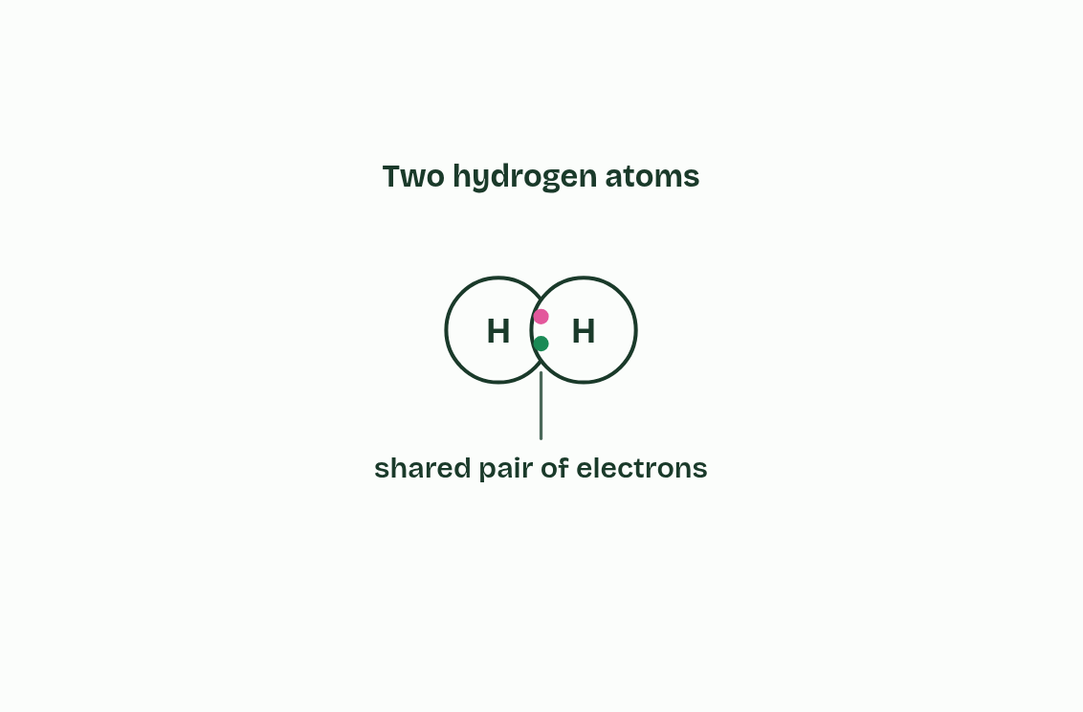
CHAPTER 1 · B1.1.1 Carbon compounds
1 / 5
Chains, branches and rings
A covalent bond is a pair of electrons shared by two atoms.
Minutes 6 to 14
Notes:
Minutes 6 to 14 of 60: Carbon’s four bonds (8 min).
The plan: Chapter 1’s figure. Pairs build methane and ethene with model kits and check that every carbon has four bonds. Then the chapter 1 predict box.
Every molecule in this guide is built round carbon atoms. To see why carbon is so good at it, start with how atoms join. A covalent bond is a pair of electrons shared by two atoms, and the shared pair holds them together.
A carbon atom has four electrons in its outer shell to share, so it can make up to four covalent bonds: four single bonds, or a double bond plus two single bonds. It bonds to other carbon atoms and to other non-metals: hydrogen, oxygen, nitrogen, phosphorus and sulfur.
Because carbon bonds to carbon, it builds skeletons. A carbon compound can have a chain, either unbranched, like the tail of a fatty acid, or branched; a single ring, like glucose; or several rings fused together, as in a steroid. Add other atoms to each skeleton and the number of possible molecules is enormous. That variety is why life, with all its forms, is built on carbon.
Example: Why every lab agrees on a nanometre Scientists can compare measurements only if a unit means the same everywhere. The SI, the international system of units, was adopted by agreement in 1960. Its prefixes scale a unit up or down in powers of ten: kilo, centi, milli, micro and nano. Biology uses all five, as the ladder below shows.

Slide 17
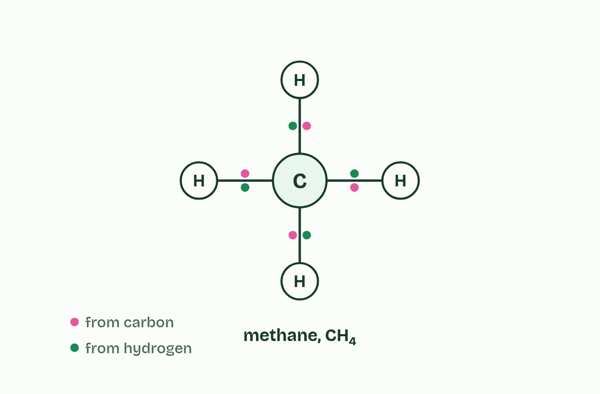
CHAPTER 1 · B1.1.1 Carbon compounds
2 / 5
Chains, branches and rings
Carbon has four electrons to share, so it makes four bonds.
Minutes 6 to 14
Notes:
Minutes 6 to 14 of 60: Carbon’s four bonds (8 min).
The plan: Chapter 1’s figure. Pairs build methane and ethene with model kits and check that every carbon has four bonds. Then the chapter 1 predict box.
Every molecule in this guide is built round carbon atoms. To see why carbon is so good at it, start with how atoms join. A covalent bond is a pair of electrons shared by two atoms, and the shared pair holds them together.
A carbon atom has four electrons in its outer shell to share, so it can make up to four covalent bonds: four single bonds, or a double bond plus two single bonds. It bonds to other carbon atoms and to other non-metals: hydrogen, oxygen, nitrogen, phosphorus and sulfur.
Because carbon bonds to carbon, it builds skeletons. A carbon compound can have a chain, either unbranched, like the tail of a fatty acid, or branched; a single ring, like glucose; or several rings fused together, as in a steroid. Add other atoms to each skeleton and the number of possible molecules is enormous. That variety is why life, with all its forms, is built on carbon.
Example: Why every lab agrees on a nanometre Scientists can compare measurements only if a unit means the same everywhere. The SI, the international system of units, was adopted by agreement in 1960. Its prefixes scale a unit up or down in powers of ten: kilo, centi, milli, micro and nano. Biology uses all five, as the ladder below shows.

Slide 18
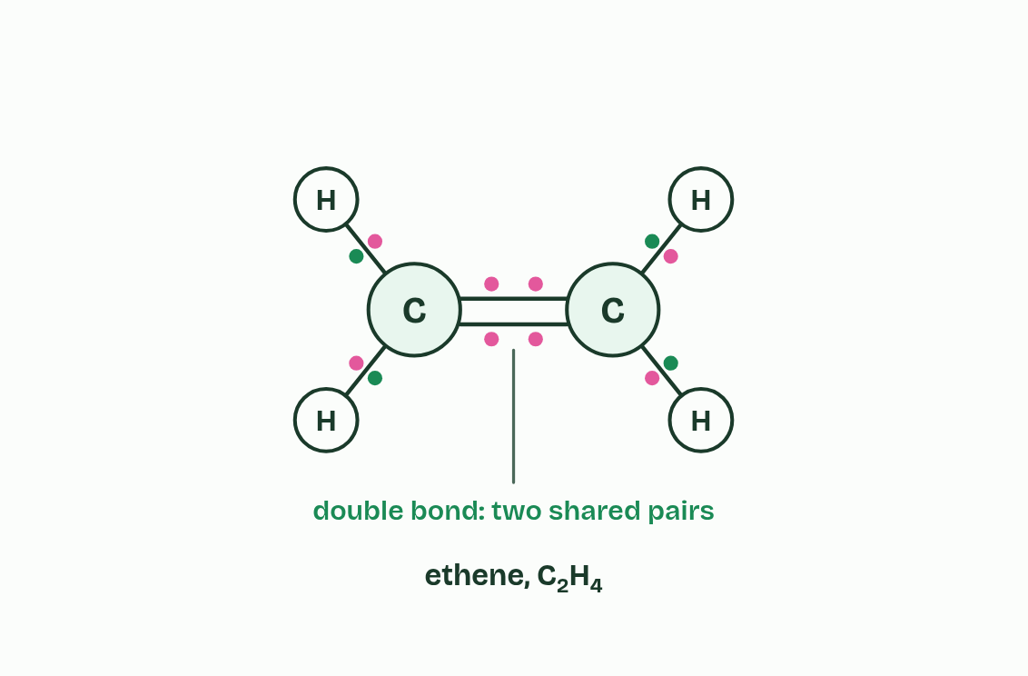
CHAPTER 1 · B1.1.1 Carbon compounds
3 / 5
Chains, branches and rings
A double bond shares two pairs: it uses two of carbon’s four.
Minutes 6 to 14
Notes:
Minutes 6 to 14 of 60: Carbon’s four bonds (8 min).
The plan: Chapter 1’s figure. Pairs build methane and ethene with model kits and check that every carbon has four bonds. Then the chapter 1 predict box.
Every molecule in this guide is built round carbon atoms. To see why carbon is so good at it, start with how atoms join. A covalent bond is a pair of electrons shared by two atoms, and the shared pair holds them together.
A carbon atom has four electrons in its outer shell to share, so it can make up to four covalent bonds: four single bonds, or a double bond plus two single bonds. It bonds to other carbon atoms and to other non-metals: hydrogen, oxygen, nitrogen, phosphorus and sulfur.
Because carbon bonds to carbon, it builds skeletons. A carbon compound can have a chain, either unbranched, like the tail of a fatty acid, or branched; a single ring, like glucose; or several rings fused together, as in a steroid. Add other atoms to each skeleton and the number of possible molecules is enormous. That variety is why life, with all its forms, is built on carbon.
Example: Why every lab agrees on a nanometre Scientists can compare measurements only if a unit means the same everywhere. The SI, the international system of units, was adopted by agreement in 1960. Its prefixes scale a unit up or down in powers of ten: kilo, centi, milli, micro and nano. Biology uses all five, as the ladder below shows.

Slide 19
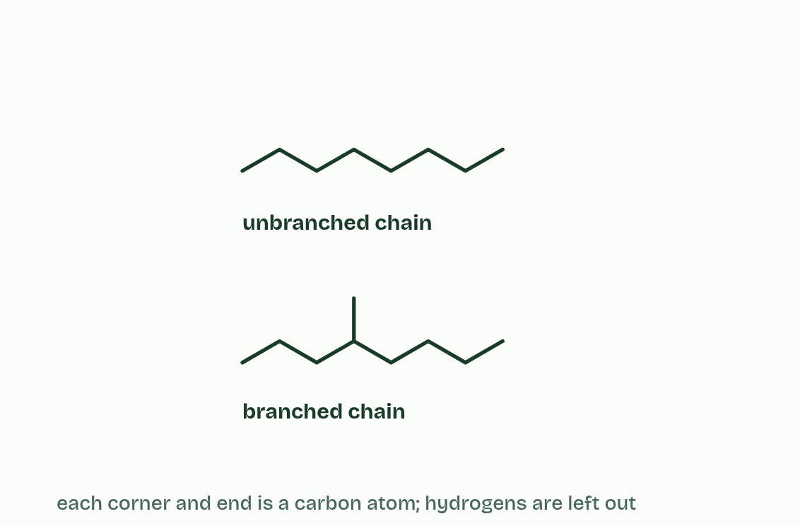
CHAPTER 1 · B1.1.1 Carbon compounds
4 / 5
Chains, branches and rings
Carbon bonds to carbon, so it builds chains, straight or branched,
Minutes 6 to 14
Notes:
Minutes 6 to 14 of 60: Carbon’s four bonds (8 min).
The plan: Chapter 1’s figure. Pairs build methane and ethene with model kits and check that every carbon has four bonds. Then the chapter 1 predict box.
Every molecule in this guide is built round carbon atoms. To see why carbon is so good at it, start with how atoms join. A covalent bond is a pair of electrons shared by two atoms, and the shared pair holds them together.
A carbon atom has four electrons in its outer shell to share, so it can make up to four covalent bonds: four single bonds, or a double bond plus two single bonds. It bonds to other carbon atoms and to other non-metals: hydrogen, oxygen, nitrogen, phosphorus and sulfur.
Because carbon bonds to carbon, it builds skeletons. A carbon compound can have a chain, either unbranched, like the tail of a fatty acid, or branched; a single ring, like glucose; or several rings fused together, as in a steroid. Add other atoms to each skeleton and the number of possible molecules is enormous. That variety is why life, with all its forms, is built on carbon.
Example: Why every lab agrees on a nanometre Scientists can compare measurements only if a unit means the same everywhere. The SI, the international system of units, was adopted by agreement in 1960. Its prefixes scale a unit up or down in powers of ten: kilo, centi, milli, micro and nano. Biology uses all five, as the ladder below shows.

Slide 20
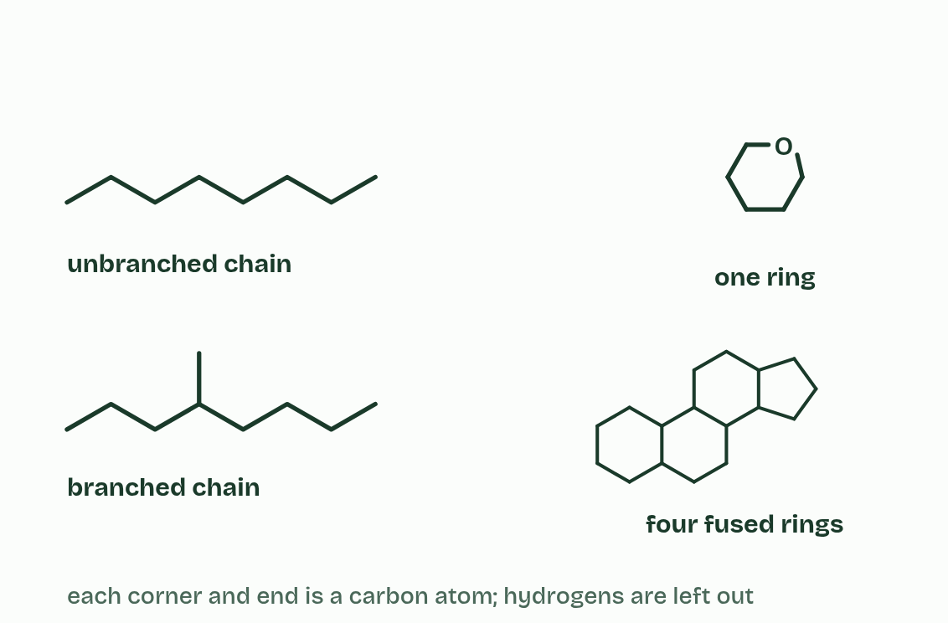
CHAPTER 1 · B1.1.1 Carbon compounds
5 / 5
Chains, branches and rings
and rings, one or several fused together.
Minutes 6 to 14
Notes:
Minutes 6 to 14 of 60: Carbon’s four bonds (8 min).
The plan: Chapter 1’s figure. Pairs build methane and ethene with model kits and check that every carbon has four bonds. Then the chapter 1 predict box.
Every molecule in this guide is built round carbon atoms. To see why carbon is so good at it, start with how atoms join. A covalent bond is a pair of electrons shared by two atoms, and the shared pair holds them together.
A carbon atom has four electrons in its outer shell to share, so it can make up to four covalent bonds: four single bonds, or a double bond plus two single bonds. It bonds to other carbon atoms and to other non-metals: hydrogen, oxygen, nitrogen, phosphorus and sulfur.
Because carbon bonds to carbon, it builds skeletons. A carbon compound can have a chain, either unbranched, like the tail of a fatty acid, or branched; a single ring, like glucose; or several rings fused together, as in a steroid. Add other atoms to each skeleton and the number of possible molecules is enormous. That variety is why life, with all its forms, is built on carbon.
Example: Why every lab agrees on a nanometre Scientists can compare measurements only if a unit means the same everywhere. The SI, the international system of units, was adopted by agreement in 1960. Its prefixes scale a unit up or down in powers of ten: kilo, centi, milli, micro and nano. Biology uses all five, as the ladder below shows.

Slide 21
CHAPTER 1 · B1.1.1 Carbon compounds
Chains, branches and rings
Carbon makes four bonds in total, and a double bond counts as two.
Three skeletons to recognise in a drawing: a chain (straight or branched), a single ring and fused rings.
Minutes 6 to 14
Notes:
Minutes 6 to 14 of 60: Carbon’s four bonds (8 min).
The plan: Chapter 1’s figure. Pairs build methane and ethene with model kits and check that every carbon has four bonds. Then the chapter 1 predict box.
Every molecule in this guide is built round carbon atoms. To see why carbon is so good at it, start with how atoms join. A covalent bond is a pair of electrons shared by two atoms, and the shared pair holds them together.
A carbon atom has four electrons in its outer shell to share, so it can make up to four covalent bonds: four single bonds, or a double bond plus two single bonds. It bonds to other carbon atoms and to other non-metals: hydrogen, oxygen, nitrogen, phosphorus and sulfur.
Because carbon bonds to carbon, it builds skeletons. A carbon compound can have a chain, either unbranched, like the tail of a fatty acid, or branched; a single ring, like glucose; or several rings fused together, as in a steroid. Add other atoms to each skeleton and the number of possible molecules is enormous. That variety is why life, with all its forms, is built on carbon.
Example: Why every lab agrees on a nanometre Scientists can compare measurements only if a unit means the same everywhere. The SI, the international system of units, was adopted by agreement in 1960. Its prefixes scale a unit up or down in powers of ten: kilo, centi, milli, micro and nano. Biology uses all five, as the ladder below shows.

Slide 22
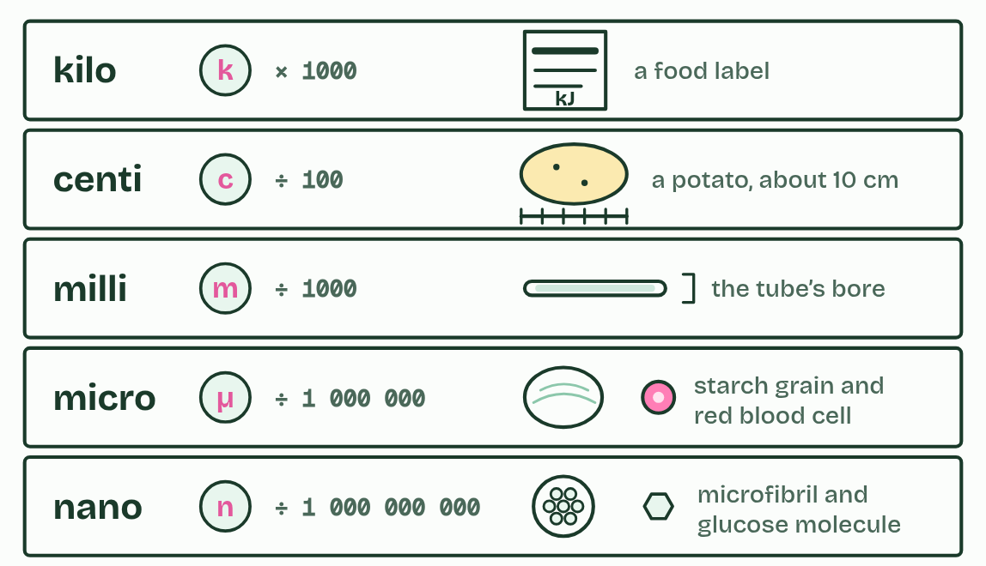
CHAPTER 1 · B1.1.1 Carbon compounds
Chains, branches and rings
Carbon makes four bonds in total, and a double bond counts as two.
Three skeletons to recognise in a drawing: a chain (straight or branched), a single ring and fused rings.
Minutes 6 to 14
Notes:
Minutes 6 to 14 of 60: Carbon’s four bonds (8 min).
The plan: Chapter 1’s figure. Pairs build methane and ethene with model kits and check that every carbon has four bonds. Then the chapter 1 predict box.
Every molecule in this guide is built round carbon atoms. To see why carbon is so good at it, start with how atoms join. A covalent bond is a pair of electrons shared by two atoms, and the shared pair holds them together.
A carbon atom has four electrons in its outer shell to share, so it can make up to four covalent bonds: four single bonds, or a double bond plus two single bonds. It bonds to other carbon atoms and to other non-metals: hydrogen, oxygen, nitrogen, phosphorus and sulfur.
Because carbon bonds to carbon, it builds skeletons. A carbon compound can have a chain, either unbranched, like the tail of a fatty acid, or branched; a single ring, like glucose; or several rings fused together, as in a steroid. Add other atoms to each skeleton and the number of possible molecules is enormous. That variety is why life, with all its forms, is built on carbon.
Example: Why every lab agrees on a nanometre Scientists can compare measurements only if a unit means the same everywhere. The SI, the international system of units, was adopted by agreement in 1960. Its prefixes scale a unit up or down in powers of ten: kilo, centi, milli, micro and nano. Biology uses all five, as the ladder below shows.
Parts of the figure:
kilo (k), × 1000. A food label gives energy in kilojoules (kJ). One kilojoule is a thousand joules.
centi (c), ÷ 100. A potato is about 10 cm long: ten centimetres.
milli (m), ÷ 1000. A thin glass tube used for melting point tests is about 1 mm across the bore.
micro (µ), ÷ 1 000 000. A starch grain from a potato cell is tens of micrometres across. A red blood cell is about 8 µm.
nano (n), ÷ 1 000 000 000. A cellulose microfibril is about 3 nm wide. One glucose molecule is under 1 nm across.

Slide 23
WATCH OUT
A double bond is not one bond: it uses two of carbon’s four. Count it twice when you check a drawing.
Minutes 6 to 14
Notes:
Minutes 6 to 14 of 60: Carbon’s four bonds (8 min).
The plan: Chapter 1’s figure. Pairs build methane and ethene with model kits and check that every carbon has four bonds. Then the chapter 1 predict box.
A common mistake: say it, then ask who can say why it is wrong.

Slide 24
PREDICT
A drawing shows a carbon atom with a double bond to an oxygen, a single bond to another carbon and single bonds to two hydrogens. What is wrong with it?
A Nothing: carbon can form as many bonds as it has neighbours
B It has five bonds’ worth: the double bond counts as two
C Oxygen can never form a double bond with carbon
Minutes 6 to 14
Notes:
Minutes 6 to 14 of 60: Carbon’s four bonds (8 min).
The plan: Chapter 1’s figure. Pairs build methane and ethene with model kits and check that every carbon has four bonds. Then the chapter 1 predict box.
Ask for a show of hands, or mini whiteboards, before revealing. (Answer: B, on the next slide.)

Slide 25
WHAT HAPPENS
A drawing shows a carbon atom with a double bond to an oxygen, a single bond to another carbon and single bonds to two hydrogens. What is wrong with it?
A Nothing: carbon can form as many bonds as it has neighbours
B It has five bonds’ worth: the double bond counts as two
C Oxygen can never form a double bond with carbon
Count the double bond as two: 2 + 1 + 1 + 1 = 5, one more than carbon can make. Take away one hydrogen and every carbon has exactly four. Checking each carbon for four bonds is the quickest way to catch an error in any molecule you draw.
Minutes 6 to 14
Notes:
Minutes 6 to 14 of 60: Carbon’s four bonds (8 min).
The plan: Chapter 1’s figure. Pairs build methane and ethene with model kits and check that every carbon has four bonds. Then the chapter 1 predict box.
Answer: B. Count the double bond as two: 2 + 1 + 1 + 1 = 5, one more than carbon can make. Take away one hydrogen and every carbon has exactly four. Checking each carbon for four bonds is the quickest way to catch an error in any molecule you draw.

Slide 26
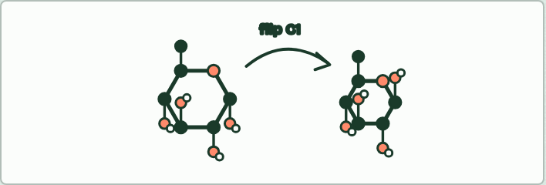
MODEL
15 MIN
Build α-glucose
THE TASK
Students build α-glucose with a molecular model kit, as they would draw it: the ring of five carbons and one oxygen, the sixth carbon above carbon 5, an OH and an H on each ring carbon, and four bonds on every carbon. Then they swap carbon 1’s H and OH to make β-glucose and compare with a partner. This is physical molecular modelling (Tool 1).
STUDENTS NEED
Model kits (one per pair), the ring diagram on the board.
Minutes 14 to 29
Notes:
Minutes 14 to 29 of 60: Build α-glucose (15 min).
The plan: The model kit activity below. Pairs build α-glucose, then swap the H and OH on carbon 1 to make β-glucose.
The activity: Build α-glucose. Students build α-glucose with a molecular model kit, as they would draw it: the ring of five carbons and one oxygen, the sixth carbon above carbon 5, an OH and an H on each ring carbon, and four bonds on every carbon. Then they swap carbon 1’s H and OH to make β-glucose and compare with a partner. This is physical molecular modelling (Tool 1).
Needs: model kits (one per pair), the ring diagram on the board.
The time: 15 minutes, minutes 14 to 29 of the plan.

Slide 27
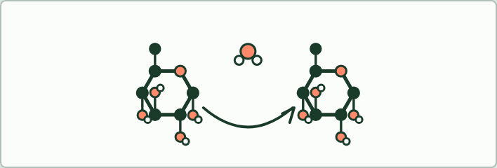
MODEL
10 MIN
Condensation by hand
THE TASK
Two pairs join their glucose models: remove an OH from one and an H from the other, build a water molecule from them, and link the rings through the remaining oxygen. Then reverse it with a water molecule, for hydrolysis.
STUDENTS NEED
The models from the first activity.
Minutes 29 to 39
Notes:
Minutes 29 to 39 of 60: Condensation by hand (10 min).
The plan: Two pairs join their α-glucose: pull off an OH and an H, make a water molecule from them and link the rings with the oxygen. Then reverse it. The bond builder on the board, then the chapter 2 predict box.
The activity: Condensation by hand. Two pairs join their glucose models: remove an OH from one and an H from the other, build a water molecule from them, and link the rings through the remaining oxygen. Then reverse it with a water molecule, for hydrolysis.
Needs: the models from the first activity.
The time: 10 minutes, minutes 29 to 39 of the plan.

Slide 28
PREDICT
Ten glucose molecules are joined into one unbranched chain. How many water molecules were released?
A 10
B 11
C 9
D 20
Minutes 29 to 39
Notes:
Minutes 29 to 39 of 60: Condensation by hand (10 min).
The plan: Two pairs join their α-glucose: pull off an OH and an H, make a water molecule from them and link the rings with the oxygen. Then reverse it. The bond builder on the board, then the chapter 2 predict box.
Ask for a show of hands, or mini whiteboards, before revealing. (Answer: C, on the next slide.)

Slide 29
WHAT HAPPENS
Ten glucose molecules are joined into one unbranched chain. How many water molecules were released?
A 10
B 11
C 9
D 20
Nine. One water leaves for every bond, and a chain of ten units has nine bonds between them. Digesting it back to glucose by hydrolysis uses nine water molecules.
Minutes 29 to 39
Notes:
Minutes 29 to 39 of 60: Condensation by hand (10 min).
The plan: Two pairs join their α-glucose: pull off an OH and an H, make a water molecule from them and link the rings with the oxygen. Then reverse it. The bond builder on the board, then the chapter 2 predict box.
Answer: C. Nine. One water leaves for every bond, and a chain of ten units has nine bonds between them. Digesting it back to glucose by hydrolysis uses nine water molecules.

Slide 30
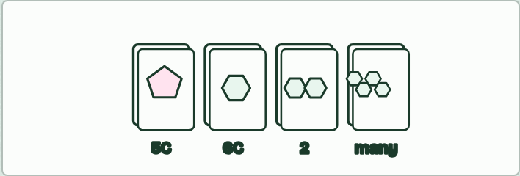
CARD SORT
15 MIN
Pentose, hexose, two or many?
THE TASK
Cards of α- and β-glucose, fructose, ribose, deoxyribose, maltose, sucrose, a piece of amylose and a glycogen branch. Sort them into pentose, hexose, disaccharide and polysaccharide. Fructose is the trap card: count carbons, not corners.
STUDENTS NEED
Printed cards, one set per pair.
Minutes 39 to 54
Notes:
Minutes 39 to 54 of 60: Pentose, hexose, two or many? (15 min).
The plan: The card sort below. Check it with chapter 3’s second figure, then the chapter 3 predict box.
The activity: Pentose, hexose, two or many?. Cards of α- and β-glucose, fructose, ribose, deoxyribose, maltose, sucrose, a piece of amylose and a glycogen branch. Sort them into pentose, hexose, disaccharide and polysaccharide. Fructose is the trap card: count carbons, not corners.
Needs: printed cards, one set per pair.
The time: 15 minutes, minutes 39 to 54 of the plan.

Slide 31
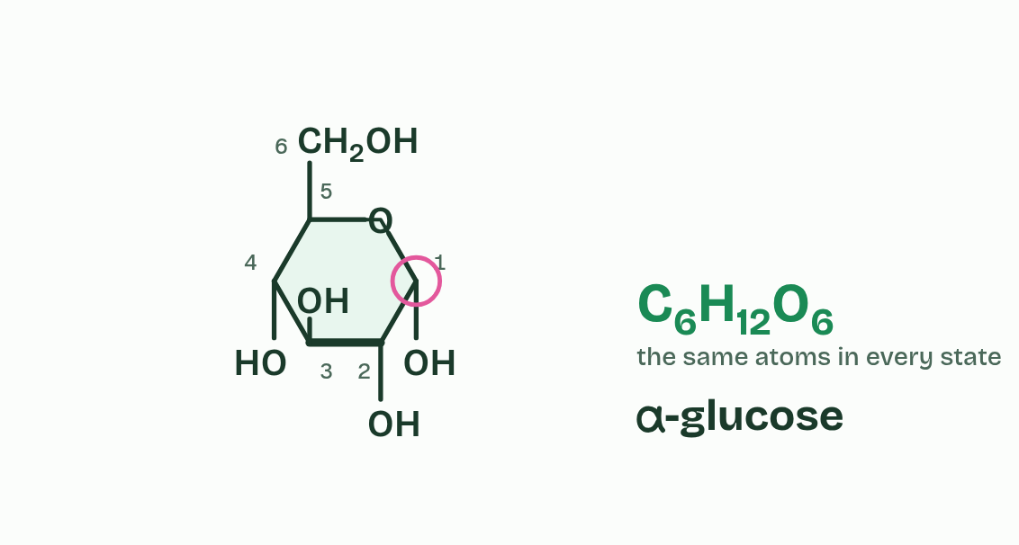
CHAPTER 3 · B1.1.4 Monosaccharides
1 / 3
Glucose: small, soluble and stable
α-glucose
Minutes 39 to 54
Notes:
Minutes 39 to 54 of 60: Pentose, hexose, two or many? (15 min).
The plan: The card sort below. Check it with chapter 3’s second figure, then the chapter 3 predict box.
A monosaccharide is one sugar unit, the monomer of carbohydrates. In cells most monosaccharides exist as rings. They are named by their number of carbon atoms: a pentose has five (ribose, deoxyribose) and a hexose has six (glucose, fructose).
To recognise one from a ring diagram, count every carbon atom, including any outside the ring in CH₂OH groups. The ring also holds one oxygen atom, which is not a carbon.
Glucose comes in two forms with the same formula, C₆H₁₂O₆: alpha (α) glucose and beta (β) glucose. They are isomers. They differ only in the OH on carbon 1: it is below the ring in α-glucose and above it in β-glucose, on the same side as the CH₂OH. That one difference decides whether glucose is built into starch or into cellulose, as the next two chapters show.
Glucose is the sugar cells run on, and four properties explain why:

Slide 32
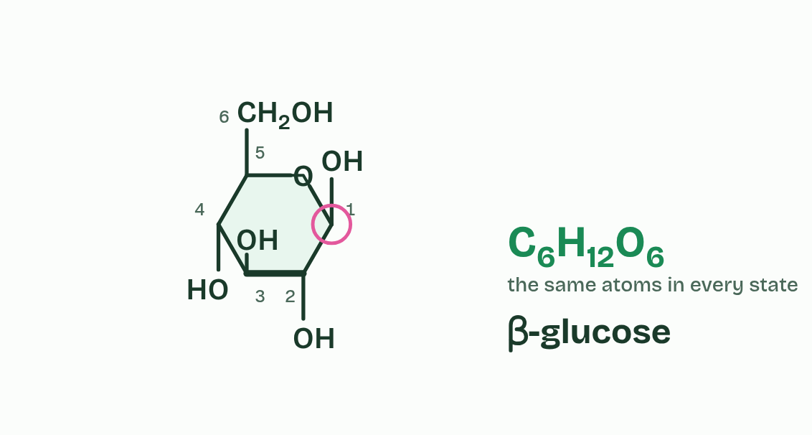
CHAPTER 3 · B1.1.4 Monosaccharides
2 / 3
Glucose: small, soluble and stable
β-glucose
Minutes 39 to 54
Notes:
Minutes 39 to 54 of 60: Pentose, hexose, two or many? (15 min).
The plan: The card sort below. Check it with chapter 3’s second figure, then the chapter 3 predict box.
A monosaccharide is one sugar unit, the monomer of carbohydrates. In cells most monosaccharides exist as rings. They are named by their number of carbon atoms: a pentose has five (ribose, deoxyribose) and a hexose has six (glucose, fructose).
To recognise one from a ring diagram, count every carbon atom, including any outside the ring in CH₂OH groups. The ring also holds one oxygen atom, which is not a carbon.
Glucose comes in two forms with the same formula, C₆H₁₂O₆: alpha (α) glucose and beta (β) glucose. They are isomers. They differ only in the OH on carbon 1: it is below the ring in α-glucose and above it in β-glucose, on the same side as the CH₂OH. That one difference decides whether glucose is built into starch or into cellulose, as the next two chapters show.
Glucose is the sugar cells run on, and four properties explain why:

Slide 33
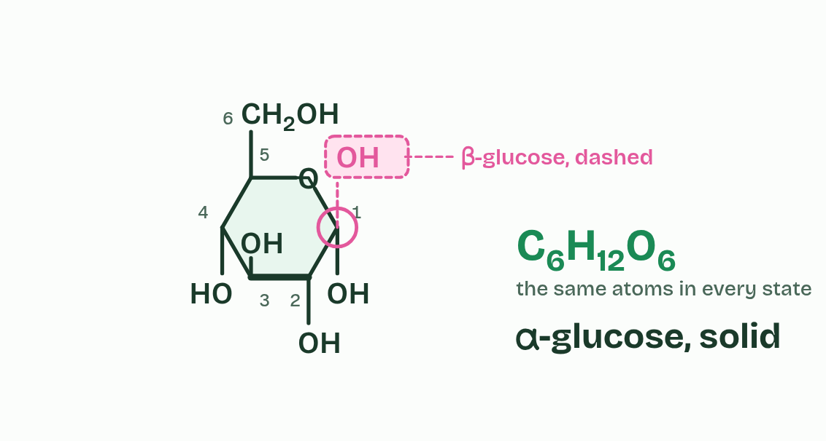
CHAPTER 3 · B1.1.4 Monosaccharides
3 / 3
Glucose: small, soluble and stable
Both
Minutes 39 to 54
Notes:
Minutes 39 to 54 of 60: Pentose, hexose, two or many? (15 min).
The plan: The card sort below. Check it with chapter 3’s second figure, then the chapter 3 predict box.
A monosaccharide is one sugar unit, the monomer of carbohydrates. In cells most monosaccharides exist as rings. They are named by their number of carbon atoms: a pentose has five (ribose, deoxyribose) and a hexose has six (glucose, fructose).
To recognise one from a ring diagram, count every carbon atom, including any outside the ring in CH₂OH groups. The ring also holds one oxygen atom, which is not a carbon.
Glucose comes in two forms with the same formula, C₆H₁₂O₆: alpha (α) glucose and beta (β) glucose. They are isomers. They differ only in the OH on carbon 1: it is below the ring in α-glucose and above it in β-glucose, on the same side as the CH₂OH. That one difference decides whether glucose is built into starch or into cellulose, as the next two chapters show.
Glucose is the sugar cells run on, and four properties explain why:

Slide 34
CHAPTER 3 · B1.1.4 Monosaccharides
Glucose: small, soluble and stable
Soluble. Its many OH groups form hydrogen bonds with water (A1.1), so it dissolves in cytoplasm and in blood plasma.
Transportable. Dissolved in plasma, it is carried to every cell.
Chemically stable. It does not react or break down by itself, so it keeps while it is stored and carried, until an enzyme acts on it.
Yields energy. Oxidised in respiration to carbon dioxide and water, it releases about 16 kJ per gram (C1.2).
Minutes 39 to 54
Notes:
Minutes 39 to 54 of 60: Pentose, hexose, two or many? (15 min).
The plan: The card sort below. Check it with chapter 3’s second figure, then the chapter 3 predict box.
A monosaccharide is one sugar unit, the monomer of carbohydrates. In cells most monosaccharides exist as rings. They are named by their number of carbon atoms: a pentose has five (ribose, deoxyribose) and a hexose has six (glucose, fructose).
To recognise one from a ring diagram, count every carbon atom, including any outside the ring in CH₂OH groups. The ring also holds one oxygen atom, which is not a carbon.
Glucose comes in two forms with the same formula, C₆H₁₂O₆: alpha (α) glucose and beta (β) glucose. They are isomers. They differ only in the OH on carbon 1: it is below the ring in α-glucose and above it in β-glucose, on the same side as the CH₂OH. That one difference decides whether glucose is built into starch or into cellulose, as the next two chapters show.
Glucose is the sugar cells run on, and four properties explain why:

Slide 35
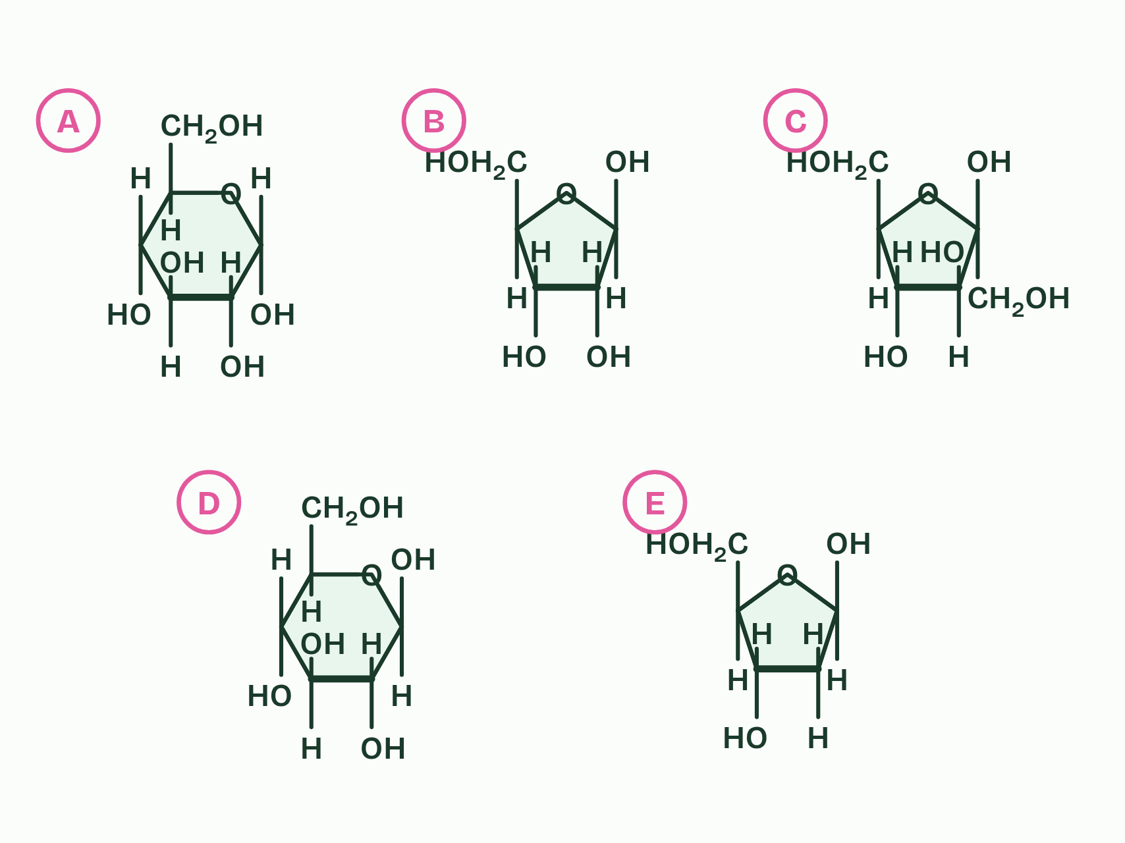
CHAPTER 3 · B1.1.4 Monosaccharides
1 / 2
Glucose: small, soluble and stable
Plain
Minutes 39 to 54
Notes:
Minutes 39 to 54 of 60: Pentose, hexose, two or many? (15 min).
The plan: The card sort below. Check it with chapter 3’s second figure, then the chapter 3 predict box.
A monosaccharide is one sugar unit, the monomer of carbohydrates. In cells most monosaccharides exist as rings. They are named by their number of carbon atoms: a pentose has five (ribose, deoxyribose) and a hexose has six (glucose, fructose).
To recognise one from a ring diagram, count every carbon atom, including any outside the ring in CH₂OH groups. The ring also holds one oxygen atom, which is not a carbon.
Glucose comes in two forms with the same formula, C₆H₁₂O₆: alpha (α) glucose and beta (β) glucose. They are isomers. They differ only in the OH on carbon 1: it is below the ring in α-glucose and above it in β-glucose, on the same side as the CH₂OH. That one difference decides whether glucose is built into starch or into cellulose, as the next two chapters show.
Glucose is the sugar cells run on, and four properties explain why:

Slide 36
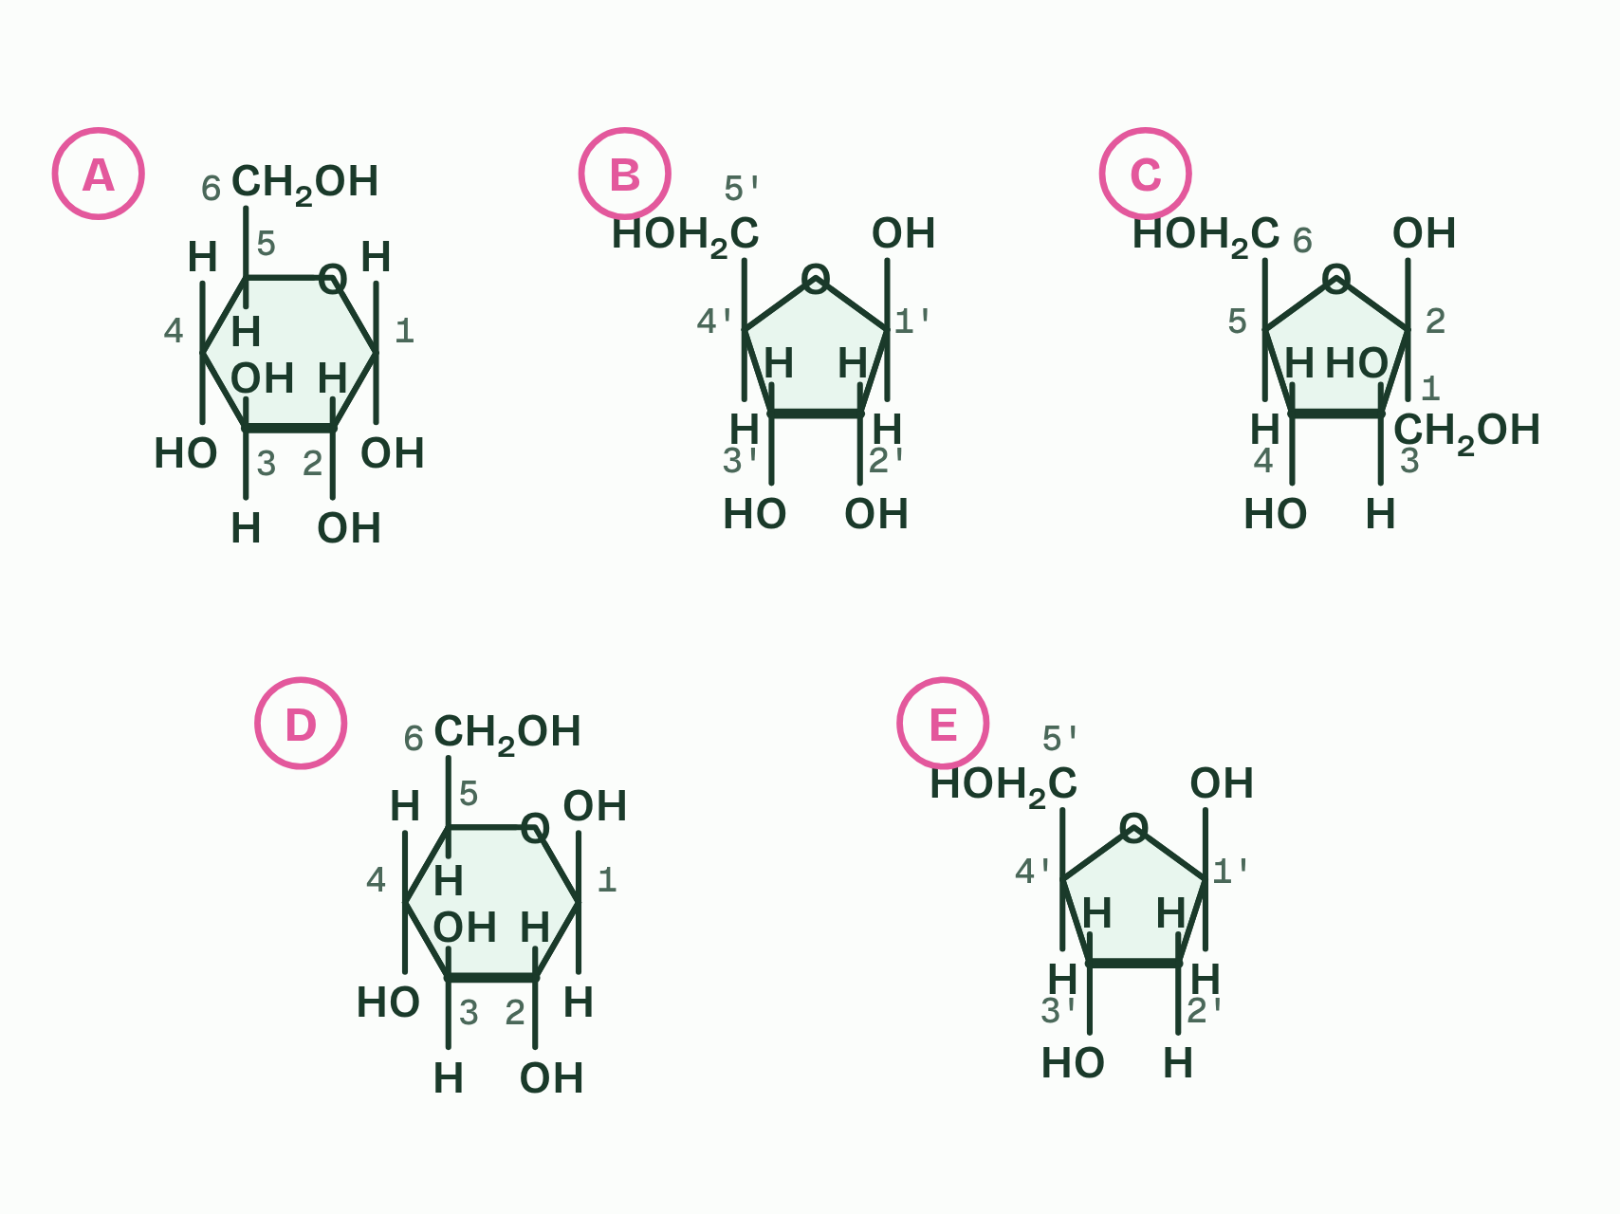
CHAPTER 3 · B1.1.4 Monosaccharides
2 / 2
Glucose: small, soluble and stable
Number the carbons
Minutes 39 to 54
Notes:
Minutes 39 to 54 of 60: Pentose, hexose, two or many? (15 min).
The plan: The card sort below. Check it with chapter 3’s second figure, then the chapter 3 predict box.
A monosaccharide is one sugar unit, the monomer of carbohydrates. In cells most monosaccharides exist as rings. They are named by their number of carbon atoms: a pentose has five (ribose, deoxyribose) and a hexose has six (glucose, fructose).
To recognise one from a ring diagram, count every carbon atom, including any outside the ring in CH₂OH groups. The ring also holds one oxygen atom, which is not a carbon.
Glucose comes in two forms with the same formula, C₆H₁₂O₆: alpha (α) glucose and beta (β) glucose. They are isomers. They differ only in the OH on carbon 1: it is below the ring in α-glucose and above it in β-glucose, on the same side as the CH₂OH. That one difference decides whether glucose is built into starch or into cellulose, as the next two chapters show.
Glucose is the sugar cells run on, and four properties explain why:

Slide 37
CHAPTER 3 · B1.1.4 Monosaccharides
Glucose: small, soluble and stable
Soluble. Its many OH groups form hydrogen bonds with water (A1.1), so it dissolves in cytoplasm and in blood plasma.
Transportable. Dissolved in plasma, it is carried to every cell.
Chemically stable. It does not react or break down by itself, so it keeps while it is stored and carried, until an enzyme acts on it.
Yields energy. Oxidised in respiration to carbon dioxide and water, it releases about 16 kJ per gram (C1.2).
Minutes 39 to 54
Notes:
Minutes 39 to 54 of 60: Pentose, hexose, two or many? (15 min).
The plan: The card sort below. Check it with chapter 3’s second figure, then the chapter 3 predict box.
A monosaccharide is one sugar unit, the monomer of carbohydrates. In cells most monosaccharides exist as rings. They are named by their number of carbon atoms: a pentose has five (ribose, deoxyribose) and a hexose has six (glucose, fructose).
To recognise one from a ring diagram, count every carbon atom, including any outside the ring in CH₂OH groups. The ring also holds one oxygen atom, which is not a carbon.
Glucose comes in two forms with the same formula, C₆H₁₂O₆: alpha (α) glucose and beta (β) glucose. They are isomers. They differ only in the OH on carbon 1: it is below the ring in α-glucose and above it in β-glucose, on the same side as the CH₂OH. That one difference decides whether glucose is built into starch or into cellulose, as the next two chapters show.
Glucose is the sugar cells run on, and four properties explain why:
Parts of the figure:
α-glucose A hexose: six carbons, five in the ring and one in the CH2OH group. It is the sugar dissolved in your blood, the one cells use for energy.
Ribose A pentose: five carbons, four in the ring and one in the CH2OH group. It is the sugar in RNA.
Fructose A hexose: six carbons, four in the ring and two in CH2OH groups outside it. It is found in fruit and, joined to glucose, in sucrose.
β-glucose A hexose: the same six carbons as sugar A, but the OH on carbon 1 points the other way. Its units make up cellulose.
Deoxyribose A pentose: five carbons, like ribose, but with an H where ribose has an OH on carbon 2. It is the sugar in DNA.

Slide 38
REMEMBER IT
ABBA: which way carbon 1’s OH points
A
B
Alpha
Beta
Minutes 39 to 54
Notes:
Minutes 39 to 54 of 60: Pentose, hexose, two or many? (15 min).
The plan: The card sort below. Check it with chapter 3’s second figure, then the chapter 3 predict box.
Ask the class what each letter stands for before revealing.

Slide 39
REMEMBER IT
ABBA: which way carbon 1’s OH points
A
B
Alpha
Beta
Below
Above
the OH on carbon 1 points down, away from the CH₂OH
the OH on carbon 1 points up, on the same side as the CH₂OH
Minutes 39 to 54
Notes:
Minutes 39 to 54 of 60: Pentose, hexose, two or many? (15 min).
The plan: The card sort below. Check it with chapter 3’s second figure, then the chapter 3 predict box.
Alpha: Below (the OH on carbon 1 points down, away from the CH₂OH)
Beta: Above (the OH on carbon 1 points up, on the same side as the CH₂OH)

Slide 40
REMEMBER IT
Why glucose is the sugar on the move
S
T
S
E
Sweet
Treats
Stay
Energetic
Minutes 39 to 54
Notes:
Minutes 39 to 54 of 60: Pentose, hexose, two or many? (15 min).
The plan: The card sort below. Check it with chapter 3’s second figure, then the chapter 3 predict box.
Ask the class what each letter stands for before revealing.

Slide 41
REMEMBER IT
Why glucose is the sugar on the move
S
T
S
E
Sweet
Treats
Stay
Energetic
Soluble
Transportable
Stable
Energy yield
its OH groups hydrogen-bond with water
dissolved, it travels in blood plasma
it keeps until an enzyme acts on it
oxidised in respiration, it releases energy
Minutes 39 to 54
Notes:
Minutes 39 to 54 of 60: Pentose, hexose, two or many? (15 min).
The plan: The card sort below. Check it with chapter 3’s second figure, then the chapter 3 predict box.
Sweet: Soluble (its OH groups hydrogen-bond with water)
Treats: Transportable (dissolved, it travels in blood plasma)
Stay: Stable (it keeps until an enzyme acts on it)
Energetic: Energy yield (oxidised in respiration, it releases energy)

Slide 42
WATCH OUT
α-glucose and β-glucose are not different sugars with different formulas. Both are C₆H₁₂O₆: only the OH on carbon 1 differs.
Minutes 39 to 54
Notes:
Minutes 39 to 54 of 60: Pentose, hexose, two or many? (15 min).
The plan: The card sort below. Check it with chapter 3’s second figure, then the chapter 3 predict box.
A common mistake: say it, then ask who can say why it is wrong.

Slide 43
PREDICT
Sugar C in the second figure has a five-sided ring. Is it a pentose or a hexose?
A A hexose: four ring carbons and two outside it make six
B A pentose: a five-cornered ring means five carbons in all
C Neither: you cannot tell without its molecular formula
Minutes 39 to 54
Notes:
Minutes 39 to 54 of 60: Pentose, hexose, two or many? (15 min).
The plan: The card sort below. Check it with chapter 3’s second figure, then the chapter 3 predict box.
Ask for a show of hands, or mini whiteboards, before revealing. (Answer: A, on the next slide.)

Slide 44
WHAT HAPPENS
Sugar C in the second figure has a five-sided ring. Is it a pentose or a hexose?
A A hexose: four ring carbons and two outside it make six
B A pentose: a five-cornered ring means five carbons in all
C Neither: you cannot tell without its molecular formula
A hexose. Its ring is four carbons and an oxygen, and two more carbons sit outside the ring as CH₂OH groups: six in all. It is fructose. Count carbons, not corners: ribose also has a five-sided ring, but only one carbon outside it, so it is a pentose.
Minutes 39 to 54
Notes:
Minutes 39 to 54 of 60: Pentose, hexose, two or many? (15 min).
The plan: The card sort below. Check it with chapter 3’s second figure, then the chapter 3 predict box.
Answer: A. A hexose. Its ring is four carbons and an oxygen, and two more carbons sit outside the ring as CH₂OH groups: six in all. It is fructose. Count carbons, not corners: ribose also has a five-sided ring, but only one carbon outside it, so it is a pentose.

Slide 45
PLENARY
Can you now...
Explain how carbon's four covalent bonds let it build chains, branches and rings (B1.1.1)
Describe how condensation joins monomers into polymers and hydrolysis splits them, saying where the water goes (B1.1.2, B1.1.3)
Tell pentoses from hexoses and alpha from beta glucose in ring diagrams, and link glucose's properties to its uses (B1.1.4)
Minutes 54 to 60
Notes:
Minutes 54 to 60 of 60: Exit (6 min).
The plan: Turn over the ABBA tiles. Then draw α-glucose from memory and ring carbon 1’s OH.
Thumbs up, sideways or down on each goal before the exit question. The goals come from the statements this lesson covers.

Slide 46
EXIT QUESTION
Before you go
Turn over the ABBA tiles.
Minutes 54 to 60
Notes:
Minutes 54 to 60 of 60: Exit (6 min).
The plan: Turn over the ABBA tiles. Then draw α-glucose from memory and ring carbon 1’s OH.

Slide 47
PRACTISE AND REVISE
Keep going
Exam practice: a fresh paper of exam questions on B1.1, marked as you go
The guide, with the animations and the dry lab
This lesson in the guide: 1 Chains, branches and rings, 2 Water out to build, water in to break, 3 Glucose: small, soluble and stable
BUILD FOR YOUR CLASS
ALREADY ON THE SITE FOR B1.1
CARD SETS ON SPLYCR
Tarsia puzzle, dominoes and picture reveal on B1.1, built from its key terms and ready to print
A pub quiz with rounds on B1.1, to present or run with no projector
An escape room built from the question bank on B1.1
Quiz: Biological Molecules
Revision map: B1.1 Carbohydrates and lipids, to fill in
Exam questions: B1.1 in the exam maker, a paper with its markscheme
Open a set to host it as a class game, or make a copy to edit.
B1.1 Carbohydrates
B1.1b Lipids
How this was made. The course structure, the activities and the teaching choices come from my own classroom, my presentations and my years of teaching IB and AP Biology. I use Claude, an AI, to help write and build the interactive guides, lesson plans, slides and practice questions, and to draw the diagrams and code the interactives. I direct the work and review it against the IB and AP specifications before it goes live.
Minute 60: after the lesson
Notes:
Every link here is live. Set the exam practice paper for homework: it is fresh each time, marked as students go and saved to their Exam practice when they are signed in.
Exam practice: https://www.biologybybradford.com/exam-maker/sit?topics=B1.1&level=HL&paper=quiz&marks=15&src=ep
The guide: https://www.biologybybradford.com/guides/ib-biology-b1-1-carbohydrates-and-lipids

