Slide 1
IB Biology B1.1
LESSON 2 OF 4
BY THE END YOU CAN
Carbohydrates and lipids
Tell pentoses from hexoses and alpha from beta glucose in ring diagrams, and link glucose's properties to its uses (B1.1.4)
Explain how coiling, branching and size suit starch and glycogen to storing energy (B1.1.5)
Explain how alternating beta glucose gives cellulose straight chains, bundled by hydrogen bonds (B1.1.6)
Explain how glycoproteins let cells recognise each other, using the ABO blood groups (B1.1.7)
Stores, fibres and name tags
B1.1.4 to B1.1.7
Starch and glycogen as stores, cellulose as a fibre, and sugar name tags on cells
60 minutes · chapters 4, 5, 6
Minute 0
Notes:
IB Biology B1.1, Carbohydrates and lipids. Lesson 2 of 4: Stores, fibres and name tags, 60 minutes.
The plan, minute by minute (each slide's footer says where you are):
0 to 5 min (5) Do now
5 to 17 min (12) Packed tight
17 to 29 min (12) Turn it over
29 to 39 min (10) Name tags
39 to 54 min (15) Molecule speed dating
54 to 60 min (6) Exit
What students get wrong:
“Insoluble because hydrophobic.” Starch and glycogen are insoluble because each molecule is huge.
Cellulose as a store. It is structural.
“Group O has no antigens.” It has the base chain, without A or B.
Stretch and support:
Support: the tiles as a starter in each lesson (ABBA, Sweet Treats Stay Energetic, Double Kinks Leave Liquids).
Support: the key terms (tap the dotted words) as a glossary, and the bond builder’s tap mode on a tablet.
Stretch: how can cellulose made by plants end up as a carbon sink for thousands of years? (The linking question on carbon sinks; forward to C4.2.)
The lesson plan to print: https://www.biologybybradford.com/guides/downloads/ib-biology-b1-1-carbohydrates-and-lipids-lesson-2-plan.pdf

Slide 2
DO NOW
Do now
“Bread, cotton and liver: what do they have in common?”
5:00
minutes
Start now: the timer is running.
Minutes 0 to 5
Notes:
Minutes 0 to 5 of 60: Do now (5 min).
The plan: “Bread, cotton and liver: what do they have in common?” (Starch, cellulose and glycogen: all glucose.) Then the Sweet Treats Stay Energetic tiles.
Start a 5 minute timer as they come in.

Slide 3
STEP 2
12 MIN
Packed tight
Students sketch the three shapes and count the ends.
Minutes 5 to 17
Notes:
Minutes 5 to 17 of 60: Packed tight (12 min).
The plan: Chapter 4’s figure and the polymers scene. Students sketch the three shapes and count the ends. Then the chapter 4 predict box.

Slide 4
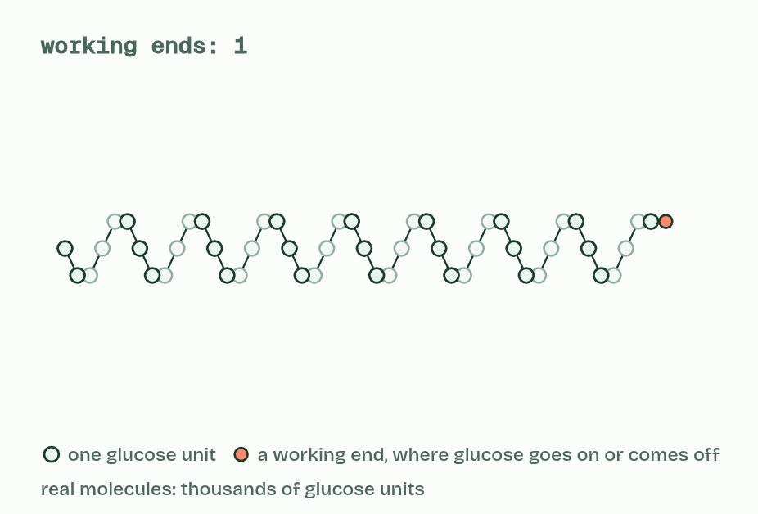
CHAPTER 4 · B1.1.5 Starch and glycogen
1 / 3
Starch and glycogen: energy packed tight
Amylose
Minutes 5 to 17
Notes:
Minutes 5 to 17 of 60: Packed tight (12 min).
The plan: Chapter 4’s figure and the polymers scene. Students sketch the three shapes and count the ends. Then the chapter 4 predict box.
Plants store energy as starch and animals (and fungi) store it as glycogen. Both are polymers of α-glucose, built by condensation.
Starch is a mixture of two polysaccharides. Amylose is an unbranched chain that coils into a helix. Amylopectin is a coiled chain with branches coming off it. Glycogen is built like amylopectin, but it branches far more often.
Coiling and branching make both stores compact: a great deal of glucose in a small space. Starch is packed into grains inside plant cells, and glycogen into granules in liver and muscle cells.
Each molecule is also huge, thousands to tens of thousands of glucose units, so it barely dissolves. Being relatively insoluble, a store stays where it is put. It does not draw water into the cell, as the same glucose dissolved in the cytoplasm would (osmosis, B2.1).
α-glucose is easy to add by condensation, to build the store, and easy to take off by hydrolysis, to use it. Enzymes do both at the ends of the chains, one glucose unit at a time.
Example: A potato tuber is roughly a sixth starch by mass. An adult human liver holds about 100 g of glycogen and the muscles about 400 g more, roughly a day’s energy.

Slide 5
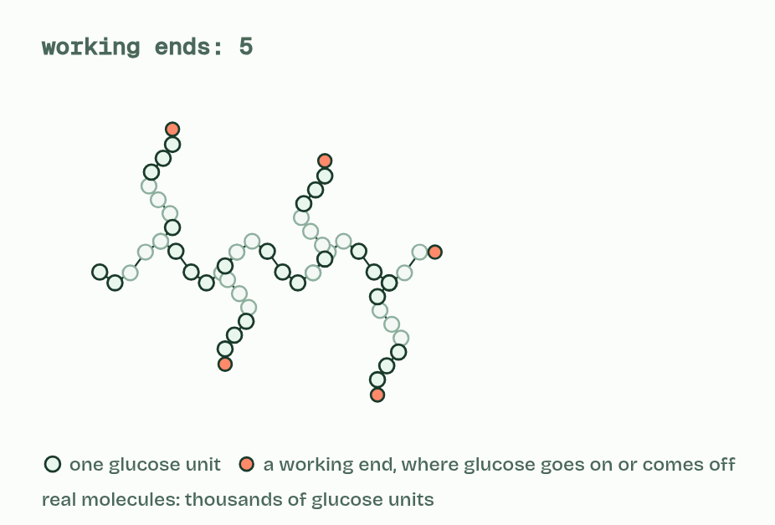
CHAPTER 4 · B1.1.5 Starch and glycogen
2 / 3
Starch and glycogen: energy packed tight
Amylopectin
Minutes 5 to 17
Notes:
Minutes 5 to 17 of 60: Packed tight (12 min).
The plan: Chapter 4’s figure and the polymers scene. Students sketch the three shapes and count the ends. Then the chapter 4 predict box.
Plants store energy as starch and animals (and fungi) store it as glycogen. Both are polymers of α-glucose, built by condensation.
Starch is a mixture of two polysaccharides. Amylose is an unbranched chain that coils into a helix. Amylopectin is a coiled chain with branches coming off it. Glycogen is built like amylopectin, but it branches far more often.
Coiling and branching make both stores compact: a great deal of glucose in a small space. Starch is packed into grains inside plant cells, and glycogen into granules in liver and muscle cells.
Each molecule is also huge, thousands to tens of thousands of glucose units, so it barely dissolves. Being relatively insoluble, a store stays where it is put. It does not draw water into the cell, as the same glucose dissolved in the cytoplasm would (osmosis, B2.1).
α-glucose is easy to add by condensation, to build the store, and easy to take off by hydrolysis, to use it. Enzymes do both at the ends of the chains, one glucose unit at a time.
Example: A potato tuber is roughly a sixth starch by mass. An adult human liver holds about 100 g of glycogen and the muscles about 400 g more, roughly a day’s energy.

Slide 6
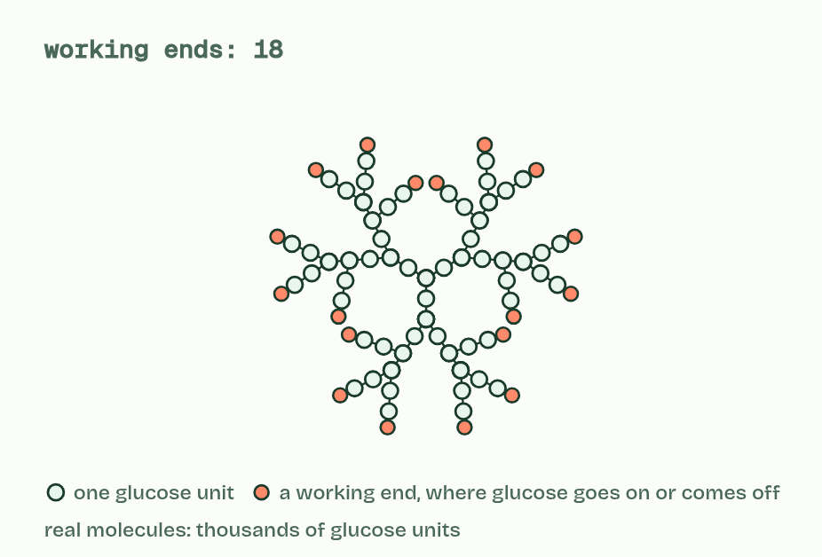
CHAPTER 4 · B1.1.5 Starch and glycogen
3 / 3
Starch and glycogen: energy packed tight
Glycogen
Minutes 5 to 17
Notes:
Minutes 5 to 17 of 60: Packed tight (12 min).
The plan: Chapter 4’s figure and the polymers scene. Students sketch the three shapes and count the ends. Then the chapter 4 predict box.
Plants store energy as starch and animals (and fungi) store it as glycogen. Both are polymers of α-glucose, built by condensation.
Starch is a mixture of two polysaccharides. Amylose is an unbranched chain that coils into a helix. Amylopectin is a coiled chain with branches coming off it. Glycogen is built like amylopectin, but it branches far more often.
Coiling and branching make both stores compact: a great deal of glucose in a small space. Starch is packed into grains inside plant cells, and glycogen into granules in liver and muscle cells.
Each molecule is also huge, thousands to tens of thousands of glucose units, so it barely dissolves. Being relatively insoluble, a store stays where it is put. It does not draw water into the cell, as the same glucose dissolved in the cytoplasm would (osmosis, B2.1).
α-glucose is easy to add by condensation, to build the store, and easy to take off by hydrolysis, to use it. Enzymes do both at the ends of the chains, one glucose unit at a time.
Example: A potato tuber is roughly a sixth starch by mass. An adult human liver holds about 100 g of glycogen and the muscles about 400 g more, roughly a day’s energy.

Slide 7
CHAPTER 4 · B1.1.5 Starch and glycogen
Starch and glycogen: energy packed tight
Plants store energy as starch and animals (and fungi) store it as glycogen.
Starch is a mixture of two polysaccharides.
Amylose is an unbranched chain that coils into a helix.
Amylopectin is a coiled chain with branches coming off it.
Minutes 5 to 17
Notes:
Minutes 5 to 17 of 60: Packed tight (12 min).
The plan: Chapter 4’s figure and the polymers scene. Students sketch the three shapes and count the ends. Then the chapter 4 predict box.
Plants store energy as starch and animals (and fungi) store it as glycogen. Both are polymers of α-glucose, built by condensation.
Starch is a mixture of two polysaccharides. Amylose is an unbranched chain that coils into a helix. Amylopectin is a coiled chain with branches coming off it. Glycogen is built like amylopectin, but it branches far more often.
Coiling and branching make both stores compact: a great deal of glucose in a small space. Starch is packed into grains inside plant cells, and glycogen into granules in liver and muscle cells.
Each molecule is also huge, thousands to tens of thousands of glucose units, so it barely dissolves. Being relatively insoluble, a store stays where it is put. It does not draw water into the cell, as the same glucose dissolved in the cytoplasm would (osmosis, B2.1).
α-glucose is easy to add by condensation, to build the store, and easy to take off by hydrolysis, to use it. Enzymes do both at the ends of the chains, one glucose unit at a time.
Example: A potato tuber is roughly a sixth starch by mass. An adult human liver holds about 100 g of glycogen and the muscles about 400 g more, roughly a day’s energy.

Slide 8
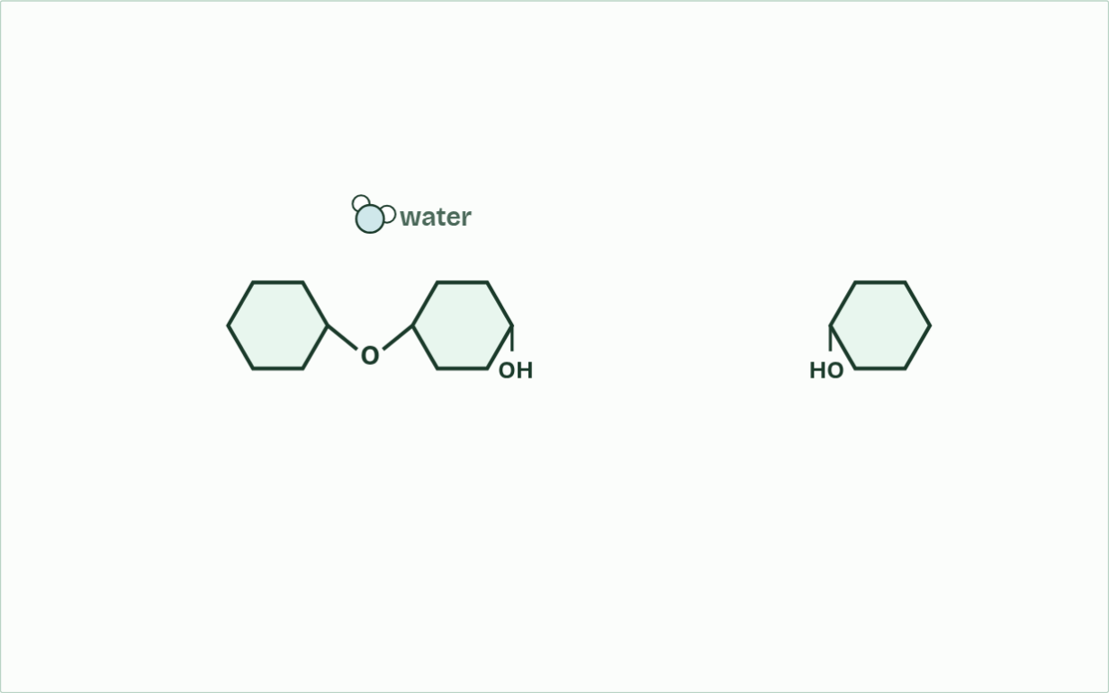
CHAPTER 4 · B1.1.5 Starch and glycogen
water released: 1
1 / 4
Starch and glycogen: energy packed tight
Glucose units join one at a time; a water molecule leaves at each link.
Minutes 5 to 17
Notes:
Minutes 5 to 17 of 60: Packed tight (12 min).
The plan: Chapter 4’s figure and the polymers scene. Students sketch the three shapes and count the ends. Then the chapter 4 predict box.
Plants store energy as starch and animals (and fungi) store it as glycogen. Both are polymers of α-glucose, built by condensation.
Starch is a mixture of two polysaccharides. Amylose is an unbranched chain that coils into a helix. Amylopectin is a coiled chain with branches coming off it. Glycogen is built like amylopectin, but it branches far more often.
Coiling and branching make both stores compact: a great deal of glucose in a small space. Starch is packed into grains inside plant cells, and glycogen into granules in liver and muscle cells.
Each molecule is also huge, thousands to tens of thousands of glucose units, so it barely dissolves. Being relatively insoluble, a store stays where it is put. It does not draw water into the cell, as the same glucose dissolved in the cytoplasm would (osmosis, B2.1).
α-glucose is easy to add by condensation, to build the store, and easy to take off by hydrolysis, to use it. Enzymes do both at the ends of the chains, one glucose unit at a time.
Example: A potato tuber is roughly a sixth starch by mass. An adult human liver holds about 100 g of glycogen and the muscles about 400 g more, roughly a day’s energy.
The animation "Watch it happen: building and using a store", paused at 1.9 s. The next slides go on through it, then play it.

Slide 9
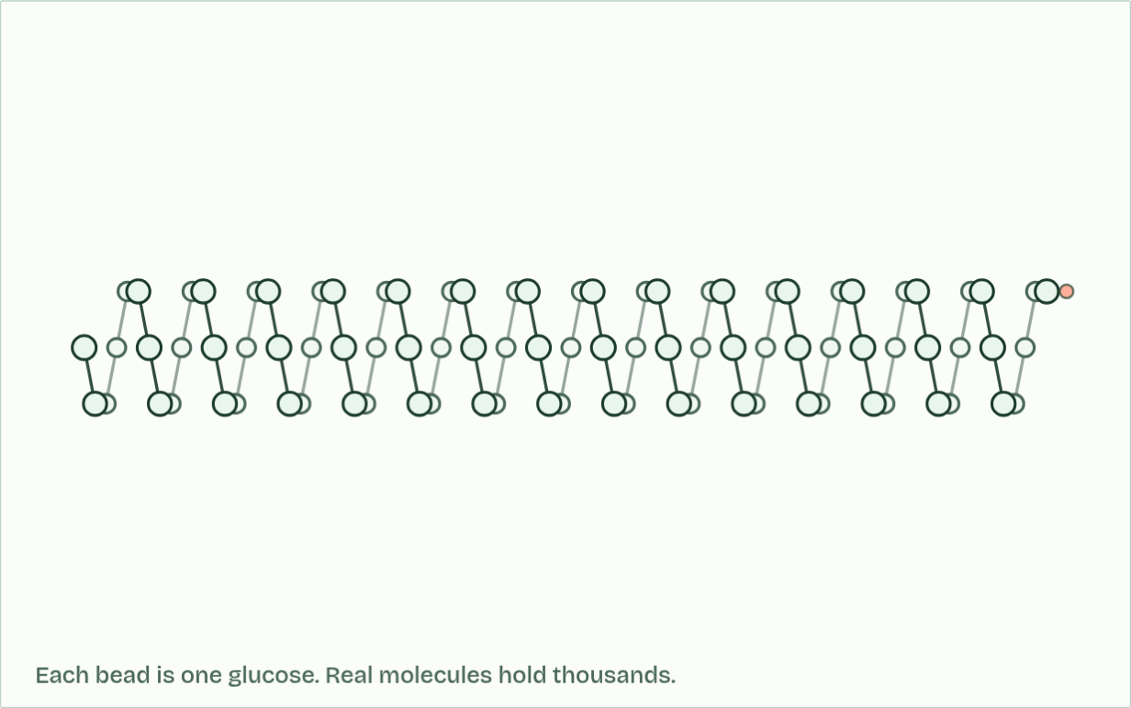
CHAPTER 4 · B1.1.5 Starch and glycogen
ends: 1
2 / 4
Starch and glycogen: energy packed tight
Amylose coils into a helix: a lot of glucose in a small space.
Minutes 5 to 17
Notes:
Minutes 5 to 17 of 60: Packed tight (12 min).
The plan: Chapter 4’s figure and the polymers scene. Students sketch the three shapes and count the ends. Then the chapter 4 predict box.
Plants store energy as starch and animals (and fungi) store it as glycogen. Both are polymers of α-glucose, built by condensation.
Starch is a mixture of two polysaccharides. Amylose is an unbranched chain that coils into a helix. Amylopectin is a coiled chain with branches coming off it. Glycogen is built like amylopectin, but it branches far more often.
Coiling and branching make both stores compact: a great deal of glucose in a small space. Starch is packed into grains inside plant cells, and glycogen into granules in liver and muscle cells.
Each molecule is also huge, thousands to tens of thousands of glucose units, so it barely dissolves. Being relatively insoluble, a store stays where it is put. It does not draw water into the cell, as the same glucose dissolved in the cytoplasm would (osmosis, B2.1).
α-glucose is easy to add by condensation, to build the store, and easy to take off by hydrolysis, to use it. Enzymes do both at the ends of the chains, one glucose unit at a time.
Example: A potato tuber is roughly a sixth starch by mass. An adult human liver holds about 100 g of glycogen and the muscles about 400 g more, roughly a day’s energy.
The animation "Watch it happen: building and using a store", paused at 8.8 s. The next slides go on through it, then play it.

Slide 10
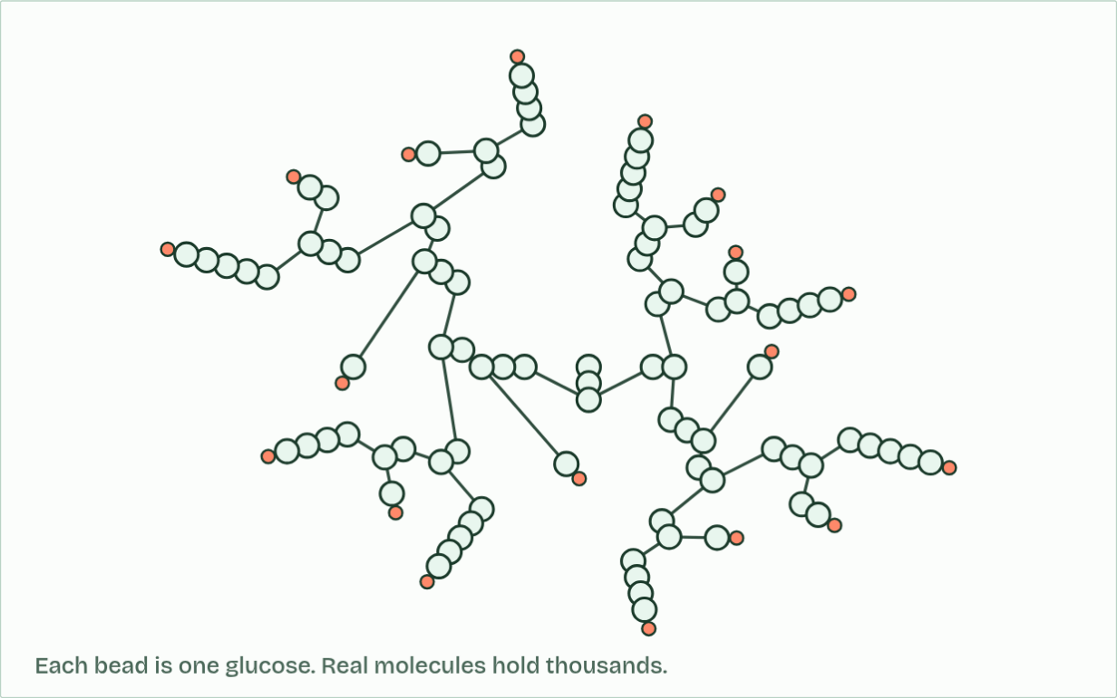
CHAPTER 4 · B1.1.5 Starch and glycogen
ends: 18
3 / 4
Starch and glycogen: energy packed tight
Amylopectin and glycogen branch, so they have many ends.
Minutes 5 to 17
Notes:
Minutes 5 to 17 of 60: Packed tight (12 min).
The plan: Chapter 4’s figure and the polymers scene. Students sketch the three shapes and count the ends. Then the chapter 4 predict box.
Plants store energy as starch and animals (and fungi) store it as glycogen. Both are polymers of α-glucose, built by condensation.
Starch is a mixture of two polysaccharides. Amylose is an unbranched chain that coils into a helix. Amylopectin is a coiled chain with branches coming off it. Glycogen is built like amylopectin, but it branches far more often.
Coiling and branching make both stores compact: a great deal of glucose in a small space. Starch is packed into grains inside plant cells, and glycogen into granules in liver and muscle cells.
Each molecule is also huge, thousands to tens of thousands of glucose units, so it barely dissolves. Being relatively insoluble, a store stays where it is put. It does not draw water into the cell, as the same glucose dissolved in the cytoplasm would (osmosis, B2.1).
α-glucose is easy to add by condensation, to build the store, and easy to take off by hydrolysis, to use it. Enzymes do both at the ends of the chains, one glucose unit at a time.
Example: A potato tuber is roughly a sixth starch by mass. An adult human liver holds about 100 g of glycogen and the muscles about 400 g more, roughly a day’s energy.
The animation "Watch it happen: building and using a store", paused at 13.6 s. The next slides go on through it, then play it.

Slide 11
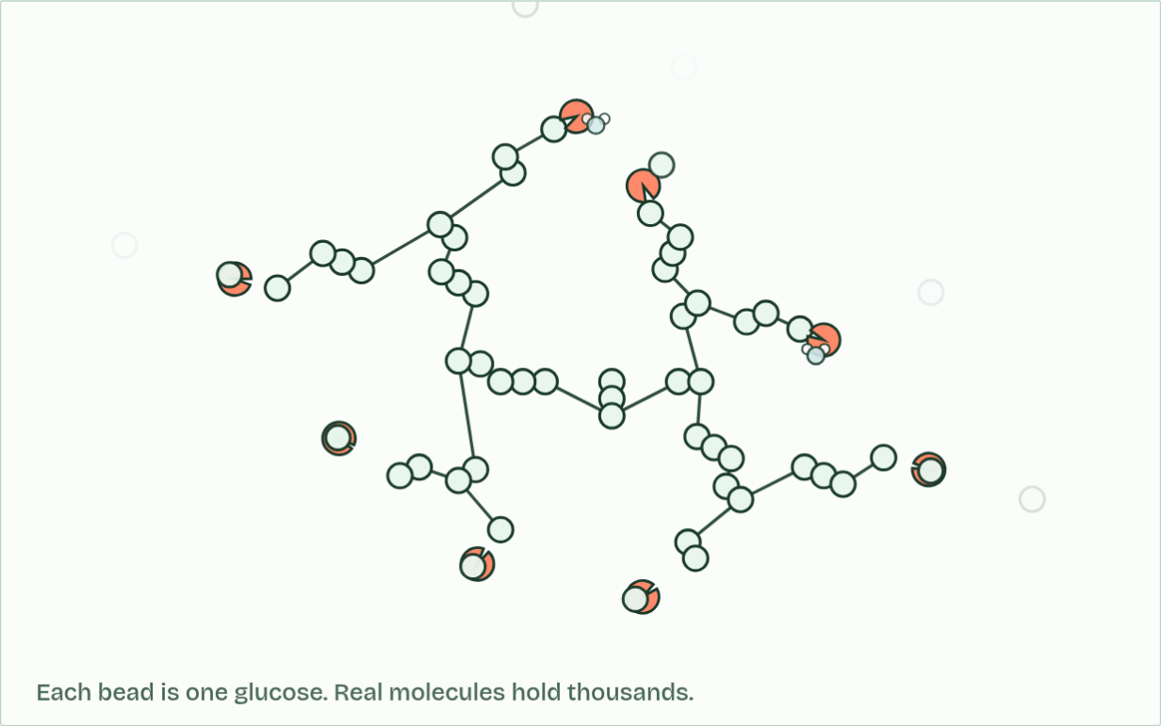
CHAPTER 4 · B1.1.5 Starch and glycogen
ends: 8, glucose released: 43
4 / 4
Starch and glycogen: energy packed tight
Enzymes take glucose off the ends, using a water molecule each time.
Minutes 5 to 17
Notes:
Minutes 5 to 17 of 60: Packed tight (12 min).
The plan: Chapter 4’s figure and the polymers scene. Students sketch the three shapes and count the ends. Then the chapter 4 predict box.
Plants store energy as starch and animals (and fungi) store it as glycogen. Both are polymers of α-glucose, built by condensation.
Starch is a mixture of two polysaccharides. Amylose is an unbranched chain that coils into a helix. Amylopectin is a coiled chain with branches coming off it. Glycogen is built like amylopectin, but it branches far more often.
Coiling and branching make both stores compact: a great deal of glucose in a small space. Starch is packed into grains inside plant cells, and glycogen into granules in liver and muscle cells.
Each molecule is also huge, thousands to tens of thousands of glucose units, so it barely dissolves. Being relatively insoluble, a store stays where it is put. It does not draw water into the cell, as the same glucose dissolved in the cytoplasm would (osmosis, B2.1).
α-glucose is easy to add by condensation, to build the store, and easy to take off by hydrolysis, to use it. Enzymes do both at the ends of the chains, one glucose unit at a time.
Example: A potato tuber is roughly a sixth starch by mass. An adult human liver holds about 100 g of glycogen and the muscles about 400 g more, roughly a day’s energy.
The animation "Watch it happen: building and using a store", paused at 18.4 s. The next slides go on through it, then play it.

Slide 12
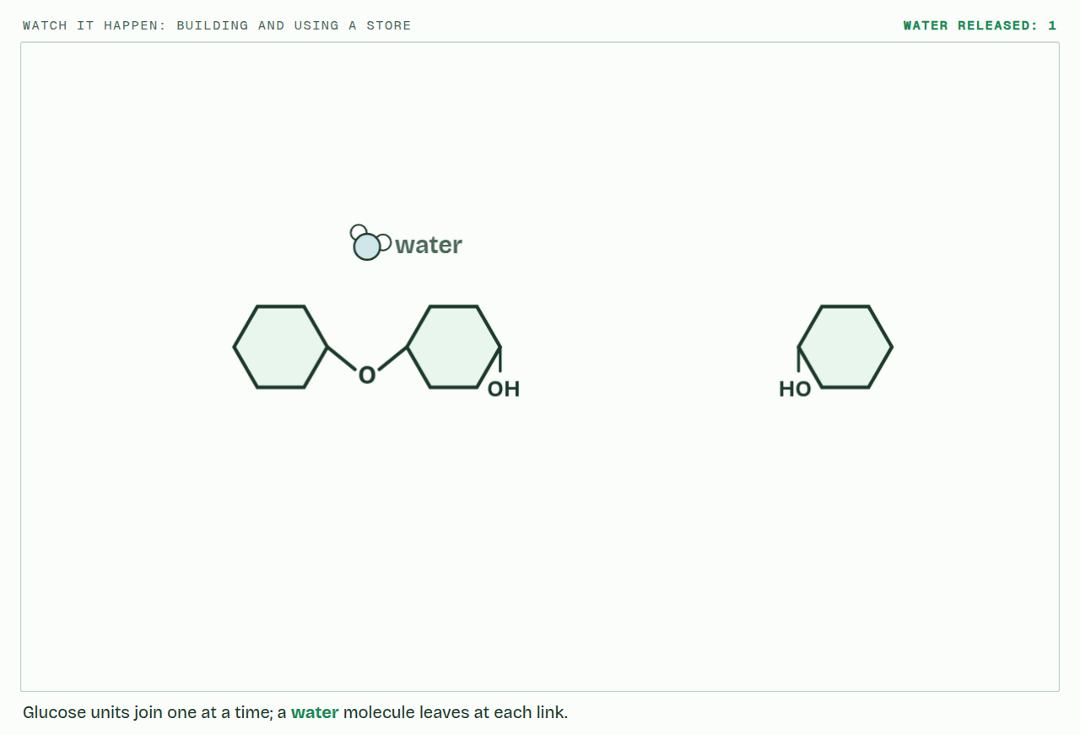
CHAPTER 4 · B1.1.5 Starch and glycogen
PLAY IT
Starch and glycogen: energy packed tight
Watch it happen: building and using a store: click to play. It loops every 20 seconds.
Minutes 5 to 17
Notes:
Minutes 5 to 17 of 60: Packed tight (12 min).
The plan: Chapter 4’s figure and the polymers scene. Students sketch the three shapes and count the ends. Then the chapter 4 predict box.
The video is polymers-358d35.mp4, one loop of the animation in the guide. It plays in PowerPoint and Keynote. Google Slides does not play a video embedded in a .pptx: download polymers-358d35.mp4 (https://www.biologybybradford.com/guides/downloads/scenes/polymers-358d35.mp4), upload it to Google Drive, then Insert > Video > Google Drive.
In the guide the class can change it as it runs: https://www.biologybybradford.com/guides/ib-biology-b1-1-carbohydrates-and-lipids#stores
What it shows, in order:
1. Glucose units join one at a time; a water molecule leaves at each link.
2. Amylose coils into a helix: a lot of glucose in a small space.
3. Amylopectin and glycogen branch, so they have many ends.
4. Enzymes take glucose off the ends, using a water molecule each time.

Slide 13
WATCH OUT
Insoluble does not mean hydrophobic. Starch and glycogen are covered in OH groups: they barely dissolve because each molecule is so large.
Minutes 5 to 17
Notes:
Minutes 5 to 17 of 60: Packed tight (12 min).
The plan: Chapter 4’s figure and the polymers scene. Students sketch the three shapes and count the ends. Then the chapter 4 predict box.
A common mistake: say it, then ask who can say why it is wrong.

Slide 14
PREDICT
An amylose molecule and a glycogen molecule hold the same number of glucose units. A sprinter’s muscles suddenly need glucose. Which store can release it faster?
A Amylose: its single coiled chain is easier for enzymes to unwind
B Both the same: they hold the same number of glucose units
C Glycogen: its many branches give enzymes many ends to work on
Minutes 5 to 17
Notes:
Minutes 5 to 17 of 60: Packed tight (12 min).
The plan: Chapter 4’s figure and the polymers scene. Students sketch the three shapes and count the ends. Then the chapter 4 predict box.
Ask for a show of hands, or mini whiteboards, before revealing. (Answer: C, on the next slide.)

Slide 15
WHAT HAPPENS
An amylose molecule and a glycogen molecule hold the same number of glucose units. A sprinter’s muscles suddenly need glucose. Which store can release it faster?
A Amylose: its single coiled chain is easier for enzymes to unwind
B Both the same: they hold the same number of glucose units
C Glycogen: its many branches give enzymes many ends to work on
Glycogen. Enzymes take glucose off the ends of chains, one unit at a time. A heavily branched molecule has many ends, so many enzymes can work on it at once. That suits animals, which may need glucose in seconds.
Minutes 5 to 17
Notes:
Minutes 5 to 17 of 60: Packed tight (12 min).
The plan: Chapter 4’s figure and the polymers scene. Students sketch the three shapes and count the ends. Then the chapter 4 predict box.
Answer: C. Glycogen. Enzymes take glucose off the ends of chains, one unit at a time. A heavily branched molecule has many ends, so many enzymes can work on it at once. That suits animals, which may need glucose in seconds.

Slide 16
STEP 3
12 MIN
Turn it over
Chapter 5: Turn every other glucose over and the chain runs straight
Minutes 17 to 29
Notes:
Minutes 17 to 29 of 60: Turn it over (12 min).
The plan: Chapter 5’s bond builder first: students try to join two β-glucose before anyone explains. Then chapter 5’s figure. Fill in a table: starch, glycogen, cellulose; monomer, shape, branches, where, job.

Slide 17
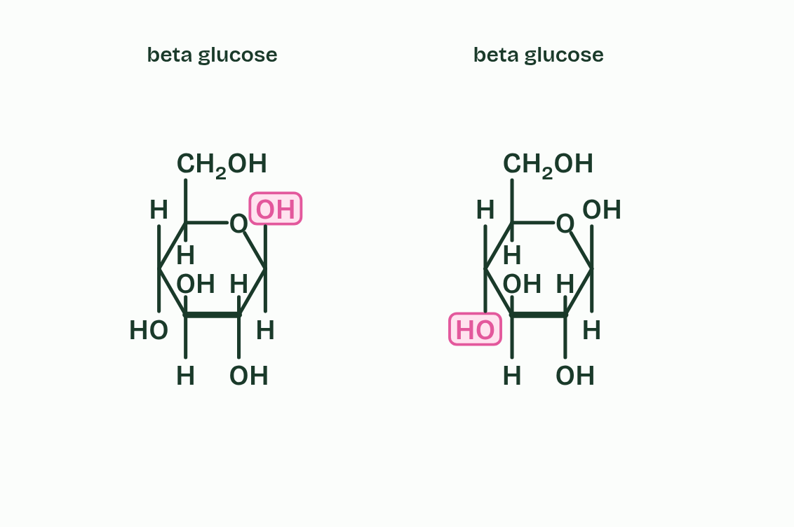
CHAPTER 5 · B1.1.6 Cellulose
1 / 6
Turn every other glucose over and the chain runs straight
Two beta glucose molecules. Their OH groups point opposite ways.
Minutes 17 to 29
Notes:
Minutes 17 to 29 of 60: Turn it over (12 min).
The plan: Chapter 5’s bond builder first: students try to join two β-glucose before anyone explains. Then chapter 5’s figure. Fill in a table: starch, glycogen, cellulose; monomer, shape, branches, where, job.
Cellulose is an unbranched polymer of β-glucose and the main material of plant cell walls. β-glucose does not join to itself the way α-glucose does. Try it in the bond builder under this chapter, then read on.
In β-glucose the OH on carbon 1 points up, but the OH on carbon 4 points down. To join two of them, the second must be turned over, so in the chain each unit is upside down compared with the one before it: alternate units point opposite ways.
The alternation keeps the chain straight rather than coiled. Straight chains lie side by side, and OH groups on neighbouring chains form hydrogen bonds that cross-link them into bundles called microfibrils.
One hydrogen bond is weak, but there are thousands along every chain, and together they make a microfibril very strong when pulled: it has high tensile strength. In a cell wall, layers of microfibrils lie at different angles. The wall resists the pressure of the cell’s contents and helps hold the plant up (D2.3).
Few organisms make an enzyme for the β links, and humans do not, so cellulose passes through us as fibre. Amylase cannot hydrolyse it (C1.1).
Example: Where it leads Because cellulose is so hard to break down, wood and peat store carbon for centuries or longer, and coal formed from ancient plant matter. Stores like these are carbon sinks (C4.2, D4.3).

Slide 18
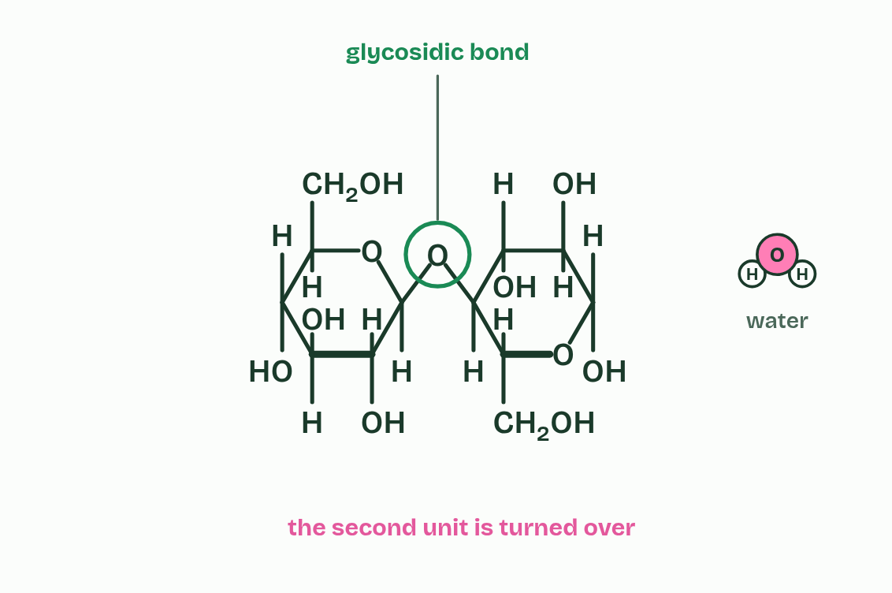
CHAPTER 5 · B1.1.6 Cellulose
2 / 6
Turn every other glucose over and the chain runs straight
Turn one over and they can join: water leaves and a bond forms.
Minutes 17 to 29
Notes:
Minutes 17 to 29 of 60: Turn it over (12 min).
The plan: Chapter 5’s bond builder first: students try to join two β-glucose before anyone explains. Then chapter 5’s figure. Fill in a table: starch, glycogen, cellulose; monomer, shape, branches, where, job.
Cellulose is an unbranched polymer of β-glucose and the main material of plant cell walls. β-glucose does not join to itself the way α-glucose does. Try it in the bond builder under this chapter, then read on.
In β-glucose the OH on carbon 1 points up, but the OH on carbon 4 points down. To join two of them, the second must be turned over, so in the chain each unit is upside down compared with the one before it: alternate units point opposite ways.
The alternation keeps the chain straight rather than coiled. Straight chains lie side by side, and OH groups on neighbouring chains form hydrogen bonds that cross-link them into bundles called microfibrils.
One hydrogen bond is weak, but there are thousands along every chain, and together they make a microfibril very strong when pulled: it has high tensile strength. In a cell wall, layers of microfibrils lie at different angles. The wall resists the pressure of the cell’s contents and helps hold the plant up (D2.3).
Few organisms make an enzyme for the β links, and humans do not, so cellulose passes through us as fibre. Amylase cannot hydrolyse it (C1.1).
Example: Where it leads Because cellulose is so hard to break down, wood and peat store carbon for centuries or longer, and coal formed from ancient plant matter. Stores like these are carbon sinks (C4.2, D4.3).

Slide 19
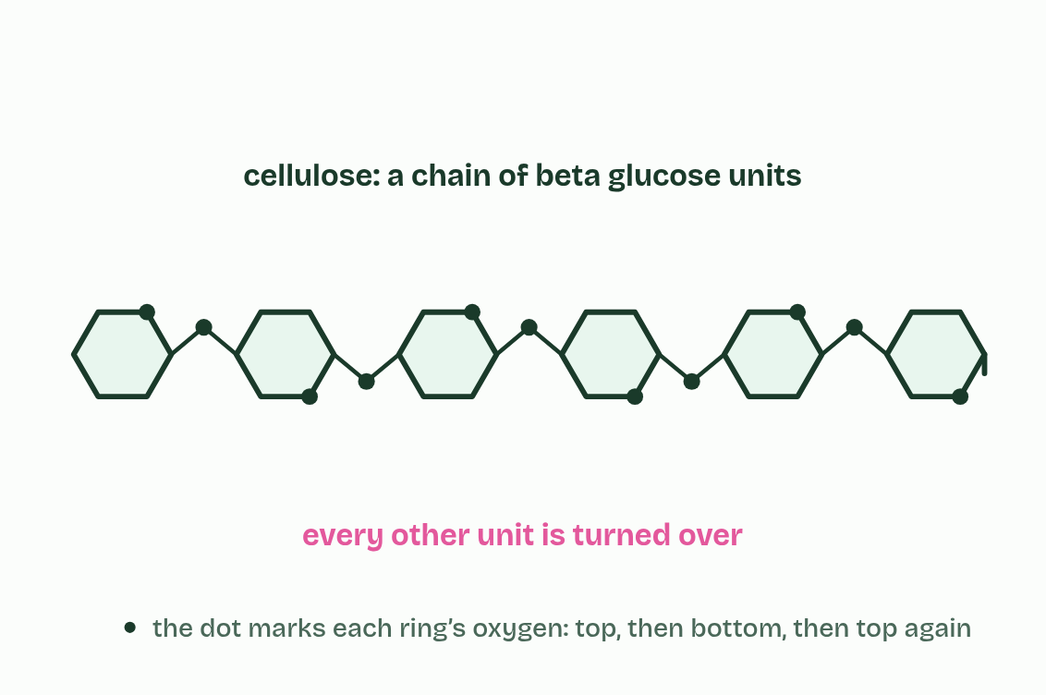
CHAPTER 5 · B1.1.6 Cellulose
3 / 6
Turn every other glucose over and the chain runs straight
Every other unit is turned over, so the chain runs straight.
Minutes 17 to 29
Notes:
Minutes 17 to 29 of 60: Turn it over (12 min).
The plan: Chapter 5’s bond builder first: students try to join two β-glucose before anyone explains. Then chapter 5’s figure. Fill in a table: starch, glycogen, cellulose; monomer, shape, branches, where, job.
Cellulose is an unbranched polymer of β-glucose and the main material of plant cell walls. β-glucose does not join to itself the way α-glucose does. Try it in the bond builder under this chapter, then read on.
In β-glucose the OH on carbon 1 points up, but the OH on carbon 4 points down. To join two of them, the second must be turned over, so in the chain each unit is upside down compared with the one before it: alternate units point opposite ways.
The alternation keeps the chain straight rather than coiled. Straight chains lie side by side, and OH groups on neighbouring chains form hydrogen bonds that cross-link them into bundles called microfibrils.
One hydrogen bond is weak, but there are thousands along every chain, and together they make a microfibril very strong when pulled: it has high tensile strength. In a cell wall, layers of microfibrils lie at different angles. The wall resists the pressure of the cell’s contents and helps hold the plant up (D2.3).
Few organisms make an enzyme for the β links, and humans do not, so cellulose passes through us as fibre. Amylase cannot hydrolyse it (C1.1).
Example: Where it leads Because cellulose is so hard to break down, wood and peat store carbon for centuries or longer, and coal formed from ancient plant matter. Stores like these are carbon sinks (C4.2, D4.3).

Slide 20
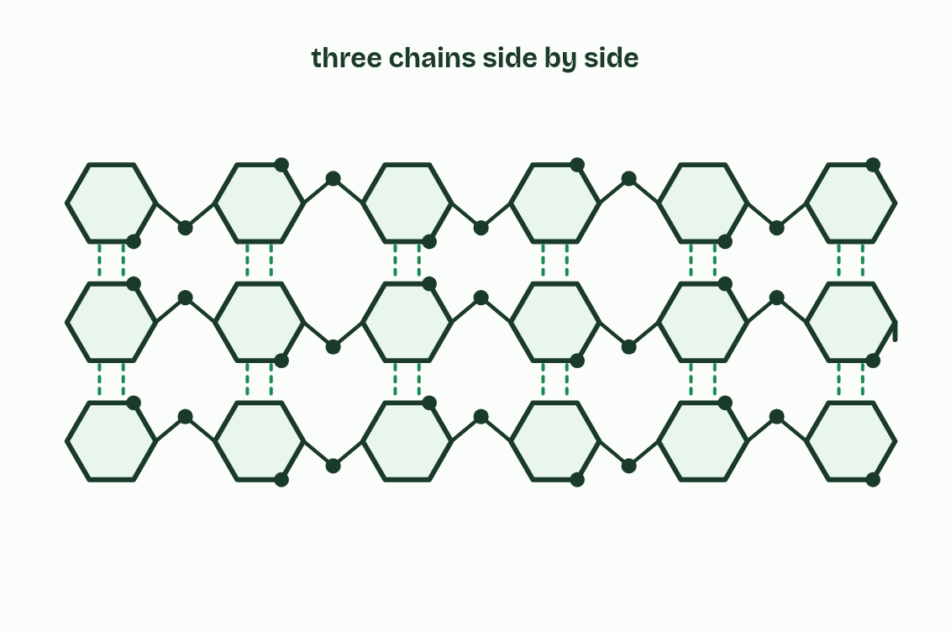
CHAPTER 5 · B1.1.6 Cellulose
4 / 6
Turn every other glucose over and the chain runs straight
Neighbouring chains are linked by many hydrogen bonds.
Minutes 17 to 29
Notes:
Minutes 17 to 29 of 60: Turn it over (12 min).
The plan: Chapter 5’s bond builder first: students try to join two β-glucose before anyone explains. Then chapter 5’s figure. Fill in a table: starch, glycogen, cellulose; monomer, shape, branches, where, job.
Cellulose is an unbranched polymer of β-glucose and the main material of plant cell walls. β-glucose does not join to itself the way α-glucose does. Try it in the bond builder under this chapter, then read on.
In β-glucose the OH on carbon 1 points up, but the OH on carbon 4 points down. To join two of them, the second must be turned over, so in the chain each unit is upside down compared with the one before it: alternate units point opposite ways.
The alternation keeps the chain straight rather than coiled. Straight chains lie side by side, and OH groups on neighbouring chains form hydrogen bonds that cross-link them into bundles called microfibrils.
One hydrogen bond is weak, but there are thousands along every chain, and together they make a microfibril very strong when pulled: it has high tensile strength. In a cell wall, layers of microfibrils lie at different angles. The wall resists the pressure of the cell’s contents and helps hold the plant up (D2.3).
Few organisms make an enzyme for the β links, and humans do not, so cellulose passes through us as fibre. Amylase cannot hydrolyse it (C1.1).
Example: Where it leads Because cellulose is so hard to break down, wood and peat store carbon for centuries or longer, and coal formed from ancient plant matter. Stores like these are carbon sinks (C4.2, D4.3).

Slide 21
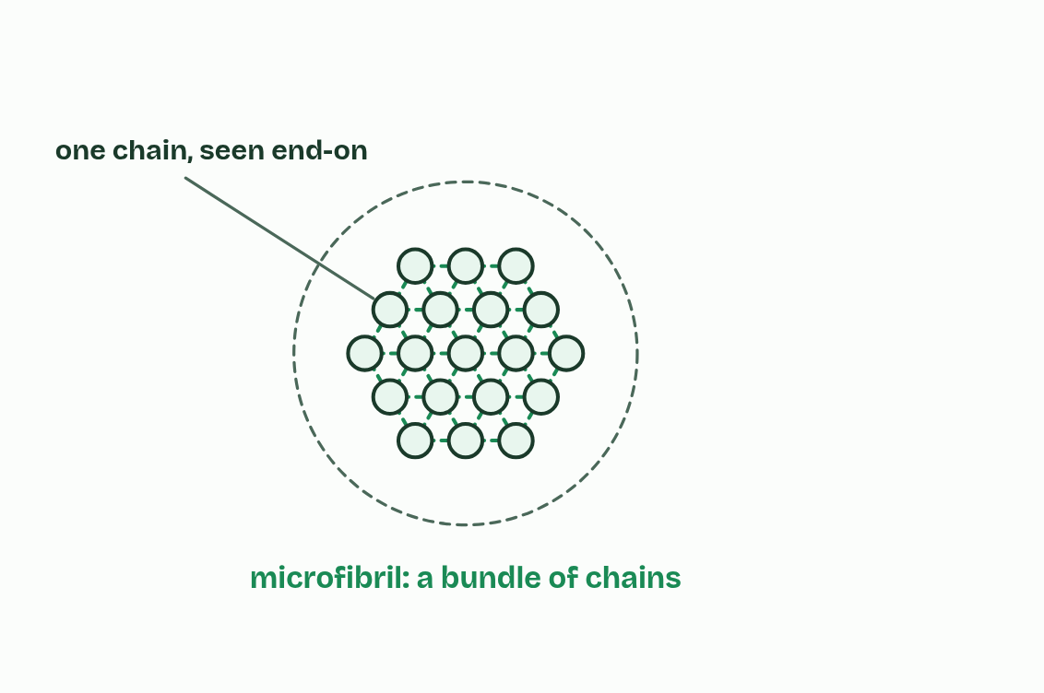
CHAPTER 5 · B1.1.6 Cellulose
5 / 6
Turn every other glucose over and the chain runs straight
Bundles of chains form microfibrils.
Minutes 17 to 29
Notes:
Minutes 17 to 29 of 60: Turn it over (12 min).
The plan: Chapter 5’s bond builder first: students try to join two β-glucose before anyone explains. Then chapter 5’s figure. Fill in a table: starch, glycogen, cellulose; monomer, shape, branches, where, job.
Cellulose is an unbranched polymer of β-glucose and the main material of plant cell walls. β-glucose does not join to itself the way α-glucose does. Try it in the bond builder under this chapter, then read on.
In β-glucose the OH on carbon 1 points up, but the OH on carbon 4 points down. To join two of them, the second must be turned over, so in the chain each unit is upside down compared with the one before it: alternate units point opposite ways.
The alternation keeps the chain straight rather than coiled. Straight chains lie side by side, and OH groups on neighbouring chains form hydrogen bonds that cross-link them into bundles called microfibrils.
One hydrogen bond is weak, but there are thousands along every chain, and together they make a microfibril very strong when pulled: it has high tensile strength. In a cell wall, layers of microfibrils lie at different angles. The wall resists the pressure of the cell’s contents and helps hold the plant up (D2.3).
Few organisms make an enzyme for the β links, and humans do not, so cellulose passes through us as fibre. Amylase cannot hydrolyse it (C1.1).
Example: Where it leads Because cellulose is so hard to break down, wood and peat store carbon for centuries or longer, and coal formed from ancient plant matter. Stores like these are carbon sinks (C4.2, D4.3).

Slide 22
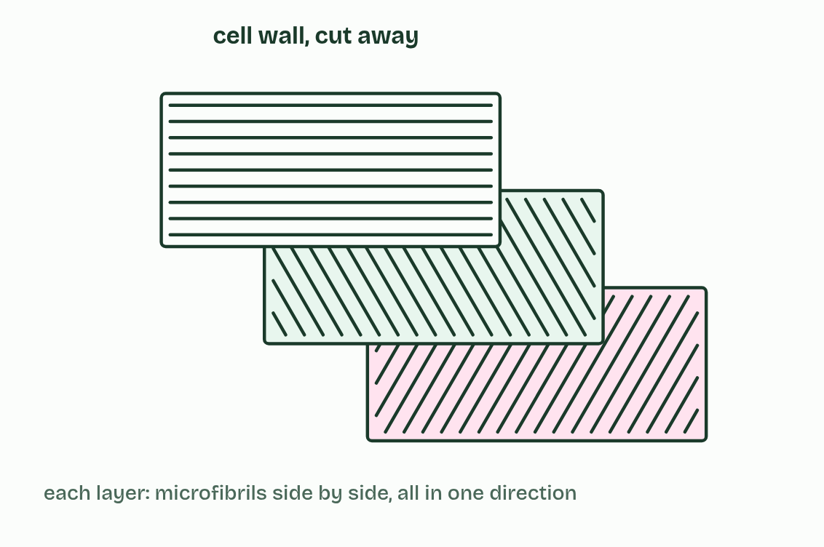
CHAPTER 5 · B1.1.6 Cellulose
6 / 6
Turn every other glucose over and the chain runs straight
Layers of microfibrils give the cell wall its strength.
Minutes 17 to 29
Notes:
Minutes 17 to 29 of 60: Turn it over (12 min).
The plan: Chapter 5’s bond builder first: students try to join two β-glucose before anyone explains. Then chapter 5’s figure. Fill in a table: starch, glycogen, cellulose; monomer, shape, branches, where, job.
Cellulose is an unbranched polymer of β-glucose and the main material of plant cell walls. β-glucose does not join to itself the way α-glucose does. Try it in the bond builder under this chapter, then read on.
In β-glucose the OH on carbon 1 points up, but the OH on carbon 4 points down. To join two of them, the second must be turned over, so in the chain each unit is upside down compared with the one before it: alternate units point opposite ways.
The alternation keeps the chain straight rather than coiled. Straight chains lie side by side, and OH groups on neighbouring chains form hydrogen bonds that cross-link them into bundles called microfibrils.
One hydrogen bond is weak, but there are thousands along every chain, and together they make a microfibril very strong when pulled: it has high tensile strength. In a cell wall, layers of microfibrils lie at different angles. The wall resists the pressure of the cell’s contents and helps hold the plant up (D2.3).
Few organisms make an enzyme for the β links, and humans do not, so cellulose passes through us as fibre. Amylase cannot hydrolyse it (C1.1).
Example: Where it leads Because cellulose is so hard to break down, wood and peat store carbon for centuries or longer, and coal formed from ancient plant matter. Stores like these are carbon sinks (C4.2, D4.3).

Slide 23
CHAPTER 5 · B1.1.6 Cellulose
Turn every other glucose over and the chain runs straight
Cellulose is an unbranched polymer of β-glucose and the main material of plant cell walls. β-glucose does not join to itself the way α-glucose does.
Straight chains lie side by side, and OH groups on neighbouring chains form hydrogen bonds that cross-link them into bundles called microfibrils.
One hydrogen bond is weak, but there are thousands along every chain, and together they make a microfibril very strong when pulled: it has high tensile strength.
In a cell wall, layers of microfibrils lie at different angles.
Minutes 17 to 29
Notes:
Minutes 17 to 29 of 60: Turn it over (12 min).
The plan: Chapter 5’s bond builder first: students try to join two β-glucose before anyone explains. Then chapter 5’s figure. Fill in a table: starch, glycogen, cellulose; monomer, shape, branches, where, job.
Cellulose is an unbranched polymer of β-glucose and the main material of plant cell walls. β-glucose does not join to itself the way α-glucose does. Try it in the bond builder under this chapter, then read on.
In β-glucose the OH on carbon 1 points up, but the OH on carbon 4 points down. To join two of them, the second must be turned over, so in the chain each unit is upside down compared with the one before it: alternate units point opposite ways.
The alternation keeps the chain straight rather than coiled. Straight chains lie side by side, and OH groups on neighbouring chains form hydrogen bonds that cross-link them into bundles called microfibrils.
One hydrogen bond is weak, but there are thousands along every chain, and together they make a microfibril very strong when pulled: it has high tensile strength. In a cell wall, layers of microfibrils lie at different angles. The wall resists the pressure of the cell’s contents and helps hold the plant up (D2.3).
Few organisms make an enzyme for the β links, and humans do not, so cellulose passes through us as fibre. Amylase cannot hydrolyse it (C1.1).
Example: Where it leads Because cellulose is so hard to break down, wood and peat store carbon for centuries or longer, and coal formed from ancient plant matter. Stores like these are carbon sinks (C4.2, D4.3).

Slide 24
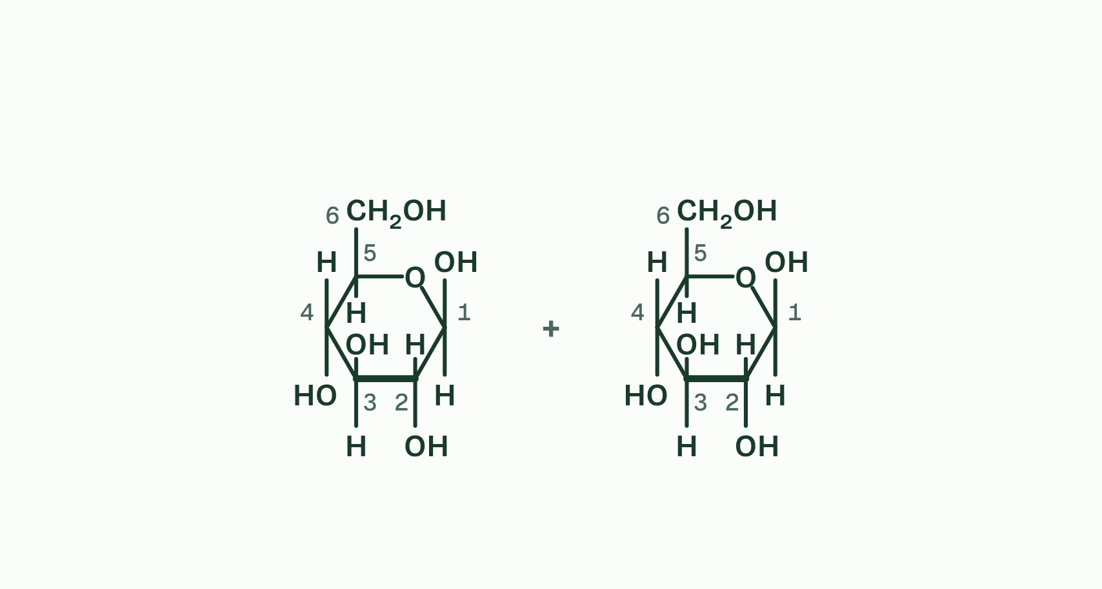
CHAPTER 5 · B1.1.6 Cellulose
1 / 4
Turn every other glucose over and the chain runs straight
Two beta glucose molecules, their carbons numbered.
Minutes 17 to 29
Notes:
Minutes 17 to 29 of 60: Turn it over (12 min).
The plan: Chapter 5’s bond builder first: students try to join two β-glucose before anyone explains. Then chapter 5’s figure. Fill in a table: starch, glycogen, cellulose; monomer, shape, branches, where, job.
Cellulose is an unbranched polymer of β-glucose and the main material of plant cell walls. β-glucose does not join to itself the way α-glucose does. Try it in the bond builder under this chapter, then read on.
In β-glucose the OH on carbon 1 points up, but the OH on carbon 4 points down. To join two of them, the second must be turned over, so in the chain each unit is upside down compared with the one before it: alternate units point opposite ways.
The alternation keeps the chain straight rather than coiled. Straight chains lie side by side, and OH groups on neighbouring chains form hydrogen bonds that cross-link them into bundles called microfibrils.
One hydrogen bond is weak, but there are thousands along every chain, and together they make a microfibril very strong when pulled: it has high tensile strength. In a cell wall, layers of microfibrils lie at different angles. The wall resists the pressure of the cell’s contents and helps hold the plant up (D2.3).
Few organisms make an enzyme for the β links, and humans do not, so cellulose passes through us as fibre. Amylase cannot hydrolyse it (C1.1).
Example: Where it leads Because cellulose is so hard to break down, wood and peat store carbon for centuries or longer, and coal formed from ancient plant matter. Stores like these are carbon sinks (C4.2, D4.3).

Slide 25
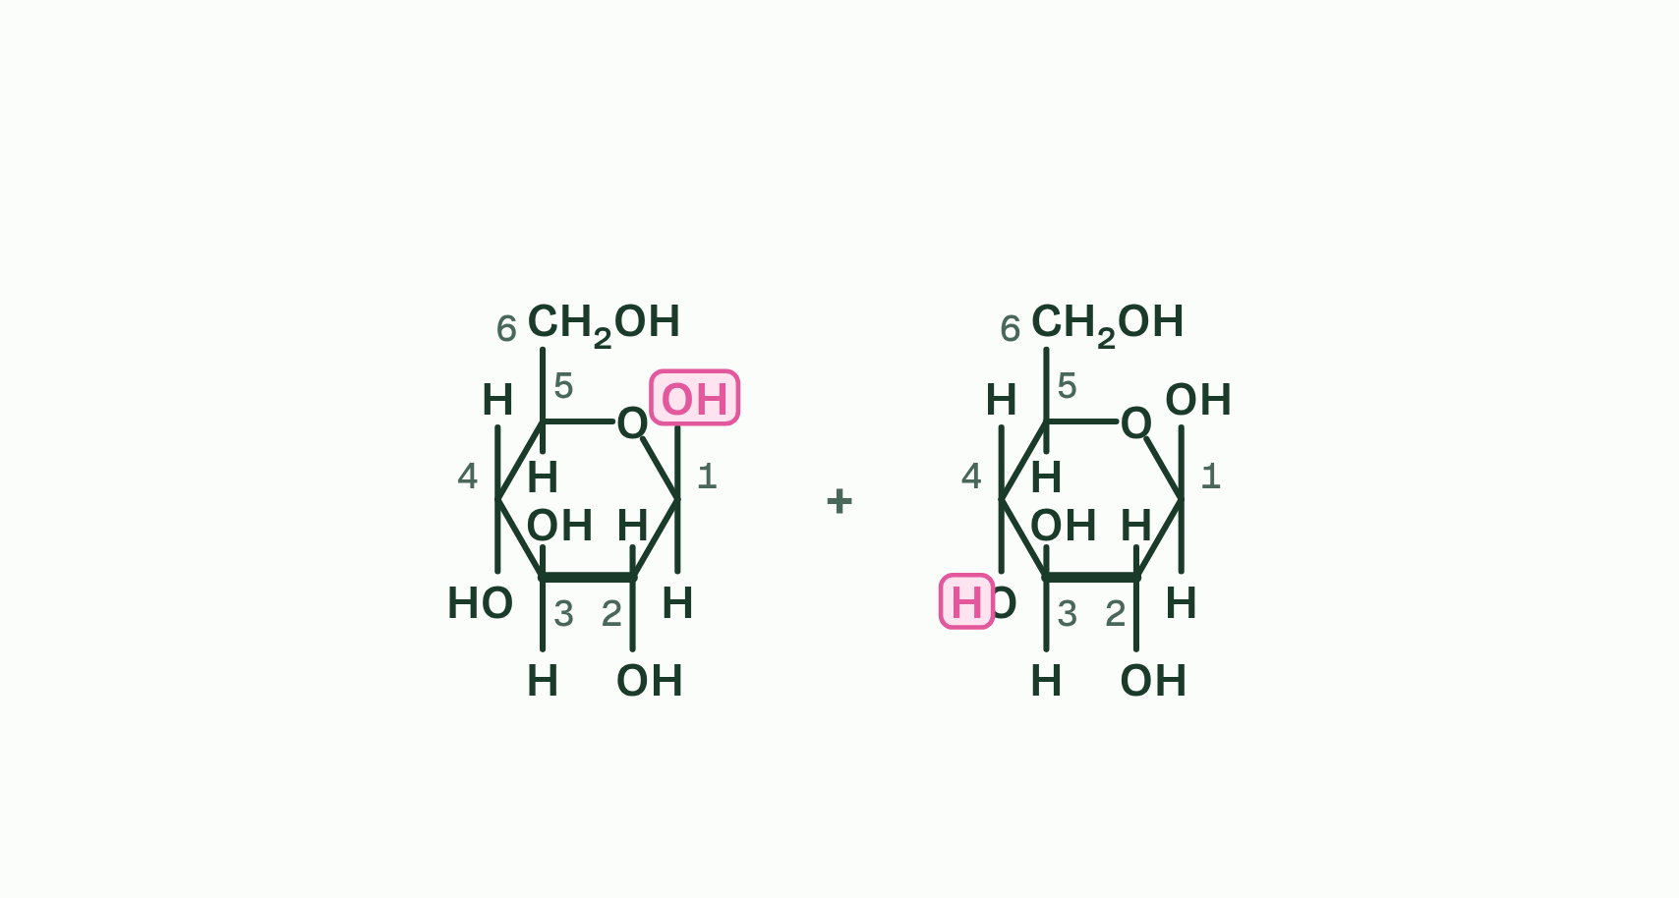
CHAPTER 5 · B1.1.6 Cellulose
2 / 4
Turn every other glucose over and the chain runs straight
The OH on carbon 1 of one points up, and the OH on carbon 4 of the other points down: they cannot meet.
Minutes 17 to 29
Notes:
Minutes 17 to 29 of 60: Turn it over (12 min).
The plan: Chapter 5’s bond builder first: students try to join two β-glucose before anyone explains. Then chapter 5’s figure. Fill in a table: starch, glycogen, cellulose; monomer, shape, branches, where, job.
Cellulose is an unbranched polymer of β-glucose and the main material of plant cell walls. β-glucose does not join to itself the way α-glucose does. Try it in the bond builder under this chapter, then read on.
In β-glucose the OH on carbon 1 points up, but the OH on carbon 4 points down. To join two of them, the second must be turned over, so in the chain each unit is upside down compared with the one before it: alternate units point opposite ways.
The alternation keeps the chain straight rather than coiled. Straight chains lie side by side, and OH groups on neighbouring chains form hydrogen bonds that cross-link them into bundles called microfibrils.
One hydrogen bond is weak, but there are thousands along every chain, and together they make a microfibril very strong when pulled: it has high tensile strength. In a cell wall, layers of microfibrils lie at different angles. The wall resists the pressure of the cell’s contents and helps hold the plant up (D2.3).
Few organisms make an enzyme for the β links, and humans do not, so cellulose passes through us as fibre. Amylase cannot hydrolyse it (C1.1).
Example: Where it leads Because cellulose is so hard to break down, wood and peat store carbon for centuries or longer, and coal formed from ancient plant matter. Stores like these are carbon sinks (C4.2, D4.3).

Slide 26
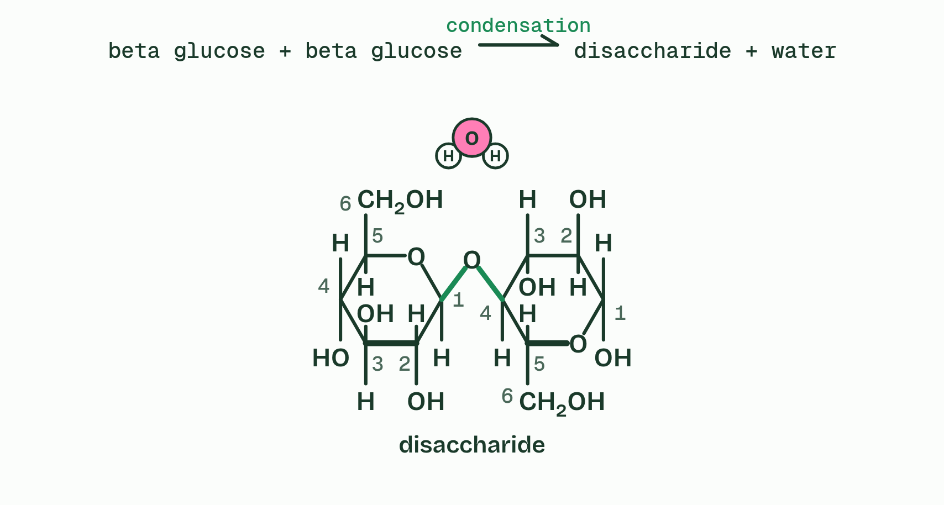
CHAPTER 5 · B1.1.6 Cellulose
3 / 4
Turn every other glucose over and the chain runs straight
Turn the second over and they meet. They leave as water, and a 1,4 glycosidic bond joins the rings, as in cellulose: condensation.
Minutes 17 to 29
Notes:
Minutes 17 to 29 of 60: Turn it over (12 min).
The plan: Chapter 5’s bond builder first: students try to join two β-glucose before anyone explains. Then chapter 5’s figure. Fill in a table: starch, glycogen, cellulose; monomer, shape, branches, where, job.
Cellulose is an unbranched polymer of β-glucose and the main material of plant cell walls. β-glucose does not join to itself the way α-glucose does. Try it in the bond builder under this chapter, then read on.
In β-glucose the OH on carbon 1 points up, but the OH on carbon 4 points down. To join two of them, the second must be turned over, so in the chain each unit is upside down compared with the one before it: alternate units point opposite ways.
The alternation keeps the chain straight rather than coiled. Straight chains lie side by side, and OH groups on neighbouring chains form hydrogen bonds that cross-link them into bundles called microfibrils.
One hydrogen bond is weak, but there are thousands along every chain, and together they make a microfibril very strong when pulled: it has high tensile strength. In a cell wall, layers of microfibrils lie at different angles. The wall resists the pressure of the cell’s contents and helps hold the plant up (D2.3).
Few organisms make an enzyme for the β links, and humans do not, so cellulose passes through us as fibre. Amylase cannot hydrolyse it (C1.1).
Example: Where it leads Because cellulose is so hard to break down, wood and peat store carbon for centuries or longer, and coal formed from ancient plant matter. Stores like these are carbon sinks (C4.2, D4.3).

Slide 27
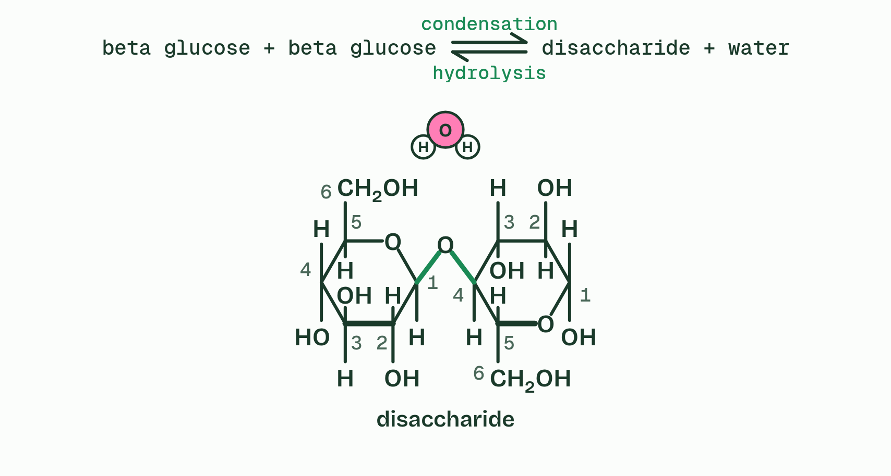
CHAPTER 5 · B1.1.6 Cellulose
4 / 4
Turn every other glucose over and the chain runs straight
Add water and the bond splits again, the H to one sugar and the OH to the other: hydrolysis.
Minutes 17 to 29
Notes:
Minutes 17 to 29 of 60: Turn it over (12 min).
The plan: Chapter 5’s bond builder first: students try to join two β-glucose before anyone explains. Then chapter 5’s figure. Fill in a table: starch, glycogen, cellulose; monomer, shape, branches, where, job.
Cellulose is an unbranched polymer of β-glucose and the main material of plant cell walls. β-glucose does not join to itself the way α-glucose does. Try it in the bond builder under this chapter, then read on.
In β-glucose the OH on carbon 1 points up, but the OH on carbon 4 points down. To join two of them, the second must be turned over, so in the chain each unit is upside down compared with the one before it: alternate units point opposite ways.
The alternation keeps the chain straight rather than coiled. Straight chains lie side by side, and OH groups on neighbouring chains form hydrogen bonds that cross-link them into bundles called microfibrils.
One hydrogen bond is weak, but there are thousands along every chain, and together they make a microfibril very strong when pulled: it has high tensile strength. In a cell wall, layers of microfibrils lie at different angles. The wall resists the pressure of the cell’s contents and helps hold the plant up (D2.3).
Few organisms make an enzyme for the β links, and humans do not, so cellulose passes through us as fibre. Amylase cannot hydrolyse it (C1.1).
Example: Where it leads Because cellulose is so hard to break down, wood and peat store carbon for centuries or longer, and coal formed from ancient plant matter. Stores like these are carbon sinks (C4.2, D4.3).

Slide 28
CHAPTER 5 · B1.1.6 Cellulose
Turn every other glucose over and the chain runs straight
Cellulose is an unbranched polymer of β-glucose and the main material of plant cell walls. β-glucose does not join to itself the way α-glucose does.
Straight chains lie side by side, and OH groups on neighbouring chains form hydrogen bonds that cross-link them into bundles called microfibrils.
One hydrogen bond is weak, but there are thousands along every chain, and together they make a microfibril very strong when pulled: it has high tensile strength.
In a cell wall, layers of microfibrils lie at different angles.
Minutes 17 to 29
Notes:
Minutes 17 to 29 of 60: Turn it over (12 min).
The plan: Chapter 5’s bond builder first: students try to join two β-glucose before anyone explains. Then chapter 5’s figure. Fill in a table: starch, glycogen, cellulose; monomer, shape, branches, where, job.
Cellulose is an unbranched polymer of β-glucose and the main material of plant cell walls. β-glucose does not join to itself the way α-glucose does. Try it in the bond builder under this chapter, then read on.
In β-glucose the OH on carbon 1 points up, but the OH on carbon 4 points down. To join two of them, the second must be turned over, so in the chain each unit is upside down compared with the one before it: alternate units point opposite ways.
The alternation keeps the chain straight rather than coiled. Straight chains lie side by side, and OH groups on neighbouring chains form hydrogen bonds that cross-link them into bundles called microfibrils.
One hydrogen bond is weak, but there are thousands along every chain, and together they make a microfibril very strong when pulled: it has high tensile strength. In a cell wall, layers of microfibrils lie at different angles. The wall resists the pressure of the cell’s contents and helps hold the plant up (D2.3).
Few organisms make an enzyme for the β links, and humans do not, so cellulose passes through us as fibre. Amylase cannot hydrolyse it (C1.1).
Example: Where it leads Because cellulose is so hard to break down, wood and peat store carbon for centuries or longer, and coal formed from ancient plant matter. Stores like these are carbon sinks (C4.2, D4.3).

Slide 29
PREDICT
Cellulose chains lie side by side in bundles. What holds neighbouring chains together?
A Glycosidic bonds between the glucose units of neighbouring chains
B Hydrogen bonds between OH groups on neighbouring chains
C Ionic bonds between charged groups on neighbouring chains
Minutes 17 to 29
Notes:
Minutes 17 to 29 of 60: Turn it over (12 min).
The plan: Chapter 5’s bond builder first: students try to join two β-glucose before anyone explains. Then chapter 5’s figure. Fill in a table: starch, glycogen, cellulose; monomer, shape, branches, where, job.
Ask for a show of hands, or mini whiteboards, before revealing. (Answer: B, on the next slide.)

Slide 30
WHAT HAPPENS
Cellulose chains lie side by side in bundles. What holds neighbouring chains together?
A Glycosidic bonds between the glucose units of neighbouring chains
B Hydrogen bonds between OH groups on neighbouring chains
C Ionic bonds between charged groups on neighbouring chains
Hydrogen bonds. Each is weak, but there are thousands along every chain, so together they hold the bundle firmly. Glycosidic bonds link glucose units within a chain, not chain to chain.
Minutes 17 to 29
Notes:
Minutes 17 to 29 of 60: Turn it over (12 min).
The plan: Chapter 5’s bond builder first: students try to join two β-glucose before anyone explains. Then chapter 5’s figure. Fill in a table: starch, glycogen, cellulose; monomer, shape, branches, where, job.
Answer: B. Hydrogen bonds. Each is weak, but there are thousands along every chain, so together they hold the bundle firmly. Glycosidic bonds link glucose units within a chain, not chain to chain.

Slide 31
WATCH OUT
Cellulose is the plant’s structure, not its energy store: it is built to stay in the wall.
Minutes 17 to 29
Notes:
Minutes 17 to 29 of 60: Turn it over (12 min).
The plan: Chapter 5’s bond builder first: students try to join two β-glucose before anyone explains. Then chapter 5’s figure. Fill in a table: starch, glycogen, cellulose; monomer, shape, branches, where, job.
A common mistake: say it, then ask who can say why it is wrong.

Slide 32
STEP 4
10 MIN
Name tags
Chapter 6: Sugar name tags on the cell surface
Minutes 29 to 39
Notes:
Minutes 29 to 39 of 60: Name tags (10 min).
The plan: Chapter 6’s figure with the O, A, B, AB switch, then the chapter 6 predict box. One minute on why transfused blood must match (forward to C3.2).

Slide 33
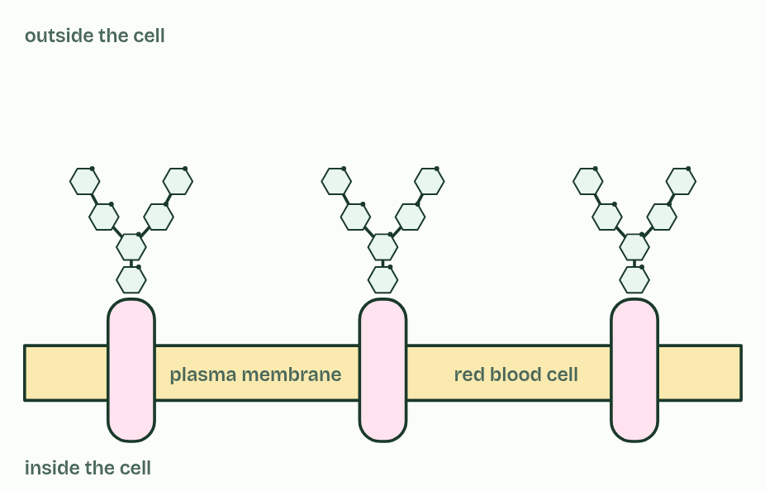
CHAPTER 6 · B1.1.7 Glycoproteins
1 / 4
Sugar name tags on the cell surface
O
Minutes 29 to 39
Notes:
Minutes 29 to 39 of 60: Name tags (10 min).
The plan: Chapter 6’s figure with the O, A, B, AB switch, then the chapter 6 predict box. One minute on why transfused blood must match (forward to C3.2).
A glycoprotein is a protein with carbohydrate chains attached. In the plasma membrane the protein sits in the membrane and its sugar chains face outwards, away from the cell.
Carbohydrate chains can differ in which monosaccharides they contain, in the order of those sugars and in how the chain branches, so they can take a huge number of forms. That makes them good identity tags, and other cells read them: this is cell-cell recognition. Cells of one tissue recognise each other and stick together, and immune cells tell the body’s own cells from foreign ones.
The ABO blood groups are the standard example. Red blood cells carry a short sugar chain on glycoproteins in their membrane. In group O the chain ends at its base. Group A cells add one extra sugar to its tip, group B cells add a different extra sugar, and group AB cells carry both kinds, on different chains. The A and B forms are antigens. A person whose cells lack one of them treats it as foreign, which is why transfused blood must match the recipient’s group (the antibody side is C3.2).
Which extra sugar a person adds depends on the alleles they inherit, IA, IB and i (D3.2). Glycoproteins also take part in the structure of the plasma membrane (B2.1).

Slide 34
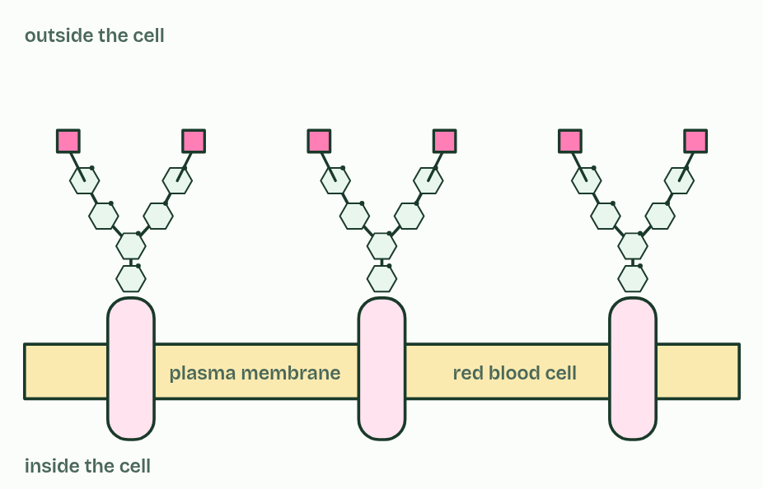
CHAPTER 6 · B1.1.7 Glycoproteins
2 / 4
Sugar name tags on the cell surface
A
Minutes 29 to 39
Notes:
Minutes 29 to 39 of 60: Name tags (10 min).
The plan: Chapter 6’s figure with the O, A, B, AB switch, then the chapter 6 predict box. One minute on why transfused blood must match (forward to C3.2).
A glycoprotein is a protein with carbohydrate chains attached. In the plasma membrane the protein sits in the membrane and its sugar chains face outwards, away from the cell.
Carbohydrate chains can differ in which monosaccharides they contain, in the order of those sugars and in how the chain branches, so they can take a huge number of forms. That makes them good identity tags, and other cells read them: this is cell-cell recognition. Cells of one tissue recognise each other and stick together, and immune cells tell the body’s own cells from foreign ones.
The ABO blood groups are the standard example. Red blood cells carry a short sugar chain on glycoproteins in their membrane. In group O the chain ends at its base. Group A cells add one extra sugar to its tip, group B cells add a different extra sugar, and group AB cells carry both kinds, on different chains. The A and B forms are antigens. A person whose cells lack one of them treats it as foreign, which is why transfused blood must match the recipient’s group (the antibody side is C3.2).
Which extra sugar a person adds depends on the alleles they inherit, IA, IB and i (D3.2). Glycoproteins also take part in the structure of the plasma membrane (B2.1).

Slide 35
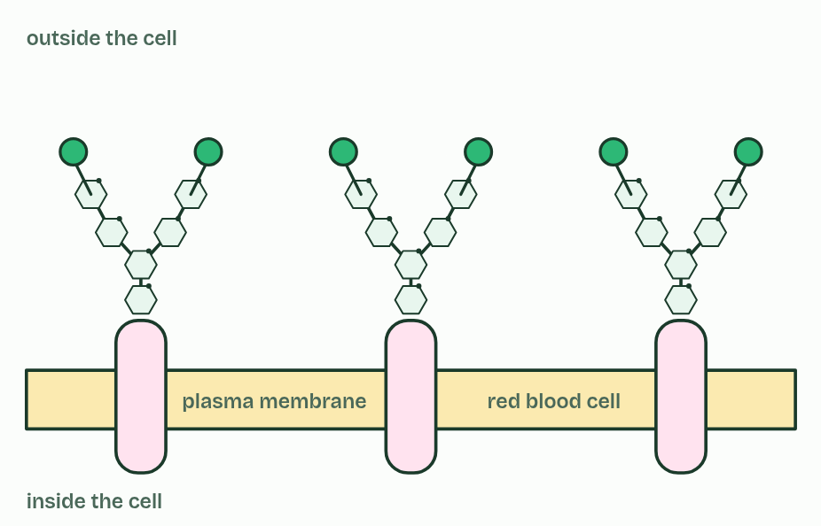
CHAPTER 6 · B1.1.7 Glycoproteins
3 / 4
Sugar name tags on the cell surface
B
Minutes 29 to 39
Notes:
Minutes 29 to 39 of 60: Name tags (10 min).
The plan: Chapter 6’s figure with the O, A, B, AB switch, then the chapter 6 predict box. One minute on why transfused blood must match (forward to C3.2).
A glycoprotein is a protein with carbohydrate chains attached. In the plasma membrane the protein sits in the membrane and its sugar chains face outwards, away from the cell.
Carbohydrate chains can differ in which monosaccharides they contain, in the order of those sugars and in how the chain branches, so they can take a huge number of forms. That makes them good identity tags, and other cells read them: this is cell-cell recognition. Cells of one tissue recognise each other and stick together, and immune cells tell the body’s own cells from foreign ones.
The ABO blood groups are the standard example. Red blood cells carry a short sugar chain on glycoproteins in their membrane. In group O the chain ends at its base. Group A cells add one extra sugar to its tip, group B cells add a different extra sugar, and group AB cells carry both kinds, on different chains. The A and B forms are antigens. A person whose cells lack one of them treats it as foreign, which is why transfused blood must match the recipient’s group (the antibody side is C3.2).
Which extra sugar a person adds depends on the alleles they inherit, IA, IB and i (D3.2). Glycoproteins also take part in the structure of the plasma membrane (B2.1).

Slide 36
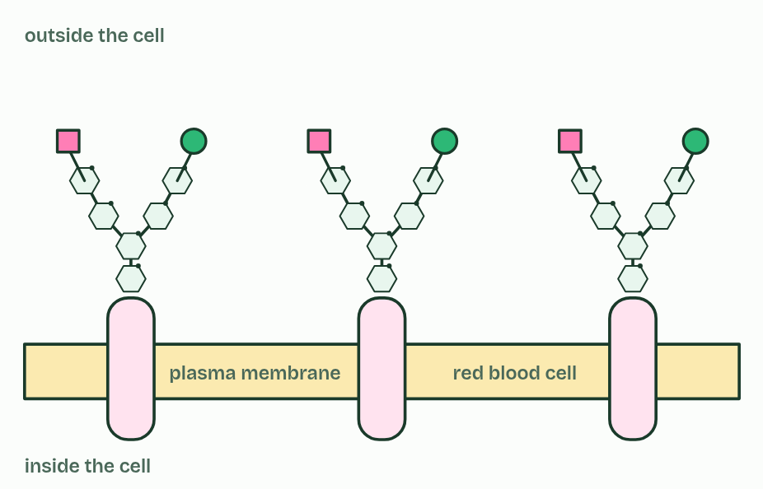
CHAPTER 6 · B1.1.7 Glycoproteins
4 / 4
Sugar name tags on the cell surface
AB
Minutes 29 to 39
Notes:
Minutes 29 to 39 of 60: Name tags (10 min).
The plan: Chapter 6’s figure with the O, A, B, AB switch, then the chapter 6 predict box. One minute on why transfused blood must match (forward to C3.2).
A glycoprotein is a protein with carbohydrate chains attached. In the plasma membrane the protein sits in the membrane and its sugar chains face outwards, away from the cell.
Carbohydrate chains can differ in which monosaccharides they contain, in the order of those sugars and in how the chain branches, so they can take a huge number of forms. That makes them good identity tags, and other cells read them: this is cell-cell recognition. Cells of one tissue recognise each other and stick together, and immune cells tell the body’s own cells from foreign ones.
The ABO blood groups are the standard example. Red blood cells carry a short sugar chain on glycoproteins in their membrane. In group O the chain ends at its base. Group A cells add one extra sugar to its tip, group B cells add a different extra sugar, and group AB cells carry both kinds, on different chains. The A and B forms are antigens. A person whose cells lack one of them treats it as foreign, which is why transfused blood must match the recipient’s group (the antibody side is C3.2).
Which extra sugar a person adds depends on the alleles they inherit, IA, IB and i (D3.2). Glycoproteins also take part in the structure of the plasma membrane (B2.1).

Slide 37
CHAPTER 6 · B1.1.7 Glycoproteins
Sugar name tags on the cell surface
A glycoprotein is a protein with carbohydrate chains attached.
Carbohydrate chains can differ in which monosaccharides they contain, in the order of those sugars and in how the chain branches, so they can take a huge number of forms. That makes them good identity tags, and other cells read them: this is cell-cell recognition.
Red blood cells carry a short sugar chain on glycoproteins in their membrane.
The A and B forms are antigens.
Minutes 29 to 39
Notes:
Minutes 29 to 39 of 60: Name tags (10 min).
The plan: Chapter 6’s figure with the O, A, B, AB switch, then the chapter 6 predict box. One minute on why transfused blood must match (forward to C3.2).
A glycoprotein is a protein with carbohydrate chains attached. In the plasma membrane the protein sits in the membrane and its sugar chains face outwards, away from the cell.
Carbohydrate chains can differ in which monosaccharides they contain, in the order of those sugars and in how the chain branches, so they can take a huge number of forms. That makes them good identity tags, and other cells read them: this is cell-cell recognition. Cells of one tissue recognise each other and stick together, and immune cells tell the body’s own cells from foreign ones.
The ABO blood groups are the standard example. Red blood cells carry a short sugar chain on glycoproteins in their membrane. In group O the chain ends at its base. Group A cells add one extra sugar to its tip, group B cells add a different extra sugar, and group AB cells carry both kinds, on different chains. The A and B forms are antigens. A person whose cells lack one of them treats it as foreign, which is why transfused blood must match the recipient’s group (the antibody side is C3.2).
Which extra sugar a person adds depends on the alleles they inherit, IA, IB and i (D3.2). Glycoproteins also take part in the structure of the plasma membrane (B2.1).
Parts of the figure:
Protein part Through the membrane.
No A or B sugar This chain stops at its base. (Its last sugar is fucose.)
A antigen One extra sugar on the tip of the chain. (The sugar is N-acetylgalactosamine.)
B antigen A different extra sugar on the tip of the chain. (The sugar is galactose.)
A antigen One extra sugar on the tip of the chain. (The sugar is N-acetylgalactosamine.)
No A or B sugar This chain stops at its base. (Its last sugar is fucose.)
A antigen One extra sugar on the tip of the chain. (The sugar is N-acetylgalactosamine.)
B antigen A different extra sugar on the tip of the chain. (The sugar is galactose.)
B antigen A different extra sugar on the tip of the chain. (The sugar is galactose.)
Protein part Through the membrane.
No A or B sugar This chain stops at its base. (Its last sugar is fucose.)
A antigen One extra sugar on the tip of the chain. (The sugar is N-acetylgalactosamine.)
B antigen A different extra sugar on the tip of the chain. (The sugar is galactose.)
A antigen One extra sugar on the tip of the chain. (The sugar is N-acetylgalactosamine.)
No A or B sugar This chain stops at its base. (Its last sugar is fucose.)
A antigen One extra sugar on the tip of the chain. (The sugar is N-acetylgalactosamine.)
B antigen A different extra sugar on the tip of the chain. (The sugar is galactose.)
B antigen A different extra sugar on the tip of the chain. (The sugar is galactose.)
Protein part Through the membrane.
No A or B sugar This chain stops at its base. (Its last sugar is fucose.)
A antigen One extra sugar on the tip of the chain. (The sugar is N-acetylgalactosamine.)
B antigen A different extra sugar on the tip of the chain. (The sugar is galactose.)
A antigen One extra sugar on the tip of the chain. (The sugar is N-acetylgalactosamine.)
No A or B sugar This chain stops at its base. (Its last sugar is fucose.)
A antigen One extra sugar on the tip of the chain. (The sugar is N-acetylgalactosamine.)
B antigen A different extra sugar on the tip of the chain. (The sugar is galactose.)
B antigen A different extra sugar on the tip of the chain. (The sugar is galactose.)

Slide 38
WATCH OUT
Group O cells are not bare. They carry the same base sugar chain: they only lack the extra A or B sugar on its tip.
Minutes 29 to 39
Notes:
Minutes 29 to 39 of 60: Name tags (10 min).
The plan: Chapter 6’s figure with the O, A, B, AB switch, then the chapter 6 predict box. One minute on why transfused blood must match (forward to C3.2).
A common mistake: say it, then ask who can say why it is wrong.

Slide 39
PREDICT
What makes a group A red blood cell different from a group B one?
A Its membrane holds a completely different kind of protein
B Group A cells keep their nuclei and group B cells lose theirs
C One different sugar at the tip of each sugar chain
Minutes 29 to 39
Notes:
Minutes 29 to 39 of 60: Name tags (10 min).
The plan: Chapter 6’s figure with the O, A, B, AB switch, then the chapter 6 predict box. One minute on why transfused blood must match (forward to C3.2).
Ask for a show of hands, or mini whiteboards, before revealing. (Answer: C, on the next slide.)

Slide 40
WHAT HAPPENS
What makes a group A red blood cell different from a group B one?
A Its membrane holds a completely different kind of protein
B Group A cells keep their nuclei and group B cells lose theirs
C One different sugar at the tip of each sugar chain
One sugar. Both carry the same glycoprotein chains. The enzyme a person’s alleles make adds one sugar to the tip, a different one for A and for B. That single sugar is enough for immune cells to tell the cells apart.
Minutes 29 to 39
Notes:
Minutes 29 to 39 of 60: Name tags (10 min).
The plan: Chapter 6’s figure with the O, A, B, AB switch, then the chapter 6 predict box. One minute on why transfused blood must match (forward to C3.2).
Answer: C. One sugar. Both carry the same glycoprotein chains. The enzyme a person’s alleles make adds one sugar to the tip, a different one for A and for B. That single sugar is enough for immune cells to tell the cells apart.

Slide 41
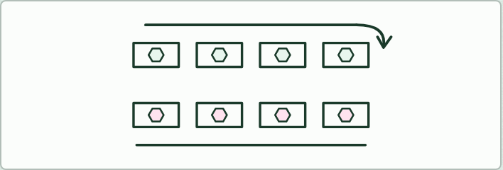
GAME
15 MIN
Molecule speed dating
THE TASK
Each student holds a card with one molecule: a drawing, its name and two facts. Pairs meet for one minute to find one thing their molecules share and one difference, then one row moves along. Six rounds. Lesson 2 uses carbohydrate cards; add lipid cards for a review of the whole topic.
STUDENTS NEED
One card per student.
Minutes 39 to 54
Notes:
Minutes 39 to 54 of 60: Molecule speed dating (15 min).
The plan: The speed dating game below, with the carbohydrate cards only.
The activity: Molecule speed dating. Each student holds a card with one molecule: a drawing, its name and two facts. Pairs meet for one minute to find one thing their molecules share and one difference, then one row moves along. Six rounds. Lesson 2 uses carbohydrate cards; add lipid cards for a review of the whole topic.
Needs: one card per student.
The time: 15 minutes, minutes 39 to 54 of the plan.

Slide 42
PLENARY
Can you now...
Tell pentoses from hexoses and alpha from beta glucose in ring diagrams, and link glucose's properties to its uses (B1.1.4)
Explain how coiling, branching and size suit starch and glycogen to storing energy (B1.1.5)
Explain how alternating beta glucose gives cellulose straight chains, bundled by hydrogen bonds (B1.1.6)
Explain how glycoproteins let cells recognise each other, using the ABO blood groups (B1.1.7)
Minutes 54 to 60
Notes:
Minutes 54 to 60 of 60: Exit (6 min).
The plan: One sentence each: why starch barely dissolves, and why cellulose is strong.
Thumbs up, sideways or down on each goal before the exit question. The goals come from the statements this lesson covers.

Slide 43
EXIT QUESTION
Before you go
One sentence each.
Minutes 54 to 60
Notes:
Minutes 54 to 60 of 60: Exit (6 min).
The plan: One sentence each: why starch barely dissolves, and why cellulose is strong.

Slide 44
PRACTISE AND REVISE
Keep going
Exam practice: a fresh paper of exam questions on B1.1, marked as you go
The guide, with the animations and the dry lab
This lesson in the guide: 4 Starch and glycogen: energy packed tight, 5 Turn every other glucose over and the chain runs straight, 6 Sugar name tags on the cell surface
BUILD FOR YOUR CLASS
ALREADY ON THE SITE FOR B1.1
CARD SETS ON SPLYCR
Tarsia puzzle, dominoes and picture reveal on B1.1, built from its key terms and ready to print
A pub quiz with rounds on B1.1, to present or run with no projector
An escape room built from the question bank on B1.1
Quiz: Biological Molecules
Revision map: B1.1 Carbohydrates and lipids, to fill in
Exam questions: B1.1 in the exam maker, a paper with its markscheme
Open a set to host it as a class game, or make a copy to edit.
B1.1 Carbohydrates
B1.1b Lipids
How this was made. The course structure, the activities and the teaching choices come from my own classroom, my presentations and my years of teaching IB and AP Biology. I use Claude, an AI, to help write and build the interactive guides, lesson plans, slides and practice questions, and to draw the diagrams and code the interactives. I direct the work and review it against the IB and AP specifications before it goes live.
Minute 60: after the lesson
Notes:
Every link here is live. Set the exam practice paper for homework: it is fresh each time, marked as students go and saved to their Exam practice when they are signed in.
Exam practice: https://www.biologybybradford.com/exam-maker/sit?topics=B1.1&level=HL&paper=quiz&marks=15&src=ep
The guide: https://www.biologybybradford.com/guides/ib-biology-b1-1-carbohydrates-and-lipids

