Slide 1
IB Biology B1.1
LESSON 3 OF 4
BY THE END YOU CAN
Carbohydrates and lipids
Explain why lipids are hydrophobic, and how condensation builds triglycerides and phospholipids (B1.1.8, B1.1.9)
Compare saturated, monounsaturated and polyunsaturated fatty acids and explain their melting points (B1.1.10)
Explain why triglycerides suit long-term energy storage and insulation, and compare them with carbohydrates as stores (B1.1.11)
Explain how amphipathic phospholipids form a bilayer in water (B1.1.12)
Lipids
B1.1.8 to B1.1.12
Why lipids avoid water, how fats and phospholipids are built, and how fats store and insulate
60 minutes · chapters 7, 8, 9, 10
Minute 0
Notes:
IB Biology B1.1, Carbohydrates and lipids. Lesson 3 of 4: Lipids, 60 minutes.
The plan, minute by minute (each slide's footer says where you are):
0 to 8 min (8) Do now: the salted butter puzzle
8 to 15 min (7) Oil and solvents
15 to 25 min (10) Make a fat, make a phospholipid
25 to 40 min (15) Fats from the fridge
40 to 50 min (10) Store and insulate
50 to 60 min (10) Half loves water
What students get wrong:
Lipids as polymers. A triglyceride is one glycerol and three fatty acids.
“Melting breaks the double bonds.” Melting separates whole molecules.
“Saturated with fat.” Saturated with hydrogen.
“Fat has more energy because its molecules are bigger.” It is per gram: more C–H, less oxygen, and no water stored with it.
“Carbohydrates are always short-term stores.” Plants keep starch for months.
“Cells build the bilayer with enzymes.” Water arranges it.
Stretch and support:
Support: the tiles as a starter in each lesson (ABBA, Sweet Treats Stay Energetic, Double Kinks Leave Liquids).
Support: a writing frame for “explain why oils are liquid”, built on the four tiles in order.
Support: the key terms (tap the dotted words) as a glossary, and the bond builder’s tap mode on a tablet.
Stretch: why do lipids release more energy per gram than carbohydrates? Compare the oxygen in glucose and in a fatty acid chain (the linking question on oxidation and reduction).
Stretch: why might fat in the lower legs of an Arctic mammal be more unsaturated than fat near its body?
Stretch: design a fair test of the fridge fats using a water bath and a thermometer instead of hands.
The lesson plan to print: https://www.biologybybradford.com/guides/downloads/ib-biology-b1-1-carbohydrates-and-lipids-lesson-3-plan.pdf

Slide 2
DO NOW
The salted butter puzzle
The chapter 7 predict box.
8:00
minutes
Start now: the timer is running.
Minutes 0 to 8
Notes:
Minutes 0 to 8 of 60: Do now: the salted butter puzzle (8 min).
The plan: The chapter 7 predict box. Then start melting the butter (the demo below) and leave it to settle.
Start a 8 minute timer as they come in.

Slide 3
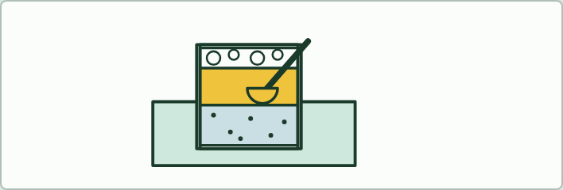
DEMO
8 MIN
The salted butter puzzle
THE TASK
Melt about 50 g of salted butter in a small beaker standing in hot water and leave it to settle for 10 minutes: foam on top, clear golden fat, a cloudy watery layer below. Ladle off the fat. Ask where the salt went, and how to show it without tasting (no tasting in a lab): evaporate a drop of each layer on a watch glass and look for crystals.
STUDENTS NEED
Salted butter, a beaker, a pan or beaker of hot water, a ladle, watch glasses.
Minutes 0 to 8
Notes:
Minutes 0 to 8 of 60: Do now: the salted butter puzzle (8 min).
The plan: The chapter 7 predict box. Then start melting the butter (the demo below) and leave it to settle.
The activity: The salted butter puzzle. Melt about 50 g of salted butter in a small beaker standing in hot water and leave it to settle for 10 minutes: foam on top, clear golden fat, a cloudy watery layer below. Ladle off the fat. Ask where the salt went, and how to show it without tasting (no tasting in a lab): evaporate a drop of each layer on a watch glass and look for crystals.
Needs: salted butter, a beaker, a pan or beaker of hot water, a ladle, watch glasses.
The time: 8 minutes, minutes 0 to 8 of the plan.

Slide 4
PREDICT
You have salted butter but need it unsalted. What could you do?
A Stir it into plenty of water and filter the salt out of the butter
B Melt it, leave it to settle, then pour the fat off the water
C Heat it hard until the salt evaporates and only the fat is left
Minutes 0 to 8
Notes:
Minutes 0 to 8 of 60: Do now: the salted butter puzzle (8 min).
The plan: The chapter 7 predict box. Then start melting the butter (the demo below) and leave it to settle.
Ask for a show of hands, or mini whiteboards, before revealing. (Answer: B, on the next slide.)

Slide 5
WHAT HAPPENS
You have salted butter but need it unsalted. What could you do?
A Stir it into plenty of water and filter the salt out of the butter
B Melt it, leave it to settle, then pour the fat off the water
C Heat it hard until the salt evaporates and only the fat is left
Melt it and let it settle. Butter is a mixture: mostly fat, with some water. Salt dissolves in water but not in fat, so it stays in the watery layer at the bottom while the fat floats above. Pour or ladle the fat off and it is almost salt-free: this is clarified butter. Stirring into water fails because the fat does not dissolve, and salt does not evaporate at kitchen temperatures.
Minutes 0 to 8
Notes:
Minutes 0 to 8 of 60: Do now: the salted butter puzzle (8 min).
The plan: The chapter 7 predict box. Then start melting the butter (the demo below) and leave it to settle.
Answer: B. Melt it and let it settle. Butter is a mixture: mostly fat, with some water. Salt dissolves in water but not in fat, so it stays in the watery layer at the bottom while the fat floats above. Pour or ladle the fat off and it is almost salt-free: this is clarified butter. Stirring into water fails because the fat does not dissolve, and salt does not evaporate at kitchen temperatures.

Slide 6
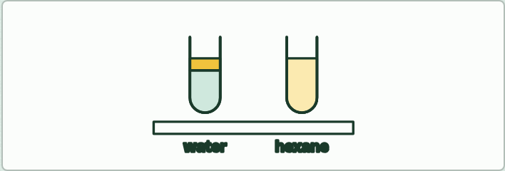
DEMO
7 MIN
Oil and solvents
THE TASK
Two tubes: a few drops of vegetable oil shaken with water, which gives two layers, and with hexane in a fume cupboard, which gives one clear layer.
STUDENTS NEED
Oil, water, hexane (fume cupboard, no flames), stoppered tubes.
Minutes 8 to 15
Notes:
Minutes 8 to 15 of 60: Oil and solvents (7 min).
The plan: The demo below, then chapter 7’s first figure. Come back to the settled butter.
The activity: Oil and solvents. Two tubes: a few drops of vegetable oil shaken with water, which gives two layers, and with hexane in a fume cupboard, which gives one clear layer.
Needs: oil, water, hexane (fume cupboard, no flames), stoppered tubes.
The time: 7 minutes, minutes 8 to 15 of the plan.

Slide 7
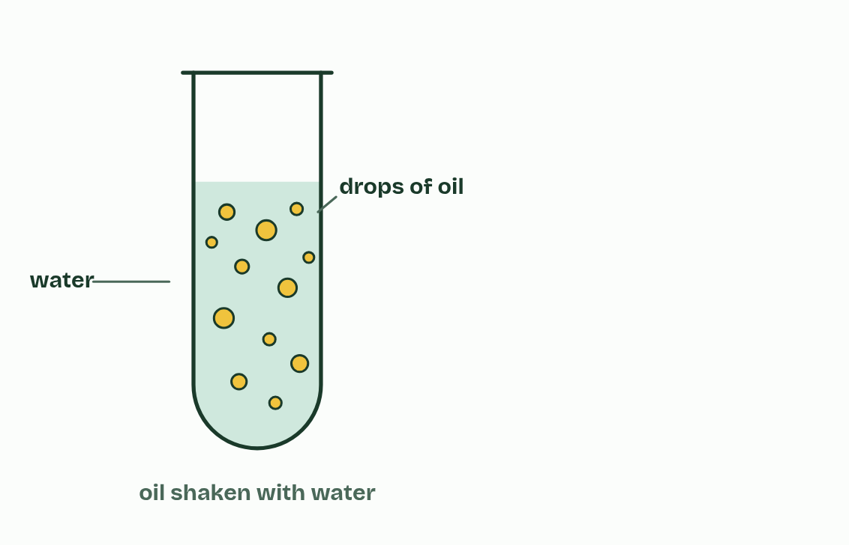
CHAPTER 7 · B1.1.8 B1.1.9 Lipids, triglycerides and phospholipids
1 / 5
Lipids keep their distance from water
Shake oil with water,
Minutes 8 to 15
Notes:
Minutes 8 to 15 of 60: Oil and solvents (7 min).
The plan: The demo below, then chapter 7’s first figure. Come back to the settled butter.
Lipids are substances made by living things that dissolve in non-polar solvents, such as hexane, but only sparingly in water. They are grouped by this behaviour, not by a shared monomer. Lipids include fats, oils, waxes and steroids.
The reason is in their atoms. Lipids are mostly carbon and hydrogen, and C–H bonds are non-polar, so there are no partial charges for water to attract (A1.1). Water molecules stay bonded to each other and push the lipid out into droplets or a separate layer: lipids are hydrophobic. Wax on a leaf and oil on a feather keep water off for this reason. A wax is a fatty acid joined to a long-chain alcohol, and its long hydrocarbon chains make a waterproof coat, as on a leaf surface or in beeswax.
Fats and oils are mostly triglycerides: one glycerol (three carbons, each with an OH group) joined to three fatty acids. A fatty acid is a hydrocarbon chain with a carboxyl group, COOH, at one end. Each one joins glycerol by condensation: the OH of the carboxyl group and the H of one of glycerol’s OH groups leave as water, and an ester bond forms. Three fatty acids mean three ester bonds and three molecules of water.
A phospholipid is glycerol joined to two fatty acids and one phosphate group, also by condensation. (In most phospholipids a further small polar group is attached to the phosphate, which we leave out.)
A triglyceride is not a polymer: it is three fatty acids on one glycerol, not a chain of repeating units.

Slide 8
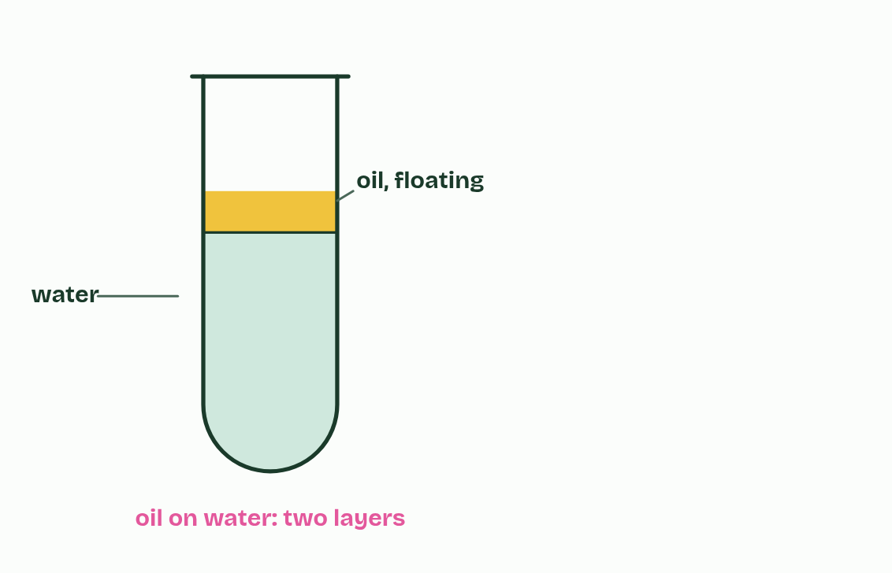
CHAPTER 7 · B1.1.8 B1.1.9 Lipids, triglycerides and phospholipids
2 / 5
Lipids keep their distance from water
and it separates and floats: it does not dissolve.
Minutes 8 to 15
Notes:
Minutes 8 to 15 of 60: Oil and solvents (7 min).
The plan: The demo below, then chapter 7’s first figure. Come back to the settled butter.
Lipids are substances made by living things that dissolve in non-polar solvents, such as hexane, but only sparingly in water. They are grouped by this behaviour, not by a shared monomer. Lipids include fats, oils, waxes and steroids.
The reason is in their atoms. Lipids are mostly carbon and hydrogen, and C–H bonds are non-polar, so there are no partial charges for water to attract (A1.1). Water molecules stay bonded to each other and push the lipid out into droplets or a separate layer: lipids are hydrophobic. Wax on a leaf and oil on a feather keep water off for this reason. A wax is a fatty acid joined to a long-chain alcohol, and its long hydrocarbon chains make a waterproof coat, as on a leaf surface or in beeswax.
Fats and oils are mostly triglycerides: one glycerol (three carbons, each with an OH group) joined to three fatty acids. A fatty acid is a hydrocarbon chain with a carboxyl group, COOH, at one end. Each one joins glycerol by condensation: the OH of the carboxyl group and the H of one of glycerol’s OH groups leave as water, and an ester bond forms. Three fatty acids mean three ester bonds and three molecules of water.
A phospholipid is glycerol joined to two fatty acids and one phosphate group, also by condensation. (In most phospholipids a further small polar group is attached to the phosphate, which we leave out.)
A triglyceride is not a polymer: it is three fatty acids on one glycerol, not a chain of repeating units.

Slide 9
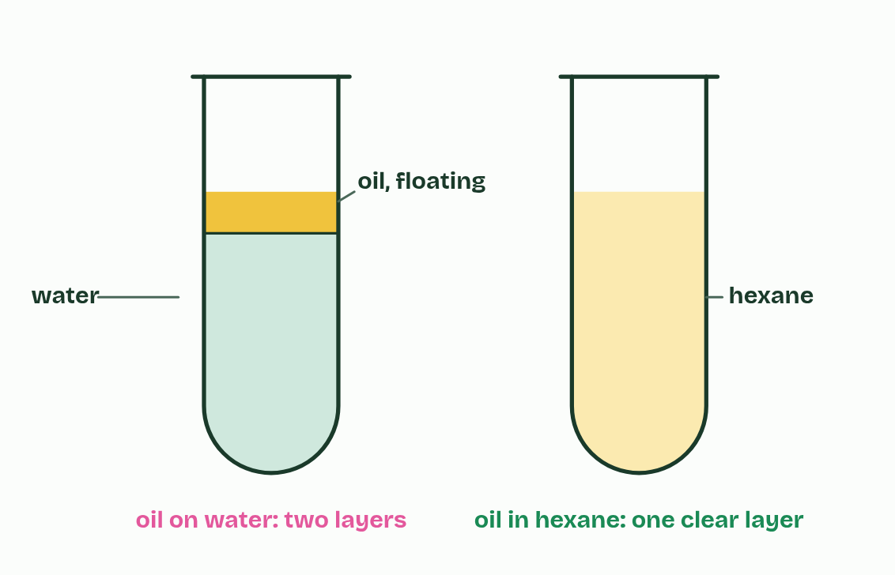
CHAPTER 7 · B1.1.8 B1.1.9 Lipids, triglycerides and phospholipids
3 / 5
Lipids keep their distance from water
In a non-polar solvent such as hexane, it dissolves.
Minutes 8 to 15
Notes:
Minutes 8 to 15 of 60: Oil and solvents (7 min).
The plan: The demo below, then chapter 7’s first figure. Come back to the settled butter.
Lipids are substances made by living things that dissolve in non-polar solvents, such as hexane, but only sparingly in water. They are grouped by this behaviour, not by a shared monomer. Lipids include fats, oils, waxes and steroids.
The reason is in their atoms. Lipids are mostly carbon and hydrogen, and C–H bonds are non-polar, so there are no partial charges for water to attract (A1.1). Water molecules stay bonded to each other and push the lipid out into droplets or a separate layer: lipids are hydrophobic. Wax on a leaf and oil on a feather keep water off for this reason. A wax is a fatty acid joined to a long-chain alcohol, and its long hydrocarbon chains make a waterproof coat, as on a leaf surface or in beeswax.
Fats and oils are mostly triglycerides: one glycerol (three carbons, each with an OH group) joined to three fatty acids. A fatty acid is a hydrocarbon chain with a carboxyl group, COOH, at one end. Each one joins glycerol by condensation: the OH of the carboxyl group and the H of one of glycerol’s OH groups leave as water, and an ester bond forms. Three fatty acids mean three ester bonds and three molecules of water.
A phospholipid is glycerol joined to two fatty acids and one phosphate group, also by condensation. (In most phospholipids a further small polar group is attached to the phosphate, which we leave out.)
A triglyceride is not a polymer: it is three fatty acids on one glycerol, not a chain of repeating units.

Slide 10
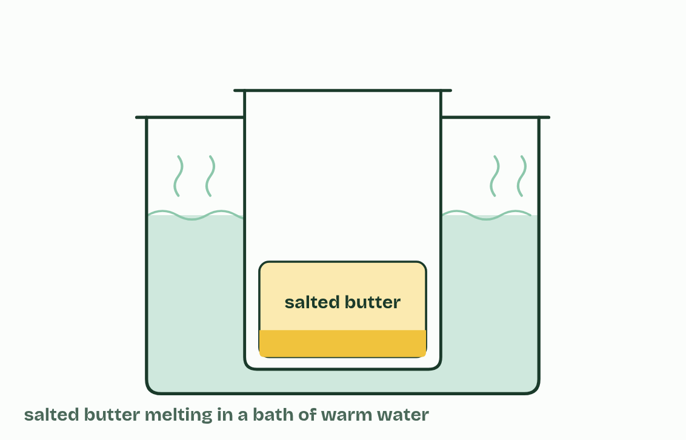
CHAPTER 7 · B1.1.8 B1.1.9 Lipids, triglycerides and phospholipids
4 / 5
Lipids keep their distance from water
Butter is mostly fat, with some water and, in salted butter, salt.
Minutes 8 to 15
Notes:
Minutes 8 to 15 of 60: Oil and solvents (7 min).
The plan: The demo below, then chapter 7’s first figure. Come back to the settled butter.
Lipids are substances made by living things that dissolve in non-polar solvents, such as hexane, but only sparingly in water. They are grouped by this behaviour, not by a shared monomer. Lipids include fats, oils, waxes and steroids.
The reason is in their atoms. Lipids are mostly carbon and hydrogen, and C–H bonds are non-polar, so there are no partial charges for water to attract (A1.1). Water molecules stay bonded to each other and push the lipid out into droplets or a separate layer: lipids are hydrophobic. Wax on a leaf and oil on a feather keep water off for this reason. A wax is a fatty acid joined to a long-chain alcohol, and its long hydrocarbon chains make a waterproof coat, as on a leaf surface or in beeswax.
Fats and oils are mostly triglycerides: one glycerol (three carbons, each with an OH group) joined to three fatty acids. A fatty acid is a hydrocarbon chain with a carboxyl group, COOH, at one end. Each one joins glycerol by condensation: the OH of the carboxyl group and the H of one of glycerol’s OH groups leave as water, and an ester bond forms. Three fatty acids mean three ester bonds and three molecules of water.
A phospholipid is glycerol joined to two fatty acids and one phosphate group, also by condensation. (In most phospholipids a further small polar group is attached to the phosphate, which we leave out.)
A triglyceride is not a polymer: it is three fatty acids on one glycerol, not a chain of repeating units.

Slide 11
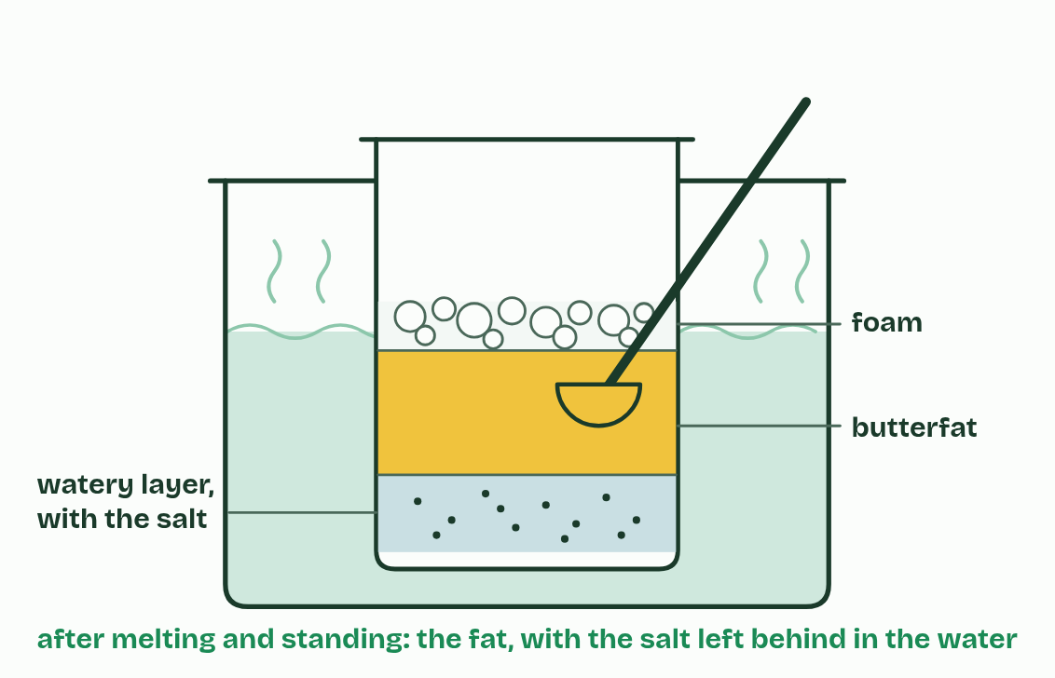
CHAPTER 7 · B1.1.8 B1.1.9 Lipids, triglycerides and phospholipids
5 / 5
Lipids keep their distance from water
Melted, the fat separates from the watery layer, and the salt stays dissolved in the water.
Minutes 8 to 15
Notes:
Minutes 8 to 15 of 60: Oil and solvents (7 min).
The plan: The demo below, then chapter 7’s first figure. Come back to the settled butter.
Lipids are substances made by living things that dissolve in non-polar solvents, such as hexane, but only sparingly in water. They are grouped by this behaviour, not by a shared monomer. Lipids include fats, oils, waxes and steroids.
The reason is in their atoms. Lipids are mostly carbon and hydrogen, and C–H bonds are non-polar, so there are no partial charges for water to attract (A1.1). Water molecules stay bonded to each other and push the lipid out into droplets or a separate layer: lipids are hydrophobic. Wax on a leaf and oil on a feather keep water off for this reason. A wax is a fatty acid joined to a long-chain alcohol, and its long hydrocarbon chains make a waterproof coat, as on a leaf surface or in beeswax.
Fats and oils are mostly triglycerides: one glycerol (three carbons, each with an OH group) joined to three fatty acids. A fatty acid is a hydrocarbon chain with a carboxyl group, COOH, at one end. Each one joins glycerol by condensation: the OH of the carboxyl group and the H of one of glycerol’s OH groups leave as water, and an ester bond forms. Three fatty acids mean three ester bonds and three molecules of water.
A phospholipid is glycerol joined to two fatty acids and one phosphate group, also by condensation. (In most phospholipids a further small polar group is attached to the phosphate, which we leave out.)
A triglyceride is not a polymer: it is three fatty acids on one glycerol, not a chain of repeating units.

Slide 12
CHAPTER 7 · B1.1.8 B1.1.9 Lipids, triglycerides and phospholipids
Lipids keep their distance from water
Lipids are substances made by living things that dissolve in non-polar solvents, such as hexane, but only sparingly in water.
Lipids include fats, oils, waxes and steroids.
Lipids are mostly carbon and hydrogen, and C–H bonds are non-polar, so there are no partial charges for water to attract (A1.1).
Water molecules stay bonded to each other and push the lipid out into droplets or a separate layer: lipids are hydrophobic.
Minutes 8 to 15
Notes:
Minutes 8 to 15 of 60: Oil and solvents (7 min).
The plan: The demo below, then chapter 7’s first figure. Come back to the settled butter.
Lipids are substances made by living things that dissolve in non-polar solvents, such as hexane, but only sparingly in water. They are grouped by this behaviour, not by a shared monomer. Lipids include fats, oils, waxes and steroids.
The reason is in their atoms. Lipids are mostly carbon and hydrogen, and C–H bonds are non-polar, so there are no partial charges for water to attract (A1.1). Water molecules stay bonded to each other and push the lipid out into droplets or a separate layer: lipids are hydrophobic. Wax on a leaf and oil on a feather keep water off for this reason. A wax is a fatty acid joined to a long-chain alcohol, and its long hydrocarbon chains make a waterproof coat, as on a leaf surface or in beeswax.
Fats and oils are mostly triglycerides: one glycerol (three carbons, each with an OH group) joined to three fatty acids. A fatty acid is a hydrocarbon chain with a carboxyl group, COOH, at one end. Each one joins glycerol by condensation: the OH of the carboxyl group and the H of one of glycerol’s OH groups leave as water, and an ester bond forms. Three fatty acids mean three ester bonds and three molecules of water.
A phospholipid is glycerol joined to two fatty acids and one phosphate group, also by condensation. (In most phospholipids a further small polar group is attached to the phosphate, which we leave out.)
A triglyceride is not a polymer: it is three fatty acids on one glycerol, not a chain of repeating units.

Slide 13
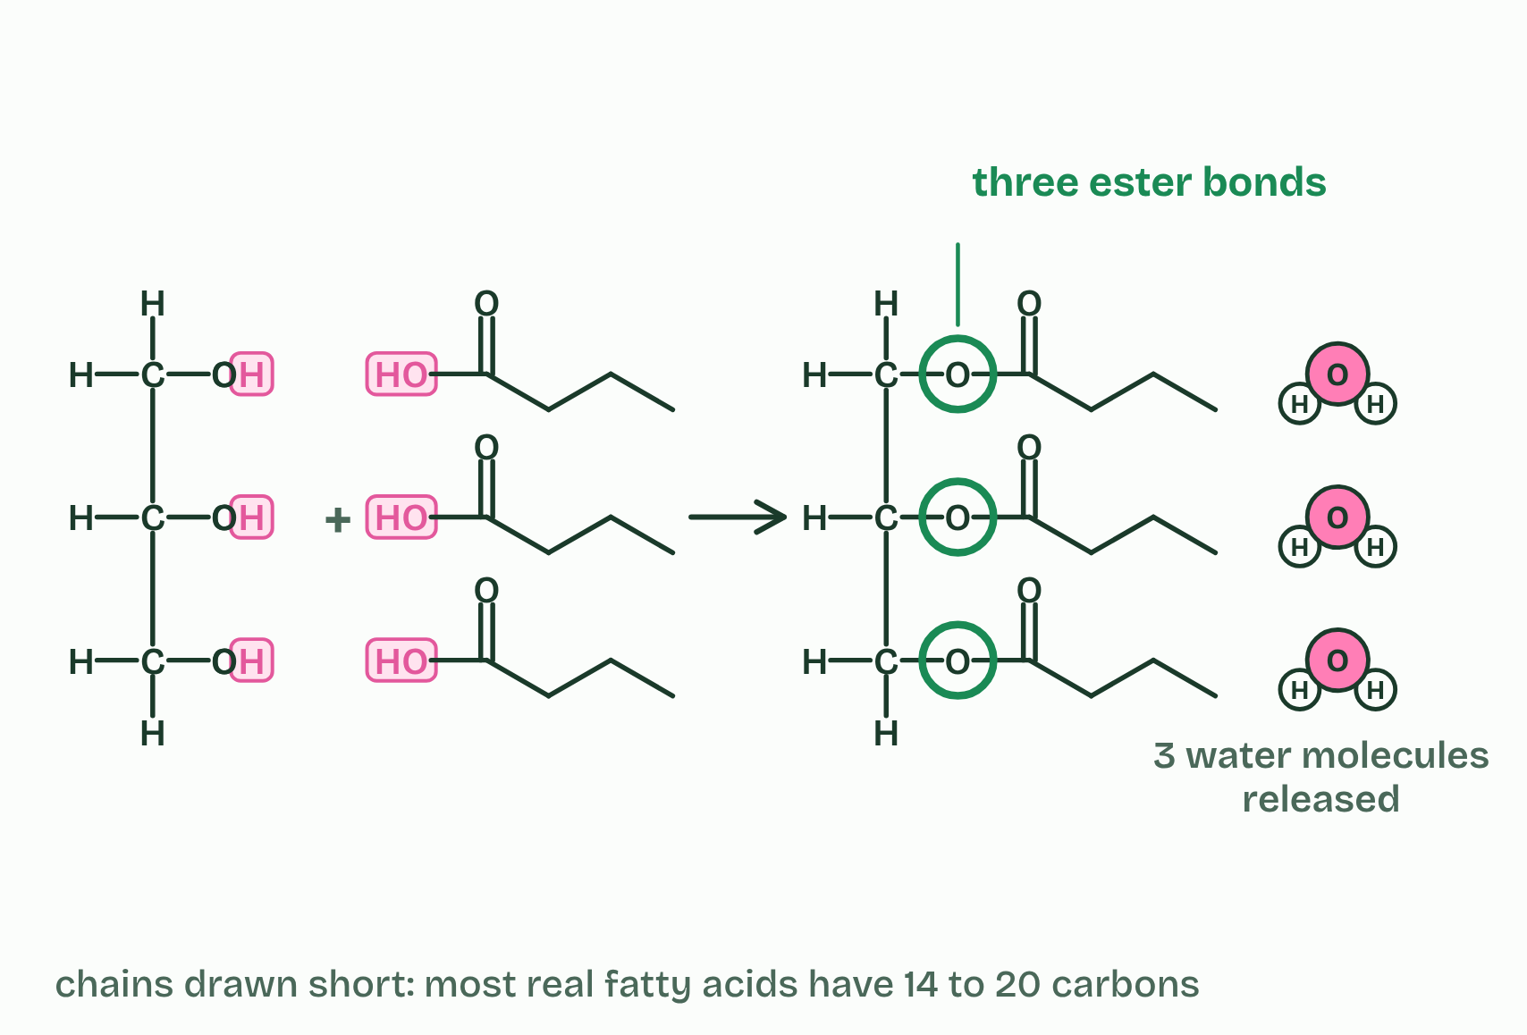
CHAPTER 7 · B1.1.8 B1.1.9 Lipids, triglycerides and phospholipids
1 / 2
Lipids keep their distance from water
Triglyceride
Minutes 8 to 15
Notes:
Minutes 8 to 15 of 60: Oil and solvents (7 min).
The plan: The demo below, then chapter 7’s first figure. Come back to the settled butter.
Lipids are substances made by living things that dissolve in non-polar solvents, such as hexane, but only sparingly in water. They are grouped by this behaviour, not by a shared monomer. Lipids include fats, oils, waxes and steroids.
The reason is in their atoms. Lipids are mostly carbon and hydrogen, and C–H bonds are non-polar, so there are no partial charges for water to attract (A1.1). Water molecules stay bonded to each other and push the lipid out into droplets or a separate layer: lipids are hydrophobic. Wax on a leaf and oil on a feather keep water off for this reason. A wax is a fatty acid joined to a long-chain alcohol, and its long hydrocarbon chains make a waterproof coat, as on a leaf surface or in beeswax.
Fats and oils are mostly triglycerides: one glycerol (three carbons, each with an OH group) joined to three fatty acids. A fatty acid is a hydrocarbon chain with a carboxyl group, COOH, at one end. Each one joins glycerol by condensation: the OH of the carboxyl group and the H of one of glycerol’s OH groups leave as water, and an ester bond forms. Three fatty acids mean three ester bonds and three molecules of water.
A phospholipid is glycerol joined to two fatty acids and one phosphate group, also by condensation. (In most phospholipids a further small polar group is attached to the phosphate, which we leave out.)
A triglyceride is not a polymer: it is three fatty acids on one glycerol, not a chain of repeating units.

Slide 14
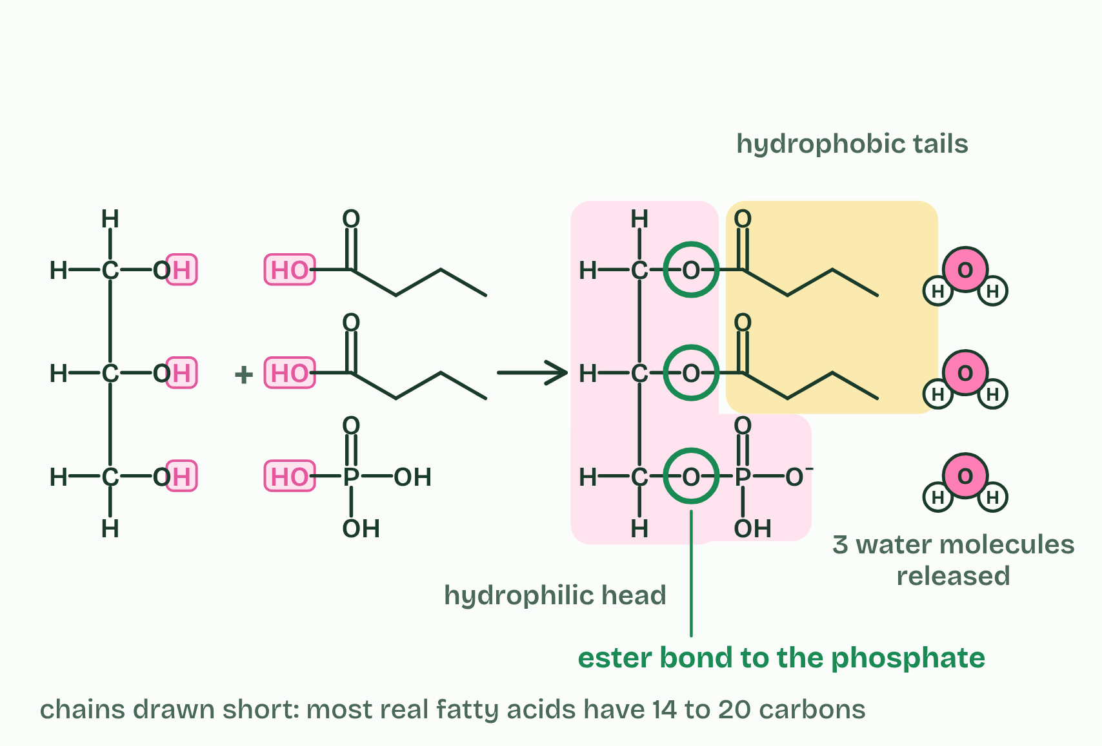
CHAPTER 7 · B1.1.8 B1.1.9 Lipids, triglycerides and phospholipids
2 / 2
Lipids keep their distance from water
Phospholipid
Minutes 8 to 15
Notes:
Minutes 8 to 15 of 60: Oil and solvents (7 min).
The plan: The demo below, then chapter 7’s first figure. Come back to the settled butter.
Lipids are substances made by living things that dissolve in non-polar solvents, such as hexane, but only sparingly in water. They are grouped by this behaviour, not by a shared monomer. Lipids include fats, oils, waxes and steroids.
The reason is in their atoms. Lipids are mostly carbon and hydrogen, and C–H bonds are non-polar, so there are no partial charges for water to attract (A1.1). Water molecules stay bonded to each other and push the lipid out into droplets or a separate layer: lipids are hydrophobic. Wax on a leaf and oil on a feather keep water off for this reason. A wax is a fatty acid joined to a long-chain alcohol, and its long hydrocarbon chains make a waterproof coat, as on a leaf surface or in beeswax.
Fats and oils are mostly triglycerides: one glycerol (three carbons, each with an OH group) joined to three fatty acids. A fatty acid is a hydrocarbon chain with a carboxyl group, COOH, at one end. Each one joins glycerol by condensation: the OH of the carboxyl group and the H of one of glycerol’s OH groups leave as water, and an ester bond forms. Three fatty acids mean three ester bonds and three molecules of water.
A phospholipid is glycerol joined to two fatty acids and one phosphate group, also by condensation. (In most phospholipids a further small polar group is attached to the phosphate, which we leave out.)
A triglyceride is not a polymer: it is three fatty acids on one glycerol, not a chain of repeating units.

Slide 15
CHAPTER 7 · B1.1.8 B1.1.9 Lipids, triglycerides and phospholipids
Lipids keep their distance from water
Lipids are substances made by living things that dissolve in non-polar solvents, such as hexane, but only sparingly in water.
Lipids include fats, oils, waxes and steroids.
Lipids are mostly carbon and hydrogen, and C–H bonds are non-polar, so there are no partial charges for water to attract (A1.1).
Water molecules stay bonded to each other and push the lipid out into droplets or a separate layer: lipids are hydrophobic.
Minutes 8 to 15
Notes:
Minutes 8 to 15 of 60: Oil and solvents (7 min).
The plan: The demo below, then chapter 7’s first figure. Come back to the settled butter.
Lipids are substances made by living things that dissolve in non-polar solvents, such as hexane, but only sparingly in water. They are grouped by this behaviour, not by a shared monomer. Lipids include fats, oils, waxes and steroids.
The reason is in their atoms. Lipids are mostly carbon and hydrogen, and C–H bonds are non-polar, so there are no partial charges for water to attract (A1.1). Water molecules stay bonded to each other and push the lipid out into droplets or a separate layer: lipids are hydrophobic. Wax on a leaf and oil on a feather keep water off for this reason. A wax is a fatty acid joined to a long-chain alcohol, and its long hydrocarbon chains make a waterproof coat, as on a leaf surface or in beeswax.
Fats and oils are mostly triglycerides: one glycerol (three carbons, each with an OH group) joined to three fatty acids. A fatty acid is a hydrocarbon chain with a carboxyl group, COOH, at one end. Each one joins glycerol by condensation: the OH of the carboxyl group and the H of one of glycerol’s OH groups leave as water, and an ester bond forms. Three fatty acids mean three ester bonds and three molecules of water.
A phospholipid is glycerol joined to two fatty acids and one phosphate group, also by condensation. (In most phospholipids a further small polar group is attached to the phosphate, which we leave out.)
A triglyceride is not a polymer: it is three fatty acids on one glycerol, not a chain of repeating units.

Slide 16
WATCH OUT
A fat is not a chain of “fat molecules”, and it is not a polymer: it is one glycerol carrying three fatty acids.
Minutes 8 to 15
Notes:
Minutes 8 to 15 of 60: Oil and solvents (7 min).
The plan: The demo below, then chapter 7’s first figure. Come back to the settled butter.
A common mistake: say it, then ask who can say why it is wrong.

Slide 17
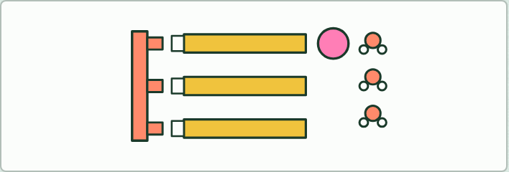
MODEL
10 MIN
Make a fat, make a phospholipid
THE TASK
Paper pieces: a glycerol strip with three OH tabs, three fatty acid strips with COOH ends, one pink phosphate circle and small water cut-outs. Students cut off an H and an OH for each join and stick them together as water. They count three for a triglyceride and three for a phospholipid. The biomolecules lab has the same task on screen.
STUDENTS NEED
Printed pieces, scissors, glue.
Minutes 15 to 25
Notes:
Minutes 15 to 25 of 60: Make a fat, make a phospholipid (10 min).
The plan: The paper model below. Count the waters: three for a triglyceride and three for a phospholipid. The lipid bond builder on the board.
The activity: Make a fat, make a phospholipid. Paper pieces: a glycerol strip with three OH tabs, three fatty acid strips with COOH ends, one pink phosphate circle and small water cut-outs. Students cut off an H and an OH for each join and stick them together as water. They count three for a triglyceride and three for a phospholipid. The biomolecules lab has the same task on screen.
Needs: printed pieces, scissors, glue.
The time: 10 minutes, minutes 15 to 25 of the plan.

Slide 18
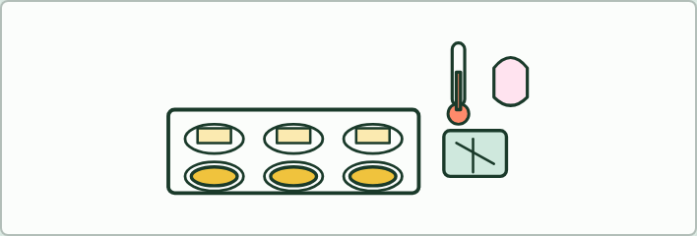
PRACTICAL
15 MIN
Fats from the fridge
THE TASK
Small samples of butter, lard, coconut oil, olive oil, sunflower oil and a margarine, straight from the fridge, in labelled dishes. Warm each in a gloved hand, or float the dishes on a tray of warm water, and record the order in which they soften and melt. Then read each label and rank the fats by their saturated, monounsaturated and polyunsaturated content. Does the order fit? Which one does not (coconut oil), and why (chapter 8, the dry lab)? Safety: no nut oils (allergy: use rapeseed instead), no tasting, wash hands. Margarine is a blend of plant oils made spreadable by processing: use its label.
STUDENTS NEED
The fats, small dishes, gloves, a tray of warm water, a thermometer, labels or photos of labels.
Minutes 25 to 40
Notes:
Minutes 25 to 40 of 60: Fats from the fridge (15 min).
The plan: The practical below. Then turn over the Double Kinks Leave Liquids tiles and set the chapter 8 predict box.
The activity: Fats from the fridge. Small samples of butter, lard, coconut oil, olive oil, sunflower oil and a margarine, straight from the fridge, in labelled dishes. Warm each in a gloved hand, or float the dishes on a tray of warm water, and record the order in which they soften and melt. Then read each label and rank the fats by their saturated, monounsaturated and polyunsaturated content. Does the order fit? Which one does not (coconut oil), and why (chapter 8, the dry lab)? Safety: no nut oils (allergy: use rapeseed instead), no tasting, wash hands. Margarine is a blend of plant oils made spreadable by processing: use its label.
Needs: the fats, small dishes, gloves, a tray of warm water, a thermometer, labels or photos of labels.
The time: 15 minutes, minutes 25 to 40 of the plan.

Slide 19
REMEMBER IT
Why unsaturated fats are oils
D
K
L
L
Double
Kinks
Leave
Liquids
Minutes 25 to 40
Notes:
Minutes 25 to 40 of 60: Fats from the fridge (15 min).
The plan: The practical below. Then turn over the Double Kinks Leave Liquids tiles and set the chapter 8 predict box.
Ask the class what each letter stands for before revealing.

Slide 20
REMEMBER IT
Why unsaturated fats are oils
D
K
L
L
Double
Kinks
Leave
Liquids
C=C double bond
Kinked chain
Loose packing
Lower melting point
one in a monounsaturated chain, two or more in a polyunsaturated one
each cis double bond bends the chain
bent chains cannot lie close, so they attract each other less
less heat separates them: an oil at room temperature
Minutes 25 to 40
Notes:
Minutes 25 to 40 of 60: Fats from the fridge (15 min).
The plan: The practical below. Then turn over the Double Kinks Leave Liquids tiles and set the chapter 8 predict box.
Double: C=C double bond (one in a monounsaturated chain, two or more in a polyunsaturated one)
Kinks: Kinked chain (each cis double bond bends the chain)
Leave: Loose packing (bent chains cannot lie close, so they attract each other less)
Liquids: Lower melting point (less heat separates them: an oil at room temperature)

Slide 21
PREDICT
Olive oil’s fatty acids are mostly monounsaturated, and ordinary sunflower oil’s are mostly polyunsaturated. Both are liquid at room temperature. You put a bottle of each in the fridge at 5 °C. Which turns cloudy and thick?
A Sunflower oil: its chains have more double bonds, so it freezes first
B Olive oil: fewer double bonds per chain, so a higher melting point
C Neither: oils are liquid fats and never go solid, however cold
Minutes 25 to 40
Notes:
Minutes 25 to 40 of 60: Fats from the fridge (15 min).
The plan: The practical below. Then turn over the Double Kinks Leave Liquids tiles and set the chapter 8 predict box.
Ask for a show of hands, or mini whiteboards, before revealing. (Answer: B, on the next slide.)

Slide 22
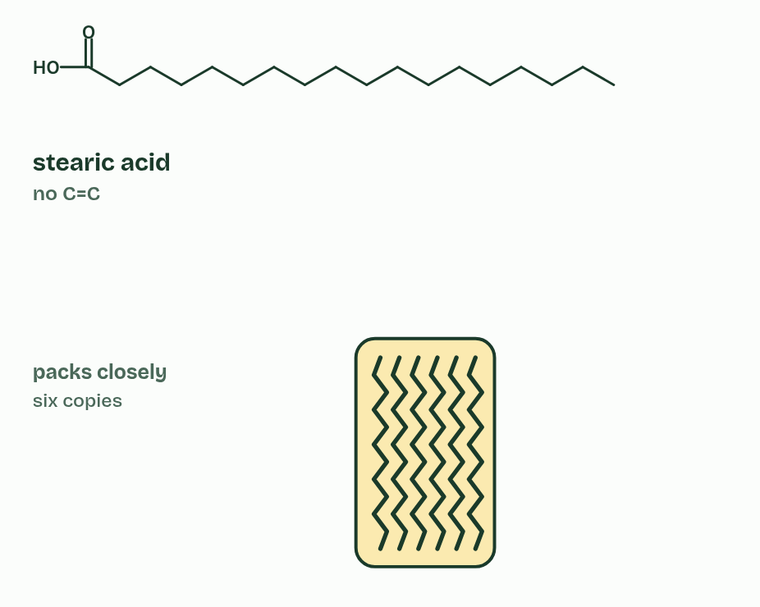
CHAPTER 8 · B1.1.10 Saturated and unsaturated fatty acids
1 / 3
Every double bond puts a kink in the tail
Saturated
Minutes 25 to 40
Notes:
Minutes 25 to 40 of 60: Fats from the fridge (15 min).
The plan: The practical below. Then turn over the Double Kinks Leave Liquids tiles and set the chapter 8 predict box.
The hydrocarbon tail of a fatty acid may or may not contain C=C double bonds. A saturated fatty acid has none: each carbon holds as many hydrogen atoms as it can, so the chain is saturated with hydrogen. An unsaturated fatty acid has at least one C=C. With one it is monounsaturated, and with two or more it is polyunsaturated.
In natural fatty acids the double bonds are almost all cis: the chain continues on the same side at both ends of the double bond, so it bends there, by about 30°. Every double bond puts one more kink in the tail. (A trans double bond, made when oils are partially hydrogenated, leaves the chain almost straight, so trans fats pack and melt much like saturated ones.)
Kinks decide the melting point. Straight saturated chains pack closely side by side, so the attractions between neighbouring molecules are strong and more heat is needed to pull them apart: a higher melting point, and a fat that is solid at room temperature. Kinked chains cannot pack closely, the attractions are weaker and the melting point is lower: an oil, liquid at room temperature. The more double bonds, the lower the melting point. Melting only separates whole molecules from each other. No covalent bond breaks.
The guidance asks about plants and endotherms. A plant is the temperature of its surroundings, and its seeds may sit in cold soil, so plants store oils rich in unsaturated fatty acids. These stay liquid when cold, so the store can still be used. An endotherm keeps its body warm, about 37 °C in a mammal, so its fat can hold a far larger share of saturated fatty acids: often a third to a half, against about a tenth in plant oils. Solid at room temperature, it is still soft at body temperature.
The rule is really about temperature. Tropical plants such as coconut and cocoa store more saturated fat, which is liquid in the tropics, and fish in cold seas, which are not endotherms, store very unsaturated oils.

Slide 23
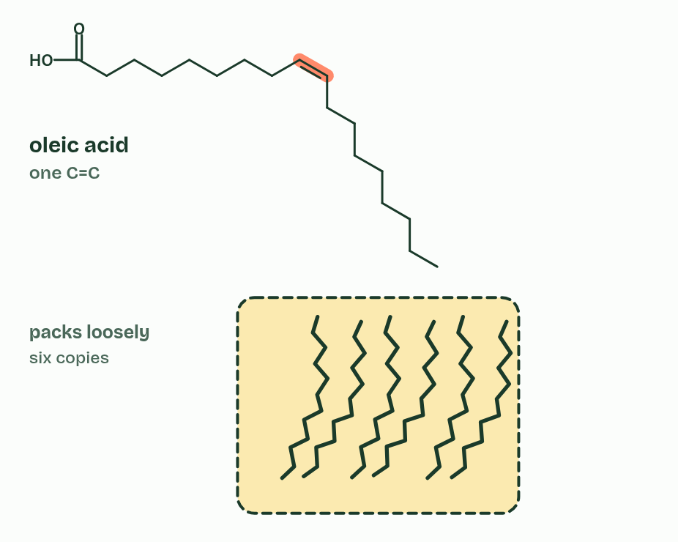
CHAPTER 8 · B1.1.10 Saturated and unsaturated fatty acids
2 / 3
Every double bond puts a kink in the tail
Monounsaturated
Minutes 25 to 40
Notes:
Minutes 25 to 40 of 60: Fats from the fridge (15 min).
The plan: The practical below. Then turn over the Double Kinks Leave Liquids tiles and set the chapter 8 predict box.
The hydrocarbon tail of a fatty acid may or may not contain C=C double bonds. A saturated fatty acid has none: each carbon holds as many hydrogen atoms as it can, so the chain is saturated with hydrogen. An unsaturated fatty acid has at least one C=C. With one it is monounsaturated, and with two or more it is polyunsaturated.
In natural fatty acids the double bonds are almost all cis: the chain continues on the same side at both ends of the double bond, so it bends there, by about 30°. Every double bond puts one more kink in the tail. (A trans double bond, made when oils are partially hydrogenated, leaves the chain almost straight, so trans fats pack and melt much like saturated ones.)
Kinks decide the melting point. Straight saturated chains pack closely side by side, so the attractions between neighbouring molecules are strong and more heat is needed to pull them apart: a higher melting point, and a fat that is solid at room temperature. Kinked chains cannot pack closely, the attractions are weaker and the melting point is lower: an oil, liquid at room temperature. The more double bonds, the lower the melting point. Melting only separates whole molecules from each other. No covalent bond breaks.
The guidance asks about plants and endotherms. A plant is the temperature of its surroundings, and its seeds may sit in cold soil, so plants store oils rich in unsaturated fatty acids. These stay liquid when cold, so the store can still be used. An endotherm keeps its body warm, about 37 °C in a mammal, so its fat can hold a far larger share of saturated fatty acids: often a third to a half, against about a tenth in plant oils. Solid at room temperature, it is still soft at body temperature.
The rule is really about temperature. Tropical plants such as coconut and cocoa store more saturated fat, which is liquid in the tropics, and fish in cold seas, which are not endotherms, store very unsaturated oils.

Slide 24
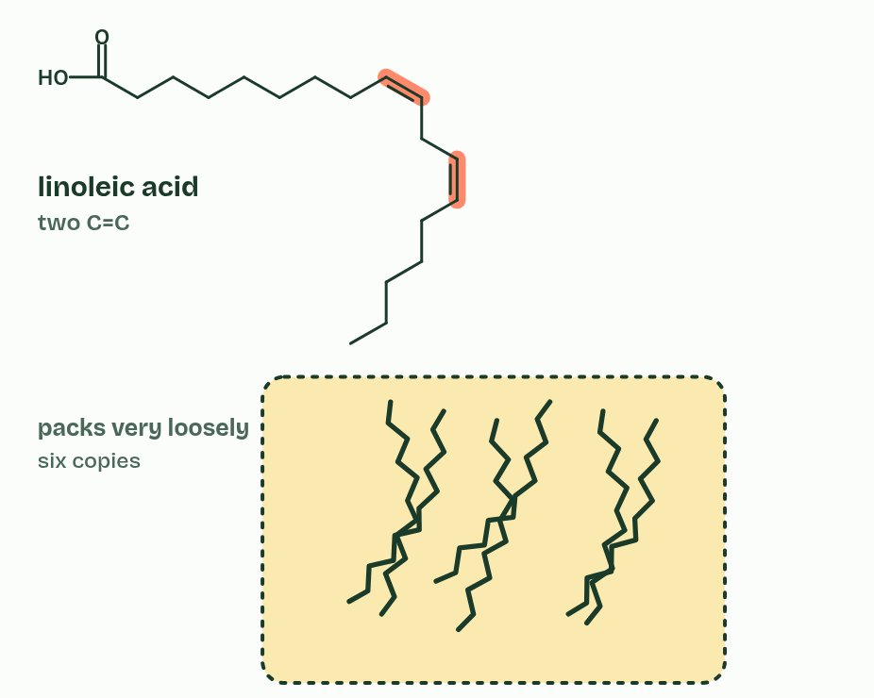
CHAPTER 8 · B1.1.10 Saturated and unsaturated fatty acids
3 / 3
Every double bond puts a kink in the tail
Polyunsaturated
Minutes 25 to 40
Notes:
Minutes 25 to 40 of 60: Fats from the fridge (15 min).
The plan: The practical below. Then turn over the Double Kinks Leave Liquids tiles and set the chapter 8 predict box.
The hydrocarbon tail of a fatty acid may or may not contain C=C double bonds. A saturated fatty acid has none: each carbon holds as many hydrogen atoms as it can, so the chain is saturated with hydrogen. An unsaturated fatty acid has at least one C=C. With one it is monounsaturated, and with two or more it is polyunsaturated.
In natural fatty acids the double bonds are almost all cis: the chain continues on the same side at both ends of the double bond, so it bends there, by about 30°. Every double bond puts one more kink in the tail. (A trans double bond, made when oils are partially hydrogenated, leaves the chain almost straight, so trans fats pack and melt much like saturated ones.)
Kinks decide the melting point. Straight saturated chains pack closely side by side, so the attractions between neighbouring molecules are strong and more heat is needed to pull them apart: a higher melting point, and a fat that is solid at room temperature. Kinked chains cannot pack closely, the attractions are weaker and the melting point is lower: an oil, liquid at room temperature. The more double bonds, the lower the melting point. Melting only separates whole molecules from each other. No covalent bond breaks.
The guidance asks about plants and endotherms. A plant is the temperature of its surroundings, and its seeds may sit in cold soil, so plants store oils rich in unsaturated fatty acids. These stay liquid when cold, so the store can still be used. An endotherm keeps its body warm, about 37 °C in a mammal, so its fat can hold a far larger share of saturated fatty acids: often a third to a half, against about a tenth in plant oils. Solid at room temperature, it is still soft at body temperature.
The rule is really about temperature. Tropical plants such as coconut and cocoa store more saturated fat, which is liquid in the tropics, and fish in cold seas, which are not endotherms, store very unsaturated oils.

Slide 25
CHAPTER 8 · B1.1.10 Saturated and unsaturated fatty acids
Every double bond puts a kink in the tail
A saturated fatty acid has none: each carbon holds as many hydrogen atoms as it can, so the chain is saturated with hydrogen.
An unsaturated fatty acid has at least one C=C.
With one it is monounsaturated, and with two or more it is polyunsaturated.
In natural fatty acids the double bonds are almost all cis: the chain continues on the same side at both ends of the double bond, so it bends there, by about 30°.
Minutes 25 to 40
Notes:
Minutes 25 to 40 of 60: Fats from the fridge (15 min).
The plan: The practical below. Then turn over the Double Kinks Leave Liquids tiles and set the chapter 8 predict box.
The hydrocarbon tail of a fatty acid may or may not contain C=C double bonds. A saturated fatty acid has none: each carbon holds as many hydrogen atoms as it can, so the chain is saturated with hydrogen. An unsaturated fatty acid has at least one C=C. With one it is monounsaturated, and with two or more it is polyunsaturated.
In natural fatty acids the double bonds are almost all cis: the chain continues on the same side at both ends of the double bond, so it bends there, by about 30°. Every double bond puts one more kink in the tail. (A trans double bond, made when oils are partially hydrogenated, leaves the chain almost straight, so trans fats pack and melt much like saturated ones.)
Kinks decide the melting point. Straight saturated chains pack closely side by side, so the attractions between neighbouring molecules are strong and more heat is needed to pull them apart: a higher melting point, and a fat that is solid at room temperature. Kinked chains cannot pack closely, the attractions are weaker and the melting point is lower: an oil, liquid at room temperature. The more double bonds, the lower the melting point. Melting only separates whole molecules from each other. No covalent bond breaks.
The guidance asks about plants and endotherms. A plant is the temperature of its surroundings, and its seeds may sit in cold soil, so plants store oils rich in unsaturated fatty acids. These stay liquid when cold, so the store can still be used. An endotherm keeps its body warm, about 37 °C in a mammal, so its fat can hold a far larger share of saturated fatty acids: often a third to a half, against about a tenth in plant oils. Solid at room temperature, it is still soft at body temperature.
The rule is really about temperature. Tropical plants such as coconut and cocoa store more saturated fat, which is liquid in the tropics, and fish in cold seas, which are not endotherms, store very unsaturated oils.

Slide 26
WHAT HAPPENS
Olive oil’s fatty acids are mostly monounsaturated, and ordinary sunflower oil’s are mostly polyunsaturated. Both are liquid at room temperature. You put a bottle of each in the fridge at 5 °C. Which turns cloudy and thick?
A Sunflower oil: its chains have more double bonds, so it freezes first
B Olive oil: fewer double bonds per chain, so a higher melting point
C Neither: oils are liquid fats and never go solid, however cold
Olive oil. With mostly one double bond per chain, its chains pack better than sunflower oil’s, so it starts to solidify at fridge temperatures while sunflower oil stays clear. More double bonds, lower melting point. The dry lab lets you measure it.
Minutes 25 to 40
Notes:
Minutes 25 to 40 of 60: Fats from the fridge (15 min).
The plan: The practical below. Then turn over the Double Kinks Leave Liquids tiles and set the chapter 8 predict box.
Answer: B. Olive oil. With mostly one double bond per chain, its chains pack better than sunflower oil’s, so it starts to solidify at fridge temperatures while sunflower oil stays clear. More double bonds, lower melting point. The dry lab lets you measure it.

Slide 27
WATCH OUT
Melting does not break double bonds or any other covalent bond: it separates whole molecules.
Minutes 25 to 40
Notes:
Minutes 25 to 40 of 60: Fats from the fridge (15 min).
The plan: The practical below. Then turn over the Double Kinks Leave Liquids tiles and set the chapter 8 predict box.
A common mistake: say it, then ask who can say why it is wrong.

Slide 28
STEP 5
10 MIN
Store and insulate
Think, pair, share on the guiding question “How do carbohydrates and lipids compare as energy stores?”, building chapter 9’s table on the board.
Minutes 40 to 50
Notes:
Minutes 40 to 50 of 60: Store and insulate (10 min).
The plan: Chapter 9’s figures. Think, pair, share on the guiding question “How do carbohydrates and lipids compare as energy stores?”, building chapter 9’s table on the board. Then the chapter 9 predict box.

Slide 29
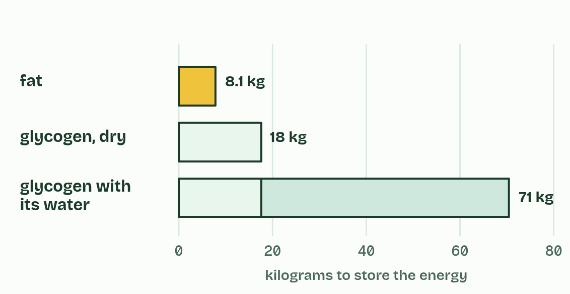
CHAPTER 9 · B1.1.11 Adipose tissue
Fat: the lightest way to carry energy
Energy dense. Fat releases about twice the energy of carbohydrate for the same mass: about 37 kJ a gram, against about 17 kJ.
Stored without water. Triglycerides are hydrophobic, so fat is stored dry. Glycogen is stored with about three times its own mass of water, so the same energy in fat weighs several times less. That matters to anything that moves, flies or migrates.
Insoluble. Even a large store has no osmotic effect on the cell.
Chemically stable. Fat keeps for months.
Minutes 40 to 50
Notes:
Minutes 40 to 50 of 60: Store and insulate (10 min).
The plan: Chapter 9’s figures. Think, pair, share on the guiding question “How do carbohydrates and lipids compare as energy stores?”, building chapter 9’s table on the board. Then the chapter 9 predict box.
Adipose tissue is made of cells that each hold a large droplet of triglyceride, under the skin and round organs. Four properties suit triglycerides to long-term energy storage.
Why keep glycogen at all? Glucose can be released from glycogen quickly, carried in the blood and respired with or without oxygen. Fat is mobilised more slowly, and fatty acids are respired only with oxygen. Glycogen suits quick, short-term needs, and fat the long term.
Triglycerides also give thermal insulation. Fat conducts heat only about half as well as muscle. An endotherm loses heat to colder surroundings faster the bigger the difference, and far faster in water than in air (A1.1, the ringed seal). So endotherms in cold habitats, above all in polar seas, have thick layers of fat called blubber, and tropical mammals have thin ones. An ectotherm makes too little heat for insulation to be worth much.
Example: Why more energy a gram? A fatty acid chain is almost all C–H bonds, with very little oxygen, so there is more to oxidise. Glucose already carries an oxygen on almost every carbon: it is partly oxidised before respiration starts (C1.2).

Slide 30
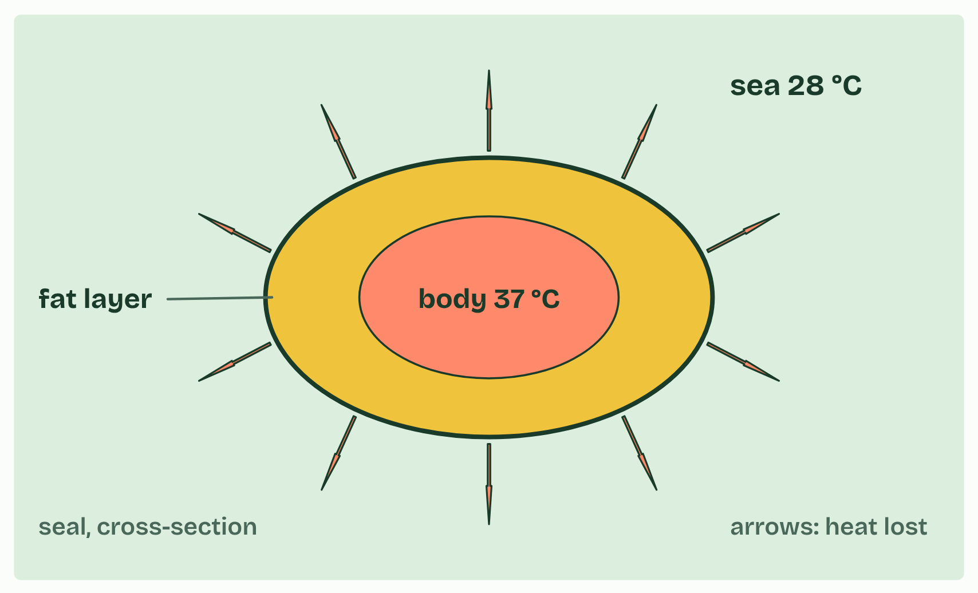
CHAPTER 9 · B1.1.11 Adipose tissue
1 / 3
Fat: the lightest way to carry energy
Tropical sea 28 °C
Minutes 40 to 50
Notes:
Minutes 40 to 50 of 60: Store and insulate (10 min).
The plan: Chapter 9’s figures. Think, pair, share on the guiding question “How do carbohydrates and lipids compare as energy stores?”, building chapter 9’s table on the board. Then the chapter 9 predict box.
Adipose tissue is made of cells that each hold a large droplet of triglyceride, under the skin and round organs. Four properties suit triglycerides to long-term energy storage.
Why keep glycogen at all? Glucose can be released from glycogen quickly, carried in the blood and respired with or without oxygen. Fat is mobilised more slowly, and fatty acids are respired only with oxygen. Glycogen suits quick, short-term needs, and fat the long term.
Triglycerides also give thermal insulation. Fat conducts heat only about half as well as muscle. An endotherm loses heat to colder surroundings faster the bigger the difference, and far faster in water than in air (A1.1, the ringed seal). So endotherms in cold habitats, above all in polar seas, have thick layers of fat called blubber, and tropical mammals have thin ones. An ectotherm makes too little heat for insulation to be worth much.
Example: Why more energy a gram? A fatty acid chain is almost all C–H bonds, with very little oxygen, so there is more to oxidise. Glucose already carries an oxygen on almost every carbon: it is partly oxidised before respiration starts (C1.2).

Slide 31
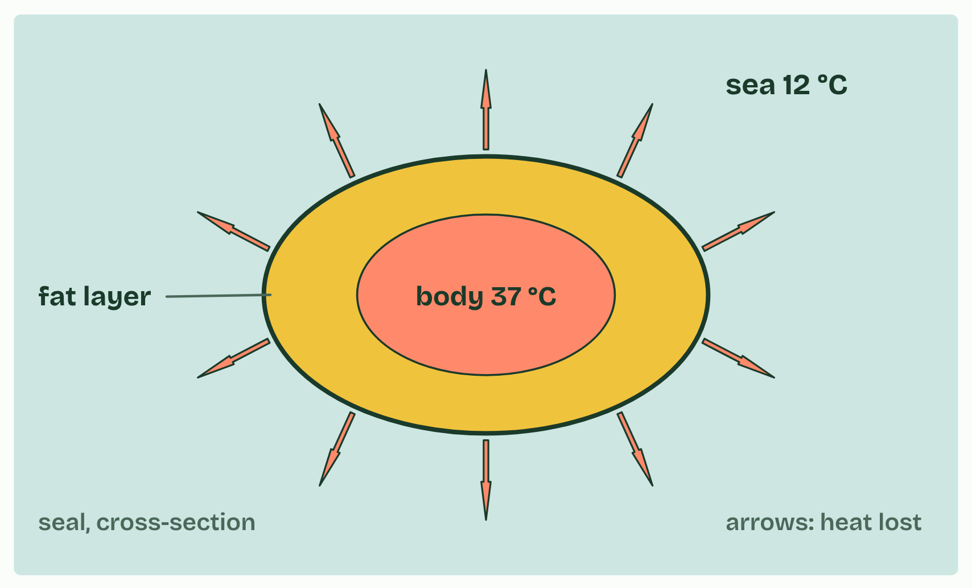
CHAPTER 9 · B1.1.11 Adipose tissue
2 / 3
Fat: the lightest way to carry energy
Temperate sea 12 °C
Minutes 40 to 50
Notes:
Minutes 40 to 50 of 60: Store and insulate (10 min).
The plan: Chapter 9’s figures. Think, pair, share on the guiding question “How do carbohydrates and lipids compare as energy stores?”, building chapter 9’s table on the board. Then the chapter 9 predict box.
Adipose tissue is made of cells that each hold a large droplet of triglyceride, under the skin and round organs. Four properties suit triglycerides to long-term energy storage.
Why keep glycogen at all? Glucose can be released from glycogen quickly, carried in the blood and respired with or without oxygen. Fat is mobilised more slowly, and fatty acids are respired only with oxygen. Glycogen suits quick, short-term needs, and fat the long term.
Triglycerides also give thermal insulation. Fat conducts heat only about half as well as muscle. An endotherm loses heat to colder surroundings faster the bigger the difference, and far faster in water than in air (A1.1, the ringed seal). So endotherms in cold habitats, above all in polar seas, have thick layers of fat called blubber, and tropical mammals have thin ones. An ectotherm makes too little heat for insulation to be worth much.
Example: Why more energy a gram? A fatty acid chain is almost all C–H bonds, with very little oxygen, so there is more to oxidise. Glucose already carries an oxygen on almost every carbon: it is partly oxidised before respiration starts (C1.2).

Slide 32
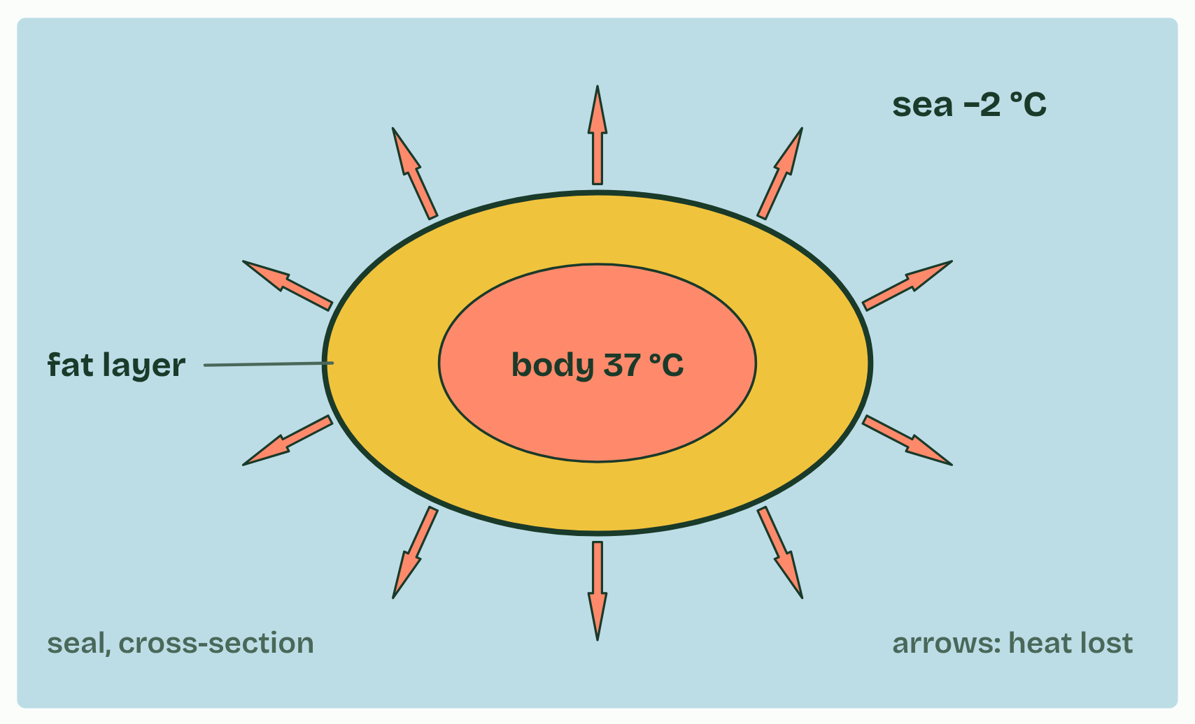
CHAPTER 9 · B1.1.11 Adipose tissue
3 / 3
Fat: the lightest way to carry energy
Polar sea −2 °C
Minutes 40 to 50
Notes:
Minutes 40 to 50 of 60: Store and insulate (10 min).
The plan: Chapter 9’s figures. Think, pair, share on the guiding question “How do carbohydrates and lipids compare as energy stores?”, building chapter 9’s table on the board. Then the chapter 9 predict box.
Adipose tissue is made of cells that each hold a large droplet of triglyceride, under the skin and round organs. Four properties suit triglycerides to long-term energy storage.
Why keep glycogen at all? Glucose can be released from glycogen quickly, carried in the blood and respired with or without oxygen. Fat is mobilised more slowly, and fatty acids are respired only with oxygen. Glycogen suits quick, short-term needs, and fat the long term.
Triglycerides also give thermal insulation. Fat conducts heat only about half as well as muscle. An endotherm loses heat to colder surroundings faster the bigger the difference, and far faster in water than in air (A1.1, the ringed seal). So endotherms in cold habitats, above all in polar seas, have thick layers of fat called blubber, and tropical mammals have thin ones. An ectotherm makes too little heat for insulation to be worth much.
Example: Why more energy a gram? A fatty acid chain is almost all C–H bonds, with very little oxygen, so there is more to oxidise. Glucose already carries an oxygen on almost every carbon: it is partly oxidised before respiration starts (C1.2).

Slide 33
CHAPTER 9 · B1.1.11 Adipose tissue
Fat: the lightest way to carry energy
Energy dense. Fat releases about twice the energy of carbohydrate for the same mass: about 37 kJ a gram, against about 17 kJ.
Stored without water. Triglycerides are hydrophobic, so fat is stored dry. Glycogen is stored with about three times its own mass of water, so the same energy in fat weighs several times less. That matters to anything that moves, flies or migrates.
Insoluble. Even a large store has no osmotic effect on the cell.
Chemically stable. Fat keeps for months.
Minutes 40 to 50
Notes:
Minutes 40 to 50 of 60: Store and insulate (10 min).
The plan: Chapter 9’s figures. Think, pair, share on the guiding question “How do carbohydrates and lipids compare as energy stores?”, building chapter 9’s table on the board. Then the chapter 9 predict box.
Adipose tissue is made of cells that each hold a large droplet of triglyceride, under the skin and round organs. Four properties suit triglycerides to long-term energy storage.
Why keep glycogen at all? Glucose can be released from glycogen quickly, carried in the blood and respired with or without oxygen. Fat is mobilised more slowly, and fatty acids are respired only with oxygen. Glycogen suits quick, short-term needs, and fat the long term.
Triglycerides also give thermal insulation. Fat conducts heat only about half as well as muscle. An endotherm loses heat to colder surroundings faster the bigger the difference, and far faster in water than in air (A1.1, the ringed seal). So endotherms in cold habitats, above all in polar seas, have thick layers of fat called blubber, and tropical mammals have thin ones. An ectotherm makes too little heat for insulation to be worth much.
Example: Why more energy a gram? A fatty acid chain is almost all C–H bonds, with very little oxygen, so there is more to oxidise. Glucose already carries an oxygen on almost every carbon: it is partly oxidised before respiration starts (C1.2).

Slide 34
WATCH OUT
Not every carbohydrate store is short-term. Plants keep starch for months in seeds and tubers: “short-term” describes glycogen in animals.
Minutes 40 to 50
Notes:
Minutes 40 to 50 of 60: Store and insulate (10 min).
The plan: Chapter 9’s figures. Think, pair, share on the guiding question “How do carbohydrates and lipids compare as energy stores?”, building chapter 9’s table on the board. Then the chapter 9 predict box.
A common mistake: say it, then ask who can say why it is wrong.

Slide 35
PREDICT
A seal and a cod swim in the same polar sea. Which needs a thick layer of fat to insulate it?
A The seal: its body stays near 37 °C, much warmer than the water
B The cod: it is far smaller than the seal, so it loses heat faster
C Both equally: they swim in the same water at the same temperature
Minutes 40 to 50
Notes:
Minutes 40 to 50 of 60: Store and insulate (10 min).
The plan: Chapter 9’s figures. Think, pair, share on the guiding question “How do carbohydrates and lipids compare as energy stores?”, building chapter 9’s table on the board. Then the chapter 9 predict box.
Ask for a show of hands, or mini whiteboards, before revealing. (Answer: A, on the next slide.)

Slide 36
WHAT HAPPENS
A seal and a cod swim in the same polar sea. Which needs a thick layer of fat to insulate it?
A The seal: its body stays near 37 °C, much warmer than the water
B The cod: it is far smaller than the seal, so it loses heat faster
C Both equally: they swim in the same water at the same temperature
The seal. It is an endotherm, holding its body near 37 °C in water close to freezing, and water draws heat away fast, so without blubber it would lose heat faster than it could make it. The cod is an ectotherm: its body sits at about the water’s temperature, so there is no warmth to keep in.
Minutes 40 to 50
Notes:
Minutes 40 to 50 of 60: Store and insulate (10 min).
The plan: Chapter 9’s figures. Think, pair, share on the guiding question “How do carbohydrates and lipids compare as energy stores?”, building chapter 9’s table on the board. Then the chapter 9 predict box.
Answer: A. The seal. It is an endotherm, holding its body near 37 °C in water close to freezing, and water draws heat away fast, so without blubber it would lose heat faster than it could make it. The cod is an ectotherm: its body sits at about the water’s temperature, so there is no warmth to keep in.

Slide 37
PLENARY
Half loves water
Students draw and label a bilayer section with the hydrophilic and hydrophobic regions and the word amphipathic.
Minutes 50 to 60
Notes:
Minutes 50 to 60 of 60: Half loves water (10 min).
The plan: Chapter 10’s figure and predict box. Students draw and label a bilayer section with the hydrophilic and hydrophobic regions and the word amphipathic.

Slide 38
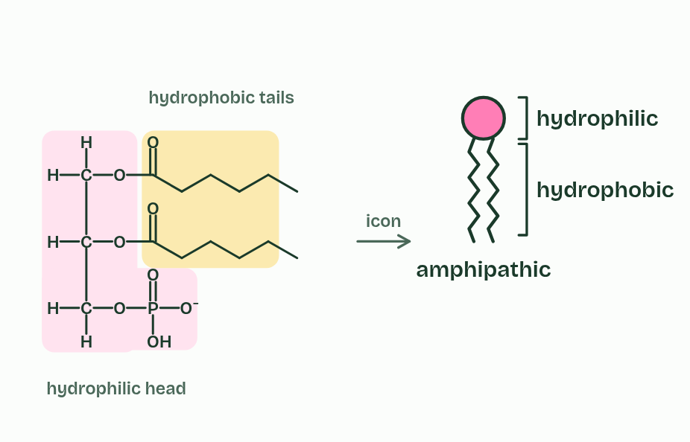
CHAPTER 10 · B1.1.12 The phospholipid bilayer
1 / 4
Half loves water, half does not
One molecule, two natures: amphipathic.
Minutes 50 to 60
Notes:
Minutes 50 to 60 of 60: Half loves water (10 min).
The plan: Chapter 10’s figure and predict box. Students draw and label a bilayer section with the hydrophilic and hydrophobic regions and the word amphipathic.
A phospholipid is amphipathic: one part of the molecule is attracted to water and another part is not. The phosphate group carries a negative charge and attracts water, and with the glycerol it forms the hydrophilic head. The two fatty acid tails are non-polar, so they are the hydrophobic tails.
In water, phospholipids arrange themselves so that their tails avoid water and their heads touch it. The result is two layers, with the tails pointing inwards and the heads facing the water on both sides: a phospholipid bilayer.
Nothing places the molecules. No enzyme arranges them and no energy is spent: the bilayer is simply what happens when molecules with hydrophilic and hydrophobic regions meet water. Its core is hydrophobic, so it is a barrier to ions and polar molecules (chapter 11 and B2.1), and it is the basis of every cell membrane (B2.1).

Slide 39
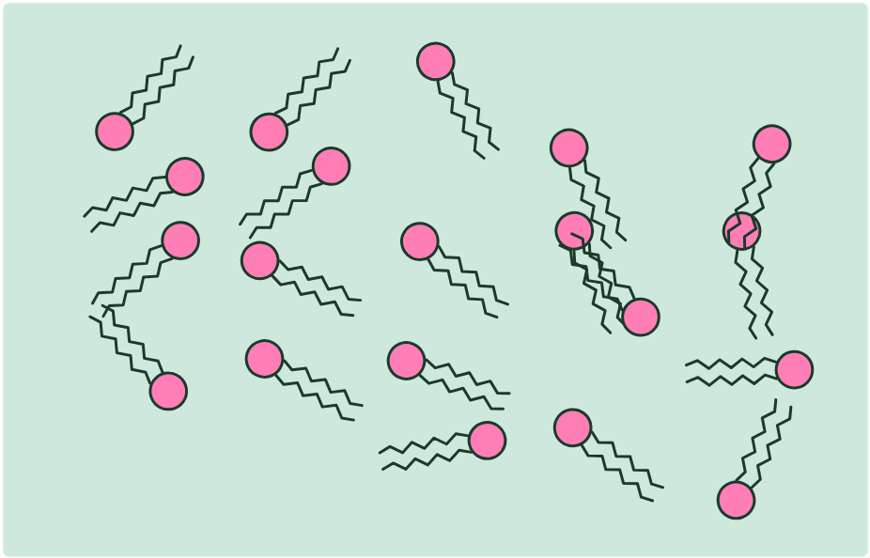
CHAPTER 10 · B1.1.12 The phospholipid bilayer
2 / 4
Half loves water, half does not
Mixed into water,
Minutes 50 to 60
Notes:
Minutes 50 to 60 of 60: Half loves water (10 min).
The plan: Chapter 10’s figure and predict box. Students draw and label a bilayer section with the hydrophilic and hydrophobic regions and the word amphipathic.
A phospholipid is amphipathic: one part of the molecule is attracted to water and another part is not. The phosphate group carries a negative charge and attracts water, and with the glycerol it forms the hydrophilic head. The two fatty acid tails are non-polar, so they are the hydrophobic tails.
In water, phospholipids arrange themselves so that their tails avoid water and their heads touch it. The result is two layers, with the tails pointing inwards and the heads facing the water on both sides: a phospholipid bilayer.
Nothing places the molecules. No enzyme arranges them and no energy is spent: the bilayer is simply what happens when molecules with hydrophilic and hydrophobic regions meet water. Its core is hydrophobic, so it is a barrier to ions and polar molecules (chapter 11 and B2.1), and it is the basis of every cell membrane (B2.1).

Slide 40
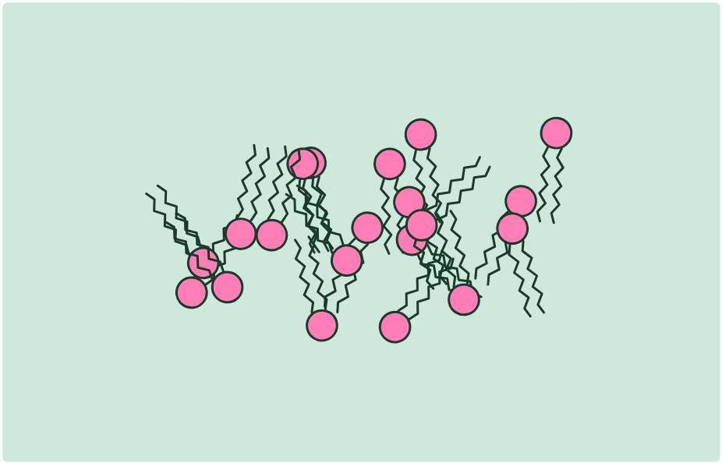
CHAPTER 10 · B1.1.12 The phospholipid bilayer
3 / 4
Half loves water, half does not
the tails turn away from water and the heads face it,
Minutes 50 to 60
Notes:
Minutes 50 to 60 of 60: Half loves water (10 min).
The plan: Chapter 10’s figure and predict box. Students draw and label a bilayer section with the hydrophilic and hydrophobic regions and the word amphipathic.
A phospholipid is amphipathic: one part of the molecule is attracted to water and another part is not. The phosphate group carries a negative charge and attracts water, and with the glycerol it forms the hydrophilic head. The two fatty acid tails are non-polar, so they are the hydrophobic tails.
In water, phospholipids arrange themselves so that their tails avoid water and their heads touch it. The result is two layers, with the tails pointing inwards and the heads facing the water on both sides: a phospholipid bilayer.
Nothing places the molecules. No enzyme arranges them and no energy is spent: the bilayer is simply what happens when molecules with hydrophilic and hydrophobic regions meet water. Its core is hydrophobic, so it is a barrier to ions and polar molecules (chapter 11 and B2.1), and it is the basis of every cell membrane (B2.1).

Slide 41
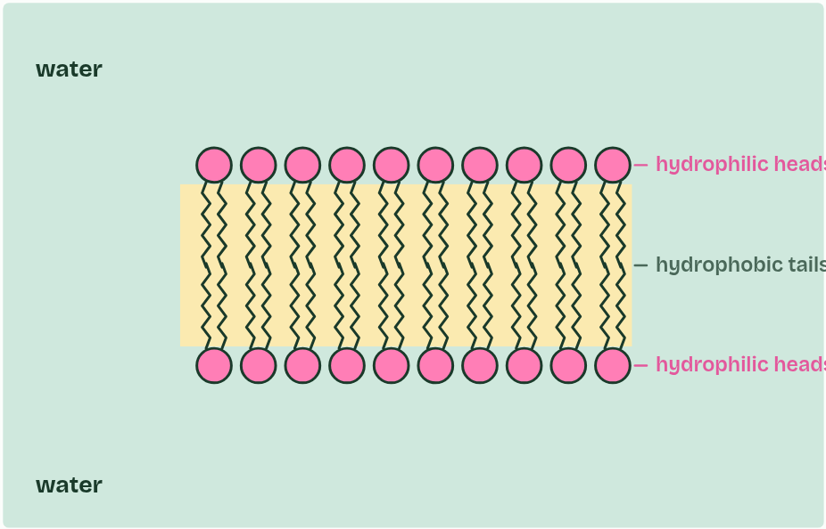
CHAPTER 10 · B1.1.12 The phospholipid bilayer
4 / 4
Half loves water, half does not
forming a bilayer, with water on both sides.
Minutes 50 to 60
Notes:
Minutes 50 to 60 of 60: Half loves water (10 min).
The plan: Chapter 10’s figure and predict box. Students draw and label a bilayer section with the hydrophilic and hydrophobic regions and the word amphipathic.
A phospholipid is amphipathic: one part of the molecule is attracted to water and another part is not. The phosphate group carries a negative charge and attracts water, and with the glycerol it forms the hydrophilic head. The two fatty acid tails are non-polar, so they are the hydrophobic tails.
In water, phospholipids arrange themselves so that their tails avoid water and their heads touch it. The result is two layers, with the tails pointing inwards and the heads facing the water on both sides: a phospholipid bilayer.
Nothing places the molecules. No enzyme arranges them and no energy is spent: the bilayer is simply what happens when molecules with hydrophilic and hydrophobic regions meet water. Its core is hydrophobic, so it is a barrier to ions and polar molecules (chapter 11 and B2.1), and it is the basis of every cell membrane (B2.1).

Slide 42
CHAPTER 10 · B1.1.12 The phospholipid bilayer
Half loves water, half does not
A phospholipid is amphipathic: one part of the molecule is attracted to water and another part is not.
The phosphate group carries a negative charge and attracts water, and with the glycerol it forms the hydrophilic head.
The two fatty acid tails are non-polar, so they are the hydrophobic tails.
The result is two layers, with the tails pointing inwards and the heads facing the water on both sides: a phospholipid bilayer.
Minutes 50 to 60
Notes:
Minutes 50 to 60 of 60: Half loves water (10 min).
The plan: Chapter 10’s figure and predict box. Students draw and label a bilayer section with the hydrophilic and hydrophobic regions and the word amphipathic.
A phospholipid is amphipathic: one part of the molecule is attracted to water and another part is not. The phosphate group carries a negative charge and attracts water, and with the glycerol it forms the hydrophilic head. The two fatty acid tails are non-polar, so they are the hydrophobic tails.
In water, phospholipids arrange themselves so that their tails avoid water and their heads touch it. The result is two layers, with the tails pointing inwards and the heads facing the water on both sides: a phospholipid bilayer.
Nothing places the molecules. No enzyme arranges them and no energy is spent: the bilayer is simply what happens when molecules with hydrophilic and hydrophobic regions meet water. Its core is hydrophobic, so it is a barrier to ions and polar molecules (chapter 11 and B2.1), and it is the basis of every cell membrane (B2.1).

Slide 43
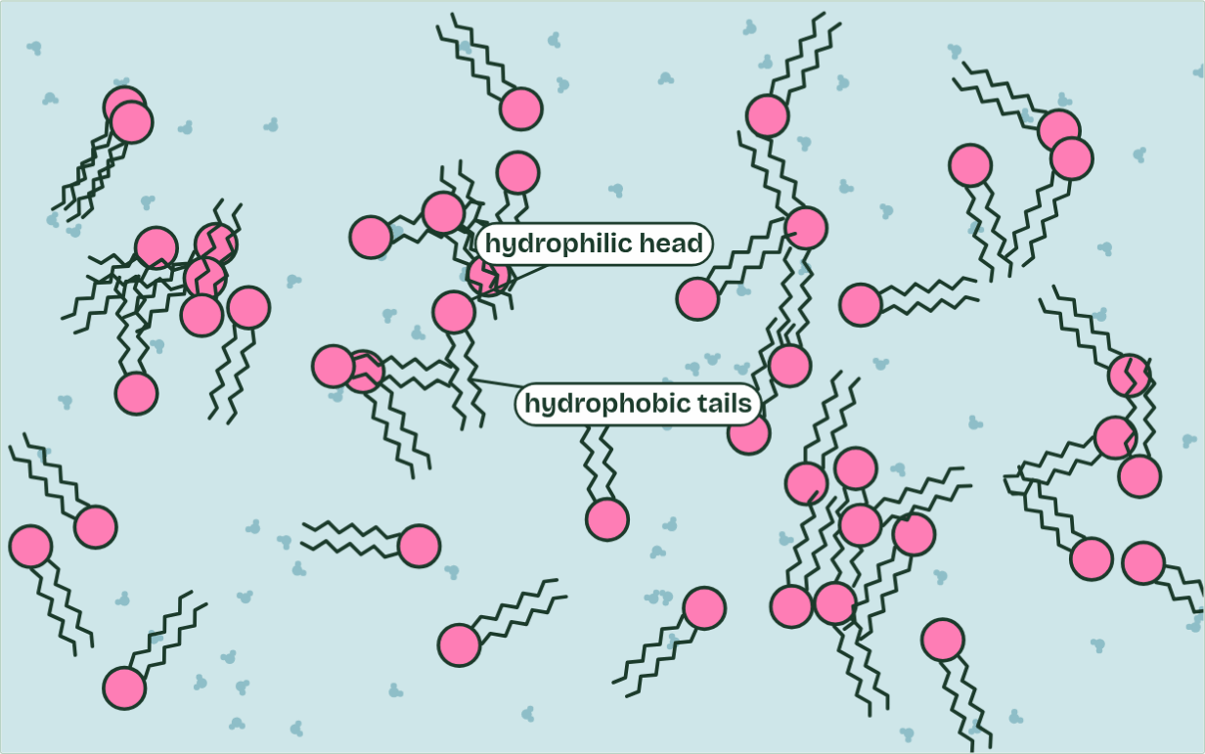
CHAPTER 10 · B1.1.12 The phospholipid bilayer
in the bilayer: 0 of 44
1 / 3
Half loves water, half does not
Phospholipids stirred into water point every which way.
Minutes 50 to 60
Notes:
Minutes 50 to 60 of 60: Half loves water (10 min).
The plan: Chapter 10’s figure and predict box. Students draw and label a bilayer section with the hydrophilic and hydrophobic regions and the word amphipathic.
A phospholipid is amphipathic: one part of the molecule is attracted to water and another part is not. The phosphate group carries a negative charge and attracts water, and with the glycerol it forms the hydrophilic head. The two fatty acid tails are non-polar, so they are the hydrophobic tails.
In water, phospholipids arrange themselves so that their tails avoid water and their heads touch it. The result is two layers, with the tails pointing inwards and the heads facing the water on both sides: a phospholipid bilayer.
Nothing places the molecules. No enzyme arranges them and no energy is spent: the bilayer is simply what happens when molecules with hydrophilic and hydrophobic regions meet water. Its core is hydrophobic, so it is a barrier to ions and polar molecules (chapter 11 and B2.1), and it is the basis of every cell membrane (B2.1).
The animation "Watch it happen: a bilayer builds itself", paused at 1.5 s. The next slides go on through it, then play it.

Slide 44
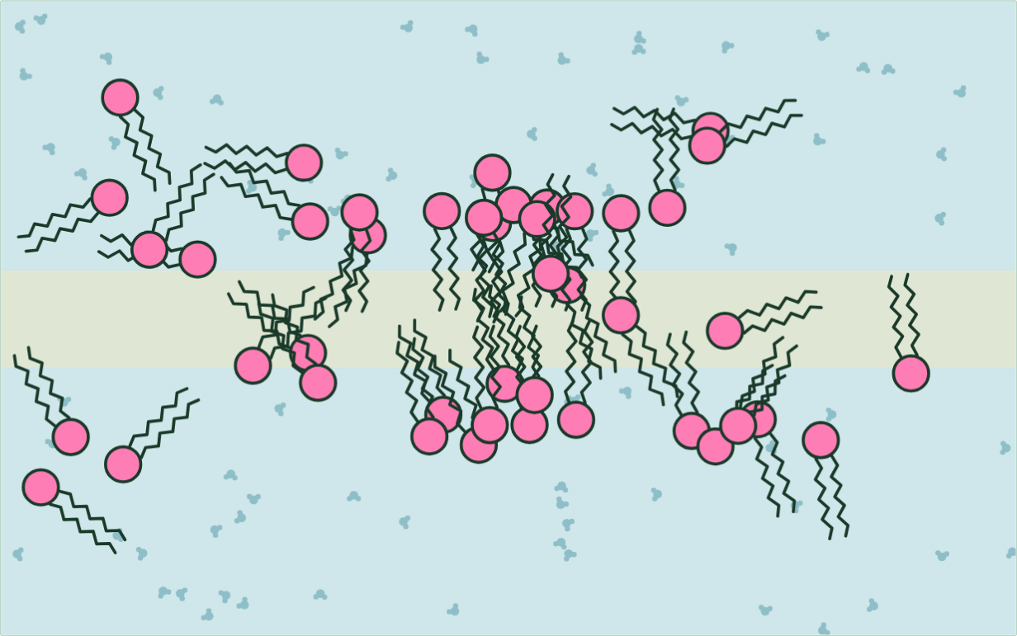
CHAPTER 10 · B1.1.12 The phospholipid bilayer
in the bilayer: 6 of 44
2 / 3
Half loves water, half does not
The tails cannot form hydrogen bonds with water, so water crowds the tails together.
Minutes 50 to 60
Notes:
Minutes 50 to 60 of 60: Half loves water (10 min).
The plan: Chapter 10’s figure and predict box. Students draw and label a bilayer section with the hydrophilic and hydrophobic regions and the word amphipathic.
A phospholipid is amphipathic: one part of the molecule is attracted to water and another part is not. The phosphate group carries a negative charge and attracts water, and with the glycerol it forms the hydrophilic head. The two fatty acid tails are non-polar, so they are the hydrophobic tails.
In water, phospholipids arrange themselves so that their tails avoid water and their heads touch it. The result is two layers, with the tails pointing inwards and the heads facing the water on both sides: a phospholipid bilayer.
Nothing places the molecules. No enzyme arranges them and no energy is spent: the bilayer is simply what happens when molecules with hydrophilic and hydrophobic regions meet water. Its core is hydrophobic, so it is a barrier to ions and polar molecules (chapter 11 and B2.1), and it is the basis of every cell membrane (B2.1).
The animation "Watch it happen: a bilayer builds itself", paused at 6.5 s. The next slides go on through it, then play it.

Slide 45
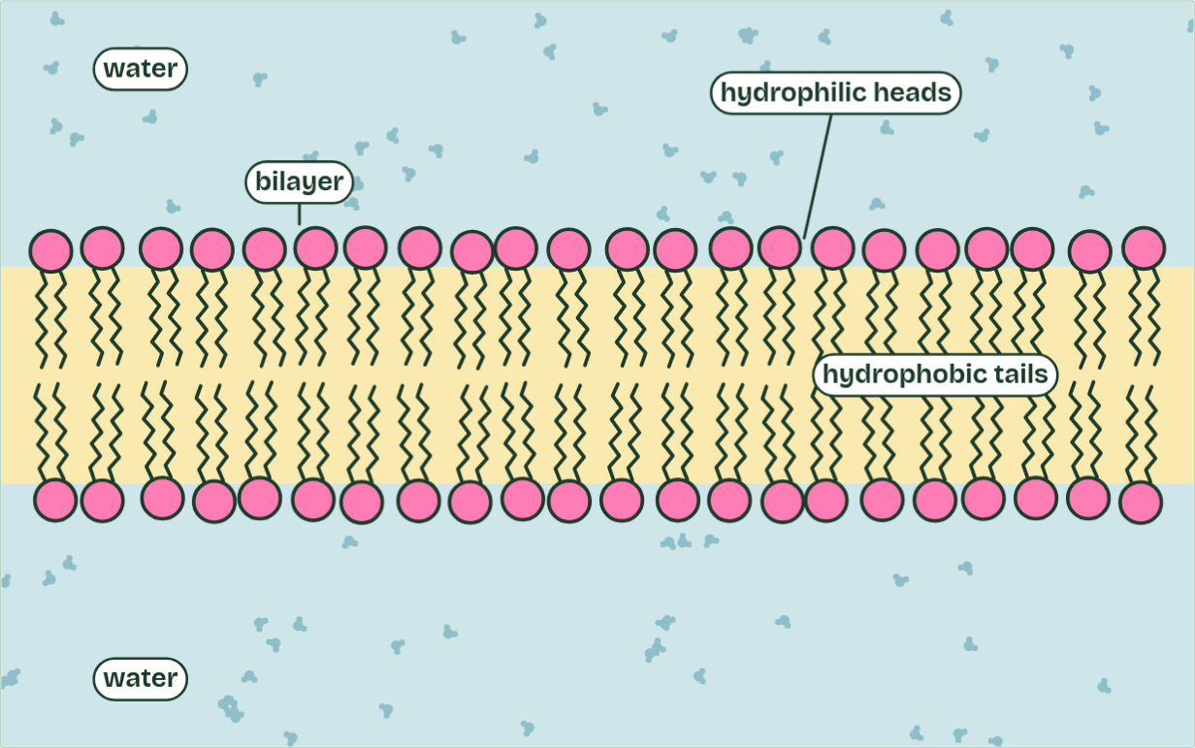
CHAPTER 10 · B1.1.12 The phospholipid bilayer
in the bilayer: 44 of 44
3 / 3
Half loves water, half does not
No enzyme placed them and no energy was spent: water arranged them.
Minutes 50 to 60
Notes:
Minutes 50 to 60 of 60: Half loves water (10 min).
The plan: Chapter 10’s figure and predict box. Students draw and label a bilayer section with the hydrophilic and hydrophobic regions and the word amphipathic.
A phospholipid is amphipathic: one part of the molecule is attracted to water and another part is not. The phosphate group carries a negative charge and attracts water, and with the glycerol it forms the hydrophilic head. The two fatty acid tails are non-polar, so they are the hydrophobic tails.
In water, phospholipids arrange themselves so that their tails avoid water and their heads touch it. The result is two layers, with the tails pointing inwards and the heads facing the water on both sides: a phospholipid bilayer.
Nothing places the molecules. No enzyme arranges them and no energy is spent: the bilayer is simply what happens when molecules with hydrophilic and hydrophobic regions meet water. Its core is hydrophobic, so it is a barrier to ions and polar molecules (chapter 11 and B2.1), and it is the basis of every cell membrane (B2.1).
The animation "Watch it happen: a bilayer builds itself", paused at 13.0 s. The next slides go on through it, then play it.

Slide 46
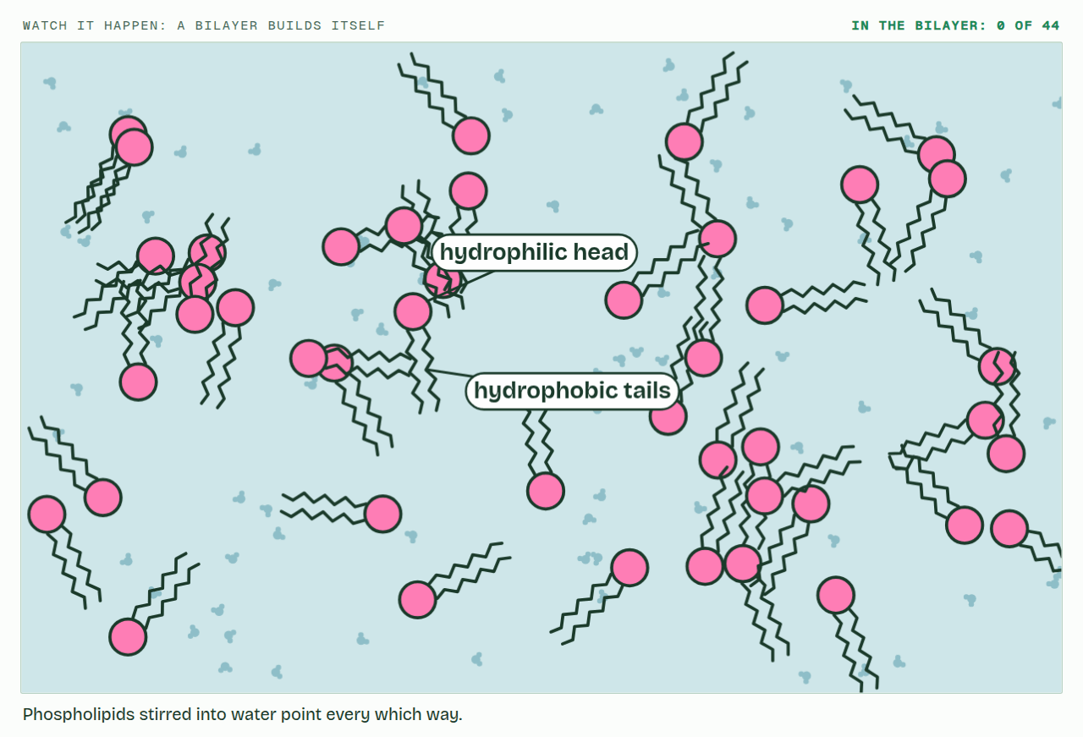
CHAPTER 10 · B1.1.12 The phospholipid bilayer
PLAY IT
Half loves water, half does not
Watch it happen: a bilayer builds itself: click to play. It loops every 16 seconds.
Minutes 50 to 60
Notes:
Minutes 50 to 60 of 60: Half loves water (10 min).
The plan: Chapter 10’s figure and predict box. Students draw and label a bilayer section with the hydrophilic and hydrophobic regions and the word amphipathic.
The video is membrane-ed3060.mp4, one loop of the animation in the guide. It plays in PowerPoint and Keynote. Google Slides does not play a video embedded in a .pptx: download membrane-ed3060.mp4 (https://www.biologybybradford.com/guides/downloads/scenes/membrane-ed3060.mp4), upload it to Google Drive, then Insert > Video > Google Drive.
In the guide the class can change it as it runs: https://www.biologybybradford.com/guides/ib-biology-b1-1-carbohydrates-and-lipids#bilayer
What it shows, in order:
1. Phospholipids stirred into water point every which way.
2. The tails cannot form hydrogen bonds with water, so water crowds the tails together.
3. No enzyme placed them and no energy was spent: water arranged them.

Slide 47
PREDICT
Phospholipids are stirred into a beaker of water, well below the surface. What do they form?
A A solid clump with the heads hidden inside and the tails facing the water
B Nothing: they all dissolve as separate molecules in the water
C A double layer: tails inside, heads facing the water on both sides
Minutes 50 to 60
Notes:
Minutes 50 to 60 of 60: Half loves water (10 min).
The plan: Chapter 10’s figure and predict box. Students draw and label a bilayer section with the hydrophilic and hydrophobic regions and the word amphipathic.
Ask for a show of hands, or mini whiteboards, before revealing. (Answer: C, on the next slide.)

Slide 48
WHAT HAPPENS
Phospholipids are stirred into a beaker of water, well below the surface. What do they form?
A A solid clump with the heads hidden inside and the tails facing the water
B Nothing: they all dissolve as separate molecules in the water
C A double layer: tails inside, heads facing the water on both sides
A bilayer. The tails cannot hydrogen-bond with water, so water molecules crowd them together, and the charged heads are attracted to water. Two layers, tails to tails, is the arrangement in which every head touches water and no tail does.
Minutes 50 to 60
Notes:
Minutes 50 to 60 of 60: Half loves water (10 min).
The plan: Chapter 10’s figure and predict box. Students draw and label a bilayer section with the hydrophilic and hydrophobic regions and the word amphipathic.
Answer: C. A bilayer. The tails cannot hydrogen-bond with water, so water molecules crowd them together, and the charged heads are attracted to water. Two layers, tails to tails, is the arrangement in which every head touches water and no tail does.

Slide 49
WATCH OUT
Cells do not build the bilayer by placing each phospholipid with an enzyme. Once the molecules are made, water arranges them.
Minutes 50 to 60
Notes:
Minutes 50 to 60 of 60: Half loves water (10 min).
The plan: Chapter 10’s figure and predict box. Students draw and label a bilayer section with the hydrophilic and hydrophobic regions and the word amphipathic.
A common mistake: say it, then ask who can say why it is wrong.

Slide 50
EXIT QUESTION
Before you go
On paper, on your own: Explain how amphipathic phospholipids form a bilayer in water.
Minutes 50 to 60
Notes:
Minutes 50 to 60 of 60: Half loves water (10 min).
The plan: Chapter 10’s figure and predict box. Students draw and label a bilayer section with the hydrophilic and hydrophobic regions and the word amphipathic.
Collect the slips: they say where to start next lesson.

Slide 51
PRACTISE AND REVISE
Keep going
Exam practice: a fresh paper of exam questions on B1.1, marked as you go
The guide, with the animations and the dry lab
This lesson in the guide: 7 Lipids keep their distance from water, 8 Every double bond puts a kink in the tail, 9 Fat: the lightest way to carry energy, 10 Half loves water, half does not
BUILD FOR YOUR CLASS
ALREADY ON THE SITE FOR B1.1
CARD SETS ON SPLYCR
Tarsia puzzle, dominoes and picture reveal on B1.1, built from its key terms and ready to print
A pub quiz with rounds on B1.1, to present or run with no projector
An escape room built from the question bank on B1.1
Quiz: Biological Molecules
Revision map: B1.1 Carbohydrates and lipids, to fill in
Exam questions: B1.1 in the exam maker, a paper with its markscheme
Open a set to host it as a class game, or make a copy to edit.
B1.1 Carbohydrates
B1.1b Lipids
How this was made. The course structure, the activities and the teaching choices come from my own classroom, my presentations and my years of teaching IB and AP Biology. I use Claude, an AI, to help write and build the interactive guides, lesson plans, slides and practice questions, and to draw the diagrams and code the interactives. I direct the work and review it against the IB and AP specifications before it goes live.
Minute 60: after the lesson
Notes:
Every link here is live. Set the exam practice paper for homework: it is fresh each time, marked as students go and saved to their Exam practice when they are signed in.
Exam practice: https://www.biologybybradford.com/exam-maker/sit?topics=B1.1&level=HL&paper=quiz&marks=15&src=ep
The guide: https://www.biologybybradford.com/guides/ib-biology-b1-1-carbohydrates-and-lipids

