Slide 1
IB Biology B1.1
LESSON 4 OF 4
BY THE END YOU CAN
Carbohydrates and lipids
Compare saturated, monounsaturated and polyunsaturated fatty acids and explain their melting points (B1.1.10)
Identify a steroid from its four rings and explain how oestradiol and testosterone cross the bilayer (B1.1.13)
Steroids, the dry lab and review
B1.1.10 and B1.1.13
Steroids crossing the bilayer, the melting points of fats, and a review of the whole subtopic
60 minutes · chapter 11 · the dry lab
Minute 0
Notes:
IB Biology B1.1, Carbohydrates and lipids. Lesson 4 of 4: Steroids, the dry lab and review, 60 minutes.
The plan, minute by minute (each slide's footer says where you are):
0 to 8 min (8) Spot the steroid
8 to 33 min (25) The dry lab: Fats on the bench
33 to 45 min (12) Codenames-style keyword game
45 to 57 min (12) Exam question, timed
57 to 60 min (3) Exit: form and function
Homework or extension: the reaction GIF, the polymer clay keyring, Tarsia or dominoes on B1.1, and the Check step. A note for the board in lesson 3: a triglyceride has three fatty acids, three ester bonds, and released three waters.
What students get wrong:
“Small molecules cross membranes and big ones do not.” Polarity decides, not size.
Stretch and support:
Support: the key terms (tap the dotted words) as a glossary, and the bond builder’s tap mode on a tablet.
Stretch: in the dry lab, predict the mystery acid’s melting point from both graphs before measuring it, and explain the size of your error.
The lesson plan to print: https://www.biologybybradford.com/guides/downloads/ib-biology-b1-1-carbohydrates-and-lipids-lesson-4-plan.pdf

Slide 2
DO NOW
Spot the steroid
Chapter 11’s first figure on the board.
8:00
minutes
Start now: the timer is running.
Minutes 0 to 8
Notes:
Minutes 0 to 8 of 60: Spot the steroid (8 min).
The plan: Chapter 11’s first figure on the board. The class votes A to F before each tap. Then the chapter 11 predict box.
Start a 8 minute timer as they come in.

Slide 3
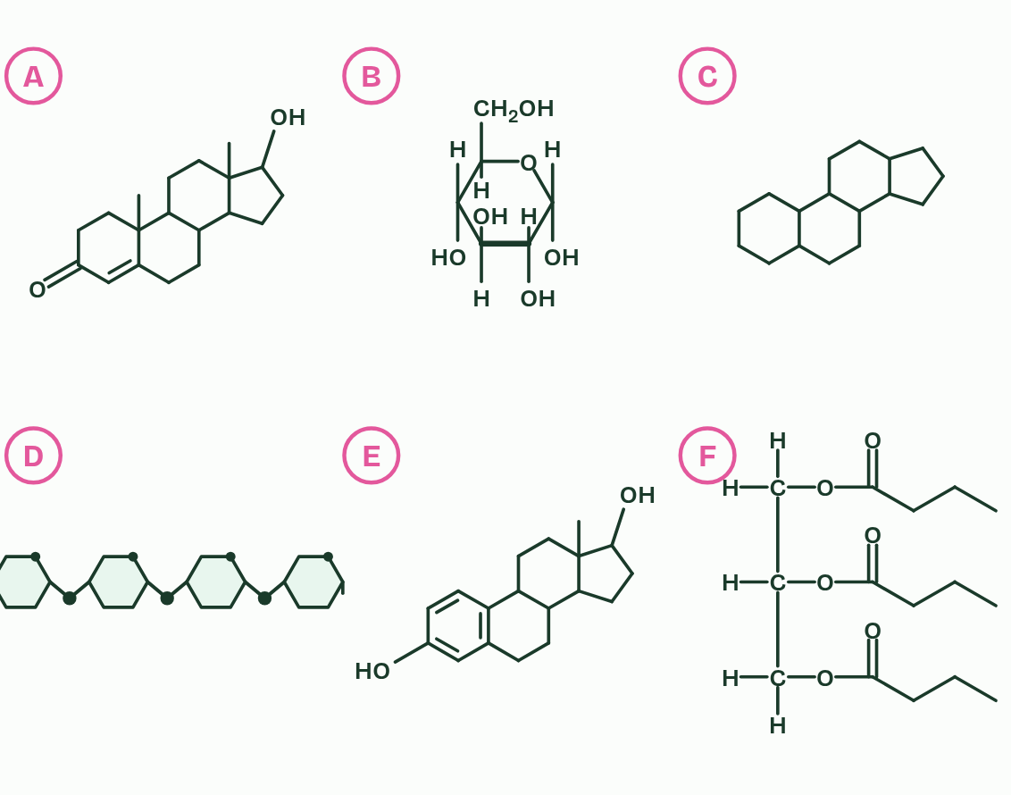
CHAPTER 11 · B1.1.13 Steroids
Four rings, and straight through the membrane
Steroids are lipids built on four fused rings: three rings of six carbons and one of five, sharing edges.
Different groups attached to the rings make different steroids.
Cholesterol, which sits in animal cell membranes (B2.1), is a steroid, and so are the sex hormones oestradiol and testosterone.
Steroids are mostly hydrocarbon, so they are non-polar.
Minutes 0 to 8
Notes:
Minutes 0 to 8 of 60: Spot the steroid (8 min).
The plan: Chapter 11’s first figure on the board. The class votes A to F before each tap. Then the chapter 11 predict box.
Steroids are lipids built on four fused rings: three rings of six carbons and one of five, sharing edges. Different groups attached to the rings make different steroids. To identify a steroid from a diagram, look for that four-ring block, whatever is attached to it.
Cholesterol, which sits in animal cell membranes (B2.1), is a steroid, and so are the sex hormones oestradiol and testosterone. The hormones are made from cholesterol.
Steroids are mostly hydrocarbon, so they are non-polar. Oestradiol has two OH groups and testosterone an OH and a C=O, but the rings dominate. They dissolve into the hydrophobic core of the bilayer and diffuse straight through it, with no transport protein. (In blood they travel bound to carrier proteins, because they barely dissolve in plasma.) Glucose and ions, although smaller, are polar or charged. They cannot cross the core and need proteins (B2.1).
Inside the target cell these hormones bind receptors that act on genes (C2.1), and oestradiol takes part in the menstrual cycle (D3.1).
Parts of the figure:
Testosterone A steroid: four fused rings, three of six carbons and one of five, sharing edges.
α-glucose Not a steroid: it has a single ring, of five carbons and an oxygen, with groups attached.
A steroid skeleton A steroid: four fused rings, three of six carbons and one of five. Nothing is attached, but the block is what makes it a steroid. Cholesterol and the sex hormones are this block with groups added.
Part of an amylose chain Not a steroid: it has four rings, but they are joined by oxygen bridges, not fused. Each ring is a whole glucose unit.
Oestradiol A steroid: four fused rings, three of six carbons and one of five. The first ring is drawn with three double bonds.
A triglyceride Not a steroid: one glycerol carrying three fatty acid chains. It is a lipid, but it has no fused rings.

Slide 4
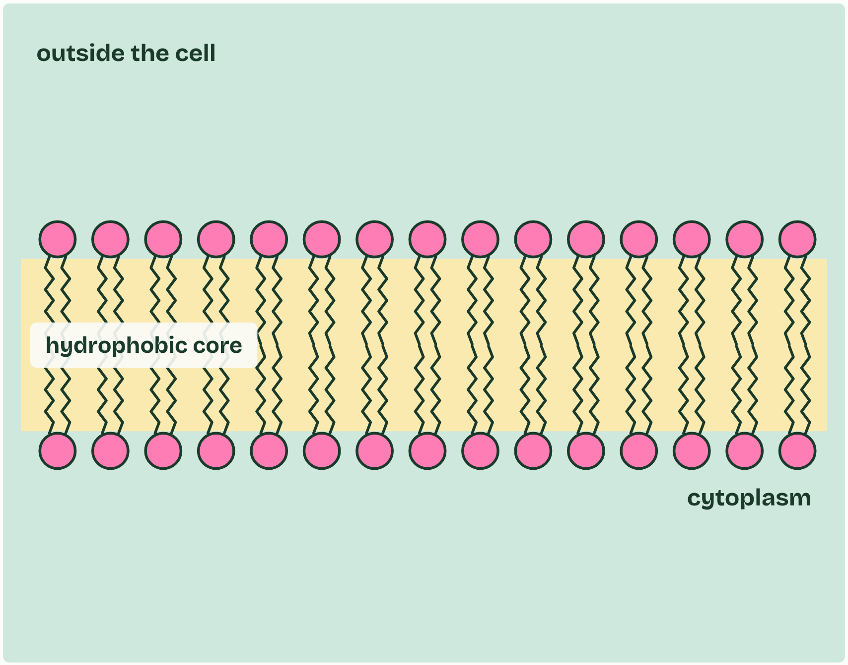
CHAPTER 11 · B1.1.13 Steroids
1 / 5
Four rings, and straight through the membrane
The bilayer’s core is hydrophobic.
Minutes 0 to 8
Notes:
Minutes 0 to 8 of 60: Spot the steroid (8 min).
The plan: Chapter 11’s first figure on the board. The class votes A to F before each tap. Then the chapter 11 predict box.
Steroids are lipids built on four fused rings: three rings of six carbons and one of five, sharing edges. Different groups attached to the rings make different steroids. To identify a steroid from a diagram, look for that four-ring block, whatever is attached to it.
Cholesterol, which sits in animal cell membranes (B2.1), is a steroid, and so are the sex hormones oestradiol and testosterone. The hormones are made from cholesterol.
Steroids are mostly hydrocarbon, so they are non-polar. Oestradiol has two OH groups and testosterone an OH and a C=O, but the rings dominate. They dissolve into the hydrophobic core of the bilayer and diffuse straight through it, with no transport protein. (In blood they travel bound to carrier proteins, because they barely dissolve in plasma.) Glucose and ions, although smaller, are polar or charged. They cannot cross the core and need proteins (B2.1).
Inside the target cell these hormones bind receptors that act on genes (C2.1), and oestradiol takes part in the menstrual cycle (D3.1).

Slide 5
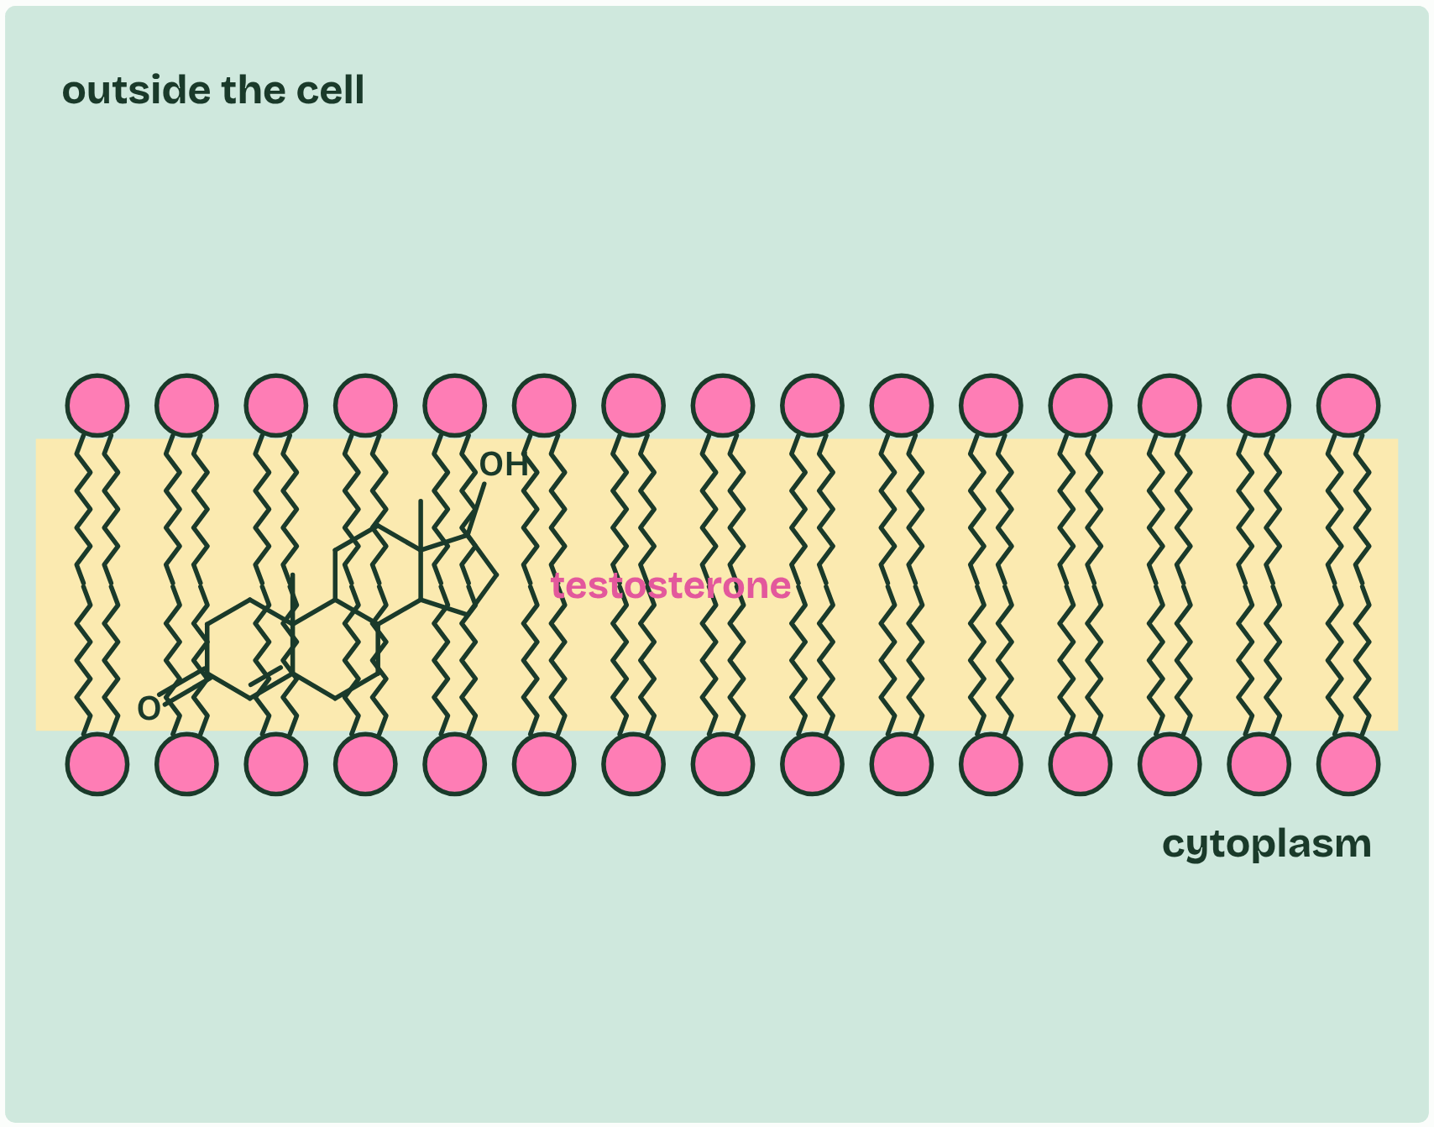
CHAPTER 11 · B1.1.13 Steroids
2 / 5
Four rings, and straight through the membrane
Non-polar testosterone dissolves into the core,
Minutes 0 to 8
Notes:
Minutes 0 to 8 of 60: Spot the steroid (8 min).
The plan: Chapter 11’s first figure on the board. The class votes A to F before each tap. Then the chapter 11 predict box.
Steroids are lipids built on four fused rings: three rings of six carbons and one of five, sharing edges. Different groups attached to the rings make different steroids. To identify a steroid from a diagram, look for that four-ring block, whatever is attached to it.
Cholesterol, which sits in animal cell membranes (B2.1), is a steroid, and so are the sex hormones oestradiol and testosterone. The hormones are made from cholesterol.
Steroids are mostly hydrocarbon, so they are non-polar. Oestradiol has two OH groups and testosterone an OH and a C=O, but the rings dominate. They dissolve into the hydrophobic core of the bilayer and diffuse straight through it, with no transport protein. (In blood they travel bound to carrier proteins, because they barely dissolve in plasma.) Glucose and ions, although smaller, are polar or charged. They cannot cross the core and need proteins (B2.1).
Inside the target cell these hormones bind receptors that act on genes (C2.1), and oestradiol takes part in the menstrual cycle (D3.1).

Slide 6
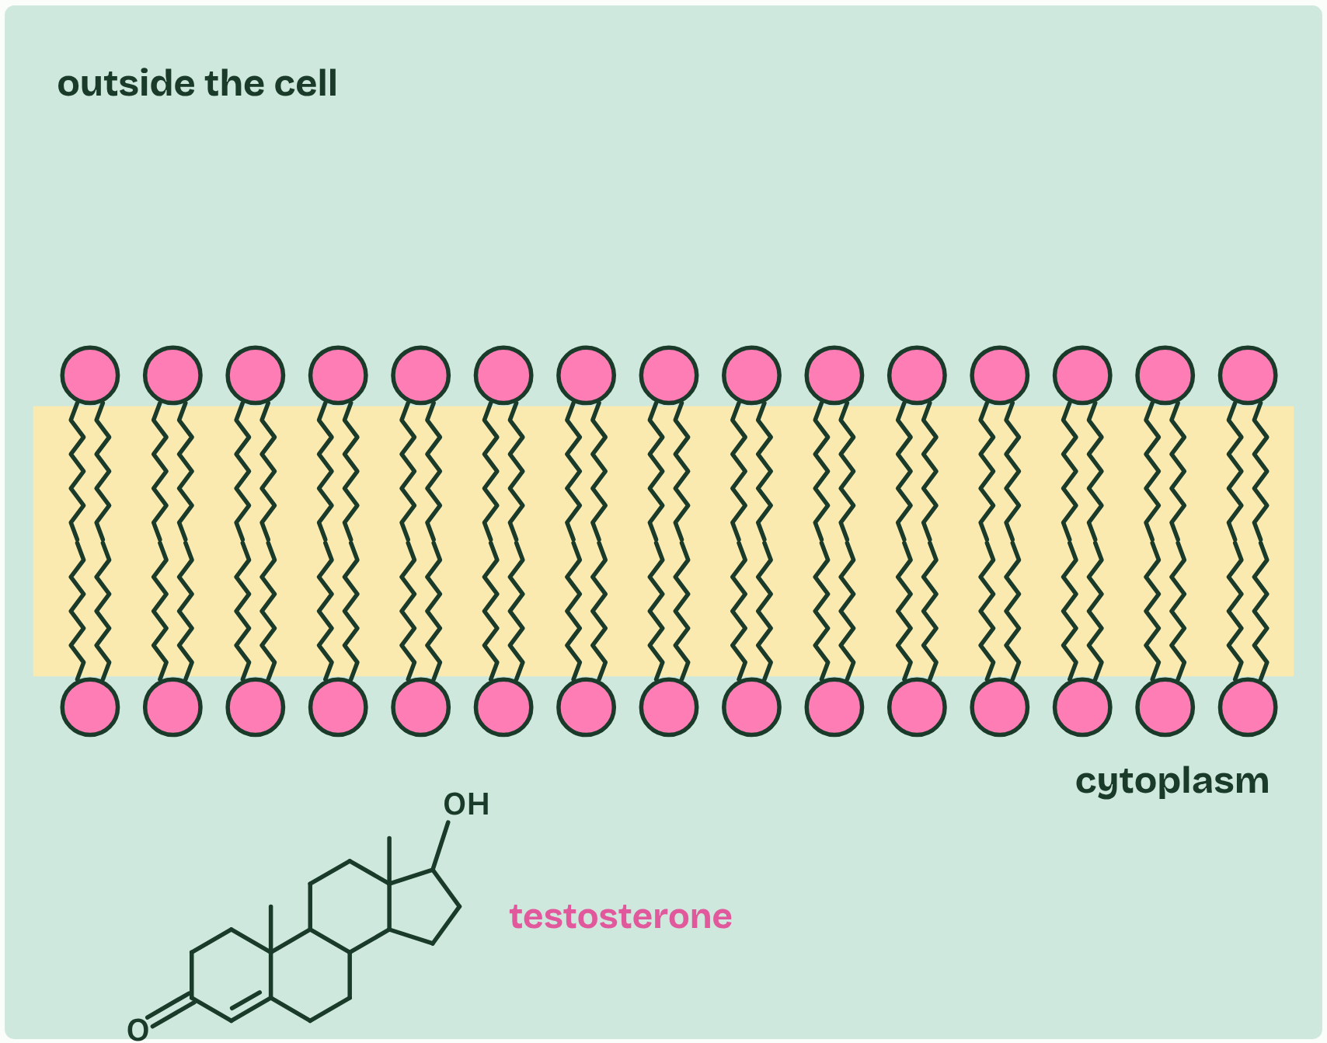
CHAPTER 11 · B1.1.13 Steroids
3 / 5
Four rings, and straight through the membrane
and diffuses out the other side.
Minutes 0 to 8
Notes:
Minutes 0 to 8 of 60: Spot the steroid (8 min).
The plan: Chapter 11’s first figure on the board. The class votes A to F before each tap. Then the chapter 11 predict box.
Steroids are lipids built on four fused rings: three rings of six carbons and one of five, sharing edges. Different groups attached to the rings make different steroids. To identify a steroid from a diagram, look for that four-ring block, whatever is attached to it.
Cholesterol, which sits in animal cell membranes (B2.1), is a steroid, and so are the sex hormones oestradiol and testosterone. The hormones are made from cholesterol.
Steroids are mostly hydrocarbon, so they are non-polar. Oestradiol has two OH groups and testosterone an OH and a C=O, but the rings dominate. They dissolve into the hydrophobic core of the bilayer and diffuse straight through it, with no transport protein. (In blood they travel bound to carrier proteins, because they barely dissolve in plasma.) Glucose and ions, although smaller, are polar or charged. They cannot cross the core and need proteins (B2.1).
Inside the target cell these hormones bind receptors that act on genes (C2.1), and oestradiol takes part in the menstrual cycle (D3.1).

Slide 7
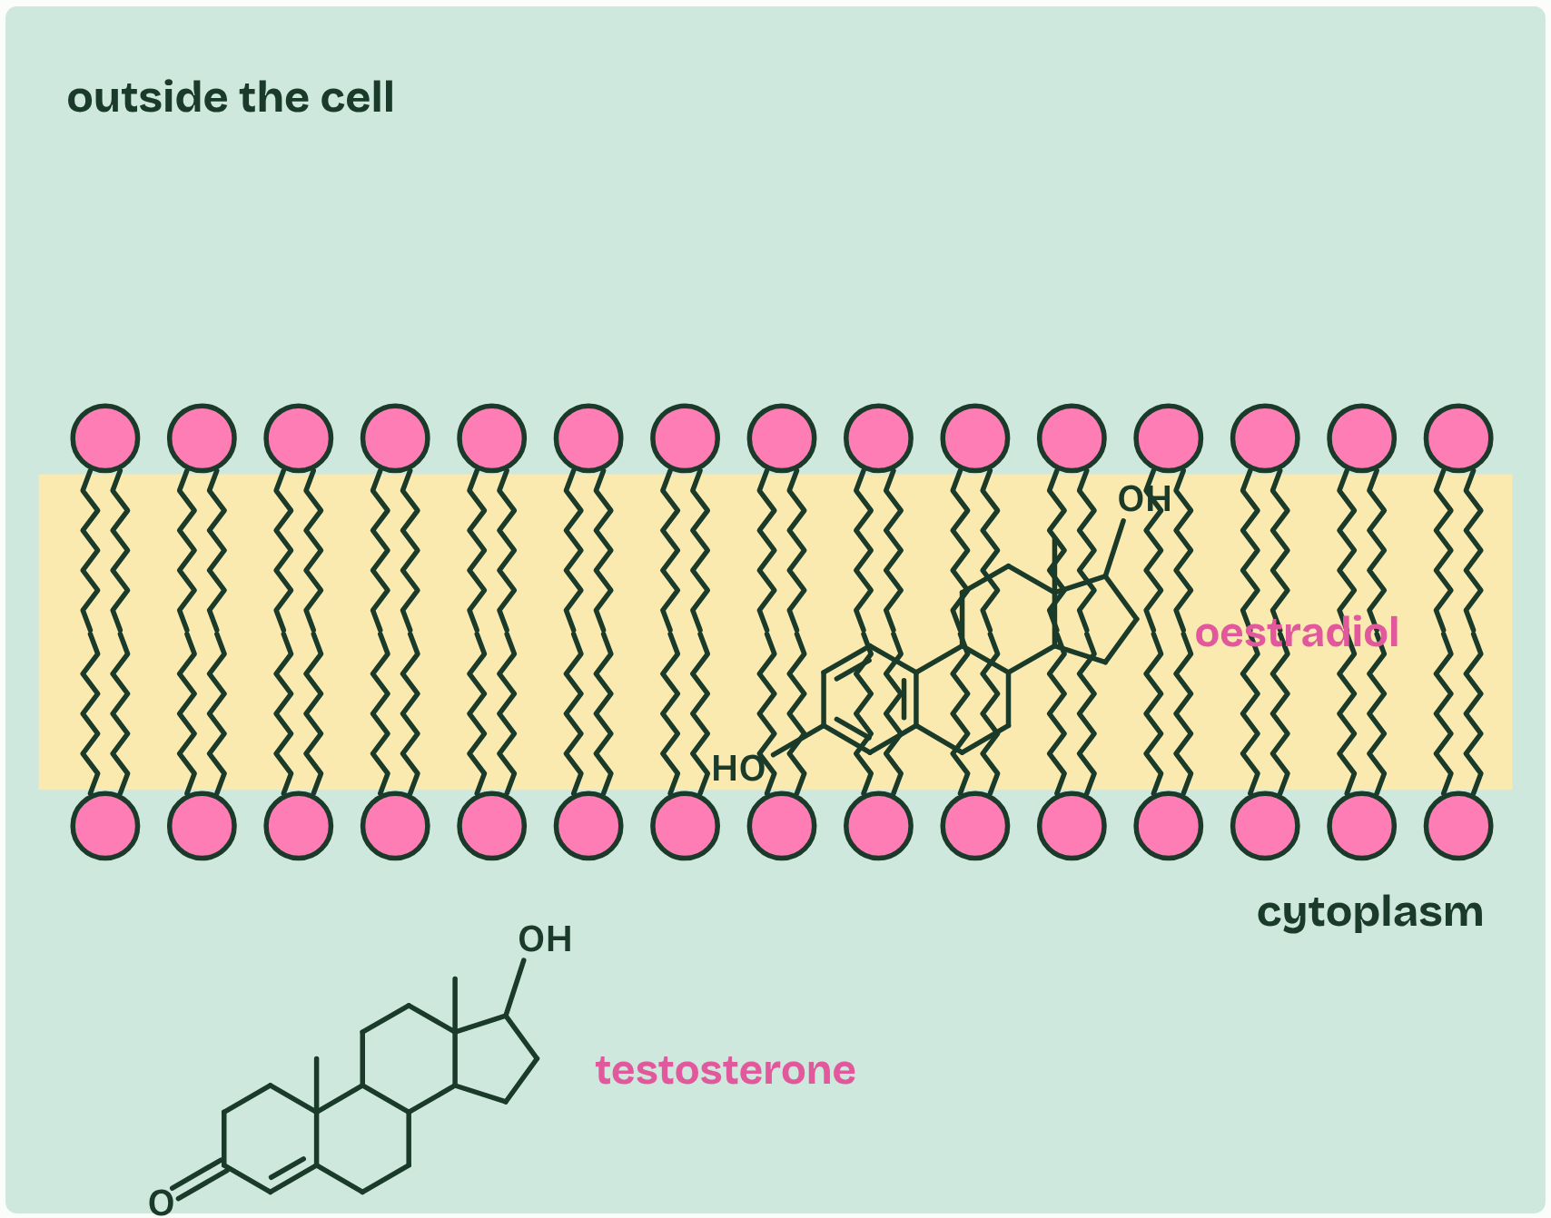
CHAPTER 11 · B1.1.13 Steroids
4 / 5
Four rings, and straight through the membrane
Oestradiol crosses the same way.
Minutes 0 to 8
Notes:
Minutes 0 to 8 of 60: Spot the steroid (8 min).
The plan: Chapter 11’s first figure on the board. The class votes A to F before each tap. Then the chapter 11 predict box.
Steroids are lipids built on four fused rings: three rings of six carbons and one of five, sharing edges. Different groups attached to the rings make different steroids. To identify a steroid from a diagram, look for that four-ring block, whatever is attached to it.
Cholesterol, which sits in animal cell membranes (B2.1), is a steroid, and so are the sex hormones oestradiol and testosterone. The hormones are made from cholesterol.
Steroids are mostly hydrocarbon, so they are non-polar. Oestradiol has two OH groups and testosterone an OH and a C=O, but the rings dominate. They dissolve into the hydrophobic core of the bilayer and diffuse straight through it, with no transport protein. (In blood they travel bound to carrier proteins, because they barely dissolve in plasma.) Glucose and ions, although smaller, are polar or charged. They cannot cross the core and need proteins (B2.1).
Inside the target cell these hormones bind receptors that act on genes (C2.1), and oestradiol takes part in the menstrual cycle (D3.1).

Slide 8
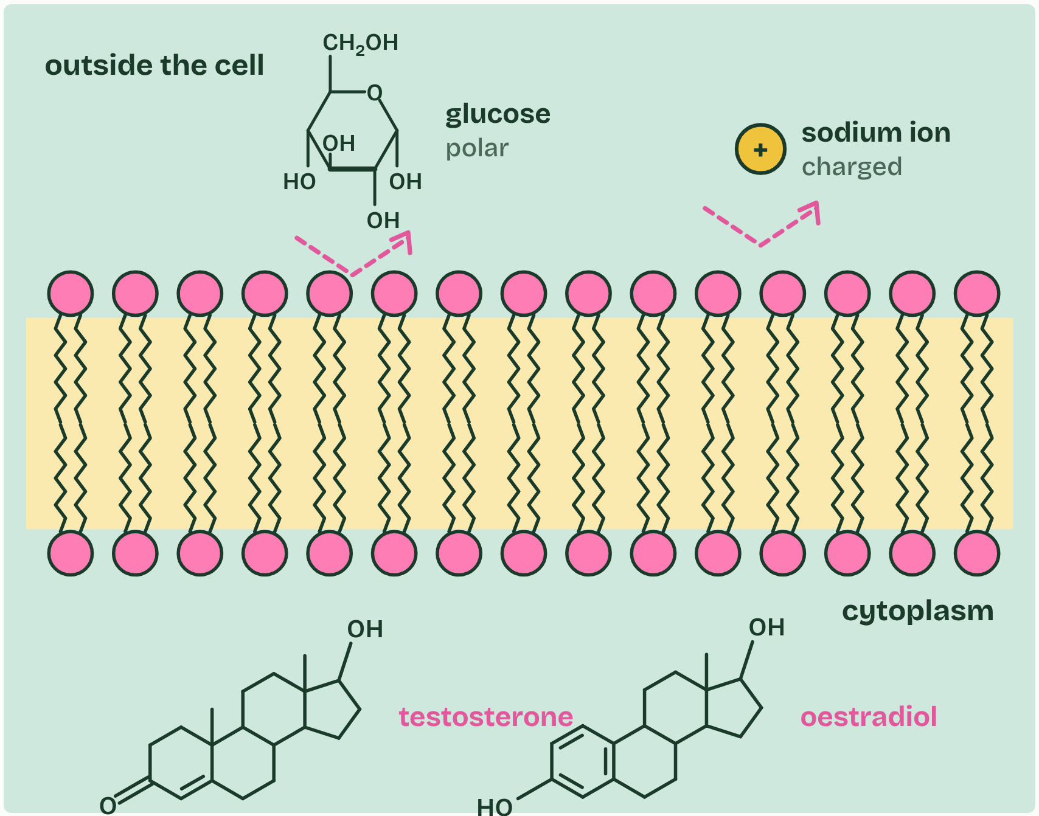
CHAPTER 11 · B1.1.13 Steroids
5 / 5
Four rings, and straight through the membrane
Polar glucose and charged ions cannot cross the core: they need proteins (B2.1).
Minutes 0 to 8
Notes:
Minutes 0 to 8 of 60: Spot the steroid (8 min).
The plan: Chapter 11’s first figure on the board. The class votes A to F before each tap. Then the chapter 11 predict box.
Steroids are lipids built on four fused rings: three rings of six carbons and one of five, sharing edges. Different groups attached to the rings make different steroids. To identify a steroid from a diagram, look for that four-ring block, whatever is attached to it.
Cholesterol, which sits in animal cell membranes (B2.1), is a steroid, and so are the sex hormones oestradiol and testosterone. The hormones are made from cholesterol.
Steroids are mostly hydrocarbon, so they are non-polar. Oestradiol has two OH groups and testosterone an OH and a C=O, but the rings dominate. They dissolve into the hydrophobic core of the bilayer and diffuse straight through it, with no transport protein. (In blood they travel bound to carrier proteins, because they barely dissolve in plasma.) Glucose and ions, although smaller, are polar or charged. They cannot cross the core and need proteins (B2.1).
Inside the target cell these hormones bind receptors that act on genes (C2.1), and oestradiol takes part in the menstrual cycle (D3.1).

Slide 9
CHAPTER 11 · B1.1.13 Steroids
Four rings, and straight through the membrane
Steroids are lipids built on four fused rings: three rings of six carbons and one of five, sharing edges.
Different groups attached to the rings make different steroids.
Cholesterol, which sits in animal cell membranes (B2.1), is a steroid, and so are the sex hormones oestradiol and testosterone.
Steroids are mostly hydrocarbon, so they are non-polar.
Minutes 0 to 8
Notes:
Minutes 0 to 8 of 60: Spot the steroid (8 min).
The plan: Chapter 11’s first figure on the board. The class votes A to F before each tap. Then the chapter 11 predict box.
Steroids are lipids built on four fused rings: three rings of six carbons and one of five, sharing edges. Different groups attached to the rings make different steroids. To identify a steroid from a diagram, look for that four-ring block, whatever is attached to it.
Cholesterol, which sits in animal cell membranes (B2.1), is a steroid, and so are the sex hormones oestradiol and testosterone. The hormones are made from cholesterol.
Steroids are mostly hydrocarbon, so they are non-polar. Oestradiol has two OH groups and testosterone an OH and a C=O, but the rings dominate. They dissolve into the hydrophobic core of the bilayer and diffuse straight through it, with no transport protein. (In blood they travel bound to carrier proteins, because they barely dissolve in plasma.) Glucose and ions, although smaller, are polar or charged. They cannot cross the core and need proteins (B2.1).
Inside the target cell these hormones bind receptors that act on genes (C2.1), and oestradiol takes part in the menstrual cycle (D3.1).

Slide 10
WATCH OUT
Not every lipid is a steroid, and not every steroid is a hormone: cholesterol is a steroid that sits in membranes.
Minutes 0 to 8
Notes:
Minutes 0 to 8 of 60: Spot the steroid (8 min).
The plan: Chapter 11’s first figure on the board. The class votes A to F before each tap. Then the chapter 11 predict box.
A common mistake: say it, then ask who can say why it is wrong.

Slide 11
PREDICT
Testosterone crosses a membrane with no transport protein. Glucose cannot. Why?
A Testosterone is the smaller molecule, so it slips between the heads
B Testosterone is non-polar, so it dissolves in the bilayer’s core
C Testosterone is pumped across the membrane by a protein using ATP
Minutes 0 to 8
Notes:
Minutes 0 to 8 of 60: Spot the steroid (8 min).
The plan: Chapter 11’s first figure on the board. The class votes A to F before each tap. Then the chapter 11 predict box.
Ask for a show of hands, or mini whiteboards, before revealing. (Answer: B, on the next slide.)

Slide 12
WHAT HAPPENS
Testosterone crosses a membrane with no transport protein. Glucose cannot. Why?
A Testosterone is the smaller molecule, so it slips between the heads
B Testosterone is non-polar, so it dissolves in the bilayer’s core
C Testosterone is pumped across the membrane by a protein using ATP
Polarity, not size. Testosterone (Mr 288) is bigger than glucose (Mr 180), but it is mostly hydrocarbon, so it mixes into the hydrophobic core. Glucose’s many OH groups bind water and are repelled by the core.
Minutes 0 to 8
Notes:
Minutes 0 to 8 of 60: Spot the steroid (8 min).
The plan: Chapter 11’s first figure on the board. The class votes A to F before each tap. Then the chapter 11 predict box.
Answer: B. Polarity, not size. Testosterone (Mr 288) is bigger than glucose (Mr 180), but it is mostly hydrocarbon, so it mixes into the hydrophobic core. Glucose’s many OH groups bind water and are repelled by the core.

Slide 13
DRY LAB
25 MIN
Fats on the bench
THE TASK
Freeze fatty acids and kitchen fats, warm them in a bath and catch the moment each one melts. The dry lab, with its tasks and questions under it, and its results as a CSV for a pooled class graph.
STUDENTS NEED
One device per pair.
Minutes 8 to 33
Notes:
Minutes 8 to 33 of 60: The dry lab: Fats on the bench (25 min).
The plan: In pairs, on the pure fatty acids bench at 1 °C a minute, stirred: the double-bond series (stearic, oleic, linoleic and α-linolenic acid) and the chain-length series (lauric to arachidic acid), three runs each. Pool the means on the board, then answer the three questions under the lab.
The activity: Fats on the bench. Freeze fatty acids and kitchen fats, warm them in a bath and catch the moment each one melts. The dry lab, with its tasks and questions under it, and its results as a CSV for a pooled class graph.
Needs: one device per pair.
The time: 25 minutes, minutes 8 to 33 of the plan.

Slide 14
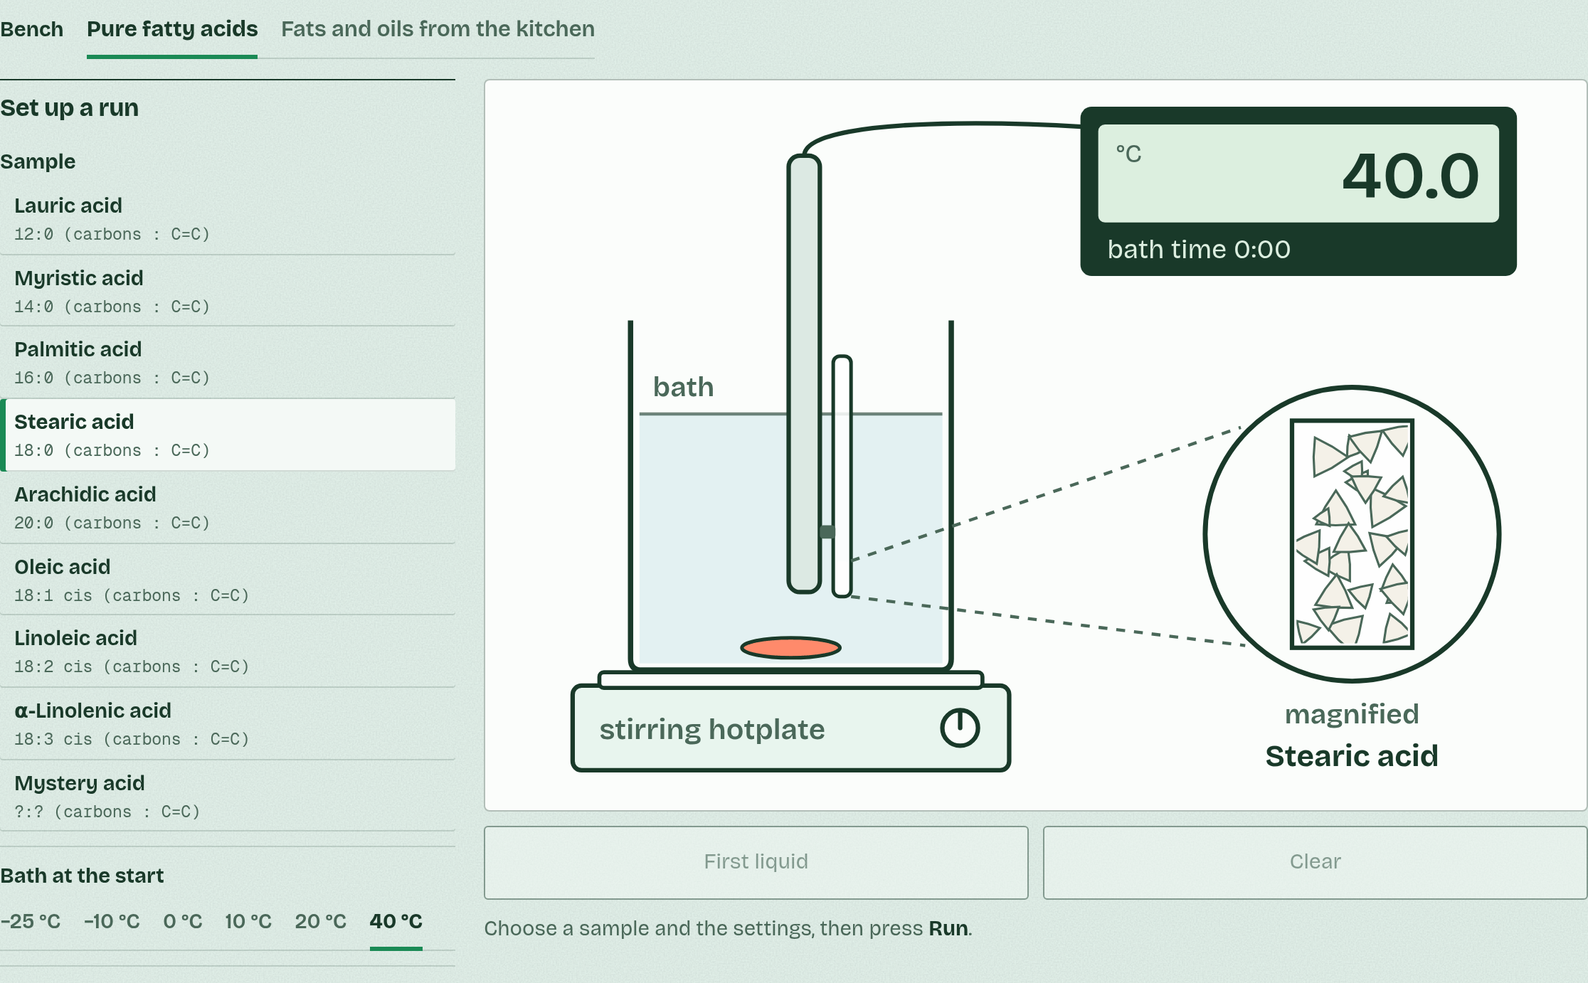
DRY LAB
Fats on the bench
Your question: How does the number of C=C double bonds in a fatty acid affect its melting point? And do the fats that plants and endotherms store fit the same pattern?
What you can change: The sample (four fatty acids with 18 carbons and 0 to 3 double bonds, saturated fatty acids with 12 to 20 carbons, a mystery acid, and eight fats and oils from the kitchen), the bath's starting temperature, how fast it warms, whether it is stirred, and how many repeats you do.
What to record: For each run: the sample, the settings, the temperature at which the first liquid appears and the temperature at which the sample turns completely clear, its melting point. Repeat each sample at least three times and take a mean.
Run it: biologybybradford.com/guides/ib-biology-b1-1-carbohydrates-and-lipids#lab
Minutes 8 to 33
Notes:
Minutes 8 to 33 of 60: The dry lab: Fats on the bench (25 min).
The plan: In pairs, on the pure fatty acids bench at 1 °C a minute, stirred: the double-bond series (stearic, oleic, linoleic and α-linolenic acid) and the chain-length series (lauric to arachidic acid), three runs each. Pool the means on the board, then answer the three questions under the lab.
The dry lab runs in the guide: https://www.biologybybradford.com/guides/ib-biology-b1-1-carbohydrates-and-lipids#lab

Slide 15
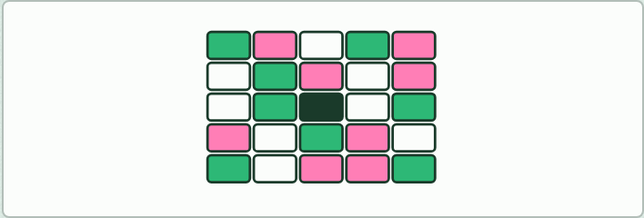
GAME
12 MIN
Codenames-style keyword game
THE TASK
A 5 by 5 grid of key terms from this guide; two teams. Each team’s clue-giver gives one word and a number that link several of their team’s terms. Use the key terms in the chapters (anabolism and catabolism belong to C1.1, so leave them out).
STUDENTS NEED
A printed or projected grid, two colours of counters.
Minutes 33 to 45
Notes:
Minutes 33 to 45 of 60: Codenames-style keyword game (12 min).
The plan: The game below, with the key terms of this guide.
The activity: Codenames-style keyword game. A 5 by 5 grid of key terms from this guide; two teams. Each team’s clue-giver gives one word and a number that link several of their team’s terms. Use the key terms in the chapters (anabolism and catabolism belong to C1.1, so leave them out).
Needs: a printed or projected grid, two colours of counters.
The time: 12 minutes, minutes 33 to 45 of the plan.

Slide 16
STEP 4
12 MIN
Exam question, timed
Make: A reaction in motion
Make: Polymer clay keyring
Minutes 45 to 57
Notes:
Minutes 45 to 57 of 60: Exam question, timed (12 min).
The plan: A written question on carbohydrate and lipid stores, or on fatty acids, from the B1.1 exam maker (in Practise and revise, below): 9 minutes, then peer-marked. For homework, the Check step.

Slide 17
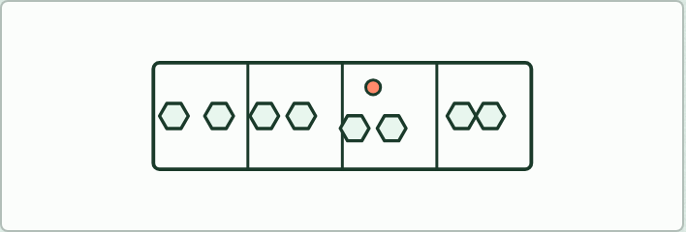
MAKE
12 MIN
A reaction in motion
THE TASK
Students make a short GIF or stop-motion film of one condensation or hydrolysis (glucose, a triglyceride or a dipeptide), showing which atoms leave as water or where the water’s H and OH go. Any GIF maker or a phone’s stop-motion app. Homework, or 20 minutes in class.
STUDENTS NEED
Devices, paper or model pieces.
Minutes 45 to 57
Notes:
Minutes 45 to 57 of 60: Exam question, timed (12 min).
The plan: A written question on carbohydrate and lipid stores, or on fatty acids, from the B1.1 exam maker (in Practise and revise, below): 9 minutes, then peer-marked. For homework, the Check step.
The activity: A reaction in motion. Students make a short GIF or stop-motion film of one condensation or hydrolysis (glucose, a triglyceride or a dipeptide), showing which atoms leave as water or where the water’s H and OH go. Any GIF maker or a phone’s stop-motion app. Homework, or 20 minutes in class.
Needs: devices, paper or model pieces.
The time: 12 minutes, minutes 45 to 57 of the plan.

Slide 18

MAKE
IF THERE IS TIME
Polymer clay keyring
THE TASK
Each student models one monomer or a short polymer in polymer clay with a consistent colour code (C black, H white, O red, N blue, and P in the kit’s own colour), on a keyring, and bakes it as the clay’s packet says. End of the unit, or homework.
STUDENTS NEED
Polymer clay, keyring loops, an oven.
Minutes 45 to 57
Notes:
Minutes 45 to 57 of 60: Exam question, timed (12 min).
The plan: A written question on carbohydrate and lipid stores, or on fatty acids, from the B1.1 exam maker (in Practise and revise, below): 9 minutes, then peer-marked. For homework, the Check step.
The activity: Polymer clay keyring. Each student models one monomer or a short polymer in polymer clay with a consistent colour code (C black, H white, O red, N blue, and P in the kit’s own colour), on a keyring, and bakes it as the clay’s packet says. End of the unit, or homework.
Needs: polymer clay, keyring loops, an oven.
The plan sets no time of its own for this activity: use it in this step, in place of part of it, or for homework.

Slide 19
PLENARY
Can you now...
Compare saturated, monounsaturated and polyunsaturated fatty acids and explain their melting points (B1.1.10)
Identify a steroid from its four rings and explain how oestradiol and testosterone cross the bilayer (B1.1.13)
Minutes 57 to 60
Notes:
Minutes 57 to 60 of 60: Exit: form and function (3 min).
The plan: One line each on how a change of form changes function: one OH turned over, branching, a double bond, a polar head, four non-polar rings.
Thumbs up, sideways or down on each goal before the exit question. The goals come from the statements this lesson covers.

Slide 20
EXIT QUESTION
Form and function
One line each on how a change of form changes function: one OH turned over, branching, a double bond, a polar head, four non-polar rings.
Minutes 57 to 60
Notes:
Minutes 57 to 60 of 60: Exit: form and function (3 min).
The plan: One line each on how a change of form changes function: one OH turned over, branching, a double bond, a polar head, four non-polar rings.

Slide 21
PRACTISE AND REVISE
Keep going
Exam practice: a fresh paper of exam questions on B1.1, marked as you go
The guide, with the animations and the dry lab
This lesson in the guide: 11 Four rings, and straight through the membrane, the dry lab
BUILD FOR YOUR CLASS
ALREADY ON THE SITE FOR B1.1
CARD SETS ON SPLYCR
Tarsia puzzle, dominoes and picture reveal on B1.1, built from its key terms and ready to print
A pub quiz with rounds on B1.1, to present or run with no projector
An escape room built from the question bank on B1.1
Quiz: Biological Molecules
Revision map: B1.1 Carbohydrates and lipids, to fill in
Exam questions: B1.1 in the exam maker, a paper with its markscheme
Open a set to host it as a class game, or make a copy to edit.
B1.1 Carbohydrates
B1.1b Lipids
How this was made. The course structure, the activities and the teaching choices come from my own classroom, my presentations and my years of teaching IB and AP Biology. I use Claude, an AI, to help write and build the interactive guides, lesson plans, slides and practice questions, and to draw the diagrams and code the interactives. I direct the work and review it against the IB and AP specifications before it goes live.
Minute 60: after the lesson
Notes:
Every link here is live. Set the exam practice paper for homework: it is fresh each time, marked as students go and saved to their Exam practice when they are signed in.
Exam practice: https://www.biologybybradford.com/exam-maker/sit?topics=B1.1&level=HL&paper=quiz&marks=15&src=ep
The guide: https://www.biologybybradford.com/guides/ib-biology-b1-1-carbohydrates-and-lipids

