Slide 1
IB Biology B1.2
LESSON 1 OF 4
BY THE END YOU CAN
Proteins
Draw a generalised amino acid and name the four groups on its alpha carbon (B1.2.1)
Explain how condensation joins amino acids with peptide bonds, write the word equation and draw a dipeptide (B1.2.2)
Explain why the number of possible polypeptides is practically endless (B1.2.4)
Amino acids and peptide bonds
B1.2.1, B1.2.2 and B1.2.4
Drawing a generalised amino acid, joining two by condensation, and why chains of twenty kinds are endless
60 minutes · chapters 1, 2
Minute 0
Notes:
IB Biology B1.2, Proteins. Lesson 1 of 4: Amino acids and peptide bonds, 60 minutes.
The plan, minute by minute (each slide's footer says where you are):
0 to 5 min (5) Do now: draw it from memory
5 to 15 min (10) The five strokes
15 to 30 min (15) Model it, then draw it
30 to 40 min (10) Peptide bonds
40 to 55 min (15) Your name in amino acids
55 to 60 min (5) Exit
What students get wrong:
The peptide bond in the wrong place: between alpha carbons, through an oxygen, or to an R group. Ring the C-N between the C=O and the N-H.
Water from one amino acid. The OH comes from the carboxyl group of one and the H from the amine group of the other.
Twenty amino acids, so twenty proteins. The order makes the protein.
Stretch and support:
Support: give a traceable amino acid template, to trace and then to complete.
Support: use the four Remember it tiles as starters.
Support: cut the figures’ captions up for students to put in order.
The lesson plan to print: https://www.biologybybradford.com/guides/downloads/ib-biology-b1-2-proteins-lesson-1-plan.pdf

Slide 2
DO NOW
Draw it from memory
Students draw an amino acid with no notes, label the two functional groups and say what the side chain is.
5:00
minutes
Start now: the timer is running.
Minutes 0 to 5
Notes:
Minutes 0 to 5 of 60: Do now: draw it from memory (5 min).
The plan: Students draw an amino acid with no notes, label the two functional groups and say what the side chain is. Keep the drawings: they are checked against the figure in the next step.
Start a 5 minute timer as they come in.

Slide 3
STEP 2
10 MIN
The five strokes
Turn over the A Cat Has Rhythm tiles.
Pairs then check each other’s drawing for the five things an examiner looks for.
Minutes 5 to 15
Notes:
Minutes 5 to 15 of 60: The five strokes (10 min).
The plan: Play chapter 1’s figure one step at a time, with students drawing along on paper. Turn over the A Cat Has Rhythm tiles. Pairs then check each other’s drawing for the five things an examiner looks for: the alpha carbon, the amine group, the carboxyl group, the hydrogen and the R group, with every bond showing.

Slide 4
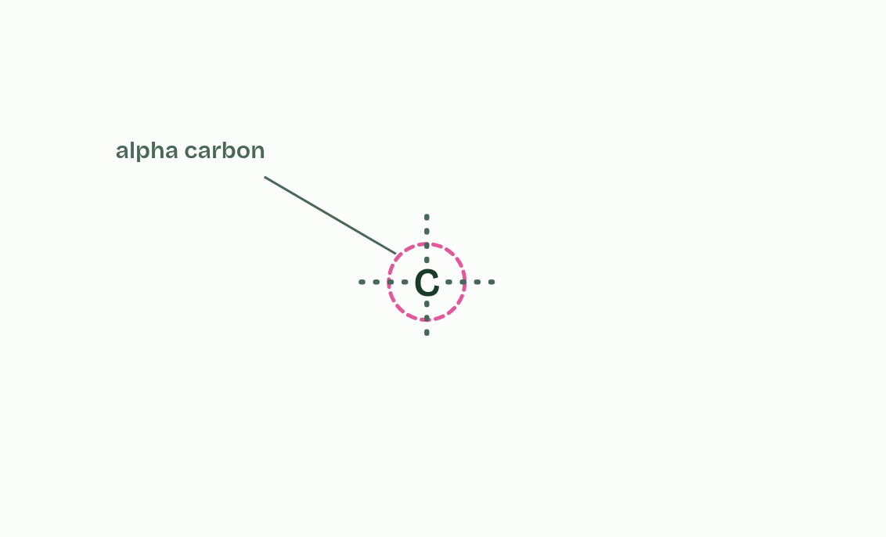
CHAPTER 1 · B1.2.1 Generalised structure of an amino acid
1 / 6
Every amino acid is built on the same core
The alpha carbon makes four bonds.
Minutes 5 to 15
Notes:
Minutes 5 to 15 of 60: The five strokes (10 min).
The plan: Play chapter 1’s figure one step at a time, with students drawing along on paper. Turn over the A Cat Has Rhythm tiles. Pairs then check each other’s drawing for the five things an examiner looks for: the alpha carbon, the amine group, the carboxyl group, the hydrogen and the R group, with every bond showing.
A protein is a polymer (B1.1), a long chain of the same kind of unit joined end to end. The units are amino acids, and every one of them starts from the same pattern.
At the middle sits one carbon atom, the alpha carbon. Carbon always makes four bonds, and here they go to four different things: an amine group (-NH₂), a carboxyl group (-COOH), a single hydrogen atom and an R group. The name says it: “amino” from the amine group, “acid” from the carboxyl group, which can give up a hydrogen ion.
The R group is the only part that varies. The genetic code uses twenty different R groups, so there are twenty amino acids. The smallest R group is a single hydrogen atom, and others are chains or rings, some containing oxygen, nitrogen or sulfur. At standard level you do not need to name any of them.

Slide 5
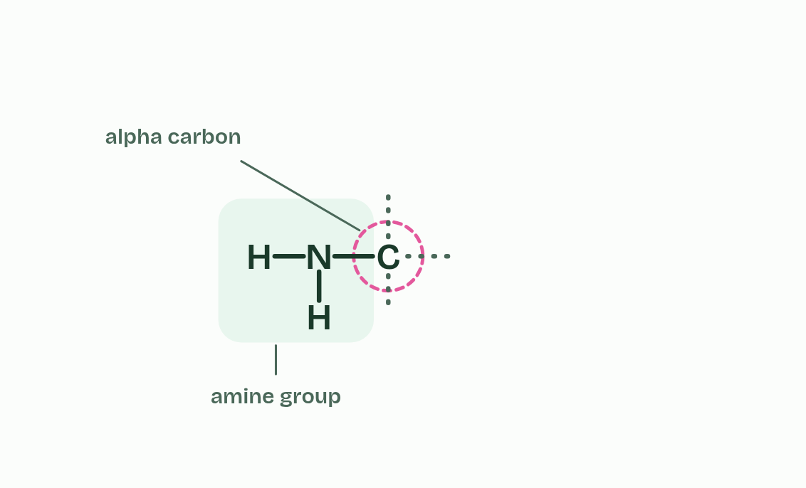
CHAPTER 1 · B1.2.1 Generalised structure of an amino acid
2 / 6
Every amino acid is built on the same core
An amine group goes on the left bond: a nitrogen with two hydrogens.
Minutes 5 to 15
Notes:
Minutes 5 to 15 of 60: The five strokes (10 min).
The plan: Play chapter 1’s figure one step at a time, with students drawing along on paper. Turn over the A Cat Has Rhythm tiles. Pairs then check each other’s drawing for the five things an examiner looks for: the alpha carbon, the amine group, the carboxyl group, the hydrogen and the R group, with every bond showing.
A protein is a polymer (B1.1), a long chain of the same kind of unit joined end to end. The units are amino acids, and every one of them starts from the same pattern.
At the middle sits one carbon atom, the alpha carbon. Carbon always makes four bonds, and here they go to four different things: an amine group (-NH₂), a carboxyl group (-COOH), a single hydrogen atom and an R group. The name says it: “amino” from the amine group, “acid” from the carboxyl group, which can give up a hydrogen ion.
The R group is the only part that varies. The genetic code uses twenty different R groups, so there are twenty amino acids. The smallest R group is a single hydrogen atom, and others are chains or rings, some containing oxygen, nitrogen or sulfur. At standard level you do not need to name any of them.

Slide 6
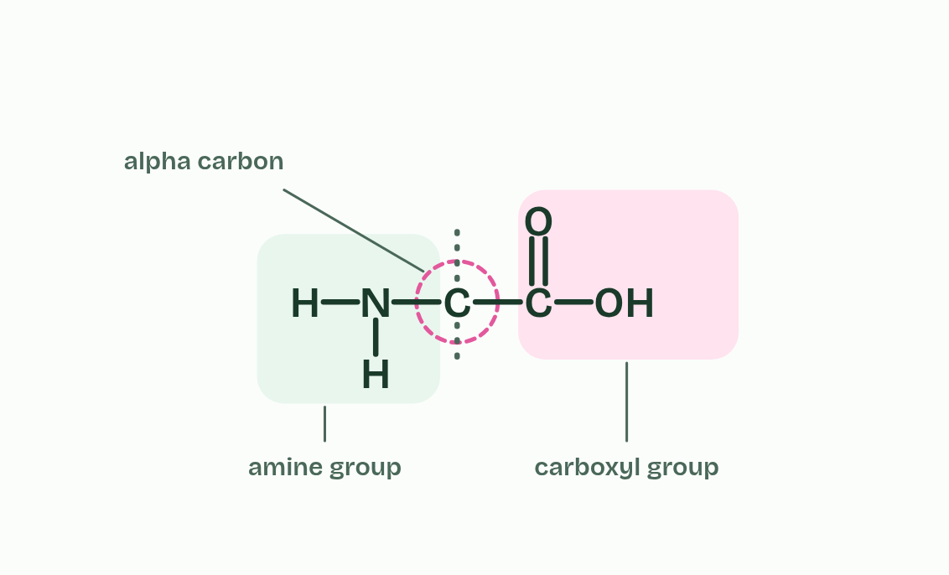
CHAPTER 1 · B1.2.1 Generalised structure of an amino acid
3 / 6
Every amino acid is built on the same core
A carboxyl group goes on the right bond: a carbon with a double bond to one oxygen and a single bond to an OH.
Minutes 5 to 15
Notes:
Minutes 5 to 15 of 60: The five strokes (10 min).
The plan: Play chapter 1’s figure one step at a time, with students drawing along on paper. Turn over the A Cat Has Rhythm tiles. Pairs then check each other’s drawing for the five things an examiner looks for: the alpha carbon, the amine group, the carboxyl group, the hydrogen and the R group, with every bond showing.
A protein is a polymer (B1.1), a long chain of the same kind of unit joined end to end. The units are amino acids, and every one of them starts from the same pattern.
At the middle sits one carbon atom, the alpha carbon. Carbon always makes four bonds, and here they go to four different things: an amine group (-NH₂), a carboxyl group (-COOH), a single hydrogen atom and an R group. The name says it: “amino” from the amine group, “acid” from the carboxyl group, which can give up a hydrogen ion.
The R group is the only part that varies. The genetic code uses twenty different R groups, so there are twenty amino acids. The smallest R group is a single hydrogen atom, and others are chains or rings, some containing oxygen, nitrogen or sulfur. At standard level you do not need to name any of them.

Slide 7
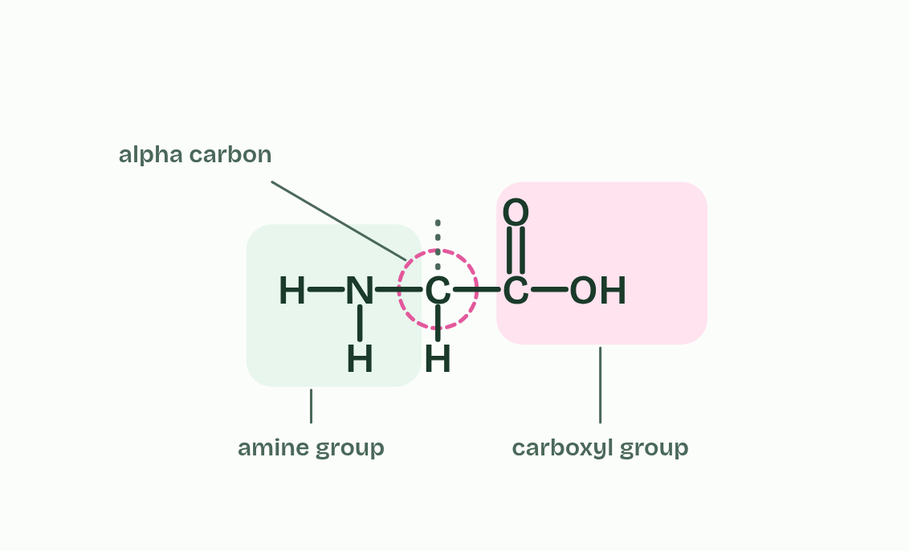
CHAPTER 1 · B1.2.1 Generalised structure of an amino acid
4 / 6
Every amino acid is built on the same core
One hydrogen atom goes on the bottom bond.
Minutes 5 to 15
Notes:
Minutes 5 to 15 of 60: The five strokes (10 min).
The plan: Play chapter 1’s figure one step at a time, with students drawing along on paper. Turn over the A Cat Has Rhythm tiles. Pairs then check each other’s drawing for the five things an examiner looks for: the alpha carbon, the amine group, the carboxyl group, the hydrogen and the R group, with every bond showing.
A protein is a polymer (B1.1), a long chain of the same kind of unit joined end to end. The units are amino acids, and every one of them starts from the same pattern.
At the middle sits one carbon atom, the alpha carbon. Carbon always makes four bonds, and here they go to four different things: an amine group (-NH₂), a carboxyl group (-COOH), a single hydrogen atom and an R group. The name says it: “amino” from the amine group, “acid” from the carboxyl group, which can give up a hydrogen ion.
The R group is the only part that varies. The genetic code uses twenty different R groups, so there are twenty amino acids. The smallest R group is a single hydrogen atom, and others are chains or rings, some containing oxygen, nitrogen or sulfur. At standard level you do not need to name any of them.

Slide 8
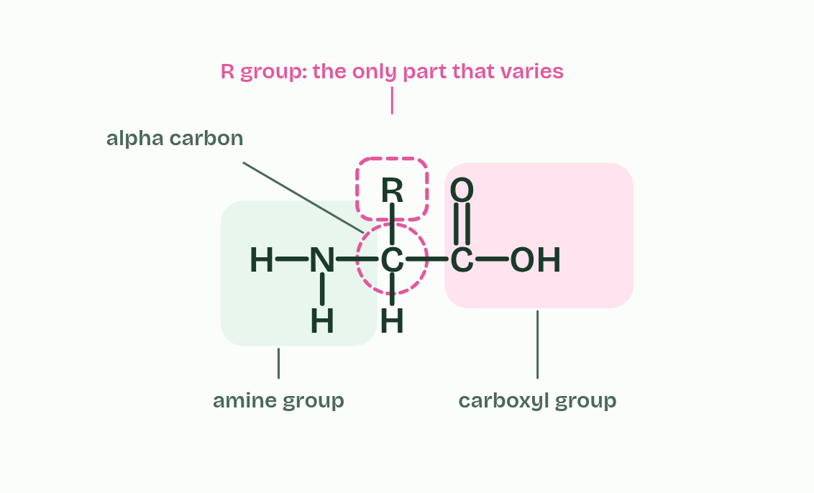
CHAPTER 1 · B1.2.1 Generalised structure of an amino acid
5 / 6
Every amino acid is built on the same core
The last bond carries the R group. It stands for whatever side chain this amino acid has.
Minutes 5 to 15
Notes:
Minutes 5 to 15 of 60: The five strokes (10 min).
The plan: Play chapter 1’s figure one step at a time, with students drawing along on paper. Turn over the A Cat Has Rhythm tiles. Pairs then check each other’s drawing for the five things an examiner looks for: the alpha carbon, the amine group, the carboxyl group, the hydrogen and the R group, with every bond showing.
A protein is a polymer (B1.1), a long chain of the same kind of unit joined end to end. The units are amino acids, and every one of them starts from the same pattern.
At the middle sits one carbon atom, the alpha carbon. Carbon always makes four bonds, and here they go to four different things: an amine group (-NH₂), a carboxyl group (-COOH), a single hydrogen atom and an R group. The name says it: “amino” from the amine group, “acid” from the carboxyl group, which can give up a hydrogen ion.
The R group is the only part that varies. The genetic code uses twenty different R groups, so there are twenty amino acids. The smallest R group is a single hydrogen atom, and others are chains or rings, some containing oxygen, nitrogen or sulfur. At standard level you do not need to name any of them.

Slide 9
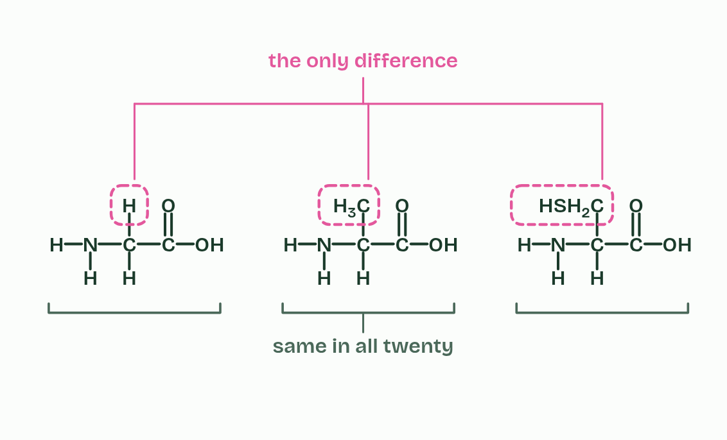
CHAPTER 1 · B1.2.1 Generalised structure of an amino acid
6 / 6
Every amino acid is built on the same core
Three different amino acids: the same core in each, and only the R group differs.
Minutes 5 to 15
Notes:
Minutes 5 to 15 of 60: The five strokes (10 min).
The plan: Play chapter 1’s figure one step at a time, with students drawing along on paper. Turn over the A Cat Has Rhythm tiles. Pairs then check each other’s drawing for the five things an examiner looks for: the alpha carbon, the amine group, the carboxyl group, the hydrogen and the R group, with every bond showing.
A protein is a polymer (B1.1), a long chain of the same kind of unit joined end to end. The units are amino acids, and every one of them starts from the same pattern.
At the middle sits one carbon atom, the alpha carbon. Carbon always makes four bonds, and here they go to four different things: an amine group (-NH₂), a carboxyl group (-COOH), a single hydrogen atom and an R group. The name says it: “amino” from the amine group, “acid” from the carboxyl group, which can give up a hydrogen ion.
The R group is the only part that varies. The genetic code uses twenty different R groups, so there are twenty amino acids. The smallest R group is a single hydrogen atom, and others are chains or rings, some containing oxygen, nitrogen or sulfur. At standard level you do not need to name any of them.

Slide 10
CHAPTER 1 · B1.2.1 Generalised structure of an amino acid
Every amino acid is built on the same core
Draw the alpha carbon in the middle, the amine group on one side and the carboxyl group on the other, hydrogen and R above and below.
Show every atom and every bond, in the un-ionised form (-NH₂ and -COOH), as the markschemes do.
Count the bonds: four on carbon, three on nitrogen, two on oxygen, one on hydrogen.
Minutes 5 to 15
Notes:
Minutes 5 to 15 of 60: The five strokes (10 min).
The plan: Play chapter 1’s figure one step at a time, with students drawing along on paper. Turn over the A Cat Has Rhythm tiles. Pairs then check each other’s drawing for the five things an examiner looks for: the alpha carbon, the amine group, the carboxyl group, the hydrogen and the R group, with every bond showing.
A protein is a polymer (B1.1), a long chain of the same kind of unit joined end to end. The units are amino acids, and every one of them starts from the same pattern.
At the middle sits one carbon atom, the alpha carbon. Carbon always makes four bonds, and here they go to four different things: an amine group (-NH₂), a carboxyl group (-COOH), a single hydrogen atom and an R group. The name says it: “amino” from the amine group, “acid” from the carboxyl group, which can give up a hydrogen ion.
The R group is the only part that varies. The genetic code uses twenty different R groups, so there are twenty amino acids. The smallest R group is a single hydrogen atom, and others are chains or rings, some containing oxygen, nitrogen or sulfur. At standard level you do not need to name any of them.

Slide 11
PREDICT
A student draws an alpha carbon bonded to -NH₂, -COOH, R and -OH. What is wrong with the drawing?
A Nothing is wrong: the alpha carbon can carry any four groups, as long as it makes four bonds
B The fourth group should be a single hydrogen atom, not -OH
C The R group is in the wrong place: it should be bonded to the nitrogen of the amine group
Minutes 5 to 15
Notes:
Minutes 5 to 15 of 60: The five strokes (10 min).
The plan: Play chapter 1’s figure one step at a time, with students drawing along on paper. Turn over the A Cat Has Rhythm tiles. Pairs then check each other’s drawing for the five things an examiner looks for: the alpha carbon, the amine group, the carboxyl group, the hydrogen and the R group, with every bond showing.
Ask for a show of hands, or mini whiteboards, before revealing. (Answer: B, on the next slide.)

Slide 12
WHAT HAPPENS
A student draws an alpha carbon bonded to -NH₂, -COOH, R and -OH. What is wrong with the drawing?
A Nothing is wrong: the alpha carbon can carry any four groups, as long as it makes four bonds
B The fourth group should be a single hydrogen atom, not -OH
C The R group is in the wrong place: it should be bonded to the nitrogen of the amine group
The alpha carbon always carries a single hydrogen atom. With -OH in its place the drawing is not an amino acid, and an examiner would not award the mark for the alpha carbon’s groups. Check every drawing for the H.
Minutes 5 to 15
Notes:
Minutes 5 to 15 of 60: The five strokes (10 min).
The plan: Play chapter 1’s figure one step at a time, with students drawing along on paper. Turn over the A Cat Has Rhythm tiles. Pairs then check each other’s drawing for the five things an examiner looks for: the alpha carbon, the amine group, the carboxyl group, the hydrogen and the R group, with every bond showing.
Answer: B. The alpha carbon always carries a single hydrogen atom. With -OH in its place the drawing is not an amino acid, and an examiner would not award the mark for the alpha carbon’s groups. Check every drawing for the H.

Slide 13
WATCH OUT
R is not an element. It stands for the side chain, whatever it is in that amino acid. And check every drawing by counting bonds: four on every carbon, three on nitrogen, two on oxygen, one on hydrogen.
Minutes 5 to 15
Notes:
Minutes 5 to 15 of 60: The five strokes (10 min).
The plan: Play chapter 1’s figure one step at a time, with students drawing along on paper. Turn over the A Cat Has Rhythm tiles. Pairs then check each other’s drawing for the five things an examiner looks for: the alpha carbon, the amine group, the carboxyl group, the hydrogen and the R group, with every bond showing.
A common mistake: say it, then ask who can say why it is wrong.

Slide 14
REMEMBER IT
The four groups on the alpha carbon
A
C
H
R
A
Cat
Has
Rhythm
Minutes 5 to 15
Notes:
Minutes 5 to 15 of 60: The five strokes (10 min).
The plan: Play chapter 1’s figure one step at a time, with students drawing along on paper. Turn over the A Cat Has Rhythm tiles. Pairs then check each other’s drawing for the five things an examiner looks for: the alpha carbon, the amine group, the carboxyl group, the hydrogen and the R group, with every bond showing.
Ask the class what each letter stands for before revealing.

Slide 15
REMEMBER IT
The four groups on the alpha carbon
A
C
H
R
A
Cat
Has
Rhythm
Amine group
Carboxyl group
Hydrogen
R group
-NH₂, on one side
-COOH, on the other side
one H atom
the only part that varies
Minutes 5 to 15
Notes:
Minutes 5 to 15 of 60: The five strokes (10 min).
The plan: Play chapter 1’s figure one step at a time, with students drawing along on paper. Turn over the A Cat Has Rhythm tiles. Pairs then check each other’s drawing for the five things an examiner looks for: the alpha carbon, the amine group, the carboxyl group, the hydrogen and the R group, with every bond showing.
A: Amine group (-NH₂, on one side)
Cat: Carboxyl group (-COOH, on the other side)
Has: Hydrogen (one H atom)
Rhythm: R group (the only part that varies)

Slide 16
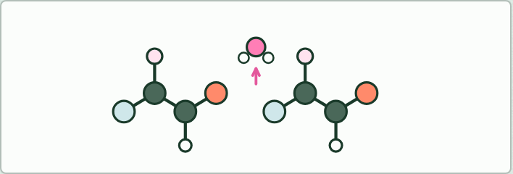
MODEL
15 MIN
Model it, then draw it
THE TASK
Pairs build two amino acids from a molecular model kit (two of the simplest, any two), take an -OH from one carboxyl group and an -H from the other amine group, join them as water, and connect the C to the N. Then they draw the dipeptide on paper and write the word equation. Last, they build a third amino acid and add it.
STUDENTS NEED
Molecular model kits (or snatoms, as in A1.1), one per pair.
Minutes 15 to 30
Notes:
Minutes 15 to 30 of 60: Model it, then draw it (15 min).
The plan: With model kits, pairs build two amino acids, take the OH and the H away as water, join the C to the N and then draw the dipeptide and write the word equation (activity below). Then they add a third amino acid.
The activity: Model it, then draw it. Pairs build two amino acids from a molecular model kit (two of the simplest, any two), take an -OH from one carboxyl group and an -H from the other amine group, join them as water, and connect the C to the N. Then they draw the dipeptide on paper and write the word equation. Last, they build a third amino acid and add it.
Needs: molecular model kits (or snatoms, as in A1.1), one per pair.
The time: 15 minutes, minutes 15 to 30 of the plan.

Slide 17
STEP 4
10 MIN
Peptide bonds
Chapter 2: Peptide bonds join amino acids, and water leaves
Minutes 30 to 40
Notes:
Minutes 30 to 40 of 60: Peptide bonds (10 min).
The plan: Chapter 2: the bond builder on the board, joining two different amino acids both ways round, then the predict box. Write the word equation once more, from memory.

Slide 18
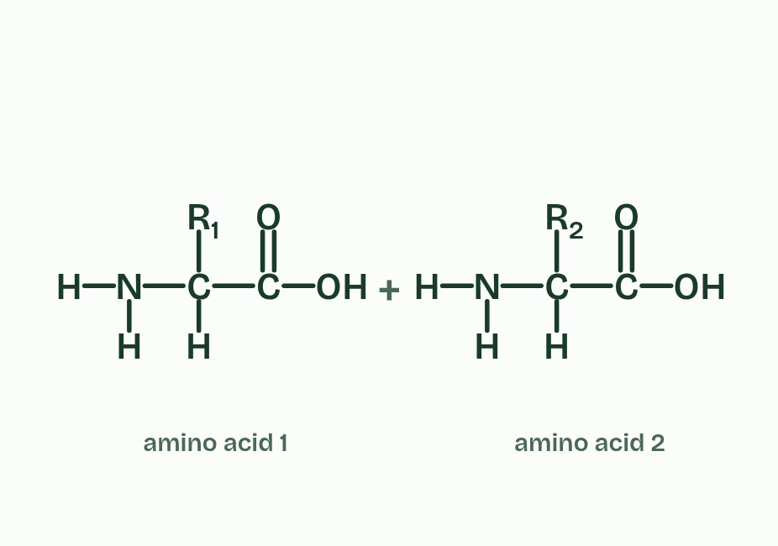
CHAPTER 2 · B1.2.2 Condensation reactions forming dipeptides and longer chains
1 / 4
Peptide bonds join amino acids, and water leaves
Two amino acids, R₁ and R₂, with the carboxyl group of the first facing the amine group of the second.
Minutes 30 to 40
Notes:
Minutes 30 to 40 of 60: Peptide bonds (10 min).
The plan: Chapter 2: the bond builder on the board, joining two different amino acids both ways round, then the predict box. Write the word equation once more, from memory.
Amino acids join by the same move as every other monomer in B1.1, a condensation reaction. The OH from the carboxyl group of one amino acid and an H from the amine group of the next leave together as a molecule of water. The carbon of the carboxyl group is then left bonded to the nitrogen of the amine group, and that C-N bond is a peptide bond, a strong covalent bond. Two amino acids make a dipeptide.
The word equation is amino acid + amino acid → dipeptide + water.
The dipeptide still has a free amine group at one end and a free carboxyl group at the other, so more amino acids can join on in the same way. A long chain is a polypeptide (a short chain of a few amino acids is sometimes called an oligopeptide). A chain of n amino acids has n − 1 peptide bonds, and n − 1 molecules of water were released making it. Hydrolysis, adding water back, reverses it, which is what digestion does to the proteins in food. In cells, ribosomes make the peptide bonds, in the order a gene sets (D1.2).
A protein is one or more polypeptides folded into a working shape. Model this reaction with a kit first (see Teach), then try the bond builder below and draw a dipeptide.
Example: Insulin has two polypeptides. The shorter has 21 amino acids and so 20 peptide bonds, and the longer has 30 and so 29.

Slide 19
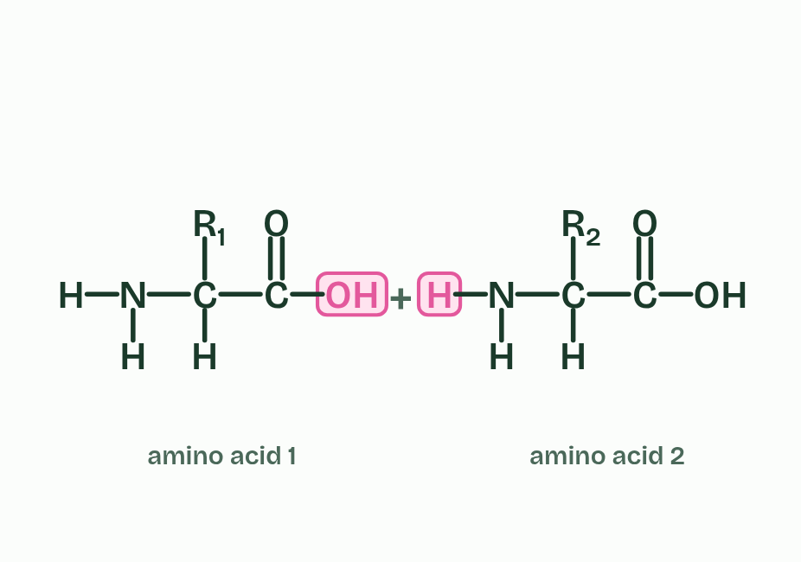
CHAPTER 2 · B1.2.2 Condensation reactions forming dipeptides and longer chains
2 / 4
Peptide bonds join amino acids, and water leaves
The OH from the carboxyl group and one H from the amine group are lit: they will leave as water.
Minutes 30 to 40
Notes:
Minutes 30 to 40 of 60: Peptide bonds (10 min).
The plan: Chapter 2: the bond builder on the board, joining two different amino acids both ways round, then the predict box. Write the word equation once more, from memory.
Amino acids join by the same move as every other monomer in B1.1, a condensation reaction. The OH from the carboxyl group of one amino acid and an H from the amine group of the next leave together as a molecule of water. The carbon of the carboxyl group is then left bonded to the nitrogen of the amine group, and that C-N bond is a peptide bond, a strong covalent bond. Two amino acids make a dipeptide.
The word equation is amino acid + amino acid → dipeptide + water.
The dipeptide still has a free amine group at one end and a free carboxyl group at the other, so more amino acids can join on in the same way. A long chain is a polypeptide (a short chain of a few amino acids is sometimes called an oligopeptide). A chain of n amino acids has n − 1 peptide bonds, and n − 1 molecules of water were released making it. Hydrolysis, adding water back, reverses it, which is what digestion does to the proteins in food. In cells, ribosomes make the peptide bonds, in the order a gene sets (D1.2).
A protein is one or more polypeptides folded into a working shape. Model this reaction with a kit first (see Teach), then try the bond builder below and draw a dipeptide.
Example: Insulin has two polypeptides. The shorter has 21 amino acids and so 20 peptide bonds, and the longer has 30 and so 29.

Slide 20
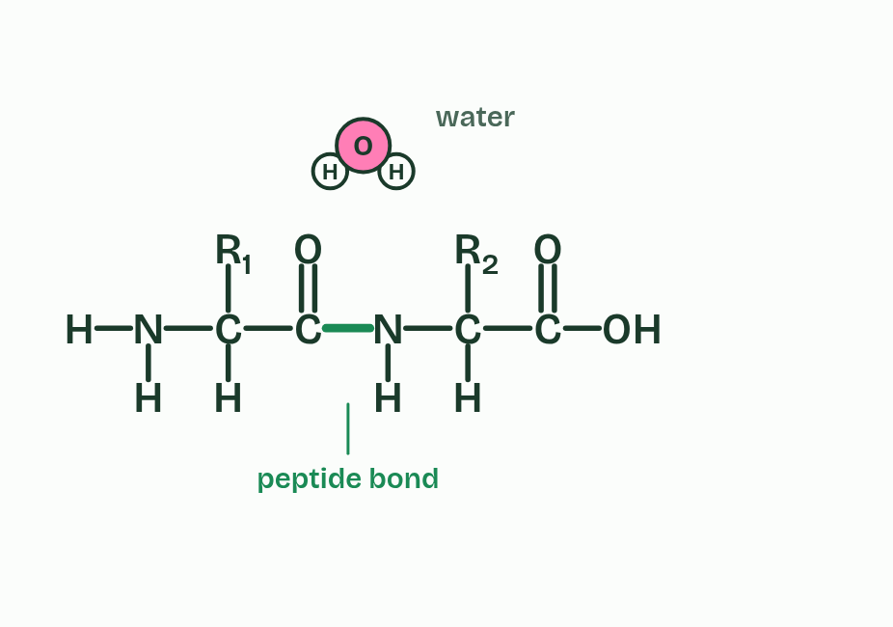
CHAPTER 2 · B1.2.2 Condensation reactions forming dipeptides and longer chains
3 / 4
Peptide bonds join amino acids, and water leaves
The carbon bonds to the nitrogen and the water drifts away. The new C-N bond is a peptide bond.
Minutes 30 to 40
Notes:
Minutes 30 to 40 of 60: Peptide bonds (10 min).
The plan: Chapter 2: the bond builder on the board, joining two different amino acids both ways round, then the predict box. Write the word equation once more, from memory.
Amino acids join by the same move as every other monomer in B1.1, a condensation reaction. The OH from the carboxyl group of one amino acid and an H from the amine group of the next leave together as a molecule of water. The carbon of the carboxyl group is then left bonded to the nitrogen of the amine group, and that C-N bond is a peptide bond, a strong covalent bond. Two amino acids make a dipeptide.
The word equation is amino acid + amino acid → dipeptide + water.
The dipeptide still has a free amine group at one end and a free carboxyl group at the other, so more amino acids can join on in the same way. A long chain is a polypeptide (a short chain of a few amino acids is sometimes called an oligopeptide). A chain of n amino acids has n − 1 peptide bonds, and n − 1 molecules of water were released making it. Hydrolysis, adding water back, reverses it, which is what digestion does to the proteins in food. In cells, ribosomes make the peptide bonds, in the order a gene sets (D1.2).
A protein is one or more polypeptides folded into a working shape. Model this reaction with a kit first (see Teach), then try the bond builder below and draw a dipeptide.
Example: Insulin has two polypeptides. The shorter has 21 amino acids and so 20 peptide bonds, and the longer has 30 and so 29.

Slide 21
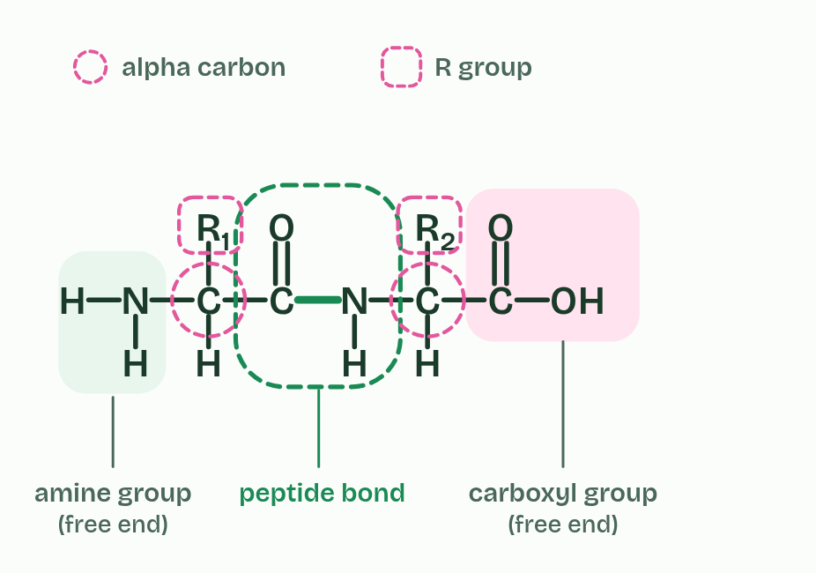
CHAPTER 2 · B1.2.2 Condensation reactions forming dipeptides and longer chains
4 / 4
Peptide bonds join amino acids, and water leaves
A dipeptide, drawn as an examiner wants it. It still has an amine group at one end and a carboxyl group at the other.
Minutes 30 to 40
Notes:
Minutes 30 to 40 of 60: Peptide bonds (10 min).
The plan: Chapter 2: the bond builder on the board, joining two different amino acids both ways round, then the predict box. Write the word equation once more, from memory.
Amino acids join by the same move as every other monomer in B1.1, a condensation reaction. The OH from the carboxyl group of one amino acid and an H from the amine group of the next leave together as a molecule of water. The carbon of the carboxyl group is then left bonded to the nitrogen of the amine group, and that C-N bond is a peptide bond, a strong covalent bond. Two amino acids make a dipeptide.
The word equation is amino acid + amino acid → dipeptide + water.
The dipeptide still has a free amine group at one end and a free carboxyl group at the other, so more amino acids can join on in the same way. A long chain is a polypeptide (a short chain of a few amino acids is sometimes called an oligopeptide). A chain of n amino acids has n − 1 peptide bonds, and n − 1 molecules of water were released making it. Hydrolysis, adding water back, reverses it, which is what digestion does to the proteins in food. In cells, ribosomes make the peptide bonds, in the order a gene sets (D1.2).
A protein is one or more polypeptides folded into a working shape. Model this reaction with a kit first (see Teach), then try the bond builder below and draw a dipeptide.
Example: Insulin has two polypeptides. The shorter has 21 amino acids and so 20 peptide bonds, and the longer has 30 and so 29.

Slide 22
CHAPTER 2 · B1.2.2 Condensation reactions forming dipeptides and longer chains
Peptide bonds join amino acids, and water leaves
The carbon of the carboxyl group is then left bonded to the nitrogen of the amine group, and that C-N bond is a peptide bond, a strong covalent bond.
Two amino acids make a dipeptide.
The word equation is amino acid + amino acid → dipeptide + water.
The dipeptide still has a free amine group at one end and a free carboxyl group at the other, so more amino acids can join on in the same way.
Minutes 30 to 40
Notes:
Minutes 30 to 40 of 60: Peptide bonds (10 min).
The plan: Chapter 2: the bond builder on the board, joining two different amino acids both ways round, then the predict box. Write the word equation once more, from memory.
Amino acids join by the same move as every other monomer in B1.1, a condensation reaction. The OH from the carboxyl group of one amino acid and an H from the amine group of the next leave together as a molecule of water. The carbon of the carboxyl group is then left bonded to the nitrogen of the amine group, and that C-N bond is a peptide bond, a strong covalent bond. Two amino acids make a dipeptide.
The word equation is amino acid + amino acid → dipeptide + water.
The dipeptide still has a free amine group at one end and a free carboxyl group at the other, so more amino acids can join on in the same way. A long chain is a polypeptide (a short chain of a few amino acids is sometimes called an oligopeptide). A chain of n amino acids has n − 1 peptide bonds, and n − 1 molecules of water were released making it. Hydrolysis, adding water back, reverses it, which is what digestion does to the proteins in food. In cells, ribosomes make the peptide bonds, in the order a gene sets (D1.2).
A protein is one or more polypeptides folded into a working shape. Model this reaction with a kit first (see Teach), then try the bond builder below and draw a dipeptide.
Example: Insulin has two polypeptides. The shorter has 21 amino acids and so 20 peptide bonds, and the longer has 30 and so 29.

Slide 23
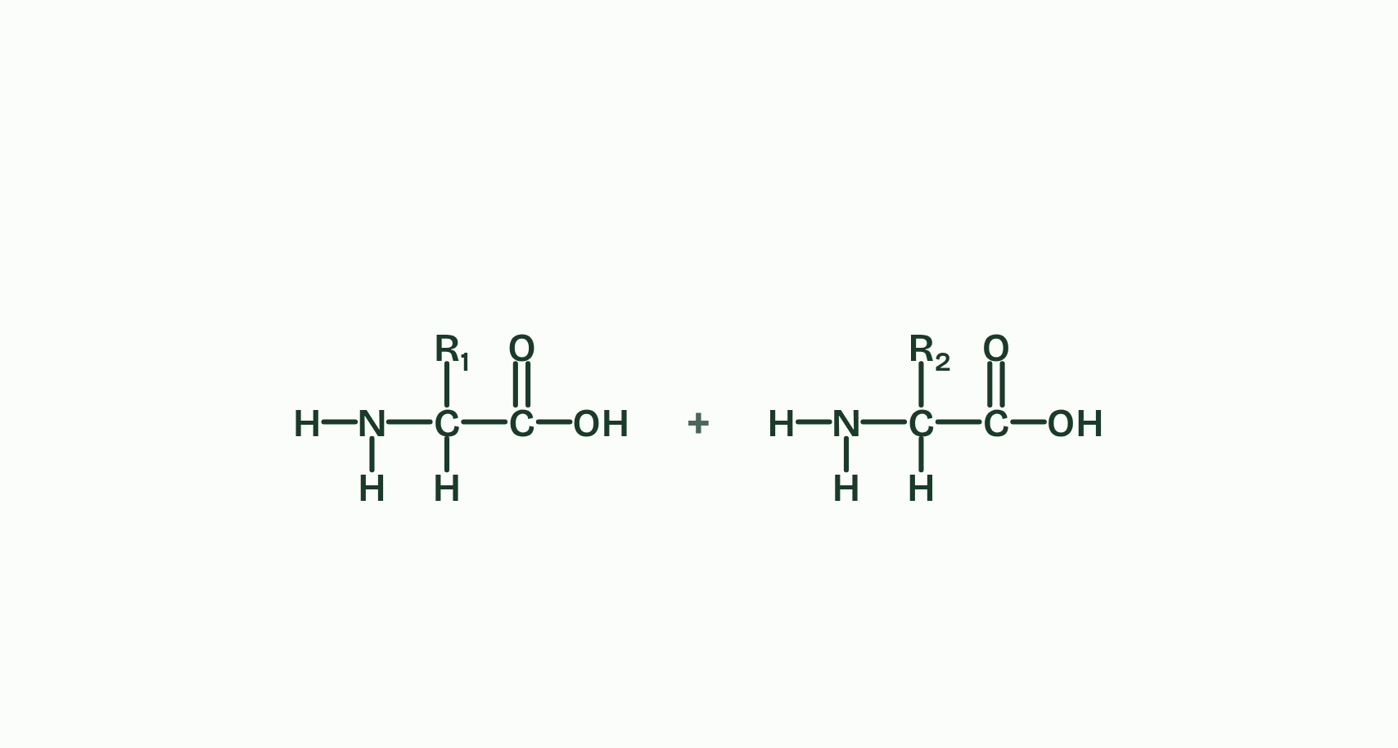
CHAPTER 2 · B1.2.2 Condensation reactions forming dipeptides and longer chains
1 / 4
Peptide bonds join amino acids, and water leaves
Two amino acids.
Minutes 30 to 40
Notes:
Minutes 30 to 40 of 60: Peptide bonds (10 min).
The plan: Chapter 2: the bond builder on the board, joining two different amino acids both ways round, then the predict box. Write the word equation once more, from memory.
Amino acids join by the same move as every other monomer in B1.1, a condensation reaction. The OH from the carboxyl group of one amino acid and an H from the amine group of the next leave together as a molecule of water. The carbon of the carboxyl group is then left bonded to the nitrogen of the amine group, and that C-N bond is a peptide bond, a strong covalent bond. Two amino acids make a dipeptide.
The word equation is amino acid + amino acid → dipeptide + water.
The dipeptide still has a free amine group at one end and a free carboxyl group at the other, so more amino acids can join on in the same way. A long chain is a polypeptide (a short chain of a few amino acids is sometimes called an oligopeptide). A chain of n amino acids has n − 1 peptide bonds, and n − 1 molecules of water were released making it. Hydrolysis, adding water back, reverses it, which is what digestion does to the proteins in food. In cells, ribosomes make the peptide bonds, in the order a gene sets (D1.2).
A protein is one or more polypeptides folded into a working shape. Model this reaction with a kit first (see Teach), then try the bond builder below and draw a dipeptide.
Example: Insulin has two polypeptides. The shorter has 21 amino acids and so 20 peptide bonds, and the longer has 30 and so 29.

Slide 24
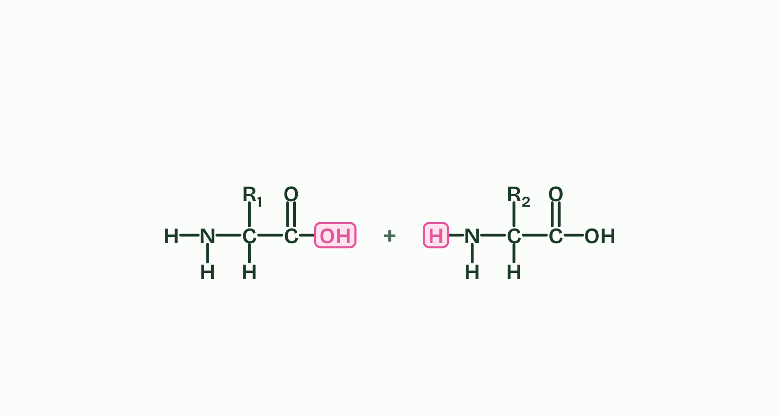
CHAPTER 2 · B1.2.2 Condensation reactions forming dipeptides and longer chains
2 / 4
Peptide bonds join amino acids, and water leaves
The OH of one's carboxyl group and an H of the other's amine group face each other.
Minutes 30 to 40
Notes:
Minutes 30 to 40 of 60: Peptide bonds (10 min).
The plan: Chapter 2: the bond builder on the board, joining two different amino acids both ways round, then the predict box. Write the word equation once more, from memory.
Amino acids join by the same move as every other monomer in B1.1, a condensation reaction. The OH from the carboxyl group of one amino acid and an H from the amine group of the next leave together as a molecule of water. The carbon of the carboxyl group is then left bonded to the nitrogen of the amine group, and that C-N bond is a peptide bond, a strong covalent bond. Two amino acids make a dipeptide.
The word equation is amino acid + amino acid → dipeptide + water.
The dipeptide still has a free amine group at one end and a free carboxyl group at the other, so more amino acids can join on in the same way. A long chain is a polypeptide (a short chain of a few amino acids is sometimes called an oligopeptide). A chain of n amino acids has n − 1 peptide bonds, and n − 1 molecules of water were released making it. Hydrolysis, adding water back, reverses it, which is what digestion does to the proteins in food. In cells, ribosomes make the peptide bonds, in the order a gene sets (D1.2).
A protein is one or more polypeptides folded into a working shape. Model this reaction with a kit first (see Teach), then try the bond builder below and draw a dipeptide.
Example: Insulin has two polypeptides. The shorter has 21 amino acids and so 20 peptide bonds, and the longer has 30 and so 29.

Slide 25
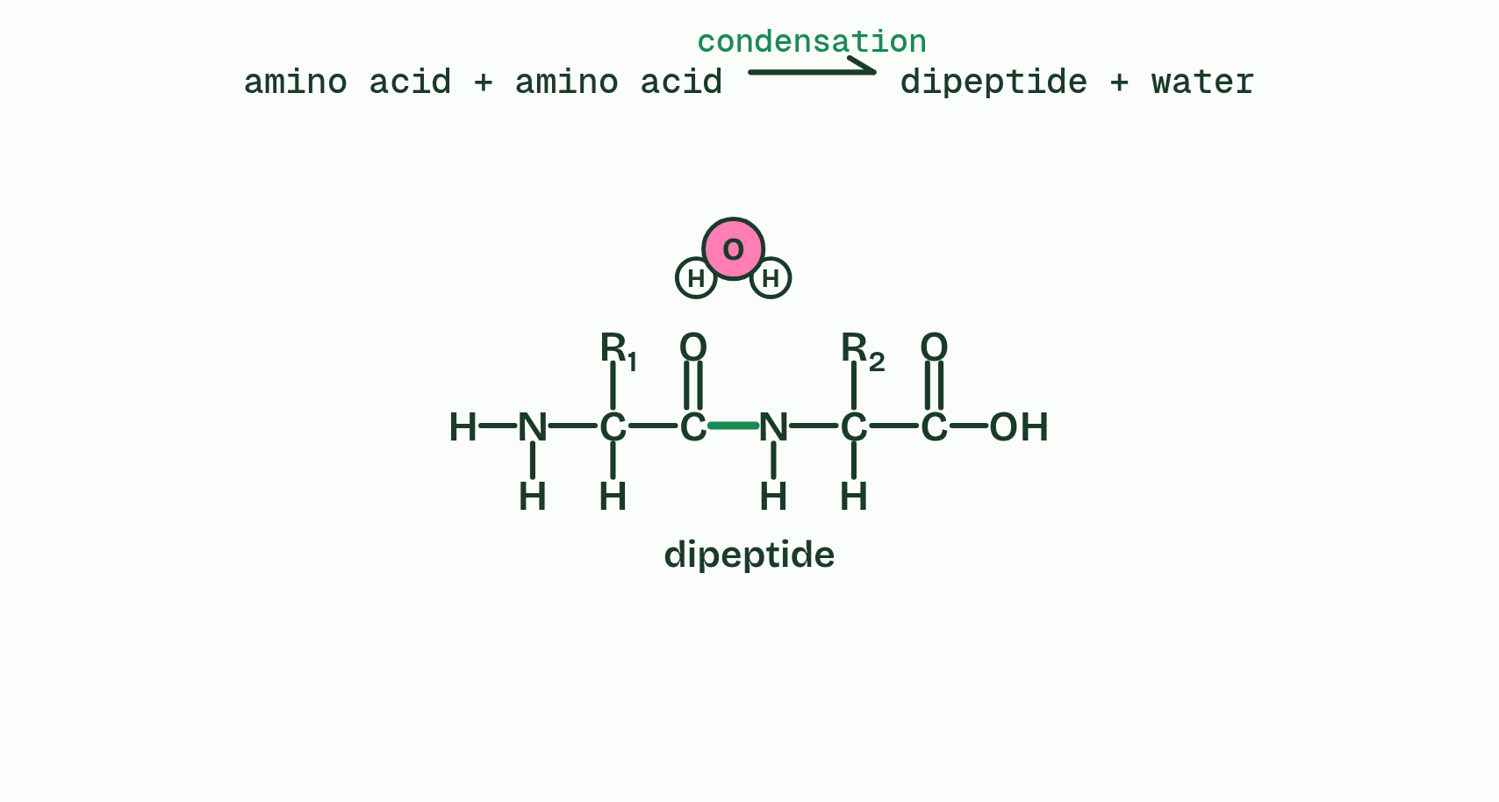
CHAPTER 2 · B1.2.2 Condensation reactions forming dipeptides and longer chains
3 / 4
Peptide bonds join amino acids, and water leaves
They leave as water, and a peptide bond joins the carbon to the nitrogen: condensation, making a dipeptide.
Minutes 30 to 40
Notes:
Minutes 30 to 40 of 60: Peptide bonds (10 min).
The plan: Chapter 2: the bond builder on the board, joining two different amino acids both ways round, then the predict box. Write the word equation once more, from memory.
Amino acids join by the same move as every other monomer in B1.1, a condensation reaction. The OH from the carboxyl group of one amino acid and an H from the amine group of the next leave together as a molecule of water. The carbon of the carboxyl group is then left bonded to the nitrogen of the amine group, and that C-N bond is a peptide bond, a strong covalent bond. Two amino acids make a dipeptide.
The word equation is amino acid + amino acid → dipeptide + water.
The dipeptide still has a free amine group at one end and a free carboxyl group at the other, so more amino acids can join on in the same way. A long chain is a polypeptide (a short chain of a few amino acids is sometimes called an oligopeptide). A chain of n amino acids has n − 1 peptide bonds, and n − 1 molecules of water were released making it. Hydrolysis, adding water back, reverses it, which is what digestion does to the proteins in food. In cells, ribosomes make the peptide bonds, in the order a gene sets (D1.2).
A protein is one or more polypeptides folded into a working shape. Model this reaction with a kit first (see Teach), then try the bond builder below and draw a dipeptide.
Example: Insulin has two polypeptides. The shorter has 21 amino acids and so 20 peptide bonds, and the longer has 30 and so 29.

Slide 26
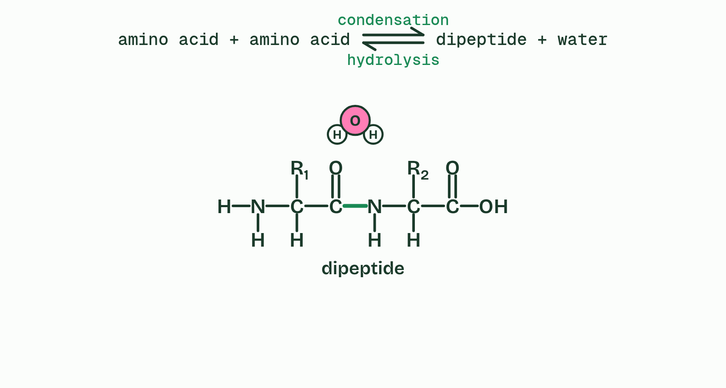
CHAPTER 2 · B1.2.2 Condensation reactions forming dipeptides and longer chains
4 / 4
Peptide bonds join amino acids, and water leaves
Add water and the peptide bond splits again, the OH back to the carbon and the H to the nitrogen: hydrolysis.
Minutes 30 to 40
Notes:
Minutes 30 to 40 of 60: Peptide bonds (10 min).
The plan: Chapter 2: the bond builder on the board, joining two different amino acids both ways round, then the predict box. Write the word equation once more, from memory.
Amino acids join by the same move as every other monomer in B1.1, a condensation reaction. The OH from the carboxyl group of one amino acid and an H from the amine group of the next leave together as a molecule of water. The carbon of the carboxyl group is then left bonded to the nitrogen of the amine group, and that C-N bond is a peptide bond, a strong covalent bond. Two amino acids make a dipeptide.
The word equation is amino acid + amino acid → dipeptide + water.
The dipeptide still has a free amine group at one end and a free carboxyl group at the other, so more amino acids can join on in the same way. A long chain is a polypeptide (a short chain of a few amino acids is sometimes called an oligopeptide). A chain of n amino acids has n − 1 peptide bonds, and n − 1 molecules of water were released making it. Hydrolysis, adding water back, reverses it, which is what digestion does to the proteins in food. In cells, ribosomes make the peptide bonds, in the order a gene sets (D1.2).
A protein is one or more polypeptides folded into a working shape. Model this reaction with a kit first (see Teach), then try the bond builder below and draw a dipeptide.
Example: Insulin has two polypeptides. The shorter has 21 amino acids and so 20 peptide bonds, and the longer has 30 and so 29.

Slide 27
CHAPTER 2 · B1.2.2 Condensation reactions forming dipeptides and longer chains
Peptide bonds join amino acids, and water leaves
The carbon of the carboxyl group is then left bonded to the nitrogen of the amine group, and that C-N bond is a peptide bond, a strong covalent bond.
Two amino acids make a dipeptide.
The word equation is amino acid + amino acid → dipeptide + water.
The dipeptide still has a free amine group at one end and a free carboxyl group at the other, so more amino acids can join on in the same way.
Minutes 30 to 40
Notes:
Minutes 30 to 40 of 60: Peptide bonds (10 min).
The plan: Chapter 2: the bond builder on the board, joining two different amino acids both ways round, then the predict box. Write the word equation once more, from memory.
Amino acids join by the same move as every other monomer in B1.1, a condensation reaction. The OH from the carboxyl group of one amino acid and an H from the amine group of the next leave together as a molecule of water. The carbon of the carboxyl group is then left bonded to the nitrogen of the amine group, and that C-N bond is a peptide bond, a strong covalent bond. Two amino acids make a dipeptide.
The word equation is amino acid + amino acid → dipeptide + water.
The dipeptide still has a free amine group at one end and a free carboxyl group at the other, so more amino acids can join on in the same way. A long chain is a polypeptide (a short chain of a few amino acids is sometimes called an oligopeptide). A chain of n amino acids has n − 1 peptide bonds, and n − 1 molecules of water were released making it. Hydrolysis, adding water back, reverses it, which is what digestion does to the proteins in food. In cells, ribosomes make the peptide bonds, in the order a gene sets (D1.2).
A protein is one or more polypeptides folded into a working shape. Model this reaction with a kit first (see Teach), then try the bond builder below and draw a dipeptide.
Example: Insulin has two polypeptides. The shorter has 21 amino acids and so 20 peptide bonds, and the longer has 30 and so 29.

Slide 28
PREDICT
Two different amino acids, A and B, are joined by one peptide bond. How many different dipeptides could they make?
A One: A joined to B is the same molecule as B joined to A, because the same two amino acids are used
B Four: any group on one amino acid can join any group on the other, so there are four ways to do it
C Two: A’s carboxyl to B’s amine, or B’s carboxyl to A’s amine, and these are different molecules
Minutes 30 to 40
Notes:
Minutes 30 to 40 of 60: Peptide bonds (10 min).
The plan: Chapter 2: the bond builder on the board, joining two different amino acids both ways round, then the predict box. Write the word equation once more, from memory.
Ask for a show of hands, or mini whiteboards, before revealing. (Answer: C, on the next slide.)

Slide 29
WHAT HAPPENS
Two different amino acids, A and B, are joined by one peptide bond. How many different dipeptides could they make?
A One: A joined to B is the same molecule as B joined to A, because the same two amino acids are used
B Four: any group on one amino acid can join any group on the other, so there are four ways to do it
C Two: A’s carboxyl to B’s amine, or B’s carboxyl to A’s amine, and these are different molecules
Two. A peptide bond always joins a carboxyl group to an amine group, so every dipeptide has an amine end and a carboxyl end. In A-B, A keeps its free amine group; in B-A, B does. The same amino acids make different molecules, which is why the order of amino acids matters (chapter 4). Try both ways round in the bond builder.
Minutes 30 to 40
Notes:
Minutes 30 to 40 of 60: Peptide bonds (10 min).
The plan: Chapter 2: the bond builder on the board, joining two different amino acids both ways round, then the predict box. Write the word equation once more, from memory.
Answer: C. Two. A peptide bond always joins a carboxyl group to an amine group, so every dipeptide has an amine end and a carboxyl end. In A-B, A keeps its free amine group; in B-A, B does. The same amino acids make different molecules, which is why the order of amino acids matters (chapter 4). Try both ways round in the bond builder.

Slide 30
WATCH OUT
The peptide bond is not between the two alpha carbons, not through an oxygen (C-O-N), and never involves an R group. And the water takes its OH from one amino acid and its H from the other, not both from the same one.
Minutes 30 to 40
Notes:
Minutes 30 to 40 of 60: Peptide bonds (10 min).
The plan: Chapter 2: the bond builder on the board, joining two different amino acids both ways round, then the predict box. Write the word equation once more, from memory.
A common mistake: say it, then ask who can say why it is wrong.

Slide 31
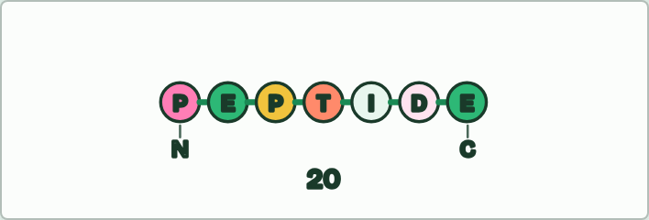
PUZZLE
15 MIN
Your name in amino acids
THE TASK
Each student spells a word or their name in the one-letter amino acid code (a table of the twenty letters on the board), draws it as a chain of beads, marks the peptide bonds, and marks the free amine group at one end and the free carboxyl group at the other. They count the bonds and the water released and work out how many sequences of that length could exist (20n). The letters B, J, O, U, X and Z have no standard amino acid (O and U are codes for rare extra ones, not the twenty). Inside a chain only the two ends keep a free amine or carboxyl group, so label the alpha carbons and R groups on every amino acid, but the amine and carboxyl only at the ends. Then they type the word into Fold a protein, under chapter 4, which counts its peptide bonds and the 20n again, and watch the chain fold; a short word stays loose, and the element says it is too short to fold up.
STUDENTS NEED
A printed one-letter table.
Minutes 40 to 55
Notes:
Minutes 40 to 55 of 60: Your name in amino acids (15 min).
The plan: Students spell a word in the one-letter code, draw it as a chain, mark the bonds and count the water released (activity below).
The activity: Your name in amino acids. Each student spells a word or their name in the one-letter amino acid code (a table of the twenty letters on the board), draws it as a chain of beads, marks the peptide bonds, and marks the free amine group at one end and the free carboxyl group at the other. They count the bonds and the water released and work out how many sequences of that length could exist (20n). The letters B, J, O, U, X and Z have no standard amino acid (O and U are codes for rare extra ones, not the twenty). Inside a chain only the two ends keep a free amine or carboxyl group, so label the alpha carbons and R groups on every amino acid, but the amine and carboxyl only at the ends. Then they type the word into Fold a protein, under chapter 4, which counts its peptide bonds and the 20n again, and watch the chain fold; a short word stays loose, and the element says it is too short to fold up.
Needs: a printed one-letter table.
The time: 15 minutes, minutes 40 to 55 of the plan.

Slide 32
PLENARY
Can you now...
Draw a generalised amino acid and name the four groups on its alpha carbon (B1.2.1)
Explain how condensation joins amino acids with peptide bonds, write the word equation and draw a dipeptide (B1.2.2)
Explain why the number of possible polypeptides is practically endless (B1.2.4)
Minutes 55 to 60
Notes:
Minutes 55 to 60 of 60: Exit (5 min).
The plan: How many different tripeptides are possible, and why?
Thumbs up, sideways or down on each goal before the exit question. The goals come from the statements this lesson covers.

Slide 33
EXIT QUESTION
Before you go
How many different tripeptides are possible, and why?
Minutes 55 to 60
Notes:
Minutes 55 to 60 of 60: Exit (5 min).
The plan: How many different tripeptides are possible, and why?

Slide 34
PRACTISE AND REVISE
Keep going
Exam practice: a fresh paper of exam questions on B1.2 at standard level, marked as you go
The guide, with the animations and the dry lab
This lesson in the guide: 1 Every amino acid is built on the same core, 2 Peptide bonds join amino acids, and water leaves
BUILD FOR YOUR CLASS
ALREADY ON THE SITE FOR B1.2
CARD SETS ON SPLYCR
Tarsia puzzle, dominoes and picture reveal on B1.2, built from its key terms and ready to print
A pub quiz with rounds on B1.2, to present or run with no projector
An escape room built from the question bank on B1.2
Revision map: B1.2 Proteins, to fill in
Exam questions: B1.2 in the exam maker, a paper with its markscheme
Open a set to host it as a class game, or make a copy to edit.
B1.2 Proteins
How this was made. The course structure, the activities and the teaching choices come from my own classroom, my presentations and my years of teaching IB and AP Biology. I use Claude, an AI, to help write and build the interactive guides, lesson plans, slides and practice questions, and to draw the diagrams and code the interactives. I direct the work and review it against the IB and AP specifications before it goes live.
Minute 60: after the lesson
Notes:
Every link here is live. Set the exam practice paper for homework: it is fresh each time, marked as students go and saved to their Exam practice when they are signed in.
Exam practice: https://www.biologybybradford.com/exam-maker/sit?topics=B1.2&level=SL&paper=quiz&marks=15&src=ep
The guide: https://www.biologybybradford.com/guides/ib-biology-b1-2-proteins

