Slide 1
IB Biology B1.2
LESSON 2 OF 4
BY THE END YOU CAN
Proteins
Explain why some amino acids must come from food, and what that means for a vegan diet (B1.2.3)
Explain why the number of possible polypeptides is practically endless (B1.2.4)
Explain how heat and pH denature a protein, and why it then stops working (B1.2.5)
Diet, variety and denaturation
B1.2.3 to B1.2.5
Essential amino acids in the diet, and how heat and pH denature a protein
60 minutes · chapters 3, 4, 5
Minute 0
Notes:
IB Biology B1.2, Proteins. Lesson 2 of 4: Diet, variety and denaturation, 60 minutes.
The plan, minute by minute (each slide's footer says where you are):
0 to 5 min (5) Do now: agree or disagree
5 to 15 min (10) The amino acid shelf
15 to 30 min (15) Protein doodles
30 to 45 min (15) Heat and acid
45 to 55 min (10) A written question
55 to 60 min (5) Exit and homework
What students get wrong:
“Essential” means more important. It means “must be eaten”.
Denaturation breaks the chain, or is caused by cold, or means the protein “dies”. It is the shape that goes.
Twenty amino acids, so twenty proteins. The order makes the protein.
Stretch and support:
Support: use the four Remember it tiles as starters.
Support: cut the figures’ captions up for students to put in order.
Stretch: why are there more possible proteins of 62 amino acids than atoms in the observable universe?
Stretch: how do the proteins of hot-spring microbes stay folded at temperatures that would denature ours?
The lesson plan to print: https://www.biologybybradford.com/guides/downloads/ib-biology-b1-2-proteins-lesson-2-plan.pdf

Slide 2
DO NOW
Agree or disagree
“Essential amino acids are more important than non-essential ones.”
Students write one sentence to say why.
5:00
minutes
Start now: the timer is running.
Minutes 0 to 5
Notes:
Minutes 0 to 5 of 60: Do now: agree or disagree (5 min).
The plan: “Essential amino acids are more important than non-essential ones.” Students write one sentence to say why. Do not correct yet.
Start a 5 minute timer as they come in.

Slide 3
STEP 2
10 MIN
The amino acid shelf
Pairs then plan a day of vegan meals that covers all nine essential amino acids, without naming any.
Minutes 5 to 15
Notes:
Minutes 5 to 15 of 60: The amino acid shelf (10 min).
The plan: Chapter 3’s figure. Pairs then plan a day of vegan meals that covers all nine essential amino acids, without naming any. Rice and lentils, or hummus and bread, make a good start.

Slide 4
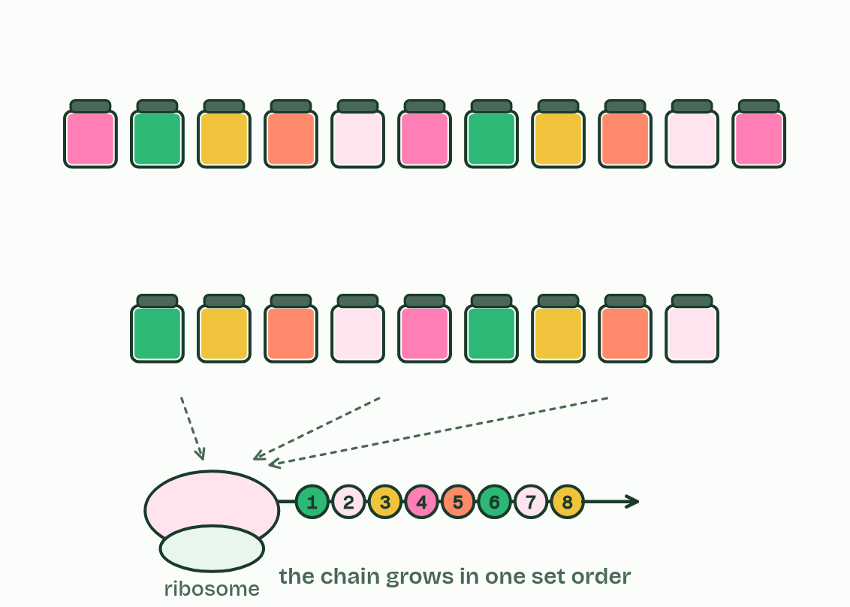
CHAPTER 3 · B1.2.3 Dietary requirements for amino acids
1 / 5
Some amino acids you must eat
Twenty jars feed the line, and the chain grows in one order, set by the gene.
Minutes 5 to 15
Notes:
Minutes 5 to 15 of 60: The amino acid shelf (10 min).
The plan: Chapter 3’s figure. Pairs then plan a day of vegan meals that covers all nine essential amino acids, without naming any. Rice and lentils, or hummus and bread, make a good start.
Your cells need all twenty amino acids to build their proteins. They can make some of them from other amino acids: these are non-essential amino acids. They cannot make the rest, which must come from food: essential amino acids. For an adult, nine of the twenty are essential. You do not need to name any of them.
“Essential” is about the diet, not importance: a protein needs every amino acid in its sequence, so the non-essential ones matter just as much. You just do not need to eat them.
The body keeps no store of spare amino acids, as it does for glycogen and fat, so essential ones are needed regularly. Food protein is digested (hydrolysed) to amino acids, which are absorbed and built into your own proteins. If one essential amino acid runs short, every protein that needs it cannot be finished: the gene sets the sequence, and no other amino acid can stand in.
Plants and animals differ here. A plant makes all twenty amino acids itself, from sugars and nitrate taken up from the soil, so it needs no amino acids from food. An animal cannot make all of them and must eat the essential ones. Some amino acids are conditional: the body can make them, but not fast enough at certain times such as infancy, pregnancy or illness. Vegan diets take all their protein from plants. Most plant foods contain every essential amino acid, but some have little of one: cereals are low in one, and beans and lentils in a different one. A variety over the day, such as rice with lentils or hummus with bread, supplies them all, and soya and quinoa have all of them in good amounts. A vegan diet needs attention, not luck. Meat, eggs and dairy carry all of them in proportions close to what we need.

Slide 5
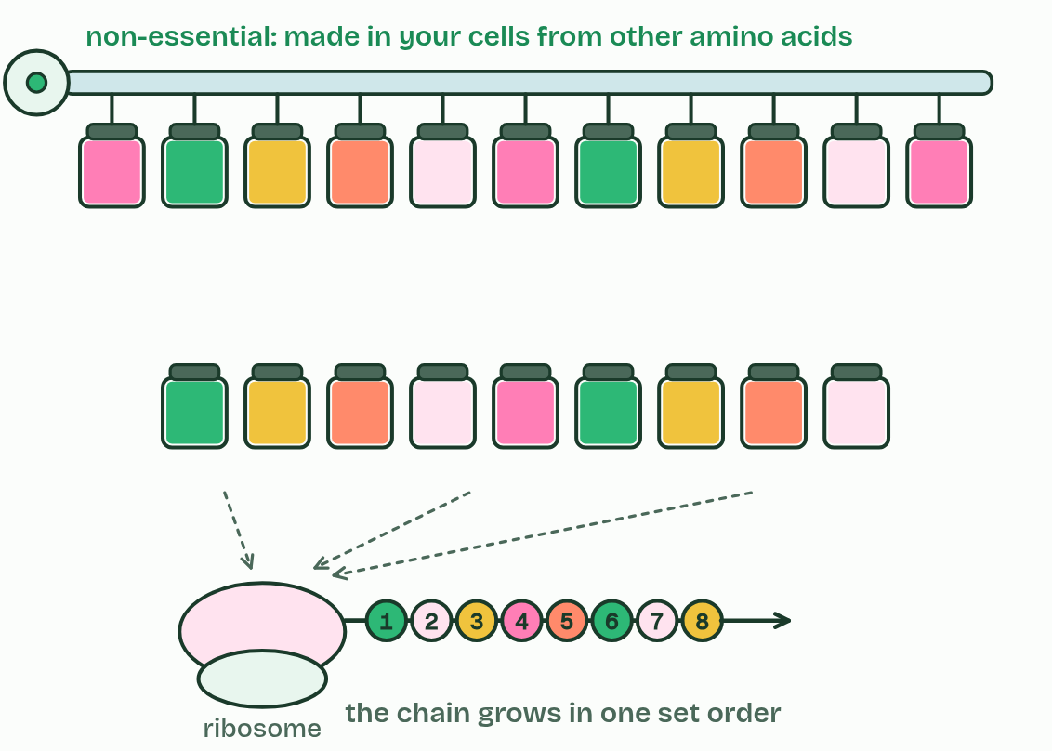
CHAPTER 3 · B1.2.3 Dietary requirements for amino acids
2 / 5
Some amino acids you must eat
Eleven jars are filled by a pipe from the cells: non-essential amino acids, which your cells can make from other amino acids.
Minutes 5 to 15
Notes:
Minutes 5 to 15 of 60: The amino acid shelf (10 min).
The plan: Chapter 3’s figure. Pairs then plan a day of vegan meals that covers all nine essential amino acids, without naming any. Rice and lentils, or hummus and bread, make a good start.
Your cells need all twenty amino acids to build their proteins. They can make some of them from other amino acids: these are non-essential amino acids. They cannot make the rest, which must come from food: essential amino acids. For an adult, nine of the twenty are essential. You do not need to name any of them.
“Essential” is about the diet, not importance: a protein needs every amino acid in its sequence, so the non-essential ones matter just as much. You just do not need to eat them.
The body keeps no store of spare amino acids, as it does for glycogen and fat, so essential ones are needed regularly. Food protein is digested (hydrolysed) to amino acids, which are absorbed and built into your own proteins. If one essential amino acid runs short, every protein that needs it cannot be finished: the gene sets the sequence, and no other amino acid can stand in.
Plants and animals differ here. A plant makes all twenty amino acids itself, from sugars and nitrate taken up from the soil, so it needs no amino acids from food. An animal cannot make all of them and must eat the essential ones. Some amino acids are conditional: the body can make them, but not fast enough at certain times such as infancy, pregnancy or illness. Vegan diets take all their protein from plants. Most plant foods contain every essential amino acid, but some have little of one: cereals are low in one, and beans and lentils in a different one. A variety over the day, such as rice with lentils or hummus with bread, supplies them all, and soya and quinoa have all of them in good amounts. A vegan diet needs attention, not luck. Meat, eggs and dairy carry all of them in proportions close to what we need.

Slide 6
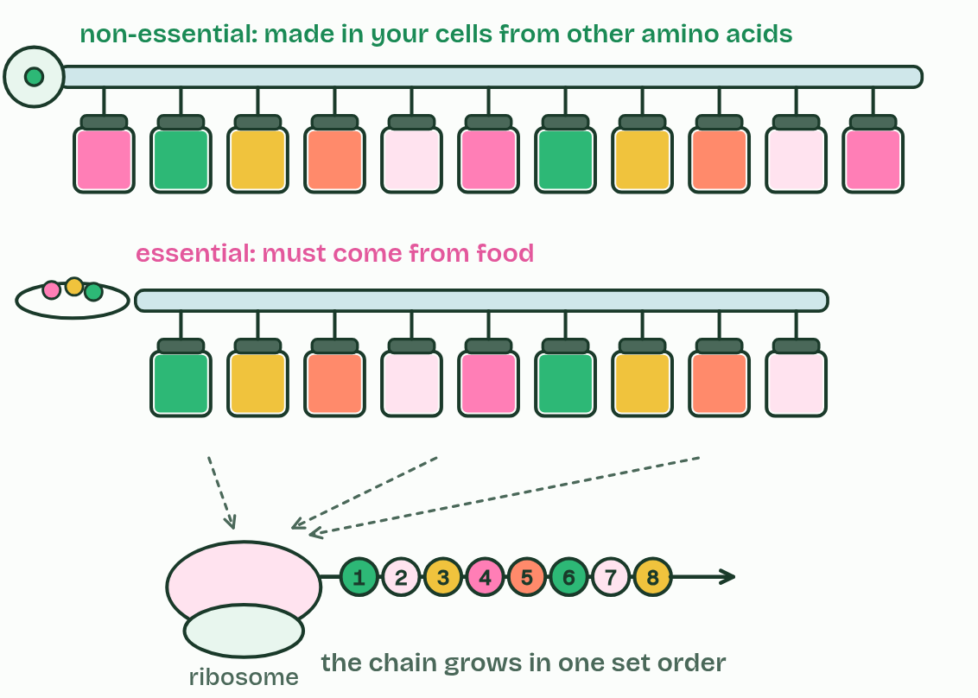
CHAPTER 3 · B1.2.3 Dietary requirements for amino acids
3 / 5
Some amino acids you must eat
Nine jars are filled only from the plate: essential amino acids, which must come from food.
Minutes 5 to 15
Notes:
Minutes 5 to 15 of 60: The amino acid shelf (10 min).
The plan: Chapter 3’s figure. Pairs then plan a day of vegan meals that covers all nine essential amino acids, without naming any. Rice and lentils, or hummus and bread, make a good start.
Your cells need all twenty amino acids to build their proteins. They can make some of them from other amino acids: these are non-essential amino acids. They cannot make the rest, which must come from food: essential amino acids. For an adult, nine of the twenty are essential. You do not need to name any of them.
“Essential” is about the diet, not importance: a protein needs every amino acid in its sequence, so the non-essential ones matter just as much. You just do not need to eat them.
The body keeps no store of spare amino acids, as it does for glycogen and fat, so essential ones are needed regularly. Food protein is digested (hydrolysed) to amino acids, which are absorbed and built into your own proteins. If one essential amino acid runs short, every protein that needs it cannot be finished: the gene sets the sequence, and no other amino acid can stand in.
Plants and animals differ here. A plant makes all twenty amino acids itself, from sugars and nitrate taken up from the soil, so it needs no amino acids from food. An animal cannot make all of them and must eat the essential ones. Some amino acids are conditional: the body can make them, but not fast enough at certain times such as infancy, pregnancy or illness. Vegan diets take all their protein from plants. Most plant foods contain every essential amino acid, but some have little of one: cereals are low in one, and beans and lentils in a different one. A variety over the day, such as rice with lentils or hummus with bread, supplies them all, and soya and quinoa have all of them in good amounts. A vegan diet needs attention, not luck. Meat, eggs and dairy carry all of them in proportions close to what we need.

Slide 7
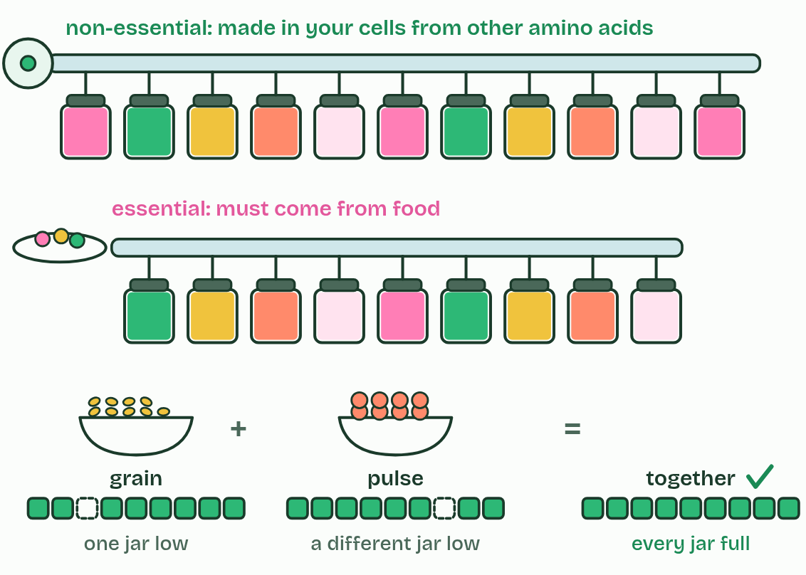
CHAPTER 3 · B1.2.3 Dietary requirements for amino acids
4 / 5
Some amino acids you must eat
A varied plant plate: grain runs a little low in one jar and pulses in a different one, and together they fill every jar. A vegan diet covers all nine with variety.
Minutes 5 to 15
Notes:
Minutes 5 to 15 of 60: The amino acid shelf (10 min).
The plan: Chapter 3’s figure. Pairs then plan a day of vegan meals that covers all nine essential amino acids, without naming any. Rice and lentils, or hummus and bread, make a good start.
Your cells need all twenty amino acids to build their proteins. They can make some of them from other amino acids: these are non-essential amino acids. They cannot make the rest, which must come from food: essential amino acids. For an adult, nine of the twenty are essential. You do not need to name any of them.
“Essential” is about the diet, not importance: a protein needs every amino acid in its sequence, so the non-essential ones matter just as much. You just do not need to eat them.
The body keeps no store of spare amino acids, as it does for glycogen and fat, so essential ones are needed regularly. Food protein is digested (hydrolysed) to amino acids, which are absorbed and built into your own proteins. If one essential amino acid runs short, every protein that needs it cannot be finished: the gene sets the sequence, and no other amino acid can stand in.
Plants and animals differ here. A plant makes all twenty amino acids itself, from sugars and nitrate taken up from the soil, so it needs no amino acids from food. An animal cannot make all of them and must eat the essential ones. Some amino acids are conditional: the body can make them, but not fast enough at certain times such as infancy, pregnancy or illness. Vegan diets take all their protein from plants. Most plant foods contain every essential amino acid, but some have little of one: cereals are low in one, and beans and lentils in a different one. A variety over the day, such as rice with lentils or hummus with bread, supplies them all, and soya and quinoa have all of them in good amounts. A vegan diet needs attention, not luck. Meat, eggs and dairy carry all of them in proportions close to what we need.

Slide 8
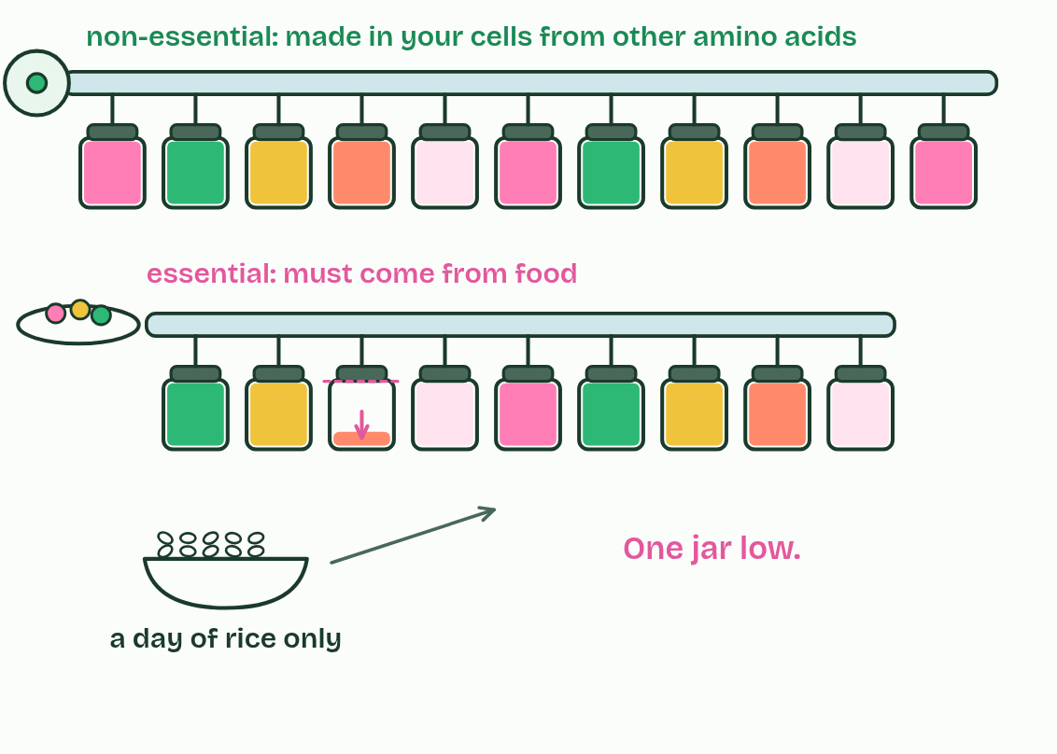
CHAPTER 3 · B1.2.3 Dietary requirements for amino acids
5 / 5
Some amino acids you must eat
A day of rice only: one jar runs low.
Minutes 5 to 15
Notes:
Minutes 5 to 15 of 60: The amino acid shelf (10 min).
The plan: Chapter 3’s figure. Pairs then plan a day of vegan meals that covers all nine essential amino acids, without naming any. Rice and lentils, or hummus and bread, make a good start.
Your cells need all twenty amino acids to build their proteins. They can make some of them from other amino acids: these are non-essential amino acids. They cannot make the rest, which must come from food: essential amino acids. For an adult, nine of the twenty are essential. You do not need to name any of them.
“Essential” is about the diet, not importance: a protein needs every amino acid in its sequence, so the non-essential ones matter just as much. You just do not need to eat them.
The body keeps no store of spare amino acids, as it does for glycogen and fat, so essential ones are needed regularly. Food protein is digested (hydrolysed) to amino acids, which are absorbed and built into your own proteins. If one essential amino acid runs short, every protein that needs it cannot be finished: the gene sets the sequence, and no other amino acid can stand in.
Plants and animals differ here. A plant makes all twenty amino acids itself, from sugars and nitrate taken up from the soil, so it needs no amino acids from food. An animal cannot make all of them and must eat the essential ones. Some amino acids are conditional: the body can make them, but not fast enough at certain times such as infancy, pregnancy or illness. Vegan diets take all their protein from plants. Most plant foods contain every essential amino acid, but some have little of one: cereals are low in one, and beans and lentils in a different one. A variety over the day, such as rice with lentils or hummus with bread, supplies them all, and soya and quinoa have all of them in good amounts. A vegan diet needs attention, not luck. Meat, eggs and dairy carry all of them in proportions close to what we need.

Slide 9
CHAPTER 3 · B1.2.3 Dietary requirements for amino acids
Some amino acids you must eat
Your cells need all twenty amino acids to build their proteins. They can make some of them from other amino acids: these are non-essential amino acids.
They can make some of them from other amino acids: these are non-essential amino acids. They cannot make the rest, which must come from food: essential amino acids.
“Essential” is about the diet, not importance: a protein needs every amino acid in its sequence, so the non-essential ones matter just as much.
Minutes 5 to 15
Notes:
Minutes 5 to 15 of 60: The amino acid shelf (10 min).
The plan: Chapter 3’s figure. Pairs then plan a day of vegan meals that covers all nine essential amino acids, without naming any. Rice and lentils, or hummus and bread, make a good start.
Your cells need all twenty amino acids to build their proteins. They can make some of them from other amino acids: these are non-essential amino acids. They cannot make the rest, which must come from food: essential amino acids. For an adult, nine of the twenty are essential. You do not need to name any of them.
“Essential” is about the diet, not importance: a protein needs every amino acid in its sequence, so the non-essential ones matter just as much. You just do not need to eat them.
The body keeps no store of spare amino acids, as it does for glycogen and fat, so essential ones are needed regularly. Food protein is digested (hydrolysed) to amino acids, which are absorbed and built into your own proteins. If one essential amino acid runs short, every protein that needs it cannot be finished: the gene sets the sequence, and no other amino acid can stand in.
Plants and animals differ here. A plant makes all twenty amino acids itself, from sugars and nitrate taken up from the soil, so it needs no amino acids from food. An animal cannot make all of them and must eat the essential ones. Some amino acids are conditional: the body can make them, but not fast enough at certain times such as infancy, pregnancy or illness. Vegan diets take all their protein from plants. Most plant foods contain every essential amino acid, but some have little of one: cereals are low in one, and beans and lentils in a different one. A variety over the day, such as rice with lentils or hummus with bread, supplies them all, and soya and quinoa have all of them in good amounts. A vegan diet needs attention, not luck. Meat, eggs and dairy carry all of them in proportions close to what we need.

Slide 10
PREDICT
You eat plenty of protein, but it lacks one essential amino acid. What happens to the proteins that need it?
A They cannot be completed, because no other amino acid can take its place in the sequence
B Your cells make the missing amino acid from other amino acids that are in plentiful supply
C Nothing changes, as long as the total amount of protein eaten is high enough
D A different amino acid is put in its place, so the proteins are still finished, if slightly altered
Minutes 5 to 15
Notes:
Minutes 5 to 15 of 60: The amino acid shelf (10 min).
The plan: Chapter 3’s figure. Pairs then plan a day of vegan meals that covers all nine essential amino acids, without naming any. Rice and lentils, or hummus and bread, make a good start.
Ask for a show of hands, or mini whiteboards, before revealing. (Answer: A, on the next slide.)

Slide 11
WHAT HAPPENS
You eat plenty of protein, but it lacks one essential amino acid. What happens to the proteins that need it?
A They cannot be completed, because no other amino acid can take its place in the sequence
B Your cells make the missing amino acid from other amino acids that are in plentiful supply
C Nothing changes, as long as the total amount of protein eaten is high enough
D A different amino acid is put in its place, so the proteins are still finished, if slightly altered
They cannot be completed. Your cells cannot make an essential amino acid, and the gene sets the sequence, so no other amino acid can take its place. Every protein that needs it stalls at that point. That is why the total amount of protein is not the whole story: the mix matters.
Minutes 5 to 15
Notes:
Minutes 5 to 15 of 60: The amino acid shelf (10 min).
The plan: Chapter 3’s figure. Pairs then plan a day of vegan meals that covers all nine essential amino acids, without naming any. Rice and lentils, or hummus and bread, make a good start.
Answer: A. They cannot be completed. Your cells cannot make an essential amino acid, and the gene sets the sequence, so no other amino acid can take its place. Every protein that needs it stalls at that point. That is why the total amount of protein is not the whole story: the mix matters.

Slide 12
WATCH OUT
Non-essential amino acids are not unimportant: they are in your proteins too, you just do not need them in food. And “vegans cannot get essential amino acids” is false: they need a variety of plant proteins.
Minutes 5 to 15
Notes:
Minutes 5 to 15 of 60: The amino acid shelf (10 min).
The plan: Chapter 3’s figure. Pairs then plan a day of vegan meals that covers all nine essential amino acids, without naming any. Rice and lentils, or hummus and bread, make a good start.
A common mistake: say it, then ask who can say why it is wrong.

Slide 13

DRAWING
15 MIN
Protein doodles
THE TASK
Each student picks three proteins from lysozyme, insulin, antibodies, rhodopsin, collagen, spider silk, glucagon and a snake venom toxin. For each they write five keywords and make two drawings answering “how does its shape suit its job?” Finish with a gallery walk.
STUDENTS NEED
A4 paper, and a short fact card for each protein written by the teacher.
Minutes 15 to 30
Notes:
Minutes 15 to 30 of 60: Protein doodles (15 min).
The plan: Students pick three proteins and make two drawings each: how does its shape suit its job? (activity below). Use chapter 4’s examples as the fact cards.
The activity: Protein doodles. Each student picks three proteins from lysozyme, insulin, antibodies, rhodopsin, collagen, spider silk, glucagon and a snake venom toxin. For each they write five keywords and make two drawings answering “how does its shape suit its job?” Finish with a gallery walk.
Needs: A4 paper, and a short fact card for each protein written by the teacher.
The time: 15 minutes, minutes 15 to 30 of the plan.

Slide 14
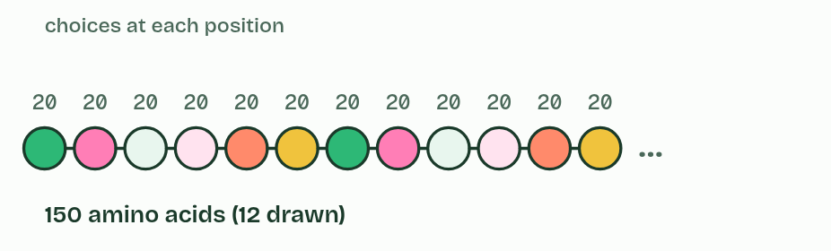
CHAPTER 4 · B1.2.4 Infinite variety of possible peptide chains
1 / 6
Twenty amino acids, endless chains
2
Minutes 15 to 30
Notes:
Minutes 15 to 30 of 60: Protein doodles (15 min).
The plan: Students pick three proteins and make two drawings each: how does its shape suit its job? (activity below). Use chapter 4’s examples as the fact cards.
The genetic code (A1.2) codes for twenty amino acids. A polypeptide can have any number of them, from a few to thousands, in any order, and the same amino acid can appear again and again.
That makes the number of possible chains enormous. There are 20 × 20 = 400 different dipeptides, 20 × 20 × 20 = 8,000 tripeptides, and 20n chains of length n. Past about 62 amino acids there are more possible sequences than there are atoms in the observable universe, and real proteins are much longer than that.
Living things use only a tiny fraction of the possible sequences. Most protein-coding genes code for one polypeptide, and all the proteins an organism makes are its proteome.
Example: Linking question What is the relationship between the genome and the proteome? The genome is all of an organism’s genes, and most of them code for a polypeptide, so the genome sets which proteins the organism can make, its proteome. Different cells use different parts of it, so a liver cell’s proteins differ from a muscle cell’s.

Slide 15
CHAPTER 4 · B1.2.4 Infinite variety of possible peptide chains
2 / 6
Twenty amino acids, endless chains
10
Minutes 15 to 30
Notes:
Minutes 15 to 30 of 60: Protein doodles (15 min).
The plan: Students pick three proteins and make two drawings each: how does its shape suit its job? (activity below). Use chapter 4’s examples as the fact cards.
The genetic code (A1.2) codes for twenty amino acids. A polypeptide can have any number of them, from a few to thousands, in any order, and the same amino acid can appear again and again.
That makes the number of possible chains enormous. There are 20 × 20 = 400 different dipeptides, 20 × 20 × 20 = 8,000 tripeptides, and 20n chains of length n. Past about 62 amino acids there are more possible sequences than there are atoms in the observable universe, and real proteins are much longer than that.
Living things use only a tiny fraction of the possible sequences. Most protein-coding genes code for one polypeptide, and all the proteins an organism makes are its proteome.
Example: Linking question What is the relationship between the genome and the proteome? The genome is all of an organism’s genes, and most of them code for a polypeptide, so the genome sets which proteins the organism can make, its proteome. Different cells use different parts of it, so a liver cell’s proteins differ from a muscle cell’s.

Slide 16
CHAPTER 4 · B1.2.4 Infinite variety of possible peptide chains
3 / 6
Twenty amino acids, endless chains
51
Minutes 15 to 30
Notes:
Minutes 15 to 30 of 60: Protein doodles (15 min).
The plan: Students pick three proteins and make two drawings each: how does its shape suit its job? (activity below). Use chapter 4’s examples as the fact cards.
The genetic code (A1.2) codes for twenty amino acids. A polypeptide can have any number of them, from a few to thousands, in any order, and the same amino acid can appear again and again.
That makes the number of possible chains enormous. There are 20 × 20 = 400 different dipeptides, 20 × 20 × 20 = 8,000 tripeptides, and 20n chains of length n. Past about 62 amino acids there are more possible sequences than there are atoms in the observable universe, and real proteins are much longer than that.
Living things use only a tiny fraction of the possible sequences. Most protein-coding genes code for one polypeptide, and all the proteins an organism makes are its proteome.
Example: Linking question What is the relationship between the genome and the proteome? The genome is all of an organism’s genes, and most of them code for a polypeptide, so the genome sets which proteins the organism can make, its proteome. Different cells use different parts of it, so a liver cell’s proteins differ from a muscle cell’s.

Slide 17
CHAPTER 4 · B1.2.4 Infinite variety of possible peptide chains
4 / 6
Twenty amino acids, endless chains
62
Minutes 15 to 30
Notes:
Minutes 15 to 30 of 60: Protein doodles (15 min).
The plan: Students pick three proteins and make two drawings each: how does its shape suit its job? (activity below). Use chapter 4’s examples as the fact cards.
The genetic code (A1.2) codes for twenty amino acids. A polypeptide can have any number of them, from a few to thousands, in any order, and the same amino acid can appear again and again.
That makes the number of possible chains enormous. There are 20 × 20 = 400 different dipeptides, 20 × 20 × 20 = 8,000 tripeptides, and 20n chains of length n. Past about 62 amino acids there are more possible sequences than there are atoms in the observable universe, and real proteins are much longer than that.
Living things use only a tiny fraction of the possible sequences. Most protein-coding genes code for one polypeptide, and all the proteins an organism makes are its proteome.
Example: Linking question What is the relationship between the genome and the proteome? The genome is all of an organism’s genes, and most of them code for a polypeptide, so the genome sets which proteins the organism can make, its proteome. Different cells use different parts of it, so a liver cell’s proteins differ from a muscle cell’s.

Slide 18
CHAPTER 4 · B1.2.4 Infinite variety of possible peptide chains
5 / 6
Twenty amino acids, endless chains
100
Minutes 15 to 30
Notes:
Minutes 15 to 30 of 60: Protein doodles (15 min).
The plan: Students pick three proteins and make two drawings each: how does its shape suit its job? (activity below). Use chapter 4’s examples as the fact cards.
The genetic code (A1.2) codes for twenty amino acids. A polypeptide can have any number of them, from a few to thousands, in any order, and the same amino acid can appear again and again.
That makes the number of possible chains enormous. There are 20 × 20 = 400 different dipeptides, 20 × 20 × 20 = 8,000 tripeptides, and 20n chains of length n. Past about 62 amino acids there are more possible sequences than there are atoms in the observable universe, and real proteins are much longer than that.
Living things use only a tiny fraction of the possible sequences. Most protein-coding genes code for one polypeptide, and all the proteins an organism makes are its proteome.
Example: Linking question What is the relationship between the genome and the proteome? The genome is all of an organism’s genes, and most of them code for a polypeptide, so the genome sets which proteins the organism can make, its proteome. Different cells use different parts of it, so a liver cell’s proteins differ from a muscle cell’s.

Slide 19
CHAPTER 4 · B1.2.4 Infinite variety of possible peptide chains
6 / 6
Twenty amino acids, endless chains
146
Minutes 15 to 30
Notes:
Minutes 15 to 30 of 60: Protein doodles (15 min).
The plan: Students pick three proteins and make two drawings each: how does its shape suit its job? (activity below). Use chapter 4’s examples as the fact cards.
The genetic code (A1.2) codes for twenty amino acids. A polypeptide can have any number of them, from a few to thousands, in any order, and the same amino acid can appear again and again.
That makes the number of possible chains enormous. There are 20 × 20 = 400 different dipeptides, 20 × 20 × 20 = 8,000 tripeptides, and 20n chains of length n. Past about 62 amino acids there are more possible sequences than there are atoms in the observable universe, and real proteins are much longer than that.
Living things use only a tiny fraction of the possible sequences. Most protein-coding genes code for one polypeptide, and all the proteins an organism makes are its proteome.
Example: Linking question What is the relationship between the genome and the proteome? The genome is all of an organism’s genes, and most of them code for a polypeptide, so the genome sets which proteins the organism can make, its proteome. Different cells use different parts of it, so a liver cell’s proteins differ from a muscle cell’s.

Slide 20
CHAPTER 4 · B1.2.4 Infinite variety of possible peptide chains
Twenty amino acids, endless chains
Glucagon, a hormone, has 29 amino acids.
Insulin, a hormone, has 51 in two chains of 21 and 30.
Lysozyme, an enzyme in egg white and tears, has 129.
Each haemoglobin chain has 141 or 146.
A collagen chain has about 1,000.
Titin, a springy protein inside muscle, has about 34,000, the largest known in humans.
Minutes 15 to 30
Notes:
Minutes 15 to 30 of 60: Protein doodles (15 min).
The plan: Students pick three proteins and make two drawings each: how does its shape suit its job? (activity below). Use chapter 4’s examples as the fact cards.
The genetic code (A1.2) codes for twenty amino acids. A polypeptide can have any number of them, from a few to thousands, in any order, and the same amino acid can appear again and again.
That makes the number of possible chains enormous. There are 20 × 20 = 400 different dipeptides, 20 × 20 × 20 = 8,000 tripeptides, and 20n chains of length n. Past about 62 amino acids there are more possible sequences than there are atoms in the observable universe, and real proteins are much longer than that.
Living things use only a tiny fraction of the possible sequences. Most protein-coding genes code for one polypeptide, and all the proteins an organism makes are its proteome.
Example: Linking question What is the relationship between the genome and the proteome? The genome is all of an organism’s genes, and most of them code for a polypeptide, so the genome sets which proteins the organism can make, its proteome. Different cells use different parts of it, so a liver cell’s proteins differ from a muscle cell’s.

Slide 21
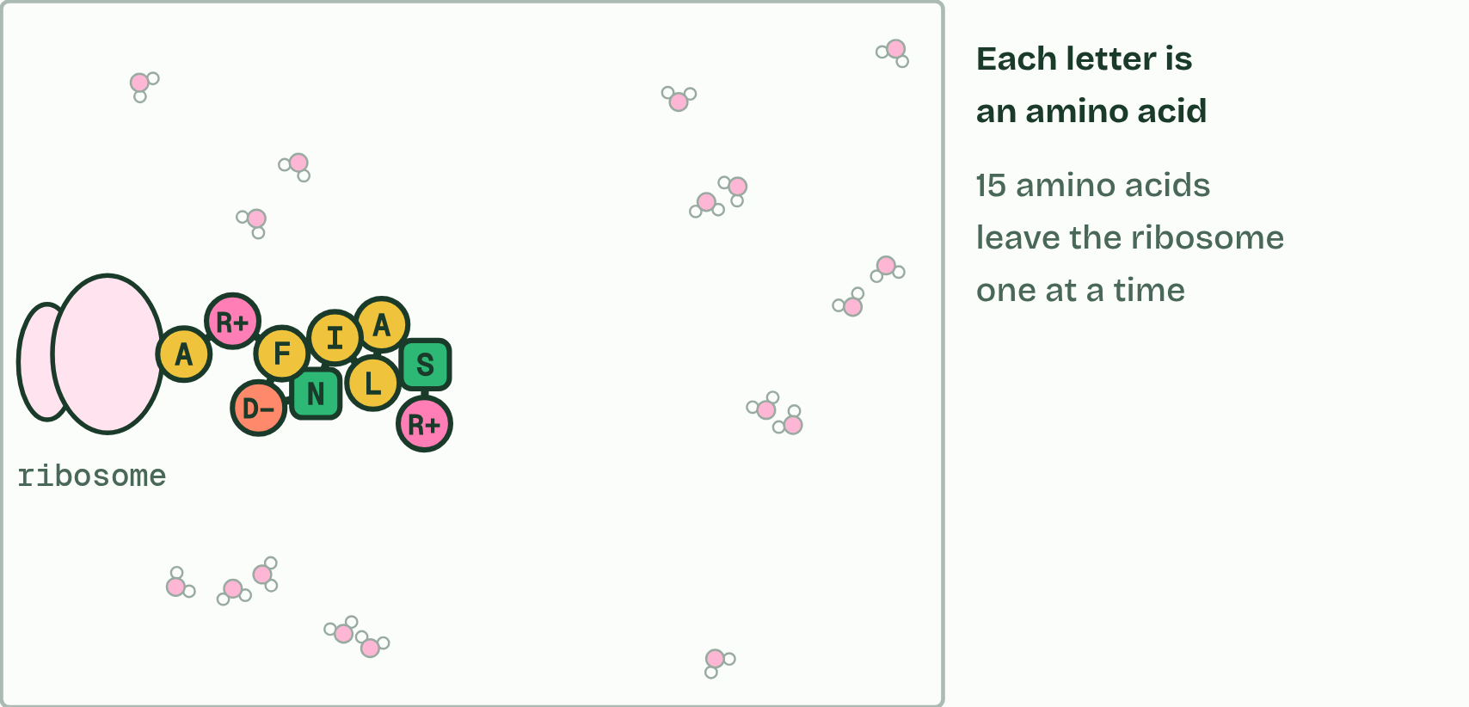
CHAPTER 4 · B1.2.4 Infinite variety of possible peptide chains
1 / 2
Twenty amino acids, endless chains
Type ROSALIND FRANKLIN: each letter is the code for one amino acid (the O is skipped: no amino acid has that letter). Its 15 amino acids are joined by 14 peptide bonds: one of 20¹⁵ (about 3 × 10¹⁹) possible chains this long. A ribosome makes the chain one amino acid at a time, and it starts to fold as it comes out.
Minutes 15 to 30
Notes:
Minutes 15 to 30 of 60: Protein doodles (15 min).
The plan: Students pick three proteins and make two drawings each: how does its shape suit its job? (activity below). Use chapter 4’s examples as the fact cards.
The genetic code (A1.2) codes for twenty amino acids. A polypeptide can have any number of them, from a few to thousands, in any order, and the same amino acid can appear again and again.
That makes the number of possible chains enormous. There are 20 × 20 = 400 different dipeptides, 20 × 20 × 20 = 8,000 tripeptides, and 20n chains of length n. Past about 62 amino acids there are more possible sequences than there are atoms in the observable universe, and real proteins are much longer than that.
Living things use only a tiny fraction of the possible sequences. Most protein-coding genes code for one polypeptide, and all the proteins an organism makes are its proteome.
Example: Linking question What is the relationship between the genome and the proteome? The genome is all of an organism’s genes, and most of them code for a polypeptide, so the genome sets which proteins the organism can make, its proteome. Different cells use different parts of it, so a liver cell’s proteins differ from a muscle cell’s.

Slide 22
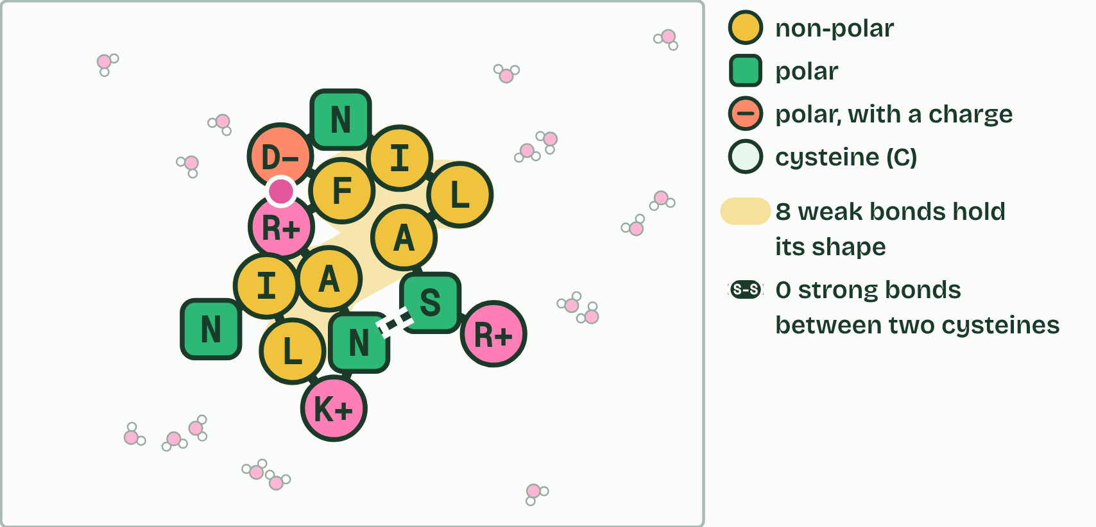
CHAPTER 4 · B1.2.4 Infinite variety of possible peptide chains
2 / 2
Twenty amino acids, endless chains
It folds into a shape of its own, held by weak bonds between its side chains.
Minutes 15 to 30
Notes:
Minutes 15 to 30 of 60: Protein doodles (15 min).
The plan: Students pick three proteins and make two drawings each: how does its shape suit its job? (activity below). Use chapter 4’s examples as the fact cards.
The genetic code (A1.2) codes for twenty amino acids. A polypeptide can have any number of them, from a few to thousands, in any order, and the same amino acid can appear again and again.
That makes the number of possible chains enormous. There are 20 × 20 = 400 different dipeptides, 20 × 20 × 20 = 8,000 tripeptides, and 20n chains of length n. Past about 62 amino acids there are more possible sequences than there are atoms in the observable universe, and real proteins are much longer than that.
Living things use only a tiny fraction of the possible sequences. Most protein-coding genes code for one polypeptide, and all the proteins an organism makes are its proteome.
Example: Linking question What is the relationship between the genome and the proteome? The genome is all of an organism’s genes, and most of them code for a polypeptide, so the genome sets which proteins the organism can make, its proteome. Different cells use different parts of it, so a liver cell’s proteins differ from a muscle cell’s.

Slide 23
CHAPTER 4 · B1.2.4 Infinite variety of possible peptide chains
Twenty amino acids, endless chains
Glucagon, a hormone, has 29 amino acids.
Insulin, a hormone, has 51 in two chains of 21 and 30.
Lysozyme, an enzyme in egg white and tears, has 129.
Each haemoglobin chain has 141 or 146.
A collagen chain has about 1,000.
Titin, a springy protein inside muscle, has about 34,000, the largest known in humans.
Minutes 15 to 30
Notes:
Minutes 15 to 30 of 60: Protein doodles (15 min).
The plan: Students pick three proteins and make two drawings each: how does its shape suit its job? (activity below). Use chapter 4’s examples as the fact cards.
The genetic code (A1.2) codes for twenty amino acids. A polypeptide can have any number of them, from a few to thousands, in any order, and the same amino acid can appear again and again.
That makes the number of possible chains enormous. There are 20 × 20 = 400 different dipeptides, 20 × 20 × 20 = 8,000 tripeptides, and 20n chains of length n. Past about 62 amino acids there are more possible sequences than there are atoms in the observable universe, and real proteins are much longer than that.
Living things use only a tiny fraction of the possible sequences. Most protein-coding genes code for one polypeptide, and all the proteins an organism makes are its proteome.
Example: Linking question What is the relationship between the genome and the proteome? The genome is all of an organism’s genes, and most of them code for a polypeptide, so the genome sets which proteins the organism can make, its proteome. Different cells use different parts of it, so a liver cell’s proteins differ from a muscle cell’s.

Slide 24
PREDICT
How many different dipeptides can be made from the 20 amino acids?
A 20, because there are only twenty amino acids to choose from
B 40, because each of the twenty amino acids can sit first or second
C 190, because a pair in either order counts once and a repeated amino acid is not allowed
D 400, because there are twenty choices at each of the two positions
Minutes 15 to 30
Notes:
Minutes 15 to 30 of 60: Protein doodles (15 min).
The plan: Students pick three proteins and make two drawings each: how does its shape suit its job? (activity below). Use chapter 4’s examples as the fact cards.
Ask for a show of hands, or mini whiteboards, before revealing. (Answer: D, on the next slide.)

Slide 25
WHAT HAPPENS
How many different dipeptides can be made from the 20 amino acids?
A 20, because there are only twenty amino acids to choose from
B 40, because each of the twenty amino acids can sit first or second
C 190, because a pair in either order counts once and a repeated amino acid is not allowed
D 400, because there are twenty choices at each of the two positions
400. There are 20 choices for the first amino acid and 20 for the second. Order matters (one way round is a different molecule from the other), and the same amino acid can appear twice. Move the slider to 2 to check, then try 3.
Minutes 15 to 30
Notes:
Minutes 15 to 30 of 60: Protein doodles (15 min).
The plan: Students pick three proteins and make two drawings each: how does its shape suit its job? (activity below). Use chapter 4’s examples as the fact cards.
Answer: D. 400. There are 20 choices for the first amino acid and 20 for the second. Order matters (one way round is a different molecule from the other), and the same amino acid can appear twice. Move the slider to 2 to check, then try 3.

Slide 26
WATCH OUT
Twenty amino acids do not mean twenty proteins. And a protein’s identity is its order: the same amino acids in a different order make a different polypeptide.
Minutes 15 to 30
Notes:
Minutes 15 to 30 of 60: Protein doodles (15 min).
The plan: Students pick three proteins and make two drawings each: how does its shape suit its job? (activity below). Use chapter 4’s examples as the fact cards.
A common mistake: say it, then ask who can say why it is wrong.

Slide 27
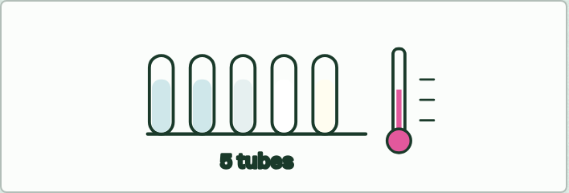
PRACTICAL (OPTIONAL)
15 MIN
Egg white, heat and acid
THE TASK
Put egg white in five tubes: room temperature, and 40, 60 and 80 °C water baths for five minutes, plus one with vinegar or lemon juice. Record clear or cloudy and runny or set, then cool the hot ones. Which change came back on cooling?
STUDENTS NEED
One egg, test tubes, water baths or a kettle and beakers, thermometers, vinegar.
Minutes 30 to 45
Notes:
Minutes 30 to 45 of 60: Heat and acid (15 min).
The plan: The egg white demonstration (optional, below), or chapter 5’s figure. Then the folding scene under it, Heat it, change the pH: let the film run once, then take the temperature past 65 °C and back to 37 °C (the chain stays unfolded and tangles), press Fresh protein and move the pH to 1.5 and to 12.5. Then the predict box: which bonds break?
The activity: Egg white, heat and acid. Put egg white in five tubes: room temperature, and 40, 60 and 80 °C water baths for five minutes, plus one with vinegar or lemon juice. Record clear or cloudy and runny or set, then cool the hot ones. Which change came back on cooling?
Needs: one egg, test tubes, water baths or a kettle and beakers, thermometers, vinegar.
The time: 15 minutes, minutes 30 to 45 of the plan.

Slide 28
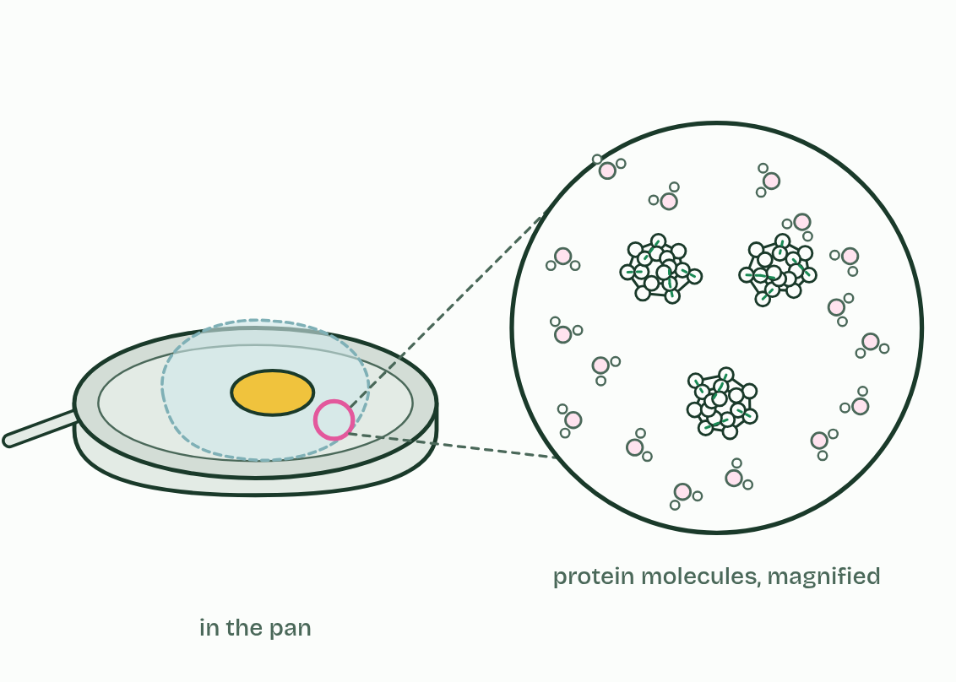
CHAPTER 5 · B1.2.5 Effect of pH and temperature on protein structure
1 / 4
Heat and pH unfold a protein
Raw egg white: clear and runny. Magnified, the proteins are folded, each on its own among the water molecules.
Minutes 30 to 45
Notes:
Minutes 30 to 45 of 60: Heat and acid (15 min).
The plan: The egg white demonstration (optional, below), or chapter 5’s figure. Then the folding scene under it, Heat it, change the pH: let the film run once, then take the temperature past 65 °C and back to 37 °C (the chain stays unfolded and tangles), press Fresh protein and move the pH to 1.5 and to 12.5. Then the predict box: which bonds break?
A protein works because of its precise three-dimensional shape: a pocket that fits one molecule, a surface that binds one partner. That shape is held in place by many weak bonds between parts of the folded chain, hydrogen bonds (met in A1.1) and attractions between charged groups.
Heat. The atoms vibrate more and more, and past a point the weak bonds break. The chain unfolds, its shape is lost and it can no longer do its job: it is denatured. The peptide bonds are covalent and much stronger, so the sequence of amino acids is unchanged.
pH. Hydrogen ions attach to groups in the R groups, or leave them, and so change their charges. The attractions between oppositely charged groups are lost and the shape changes. Each protein keeps its shape over a range of pH, and far outside it the protein denatures.
Denaturation is usually permanent. Heated chains tangle with each other and do not refold when cooled, which is why an egg white stays white and solid. Each protein’s limits suit where it works: proteins in the stomach keep their shape at about pH 2, and the proteins of microbes in hot springs stay folded at temperatures that would denature ours. Cooling slows a protein down but does not unfold it.
Example: Try it The enzyme in your spit, a home lab in C1.1, times salivary amylase breaking down starch at cold, room and warm temperatures. Amylase is a protein, and denaturation is the reason the hottest tube behaves as it does.

Slide 29
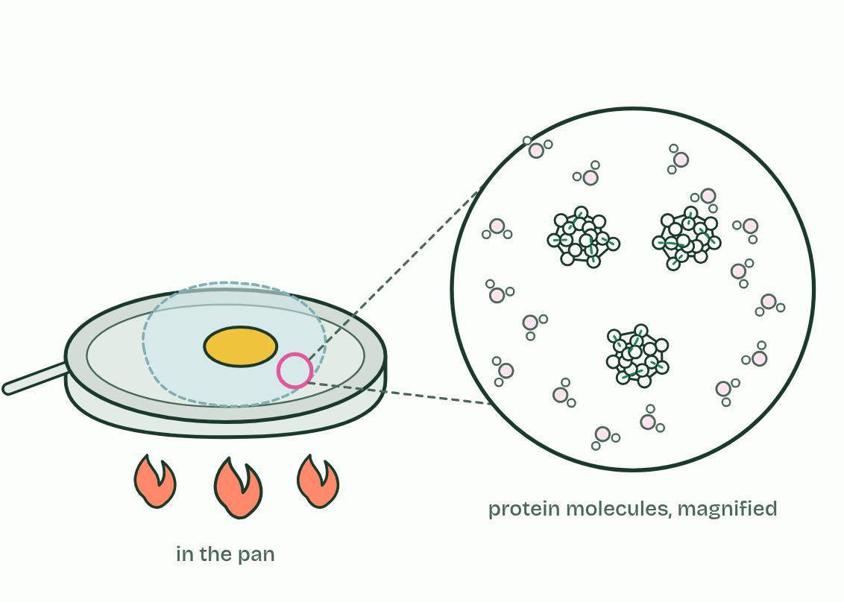
CHAPTER 5 · B1.2.5 Effect of pH and temperature on protein structure
2 / 4
Heat and pH unfold a protein
Heat makes the molecules jiggle harder and breaks the bonds that hold the folds.
Minutes 30 to 45
Notes:
Minutes 30 to 45 of 60: Heat and acid (15 min).
The plan: The egg white demonstration (optional, below), or chapter 5’s figure. Then the folding scene under it, Heat it, change the pH: let the film run once, then take the temperature past 65 °C and back to 37 °C (the chain stays unfolded and tangles), press Fresh protein and move the pH to 1.5 and to 12.5. Then the predict box: which bonds break?
A protein works because of its precise three-dimensional shape: a pocket that fits one molecule, a surface that binds one partner. That shape is held in place by many weak bonds between parts of the folded chain, hydrogen bonds (met in A1.1) and attractions between charged groups.
Heat. The atoms vibrate more and more, and past a point the weak bonds break. The chain unfolds, its shape is lost and it can no longer do its job: it is denatured. The peptide bonds are covalent and much stronger, so the sequence of amino acids is unchanged.
pH. Hydrogen ions attach to groups in the R groups, or leave them, and so change their charges. The attractions between oppositely charged groups are lost and the shape changes. Each protein keeps its shape over a range of pH, and far outside it the protein denatures.
Denaturation is usually permanent. Heated chains tangle with each other and do not refold when cooled, which is why an egg white stays white and solid. Each protein’s limits suit where it works: proteins in the stomach keep their shape at about pH 2, and the proteins of microbes in hot springs stay folded at temperatures that would denature ours. Cooling slows a protein down but does not unfold it.
Example: Try it The enzyme in your spit, a home lab in C1.1, times salivary amylase breaking down starch at cold, room and warm temperatures. Amylase is a protein, and denaturation is the reason the hottest tube behaves as it does.

Slide 30
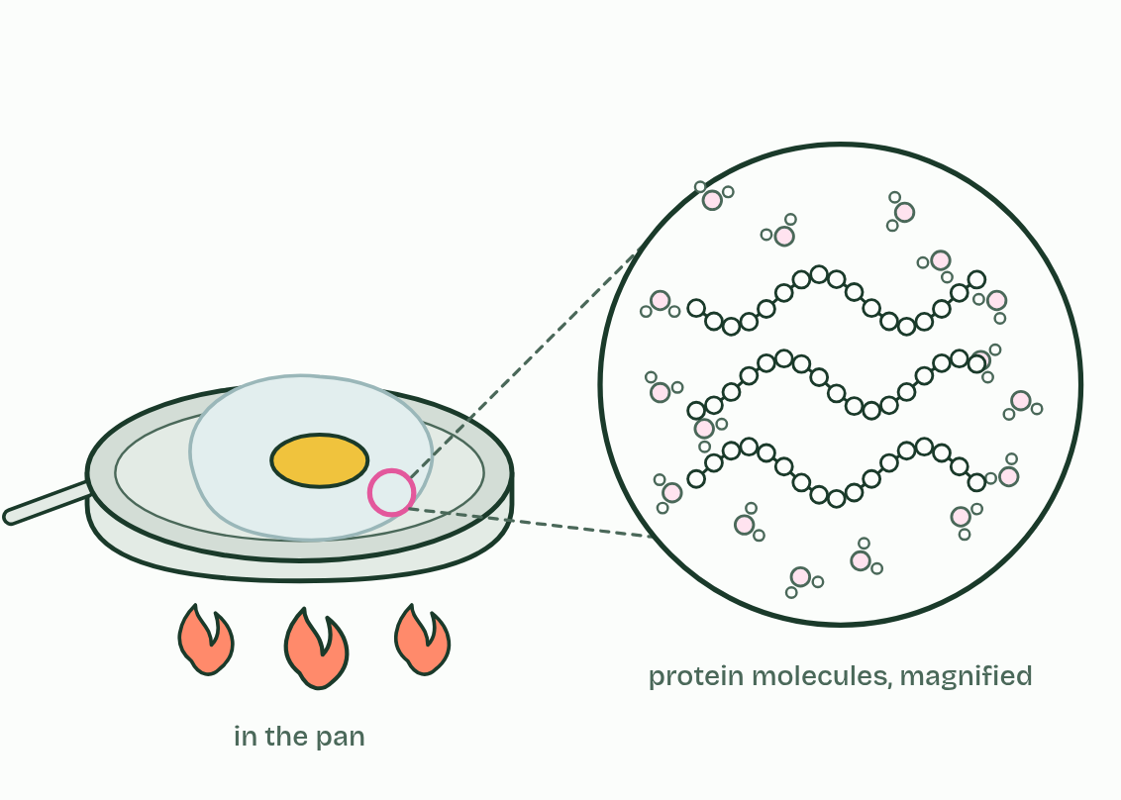
CHAPTER 5 · B1.2.5 Effect of pH and temperature on protein structure
3 / 4
Heat and pH unfold a protein
The chains unfold: with the bonds gone, their shape is gone.
Minutes 30 to 45
Notes:
Minutes 30 to 45 of 60: Heat and acid (15 min).
The plan: The egg white demonstration (optional, below), or chapter 5’s figure. Then the folding scene under it, Heat it, change the pH: let the film run once, then take the temperature past 65 °C and back to 37 °C (the chain stays unfolded and tangles), press Fresh protein and move the pH to 1.5 and to 12.5. Then the predict box: which bonds break?
A protein works because of its precise three-dimensional shape: a pocket that fits one molecule, a surface that binds one partner. That shape is held in place by many weak bonds between parts of the folded chain, hydrogen bonds (met in A1.1) and attractions between charged groups.
Heat. The atoms vibrate more and more, and past a point the weak bonds break. The chain unfolds, its shape is lost and it can no longer do its job: it is denatured. The peptide bonds are covalent and much stronger, so the sequence of amino acids is unchanged.
pH. Hydrogen ions attach to groups in the R groups, or leave them, and so change their charges. The attractions between oppositely charged groups are lost and the shape changes. Each protein keeps its shape over a range of pH, and far outside it the protein denatures.
Denaturation is usually permanent. Heated chains tangle with each other and do not refold when cooled, which is why an egg white stays white and solid. Each protein’s limits suit where it works: proteins in the stomach keep their shape at about pH 2, and the proteins of microbes in hot springs stay folded at temperatures that would denature ours. Cooling slows a protein down but does not unfold it.
Example: Try it The enzyme in your spit, a home lab in C1.1, times salivary amylase breaking down starch at cold, room and warm temperatures. Amylase is a protein, and denaturation is the reason the hottest tube behaves as it does.

Slide 31
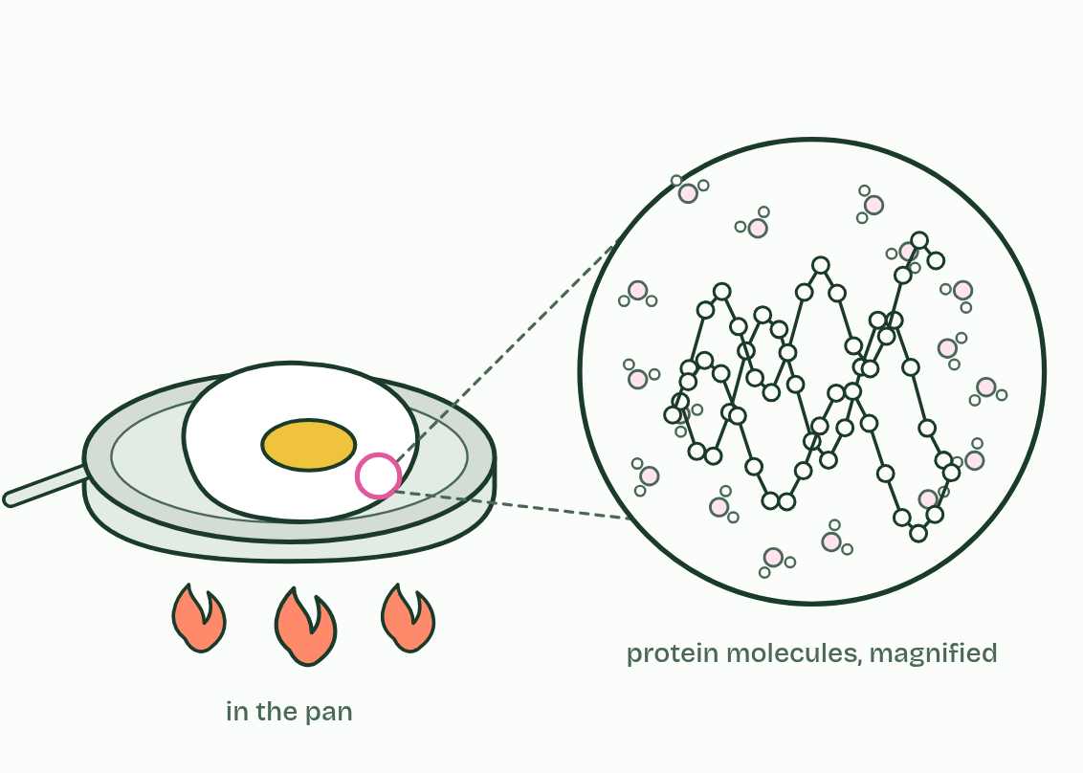
CHAPTER 5 · B1.2.5 Effect of pH and temperature on protein structure
4 / 4
Heat and pH unfold a protein
Unfolded chains tangle together and the egg white sets, white and solid. The proteins are denatured.
Minutes 30 to 45
Notes:
Minutes 30 to 45 of 60: Heat and acid (15 min).
The plan: The egg white demonstration (optional, below), or chapter 5’s figure. Then the folding scene under it, Heat it, change the pH: let the film run once, then take the temperature past 65 °C and back to 37 °C (the chain stays unfolded and tangles), press Fresh protein and move the pH to 1.5 and to 12.5. Then the predict box: which bonds break?
A protein works because of its precise three-dimensional shape: a pocket that fits one molecule, a surface that binds one partner. That shape is held in place by many weak bonds between parts of the folded chain, hydrogen bonds (met in A1.1) and attractions between charged groups.
Heat. The atoms vibrate more and more, and past a point the weak bonds break. The chain unfolds, its shape is lost and it can no longer do its job: it is denatured. The peptide bonds are covalent and much stronger, so the sequence of amino acids is unchanged.
pH. Hydrogen ions attach to groups in the R groups, or leave them, and so change their charges. The attractions between oppositely charged groups are lost and the shape changes. Each protein keeps its shape over a range of pH, and far outside it the protein denatures.
Denaturation is usually permanent. Heated chains tangle with each other and do not refold when cooled, which is why an egg white stays white and solid. Each protein’s limits suit where it works: proteins in the stomach keep their shape at about pH 2, and the proteins of microbes in hot springs stay folded at temperatures that would denature ours. Cooling slows a protein down but does not unfold it.
Example: Try it The enzyme in your spit, a home lab in C1.1, times salivary amylase breaking down starch at cold, room and warm temperatures. Amylase is a protein, and denaturation is the reason the hottest tube behaves as it does.

Slide 32
CHAPTER 5 · B1.2.5 Effect of pH and temperature on protein structure
Heat and pH unfold a protein
The chain unfolds, its shape is lost and it can no longer do its job: it is denatured.
A protein works because of its precise three-dimensional shape: a pocket that fits one molecule, a surface that binds one partner.
pH.
Minutes 30 to 45
Notes:
Minutes 30 to 45 of 60: Heat and acid (15 min).
The plan: The egg white demonstration (optional, below), or chapter 5’s figure. Then the folding scene under it, Heat it, change the pH: let the film run once, then take the temperature past 65 °C and back to 37 °C (the chain stays unfolded and tangles), press Fresh protein and move the pH to 1.5 and to 12.5. Then the predict box: which bonds break?
A protein works because of its precise three-dimensional shape: a pocket that fits one molecule, a surface that binds one partner. That shape is held in place by many weak bonds between parts of the folded chain, hydrogen bonds (met in A1.1) and attractions between charged groups.
Heat. The atoms vibrate more and more, and past a point the weak bonds break. The chain unfolds, its shape is lost and it can no longer do its job: it is denatured. The peptide bonds are covalent and much stronger, so the sequence of amino acids is unchanged.
pH. Hydrogen ions attach to groups in the R groups, or leave them, and so change their charges. The attractions between oppositely charged groups are lost and the shape changes. Each protein keeps its shape over a range of pH, and far outside it the protein denatures.
Denaturation is usually permanent. Heated chains tangle with each other and do not refold when cooled, which is why an egg white stays white and solid. Each protein’s limits suit where it works: proteins in the stomach keep their shape at about pH 2, and the proteins of microbes in hot springs stay folded at temperatures that would denature ours. Cooling slows a protein down but does not unfold it.
Example: Try it The enzyme in your spit, a home lab in C1.1, times salivary amylase breaking down starch at cold, room and warm temperatures. Amylase is a protein, and denaturation is the reason the hottest tube behaves as it does.

Slide 33
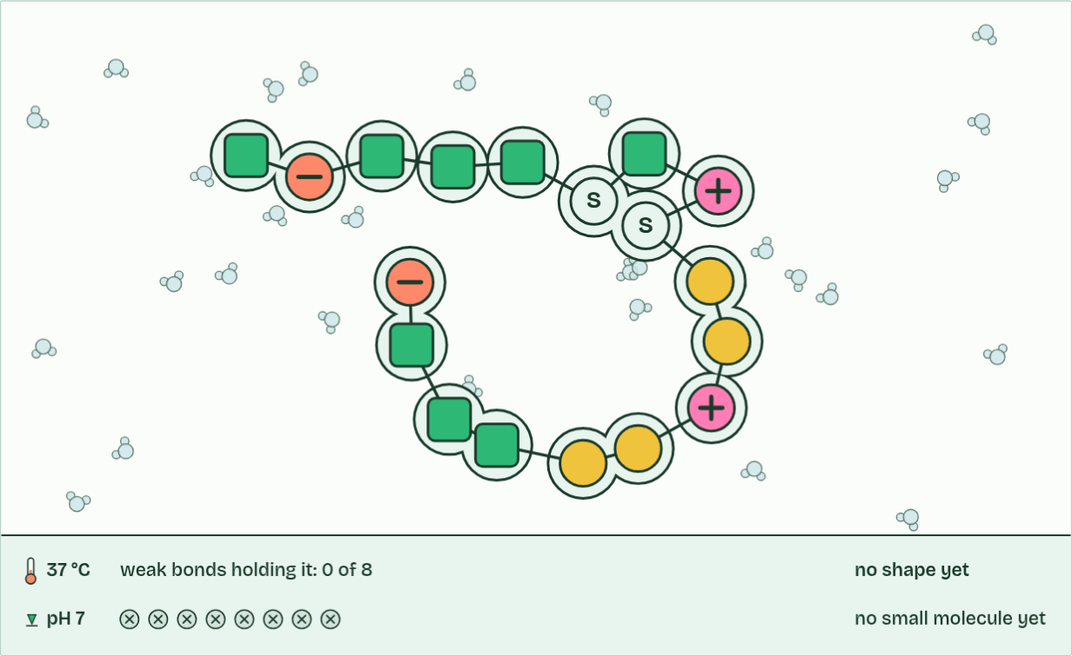
CHAPTER 5 · B1.2.5 Effect of pH and temperature on protein structure
37 °C, pH 7
1 / 3
Heat and pH unfold a protein
A new chain of amino acids among water molecules: as yet it has no shape.
Minutes 30 to 45
Notes:
Minutes 30 to 45 of 60: Heat and acid (15 min).
The plan: The egg white demonstration (optional, below), or chapter 5’s figure. Then the folding scene under it, Heat it, change the pH: let the film run once, then take the temperature past 65 °C and back to 37 °C (the chain stays unfolded and tangles), press Fresh protein and move the pH to 1.5 and to 12.5. Then the predict box: which bonds break?
A protein works because of its precise three-dimensional shape: a pocket that fits one molecule, a surface that binds one partner. That shape is held in place by many weak bonds between parts of the folded chain, hydrogen bonds (met in A1.1) and attractions between charged groups.
Heat. The atoms vibrate more and more, and past a point the weak bonds break. The chain unfolds, its shape is lost and it can no longer do its job: it is denatured. The peptide bonds are covalent and much stronger, so the sequence of amino acids is unchanged.
pH. Hydrogen ions attach to groups in the R groups, or leave them, and so change their charges. The attractions between oppositely charged groups are lost and the shape changes. Each protein keeps its shape over a range of pH, and far outside it the protein denatures.
Denaturation is usually permanent. Heated chains tangle with each other and do not refold when cooled, which is why an egg white stays white and solid. Each protein’s limits suit where it works: proteins in the stomach keep their shape at about pH 2, and the proteins of microbes in hot springs stay folded at temperatures that would denature ours. Cooling slows a protein down but does not unfold it.
Example: Try it The enzyme in your spit, a home lab in C1.1, times salivary amylase breaking down starch at cold, room and warm temperatures. Amylase is a protein, and denaturation is the reason the hottest tube behaves as it does.
The animation "Heat it, change the pH", paused at 3.0 s. The next slides go on through it, then play it.

Slide 34
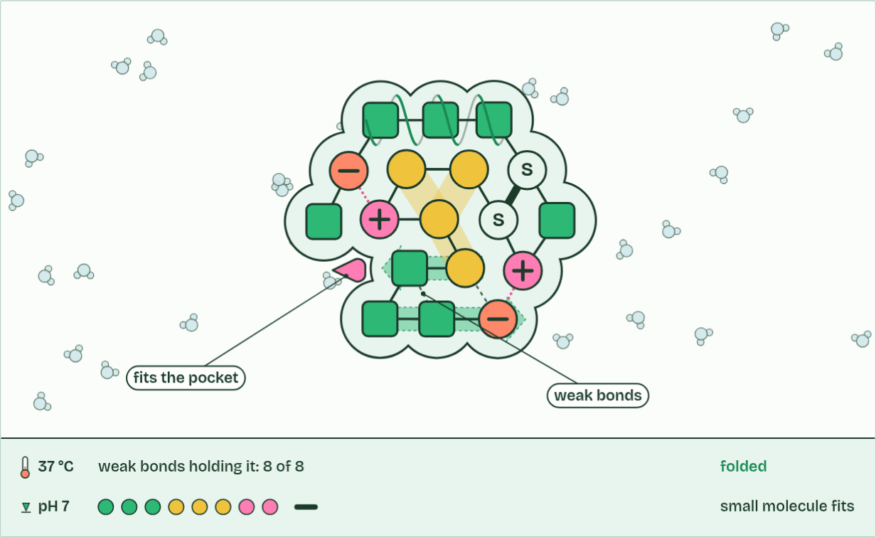
CHAPTER 5 · B1.2.5 Effect of pH and temperature on protein structure
37 °C, pH 7
2 / 3
Heat and pH unfold a protein
A small molecule fits its pocket: one precise shape, one job.
Minutes 30 to 45
Notes:
Minutes 30 to 45 of 60: Heat and acid (15 min).
The plan: The egg white demonstration (optional, below), or chapter 5’s figure. Then the folding scene under it, Heat it, change the pH: let the film run once, then take the temperature past 65 °C and back to 37 °C (the chain stays unfolded and tangles), press Fresh protein and move the pH to 1.5 and to 12.5. Then the predict box: which bonds break?
A protein works because of its precise three-dimensional shape: a pocket that fits one molecule, a surface that binds one partner. That shape is held in place by many weak bonds between parts of the folded chain, hydrogen bonds (met in A1.1) and attractions between charged groups.
Heat. The atoms vibrate more and more, and past a point the weak bonds break. The chain unfolds, its shape is lost and it can no longer do its job: it is denatured. The peptide bonds are covalent and much stronger, so the sequence of amino acids is unchanged.
pH. Hydrogen ions attach to groups in the R groups, or leave them, and so change their charges. The attractions between oppositely charged groups are lost and the shape changes. Each protein keeps its shape over a range of pH, and far outside it the protein denatures.
Denaturation is usually permanent. Heated chains tangle with each other and do not refold when cooled, which is why an egg white stays white and solid. Each protein’s limits suit where it works: proteins in the stomach keep their shape at about pH 2, and the proteins of microbes in hot springs stay folded at temperatures that would denature ours. Cooling slows a protein down but does not unfold it.
Example: Try it The enzyme in your spit, a home lab in C1.1, times salivary amylase breaking down starch at cold, room and warm temperatures. Amylase is a protein, and denaturation is the reason the hottest tube behaves as it does.
The animation "Heat it, change the pH", paused at 9.0 s. The next slides go on through it, then play it.

Slide 35
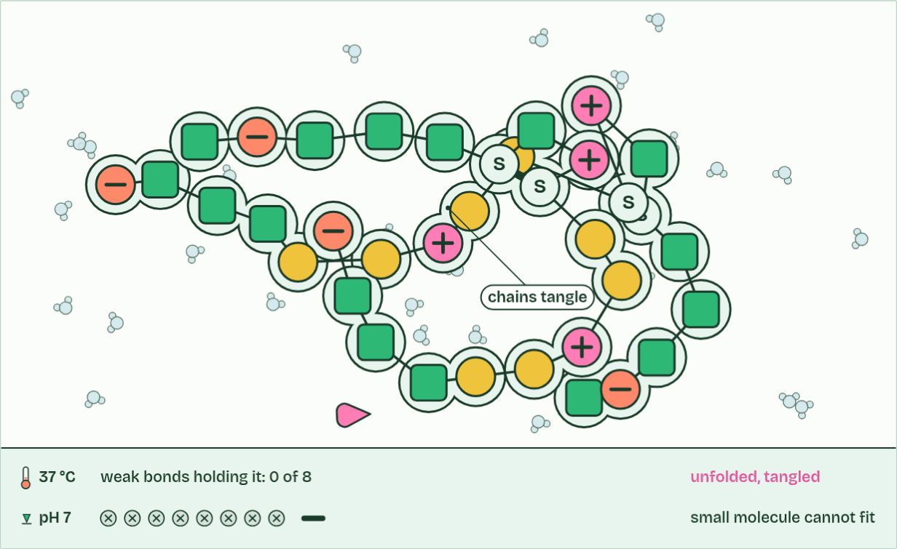
CHAPTER 5 · B1.2.5 Effect of pH and temperature on protein structure
37 °C, pH 7
3 / 3
Heat and pH unfold a protein
Cooled again, it does not refold: the unfolded chains tangle together instead.
Minutes 30 to 45
Notes:
Minutes 30 to 45 of 60: Heat and acid (15 min).
The plan: The egg white demonstration (optional, below), or chapter 5’s figure. Then the folding scene under it, Heat it, change the pH: let the film run once, then take the temperature past 65 °C and back to 37 °C (the chain stays unfolded and tangles), press Fresh protein and move the pH to 1.5 and to 12.5. Then the predict box: which bonds break?
A protein works because of its precise three-dimensional shape: a pocket that fits one molecule, a surface that binds one partner. That shape is held in place by many weak bonds between parts of the folded chain, hydrogen bonds (met in A1.1) and attractions between charged groups.
Heat. The atoms vibrate more and more, and past a point the weak bonds break. The chain unfolds, its shape is lost and it can no longer do its job: it is denatured. The peptide bonds are covalent and much stronger, so the sequence of amino acids is unchanged.
pH. Hydrogen ions attach to groups in the R groups, or leave them, and so change their charges. The attractions between oppositely charged groups are lost and the shape changes. Each protein keeps its shape over a range of pH, and far outside it the protein denatures.
Denaturation is usually permanent. Heated chains tangle with each other and do not refold when cooled, which is why an egg white stays white and solid. Each protein’s limits suit where it works: proteins in the stomach keep their shape at about pH 2, and the proteins of microbes in hot springs stay folded at temperatures that would denature ours. Cooling slows a protein down but does not unfold it.
Example: Try it The enzyme in your spit, a home lab in C1.1, times salivary amylase breaking down starch at cold, room and warm temperatures. Amylase is a protein, and denaturation is the reason the hottest tube behaves as it does.
The animation "Heat it, change the pH", paused at 16.0 s. The next slides go on through it, then play it.

Slide 36
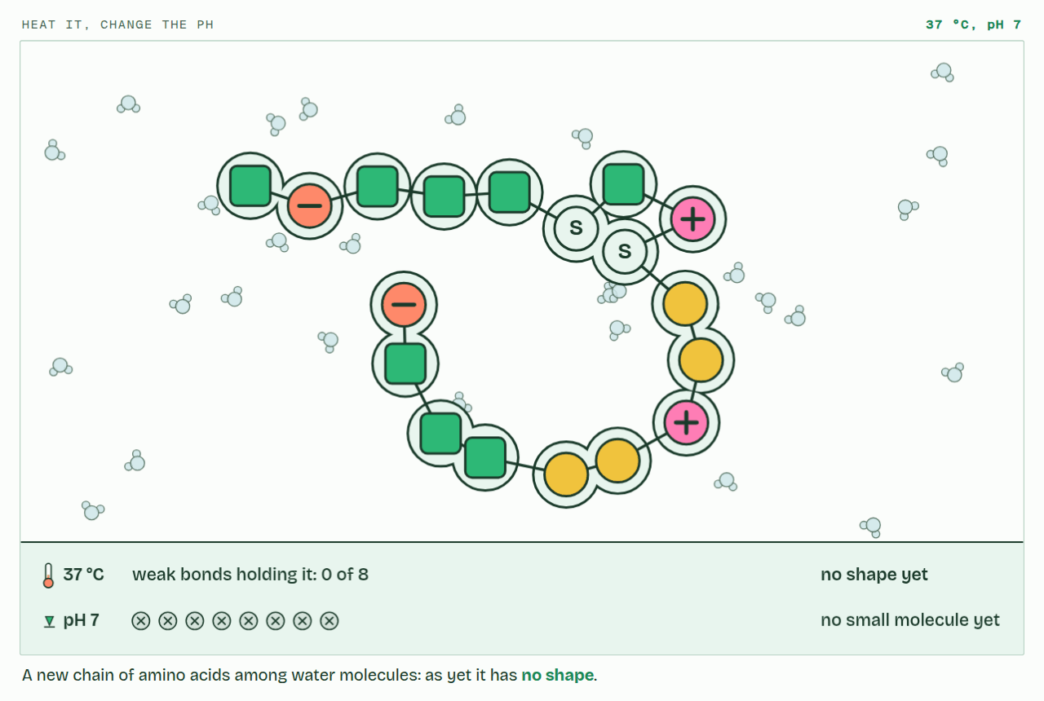
CHAPTER 5 · B1.2.5 Effect of pH and temperature on protein structure
PLAY IT
Heat and pH unfold a protein
Heat it, change the pH: click to play. It loops every 20 seconds.
Minutes 30 to 45
Notes:
Minutes 30 to 45 of 60: Heat and acid (15 min).
The plan: The egg white demonstration (optional, below), or chapter 5’s figure. Then the folding scene under it, Heat it, change the pH: let the film run once, then take the temperature past 65 °C and back to 37 °C (the chain stays unfolded and tangles), press Fresh protein and move the pH to 1.5 and to 12.5. Then the predict box: which bonds break?
The video is folding-dcb087.mp4, one loop of the animation in the guide. It plays in PowerPoint and Keynote. Google Slides does not play a video embedded in a .pptx: download folding-dcb087.mp4 (https://www.biologybybradford.com/guides/downloads/scenes/folding-dcb087.mp4), upload it to Google Drive, then Insert > Video > Google Drive.
In the guide the class can change it as it runs: https://www.biologybybradford.com/guides/ib-biology-b1-2-proteins#denaturation
What it shows, in order:
1. A new chain of amino acids among water molecules: as yet it has no shape.
2. A small molecule fits its pocket: one precise shape, one job.
3. Cooled again, it does not refold: the unfolded chains tangle together instead.

Slide 37
PREDICT
When an egg sets in a hot pan, which bonds break?
A The peptide bonds, so the chains fall apart into separate amino acids as the egg cooks
B Neither: the protein just melts, like fat, and goes solid again as it cools
C The weak bonds that hold the fold, while the peptide bonds stay intact
D Both the weak bonds and the peptide bonds, so everything comes apart
Minutes 30 to 45
Notes:
Minutes 30 to 45 of 60: Heat and acid (15 min).
The plan: The egg white demonstration (optional, below), or chapter 5’s figure. Then the folding scene under it, Heat it, change the pH: let the film run once, then take the temperature past 65 °C and back to 37 °C (the chain stays unfolded and tangles), press Fresh protein and move the pH to 1.5 and to 12.5. Then the predict box: which bonds break?
Ask for a show of hands, or mini whiteboards, before revealing. (Answer: C, on the next slide.)

Slide 38
WHAT HAPPENS
When an egg sets in a hot pan, which bonds break?
A The peptide bonds, so the chains fall apart into separate amino acids as the egg cooks
B Neither: the protein just melts, like fat, and goes solid again as it cools
C The weak bonds that hold the fold, while the peptide bonds stay intact
D Both the weak bonds and the peptide bonds, so everything comes apart
Only the weak bonds that hold the fold. The chain of amino acids is still whole: a cooked egg is digested into exactly the same amino acids as a raw one. What heat destroys is the shape, and with it the job.
Minutes 30 to 45
Notes:
Minutes 30 to 45 of 60: Heat and acid (15 min).
The plan: The egg white demonstration (optional, below), or chapter 5’s figure. Then the folding scene under it, Heat it, change the pH: let the film run once, then take the temperature past 65 °C and back to 37 °C (the chain stays unfolded and tangles), press Fresh protein and move the pH to 1.5 and to 12.5. Then the predict box: which bonds break?
Answer: C. Only the weak bonds that hold the fold. The chain of amino acids is still whole: a cooked egg is digested into exactly the same amino acids as a raw one. What heat destroys is the shape, and with it the job.

Slide 39
WATCH OUT
Denatured does not mean dead (a protein was never alive), melted or dissolved. Cold does not denature: a protein in the fridge is slow but whole. And cooling a heat-denatured protein does not usually bring its shape back.
Minutes 30 to 45
Notes:
Minutes 30 to 45 of 60: Heat and acid (15 min).
The plan: The egg white demonstration (optional, below), or chapter 5’s figure. Then the folding scene under it, Heat it, change the pH: let the film run once, then take the temperature past 65 °C and back to 37 °C (the chain stays unfolded and tangles), press Fresh protein and move the pH to 1.5 and to 12.5. Then the predict box: which bonds break?
A common mistake: say it, then ask who can say why it is wrong.

Slide 40
STEP 5
10 MIN
A written question
Set an SL written question from the B1.2 exam maker, such as drawing a dipeptide or explaining essential amino acids, and peer-mark it.
Minutes 45 to 55
Notes:
Minutes 45 to 55 of 60: A written question (10 min).
The plan: Set an SL written question from the B1.2 exam maker (in Practise and revise), such as drawing a dipeptide or explaining essential amino acids, and peer-mark it. Point out that the markscheme has more points than marks.

Slide 41
PLENARY
Can you now...
Explain why some amino acids must come from food, and what that means for a vegan diet (B1.2.3)
Explain why the number of possible polypeptides is practically endless (B1.2.4)
Explain how heat and pH denature a protein, and why it then stops working (B1.2.5)
Minutes 55 to 60
Notes:
Minutes 55 to 60 of 60: Exit and homework (5 min).
The plan: Homework: the Check step. The amylase home lab (C1.1) makes good optional homework: denaturation you can time.
Thumbs up, sideways or down on each goal before the exit question. The goals come from the statements this lesson covers.

Slide 42
EXIT QUESTION
Before you go
Homework: the Check step.
Minutes 55 to 60
Notes:
Minutes 55 to 60 of 60: Exit and homework (5 min).
The plan: Homework: the Check step. The amylase home lab (C1.1) makes good optional homework: denaturation you can time.

Slide 43
PRACTISE AND REVISE
Keep going
Exam practice: a fresh paper of exam questions on B1.2 at standard level, marked as you go
The guide, with the animations and the dry lab
This lesson in the guide: 3 Some amino acids you must eat, 4 Twenty amino acids, endless chains, 5 Heat and pH unfold a protein
BUILD FOR YOUR CLASS
ALREADY ON THE SITE FOR B1.2
CARD SETS ON SPLYCR
Tarsia puzzle, dominoes and picture reveal on B1.2, built from its key terms and ready to print
A pub quiz with rounds on B1.2, to present or run with no projector
An escape room built from the question bank on B1.2
Revision map: B1.2 Proteins, to fill in
Exam questions: B1.2 in the exam maker, a paper with its markscheme
Open a set to host it as a class game, or make a copy to edit.
B1.2 Proteins
How this was made. The course structure, the activities and the teaching choices come from my own classroom, my presentations and my years of teaching IB and AP Biology. I use Claude, an AI, to help write and build the interactive guides, lesson plans, slides and practice questions, and to draw the diagrams and code the interactives. I direct the work and review it against the IB and AP specifications before it goes live.
Minute 60: after the lesson
Notes:
Every link here is live. Set the exam practice paper for homework: it is fresh each time, marked as students go and saved to their Exam practice when they are signed in.
Exam practice: https://www.biologybybradford.com/exam-maker/sit?topics=B1.2&level=SL&paper=quiz&marks=15&src=ep
The guide: https://www.biologybybradford.com/guides/ib-biology-b1-2-proteins

