Slide 1
IB Biology B1.2
LESSON 3 OF 4
HL
BY THE END YOU CAN
Proteins
Classify R groups and explain how they set the properties of a polypeptide (B1.2.6)
Explain how the sequence of amino acids gives every copy of a protein the same precise shape (B1.2.7)
Describe the alpha helix and beta-pleated sheet and the hydrogen bonds that hold them (B1.2.8)
Name the four kinds of bond that hold a tertiary structure, and say where polar and non-polar R groups end up (B1.2.9, B1.2.10)
R groups and the levels of structure
B1.2.6 to B1.2.9
Sorting R groups, then the primary, secondary and tertiary structure and the bonds that hold each
60 minutes · chapters 6, 7, 8, 9
Minute 0
Notes:
IB Biology B1.2, Proteins. Lesson 3 of 4: R groups and the levels of structure (higher level), 60 minutes.
The plan, minute by minute (each slide's footer says where you are):
0 to 5 min (5) Do now: sort six R groups
5 to 25 min (20) Pipe-cleaner polypeptide
25 to 35 min (10) Helix and sheet
35 to 50 min (15) What holds the fold
50 to 60 min (10) An HL written question
What students get wrong:
Secondary structure is held by R groups. It is held by the backbone C=O and N-H.
Acidic R groups are positive. They are negative: the carboxyl group has lost a hydrogen ion.
Stretch and support:
Support: give a word bank for the four levels table.
Stretch: why do all the molecules of one sequence fold the same way, and what did Anfinsen’s experiment add?
Stretch: why are disulfide bonds commoner in proteins that leave the cell? (The cytoplasm is a reducing place, so they do not form well inside.)
Stretch: compare an AlphaFold prediction with an experimental structure of the same protein.
The lesson plan to print: https://www.biologybybradford.com/guides/downloads/ib-biology-b1-2-proteins-lesson-3-plan.pdf

Slide 2
DO NOW
Sort six R groups
Print chapter 6’s six R group cards and sort them into hydrophobic, polar, acidic and basic, then turn over the Hungry Pandas Ate Bamboo tiles.
5:00
minutes
Start now: the timer is running.
Minutes 0 to 5
Notes:
Minutes 0 to 5 of 60: Do now: sort six R groups (5 min).
The plan: Print chapter 6’s six R group cards and sort them into hydrophobic, polar, acidic and basic, then turn over the Hungry Pandas Ate Bamboo tiles.
Start a 5 minute timer as they come in.

Slide 3
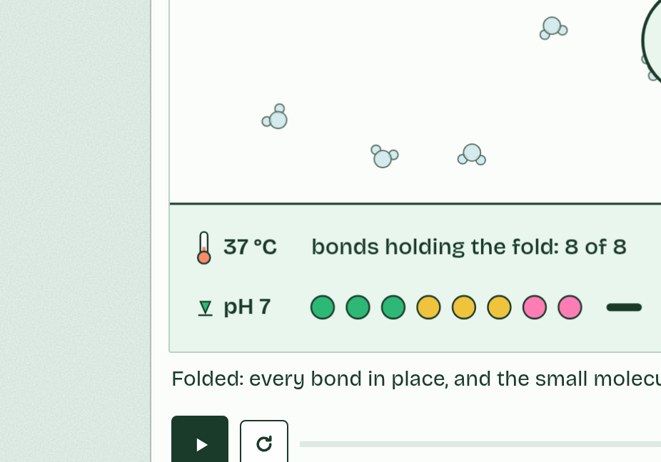
CHAPTER 6 · B1.2.6 Chemical diversity in the R groups
The R groups decide how a chain behaves
Hydrophobic R groups are non-polar, mostly carbon and hydrogen, and water does not attract them.
Hydrophilic R groups are attracted to water, and they are either polar, with partial charges that let them form hydrogen bonds, or charged.
Charged R groups are acidic or basic.
An acidic R group contains a carboxyl group, which loses a hydrogen ion and becomes negative (-COO⁻).
Minutes 0 to 5
Notes:
Minutes 0 to 5 of 60: Do now: sort six R groups (5 min).
The plan: Print chapter 6’s six R group cards and sort them into hydrophobic, polar, acidic and basic, then turn over the Hungry Pandas Ate Bamboo tiles.
R groups differ in size, shape and chemistry, and those differences give a polypeptide its properties: which parts face water, what binds to what, and where the chain carries charge. You do not need to name any R group, but you do need to sort them.
There are two big classes. Hydrophobic R groups are non-polar, mostly carbon and hydrogen, and water does not attract them. Hydrophilic R groups are attracted to water, and they are either polar, with partial charges that let them form hydrogen bonds, or charged.
Charged R groups are acidic or basic. An acidic R group contains a carboxyl group, which loses a hydrogen ion and becomes negative (-COO⁻). A basic R group contains an amine group, which gains a hydrogen ion and becomes positive (-NH₃⁺). At the pH inside a cell both are charged, and a change in pH changes that (chapters 5 and 9).

Slide 4
PREDICT
An R group contains a carboxyl group. Inside a cell, at about pH 7, it is:
A Uncharged and hydrophobic, so water does not attract it
B Negatively charged, because it has lost a hydrogen ion
C Positively charged, because it has gained a hydrogen ion
Minutes 0 to 5
Notes:
Minutes 0 to 5 of 60: Do now: sort six R groups (5 min).
The plan: Print chapter 6’s six R group cards and sort them into hydrophobic, polar, acidic and basic, then turn over the Hungry Pandas Ate Bamboo tiles.
Ask for a show of hands, or mini whiteboards, before revealing. (Answer: B, on the next slide.)

Slide 5
WHAT HAPPENS
An R group contains a carboxyl group. Inside a cell, at about pH 7, it is:
A Uncharged and hydrophobic, so water does not attract it
B Negatively charged, because it has lost a hydrogen ion
C Positively charged, because it has gained a hydrogen ion
Negatively charged. A carboxyl group gives up its hydrogen ion and is left negative: an acidic R group. An amine group does the opposite, gaining a hydrogen ion to become positive: a basic R group. Both are hydrophilic.
Minutes 0 to 5
Notes:
Minutes 0 to 5 of 60: Do now: sort six R groups (5 min).
The plan: Print chapter 6’s six R group cards and sort them into hydrophobic, polar, acidic and basic, then turn over the Hungry Pandas Ate Bamboo tiles.
Answer: B. Negatively charged. A carboxyl group gives up its hydrogen ion and is left negative: an acidic R group. An amine group does the opposite, gaining a hydrogen ion to become positive: a basic R group. Both are hydrophilic.

Slide 6
WATCH OUT
Hydrophilic does not mean charged: polar R groups are hydrophilic with no overall charge. Acidic R groups are negative, not positive. And a charge can come and go with pH.
Minutes 0 to 5
Notes:
Minutes 0 to 5 of 60: Do now: sort six R groups (5 min).
The plan: Print chapter 6’s six R group cards and sort them into hydrophobic, polar, acidic and basic, then turn over the Hungry Pandas Ate Bamboo tiles.
A common mistake: say it, then ask who can say why it is wrong.

Slide 7
REMEMBER IT
The four kinds of R group
H
P
A
B
Hungry
Pandas
Ate
Bamboo
Minutes 0 to 5
Notes:
Minutes 0 to 5 of 60: Do now: sort six R groups (5 min).
The plan: Print chapter 6’s six R group cards and sort them into hydrophobic, polar, acidic and basic, then turn over the Hungry Pandas Ate Bamboo tiles.
Ask the class what each letter stands for before revealing.

Slide 8
REMEMBER IT
The four kinds of R group
H
P
A
B
Hungry
Pandas
Ate
Bamboo
Hydrophobic
Polar
Acidic
Basic
non-polar, hides from water
partial charges, hydrogen bonds
loses H⁺, negative
gains H⁺, positive
Minutes 0 to 5
Notes:
Minutes 0 to 5 of 60: Do now: sort six R groups (5 min).
The plan: Print chapter 6’s six R group cards and sort them into hydrophobic, polar, acidic and basic, then turn over the Hungry Pandas Ate Bamboo tiles.
Hungry: Hydrophobic (non-polar, hides from water)
Pandas: Polar (partial charges, hydrogen bonds)
Ate: Acidic (loses H⁺, negative)
Bamboo: Basic (gains H⁺, positive)

Slide 9

MODEL · HL
20 MIN
Pipe-cleaner polypeptide
THE TASK
Each pair gets a gene card listing a sequence of colours (yellow hydrophobic, green polar, pink and coral charged, two cysteine colours) and threads short coloured pieces onto a long pipe cleaner in that order: they are the ribosome, and that is primary structure. They twist one stretch round a pencil (helix), zigzag another against itself (sheet), then fold the whole thing so the yellows meet in the middle, clip the two cysteines together (disulfide bond) and join on to another pair’s chain (quaternary). Pairs with the same card compare: same shape?
STUDENTS NEED
Long pipe cleaners, short coloured pieces (or beads), pencils, paper clips, gene cards.
Minutes 5 to 25
Notes:
Minutes 5 to 25 of 60: Pipe-cleaner polypeptide (20 min).
The plan: Pairs thread a gene card’s coloured pieces onto a pipe cleaner, coil one stretch, pleat another, fold the whole thing and clip the cysteines together (activity below).
The activity: Pipe-cleaner polypeptide. Each pair gets a gene card listing a sequence of colours (yellow hydrophobic, green polar, pink and coral charged, two cysteine colours) and threads short coloured pieces onto a long pipe cleaner in that order: they are the ribosome, and that is primary structure. They twist one stretch round a pencil (helix), zigzag another against itself (sheet), then fold the whole thing so the yellows meet in the middle, clip the two cysteines together (disulfide bond) and join on to another pair’s chain (quaternary). Pairs with the same card compare: same shape?
Needs: long pipe cleaners, short coloured pieces (or beads), pencils, paper clips, gene cards.
The time: 20 minutes, minutes 5 to 25 of the plan.

Slide 10
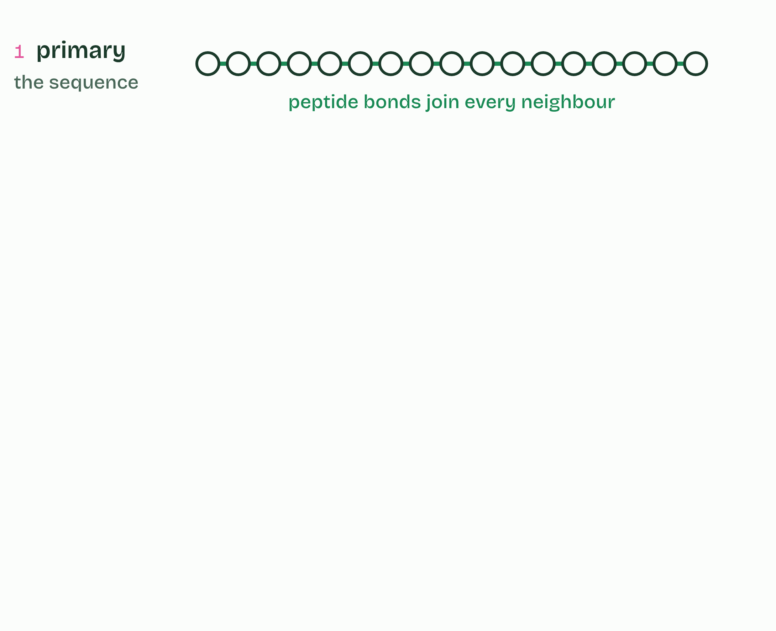
CHAPTER 7 · B1.2.7 Impact of primary structure on conformation
1 / 5
The sequence sets the shape
Primary structure: a sequence of amino acids, each joined to the next by a peptide bond.
Minutes 5 to 25
Notes:
Minutes 5 to 25 of 60: Pipe-cleaner polypeptide (20 min).
The plan: Pairs thread a gene card’s coloured pieces onto a pipe cleaner, coil one stretch, pleat another, fold the whole thing and clip the cysteines together (activity below).
The primary structure of a protein is the sequence of amino acids in its polypeptide, and a gene sets it. The sequence, and the exact position of each amino acid in it, decide the three-dimensional shape (its conformation): where the chain coils or pleats (secondary structure, chapter 8), how the whole chain folds (tertiary, chapters 9 and 10) and how chains fit together (quaternary, chapter 11).
So proteins have precise, predictable and repeatable structures, despite their complexity. Every insulin molecule your pancreas makes has the same shape, and fits insulin receptors anywhere in your body. Change one amino acid in a key position and the shape can change: in D1.3 you will meet a single changed amino acid in haemoglobin with large effects.
Example: How we know Christian Anfinsen unfolded the enzyme ribonuclease with chemicals and then removed them. The chains refolded by themselves into the working shape, so the information for the shape is in the sequence (Nobel Prize in Chemistry, 1972). Since 2020 a computer model trained on known structures, AlphaFold, has predicted the shape of many proteins from their sequence alone, often close to what experiments find, and its database holds predictions for over 200 million proteins. Models earn trust by being tested against evidence.

Slide 11
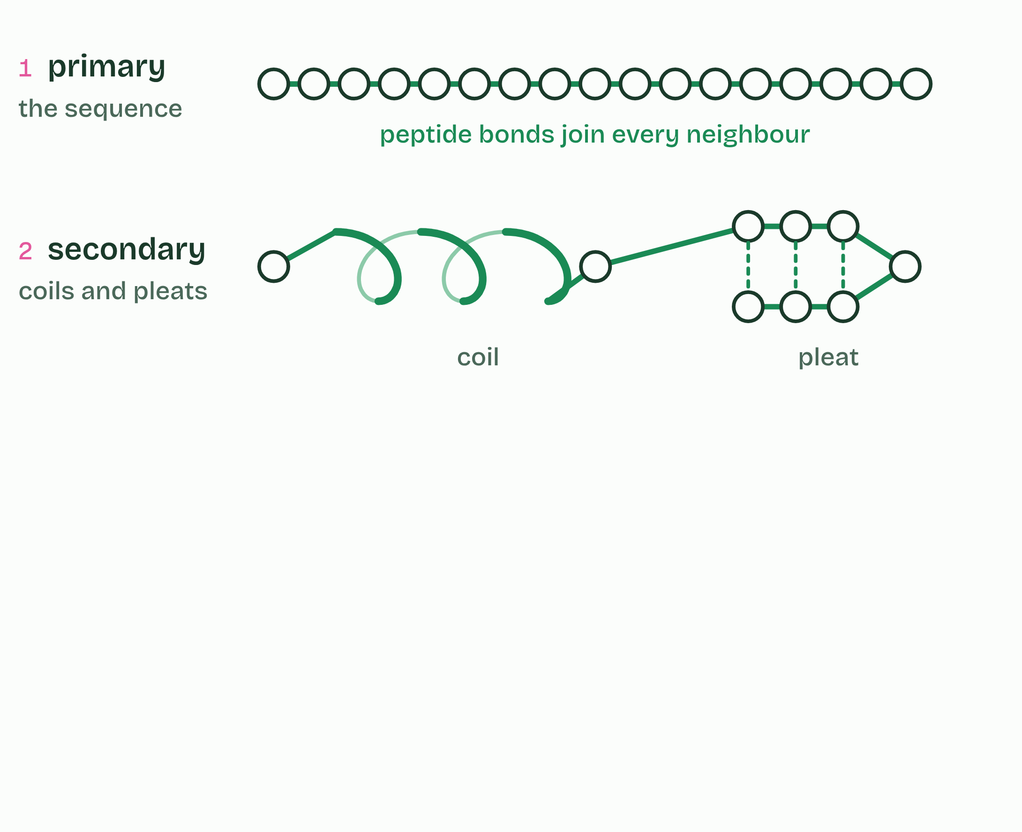
CHAPTER 7 · B1.2.7 Impact of primary structure on conformation
2 / 5
The sequence sets the shape
Secondary structure: one stretch coils and another pleats beside itself, held by dashed hydrogen bonds.
Minutes 5 to 25
Notes:
Minutes 5 to 25 of 60: Pipe-cleaner polypeptide (20 min).
The plan: Pairs thread a gene card’s coloured pieces onto a pipe cleaner, coil one stretch, pleat another, fold the whole thing and clip the cysteines together (activity below).
The primary structure of a protein is the sequence of amino acids in its polypeptide, and a gene sets it. The sequence, and the exact position of each amino acid in it, decide the three-dimensional shape (its conformation): where the chain coils or pleats (secondary structure, chapter 8), how the whole chain folds (tertiary, chapters 9 and 10) and how chains fit together (quaternary, chapter 11).
So proteins have precise, predictable and repeatable structures, despite their complexity. Every insulin molecule your pancreas makes has the same shape, and fits insulin receptors anywhere in your body. Change one amino acid in a key position and the shape can change: in D1.3 you will meet a single changed amino acid in haemoglobin with large effects.
Example: How we know Christian Anfinsen unfolded the enzyme ribonuclease with chemicals and then removed them. The chains refolded by themselves into the working shape, so the information for the shape is in the sequence (Nobel Prize in Chemistry, 1972). Since 2020 a computer model trained on known structures, AlphaFold, has predicted the shape of many proteins from their sequence alone, often close to what experiments find, and its database holds predictions for over 200 million proteins. Models earn trust by being tested against evidence.

Slide 12
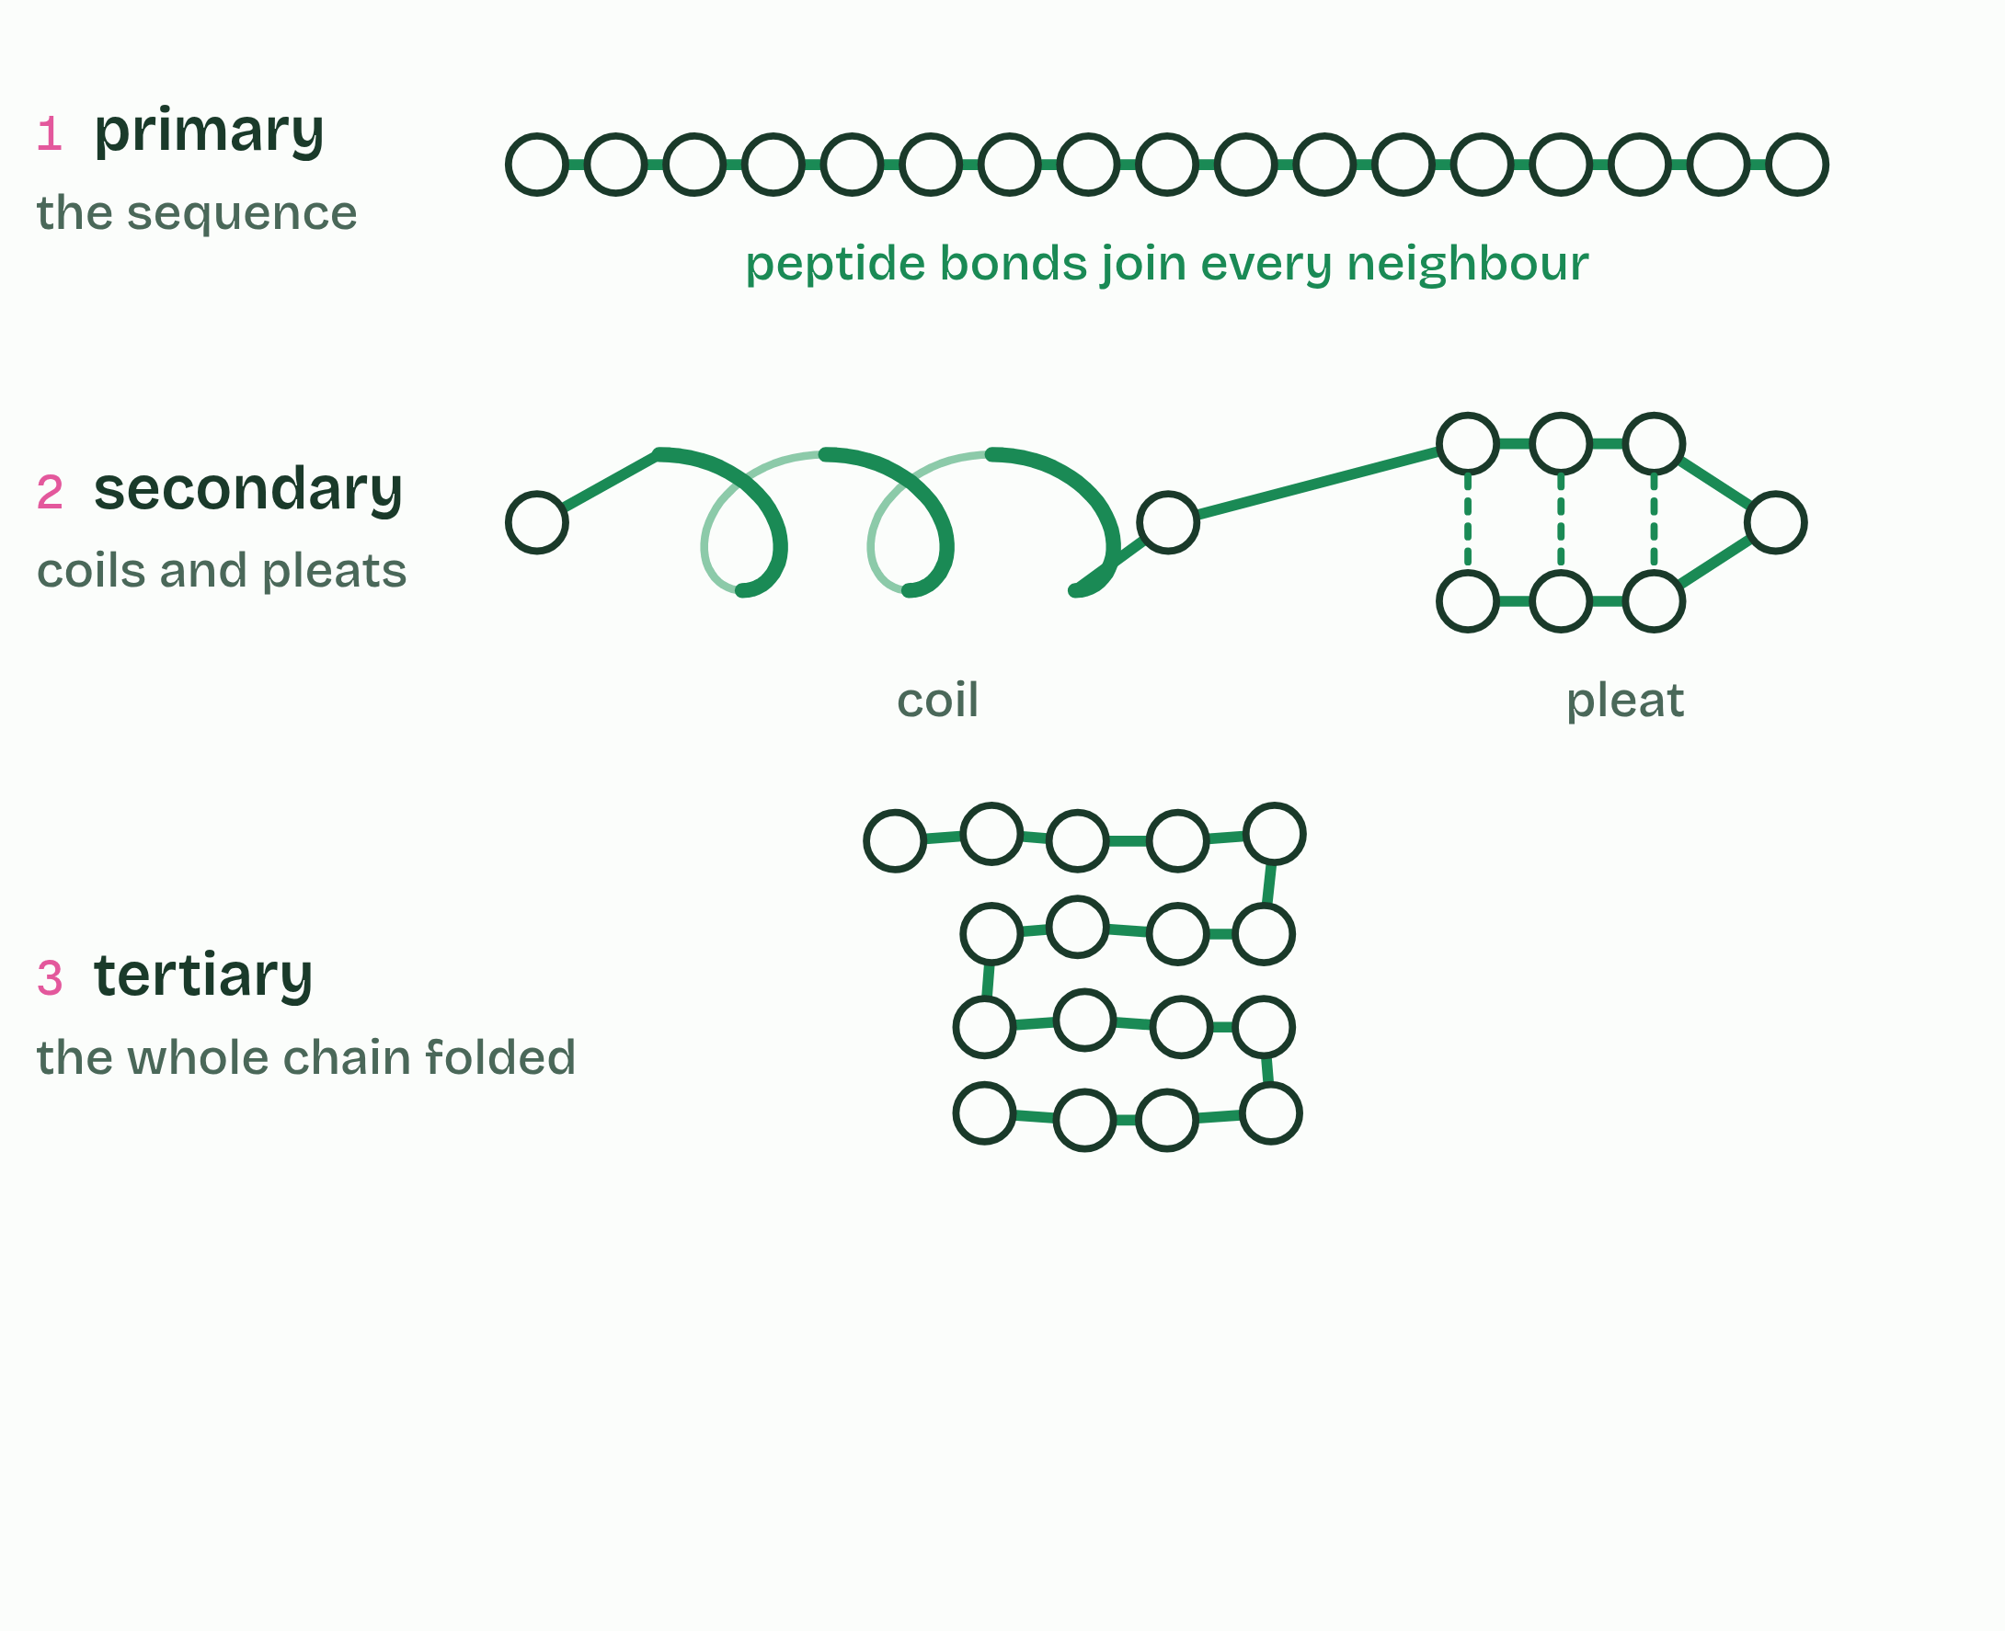
CHAPTER 7 · B1.2.7 Impact of primary structure on conformation
3 / 5
The sequence sets the shape
Tertiary structure: the whole chain folded into a compact shape.
Minutes 5 to 25
Notes:
Minutes 5 to 25 of 60: Pipe-cleaner polypeptide (20 min).
The plan: Pairs thread a gene card’s coloured pieces onto a pipe cleaner, coil one stretch, pleat another, fold the whole thing and clip the cysteines together (activity below).
The primary structure of a protein is the sequence of amino acids in its polypeptide, and a gene sets it. The sequence, and the exact position of each amino acid in it, decide the three-dimensional shape (its conformation): where the chain coils or pleats (secondary structure, chapter 8), how the whole chain folds (tertiary, chapters 9 and 10) and how chains fit together (quaternary, chapter 11).
So proteins have precise, predictable and repeatable structures, despite their complexity. Every insulin molecule your pancreas makes has the same shape, and fits insulin receptors anywhere in your body. Change one amino acid in a key position and the shape can change: in D1.3 you will meet a single changed amino acid in haemoglobin with large effects.
Example: How we know Christian Anfinsen unfolded the enzyme ribonuclease with chemicals and then removed them. The chains refolded by themselves into the working shape, so the information for the shape is in the sequence (Nobel Prize in Chemistry, 1972). Since 2020 a computer model trained on known structures, AlphaFold, has predicted the shape of many proteins from their sequence alone, often close to what experiments find, and its database holds predictions for over 200 million proteins. Models earn trust by being tested against evidence.

Slide 13
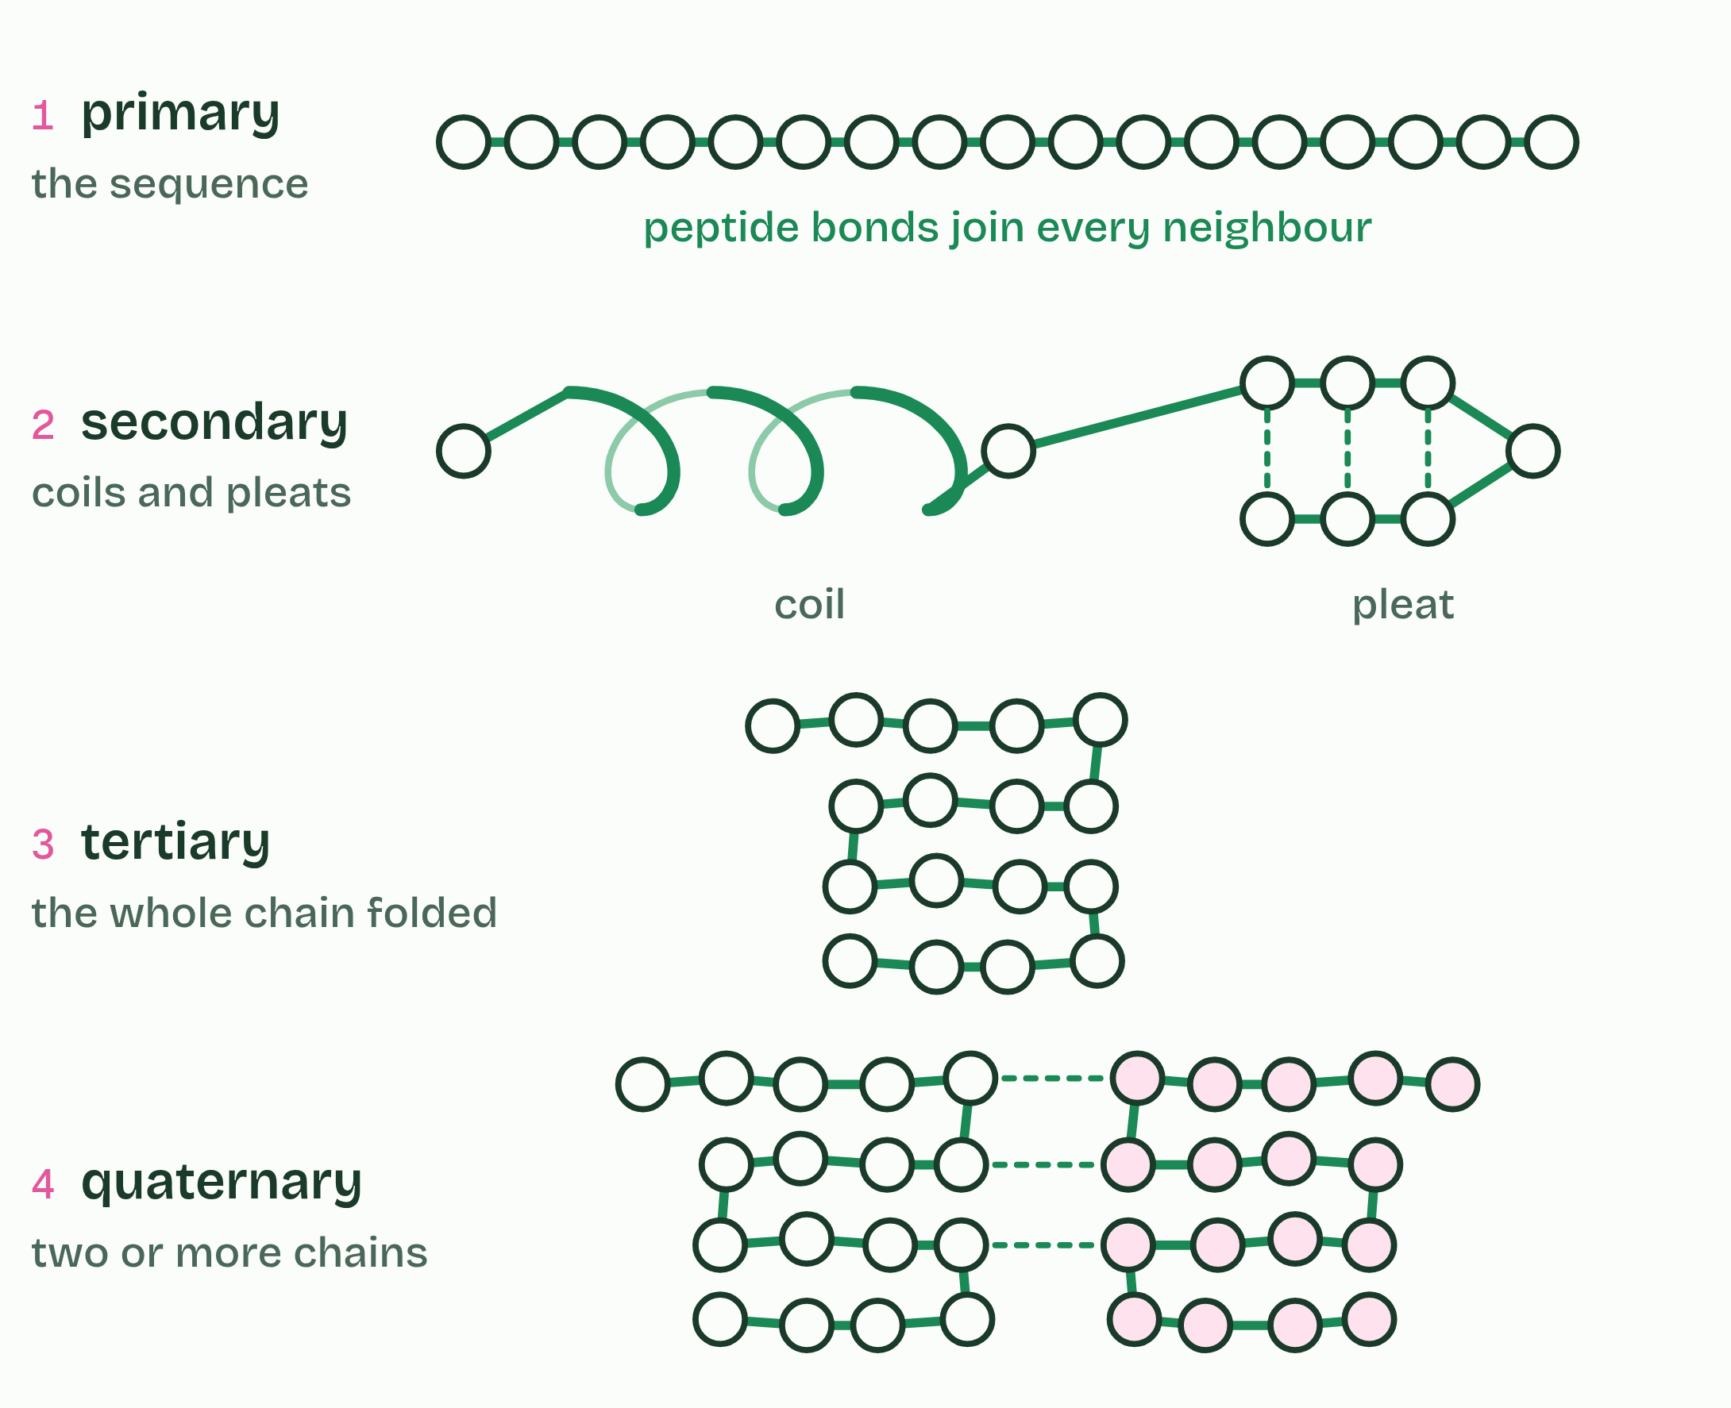
CHAPTER 7 · B1.2.7 Impact of primary structure on conformation
4 / 5
The sequence sets the shape
Quaternary structure: two or more folded chains together. Not every protein has one.
Minutes 5 to 25
Notes:
Minutes 5 to 25 of 60: Pipe-cleaner polypeptide (20 min).
The plan: Pairs thread a gene card’s coloured pieces onto a pipe cleaner, coil one stretch, pleat another, fold the whole thing and clip the cysteines together (activity below).
The primary structure of a protein is the sequence of amino acids in its polypeptide, and a gene sets it. The sequence, and the exact position of each amino acid in it, decide the three-dimensional shape (its conformation): where the chain coils or pleats (secondary structure, chapter 8), how the whole chain folds (tertiary, chapters 9 and 10) and how chains fit together (quaternary, chapter 11).
So proteins have precise, predictable and repeatable structures, despite their complexity. Every insulin molecule your pancreas makes has the same shape, and fits insulin receptors anywhere in your body. Change one amino acid in a key position and the shape can change: in D1.3 you will meet a single changed amino acid in haemoglobin with large effects.
Example: How we know Christian Anfinsen unfolded the enzyme ribonuclease with chemicals and then removed them. The chains refolded by themselves into the working shape, so the information for the shape is in the sequence (Nobel Prize in Chemistry, 1972). Since 2020 a computer model trained on known structures, AlphaFold, has predicted the shape of many proteins from their sequence alone, often close to what experiments find, and its database holds predictions for over 200 million proteins. Models earn trust by being tested against evidence.

Slide 14
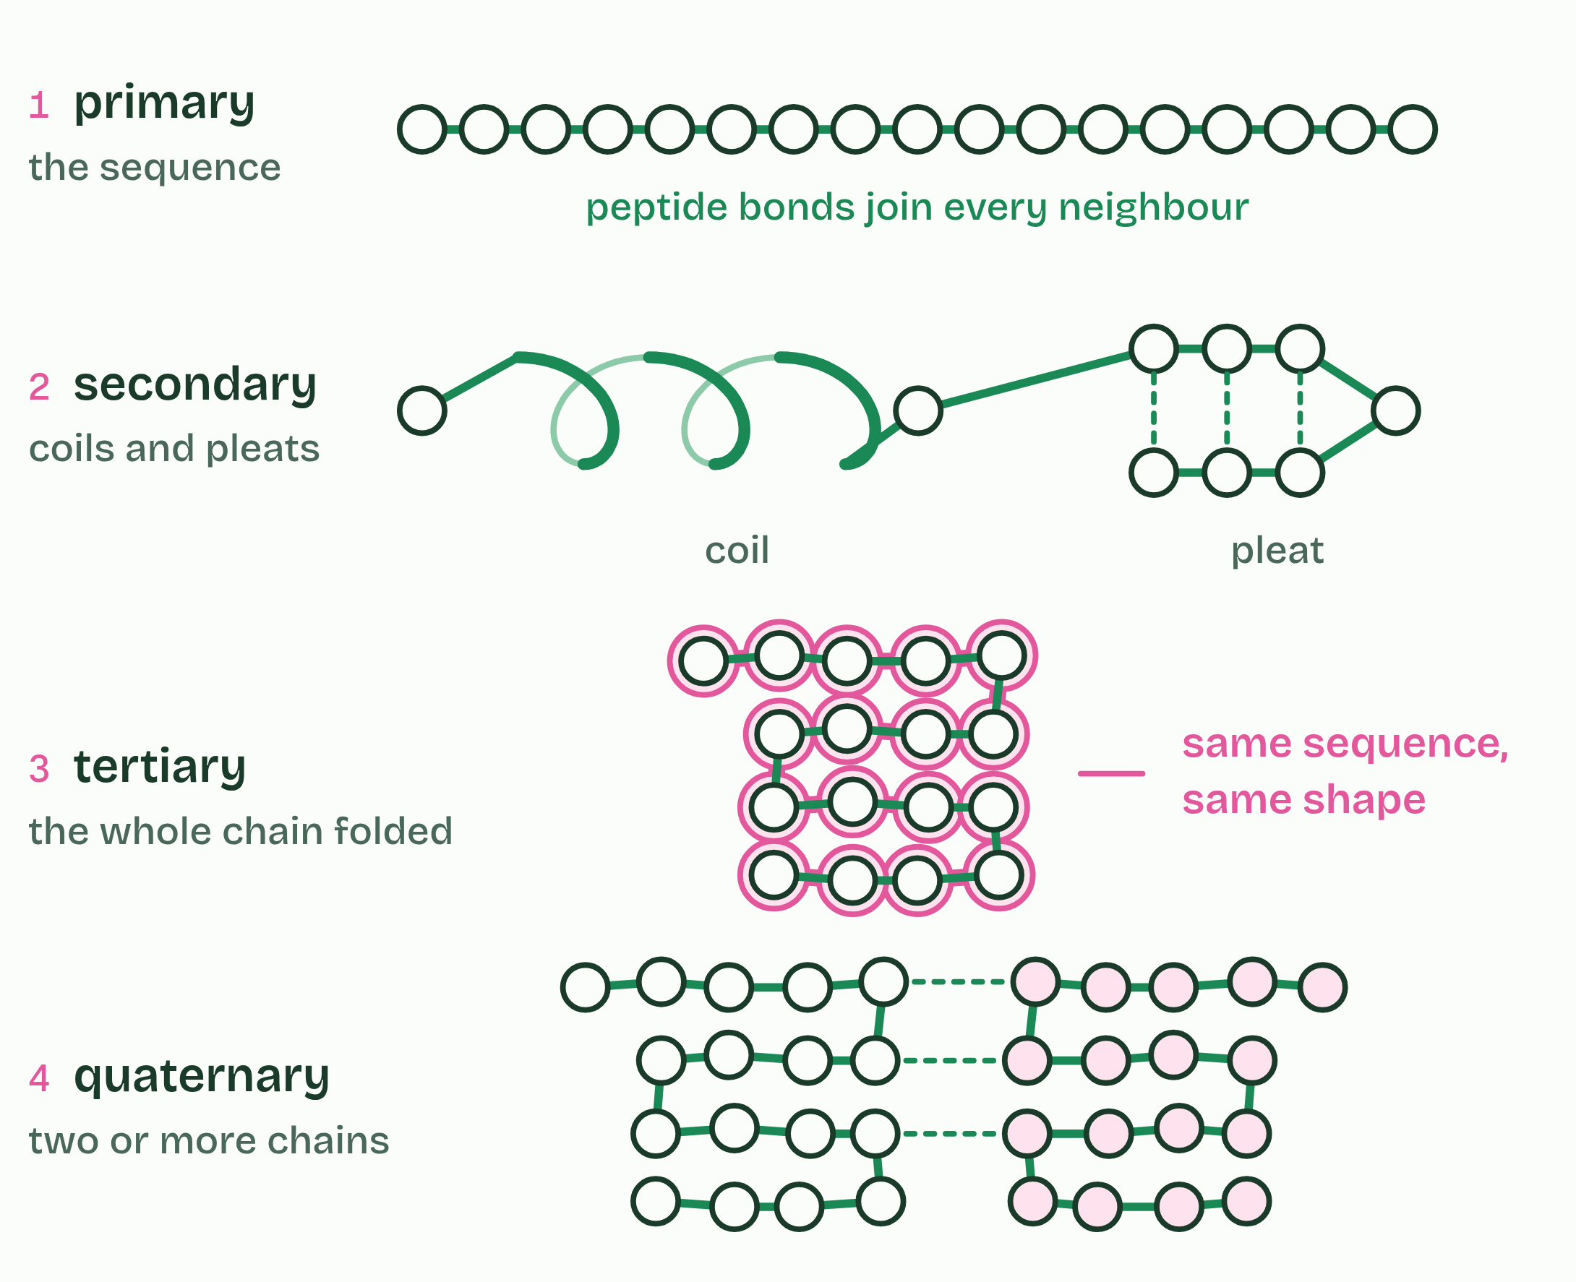
CHAPTER 7 · B1.2.7 Impact of primary structure on conformation
5 / 5
The sequence sets the shape
A second copy of the same sequence folds into the same shape: same sequence, same shape, every time.
Minutes 5 to 25
Notes:
Minutes 5 to 25 of 60: Pipe-cleaner polypeptide (20 min).
The plan: Pairs thread a gene card’s coloured pieces onto a pipe cleaner, coil one stretch, pleat another, fold the whole thing and clip the cysteines together (activity below).
The primary structure of a protein is the sequence of amino acids in its polypeptide, and a gene sets it. The sequence, and the exact position of each amino acid in it, decide the three-dimensional shape (its conformation): where the chain coils or pleats (secondary structure, chapter 8), how the whole chain folds (tertiary, chapters 9 and 10) and how chains fit together (quaternary, chapter 11).
So proteins have precise, predictable and repeatable structures, despite their complexity. Every insulin molecule your pancreas makes has the same shape, and fits insulin receptors anywhere in your body. Change one amino acid in a key position and the shape can change: in D1.3 you will meet a single changed amino acid in haemoglobin with large effects.
Example: How we know Christian Anfinsen unfolded the enzyme ribonuclease with chemicals and then removed them. The chains refolded by themselves into the working shape, so the information for the shape is in the sequence (Nobel Prize in Chemistry, 1972). Since 2020 a computer model trained on known structures, AlphaFold, has predicted the shape of many proteins from their sequence alone, often close to what experiments find, and its database holds predictions for over 200 million proteins. Models earn trust by being tested against evidence.

Slide 15
CHAPTER 7 · B1.2.7 Impact of primary structure on conformation
The sequence sets the shape
The primary structure of a protein is the sequence of amino acids in its polypeptide, and a gene sets it.
So proteins have precise, predictable and repeatable structures, despite their complexity.
Minutes 5 to 25
Notes:
Minutes 5 to 25 of 60: Pipe-cleaner polypeptide (20 min).
The plan: Pairs thread a gene card’s coloured pieces onto a pipe cleaner, coil one stretch, pleat another, fold the whole thing and clip the cysteines together (activity below).
The primary structure of a protein is the sequence of amino acids in its polypeptide, and a gene sets it. The sequence, and the exact position of each amino acid in it, decide the three-dimensional shape (its conformation): where the chain coils or pleats (secondary structure, chapter 8), how the whole chain folds (tertiary, chapters 9 and 10) and how chains fit together (quaternary, chapter 11).
So proteins have precise, predictable and repeatable structures, despite their complexity. Every insulin molecule your pancreas makes has the same shape, and fits insulin receptors anywhere in your body. Change one amino acid in a key position and the shape can change: in D1.3 you will meet a single changed amino acid in haemoglobin with large effects.
Example: How we know Christian Anfinsen unfolded the enzyme ribonuclease with chemicals and then removed them. The chains refolded by themselves into the working shape, so the information for the shape is in the sequence (Nobel Prize in Chemistry, 1972). Since 2020 a computer model trained on known structures, AlphaFold, has predicted the shape of many proteins from their sequence alone, often close to what experiments find, and its database holds predictions for over 200 million proteins. Models earn trust by being tested against evidence.

Slide 16
PREDICT
Two people make insulin from the same gene sequence. Do their insulin molecules have the same shape?
A Yes, exactly: the same sequence folds the same way every time
B Roughly: folding is random, so every molecule differs a little from the next
C Only if the two people are related, because they share the same alleles for it
Minutes 5 to 25
Notes:
Minutes 5 to 25 of 60: Pipe-cleaner polypeptide (20 min).
The plan: Pairs thread a gene card’s coloured pieces onto a pipe cleaner, coil one stretch, pleat another, fold the whole thing and clip the cysteines together (activity below).
Ask for a show of hands, or mini whiteboards, before revealing. (Answer: A, on the next slide.)

Slide 17
WHAT HAPPENS
Two people make insulin from the same gene sequence. Do their insulin molecules have the same shape?
A Yes, exactly: the same sequence folds the same way every time
B Roughly: folding is random, so every molecule differs a little from the next
C Only if the two people are related, because they share the same alleles for it
Yes. Proteins have precise, repeatable shapes. The sequence of R groups decides which bonds can form and where, so the same sequence folds the same way every time. That is why one hormone fits the same receptor in every cell, and why a protein’s shape can be predicted from its sequence.
Minutes 5 to 25
Notes:
Minutes 5 to 25 of 60: Pipe-cleaner polypeptide (20 min).
The plan: Pairs thread a gene card’s coloured pieces onto a pipe cleaner, coil one stretch, pleat another, fold the whole thing and clip the cysteines together (activity below).
Answer: A. Yes. Proteins have precise, repeatable shapes. The sequence of R groups decides which bonds can form and where, so the same sequence folds the same way every time. That is why one hormone fits the same receptor in every cell, and why a protein’s shape can be predicted from its sequence.

Slide 18
WATCH OUT
Primary structure is the sequence, not a shape, but it decides every level after it. Folding is not random.
Minutes 5 to 25
Notes:
Minutes 5 to 25 of 60: Pipe-cleaner polypeptide (20 min).
The plan: Pairs thread a gene card’s coloured pieces onto a pipe cleaner, coil one stretch, pleat another, fold the whole thing and clip the cysteines together (activity below).
A common mistake: say it, then ask who can say why it is wrong.

Slide 19
STEP 3
10 MIN
Helix and sheet
Chapter 8: Coils and pleats held by hydrogen bonds
Minutes 25 to 35
Notes:
Minutes 25 to 35 of 60: Helix and sheet (10 min).
The plan: Chapter 8: students sketch an alpha helix and a beta-pleated sheet with their hydrogen bonds, labelling the two groups that form each bond.

Slide 20
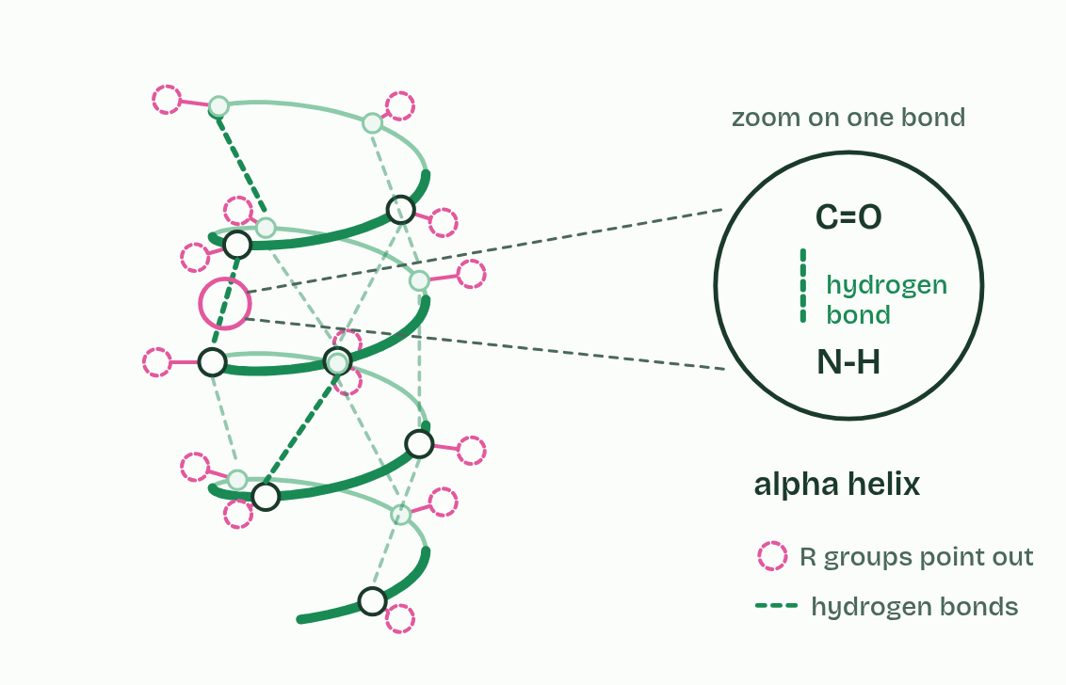
CHAPTER 8 · B1.2.8 Pleating and coiling of secondary structure
1 / 3
Coils and pleats held by hydrogen bonds
Helix
Minutes 25 to 35
Notes:
Minutes 25 to 35 of 60: Helix and sheet (10 min).
The plan: Chapter 8: students sketch an alpha helix and a beta-pleated sheet with their hydrogen bonds, labelling the two groups that form each bond.
The polypeptide backbone is the repeating N-C-C pattern (the amine nitrogen, the alpha carbon, the carboxyl carbon) with the R groups hanging off it. Every peptide bond sits between a C=O group, whose oxygen is slightly negative, and an N-H group, whose hydrogen is slightly positive. These backbone groups are polar (A1.1), so a C=O and an N-H further along the chain can form a hydrogen bond. Where the chain makes these bonds in regular positions, it settles into a regular shape, its secondary structure.
In an alpha helix the chain coils, and each C=O bonds with the N-H four amino acids further along. The bonds fall in regular positions along the coil, and the R groups point outwards. In a beta-pleated sheet, stretches of the chain lie side by side, running the same way or opposite ways, and C=O groups in one stretch bond to N-H groups in the next. The chain zigzags, which makes the pleats, and the R groups point alternately above and below the sheet.
Each bond is weak, but hundreds in regular positions make the structure stable. One protein usually has stretches of both, joined by less regular loops.

Slide 21
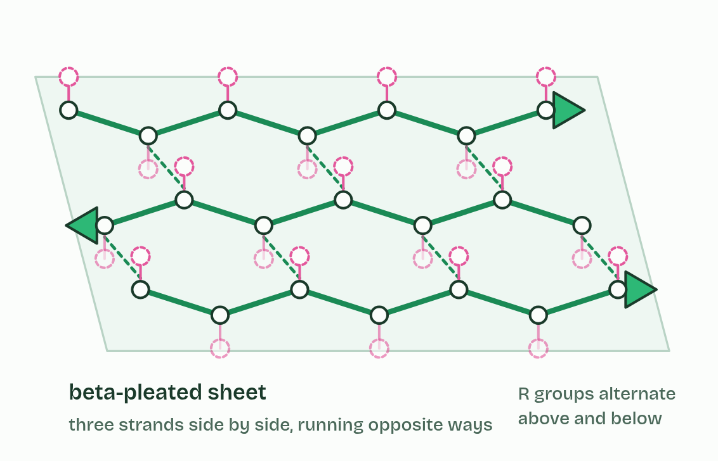
CHAPTER 8 · B1.2.8 Pleating and coiling of secondary structure
2 / 3
Coils and pleats held by hydrogen bonds
Sheet
Minutes 25 to 35
Notes:
Minutes 25 to 35 of 60: Helix and sheet (10 min).
The plan: Chapter 8: students sketch an alpha helix and a beta-pleated sheet with their hydrogen bonds, labelling the two groups that form each bond.
The polypeptide backbone is the repeating N-C-C pattern (the amine nitrogen, the alpha carbon, the carboxyl carbon) with the R groups hanging off it. Every peptide bond sits between a C=O group, whose oxygen is slightly negative, and an N-H group, whose hydrogen is slightly positive. These backbone groups are polar (A1.1), so a C=O and an N-H further along the chain can form a hydrogen bond. Where the chain makes these bonds in regular positions, it settles into a regular shape, its secondary structure.
In an alpha helix the chain coils, and each C=O bonds with the N-H four amino acids further along. The bonds fall in regular positions along the coil, and the R groups point outwards. In a beta-pleated sheet, stretches of the chain lie side by side, running the same way or opposite ways, and C=O groups in one stretch bond to N-H groups in the next. The chain zigzags, which makes the pleats, and the R groups point alternately above and below the sheet.
Each bond is weak, but hundreds in regular positions make the structure stable. One protein usually has stretches of both, joined by less regular loops.

Slide 22
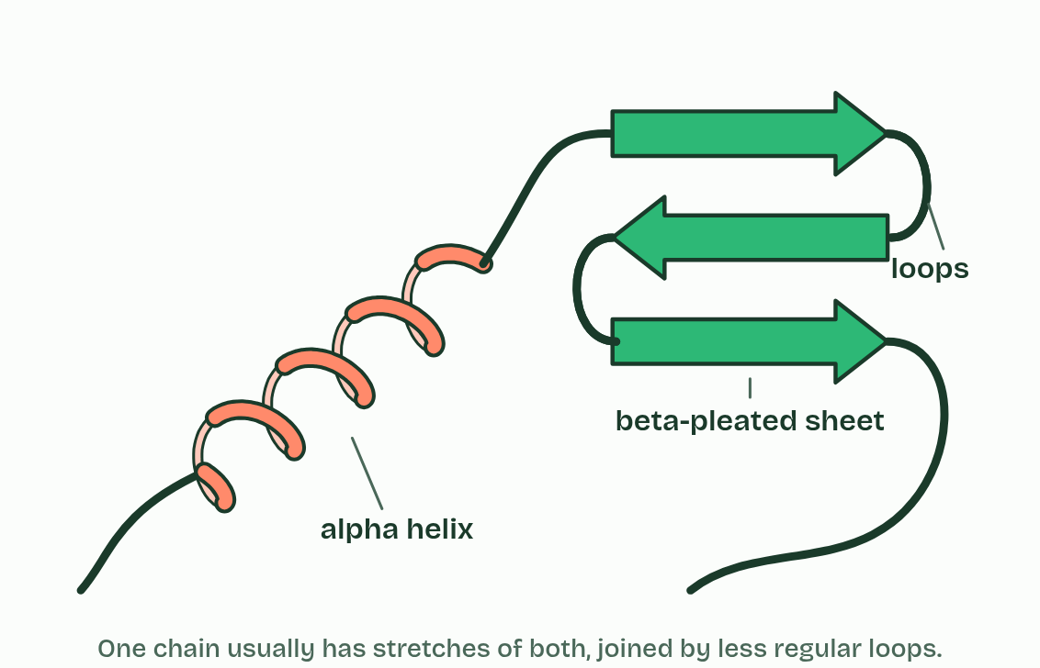
CHAPTER 8 · B1.2.8 Pleating and coiling of secondary structure
3 / 3
Coils and pleats held by hydrogen bonds
In a protein
Minutes 25 to 35
Notes:
Minutes 25 to 35 of 60: Helix and sheet (10 min).
The plan: Chapter 8: students sketch an alpha helix and a beta-pleated sheet with their hydrogen bonds, labelling the two groups that form each bond.
The polypeptide backbone is the repeating N-C-C pattern (the amine nitrogen, the alpha carbon, the carboxyl carbon) with the R groups hanging off it. Every peptide bond sits between a C=O group, whose oxygen is slightly negative, and an N-H group, whose hydrogen is slightly positive. These backbone groups are polar (A1.1), so a C=O and an N-H further along the chain can form a hydrogen bond. Where the chain makes these bonds in regular positions, it settles into a regular shape, its secondary structure.
In an alpha helix the chain coils, and each C=O bonds with the N-H four amino acids further along. The bonds fall in regular positions along the coil, and the R groups point outwards. In a beta-pleated sheet, stretches of the chain lie side by side, running the same way or opposite ways, and C=O groups in one stretch bond to N-H groups in the next. The chain zigzags, which makes the pleats, and the R groups point alternately above and below the sheet.
Each bond is weak, but hundreds in regular positions make the structure stable. One protein usually has stretches of both, joined by less regular loops.

Slide 23
CHAPTER 8 · B1.2.8 Pleating and coiling of secondary structure
Coils and pleats held by hydrogen bonds
Where the chain makes these bonds in regular positions, it settles into a regular shape, its secondary structure.
In an alpha helix the chain coils, and each C=O bonds with the N-H four amino acids further along.
In a beta-pleated sheet, stretches of the chain lie side by side, running the same way or opposite ways, and C=O groups in one stretch bond to N-H groups in the next.
Minutes 25 to 35
Notes:
Minutes 25 to 35 of 60: Helix and sheet (10 min).
The plan: Chapter 8: students sketch an alpha helix and a beta-pleated sheet with their hydrogen bonds, labelling the two groups that form each bond.
The polypeptide backbone is the repeating N-C-C pattern (the amine nitrogen, the alpha carbon, the carboxyl carbon) with the R groups hanging off it. Every peptide bond sits between a C=O group, whose oxygen is slightly negative, and an N-H group, whose hydrogen is slightly positive. These backbone groups are polar (A1.1), so a C=O and an N-H further along the chain can form a hydrogen bond. Where the chain makes these bonds in regular positions, it settles into a regular shape, its secondary structure.
In an alpha helix the chain coils, and each C=O bonds with the N-H four amino acids further along. The bonds fall in regular positions along the coil, and the R groups point outwards. In a beta-pleated sheet, stretches of the chain lie side by side, running the same way or opposite ways, and C=O groups in one stretch bond to N-H groups in the next. The chain zigzags, which makes the pleats, and the R groups point alternately above and below the sheet.
Each bond is weak, but hundreds in regular positions make the structure stable. One protein usually has stretches of both, joined by less regular loops.
Parts of the figure:
Hydrogen bond the O of a C=O group in one amino acid and the H of an N-H group four amino acids further along. Both groups are in the backbone.
Hydrogen bond the O of a C=O group in one amino acid and the H of an N-H group four amino acids further along. Both groups are in the backbone.
Hydrogen bond the O of a C=O group in one amino acid and the H of an N-H group four amino acids further along. Both groups are in the backbone.
Hydrogen bond the O of a C=O group in one amino acid and the H of an N-H group four amino acids further along. Both groups are in the backbone.
Hydrogen bond the O of a C=O group in one amino acid and the H of an N-H group four amino acids further along. Both groups are in the backbone.
Hydrogen bond the O of a C=O group in one amino acid and the H of an N-H group four amino acids further along. Both groups are in the backbone.
Hydrogen bond the O of a C=O group in one amino acid and the H of an N-H group four amino acids further along. Both groups are in the backbone.
Hydrogen bond the O of a C=O group in one amino acid and the H of an N-H group four amino acids further along. Both groups are in the backbone.
Hydrogen bond the O of a C=O group in one amino acid and the H of an N-H group four amino acids further along. Both groups are in the backbone.
Hydrogen bond the O of a C=O group in one amino acid and the H of an N-H group four amino acids further along. Both groups are in the backbone.
Hydrogen bond the O of a C=O group in one strand and the H of an N-H group in the strand beside it. Both groups are in the backbone.
Hydrogen bond the O of a C=O group in one strand and the H of an N-H group in the strand beside it. Both groups are in the backbone.
Hydrogen bond the O of a C=O group in one strand and the H of an N-H group in the strand beside it. Both groups are in the backbone.
Hydrogen bond the O of a C=O group in one strand and the H of an N-H group in the strand beside it. Both groups are in the backbone.
Hydrogen bond the O of a C=O group in one strand and the H of an N-H group in the strand beside it. Both groups are in the backbone.
Hydrogen bond the O of a C=O group in one strand and the H of an N-H group in the strand beside it. Both groups are in the backbone.
Hydrogen bond the O of a C=O group in one strand and the H of an N-H group in the strand beside it. Both groups are in the backbone.
Alpha helix one stretch of the chain coiled, held by hydrogen bonds between backbone groups in regular positions.
Beta-pleated sheet stretches of the chain side by side, held by hydrogen bonds between backbone groups.
Loops the less regular stretches that join the helices and sheets together.

Slide 24
PREDICT
Which groups form the hydrogen bonds that hold an alpha helix?
A The R groups of neighbouring amino acids, in regular positions
B Water molecules around the helix, bonded to two parts of the chain
C The amine and carboxyl groups at the two ends of the chain
D The C=O and N-H groups of the peptide bonds in the backbone
Minutes 25 to 35
Notes:
Minutes 25 to 35 of 60: Helix and sheet (10 min).
The plan: Chapter 8: students sketch an alpha helix and a beta-pleated sheet with their hydrogen bonds, labelling the two groups that form each bond.
Ask for a show of hands, or mini whiteboards, before revealing. (Answer: D, on the next slide.)

Slide 25
WHAT HAPPENS
Which groups form the hydrogen bonds that hold an alpha helix?
A The R groups of neighbouring amino acids, in regular positions
B Water molecules around the helix, bonded to two parts of the chain
C The amine and carboxyl groups at the two ends of the chain
D The C=O and N-H groups of the peptide bonds in the backbone
The backbone’s own C=O and N-H groups, in regular positions four amino acids apart. That is why almost any stretch of chain can coil or pleat: the groups that bond are in every amino acid. The R groups decide which stretches do.
Minutes 25 to 35
Notes:
Minutes 25 to 35 of 60: Helix and sheet (10 min).
The plan: Chapter 8: students sketch an alpha helix and a beta-pleated sheet with their hydrogen bonds, labelling the two groups that form each bond.
Answer: D. The backbone’s own C=O and N-H groups, in regular positions four amino acids apart. That is why almost any stretch of chain can coil or pleat: the groups that bond are in every amino acid. The R groups decide which stretches do.

Slide 26
WATCH OUT
Secondary structure bonds are between backbone groups, not R groups. An alpha helix is one coiled polypeptide, nothing to do with the double helix of DNA. And collagen’s helix is not an alpha helix (chapter 11).
Minutes 25 to 35
Notes:
Minutes 25 to 35 of 60: Helix and sheet (10 min).
The plan: Chapter 8: students sketch an alpha helix and a beta-pleated sheet with their hydrogen bonds, labelling the two groups that form each bond.
A common mistake: say it, then ask who can say why it is wrong.

Slide 27
STEP 4
15 MIN
What holds the fold
Chapter 9: Four kinds of bond hold the fold
Writing: Four levels table
Minutes 35 to 50
Notes:
Minutes 35 to 50 of 60: What holds the fold (15 min).
The plan: Chapter 9’s figure, one bond at a time, ending with Lower the pH. Start the four levels table, rows 1 to 3.

Slide 28
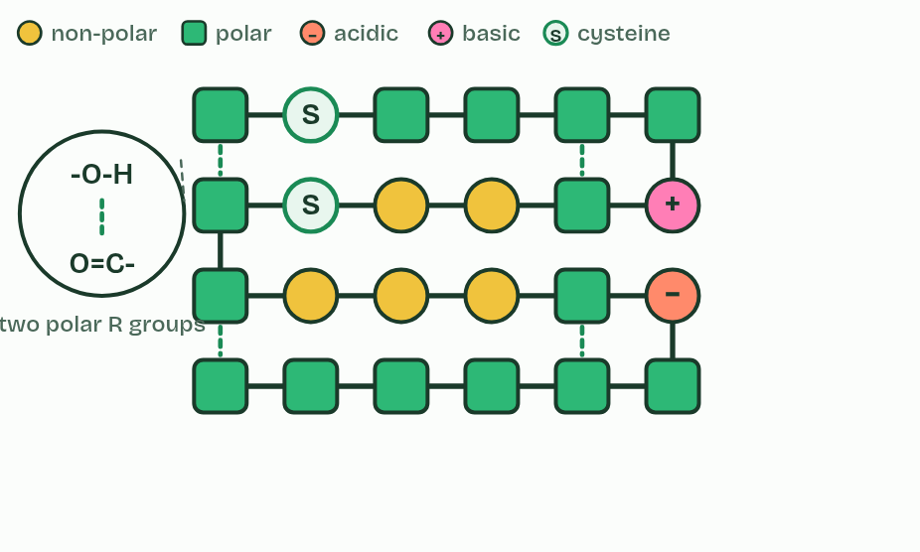
CHAPTER 9 · B1.2.9 Dependence of tertiary structure on four kinds of bond
1 / 6
Four kinds of bond hold the fold
Hydrogen
Minutes 35 to 50
Notes:
Minutes 35 to 50 of 60: What holds the fold (15 min).
The plan: Chapter 9’s figure, one bond at a time, ending with Lower the pH. Start the four levels table, rows 1 to 3.
Tertiary structure is the three-dimensional shape of the whole polypeptide. It is held by bonds between R groups, often far apart in the sequence.
This links back to chapter 5. Heat breaks hydrogen bonds, ionic bonds and hydrophobic interactions, and a change of pH alters charges and so breaks ionic bonds. The disulfide bonds are covalent, so they survive much more.

Slide 29
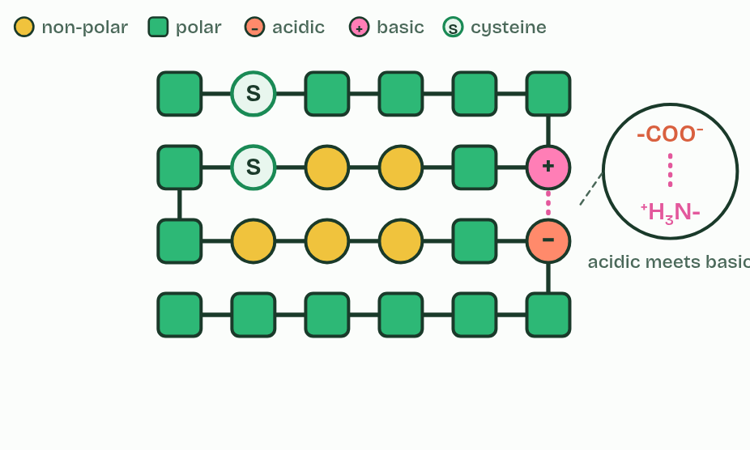
CHAPTER 9 · B1.2.9 Dependence of tertiary structure on four kinds of bond
2 / 6
Four kinds of bond hold the fold
Ionic
Minutes 35 to 50
Notes:
Minutes 35 to 50 of 60: What holds the fold (15 min).
The plan: Chapter 9’s figure, one bond at a time, ending with Lower the pH. Start the four levels table, rows 1 to 3.
Tertiary structure is the three-dimensional shape of the whole polypeptide. It is held by bonds between R groups, often far apart in the sequence.
This links back to chapter 5. Heat breaks hydrogen bonds, ionic bonds and hydrophobic interactions, and a change of pH alters charges and so breaks ionic bonds. The disulfide bonds are covalent, so they survive much more.

Slide 30
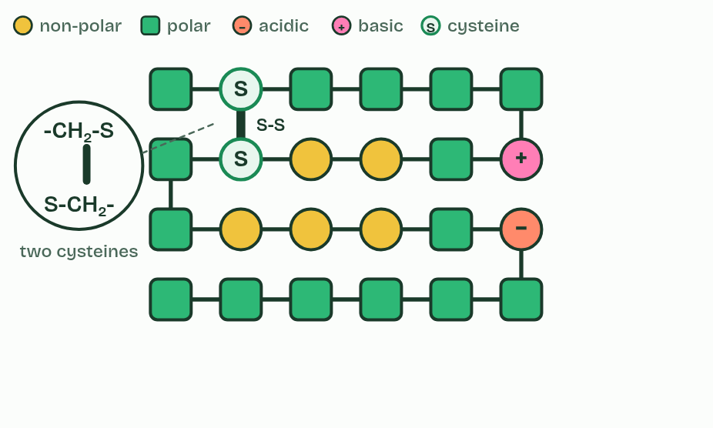
CHAPTER 9 · B1.2.9 Dependence of tertiary structure on four kinds of bond
3 / 6
Four kinds of bond hold the fold
Disulfide
Minutes 35 to 50
Notes:
Minutes 35 to 50 of 60: What holds the fold (15 min).
The plan: Chapter 9’s figure, one bond at a time, ending with Lower the pH. Start the four levels table, rows 1 to 3.
Tertiary structure is the three-dimensional shape of the whole polypeptide. It is held by bonds between R groups, often far apart in the sequence.
This links back to chapter 5. Heat breaks hydrogen bonds, ionic bonds and hydrophobic interactions, and a change of pH alters charges and so breaks ionic bonds. The disulfide bonds are covalent, so they survive much more.

Slide 31
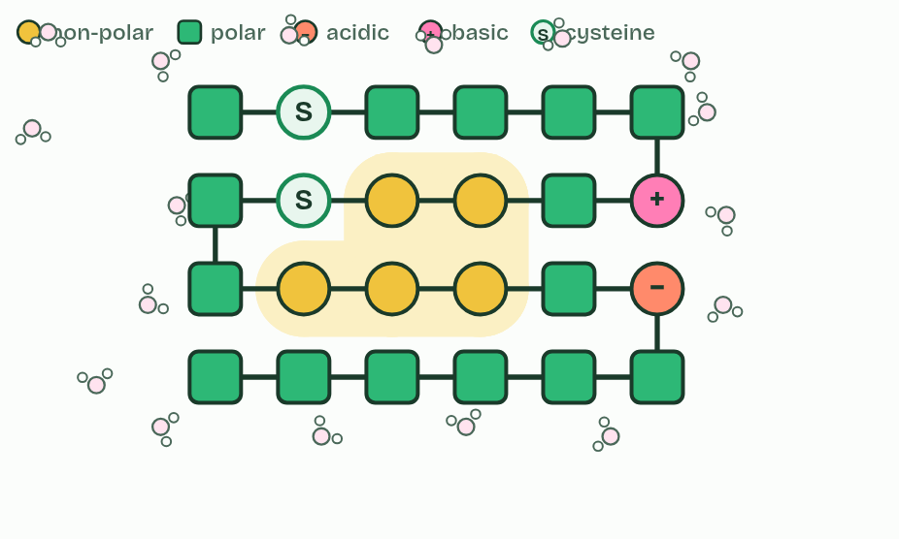
CHAPTER 9 · B1.2.9 Dependence of tertiary structure on four kinds of bond
4 / 6
Four kinds of bond hold the fold
Hydrophobic
Minutes 35 to 50
Notes:
Minutes 35 to 50 of 60: What holds the fold (15 min).
The plan: Chapter 9’s figure, one bond at a time, ending with Lower the pH. Start the four levels table, rows 1 to 3.
Tertiary structure is the three-dimensional shape of the whole polypeptide. It is held by bonds between R groups, often far apart in the sequence.
This links back to chapter 5. Heat breaks hydrogen bonds, ionic bonds and hydrophobic interactions, and a change of pH alters charges and so breaks ionic bonds. The disulfide bonds are covalent, so they survive much more.

Slide 32
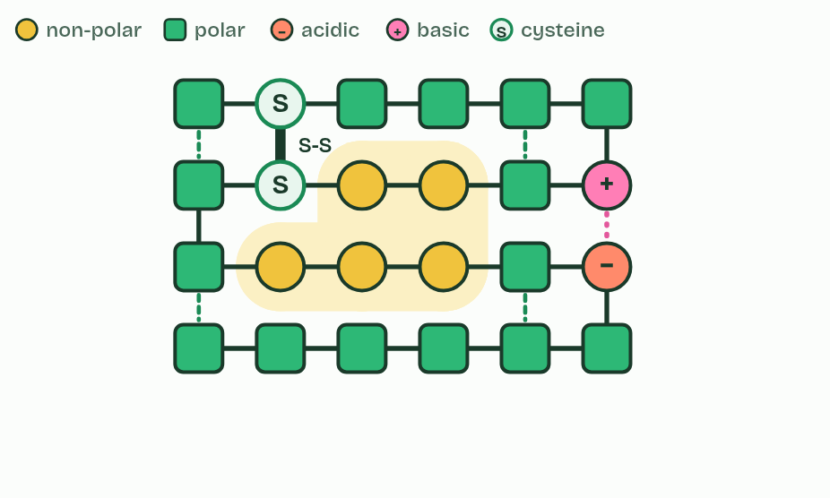
CHAPTER 9 · B1.2.9 Dependence of tertiary structure on four kinds of bond
5 / 6
Four kinds of bond hold the fold
All
Minutes 35 to 50
Notes:
Minutes 35 to 50 of 60: What holds the fold (15 min).
The plan: Chapter 9’s figure, one bond at a time, ending with Lower the pH. Start the four levels table, rows 1 to 3.
Tertiary structure is the three-dimensional shape of the whole polypeptide. It is held by bonds between R groups, often far apart in the sequence.
This links back to chapter 5. Heat breaks hydrogen bonds, ionic bonds and hydrophobic interactions, and a change of pH alters charges and so breaks ionic bonds. The disulfide bonds are covalent, so they survive much more.

Slide 33
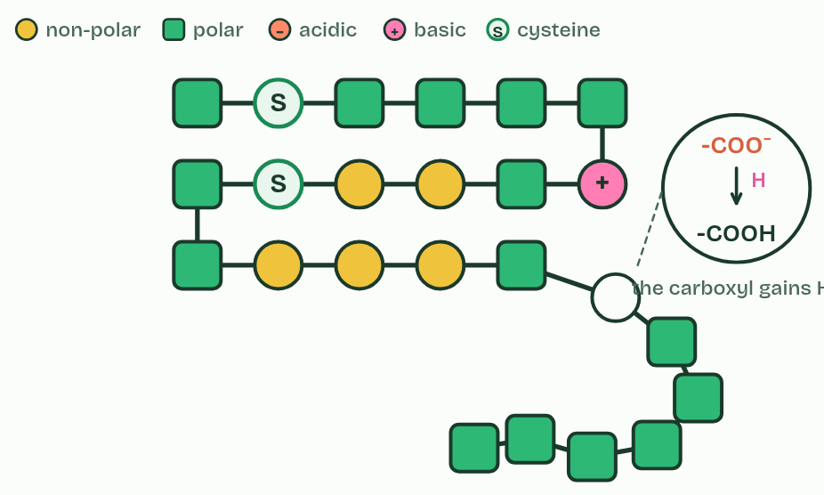
CHAPTER 9 · B1.2.9 Dependence of tertiary structure on four kinds of bond
6 / 6
Four kinds of bond hold the fold
Lower the pH
Minutes 35 to 50
Notes:
Minutes 35 to 50 of 60: What holds the fold (15 min).
The plan: Chapter 9’s figure, one bond at a time, ending with Lower the pH. Start the four levels table, rows 1 to 3.
Tertiary structure is the three-dimensional shape of the whole polypeptide. It is held by bonds between R groups, often far apart in the sequence.
This links back to chapter 5. Heat breaks hydrogen bonds, ionic bonds and hydrophobic interactions, and a change of pH alters charges and so breaks ionic bonds. The disulfide bonds are covalent, so they survive much more.

Slide 34
CHAPTER 9 · B1.2.9 Dependence of tertiary structure on four kinds of bond
Four kinds of bond hold the fold
Hydrogen bonds between polar R groups.
Ionic bonds between a positively charged (basic) and a negatively charged (acidic) R group. The amine and carboxyl groups in R groups become charged by gaining or losing a hydrogen ion, and only then can they form ionic bonds.
Disulfide bonds, covalent bonds between the sulfur atoms of two cysteines, the only amino acid you need to name. This is the strongest of the four.
Hydrophobic interactions: non-polar R groups cluster together, away from water.
Minutes 35 to 50
Notes:
Minutes 35 to 50 of 60: What holds the fold (15 min).
The plan: Chapter 9’s figure, one bond at a time, ending with Lower the pH. Start the four levels table, rows 1 to 3.
Tertiary structure is the three-dimensional shape of the whole polypeptide. It is held by bonds between R groups, often far apart in the sequence.
This links back to chapter 5. Heat breaks hydrogen bonds, ionic bonds and hydrophobic interactions, and a change of pH alters charges and so breaks ionic bonds. The disulfide bonds are covalent, so they survive much more.

Slide 35
PREDICT
An ionic bond holds two parts of a protein together. The pH falls to 2. Why might the bond break?
A Acid breaks the peptide bonds, so the chain falls apart into amino acids
B The negative carboxyl R group gains a hydrogen ion and loses its charge
C The positive R group loses its charge, so nothing is left to attract the negative one
D Hydrogen ions break the disulfide bonds, which are the weakest of the four
Minutes 35 to 50
Notes:
Minutes 35 to 50 of 60: What holds the fold (15 min).
The plan: Chapter 9’s figure, one bond at a time, ending with Lower the pH. Start the four levels table, rows 1 to 3.
Ask for a show of hands, or mini whiteboards, before revealing. (Answer: B, on the next slide.)

Slide 36
WHAT HAPPENS
An ionic bond holds two parts of a protein together. The pH falls to 2. Why might the bond break?
A Acid breaks the peptide bonds, so the chain falls apart into amino acids
B The negative carboxyl R group gains a hydrogen ion and loses its charge
C The positive R group loses its charge, so nothing is left to attract the negative one
D Hydrogen ions break the disulfide bonds, which are the weakest of the four
In acid, a -COO⁻ picks up a hydrogen ion and becomes -COOH, with no charge, so nothing attracts it to the positive R group. Press Lower the pH to watch it. In strong alkali the opposite happens: -NH₃⁺ loses its hydrogen ion.
Minutes 35 to 50
Notes:
Minutes 35 to 50 of 60: What holds the fold (15 min).
The plan: Chapter 9’s figure, one bond at a time, ending with Lower the pH. Start the four levels table, rows 1 to 3.
Answer: B. In acid, a -COO⁻ picks up a hydrogen ion and becomes -COOH, with no charge, so nothing attracts it to the positive R group. Press Lower the pH to watch it. In strong alkali the opposite happens: -NH₃⁺ loses its hydrogen ion.

Slide 37
REMEMBER IT
The bonds that hold a tertiary structure
H
H
I
D
Happy
Hippos
Ignore
Dentists
Minutes 35 to 50
Notes:
Minutes 35 to 50 of 60: What holds the fold (15 min).
The plan: Chapter 9’s figure, one bond at a time, ending with Lower the pH. Start the four levels table, rows 1 to 3.
Ask the class what each letter stands for before revealing.

Slide 38
REMEMBER IT
The bonds that hold a tertiary structure
H
H
I
D
Happy
Hippos
Ignore
Dentists
Hydrogen bonds
Hydrophobic interactions
Ionic bonds
Disulfide bonds
between polar R groups
non-polar R groups huddle away from water
between + and − R groups
two cysteines; the only covalent one
Minutes 35 to 50
Notes:
Minutes 35 to 50 of 60: What holds the fold (15 min).
The plan: Chapter 9’s figure, one bond at a time, ending with Lower the pH. Start the four levels table, rows 1 to 3.
Happy: Hydrogen bonds (between polar R groups)
Hippos: Hydrophobic interactions (non-polar R groups huddle away from water)
Ignore: Ionic bonds (between + and − R groups)
Dentists: Disulfide bonds (two cysteines; the only covalent one)

Slide 39
WATCH OUT
A disulfide bond is covalent and forms only between two cysteines: it is not a kind of hydrogen bond. Ionic bonds need charged R groups, not just polar ones. And hydrophobic interactions are not attractions between the R groups and water.
Minutes 35 to 50
Notes:
Minutes 35 to 50 of 60: What holds the fold (15 min).
The plan: Chapter 9’s figure, one bond at a time, ending with Lower the pH. Start the four levels table, rows 1 to 3.
A common mistake: say it, then ask who can say why it is wrong.

Slide 40
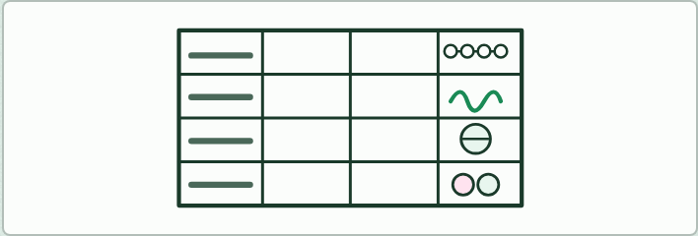
WRITING · HL
15 MIN
Four levels table
THE TASK
Students fill a table with a row each for primary, secondary, tertiary and quaternary structure and columns for what it is, what holds it, a sketch and an example. On the sketches they place the labels: peptide bond, amine group, carboxyl group, hydrogen bond (between which groups?), disulfide bond, ionic bond, hydrophobic interactions and prosthetic group.
STUDENTS NEED
An A3 table template.
Minutes 35 to 50
Notes:
Minutes 35 to 50 of 60: What holds the fold (15 min).
The plan: Chapter 9’s figure, one bond at a time, ending with Lower the pH. Start the four levels table, rows 1 to 3.
The activity: Four levels table. Students fill a table with a row each for primary, secondary, tertiary and quaternary structure and columns for what it is, what holds it, a sketch and an example. On the sketches they place the labels: peptide bond, amine group, carboxyl group, hydrogen bond (between which groups?), disulfide bond, ionic bond, hydrophobic interactions and prosthetic group.
Needs: an A3 table template.
The time: 15 minutes, minutes 35 to 50 of the plan.

Slide 41
PLENARY
An HL written question
Set an HL written question from the exam maker (the bonds of the tertiary structure, or secondary structure) and peer-mark it.
Minutes 50 to 60
Notes:
Minutes 50 to 60 of 60: An HL written question (10 min).
The plan: Set an HL written question from the exam maker (the bonds of the tertiary structure, or secondary structure) and peer-mark it.

Slide 42
EXIT QUESTION
Before you go
On paper, on your own: Name the four kinds of bond that hold a tertiary structure, and say where polar and non-polar R groups end up.
Minutes 50 to 60
Notes:
Minutes 50 to 60 of 60: An HL written question (10 min).
The plan: Set an HL written question from the exam maker (the bonds of the tertiary structure, or secondary structure) and peer-mark it.
Collect the slips: they say where to start next lesson.

Slide 43
PRACTISE AND REVISE
Keep going
Exam practice: a fresh paper of exam questions on B1.2 at higher level, marked as you go
The guide, with the animations and the dry lab
This lesson in the guide: 6 The R groups decide how a chain behaves, 7 The sequence sets the shape, 8 Coils and pleats held by hydrogen bonds, 9 Four kinds of bond hold the fold
BUILD FOR YOUR CLASS
ALREADY ON THE SITE FOR B1.2
CARD SETS ON SPLYCR
Tarsia puzzle, dominoes and picture reveal on B1.2, built from its key terms and ready to print
A pub quiz with rounds on B1.2, to present or run with no projector
An escape room built from the question bank on B1.2
Quiz: Proteins (HL)
Revision map: B1.2 Proteins, to fill in
Exam questions: B1.2 in the exam maker, a paper with its markscheme
Open a set to host it as a class game, or make a copy to edit.
B1.2 Proteins
How this was made. The course structure, the activities and the teaching choices come from my own classroom, my presentations and my years of teaching IB and AP Biology. I use Claude, an AI, to help write and build the interactive guides, lesson plans, slides and practice questions, and to draw the diagrams and code the interactives. I direct the work and review it against the IB and AP specifications before it goes live.
Minute 60: after the lesson
Notes:
Every link here is live. Set the exam practice paper for homework: it is fresh each time, marked as students go and saved to their Exam practice when they are signed in.
Exam practice: https://www.biologybybradford.com/exam-maker/sit?topics=B1.2&level=HL&paper=quiz&marks=15&src=ep
The guide: https://www.biologybybradford.com/guides/ib-biology-b1-2-proteins

