Slide 1
IB Biology B1.2
LESSON 4 OF 4
HL
BY THE END YOU CAN
Proteins
Name the four kinds of bond that hold a tertiary structure, and say where polar and non-polar R groups end up (B1.2.9, B1.2.10)
Compare insulin, collagen and haemoglobin: chains, conjugated or not, globular or fibrous, and how form suits function (B1.2.11, B1.2.12)
Folding, quaternary structure, globular and fibrous proteins
B1.2.10 to B1.2.12
Non-polar inside and polar outside, quaternary structure, and globular against fibrous proteins
60 minutes · chapters 10, 11, 12
Minute 0
Notes:
IB Biology B1.2, Proteins. Lesson 4 of 4: Folding, quaternary structure, globular and fibrous proteins (higher level), 60 minutes.
The plan, minute by minute (each slide's footer says where you are):
0 to 10 min (10) Paper folding
10 to 25 min (15) Fold a protein
25 to 35 min (10) Quaternary
35 to 50 min (15) Globular or fibrous crossword
50 to 60 min (10) An HL question on insulin and collagen
What students get wrong:
Quaternary means four chains, and conjugated means two proteins joined. Quaternary means more than one chain; conjugated means a non-polypeptide part.
Collagen is made of alpha helices. Its three chains each form a narrower helix of their own.
Globular always means functional and fibrous always structural. Actin and tubulin are globular units that build structural filaments.
Hydrophobic R groups are repelled by water. Water bonds to itself instead, which leaves them together.
Stretch and support:
Support: give a word bank for the four levels table.
The lesson plan to print: https://www.biologybybradford.com/guides/downloads/ib-biology-b1-2-proteins-lesson-4-plan.pdf

Slide 2
DO NOW
Paper folding
Pairs fold a paper strip so the yellow squares end up inside, clip the two cysteines, then lay it in a tray of water.
10:00
minutes
Start now: the timer is running.
Minutes 0 to 10
Notes:
Minutes 0 to 10 of 60: Paper folding (10 min).
The plan: Pairs fold a paper strip so the yellow squares end up inside, clip the two cysteines, then lay it in a tray of water (activity below).
Start a 10 minute timer as they come in.

Slide 3
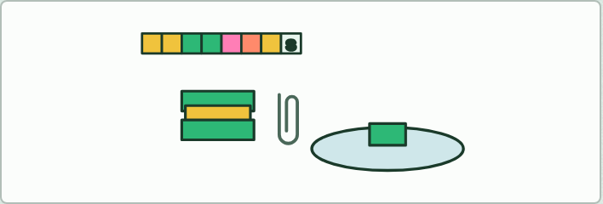
MODEL · HL
10 MIN
Paper folding
THE TASK
Give each student a strip of paper squares coloured yellow (hydrophobic), green (polar), two pink or coral (charged) and two marked S (cysteine). They fold it so every yellow is hidden inside and the greens face out, clip the two S squares together, and lay it in a tray of water: which colours touch the water? Then they fold a chain in Fold a protein, under chapter 10, and compare.
STUDENTS NEED
Printed strips, paper clips, a tray of water.
Minutes 0 to 10
Notes:
Minutes 0 to 10 of 60: Paper folding (10 min).
The plan: Pairs fold a paper strip so the yellow squares end up inside, clip the two cysteines, then lay it in a tray of water (activity below).
The activity: Paper folding. Give each student a strip of paper squares coloured yellow (hydrophobic), green (polar), two pink or coral (charged) and two marked S (cysteine). They fold it so every yellow is hidden inside and the greens face out, clip the two S squares together, and lay it in a tray of water: which colours touch the water? Then they fold a chain in Fold a protein, under chapter 10, and compare.
Needs: printed strips, paper clips, a tray of water.
The time: 10 minutes, minutes 0 to 10 of the plan.

Slide 4
STEP 2
15 MIN
Fold a protein
In pairs, at Fold a protein under chapter 10.
Each pair says what changed and why.
Minutes 10 to 25
Notes:
Minutes 10 to 25 of 60: Fold a protein (15 min).
The plan: In pairs, at Fold a protein under chapter 10: fold a full name in water (a first name alone is usually too short to fold, and the element says so), then the made-up membrane protein across a membrane; then the sickle cell change with Make a second copy, and a frameshift. Each pair says what changed and why. The same chain folds the same way on every screen in the room.

Slide 5
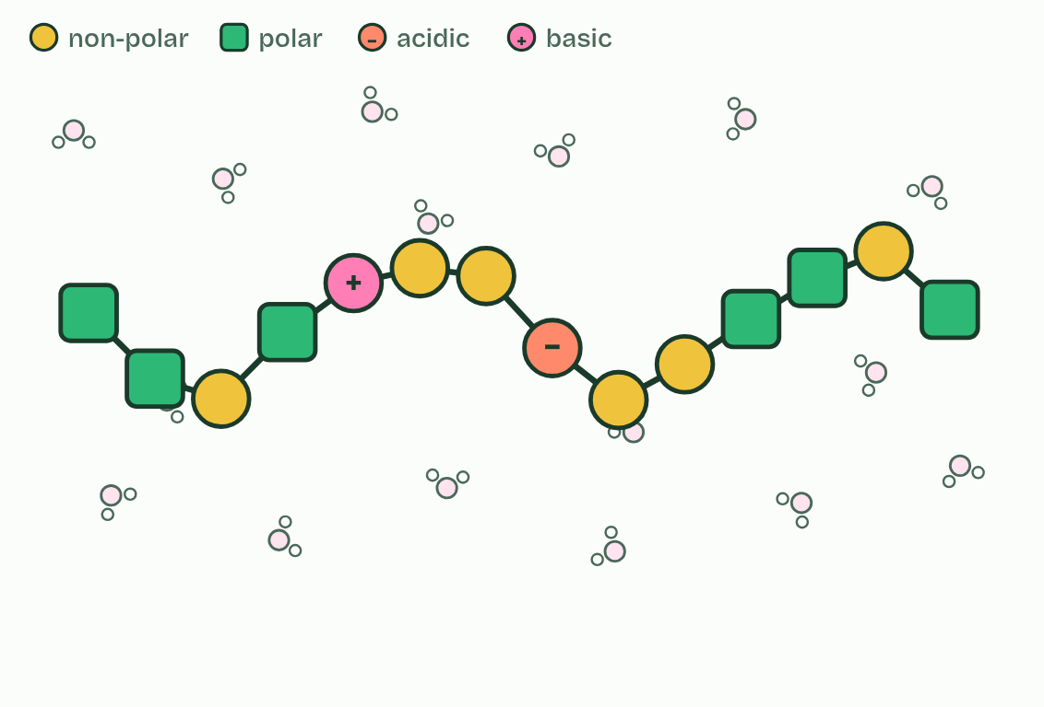
CHAPTER 10 · B1.2.10 Effect of polar and non-polar amino acids on tertiary structure
1 / 3
Oily inside, watery outside
Unfolded
Minutes 10 to 25
Notes:
Minutes 10 to 25 of 60: Fold a protein (15 min).
The plan: In pairs, at Fold a protein under chapter 10: fold a full name in water (a first name alone is usually too short to fold, and the element says so), then the made-up membrane protein across a membrane; then the sickle cell change with Make a second copy, and a frameshift. Each pair says what changed and why. The same chain folds the same way on every screen in the room.
In proteins that dissolve in water, such as the globular proteins of chapter 12, the hydrophobic R groups cluster in the core, away from the water. The hydrophilic R groups, polar and charged, sit on the surface, where they interact with water. That watery surface is why the protein dissolves.
Why? Water molecules form hydrogen bonds with each other and with polar groups, but not with non-polar ones, so the non-polar R groups end up pushed together. This drives much of the folding. Water does not push them away as a magnet would: it simply bonds to itself and to polar groups instead.
Integral proteins work the other way round. They have regions of hydrophobic amino acids where they cross the membrane, lying among the hydrophobic tails of the phospholipids (B1.1), and hydrophilic regions where the protein meets water on each side (B2.1). A stretch of about 20 hydrophobic amino acids, coiled as a helix, is enough to cross the bilayer once. In a channel protein the chain crosses several times, and the hydrophilic amino acids face inwards to line the pore that ions or water pass through, while the hydrophobic ones face the lipids outside.

Slide 6
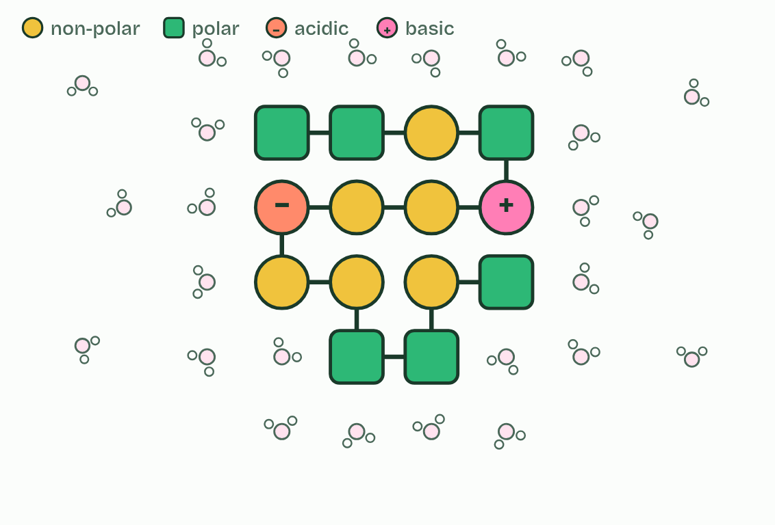
CHAPTER 10 · B1.2.10 Effect of polar and non-polar amino acids on tertiary structure
2 / 3
Oily inside, watery outside
In water
Minutes 10 to 25
Notes:
Minutes 10 to 25 of 60: Fold a protein (15 min).
The plan: In pairs, at Fold a protein under chapter 10: fold a full name in water (a first name alone is usually too short to fold, and the element says so), then the made-up membrane protein across a membrane; then the sickle cell change with Make a second copy, and a frameshift. Each pair says what changed and why. The same chain folds the same way on every screen in the room.
In proteins that dissolve in water, such as the globular proteins of chapter 12, the hydrophobic R groups cluster in the core, away from the water. The hydrophilic R groups, polar and charged, sit on the surface, where they interact with water. That watery surface is why the protein dissolves.
Why? Water molecules form hydrogen bonds with each other and with polar groups, but not with non-polar ones, so the non-polar R groups end up pushed together. This drives much of the folding. Water does not push them away as a magnet would: it simply bonds to itself and to polar groups instead.
Integral proteins work the other way round. They have regions of hydrophobic amino acids where they cross the membrane, lying among the hydrophobic tails of the phospholipids (B1.1), and hydrophilic regions where the protein meets water on each side (B2.1). A stretch of about 20 hydrophobic amino acids, coiled as a helix, is enough to cross the bilayer once. In a channel protein the chain crosses several times, and the hydrophilic amino acids face inwards to line the pore that ions or water pass through, while the hydrophobic ones face the lipids outside.

Slide 7
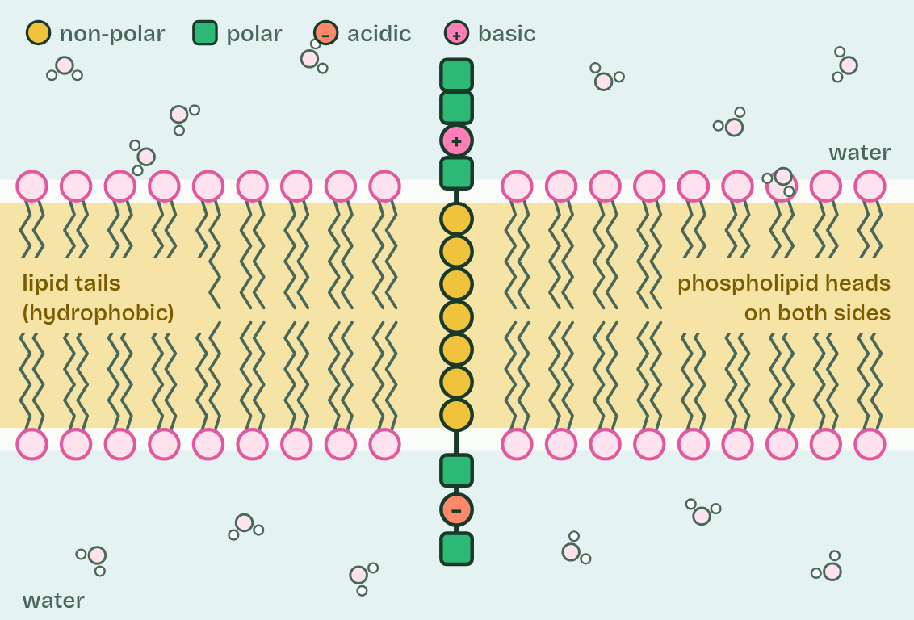
CHAPTER 10 · B1.2.10 Effect of polar and non-polar amino acids on tertiary structure
3 / 3
Oily inside, watery outside
In a membrane
Minutes 10 to 25
Notes:
Minutes 10 to 25 of 60: Fold a protein (15 min).
The plan: In pairs, at Fold a protein under chapter 10: fold a full name in water (a first name alone is usually too short to fold, and the element says so), then the made-up membrane protein across a membrane; then the sickle cell change with Make a second copy, and a frameshift. Each pair says what changed and why. The same chain folds the same way on every screen in the room.
In proteins that dissolve in water, such as the globular proteins of chapter 12, the hydrophobic R groups cluster in the core, away from the water. The hydrophilic R groups, polar and charged, sit on the surface, where they interact with water. That watery surface is why the protein dissolves.
Why? Water molecules form hydrogen bonds with each other and with polar groups, but not with non-polar ones, so the non-polar R groups end up pushed together. This drives much of the folding. Water does not push them away as a magnet would: it simply bonds to itself and to polar groups instead.
Integral proteins work the other way round. They have regions of hydrophobic amino acids where they cross the membrane, lying among the hydrophobic tails of the phospholipids (B1.1), and hydrophilic regions where the protein meets water on each side (B2.1). A stretch of about 20 hydrophobic amino acids, coiled as a helix, is enough to cross the bilayer once. In a channel protein the chain crosses several times, and the hydrophilic amino acids face inwards to line the pore that ions or water pass through, while the hydrophobic ones face the lipids outside.

Slide 8
CHAPTER 10 · B1.2.10 Effect of polar and non-polar amino acids on tertiary structure
Oily inside, watery outside
Integral proteins work the other way round.
In proteins that dissolve in water, such as the globular proteins of chapter 12, the hydrophobic R groups cluster in the core, away from the water.
Why?
Minutes 10 to 25
Notes:
Minutes 10 to 25 of 60: Fold a protein (15 min).
The plan: In pairs, at Fold a protein under chapter 10: fold a full name in water (a first name alone is usually too short to fold, and the element says so), then the made-up membrane protein across a membrane; then the sickle cell change with Make a second copy, and a frameshift. Each pair says what changed and why. The same chain folds the same way on every screen in the room.
In proteins that dissolve in water, such as the globular proteins of chapter 12, the hydrophobic R groups cluster in the core, away from the water. The hydrophilic R groups, polar and charged, sit on the surface, where they interact with water. That watery surface is why the protein dissolves.
Why? Water molecules form hydrogen bonds with each other and with polar groups, but not with non-polar ones, so the non-polar R groups end up pushed together. This drives much of the folding. Water does not push them away as a magnet would: it simply bonds to itself and to polar groups instead.
Integral proteins work the other way round. They have regions of hydrophobic amino acids where they cross the membrane, lying among the hydrophobic tails of the phospholipids (B1.1), and hydrophilic regions where the protein meets water on each side (B2.1). A stretch of about 20 hydrophobic amino acids, coiled as a helix, is enough to cross the bilayer once. In a channel protein the chain crosses several times, and the hydrophilic amino acids face inwards to line the pore that ions or water pass through, while the hydrophobic ones face the lipids outside.

Slide 9
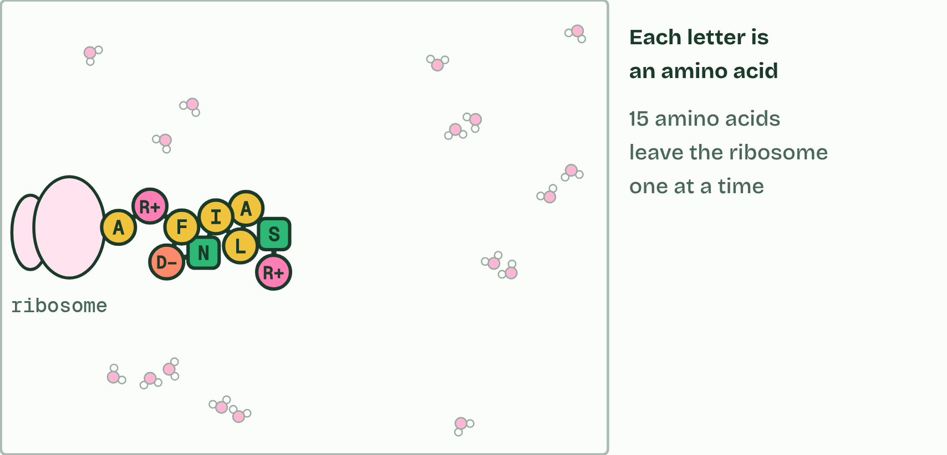
CHAPTER 10 · B1.2.10 Effect of polar and non-polar amino acids on tertiary structure
1 / 2
Oily inside, watery outside
Type ROSALIND FRANKLIN: each letter is the code for one amino acid (the O is skipped: no amino acid has that letter). A ribosome makes the chain one amino acid at a time, and it starts to fold as it comes out.
Minutes 10 to 25
Notes:
Minutes 10 to 25 of 60: Fold a protein (15 min).
The plan: In pairs, at Fold a protein under chapter 10: fold a full name in water (a first name alone is usually too short to fold, and the element says so), then the made-up membrane protein across a membrane; then the sickle cell change with Make a second copy, and a frameshift. Each pair says what changed and why. The same chain folds the same way on every screen in the room.
In proteins that dissolve in water, such as the globular proteins of chapter 12, the hydrophobic R groups cluster in the core, away from the water. The hydrophilic R groups, polar and charged, sit on the surface, where they interact with water. That watery surface is why the protein dissolves.
Why? Water molecules form hydrogen bonds with each other and with polar groups, but not with non-polar ones, so the non-polar R groups end up pushed together. This drives much of the folding. Water does not push them away as a magnet would: it simply bonds to itself and to polar groups instead.
Integral proteins work the other way round. They have regions of hydrophobic amino acids where they cross the membrane, lying among the hydrophobic tails of the phospholipids (B1.1), and hydrophilic regions where the protein meets water on each side (B2.1). A stretch of about 20 hydrophobic amino acids, coiled as a helix, is enough to cross the bilayer once. In a channel protein the chain crosses several times, and the hydrophilic amino acids face inwards to line the pore that ions or water pass through, while the hydrophobic ones face the lipids outside.

Slide 10
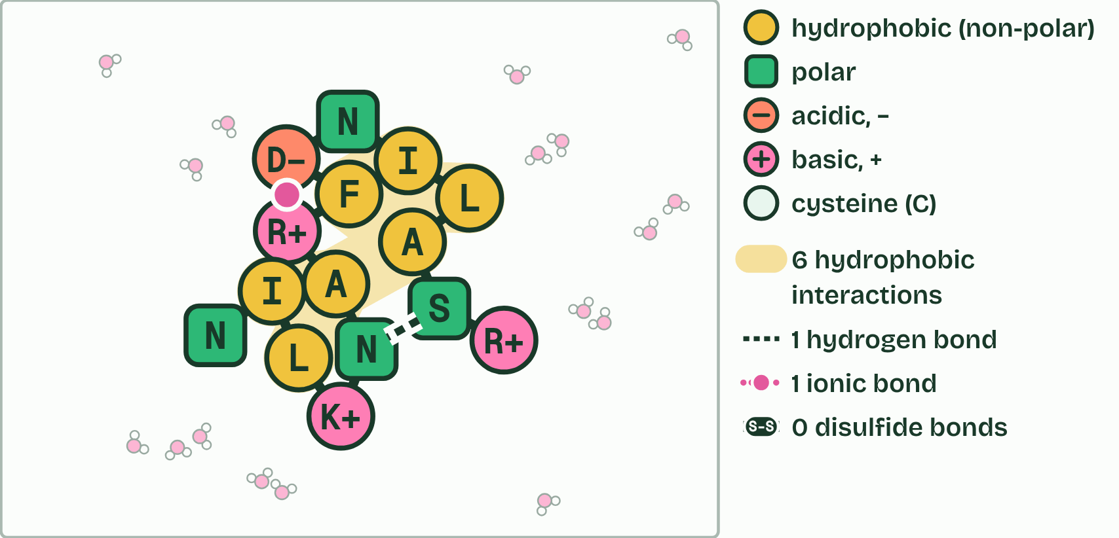
CHAPTER 10 · B1.2.10 Effect of polar and non-polar amino acids on tertiary structure
2 / 2
Oily inside, watery outside
In water it folds: the non-polar ones gather inside, away from the water (6 of 7), and the polar ones face outwards. Hydrophobic interactions, hydrogen bonds and ionic bonds hold it.
Minutes 10 to 25
Notes:
Minutes 10 to 25 of 60: Fold a protein (15 min).
The plan: In pairs, at Fold a protein under chapter 10: fold a full name in water (a first name alone is usually too short to fold, and the element says so), then the made-up membrane protein across a membrane; then the sickle cell change with Make a second copy, and a frameshift. Each pair says what changed and why. The same chain folds the same way on every screen in the room.
In proteins that dissolve in water, such as the globular proteins of chapter 12, the hydrophobic R groups cluster in the core, away from the water. The hydrophilic R groups, polar and charged, sit on the surface, where they interact with water. That watery surface is why the protein dissolves.
Why? Water molecules form hydrogen bonds with each other and with polar groups, but not with non-polar ones, so the non-polar R groups end up pushed together. This drives much of the folding. Water does not push them away as a magnet would: it simply bonds to itself and to polar groups instead.
Integral proteins work the other way round. They have regions of hydrophobic amino acids where they cross the membrane, lying among the hydrophobic tails of the phospholipids (B1.1), and hydrophilic regions where the protein meets water on each side (B2.1). A stretch of about 20 hydrophobic amino acids, coiled as a helix, is enough to cross the bilayer once. In a channel protein the chain crosses several times, and the hydrophilic amino acids face inwards to line the pore that ions or water pass through, while the hydrophobic ones face the lipids outside.

Slide 11
CHAPTER 10 · B1.2.10 Effect of polar and non-polar amino acids on tertiary structure
Oily inside, watery outside
Integral proteins work the other way round.
In proteins that dissolve in water, such as the globular proteins of chapter 12, the hydrophobic R groups cluster in the core, away from the water.
Why?
Minutes 10 to 25
Notes:
Minutes 10 to 25 of 60: Fold a protein (15 min).
The plan: In pairs, at Fold a protein under chapter 10: fold a full name in water (a first name alone is usually too short to fold, and the element says so), then the made-up membrane protein across a membrane; then the sickle cell change with Make a second copy, and a frameshift. Each pair says what changed and why. The same chain folds the same way on every screen in the room.
In proteins that dissolve in water, such as the globular proteins of chapter 12, the hydrophobic R groups cluster in the core, away from the water. The hydrophilic R groups, polar and charged, sit on the surface, where they interact with water. That watery surface is why the protein dissolves.
Why? Water molecules form hydrogen bonds with each other and with polar groups, but not with non-polar ones, so the non-polar R groups end up pushed together. This drives much of the folding. Water does not push them away as a magnet would: it simply bonds to itself and to polar groups instead.
Integral proteins work the other way round. They have regions of hydrophobic amino acids where they cross the membrane, lying among the hydrophobic tails of the phospholipids (B1.1), and hydrophilic regions where the protein meets water on each side (B2.1). A stretch of about 20 hydrophobic amino acids, coiled as a helix, is enough to cross the bilayer once. In a channel protein the chain crosses several times, and the hydrophilic amino acids face inwards to line the pore that ions or water pass through, while the hydrophobic ones face the lipids outside.

Slide 12
PREDICT
A protein dissolves in blood plasma. Where are most of its hydrophobic R groups?
A On the surface, where they touch the water and help the protein to dissolve
B At the two ends of the chain, where they are free to move about
C Clustered in the core of the protein, away from the water
D Spread evenly through it, so that no part of the chain is more water-loving
Minutes 10 to 25
Notes:
Minutes 10 to 25 of 60: Fold a protein (15 min).
The plan: In pairs, at Fold a protein under chapter 10: fold a full name in water (a first name alone is usually too short to fold, and the element says so), then the made-up membrane protein across a membrane; then the sickle cell change with Make a second copy, and a frameshift. Each pair says what changed and why. The same chain folds the same way on every screen in the room.
Ask for a show of hands, or mini whiteboards, before revealing. (Answer: C, on the next slide.)

Slide 13
WHAT HAPPENS
A protein dissolves in blood plasma. Where are most of its hydrophobic R groups?
A On the surface, where they touch the water and help the protein to dissolve
B At the two ends of the chain, where they are free to move about
C Clustered in the core of the protein, away from the water
D Spread evenly through it, so that no part of the chain is more water-loving
In the core. Hydrophobic R groups are not attracted to water, so in the folded protein they end up together inside, while hydrophilic ones cover the surface and keep it in solution. Fold a protein below and watch a chain do the same as it folds.
Minutes 10 to 25
Notes:
Minutes 10 to 25 of 60: Fold a protein (15 min).
The plan: In pairs, at Fold a protein under chapter 10: fold a full name in water (a first name alone is usually too short to fold, and the element says so), then the made-up membrane protein across a membrane; then the sickle cell change with Make a second copy, and a frameshift. Each pair says what changed and why. The same chain folds the same way on every screen in the room.
Answer: C. In the core. Hydrophobic R groups are not attracted to water, so in the folded protein they end up together inside, while hydrophilic ones cover the surface and keep it in solution. Fold a protein below and watch a chain do the same as it folds.

Slide 14
WATCH OUT
Hydrophobic amino acids are not “bad”: without them there would be no core and no membrane protein. And a chain does not fold because someone puts it there: it folds by itself as it jostles in water.
Minutes 10 to 25
Notes:
Minutes 10 to 25 of 60: Fold a protein (15 min).
The plan: In pairs, at Fold a protein under chapter 10: fold a full name in water (a first name alone is usually too short to fold, and the element says so), then the made-up membrane protein across a membrane; then the sickle cell change with Make a second copy, and a frameshift. Each pair says what changed and why. The same chain folds the same way on every screen in the room.
A common mistake: say it, then ask who can say why it is wrong.

Slide 15
STEP 3
10 MIN
Quaternary
Cryo-EM discussion: why can’t a light microscope see one protein?
Minutes 25 to 35
Notes:
Minutes 25 to 35 of 60: Quaternary (10 min).
The plan: Chapter 11’s three proteins. Finish the four levels table. Cryo-EM discussion: why can’t a light microscope see one protein? Optional: haemoglobin in 3D (activity below).

Slide 16
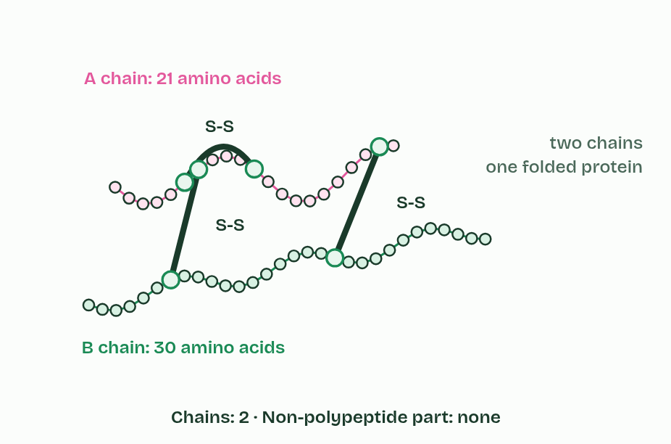
CHAPTER 11 · B1.2.11 Quaternary structure of non-conjugated and conjugated proteins
1 / 3
More than one chain: quaternary structure
Insulin
Minutes 25 to 35
Notes:
Minutes 25 to 35 of 60: Quaternary (10 min).
The plan: Chapter 11’s three proteins. Finish the four levels table. Cryo-EM discussion: why can’t a light microscope see one protein? Optional: haemoglobin in 3D (activity below).
Some proteins are a single polypeptide. Others are two or more polypeptides held together, and their arrangement is the quaternary structure, held by the same kinds of bond as the tertiary.
A non-conjugated protein is made of polypeptide only. Insulin has two polypeptides, of 21 and 30 amino acids, linked by two disulfide bonds, with a third disulfide bond within the shorter chain. Collagen has three polypeptides, each about 1,000 amino acids long, wound round each other into a triple helix like a rope. Every third amino acid is the smallest one, which lets the chains pack tightly, and hydrogen bonds between the chains hold the rope together.
A conjugated protein includes a part that is not polypeptide, a prosthetic group. Haemoglobin has four polypeptides, two of one kind and two of another, each holding a haem group with an iron ion at its centre. Each haem binds one oxygen molecule, so one haemoglobin carries up to four.
Example: How we know Technology lets us see what our senses cannot. A haemoglobin molecule is about 5 to 6 nm across, and a light microscope cannot resolve anything smaller than about 200 nm. Cryogenic electron microscopy (cryo-EM) freezes proteins so fast that the water around them turns to glass-like ice, not crystals, then images single molecules with electrons. A computer combines thousands of images of molecules lying at different angles into a 3D structure, so it shows single proteins and the molecules they bind without growing crystals, as X-ray crystallography needs (Nobel Prize in Chemistry, 2017).

Slide 17
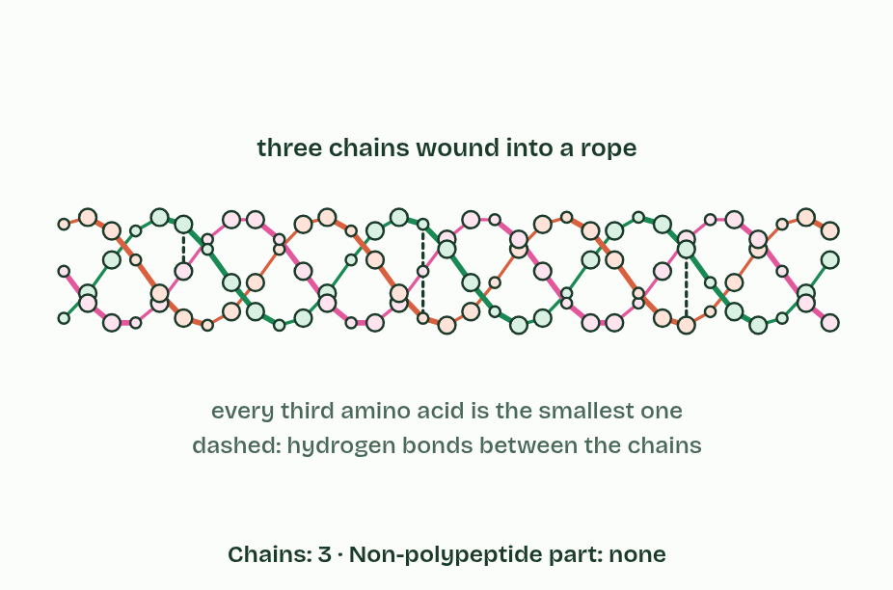
CHAPTER 11 · B1.2.11 Quaternary structure of non-conjugated and conjugated proteins
2 / 3
More than one chain: quaternary structure
Collagen
Minutes 25 to 35
Notes:
Minutes 25 to 35 of 60: Quaternary (10 min).
The plan: Chapter 11’s three proteins. Finish the four levels table. Cryo-EM discussion: why can’t a light microscope see one protein? Optional: haemoglobin in 3D (activity below).
Some proteins are a single polypeptide. Others are two or more polypeptides held together, and their arrangement is the quaternary structure, held by the same kinds of bond as the tertiary.
A non-conjugated protein is made of polypeptide only. Insulin has two polypeptides, of 21 and 30 amino acids, linked by two disulfide bonds, with a third disulfide bond within the shorter chain. Collagen has three polypeptides, each about 1,000 amino acids long, wound round each other into a triple helix like a rope. Every third amino acid is the smallest one, which lets the chains pack tightly, and hydrogen bonds between the chains hold the rope together.
A conjugated protein includes a part that is not polypeptide, a prosthetic group. Haemoglobin has four polypeptides, two of one kind and two of another, each holding a haem group with an iron ion at its centre. Each haem binds one oxygen molecule, so one haemoglobin carries up to four.
Example: How we know Technology lets us see what our senses cannot. A haemoglobin molecule is about 5 to 6 nm across, and a light microscope cannot resolve anything smaller than about 200 nm. Cryogenic electron microscopy (cryo-EM) freezes proteins so fast that the water around them turns to glass-like ice, not crystals, then images single molecules with electrons. A computer combines thousands of images of molecules lying at different angles into a 3D structure, so it shows single proteins and the molecules they bind without growing crystals, as X-ray crystallography needs (Nobel Prize in Chemistry, 2017).

Slide 18
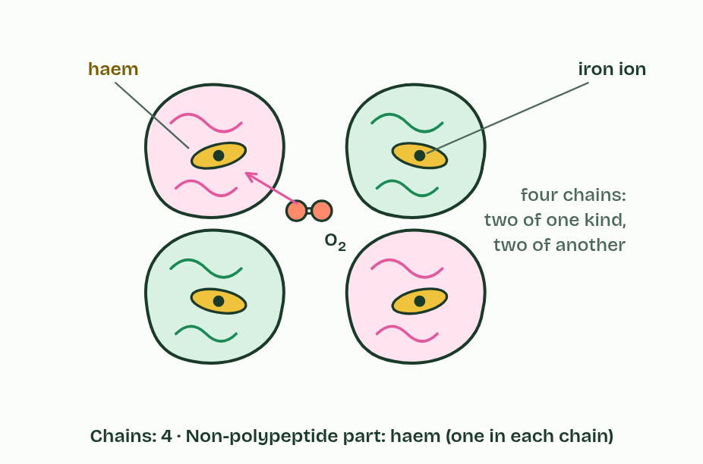
CHAPTER 11 · B1.2.11 Quaternary structure of non-conjugated and conjugated proteins
3 / 3
More than one chain: quaternary structure
Haemoglobin
Minutes 25 to 35
Notes:
Minutes 25 to 35 of 60: Quaternary (10 min).
The plan: Chapter 11’s three proteins. Finish the four levels table. Cryo-EM discussion: why can’t a light microscope see one protein? Optional: haemoglobin in 3D (activity below).
Some proteins are a single polypeptide. Others are two or more polypeptides held together, and their arrangement is the quaternary structure, held by the same kinds of bond as the tertiary.
A non-conjugated protein is made of polypeptide only. Insulin has two polypeptides, of 21 and 30 amino acids, linked by two disulfide bonds, with a third disulfide bond within the shorter chain. Collagen has three polypeptides, each about 1,000 amino acids long, wound round each other into a triple helix like a rope. Every third amino acid is the smallest one, which lets the chains pack tightly, and hydrogen bonds between the chains hold the rope together.
A conjugated protein includes a part that is not polypeptide, a prosthetic group. Haemoglobin has four polypeptides, two of one kind and two of another, each holding a haem group with an iron ion at its centre. Each haem binds one oxygen molecule, so one haemoglobin carries up to four.
Example: How we know Technology lets us see what our senses cannot. A haemoglobin molecule is about 5 to 6 nm across, and a light microscope cannot resolve anything smaller than about 200 nm. Cryogenic electron microscopy (cryo-EM) freezes proteins so fast that the water around them turns to glass-like ice, not crystals, then images single molecules with electrons. A computer combines thousands of images of molecules lying at different angles into a 3D structure, so it shows single proteins and the molecules they bind without growing crystals, as X-ray crystallography needs (Nobel Prize in Chemistry, 2017).

Slide 19
CHAPTER 11 · B1.2.11 Quaternary structure of non-conjugated and conjugated proteins
More than one chain: quaternary structure
Others are two or more polypeptides held together, and their arrangement is the quaternary structure, held by the same kinds of bond as the tertiary.
A non-conjugated protein is made of polypeptide only.
A conjugated protein includes a part that is not polypeptide, a prosthetic group.
Minutes 25 to 35
Notes:
Minutes 25 to 35 of 60: Quaternary (10 min).
The plan: Chapter 11’s three proteins. Finish the four levels table. Cryo-EM discussion: why can’t a light microscope see one protein? Optional: haemoglobin in 3D (activity below).
Some proteins are a single polypeptide. Others are two or more polypeptides held together, and their arrangement is the quaternary structure, held by the same kinds of bond as the tertiary.
A non-conjugated protein is made of polypeptide only. Insulin has two polypeptides, of 21 and 30 amino acids, linked by two disulfide bonds, with a third disulfide bond within the shorter chain. Collagen has three polypeptides, each about 1,000 amino acids long, wound round each other into a triple helix like a rope. Every third amino acid is the smallest one, which lets the chains pack tightly, and hydrogen bonds between the chains hold the rope together.
A conjugated protein includes a part that is not polypeptide, a prosthetic group. Haemoglobin has four polypeptides, two of one kind and two of another, each holding a haem group with an iron ion at its centre. Each haem binds one oxygen molecule, so one haemoglobin carries up to four.
Example: How we know Technology lets us see what our senses cannot. A haemoglobin molecule is about 5 to 6 nm across, and a light microscope cannot resolve anything smaller than about 200 nm. Cryogenic electron microscopy (cryo-EM) freezes proteins so fast that the water around them turns to glass-like ice, not crystals, then images single molecules with electrons. A computer combines thousands of images of molecules lying at different angles into a 3D structure, so it shows single proteins and the molecules they bind without growing crystals, as X-ray crystallography needs (Nobel Prize in Chemistry, 2017).

Slide 20
PREDICT
A haemoglobin molecule is about 5 to 6 nm across. Could you see one with the best light microscope?
A Yes, at the highest magnification, if the best objective lens and a bright enough light are used
B No: it is far smaller than the smallest thing light can resolve, about 200 nm
C Only if it is stained, because a stain makes any molecule large enough to see
Minutes 25 to 35
Notes:
Minutes 25 to 35 of 60: Quaternary (10 min).
The plan: Chapter 11’s three proteins. Finish the four levels table. Cryo-EM discussion: why can’t a light microscope see one protein? Optional: haemoglobin in 3D (activity below).
Ask for a show of hands, or mini whiteboards, before revealing. (Answer: B, on the next slide.)

Slide 21
WHAT HAPPENS
A haemoglobin molecule is about 5 to 6 nm across. Could you see one with the best light microscope?
A Yes, at the highest magnification, if the best objective lens and a bright enough light are used
B No: it is far smaller than the smallest thing light can resolve, about 200 nm
C Only if it is stained, because a stain makes any molecule large enough to see
No. A light microscope cannot separate details closer than about 200 nm, some 40 times the size of a haemoglobin molecule. Electron microscopes, and now cryo-EM, image single molecules: technology extends our senses.
Minutes 25 to 35
Notes:
Minutes 25 to 35 of 60: Quaternary (10 min).
The plan: Chapter 11’s three proteins. Finish the four levels table. Cryo-EM discussion: why can’t a light microscope see one protein? Optional: haemoglobin in 3D (activity below).
Answer: B. No. A light microscope cannot separate details closer than about 200 nm, some 40 times the size of a haemoglobin molecule. Electron microscopes, and now cryo-EM, image single molecules: technology extends our senses.

Slide 22
REMEMBER IT
The three named proteins, in order of chains
I
S
H
I
See
Him
Minutes 25 to 35
Notes:
Minutes 25 to 35 of 60: Quaternary (10 min).
The plan: Chapter 11’s three proteins. Finish the four levels table. Cryo-EM discussion: why can’t a light microscope see one protein? Optional: haemoglobin in 3D (activity below).
Ask the class what each letter stands for before revealing.

Slide 23
REMEMBER IT
The three named proteins, in order of chains
I
S
H
I
See
Him
Insulin
Collagen
Haemoglobin
2 chains; globular; non-conjugated
3 chains; fibrous; non-conjugated
4 chains plus haem; globular; conjugated
Minutes 25 to 35
Notes:
Minutes 25 to 35 of 60: Quaternary (10 min).
The plan: Chapter 11’s three proteins. Finish the four levels table. Cryo-EM discussion: why can’t a light microscope see one protein? Optional: haemoglobin in 3D (activity below).
I: Insulin (2 chains; globular; non-conjugated)
See: Collagen (3 chains; fibrous; non-conjugated)
Him: Haemoglobin (4 chains plus haem; globular; conjugated)

Slide 24
WATCH OUT
Quaternary means more than one chain, not four (haemoglobin just happens to have four). Conjugated means joined to a non-protein group, not to another protein. And collagen’s triple helix is not three alpha helices: each chain is a narrower helix of its own.
Minutes 25 to 35
Notes:
Minutes 25 to 35 of 60: Quaternary (10 min).
The plan: Chapter 11’s three proteins. Finish the four levels table. Cryo-EM discussion: why can’t a light microscope see one protein? Optional: haemoglobin in 3D (activity below).
A common mistake: say it, then ask who can say why it is wrong.

Slide 25
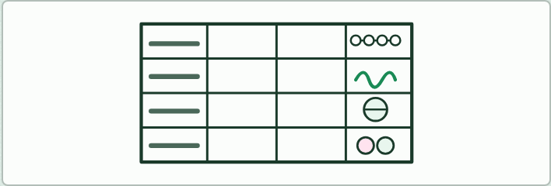
WRITING · HL
10 MIN
Four levels table
THE TASK
Students fill a table with a row each for primary, secondary, tertiary and quaternary structure and columns for what it is, what holds it, a sketch and an example. On the sketches they place the labels: peptide bond, amine group, carboxyl group, hydrogen bond (between which groups?), disulfide bond, ionic bond, hydrophobic interactions and prosthetic group.
STUDENTS NEED
An A3 table template.
Minutes 25 to 35
Notes:
Minutes 25 to 35 of 60: Quaternary (10 min).
The plan: Chapter 11’s three proteins. Finish the four levels table. Cryo-EM discussion: why can’t a light microscope see one protein? Optional: haemoglobin in 3D (activity below).
The activity: Four levels table. Students fill a table with a row each for primary, secondary, tertiary and quaternary structure and columns for what it is, what holds it, a sketch and an example. On the sketches they place the labels: peptide bond, amine group, carboxyl group, hydrogen bond (between which groups?), disulfide bond, ionic bond, hydrophobic interactions and prosthetic group.
Needs: an A3 table template.
The time: 10 minutes, minutes 25 to 35 of the plan.

Slide 26

DIGITAL MODEL · HL, OPTIONAL
10 MIN
Haemoglobin in 3D
THE TASK
Students open a haemoglobin entry and an insulin entry in the RCSB Protein Data Bank’s free 3D viewer. They count the chains, find the four haem groups, and colour the structure by hydrophobicity to see where the non-polar amino acids are. Suggested entries: haemoglobin 4HHB and insulin 4INS (check the entry IDs open before the lesson).
STUDENTS NEED
Devices.
Minutes 25 to 35
Notes:
Minutes 25 to 35 of 60: Quaternary (10 min).
The plan: Chapter 11’s three proteins. Finish the four levels table. Cryo-EM discussion: why can’t a light microscope see one protein? Optional: haemoglobin in 3D (activity below).
The activity: Haemoglobin in 3D. Students open a haemoglobin entry and an insulin entry in the RCSB Protein Data Bank’s free 3D viewer. They count the chains, find the four haem groups, and colour the structure by hydrophobicity to see where the non-polar amino acids are. Suggested entries: haemoglobin 4HHB and insulin 4INS (check the entry IDs open before the lesson).
Needs: devices.
The time: 10 minutes, minutes 25 to 35 of the plan.

Slide 27
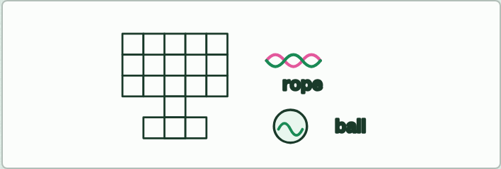
RESEARCH AND WRITING · HL
15 MIN
Globular or fibrous crossword
THE TASK
Each student researches one protein and writes a crossword of 10 to 12 clues, every clue a question about its structure and function; they swap and solve. Globular: an enzyme (catalase, amylase, lipase, DNA polymerase), insulin, glucagon, haemoglobin, myoglobin, an antibody, albumin, ferritin, growth hormone. Fibrous: collagen, keratin, elastin, silk fibroin, titin. Discussion cases: myosin (a fibrous tail with globular heads), actin and tubulin (globular units that make structural filaments), and fibrin (fibrous, built when the soluble fibrinogen of blood plasma is cut). Steroid hormones such as oestradiol and testosterone are lipids, not proteins.
STUDENTS NEED
Squared paper or a free crossword maker.
Minutes 35 to 50
Notes:
Minutes 35 to 50 of 60: Globular or fibrous crossword (15 min).
The plan: Students start their crosswords in class and finish them at home (activity below).
The activity: Globular or fibrous crossword. Each student researches one protein and writes a crossword of 10 to 12 clues, every clue a question about its structure and function; they swap and solve. Globular: an enzyme (catalase, amylase, lipase, DNA polymerase), insulin, glucagon, haemoglobin, myoglobin, an antibody, albumin, ferritin, growth hormone. Fibrous: collagen, keratin, elastin, silk fibroin, titin. Discussion cases: myosin (a fibrous tail with globular heads), actin and tubulin (globular units that make structural filaments), and fibrin (fibrous, built when the soluble fibrinogen of blood plasma is cut). Steroid hormones such as oestradiol and testosterone are lipids, not proteins.
Needs: squared paper or a free crossword maker.
The time: 15 minutes, minutes 35 to 50 of the plan.

Slide 28
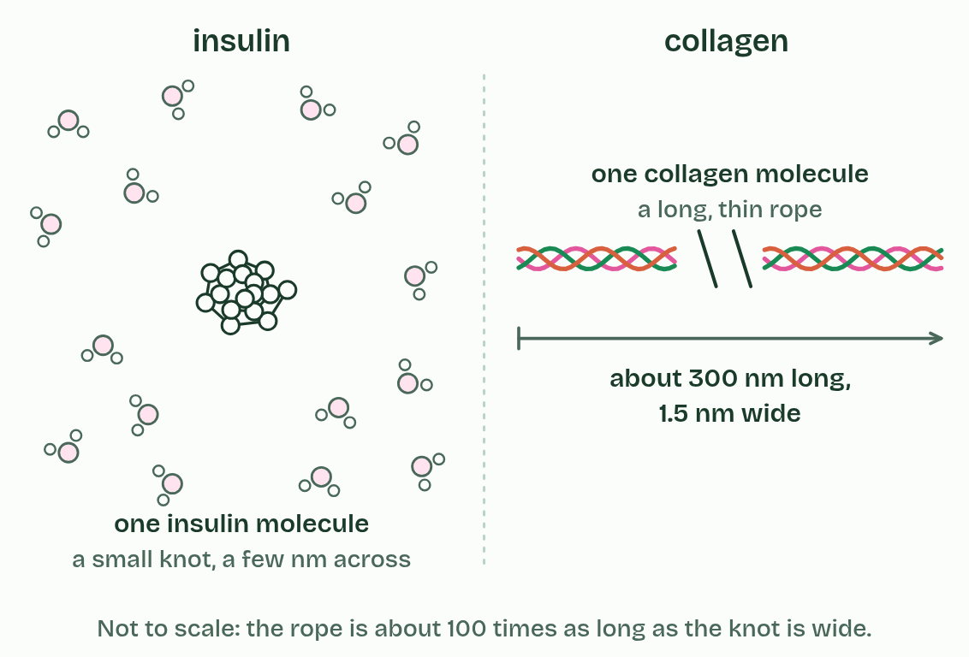
CHAPTER 12 · B1.2.12 Relationship of form and function in globular and fibrous proteins
1 / 5
Balls and ropes: globular and fibrous proteins
One insulin molecule is a small rounded knot among water molecules. One collagen molecule is a long, thin rope, about 100 times longer than the knot is wide.
Minutes 35 to 50
Notes:
Minutes 35 to 50 of 60: Globular or fibrous crossword (15 min).
The plan: Students start their crosswords in class and finish them at home (activity below).
Globular proteins are folded into compact, rounded shapes. Their hydrophilic surfaces make most of them soluble, and their precise shapes let them bind specific molecules: enzymes, hormones, transport proteins and antibodies.
Insulin shows how form suits function. It is small and compact. It is soluble, so it is carried dissolved in the blood plasma from the pancreas to every tissue. Its precise shape binds the insulin receptor on target cells (liver, muscle and fat cells), and its disulfide bonds keep that shape stable.
Fibrous proteins are long and narrow, often with a repeating sequence, usually insoluble and strong, and have structural jobs. Collagen is three chains wound into a rope. The ropes lie side by side, staggered, and are cross-linked into fibrils, which are bundled into fibres. It is insoluble and has great tensile strength, which means it resists pulling. It is in skin, tendons, ligaments, bone, cartilage and blood vessel walls, and it is the most abundant protein in the human body.
The rule of thumb is that globular proteins do something and fibrous ones are something. It has exceptions: actin and tubulin are globular units that link into structural filaments.

Slide 29
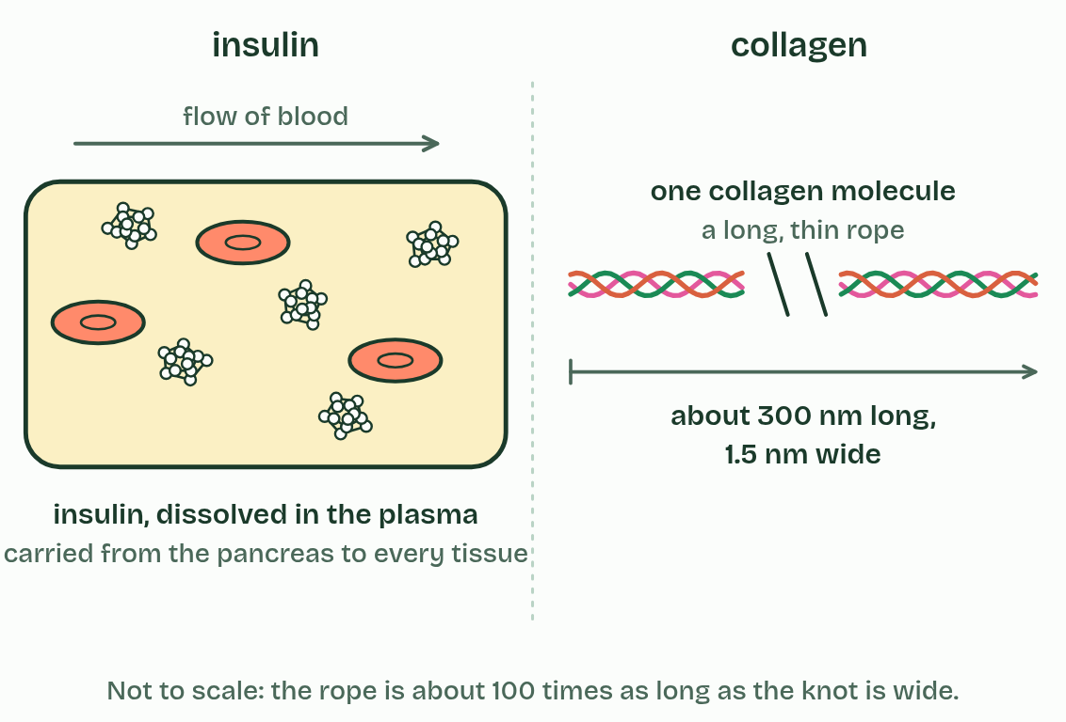
CHAPTER 12 · B1.2.12 Relationship of form and function in globular and fibrous proteins
2 / 5
Balls and ropes: globular and fibrous proteins
Insulin is soluble: dissolved in the plasma, it is carried round the body in the blood.
Minutes 35 to 50
Notes:
Minutes 35 to 50 of 60: Globular or fibrous crossword (15 min).
The plan: Students start their crosswords in class and finish them at home (activity below).
Globular proteins are folded into compact, rounded shapes. Their hydrophilic surfaces make most of them soluble, and their precise shapes let them bind specific molecules: enzymes, hormones, transport proteins and antibodies.
Insulin shows how form suits function. It is small and compact. It is soluble, so it is carried dissolved in the blood plasma from the pancreas to every tissue. Its precise shape binds the insulin receptor on target cells (liver, muscle and fat cells), and its disulfide bonds keep that shape stable.
Fibrous proteins are long and narrow, often with a repeating sequence, usually insoluble and strong, and have structural jobs. Collagen is three chains wound into a rope. The ropes lie side by side, staggered, and are cross-linked into fibrils, which are bundled into fibres. It is insoluble and has great tensile strength, which means it resists pulling. It is in skin, tendons, ligaments, bone, cartilage and blood vessel walls, and it is the most abundant protein in the human body.
The rule of thumb is that globular proteins do something and fibrous ones are something. It has exceptions: actin and tubulin are globular units that link into structural filaments.

Slide 30
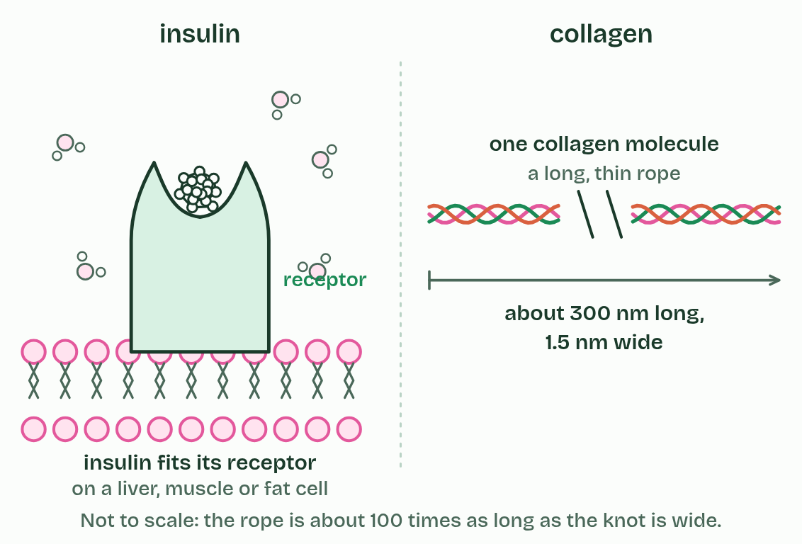
CHAPTER 12 · B1.2.12 Relationship of form and function in globular and fibrous proteins
3 / 5
Balls and ropes: globular and fibrous proteins
Insulin has a precise shape that fits the receptor on its target cells, liver, muscle and fat cells, like a key in a lock.
Minutes 35 to 50
Notes:
Minutes 35 to 50 of 60: Globular or fibrous crossword (15 min).
The plan: Students start their crosswords in class and finish them at home (activity below).
Globular proteins are folded into compact, rounded shapes. Their hydrophilic surfaces make most of them soluble, and their precise shapes let them bind specific molecules: enzymes, hormones, transport proteins and antibodies.
Insulin shows how form suits function. It is small and compact. It is soluble, so it is carried dissolved in the blood plasma from the pancreas to every tissue. Its precise shape binds the insulin receptor on target cells (liver, muscle and fat cells), and its disulfide bonds keep that shape stable.
Fibrous proteins are long and narrow, often with a repeating sequence, usually insoluble and strong, and have structural jobs. Collagen is three chains wound into a rope. The ropes lie side by side, staggered, and are cross-linked into fibrils, which are bundled into fibres. It is insoluble and has great tensile strength, which means it resists pulling. It is in skin, tendons, ligaments, bone, cartilage and blood vessel walls, and it is the most abundant protein in the human body.
The rule of thumb is that globular proteins do something and fibrous ones are something. It has exceptions: actin and tubulin are globular units that link into structural filaments.

Slide 31
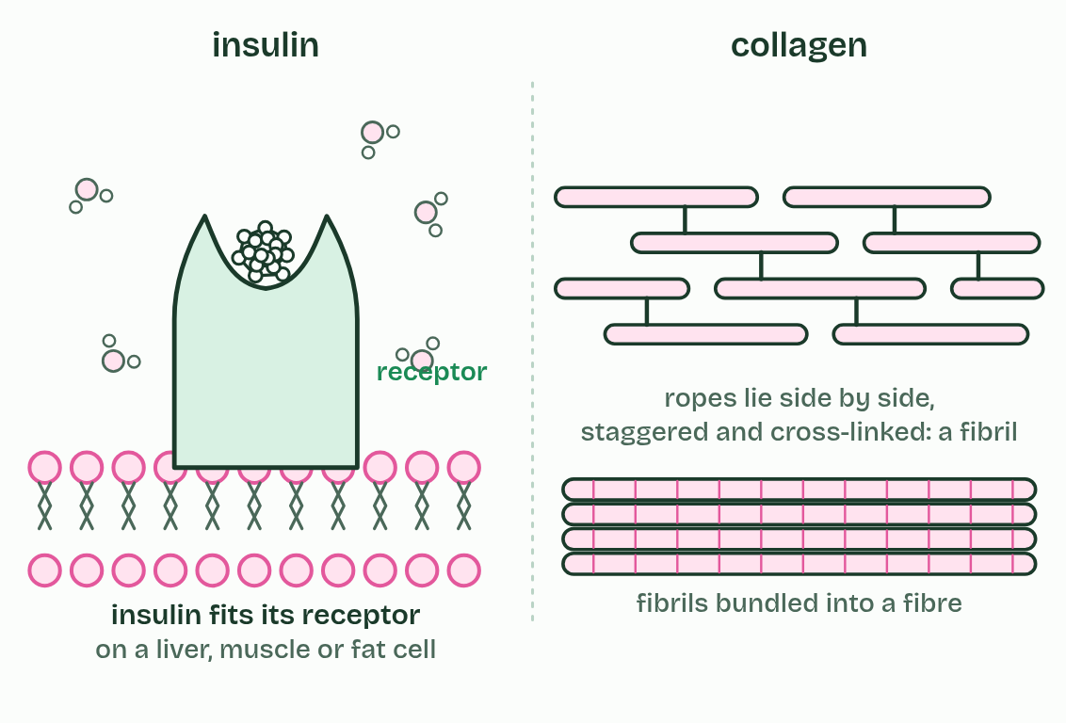
CHAPTER 12 · B1.2.12 Relationship of form and function in globular and fibrous proteins
4 / 5
Balls and ropes: globular and fibrous proteins
Collagen ropes lie side by side, staggered and cross-linked, into fibrils, and fibrils are bundled into fibres.
Minutes 35 to 50
Notes:
Minutes 35 to 50 of 60: Globular or fibrous crossword (15 min).
The plan: Students start their crosswords in class and finish them at home (activity below).
Globular proteins are folded into compact, rounded shapes. Their hydrophilic surfaces make most of them soluble, and their precise shapes let them bind specific molecules: enzymes, hormones, transport proteins and antibodies.
Insulin shows how form suits function. It is small and compact. It is soluble, so it is carried dissolved in the blood plasma from the pancreas to every tissue. Its precise shape binds the insulin receptor on target cells (liver, muscle and fat cells), and its disulfide bonds keep that shape stable.
Fibrous proteins are long and narrow, often with a repeating sequence, usually insoluble and strong, and have structural jobs. Collagen is three chains wound into a rope. The ropes lie side by side, staggered, and are cross-linked into fibrils, which are bundled into fibres. It is insoluble and has great tensile strength, which means it resists pulling. It is in skin, tendons, ligaments, bone, cartilage and blood vessel walls, and it is the most abundant protein in the human body.
The rule of thumb is that globular proteins do something and fibrous ones are something. It has exceptions: actin and tubulin are globular units that link into structural filaments.

Slide 32
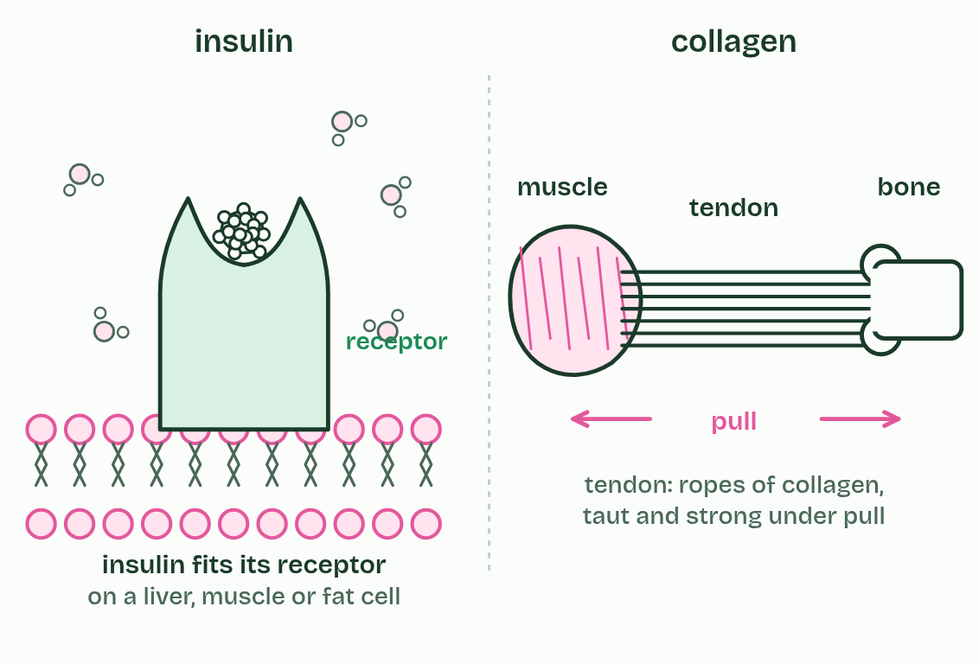
CHAPTER 12 · B1.2.12 Relationship of form and function in globular and fibrous proteins
5 / 5
Balls and ropes: globular and fibrous proteins
In a tendon, collagen fibres are insoluble and strong: they stay taut when muscle pulls on bone.
Minutes 35 to 50
Notes:
Minutes 35 to 50 of 60: Globular or fibrous crossword (15 min).
The plan: Students start their crosswords in class and finish them at home (activity below).
Globular proteins are folded into compact, rounded shapes. Their hydrophilic surfaces make most of them soluble, and their precise shapes let them bind specific molecules: enzymes, hormones, transport proteins and antibodies.
Insulin shows how form suits function. It is small and compact. It is soluble, so it is carried dissolved in the blood plasma from the pancreas to every tissue. Its precise shape binds the insulin receptor on target cells (liver, muscle and fat cells), and its disulfide bonds keep that shape stable.
Fibrous proteins are long and narrow, often with a repeating sequence, usually insoluble and strong, and have structural jobs. Collagen is three chains wound into a rope. The ropes lie side by side, staggered, and are cross-linked into fibrils, which are bundled into fibres. It is insoluble and has great tensile strength, which means it resists pulling. It is in skin, tendons, ligaments, bone, cartilage and blood vessel walls, and it is the most abundant protein in the human body.
The rule of thumb is that globular proteins do something and fibrous ones are something. It has exceptions: actin and tubulin are globular units that link into structural filaments.

Slide 33
CHAPTER 12 · B1.2.12 Relationship of form and function in globular and fibrous proteins
Balls and ropes: globular and fibrous proteins
Globular proteins are folded into compact, rounded shapes.
Fibrous proteins are long and narrow, often with a repeating sequence, usually insoluble and strong, and have structural jobs.
The rule of thumb is that globular proteins do something and fibrous ones are something.
Minutes 35 to 50
Notes:
Minutes 35 to 50 of 60: Globular or fibrous crossword (15 min).
The plan: Students start their crosswords in class and finish them at home (activity below).
Globular proteins are folded into compact, rounded shapes. Their hydrophilic surfaces make most of them soluble, and their precise shapes let them bind specific molecules: enzymes, hormones, transport proteins and antibodies.
Insulin shows how form suits function. It is small and compact. It is soluble, so it is carried dissolved in the blood plasma from the pancreas to every tissue. Its precise shape binds the insulin receptor on target cells (liver, muscle and fat cells), and its disulfide bonds keep that shape stable.
Fibrous proteins are long and narrow, often with a repeating sequence, usually insoluble and strong, and have structural jobs. Collagen is three chains wound into a rope. The ropes lie side by side, staggered, and are cross-linked into fibrils, which are bundled into fibres. It is insoluble and has great tensile strength, which means it resists pulling. It is in skin, tendons, ligaments, bone, cartilage and blood vessel walls, and it is the most abundant protein in the human body.
The rule of thumb is that globular proteins do something and fibrous ones are something. It has exceptions: actin and tubulin are globular units that link into structural filaments.

Slide 34
PREDICT
A protein is long and thin, has a repeating sequence and does not dissolve in water. What is its most likely job?
A A hormone carried in the blood, because it has to dissolve and reach its target
B An enzyme, because enzymes are always long and thin so that they reach their substrate
C An antibody, which has to be long and thin to wrap round the microbes it destroys
D A structural protein, as found in tendons, skin and blood vessel walls
Minutes 35 to 50
Notes:
Minutes 35 to 50 of 60: Globular or fibrous crossword (15 min).
The plan: Students start their crosswords in class and finish them at home (activity below).
Ask for a show of hands, or mini whiteboards, before revealing. (Answer: D, on the next slide.)

Slide 35
WHAT HAPPENS
A protein is long and thin, has a repeating sequence and does not dissolve in water. What is its most likely job?
A A hormone carried in the blood, because it has to dissolve and reach its target
B An enzyme, because enzymes are always long and thin so that they reach their substrate
C An antibody, which has to be long and thin to wrap round the microbes it destroys
D A structural protein, as found in tendons, skin and blood vessel walls
A structural one. Long, repetitive and insoluble are the marks of a fibrous protein: strength, not binding. Hormones, enzymes and antibodies have to dissolve and fit specific molecules, which needs a compact, globular shape.
Minutes 35 to 50
Notes:
Minutes 35 to 50 of 60: Globular or fibrous crossword (15 min).
The plan: Students start their crosswords in class and finish them at home (activity below).
Answer: D. A structural one. Long, repetitive and insoluble are the marks of a fibrous protein: strength, not binding. Hormones, enzymes and antibodies have to dissolve and fit specific molecules, which needs a compact, globular shape.

Slide 36
WATCH OUT
The functional and structural rule is only a rule of thumb (actin and tubulin). And a fibrous protein is fibrous in shape as a single molecule: it is not “made of fibres”.
Minutes 35 to 50
Notes:
Minutes 35 to 50 of 60: Globular or fibrous crossword (15 min).
The plan: Students start their crosswords in class and finish them at home (activity below).
A common mistake: say it, then ask who can say why it is wrong.

Slide 37
PLENARY
An HL question on insulin and collagen
A written question on form and function, peer-marked.
Minutes 50 to 60
Notes:
Minutes 50 to 60 of 60: An HL question on insulin and collagen (10 min).
The plan: A written question on form and function, peer-marked. Homework: the Check step at HL.

Slide 38
EXIT QUESTION
Before you go
On paper, on your own: Compare insulin, collagen and haemoglobin: chains, conjugated or not, globular or fibrous, and how form suits function.
Minutes 50 to 60
Notes:
Minutes 50 to 60 of 60: An HL question on insulin and collagen (10 min).
The plan: A written question on form and function, peer-marked. Homework: the Check step at HL.
Collect the slips: they say where to start next lesson.

Slide 39
PRACTISE AND REVISE
Keep going
Exam practice: a fresh paper of exam questions on B1.2 at higher level, marked as you go
The guide, with the animations and the dry lab
This lesson in the guide: 10 Oily inside, watery outside, 11 More than one chain: quaternary structure, 12 Balls and ropes: globular and fibrous proteins
BUILD FOR YOUR CLASS
ALREADY ON THE SITE FOR B1.2
CARD SETS ON SPLYCR
Tarsia puzzle, dominoes and picture reveal on B1.2, built from its key terms and ready to print
A pub quiz with rounds on B1.2, to present or run with no projector
An escape room built from the question bank on B1.2
Quiz: Proteins (HL)
Revision map: B1.2 Proteins, to fill in
Exam questions: B1.2 in the exam maker, a paper with its markscheme
Open a set to host it as a class game, or make a copy to edit.
B1.2 Proteins
How this was made. The course structure, the activities and the teaching choices come from my own classroom, my presentations and my years of teaching IB and AP Biology. I use Claude, an AI, to help write and build the interactive guides, lesson plans, slides and practice questions, and to draw the diagrams and code the interactives. I direct the work and review it against the IB and AP specifications before it goes live.
Minute 60: after the lesson
Notes:
Every link here is live. Set the exam practice paper for homework: it is fresh each time, marked as students go and saved to their Exam practice when they are signed in.
Exam practice: https://www.biologybybradford.com/exam-maker/sit?topics=B1.2&level=HL&paper=quiz&marks=15&src=ep
The guide: https://www.biologybybradford.com/guides/ib-biology-b1-2-proteins

