Slide 1
IB Biology C1.1
LESSON 1 OF 5
BY THE END YOU CAN
Enzymes and metabolism
Explain why cells need catalysts, and what an enzyme's speed does for digestion, growth and keeping cool enough to live (C1.1.1)
Describe metabolism as a web of linked reactions, and sort reactions into anabolic and catabolic with an example of each (C1.1.2, C1.1.3)
Read an energy diagram and explain how an enzyme lowers the activation energy without changing the energy released (C1.1.10)
Why life needs enzymes
C1.1.1, C1.1.2, C1.1.3, C1.1.10
What enzymes are for, metabolism as a web, anabolic and catabolic, and the activation energy hill
60 minutes · chapters 1, 2, 3
Minute 0
Notes:
IB Biology C1.1, Enzymes and metabolism. Lesson 1 of 5: Why life needs enzymes, 60 minutes.
The plan, minute by minute (each slide's footer says where you are):
0 to 6 min (6) Do now: how long without an enzyme?
6 to 16 min (10) Why speed matters
16 to 28 min (12) Build or break?
28 to 42 min (14) Draw the hill
42 to 54 min (12) Enzymes and their substrates
54 to 60 min (6) Exit: label the diagram
What students get wrong:
Enzymes are used up. They come out unchanged and work again.
Enzymes make reactions happen that otherwise could not. They speed up reactions that are possible but slow.
An enzyme changes the energy released. It lowers only the activation energy.
Breaking bonds releases energy. Breaking takes energy in; making bonds releases it.
All catabolism is hydrolysis. Respiration is an oxidation.
Stretch and support:
Support: the figures' captions as cut-up cards to put in order; the dotted key terms as a glossary; a writing frame for "explain the effect of temperature" (rise, optimum, fall, each with its reason).
Stretch: some enzymes speed reactions up more than a million million times. Why might the slowest reactions without enzymes be the ones cells most need enzymes for?
The lesson plan to print: https://www.biologybybradford.com/guides/downloads/ib-biology-c1-1-enzymes-and-metabolism-lesson-1-plan.pdf

Slide 2
DO NOW
How long without an enzyme?
Students call out the gap between the two clocks.
6:00
minutes
Start now: the timer is running.
Minutes 0 to 6
Notes:
Minutes 0 to 6 of 60: Do now: how long without an enzyme? (6 min).
The plan: Put chapter 1's predict box on the board and take a vote with fingers, 1 to 4. Leave the votes up, then play chapter 1's figure: the same bond in starch, broken two ways. Students call out the gap between the two clocks.
Start a 6 minute timer as they come in.

Slide 3
PREDICT
With no enzyme at all, how long would water at room temperature take to break half the bonds between the glucose units in starch?
A About a week
B About a hundred thousand years
C About five million years
D About two hundred years
Minutes 0 to 6
Notes:
Minutes 0 to 6 of 60: Do now: how long without an enzyme? (6 min).
The plan: Put chapter 1's predict box on the board and take a vote with fingers, 1 to 4. Leave the votes up, then play chapter 1's figure: the same bond in starch, broken two ways. Students call out the gap between the two clocks.
Ask for a show of hands, or mini whiteboards, before revealing. (Answer: C, on the next slide.)

Slide 4
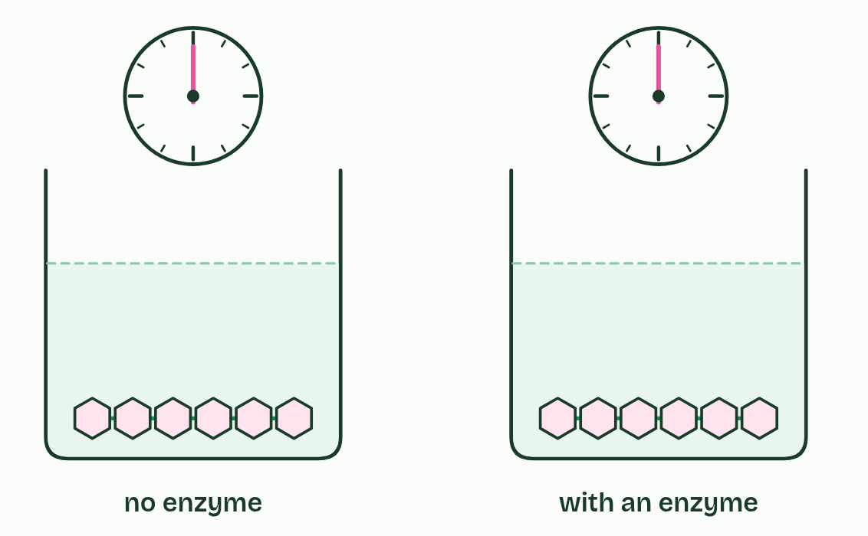
CHAPTER 1 · C1.1.1 Enzymes as catalysts
1 / 3
Seconds, not millions of years
The same bond in starch, broken two ways.
Minutes 0 to 6
Notes:
Minutes 0 to 6 of 60: Do now: how long without an enzyme? (6 min).
The plan: Put chapter 1's predict box on the board and take a vote with fingers, 1 to 4. Leave the votes up, then play chapter 1's figure: the same bond in starch, broken two ways. Students call out the gap between the two clocks.
A catalyst is a substance that speeds up a chemical reaction without being used up by it. The same molecule works again and again. Enzymes are the catalysts of living things, and nearly all of them are proteins (chapter 4 shows how their shape does the job).
Cells need them because many of the reactions in a cell are possible but hopelessly slow on their own at body temperature. The rate of reaction has to be fast enough for life, and an enzyme raises it enormously.
Speed matters in three places:
There is another way to speed up a reaction: heat it. A cell cannot do that, because a temperature high enough to make these reactions fast would unfold the cell's own proteins (chapter 6). Enzymes give the speed at 37 °C instead.
An enzyme is not used up, so a cell needs only a little of each one. A single catalase molecule can deal with millions of hydrogen peroxide molecules every second. Enzymes do not make impossible reactions happen. They make possible ones fast (chapter 3 shows how).

Slide 5
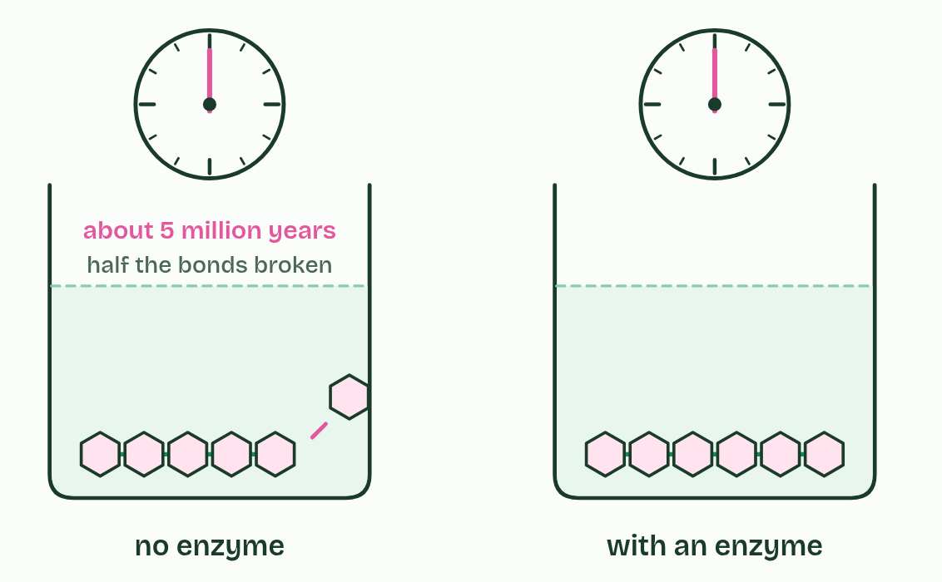
CHAPTER 1 · C1.1.1 Enzymes as catalysts
2 / 3
Seconds, not millions of years
With water alone at room temperature, half the bonds take millions of years to break.
Minutes 0 to 6
Notes:
Minutes 0 to 6 of 60: Do now: how long without an enzyme? (6 min).
The plan: Put chapter 1's predict box on the board and take a vote with fingers, 1 to 4. Leave the votes up, then play chapter 1's figure: the same bond in starch, broken two ways. Students call out the gap between the two clocks.
A catalyst is a substance that speeds up a chemical reaction without being used up by it. The same molecule works again and again. Enzymes are the catalysts of living things, and nearly all of them are proteins (chapter 4 shows how their shape does the job).
Cells need them because many of the reactions in a cell are possible but hopelessly slow on their own at body temperature. The rate of reaction has to be fast enough for life, and an enzyme raises it enormously.
Speed matters in three places:
There is another way to speed up a reaction: heat it. A cell cannot do that, because a temperature high enough to make these reactions fast would unfold the cell's own proteins (chapter 6). Enzymes give the speed at 37 °C instead.
An enzyme is not used up, so a cell needs only a little of each one. A single catalase molecule can deal with millions of hydrogen peroxide molecules every second. Enzymes do not make impossible reactions happen. They make possible ones fast (chapter 3 shows how).

Slide 6
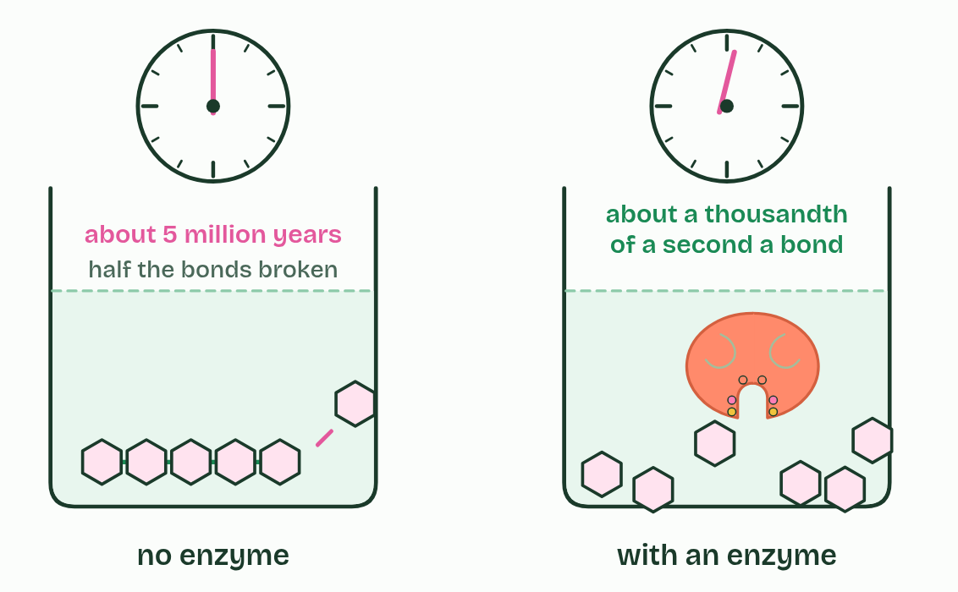
CHAPTER 1 · C1.1.1 Enzymes as catalysts
3 / 3
Seconds, not millions of years
Amylase breaks each one in about a thousandth of a second, at body temperature.
Minutes 0 to 6
Notes:
Minutes 0 to 6 of 60: Do now: how long without an enzyme? (6 min).
The plan: Put chapter 1's predict box on the board and take a vote with fingers, 1 to 4. Leave the votes up, then play chapter 1's figure: the same bond in starch, broken two ways. Students call out the gap between the two clocks.
A catalyst is a substance that speeds up a chemical reaction without being used up by it. The same molecule works again and again. Enzymes are the catalysts of living things, and nearly all of them are proteins (chapter 4 shows how their shape does the job).
Cells need them because many of the reactions in a cell are possible but hopelessly slow on their own at body temperature. The rate of reaction has to be fast enough for life, and an enzyme raises it enormously.
Speed matters in three places:
There is another way to speed up a reaction: heat it. A cell cannot do that, because a temperature high enough to make these reactions fast would unfold the cell's own proteins (chapter 6). Enzymes give the speed at 37 °C instead.
An enzyme is not used up, so a cell needs only a little of each one. A single catalase molecule can deal with millions of hydrogen peroxide molecules every second. Enzymes do not make impossible reactions happen. They make possible ones fast (chapter 3 shows how).

Slide 7
CHAPTER 1 · C1.1.1 Enzymes as catalysts
Seconds, not millions of years
Digestion. Food spends only a few hours in your gut. Its starch, protein and fat must be broken down in that time, or the food leaves unabsorbed.
Growth. A cell has to copy all of its DNA before it divides.
Response. A nerve or a muscle has to respond in a fraction of a second.
Minutes 0 to 6
Notes:
Minutes 0 to 6 of 60: Do now: how long without an enzyme? (6 min).
The plan: Put chapter 1's predict box on the board and take a vote with fingers, 1 to 4. Leave the votes up, then play chapter 1's figure: the same bond in starch, broken two ways. Students call out the gap between the two clocks.
A catalyst is a substance that speeds up a chemical reaction without being used up by it. The same molecule works again and again. Enzymes are the catalysts of living things, and nearly all of them are proteins (chapter 4 shows how their shape does the job).
Cells need them because many of the reactions in a cell are possible but hopelessly slow on their own at body temperature. The rate of reaction has to be fast enough for life, and an enzyme raises it enormously.
Speed matters in three places:
There is another way to speed up a reaction: heat it. A cell cannot do that, because a temperature high enough to make these reactions fast would unfold the cell's own proteins (chapter 6). Enzymes give the speed at 37 °C instead.
An enzyme is not used up, so a cell needs only a little of each one. A single catalase molecule can deal with millions of hydrogen peroxide molecules every second. Enzymes do not make impossible reactions happen. They make possible ones fast (chapter 3 shows how).

Slide 8
WHAT HAPPENS
With no enzyme at all, how long would water at room temperature take to break half the bonds between the glucose units in starch?
A About a week
B About a hundred thousand years
C About five million years
D About two hundred years
About five million years, by one careful measurement. The reaction is possible, but so slow it might as well not happen. Amylase in your saliva does the same job in a fraction of a second. That gap, repeated across thousands of reactions, is why life needs enzymes.
Minutes 0 to 6
Notes:
Minutes 0 to 6 of 60: Do now: how long without an enzyme? (6 min).
The plan: Put chapter 1's predict box on the board and take a vote with fingers, 1 to 4. Leave the votes up, then play chapter 1's figure: the same bond in starch, broken two ways. Students call out the gap between the two clocks.
Answer: C. About five million years, by one careful measurement. The reaction is possible, but so slow it might as well not happen. Amylase in your saliva does the same job in a fraction of a second. That gap, repeated across thousands of reactions, is why life needs enzymes.

Slide 9
WATCH OUT
An enzyme is not used up by the reaction it catalyses. The substrate changes; the enzyme comes out as it went in.
Minutes 0 to 6
Notes:
Minutes 0 to 6 of 60: Do now: how long without an enzyme? (6 min).
The plan: Put chapter 1's predict box on the board and take a vote with fingers, 1 to 4. Leave the votes up, then play chapter 1's figure: the same bond in starch, broken two ways. Students call out the gap between the two clocks.
A common mistake: say it, then ask who can say why it is wrong.

Slide 10
STEP 2
10 MIN
Why speed matters
Pairs list what would go wrong in a body with no enzymes.
Minutes 6 to 16
Notes:
Minutes 6 to 16 of 60: Why speed matters (10 min).
The plan: Pairs list what would go wrong in a body with no enzymes. Take three answers and land on digestion in the hours food spends in the gut, copying all the DNA before a cell divides, and working at 37 °C. Then chapter 1's points: a catalyst is not used up, and heat is not an option for a cell.

Slide 11
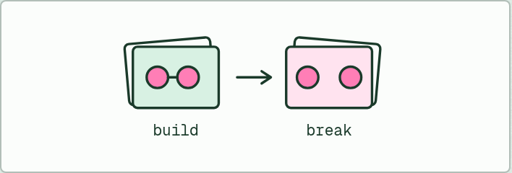
CARD SORT
12 MIN
Build or break?
THE TASK
Twelve cards, two headings: anabolic and catabolic. The six reactions of chapter 2's sorter, plus DNA replication, making a phospholipid from glycerol and fatty acids, lipid digestion in the small intestine, breaking glycogen down to glucose in the liver, starch made in a potato, and protein broken down to amino acids in a cell. Each card is placed with the reaction type written under it: condensation, hydrolysis, oxidation or photosynthesis.
STUDENTS NEED
Printed card sets, one per pair.
Minutes 16 to 28
Notes:
Minutes 16 to 28 of 60: Build or break? (12 min).
The plan: Chapter 2: step through the figure, from one reaction to a web. Then Build or break? in pairs, with the card sort below, and the chapter's own sorter on the board for the two cards the class argued over most. Finish with the Add and Cut tiles.
The activity: Build or break?. Twelve cards, two headings: anabolic and catabolic. The six reactions of chapter 2's sorter, plus DNA replication, making a phospholipid from glycerol and fatty acids, lipid digestion in the small intestine, breaking glycogen down to glucose in the liver, starch made in a potato, and protein broken down to amino acids in a cell. Each card is placed with the reaction type written under it: condensation, hydrolysis, oxidation or photosynthesis.
Needs: printed card sets, one per pair.
The time: 12 minutes, minutes 16 to 28 of the plan.

Slide 12
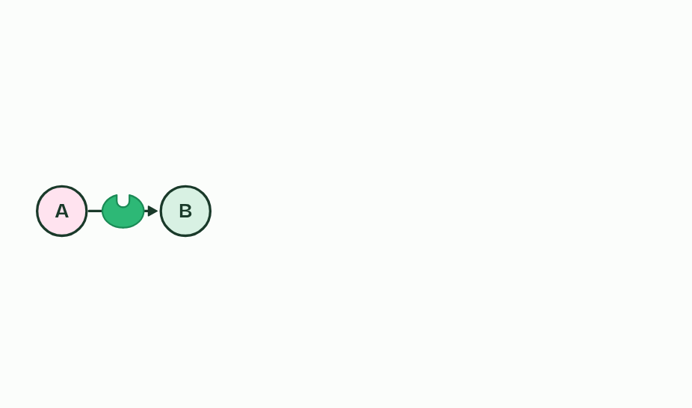
CHAPTER 2 · C1.1.2 C1.1.3 Role of enzymes in metabolism; anabolic and catabolic reactions
1 / 3
A web of reactions, an enzyme for each
One reaction, one enzyme.
Minutes 16 to 28
Notes:
Minutes 16 to 28 of 60: Build or break? (12 min).
The plan: Chapter 2: step through the figure, from one reaction to a web. Then Build or break? in pairs, with the card sort below, and the chapter's own sorter on the board for the two cards the class argued over most. Finish with the Add and Cut tiles.
Metabolism is every chemical reaction going on in an organism. There are thousands of them, and they are linked: the product of one reaction is the substrate of the next, and many molecules feed several reactions at once. It is a web, not a list. A metabolic pathway is one thread of it, a series of steps with an enzyme for each.
Each enzyme catalyses one reaction, or one kind of reaction. This enzyme specificity (chapter 6 shows why) is why a cell needs thousands of different enzymes, one for each step. It is also how a cell stays in control: a reaction runs only if its enzyme is there and working. Make more of an enzyme, or less, or switch it off, and that step speeds up, slows or stops.
Metabolic reactions fall into two groups. Anabolic reactions build larger molecules from smaller ones and take in energy. Monomers are joined into macromolecules by condensation, as when amino acids become a polypeptide in protein synthesis, or glucose becomes glycogen. Photosynthesis is anabolic too: it builds glucose from carbon dioxide and water.
Catabolic reactions break larger molecules into smaller ones and release energy. In digestion, macromolecules are broken into monomers by hydrolysis. In respiration, substrates such as glucose are broken down by oxidation. Drawing on a glycogen store, by breaking it back into glucose, is catabolic too. So not all catabolism is hydrolysis.

Slide 13
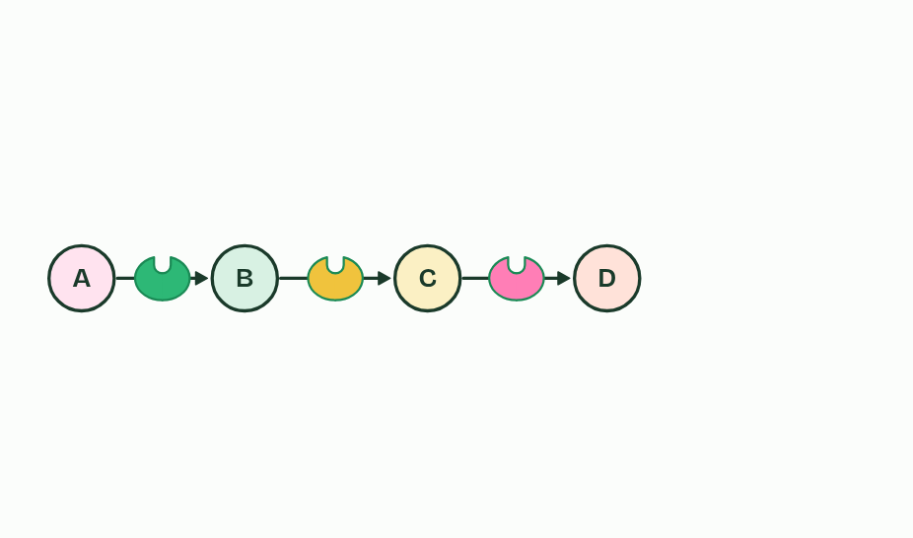
CHAPTER 2 · C1.1.2 C1.1.3 Role of enzymes in metabolism; anabolic and catabolic reactions
2 / 3
A web of reactions, an enzyme for each
The product of one reaction is the substrate of the next.
Minutes 16 to 28
Notes:
Minutes 16 to 28 of 60: Build or break? (12 min).
The plan: Chapter 2: step through the figure, from one reaction to a web. Then Build or break? in pairs, with the card sort below, and the chapter's own sorter on the board for the two cards the class argued over most. Finish with the Add and Cut tiles.
Metabolism is every chemical reaction going on in an organism. There are thousands of them, and they are linked: the product of one reaction is the substrate of the next, and many molecules feed several reactions at once. It is a web, not a list. A metabolic pathway is one thread of it, a series of steps with an enzyme for each.
Each enzyme catalyses one reaction, or one kind of reaction. This enzyme specificity (chapter 6 shows why) is why a cell needs thousands of different enzymes, one for each step. It is also how a cell stays in control: a reaction runs only if its enzyme is there and working. Make more of an enzyme, or less, or switch it off, and that step speeds up, slows or stops.
Metabolic reactions fall into two groups. Anabolic reactions build larger molecules from smaller ones and take in energy. Monomers are joined into macromolecules by condensation, as when amino acids become a polypeptide in protein synthesis, or glucose becomes glycogen. Photosynthesis is anabolic too: it builds glucose from carbon dioxide and water.
Catabolic reactions break larger molecules into smaller ones and release energy. In digestion, macromolecules are broken into monomers by hydrolysis. In respiration, substrates such as glucose are broken down by oxidation. Drawing on a glycogen store, by breaking it back into glucose, is catabolic too. So not all catabolism is hydrolysis.

Slide 14
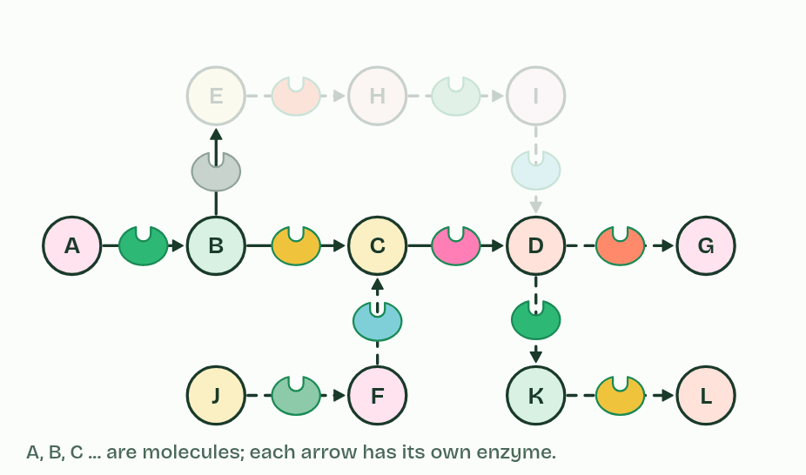
CHAPTER 2 · C1.1.2 C1.1.3 Role of enzymes in metabolism; anabolic and catabolic reactions
3 / 3
A web of reactions, an enzyme for each
Thousands of linked reactions make metabolism. Switch off one enzyme and one step stops.
Minutes 16 to 28
Notes:
Minutes 16 to 28 of 60: Build or break? (12 min).
The plan: Chapter 2: step through the figure, from one reaction to a web. Then Build or break? in pairs, with the card sort below, and the chapter's own sorter on the board for the two cards the class argued over most. Finish with the Add and Cut tiles.
Metabolism is every chemical reaction going on in an organism. There are thousands of them, and they are linked: the product of one reaction is the substrate of the next, and many molecules feed several reactions at once. It is a web, not a list. A metabolic pathway is one thread of it, a series of steps with an enzyme for each.
Each enzyme catalyses one reaction, or one kind of reaction. This enzyme specificity (chapter 6 shows why) is why a cell needs thousands of different enzymes, one for each step. It is also how a cell stays in control: a reaction runs only if its enzyme is there and working. Make more of an enzyme, or less, or switch it off, and that step speeds up, slows or stops.
Metabolic reactions fall into two groups. Anabolic reactions build larger molecules from smaller ones and take in energy. Monomers are joined into macromolecules by condensation, as when amino acids become a polypeptide in protein synthesis, or glucose becomes glycogen. Photosynthesis is anabolic too: it builds glucose from carbon dioxide and water.
Catabolic reactions break larger molecules into smaller ones and release energy. In digestion, macromolecules are broken into monomers by hydrolysis. In respiration, substrates such as glucose are broken down by oxidation. Drawing on a glycogen store, by breaking it back into glucose, is catabolic too. So not all catabolism is hydrolysis.

Slide 15
CHAPTER 2 · C1.1.2 C1.1.3 Role of enzymes in metabolism; anabolic and catabolic reactions
A web of reactions, an enzyme for each
Metabolism is every chemical reaction going on in an organism.
A metabolic pathway is one thread of it, a series of steps with an enzyme for each.
This enzyme specificity (chapter 6 shows why) is why a cell needs thousands of different enzymes, one for each step.
Anabolic reactions build larger molecules from smaller ones and take in energy.
Minutes 16 to 28
Notes:
Minutes 16 to 28 of 60: Build or break? (12 min).
The plan: Chapter 2: step through the figure, from one reaction to a web. Then Build or break? in pairs, with the card sort below, and the chapter's own sorter on the board for the two cards the class argued over most. Finish with the Add and Cut tiles.
Metabolism is every chemical reaction going on in an organism. There are thousands of them, and they are linked: the product of one reaction is the substrate of the next, and many molecules feed several reactions at once. It is a web, not a list. A metabolic pathway is one thread of it, a series of steps with an enzyme for each.
Each enzyme catalyses one reaction, or one kind of reaction. This enzyme specificity (chapter 6 shows why) is why a cell needs thousands of different enzymes, one for each step. It is also how a cell stays in control: a reaction runs only if its enzyme is there and working. Make more of an enzyme, or less, or switch it off, and that step speeds up, slows or stops.
Metabolic reactions fall into two groups. Anabolic reactions build larger molecules from smaller ones and take in energy. Monomers are joined into macromolecules by condensation, as when amino acids become a polypeptide in protein synthesis, or glucose becomes glycogen. Photosynthesis is anabolic too: it builds glucose from carbon dioxide and water.
Catabolic reactions break larger molecules into smaller ones and release energy. In digestion, macromolecules are broken into monomers by hydrolysis. In respiration, substrates such as glucose are broken down by oxidation. Drawing on a glycogen store, by breaking it back into glucose, is catabolic too. So not all catabolism is hydrolysis.

Slide 16
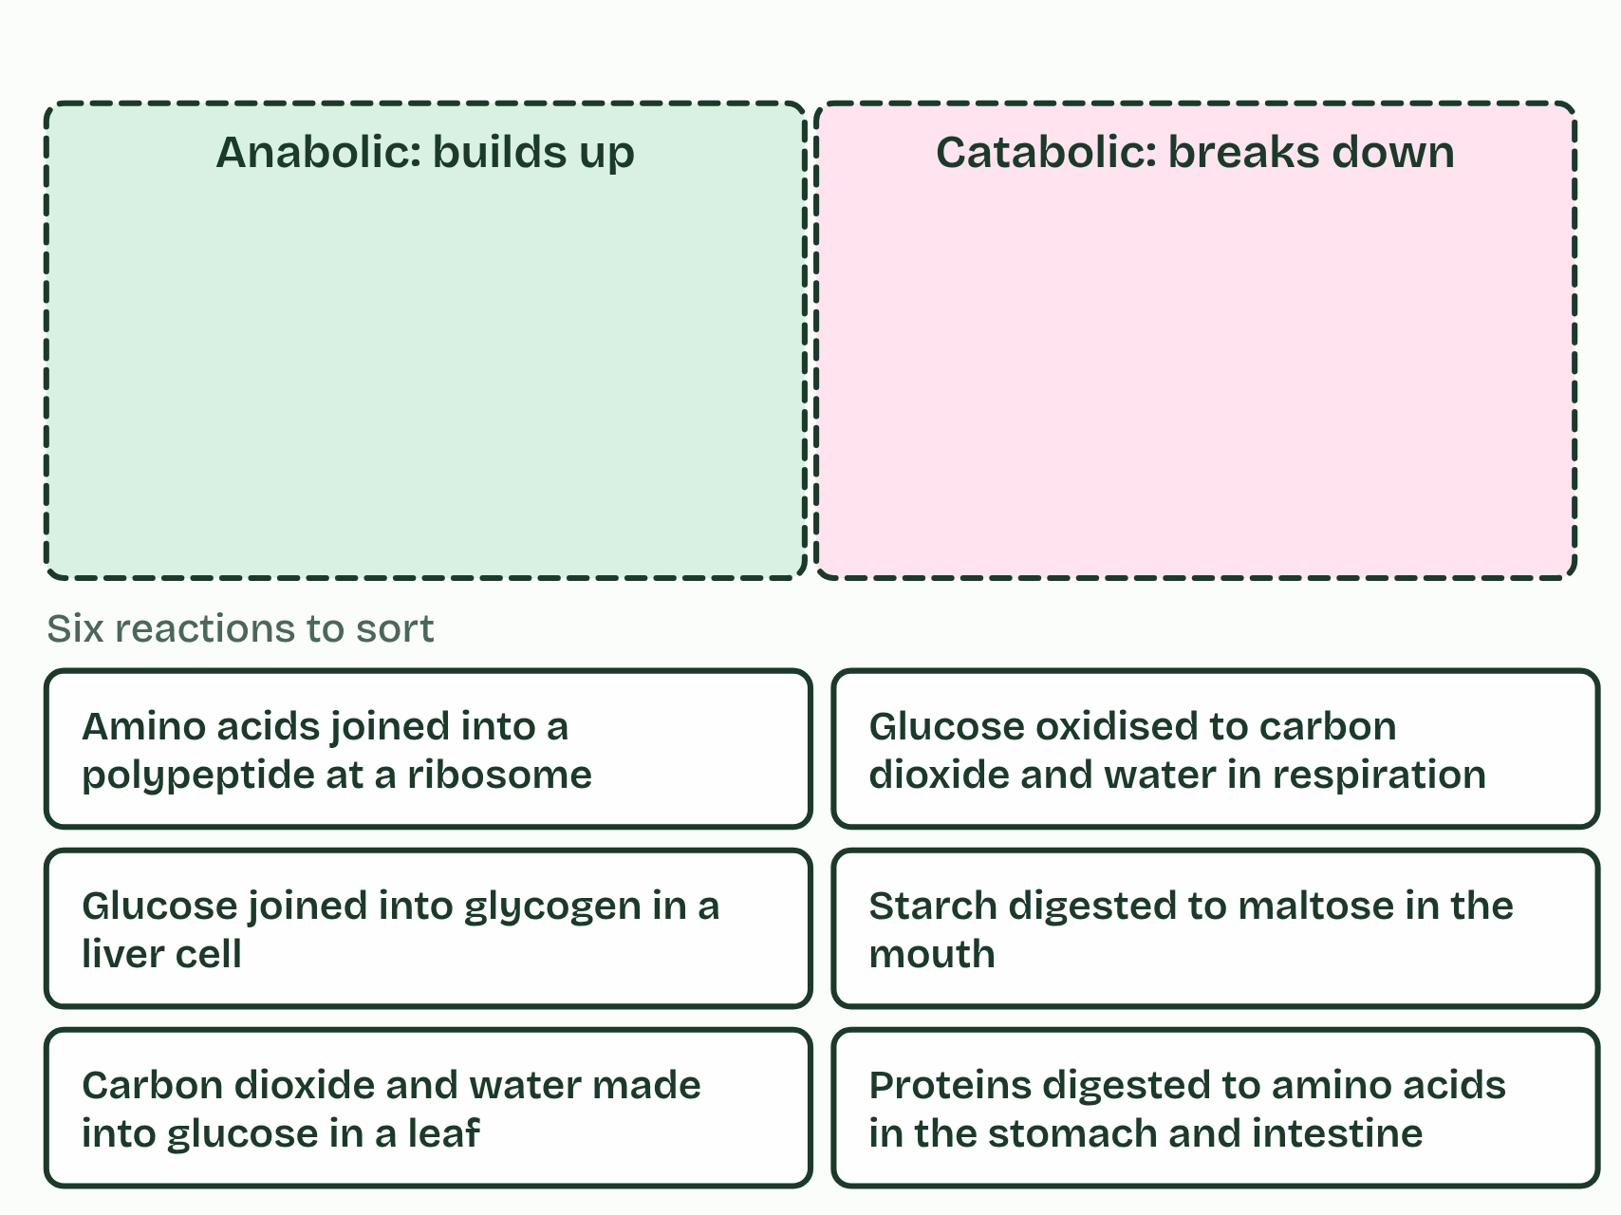
CHAPTER 2 · C1.1.2 C1.1.3 Role of enzymes in metabolism; anabolic and catabolic reactions
A web of reactions, an enzyme for each
Metabolism is every chemical reaction going on in an organism.
A metabolic pathway is one thread of it, a series of steps with an enzyme for each.
This enzyme specificity (chapter 6 shows why) is why a cell needs thousands of different enzymes, one for each step.
Anabolic reactions build larger molecules from smaller ones and take in energy.
Minutes 16 to 28
Notes:
Minutes 16 to 28 of 60: Build or break? (12 min).
The plan: Chapter 2: step through the figure, from one reaction to a web. Then Build or break? in pairs, with the card sort below, and the chapter's own sorter on the board for the two cards the class argued over most. Finish with the Add and Cut tiles.
Metabolism is every chemical reaction going on in an organism. There are thousands of them, and they are linked: the product of one reaction is the substrate of the next, and many molecules feed several reactions at once. It is a web, not a list. A metabolic pathway is one thread of it, a series of steps with an enzyme for each.
Each enzyme catalyses one reaction, or one kind of reaction. This enzyme specificity (chapter 6 shows why) is why a cell needs thousands of different enzymes, one for each step. It is also how a cell stays in control: a reaction runs only if its enzyme is there and working. Make more of an enzyme, or less, or switch it off, and that step speeds up, slows or stops.
Metabolic reactions fall into two groups. Anabolic reactions build larger molecules from smaller ones and take in energy. Monomers are joined into macromolecules by condensation, as when amino acids become a polypeptide in protein synthesis, or glucose becomes glycogen. Photosynthesis is anabolic too: it builds glucose from carbon dioxide and water.
Catabolic reactions break larger molecules into smaller ones and release energy. In digestion, macromolecules are broken into monomers by hydrolysis. In respiration, substrates such as glucose are broken down by oxidation. Drawing on a glycogen store, by breaking it back into glucose, is catabolic too. So not all catabolism is hydrolysis.

Slide 17
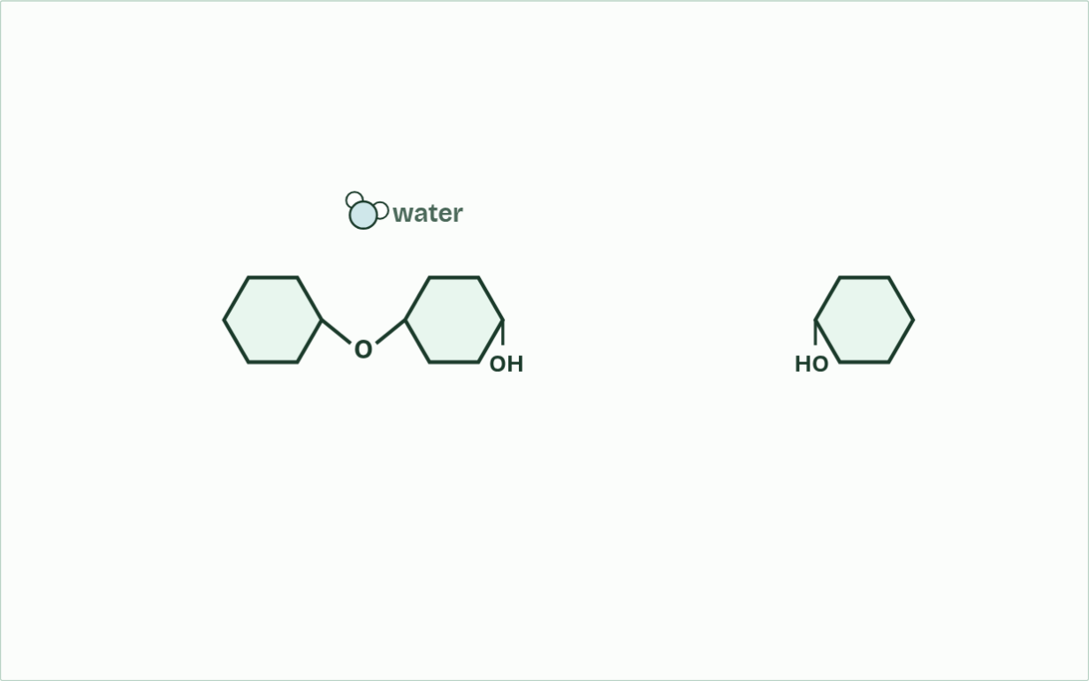
CHAPTER 2 · C1.1.2 C1.1.3 Role of enzymes in metabolism; anabolic and catabolic reactions
water released: 1
1 / 4
A web of reactions, an enzyme for each
Glucose units join one at a time; a water molecule leaves at each link.
Minutes 16 to 28
Notes:
Minutes 16 to 28 of 60: Build or break? (12 min).
The plan: Chapter 2: step through the figure, from one reaction to a web. Then Build or break? in pairs, with the card sort below, and the chapter's own sorter on the board for the two cards the class argued over most. Finish with the Add and Cut tiles.
Metabolism is every chemical reaction going on in an organism. There are thousands of them, and they are linked: the product of one reaction is the substrate of the next, and many molecules feed several reactions at once. It is a web, not a list. A metabolic pathway is one thread of it, a series of steps with an enzyme for each.
Each enzyme catalyses one reaction, or one kind of reaction. This enzyme specificity (chapter 6 shows why) is why a cell needs thousands of different enzymes, one for each step. It is also how a cell stays in control: a reaction runs only if its enzyme is there and working. Make more of an enzyme, or less, or switch it off, and that step speeds up, slows or stops.
Metabolic reactions fall into two groups. Anabolic reactions build larger molecules from smaller ones and take in energy. Monomers are joined into macromolecules by condensation, as when amino acids become a polypeptide in protein synthesis, or glucose becomes glycogen. Photosynthesis is anabolic too: it builds glucose from carbon dioxide and water.
Catabolic reactions break larger molecules into smaller ones and release energy. In digestion, macromolecules are broken into monomers by hydrolysis. In respiration, substrates such as glucose are broken down by oxidation. Drawing on a glycogen store, by breaking it back into glucose, is catabolic too. So not all catabolism is hydrolysis.
The animation "Build glycogen, then break it down", paused at 1.9 s. The next slides go on through it, then play it.

Slide 18
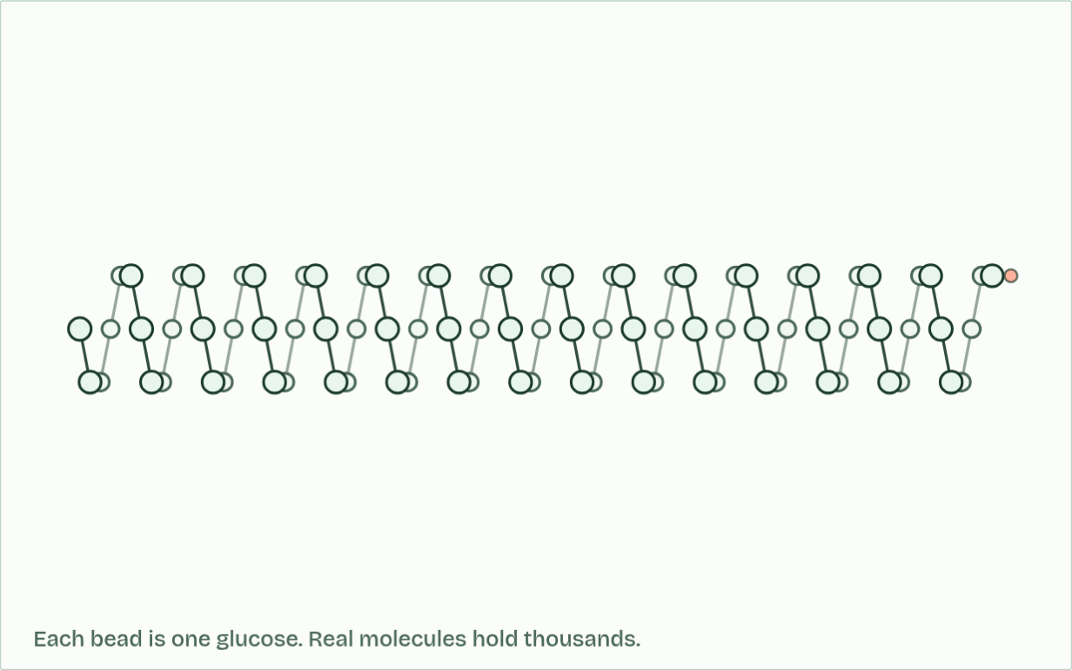
CHAPTER 2 · C1.1.2 C1.1.3 Role of enzymes in metabolism; anabolic and catabolic reactions
ends: 1
2 / 4
A web of reactions, an enzyme for each
Amylose coils into a helix: a lot of glucose in a small space.
Minutes 16 to 28
Notes:
Minutes 16 to 28 of 60: Build or break? (12 min).
The plan: Chapter 2: step through the figure, from one reaction to a web. Then Build or break? in pairs, with the card sort below, and the chapter's own sorter on the board for the two cards the class argued over most. Finish with the Add and Cut tiles.
Metabolism is every chemical reaction going on in an organism. There are thousands of them, and they are linked: the product of one reaction is the substrate of the next, and many molecules feed several reactions at once. It is a web, not a list. A metabolic pathway is one thread of it, a series of steps with an enzyme for each.
Each enzyme catalyses one reaction, or one kind of reaction. This enzyme specificity (chapter 6 shows why) is why a cell needs thousands of different enzymes, one for each step. It is also how a cell stays in control: a reaction runs only if its enzyme is there and working. Make more of an enzyme, or less, or switch it off, and that step speeds up, slows or stops.
Metabolic reactions fall into two groups. Anabolic reactions build larger molecules from smaller ones and take in energy. Monomers are joined into macromolecules by condensation, as when amino acids become a polypeptide in protein synthesis, or glucose becomes glycogen. Photosynthesis is anabolic too: it builds glucose from carbon dioxide and water.
Catabolic reactions break larger molecules into smaller ones and release energy. In digestion, macromolecules are broken into monomers by hydrolysis. In respiration, substrates such as glucose are broken down by oxidation. Drawing on a glycogen store, by breaking it back into glucose, is catabolic too. So not all catabolism is hydrolysis.
The animation "Build glycogen, then break it down", paused at 8.8 s. The next slides go on through it, then play it.

Slide 19
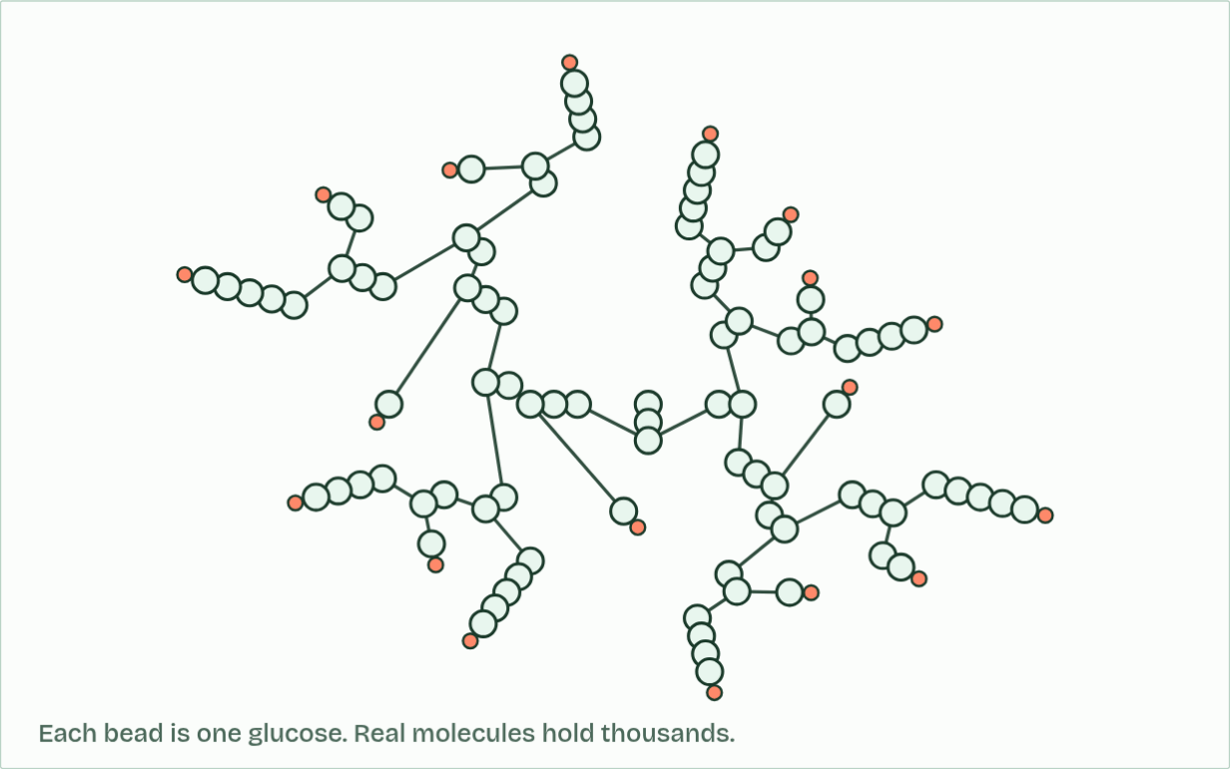
CHAPTER 2 · C1.1.2 C1.1.3 Role of enzymes in metabolism; anabolic and catabolic reactions
ends: 18
3 / 4
A web of reactions, an enzyme for each
Amylopectin and glycogen branch, so they have many ends.
Minutes 16 to 28
Notes:
Minutes 16 to 28 of 60: Build or break? (12 min).
The plan: Chapter 2: step through the figure, from one reaction to a web. Then Build or break? in pairs, with the card sort below, and the chapter's own sorter on the board for the two cards the class argued over most. Finish with the Add and Cut tiles.
Metabolism is every chemical reaction going on in an organism. There are thousands of them, and they are linked: the product of one reaction is the substrate of the next, and many molecules feed several reactions at once. It is a web, not a list. A metabolic pathway is one thread of it, a series of steps with an enzyme for each.
Each enzyme catalyses one reaction, or one kind of reaction. This enzyme specificity (chapter 6 shows why) is why a cell needs thousands of different enzymes, one for each step. It is also how a cell stays in control: a reaction runs only if its enzyme is there and working. Make more of an enzyme, or less, or switch it off, and that step speeds up, slows or stops.
Metabolic reactions fall into two groups. Anabolic reactions build larger molecules from smaller ones and take in energy. Monomers are joined into macromolecules by condensation, as when amino acids become a polypeptide in protein synthesis, or glucose becomes glycogen. Photosynthesis is anabolic too: it builds glucose from carbon dioxide and water.
Catabolic reactions break larger molecules into smaller ones and release energy. In digestion, macromolecules are broken into monomers by hydrolysis. In respiration, substrates such as glucose are broken down by oxidation. Drawing on a glycogen store, by breaking it back into glucose, is catabolic too. So not all catabolism is hydrolysis.
The animation "Build glycogen, then break it down", paused at 13.6 s. The next slides go on through it, then play it.

Slide 20
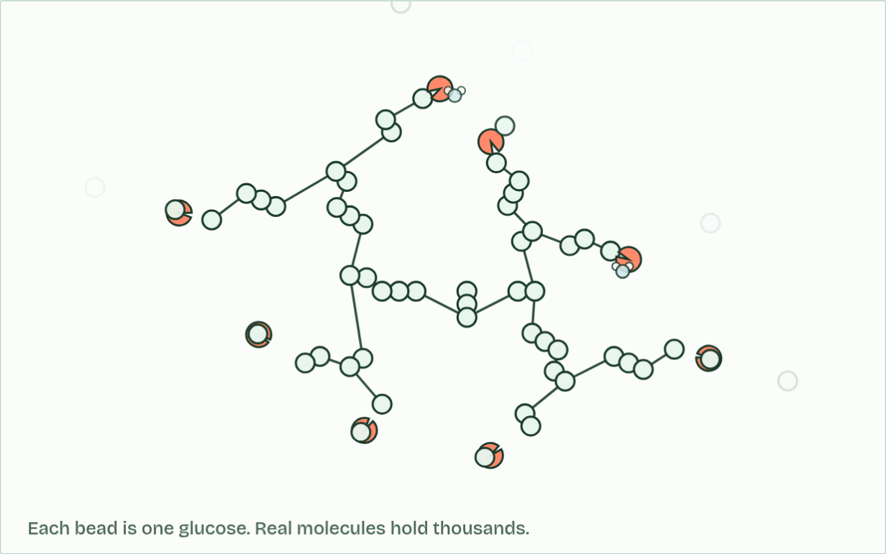
CHAPTER 2 · C1.1.2 C1.1.3 Role of enzymes in metabolism; anabolic and catabolic reactions
ends: 8, glucose released: 43
4 / 4
A web of reactions, an enzyme for each
Enzymes take glucose off the ends, using a water molecule each time.
Minutes 16 to 28
Notes:
Minutes 16 to 28 of 60: Build or break? (12 min).
The plan: Chapter 2: step through the figure, from one reaction to a web. Then Build or break? in pairs, with the card sort below, and the chapter's own sorter on the board for the two cards the class argued over most. Finish with the Add and Cut tiles.
Metabolism is every chemical reaction going on in an organism. There are thousands of them, and they are linked: the product of one reaction is the substrate of the next, and many molecules feed several reactions at once. It is a web, not a list. A metabolic pathway is one thread of it, a series of steps with an enzyme for each.
Each enzyme catalyses one reaction, or one kind of reaction. This enzyme specificity (chapter 6 shows why) is why a cell needs thousands of different enzymes, one for each step. It is also how a cell stays in control: a reaction runs only if its enzyme is there and working. Make more of an enzyme, or less, or switch it off, and that step speeds up, slows or stops.
Metabolic reactions fall into two groups. Anabolic reactions build larger molecules from smaller ones and take in energy. Monomers are joined into macromolecules by condensation, as when amino acids become a polypeptide in protein synthesis, or glucose becomes glycogen. Photosynthesis is anabolic too: it builds glucose from carbon dioxide and water.
Catabolic reactions break larger molecules into smaller ones and release energy. In digestion, macromolecules are broken into monomers by hydrolysis. In respiration, substrates such as glucose are broken down by oxidation. Drawing on a glycogen store, by breaking it back into glucose, is catabolic too. So not all catabolism is hydrolysis.
The animation "Build glycogen, then break it down", paused at 18.4 s. The next slides go on through it, then play it.

Slide 21
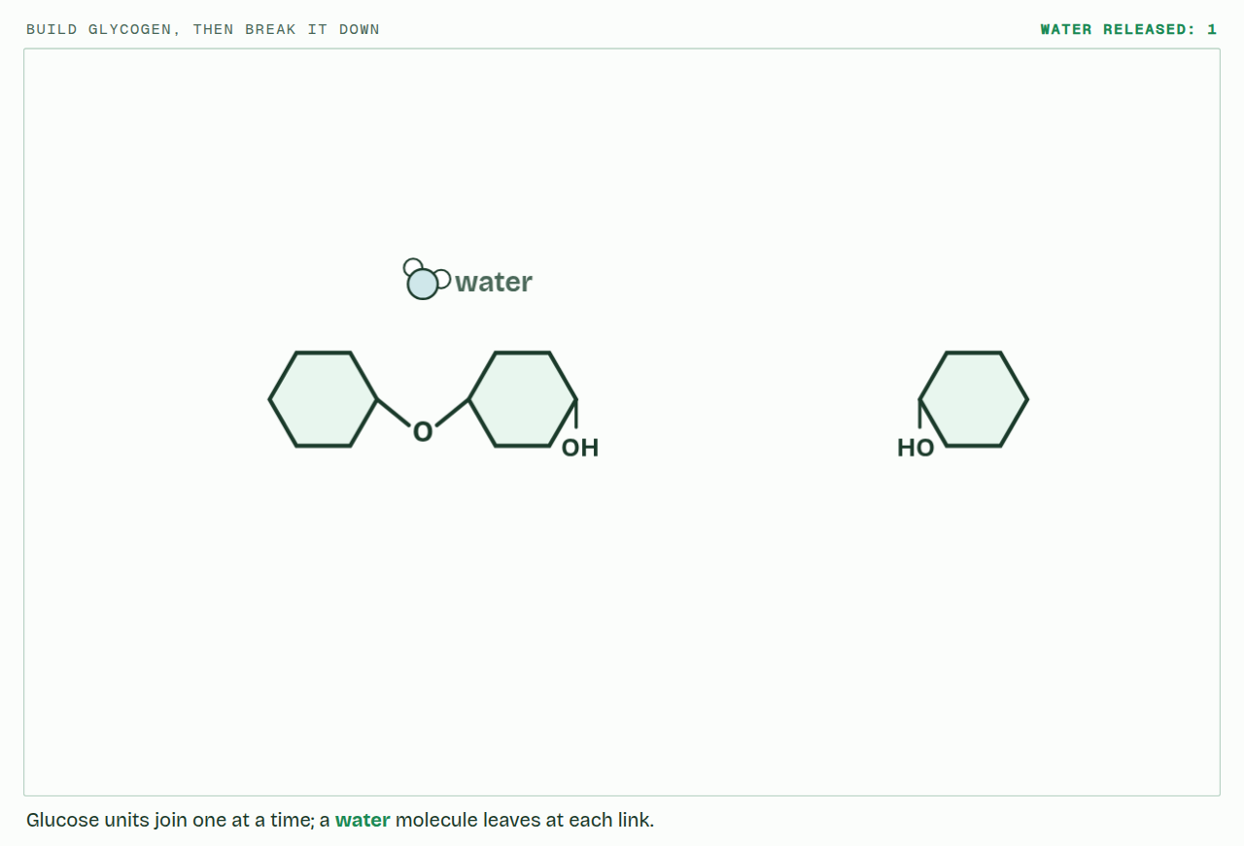
CHAPTER 2 · C1.1.2 C1.1.3 Role of enzymes in metabolism; anabolic and catabolic reactions
PLAY IT
A web of reactions, an enzyme for each
Build glycogen, then break it down: click to play. It loops every 20 seconds.
Minutes 16 to 28
Notes:
Minutes 16 to 28 of 60: Build or break? (12 min).
The plan: Chapter 2: step through the figure, from one reaction to a web. Then Build or break? in pairs, with the card sort below, and the chapter's own sorter on the board for the two cards the class argued over most. Finish with the Add and Cut tiles.
The video is polymers-358d35.mp4, one loop of the animation in the guide. It plays in PowerPoint and Keynote. Google Slides does not play a video embedded in a .pptx: download polymers-358d35.mp4 (https://www.biologybybradford.com/guides/downloads/scenes/polymers-358d35.mp4), upload it to Google Drive, then Insert > Video > Google Drive.
In the guide the class can change it as it runs: https://www.biologybybradford.com/guides/ib-biology-c1-1-enzymes-and-metabolism#metabolism
What it shows, in order:
1. Glucose units join one at a time; a water molecule leaves at each link.
2. Amylose coils into a helix: a lot of glucose in a small space.
3. Amylopectin and glycogen branch, so they have many ends.
4. Enzymes take glucose off the ends, using a water molecule each time.

Slide 22
PREDICT
A liver cell makes thousands of different enzymes. Why so many?
A Each enzyme catalyses one kind of reaction
B Enzymes are used up, so the cell keeps spares
C More kinds of enzyme make every reaction faster
D Each organelle needs its own copy of every enzyme
Minutes 16 to 28
Notes:
Minutes 16 to 28 of 60: Build or break? (12 min).
The plan: Chapter 2: step through the figure, from one reaction to a web. Then Build or break? in pairs, with the card sort below, and the chapter's own sorter on the board for the two cards the class argued over most. Finish with the Add and Cut tiles.
Ask for a show of hands, or mini whiteboards, before revealing. (Answer: A, on the next slide.)

Slide 23
WHAT HAPPENS
A liver cell makes thousands of different enzymes. Why so many?
A Each enzyme catalyses one kind of reaction
B Enzymes are used up, so the cell keeps spares
C More kinds of enzyme make every reaction faster
D Each organelle needs its own copy of every enzyme
Each enzyme fits one substrate, or one kind of substrate, so it catalyses one kind of reaction. Thousands of reactions need thousands of enzymes, and having a separate enzyme for each step is also what lets the cell control each step on its own.
Minutes 16 to 28
Notes:
Minutes 16 to 28 of 60: Build or break? (12 min).
The plan: Chapter 2: step through the figure, from one reaction to a web. Then Build or break? in pairs, with the card sort below, and the chapter's own sorter on the board for the two cards the class argued over most. Finish with the Add and Cut tiles.
Answer: A. Each enzyme fits one substrate, or one kind of substrate, so it catalyses one kind of reaction. Thousands of reactions need thousands of enzymes, and having a separate enzyme for each step is also what lets the cell control each step on its own.

Slide 24
WATCH OUT
In science, metabolism is not how fast you burn food. It is every reaction in the body, building as well as breaking.
Minutes 16 to 28
Notes:
Minutes 16 to 28 of 60: Build or break? (12 min).
The plan: Chapter 2: step through the figure, from one reaction to a web. Then Build or break? in pairs, with the card sort below, and the chapter's own sorter on the board for the two cards the class argued over most. Finish with the Add and Cut tiles.
A common mistake: say it, then ask who can say why it is wrong.

Slide 25
REMEMBER IT
The two halves of metabolism
A
C
Add
Cut
Minutes 16 to 28
Notes:
Minutes 16 to 28 of 60: Build or break? (12 min).
The plan: Chapter 2: step through the figure, from one reaction to a web. Then Build or break? in pairs, with the card sort below, and the chapter's own sorter on the board for the two cards the class argued over most. Finish with the Add and Cut tiles.
Ask the class what each letter stands for before revealing.

Slide 26
REMEMBER IT
The two halves of metabolism
A
C
Add
Cut
Anabolic
Catabolic
builds bigger molecules from smaller ones, takes in energy
breaks bigger molecules into smaller ones, releases energy
Minutes 16 to 28
Notes:
Minutes 16 to 28 of 60: Build or break? (12 min).
The plan: Chapter 2: step through the figure, from one reaction to a web. Then Build or break? in pairs, with the card sort below, and the chapter's own sorter on the board for the two cards the class argued over most. Finish with the Add and Cut tiles.
Add: Anabolic (builds bigger molecules from smaller ones, takes in energy)
Cut: Catabolic (breaks bigger molecules into smaller ones, releases energy)

Slide 27
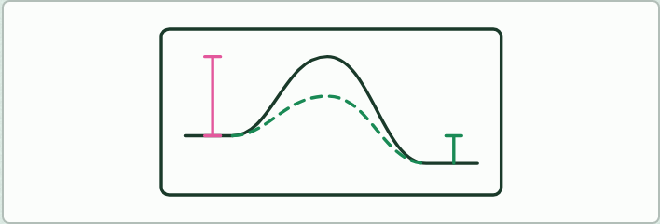
DRAWING
14 MIN
Draw the hill
THE TASK
Students draw an energy diagram on a mini whiteboard for a reaction that releases energy, with and without an enzyme. They label the two activation energies and the energy released overall, then draw a second diagram for a reaction that takes energy in. Check each step against chapter 3's figure.
STUDENTS NEED
Mini whiteboards and pens.
Minutes 28 to 42
Notes:
Minutes 28 to 42 of 60: Draw the hill (14 min).
The plan: Mini whiteboards, alongside chapter 3's figure, one step at a time. Stop before step 4 and take the predict: what happens to the energy released overall? Students redraw the diagram with the lower hill and check the start and end levels against the figure.
The activity: Draw the hill. Students draw an energy diagram on a mini whiteboard for a reaction that releases energy, with and without an enzyme. They label the two activation energies and the energy released overall, then draw a second diagram for a reaction that takes energy in. Check each step against chapter 3's figure.
Needs: mini whiteboards and pens.
The time: 14 minutes, minutes 28 to 42 of the plan.

Slide 28
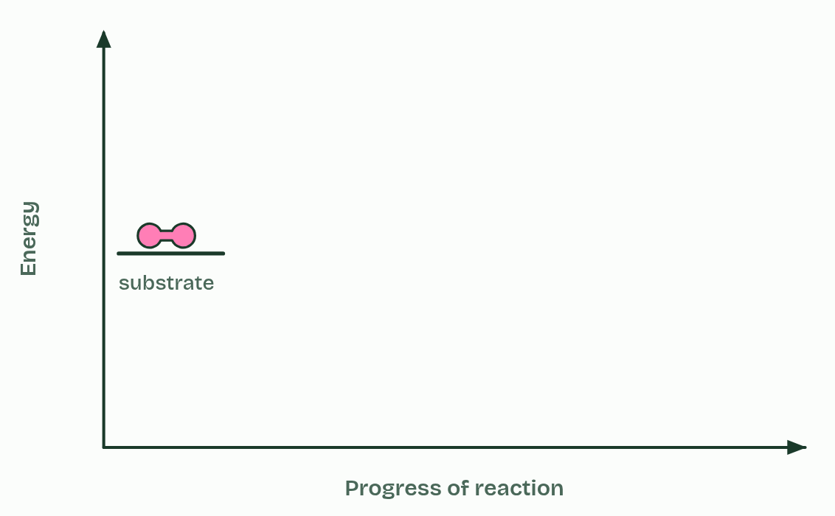
CHAPTER 3 · C1.1.10 Effect of enzymes on activation energy
1 / 5
A lower hill to climb
A substrate, before it reacts.
Minutes 28 to 42
Notes:
Minutes 28 to 42 of 60: Draw the hill (14 min).
The plan: Mini whiteboards, alongside chapter 3's figure, one step at a time. Stop before step 4 and take the predict: what happens to the energy released overall? Students redraw the diagram with the lower hill and check the start and end levels against the figure.
For a substrate to react, some of its bonds must be strained and broken, and breaking bonds takes energy. The energy needed before the reaction can run is the activation energy. On an energy diagram it is a hill that the reaction has to climb: energy up the side, progress of the reaction along the bottom. At the top of the hill the substrate is in an unstable in-between state, part way between substrate and products.
Bond breaking takes in energy. Bond making releases it. When the new bonds of the products form, energy comes out. If more comes out than went in, the reaction releases energy overall and the products sit lower than the substrate. Most catabolic reactions are like this. If less comes out, the reaction takes in energy overall and needs a supply of energy to run, as most anabolic reactions do.
An enzyme lowers the hill. As the substrate binds, the active site strains its bonds and holds it in the right position to react (chapter 4), so less energy is needed to reach the top. At 37 °C many more molecules have that much energy, and the reaction runs faster.
Reading the graph: measure the activation energy from the substrate's level up to the peak, and the energy released or taken in overall from the substrate's level to the products'.

Slide 29
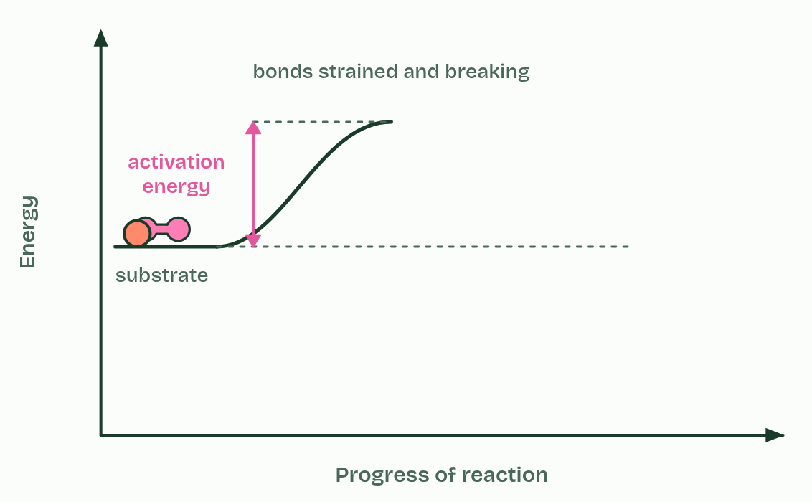
CHAPTER 3 · C1.1.10 Effect of enzymes on activation energy
2 / 5
A lower hill to climb
Breaking its bonds needs energy first: the activation energy.
Minutes 28 to 42
Notes:
Minutes 28 to 42 of 60: Draw the hill (14 min).
The plan: Mini whiteboards, alongside chapter 3's figure, one step at a time. Stop before step 4 and take the predict: what happens to the energy released overall? Students redraw the diagram with the lower hill and check the start and end levels against the figure.
For a substrate to react, some of its bonds must be strained and broken, and breaking bonds takes energy. The energy needed before the reaction can run is the activation energy. On an energy diagram it is a hill that the reaction has to climb: energy up the side, progress of the reaction along the bottom. At the top of the hill the substrate is in an unstable in-between state, part way between substrate and products.
Bond breaking takes in energy. Bond making releases it. When the new bonds of the products form, energy comes out. If more comes out than went in, the reaction releases energy overall and the products sit lower than the substrate. Most catabolic reactions are like this. If less comes out, the reaction takes in energy overall and needs a supply of energy to run, as most anabolic reactions do.
An enzyme lowers the hill. As the substrate binds, the active site strains its bonds and holds it in the right position to react (chapter 4), so less energy is needed to reach the top. At 37 °C many more molecules have that much energy, and the reaction runs faster.
Reading the graph: measure the activation energy from the substrate's level up to the peak, and the energy released or taken in overall from the substrate's level to the products'.

Slide 30
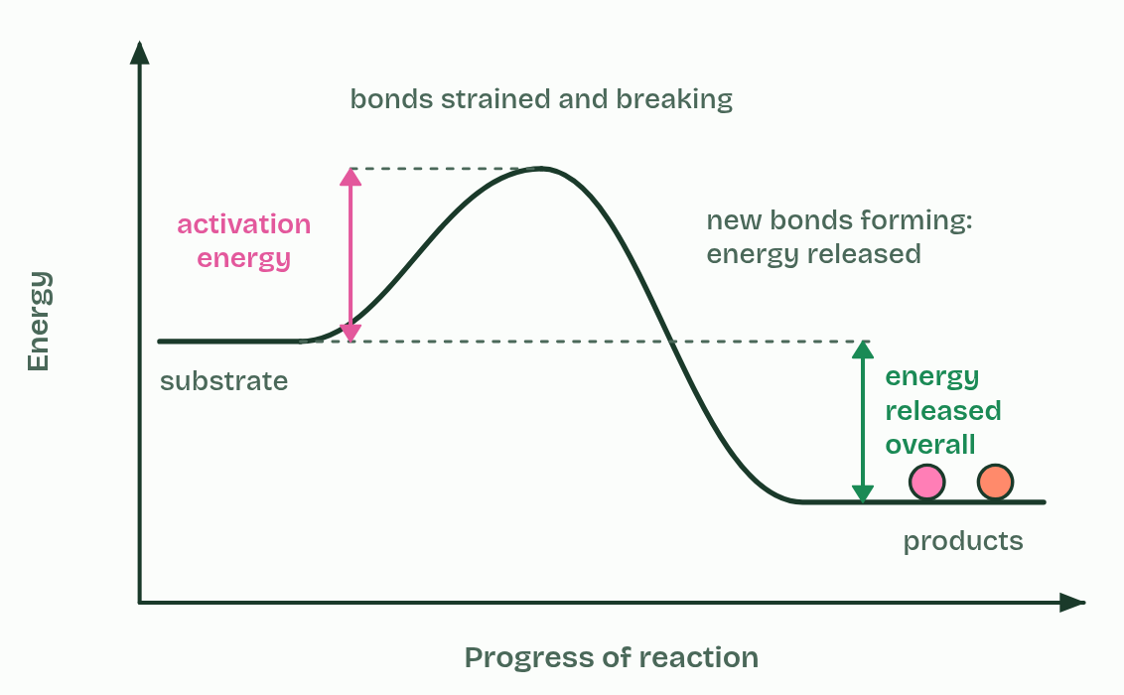
CHAPTER 3 · C1.1.10 Effect of enzymes on activation energy
3 / 5
A lower hill to climb
Making new bonds releases energy. Here more comes out than went in.
Minutes 28 to 42
Notes:
Minutes 28 to 42 of 60: Draw the hill (14 min).
The plan: Mini whiteboards, alongside chapter 3's figure, one step at a time. Stop before step 4 and take the predict: what happens to the energy released overall? Students redraw the diagram with the lower hill and check the start and end levels against the figure.
For a substrate to react, some of its bonds must be strained and broken, and breaking bonds takes energy. The energy needed before the reaction can run is the activation energy. On an energy diagram it is a hill that the reaction has to climb: energy up the side, progress of the reaction along the bottom. At the top of the hill the substrate is in an unstable in-between state, part way between substrate and products.
Bond breaking takes in energy. Bond making releases it. When the new bonds of the products form, energy comes out. If more comes out than went in, the reaction releases energy overall and the products sit lower than the substrate. Most catabolic reactions are like this. If less comes out, the reaction takes in energy overall and needs a supply of energy to run, as most anabolic reactions do.
An enzyme lowers the hill. As the substrate binds, the active site strains its bonds and holds it in the right position to react (chapter 4), so less energy is needed to reach the top. At 37 °C many more molecules have that much energy, and the reaction runs faster.
Reading the graph: measure the activation energy from the substrate's level up to the peak, and the energy released or taken in overall from the substrate's level to the products'.

Slide 31
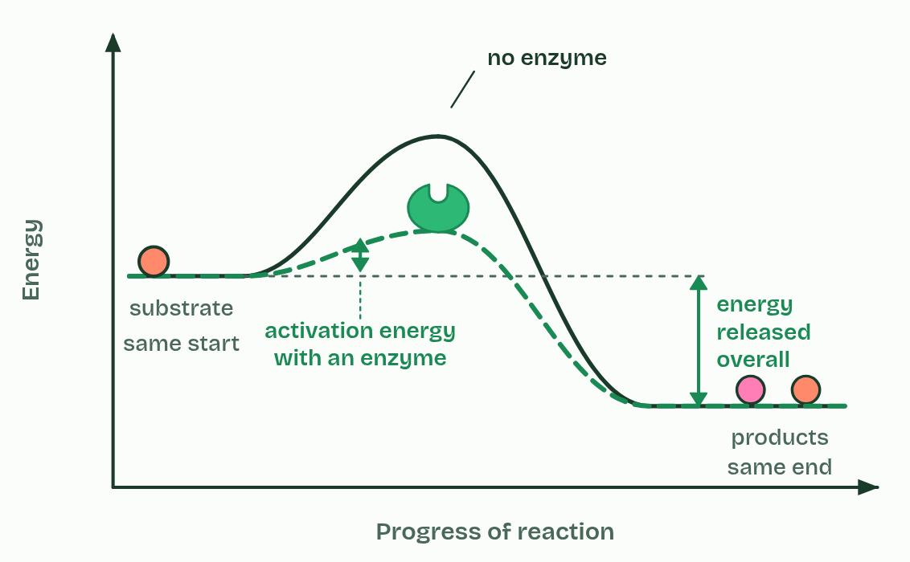
CHAPTER 3 · C1.1.10 Effect of enzymes on activation energy
4 / 5
A lower hill to climb
With an enzyme, the hill is lower. Start and end do not move.
Minutes 28 to 42
Notes:
Minutes 28 to 42 of 60: Draw the hill (14 min).
The plan: Mini whiteboards, alongside chapter 3's figure, one step at a time. Stop before step 4 and take the predict: what happens to the energy released overall? Students redraw the diagram with the lower hill and check the start and end levels against the figure.
For a substrate to react, some of its bonds must be strained and broken, and breaking bonds takes energy. The energy needed before the reaction can run is the activation energy. On an energy diagram it is a hill that the reaction has to climb: energy up the side, progress of the reaction along the bottom. At the top of the hill the substrate is in an unstable in-between state, part way between substrate and products.
Bond breaking takes in energy. Bond making releases it. When the new bonds of the products form, energy comes out. If more comes out than went in, the reaction releases energy overall and the products sit lower than the substrate. Most catabolic reactions are like this. If less comes out, the reaction takes in energy overall and needs a supply of energy to run, as most anabolic reactions do.
An enzyme lowers the hill. As the substrate binds, the active site strains its bonds and holds it in the right position to react (chapter 4), so less energy is needed to reach the top. At 37 °C many more molecules have that much energy, and the reaction runs faster.
Reading the graph: measure the activation energy from the substrate's level up to the peak, and the energy released or taken in overall from the substrate's level to the products'.

Slide 32
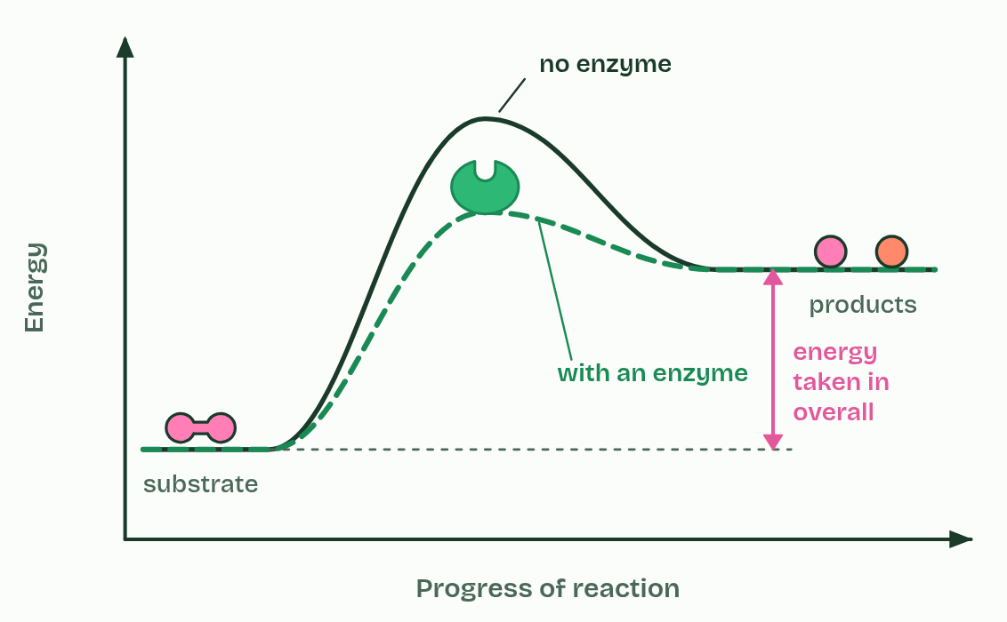
CHAPTER 3 · C1.1.10 Effect of enzymes on activation energy
5 / 5
A lower hill to climb
A building reaction ends higher than it starts. An enzyme lowers its hill too.
Minutes 28 to 42
Notes:
Minutes 28 to 42 of 60: Draw the hill (14 min).
The plan: Mini whiteboards, alongside chapter 3's figure, one step at a time. Stop before step 4 and take the predict: what happens to the energy released overall? Students redraw the diagram with the lower hill and check the start and end levels against the figure.
For a substrate to react, some of its bonds must be strained and broken, and breaking bonds takes energy. The energy needed before the reaction can run is the activation energy. On an energy diagram it is a hill that the reaction has to climb: energy up the side, progress of the reaction along the bottom. At the top of the hill the substrate is in an unstable in-between state, part way between substrate and products.
Bond breaking takes in energy. Bond making releases it. When the new bonds of the products form, energy comes out. If more comes out than went in, the reaction releases energy overall and the products sit lower than the substrate. Most catabolic reactions are like this. If less comes out, the reaction takes in energy overall and needs a supply of energy to run, as most anabolic reactions do.
An enzyme lowers the hill. As the substrate binds, the active site strains its bonds and holds it in the right position to react (chapter 4), so less energy is needed to reach the top. At 37 °C many more molecules have that much energy, and the reaction runs faster.
Reading the graph: measure the activation energy from the substrate's level up to the peak, and the energy released or taken in overall from the substrate's level to the products'.

Slide 33
CHAPTER 3 · C1.1.10 Effect of enzymes on activation energy
A lower hill to climb
Activation energy is the energy needed to strain and break bonds so the reaction can start.
Breaking bonds takes in energy; making bonds releases it.
On an energy diagram, activation energy is the climb from the substrate up to the peak.
Minutes 28 to 42
Notes:
Minutes 28 to 42 of 60: Draw the hill (14 min).
The plan: Mini whiteboards, alongside chapter 3's figure, one step at a time. Stop before step 4 and take the predict: what happens to the energy released overall? Students redraw the diagram with the lower hill and check the start and end levels against the figure.
For a substrate to react, some of its bonds must be strained and broken, and breaking bonds takes energy. The energy needed before the reaction can run is the activation energy. On an energy diagram it is a hill that the reaction has to climb: energy up the side, progress of the reaction along the bottom. At the top of the hill the substrate is in an unstable in-between state, part way between substrate and products.
Bond breaking takes in energy. Bond making releases it. When the new bonds of the products form, energy comes out. If more comes out than went in, the reaction releases energy overall and the products sit lower than the substrate. Most catabolic reactions are like this. If less comes out, the reaction takes in energy overall and needs a supply of energy to run, as most anabolic reactions do.
An enzyme lowers the hill. As the substrate binds, the active site strains its bonds and holds it in the right position to react (chapter 4), so less energy is needed to reach the top. At 37 °C many more molecules have that much energy, and the reaction runs faster.
Reading the graph: measure the activation energy from the substrate's level up to the peak, and the energy released or taken in overall from the substrate's level to the products'.

Slide 34
PREDICT
An enzyme lowers the activation energy of a reaction that releases energy. What happens to the energy released overall?
A It rises, because less goes into the climb
B It falls, because the enzyme keeps some of it
C It doubles, because two reactions now happen
D Nothing: the start and end levels stay put
Minutes 28 to 42
Notes:
Minutes 28 to 42 of 60: Draw the hill (14 min).
The plan: Mini whiteboards, alongside chapter 3's figure, one step at a time. Stop before step 4 and take the predict: what happens to the energy released overall? Students redraw the diagram with the lower hill and check the start and end levels against the figure.
Ask for a show of hands, or mini whiteboards, before revealing. (Answer: D, on the next slide.)

Slide 35
WHAT HAPPENS
An enzyme lowers the activation energy of a reaction that releases energy. What happens to the energy released overall?
A It rises, because less goes into the climb
B It falls, because the enzyme keeps some of it
C It doubles, because two reactions now happen
D Nothing: the start and end levels stay put
Nothing changes it. The energy released overall is the difference between the substrate and the products, and the enzyme changes neither. It lowers only the hill between them, so the reaction gets going more easily and runs faster.
Minutes 28 to 42
Notes:
Minutes 28 to 42 of 60: Draw the hill (14 min).
The plan: Mini whiteboards, alongside chapter 3's figure, one step at a time. Stop before step 4 and take the predict: what happens to the energy released overall? Students redraw the diagram with the lower hill and check the start and end levels against the figure.
Answer: D. Nothing changes it. The energy released overall is the difference between the substrate and the products, and the enzyme changes neither. It lowers only the hill between them, so the reaction gets going more easily and runs faster.

Slide 36
WATCH OUT
An enzyme does not give the substrate energy, and it does not change how much energy a reaction releases. It lowers the energy needed to get the reaction started.
Minutes 28 to 42
Notes:
Minutes 28 to 42 of 60: Draw the hill (14 min).
The plan: Mini whiteboards, alongside chapter 3's figure, one step at a time. Stop before step 4 and take the predict: what happens to the energy released overall? Students redraw the diagram with the lower hill and check the start and end levels against the figure.
A common mistake: say it, then ask who can say why it is wrong.

Slide 37
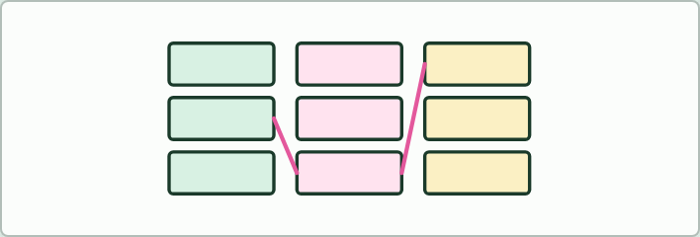
CARD GAME
12 MIN
Enzymes and their substrates
THE TASK
Triples to match, in three colours: amylase, starch, maltose; lipase, triglycerides, fatty acids and glycerol; pepsin, proteins, shorter peptides; catalase, hydrogen peroxide, water and oxygen; lactase, lactose, glucose and galactose; sucrase, sucrose, glucose and fructose; DNA polymerase, nucleotides, a DNA strand. Then ask: which are anabolic? Link the names to chapter 2 and to the specificity of chapter 6.
STUDENTS NEED
Triples of cards in three colours.
Minutes 42 to 54
Notes:
Minutes 42 to 54 of 60: Enzymes and their substrates (12 min).
The plan: The card match below, in groups. Then ask which of the seven reactions are anabolic, and which of the enzymes would have to be present in a liver cell.
The activity: Enzymes and their substrates. Triples to match, in three colours: amylase, starch, maltose; lipase, triglycerides, fatty acids and glycerol; pepsin, proteins, shorter peptides; catalase, hydrogen peroxide, water and oxygen; lactase, lactose, glucose and galactose; sucrase, sucrose, glucose and fructose; DNA polymerase, nucleotides, a DNA strand. Then ask: which are anabolic? Link the names to chapter 2 and to the specificity of chapter 6.
Needs: triples of cards in three colours.
The time: 12 minutes, minutes 42 to 54 of the plan.

Slide 38
PLENARY
Can you now...
Explain why cells need catalysts, and what an enzyme's speed does for digestion, growth and keeping cool enough to live (C1.1.1)
Describe metabolism as a web of linked reactions, and sort reactions into anabolic and catabolic with an example of each (C1.1.2, C1.1.3)
Read an energy diagram and explain how an enzyme lowers the activation energy without changing the energy released (C1.1.10)
Minutes 54 to 60
Notes:
Minutes 54 to 60 of 60: Exit: label the diagram (6 min).
The plan: On a sketch of an energy diagram, students label the activation energy with and without an enzyme, and the energy released overall.
Thumbs up, sideways or down on each goal before the exit question. The goals come from the statements this lesson covers.

Slide 39
EXIT QUESTION
Label the diagram
On a sketch of an energy diagram, students label the activation energy with and without an enzyme, and the energy released overall.
Minutes 54 to 60
Notes:
Minutes 54 to 60 of 60: Exit: label the diagram (6 min).
The plan: On a sketch of an energy diagram, students label the activation energy with and without an enzyme, and the energy released overall.

Slide 40
PRACTISE AND REVISE
Keep going
Exam practice: a fresh paper of exam questions on C1.1 at standard level, marked as you go
The guide, with the animations and the dry lab
This lesson in the guide: 1 Seconds, not millions of years, 2 A web of reactions, an enzyme for each, 3 A lower hill to climb
BUILD FOR YOUR CLASS
ALREADY ON THE SITE FOR C1.1
CARD SETS ON SPLYCR
Tarsia puzzle, dominoes and picture reveal on C1.1, built from its key terms and ready to print
A pub quiz with rounds on C1.1, to present or run with no projector
An escape room built from the question bank on C1.1
Lab: The Enzyme in Your Spit
Summary doodle: Enzymes & Metabolism
Quiz: Enzymes
Revision map: C1.1 Enzymes and metabolism, to fill in
Exam questions: C1.1 in the exam maker, a paper with its markscheme
Open a set to host it as a class game, or make a copy to edit.
C1.1 Enzymes and Metabolism
How this was made. The course structure, the activities and the teaching choices come from my own classroom, my presentations and my years of teaching IB and AP Biology. I use Claude, an AI, to help write and build the interactive guides, lesson plans, slides and practice questions, and to draw the diagrams and code the interactives. I direct the work and review it against the IB and AP specifications before it goes live.
Minute 60: after the lesson
Notes:
Every link here is live. Set the exam practice paper for homework: it is fresh each time, marked as students go and saved to their Exam practice when they are signed in.
Exam practice: https://www.biologybybradford.com/exam-maker/sit?topics=C1.1&level=SL&paper=quiz&marks=15&src=ep
The guide: https://www.biologybybradford.com/guides/ib-biology-c1-1-enzymes-and-metabolism

