Slide 1
IB Biology C1.1
LESSON 2 OF 5
BY THE END YOU CAN
Enzymes and metabolism
Explain how a few amino acids, held in place by the whole folded protein, make an active site, and how induced fit works (C1.1.4, C1.1.5)
Explain why substrate and active site must collide, and how enzymes fixed in membranes still meet their substrates (C1.1.6)
Explain how the shape of the active site makes an enzyme specific, and why denaturation stops it working (C1.1.7)
Sketch and explain the effects of temperature, pH and substrate concentration on the rate, using collision theory and denaturation (C1.1.8)
Fit, collisions and shape
C1.1.4 to C1.1.8
The active site and induced fit, collisions, specificity and denaturation, and the three graphs
60 minutes · chapters 4, 5, 6, 7
Minute 0
Notes:
IB Biology C1.1, Enzymes and metabolism. Lesson 2 of 5: Fit, collisions and shape, 60 minutes.
The plan, minute by minute (each slide's footer says where you are):
0 to 5 min (5) Do now: what is wrong with this?
5 to 17 min (12) Lock and key, then induced fit
17 to 23 min (6) Who moves?
23 to 31 min (8) Fit, or no fit
31 to 45 min (14) Sketch, then check
45 to 55 min (10) Timed written question
55 to 60 min (5) Exit
What students get wrong:
The active site is the whole enzyme, rigid like a lock. It is a few amino acids, and they move (induced fit).
Enzymes are alive and are killed by heat; cold denatures them. They denature with heat; cold only slows them.
The optimum is always 37 °C. It depends on the enzyme.
The rate levels off because the substrate runs out. The active sites are busy: saturation.
Higher temperature always means faster. Only up to the optimum.
Stretch and support:
Support: the figures' captions as cut-up cards to put in order; the dotted key terms as a glossary; a writing frame for "explain the effect of temperature" (rise, optimum, fall, each with its reason).
Support: the Tigers Prefer Steak and Bind, Bend, Break, Bye tiles as starters.
Stretch: the DNA polymerase used in PCR comes from a bacterium of hot springs (D1.1). Predict its temperature curve, and say what about its structure might keep it folded.
The lesson plan to print: https://www.biologybybradford.com/guides/downloads/ib-biology-c1-1-enzymes-and-metabolism-lesson-2-plan.pdf

Slide 2
DO NOW
What is wrong with this?
"The enzyme was killed by the heat, and it died in the fridge too."
Students write two corrections each, then compare.
5:00
minutes
Start now: the timer is running.
Minutes 0 to 5
Notes:
Minutes 0 to 5 of 60: Do now: what is wrong with this? (5 min).
The plan: "The enzyme was killed by the heat, and it died in the fridge too." Students write two corrections each, then compare. Keep the corrections for the end of the lesson.
Start a 5 minute timer as they come in.

Slide 3
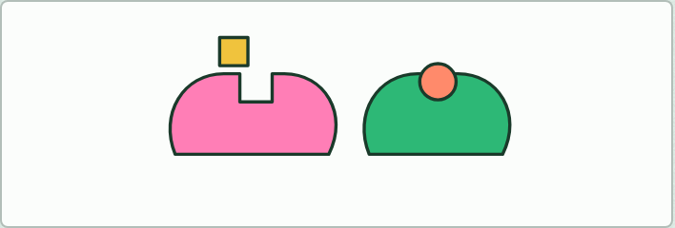
MODEL
12 MIN
Lock and key, then induced fit
THE TASK
Pairs make an enzyme and its substrate twice from plasticine. The first time, a rigid notch and a key that slots in. The second time, a soft site that closes round the substrate and pinches it at the bond to break. A photo of each for notes, and one sentence each on what the second model explains that the first does not. Keep the enzyme: an allosteric site is added to it in lesson 4.
STUDENTS NEED
Plasticine in two colours, a plastic knife, phones for photos.
Minutes 5 to 17
Notes:
Minutes 5 to 17 of 60: Lock and key, then induced fit (12 min).
The plan: The plasticine models below, then chapter 4's figure and predict. Students first make a rigid site and a key, then a soft site that closes and pinches the substrate. Finish with the Bind, Bend, Break, Bye tiles.
The activity: Lock and key, then induced fit. Pairs make an enzyme and its substrate twice from plasticine. The first time, a rigid notch and a key that slots in. The second time, a soft site that closes round the substrate and pinches it at the bond to break. A photo of each for notes, and one sentence each on what the second model explains that the first does not. Keep the enzyme: an allosteric site is added to it in lesson 4.
Needs: plasticine in two colours, a plastic knife, phones for photos.
The time: 12 minutes, minutes 5 to 17 of the plan.

Slide 4
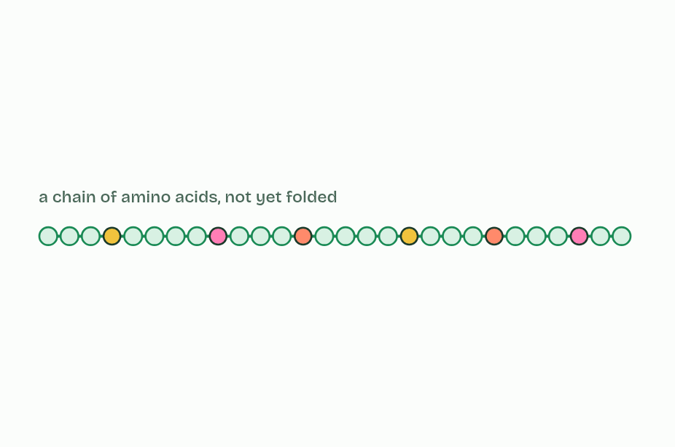
CHAPTER 4 · C1.1.4 C1.1.5 Globular proteins with an active site; induced-fit binding
1 / 5
A pocket held in shape
Only a few amino acids will form the site, far apart in the chain.
Minutes 5 to 17
Notes:
Minutes 5 to 17 of 60: Lock and key, then induced fit (12 min).
The plan: The plasticine models below, then chapter 4's figure and predict. Students first make a rigid site and a key, then a soft site that closes and pinches the substrate. Finish with the Bind, Bend, Break, Bye tiles.
Enzymes are globular proteins: one or more polypeptide chains folded into a compact, roughly round shape that dissolves in water (B1.2). Their water-loving R groups mostly face outwards and the water-hating ones are tucked inside, which is why they dissolve. Most enzymes are named for their substrate or their job, with the ending -ase: lipase acts on lipids, a protease on proteins and lactase on lactose.
The active site is the small region where the substrate binds and the reaction happens. It is made of only a few amino acids, often from far-apart places in the chain, brought together by the fold. In lysozyme from egg white, a protein of 129 amino acids, a handful line a groove in its surface and two of them do the chemistry.
The rest of the protein matters as much. Interactions between amino acids all through the folded chain hold the active site in shape and give it the right charges and chemical groups for catalysis.
When the substrate binds, the two form an enzyme-substrate complex. Both change shape as it forms: the active site closes in around the substrate, and the substrate is pulled and bent, straining the bonds that are about to break. This is induced fit. The substrate is converted into products, which no longer fit and leave, and the enzyme returns to its starting shape, ready for another substrate.
Example: Built as a model Two models, a century apart. Emil Fischer's lock and key (1894) pictured a rigid site that the substrate fits like a key. Daniel Koshland's induced fit (1958) pictured a site that changes shape as the substrate binds. Both are models. Lock and key cannot explain how binding can improve the fit, or how bonds get strained; induced fit explains both, and matches what is seen in hexokinase, whose two lobes close like jaws round glucose.

Slide 5
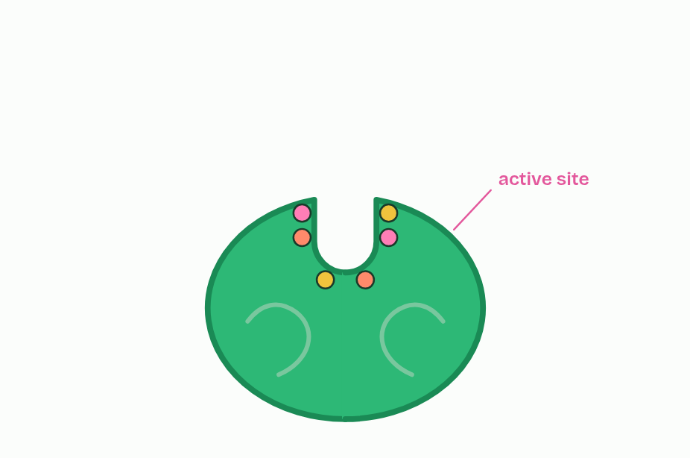
CHAPTER 4 · C1.1.4 C1.1.5 Globular proteins with an active site; induced-fit binding
2 / 5
A pocket held in shape
Folding brings them together: the active site.
Minutes 5 to 17
Notes:
Minutes 5 to 17 of 60: Lock and key, then induced fit (12 min).
The plan: The plasticine models below, then chapter 4's figure and predict. Students first make a rigid site and a key, then a soft site that closes and pinches the substrate. Finish with the Bind, Bend, Break, Bye tiles.
Enzymes are globular proteins: one or more polypeptide chains folded into a compact, roughly round shape that dissolves in water (B1.2). Their water-loving R groups mostly face outwards and the water-hating ones are tucked inside, which is why they dissolve. Most enzymes are named for their substrate or their job, with the ending -ase: lipase acts on lipids, a protease on proteins and lactase on lactose.
The active site is the small region where the substrate binds and the reaction happens. It is made of only a few amino acids, often from far-apart places in the chain, brought together by the fold. In lysozyme from egg white, a protein of 129 amino acids, a handful line a groove in its surface and two of them do the chemistry.
The rest of the protein matters as much. Interactions between amino acids all through the folded chain hold the active site in shape and give it the right charges and chemical groups for catalysis.
When the substrate binds, the two form an enzyme-substrate complex. Both change shape as it forms: the active site closes in around the substrate, and the substrate is pulled and bent, straining the bonds that are about to break. This is induced fit. The substrate is converted into products, which no longer fit and leave, and the enzyme returns to its starting shape, ready for another substrate.
Example: Built as a model Two models, a century apart. Emil Fischer's lock and key (1894) pictured a rigid site that the substrate fits like a key. Daniel Koshland's induced fit (1958) pictured a site that changes shape as the substrate binds. Both are models. Lock and key cannot explain how binding can improve the fit, or how bonds get strained; induced fit explains both, and matches what is seen in hexokinase, whose two lobes close like jaws round glucose.

Slide 6
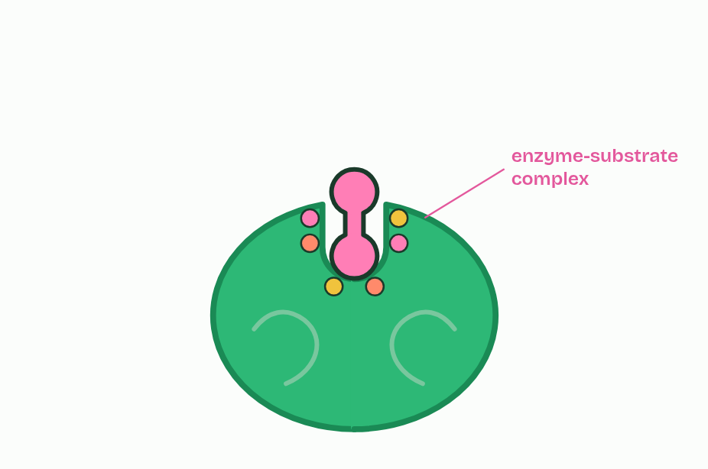
CHAPTER 4 · C1.1.4 C1.1.5 Globular proteins with an active site; induced-fit binding
3 / 5
A pocket held in shape
The substrate binds: an enzyme-substrate complex.
Minutes 5 to 17
Notes:
Minutes 5 to 17 of 60: Lock and key, then induced fit (12 min).
The plan: The plasticine models below, then chapter 4's figure and predict. Students first make a rigid site and a key, then a soft site that closes and pinches the substrate. Finish with the Bind, Bend, Break, Bye tiles.
Enzymes are globular proteins: one or more polypeptide chains folded into a compact, roughly round shape that dissolves in water (B1.2). Their water-loving R groups mostly face outwards and the water-hating ones are tucked inside, which is why they dissolve. Most enzymes are named for their substrate or their job, with the ending -ase: lipase acts on lipids, a protease on proteins and lactase on lactose.
The active site is the small region where the substrate binds and the reaction happens. It is made of only a few amino acids, often from far-apart places in the chain, brought together by the fold. In lysozyme from egg white, a protein of 129 amino acids, a handful line a groove in its surface and two of them do the chemistry.
The rest of the protein matters as much. Interactions between amino acids all through the folded chain hold the active site in shape and give it the right charges and chemical groups for catalysis.
When the substrate binds, the two form an enzyme-substrate complex. Both change shape as it forms: the active site closes in around the substrate, and the substrate is pulled and bent, straining the bonds that are about to break. This is induced fit. The substrate is converted into products, which no longer fit and leave, and the enzyme returns to its starting shape, ready for another substrate.
Example: Built as a model Two models, a century apart. Emil Fischer's lock and key (1894) pictured a rigid site that the substrate fits like a key. Daniel Koshland's induced fit (1958) pictured a site that changes shape as the substrate binds. Both are models. Lock and key cannot explain how binding can improve the fit, or how bonds get strained; induced fit explains both, and matches what is seen in hexokinase, whose two lobes close like jaws round glucose.

Slide 7
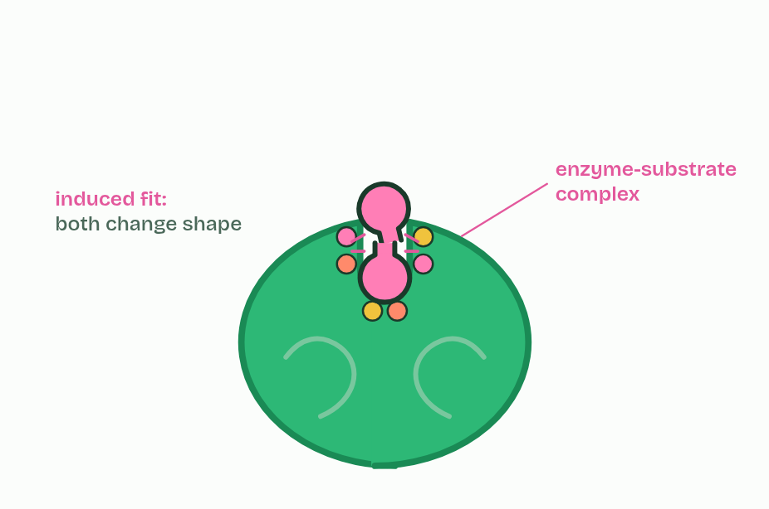
CHAPTER 4 · C1.1.4 C1.1.5 Globular proteins with an active site; induced-fit binding
4 / 5
A pocket held in shape
Both change shape: induced fit strains the substrate's bonds.
Minutes 5 to 17
Notes:
Minutes 5 to 17 of 60: Lock and key, then induced fit (12 min).
The plan: The plasticine models below, then chapter 4's figure and predict. Students first make a rigid site and a key, then a soft site that closes and pinches the substrate. Finish with the Bind, Bend, Break, Bye tiles.
Enzymes are globular proteins: one or more polypeptide chains folded into a compact, roughly round shape that dissolves in water (B1.2). Their water-loving R groups mostly face outwards and the water-hating ones are tucked inside, which is why they dissolve. Most enzymes are named for their substrate or their job, with the ending -ase: lipase acts on lipids, a protease on proteins and lactase on lactose.
The active site is the small region where the substrate binds and the reaction happens. It is made of only a few amino acids, often from far-apart places in the chain, brought together by the fold. In lysozyme from egg white, a protein of 129 amino acids, a handful line a groove in its surface and two of them do the chemistry.
The rest of the protein matters as much. Interactions between amino acids all through the folded chain hold the active site in shape and give it the right charges and chemical groups for catalysis.
When the substrate binds, the two form an enzyme-substrate complex. Both change shape as it forms: the active site closes in around the substrate, and the substrate is pulled and bent, straining the bonds that are about to break. This is induced fit. The substrate is converted into products, which no longer fit and leave, and the enzyme returns to its starting shape, ready for another substrate.
Example: Built as a model Two models, a century apart. Emil Fischer's lock and key (1894) pictured a rigid site that the substrate fits like a key. Daniel Koshland's induced fit (1958) pictured a site that changes shape as the substrate binds. Both are models. Lock and key cannot explain how binding can improve the fit, or how bonds get strained; induced fit explains both, and matches what is seen in hexokinase, whose two lobes close like jaws round glucose.

Slide 8
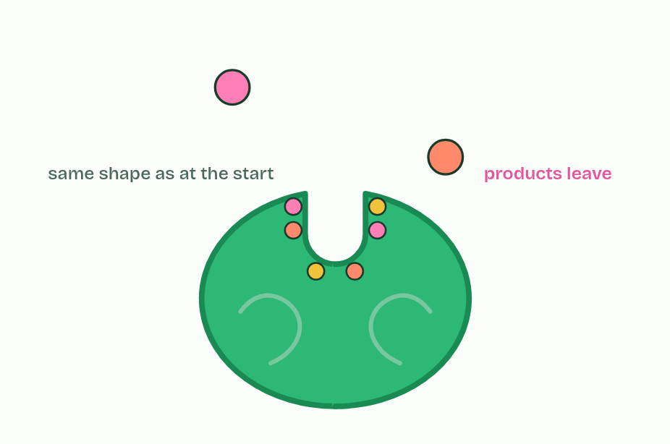
CHAPTER 4 · C1.1.4 C1.1.5 Globular proteins with an active site; induced-fit binding
5 / 5
A pocket held in shape
Products leave; the enzyme is unchanged.
Minutes 5 to 17
Notes:
Minutes 5 to 17 of 60: Lock and key, then induced fit (12 min).
The plan: The plasticine models below, then chapter 4's figure and predict. Students first make a rigid site and a key, then a soft site that closes and pinches the substrate. Finish with the Bind, Bend, Break, Bye tiles.
Enzymes are globular proteins: one or more polypeptide chains folded into a compact, roughly round shape that dissolves in water (B1.2). Their water-loving R groups mostly face outwards and the water-hating ones are tucked inside, which is why they dissolve. Most enzymes are named for their substrate or their job, with the ending -ase: lipase acts on lipids, a protease on proteins and lactase on lactose.
The active site is the small region where the substrate binds and the reaction happens. It is made of only a few amino acids, often from far-apart places in the chain, brought together by the fold. In lysozyme from egg white, a protein of 129 amino acids, a handful line a groove in its surface and two of them do the chemistry.
The rest of the protein matters as much. Interactions between amino acids all through the folded chain hold the active site in shape and give it the right charges and chemical groups for catalysis.
When the substrate binds, the two form an enzyme-substrate complex. Both change shape as it forms: the active site closes in around the substrate, and the substrate is pulled and bent, straining the bonds that are about to break. This is induced fit. The substrate is converted into products, which no longer fit and leave, and the enzyme returns to its starting shape, ready for another substrate.
Example: Built as a model Two models, a century apart. Emil Fischer's lock and key (1894) pictured a rigid site that the substrate fits like a key. Daniel Koshland's induced fit (1958) pictured a site that changes shape as the substrate binds. Both are models. Lock and key cannot explain how binding can improve the fit, or how bonds get strained; induced fit explains both, and matches what is seen in hexokinase, whose two lobes close like jaws round glucose.

Slide 9
CHAPTER 4 · C1.1.4 C1.1.5 Globular proteins with an active site; induced-fit binding
A pocket held in shape
Enzymes are globular proteins: one or more polypeptide chains folded into a compact, roughly round shape that dissolves in water (B1.2).
Most enzymes are named for their substrate or their job, with the ending -ase: lipase acts on lipids, a protease on proteins and lactase on lactose.
The active site is the small region where the substrate binds and the reaction happens.
Interactions between amino acids all through the folded chain hold the active site in shape and give it the right charges and chemical groups for catalysis.
Minutes 5 to 17
Notes:
Minutes 5 to 17 of 60: Lock and key, then induced fit (12 min).
The plan: The plasticine models below, then chapter 4's figure and predict. Students first make a rigid site and a key, then a soft site that closes and pinches the substrate. Finish with the Bind, Bend, Break, Bye tiles.
Enzymes are globular proteins: one or more polypeptide chains folded into a compact, roughly round shape that dissolves in water (B1.2). Their water-loving R groups mostly face outwards and the water-hating ones are tucked inside, which is why they dissolve. Most enzymes are named for their substrate or their job, with the ending -ase: lipase acts on lipids, a protease on proteins and lactase on lactose.
The active site is the small region where the substrate binds and the reaction happens. It is made of only a few amino acids, often from far-apart places in the chain, brought together by the fold. In lysozyme from egg white, a protein of 129 amino acids, a handful line a groove in its surface and two of them do the chemistry.
The rest of the protein matters as much. Interactions between amino acids all through the folded chain hold the active site in shape and give it the right charges and chemical groups for catalysis.
When the substrate binds, the two form an enzyme-substrate complex. Both change shape as it forms: the active site closes in around the substrate, and the substrate is pulled and bent, straining the bonds that are about to break. This is induced fit. The substrate is converted into products, which no longer fit and leave, and the enzyme returns to its starting shape, ready for another substrate.
Example: Built as a model Two models, a century apart. Emil Fischer's lock and key (1894) pictured a rigid site that the substrate fits like a key. Daniel Koshland's induced fit (1958) pictured a site that changes shape as the substrate binds. Both are models. Lock and key cannot explain how binding can improve the fit, or how bonds get strained; induced fit explains both, and matches what is seen in hexokinase, whose two lobes close like jaws round glucose.

Slide 10
PREDICT
An enzyme has 300 amino acids, and only about six touch the substrate. A mutation changes one amino acid far from the active site, and the enzyme stops working. How?
A Every amino acid touches the substrate at some moment
B It changed how the chain folds, so the site lost its shape
C The substrate now binds to the changed amino acid instead
D The enzyme can no longer move through the cytoplasm to meet substrates
Minutes 5 to 17
Notes:
Minutes 5 to 17 of 60: Lock and key, then induced fit (12 min).
The plan: The plasticine models below, then chapter 4's figure and predict. Students first make a rigid site and a key, then a soft site that closes and pinches the substrate. Finish with the Bind, Bend, Break, Bye tiles.
Ask for a show of hands, or mini whiteboards, before revealing. (Answer: B, on the next slide.)

Slide 11
WHAT HAPPENS
An enzyme has 300 amino acids, and only about six touch the substrate. A mutation changes one amino acid far from the active site, and the enzyme stops working. How?
A Every amino acid touches the substrate at some moment
B It changed how the chain folds, so the site lost its shape
C The substrate now binds to the changed amino acid instead
D The enzyme can no longer move through the cytoplasm to meet substrates
The active site's shape and chemistry depend on the whole fold, and the fold is held by interactions between amino acids all through the chain. Change one, and the fold can shift enough to change the site, so the substrate no longer binds well or no longer reacts.
Minutes 5 to 17
Notes:
Minutes 5 to 17 of 60: Lock and key, then induced fit (12 min).
The plan: The plasticine models below, then chapter 4's figure and predict. Students first make a rigid site and a key, then a soft site that closes and pinches the substrate. Finish with the Bind, Bend, Break, Bye tiles.
Answer: B. The active site's shape and chemistry depend on the whole fold, and the fold is held by interactions between amino acids all through the chain. Change one, and the fold can shift enough to change the site, so the substrate no longer binds well or no longer reacts.

Slide 12
WATCH OUT
The active site is not the whole enzyme, and not a fixed, rigid hole. It is a few amino acids that move as the substrate binds.
Minutes 5 to 17
Notes:
Minutes 5 to 17 of 60: Lock and key, then induced fit (12 min).
The plan: The plasticine models below, then chapter 4's figure and predict. Students first make a rigid site and a key, then a soft site that closes and pinches the substrate. Finish with the Bind, Bend, Break, Bye tiles.
A common mistake: say it, then ask who can say why it is wrong.

Slide 13
REMEMBER IT
What happens at the active site
B
B
B
B
Bind
Bend
Break
Bye
Minutes 5 to 17
Notes:
Minutes 5 to 17 of 60: Lock and key, then induced fit (12 min).
The plan: The plasticine models below, then chapter 4's figure and predict. Students first make a rigid site and a key, then a soft site that closes and pinches the substrate. Finish with the Bind, Bend, Break, Bye tiles.
Ask the class what each letter stands for before revealing.

Slide 14
REMEMBER IT
What happens at the active site
B
B
B
B
Bind
Bend
Break
Bye
Binding
Induced fit
Reaction
Release
the substrate binds the active site
both change shape; the substrate's bonds are strained
bonds break and new ones form: products
the products leave; the enzyme is free again
Minutes 5 to 17
Notes:
Minutes 5 to 17 of 60: Lock and key, then induced fit (12 min).
The plan: The plasticine models below, then chapter 4's figure and predict. Students first make a rigid site and a key, then a soft site that closes and pinches the substrate. Finish with the Bind, Bend, Break, Bye tiles.
Bind: Binding (the substrate binds the active site)
Bend: Induced fit (both change shape; the substrate's bonds are strained)
Break: Reaction (bonds break and new ones form: products)
Bye: Release (the products leave; the enzyme is free again)

Slide 15
STEP 3
6 MIN
Who moves?
Students say who moves in each state before the readout appears.
Minutes 17 to 23
Notes:
Minutes 17 to 23 of 60: Who moves? (6 min).
The plan: Chapter 5: the lactase predict first, then the three states of the figure. Students say who moves in each state before the readout appears.

Slide 16
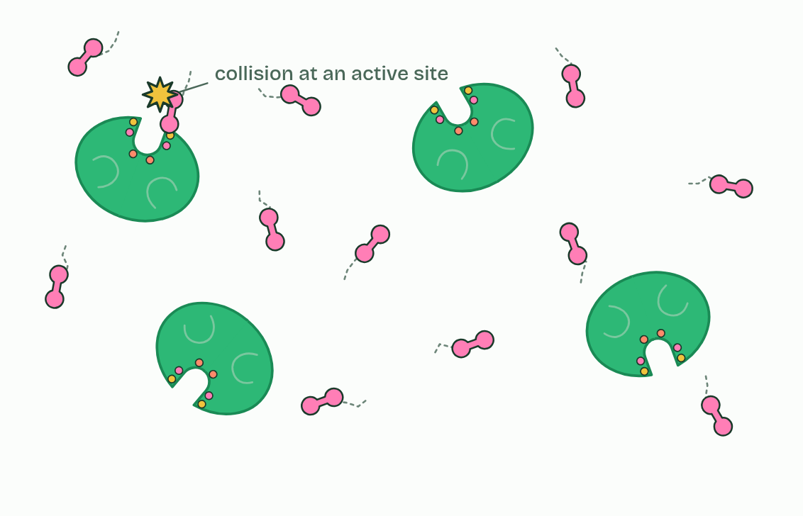
CHAPTER 5 · C1.1.6 Molecular motion and substrate-active site collisions
1 / 3
Meeting by chance
In solution
Minutes 17 to 23
Notes:
Minutes 17 to 23 of 60: Who moves? (6 min).
The plan: Chapter 5: the lactase predict first, then the three states of the figure. Students say who moves in each state before the readout appears.
Enzymes and substrates are dissolved in water: in the cytoplasm, in the contents of the gut, in blood plasma. Their molecules move all the time and at random, jostled by the water molecules around them. This molecular motion is what brings them together.
A reaction can happen only when a substrate and an active site meet in a collision, and only if the substrate arrives the right way round (its orientation) and close enough to bind. Most collisions miss the site, or arrive the wrong way round, and the molecules bounce apart.
More collisions a second means a faster rate. Warmer molecules move faster and collide more often; more substrate or more enzyme in the same volume means more meetings. Chapter 7 puts numbers on both, and the film that follows it lets you watch these meetings and change them.
Movement is needed, but not both partners have to move. Sometimes an immobilised enzyme is held still, embedded in a membrane. Sometimes it is a large substrate that is held still, such as a cellulose fibre in a plant cell wall, and the enzyme moves to it: cellulase released by a fungus reaches the fibre and digests it where it lies. Tap the three states to compare them.
Fixing an enzyme in place also keeps it where its products are wanted. Lactase sits in the membrane of the cells that line the small intestine, so the glucose and galactose it makes appear right at the surface of the cells that absorb them.
Example: On purpose Industry fixes enzymes on purpose too: lactase held on beads makes lactose-free milk as the milk flows past.

Slide 17
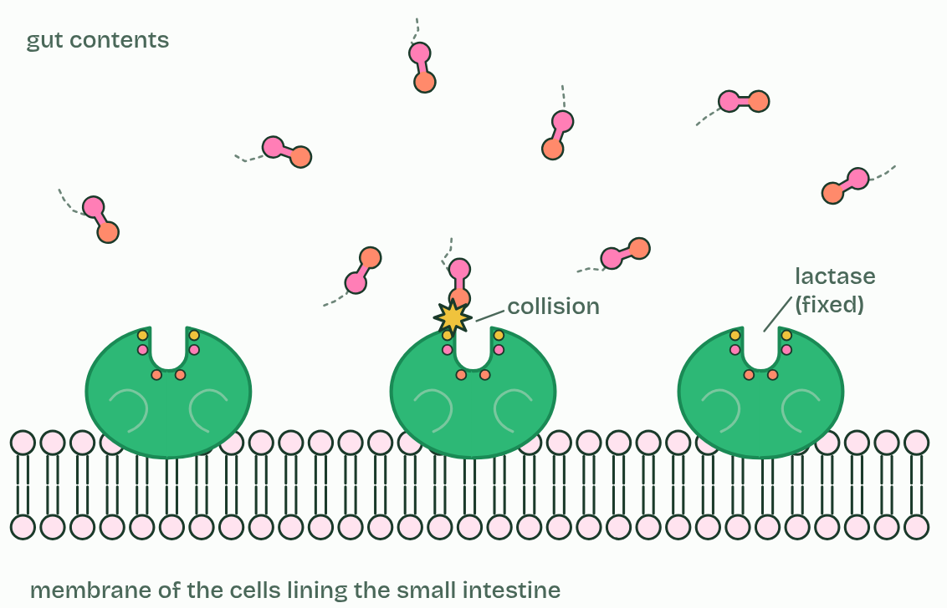
CHAPTER 5 · C1.1.6 Molecular motion and substrate-active site collisions
2 / 3
Meeting by chance
Enzyme fixed in a membrane
Minutes 17 to 23
Notes:
Minutes 17 to 23 of 60: Who moves? (6 min).
The plan: Chapter 5: the lactase predict first, then the three states of the figure. Students say who moves in each state before the readout appears.
Enzymes and substrates are dissolved in water: in the cytoplasm, in the contents of the gut, in blood plasma. Their molecules move all the time and at random, jostled by the water molecules around them. This molecular motion is what brings them together.
A reaction can happen only when a substrate and an active site meet in a collision, and only if the substrate arrives the right way round (its orientation) and close enough to bind. Most collisions miss the site, or arrive the wrong way round, and the molecules bounce apart.
More collisions a second means a faster rate. Warmer molecules move faster and collide more often; more substrate or more enzyme in the same volume means more meetings. Chapter 7 puts numbers on both, and the film that follows it lets you watch these meetings and change them.
Movement is needed, but not both partners have to move. Sometimes an immobilised enzyme is held still, embedded in a membrane. Sometimes it is a large substrate that is held still, such as a cellulose fibre in a plant cell wall, and the enzyme moves to it: cellulase released by a fungus reaches the fibre and digests it where it lies. Tap the three states to compare them.
Fixing an enzyme in place also keeps it where its products are wanted. Lactase sits in the membrane of the cells that line the small intestine, so the glucose and galactose it makes appear right at the surface of the cells that absorb them.
Example: On purpose Industry fixes enzymes on purpose too: lactase held on beads makes lactose-free milk as the milk flows past.

Slide 18
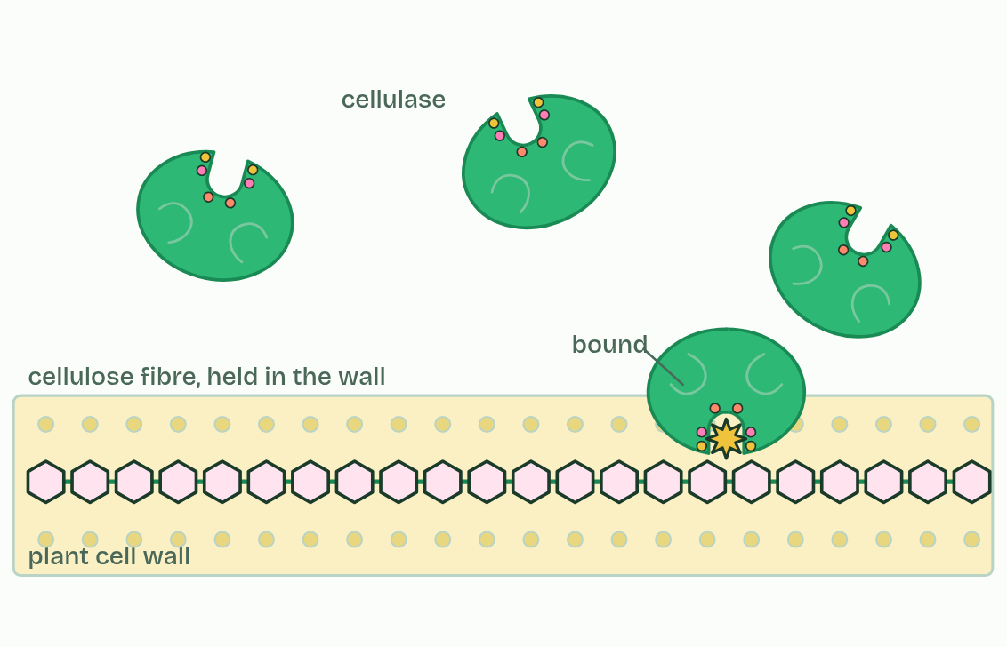
CHAPTER 5 · C1.1.6 Molecular motion and substrate-active site collisions
3 / 3
Meeting by chance
Substrate held still
Minutes 17 to 23
Notes:
Minutes 17 to 23 of 60: Who moves? (6 min).
The plan: Chapter 5: the lactase predict first, then the three states of the figure. Students say who moves in each state before the readout appears.
Enzymes and substrates are dissolved in water: in the cytoplasm, in the contents of the gut, in blood plasma. Their molecules move all the time and at random, jostled by the water molecules around them. This molecular motion is what brings them together.
A reaction can happen only when a substrate and an active site meet in a collision, and only if the substrate arrives the right way round (its orientation) and close enough to bind. Most collisions miss the site, or arrive the wrong way round, and the molecules bounce apart.
More collisions a second means a faster rate. Warmer molecules move faster and collide more often; more substrate or more enzyme in the same volume means more meetings. Chapter 7 puts numbers on both, and the film that follows it lets you watch these meetings and change them.
Movement is needed, but not both partners have to move. Sometimes an immobilised enzyme is held still, embedded in a membrane. Sometimes it is a large substrate that is held still, such as a cellulose fibre in a plant cell wall, and the enzyme moves to it: cellulase released by a fungus reaches the fibre and digests it where it lies. Tap the three states to compare them.
Fixing an enzyme in place also keeps it where its products are wanted. Lactase sits in the membrane of the cells that line the small intestine, so the glucose and galactose it makes appear right at the surface of the cells that absorb them.
Example: On purpose Industry fixes enzymes on purpose too: lactase held on beads makes lactose-free milk as the milk flows past.

Slide 19
CHAPTER 5 · C1.1.6 Molecular motion and substrate-active site collisions
Meeting by chance
Their molecules move all the time and at random, jostled by the water molecules around them. This molecular motion is what brings them together.
A reaction can happen only when a substrate and an active site meet in a collision, and only if the substrate arrives the right way round (its orientation) and close enough to bind.
Most collisions miss the site, or arrive the wrong way round, and the molecules bounce apart.
More collisions a second means a faster rate.
Minutes 17 to 23
Notes:
Minutes 17 to 23 of 60: Who moves? (6 min).
The plan: Chapter 5: the lactase predict first, then the three states of the figure. Students say who moves in each state before the readout appears.
Enzymes and substrates are dissolved in water: in the cytoplasm, in the contents of the gut, in blood plasma. Their molecules move all the time and at random, jostled by the water molecules around them. This molecular motion is what brings them together.
A reaction can happen only when a substrate and an active site meet in a collision, and only if the substrate arrives the right way round (its orientation) and close enough to bind. Most collisions miss the site, or arrive the wrong way round, and the molecules bounce apart.
More collisions a second means a faster rate. Warmer molecules move faster and collide more often; more substrate or more enzyme in the same volume means more meetings. Chapter 7 puts numbers on both, and the film that follows it lets you watch these meetings and change them.
Movement is needed, but not both partners have to move. Sometimes an immobilised enzyme is held still, embedded in a membrane. Sometimes it is a large substrate that is held still, such as a cellulose fibre in a plant cell wall, and the enzyme moves to it: cellulase released by a fungus reaches the fibre and digests it where it lies. Tap the three states to compare them.
Fixing an enzyme in place also keeps it where its products are wanted. Lactase sits in the membrane of the cells that line the small intestine, so the glucose and galactose it makes appear right at the surface of the cells that absorb them.
Example: On purpose Industry fixes enzymes on purpose too: lactase held on beads makes lactose-free milk as the milk flows past.

Slide 20
PREDICT
Lactase sits fixed in the membrane of cells lining your small intestine. It cannot move. How does lactose reach its active site?
A The membrane pumps lactose to it
B The active site attracts lactose from across the whole gut
C Lactase reaches out and grabs passing lactose
D Lactose molecules move at random and collide with it
Minutes 17 to 23
Notes:
Minutes 17 to 23 of 60: Who moves? (6 min).
The plan: Chapter 5: the lactase predict first, then the three states of the figure. Students say who moves in each state before the readout appears.
Ask for a show of hands, or mini whiteboards, before revealing. (Answer: D, on the next slide.)

Slide 21
WHAT HAPPENS
Lactase sits fixed in the membrane of cells lining your small intestine. It cannot move. How does lactose reach its active site?
A The membrane pumps lactose to it
B The active site attracts lactose from across the whole gut
C Lactase reaches out and grabs passing lactose
D Lactose molecules move at random and collide with it
Lactose molecules in the gut contents move at random, like every dissolved molecule. Some collide with the membrane, a few of those with a lactase active site the right way round, and those bind. Only one partner has to move for a collision.
Minutes 17 to 23
Notes:
Minutes 17 to 23 of 60: Who moves? (6 min).
The plan: Chapter 5: the lactase predict first, then the three states of the figure. Students say who moves in each state before the readout appears.
Answer: D. Lactose molecules in the gut contents move at random, like every dissolved molecule. Some collide with the membrane, a few of those with a lactase active site the right way round, and those bind. Only one partner has to move for a collision.

Slide 22
STEP 4
8 MIN
Fit, or no fit
Chapter 6: Lose the shape, lose the fit
Minutes 23 to 31
Notes:
Minutes 23 to 31 of 60: Fit, or no fit (8 min).
The plan: Chapter 6's states, then the pepsin predict. Link back to what students saw in B1.2 when a protein unfolded, and name the two causes: heat and pH.

Slide 23
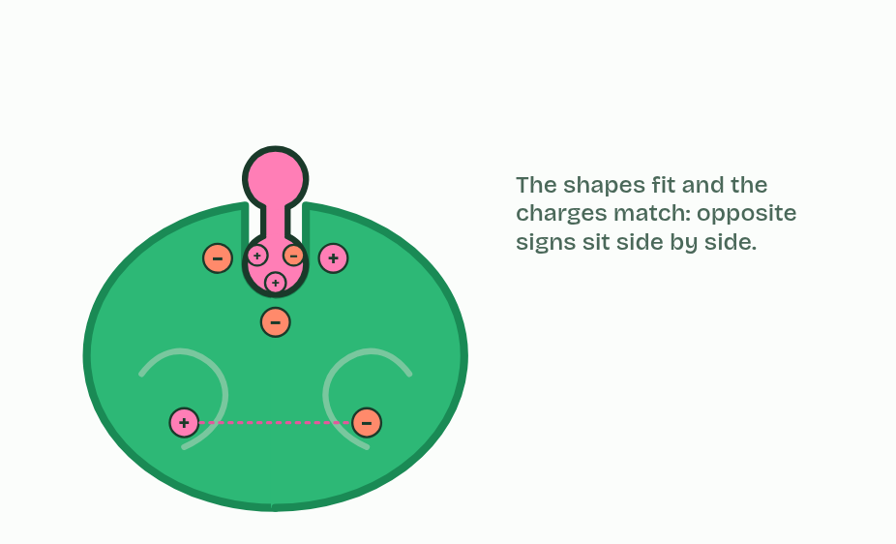
CHAPTER 6 · C1.1.7 Active site structure, specificity and denaturation
1 / 4
Lose the shape, lose the fit
Its substrate
Minutes 23 to 31
Notes:
Minutes 23 to 31 of 60: Fit, or no fit (8 min).
The plan: Chapter 6's states, then the pepsin predict. Link back to what students saw in B1.2 when a protein unfolded, and name the two causes: heat and pH.
The active site's shape and charges match its substrate's, so few other molecules bind. This is enzyme-substrate specificity. Some enzymes act on one substrate, or very nearly: urease on urea. Others act on a family of similar substrates: lipase on many lipids, a protease on many peptide bonds. The rule is the same: what binds is what fits.
The shape is held by weak interactions between amino acids: hydrogen bonds, ionic bonds and interactions between non-polar R groups (B1.2), with a few strong ones. That is why the shape can be lost. You watched a protein unfold in B1.2.
Heat makes the chain vibrate harder. Above a certain temperature the weak bonds break, the chain unfolds and the active site loses its shape. A pH far from the enzyme's normal one changes the charges on R groups in and around the site, because they gain or lose hydrogen ions, so ionic bonds break and the site's charges no longer match the substrate. Either way the substrate no longer binds, or binds and does not react. This is denaturation.
A denatured enzyme is not killed: it was never alive. Heat denaturation is usually permanent, and cooling does not refold the chain. A small, brief change in pH can sometimes be undone when the pH returns, but an extreme one usually cannot. Cold does not denature an enzyme at all. It slows the enzyme, because there are fewer collisions (chapter 7), and the enzyme works again when it is warmed.

Slide 24
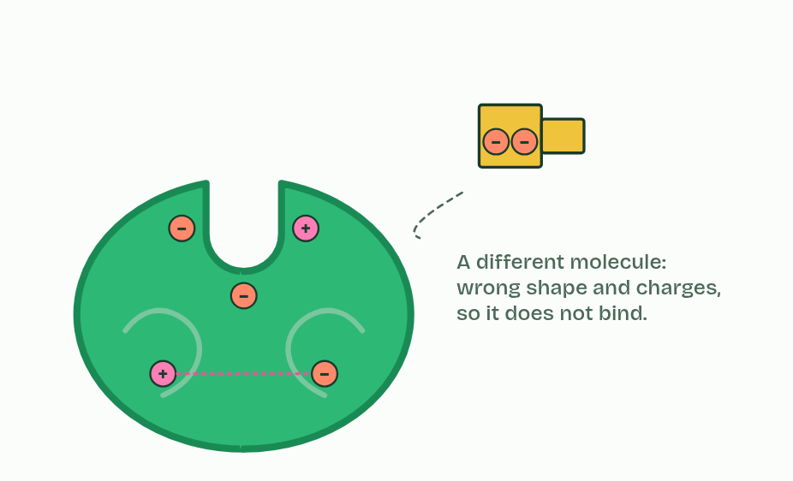
CHAPTER 6 · C1.1.7 Active site structure, specificity and denaturation
2 / 4
Lose the shape, lose the fit
A different molecule
Minutes 23 to 31
Notes:
Minutes 23 to 31 of 60: Fit, or no fit (8 min).
The plan: Chapter 6's states, then the pepsin predict. Link back to what students saw in B1.2 when a protein unfolded, and name the two causes: heat and pH.
The active site's shape and charges match its substrate's, so few other molecules bind. This is enzyme-substrate specificity. Some enzymes act on one substrate, or very nearly: urease on urea. Others act on a family of similar substrates: lipase on many lipids, a protease on many peptide bonds. The rule is the same: what binds is what fits.
The shape is held by weak interactions between amino acids: hydrogen bonds, ionic bonds and interactions between non-polar R groups (B1.2), with a few strong ones. That is why the shape can be lost. You watched a protein unfold in B1.2.
Heat makes the chain vibrate harder. Above a certain temperature the weak bonds break, the chain unfolds and the active site loses its shape. A pH far from the enzyme's normal one changes the charges on R groups in and around the site, because they gain or lose hydrogen ions, so ionic bonds break and the site's charges no longer match the substrate. Either way the substrate no longer binds, or binds and does not react. This is denaturation.
A denatured enzyme is not killed: it was never alive. Heat denaturation is usually permanent, and cooling does not refold the chain. A small, brief change in pH can sometimes be undone when the pH returns, but an extreme one usually cannot. Cold does not denature an enzyme at all. It slows the enzyme, because there are fewer collisions (chapter 7), and the enzyme works again when it is warmed.

Slide 25
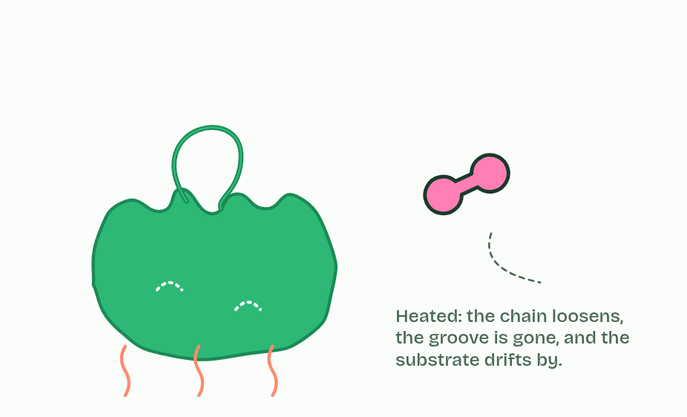
CHAPTER 6 · C1.1.7 Active site structure, specificity and denaturation
3 / 4
Lose the shape, lose the fit
Too hot
Minutes 23 to 31
Notes:
Minutes 23 to 31 of 60: Fit, or no fit (8 min).
The plan: Chapter 6's states, then the pepsin predict. Link back to what students saw in B1.2 when a protein unfolded, and name the two causes: heat and pH.
The active site's shape and charges match its substrate's, so few other molecules bind. This is enzyme-substrate specificity. Some enzymes act on one substrate, or very nearly: urease on urea. Others act on a family of similar substrates: lipase on many lipids, a protease on many peptide bonds. The rule is the same: what binds is what fits.
The shape is held by weak interactions between amino acids: hydrogen bonds, ionic bonds and interactions between non-polar R groups (B1.2), with a few strong ones. That is why the shape can be lost. You watched a protein unfold in B1.2.
Heat makes the chain vibrate harder. Above a certain temperature the weak bonds break, the chain unfolds and the active site loses its shape. A pH far from the enzyme's normal one changes the charges on R groups in and around the site, because they gain or lose hydrogen ions, so ionic bonds break and the site's charges no longer match the substrate. Either way the substrate no longer binds, or binds and does not react. This is denaturation.
A denatured enzyme is not killed: it was never alive. Heat denaturation is usually permanent, and cooling does not refold the chain. A small, brief change in pH can sometimes be undone when the pH returns, but an extreme one usually cannot. Cold does not denature an enzyme at all. It slows the enzyme, because there are fewer collisions (chapter 7), and the enzyme works again when it is warmed.

Slide 26
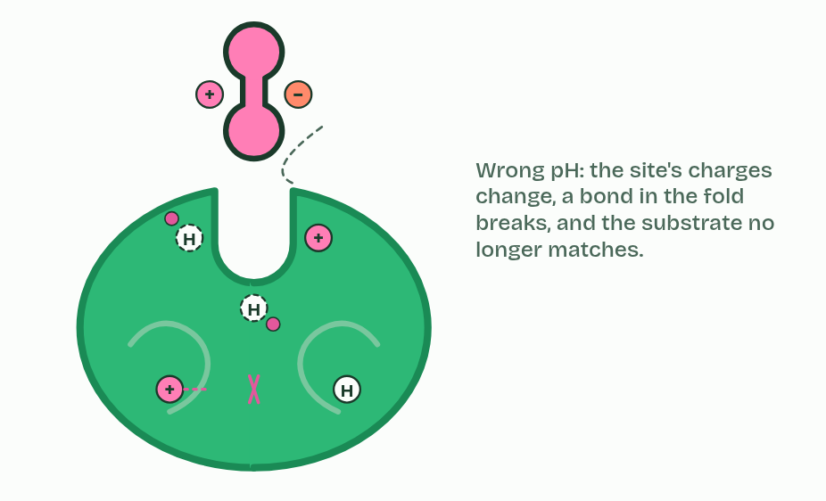
CHAPTER 6 · C1.1.7 Active site structure, specificity and denaturation
4 / 4
Lose the shape, lose the fit
Wrong pH
Minutes 23 to 31
Notes:
Minutes 23 to 31 of 60: Fit, or no fit (8 min).
The plan: Chapter 6's states, then the pepsin predict. Link back to what students saw in B1.2 when a protein unfolded, and name the two causes: heat and pH.
The active site's shape and charges match its substrate's, so few other molecules bind. This is enzyme-substrate specificity. Some enzymes act on one substrate, or very nearly: urease on urea. Others act on a family of similar substrates: lipase on many lipids, a protease on many peptide bonds. The rule is the same: what binds is what fits.
The shape is held by weak interactions between amino acids: hydrogen bonds, ionic bonds and interactions between non-polar R groups (B1.2), with a few strong ones. That is why the shape can be lost. You watched a protein unfold in B1.2.
Heat makes the chain vibrate harder. Above a certain temperature the weak bonds break, the chain unfolds and the active site loses its shape. A pH far from the enzyme's normal one changes the charges on R groups in and around the site, because they gain or lose hydrogen ions, so ionic bonds break and the site's charges no longer match the substrate. Either way the substrate no longer binds, or binds and does not react. This is denaturation.
A denatured enzyme is not killed: it was never alive. Heat denaturation is usually permanent, and cooling does not refold the chain. A small, brief change in pH can sometimes be undone when the pH returns, but an extreme one usually cannot. Cold does not denature an enzyme at all. It slows the enzyme, because there are fewer collisions (chapter 7), and the enzyme works again when it is warmed.

Slide 27
CHAPTER 6 · C1.1.7 Active site structure, specificity and denaturation
Lose the shape, lose the fit
The active site's shape and charges match its substrate's, so few other molecules bind. This is enzyme-substrate specificity.
Either way the substrate no longer binds, or binds and does not react. This is denaturation.
Heat denaturation is usually permanent, and cooling does not refold the chain.
Minutes 23 to 31
Notes:
Minutes 23 to 31 of 60: Fit, or no fit (8 min).
The plan: Chapter 6's states, then the pepsin predict. Link back to what students saw in B1.2 when a protein unfolded, and name the two causes: heat and pH.
The active site's shape and charges match its substrate's, so few other molecules bind. This is enzyme-substrate specificity. Some enzymes act on one substrate, or very nearly: urease on urea. Others act on a family of similar substrates: lipase on many lipids, a protease on many peptide bonds. The rule is the same: what binds is what fits.
The shape is held by weak interactions between amino acids: hydrogen bonds, ionic bonds and interactions between non-polar R groups (B1.2), with a few strong ones. That is why the shape can be lost. You watched a protein unfold in B1.2.
Heat makes the chain vibrate harder. Above a certain temperature the weak bonds break, the chain unfolds and the active site loses its shape. A pH far from the enzyme's normal one changes the charges on R groups in and around the site, because they gain or lose hydrogen ions, so ionic bonds break and the site's charges no longer match the substrate. Either way the substrate no longer binds, or binds and does not react. This is denaturation.
A denatured enzyme is not killed: it was never alive. Heat denaturation is usually permanent, and cooling does not refold the chain. A small, brief change in pH can sometimes be undone when the pH returns, but an extreme one usually cannot. Cold does not denature an enzyme at all. It slows the enzyme, because there are fewer collisions (chapter 7), and the enzyme works again when it is warmed.

Slide 28
PREDICT
Pepsin digests protein in the stomach at about pH 2. Carried on into the small intestine at about pH 8, what happens to it?
A It denatures: its active site changes shape and charge
B It works faster, because collisions are more frequent at pH 8
C It is unaffected, because pH only changes the substrate
D It reshapes its active site to fit the new substrates there
Minutes 23 to 31
Notes:
Minutes 23 to 31 of 60: Fit, or no fit (8 min).
The plan: Chapter 6's states, then the pepsin predict. Link back to what students saw in B1.2 when a protein unfolded, and name the two causes: heat and pH.
Ask for a show of hands, or mini whiteboards, before revealing. (Answer: A, on the next slide.)

Slide 29
WHAT HAPPENS
Pepsin digests protein in the stomach at about pH 2. Carried on into the small intestine at about pH 8, what happens to it?
A It denatures: its active site changes shape and charge
B It works faster, because collisions are more frequent at pH 8
C It is unaffected, because pH only changes the substrate
D It reshapes its active site to fit the new substrates there
Pepsin's shape is held partly by ionic bonds that suit pH 2. At pH 8 its R groups lose hydrogen ions, the charges change, the bonds break and the active site changes shape. Pepsin stops working in the intestine, where other proteases suited to pH 8 take over.
Minutes 23 to 31
Notes:
Minutes 23 to 31 of 60: Fit, or no fit (8 min).
The plan: Chapter 6's states, then the pepsin predict. Link back to what students saw in B1.2 when a protein unfolded, and name the two causes: heat and pH.
Answer: A. Pepsin's shape is held partly by ionic bonds that suit pH 2. At pH 8 its R groups lose hydrogen ions, the charges change, the bonds break and the active site changes shape. Pepsin stops working in the intestine, where other proteases suited to pH 8 take over.

Slide 30
WATCH OUT
Enzymes are not killed by heat, and cold does not denature them. Heat denatures; cold only slows.
Minutes 23 to 31
Notes:
Minutes 23 to 31 of 60: Fit, or no fit (8 min).
The plan: Chapter 6's states, then the pepsin predict. Link back to what students saw in B1.2 when a protein unfolded, and name the two causes: heat and pH.
A common mistake: say it, then ask who can say why it is wrong.

Slide 31
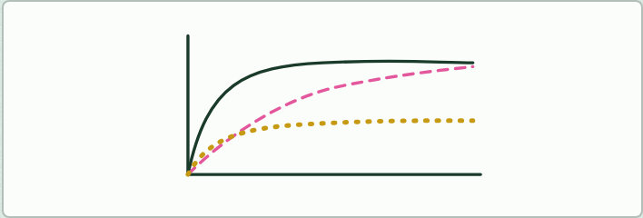
DRAWING
14 MIN
Sketch, then check
THE TASK
Lesson 2: students sketch the three graphs of chapter 7 from memory, then play the figure and correct their sketches in another colour.Lesson 5: on one set of axes, draw rate against substrate concentration with no inhibitor, then a line for something competing for the active site, then one for something changing the active site's shape. Check against chapter 12's graph.
STUDENTS NEED
Mini whiteboards, two colours of pen.
Minutes 31 to 45
Notes:
Minutes 31 to 45 of 60: Sketch, then check (14 min).
The plan: Chapter 7: students sketch all three graphs before the figure plays (Sketch, then check, below) and mark their own sketches against it. Take the plateau predict on whiteboards with a one-sentence reason. Then the collisions film, which sits after chapter 7: students call out what will happen before each slider move. Tigers Prefer Steak. Set Make a gif for homework.
The activity: Sketch, then check. Lesson 2: students sketch the three graphs of chapter 7 from memory, then play the figure and correct their sketches in another colour.Lesson 5: on one set of axes, draw rate against substrate concentration with no inhibitor, then a line for something competing for the active site, then one for something changing the active site's shape. Check against chapter 12's graph.
Needs: mini whiteboards, two colours of pen.
The time: 14 minutes, minutes 31 to 45 of the plan.

Slide 32
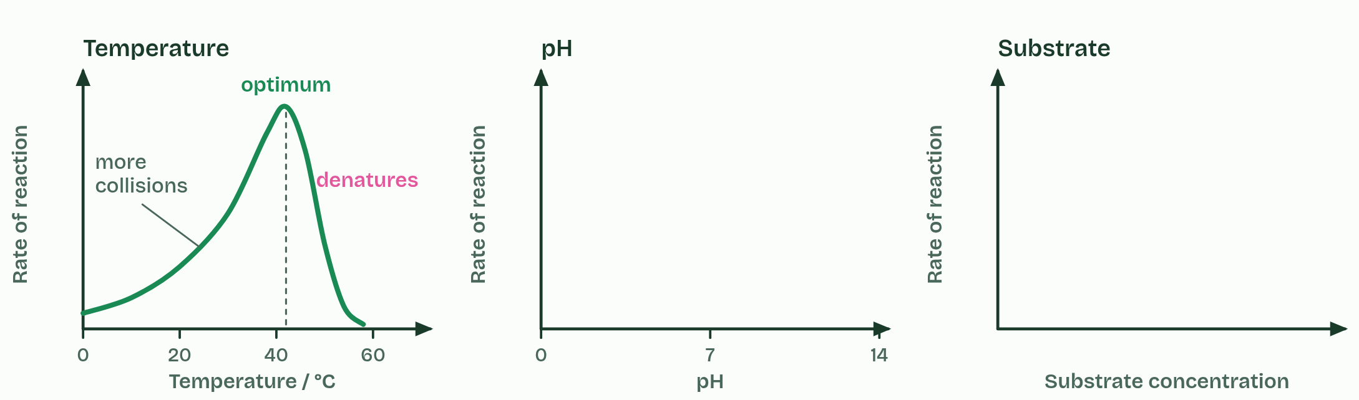
CHAPTER 7 · C1.1.8 Effects of temperature, pH and substrate concentration
1 / 4
Three graphs to know
Temperature: faster collisions, then denaturation.
Minutes 31 to 45
Notes:
Minutes 31 to 45 of 60: Sketch, then check (14 min).
The plan: Chapter 7: students sketch all three graphs before the figure plays (Sketch, then check, below) and mark their own sketches against it. Take the plateau predict on whiteboards with a one-sentence reason. Then the collisions film, which sits after chapter 7: students call out what will happen before each slider move. Tigers Prefer Steak. Set Make a gif for homework.
Sketch it first. On paper or a whiteboard, sketch rate of reaction against temperature, against pH and against substrate concentration before you play the figure. Then check yourself against it.
Temperature. Below the optimum, warming the solution makes enzyme and substrate move faster, so they collide more often and more collisions have enough energy to react. The rate rises, roughly doubling for every 10 °C. Above the optimum the enzyme denatures faster than the extra collisions can help, and the rate falls steeply. So the curve is not symmetrical: a gentle rise, a steep fall. Optima differ. Many human enzymes work best at about 37 to 40 °C; the DNA polymerase of a bacterium from hot springs works best at about 75 °C.
pH. Each enzyme works fastest at its own optimum pH, and the rate falls either side as the charges in the active site change and, further out, the enzyme denatures. Pepsin in the stomach prefers about pH 2, salivary amylase about pH 7 and trypsin in the small intestine about pH 8.
Substrate concentration. At low concentration, more substrate means more collisions with free active sites, so the rate rises almost in step. Then the curve bends over and levels off at a maximum. More enzyme would raise that maximum. All three effects follow from collision theory and denaturation.
Describe a graph in parts, with numbers from its axes: "rises steadily to an optimum near 40 °C, then falls steeply". These smooth curves are sketch graphs: models of the general pattern, not the data of one enzyme. Real results scatter and have their own optimum, and a model is tested against results from experiments such as the dry lab's.

Slide 33
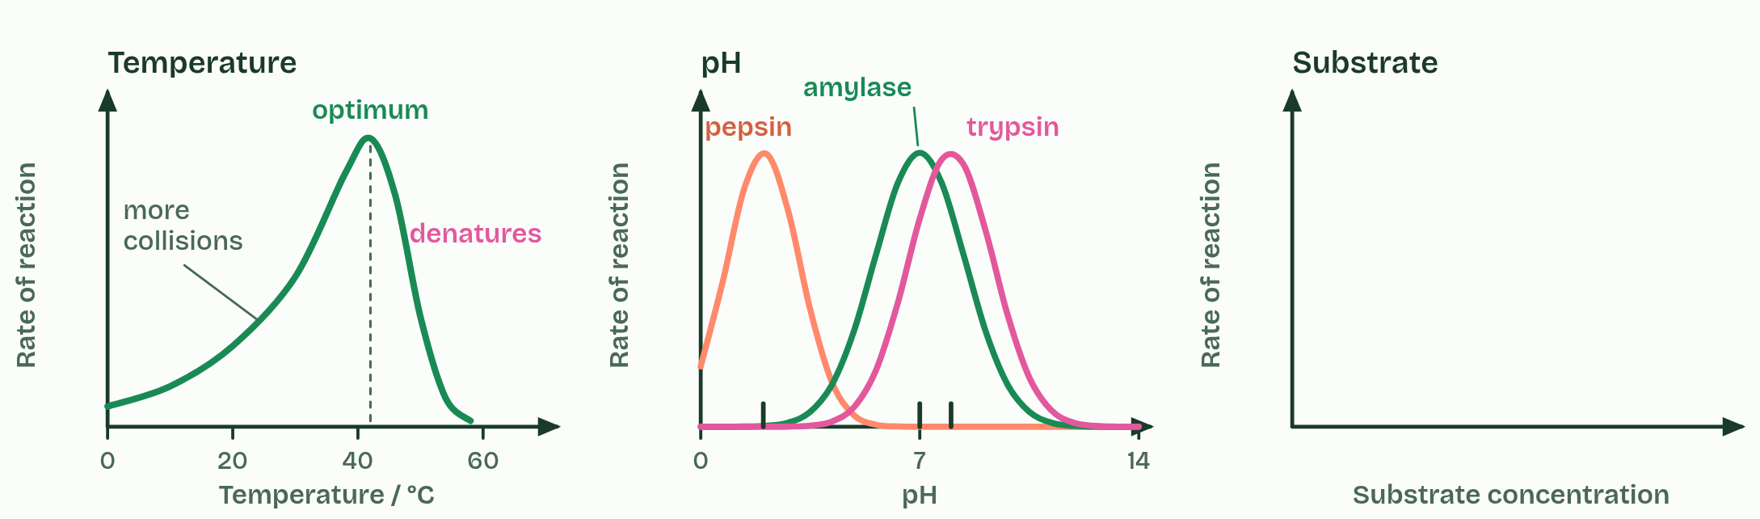
CHAPTER 7 · C1.1.8 Effects of temperature, pH and substrate concentration
2 / 4
Three graphs to know
pH: each enzyme has its own optimum.
Minutes 31 to 45
Notes:
Minutes 31 to 45 of 60: Sketch, then check (14 min).
The plan: Chapter 7: students sketch all three graphs before the figure plays (Sketch, then check, below) and mark their own sketches against it. Take the plateau predict on whiteboards with a one-sentence reason. Then the collisions film, which sits after chapter 7: students call out what will happen before each slider move. Tigers Prefer Steak. Set Make a gif for homework.
Sketch it first. On paper or a whiteboard, sketch rate of reaction against temperature, against pH and against substrate concentration before you play the figure. Then check yourself against it.
Temperature. Below the optimum, warming the solution makes enzyme and substrate move faster, so they collide more often and more collisions have enough energy to react. The rate rises, roughly doubling for every 10 °C. Above the optimum the enzyme denatures faster than the extra collisions can help, and the rate falls steeply. So the curve is not symmetrical: a gentle rise, a steep fall. Optima differ. Many human enzymes work best at about 37 to 40 °C; the DNA polymerase of a bacterium from hot springs works best at about 75 °C.
pH. Each enzyme works fastest at its own optimum pH, and the rate falls either side as the charges in the active site change and, further out, the enzyme denatures. Pepsin in the stomach prefers about pH 2, salivary amylase about pH 7 and trypsin in the small intestine about pH 8.
Substrate concentration. At low concentration, more substrate means more collisions with free active sites, so the rate rises almost in step. Then the curve bends over and levels off at a maximum. More enzyme would raise that maximum. All three effects follow from collision theory and denaturation.
Describe a graph in parts, with numbers from its axes: "rises steadily to an optimum near 40 °C, then falls steeply". These smooth curves are sketch graphs: models of the general pattern, not the data of one enzyme. Real results scatter and have their own optimum, and a model is tested against results from experiments such as the dry lab's.

Slide 34
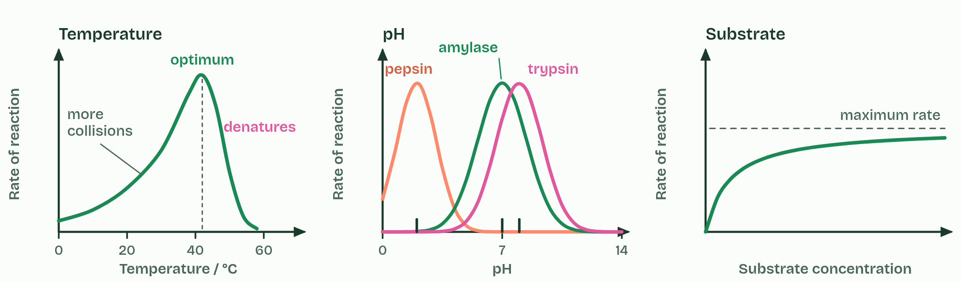
CHAPTER 7 · C1.1.8 Effects of temperature, pH and substrate concentration
3 / 4
Three graphs to know
Substrate: the rate rises, then levels off.
Minutes 31 to 45
Notes:
Minutes 31 to 45 of 60: Sketch, then check (14 min).
The plan: Chapter 7: students sketch all three graphs before the figure plays (Sketch, then check, below) and mark their own sketches against it. Take the plateau predict on whiteboards with a one-sentence reason. Then the collisions film, which sits after chapter 7: students call out what will happen before each slider move. Tigers Prefer Steak. Set Make a gif for homework.
Sketch it first. On paper or a whiteboard, sketch rate of reaction against temperature, against pH and against substrate concentration before you play the figure. Then check yourself against it.
Temperature. Below the optimum, warming the solution makes enzyme and substrate move faster, so they collide more often and more collisions have enough energy to react. The rate rises, roughly doubling for every 10 °C. Above the optimum the enzyme denatures faster than the extra collisions can help, and the rate falls steeply. So the curve is not symmetrical: a gentle rise, a steep fall. Optima differ. Many human enzymes work best at about 37 to 40 °C; the DNA polymerase of a bacterium from hot springs works best at about 75 °C.
pH. Each enzyme works fastest at its own optimum pH, and the rate falls either side as the charges in the active site change and, further out, the enzyme denatures. Pepsin in the stomach prefers about pH 2, salivary amylase about pH 7 and trypsin in the small intestine about pH 8.
Substrate concentration. At low concentration, more substrate means more collisions with free active sites, so the rate rises almost in step. Then the curve bends over and levels off at a maximum. More enzyme would raise that maximum. All three effects follow from collision theory and denaturation.
Describe a graph in parts, with numbers from its axes: "rises steadily to an optimum near 40 °C, then falls steeply". These smooth curves are sketch graphs: models of the general pattern, not the data of one enzyme. Real results scatter and have their own optimum, and a model is tested against results from experiments such as the dry lab's.

Slide 35
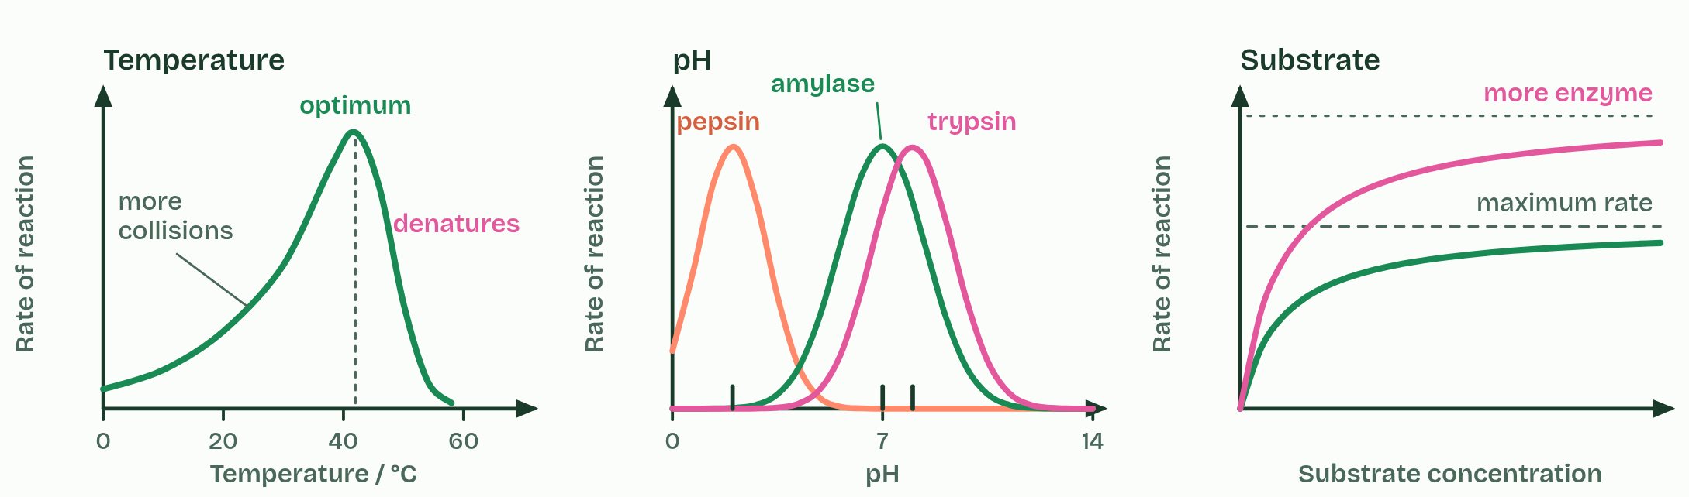
CHAPTER 7 · C1.1.8 Effects of temperature, pH and substrate concentration
4 / 4
Three graphs to know
More enzyme raises the maximum.
Minutes 31 to 45
Notes:
Minutes 31 to 45 of 60: Sketch, then check (14 min).
The plan: Chapter 7: students sketch all three graphs before the figure plays (Sketch, then check, below) and mark their own sketches against it. Take the plateau predict on whiteboards with a one-sentence reason. Then the collisions film, which sits after chapter 7: students call out what will happen before each slider move. Tigers Prefer Steak. Set Make a gif for homework.
Sketch it first. On paper or a whiteboard, sketch rate of reaction against temperature, against pH and against substrate concentration before you play the figure. Then check yourself against it.
Temperature. Below the optimum, warming the solution makes enzyme and substrate move faster, so they collide more often and more collisions have enough energy to react. The rate rises, roughly doubling for every 10 °C. Above the optimum the enzyme denatures faster than the extra collisions can help, and the rate falls steeply. So the curve is not symmetrical: a gentle rise, a steep fall. Optima differ. Many human enzymes work best at about 37 to 40 °C; the DNA polymerase of a bacterium from hot springs works best at about 75 °C.
pH. Each enzyme works fastest at its own optimum pH, and the rate falls either side as the charges in the active site change and, further out, the enzyme denatures. Pepsin in the stomach prefers about pH 2, salivary amylase about pH 7 and trypsin in the small intestine about pH 8.
Substrate concentration. At low concentration, more substrate means more collisions with free active sites, so the rate rises almost in step. Then the curve bends over and levels off at a maximum. More enzyme would raise that maximum. All three effects follow from collision theory and denaturation.
Describe a graph in parts, with numbers from its axes: "rises steadily to an optimum near 40 °C, then falls steeply". These smooth curves are sketch graphs: models of the general pattern, not the data of one enzyme. Real results scatter and have their own optimum, and a model is tested against results from experiments such as the dry lab's.

Slide 36
CHAPTER 7 · C1.1.8 Effects of temperature, pH and substrate concentration
Three graphs to know
Below the optimum, warming the solution makes enzyme and substrate move faster, so they collide more often and more collisions have enough energy to react.
Above the optimum the enzyme denatures faster than the extra collisions can help, and the rate falls steeply.
Each enzyme works fastest at its own optimum pH, and the rate falls either side as the charges in the active site change and, further out, the enzyme denatures.
All three effects follow from collision theory and denaturation.
Minutes 31 to 45
Notes:
Minutes 31 to 45 of 60: Sketch, then check (14 min).
The plan: Chapter 7: students sketch all three graphs before the figure plays (Sketch, then check, below) and mark their own sketches against it. Take the plateau predict on whiteboards with a one-sentence reason. Then the collisions film, which sits after chapter 7: students call out what will happen before each slider move. Tigers Prefer Steak. Set Make a gif for homework.
Sketch it first. On paper or a whiteboard, sketch rate of reaction against temperature, against pH and against substrate concentration before you play the figure. Then check yourself against it.
Temperature. Below the optimum, warming the solution makes enzyme and substrate move faster, so they collide more often and more collisions have enough energy to react. The rate rises, roughly doubling for every 10 °C. Above the optimum the enzyme denatures faster than the extra collisions can help, and the rate falls steeply. So the curve is not symmetrical: a gentle rise, a steep fall. Optima differ. Many human enzymes work best at about 37 to 40 °C; the DNA polymerase of a bacterium from hot springs works best at about 75 °C.
pH. Each enzyme works fastest at its own optimum pH, and the rate falls either side as the charges in the active site change and, further out, the enzyme denatures. Pepsin in the stomach prefers about pH 2, salivary amylase about pH 7 and trypsin in the small intestine about pH 8.
Substrate concentration. At low concentration, more substrate means more collisions with free active sites, so the rate rises almost in step. Then the curve bends over and levels off at a maximum. More enzyme would raise that maximum. All three effects follow from collision theory and denaturation.
Describe a graph in parts, with numbers from its axes: "rises steadily to an optimum near 40 °C, then falls steeply". These smooth curves are sketch graphs: models of the general pattern, not the data of one enzyme. Real results scatter and have their own optimum, and a model is tested against results from experiments such as the dry lab's.

Slide 37
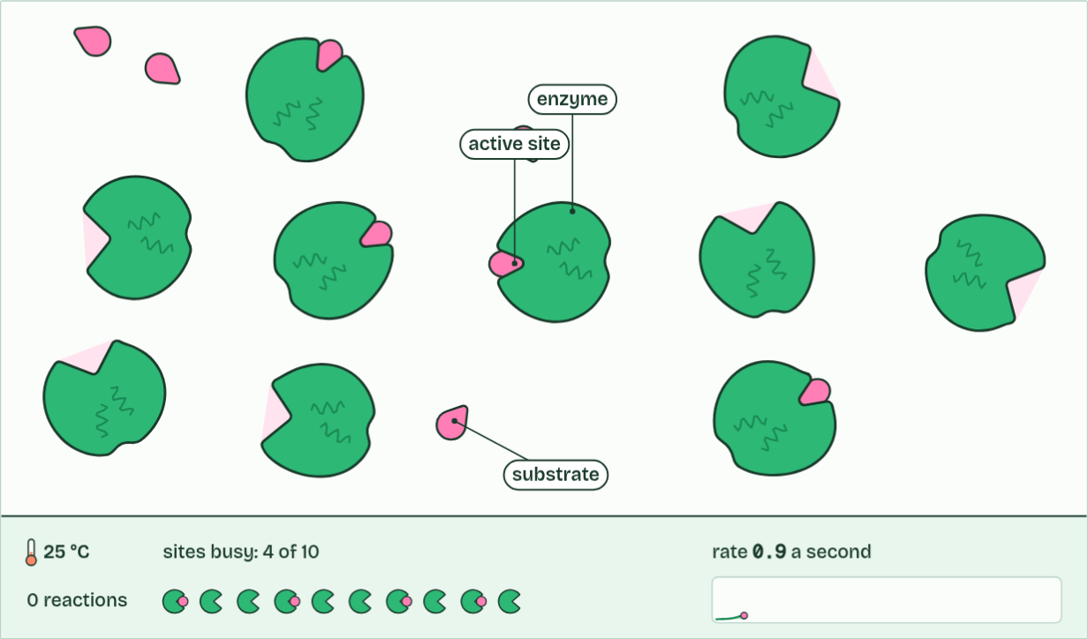
CHAPTER 7 · C1.1.8 Effects of temperature, pH and substrate concentration
0 reactions
1 / 3
Three graphs to know
Molecules move at random, and most collisions miss the active site.
Minutes 31 to 45
Notes:
Minutes 31 to 45 of 60: Sketch, then check (14 min).
The plan: Chapter 7: students sketch all three graphs before the figure plays (Sketch, then check, below) and mark their own sketches against it. Take the plateau predict on whiteboards with a one-sentence reason. Then the collisions film, which sits after chapter 7: students call out what will happen before each slider move. Tigers Prefer Steak. Set Make a gif for homework.
Sketch it first. On paper or a whiteboard, sketch rate of reaction against temperature, against pH and against substrate concentration before you play the figure. Then check yourself against it.
Temperature. Below the optimum, warming the solution makes enzyme and substrate move faster, so they collide more often and more collisions have enough energy to react. The rate rises, roughly doubling for every 10 °C. Above the optimum the enzyme denatures faster than the extra collisions can help, and the rate falls steeply. So the curve is not symmetrical: a gentle rise, a steep fall. Optima differ. Many human enzymes work best at about 37 to 40 °C; the DNA polymerase of a bacterium from hot springs works best at about 75 °C.
pH. Each enzyme works fastest at its own optimum pH, and the rate falls either side as the charges in the active site change and, further out, the enzyme denatures. Pepsin in the stomach prefers about pH 2, salivary amylase about pH 7 and trypsin in the small intestine about pH 8.
Substrate concentration. At low concentration, more substrate means more collisions with free active sites, so the rate rises almost in step. Then the curve bends over and levels off at a maximum. More enzyme would raise that maximum. All three effects follow from collision theory and denaturation.
Describe a graph in parts, with numbers from its axes: "rises steadily to an optimum near 40 °C, then falls steeply". These smooth curves are sketch graphs: models of the general pattern, not the data of one enzyme. Real results scatter and have their own optimum, and a model is tested against results from experiments such as the dry lab's.
The animation "Watch it happen: collisions, substrate and heat", paused at 2.0 s. The next slides go on through it, then play it.

Slide 38
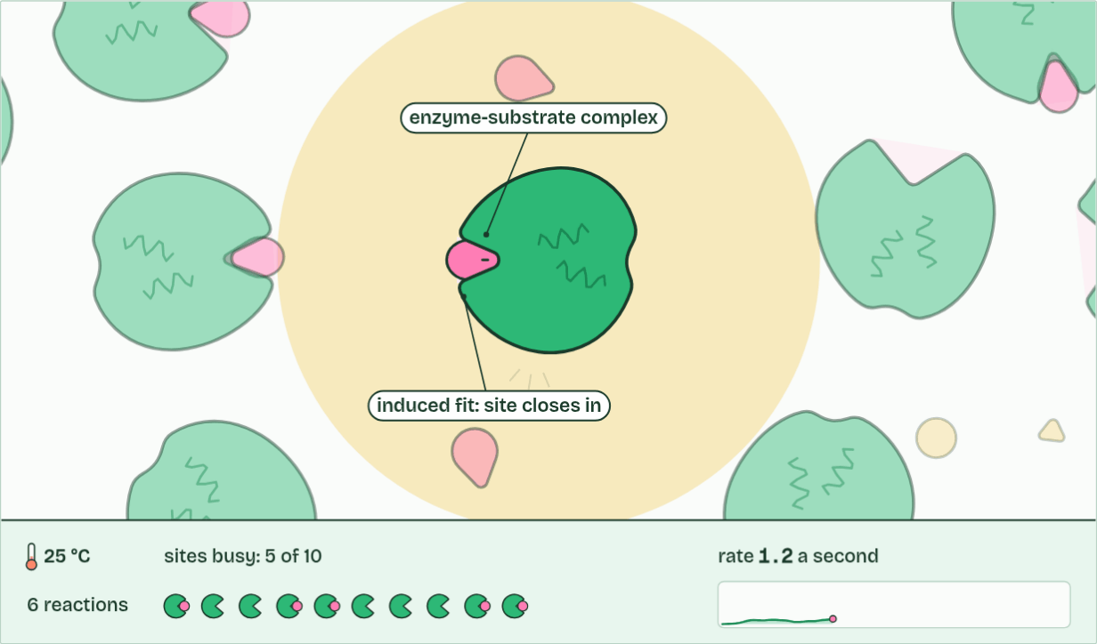
CHAPTER 7 · C1.1.8 Effects of temperature, pH and substrate concentration
6 reactions
2 / 3
Three graphs to know
A successful collision: it binds and reacts, and the enzyme is unchanged.
Minutes 31 to 45
Notes:
Minutes 31 to 45 of 60: Sketch, then check (14 min).
The plan: Chapter 7: students sketch all three graphs before the figure plays (Sketch, then check, below) and mark their own sketches against it. Take the plateau predict on whiteboards with a one-sentence reason. Then the collisions film, which sits after chapter 7: students call out what will happen before each slider move. Tigers Prefer Steak. Set Make a gif for homework.
Sketch it first. On paper or a whiteboard, sketch rate of reaction against temperature, against pH and against substrate concentration before you play the figure. Then check yourself against it.
Temperature. Below the optimum, warming the solution makes enzyme and substrate move faster, so they collide more often and more collisions have enough energy to react. The rate rises, roughly doubling for every 10 °C. Above the optimum the enzyme denatures faster than the extra collisions can help, and the rate falls steeply. So the curve is not symmetrical: a gentle rise, a steep fall. Optima differ. Many human enzymes work best at about 37 to 40 °C; the DNA polymerase of a bacterium from hot springs works best at about 75 °C.
pH. Each enzyme works fastest at its own optimum pH, and the rate falls either side as the charges in the active site change and, further out, the enzyme denatures. Pepsin in the stomach prefers about pH 2, salivary amylase about pH 7 and trypsin in the small intestine about pH 8.
Substrate concentration. At low concentration, more substrate means more collisions with free active sites, so the rate rises almost in step. Then the curve bends over and levels off at a maximum. More enzyme would raise that maximum. All three effects follow from collision theory and denaturation.
Describe a graph in parts, with numbers from its axes: "rises steadily to an optimum near 40 °C, then falls steeply". These smooth curves are sketch graphs: models of the general pattern, not the data of one enzyme. Real results scatter and have their own optimum, and a model is tested against results from experiments such as the dry lab's.
The animation "Watch it happen: collisions, substrate and heat", paused at 7.8 s. The next slides go on through it, then play it.

Slide 39
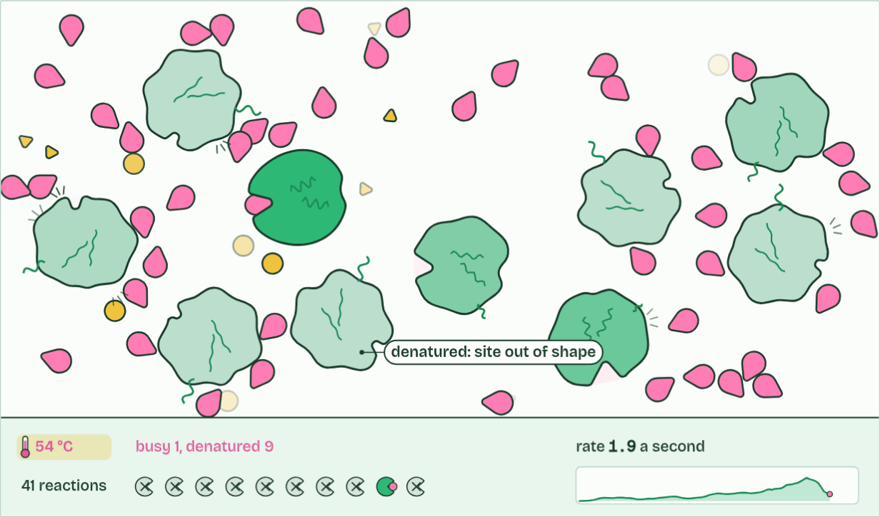
CHAPTER 7 · C1.1.8 Effects of temperature, pH and substrate concentration
41 reactions
3 / 3
Three graphs to know
Too hot: enzymes denature. Active sites lose their shape, and the rate falls.
Minutes 31 to 45
Notes:
Minutes 31 to 45 of 60: Sketch, then check (14 min).
The plan: Chapter 7: students sketch all three graphs before the figure plays (Sketch, then check, below) and mark their own sketches against it. Take the plateau predict on whiteboards with a one-sentence reason. Then the collisions film, which sits after chapter 7: students call out what will happen before each slider move. Tigers Prefer Steak. Set Make a gif for homework.
Sketch it first. On paper or a whiteboard, sketch rate of reaction against temperature, against pH and against substrate concentration before you play the figure. Then check yourself against it.
Temperature. Below the optimum, warming the solution makes enzyme and substrate move faster, so they collide more often and more collisions have enough energy to react. The rate rises, roughly doubling for every 10 °C. Above the optimum the enzyme denatures faster than the extra collisions can help, and the rate falls steeply. So the curve is not symmetrical: a gentle rise, a steep fall. Optima differ. Many human enzymes work best at about 37 to 40 °C; the DNA polymerase of a bacterium from hot springs works best at about 75 °C.
pH. Each enzyme works fastest at its own optimum pH, and the rate falls either side as the charges in the active site change and, further out, the enzyme denatures. Pepsin in the stomach prefers about pH 2, salivary amylase about pH 7 and trypsin in the small intestine about pH 8.
Substrate concentration. At low concentration, more substrate means more collisions with free active sites, so the rate rises almost in step. Then the curve bends over and levels off at a maximum. More enzyme would raise that maximum. All three effects follow from collision theory and denaturation.
Describe a graph in parts, with numbers from its axes: "rises steadily to an optimum near 40 °C, then falls steeply". These smooth curves are sketch graphs: models of the general pattern, not the data of one enzyme. Real results scatter and have their own optimum, and a model is tested against results from experiments such as the dry lab's.
The animation "Watch it happen: collisions, substrate and heat", paused at 21.8 s. The next slides go on through it, then play it.

Slide 40
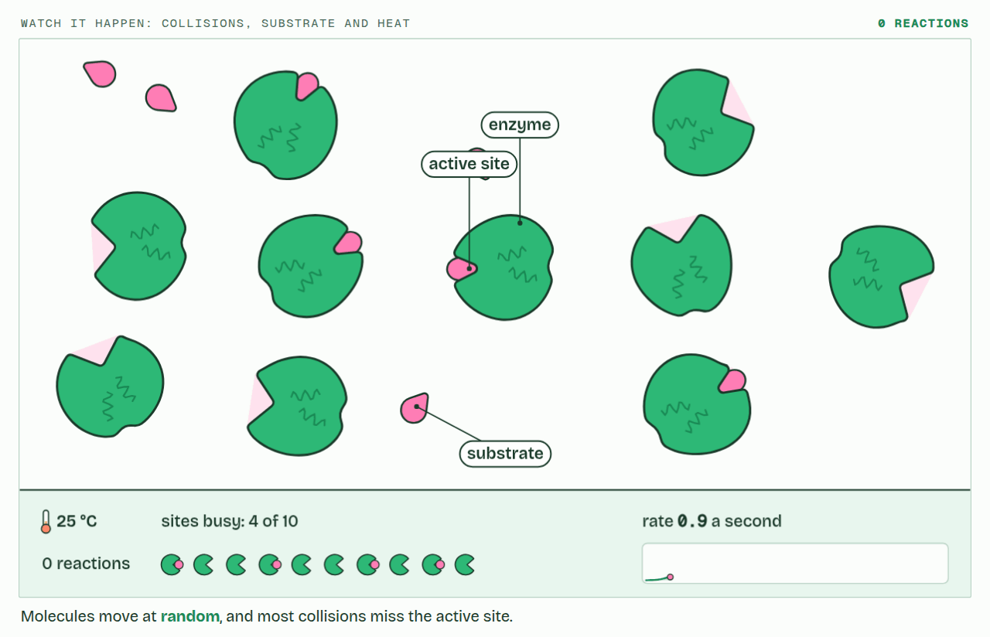
CHAPTER 7 · C1.1.8 Effects of temperature, pH and substrate concentration
PLAY IT
Three graphs to know
Watch it happen: collisions, substrate and heat: click to play. It loops every 24 seconds.
Minutes 31 to 45
Notes:
Minutes 31 to 45 of 60: Sketch, then check (14 min).
The plan: Chapter 7: students sketch all three graphs before the figure plays (Sketch, then check, below) and mark their own sketches against it. Take the plateau predict on whiteboards with a one-sentence reason. Then the collisions film, which sits after chapter 7: students call out what will happen before each slider move. Tigers Prefer Steak. Set Make a gif for homework.
The video is collisions-dab518.mp4, one loop of the animation in the guide. It plays in PowerPoint and Keynote. Google Slides does not play a video embedded in a .pptx: download collisions-dab518.mp4 (https://www.biologybybradford.com/guides/downloads/scenes/collisions-dab518.mp4), upload it to Google Drive, then Insert > Video > Google Drive.
In the guide the class can change it as it runs: https://www.biologybybradford.com/guides/ib-biology-c1-1-enzymes-and-metabolism#factors
What it shows, in order:
1. Molecules move at random, and most collisions miss the active site.
2. A successful collision: it binds and reacts, and the enzyme is unchanged.
3. Too hot: enzymes denature. Active sites lose their shape, and the rate falls.

Slide 41
PREDICT
On a graph of rate against substrate concentration, the curve levels off. Why?
A The substrate has all been used up
B The enzyme is denatured by so much substrate
C Nearly every active site is already busy
D Molecules collide less often when crowded
Minutes 31 to 45
Notes:
Minutes 31 to 45 of 60: Sketch, then check (14 min).
The plan: Chapter 7: students sketch all three graphs before the figure plays (Sketch, then check, below) and mark their own sketches against it. Take the plateau predict on whiteboards with a one-sentence reason. Then the collisions film, which sits after chapter 7: students call out what will happen before each slider move. Tigers Prefer Steak. Set Make a gif for homework.
Ask for a show of hands, or mini whiteboards, before revealing. (Answer: C, on the next slide.)

Slide 42
WHAT HAPPENS
On a graph of rate against substrate concentration, the curve levels off. Why?
A The substrate has all been used up
B The enzyme is denatured by so much substrate
C Nearly every active site is already busy
D Molecules collide less often when crowded
At high substrate concentration nearly every active site is occupied at any moment. A substrate molecule arriving at a busy enzyme has to wait, so adding more substrate barely raises the rate. This is saturation. The substrate has not run out: there is more of it than ever. Only more enzyme can raise the maximum.
Minutes 31 to 45
Notes:
Minutes 31 to 45 of 60: Sketch, then check (14 min).
The plan: Chapter 7: students sketch all three graphs before the figure plays (Sketch, then check, below) and mark their own sketches against it. Take the plateau predict on whiteboards with a one-sentence reason. Then the collisions film, which sits after chapter 7: students call out what will happen before each slider move. Tigers Prefer Steak. Set Make a gif for homework.
Answer: C. At high substrate concentration nearly every active site is occupied at any moment. A substrate molecule arriving at a busy enzyme has to wait, so adding more substrate barely raises the rate. This is saturation. The substrate has not run out: there is more of it than ever. Only more enzyme can raise the maximum.

Slide 43
WATCH OUT
The optimum is not always 37 °C. That is roughly where many human enzymes peak; enzymes from other organisms peak far higher or lower.
Minutes 31 to 45
Notes:
Minutes 31 to 45 of 60: Sketch, then check (14 min).
The plan: Chapter 7: students sketch all three graphs before the figure plays (Sketch, then check, below) and mark their own sketches against it. Take the plateau predict on whiteboards with a one-sentence reason. Then the collisions film, which sits after chapter 7: students call out what will happen before each slider move. Tigers Prefer Steak. Set Make a gif for homework.
A common mistake: say it, then ask who can say why it is wrong.

Slide 44
REMEMBER IT
The three factors you must explain
T
P
S
Tigers
Prefer
Steak
Minutes 31 to 45
Notes:
Minutes 31 to 45 of 60: Sketch, then check (14 min).
The plan: Chapter 7: students sketch all three graphs before the figure plays (Sketch, then check, below) and mark their own sketches against it. Take the plateau predict on whiteboards with a one-sentence reason. Then the collisions film, which sits after chapter 7: students call out what will happen before each slider move. Tigers Prefer Steak. Set Make a gif for homework.
Ask the class what each letter stands for before revealing.

Slide 45
REMEMBER IT
The three factors you must explain
T
P
S
Tigers
Prefer
Steak
Temperature
pH
Substrate concentration
collisions, then denaturation
charges in the active site
collisions, then saturation
Minutes 31 to 45
Notes:
Minutes 31 to 45 of 60: Sketch, then check (14 min).
The plan: Chapter 7: students sketch all three graphs before the figure plays (Sketch, then check, below) and mark their own sketches against it. Take the plateau predict on whiteboards with a one-sentence reason. Then the collisions film, which sits after chapter 7: students call out what will happen before each slider move. Tigers Prefer Steak. Set Make a gif for homework.
Tigers: Temperature (collisions, then denaturation)
Prefer: pH (charges in the active site)
Steak: Substrate concentration (collisions, then saturation)

Slide 46
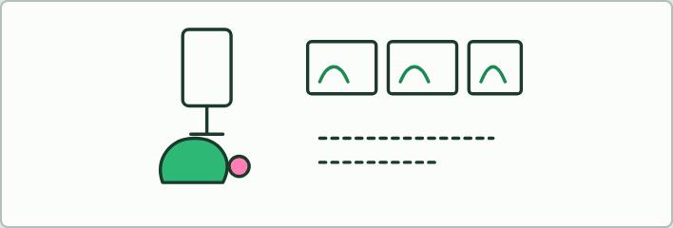
ANIMATION
14 MIN
Make a gif
THE TASK
Homework, from chapter 7. Pairs make a 10 to 20 second stop-motion or gif of one factor: temperature, pH or substrate concentration. It shows enzymes and substrate interacting, how the factor changes the collisions, the shape or the saturation, and ends with the sketch graph. A good one has short sentences with the key words, sums up the point at the end, leaves time to read each frame and looks clear. Plasticine, paper cut-outs or doodles, and any free gif or stop-motion app.
STUDENTS NEED
Phones, plasticine or paper.
Minutes 31 to 45
Notes:
Minutes 31 to 45 of 60: Sketch, then check (14 min).
The plan: Chapter 7: students sketch all three graphs before the figure plays (Sketch, then check, below) and mark their own sketches against it. Take the plateau predict on whiteboards with a one-sentence reason. Then the collisions film, which sits after chapter 7: students call out what will happen before each slider move. Tigers Prefer Steak. Set Make a gif for homework.
The activity: Make a gif. Homework, from chapter 7. Pairs make a 10 to 20 second stop-motion or gif of one factor: temperature, pH or substrate concentration. It shows enzymes and substrate interacting, how the factor changes the collisions, the shape or the saturation, and ends with the sketch graph. A good one has short sentences with the key words, sums up the point at the end, leaves time to read each frame and looks clear. Plasticine, paper cut-outs or doodles, and any free gif or stop-motion app.
Needs: phones, plasticine or paper.
The time: 14 minutes, minutes 31 to 45 of the plan.

Slide 47
STEP 6
10 MIN
Timed written question
A written question on the effect of temperature or pH from the C1.1 exam maker, timed at 7 minutes, peer-marked against the markscheme.
Minutes 45 to 55
Notes:
Minutes 45 to 55 of 60: Timed written question (10 min).
The plan: A written question on the effect of temperature or pH from the C1.1 exam maker, timed at 7 minutes, peer-marked against the markscheme.

Slide 48
PLENARY
Can you now...
Explain how a few amino acids, held in place by the whole folded protein, make an active site, and how induced fit works (C1.1.4, C1.1.5)
Explain why substrate and active site must collide, and how enzymes fixed in membranes still meet their substrates (C1.1.6)
Explain how the shape of the active site makes an enzyme specific, and why denaturation stops it working (C1.1.7)
Sketch and explain the effects of temperature, pH and substrate concentration on the rate, using collision theory and denaturation (C1.1.8)
Minutes 55 to 60
Notes:
Minutes 55 to 60 of 60: Exit (5 min).
The plan: One sentence each: why the rate rises as an enzyme warms towards its optimum, and why it falls beyond it.
Thumbs up, sideways or down on each goal before the exit question. The goals come from the statements this lesson covers.

Slide 49
EXIT QUESTION
Before you go
One sentence each.
Minutes 55 to 60
Notes:
Minutes 55 to 60 of 60: Exit (5 min).
The plan: One sentence each: why the rate rises as an enzyme warms towards its optimum, and why it falls beyond it.

Slide 50
PRACTISE AND REVISE
Keep going
Exam practice: a fresh paper of exam questions on C1.1 at standard level, marked as you go
The guide, with the animations and the dry lab
This lesson in the guide: 4 A pocket held in shape, 5 Meeting by chance, 6 Lose the shape, lose the fit, 7 Three graphs to know
BUILD FOR YOUR CLASS
ALREADY ON THE SITE FOR C1.1
CARD SETS ON SPLYCR
Tarsia puzzle, dominoes and picture reveal on C1.1, built from its key terms and ready to print
A pub quiz with rounds on C1.1, to present or run with no projector
An escape room built from the question bank on C1.1
Lab: The Enzyme in Your Spit
Summary doodle: Enzymes & Metabolism
Quiz: Enzymes
Revision map: C1.1 Enzymes and metabolism, to fill in
Exam questions: C1.1 in the exam maker, a paper with its markscheme
Open a set to host it as a class game, or make a copy to edit.
C1.1 Enzymes and Metabolism
How this was made. The course structure, the activities and the teaching choices come from my own classroom, my presentations and my years of teaching IB and AP Biology. I use Claude, an AI, to help write and build the interactive guides, lesson plans, slides and practice questions, and to draw the diagrams and code the interactives. I direct the work and review it against the IB and AP specifications before it goes live.
Minute 60: after the lesson
Notes:
Every link here is live. Set the exam practice paper for homework: it is fresh each time, marked as students go and saved to their Exam practice when they are signed in.
Exam practice: https://www.biologybybradford.com/exam-maker/sit?topics=C1.1&level=SL&paper=quiz&marks=15&src=ep
The guide: https://www.biologybybradford.com/guides/ib-biology-c1-1-enzymes-and-metabolism

