Slide 1
IB Biology C1.1
LESSON 3 OF 5
BY THE END YOU CAN
Enzymes and metabolism
Work out a rate from your own results or from secondary data, including the initial rate from a tangent (C1.1.9)
Measuring a rate
C1.1.9
How to measure an enzyme's rate, the initial rate, and planning, running and evaluating the catalase investigation
60 minutes · chapters 7, 8 · the dry lab
Minute 0
Notes:
IB Biology C1.1, Enzymes and metabolism. Lesson 3 of 5: Measuring a rate, 60 minutes.
The plan, minute by minute (each slide's footer says where you are):
0 to 5 min (5) Do now: elephant's toothpaste
5 to 15 min (10) Chapter 8: read the rate
15 to 25 min (10) Catalase over water
25 to 55 min (30) The dry lab with the coach
55 to 60 min (5) Exit
What students get wrong:
The amount of product at the end measures the rate. It measures how much substrate went in; use the initial rate.
A longer time means a faster rate. Rate = 1 ÷ time.
Stretch and support:
Support: the figures' captions as cut-up cards to put in order; the dotted key terms as a glossary; a writing frame for "explain the effect of temperature" (rise, optimum, fall, each with its reason).
Stretch: in the dry lab, find the temperature at which half the enzyme is lost within the run. How would you design a run to separate the effect of heat on collisions from its effect on denaturation?
The lesson plan to print: https://www.biologybybradford.com/guides/downloads/ib-biology-c1-1-enzymes-and-metabolism-lesson-3-plan.pdf

Slide 2
DO NOW
Elephant's toothpaste
The demonstration below.
Ask: "How could you measure how fast that happened?"
5:00
minutes
Start now: the timer is running.
Minutes 0 to 5
Notes:
Minutes 0 to 5 of 60: Do now: elephant's toothpaste (5 min).
The plan: The demonstration below. Ask: "How could you measure how fast that happened?" Collect the measures students suggest: foam height, time, mass lost, volume of gas.
Start a 5 minute timer as they come in.

Slide 3

DEMONSTRATION
5 MIN
Elephant's toothpaste
THE TASK
A safe version: in a 250 cm³ measuring cylinder on a tray, put 30 cm³ of 6% (20 volume) hydrogen peroxide, a squirt of washing-up liquid and a few drops of food colouring. Tip in a tablespoon of dried yeast stirred into warm water. Foam rises, because the catalase in the yeast speeds up the breakdown of the peroxide to water and oxygen. Wear eye protection: 6% hydrogen peroxide irritates eyes and skin, so rinse splashes at once. The 30% peroxide and potassium iodide version is for the teacher alone.
STUDENTS NEED
The above, a tray, eye protection, gloves for the teacher.
Minutes 0 to 5
Notes:
Minutes 0 to 5 of 60: Do now: elephant's toothpaste (5 min).
The plan: The demonstration below. Ask: "How could you measure how fast that happened?" Collect the measures students suggest: foam height, time, mass lost, volume of gas.
The activity: Elephant's toothpaste. A safe version: in a 250 cm³ measuring cylinder on a tray, put 30 cm³ of 6% (20 volume) hydrogen peroxide, a squirt of washing-up liquid and a few drops of food colouring. Tip in a tablespoon of dried yeast stirred into warm water. Foam rises, because the catalase in the yeast speeds up the breakdown of the peroxide to water and oxygen. Wear eye protection: 6% hydrogen peroxide irritates eyes and skin, so rinse splashes at once. The 30% peroxide and potassium iodide version is for the teacher alone.
Needs: the above, a tray, eye protection, gloves for the teacher.
The time: 5 minutes, minutes 0 to 5 of the plan.

Slide 4
STEP 2
10 MIN
Chapter 8: read the rate
Chapter 8: Measuring a rate
Minutes 5 to 15
Notes:
Minutes 5 to 15 of 60: Chapter 8: read the rate (10 min).
The plan: Product made or substrate used. Step through the figure: the points, the curve, the tangent and its gradient. At step 4, students draw their own gradient triangle on the 35 °C tangent and work out its initial rate before reading the label, then the predict (rate is 1 ÷ time).

Slide 5
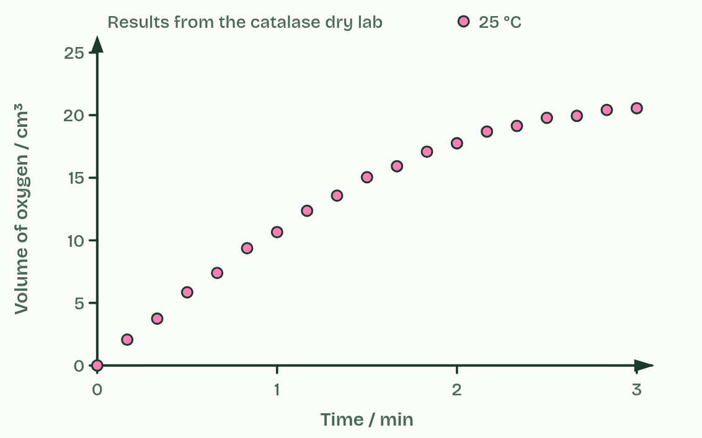
CHAPTER 8 · C1.1.9 Measurements in enzyme-catalysed reactions
1 / 4
Measuring a rate
Oxygen collected every 10 seconds.
Minutes 5 to 15
Notes:
Minutes 5 to 15 of 60: Chapter 8: read the rate (10 min).
The plan: Product made or substrate used. Step through the figure: the points, the curve, the tangent and its gradient. At step 4, students draw their own gradient triangle on the 35 °C tangent and work out its initial rate before reading the label, then the predict (rate is 1 ÷ time).
A rate of reaction is a change per unit time. For an enzyme, you can measure either how fast a product appears or how fast the substrate disappears. Catalase makes oxygen, which can be collected in a gas syringe and read in cm³ min⁻¹. Amylase uses up starch, which can be tested with iodine solution: you time how long it takes before a drop no longer turns blue-black.
Plot the product against time and the curve is steepest at the start, then flattens as the substrate is used up. The initial rate is the gradient at the very start, before the substrate runs low, and it measures the enzyme under the conditions you set. Draw a tangent to the curve at time zero and work out its gradient: rise over run, with units.
Where you only time an end point (the starch has gone, a paper disc has floated up), the rate is 1 ÷ time, in s⁻¹. Twice as fast means half the time.
One enzyme can be followed three ways. For catalase: the oxygen collected in a gas syringe; the oxygen collected over water in an upturned measuring cylinder; or a small filter paper disc soaked in extract, dropped into the peroxide and timed as it rises on the oxygen it makes.
A fair test changes one variable (the independent variable), measures the rate (the dependent variable) and keeps everything else the same: temperature in a water bath, pH with a buffer, the same volumes and concentrations. Repeat each value at least three times, and include controls, such as no enzyme and boiled enzyme.
You can also work out rates from secondary data: someone else's results in a table or graph. Reading the gradients is the same. The dry lab below is the place to do it all.

Slide 6
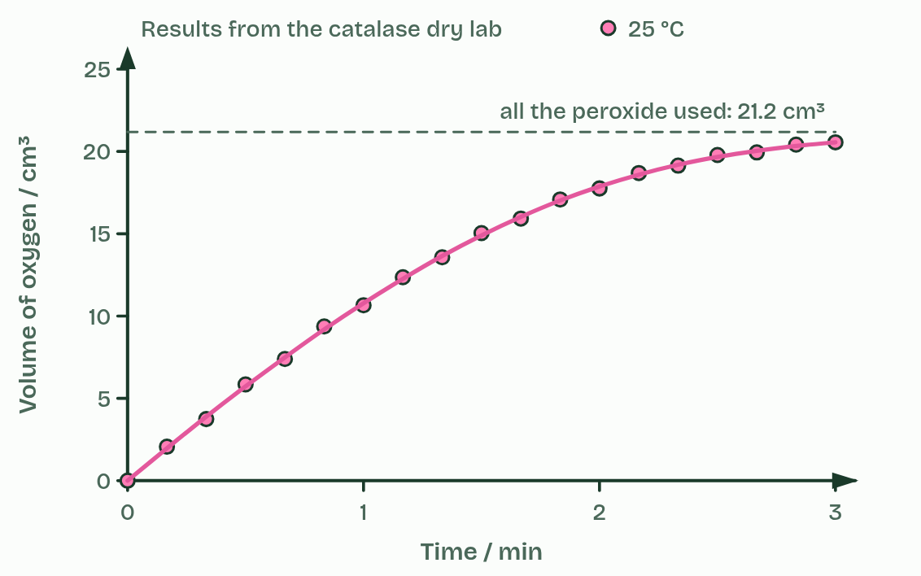
CHAPTER 8 · C1.1.9 Measurements in enzyme-catalysed reactions
2 / 4
Measuring a rate
Fast at first, then slower as the substrate runs out.
Minutes 5 to 15
Notes:
Minutes 5 to 15 of 60: Chapter 8: read the rate (10 min).
The plan: Product made or substrate used. Step through the figure: the points, the curve, the tangent and its gradient. At step 4, students draw their own gradient triangle on the 35 °C tangent and work out its initial rate before reading the label, then the predict (rate is 1 ÷ time).
A rate of reaction is a change per unit time. For an enzyme, you can measure either how fast a product appears or how fast the substrate disappears. Catalase makes oxygen, which can be collected in a gas syringe and read in cm³ min⁻¹. Amylase uses up starch, which can be tested with iodine solution: you time how long it takes before a drop no longer turns blue-black.
Plot the product against time and the curve is steepest at the start, then flattens as the substrate is used up. The initial rate is the gradient at the very start, before the substrate runs low, and it measures the enzyme under the conditions you set. Draw a tangent to the curve at time zero and work out its gradient: rise over run, with units.
Where you only time an end point (the starch has gone, a paper disc has floated up), the rate is 1 ÷ time, in s⁻¹. Twice as fast means half the time.
One enzyme can be followed three ways. For catalase: the oxygen collected in a gas syringe; the oxygen collected over water in an upturned measuring cylinder; or a small filter paper disc soaked in extract, dropped into the peroxide and timed as it rises on the oxygen it makes.
A fair test changes one variable (the independent variable), measures the rate (the dependent variable) and keeps everything else the same: temperature in a water bath, pH with a buffer, the same volumes and concentrations. Repeat each value at least three times, and include controls, such as no enzyme and boiled enzyme.
You can also work out rates from secondary data: someone else's results in a table or graph. Reading the gradients is the same. The dry lab below is the place to do it all.

Slide 7
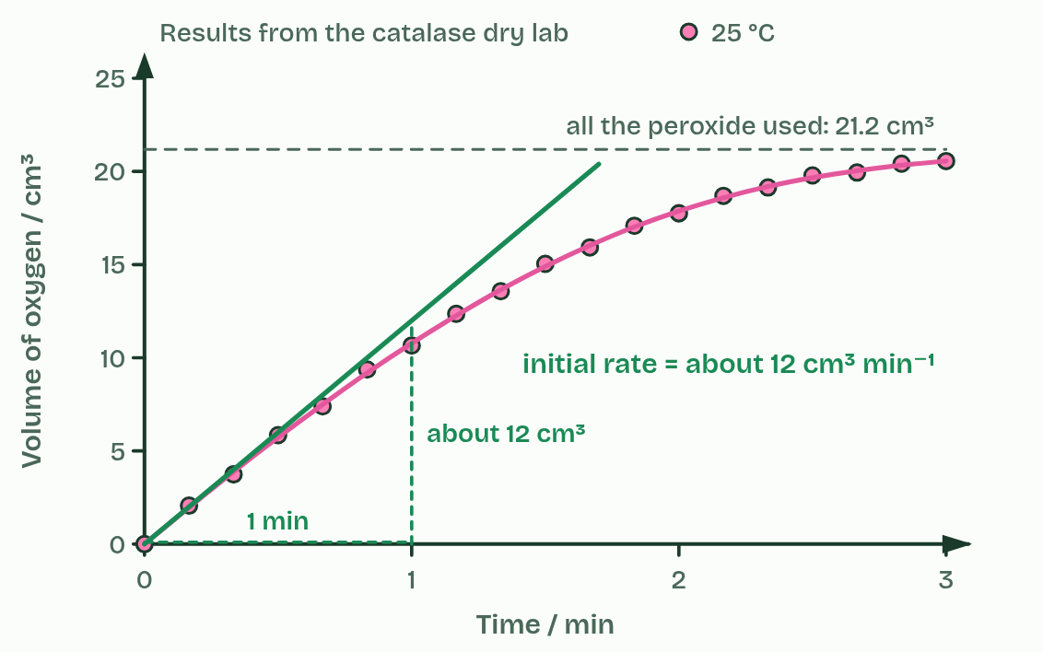
CHAPTER 8 · C1.1.9 Measurements in enzyme-catalysed reactions
3 / 4
Measuring a rate
The initial rate is the gradient of a tangent at the start.
Minutes 5 to 15
Notes:
Minutes 5 to 15 of 60: Chapter 8: read the rate (10 min).
The plan: Product made or substrate used. Step through the figure: the points, the curve, the tangent and its gradient. At step 4, students draw their own gradient triangle on the 35 °C tangent and work out its initial rate before reading the label, then the predict (rate is 1 ÷ time).
A rate of reaction is a change per unit time. For an enzyme, you can measure either how fast a product appears or how fast the substrate disappears. Catalase makes oxygen, which can be collected in a gas syringe and read in cm³ min⁻¹. Amylase uses up starch, which can be tested with iodine solution: you time how long it takes before a drop no longer turns blue-black.
Plot the product against time and the curve is steepest at the start, then flattens as the substrate is used up. The initial rate is the gradient at the very start, before the substrate runs low, and it measures the enzyme under the conditions you set. Draw a tangent to the curve at time zero and work out its gradient: rise over run, with units.
Where you only time an end point (the starch has gone, a paper disc has floated up), the rate is 1 ÷ time, in s⁻¹. Twice as fast means half the time.
One enzyme can be followed three ways. For catalase: the oxygen collected in a gas syringe; the oxygen collected over water in an upturned measuring cylinder; or a small filter paper disc soaked in extract, dropped into the peroxide and timed as it rises on the oxygen it makes.
A fair test changes one variable (the independent variable), measures the rate (the dependent variable) and keeps everything else the same: temperature in a water bath, pH with a buffer, the same volumes and concentrations. Repeat each value at least three times, and include controls, such as no enzyme and boiled enzyme.
You can also work out rates from secondary data: someone else's results in a table or graph. Reading the gradients is the same. The dry lab below is the place to do it all.

Slide 8
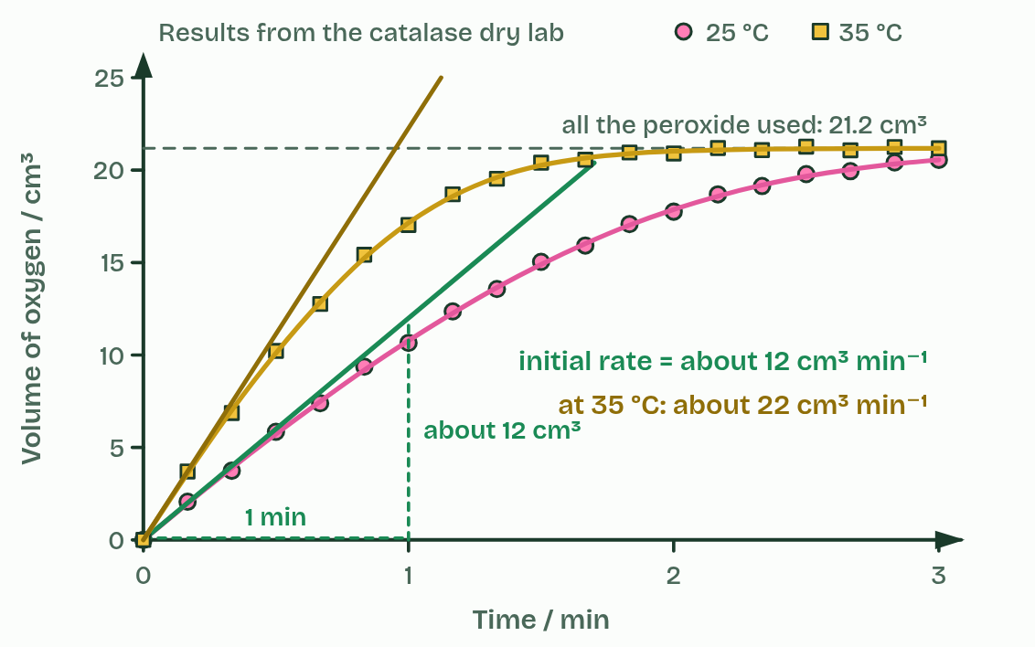
CHAPTER 8 · C1.1.9 Measurements in enzyme-catalysed reactions
4 / 4
Measuring a rate
Warmer: a steeper start, the same total.
Minutes 5 to 15
Notes:
Minutes 5 to 15 of 60: Chapter 8: read the rate (10 min).
The plan: Product made or substrate used. Step through the figure: the points, the curve, the tangent and its gradient. At step 4, students draw their own gradient triangle on the 35 °C tangent and work out its initial rate before reading the label, then the predict (rate is 1 ÷ time).
A rate of reaction is a change per unit time. For an enzyme, you can measure either how fast a product appears or how fast the substrate disappears. Catalase makes oxygen, which can be collected in a gas syringe and read in cm³ min⁻¹. Amylase uses up starch, which can be tested with iodine solution: you time how long it takes before a drop no longer turns blue-black.
Plot the product against time and the curve is steepest at the start, then flattens as the substrate is used up. The initial rate is the gradient at the very start, before the substrate runs low, and it measures the enzyme under the conditions you set. Draw a tangent to the curve at time zero and work out its gradient: rise over run, with units.
Where you only time an end point (the starch has gone, a paper disc has floated up), the rate is 1 ÷ time, in s⁻¹. Twice as fast means half the time.
One enzyme can be followed three ways. For catalase: the oxygen collected in a gas syringe; the oxygen collected over water in an upturned measuring cylinder; or a small filter paper disc soaked in extract, dropped into the peroxide and timed as it rises on the oxygen it makes.
A fair test changes one variable (the independent variable), measures the rate (the dependent variable) and keeps everything else the same: temperature in a water bath, pH with a buffer, the same volumes and concentrations. Repeat each value at least three times, and include controls, such as no enzyme and boiled enzyme.
You can also work out rates from secondary data: someone else's results in a table or graph. Reading the gradients is the same. The dry lab below is the place to do it all.

Slide 9
CHAPTER 8 · C1.1.9 Measurements in enzyme-catalysed reactions
Measuring a rate
A rate of reaction is a change per unit time.
The initial rate is the gradient at the very start, before the substrate runs low, and it measures the enzyme under the conditions you set.
Draw a tangent to the curve at time zero and work out its gradient: rise over run, with units.
You can also work out rates from secondary data: someone else's results in a table or graph.
Minutes 5 to 15
Notes:
Minutes 5 to 15 of 60: Chapter 8: read the rate (10 min).
The plan: Product made or substrate used. Step through the figure: the points, the curve, the tangent and its gradient. At step 4, students draw their own gradient triangle on the 35 °C tangent and work out its initial rate before reading the label, then the predict (rate is 1 ÷ time).
A rate of reaction is a change per unit time. For an enzyme, you can measure either how fast a product appears or how fast the substrate disappears. Catalase makes oxygen, which can be collected in a gas syringe and read in cm³ min⁻¹. Amylase uses up starch, which can be tested with iodine solution: you time how long it takes before a drop no longer turns blue-black.
Plot the product against time and the curve is steepest at the start, then flattens as the substrate is used up. The initial rate is the gradient at the very start, before the substrate runs low, and it measures the enzyme under the conditions you set. Draw a tangent to the curve at time zero and work out its gradient: rise over run, with units.
Where you only time an end point (the starch has gone, a paper disc has floated up), the rate is 1 ÷ time, in s⁻¹. Twice as fast means half the time.
One enzyme can be followed three ways. For catalase: the oxygen collected in a gas syringe; the oxygen collected over water in an upturned measuring cylinder; or a small filter paper disc soaked in extract, dropped into the peroxide and timed as it rises on the oxygen it makes.
A fair test changes one variable (the independent variable), measures the rate (the dependent variable) and keeps everything else the same: temperature in a water bath, pH with a buffer, the same volumes and concentrations. Repeat each value at least three times, and include controls, such as no enzyme and boiled enzyme.
You can also work out rates from secondary data: someone else's results in a table or graph. Reading the gradients is the same. The dry lab below is the place to do it all.

Slide 10
PREDICT
A drop of a starch and amylase mixture stops turning iodine blue-black after 40 s at 30 °C and after 80 s at 20 °C. Compare the rates.
A The rate is higher at 20 °C, because it took longer
B The rate at 30 °C is double: rate is 1 ÷ time
C The rates are the same: the same starch was broken down
D The rate at 30 °C is 40 units higher than at 20 °C
Minutes 5 to 15
Notes:
Minutes 5 to 15 of 60: Chapter 8: read the rate (10 min).
The plan: Product made or substrate used. Step through the figure: the points, the curve, the tangent and its gradient. At step 4, students draw their own gradient triangle on the 35 °C tangent and work out its initial rate before reading the label, then the predict (rate is 1 ÷ time).
Ask for a show of hands, or mini whiteboards, before revealing. (Answer: B, on the next slide.)

Slide 11
WHAT HAPPENS
A drop of a starch and amylase mixture stops turning iodine blue-black after 40 s at 30 °C and after 80 s at 20 °C. Compare the rates.
A The rate is higher at 20 °C, because it took longer
B The rate at 30 °C is double: rate is 1 ÷ time
C The rates are the same: the same starch was broken down
D The rate at 30 °C is 40 units higher than at 20 °C
Rate = 1 ÷ time: 1 ÷ 40 s = 0.025 s⁻¹ at 30 °C and 1 ÷ 80 s = 0.0125 s⁻¹ at 20 °C. Half the time means twice the rate.
Minutes 5 to 15
Notes:
Minutes 5 to 15 of 60: Chapter 8: read the rate (10 min).
The plan: Product made or substrate used. Step through the figure: the points, the curve, the tangent and its gradient. At step 4, students draw their own gradient triangle on the 35 °C tangent and work out its initial rate before reading the label, then the predict (rate is 1 ÷ time).
Answer: B. Rate = 1 ÷ time: 1 ÷ 40 s = 0.025 s⁻¹ at 30 °C and 1 ÷ 80 s = 0.0125 s⁻¹ at 20 °C. Half the time means twice the rate.

Slide 12
WATCH OUT
The total amount of product at the end measures how much substrate you put in, not how fast the enzyme works. Use the initial rate.
Minutes 5 to 15
Notes:
Minutes 5 to 15 of 60: Chapter 8: read the rate (10 min).
The plan: Product made or substrate used. Step through the figure: the points, the curve, the tangent and its gradient. At step 4, students draw their own gradient triangle on the 35 °C tangent and work out its initial rate before reading the label, then the predict (rate is 1 ÷ time).
A common mistake: say it, then ask who can say why it is wrong.

Slide 13
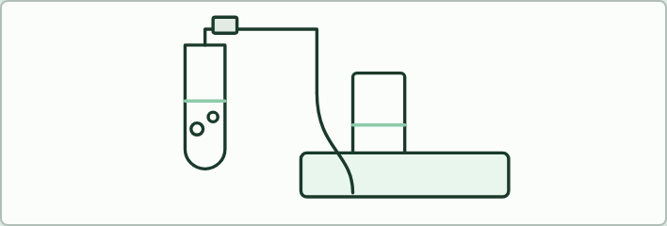
PRACTICAL
10 MIN
Catalase over water
THE TASK
A demonstration, or pairs if there is time. A level spatula of dried yeast (weighed once, about 0.1 g) goes into 5 cm³ of 3% hydrogen peroxide in a boiling tube, and the bung is pushed in at once. A delivery tube leads to an upturned 100 cm³ measuring cylinder full of water in a trough; read the gas every 10 seconds. (5 cm³ of 3% can give about 53 cm³ of oxygen, so a 25 cm³ cylinder would overflow.) The dry lab uses potato extract and this uses yeast: two sources of one enzyme, so say so. Then the evaluation table: a weakness, its effect on the results, and an improvement. Weaknesses: gas lost before the bung goes in, reading the meniscus in a moving cylinder, the yeast at room temperature while the peroxide sits in a bath, and only one run. The improvements lead to the dry lab's gas syringe and water bath.
STUDENTS NEED
Dried yeast, 3% (10 volume) hydrogen peroxide, boiling tubes, bungs with delivery tubes, measuring cylinders, a trough, a stopwatch, eye protection.
Minutes 15 to 25
Notes:
Minutes 15 to 25 of 60: Catalase over water (10 min).
The plan: The demonstration below: how much of the oxygen made do you think ends up in the cylinder, and what could lose it? Pairs fill one row of the evaluation table: a weakness, its effect on the results, and an improvement.
The activity: Catalase over water. A demonstration, or pairs if there is time. A level spatula of dried yeast (weighed once, about 0.1 g) goes into 5 cm³ of 3% hydrogen peroxide in a boiling tube, and the bung is pushed in at once. A delivery tube leads to an upturned 100 cm³ measuring cylinder full of water in a trough; read the gas every 10 seconds. (5 cm³ of 3% can give about 53 cm³ of oxygen, so a 25 cm³ cylinder would overflow.) The dry lab uses potato extract and this uses yeast: two sources of one enzyme, so say so. Then the evaluation table: a weakness, its effect on the results, and an improvement. Weaknesses: gas lost before the bung goes in, reading the meniscus in a moving cylinder, the yeast at room temperature while the peroxide sits in a bath, and only one run. The improvements lead to the dry lab's gas syringe and water bath.
Needs: dried yeast, 3% (10 volume) hydrogen peroxide, boiling tubes, bungs with delivery tubes, measuring cylinders, a trough, a stopwatch, eye protection.
The time: 10 minutes, minutes 15 to 25 of the plan.

Slide 14
STEP 4
30 MIN
The dry lab with the coach
In pairs on the dry lab.
Start with How?
Why?
Minutes 25 to 55
Notes:
Minutes 25 to 55 of 60: The dry lab with the coach (30 min).
The plan: In pairs on the dry lab. Start with How? Why? Units? in the coach, then run a temperature series with three repeats, find the means and standard deviations and draw the graph with error bars. Ask pairs to compare their curve with chapter 7's sketch graph.

Slide 15
DRY LAB
30 MIN
Catalase and hydrogen peroxide
THE TASK
The dry lab above, with the tasks and questions under it and the coach beneath. Results go to a CSV for a class graph, and the coach's write-up is copied into notes.
STUDENTS NEED
One device per pair.
Minutes 25 to 55
Notes:
Minutes 25 to 55 of 60: The dry lab with the coach (30 min).
The plan: In pairs on the dry lab. Start with How? Why? Units? in the coach, then run a temperature series with three repeats, find the means and standard deviations and draw the graph with error bars. Ask pairs to compare their curve with chapter 7's sketch graph.
The activity: Catalase and hydrogen peroxide. The dry lab above, with the tasks and questions under it and the coach beneath. Results go to a CSV for a class graph, and the coach's write-up is copied into notes.
Needs: one device per pair.
The time: 30 minutes, minutes 25 to 55 of the plan.

Slide 16
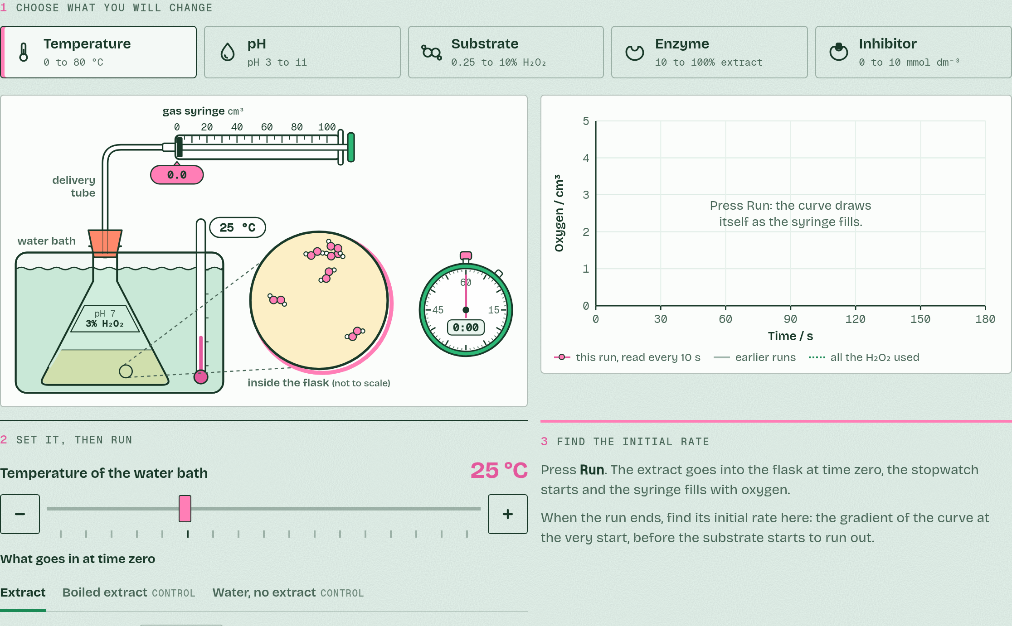
DRY LAB
Catalase and hydrogen peroxide
Your question: How does one factor change the initial rate at which catalase breaks down hydrogen peroxide? Start with temperature: where is the optimum, and what happens beyond it?
What you can change: One independent variable at a time: temperature, pH, hydrogen peroxide concentration or extract concentration. Everything else stays fixed unless you change it on purpose.
What to record: The volume of oxygen every 10 seconds, then the initial rate in cm³ min⁻¹: the gradient at the very start. At least three trials at each value (the bench allows five), a mean and a standard deviation, and a graph of the means with error bars. The coach under the bench helps you plan, process and evaluate.
Run it: biologybybradford.com/guides/ib-biology-c1-1-enzymes-and-metabolism#lab
Minutes 25 to 55
Notes:
Minutes 25 to 55 of 60: The dry lab with the coach (30 min).
The plan: In pairs on the dry lab. Start with How? Why? Units? in the coach, then run a temperature series with three repeats, find the means and standard deviations and draw the graph with error bars. Ask pairs to compare their curve with chapter 7's sketch graph.
The dry lab runs in the guide: https://www.biologybybradford.com/guides/ib-biology-c1-1-enzymes-and-metabolism#lab

Slide 17
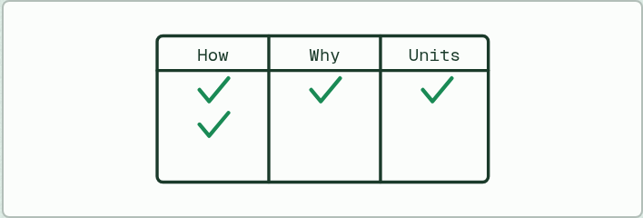
PLANNING
30 MIN
How? Why? Units?
THE TASK
Before running the dry lab, pairs fill the coach's variables table: for each variable, how it is set or measured, why it matters, and its unit. The planning questions become the coach's checklist: the range of values, time for the reaction, controlled variables, a negative control with no enzyme, a positive control, bringing the enzyme to temperature first, the precision of the measurement, and safety.
STUDENTS NEED
A device per pair.
Minutes 25 to 55
Notes:
Minutes 25 to 55 of 60: The dry lab with the coach (30 min).
The plan: In pairs on the dry lab. Start with How? Why? Units? in the coach, then run a temperature series with three repeats, find the means and standard deviations and draw the graph with error bars. Ask pairs to compare their curve with chapter 7's sketch graph.
The activity: How? Why? Units?. Before running the dry lab, pairs fill the coach's variables table: for each variable, how it is set or measured, why it matters, and its unit. The planning questions become the coach's checklist: the range of values, time for the reaction, controlled variables, a negative control with no enzyme, a positive control, bringing the enzyme to temperature first, the precision of the measurement, and safety.
Needs: a device per pair.
The time: 30 minutes, minutes 25 to 55 of the plan.

Slide 18
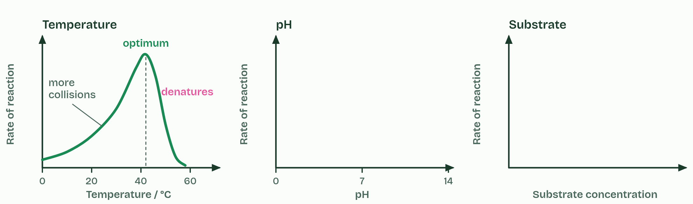
CHAPTER 7 · C1.1.8 Effects of temperature, pH and substrate concentration
1 / 4
Three graphs to know
Temperature: faster collisions, then denaturation.
Minutes 25 to 55
Notes:
Minutes 25 to 55 of 60: The dry lab with the coach (30 min).
The plan: In pairs on the dry lab. Start with How? Why? Units? in the coach, then run a temperature series with three repeats, find the means and standard deviations and draw the graph with error bars. Ask pairs to compare their curve with chapter 7's sketch graph.
Sketch it first. On paper or a whiteboard, sketch rate of reaction against temperature, against pH and against substrate concentration before you play the figure. Then check yourself against it.
Temperature. Below the optimum, warming the solution makes enzyme and substrate move faster, so they collide more often and more collisions have enough energy to react. The rate rises, roughly doubling for every 10 °C. Above the optimum the enzyme denatures faster than the extra collisions can help, and the rate falls steeply. So the curve is not symmetrical: a gentle rise, a steep fall. Optima differ. Many human enzymes work best at about 37 to 40 °C; the DNA polymerase of a bacterium from hot springs works best at about 75 °C.
pH. Each enzyme works fastest at its own optimum pH, and the rate falls either side as the charges in the active site change and, further out, the enzyme denatures. Pepsin in the stomach prefers about pH 2, salivary amylase about pH 7 and trypsin in the small intestine about pH 8.
Substrate concentration. At low concentration, more substrate means more collisions with free active sites, so the rate rises almost in step. Then the curve bends over and levels off at a maximum. More enzyme would raise that maximum. All three effects follow from collision theory and denaturation.
Describe a graph in parts, with numbers from its axes: "rises steadily to an optimum near 40 °C, then falls steeply". These smooth curves are sketch graphs: models of the general pattern, not the data of one enzyme. Real results scatter and have their own optimum, and a model is tested against results from experiments such as the dry lab's.

Slide 19
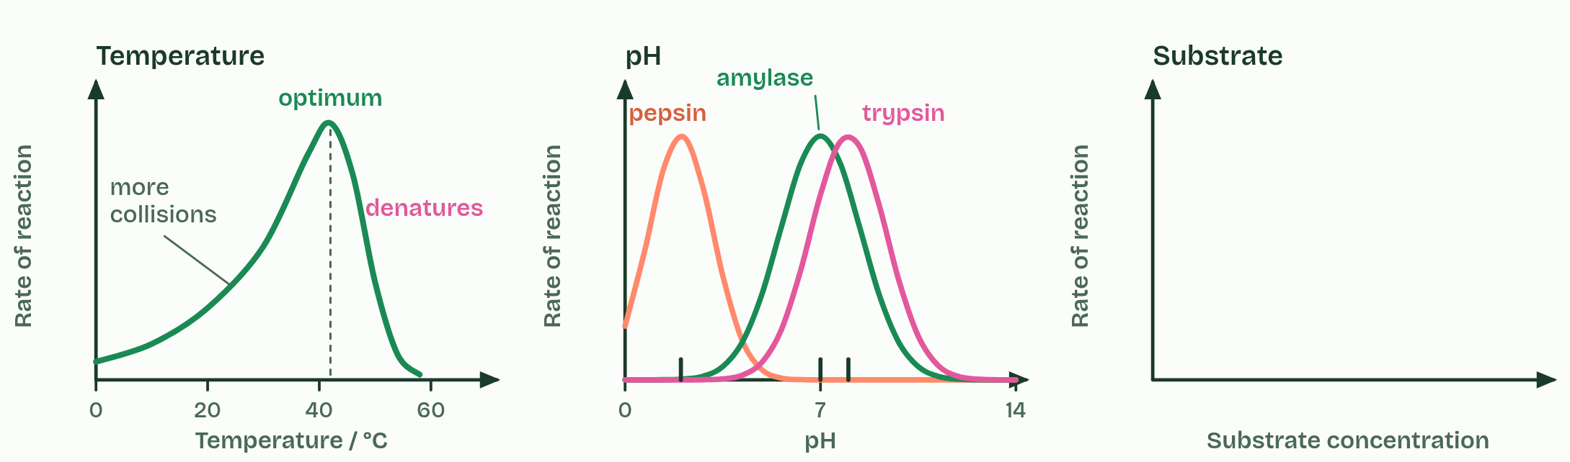
CHAPTER 7 · C1.1.8 Effects of temperature, pH and substrate concentration
2 / 4
Three graphs to know
pH: each enzyme has its own optimum.
Minutes 25 to 55
Notes:
Minutes 25 to 55 of 60: The dry lab with the coach (30 min).
The plan: In pairs on the dry lab. Start with How? Why? Units? in the coach, then run a temperature series with three repeats, find the means and standard deviations and draw the graph with error bars. Ask pairs to compare their curve with chapter 7's sketch graph.
Sketch it first. On paper or a whiteboard, sketch rate of reaction against temperature, against pH and against substrate concentration before you play the figure. Then check yourself against it.
Temperature. Below the optimum, warming the solution makes enzyme and substrate move faster, so they collide more often and more collisions have enough energy to react. The rate rises, roughly doubling for every 10 °C. Above the optimum the enzyme denatures faster than the extra collisions can help, and the rate falls steeply. So the curve is not symmetrical: a gentle rise, a steep fall. Optima differ. Many human enzymes work best at about 37 to 40 °C; the DNA polymerase of a bacterium from hot springs works best at about 75 °C.
pH. Each enzyme works fastest at its own optimum pH, and the rate falls either side as the charges in the active site change and, further out, the enzyme denatures. Pepsin in the stomach prefers about pH 2, salivary amylase about pH 7 and trypsin in the small intestine about pH 8.
Substrate concentration. At low concentration, more substrate means more collisions with free active sites, so the rate rises almost in step. Then the curve bends over and levels off at a maximum. More enzyme would raise that maximum. All three effects follow from collision theory and denaturation.
Describe a graph in parts, with numbers from its axes: "rises steadily to an optimum near 40 °C, then falls steeply". These smooth curves are sketch graphs: models of the general pattern, not the data of one enzyme. Real results scatter and have their own optimum, and a model is tested against results from experiments such as the dry lab's.

Slide 20
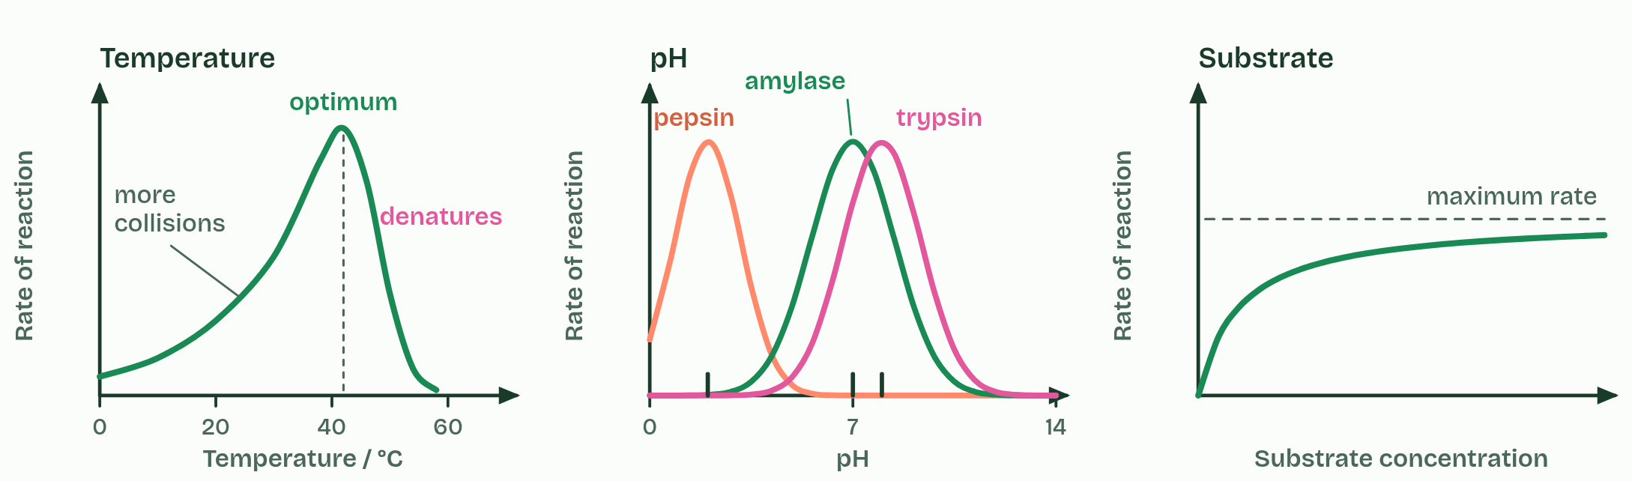
CHAPTER 7 · C1.1.8 Effects of temperature, pH and substrate concentration
3 / 4
Three graphs to know
Substrate: the rate rises, then levels off.
Minutes 25 to 55
Notes:
Minutes 25 to 55 of 60: The dry lab with the coach (30 min).
The plan: In pairs on the dry lab. Start with How? Why? Units? in the coach, then run a temperature series with three repeats, find the means and standard deviations and draw the graph with error bars. Ask pairs to compare their curve with chapter 7's sketch graph.
Sketch it first. On paper or a whiteboard, sketch rate of reaction against temperature, against pH and against substrate concentration before you play the figure. Then check yourself against it.
Temperature. Below the optimum, warming the solution makes enzyme and substrate move faster, so they collide more often and more collisions have enough energy to react. The rate rises, roughly doubling for every 10 °C. Above the optimum the enzyme denatures faster than the extra collisions can help, and the rate falls steeply. So the curve is not symmetrical: a gentle rise, a steep fall. Optima differ. Many human enzymes work best at about 37 to 40 °C; the DNA polymerase of a bacterium from hot springs works best at about 75 °C.
pH. Each enzyme works fastest at its own optimum pH, and the rate falls either side as the charges in the active site change and, further out, the enzyme denatures. Pepsin in the stomach prefers about pH 2, salivary amylase about pH 7 and trypsin in the small intestine about pH 8.
Substrate concentration. At low concentration, more substrate means more collisions with free active sites, so the rate rises almost in step. Then the curve bends over and levels off at a maximum. More enzyme would raise that maximum. All three effects follow from collision theory and denaturation.
Describe a graph in parts, with numbers from its axes: "rises steadily to an optimum near 40 °C, then falls steeply". These smooth curves are sketch graphs: models of the general pattern, not the data of one enzyme. Real results scatter and have their own optimum, and a model is tested against results from experiments such as the dry lab's.

Slide 21
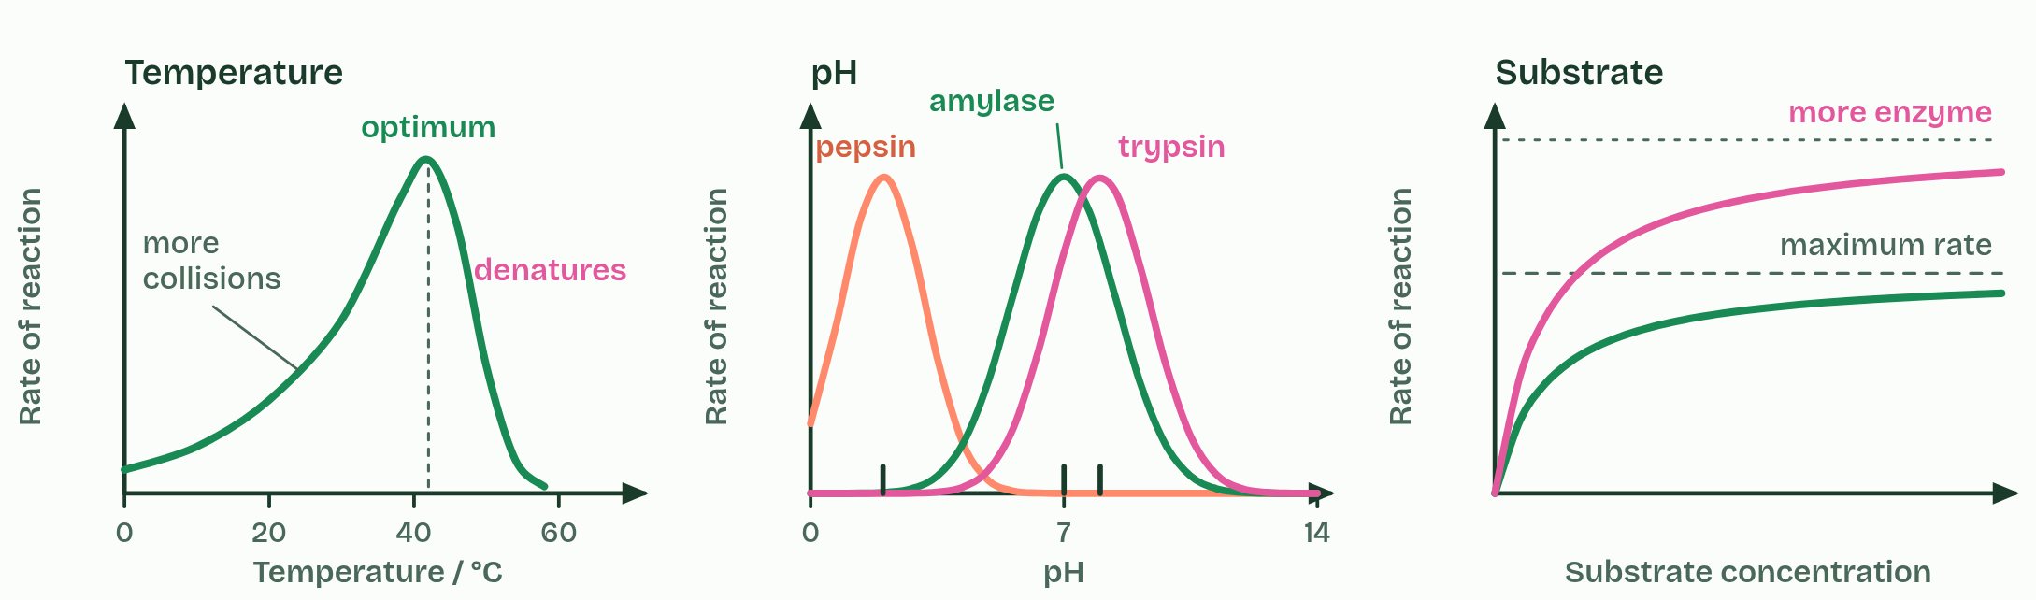
CHAPTER 7 · C1.1.8 Effects of temperature, pH and substrate concentration
4 / 4
Three graphs to know
More enzyme raises the maximum.
Minutes 25 to 55
Notes:
Minutes 25 to 55 of 60: The dry lab with the coach (30 min).
The plan: In pairs on the dry lab. Start with How? Why? Units? in the coach, then run a temperature series with three repeats, find the means and standard deviations and draw the graph with error bars. Ask pairs to compare their curve with chapter 7's sketch graph.
Sketch it first. On paper or a whiteboard, sketch rate of reaction against temperature, against pH and against substrate concentration before you play the figure. Then check yourself against it.
Temperature. Below the optimum, warming the solution makes enzyme and substrate move faster, so they collide more often and more collisions have enough energy to react. The rate rises, roughly doubling for every 10 °C. Above the optimum the enzyme denatures faster than the extra collisions can help, and the rate falls steeply. So the curve is not symmetrical: a gentle rise, a steep fall. Optima differ. Many human enzymes work best at about 37 to 40 °C; the DNA polymerase of a bacterium from hot springs works best at about 75 °C.
pH. Each enzyme works fastest at its own optimum pH, and the rate falls either side as the charges in the active site change and, further out, the enzyme denatures. Pepsin in the stomach prefers about pH 2, salivary amylase about pH 7 and trypsin in the small intestine about pH 8.
Substrate concentration. At low concentration, more substrate means more collisions with free active sites, so the rate rises almost in step. Then the curve bends over and levels off at a maximum. More enzyme would raise that maximum. All three effects follow from collision theory and denaturation.
Describe a graph in parts, with numbers from its axes: "rises steadily to an optimum near 40 °C, then falls steeply". These smooth curves are sketch graphs: models of the general pattern, not the data of one enzyme. Real results scatter and have their own optimum, and a model is tested against results from experiments such as the dry lab's.

Slide 22
CHAPTER 7 · C1.1.8 Effects of temperature, pH and substrate concentration
Three graphs to know
Below the optimum, warming the solution makes enzyme and substrate move faster, so they collide more often and more collisions have enough energy to react.
Above the optimum the enzyme denatures faster than the extra collisions can help, and the rate falls steeply.
Each enzyme works fastest at its own optimum pH, and the rate falls either side as the charges in the active site change and, further out, the enzyme denatures.
All three effects follow from collision theory and denaturation.
Minutes 25 to 55
Notes:
Minutes 25 to 55 of 60: The dry lab with the coach (30 min).
The plan: In pairs on the dry lab. Start with How? Why? Units? in the coach, then run a temperature series with three repeats, find the means and standard deviations and draw the graph with error bars. Ask pairs to compare their curve with chapter 7's sketch graph.
Sketch it first. On paper or a whiteboard, sketch rate of reaction against temperature, against pH and against substrate concentration before you play the figure. Then check yourself against it.
Temperature. Below the optimum, warming the solution makes enzyme and substrate move faster, so they collide more often and more collisions have enough energy to react. The rate rises, roughly doubling for every 10 °C. Above the optimum the enzyme denatures faster than the extra collisions can help, and the rate falls steeply. So the curve is not symmetrical: a gentle rise, a steep fall. Optima differ. Many human enzymes work best at about 37 to 40 °C; the DNA polymerase of a bacterium from hot springs works best at about 75 °C.
pH. Each enzyme works fastest at its own optimum pH, and the rate falls either side as the charges in the active site change and, further out, the enzyme denatures. Pepsin in the stomach prefers about pH 2, salivary amylase about pH 7 and trypsin in the small intestine about pH 8.
Substrate concentration. At low concentration, more substrate means more collisions with free active sites, so the rate rises almost in step. Then the curve bends over and levels off at a maximum. More enzyme would raise that maximum. All three effects follow from collision theory and denaturation.
Describe a graph in parts, with numbers from its axes: "rises steadily to an optimum near 40 °C, then falls steeply". These smooth curves are sketch graphs: models of the general pattern, not the data of one enzyme. Real results scatter and have their own optimum, and a model is tested against results from experiments such as the dry lab's.

Slide 23
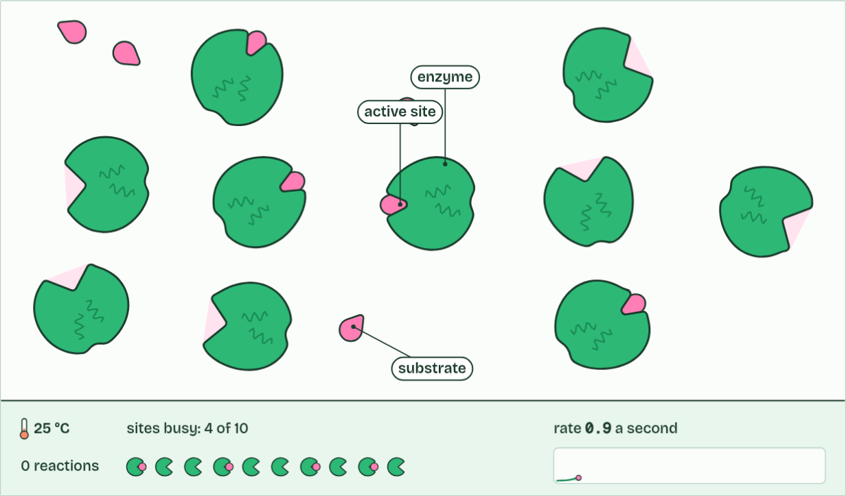
CHAPTER 7 · C1.1.8 Effects of temperature, pH and substrate concentration
0 reactions
1 / 3
Three graphs to know
Molecules move at random, and most collisions miss the active site.
Minutes 25 to 55
Notes:
Minutes 25 to 55 of 60: The dry lab with the coach (30 min).
The plan: In pairs on the dry lab. Start with How? Why? Units? in the coach, then run a temperature series with three repeats, find the means and standard deviations and draw the graph with error bars. Ask pairs to compare their curve with chapter 7's sketch graph.
Sketch it first. On paper or a whiteboard, sketch rate of reaction against temperature, against pH and against substrate concentration before you play the figure. Then check yourself against it.
Temperature. Below the optimum, warming the solution makes enzyme and substrate move faster, so they collide more often and more collisions have enough energy to react. The rate rises, roughly doubling for every 10 °C. Above the optimum the enzyme denatures faster than the extra collisions can help, and the rate falls steeply. So the curve is not symmetrical: a gentle rise, a steep fall. Optima differ. Many human enzymes work best at about 37 to 40 °C; the DNA polymerase of a bacterium from hot springs works best at about 75 °C.
pH. Each enzyme works fastest at its own optimum pH, and the rate falls either side as the charges in the active site change and, further out, the enzyme denatures. Pepsin in the stomach prefers about pH 2, salivary amylase about pH 7 and trypsin in the small intestine about pH 8.
Substrate concentration. At low concentration, more substrate means more collisions with free active sites, so the rate rises almost in step. Then the curve bends over and levels off at a maximum. More enzyme would raise that maximum. All three effects follow from collision theory and denaturation.
Describe a graph in parts, with numbers from its axes: "rises steadily to an optimum near 40 °C, then falls steeply". These smooth curves are sketch graphs: models of the general pattern, not the data of one enzyme. Real results scatter and have their own optimum, and a model is tested against results from experiments such as the dry lab's.
The animation "Watch it happen: collisions, substrate and heat", paused at 2.0 s. The next slides go on through it, then play it.

Slide 24
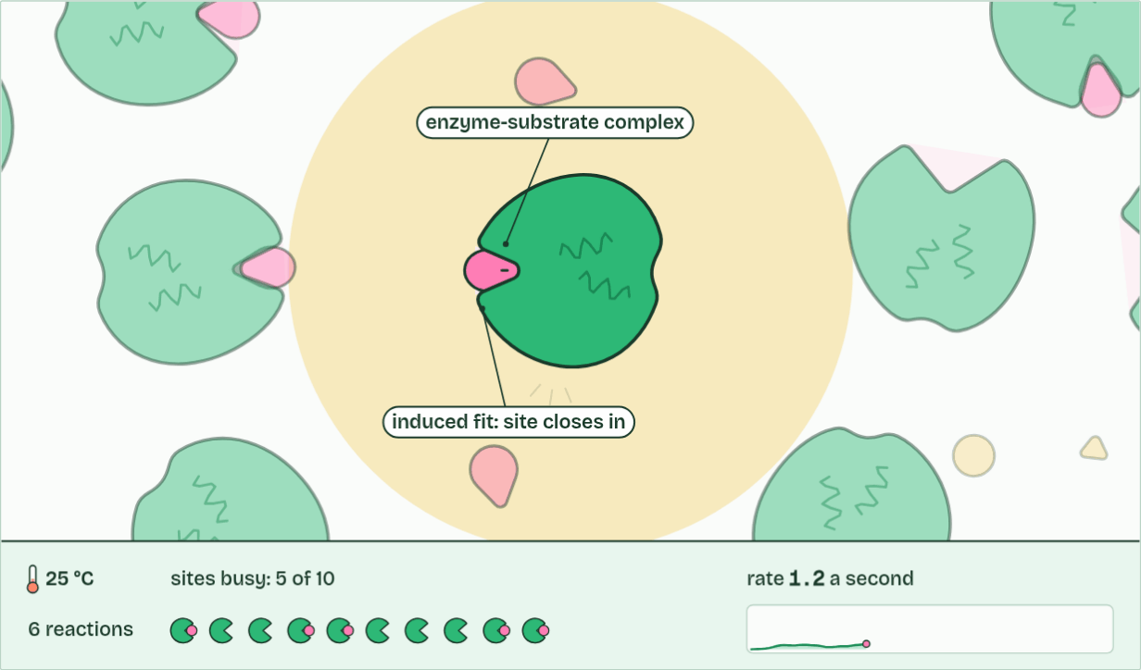
CHAPTER 7 · C1.1.8 Effects of temperature, pH and substrate concentration
6 reactions
2 / 3
Three graphs to know
A successful collision: it binds and reacts, and the enzyme is unchanged.
Minutes 25 to 55
Notes:
Minutes 25 to 55 of 60: The dry lab with the coach (30 min).
The plan: In pairs on the dry lab. Start with How? Why? Units? in the coach, then run a temperature series with three repeats, find the means and standard deviations and draw the graph with error bars. Ask pairs to compare their curve with chapter 7's sketch graph.
Sketch it first. On paper or a whiteboard, sketch rate of reaction against temperature, against pH and against substrate concentration before you play the figure. Then check yourself against it.
Temperature. Below the optimum, warming the solution makes enzyme and substrate move faster, so they collide more often and more collisions have enough energy to react. The rate rises, roughly doubling for every 10 °C. Above the optimum the enzyme denatures faster than the extra collisions can help, and the rate falls steeply. So the curve is not symmetrical: a gentle rise, a steep fall. Optima differ. Many human enzymes work best at about 37 to 40 °C; the DNA polymerase of a bacterium from hot springs works best at about 75 °C.
pH. Each enzyme works fastest at its own optimum pH, and the rate falls either side as the charges in the active site change and, further out, the enzyme denatures. Pepsin in the stomach prefers about pH 2, salivary amylase about pH 7 and trypsin in the small intestine about pH 8.
Substrate concentration. At low concentration, more substrate means more collisions with free active sites, so the rate rises almost in step. Then the curve bends over and levels off at a maximum. More enzyme would raise that maximum. All three effects follow from collision theory and denaturation.
Describe a graph in parts, with numbers from its axes: "rises steadily to an optimum near 40 °C, then falls steeply". These smooth curves are sketch graphs: models of the general pattern, not the data of one enzyme. Real results scatter and have their own optimum, and a model is tested against results from experiments such as the dry lab's.
The animation "Watch it happen: collisions, substrate and heat", paused at 7.8 s. The next slides go on through it, then play it.

Slide 25
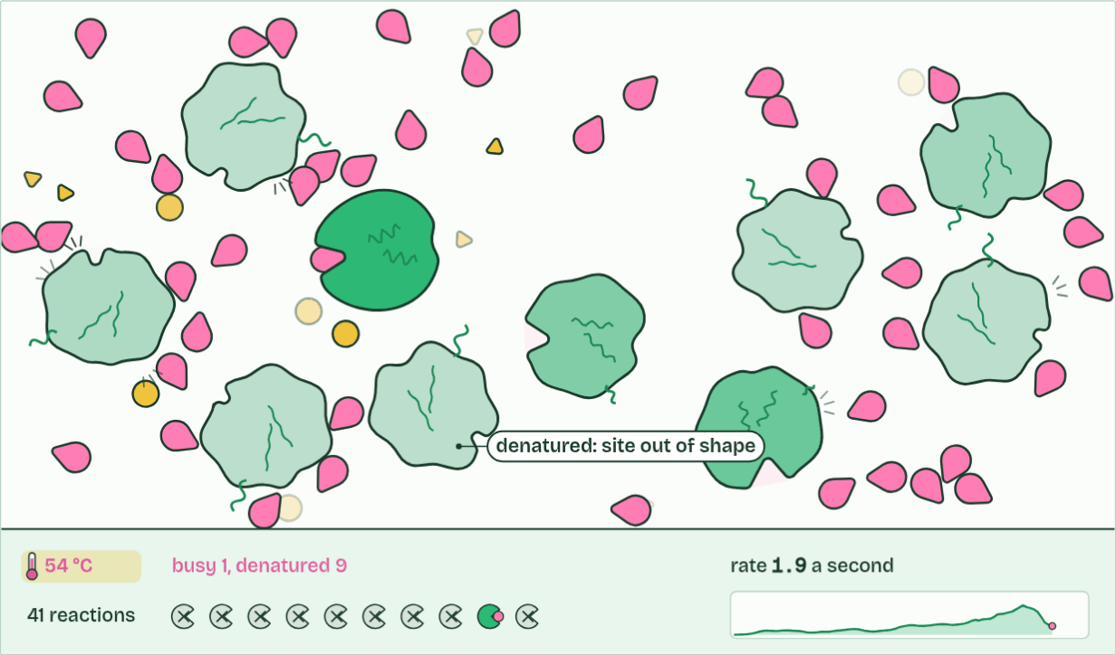
CHAPTER 7 · C1.1.8 Effects of temperature, pH and substrate concentration
41 reactions
3 / 3
Three graphs to know
Too hot: enzymes denature. Active sites lose their shape, and the rate falls.
Minutes 25 to 55
Notes:
Minutes 25 to 55 of 60: The dry lab with the coach (30 min).
The plan: In pairs on the dry lab. Start with How? Why? Units? in the coach, then run a temperature series with three repeats, find the means and standard deviations and draw the graph with error bars. Ask pairs to compare their curve with chapter 7's sketch graph.
Sketch it first. On paper or a whiteboard, sketch rate of reaction against temperature, against pH and against substrate concentration before you play the figure. Then check yourself against it.
Temperature. Below the optimum, warming the solution makes enzyme and substrate move faster, so they collide more often and more collisions have enough energy to react. The rate rises, roughly doubling for every 10 °C. Above the optimum the enzyme denatures faster than the extra collisions can help, and the rate falls steeply. So the curve is not symmetrical: a gentle rise, a steep fall. Optima differ. Many human enzymes work best at about 37 to 40 °C; the DNA polymerase of a bacterium from hot springs works best at about 75 °C.
pH. Each enzyme works fastest at its own optimum pH, and the rate falls either side as the charges in the active site change and, further out, the enzyme denatures. Pepsin in the stomach prefers about pH 2, salivary amylase about pH 7 and trypsin in the small intestine about pH 8.
Substrate concentration. At low concentration, more substrate means more collisions with free active sites, so the rate rises almost in step. Then the curve bends over and levels off at a maximum. More enzyme would raise that maximum. All three effects follow from collision theory and denaturation.
Describe a graph in parts, with numbers from its axes: "rises steadily to an optimum near 40 °C, then falls steeply". These smooth curves are sketch graphs: models of the general pattern, not the data of one enzyme. Real results scatter and have their own optimum, and a model is tested against results from experiments such as the dry lab's.
The animation "Watch it happen: collisions, substrate and heat", paused at 21.8 s. The next slides go on through it, then play it.

Slide 26
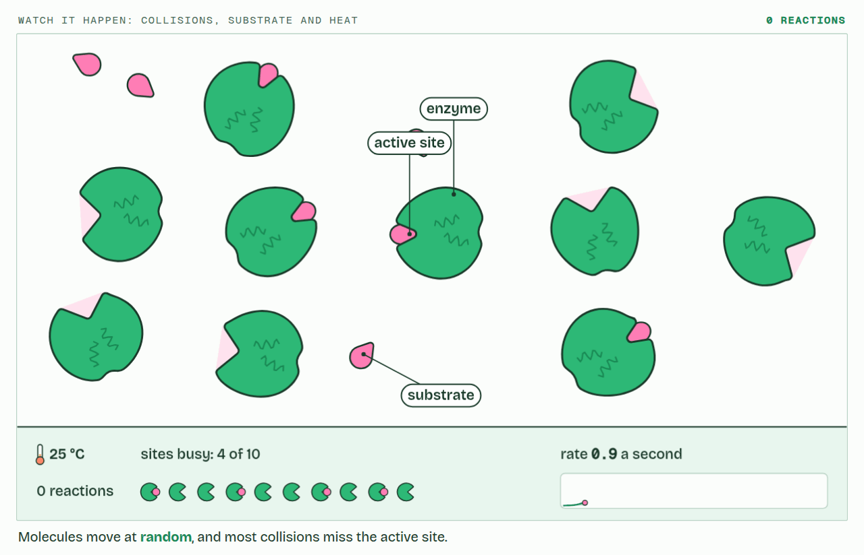
CHAPTER 7 · C1.1.8 Effects of temperature, pH and substrate concentration
PLAY IT
Three graphs to know
Watch it happen: collisions, substrate and heat: click to play. It loops every 24 seconds.
Minutes 25 to 55
Notes:
Minutes 25 to 55 of 60: The dry lab with the coach (30 min).
The plan: In pairs on the dry lab. Start with How? Why? Units? in the coach, then run a temperature series with three repeats, find the means and standard deviations and draw the graph with error bars. Ask pairs to compare their curve with chapter 7's sketch graph.
The video is collisions-dab518.mp4, one loop of the animation in the guide. It plays in PowerPoint and Keynote. Google Slides does not play a video embedded in a .pptx: download collisions-dab518.mp4 (https://www.biologybybradford.com/guides/downloads/scenes/collisions-dab518.mp4), upload it to Google Drive, then Insert > Video > Google Drive.
In the guide the class can change it as it runs: https://www.biologybybradford.com/guides/ib-biology-c1-1-enzymes-and-metabolism#factors
What it shows, in order:
1. Molecules move at random, and most collisions miss the active site.
2. A successful collision: it binds and reacts, and the enzyme is unchanged.
3. Too hot: enzymes denature. Active sites lose their shape, and the rate falls.

Slide 27
PREDICT
On a graph of rate against substrate concentration, the curve levels off. Why?
A The substrate has all been used up
B The enzyme is denatured by so much substrate
C Nearly every active site is already busy
D Molecules collide less often when crowded
Minutes 25 to 55
Notes:
Minutes 25 to 55 of 60: The dry lab with the coach (30 min).
The plan: In pairs on the dry lab. Start with How? Why? Units? in the coach, then run a temperature series with three repeats, find the means and standard deviations and draw the graph with error bars. Ask pairs to compare their curve with chapter 7's sketch graph.
Ask for a show of hands, or mini whiteboards, before revealing. (Answer: C, on the next slide.)

Slide 28
WHAT HAPPENS
On a graph of rate against substrate concentration, the curve levels off. Why?
A The substrate has all been used up
B The enzyme is denatured by so much substrate
C Nearly every active site is already busy
D Molecules collide less often when crowded
At high substrate concentration nearly every active site is occupied at any moment. A substrate molecule arriving at a busy enzyme has to wait, so adding more substrate barely raises the rate. This is saturation. The substrate has not run out: there is more of it than ever. Only more enzyme can raise the maximum.
Minutes 25 to 55
Notes:
Minutes 25 to 55 of 60: The dry lab with the coach (30 min).
The plan: In pairs on the dry lab. Start with How? Why? Units? in the coach, then run a temperature series with three repeats, find the means and standard deviations and draw the graph with error bars. Ask pairs to compare their curve with chapter 7's sketch graph.
Answer: C. At high substrate concentration nearly every active site is occupied at any moment. A substrate molecule arriving at a busy enzyme has to wait, so adding more substrate barely raises the rate. This is saturation. The substrate has not run out: there is more of it than ever. Only more enzyme can raise the maximum.

Slide 29
REMEMBER IT
The three factors you must explain
T
P
S
Tigers
Prefer
Steak
Minutes 25 to 55
Notes:
Minutes 25 to 55 of 60: The dry lab with the coach (30 min).
The plan: In pairs on the dry lab. Start with How? Why? Units? in the coach, then run a temperature series with three repeats, find the means and standard deviations and draw the graph with error bars. Ask pairs to compare their curve with chapter 7's sketch graph.
Ask the class what each letter stands for before revealing.

Slide 30
REMEMBER IT
The three factors you must explain
T
P
S
Tigers
Prefer
Steak
Temperature
pH
Substrate concentration
collisions, then denaturation
charges in the active site
collisions, then saturation
Minutes 25 to 55
Notes:
Minutes 25 to 55 of 60: The dry lab with the coach (30 min).
The plan: In pairs on the dry lab. Start with How? Why? Units? in the coach, then run a temperature series with three repeats, find the means and standard deviations and draw the graph with error bars. Ask pairs to compare their curve with chapter 7's sketch graph.
Tigers: Temperature (collisions, then denaturation)
Prefer: pH (charges in the active site)
Steak: Substrate concentration (collisions, then saturation)

Slide 31
WATCH OUT
The optimum is not always 37 °C. That is roughly where many human enzymes peak; enzymes from other organisms peak far higher or lower.
Minutes 25 to 55
Notes:
Minutes 25 to 55 of 60: The dry lab with the coach (30 min).
The plan: In pairs on the dry lab. Start with How? Why? Units? in the coach, then run a temperature series with three repeats, find the means and standard deviations and draw the graph with error bars. Ask pairs to compare their curve with chapter 7's sketch graph.
A common mistake: say it, then ask who can say why it is wrong.

Slide 32

PRACTICAL
IF THERE IS TIME
The enzyme in your spit
THE TASK
Optional, for a practical lesson outside the three hours. The site's own lab, the enzyme in your spit, with its sheet: salivary amylase and starch at cold, room and warm temperatures, iodine as the end point, and the rate worked out as 1 ÷ time.
STUDENTS NEED
As the lab page lists.
Minutes 25 to 55
Notes:
Minutes 25 to 55 of 60: The dry lab with the coach (30 min).
The plan: In pairs on the dry lab. Start with How? Why? Units? in the coach, then run a temperature series with three repeats, find the means and standard deviations and draw the graph with error bars. Ask pairs to compare their curve with chapter 7's sketch graph.
The activity: The enzyme in your spit. Optional, for a practical lesson outside the three hours. The site's own lab, the enzyme in your spit, with its sheet: salivary amylase and starch at cold, room and warm temperatures, iodine as the end point, and the rate worked out as 1 ÷ time.
Needs: as the lab page lists.
The plan sets no time of its own for this activity: use it in this step, in place of part of it, or for homework.

Slide 33
PLENARY
Can you now...
Work out a rate from your own results or from secondary data, including the initial rate from a tangent (C1.1.9)
Minutes 55 to 60
Notes:
Minutes 55 to 60 of 60: Exit (5 min).
The plan: Write your research question, and one weakness of the method with its improvement.
Thumbs up, sideways or down on each goal before the exit question. The goals come from the statements this lesson covers.

Slide 34
EXIT QUESTION
Before you go
Write your research question, and one weakness of the method with its improvement.
Minutes 55 to 60
Notes:
Minutes 55 to 60 of 60: Exit (5 min).
The plan: Write your research question, and one weakness of the method with its improvement.

Slide 35
PRACTISE AND REVISE
Keep going
Exam practice: a fresh paper of exam questions on C1.1 at standard level, marked as you go
The guide, with the animations and the dry lab
This lesson in the guide: 7 Three graphs to know, 8 Measuring a rate, the dry lab
BUILD FOR YOUR CLASS
ALREADY ON THE SITE FOR C1.1
CARD SETS ON SPLYCR
Tarsia puzzle, dominoes and picture reveal on C1.1, built from its key terms and ready to print
A pub quiz with rounds on C1.1, to present or run with no projector
An escape room built from the question bank on C1.1
Lab: The Enzyme in Your Spit
Summary doodle: Enzymes & Metabolism
Quiz: Enzymes
Revision map: C1.1 Enzymes and metabolism, to fill in
Exam questions: C1.1 in the exam maker, a paper with its markscheme
Open a set to host it as a class game, or make a copy to edit.
C1.1 Enzymes and Metabolism
How this was made. The course structure, the activities and the teaching choices come from my own classroom, my presentations and my years of teaching IB and AP Biology. I use Claude, an AI, to help write and build the interactive guides, lesson plans, slides and practice questions, and to draw the diagrams and code the interactives. I direct the work and review it against the IB and AP specifications before it goes live.
Minute 60: after the lesson
Notes:
Every link here is live. Set the exam practice paper for homework: it is fresh each time, marked as students go and saved to their Exam practice when they are signed in.
Exam practice: https://www.biologybybradford.com/exam-maker/sit?topics=C1.1&level=SL&paper=quiz&marks=15&src=ep
The guide: https://www.biologybybradford.com/guides/ib-biology-c1-1-enzymes-and-metabolism

