Slide 1
IB Biology C1.1
LESSON 4 OF 5
HL
BY THE END YOU CAN
Enzymes and metabolism
Compare enzymes at work inside cells and outside them, and linear pathways with cycles (C1.1.11, C1.1.13)
Explain why metabolism always releases heat, and how mammals and birds use it (C1.1.12)
Explain how a molecule binding an allosteric site stops an enzyme, and why the binding can be undone (C1.1.14)
Pathways, places and heat
C1.1.11 to C1.1.14
Enzymes inside and outside cells, linear and cyclical pathways, heat from metabolism, and the allosteric site
60 minutes · chapters 9, 10, 11
Minute 0
Notes:
IB Biology C1.1, Enzymes and metabolism. Lesson 4 of 5: Pathways, places and heat (higher level), 60 minutes.
The plan, minute by minute (each slide's footer says where you are):
0 to 5 min (5) Do now: Inside or outside?
5 to 20 min (15) Chapter 9: chains and cycles
20 to 32 min (12) Chapter 10: warm from the inside
32 to 45 min (13) Chapter 11: a second site
45 to 55 min (10) Timed written question
55 to 60 min (5) Exit
What students get wrong:
Intracellular means in the cytoplasm. It means anywhere inside the cell, an organelle included.
Heat from respiration is waste with no use. Mammals and birds depend on it.
All inhibitors block the active site. Non-competitive ones bind elsewhere.
Stretch and support:
Stretch: make a Tarsia puzzle on C1.1 better than the site's own, in the Tarsia builder.
The lesson plan to print: https://www.biologybybradford.com/guides/downloads/ib-biology-c1-1-enzymes-and-metabolism-lesson-4-plan.pdf

Slide 2
DO NOW
Inside or outside?
The card sort below, as a first look: students place each process inside or outside a cell on an A3 outline.
5:00
minutes
Start now: the timer is running.
Minutes 0 to 5
Notes:
Minutes 0 to 5 of 60: Do now: Inside or outside? (5 min).
The plan: The card sort below, as a first look: students place each process inside or outside a cell on an A3 outline. Come back to it at the end of chapter 9.
Start a 5 minute timer as they come in.

Slide 3
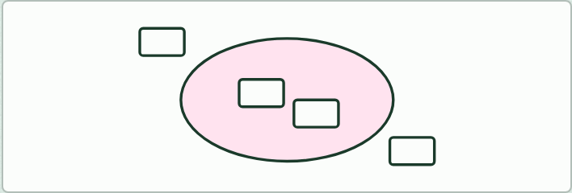
CARD SORT · HL
5 MIN
Inside or outside?
THE TASK
Cards: glycolysis, the Krebs cycle, the Calvin cycle, DNA replication, protein synthesis, starch digestion in the mouth, protein digestion in the stomach, lipid digestion in the small intestine, and lysozyme breaking bacterial walls in tears. Sort them onto a drawing of a cell with its outside marked. Then ask which are linear and which cyclical.
STUDENTS NEED
The cards and an A3 cell outline per group.
Minutes 0 to 5
Notes:
Minutes 0 to 5 of 60: Do now: Inside or outside? (5 min).
The plan: The card sort below, as a first look: students place each process inside or outside a cell on an A3 outline. Come back to it at the end of chapter 9.
The activity: Inside or outside?. Cards: glycolysis, the Krebs cycle, the Calvin cycle, DNA replication, protein synthesis, starch digestion in the mouth, protein digestion in the stomach, lipid digestion in the small intestine, and lysozyme breaking bacterial walls in tears. Sort them onto a drawing of a cell with its outside marked. Then ask which are linear and which cyclical.
Needs: the cards and an A3 cell outline per group.
The time: 5 minutes, minutes 0 to 5 of the plan.

Slide 4
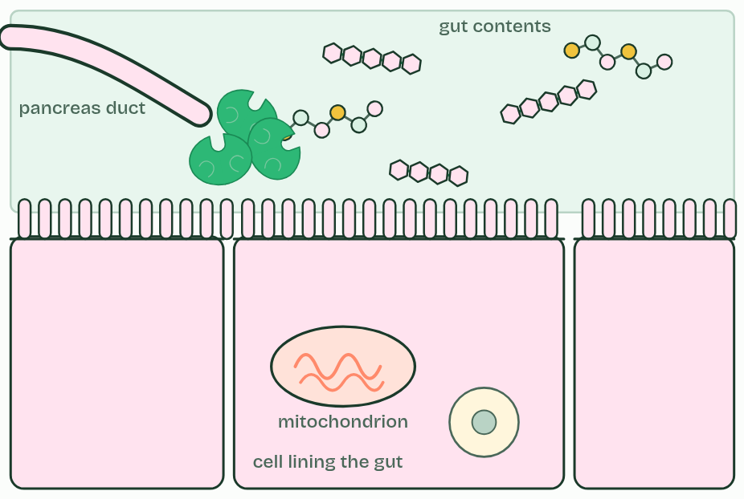
CHAPTER 9 · C1.1.11 C1.1.13 Intracellular and extracellular reactions; linear and cyclical pathways
Chains, cycles, inside and out
Intracellular reactions happen inside cells, catalysed by enzymes that stay there.
"Inside" means anywhere inside: in the cytoplasm, as glycolysis, the first stage of respiration, does, or inside an organelle, as the Krebs cycle does in the matrix of a mitochondrion.
Extracellular reactions happen outside the cells that made the enzymes.
Enzymes that stay in the cytoplasm, such as those of glycolysis, are made by free ribosomes.
Minutes 0 to 5
Notes:
Minutes 0 to 5 of 60: Do now: Inside or outside? (5 min).
The plan: The card sort below, as a first look: students place each process inside or outside a cell on an A3 outline. Come back to it at the end of chapter 9.
Intracellular reactions happen inside cells, catalysed by enzymes that stay there. "Inside" means anywhere inside: in the cytoplasm, as glycolysis, the first stage of respiration, does, or inside an organelle, as the Krebs cycle does in the matrix of a mitochondrion. Extracellular reactions happen outside the cells that made the enzymes. The example is chemical digestion in the gut: cells of the salivary glands, the stomach lining and the pancreas make digestive enzymes and secrete them into the gut, where they hydrolyse food molecules.
The two kinds are made in different places. Enzymes that stay in the cytoplasm, such as those of glycolysis, are made by free ribosomes. Enzymes for export are made by ribosomes on the rough endoplasmic reticulum, packaged by the Golgi apparatus and released by exocytosis (B2.2).
Most metabolism runs as pathways, a series of steps each with its own enzyme. In a linear pathway the first substrate is turned, step by step, into a different end product. Glycolysis is the example: glucose goes in at the start and pyruvate comes out about ten steps later. A cyclical pathway ends by remaking the molecule it started from. Something is added at each turn and something leaves, but the carrier molecule comes back round, so a small amount of it keeps the cycle turning. The Krebs cycle (C1.2) and the Calvin cycle (C1.3) are the examples.
Why pathways, and not one leap? Each step needs only a small activation energy, energy is released or used a little at a time, and each step's enzyme is a point of control (chapter 13).
Parts of the figure:
The gut contents This is outside every cell. Digestive enzymes that were secreted into the gut break the food down here: an extracellular reaction.
Duct from the pancreas Cells in the pancreas make digestive enzymes and secrete them along this duct into the gut.
Inside a cell Glycolysis runs here, in the cytoplasm. Everything inside the cell's membrane is intracellular.
The cell's own membrane Microvilli, its fingers, carry enzymes fixed in the membrane that finish digestion at the cell surface (chapter 5).
An organelle inside the cell The Krebs cycle runs in the matrix of the mitochondrion. This is inside a cell too, so it is intracellular.

Slide 5
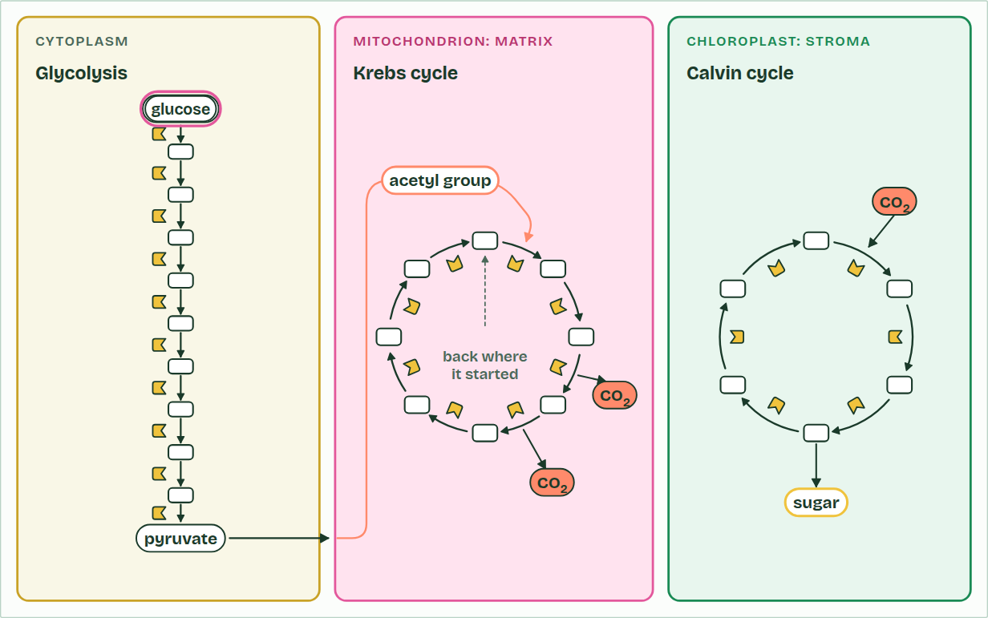
CHAPTER 9 · C1.1.11 C1.1.13 Intracellular and extracellular reactions; linear and cyclical pathways
Glycolysis
1 / 3
Chains, cycles, inside and out
Glycolysis, in the cytoplasm: glucose is changed a step at a time, each step by its own enzyme.
Minutes 0 to 5
Notes:
Minutes 0 to 5 of 60: Do now: Inside or outside? (5 min).
The plan: The card sort below, as a first look: students place each process inside or outside a cell on an A3 outline. Come back to it at the end of chapter 9.
Intracellular reactions happen inside cells, catalysed by enzymes that stay there. "Inside" means anywhere inside: in the cytoplasm, as glycolysis, the first stage of respiration, does, or inside an organelle, as the Krebs cycle does in the matrix of a mitochondrion. Extracellular reactions happen outside the cells that made the enzymes. The example is chemical digestion in the gut: cells of the salivary glands, the stomach lining and the pancreas make digestive enzymes and secrete them into the gut, where they hydrolyse food molecules.
The two kinds are made in different places. Enzymes that stay in the cytoplasm, such as those of glycolysis, are made by free ribosomes. Enzymes for export are made by ribosomes on the rough endoplasmic reticulum, packaged by the Golgi apparatus and released by exocytosis (B2.2).
Most metabolism runs as pathways, a series of steps each with its own enzyme. In a linear pathway the first substrate is turned, step by step, into a different end product. Glycolysis is the example: glucose goes in at the start and pyruvate comes out about ten steps later. A cyclical pathway ends by remaking the molecule it started from. Something is added at each turn and something leaves, but the carrier molecule comes back round, so a small amount of it keeps the cycle turning. The Krebs cycle (C1.2) and the Calvin cycle (C1.3) are the examples.
Why pathways, and not one leap? Each step needs only a small activation energy, energy is released or used a little at a time, and each step's enzyme is a point of control (chapter 13).
The animation "Three pathways on one map", paused at 0.6 s. The next slides go on through it, then play it.

Slide 6
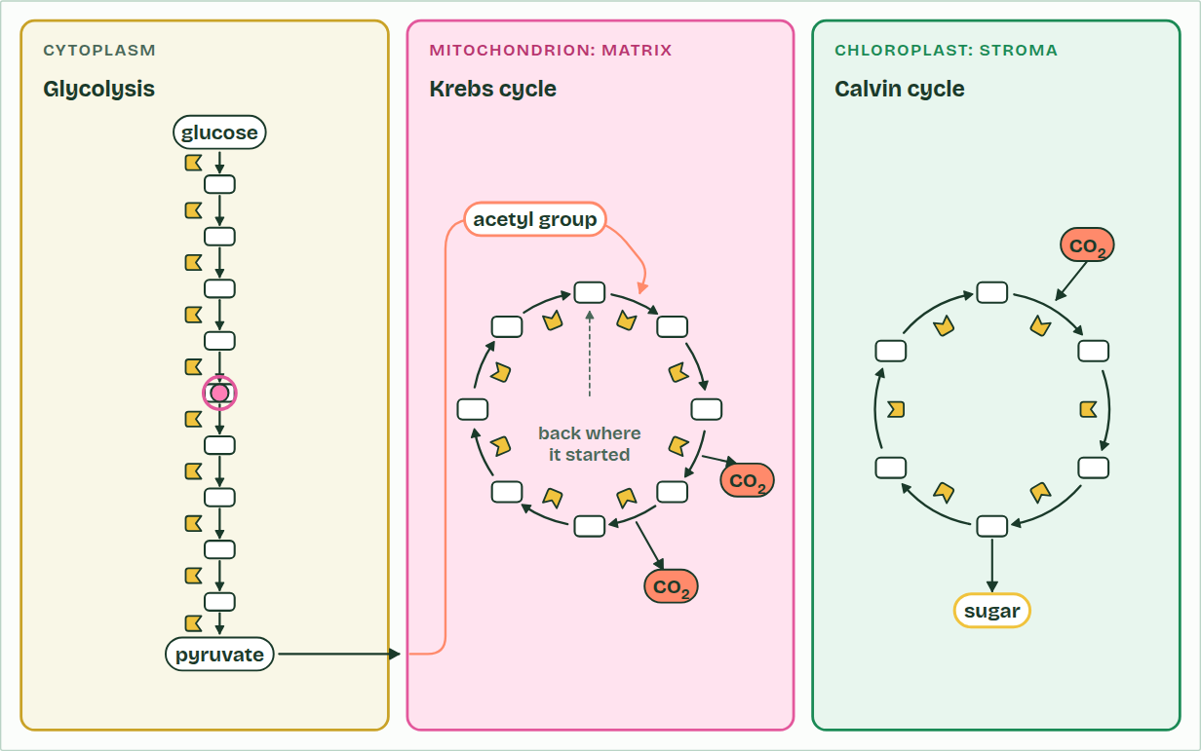
CHAPTER 9 · C1.1.11 C1.1.13 Intracellular and extracellular reactions; linear and cyclical pathways
Glycolysis
2 / 3
Chains, cycles, inside and out
A linear pathway: what goes in at one end leaves at the other as something else, pyruvate.
Minutes 0 to 5
Notes:
Minutes 0 to 5 of 60: Do now: Inside or outside? (5 min).
The plan: The card sort below, as a first look: students place each process inside or outside a cell on an A3 outline. Come back to it at the end of chapter 9.
Intracellular reactions happen inside cells, catalysed by enzymes that stay there. "Inside" means anywhere inside: in the cytoplasm, as glycolysis, the first stage of respiration, does, or inside an organelle, as the Krebs cycle does in the matrix of a mitochondrion. Extracellular reactions happen outside the cells that made the enzymes. The example is chemical digestion in the gut: cells of the salivary glands, the stomach lining and the pancreas make digestive enzymes and secrete them into the gut, where they hydrolyse food molecules.
The two kinds are made in different places. Enzymes that stay in the cytoplasm, such as those of glycolysis, are made by free ribosomes. Enzymes for export are made by ribosomes on the rough endoplasmic reticulum, packaged by the Golgi apparatus and released by exocytosis (B2.2).
Most metabolism runs as pathways, a series of steps each with its own enzyme. In a linear pathway the first substrate is turned, step by step, into a different end product. Glycolysis is the example: glucose goes in at the start and pyruvate comes out about ten steps later. A cyclical pathway ends by remaking the molecule it started from. Something is added at each turn and something leaves, but the carrier molecule comes back round, so a small amount of it keeps the cycle turning. The Krebs cycle (C1.2) and the Calvin cycle (C1.3) are the examples.
Why pathways, and not one leap? Each step needs only a small activation energy, energy is released or used a little at a time, and each step's enzyme is a point of control (chapter 13).
The animation "Three pathways on one map", paused at 4.0 s. The next slides go on through it, then play it.

Slide 7
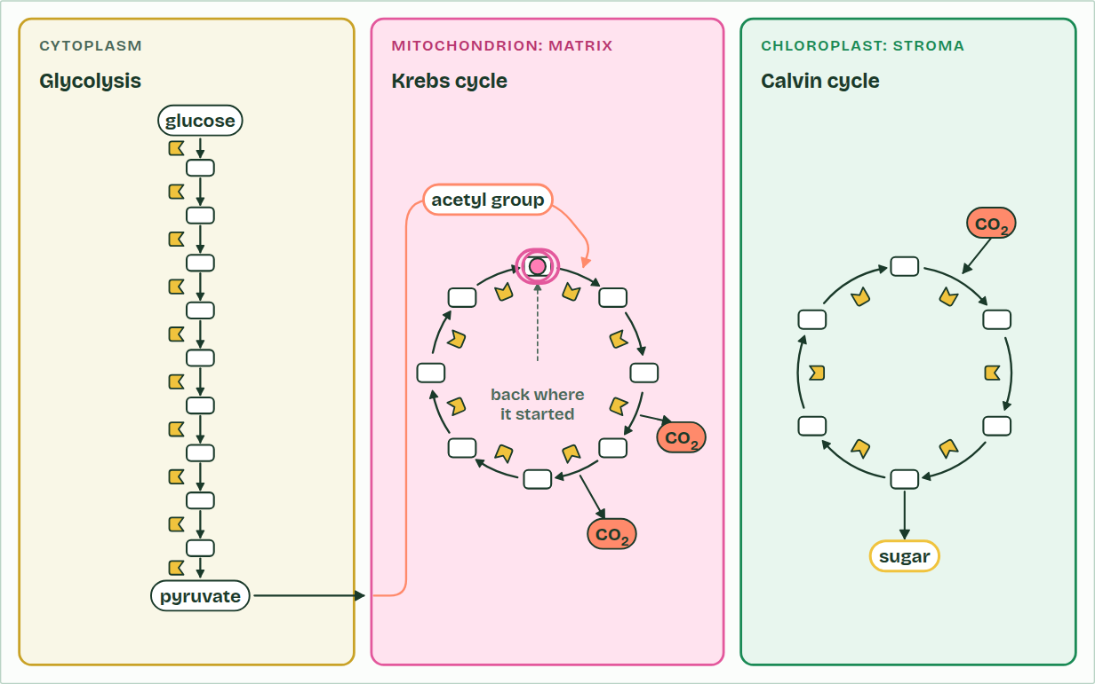
CHAPTER 9 · C1.1.11 C1.1.13 Intracellular and extracellular reactions; linear and cyclical pathways
Krebs cycle
3 / 3
Chains, cycles, inside and out
Back where it started: the last step remakes the molecule the first step needs. A cycle.
Minutes 0 to 5
Notes:
Minutes 0 to 5 of 60: Do now: Inside or outside? (5 min).
The plan: The card sort below, as a first look: students place each process inside or outside a cell on an A3 outline. Come back to it at the end of chapter 9.
Intracellular reactions happen inside cells, catalysed by enzymes that stay there. "Inside" means anywhere inside: in the cytoplasm, as glycolysis, the first stage of respiration, does, or inside an organelle, as the Krebs cycle does in the matrix of a mitochondrion. Extracellular reactions happen outside the cells that made the enzymes. The example is chemical digestion in the gut: cells of the salivary glands, the stomach lining and the pancreas make digestive enzymes and secrete them into the gut, where they hydrolyse food molecules.
The two kinds are made in different places. Enzymes that stay in the cytoplasm, such as those of glycolysis, are made by free ribosomes. Enzymes for export are made by ribosomes on the rough endoplasmic reticulum, packaged by the Golgi apparatus and released by exocytosis (B2.2).
Most metabolism runs as pathways, a series of steps each with its own enzyme. In a linear pathway the first substrate is turned, step by step, into a different end product. Glycolysis is the example: glucose goes in at the start and pyruvate comes out about ten steps later. A cyclical pathway ends by remaking the molecule it started from. Something is added at each turn and something leaves, but the carrier molecule comes back round, so a small amount of it keeps the cycle turning. The Krebs cycle (C1.2) and the Calvin cycle (C1.3) are the examples.
Why pathways, and not one leap? Each step needs only a small activation energy, energy is released or used a little at a time, and each step's enzyme is a point of control (chapter 13).
The animation "Three pathways on one map", paused at 15.5 s. The next slides go on through it, then play it.

Slide 8
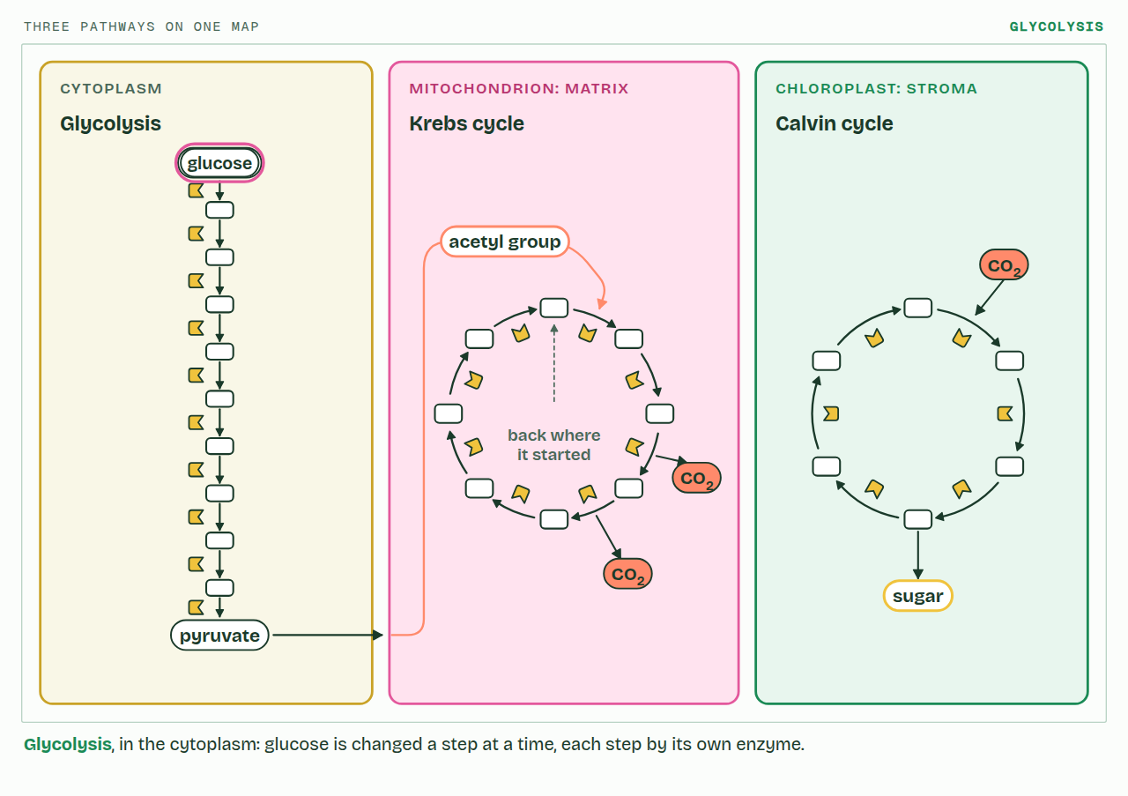
CHAPTER 9 · C1.1.11 C1.1.13 Intracellular and extracellular reactions; linear and cyclical pathways
PLAY IT
Chains, cycles, inside and out
Three pathways on one map: click to play. It loops every 24 seconds.
Minutes 0 to 5
Notes:
Minutes 0 to 5 of 60: Do now: Inside or outside? (5 min).
The plan: The card sort below, as a first look: students place each process inside or outside a cell on an A3 outline. Come back to it at the end of chapter 9.
The video is pathways-fa8f6c.mp4, one loop of the animation in the guide. It plays in PowerPoint and Keynote. Google Slides does not play a video embedded in a .pptx: download pathways-fa8f6c.mp4 (https://www.biologybybradford.com/guides/downloads/scenes/pathways-fa8f6c.mp4), upload it to Google Drive, then Insert > Video > Google Drive.
In the guide the class can change it as it runs: https://www.biologybybradford.com/guides/ib-biology-c1-1-enzymes-and-metabolism#pathways
What it shows, in order:
1. Glycolysis, in the cytoplasm: glucose is changed a step at a time, each step by its own enzyme.
2. A linear pathway: what goes in at one end leaves at the other as something else, pyruvate.
3. Back where it started: the last step remakes the molecule the first step needs. A cycle.

Slide 9
PREDICT
Glycolysis runs in the cytoplasm, the Krebs cycle inside mitochondria, and protein digestion in your stomach. Which are intracellular?
A Protein digestion only: it happens inside an organ
B Glycolysis only: mitochondria are outside the cytoplasm
C All three: the stomach is inside your body
D Glycolysis and the Krebs cycle: both inside cells
Minutes 0 to 5
Notes:
Minutes 0 to 5 of 60: Do now: Inside or outside? (5 min).
The plan: The card sort below, as a first look: students place each process inside or outside a cell on an A3 outline. Come back to it at the end of chapter 9.
Ask for a show of hands, or mini whiteboards, before revealing. (Answer: D, on the next slide.)

Slide 10
WHAT HAPPENS
Glycolysis runs in the cytoplasm, the Krebs cycle inside mitochondria, and protein digestion in your stomach. Which are intracellular?
A Protein digestion only: it happens inside an organ
B Glycolysis only: mitochondria are outside the cytoplasm
C All three: the stomach is inside your body
D Glycolysis and the Krebs cycle: both inside cells
Intracellular means inside a cell, in any part of it, so glycolysis and the Krebs cycle both count. The stomach's contents are outside every cell, even though they are inside your body: digestion there is extracellular.
Minutes 0 to 5
Notes:
Minutes 0 to 5 of 60: Do now: Inside or outside? (5 min).
The plan: The card sort below, as a first look: students place each process inside or outside a cell on an A3 outline. Come back to it at the end of chapter 9.
Answer: D. Intracellular means inside a cell, in any part of it, so glycolysis and the Krebs cycle both count. The stomach's contents are outside every cell, even though they are inside your body: digestion there is extracellular.

Slide 11
WATCH OUT
A cycle does not make something from nothing. Molecules join at each turn and products leave; what comes back round is the carrier molecule.
Minutes 0 to 5
Notes:
Minutes 0 to 5 of 60: Do now: Inside or outside? (5 min).
The plan: The card sort below, as a first look: students place each process inside or outside a cell on an A3 outline. Come back to it at the end of chapter 9.
A common mistake: say it, then ask who can say why it is wrong.

Slide 12
STEP 2
15 MIN
Chapter 9: chains and cycles
Teach the mnemonic: "Glycolysis goes; Krebs and Calvin come round."
Minutes 5 to 20
Notes:
Minutes 5 to 20 of 60: Chapter 9: chains and cycles (15 min).
The plan: Chapter 9: the predict, then the figure, tapping each part of the gut wall. Then the metabolism map on the board: run each pathway and ask whether its starting molecule comes back round. Teach the mnemonic: "Glycolysis goes; Krebs and Calvin come round."

Slide 13
STEP 3
12 MIN
Chapter 10: warm from the inside
Ask: why does a bird need a warm body?
Minutes 20 to 32
Notes:
Minutes 20 to 32 of 60: Chapter 10: warm from the inside (12 min).
The plan: Chapter 10: the predict (mouse or lizard), then both states of the figure. Ask: why does a bird need a warm body?

Slide 14
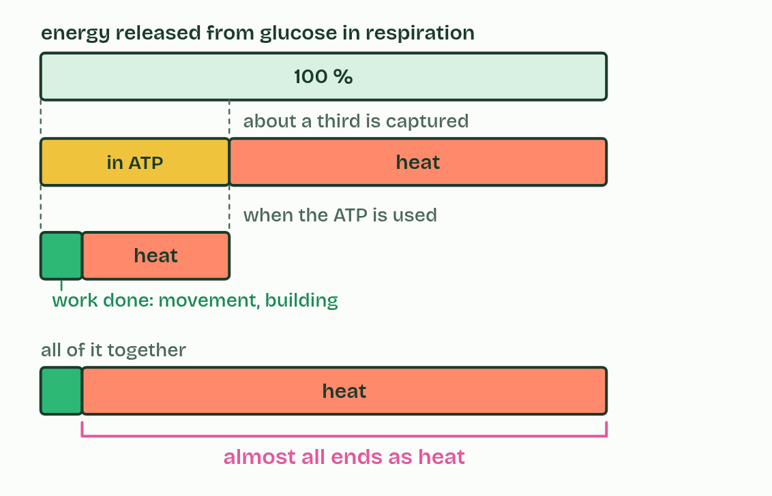
CHAPTER 10 · C1.1.12 Generation of heat by metabolism
1 / 2
Warm from the inside
Energy from glucose
Minutes 20 to 32
Notes:
Minutes 20 to 32 of 60: Chapter 10: warm from the inside (12 min).
The plan: Chapter 10: the predict (mouse or lizard), then both states of the figure. Ask: why does a bird need a warm body?
No energy transfer in metabolism is 100% efficient. The efficiency of a transfer is the share of the energy that ends up where it is wanted. When respiration releases the energy in glucose, only about a third is captured in ATP, and the rest is released as heat. When the ATP is then used, to contract a muscle or to build a protein, most of that energy ends as heat too. Heat generation is inevitable.
The faster the metabolism, the more heat. You get hot when you run because your muscles respire faster, and a resting adult gives off about as much heat as a lamp of 80 to 100 watts.
Mammals and birds depend on this heat. They keep a high and constant body temperature, about 37 °C in most mammals and about 40 to 42 °C in most birds, mostly well above the air around them, by generating heat from their metabolism. They are endotherms. A few other animals warm themselves from their own metabolism at times: a bumblebee shivers its flight muscles to warm up before take-off.
This is how an endotherm keeps its temperature steady. When the air turns colder it loses heat faster, so its metabolic rate rises to replace what is lost, and its body temperature stays where it was (D3.3 shows how the change is controlled).
Why does it pay? Enzymes work fastest near their optimum, so a steady warm body keeps every reaction fast and predictable, whatever the weather (chapter 7).

Slide 15
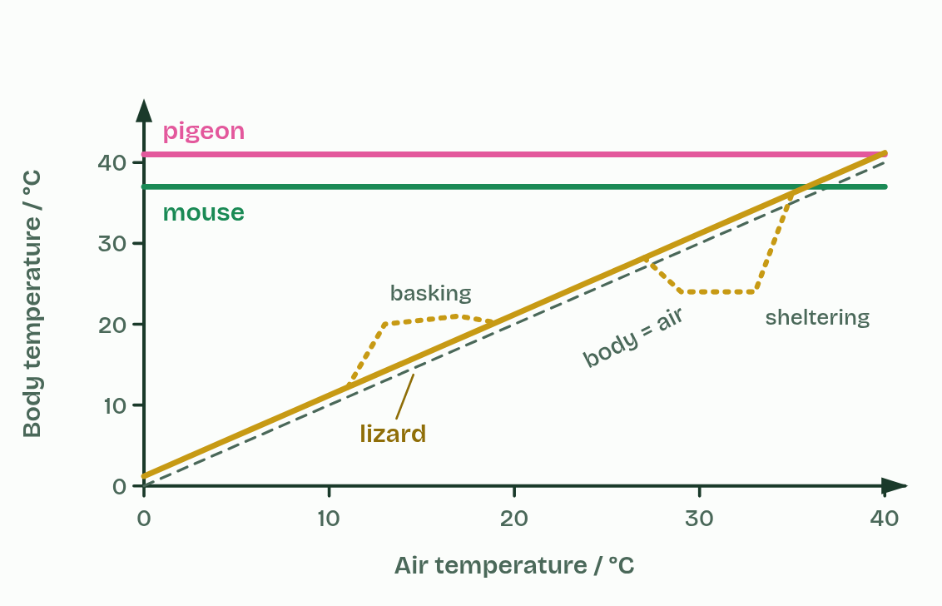
CHAPTER 10 · C1.1.12 Generation of heat by metabolism
2 / 2
Warm from the inside
Body against air temperature
Minutes 20 to 32
Notes:
Minutes 20 to 32 of 60: Chapter 10: warm from the inside (12 min).
The plan: Chapter 10: the predict (mouse or lizard), then both states of the figure. Ask: why does a bird need a warm body?
No energy transfer in metabolism is 100% efficient. The efficiency of a transfer is the share of the energy that ends up where it is wanted. When respiration releases the energy in glucose, only about a third is captured in ATP, and the rest is released as heat. When the ATP is then used, to contract a muscle or to build a protein, most of that energy ends as heat too. Heat generation is inevitable.
The faster the metabolism, the more heat. You get hot when you run because your muscles respire faster, and a resting adult gives off about as much heat as a lamp of 80 to 100 watts.
Mammals and birds depend on this heat. They keep a high and constant body temperature, about 37 °C in most mammals and about 40 to 42 °C in most birds, mostly well above the air around them, by generating heat from their metabolism. They are endotherms. A few other animals warm themselves from their own metabolism at times: a bumblebee shivers its flight muscles to warm up before take-off.
This is how an endotherm keeps its temperature steady. When the air turns colder it loses heat faster, so its metabolic rate rises to replace what is lost, and its body temperature stays where it was (D3.3 shows how the change is controlled).
Why does it pay? Enzymes work fastest near their optimum, so a steady warm body keeps every reaction fast and predictable, whatever the weather (chapter 7).

Slide 16
CHAPTER 10 · C1.1.12 Generation of heat by metabolism
Warm from the inside
The efficiency of a transfer is the share of the energy that ends up where it is wanted.
When respiration releases the energy in glucose, only about a third is captured in ATP, and the rest is released as heat.
When the ATP is then used, to contract a muscle or to build a protein, most of that energy ends as heat too.
Heat generation is inevitable.
Minutes 20 to 32
Notes:
Minutes 20 to 32 of 60: Chapter 10: warm from the inside (12 min).
The plan: Chapter 10: the predict (mouse or lizard), then both states of the figure. Ask: why does a bird need a warm body?
No energy transfer in metabolism is 100% efficient. The efficiency of a transfer is the share of the energy that ends up where it is wanted. When respiration releases the energy in glucose, only about a third is captured in ATP, and the rest is released as heat. When the ATP is then used, to contract a muscle or to build a protein, most of that energy ends as heat too. Heat generation is inevitable.
The faster the metabolism, the more heat. You get hot when you run because your muscles respire faster, and a resting adult gives off about as much heat as a lamp of 80 to 100 watts.
Mammals and birds depend on this heat. They keep a high and constant body temperature, about 37 °C in most mammals and about 40 to 42 °C in most birds, mostly well above the air around them, by generating heat from their metabolism. They are endotherms. A few other animals warm themselves from their own metabolism at times: a bumblebee shivers its flight muscles to warm up before take-off.
This is how an endotherm keeps its temperature steady. When the air turns colder it loses heat faster, so its metabolic rate rises to replace what is lost, and its body temperature stays where it was (D3.3 shows how the change is controlled).
Why does it pay? Enzymes work fastest near their optimum, so a steady warm body keeps every reaction fast and predictable, whatever the weather (chapter 7).

Slide 17
PREDICT
A mouse and a lizard of the same mass sit at 20 °C for a day. Which needs more food, and why?
A The lizard: it must make up for its cold body
B Neither: animals of the same mass need the same food
C The mouse: heat from respiration keeps it at 37 °C
D The mouse: its enzymes waste more of their energy
Minutes 20 to 32
Notes:
Minutes 20 to 32 of 60: Chapter 10: warm from the inside (12 min).
The plan: Chapter 10: the predict (mouse or lizard), then both states of the figure. Ask: why does a bird need a warm body?
Ask for a show of hands, or mini whiteboards, before revealing. (Answer: C, on the next slide.)

Slide 18
WHAT HAPPENS
A mouse and a lizard of the same mass sit at 20 °C for a day. Which needs more food, and why?
A The lizard: it must make up for its cold body
B Neither: animals of the same mass need the same food
C The mouse: heat from respiration keeps it at 37 °C
D The mouse: its enzymes waste more of their energy
The mouse. To stay at 37 °C in air at 20 °C it loses heat all the time and replaces it from respiration, so it respires far faster and needs several times the food. The lizard's body cools to near 20 °C, its reactions slow, and it needs much less.
Minutes 20 to 32
Notes:
Minutes 20 to 32 of 60: Chapter 10: warm from the inside (12 min).
The plan: Chapter 10: the predict (mouse or lizard), then both states of the figure. Ask: why does a bird need a warm body?
Answer: C. The mouse. To stay at 37 °C in air at 20 °C it loses heat all the time and replaces it from respiration, so it respires far faster and needs several times the food. The lizard's body cools to near 20 °C, its reactions slow, and it needs much less.

Slide 19
WATCH OUT
Heat from metabolism is not a fault to be fixed. It is unavoidable, and for mammals and birds it is what keeps every enzyme near its optimum.
Minutes 20 to 32
Notes:
Minutes 20 to 32 of 60: Chapter 10: warm from the inside (12 min).
The plan: Chapter 10: the predict (mouse or lizard), then both states of the figure. Ask: why does a bird need a warm body?
A common mistake: say it, then ask who can say why it is wrong.

Slide 20
STEP 4
13 MIN
Chapter 11: a second site
Students add an allosteric site to the plasticine enzyme from lesson 2 and show the active site changing shape.
Minutes 32 to 45
Notes:
Minutes 32 to 45 of 60: Chapter 11: a second site (13 min).
The plan: Chapter 11: the predict, then the figure. Students add an allosteric site to the plasticine enzyme from lesson 2 and show the active site changing shape.

Slide 21
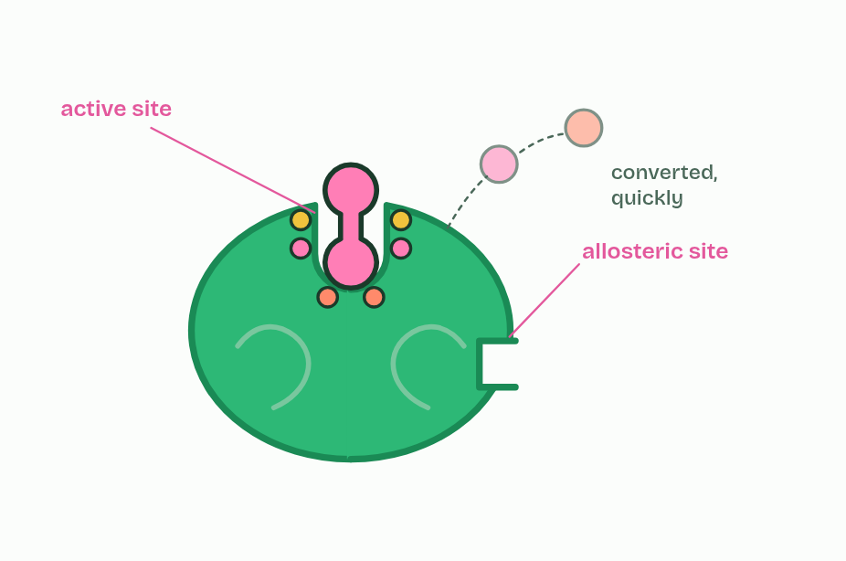
CHAPTER 11 · C1.1.14 Allosteric sites and non-competitive inhibition
1 / 4
A second site
An active site, and a second site elsewhere: the allosteric site.
Minutes 32 to 45
Notes:
Minutes 32 to 45 of 60: Chapter 11: a second site (13 min).
The plan: Chapter 11: the predict, then the figure. Students add an allosteric site to the plasticine enzyme from lesson 2 and show the active site changing shape.
An inhibitor is a molecule that binds to an enzyme and slows or stops its reaction. Many enzymes have, as well as the active site, a second site elsewhere on the molecule: an allosteric site. Like the active site, it is specific: only particular molecules fit and bind.
When one binds, it changes the interactions inside the enzyme, so the enzyme's shape changes, a conformational change, and that alters the active site enough to stop catalysis. The substrate no longer binds, or binds and does not react. This is non-competitive inhibition: the inhibitor does not compete with the substrate for the active site.
The binding is reversible. When the inhibitor leaves, the enzyme returns to its working shape. So the amount of inhibition depends on how much inhibitor there is: the more inhibitor, the bigger the share of enzyme molecules switched off at any moment.
Adding more substrate does not help, because substrate cannot push a molecule off a site it does not bind to (the graph is in chapter 12). And this is how a cell switches enzymes off and on (chapter 13).

Slide 22
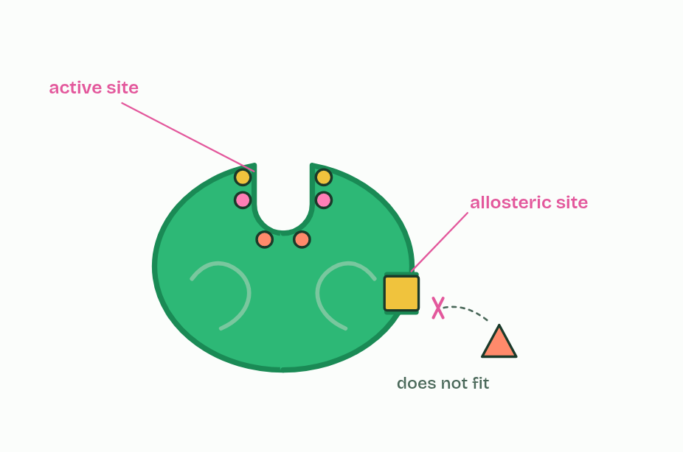
CHAPTER 11 · C1.1.14 Allosteric sites and non-competitive inhibition
2 / 4
A second site
Only a specific molecule fits the allosteric site.
Minutes 32 to 45
Notes:
Minutes 32 to 45 of 60: Chapter 11: a second site (13 min).
The plan: Chapter 11: the predict, then the figure. Students add an allosteric site to the plasticine enzyme from lesson 2 and show the active site changing shape.
An inhibitor is a molecule that binds to an enzyme and slows or stops its reaction. Many enzymes have, as well as the active site, a second site elsewhere on the molecule: an allosteric site. Like the active site, it is specific: only particular molecules fit and bind.
When one binds, it changes the interactions inside the enzyme, so the enzyme's shape changes, a conformational change, and that alters the active site enough to stop catalysis. The substrate no longer binds, or binds and does not react. This is non-competitive inhibition: the inhibitor does not compete with the substrate for the active site.
The binding is reversible. When the inhibitor leaves, the enzyme returns to its working shape. So the amount of inhibition depends on how much inhibitor there is: the more inhibitor, the bigger the share of enzyme molecules switched off at any moment.
Adding more substrate does not help, because substrate cannot push a molecule off a site it does not bind to (the graph is in chapter 12). And this is how a cell switches enzymes off and on (chapter 13).

Slide 23
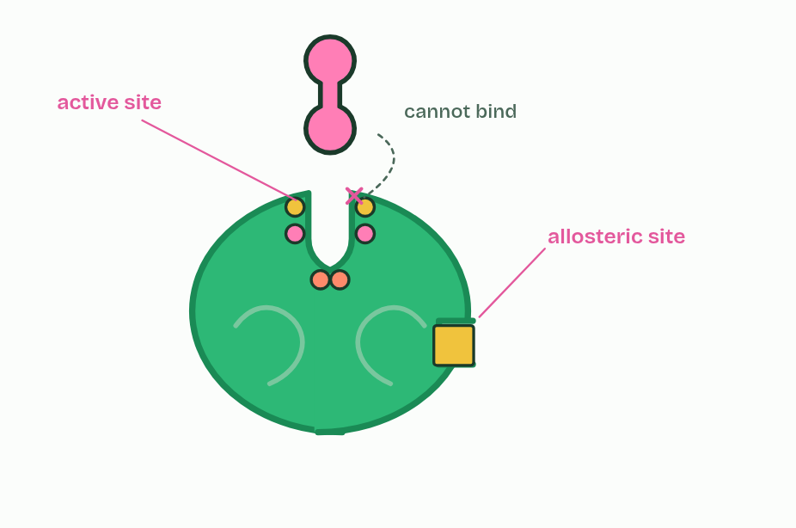
CHAPTER 11 · C1.1.14 Allosteric sites and non-competitive inhibition
3 / 4
A second site
Binding changes the enzyme's shape, and with it the active site.
Minutes 32 to 45
Notes:
Minutes 32 to 45 of 60: Chapter 11: a second site (13 min).
The plan: Chapter 11: the predict, then the figure. Students add an allosteric site to the plasticine enzyme from lesson 2 and show the active site changing shape.
An inhibitor is a molecule that binds to an enzyme and slows or stops its reaction. Many enzymes have, as well as the active site, a second site elsewhere on the molecule: an allosteric site. Like the active site, it is specific: only particular molecules fit and bind.
When one binds, it changes the interactions inside the enzyme, so the enzyme's shape changes, a conformational change, and that alters the active site enough to stop catalysis. The substrate no longer binds, or binds and does not react. This is non-competitive inhibition: the inhibitor does not compete with the substrate for the active site.
The binding is reversible. When the inhibitor leaves, the enzyme returns to its working shape. So the amount of inhibition depends on how much inhibitor there is: the more inhibitor, the bigger the share of enzyme molecules switched off at any moment.
Adding more substrate does not help, because substrate cannot push a molecule off a site it does not bind to (the graph is in chapter 12). And this is how a cell switches enzymes off and on (chapter 13).

Slide 24
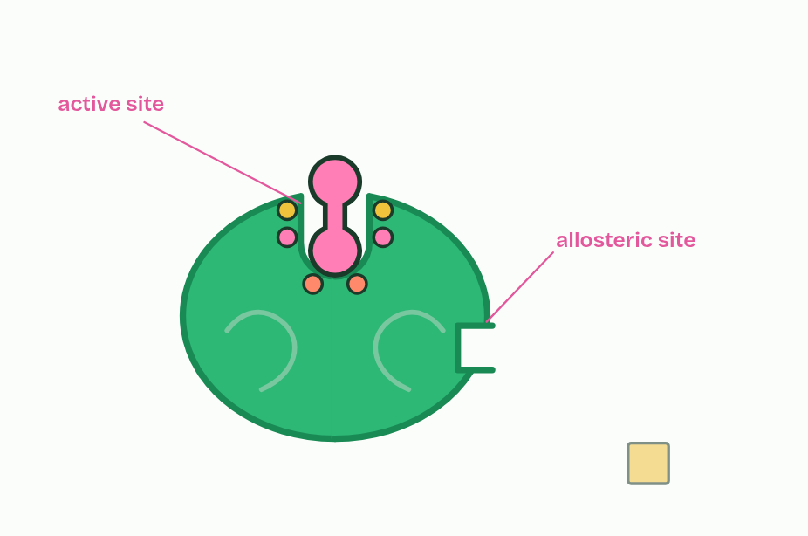
CHAPTER 11 · C1.1.14 Allosteric sites and non-competitive inhibition
4 / 4
A second site
The binding is reversible: the inhibitor leaves, the enzyme works again.
Minutes 32 to 45
Notes:
Minutes 32 to 45 of 60: Chapter 11: a second site (13 min).
The plan: Chapter 11: the predict, then the figure. Students add an allosteric site to the plasticine enzyme from lesson 2 and show the active site changing shape.
An inhibitor is a molecule that binds to an enzyme and slows or stops its reaction. Many enzymes have, as well as the active site, a second site elsewhere on the molecule: an allosteric site. Like the active site, it is specific: only particular molecules fit and bind.
When one binds, it changes the interactions inside the enzyme, so the enzyme's shape changes, a conformational change, and that alters the active site enough to stop catalysis. The substrate no longer binds, or binds and does not react. This is non-competitive inhibition: the inhibitor does not compete with the substrate for the active site.
The binding is reversible. When the inhibitor leaves, the enzyme returns to its working shape. So the amount of inhibition depends on how much inhibitor there is: the more inhibitor, the bigger the share of enzyme molecules switched off at any moment.
Adding more substrate does not help, because substrate cannot push a molecule off a site it does not bind to (the graph is in chapter 12). And this is how a cell switches enzymes off and on (chapter 13).

Slide 25
CHAPTER 11 · C1.1.14 Allosteric sites and non-competitive inhibition
A second site
An inhibitor is a molecule that binds to an enzyme and slows or stops its reaction.
Many enzymes have, as well as the active site, a second site elsewhere on the molecule: an allosteric site.
When one binds, it changes the interactions inside the enzyme, so the enzyme's shape changes, a conformational change, and that alters the active site enough to stop catalysis.
This is non-competitive inhibition: the inhibitor does not compete with the substrate for the active site.
Minutes 32 to 45
Notes:
Minutes 32 to 45 of 60: Chapter 11: a second site (13 min).
The plan: Chapter 11: the predict, then the figure. Students add an allosteric site to the plasticine enzyme from lesson 2 and show the active site changing shape.
An inhibitor is a molecule that binds to an enzyme and slows or stops its reaction. Many enzymes have, as well as the active site, a second site elsewhere on the molecule: an allosteric site. Like the active site, it is specific: only particular molecules fit and bind.
When one binds, it changes the interactions inside the enzyme, so the enzyme's shape changes, a conformational change, and that alters the active site enough to stop catalysis. The substrate no longer binds, or binds and does not react. This is non-competitive inhibition: the inhibitor does not compete with the substrate for the active site.
The binding is reversible. When the inhibitor leaves, the enzyme returns to its working shape. So the amount of inhibition depends on how much inhibitor there is: the more inhibitor, the bigger the share of enzyme molecules switched off at any moment.
Adding more substrate does not help, because substrate cannot push a molecule off a site it does not bind to (the graph is in chapter 12). And this is how a cell switches enzymes off and on (chapter 13).

Slide 26
PREDICT
An allosteric inhibitor binds nowhere near the active site. How can it stop the enzyme?
A Binding changes the enzyme's shape, active site included
B It blocks the path the substrate takes to the active site
C It reacts with the substrate before the enzyme can
D It breaks peptide bonds deep inside the enzyme's folded chain
Minutes 32 to 45
Notes:
Minutes 32 to 45 of 60: Chapter 11: a second site (13 min).
The plan: Chapter 11: the predict, then the figure. Students add an allosteric site to the plasticine enzyme from lesson 2 and show the active site changing shape.
Ask for a show of hands, or mini whiteboards, before revealing. (Answer: A, on the next slide.)

Slide 27
WHAT HAPPENS
An allosteric inhibitor binds nowhere near the active site. How can it stop the enzyme?
A Binding changes the enzyme's shape, active site included
B It blocks the path the substrate takes to the active site
C It reacts with the substrate before the enzyme can
D It breaks peptide bonds deep inside the enzyme's folded chain
Binding at the allosteric site changes interactions between amino acids within the enzyme, so the whole protein shifts shape, the active site with it. The substrate no longer fits. Nothing is broken: when the inhibitor leaves, the shape returns.
Minutes 32 to 45
Notes:
Minutes 32 to 45 of 60: Chapter 11: a second site (13 min).
The plan: Chapter 11: the predict, then the figure. Students add an allosteric site to the plasticine enzyme from lesson 2 and show the active site changing shape.
Answer: A. Binding at the allosteric site changes interactions between amino acids within the enzyme, so the whole protein shifts shape, the active site with it. The substrate no longer fits. Nothing is broken: when the inhibitor leaves, the shape returns.

Slide 28
WATCH OUT
Not every inhibitor blocks the active site. A non-competitive inhibitor never touches it.
Minutes 32 to 45
Notes:
Minutes 32 to 45 of 60: Chapter 11: a second site (13 min).
The plan: Chapter 11: the predict, then the figure. Students add an allosteric site to the plasticine enzyme from lesson 2 and show the active site changing shape.
A common mistake: say it, then ask who can say why it is wrong.

Slide 29
STEP 5
10 MIN
Timed written question
A short written question on C1.1.11 to C1.1.13 from the exam maker, timed and marked.
Minutes 45 to 55
Notes:
Minutes 45 to 55 of 60: Timed written question (10 min).
The plan: A short written question on C1.1.11 to C1.1.13 from the exam maker, timed and marked.

Slide 30
PLENARY
Can you now...
Compare enzymes at work inside cells and outside them, and linear pathways with cycles (C1.1.11, C1.1.13)
Explain why metabolism always releases heat, and how mammals and birds use it (C1.1.12)
Explain how a molecule binding an allosteric site stops an enzyme, and why the binding can be undone (C1.1.14)
Minutes 55 to 60
Notes:
Minutes 55 to 60 of 60: Exit (5 min).
The plan: One difference between a linear and a cyclical pathway, with an example of each.
Thumbs up, sideways or down on each goal before the exit question. The goals come from the statements this lesson covers.

Slide 31
EXIT QUESTION
Before you go
One difference between a linear and a cyclical pathway, with an example of each.
Minutes 55 to 60
Notes:
Minutes 55 to 60 of 60: Exit (5 min).
The plan: One difference between a linear and a cyclical pathway, with an example of each.

Slide 32
PRACTISE AND REVISE
Keep going
Exam practice: a fresh paper of exam questions on C1.1 at higher level, marked as you go
The guide, with the animations and the dry lab
This lesson in the guide: 9 Chains, cycles, inside and out, 10 Warm from the inside, 11 A second site
BUILD FOR YOUR CLASS
ALREADY ON THE SITE FOR C1.1
CARD SETS ON SPLYCR
Tarsia puzzle, dominoes and picture reveal on C1.1, built from its key terms and ready to print
A pub quiz with rounds on C1.1, to present or run with no projector
An escape room built from the question bank on C1.1
Lesson: Enzymes & Metabolism HL (HL)
Lab: The Enzyme in Your Spit
Summary doodle: Enzymes & Metabolism
Quiz: Enzymes
Quiz: Enzymes & Metabolism (HL)
Revision map: C1.1 Enzymes and metabolism, to fill in
Exam questions: C1.1 in the exam maker, a paper with its markscheme
Open a set to host it as a class game, or make a copy to edit.
C1.1 Enzymes and Metabolism
How this was made. The course structure, the activities and the teaching choices come from my own classroom, my presentations and my years of teaching IB and AP Biology. I use Claude, an AI, to help write and build the interactive guides, lesson plans, slides and practice questions, and to draw the diagrams and code the interactives. I direct the work and review it against the IB and AP specifications before it goes live.
Minute 60: after the lesson
Notes:
Every link here is live. Set the exam practice paper for homework: it is fresh each time, marked as students go and saved to their Exam practice when they are signed in.
Exam practice: https://www.biologybybradford.com/exam-maker/sit?topics=C1.1&level=HL&paper=quiz&marks=15&src=ep
The guide: https://www.biologybybradford.com/guides/ib-biology-c1-1-enzymes-and-metabolism

