Slide 1
IB Biology C1.1
LESSON 5 OF 5
HL
BY THE END YOU CAN
Enzymes and metabolism
Explain how statins inhibit an enzyme competitively, and contrast competitive and non-competitive inhibition on a graph (C1.1.15)
Explain how isoleucine controls its own pathway by feedback inhibition (C1.1.16)
Explain how penicillin inhibits transpeptidase for good, and how a changed transpeptidase makes bacteria resistant (C1.1.17)
Stopping enzymes
C1.1.15 to C1.1.17
Competitive inhibition and statins, feedback inhibition of the isoleucine pathway, and penicillin
60 minutes · chapters 12, 13, 14
Minute 0
Notes:
IB Biology C1.1, Enzymes and metabolism. Lesson 5 of 5: Stopping enzymes (higher level), 60 minutes.
The plan, minute by minute (each slide's footer says where you are):
0 to 6 min (6) Do now: Sketch, then check
6 to 18 min (12) Chapter 12: statins
18 to 30 min (12) Chapter 13: the pathway valve
30 to 40 min (10) Chapter 14: a trap that springs once
40 to 55 min (15) Plan an 8-mark answer
55 to 60 min (5) Exit
What students get wrong:
All inhibitors block the active site. Non-competitive ones bind elsewhere.
More substrate overcomes any inhibitor. Only a competitive one.
Feedback inhibits the last enzyme. It inhibits the first, at the start of the pathway.
Penicillin is a competitive inhibitor. It binds covalently, for good.
Bacteria become resistant because penicillin changes them. The changed transpeptidase arose by mutation; penicillin selects it.
Stretch and support:
Stretch: methanol poisoning can be treated with ethanol, which competes with methanol for the active site of the same liver enzyme. Explain why a large dose of ethanol is needed, and has to be kept up, using chapter 12's graph.
Stretch: why might the isoleucine pathway's first enzyme respond to isoleucine in a switch-like way rather than gradually, and what would that give the cell? (Beyond the guide; for discussion only.)
Stretch: make a Tarsia puzzle on C1.1 better than the site's own, in the Tarsia builder.
The lesson plan to print: https://www.biologybybradford.com/guides/downloads/ib-biology-c1-1-enzymes-and-metabolism-lesson-5-plan.pdf

Slide 2
DO NOW
Sketch, then check
The higher level version, below: three lines on one graph.
Students draw their prediction before chapter 12.
6:00
minutes
Start now: the timer is running.
Minutes 0 to 6
Notes:
Minutes 0 to 6 of 60: Do now: Sketch, then check (6 min).
The plan: The higher level version, below: three lines on one graph. Students draw their prediction before chapter 12.
Start a 6 minute timer as they come in.

Slide 3
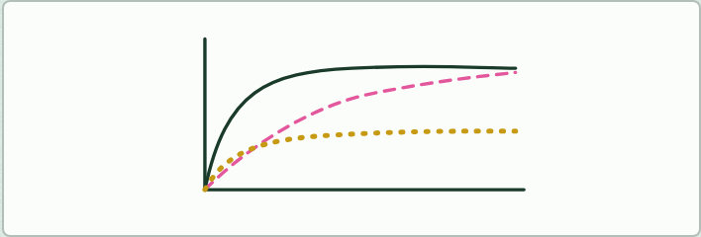
DRAWING
6 MIN
Sketch, then check
THE TASK
Lesson 2: students sketch the three graphs of chapter 7 from memory, then play the figure and correct their sketches in another colour.Lesson 5: on one set of axes, draw rate against substrate concentration with no inhibitor, then a line for something competing for the active site, then one for something changing the active site's shape. Check against chapter 12's graph.
STUDENTS NEED
Mini whiteboards, two colours of pen.
Minutes 0 to 6
Notes:
Minutes 0 to 6 of 60: Do now: Sketch, then check (6 min).
The plan: The higher level version, below: three lines on one graph. Students draw their prediction before chapter 12.
The activity: Sketch, then check. Lesson 2: students sketch the three graphs of chapter 7 from memory, then play the figure and correct their sketches in another colour.Lesson 5: on one set of axes, draw rate against substrate concentration with no inhibitor, then a line for something competing for the active site, then one for something changing the active site's shape. Check against chapter 12's graph.
Needs: mini whiteboards, two colours of pen.
The time: 6 minutes, minutes 0 to 6 of the plan.

Slide 4
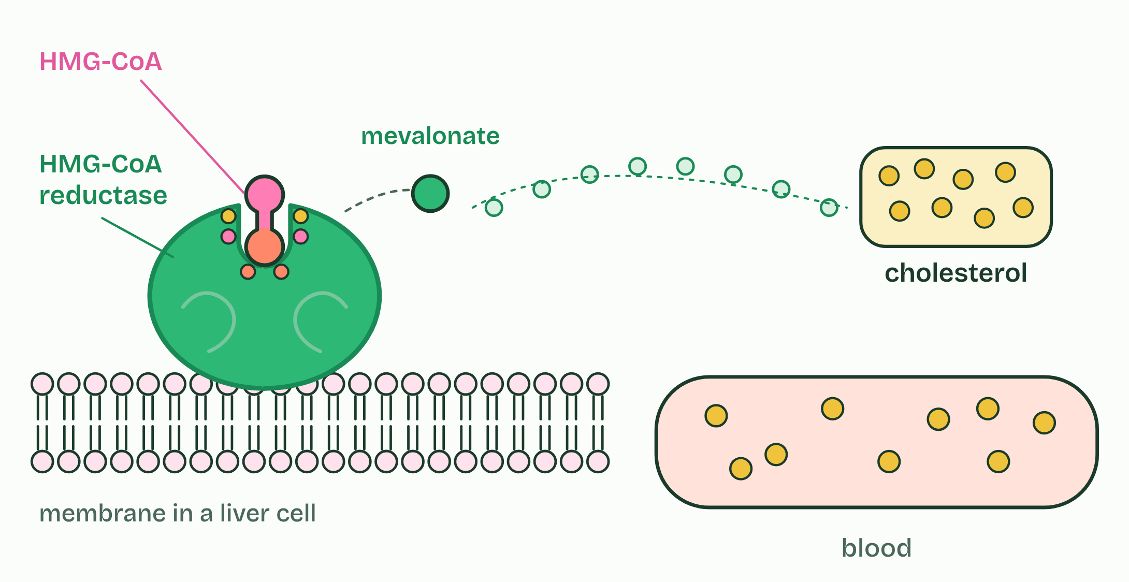
CHAPTER 12 · C1.1.15 Competitive inhibition
1 / 4
A look-alike in the active site
HMG-CoA reductase: an early step on the way to cholesterol.
Minutes 0 to 6
Notes:
Minutes 0 to 6 of 60: Do now: Sketch, then check (6 min).
The plan: The higher level version, below: three lines on one graph. Students draw their prediction before chapter 12.
A competitive inhibitor is similar enough in shape and chemistry to the substrate to bind the active site. While it is there, no substrate can bind. It is not converted, and it leaves again, so the binding is reversible.
Substrate and inhibitor take turns: each active site is taken by whichever happens to collide with it first. So the effect depends on how much of each there is.
A non-competitive inhibitor is different (chapter 11): it binds elsewhere and changes the site. How do the two behave when you add more substrate? Make your prediction, then open the graph.
Statins are the example. They are taken to lower blood cholesterol. In liver cells the enzyme HMG-CoA reductase converts HMG-CoA to mevalonate, an early step on the pathway that makes cholesterol. Part of a statin molecule resembles HMG-CoA, so it binds the active site and blocks it. Less cholesterol is made in the liver, and the level in the blood falls. A statin binds the site far more tightly than the substrate does, so a small dose is enough.
On a graph of rate against substrate concentration, a competitive inhibitor gives a curve that starts low but climbs towards the same plateau as the uninhibited enzyme. A non-competitive inhibitor gives a curve with a lower plateau.
Example: Two more, not to learn Relenza, a drug for influenza, was designed in Australia from the shape of the active site of the virus's enzyme neuraminidase. The enzyme snips sugar ends off the cell surface so that new virus particles can float free; Relenza fills the site, so they stay stuck. It is a competitive inhibitor. Cyanide is a poison that stops the last enzyme of the respiration chain. It is often called a non-competitive inhibitor, but it binds the iron atom at the very spot where oxygen binds, so it is better described as blocking that site. Neither is in the syllabus: the examples to know are statins and penicillin.

Slide 5
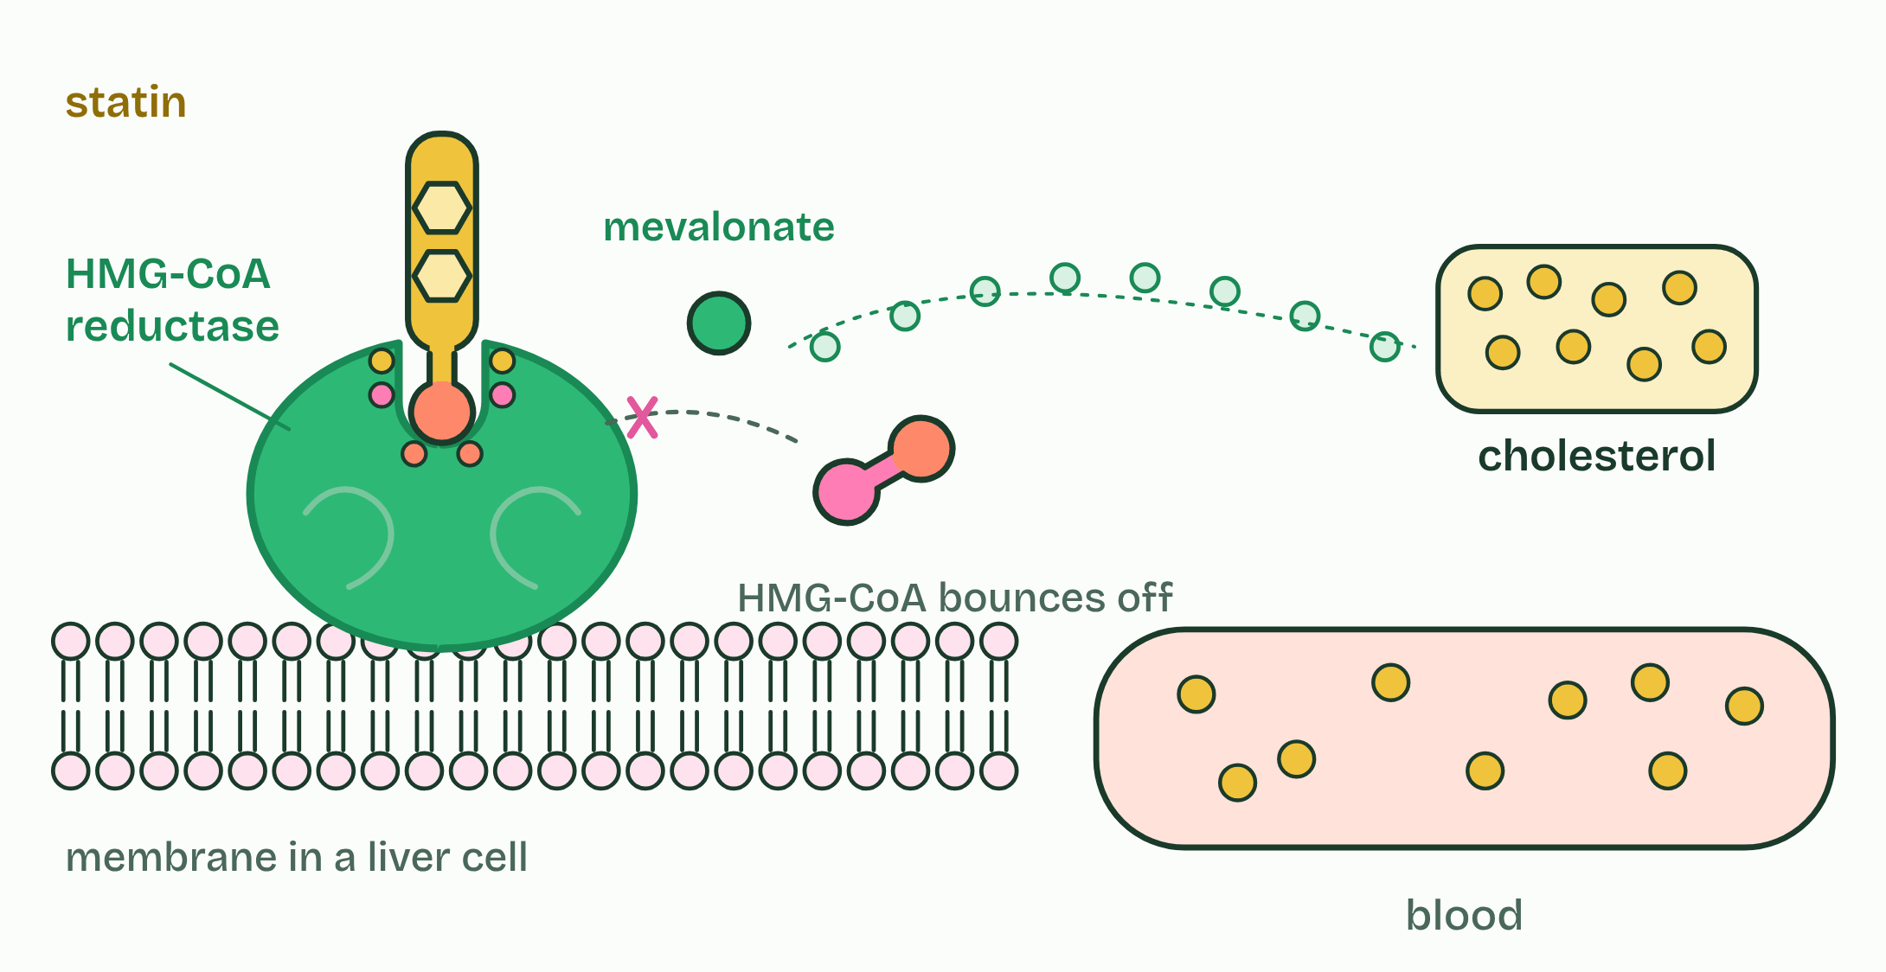
CHAPTER 12 · C1.1.15 Competitive inhibition
2 / 4
A look-alike in the active site
Part of a statin looks like the substrate and binds the active site.
Minutes 0 to 6
Notes:
Minutes 0 to 6 of 60: Do now: Sketch, then check (6 min).
The plan: The higher level version, below: three lines on one graph. Students draw their prediction before chapter 12.
A competitive inhibitor is similar enough in shape and chemistry to the substrate to bind the active site. While it is there, no substrate can bind. It is not converted, and it leaves again, so the binding is reversible.
Substrate and inhibitor take turns: each active site is taken by whichever happens to collide with it first. So the effect depends on how much of each there is.
A non-competitive inhibitor is different (chapter 11): it binds elsewhere and changes the site. How do the two behave when you add more substrate? Make your prediction, then open the graph.
Statins are the example. They are taken to lower blood cholesterol. In liver cells the enzyme HMG-CoA reductase converts HMG-CoA to mevalonate, an early step on the pathway that makes cholesterol. Part of a statin molecule resembles HMG-CoA, so it binds the active site and blocks it. Less cholesterol is made in the liver, and the level in the blood falls. A statin binds the site far more tightly than the substrate does, so a small dose is enough.
On a graph of rate against substrate concentration, a competitive inhibitor gives a curve that starts low but climbs towards the same plateau as the uninhibited enzyme. A non-competitive inhibitor gives a curve with a lower plateau.
Example: Two more, not to learn Relenza, a drug for influenza, was designed in Australia from the shape of the active site of the virus's enzyme neuraminidase. The enzyme snips sugar ends off the cell surface so that new virus particles can float free; Relenza fills the site, so they stay stuck. It is a competitive inhibitor. Cyanide is a poison that stops the last enzyme of the respiration chain. It is often called a non-competitive inhibitor, but it binds the iron atom at the very spot where oxygen binds, so it is better described as blocking that site. Neither is in the syllabus: the examples to know are statins and penicillin.

Slide 6
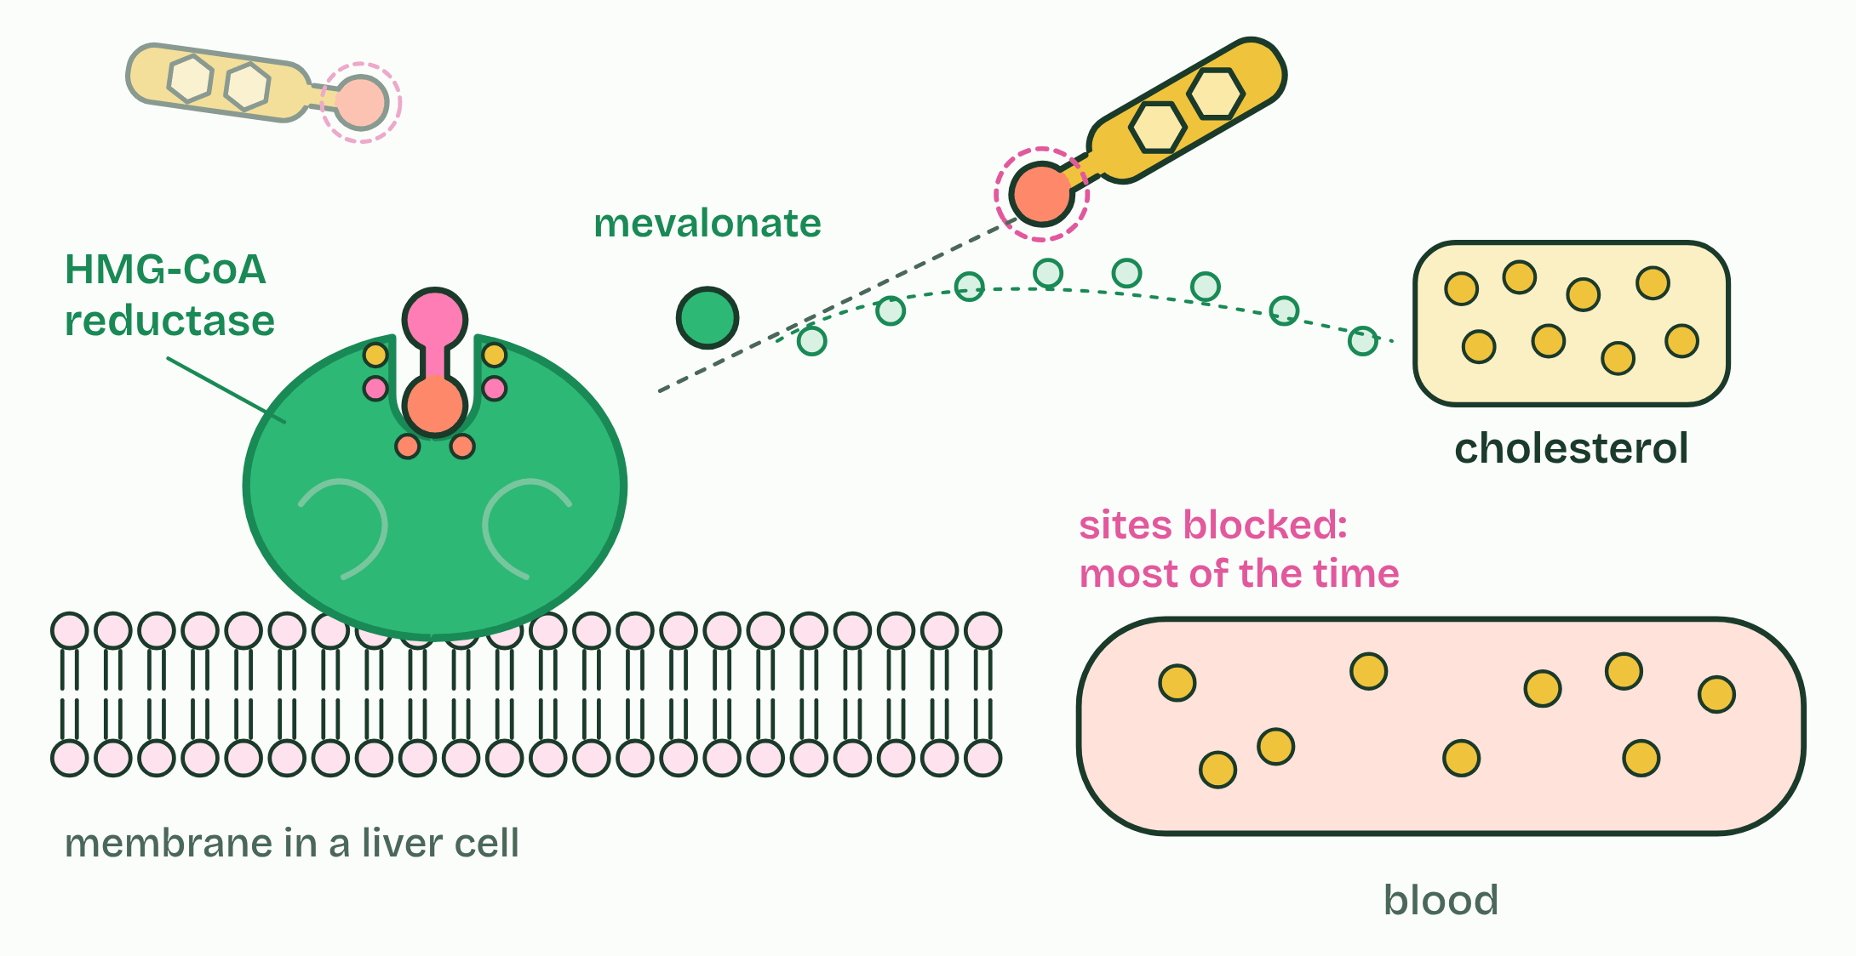
CHAPTER 12 · C1.1.15 Competitive inhibition
3 / 4
A look-alike in the active site
It binds and leaves: competitive and reversible.
Minutes 0 to 6
Notes:
Minutes 0 to 6 of 60: Do now: Sketch, then check (6 min).
The plan: The higher level version, below: three lines on one graph. Students draw their prediction before chapter 12.
A competitive inhibitor is similar enough in shape and chemistry to the substrate to bind the active site. While it is there, no substrate can bind. It is not converted, and it leaves again, so the binding is reversible.
Substrate and inhibitor take turns: each active site is taken by whichever happens to collide with it first. So the effect depends on how much of each there is.
A non-competitive inhibitor is different (chapter 11): it binds elsewhere and changes the site. How do the two behave when you add more substrate? Make your prediction, then open the graph.
Statins are the example. They are taken to lower blood cholesterol. In liver cells the enzyme HMG-CoA reductase converts HMG-CoA to mevalonate, an early step on the pathway that makes cholesterol. Part of a statin molecule resembles HMG-CoA, so it binds the active site and blocks it. Less cholesterol is made in the liver, and the level in the blood falls. A statin binds the site far more tightly than the substrate does, so a small dose is enough.
On a graph of rate against substrate concentration, a competitive inhibitor gives a curve that starts low but climbs towards the same plateau as the uninhibited enzyme. A non-competitive inhibitor gives a curve with a lower plateau.
Example: Two more, not to learn Relenza, a drug for influenza, was designed in Australia from the shape of the active site of the virus's enzyme neuraminidase. The enzyme snips sugar ends off the cell surface so that new virus particles can float free; Relenza fills the site, so they stay stuck. It is a competitive inhibitor. Cyanide is a poison that stops the last enzyme of the respiration chain. It is often called a non-competitive inhibitor, but it binds the iron atom at the very spot where oxygen binds, so it is better described as blocking that site. Neither is in the syllabus: the examples to know are statins and penicillin.

Slide 7
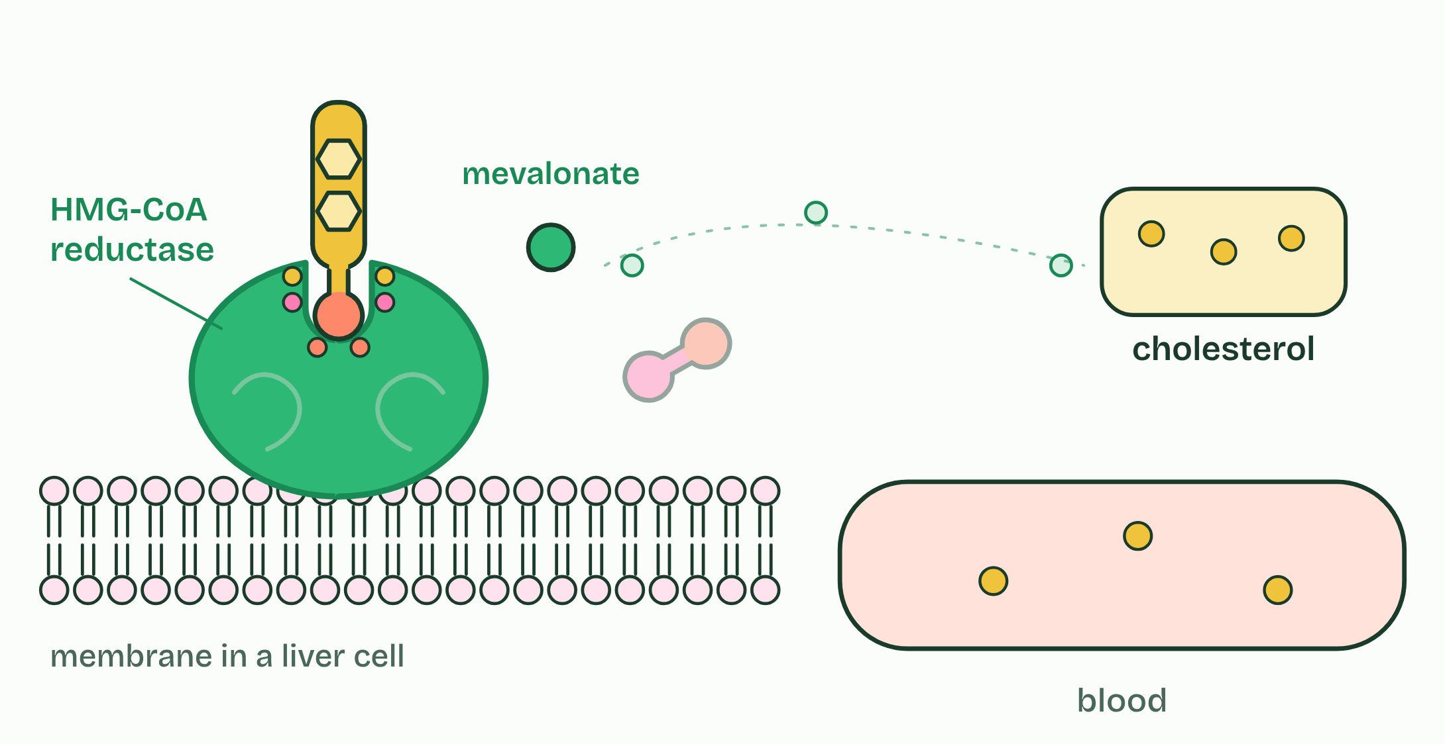
CHAPTER 12 · C1.1.15 Competitive inhibition
4 / 4
A look-alike in the active site
Less cholesterol is made, and blood cholesterol falls.
Minutes 0 to 6
Notes:
Minutes 0 to 6 of 60: Do now: Sketch, then check (6 min).
The plan: The higher level version, below: three lines on one graph. Students draw their prediction before chapter 12.
A competitive inhibitor is similar enough in shape and chemistry to the substrate to bind the active site. While it is there, no substrate can bind. It is not converted, and it leaves again, so the binding is reversible.
Substrate and inhibitor take turns: each active site is taken by whichever happens to collide with it first. So the effect depends on how much of each there is.
A non-competitive inhibitor is different (chapter 11): it binds elsewhere and changes the site. How do the two behave when you add more substrate? Make your prediction, then open the graph.
Statins are the example. They are taken to lower blood cholesterol. In liver cells the enzyme HMG-CoA reductase converts HMG-CoA to mevalonate, an early step on the pathway that makes cholesterol. Part of a statin molecule resembles HMG-CoA, so it binds the active site and blocks it. Less cholesterol is made in the liver, and the level in the blood falls. A statin binds the site far more tightly than the substrate does, so a small dose is enough.
On a graph of rate against substrate concentration, a competitive inhibitor gives a curve that starts low but climbs towards the same plateau as the uninhibited enzyme. A non-competitive inhibitor gives a curve with a lower plateau.
Example: Two more, not to learn Relenza, a drug for influenza, was designed in Australia from the shape of the active site of the virus's enzyme neuraminidase. The enzyme snips sugar ends off the cell surface so that new virus particles can float free; Relenza fills the site, so they stay stuck. It is a competitive inhibitor. Cyanide is a poison that stops the last enzyme of the respiration chain. It is often called a non-competitive inhibitor, but it binds the iron atom at the very spot where oxygen binds, so it is better described as blocking that site. Neither is in the syllabus: the examples to know are statins and penicillin.

Slide 8
CHAPTER 12 · C1.1.15 Competitive inhibition
A look-alike in the active site
A competitive inhibitor is similar enough in shape and chemistry to the substrate to bind the active site.
A non-competitive inhibitor is different (chapter 11): it binds elsewhere and changes the site.
Statins are the example.
They are taken to lower blood cholesterol.
Minutes 0 to 6
Notes:
Minutes 0 to 6 of 60: Do now: Sketch, then check (6 min).
The plan: The higher level version, below: three lines on one graph. Students draw their prediction before chapter 12.
A competitive inhibitor is similar enough in shape and chemistry to the substrate to bind the active site. While it is there, no substrate can bind. It is not converted, and it leaves again, so the binding is reversible.
Substrate and inhibitor take turns: each active site is taken by whichever happens to collide with it first. So the effect depends on how much of each there is.
A non-competitive inhibitor is different (chapter 11): it binds elsewhere and changes the site. How do the two behave when you add more substrate? Make your prediction, then open the graph.
Statins are the example. They are taken to lower blood cholesterol. In liver cells the enzyme HMG-CoA reductase converts HMG-CoA to mevalonate, an early step on the pathway that makes cholesterol. Part of a statin molecule resembles HMG-CoA, so it binds the active site and blocks it. Less cholesterol is made in the liver, and the level in the blood falls. A statin binds the site far more tightly than the substrate does, so a small dose is enough.
On a graph of rate against substrate concentration, a competitive inhibitor gives a curve that starts low but climbs towards the same plateau as the uninhibited enzyme. A non-competitive inhibitor gives a curve with a lower plateau.
Example: Two more, not to learn Relenza, a drug for influenza, was designed in Australia from the shape of the active site of the virus's enzyme neuraminidase. The enzyme snips sugar ends off the cell surface so that new virus particles can float free; Relenza fills the site, so they stay stuck. It is a competitive inhibitor. Cyanide is a poison that stops the last enzyme of the respiration chain. It is often called a non-competitive inhibitor, but it binds the iron atom at the very spot where oxygen binds, so it is better described as blocking that site. Neither is in the syllabus: the examples to know are statins and penicillin.

Slide 9
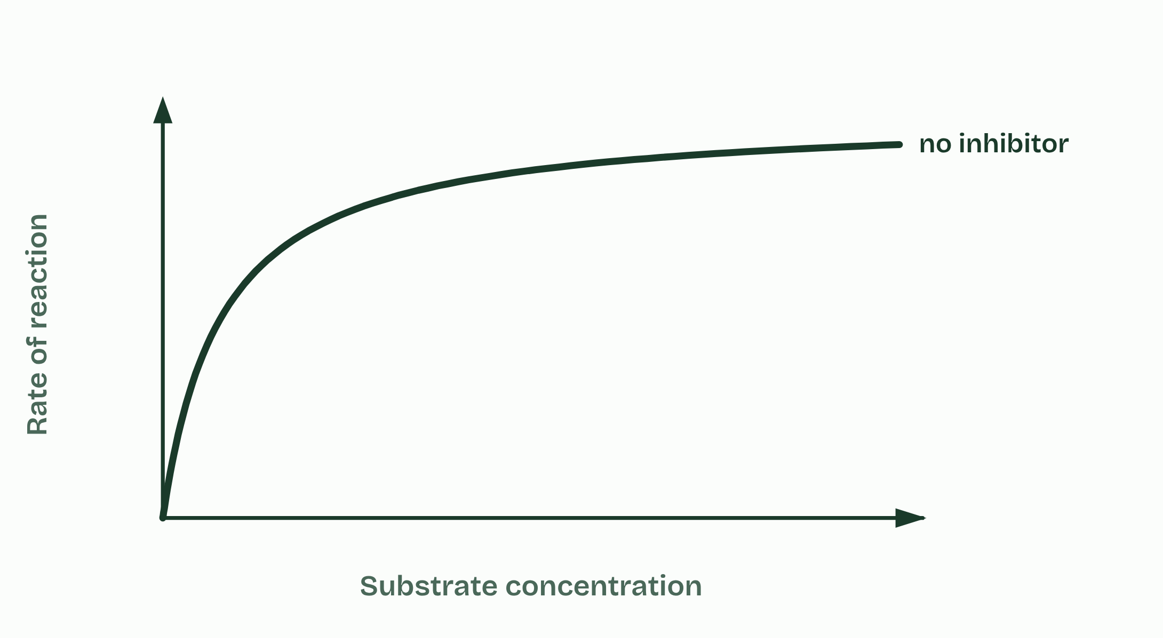
CHAPTER 12 · C1.1.15 Competitive inhibition
1 / 4
A look-alike in the active site
No inhibitor
Minutes 0 to 6
Notes:
Minutes 0 to 6 of 60: Do now: Sketch, then check (6 min).
The plan: The higher level version, below: three lines on one graph. Students draw their prediction before chapter 12.
A competitive inhibitor is similar enough in shape and chemistry to the substrate to bind the active site. While it is there, no substrate can bind. It is not converted, and it leaves again, so the binding is reversible.
Substrate and inhibitor take turns: each active site is taken by whichever happens to collide with it first. So the effect depends on how much of each there is.
A non-competitive inhibitor is different (chapter 11): it binds elsewhere and changes the site. How do the two behave when you add more substrate? Make your prediction, then open the graph.
Statins are the example. They are taken to lower blood cholesterol. In liver cells the enzyme HMG-CoA reductase converts HMG-CoA to mevalonate, an early step on the pathway that makes cholesterol. Part of a statin molecule resembles HMG-CoA, so it binds the active site and blocks it. Less cholesterol is made in the liver, and the level in the blood falls. A statin binds the site far more tightly than the substrate does, so a small dose is enough.
On a graph of rate against substrate concentration, a competitive inhibitor gives a curve that starts low but climbs towards the same plateau as the uninhibited enzyme. A non-competitive inhibitor gives a curve with a lower plateau.
Example: Two more, not to learn Relenza, a drug for influenza, was designed in Australia from the shape of the active site of the virus's enzyme neuraminidase. The enzyme snips sugar ends off the cell surface so that new virus particles can float free; Relenza fills the site, so they stay stuck. It is a competitive inhibitor. Cyanide is a poison that stops the last enzyme of the respiration chain. It is often called a non-competitive inhibitor, but it binds the iron atom at the very spot where oxygen binds, so it is better described as blocking that site. Neither is in the syllabus: the examples to know are statins and penicillin.

Slide 10
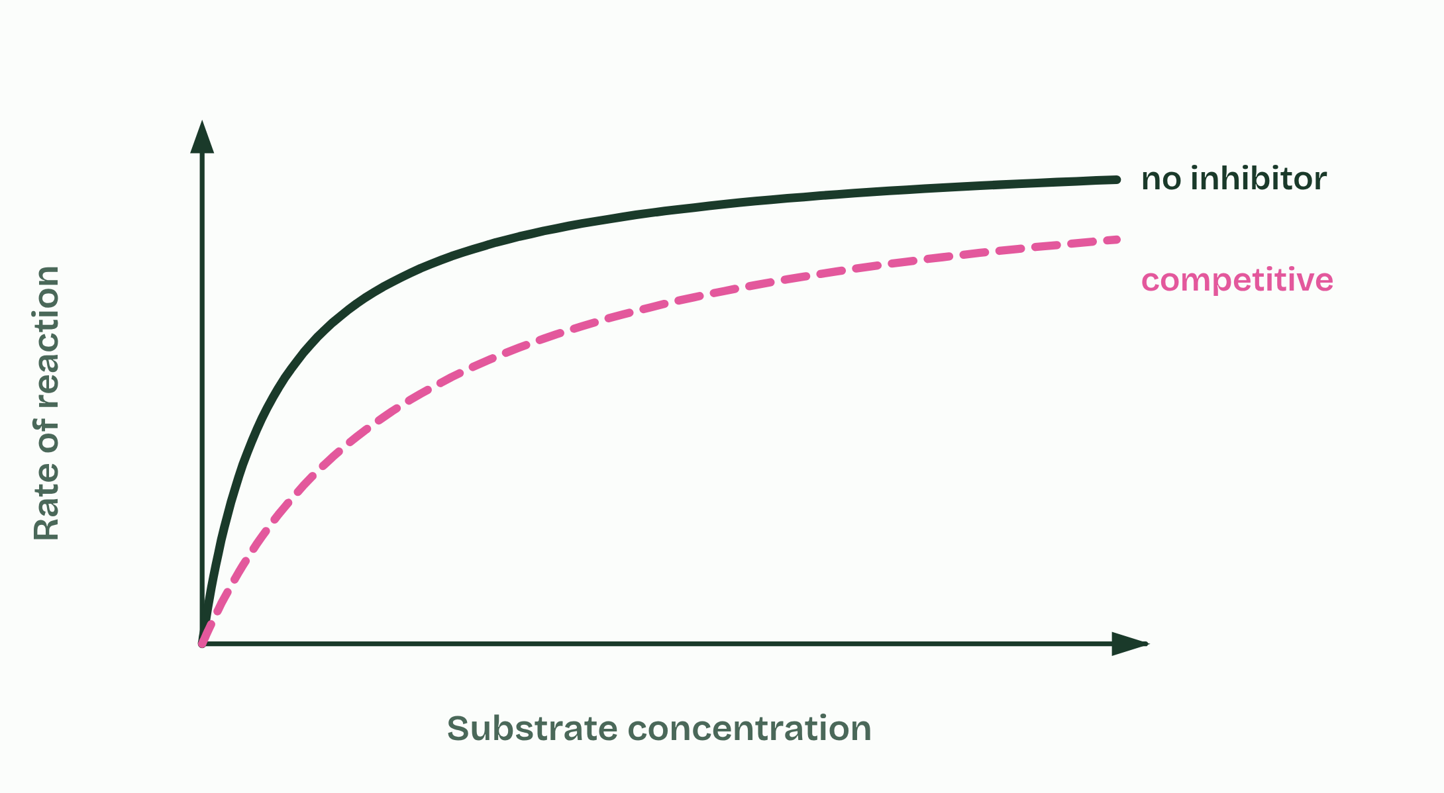
CHAPTER 12 · C1.1.15 Competitive inhibition
2 / 4
A look-alike in the active site
Competitive
Minutes 0 to 6
Notes:
Minutes 0 to 6 of 60: Do now: Sketch, then check (6 min).
The plan: The higher level version, below: three lines on one graph. Students draw their prediction before chapter 12.
A competitive inhibitor is similar enough in shape and chemistry to the substrate to bind the active site. While it is there, no substrate can bind. It is not converted, and it leaves again, so the binding is reversible.
Substrate and inhibitor take turns: each active site is taken by whichever happens to collide with it first. So the effect depends on how much of each there is.
A non-competitive inhibitor is different (chapter 11): it binds elsewhere and changes the site. How do the two behave when you add more substrate? Make your prediction, then open the graph.
Statins are the example. They are taken to lower blood cholesterol. In liver cells the enzyme HMG-CoA reductase converts HMG-CoA to mevalonate, an early step on the pathway that makes cholesterol. Part of a statin molecule resembles HMG-CoA, so it binds the active site and blocks it. Less cholesterol is made in the liver, and the level in the blood falls. A statin binds the site far more tightly than the substrate does, so a small dose is enough.
On a graph of rate against substrate concentration, a competitive inhibitor gives a curve that starts low but climbs towards the same plateau as the uninhibited enzyme. A non-competitive inhibitor gives a curve with a lower plateau.
Example: Two more, not to learn Relenza, a drug for influenza, was designed in Australia from the shape of the active site of the virus's enzyme neuraminidase. The enzyme snips sugar ends off the cell surface so that new virus particles can float free; Relenza fills the site, so they stay stuck. It is a competitive inhibitor. Cyanide is a poison that stops the last enzyme of the respiration chain. It is often called a non-competitive inhibitor, but it binds the iron atom at the very spot where oxygen binds, so it is better described as blocking that site. Neither is in the syllabus: the examples to know are statins and penicillin.

Slide 11
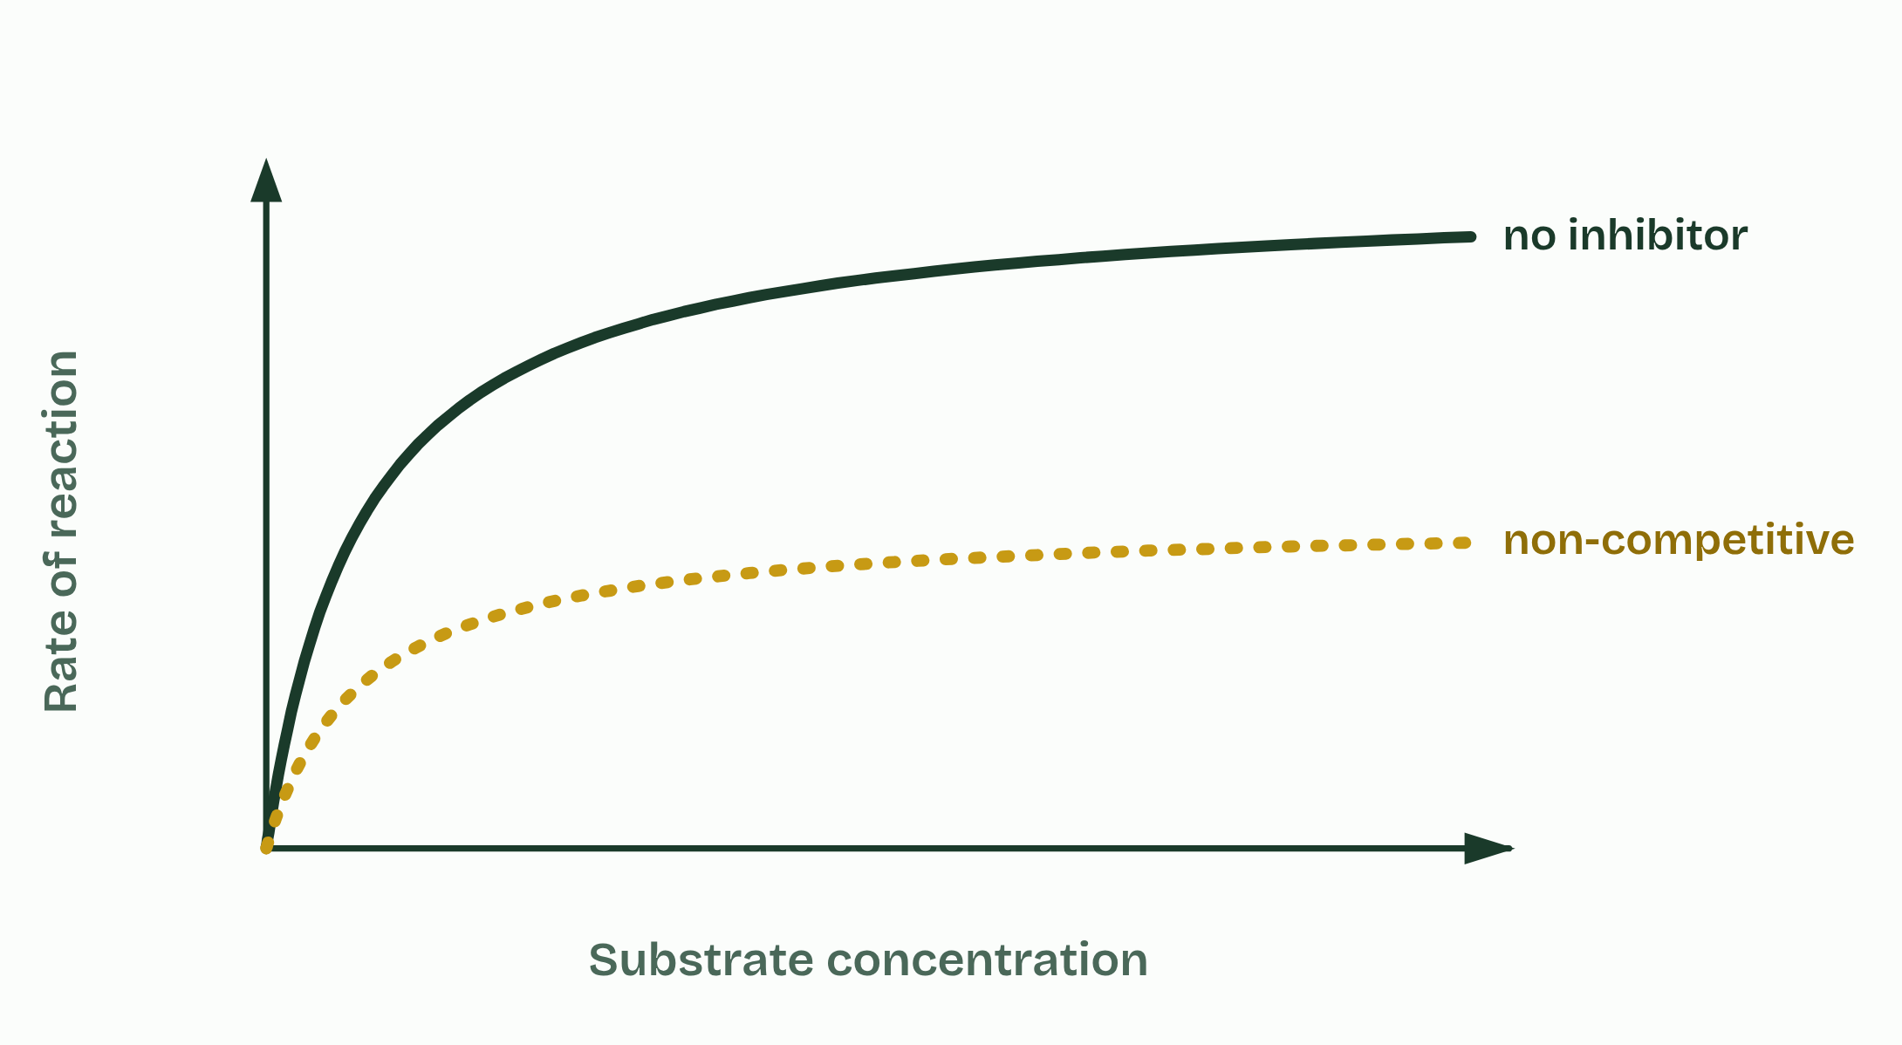
CHAPTER 12 · C1.1.15 Competitive inhibition
3 / 4
A look-alike in the active site
Non-competitive
Minutes 0 to 6
Notes:
Minutes 0 to 6 of 60: Do now: Sketch, then check (6 min).
The plan: The higher level version, below: three lines on one graph. Students draw their prediction before chapter 12.
A competitive inhibitor is similar enough in shape and chemistry to the substrate to bind the active site. While it is there, no substrate can bind. It is not converted, and it leaves again, so the binding is reversible.
Substrate and inhibitor take turns: each active site is taken by whichever happens to collide with it first. So the effect depends on how much of each there is.
A non-competitive inhibitor is different (chapter 11): it binds elsewhere and changes the site. How do the two behave when you add more substrate? Make your prediction, then open the graph.
Statins are the example. They are taken to lower blood cholesterol. In liver cells the enzyme HMG-CoA reductase converts HMG-CoA to mevalonate, an early step on the pathway that makes cholesterol. Part of a statin molecule resembles HMG-CoA, so it binds the active site and blocks it. Less cholesterol is made in the liver, and the level in the blood falls. A statin binds the site far more tightly than the substrate does, so a small dose is enough.
On a graph of rate against substrate concentration, a competitive inhibitor gives a curve that starts low but climbs towards the same plateau as the uninhibited enzyme. A non-competitive inhibitor gives a curve with a lower plateau.
Example: Two more, not to learn Relenza, a drug for influenza, was designed in Australia from the shape of the active site of the virus's enzyme neuraminidase. The enzyme snips sugar ends off the cell surface so that new virus particles can float free; Relenza fills the site, so they stay stuck. It is a competitive inhibitor. Cyanide is a poison that stops the last enzyme of the respiration chain. It is often called a non-competitive inhibitor, but it binds the iron atom at the very spot where oxygen binds, so it is better described as blocking that site. Neither is in the syllabus: the examples to know are statins and penicillin.

Slide 12
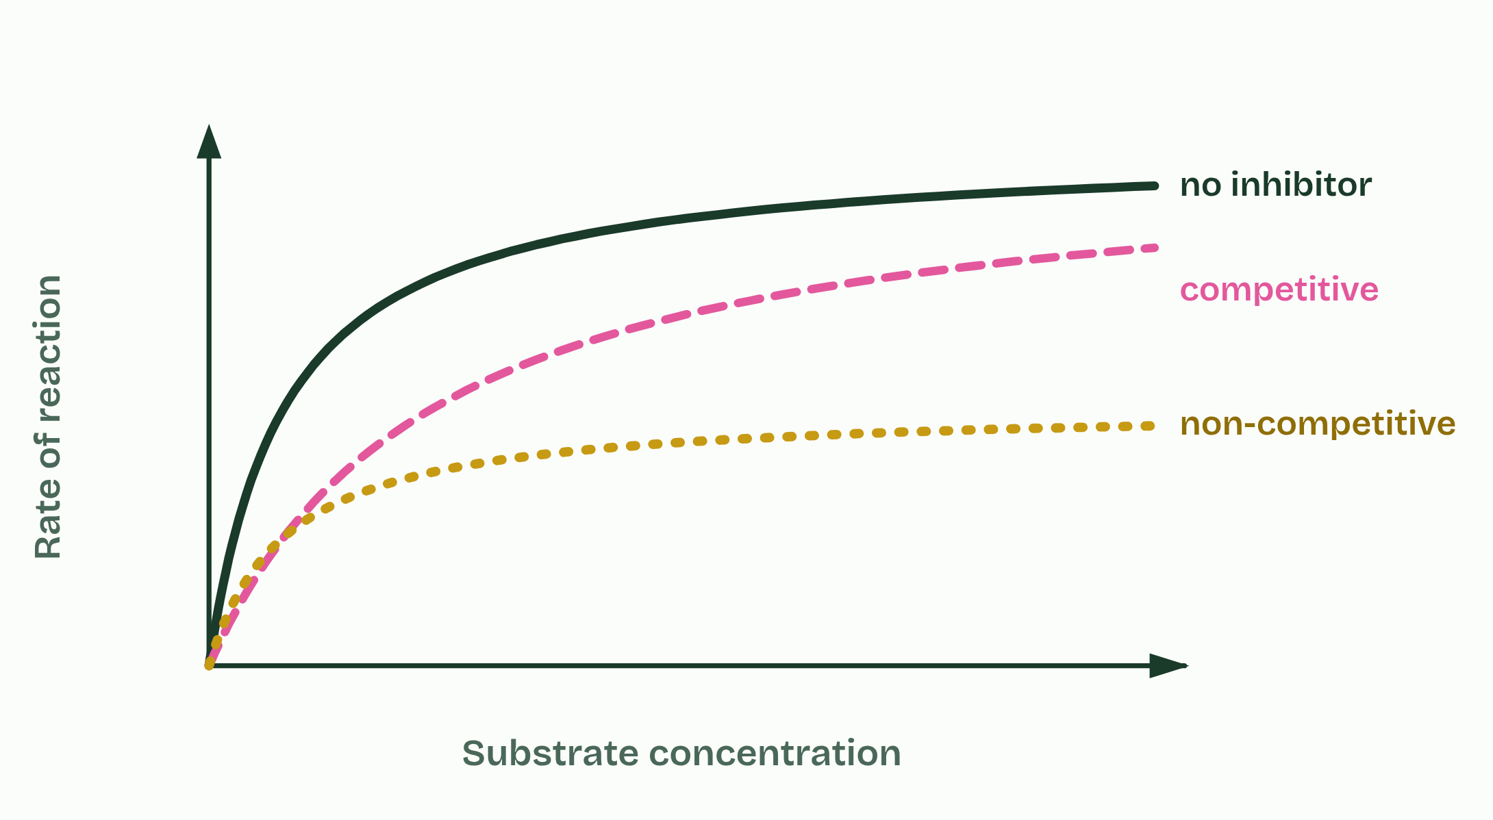
CHAPTER 12 · C1.1.15 Competitive inhibition
4 / 4
A look-alike in the active site
All three
Minutes 0 to 6
Notes:
Minutes 0 to 6 of 60: Do now: Sketch, then check (6 min).
The plan: The higher level version, below: three lines on one graph. Students draw their prediction before chapter 12.
A competitive inhibitor is similar enough in shape and chemistry to the substrate to bind the active site. While it is there, no substrate can bind. It is not converted, and it leaves again, so the binding is reversible.
Substrate and inhibitor take turns: each active site is taken by whichever happens to collide with it first. So the effect depends on how much of each there is.
A non-competitive inhibitor is different (chapter 11): it binds elsewhere and changes the site. How do the two behave when you add more substrate? Make your prediction, then open the graph.
Statins are the example. They are taken to lower blood cholesterol. In liver cells the enzyme HMG-CoA reductase converts HMG-CoA to mevalonate, an early step on the pathway that makes cholesterol. Part of a statin molecule resembles HMG-CoA, so it binds the active site and blocks it. Less cholesterol is made in the liver, and the level in the blood falls. A statin binds the site far more tightly than the substrate does, so a small dose is enough.
On a graph of rate against substrate concentration, a competitive inhibitor gives a curve that starts low but climbs towards the same plateau as the uninhibited enzyme. A non-competitive inhibitor gives a curve with a lower plateau.
Example: Two more, not to learn Relenza, a drug for influenza, was designed in Australia from the shape of the active site of the virus's enzyme neuraminidase. The enzyme snips sugar ends off the cell surface so that new virus particles can float free; Relenza fills the site, so they stay stuck. It is a competitive inhibitor. Cyanide is a poison that stops the last enzyme of the respiration chain. It is often called a non-competitive inhibitor, but it binds the iron atom at the very spot where oxygen binds, so it is better described as blocking that site. Neither is in the syllabus: the examples to know are statins and penicillin.

Slide 13
CHAPTER 12 · C1.1.15 Competitive inhibition
A look-alike in the active site
A competitive inhibitor is similar enough in shape and chemistry to the substrate to bind the active site.
A non-competitive inhibitor is different (chapter 11): it binds elsewhere and changes the site.
Statins are the example.
They are taken to lower blood cholesterol.
Minutes 0 to 6
Notes:
Minutes 0 to 6 of 60: Do now: Sketch, then check (6 min).
The plan: The higher level version, below: three lines on one graph. Students draw their prediction before chapter 12.
A competitive inhibitor is similar enough in shape and chemistry to the substrate to bind the active site. While it is there, no substrate can bind. It is not converted, and it leaves again, so the binding is reversible.
Substrate and inhibitor take turns: each active site is taken by whichever happens to collide with it first. So the effect depends on how much of each there is.
A non-competitive inhibitor is different (chapter 11): it binds elsewhere and changes the site. How do the two behave when you add more substrate? Make your prediction, then open the graph.
Statins are the example. They are taken to lower blood cholesterol. In liver cells the enzyme HMG-CoA reductase converts HMG-CoA to mevalonate, an early step on the pathway that makes cholesterol. Part of a statin molecule resembles HMG-CoA, so it binds the active site and blocks it. Less cholesterol is made in the liver, and the level in the blood falls. A statin binds the site far more tightly than the substrate does, so a small dose is enough.
On a graph of rate against substrate concentration, a competitive inhibitor gives a curve that starts low but climbs towards the same plateau as the uninhibited enzyme. A non-competitive inhibitor gives a curve with a lower plateau.
Example: Two more, not to learn Relenza, a drug for influenza, was designed in Australia from the shape of the active site of the virus's enzyme neuraminidase. The enzyme snips sugar ends off the cell surface so that new virus particles can float free; Relenza fills the site, so they stay stuck. It is a competitive inhibitor. Cyanide is a poison that stops the last enzyme of the respiration chain. It is often called a non-competitive inhibitor, but it binds the iron atom at the very spot where oxygen binds, so it is better described as blocking that site. Neither is in the syllabus: the examples to know are statins and penicillin.

Slide 14
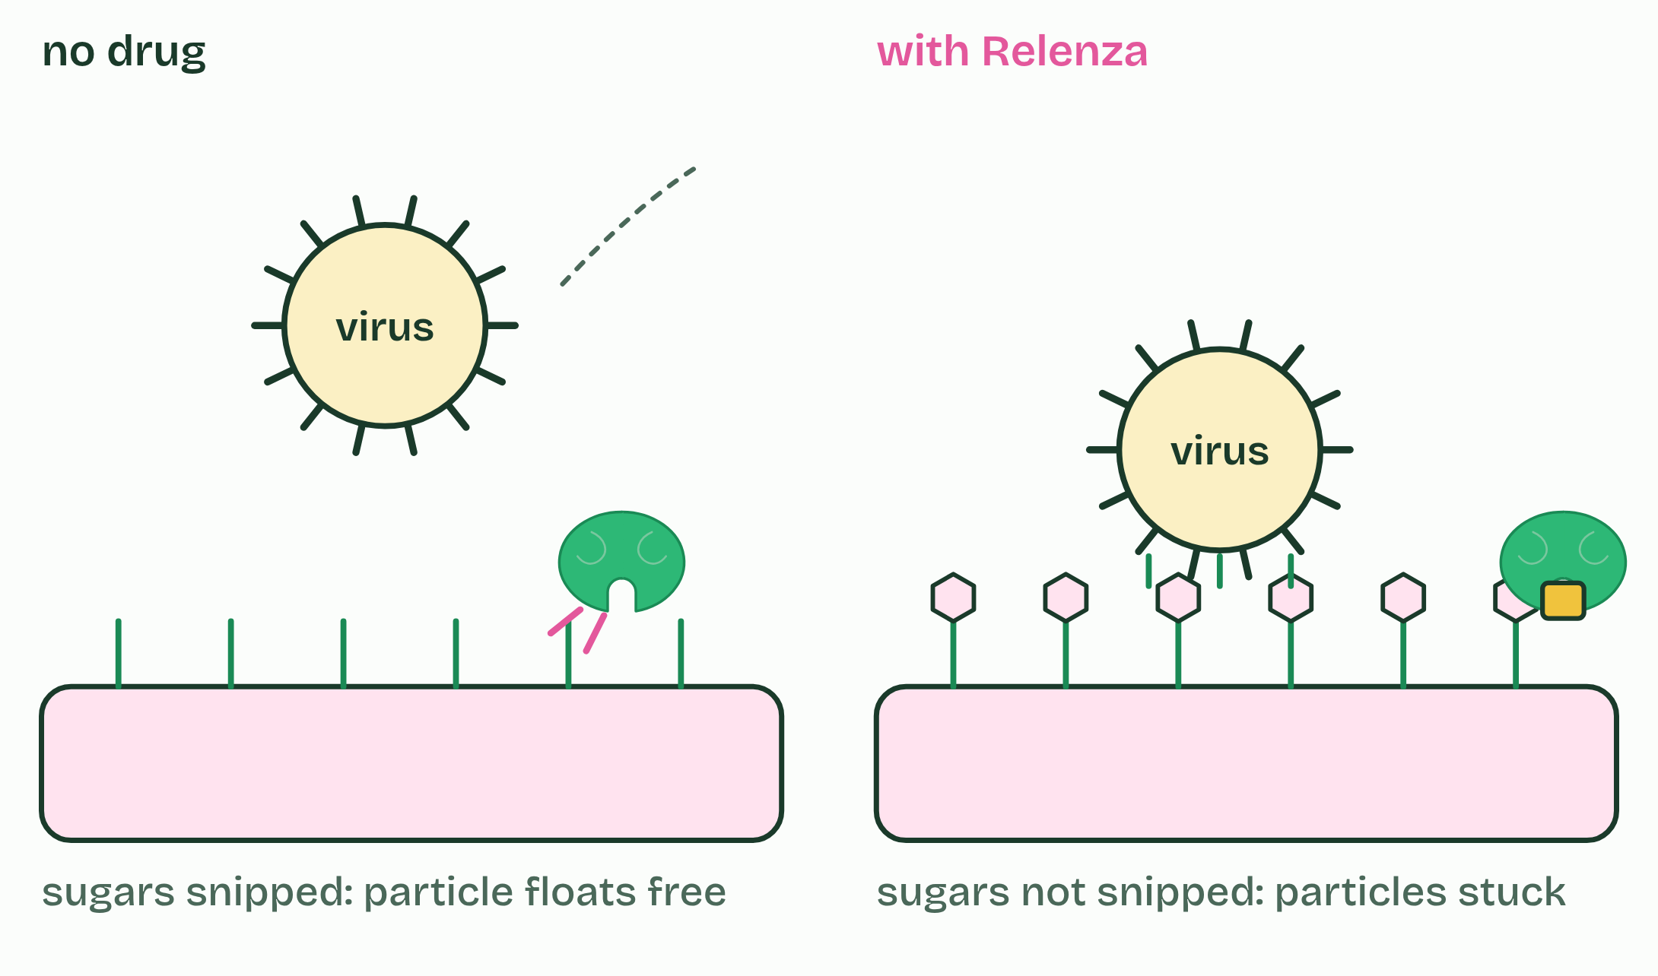
CHAPTER 12 · C1.1.15 Competitive inhibition
1 / 2
A look-alike in the active site
Relenza: a competitive inhibitor designed to fit a virus's enzyme.
Minutes 0 to 6
Notes:
Minutes 0 to 6 of 60: Do now: Sketch, then check (6 min).
The plan: The higher level version, below: three lines on one graph. Students draw their prediction before chapter 12.
A competitive inhibitor is similar enough in shape and chemistry to the substrate to bind the active site. While it is there, no substrate can bind. It is not converted, and it leaves again, so the binding is reversible.
Substrate and inhibitor take turns: each active site is taken by whichever happens to collide with it first. So the effect depends on how much of each there is.
A non-competitive inhibitor is different (chapter 11): it binds elsewhere and changes the site. How do the two behave when you add more substrate? Make your prediction, then open the graph.
Statins are the example. They are taken to lower blood cholesterol. In liver cells the enzyme HMG-CoA reductase converts HMG-CoA to mevalonate, an early step on the pathway that makes cholesterol. Part of a statin molecule resembles HMG-CoA, so it binds the active site and blocks it. Less cholesterol is made in the liver, and the level in the blood falls. A statin binds the site far more tightly than the substrate does, so a small dose is enough.
On a graph of rate against substrate concentration, a competitive inhibitor gives a curve that starts low but climbs towards the same plateau as the uninhibited enzyme. A non-competitive inhibitor gives a curve with a lower plateau.
Example: Two more, not to learn Relenza, a drug for influenza, was designed in Australia from the shape of the active site of the virus's enzyme neuraminidase. The enzyme snips sugar ends off the cell surface so that new virus particles can float free; Relenza fills the site, so they stay stuck. It is a competitive inhibitor. Cyanide is a poison that stops the last enzyme of the respiration chain. It is often called a non-competitive inhibitor, but it binds the iron atom at the very spot where oxygen binds, so it is better described as blocking that site. Neither is in the syllabus: the examples to know are statins and penicillin.

Slide 15
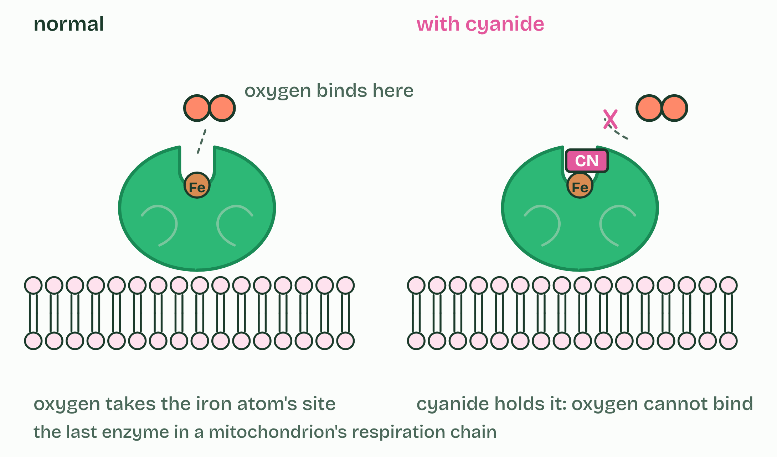
CHAPTER 12 · C1.1.15 Competitive inhibition
2 / 2
A look-alike in the active site
Cyanide: a poison that takes the place where oxygen binds.
Minutes 0 to 6
Notes:
Minutes 0 to 6 of 60: Do now: Sketch, then check (6 min).
The plan: The higher level version, below: three lines on one graph. Students draw their prediction before chapter 12.
A competitive inhibitor is similar enough in shape and chemistry to the substrate to bind the active site. While it is there, no substrate can bind. It is not converted, and it leaves again, so the binding is reversible.
Substrate and inhibitor take turns: each active site is taken by whichever happens to collide with it first. So the effect depends on how much of each there is.
A non-competitive inhibitor is different (chapter 11): it binds elsewhere and changes the site. How do the two behave when you add more substrate? Make your prediction, then open the graph.
Statins are the example. They are taken to lower blood cholesterol. In liver cells the enzyme HMG-CoA reductase converts HMG-CoA to mevalonate, an early step on the pathway that makes cholesterol. Part of a statin molecule resembles HMG-CoA, so it binds the active site and blocks it. Less cholesterol is made in the liver, and the level in the blood falls. A statin binds the site far more tightly than the substrate does, so a small dose is enough.
On a graph of rate against substrate concentration, a competitive inhibitor gives a curve that starts low but climbs towards the same plateau as the uninhibited enzyme. A non-competitive inhibitor gives a curve with a lower plateau.
Example: Two more, not to learn Relenza, a drug for influenza, was designed in Australia from the shape of the active site of the virus's enzyme neuraminidase. The enzyme snips sugar ends off the cell surface so that new virus particles can float free; Relenza fills the site, so they stay stuck. It is a competitive inhibitor. Cyanide is a poison that stops the last enzyme of the respiration chain. It is often called a non-competitive inhibitor, but it binds the iron atom at the very spot where oxygen binds, so it is better described as blocking that site. Neither is in the syllabus: the examples to know are statins and penicillin.

Slide 16
CHAPTER 12 · C1.1.15 Competitive inhibition
A look-alike in the active site
A competitive inhibitor is similar enough in shape and chemistry to the substrate to bind the active site.
A non-competitive inhibitor is different (chapter 11): it binds elsewhere and changes the site.
Statins are the example.
They are taken to lower blood cholesterol.
Minutes 0 to 6
Notes:
Minutes 0 to 6 of 60: Do now: Sketch, then check (6 min).
The plan: The higher level version, below: three lines on one graph. Students draw their prediction before chapter 12.
A competitive inhibitor is similar enough in shape and chemistry to the substrate to bind the active site. While it is there, no substrate can bind. It is not converted, and it leaves again, so the binding is reversible.
Substrate and inhibitor take turns: each active site is taken by whichever happens to collide with it first. So the effect depends on how much of each there is.
A non-competitive inhibitor is different (chapter 11): it binds elsewhere and changes the site. How do the two behave when you add more substrate? Make your prediction, then open the graph.
Statins are the example. They are taken to lower blood cholesterol. In liver cells the enzyme HMG-CoA reductase converts HMG-CoA to mevalonate, an early step on the pathway that makes cholesterol. Part of a statin molecule resembles HMG-CoA, so it binds the active site and blocks it. Less cholesterol is made in the liver, and the level in the blood falls. A statin binds the site far more tightly than the substrate does, so a small dose is enough.
On a graph of rate against substrate concentration, a competitive inhibitor gives a curve that starts low but climbs towards the same plateau as the uninhibited enzyme. A non-competitive inhibitor gives a curve with a lower plateau.
Example: Two more, not to learn Relenza, a drug for influenza, was designed in Australia from the shape of the active site of the virus's enzyme neuraminidase. The enzyme snips sugar ends off the cell surface so that new virus particles can float free; Relenza fills the site, so they stay stuck. It is a competitive inhibitor. Cyanide is a poison that stops the last enzyme of the respiration chain. It is often called a non-competitive inhibitor, but it binds the iron atom at the very spot where oxygen binds, so it is better described as blocking that site. Neither is in the syllabus: the examples to know are statins and penicillin.

Slide 17
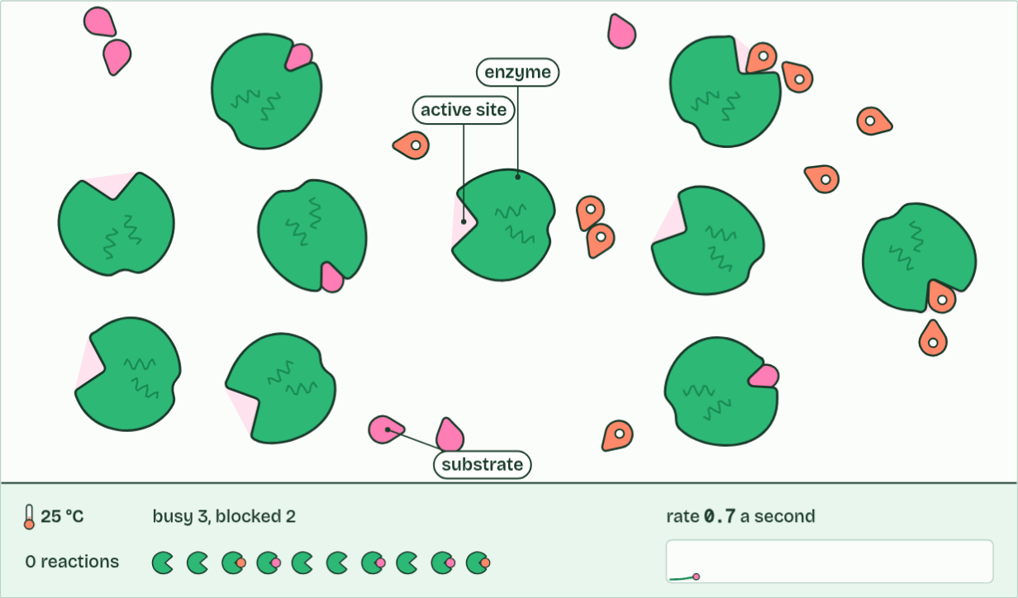
CHAPTER 12 · C1.1.15 Competitive inhibition
0 reactions
1 / 3
A look-alike in the active site
Molecules move at random, and most collisions miss the active site.
Minutes 0 to 6
Notes:
Minutes 0 to 6 of 60: Do now: Sketch, then check (6 min).
The plan: The higher level version, below: three lines on one graph. Students draw their prediction before chapter 12.
A competitive inhibitor is similar enough in shape and chemistry to the substrate to bind the active site. While it is there, no substrate can bind. It is not converted, and it leaves again, so the binding is reversible.
Substrate and inhibitor take turns: each active site is taken by whichever happens to collide with it first. So the effect depends on how much of each there is.
A non-competitive inhibitor is different (chapter 11): it binds elsewhere and changes the site. How do the two behave when you add more substrate? Make your prediction, then open the graph.
Statins are the example. They are taken to lower blood cholesterol. In liver cells the enzyme HMG-CoA reductase converts HMG-CoA to mevalonate, an early step on the pathway that makes cholesterol. Part of a statin molecule resembles HMG-CoA, so it binds the active site and blocks it. Less cholesterol is made in the liver, and the level in the blood falls. A statin binds the site far more tightly than the substrate does, so a small dose is enough.
On a graph of rate against substrate concentration, a competitive inhibitor gives a curve that starts low but climbs towards the same plateau as the uninhibited enzyme. A non-competitive inhibitor gives a curve with a lower plateau.
Example: Two more, not to learn Relenza, a drug for influenza, was designed in Australia from the shape of the active site of the virus's enzyme neuraminidase. The enzyme snips sugar ends off the cell surface so that new virus particles can float free; Relenza fills the site, so they stay stuck. It is a competitive inhibitor. Cyanide is a poison that stops the last enzyme of the respiration chain. It is often called a non-competitive inhibitor, but it binds the iron atom at the very spot where oxygen binds, so it is better described as blocking that site. Neither is in the syllabus: the examples to know are statins and penicillin.
The animation "Add an inhibitor", paused at 2.0 s. The next slides go on through it, then play it.

Slide 18
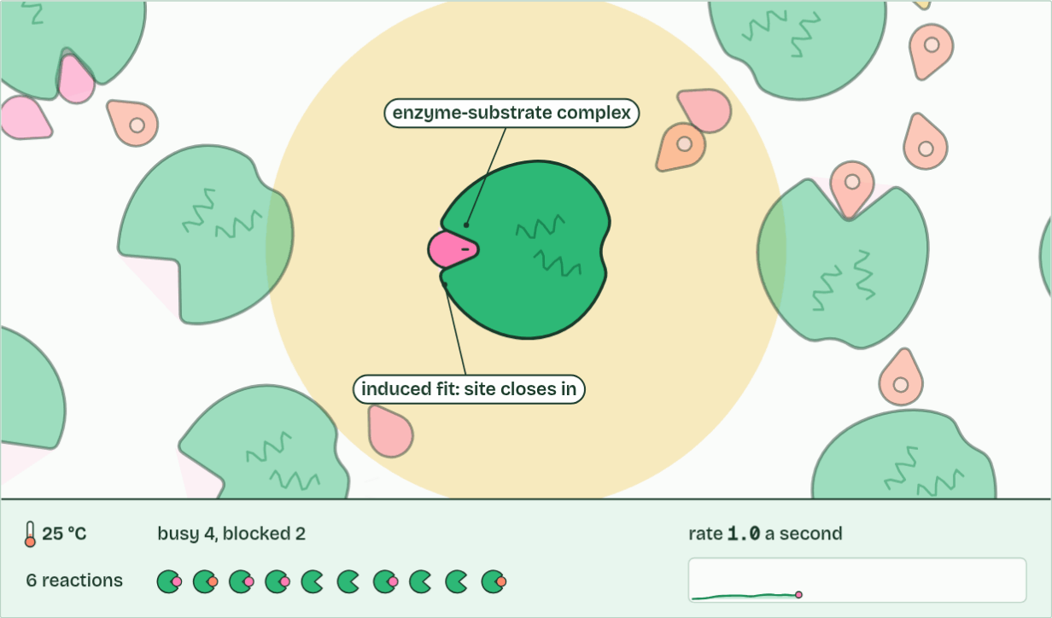
CHAPTER 12 · C1.1.15 Competitive inhibition
6 reactions
2 / 3
A look-alike in the active site
A successful collision: it binds and reacts, and the enzyme is unchanged.
Minutes 0 to 6
Notes:
Minutes 0 to 6 of 60: Do now: Sketch, then check (6 min).
The plan: The higher level version, below: three lines on one graph. Students draw their prediction before chapter 12.
A competitive inhibitor is similar enough in shape and chemistry to the substrate to bind the active site. While it is there, no substrate can bind. It is not converted, and it leaves again, so the binding is reversible.
Substrate and inhibitor take turns: each active site is taken by whichever happens to collide with it first. So the effect depends on how much of each there is.
A non-competitive inhibitor is different (chapter 11): it binds elsewhere and changes the site. How do the two behave when you add more substrate? Make your prediction, then open the graph.
Statins are the example. They are taken to lower blood cholesterol. In liver cells the enzyme HMG-CoA reductase converts HMG-CoA to mevalonate, an early step on the pathway that makes cholesterol. Part of a statin molecule resembles HMG-CoA, so it binds the active site and blocks it. Less cholesterol is made in the liver, and the level in the blood falls. A statin binds the site far more tightly than the substrate does, so a small dose is enough.
On a graph of rate against substrate concentration, a competitive inhibitor gives a curve that starts low but climbs towards the same plateau as the uninhibited enzyme. A non-competitive inhibitor gives a curve with a lower plateau.
Example: Two more, not to learn Relenza, a drug for influenza, was designed in Australia from the shape of the active site of the virus's enzyme neuraminidase. The enzyme snips sugar ends off the cell surface so that new virus particles can float free; Relenza fills the site, so they stay stuck. It is a competitive inhibitor. Cyanide is a poison that stops the last enzyme of the respiration chain. It is often called a non-competitive inhibitor, but it binds the iron atom at the very spot where oxygen binds, so it is better described as blocking that site. Neither is in the syllabus: the examples to know are statins and penicillin.
The animation "Add an inhibitor", paused at 7.8 s. The next slides go on through it, then play it.

Slide 19
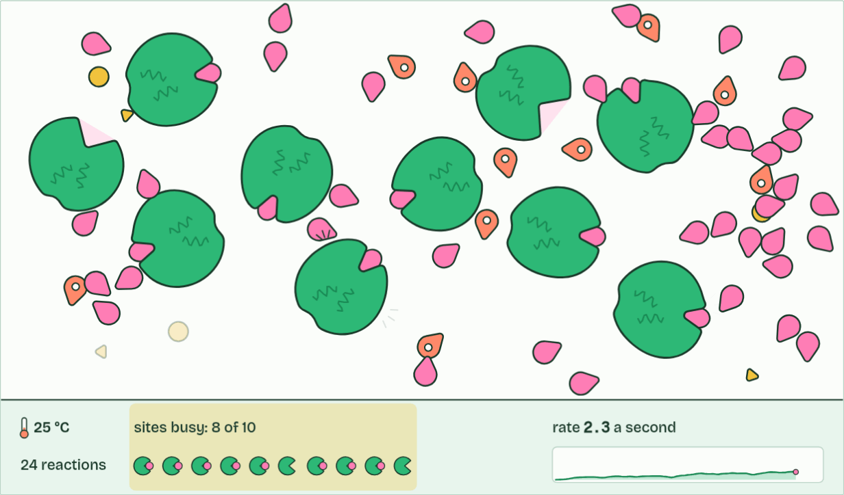
CHAPTER 12 · C1.1.15 Competitive inhibition
24 reactions
3 / 3
A look-alike in the active site
Plenty of substrate outcompetes it, so the rate climbs back near its maximum.
Minutes 0 to 6
Notes:
Minutes 0 to 6 of 60: Do now: Sketch, then check (6 min).
The plan: The higher level version, below: three lines on one graph. Students draw their prediction before chapter 12.
A competitive inhibitor is similar enough in shape and chemistry to the substrate to bind the active site. While it is there, no substrate can bind. It is not converted, and it leaves again, so the binding is reversible.
Substrate and inhibitor take turns: each active site is taken by whichever happens to collide with it first. So the effect depends on how much of each there is.
A non-competitive inhibitor is different (chapter 11): it binds elsewhere and changes the site. How do the two behave when you add more substrate? Make your prediction, then open the graph.
Statins are the example. They are taken to lower blood cholesterol. In liver cells the enzyme HMG-CoA reductase converts HMG-CoA to mevalonate, an early step on the pathway that makes cholesterol. Part of a statin molecule resembles HMG-CoA, so it binds the active site and blocks it. Less cholesterol is made in the liver, and the level in the blood falls. A statin binds the site far more tightly than the substrate does, so a small dose is enough.
On a graph of rate against substrate concentration, a competitive inhibitor gives a curve that starts low but climbs towards the same plateau as the uninhibited enzyme. A non-competitive inhibitor gives a curve with a lower plateau.
Example: Two more, not to learn Relenza, a drug for influenza, was designed in Australia from the shape of the active site of the virus's enzyme neuraminidase. The enzyme snips sugar ends off the cell surface so that new virus particles can float free; Relenza fills the site, so they stay stuck. It is a competitive inhibitor. Cyanide is a poison that stops the last enzyme of the respiration chain. It is often called a non-competitive inhibitor, but it binds the iron atom at the very spot where oxygen binds, so it is better described as blocking that site. Neither is in the syllabus: the examples to know are statins and penicillin.
The animation "Add an inhibitor", paused at 21.8 s. The next slides go on through it, then play it.

Slide 20
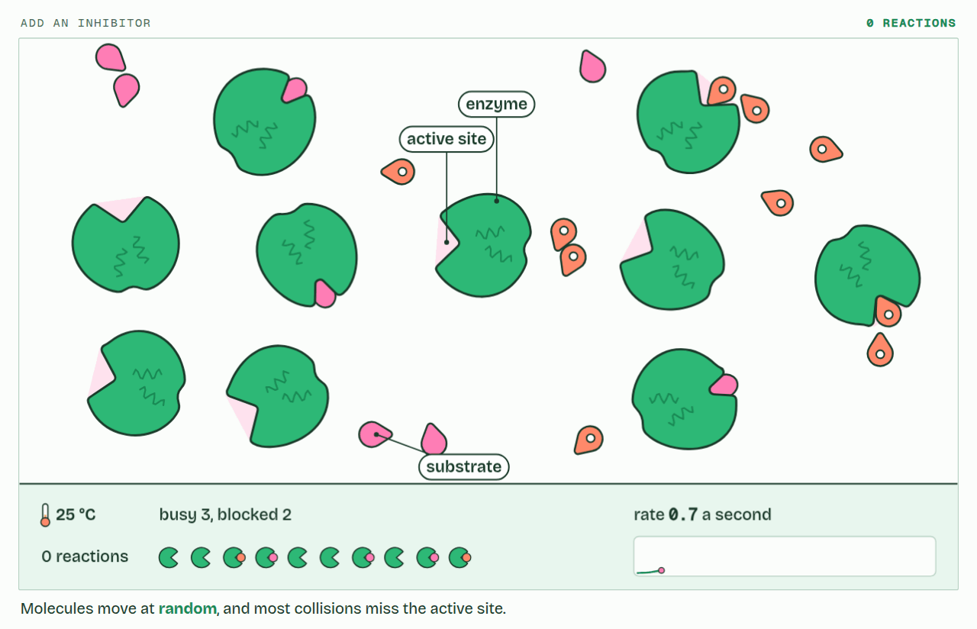
CHAPTER 12 · C1.1.15 Competitive inhibition
PLAY IT
A look-alike in the active site
Add an inhibitor: click to play. It loops every 24 seconds.
Minutes 0 to 6
Notes:
Minutes 0 to 6 of 60: Do now: Sketch, then check (6 min).
The plan: The higher level version, below: three lines on one graph. Students draw their prediction before chapter 12.
The video is collisions-10cae4.mp4, one loop of the animation in the guide. It plays in PowerPoint and Keynote. Google Slides does not play a video embedded in a .pptx: download collisions-10cae4.mp4 (https://www.biologybybradford.com/guides/downloads/scenes/collisions-10cae4.mp4), upload it to Google Drive, then Insert > Video > Google Drive.
In the guide the class can change it as it runs: https://www.biologybybradford.com/guides/ib-biology-c1-1-enzymes-and-metabolism#competitive
What it shows, in order:
1. Molecules move at random, and most collisions miss the active site.
2. A successful collision: it binds and reacts, and the enzyme is unchanged.
3. Plenty of substrate outcompetes it, so the rate climbs back near its maximum.

Slide 21
PREDICT
Two samples of an enzyme: one with a competitive inhibitor, one with a non-competitive inhibitor. You add far more substrate to both. In which does the inhibitor's effect fade?
A The non-competitive one: substrate pushes it off
B Both, equally: more substrate means more collisions
C Neither: once bound, inhibitors stay for good
D The competitive one: substrate wins the site back
Minutes 0 to 6
Notes:
Minutes 0 to 6 of 60: Do now: Sketch, then check (6 min).
The plan: The higher level version, below: three lines on one graph. Students draw their prediction before chapter 12.
Ask for a show of hands, or mini whiteboards, before revealing. (Answer: D, on the next slide.)

Slide 22
WHAT HAPPENS
Two samples of an enzyme: one with a competitive inhibitor, one with a non-competitive inhibitor. You add far more substrate to both. In which does the inhibitor's effect fade?
A The non-competitive one: substrate pushes it off
B Both, equally: more substrate means more collisions
C Neither: once bound, inhibitors stay for good
D The competitive one: substrate wins the site back
With far more substrate than competitive inhibitor, substrate molecules win almost every active site, so the rate climbs back towards its maximum. The non-competitive inhibitor binds elsewhere; substrate cannot compete for that site, so the enzyme molecules holding it stay off, however much substrate you add.
Minutes 0 to 6
Notes:
Minutes 0 to 6 of 60: Do now: Sketch, then check (6 min).
The plan: The higher level version, below: three lines on one graph. Students draw their prediction before chapter 12.
Answer: D. With far more substrate than competitive inhibitor, substrate molecules win almost every active site, so the rate climbs back towards its maximum. The non-competitive inhibitor binds elsewhere; substrate cannot compete for that site, so the enzyme molecules holding it stay off, however much substrate you add.

Slide 23
STEP 2
12 MIN
Chapter 12: statins
Chapter 12: the statins figure, the predict, then the graph's states against their sketches.
Minutes 6 to 18
Notes:
Minutes 6 to 18 of 60: Chapter 12: statins (12 min).
The plan: Chapter 12: the statins figure, the predict, then the graph's states against their sketches. Then the collisions film with each inhibitor.

Slide 24
STEP 3
12 MIN
Chapter 13: the pathway valve
Chapter 13: The end product shuts the gate
Minutes 18 to 30
Notes:
Minutes 18 to 30 of 60: Chapter 13: the pathway valve (12 min).
The plan: Chapter 13: the predict, then the Pathway valve. Set Fast, then Slow, then untick the allosteric site. Ask what would happen to a bacterium with that mutation.

Slide 25
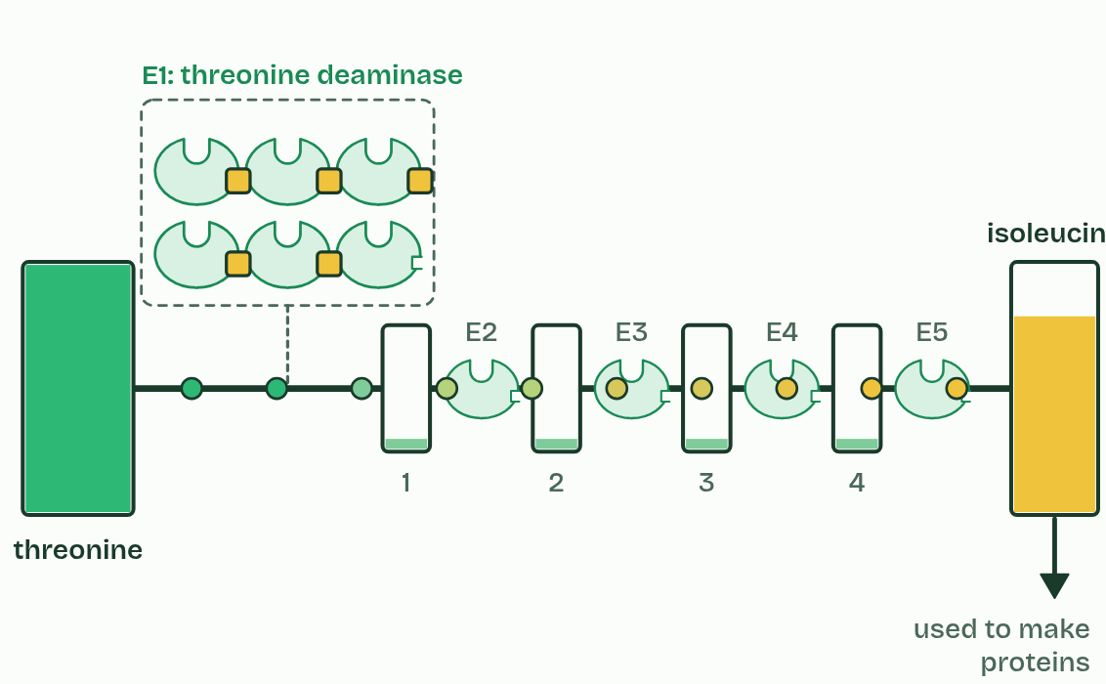
CHAPTER 13 · C1.1.16 Regulation of metabolic pathways by feedback inhibition
1 / 3
The end product shuts the gate
Slow
Minutes 18 to 30
Notes:
Minutes 18 to 30 of 60: Chapter 13: the pathway valve (12 min).
The plan: Chapter 13: the predict, then the Pathway valve. Set Fast, then Slow, then untick the allosteric site. Ask what would happen to a bacterium with that mutation.
In feedback inhibition (end-product inhibition), the last product of a pathway inhibits an enzyme near its start, usually the first, by binding to its allosteric site (chapter 11). When the product builds up, more of the first enzyme's molecules have it bound, so the pathway slows. When the cell uses the product up, it leaves the allosteric sites, the enzyme works again and the pathway speeds up. The product's own level sets its rate of production. This is negative feedback.
The example is the pathway that makes the amino acid isoleucine. Plants and bacteria make it from another amino acid, threonine, in five steps, each with its own enzyme. Isoleucine binds the allosteric site of the first enzyme, threonine deaminase. Humans cannot make isoleucine (it is an essential amino acid, B1.2) and get it from food.
Nothing here is switched simply on or off. The share of enzyme that is inhibited follows the end product's concentration, so production matches use. In the valve, change how fast the cell uses isoleucine and watch the first enzymes (the six small ones with a notch) fill and empty.

Slide 26
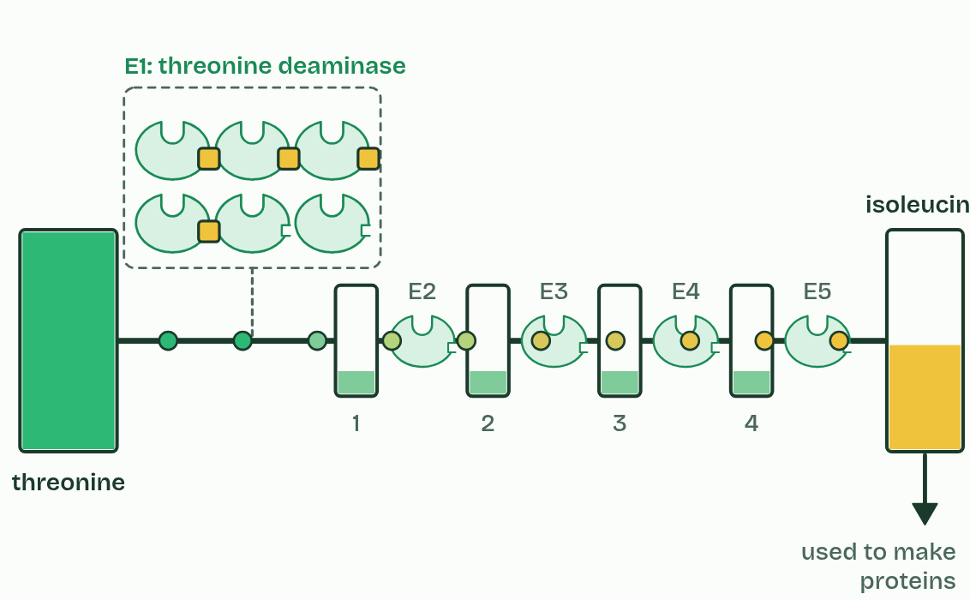
CHAPTER 13 · C1.1.16 Regulation of metabolic pathways by feedback inhibition
2 / 3
The end product shuts the gate
Normal
Minutes 18 to 30
Notes:
Minutes 18 to 30 of 60: Chapter 13: the pathway valve (12 min).
The plan: Chapter 13: the predict, then the Pathway valve. Set Fast, then Slow, then untick the allosteric site. Ask what would happen to a bacterium with that mutation.
In feedback inhibition (end-product inhibition), the last product of a pathway inhibits an enzyme near its start, usually the first, by binding to its allosteric site (chapter 11). When the product builds up, more of the first enzyme's molecules have it bound, so the pathway slows. When the cell uses the product up, it leaves the allosteric sites, the enzyme works again and the pathway speeds up. The product's own level sets its rate of production. This is negative feedback.
The example is the pathway that makes the amino acid isoleucine. Plants and bacteria make it from another amino acid, threonine, in five steps, each with its own enzyme. Isoleucine binds the allosteric site of the first enzyme, threonine deaminase. Humans cannot make isoleucine (it is an essential amino acid, B1.2) and get it from food.
Nothing here is switched simply on or off. The share of enzyme that is inhibited follows the end product's concentration, so production matches use. In the valve, change how fast the cell uses isoleucine and watch the first enzymes (the six small ones with a notch) fill and empty.

Slide 27
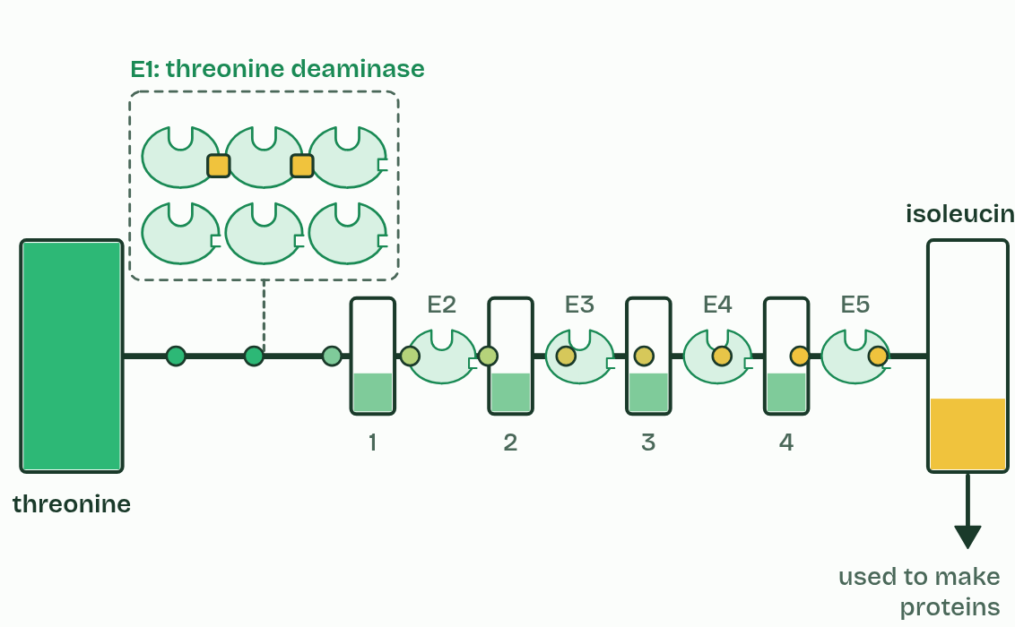
CHAPTER 13 · C1.1.16 Regulation of metabolic pathways by feedback inhibition
3 / 3
The end product shuts the gate
Fast
Minutes 18 to 30
Notes:
Minutes 18 to 30 of 60: Chapter 13: the pathway valve (12 min).
The plan: Chapter 13: the predict, then the Pathway valve. Set Fast, then Slow, then untick the allosteric site. Ask what would happen to a bacterium with that mutation.
In feedback inhibition (end-product inhibition), the last product of a pathway inhibits an enzyme near its start, usually the first, by binding to its allosteric site (chapter 11). When the product builds up, more of the first enzyme's molecules have it bound, so the pathway slows. When the cell uses the product up, it leaves the allosteric sites, the enzyme works again and the pathway speeds up. The product's own level sets its rate of production. This is negative feedback.
The example is the pathway that makes the amino acid isoleucine. Plants and bacteria make it from another amino acid, threonine, in five steps, each with its own enzyme. Isoleucine binds the allosteric site of the first enzyme, threonine deaminase. Humans cannot make isoleucine (it is an essential amino acid, B1.2) and get it from food.
Nothing here is switched simply on or off. The share of enzyme that is inhibited follows the end product's concentration, so production matches use. In the valve, change how fast the cell uses isoleucine and watch the first enzymes (the six small ones with a notch) fill and empty.

Slide 28
CHAPTER 13 · C1.1.16 Regulation of metabolic pathways by feedback inhibition
The end product shuts the gate
In feedback inhibition (end-product inhibition), the last product of a pathway inhibits an enzyme near its start, usually the first, by binding to its allosteric site (chapter 11).
The example is the pathway that makes the amino acid isoleucine.
Plants and bacteria make it from another amino acid, threonine, in five steps, each with its own enzyme.
Isoleucine binds the allosteric site of the first enzyme, threonine deaminase.
Minutes 18 to 30
Notes:
Minutes 18 to 30 of 60: Chapter 13: the pathway valve (12 min).
The plan: Chapter 13: the predict, then the Pathway valve. Set Fast, then Slow, then untick the allosteric site. Ask what would happen to a bacterium with that mutation.
In feedback inhibition (end-product inhibition), the last product of a pathway inhibits an enzyme near its start, usually the first, by binding to its allosteric site (chapter 11). When the product builds up, more of the first enzyme's molecules have it bound, so the pathway slows. When the cell uses the product up, it leaves the allosteric sites, the enzyme works again and the pathway speeds up. The product's own level sets its rate of production. This is negative feedback.
The example is the pathway that makes the amino acid isoleucine. Plants and bacteria make it from another amino acid, threonine, in five steps, each with its own enzyme. Isoleucine binds the allosteric site of the first enzyme, threonine deaminase. Humans cannot make isoleucine (it is an essential amino acid, B1.2) and get it from food.
Nothing here is switched simply on or off. The share of enzyme that is inhibited follows the end product's concentration, so production matches use. In the valve, change how fast the cell uses isoleucine and watch the first enzymes (the six small ones with a notch) fill and empty.

Slide 29
PREDICT
Isoleucine inhibits the first enzyme of its five-step pathway, not the last. Why the first?
A The first enzyme is the only one with an active site
B So no threonine is spent on intermediates nobody needs
C Isoleucine is too large to reach the later enzymes
D The last enzyme makes isoleucine, so it cannot be stopped
Minutes 18 to 30
Notes:
Minutes 18 to 30 of 60: Chapter 13: the pathway valve (12 min).
The plan: Chapter 13: the predict, then the Pathway valve. Set Fast, then Slow, then untick the allosteric site. Ask what would happen to a bacterium with that mutation.
Ask for a show of hands, or mini whiteboards, before revealing. (Answer: B, on the next slide.)

Slide 30
WHAT HAPPENS
Isoleucine inhibits the first enzyme of its five-step pathway, not the last. Why the first?
A The first enzyme is the only one with an active site
B So no threonine is spent on intermediates nobody needs
C Isoleucine is too large to reach the later enzymes
D The last enzyme makes isoleucine, so it cannot be stopped
Stopping the first step stops the whole pathway at its entrance. If the last enzyme were inhibited instead, the first four would keep using threonine and filling the cell with intermediates that go nowhere. Untick "Allosteric site working" to see what happens without the brake.
Minutes 18 to 30
Notes:
Minutes 18 to 30 of 60: Chapter 13: the pathway valve (12 min).
The plan: Chapter 13: the predict, then the Pathway valve. Set Fast, then Slow, then untick the allosteric site. Ask what would happen to a bacterium with that mutation.
Answer: B. Stopping the first step stops the whole pathway at its entrance. If the last enzyme were inhibited instead, the first four would keep using threonine and filling the cell with intermediates that go nowhere. Untick "Allosteric site working" to see what happens without the brake.

Slide 31
WATCH OUT
Feedback inhibition is not permanent and not an on and off switch. It is reversible binding, and the share of the enzyme inhibited follows the end product's concentration.
Minutes 18 to 30
Notes:
Minutes 18 to 30 of 60: Chapter 13: the pathway valve (12 min).
The plan: Chapter 13: the predict, then the Pathway valve. Set Fast, then Slow, then untick the allosteric site. Ask what would happen to a bacterium with that mutation.
A common mistake: say it, then ask who can say why it is wrong.

Slide 32
STEP 4
10 MIN
Chapter 14: a trap that springs once
Chapter 14: A trap that springs once
Minutes 30 to 40
Notes:
Minutes 30 to 40 of 60: Chapter 14: a trap that springs once (10 min).
The plan: Chapter 14: the predict, then the figure. Finish with Copycat, Nudge, Mousetrap.

Slide 33
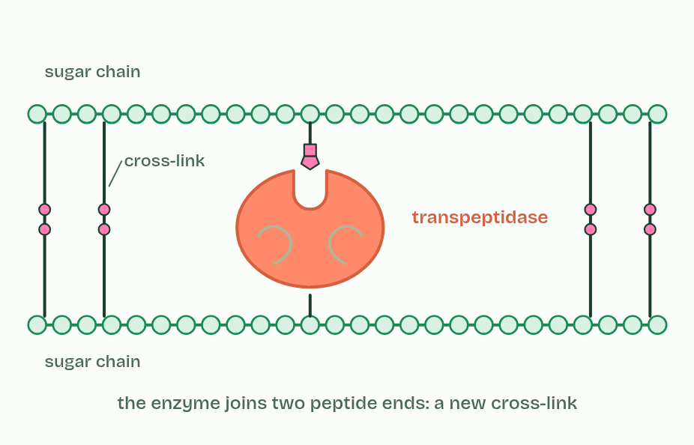
CHAPTER 14 · C1.1.17 Mechanism-based inhibition
1 / 5
A trap that springs once
Transpeptidase cross-links the wall's sugar chains.
Minutes 30 to 40
Notes:
Minutes 30 to 40 of 60: Chapter 14: a trap that springs once (10 min).
The plan: Chapter 14: the predict, then the figure. Finish with Copycat, Nudge, Mousetrap.
In mechanism-based inhibition an inhibitor enters the active site as if it were a substrate, and the enzyme starts to act on it. But the reaction stops part way, with the inhibitor held by a covalent bond. The active site is chemically changed and stays blocked for good: the inhibition is irreversible. That enzyme molecule is out of action until the cell makes new ones.
Penicillin is the example, and it was the first widely used antibiotic (Fleming noticed it in 1928, and it came into use in the early 1940s). A bacterial cell wall (A2.2) is made of long sugar chains cross-linked by short peptides, and the enzyme transpeptidase makes those cross-links.
Penicillin looks like the end of the peptide that transpeptidase normally joins. It enters the active site and the enzyme attacks it: a ring in the penicillin molecule opens, and penicillin ends up bonded covalently to the active site. New wall is then built without cross-links, so it is weak. As the bacterium grows, water enters, the wall gives way and the cell bursts. Human cells have no cell wall, and so none of the wall-building enzyme that penicillin targets, so penicillin does not harm them (C3.2 returns to antibiotics).
Some bacteria are not harmed. They show antibiotic resistance: they carry a changed transpeptidase, whose active site has a different shape that penicillin binds poorly but that still makes cross-links, so their walls are built normally in penicillin. MRSA is the well-known case. Such variants arise by mutation and spread by natural selection when penicillin is used (C3.2). Other bacteria resist in another way, by making an enzyme that breaks penicillin down, but that is a different mechanism.

Slide 34
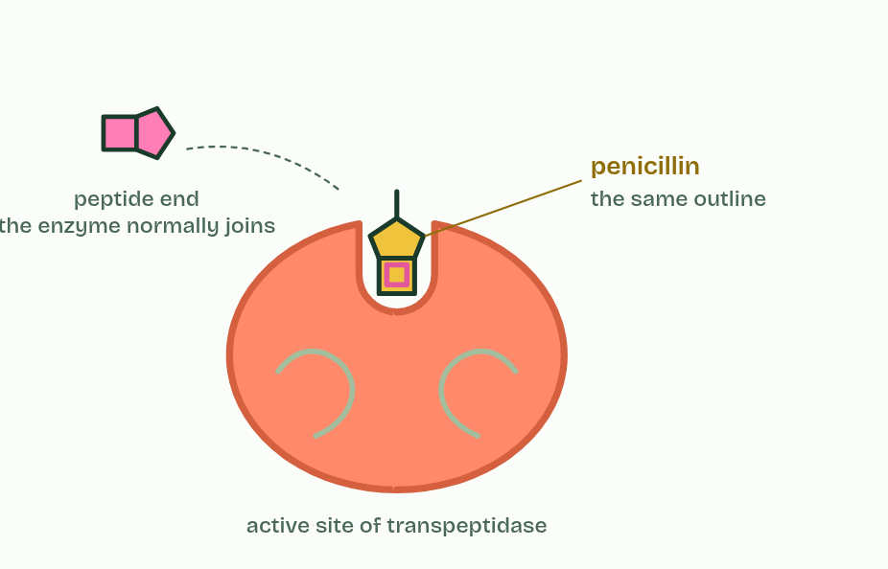
CHAPTER 14 · C1.1.17 Mechanism-based inhibition
2 / 5
A trap that springs once
Penicillin looks like the peptide the enzyme joins.
Minutes 30 to 40
Notes:
Minutes 30 to 40 of 60: Chapter 14: a trap that springs once (10 min).
The plan: Chapter 14: the predict, then the figure. Finish with Copycat, Nudge, Mousetrap.
In mechanism-based inhibition an inhibitor enters the active site as if it were a substrate, and the enzyme starts to act on it. But the reaction stops part way, with the inhibitor held by a covalent bond. The active site is chemically changed and stays blocked for good: the inhibition is irreversible. That enzyme molecule is out of action until the cell makes new ones.
Penicillin is the example, and it was the first widely used antibiotic (Fleming noticed it in 1928, and it came into use in the early 1940s). A bacterial cell wall (A2.2) is made of long sugar chains cross-linked by short peptides, and the enzyme transpeptidase makes those cross-links.
Penicillin looks like the end of the peptide that transpeptidase normally joins. It enters the active site and the enzyme attacks it: a ring in the penicillin molecule opens, and penicillin ends up bonded covalently to the active site. New wall is then built without cross-links, so it is weak. As the bacterium grows, water enters, the wall gives way and the cell bursts. Human cells have no cell wall, and so none of the wall-building enzyme that penicillin targets, so penicillin does not harm them (C3.2 returns to antibiotics).
Some bacteria are not harmed. They show antibiotic resistance: they carry a changed transpeptidase, whose active site has a different shape that penicillin binds poorly but that still makes cross-links, so their walls are built normally in penicillin. MRSA is the well-known case. Such variants arise by mutation and spread by natural selection when penicillin is used (C3.2). Other bacteria resist in another way, by making an enzyme that breaks penicillin down, but that is a different mechanism.

Slide 35
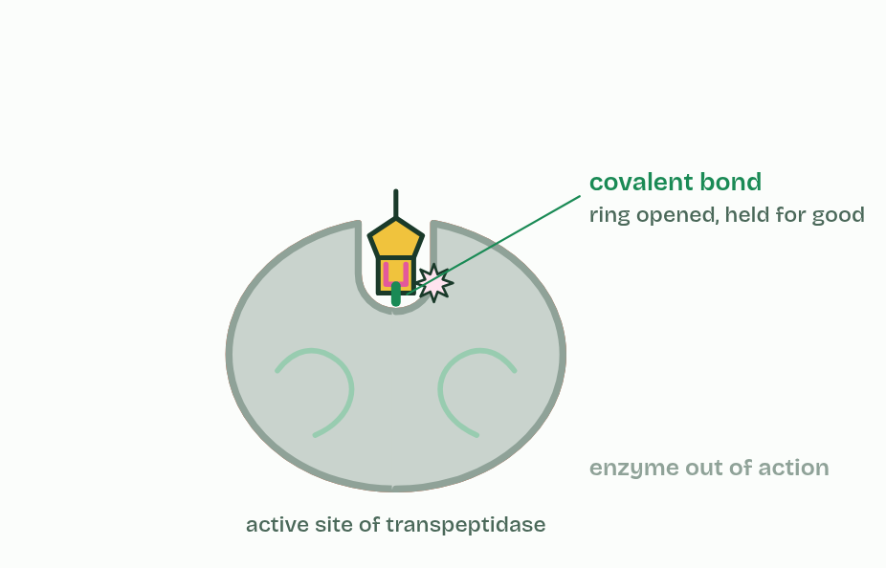
CHAPTER 14 · C1.1.17 Mechanism-based inhibition
3 / 5
A trap that springs once
The enzyme starts to act on it, and is trapped by a covalent bond: irreversible.
Minutes 30 to 40
Notes:
Minutes 30 to 40 of 60: Chapter 14: a trap that springs once (10 min).
The plan: Chapter 14: the predict, then the figure. Finish with Copycat, Nudge, Mousetrap.
In mechanism-based inhibition an inhibitor enters the active site as if it were a substrate, and the enzyme starts to act on it. But the reaction stops part way, with the inhibitor held by a covalent bond. The active site is chemically changed and stays blocked for good: the inhibition is irreversible. That enzyme molecule is out of action until the cell makes new ones.
Penicillin is the example, and it was the first widely used antibiotic (Fleming noticed it in 1928, and it came into use in the early 1940s). A bacterial cell wall (A2.2) is made of long sugar chains cross-linked by short peptides, and the enzyme transpeptidase makes those cross-links.
Penicillin looks like the end of the peptide that transpeptidase normally joins. It enters the active site and the enzyme attacks it: a ring in the penicillin molecule opens, and penicillin ends up bonded covalently to the active site. New wall is then built without cross-links, so it is weak. As the bacterium grows, water enters, the wall gives way and the cell bursts. Human cells have no cell wall, and so none of the wall-building enzyme that penicillin targets, so penicillin does not harm them (C3.2 returns to antibiotics).
Some bacteria are not harmed. They show antibiotic resistance: they carry a changed transpeptidase, whose active site has a different shape that penicillin binds poorly but that still makes cross-links, so their walls are built normally in penicillin. MRSA is the well-known case. Such variants arise by mutation and spread by natural selection when penicillin is used (C3.2). Other bacteria resist in another way, by making an enzyme that breaks penicillin down, but that is a different mechanism.

Slide 36
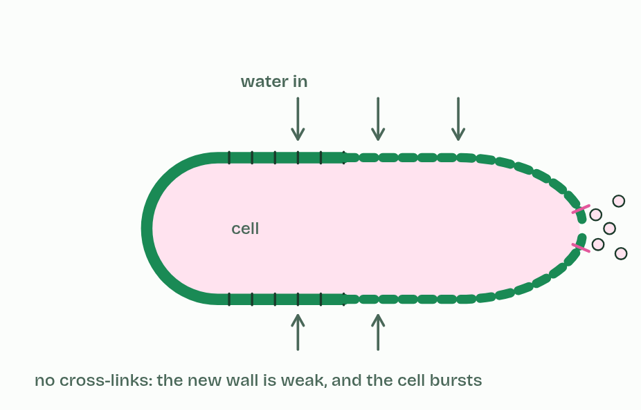
CHAPTER 14 · C1.1.17 Mechanism-based inhibition
4 / 5
A trap that springs once
Without cross-links, the wall gives way and the cell bursts.
Minutes 30 to 40
Notes:
Minutes 30 to 40 of 60: Chapter 14: a trap that springs once (10 min).
The plan: Chapter 14: the predict, then the figure. Finish with Copycat, Nudge, Mousetrap.
In mechanism-based inhibition an inhibitor enters the active site as if it were a substrate, and the enzyme starts to act on it. But the reaction stops part way, with the inhibitor held by a covalent bond. The active site is chemically changed and stays blocked for good: the inhibition is irreversible. That enzyme molecule is out of action until the cell makes new ones.
Penicillin is the example, and it was the first widely used antibiotic (Fleming noticed it in 1928, and it came into use in the early 1940s). A bacterial cell wall (A2.2) is made of long sugar chains cross-linked by short peptides, and the enzyme transpeptidase makes those cross-links.
Penicillin looks like the end of the peptide that transpeptidase normally joins. It enters the active site and the enzyme attacks it: a ring in the penicillin molecule opens, and penicillin ends up bonded covalently to the active site. New wall is then built without cross-links, so it is weak. As the bacterium grows, water enters, the wall gives way and the cell bursts. Human cells have no cell wall, and so none of the wall-building enzyme that penicillin targets, so penicillin does not harm them (C3.2 returns to antibiotics).
Some bacteria are not harmed. They show antibiotic resistance: they carry a changed transpeptidase, whose active site has a different shape that penicillin binds poorly but that still makes cross-links, so their walls are built normally in penicillin. MRSA is the well-known case. Such variants arise by mutation and spread by natural selection when penicillin is used (C3.2). Other bacteria resist in another way, by making an enzyme that breaks penicillin down, but that is a different mechanism.

Slide 37
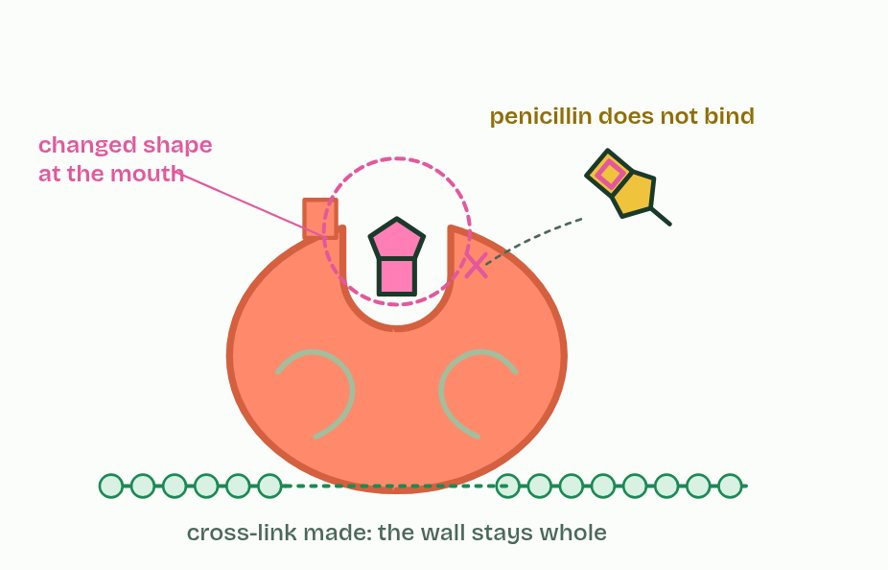
CHAPTER 14 · C1.1.17 Mechanism-based inhibition
5 / 5
A trap that springs once
A changed transpeptidase binds penicillin poorly: resistance.
Minutes 30 to 40
Notes:
Minutes 30 to 40 of 60: Chapter 14: a trap that springs once (10 min).
The plan: Chapter 14: the predict, then the figure. Finish with Copycat, Nudge, Mousetrap.
In mechanism-based inhibition an inhibitor enters the active site as if it were a substrate, and the enzyme starts to act on it. But the reaction stops part way, with the inhibitor held by a covalent bond. The active site is chemically changed and stays blocked for good: the inhibition is irreversible. That enzyme molecule is out of action until the cell makes new ones.
Penicillin is the example, and it was the first widely used antibiotic (Fleming noticed it in 1928, and it came into use in the early 1940s). A bacterial cell wall (A2.2) is made of long sugar chains cross-linked by short peptides, and the enzyme transpeptidase makes those cross-links.
Penicillin looks like the end of the peptide that transpeptidase normally joins. It enters the active site and the enzyme attacks it: a ring in the penicillin molecule opens, and penicillin ends up bonded covalently to the active site. New wall is then built without cross-links, so it is weak. As the bacterium grows, water enters, the wall gives way and the cell bursts. Human cells have no cell wall, and so none of the wall-building enzyme that penicillin targets, so penicillin does not harm them (C3.2 returns to antibiotics).
Some bacteria are not harmed. They show antibiotic resistance: they carry a changed transpeptidase, whose active site has a different shape that penicillin binds poorly but that still makes cross-links, so their walls are built normally in penicillin. MRSA is the well-known case. Such variants arise by mutation and spread by natural selection when penicillin is used (C3.2). Other bacteria resist in another way, by making an enzyme that breaks penicillin down, but that is a different mechanism.

Slide 38
CHAPTER 14 · C1.1.17 Mechanism-based inhibition
A trap that springs once
In mechanism-based inhibition an inhibitor enters the active site as if it were a substrate, and the enzyme starts to act on it.
But the reaction stops part way, with the inhibitor held by a covalent bond.
The active site is chemically changed and stays blocked for good: the inhibition is irreversible.
A bacterial cell wall (A2.2) is made of long sugar chains cross-linked by short peptides, and the enzyme transpeptidase makes those cross-links.
Minutes 30 to 40
Notes:
Minutes 30 to 40 of 60: Chapter 14: a trap that springs once (10 min).
The plan: Chapter 14: the predict, then the figure. Finish with Copycat, Nudge, Mousetrap.
In mechanism-based inhibition an inhibitor enters the active site as if it were a substrate, and the enzyme starts to act on it. But the reaction stops part way, with the inhibitor held by a covalent bond. The active site is chemically changed and stays blocked for good: the inhibition is irreversible. That enzyme molecule is out of action until the cell makes new ones.
Penicillin is the example, and it was the first widely used antibiotic (Fleming noticed it in 1928, and it came into use in the early 1940s). A bacterial cell wall (A2.2) is made of long sugar chains cross-linked by short peptides, and the enzyme transpeptidase makes those cross-links.
Penicillin looks like the end of the peptide that transpeptidase normally joins. It enters the active site and the enzyme attacks it: a ring in the penicillin molecule opens, and penicillin ends up bonded covalently to the active site. New wall is then built without cross-links, so it is weak. As the bacterium grows, water enters, the wall gives way and the cell bursts. Human cells have no cell wall, and so none of the wall-building enzyme that penicillin targets, so penicillin does not harm them (C3.2 returns to antibiotics).
Some bacteria are not harmed. They show antibiotic resistance: they carry a changed transpeptidase, whose active site has a different shape that penicillin binds poorly but that still makes cross-links, so their walls are built normally in penicillin. MRSA is the well-known case. Such variants arise by mutation and spread by natural selection when penicillin is used (C3.2). Other bacteria resist in another way, by making an enzyme that breaks penicillin down, but that is a different mechanism.

Slide 39
PREDICT
A strain of bacteria keeps building strong walls in penicillin. Its transpeptidase still makes cross-links. What has most likely changed?
A It has stopped making a cell wall at all
B Penicillin now binds an allosteric site on the enzyme instead
C Its transpeptidase's active site binds penicillin poorly
D Its wall has grown so thick that penicillin cannot get in
Minutes 30 to 40
Notes:
Minutes 30 to 40 of 60: Chapter 14: a trap that springs once (10 min).
The plan: Chapter 14: the predict, then the figure. Finish with Copycat, Nudge, Mousetrap.
Ask for a show of hands, or mini whiteboards, before revealing. (Answer: C, on the next slide.)

Slide 40
WHAT HAPPENS
A strain of bacteria keeps building strong walls in penicillin. Its transpeptidase still makes cross-links. What has most likely changed?
A It has stopped making a cell wall at all
B Penicillin now binds an allosteric site on the enzyme instead
C Its transpeptidase's active site binds penicillin poorly
D Its wall has grown so thick that penicillin cannot get in
The strain has a changed transpeptidase. Its active site still joins the peptide ends, but its shape no longer lets penicillin bind well, so the trap never springs. A mutation made the change; using penicillin selects the bacteria that carry it.
Minutes 30 to 40
Notes:
Minutes 30 to 40 of 60: Chapter 14: a trap that springs once (10 min).
The plan: Chapter 14: the predict, then the figure. Finish with Copycat, Nudge, Mousetrap.
Answer: C. The strain has a changed transpeptidase. Its active site still joins the peptide ends, but its shape no longer lets penicillin bind well, so the trap never springs. A mutation made the change; using penicillin selects the bacteria that carry it.

Slide 41
WATCH OUT
Penicillin is not a competitive inhibitor that "stays a long time". It is bonded covalently and the enzyme never recovers.
Minutes 30 to 40
Notes:
Minutes 30 to 40 of 60: Chapter 14: a trap that springs once (10 min).
The plan: Chapter 14: the predict, then the figure. Finish with Copycat, Nudge, Mousetrap.
A common mistake: say it, then ask who can say why it is wrong.

Slide 42
REMEMBER IT
Three ways to stop an enzyme
C
N
M
Copycat
Nudge
Mousetrap
Minutes 30 to 40
Notes:
Minutes 30 to 40 of 60: Chapter 14: a trap that springs once (10 min).
The plan: Chapter 14: the predict, then the figure. Finish with Copycat, Nudge, Mousetrap.
Ask the class what each letter stands for before revealing.

Slide 43
REMEMBER IT
Three ways to stop an enzyme
C
N
M
Copycat
Nudge
Mousetrap
Competitive
Non-competitive
Mechanism-based
a look-alike takes the active site, reversibly
binds the allosteric site and changes the active site, reversibly
springs once in the active site and holds for good
Minutes 30 to 40
Notes:
Minutes 30 to 40 of 60: Chapter 14: a trap that springs once (10 min).
The plan: Chapter 14: the predict, then the figure. Finish with Copycat, Nudge, Mousetrap.
Copycat: Competitive (a look-alike takes the active site, reversibly)
Nudge: Non-competitive (binds the allosteric site and changes the active site, reversibly)
Mousetrap: Mechanism-based (springs once in the active site and holds for good)

Slide 44
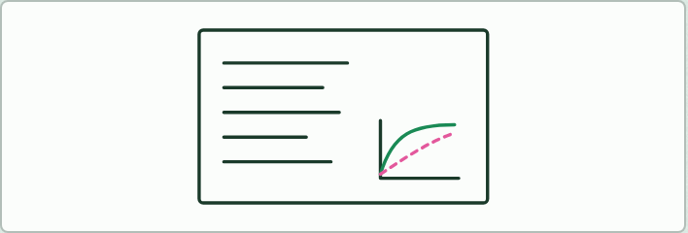
WRITING · HL
15 MIN
Plan an 8-mark answer
THE TASK
"Three molecules stop three enzymes: a statin, isoleucine and penicillin. Compare how each one does it, and say which can be undone. [8]" Plan in keywords first (competitive: binds the active site, resembles the substrate, reversible, more substrate overcomes it, statins; non-competitive: allosteric site, shape change, reversible, more substrate does not help; mechanism-based: covalent, irreversible, penicillin and transpeptidase; feedback with isoleucine; a sketch graph), then write. Peer mark against the points the class agrees.
STUDENTS NEED
Lined paper.
Minutes 40 to 55
Notes:
Minutes 40 to 55 of 60: Plan an 8-mark answer (15 min).
The plan: The writing task below: plan in keywords, then write.
The activity: Plan an 8-mark answer. "Three molecules stop three enzymes: a statin, isoleucine and penicillin. Compare how each one does it, and say which can be undone. [8]" Plan in keywords first (competitive: binds the active site, resembles the substrate, reversible, more substrate overcomes it, statins; non-competitive: allosteric site, shape change, reversible, more substrate does not help; mechanism-based: covalent, irreversible, penicillin and transpeptidase; feedback with isoleucine; a sketch graph), then write. Peer mark against the points the class agrees.
Needs: lined paper.
The time: 15 minutes, minutes 40 to 55 of the plan.

Slide 45
PLENARY
Can you now...
Explain how statins inhibit an enzyme competitively, and contrast competitive and non-competitive inhibition on a graph (C1.1.15)
Explain how isoleucine controls its own pathway by feedback inhibition (C1.1.16)
Explain how penicillin inhibits transpeptidase for good, and how a changed transpeptidase makes bacteria resistant (C1.1.17)
Minutes 55 to 60
Notes:
Minutes 55 to 60 of 60: Exit (5 min).
The plan: Why can more substrate overcome a statin but not penicillin?
Thumbs up, sideways or down on each goal before the exit question. The goals come from the statements this lesson covers.

Slide 46
EXIT QUESTION
Before you go
Why can more substrate overcome a statin but not penicillin?
Minutes 55 to 60
Notes:
Minutes 55 to 60 of 60: Exit (5 min).
The plan: Why can more substrate overcome a statin but not penicillin?

Slide 47
PRACTISE AND REVISE
Keep going
Exam practice: a fresh paper of exam questions on C1.1 at higher level, marked as you go
The guide, with the animations and the dry lab
This lesson in the guide: 12 A look-alike in the active site, 13 The end product shuts the gate, 14 A trap that springs once
BUILD FOR YOUR CLASS
ALREADY ON THE SITE FOR C1.1
CARD SETS ON SPLYCR
Tarsia puzzle, dominoes and picture reveal on C1.1, built from its key terms and ready to print
A pub quiz with rounds on C1.1, to present or run with no projector
An escape room built from the question bank on C1.1
Lesson: Enzymes & Metabolism HL (HL)
Lab: The Enzyme in Your Spit
Summary doodle: Enzymes & Metabolism
Quiz: Enzymes
Quiz: Enzymes & Metabolism (HL)
Revision map: C1.1 Enzymes and metabolism, to fill in
Exam questions: C1.1 in the exam maker, a paper with its markscheme
Open a set to host it as a class game, or make a copy to edit.
C1.1 Enzymes and Metabolism
How this was made. The course structure, the activities and the teaching choices come from my own classroom, my presentations and my years of teaching IB and AP Biology. I use Claude, an AI, to help write and build the interactive guides, lesson plans, slides and practice questions, and to draw the diagrams and code the interactives. I direct the work and review it against the IB and AP specifications before it goes live.
Minute 60: after the lesson
Notes:
Every link here is live. Set the exam practice paper for homework: it is fresh each time, marked as students go and saved to their Exam practice when they are signed in.
Exam practice: https://www.biologybybradford.com/exam-maker/sit?topics=C1.1&level=HL&paper=quiz&marks=15&src=ep
The guide: https://www.biologybybradford.com/guides/ib-biology-c1-1-enzymes-and-metabolism

