Slide 1
IB Biology C1.2
LESSON 1 OF 5
BY THE END YOU CAN
Cell respiration
Describe ATP as a nucleotide and explain what makes it suit the job of moving energy around a cell (C1.2.1)
Explain how hydrolysis of ATP releases energy for active transport, building molecules and movement, and why remaking it takes energy (C1.2.2, C1.2.3)
Explain respiration as the cell's way of making ATP from carbon compounds, and tell it apart from gas exchange (C1.2.4)
Compare aerobic and anaerobic respiration in humans, with word equations for both (C1.2.5)
ATP, and two ways to make it
C1.2.1 to C1.2.5
ATP as the cell’s energy currency, what it pays for, respiration against gas exchange, and aerobic against anaerobic respiration
60 minutes · chapters 1, 2, 3, 4
Minute 0
Notes:
IB Biology C1.2, Cell respiration. Lesson 1 of 5: ATP, and two ways to make it, 60 minutes.
The plan, minute by minute (each slide's footer says where you are):
0 to 5 min (5) Do now: which need energy?
5 to 15 min (10) ATP, spent and remade
15 to 23 min (8) Burning or respiring?
23 to 35 min (12) Compare the two routes
35 to 43 min (8) The respiration film
43 to 55 min (12) The ATP budget
55 to 60 min (5) Exit: true or false
What students get wrong:
Respiration is breathing. Respiration is chemistry in every cell; breathing moves air and gas exchange moves gases.
Respiration makes energy. It releases energy from the fuel and transfers it to ATP.
Energy is stored in the bond between phosphates, and breaking it releases energy. Breaking bonds takes energy; hydrolysis releases energy overall, because ADP and phosphate hold less than ATP and water did. Check the slides you borrow for this.
ATP is an energy store. A cell holds only a little and remakes it all the time.
Plants photosynthesise instead of respiring. Every living cell respires all the time.
All of aerobic respiration happens in the mitochondria. Glycolysis is in the cytoplasm.
Anaerobic respiration in humans makes carbon dioxide. The product in human muscle is lactate only.
Muscles switch from aerobic to anaerobic. Anaerobic respiration adds to aerobic respiration when oxygen cannot keep up.
Stretch and support:
Support: give the captions of chapter 4’s figure as cut-up cards to sort into “with oxygen” and “without”, the dotted key terms as a glossary, and a writing frame for “compare aerobic and anaerobic respiration” (one row of the table, one sentence each).
Support: use the BAM and LOW tiles as sentence starters.
Stretch: a resting adult remakes roughly their own body mass of ATP each day, from a stock of well under a kilogram. How many times a day is each ATP molecule remade?
Stretch: compare each sprint round’s ATP per glucose with the aerobic figure: how many times more glucose does the sprint need for the same ATP?
The lesson plan to print: https://www.biologybybradford.com/guides/downloads/ib-biology-c1-2-cell-respiration-lesson-1-plan.pdf

Slide 2
DO NOW
Which need energy?
Pairs list the functions of life they remember and star every one that needs energy.
Students then say which kind of job each is.
5:00
minutes
Start now: the timer is running.
Minutes 0 to 5
Notes:
Minutes 0 to 5 of 60: Do now: which need energy? (5 min).
The plan: Pairs list the functions of life they remember and star every one that needs energy (activity below). Land on: all of them. Students then say which kind of job each is.
Start a 5 minute timer as they come in.

Slide 3
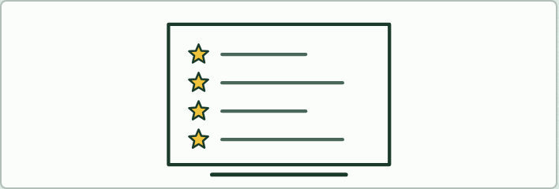
DISCUSSION
5 MIN
Which need energy?
THE TASK
Pairs list the functions of life (nutrition, metabolism, growth, response, excretion, homeostasis, reproduction, and movement where it applies) and star the ones that need energy. Every one does: which kind of ATP job is each one (building, active transport, movement)?
STUDENTS NEED
Mini whiteboards.
Minutes 0 to 5
Notes:
Minutes 0 to 5 of 60: Do now: which need energy? (5 min).
The plan: Pairs list the functions of life they remember and star every one that needs energy (activity below). Land on: all of them. Students then say which kind of job each is.
The activity: Which need energy?. Pairs list the functions of life (nutrition, metabolism, growth, response, excretion, homeostasis, reproduction, and movement where it applies) and star the ones that need energy. Every one does: which kind of ATP job is each one (building, active transport, movement)?
Needs: mini whiteboards.
The time: 5 minutes, minutes 0 to 5 of the plan.

Slide 4
STEP 2
10 MIN
ATP, spent and remade
Students build ATP on mini whiteboards from a nucleotide, then play chapter 1’s figure and make its predict.
Ask: “Where does the energy to remake ATP come from?” before step 3.
Minutes 5 to 15
Notes:
Minutes 5 to 15 of 60: ATP, spent and remade (10 min).
The plan: Students build ATP on mini whiteboards from a nucleotide (activity below), then play chapter 1’s figure and make its predict. Then chapter 2’s figure step by step, stopping on each caption, and the BAM tiles. Ask: “Where does the energy to remake ATP come from?” before step 3.

Slide 5
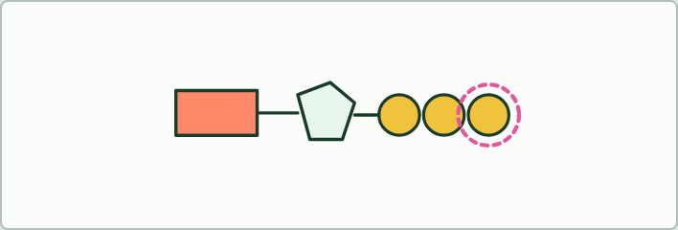
MODEL
10 MIN
Build ATP
THE TASK
On mini whiteboards, draw three shapes for a nucleotide (a rectangle, a pentagon and a circle), then add two more circles: ADP, then ATP. Label the base, the sugar and the phosphates, and circle the part removed by hydrolysis.
STUDENTS NEED
Mini whiteboards and pens.
Minutes 5 to 15
Notes:
Minutes 5 to 15 of 60: ATP, spent and remade (10 min).
The plan: Students build ATP on mini whiteboards from a nucleotide (activity below), then play chapter 1’s figure and make its predict. Then chapter 2’s figure step by step, stopping on each caption, and the BAM tiles. Ask: “Where does the energy to remake ATP come from?” before step 3.
The activity: Build ATP. On mini whiteboards, draw three shapes for a nucleotide (a rectangle, a pentagon and a circle), then add two more circles: ADP, then ATP. Label the base, the sugar and the phosphates, and circle the part removed by hydrolysis.
Needs: mini whiteboards and pens.
The time: 10 minutes, minutes 5 to 15 of the plan.

Slide 6
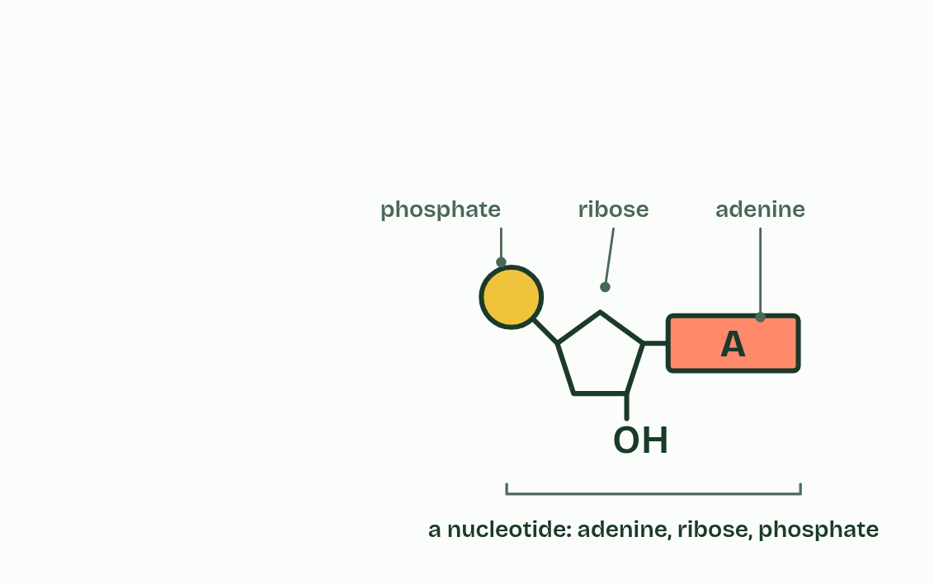
CHAPTER 1 · C1.2.1 ATP as the molecule that distributes energy within cells
1 / 4
The cell's small change
A nucleotide: adenine, ribose and one phosphate.
Minutes 5 to 15
Notes:
Minutes 5 to 15 of 60: ATP, spent and remade (10 min).
The plan: Students build ATP on mini whiteboards from a nucleotide (activity below), then play chapter 1’s figure and make its predict. Then chapter 2’s figure step by step, stopping on each caption, and the BAM tiles. Ask: “Where does the energy to remake ATP come from?” before step 3.
Every cell is busy all the time: pumping ions across its membrane, building molecules, moving things about. Each of those jobs needs energy, and in every living cell the energy arrives in the same form. It is carried by one molecule, ATP.
ATP stands for adenosine triphosphate. Take the base adenine, join it to the sugar ribose and add one phosphate group, and you have a nucleotide, the same kind of unit that RNA is built from (A1.2). ATP is that nucleotide with two more phosphate groups added in a chain.
Why is this the molecule that does the job? Because of a short list of properties, each with its reason.
That is why ATP is called the cell's energy currency. Like coins, it is one kind of token that every job accepts. The savings are the food molecules: glycogen, starch and fat. ATP is the small change that is actually spent, and a cell holds only enough for seconds to a minute or two of work before it has to make more (chapter 3).

Slide 7
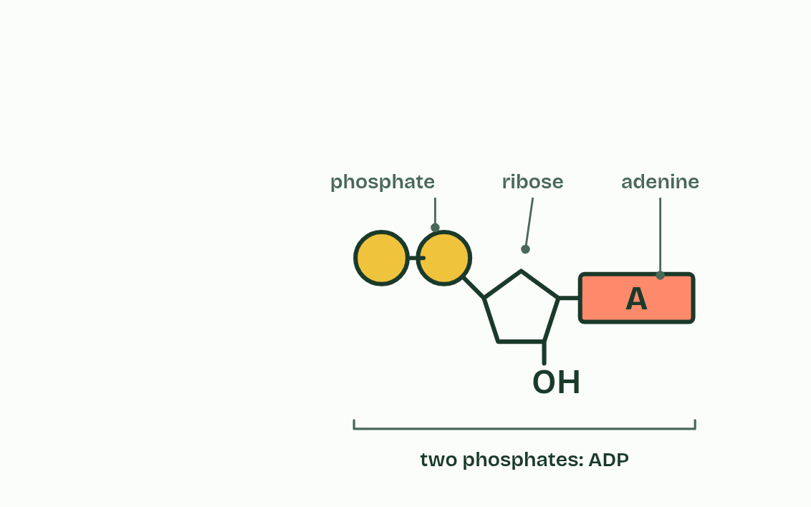
CHAPTER 1 · C1.2.1 ATP as the molecule that distributes energy within cells
2 / 4
The cell's small change
Add a phosphate: ADP.
Minutes 5 to 15
Notes:
Minutes 5 to 15 of 60: ATP, spent and remade (10 min).
The plan: Students build ATP on mini whiteboards from a nucleotide (activity below), then play chapter 1’s figure and make its predict. Then chapter 2’s figure step by step, stopping on each caption, and the BAM tiles. Ask: “Where does the energy to remake ATP come from?” before step 3.
Every cell is busy all the time: pumping ions across its membrane, building molecules, moving things about. Each of those jobs needs energy, and in every living cell the energy arrives in the same form. It is carried by one molecule, ATP.
ATP stands for adenosine triphosphate. Take the base adenine, join it to the sugar ribose and add one phosphate group, and you have a nucleotide, the same kind of unit that RNA is built from (A1.2). ATP is that nucleotide with two more phosphate groups added in a chain.
Why is this the molecule that does the job? Because of a short list of properties, each with its reason.
That is why ATP is called the cell's energy currency. Like coins, it is one kind of token that every job accepts. The savings are the food molecules: glycogen, starch and fat. ATP is the small change that is actually spent, and a cell holds only enough for seconds to a minute or two of work before it has to make more (chapter 3).

Slide 8
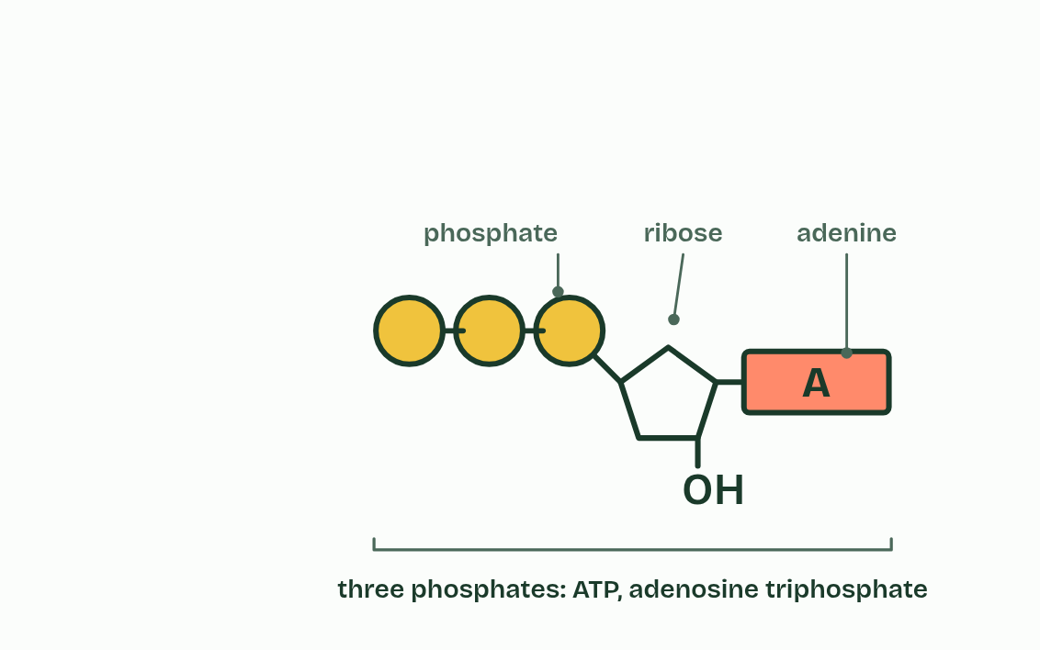
CHAPTER 1 · C1.2.1 ATP as the molecule that distributes energy within cells
3 / 4
The cell's small change
Add another: ATP, adenosine triphosphate.
Minutes 5 to 15
Notes:
Minutes 5 to 15 of 60: ATP, spent and remade (10 min).
The plan: Students build ATP on mini whiteboards from a nucleotide (activity below), then play chapter 1’s figure and make its predict. Then chapter 2’s figure step by step, stopping on each caption, and the BAM tiles. Ask: “Where does the energy to remake ATP come from?” before step 3.
Every cell is busy all the time: pumping ions across its membrane, building molecules, moving things about. Each of those jobs needs energy, and in every living cell the energy arrives in the same form. It is carried by one molecule, ATP.
ATP stands for adenosine triphosphate. Take the base adenine, join it to the sugar ribose and add one phosphate group, and you have a nucleotide, the same kind of unit that RNA is built from (A1.2). ATP is that nucleotide with two more phosphate groups added in a chain.
Why is this the molecule that does the job? Because of a short list of properties, each with its reason.
That is why ATP is called the cell's energy currency. Like coins, it is one kind of token that every job accepts. The savings are the food molecules: glycogen, starch and fat. ATP is the small change that is actually spent, and a cell holds only enough for seconds to a minute or two of work before it has to make more (chapter 3).

Slide 9
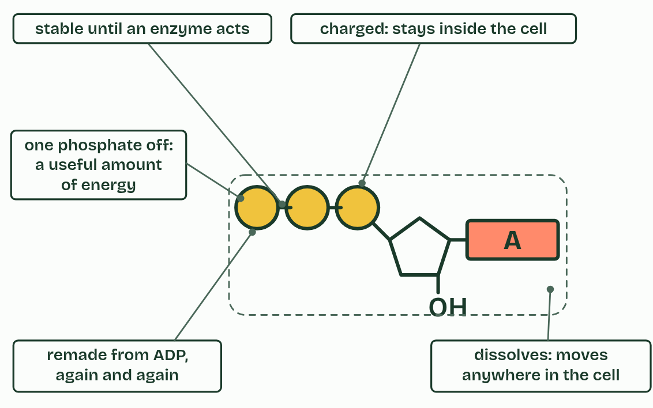
CHAPTER 1 · C1.2.1 ATP as the molecule that distributes energy within cells
4 / 4
The cell's small change
What makes it the cell's energy currency.
Minutes 5 to 15
Notes:
Minutes 5 to 15 of 60: ATP, spent and remade (10 min).
The plan: Students build ATP on mini whiteboards from a nucleotide (activity below), then play chapter 1’s figure and make its predict. Then chapter 2’s figure step by step, stopping on each caption, and the BAM tiles. Ask: “Where does the energy to remake ATP come from?” before step 3.
Every cell is busy all the time: pumping ions across its membrane, building molecules, moving things about. Each of those jobs needs energy, and in every living cell the energy arrives in the same form. It is carried by one molecule, ATP.
ATP stands for adenosine triphosphate. Take the base adenine, join it to the sugar ribose and add one phosphate group, and you have a nucleotide, the same kind of unit that RNA is built from (A1.2). ATP is that nucleotide with two more phosphate groups added in a chain.
Why is this the molecule that does the job? Because of a short list of properties, each with its reason.
That is why ATP is called the cell's energy currency. Like coins, it is one kind of token that every job accepts. The savings are the food molecules: glycogen, starch and fat. ATP is the small change that is actually spent, and a cell holds only enough for seconds to a minute or two of work before it has to make more (chapter 3).

Slide 10
CHAPTER 1 · C1.2.1 ATP as the molecule that distributes energy within cells
The cell's small change
It dissolves in water, so it moves freely through the cytoplasm to wherever it is needed.
It is stable in the watery cytoplasm until an enzyme acts on it, so its energy is not wasted on the way.
Taking off one phosphate releases a modest amount of energy, enough for one step of a pump or one step in building a molecule, so little is lost as heat.
The phosphate can be passed on to another molecule, making that molecule more reactive.
Its charged phosphate groups keep it from leaking out through the membrane.
It is remade from ADP and phosphate quickly and endlessly, so a cell needs only a small stock.
Minutes 5 to 15
Notes:
Minutes 5 to 15 of 60: ATP, spent and remade (10 min).
The plan: Students build ATP on mini whiteboards from a nucleotide (activity below), then play chapter 1’s figure and make its predict. Then chapter 2’s figure step by step, stopping on each caption, and the BAM tiles. Ask: “Where does the energy to remake ATP come from?” before step 3.
Every cell is busy all the time: pumping ions across its membrane, building molecules, moving things about. Each of those jobs needs energy, and in every living cell the energy arrives in the same form. It is carried by one molecule, ATP.
ATP stands for adenosine triphosphate. Take the base adenine, join it to the sugar ribose and add one phosphate group, and you have a nucleotide, the same kind of unit that RNA is built from (A1.2). ATP is that nucleotide with two more phosphate groups added in a chain.
Why is this the molecule that does the job? Because of a short list of properties, each with its reason.
That is why ATP is called the cell's energy currency. Like coins, it is one kind of token that every job accepts. The savings are the food molecules: glycogen, starch and fat. ATP is the small change that is actually spent, and a cell holds only enough for seconds to a minute or two of work before it has to make more (chapter 3).

Slide 11
PREDICT
Removing one phosphate from ATP releases only a modest amount of energy. Why does that suit a cell?
A Small amounts of energy can be stored for weeks
B A job can take what it needs, with little wasted
C Small amounts of energy can never heat up the cell at all
D It means the ATP never has to be remade
Minutes 5 to 15
Notes:
Minutes 5 to 15 of 60: ATP, spent and remade (10 min).
The plan: Students build ATP on mini whiteboards from a nucleotide (activity below), then play chapter 1’s figure and make its predict. Then chapter 2’s figure step by step, stopping on each caption, and the BAM tiles. Ask: “Where does the energy to remake ATP come from?” before step 3.
Ask for a show of hands, or mini whiteboards, before revealing. (Answer: B, on the next slide.)

Slide 12
WHAT HAPPENS
Removing one phosphate from ATP releases only a modest amount of energy. Why does that suit a cell?
A Small amounts of energy can be stored for weeks
B A job can take what it needs, with little wasted
C Small amounts of energy can never heat up the cell at all
D It means the ATP never has to be remade
Most jobs in a cell come in small steps: one stroke of a pump, one step in building a protein. A packet of energy close to the size of the job means little is wasted as heat, and a big job simply uses many ATP. A glucose molecule holds far more energy than any one job needs, which is why the cell turns it into ATP first.
Minutes 5 to 15
Notes:
Minutes 5 to 15 of 60: ATP, spent and remade (10 min).
The plan: Students build ATP on mini whiteboards from a nucleotide (activity below), then play chapter 1’s figure and make its predict. Then chapter 2’s figure step by step, stopping on each caption, and the BAM tiles. Ask: “Where does the energy to remake ATP come from?” before step 3.
Answer: B. Most jobs in a cell come in small steps: one stroke of a pump, one step in building a protein. A packet of energy close to the size of the job means little is wasted as heat, and a big job simply uses many ATP. A glucose molecule holds far more energy than any one job needs, which is why the cell turns it into ATP first.

Slide 13
WATCH OUT
ATP is not the cell's energy store. A cell keeps only a little and remakes it constantly; the stores are glycogen, starch and fat.
Minutes 5 to 15
Notes:
Minutes 5 to 15 of 60: ATP, spent and remade (10 min).
The plan: Students build ATP on mini whiteboards from a nucleotide (activity below), then play chapter 1’s figure and make its predict. Then chapter 2’s figure step by step, stopping on each caption, and the BAM tiles. Ask: “Where does the energy to remake ATP come from?” before step 3.
A common mistake: say it, then ask who can say why it is wrong.

Slide 14
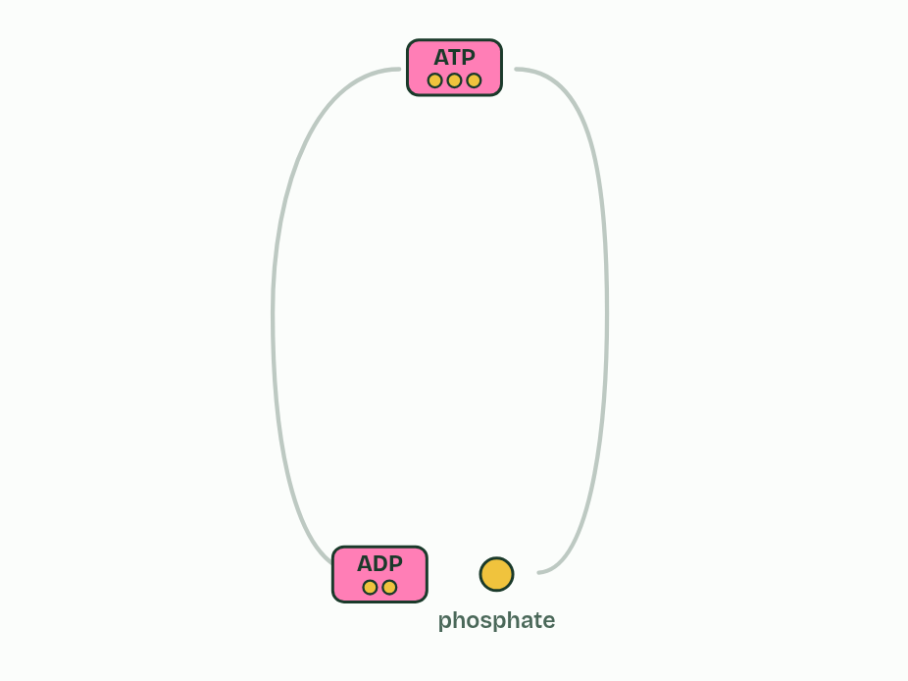
CHAPTER 2 · C1.2.2 C1.2.3 What ATP pays for, and the energy it moves
1 / 4
Spend it, remake it
ATP, ADP and phosphate: the same molecules, used again and again.
Minutes 5 to 15
Notes:
Minutes 5 to 15 of 60: ATP, spent and remade (10 min).
The plan: Students build ATP on mini whiteboards from a nucleotide (activity below), then play chapter 1’s figure and make its predict. Then chapter 2’s figure step by step, stopping on each caption, and the BAM tiles. Ask: “Where does the energy to remake ATP come from?” before step 3.
A cell gets energy out of ATP by splitting it with water. In hydrolysis, a water molecule is used to take the last phosphate group off, and ATP becomes ADP (adenosine diphosphate) and a free phosphate. Energy is released, and the cell spends it.
Where does that energy come from? Not from “breaking a high-energy bond”: breaking any bond takes energy (C1.1). ADP and phosphate together are more stable than ATP and water were, and hold less energy, so the reaction releases the difference. It is the same rule as every other reaction.
Going the other way takes energy. To remake ATP, a phosphate is joined back on to ADP and water is released. In almost every cell the energy comes from respiration (this guide), and in the chloroplasts of a plant it comes from light (C1.3). So the ATP, the ADP and the phosphate go round and round, in the ATP and ADP cycle. Only the energy flows through. No transfer of energy is perfectly efficient, so some of it spreads out as heat each time ATP is spent and each time it is remade, which is part of why you are warm.
The energy pays for three kinds of job.
The guide asks for no number of kilojoules. What matters is that the energy from one ATP is enough for one step of many different tasks, and the cell uses a great many of them every second.

Slide 15
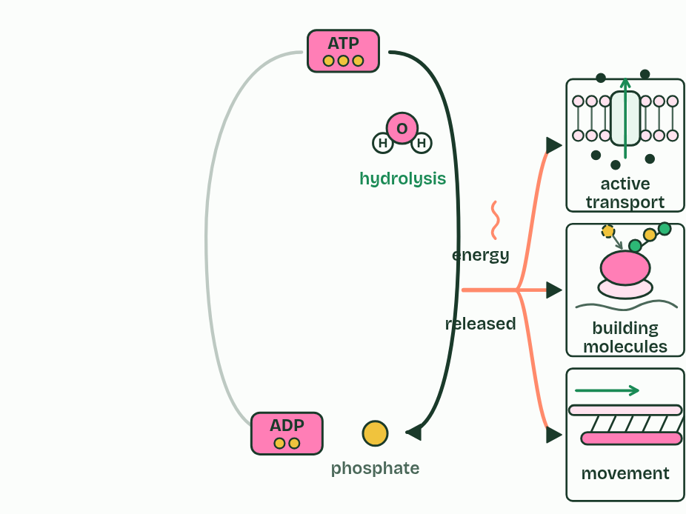
CHAPTER 2 · C1.2.2 C1.2.3 What ATP pays for, and the energy it moves
2 / 4
Spend it, remake it
Hydrolysis: water splits off the last phosphate. Energy is released for pumps, building and movement.
Minutes 5 to 15
Notes:
Minutes 5 to 15 of 60: ATP, spent and remade (10 min).
The plan: Students build ATP on mini whiteboards from a nucleotide (activity below), then play chapter 1’s figure and make its predict. Then chapter 2’s figure step by step, stopping on each caption, and the BAM tiles. Ask: “Where does the energy to remake ATP come from?” before step 3.
A cell gets energy out of ATP by splitting it with water. In hydrolysis, a water molecule is used to take the last phosphate group off, and ATP becomes ADP (adenosine diphosphate) and a free phosphate. Energy is released, and the cell spends it.
Where does that energy come from? Not from “breaking a high-energy bond”: breaking any bond takes energy (C1.1). ADP and phosphate together are more stable than ATP and water were, and hold less energy, so the reaction releases the difference. It is the same rule as every other reaction.
Going the other way takes energy. To remake ATP, a phosphate is joined back on to ADP and water is released. In almost every cell the energy comes from respiration (this guide), and in the chloroplasts of a plant it comes from light (C1.3). So the ATP, the ADP and the phosphate go round and round, in the ATP and ADP cycle. Only the energy flows through. No transfer of energy is perfectly efficient, so some of it spreads out as heat each time ATP is spent and each time it is remade, which is part of why you are warm.
The energy pays for three kinds of job.
The guide asks for no number of kilojoules. What matters is that the energy from one ATP is enough for one step of many different tasks, and the cell uses a great many of them every second.

Slide 16
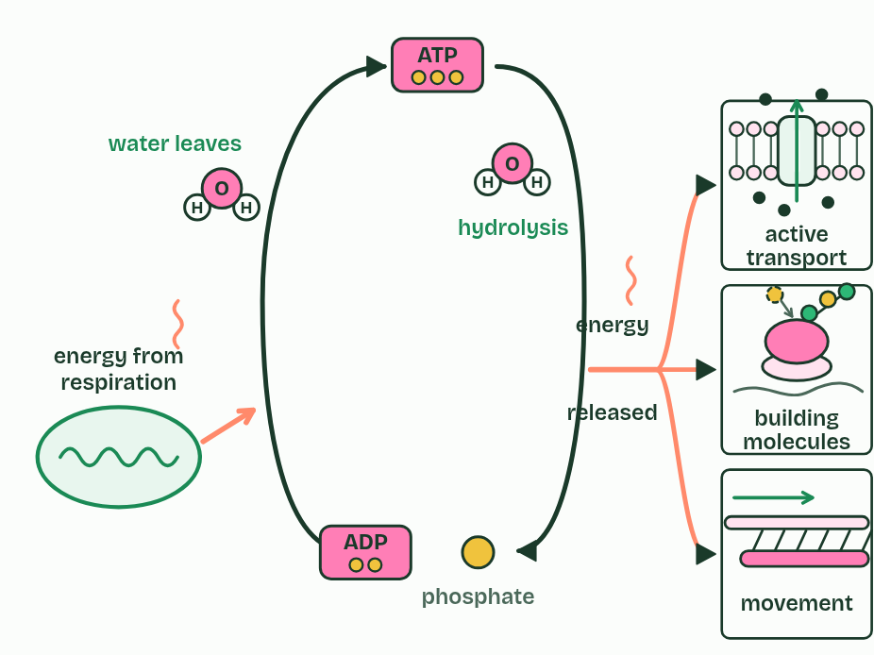
CHAPTER 2 · C1.2.2 C1.2.3 What ATP pays for, and the energy it moves
3 / 4
Spend it, remake it
Remaking ATP needs energy: from respiration.
Minutes 5 to 15
Notes:
Minutes 5 to 15 of 60: ATP, spent and remade (10 min).
The plan: Students build ATP on mini whiteboards from a nucleotide (activity below), then play chapter 1’s figure and make its predict. Then chapter 2’s figure step by step, stopping on each caption, and the BAM tiles. Ask: “Where does the energy to remake ATP come from?” before step 3.
A cell gets energy out of ATP by splitting it with water. In hydrolysis, a water molecule is used to take the last phosphate group off, and ATP becomes ADP (adenosine diphosphate) and a free phosphate. Energy is released, and the cell spends it.
Where does that energy come from? Not from “breaking a high-energy bond”: breaking any bond takes energy (C1.1). ADP and phosphate together are more stable than ATP and water were, and hold less energy, so the reaction releases the difference. It is the same rule as every other reaction.
Going the other way takes energy. To remake ATP, a phosphate is joined back on to ADP and water is released. In almost every cell the energy comes from respiration (this guide), and in the chloroplasts of a plant it comes from light (C1.3). So the ATP, the ADP and the phosphate go round and round, in the ATP and ADP cycle. Only the energy flows through. No transfer of energy is perfectly efficient, so some of it spreads out as heat each time ATP is spent and each time it is remade, which is part of why you are warm.
The energy pays for three kinds of job.
The guide asks for no number of kilojoules. What matters is that the energy from one ATP is enough for one step of many different tasks, and the cell uses a great many of them every second.

Slide 17
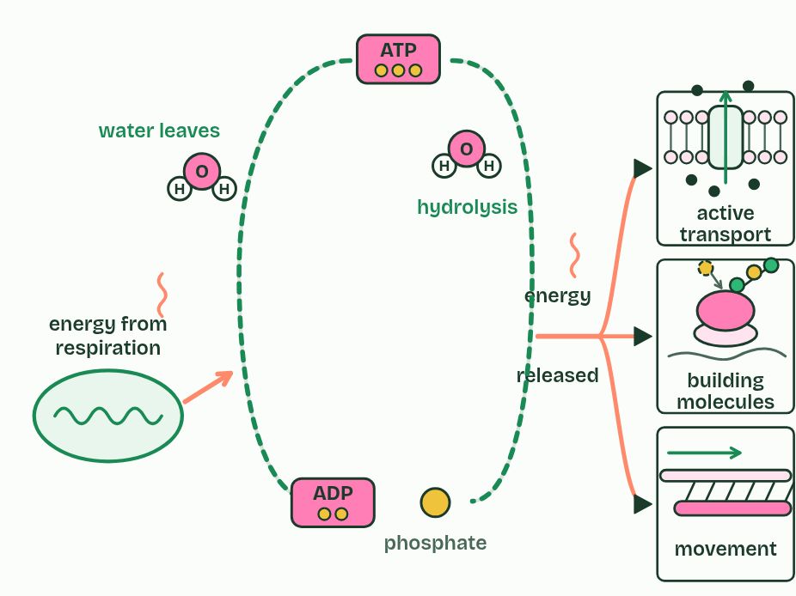
CHAPTER 2 · C1.2.2 C1.2.3 What ATP pays for, and the energy it moves
4 / 4
Spend it, remake it
Spent and remade, over and over: the energy flows through, and some is lost as heat.
Minutes 5 to 15
Notes:
Minutes 5 to 15 of 60: ATP, spent and remade (10 min).
The plan: Students build ATP on mini whiteboards from a nucleotide (activity below), then play chapter 1’s figure and make its predict. Then chapter 2’s figure step by step, stopping on each caption, and the BAM tiles. Ask: “Where does the energy to remake ATP come from?” before step 3.
A cell gets energy out of ATP by splitting it with water. In hydrolysis, a water molecule is used to take the last phosphate group off, and ATP becomes ADP (adenosine diphosphate) and a free phosphate. Energy is released, and the cell spends it.
Where does that energy come from? Not from “breaking a high-energy bond”: breaking any bond takes energy (C1.1). ADP and phosphate together are more stable than ATP and water were, and hold less energy, so the reaction releases the difference. It is the same rule as every other reaction.
Going the other way takes energy. To remake ATP, a phosphate is joined back on to ADP and water is released. In almost every cell the energy comes from respiration (this guide), and in the chloroplasts of a plant it comes from light (C1.3). So the ATP, the ADP and the phosphate go round and round, in the ATP and ADP cycle. Only the energy flows through. No transfer of energy is perfectly efficient, so some of it spreads out as heat each time ATP is spent and each time it is remade, which is part of why you are warm.
The energy pays for three kinds of job.
The guide asks for no number of kilojoules. What matters is that the energy from one ATP is enough for one step of many different tasks, and the cell uses a great many of them every second.

Slide 18
CHAPTER 2 · C1.2.2 C1.2.3 What ATP pays for, and the energy it moves
Spend it, remake it
Active transport: a pump in the membrane moves ions against their concentration gradient (B2.1).
Building macromolecules, anabolism: a ribosome joins amino acids into a protein, and nucleotides are joined into DNA (C1.1).
Movement: of the whole cell, as a sperm’s tail or a muscle fibre moves, or of parts of it, as chromosomes are pulled apart in mitosis.
Minutes 5 to 15
Notes:
Minutes 5 to 15 of 60: ATP, spent and remade (10 min).
The plan: Students build ATP on mini whiteboards from a nucleotide (activity below), then play chapter 1’s figure and make its predict. Then chapter 2’s figure step by step, stopping on each caption, and the BAM tiles. Ask: “Where does the energy to remake ATP come from?” before step 3.
A cell gets energy out of ATP by splitting it with water. In hydrolysis, a water molecule is used to take the last phosphate group off, and ATP becomes ADP (adenosine diphosphate) and a free phosphate. Energy is released, and the cell spends it.
Where does that energy come from? Not from “breaking a high-energy bond”: breaking any bond takes energy (C1.1). ADP and phosphate together are more stable than ATP and water were, and hold less energy, so the reaction releases the difference. It is the same rule as every other reaction.
Going the other way takes energy. To remake ATP, a phosphate is joined back on to ADP and water is released. In almost every cell the energy comes from respiration (this guide), and in the chloroplasts of a plant it comes from light (C1.3). So the ATP, the ADP and the phosphate go round and round, in the ATP and ADP cycle. Only the energy flows through. No transfer of energy is perfectly efficient, so some of it spreads out as heat each time ATP is spent and each time it is remade, which is part of why you are warm.
The energy pays for three kinds of job.
The guide asks for no number of kilojoules. What matters is that the energy from one ATP is enough for one step of many different tasks, and the cell uses a great many of them every second.

Slide 19
PREDICT
Remaking ATP from ADP and phosphate needs energy. Where does a muscle cell get it?
A From respiring glucose or fat
B From the warmth of the blood around it
C From sunlight falling on the skin
D From breaking ADP down further
Minutes 5 to 15
Notes:
Minutes 5 to 15 of 60: ATP, spent and remade (10 min).
The plan: Students build ATP on mini whiteboards from a nucleotide (activity below), then play chapter 1’s figure and make its predict. Then chapter 2’s figure step by step, stopping on each caption, and the BAM tiles. Ask: “Where does the energy to remake ATP come from?” before step 3.
Ask for a show of hands, or mini whiteboards, before revealing. (Answer: A, on the next slide.)

Slide 20
WHAT HAPPENS
Remaking ATP from ADP and phosphate needs energy. Where does a muscle cell get it?
A From respiring glucose or fat
B From the warmth of the blood around it
C From sunlight falling on the skin
D From breaking ADP down further
From respiration. The energy released step by step as glucose or fat is broken down is used to join phosphate back onto ADP. Body warmth cannot do it: heat is energy that has already been lost from reactions, and it cannot be put back into a molecule.
Minutes 5 to 15
Notes:
Minutes 5 to 15 of 60: ATP, spent and remade (10 min).
The plan: Students build ATP on mini whiteboards from a nucleotide (activity below), then play chapter 1’s figure and make its predict. Then chapter 2’s figure step by step, stopping on each caption, and the BAM tiles. Ask: “Where does the energy to remake ATP come from?” before step 3.
Answer: A. From respiration. The energy released step by step as glucose or fat is broken down is used to join phosphate back onto ADP. Body warmth cannot do it: heat is energy that has already been lost from reactions, and it cannot be put back into a molecule.

Slide 21
REMEMBER IT
What ATP pays for
B
A
M
B
A
M
Minutes 5 to 15
Notes:
Minutes 5 to 15 of 60: ATP, spent and remade (10 min).
The plan: Students build ATP on mini whiteboards from a nucleotide (activity below), then play chapter 1’s figure and make its predict. Then chapter 2’s figure step by step, stopping on each caption, and the BAM tiles. Ask: “Where does the energy to remake ATP come from?” before step 3.
Ask the class what each letter stands for before revealing.

Slide 22
REMEMBER IT
What ATP pays for
B
A
M
B
A
M
Building
Active transport
Movement
joining small molecules into large ones (anabolism)
pumping against the gradient
of the whole cell or of its parts
Minutes 5 to 15
Notes:
Minutes 5 to 15 of 60: ATP, spent and remade (10 min).
The plan: Students build ATP on mini whiteboards from a nucleotide (activity below), then play chapter 1’s figure and make its predict. Then chapter 2’s figure step by step, stopping on each caption, and the BAM tiles. Ask: “Where does the energy to remake ATP come from?” before step 3.
B: Building (joining small molecules into large ones (anabolism))
A: Active transport (pumping against the gradient)
M: Movement (of the whole cell or of its parts)

Slide 23
WATCH OUT
Energy is not “stored in the bond” between phosphates, and breaking that bond does not release energy. Breaking a bond always takes energy; the energy released by hydrolysis is the difference between ATP and water before, and ADP and phosphate after.
Minutes 5 to 15
Notes:
Minutes 5 to 15 of 60: ATP, spent and remade (10 min).
The plan: Students build ATP on mini whiteboards from a nucleotide (activity below), then play chapter 1’s figure and make its predict. Then chapter 2’s figure step by step, stopping on each caption, and the BAM tiles. Ask: “Where does the energy to remake ATP come from?” before step 3.
A common mistake: say it, then ask who can say why it is wrong.

Slide 24
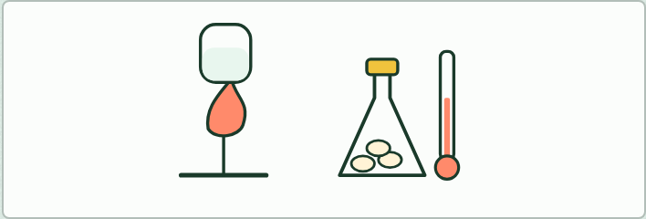
DEMONSTRATION
8 MIN
Burning or respiring?
THE TASK
Set a corn puff or a crisp alight on a mounted needle under a boiling tube of water (no nuts: allergies), beside a stoppered flask of soaked seeds with a thermometer that warms slowly over a day (set it up the day before). Same fuel and the same products; one fast and uncontrolled, the other a step at a time and making ATP. Safety: eye protection, a heat-proof mat, a fire blanket to hand, and the teacher holds the needle.
STUDENTS NEED
Corn snacks, a mounted needle, a Bunsen burner, a boiling tube in a clamp, a vacuum flask of soaked seeds with a thermometer.
Minutes 15 to 23
Notes:
Minutes 15 to 23 of 60: Burning or respiring? (8 min).
The plan: Chapter 3: the predict about the leaf as a vote with hands up. Run the demonstration (below), then play the figure’s three settings: burning, cell respiration and gas exchange. Students decide which of the three releases energy and which makes ATP.
The activity: Burning or respiring?. Set a corn puff or a crisp alight on a mounted needle under a boiling tube of water (no nuts: allergies), beside a stoppered flask of soaked seeds with a thermometer that warms slowly over a day (set it up the day before). Same fuel and the same products; one fast and uncontrolled, the other a step at a time and making ATP. Safety: eye protection, a heat-proof mat, a fire blanket to hand, and the teacher holds the needle.
Needs: corn snacks, a mounted needle, a Bunsen burner, a boiling tube in a clamp, a vacuum flask of soaked seeds with a thermometer.
The time: 8 minutes, minutes 15 to 23 of the plan.

Slide 25
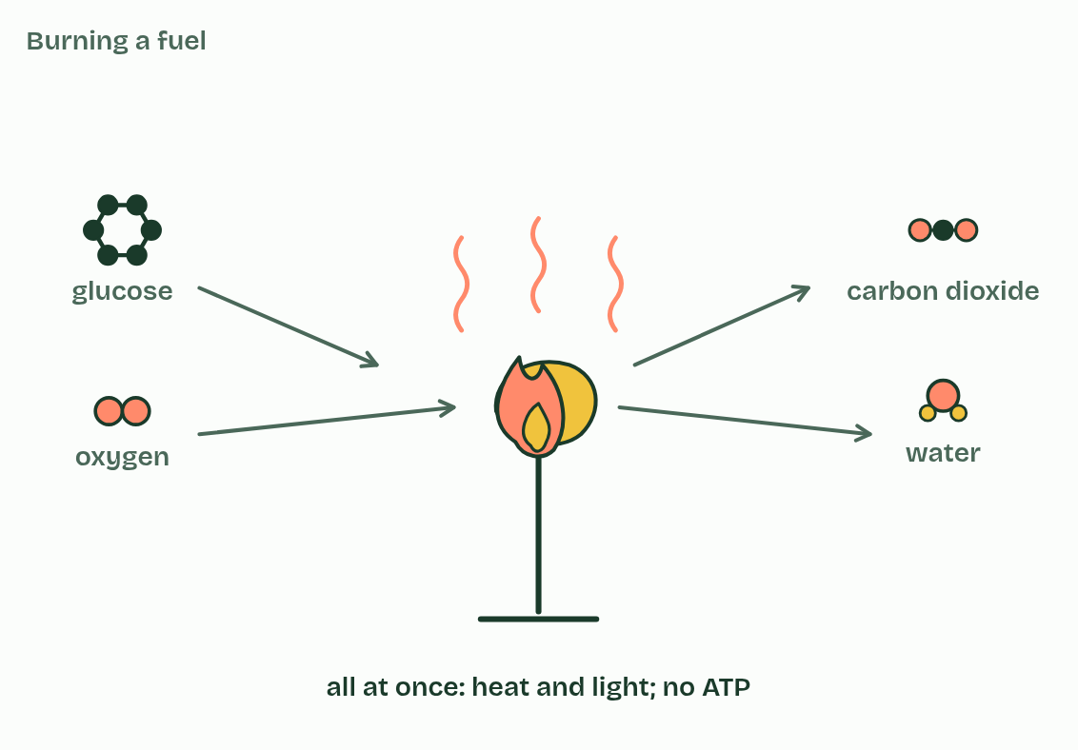
CHAPTER 3 · C1.2.4 Cell respiration as a system for producing ATP using energy from carbon compounds
1 / 3
Fuel in, ATP out
Burning
Minutes 15 to 23
Notes:
Minutes 15 to 23 of 60: Burning or respiring? (8 min).
The plan: Chapter 3: the predict about the leaf as a vote with hands up. Run the demonstration (below), then play the figure’s three settings: burning, cell respiration and gas exchange. Students decide which of the three releases energy and which makes ATP.
Cell respiration is how a cell makes ATP, using energy released from carbon compounds. It happens in every living cell, all the time, because ATP is used all the time and only a little is kept (chapter 1). That includes plants: a leaf cell respires by day and by night.
The fuels are called respiratory substrates. The main two are glucose and fatty acids, but a cell can use a wide range of carbon compounds, amino acids among them when food is short. Glycogen in liver and muscle, and starch in a plant, are broken down to glucose first.
Respiration releases the energy a step at a time, each step helped by its own enzyme at body temperature. Burning glucose is combustion. It starts with glucose and oxygen and ends with carbon dioxide and water, as respiration does, and it releases the same total energy. But combustion releases it all at once, as heat and light, and makes no ATP. One is controlled and useful to a cell, the other is not.
Respiration is not gas exchange. Respiration is chemistry inside cells. Gas exchange is oxygen and carbon dioxide diffusing across a surface, in the lungs, the gills or a leaf, with no reaction and no energy released. The carbon dioxide you breathe out was made in the mitochondria of your cells, and it only leaves through your lungs. Breathing moves the air; that is not respiration either.
Follow one carbon atom from the air, into a leaf and back out of a mitochondrion: the carbon trail, in C1.3.

Slide 26
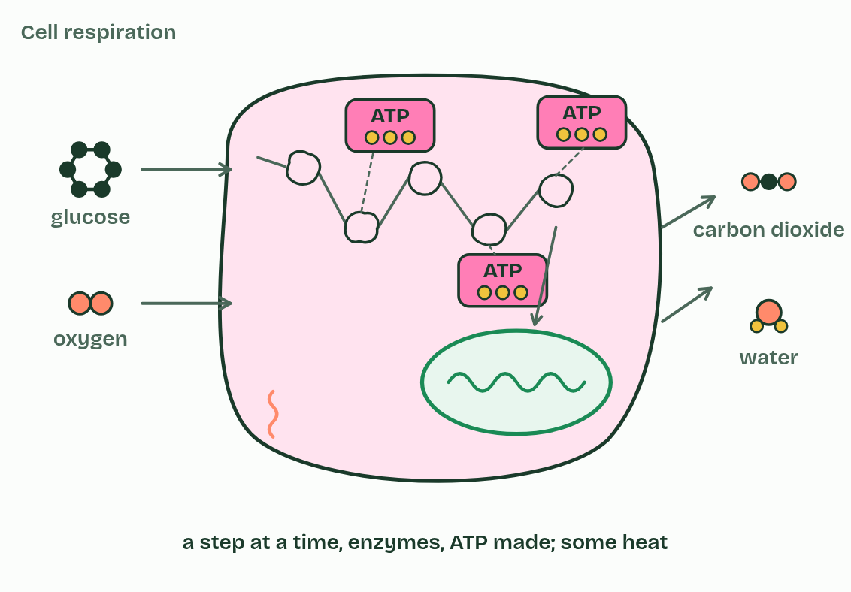
CHAPTER 3 · C1.2.4 Cell respiration as a system for producing ATP using energy from carbon compounds
2 / 3
Fuel in, ATP out
Cell respiration
Minutes 15 to 23
Notes:
Minutes 15 to 23 of 60: Burning or respiring? (8 min).
The plan: Chapter 3: the predict about the leaf as a vote with hands up. Run the demonstration (below), then play the figure’s three settings: burning, cell respiration and gas exchange. Students decide which of the three releases energy and which makes ATP.
Cell respiration is how a cell makes ATP, using energy released from carbon compounds. It happens in every living cell, all the time, because ATP is used all the time and only a little is kept (chapter 1). That includes plants: a leaf cell respires by day and by night.
The fuels are called respiratory substrates. The main two are glucose and fatty acids, but a cell can use a wide range of carbon compounds, amino acids among them when food is short. Glycogen in liver and muscle, and starch in a plant, are broken down to glucose first.
Respiration releases the energy a step at a time, each step helped by its own enzyme at body temperature. Burning glucose is combustion. It starts with glucose and oxygen and ends with carbon dioxide and water, as respiration does, and it releases the same total energy. But combustion releases it all at once, as heat and light, and makes no ATP. One is controlled and useful to a cell, the other is not.
Respiration is not gas exchange. Respiration is chemistry inside cells. Gas exchange is oxygen and carbon dioxide diffusing across a surface, in the lungs, the gills or a leaf, with no reaction and no energy released. The carbon dioxide you breathe out was made in the mitochondria of your cells, and it only leaves through your lungs. Breathing moves the air; that is not respiration either.
Follow one carbon atom from the air, into a leaf and back out of a mitochondrion: the carbon trail, in C1.3.

Slide 27
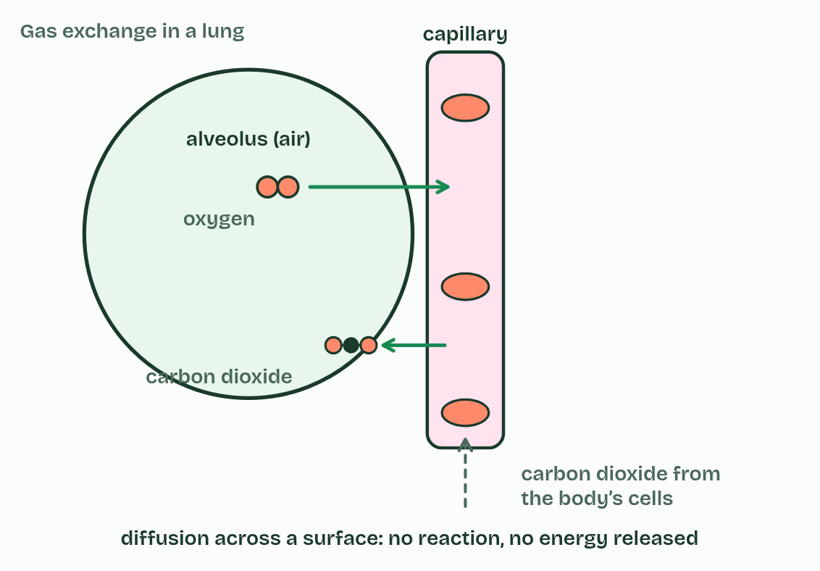
CHAPTER 3 · C1.2.4 Cell respiration as a system for producing ATP using energy from carbon compounds
3 / 3
Fuel in, ATP out
Gas exchange
Minutes 15 to 23
Notes:
Minutes 15 to 23 of 60: Burning or respiring? (8 min).
The plan: Chapter 3: the predict about the leaf as a vote with hands up. Run the demonstration (below), then play the figure’s three settings: burning, cell respiration and gas exchange. Students decide which of the three releases energy and which makes ATP.
Cell respiration is how a cell makes ATP, using energy released from carbon compounds. It happens in every living cell, all the time, because ATP is used all the time and only a little is kept (chapter 1). That includes plants: a leaf cell respires by day and by night.
The fuels are called respiratory substrates. The main two are glucose and fatty acids, but a cell can use a wide range of carbon compounds, amino acids among them when food is short. Glycogen in liver and muscle, and starch in a plant, are broken down to glucose first.
Respiration releases the energy a step at a time, each step helped by its own enzyme at body temperature. Burning glucose is combustion. It starts with glucose and oxygen and ends with carbon dioxide and water, as respiration does, and it releases the same total energy. But combustion releases it all at once, as heat and light, and makes no ATP. One is controlled and useful to a cell, the other is not.
Respiration is not gas exchange. Respiration is chemistry inside cells. Gas exchange is oxygen and carbon dioxide diffusing across a surface, in the lungs, the gills or a leaf, with no reaction and no energy released. The carbon dioxide you breathe out was made in the mitochondria of your cells, and it only leaves through your lungs. Breathing moves the air; that is not respiration either.
Follow one carbon atom from the air, into a leaf and back out of a mitochondrion: the carbon trail, in C1.3.

Slide 28
CHAPTER 3 · C1.2.4 Cell respiration as a system for producing ATP using energy from carbon compounds
Fuel in, ATP out
Cell respiration is how a cell makes ATP, using energy released from carbon compounds.
The fuels are called respiratory substrates.
The main two are glucose and fatty acids, but a cell can use a wide range of carbon compounds, amino acids among them when food is short.
Glycogen in liver and muscle, and starch in a plant, are broken down to glucose first.
Minutes 15 to 23
Notes:
Minutes 15 to 23 of 60: Burning or respiring? (8 min).
The plan: Chapter 3: the predict about the leaf as a vote with hands up. Run the demonstration (below), then play the figure’s three settings: burning, cell respiration and gas exchange. Students decide which of the three releases energy and which makes ATP.
Cell respiration is how a cell makes ATP, using energy released from carbon compounds. It happens in every living cell, all the time, because ATP is used all the time and only a little is kept (chapter 1). That includes plants: a leaf cell respires by day and by night.
The fuels are called respiratory substrates. The main two are glucose and fatty acids, but a cell can use a wide range of carbon compounds, amino acids among them when food is short. Glycogen in liver and muscle, and starch in a plant, are broken down to glucose first.
Respiration releases the energy a step at a time, each step helped by its own enzyme at body temperature. Burning glucose is combustion. It starts with glucose and oxygen and ends with carbon dioxide and water, as respiration does, and it releases the same total energy. But combustion releases it all at once, as heat and light, and makes no ATP. One is controlled and useful to a cell, the other is not.
Respiration is not gas exchange. Respiration is chemistry inside cells. Gas exchange is oxygen and carbon dioxide diffusing across a surface, in the lungs, the gills or a leaf, with no reaction and no energy released. The carbon dioxide you breathe out was made in the mitochondria of your cells, and it only leaves through your lungs. Breathing moves the air; that is not respiration either.
Follow one carbon atom from the air, into a leaf and back out of a mitochondrion: the carbon trail, in C1.3.

Slide 29
PREDICT
A leaf in bright light takes in carbon dioxide and gives out oxygen. Is it respiring?
A No: a leaf photosynthesises instead of respiring
B No: plants respire only at night
C Yes: all its living cells respire all the time
D Only its roots respire, below ground
Minutes 15 to 23
Notes:
Minutes 15 to 23 of 60: Burning or respiring? (8 min).
The plan: Chapter 3: the predict about the leaf as a vote with hands up. Run the demonstration (below), then play the figure’s three settings: burning, cell respiration and gas exchange. Students decide which of the three releases energy and which makes ATP.
Ask for a show of hands, or mini whiteboards, before revealing. (Answer: C, on the next slide.)

Slide 30
WHAT HAPPENS
A leaf in bright light takes in carbon dioxide and gives out oxygen. Is it respiring?
A No: a leaf photosynthesises instead of respiring
B No: plants respire only at night
C Yes: all its living cells respire all the time
D Only its roots respire, below ground
Yes. Every living cell respires all the time, because every cell needs ATP every second. In bright light the leaf photosynthesises faster than it respires, so overall it takes in carbon dioxide and gives out oxygen: the gas exchange you measure is the difference between the two (C1.3).
Minutes 15 to 23
Notes:
Minutes 15 to 23 of 60: Burning or respiring? (8 min).
The plan: Chapter 3: the predict about the leaf as a vote with hands up. Run the demonstration (below), then play the figure’s three settings: burning, cell respiration and gas exchange. Students decide which of the three releases energy and which makes ATP.
Answer: C. Yes. Every living cell respires all the time, because every cell needs ATP every second. In bright light the leaf photosynthesises faster than it respires, so overall it takes in carbon dioxide and gives out oxygen: the gas exchange you measure is the difference between the two (C1.3).

Slide 31
WATCH OUT
“Respiration” in everyday English means breathing. In biology it is the chemistry that makes ATP in every cell. Breathing moves air; gas exchange moves gases across a surface; neither releases energy.
Minutes 15 to 23
Notes:
Minutes 15 to 23 of 60: Burning or respiring? (8 min).
The plan: Chapter 3: the predict about the leaf as a vote with hands up. Run the demonstration (below), then play the figure’s three settings: burning, cell respiration and gas exchange. Students decide which of the three releases energy and which makes ATP.
A common mistake: say it, then ask who can say why it is wrong.

Slide 32
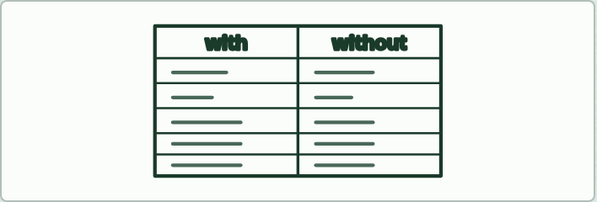
TABLE
12 MIN
Compare the two routes
THE TASK
A table to fill in pairs: substrates, oxygen needed, ATP per glucose, waste products, where in the cell, mitochondria needed, and the word equation. Check it against chapter 4’s figure.
STUDENTS NEED
The printed table.
Minutes 23 to 35
Notes:
Minutes 23 to 35 of 60: Compare the two routes (12 min).
The plan: Chapter 4: the predict, then students fill in the comparison table in pairs (below) and check it against the figure’s two settings. Write both word equations on the board from memory. Turn over the LOW tiles.
The activity: Compare the two routes. A table to fill in pairs: substrates, oxygen needed, ATP per glucose, waste products, where in the cell, mitochondria needed, and the word equation. Check it against chapter 4’s figure.
Needs: the printed table.
The time: 12 minutes, minutes 23 to 35 of the plan.

Slide 33
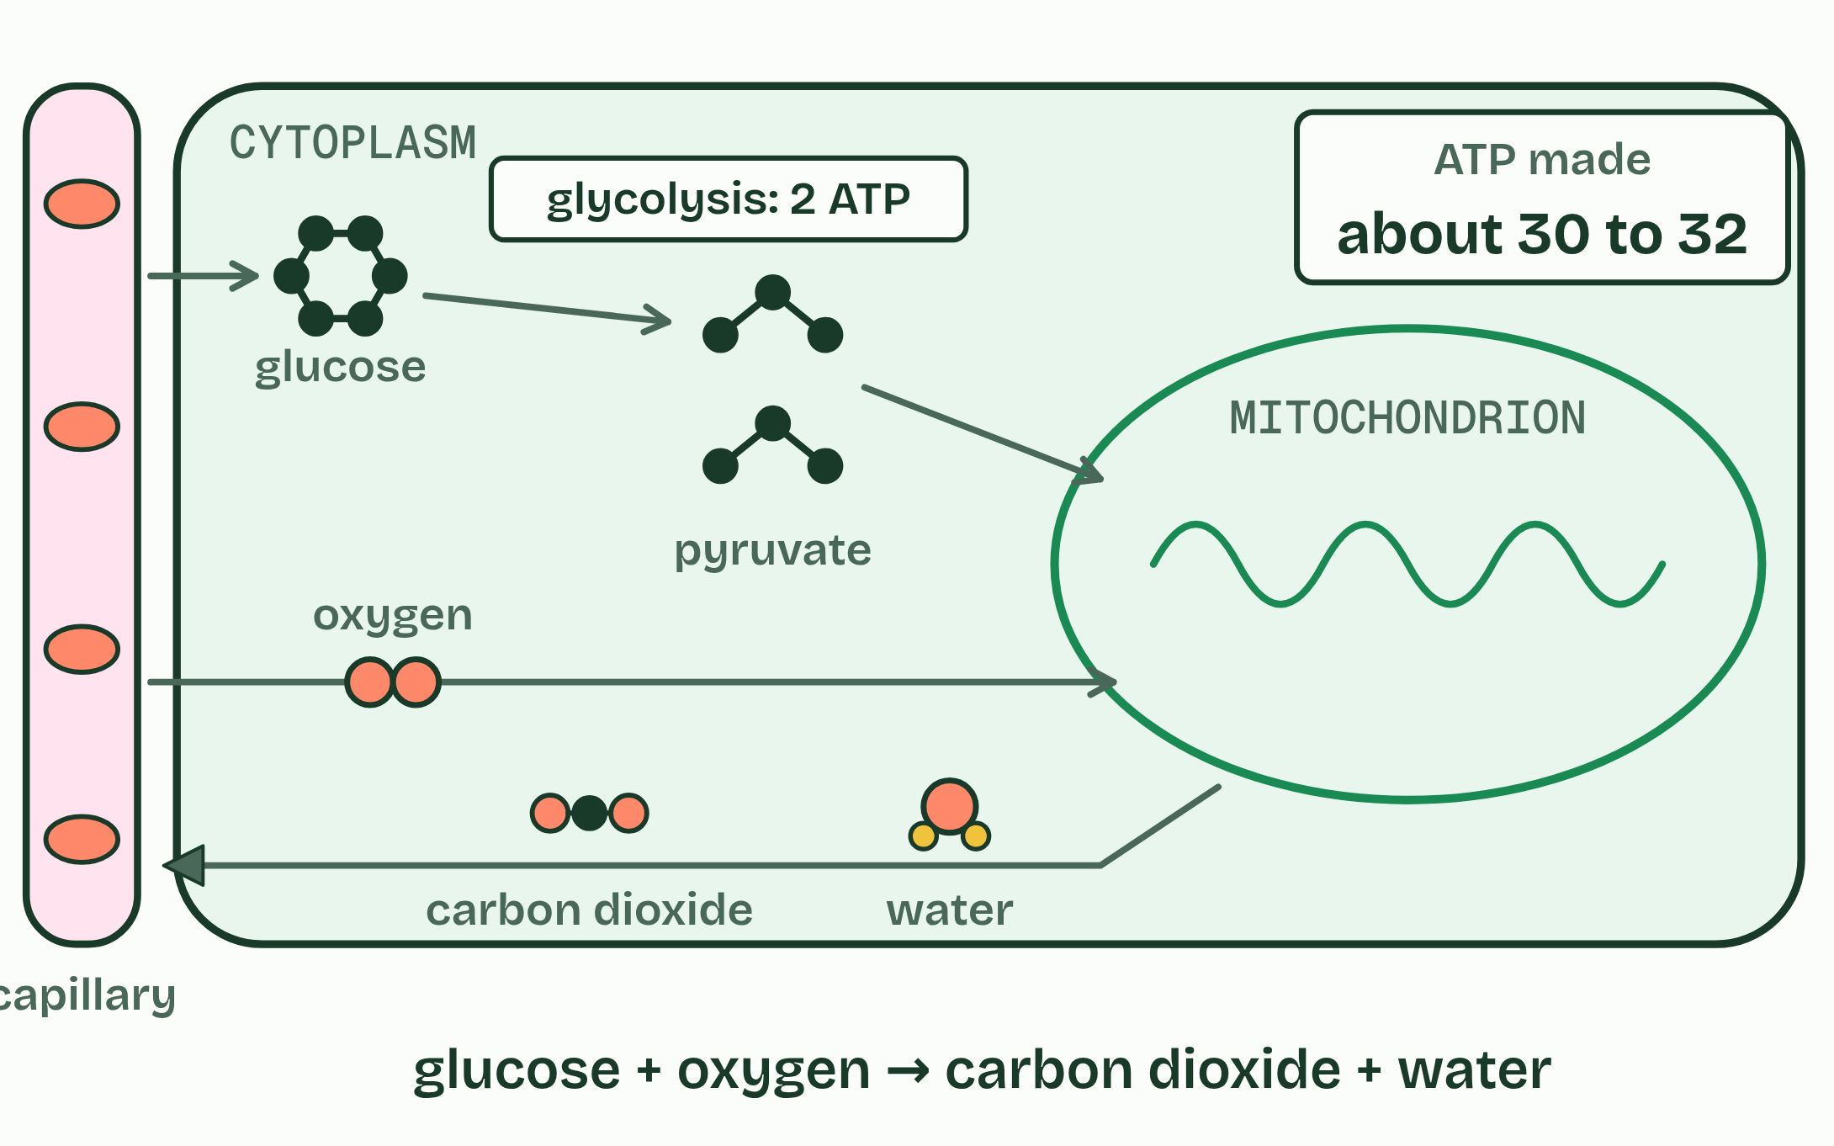
CHAPTER 4 · C1.2.5 Differences between anaerobic and aerobic cell respiration in humans
1 / 2
With oxygen and without
Plenty of oxygen
Minutes 23 to 35
Notes:
Minutes 23 to 35 of 60: Compare the two routes (12 min).
The plan: Chapter 4: the predict, then students fill in the comparison table in pairs (below) and check it against the figure’s two settings. Write both word equations on the board from memory. Turn over the LOW tiles.
Both kinds of respiration start the same way, in the cytoplasm. A glucose molecule is split into two molecules of pyruvate in a process called glycolysis, which releases enough energy to make a small amount of ATP. After that the routes divide, according to whether there is oxygen, and they differ most in their yield of ATP for each glucose.
Aerobic respiration goes on with oxygen. The pyruvate goes into a mitochondrion and is broken down completely, to carbon dioxide and water, and a large amount of ATP is made. The word equation is glucose + oxygen → carbon dioxide + water. It needs mitochondria and oxygen, and it can use fatty acids and other compounds as well as glucose.
Anaerobic respiration in humans stops early. When there is not enough oxygen, the pyruvate stays in the cytoplasm and is turned into lactate. The word equation is glucose → lactate. It needs no mitochondria, no oxygen, and makes no carbon dioxide, but only glucose can be used: fatty acids cannot be respired without oxygen.
When does a human cell respire anaerobically? When muscles work so hard that the blood cannot bring oxygen fast enough: a short sprint, a heavy lift. Anaerobic respiration gives ATP at once, without waiting for oxygen, but only for a short time. Muscles do not switch from one route to the other. Aerobic respiration goes on, and anaerobic respiration adds to it.

Slide 34
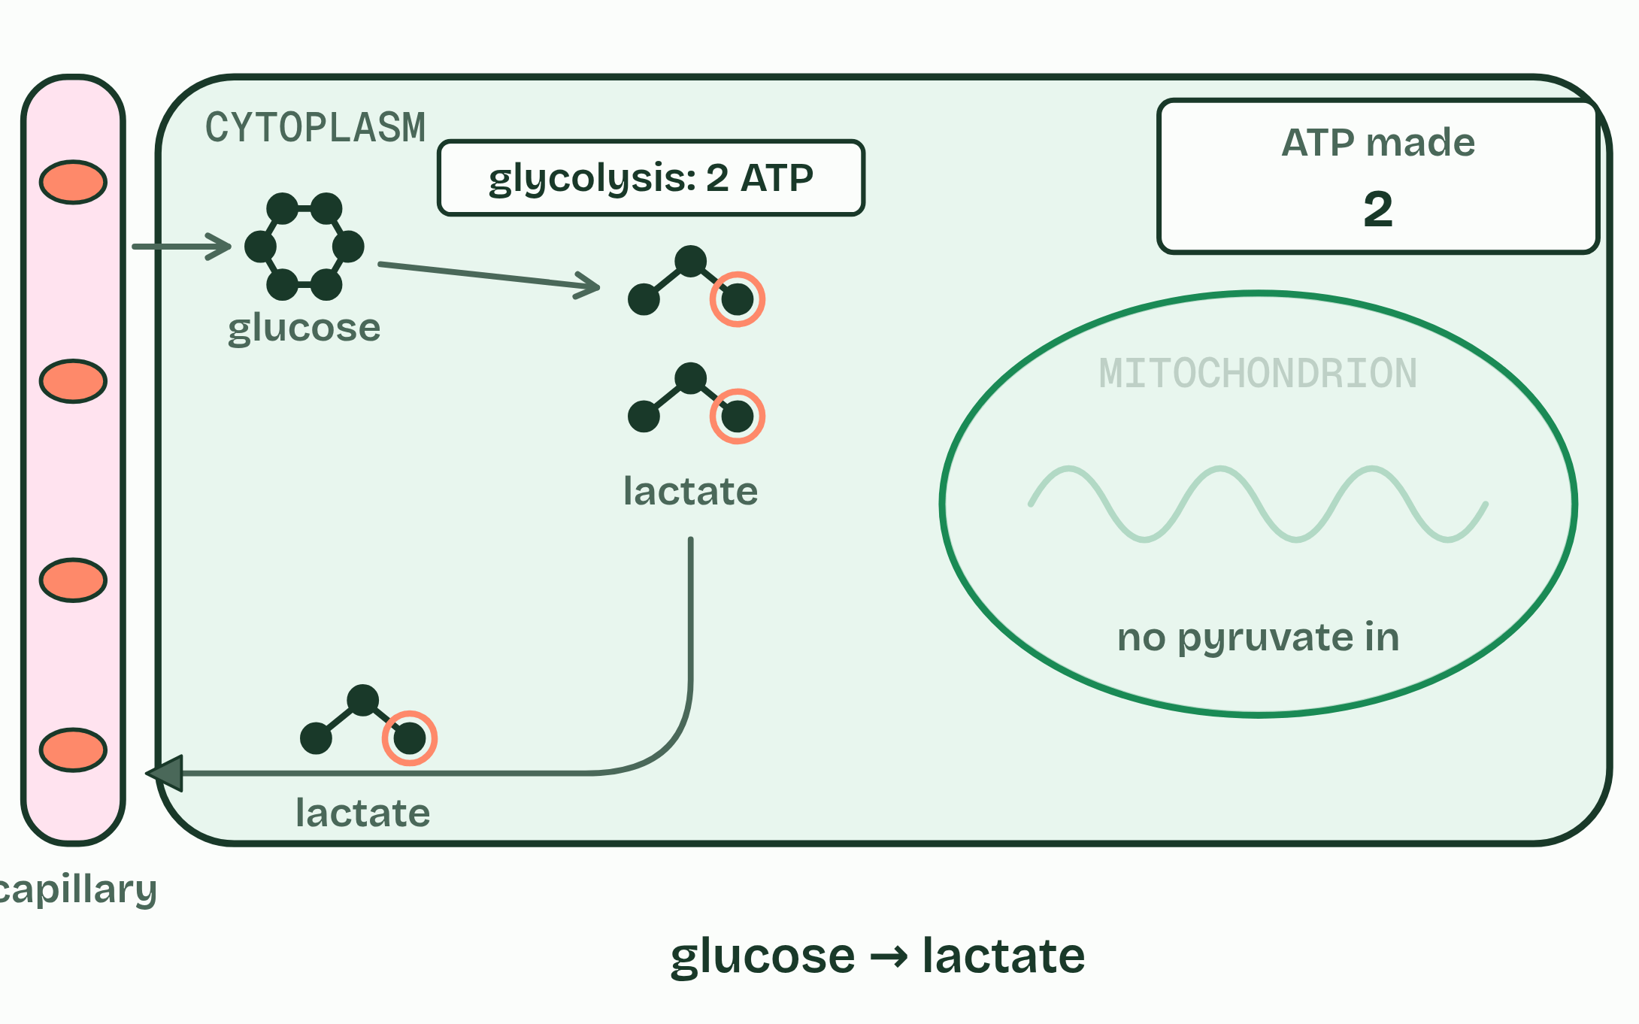
CHAPTER 4 · C1.2.5 Differences between anaerobic and aerobic cell respiration in humans
2 / 2
With oxygen and without
Not enough oxygen
Minutes 23 to 35
Notes:
Minutes 23 to 35 of 60: Compare the two routes (12 min).
The plan: Chapter 4: the predict, then students fill in the comparison table in pairs (below) and check it against the figure’s two settings. Write both word equations on the board from memory. Turn over the LOW tiles.
Both kinds of respiration start the same way, in the cytoplasm. A glucose molecule is split into two molecules of pyruvate in a process called glycolysis, which releases enough energy to make a small amount of ATP. After that the routes divide, according to whether there is oxygen, and they differ most in their yield of ATP for each glucose.
Aerobic respiration goes on with oxygen. The pyruvate goes into a mitochondrion and is broken down completely, to carbon dioxide and water, and a large amount of ATP is made. The word equation is glucose + oxygen → carbon dioxide + water. It needs mitochondria and oxygen, and it can use fatty acids and other compounds as well as glucose.
Anaerobic respiration in humans stops early. When there is not enough oxygen, the pyruvate stays in the cytoplasm and is turned into lactate. The word equation is glucose → lactate. It needs no mitochondria, no oxygen, and makes no carbon dioxide, but only glucose can be used: fatty acids cannot be respired without oxygen.
When does a human cell respire anaerobically? When muscles work so hard that the blood cannot bring oxygen fast enough: a short sprint, a heavy lift. Anaerobic respiration gives ATP at once, without waiting for oxygen, but only for a short time. Muscles do not switch from one route to the other. Aerobic respiration goes on, and anaerobic respiration adds to it.

Slide 35
CHAPTER 4 · C1.2.5 Differences between anaerobic and aerobic cell respiration in humans
With oxygen and without
A glucose molecule is split into two molecules of pyruvate in a process called glycolysis, which releases enough energy to make a small amount of ATP.
After that the routes divide, according to whether there is oxygen, and they differ most in their yield of ATP for each glucose.
Aerobic respiration goes on with oxygen.
The pyruvate goes into a mitochondrion and is broken down completely, to carbon dioxide and water, and a large amount of ATP is made.
Minutes 23 to 35
Notes:
Minutes 23 to 35 of 60: Compare the two routes (12 min).
The plan: Chapter 4: the predict, then students fill in the comparison table in pairs (below) and check it against the figure’s two settings. Write both word equations on the board from memory. Turn over the LOW tiles.
Both kinds of respiration start the same way, in the cytoplasm. A glucose molecule is split into two molecules of pyruvate in a process called glycolysis, which releases enough energy to make a small amount of ATP. After that the routes divide, according to whether there is oxygen, and they differ most in their yield of ATP for each glucose.
Aerobic respiration goes on with oxygen. The pyruvate goes into a mitochondrion and is broken down completely, to carbon dioxide and water, and a large amount of ATP is made. The word equation is glucose + oxygen → carbon dioxide + water. It needs mitochondria and oxygen, and it can use fatty acids and other compounds as well as glucose.
Anaerobic respiration in humans stops early. When there is not enough oxygen, the pyruvate stays in the cytoplasm and is turned into lactate. The word equation is glucose → lactate. It needs no mitochondria, no oxygen, and makes no carbon dioxide, but only glucose can be used: fatty acids cannot be respired without oxygen.
When does a human cell respire anaerobically? When muscles work so hard that the blood cannot bring oxygen fast enough: a short sprint, a heavy lift. Anaerobic respiration gives ATP at once, without waiting for oxygen, but only for a short time. Muscles do not switch from one route to the other. Aerobic respiration goes on, and anaerobic respiration adds to it.

Slide 36
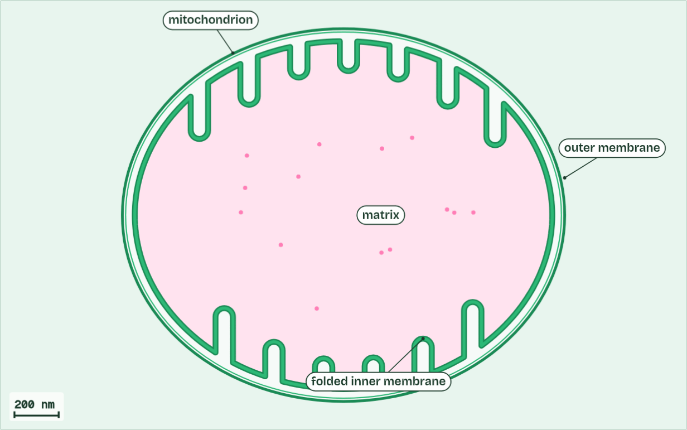
CHAPTER 4 · C1.2.5 Differences between anaerobic and aerobic cell respiration in humans
ATP 0
1 / 5
With oxygen and without
One mitochondrion. Its inner membrane is deeply folded.
Minutes 23 to 35
Notes:
Minutes 23 to 35 of 60: Compare the two routes (12 min).
The plan: Chapter 4: the predict, then students fill in the comparison table in pairs (below) and check it against the figure’s two settings. Write both word equations on the board from memory. Turn over the LOW tiles.
Both kinds of respiration start the same way, in the cytoplasm. A glucose molecule is split into two molecules of pyruvate in a process called glycolysis, which releases enough energy to make a small amount of ATP. After that the routes divide, according to whether there is oxygen, and they differ most in their yield of ATP for each glucose.
Aerobic respiration goes on with oxygen. The pyruvate goes into a mitochondrion and is broken down completely, to carbon dioxide and water, and a large amount of ATP is made. The word equation is glucose + oxygen → carbon dioxide + water. It needs mitochondria and oxygen, and it can use fatty acids and other compounds as well as glucose.
Anaerobic respiration in humans stops early. When there is not enough oxygen, the pyruvate stays in the cytoplasm and is turned into lactate. The word equation is glucose → lactate. It needs no mitochondria, no oxygen, and makes no carbon dioxide, but only glucose can be used: fatty acids cannot be respired without oxygen.
When does a human cell respire anaerobically? When muscles work so hard that the blood cannot bring oxygen fast enough: a short sprint, a heavy lift. Anaerobic respiration gives ATP at once, without waiting for oxygen, but only for a short time. Muscles do not switch from one route to the other. Aerobic respiration goes on, and anaerobic respiration adds to it.
The animation "Follow one glucose", paused at 5.9 s. The next slides go on through it, then play it.

Slide 37
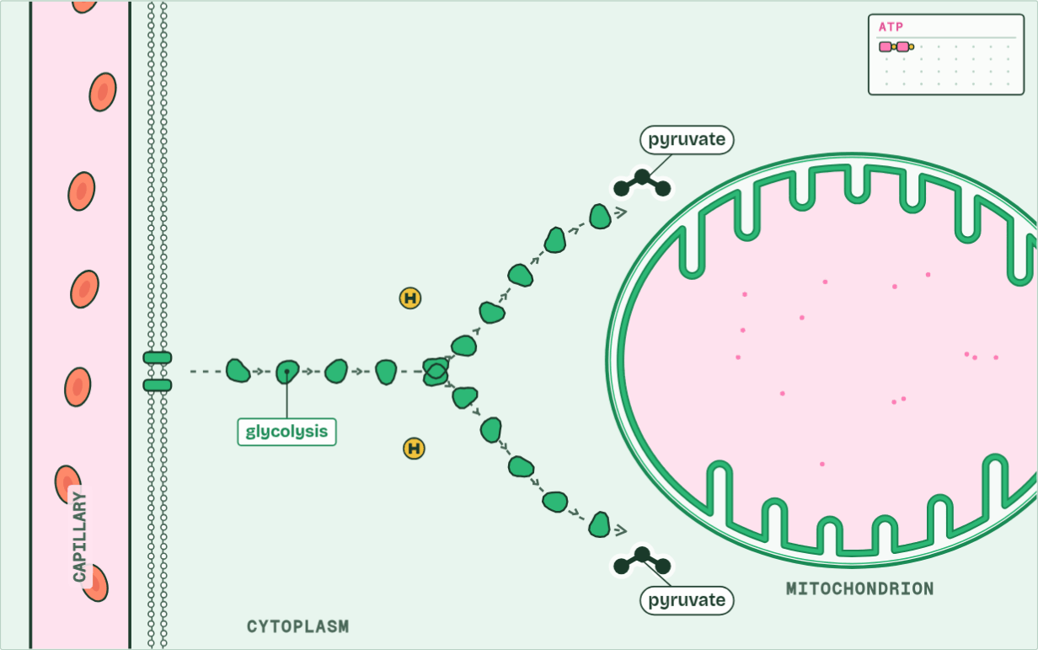
CHAPTER 4 · C1.2.5 Differences between anaerobic and aerobic cell respiration in humans
ATP 2
2 / 5
With oxygen and without
Splitting glucose into two pyruvate in the cytoplasm gives a little ATP: 2.
Minutes 23 to 35
Notes:
Minutes 23 to 35 of 60: Compare the two routes (12 min).
The plan: Chapter 4: the predict, then students fill in the comparison table in pairs (below) and check it against the figure’s two settings. Write both word equations on the board from memory. Turn over the LOW tiles.
Both kinds of respiration start the same way, in the cytoplasm. A glucose molecule is split into two molecules of pyruvate in a process called glycolysis, which releases enough energy to make a small amount of ATP. After that the routes divide, according to whether there is oxygen, and they differ most in their yield of ATP for each glucose.
Aerobic respiration goes on with oxygen. The pyruvate goes into a mitochondrion and is broken down completely, to carbon dioxide and water, and a large amount of ATP is made. The word equation is glucose + oxygen → carbon dioxide + water. It needs mitochondria and oxygen, and it can use fatty acids and other compounds as well as glucose.
Anaerobic respiration in humans stops early. When there is not enough oxygen, the pyruvate stays in the cytoplasm and is turned into lactate. The word equation is glucose → lactate. It needs no mitochondria, no oxygen, and makes no carbon dioxide, but only glucose can be used: fatty acids cannot be respired without oxygen.
When does a human cell respire anaerobically? When muscles work so hard that the blood cannot bring oxygen fast enough: a short sprint, a heavy lift. Anaerobic respiration gives ATP at once, without waiting for oxygen, but only for a short time. Muscles do not switch from one route to the other. Aerobic respiration goes on, and anaerobic respiration adds to it.
The animation "Follow one glucose", paused at 19.5 s. The next slides go on through it, then play it.

Slide 38
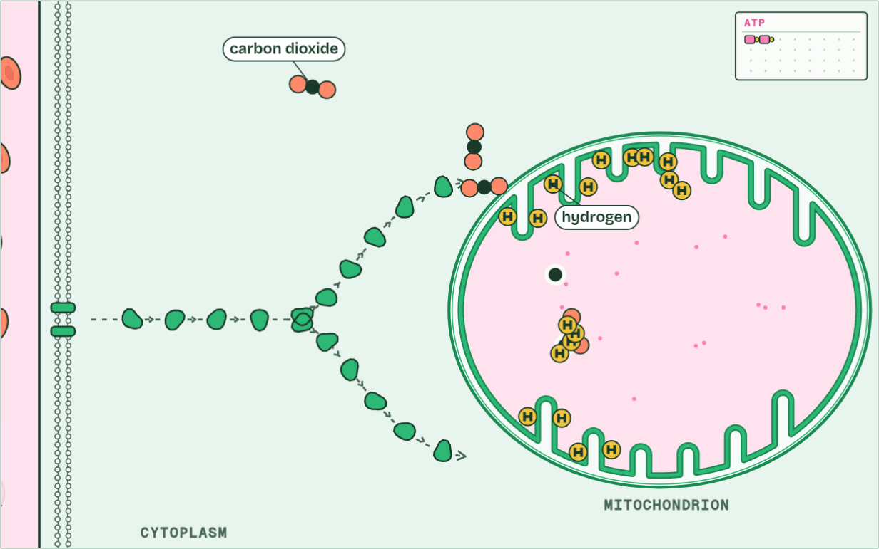
CHAPTER 4 · C1.2.5 Differences between anaerobic and aerobic cell respiration in humans
ATP 2
3 / 5
With oxygen and without
With oxygen, pyruvate goes into a mitochondrion. Its carbon leaves as carbon dioxide; its hydrogen goes to the folds of the inner membrane.
Minutes 23 to 35
Notes:
Minutes 23 to 35 of 60: Compare the two routes (12 min).
The plan: Chapter 4: the predict, then students fill in the comparison table in pairs (below) and check it against the figure’s two settings. Write both word equations on the board from memory. Turn over the LOW tiles.
Both kinds of respiration start the same way, in the cytoplasm. A glucose molecule is split into two molecules of pyruvate in a process called glycolysis, which releases enough energy to make a small amount of ATP. After that the routes divide, according to whether there is oxygen, and they differ most in their yield of ATP for each glucose.
Aerobic respiration goes on with oxygen. The pyruvate goes into a mitochondrion and is broken down completely, to carbon dioxide and water, and a large amount of ATP is made. The word equation is glucose + oxygen → carbon dioxide + water. It needs mitochondria and oxygen, and it can use fatty acids and other compounds as well as glucose.
Anaerobic respiration in humans stops early. When there is not enough oxygen, the pyruvate stays in the cytoplasm and is turned into lactate. The word equation is glucose → lactate. It needs no mitochondria, no oxygen, and makes no carbon dioxide, but only glucose can be used: fatty acids cannot be respired without oxygen.
When does a human cell respire anaerobically? When muscles work so hard that the blood cannot bring oxygen fast enough: a short sprint, a heavy lift. Anaerobic respiration gives ATP at once, without waiting for oxygen, but only for a short time. Muscles do not switch from one route to the other. Aerobic respiration goes on, and anaerobic respiration adds to it.
The animation "Follow one glucose", paused at 24.1 s. The next slides go on through it, then play it.

Slide 39
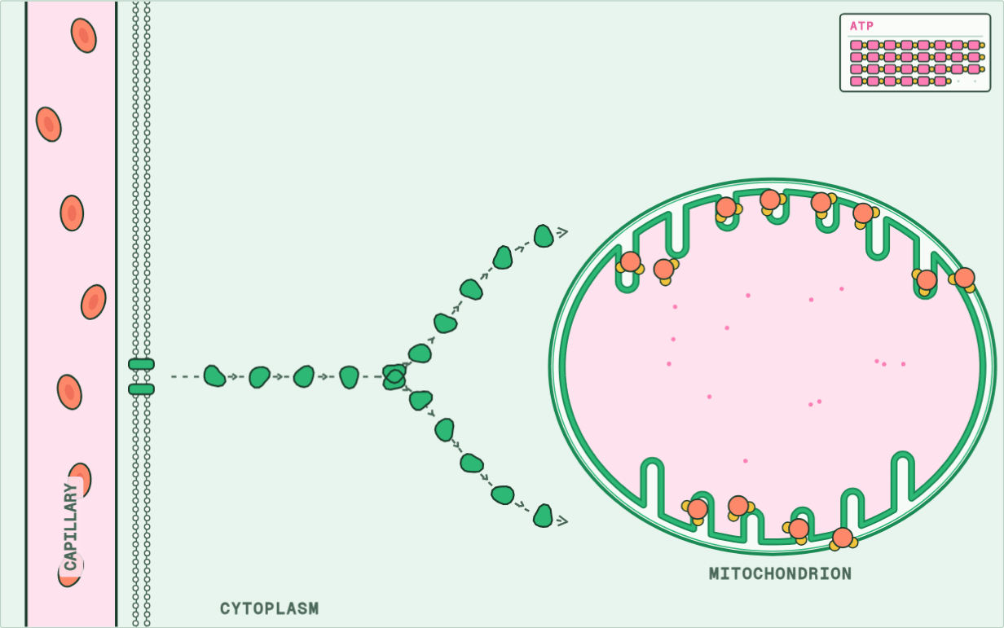
CHAPTER 4 · C1.2.5 Differences between anaerobic and aerobic cell respiration in humans
ATP about 30 to 32
4 / 5
With oxygen and without
Oxygen joins the hydrogen to make water. Here, at the folds, most of the ATP is made: about 30 to 32 from one glucose.
Minutes 23 to 35
Notes:
Minutes 23 to 35 of 60: Compare the two routes (12 min).
The plan: Chapter 4: the predict, then students fill in the comparison table in pairs (below) and check it against the figure’s two settings. Write both word equations on the board from memory. Turn over the LOW tiles.
Both kinds of respiration start the same way, in the cytoplasm. A glucose molecule is split into two molecules of pyruvate in a process called glycolysis, which releases enough energy to make a small amount of ATP. After that the routes divide, according to whether there is oxygen, and they differ most in their yield of ATP for each glucose.
Aerobic respiration goes on with oxygen. The pyruvate goes into a mitochondrion and is broken down completely, to carbon dioxide and water, and a large amount of ATP is made. The word equation is glucose + oxygen → carbon dioxide + water. It needs mitochondria and oxygen, and it can use fatty acids and other compounds as well as glucose.
Anaerobic respiration in humans stops early. When there is not enough oxygen, the pyruvate stays in the cytoplasm and is turned into lactate. The word equation is glucose → lactate. It needs no mitochondria, no oxygen, and makes no carbon dioxide, but only glucose can be used: fatty acids cannot be respired without oxygen.
When does a human cell respire anaerobically? When muscles work so hard that the blood cannot bring oxygen fast enough: a short sprint, a heavy lift. Anaerobic respiration gives ATP at once, without waiting for oxygen, but only for a short time. Muscles do not switch from one route to the other. Aerobic respiration goes on, and anaerobic respiration adds to it.
The animation "Follow one glucose", paused at 36.9 s. The next slides go on through it, then play it.

Slide 40
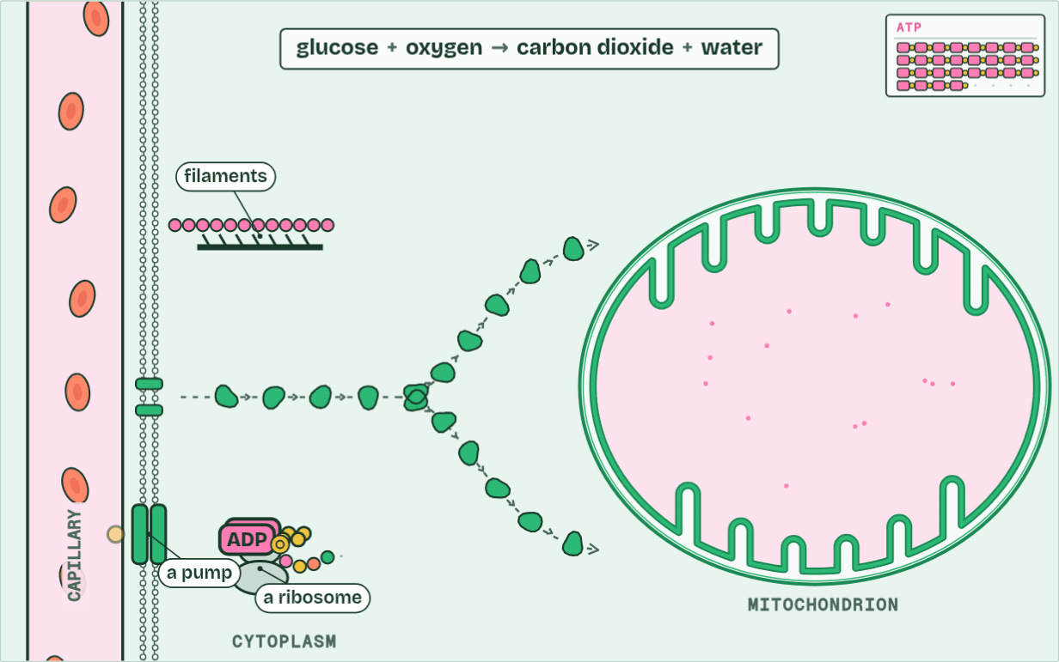
CHAPTER 4 · C1.2.5 Differences between anaerobic and aerobic cell respiration in humans
ATP about 30 to 32
5 / 5
With oxygen and without
Aerobic respiration: glucose + oxygen → carbon dioxide + water. The energy released remakes ATP for the cell’s work.
Minutes 23 to 35
Notes:
Minutes 23 to 35 of 60: Compare the two routes (12 min).
The plan: Chapter 4: the predict, then students fill in the comparison table in pairs (below) and check it against the figure’s two settings. Write both word equations on the board from memory. Turn over the LOW tiles.
Both kinds of respiration start the same way, in the cytoplasm. A glucose molecule is split into two molecules of pyruvate in a process called glycolysis, which releases enough energy to make a small amount of ATP. After that the routes divide, according to whether there is oxygen, and they differ most in their yield of ATP for each glucose.
Aerobic respiration goes on with oxygen. The pyruvate goes into a mitochondrion and is broken down completely, to carbon dioxide and water, and a large amount of ATP is made. The word equation is glucose + oxygen → carbon dioxide + water. It needs mitochondria and oxygen, and it can use fatty acids and other compounds as well as glucose.
Anaerobic respiration in humans stops early. When there is not enough oxygen, the pyruvate stays in the cytoplasm and is turned into lactate. The word equation is glucose → lactate. It needs no mitochondria, no oxygen, and makes no carbon dioxide, but only glucose can be used: fatty acids cannot be respired without oxygen.
When does a human cell respire anaerobically? When muscles work so hard that the blood cannot bring oxygen fast enough: a short sprint, a heavy lift. Anaerobic respiration gives ATP at once, without waiting for oxygen, but only for a short time. Muscles do not switch from one route to the other. Aerobic respiration goes on, and anaerobic respiration adds to it.
The animation "Follow one glucose", paused at 41.3 s. The next slides go on through it, then play it.

Slide 41
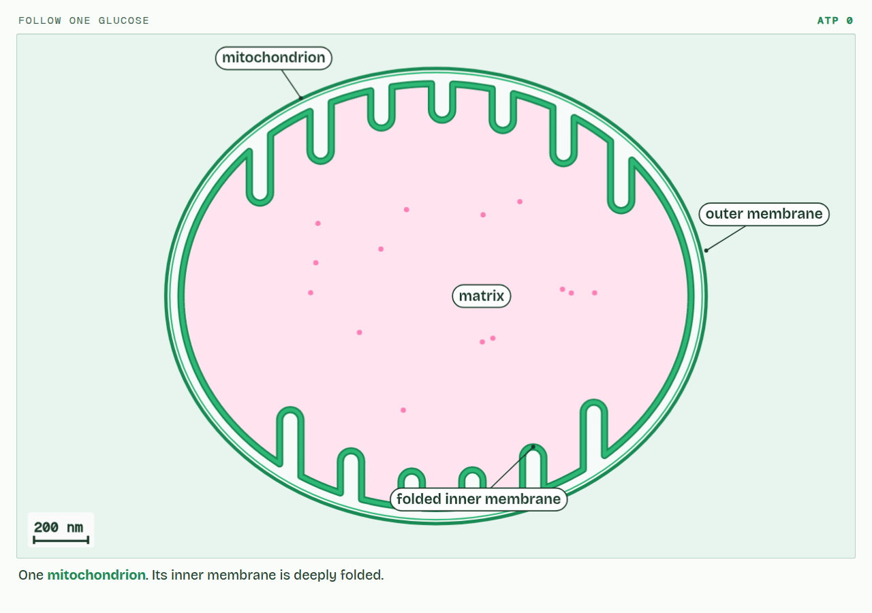
CHAPTER 4 · C1.2.5 Differences between anaerobic and aerobic cell respiration in humans
PLAY IT
With oxygen and without
Follow one glucose: click to play. It loops every 46 seconds.
Minutes 23 to 35
Notes:
Minutes 23 to 35 of 60: Compare the two routes (12 min).
The plan: Chapter 4: the predict, then students fill in the comparison table in pairs (below) and check it against the figure’s two settings. Write both word equations on the board from memory. Turn over the LOW tiles.
The video is respiration-e9217c.mp4, one loop of the animation in the guide. It plays in PowerPoint and Keynote. Google Slides does not play a video embedded in a .pptx: download respiration-e9217c.mp4 (https://www.biologybybradford.com/guides/downloads/scenes/respiration-e9217c.mp4), upload it to Google Drive, then Insert > Video > Google Drive.
In the guide the class can change it as it runs: https://www.biologybybradford.com/guides/ib-biology-c1-2-cell-respiration#two-routes
What it shows, in order:
1. One mitochondrion. Its inner membrane is deeply folded.
2. Splitting glucose into two pyruvate in the cytoplasm gives a little ATP: 2.
3. With oxygen, pyruvate goes into a mitochondrion. Its carbon leaves as carbon dioxide; its hydrogen goes to the folds of the inner membrane.
4. Oxygen joins the hydrogen to make water. Here, at the folds, most of the ATP is made: about 30 to 32 from one glucose.
5. Aerobic respiration: glucose + oxygen → carbon dioxide + water. The energy released remakes ATP for the cell’s work.

Slide 42
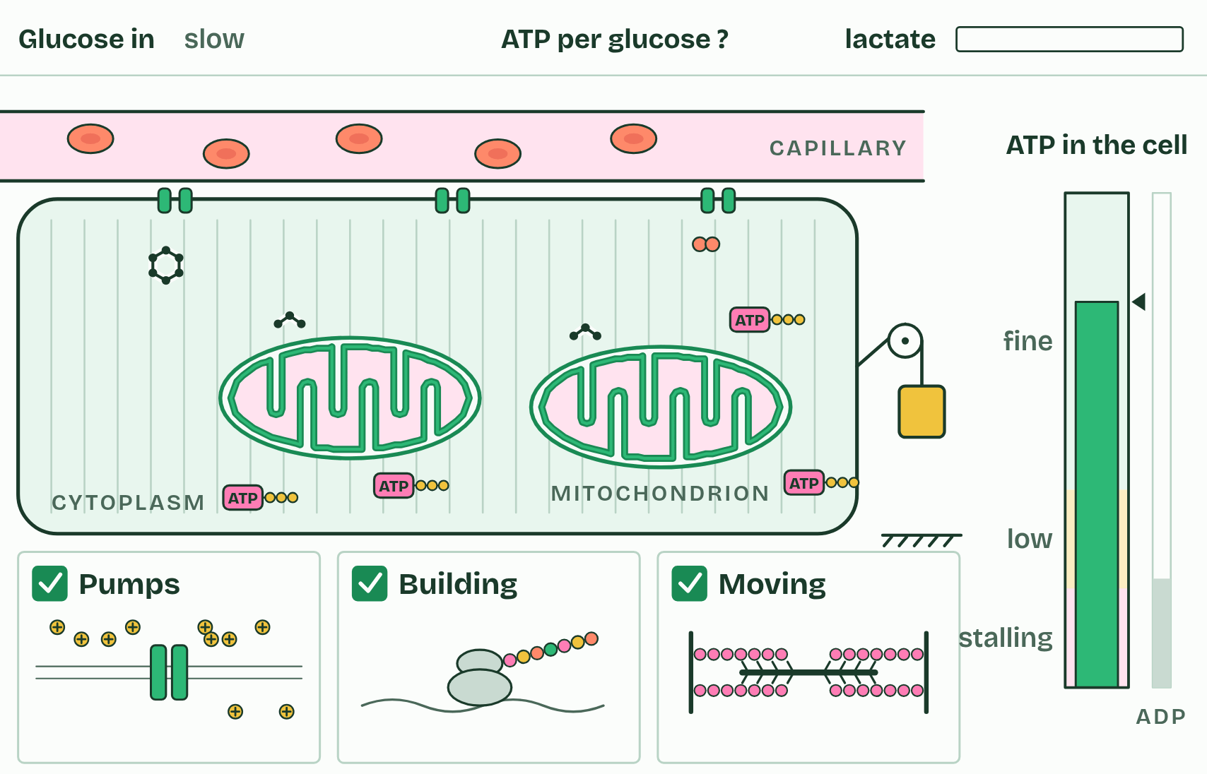
CHAPTER 4 · C1.2.5 Differences between anaerobic and aerobic cell respiration in humans
1 / 4
With oxygen and without
Rest: the mitochondria keep up easily.
Minutes 23 to 35
Notes:
Minutes 23 to 35 of 60: Compare the two routes (12 min).
The plan: Chapter 4: the predict, then students fill in the comparison table in pairs (below) and check it against the figure’s two settings. Write both word equations on the board from memory. Turn over the LOW tiles.
Both kinds of respiration start the same way, in the cytoplasm. A glucose molecule is split into two molecules of pyruvate in a process called glycolysis, which releases enough energy to make a small amount of ATP. After that the routes divide, according to whether there is oxygen, and they differ most in their yield of ATP for each glucose.
Aerobic respiration goes on with oxygen. The pyruvate goes into a mitochondrion and is broken down completely, to carbon dioxide and water, and a large amount of ATP is made. The word equation is glucose + oxygen → carbon dioxide + water. It needs mitochondria and oxygen, and it can use fatty acids and other compounds as well as glucose.
Anaerobic respiration in humans stops early. When there is not enough oxygen, the pyruvate stays in the cytoplasm and is turned into lactate. The word equation is glucose → lactate. It needs no mitochondria, no oxygen, and makes no carbon dioxide, but only glucose can be used: fatty acids cannot be respired without oxygen.
When does a human cell respire anaerobically? When muscles work so hard that the blood cannot bring oxygen fast enough: a short sprint, a heavy lift. Anaerobic respiration gives ATP at once, without waiting for oxygen, but only for a short time. Muscles do not switch from one route to the other. Aerobic respiration goes on, and anaerobic respiration adds to it.

Slide 43
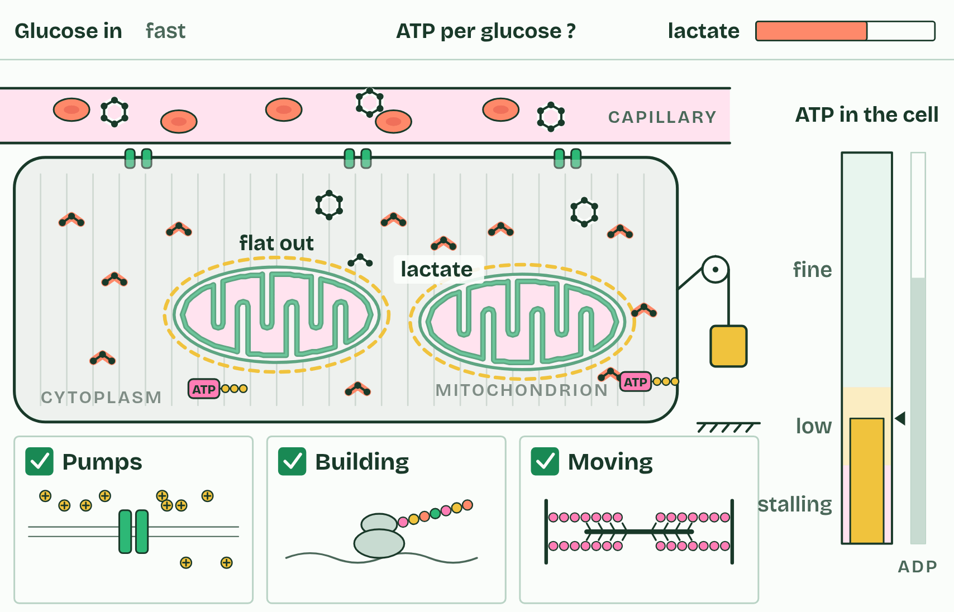
CHAPTER 4 · C1.2.5 Differences between anaerobic and aerobic cell respiration in humans
2 / 4
With oxygen and without
A sprint: demand outruns the oxygen supply.
Minutes 23 to 35
Notes:
Minutes 23 to 35 of 60: Compare the two routes (12 min).
The plan: Chapter 4: the predict, then students fill in the comparison table in pairs (below) and check it against the figure’s two settings. Write both word equations on the board from memory. Turn over the LOW tiles.
Both kinds of respiration start the same way, in the cytoplasm. A glucose molecule is split into two molecules of pyruvate in a process called glycolysis, which releases enough energy to make a small amount of ATP. After that the routes divide, according to whether there is oxygen, and they differ most in their yield of ATP for each glucose.
Aerobic respiration goes on with oxygen. The pyruvate goes into a mitochondrion and is broken down completely, to carbon dioxide and water, and a large amount of ATP is made. The word equation is glucose + oxygen → carbon dioxide + water. It needs mitochondria and oxygen, and it can use fatty acids and other compounds as well as glucose.
Anaerobic respiration in humans stops early. When there is not enough oxygen, the pyruvate stays in the cytoplasm and is turned into lactate. The word equation is glucose → lactate. It needs no mitochondria, no oxygen, and makes no carbon dioxide, but only glucose can be used: fatty acids cannot be respired without oxygen.
When does a human cell respire anaerobically? When muscles work so hard that the blood cannot bring oxygen fast enough: a short sprint, a heavy lift. Anaerobic respiration gives ATP at once, without waiting for oxygen, but only for a short time. Muscles do not switch from one route to the other. Aerobic respiration goes on, and anaerobic respiration adds to it.

Slide 44
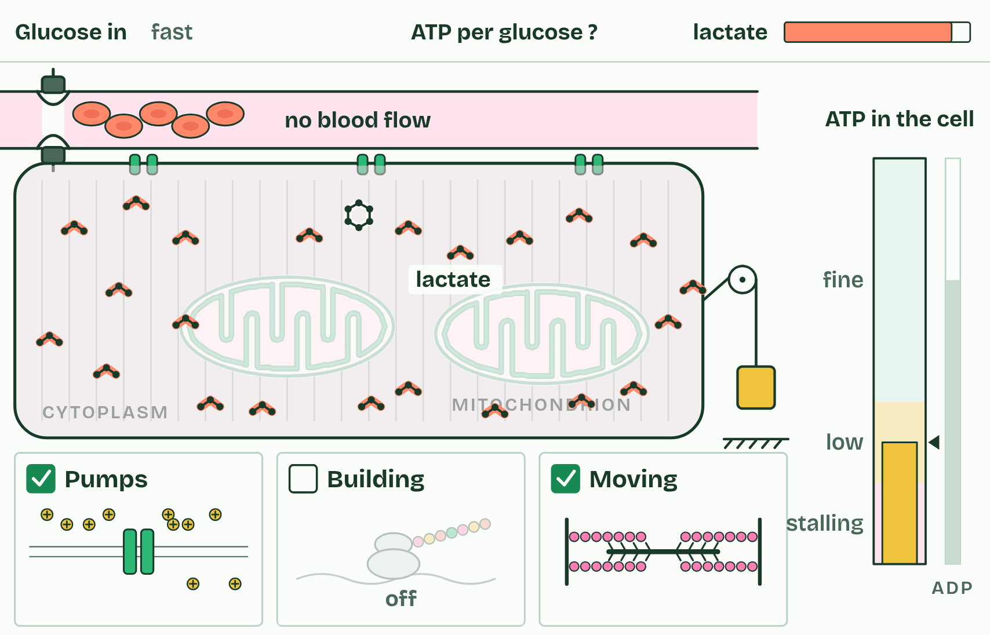
CHAPTER 4 · C1.2.5 Differences between anaerobic and aerobic cell respiration in humans
3 / 4
With oxygen and without
No oxygen: what happens to the ATP from each glucose?
Minutes 23 to 35
Notes:
Minutes 23 to 35 of 60: Compare the two routes (12 min).
The plan: Chapter 4: the predict, then students fill in the comparison table in pairs (below) and check it against the figure’s two settings. Write both word equations on the board from memory. Turn over the LOW tiles.
Both kinds of respiration start the same way, in the cytoplasm. A glucose molecule is split into two molecules of pyruvate in a process called glycolysis, which releases enough energy to make a small amount of ATP. After that the routes divide, according to whether there is oxygen, and they differ most in their yield of ATP for each glucose.
Aerobic respiration goes on with oxygen. The pyruvate goes into a mitochondrion and is broken down completely, to carbon dioxide and water, and a large amount of ATP is made. The word equation is glucose + oxygen → carbon dioxide + water. It needs mitochondria and oxygen, and it can use fatty acids and other compounds as well as glucose.
Anaerobic respiration in humans stops early. When there is not enough oxygen, the pyruvate stays in the cytoplasm and is turned into lactate. The word equation is glucose → lactate. It needs no mitochondria, no oxygen, and makes no carbon dioxide, but only glucose can be used: fatty acids cannot be respired without oxygen.
When does a human cell respire anaerobically? When muscles work so hard that the blood cannot bring oxygen fast enough: a short sprint, a heavy lift. Anaerobic respiration gives ATP at once, without waiting for oxygen, but only for a short time. Muscles do not switch from one route to the other. Aerobic respiration goes on, and anaerobic respiration adds to it.

Slide 45
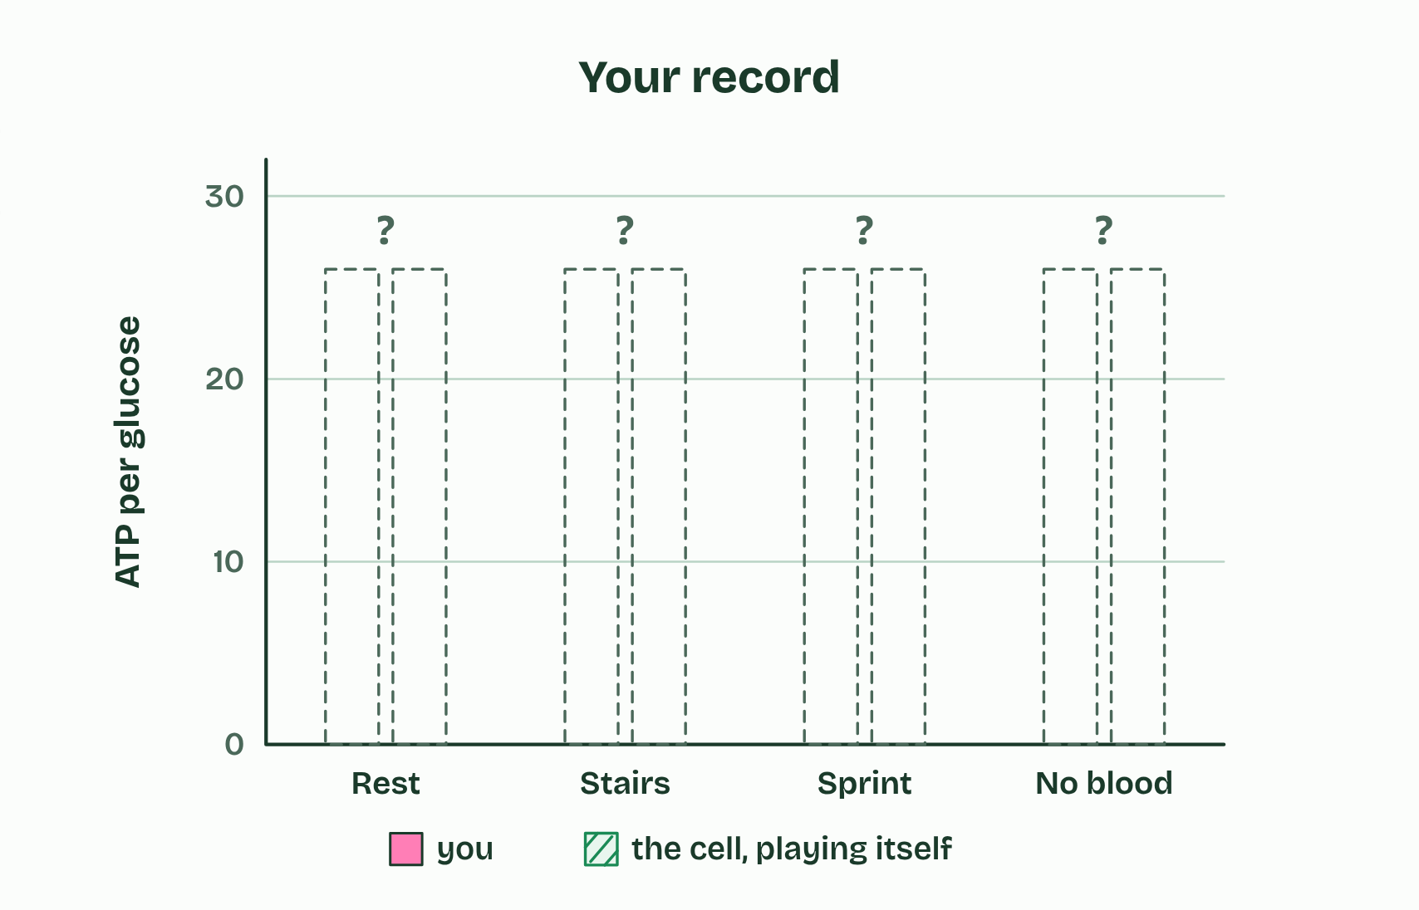
CHAPTER 4 · C1.2.5 Differences between anaerobic and aerobic cell respiration in humans
4 / 4
With oxygen and without
Play the rounds to fill in the record.
Minutes 23 to 35
Notes:
Minutes 23 to 35 of 60: Compare the two routes (12 min).
The plan: Chapter 4: the predict, then students fill in the comparison table in pairs (below) and check it against the figure’s two settings. Write both word equations on the board from memory. Turn over the LOW tiles.
Both kinds of respiration start the same way, in the cytoplasm. A glucose molecule is split into two molecules of pyruvate in a process called glycolysis, which releases enough energy to make a small amount of ATP. After that the routes divide, according to whether there is oxygen, and they differ most in their yield of ATP for each glucose.
Aerobic respiration goes on with oxygen. The pyruvate goes into a mitochondrion and is broken down completely, to carbon dioxide and water, and a large amount of ATP is made. The word equation is glucose + oxygen → carbon dioxide + water. It needs mitochondria and oxygen, and it can use fatty acids and other compounds as well as glucose.
Anaerobic respiration in humans stops early. When there is not enough oxygen, the pyruvate stays in the cytoplasm and is turned into lactate. The word equation is glucose → lactate. It needs no mitochondria, no oxygen, and makes no carbon dioxide, but only glucose can be used: fatty acids cannot be respired without oxygen.
When does a human cell respire anaerobically? When muscles work so hard that the blood cannot bring oxygen fast enough: a short sprint, a heavy lift. Anaerobic respiration gives ATP at once, without waiting for oxygen, but only for a short time. Muscles do not switch from one route to the other. Aerobic respiration goes on, and anaerobic respiration adds to it.

Slide 46
CHAPTER 4 · C1.2.5 Differences between anaerobic and aerobic cell respiration in humans
With oxygen and without
A glucose molecule is split into two molecules of pyruvate in a process called glycolysis, which releases enough energy to make a small amount of ATP.
After that the routes divide, according to whether there is oxygen, and they differ most in their yield of ATP for each glucose.
Aerobic respiration goes on with oxygen.
The pyruvate goes into a mitochondrion and is broken down completely, to carbon dioxide and water, and a large amount of ATP is made.
Minutes 23 to 35
Notes:
Minutes 23 to 35 of 60: Compare the two routes (12 min).
The plan: Chapter 4: the predict, then students fill in the comparison table in pairs (below) and check it against the figure’s two settings. Write both word equations on the board from memory. Turn over the LOW tiles.
Both kinds of respiration start the same way, in the cytoplasm. A glucose molecule is split into two molecules of pyruvate in a process called glycolysis, which releases enough energy to make a small amount of ATP. After that the routes divide, according to whether there is oxygen, and they differ most in their yield of ATP for each glucose.
Aerobic respiration goes on with oxygen. The pyruvate goes into a mitochondrion and is broken down completely, to carbon dioxide and water, and a large amount of ATP is made. The word equation is glucose + oxygen → carbon dioxide + water. It needs mitochondria and oxygen, and it can use fatty acids and other compounds as well as glucose.
Anaerobic respiration in humans stops early. When there is not enough oxygen, the pyruvate stays in the cytoplasm and is turned into lactate. The word equation is glucose → lactate. It needs no mitochondria, no oxygen, and makes no carbon dioxide, but only glucose can be used: fatty acids cannot be respired without oxygen.
When does a human cell respire anaerobically? When muscles work so hard that the blood cannot bring oxygen fast enough: a short sprint, a heavy lift. Anaerobic respiration gives ATP at once, without waiting for oxygen, but only for a short time. Muscles do not switch from one route to the other. Aerobic respiration goes on, and anaerobic respiration adds to it.

Slide 47
PREDICT
A sprinter’s leg muscles run short of oxygen. Per glucose, how much ATP does anaerobic respiration make compared with aerobic?
A About the same, just faster
B About half as much
C About one fifteenth as much
D None at all: it only makes lactate
Minutes 23 to 35
Notes:
Minutes 23 to 35 of 60: Compare the two routes (12 min).
The plan: Chapter 4: the predict, then students fill in the comparison table in pairs (below) and check it against the figure’s two settings. Write both word equations on the board from memory. Turn over the LOW tiles.
Ask for a show of hands, or mini whiteboards, before revealing. (Answer: C, on the next slide.)

Slide 48
WHAT HAPPENS
A sprinter’s leg muscles run short of oxygen. Per glucose, how much ATP does anaerobic respiration make compared with aerobic?
A About the same, just faster
B About half as much
C About one fifteenth as much
D None at all: it only makes lactate
About one fifteenth: 2 ATP against about 30 to 32. Without oxygen the glucose is only split, not broken down completely, so most of its energy is still locked in the lactate. The sprinter’s muscles burn through glucose far faster to keep up, which is one reason a sprint cannot last.
Minutes 23 to 35
Notes:
Minutes 23 to 35 of 60: Compare the two routes (12 min).
The plan: Chapter 4: the predict, then students fill in the comparison table in pairs (below) and check it against the figure’s two settings. Write both word equations on the board from memory. Turn over the LOW tiles.
Answer: C. About one fifteenth: 2 ATP against about 30 to 32. Without oxygen the glucose is only split, not broken down completely, so most of its energy is still locked in the lactate. The sprinter’s muscles burn through glucose far faster to keep up, which is one reason a sprint cannot last.

Slide 49
REMEMBER IT
Anaerobic in humans is LOW
L
O
W
L
O
W
Minutes 23 to 35
Notes:
Minutes 23 to 35 of 60: Compare the two routes (12 min).
The plan: Chapter 4: the predict, then students fill in the comparison table in pairs (below) and check it against the figure’s two settings. Write both word equations on the board from memory. Turn over the LOW tiles.
Ask the class what each letter stands for before revealing.

Slide 50
REMEMBER IT
Anaerobic in humans is LOW
L
O
W
L
O
W
Lactate
Only 2 ATP
Without oxygen
the waste product
per glucose
in the cytoplasm
Minutes 23 to 35
Notes:
Minutes 23 to 35 of 60: Compare the two routes (12 min).
The plan: Chapter 4: the predict, then students fill in the comparison table in pairs (below) and check it against the figure’s two settings. Write both word equations on the board from memory. Turn over the LOW tiles.
L: Lactate (the waste product)
O: Only 2 ATP (per glucose)
W: Without oxygen (in the cytoplasm)

Slide 51
WATCH OUT
Glycolysis happens in the cytoplasm in both routes; only what follows it happens in the mitochondria.
Minutes 23 to 35
Notes:
Minutes 23 to 35 of 60: Compare the two routes (12 min).
The plan: Chapter 4: the predict, then students fill in the comparison table in pairs (below) and check it against the figure’s two settings. Write both word equations on the board from memory. Turn over the LOW tiles.
A common mistake: say it, then ask who can say why it is wrong.

Slide 52
STEP 5
8 MIN
The respiration film
Play the SL respiration film once through.
Minutes 35 to 43
Notes:
Minutes 35 to 43 of 60: The respiration film (8 min).
The plan: Play the SL respiration film once through. Then turn the oxygen off at the end: students call out what will change before you press it.

Slide 53
GAME
12 MIN
The ATP budget
THE TASK
Pairs at one device, rounds 1 to 4 after chapter 4. Collect each pair’s ATP per glucose for rounds 3 and 4 on the board and compare: what did a sprint cost in glucose, and what happened with the blood supply blocked?
STUDENTS NEED
One device per pair.
Minutes 43 to 55
Notes:
Minutes 43 to 55 of 60: The ATP budget (12 min).
The plan: In pairs, rounds 1 to 4 (the game after chapter 4). Collect each pair’s ATP per glucose for the sprint and the blocked blood supply on the board.
The activity: The ATP budget. Pairs at one device, rounds 1 to 4 after chapter 4. Collect each pair’s ATP per glucose for rounds 3 and 4 on the board and compare: what did a sprint cost in glucose, and what happened with the blood supply blocked?
Needs: one device per pair.
The time: 12 minutes, minutes 43 to 55 of the plan.

Slide 54
PLENARY
Can you now...
Describe ATP as a nucleotide and explain what makes it suit the job of moving energy around a cell (C1.2.1)
Explain how hydrolysis of ATP releases energy for active transport, building molecules and movement, and why remaking it takes energy (C1.2.2, C1.2.3)
Explain respiration as the cell's way of making ATP from carbon compounds, and tell it apart from gas exchange (C1.2.4)
Compare aerobic and anaerobic respiration in humans, with word equations for both (C1.2.5)
Minutes 55 to 60
Notes:
Minutes 55 to 60 of 60: Exit: true or false (5 min).
The plan: Five statements from the set below, a reason for each false one.
Thumbs up, sideways or down on each goal before the exit question. The goals come from the statements this lesson covers.

Slide 55
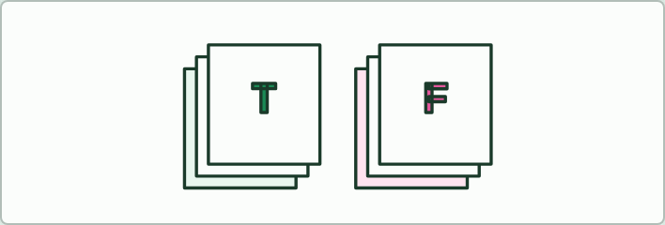
QUIZ
5 MIN
True or false
THE TASK
Ten statements, five set as the exit: “Glycolysis happens in the cytoplasm” (true); “Chloroplasts are where a plant cell respires aerobically” (false: mitochondria, after glycolysis in the cytoplasm); “Anaerobic respiration in muscle makes carbon dioxide” (false); “Aerobic respiration gives about 30 to 32 ATP per glucose” (true); “The oxygen you breathe in ends up in the carbon dioxide you breathe out” (false: it ends up in water); “Plants respire only at night” (false); “ATP is the cell’s long-term energy store” (false); “Lactate is made from pyruvate when oxygen is short” (true); “Anaerobic respiration in muscle makes a net 2 ATP per glucose” (true); “Respiration makes energy” (false: it releases it).
STUDENTS NEED
The statements on the board, or on cards.
Minutes 55 to 60
Notes:
Minutes 55 to 60 of 60: Exit: true or false (5 min).
The plan: Five statements from the set below, a reason for each false one.
The activity: True or false. Ten statements, five set as the exit: “Glycolysis happens in the cytoplasm” (true); “Chloroplasts are where a plant cell respires aerobically” (false: mitochondria, after glycolysis in the cytoplasm); “Anaerobic respiration in muscle makes carbon dioxide” (false); “Aerobic respiration gives about 30 to 32 ATP per glucose” (true); “The oxygen you breathe in ends up in the carbon dioxide you breathe out” (false: it ends up in water); “Plants respire only at night” (false); “ATP is the cell’s long-term energy store” (false); “Lactate is made from pyruvate when oxygen is short” (true); “Anaerobic respiration in muscle makes a net 2 ATP per glucose” (true); “Respiration makes energy” (false: it releases it).
Needs: the statements on the board, or on cards.
The time: 5 minutes, minutes 55 to 60 of the plan.

Slide 56
PRACTISE AND REVISE
Keep going
Exam practice: a fresh paper of exam questions on C1.2 at standard level, marked as you go
The guide, with the animations and the dry lab
This lesson in the guide: 1 The cell's small change, 2 Spend it, remake it, 3 Fuel in, ATP out, 4 With oxygen and without
BUILD FOR YOUR CLASS
ALREADY ON THE SITE FOR C1.2
CARD SETS ON SPLYCR
Tarsia puzzle, dominoes and picture reveal on C1.2, built from its key terms and ready to print
A pub quiz with rounds on C1.2, to present or run with no projector
An escape room built from the question bank on C1.2
Lesson: Cell Respiration
Quiz: Cell Respiration
Revision map: C1.2 Cell respiration, to fill in
Exam questions: C1.2 in the exam maker, a paper with its markscheme
Open a set to host it as a class game, or make a copy to edit.
C1.2 Cell Respiration
B3.2–C2.2 Plant Transport, Respiration & Neural Signalling
How this was made. The course structure, the activities and the teaching choices come from my own classroom, my presentations and my years of teaching IB and AP Biology. I use Claude, an AI, to help write and build the interactive guides, lesson plans, slides and practice questions, and to draw the diagrams and code the interactives. I direct the work and review it against the IB and AP specifications before it goes live.
Minute 60: after the lesson
Notes:
Every link here is live. Set the exam practice paper for homework: it is fresh each time, marked as students go and saved to their Exam practice when they are signed in.
Exam practice: https://www.biologybybradford.com/exam-maker/sit?topics=C1.2&level=SL&paper=quiz&marks=15&src=ep
The guide: https://www.biologybybradford.com/guides/ib-biology-c1-2-cell-respiration

