Slide 1
IB Biology C1.2
LESSON 2 OF 5
BY THE END YOU CAN
Cell respiration
Measure the rate of respiration with a respirometer and work it out from raw or secondary data (C1.2.6)
Measuring a rate you cannot see
C1.2.6
Measuring respiration rate: the dough lab, the respirometer, the control, and the rate per gram per minute
60 minutes · chapter 5 · the dry lab
Minute 0
Notes:
IB Biology C1.2, Cell respiration. Lesson 2 of 5: Measuring a rate you cannot see, 60 minutes.
The plan, minute by minute (each slide's footer says where you are):
0 to 5 min (5) Do now: how fast is a seed respiring?
5 to 15 min (10) Rising dough
15 to 25 min (10) How a respirometer works
25 to 45 min (20) The dry lab with the IA coach
45 to 55 min (10) Back to the dough
55 to 60 min (5) Exit: work out a rate
What students get wrong:
The drop moves because the seeds give out carbon dioxide. It is absorbed; the drop moves because oxygen is taken up.
The control is “to compare”. The bead tube shows what moves the drop that is not respiration, so it can be subtracted.
A disaccharide must be slower than glucose for yeast. Yeast split sucrose outside the cell with an enzyme, so it is nearly as fast.
Stretch and support:
Support: give the captions of chapter 4’s figure as cut-up cards to sort into “with oxygen” and “without”, the dotted key terms as a glossary, and a writing frame for “compare aerobic and anaerobic respiration” (one row of the table, one sentence each).
Stretch: in the dry lab, find the time with the clip open below which the control matters most, and explain from the gas law why a cold bath fakes respiration.
Stretch: design a dough experiment to separate the flour’s own sugars from the added starch (hint: a flour that has been heated to destroy its enzymes).
Stretch: shadow puppets: in groups, answer two written questions from the C1.2 exam maker as shadow puppets, so the class has to explain each step aloud.
The lesson plan to print: https://www.biologybybradford.com/guides/downloads/ib-biology-c1-2-cell-respiration-lesson-2-plan.pdf

Slide 2
DO NOW
How fast is a seed respiring?
“How could you tell how fast a seed is respiring without opening it?”
Students write three ideas each.
5:00
minutes
Start now: the timer is running.
Minutes 0 to 5
Notes:
Minutes 0 to 5 of 60: Do now: how fast is a seed respiring? (5 min).
The plan: “How could you tell how fast a seed is respiring without opening it?” Students write three ideas each. Collect them: oxygen in, carbon dioxide out, fuel used.
Start a 5 minute timer as they come in.

Slide 3
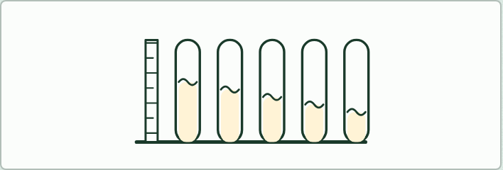
PRACTICAL
10 MIN
Rising dough
THE TASK
Make one dough: stir 4 g of dried yeast into 75 cm³ of warm water (about 35 °C), then add plain flour until it is a thick batter that just drops from a spatula (about 20 spatulas). Divide it into five equal portions in small beakers and stir 2 g of one sugar into each (glucose, fructose, sucrose, starch, and none): weigh the sugar rather than using “two spatulas”. Spoon each into a boiling tube to a height of 30 mm, mark the level, stand the tubes in a water bath at 30 °C (or record the room temperature), and read the height of the top every 5 minutes for 30 minutes.Students then design their own results table (time, height in mm with its uncertainty, a column for each sugar), graph height against time with a line for each sugar, and write a conclusion and an evaluation: which sugar was fastest and why, which variables were not controlled (the consistency of the dough, the temperature), and two specific improvements.
STUDENTS NEED
Dried yeast, plain flour, glucose, fructose, sucrose and starch, a balance, spatulas, small beakers, five boiling tubes and a rack per pair, rulers, a water bath or a thermometer, a timer.
Minutes 5 to 15
Notes:
Minutes 5 to 15 of 60: Rising dough (10 min).
The plan: Pairs make the dough, set up five tubes and take the first reading (the practical below). Readings every 5 minutes through the lesson, one student a pair keeping time.
The activity: Rising dough. Make one dough: stir 4 g of dried yeast into 75 cm³ of warm water (about 35 °C), then add plain flour until it is a thick batter that just drops from a spatula (about 20 spatulas). Divide it into five equal portions in small beakers and stir 2 g of one sugar into each (glucose, fructose, sucrose, starch, and none): weigh the sugar rather than using “two spatulas”. Spoon each into a boiling tube to a height of 30 mm, mark the level, stand the tubes in a water bath at 30 °C (or record the room temperature), and read the height of the top every 5 minutes for 30 minutes.Students then design their own results table (time, height in mm with its uncertainty, a column for each sugar), graph height against time with a line for each sugar, and write a conclusion and an evaluation: which sugar was fastest and why, which variables were not controlled (the consistency of the dough, the temperature), and two specific improvements.
Needs: dried yeast, plain flour, glucose, fructose, sucrose and starch, a balance, spatulas, small beakers, five boiling tubes and a rack per pair, rulers, a water bath or a thermometer, a timer.
The time: 10 minutes, minutes 5 to 15 of the plan.

Slide 4
STEP 3
10 MIN
How a respirometer works
Chapter 5: A rate you cannot see
Demonstration (optional): A real respirometer
Minutes 15 to 25
Notes:
Minutes 15 to 25 of 60: How a respirometer works (10 min).
The plan: Chapter 5: the predict about the drop, then the explore figure part by part: why the potassium hydroxide, why the beads, why the clip. Then figure 5.2’s worked rate, one step at a time.

Slide 5
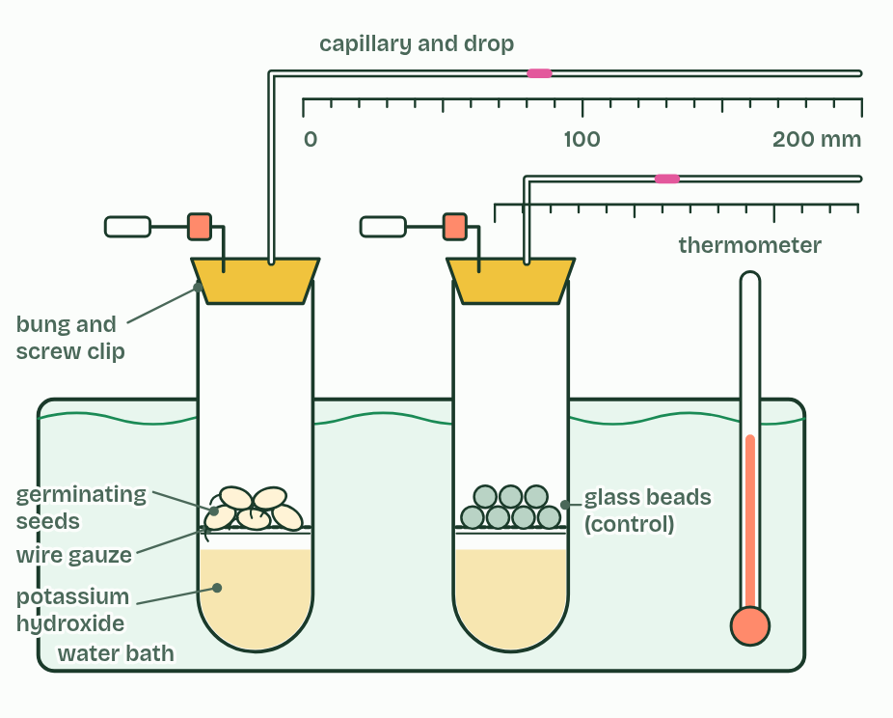
CHAPTER 5 · C1.2.6 Variables affecting the rate of cell respiration
A rate you cannot see
Oxygen uptake in a respirometer: germinating seeds in a sealed tube, with potassium hydroxide to absorb the carbon dioxide they give out, and a drop of coloured liquid in a capillary whose movement shows the change in gas volume.
Carbon dioxide output: a gas sensor or data logger in a sealed chamber, or hydrogencarbonate indicator changing colour. With yeast, the rise of a dough or the gas collected over a sugar solution works too (the dry lab's dough mode).
Fuel used: the fall in the glucose in a yeast culture, measured with test strips.
Minutes 15 to 25
Notes:
Minutes 15 to 25 of 60: How a respirometer works (10 min).
The plan: Chapter 5: the predict about the drop, then the explore figure part by part: why the potassium hydroxide, why the beads, why the clip. Then figure 5.2’s worked rate, one step at a time.
Respiration happens inside cells, so you cannot watch it. You measure it from what goes in or comes out: oxygen taken up, carbon dioxide given out, or fuel used. The rate of respiration is the amount changed divided by the time taken, and for living material it is given per gram per minute as well, so that samples of different mass can be compared.
A class can do it three ways.
The capillary is a long thin cylinder, so the volume of gas is πr² × the distance the drop moved, where r is half the bore. A bore of 1 mm holds 0.785 mm³ for every mm.
A second tube, the same in every way but with glass beads in place of the seeds, is the control. Anything that moves its drop, such as the gas warming or cooling or the air pressure changing, is not respiration, so its movement is taken off the seeds’.
What changes the rate? Temperature: respiration is enzymes at work, so it speeds up as it warms until they begin to denature (C1.1). How far germination has gone: dry seeds hardly respire, and soaked ones respire more each day. The mass of the seeds, and the kind of seed. With yeast: the sugar it is given, the temperature, and how much oxygen there is. The seeds are kept in the dark so that they cannot photosynthesise and hide the gas changes.
In an experiment on any of these, the one thing you change on purpose is the independent variable (the temperature, say), the rate you measure is the dependent variable, and everything else you hold the same is a controlled variable: the mass and age of the seeds, the volume of the tube, the time. You may also be asked to work out a rate from someone else’s numbers: the steps are the same (figure 5.2).
Parts of the figure:
Water bath and thermometer Keep the temperature steady, because gas expands as it warms.
Potassium hydroxide An alkali that absorbs carbon dioxide. Without it, the carbon dioxide given out would make up for the oxygen taken in.
Wire gauze Holds the seeds above the potassium hydroxide, so they never touch it.
Germinating seeds Soaked a few days ago, respiring hard, and kept in the dark. Weighed first, so the rate can be given per gram.
Glass bead tube The control: the same volume of glass beads, the same everything else. Anything that moves its drop is not respiration.
Bung and screw clip Seal the tube. Left open while the tube warms to the bath, then closed to start.
Capillary and coloured drop The drop moves as the gas inside shrinks. The bore sets how far it moves for each mm³.
Scale Read in mm. Each reading is ± 0.5 mm.

Slide 6
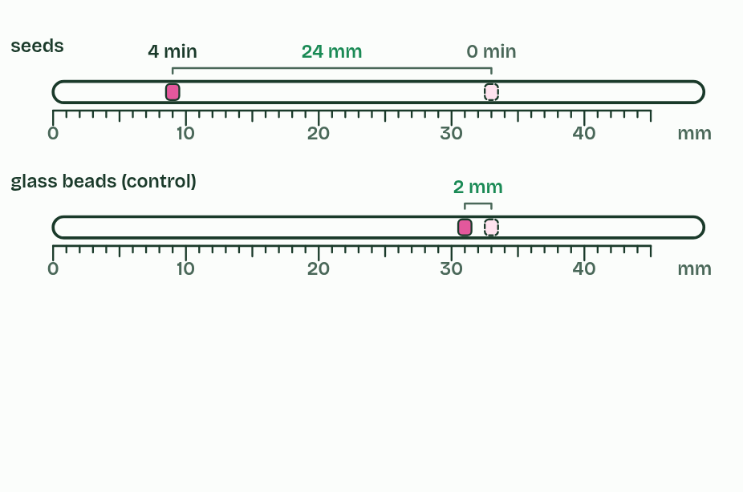
CHAPTER 5 · C1.2.6 Variables affecting the rate of cell respiration
1 / 4
A rate you cannot see
Read both drops at the start and the end.
Minutes 15 to 25
Notes:
Minutes 15 to 25 of 60: How a respirometer works (10 min).
The plan: Chapter 5: the predict about the drop, then the explore figure part by part: why the potassium hydroxide, why the beads, why the clip. Then figure 5.2’s worked rate, one step at a time.
Respiration happens inside cells, so you cannot watch it. You measure it from what goes in or comes out: oxygen taken up, carbon dioxide given out, or fuel used. The rate of respiration is the amount changed divided by the time taken, and for living material it is given per gram per minute as well, so that samples of different mass can be compared.
A class can do it three ways.
The capillary is a long thin cylinder, so the volume of gas is πr² × the distance the drop moved, where r is half the bore. A bore of 1 mm holds 0.785 mm³ for every mm.
A second tube, the same in every way but with glass beads in place of the seeds, is the control. Anything that moves its drop, such as the gas warming or cooling or the air pressure changing, is not respiration, so its movement is taken off the seeds’.
What changes the rate? Temperature: respiration is enzymes at work, so it speeds up as it warms until they begin to denature (C1.1). How far germination has gone: dry seeds hardly respire, and soaked ones respire more each day. The mass of the seeds, and the kind of seed. With yeast: the sugar it is given, the temperature, and how much oxygen there is. The seeds are kept in the dark so that they cannot photosynthesise and hide the gas changes.
In an experiment on any of these, the one thing you change on purpose is the independent variable (the temperature, say), the rate you measure is the dependent variable, and everything else you hold the same is a controlled variable: the mass and age of the seeds, the volume of the tube, the time. You may also be asked to work out a rate from someone else’s numbers: the steps are the same (figure 5.2).

Slide 7
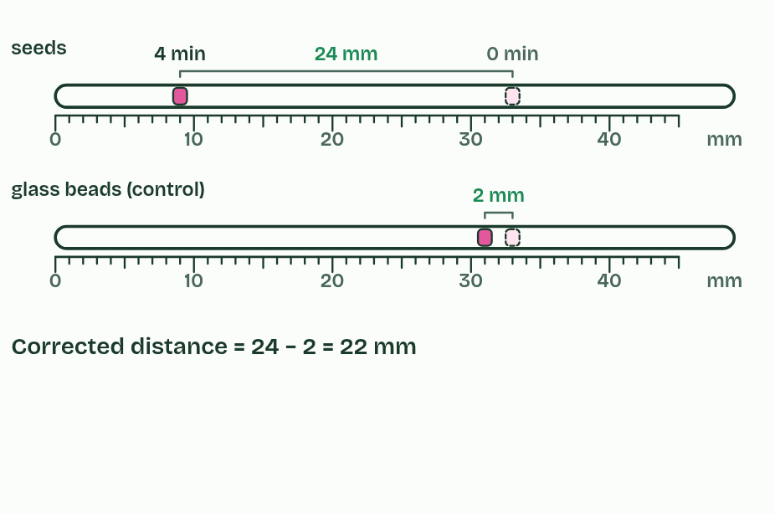
CHAPTER 5 · C1.2.6 Variables affecting the rate of cell respiration
2 / 4
A rate you cannot see
Take off the control’s movement.
Minutes 15 to 25
Notes:
Minutes 15 to 25 of 60: How a respirometer works (10 min).
The plan: Chapter 5: the predict about the drop, then the explore figure part by part: why the potassium hydroxide, why the beads, why the clip. Then figure 5.2’s worked rate, one step at a time.
Respiration happens inside cells, so you cannot watch it. You measure it from what goes in or comes out: oxygen taken up, carbon dioxide given out, or fuel used. The rate of respiration is the amount changed divided by the time taken, and for living material it is given per gram per minute as well, so that samples of different mass can be compared.
A class can do it three ways.
The capillary is a long thin cylinder, so the volume of gas is πr² × the distance the drop moved, where r is half the bore. A bore of 1 mm holds 0.785 mm³ for every mm.
A second tube, the same in every way but with glass beads in place of the seeds, is the control. Anything that moves its drop, such as the gas warming or cooling or the air pressure changing, is not respiration, so its movement is taken off the seeds’.
What changes the rate? Temperature: respiration is enzymes at work, so it speeds up as it warms until they begin to denature (C1.1). How far germination has gone: dry seeds hardly respire, and soaked ones respire more each day. The mass of the seeds, and the kind of seed. With yeast: the sugar it is given, the temperature, and how much oxygen there is. The seeds are kept in the dark so that they cannot photosynthesise and hide the gas changes.
In an experiment on any of these, the one thing you change on purpose is the independent variable (the temperature, say), the rate you measure is the dependent variable, and everything else you hold the same is a controlled variable: the mass and age of the seeds, the volume of the tube, the time. You may also be asked to work out a rate from someone else’s numbers: the steps are the same (figure 5.2).

Slide 8
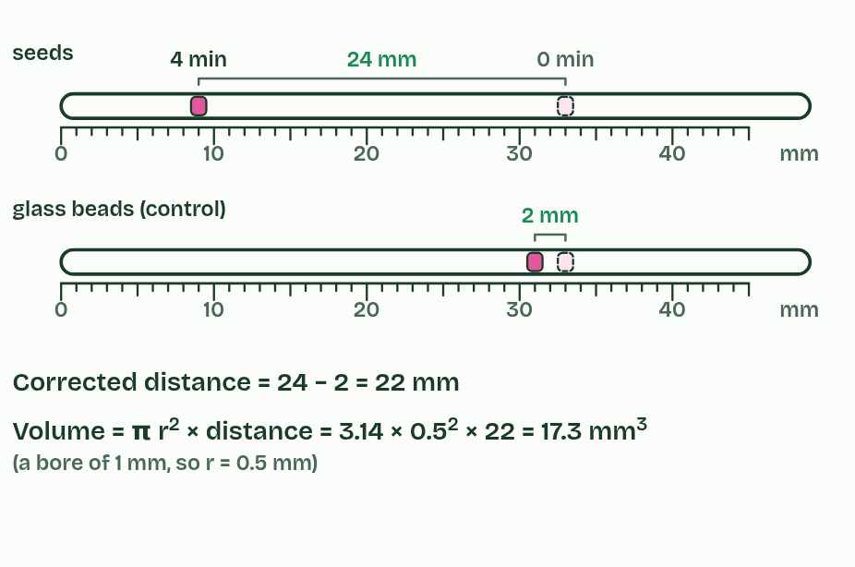
CHAPTER 5 · C1.2.6 Variables affecting the rate of cell respiration
3 / 4
A rate you cannot see
Turn distance into volume with the bore.
Minutes 15 to 25
Notes:
Minutes 15 to 25 of 60: How a respirometer works (10 min).
The plan: Chapter 5: the predict about the drop, then the explore figure part by part: why the potassium hydroxide, why the beads, why the clip. Then figure 5.2’s worked rate, one step at a time.
Respiration happens inside cells, so you cannot watch it. You measure it from what goes in or comes out: oxygen taken up, carbon dioxide given out, or fuel used. The rate of respiration is the amount changed divided by the time taken, and for living material it is given per gram per minute as well, so that samples of different mass can be compared.
A class can do it three ways.
The capillary is a long thin cylinder, so the volume of gas is πr² × the distance the drop moved, where r is half the bore. A bore of 1 mm holds 0.785 mm³ for every mm.
A second tube, the same in every way but with glass beads in place of the seeds, is the control. Anything that moves its drop, such as the gas warming or cooling or the air pressure changing, is not respiration, so its movement is taken off the seeds’.
What changes the rate? Temperature: respiration is enzymes at work, so it speeds up as it warms until they begin to denature (C1.1). How far germination has gone: dry seeds hardly respire, and soaked ones respire more each day. The mass of the seeds, and the kind of seed. With yeast: the sugar it is given, the temperature, and how much oxygen there is. The seeds are kept in the dark so that they cannot photosynthesise and hide the gas changes.
In an experiment on any of these, the one thing you change on purpose is the independent variable (the temperature, say), the rate you measure is the dependent variable, and everything else you hold the same is a controlled variable: the mass and age of the seeds, the volume of the tube, the time. You may also be asked to work out a rate from someone else’s numbers: the steps are the same (figure 5.2).

Slide 9
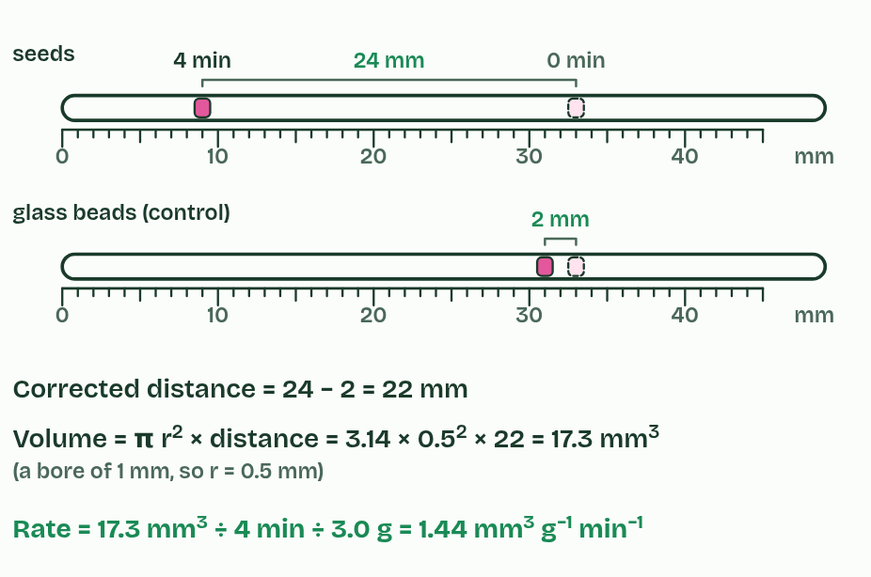
CHAPTER 5 · C1.2.6 Variables affecting the rate of cell respiration
4 / 4
A rate you cannot see
Divide by time and by mass.
Minutes 15 to 25
Notes:
Minutes 15 to 25 of 60: How a respirometer works (10 min).
The plan: Chapter 5: the predict about the drop, then the explore figure part by part: why the potassium hydroxide, why the beads, why the clip. Then figure 5.2’s worked rate, one step at a time.
Respiration happens inside cells, so you cannot watch it. You measure it from what goes in or comes out: oxygen taken up, carbon dioxide given out, or fuel used. The rate of respiration is the amount changed divided by the time taken, and for living material it is given per gram per minute as well, so that samples of different mass can be compared.
A class can do it three ways.
The capillary is a long thin cylinder, so the volume of gas is πr² × the distance the drop moved, where r is half the bore. A bore of 1 mm holds 0.785 mm³ for every mm.
A second tube, the same in every way but with glass beads in place of the seeds, is the control. Anything that moves its drop, such as the gas warming or cooling or the air pressure changing, is not respiration, so its movement is taken off the seeds’.
What changes the rate? Temperature: respiration is enzymes at work, so it speeds up as it warms until they begin to denature (C1.1). How far germination has gone: dry seeds hardly respire, and soaked ones respire more each day. The mass of the seeds, and the kind of seed. With yeast: the sugar it is given, the temperature, and how much oxygen there is. The seeds are kept in the dark so that they cannot photosynthesise and hide the gas changes.
In an experiment on any of these, the one thing you change on purpose is the independent variable (the temperature, say), the rate you measure is the dependent variable, and everything else you hold the same is a controlled variable: the mass and age of the seeds, the volume of the tube, the time. You may also be asked to work out a rate from someone else’s numbers: the steps are the same (figure 5.2).

Slide 10
CHAPTER 5 · C1.2.6 Variables affecting the rate of cell respiration
A rate you cannot see
Oxygen uptake in a respirometer: germinating seeds in a sealed tube, with potassium hydroxide to absorb the carbon dioxide they give out, and a drop of coloured liquid in a capillary whose movement shows the change in gas volume.
Carbon dioxide output: a gas sensor or data logger in a sealed chamber, or hydrogencarbonate indicator changing colour. With yeast, the rise of a dough or the gas collected over a sugar solution works too (the dry lab's dough mode).
Fuel used: the fall in the glucose in a yeast culture, measured with test strips.
Minutes 15 to 25
Notes:
Minutes 15 to 25 of 60: How a respirometer works (10 min).
The plan: Chapter 5: the predict about the drop, then the explore figure part by part: why the potassium hydroxide, why the beads, why the clip. Then figure 5.2’s worked rate, one step at a time.
Respiration happens inside cells, so you cannot watch it. You measure it from what goes in or comes out: oxygen taken up, carbon dioxide given out, or fuel used. The rate of respiration is the amount changed divided by the time taken, and for living material it is given per gram per minute as well, so that samples of different mass can be compared.
A class can do it three ways.
The capillary is a long thin cylinder, so the volume of gas is πr² × the distance the drop moved, where r is half the bore. A bore of 1 mm holds 0.785 mm³ for every mm.
A second tube, the same in every way but with glass beads in place of the seeds, is the control. Anything that moves its drop, such as the gas warming or cooling or the air pressure changing, is not respiration, so its movement is taken off the seeds’.
What changes the rate? Temperature: respiration is enzymes at work, so it speeds up as it warms until they begin to denature (C1.1). How far germination has gone: dry seeds hardly respire, and soaked ones respire more each day. The mass of the seeds, and the kind of seed. With yeast: the sugar it is given, the temperature, and how much oxygen there is. The seeds are kept in the dark so that they cannot photosynthesise and hide the gas changes.
In an experiment on any of these, the one thing you change on purpose is the independent variable (the temperature, say), the rate you measure is the dependent variable, and everything else you hold the same is a controlled variable: the mass and age of the seeds, the volume of the tube, the time. You may also be asked to work out a rate from someone else’s numbers: the steps are the same (figure 5.2).

Slide 11
PREDICT
In the respirometer the seeds respire and the potassium hydroxide absorbs their carbon dioxide. Which way does the drop move?
A Away from the seeds, pushed by the carbon dioxide they give out
B Towards the seeds, as they take in oxygen
C Towards the seeds, as they give out water vapour
D It stays still: the gases in and out balance
Minutes 15 to 25
Notes:
Minutes 15 to 25 of 60: How a respirometer works (10 min).
The plan: Chapter 5: the predict about the drop, then the explore figure part by part: why the potassium hydroxide, why the beads, why the clip. Then figure 5.2’s worked rate, one step at a time.
Ask for a show of hands, or mini whiteboards, before revealing. (Answer: B, on the next slide.)

Slide 12
WHAT HAPPENS
In the respirometer the seeds respire and the potassium hydroxide absorbs their carbon dioxide. Which way does the drop move?
A Away from the seeds, pushed by the carbon dioxide they give out
B Towards the seeds, as they take in oxygen
C Towards the seeds, as they give out water vapour
D It stays still: the gases in and out balance
Towards the seeds. They take oxygen out of the air in the tube; the carbon dioxide they give out is absorbed as fast as it is made, so the gas shrinks and the drop is pulled in. How far it moves each minute is how fast they take up oxygen. Take the potassium hydroxide away and the drop hardly moves (the dry lab lets you try).
Minutes 15 to 25
Notes:
Minutes 15 to 25 of 60: How a respirometer works (10 min).
The plan: Chapter 5: the predict about the drop, then the explore figure part by part: why the potassium hydroxide, why the beads, why the clip. Then figure 5.2’s worked rate, one step at a time.
Answer: B. Towards the seeds. They take oxygen out of the air in the tube; the carbon dioxide they give out is absorbed as fast as it is made, so the gas shrinks and the drop is pulled in. How far it moves each minute is how fast they take up oxygen. Take the potassium hydroxide away and the drop hardly moves (the dry lab lets you try).

Slide 13
WATCH OUT
The drop does not move because the seeds give out carbon dioxide: that is removed. It moves because of what the seeds take up.
Minutes 15 to 25
Notes:
Minutes 15 to 25 of 60: How a respirometer works (10 min).
The plan: Chapter 5: the predict about the drop, then the explore figure part by part: why the potassium hydroxide, why the beads, why the clip. Then figure 5.2’s worked rate, one step at a time.
A common mistake: say it, then ask who can say why it is wrong.

Slide 14

DEMONSTRATION (OPTIONAL)
IF THERE IS TIME
A real respirometer
THE TASK
Two boiling tubes in a beaker of water at room temperature: 3-day mung beans on a gauze over potassium hydroxide solution in one, and glass beads of the same volume over the same in the other. Fit bungs with a bent capillary and a drop of coloured water, and a screw clip on a side arm. Run it alongside the dough while students work. Safety: potassium hydroxide is corrosive; use eye protection and gloves, and the teacher sets it up.
STUDENTS NEED
As listed, and a mm scale behind each capillary.
Minutes 15 to 25
Notes:
Minutes 15 to 25 of 60: How a respirometer works (10 min).
The plan: Chapter 5: the predict about the drop, then the explore figure part by part: why the potassium hydroxide, why the beads, why the clip. Then figure 5.2’s worked rate, one step at a time.
The activity: A real respirometer. Two boiling tubes in a beaker of water at room temperature: 3-day mung beans on a gauze over potassium hydroxide solution in one, and glass beads of the same volume over the same in the other. Fit bungs with a bent capillary and a drop of coloured water, and a screw clip on a side arm. Run it alongside the dough while students work. Safety: potassium hydroxide is corrosive; use eye protection and gloves, and the teacher sets it up.
Needs: as listed, and a mm scale behind each capillary.
The plan sets no time of its own for this activity: use it in this step, in place of part of it, or for homework.

Slide 15
DRY LAB
20 MIN
The dry lab
THE TASK
One device per pair. Results go to a CSV for a class graph, and the coach’s write-up is copied into notes. Start with temperature; pairs who finish run the dough mode.
STUDENTS NEED
One device per pair.
Minutes 25 to 45
Notes:
Minutes 25 to 45 of 60: The dry lab with the IA coach (20 min).
The plan: In pairs on the dry lab. First How? Why? Units? in the coach (below), then a temperature series of three trials at five temperatures, with means and standard deviations. Download the results as a CSV for a class graph.
The activity: The dry lab. One device per pair. Results go to a CSV for a class graph, and the coach’s write-up is copied into notes. Start with temperature; pairs who finish run the dough mode.
Needs: one device per pair.
The time: 20 minutes, minutes 25 to 45 of the plan.

Slide 16
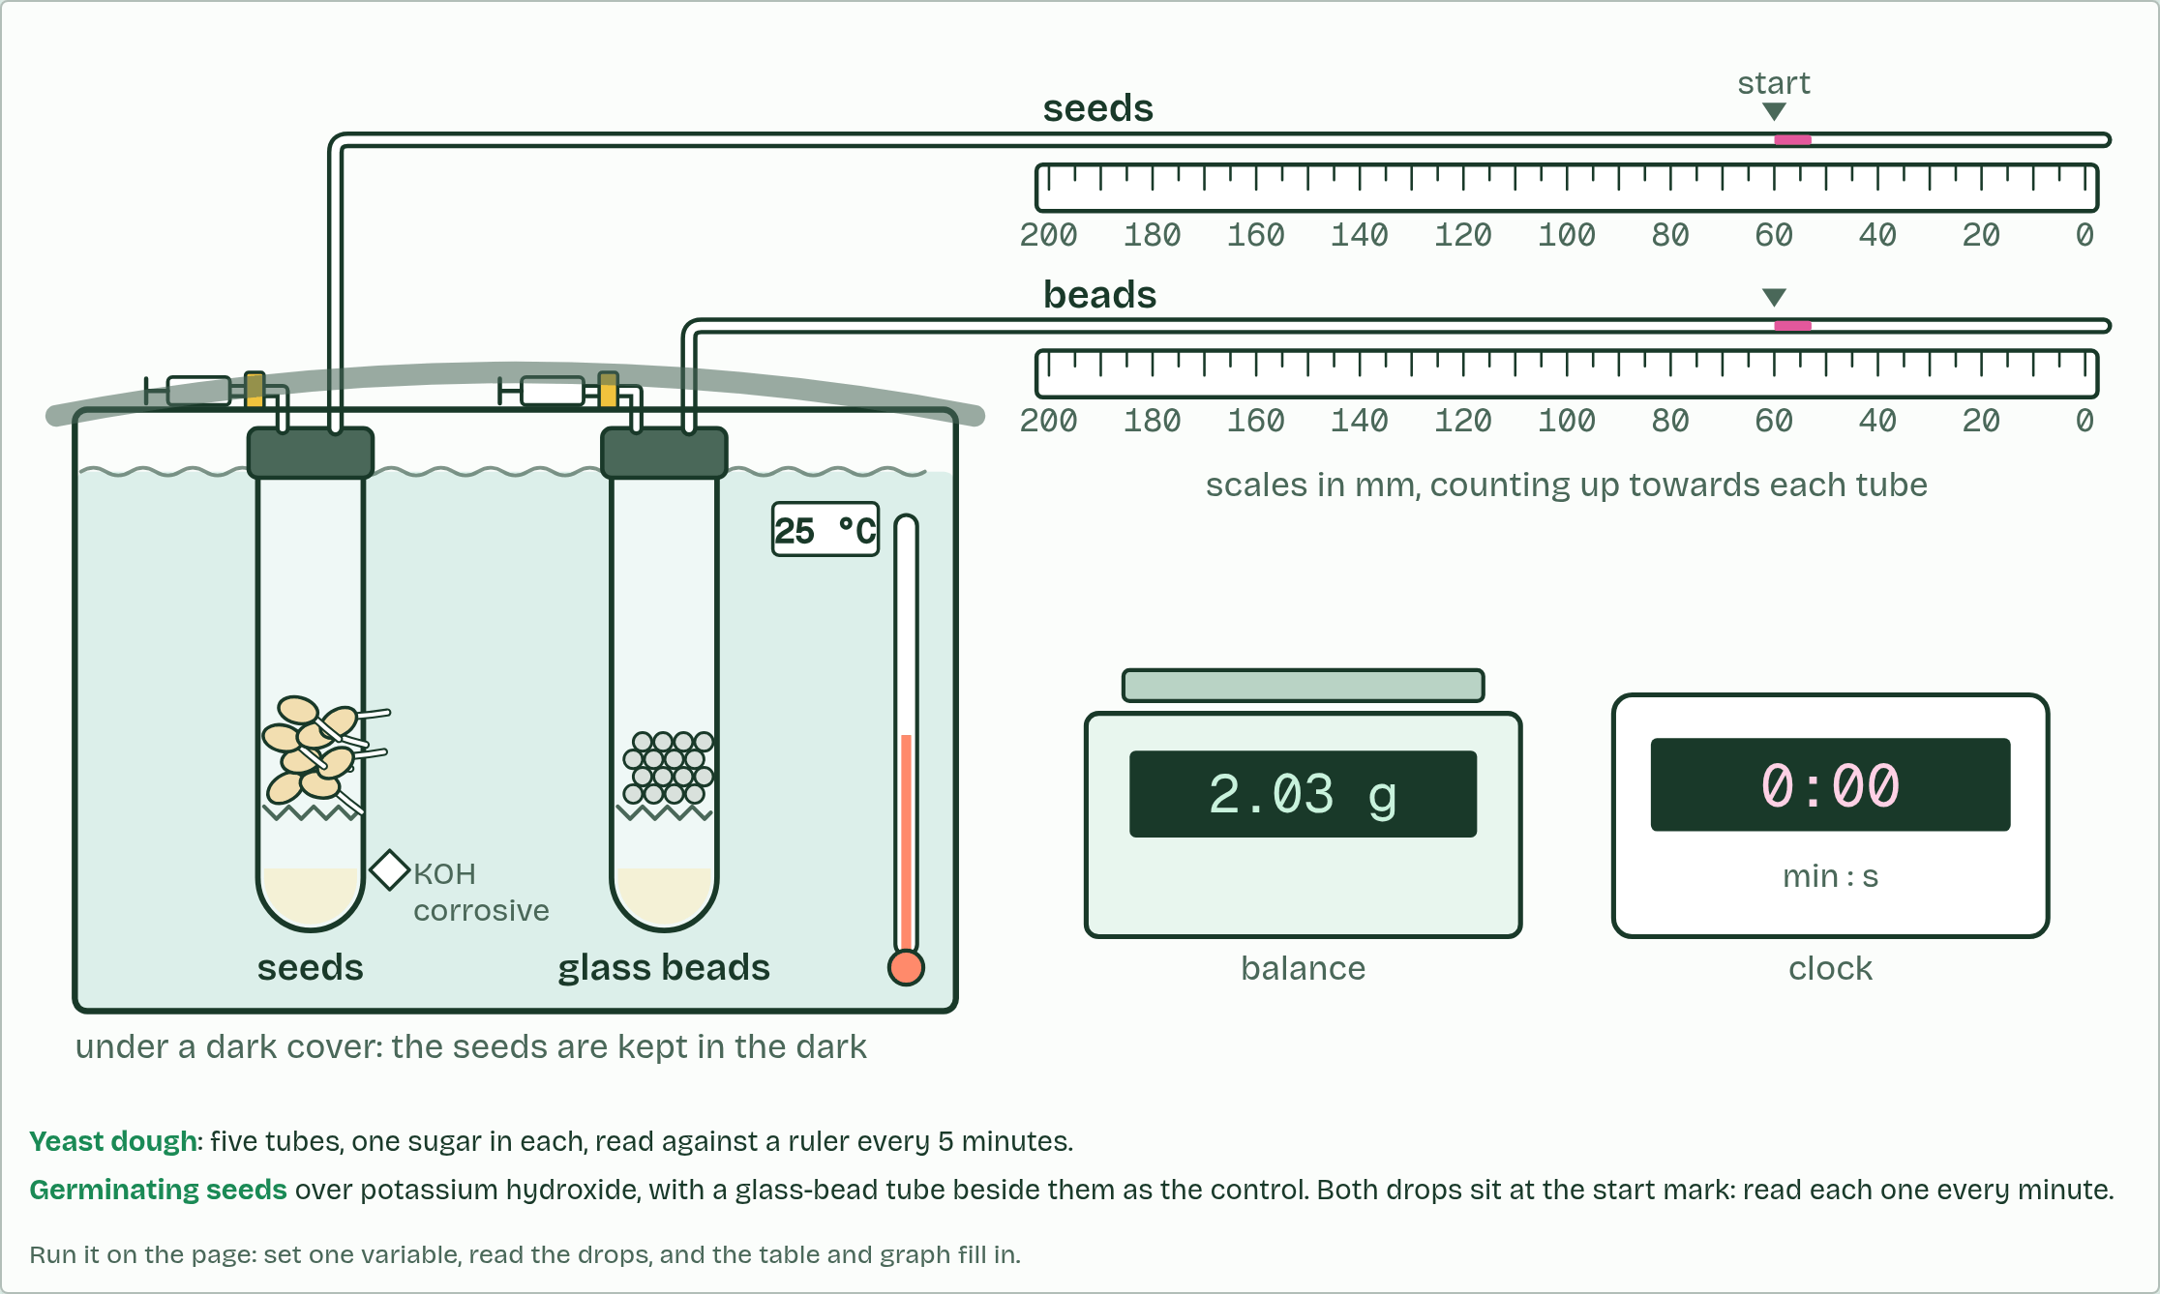
DRY LAB
Respirometer: seeds and dough
Your question: How does one factor change the rate at which germinating seeds take up oxygen? Start with temperature. Then try the dough: which sugar makes yeast respire fastest?
What you can change: One independent variable at a time: the water bath's temperature, how long ago the seeds were soaked, the mass of seeds, or whether the potassium hydroxide is in. In dough mode, the sugar. Everything else stays fixed unless you change it on purpose.
What to record: The drop's position on the scale every minute, in mm, for the seeds and for the glass-bead tube beside them. Then the rate in mm³ of oxygen per gram per minute, three or more trials at each value, a mean and a standard deviation, and a graph. The coach under the bench helps you plan, process and evaluate.
Run it: biologybybradford.com/guides/ib-biology-c1-2-cell-respiration#lab
Minutes 25 to 45
Notes:
Minutes 25 to 45 of 60: The dry lab with the IA coach (20 min).
The plan: In pairs on the dry lab. First How? Why? Units? in the coach (below), then a temperature series of three trials at five temperatures, with means and standard deviations. Download the results as a CSV for a class graph.
The dry lab runs in the guide: https://www.biologybybradford.com/guides/ib-biology-c1-2-cell-respiration#lab

Slide 17

PLANNING
20 MIN
How? Why? Units?
THE TASK
Before running the dry lab, pairs fill in the coach’s variables table: for each variable, how it is set or measured, why it matters and its unit. Then they use the planning questions as a checklist: the range of values, the time for the run, the controlled variables, a negative control, the precision of the measurement, and safety.
STUDENTS NEED
A device per pair.
Minutes 25 to 45
Notes:
Minutes 25 to 45 of 60: The dry lab with the IA coach (20 min).
The plan: In pairs on the dry lab. First How? Why? Units? in the coach (below), then a temperature series of three trials at five temperatures, with means and standard deviations. Download the results as a CSV for a class graph.
The activity: How? Why? Units?. Before running the dry lab, pairs fill in the coach’s variables table: for each variable, how it is set or measured, why it matters and its unit. Then they use the planning questions as a checklist: the range of values, the time for the run, the controlled variables, a negative control, the precision of the measurement, and safety.
Needs: a device per pair.
The time: 20 minutes, minutes 25 to 45 of the plan.

Slide 18
STEP 5
10 MIN
Back to the dough
Each pair works out its rate over 5 to 20 minutes and adds it to a class table.
Compare it with the dry lab’s dough mode and ask why sucrose is nearly as fast as glucose.
Minutes 45 to 55
Notes:
Minutes 45 to 55 of 60: Back to the dough (10 min).
The plan: Final readings. Each pair works out its rate over 5 to 20 minutes and adds it to a class table. Compare it with the dry lab’s dough mode and ask why sucrose is nearly as fast as glucose.

Slide 19
PLENARY
Can you now...
Measure the rate of respiration with a respirometer and work it out from raw or secondary data (C1.2.6)
Minutes 55 to 60
Notes:
Minutes 55 to 60 of 60: Exit: work out a rate (5 min).
The plan: A drop moved 18 mm in 5 minutes in a bore of 1 mm; the control moved 1 mm; there was 2.5 g of seeds. Work out the rate.
Thumbs up, sideways or down on each goal before the exit question. The goals come from the statements this lesson covers.

Slide 20
EXIT QUESTION
Work out a rate
Work out the rate.
Minutes 55 to 60
Notes:
Minutes 55 to 60 of 60: Exit: work out a rate (5 min).
The plan: A drop moved 18 mm in 5 minutes in a bore of 1 mm; the control moved 1 mm; there was 2.5 g of seeds. Work out the rate.

Slide 21
PRACTISE AND REVISE
Keep going
Exam practice: a fresh paper of exam questions on C1.2 at standard level, marked as you go
The guide, with the animations and the dry lab
This lesson in the guide: 5 A rate you cannot see, the dry lab
BUILD FOR YOUR CLASS
ALREADY ON THE SITE FOR C1.2
CARD SETS ON SPLYCR
Tarsia puzzle, dominoes and picture reveal on C1.2, built from its key terms and ready to print
A pub quiz with rounds on C1.2, to present or run with no projector
An escape room built from the question bank on C1.2
Lesson: Cell Respiration
Quiz: Cell Respiration
Revision map: C1.2 Cell respiration, to fill in
Exam questions: C1.2 in the exam maker, a paper with its markscheme
Open a set to host it as a class game, or make a copy to edit.
C1.2 Cell Respiration
B3.2–C2.2 Plant Transport, Respiration & Neural Signalling
How this was made. The course structure, the activities and the teaching choices come from my own classroom, my presentations and my years of teaching IB and AP Biology. I use Claude, an AI, to help write and build the interactive guides, lesson plans, slides and practice questions, and to draw the diagrams and code the interactives. I direct the work and review it against the IB and AP specifications before it goes live.
Minute 60: after the lesson
Notes:
Every link here is live. Set the exam practice paper for homework: it is fresh each time, marked as students go and saved to their Exam practice when they are signed in.
Exam practice: https://www.biologybybradford.com/exam-maker/sit?topics=C1.2&level=SL&paper=quiz&marks=15&src=ep
The guide: https://www.biologybybradford.com/guides/ib-biology-c1-2-cell-respiration

