Slide 1
IB Biology C1.2
LESSON 3 OF 5
HL
BY THE END YOU CAN
Cell respiration
Explain oxidation as the removal of hydrogen, and NAD as the carrier that is reduced when it accepts it (C1.2.7)
Outline glycolysis: phosphorylation, lysis, oxidation and ATP formation, with its net yield (C1.2.8)
Explain how making lactate, or ethanol and carbon dioxide in yeast, gives NAD back so glycolysis can go on, and how bakers and brewers use yeast (C1.2.9, C1.2.10)
Hydrogen off, and glycolysis
C1.2.7 to C1.2.10
Oxidation as hydrogen removal and NAD as its carrier, the four stages of glycolysis, and lactate and ethanol as ways to give NAD back
60 minutes · chapters 6, 7, 8
Minute 0
Notes:
IB Biology C1.2, Cell respiration. Lesson 3 of 5: Hydrogen off, and glycolysis (higher level), 60 minutes.
The plan, minute by minute (each slide's footer says where you are):
0 to 5 min (5) Do now: OIL RIG
5 to 15 min (10) Hydrogen and NAD
15 to 30 min (15) Glycolysis stepping stones
30 to 42 min (12) Giving NAD back
42 to 55 min (13) A written question
55 to 60 min (5) Exit
What students get wrong:
Oxidation means adding oxygen. In respiration it is mostly removing hydrogen, and so electrons.
Glycolysis needs oxygen, or happens in the mitochondrion. Neither.
Lactate is made to get rid of pyruvate. It is made to give NAD back.
Lactic acid makes muscles sore the next day. It does not: the acid of hard exercise is not lactate itself, and next-day soreness is something else.
Stretch and support:
Stretch: some yeasts ferment even with oxygen when sugar is plentiful. What would that do to a dough, and to the yield of ATP per glucose?
Stretch: make a Tarsia puzzle on C1.2 that is better than the site’s own, in the Tarsia builder.
Consequences for ecosystems: respiration returns carbon dioxide to the air and releases heat at every transfer. Use both to start the energy flow of C4.2: where does the energy of a food chain go?
The lesson plan to print: https://www.biologybybradford.com/guides/downloads/ib-biology-c1-2-cell-respiration-lesson-3-plan.pdf

Slide 2
DO NOW
OIL RIG
Three reactions on the board.
Students label each molecule oxidised or reduced and say what moved.
5:00
minutes
Start now: the timer is running.
Minutes 0 to 5
Notes:
Minutes 0 to 5 of 60: Do now: OIL RIG (5 min).
The plan: Three reactions on the board. Students label each molecule oxidised or reduced and say what moved. Then turn over the OIL RIG tiles.
Start a 5 minute timer as they come in.

Slide 3
REMEMBER IT
Oxidation and reduction
O
R
Oil
Rig
Minutes 0 to 5
Notes:
Minutes 0 to 5 of 60: Do now: OIL RIG (5 min).
The plan: Three reactions on the board. Students label each molecule oxidised or reduced and say what moved. Then turn over the OIL RIG tiles.
Ask the class what each letter stands for before revealing.

Slide 4
REMEMBER IT
Oxidation and reduction
O
R
Oil
Rig
Oxidation Is Loss
Reduction Is Gain
of electrons
of electrons
Minutes 0 to 5
Notes:
Minutes 0 to 5 of 60: Do now: OIL RIG (5 min).
The plan: Three reactions on the board. Students label each molecule oxidised or reduced and say what moved. Then turn over the OIL RIG tiles.
Oil: Oxidation Is Loss (of electrons)
Rig: Reduction Is Gain (of electrons)

Slide 5
STEP 2
10 MIN
Hydrogen and NAD
Chapter 6: Taking hydrogen away
Minutes 5 to 15
Notes:
Minutes 5 to 15 of 60: Hydrogen and NAD (10 min).
The plan: Chapter 6: the predict, then the figure one step at a time. NAD is a carrier that must be emptied to be used again: ask students why a cell cannot just make a lot more of it.

Slide 6
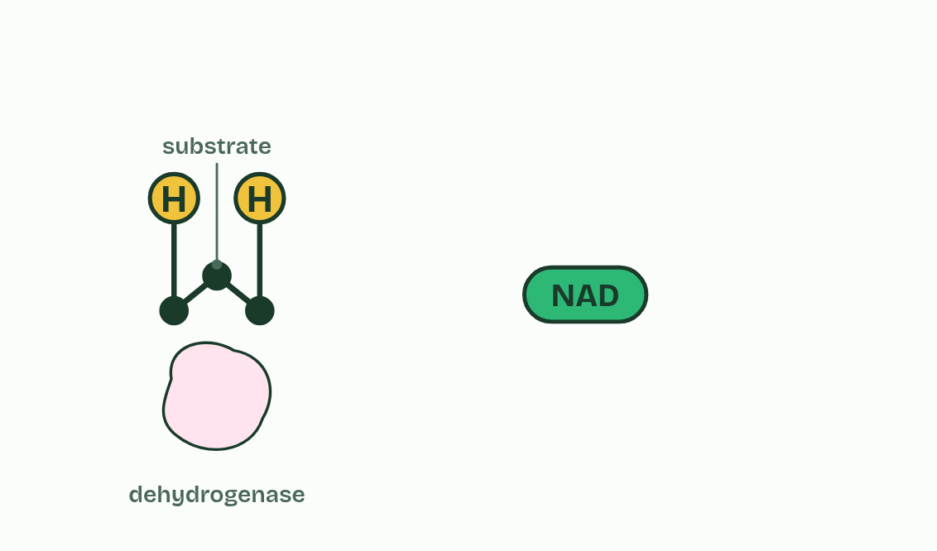
CHAPTER 6 · C1.2.7 Role of NAD as a carrier of hydrogen, and oxidation by removal of hydrogen
1 / 4
Taking hydrogen away
A substrate, an enzyme, and NAD.
Minutes 5 to 15
Notes:
Minutes 5 to 15 of 60: Hydrogen and NAD (10 min).
The plan: Chapter 6: the predict, then the figure one step at a time. NAD is a carrier that must be emptied to be used again: ask students why a cell cannot just make a lot more of it.
In respiration, energy is released from fuel molecules by taking hydrogen off them. To see why, you need two words. Oxidation is the loss of electrons, and reduction is the gain of electrons. They always happen together: what one molecule loses, another gains. A reaction that does both is a redox reaction.
A hydrogen atom is a proton and an electron. So when hydrogen is removed from a molecule, which is called dehydrogenation, it loses electrons too, and has been oxidised. The enzymes that do it are dehydrogenases.
The hydrogen has to go somewhere. It is accepted by NAD, a molecule built from nucleotides, like ATP. When NAD accepts hydrogen it is reduced, and is then called reduced NAD. Reduced NAD carries the hydrogen, and the energy that comes with it, to where it is used (the electron transport chain, chapters 10 and 11), and is turned back into NAD there. So NAD is a hydrogen carrier.
A cell has only a little NAD, so it must be unloaded and used again and again, as ATP is. Every stage of respiration that follows either loads NAD or depends on NAD being given back (chapter 8).
Why does it matter? A large part of the energy in a fuel is in its hydrogen and the electrons that go with it. Respiration is, step by step, taking hydrogen off the fuel and passing it to oxygen: that is the role of hydrogen, and of oxygen, in the release of energy.

Slide 7
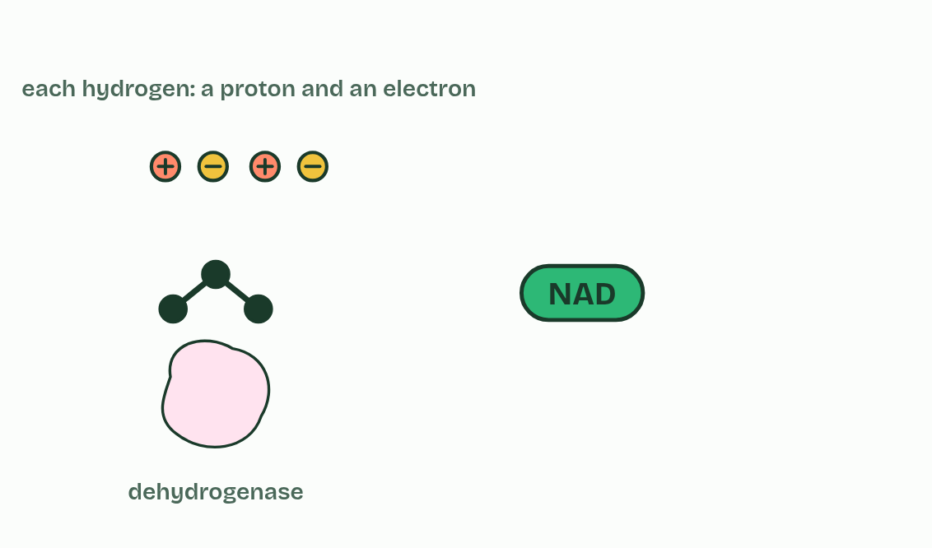
CHAPTER 6 · C1.2.7 Role of NAD as a carrier of hydrogen, and oxidation by removal of hydrogen
2 / 4
Taking hydrogen away
Hydrogen is removed: dehydrogenation. Each hydrogen is a proton and an electron.
Minutes 5 to 15
Notes:
Minutes 5 to 15 of 60: Hydrogen and NAD (10 min).
The plan: Chapter 6: the predict, then the figure one step at a time. NAD is a carrier that must be emptied to be used again: ask students why a cell cannot just make a lot more of it.
In respiration, energy is released from fuel molecules by taking hydrogen off them. To see why, you need two words. Oxidation is the loss of electrons, and reduction is the gain of electrons. They always happen together: what one molecule loses, another gains. A reaction that does both is a redox reaction.
A hydrogen atom is a proton and an electron. So when hydrogen is removed from a molecule, which is called dehydrogenation, it loses electrons too, and has been oxidised. The enzymes that do it are dehydrogenases.
The hydrogen has to go somewhere. It is accepted by NAD, a molecule built from nucleotides, like ATP. When NAD accepts hydrogen it is reduced, and is then called reduced NAD. Reduced NAD carries the hydrogen, and the energy that comes with it, to where it is used (the electron transport chain, chapters 10 and 11), and is turned back into NAD there. So NAD is a hydrogen carrier.
A cell has only a little NAD, so it must be unloaded and used again and again, as ATP is. Every stage of respiration that follows either loads NAD or depends on NAD being given back (chapter 8).
Why does it matter? A large part of the energy in a fuel is in its hydrogen and the electrons that go with it. Respiration is, step by step, taking hydrogen off the fuel and passing it to oxygen: that is the role of hydrogen, and of oxygen, in the release of energy.

Slide 8
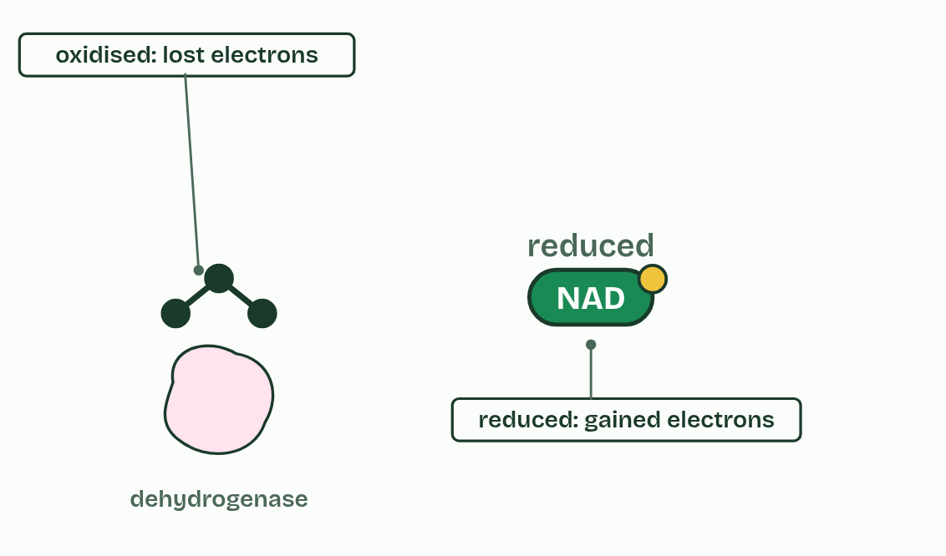
CHAPTER 6 · C1.2.7 Role of NAD as a carrier of hydrogen, and oxidation by removal of hydrogen
3 / 4
Taking hydrogen away
The substrate is oxidised; NAD is reduced. A redox reaction.
Minutes 5 to 15
Notes:
Minutes 5 to 15 of 60: Hydrogen and NAD (10 min).
The plan: Chapter 6: the predict, then the figure one step at a time. NAD is a carrier that must be emptied to be used again: ask students why a cell cannot just make a lot more of it.
In respiration, energy is released from fuel molecules by taking hydrogen off them. To see why, you need two words. Oxidation is the loss of electrons, and reduction is the gain of electrons. They always happen together: what one molecule loses, another gains. A reaction that does both is a redox reaction.
A hydrogen atom is a proton and an electron. So when hydrogen is removed from a molecule, which is called dehydrogenation, it loses electrons too, and has been oxidised. The enzymes that do it are dehydrogenases.
The hydrogen has to go somewhere. It is accepted by NAD, a molecule built from nucleotides, like ATP. When NAD accepts hydrogen it is reduced, and is then called reduced NAD. Reduced NAD carries the hydrogen, and the energy that comes with it, to where it is used (the electron transport chain, chapters 10 and 11), and is turned back into NAD there. So NAD is a hydrogen carrier.
A cell has only a little NAD, so it must be unloaded and used again and again, as ATP is. Every stage of respiration that follows either loads NAD or depends on NAD being given back (chapter 8).
Why does it matter? A large part of the energy in a fuel is in its hydrogen and the electrons that go with it. Respiration is, step by step, taking hydrogen off the fuel and passing it to oxygen: that is the role of hydrogen, and of oxygen, in the release of energy.

Slide 9
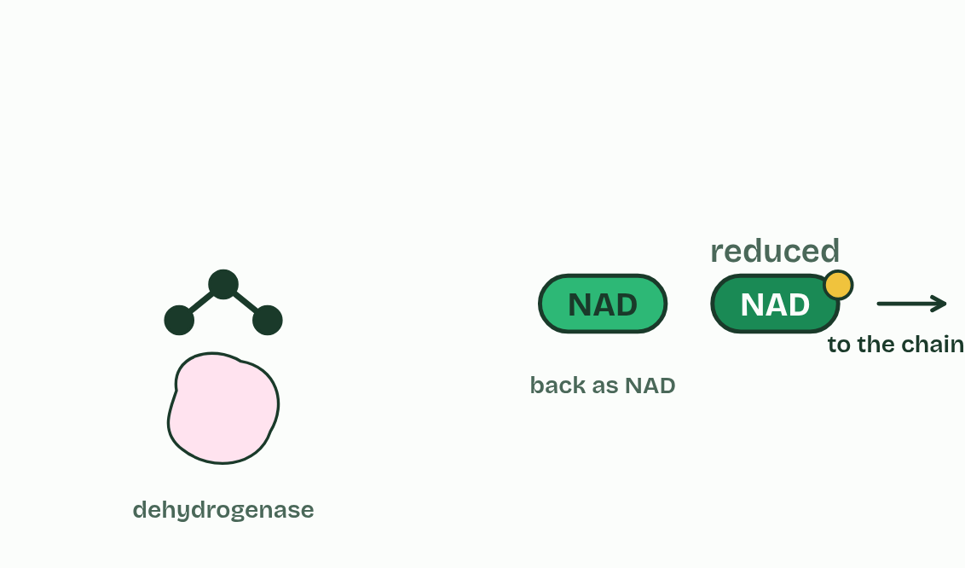
CHAPTER 6 · C1.2.7 Role of NAD as a carrier of hydrogen, and oxidation by removal of hydrogen
4 / 4
Taking hydrogen away
Reduced NAD carries the hydrogen away and comes back as NAD.
Minutes 5 to 15
Notes:
Minutes 5 to 15 of 60: Hydrogen and NAD (10 min).
The plan: Chapter 6: the predict, then the figure one step at a time. NAD is a carrier that must be emptied to be used again: ask students why a cell cannot just make a lot more of it.
In respiration, energy is released from fuel molecules by taking hydrogen off them. To see why, you need two words. Oxidation is the loss of electrons, and reduction is the gain of electrons. They always happen together: what one molecule loses, another gains. A reaction that does both is a redox reaction.
A hydrogen atom is a proton and an electron. So when hydrogen is removed from a molecule, which is called dehydrogenation, it loses electrons too, and has been oxidised. The enzymes that do it are dehydrogenases.
The hydrogen has to go somewhere. It is accepted by NAD, a molecule built from nucleotides, like ATP. When NAD accepts hydrogen it is reduced, and is then called reduced NAD. Reduced NAD carries the hydrogen, and the energy that comes with it, to where it is used (the electron transport chain, chapters 10 and 11), and is turned back into NAD there. So NAD is a hydrogen carrier.
A cell has only a little NAD, so it must be unloaded and used again and again, as ATP is. Every stage of respiration that follows either loads NAD or depends on NAD being given back (chapter 8).
Why does it matter? A large part of the energy in a fuel is in its hydrogen and the electrons that go with it. Respiration is, step by step, taking hydrogen off the fuel and passing it to oxygen: that is the role of hydrogen, and of oxygen, in the release of energy.

Slide 10
CHAPTER 6 · C1.2.7 Role of NAD as a carrier of hydrogen, and oxidation by removal of hydrogen
Taking hydrogen away
Oxidation is the loss of electrons, and reduction is the gain of electrons.
A reaction that does both is a redox reaction.
So when hydrogen is removed from a molecule, which is called dehydrogenation, it loses electrons too, and has been oxidised.
The hydrogen has to go somewhere. It is accepted by NAD, a molecule built from nucleotides, like ATP.
Minutes 5 to 15
Notes:
Minutes 5 to 15 of 60: Hydrogen and NAD (10 min).
The plan: Chapter 6: the predict, then the figure one step at a time. NAD is a carrier that must be emptied to be used again: ask students why a cell cannot just make a lot more of it.
In respiration, energy is released from fuel molecules by taking hydrogen off them. To see why, you need two words. Oxidation is the loss of electrons, and reduction is the gain of electrons. They always happen together: what one molecule loses, another gains. A reaction that does both is a redox reaction.
A hydrogen atom is a proton and an electron. So when hydrogen is removed from a molecule, which is called dehydrogenation, it loses electrons too, and has been oxidised. The enzymes that do it are dehydrogenases.
The hydrogen has to go somewhere. It is accepted by NAD, a molecule built from nucleotides, like ATP. When NAD accepts hydrogen it is reduced, and is then called reduced NAD. Reduced NAD carries the hydrogen, and the energy that comes with it, to where it is used (the electron transport chain, chapters 10 and 11), and is turned back into NAD there. So NAD is a hydrogen carrier.
A cell has only a little NAD, so it must be unloaded and used again and again, as ATP is. Every stage of respiration that follows either loads NAD or depends on NAD being given back (chapter 8).
Why does it matter? A large part of the energy in a fuel is in its hydrogen and the electrons that go with it. Respiration is, step by step, taking hydrogen off the fuel and passing it to oxygen: that is the role of hydrogen, and of oxygen, in the release of energy.

Slide 11
PREDICT
A dehydrogenase takes two hydrogens off a molecule of fuel. What has happened to that molecule?
A It is reduced, because it has gained a charge
B It is phosphorylated by the hydrogen
C Nothing; only the NAD changes
D It is oxidised: it has lost electrons
Minutes 5 to 15
Notes:
Minutes 5 to 15 of 60: Hydrogen and NAD (10 min).
The plan: Chapter 6: the predict, then the figure one step at a time. NAD is a carrier that must be emptied to be used again: ask students why a cell cannot just make a lot more of it.
Ask for a show of hands, or mini whiteboards, before revealing. (Answer: D, on the next slide.)

Slide 12
WHAT HAPPENS
A dehydrogenase takes two hydrogens off a molecule of fuel. What has happened to that molecule?
A It is reduced, because it has gained a charge
B It is phosphorylated by the hydrogen
C Nothing; only the NAD changes
D It is oxidised: it has lost electrons
It is oxidised. Each hydrogen taken away carries an electron with it, and losing electrons is oxidation. The NAD that accepts them gains the electrons and is reduced. In respiration, oxidation almost always means hydrogen being taken off the fuel.
Minutes 5 to 15
Notes:
Minutes 5 to 15 of 60: Hydrogen and NAD (10 min).
The plan: Chapter 6: the predict, then the figure one step at a time. NAD is a carrier that must be emptied to be used again: ask students why a cell cannot just make a lot more of it.
Answer: D. It is oxidised. Each hydrogen taken away carries an electron with it, and losing electrons is oxidation. The NAD that accepts them gains the electrons and is reduced. In respiration, oxidation almost always means hydrogen being taken off the fuel.

Slide 13
WATCH OUT
Reduced NAD carries hydrogen, protons and electrons together, and the energy that comes with them. It is not ATP and it is not “energy” itself.
Minutes 5 to 15
Notes:
Minutes 5 to 15 of 60: Hydrogen and NAD (10 min).
The plan: Chapter 6: the predict, then the figure one step at a time. NAD is a carrier that must be emptied to be used again: ask students why a cell cannot just make a lot more of it.
A common mistake: say it, then ask who can say why it is wrong.

Slide 14
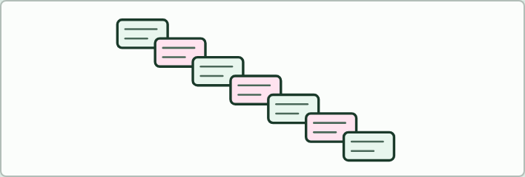
CARD ORDER · HL
15 MIN
Glycolysis stepping stones
THE TASK
Seven cards, each a half sentence, to put in order and complete: what glycolysis is; where it happens; phosphorylation by 2 ATP; the split into two 3-carbon sugars; oxidation by NAD; ATP formation; the end products and the net yield. Then a second set with gaps, for homework.
STUDENTS NEED
Card sets, one per pair.
Minutes 15 to 30
Notes:
Minutes 15 to 30 of 60: Glycolysis stepping stones (15 min).
The plan: Pairs order the seven cards (activity below), then check against chapter 7’s figure and make its predict. Turn over the Penguins tiles.
The activity: Glycolysis stepping stones. Seven cards, each a half sentence, to put in order and complete: what glycolysis is; where it happens; phosphorylation by 2 ATP; the split into two 3-carbon sugars; oxidation by NAD; ATP formation; the end products and the net yield. Then a second set with gaps, for homework.
Needs: card sets, one per pair.
The time: 15 minutes, minutes 15 to 30 of the plan.

Slide 15
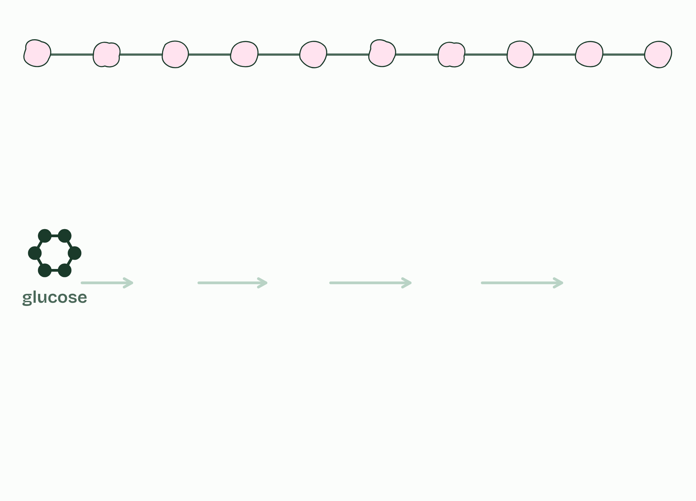
CHAPTER 7 · C1.2.8 Conversion of glucose to pyruvate in glycolysis, with a net yield of ATP and reduced NAD
1 / 6
Two ATP in, four out
One glucose, in the cytoplasm.
Minutes 15 to 30
Notes:
Minutes 15 to 30 of 60: Glycolysis stepping stones (15 min).
The plan: Pairs order the seven cards (activity below), then check against chapter 7’s figure and make its predict. Turn over the Penguins tiles.
Glycolysis turns one glucose into two pyruvate, in the cytoplasm, in about ten steps. Each step has its own enzyme, and the product of one step is the substrate of the next: it is a metabolic pathway (C1.1). The guide groups the steps into four stages, and you do not need to name the molecules in between.

Slide 16
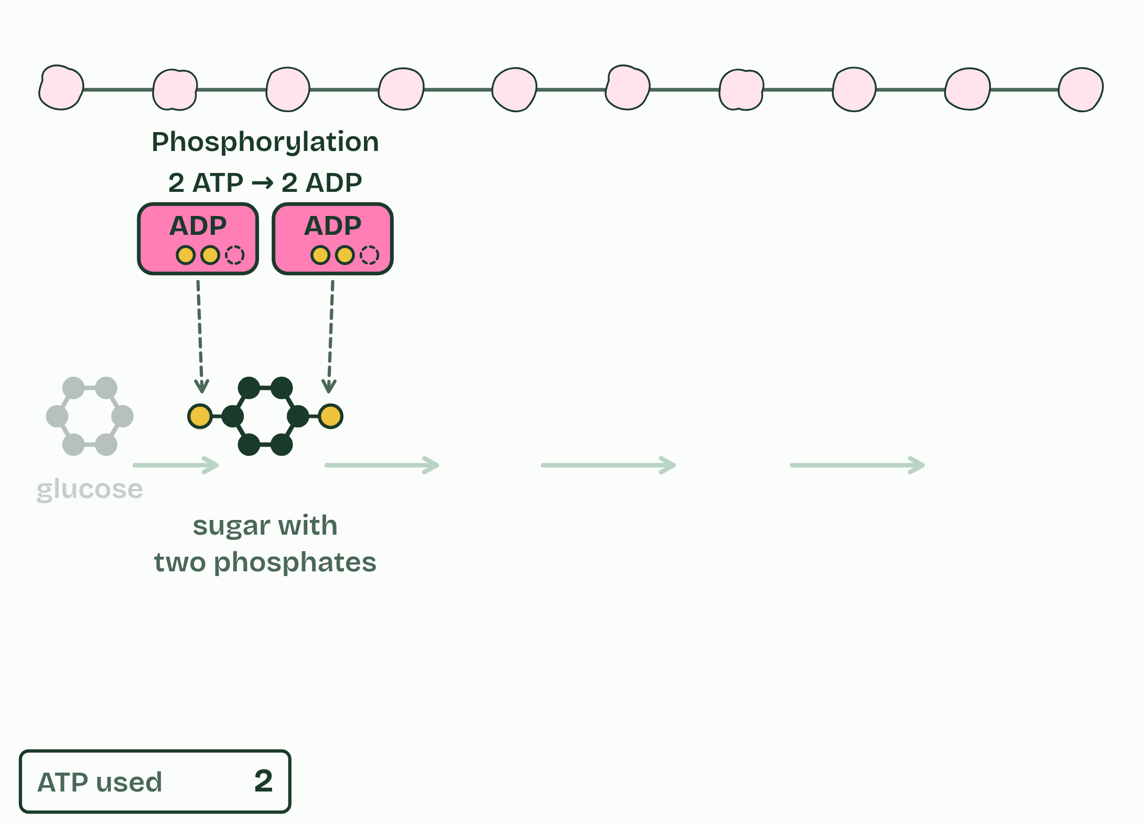
CHAPTER 7 · C1.2.8 Conversion of glucose to pyruvate in glycolysis, with a net yield of ATP and reduced NAD
2 / 6
Two ATP in, four out
Phosphorylation: 2 ATP spent, the sugar made reactive.
Minutes 15 to 30
Notes:
Minutes 15 to 30 of 60: Glycolysis stepping stones (15 min).
The plan: Pairs order the seven cards (activity below), then check against chapter 7’s figure and make its predict. Turn over the Penguins tiles.
Glycolysis turns one glucose into two pyruvate, in the cytoplasm, in about ten steps. Each step has its own enzyme, and the product of one step is the substrate of the next: it is a metabolic pathway (C1.1). The guide groups the steps into four stages, and you do not need to name the molecules in between.

Slide 17
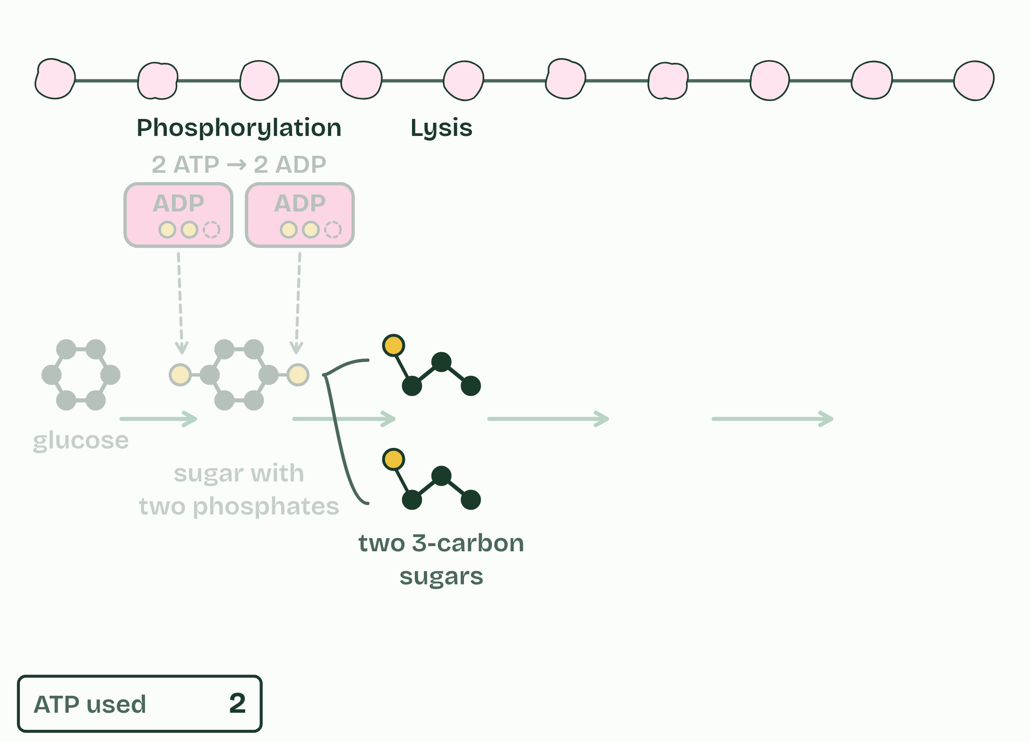
CHAPTER 7 · C1.2.8 Conversion of glucose to pyruvate in glycolysis, with a net yield of ATP and reduced NAD
3 / 6
Two ATP in, four out
Lysis: split into two 3-carbon sugars.
Minutes 15 to 30
Notes:
Minutes 15 to 30 of 60: Glycolysis stepping stones (15 min).
The plan: Pairs order the seven cards (activity below), then check against chapter 7’s figure and make its predict. Turn over the Penguins tiles.
Glycolysis turns one glucose into two pyruvate, in the cytoplasm, in about ten steps. Each step has its own enzyme, and the product of one step is the substrate of the next: it is a metabolic pathway (C1.1). The guide groups the steps into four stages, and you do not need to name the molecules in between.

Slide 18
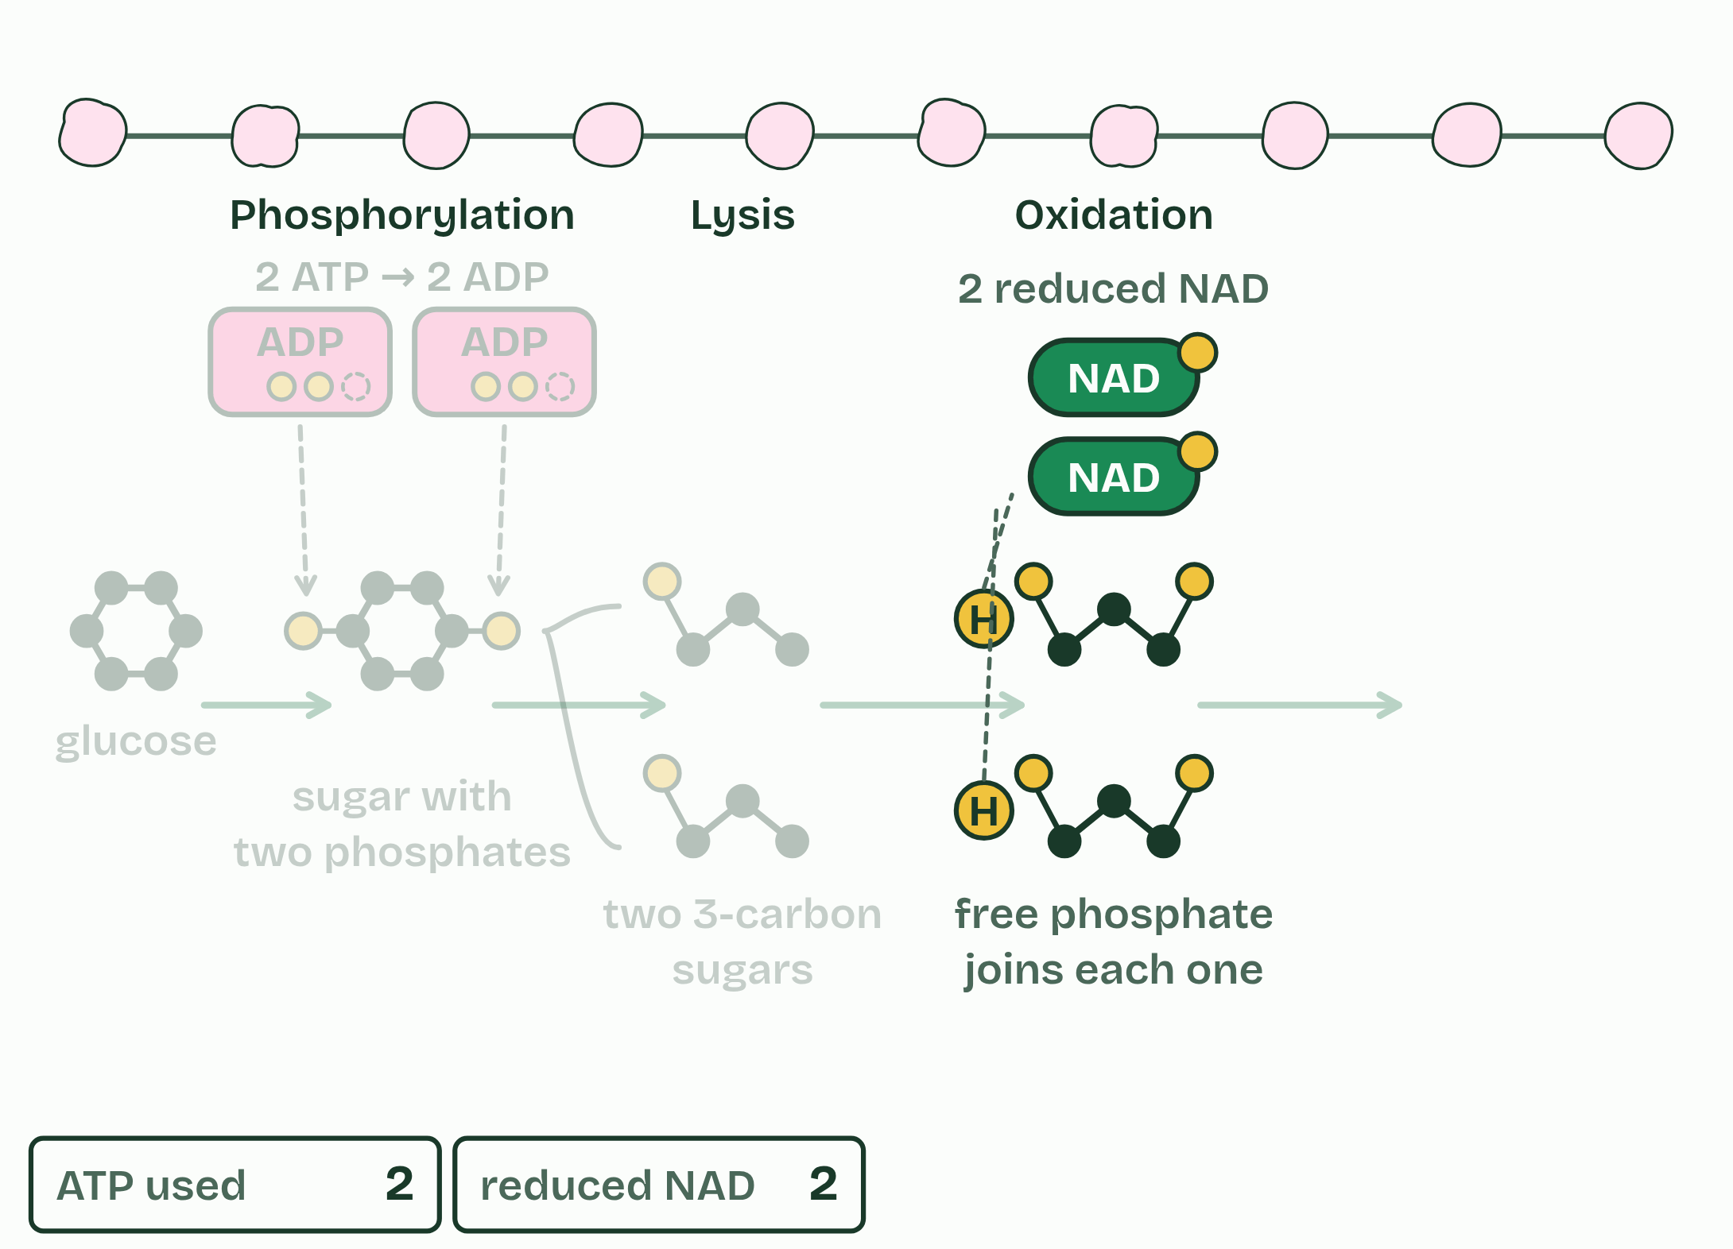
CHAPTER 7 · C1.2.8 Conversion of glucose to pyruvate in glycolysis, with a net yield of ATP and reduced NAD
4 / 6
Two ATP in, four out
Oxidation: hydrogen to NAD, making 2 reduced NAD.
Minutes 15 to 30
Notes:
Minutes 15 to 30 of 60: Glycolysis stepping stones (15 min).
The plan: Pairs order the seven cards (activity below), then check against chapter 7’s figure and make its predict. Turn over the Penguins tiles.
Glycolysis turns one glucose into two pyruvate, in the cytoplasm, in about ten steps. Each step has its own enzyme, and the product of one step is the substrate of the next: it is a metabolic pathway (C1.1). The guide groups the steps into four stages, and you do not need to name the molecules in between.

Slide 19
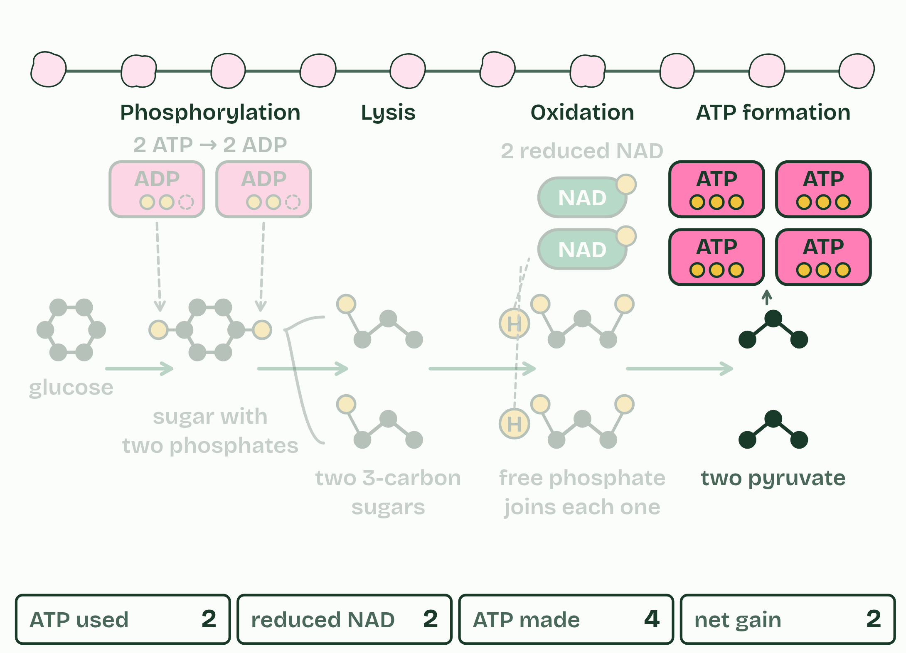
CHAPTER 7 · C1.2.8 Conversion of glucose to pyruvate in glycolysis, with a net yield of ATP and reduced NAD
5 / 6
Two ATP in, four out
ATP formation: 4 ATP made, so 2 gained.
Minutes 15 to 30
Notes:
Minutes 15 to 30 of 60: Glycolysis stepping stones (15 min).
The plan: Pairs order the seven cards (activity below), then check against chapter 7’s figure and make its predict. Turn over the Penguins tiles.
Glycolysis turns one glucose into two pyruvate, in the cytoplasm, in about ten steps. Each step has its own enzyme, and the product of one step is the substrate of the next: it is a metabolic pathway (C1.1). The guide groups the steps into four stages, and you do not need to name the molecules in between.

Slide 20
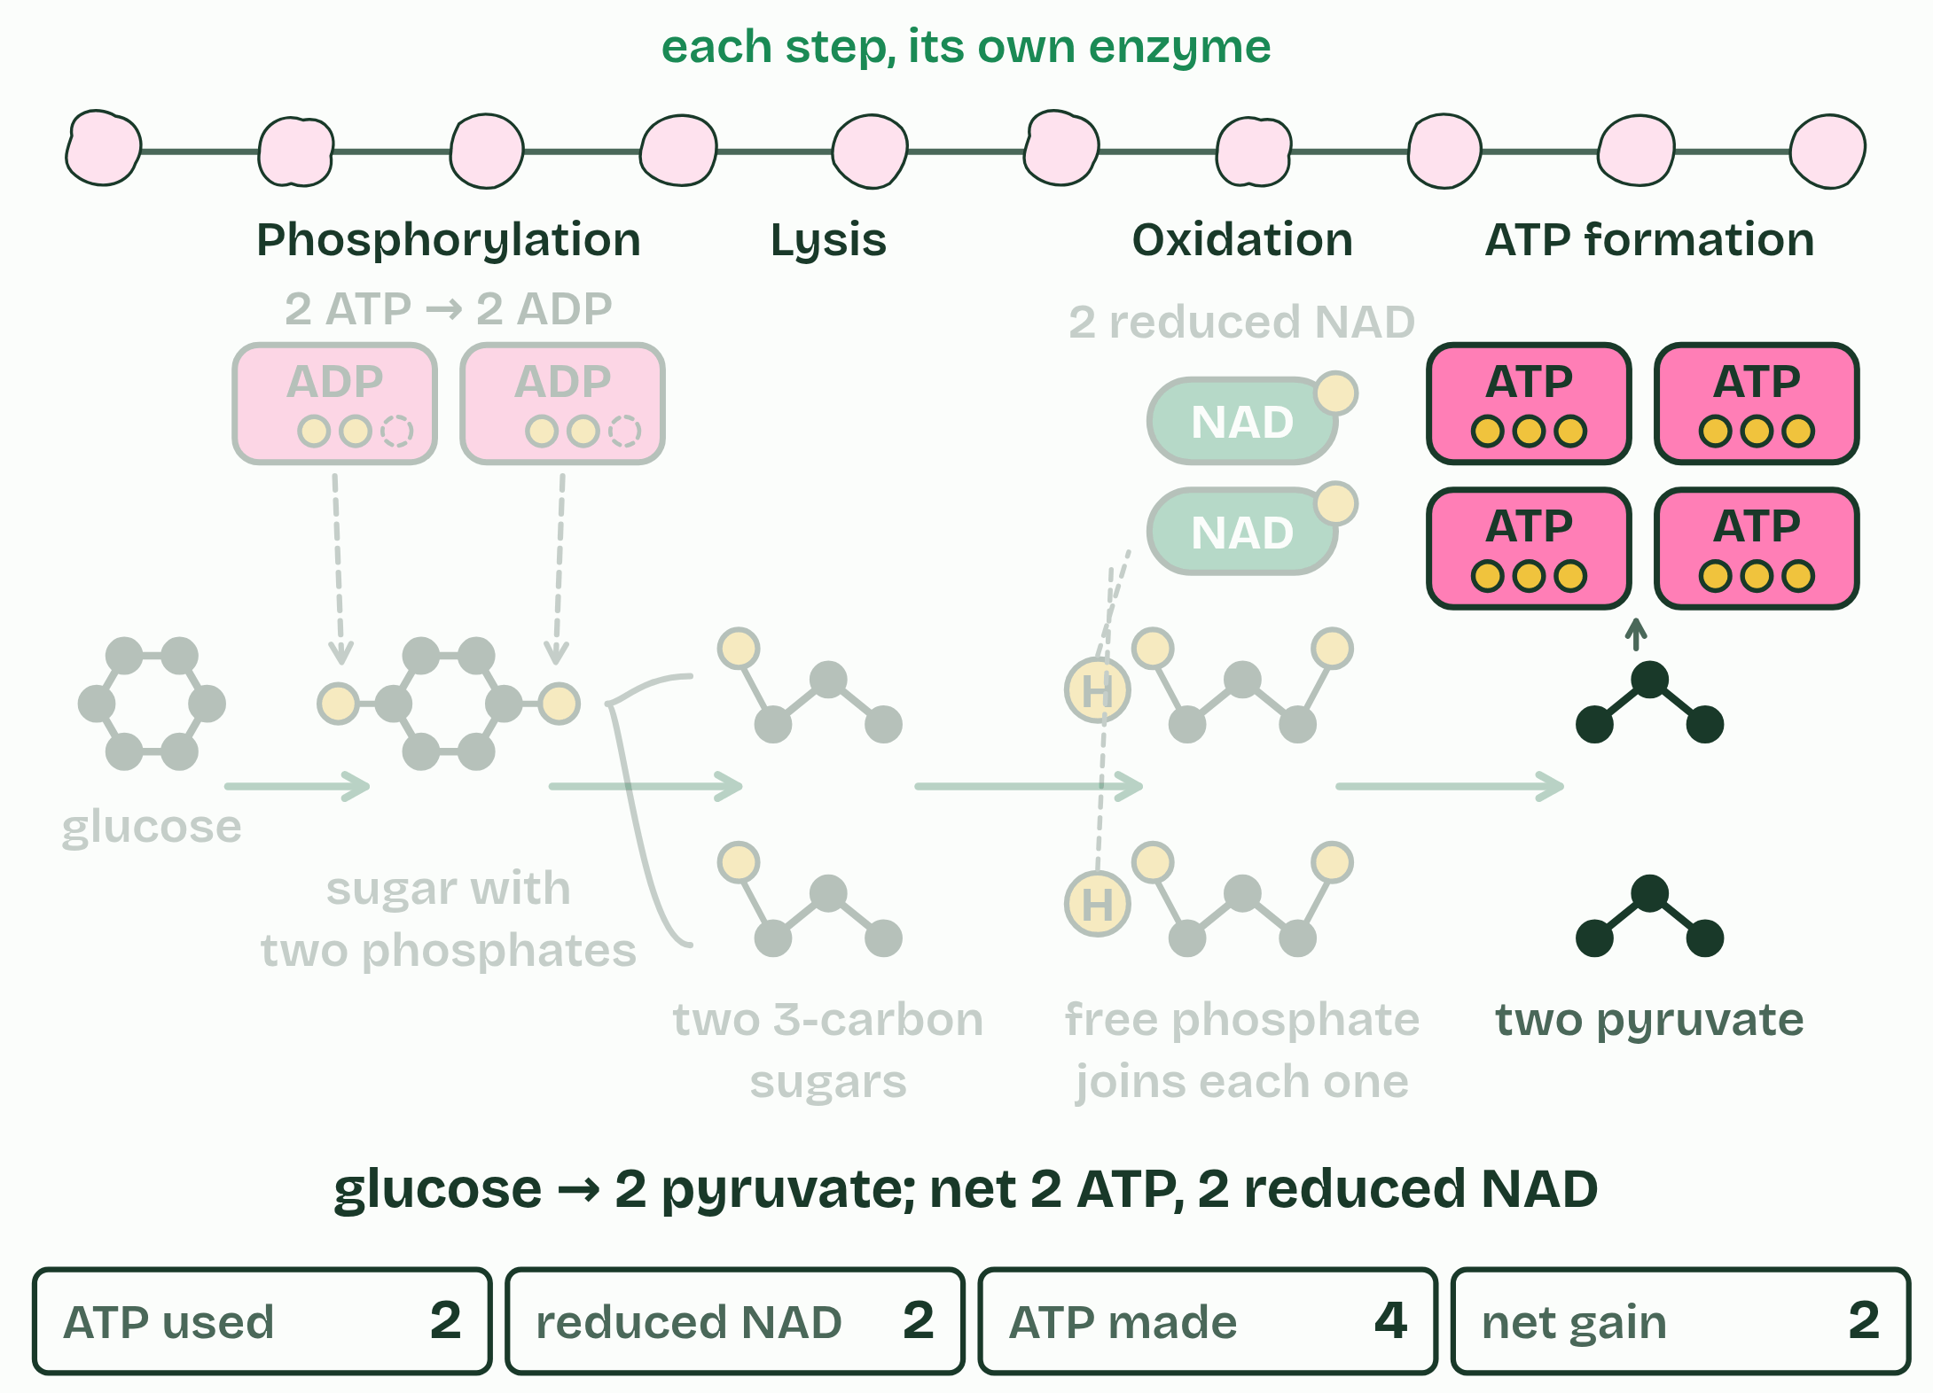
CHAPTER 7 · C1.2.8 Conversion of glucose to pyruvate in glycolysis, with a net yield of ATP and reduced NAD
6 / 6
Two ATP in, four out
Ten steps, ten enzymes, two pyruvate.
Minutes 15 to 30
Notes:
Minutes 15 to 30 of 60: Glycolysis stepping stones (15 min).
The plan: Pairs order the seven cards (activity below), then check against chapter 7’s figure and make its predict. Turn over the Penguins tiles.
Glycolysis turns one glucose into two pyruvate, in the cytoplasm, in about ten steps. Each step has its own enzyme, and the product of one step is the substrate of the next: it is a metabolic pathway (C1.1). The guide groups the steps into four stages, and you do not need to name the molecules in between.

Slide 21
CHAPTER 7 · C1.2.8 Conversion of glucose to pyruvate in glycolysis, with a net yield of ATP and reduced NAD
Two ATP in, four out
Phosphorylation: two ATP each give a phosphate group to the glucose. That costs 2 ATP, but a sugar carrying two charged phosphates is made reactive and ready to split.
Lysis: the 6-carbon sugar with its two phosphates splits into two 3-carbon sugars, each with one phosphate.
Oxidation: hydrogen is taken off each 3-carbon sugar and accepted by NAD, so two reduced NAD are made for the glucose. The energy released lets each 3-carbon sugar take on a second phosphate, a free one from the cytoplasm, not one from ATP.
ATP formation: each 3-carbon sugar passes its two phosphates to ADP, making ATP directly, and ends as pyruvate.
Minutes 15 to 30
Notes:
Minutes 15 to 30 of 60: Glycolysis stepping stones (15 min).
The plan: Pairs order the seven cards (activity below), then check against chapter 7’s figure and make its predict. Turn over the Penguins tiles.
Glycolysis turns one glucose into two pyruvate, in the cytoplasm, in about ten steps. Each step has its own enzyme, and the product of one step is the substrate of the next: it is a metabolic pathway (C1.1). The guide groups the steps into four stages, and you do not need to name the molecules in between.

Slide 22
PREDICT
Glycolysis spends 2 ATP at the start. How many does it make by the end, from one glucose?
A 4, so the cell gains 2
B 2, so it only breaks even
C 6, one for each carbon in glucose
D 30, from the hydrogen it removes
Minutes 15 to 30
Notes:
Minutes 15 to 30 of 60: Glycolysis stepping stones (15 min).
The plan: Pairs order the seven cards (activity below), then check against chapter 7’s figure and make its predict. Turn over the Penguins tiles.
Ask for a show of hands, or mini whiteboards, before revealing. (Answer: A, on the next slide.)

Slide 23
WHAT HAPPENS
Glycolysis spends 2 ATP at the start. How many does it make by the end, from one glucose?
A 4, so the cell gains 2
B 2, so it only breaks even
C 6, one for each carbon in glucose
D 30, from the hydrogen it removes
Four, for a net gain of two. The two spent at the start make the sugar reactive enough to split; the four made later come from energy released as the 3-carbon sugars are oxidised and changed into pyruvate. So for one glucose the net yield is 2 ATP, with 2 reduced NAD and 2 pyruvate. No oxygen is used anywhere in glycolysis, so it is the same in aerobic and anaerobic respiration. The big yield comes later, in the mitochondrion.
Minutes 15 to 30
Notes:
Minutes 15 to 30 of 60: Glycolysis stepping stones (15 min).
The plan: Pairs order the seven cards (activity below), then check against chapter 7’s figure and make its predict. Turn over the Penguins tiles.
Answer: A. Four, for a net gain of two. The two spent at the start make the sugar reactive enough to split; the four made later come from energy released as the 3-carbon sugars are oxidised and changed into pyruvate. So for one glucose the net yield is 2 ATP, with 2 reduced NAD and 2 pyruvate. No oxygen is used anywhere in glycolysis, so it is the same in aerobic and anaerobic respiration. The big yield comes later, in the mitochondrion.

Slide 24
REMEMBER IT
The four stages of glycolysis, in order
P
L
O
A
Penguins
Love
Orange
Anchovies
Minutes 15 to 30
Notes:
Minutes 15 to 30 of 60: Glycolysis stepping stones (15 min).
The plan: Pairs order the seven cards (activity below), then check against chapter 7’s figure and make its predict. Turn over the Penguins tiles.
Ask the class what each letter stands for before revealing.

Slide 25
REMEMBER IT
The four stages of glycolysis, in order
P
L
O
A
Penguins
Love
Orange
Anchovies
Phosphorylation
Lysis
Oxidation
ATP formation
2 ATP spent
6 carbons split into 3 and 3
hydrogen to NAD
4 ATP made
Minutes 15 to 30
Notes:
Minutes 15 to 30 of 60: Glycolysis stepping stones (15 min).
The plan: Pairs order the seven cards (activity below), then check against chapter 7’s figure and make its predict. Turn over the Penguins tiles.
Penguins: Phosphorylation (2 ATP spent)
Love: Lysis (6 carbons split into 3 and 3)
Orange: Oxidation (hydrogen to NAD)
Anchovies: ATP formation (4 ATP made)

Slide 26
WATCH OUT
Glycolysis does not need oxygen, and it does not happen in the mitochondrion.
Minutes 15 to 30
Notes:
Minutes 15 to 30 of 60: Glycolysis stepping stones (15 min).
The plan: Pairs order the seven cards (activity below), then check against chapter 7’s figure and make its predict. Turn over the Penguins tiles.
A common mistake: say it, then ask who can say why it is wrong.

Slide 27
STEP 4
12 MIN
Giving NAD back
Chapter 8: Giving NAD back
Minutes 30 to 42
Notes:
Minutes 30 to 42 of 60: Giving NAD back (12 min).
The plan: Chapter 8: the predict, then the figure’s three settings: glycolysis alone, muscle and yeast. Then the ATP budget’s round 5 on the board: tick and untick Lactate made and watch the NAD.

Slide 28
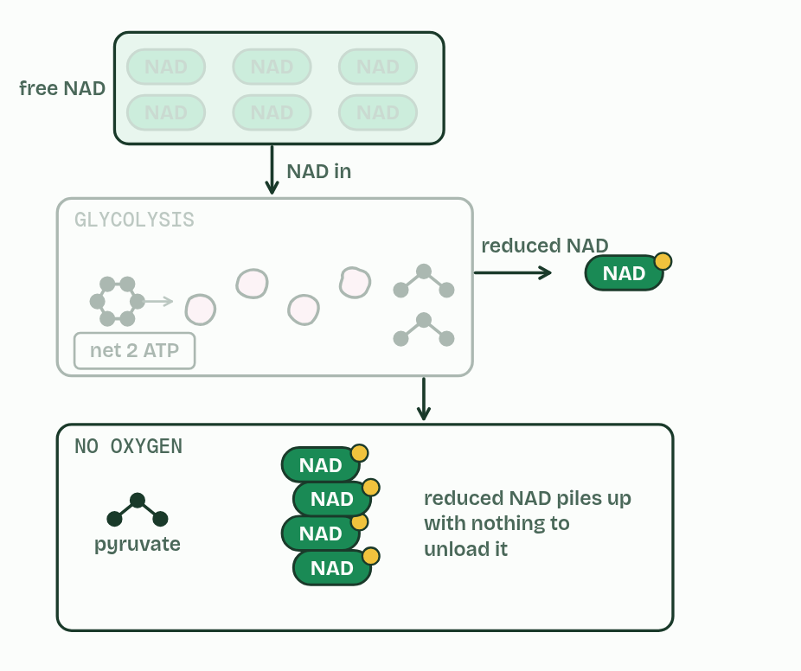
CHAPTER 8 · C1.2.9 C1.2.10 Lactate and ethanol as ways of regenerating NAD, and brewing and baking
1 / 3
Giving NAD back
Glycolysis alone
Minutes 30 to 42
Notes:
Minutes 30 to 42 of 60: Giving NAD back (12 min).
The plan: Chapter 8: the predict, then the figure’s three settings: glycolysis alone, muscle and yeast. Then the ATP budget’s round 5 on the board: tick and untick Lactate made and watch the NAD.
Glycolysis needs NAD. Every glucose that goes through it turns two NAD into reduced NAD. A cell has only a little NAD, so if reduced NAD is not turned back into NAD, glycolysis stops very quickly. Giving NAD back is called the regeneration of NAD.
With oxygen, reduced NAD is unloaded at the electron transport chain in the mitochondrion (chapters 10 and 11). Without oxygen it cannot be, so a cell needs another way to give NAD back.
In human muscle, pyruvate takes the hydrogen from reduced NAD and becomes lactate. NAD is given back, so glycolysis can go on, with a net yield of 2 ATP per glucose. Making lactate releases no extra energy: its whole point is to give NAD back.
Yeast follow the same pathway as far as pyruvate. Without oxygen, each pyruvate loses a carbon as carbon dioxide, and what is left takes the hydrogen from reduced NAD to become ethanol. NAD is given back, and the yield is again 2 ATP per glucose. Only the last step differs from humans, and so the final products do.
Bakers and brewers use what yeast make. In baking, yeast respire the sugars in the dough and the carbon dioxide forms bubbles that stretch it, so the dough rises; the ethanol evaporates in the oven. In brewing, yeast in a sugary liquid made from barley or grapes, with little air, make ethanol, which is kept, while the carbon dioxide escapes or is kept in for fizz. Early in a dough or a brew there is oxygen and the yeast respire aerobically, so carbon dioxide is given off from the start; as the oxygen runs out, anaerobic respiration takes over. Anaerobic respiration in yeast is often called fermentation.

Slide 29
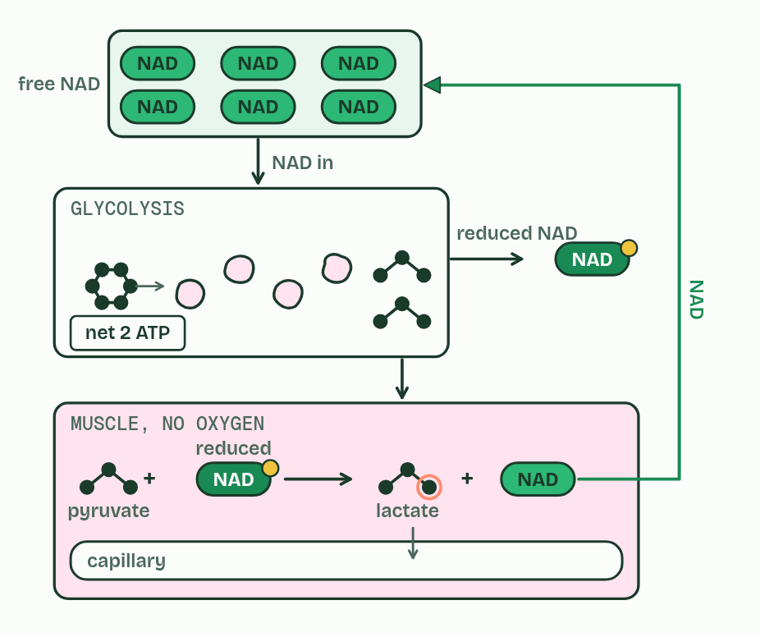
CHAPTER 8 · C1.2.9 C1.2.10 Lactate and ethanol as ways of regenerating NAD, and brewing and baking
2 / 3
Giving NAD back
Muscle
Minutes 30 to 42
Notes:
Minutes 30 to 42 of 60: Giving NAD back (12 min).
The plan: Chapter 8: the predict, then the figure’s three settings: glycolysis alone, muscle and yeast. Then the ATP budget’s round 5 on the board: tick and untick Lactate made and watch the NAD.
Glycolysis needs NAD. Every glucose that goes through it turns two NAD into reduced NAD. A cell has only a little NAD, so if reduced NAD is not turned back into NAD, glycolysis stops very quickly. Giving NAD back is called the regeneration of NAD.
With oxygen, reduced NAD is unloaded at the electron transport chain in the mitochondrion (chapters 10 and 11). Without oxygen it cannot be, so a cell needs another way to give NAD back.
In human muscle, pyruvate takes the hydrogen from reduced NAD and becomes lactate. NAD is given back, so glycolysis can go on, with a net yield of 2 ATP per glucose. Making lactate releases no extra energy: its whole point is to give NAD back.
Yeast follow the same pathway as far as pyruvate. Without oxygen, each pyruvate loses a carbon as carbon dioxide, and what is left takes the hydrogen from reduced NAD to become ethanol. NAD is given back, and the yield is again 2 ATP per glucose. Only the last step differs from humans, and so the final products do.
Bakers and brewers use what yeast make. In baking, yeast respire the sugars in the dough and the carbon dioxide forms bubbles that stretch it, so the dough rises; the ethanol evaporates in the oven. In brewing, yeast in a sugary liquid made from barley or grapes, with little air, make ethanol, which is kept, while the carbon dioxide escapes or is kept in for fizz. Early in a dough or a brew there is oxygen and the yeast respire aerobically, so carbon dioxide is given off from the start; as the oxygen runs out, anaerobic respiration takes over. Anaerobic respiration in yeast is often called fermentation.

Slide 30
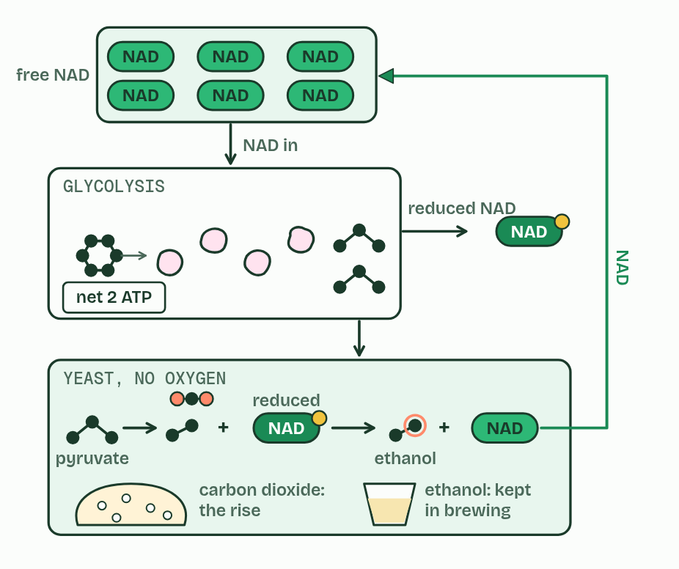
CHAPTER 8 · C1.2.9 C1.2.10 Lactate and ethanol as ways of regenerating NAD, and brewing and baking
3 / 3
Giving NAD back
Yeast
Minutes 30 to 42
Notes:
Minutes 30 to 42 of 60: Giving NAD back (12 min).
The plan: Chapter 8: the predict, then the figure’s three settings: glycolysis alone, muscle and yeast. Then the ATP budget’s round 5 on the board: tick and untick Lactate made and watch the NAD.
Glycolysis needs NAD. Every glucose that goes through it turns two NAD into reduced NAD. A cell has only a little NAD, so if reduced NAD is not turned back into NAD, glycolysis stops very quickly. Giving NAD back is called the regeneration of NAD.
With oxygen, reduced NAD is unloaded at the electron transport chain in the mitochondrion (chapters 10 and 11). Without oxygen it cannot be, so a cell needs another way to give NAD back.
In human muscle, pyruvate takes the hydrogen from reduced NAD and becomes lactate. NAD is given back, so glycolysis can go on, with a net yield of 2 ATP per glucose. Making lactate releases no extra energy: its whole point is to give NAD back.
Yeast follow the same pathway as far as pyruvate. Without oxygen, each pyruvate loses a carbon as carbon dioxide, and what is left takes the hydrogen from reduced NAD to become ethanol. NAD is given back, and the yield is again 2 ATP per glucose. Only the last step differs from humans, and so the final products do.
Bakers and brewers use what yeast make. In baking, yeast respire the sugars in the dough and the carbon dioxide forms bubbles that stretch it, so the dough rises; the ethanol evaporates in the oven. In brewing, yeast in a sugary liquid made from barley or grapes, with little air, make ethanol, which is kept, while the carbon dioxide escapes or is kept in for fizz. Early in a dough or a brew there is oxygen and the yeast respire aerobically, so carbon dioxide is given off from the start; as the oxygen runs out, anaerobic respiration takes over. Anaerobic respiration in yeast is often called fermentation.

Slide 31
CHAPTER 8 · C1.2.9 C1.2.10 Lactate and ethanol as ways of regenerating NAD, and brewing and baking
Giving NAD back
Giving NAD back is called the regeneration of NAD.
Yeast follow the same pathway as far as pyruvate.
Without oxygen, each pyruvate loses a carbon as carbon dioxide, and what is left takes the hydrogen from reduced NAD to become ethanol.
Bakers and brewers use what yeast make.
Minutes 30 to 42
Notes:
Minutes 30 to 42 of 60: Giving NAD back (12 min).
The plan: Chapter 8: the predict, then the figure’s three settings: glycolysis alone, muscle and yeast. Then the ATP budget’s round 5 on the board: tick and untick Lactate made and watch the NAD.
Glycolysis needs NAD. Every glucose that goes through it turns two NAD into reduced NAD. A cell has only a little NAD, so if reduced NAD is not turned back into NAD, glycolysis stops very quickly. Giving NAD back is called the regeneration of NAD.
With oxygen, reduced NAD is unloaded at the electron transport chain in the mitochondrion (chapters 10 and 11). Without oxygen it cannot be, so a cell needs another way to give NAD back.
In human muscle, pyruvate takes the hydrogen from reduced NAD and becomes lactate. NAD is given back, so glycolysis can go on, with a net yield of 2 ATP per glucose. Making lactate releases no extra energy: its whole point is to give NAD back.
Yeast follow the same pathway as far as pyruvate. Without oxygen, each pyruvate loses a carbon as carbon dioxide, and what is left takes the hydrogen from reduced NAD to become ethanol. NAD is given back, and the yield is again 2 ATP per glucose. Only the last step differs from humans, and so the final products do.
Bakers and brewers use what yeast make. In baking, yeast respire the sugars in the dough and the carbon dioxide forms bubbles that stretch it, so the dough rises; the ethanol evaporates in the oven. In brewing, yeast in a sugary liquid made from barley or grapes, with little air, make ethanol, which is kept, while the carbon dioxide escapes or is kept in for fizz. Early in a dough or a brew there is oxygen and the yeast respire aerobically, so carbon dioxide is given off from the start; as the oxygen runs out, anaerobic respiration takes over. Anaerobic respiration in yeast is often called fermentation.

Slide 32
PREDICT
Without oxygen, why does a muscle cell turn pyruvate into lactate instead of leaving it as pyruvate?
A Lactate stores more energy for later
B Pyruvate is poisonous to muscle cells, so it must be changed
C Lactate can be turned straight into ATP
D It gives NAD back, so glycolysis can go on
Minutes 30 to 42
Notes:
Minutes 30 to 42 of 60: Giving NAD back (12 min).
The plan: Chapter 8: the predict, then the figure’s three settings: glycolysis alone, muscle and yeast. Then the ATP budget’s round 5 on the board: tick and untick Lactate made and watch the NAD.
Ask for a show of hands, or mini whiteboards, before revealing. (Answer: D, on the next slide.)

Slide 33
WHAT HAPPENS
Without oxygen, why does a muscle cell turn pyruvate into lactate instead of leaving it as pyruvate?
A Lactate stores more energy for later
B Pyruvate is poisonous to muscle cells, so it must be changed
C Lactate can be turned straight into ATP
D It gives NAD back, so glycolysis can go on
To give NAD back. Glycolysis turns NAD into reduced NAD, and without oxygen nothing else can unload it. Turning pyruvate into lactate takes the hydrogen off reduced NAD, so NAD is free to collect more, and glycolysis keeps making its 2 ATP per glucose.
Minutes 30 to 42
Notes:
Minutes 30 to 42 of 60: Giving NAD back (12 min).
The plan: Chapter 8: the predict, then the figure’s three settings: glycolysis alone, muscle and yeast. Then the ATP budget’s round 5 on the board: tick and untick Lactate made and watch the NAD.
Answer: D. To give NAD back. Glycolysis turns NAD into reduced NAD, and without oxygen nothing else can unload it. Turning pyruvate into lactate takes the hydrogen off reduced NAD, so NAD is free to collect more, and glycolysis keeps making its 2 ATP per glucose.

Slide 34
WATCH OUT
Yeast without oxygen make ethanol and carbon dioxide, not lactate; humans make lactate, not ethanol or carbon dioxide.
Minutes 30 to 42
Notes:
Minutes 30 to 42 of 60: Giving NAD back (12 min).
The plan: Chapter 8: the predict, then the figure’s three settings: glycolysis alone, muscle and yeast. Then the ATP budget’s round 5 on the board: tick and untick Lactate made and watch the NAD.
A common mistake: say it, then ask who can say why it is wrong.

Slide 35
STEP 5
13 MIN
A written question
Each pair then writes one line on bread and one on beer.
Minutes 42 to 55
Notes:
Minutes 42 to 55 of 60: A written question (13 min).
The plan: A written question on glycolysis or fermentation from the C1.2 exam maker (in Practise and revise), timed at 9 minutes and peer-marked against the markscheme. Each pair then writes one line on bread and one on beer.

Slide 36
PLENARY
Can you now...
Explain oxidation as the removal of hydrogen, and NAD as the carrier that is reduced when it accepts it (C1.2.7)
Outline glycolysis: phosphorylation, lysis, oxidation and ATP formation, with its net yield (C1.2.8)
Explain how making lactate, or ethanol and carbon dioxide in yeast, gives NAD back so glycolysis can go on, and how bakers and brewers use yeast (C1.2.9, C1.2.10)
Minutes 55 to 60
Notes:
Minutes 55 to 60 of 60: Exit (5 min).
The plan: Why can glycolysis go on without oxygen in a muscle, and what would stop it?
Thumbs up, sideways or down on each goal before the exit question. The goals come from the statements this lesson covers.

Slide 37
EXIT QUESTION
Before you go
Why can glycolysis go on without oxygen in a muscle, and what would stop it?
Minutes 55 to 60
Notes:
Minutes 55 to 60 of 60: Exit (5 min).
The plan: Why can glycolysis go on without oxygen in a muscle, and what would stop it?

Slide 38
PRACTISE AND REVISE
Keep going
Exam practice: a fresh paper of exam questions on C1.2 at higher level, marked as you go
The guide, with the animations and the dry lab
This lesson in the guide: 6 Taking hydrogen away, 7 Two ATP in, four out, 8 Giving NAD back
BUILD FOR YOUR CLASS
ALREADY ON THE SITE FOR C1.2
CARD SETS ON SPLYCR
Tarsia puzzle, dominoes and picture reveal on C1.2, built from its key terms and ready to print
A pub quiz with rounds on C1.2, to present or run with no projector
An escape room built from the question bank on C1.2
Lesson: Cell Respiration HL (HL)
Lesson: Cell Respiration
Quiz: Cell Respiration
Quiz: Cell Respiration (HL)
Revision map: C1.2 Cell respiration, to fill in
Exam questions: C1.2 in the exam maker, a paper with its markscheme
Open a set to host it as a class game, or make a copy to edit.
C1.2 Cell Respiration
B3.2–C2.2 Plant Transport, Respiration & Neural Signalling
How this was made. The course structure, the activities and the teaching choices come from my own classroom, my presentations and my years of teaching IB and AP Biology. I use Claude, an AI, to help write and build the interactive guides, lesson plans, slides and practice questions, and to draw the diagrams and code the interactives. I direct the work and review it against the IB and AP specifications before it goes live.
Minute 60: after the lesson
Notes:
Every link here is live. Set the exam practice paper for homework: it is fresh each time, marked as students go and saved to their Exam practice when they are signed in.
Exam practice: https://www.biologybybradford.com/exam-maker/sit?topics=C1.2&level=HL&paper=quiz&marks=15&src=ep
The guide: https://www.biologybybradford.com/guides/ib-biology-c1-2-cell-respiration

