Slide 1
IB Biology C1.2
LESSON 4 OF 5
HL
BY THE END YOU CAN
Cell respiration
Outline the link reaction and the Krebs cycle: where the carbon dioxide and the reduced NAD come from (C1.2.11, C1.2.12)
Compare lipids and carbohydrates as fuels: energy per gram, and which routes each can take (C1.2.17)
Inside the matrix, and which fuel
C1.2.11, C1.2.12 and C1.2.17
The link reaction and the Krebs cycle, counting carbons and carriers, and fat against sugar as fuels
60 minutes · chapters 9, 12
Minute 0
Notes:
IB Biology C1.2, Cell respiration. Lesson 4 of 5: Inside the matrix, and which fuel (higher level), 60 minutes.
The plan, minute by minute (each slide's footer says where you are):
0 to 5 min (5) Do now: draw a mitochondrion
5 to 15 min (10) The link reaction
15 to 30 min (15) Build the Krebs cycle
30 to 38 min (8) Name the reaction
38 to 55 min (17) Fat or sugar?
55 to 60 min (5) Exit
What students get wrong:
The Krebs cycle makes most of the ATP. It makes reduced NAD; the chain makes most of the ATP.
The carbon dioxide breathed out comes from the oxygen breathed in. It comes from the fuel’s carbon, in the link reaction and the Krebs cycle.
Fat gives more energy because its molecules are bigger. A fatty acid holds less oxygen and more oxidisable hydrogen and carbon per gram.
Fat can be respired anaerobically. It enters at the Krebs cycle, so it needs oxygen.
Stretch and support:
Stretch: the respiratory quotient (carbon dioxide given out divided by oxygen taken up) for glucose is 1.0 and for palmitic acid 16 divided by 23. Work out what an athlete’s breath would show as they switch from fat to carbohydrate.
Stretch: make a Tarsia puzzle on C1.2 that is better than the site’s own, in the Tarsia builder.
Consequences for ecosystems: respiration returns carbon dioxide to the air and releases heat at every transfer. Use both to start the energy flow of C4.2: where does the energy of a food chain go?
The lesson plan to print: https://www.biologybybradford.com/guides/downloads/ib-biology-c1-2-cell-respiration-lesson-4-plan.pdf

Slide 2
DO NOW
Draw a mitochondrion
From memory, with no notes, and label it.
5:00
minutes
Start now: the timer is running.
Minutes 0 to 5
Notes:
Minutes 0 to 5 of 60: Do now: draw a mitochondrion (5 min).
The plan: From memory, with no notes (activity below), and label it. Keep the drawings: they are used again in lesson 5.
Start a 5 minute timer as they come in.

Slide 3
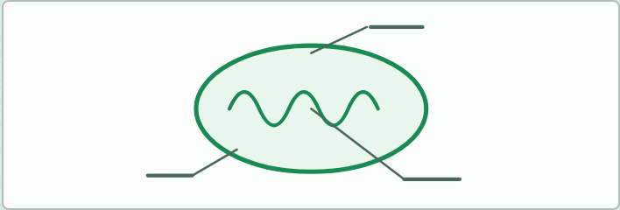
DRAWING · HL
5 MIN
Draw a mitochondrion
THE TASK
From memory: the outer membrane, the inner membrane folded into cristae, the matrix, the intermembrane space, and ribosomes and DNA. Then add where the link reaction, the Krebs cycle and the chain happen.
STUDENTS NEED
Paper.
Minutes 0 to 5
Notes:
Minutes 0 to 5 of 60: Do now: draw a mitochondrion (5 min).
The plan: From memory, with no notes (activity below), and label it. Keep the drawings: they are used again in lesson 5.
The activity: Draw a mitochondrion. From memory: the outer membrane, the inner membrane folded into cristae, the matrix, the intermembrane space, and ribosomes and DNA. Then add where the link reaction, the Krebs cycle and the chain happen.
Needs: paper.
The time: 5 minutes, minutes 0 to 5 of the plan.

Slide 4
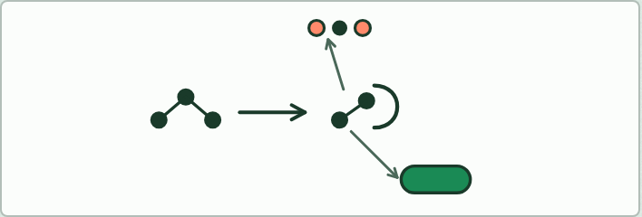
DRAWING · HL
10 MIN
The link reaction as a diagram
THE TASK
From a written summary, draw the link reaction: pyruvate in, carbon dioxide out, hydrogen to NAD, and the acetyl group onto coenzyme A.
STUDENTS NEED
Paper.
Minutes 5 to 15
Notes:
Minutes 5 to 15 of 60: The link reaction (10 min).
The plan: Chapter 9: students draw the link reaction from a written summary (activity below), then play the first two steps of the figure to check it.
The activity: The link reaction as a diagram. From a written summary, draw the link reaction: pyruvate in, carbon dioxide out, hydrogen to NAD, and the acetyl group onto coenzyme A.
Needs: paper.
The time: 10 minutes, minutes 5 to 15 of the plan.

Slide 5
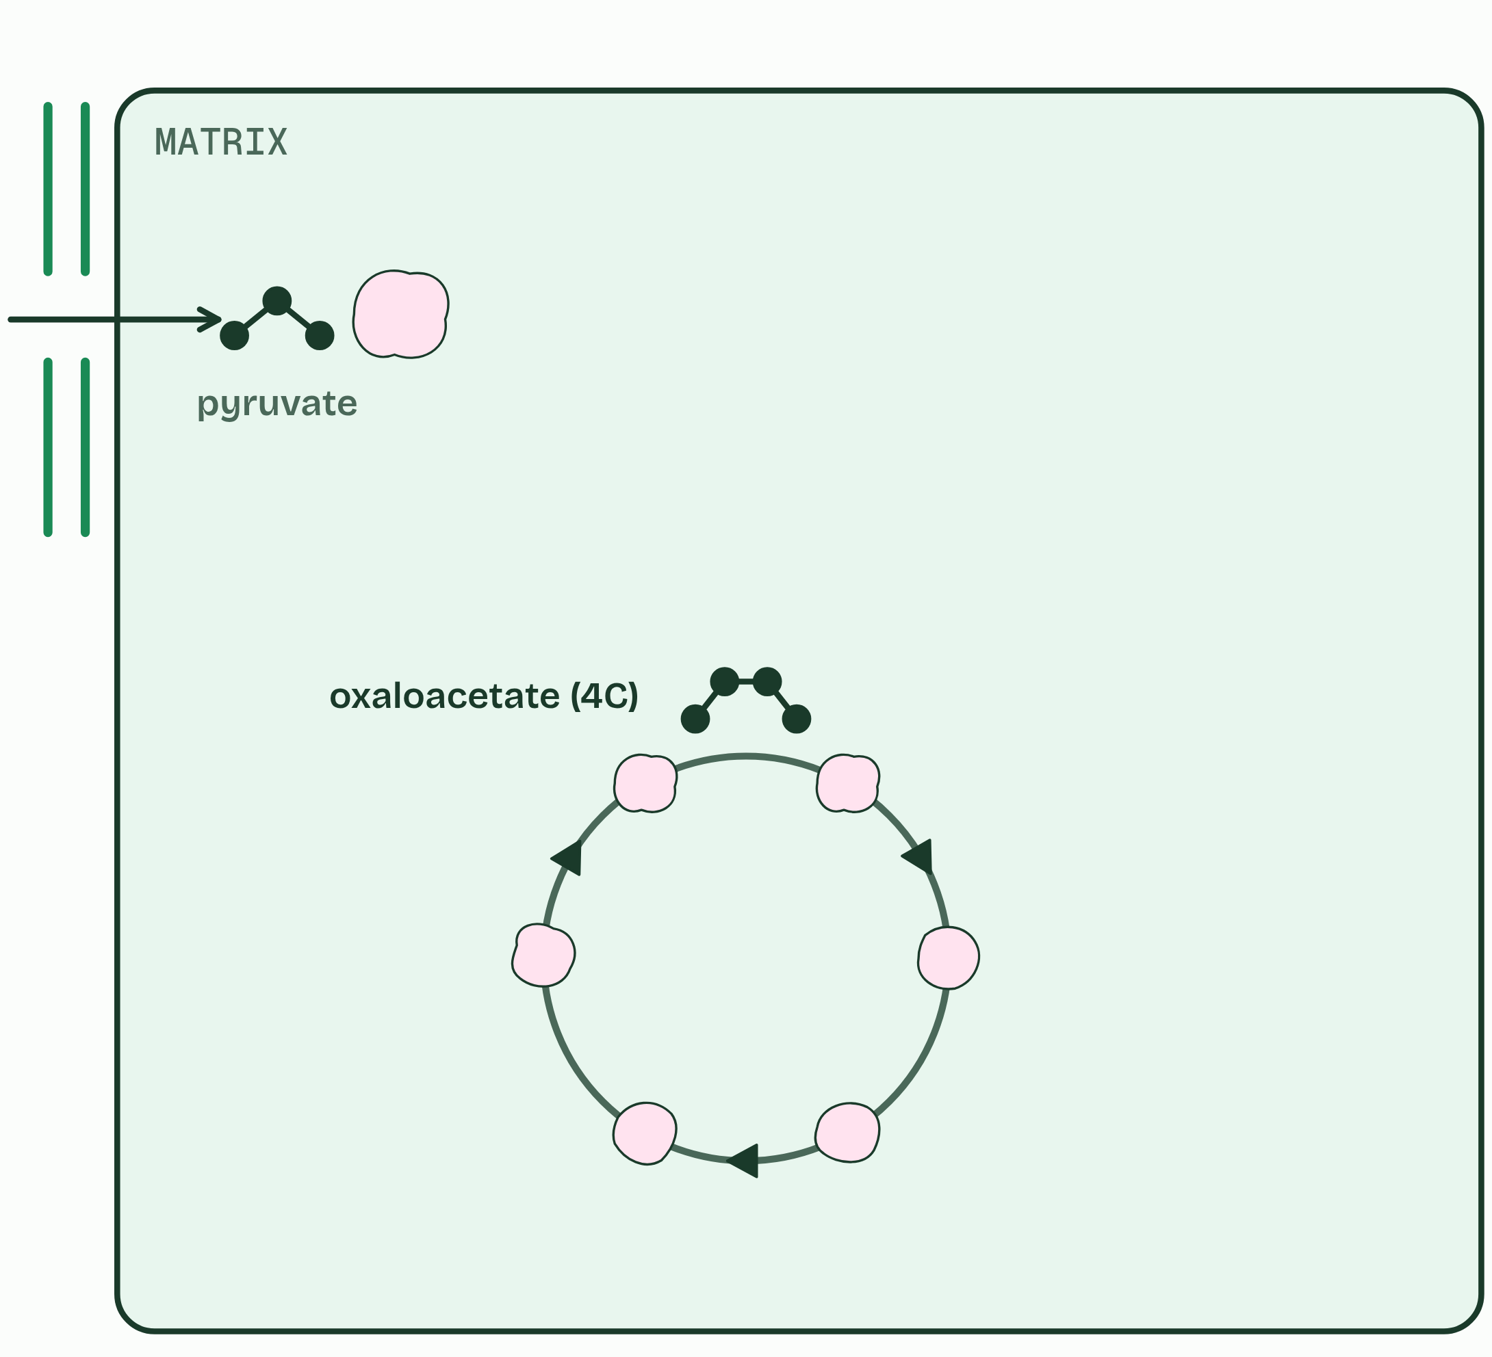
CHAPTER 9 · C1.2.11 C1.2.12 The link reaction, and the Krebs cycle
1 / 6
The carbon leaves as carbon dioxide
Pyruvate goes into the matrix.
Minutes 5 to 15
Notes:
Minutes 5 to 15 of 60: The link reaction (10 min).
The plan: Chapter 9: students draw the link reaction from a written summary (activity below), then play the first two steps of the figure to check it.
With oxygen, pyruvate is carried from the cytoplasm into the matrix, the fluid inside the inner membrane of the mitochondrion. Two sets of reactions follow, one after the other.
The link reaction links glycolysis to the Krebs cycle. Each pyruvate (3C) is decarboxylated, which takes a carbon off as carbon dioxide, and oxidised: hydrogen is removed and accepted by NAD. The 2-carbon acetyl group that is left is picked up by coenzyme A and carried to the cycle. Fatty acids and other carbohydrates are also broken down to acetyl groups, which join the same route (chapter 12). All of this happens twice for each glucose, once for each pyruvate.
In the Krebs cycle, the acetyl group is transferred to oxaloacetate (4C) to make citrate (6C). Round the cycle the compound is oxidised four times, each a dehydrogenation: three load NAD, and one loads another carrier. One ATP is made. Then oxaloacetate is remade, ready for the next acetyl group, and the cycle turns twice for each glucose.
Glycolysis and the Krebs cycle sit beside the Calvin cycle on one map in C1.3.

Slide 6
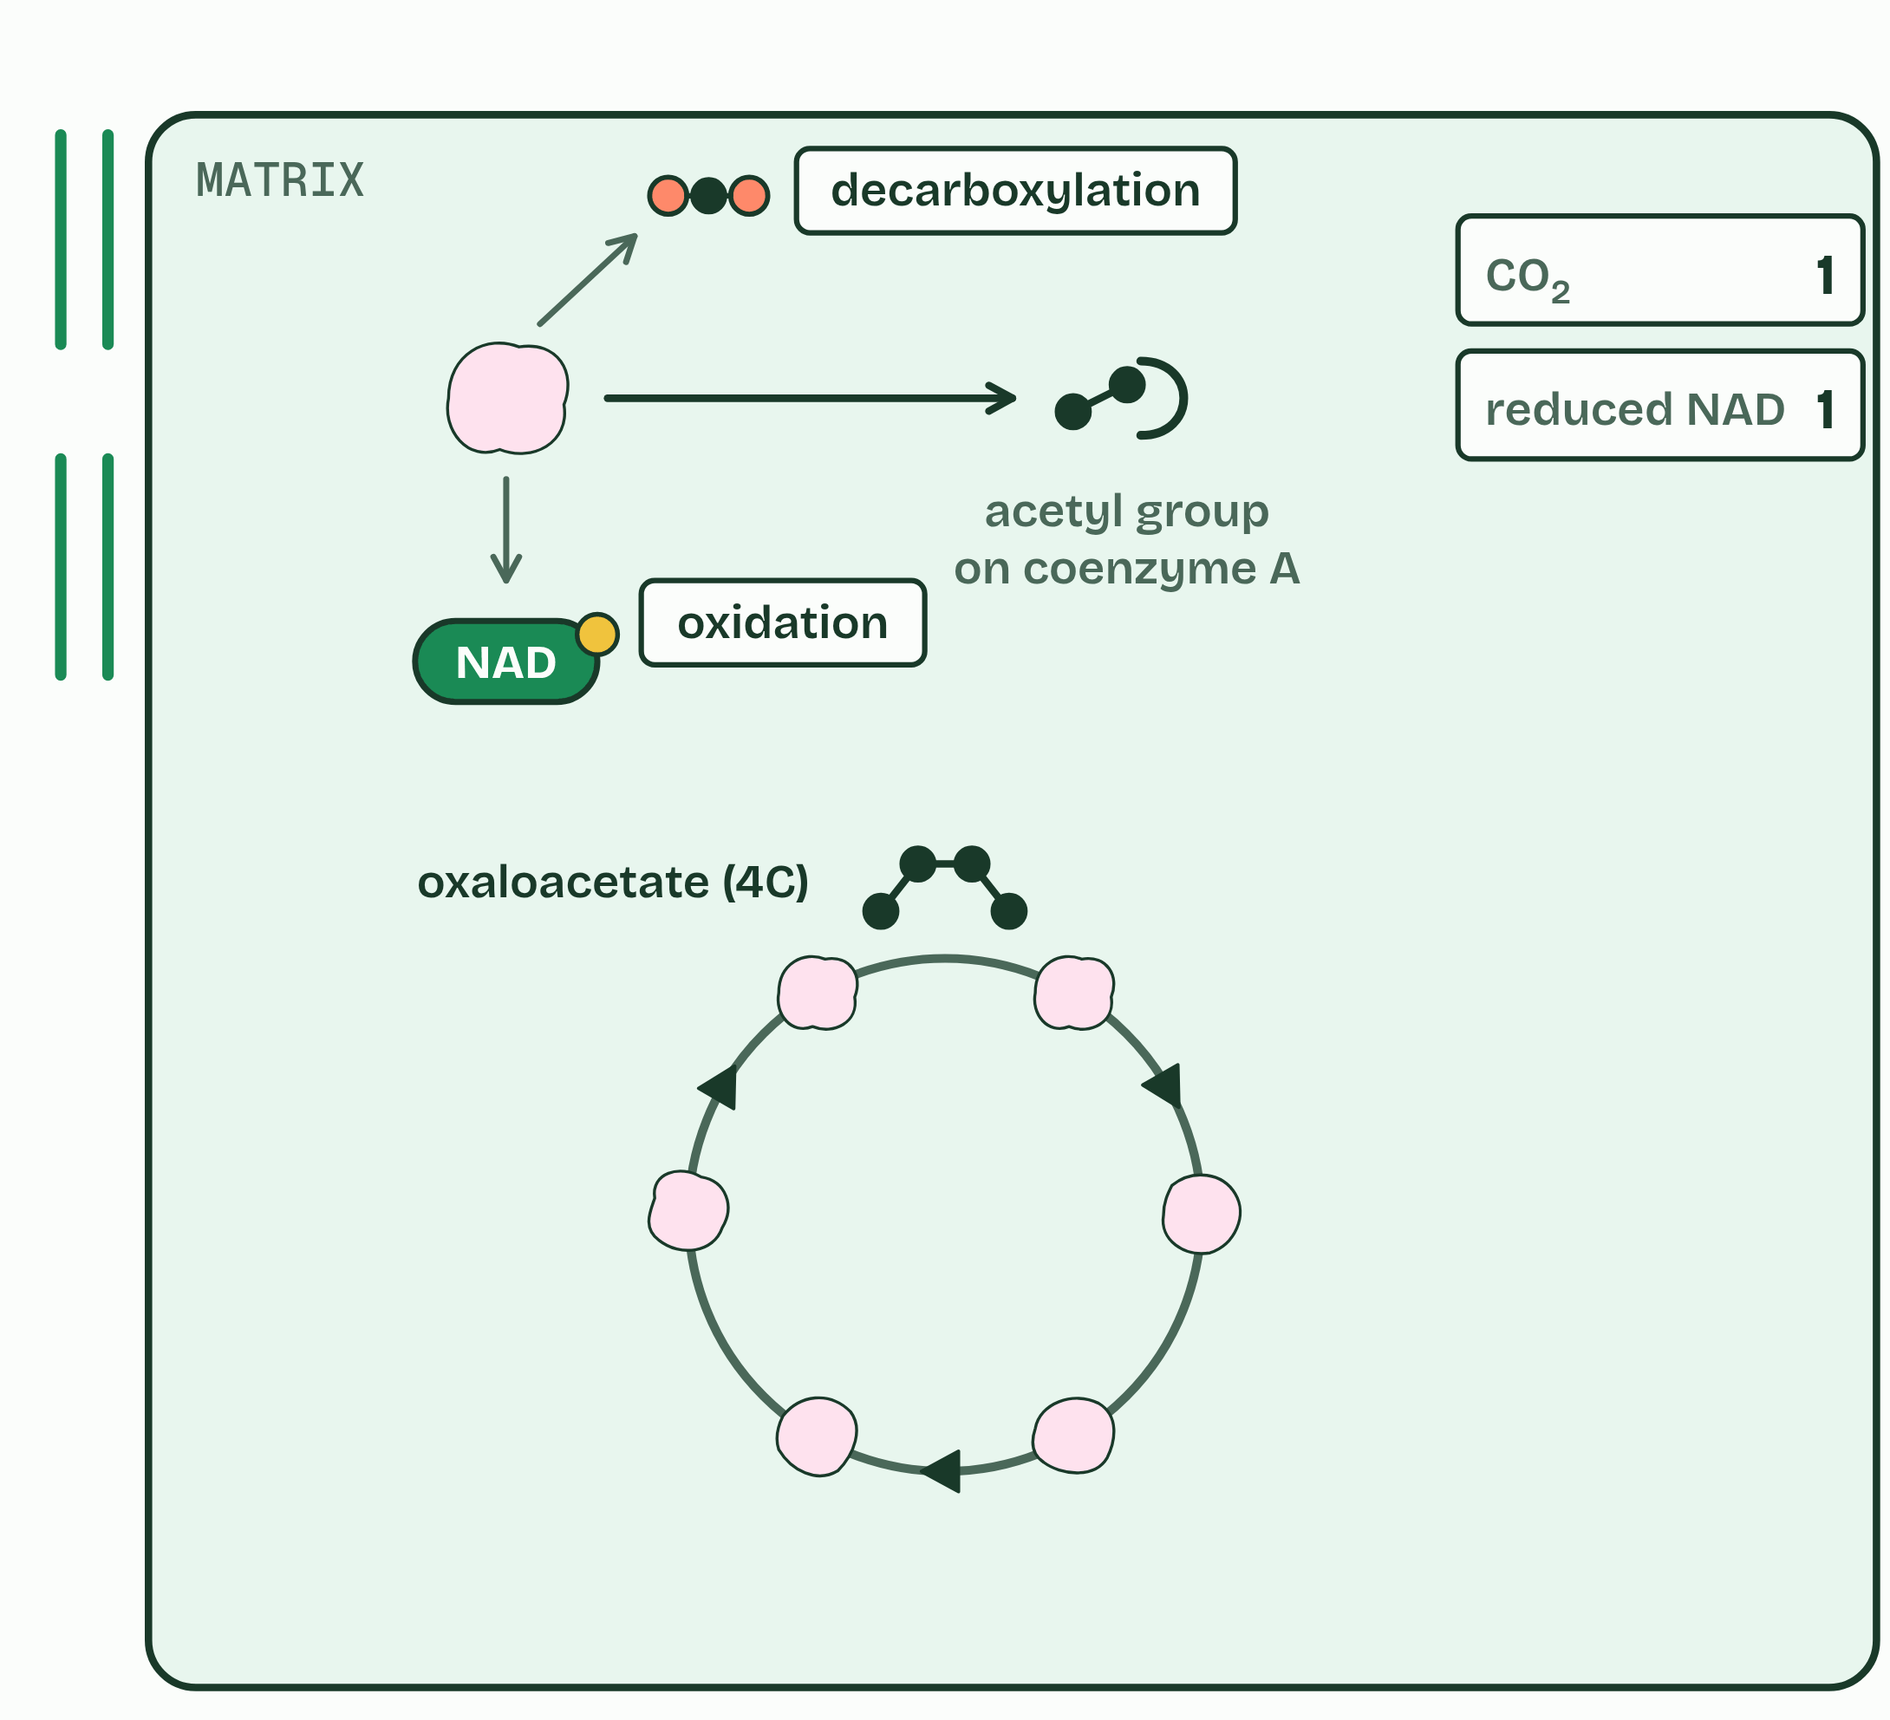
CHAPTER 9 · C1.2.11 C1.2.12 The link reaction, and the Krebs cycle
2 / 6
The carbon leaves as carbon dioxide
Link reaction: a carbon off as CO₂ (decarboxylation), hydrogen to NAD (oxidation). The acetyl group goes on with coenzyme A.
Minutes 5 to 15
Notes:
Minutes 5 to 15 of 60: The link reaction (10 min).
The plan: Chapter 9: students draw the link reaction from a written summary (activity below), then play the first two steps of the figure to check it.
With oxygen, pyruvate is carried from the cytoplasm into the matrix, the fluid inside the inner membrane of the mitochondrion. Two sets of reactions follow, one after the other.
The link reaction links glycolysis to the Krebs cycle. Each pyruvate (3C) is decarboxylated, which takes a carbon off as carbon dioxide, and oxidised: hydrogen is removed and accepted by NAD. The 2-carbon acetyl group that is left is picked up by coenzyme A and carried to the cycle. Fatty acids and other carbohydrates are also broken down to acetyl groups, which join the same route (chapter 12). All of this happens twice for each glucose, once for each pyruvate.
In the Krebs cycle, the acetyl group is transferred to oxaloacetate (4C) to make citrate (6C). Round the cycle the compound is oxidised four times, each a dehydrogenation: three load NAD, and one loads another carrier. One ATP is made. Then oxaloacetate is remade, ready for the next acetyl group, and the cycle turns twice for each glucose.
Glycolysis and the Krebs cycle sit beside the Calvin cycle on one map in C1.3.

Slide 7
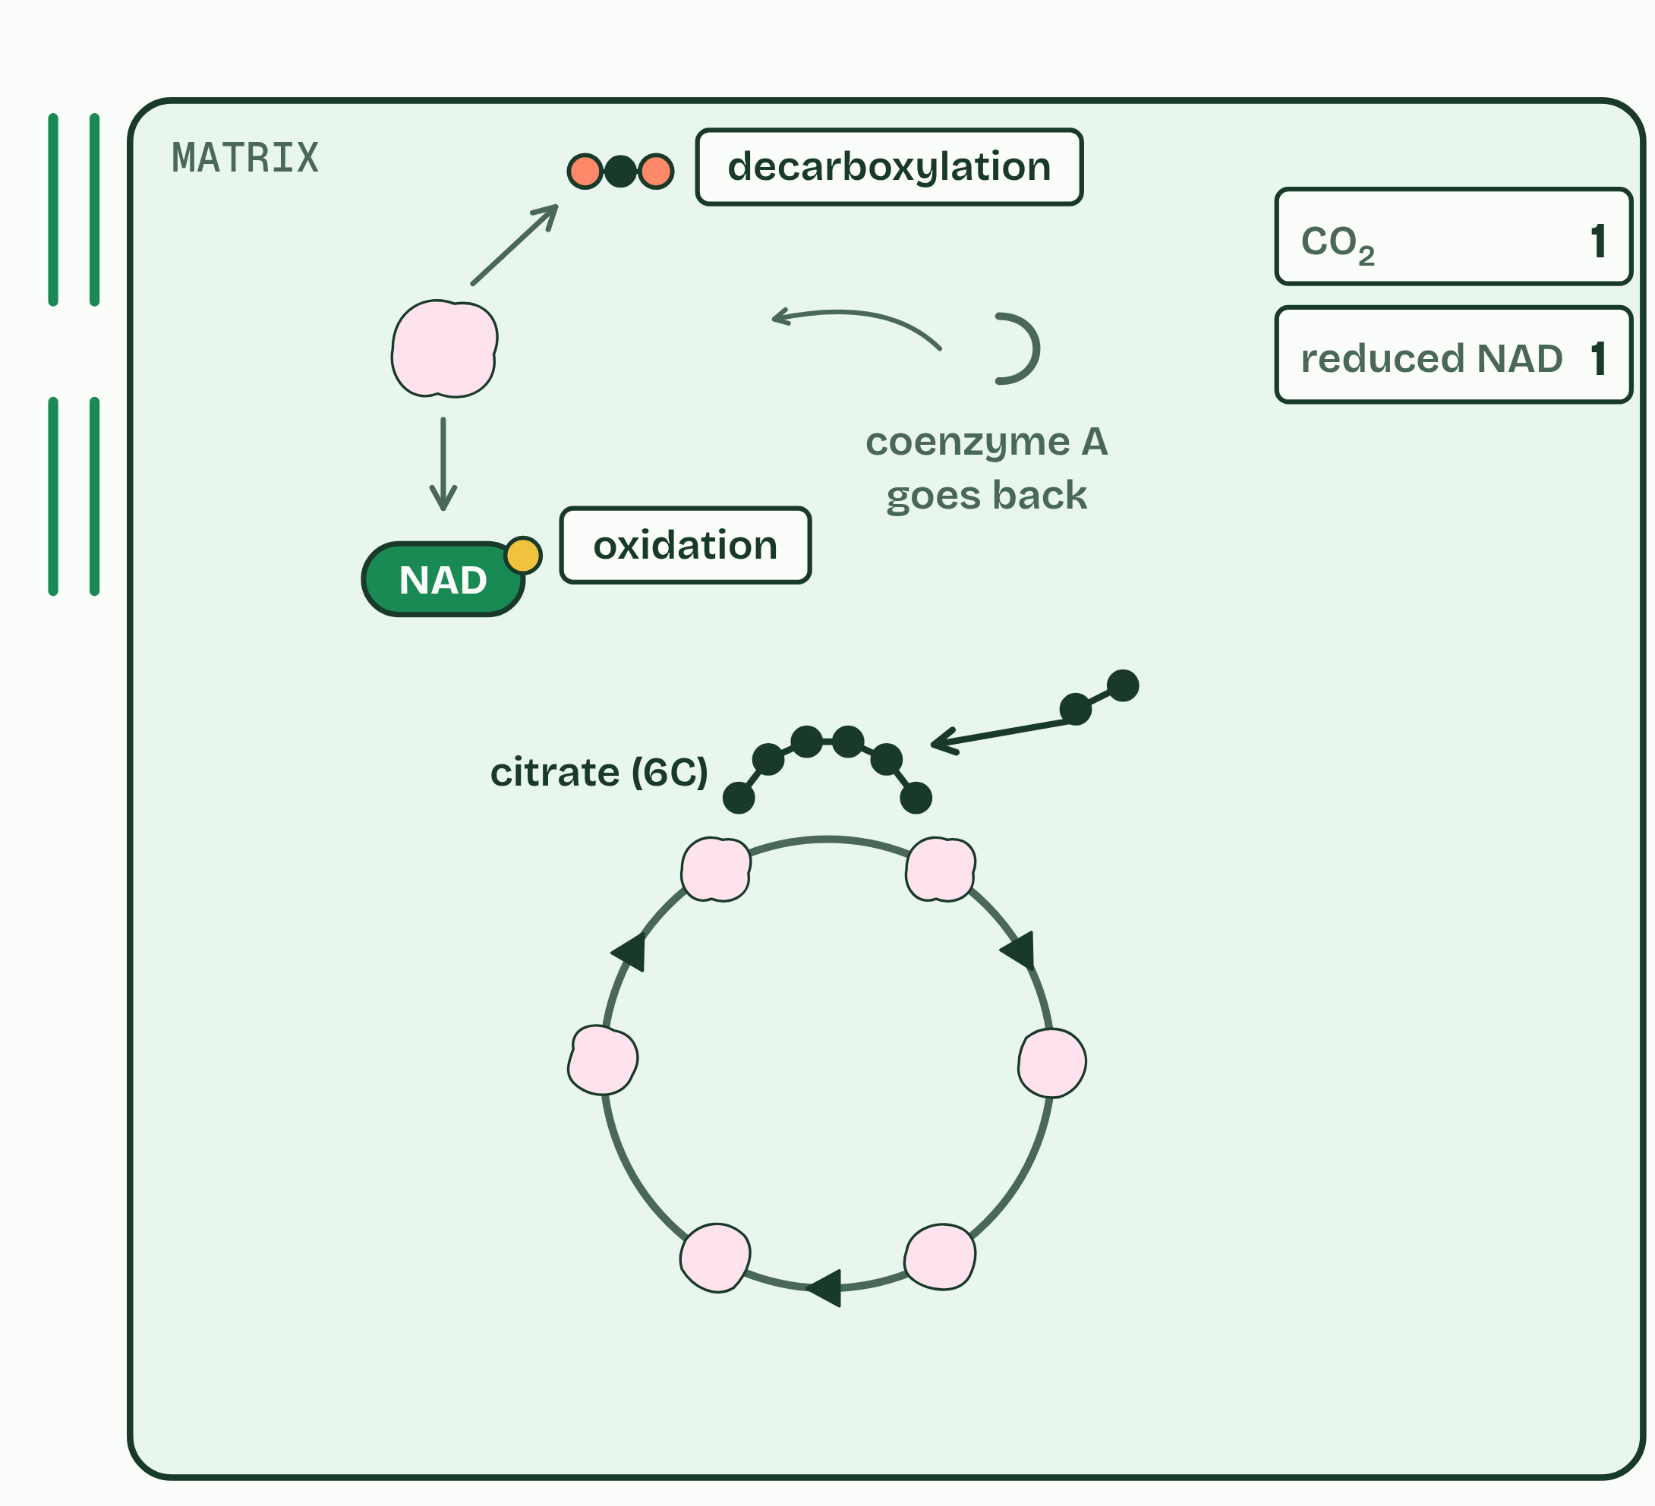
CHAPTER 9 · C1.2.11 C1.2.12 The link reaction, and the Krebs cycle
3 / 6
The carbon leaves as carbon dioxide
Acetyl (2C) + oxaloacetate (4C) → citrate (6C).
Minutes 5 to 15
Notes:
Minutes 5 to 15 of 60: The link reaction (10 min).
The plan: Chapter 9: students draw the link reaction from a written summary (activity below), then play the first two steps of the figure to check it.
With oxygen, pyruvate is carried from the cytoplasm into the matrix, the fluid inside the inner membrane of the mitochondrion. Two sets of reactions follow, one after the other.
The link reaction links glycolysis to the Krebs cycle. Each pyruvate (3C) is decarboxylated, which takes a carbon off as carbon dioxide, and oxidised: hydrogen is removed and accepted by NAD. The 2-carbon acetyl group that is left is picked up by coenzyme A and carried to the cycle. Fatty acids and other carbohydrates are also broken down to acetyl groups, which join the same route (chapter 12). All of this happens twice for each glucose, once for each pyruvate.
In the Krebs cycle, the acetyl group is transferred to oxaloacetate (4C) to make citrate (6C). Round the cycle the compound is oxidised four times, each a dehydrogenation: three load NAD, and one loads another carrier. One ATP is made. Then oxaloacetate is remade, ready for the next acetyl group, and the cycle turns twice for each glucose.
Glycolysis and the Krebs cycle sit beside the Calvin cycle on one map in C1.3.

Slide 8
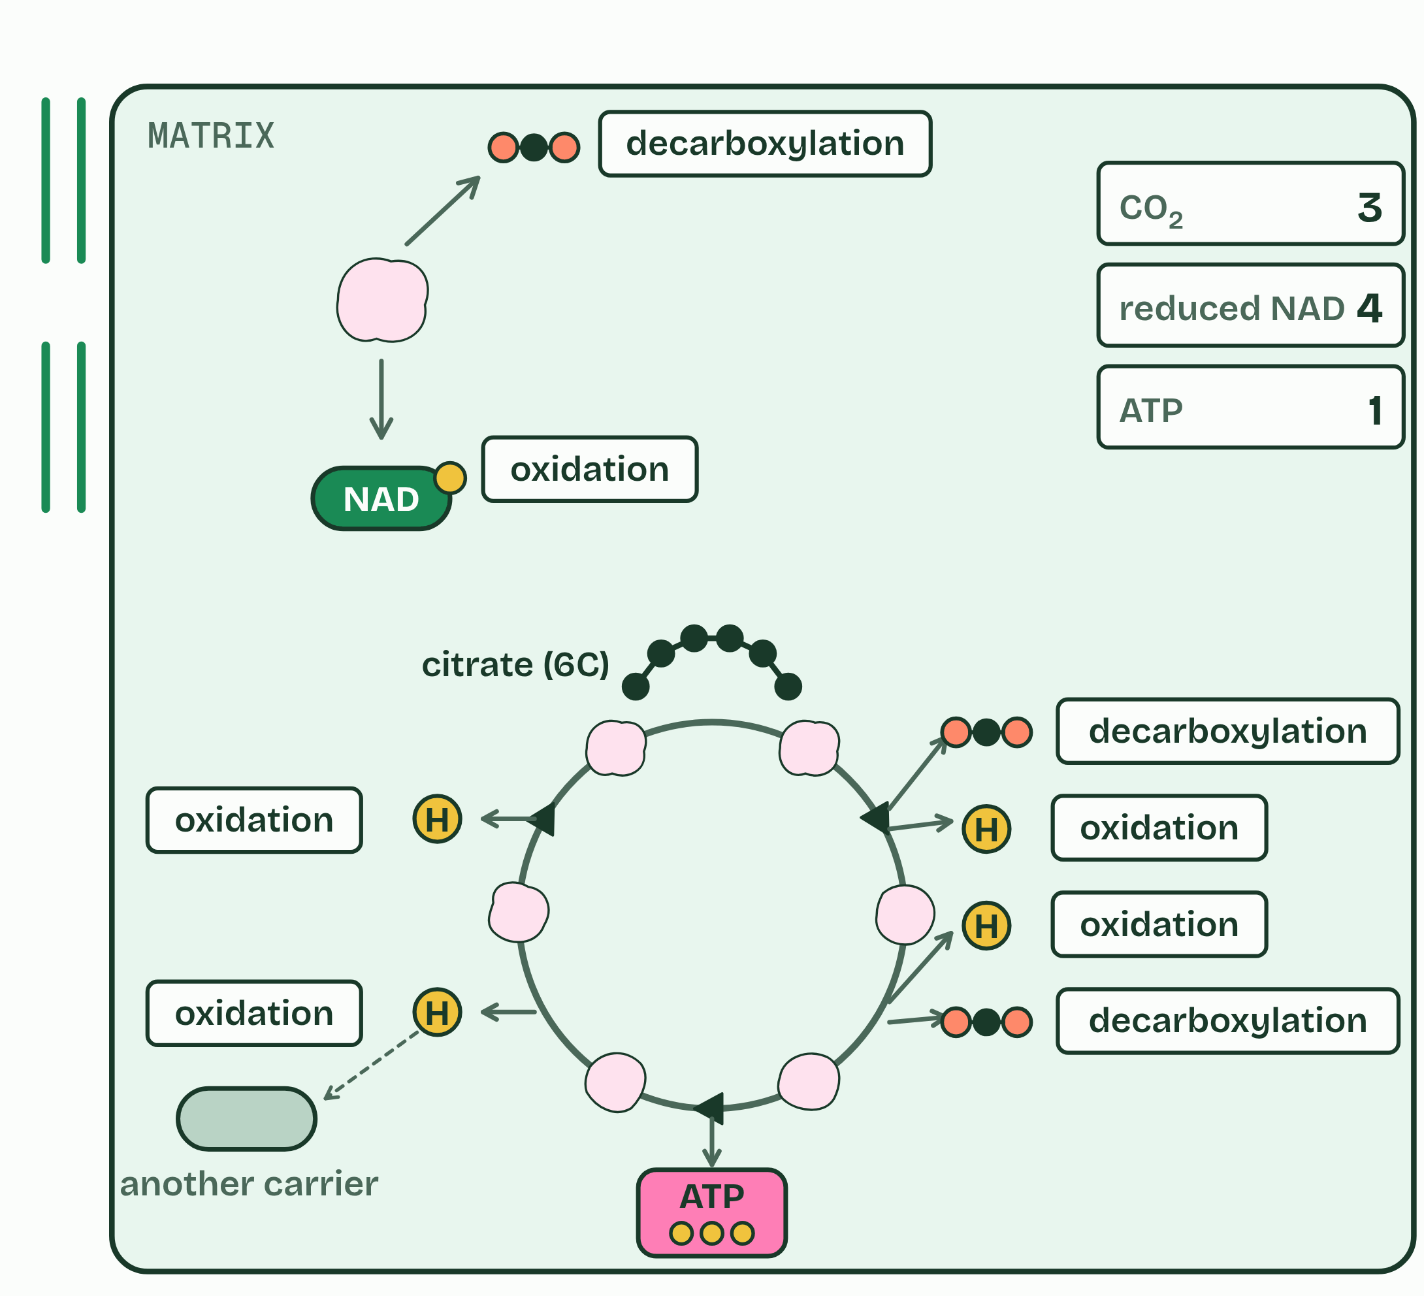
CHAPTER 9 · C1.2.11 C1.2.12 The link reaction, and the Krebs cycle
4 / 6
The carbon leaves as carbon dioxide
Two decarboxylations, four oxidations, one ATP.
Minutes 5 to 15
Notes:
Minutes 5 to 15 of 60: The link reaction (10 min).
The plan: Chapter 9: students draw the link reaction from a written summary (activity below), then play the first two steps of the figure to check it.
With oxygen, pyruvate is carried from the cytoplasm into the matrix, the fluid inside the inner membrane of the mitochondrion. Two sets of reactions follow, one after the other.
The link reaction links glycolysis to the Krebs cycle. Each pyruvate (3C) is decarboxylated, which takes a carbon off as carbon dioxide, and oxidised: hydrogen is removed and accepted by NAD. The 2-carbon acetyl group that is left is picked up by coenzyme A and carried to the cycle. Fatty acids and other carbohydrates are also broken down to acetyl groups, which join the same route (chapter 12). All of this happens twice for each glucose, once for each pyruvate.
In the Krebs cycle, the acetyl group is transferred to oxaloacetate (4C) to make citrate (6C). Round the cycle the compound is oxidised four times, each a dehydrogenation: three load NAD, and one loads another carrier. One ATP is made. Then oxaloacetate is remade, ready for the next acetyl group, and the cycle turns twice for each glucose.
Glycolysis and the Krebs cycle sit beside the Calvin cycle on one map in C1.3.

Slide 9
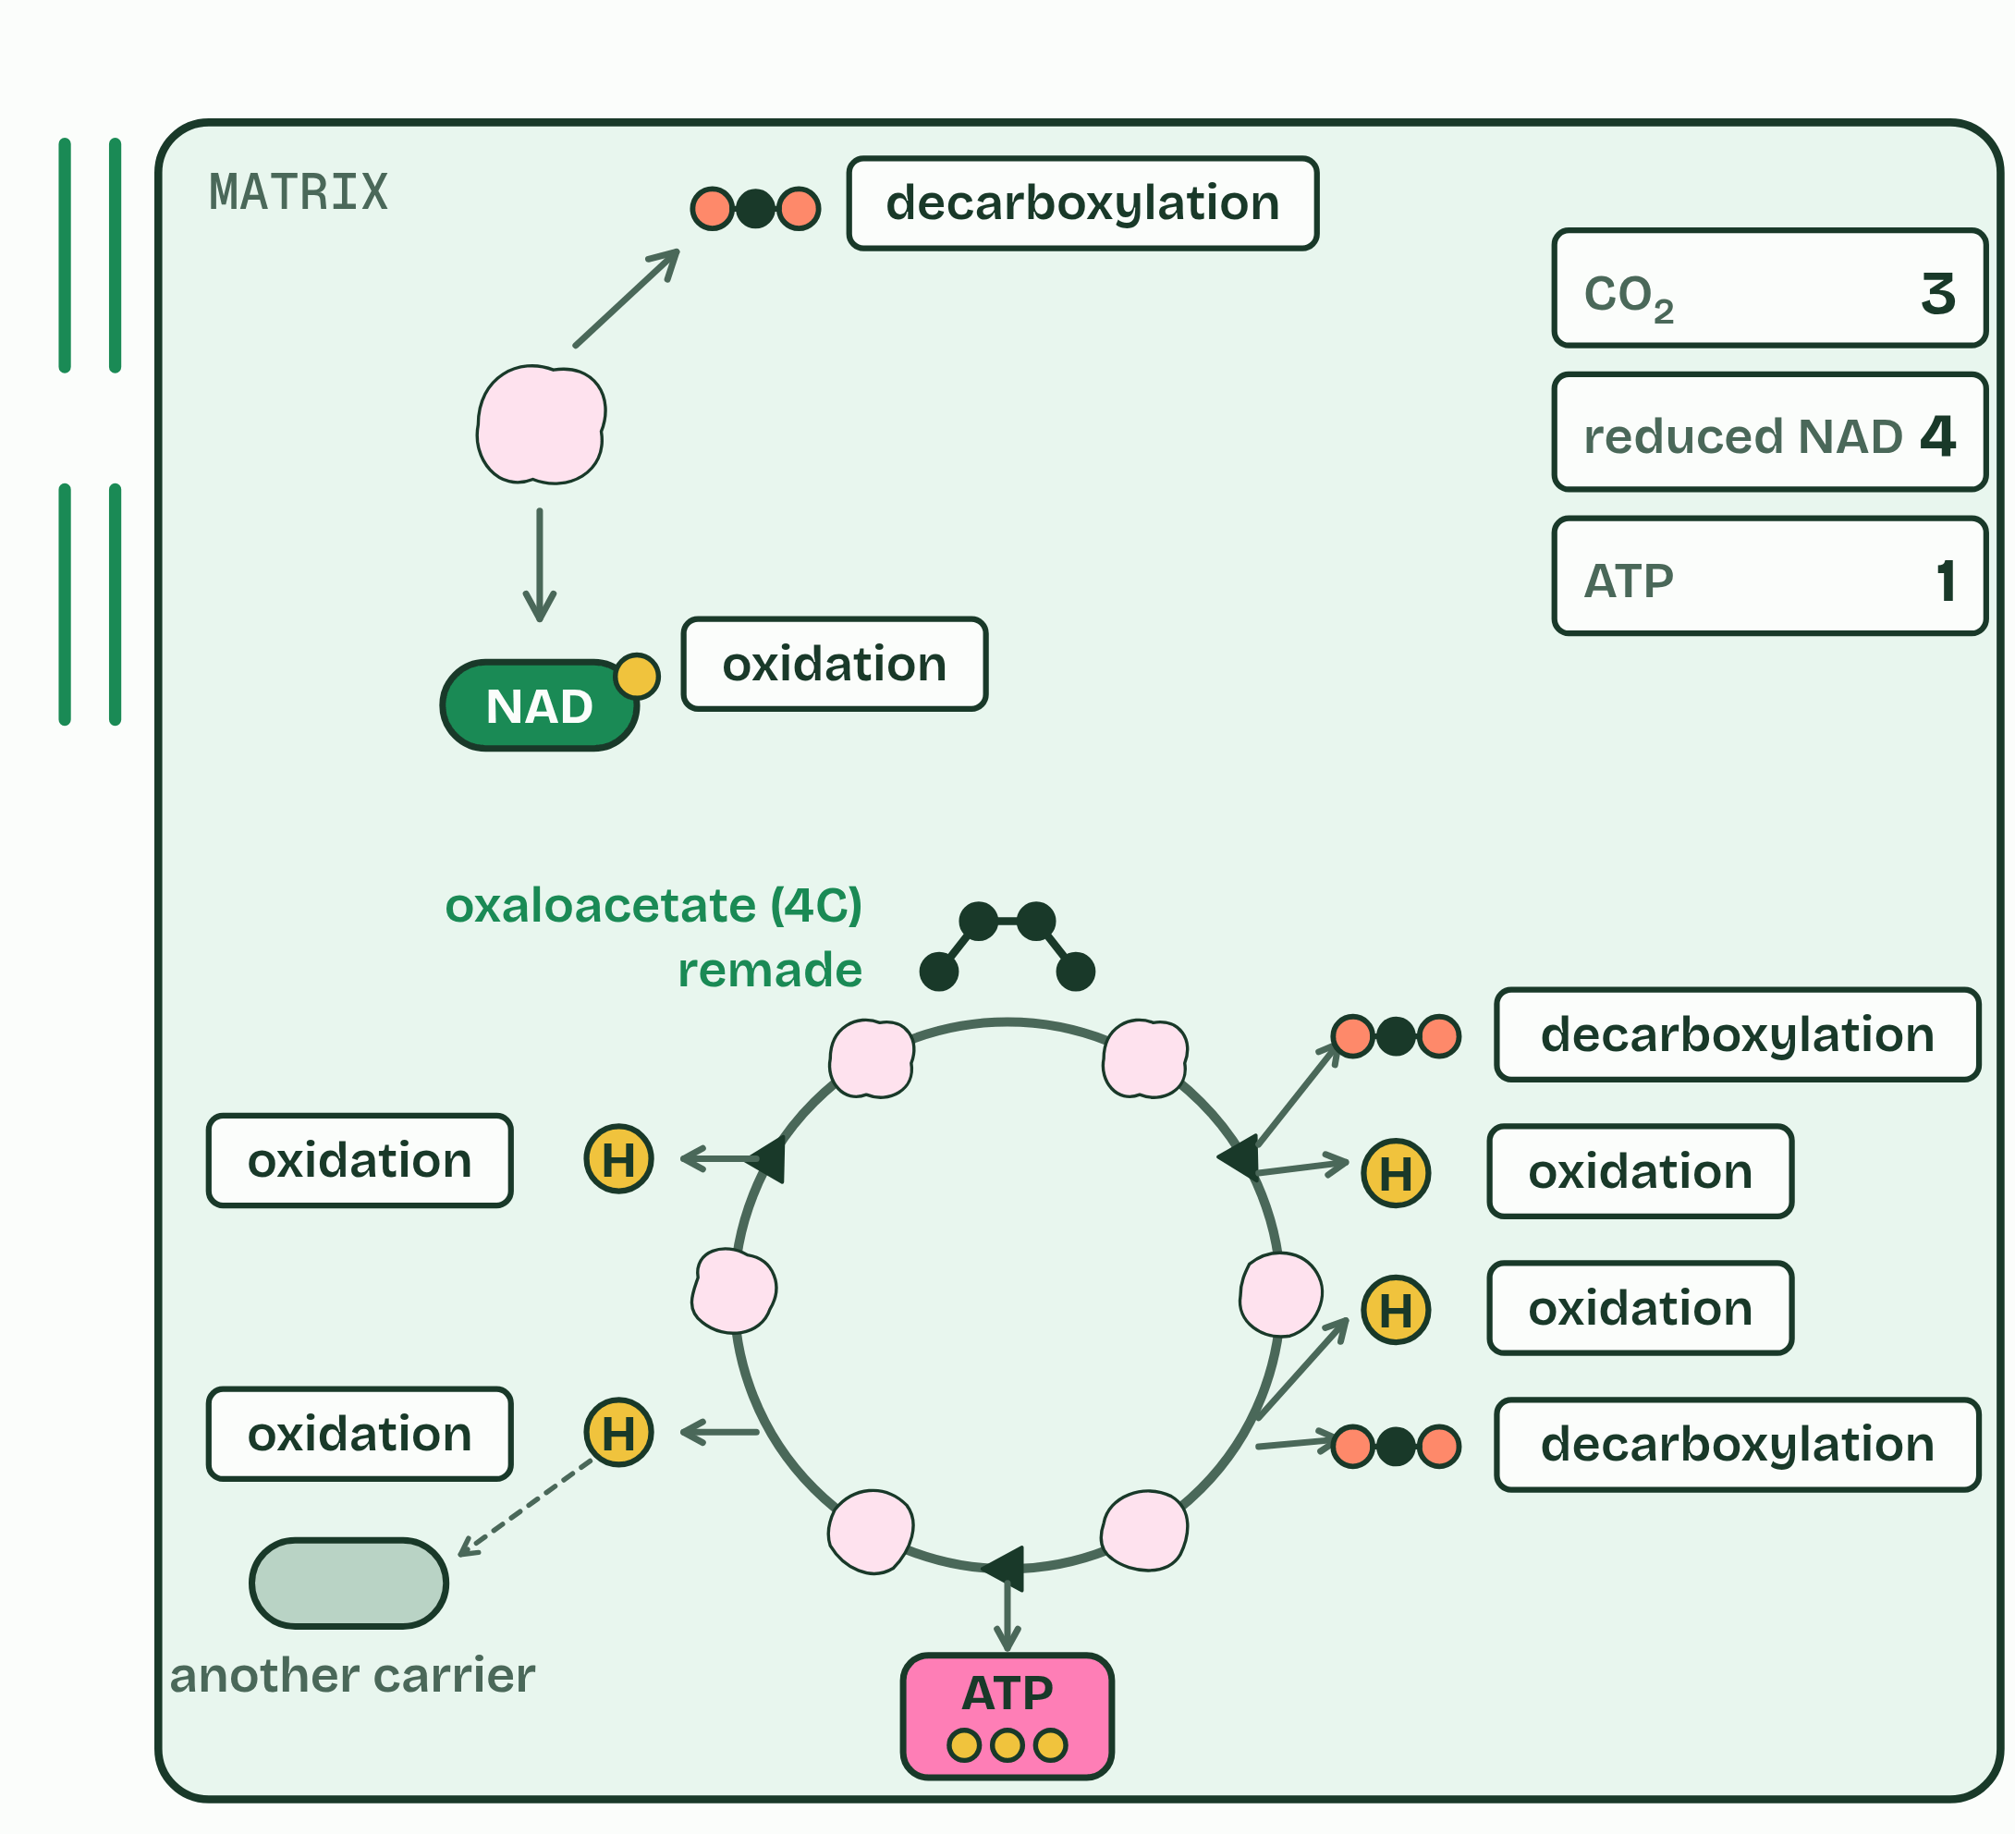
CHAPTER 9 · C1.2.11 C1.2.12 The link reaction, and the Krebs cycle
5 / 6
The carbon leaves as carbon dioxide
Oxaloacetate is remade: a cycle.
Minutes 5 to 15
Notes:
Minutes 5 to 15 of 60: The link reaction (10 min).
The plan: Chapter 9: students draw the link reaction from a written summary (activity below), then play the first two steps of the figure to check it.
With oxygen, pyruvate is carried from the cytoplasm into the matrix, the fluid inside the inner membrane of the mitochondrion. Two sets of reactions follow, one after the other.
The link reaction links glycolysis to the Krebs cycle. Each pyruvate (3C) is decarboxylated, which takes a carbon off as carbon dioxide, and oxidised: hydrogen is removed and accepted by NAD. The 2-carbon acetyl group that is left is picked up by coenzyme A and carried to the cycle. Fatty acids and other carbohydrates are also broken down to acetyl groups, which join the same route (chapter 12). All of this happens twice for each glucose, once for each pyruvate.
In the Krebs cycle, the acetyl group is transferred to oxaloacetate (4C) to make citrate (6C). Round the cycle the compound is oxidised four times, each a dehydrogenation: three load NAD, and one loads another carrier. One ATP is made. Then oxaloacetate is remade, ready for the next acetyl group, and the cycle turns twice for each glucose.
Glycolysis and the Krebs cycle sit beside the Calvin cycle on one map in C1.3.

Slide 10
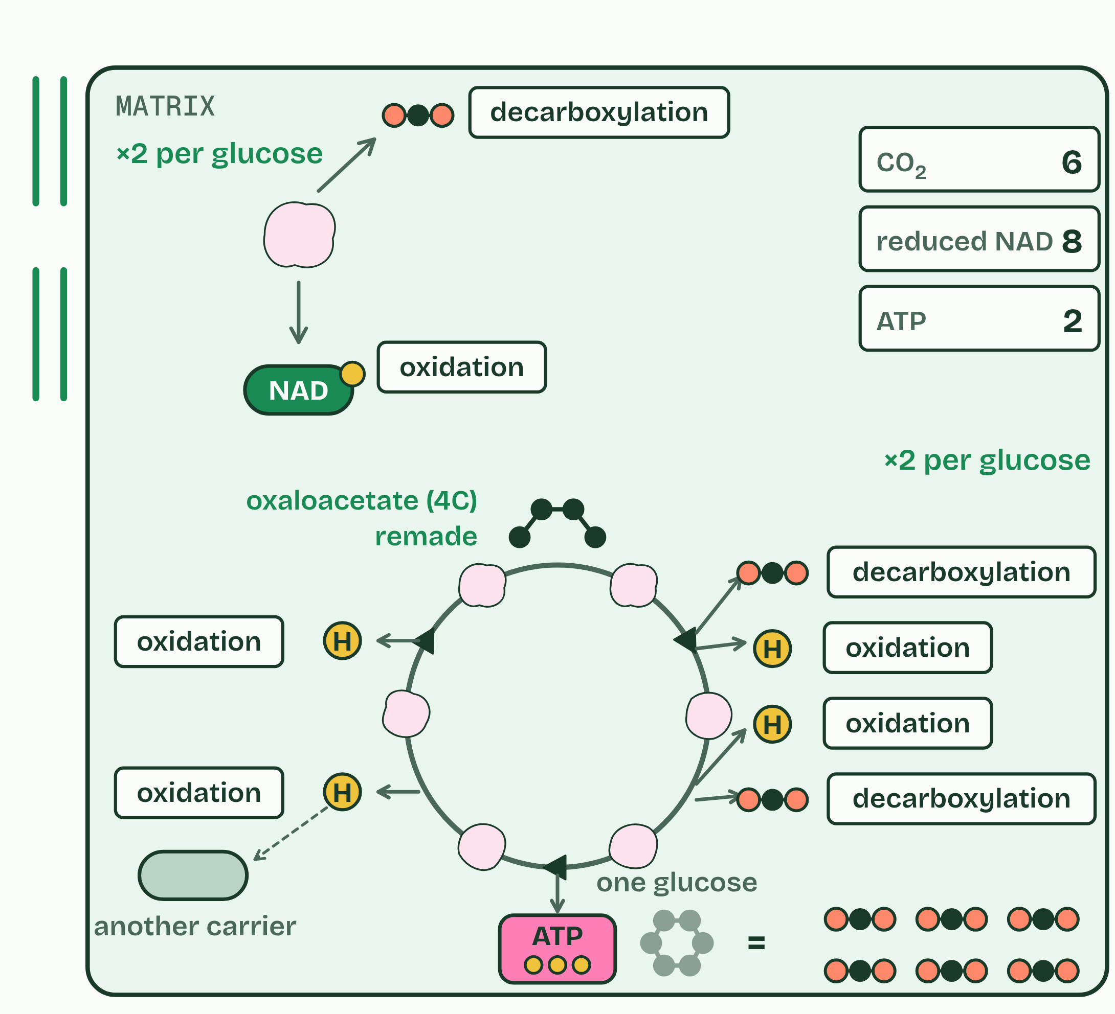
CHAPTER 9 · C1.2.11 C1.2.12 The link reaction, and the Krebs cycle
6 / 6
The carbon leaves as carbon dioxide
Two turns per glucose: all six carbons gone as CO₂.
Minutes 5 to 15
Notes:
Minutes 5 to 15 of 60: The link reaction (10 min).
The plan: Chapter 9: students draw the link reaction from a written summary (activity below), then play the first two steps of the figure to check it.
With oxygen, pyruvate is carried from the cytoplasm into the matrix, the fluid inside the inner membrane of the mitochondrion. Two sets of reactions follow, one after the other.
The link reaction links glycolysis to the Krebs cycle. Each pyruvate (3C) is decarboxylated, which takes a carbon off as carbon dioxide, and oxidised: hydrogen is removed and accepted by NAD. The 2-carbon acetyl group that is left is picked up by coenzyme A and carried to the cycle. Fatty acids and other carbohydrates are also broken down to acetyl groups, which join the same route (chapter 12). All of this happens twice for each glucose, once for each pyruvate.
In the Krebs cycle, the acetyl group is transferred to oxaloacetate (4C) to make citrate (6C). Round the cycle the compound is oxidised four times, each a dehydrogenation: three load NAD, and one loads another carrier. One ATP is made. Then oxaloacetate is remade, ready for the next acetyl group, and the cycle turns twice for each glucose.
Glycolysis and the Krebs cycle sit beside the Calvin cycle on one map in C1.3.

Slide 11
CHAPTER 9 · C1.2.11 C1.2.12 The link reaction, and the Krebs cycle
The carbon leaves as carbon dioxide
With oxygen, pyruvate is carried from the cytoplasm into the matrix, the fluid inside the inner membrane of the mitochondrion.
The link reaction links glycolysis to the Krebs cycle.
Each pyruvate (3C) is decarboxylated, which takes a carbon off as carbon dioxide, and oxidised: hydrogen is removed and accepted by NAD.
The 2-carbon acetyl group that is left is picked up by coenzyme A and carried to the cycle.
Minutes 5 to 15
Notes:
Minutes 5 to 15 of 60: The link reaction (10 min).
The plan: Chapter 9: students draw the link reaction from a written summary (activity below), then play the first two steps of the figure to check it.
With oxygen, pyruvate is carried from the cytoplasm into the matrix, the fluid inside the inner membrane of the mitochondrion. Two sets of reactions follow, one after the other.
The link reaction links glycolysis to the Krebs cycle. Each pyruvate (3C) is decarboxylated, which takes a carbon off as carbon dioxide, and oxidised: hydrogen is removed and accepted by NAD. The 2-carbon acetyl group that is left is picked up by coenzyme A and carried to the cycle. Fatty acids and other carbohydrates are also broken down to acetyl groups, which join the same route (chapter 12). All of this happens twice for each glucose, once for each pyruvate.
In the Krebs cycle, the acetyl group is transferred to oxaloacetate (4C) to make citrate (6C). Round the cycle the compound is oxidised four times, each a dehydrogenation: three load NAD, and one loads another carrier. One ATP is made. Then oxaloacetate is remade, ready for the next acetyl group, and the cycle turns twice for each glucose.
Glycolysis and the Krebs cycle sit beside the Calvin cycle on one map in C1.3.

Slide 12
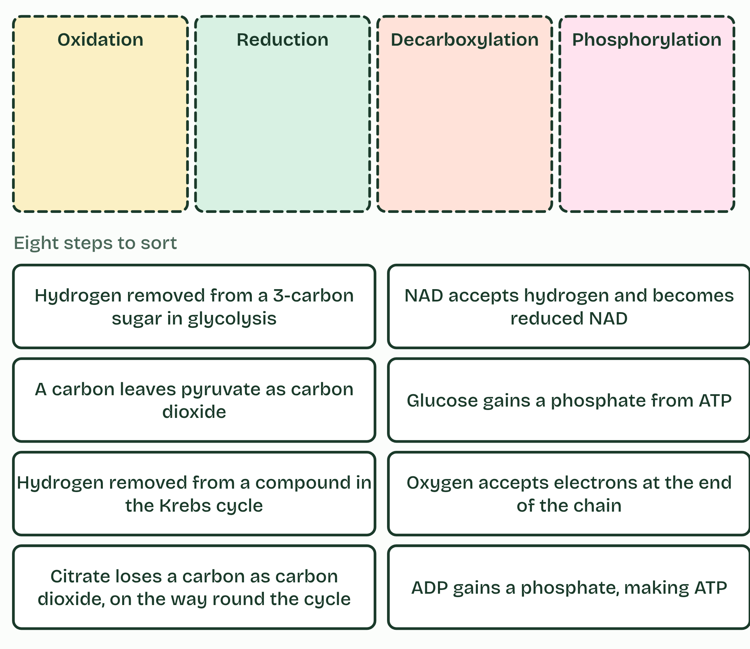
CHAPTER 9 · C1.2.11 C1.2.12 The link reaction, and the Krebs cycle
The carbon leaves as carbon dioxide
With oxygen, pyruvate is carried from the cytoplasm into the matrix, the fluid inside the inner membrane of the mitochondrion.
The link reaction links glycolysis to the Krebs cycle.
Each pyruvate (3C) is decarboxylated, which takes a carbon off as carbon dioxide, and oxidised: hydrogen is removed and accepted by NAD.
The 2-carbon acetyl group that is left is picked up by coenzyme A and carried to the cycle.
Minutes 5 to 15
Notes:
Minutes 5 to 15 of 60: The link reaction (10 min).
The plan: Chapter 9: students draw the link reaction from a written summary (activity below), then play the first two steps of the figure to check it.
With oxygen, pyruvate is carried from the cytoplasm into the matrix, the fluid inside the inner membrane of the mitochondrion. Two sets of reactions follow, one after the other.
The link reaction links glycolysis to the Krebs cycle. Each pyruvate (3C) is decarboxylated, which takes a carbon off as carbon dioxide, and oxidised: hydrogen is removed and accepted by NAD. The 2-carbon acetyl group that is left is picked up by coenzyme A and carried to the cycle. Fatty acids and other carbohydrates are also broken down to acetyl groups, which join the same route (chapter 12). All of this happens twice for each glucose, once for each pyruvate.
In the Krebs cycle, the acetyl group is transferred to oxaloacetate (4C) to make citrate (6C). Round the cycle the compound is oxidised four times, each a dehydrogenation: three load NAD, and one loads another carrier. One ATP is made. Then oxaloacetate is remade, ready for the next acetyl group, and the cycle turns twice for each glucose.
Glycolysis and the Krebs cycle sit beside the Calvin cycle on one map in C1.3.

Slide 13
PREDICT
Each turn of the Krebs cycle takes in a 2-carbon acetyl group. Why does the cycle not fill up with carbon?
A The carbons are kept, stored in the matrix as citrate
B Two carbons leave as carbon dioxide each turn
C The acetyl carbons are turned into ATP
D Oxaloacetate takes the carbons out of the mitochondrion
Minutes 5 to 15
Notes:
Minutes 5 to 15 of 60: The link reaction (10 min).
The plan: Chapter 9: students draw the link reaction from a written summary (activity below), then play the first two steps of the figure to check it.
Ask for a show of hands, or mini whiteboards, before revealing. (Answer: B, on the next slide.)

Slide 14
WHAT HAPPENS
Each turn of the Krebs cycle takes in a 2-carbon acetyl group. Why does the cycle not fill up with carbon?
A The carbons are kept, stored in the matrix as citrate
B Two carbons leave as carbon dioxide each turn
C The acetyl carbons are turned into ATP
D Oxaloacetate takes the carbons out of the mitochondrion
Two carbons leave as carbon dioxide in every turn, in the two decarboxylations, and the cycle ends where it started, with the 4-carbon oxaloacetate. Two carbons in, two out: this is where most of the carbon dioxide you breathe out is made. Count the carbons: glucose has 6; two leave as carbon dioxide in the link reactions and four in the two turns of the cycle, so all six are gone. The carriers, not the ATP, are the main product so far: per glucose the cycle makes only 2 ATP, and the chain turns the reduced NAD into most of the ATP (chapters 10 and 11).
Minutes 5 to 15
Notes:
Minutes 5 to 15 of 60: The link reaction (10 min).
The plan: Chapter 9: students draw the link reaction from a written summary (activity below), then play the first two steps of the figure to check it.
Answer: B. Two carbons leave as carbon dioxide in every turn, in the two decarboxylations, and the cycle ends where it started, with the 4-carbon oxaloacetate. Two carbons in, two out: this is where most of the carbon dioxide you breathe out is made. Count the carbons: glucose has 6; two leave as carbon dioxide in the link reactions and four in the two turns of the cycle, so all six are gone. The carriers, not the ATP, are the main product so far: per glucose the cycle makes only 2 ATP, and the chain turns the reduced NAD into most of the ATP (chapters 10 and 11).

Slide 15
WATCH OUT
The Krebs cycle makes little ATP directly, only one a turn. Its main product is reduced NAD, which the chain turns into most of the ATP.
Minutes 5 to 15
Notes:
Minutes 5 to 15 of 60: The link reaction (10 min).
The plan: Chapter 9: students draw the link reaction from a written summary (activity below), then play the first two steps of the figure to check it.
A common mistake: say it, then ask who can say why it is wrong.

Slide 16
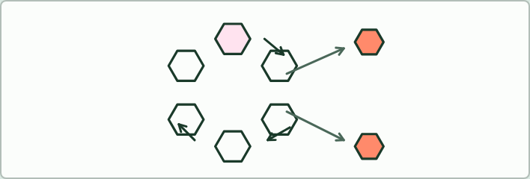
CARD MODEL · HL
15 MIN
Build the Krebs cycle
THE TASK
Hexagon cards to arrange in a ring: acetyl group (2C), oxaloacetate (4C), citrate (6C), decarboxylation (twice), oxidation (four times) and ATP, with arrows drawn between them. The rule: only citrate and oxaloacetate are named.
STUDENTS NEED
Printed hexagon sets, A3 paper.
Minutes 15 to 30
Notes:
Minutes 15 to 30 of 60: Build the Krebs cycle (15 min).
The plan: Pairs build the cycle with hexagon cards (below), then play the rest of chapter 9’s figure and make its predict. Count the carbons out loud.
The activity: Build the Krebs cycle. Hexagon cards to arrange in a ring: acetyl group (2C), oxaloacetate (4C), citrate (6C), decarboxylation (twice), oxidation (four times) and ATP, with arrows drawn between them. The rule: only citrate and oxaloacetate are named.
Needs: printed hexagon sets, A3 paper.
The time: 15 minutes, minutes 15 to 30 of the plan.

Slide 17
STEP 4
8 MIN
Name the reaction
Chapter 9’s sorter in pairs, then on the board for the two cards most argued over.
Minutes 30 to 38
Notes:
Minutes 30 to 38 of 60: Name the reaction (8 min).
The plan: Chapter 9’s sorter in pairs, then on the board for the two cards most argued over.

Slide 18
STEP 5
17 MIN
Fat or sugar?
Chapter 12: Fat or sugar?
Calculation: Count the oxygen
Minutes 38 to 55
Notes:
Minutes 38 to 55 of 60: Fat or sugar? (17 min).
The plan: Chapter 12: the predict, then Count the oxygen (below), then the figure’s two settings. The chain is lesson 5, so here say only that fat enters at the Krebs cycle, which runs only while oxygen is there; the chapter’s watch-out is read again in lesson 5.

Slide 19
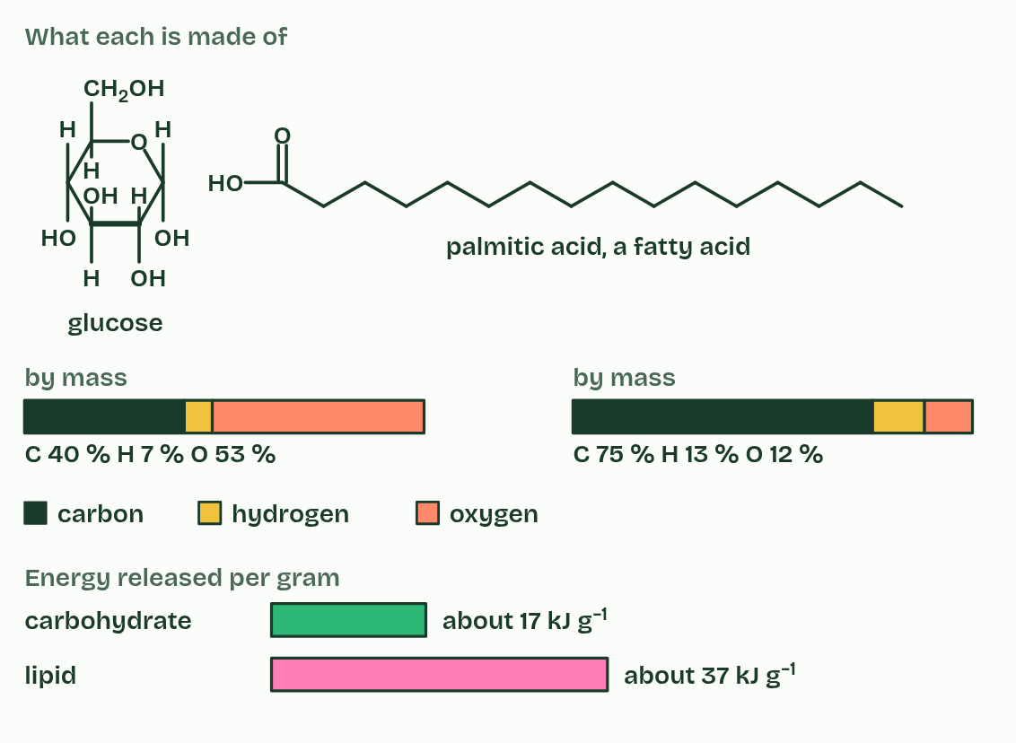
CHAPTER 12 · C1.2.17 Differences between lipids and carbohydrates as respiratory substrates
1 / 2
Fat or sugar?
What is in them
Minutes 38 to 55
Notes:
Minutes 38 to 55 of 60: Fat or sugar? (17 min).
The plan: Chapter 12: the predict, then Count the oxygen (below), then the figure’s two settings. The chain is lesson 5, so here say only that fat enters at the Krebs cycle, which runs only while oxygen is there; the chapter’s watch-out is read again in lesson 5.
Glucose and fatty acids are the two main fuels, and they are not equal. Lipids release about twice as much energy per gram as carbohydrates when they are respired: about 37 kJ in each gram against about 17.
They also take different routes. Carbohydrate goes through glycolysis, so it can be respired with oxygen or without. A fatty acid is cut into 2-carbon acetyl groups, which enter the Krebs cycle at once as acetyl CoA (acetyl coenzyme A). Glycolysis is the one stage that works without oxygen, and a fatty acid never goes through it: no oxygen, no use for fat.
In practice, muscles use fat for long, steady work, such as walking, a gentle jog or a migrating bird in flight, and carbohydrate for hard, fast work, when oxygen is short. That is why fat is the long-term store and glycogen the quick one (B1.1).

Slide 20
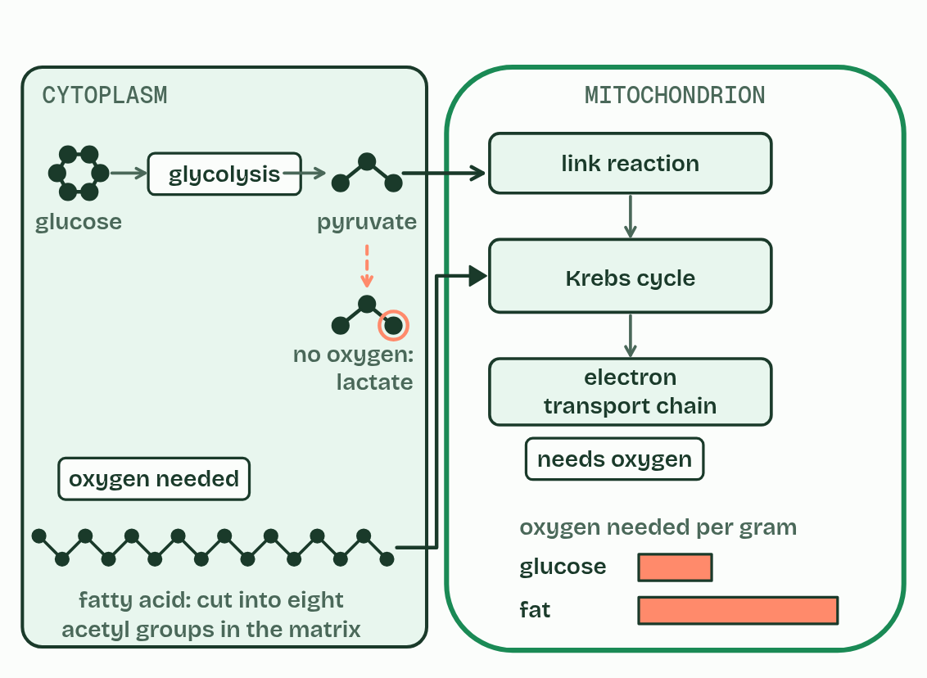
CHAPTER 12 · C1.2.17 Differences between lipids and carbohydrates as respiratory substrates
2 / 2
Fat or sugar?
How they are respired
Minutes 38 to 55
Notes:
Minutes 38 to 55 of 60: Fat or sugar? (17 min).
The plan: Chapter 12: the predict, then Count the oxygen (below), then the figure’s two settings. The chain is lesson 5, so here say only that fat enters at the Krebs cycle, which runs only while oxygen is there; the chapter’s watch-out is read again in lesson 5.
Glucose and fatty acids are the two main fuels, and they are not equal. Lipids release about twice as much energy per gram as carbohydrates when they are respired: about 37 kJ in each gram against about 17.
They also take different routes. Carbohydrate goes through glycolysis, so it can be respired with oxygen or without. A fatty acid is cut into 2-carbon acetyl groups, which enter the Krebs cycle at once as acetyl CoA (acetyl coenzyme A). Glycolysis is the one stage that works without oxygen, and a fatty acid never goes through it: no oxygen, no use for fat.
In practice, muscles use fat for long, steady work, such as walking, a gentle jog or a migrating bird in flight, and carbohydrate for hard, fast work, when oxygen is short. That is why fat is the long-term store and glycogen the quick one (B1.1).

Slide 21
CHAPTER 12 · C1.2.17 Differences between lipids and carbohydrates as respiratory substrates
Fat or sugar?
Lipids release about twice as much energy per gram as carbohydrates when they are respired: about 37 kJ in each gram against about 17.
A fatty acid is cut into 2-carbon acetyl groups, which enter the Krebs cycle at once as acetyl CoA (acetyl coenzyme A).
In practice, muscles use fat for long, steady work, such as walking, a gentle jog or a migrating bird in flight, and carbohydrate for hard, fast work, when oxygen is short.
Minutes 38 to 55
Notes:
Minutes 38 to 55 of 60: Fat or sugar? (17 min).
The plan: Chapter 12: the predict, then Count the oxygen (below), then the figure’s two settings. The chain is lesson 5, so here say only that fat enters at the Krebs cycle, which runs only while oxygen is there; the chapter’s watch-out is read again in lesson 5.
Glucose and fatty acids are the two main fuels, and they are not equal. Lipids release about twice as much energy per gram as carbohydrates when they are respired: about 37 kJ in each gram against about 17.
They also take different routes. Carbohydrate goes through glycolysis, so it can be respired with oxygen or without. A fatty acid is cut into 2-carbon acetyl groups, which enter the Krebs cycle at once as acetyl CoA (acetyl coenzyme A). Glycolysis is the one stage that works without oxygen, and a fatty acid never goes through it: no oxygen, no use for fat.
In practice, muscles use fat for long, steady work, such as walking, a gentle jog or a migrating bird in flight, and carbohydrate for hard, fast work, when oxygen is short. That is why fat is the long-term store and glycogen the quick one (B1.1).

Slide 22
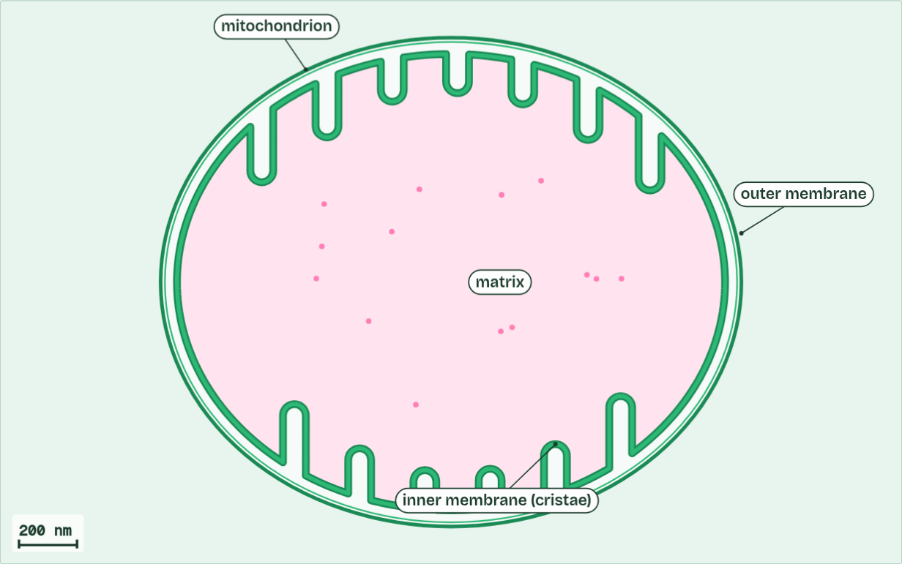
CHAPTER 12 · C1.2.17 Differences between lipids and carbohydrates as respiratory substrates
ATP net 0
1 / 6
Fat or sugar?
Inside a muscle fibre, one mitochondrion: the folded inner membrane (cristae), the matrix inside it.
Minutes 38 to 55
Notes:
Minutes 38 to 55 of 60: Fat or sugar? (17 min).
The plan: Chapter 12: the predict, then Count the oxygen (below), then the figure’s two settings. The chain is lesson 5, so here say only that fat enters at the Krebs cycle, which runs only while oxygen is there; the chapter’s watch-out is read again in lesson 5.
Glucose and fatty acids are the two main fuels, and they are not equal. Lipids release about twice as much energy per gram as carbohydrates when they are respired: about 37 kJ in each gram against about 17.
They also take different routes. Carbohydrate goes through glycolysis, so it can be respired with oxygen or without. A fatty acid is cut into 2-carbon acetyl groups, which enter the Krebs cycle at once as acetyl CoA (acetyl coenzyme A). Glycolysis is the one stage that works without oxygen, and a fatty acid never goes through it: no oxygen, no use for fat.
In practice, muscles use fat for long, steady work, such as walking, a gentle jog or a migrating bird in flight, and carbohydrate for hard, fast work, when oxygen is short. That is why fat is the long-term store and glycogen the quick one (B1.1).
The animation "The whole journey", paused at 5.9 s. The next slides go on through it, then play it.

Slide 23
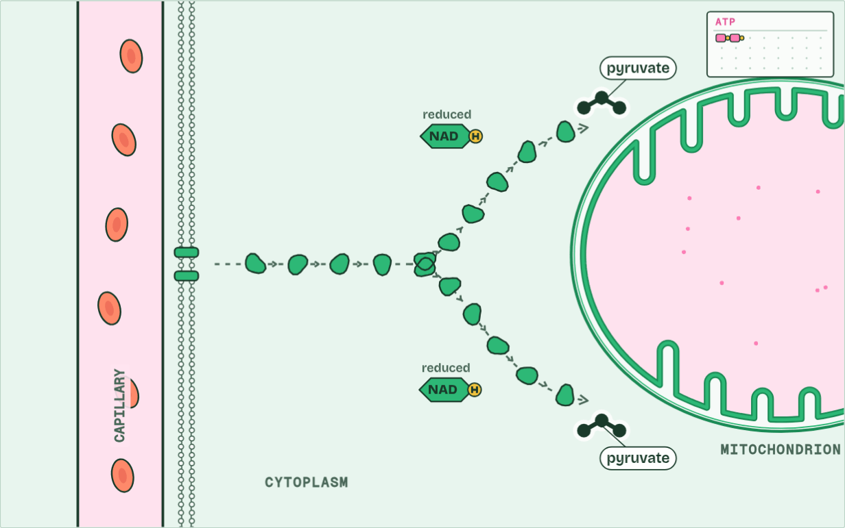
CHAPTER 12 · C1.2.17 Differences between lipids and carbohydrates as respiratory substrates
ATP net 2
2 / 6
Fat or sugar?
Net from one glucose: 2 ATP, 2 reduced NAD and 2 pyruvate.
Minutes 38 to 55
Notes:
Minutes 38 to 55 of 60: Fat or sugar? (17 min).
The plan: Chapter 12: the predict, then Count the oxygen (below), then the figure’s two settings. The chain is lesson 5, so here say only that fat enters at the Krebs cycle, which runs only while oxygen is there; the chapter’s watch-out is read again in lesson 5.
Glucose and fatty acids are the two main fuels, and they are not equal. Lipids release about twice as much energy per gram as carbohydrates when they are respired: about 37 kJ in each gram against about 17.
They also take different routes. Carbohydrate goes through glycolysis, so it can be respired with oxygen or without. A fatty acid is cut into 2-carbon acetyl groups, which enter the Krebs cycle at once as acetyl CoA (acetyl coenzyme A). Glycolysis is the one stage that works without oxygen, and a fatty acid never goes through it: no oxygen, no use for fat.
In practice, muscles use fat for long, steady work, such as walking, a gentle jog or a migrating bird in flight, and carbohydrate for hard, fast work, when oxygen is short. That is why fat is the long-term store and glycogen the quick one (B1.1).
The animation "The whole journey", paused at 21.7 s. The next slides go on through it, then play it.

Slide 24
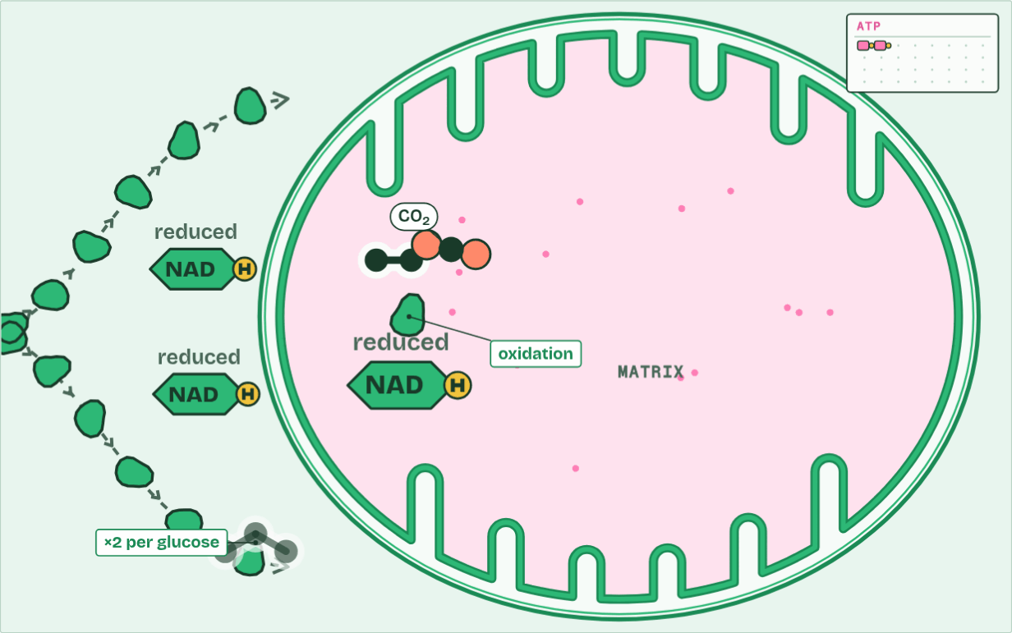
CHAPTER 12 · C1.2.17 Differences between lipids and carbohydrates as respiratory substrates
ATP net 2
3 / 6
Fat or sugar?
The link reaction, in the matrix: pyruvate loses a carbon as CO2 (decarboxylation) and hydrogen to NAD (oxidation).
Minutes 38 to 55
Notes:
Minutes 38 to 55 of 60: Fat or sugar? (17 min).
The plan: Chapter 12: the predict, then Count the oxygen (below), then the figure’s two settings. The chain is lesson 5, so here say only that fat enters at the Krebs cycle, which runs only while oxygen is there; the chapter’s watch-out is read again in lesson 5.
Glucose and fatty acids are the two main fuels, and they are not equal. Lipids release about twice as much energy per gram as carbohydrates when they are respired: about 37 kJ in each gram against about 17.
They also take different routes. Carbohydrate goes through glycolysis, so it can be respired with oxygen or without. A fatty acid is cut into 2-carbon acetyl groups, which enter the Krebs cycle at once as acetyl CoA (acetyl coenzyme A). Glycolysis is the one stage that works without oxygen, and a fatty acid never goes through it: no oxygen, no use for fat.
In practice, muscles use fat for long, steady work, such as walking, a gentle jog or a migrating bird in flight, and carbohydrate for hard, fast work, when oxygen is short. That is why fat is the long-term store and glycogen the quick one (B1.1).
The animation "The whole journey", paused at 29.4 s. The next slides go on through it, then play it.

Slide 25
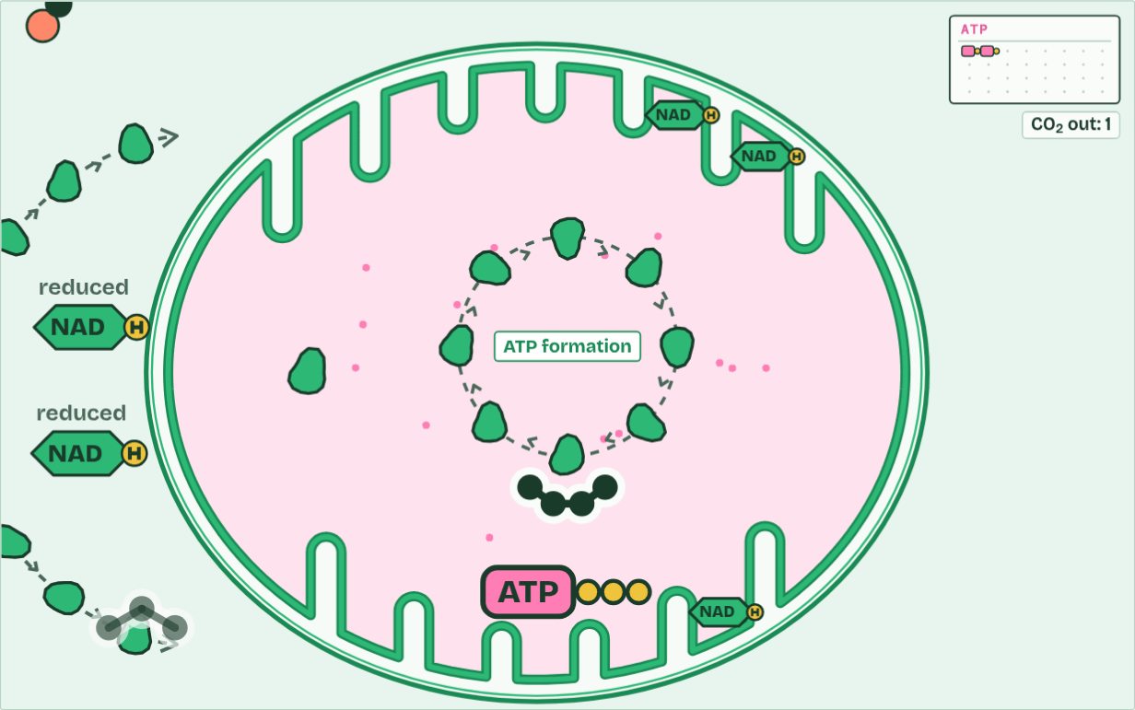
CHAPTER 12 · C1.2.17 Differences between lipids and carbohydrates as respiratory substrates
ATP net 2
4 / 6
Fat or sugar?
One ATP is made, and a fourth oxidation passes hydrogen to another carrier.
Minutes 38 to 55
Notes:
Minutes 38 to 55 of 60: Fat or sugar? (17 min).
The plan: Chapter 12: the predict, then Count the oxygen (below), then the figure’s two settings. The chain is lesson 5, so here say only that fat enters at the Krebs cycle, which runs only while oxygen is there; the chapter’s watch-out is read again in lesson 5.
Glucose and fatty acids are the two main fuels, and they are not equal. Lipids release about twice as much energy per gram as carbohydrates when they are respired: about 37 kJ in each gram against about 17.
They also take different routes. Carbohydrate goes through glycolysis, so it can be respired with oxygen or without. A fatty acid is cut into 2-carbon acetyl groups, which enter the Krebs cycle at once as acetyl CoA (acetyl coenzyme A). Glycolysis is the one stage that works without oxygen, and a fatty acid never goes through it: no oxygen, no use for fat.
In practice, muscles use fat for long, steady work, such as walking, a gentle jog or a migrating bird in flight, and carbohydrate for hard, fast work, when oxygen is short. That is why fat is the long-term store and glycogen the quick one (B1.1).
The animation "The whole journey", paused at 42.7 s. The next slides go on through it, then play it.

Slide 26
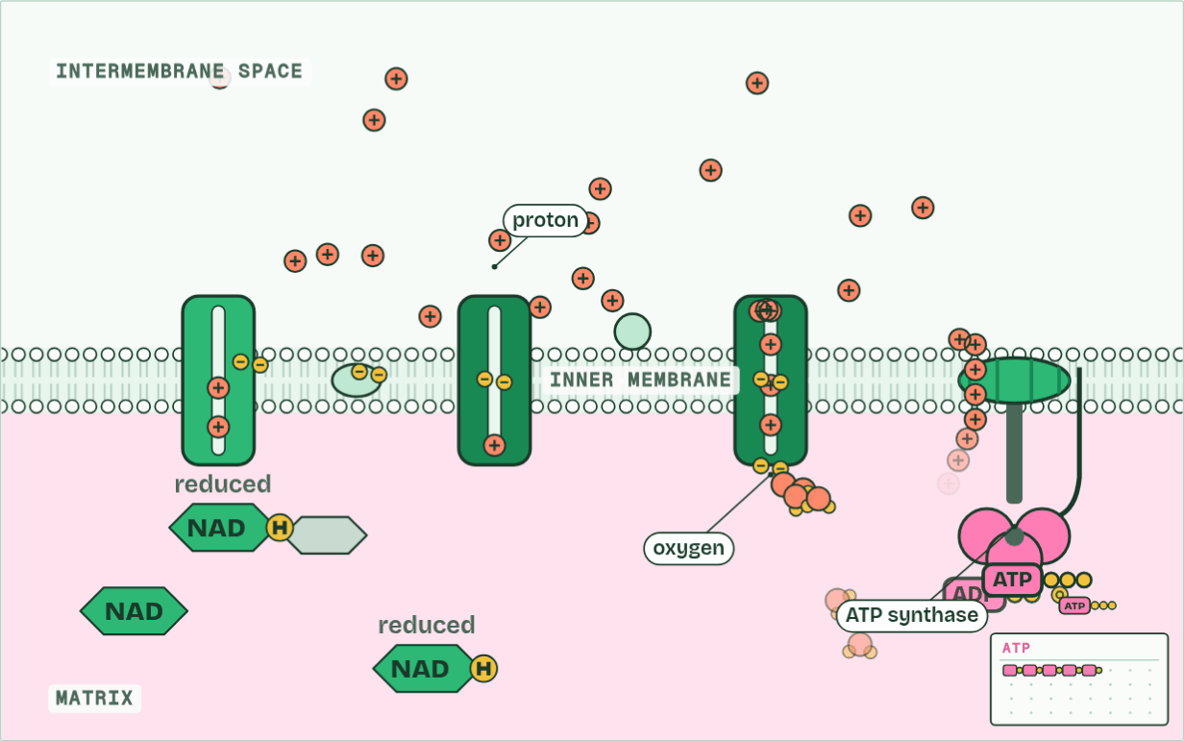
CHAPTER 12 · C1.2.17 Differences between lipids and carbohydrates as respiratory substrates
ATP net 5
5 / 6
Fat or sugar?
Protons flow back through ATP synthase, turning it: most of the ATP is made here. Oxygen takes the electrons at the end, making water.
Minutes 38 to 55
Notes:
Minutes 38 to 55 of 60: Fat or sugar? (17 min).
The plan: Chapter 12: the predict, then Count the oxygen (below), then the figure’s two settings. The chain is lesson 5, so here say only that fat enters at the Krebs cycle, which runs only while oxygen is there; the chapter’s watch-out is read again in lesson 5.
Glucose and fatty acids are the two main fuels, and they are not equal. Lipids release about twice as much energy per gram as carbohydrates when they are respired: about 37 kJ in each gram against about 17.
They also take different routes. Carbohydrate goes through glycolysis, so it can be respired with oxygen or without. A fatty acid is cut into 2-carbon acetyl groups, which enter the Krebs cycle at once as acetyl CoA (acetyl coenzyme A). Glycolysis is the one stage that works without oxygen, and a fatty acid never goes through it: no oxygen, no use for fat.
In practice, muscles use fat for long, steady work, such as walking, a gentle jog or a migrating bird in flight, and carbohydrate for hard, fast work, when oxygen is short. That is why fat is the long-term store and glycogen the quick one (B1.1).
The animation "The whole journey", paused at 61.6 s. The next slides go on through it, then play it.

Slide 27
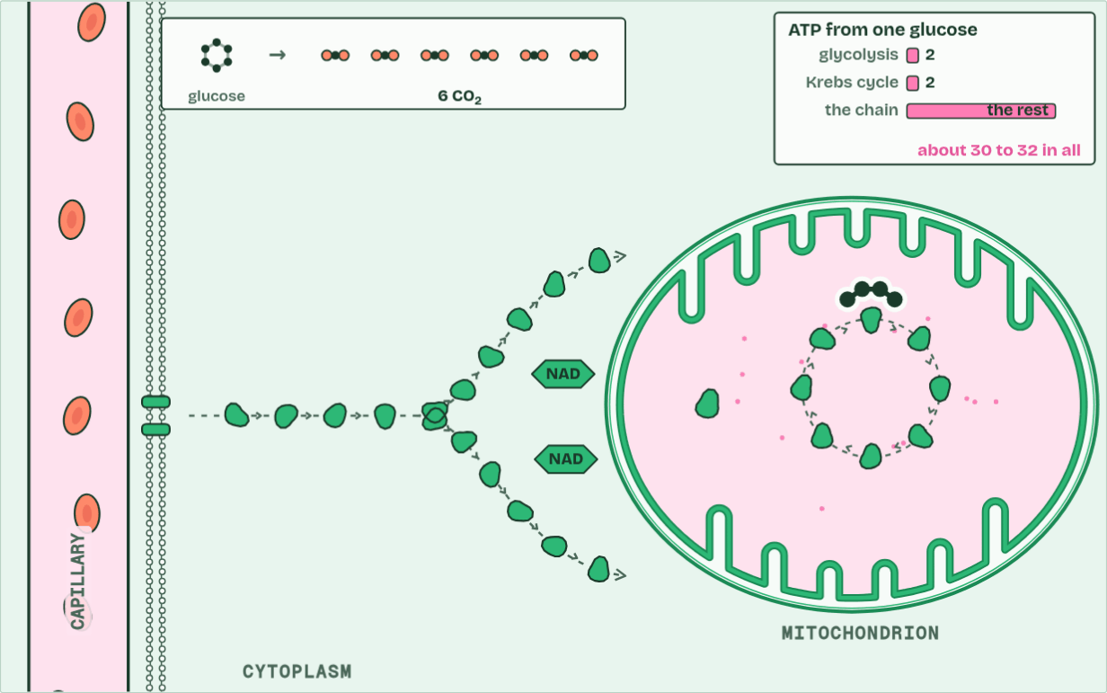
CHAPTER 12 · C1.2.17 Differences between lipids and carbohydrates as respiratory substrates
ATP about 30 to 32
6 / 6
Fat or sugar?
From one glucose: 6 CO2, water, and about 30 to 32 ATP, nearly all of it from the chain.
Minutes 38 to 55
Notes:
Minutes 38 to 55 of 60: Fat or sugar? (17 min).
The plan: Chapter 12: the predict, then Count the oxygen (below), then the figure’s two settings. The chain is lesson 5, so here say only that fat enters at the Krebs cycle, which runs only while oxygen is there; the chapter’s watch-out is read again in lesson 5.
Glucose and fatty acids are the two main fuels, and they are not equal. Lipids release about twice as much energy per gram as carbohydrates when they are respired: about 37 kJ in each gram against about 17.
They also take different routes. Carbohydrate goes through glycolysis, so it can be respired with oxygen or without. A fatty acid is cut into 2-carbon acetyl groups, which enter the Krebs cycle at once as acetyl CoA (acetyl coenzyme A). Glycolysis is the one stage that works without oxygen, and a fatty acid never goes through it: no oxygen, no use for fat.
In practice, muscles use fat for long, steady work, such as walking, a gentle jog or a migrating bird in flight, and carbohydrate for hard, fast work, when oxygen is short. That is why fat is the long-term store and glycogen the quick one (B1.1).
The animation "The whole journey", paused at 74.6 s. The next slides go on through it, then play it.

Slide 28
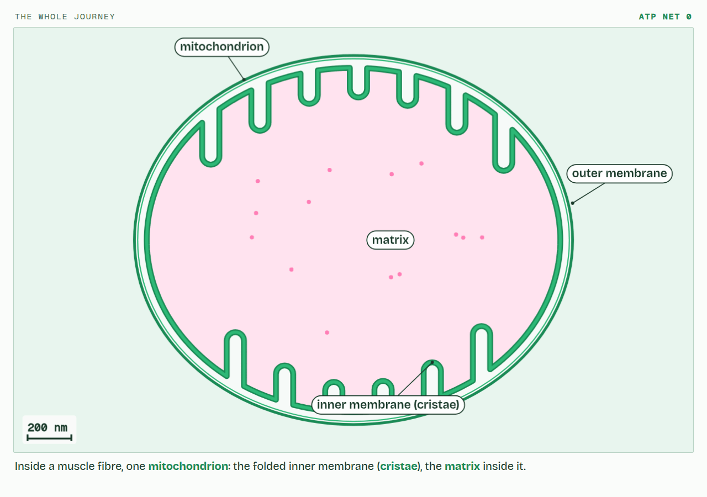
CHAPTER 12 · C1.2.17 Differences between lipids and carbohydrates as respiratory substrates
PLAY IT
Fat or sugar?
The whole journey: click to play. It loops every 77 seconds.
Minutes 38 to 55
Notes:
Minutes 38 to 55 of 60: Fat or sugar? (17 min).
The plan: Chapter 12: the predict, then Count the oxygen (below), then the figure’s two settings. The chain is lesson 5, so here say only that fat enters at the Krebs cycle, which runs only while oxygen is there; the chapter’s watch-out is read again in lesson 5.
The video is respiration-f1d54b.mp4, one loop of the animation in the guide. It plays in PowerPoint and Keynote. Google Slides does not play a video embedded in a .pptx: download respiration-f1d54b.mp4 (https://www.biologybybradford.com/guides/downloads/scenes/respiration-f1d54b.mp4), upload it to Google Drive, then Insert > Video > Google Drive.
In the guide the class can change it as it runs: https://www.biologybybradford.com/guides/ib-biology-c1-2-cell-respiration#fuels
What it shows, in order:
1. Inside a muscle fibre, one mitochondrion: the folded inner membrane (cristae), the matrix inside it.
2. Net from one glucose: 2 ATP, 2 reduced NAD and 2 pyruvate.
3. The link reaction, in the matrix: pyruvate loses a carbon as CO2 (decarboxylation) and hydrogen to NAD (oxidation).
4. One ATP is made, and a fourth oxidation passes hydrogen to another carrier.
5. Protons flow back through ATP synthase, turning it: most of the ATP is made here. Oxygen takes the electrons at the end, making water.
6. From one glucose: 6 CO2, water, and about 30 to 32 ATP, nearly all of it from the chain.

Slide 29
PREDICT
Gram for gram, fat releases about twice the energy of carbohydrate when respired. Why?
A Fat molecules are much bigger, so they hold more bonds
B Fat is respired anaerobically, which is faster
C Fat holds less oxygen and more hydrogen to oxidise
D Fat skips glycolysis, so no ATP is spent
Minutes 38 to 55
Notes:
Minutes 38 to 55 of 60: Fat or sugar? (17 min).
The plan: Chapter 12: the predict, then Count the oxygen (below), then the figure’s two settings. The chain is lesson 5, so here say only that fat enters at the Krebs cycle, which runs only while oxygen is there; the chapter’s watch-out is read again in lesson 5.
Ask for a show of hands, or mini whiteboards, before revealing. (Answer: C, on the next slide.)

Slide 30
WHAT HAPPENS
Gram for gram, fat releases about twice the energy of carbohydrate when respired. Why?
A Fat molecules are much bigger, so they hold more bonds
B Fat is respired anaerobically, which is faster
C Fat holds less oxygen and more hydrogen to oxidise
D Fat skips glycolysis, so no ATP is spent
A fatty acid is mostly carbon and hydrogen, with very little oxygen: palmitic acid, a common fatty acid, is only about one eighth oxygen by mass, and glucose about a half. So a gram of fat has far more oxidisable hydrogen and carbon to oxidise, and respiring it takes about 2.7 times as much oxygen per gram: 23 oxygen molecules for one palmitic acid, against 6 for one glucose. Size does not matter (a gram is a gram), and fat cannot be respired anaerobically at all.
Minutes 38 to 55
Notes:
Minutes 38 to 55 of 60: Fat or sugar? (17 min).
The plan: Chapter 12: the predict, then Count the oxygen (below), then the figure’s two settings. The chain is lesson 5, so here say only that fat enters at the Krebs cycle, which runs only while oxygen is there; the chapter’s watch-out is read again in lesson 5.
Answer: C. A fatty acid is mostly carbon and hydrogen, with very little oxygen: palmitic acid, a common fatty acid, is only about one eighth oxygen by mass, and glucose about a half. So a gram of fat has far more oxidisable hydrogen and carbon to oxidise, and respiring it takes about 2.7 times as much oxygen per gram: 23 oxygen molecules for one palmitic acid, against 6 for one glucose. Size does not matter (a gram is a gram), and fat cannot be respired anaerobically at all.

Slide 31
WATCH OUT
Fat cannot be used anaerobically: fatty acids enter at the Krebs cycle, which needs the chain, which needs oxygen. A sprint runs on carbohydrate.
Minutes 38 to 55
Notes:
Minutes 38 to 55 of 60: Fat or sugar? (17 min).
The plan: Chapter 12: the predict, then Count the oxygen (below), then the figure’s two settings. The chain is lesson 5, so here say only that fat enters at the Krebs cycle, which runs only while oxygen is there; the chapter’s watch-out is read again in lesson 5.
A common mistake: say it, then ask who can say why it is wrong.

Slide 32
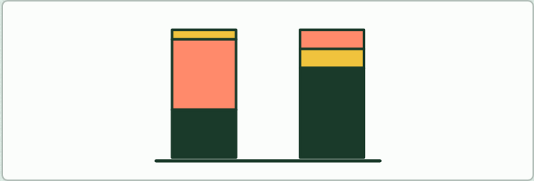
CALCULATION · HL
17 MIN
Count the oxygen
THE TASK
From the formulae C₆H₁₂O₆ and C₁₆H₃₂O₂, work out the percentage of each that is oxygen by mass, and the oxygen needed to respire one of each (6 and 23 O₂). Then: which gives more energy per gram, and why?
STUDENTS NEED
Calculators.
Minutes 38 to 55
Notes:
Minutes 38 to 55 of 60: Fat or sugar? (17 min).
The plan: Chapter 12: the predict, then Count the oxygen (below), then the figure’s two settings. The chain is lesson 5, so here say only that fat enters at the Krebs cycle, which runs only while oxygen is there; the chapter’s watch-out is read again in lesson 5.
The activity: Count the oxygen. From the formulae C₆H₁₂O₆ and C₁₆H₃₂O₂, work out the percentage of each that is oxygen by mass, and the oxygen needed to respire one of each (6 and 23 O₂). Then: which gives more energy per gram, and why?
Needs: calculators.
The time: 17 minutes, minutes 38 to 55 of the plan.

Slide 33
PLENARY
Can you now...
Outline the link reaction and the Krebs cycle: where the carbon dioxide and the reduced NAD come from (C1.2.11, C1.2.12)
Compare lipids and carbohydrates as fuels: energy per gram, and which routes each can take (C1.2.17)
Minutes 55 to 60
Notes:
Minutes 55 to 60 of 60: Exit (5 min).
The plan: One reason fat gives more energy per gram, and one thing fat cannot do that glucose can.
Thumbs up, sideways or down on each goal before the exit question. The goals come from the statements this lesson covers.

Slide 34
EXIT QUESTION
Before you go
One reason fat gives more energy per gram, and one thing fat cannot do that glucose can.
Minutes 55 to 60
Notes:
Minutes 55 to 60 of 60: Exit (5 min).
The plan: One reason fat gives more energy per gram, and one thing fat cannot do that glucose can.

Slide 35
PRACTISE AND REVISE
Keep going
Exam practice: a fresh paper of exam questions on C1.2 at higher level, marked as you go
The guide, with the animations and the dry lab
This lesson in the guide: 9 The carbon leaves as carbon dioxide, 12 Fat or sugar?
BUILD FOR YOUR CLASS
ALREADY ON THE SITE FOR C1.2
CARD SETS ON SPLYCR
Tarsia puzzle, dominoes and picture reveal on C1.2, built from its key terms and ready to print
A pub quiz with rounds on C1.2, to present or run with no projector
An escape room built from the question bank on C1.2
Lesson: Cell Respiration HL (HL)
Lesson: Cell Respiration
Quiz: Cell Respiration
Quiz: Cell Respiration (HL)
Revision map: C1.2 Cell respiration, to fill in
Exam questions: C1.2 in the exam maker, a paper with its markscheme
Open a set to host it as a class game, or make a copy to edit.
C1.2 Cell Respiration
B3.2–C2.2 Plant Transport, Respiration & Neural Signalling
How this was made. The course structure, the activities and the teaching choices come from my own classroom, my presentations and my years of teaching IB and AP Biology. I use Claude, an AI, to help write and build the interactive guides, lesson plans, slides and practice questions, and to draw the diagrams and code the interactives. I direct the work and review it against the IB and AP specifications before it goes live.
Minute 60: after the lesson
Notes:
Every link here is live. Set the exam practice paper for homework: it is fresh each time, marked as students go and saved to their Exam practice when they are signed in.
Exam practice: https://www.biologybybradford.com/exam-maker/sit?topics=C1.2&level=HL&paper=quiz&marks=15&src=ep
The guide: https://www.biologybybradford.com/guides/ib-biology-c1-2-cell-respiration

