Slide 1
IB Biology C1.2
LESSON 5 OF 5
HL
BY THE END YOU CAN
Cell respiration
Explain how electrons passed along the chain build a proton gradient across the inner membrane (C1.2.13, C1.2.14)
Explain how ATP synthase uses the proton gradient to make ATP, and why oxygen is needed at the end of the chain (C1.2.15, C1.2.16)
The chain, the turbine and the whole journey
C1.2.13 to C1.2.16
Reduced NAD and the electron transport chain, the proton gradient, ATP synthase and oxygen as the last acceptor
60 minutes · chapters 10, 11
Minute 0
Notes:
IB Biology C1.2, Cell respiration. Lesson 5 of 5: The chain, the turbine and the whole journey (higher level), 60 minutes.
The plan, minute by minute (each slide's footer says where you are):
0 to 5 min (5) Do now: what does oxygen do?
5 to 17 min (12) The chain
17 to 30 min (13) The turbine
30 to 38 min (8) The whole journey
38 to 48 min (10) The loop game
48 to 55 min (7) Plan an 8-mark answer
55 to 60 min (5) Exit
What students get wrong:
The chain makes ATP. It makes a proton gradient; ATP synthase makes the ATP.
ATP synthase pumps protons. Protons flow down through it and turn it.
Oxygen turns into carbon dioxide. It ends up in water.
Aerobic respiration gives 36 to 38 ATP. About 30 to 32 is the figure now used. Many older sources and papers give 36 to 38.
Stretch and support:
Stretch: cyanide stops the last carrier passing electrons to oxygen. Predict, stage by stage, what stops in a cell, and why the blood leaving the tissues is still rich in oxygen while the cells run short of ATP (breathing and gas exchange are not respiration).
Stretch: make a Tarsia puzzle on C1.2 that is better than the site’s own, in the Tarsia builder.
Consequences for ecosystems: respiration returns carbon dioxide to the air and releases heat at every transfer. Use both to start the energy flow of C4.2: where does the energy of a food chain go?
The lesson plan to print: https://www.biologybybradford.com/guides/downloads/ib-biology-c1-2-cell-respiration-lesson-5-plan.pdf

Slide 2
DO NOW
What does oxygen do?
In one sentence, what does oxygen do in respiration?
5:00
minutes
Start now: the timer is running.
Minutes 0 to 5
Notes:
Minutes 0 to 5 of 60: Do now: what does oxygen do? (5 min).
The plan: In one sentence, what does oxygen do in respiration? Keep the answer for the exit.
Start a 5 minute timer as they come in.

Slide 3
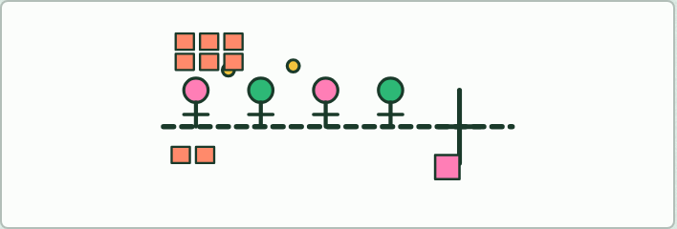
ROLE PLAY · HL
12 MIN
Be the chain
THE TASK
A rope on the floor is the inner membrane. Three students are pumps and two are carriers, standing on it; one is ATP synthase, a turnstile in the rope. “Reduced NAD” brings a pair of tennis balls (electrons) to the first pump; each time the balls are passed on, that pump moves one bean bag (a proton) across the rope into the “intermembrane space”. When the space is crowded, bean bags may go back only through the turnstile, and each one that goes through hands an “ATP” card to the matrix. “Oxygen” at the end takes the balls and two bean bags. Then oxygen sits down: what happens?
STUDENTS NEED
A rope, two tennis balls, ten bean bags, ATP cards, labels on lanyards.
Minutes 5 to 17
Notes:
Minutes 5 to 17 of 60: The chain (12 min).
The plan: Chapter 10: the predict, then Be the chain (the role play below), then the figure, stopping on each caption.
The activity: Be the chain. A rope on the floor is the inner membrane. Three students are pumps and two are carriers, standing on it; one is ATP synthase, a turnstile in the rope. “Reduced NAD” brings a pair of tennis balls (electrons) to the first pump; each time the balls are passed on, that pump moves one bean bag (a proton) across the rope into the “intermembrane space”. When the space is crowded, bean bags may go back only through the turnstile, and each one that goes through hands an “ATP” card to the matrix. “Oxygen” at the end takes the balls and two bean bags. Then oxygen sits down: what happens?
Needs: a rope, two tennis balls, ten bean bags, ATP cards, labels on lanyards.
The time: 12 minutes, minutes 5 to 17 of the plan.

Slide 4
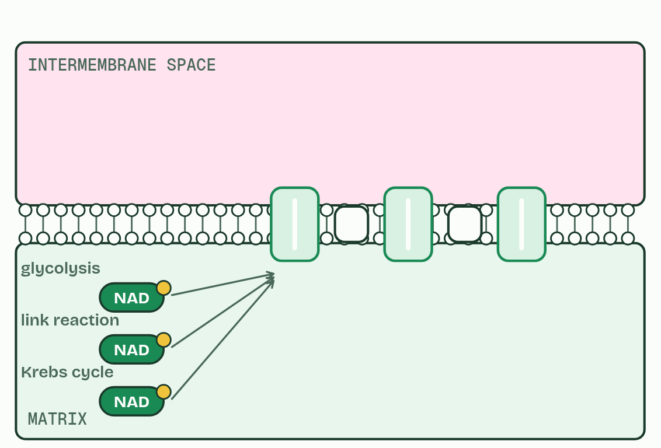
CHAPTER 10 · C1.2.13 C1.2.14 Reduced NAD and the electron transport chain; the proton gradient
1 / 4
Down the chain
Reduced NAD from all three stages arrives at the inner membrane.
Minutes 5 to 17
Notes:
Minutes 5 to 17 of 60: The chain (12 min).
The plan: Chapter 10: the predict, then Be the chain (the role play below), then the figure, stopping on each caption.
Reduced NAD is made in three places: glycolysis, the link reaction and the Krebs cycle. The electrons they carry all end up at the inner membrane of the mitochondrion, which is folded into cristae to give room for many copies of what happens there.
In that membrane sits the electron transport chain: a series of electron carriers, some of them proton pumps. A pair of electrons is passed from reduced NAD to the first carrier, and the reduced NAD is turned back into NAD, which goes back for more hydrogen. That is the transfer of energy.
The electrons are passed from carrier to carrier, each holding them a little more tightly than the one before, so they always move on and never go back. A little energy is released at each step, like a ball dropping down a staircase. Oxygen, at the very end, holds them most tightly of all (chapter 11). You do not need to name the carriers: “the chain” and “proton pumps” are enough.
The pumps use that energy to move protons (hydrogen ions) from the matrix, across the inner membrane, into the narrow intermembrane space. They pile up there, so there are far more protons in the space than in the matrix: a proton gradient. The membrane does not let them leak back, so the gradient is a store of energy, like water held behind a dam. Chapter 11 lets it out.

Slide 5
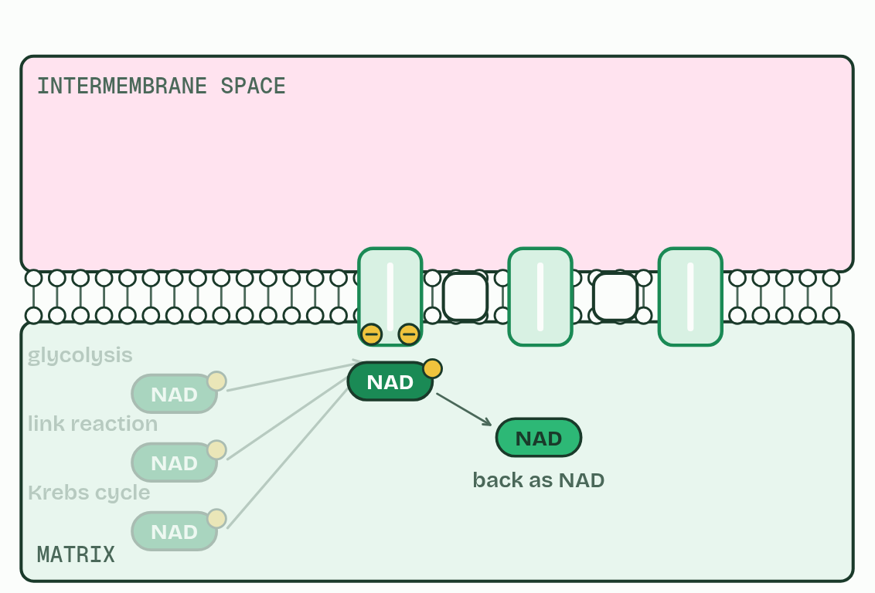
CHAPTER 10 · C1.2.13 C1.2.14 Reduced NAD and the electron transport chain; the proton gradient
2 / 4
Down the chain
It hands a pair of electrons to the first carrier, and becomes NAD again.
Minutes 5 to 17
Notes:
Minutes 5 to 17 of 60: The chain (12 min).
The plan: Chapter 10: the predict, then Be the chain (the role play below), then the figure, stopping on each caption.
Reduced NAD is made in three places: glycolysis, the link reaction and the Krebs cycle. The electrons they carry all end up at the inner membrane of the mitochondrion, which is folded into cristae to give room for many copies of what happens there.
In that membrane sits the electron transport chain: a series of electron carriers, some of them proton pumps. A pair of electrons is passed from reduced NAD to the first carrier, and the reduced NAD is turned back into NAD, which goes back for more hydrogen. That is the transfer of energy.
The electrons are passed from carrier to carrier, each holding them a little more tightly than the one before, so they always move on and never go back. A little energy is released at each step, like a ball dropping down a staircase. Oxygen, at the very end, holds them most tightly of all (chapter 11). You do not need to name the carriers: “the chain” and “proton pumps” are enough.
The pumps use that energy to move protons (hydrogen ions) from the matrix, across the inner membrane, into the narrow intermembrane space. They pile up there, so there are far more protons in the space than in the matrix: a proton gradient. The membrane does not let them leak back, so the gradient is a store of energy, like water held behind a dam. Chapter 11 lets it out.

Slide 6
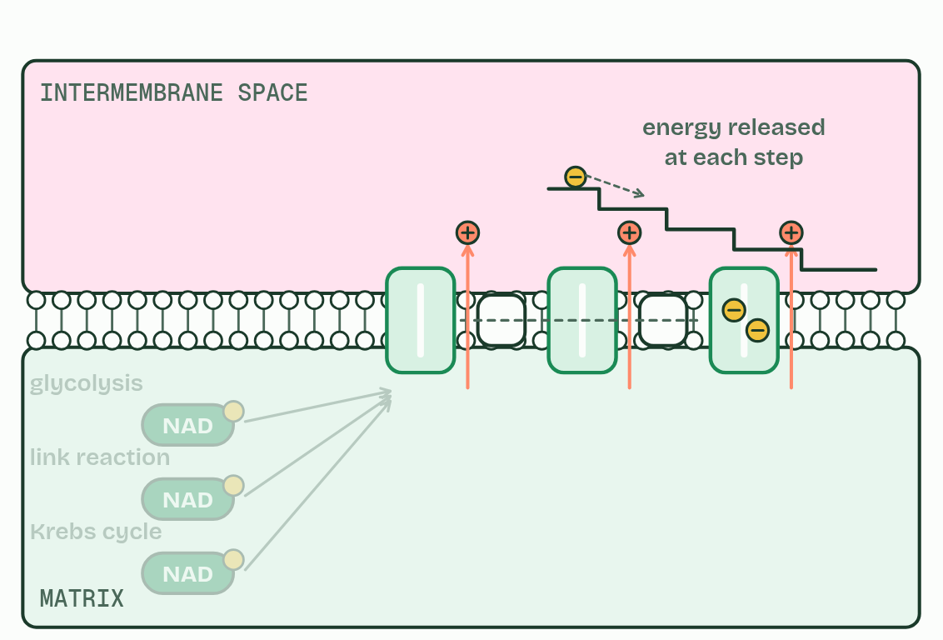
CHAPTER 10 · C1.2.13 C1.2.14 Reduced NAD and the electron transport chain; the proton gradient
3 / 4
Down the chain
Each step down releases a little energy, used to pump protons.
Minutes 5 to 17
Notes:
Minutes 5 to 17 of 60: The chain (12 min).
The plan: Chapter 10: the predict, then Be the chain (the role play below), then the figure, stopping on each caption.
Reduced NAD is made in three places: glycolysis, the link reaction and the Krebs cycle. The electrons they carry all end up at the inner membrane of the mitochondrion, which is folded into cristae to give room for many copies of what happens there.
In that membrane sits the electron transport chain: a series of electron carriers, some of them proton pumps. A pair of electrons is passed from reduced NAD to the first carrier, and the reduced NAD is turned back into NAD, which goes back for more hydrogen. That is the transfer of energy.
The electrons are passed from carrier to carrier, each holding them a little more tightly than the one before, so they always move on and never go back. A little energy is released at each step, like a ball dropping down a staircase. Oxygen, at the very end, holds them most tightly of all (chapter 11). You do not need to name the carriers: “the chain” and “proton pumps” are enough.
The pumps use that energy to move protons (hydrogen ions) from the matrix, across the inner membrane, into the narrow intermembrane space. They pile up there, so there are far more protons in the space than in the matrix: a proton gradient. The membrane does not let them leak back, so the gradient is a store of energy, like water held behind a dam. Chapter 11 lets it out.

Slide 7
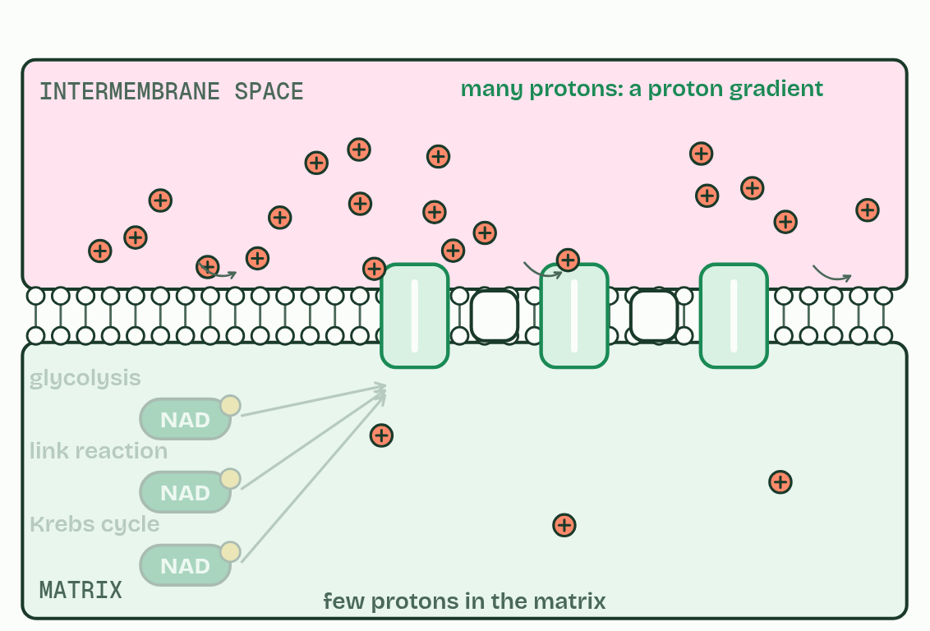
CHAPTER 10 · C1.2.13 C1.2.14 Reduced NAD and the electron transport chain; the proton gradient
4 / 4
Down the chain
Protons pile up in the intermembrane space: a proton gradient.
Minutes 5 to 17
Notes:
Minutes 5 to 17 of 60: The chain (12 min).
The plan: Chapter 10: the predict, then Be the chain (the role play below), then the figure, stopping on each caption.
Reduced NAD is made in three places: glycolysis, the link reaction and the Krebs cycle. The electrons they carry all end up at the inner membrane of the mitochondrion, which is folded into cristae to give room for many copies of what happens there.
In that membrane sits the electron transport chain: a series of electron carriers, some of them proton pumps. A pair of electrons is passed from reduced NAD to the first carrier, and the reduced NAD is turned back into NAD, which goes back for more hydrogen. That is the transfer of energy.
The electrons are passed from carrier to carrier, each holding them a little more tightly than the one before, so they always move on and never go back. A little energy is released at each step, like a ball dropping down a staircase. Oxygen, at the very end, holds them most tightly of all (chapter 11). You do not need to name the carriers: “the chain” and “proton pumps” are enough.
The pumps use that energy to move protons (hydrogen ions) from the matrix, across the inner membrane, into the narrow intermembrane space. They pile up there, so there are far more protons in the space than in the matrix: a proton gradient. The membrane does not let them leak back, so the gradient is a store of energy, like water held behind a dam. Chapter 11 lets it out.

Slide 8
CHAPTER 10 · C1.2.13 C1.2.14 Reduced NAD and the electron transport chain; the proton gradient
Down the chain
The electrons they carry all end up at the inner membrane of the mitochondrion, which is folded into cristae to give room for many copies of what happens there.
In that membrane sits the electron transport chain: a series of electron carriers, some of them proton pumps.
The pumps use that energy to move protons (hydrogen ions) from the matrix, across the inner membrane, into the narrow intermembrane space.
They pile up there, so there are far more protons in the space than in the matrix: a proton gradient.
Minutes 5 to 17
Notes:
Minutes 5 to 17 of 60: The chain (12 min).
The plan: Chapter 10: the predict, then Be the chain (the role play below), then the figure, stopping on each caption.
Reduced NAD is made in three places: glycolysis, the link reaction and the Krebs cycle. The electrons they carry all end up at the inner membrane of the mitochondrion, which is folded into cristae to give room for many copies of what happens there.
In that membrane sits the electron transport chain: a series of electron carriers, some of them proton pumps. A pair of electrons is passed from reduced NAD to the first carrier, and the reduced NAD is turned back into NAD, which goes back for more hydrogen. That is the transfer of energy.
The electrons are passed from carrier to carrier, each holding them a little more tightly than the one before, so they always move on and never go back. A little energy is released at each step, like a ball dropping down a staircase. Oxygen, at the very end, holds them most tightly of all (chapter 11). You do not need to name the carriers: “the chain” and “proton pumps” are enough.
The pumps use that energy to move protons (hydrogen ions) from the matrix, across the inner membrane, into the narrow intermembrane space. They pile up there, so there are far more protons in the space than in the matrix: a proton gradient. The membrane does not let them leak back, so the gradient is a store of energy, like water held behind a dam. Chapter 11 lets it out.

Slide 9
PREDICT
Electrons pass along the chain of carriers, releasing a little energy at each step. What is that energy used for?
A Making ATP directly at each carrier
B Splitting water into hydrogen and oxygen
C Heating the matrix to the right temperature
D Pumping protons across the inner membrane
Minutes 5 to 17
Notes:
Minutes 5 to 17 of 60: The chain (12 min).
The plan: Chapter 10: the predict, then Be the chain (the role play below), then the figure, stopping on each caption.
Ask for a show of hands, or mini whiteboards, before revealing. (Answer: D, on the next slide.)

Slide 10
WHAT HAPPENS
Electrons pass along the chain of carriers, releasing a little energy at each step. What is that energy used for?
A Making ATP directly at each carrier
B Splitting water into hydrogen and oxygen
C Heating the matrix to the right temperature
D Pumping protons across the inner membrane
Pumping protons, from the matrix into the intermembrane space. No ATP is made at the carriers themselves; the energy is first stored as a gradient of protons, and the gradient is spent making ATP in chapter 11.
Minutes 5 to 17
Notes:
Minutes 5 to 17 of 60: The chain (12 min).
The plan: Chapter 10: the predict, then Be the chain (the role play below), then the figure, stopping on each caption.
Answer: D. Pumping protons, from the matrix into the intermembrane space. No ATP is made at the carriers themselves; the energy is first stored as a gradient of protons, and the gradient is spent making ATP in chapter 11.

Slide 11
WATCH OUT
The chain does not make ATP; it makes a proton gradient. And “proton” here means a hydrogen ion, not a hydrogen atom.
Minutes 5 to 17
Notes:
Minutes 5 to 17 of 60: The chain (12 min).
The plan: Chapter 10: the predict, then Be the chain (the role play below), then the figure, stopping on each caption.
A common mistake: say it, then ask who can say why it is wrong.

Slide 12
STEP 3
13 MIN
The turbine
Chapter 11: Protons through the turbine
Minutes 17 to 30
Notes:
Minutes 17 to 30 of 60: The turbine (13 min).
The plan: Chapter 11: the predict, then the figure, then the chemiosmosis film: turn the oxygen off and watch what stops first.

Slide 13
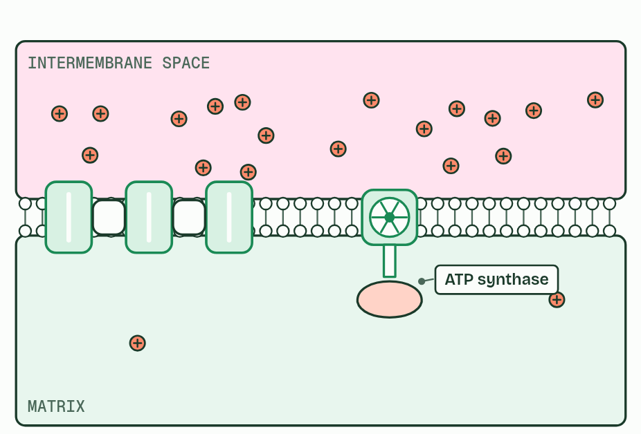
CHAPTER 11 · C1.2.15 C1.2.16 Chemiosmosis and ATP synthesis; oxygen as the terminal electron acceptor
1 / 4
Protons through the turbine
One way back for the protons: ATP synthase.
Minutes 17 to 30
Notes:
Minutes 17 to 30 of 60: The turbine (13 min).
The plan: Chapter 11: the predict, then the figure, then the chemiosmosis film: turn the oxygen off and watch what stops first.
Protons can return to the matrix through one protein only: ATP synthase. It spans the inner membrane, with a channel through it, a part that turns, and a head in the matrix where ATP is made.
As protons flow down their gradient through the channel, they turn the rotor. The turning changes the shape of the head, which joins ADP and phosphate into ATP. ATP synthase couples the energy released by the flow of protons to the phosphorylation of ADP. Making ATP with the energy of a proton gradient across a membrane is called chemiosmosis. (Biochemists call the chain and the synthase together oxidative phosphorylation.)
The chain needs one more thing at its end. Oxygen is the terminal electron acceptor: it takes the electrons from the last carrier, and protons from the matrix, and becomes water, called metabolic water. That empties the chain so that electrons keep flowing, and taking protons from the matrix helps to keep the gradient steep. Most of the ATP from one glucose, about 30 to 32 in all, is made here.
Example: How we know (beyond the guide) In 1961 Peter Mitchell suggested that the chain and the making of ATP were linked by a gradient of protons, not by some unknown high-energy chemical. Most biochemists doubted it for years. Experiments in the 1960s and 1970s, in which membranes given an artificial proton gradient made ATP, won them over, and he received the Nobel Prize in Chemistry in 1978.

Slide 14
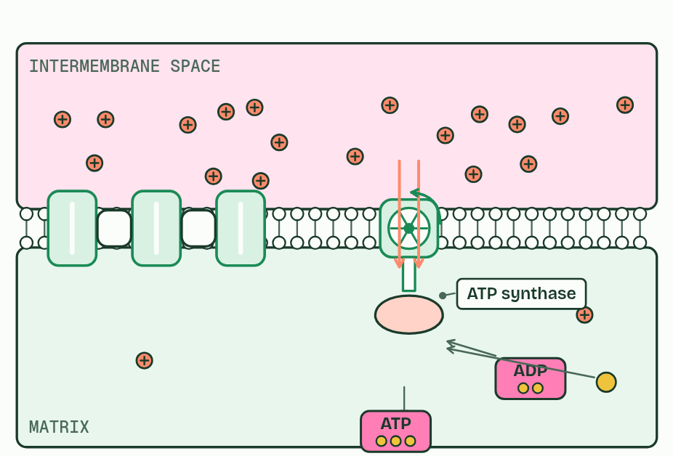
CHAPTER 11 · C1.2.15 C1.2.16 Chemiosmosis and ATP synthesis; oxygen as the terminal electron acceptor
2 / 4
Protons through the turbine
Protons flowing down the gradient turn it, and their energy joins ADP and phosphate: ATP.
Minutes 17 to 30
Notes:
Minutes 17 to 30 of 60: The turbine (13 min).
The plan: Chapter 11: the predict, then the figure, then the chemiosmosis film: turn the oxygen off and watch what stops first.
Protons can return to the matrix through one protein only: ATP synthase. It spans the inner membrane, with a channel through it, a part that turns, and a head in the matrix where ATP is made.
As protons flow down their gradient through the channel, they turn the rotor. The turning changes the shape of the head, which joins ADP and phosphate into ATP. ATP synthase couples the energy released by the flow of protons to the phosphorylation of ADP. Making ATP with the energy of a proton gradient across a membrane is called chemiosmosis. (Biochemists call the chain and the synthase together oxidative phosphorylation.)
The chain needs one more thing at its end. Oxygen is the terminal electron acceptor: it takes the electrons from the last carrier, and protons from the matrix, and becomes water, called metabolic water. That empties the chain so that electrons keep flowing, and taking protons from the matrix helps to keep the gradient steep. Most of the ATP from one glucose, about 30 to 32 in all, is made here.
Example: How we know (beyond the guide) In 1961 Peter Mitchell suggested that the chain and the making of ATP were linked by a gradient of protons, not by some unknown high-energy chemical. Most biochemists doubted it for years. Experiments in the 1960s and 1970s, in which membranes given an artificial proton gradient made ATP, won them over, and he received the Nobel Prize in Chemistry in 1978.

Slide 15
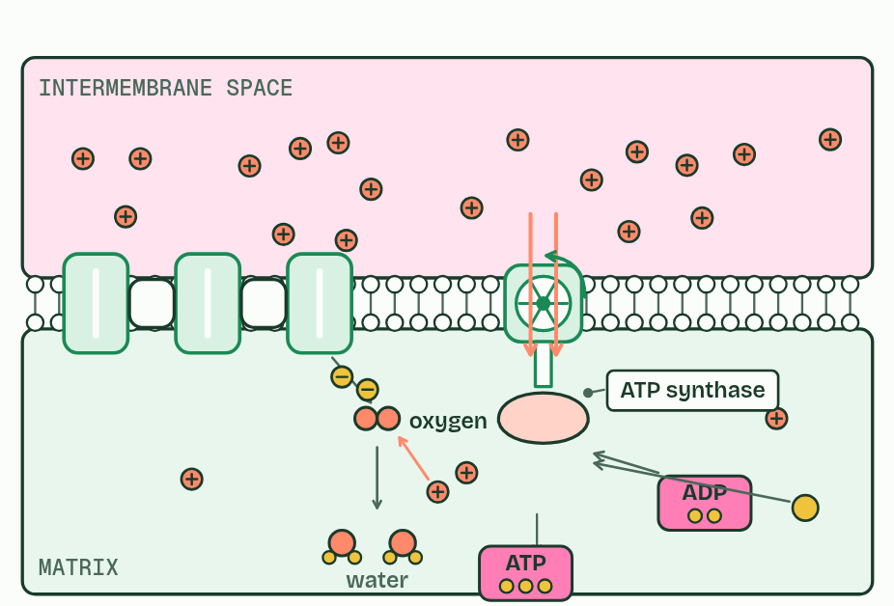
CHAPTER 11 · C1.2.15 C1.2.16 Chemiosmosis and ATP synthesis; oxygen as the terminal electron acceptor
3 / 4
Protons through the turbine
Oxygen takes the electrons and protons at the end, making water.
Minutes 17 to 30
Notes:
Minutes 17 to 30 of 60: The turbine (13 min).
The plan: Chapter 11: the predict, then the figure, then the chemiosmosis film: turn the oxygen off and watch what stops first.
Protons can return to the matrix through one protein only: ATP synthase. It spans the inner membrane, with a channel through it, a part that turns, and a head in the matrix where ATP is made.
As protons flow down their gradient through the channel, they turn the rotor. The turning changes the shape of the head, which joins ADP and phosphate into ATP. ATP synthase couples the energy released by the flow of protons to the phosphorylation of ADP. Making ATP with the energy of a proton gradient across a membrane is called chemiosmosis. (Biochemists call the chain and the synthase together oxidative phosphorylation.)
The chain needs one more thing at its end. Oxygen is the terminal electron acceptor: it takes the electrons from the last carrier, and protons from the matrix, and becomes water, called metabolic water. That empties the chain so that electrons keep flowing, and taking protons from the matrix helps to keep the gradient steep. Most of the ATP from one glucose, about 30 to 32 in all, is made here.
Example: How we know (beyond the guide) In 1961 Peter Mitchell suggested that the chain and the making of ATP were linked by a gradient of protons, not by some unknown high-energy chemical. Most biochemists doubted it for years. Experiments in the 1960s and 1970s, in which membranes given an artificial proton gradient made ATP, won them over, and he received the Nobel Prize in Chemistry in 1978.

Slide 16
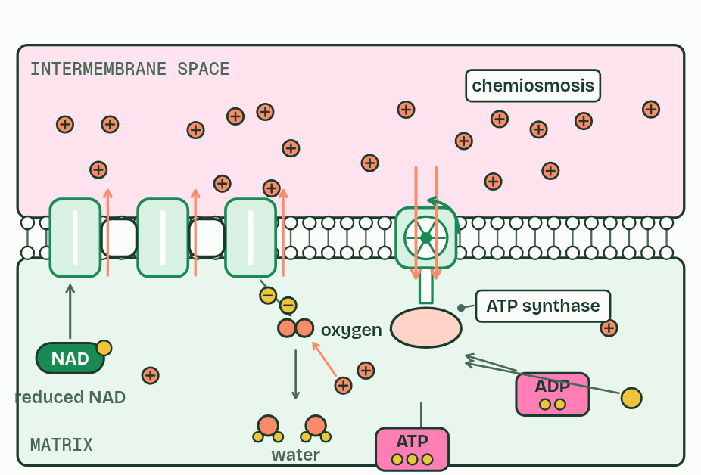
CHAPTER 11 · C1.2.15 C1.2.16 Chemiosmosis and ATP synthesis; oxygen as the terminal electron acceptor
4 / 4
Protons through the turbine
Chemiosmosis: the gradient makes ATP, and oxygen keeps the chain flowing.
Minutes 17 to 30
Notes:
Minutes 17 to 30 of 60: The turbine (13 min).
The plan: Chapter 11: the predict, then the figure, then the chemiosmosis film: turn the oxygen off and watch what stops first.
Protons can return to the matrix through one protein only: ATP synthase. It spans the inner membrane, with a channel through it, a part that turns, and a head in the matrix where ATP is made.
As protons flow down their gradient through the channel, they turn the rotor. The turning changes the shape of the head, which joins ADP and phosphate into ATP. ATP synthase couples the energy released by the flow of protons to the phosphorylation of ADP. Making ATP with the energy of a proton gradient across a membrane is called chemiosmosis. (Biochemists call the chain and the synthase together oxidative phosphorylation.)
The chain needs one more thing at its end. Oxygen is the terminal electron acceptor: it takes the electrons from the last carrier, and protons from the matrix, and becomes water, called metabolic water. That empties the chain so that electrons keep flowing, and taking protons from the matrix helps to keep the gradient steep. Most of the ATP from one glucose, about 30 to 32 in all, is made here.
Example: How we know (beyond the guide) In 1961 Peter Mitchell suggested that the chain and the making of ATP were linked by a gradient of protons, not by some unknown high-energy chemical. Most biochemists doubted it for years. Experiments in the 1960s and 1970s, in which membranes given an artificial proton gradient made ATP, won them over, and he received the Nobel Prize in Chemistry in 1978.

Slide 17
CHAPTER 11 · C1.2.15 C1.2.16 Chemiosmosis and ATP synthesis; oxygen as the terminal electron acceptor
Protons through the turbine
Protons can return to the matrix through one protein only: ATP synthase.
ATP synthase couples the energy released by the flow of protons to the phosphorylation of ADP.
Making ATP with the energy of a proton gradient across a membrane is called chemiosmosis.
Oxygen is the terminal electron acceptor: it takes the electrons from the last carrier, and protons from the matrix, and becomes water, called metabolic water.
Minutes 17 to 30
Notes:
Minutes 17 to 30 of 60: The turbine (13 min).
The plan: Chapter 11: the predict, then the figure, then the chemiosmosis film: turn the oxygen off and watch what stops first.
Protons can return to the matrix through one protein only: ATP synthase. It spans the inner membrane, with a channel through it, a part that turns, and a head in the matrix where ATP is made.
As protons flow down their gradient through the channel, they turn the rotor. The turning changes the shape of the head, which joins ADP and phosphate into ATP. ATP synthase couples the energy released by the flow of protons to the phosphorylation of ADP. Making ATP with the energy of a proton gradient across a membrane is called chemiosmosis. (Biochemists call the chain and the synthase together oxidative phosphorylation.)
The chain needs one more thing at its end. Oxygen is the terminal electron acceptor: it takes the electrons from the last carrier, and protons from the matrix, and becomes water, called metabolic water. That empties the chain so that electrons keep flowing, and taking protons from the matrix helps to keep the gradient steep. Most of the ATP from one glucose, about 30 to 32 in all, is made here.
Example: How we know (beyond the guide) In 1961 Peter Mitchell suggested that the chain and the making of ATP were linked by a gradient of protons, not by some unknown high-energy chemical. Most biochemists doubted it for years. Experiments in the 1960s and 1970s, in which membranes given an artificial proton gradient made ATP, won them over, and he received the Nobel Prize in Chemistry in 1978.

Slide 18
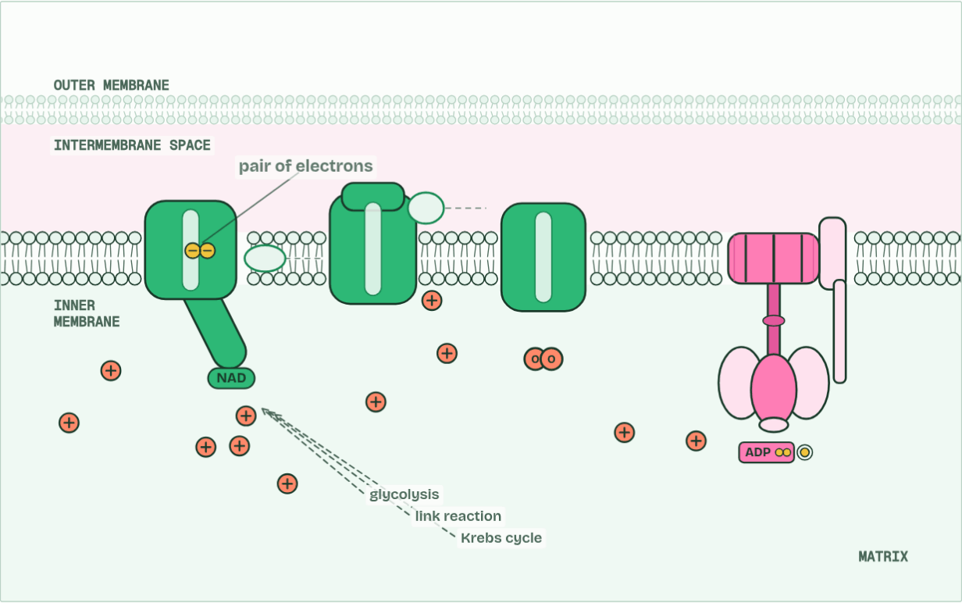
CHAPTER 11 · C1.2.15 C1.2.16 Chemiosmosis and ATP synthesis; oxygen as the terminal electron acceptor
H+ in the space 0 · ATP 0
1 / 5
Protons through the turbine
Reduced NAD from glycolysis, the link reaction and the Krebs cycle hands a pair of electrons to the first carrier, and becomes NAD again.
Minutes 17 to 30
Notes:
Minutes 17 to 30 of 60: The turbine (13 min).
The plan: Chapter 11: the predict, then the figure, then the chemiosmosis film: turn the oxygen off and watch what stops first.
Protons can return to the matrix through one protein only: ATP synthase. It spans the inner membrane, with a channel through it, a part that turns, and a head in the matrix where ATP is made.
As protons flow down their gradient through the channel, they turn the rotor. The turning changes the shape of the head, which joins ADP and phosphate into ATP. ATP synthase couples the energy released by the flow of protons to the phosphorylation of ADP. Making ATP with the energy of a proton gradient across a membrane is called chemiosmosis. (Biochemists call the chain and the synthase together oxidative phosphorylation.)
The chain needs one more thing at its end. Oxygen is the terminal electron acceptor: it takes the electrons from the last carrier, and protons from the matrix, and becomes water, called metabolic water. That empties the chain so that electrons keep flowing, and taking protons from the matrix helps to keep the gradient steep. Most of the ATP from one glucose, about 30 to 32 in all, is made here.
Example: How we know (beyond the guide) In 1961 Peter Mitchell suggested that the chain and the making of ATP were linked by a gradient of protons, not by some unknown high-energy chemical. Most biochemists doubted it for years. Experiments in the 1960s and 1970s, in which membranes given an artificial proton gradient made ATP, won them over, and he received the Nobel Prize in Chemistry in 1978.
The animation "The chain and the turbine", paused at 6.0 s. The next slides go on through it, then play it.

Slide 19
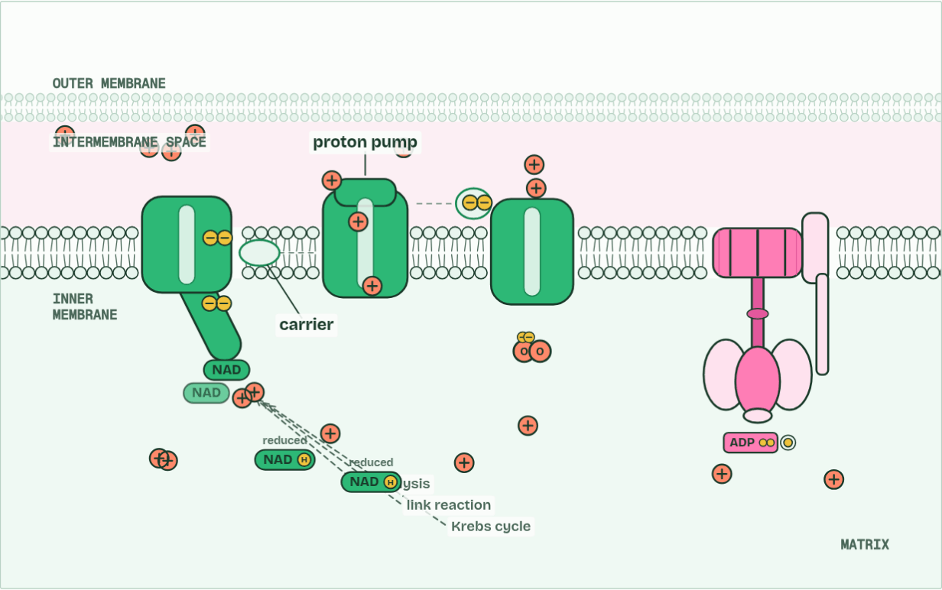
CHAPTER 11 · C1.2.15 C1.2.16 Chemiosmosis and ATP synthesis; oxygen as the terminal electron acceptor
H+ in the space 8 · ATP 0
2 / 5
Protons through the turbine
As the electrons pass along the chain they give up energy, which the carriers use to pump protons into the intermembrane space.
Minutes 17 to 30
Notes:
Minutes 17 to 30 of 60: The turbine (13 min).
The plan: Chapter 11: the predict, then the figure, then the chemiosmosis film: turn the oxygen off and watch what stops first.
Protons can return to the matrix through one protein only: ATP synthase. It spans the inner membrane, with a channel through it, a part that turns, and a head in the matrix where ATP is made.
As protons flow down their gradient through the channel, they turn the rotor. The turning changes the shape of the head, which joins ADP and phosphate into ATP. ATP synthase couples the energy released by the flow of protons to the phosphorylation of ADP. Making ATP with the energy of a proton gradient across a membrane is called chemiosmosis. (Biochemists call the chain and the synthase together oxidative phosphorylation.)
The chain needs one more thing at its end. Oxygen is the terminal electron acceptor: it takes the electrons from the last carrier, and protons from the matrix, and becomes water, called metabolic water. That empties the chain so that electrons keep flowing, and taking protons from the matrix helps to keep the gradient steep. Most of the ATP from one glucose, about 30 to 32 in all, is made here.
Example: How we know (beyond the guide) In 1961 Peter Mitchell suggested that the chain and the making of ATP were linked by a gradient of protons, not by some unknown high-energy chemical. Most biochemists doubted it for years. Experiments in the 1960s and 1970s, in which membranes given an artificial proton gradient made ATP, won them over, and he received the Nobel Prize in Chemistry in 1978.
The animation "The chain and the turbine", paused at 12.5 s. The next slides go on through it, then play it.

Slide 20
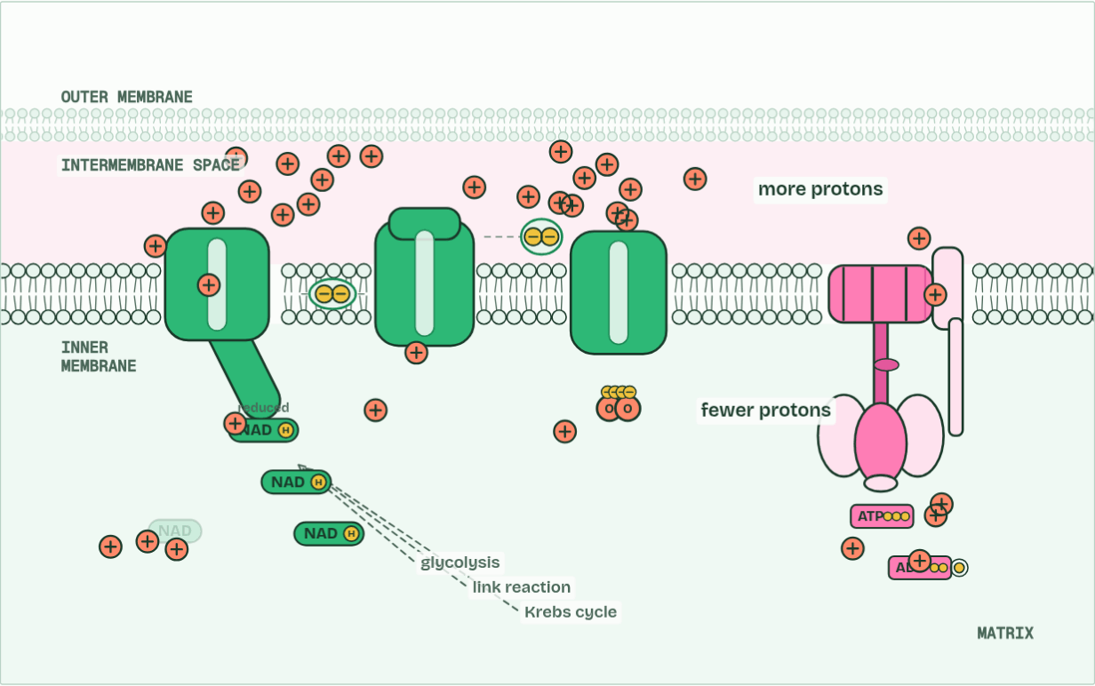
CHAPTER 11 · C1.2.15 C1.2.16 Chemiosmosis and ATP synthesis; oxygen as the terminal electron acceptor
H+ in the space 23 · ATP 1
3 / 5
Protons through the turbine
Protons pile up in the narrow space: a proton gradient. The membrane will not let them back through, except at one place.
Minutes 17 to 30
Notes:
Minutes 17 to 30 of 60: The turbine (13 min).
The plan: Chapter 11: the predict, then the figure, then the chemiosmosis film: turn the oxygen off and watch what stops first.
Protons can return to the matrix through one protein only: ATP synthase. It spans the inner membrane, with a channel through it, a part that turns, and a head in the matrix where ATP is made.
As protons flow down their gradient through the channel, they turn the rotor. The turning changes the shape of the head, which joins ADP and phosphate into ATP. ATP synthase couples the energy released by the flow of protons to the phosphorylation of ADP. Making ATP with the energy of a proton gradient across a membrane is called chemiosmosis. (Biochemists call the chain and the synthase together oxidative phosphorylation.)
The chain needs one more thing at its end. Oxygen is the terminal electron acceptor: it takes the electrons from the last carrier, and protons from the matrix, and becomes water, called metabolic water. That empties the chain so that electrons keep flowing, and taking protons from the matrix helps to keep the gradient steep. Most of the ATP from one glucose, about 30 to 32 in all, is made here.
Example: How we know (beyond the guide) In 1961 Peter Mitchell suggested that the chain and the making of ATP were linked by a gradient of protons, not by some unknown high-energy chemical. Most biochemists doubted it for years. Experiments in the 1960s and 1970s, in which membranes given an artificial proton gradient made ATP, won them over, and he received the Nobel Prize in Chemistry in 1978.
The animation "The chain and the turbine", paused at 18.5 s. The next slides go on through it, then play it.

Slide 21
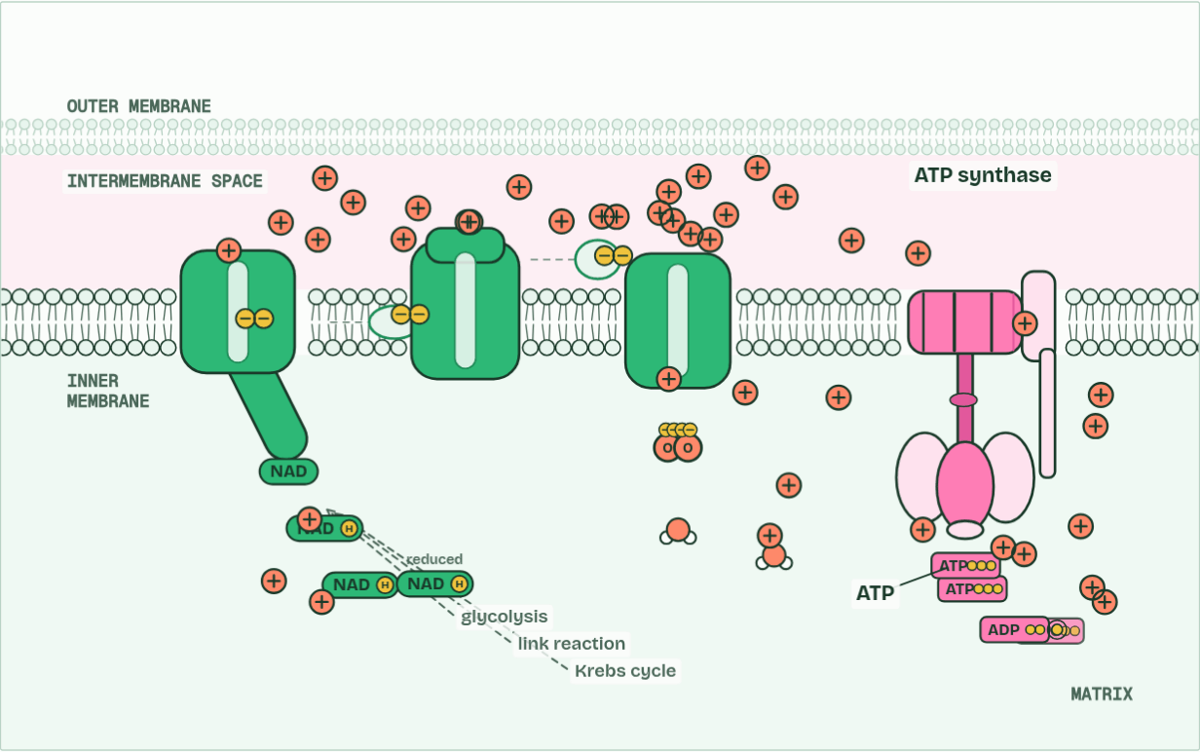
CHAPTER 11 · C1.2.15 C1.2.16 Chemiosmosis and ATP synthesis; oxygen as the terminal electron acceptor
H+ in the space 24 · ATP 8
4 / 5
Protons through the turbine
Protons flow back down their gradient through ATP synthase, turning it. The energy joins ADP and phosphate: ATP.
Minutes 17 to 30
Notes:
Minutes 17 to 30 of 60: The turbine (13 min).
The plan: Chapter 11: the predict, then the figure, then the chemiosmosis film: turn the oxygen off and watch what stops first.
Protons can return to the matrix through one protein only: ATP synthase. It spans the inner membrane, with a channel through it, a part that turns, and a head in the matrix where ATP is made.
As protons flow down their gradient through the channel, they turn the rotor. The turning changes the shape of the head, which joins ADP and phosphate into ATP. ATP synthase couples the energy released by the flow of protons to the phosphorylation of ADP. Making ATP with the energy of a proton gradient across a membrane is called chemiosmosis. (Biochemists call the chain and the synthase together oxidative phosphorylation.)
The chain needs one more thing at its end. Oxygen is the terminal electron acceptor: it takes the electrons from the last carrier, and protons from the matrix, and becomes water, called metabolic water. That empties the chain so that electrons keep flowing, and taking protons from the matrix helps to keep the gradient steep. Most of the ATP from one glucose, about 30 to 32 in all, is made here.
Example: How we know (beyond the guide) In 1961 Peter Mitchell suggested that the chain and the making of ATP were linked by a gradient of protons, not by some unknown high-energy chemical. Most biochemists doubted it for years. Experiments in the 1960s and 1970s, in which membranes given an artificial proton gradient made ATP, won them over, and he received the Nobel Prize in Chemistry in 1978.
The animation "The chain and the turbine", paused at 26.0 s. The next slides go on through it, then play it.

Slide 22
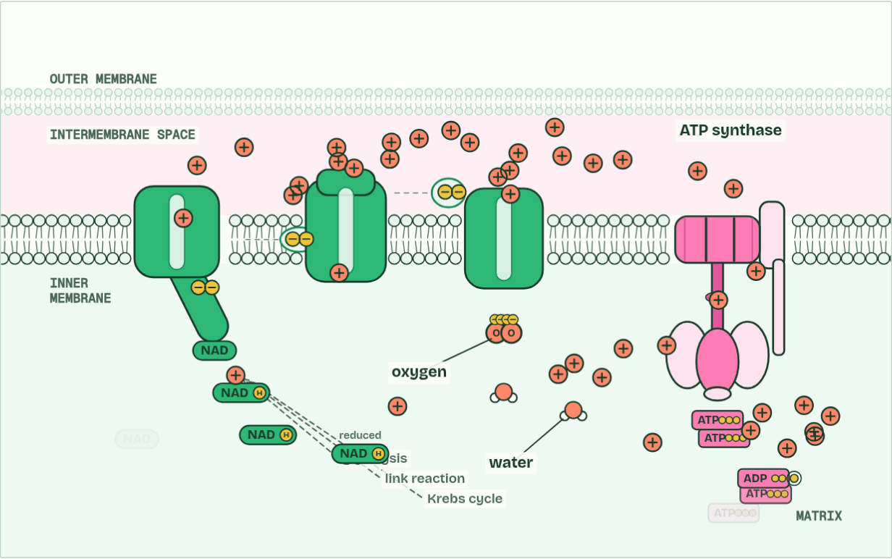
CHAPTER 11 · C1.2.15 C1.2.16 Chemiosmosis and ATP synthesis; oxygen as the terminal electron acceptor
H+ in the space 22 · ATP 16
5 / 5
Protons through the turbine
Oxygen takes the electrons at the end of the chain, with protons from the matrix, making water. That keeps the electrons flowing.
Minutes 17 to 30
Notes:
Minutes 17 to 30 of 60: The turbine (13 min).
The plan: Chapter 11: the predict, then the figure, then the chemiosmosis film: turn the oxygen off and watch what stops first.
Protons can return to the matrix through one protein only: ATP synthase. It spans the inner membrane, with a channel through it, a part that turns, and a head in the matrix where ATP is made.
As protons flow down their gradient through the channel, they turn the rotor. The turning changes the shape of the head, which joins ADP and phosphate into ATP. ATP synthase couples the energy released by the flow of protons to the phosphorylation of ADP. Making ATP with the energy of a proton gradient across a membrane is called chemiosmosis. (Biochemists call the chain and the synthase together oxidative phosphorylation.)
The chain needs one more thing at its end. Oxygen is the terminal electron acceptor: it takes the electrons from the last carrier, and protons from the matrix, and becomes water, called metabolic water. That empties the chain so that electrons keep flowing, and taking protons from the matrix helps to keep the gradient steep. Most of the ATP from one glucose, about 30 to 32 in all, is made here.
Example: How we know (beyond the guide) In 1961 Peter Mitchell suggested that the chain and the making of ATP were linked by a gradient of protons, not by some unknown high-energy chemical. Most biochemists doubted it for years. Experiments in the 1960s and 1970s, in which membranes given an artificial proton gradient made ATP, won them over, and he received the Nobel Prize in Chemistry in 1978.
The animation "The chain and the turbine", paused at 33.0 s. The next slides go on through it, then play it.

Slide 23
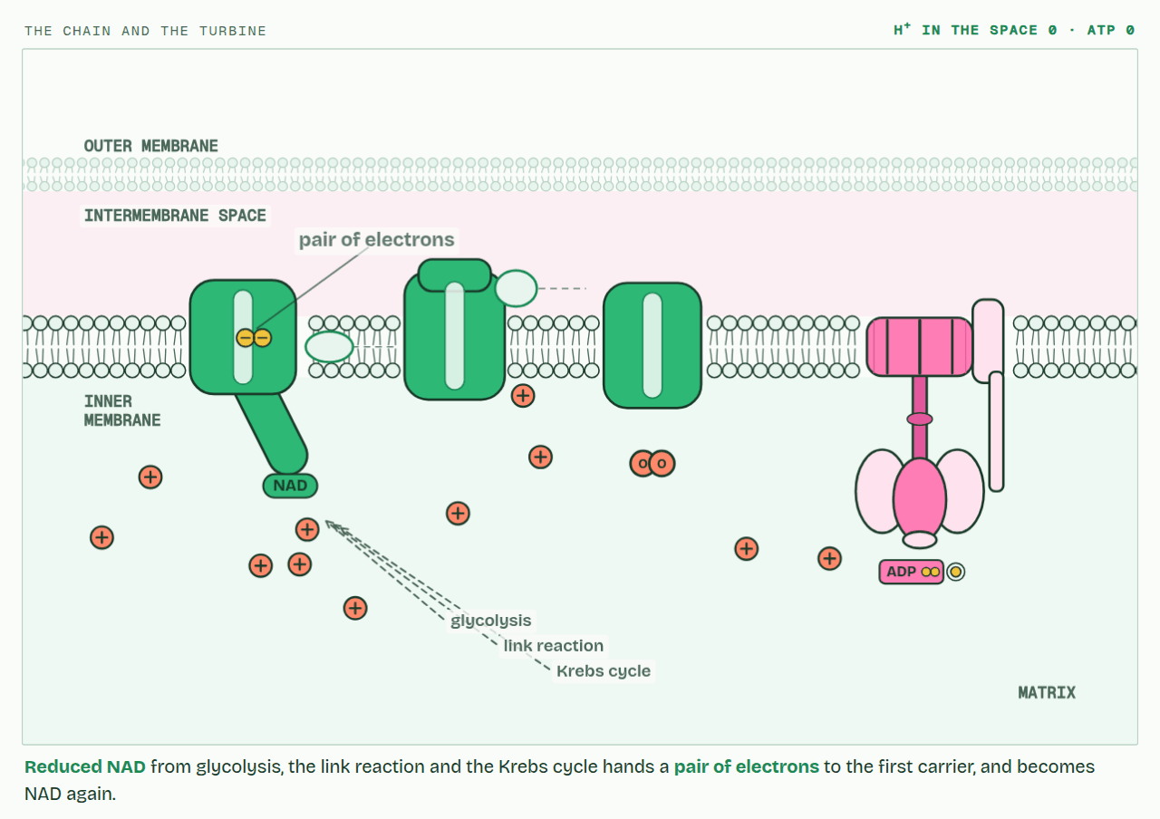
CHAPTER 11 · C1.2.15 C1.2.16 Chemiosmosis and ATP synthesis; oxygen as the terminal electron acceptor
PLAY IT
Protons through the turbine
The chain and the turbine: click to play. It loops every 36 seconds.
Minutes 17 to 30
Notes:
Minutes 17 to 30 of 60: The turbine (13 min).
The plan: Chapter 11: the predict, then the figure, then the chemiosmosis film: turn the oxygen off and watch what stops first.
The video is chemiosmosis-fcb61c.mp4, one loop of the animation in the guide. It plays in PowerPoint and Keynote. Google Slides does not play a video embedded in a .pptx: download chemiosmosis-fcb61c.mp4 (https://www.biologybybradford.com/guides/downloads/scenes/chemiosmosis-fcb61c.mp4), upload it to Google Drive, then Insert > Video > Google Drive.
In the guide the class can change it as it runs: https://www.biologybybradford.com/guides/ib-biology-c1-2-cell-respiration#synthase
What it shows, in order:
1. Reduced NAD from glycolysis, the link reaction and the Krebs cycle hands a pair of electrons to the first carrier, and becomes NAD again.
2. As the electrons pass along the chain they give up energy, which the carriers use to pump protons into the intermembrane space.
3. Protons pile up in the narrow space: a proton gradient. The membrane will not let them back through, except at one place.
4. Protons flow back down their gradient through ATP synthase, turning it. The energy joins ADP and phosphate: ATP.
5. Oxygen takes the electrons at the end of the chain, with protons from the matrix, making water. That keeps the electrons flowing.

Slide 24
PREDICT
A cell’s mitochondria run out of oxygen. What happens to the electron transport chain?
A Electrons back up and the pumping stops
B It runs faster to make up for it
C It keeps pumping, but makes no water
D ATP synthase runs backwards and starts to make oxygen
Minutes 17 to 30
Notes:
Minutes 17 to 30 of 60: The turbine (13 min).
The plan: Chapter 11: the predict, then the figure, then the chemiosmosis film: turn the oxygen off and watch what stops first.
Ask for a show of hands, or mini whiteboards, before revealing. (Answer: A, on the next slide.)

Slide 25
WHAT HAPPENS
A cell’s mitochondria run out of oxygen. What happens to the electron transport chain?
A Electrons back up and the pumping stops
B It runs faster to make up for it
C It keeps pumping, but makes no water
D ATP synthase runs backwards and starts to make oxygen
The electrons back up. With nothing to take them at the end, the last carrier stays full, then the one before it, all the way back. No electrons flow, so no protons are pumped, the gradient runs down and ATP synthase stops. Reduced NAD cannot be unloaded either. Try it in the film below.
Minutes 17 to 30
Notes:
Minutes 17 to 30 of 60: The turbine (13 min).
The plan: Chapter 11: the predict, then the figure, then the chemiosmosis film: turn the oxygen off and watch what stops first.
Answer: A. The electrons back up. With nothing to take them at the end, the last carrier stays full, then the one before it, all the way back. No electrons flow, so no protons are pumped, the gradient runs down and ATP synthase stops. Reduced NAD cannot be unloaded either. Try it in the film below.

Slide 26
WATCH OUT
ATP synthase is not a pump: protons flow through it, down their gradient, and that flow drives it. The pumps are in the chain.
Minutes 17 to 30
Notes:
Minutes 17 to 30 of 60: The turbine (13 min).
The plan: Chapter 11: the predict, then the figure, then the chemiosmosis film: turn the oxygen off and watch what stops first.
A common mistake: say it, then ask who can say why it is wrong.

Slide 27
STEP 4
8 MIN
The whole journey
Summary · hl (optional): Four corners
Minutes 30 to 38
Notes:
Minutes 30 to 38 of 60: The whole journey (8 min).
The plan: The HL respiration film from start to end. Switch the fuel to a fatty acid, then the cell to yeast. Grandma Likes Knitting Everything for the order: Glycolysis, Link reaction, Krebs cycle, Electron transport chain.

Slide 28
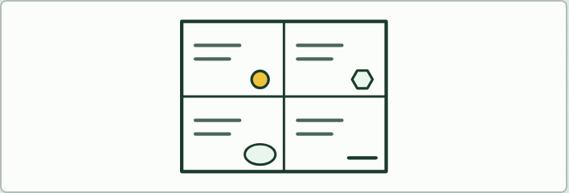
SUMMARY · HL (OPTIONAL)
IF THERE IS TIME
Four corners
THE TASK
Divide a page into four: glycolysis, link reaction, Krebs cycle, and chain and chemiosmosis. In each corner, ten keywords and a small picture: where, what, why and how.
STUDENTS NEED
A3 paper.
Minutes 30 to 38
Notes:
Minutes 30 to 38 of 60: The whole journey (8 min).
The plan: The HL respiration film from start to end. Switch the fuel to a fatty acid, then the cell to yeast. Grandma Likes Knitting Everything for the order: Glycolysis, Link reaction, Krebs cycle, Electron transport chain.
The activity: Four corners. Divide a page into four: glycolysis, link reaction, Krebs cycle, and chain and chemiosmosis. In each corner, ten keywords and a small picture: where, what, why and how.
Needs: A3 paper.
The plan sets no time of its own for this activity: use it in this step, in place of part of it, or for homework.

Slide 29
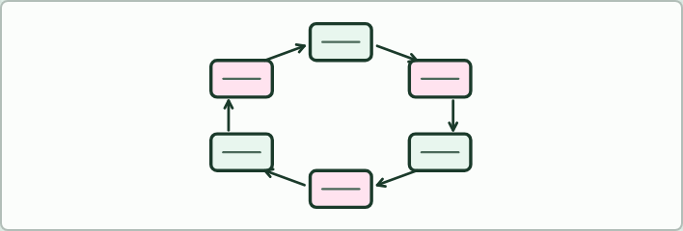
LOOP GAME · HL
10 MIN
The loop game
THE TASK
Eighteen cards, each an answer and a question, that loop back to the start. Each student reads their answer and the next question until the loop closes. The corrections to look for: aerobic respiration gives about 30 to 32 ATP (not 36 to 38); the Krebs cycle’s main product is reduced NAD (no FADH₂ at IB); the product in humans is lactate (not “lactic acid”); and hydrolysis of ATP releases energy.
STUDENTS NEED
A printed set, one card per student.
Minutes 38 to 48
Notes:
Minutes 38 to 48 of 60: The loop game (10 min).
The plan: One card each (below), corrected: students read their answer and the next question until the loop is closed.
The activity: The loop game. Eighteen cards, each an answer and a question, that loop back to the start. Each student reads their answer and the next question until the loop closes. The corrections to look for: aerobic respiration gives about 30 to 32 ATP (not 36 to 38); the Krebs cycle’s main product is reduced NAD (no FADH₂ at IB); the product in humans is lactate (not “lactic acid”); and hydrolysis of ATP releases energy.
Needs: a printed set, one card per student.
The time: 10 minutes, minutes 38 to 48 of the plan.

Slide 30
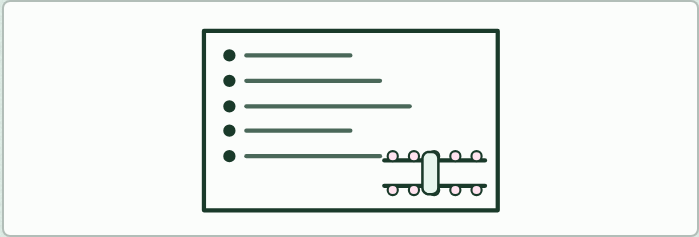
WRITING · HL
7 MIN
Plan an 8-mark answer
THE TASK
“Explain how ATP is made in the mitochondrion by chemiosmosis.” Plan it in keywords first: reduced NAD from three stages, a pair of electrons to the first carrier, energy released along the chain, protons pumped into the intermembrane space, a gradient, ATP synthase, protons flow back, ADP and phosphate joined, oxygen as terminal acceptor, water, which keeps the chain flowing, and cristae for area. Then write it.
STUDENTS NEED
Lined paper.
Minutes 48 to 55
Notes:
Minutes 48 to 55 of 60: Plan an 8-mark answer (7 min).
The plan: Plan “Explain how ATP is made in the mitochondrion by chemiosmosis” in keywords (activity below). Write it for homework, then check it with the Check step.
The activity: Plan an 8-mark answer. “Explain how ATP is made in the mitochondrion by chemiosmosis.” Plan it in keywords first: reduced NAD from three stages, a pair of electrons to the first carrier, energy released along the chain, protons pumped into the intermembrane space, a gradient, ATP synthase, protons flow back, ADP and phosphate joined, oxygen as terminal acceptor, water, which keeps the chain flowing, and cristae for area. Then write it.
Needs: lined paper.
The time: 7 minutes, minutes 48 to 55 of the plan.

Slide 31
PLENARY
Can you now...
Explain how electrons passed along the chain build a proton gradient across the inner membrane (C1.2.13, C1.2.14)
Explain how ATP synthase uses the proton gradient to make ATP, and why oxygen is needed at the end of the chain (C1.2.15, C1.2.16)
Minutes 55 to 60
Notes:
Minutes 55 to 60 of 60: Exit (5 min).
The plan: Rewrite your Do now sentence so that it would earn two marks.
Thumbs up, sideways or down on each goal before the exit question. The goals come from the statements this lesson covers.

Slide 32
EXIT QUESTION
Before you go
Rewrite your Do now sentence so that it would earn two marks.
Minutes 55 to 60
Notes:
Minutes 55 to 60 of 60: Exit (5 min).
The plan: Rewrite your Do now sentence so that it would earn two marks.

Slide 33
PRACTISE AND REVISE
Keep going
Exam practice: a fresh paper of exam questions on C1.2 at higher level, marked as you go
The guide, with the animations and the dry lab
This lesson in the guide: 10 Down the chain, 11 Protons through the turbine
BUILD FOR YOUR CLASS
ALREADY ON THE SITE FOR C1.2
CARD SETS ON SPLYCR
Tarsia puzzle, dominoes and picture reveal on C1.2, built from its key terms and ready to print
A pub quiz with rounds on C1.2, to present or run with no projector
An escape room built from the question bank on C1.2
Lesson: Cell Respiration HL (HL)
Lesson: Cell Respiration
Quiz: Cell Respiration
Quiz: Cell Respiration (HL)
Revision map: C1.2 Cell respiration, to fill in
Exam questions: C1.2 in the exam maker, a paper with its markscheme
Open a set to host it as a class game, or make a copy to edit.
C1.2 Cell Respiration
B3.2–C2.2 Plant Transport, Respiration & Neural Signalling
How this was made. The course structure, the activities and the teaching choices come from my own classroom, my presentations and my years of teaching IB and AP Biology. I use Claude, an AI, to help write and build the interactive guides, lesson plans, slides and practice questions, and to draw the diagrams and code the interactives. I direct the work and review it against the IB and AP specifications before it goes live.
Minute 60: after the lesson
Notes:
Every link here is live. Set the exam practice paper for homework: it is fresh each time, marked as students go and saved to their Exam practice when they are signed in.
Exam practice: https://www.biologybybradford.com/exam-maker/sit?topics=C1.2&level=HL&paper=quiz&marks=15&src=ep
The guide: https://www.biologybybradford.com/guides/ib-biology-c1-2-cell-respiration

