Slide 1
IB Biology C1.3
LESSON 1 OF 6
BY THE END YOU CAN
Photosynthesis
Explain how photosynthesis turns light energy into the chemical energy of carbon compounds, and why ecosystems depend on it (C1.3.1)
Write the word equation, say where each atom of glucose comes from, and explain why the oxygen given off comes from water (C1.3.2, C1.3.3)
Explain why pigments absorb only some wavelengths, and read and sketch an absorption spectrum with wavelengths and colours (C1.3.5)
Light into sugar
C1.3.1, C1.3.2, C1.3.3 and C1.3.5
Where the energy and the atoms of glucose come from, why the oxygen is from water, and why leaves absorb red and blue light
60 minutes · chapters 1, 2, 4
Minute 0
Notes:
IB Biology C1.3, Photosynthesis. Lesson 1 of 6: Light into sugar, 60 minutes.
The plan, minute by minute (each slide's footer says where you are):
0 to 6 min (6) Do now: sketch the equation
6 to 14 min (8) Where the energy comes from
14 to 28 min (14) Where the atoms go
28 to 38 min (10) Two processes compared
38 to 54 min (16) Why leaves are green
54 to 60 min (6) Exit
What students get wrong:
The oxygen comes from carbon dioxide. It comes from water (chapter 2).
Plants get their mass from the soil. Most of it is carbon and oxygen from the air.
Plants photosynthesise by day and respire by night. They respire all the time.
Leaves are green because chlorophyll makes green light. Green is what is not absorbed.
Light splits water directly. Chlorophyll absorbs the light, and its energy is used to split the water; light falling on water does not split it.
Stretch and support:
Support: chapter captions as cut-up cards to put in order; the dotted key terms as a glossary; a writing frame for “explain the effect of light intensity” (rise, why, plateau, why).
Stretch: if all the oxygen given off comes from water, the equation needs 12 water molecules in and 6 out. Write that equation and say why.
The lesson plan to print: https://www.biologybybradford.com/guides/downloads/ib-biology-c1-3-photosynthesis-lesson-1-plan.pdf

Slide 2
DO NOW
Sketch the equation
Students draw photosynthesis as a picture with its inputs, outputs and conditions, from memory, then share it with a partner.
6:00
minutes
Start now: the timer is running.
Minutes 0 to 6
Notes:
Minutes 0 to 6 of 60: Do now: sketch the equation (6 min).
The plan: Students draw photosynthesis as a picture with its inputs, outputs and conditions, from memory (activity below), then share it with a partner.
Start a 6 minute timer as they come in.

Slide 3
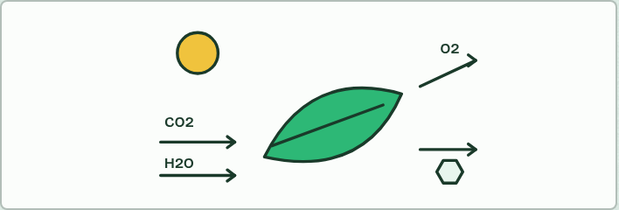
DO NOW
6 MIN
Sketch the equation
THE TASK
Students draw photosynthesis as a picture: what goes in, what comes out, where, and what it needs. Shared with a partner, then compared with chapter 2’s figure.
STUDENTS NEED
Mini whiteboards.
Minutes 0 to 6
Notes:
Minutes 0 to 6 of 60: Do now: sketch the equation (6 min).
The plan: Students draw photosynthesis as a picture with its inputs, outputs and conditions, from memory (activity below), then share it with a partner.
The activity: Sketch the equation. Students draw photosynthesis as a picture: what goes in, what comes out, where, and what it needs. Shared with a partner, then compared with chapter 2’s figure.
Needs: mini whiteboards.
The time: 6 minutes, minutes 0 to 6 of the plan.

Slide 4
STEP 2
8 MIN
Where the energy comes from
Pairs draw the Energy flowchart.
Minutes 6 to 14
Notes:
Minutes 6 to 14 of 60: Where the energy comes from (8 min).
The plan: Chapter 1: the predict (the cheese) as a vote, then the figure. Pairs draw the Energy flowchart (below).

Slide 5
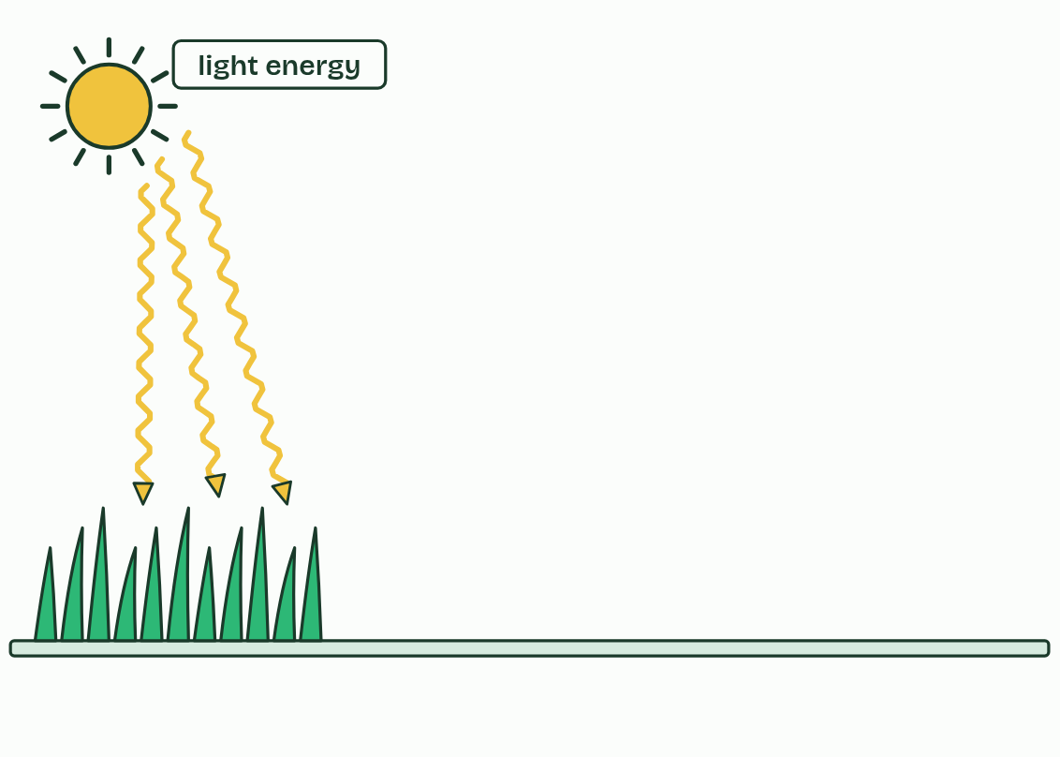
CHAPTER 1 · C1.3.1 Light energy to chemical energy
1 / 4
Sunlight in, chemical energy out
Light energy from the Sun reaches a leaf.
Minutes 6 to 14
Notes:
Minutes 6 to 14 of 60: Where the energy comes from (8 min).
The plan: Chapter 1: the predict (the cheese) as a vote, then the figure. Pairs draw the Energy flowchart (below).
Photosynthesis transforms light energy into chemical energy. In a leaf, pigments absorb light, and that energy ends up in the bonds of carbon compounds the plant builds: first sugars, then everything else it is made of. Light is not stored. It is changed into a different form, an energy transformation.
That chemical energy runs nearly every food chain. Plants, algae and cyanobacteria are producers. A rabbit eating grass, and a fox eating the rabbit, are living on energy the grass caught from the Sun. A few ecosystems, round deep-sea vents, run on chemical energy from the vent instead (C4.2 returns to this), but almost all the others depend on photosynthesis.
Cells need that energy for three kinds of work: building large molecules (anabolism, C1.1), moving substances against their gradients (active transport, B2.1), and movement, from muscle contraction to the pulling apart of chromosomes. Respiration (C1.2) releases the energy from carbon compounds and holds it in ATP, which pays for the work. At every step some energy leaves as heat. Energy flows through an ecosystem and is not recycled; carbon is (C4.2).

Slide 6
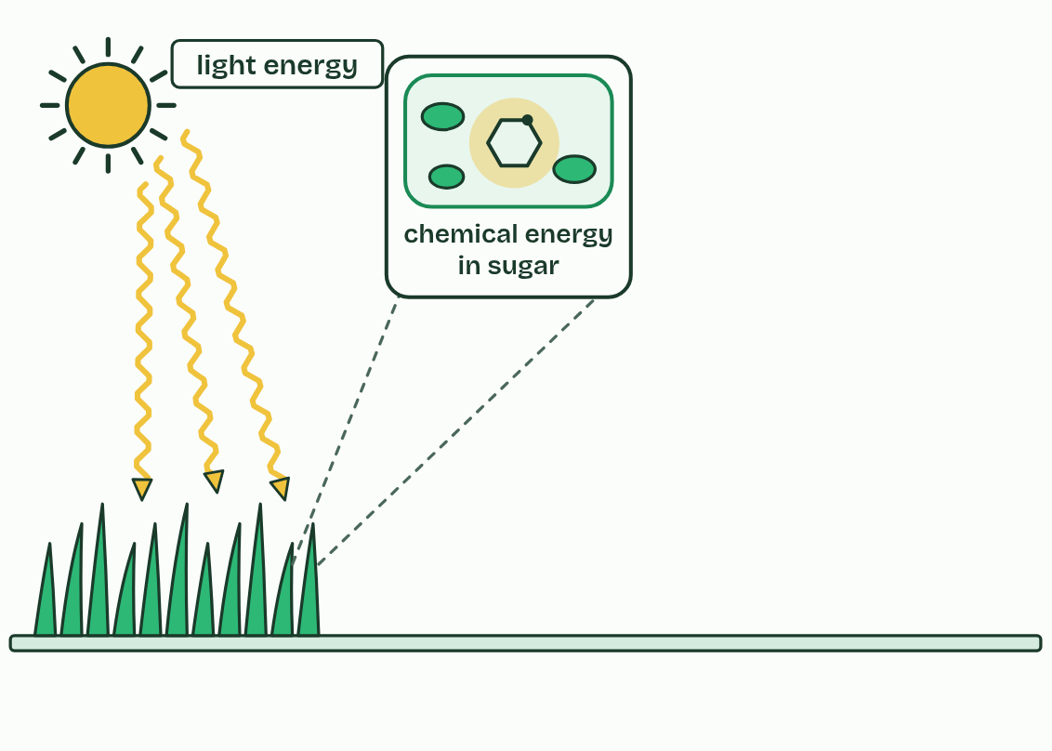
CHAPTER 1 · C1.3.1 Light energy to chemical energy
2 / 4
Sunlight in, chemical energy out
Photosynthesis turns it into chemical energy in the bonds of sugar.
Minutes 6 to 14
Notes:
Minutes 6 to 14 of 60: Where the energy comes from (8 min).
The plan: Chapter 1: the predict (the cheese) as a vote, then the figure. Pairs draw the Energy flowchart (below).
Photosynthesis transforms light energy into chemical energy. In a leaf, pigments absorb light, and that energy ends up in the bonds of carbon compounds the plant builds: first sugars, then everything else it is made of. Light is not stored. It is changed into a different form, an energy transformation.
That chemical energy runs nearly every food chain. Plants, algae and cyanobacteria are producers. A rabbit eating grass, and a fox eating the rabbit, are living on energy the grass caught from the Sun. A few ecosystems, round deep-sea vents, run on chemical energy from the vent instead (C4.2 returns to this), but almost all the others depend on photosynthesis.
Cells need that energy for three kinds of work: building large molecules (anabolism, C1.1), moving substances against their gradients (active transport, B2.1), and movement, from muscle contraction to the pulling apart of chromosomes. Respiration (C1.2) releases the energy from carbon compounds and holds it in ATP, which pays for the work. At every step some energy leaves as heat. Energy flows through an ecosystem and is not recycled; carbon is (C4.2).

Slide 7
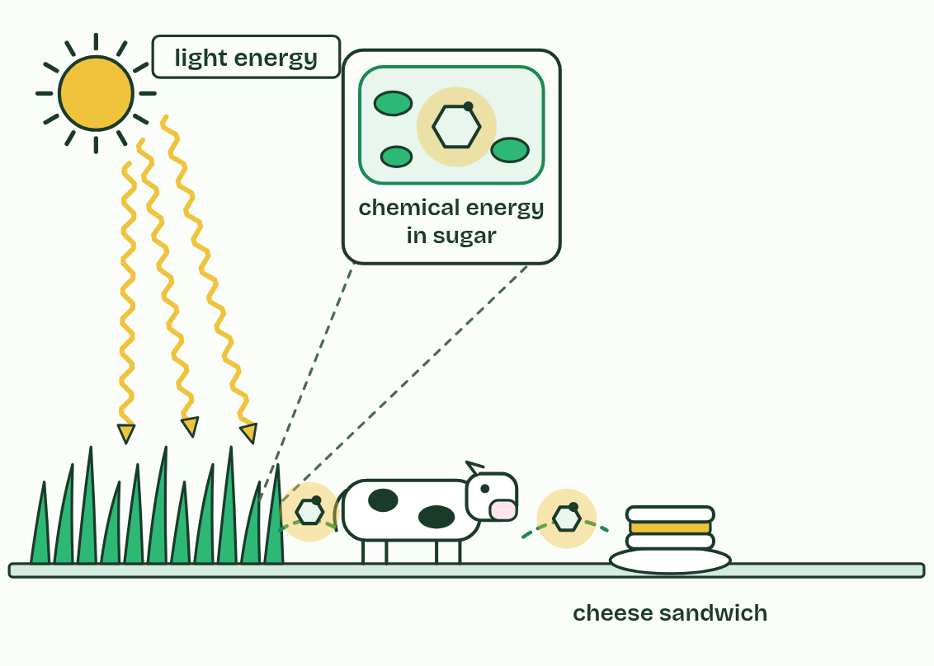
CHAPTER 1 · C1.3.1 Light energy to chemical energy
3 / 4
Sunlight in, chemical energy out
The cow lives on that energy, and stores some of it in milk.
Minutes 6 to 14
Notes:
Minutes 6 to 14 of 60: Where the energy comes from (8 min).
The plan: Chapter 1: the predict (the cheese) as a vote, then the figure. Pairs draw the Energy flowchart (below).
Photosynthesis transforms light energy into chemical energy. In a leaf, pigments absorb light, and that energy ends up in the bonds of carbon compounds the plant builds: first sugars, then everything else it is made of. Light is not stored. It is changed into a different form, an energy transformation.
That chemical energy runs nearly every food chain. Plants, algae and cyanobacteria are producers. A rabbit eating grass, and a fox eating the rabbit, are living on energy the grass caught from the Sun. A few ecosystems, round deep-sea vents, run on chemical energy from the vent instead (C4.2 returns to this), but almost all the others depend on photosynthesis.
Cells need that energy for three kinds of work: building large molecules (anabolism, C1.1), moving substances against their gradients (active transport, B2.1), and movement, from muscle contraction to the pulling apart of chromosomes. Respiration (C1.2) releases the energy from carbon compounds and holds it in ATP, which pays for the work. At every step some energy leaves as heat. Energy flows through an ecosystem and is not recycled; carbon is (C4.2).

Slide 8
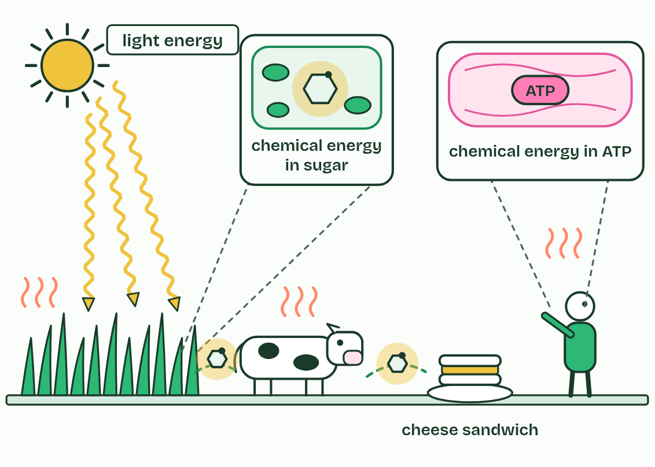
CHAPTER 1 · C1.3.1 Light energy to chemical energy
4 / 4
Sunlight in, chemical energy out
You release it in respiration, as ATP, and every step loses some as heat.
Minutes 6 to 14
Notes:
Minutes 6 to 14 of 60: Where the energy comes from (8 min).
The plan: Chapter 1: the predict (the cheese) as a vote, then the figure. Pairs draw the Energy flowchart (below).
Photosynthesis transforms light energy into chemical energy. In a leaf, pigments absorb light, and that energy ends up in the bonds of carbon compounds the plant builds: first sugars, then everything else it is made of. Light is not stored. It is changed into a different form, an energy transformation.
That chemical energy runs nearly every food chain. Plants, algae and cyanobacteria are producers. A rabbit eating grass, and a fox eating the rabbit, are living on energy the grass caught from the Sun. A few ecosystems, round deep-sea vents, run on chemical energy from the vent instead (C4.2 returns to this), but almost all the others depend on photosynthesis.
Cells need that energy for three kinds of work: building large molecules (anabolism, C1.1), moving substances against their gradients (active transport, B2.1), and movement, from muscle contraction to the pulling apart of chromosomes. Respiration (C1.2) releases the energy from carbon compounds and holds it in ATP, which pays for the work. At every step some energy leaves as heat. Energy flows through an ecosystem and is not recycled; carbon is (C4.2).

Slide 9
CHAPTER 1 · C1.3.1 Light energy to chemical energy
Sunlight in, chemical energy out
Photosynthesis transforms light energy into the chemical energy of carbon compounds.
Producers make the carbon compounds that every consumer in a food chain depends on.
Energy flows light, then chemical energy in sugar, then ATP, then work and heat.
Minutes 6 to 14
Notes:
Minutes 6 to 14 of 60: Where the energy comes from (8 min).
The plan: Chapter 1: the predict (the cheese) as a vote, then the figure. Pairs draw the Energy flowchart (below).
Photosynthesis transforms light energy into chemical energy. In a leaf, pigments absorb light, and that energy ends up in the bonds of carbon compounds the plant builds: first sugars, then everything else it is made of. Light is not stored. It is changed into a different form, an energy transformation.
That chemical energy runs nearly every food chain. Plants, algae and cyanobacteria are producers. A rabbit eating grass, and a fox eating the rabbit, are living on energy the grass caught from the Sun. A few ecosystems, round deep-sea vents, run on chemical energy from the vent instead (C4.2 returns to this), but almost all the others depend on photosynthesis.
Cells need that energy for three kinds of work: building large molecules (anabolism, C1.1), moving substances against their gradients (active transport, B2.1), and movement, from muscle contraction to the pulling apart of chromosomes. Respiration (C1.2) releases the energy from carbon compounds and holds it in ATP, which pays for the work. At every step some energy leaves as heat. Energy flows through an ecosystem and is not recycled; carbon is (C4.2).

Slide 10
PREDICT
The chemical energy in a slice of cheese: where did it first come from?
A Heat made in the cow’s own muscles
B Light caught by the grass it ate
C Minerals the grass took from the soil
D Sugars dissolved in the water it drank
Minutes 6 to 14
Notes:
Minutes 6 to 14 of 60: Where the energy comes from (8 min).
The plan: Chapter 1: the predict (the cheese) as a vote, then the figure. Pairs draw the Energy flowchart (below).
Ask for a show of hands, or mini whiteboards, before revealing. (Answer: B, on the next slide.)

Slide 11
WHAT HAPPENS
The chemical energy in a slice of cheese: where did it first come from?
A Heat made in the cow’s own muscles
B Light caught by the grass it ate
C Minerals the grass took from the soil
D Sugars dissolved in the water it drank
From sunlight, caught by grass. The cow turned some of the grass’s chemical energy into milk; the cheese holds what is left. Follow the energy in almost any food back far enough and you reach a leaf in the light.
Minutes 6 to 14
Notes:
Minutes 6 to 14 of 60: Where the energy comes from (8 min).
The plan: Chapter 1: the predict (the cheese) as a vote, then the figure. Pairs draw the Energy flowchart (below).
Answer: B. From sunlight, caught by grass. The cow turned some of the grass’s chemical energy into milk; the cheese holds what is left. Follow the energy in almost any food back far enough and you reach a leaf in the light.

Slide 12
WATCH OUT
Photosynthesis does not make energy; it changes light energy into chemical energy. And plants respire too, in the dark and in the light: they use some of the sugar they make.
Minutes 6 to 14
Notes:
Minutes 6 to 14 of 60: Where the energy comes from (8 min).
The plan: Chapter 1: the predict (the cheese) as a vote, then the figure. Pairs draw the Energy flowchart (below).
A common mistake: say it, then ask who can say why it is wrong.

Slide 13

PAIRS
8 MIN
Energy flowchart
THE TASK
Eight cards (Sun, light energy, leaf, chemical energy in glucose, a rabbit, chemical energy in ATP, muscle contraction, heat) laid as a flowchart (chapter 1). Then pairs add where heat leaves at every step.
STUDENTS NEED
Card sets.
Minutes 6 to 14
Notes:
Minutes 6 to 14 of 60: Where the energy comes from (8 min).
The plan: Chapter 1: the predict (the cheese) as a vote, then the figure. Pairs draw the Energy flowchart (below).
The activity: Energy flowchart. Eight cards (Sun, light energy, leaf, chemical energy in glucose, a rabbit, chemical energy in ATP, muscle contraction, heat) laid as a flowchart (chapter 1). Then pairs add where heat leaves at every step.
Needs: card sets.
The time: 8 minutes, minutes 6 to 14 of the plan.

Slide 14
STEP 3
14 MIN
Where the atoms go
Chapter 2: Carbon from the air, hydrogen from water
Card sort: Where does each atom go?
Minutes 14 to 28
Notes:
Minutes 14 to 28 of 60: Where the atoms go (14 min).
The plan: Chapter 2: the predict, then the figure step by step. Then Where does each atom go? (the card sort below, or the chapter’s sorter on the board).

Slide 15
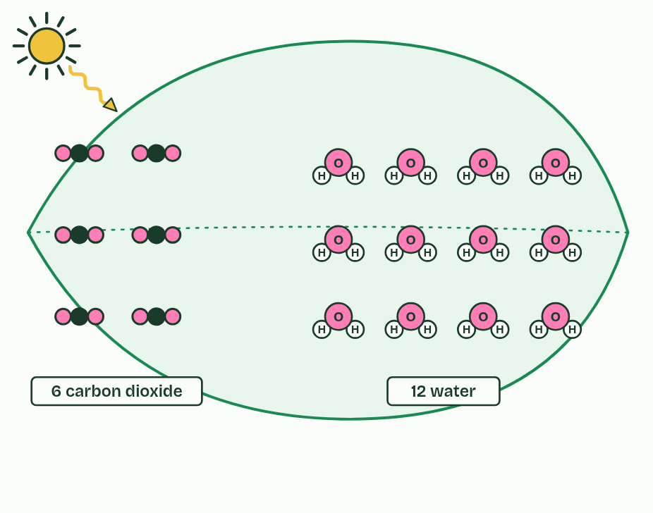
CHAPTER 2 · C1.3.2 C1.3.3 Carbon dioxide to glucose, with oxygen as a by-product
1 / 4
Carbon from the air, hydrogen from water
What goes in: carbon dioxide from the air, water from the soil.
Minutes 14 to 28
Notes:
Minutes 14 to 28 of 60: Where the atoms go (14 min).
The plan: Chapter 2: the predict, then the figure step by step. Then Where does each atom go? (the card sort below, or the chapter’s sorter on the board).
The word equation for photosynthesis is carbon dioxide + water → glucose + oxygen, with light energy and chlorophyll written over the arrow. In symbols it reads 6CO₂ + 6H₂O → C₆H₁₂O₆ + 6O₂, and the product that matters is glucose.
Look at the molecules. Carbon dioxide has carbon and oxygen but no hydrogen, and glucose needs plenty. The plant gets its hydrogen from water. It splits water using energy from the light that chlorophyll absorbs, a step called photolysis, and the hydrogen is added to carbon dioxide to build glucose. So glucose’s carbon and oxygen come from carbon dioxide, and its hydrogen comes from water. Most of a tree’s dry mass is carbon and oxygen taken from the air, not from the soil.
The oxygen gas a leaf gives off is a by-product. It comes from the water that was split, not from carbon dioxide. Every organism that photosynthesises this way gives off oxygen: plants, algae (from single cells to seaweeds) and cyanobacteria.
Example: How we know In 1941 Ruben and colleagues gave algae water made with a heavy form of oxygen. The oxygen gas the algae gave off was heavy too. When the heavy oxygen was in the carbon dioxide instead, the gas was not. The oxygen had come from the water.

Slide 16
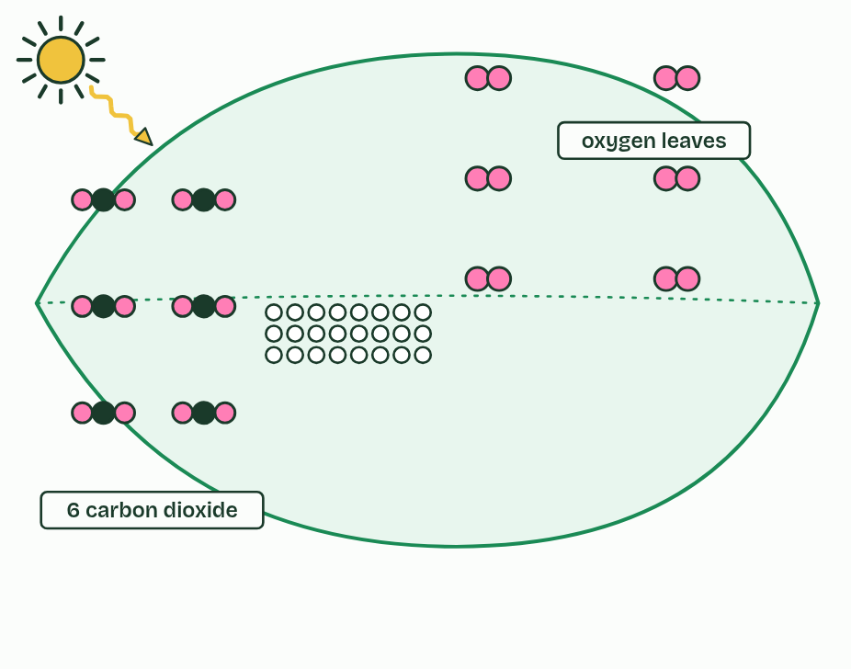
CHAPTER 2 · C1.3.2 C1.3.3 Carbon dioxide to glucose, with oxygen as a by-product
2 / 4
Carbon from the air, hydrogen from water
Light energy splits water. The oxygen leaves as a by-product.
Minutes 14 to 28
Notes:
Minutes 14 to 28 of 60: Where the atoms go (14 min).
The plan: Chapter 2: the predict, then the figure step by step. Then Where does each atom go? (the card sort below, or the chapter’s sorter on the board).
The word equation for photosynthesis is carbon dioxide + water → glucose + oxygen, with light energy and chlorophyll written over the arrow. In symbols it reads 6CO₂ + 6H₂O → C₆H₁₂O₆ + 6O₂, and the product that matters is glucose.
Look at the molecules. Carbon dioxide has carbon and oxygen but no hydrogen, and glucose needs plenty. The plant gets its hydrogen from water. It splits water using energy from the light that chlorophyll absorbs, a step called photolysis, and the hydrogen is added to carbon dioxide to build glucose. So glucose’s carbon and oxygen come from carbon dioxide, and its hydrogen comes from water. Most of a tree’s dry mass is carbon and oxygen taken from the air, not from the soil.
The oxygen gas a leaf gives off is a by-product. It comes from the water that was split, not from carbon dioxide. Every organism that photosynthesises this way gives off oxygen: plants, algae (from single cells to seaweeds) and cyanobacteria.
Example: How we know In 1941 Ruben and colleagues gave algae water made with a heavy form of oxygen. The oxygen gas the algae gave off was heavy too. When the heavy oxygen was in the carbon dioxide instead, the gas was not. The oxygen had come from the water.

Slide 17
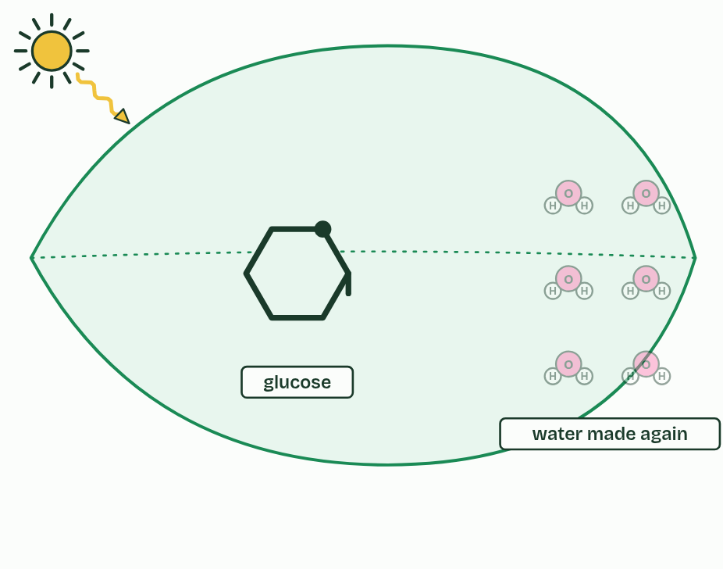
CHAPTER 2 · C1.3.2 C1.3.3 Carbon dioxide to glucose, with oxygen as a by-product
3 / 4
Carbon from the air, hydrogen from water
The hydrogen is added to carbon dioxide, building glucose.
Minutes 14 to 28
Notes:
Minutes 14 to 28 of 60: Where the atoms go (14 min).
The plan: Chapter 2: the predict, then the figure step by step. Then Where does each atom go? (the card sort below, or the chapter’s sorter on the board).
The word equation for photosynthesis is carbon dioxide + water → glucose + oxygen, with light energy and chlorophyll written over the arrow. In symbols it reads 6CO₂ + 6H₂O → C₆H₁₂O₆ + 6O₂, and the product that matters is glucose.
Look at the molecules. Carbon dioxide has carbon and oxygen but no hydrogen, and glucose needs plenty. The plant gets its hydrogen from water. It splits water using energy from the light that chlorophyll absorbs, a step called photolysis, and the hydrogen is added to carbon dioxide to build glucose. So glucose’s carbon and oxygen come from carbon dioxide, and its hydrogen comes from water. Most of a tree’s dry mass is carbon and oxygen taken from the air, not from the soil.
The oxygen gas a leaf gives off is a by-product. It comes from the water that was split, not from carbon dioxide. Every organism that photosynthesises this way gives off oxygen: plants, algae (from single cells to seaweeds) and cyanobacteria.
Example: How we know In 1941 Ruben and colleagues gave algae water made with a heavy form of oxygen. The oxygen gas the algae gave off was heavy too. When the heavy oxygen was in the carbon dioxide instead, the gas was not. The oxygen had come from the water.

Slide 18
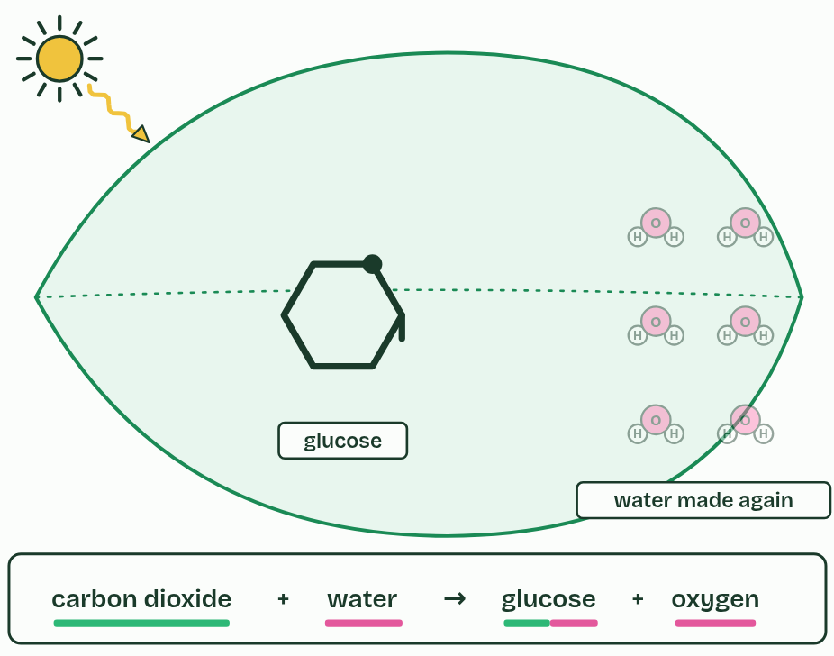
CHAPTER 2 · C1.3.2 C1.3.3 Carbon dioxide to glucose, with oxygen as a by-product
4 / 4
Carbon from the air, hydrogen from water
carbon dioxide + water → glucose + oxygen. The bars show where each atom came from: green, carbon dioxide; pink, water.
Minutes 14 to 28
Notes:
Minutes 14 to 28 of 60: Where the atoms go (14 min).
The plan: Chapter 2: the predict, then the figure step by step. Then Where does each atom go? (the card sort below, or the chapter’s sorter on the board).
The word equation for photosynthesis is carbon dioxide + water → glucose + oxygen, with light energy and chlorophyll written over the arrow. In symbols it reads 6CO₂ + 6H₂O → C₆H₁₂O₆ + 6O₂, and the product that matters is glucose.
Look at the molecules. Carbon dioxide has carbon and oxygen but no hydrogen, and glucose needs plenty. The plant gets its hydrogen from water. It splits water using energy from the light that chlorophyll absorbs, a step called photolysis, and the hydrogen is added to carbon dioxide to build glucose. So glucose’s carbon and oxygen come from carbon dioxide, and its hydrogen comes from water. Most of a tree’s dry mass is carbon and oxygen taken from the air, not from the soil.
The oxygen gas a leaf gives off is a by-product. It comes from the water that was split, not from carbon dioxide. Every organism that photosynthesises this way gives off oxygen: plants, algae (from single cells to seaweeds) and cyanobacteria.
Example: How we know In 1941 Ruben and colleagues gave algae water made with a heavy form of oxygen. The oxygen gas the algae gave off was heavy too. When the heavy oxygen was in the carbon dioxide instead, the gas was not. The oxygen had come from the water.

Slide 19
CHAPTER 2 · C1.3.2 C1.3.3 Carbon dioxide to glucose, with oxygen as a by-product
Carbon from the air, hydrogen from water
Carbon dioxide + water → glucose + oxygen, with light energy and chlorophyll over the arrow.
Glucose’s carbon and oxygen come from carbon dioxide; its hydrogen comes from water.
The oxygen given off comes from the water that is split, and is a by-product.
Minutes 14 to 28
Notes:
Minutes 14 to 28 of 60: Where the atoms go (14 min).
The plan: Chapter 2: the predict, then the figure step by step. Then Where does each atom go? (the card sort below, or the chapter’s sorter on the board).
The word equation for photosynthesis is carbon dioxide + water → glucose + oxygen, with light energy and chlorophyll written over the arrow. In symbols it reads 6CO₂ + 6H₂O → C₆H₁₂O₆ + 6O₂, and the product that matters is glucose.
Look at the molecules. Carbon dioxide has carbon and oxygen but no hydrogen, and glucose needs plenty. The plant gets its hydrogen from water. It splits water using energy from the light that chlorophyll absorbs, a step called photolysis, and the hydrogen is added to carbon dioxide to build glucose. So glucose’s carbon and oxygen come from carbon dioxide, and its hydrogen comes from water. Most of a tree’s dry mass is carbon and oxygen taken from the air, not from the soil.
The oxygen gas a leaf gives off is a by-product. It comes from the water that was split, not from carbon dioxide. Every organism that photosynthesises this way gives off oxygen: plants, algae (from single cells to seaweeds) and cyanobacteria.
Example: How we know In 1941 Ruben and colleagues gave algae water made with a heavy form of oxygen. The oxygen gas the algae gave off was heavy too. When the heavy oxygen was in the carbon dioxide instead, the gas was not. The oxygen had come from the water.

Slide 20
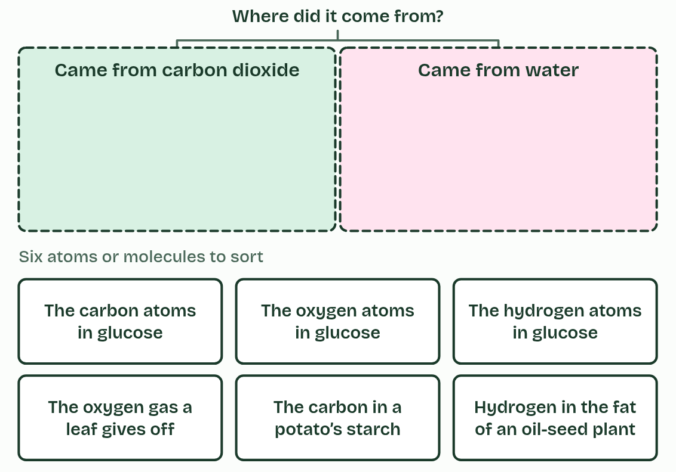
CHAPTER 2 · C1.3.2 C1.3.3 Carbon dioxide to glucose, with oxygen as a by-product
Carbon from the air, hydrogen from water
Carbon dioxide + water → glucose + oxygen, with light energy and chlorophyll over the arrow.
Glucose’s carbon and oxygen come from carbon dioxide; its hydrogen comes from water.
The oxygen given off comes from the water that is split, and is a by-product.
Minutes 14 to 28
Notes:
Minutes 14 to 28 of 60: Where the atoms go (14 min).
The plan: Chapter 2: the predict, then the figure step by step. Then Where does each atom go? (the card sort below, or the chapter’s sorter on the board).
The word equation for photosynthesis is carbon dioxide + water → glucose + oxygen, with light energy and chlorophyll written over the arrow. In symbols it reads 6CO₂ + 6H₂O → C₆H₁₂O₆ + 6O₂, and the product that matters is glucose.
Look at the molecules. Carbon dioxide has carbon and oxygen but no hydrogen, and glucose needs plenty. The plant gets its hydrogen from water. It splits water using energy from the light that chlorophyll absorbs, a step called photolysis, and the hydrogen is added to carbon dioxide to build glucose. So glucose’s carbon and oxygen come from carbon dioxide, and its hydrogen comes from water. Most of a tree’s dry mass is carbon and oxygen taken from the air, not from the soil.
The oxygen gas a leaf gives off is a by-product. It comes from the water that was split, not from carbon dioxide. Every organism that photosynthesises this way gives off oxygen: plants, algae (from single cells to seaweeds) and cyanobacteria.
Example: How we know In 1941 Ruben and colleagues gave algae water made with a heavy form of oxygen. The oxygen gas the algae gave off was heavy too. When the heavy oxygen was in the carbon dioxide instead, the gas was not. The oxygen had come from the water.

Slide 21
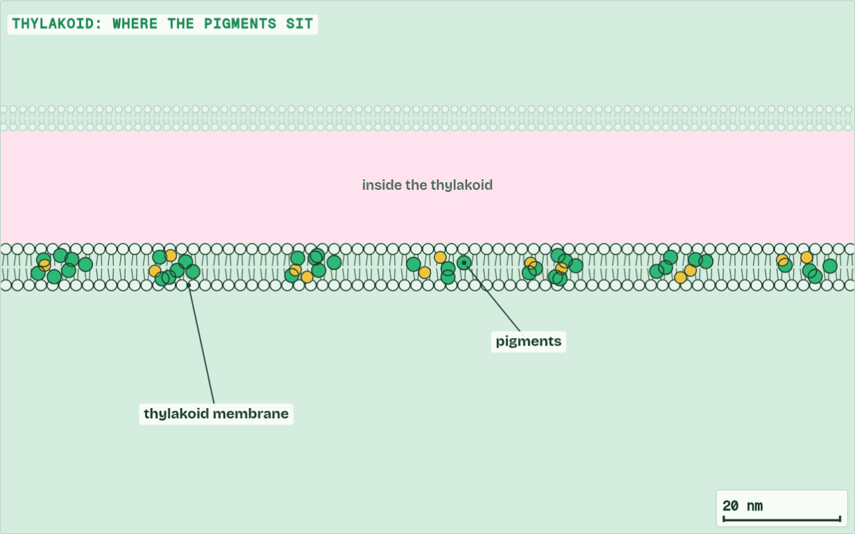
CHAPTER 2 · C1.3.2 C1.3.3 Carbon dioxide to glucose, with oxygen as a by-product
Thylakoid
1 / 6
Carbon from the air, hydrogen from water
Into a leaf, a palisade cell, a chloroplast and the thylakoids where its pigments sit.
Minutes 14 to 28
Notes:
Minutes 14 to 28 of 60: Where the atoms go (14 min).
The plan: Chapter 2: the predict, then the figure step by step. Then Where does each atom go? (the card sort below, or the chapter’s sorter on the board).
The word equation for photosynthesis is carbon dioxide + water → glucose + oxygen, with light energy and chlorophyll written over the arrow. In symbols it reads 6CO₂ + 6H₂O → C₆H₁₂O₆ + 6O₂, and the product that matters is glucose.
Look at the molecules. Carbon dioxide has carbon and oxygen but no hydrogen, and glucose needs plenty. The plant gets its hydrogen from water. It splits water using energy from the light that chlorophyll absorbs, a step called photolysis, and the hydrogen is added to carbon dioxide to build glucose. So glucose’s carbon and oxygen come from carbon dioxide, and its hydrogen comes from water. Most of a tree’s dry mass is carbon and oxygen taken from the air, not from the soil.
The oxygen gas a leaf gives off is a by-product. It comes from the water that was split, not from carbon dioxide. Every organism that photosynthesises this way gives off oxygen: plants, algae (from single cells to seaweeds) and cyanobacteria.
Example: How we know In 1941 Ruben and colleagues gave algae water made with a heavy form of oxygen. The oxygen gas the algae gave off was heavy too. When the heavy oxygen was in the carbon dioxide instead, the gas was not. The oxygen had come from the water.
The animation "From light to sugar", paused at 8.9 s. The next slides go on through it, then play it.

Slide 22
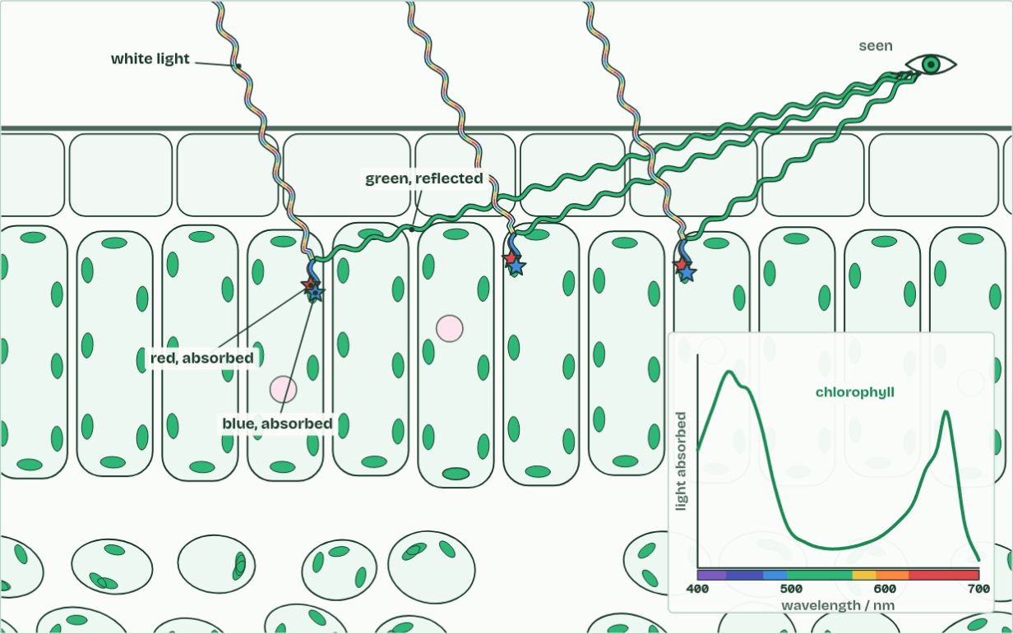
CHAPTER 2 · C1.3.2 C1.3.3 Carbon dioxide to glucose, with oxygen as a by-product
Leaf
2 / 6
Carbon from the air, hydrogen from water
Chlorophyll absorbs red and blue light and reflects green.
Minutes 14 to 28
Notes:
Minutes 14 to 28 of 60: Where the atoms go (14 min).
The plan: Chapter 2: the predict, then the figure step by step. Then Where does each atom go? (the card sort below, or the chapter’s sorter on the board).
The word equation for photosynthesis is carbon dioxide + water → glucose + oxygen, with light energy and chlorophyll written over the arrow. In symbols it reads 6CO₂ + 6H₂O → C₆H₁₂O₆ + 6O₂, and the product that matters is glucose.
Look at the molecules. Carbon dioxide has carbon and oxygen but no hydrogen, and glucose needs plenty. The plant gets its hydrogen from water. It splits water using energy from the light that chlorophyll absorbs, a step called photolysis, and the hydrogen is added to carbon dioxide to build glucose. So glucose’s carbon and oxygen come from carbon dioxide, and its hydrogen comes from water. Most of a tree’s dry mass is carbon and oxygen taken from the air, not from the soil.
The oxygen gas a leaf gives off is a by-product. It comes from the water that was split, not from carbon dioxide. Every organism that photosynthesises this way gives off oxygen: plants, algae (from single cells to seaweeds) and cyanobacteria.
Example: How we know In 1941 Ruben and colleagues gave algae water made with a heavy form of oxygen. The oxygen gas the algae gave off was heavy too. When the heavy oxygen was in the carbon dioxide instead, the gas was not. The oxygen had come from the water.
The animation "From light to sugar", paused at 15.0 s. The next slides go on through it, then play it.

Slide 23
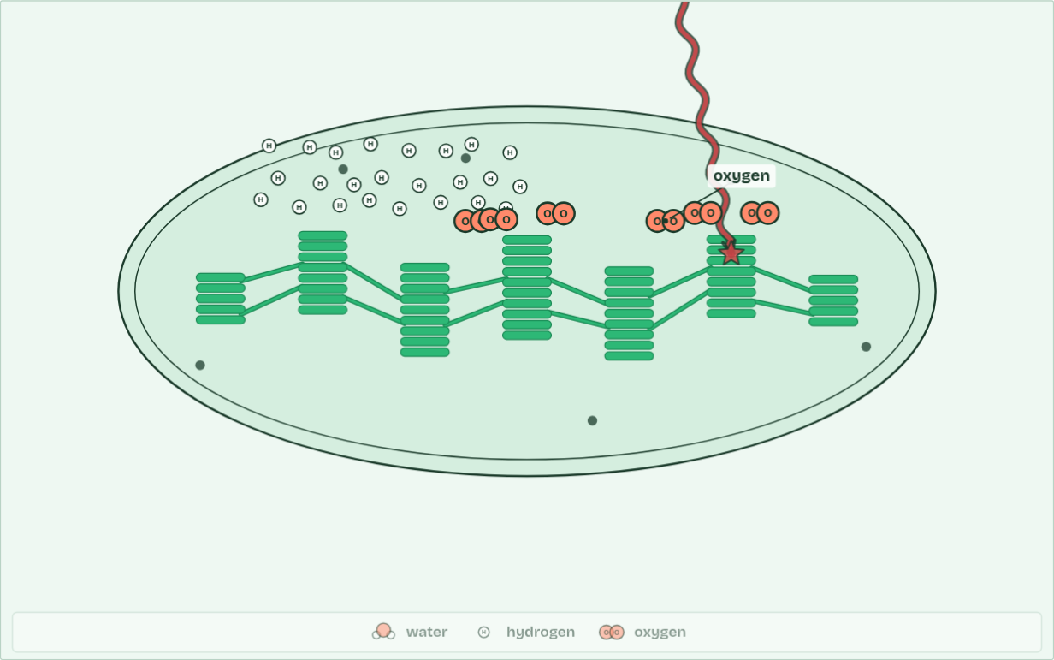
CHAPTER 2 · C1.3.2 C1.3.3 Carbon dioxide to glucose, with oxygen as a by-product
Chloroplast · oxygen 6
3 / 6
Carbon from the air, hydrogen from water
Energy absorbed by chlorophyll splits water. The oxygen is given off as a by-product.
Minutes 14 to 28
Notes:
Minutes 14 to 28 of 60: Where the atoms go (14 min).
The plan: Chapter 2: the predict, then the figure step by step. Then Where does each atom go? (the card sort below, or the chapter’s sorter on the board).
The word equation for photosynthesis is carbon dioxide + water → glucose + oxygen, with light energy and chlorophyll written over the arrow. In symbols it reads 6CO₂ + 6H₂O → C₆H₁₂O₆ + 6O₂, and the product that matters is glucose.
Look at the molecules. Carbon dioxide has carbon and oxygen but no hydrogen, and glucose needs plenty. The plant gets its hydrogen from water. It splits water using energy from the light that chlorophyll absorbs, a step called photolysis, and the hydrogen is added to carbon dioxide to build glucose. So glucose’s carbon and oxygen come from carbon dioxide, and its hydrogen comes from water. Most of a tree’s dry mass is carbon and oxygen taken from the air, not from the soil.
The oxygen gas a leaf gives off is a by-product. It comes from the water that was split, not from carbon dioxide. Every organism that photosynthesises this way gives off oxygen: plants, algae (from single cells to seaweeds) and cyanobacteria.
Example: How we know In 1941 Ruben and colleagues gave algae water made with a heavy form of oxygen. The oxygen gas the algae gave off was heavy too. When the heavy oxygen was in the carbon dioxide instead, the gas was not. The oxygen had come from the water.
The animation "From light to sugar", paused at 20.8 s. The next slides go on through it, then play it.

Slide 24
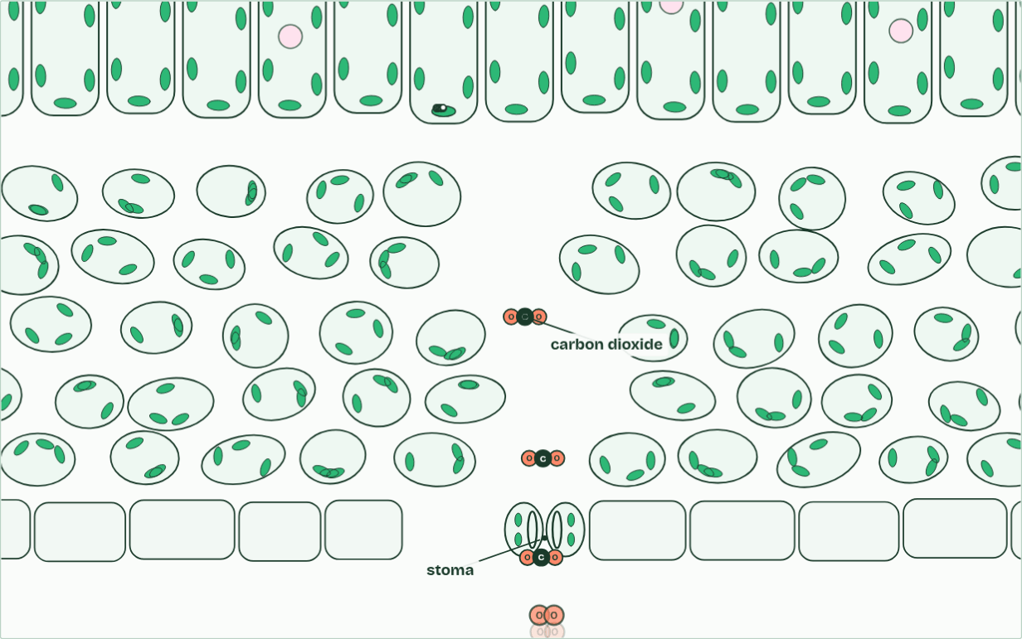
CHAPTER 2 · C1.3.2 C1.3.3 Carbon dioxide to glucose, with oxygen as a by-product
Leaf · carbon dioxide 2
4 / 6
Carbon from the air, hydrogen from water
Carbon dioxide diffuses in from the air.
Minutes 14 to 28
Notes:
Minutes 14 to 28 of 60: Where the atoms go (14 min).
The plan: Chapter 2: the predict, then the figure step by step. Then Where does each atom go? (the card sort below, or the chapter’s sorter on the board).
The word equation for photosynthesis is carbon dioxide + water → glucose + oxygen, with light energy and chlorophyll written over the arrow. In symbols it reads 6CO₂ + 6H₂O → C₆H₁₂O₆ + 6O₂, and the product that matters is glucose.
Look at the molecules. Carbon dioxide has carbon and oxygen but no hydrogen, and glucose needs plenty. The plant gets its hydrogen from water. It splits water using energy from the light that chlorophyll absorbs, a step called photolysis, and the hydrogen is added to carbon dioxide to build glucose. So glucose’s carbon and oxygen come from carbon dioxide, and its hydrogen comes from water. Most of a tree’s dry mass is carbon and oxygen taken from the air, not from the soil.
The oxygen gas a leaf gives off is a by-product. It comes from the water that was split, not from carbon dioxide. Every organism that photosynthesises this way gives off oxygen: plants, algae (from single cells to seaweeds) and cyanobacteria.
Example: How we know In 1941 Ruben and colleagues gave algae water made with a heavy form of oxygen. The oxygen gas the algae gave off was heavy too. When the heavy oxygen was in the carbon dioxide instead, the gas was not. The oxygen had come from the water.
The animation "From light to sugar", paused at 25.0 s. The next slides go on through it, then play it.

Slide 25
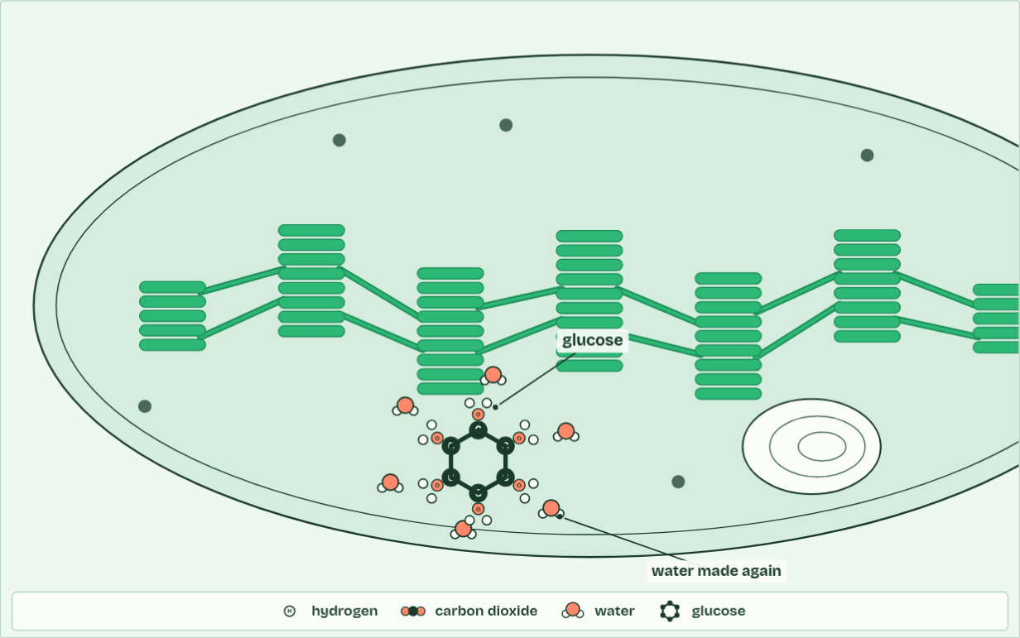
CHAPTER 2 · C1.3.2 C1.3.3 Carbon dioxide to glucose, with oxygen as a by-product
Chloroplast · glucose 1
5 / 6
Carbon from the air, hydrogen from water
Hydrogen from water is added to carbon dioxide, building glucose, which can be stored as starch.
Minutes 14 to 28
Notes:
Minutes 14 to 28 of 60: Where the atoms go (14 min).
The plan: Chapter 2: the predict, then the figure step by step. Then Where does each atom go? (the card sort below, or the chapter’s sorter on the board).
The word equation for photosynthesis is carbon dioxide + water → glucose + oxygen, with light energy and chlorophyll written over the arrow. In symbols it reads 6CO₂ + 6H₂O → C₆H₁₂O₆ + 6O₂, and the product that matters is glucose.
Look at the molecules. Carbon dioxide has carbon and oxygen but no hydrogen, and glucose needs plenty. The plant gets its hydrogen from water. It splits water using energy from the light that chlorophyll absorbs, a step called photolysis, and the hydrogen is added to carbon dioxide to build glucose. So glucose’s carbon and oxygen come from carbon dioxide, and its hydrogen comes from water. Most of a tree’s dry mass is carbon and oxygen taken from the air, not from the soil.
The oxygen gas a leaf gives off is a by-product. It comes from the water that was split, not from carbon dioxide. Every organism that photosynthesises this way gives off oxygen: plants, algae (from single cells to seaweeds) and cyanobacteria.
Example: How we know In 1941 Ruben and colleagues gave algae water made with a heavy form of oxygen. The oxygen gas the algae gave off was heavy too. When the heavy oxygen was in the carbon dioxide instead, the gas was not. The oxygen had come from the water.
The animation "From light to sugar", paused at 33.4 s. The next slides go on through it, then play it.

Slide 26
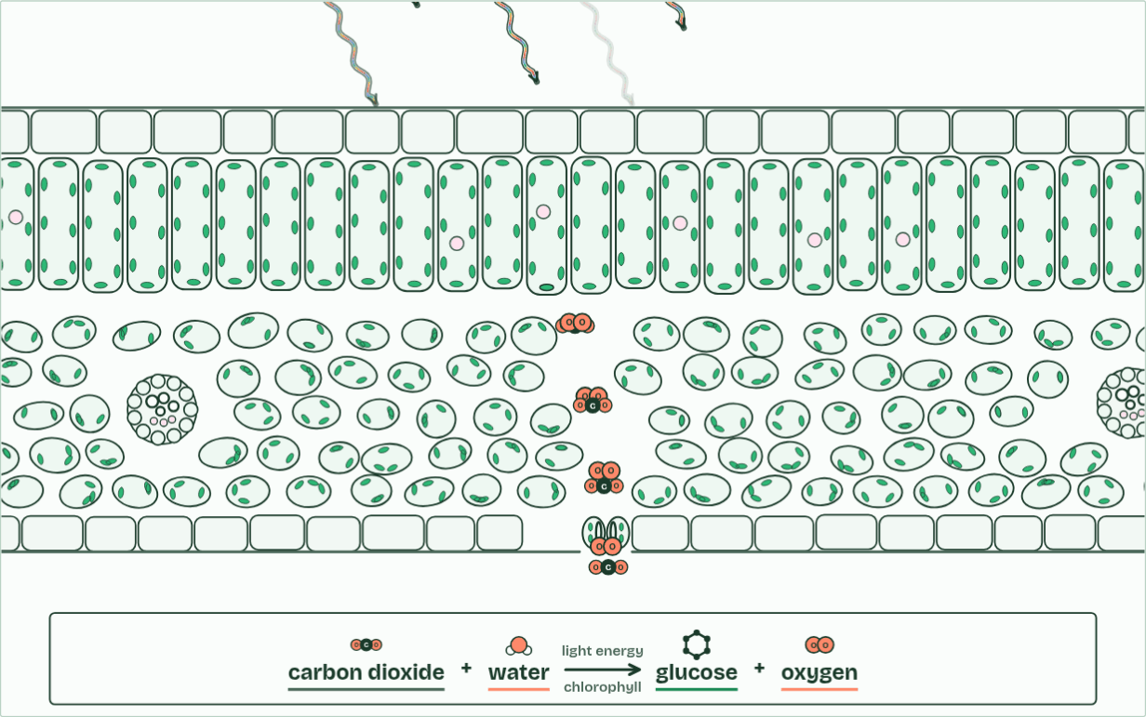
CHAPTER 2 · C1.3.2 C1.3.3 Carbon dioxide to glucose, with oxygen as a by-product
Leaf · glucose 1
6 / 6
Carbon from the air, hydrogen from water
carbon dioxide + water → glucose + oxygen
Minutes 14 to 28
Notes:
Minutes 14 to 28 of 60: Where the atoms go (14 min).
The plan: Chapter 2: the predict, then the figure step by step. Then Where does each atom go? (the card sort below, or the chapter’s sorter on the board).
The word equation for photosynthesis is carbon dioxide + water → glucose + oxygen, with light energy and chlorophyll written over the arrow. In symbols it reads 6CO₂ + 6H₂O → C₆H₁₂O₆ + 6O₂, and the product that matters is glucose.
Look at the molecules. Carbon dioxide has carbon and oxygen but no hydrogen, and glucose needs plenty. The plant gets its hydrogen from water. It splits water using energy from the light that chlorophyll absorbs, a step called photolysis, and the hydrogen is added to carbon dioxide to build glucose. So glucose’s carbon and oxygen come from carbon dioxide, and its hydrogen comes from water. Most of a tree’s dry mass is carbon and oxygen taken from the air, not from the soil.
The oxygen gas a leaf gives off is a by-product. It comes from the water that was split, not from carbon dioxide. Every organism that photosynthesises this way gives off oxygen: plants, algae (from single cells to seaweeds) and cyanobacteria.
Example: How we know In 1941 Ruben and colleagues gave algae water made with a heavy form of oxygen. The oxygen gas the algae gave off was heavy too. When the heavy oxygen was in the carbon dioxide instead, the gas was not. The oxygen had come from the water.
The animation "From light to sugar", paused at 41.5 s. The next slides go on through it, then play it.

Slide 27
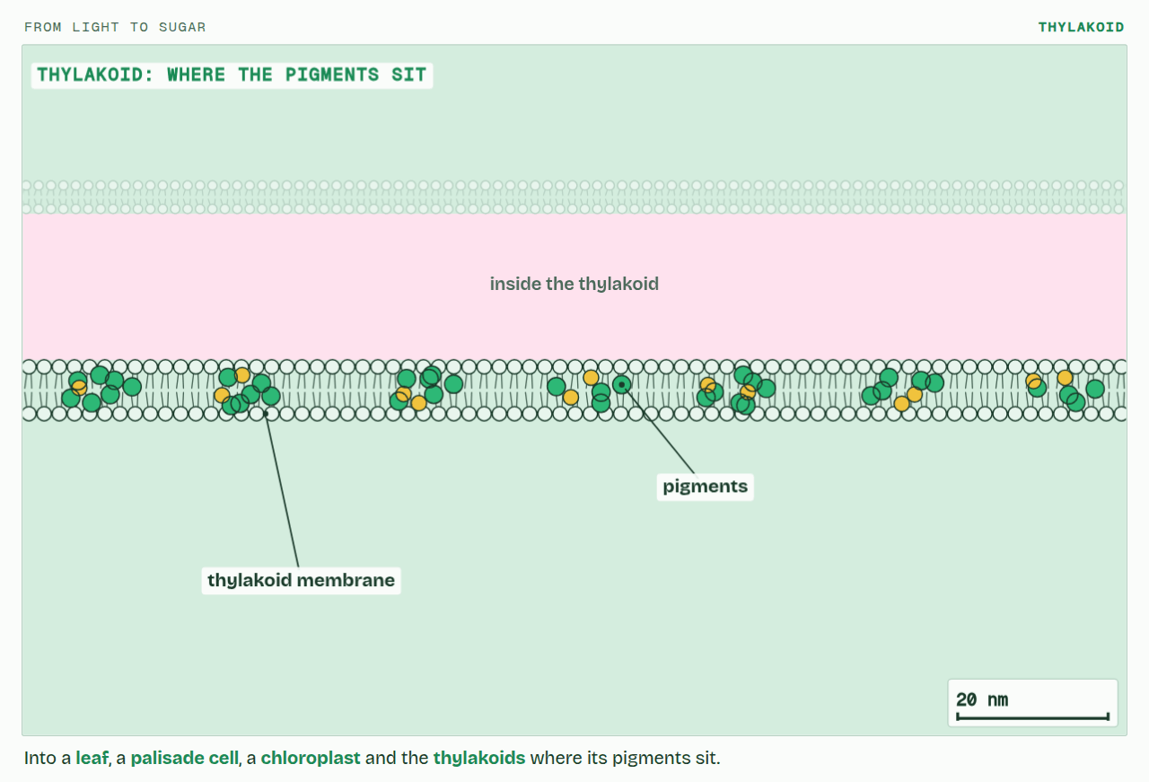
CHAPTER 2 · C1.3.2 C1.3.3 Carbon dioxide to glucose, with oxygen as a by-product
PLAY IT
Carbon from the air, hydrogen from water
From light to sugar: click to play. It loops every 42 seconds.
Minutes 14 to 28
Notes:
Minutes 14 to 28 of 60: Where the atoms go (14 min).
The plan: Chapter 2: the predict, then the figure step by step. Then Where does each atom go? (the card sort below, or the chapter’s sorter on the board).
The video is photosynthesis-b2ff08.mp4, one loop of the animation in the guide. It plays in PowerPoint and Keynote. Google Slides does not play a video embedded in a .pptx: download photosynthesis-b2ff08.mp4 (https://www.biologybybradford.com/guides/downloads/scenes/photosynthesis-b2ff08.mp4), upload it to Google Drive, then Insert > Video > Google Drive.
In the guide the class can change it as it runs: https://www.biologybybradford.com/guides/ib-biology-c1-3-photosynthesis#equation
What it shows, in order:
1. Into a leaf, a palisade cell, a chloroplast and the thylakoids where its pigments sit.
2. Chlorophyll absorbs red and blue light and reflects green.
3. Energy absorbed by chlorophyll splits water. The oxygen is given off as a by-product.
4. Carbon dioxide diffuses in from the air.
5. Hydrogen from water is added to carbon dioxide, building glucose, which can be stored as starch.
6. carbon dioxide + water → glucose + oxygen

Slide 28
PREDICT
Where does the oxygen gas a leaf gives off come from?
A From the carbon dioxide it absorbs
B From both, half and half
C From the glucose it breaks down
D From the water it splits
Minutes 14 to 28
Notes:
Minutes 14 to 28 of 60: Where the atoms go (14 min).
The plan: Chapter 2: the predict, then the figure step by step. Then Where does each atom go? (the card sort below, or the chapter’s sorter on the board).
Ask for a show of hands, or mini whiteboards, before revealing. (Answer: D, on the next slide.)

Slide 29
WHAT HAPPENS
Where does the oxygen gas a leaf gives off come from?
A From the carbon dioxide it absorbs
B From both, half and half
C From the glucose it breaks down
D From the water it splits
From water. The plant splits water to get hydrogen, and the oxygen left over is given off. Ruben’s heavy-oxygen experiment showed it: heavy oxygen in the water came out as heavy oxygen gas; heavy oxygen in the carbon dioxide did not.
Minutes 14 to 28
Notes:
Minutes 14 to 28 of 60: Where the atoms go (14 min).
The plan: Chapter 2: the predict, then the figure step by step. Then Where does each atom go? (the card sort below, or the chapter’s sorter on the board).
Answer: D. From water. The plant splits water to get hydrogen, and the oxygen left over is given off. Ruben’s heavy-oxygen experiment showed it: heavy oxygen in the water came out as heavy oxygen gas; heavy oxygen in the carbon dioxide did not.

Slide 30
WATCH OUT
“The oxygen comes from carbon dioxide” is the commonest slip, because the equation seems to say so. Carbon dioxide’s oxygen ends up in the glucose and in the water that is made again. And light does not split water by itself: chlorophyll catches the light first (chapter 9).
Minutes 14 to 28
Notes:
Minutes 14 to 28 of 60: Where the atoms go (14 min).
The plan: Chapter 2: the predict, then the figure step by step. Then Where does each atom go? (the card sort below, or the chapter’s sorter on the board).
A common mistake: say it, then ask who can say why it is wrong.

Slide 31
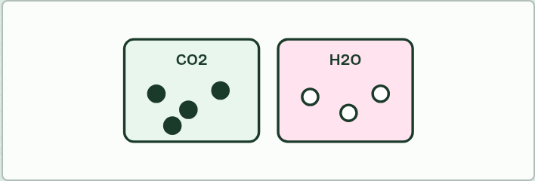
CARD SORT
14 MIN
Where does each atom go?
THE TASK
Ten small cards (each a coloured atom: the carbon, hydrogen and oxygen atoms of glucose, the oxygen gas, the carbon in starch, the hydrogen in a fat, the oxygen atoms in the carbon dioxide, and so on) sorted onto two mats, “from carbon dioxide” and “from water” (chapter 2). The class then hears the heavy-oxygen story.
STUDENTS NEED
Card sets and two mats per pair.
Minutes 14 to 28
Notes:
Minutes 14 to 28 of 60: Where the atoms go (14 min).
The plan: Chapter 2: the predict, then the figure step by step. Then Where does each atom go? (the card sort below, or the chapter’s sorter on the board).
The activity: Where does each atom go?. Ten small cards (each a coloured atom: the carbon, hydrogen and oxygen atoms of glucose, the oxygen gas, the carbon in starch, the hydrogen in a fat, the oxygen atoms in the carbon dioxide, and so on) sorted onto two mats, “from carbon dioxide” and “from water” (chapter 2). The class then hears the heavy-oxygen story.
Needs: card sets and two mats per pair.
The time: 14 minutes, minutes 14 to 28 of the plan.

Slide 32
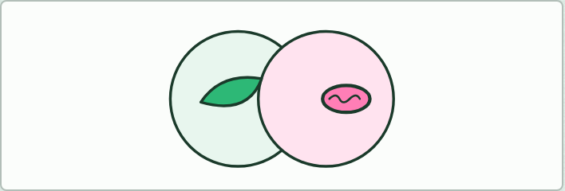
VENN
10 MIN
Two processes compared
THE TASK
A two-circle Venn: photosynthesis and respiration. Where it happens, inputs, outputs, energy in or out, and which organisms. At least three things go in the overlap (ATP made, membranes, enzymes, both in plant cells).
STUDENTS NEED
An A4 Venn sheet.
Minutes 28 to 38
Notes:
Minutes 28 to 38 of 60: Two processes compared (10 min).
The plan: The Venn below: respiration, met in C1.2, against photosynthesis.
The activity: Two processes compared. A two-circle Venn: photosynthesis and respiration. Where it happens, inputs, outputs, energy in or out, and which organisms. At least three things go in the overlap (ATP made, membranes, enzymes, both in plant cells).
Needs: an A4 Venn sheet.
The time: 10 minutes, minutes 28 to 38 of the plan.

Slide 33
STEP 5
16 MIN
Why leaves are green
Students sketch the spectrum on paper, then set chapter 4’s handles on the board.
Minutes 38 to 54
Notes:
Minutes 38 to 54 of 60: Why leaves are green (16 min).
The plan: Chapter 4: the predict. Students sketch the spectrum on paper (Draw the spectrum, below), then set chapter 4’s handles on the board. Play the figure, then turn over the Richard Of York tiles.

Slide 34
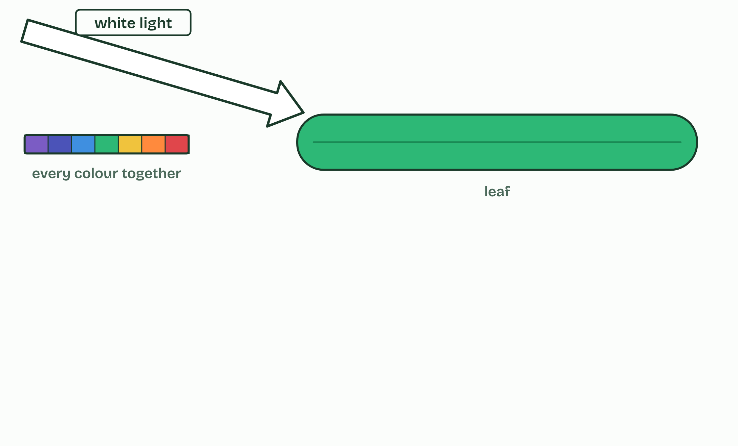
CHAPTER 4 · C1.3.5 Absorption of specific wavelengths by photosynthetic pigments
1 / 4
Why some colours and not others
White light is every colour together.
Minutes 38 to 54
Notes:
Minutes 38 to 54 of 60: Why leaves are green (16 min).
The plan: Chapter 4: the predict. Students sketch the spectrum on paper (Draw the spectrum, below), then set chapter 4’s handles on the board. Play the figure, then turn over the Richard Of York tiles.
Visible light is the band of wavelengths from about 400 nm (violet) to about 700 nm (red). White light is every one of them together, and the shorter the wavelength, the more energy each photon carries.
A pigment absorbs a photon only if the photon’s energy matches a jump one of its electrons can make to a higher energy level. The electron is then excited. Photons with other energies are not absorbed: they pass through the pigment or bounce off it, which is reflection.
Chlorophyll’s electrons can make jumps that match blue and red photons, so it absorbs those strongly and very little green. The green is reflected or passes through. That is why leaves look green: you see the light they did not use. The energy of the excited electron is what photosynthesis turns into chemical energy.
Accessory pigments, the carotenoids, absorb blue and blue-green light that chlorophyll a takes up less, and widen the range of light a leaf can use. In autumn the chlorophyll breaks down first, and the carotenoids show as yellow and orange. An absorption spectrum shows, wavelength by wavelength, how much of the light a pigment takes in. Draw it with both the wavelengths in nm and the colours along the horizontal axis.

Slide 35
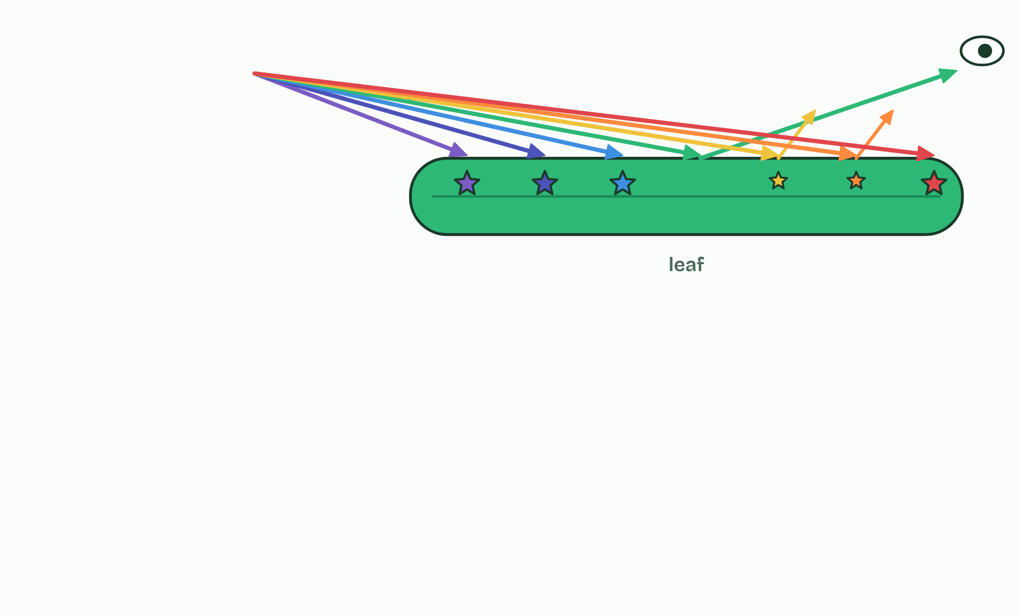
CHAPTER 4 · C1.3.5 Absorption of specific wavelengths by photosynthetic pigments
2 / 4
Why some colours and not others
Chlorophyll absorbs blue and red and reflects most green.
Minutes 38 to 54
Notes:
Minutes 38 to 54 of 60: Why leaves are green (16 min).
The plan: Chapter 4: the predict. Students sketch the spectrum on paper (Draw the spectrum, below), then set chapter 4’s handles on the board. Play the figure, then turn over the Richard Of York tiles.
Visible light is the band of wavelengths from about 400 nm (violet) to about 700 nm (red). White light is every one of them together, and the shorter the wavelength, the more energy each photon carries.
A pigment absorbs a photon only if the photon’s energy matches a jump one of its electrons can make to a higher energy level. The electron is then excited. Photons with other energies are not absorbed: they pass through the pigment or bounce off it, which is reflection.
Chlorophyll’s electrons can make jumps that match blue and red photons, so it absorbs those strongly and very little green. The green is reflected or passes through. That is why leaves look green: you see the light they did not use. The energy of the excited electron is what photosynthesis turns into chemical energy.
Accessory pigments, the carotenoids, absorb blue and blue-green light that chlorophyll a takes up less, and widen the range of light a leaf can use. In autumn the chlorophyll breaks down first, and the carotenoids show as yellow and orange. An absorption spectrum shows, wavelength by wavelength, how much of the light a pigment takes in. Draw it with both the wavelengths in nm and the colours along the horizontal axis.

Slide 36
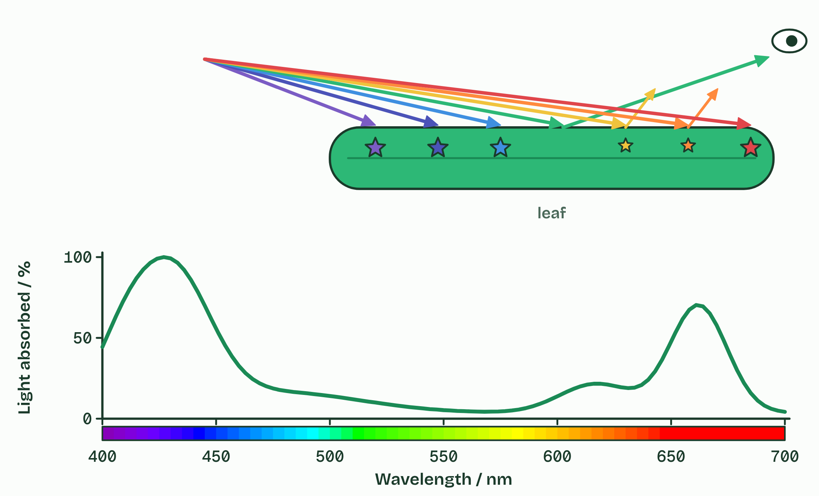
CHAPTER 4 · C1.3.5 Absorption of specific wavelengths by photosynthetic pigments
3 / 4
Why some colours and not others
An absorption spectrum: how much of each wavelength a pigment absorbs. These are for pigments dissolved in a solvent.
Minutes 38 to 54
Notes:
Minutes 38 to 54 of 60: Why leaves are green (16 min).
The plan: Chapter 4: the predict. Students sketch the spectrum on paper (Draw the spectrum, below), then set chapter 4’s handles on the board. Play the figure, then turn over the Richard Of York tiles.
Visible light is the band of wavelengths from about 400 nm (violet) to about 700 nm (red). White light is every one of them together, and the shorter the wavelength, the more energy each photon carries.
A pigment absorbs a photon only if the photon’s energy matches a jump one of its electrons can make to a higher energy level. The electron is then excited. Photons with other energies are not absorbed: they pass through the pigment or bounce off it, which is reflection.
Chlorophyll’s electrons can make jumps that match blue and red photons, so it absorbs those strongly and very little green. The green is reflected or passes through. That is why leaves look green: you see the light they did not use. The energy of the excited electron is what photosynthesis turns into chemical energy.
Accessory pigments, the carotenoids, absorb blue and blue-green light that chlorophyll a takes up less, and widen the range of light a leaf can use. In autumn the chlorophyll breaks down first, and the carotenoids show as yellow and orange. An absorption spectrum shows, wavelength by wavelength, how much of the light a pigment takes in. Draw it with both the wavelengths in nm and the colours along the horizontal axis.

Slide 37
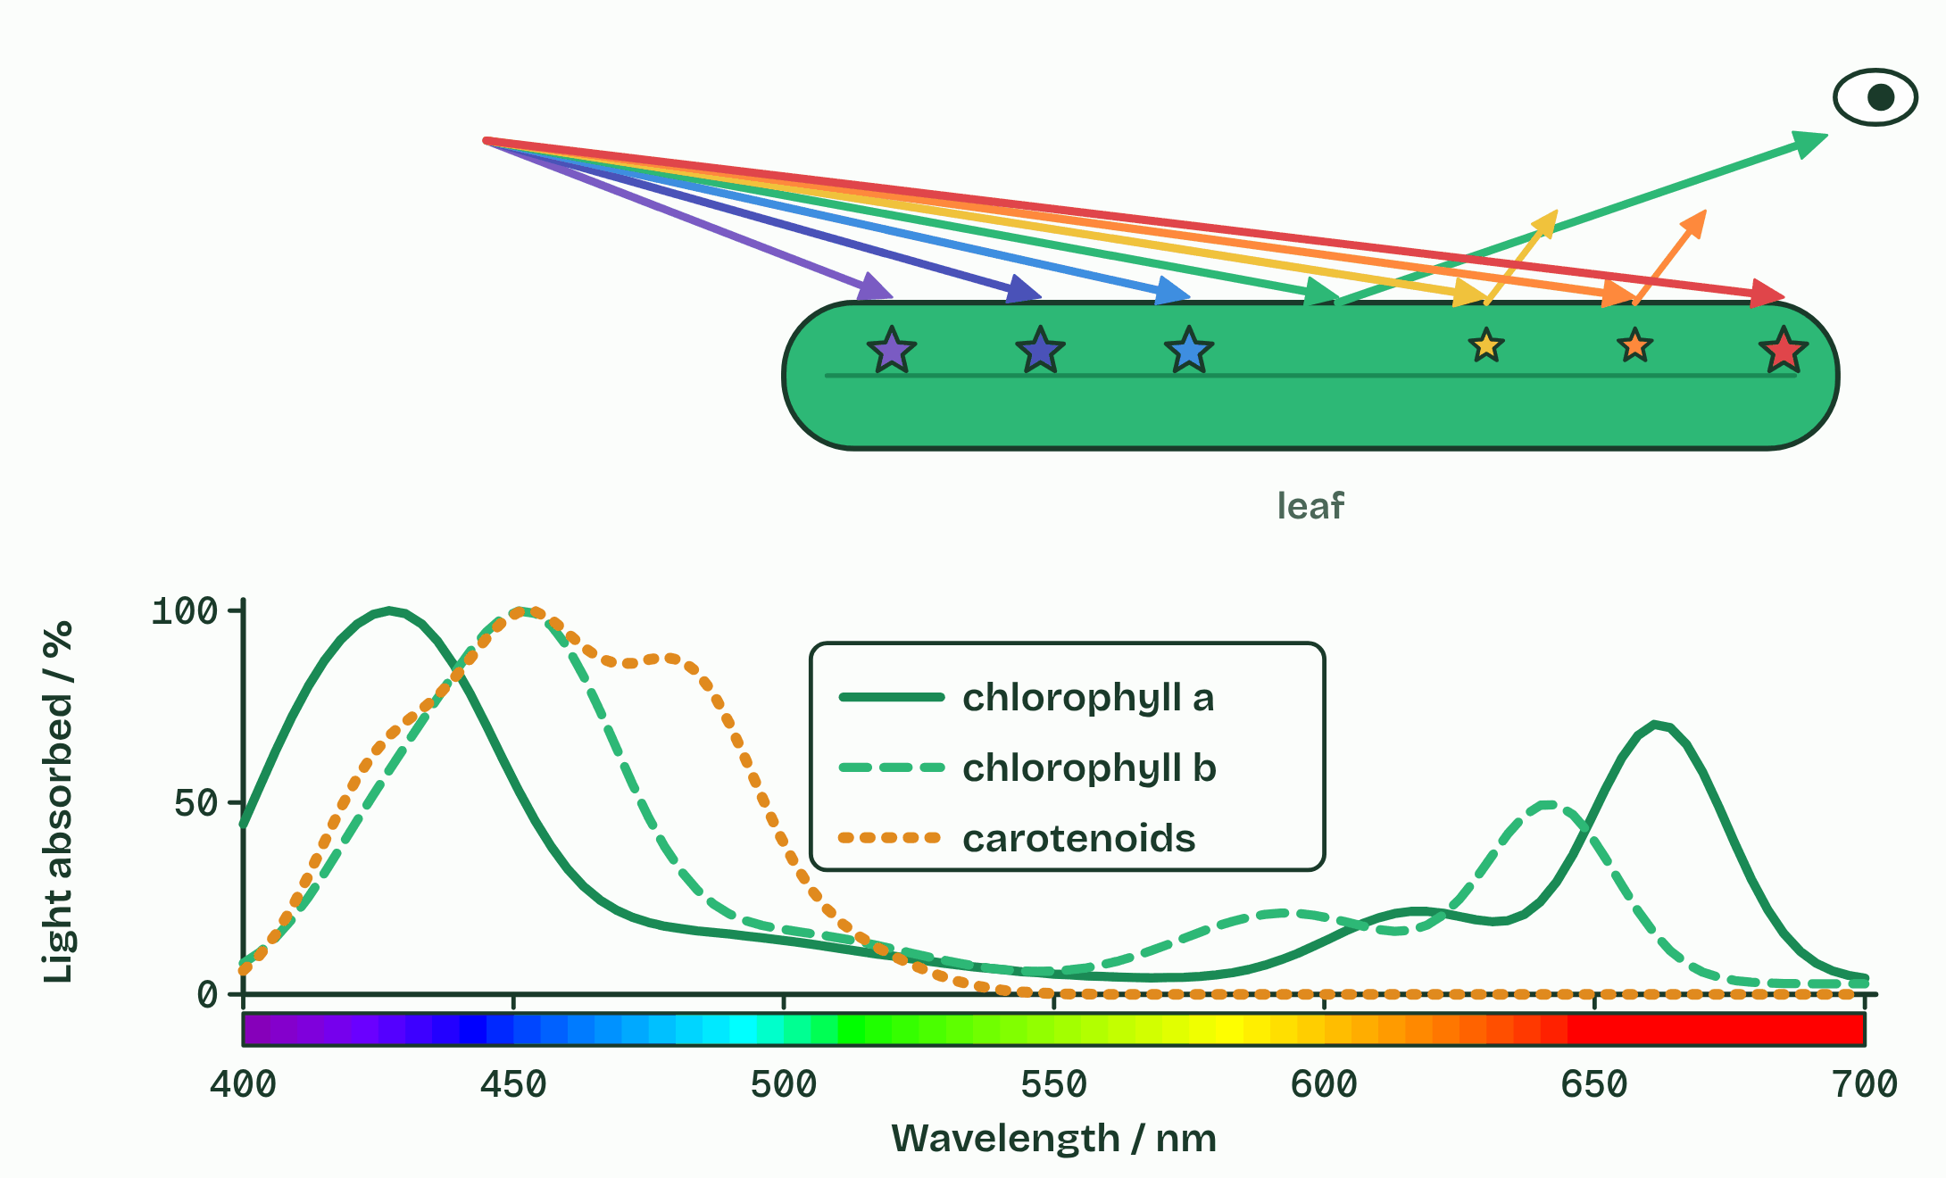
CHAPTER 4 · C1.3.5 Absorption of specific wavelengths by photosynthetic pigments
4 / 4
Why some colours and not others
Accessory pigments absorb where chlorophyll a absorbs least.
Minutes 38 to 54
Notes:
Minutes 38 to 54 of 60: Why leaves are green (16 min).
The plan: Chapter 4: the predict. Students sketch the spectrum on paper (Draw the spectrum, below), then set chapter 4’s handles on the board. Play the figure, then turn over the Richard Of York tiles.
Visible light is the band of wavelengths from about 400 nm (violet) to about 700 nm (red). White light is every one of them together, and the shorter the wavelength, the more energy each photon carries.
A pigment absorbs a photon only if the photon’s energy matches a jump one of its electrons can make to a higher energy level. The electron is then excited. Photons with other energies are not absorbed: they pass through the pigment or bounce off it, which is reflection.
Chlorophyll’s electrons can make jumps that match blue and red photons, so it absorbs those strongly and very little green. The green is reflected or passes through. That is why leaves look green: you see the light they did not use. The energy of the excited electron is what photosynthesis turns into chemical energy.
Accessory pigments, the carotenoids, absorb blue and blue-green light that chlorophyll a takes up less, and widen the range of light a leaf can use. In autumn the chlorophyll breaks down first, and the carotenoids show as yellow and orange. An absorption spectrum shows, wavelength by wavelength, how much of the light a pigment takes in. Draw it with both the wavelengths in nm and the colours along the horizontal axis.

Slide 38
CHAPTER 4 · C1.3.5 Absorption of specific wavelengths by photosynthetic pigments
Why some colours and not others
Visible light runs from about 400 nm (violet) to about 700 nm (red).
A photon is absorbed only if its energy matches a jump an electron in the pigment can make.
Chlorophyll absorbs blue and red strongly and reflects green, so a leaf looks green.
The horizontal axis of an absorption spectrum carries wavelengths and colours.
Minutes 38 to 54
Notes:
Minutes 38 to 54 of 60: Why leaves are green (16 min).
The plan: Chapter 4: the predict. Students sketch the spectrum on paper (Draw the spectrum, below), then set chapter 4’s handles on the board. Play the figure, then turn over the Richard Of York tiles.
Visible light is the band of wavelengths from about 400 nm (violet) to about 700 nm (red). White light is every one of them together, and the shorter the wavelength, the more energy each photon carries.
A pigment absorbs a photon only if the photon’s energy matches a jump one of its electrons can make to a higher energy level. The electron is then excited. Photons with other energies are not absorbed: they pass through the pigment or bounce off it, which is reflection.
Chlorophyll’s electrons can make jumps that match blue and red photons, so it absorbs those strongly and very little green. The green is reflected or passes through. That is why leaves look green: you see the light they did not use. The energy of the excited electron is what photosynthesis turns into chemical energy.
Accessory pigments, the carotenoids, absorb blue and blue-green light that chlorophyll a takes up less, and widen the range of light a leaf can use. In autumn the chlorophyll breaks down first, and the carotenoids show as yellow and orange. An absorption spectrum shows, wavelength by wavelength, how much of the light a pigment takes in. Draw it with both the wavelengths in nm and the colours along the horizontal axis.

Slide 39
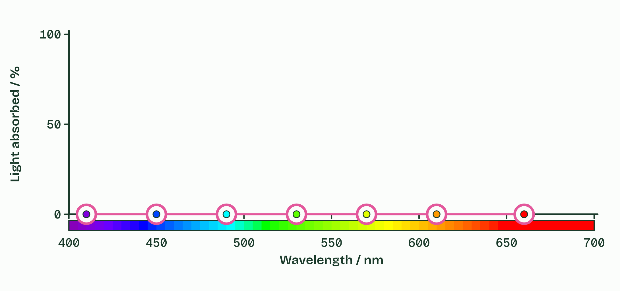
CHAPTER 4 · C1.3.5 Absorption of specific wavelengths by photosynthetic pigments
Why some colours and not others
Visible light runs from about 400 nm (violet) to about 700 nm (red).
A photon is absorbed only if its energy matches a jump an electron in the pigment can make.
Chlorophyll absorbs blue and red strongly and reflects green, so a leaf looks green.
The horizontal axis of an absorption spectrum carries wavelengths and colours.
Minutes 38 to 54
Notes:
Minutes 38 to 54 of 60: Why leaves are green (16 min).
The plan: Chapter 4: the predict. Students sketch the spectrum on paper (Draw the spectrum, below), then set chapter 4’s handles on the board. Play the figure, then turn over the Richard Of York tiles.
Visible light is the band of wavelengths from about 400 nm (violet) to about 700 nm (red). White light is every one of them together, and the shorter the wavelength, the more energy each photon carries.
A pigment absorbs a photon only if the photon’s energy matches a jump one of its electrons can make to a higher energy level. The electron is then excited. Photons with other energies are not absorbed: they pass through the pigment or bounce off it, which is reflection.
Chlorophyll’s electrons can make jumps that match blue and red photons, so it absorbs those strongly and very little green. The green is reflected or passes through. That is why leaves look green: you see the light they did not use. The energy of the excited electron is what photosynthesis turns into chemical energy.
Accessory pigments, the carotenoids, absorb blue and blue-green light that chlorophyll a takes up less, and widen the range of light a leaf can use. In autumn the chlorophyll breaks down first, and the carotenoids show as yellow and orange. An absorption spectrum shows, wavelength by wavelength, how much of the light a pigment takes in. Draw it with both the wavelengths in nm and the colours along the horizontal axis.

Slide 40
PREDICT
Why does chlorophyll absorb red and blue light but very little green?
A Green light has too little energy to reach the chloroplasts
B Green light is all used up by the leaf’s surface
C Chlorophyll is broken down by green light, so avoids it
D Red and blue photons match jumps its electrons can make
Minutes 38 to 54
Notes:
Minutes 38 to 54 of 60: Why leaves are green (16 min).
The plan: Chapter 4: the predict. Students sketch the spectrum on paper (Draw the spectrum, below), then set chapter 4’s handles on the board. Play the figure, then turn over the Richard Of York tiles.
Ask for a show of hands, or mini whiteboards, before revealing. (Answer: D, on the next slide.)

Slide 41
WHAT HAPPENS
Why does chlorophyll absorb red and blue light but very little green?
A Green light has too little energy to reach the chloroplasts
B Green light is all used up by the leaf’s surface
C Chlorophyll is broken down by green light, so avoids it
D Red and blue photons match jumps its electrons can make
A photon is absorbed only if its energy matches a jump an electron in the pigment can make. Chlorophyll’s electrons have jumps that match red and blue photons, not green ones, so green passes through or bounces off.
Minutes 38 to 54
Notes:
Minutes 38 to 54 of 60: Why leaves are green (16 min).
The plan: Chapter 4: the predict. Students sketch the spectrum on paper (Draw the spectrum, below), then set chapter 4’s handles on the board. Play the figure, then turn over the Richard Of York tiles.
Answer: D. A photon is absorbed only if its energy matches a jump an electron in the pigment can make. Chlorophyll’s electrons have jumps that match red and blue photons, not green ones, so green passes through or bounces off.

Slide 42
REMEMBER IT
The colours, longest wavelength first
R
O
Y
G
B
I
V
Richard
Of
York
Gave
Battle
In
Vain
Minutes 38 to 54
Notes:
Minutes 38 to 54 of 60: Why leaves are green (16 min).
The plan: Chapter 4: the predict. Students sketch the spectrum on paper (Draw the spectrum, below), then set chapter 4’s handles on the board. Play the figure, then turn over the Richard Of York tiles.
Ask the class what each letter stands for before revealing.

Slide 43
REMEMBER IT
The colours, longest wavelength first
R
O
Y
G
B
I
V
Richard
Of
York
Gave
Battle
In
Vain
Red
Orange
Yellow
Green
Blue
Indigo
Violet
about 700 nm, absorbed
about 610 nm
about 580 nm
about 530 nm, mostly reflected
about 450 nm, absorbed
about 440 nm
about 400 nm
Minutes 38 to 54
Notes:
Minutes 38 to 54 of 60: Why leaves are green (16 min).
The plan: Chapter 4: the predict. Students sketch the spectrum on paper (Draw the spectrum, below), then set chapter 4’s handles on the board. Play the figure, then turn over the Richard Of York tiles.
Richard: Red (about 700 nm, absorbed)
Of: Orange (about 610 nm)
York: Yellow (about 580 nm)
Gave: Green (about 530 nm, mostly reflected)
Battle: Blue (about 450 nm, absorbed)
In: Indigo (about 440 nm)
Vain: Violet (about 400 nm)

Slide 44
WATCH OUT
A leaf is not green because chlorophyll makes green light. Green is the light it did not absorb.
Minutes 38 to 54
Notes:
Minutes 38 to 54 of 60: Why leaves are green (16 min).
The plan: Chapter 4: the predict. Students sketch the spectrum on paper (Draw the spectrum, below), then set chapter 4’s handles on the board. Play the figure, then turn over the Richard Of York tiles.
A common mistake: say it, then ask who can say why it is wrong.

Slide 45
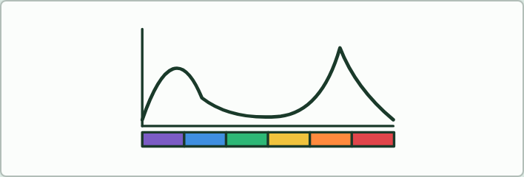
SKETCH
16 MIN
Draw the spectrum
THE TASK
On axes with wavelengths and a coloured strip of the visible spectrum, students sketch chlorophyll’s absorption spectrum in pencil, then chlorophyll b’s in another colour, and check against chapter 4’s figure.
STUDENTS NEED
Printed axes and coloured pencils.
Minutes 38 to 54
Notes:
Minutes 38 to 54 of 60: Why leaves are green (16 min).
The plan: Chapter 4: the predict. Students sketch the spectrum on paper (Draw the spectrum, below), then set chapter 4’s handles on the board. Play the figure, then turn over the Richard Of York tiles.
The activity: Draw the spectrum. On axes with wavelengths and a coloured strip of the visible spectrum, students sketch chlorophyll’s absorption spectrum in pencil, then chlorophyll b’s in another colour, and check against chapter 4’s figure.
Needs: printed axes and coloured pencils.
The time: 16 minutes, minutes 38 to 54 of the plan.

Slide 46
PLENARY
Can you now...
Explain how photosynthesis turns light energy into the chemical energy of carbon compounds, and why ecosystems depend on it (C1.3.1)
Write the word equation, say where each atom of glucose comes from, and explain why the oxygen given off comes from water (C1.3.2, C1.3.3)
Explain why pigments absorb only some wavelengths, and read and sketch an absorption spectrum with wavelengths and colours (C1.3.5)
Minutes 54 to 60
Notes:
Minutes 54 to 60 of 60: Exit (6 min).
The plan: Label where each atom of glucose came from, and say in one sentence why a leaf looks green.
Thumbs up, sideways or down on each goal before the exit question. The goals come from the statements this lesson covers.

Slide 47
EXIT QUESTION
Before you go
Label where each atom of glucose came from, and say in one sentence why a leaf looks green.
Minutes 54 to 60
Notes:
Minutes 54 to 60 of 60: Exit (6 min).
The plan: Label where each atom of glucose came from, and say in one sentence why a leaf looks green.

Slide 48
PRACTISE AND REVISE
Keep going
Exam practice: a fresh paper of exam questions on C1.3 at standard level, marked as you go
The guide, with the animations and the dry lab
This lesson in the guide: 1 Sunlight in, chemical energy out, 2 Carbon from the air, hydrogen from water, 4 Why some colours and not others
BUILD FOR YOUR CLASS
ALREADY ON THE SITE FOR C1.3
CARD SETS ON SPLYCR
Tarsia puzzle, dominoes and picture reveal on C1.3, built from its key terms and ready to print
A pub quiz with rounds on C1.3, to present or run with no projector
An escape room built from the question bank on C1.3
Quiz: Photosynthesis
Revision map: C1.3 Photosynthesis, to fill in
Exam questions: C1.3 in the exam maker, a paper with its markscheme
Open a set to host it as a class game, or make a copy to edit.
C1.3 Photosynthesis (SL)
How this was made. The course structure, the activities and the teaching choices come from my own classroom, my presentations and my years of teaching IB and AP Biology. I use Claude, an AI, to help write and build the interactive guides, lesson plans, slides and practice questions, and to draw the diagrams and code the interactives. I direct the work and review it against the IB and AP specifications before it goes live.
Minute 60: after the lesson
Notes:
Every link here is live. Set the exam practice paper for homework: it is fresh each time, marked as students go and saved to their Exam practice when they are signed in.
Exam practice: https://www.biologybybradford.com/exam-maker/sit?topics=C1.3&level=SL&paper=quiz&marks=15&src=ep
The guide: https://www.biologybybradford.com/guides/ib-biology-c1-3-photosynthesis

