Slide 1
IB Biology C1.3
LESSON 2 OF 6
BY THE END YOU CAN
Photosynthesis
Separate leaf pigments by chromatography, work out Rf values and identify each pigment by colour and Rf (C1.3.4)
Compare absorption and action spectra, and plot an action spectrum from oxygen or carbon dioxide data (C1.3.6)
Pigments and spectra
C1.3.4 and C1.3.6
Separating leaf pigments by chromatography, working out Rf, and comparing absorption and action spectra
60 minutes · chapters 3, 5
Minute 0
Notes:
IB Biology C1.3, Photosynthesis. Lesson 2 of 6: Pigments and spectra, 60 minutes.
The plan, minute by minute (each slide's footer says where you are):
0 to 5 min (5) Do now: one green or several?
5 to 35 min (30) Separate the greens
35 to 43 min (8) Measure and identify
43 to 55 min (12) Engelmann’s bacteria
55 to 60 min (5) Exit
What students get wrong:
Rf can be more than 1, or is measured from the bottom of the paper. It is measured from the origin, and is always under 1.
The action spectrum is the same as the absorption spectrum. It is the rate at each wavelength: it follows absorption but is not identical.
Stretch and support:
Support: chapter captions as cut-up cards to put in order; the dotted key terms as a glossary; a writing frame for “explain the effect of light intensity” (rise, why, plateau, why).
Stretch: why might a red seaweed’s pigments not show up at all in this solvent?
Stretch: compare chlorophyll with haemoglobin and melanin: what does each absorb, and what is it for?
The lesson plan to print: https://www.biologybybradford.com/guides/downloads/ib-biology-c1-3-photosynthesis-lesson-2-plan.pdf

Slide 2
DO NOW
One green or several?
“Is the green of a leaf one pigment or several? Which would travel furthest in a solvent, and why?”
Students write a sentence each.
5:00
minutes
Start now: the timer is running.
Minutes 0 to 5
Notes:
Minutes 0 to 5 of 60: Do now: one green or several? (5 min).
The plan: “Is the green of a leaf one pigment or several? Which would travel furthest in a solvent, and why?” Students write a sentence each. Do not correct yet.
Start a 5 minute timer as they come in.

Slide 3

PRACTICAL
30 MIN
Separate the greens
THE TASK
Paper chromatography of spinach (chapter 3). Grind 4 or 5 leaves with a little sand and 1 cm³ of propanone to a paste. Draw a pencil origin 2 cm from the bottom of a strip of chromatography paper. Spot the extract with a fine pipette, drying between spots, until there is a small dark spot (under 2 mm). Stand the strip in solvent below the origin in a stoppered boiling tube. Take it out before the front reaches the top and mark the front at once. Measure and work out each Rf, and identify from the table for that solvent. Safety: propanone is highly flammable and an irritant: no flames, good ventilation, eye protection.
STUDENTS NEED
Spinach, sand, mortar and pestle, propanone, chromatography paper or TLC strips, boiling tubes with bungs, fine pipettes, pencils, rulers, eye protection.
Minutes 5 to 35
Notes:
Minutes 5 to 35 of 60: Separate the greens (30 min).
The plan: The practical below: grind, spot, run. While the solvent climbs, chapter 3’s figure is on the board (slide the time), then the Rf predict.
The activity: Separate the greens. Paper chromatography of spinach (chapter 3). Grind 4 or 5 leaves with a little sand and 1 cm³ of propanone to a paste. Draw a pencil origin 2 cm from the bottom of a strip of chromatography paper. Spot the extract with a fine pipette, drying between spots, until there is a small dark spot (under 2 mm). Stand the strip in solvent below the origin in a stoppered boiling tube. Take it out before the front reaches the top and mark the front at once. Measure and work out each Rf, and identify from the table for that solvent. Safety: propanone is highly flammable and an irritant: no flames, good ventilation, eye protection.
Needs: spinach, sand, mortar and pestle, propanone, chromatography paper or TLC strips, boiling tubes with bungs, fine pipettes, pencils, rulers, eye protection.
The time: 30 minutes, minutes 5 to 35 of the plan.

Slide 4
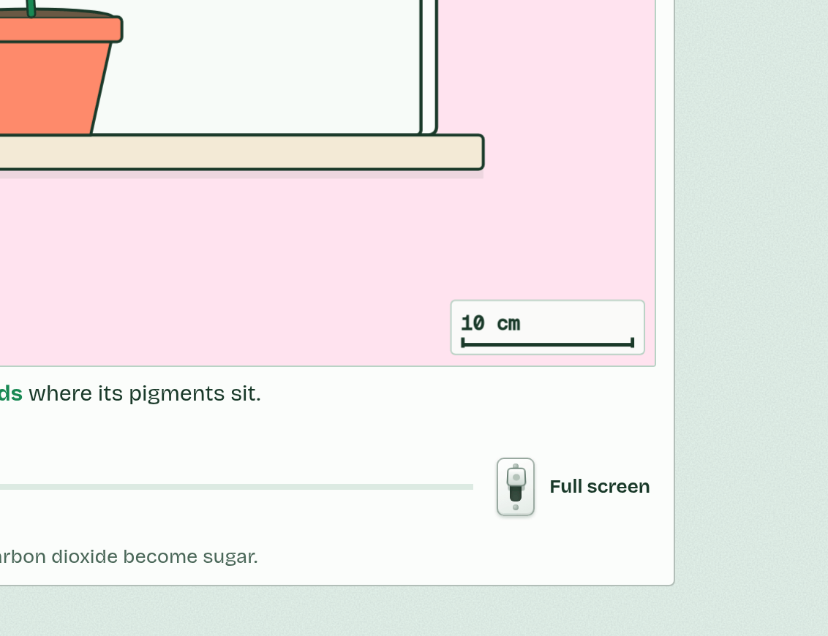
CHAPTER 3 · C1.3.4 Separation and identification of pigments by chromatography
More than one green
Pencil, not ink, for the origin: ink is a mixture and runs too.
A small, dark spot, built up by drying between drops.
Solvent below the origin, and a lid on the tube.
Take the strip out before the front reaches the top, and mark the front at once.
Work quickly: pigments fade in the light.
Minutes 5 to 35
Notes:
Minutes 5 to 35 of 60: Separate the greens (30 min).
The plan: The practical below: grind, spot, run. While the solvent climbs, chapter 3’s figure is on the board (slide the time), then the Rf predict.
A leaf’s green is not one pigment but several, mixed. Chlorophyll a is the main one, blue-green. Chlorophyll b is yellow-green. Beside them are the yellow and orange carotenoids: carotenes and xanthophylls. All of them sit in the membranes of the chloroplast’s thylakoids.
Chromatography separates a mixture. A small, dark spot of leaf extract goes on a pencil line, the origin, near the bottom of a strip of chromatography paper (or a thin-layer plate, the stationary phase). The strip stands in a shallow layer of solvent (the mobile phase) below the spot, in a closed tube. The solvent climbs and carries the pigments with it.
Each pigment travels at its own speed. The more soluble it is in the solvent, and the less it clings to the paper, the further it goes. So the pigments end up as separate bands.
Rf has no units and is always less than 1. You identify a pigment by its colour and its Rf, read against a table made with the same solvent and the same paper or plate. Thin-layer plates run faster and separate better than paper.
Example: Rf = distance moved by the pigment ÷ distance moved by the solvent front, both from the origin, the pigment to the middle of its band.

Slide 5
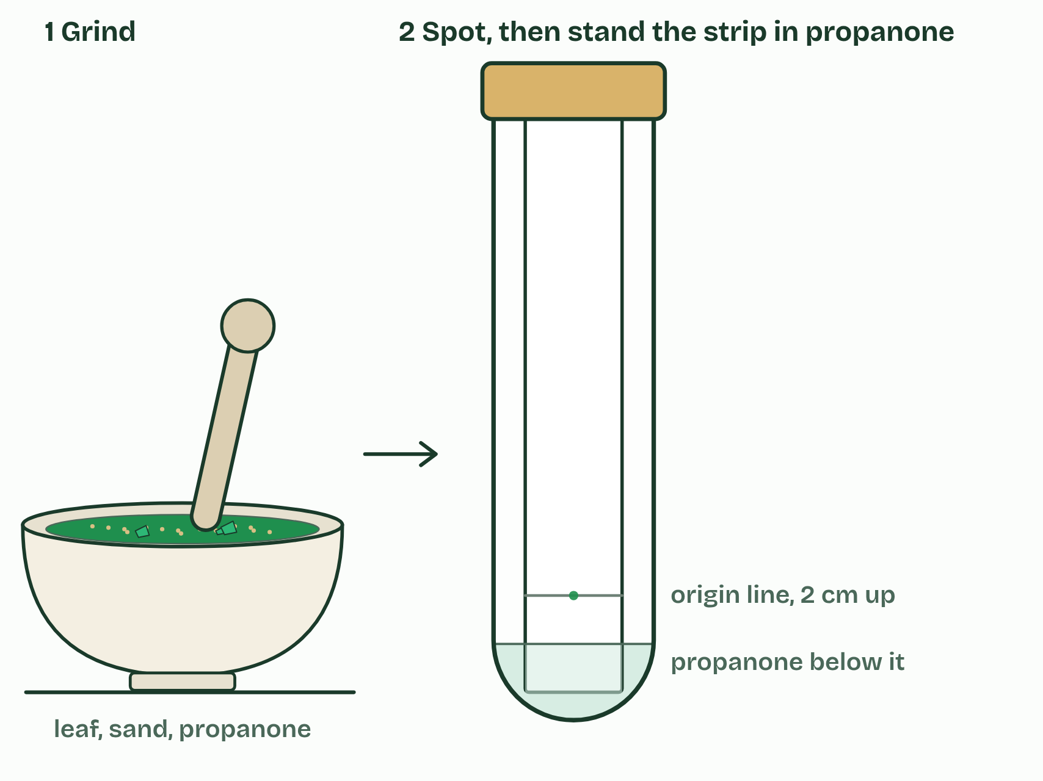
CHAPTER 3 · C1.3.4 Separation and identification of pigments by chromatography
1 / 3
More than one green
Grind a leaf with a little sand and a few drops of propanone. Spot the extract on a pencil line 2 cm from the bottom of the strip, then stand the strip in propanone, below the line, with the lid on.
Minutes 5 to 35
Notes:
Minutes 5 to 35 of 60: Separate the greens (30 min).
The plan: The practical below: grind, spot, run. While the solvent climbs, chapter 3’s figure is on the board (slide the time), then the Rf predict.
A leaf’s green is not one pigment but several, mixed. Chlorophyll a is the main one, blue-green. Chlorophyll b is yellow-green. Beside them are the yellow and orange carotenoids: carotenes and xanthophylls. All of them sit in the membranes of the chloroplast’s thylakoids.
Chromatography separates a mixture. A small, dark spot of leaf extract goes on a pencil line, the origin, near the bottom of a strip of chromatography paper (or a thin-layer plate, the stationary phase). The strip stands in a shallow layer of solvent (the mobile phase) below the spot, in a closed tube. The solvent climbs and carries the pigments with it.
Each pigment travels at its own speed. The more soluble it is in the solvent, and the less it clings to the paper, the further it goes. So the pigments end up as separate bands.
Rf has no units and is always less than 1. You identify a pigment by its colour and its Rf, read against a table made with the same solvent and the same paper or plate. Thin-layer plates run faster and separate better than paper.
Example: Rf = distance moved by the pigment ÷ distance moved by the solvent front, both from the origin, the pigment to the middle of its band.

Slide 6
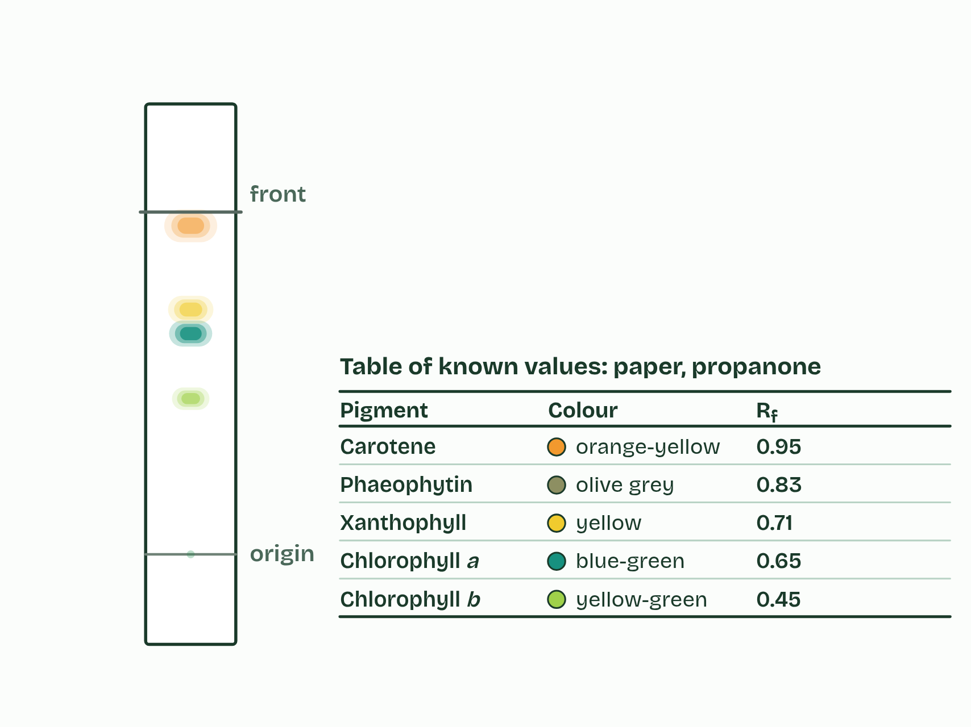
CHAPTER 3 · C1.3.4 Separation and identification of pigments by chromatography
2 / 3
More than one green
Take the strip out before the solvent reaches the top and mark the front in pencil at once. The pigments have separated into bands. The table beside it lists known values for this solvent.
Minutes 5 to 35
Notes:
Minutes 5 to 35 of 60: Separate the greens (30 min).
The plan: The practical below: grind, spot, run. While the solvent climbs, chapter 3’s figure is on the board (slide the time), then the Rf predict.
A leaf’s green is not one pigment but several, mixed. Chlorophyll a is the main one, blue-green. Chlorophyll b is yellow-green. Beside them are the yellow and orange carotenoids: carotenes and xanthophylls. All of them sit in the membranes of the chloroplast’s thylakoids.
Chromatography separates a mixture. A small, dark spot of leaf extract goes on a pencil line, the origin, near the bottom of a strip of chromatography paper (or a thin-layer plate, the stationary phase). The strip stands in a shallow layer of solvent (the mobile phase) below the spot, in a closed tube. The solvent climbs and carries the pigments with it.
Each pigment travels at its own speed. The more soluble it is in the solvent, and the less it clings to the paper, the further it goes. So the pigments end up as separate bands.
Rf has no units and is always less than 1. You identify a pigment by its colour and its Rf, read against a table made with the same solvent and the same paper or plate. Thin-layer plates run faster and separate better than paper.
Example: Rf = distance moved by the pigment ÷ distance moved by the solvent front, both from the origin, the pigment to the middle of its band.

Slide 7
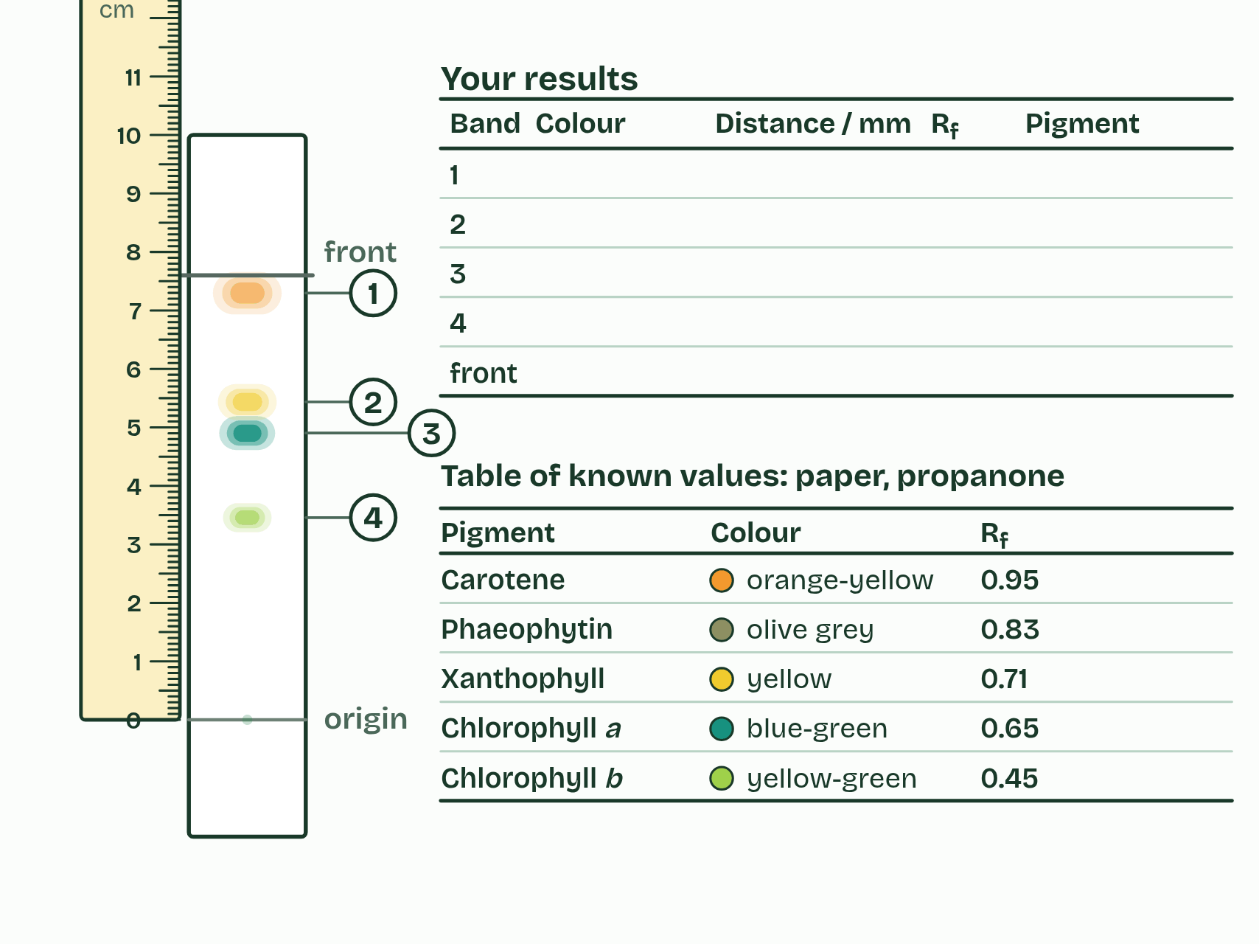
CHAPTER 3 · C1.3.4 Separation and identification of pigments by chromatography
3 / 3
More than one green
Measure from the origin line to the middle of each band and to the front. Work out Rf for each band, then name each pigment from its colour and its Rf.
Minutes 5 to 35
Notes:
Minutes 5 to 35 of 60: Separate the greens (30 min).
The plan: The practical below: grind, spot, run. While the solvent climbs, chapter 3’s figure is on the board (slide the time), then the Rf predict.
A leaf’s green is not one pigment but several, mixed. Chlorophyll a is the main one, blue-green. Chlorophyll b is yellow-green. Beside them are the yellow and orange carotenoids: carotenes and xanthophylls. All of them sit in the membranes of the chloroplast’s thylakoids.
Chromatography separates a mixture. A small, dark spot of leaf extract goes on a pencil line, the origin, near the bottom of a strip of chromatography paper (or a thin-layer plate, the stationary phase). The strip stands in a shallow layer of solvent (the mobile phase) below the spot, in a closed tube. The solvent climbs and carries the pigments with it.
Each pigment travels at its own speed. The more soluble it is in the solvent, and the less it clings to the paper, the further it goes. So the pigments end up as separate bands.
Rf has no units and is always less than 1. You identify a pigment by its colour and its Rf, read against a table made with the same solvent and the same paper or plate. Thin-layer plates run faster and separate better than paper.
Example: Rf = distance moved by the pigment ÷ distance moved by the solvent front, both from the origin, the pigment to the middle of its band.

Slide 8
CHAPTER 3 · C1.3.4 Separation and identification of pigments by chromatography
More than one green
Pencil, not ink, for the origin: ink is a mixture and runs too.
A small, dark spot, built up by drying between drops.
Solvent below the origin, and a lid on the tube.
Take the strip out before the front reaches the top, and mark the front at once.
Work quickly: pigments fade in the light.
Minutes 5 to 35
Notes:
Minutes 5 to 35 of 60: Separate the greens (30 min).
The plan: The practical below: grind, spot, run. While the solvent climbs, chapter 3’s figure is on the board (slide the time), then the Rf predict.
A leaf’s green is not one pigment but several, mixed. Chlorophyll a is the main one, blue-green. Chlorophyll b is yellow-green. Beside them are the yellow and orange carotenoids: carotenes and xanthophylls. All of them sit in the membranes of the chloroplast’s thylakoids.
Chromatography separates a mixture. A small, dark spot of leaf extract goes on a pencil line, the origin, near the bottom of a strip of chromatography paper (or a thin-layer plate, the stationary phase). The strip stands in a shallow layer of solvent (the mobile phase) below the spot, in a closed tube. The solvent climbs and carries the pigments with it.
Each pigment travels at its own speed. The more soluble it is in the solvent, and the less it clings to the paper, the further it goes. So the pigments end up as separate bands.
Rf has no units and is always less than 1. You identify a pigment by its colour and its Rf, read against a table made with the same solvent and the same paper or plate. Thin-layer plates run faster and separate better than paper.
Example: Rf = distance moved by the pigment ÷ distance moved by the solvent front, both from the origin, the pigment to the middle of its band.

Slide 9
PREDICT
The solvent front has moved 8.0 cm from the origin and a yellow band 5.7 cm. What is the band’s Rf?
A 1.40
B 0.71
C 0.57
D 2.30
Minutes 5 to 35
Notes:
Minutes 5 to 35 of 60: Separate the greens (30 min).
The plan: The practical below: grind, spot, run. While the solvent climbs, chapter 3’s figure is on the board (slide the time), then the Rf predict.
Ask for a show of hands, or mini whiteboards, before revealing. (Answer: B, on the next slide.)

Slide 10
WHAT HAPPENS
The solvent front has moved 8.0 cm from the origin and a yellow band 5.7 cm. What is the band’s Rf?
A 1.40
B 0.71
C 0.57
D 2.30
5.7 ÷ 8.0 = 0.71. Pigment distance over solvent distance, both from the origin; Rf is always less than 1, so 1.40 has the division upside down. In propanone on paper, a yellow band at 0.71 is a xanthophyll.
Minutes 5 to 35
Notes:
Minutes 5 to 35 of 60: Separate the greens (30 min).
The plan: The practical below: grind, spot, run. While the solvent climbs, chapter 3’s figure is on the board (slide the time), then the Rf predict.
Answer: B. 5.7 ÷ 8.0 = 0.71. Pigment distance over solvent distance, both from the origin; Rf is always less than 1, so 1.40 has the division upside down. In propanone on paper, a yellow band at 0.71 is a xanthophyll.

Slide 11
WATCH OUT
Measure from the origin line, not from the bottom of the paper, and to the middle of the band. And an Rf only means something beside a table made with the same solvent.
Minutes 5 to 35
Notes:
Minutes 5 to 35 of 60: Separate the greens (30 min).
The plan: The practical below: grind, spot, run. While the solvent climbs, chapter 3’s figure is on the board (slide the time), then the Rf predict.
A common mistake: say it, then ask who can say why it is wrong.

Slide 12
STEP 3
8 MIN
Measure and identify
Pairs answer the four Chromatography questions.
Minutes 35 to 43
Notes:
Minutes 35 to 43 of 60: Measure and identify (8 min).
The plan: Measure the strip, work out each Rf and identify the pigments from the table. Pairs answer the four Chromatography questions (below). No lab: use the chromatography bench instead, in pairs.

Slide 13

DISCUSS
8 MIN
Chromatography questions
THE TASK
Four questions. A pigment that clings to the paper: does it move faster or slower? One that dissolves well in the solvent? What makes one pigment outrun another? How do you identify one? Pairs answer in one sentence each, then the class agrees model answers.
STUDENTS NEED
The questions on the board.
Minutes 35 to 43
Notes:
Minutes 35 to 43 of 60: Measure and identify (8 min).
The plan: Measure the strip, work out each Rf and identify the pigments from the table. Pairs answer the four Chromatography questions (below). No lab: use the chromatography bench instead, in pairs.
The activity: Chromatography questions. Four questions. A pigment that clings to the paper: does it move faster or slower? One that dissolves well in the solvent? What makes one pigment outrun another? How do you identify one? Pairs answer in one sentence each, then the class agrees model answers.
Needs: the questions on the board.
The time: 8 minutes, minutes 35 to 43 of the plan.

Slide 14
STEP 4
12 MIN
Engelmann’s bacteria
Chapter 5: Absorbed is not the same as used
Minutes 43 to 55
Notes:
Minutes 43 to 55 of 60: Engelmann’s bacteria (12 min).
The plan: Chapter 5: the predict (Engelmann), then Engelmann’s experiment: split the light, count, compare. Then Plot it, done as a class on the board.

Slide 15
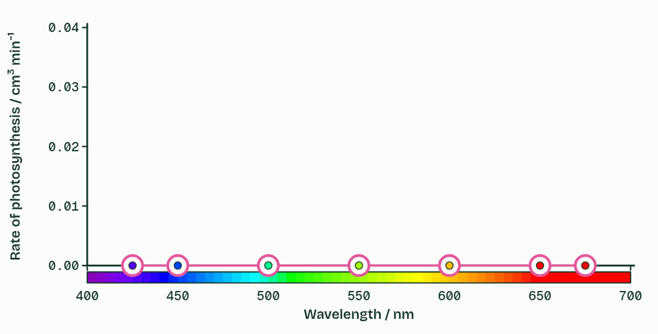
CHAPTER 5 · C1.3.6 Absorption and action spectra compared
Absorbed is not the same as used
Rate of photosynthesis = oxygen produced (or carbon dioxide consumed) ÷ time.
Similar: both spectra peak in blue and red and dip in green.
Different: the action spectrum is a rate, its green dip is shallower, and its blue peak is lower than the absorption there.
Minutes 43 to 55
Notes:
Minutes 43 to 55 of 60: Engelmann’s bacteria (12 min).
The plan: Chapter 5: the predict (Engelmann), then Engelmann’s experiment: split the light, count, compare. Then Plot it, done as a class on the board.
An action spectrum plots how fast photosynthesis runs against the wavelength of the light a plant is given. You measure it by lighting the plant with one colour at a time, the same amount of light each time, and measuring the oxygen it gives off or the carbon dioxide it takes in. The rate of photosynthesis is the amount of oxygen produced (or carbon dioxide consumed) divided by the time taken, for example cm³ of oxygen ÷ 10 minutes, in cm³ min⁻¹. Then plot rate against wavelength.
The two spectra are alike because the light a leaf uses is the light its pigments absorb: both peak in the blue and the red and dip in the green. They are not the same. The action spectrum’s green dip is shallower, because chlorophyll b and the carotenoids absorb some of those wavelengths and pass the energy on, and because in a thick leaf green light bounces about and more of it is absorbed in the end. And absorbing light is not always using it: some of the energy that carotenoids absorb in the blue is lost as heat, so the action spectrum’s blue peak is lower than the combined absorption there.
Example: How we know In 1882 Theodor Engelmann lit a strand of a green alga with a spectrum from a prism and added bacteria that swim towards oxygen. They crowded where red and blue light fell. It was the first action spectrum, measured with living bacteria as oxygen detectors. The film below repeats it.

Slide 16
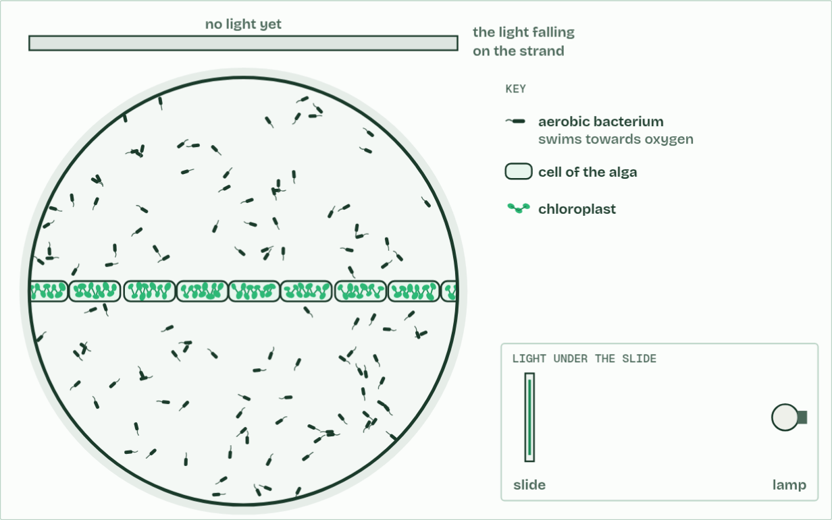
CHAPTER 5 · C1.3.6 Absorption and action spectra compared
No light
1 / 4
Absorbed is not the same as used
A strand of green alga, and bacteria that swim towards oxygen.
Minutes 43 to 55
Notes:
Minutes 43 to 55 of 60: Engelmann’s bacteria (12 min).
The plan: Chapter 5: the predict (Engelmann), then Engelmann’s experiment: split the light, count, compare. Then Plot it, done as a class on the board.
An action spectrum plots how fast photosynthesis runs against the wavelength of the light a plant is given. You measure it by lighting the plant with one colour at a time, the same amount of light each time, and measuring the oxygen it gives off or the carbon dioxide it takes in. The rate of photosynthesis is the amount of oxygen produced (or carbon dioxide consumed) divided by the time taken, for example cm³ of oxygen ÷ 10 minutes, in cm³ min⁻¹. Then plot rate against wavelength.
The two spectra are alike because the light a leaf uses is the light its pigments absorb: both peak in the blue and the red and dip in the green. They are not the same. The action spectrum’s green dip is shallower, because chlorophyll b and the carotenoids absorb some of those wavelengths and pass the energy on, and because in a thick leaf green light bounces about and more of it is absorbed in the end. And absorbing light is not always using it: some of the energy that carotenoids absorb in the blue is lost as heat, so the action spectrum’s blue peak is lower than the combined absorption there.
Example: How we know In 1882 Theodor Engelmann lit a strand of a green alga with a spectrum from a prism and added bacteria that swim towards oxygen. They crowded where red and blue light fell. It was the first action spectrum, measured with living bacteria as oxygen detectors. The film below repeats it.
The animation "Engelmann’s bacteria", paused at 4.0 s. The next slides go on through it, then play it.

Slide 17
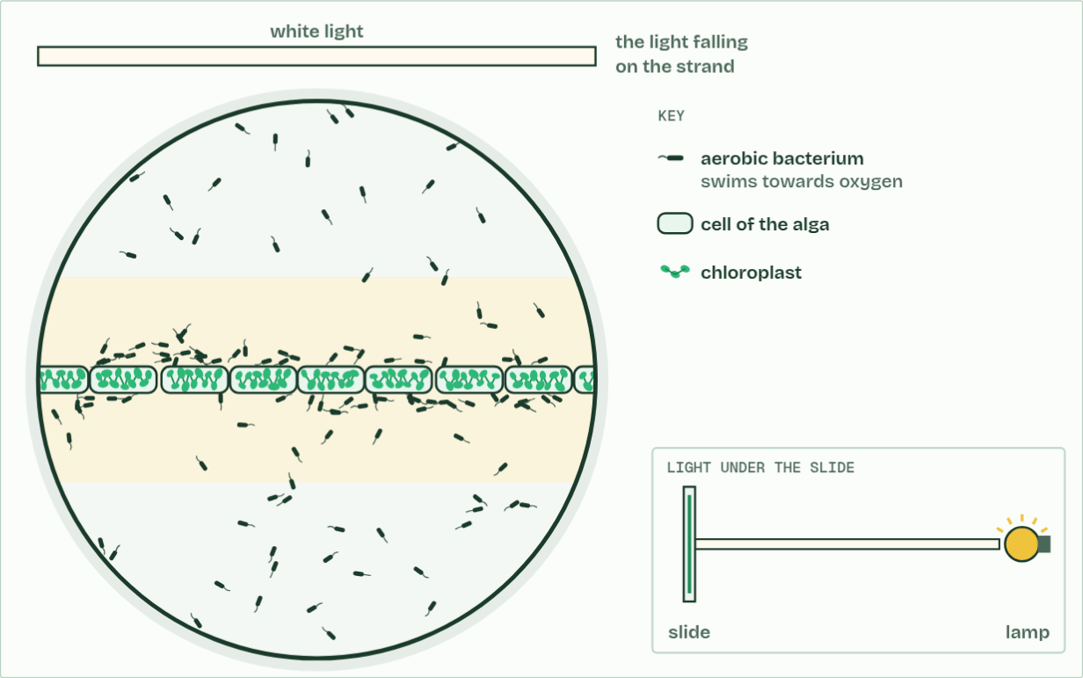
CHAPTER 5 · C1.3.6 Absorption and action spectra compared
White light
2 / 4
Absorbed is not the same as used
In white light the whole strand gives off oxygen. The bacteria gather evenly.
Minutes 43 to 55
Notes:
Minutes 43 to 55 of 60: Engelmann’s bacteria (12 min).
The plan: Chapter 5: the predict (Engelmann), then Engelmann’s experiment: split the light, count, compare. Then Plot it, done as a class on the board.
An action spectrum plots how fast photosynthesis runs against the wavelength of the light a plant is given. You measure it by lighting the plant with one colour at a time, the same amount of light each time, and measuring the oxygen it gives off or the carbon dioxide it takes in. The rate of photosynthesis is the amount of oxygen produced (or carbon dioxide consumed) divided by the time taken, for example cm³ of oxygen ÷ 10 minutes, in cm³ min⁻¹. Then plot rate against wavelength.
The two spectra are alike because the light a leaf uses is the light its pigments absorb: both peak in the blue and the red and dip in the green. They are not the same. The action spectrum’s green dip is shallower, because chlorophyll b and the carotenoids absorb some of those wavelengths and pass the energy on, and because in a thick leaf green light bounces about and more of it is absorbed in the end. And absorbing light is not always using it: some of the energy that carotenoids absorb in the blue is lost as heat, so the action spectrum’s blue peak is lower than the combined absorption there.
Example: How we know In 1882 Theodor Engelmann lit a strand of a green alga with a spectrum from a prism and added bacteria that swim towards oxygen. They crowded where red and blue light fell. It was the first action spectrum, measured with living bacteria as oxygen detectors. The film below repeats it.
The animation "Engelmann’s bacteria", paused at 11.0 s. The next slides go on through it, then play it.

Slide 18
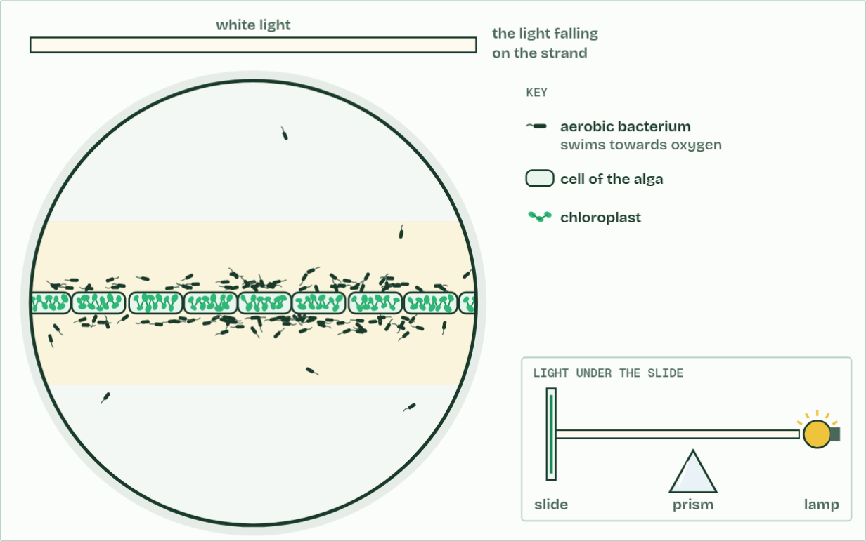
CHAPTER 5 · C1.3.6 Absorption and action spectra compared
A prism
3 / 4
Absorbed is not the same as used
Engelmann put a prism under the slide. What will the bacteria do?
Minutes 43 to 55
Notes:
Minutes 43 to 55 of 60: Engelmann’s bacteria (12 min).
The plan: Chapter 5: the predict (Engelmann), then Engelmann’s experiment: split the light, count, compare. Then Plot it, done as a class on the board.
An action spectrum plots how fast photosynthesis runs against the wavelength of the light a plant is given. You measure it by lighting the plant with one colour at a time, the same amount of light each time, and measuring the oxygen it gives off or the carbon dioxide it takes in. The rate of photosynthesis is the amount of oxygen produced (or carbon dioxide consumed) divided by the time taken, for example cm³ of oxygen ÷ 10 minutes, in cm³ min⁻¹. Then plot rate against wavelength.
The two spectra are alike because the light a leaf uses is the light its pigments absorb: both peak in the blue and the red and dip in the green. They are not the same. The action spectrum’s green dip is shallower, because chlorophyll b and the carotenoids absorb some of those wavelengths and pass the energy on, and because in a thick leaf green light bounces about and more of it is absorbed in the end. And absorbing light is not always using it: some of the energy that carotenoids absorb in the blue is lost as heat, so the action spectrum’s blue peak is lower than the combined absorption there.
Example: How we know In 1882 Theodor Engelmann lit a strand of a green alga with a spectrum from a prism and added bacteria that swim towards oxygen. They crowded where red and blue light fell. It was the first action spectrum, measured with living bacteria as oxygen detectors. The film below repeats it.
The animation "Engelmann’s bacteria", paused at 24.0 s. The next slides go on through it, then play it.

Slide 19
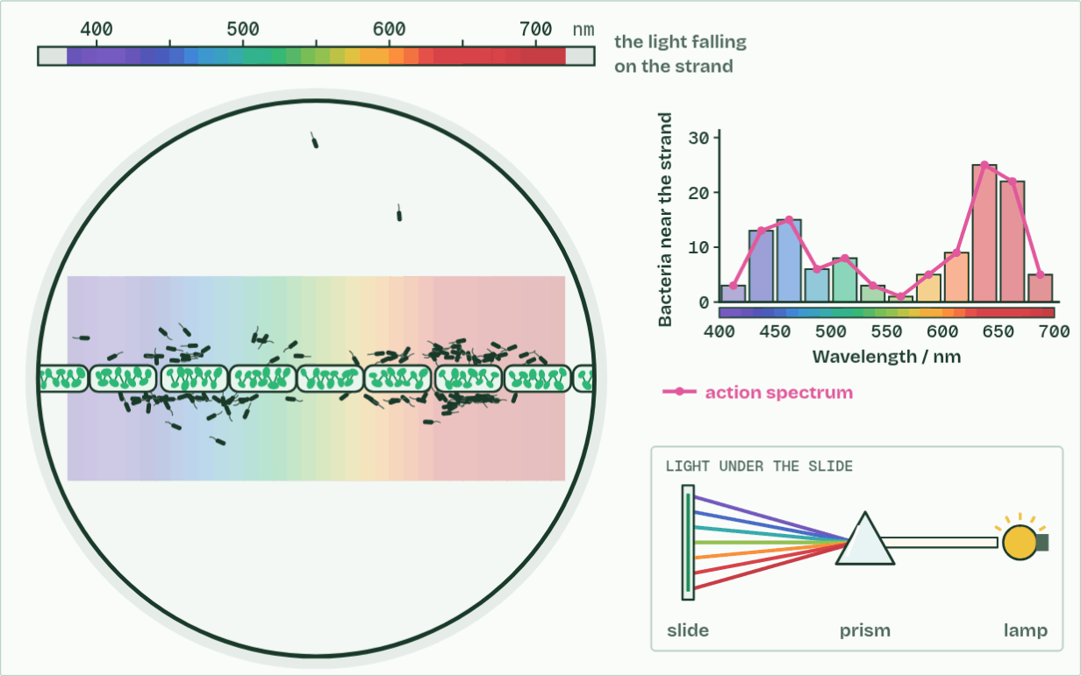
CHAPTER 5 · C1.3.6 Absorption and action spectra compared
Spectrum
4 / 4
Absorbed is not the same as used
The bacteria crowd where red and blue light fall. Counted, they draw an action spectrum.
Minutes 43 to 55
Notes:
Minutes 43 to 55 of 60: Engelmann’s bacteria (12 min).
The plan: Chapter 5: the predict (Engelmann), then Engelmann’s experiment: split the light, count, compare. Then Plot it, done as a class on the board.
An action spectrum plots how fast photosynthesis runs against the wavelength of the light a plant is given. You measure it by lighting the plant with one colour at a time, the same amount of light each time, and measuring the oxygen it gives off or the carbon dioxide it takes in. The rate of photosynthesis is the amount of oxygen produced (or carbon dioxide consumed) divided by the time taken, for example cm³ of oxygen ÷ 10 minutes, in cm³ min⁻¹. Then plot rate against wavelength.
The two spectra are alike because the light a leaf uses is the light its pigments absorb: both peak in the blue and the red and dip in the green. They are not the same. The action spectrum’s green dip is shallower, because chlorophyll b and the carotenoids absorb some of those wavelengths and pass the energy on, and because in a thick leaf green light bounces about and more of it is absorbed in the end. And absorbing light is not always using it: some of the energy that carotenoids absorb in the blue is lost as heat, so the action spectrum’s blue peak is lower than the combined absorption there.
Example: How we know In 1882 Theodor Engelmann lit a strand of a green alga with a spectrum from a prism and added bacteria that swim towards oxygen. They crowded where red and blue light fell. It was the first action spectrum, measured with living bacteria as oxygen detectors. The film below repeats it.
The animation "Engelmann’s bacteria", paused at 42.0 s. The next slides go on through it, then play it.

Slide 20
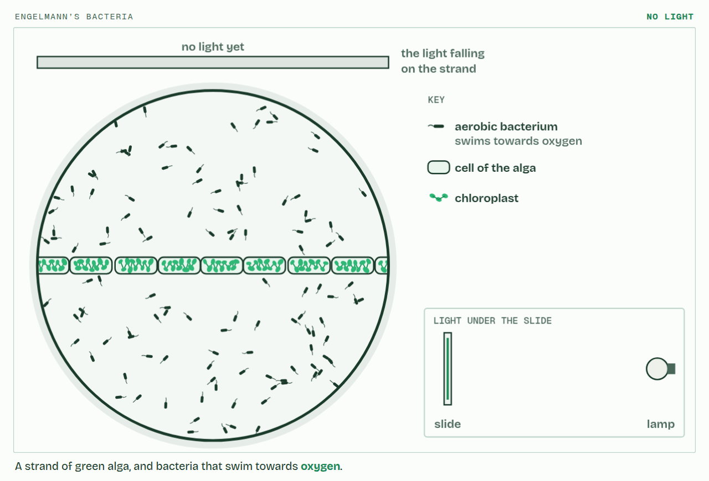
CHAPTER 5 · C1.3.6 Absorption and action spectra compared
PLAY IT
Absorbed is not the same as used
Engelmann’s bacteria: click to play. It loops every 30 seconds.
Minutes 43 to 55
Notes:
Minutes 43 to 55 of 60: Engelmann’s bacteria (12 min).
The plan: Chapter 5: the predict (Engelmann), then Engelmann’s experiment: split the light, count, compare. Then Plot it, done as a class on the board.
The video is engelmann-1f3022.mp4, one loop of the animation in the guide. It plays in PowerPoint and Keynote. Google Slides does not play a video embedded in a .pptx: download engelmann-1f3022.mp4 (https://www.biologybybradford.com/guides/downloads/scenes/engelmann-1f3022.mp4), upload it to Google Drive, then Insert > Video > Google Drive.
In the guide the class can change it as it runs: https://www.biologybybradford.com/guides/ib-biology-c1-3-photosynthesis#action
What it shows, in order:
1. A strand of green alga, and bacteria that swim towards oxygen.
2. In white light the whole strand gives off oxygen. The bacteria gather evenly.
3. Engelmann put a prism under the slide. What will the bacteria do?
4. The bacteria crowd where red and blue light fall. Counted, they draw an action spectrum.

Slide 21
PREDICT
Engelmann shone a spectrum along a strand of alga and added bacteria that swim towards oxygen. Where did the bacteria gather?
A Under the red and the blue light
B Evenly all along the strand of alga
C Under the green light, and nowhere else
D At the violet end of the strand
Minutes 43 to 55
Notes:
Minutes 43 to 55 of 60: Engelmann’s bacteria (12 min).
The plan: Chapter 5: the predict (Engelmann), then Engelmann’s experiment: split the light, count, compare. Then Plot it, done as a class on the board.
Ask for a show of hands, or mini whiteboards, before revealing. (Answer: A, on the next slide.)

Slide 22
WHAT HAPPENS
Engelmann shone a spectrum along a strand of alga and added bacteria that swim towards oxygen. Where did the bacteria gather?
A Under the red and the blue light
B Evenly all along the strand of alga
C Under the green light, and nowhere else
D At the violet end of the strand
Under the red and the blue. Those are the colours the alga’s pigments absorb and use, so those parts of the strand gave off most oxygen. Engelmann measured an action spectrum with no instruments but a microscope and a prism.
Minutes 43 to 55
Notes:
Minutes 43 to 55 of 60: Engelmann’s bacteria (12 min).
The plan: Chapter 5: the predict (Engelmann), then Engelmann’s experiment: split the light, count, compare. Then Plot it, done as a class on the board.
Answer: A. Under the red and the blue. Those are the colours the alga’s pigments absorb and use, so those parts of the strand gave off most oxygen. Engelmann measured an action spectrum with no instruments but a microscope and a prism.

Slide 23
WATCH OUT
An action spectrum is not “the light a plant absorbs”. It is what the plant does with each colour: its rate of photosynthesis.
Minutes 43 to 55
Notes:
Minutes 43 to 55 of 60: Engelmann’s bacteria (12 min).
The plan: Chapter 5: the predict (Engelmann), then Engelmann’s experiment: split the light, count, compare. Then Plot it, done as a class on the board.
A common mistake: say it, then ask who can say why it is wrong.

Slide 24
PLENARY
Can you now...
Separate leaf pigments by chromatography, work out Rf values and identify each pigment by colour and Rf (C1.3.4)
Compare absorption and action spectra, and plot an action spectrum from oxygen or carbon dioxide data (C1.3.6)
Minutes 55 to 60
Notes:
Minutes 55 to 60 of 60: Exit (5 min).
The plan: Work out an Rf from two distances, and give one similarity and one difference between the absorption and action spectra.
Thumbs up, sideways or down on each goal before the exit question. The goals come from the statements this lesson covers.

Slide 25
EXIT QUESTION
Before you go
Work out an Rf from two distances, and give one similarity and one difference between the absorption and action spectra.
Minutes 55 to 60
Notes:
Minutes 55 to 60 of 60: Exit (5 min).
The plan: Work out an Rf from two distances, and give one similarity and one difference between the absorption and action spectra.

Slide 26
PRACTISE AND REVISE
Keep going
Exam practice: a fresh paper of exam questions on C1.3 at standard level, marked as you go
The guide, with the animations and the dry lab
This lesson in the guide: 3 More than one green, 5 Absorbed is not the same as used
BUILD FOR YOUR CLASS
ALREADY ON THE SITE FOR C1.3
CARD SETS ON SPLYCR
Tarsia puzzle, dominoes and picture reveal on C1.3, built from its key terms and ready to print
A pub quiz with rounds on C1.3, to present or run with no projector
An escape room built from the question bank on C1.3
Quiz: Photosynthesis
Revision map: C1.3 Photosynthesis, to fill in
Exam questions: C1.3 in the exam maker, a paper with its markscheme
Open a set to host it as a class game, or make a copy to edit.
C1.3 Photosynthesis (SL)
How this was made. The course structure, the activities and the teaching choices come from my own classroom, my presentations and my years of teaching IB and AP Biology. I use Claude, an AI, to help write and build the interactive guides, lesson plans, slides and practice questions, and to draw the diagrams and code the interactives. I direct the work and review it against the IB and AP specifications before it goes live.
Minute 60: after the lesson
Notes:
Every link here is live. Set the exam practice paper for homework: it is fresh each time, marked as students go and saved to their Exam practice when they are signed in.
Exam practice: https://www.biologybybradford.com/exam-maker/sit?topics=C1.3&level=SL&paper=quiz&marks=15&src=ep
The guide: https://www.biologybybradford.com/guides/ib-biology-c1-3-photosynthesis

