Slide 1
IB Biology C1.3
LESSON 3 OF 6
BY THE END YOU CAN
Photosynthesis
Suggest and test hypotheses about light, carbon dioxide and temperature as limiting factors, naming the variables (C1.3.7)
Compare greenhouse and FACE experiments as ways of predicting how plants will grow in tomorrow's air (C1.3.8)
Limiting factors, and tomorrow’s air
C1.3.7 and C1.3.8
Light, carbon dioxide and temperature as limiting factors, how to vary each, and greenhouse against FACE experiments
60 minutes · chapters 6, 7 · the dry lab
Minute 0
Notes:
IB Biology C1.3, Photosynthesis. Lesson 3 of 6: Limiting factors, and tomorrow’s air, 60 minutes.
The plan, minute by minute (each slide's footer says where you are):
0 to 5 min (5) Do now: sketch it
5 to 17 min (12) Leaf discs, set going
17 to 27 min (10) Sketch, then check
27 to 35 min (8) Which question is better?
35 to 47 min (12) Greenhouse against FACE
47 to 55 min (8) Leaf discs: the last counts
55 to 60 min (5) Exit
What students get wrong:
A limiting factor stops photosynthesis. It sets the rate; it is the one in shortest supply.
More light always means a faster rate. Only while light is limiting.
The plateau means the plant is “full”. It means another factor now limits.
Lamp distance is the light intensity. Intensity falls about as 1 &divide; distance²: measure it, and watch for heat.
Stretch and support:
Support: chapter captions as cut-up cards to put in order; the dotted key terms as a glossary; a writing frame for “explain the effect of light intensity” (rise, why, plateau, why).
Stretch: in the dry lab, plot rate against 1 &divide; distance² and find where the straight line ends. What does that point tell you?
Stretch: a greenhouse grower can add carbon dioxide, light or heat. Using a sketch graph, which should she add first on a dull winter day, and why?
The lesson plan to print: https://www.biologybybradford.com/guides/downloads/ib-biology-c1-3-photosynthesis-lesson-3-plan.pdf

Slide 2
DO NOW
Sketch it
Rate of photosynthesis against light intensity, with no help (the first stage of chapter 6’s sketches).
5:00
minutes
Start now: the timer is running.
Minutes 0 to 5
Notes:
Minutes 0 to 5 of 60: Do now: sketch it (5 min).
The plan: Rate of photosynthesis against light intensity, with no help (the first stage of chapter 6’s sketches).
Start a 5 minute timer as they come in.

Slide 3
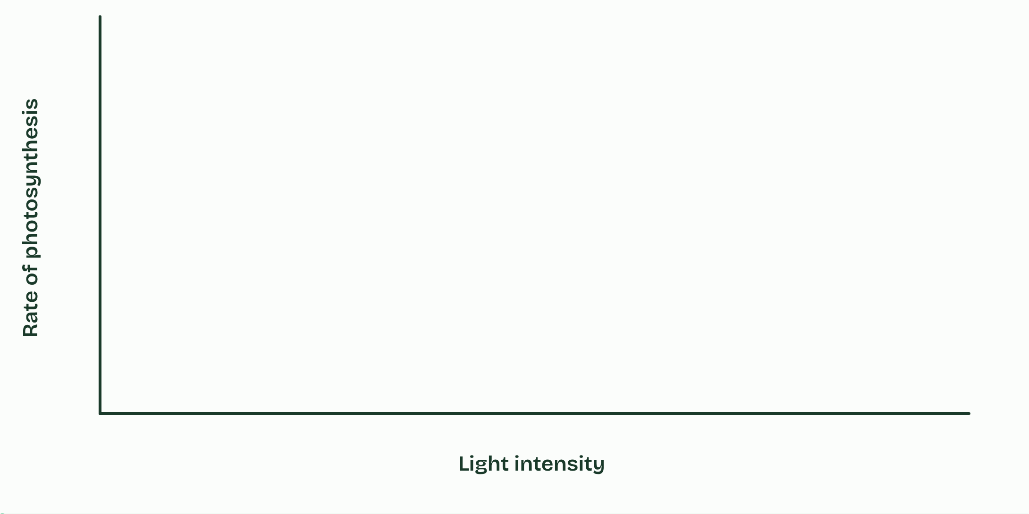
CHAPTER 6 · C1.3.7 Varying light, carbon dioxide and temperature to test limiting factors
Whatever runs short sets the pace
Limiting factor: the factor in shortest supply, which sets the rate.
Light, carbon dioxide and temperature are the three to know; raise the limiting one and the rate rises, until another takes over.
A hypothesis names the independent, dependent and controlled variables.
Minutes 0 to 5
Notes:
Minutes 0 to 5 of 60: Do now: sketch it (5 min).
The plan: Rate of photosynthesis against light intensity, with no help (the first stage of chapter 6’s sketches).
Photosynthesis needs light, carbon dioxide and a suitable temperature all at once. When several factors affect a rate, the one in shortest supply holds it back. Raising that limiting factor speeds the process up, and raising the others does nothing, until one of them becomes the shortest. Blackman stated this as the law of limiting factors in 1905.
Light intensity limits the supply of energy for splitting water. The rate rises with light, then levels off when something else limits. Carbon dioxide concentration limits the fixing of carbon in the same way. Temperature acts on the enzymes (you saw why in C1.1): the rate rises to an optimum, about 25 to 30 °C for many temperate plants, then falls as the enzymes denature. In dim light, temperature matters little, because light is the limit. Where a curve levels off, another factor sets the height of the plateau: raise that one and the plateau rises.
To test each factor, vary it on its own. Move a lamp to change the light (the intensity falls roughly as 1 ÷ distance², so use a light meter, with a heat shield between lamp and water). Dissolve sodium hydrogencarbonate in the water round pondweed or leaf discs to change the carbon dioxide (0 to 5 %). Use a water bath for temperature. Measure the rate by counting oxygen bubbles or collecting the gas, by the time leaf discs take to float, by the carbon dioxide taken up (hydrogencarbonate indicator), or by the gain in dry mass, which is slow and indirect.
A hypothesis is a provisional explanation that must be tested again and again. You can write it from theory before the experiment (“if carbon dioxide is the limiting factor, the rate will rise and then level off”), or from the evidence of a first run. Either way you name the independent variable (what you change), the dependent variable (what you measure) and the controlled variables (everything else, kept the same). Then test it on the bench, in the dry lab.

Slide 4
PREDICT
A plant at 15 °C is given more and more light until its rate levels off. Then it is warmed to 25 °C. What happens to the rate?
A Nothing: light was never the problem
B It rises to a higher plateau
C It falls, as the enzymes denature
D It drops, then climbs back to where it was
Minutes 0 to 5
Notes:
Minutes 0 to 5 of 60: Do now: sketch it (5 min).
The plan: Rate of photosynthesis against light intensity, with no help (the first stage of chapter 6’s sketches).
Ask for a show of hands, or mini whiteboards, before revealing. (Answer: B, on the next slide.)

Slide 5
WHAT HAPPENS
A plant at 15 °C is given more and more light until its rate levels off. Then it is warmed to 25 °C. What happens to the rate?
A Nothing: light was never the problem
B It rises to a higher plateau
C It falls, as the enzymes denature
D It drops, then climbs back to where it was
On the plateau, light was no longer limiting: temperature was. Warming speeds up the enzymes, so the rate climbs to a new, higher plateau, until something else (carbon dioxide, perhaps) limits it.
Minutes 0 to 5
Notes:
Minutes 0 to 5 of 60: Do now: sketch it (5 min).
The plan: Rate of photosynthesis against light intensity, with no help (the first stage of chapter 6’s sketches).
Answer: B. On the plateau, light was no longer limiting: temperature was. Warming speeds up the enzymes, so the rate climbs to a new, higher plateau, until something else (carbon dioxide, perhaps) limits it.

Slide 6
WATCH OUT
A limiting factor is not “a factor that stops photosynthesis”. It is the one in shortest supply, setting the rate. Raise it and the rate rises, until another one takes over.
Minutes 0 to 5
Notes:
Minutes 0 to 5 of 60: Do now: sketch it (5 min).
The plan: Rate of photosynthesis against light intensity, with no help (the first stage of chapter 6’s sketches).
A common mistake: say it, then ask who can say why it is wrong.

Slide 7

PRACTICAL
12 MIN
Leaf discs
THE TASK
Punch ten discs from a spinach leaf (avoiding veins) for each cup (chapter 6). Draw the air out of them in a 10 cm³ plastic syringe of the cup’s solution with a drop of washing-up liquid (a finger on the nozzle, pull the plunger, release, repeat until they sink). Tip them into a cup of the same solution: 0 %, 0.2 % and 0.5 % sodium hydrogencarbonate (1 g in 100 cm³ is 1 %). Stand each cup the same distance from a lamp. Count the discs floating every minute for 15 to 20 minutes, and find the time for half to float.
STUDENTS NEED
Spinach, a hole punch, 10 cm³ plastic syringes, sodium hydrogencarbonate, washing-up liquid, clear cups, a lamp, a metre rule, timers.
Minutes 5 to 17
Notes:
Minutes 5 to 17 of 60: Leaf discs, set going (12 min).
The plan: The leaf disc practical below, set going in groups at three hydrogencarbonate concentrations. One student in each group counts the floating discs every minute through the next steps.
The activity: Leaf discs. Punch ten discs from a spinach leaf (avoiding veins) for each cup (chapter 6). Draw the air out of them in a 10 cm³ plastic syringe of the cup’s solution with a drop of washing-up liquid (a finger on the nozzle, pull the plunger, release, repeat until they sink). Tip them into a cup of the same solution: 0 %, 0.2 % and 0.5 % sodium hydrogencarbonate (1 g in 100 cm³ is 1 %). Stand each cup the same distance from a lamp. Count the discs floating every minute for 15 to 20 minutes, and find the time for half to float.
Needs: spinach, a hole punch, 10 cm³ plastic syringes, sodium hydrogencarbonate, washing-up liquid, clear cups, a lamp, a metre rule, timers.
The time: 12 minutes, minutes 5 to 17 of the plan.

Slide 8

TABLE
IF THERE IS TIME
Three ways to measure it
THE TASK
A three-row table: oxygen given off, carbon dioxide taken up, gain in mass. For each, how it is measured and the theory behind the method. If there is time, or set it with the dry lab homework: lesson 3’s minutes have no slot for it.
STUDENTS NEED
A printed table.
Minutes 5 to 17
Notes:
Minutes 5 to 17 of 60: Leaf discs, set going (12 min).
The plan: The leaf disc practical below, set going in groups at three hydrogencarbonate concentrations. One student in each group counts the floating discs every minute through the next steps.
The activity: Three ways to measure it. A three-row table: oxygen given off, carbon dioxide taken up, gain in mass. For each, how it is measured and the theory behind the method. If there is time, or set it with the dry lab homework: lesson 3’s minutes have no slot for it.
Needs: a printed table.
The plan sets no time of its own for this activity: use it in this step, in place of part of it, or for homework.

Slide 9

PRACTICAL
IF THERE IS TIME
Algal balls
THE TASK
An alternative to the leaf discs, if there is time or in another lesson. Algae trapped in alginate beads sit in bottles of red hydrogencarbonate indicator, the bottles along a metre rule from a lamp. After an hour or so the indicator turns purple where carbon dioxide is taken up (photosynthesis faster than respiration) and yellow where it is added. Make the beads with sodium alginate and calcium chloride, by the SAPS method; compare with a colour chart or a colorimeter at 550 nm.
STUDENTS NEED
Concentrated algae, 2 % sodium alginate, 2 % calcium chloride, hydrogencarbonate indicator, small bottles with lids, a lamp, a metre rule.
Minutes 5 to 17
Notes:
Minutes 5 to 17 of 60: Leaf discs, set going (12 min).
The plan: The leaf disc practical below, set going in groups at three hydrogencarbonate concentrations. One student in each group counts the floating discs every minute through the next steps.
The activity: Algal balls. An alternative to the leaf discs, if there is time or in another lesson. Algae trapped in alginate beads sit in bottles of red hydrogencarbonate indicator, the bottles along a metre rule from a lamp. After an hour or so the indicator turns purple where carbon dioxide is taken up (photosynthesis faster than respiration) and yellow where it is added. Make the beads with sodium alginate and calcium chloride, by the SAPS method; compare with a colour chart or a colorimeter at 550 nm.
Needs: concentrated algae, 2 % sodium alginate, 2 % calcium chloride, hydrogencarbonate indicator, small bottles with lids, a lamp, a metre rule.
The plan sets no time of its own for this activity: use it in this step, in place of part of it, or for homework.

Slide 10
STEP 3
10 MIN
Sketch, then check
Minutes 17 to 27
Notes:
Minutes 17 to 27 of 60: Sketch, then check (10 min).
The plan: Chapter 6: Sketch, then check, stages 2 and 3 on the board against the students’ own sketches. Then the predict, then the Lazy Cats Toast tiles.

Slide 11
REMEMBER IT
The three limiting factors
L
C
T
Lazy
Cats
Toast
Minutes 17 to 27
Notes:
Minutes 17 to 27 of 60: Sketch, then check (10 min).
The plan: Chapter 6: Sketch, then check, stages 2 and 3 on the board against the students’ own sketches. Then the predict, then the Lazy Cats Toast tiles.
Ask the class what each letter stands for before revealing.

Slide 12
REMEMBER IT
The three limiting factors
L
C
T
Lazy
Cats
Toast
Light intensity
Carbon dioxide concentration
Temperature
the supply of energy for splitting water
the carbon to fix
the speed of the enzymes, up to their optimum
Minutes 17 to 27
Notes:
Minutes 17 to 27 of 60: Sketch, then check (10 min).
The plan: Chapter 6: Sketch, then check, stages 2 and 3 on the board against the students’ own sketches. Then the predict, then the Lazy Cats Toast tiles.
Lazy: Light intensity (the supply of energy for splitting water)
Cats: Carbon dioxide concentration (the carbon to fix)
Toast: Temperature (the speed of the enzymes, up to their optimum)

Slide 13

WRITE
8 MIN
Which question is better?
THE TASK
Two research questions for the leaf disc lab: one names the independent variable with its range and units, the dependent variable and how it is measured, and the organism; the other does not. Students say which is better and why, then write their own for the dry lab.
STUDENTS NEED
The two questions on the board.
Minutes 27 to 35
Notes:
Minutes 27 to 35 of 60: Which question is better? (8 min).
The plan: The activity below, then the leaf disc lab’s variables: how is each varied, why, and in what units?
The activity: Which question is better?. Two research questions for the leaf disc lab: one names the independent variable with its range and units, the dependent variable and how it is measured, and the organism; the other does not. Students say which is better and why, then write their own for the dry lab.
Needs: the two questions on the board.
The time: 8 minutes, minutes 27 to 35 of the plan.

Slide 14
STEP 5
12 MIN
Greenhouse against FACE
Students fill a two-column table, greenhouse and FACE, with one controlled variable for each.
Minutes 35 to 47
Notes:
Minutes 35 to 47 of 60: Greenhouse against FACE (12 min).
The plan: Chapter 7: the predict, then the figure. Students fill a two-column table, greenhouse and FACE, with one controlled variable for each.

Slide 15
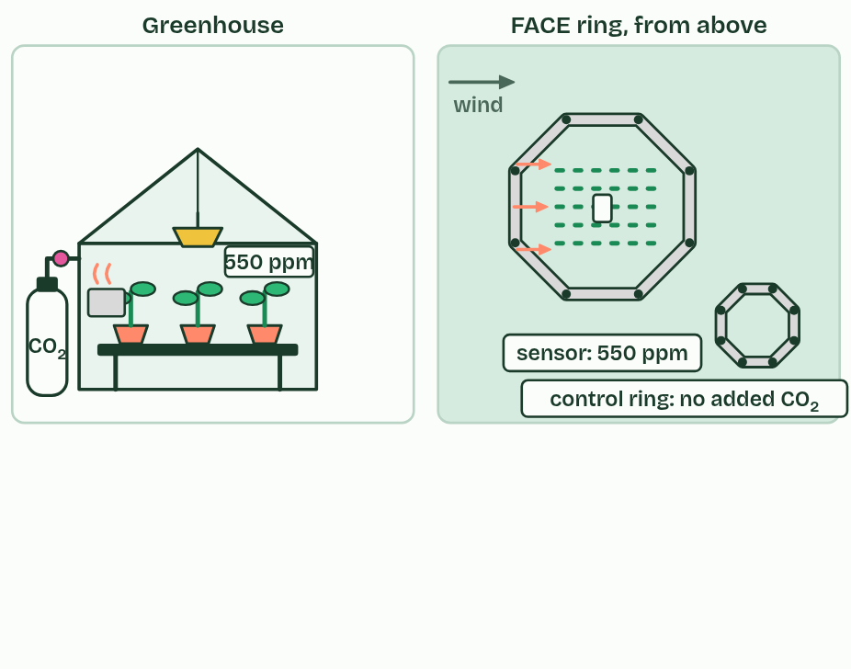
CHAPTER 7 · C1.3.8 Carbon dioxide enrichment experiments
1 / 3
Tomorrow’s air, today
Two ways to grow plants in tomorrow’s air.
Minutes 35 to 47
Notes:
Minutes 35 to 47 of 60: Greenhouse against FACE (12 min).
The plan: Chapter 7: the predict, then the figure. Students fill a two-column table, greenhouse and FACE, with one controlled variable for each.
The air’s carbon dioxide has risen from about 280 parts per million before the industrial revolution to over 420 now, mostly from burning fossil fuels and clearing forests (D4.3 returns to this). Carbon dioxide is often a limiting factor, so will crops and forests grow faster in tomorrow’s air?
Carbon dioxide enrichment experiments grow plants in the carbon dioxide expected later this century (about 550 to 600 ppm) beside plants in today’s air, and compare photosynthesis, growth and yield. They ask whether the rate of photosynthesis rises and stays up, how much growth and yield gain, which plants gain most, and whether another factor (water, nitrogen or temperature) soon takes over as the limit.
In an enclosed greenhouse experiment, carbon dioxide from a gas cylinder holds the air at the chosen level. Temperature, light, water and nutrients can be controlled, so carbon dioxide is the only variable that differs. But pots restrict roots, the enclosure changes light and humidity, and only small plants fit. Commercial growers already enrich greenhouses to raise yields of crops such as tomatoes.
In free-air carbon dioxide enrichment (FACE), a ring of pipes up to about 20 to 30 m across stands in a field or a forest. A sensor in the middle measures the carbon dioxide, and a computer sets how much the upwind pipes release to hold the target level. Control rings with the same pipes but no added carbon dioxide stand nearby. The plants grow in real soil, weather and competition, and whole trees can be studied. But temperature, rain and light cannot be controlled, and the gas is costly.
Careful control of variables is part of designing an experiment. It is easier in a laboratory or greenhouse, but some questions can only be answered in the field. A controlled variable in a greenhouse is the temperature; in FACE it is the crop variety, the sowing date or the pipes in the control rings. Crops in FACE rings gained less yield from extra carbon dioxide than enclosure studies had predicted, probably because in a field another factor soon becomes limiting.

Slide 16
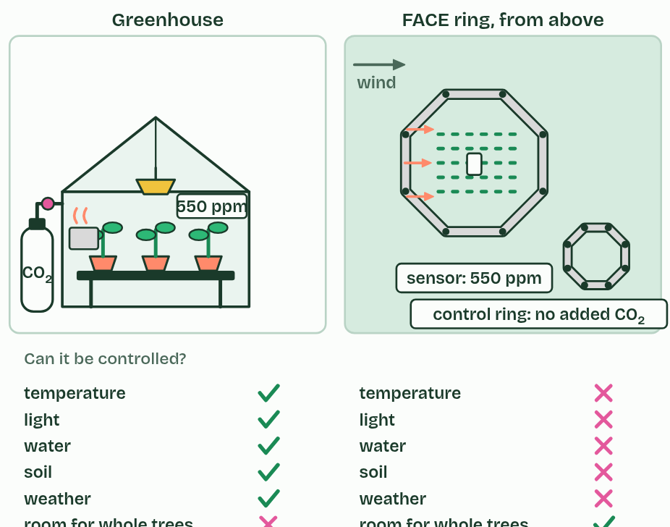
CHAPTER 7 · C1.3.8 Carbon dioxide enrichment experiments
2 / 3
Tomorrow’s air, today
A greenhouse controls more variables; a FACE ring keeps real field conditions.
Minutes 35 to 47
Notes:
Minutes 35 to 47 of 60: Greenhouse against FACE (12 min).
The plan: Chapter 7: the predict, then the figure. Students fill a two-column table, greenhouse and FACE, with one controlled variable for each.
The air’s carbon dioxide has risen from about 280 parts per million before the industrial revolution to over 420 now, mostly from burning fossil fuels and clearing forests (D4.3 returns to this). Carbon dioxide is often a limiting factor, so will crops and forests grow faster in tomorrow’s air?
Carbon dioxide enrichment experiments grow plants in the carbon dioxide expected later this century (about 550 to 600 ppm) beside plants in today’s air, and compare photosynthesis, growth and yield. They ask whether the rate of photosynthesis rises and stays up, how much growth and yield gain, which plants gain most, and whether another factor (water, nitrogen or temperature) soon takes over as the limit.
In an enclosed greenhouse experiment, carbon dioxide from a gas cylinder holds the air at the chosen level. Temperature, light, water and nutrients can be controlled, so carbon dioxide is the only variable that differs. But pots restrict roots, the enclosure changes light and humidity, and only small plants fit. Commercial growers already enrich greenhouses to raise yields of crops such as tomatoes.
In free-air carbon dioxide enrichment (FACE), a ring of pipes up to about 20 to 30 m across stands in a field or a forest. A sensor in the middle measures the carbon dioxide, and a computer sets how much the upwind pipes release to hold the target level. Control rings with the same pipes but no added carbon dioxide stand nearby. The plants grow in real soil, weather and competition, and whole trees can be studied. But temperature, rain and light cannot be controlled, and the gas is costly.
Careful control of variables is part of designing an experiment. It is easier in a laboratory or greenhouse, but some questions can only be answered in the field. A controlled variable in a greenhouse is the temperature; in FACE it is the crop variety, the sowing date or the pipes in the control rings. Crops in FACE rings gained less yield from extra carbon dioxide than enclosure studies had predicted, probably because in a field another factor soon becomes limiting.

Slide 17
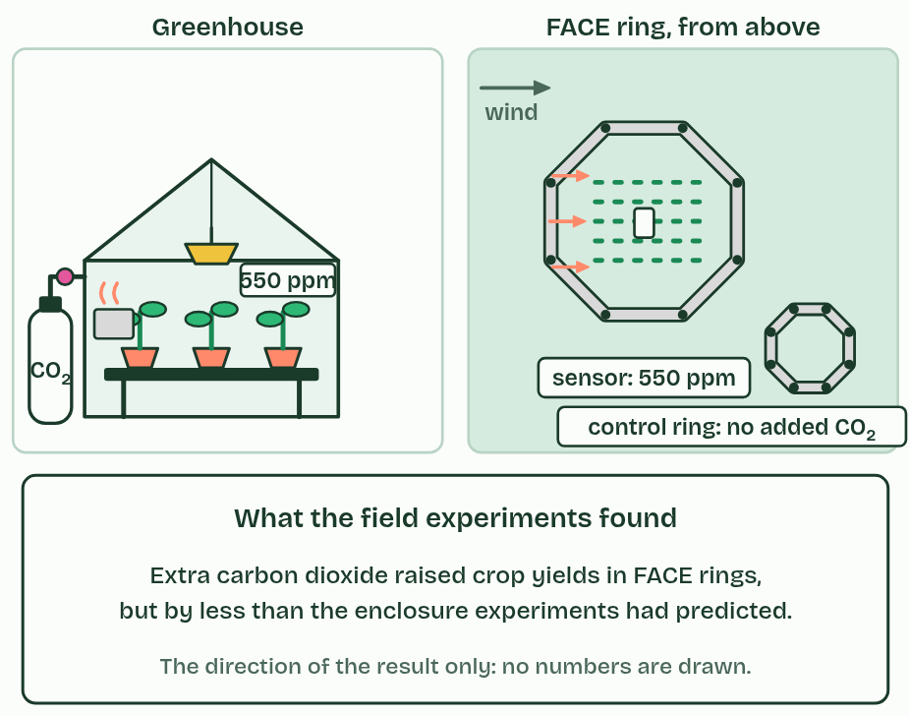
CHAPTER 7 · C1.3.8 Carbon dioxide enrichment experiments
3 / 3
Tomorrow’s air, today
In the field, the gain in yield was smaller.
Minutes 35 to 47
Notes:
Minutes 35 to 47 of 60: Greenhouse against FACE (12 min).
The plan: Chapter 7: the predict, then the figure. Students fill a two-column table, greenhouse and FACE, with one controlled variable for each.
The air’s carbon dioxide has risen from about 280 parts per million before the industrial revolution to over 420 now, mostly from burning fossil fuels and clearing forests (D4.3 returns to this). Carbon dioxide is often a limiting factor, so will crops and forests grow faster in tomorrow’s air?
Carbon dioxide enrichment experiments grow plants in the carbon dioxide expected later this century (about 550 to 600 ppm) beside plants in today’s air, and compare photosynthesis, growth and yield. They ask whether the rate of photosynthesis rises and stays up, how much growth and yield gain, which plants gain most, and whether another factor (water, nitrogen or temperature) soon takes over as the limit.
In an enclosed greenhouse experiment, carbon dioxide from a gas cylinder holds the air at the chosen level. Temperature, light, water and nutrients can be controlled, so carbon dioxide is the only variable that differs. But pots restrict roots, the enclosure changes light and humidity, and only small plants fit. Commercial growers already enrich greenhouses to raise yields of crops such as tomatoes.
In free-air carbon dioxide enrichment (FACE), a ring of pipes up to about 20 to 30 m across stands in a field or a forest. A sensor in the middle measures the carbon dioxide, and a computer sets how much the upwind pipes release to hold the target level. Control rings with the same pipes but no added carbon dioxide stand nearby. The plants grow in real soil, weather and competition, and whole trees can be studied. But temperature, rain and light cannot be controlled, and the gas is costly.
Careful control of variables is part of designing an experiment. It is easier in a laboratory or greenhouse, but some questions can only be answered in the field. A controlled variable in a greenhouse is the temperature; in FACE it is the crop variety, the sowing date or the pipes in the control rings. Crops in FACE rings gained less yield from extra carbon dioxide than enclosure studies had predicted, probably because in a field another factor soon becomes limiting.

Slide 18
CHAPTER 7 · C1.3.8 Carbon dioxide enrichment experiments
Tomorrow’s air, today
Enrichment experiments predict how plants will respond to the carbon dioxide of the future.
A greenhouse controls more variables; FACE keeps field conditions and real ecosystems.
Name a controlled variable for each: the greenhouse’s temperature, FACE’s crop variety and sowing date.
Minutes 35 to 47
Notes:
Minutes 35 to 47 of 60: Greenhouse against FACE (12 min).
The plan: Chapter 7: the predict, then the figure. Students fill a two-column table, greenhouse and FACE, with one controlled variable for each.
The air’s carbon dioxide has risen from about 280 parts per million before the industrial revolution to over 420 now, mostly from burning fossil fuels and clearing forests (D4.3 returns to this). Carbon dioxide is often a limiting factor, so will crops and forests grow faster in tomorrow’s air?
Carbon dioxide enrichment experiments grow plants in the carbon dioxide expected later this century (about 550 to 600 ppm) beside plants in today’s air, and compare photosynthesis, growth and yield. They ask whether the rate of photosynthesis rises and stays up, how much growth and yield gain, which plants gain most, and whether another factor (water, nitrogen or temperature) soon takes over as the limit.
In an enclosed greenhouse experiment, carbon dioxide from a gas cylinder holds the air at the chosen level. Temperature, light, water and nutrients can be controlled, so carbon dioxide is the only variable that differs. But pots restrict roots, the enclosure changes light and humidity, and only small plants fit. Commercial growers already enrich greenhouses to raise yields of crops such as tomatoes.
In free-air carbon dioxide enrichment (FACE), a ring of pipes up to about 20 to 30 m across stands in a field or a forest. A sensor in the middle measures the carbon dioxide, and a computer sets how much the upwind pipes release to hold the target level. Control rings with the same pipes but no added carbon dioxide stand nearby. The plants grow in real soil, weather and competition, and whole trees can be studied. But temperature, rain and light cannot be controlled, and the gas is costly.
Careful control of variables is part of designing an experiment. It is easier in a laboratory or greenhouse, but some questions can only be answered in the field. A controlled variable in a greenhouse is the temperature; in FACE it is the crop variety, the sowing date or the pipes in the control rings. Crops in FACE rings gained less yield from extra carbon dioxide than enclosure studies had predicted, probably because in a field another factor soon becomes limiting.

Slide 19
PREDICT
Crops given extra carbon dioxide gained less yield in FACE rings than in enclosures. What is the most likely reason?
A FACE rings leak most of their carbon dioxide
B Field crops are a different variety
C In fields, another factor soon limits
D Field soil absorbs the extra carbon dioxide
Minutes 35 to 47
Notes:
Minutes 35 to 47 of 60: Greenhouse against FACE (12 min).
The plan: Chapter 7: the predict, then the figure. Students fill a two-column table, greenhouse and FACE, with one controlled variable for each.
Ask for a show of hands, or mini whiteboards, before revealing. (Answer: C, on the next slide.)

Slide 20
WHAT HAPPENS
Crops given extra carbon dioxide gained less yield in FACE rings than in enclosures. What is the most likely reason?
A FACE rings leak most of their carbon dioxide
B Field crops are a different variety
C In fields, another factor soon limits
D Field soil absorbs the extra carbon dioxide
In a field, water, nitrogen or temperature soon becomes limiting, so extra carbon dioxide helps less than it did where everything else was kept ideal. That is why the field experiments are the better guide to tomorrow’s harvests, even though they control fewer variables.
Minutes 35 to 47
Notes:
Minutes 35 to 47 of 60: Greenhouse against FACE (12 min).
The plan: Chapter 7: the predict, then the figure. Students fill a two-column table, greenhouse and FACE, with one controlled variable for each.
Answer: C. In a field, water, nitrogen or temperature soon becomes limiting, so extra carbon dioxide helps less than it did where everything else was kept ideal. That is why the field experiments are the better guide to tomorrow’s harvests, even though they control fewer variables.

Slide 21
WATCH OUT
More carbon dioxide does not mean more growth for ever. It helps only while carbon dioxide is the limiting factor (chapter 6).
Minutes 35 to 47
Notes:
Minutes 35 to 47 of 60: Greenhouse against FACE (12 min).
The plan: Chapter 7: the predict, then the figure. Students fill a two-column table, greenhouse and FACE, with one controlled variable for each.
A common mistake: say it, then ask who can say why it is wrong.

Slide 22
STEP 6
8 MIN
Leaf discs: the last counts
The dry lab: Pondweed and the lamp
Minutes 47 to 55
Notes:
Minutes 47 to 55 of 60: Leaf discs: the last counts (8 min).
The plan: Last counts, then each group’s time for half the discs to float goes on the board. The dry lab (the pondweed bench) is shown on the board with one distance series, and set for homework, written up with the coach.

Slide 23
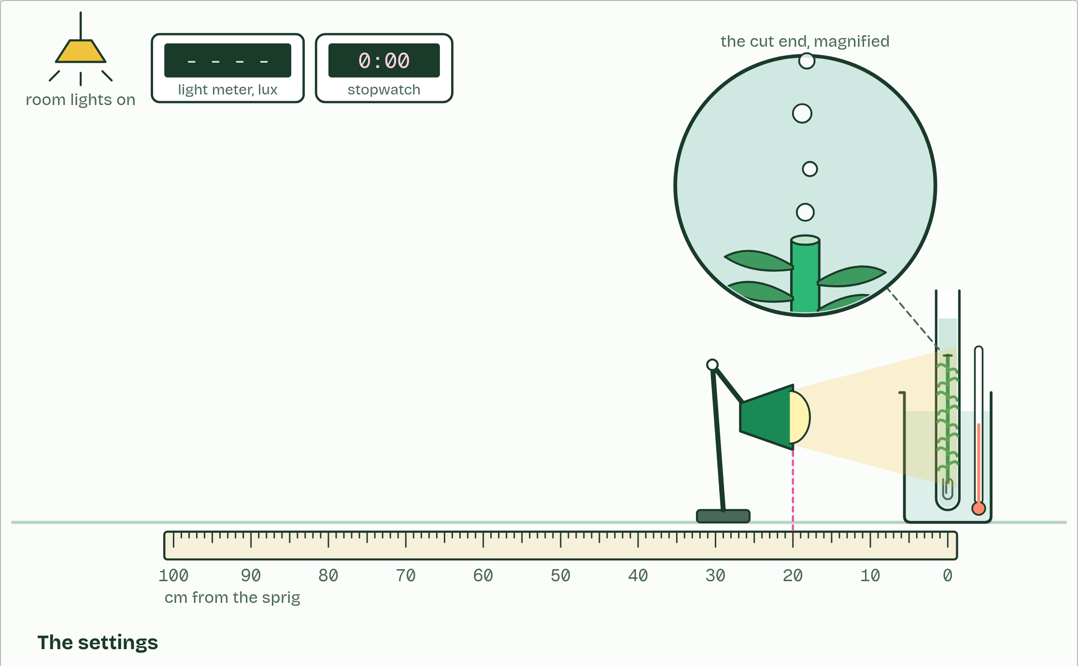
DRY LAB
Pondweed and the lamp
Your question: How does one limiting factor change the rate of photosynthesis? Start with the lamp: how does the rate change as the lamp moves away, and is it the distance or the light that matters?
What you can change: One independent variable at a time: the distance of the lamp (with a light meter to read the light), the concentration of sodium hydrogencarbonate, the temperature of the water, or the colour of a filter. Everything else stays fixed unless you change it on purpose, and some of it changes when you are not looking.
What to record: Bubbles counted in each of three minutes, after the sprig has settled, then the mean rate in bubbles per minute; or the time for half the leaf discs to float. Three trials at each value, a mean and a standard deviation, and a graph of the means with error bars. The coach under the bench helps you plan, process and evaluate.
Run it: biologybybradford.com/guides/ib-biology-c1-3-photosynthesis#lab
Minutes 47 to 55
Notes:
Minutes 47 to 55 of 60: Leaf discs: the last counts (8 min).
The plan: Last counts, then each group’s time for half the discs to float goes on the board. The dry lab (the pondweed bench) is shown on the board with one distance series, and set for homework, written up with the coach.
The dry lab runs in the guide: https://www.biologybybradford.com/guides/ib-biology-c1-3-photosynthesis#lab

Slide 24
PLENARY
Can you now...
Suggest and test hypotheses about light, carbon dioxide and temperature as limiting factors, naming the variables (C1.3.7)
Compare greenhouse and FACE experiments as ways of predicting how plants will grow in tomorrow's air (C1.3.8)
Minutes 55 to 60
Notes:
Minutes 55 to 60 of 60: Exit (5 min).
The plan: Name the limiting factor at three points on a sketch graph.
Thumbs up, sideways or down on each goal before the exit question. The goals come from the statements this lesson covers.

Slide 25
EXIT QUESTION
Before you go
Name the limiting factor at three points on a sketch graph.
Minutes 55 to 60
Notes:
Minutes 55 to 60 of 60: Exit (5 min).
The plan: Name the limiting factor at three points on a sketch graph.

Slide 26
PRACTISE AND REVISE
Keep going
Exam practice: a fresh paper of exam questions on C1.3 at standard level, marked as you go
The guide, with the animations and the dry lab
This lesson in the guide: 6 Whatever runs short sets the pace, 7 Tomorrow’s air, today, the dry lab
BUILD FOR YOUR CLASS
ALREADY ON THE SITE FOR C1.3
CARD SETS ON SPLYCR
Tarsia puzzle, dominoes and picture reveal on C1.3, built from its key terms and ready to print
A pub quiz with rounds on C1.3, to present or run with no projector
An escape room built from the question bank on C1.3
Quiz: Photosynthesis
Revision map: C1.3 Photosynthesis, to fill in
Exam questions: C1.3 in the exam maker, a paper with its markscheme
Open a set to host it as a class game, or make a copy to edit.
C1.3 Photosynthesis (SL)
How this was made. The course structure, the activities and the teaching choices come from my own classroom, my presentations and my years of teaching IB and AP Biology. I use Claude, an AI, to help write and build the interactive guides, lesson plans, slides and practice questions, and to draw the diagrams and code the interactives. I direct the work and review it against the IB and AP specifications before it goes live.
Minute 60: after the lesson
Notes:
Every link here is live. Set the exam practice paper for homework: it is fresh each time, marked as students go and saved to their Exam practice when they are signed in.
Exam practice: https://www.biologybybradford.com/exam-maker/sit?topics=C1.3&level=SL&paper=quiz&marks=15&src=ep
The guide: https://www.biologybybradford.com/guides/ib-biology-c1-3-photosynthesis

