Slide 1
IB Biology C1.3
LESSON 4 OF 6
HL
BY THE END YOU CAN
Photosynthesis
Describe a photosystem and explain why pigments work only as an array round a reaction centre (C1.3.9, C1.3.10)
Explain how photolysis at photosystem II supplies electrons and protons, and what its waste oxygen did to the Earth (C1.3.11)
Photosystems and water
C1.3.9, C1.3.10 and C1.3.11
Pigments in arrays round a reaction centre, why one pigment alone is useless, and photolysis at photosystem II and its consequences for Earth
60 minutes · chapters 8, 9
Minute 0
Notes:
IB Biology C1.3, Photosynthesis. Lesson 4 of 6: Photosystems and water (higher level), 60 minutes.
The plan, minute by minute (each slide's footer says where you are):
0 to 6 min (6) Do now: annotate it
6 to 14 min (8) Redox again
14 to 20 min (6) The glowing chlorophyll demonstration
20 to 32 min (12) An array and a reaction centre
32 to 46 min (14) Water split
46 to 54 min (8) A written question
54 to 60 min (6) Exit
A teacher’s mnemonic for the order: Two before One. Photosystem II goes first, and splits water; photosystem I reduces NADP.
What students get wrong:
Every pigment in a photosystem gives off electrons. They pass on energy; only the reaction centre emits an electron.
Oxygen from photolysis is used in the Calvin cycle. It is waste; the protons and electrons are used.
Stretch and support:
Stretch: the reaction centres of photosystems II and I absorb best at about 680 and 700 nm (their names, P680 and P700, are beyond the guide). Why might two photosystems in series be needed to lift electrons from water all the way to NADP? (The Z scheme, for discussion.)
Stretch: make a respiration and photosynthesis Tarsia puzzle in the Tarsia builder, ticking C1.2 and C1.3 together.
The lesson plan to print: https://www.biologybybradford.com/guides/downloads/ib-biology-c1-3-photosynthesis-lesson-4-plan.pdf

Slide 2
DO NOW
Annotate it
Annotate it: an unlabelled drawing of a chloroplast with the two stages, from SL memory.
6:00
minutes
Start now: the timer is running.
Minutes 0 to 6
Notes:
Minutes 0 to 6 of 60: Do now: annotate it (6 min).
The plan: Annotate it (below): an unlabelled drawing of a chloroplast with the two stages, from SL memory.
Start a 6 minute timer as they come in.

Slide 3

DO NOW
6 MIN
Annotate it
THE TASK
A chloroplast outline with the two stages shown as boxes, unlabelled. Students label photolysis, waste, reduced NADP, ATP, the thylakoid and the stroma.
STUDENTS NEED
The printed outline.
Minutes 0 to 6
Notes:
Minutes 0 to 6 of 60: Do now: annotate it (6 min).
The plan: Annotate it (below): an unlabelled drawing of a chloroplast with the two stages, from SL memory.
The activity: Annotate it. A chloroplast outline with the two stages shown as boxes, unlabelled. Students label photolysis, waste, reduced NADP, ATP, the thylakoid and the stroma.
Needs: the printed outline.
The time: 6 minutes, minutes 0 to 6 of the plan.

Slide 4
STEP 2
8 MIN
Redox again
Which molecule in photosynthesis is reduced?
Minutes 6 to 14
Notes:
Minutes 6 to 14 of 60: Redox again (8 min).
The plan: Oxidation is loss of electrons or hydrogen, reduction is gain (a C1.2 recap). Which molecule in photosynthesis is reduced?

Slide 5

DEMO
6 MIN
Glowing chlorophyll
THE TASK
A boiling tube of spinach extract in propanone, in a dark room, lit from the side by a bright white torch (or a blue LED): it glows deep red. A whole leaf under the same light does not. Ask: where did the energy go in the leaf? (chapter 8’s predict). Safety: propanone, as in Separate the greens.
STUDENTS NEED
Extract, a boiling tube, a bright torch, a dark corner.
Minutes 14 to 20
Notes:
Minutes 14 to 20 of 60: The glowing chlorophyll demonstration (6 min).
The plan: The demonstration below, with chapter 8’s predict made first.
The activity: Glowing chlorophyll. A boiling tube of spinach extract in propanone, in a dark room, lit from the side by a bright white torch (or a blue LED): it glows deep red. A whole leaf under the same light does not. Ask: where did the energy go in the leaf? (chapter 8’s predict). Safety: propanone, as in Separate the greens.
Needs: extract, a boiling tube, a bright torch, a dark corner.
The time: 6 minutes, minutes 14 to 20 of the plan.

Slide 6
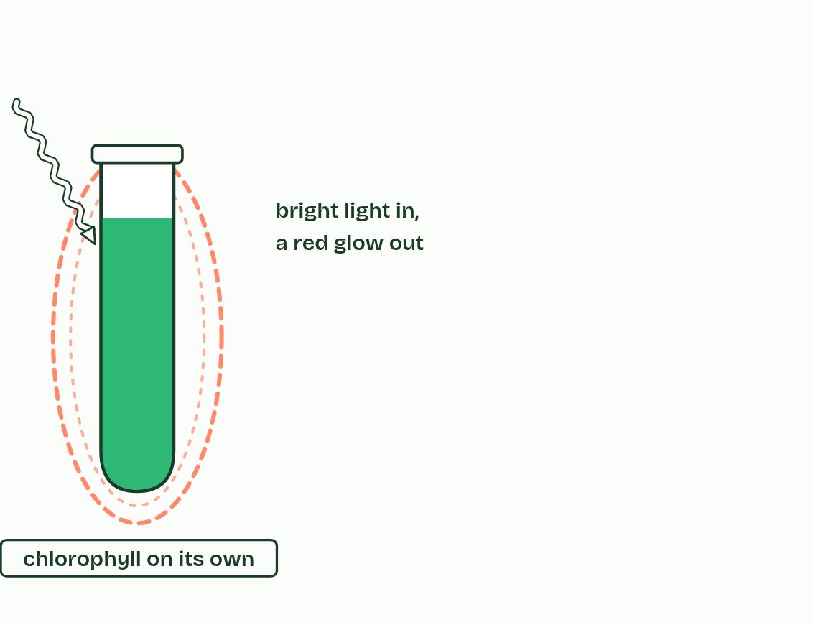
CHAPTER 8 · C1.3.9 C1.3.10 Photosystems, and the advantage of the array
1 / 5
Pigments in an array
On its own, chlorophyll gives the energy straight back, as red light.
Minutes 14 to 20
Notes:
Minutes 14 to 20 of 60: The glowing chlorophyll demonstration (6 min).
The plan: The demonstration below, with chapter 8’s predict made first.
A photosystem is an array of a few hundred pigment molecules, chlorophylls and accessory pigments, held in fixed positions by proteins. Photosystems are always in a membrane: the thylakoid membranes of a chloroplast, or the internal membranes of a cyanobacterium. At the heart of each is the reaction centre, a special chlorophyll a.
Light absorbed by any pigment in the array excites an electron in that pigment. The energy, not the electron, passes from pigment to pigment, inwards, until it reaches the reaction centre. There an excited electron is emitted: it leaves the chlorophyll altogether, passing to an electron acceptor beside it in the membrane. There are two kinds of photosystem, photosystem II and photosystem I, numbered in the order they were discovered. Electrons pass through II first.
Why an array? A single chlorophyll molecule, even in sunlight, absorbs a photon only every so often, and its excitation lasts only a few billionths of a second. On its own, the energy is lost as heat or given out again as red light, and it cannot do any part of photosynthesis. In an array, hundreds of pigments collect light and funnel it to one reaction centre, which keeps it busy. Different pigments widen the range of wavelengths caught. And their fixed spacing lets energy jump from one to the next before it is lost.
Example: Seeing it Chlorophyll extracted into propanone glows deep red under a bright light. Chlorophyll in a leaf hardly glows. In the leaf the energy is used. In the tube there is no array and no acceptor, so it comes straight back out as light.

Slide 7
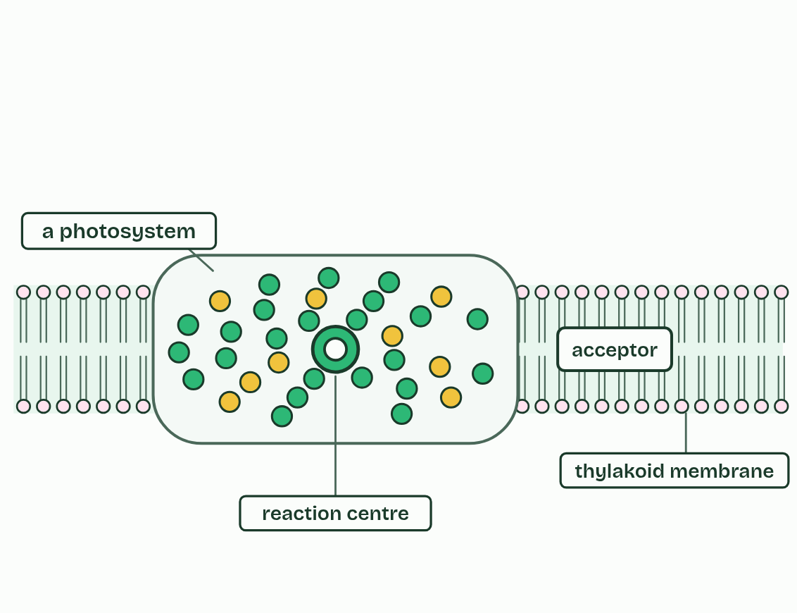
CHAPTER 8 · C1.3.9 C1.3.10 Photosystems, and the advantage of the array
2 / 5
Pigments in an array
A photosystem: hundreds of pigments around a reaction centre, in a membrane.
Minutes 14 to 20
Notes:
Minutes 14 to 20 of 60: The glowing chlorophyll demonstration (6 min).
The plan: The demonstration below, with chapter 8’s predict made first.
A photosystem is an array of a few hundred pigment molecules, chlorophylls and accessory pigments, held in fixed positions by proteins. Photosystems are always in a membrane: the thylakoid membranes of a chloroplast, or the internal membranes of a cyanobacterium. At the heart of each is the reaction centre, a special chlorophyll a.
Light absorbed by any pigment in the array excites an electron in that pigment. The energy, not the electron, passes from pigment to pigment, inwards, until it reaches the reaction centre. There an excited electron is emitted: it leaves the chlorophyll altogether, passing to an electron acceptor beside it in the membrane. There are two kinds of photosystem, photosystem II and photosystem I, numbered in the order they were discovered. Electrons pass through II first.
Why an array? A single chlorophyll molecule, even in sunlight, absorbs a photon only every so often, and its excitation lasts only a few billionths of a second. On its own, the energy is lost as heat or given out again as red light, and it cannot do any part of photosynthesis. In an array, hundreds of pigments collect light and funnel it to one reaction centre, which keeps it busy. Different pigments widen the range of wavelengths caught. And their fixed spacing lets energy jump from one to the next before it is lost.
Example: Seeing it Chlorophyll extracted into propanone glows deep red under a bright light. Chlorophyll in a leaf hardly glows. In the leaf the energy is used. In the tube there is no array and no acceptor, so it comes straight back out as light.

Slide 8
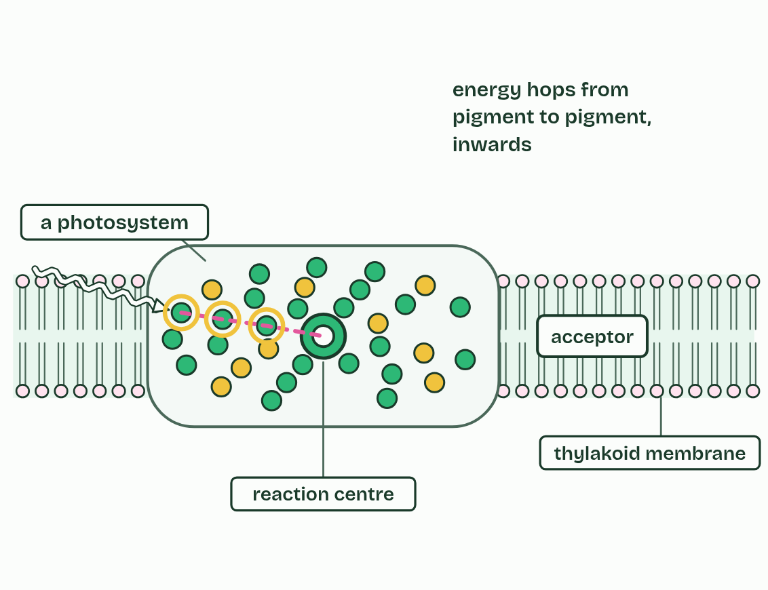
CHAPTER 8 · C1.3.9 C1.3.10 Photosystems, and the advantage of the array
3 / 5
Pigments in an array
The energy hops from pigment to pigment, inwards.
Minutes 14 to 20
Notes:
Minutes 14 to 20 of 60: The glowing chlorophyll demonstration (6 min).
The plan: The demonstration below, with chapter 8’s predict made first.
A photosystem is an array of a few hundred pigment molecules, chlorophylls and accessory pigments, held in fixed positions by proteins. Photosystems are always in a membrane: the thylakoid membranes of a chloroplast, or the internal membranes of a cyanobacterium. At the heart of each is the reaction centre, a special chlorophyll a.
Light absorbed by any pigment in the array excites an electron in that pigment. The energy, not the electron, passes from pigment to pigment, inwards, until it reaches the reaction centre. There an excited electron is emitted: it leaves the chlorophyll altogether, passing to an electron acceptor beside it in the membrane. There are two kinds of photosystem, photosystem II and photosystem I, numbered in the order they were discovered. Electrons pass through II first.
Why an array? A single chlorophyll molecule, even in sunlight, absorbs a photon only every so often, and its excitation lasts only a few billionths of a second. On its own, the energy is lost as heat or given out again as red light, and it cannot do any part of photosynthesis. In an array, hundreds of pigments collect light and funnel it to one reaction centre, which keeps it busy. Different pigments widen the range of wavelengths caught. And their fixed spacing lets energy jump from one to the next before it is lost.
Example: Seeing it Chlorophyll extracted into propanone glows deep red under a bright light. Chlorophyll in a leaf hardly glows. In the leaf the energy is used. In the tube there is no array and no acceptor, so it comes straight back out as light.

Slide 9
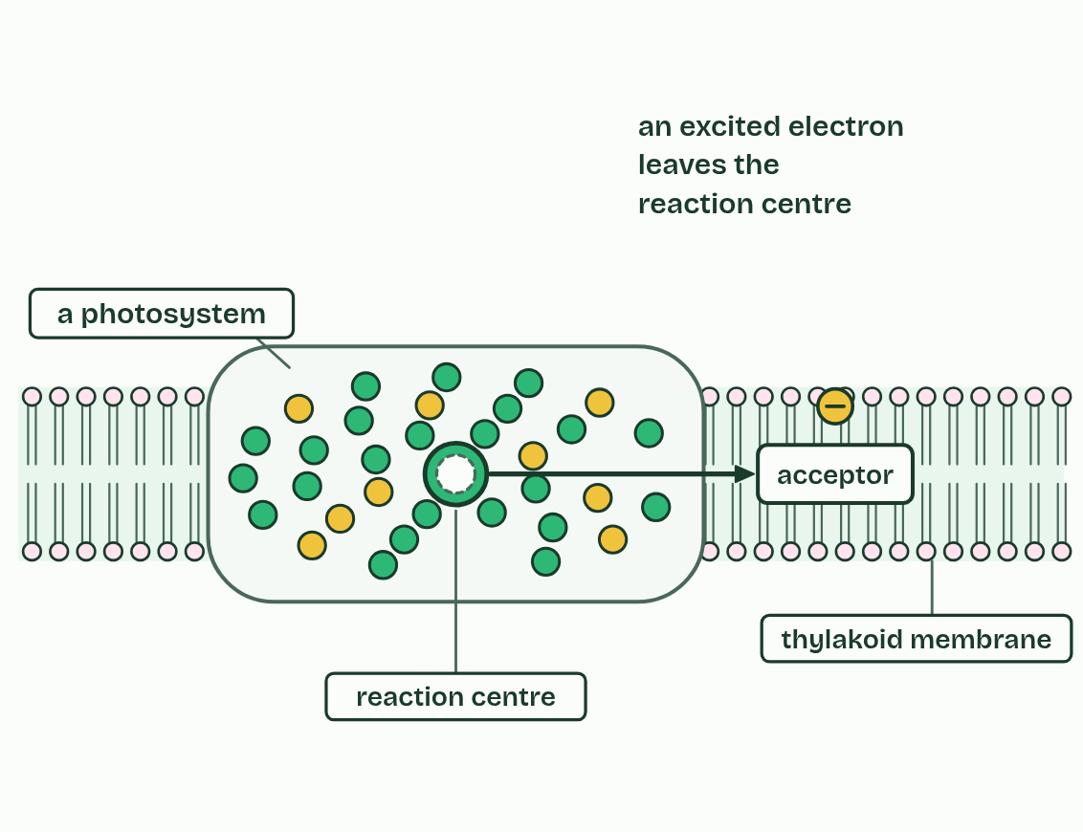
CHAPTER 8 · C1.3.9 C1.3.10 Photosystems, and the advantage of the array
4 / 5
Pigments in an array
The reaction centre emits an excited electron.
Minutes 14 to 20
Notes:
Minutes 14 to 20 of 60: The glowing chlorophyll demonstration (6 min).
The plan: The demonstration below, with chapter 8’s predict made first.
A photosystem is an array of a few hundred pigment molecules, chlorophylls and accessory pigments, held in fixed positions by proteins. Photosystems are always in a membrane: the thylakoid membranes of a chloroplast, or the internal membranes of a cyanobacterium. At the heart of each is the reaction centre, a special chlorophyll a.
Light absorbed by any pigment in the array excites an electron in that pigment. The energy, not the electron, passes from pigment to pigment, inwards, until it reaches the reaction centre. There an excited electron is emitted: it leaves the chlorophyll altogether, passing to an electron acceptor beside it in the membrane. There are two kinds of photosystem, photosystem II and photosystem I, numbered in the order they were discovered. Electrons pass through II first.
Why an array? A single chlorophyll molecule, even in sunlight, absorbs a photon only every so often, and its excitation lasts only a few billionths of a second. On its own, the energy is lost as heat or given out again as red light, and it cannot do any part of photosynthesis. In an array, hundreds of pigments collect light and funnel it to one reaction centre, which keeps it busy. Different pigments widen the range of wavelengths caught. And their fixed spacing lets energy jump from one to the next before it is lost.
Example: Seeing it Chlorophyll extracted into propanone glows deep red under a bright light. Chlorophyll in a leaf hardly glows. In the leaf the energy is used. In the tube there is no array and no acceptor, so it comes straight back out as light.

Slide 10
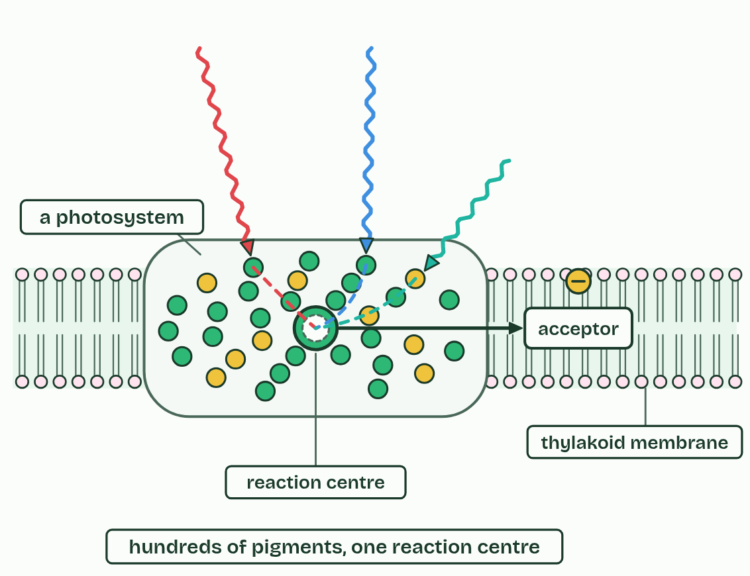
CHAPTER 8 · C1.3.9 C1.3.10 Photosystems, and the advantage of the array
5 / 5
Pigments in an array
Many pigments, many colours, all feeding one reaction centre.
Minutes 14 to 20
Notes:
Minutes 14 to 20 of 60: The glowing chlorophyll demonstration (6 min).
The plan: The demonstration below, with chapter 8’s predict made first.
A photosystem is an array of a few hundred pigment molecules, chlorophylls and accessory pigments, held in fixed positions by proteins. Photosystems are always in a membrane: the thylakoid membranes of a chloroplast, or the internal membranes of a cyanobacterium. At the heart of each is the reaction centre, a special chlorophyll a.
Light absorbed by any pigment in the array excites an electron in that pigment. The energy, not the electron, passes from pigment to pigment, inwards, until it reaches the reaction centre. There an excited electron is emitted: it leaves the chlorophyll altogether, passing to an electron acceptor beside it in the membrane. There are two kinds of photosystem, photosystem II and photosystem I, numbered in the order they were discovered. Electrons pass through II first.
Why an array? A single chlorophyll molecule, even in sunlight, absorbs a photon only every so often, and its excitation lasts only a few billionths of a second. On its own, the energy is lost as heat or given out again as red light, and it cannot do any part of photosynthesis. In an array, hundreds of pigments collect light and funnel it to one reaction centre, which keeps it busy. Different pigments widen the range of wavelengths caught. And their fixed spacing lets energy jump from one to the next before it is lost.
Example: Seeing it Chlorophyll extracted into propanone glows deep red under a bright light. Chlorophyll in a leaf hardly glows. In the leaf the energy is used. In the tube there is no array and no acceptor, so it comes straight back out as light.

Slide 11
CHAPTER 8 · C1.3.9 C1.3.10 Photosystems, and the advantage of the array
Pigments in an array
A photosystem is an array of pigments round a reaction centre, always in a membrane.
Pigments pass on energy; only the reaction centre emits an excited electron.
One pigment alone could not do any part of photosynthesis.
Minutes 14 to 20
Notes:
Minutes 14 to 20 of 60: The glowing chlorophyll demonstration (6 min).
The plan: The demonstration below, with chapter 8’s predict made first.
A photosystem is an array of a few hundred pigment molecules, chlorophylls and accessory pigments, held in fixed positions by proteins. Photosystems are always in a membrane: the thylakoid membranes of a chloroplast, or the internal membranes of a cyanobacterium. At the heart of each is the reaction centre, a special chlorophyll a.
Light absorbed by any pigment in the array excites an electron in that pigment. The energy, not the electron, passes from pigment to pigment, inwards, until it reaches the reaction centre. There an excited electron is emitted: it leaves the chlorophyll altogether, passing to an electron acceptor beside it in the membrane. There are two kinds of photosystem, photosystem II and photosystem I, numbered in the order they were discovered. Electrons pass through II first.
Why an array? A single chlorophyll molecule, even in sunlight, absorbs a photon only every so often, and its excitation lasts only a few billionths of a second. On its own, the energy is lost as heat or given out again as red light, and it cannot do any part of photosynthesis. In an array, hundreds of pigments collect light and funnel it to one reaction centre, which keeps it busy. Different pigments widen the range of wavelengths caught. And their fixed spacing lets energy jump from one to the next before it is lost.
Example: Seeing it Chlorophyll extracted into propanone glows deep red under a bright light. Chlorophyll in a leaf hardly glows. In the leaf the energy is used. In the tube there is no array and no acceptor, so it comes straight back out as light.

Slide 12
PREDICT
Chlorophyll dissolved in propanone glows red under a bright light. Chlorophyll in a leaf hardly glows at all. Why?
A The leaf’s chlorophyll is a different molecule
B Propanone makes the chlorophyll absorb more light
C Leaves reflect all of their red light away
D In a leaf the energy is passed on and used
Minutes 14 to 20
Notes:
Minutes 14 to 20 of 60: The glowing chlorophyll demonstration (6 min).
The plan: The demonstration below, with chapter 8’s predict made first.
Ask for a show of hands, or mini whiteboards, before revealing. (Answer: D, on the next slide.)

Slide 13
WHAT HAPPENS
Chlorophyll dissolved in propanone glows red under a bright light. Chlorophyll in a leaf hardly glows at all. Why?
A The leaf’s chlorophyll is a different molecule
B Propanone makes the chlorophyll absorb more light
C Leaves reflect all of their red light away
D In a leaf the energy is passed on and used
In the leaf, chlorophyll is part of a photosystem. The energy it absorbs is passed inwards to a reaction centre and used to emit an electron. In the tube there is no array and nowhere to pass the energy, so it comes back out as red light.
Minutes 14 to 20
Notes:
Minutes 14 to 20 of 60: The glowing chlorophyll demonstration (6 min).
The plan: The demonstration below, with chapter 8’s predict made first.
Answer: D. In the leaf, chlorophyll is part of a photosystem. The energy it absorbs is passed inwards to a reaction centre and used to emit an electron. In the tube there is no array and nowhere to pass the energy, so it comes back out as red light.

Slide 14
WATCH OUT
Pigments in the array pass on energy, not electrons. Only the reaction centre emits an electron.
Minutes 14 to 20
Notes:
Minutes 14 to 20 of 60: The glowing chlorophyll demonstration (6 min).
The plan: The demonstration below, with chapter 8’s predict made first.
A common mistake: say it, then ask who can say why it is wrong.

Slide 15
STEP 4
12 MIN
An array and a reaction centre
Model: Pass the energy
Minutes 20 to 32
Notes:
Minutes 20 to 32 of 60: An array and a reaction centre (12 min).
The plan: Chapter 8’s figure step by step. Then Pass the energy (below).

Slide 16

MODEL
12 MIN
Pass the energy
THE TASK
Students stand as a photosystem: eight to ten “pigments” in a ring round one “reaction centre”, with an “acceptor” beside them. A light card (a photon) handed to any outer pigment is passed inwards hand to hand (the energy moves, not the card’s owner) to the reaction centre, who hands a yellow “electron” token to the acceptor and is left short. Who refills it? (Photolysis, chapter 9.) Then one student alone with a light card can only drop it (heat, or red light).
STUDENTS NEED
Light cards and a few yellow tokens.
Minutes 20 to 32
Notes:
Minutes 20 to 32 of 60: An array and a reaction centre (12 min).
The plan: Chapter 8’s figure step by step. Then Pass the energy (below).
The activity: Pass the energy. Students stand as a photosystem: eight to ten “pigments” in a ring round one “reaction centre”, with an “acceptor” beside them. A light card (a photon) handed to any outer pigment is passed inwards hand to hand (the energy moves, not the card’s owner) to the reaction centre, who hands a yellow “electron” token to the acceptor and is left short. Who refills it? (Photolysis, chapter 9.) Then one student alone with a light card can only drop it (heat, or red light).
Needs: light cards and a few yellow tokens.
The time: 12 minutes, minutes 20 to 32 of the plan.

Slide 17
STEP 5
14 MIN
Water split
Chapter 9: Water split, oxygen spare
Minutes 32 to 46
Notes:
Minutes 32 to 46 of 60: Water split (14 min).
The plan: Chapter 9: the predict, the figure, then the Please Eat Oranges tiles. The Great Oxidation figure follows, with the banded iron story told in two minutes.

Slide 18
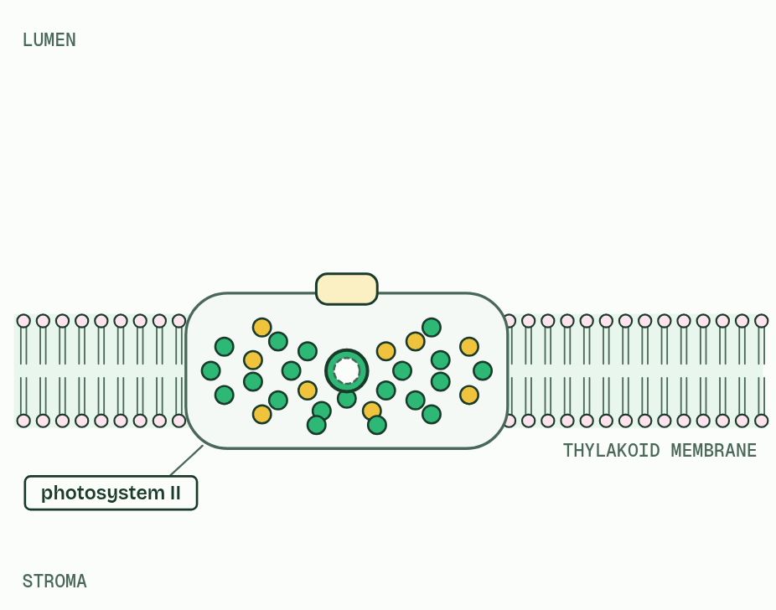
CHAPTER 9 · C1.3.11 Oxygen from the photolysis of water in photosystem II
1 / 4
Water split, oxygen spare
Photosystem II has lost electrons.
Minutes 32 to 46
Notes:
Minutes 32 to 46 of 60: Water split (14 min).
The plan: Chapter 9: the predict, the figure, then the Please Eat Oranges tiles. The Great Oxidation figure follows, with the banded iron story told in two minutes.
Photosystem II’s reaction centre has emitted its electrons, so it needs more. It takes them from water. The splitting of water, photolysis, is done by an enzyme on the lumen side of photosystem II. Two water molecules give four electrons, four protons and one oxygen molecule.
The electrons refill the reaction centre, so it can be excited again. The protons are released into the lumen, where they add to the proton gradient (chapter 10). Both are used. The oxygen is a waste product: it diffuses out of the chloroplast, the cell and the leaf. Light does not split water directly. It excites the reaction centre, and the electron-short reaction centre pulls electrons from water.
The advent of oxygen from photolysis had immense consequences on Earth. Cyanobacteria were the first organisms to split water. The oxygen they released first reacted with iron dissolved in the oceans, which settled as layers of iron oxide on the sea floor: the banded iron formations. When the iron was used up, oxygen built up in the air, in the Great Oxidation Event, about 2.4 billion years ago. Oxygen poisoned many anaerobic organisms. It formed the ozone layer, which screens ultraviolet light. And it made aerobic respiration possible, with its far higher yield of ATP (C1.2), on which large, active organisms depend.

Slide 19
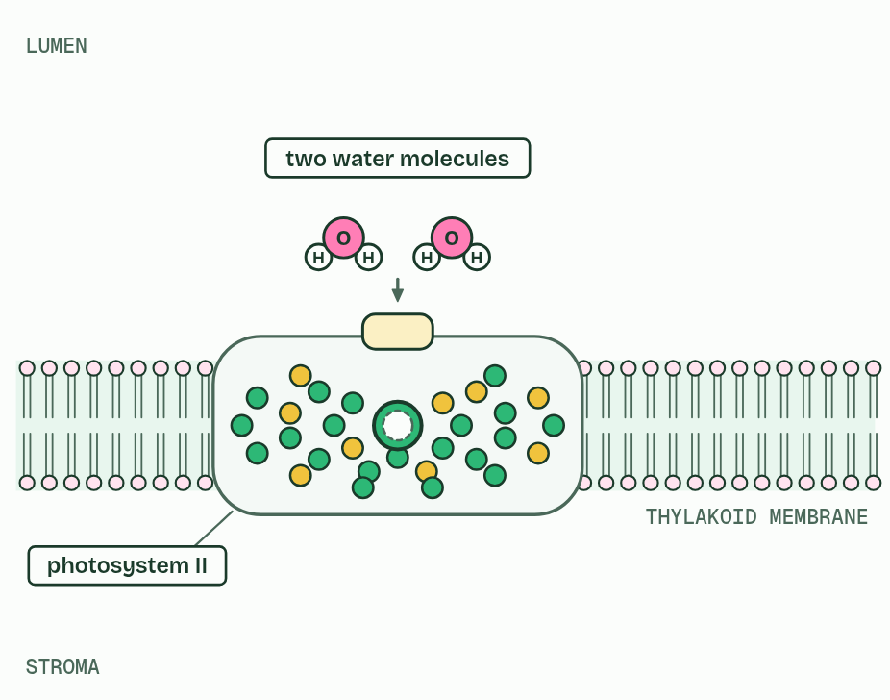
CHAPTER 9 · C1.3.11 Oxygen from the photolysis of water in photosystem II
2 / 4
Water split, oxygen spare
It takes more from water.
Minutes 32 to 46
Notes:
Minutes 32 to 46 of 60: Water split (14 min).
The plan: Chapter 9: the predict, the figure, then the Please Eat Oranges tiles. The Great Oxidation figure follows, with the banded iron story told in two minutes.
Photosystem II’s reaction centre has emitted its electrons, so it needs more. It takes them from water. The splitting of water, photolysis, is done by an enzyme on the lumen side of photosystem II. Two water molecules give four electrons, four protons and one oxygen molecule.
The electrons refill the reaction centre, so it can be excited again. The protons are released into the lumen, where they add to the proton gradient (chapter 10). Both are used. The oxygen is a waste product: it diffuses out of the chloroplast, the cell and the leaf. Light does not split water directly. It excites the reaction centre, and the electron-short reaction centre pulls electrons from water.
The advent of oxygen from photolysis had immense consequences on Earth. Cyanobacteria were the first organisms to split water. The oxygen they released first reacted with iron dissolved in the oceans, which settled as layers of iron oxide on the sea floor: the banded iron formations. When the iron was used up, oxygen built up in the air, in the Great Oxidation Event, about 2.4 billion years ago. Oxygen poisoned many anaerobic organisms. It formed the ozone layer, which screens ultraviolet light. And it made aerobic respiration possible, with its far higher yield of ATP (C1.2), on which large, active organisms depend.

Slide 20
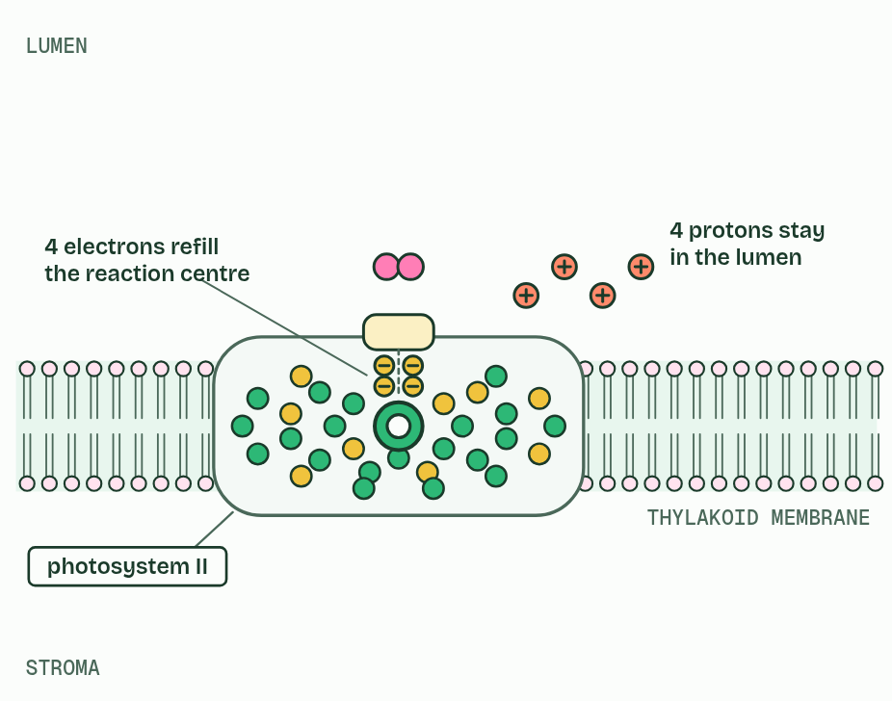
CHAPTER 9 · C1.3.11 Oxygen from the photolysis of water in photosystem II
3 / 4
Water split, oxygen spare
Photolysis: electrons refill the reaction centre; protons stay in the lumen.
Minutes 32 to 46
Notes:
Minutes 32 to 46 of 60: Water split (14 min).
The plan: Chapter 9: the predict, the figure, then the Please Eat Oranges tiles. The Great Oxidation figure follows, with the banded iron story told in two minutes.
Photosystem II’s reaction centre has emitted its electrons, so it needs more. It takes them from water. The splitting of water, photolysis, is done by an enzyme on the lumen side of photosystem II. Two water molecules give four electrons, four protons and one oxygen molecule.
The electrons refill the reaction centre, so it can be excited again. The protons are released into the lumen, where they add to the proton gradient (chapter 10). Both are used. The oxygen is a waste product: it diffuses out of the chloroplast, the cell and the leaf. Light does not split water directly. It excites the reaction centre, and the electron-short reaction centre pulls electrons from water.
The advent of oxygen from photolysis had immense consequences on Earth. Cyanobacteria were the first organisms to split water. The oxygen they released first reacted with iron dissolved in the oceans, which settled as layers of iron oxide on the sea floor: the banded iron formations. When the iron was used up, oxygen built up in the air, in the Great Oxidation Event, about 2.4 billion years ago. Oxygen poisoned many anaerobic organisms. It formed the ozone layer, which screens ultraviolet light. And it made aerobic respiration possible, with its far higher yield of ATP (C1.2), on which large, active organisms depend.

Slide 21
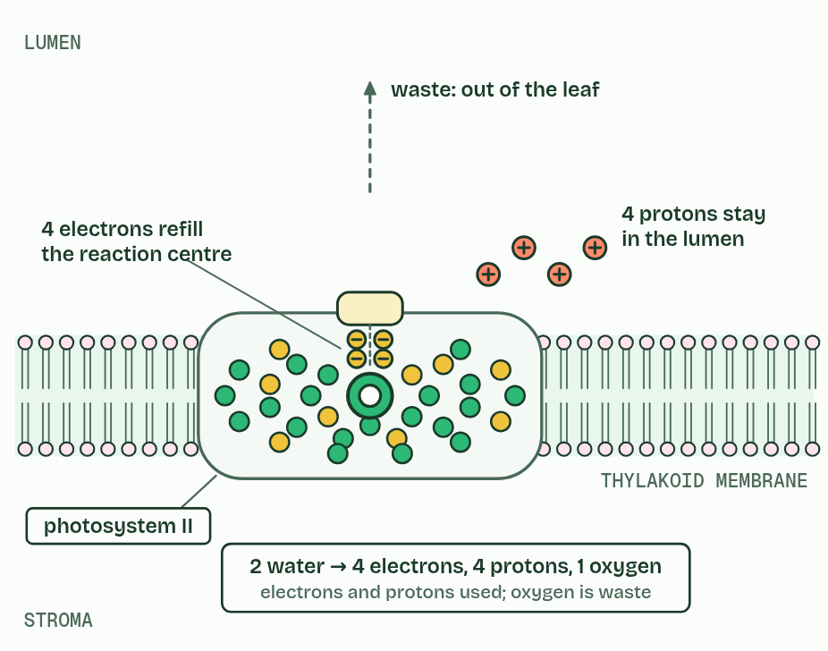
CHAPTER 9 · C1.3.11 Oxygen from the photolysis of water in photosystem II
4 / 4
Water split, oxygen spare
The oxygen is a waste product.
Minutes 32 to 46
Notes:
Minutes 32 to 46 of 60: Water split (14 min).
The plan: Chapter 9: the predict, the figure, then the Please Eat Oranges tiles. The Great Oxidation figure follows, with the banded iron story told in two minutes.
Photosystem II’s reaction centre has emitted its electrons, so it needs more. It takes them from water. The splitting of water, photolysis, is done by an enzyme on the lumen side of photosystem II. Two water molecules give four electrons, four protons and one oxygen molecule.
The electrons refill the reaction centre, so it can be excited again. The protons are released into the lumen, where they add to the proton gradient (chapter 10). Both are used. The oxygen is a waste product: it diffuses out of the chloroplast, the cell and the leaf. Light does not split water directly. It excites the reaction centre, and the electron-short reaction centre pulls electrons from water.
The advent of oxygen from photolysis had immense consequences on Earth. Cyanobacteria were the first organisms to split water. The oxygen they released first reacted with iron dissolved in the oceans, which settled as layers of iron oxide on the sea floor: the banded iron formations. When the iron was used up, oxygen built up in the air, in the Great Oxidation Event, about 2.4 billion years ago. Oxygen poisoned many anaerobic organisms. It formed the ozone layer, which screens ultraviolet light. And it made aerobic respiration possible, with its far higher yield of ATP (C1.2), on which large, active organisms depend.

Slide 22
CHAPTER 9 · C1.3.11 Oxygen from the photolysis of water in photosystem II
Water split, oxygen spare
Photolysis at photosystem II: 2 water give 4 electrons, 4 protons and 1 oxygen.
The electrons and protons are used; the oxygen is waste.
Light excites the reaction centre; the reaction centre takes electrons from water.
Minutes 32 to 46
Notes:
Minutes 32 to 46 of 60: Water split (14 min).
The plan: Chapter 9: the predict, the figure, then the Please Eat Oranges tiles. The Great Oxidation figure follows, with the banded iron story told in two minutes.
Photosystem II’s reaction centre has emitted its electrons, so it needs more. It takes them from water. The splitting of water, photolysis, is done by an enzyme on the lumen side of photosystem II. Two water molecules give four electrons, four protons and one oxygen molecule.
The electrons refill the reaction centre, so it can be excited again. The protons are released into the lumen, where they add to the proton gradient (chapter 10). Both are used. The oxygen is a waste product: it diffuses out of the chloroplast, the cell and the leaf. Light does not split water directly. It excites the reaction centre, and the electron-short reaction centre pulls electrons from water.
The advent of oxygen from photolysis had immense consequences on Earth. Cyanobacteria were the first organisms to split water. The oxygen they released first reacted with iron dissolved in the oceans, which settled as layers of iron oxide on the sea floor: the banded iron formations. When the iron was used up, oxygen built up in the air, in the Great Oxidation Event, about 2.4 billion years ago. Oxygen poisoned many anaerobic organisms. It formed the ozone layer, which screens ultraviolet light. And it made aerobic respiration possible, with its far higher yield of ATP (C1.2), on which large, active organisms depend.

Slide 23
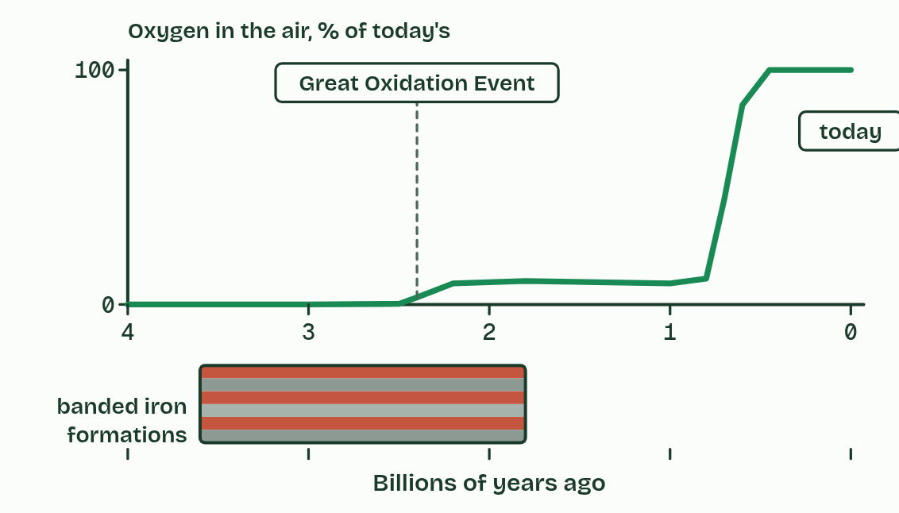
CHAPTER 9 · C1.3.11 Oxygen from the photolysis of water in photosystem II
Water split, oxygen spare
Photolysis at photosystem II: 2 water give 4 electrons, 4 protons and 1 oxygen.
The electrons and protons are used; the oxygen is waste.
Light excites the reaction centre; the reaction centre takes electrons from water.
Minutes 32 to 46
Notes:
Minutes 32 to 46 of 60: Water split (14 min).
The plan: Chapter 9: the predict, the figure, then the Please Eat Oranges tiles. The Great Oxidation figure follows, with the banded iron story told in two minutes.
Photosystem II’s reaction centre has emitted its electrons, so it needs more. It takes them from water. The splitting of water, photolysis, is done by an enzyme on the lumen side of photosystem II. Two water molecules give four electrons, four protons and one oxygen molecule.
The electrons refill the reaction centre, so it can be excited again. The protons are released into the lumen, where they add to the proton gradient (chapter 10). Both are used. The oxygen is a waste product: it diffuses out of the chloroplast, the cell and the leaf. Light does not split water directly. It excites the reaction centre, and the electron-short reaction centre pulls electrons from water.
The advent of oxygen from photolysis had immense consequences on Earth. Cyanobacteria were the first organisms to split water. The oxygen they released first reacted with iron dissolved in the oceans, which settled as layers of iron oxide on the sea floor: the banded iron formations. When the iron was used up, oxygen built up in the air, in the Great Oxidation Event, about 2.4 billion years ago. Oxygen poisoned many anaerobic organisms. It formed the ozone layer, which screens ultraviolet light. And it made aerobic respiration possible, with its far higher yield of ATP (C1.2), on which large, active organisms depend.

Slide 24
PREDICT
Cyanobacteria were splitting water for a long time before oxygen built up in the air. Where did their oxygen go at first?
A Into iron dissolved in the oceans
B Into an ozone layer forming high above
C Back into their own respiration, all of it
D Out into space through the thin air
Minutes 32 to 46
Notes:
Minutes 32 to 46 of 60: Water split (14 min).
The plan: Chapter 9: the predict, the figure, then the Please Eat Oranges tiles. The Great Oxidation figure follows, with the banded iron story told in two minutes.
Ask for a show of hands, or mini whiteboards, before revealing. (Answer: A, on the next slide.)

Slide 25
WHAT HAPPENS
Cyanobacteria were splitting water for a long time before oxygen built up in the air. Where did their oxygen go at first?
A Into iron dissolved in the oceans
B Into an ozone layer forming high above
C Back into their own respiration, all of it
D Out into space through the thin air
Into iron. The oceans held dissolved iron, which oxygen turned into insoluble iron oxide that settled as red bands in the rock. Only when that iron was used up could oxygen build up in the air.
Minutes 32 to 46
Notes:
Minutes 32 to 46 of 60: Water split (14 min).
The plan: Chapter 9: the predict, the figure, then the Please Eat Oranges tiles. The Great Oxidation figure follows, with the banded iron story told in two minutes.
Answer: A. Into iron. The oceans held dissolved iron, which oxygen turned into insoluble iron oxide that settled as red bands in the rock. Only when that iron was used up could oxygen build up in the air.

Slide 26
WATCH OUT
The protons and electrons from water are used; only the oxygen is waste. And it is photosystem II, not photosystem I, that splits water.
Minutes 32 to 46
Notes:
Minutes 32 to 46 of 60: Water split (14 min).
The plan: Chapter 9: the predict, the figure, then the Please Eat Oranges tiles. The Great Oxidation figure follows, with the banded iron story told in two minutes.
A common mistake: say it, then ask who can say why it is wrong.

Slide 27
REMEMBER IT
What photolysis gives
P
E
O
Please
Eat
Oranges
Minutes 32 to 46
Notes:
Minutes 32 to 46 of 60: Water split (14 min).
The plan: Chapter 9: the predict, the figure, then the Please Eat Oranges tiles. The Great Oxidation figure follows, with the banded iron story told in two minutes.
Ask the class what each letter stands for before revealing.

Slide 28
REMEMBER IT
What photolysis gives
P
E
O
Please
Eat
Oranges
Protons
Electrons
Oxygen
into the lumen, for the gradient
back into photosystem II’s reaction centre
thrown away as waste
Minutes 32 to 46
Notes:
Minutes 32 to 46 of 60: Water split (14 min).
The plan: Chapter 9: the predict, the figure, then the Please Eat Oranges tiles. The Great Oxidation figure follows, with the banded iron story told in two minutes.
Please: Protons (into the lumen, for the gradient)
Eat: Electrons (back into photosystem II’s reaction centre)
Oranges: Oxygen (thrown away as waste)

Slide 29
STEP 6
8 MIN
A written question
A short written question on C1.3.9 to C1.3.11 from the exam maker, timed and marked.
Minutes 46 to 54
Notes:
Minutes 46 to 54 of 60: A written question (8 min).
The plan: A short written question on C1.3.9 to C1.3.11 from the exam maker (in Practise and revise), timed and marked.

Slide 30
PLENARY
Can you now...
Describe a photosystem and explain why pigments work only as an array round a reaction centre (C1.3.9, C1.3.10)
Explain how photolysis at photosystem II supplies electrons and protons, and what its waste oxygen did to the Earth (C1.3.11)
Minutes 54 to 60
Notes:
Minutes 54 to 60 of 60: Exit (6 min).
The plan: Why can a single chlorophyll molecule not do any part of photosynthesis?
Thumbs up, sideways or down on each goal before the exit question. The goals come from the statements this lesson covers.

Slide 31
EXIT QUESTION
Before you go
Why can a single chlorophyll molecule not do any part of photosynthesis?
Minutes 54 to 60
Notes:
Minutes 54 to 60 of 60: Exit (6 min).
The plan: Why can a single chlorophyll molecule not do any part of photosynthesis?

Slide 32
PRACTISE AND REVISE
Keep going
Exam practice: a fresh paper of exam questions on C1.3 at higher level, marked as you go
The guide, with the animations and the dry lab
This lesson in the guide: 8 Pigments in an array, 9 Water split, oxygen spare
BUILD FOR YOUR CLASS
ALREADY ON THE SITE FOR C1.3
CARD SETS ON SPLYCR
Tarsia puzzle, dominoes and picture reveal on C1.3, built from its key terms and ready to print
A pub quiz with rounds on C1.3, to present or run with no projector
An escape room built from the question bank on C1.3
Quiz: Photosynthesis
Quiz: Photosynthesis (HL)
Revision map: C1.3 Photosynthesis, to fill in
Exam questions: C1.3 in the exam maker, a paper with its markscheme
Open a set to host it as a class game, or make a copy to edit.
C1.3 Photosynthesis (SL)
C1.3 Photosynthesis (HL)
How this was made. The course structure, the activities and the teaching choices come from my own classroom, my presentations and my years of teaching IB and AP Biology. I use Claude, an AI, to help write and build the interactive guides, lesson plans, slides and practice questions, and to draw the diagrams and code the interactives. I direct the work and review it against the IB and AP specifications before it goes live.
Minute 60: after the lesson
Notes:
Every link here is live. Set the exam practice paper for homework: it is fresh each time, marked as students go and saved to their Exam practice when they are signed in.
Exam practice: https://www.biologybybradford.com/exam-maker/sit?topics=C1.3&level=HL&paper=quiz&marks=15&src=ep
The guide: https://www.biologybybradford.com/guides/ib-biology-c1-3-photosynthesis

