Slide 1
IB Biology C1.3
LESSON 5 OF 6
HL
BY THE END YOU CAN
Photosynthesis
Explain how a proton gradient and ATP synthase make ATP in the thylakoid, by cyclic and non-cyclic photophosphorylation (C1.3.12)
Explain how photosystem I reduces NADP, and where in a thylakoid each light-dependent step happens (C1.3.13, C1.3.14)
The thylakoid at work
C1.3.12, C1.3.13 and C1.3.14
Chemiosmosis in the thylakoid, cyclic and non-cyclic photophosphorylation, NADP reduced at photosystem I, and where each step happens
60 minutes · chapters 10, 11
Minute 0
Notes:
IB Biology C1.3, Photosynthesis. Lesson 5 of 6: The thylakoid at work (higher level), 60 minutes.
The plan, minute by minute (each slide's footer says where you are):
0 to 5 min (5) Do now: where do protons collect?
5 to 17 min (12) The thylakoid, step by step
17 to 32 min (15) Act it out
32 to 42 min (10) NADP and the map
42 to 55 min (13) Plan a 7-mark answer
55 to 60 min (5) Exit
What students get wrong:
Protons collect in the stroma, or in the “intermembrane space”. They collect in the lumen.
Cyclic photophosphorylation makes reduced NADP. It makes ATP only.
ATP and reduced NADP “move to the stroma”. They are made on the stroma side.
Stretch and support:
Stretch: compare a mitochondrion’s chain with the thylakoid’s in a table: source of electrons, last acceptor, where protons collect, where ATP is made.
Stretch: make a respiration and photosynthesis Tarsia puzzle in the Tarsia builder, ticking C1.2 and C1.3 together.
The lesson plan to print: https://www.biologybybradford.com/guides/downloads/ib-biology-c1-3-photosynthesis-lesson-5-plan.pdf

Slide 2
DO NOW
Where do protons collect?
In a mitochondrion, where do protons collect, and where is ATP made?
5:00
minutes
Start now: the timer is running.
Minutes 0 to 5
Notes:
Minutes 0 to 5 of 60: Do now: where do protons collect? (5 min).
The plan: In a mitochondrion, where do protons collect, and where is ATP made? Now guess for a chloroplast (chapter 10’s predict).
Start a 5 minute timer as they come in.

Slide 3
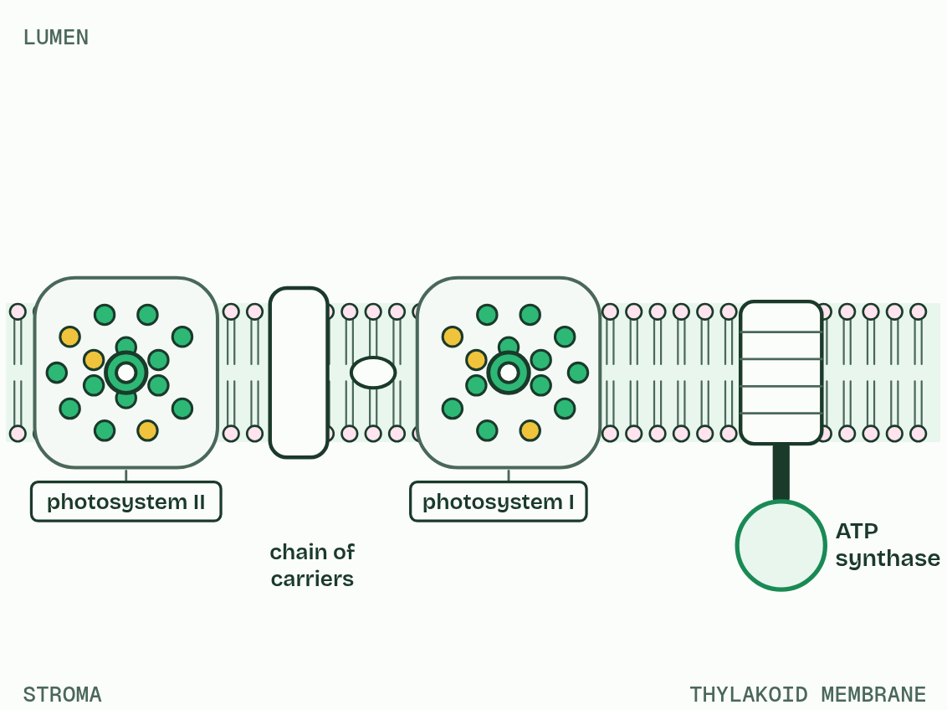
CHAPTER 10 · C1.3.12 ATP production by chemiosmosis in thylakoids
1 / 5
Protons downhill make ATP
The thylakoid membrane: photosystems, a chain of carriers and ATP synthase.
Minutes 0 to 5
Notes:
Minutes 0 to 5 of 60: Do now: where do protons collect? (5 min).
The plan: In a mitochondrion, where do protons collect, and where is ATP made? Now guess for a chloroplast (chapter 10’s predict).
The excited electron from photosystem II passes along a chain of electron carriers in the thylakoid membrane towards photosystem I, giving up energy at each step. One carrier uses that energy for proton pumping: it moves protons across the membrane from the stroma into the thylakoid lumen.
Protons come into the lumen two ways: pumped by the chain, and released by photolysis. The lumen is small, so their concentration rises fast, and the membrane does not let them back. That difference is the proton gradient. The only way back to the stroma is through ATP synthase, a protein that spans the membrane. Protons flowing down their gradient turn part of it, and the energy joins ADP and phosphate: ATP, made on the stroma side. Making ATP with energy from a proton gradient is chemiosmosis, and when light is the first source the whole process is photophosphorylation.
You met the same machine in mitochondria (C1.2). The difference is direction: a thylakoid pumps protons into its lumen and makes ATP outside it, in the stroma, while a mitochondrion pumps them out of the matrix and makes ATP inside it.
In non-cyclic photophosphorylation the electrons come from photosystem II, pass along the chain to photosystem I and on to NADP (chapter 11). In cyclic photophosphorylation, electrons excited at photosystem I go back to the chain, pump more protons and return to photosystem I. It makes ATP only: no reduced NADP, no water split, no oxygen. It tops up the ATP, because the Calvin cycle uses more ATP than reduced NADP.

Slide 4
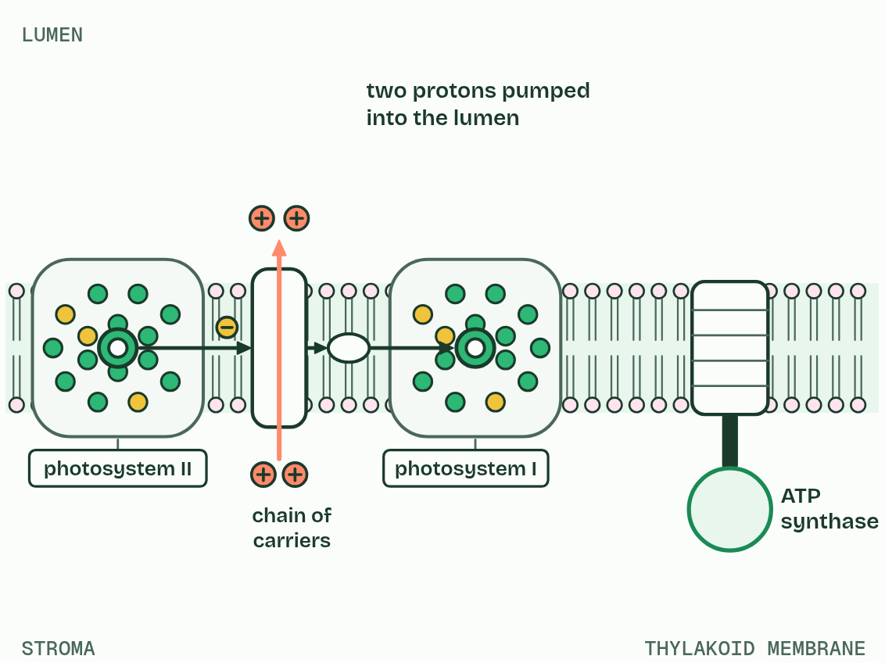
CHAPTER 10 · C1.3.12 ATP production by chemiosmosis in thylakoids
2 / 5
Protons downhill make ATP
Electrons give up energy along the chain, which pumps protons into the lumen.
Minutes 0 to 5
Notes:
Minutes 0 to 5 of 60: Do now: where do protons collect? (5 min).
The plan: In a mitochondrion, where do protons collect, and where is ATP made? Now guess for a chloroplast (chapter 10’s predict).
The excited electron from photosystem II passes along a chain of electron carriers in the thylakoid membrane towards photosystem I, giving up energy at each step. One carrier uses that energy for proton pumping: it moves protons across the membrane from the stroma into the thylakoid lumen.
Protons come into the lumen two ways: pumped by the chain, and released by photolysis. The lumen is small, so their concentration rises fast, and the membrane does not let them back. That difference is the proton gradient. The only way back to the stroma is through ATP synthase, a protein that spans the membrane. Protons flowing down their gradient turn part of it, and the energy joins ADP and phosphate: ATP, made on the stroma side. Making ATP with energy from a proton gradient is chemiosmosis, and when light is the first source the whole process is photophosphorylation.
You met the same machine in mitochondria (C1.2). The difference is direction: a thylakoid pumps protons into its lumen and makes ATP outside it, in the stroma, while a mitochondrion pumps them out of the matrix and makes ATP inside it.
In non-cyclic photophosphorylation the electrons come from photosystem II, pass along the chain to photosystem I and on to NADP (chapter 11). In cyclic photophosphorylation, electrons excited at photosystem I go back to the chain, pump more protons and return to photosystem I. It makes ATP only: no reduced NADP, no water split, no oxygen. It tops up the ATP, because the Calvin cycle uses more ATP than reduced NADP.

Slide 5
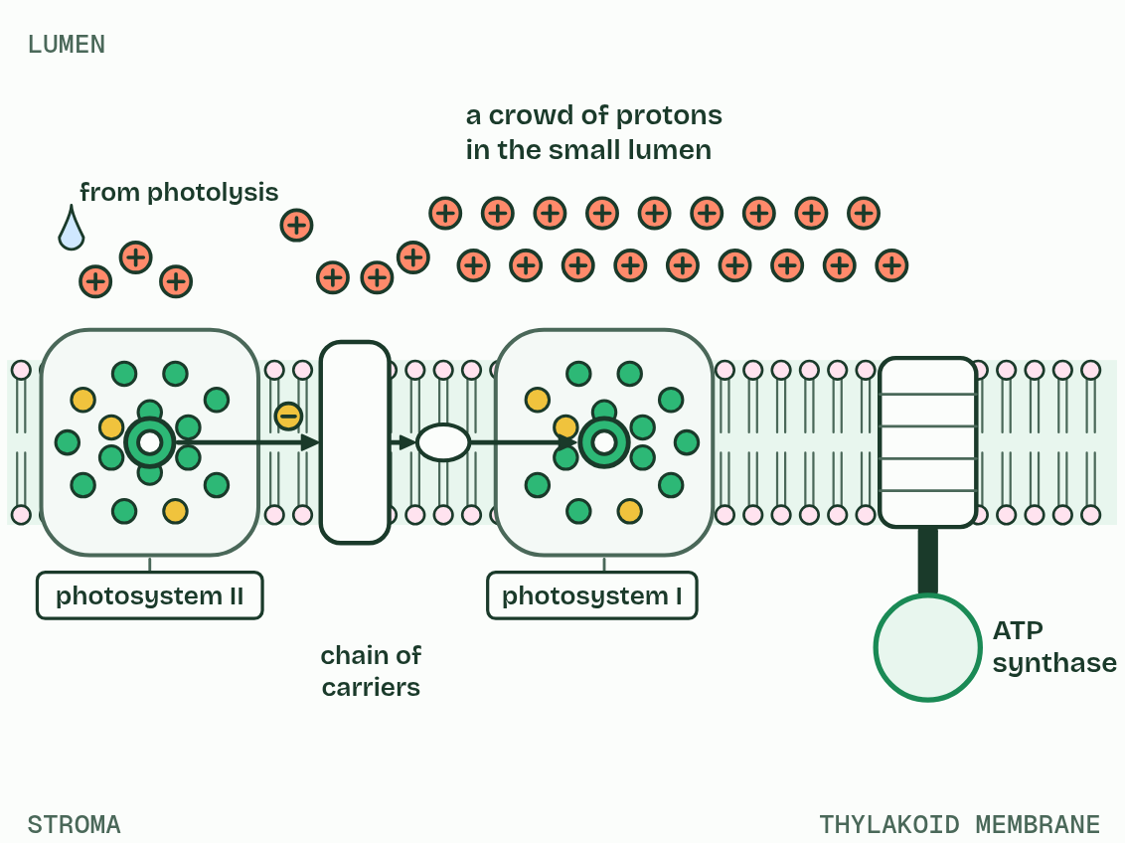
CHAPTER 10 · C1.3.12 ATP production by chemiosmosis in thylakoids
3 / 5
Protons downhill make ATP
Protons pile up in the small lumen: a proton gradient.
Minutes 0 to 5
Notes:
Minutes 0 to 5 of 60: Do now: where do protons collect? (5 min).
The plan: In a mitochondrion, where do protons collect, and where is ATP made? Now guess for a chloroplast (chapter 10’s predict).
The excited electron from photosystem II passes along a chain of electron carriers in the thylakoid membrane towards photosystem I, giving up energy at each step. One carrier uses that energy for proton pumping: it moves protons across the membrane from the stroma into the thylakoid lumen.
Protons come into the lumen two ways: pumped by the chain, and released by photolysis. The lumen is small, so their concentration rises fast, and the membrane does not let them back. That difference is the proton gradient. The only way back to the stroma is through ATP synthase, a protein that spans the membrane. Protons flowing down their gradient turn part of it, and the energy joins ADP and phosphate: ATP, made on the stroma side. Making ATP with energy from a proton gradient is chemiosmosis, and when light is the first source the whole process is photophosphorylation.
You met the same machine in mitochondria (C1.2). The difference is direction: a thylakoid pumps protons into its lumen and makes ATP outside it, in the stroma, while a mitochondrion pumps them out of the matrix and makes ATP inside it.
In non-cyclic photophosphorylation the electrons come from photosystem II, pass along the chain to photosystem I and on to NADP (chapter 11). In cyclic photophosphorylation, electrons excited at photosystem I go back to the chain, pump more protons and return to photosystem I. It makes ATP only: no reduced NADP, no water split, no oxygen. It tops up the ATP, because the Calvin cycle uses more ATP than reduced NADP.

Slide 6
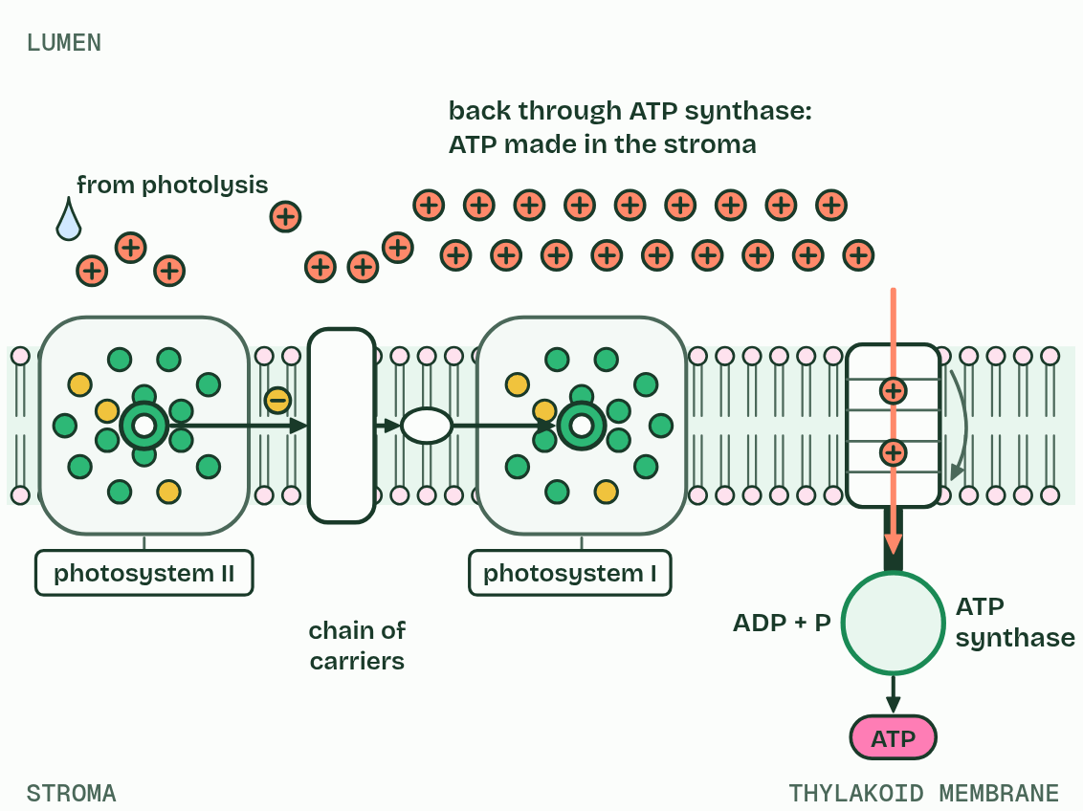
CHAPTER 10 · C1.3.12 ATP production by chemiosmosis in thylakoids
4 / 5
Protons downhill make ATP
They flow back through ATP synthase, which makes ATP in the stroma: chemiosmosis.
Minutes 0 to 5
Notes:
Minutes 0 to 5 of 60: Do now: where do protons collect? (5 min).
The plan: In a mitochondrion, where do protons collect, and where is ATP made? Now guess for a chloroplast (chapter 10’s predict).
The excited electron from photosystem II passes along a chain of electron carriers in the thylakoid membrane towards photosystem I, giving up energy at each step. One carrier uses that energy for proton pumping: it moves protons across the membrane from the stroma into the thylakoid lumen.
Protons come into the lumen two ways: pumped by the chain, and released by photolysis. The lumen is small, so their concentration rises fast, and the membrane does not let them back. That difference is the proton gradient. The only way back to the stroma is through ATP synthase, a protein that spans the membrane. Protons flowing down their gradient turn part of it, and the energy joins ADP and phosphate: ATP, made on the stroma side. Making ATP with energy from a proton gradient is chemiosmosis, and when light is the first source the whole process is photophosphorylation.
You met the same machine in mitochondria (C1.2). The difference is direction: a thylakoid pumps protons into its lumen and makes ATP outside it, in the stroma, while a mitochondrion pumps them out of the matrix and makes ATP inside it.
In non-cyclic photophosphorylation the electrons come from photosystem II, pass along the chain to photosystem I and on to NADP (chapter 11). In cyclic photophosphorylation, electrons excited at photosystem I go back to the chain, pump more protons and return to photosystem I. It makes ATP only: no reduced NADP, no water split, no oxygen. It tops up the ATP, because the Calvin cycle uses more ATP than reduced NADP.

Slide 7
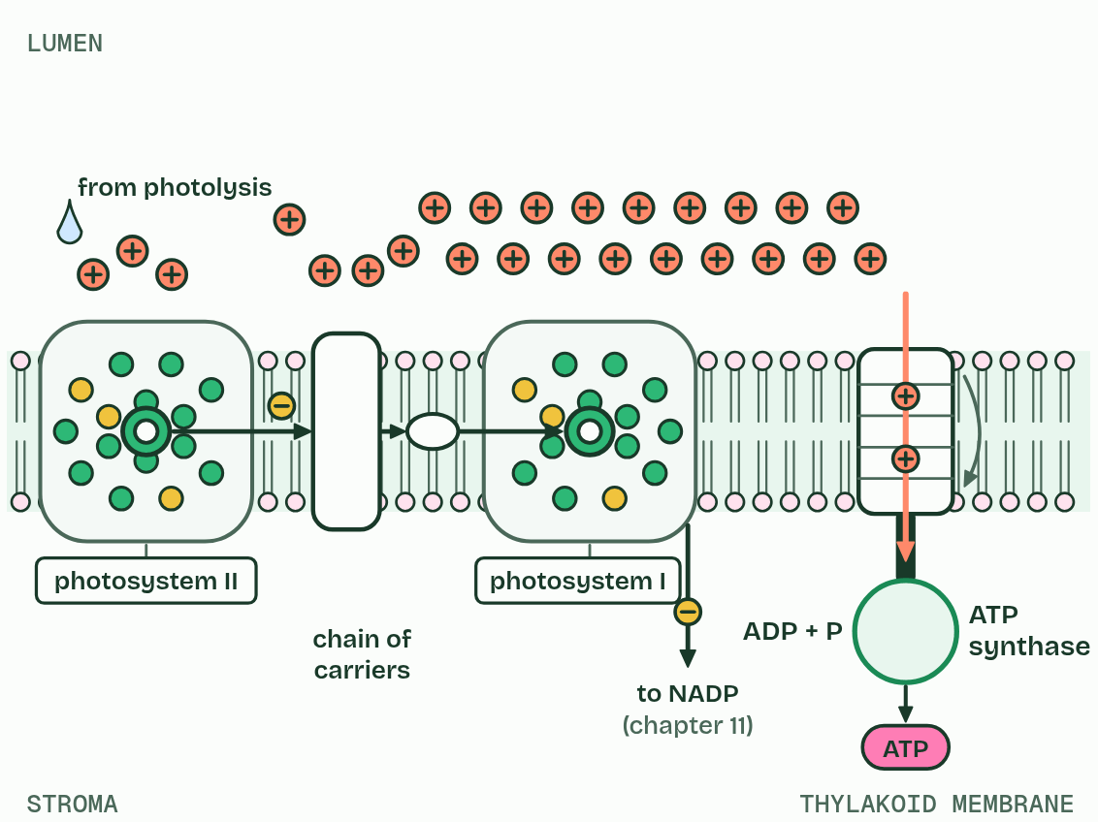
CHAPTER 10 · C1.3.12 ATP production by chemiosmosis in thylakoids
5 / 5
Protons downhill make ATP
Non-cyclic: on to NADP. Cyclic: back round the chain, for more ATP.
Minutes 0 to 5
Notes:
Minutes 0 to 5 of 60: Do now: where do protons collect? (5 min).
The plan: In a mitochondrion, where do protons collect, and where is ATP made? Now guess for a chloroplast (chapter 10’s predict).
The excited electron from photosystem II passes along a chain of electron carriers in the thylakoid membrane towards photosystem I, giving up energy at each step. One carrier uses that energy for proton pumping: it moves protons across the membrane from the stroma into the thylakoid lumen.
Protons come into the lumen two ways: pumped by the chain, and released by photolysis. The lumen is small, so their concentration rises fast, and the membrane does not let them back. That difference is the proton gradient. The only way back to the stroma is through ATP synthase, a protein that spans the membrane. Protons flowing down their gradient turn part of it, and the energy joins ADP and phosphate: ATP, made on the stroma side. Making ATP with energy from a proton gradient is chemiosmosis, and when light is the first source the whole process is photophosphorylation.
You met the same machine in mitochondria (C1.2). The difference is direction: a thylakoid pumps protons into its lumen and makes ATP outside it, in the stroma, while a mitochondrion pumps them out of the matrix and makes ATP inside it.
In non-cyclic photophosphorylation the electrons come from photosystem II, pass along the chain to photosystem I and on to NADP (chapter 11). In cyclic photophosphorylation, electrons excited at photosystem I go back to the chain, pump more protons and return to photosystem I. It makes ATP only: no reduced NADP, no water split, no oxygen. It tops up the ATP, because the Calvin cycle uses more ATP than reduced NADP.

Slide 8
CHAPTER 10 · C1.3.12 ATP production by chemiosmosis in thylakoids
Protons downhill make ATP
Electrons along the chain pump protons from the stroma into the lumen; photolysis adds more.
Protons flow back through ATP synthase, which makes ATP on the stroma side.
Non-cyclic: electrons from photosystem II to NADP. Cyclic: electrons from photosystem I round the chain again, for ATP only.
Minutes 0 to 5
Notes:
Minutes 0 to 5 of 60: Do now: where do protons collect? (5 min).
The plan: In a mitochondrion, where do protons collect, and where is ATP made? Now guess for a chloroplast (chapter 10’s predict).
The excited electron from photosystem II passes along a chain of electron carriers in the thylakoid membrane towards photosystem I, giving up energy at each step. One carrier uses that energy for proton pumping: it moves protons across the membrane from the stroma into the thylakoid lumen.
Protons come into the lumen two ways: pumped by the chain, and released by photolysis. The lumen is small, so their concentration rises fast, and the membrane does not let them back. That difference is the proton gradient. The only way back to the stroma is through ATP synthase, a protein that spans the membrane. Protons flowing down their gradient turn part of it, and the energy joins ADP and phosphate: ATP, made on the stroma side. Making ATP with energy from a proton gradient is chemiosmosis, and when light is the first source the whole process is photophosphorylation.
You met the same machine in mitochondria (C1.2). The difference is direction: a thylakoid pumps protons into its lumen and makes ATP outside it, in the stroma, while a mitochondrion pumps them out of the matrix and makes ATP inside it.
In non-cyclic photophosphorylation the electrons come from photosystem II, pass along the chain to photosystem I and on to NADP (chapter 11). In cyclic photophosphorylation, electrons excited at photosystem I go back to the chain, pump more protons and return to photosystem I. It makes ATP only: no reduced NADP, no water split, no oxygen. It tops up the ATP, because the Calvin cycle uses more ATP than reduced NADP.

Slide 9
PREDICT
In a working chloroplast, where do protons build up?
A In the stroma, round the thylakoids
B In the intermembrane space of the chloroplast
C In the lumen, inside each thylakoid
D In the cytoplasm, outside the chloroplast
Minutes 0 to 5
Notes:
Minutes 0 to 5 of 60: Do now: where do protons collect? (5 min).
The plan: In a mitochondrion, where do protons collect, and where is ATP made? Now guess for a chloroplast (chapter 10’s predict).
Ask for a show of hands, or mini whiteboards, before revealing. (Answer: C, on the next slide.)

Slide 10
WHAT HAPPENS
In a working chloroplast, where do protons build up?
A In the stroma, round the thylakoids
B In the intermembrane space of the chloroplast
C In the lumen, inside each thylakoid
D In the cytoplasm, outside the chloroplast
In the lumen. The chain pumps protons in from the stroma, and photolysis releases more there. The lumen’s small volume lets a steep gradient build fast, and ATP synthase lets them back out into the stroma, where the ATP is made.
Minutes 0 to 5
Notes:
Minutes 0 to 5 of 60: Do now: where do protons collect? (5 min).
The plan: In a mitochondrion, where do protons collect, and where is ATP made? Now guess for a chloroplast (chapter 10’s predict).
Answer: C. In the lumen. The chain pumps protons in from the stroma, and photolysis releases more there. The lumen’s small volume lets a steep gradient build fast, and ATP synthase lets them back out into the stroma, where the ATP is made.

Slide 11
WATCH OUT
Protons do not collect in an “intermembrane space”, as they do in a mitochondrion. In a chloroplast they collect in the thylakoid lumen.
Minutes 0 to 5
Notes:
Minutes 0 to 5 of 60: Do now: where do protons collect? (5 min).
The plan: In a mitochondrion, where do protons collect, and where is ATP made? Now guess for a chloroplast (chapter 10’s predict).
A common mistake: say it, then ask who can say why it is wrong.

Slide 12
STEP 2
12 MIN
The thylakoid, step by step
Switch to Cyclic: what stops?
Minutes 5 to 17
Notes:
Minutes 5 to 17 of 60: The thylakoid, step by step (12 min).
The plan: Chapter 10’s figure step by step. Switch to Cyclic: what stops?

Slide 13

MODEL
15 MIN
Act it out
THE TASK
On an A3 drawing of a thylakoid membrane (stroma below, lumen above), pairs model the light-dependent reactions (chapters 10 and 11). Plasticine balls are protons. A sticky note stands for NADP, which turns into reduced NADP only once it holds two electron tokens and one proton. ADP and phosphate balls are joined at ATP synthase only as protons pass through it. Then one partner narrates while the other moves the pieces, using a markscheme’s points as the script.
STUDENTS NEED
A3 thylakoid drawings, plasticine in two colours, sticky notes and tokens.
Minutes 17 to 32
Notes:
Minutes 17 to 32 of 60: Act it out (15 min).
The plan: Act it out (below): the light-dependent reactions modelled in plasticine on an A3 thylakoid.
The activity: Act it out. On an A3 drawing of a thylakoid membrane (stroma below, lumen above), pairs model the light-dependent reactions (chapters 10 and 11). Plasticine balls are protons. A sticky note stands for NADP, which turns into reduced NADP only once it holds two electron tokens and one proton. ADP and phosphate balls are joined at ATP synthase only as protons pass through it. Then one partner narrates while the other moves the pieces, using a markscheme’s points as the script.
Needs: A3 thylakoid drawings, plasticine in two colours, sticky notes and tokens.
The time: 15 minutes, minutes 17 to 32 of the plan.

Slide 14
STEP 4
10 MIN
NADP and the map
Chapter 11: NADP reduced, and the thylakoid as a system
Minutes 32 to 42
Notes:
Minutes 32 to 42 of 60: NADP and the map (10 min).
The plan: Chapter 11: the predict, then Map the thylakoid with the labels hidden and the Loads and Spends tiles. Then the chemiosmosis film (thylakoid), with the light off.

Slide 15
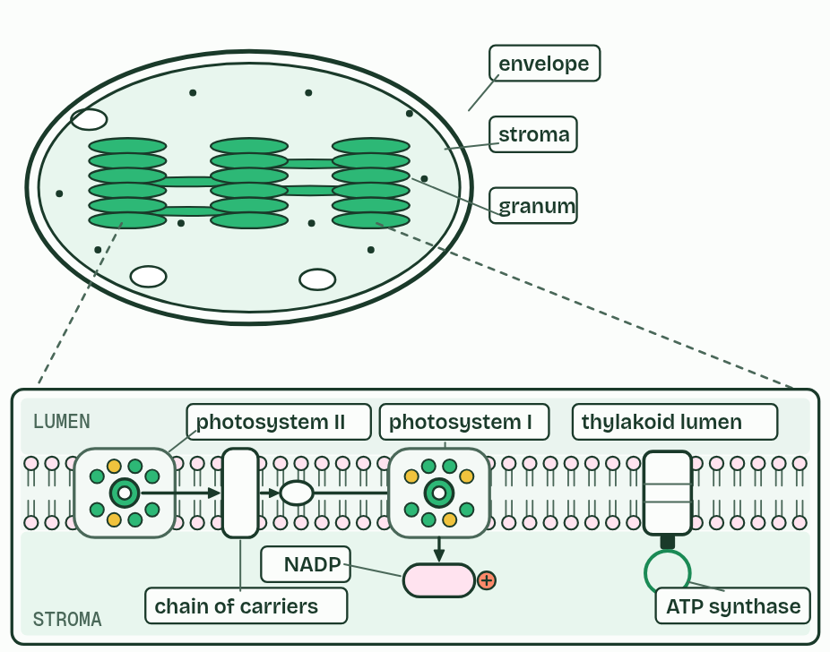
CHAPTER 11 · C1.3.13 C1.3.14 NADP reduced by photosystem I, and the thylakoid as a system
NADP reduced, and the thylakoid as a system
NADP is reduced at photosystem I, by two electrons from it and a proton from the stroma.
Photolysis and the proton store are on the lumen side; ATP and reduced NADP are made on the stroma side.
Grana give a large area of membrane; the small lumen gives a steep gradient fast.
Minutes 32 to 42
Notes:
Minutes 32 to 42 of 60: NADP and the map (10 min).
The plan: Chapter 11: the predict, then Map the thylakoid with the labels hidden and the Loads and Spends tiles. Then the chemiosmosis film (thylakoid), with the light off.
Electrons arriving at photosystem I have given up energy along the chain. Light absorbed by photosystem I’s array excites them again, and from its reaction centre they pass, by a short carrier on the stroma side, to NADP. NADP picks up two electrons from photosystem I and one hydrogen ion (a proton) from the stroma, and becomes reduced NADP. This is a reduction, and taking that proton from the stroma steepens the gradient a little.
Reduced NADP carries the hydrogen, as electrons and a proton, to the Calvin cycle in the stroma, where it reduces carbon compounds (chapter 13). This is how the hydrogen from chapter 2 gets from water to carbon dioxide: water’s electrons go through photosystem II, the chain and photosystem I, to NADP.
A thylakoid is a system in which every part has its place. On the lumen side: photolysis at photosystem II, and the store of protons. In the membrane: the photosystems, the chain and ATP synthase, held in order so electrons pass from one to the next. On the stroma side: ATP is made and NADP is reduced, right where the Calvin cycle’s enzymes are. Thylakoids are stacked in grana, joined by single unstacked sheets of membrane that run through the stroma; the stacking gives a large area of membrane, and the small lumen builds a steep gradient fast. Nothing has to “move to the stroma”: ATP and reduced NADP are made in it.
Parts of the figure:
Stroma The fluid round the thylakoids. The Calvin cycle runs here, and ATP and reduced NADP are made and used here.
Envelope Two membranes round the chloroplast. The thylakoids are a separate system inside it.
Granum A stack of thylakoids. Stacking gives a large area of membrane in a small space, and single sheets join one stack to the next.
Granum A stack of thylakoids. Stacking gives a large area of membrane in a small space, and single sheets join one stack to the next.
Granum A stack of thylakoids. Stacking gives a large area of membrane in a small space, and single sheets join one stack to the next.
Thylakoid lumen The small space inside a thylakoid. Photolysis happens on its side of photosystem II, and protons pile up here.
Stroma The fluid round the thylakoids. The Calvin cycle runs here, and ATP and reduced NADP are made and used here.
Photosystem II Splits water on the lumen side and passes its electrons on.
Chain of carriers Passes electrons from photosystem II towards photosystem I, and pumps protons into the lumen.
Photosystem I Its excited electrons pass on, on the stroma side, to NADP.
NADP Reduced here, on the stroma side, by two electrons from photosystem I and a proton from the stroma.
ATP synthase Lets protons flow back from the lumen to the stroma and makes ATP on the stroma side.

Slide 16
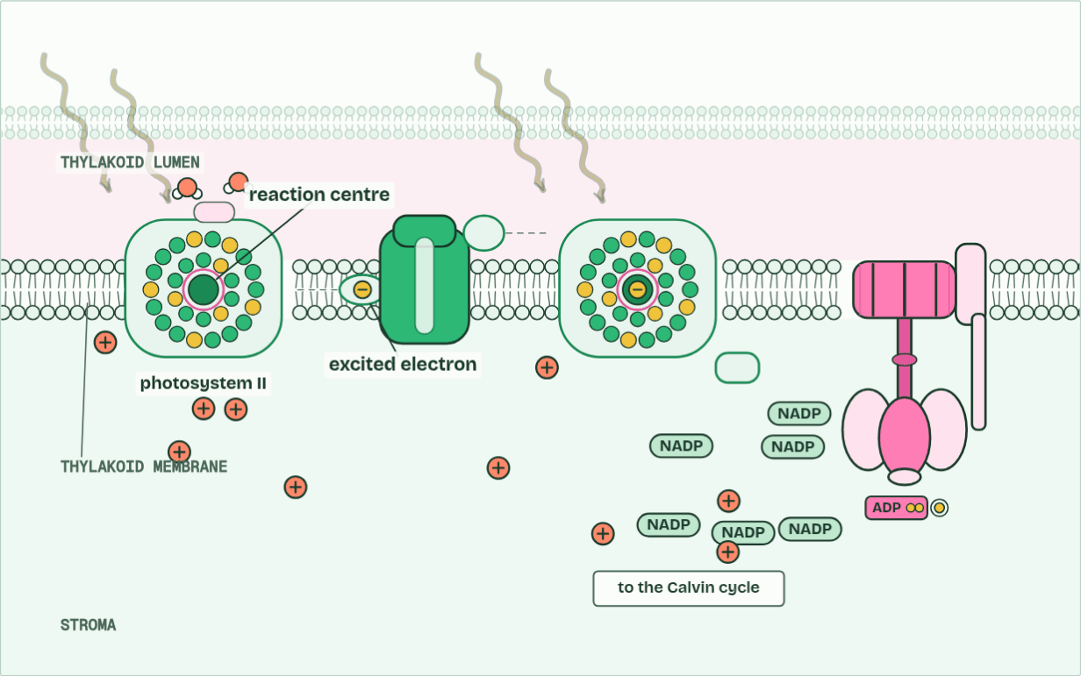
CHAPTER 11 · C1.3.13 C1.3.14 NADP reduced by photosystem I, and the thylakoid as a system
H+ in the lumen 0 · ATP 0 · O2 0
1 / 6
NADP reduced, and the thylakoid as a system
Light energy is passed through an array of pigments to the reaction centre, a special chlorophyll, which gives off an excited electron.
Minutes 32 to 42
Notes:
Minutes 32 to 42 of 60: NADP and the map (10 min).
The plan: Chapter 11: the predict, then Map the thylakoid with the labels hidden and the Loads and Spends tiles. Then the chemiosmosis film (thylakoid), with the light off.
Electrons arriving at photosystem I have given up energy along the chain. Light absorbed by photosystem I’s array excites them again, and from its reaction centre they pass, by a short carrier on the stroma side, to NADP. NADP picks up two electrons from photosystem I and one hydrogen ion (a proton) from the stroma, and becomes reduced NADP. This is a reduction, and taking that proton from the stroma steepens the gradient a little.
Reduced NADP carries the hydrogen, as electrons and a proton, to the Calvin cycle in the stroma, where it reduces carbon compounds (chapter 13). This is how the hydrogen from chapter 2 gets from water to carbon dioxide: water’s electrons go through photosystem II, the chain and photosystem I, to NADP.
A thylakoid is a system in which every part has its place. On the lumen side: photolysis at photosystem II, and the store of protons. In the membrane: the photosystems, the chain and ATP synthase, held in order so electrons pass from one to the next. On the stroma side: ATP is made and NADP is reduced, right where the Calvin cycle’s enzymes are. Thylakoids are stacked in grana, joined by single unstacked sheets of membrane that run through the stroma; the stacking gives a large area of membrane, and the small lumen builds a steep gradient fast. Nothing has to “move to the stroma”: ATP and reduced NADP are made in it.
The animation "The thylakoid at work", paused at 7.0 s. The next slides go on through it, then play it.

Slide 17
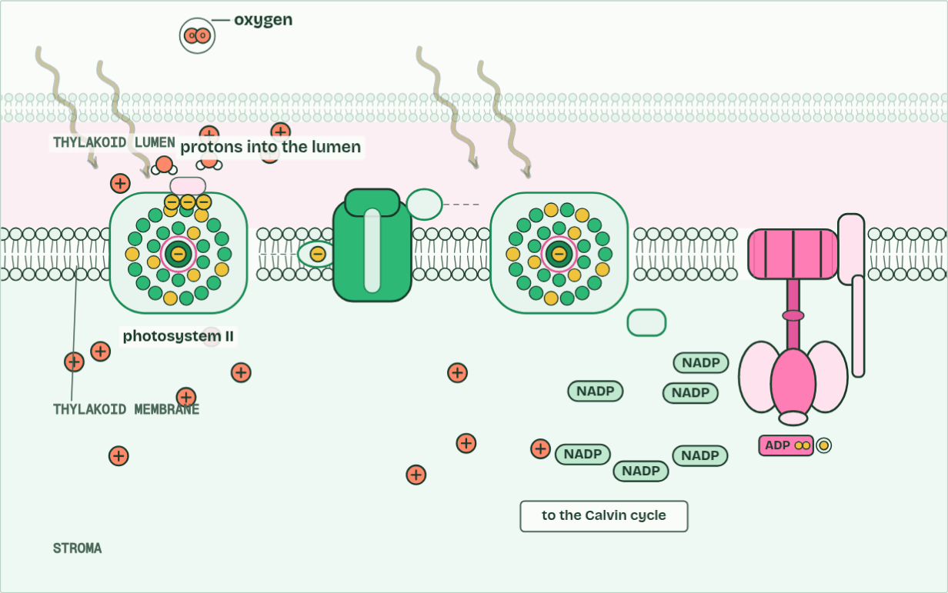
CHAPTER 11 · C1.3.13 C1.3.14 NADP reduced by photosystem I, and the thylakoid as a system
H+ in the lumen 4 · ATP 0 · O2 1
2 / 6
NADP reduced, and the thylakoid as a system
The reaction centre replaces its lost electrons by splitting water (photolysis). The protons stay in the lumen; the oxygen is a waste product.
Minutes 32 to 42
Notes:
Minutes 32 to 42 of 60: NADP and the map (10 min).
The plan: Chapter 11: the predict, then Map the thylakoid with the labels hidden and the Loads and Spends tiles. Then the chemiosmosis film (thylakoid), with the light off.
Electrons arriving at photosystem I have given up energy along the chain. Light absorbed by photosystem I’s array excites them again, and from its reaction centre they pass, by a short carrier on the stroma side, to NADP. NADP picks up two electrons from photosystem I and one hydrogen ion (a proton) from the stroma, and becomes reduced NADP. This is a reduction, and taking that proton from the stroma steepens the gradient a little.
Reduced NADP carries the hydrogen, as electrons and a proton, to the Calvin cycle in the stroma, where it reduces carbon compounds (chapter 13). This is how the hydrogen from chapter 2 gets from water to carbon dioxide: water’s electrons go through photosystem II, the chain and photosystem I, to NADP.
A thylakoid is a system in which every part has its place. On the lumen side: photolysis at photosystem II, and the store of protons. In the membrane: the photosystems, the chain and ATP synthase, held in order so electrons pass from one to the next. On the stroma side: ATP is made and NADP is reduced, right where the Calvin cycle’s enzymes are. Thylakoids are stacked in grana, joined by single unstacked sheets of membrane that run through the stroma; the stacking gives a large area of membrane, and the small lumen builds a steep gradient fast. Nothing has to “move to the stroma”: ATP and reduced NADP are made in it.
The animation "The thylakoid at work", paused at 13.0 s. The next slides go on through it, then play it.

Slide 18
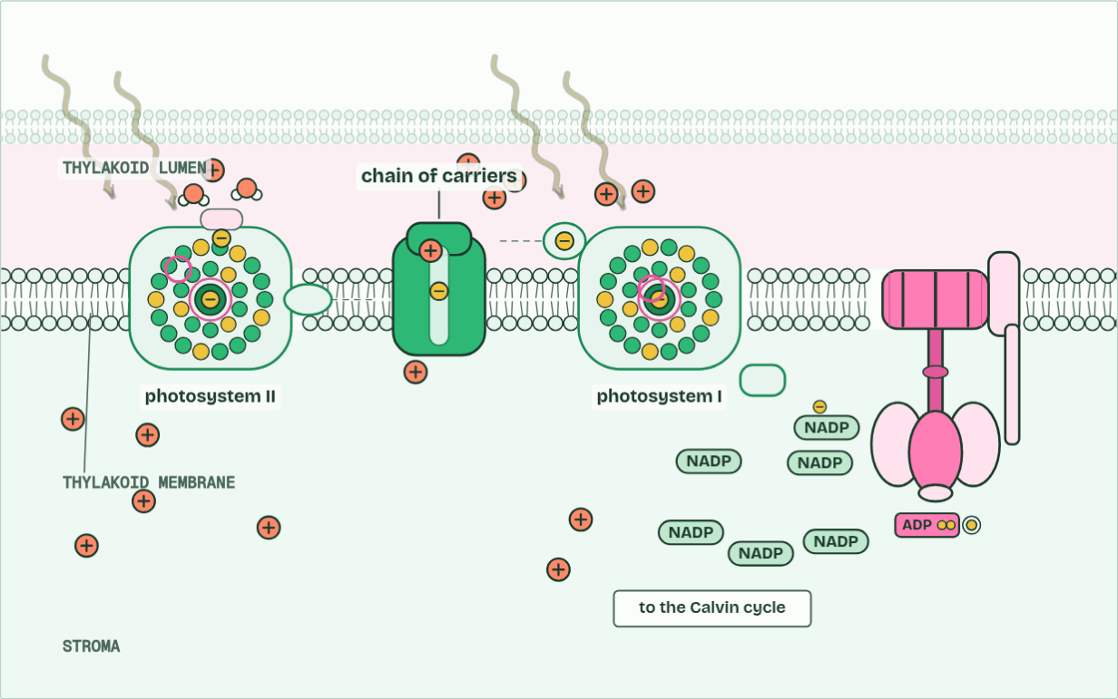
CHAPTER 11 · C1.3.13 C1.3.14 NADP reduced by photosystem I, and the thylakoid as a system
H+ in the lumen 6 · ATP 0 · O2 1
3 / 6
NADP reduced, and the thylakoid as a system
The electron passes along a chain of carriers, which uses its energy to pump protons from the stroma into the lumen.
Minutes 32 to 42
Notes:
Minutes 32 to 42 of 60: NADP and the map (10 min).
The plan: Chapter 11: the predict, then Map the thylakoid with the labels hidden and the Loads and Spends tiles. Then the chemiosmosis film (thylakoid), with the light off.
Electrons arriving at photosystem I have given up energy along the chain. Light absorbed by photosystem I’s array excites them again, and from its reaction centre they pass, by a short carrier on the stroma side, to NADP. NADP picks up two electrons from photosystem I and one hydrogen ion (a proton) from the stroma, and becomes reduced NADP. This is a reduction, and taking that proton from the stroma steepens the gradient a little.
Reduced NADP carries the hydrogen, as electrons and a proton, to the Calvin cycle in the stroma, where it reduces carbon compounds (chapter 13). This is how the hydrogen from chapter 2 gets from water to carbon dioxide: water’s electrons go through photosystem II, the chain and photosystem I, to NADP.
A thylakoid is a system in which every part has its place. On the lumen side: photolysis at photosystem II, and the store of protons. In the membrane: the photosystems, the chain and ATP synthase, held in order so electrons pass from one to the next. On the stroma side: ATP is made and NADP is reduced, right where the Calvin cycle’s enzymes are. Thylakoids are stacked in grana, joined by single unstacked sheets of membrane that run through the stroma; the stacking gives a large area of membrane, and the small lumen builds a steep gradient fast. Nothing has to “move to the stroma”: ATP and reduced NADP are made in it.
The animation "The thylakoid at work", paused at 19.0 s. The next slides go on through it, then play it.

Slide 19
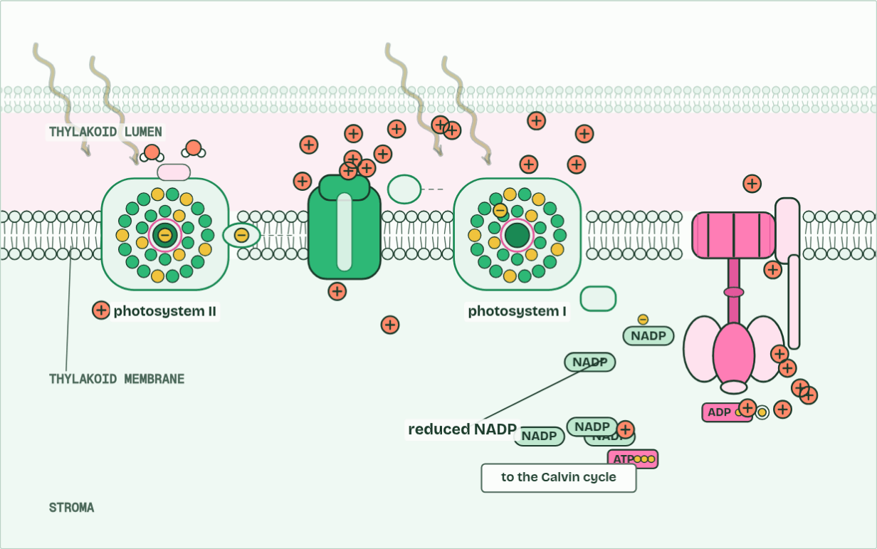
CHAPTER 11 · C1.3.13 C1.3.14 NADP reduced by photosystem I, and the thylakoid as a system
H+ in the lumen 16 · ATP 1 · O2 2
4 / 6
NADP reduced, and the thylakoid as a system
At photosystem I light lifts the electron again. Two electrons and a proton from the stroma reduce NADP.
Minutes 32 to 42
Notes:
Minutes 32 to 42 of 60: NADP and the map (10 min).
The plan: Chapter 11: the predict, then Map the thylakoid with the labels hidden and the Loads and Spends tiles. Then the chemiosmosis film (thylakoid), with the light off.
Electrons arriving at photosystem I have given up energy along the chain. Light absorbed by photosystem I’s array excites them again, and from its reaction centre they pass, by a short carrier on the stroma side, to NADP. NADP picks up two electrons from photosystem I and one hydrogen ion (a proton) from the stroma, and becomes reduced NADP. This is a reduction, and taking that proton from the stroma steepens the gradient a little.
Reduced NADP carries the hydrogen, as electrons and a proton, to the Calvin cycle in the stroma, where it reduces carbon compounds (chapter 13). This is how the hydrogen from chapter 2 gets from water to carbon dioxide: water’s electrons go through photosystem II, the chain and photosystem I, to NADP.
A thylakoid is a system in which every part has its place. On the lumen side: photolysis at photosystem II, and the store of protons. In the membrane: the photosystems, the chain and ATP synthase, held in order so electrons pass from one to the next. On the stroma side: ATP is made and NADP is reduced, right where the Calvin cycle’s enzymes are. Thylakoids are stacked in grana, joined by single unstacked sheets of membrane that run through the stroma; the stacking gives a large area of membrane, and the small lumen builds a steep gradient fast. Nothing has to “move to the stroma”: ATP and reduced NADP are made in it.
The animation "The thylakoid at work", paused at 25.5 s. The next slides go on through it, then play it.

Slide 20
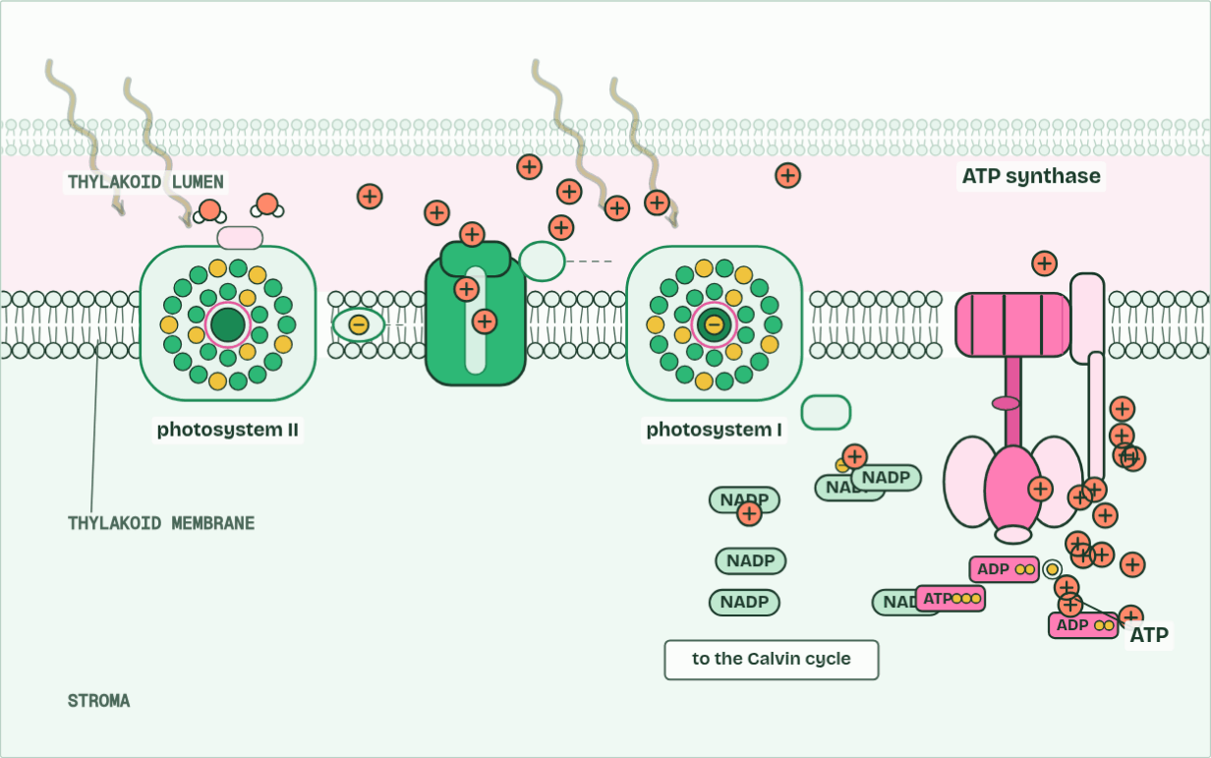
CHAPTER 11 · C1.3.13 C1.3.14 NADP reduced by photosystem I, and the thylakoid as a system
H+ in the lumen 10 · ATP 7 · O2 3
5 / 6
NADP reduced, and the thylakoid as a system
Protons flow out of the lumen through ATP synthase, making ATP in the stroma, where the Calvin cycle will use it.
Minutes 32 to 42
Notes:
Minutes 32 to 42 of 60: NADP and the map (10 min).
The plan: Chapter 11: the predict, then Map the thylakoid with the labels hidden and the Loads and Spends tiles. Then the chemiosmosis film (thylakoid), with the light off.
Electrons arriving at photosystem I have given up energy along the chain. Light absorbed by photosystem I’s array excites them again, and from its reaction centre they pass, by a short carrier on the stroma side, to NADP. NADP picks up two electrons from photosystem I and one hydrogen ion (a proton) from the stroma, and becomes reduced NADP. This is a reduction, and taking that proton from the stroma steepens the gradient a little.
Reduced NADP carries the hydrogen, as electrons and a proton, to the Calvin cycle in the stroma, where it reduces carbon compounds (chapter 13). This is how the hydrogen from chapter 2 gets from water to carbon dioxide: water’s electrons go through photosystem II, the chain and photosystem I, to NADP.
A thylakoid is a system in which every part has its place. On the lumen side: photolysis at photosystem II, and the store of protons. In the membrane: the photosystems, the chain and ATP synthase, held in order so electrons pass from one to the next. On the stroma side: ATP is made and NADP is reduced, right where the Calvin cycle’s enzymes are. Thylakoids are stacked in grana, joined by single unstacked sheets of membrane that run through the stroma; the stacking gives a large area of membrane, and the small lumen builds a steep gradient fast. Nothing has to “move to the stroma”: ATP and reduced NADP are made in it.
The animation "The thylakoid at work", paused at 33.0 s. The next slides go on through it, then play it.

Slide 21
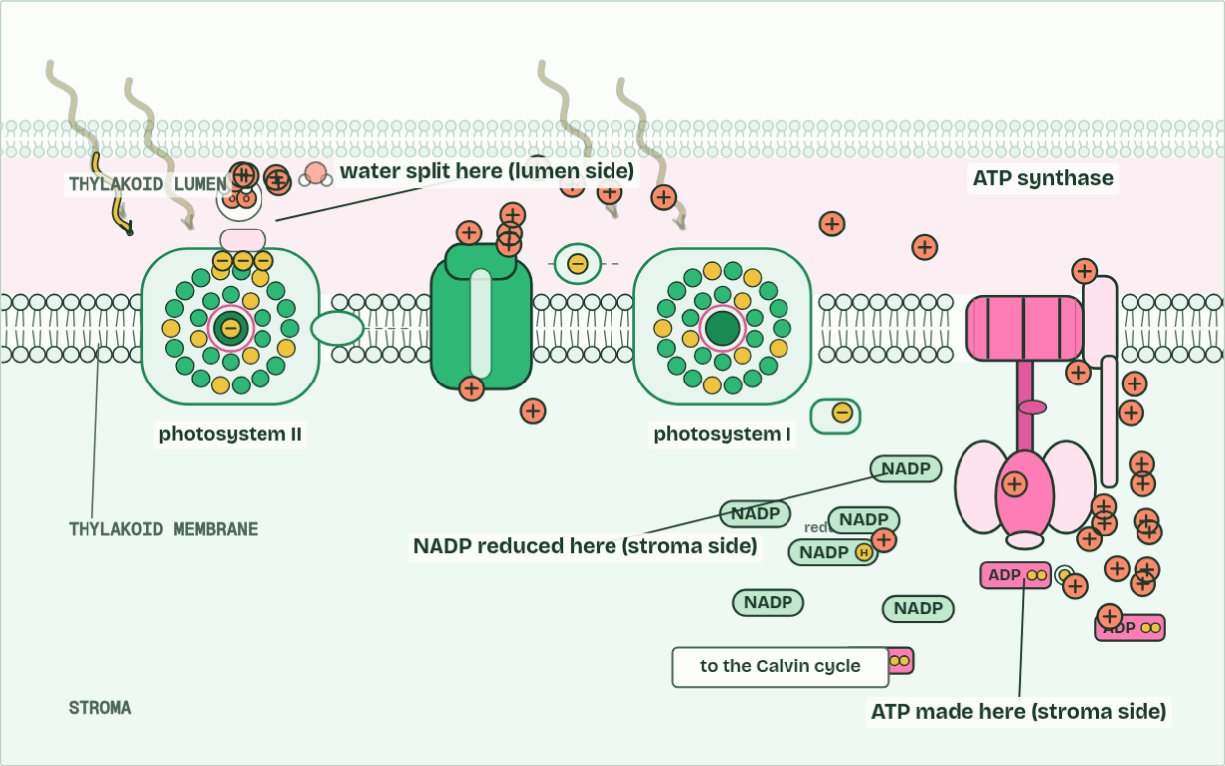
CHAPTER 11 · C1.3.13 C1.3.14 NADP reduced by photosystem I, and the thylakoid as a system
H+ in the lumen 16 · ATP 11 · O2 5
6 / 6
NADP reduced, and the thylakoid as a system
The thylakoid as a system: water split on the lumen side, ATP and reduced NADP made on the stroma side.
Minutes 32 to 42
Notes:
Minutes 32 to 42 of 60: NADP and the map (10 min).
The plan: Chapter 11: the predict, then Map the thylakoid with the labels hidden and the Loads and Spends tiles. Then the chemiosmosis film (thylakoid), with the light off.
Electrons arriving at photosystem I have given up energy along the chain. Light absorbed by photosystem I’s array excites them again, and from its reaction centre they pass, by a short carrier on the stroma side, to NADP. NADP picks up two electrons from photosystem I and one hydrogen ion (a proton) from the stroma, and becomes reduced NADP. This is a reduction, and taking that proton from the stroma steepens the gradient a little.
Reduced NADP carries the hydrogen, as electrons and a proton, to the Calvin cycle in the stroma, where it reduces carbon compounds (chapter 13). This is how the hydrogen from chapter 2 gets from water to carbon dioxide: water’s electrons go through photosystem II, the chain and photosystem I, to NADP.
A thylakoid is a system in which every part has its place. On the lumen side: photolysis at photosystem II, and the store of protons. In the membrane: the photosystems, the chain and ATP synthase, held in order so electrons pass from one to the next. On the stroma side: ATP is made and NADP is reduced, right where the Calvin cycle’s enzymes are. Thylakoids are stacked in grana, joined by single unstacked sheets of membrane that run through the stroma; the stacking gives a large area of membrane, and the small lumen builds a steep gradient fast. Nothing has to “move to the stroma”: ATP and reduced NADP are made in it.
The animation "The thylakoid at work", paused at 40.0 s. The next slides go on through it, then play it.

Slide 22
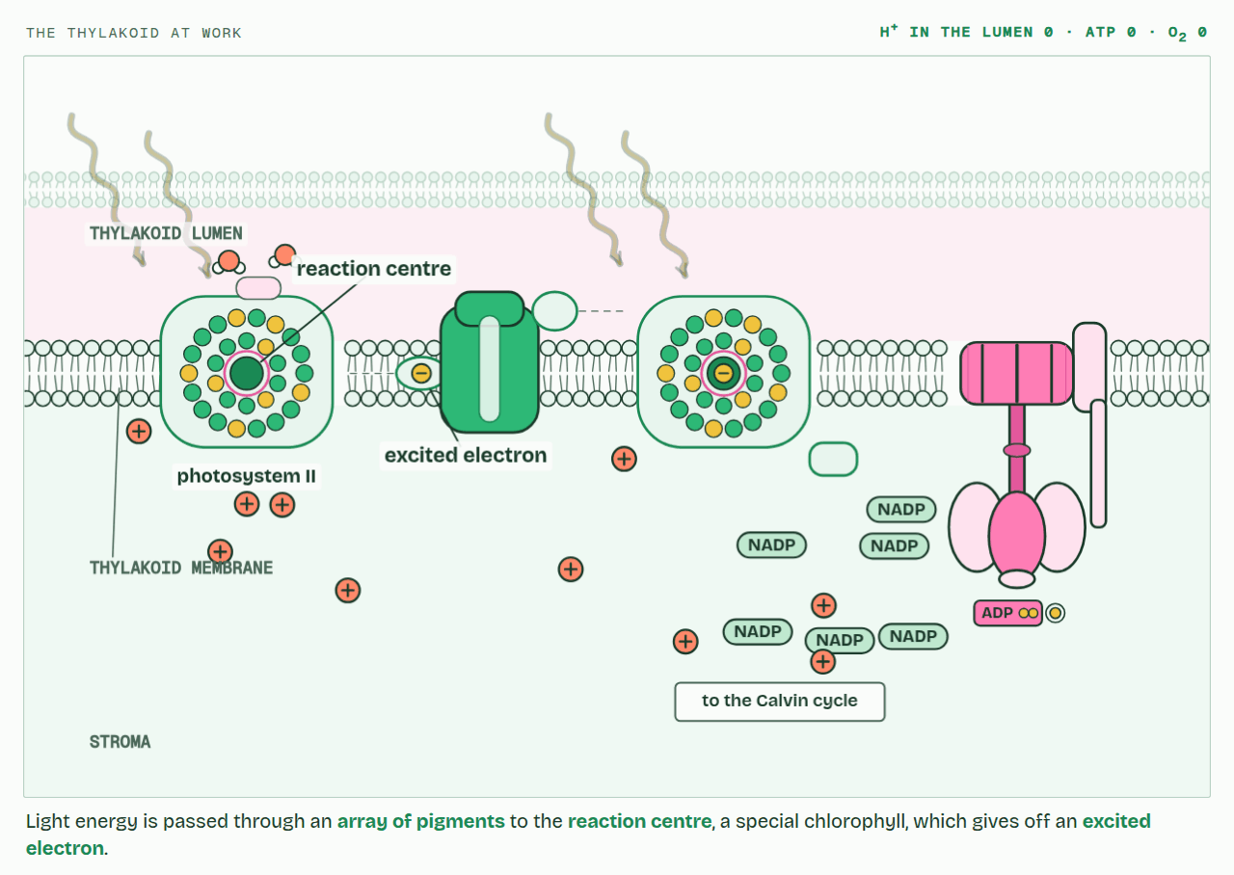
CHAPTER 11 · C1.3.13 C1.3.14 NADP reduced by photosystem I, and the thylakoid as a system
PLAY IT
NADP reduced, and the thylakoid as a system
The thylakoid at work: click to play. It loops every 42 seconds.
Minutes 32 to 42
Notes:
Minutes 32 to 42 of 60: NADP and the map (10 min).
The plan: Chapter 11: the predict, then Map the thylakoid with the labels hidden and the Loads and Spends tiles. Then the chemiosmosis film (thylakoid), with the light off.
The video is chemiosmosis-305eab.mp4, one loop of the animation in the guide. It plays in PowerPoint and Keynote. Google Slides does not play a video embedded in a .pptx: download chemiosmosis-305eab.mp4 (https://www.biologybybradford.com/guides/downloads/scenes/chemiosmosis-305eab.mp4), upload it to Google Drive, then Insert > Video > Google Drive.
In the guide the class can change it as it runs: https://www.biologybybradford.com/guides/ib-biology-c1-3-photosynthesis#nadp
What it shows, in order:
1. Light energy is passed through an array of pigments to the reaction centre, a special chlorophyll, which gives off an excited electron.
2. The reaction centre replaces its lost electrons by splitting water (photolysis). The protons stay in the lumen; the oxygen is a waste product.
3. The electron passes along a chain of carriers, which uses its energy to pump protons from the stroma into the lumen.
4. At photosystem I light lifts the electron again. Two electrons and a proton from the stroma reduce NADP.
5. Protons flow out of the lumen through ATP synthase, making ATP in the stroma, where the Calvin cycle will use it.
6. The thylakoid as a system: water split on the lumen side, ATP and reduced NADP made on the stroma side.

Slide 23
PREDICT
On which side of the thylakoid membrane is NADP reduced, and why does that side make sense?
A The stroma side, where the Calvin cycle uses it
B The lumen side, where protons are most crowded
C The lumen side, so it can cross to the stroma
D Either side, since NADP passes through the membrane
Minutes 32 to 42
Notes:
Minutes 32 to 42 of 60: NADP and the map (10 min).
The plan: Chapter 11: the predict, then Map the thylakoid with the labels hidden and the Loads and Spends tiles. Then the chemiosmosis film (thylakoid), with the light off.
Ask for a show of hands, or mini whiteboards, before revealing. (Answer: A, on the next slide.)

Slide 24
WHAT HAPPENS
On which side of the thylakoid membrane is NADP reduced, and why does that side make sense?
A The stroma side, where the Calvin cycle uses it
B The lumen side, where protons are most crowded
C The lumen side, so it can cross to the stroma
D Either side, since NADP passes through the membrane
The stroma side. Photosystem I hands its electrons to NADP there, with a proton from the stroma, and the reduced NADP is made exactly where the Calvin cycle will use it. Nothing has to cross the membrane.
Minutes 32 to 42
Notes:
Minutes 32 to 42 of 60: NADP and the map (10 min).
The plan: Chapter 11: the predict, then Map the thylakoid with the labels hidden and the Loads and Spends tiles. Then the chemiosmosis film (thylakoid), with the light off.
Answer: A. The stroma side. Photosystem I hands its electrons to NADP there, with a proton from the stroma, and the reduced NADP is made exactly where the Calvin cycle will use it. Nothing has to cross the membrane.

Slide 25
WATCH OUT
NADP is reduced at photosystem I, not photosystem II; photosystem II splits water. Electrons go through II first: the numbers record the order of discovery.
Minutes 32 to 42
Notes:
Minutes 32 to 42 of 60: NADP and the map (10 min).
The plan: Chapter 11: the predict, then Map the thylakoid with the labels hidden and the Loads and Spends tiles. Then the chemiosmosis film (thylakoid), with the light off.
A common mistake: say it, then ask who can say why it is wrong.

Slide 26
REMEMBER IT
Two sides of the thylakoid
L
S
Loads
Spends
Minutes 32 to 42
Notes:
Minutes 32 to 42 of 60: NADP and the map (10 min).
The plan: Chapter 11: the predict, then Map the thylakoid with the labels hidden and the Loads and Spends tiles. Then the chemiosmosis film (thylakoid), with the light off.
Ask the class what each letter stands for before revealing.

Slide 27
REMEMBER IT
Two sides of the thylakoid
L
S
Loads
Spends
Lumen
Stroma
where protons pile up and water is split
where ATP and reduced NADP are made, then spent by the Calvin cycle
Minutes 32 to 42
Notes:
Minutes 32 to 42 of 60: NADP and the map (10 min).
The plan: Chapter 11: the predict, then Map the thylakoid with the labels hidden and the Loads and Spends tiles. Then the chemiosmosis film (thylakoid), with the light off.
Loads: Lumen (where protons pile up and water is split)
Spends: Stroma (where ATP and reduced NADP are made, then spent by the Calvin cycle)

Slide 28

WRITE
13 MIN
Plan a 7-mark answer
THE TASK
The C1.3 exam maker’s higher level extended question on how the light-dependent reactions produce ATP and NADPH (7 marks; the question says NADPH where this guide says reduced NADP). Students list the points they will make (photosystems, photolysis, chain, pumping, gradient, ATP synthase, photosystem I, NADP, cyclic), then write. Peer mark against the exam maker’s markscheme.
STUDENTS NEED
Lined paper.
Minutes 42 to 55
Notes:
Minutes 42 to 55 of 60: Plan a 7-mark answer (13 min).
The plan: Plan a 7-mark answer (below) on the light-dependent reactions, then write it.
The activity: Plan a 7-mark answer. The C1.3 exam maker’s higher level extended question on how the light-dependent reactions produce ATP and NADPH (7 marks; the question says NADPH where this guide says reduced NADP). Students list the points they will make (photosystems, photolysis, chain, pumping, gradient, ATP synthase, photosystem I, NADP, cyclic), then write. Peer mark against the exam maker’s markscheme.
Needs: lined paper.
The time: 13 minutes, minutes 42 to 55 of the plan.

Slide 29
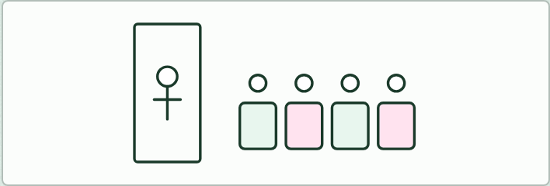
ROLE PLAY
13 MIN
Meet the membrane
THE TASK
If there is time. One student is the host at the door of the thylakoid; each other student is a part (photosystem II, photosystem I, a carrier, ATP synthase, ATP, ADP, NADP, reduced NADP, a proton, an electron, water, the lumen, the stroma) and introduces themselves to the host: where they live and who they work with.
STUDENTS NEED
Name cards.
Minutes 42 to 55
Notes:
Minutes 42 to 55 of 60: Plan a 7-mark answer (13 min).
The plan: Plan a 7-mark answer (below) on the light-dependent reactions, then write it.
The activity: Meet the membrane. If there is time. One student is the host at the door of the thylakoid; each other student is a part (photosystem II, photosystem I, a carrier, ATP synthase, ATP, ADP, NADP, reduced NADP, a proton, an electron, water, the lumen, the stroma) and introduces themselves to the host: where they live and who they work with.
Needs: name cards.
The time: 13 minutes, minutes 42 to 55 of the plan.

Slide 30
PLENARY
Can you now...
Explain how a proton gradient and ATP synthase make ATP in the thylakoid, by cyclic and non-cyclic photophosphorylation (C1.3.12)
Explain how photosystem I reduces NADP, and where in a thylakoid each light-dependent step happens (C1.3.13, C1.3.14)
Minutes 55 to 60
Notes:
Minutes 55 to 60 of 60: Exit (5 min).
The plan: Where in a thylakoid are water split, ATP made and NADP reduced?
Thumbs up, sideways or down on each goal before the exit question. The goals come from the statements this lesson covers.

Slide 31
EXIT QUESTION
Before you go
Where in a thylakoid are water split, ATP made and NADP reduced?
Minutes 55 to 60
Notes:
Minutes 55 to 60 of 60: Exit (5 min).
The plan: Where in a thylakoid are water split, ATP made and NADP reduced?

Slide 32
PRACTISE AND REVISE
Keep going
Exam practice: a fresh paper of exam questions on C1.3 at higher level, marked as you go
The guide, with the animations and the dry lab
This lesson in the guide: 10 Protons downhill make ATP, 11 NADP reduced, and the thylakoid as a system
BUILD FOR YOUR CLASS
ALREADY ON THE SITE FOR C1.3
CARD SETS ON SPLYCR
Tarsia puzzle, dominoes and picture reveal on C1.3, built from its key terms and ready to print
A pub quiz with rounds on C1.3, to present or run with no projector
An escape room built from the question bank on C1.3
Quiz: Photosynthesis
Quiz: Photosynthesis (HL)
Revision map: C1.3 Photosynthesis, to fill in
Exam questions: C1.3 in the exam maker, a paper with its markscheme
Open a set to host it as a class game, or make a copy to edit.
C1.3 Photosynthesis (SL)
C1.3 Photosynthesis (HL)
How this was made. The course structure, the activities and the teaching choices come from my own classroom, my presentations and my years of teaching IB and AP Biology. I use Claude, an AI, to help write and build the interactive guides, lesson plans, slides and practice questions, and to draw the diagrams and code the interactives. I direct the work and review it against the IB and AP specifications before it goes live.
Minute 60: after the lesson
Notes:
Every link here is live. Set the exam practice paper for homework: it is fresh each time, marked as students go and saved to their Exam practice when they are signed in.
Exam practice: https://www.biologybybradford.com/exam-maker/sit?topics=C1.3&level=HL&paper=quiz&marks=15&src=ep
The guide: https://www.biologybybradford.com/guides/ib-biology-c1-3-photosynthesis

