Slide 1
IB Biology C1.3
LESSON 6 OF 6
HL
BY THE END YOU CAN
Photosynthesis
Explain how Rubisco fixes carbon dioxide onto RuBP, and why the stroma needs so much of it (C1.3.15)
Follow the carbon through the Calvin cycle: GP reduced to TP, and five TP in six remade into RuBP (C1.3.16, C1.3.17)
Explain how every carbon compound in a plant is made from the Calvin cycle's products with mineral nutrients (C1.3.18)
Explain why the light-dependent and light-independent reactions stop without each other (C1.3.19)
The Calvin cycle, and the whole system
C1.3.15 to C1.3.19
Rubisco and carbon fixation, GP to TP, RuBP remade, every compound from the Calvin cycle, and why each half needs the other
60 minutes · chapters 12, 13, 14, 15
Minute 0
Notes:
IB Biology C1.3, Photosynthesis. Lesson 6 of 6: The Calvin cycle, and the whole system (higher level), 60 minutes.
The plan, minute by minute (each slide's footer says where you are):
0 to 5 min (5) Do now: true or false?
5 to 17 min (12) Rubisco
17 to 29 min (12) Count the carbons
29 to 35 min (6) Where the carbon goes
35 to 45 min (10) Each half needs the other
45 to 55 min (10) Hexagons
55 to 60 min (5) Exit
What students get wrong:
The light-independent reactions happen in the dark. They need the light reactions’ products, so they run in the light.
The light-dependent reactions make glucose. The Calvin cycle does.
Glyceraldehyde 3-phosphate is reduced in the Calvin cycle. GP (glycerate 3-phosphate) is reduced to TP.
Rubisco is abundant because it is used up. It is abundant because it is slow.
No carbon dioxide only stops the Calvin cycle. It stops photosystem II too (chapter 15).
Stretch and support:
Stretch: in the 1950s Calvin’s group switched the light off on algae and measured the cycle’s molecules: GP rose and RuBP fell. Explain both from the cycle.
Support: leave the Count the carbons balls on the bench while students write; use the Fresh Rolls Rise tiles as a frame.
Stretch: make a respiration and photosynthesis Tarsia puzzle in the Tarsia builder, ticking C1.2 and C1.3 together.
The lesson plan to print: https://www.biologybybradford.com/guides/downloads/ib-biology-c1-3-photosynthesis-lesson-6-plan.pdf

Slide 2
DO NOW
True or false?
True or false, with a reason: “The light-independent reactions happen at night.”
5:00
minutes
Start now: the timer is running.
Minutes 0 to 5
Notes:
Minutes 0 to 5 of 60: Do now: true or false? (5 min).
The plan: True or false, with a reason: “The light-independent reactions happen at night.”
Start a 5 minute timer as they come in.

Slide 3
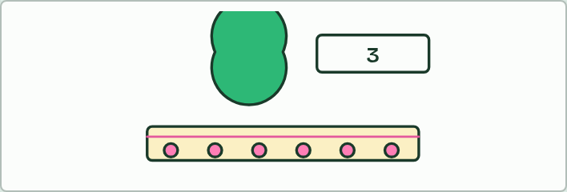
GAME
12 MIN
The Rubisco race
THE TASK
Pairs play rounds 1 and 2 on one device (chapter 12): how many Rubisco to keep up, and how many on the hot day?
STUDENTS NEED
A device per pair.
Minutes 5 to 17
Notes:
Minutes 5 to 17 of 60: Rubisco (12 min).
The plan: Chapter 12: the predict, the figure, then rounds 1 and 2 of the Rubisco race in pairs.
The activity: The Rubisco race. Pairs play rounds 1 and 2 on one device (chapter 12): how many Rubisco to keep up, and how many on the hot day?
Needs: a device per pair.
The time: 12 minutes, minutes 5 to 17 of the plan.

Slide 4
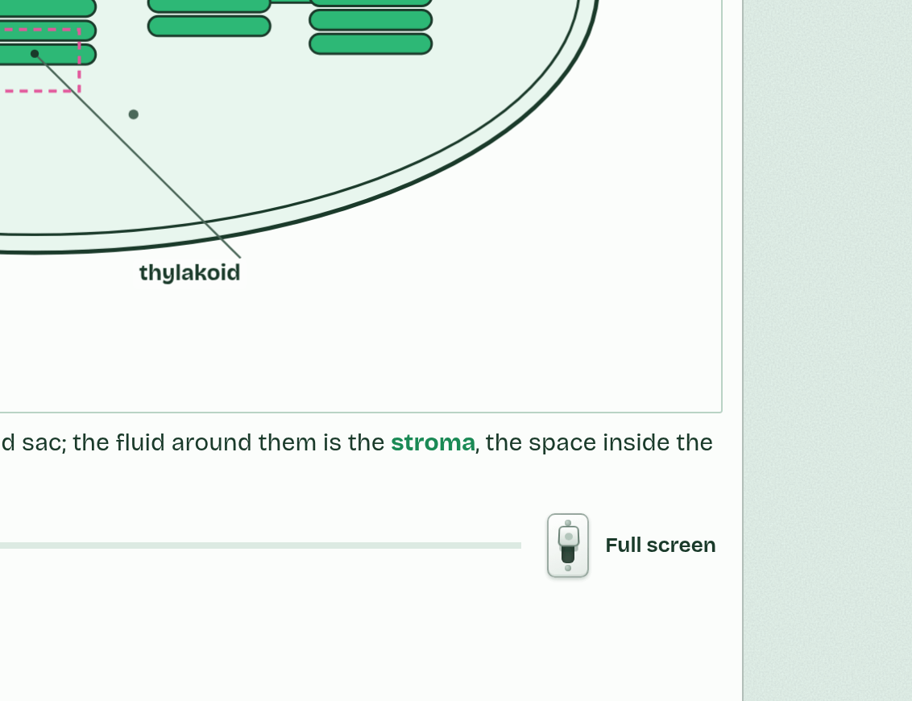
CHAPTER 12 · C1.3.15 Carbon fixation by Rubisco
1 / 4
Fixing carbon, slowly
RuBP, a five-carbon sugar, waits in Rubisco’s active site.
Minutes 5 to 17
Notes:
Minutes 5 to 17 of 60: Rubisco (12 min).
The plan: Chapter 12: the predict, the figure, then rounds 1 and 2 of the Rubisco race in pairs.
The light-independent reactions are a cycle in the stroma, the Calvin cycle, named after Melvin Calvin, who worked it out with radioactive carbon in algae. Its first step is carbon fixation. Carbon dioxide joins a five-carbon sugar already in the stroma, ribulose bisphosphate (RuBP). The six carbons split at once into two molecules of the three-carbon glycerate 3-phosphate (GP). The enzyme is Rubisco. So the substrates are RuBP and carbon dioxide, and the product is GP.
“Fixation” means turning carbon from a gas into part of an organic molecule: the carbon is now held. Adding carbon dioxide to a molecule is also called carboxylation, so fixation by Rubisco is the carboxylation of RuBP.
Rubisco is slow. Each active site fixes only about three carbon dioxide molecules a second, where catalase (C1.1) breaks down millions of hydrogen peroxide molecules a second. And it is not effective at low carbon dioxide concentrations: when carbon dioxide is scarce (on a hot day, with the stomata closed) it works far below its best. So the stroma needs a high concentration of Rubisco to fix carbon dioxide as fast as the light-dependent reactions supply ATP and reduced NADP. Rubisco is up to about half of the soluble protein in a leaf, and it is the most abundant enzyme on Earth.

Slide 5
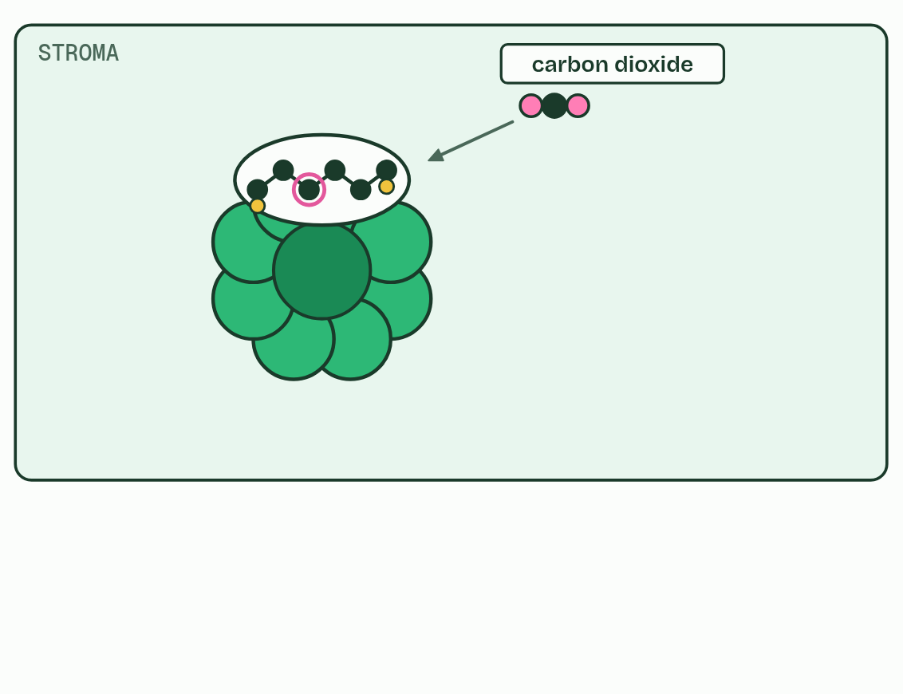
CHAPTER 12 · C1.3.15 Carbon fixation by Rubisco
2 / 4
Fixing carbon, slowly
Carbon dioxide joins it: carbon fixation.
Minutes 5 to 17
Notes:
Minutes 5 to 17 of 60: Rubisco (12 min).
The plan: Chapter 12: the predict, the figure, then rounds 1 and 2 of the Rubisco race in pairs.
The light-independent reactions are a cycle in the stroma, the Calvin cycle, named after Melvin Calvin, who worked it out with radioactive carbon in algae. Its first step is carbon fixation. Carbon dioxide joins a five-carbon sugar already in the stroma, ribulose bisphosphate (RuBP). The six carbons split at once into two molecules of the three-carbon glycerate 3-phosphate (GP). The enzyme is Rubisco. So the substrates are RuBP and carbon dioxide, and the product is GP.
“Fixation” means turning carbon from a gas into part of an organic molecule: the carbon is now held. Adding carbon dioxide to a molecule is also called carboxylation, so fixation by Rubisco is the carboxylation of RuBP.
Rubisco is slow. Each active site fixes only about three carbon dioxide molecules a second, where catalase (C1.1) breaks down millions of hydrogen peroxide molecules a second. And it is not effective at low carbon dioxide concentrations: when carbon dioxide is scarce (on a hot day, with the stomata closed) it works far below its best. So the stroma needs a high concentration of Rubisco to fix carbon dioxide as fast as the light-dependent reactions supply ATP and reduced NADP. Rubisco is up to about half of the soluble protein in a leaf, and it is the most abundant enzyme on Earth.

Slide 6
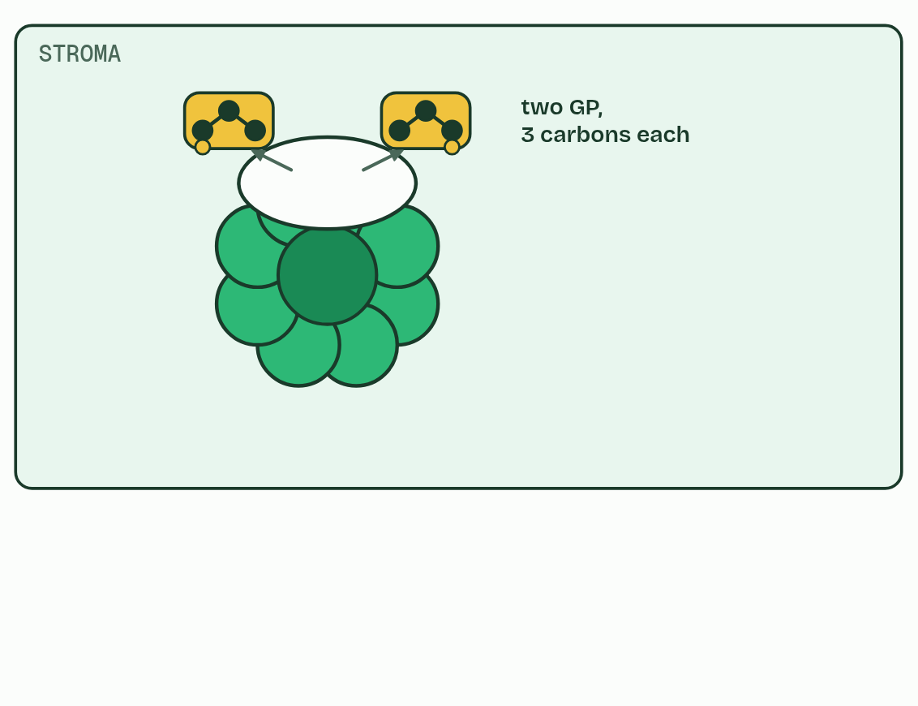
CHAPTER 12 · C1.3.15 Carbon fixation by Rubisco
3 / 4
Fixing carbon, slowly
The six carbons split into two GP.
Minutes 5 to 17
Notes:
Minutes 5 to 17 of 60: Rubisco (12 min).
The plan: Chapter 12: the predict, the figure, then rounds 1 and 2 of the Rubisco race in pairs.
The light-independent reactions are a cycle in the stroma, the Calvin cycle, named after Melvin Calvin, who worked it out with radioactive carbon in algae. Its first step is carbon fixation. Carbon dioxide joins a five-carbon sugar already in the stroma, ribulose bisphosphate (RuBP). The six carbons split at once into two molecules of the three-carbon glycerate 3-phosphate (GP). The enzyme is Rubisco. So the substrates are RuBP and carbon dioxide, and the product is GP.
“Fixation” means turning carbon from a gas into part of an organic molecule: the carbon is now held. Adding carbon dioxide to a molecule is also called carboxylation, so fixation by Rubisco is the carboxylation of RuBP.
Rubisco is slow. Each active site fixes only about three carbon dioxide molecules a second, where catalase (C1.1) breaks down millions of hydrogen peroxide molecules a second. And it is not effective at low carbon dioxide concentrations: when carbon dioxide is scarce (on a hot day, with the stomata closed) it works far below its best. So the stroma needs a high concentration of Rubisco to fix carbon dioxide as fast as the light-dependent reactions supply ATP and reduced NADP. Rubisco is up to about half of the soluble protein in a leaf, and it is the most abundant enzyme on Earth.

Slide 7
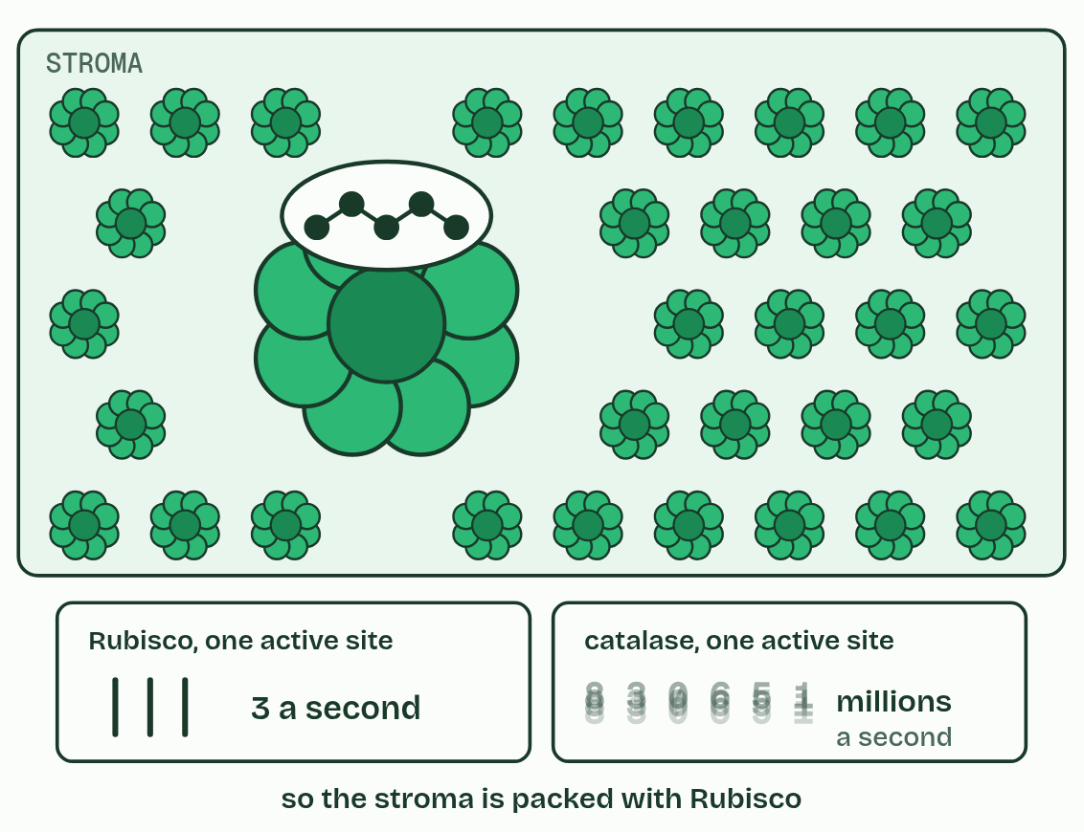
CHAPTER 12 · C1.3.15 Carbon fixation by Rubisco
4 / 4
Fixing carbon, slowly
Rubisco is slow, so a leaf makes a lot of it.
Minutes 5 to 17
Notes:
Minutes 5 to 17 of 60: Rubisco (12 min).
The plan: Chapter 12: the predict, the figure, then rounds 1 and 2 of the Rubisco race in pairs.
The light-independent reactions are a cycle in the stroma, the Calvin cycle, named after Melvin Calvin, who worked it out with radioactive carbon in algae. Its first step is carbon fixation. Carbon dioxide joins a five-carbon sugar already in the stroma, ribulose bisphosphate (RuBP). The six carbons split at once into two molecules of the three-carbon glycerate 3-phosphate (GP). The enzyme is Rubisco. So the substrates are RuBP and carbon dioxide, and the product is GP.
“Fixation” means turning carbon from a gas into part of an organic molecule: the carbon is now held. Adding carbon dioxide to a molecule is also called carboxylation, so fixation by Rubisco is the carboxylation of RuBP.
Rubisco is slow. Each active site fixes only about three carbon dioxide molecules a second, where catalase (C1.1) breaks down millions of hydrogen peroxide molecules a second. And it is not effective at low carbon dioxide concentrations: when carbon dioxide is scarce (on a hot day, with the stomata closed) it works far below its best. So the stroma needs a high concentration of Rubisco to fix carbon dioxide as fast as the light-dependent reactions supply ATP and reduced NADP. Rubisco is up to about half of the soluble protein in a leaf, and it is the most abundant enzyme on Earth.

Slide 8
CHAPTER 12 · C1.3.15 Carbon fixation by Rubisco
Fixing carbon, slowly
Carbon fixation: carbon dioxide joins RuBP (5 carbons), which splits into two GP (3 carbons each).
The enzyme is Rubisco: slow, and poor at low carbon dioxide concentrations.
The stroma needs a high concentration of Rubisco for that reason.
Minutes 5 to 17
Notes:
Minutes 5 to 17 of 60: Rubisco (12 min).
The plan: Chapter 12: the predict, the figure, then rounds 1 and 2 of the Rubisco race in pairs.
The light-independent reactions are a cycle in the stroma, the Calvin cycle, named after Melvin Calvin, who worked it out with radioactive carbon in algae. Its first step is carbon fixation. Carbon dioxide joins a five-carbon sugar already in the stroma, ribulose bisphosphate (RuBP). The six carbons split at once into two molecules of the three-carbon glycerate 3-phosphate (GP). The enzyme is Rubisco. So the substrates are RuBP and carbon dioxide, and the product is GP.
“Fixation” means turning carbon from a gas into part of an organic molecule: the carbon is now held. Adding carbon dioxide to a molecule is also called carboxylation, so fixation by Rubisco is the carboxylation of RuBP.
Rubisco is slow. Each active site fixes only about three carbon dioxide molecules a second, where catalase (C1.1) breaks down millions of hydrogen peroxide molecules a second. And it is not effective at low carbon dioxide concentrations: when carbon dioxide is scarce (on a hot day, with the stomata closed) it works far below its best. So the stroma needs a high concentration of Rubisco to fix carbon dioxide as fast as the light-dependent reactions supply ATP and reduced NADP. Rubisco is up to about half of the soluble protein in a leaf, and it is the most abundant enzyme on Earth.

Slide 9
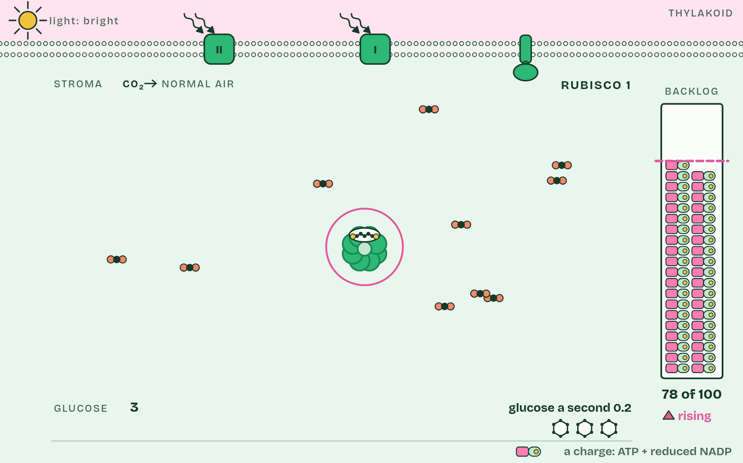
CHAPTER 12 · C1.3.15 Carbon fixation by Rubisco
1 / 4
Fixing carbon, slowly
One Rubisco cannot keep up.
Minutes 5 to 17
Notes:
Minutes 5 to 17 of 60: Rubisco (12 min).
The plan: Chapter 12: the predict, the figure, then rounds 1 and 2 of the Rubisco race in pairs.
The light-independent reactions are a cycle in the stroma, the Calvin cycle, named after Melvin Calvin, who worked it out with radioactive carbon in algae. Its first step is carbon fixation. Carbon dioxide joins a five-carbon sugar already in the stroma, ribulose bisphosphate (RuBP). The six carbons split at once into two molecules of the three-carbon glycerate 3-phosphate (GP). The enzyme is Rubisco. So the substrates are RuBP and carbon dioxide, and the product is GP.
“Fixation” means turning carbon from a gas into part of an organic molecule: the carbon is now held. Adding carbon dioxide to a molecule is also called carboxylation, so fixation by Rubisco is the carboxylation of RuBP.
Rubisco is slow. Each active site fixes only about three carbon dioxide molecules a second, where catalase (C1.1) breaks down millions of hydrogen peroxide molecules a second. And it is not effective at low carbon dioxide concentrations: when carbon dioxide is scarce (on a hot day, with the stomata closed) it works far below its best. So the stroma needs a high concentration of Rubisco to fix carbon dioxide as fast as the light-dependent reactions supply ATP and reduced NADP. Rubisco is up to about half of the soluble protein in a leaf, and it is the most abundant enzyme on Earth.

Slide 10
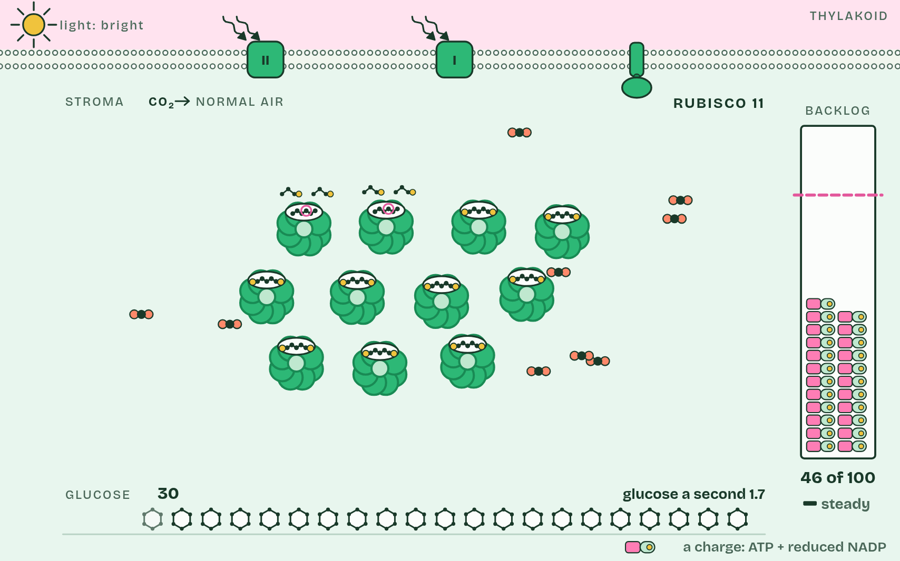
CHAPTER 12 · C1.3.15 Carbon fixation by Rubisco
2 / 4
Fixing carbon, slowly
Eleven keep pace with bright light.
Minutes 5 to 17
Notes:
Minutes 5 to 17 of 60: Rubisco (12 min).
The plan: Chapter 12: the predict, the figure, then rounds 1 and 2 of the Rubisco race in pairs.
The light-independent reactions are a cycle in the stroma, the Calvin cycle, named after Melvin Calvin, who worked it out with radioactive carbon in algae. Its first step is carbon fixation. Carbon dioxide joins a five-carbon sugar already in the stroma, ribulose bisphosphate (RuBP). The six carbons split at once into two molecules of the three-carbon glycerate 3-phosphate (GP). The enzyme is Rubisco. So the substrates are RuBP and carbon dioxide, and the product is GP.
“Fixation” means turning carbon from a gas into part of an organic molecule: the carbon is now held. Adding carbon dioxide to a molecule is also called carboxylation, so fixation by Rubisco is the carboxylation of RuBP.
Rubisco is slow. Each active site fixes only about three carbon dioxide molecules a second, where catalase (C1.1) breaks down millions of hydrogen peroxide molecules a second. And it is not effective at low carbon dioxide concentrations: when carbon dioxide is scarce (on a hot day, with the stomata closed) it works far below its best. So the stroma needs a high concentration of Rubisco to fix carbon dioxide as fast as the light-dependent reactions supply ATP and reduced NADP. Rubisco is up to about half of the soluble protein in a leaf, and it is the most abundant enzyme on Earth.

Slide 11
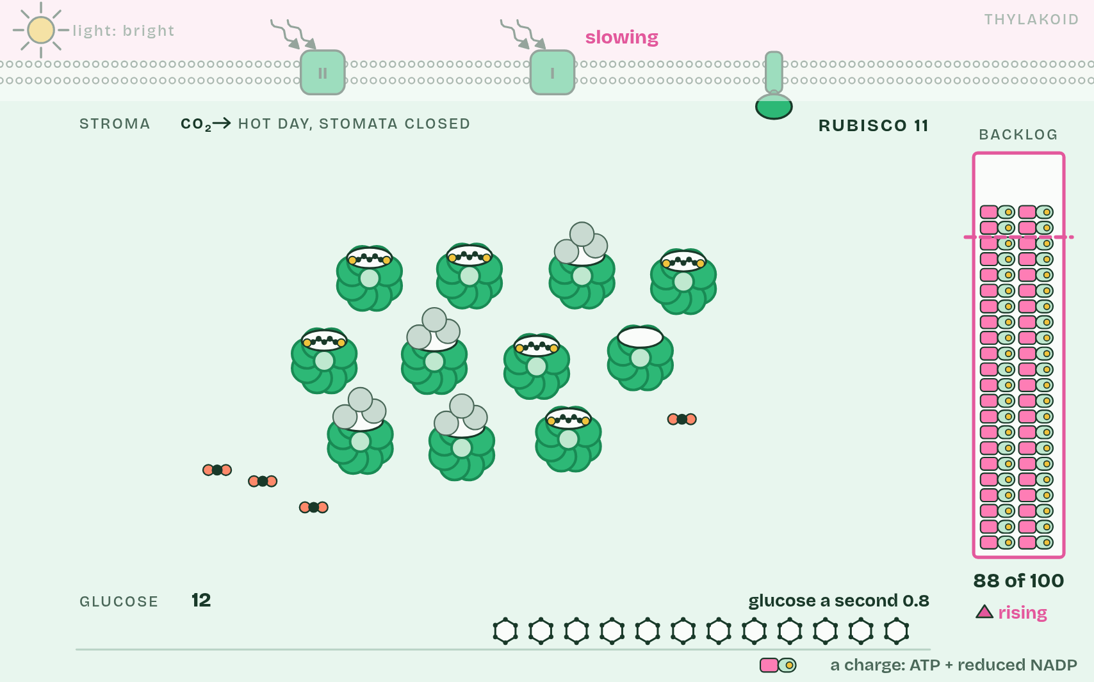
CHAPTER 12 · C1.3.15 Carbon fixation by Rubisco
3 / 4
Fixing carbon, slowly
With little carbon dioxide, each does less and fumbles more.
Minutes 5 to 17
Notes:
Minutes 5 to 17 of 60: Rubisco (12 min).
The plan: Chapter 12: the predict, the figure, then rounds 1 and 2 of the Rubisco race in pairs.
The light-independent reactions are a cycle in the stroma, the Calvin cycle, named after Melvin Calvin, who worked it out with radioactive carbon in algae. Its first step is carbon fixation. Carbon dioxide joins a five-carbon sugar already in the stroma, ribulose bisphosphate (RuBP). The six carbons split at once into two molecules of the three-carbon glycerate 3-phosphate (GP). The enzyme is Rubisco. So the substrates are RuBP and carbon dioxide, and the product is GP.
“Fixation” means turning carbon from a gas into part of an organic molecule: the carbon is now held. Adding carbon dioxide to a molecule is also called carboxylation, so fixation by Rubisco is the carboxylation of RuBP.
Rubisco is slow. Each active site fixes only about three carbon dioxide molecules a second, where catalase (C1.1) breaks down millions of hydrogen peroxide molecules a second. And it is not effective at low carbon dioxide concentrations: when carbon dioxide is scarce (on a hot day, with the stomata closed) it works far below its best. So the stroma needs a high concentration of Rubisco to fix carbon dioxide as fast as the light-dependent reactions supply ATP and reduced NADP. Rubisco is up to about half of the soluble protein in a leaf, and it is the most abundant enzyme on Earth.

Slide 12
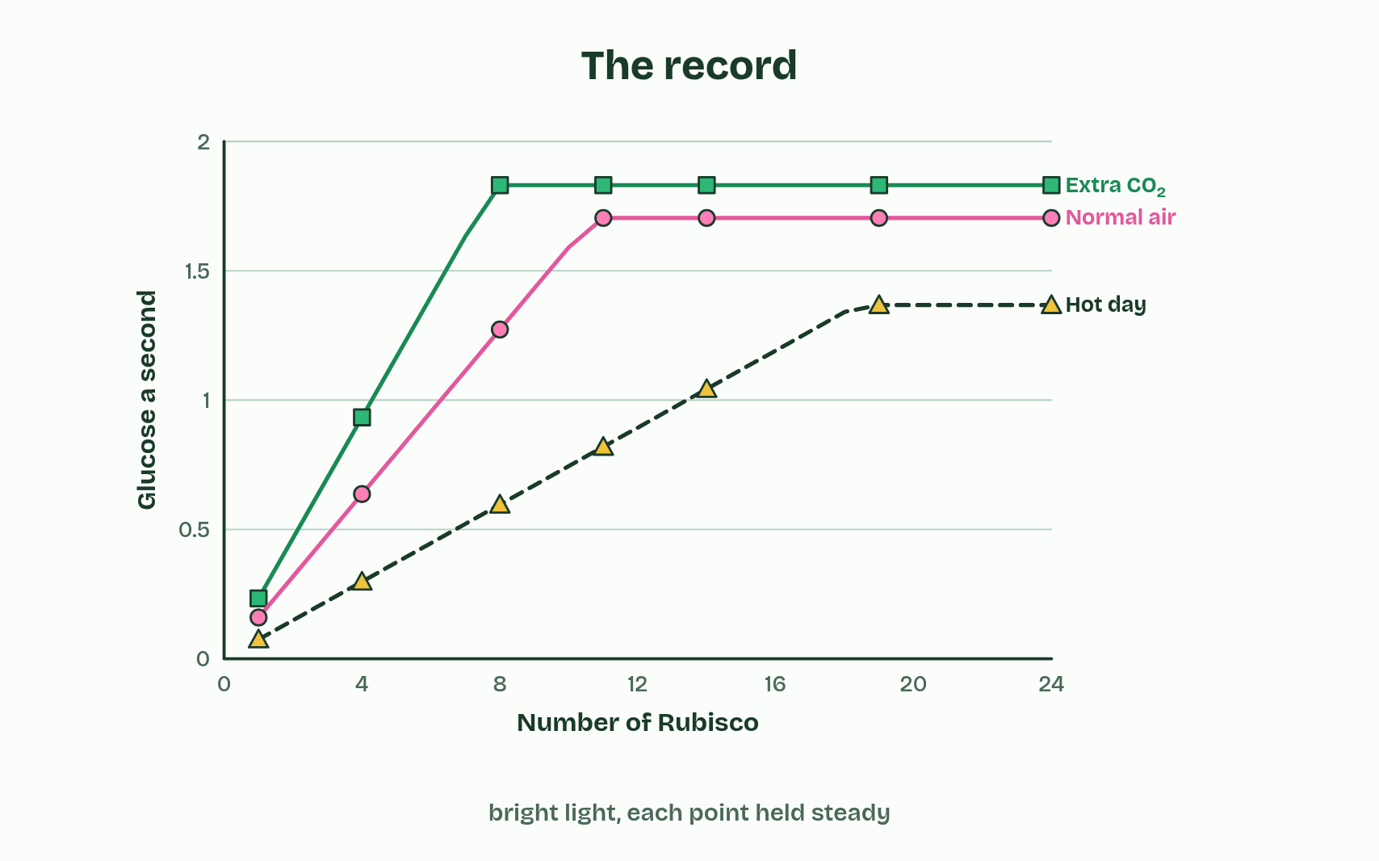
CHAPTER 12 · C1.3.15 Carbon fixation by Rubisco
4 / 4
Fixing carbon, slowly
More Rubisco helps until light is the limit.
Minutes 5 to 17
Notes:
Minutes 5 to 17 of 60: Rubisco (12 min).
The plan: Chapter 12: the predict, the figure, then rounds 1 and 2 of the Rubisco race in pairs.
The light-independent reactions are a cycle in the stroma, the Calvin cycle, named after Melvin Calvin, who worked it out with radioactive carbon in algae. Its first step is carbon fixation. Carbon dioxide joins a five-carbon sugar already in the stroma, ribulose bisphosphate (RuBP). The six carbons split at once into two molecules of the three-carbon glycerate 3-phosphate (GP). The enzyme is Rubisco. So the substrates are RuBP and carbon dioxide, and the product is GP.
“Fixation” means turning carbon from a gas into part of an organic molecule: the carbon is now held. Adding carbon dioxide to a molecule is also called carboxylation, so fixation by Rubisco is the carboxylation of RuBP.
Rubisco is slow. Each active site fixes only about three carbon dioxide molecules a second, where catalase (C1.1) breaks down millions of hydrogen peroxide molecules a second. And it is not effective at low carbon dioxide concentrations: when carbon dioxide is scarce (on a hot day, with the stomata closed) it works far below its best. So the stroma needs a high concentration of Rubisco to fix carbon dioxide as fast as the light-dependent reactions supply ATP and reduced NADP. Rubisco is up to about half of the soluble protein in a leaf, and it is the most abundant enzyme on Earth.

Slide 13
CHAPTER 12 · C1.3.15 Carbon fixation by Rubisco
Fixing carbon, slowly
Carbon fixation: carbon dioxide joins RuBP (5 carbons), which splits into two GP (3 carbons each).
The enzyme is Rubisco: slow, and poor at low carbon dioxide concentrations.
The stroma needs a high concentration of Rubisco for that reason.
Minutes 5 to 17
Notes:
Minutes 5 to 17 of 60: Rubisco (12 min).
The plan: Chapter 12: the predict, the figure, then rounds 1 and 2 of the Rubisco race in pairs.
The light-independent reactions are a cycle in the stroma, the Calvin cycle, named after Melvin Calvin, who worked it out with radioactive carbon in algae. Its first step is carbon fixation. Carbon dioxide joins a five-carbon sugar already in the stroma, ribulose bisphosphate (RuBP). The six carbons split at once into two molecules of the three-carbon glycerate 3-phosphate (GP). The enzyme is Rubisco. So the substrates are RuBP and carbon dioxide, and the product is GP.
“Fixation” means turning carbon from a gas into part of an organic molecule: the carbon is now held. Adding carbon dioxide to a molecule is also called carboxylation, so fixation by Rubisco is the carboxylation of RuBP.
Rubisco is slow. Each active site fixes only about three carbon dioxide molecules a second, where catalase (C1.1) breaks down millions of hydrogen peroxide molecules a second. And it is not effective at low carbon dioxide concentrations: when carbon dioxide is scarce (on a hot day, with the stomata closed) it works far below its best. So the stroma needs a high concentration of Rubisco to fix carbon dioxide as fast as the light-dependent reactions supply ATP and reduced NADP. Rubisco is up to about half of the soluble protein in a leaf, and it is the most abundant enzyme on Earth.

Slide 14
PREDICT
A leaf cell could save a lot of protein by making less Rubisco. Why doesn’t it?
A Rubisco is used up in every reaction it runs
B Rubisco is also the leaf’s main green pigment
C Spare Rubisco is where the leaf stores sugar
D Each Rubisco fixes only a few CO₂ a second
Minutes 5 to 17
Notes:
Minutes 5 to 17 of 60: Rubisco (12 min).
The plan: Chapter 12: the predict, the figure, then rounds 1 and 2 of the Rubisco race in pairs.
Ask for a show of hands, or mini whiteboards, before revealing. (Answer: D, on the next slide.)

Slide 15
WHAT HAPPENS
A leaf cell could save a lot of protein by making less Rubisco. Why doesn’t it?
A Rubisco is used up in every reaction it runs
B Rubisco is also the leaf’s main green pigment
C Spare Rubisco is where the leaf stores sugar
D Each Rubisco fixes only a few CO₂ a second
Rubisco is slow, and slower still when carbon dioxide is low. To fix carbon dioxide as fast as the light reactions supply ATP and reduced NADP, a leaf needs a great many Rubisco molecules. That is why it is the most abundant enzyme on Earth.
Minutes 5 to 17
Notes:
Minutes 5 to 17 of 60: Rubisco (12 min).
The plan: Chapter 12: the predict, the figure, then rounds 1 and 2 of the Rubisco race in pairs.
Answer: D. Rubisco is slow, and slower still when carbon dioxide is low. To fix carbon dioxide as fast as the light reactions supply ATP and reduced NADP, a leaf needs a great many Rubisco molecules. That is why it is the most abundant enzyme on Earth.

Slide 16
WATCH OUT
Rubisco is an enzyme, not a product of the cycle, and it is not used up. It is abundant because it is slow, not because it is special in any other way.
Minutes 5 to 17
Notes:
Minutes 5 to 17 of 60: Rubisco (12 min).
The plan: Chapter 12: the predict, the figure, then rounds 1 and 2 of the Rubisco race in pairs.
A common mistake: say it, then ask who can say why it is wrong.

Slide 17
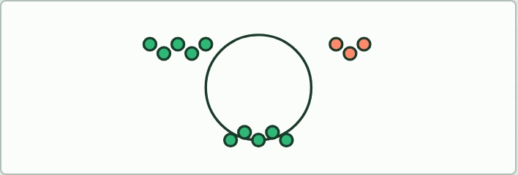
MODEL
12 MIN
Count the carbons
THE TASK
Plasticine balls as carbon atoms (chapter 13). Three RuBP of five balls each and three carbon dioxide of one: fix them into six GP of three; turn them into TP (an ATP card and a reduced NADP card each); take one TP out; remake three RuBP from the five left. Count the balls at every stage: fifteen plus three in, fifteen plus three out.
STUDENTS NEED
Plasticine in two colours, and ATP and reduced NADP cards.
Minutes 17 to 29
Notes:
Minutes 17 to 29 of 60: Count the carbons (12 min).
The plan: Chapter 13: the predict, then Count the carbons (below) in plasticine alongside the figure. Then the Fresh Rolls Rise tiles.
The activity: Count the carbons. Plasticine balls as carbon atoms (chapter 13). Three RuBP of five balls each and three carbon dioxide of one: fix them into six GP of three; turn them into TP (an ATP card and a reduced NADP card each); take one TP out; remake three RuBP from the five left. Count the balls at every stage: fifteen plus three in, fifteen plus three out.
Needs: plasticine in two colours, and ATP and reduced NADP cards.
The time: 12 minutes, minutes 17 to 29 of the plan.

Slide 18
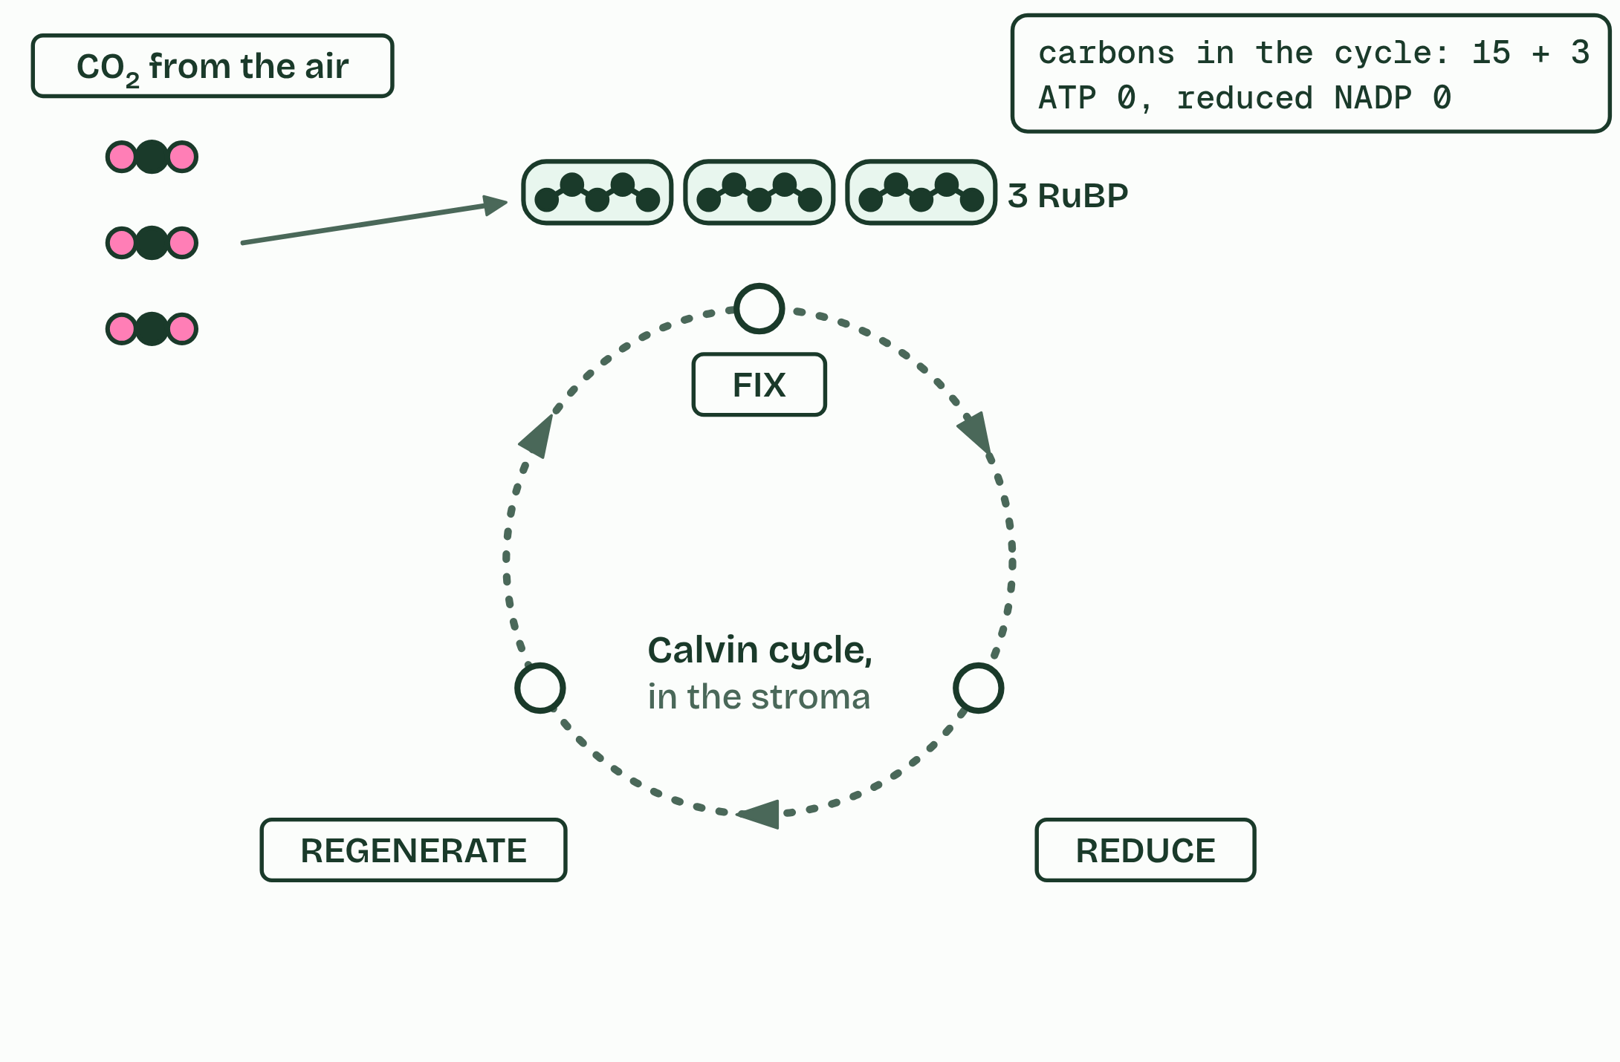
CHAPTER 13 · C1.3.16 C1.3.17 Triose phosphate from GP, and RuBP regenerated
1 / 6
GP to TP, and RuBP made again
Three RuBP wait for three carbon dioxide.
Minutes 17 to 29
Notes:
Minutes 17 to 29 of 60: Count the carbons (12 min).
The plan: Chapter 13: the predict, then Count the carbons (below) in plasticine alongside the figure. Then the Fresh Rolls Rise tiles.
Reduced NADP and ATP from the light-dependent reactions turn GP into triose phosphate (TP), a three-carbon sugar, in the stroma. Reduced NADP gives the hydrogen (it reduces GP) and ATP gives the energy. NADP and ADP go back to the thylakoid. TP is the first sugar and the cycle’s product: some of it leaves to make glucose and everything else (chapter 14).
The rest has to remake RuBP, using more ATP. Five TP (fifteen carbons) are rearranged into three RuBP (fifteen carbons), so the cycle can fix carbon dioxide again. This is regeneration. You do not need the steps in between. Counting a round: three RuBP fix three carbon dioxide to give six GP; six GP give six TP; one TP leaves; five remake three RuBP. Three carbons in, three carbons out as one TP.
To make one glucose (six carbons, two TP), six carbon dioxide must be fixed, and five-sixths of all the TP made goes back to RuBP. Without regenerating RuBP, fixation would stop within moments. One turn of the cycle fixes one carbon dioxide, so six turns make one glucose. The figure runs three turns at a time (a “round”) only because three is the smallest number that gives a whole TP out.
Why a cycle? The molecule that accepts carbon dioxide is remade every turn, so a small stock of RuBP keeps fixing carbon as long as ATP and reduced NADP keep coming. The tally in the corner counts ATP and reduced NADP as they are used; it is there to show the cost, not to be learned.

Slide 19
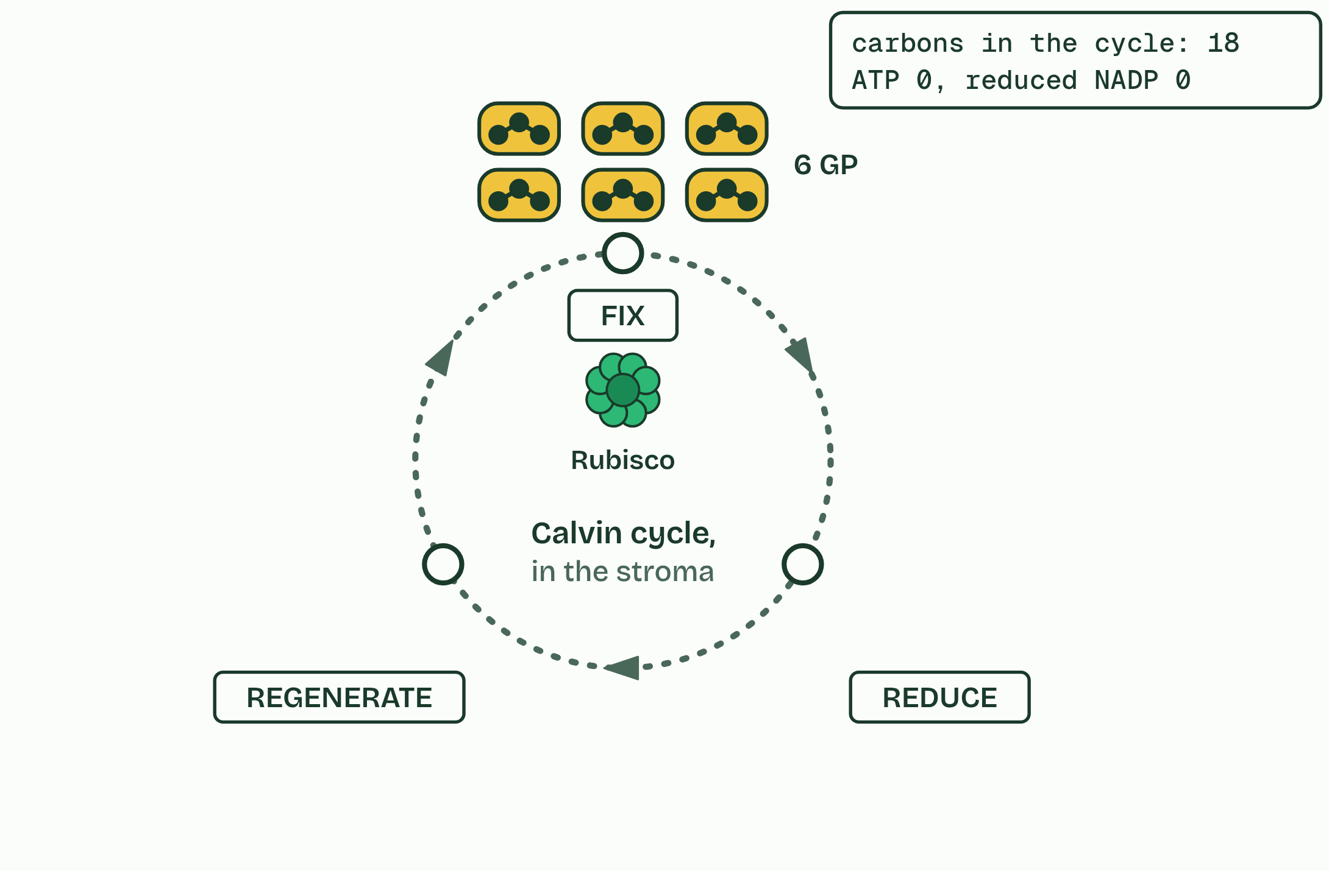
CHAPTER 13 · C1.3.16 C1.3.17 Triose phosphate from GP, and RuBP regenerated
2 / 6
GP to TP, and RuBP made again
Rubisco fixes them: six GP.
Minutes 17 to 29
Notes:
Minutes 17 to 29 of 60: Count the carbons (12 min).
The plan: Chapter 13: the predict, then Count the carbons (below) in plasticine alongside the figure. Then the Fresh Rolls Rise tiles.
Reduced NADP and ATP from the light-dependent reactions turn GP into triose phosphate (TP), a three-carbon sugar, in the stroma. Reduced NADP gives the hydrogen (it reduces GP) and ATP gives the energy. NADP and ADP go back to the thylakoid. TP is the first sugar and the cycle’s product: some of it leaves to make glucose and everything else (chapter 14).
The rest has to remake RuBP, using more ATP. Five TP (fifteen carbons) are rearranged into three RuBP (fifteen carbons), so the cycle can fix carbon dioxide again. This is regeneration. You do not need the steps in between. Counting a round: three RuBP fix three carbon dioxide to give six GP; six GP give six TP; one TP leaves; five remake three RuBP. Three carbons in, three carbons out as one TP.
To make one glucose (six carbons, two TP), six carbon dioxide must be fixed, and five-sixths of all the TP made goes back to RuBP. Without regenerating RuBP, fixation would stop within moments. One turn of the cycle fixes one carbon dioxide, so six turns make one glucose. The figure runs three turns at a time (a “round”) only because three is the smallest number that gives a whole TP out.
Why a cycle? The molecule that accepts carbon dioxide is remade every turn, so a small stock of RuBP keeps fixing carbon as long as ATP and reduced NADP keep coming. The tally in the corner counts ATP and reduced NADP as they are used; it is there to show the cost, not to be learned.

Slide 20
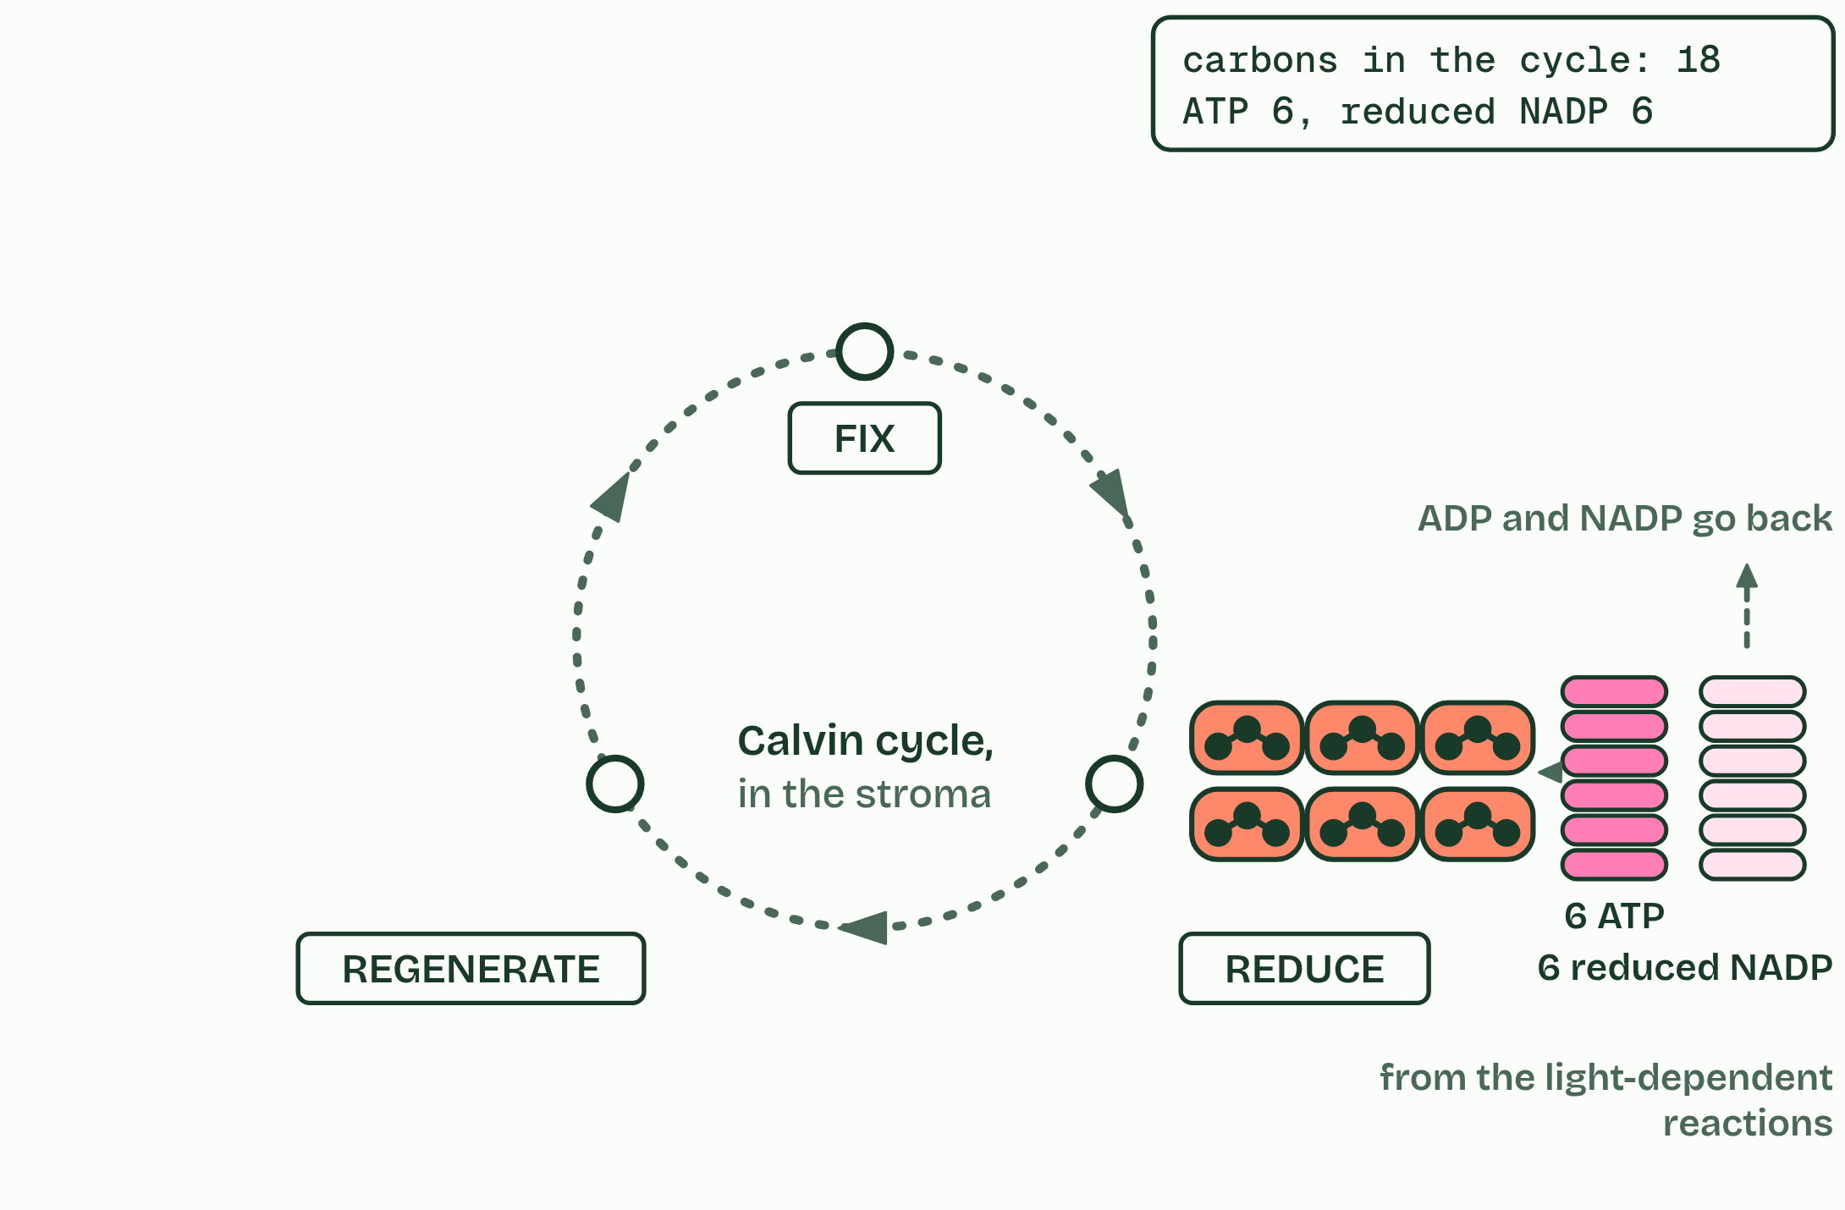
CHAPTER 13 · C1.3.16 C1.3.17 Triose phosphate from GP, and RuBP regenerated
3 / 6
GP to TP, and RuBP made again
Reduced NADP and ATP turn GP into TP.
Minutes 17 to 29
Notes:
Minutes 17 to 29 of 60: Count the carbons (12 min).
The plan: Chapter 13: the predict, then Count the carbons (below) in plasticine alongside the figure. Then the Fresh Rolls Rise tiles.
Reduced NADP and ATP from the light-dependent reactions turn GP into triose phosphate (TP), a three-carbon sugar, in the stroma. Reduced NADP gives the hydrogen (it reduces GP) and ATP gives the energy. NADP and ADP go back to the thylakoid. TP is the first sugar and the cycle’s product: some of it leaves to make glucose and everything else (chapter 14).
The rest has to remake RuBP, using more ATP. Five TP (fifteen carbons) are rearranged into three RuBP (fifteen carbons), so the cycle can fix carbon dioxide again. This is regeneration. You do not need the steps in between. Counting a round: three RuBP fix three carbon dioxide to give six GP; six GP give six TP; one TP leaves; five remake three RuBP. Three carbons in, three carbons out as one TP.
To make one glucose (six carbons, two TP), six carbon dioxide must be fixed, and five-sixths of all the TP made goes back to RuBP. Without regenerating RuBP, fixation would stop within moments. One turn of the cycle fixes one carbon dioxide, so six turns make one glucose. The figure runs three turns at a time (a “round”) only because three is the smallest number that gives a whole TP out.
Why a cycle? The molecule that accepts carbon dioxide is remade every turn, so a small stock of RuBP keeps fixing carbon as long as ATP and reduced NADP keep coming. The tally in the corner counts ATP and reduced NADP as they are used; it is there to show the cost, not to be learned.

Slide 21
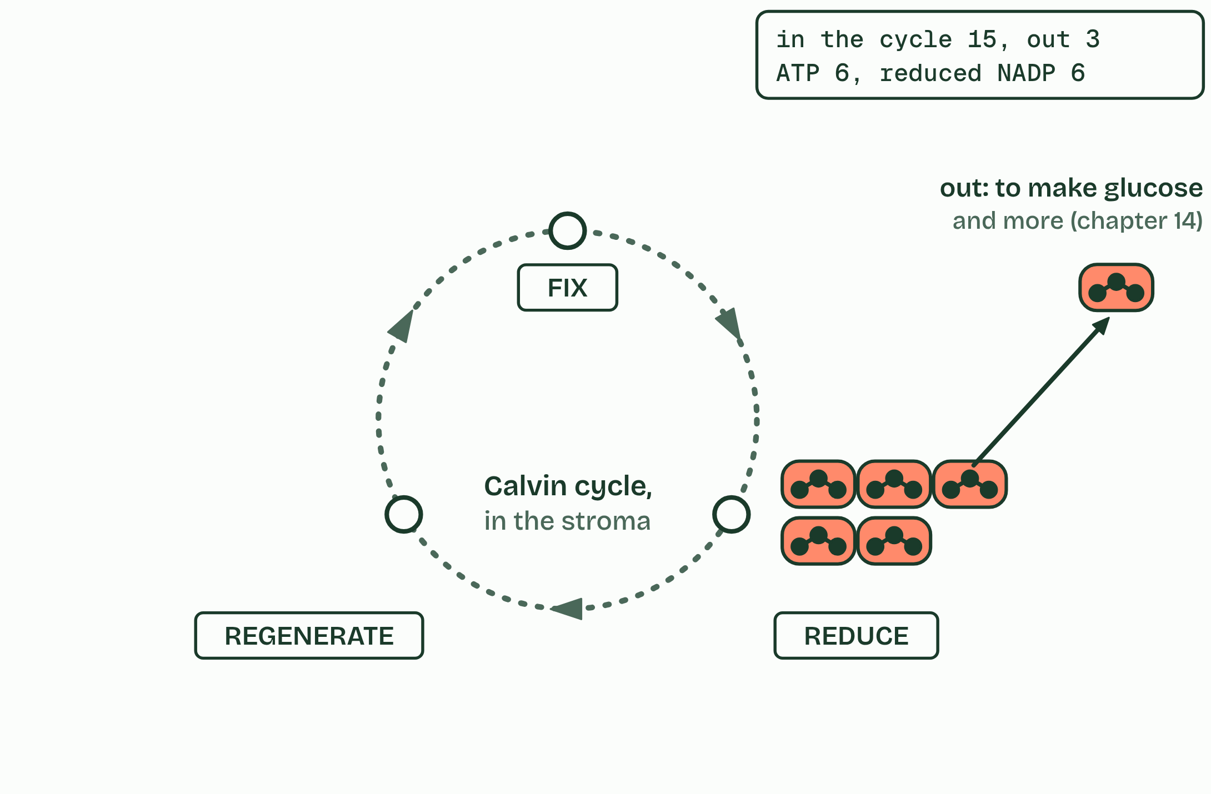
CHAPTER 13 · C1.3.16 C1.3.17 Triose phosphate from GP, and RuBP regenerated
4 / 6
GP to TP, and RuBP made again
One TP in six leaves the cycle.
Minutes 17 to 29
Notes:
Minutes 17 to 29 of 60: Count the carbons (12 min).
The plan: Chapter 13: the predict, then Count the carbons (below) in plasticine alongside the figure. Then the Fresh Rolls Rise tiles.
Reduced NADP and ATP from the light-dependent reactions turn GP into triose phosphate (TP), a three-carbon sugar, in the stroma. Reduced NADP gives the hydrogen (it reduces GP) and ATP gives the energy. NADP and ADP go back to the thylakoid. TP is the first sugar and the cycle’s product: some of it leaves to make glucose and everything else (chapter 14).
The rest has to remake RuBP, using more ATP. Five TP (fifteen carbons) are rearranged into three RuBP (fifteen carbons), so the cycle can fix carbon dioxide again. This is regeneration. You do not need the steps in between. Counting a round: three RuBP fix three carbon dioxide to give six GP; six GP give six TP; one TP leaves; five remake three RuBP. Three carbons in, three carbons out as one TP.
To make one glucose (six carbons, two TP), six carbon dioxide must be fixed, and five-sixths of all the TP made goes back to RuBP. Without regenerating RuBP, fixation would stop within moments. One turn of the cycle fixes one carbon dioxide, so six turns make one glucose. The figure runs three turns at a time (a “round”) only because three is the smallest number that gives a whole TP out.
Why a cycle? The molecule that accepts carbon dioxide is remade every turn, so a small stock of RuBP keeps fixing carbon as long as ATP and reduced NADP keep coming. The tally in the corner counts ATP and reduced NADP as they are used; it is there to show the cost, not to be learned.

Slide 22
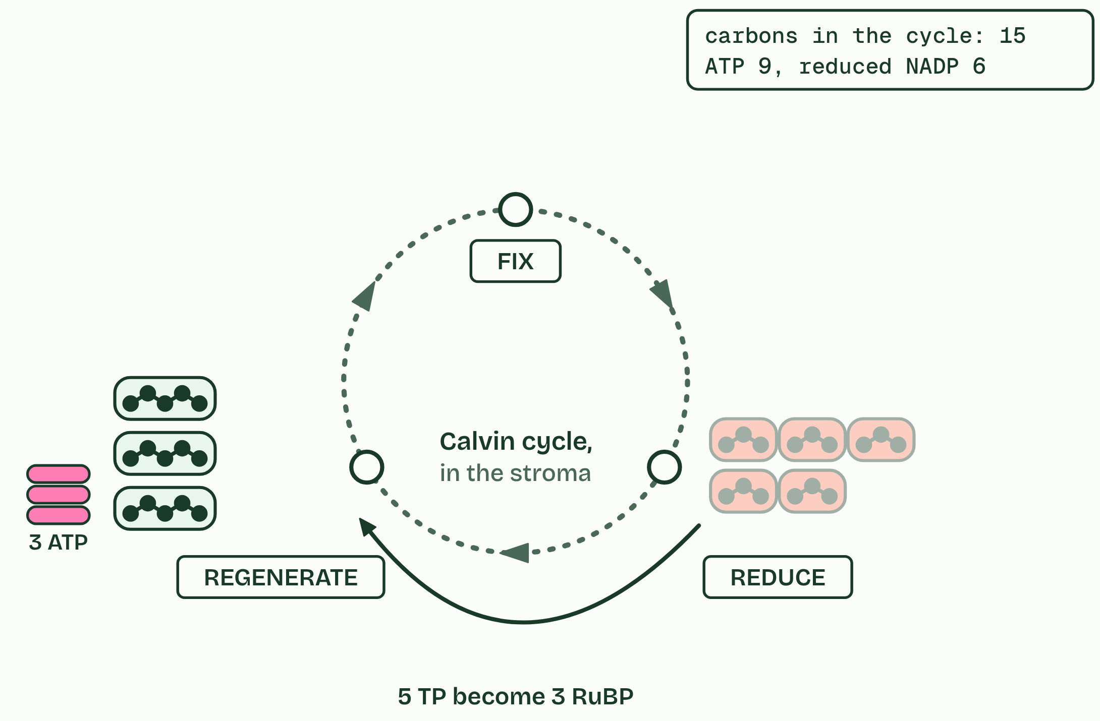
CHAPTER 13 · C1.3.16 C1.3.17 Triose phosphate from GP, and RuBP regenerated
5 / 6
GP to TP, and RuBP made again
Five TP are remade into three RuBP, using ATP.
Minutes 17 to 29
Notes:
Minutes 17 to 29 of 60: Count the carbons (12 min).
The plan: Chapter 13: the predict, then Count the carbons (below) in plasticine alongside the figure. Then the Fresh Rolls Rise tiles.
Reduced NADP and ATP from the light-dependent reactions turn GP into triose phosphate (TP), a three-carbon sugar, in the stroma. Reduced NADP gives the hydrogen (it reduces GP) and ATP gives the energy. NADP and ADP go back to the thylakoid. TP is the first sugar and the cycle’s product: some of it leaves to make glucose and everything else (chapter 14).
The rest has to remake RuBP, using more ATP. Five TP (fifteen carbons) are rearranged into three RuBP (fifteen carbons), so the cycle can fix carbon dioxide again. This is regeneration. You do not need the steps in between. Counting a round: three RuBP fix three carbon dioxide to give six GP; six GP give six TP; one TP leaves; five remake three RuBP. Three carbons in, three carbons out as one TP.
To make one glucose (six carbons, two TP), six carbon dioxide must be fixed, and five-sixths of all the TP made goes back to RuBP. Without regenerating RuBP, fixation would stop within moments. One turn of the cycle fixes one carbon dioxide, so six turns make one glucose. The figure runs three turns at a time (a “round”) only because three is the smallest number that gives a whole TP out.
Why a cycle? The molecule that accepts carbon dioxide is remade every turn, so a small stock of RuBP keeps fixing carbon as long as ATP and reduced NADP keep coming. The tally in the corner counts ATP and reduced NADP as they are used; it is there to show the cost, not to be learned.

Slide 23
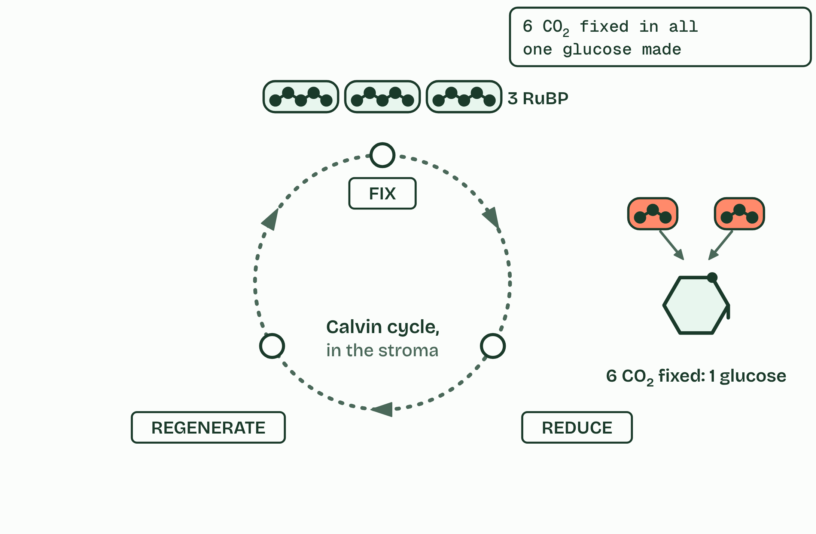
CHAPTER 13 · C1.3.16 C1.3.17 Triose phosphate from GP, and RuBP regenerated
6 / 6
GP to TP, and RuBP made again
Six turns, six carbon dioxide: one glucose.
Minutes 17 to 29
Notes:
Minutes 17 to 29 of 60: Count the carbons (12 min).
The plan: Chapter 13: the predict, then Count the carbons (below) in plasticine alongside the figure. Then the Fresh Rolls Rise tiles.
Reduced NADP and ATP from the light-dependent reactions turn GP into triose phosphate (TP), a three-carbon sugar, in the stroma. Reduced NADP gives the hydrogen (it reduces GP) and ATP gives the energy. NADP and ADP go back to the thylakoid. TP is the first sugar and the cycle’s product: some of it leaves to make glucose and everything else (chapter 14).
The rest has to remake RuBP, using more ATP. Five TP (fifteen carbons) are rearranged into three RuBP (fifteen carbons), so the cycle can fix carbon dioxide again. This is regeneration. You do not need the steps in between. Counting a round: three RuBP fix three carbon dioxide to give six GP; six GP give six TP; one TP leaves; five remake three RuBP. Three carbons in, three carbons out as one TP.
To make one glucose (six carbons, two TP), six carbon dioxide must be fixed, and five-sixths of all the TP made goes back to RuBP. Without regenerating RuBP, fixation would stop within moments. One turn of the cycle fixes one carbon dioxide, so six turns make one glucose. The figure runs three turns at a time (a “round”) only because three is the smallest number that gives a whole TP out.
Why a cycle? The molecule that accepts carbon dioxide is remade every turn, so a small stock of RuBP keeps fixing carbon as long as ATP and reduced NADP keep coming. The tally in the corner counts ATP and reduced NADP as they are used; it is there to show the cost, not to be learned.

Slide 24
CHAPTER 13 · C1.3.16 C1.3.17 Triose phosphate from GP, and RuBP regenerated
GP to TP, and RuBP made again
GP is reduced to TP, using reduced NADP and ATP.
Five TP of every six made are remade into three RuBP, using ATP; one in six leaves.
Six turns of the cycle fix six carbon dioxide and make one glucose.
Minutes 17 to 29
Notes:
Minutes 17 to 29 of 60: Count the carbons (12 min).
The plan: Chapter 13: the predict, then Count the carbons (below) in plasticine alongside the figure. Then the Fresh Rolls Rise tiles.
Reduced NADP and ATP from the light-dependent reactions turn GP into triose phosphate (TP), a three-carbon sugar, in the stroma. Reduced NADP gives the hydrogen (it reduces GP) and ATP gives the energy. NADP and ADP go back to the thylakoid. TP is the first sugar and the cycle’s product: some of it leaves to make glucose and everything else (chapter 14).
The rest has to remake RuBP, using more ATP. Five TP (fifteen carbons) are rearranged into three RuBP (fifteen carbons), so the cycle can fix carbon dioxide again. This is regeneration. You do not need the steps in between. Counting a round: three RuBP fix three carbon dioxide to give six GP; six GP give six TP; one TP leaves; five remake three RuBP. Three carbons in, three carbons out as one TP.
To make one glucose (six carbons, two TP), six carbon dioxide must be fixed, and five-sixths of all the TP made goes back to RuBP. Without regenerating RuBP, fixation would stop within moments. One turn of the cycle fixes one carbon dioxide, so six turns make one glucose. The figure runs three turns at a time (a “round”) only because three is the smallest number that gives a whole TP out.
Why a cycle? The molecule that accepts carbon dioxide is remade every turn, so a small stock of RuBP keeps fixing carbon as long as ATP and reduced NADP keep coming. The tally in the corner counts ATP and reduced NADP as they are used; it is there to show the cost, not to be learned.

Slide 25
PREDICT
Of every six TP the Calvin cycle makes, how many must be used to remake RuBP?
A One
B Three
C Five
D Six
Minutes 17 to 29
Notes:
Minutes 17 to 29 of 60: Count the carbons (12 min).
The plan: Chapter 13: the predict, then Count the carbons (below) in plasticine alongside the figure. Then the Fresh Rolls Rise tiles.
Ask for a show of hands, or mini whiteboards, before revealing. (Answer: C, on the next slide.)

Slide 26
WHAT HAPPENS
Of every six TP the Calvin cycle makes, how many must be used to remake RuBP?
A One
B Three
C Five
D Six
Five. They hold fifteen carbons, exactly enough for three RuBP, so the cycle can fix three more carbon dioxide. Only one TP in six, three carbons, leaves: the three carbons that came in as carbon dioxide.
Minutes 17 to 29
Notes:
Minutes 17 to 29 of 60: Count the carbons (12 min).
The plan: Chapter 13: the predict, then Count the carbons (below) in plasticine alongside the figure. Then the Fresh Rolls Rise tiles.
Answer: C. Five. They hold fifteen carbons, exactly enough for three RuBP, so the cycle can fix three more carbon dioxide. Only one TP in six, three carbons, leaves: the three carbons that came in as carbon dioxide.

Slide 27
WATCH OUT
It is GP (glycerate 3-phosphate) that is reduced, to TP. “Glyceraldehyde 3-phosphate” is another name for a triose phosphate, so “the reduction of glyceraldehyde 3-phosphate” has the stages muddled.
Minutes 17 to 29
Notes:
Minutes 17 to 29 of 60: Count the carbons (12 min).
The plan: Chapter 13: the predict, then Count the carbons (below) in plasticine alongside the figure. Then the Fresh Rolls Rise tiles.
A common mistake: say it, then ask who can say why it is wrong.

Slide 28
REMEMBER IT
The Calvin cycle’s three stages
F
R
R
Fresh
Rolls
Rise
Minutes 17 to 29
Notes:
Minutes 17 to 29 of 60: Count the carbons (12 min).
The plan: Chapter 13: the predict, then Count the carbons (below) in plasticine alongside the figure. Then the Fresh Rolls Rise tiles.
Ask the class what each letter stands for before revealing.

Slide 29
REMEMBER IT
The Calvin cycle’s three stages
F
R
R
Fresh
Rolls
Rise
Fix
Reduce
Regenerate
Rubisco joins carbon dioxide to RuBP, making GP
ATP and reduced NADP turn GP into TP
five TP in six remade into RuBP, using ATP
Minutes 17 to 29
Notes:
Minutes 17 to 29 of 60: Count the carbons (12 min).
The plan: Chapter 13: the predict, then Count the carbons (below) in plasticine alongside the figure. Then the Fresh Rolls Rise tiles.
Fresh: Fix (Rubisco joins carbon dioxide to RuBP, making GP)
Rolls: Reduce (ATP and reduced NADP turn GP into TP)
Rise: Regenerate (five TP in six remade into RuBP, using ATP)

Slide 30
STEP 4
6 MIN
Where the carbon goes
Chapter 14: Every carbon came this way
Minutes 29 to 35
Notes:
Minutes 29 to 35 of 60: Where the carbon goes (6 min).
The plan: Chapter 14: the predict, then the carbon trail on its Built into the plant route.

Slide 31
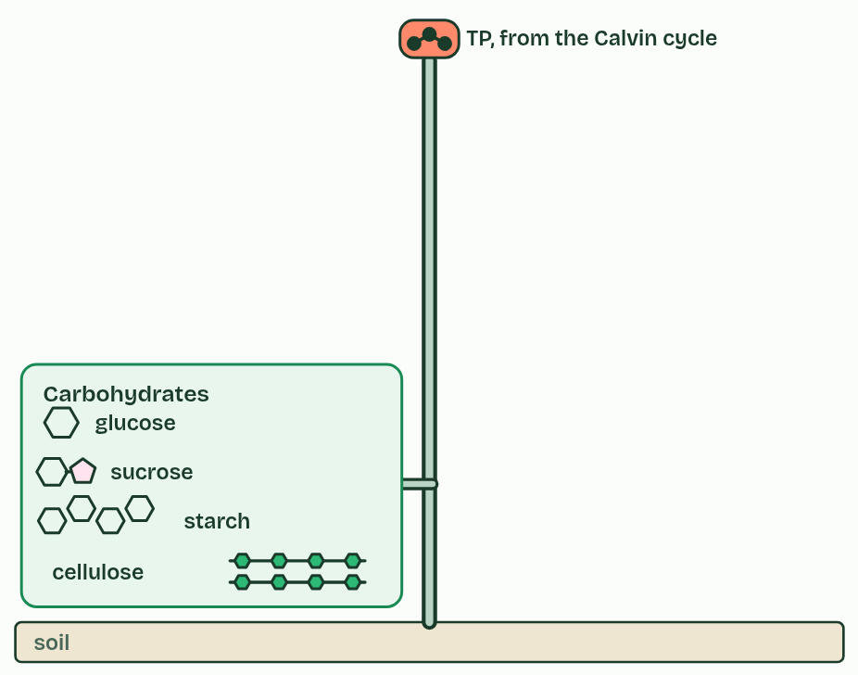
CHAPTER 14 · C1.3.18 Carbohydrates, amino acids and other compounds from the Calvin cycle
1 / 4
Every carbon came this way
From TP: sugars, starch and cellulose.
Minutes 29 to 35
Notes:
Minutes 29 to 35 of 60: Where the carbon goes (6 min).
The plan: Chapter 14: the predict, then the carbon trail on its Built into the plant route.
Every carbon atom in every compound of a photosynthesising organism was fixed in the Calvin cycle. Its other carbon compounds are made by metabolic pathways that can be traced back to triose phosphate, or to another intermediate of the cycle. You do not need the details of the pathways.
Carbohydrates come first: TP makes glucose, and glucose makes sucrose (the sugar carried in the phloem), starch (the store) and cellulose (the cell walls). Lipids follow: TP makes glycerol and, through the acetyl groups of respiration, fatty acids, which join into triglycerides and, with phosphate, into phospholipids.
Amino acids need nitrogen as well as carbon. It comes from nitrate (or ammonium) taken up from the soil, and two amino acids need sulfur too. Nucleotides need nitrogen for their bases and phosphorus for their phosphate. These mineral nutrients come in through the roots by active transport (B2.1).
Fixation in the Calvin cycle is how carbon enters every food web: the carbon fixed in a leaf ends up in the plant’s own body, in whatever eats it, or back in the air through respiration. The carbon trail below follows one atom.

Slide 32
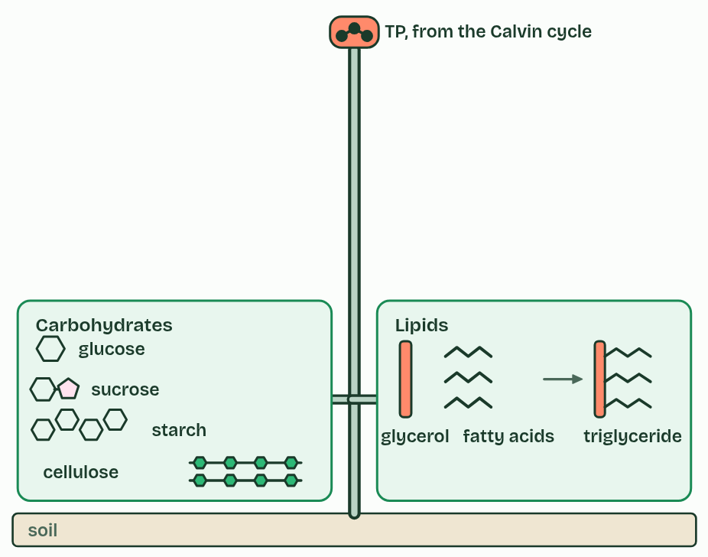
CHAPTER 14 · C1.3.18 Carbohydrates, amino acids and other compounds from the Calvin cycle
2 / 4
Every carbon came this way
Lipids.
Minutes 29 to 35
Notes:
Minutes 29 to 35 of 60: Where the carbon goes (6 min).
The plan: Chapter 14: the predict, then the carbon trail on its Built into the plant route.
Every carbon atom in every compound of a photosynthesising organism was fixed in the Calvin cycle. Its other carbon compounds are made by metabolic pathways that can be traced back to triose phosphate, or to another intermediate of the cycle. You do not need the details of the pathways.
Carbohydrates come first: TP makes glucose, and glucose makes sucrose (the sugar carried in the phloem), starch (the store) and cellulose (the cell walls). Lipids follow: TP makes glycerol and, through the acetyl groups of respiration, fatty acids, which join into triglycerides and, with phosphate, into phospholipids.
Amino acids need nitrogen as well as carbon. It comes from nitrate (or ammonium) taken up from the soil, and two amino acids need sulfur too. Nucleotides need nitrogen for their bases and phosphorus for their phosphate. These mineral nutrients come in through the roots by active transport (B2.1).
Fixation in the Calvin cycle is how carbon enters every food web: the carbon fixed in a leaf ends up in the plant’s own body, in whatever eats it, or back in the air through respiration. The carbon trail below follows one atom.

Slide 33
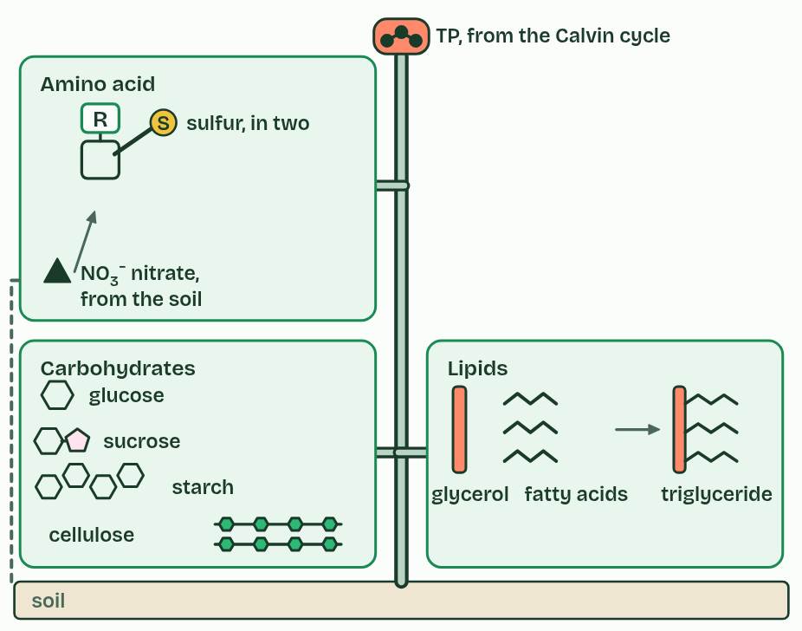
CHAPTER 14 · C1.3.18 Carbohydrates, amino acids and other compounds from the Calvin cycle
3 / 4
Every carbon came this way
Amino acids, with nitrogen from nitrate.
Minutes 29 to 35
Notes:
Minutes 29 to 35 of 60: Where the carbon goes (6 min).
The plan: Chapter 14: the predict, then the carbon trail on its Built into the plant route.
Every carbon atom in every compound of a photosynthesising organism was fixed in the Calvin cycle. Its other carbon compounds are made by metabolic pathways that can be traced back to triose phosphate, or to another intermediate of the cycle. You do not need the details of the pathways.
Carbohydrates come first: TP makes glucose, and glucose makes sucrose (the sugar carried in the phloem), starch (the store) and cellulose (the cell walls). Lipids follow: TP makes glycerol and, through the acetyl groups of respiration, fatty acids, which join into triglycerides and, with phosphate, into phospholipids.
Amino acids need nitrogen as well as carbon. It comes from nitrate (or ammonium) taken up from the soil, and two amino acids need sulfur too. Nucleotides need nitrogen for their bases and phosphorus for their phosphate. These mineral nutrients come in through the roots by active transport (B2.1).
Fixation in the Calvin cycle is how carbon enters every food web: the carbon fixed in a leaf ends up in the plant’s own body, in whatever eats it, or back in the air through respiration. The carbon trail below follows one atom.

Slide 34
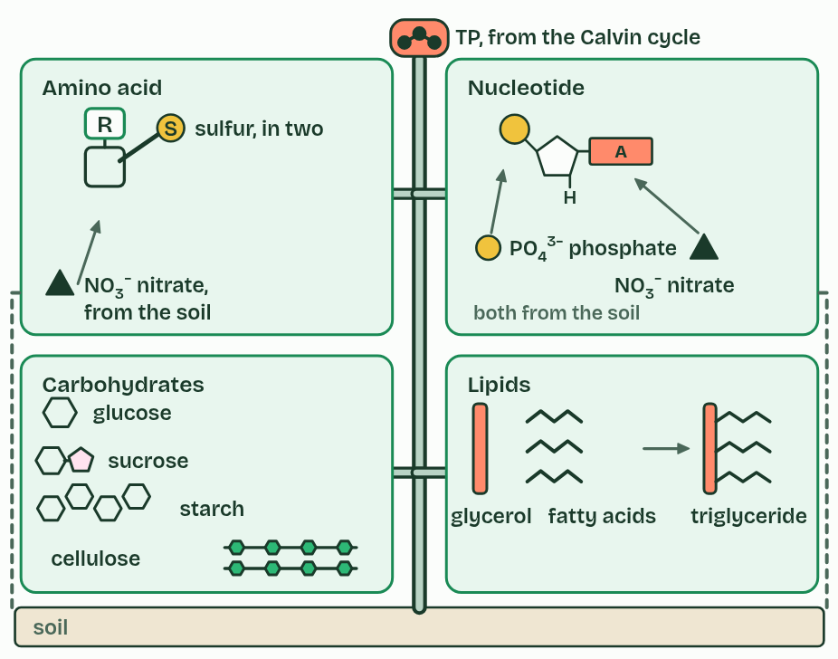
CHAPTER 14 · C1.3.18 Carbohydrates, amino acids and other compounds from the Calvin cycle
4 / 4
Every carbon came this way
Nucleotides, with nitrogen and phosphate.
Minutes 29 to 35
Notes:
Minutes 29 to 35 of 60: Where the carbon goes (6 min).
The plan: Chapter 14: the predict, then the carbon trail on its Built into the plant route.
Every carbon atom in every compound of a photosynthesising organism was fixed in the Calvin cycle. Its other carbon compounds are made by metabolic pathways that can be traced back to triose phosphate, or to another intermediate of the cycle. You do not need the details of the pathways.
Carbohydrates come first: TP makes glucose, and glucose makes sucrose (the sugar carried in the phloem), starch (the store) and cellulose (the cell walls). Lipids follow: TP makes glycerol and, through the acetyl groups of respiration, fatty acids, which join into triglycerides and, with phosphate, into phospholipids.
Amino acids need nitrogen as well as carbon. It comes from nitrate (or ammonium) taken up from the soil, and two amino acids need sulfur too. Nucleotides need nitrogen for their bases and phosphorus for their phosphate. These mineral nutrients come in through the roots by active transport (B2.1).
Fixation in the Calvin cycle is how carbon enters every food web: the carbon fixed in a leaf ends up in the plant’s own body, in whatever eats it, or back in the air through respiration. The carbon trail below follows one atom.

Slide 35
CHAPTER 14 · C1.3.18 Carbohydrates, amino acids and other compounds from the Calvin cycle
Every carbon came this way
All the carbon in a plant’s compounds was fixed in the Calvin cycle.
Sugars, starch, cellulose, lipids, amino acids and nucleotides are made by pathways that start from TP.
Amino acids and nucleotides also need mineral nutrients: nitrate, and phosphate.
Minutes 29 to 35
Notes:
Minutes 29 to 35 of 60: Where the carbon goes (6 min).
The plan: Chapter 14: the predict, then the carbon trail on its Built into the plant route.
Every carbon atom in every compound of a photosynthesising organism was fixed in the Calvin cycle. Its other carbon compounds are made by metabolic pathways that can be traced back to triose phosphate, or to another intermediate of the cycle. You do not need the details of the pathways.
Carbohydrates come first: TP makes glucose, and glucose makes sucrose (the sugar carried in the phloem), starch (the store) and cellulose (the cell walls). Lipids follow: TP makes glycerol and, through the acetyl groups of respiration, fatty acids, which join into triglycerides and, with phosphate, into phospholipids.
Amino acids need nitrogen as well as carbon. It comes from nitrate (or ammonium) taken up from the soil, and two amino acids need sulfur too. Nucleotides need nitrogen for their bases and phosphorus for their phosphate. These mineral nutrients come in through the roots by active transport (B2.1).
Fixation in the Calvin cycle is how carbon enters every food web: the carbon fixed in a leaf ends up in the plant’s own body, in whatever eats it, or back in the air through respiration. The carbon trail below follows one atom.

Slide 36
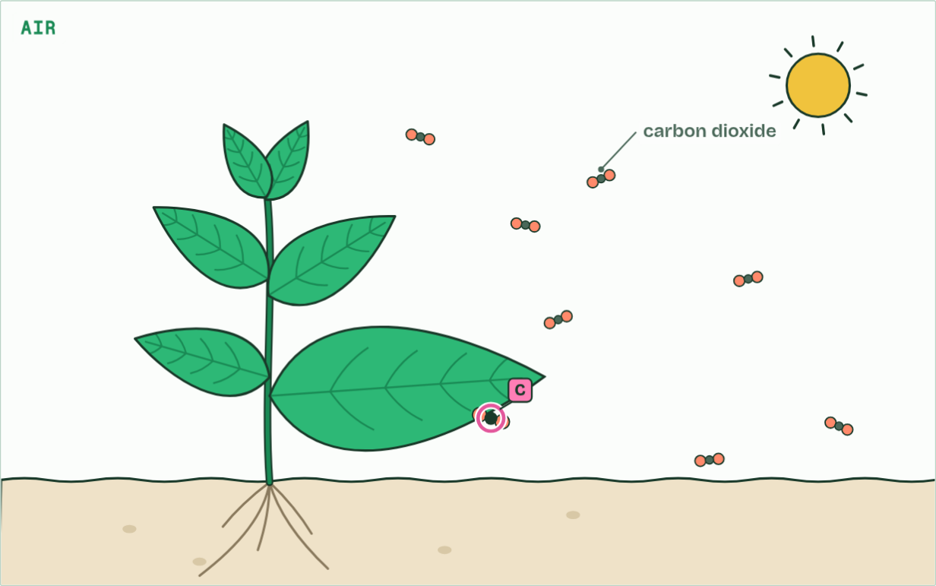
CHAPTER 14 · C1.3.18 Carbohydrates, amino acids and other compounds from the Calvin cycle
Air
1 / 6
Every carbon came this way
One carbon atom, in a molecule of carbon dioxide in the air.
Minutes 29 to 35
Notes:
Minutes 29 to 35 of 60: Where the carbon goes (6 min).
The plan: Chapter 14: the predict, then the carbon trail on its Built into the plant route.
Every carbon atom in every compound of a photosynthesising organism was fixed in the Calvin cycle. Its other carbon compounds are made by metabolic pathways that can be traced back to triose phosphate, or to another intermediate of the cycle. You do not need the details of the pathways.
Carbohydrates come first: TP makes glucose, and glucose makes sucrose (the sugar carried in the phloem), starch (the store) and cellulose (the cell walls). Lipids follow: TP makes glycerol and, through the acetyl groups of respiration, fatty acids, which join into triglycerides and, with phosphate, into phospholipids.
Amino acids need nitrogen as well as carbon. It comes from nitrate (or ammonium) taken up from the soil, and two amino acids need sulfur too. Nucleotides need nitrogen for their bases and phosphorus for their phosphate. These mineral nutrients come in through the roots by active transport (B2.1).
Fixation in the Calvin cycle is how carbon enters every food web: the carbon fixed in a leaf ends up in the plant’s own body, in whatever eats it, or back in the air through respiration. The carbon trail below follows one atom.
The animation "Follow one carbon atom", paused at 3.0 s. The next slides go on through it, then play it.

Slide 37
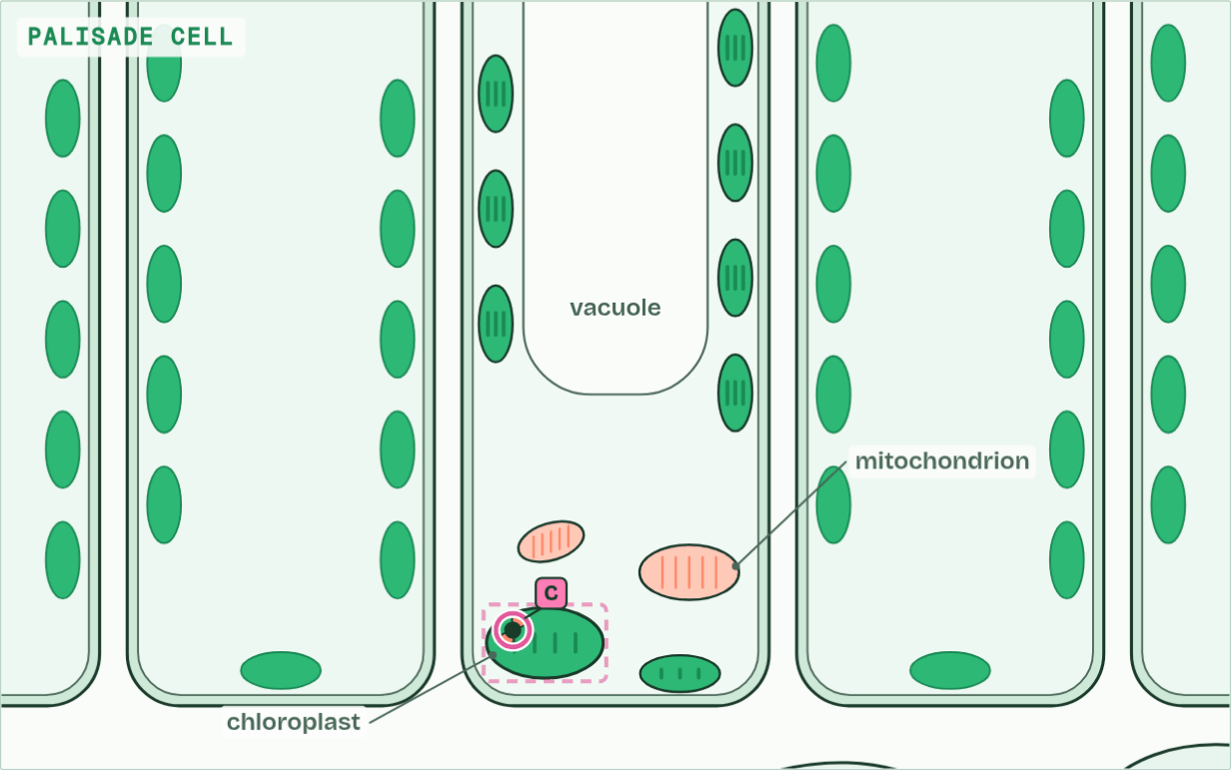
CHAPTER 14 · C1.3.18 Carbohydrates, amino acids and other compounds from the Calvin cycle
Chloroplast
2 / 6
Every carbon came this way
It diffuses in through a stoma and into a chloroplast.
Minutes 29 to 35
Notes:
Minutes 29 to 35 of 60: Where the carbon goes (6 min).
The plan: Chapter 14: the predict, then the carbon trail on its Built into the plant route.
Every carbon atom in every compound of a photosynthesising organism was fixed in the Calvin cycle. Its other carbon compounds are made by metabolic pathways that can be traced back to triose phosphate, or to another intermediate of the cycle. You do not need the details of the pathways.
Carbohydrates come first: TP makes glucose, and glucose makes sucrose (the sugar carried in the phloem), starch (the store) and cellulose (the cell walls). Lipids follow: TP makes glycerol and, through the acetyl groups of respiration, fatty acids, which join into triglycerides and, with phosphate, into phospholipids.
Amino acids need nitrogen as well as carbon. It comes from nitrate (or ammonium) taken up from the soil, and two amino acids need sulfur too. Nucleotides need nitrogen for their bases and phosphorus for their phosphate. These mineral nutrients come in through the roots by active transport (B2.1).
Fixation in the Calvin cycle is how carbon enters every food web: the carbon fixed in a leaf ends up in the plant’s own body, in whatever eats it, or back in the air through respiration. The carbon trail below follows one atom.
The animation "Follow one carbon atom", paused at 9.0 s. The next slides go on through it, then play it.

Slide 38
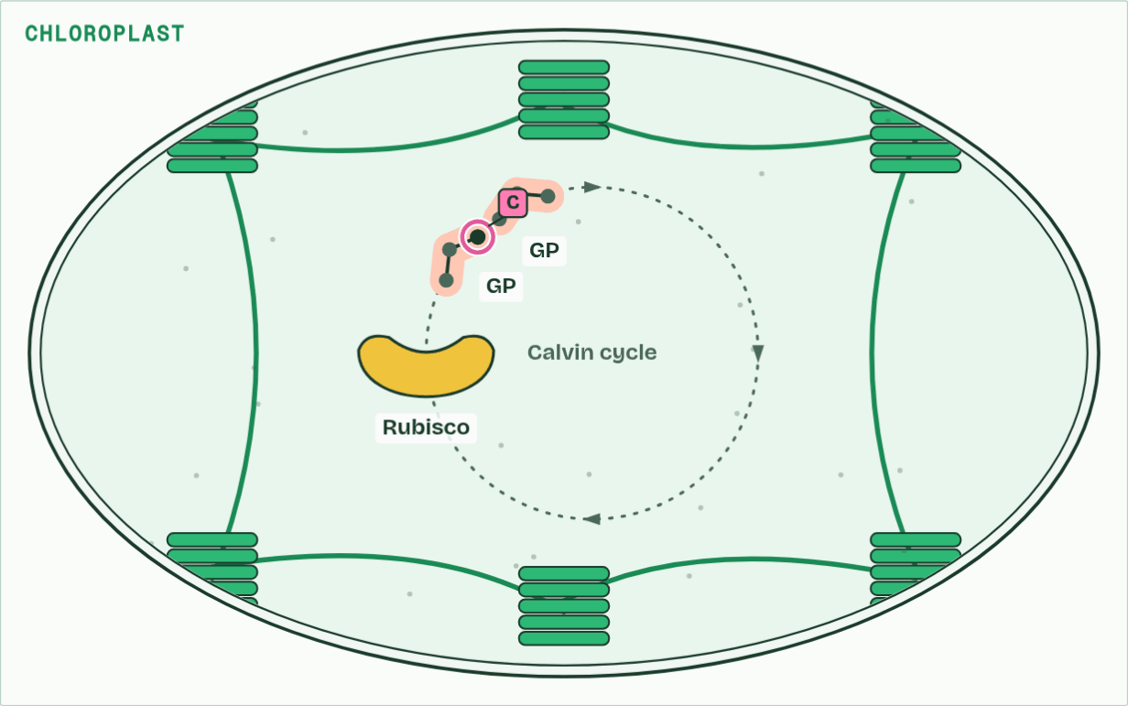
CHAPTER 14 · C1.3.18 Carbohydrates, amino acids and other compounds from the Calvin cycle
Chloroplast
3 / 6
Every carbon came this way
Rubisco joins the CO2 to RuBP; the product splits into two molecules of GP.
Minutes 29 to 35
Notes:
Minutes 29 to 35 of 60: Where the carbon goes (6 min).
The plan: Chapter 14: the predict, then the carbon trail on its Built into the plant route.
Every carbon atom in every compound of a photosynthesising organism was fixed in the Calvin cycle. Its other carbon compounds are made by metabolic pathways that can be traced back to triose phosphate, or to another intermediate of the cycle. You do not need the details of the pathways.
Carbohydrates come first: TP makes glucose, and glucose makes sucrose (the sugar carried in the phloem), starch (the store) and cellulose (the cell walls). Lipids follow: TP makes glycerol and, through the acetyl groups of respiration, fatty acids, which join into triglycerides and, with phosphate, into phospholipids.
Amino acids need nitrogen as well as carbon. It comes from nitrate (or ammonium) taken up from the soil, and two amino acids need sulfur too. Nucleotides need nitrogen for their bases and phosphorus for their phosphate. These mineral nutrients come in through the roots by active transport (B2.1).
Fixation in the Calvin cycle is how carbon enters every food web: the carbon fixed in a leaf ends up in the plant’s own body, in whatever eats it, or back in the air through respiration. The carbon trail below follows one atom.
The animation "Follow one carbon atom", paused at 14.0 s. The next slides go on through it, then play it.

Slide 39
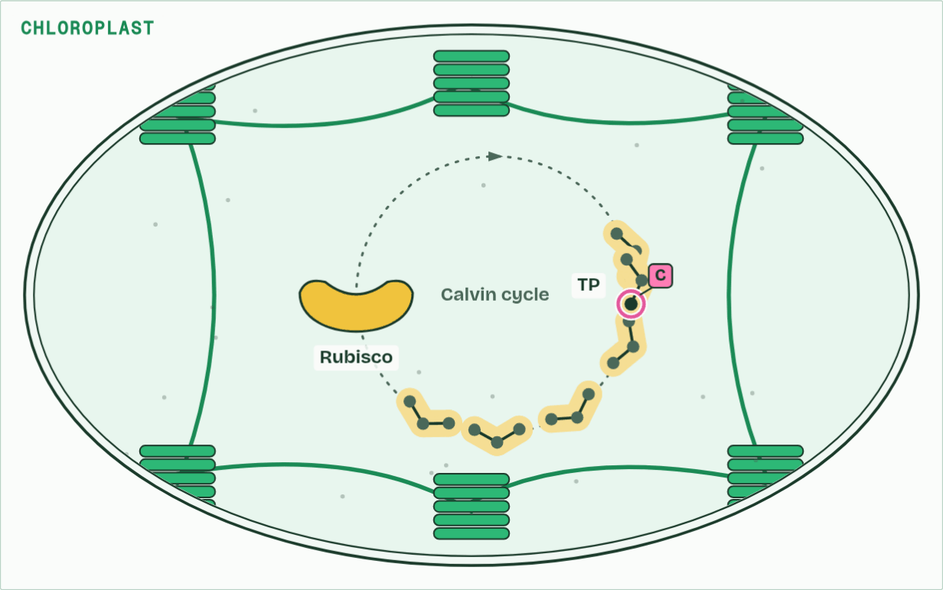
CHAPTER 14 · C1.3.18 Carbohydrates, amino acids and other compounds from the Calvin cycle
Chloroplast
4 / 6
Every carbon came this way
GP is reduced to TP with ATP and reduced NADP. One TP in six leaves the cycle; the rest remake RuBP.
Minutes 29 to 35
Notes:
Minutes 29 to 35 of 60: Where the carbon goes (6 min).
The plan: Chapter 14: the predict, then the carbon trail on its Built into the plant route.
Every carbon atom in every compound of a photosynthesising organism was fixed in the Calvin cycle. Its other carbon compounds are made by metabolic pathways that can be traced back to triose phosphate, or to another intermediate of the cycle. You do not need the details of the pathways.
Carbohydrates come first: TP makes glucose, and glucose makes sucrose (the sugar carried in the phloem), starch (the store) and cellulose (the cell walls). Lipids follow: TP makes glycerol and, through the acetyl groups of respiration, fatty acids, which join into triglycerides and, with phosphate, into phospholipids.
Amino acids need nitrogen as well as carbon. It comes from nitrate (or ammonium) taken up from the soil, and two amino acids need sulfur too. Nucleotides need nitrogen for their bases and phosphorus for their phosphate. These mineral nutrients come in through the roots by active transport (B2.1).
Fixation in the Calvin cycle is how carbon enters every food web: the carbon fixed in a leaf ends up in the plant’s own body, in whatever eats it, or back in the air through respiration. The carbon trail below follows one atom.
The animation "Follow one carbon atom", paused at 20.0 s. The next slides go on through it, then play it.

Slide 40
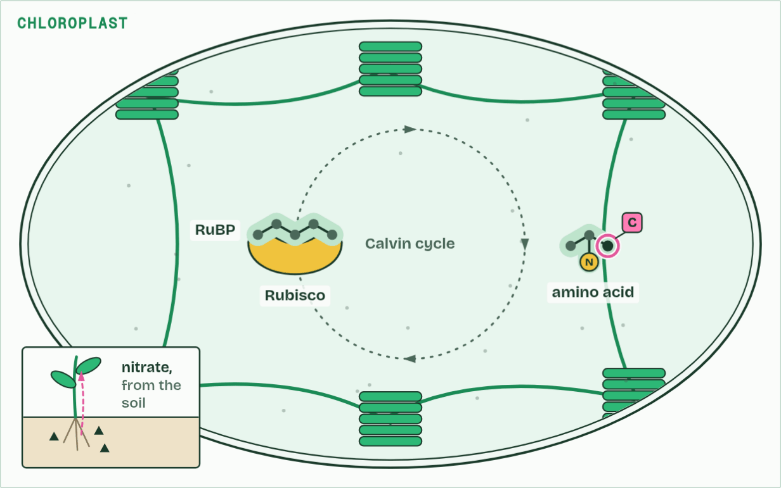
CHAPTER 14 · C1.3.18 Carbohydrates, amino acids and other compounds from the Calvin cycle
Chloroplast
5 / 6
Every carbon came this way
Every carbon compound in the plant is made from the Calvin cycle’s products. Here, with nitrogen from nitrate in the soil, an amino acid.
Minutes 29 to 35
Notes:
Minutes 29 to 35 of 60: Where the carbon goes (6 min).
The plan: Chapter 14: the predict, then the carbon trail on its Built into the plant route.
Every carbon atom in every compound of a photosynthesising organism was fixed in the Calvin cycle. Its other carbon compounds are made by metabolic pathways that can be traced back to triose phosphate, or to another intermediate of the cycle. You do not need the details of the pathways.
Carbohydrates come first: TP makes glucose, and glucose makes sucrose (the sugar carried in the phloem), starch (the store) and cellulose (the cell walls). Lipids follow: TP makes glycerol and, through the acetyl groups of respiration, fatty acids, which join into triglycerides and, with phosphate, into phospholipids.
Amino acids need nitrogen as well as carbon. It comes from nitrate (or ammonium) taken up from the soil, and two amino acids need sulfur too. Nucleotides need nitrogen for their bases and phosphorus for their phosphate. These mineral nutrients come in through the roots by active transport (B2.1).
Fixation in the Calvin cycle is how carbon enters every food web: the carbon fixed in a leaf ends up in the plant’s own body, in whatever eats it, or back in the air through respiration. The carbon trail below follows one atom.
The animation "Follow one carbon atom", paused at 26.0 s. The next slides go on through it, then play it.

Slide 41
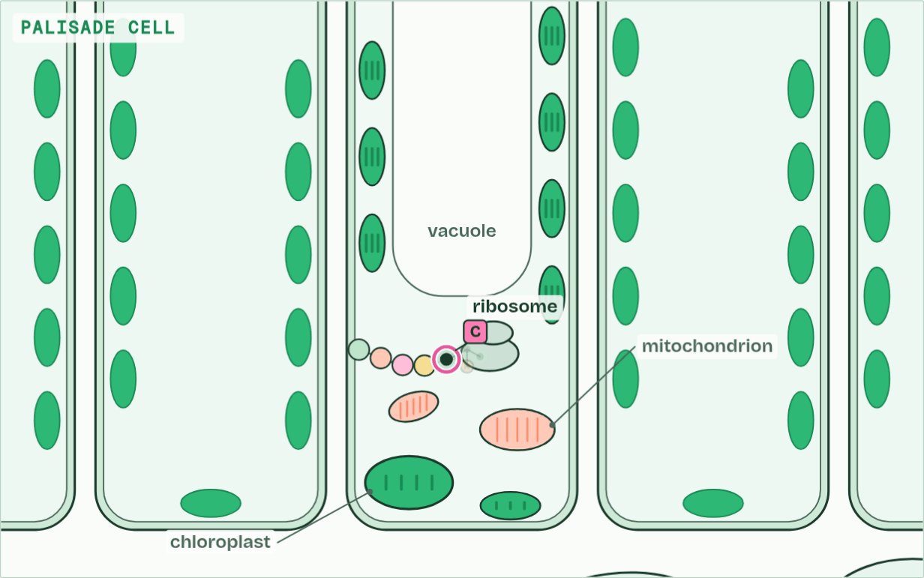
CHAPTER 14 · C1.3.18 Carbohydrates, amino acids and other compounds from the Calvin cycle
Cytoplasm
6 / 6
Every carbon came this way
Joined into a protein, the atom stays in the plant until the plant, or whatever eats it, respires it.
Minutes 29 to 35
Notes:
Minutes 29 to 35 of 60: Where the carbon goes (6 min).
The plan: Chapter 14: the predict, then the carbon trail on its Built into the plant route.
Every carbon atom in every compound of a photosynthesising organism was fixed in the Calvin cycle. Its other carbon compounds are made by metabolic pathways that can be traced back to triose phosphate, or to another intermediate of the cycle. You do not need the details of the pathways.
Carbohydrates come first: TP makes glucose, and glucose makes sucrose (the sugar carried in the phloem), starch (the store) and cellulose (the cell walls). Lipids follow: TP makes glycerol and, through the acetyl groups of respiration, fatty acids, which join into triglycerides and, with phosphate, into phospholipids.
Amino acids need nitrogen as well as carbon. It comes from nitrate (or ammonium) taken up from the soil, and two amino acids need sulfur too. Nucleotides need nitrogen for their bases and phosphorus for their phosphate. These mineral nutrients come in through the roots by active transport (B2.1).
Fixation in the Calvin cycle is how carbon enters every food web: the carbon fixed in a leaf ends up in the plant’s own body, in whatever eats it, or back in the air through respiration. The carbon trail below follows one atom.
The animation "Follow one carbon atom", paused at 33.0 s. The next slides go on through it, then play it.

Slide 42
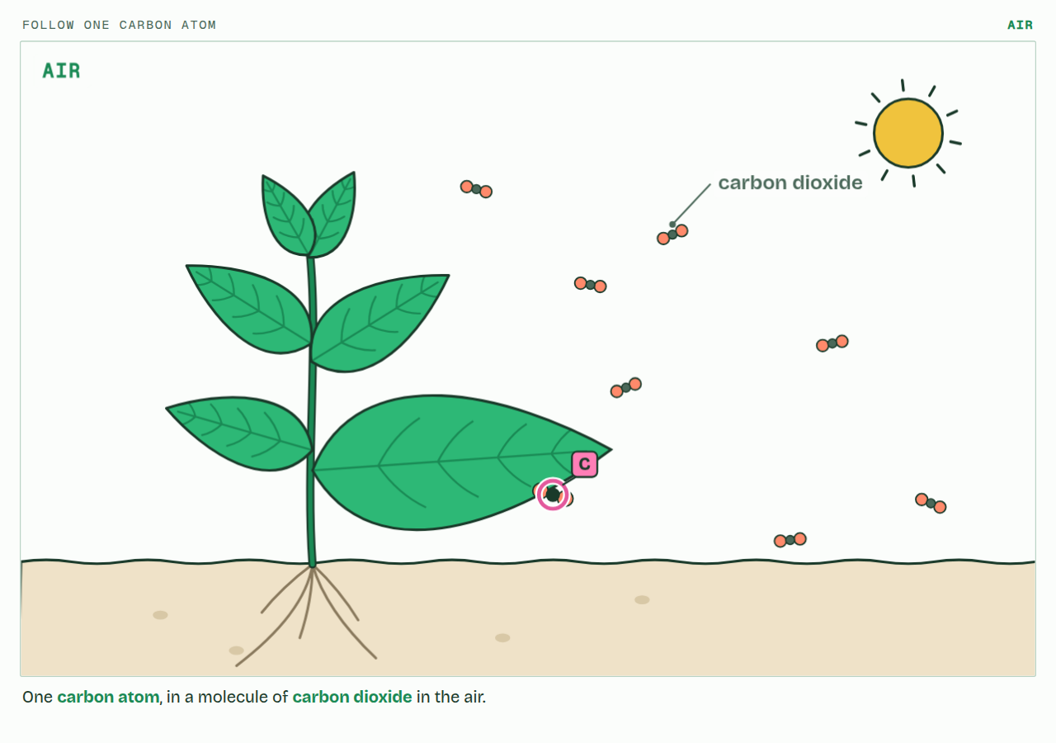
CHAPTER 14 · C1.3.18 Carbohydrates, amino acids and other compounds from the Calvin cycle
PLAY IT
Every carbon came this way
Follow one carbon atom: click to play. It loops every 36 seconds.
Minutes 29 to 35
Notes:
Minutes 29 to 35 of 60: Where the carbon goes (6 min).
The plan: Chapter 14: the predict, then the carbon trail on its Built into the plant route.
The video is carbon-7b890a.mp4, one loop of the animation in the guide. It plays in PowerPoint and Keynote. Google Slides does not play a video embedded in a .pptx: download carbon-7b890a.mp4 (https://www.biologybybradford.com/guides/downloads/scenes/carbon-7b890a.mp4), upload it to Google Drive, then Insert > Video > Google Drive.
In the guide the class can change it as it runs: https://www.biologybybradford.com/guides/ib-biology-c1-3-photosynthesis#products
What it shows, in order:
1. One carbon atom, in a molecule of carbon dioxide in the air.
2. It diffuses in through a stoma and into a chloroplast.
3. Rubisco joins the CO2 to RuBP; the product splits into two molecules of GP.
4. GP is reduced to TP with ATP and reduced NADP. One TP in six leaves the cycle; the rest remake RuBP.
5. Every carbon compound in the plant is made from the Calvin cycle’s products. Here, with nitrogen from nitrate in the soil, an amino acid.
6. Joined into a protein, the atom stays in the plant until the plant, or whatever eats it, respires it.

Slide 43
PREDICT
A plant has plenty of light, water and carbon dioxide, but its soil has no nitrate. Which will it fail to make?
A Proteins
B Starch
C Cellulose
D Sucrose
Minutes 29 to 35
Notes:
Minutes 29 to 35 of 60: Where the carbon goes (6 min).
The plan: Chapter 14: the predict, then the carbon trail on its Built into the plant route.
Ask for a show of hands, or mini whiteboards, before revealing. (Answer: A, on the next slide.)

Slide 44
WHAT HAPPENS
A plant has plenty of light, water and carbon dioxide, but its soil has no nitrate. Which will it fail to make?
A Proteins
B Starch
C Cellulose
D Sucrose
Proteins. Their amino acids need nitrogen, and nitrate is the plant’s source of it. It can still fix carbon and make sugars, starch and cellulose, but it cannot build enzymes, Rubisco included, so it soon grows poorly and its leaves yellow.
Minutes 29 to 35
Notes:
Minutes 29 to 35 of 60: Where the carbon goes (6 min).
The plan: Chapter 14: the predict, then the carbon trail on its Built into the plant route.
Answer: A. Proteins. Their amino acids need nitrogen, and nitrate is the plant’s source of it. It can still fix carbon and make sugars, starch and cellulose, but it cannot build enzymes, Rubisco included, so it soon grows poorly and its leaves yellow.

Slide 45
WATCH OUT
Plants do not take carbon from the soil. Every carbon atom came from carbon dioxide, in the air or dissolved in water, through the Calvin cycle.
Minutes 29 to 35
Notes:
Minutes 29 to 35 of 60: Where the carbon goes (6 min).
The plan: Chapter 14: the predict, then the carbon trail on its Built into the plant route.
A common mistake: say it, then ask who can say why it is wrong.

Slide 46
STEP 5
10 MIN
Each half needs the other
Chapter 15: Each half needs the other
Diagram: Improve the diagram
Minutes 35 to 45
Notes:
Minutes 35 to 45 of 60: Each half needs the other (10 min).
The plan: Chapter 15: the predict, the figure’s three states, then the photosynthesis film, HL, with the light off and then the carbon dioxide off. The metabolism map’s Follow a molecule, on ATP.

Slide 47
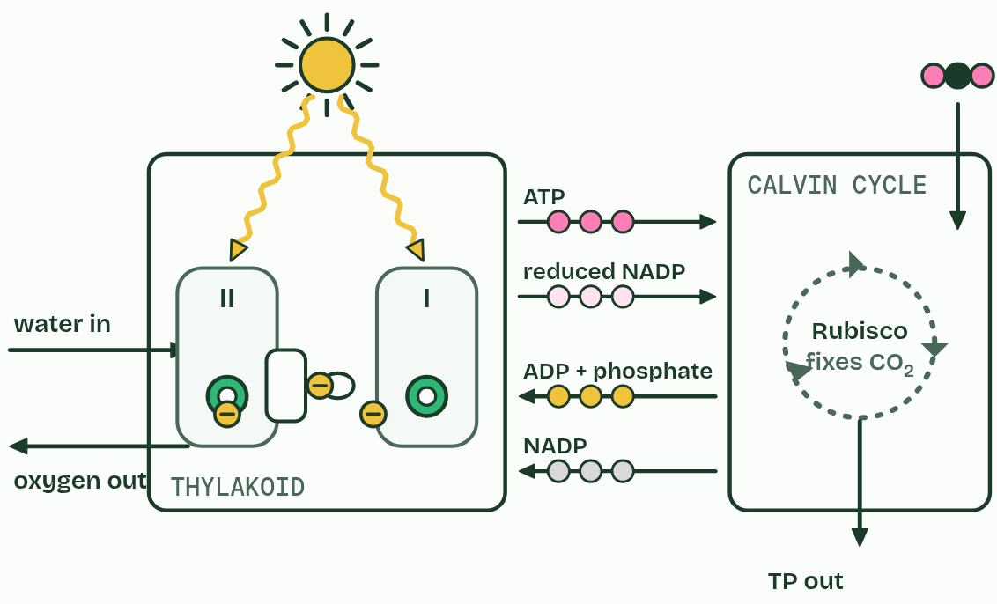
CHAPTER 15 · C1.3.19 Interdependence of the light-dependent and light-independent reactions
1 / 3
Each half needs the other
Light and carbon dioxide
Minutes 35 to 45
Notes:
Minutes 35 to 45 of 60: Each half needs the other (10 min).
The plan: Chapter 15: the predict, the figure’s three states, then the photosynthesis film, HL, with the light off and then the carbon dioxide off. The metabolism map’s Follow a molecule, on ATP.
The light-dependent reactions in the thylakoids make ATP and reduced NADP. The light-independent reactions, the Calvin cycle in the stroma, use them and hand back ADP, phosphate and NADP. Each half needs what the other makes: that is their interdependence.
No light. The photosystems are not excited, so no ATP or reduced NADP is made. The Calvin cycle runs on for a few seconds on what is left, then stops.
No carbon dioxide. The Calvin cycle cannot fix carbon, so it stops using ATP and reduced NADP, and no NADP comes back. Once all the stroma’s NADP is reduced, photosystem I has nothing to pass its electrons to. The chain backs up, and photosystem II cannot pass its electrons on, so it stops, and so does photolysis.
So a leaf’s two halves run at the pace of the slower one, which links back to limiting factors (chapter 6). In bright light, carbon dioxide or Rubisco limits the rate; in dim light, the light-dependent reactions do. And a plant in the dark still respires. Everything in Unit 4 so far is on one map below, the metabolism map, where you can see both.

Slide 48
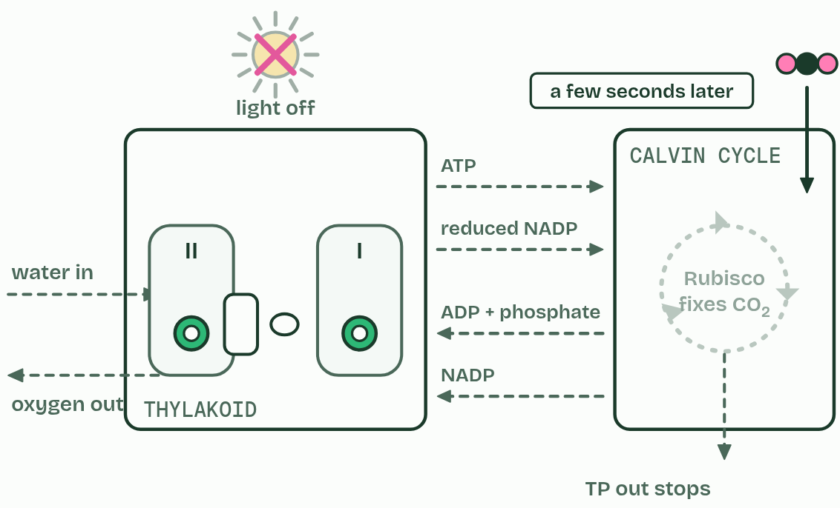
CHAPTER 15 · C1.3.19 Interdependence of the light-dependent and light-independent reactions
2 / 3
Each half needs the other
Lights off
Minutes 35 to 45
Notes:
Minutes 35 to 45 of 60: Each half needs the other (10 min).
The plan: Chapter 15: the predict, the figure’s three states, then the photosynthesis film, HL, with the light off and then the carbon dioxide off. The metabolism map’s Follow a molecule, on ATP.
The light-dependent reactions in the thylakoids make ATP and reduced NADP. The light-independent reactions, the Calvin cycle in the stroma, use them and hand back ADP, phosphate and NADP. Each half needs what the other makes: that is their interdependence.
No light. The photosystems are not excited, so no ATP or reduced NADP is made. The Calvin cycle runs on for a few seconds on what is left, then stops.
No carbon dioxide. The Calvin cycle cannot fix carbon, so it stops using ATP and reduced NADP, and no NADP comes back. Once all the stroma’s NADP is reduced, photosystem I has nothing to pass its electrons to. The chain backs up, and photosystem II cannot pass its electrons on, so it stops, and so does photolysis.
So a leaf’s two halves run at the pace of the slower one, which links back to limiting factors (chapter 6). In bright light, carbon dioxide or Rubisco limits the rate; in dim light, the light-dependent reactions do. And a plant in the dark still respires. Everything in Unit 4 so far is on one map below, the metabolism map, where you can see both.

Slide 49
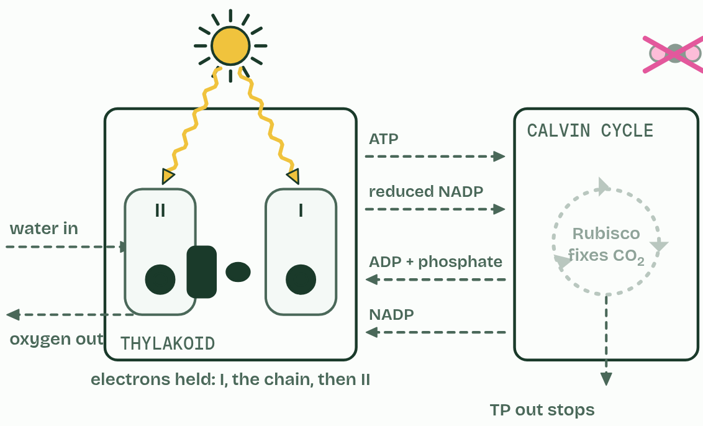
CHAPTER 15 · C1.3.19 Interdependence of the light-dependent and light-independent reactions
3 / 3
Each half needs the other
No carbon dioxide
Minutes 35 to 45
Notes:
Minutes 35 to 45 of 60: Each half needs the other (10 min).
The plan: Chapter 15: the predict, the figure’s three states, then the photosynthesis film, HL, with the light off and then the carbon dioxide off. The metabolism map’s Follow a molecule, on ATP.
The light-dependent reactions in the thylakoids make ATP and reduced NADP. The light-independent reactions, the Calvin cycle in the stroma, use them and hand back ADP, phosphate and NADP. Each half needs what the other makes: that is their interdependence.
No light. The photosystems are not excited, so no ATP or reduced NADP is made. The Calvin cycle runs on for a few seconds on what is left, then stops.
No carbon dioxide. The Calvin cycle cannot fix carbon, so it stops using ATP and reduced NADP, and no NADP comes back. Once all the stroma’s NADP is reduced, photosystem I has nothing to pass its electrons to. The chain backs up, and photosystem II cannot pass its electrons on, so it stops, and so does photolysis.
So a leaf’s two halves run at the pace of the slower one, which links back to limiting factors (chapter 6). In bright light, carbon dioxide or Rubisco limits the rate; in dim light, the light-dependent reactions do. And a plant in the dark still respires. Everything in Unit 4 so far is on one map below, the metabolism map, where you can see both.

Slide 50
CHAPTER 15 · C1.3.19 Interdependence of the light-dependent and light-independent reactions
Each half needs the other
Light-dependent reactions make ATP and reduced NADP; the Calvin cycle uses them and returns ADP, phosphate and NADP.
No light: the Calvin cycle stops a few seconds later.
No carbon dioxide: NADP is not returned, so photosystem I fills, then the chain, then photosystem II stops.
Minutes 35 to 45
Notes:
Minutes 35 to 45 of 60: Each half needs the other (10 min).
The plan: Chapter 15: the predict, the figure’s three states, then the photosynthesis film, HL, with the light off and then the carbon dioxide off. The metabolism map’s Follow a molecule, on ATP.
The light-dependent reactions in the thylakoids make ATP and reduced NADP. The light-independent reactions, the Calvin cycle in the stroma, use them and hand back ADP, phosphate and NADP. Each half needs what the other makes: that is their interdependence.
No light. The photosystems are not excited, so no ATP or reduced NADP is made. The Calvin cycle runs on for a few seconds on what is left, then stops.
No carbon dioxide. The Calvin cycle cannot fix carbon, so it stops using ATP and reduced NADP, and no NADP comes back. Once all the stroma’s NADP is reduced, photosystem I has nothing to pass its electrons to. The chain backs up, and photosystem II cannot pass its electrons on, so it stops, and so does photolysis.
So a leaf’s two halves run at the pace of the slower one, which links back to limiting factors (chapter 6). In bright light, carbon dioxide or Rubisco limits the rate; in dim light, the light-dependent reactions do. And a plant in the dark still respires. Everything in Unit 4 so far is on one map below, the metabolism map, where you can see both.

Slide 51
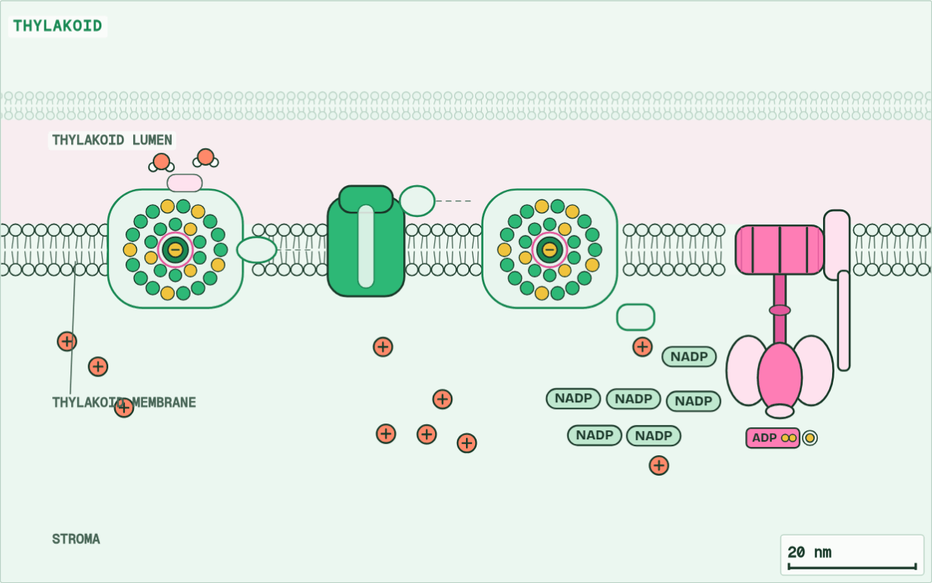
CHAPTER 15 · C1.3.19 Interdependence of the light-dependent and light-independent reactions
Thylakoid
1 / 10
Each half needs the other
Into a leaf, a palisade cell, a chloroplast, and one thylakoid membrane.
Minutes 35 to 45
Notes:
Minutes 35 to 45 of 60: Each half needs the other (10 min).
The plan: Chapter 15: the predict, the figure’s three states, then the photosynthesis film, HL, with the light off and then the carbon dioxide off. The metabolism map’s Follow a molecule, on ATP.
The light-dependent reactions in the thylakoids make ATP and reduced NADP. The light-independent reactions, the Calvin cycle in the stroma, use them and hand back ADP, phosphate and NADP. Each half needs what the other makes: that is their interdependence.
No light. The photosystems are not excited, so no ATP or reduced NADP is made. The Calvin cycle runs on for a few seconds on what is left, then stops.
No carbon dioxide. The Calvin cycle cannot fix carbon, so it stops using ATP and reduced NADP, and no NADP comes back. Once all the stroma’s NADP is reduced, photosystem I has nothing to pass its electrons to. The chain backs up, and photosystem II cannot pass its electrons on, so it stops, and so does photolysis.
So a leaf’s two halves run at the pace of the slower one, which links back to limiting factors (chapter 6). In bright light, carbon dioxide or Rubisco limits the rate; in dim light, the light-dependent reactions do. And a plant in the dark still respires. Everything in Unit 4 so far is on one map below, the metabolism map, where you can see both.
The animation "Photosynthesis, the whole system", paused at 8.9 s. The next slides go on through it, then play it.

Slide 52
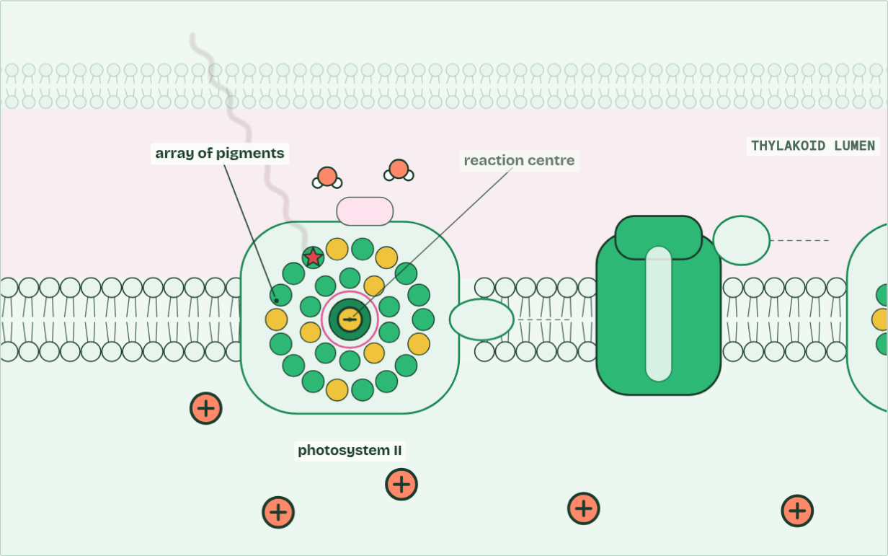
CHAPTER 15 · C1.3.19 Interdependence of the light-dependent and light-independent reactions
H+ in the lumen 0 · ATP 0 · O2 0
2 / 10
Each half needs the other
Light energy passes through an array of pigments to the reaction centre, which emits an excited electron.
Minutes 35 to 45
Notes:
Minutes 35 to 45 of 60: Each half needs the other (10 min).
The plan: Chapter 15: the predict, the figure’s three states, then the photosynthesis film, HL, with the light off and then the carbon dioxide off. The metabolism map’s Follow a molecule, on ATP.
The light-dependent reactions in the thylakoids make ATP and reduced NADP. The light-independent reactions, the Calvin cycle in the stroma, use them and hand back ADP, phosphate and NADP. Each half needs what the other makes: that is their interdependence.
No light. The photosystems are not excited, so no ATP or reduced NADP is made. The Calvin cycle runs on for a few seconds on what is left, then stops.
No carbon dioxide. The Calvin cycle cannot fix carbon, so it stops using ATP and reduced NADP, and no NADP comes back. Once all the stroma’s NADP is reduced, photosystem I has nothing to pass its electrons to. The chain backs up, and photosystem II cannot pass its electrons on, so it stops, and so does photolysis.
So a leaf’s two halves run at the pace of the slower one, which links back to limiting factors (chapter 6). In bright light, carbon dioxide or Rubisco limits the rate; in dim light, the light-dependent reactions do. And a plant in the dark still respires. Everything in Unit 4 so far is on one map below, the metabolism map, where you can see both.
The animation "Photosynthesis, the whole system", paused at 13.0 s. The next slides go on through it, then play it.

Slide 53
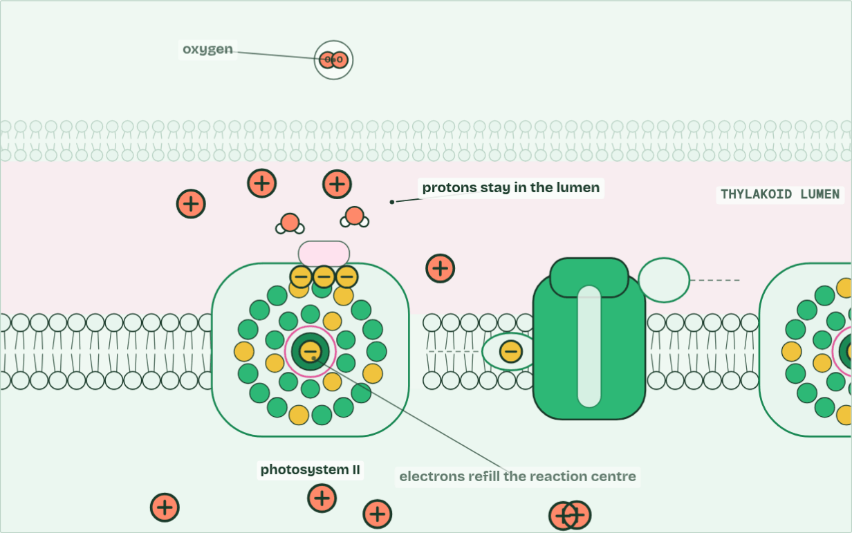
CHAPTER 15 · C1.3.19 Interdependence of the light-dependent and light-independent reactions
H+ in the lumen 4 · ATP 0 · O2 1
3 / 10
Each half needs the other
Photolysis: water is split. Its electrons refill photosystem II, its protons stay in the lumen, and its oxygen is a waste product.
Minutes 35 to 45
Notes:
Minutes 35 to 45 of 60: Each half needs the other (10 min).
The plan: Chapter 15: the predict, the figure’s three states, then the photosynthesis film, HL, with the light off and then the carbon dioxide off. The metabolism map’s Follow a molecule, on ATP.
The light-dependent reactions in the thylakoids make ATP and reduced NADP. The light-independent reactions, the Calvin cycle in the stroma, use them and hand back ADP, phosphate and NADP. Each half needs what the other makes: that is their interdependence.
No light. The photosystems are not excited, so no ATP or reduced NADP is made. The Calvin cycle runs on for a few seconds on what is left, then stops.
No carbon dioxide. The Calvin cycle cannot fix carbon, so it stops using ATP and reduced NADP, and no NADP comes back. Once all the stroma’s NADP is reduced, photosystem I has nothing to pass its electrons to. The chain backs up, and photosystem II cannot pass its electrons on, so it stops, and so does photolysis.
So a leaf’s two halves run at the pace of the slower one, which links back to limiting factors (chapter 6). In bright light, carbon dioxide or Rubisco limits the rate; in dim light, the light-dependent reactions do. And a plant in the dark still respires. Everything in Unit 4 so far is on one map below, the metabolism map, where you can see both.
The animation "Photosynthesis, the whole system", paused at 21.0 s. The next slides go on through it, then play it.

Slide 54
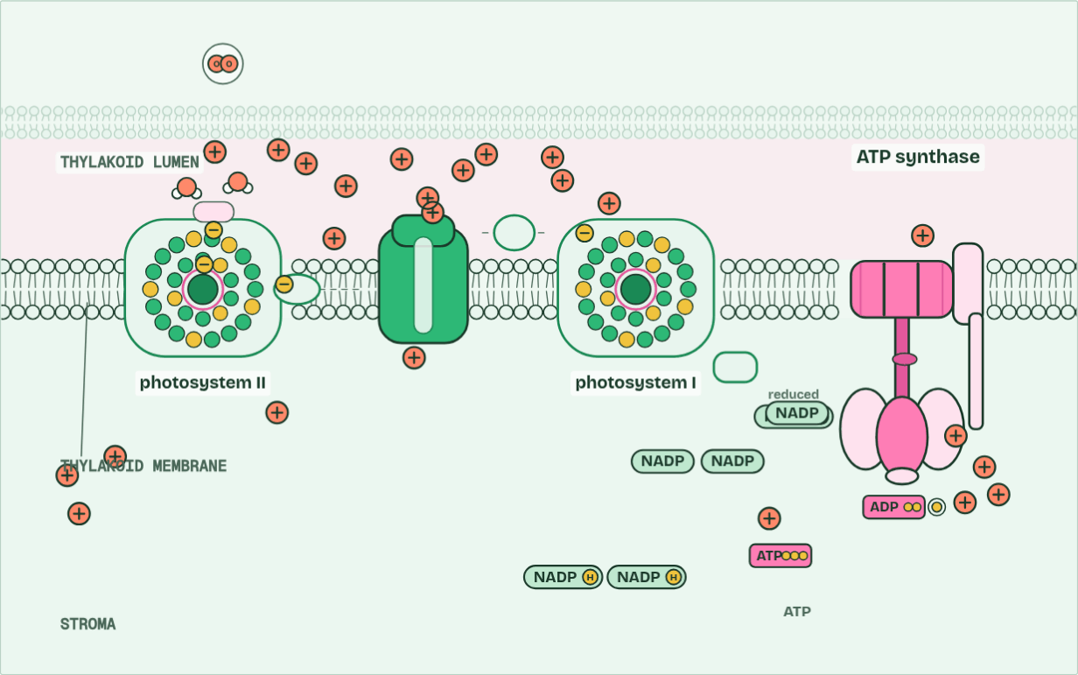
CHAPTER 15 · C1.3.19 Interdependence of the light-dependent and light-independent reactions
H+ in the lumen 14 · ATP 1 · O2 2
4 / 10
Each half needs the other
Electrons passing along the chain pump protons into the lumen; protons flowing back through ATP synthase make ATP.
Minutes 35 to 45
Notes:
Minutes 35 to 45 of 60: Each half needs the other (10 min).
The plan: Chapter 15: the predict, the figure’s three states, then the photosynthesis film, HL, with the light off and then the carbon dioxide off. The metabolism map’s Follow a molecule, on ATP.
The light-dependent reactions in the thylakoids make ATP and reduced NADP. The light-independent reactions, the Calvin cycle in the stroma, use them and hand back ADP, phosphate and NADP. Each half needs what the other makes: that is their interdependence.
No light. The photosystems are not excited, so no ATP or reduced NADP is made. The Calvin cycle runs on for a few seconds on what is left, then stops.
No carbon dioxide. The Calvin cycle cannot fix carbon, so it stops using ATP and reduced NADP, and no NADP comes back. Once all the stroma’s NADP is reduced, photosystem I has nothing to pass its electrons to. The chain backs up, and photosystem II cannot pass its electrons on, so it stops, and so does photolysis.
So a leaf’s two halves run at the pace of the slower one, which links back to limiting factors (chapter 6). In bright light, carbon dioxide or Rubisco limits the rate; in dim light, the light-dependent reactions do. And a plant in the dark still respires. Everything in Unit 4 so far is on one map below, the metabolism map, where you can see both.
The animation "Photosynthesis, the whole system", paused at 30.0 s. The next slides go on through it, then play it.

Slide 55
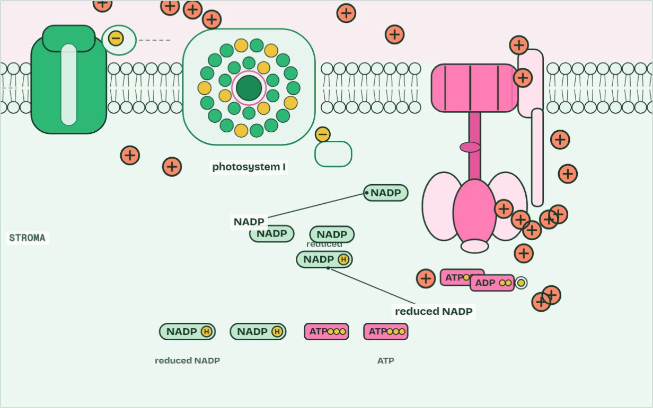
CHAPTER 15 · C1.3.19 Interdependence of the light-dependent and light-independent reactions
ATP 5 · reduced NADP 5 · O2 3
5 / 10
Each half needs the other
At photosystem I the electrons are lifted again and reduce NADP, with a proton from the stroma.
Minutes 35 to 45
Notes:
Minutes 35 to 45 of 60: Each half needs the other (10 min).
The plan: Chapter 15: the predict, the figure’s three states, then the photosynthesis film, HL, with the light off and then the carbon dioxide off. The metabolism map’s Follow a molecule, on ATP.
The light-dependent reactions in the thylakoids make ATP and reduced NADP. The light-independent reactions, the Calvin cycle in the stroma, use them and hand back ADP, phosphate and NADP. Each half needs what the other makes: that is their interdependence.
No light. The photosystems are not excited, so no ATP or reduced NADP is made. The Calvin cycle runs on for a few seconds on what is left, then stops.
No carbon dioxide. The Calvin cycle cannot fix carbon, so it stops using ATP and reduced NADP, and no NADP comes back. Once all the stroma’s NADP is reduced, photosystem I has nothing to pass its electrons to. The chain backs up, and photosystem II cannot pass its electrons on, so it stops, and so does photolysis.
So a leaf’s two halves run at the pace of the slower one, which links back to limiting factors (chapter 6). In bright light, carbon dioxide or Rubisco limits the rate; in dim light, the light-dependent reactions do. And a plant in the dark still respires. Everything in Unit 4 so far is on one map below, the metabolism map, where you can see both.
The animation "Photosynthesis, the whole system", paused at 37.0 s. The next slides go on through it, then play it.

Slide 56
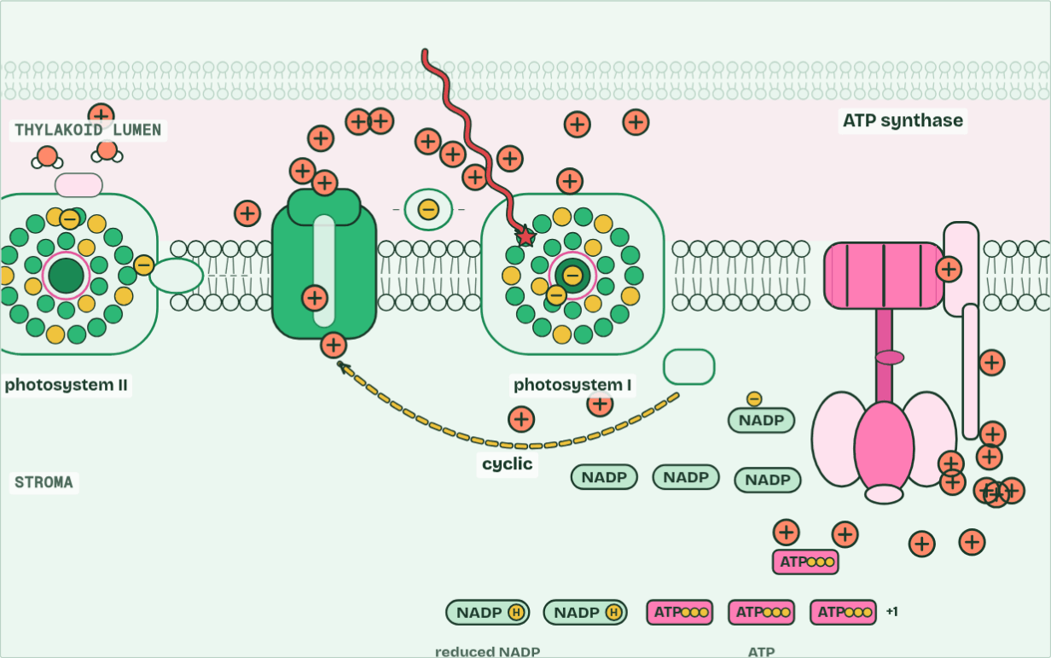
CHAPTER 15 · C1.3.19 Interdependence of the light-dependent and light-independent reactions
ATP 9 · reduced NADP 6 · O2 4
6 / 10
Each half needs the other
Sometimes the electron from photosystem I goes back round the chain (cyclic): more ATP, and no NADP reduced.
Minutes 35 to 45
Notes:
Minutes 35 to 45 of 60: Each half needs the other (10 min).
The plan: Chapter 15: the predict, the figure’s three states, then the photosynthesis film, HL, with the light off and then the carbon dioxide off. The metabolism map’s Follow a molecule, on ATP.
The light-dependent reactions in the thylakoids make ATP and reduced NADP. The light-independent reactions, the Calvin cycle in the stroma, use them and hand back ADP, phosphate and NADP. Each half needs what the other makes: that is their interdependence.
No light. The photosystems are not excited, so no ATP or reduced NADP is made. The Calvin cycle runs on for a few seconds on what is left, then stops.
No carbon dioxide. The Calvin cycle cannot fix carbon, so it stops using ATP and reduced NADP, and no NADP comes back. Once all the stroma’s NADP is reduced, photosystem I has nothing to pass its electrons to. The chain backs up, and photosystem II cannot pass its electrons on, so it stops, and so does photolysis.
So a leaf’s two halves run at the pace of the slower one, which links back to limiting factors (chapter 6). In bright light, carbon dioxide or Rubisco limits the rate; in dim light, the light-dependent reactions do. And a plant in the dark still respires. Everything in Unit 4 so far is on one map below, the metabolism map, where you can see both.
The animation "Photosynthesis, the whole system", paused at 43.4 s. The next slides go on through it, then play it.

Slide 57
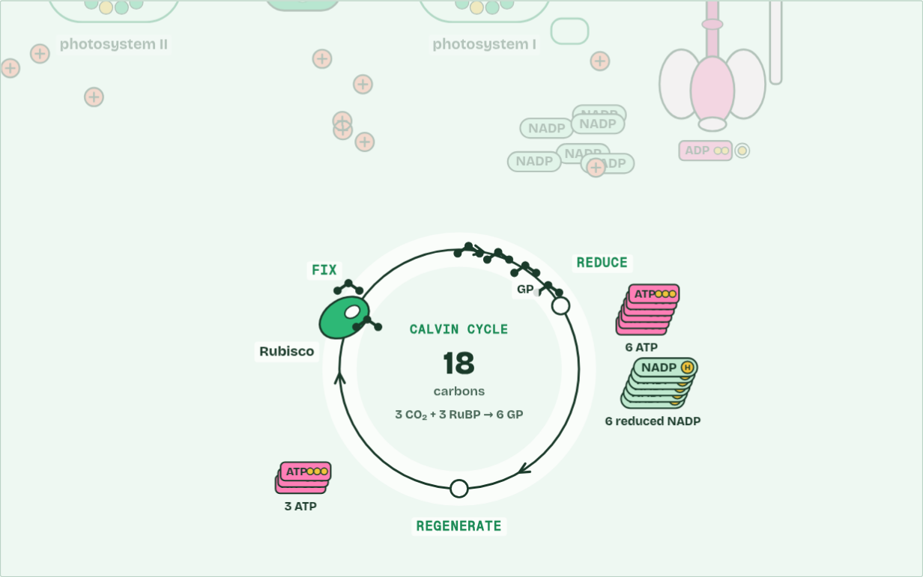
CHAPTER 15 · C1.3.19 Interdependence of the light-dependent and light-independent reactions
Stroma · carbons 18
7 / 10
Each half needs the other
Rubisco fixes 3 CO2 onto 3 RuBP: 6 GP.
Minutes 35 to 45
Notes:
Minutes 35 to 45 of 60: Each half needs the other (10 min).
The plan: Chapter 15: the predict, the figure’s three states, then the photosynthesis film, HL, with the light off and then the carbon dioxide off. The metabolism map’s Follow a molecule, on ATP.
The light-dependent reactions in the thylakoids make ATP and reduced NADP. The light-independent reactions, the Calvin cycle in the stroma, use them and hand back ADP, phosphate and NADP. Each half needs what the other makes: that is their interdependence.
No light. The photosystems are not excited, so no ATP or reduced NADP is made. The Calvin cycle runs on for a few seconds on what is left, then stops.
No carbon dioxide. The Calvin cycle cannot fix carbon, so it stops using ATP and reduced NADP, and no NADP comes back. Once all the stroma’s NADP is reduced, photosystem I has nothing to pass its electrons to. The chain backs up, and photosystem II cannot pass its electrons on, so it stops, and so does photolysis.
So a leaf’s two halves run at the pace of the slower one, which links back to limiting factors (chapter 6). In bright light, carbon dioxide or Rubisco limits the rate; in dim light, the light-dependent reactions do. And a plant in the dark still respires. Everything in Unit 4 so far is on one map below, the metabolism map, where you can see both.
The animation "Photosynthesis, the whole system", paused at 54.5 s. The next slides go on through it, then play it.

Slide 58
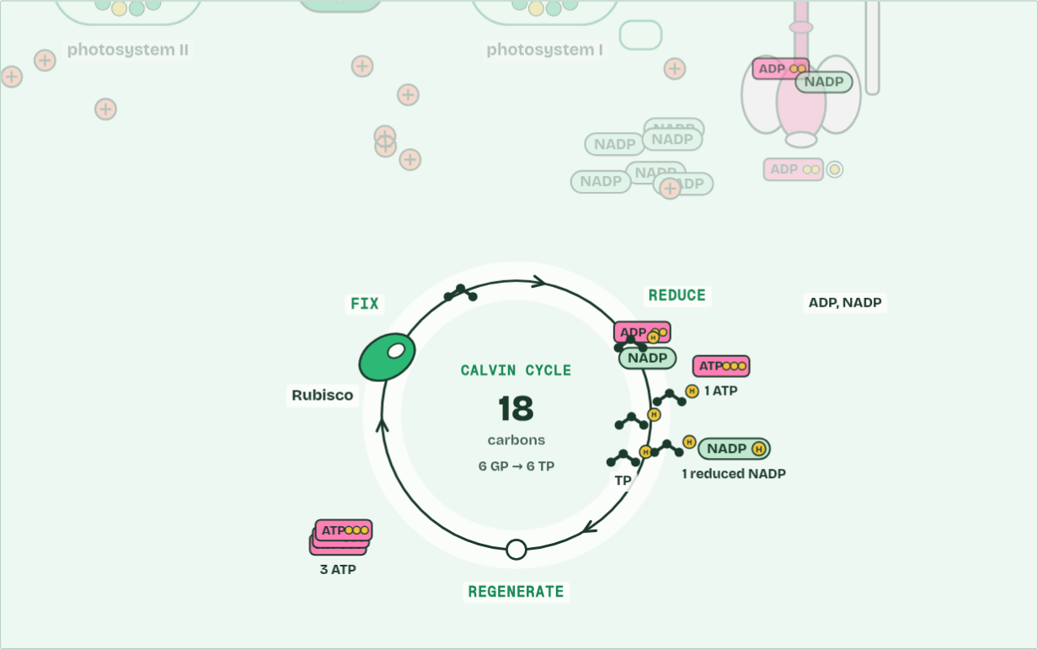
CHAPTER 15 · C1.3.19 Interdependence of the light-dependent and light-independent reactions
Stroma · carbons 18
8 / 10
Each half needs the other
ATP and reduced NADP turn 6 GP into 6 TP; ADP and NADP go back to the thylakoid.
Minutes 35 to 45
Notes:
Minutes 35 to 45 of 60: Each half needs the other (10 min).
The plan: Chapter 15: the predict, the figure’s three states, then the photosynthesis film, HL, with the light off and then the carbon dioxide off. The metabolism map’s Follow a molecule, on ATP.
The light-dependent reactions in the thylakoids make ATP and reduced NADP. The light-independent reactions, the Calvin cycle in the stroma, use them and hand back ADP, phosphate and NADP. Each half needs what the other makes: that is their interdependence.
No light. The photosystems are not excited, so no ATP or reduced NADP is made. The Calvin cycle runs on for a few seconds on what is left, then stops.
No carbon dioxide. The Calvin cycle cannot fix carbon, so it stops using ATP and reduced NADP, and no NADP comes back. Once all the stroma’s NADP is reduced, photosystem I has nothing to pass its electrons to. The chain backs up, and photosystem II cannot pass its electrons on, so it stops, and so does photolysis.
So a leaf’s two halves run at the pace of the slower one, which links back to limiting factors (chapter 6). In bright light, carbon dioxide or Rubisco limits the rate; in dim light, the light-dependent reactions do. And a plant in the dark still respires. Everything in Unit 4 so far is on one map below, the metabolism map, where you can see both.
The animation "Photosynthesis, the whole system", paused at 62.0 s. The next slides go on through it, then play it.

Slide 59
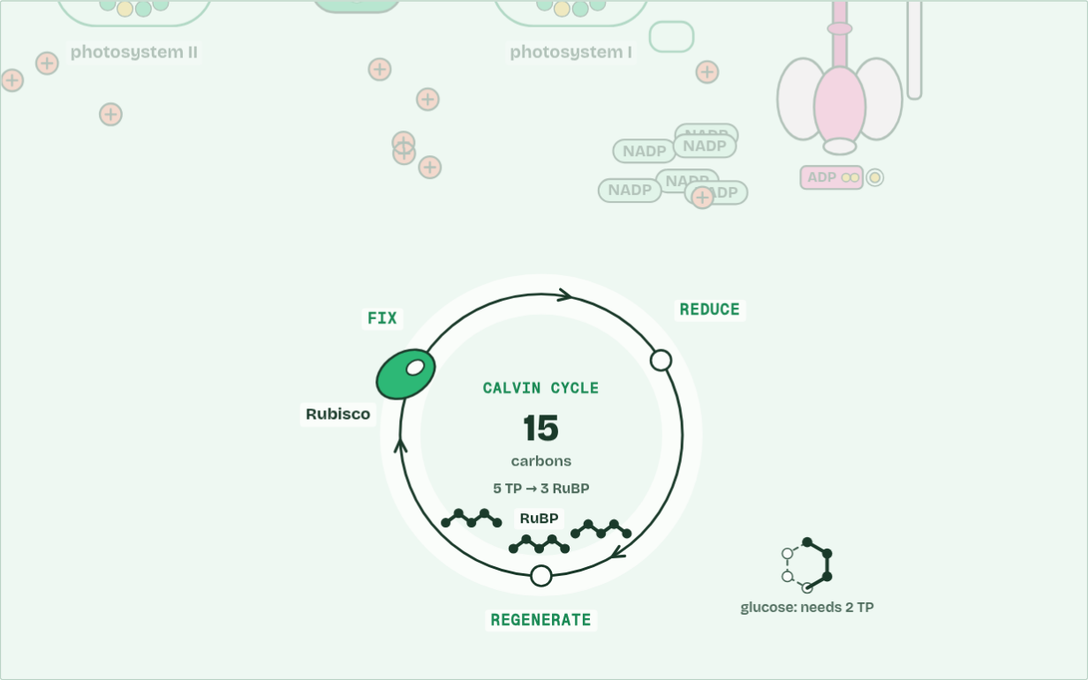
CHAPTER 15 · C1.3.19 Interdependence of the light-dependent and light-independent reactions
Stroma · carbons 15
9 / 10
Each half needs the other
1 TP leaves the cycle; the other 5 are remade into 3 RuBP, using ATP.
Minutes 35 to 45
Notes:
Minutes 35 to 45 of 60: Each half needs the other (10 min).
The plan: Chapter 15: the predict, the figure’s three states, then the photosynthesis film, HL, with the light off and then the carbon dioxide off. The metabolism map’s Follow a molecule, on ATP.
The light-dependent reactions in the thylakoids make ATP and reduced NADP. The light-independent reactions, the Calvin cycle in the stroma, use them and hand back ADP, phosphate and NADP. Each half needs what the other makes: that is their interdependence.
No light. The photosystems are not excited, so no ATP or reduced NADP is made. The Calvin cycle runs on for a few seconds on what is left, then stops.
No carbon dioxide. The Calvin cycle cannot fix carbon, so it stops using ATP and reduced NADP, and no NADP comes back. Once all the stroma’s NADP is reduced, photosystem I has nothing to pass its electrons to. The chain backs up, and photosystem II cannot pass its electrons on, so it stops, and so does photolysis.
So a leaf’s two halves run at the pace of the slower one, which links back to limiting factors (chapter 6). In bright light, carbon dioxide or Rubisco limits the rate; in dim light, the light-dependent reactions do. And a plant in the dark still respires. Everything in Unit 4 so far is on one map below, the metabolism map, where you can see both.
The animation "Photosynthesis, the whole system", paused at 72.5 s. The next slides go on through it, then play it.

Slide 60
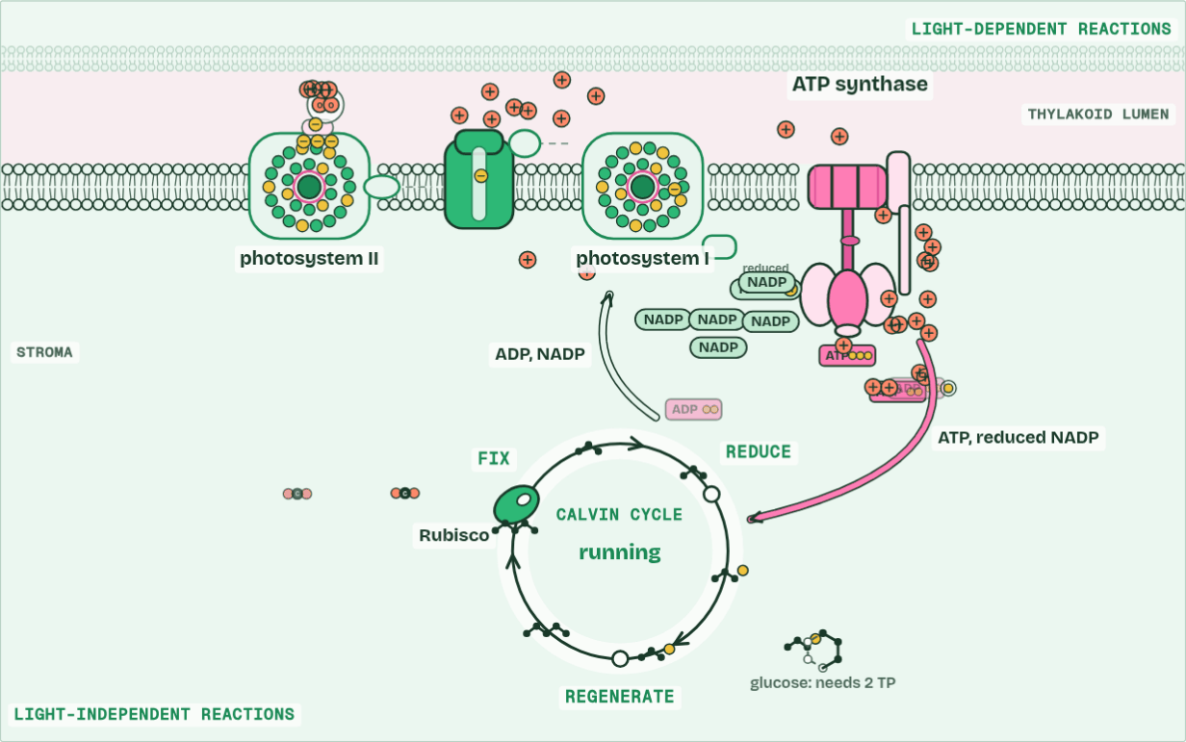
CHAPTER 15 · C1.3.19 Interdependence of the light-dependent and light-independent reactions
ATP 36 · O2 11
10 / 10
Each half needs the other
Two halves, each running on what the other makes: ATP and reduced NADP one way, ADP and NADP the other.
Minutes 35 to 45
Notes:
Minutes 35 to 45 of 60: Each half needs the other (10 min).
The plan: Chapter 15: the predict, the figure’s three states, then the photosynthesis film, HL, with the light off and then the carbon dioxide off. The metabolism map’s Follow a molecule, on ATP.
The light-dependent reactions in the thylakoids make ATP and reduced NADP. The light-independent reactions, the Calvin cycle in the stroma, use them and hand back ADP, phosphate and NADP. Each half needs what the other makes: that is their interdependence.
No light. The photosystems are not excited, so no ATP or reduced NADP is made. The Calvin cycle runs on for a few seconds on what is left, then stops.
No carbon dioxide. The Calvin cycle cannot fix carbon, so it stops using ATP and reduced NADP, and no NADP comes back. Once all the stroma’s NADP is reduced, photosystem I has nothing to pass its electrons to. The chain backs up, and photosystem II cannot pass its electrons on, so it stops, and so does photolysis.
So a leaf’s two halves run at the pace of the slower one, which links back to limiting factors (chapter 6). In bright light, carbon dioxide or Rubisco limits the rate; in dim light, the light-dependent reactions do. And a plant in the dark still respires. Everything in Unit 4 so far is on one map below, the metabolism map, where you can see both.
The animation "Photosynthesis, the whole system", paused at 82.0 s. The next slides go on through it, then play it.

Slide 61
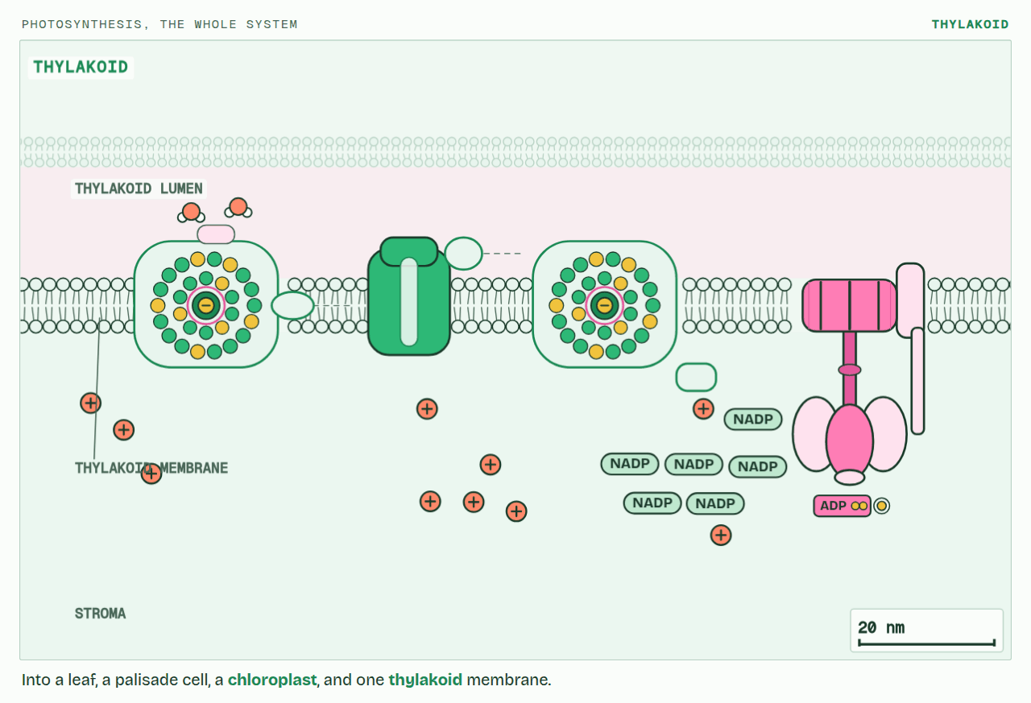
CHAPTER 15 · C1.3.19 Interdependence of the light-dependent and light-independent reactions
PLAY IT
Each half needs the other
Photosynthesis, the whole system: click to play. It loops every 84 seconds.
Minutes 35 to 45
Notes:
Minutes 35 to 45 of 60: Each half needs the other (10 min).
The plan: Chapter 15: the predict, the figure’s three states, then the photosynthesis film, HL, with the light off and then the carbon dioxide off. The metabolism map’s Follow a molecule, on ATP.
The video is photosynthesis-f16464.mp4, one loop of the animation in the guide. It plays in PowerPoint and Keynote. Google Slides does not play a video embedded in a .pptx: download photosynthesis-f16464.mp4 (https://www.biologybybradford.com/guides/downloads/scenes/photosynthesis-f16464.mp4), upload it to Google Drive, then Insert > Video > Google Drive.
In the guide the class can change it as it runs: https://www.biologybybradford.com/guides/ib-biology-c1-3-photosynthesis#interdependence
What it shows, in order:
1. Into a leaf, a palisade cell, a chloroplast, and one thylakoid membrane.
2. Light energy passes through an array of pigments to the reaction centre, which emits an excited electron.
3. Photolysis: water is split. Its electrons refill photosystem II, its protons stay in the lumen, and its oxygen is a waste product.
4. Electrons passing along the chain pump protons into the lumen; protons flowing back through ATP synthase make ATP.
5. At photosystem I the electrons are lifted again and reduce NADP, with a proton from the stroma.
6. Sometimes the electron from photosystem I goes back round the chain (cyclic): more ATP, and no NADP reduced.
7. Rubisco fixes 3 CO2 onto 3 RuBP: 6 GP.
8. ATP and reduced NADP turn 6 GP into 6 TP; ADP and NADP go back to the thylakoid.
9. 1 TP leaves the cycle; the other 5 are remade into 3 RuBP, using ATP.
10. Two halves, each running on what the other makes: ATP and reduced NADP one way, ADP and NADP the other.

Slide 62
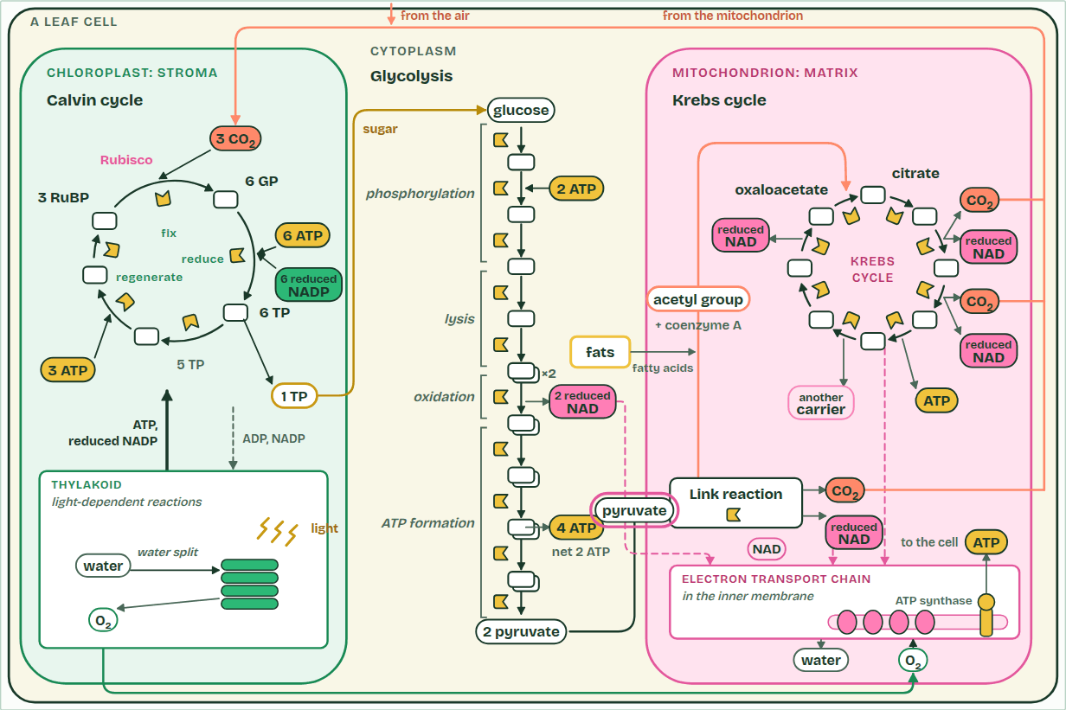
CHAPTER 15 · C1.3.19 Interdependence of the light-dependent and light-independent reactions
Link reaction
1 / 4
Each half needs the other
The link reaction, in the matrix: each pyruvate loses carbon dioxide and is oxidised, making reduced NAD, and coenzyme A carries the acetyl group on.
Minutes 35 to 45
Notes:
Minutes 35 to 45 of 60: Each half needs the other (10 min).
The plan: Chapter 15: the predict, the figure’s three states, then the photosynthesis film, HL, with the light off and then the carbon dioxide off. The metabolism map’s Follow a molecule, on ATP.
The light-dependent reactions in the thylakoids make ATP and reduced NADP. The light-independent reactions, the Calvin cycle in the stroma, use them and hand back ADP, phosphate and NADP. Each half needs what the other makes: that is their interdependence.
No light. The photosystems are not excited, so no ATP or reduced NADP is made. The Calvin cycle runs on for a few seconds on what is left, then stops.
No carbon dioxide. The Calvin cycle cannot fix carbon, so it stops using ATP and reduced NADP, and no NADP comes back. Once all the stroma’s NADP is reduced, photosystem I has nothing to pass its electrons to. The chain backs up, and photosystem II cannot pass its electrons on, so it stops, and so does photolysis.
So a leaf’s two halves run at the pace of the slower one, which links back to limiting factors (chapter 6). In bright light, carbon dioxide or Rubisco limits the rate; in dim light, the light-dependent reactions do. And a plant in the dark still respires. Everything in Unit 4 so far is on one map below, the metabolism map, where you can see both.
The animation "Respiration and photosynthesis on one map", paused at 6.0 s. The next slides go on through it, then play it.

Slide 63
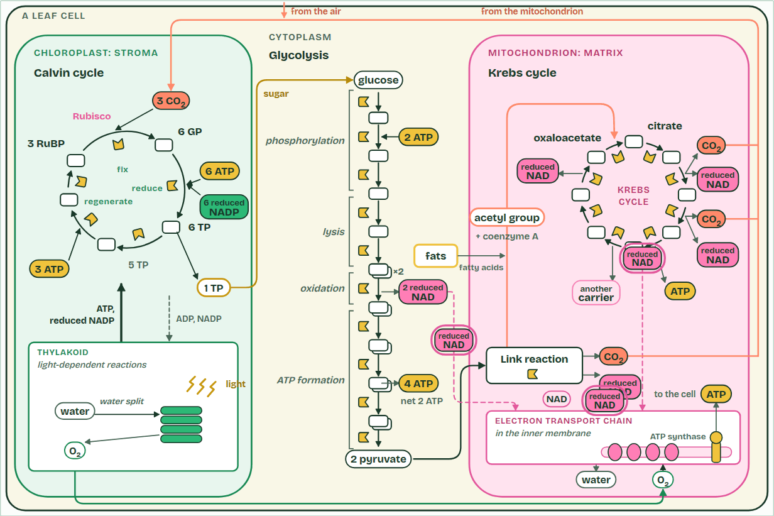
CHAPTER 15 · C1.3.19 Interdependence of the light-dependent and light-independent reactions
To the chain
2 / 4
Each half needs the other
Reduced NAD from glycolysis, the link reaction and the Krebs cycle hands its electrons to the electron transport chain, and goes back as NAD.
Minutes 35 to 45
Notes:
Minutes 35 to 45 of 60: Each half needs the other (10 min).
The plan: Chapter 15: the predict, the figure’s three states, then the photosynthesis film, HL, with the light off and then the carbon dioxide off. The metabolism map’s Follow a molecule, on ATP.
The light-dependent reactions in the thylakoids make ATP and reduced NADP. The light-independent reactions, the Calvin cycle in the stroma, use them and hand back ADP, phosphate and NADP. Each half needs what the other makes: that is their interdependence.
No light. The photosystems are not excited, so no ATP or reduced NADP is made. The Calvin cycle runs on for a few seconds on what is left, then stops.
No carbon dioxide. The Calvin cycle cannot fix carbon, so it stops using ATP and reduced NADP, and no NADP comes back. Once all the stroma’s NADP is reduced, photosystem I has nothing to pass its electrons to. The chain backs up, and photosystem II cannot pass its electrons on, so it stops, and so does photolysis.
So a leaf’s two halves run at the pace of the slower one, which links back to limiting factors (chapter 6). In bright light, carbon dioxide or Rubisco limits the rate; in dim light, the light-dependent reactions do. And a plant in the dark still respires. Everything in Unit 4 so far is on one map below, the metabolism map, where you can see both.
The animation "Respiration and photosynthesis on one map", paused at 16.0 s. The next slides go on through it, then play it.

Slide 64
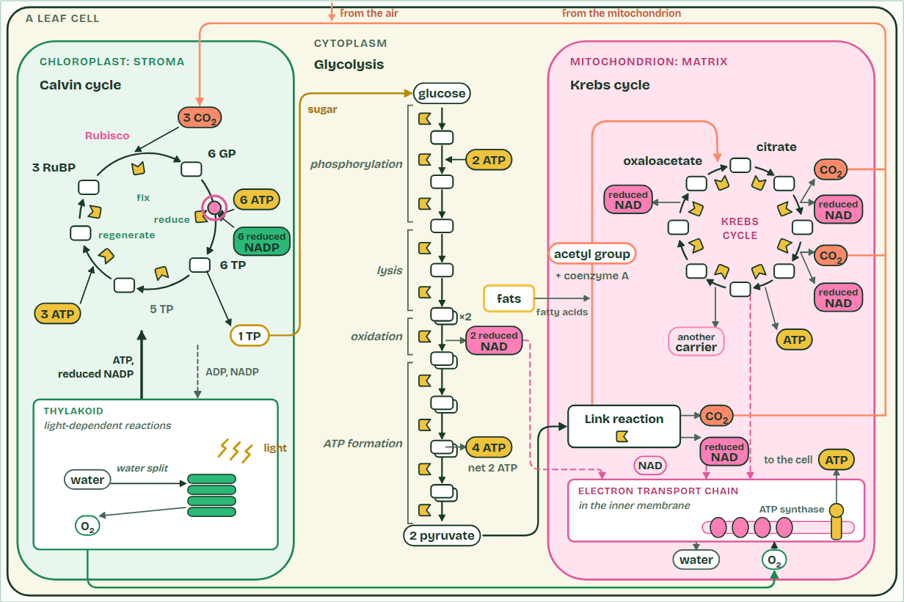
CHAPTER 15 · C1.3.19 Interdependence of the light-dependent and light-independent reactions
Calvin cycle
3 / 4
Each half needs the other
ATP and reduced NADP from the thylakoid reduce GP to TP. One TP in six leaves; the other five, with more ATP, remake RuBP.
Minutes 35 to 45
Notes:
Minutes 35 to 45 of 60: Each half needs the other (10 min).
The plan: Chapter 15: the predict, the figure’s three states, then the photosynthesis film, HL, with the light off and then the carbon dioxide off. The metabolism map’s Follow a molecule, on ATP.
The light-dependent reactions in the thylakoids make ATP and reduced NADP. The light-independent reactions, the Calvin cycle in the stroma, use them and hand back ADP, phosphate and NADP. Each half needs what the other makes: that is their interdependence.
No light. The photosystems are not excited, so no ATP or reduced NADP is made. The Calvin cycle runs on for a few seconds on what is left, then stops.
No carbon dioxide. The Calvin cycle cannot fix carbon, so it stops using ATP and reduced NADP, and no NADP comes back. Once all the stroma’s NADP is reduced, photosystem I has nothing to pass its electrons to. The chain backs up, and photosystem II cannot pass its electrons on, so it stops, and so does photolysis.
So a leaf’s two halves run at the pace of the slower one, which links back to limiting factors (chapter 6). In bright light, carbon dioxide or Rubisco limits the rate; in dim light, the light-dependent reactions do. And a plant in the dark still respires. Everything in Unit 4 so far is on one map below, the metabolism map, where you can see both.
The animation "Respiration and photosynthesis on one map", paused at 28.0 s. The next slides go on through it, then play it.

Slide 65
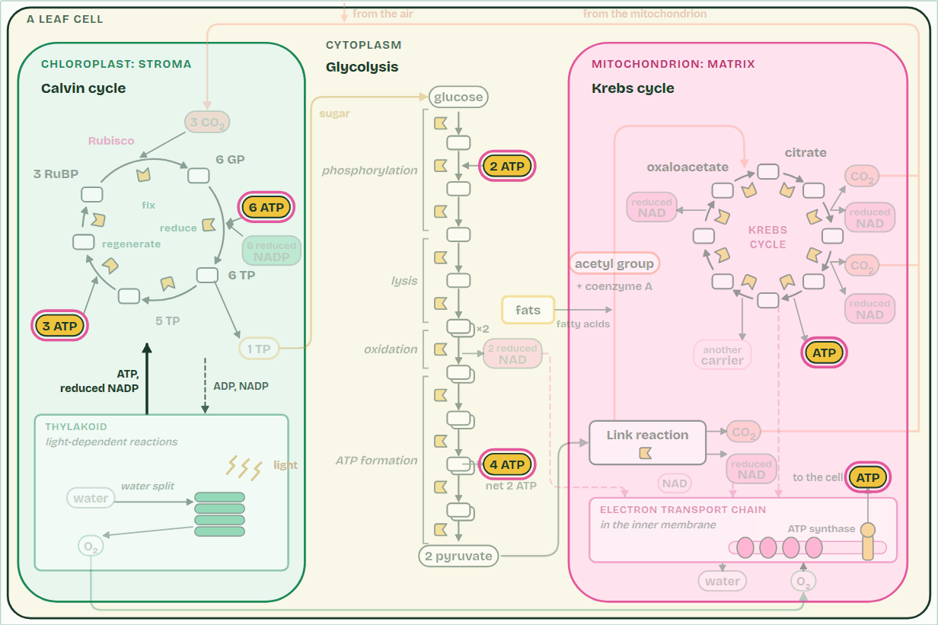
CHAPTER 15 · C1.3.19 Interdependence of the light-dependent and light-independent reactions
Follow ATP
4 / 4
Each half needs the other
Follow ATP: made in glycolysis, the Krebs cycle, at the electron transport chain and in the thylakoid; used in glycolysis, the Calvin cycle and all over the cell.
Minutes 35 to 45
Notes:
Minutes 35 to 45 of 60: Each half needs the other (10 min).
The plan: Chapter 15: the predict, the figure’s three states, then the photosynthesis film, HL, with the light off and then the carbon dioxide off. The metabolism map’s Follow a molecule, on ATP.
The light-dependent reactions in the thylakoids make ATP and reduced NADP. The light-independent reactions, the Calvin cycle in the stroma, use them and hand back ADP, phosphate and NADP. Each half needs what the other makes: that is their interdependence.
No light. The photosystems are not excited, so no ATP or reduced NADP is made. The Calvin cycle runs on for a few seconds on what is left, then stops.
No carbon dioxide. The Calvin cycle cannot fix carbon, so it stops using ATP and reduced NADP, and no NADP comes back. Once all the stroma’s NADP is reduced, photosystem I has nothing to pass its electrons to. The chain backs up, and photosystem II cannot pass its electrons on, so it stops, and so does photolysis.
So a leaf’s two halves run at the pace of the slower one, which links back to limiting factors (chapter 6). In bright light, carbon dioxide or Rubisco limits the rate; in dim light, the light-dependent reactions do. And a plant in the dark still respires. Everything in Unit 4 so far is on one map below, the metabolism map, where you can see both.
The animation "Respiration and photosynthesis on one map", paused at 34.0 s. The next slides go on through it, then play it.

Slide 66
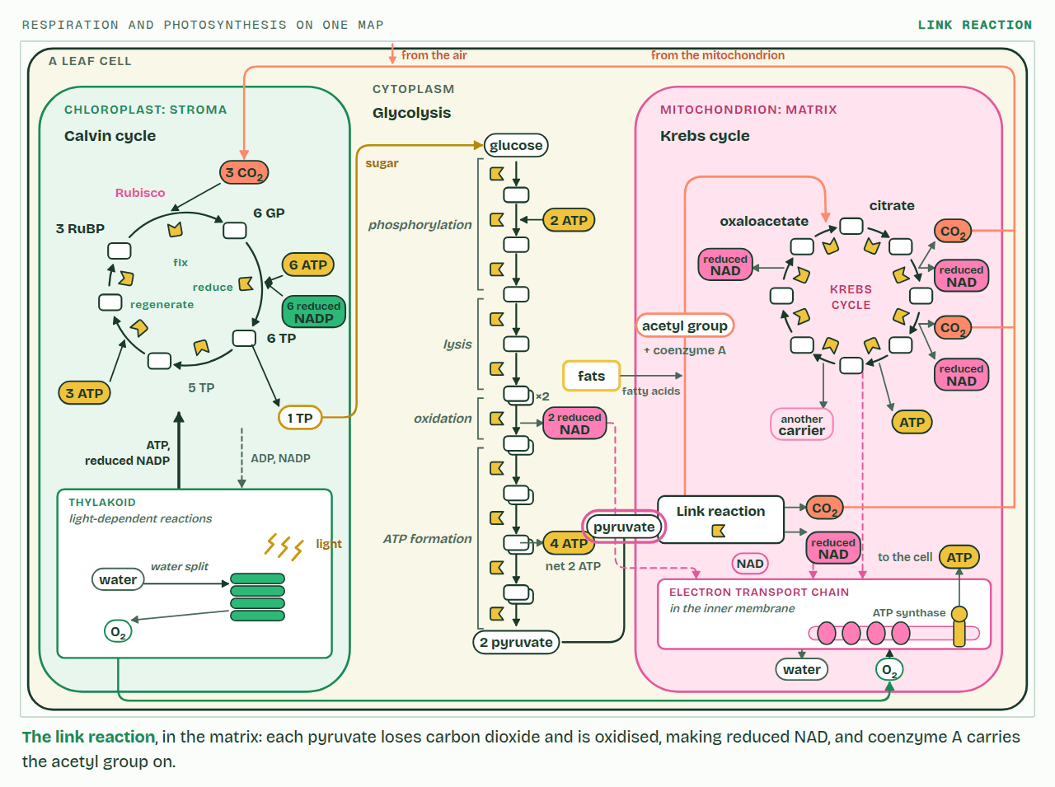
CHAPTER 15 · C1.3.19 Interdependence of the light-dependent and light-independent reactions
PLAY IT
Each half needs the other
Respiration and photosynthesis on one map: click to play. It loops every 36 seconds.
Minutes 35 to 45
Notes:
Minutes 35 to 45 of 60: Each half needs the other (10 min).
The plan: Chapter 15: the predict, the figure’s three states, then the photosynthesis film, HL, with the light off and then the carbon dioxide off. The metabolism map’s Follow a molecule, on ATP.
The video is pathways-643cf3.mp4, one loop of the animation in the guide. It plays in PowerPoint and Keynote. Google Slides does not play a video embedded in a .pptx: download pathways-643cf3.mp4 (https://www.biologybybradford.com/guides/downloads/scenes/pathways-643cf3.mp4), upload it to Google Drive, then Insert > Video > Google Drive.
In the guide the class can change it as it runs: https://www.biologybybradford.com/guides/ib-biology-c1-3-photosynthesis#interdependence
What it shows, in order:
1. The link reaction, in the matrix: each pyruvate loses carbon dioxide and is oxidised, making reduced NAD, and coenzyme A carries the acetyl group on.
2. Reduced NAD from glycolysis, the link reaction and the Krebs cycle hands its electrons to the electron transport chain, and goes back as NAD.
3. ATP and reduced NADP from the thylakoid reduce GP to TP. One TP in six leaves; the other five, with more ATP, remake RuBP.
4. Follow ATP: made in glycolysis, the Krebs cycle, at the electron transport chain and in the thylakoid; used in glycolysis, the Calvin cycle and all over the cell.

Slide 67
PREDICT
A leaf in bright light is suddenly given no carbon dioxide. What happens to photosystem II?
A It speeds up, with nothing to slow it
B It goes on, but sends electrons round cyclically
C It stops, as NADP runs out further on
D It starts splitting carbon dioxide instead
Minutes 35 to 45
Notes:
Minutes 35 to 45 of 60: Each half needs the other (10 min).
The plan: Chapter 15: the predict, the figure’s three states, then the photosynthesis film, HL, with the light off and then the carbon dioxide off. The metabolism map’s Follow a molecule, on ATP.
Ask for a show of hands, or mini whiteboards, before revealing. (Answer: C, on the next slide.)

Slide 68
WHAT HAPPENS
A leaf in bright light is suddenly given no carbon dioxide. What happens to photosystem II?
A It speeds up, with nothing to slow it
B It goes on, but sends electrons round cyclically
C It stops, as NADP runs out further on
D It starts splitting carbon dioxide instead
It stops. With no carbon dioxide the Calvin cycle stops using reduced NADP, so no NADP comes back. Photosystem I has nowhere to put its electrons, the chain fills up, and photosystem II cannot pass its electrons on. Water stops being split, and no oxygen is given off.
Minutes 35 to 45
Notes:
Minutes 35 to 45 of 60: Each half needs the other (10 min).
The plan: Chapter 15: the predict, the figure’s three states, then the photosynthesis film, HL, with the light off and then the carbon dioxide off. The metabolism map’s Follow a molecule, on ATP.
Answer: C. It stops. With no carbon dioxide the Calvin cycle stops using reduced NADP, so no NADP comes back. Photosystem I has nowhere to put its electrons, the chain fills up, and photosystem II cannot pass its electrons on. Water stops being split, and no oxygen is given off.

Slide 69
WATCH OUT
“Light-independent” does not mean “happens in the dark”. The Calvin cycle needs the products of the light reactions, so in a leaf it runs only in the light.
Minutes 35 to 45
Notes:
Minutes 35 to 45 of 60: Each half needs the other (10 min).
The plan: Chapter 15: the predict, the figure’s three states, then the photosynthesis film, HL, with the light off and then the carbon dioxide off. The metabolism map’s Follow a molecule, on ATP.
A common mistake: say it, then ask who can say why it is wrong.

Slide 70
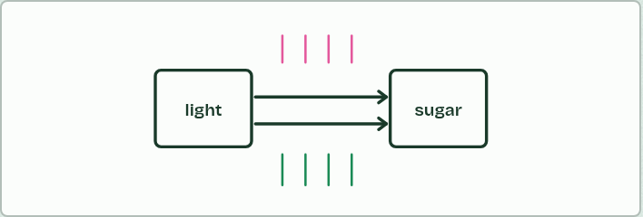
DIAGRAM
IF THERE IS TIME
Improve the diagram
THE TASK
If there is time. A deliberately thin diagram of photosynthesis (two boxes, “light” in, “sugar” out). Students add every detail they now know, in two colours: one for SL and one for HL.
STUDENTS NEED
The printed diagram.
Minutes 35 to 45
Notes:
Minutes 35 to 45 of 60: Each half needs the other (10 min).
The plan: Chapter 15: the predict, the figure’s three states, then the photosynthesis film, HL, with the light off and then the carbon dioxide off. The metabolism map’s Follow a molecule, on ATP.
The activity: Improve the diagram. If there is time. A deliberately thin diagram of photosynthesis (two boxes, “light” in, “sugar” out). Students add every detail they now know, in two colours: one for SL and one for HL.
Needs: the printed diagram.
The plan sets no time of its own for this activity: use it in this step, in place of part of it, or for homework.

Slide 71
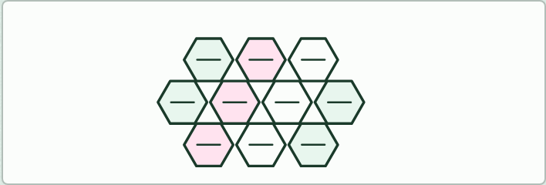
CARD SORT
10 MIN
Hexagons
THE TASK
Our own set of 24 hexagon cards (terms from both stages: photon, photosystem II, photolysis, oxygen, chain of carriers, proton gradient, ATP synthase, photosystem I, NADP, reduced NADP, stroma, lumen, Rubisco, RuBP, GP, TP, carbon dioxide, ATP, ADP, Calvin cycle, glucose, nitrate, starch, light). Groups join hexagons edge to edge only where they can say the link aloud, then tell the whole story in order.
STUDENTS NEED
Printed hexagons for each group.
Minutes 45 to 55
Notes:
Minutes 45 to 55 of 60: Hexagons (10 min).
The plan: Hexagons (below), in groups, telling the whole story.
The activity: Hexagons. Our own set of 24 hexagon cards (terms from both stages: photon, photosystem II, photolysis, oxygen, chain of carriers, proton gradient, ATP synthase, photosystem I, NADP, reduced NADP, stroma, lumen, Rubisco, RuBP, GP, TP, carbon dioxide, ATP, ADP, Calvin cycle, glucose, nitrate, starch, light). Groups join hexagons edge to edge only where they can say the link aloud, then tell the whole story in order.
Needs: printed hexagons for each group.
The time: 10 minutes, minutes 45 to 55 of the plan.

Slide 72
PLENARY
Can you now...
Explain how Rubisco fixes carbon dioxide onto RuBP, and why the stroma needs so much of it (C1.3.15)
Follow the carbon through the Calvin cycle: GP reduced to TP, and five TP in six remade into RuBP (C1.3.16, C1.3.17)
Explain how every carbon compound in a plant is made from the Calvin cycle's products with mineral nutrients (C1.3.18)
Explain why the light-dependent and light-independent reactions stop without each other (C1.3.19)
Minutes 55 to 60
Notes:
Minutes 55 to 60 of 60: Exit (5 min).
The plan: With no carbon dioxide, why does photosystem II stop?
Thumbs up, sideways or down on each goal before the exit question. The goals come from the statements this lesson covers.

Slide 73
EXIT QUESTION
Before you go
With no carbon dioxide, why does photosystem II stop?
Minutes 55 to 60
Notes:
Minutes 55 to 60 of 60: Exit (5 min).
The plan: With no carbon dioxide, why does photosystem II stop?

Slide 74
PRACTISE AND REVISE
Keep going
Exam practice: a fresh paper of exam questions on C1.3 at higher level, marked as you go
The guide, with the animations and the dry lab
This lesson in the guide: 12 Fixing carbon, slowly, 13 GP to TP, and RuBP made again, 14 Every carbon came this way, 15 Each half needs the other
BUILD FOR YOUR CLASS
ALREADY ON THE SITE FOR C1.3
CARD SETS ON SPLYCR
Tarsia puzzle, dominoes and picture reveal on C1.3, built from its key terms and ready to print
A pub quiz with rounds on C1.3, to present or run with no projector
An escape room built from the question bank on C1.3
Quiz: Photosynthesis
Quiz: Photosynthesis (HL)
Revision map: C1.3 Photosynthesis, to fill in
Exam questions: C1.3 in the exam maker, a paper with its markscheme
Open a set to host it as a class game, or make a copy to edit.
C1.3 Photosynthesis (SL)
C1.3 Photosynthesis (HL)
How this was made. The course structure, the activities and the teaching choices come from my own classroom, my presentations and my years of teaching IB and AP Biology. I use Claude, an AI, to help write and build the interactive guides, lesson plans, slides and practice questions, and to draw the diagrams and code the interactives. I direct the work and review it against the IB and AP specifications before it goes live.
Minute 60: after the lesson
Notes:
Every link here is live. Set the exam practice paper for homework: it is fresh each time, marked as students go and saved to their Exam practice when they are signed in.
Exam practice: https://www.biologybybradford.com/exam-maker/sit?topics=C1.3&level=HL&paper=quiz&marks=15&src=ep
The guide: https://www.biologybybradford.com/guides/ib-biology-c1-3-photosynthesis

